Slide 1
NESSIE
NIGHTTIME ELEVATED SYSTEM FOR SATELLITE IMAGING AND EVALUATION

Slide 2
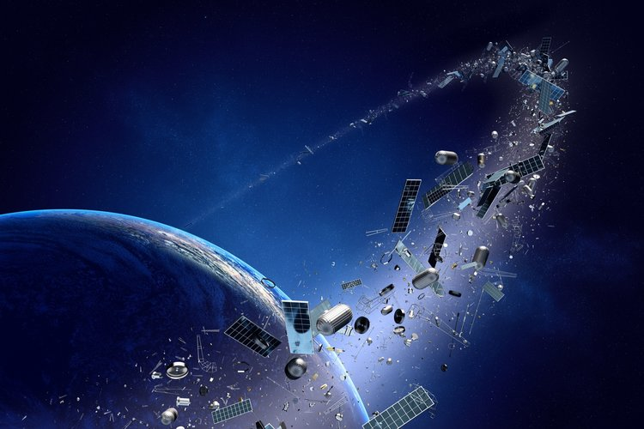
Project Overview
Space Domain Awareness (SDA)
Determine the orbital characteristics of objects in space
Currently there are only two methods
Radar
Expensive
Telescopes
Cheaper, but can be blocked by cloud cover
Both are fully booked and can't collect enough data
Over 500,000 estimated objects in orbit
-https://www.nasa.gov/mission_pages/station/news/orbital_debris.html
Notes:
So the the Problem- There are millions of objects in space, and many of these we don’t know there exact location or trajectory. This is dangerous because multi million or even billion dollar satellites are susceptible to collision. That’s where the Field of SSA comes in, to analyze these parameters and provide the necessary info to perform maneuvers to save space systems, but this isn't easy or cheap in general. Radar cost millions, and ground based telescopes can be occluded by cloud cover, which has lead to a global need for SSA platforms. So How do we solve this problem-

Slide 3
Our Mission:
MANTA
Full-Scale SSA UAV
Operates at 18,000 ft
Fully realized optical payload
Mass 15 lbs
Contained in 12” cube
Requires 132 W of Power
NESSIE
Proof of concept vehicle
Operates at 400 ft AGL
Payload bay capability
Mass 1 lb
Contained in 4.9” cube
Requires 5.6 W of Power
Provide path to flight at full-scale
Scale 1 : 2.5
Notes:
The initial mission was MANTA which was intended to get to 18,000 ft and had a 15 lb payload
we decided to move to a scale model since the initial vehicle was too large and costly for us to build
the model NESSIE will be a proof of concept that the project could work.

Slide 4
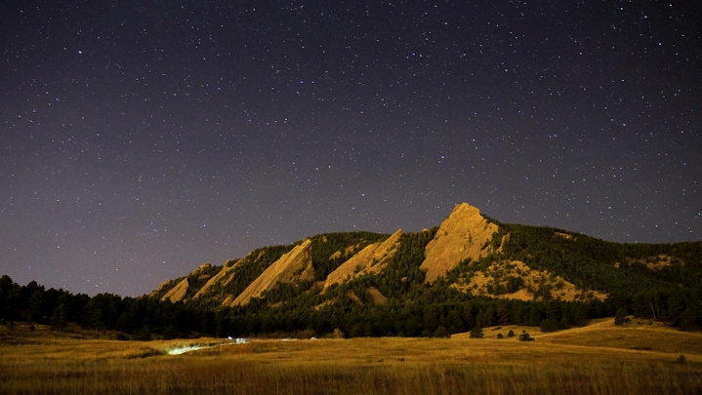
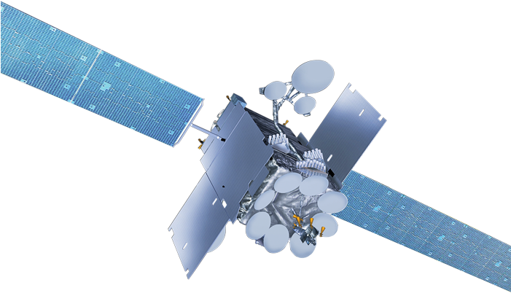
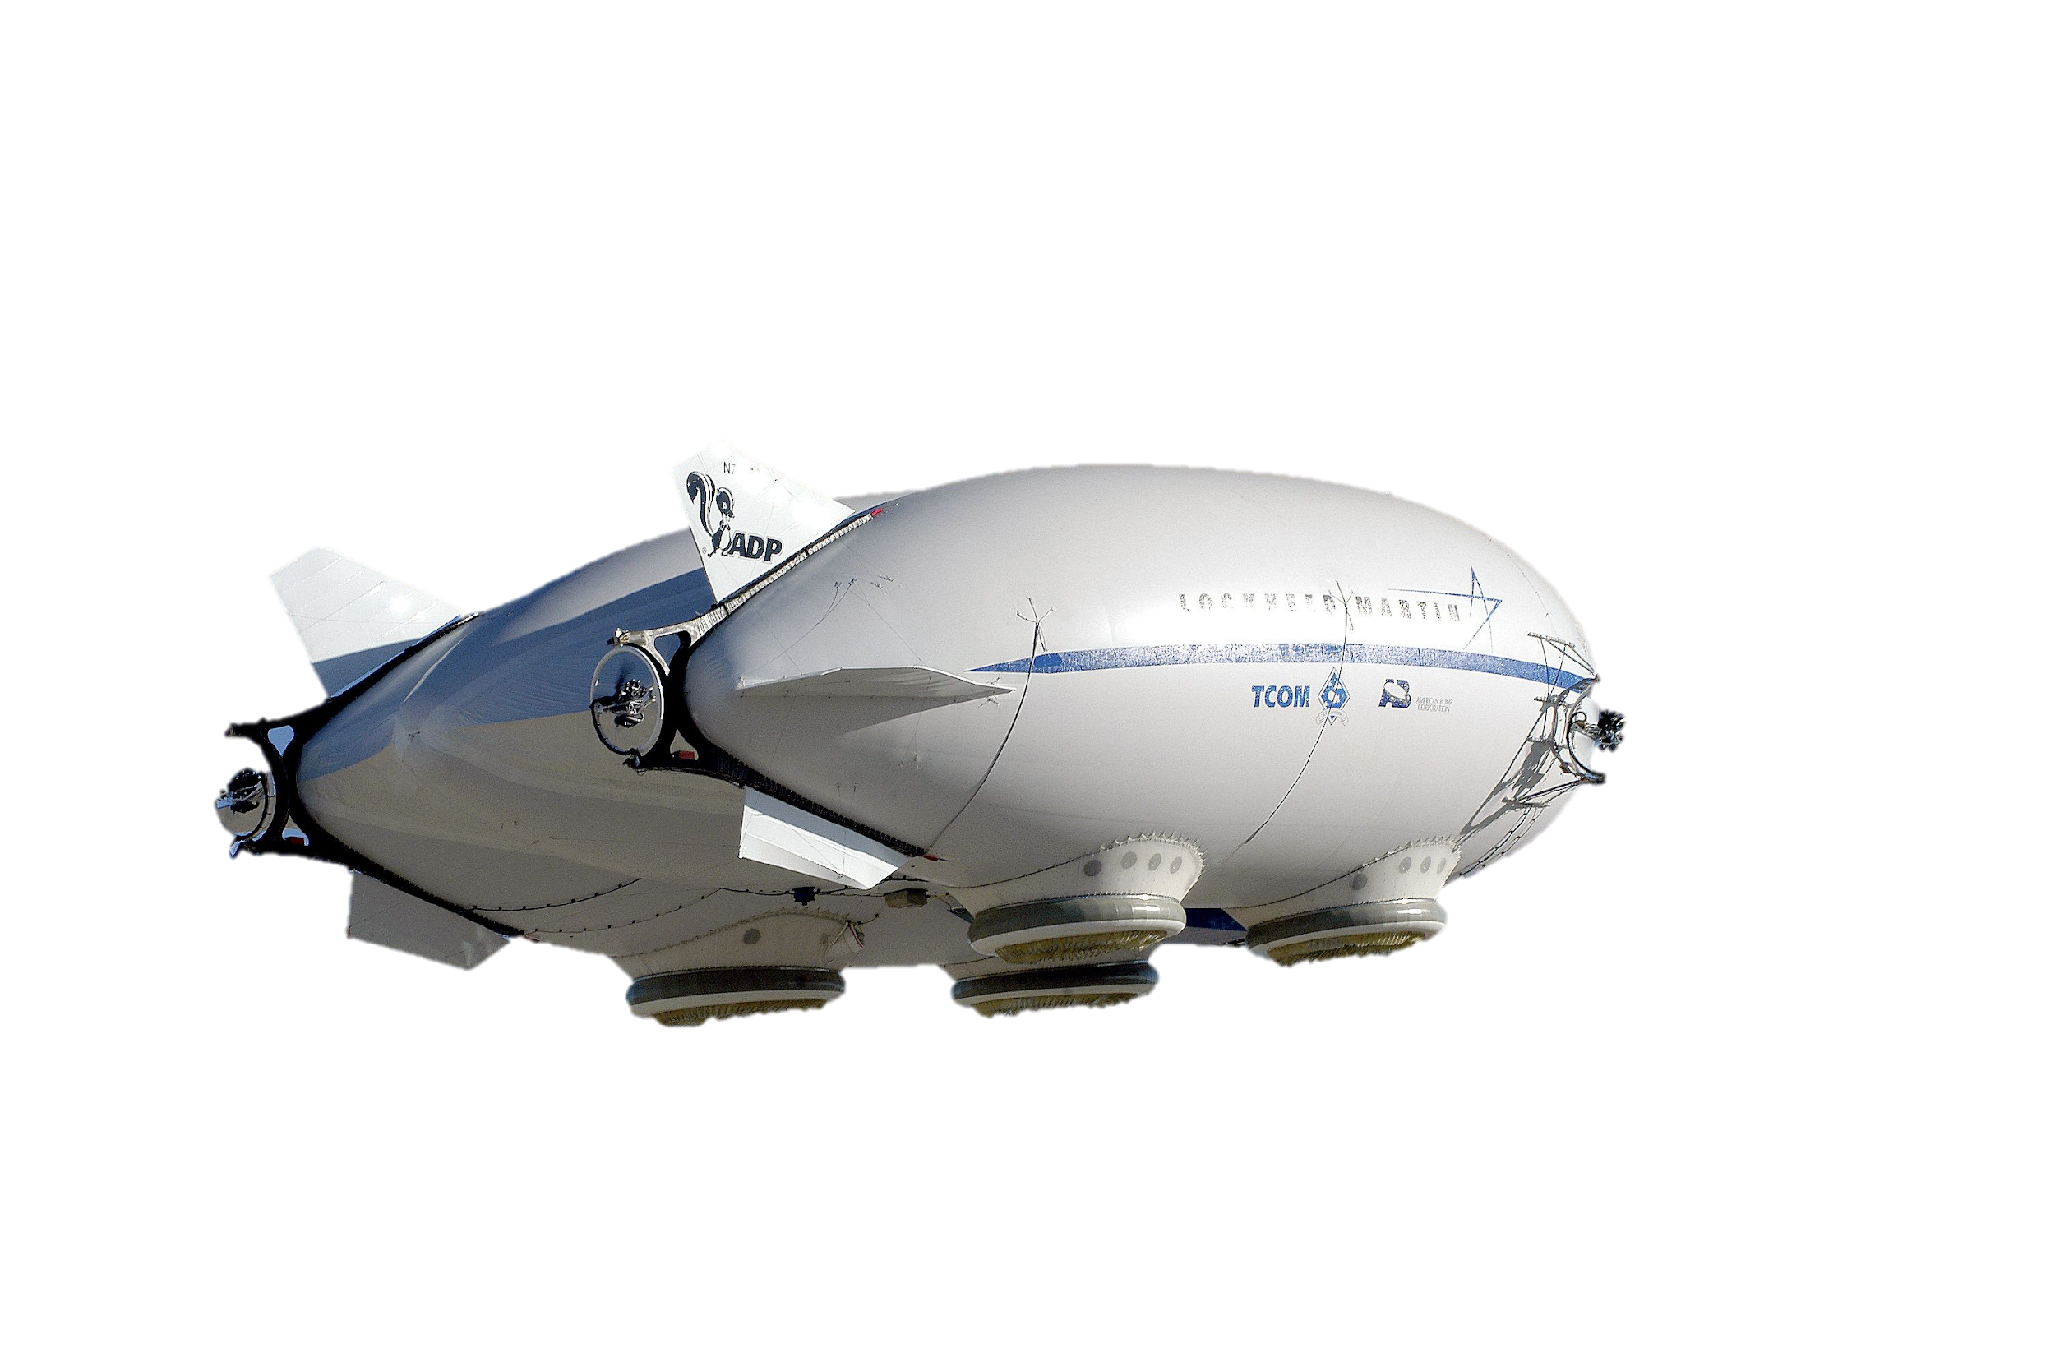
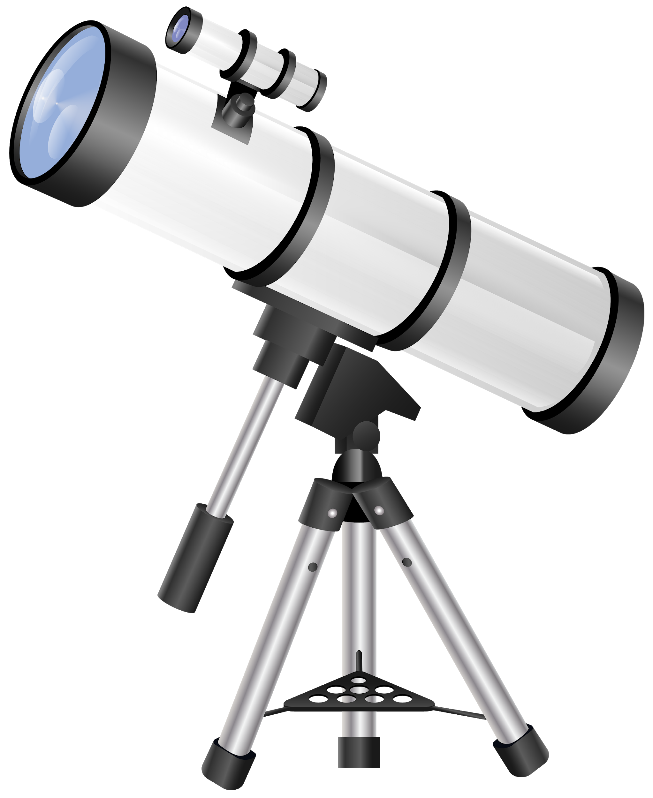
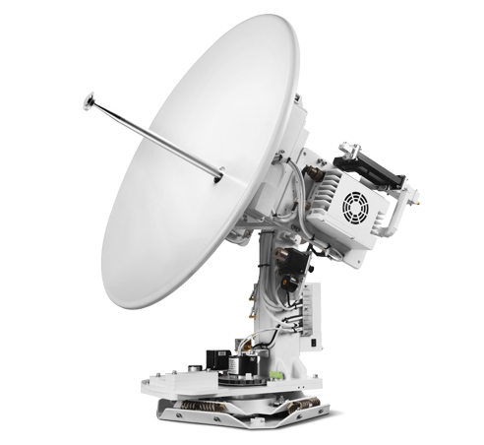
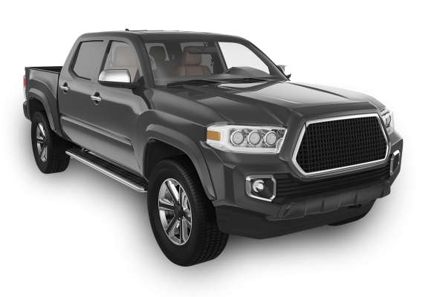
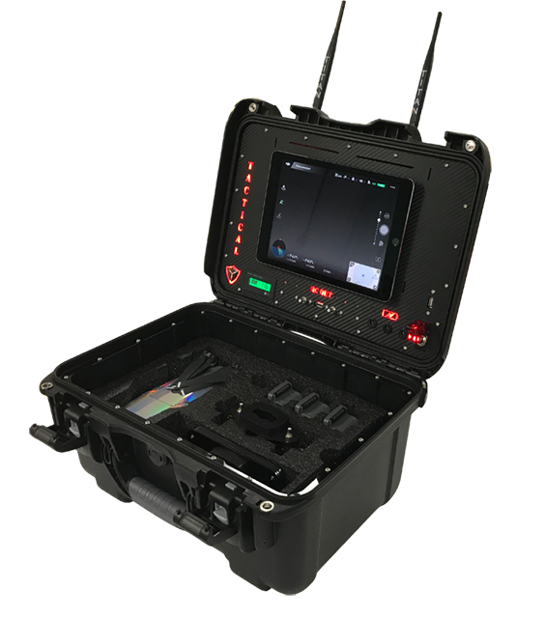
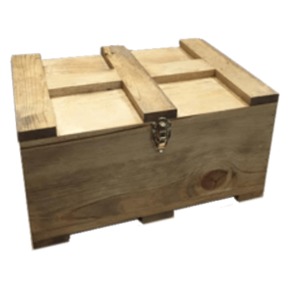
Stay on a 65,600 ft to 164,000 ft distance from takeoff spot
Legend:
🡪 Requirements
🡪 Operations flow
10 arcseconds object centroid identification accuracy, 3 sigma precision
5. Point optical system, capture image, measure time and position
Dimness ≥ 13 apparent magnitude
4. Pointing and stabilization check, autonomous flight
6. Store image and data
7. Start autonomous descent to Ground Station when battery is low.
Max altitude 18,000 ft
Loop
3. Manual ascent above clouds, uplink from ground station
Constantly downlink position and status data to ground station
8. Manual landing, uplink from ground station
1. System transportation
2. Unload/ Assembly/ Prep.
Ground Station
End of mission 14 hours after first ascent
Land 300 ft (100 yards) from takeoff spot
Notes:
This Figure illustrates the full mission scope where a team would go out to a location deploy the NESSIE system, collect SSA data for a time period and descend. So Where our team comes in this

Slide 5
Stay within 400 ft of takeoff spot
Legend:
🡪 Requirements
🡪 Operations flow
4. Systems check, Manual flight
5. Continuously collect acceleration data from onboard IMUs
Provide power and data connectivity to payload
6. Start manual descent to Ground Station when battery is low.
Max altitude 80 ft
Downlink position and status data to ground station
7. Manual landing, uplink from ground station
3. Manual ascent, uplink from ground station
1. System transportation
End of mission when battery reaches ~20%
2. Unload/ Assembly/ Prep.
Ground Station
Land 300 ft (100 yards) from takeoff spot
Notes:
This Figure represents the CONPOPS of our Sr. Project team.
Will drive out to a field
prep our A/c
Ascend it to 400ft
Conduct a comm check
Collect data for XXX mins
Descend and land saftley

Slide 6
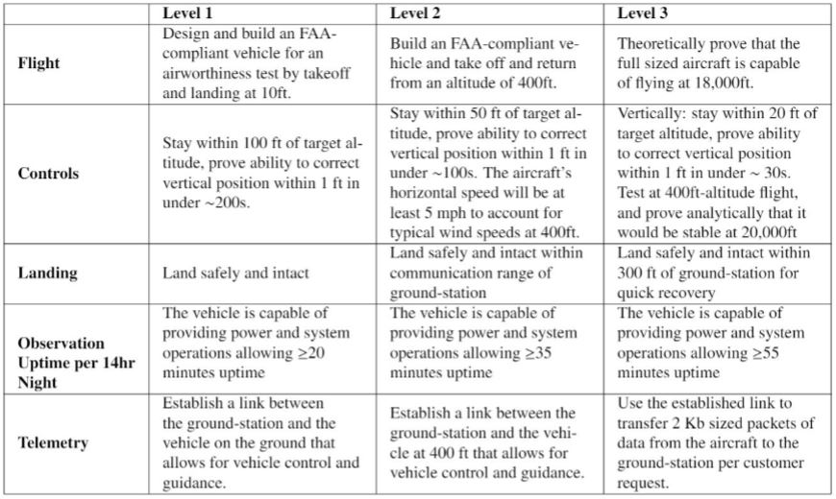
Levels of Success

Slide 7
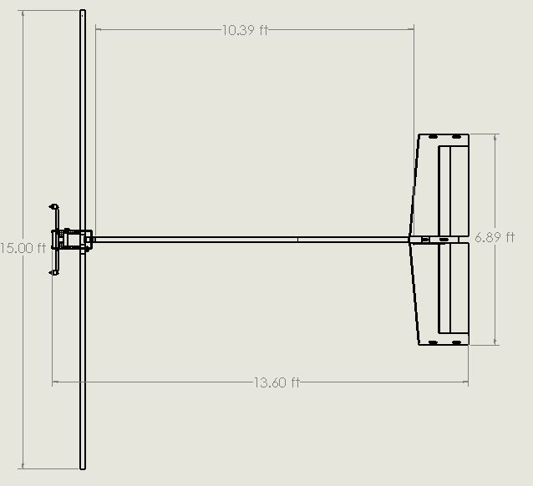
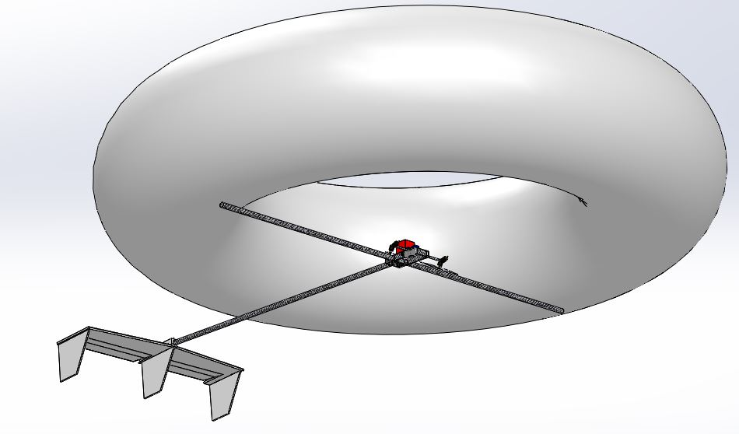
Design Description - Overall Outcome
Measured mass of the envelope, measured mass of the gongola, mass of the lifting gas, volume of the envelope, net lift of the envelope
Figure of NESSIE CAD with most important dimensions and description of functionality of most important parts
Notes:
This is a top level description of the overall outcome of your design efforts. It should show what the whole system looks like, its key parameters (dimensions, mass, data rates, etc.), what the major elements or subsystems are, and most importantly, how it works. Include a functional block diagram. This provides the context and terminology for more detailed descriptions later in the presentation.

Slide 8
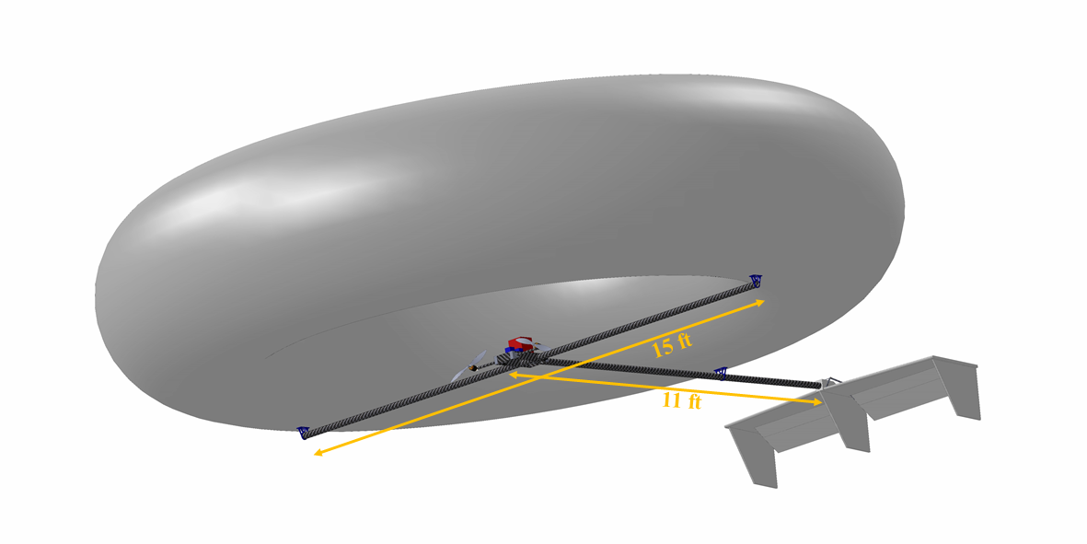
Design Description - Overall Outcome
Gondola & avionics:
4S Lipo battery, 5,200 mAh
PixHawk 4 Mini
PixHawk Radio Kit
Arduino Nano 33 BLE
Total measured mass = 5.57 lbs.
Envelope:
PVC film 7/1000” thick
Measured mass = 35.8 lbs.
Volume = 888 ft^3
Net lift = 19.2 lbs.
Dimensions: R = 7.5 ft, r = 2.5 ft.
Propeller blades and motors (2x):
Diameter = 1.3 ft.
Carbon fiber blades
Combined thrust = 14.8 lbf
Tail:
EPS foam coated with epoxy resin
Expected combined mass = 0.22 lbs.
Edge Connectors (3x):
3D Printed PLA
Measured combined mass = 0.22 lbs.
Structural tubes (3x):
Carbon fiber
Measured combined mass = 3.06 lbs.
Notes:
This is a top level description of the overall outcome of your design efforts. It should show what the whole system looks like, its key parameters (dimensions, mass, data rates, etc.), what the major elements or subsystems are, and most importantly, how it works. Include a functional block diagram. This provides the context and terminology for more detailed descriptions later in the presentation.

Slide 9
Design Description - FBD
Legend
GPS
IMU Battery
IMU
Motor Shaft Servo
5V Power
Power
I²C
Data
Sensor
Elevator Servo
MavLink
Controls
Components
Receiver
Pixhawk 4 Mini
Release Valve
14.8V Power
Processor
4.2 kB/s
Telemetry
ESC 1
Motor 1
MavLink
UART
ESC 2
Motor 2
Ground Station
5V BEC
PDB
LEDs
Battery
9
Notes:
This is a top level description of the overall outcome of your design efforts. It should show what the whole system looks like, its key parameters (dimensions, mass, data rates, etc.), what the major elements or subsystems are, and most importantly, how it works. Include a functional block diagram. This provides the context and terminology for more detailed descriptions later in the presentation.
BEC - Battery Eliminator circuit
PDB - distribution board
ESC - electronic speed control

Slide 10
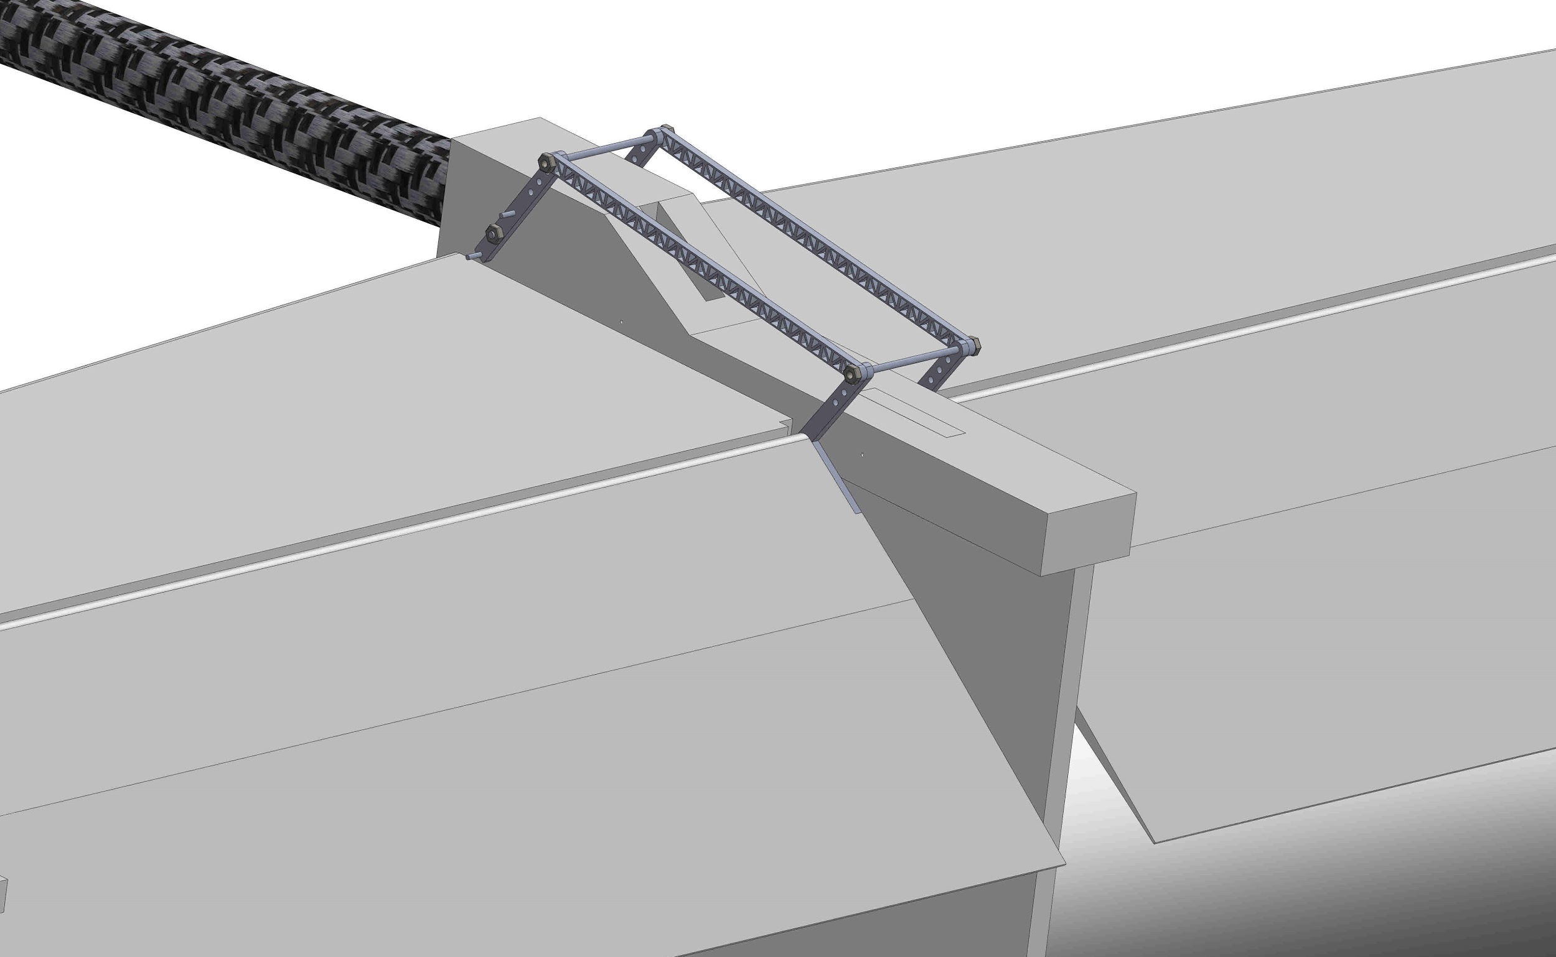
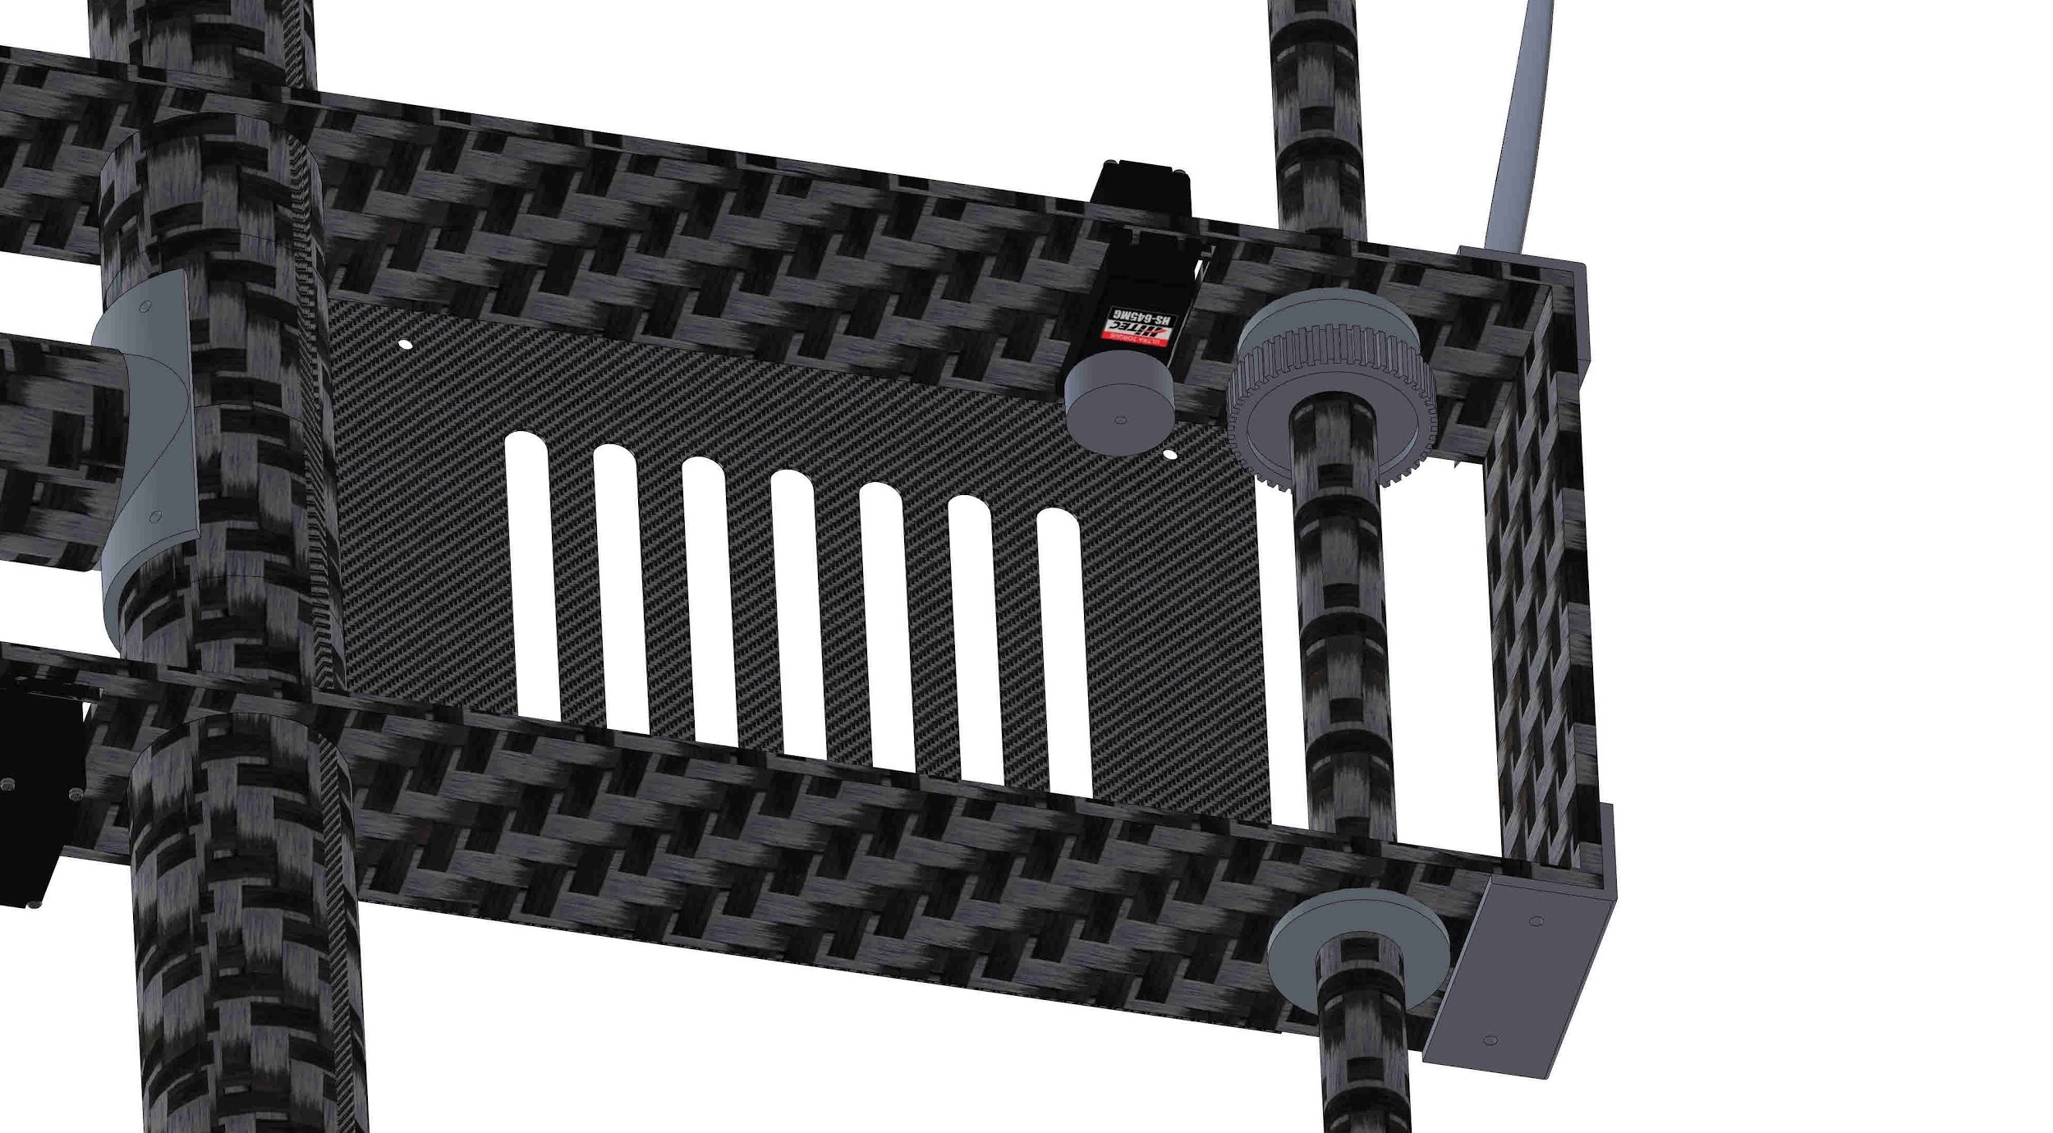
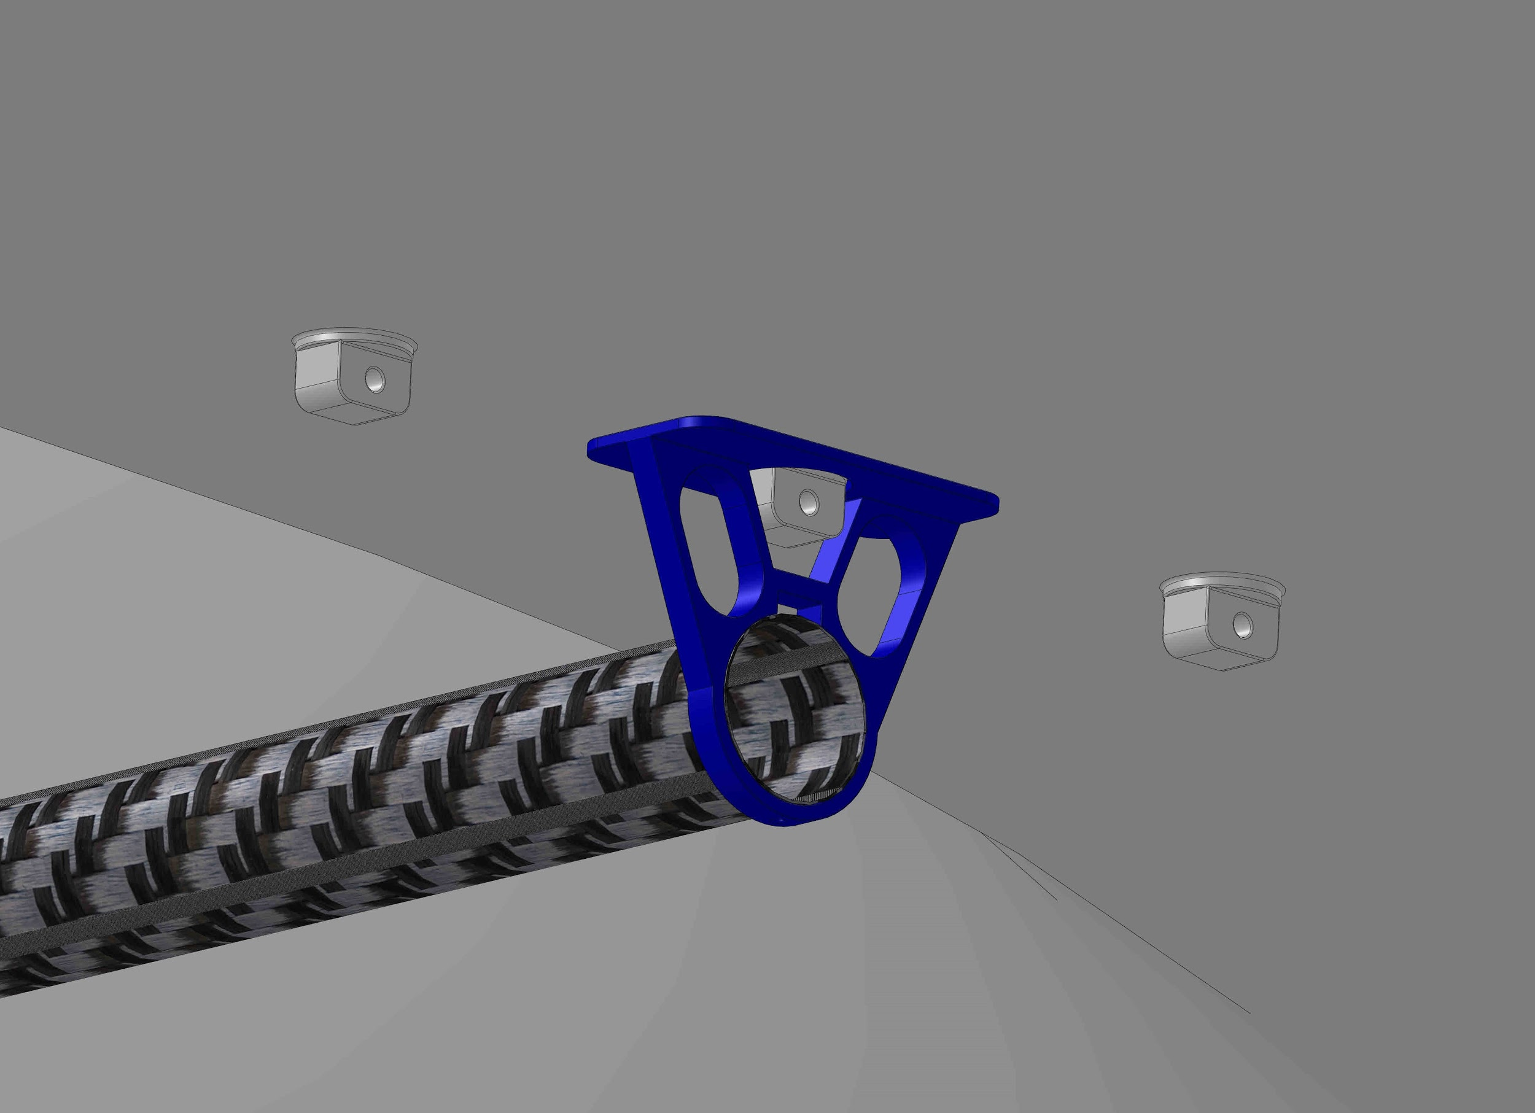
Design Description - Major changes from TRR
The lifting gas was switched to helium for safety concerns regarding handling the gas, and filling/deflating the envelope.
The envelope is 8.45 lbs lighter than expected, therefore a ballast was added to meet the design weight and prevent the blimp from flying over the height limit.
Servos, mechanical links, and gears had to be incorporated to the tail, and gondola to control the horizontal control surfaces, and to rotate the motor shaft, respectively.
Ballast connected at the unused envelope connections
Elevator servo links
Motor shaft gears
Notes:
Highlight major changes made since TRR, and briefly explain why they were made.

Slide 11
Design Description - Critical Project Elements
Critical Project Element (CPE) | Description | Reason
Optical system mount capacity | Provide sufficient payload bay for scaled optical system | A mount capacity is needed for the optical system that will take the images that are required to fulfill the mission.
Aircraft stability | Aircraft must be stable | Stability allows the optical system to remove any frequency of less than 6.7 Hz in order to take clear images of the desired objects
Aircraft control | Aircraft will be controllable | Control allows it to fly up to a commanded altitude and position, collect data, and then return, all while enduring wind gusts and other perturbations.
Aircraft structure | Aircraft will be structurally sound | A gondola must be built to carry electrical components and interfaced with the balloon.
Path forward | The team will provide legal and technical documentation to continue towards MANTA | The path forward is needed to allow the customer to know what process he must follow to be able to complete the mission as he desires
Notes:
Identify the elements in the design that are critical for project success (critical project
elements), and explain why.
** I believe we have a value in terms of frequency. 6.7Hz

Slide 12
Test Overview: Path Forward
Testing and Verification
Fall Semester
FOV Test ✔
Wind Speed Test ✔
Avionics Test
Power Test
Manual Controller Test
Envelope
Test ✔
February
Gondola Shake Test
Gondola Control Surface Test
March
Complete System Test:
April
Indoor Tethered Test
Outdoor Tethered Test
Outdoor Flight Test
Notes:
Here we have the test along with the time and order they had/should get done. We ran behind on schedule due to manufacturing and had issues that couldn’t be debugged on time with the tests we ran which cause the february test to be unfinished.
Note: Gondola Shake Test is now Object Determination Test

Slide 13
Test Overview: Parts/Hardware Operation Testing
Avionics Test:
Ensure all avionics are electrically connected
Ensure all avionics – servos are physically connected
Verify all surfaces are working properly with ground-control readout
Power Test:
Determine the amount of power the system will consume – run all avionics on full power and measure the current draw with ammeter
Quantify the amount of power needed for the final field test
Compare these values to the predicted model
Manual Controller Test:
Establish the connection between the avionics and the manual controller
Perform full surface check with inputs from the controller – verify that commands are received
Purpose: To verify that the hardware is properly working before any integrated testing

Slide 14
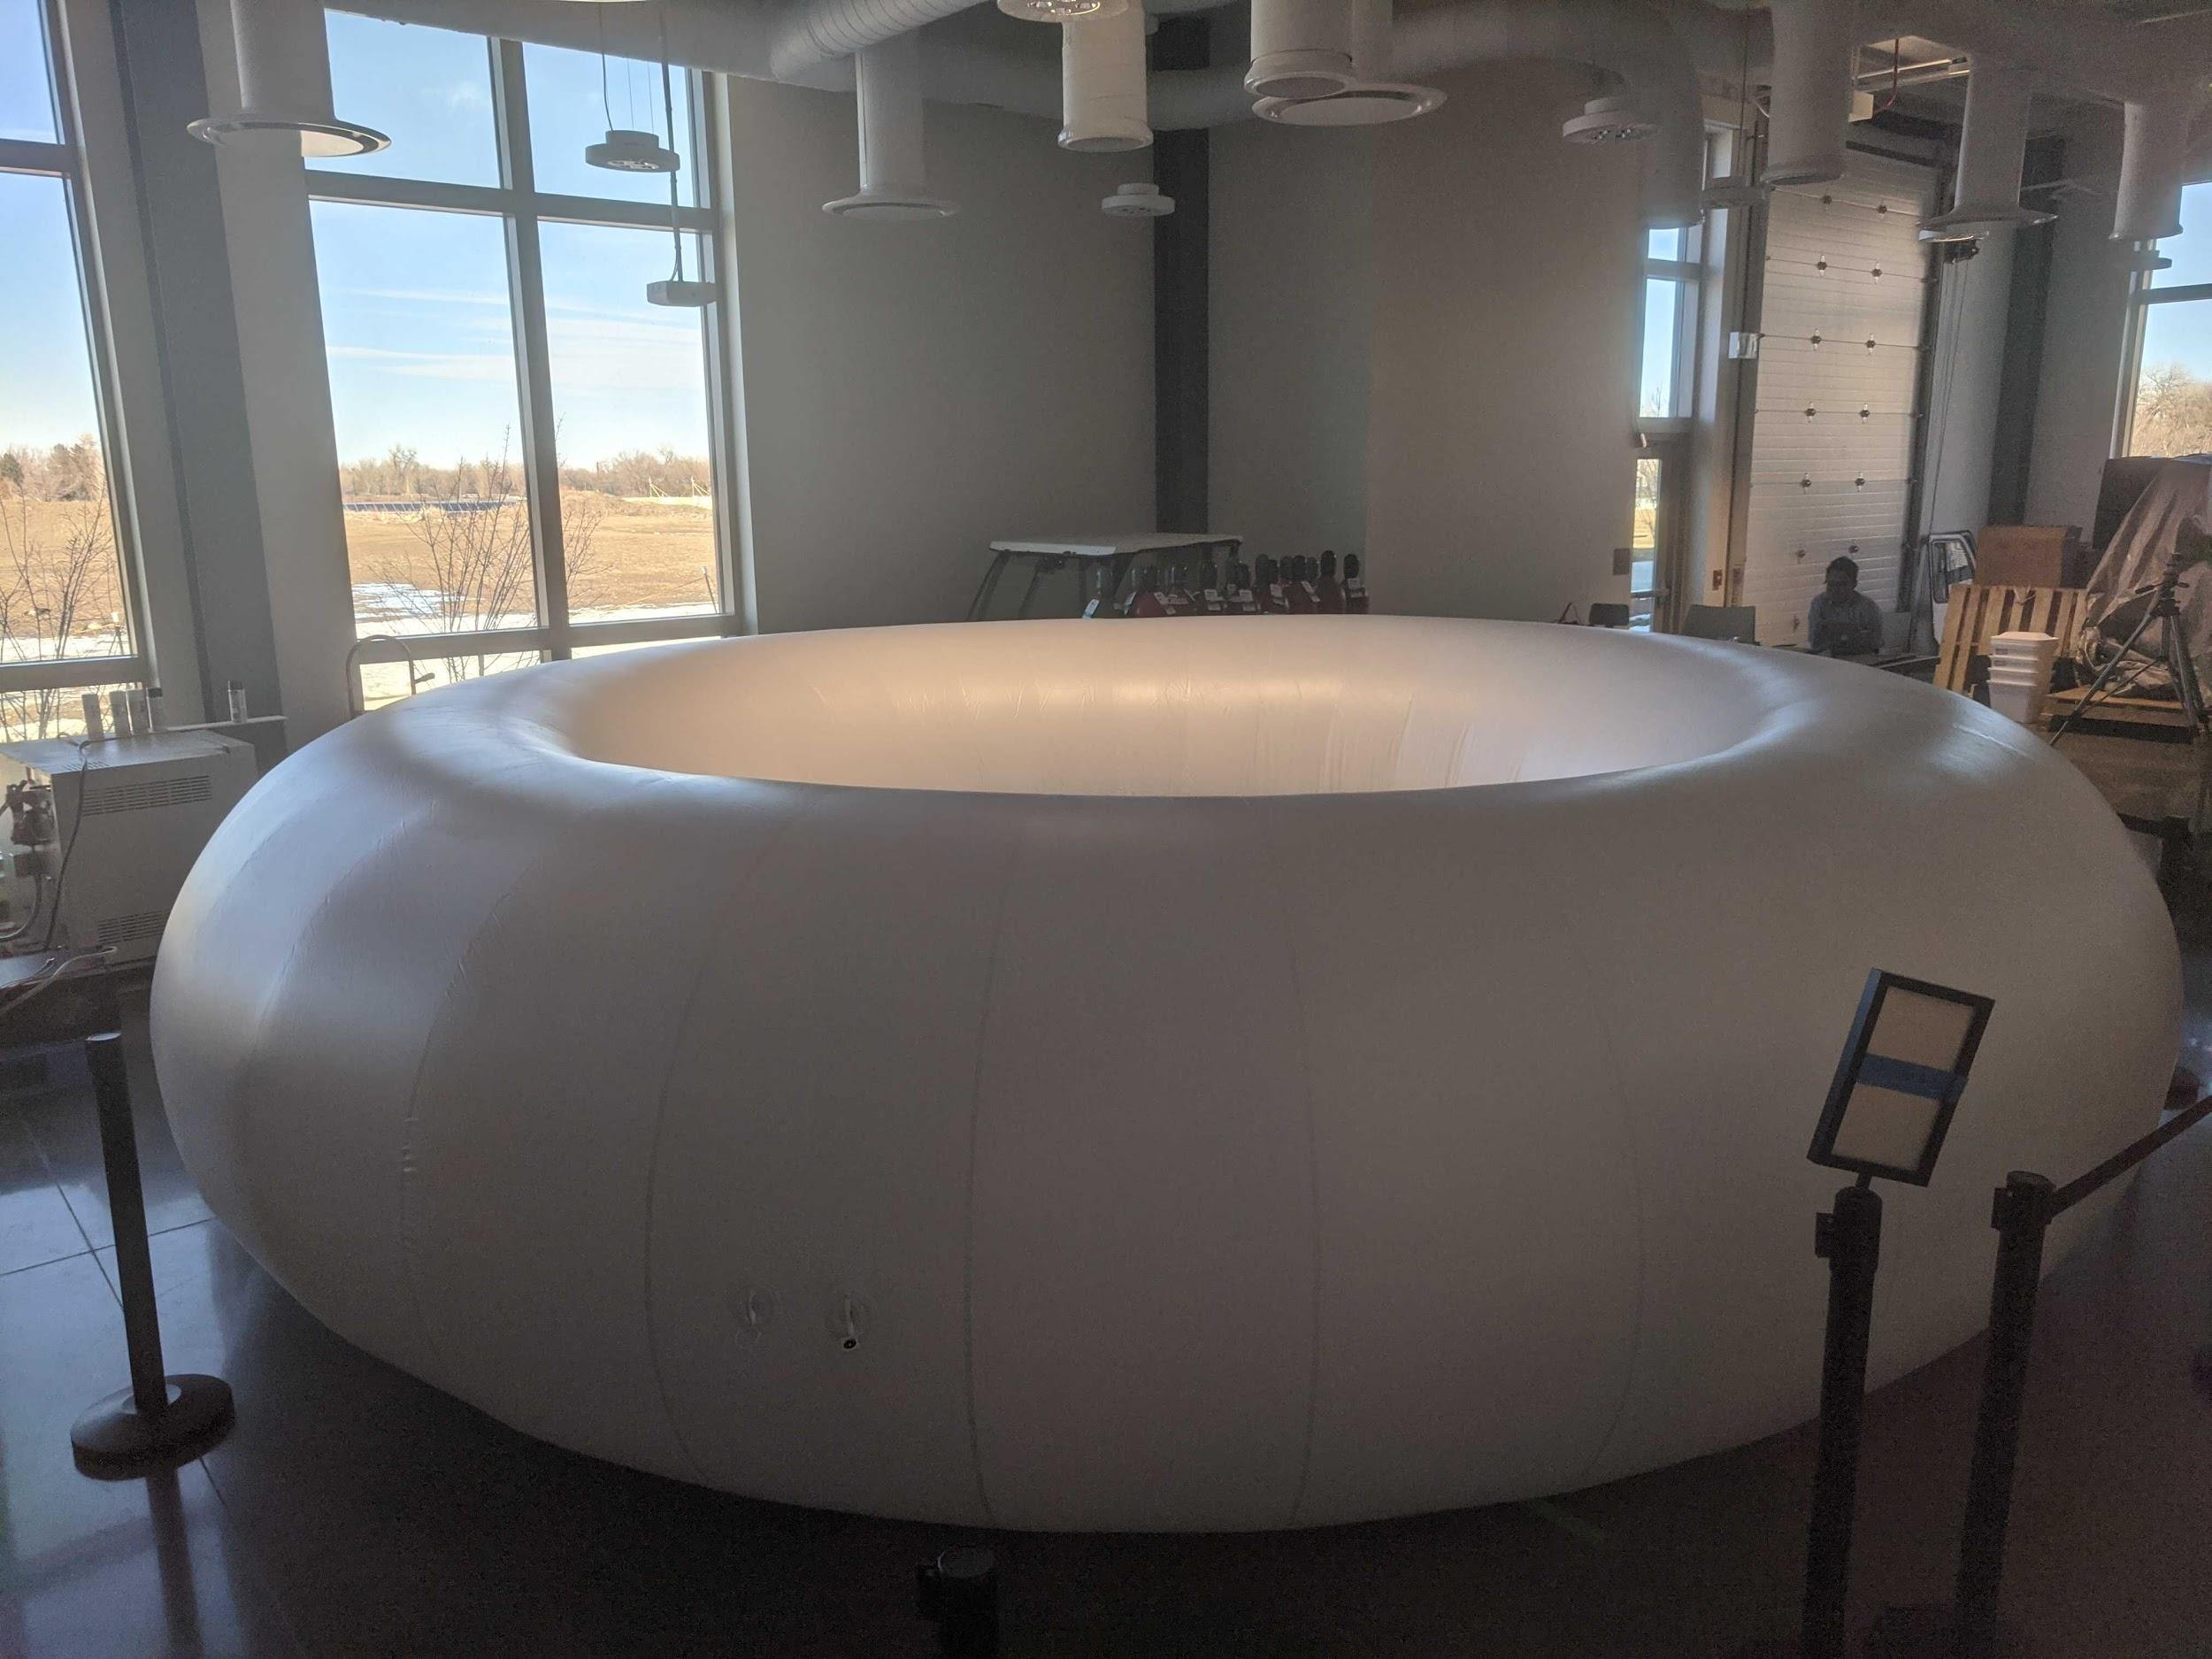
Test Overview: Envelope Inflation Test
Test Description
Test duration of inflation time
Pressurized air
Ensure no punctures/leaks
Instruments/Materials/Equipment Used
Aircraft Balloon Envelope
Building pressurized air outlets
Test Environment
AERO Building North High Bay
Design/Functional/Requirements Relation
FR 2 - System shall be capable of flying at 400 ft
DR 3.1 - System shall provide sufficient lifting force

Slide 15
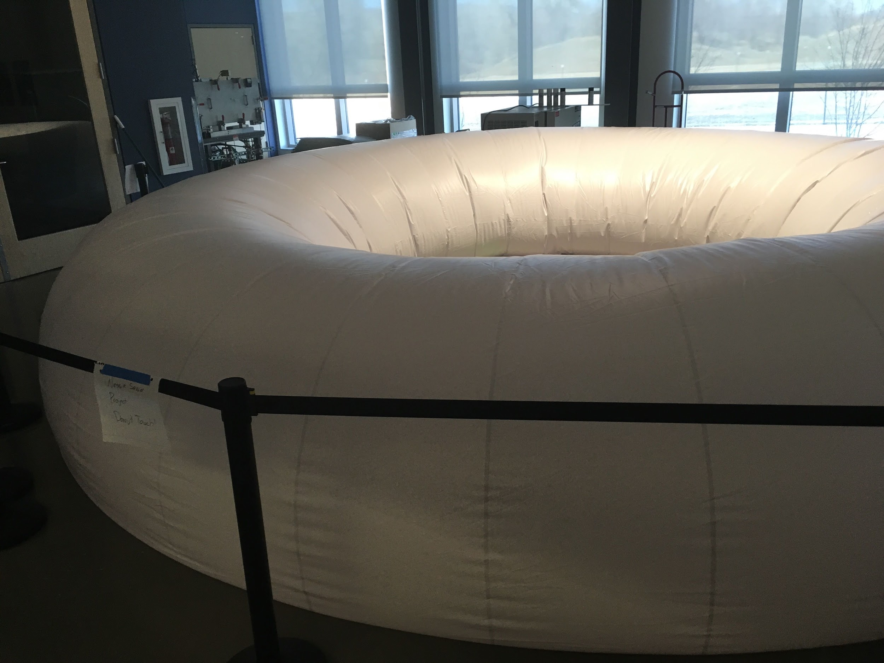
Test Overview: Envelope Deflation Test
Test Description
Determine viability of deflating the balloon without external aid
Release valve & Burn wire
Instruments/Materials/Equipment Used
Same as previous
Tape measure
Height of envelope
Test Environment
AERO Building North High Bay
Section cordoned off to avoid stepping on envelope
Design/Functional/Requirements Relation
DR 3.3.2 - System shall provide sufficient lifting force
PAB request for safety

Slide 16
Test Overview: Object Determination Test
Formerly known as the Shaker Table Test
Test Description
Shake test designed to verify NESSIE is a platform suitable to capture space images
No model is necessary for verifying/validating
Instruments/Materials/Equipment Used
Raspberry Pi, Monitor, Camera, shaker platform (cutting board) & mount, MATLAB
Note we are not using the shaker table located in the pilot. 1D vibrations aren’t realistic enough.
Test Environment
Test would have been conducted at home or in Aero conference room with no safety concerns.
Design/Functional/Requirements Relation
FR1 - “ability to take images for orbit determination”

Slide 17
Test Overview: Tethered Tests
Test Description
Designed to provide a comprehensive test of integrated system in a controlled setting
Tethers mitigate risk of fly-away due to uncertain performance during first tests
Instruments/Materials/Equipment Used
NESSIE
RC controller
Helium gas
Testing Environment
Indoor Flight Space/CU South Boulder
No concerns related to helium lifting gas
Most significant concerns are those related to puncture of the envelope
Design/Functional Requirements Relation
Helps validate DR 1.1, 2.2, 3.3, 4.2, and 4.3 regarding in-flight controllability and ability to land

Slide 18
Test Overview: Tethered Tests
Expected Test Procedure
Transportation to flight area
Ensure travel time is factored in to allow for prompt 10:30 am start time
Test area set up
Emplant mooring stakes (outdoor test only)
Place ground tarp (outdoor test only)
Assemble NESSIE structure
Fill NESSIE with helium gas
Fill Procedure in backup slide here
Once rigid, NESSIE’s gondola will be affixed to gas envelope.
NESSIE flight
See next slide for this procedure
Nessie landing and recovery
See next slide for this procedure
Gas venting/recapture
Helium from NESSIE will be vented
Data recovery
In-flight IMU data
GPS and any available flight controller data
Pilot qualitative comments on vehicle performance will be recorded

Slide 19
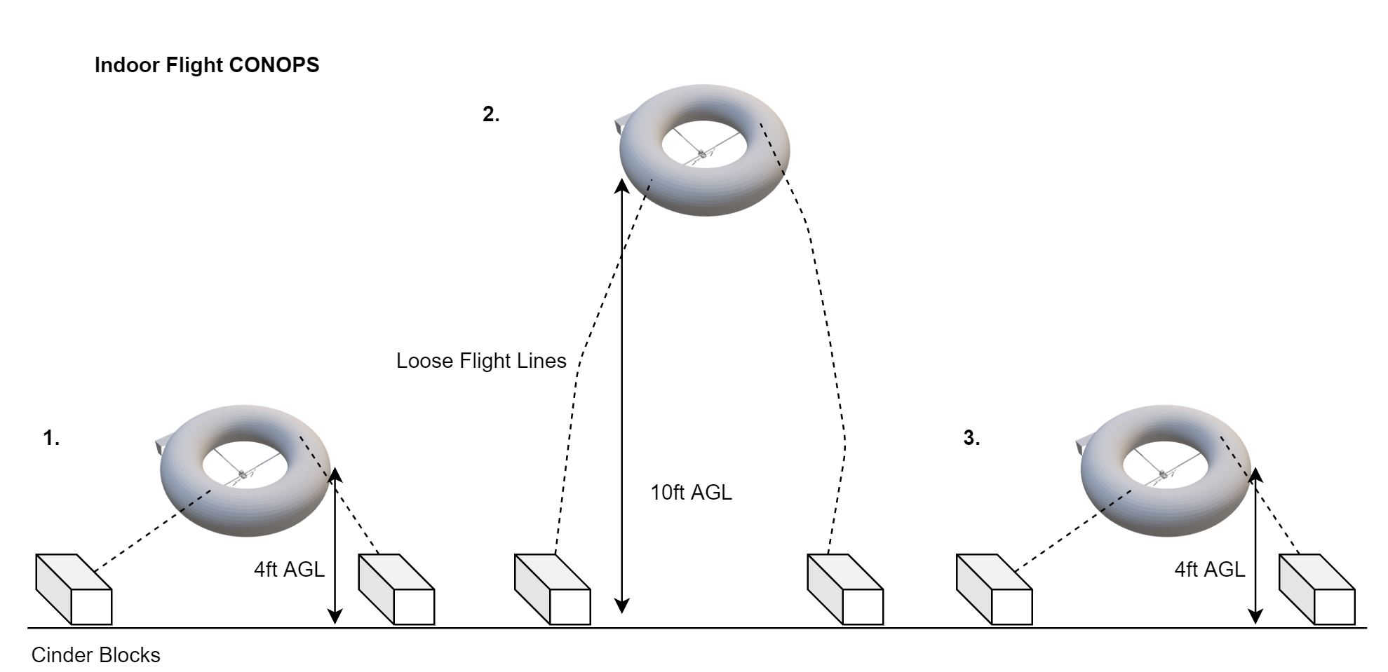
Test Overview: Tethered Flight Tests
Expected Flight Procedure:
Tethered Flight
NESSIE will fly to 4 ft AGL
Box Pattern
NESSIE will fly in a small box pattern to establish control
NESSIE is taking data for FR1 here
Reduce Altitude
NESSIE will use its motors to descend to 4 ft AGL
Recapture
NESSIE will be secured

Slide 20
Test Overview: Outdoor Free Flight Test
Test Description
Demonstrate system performance in its complete operational environment
Instruments/Materials/Equipment Used
NESSIE
RC controller
Helium gas
Testing Environment
CU South Boulder
Table Mountain flight space is backup
Limited potential for fly-away
Performance will be better characterized
Design/Functional Requirements Relation
Helps validate DR 1.1, 2.2, 3.3, 4.2, and 4.3 regarding in-flight controllability and ability to land
Will focus heavily on collection of IMU data

Slide 21
Test Overview: Outdoor Free Flight Test
Expected Test Procedure
Transportation to flight area
Ensure travel time is factored in to allow for prompt 10:30 am start time
Test area set up
Emplant mooring stakes
Place ground tarp
Assemble NESSIE structure
Fill NESSIE with helium gas
Fill Procedure in backup slide here
Once rigid, NESSIE’s gondola will be affixed to gas envelope.
NESSIE flight
See next slide for this procedure
Nessie landing and recovery
See next slide for this procedure
Gas venting/recapture
Helium from NESSIE will be vented
Data recovery
In-flight IMU data
GPS and any available flight controller data
Pilot qualitative comments on vehicle performance will be recorded

Slide 22
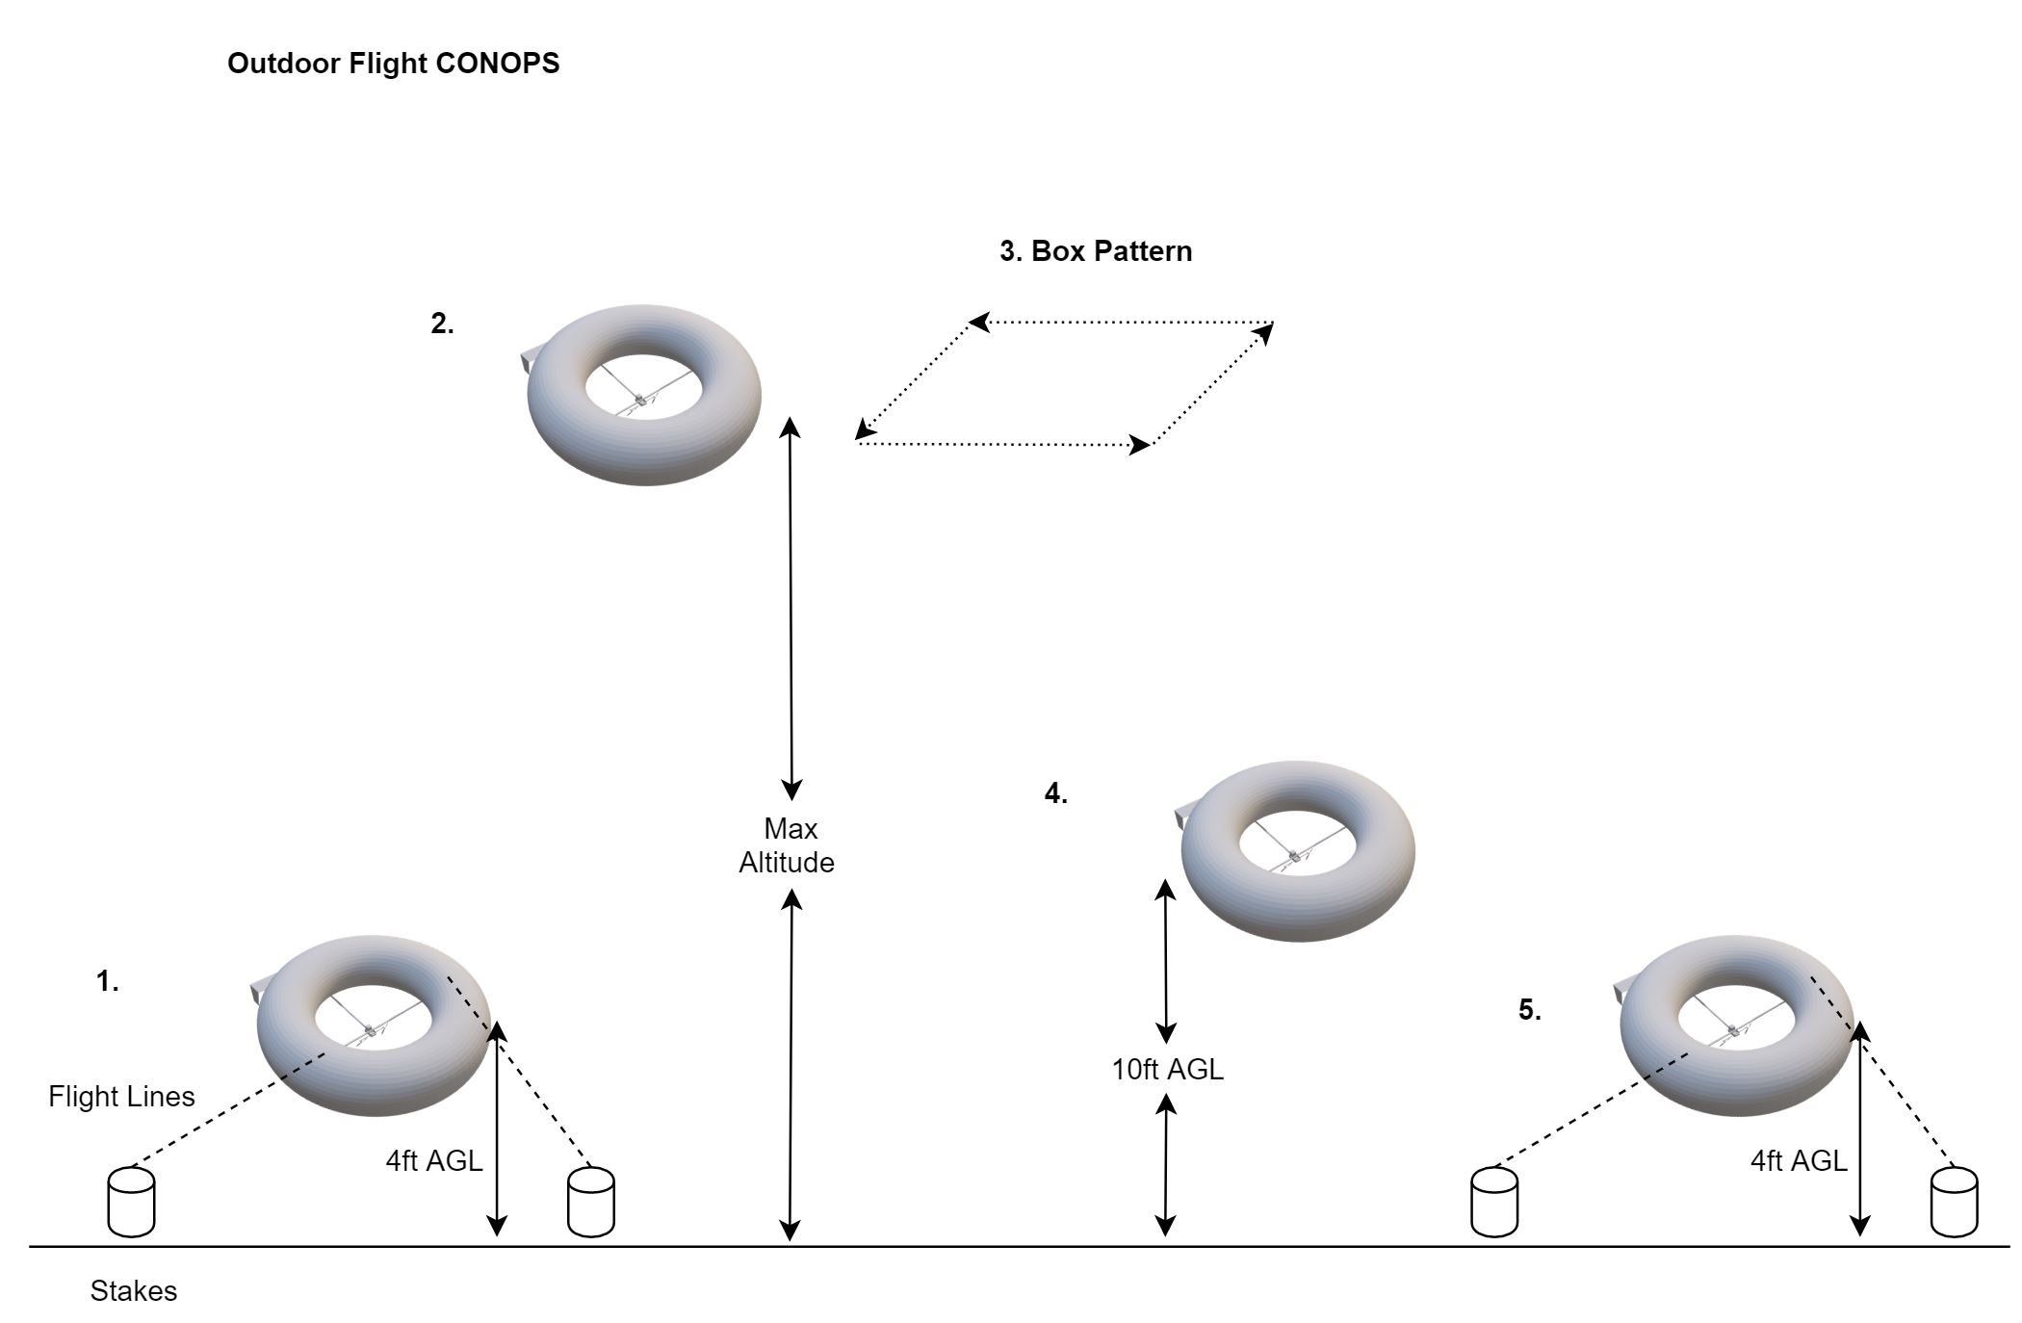
Test Overview: Outdoor Free Flight Test
Expected Flight Procedure:
Untethered Flight
NESSIE will fly to 80 ft AGL
Box Pattern
NESSIE will fly in a box pattern to establish control
NESSIE is taking data for FR1 here
Reduce Altitude
NESSIE will use its motors to descend to 10 ft AGL
Recapture
NESSIE will be recaptured and staked via its tethers.
At any time, if control is lost, emergency solenoid and burn wire can be used in this test.

Slide 23
Test Results: Envelope Inflation Test
Test Description
Verifies that leaks or tears in the envelope are non-existent or negligible
Preliminary investigation into effects of diffusion
Data Type
Volume over time recorded via time-lapse video
Sources of error/uncertainty
Volume is based on height measurements in the video
Envelope filled with air instead of helium, diffusion of helium molecules at a different rate than diffusion of air
Design/Functional Requirements Satisfied
This test was mostly to verify there were no issues with the envelope before moving on to further testing
Related to FR 2 and DR 3.1 regarding capability of operating at design altitude and maintaining lifting force

Slide 24
Test Results: Envelope Inflation Test
Results:
No leaks detected
Effects of diffusion deemed negligible over course of testing period
Verification and Validation:
No change in volume of the envelope implies that lift will remain constant
Validates FR2 and DR 3.1

Slide 25
Test Results: Envelope Inflation Test
Test Description
This test is to determine the viability of deflating the balloon without external aid.
Data Type
By measuring the height of the envelope, the volume of the balloon can be estimated, assuming a flat bottomed torus
Sources of error/uncertainty
As the tape measure cannot be placed directly next to the top of the envelope, human error of 1” is involved in making the height measurements
The balloon likely does not deflate exactly as predicted, further complicating percentage fill volume estimation
Low number of data points
Design/Functional Requirements Satisfied
The requirements were not satisfied for this particular test
Balloon would take an unacceptable amount of time to deflate on its own
Notes:
At an estimated 6 hour deflation time, this means the balloon would take an unacceptable amount of time to descend and to finish outgassing. If using hydrogen, the balloon would have to be left to finish this deflation process due to the risk of static shock, making it difficult to practically use. Note that both of these issues are mitigated by lifting gas choice and burn-wire systems.

Slide 26
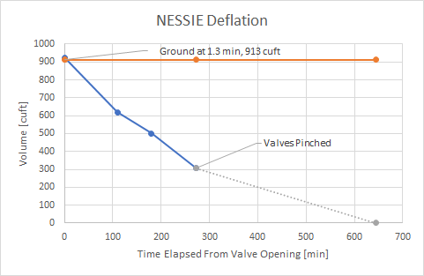
Test Results: Envelope Deflation Test
Verification and Validation:
DR 3.3.2 Satisfied, NESSIE can descend safely
Deflated to neutrally buoyant in 1.3 min
Note this was air, assuming time is proportional to density helium would take 9.7 minutes
Once valves were pinched, deflation stopped, requiring physical assistance.
Start
2 hours in

Slide 27
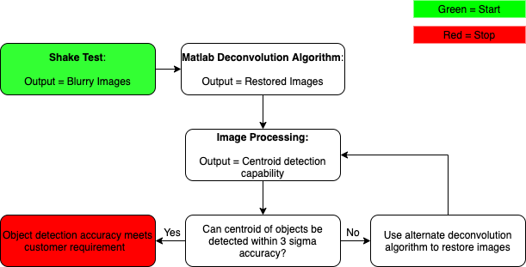
Test Results: Object Determination Test
Status: Incomplete
Phase 1: Shake camera → Blurry images + Data
Phase 2: Matlab → Obtain restored images
Phase 3: Image Process → Obtain 3σ capability
Phase 4: Confirm validation
Validation for FR1 is confirmed by comparing vibrational data from shaker test with vibrational data from integrated flight test.

Slide 28
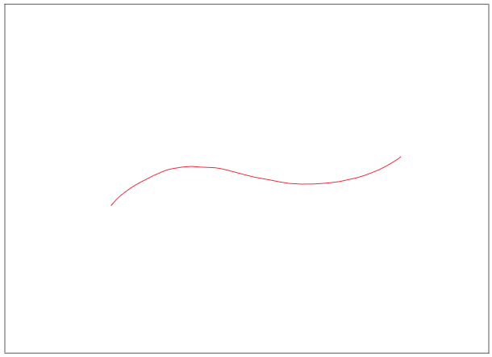
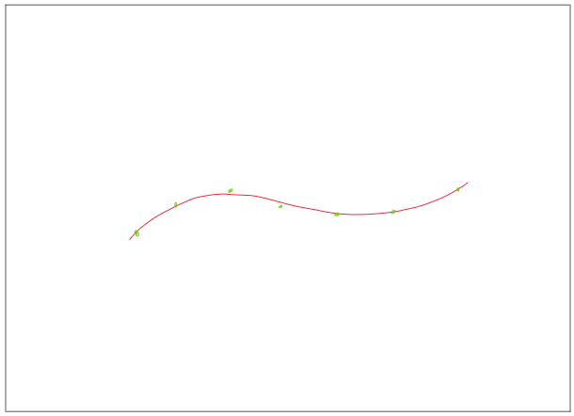
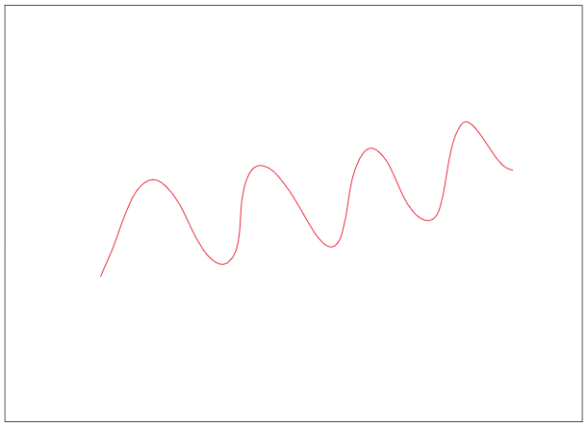
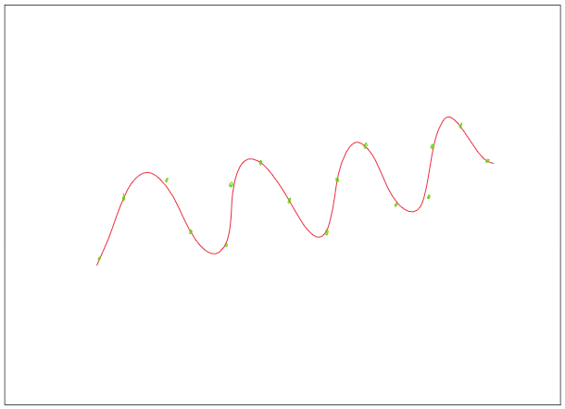
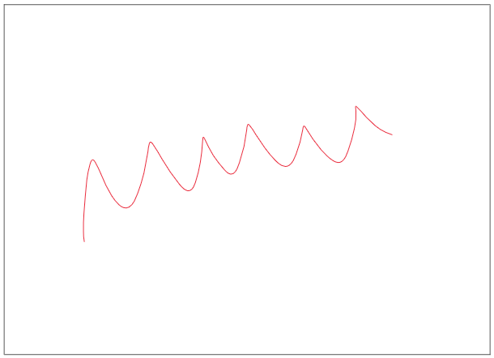
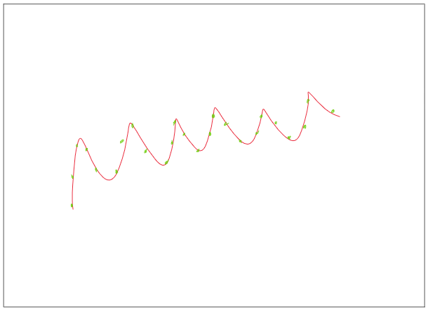
Test Results: Object Determination Test
Phase I: Image Capture Expected Results
Phase II: Deconvolute Image & Restore
1 Hz image
4 Hz image
6 Hz image

Slide 29
Test Results: Tethered Tests
Expected Results:
Verification and Validation:
Visual confirmation of vehicle reacting to controller input
Land at desired location at velocities under 3 m/s.
Verify that the vehicle is doing what the data is reading.
Envelope attachment hardware, and surroundings, with no visible damage.
Check the battery for remaining power/energy
Controllability of vehicle FR. 2, FR 3
Ability to land unharmed FR. 2
Successful data transfer from vehicle to station DR.4.3 & 4.2
Envelope supports intact FR.1
Power usage per minute DR.1
Notes:
I am mentioning that there is no wind therefore the landing verification velocity should be at 3 m/s or less.
***- I think it would be a good data to have and quantify.

Slide 30
Test Results: Outdoor Free Flight Test
Expected Results:
Verification and Validation:
Power usage per minute DR.1
Altitude control-ability FR. 3
5 mph gusts resistance FR. 2
Vibrational data returned from IMU FR. 1, DR.1
Would require post-processing
Check for battery remaining power*
Vehicle is capable of maintaining desired altitude within ±50 ft
Aircraft maintain stability with incoming wind shear
Vibrational data would confirm that flight is stable enough to take images sufficient for calculating initial orbit determination
Notes:
*- Same as slide 23. Here to see the how much the incomming gusts affect power usage.
**- is 20ft a good range? Let me know what you think.

Slide 31
Levels of Success Completed
Legend
Highly expected
Moderately expected
Notes:
✔

Slide 32
Systems Engineering: Left Side of V
Feasibility
Study/
Concept
Exploration
System Engineering V
Operations and Maintenance
Key Trade Studies
Developed the overall mission and design space
Dirigible rather than Fixed-wing
Potential uptime, relative stability
Torus shaped balloon vs traditional
Superior exposure times
Concept of Operations
System Validation Plan
System Validation
Requirements Development:
Notional Payload Requirements
Extensive optical and vibrational analysis to define this payload
Drove vehicle size, geometry, needed stability, etc
Customer Derived
Flight time, relative size (~carried by 3 people)
Regulations
FAA 55 lb limit, altitude restrictions
System Verification Plan
System Verification & Deployment
System Requirements
Subsystem
Verification Plan
High-Level Design
Subsystem
Verification
Unit/Device Test Plan
Detailed Design
Unit Device Testing
Systems Engineering V, Left Hand Side:
Almost entirely completed in Fall semester
PDD, CDD, PDR, CDR, FFR
Software/ Hardware
Development
Field Installation
Notes:
Summarize the systems engineering approach for the project (e.g. guided by the systems engineering “V”, conducted trades (briefly describe key trades that led to your team’s design), derived and flowed down requirements from functional objectives, developed Interface Control Documents, assessed risk (used FMEA or other approach) and etc.).

Slide 33
Systems Engineering: Software/Hardware Development Status
Legend:
Finished as of CU Closure
In-progress as of CU Closure
Feasibility
Study/
Concept
Exploration
System Engineering V
Operations and Maintenance
Subsystems
Avionics:
Power: Battery, ESC, BEC interfaces
Flight Controller: Connections to all relevant systems
Radio: connection, control gains
P/L IMU: connection, decoding, interface
Actuators: Motors & servo connections, BEC power
Structure:
Arms: Cut to length, Pin holes drilled
Tail Boom: Extended with Al spline, pin holes drilled
Gondola: Box cut and assembled
T Connection: pipes turned to proper radius, milled to shape, welded
Tail: H stab cut to shape/thickness, V stab cut, elevator cut, assembled
Balloon:
Vendor Requirements, bought and paid for
Interfaces: 3d printed attachments
Additional Notes: Potential changes needed: Given the ongoing He vs H2 conversations w/ CU several potential modifications may have been needed, including adding valves(~10) and moving valve locations, and other potential changes
Concept of Operations
System Validation Plan
System Validation
System Verification Plan
System Verification & Deployment
System Requirements
Subsystem
Verification Plan
High-Level Design
Subsystem
Verification
Unit/Device Test Plan
Detailed Design
Unit Device Testing
Software/ Hardware
Development
Field Installation
Notes:
Summarize the systems engineering approach for the project (e.g. guided by the systems engineering “V”, conducted trades (briefly describe key trades that led to your team’s design), derived and flowed down requirements from functional objectives, developed Interface Control Documents, assessed risk (used FMEA or other approach) and etc.).

Slide 34
Systems Engineering: Right Side of V
Feasibility
Study/
Concept
Exploration
System Engineering V
Operations and Maintenance
All in progress as of Spring 2020
Individual unit tests largely complete
Largest was balloon
Mostly Avionics
Still missing BEC
Subsystems Verification
In progress
Avionics waiting on lynchpin of BEC
Structures getting close
System Verification
Test flights were scheduled for April 6th
System Validation
Would have involved post processing of test data, ensuring that images were sufficient
Concept of Operations
System Validation Plan
System Validation
System Verification Plan
System Verification & Deployment
System Requirements
Subsystem
Verification Plan
High-Level Design
Subsystem
Verification
Unit/Device Test Plan
Detailed Design
Unit Device Testing
Software/ Hardware
Development
Field Installation
Notes:
Summarize the systems engineering approach for the project (e.g. guided by the systems engineering “V”, conducted trades (briefly describe key trades that led to your team’s design), derived and flowed down requirements from functional objectives, developed Interface Control Documents, assessed risk (used FMEA or other approach) and etc.).

Slide 35
Systems Engineering: Risk Assessment vs Challenges
Tabulated Planned Risk Cases:
(Selected for relevance) (premitigation)
Major Unforeseen Risks:
A global pandemic
Issues with Balloon material (massive delay)
Delayed BEC
Helium vs Hydrogen question
Hundreds of man-hours used for this
FMEA Score | Risk | Actual Impact
20 | Battery overheats or explodes | This did not occur, even with extensive charging and discharging tests and being left idle for 2+ weeks
10 | Balloon Ruptures or Explodes | Despite relatively rough handling (gritty concrete floor, air was forced out by body weight,etc) during inflation/deflation tests, no damage was detected. Material was more robust and easier to patch than expected
15 | Storage Space Insufficient | This was never an issue, due to the fact that the balloon was only stored full once, and that space was relatively easy to obtain
5 | Costs Exceed Budget | Did not occur, but risk was underpredicted. Likelihood was taken to be small because EEF was assumed guaranteed and purchasing did not begin until Spring
3 | Shipping Time Too Long | Underestimated consequence and likelihood in planning phase, pushed schedule several times. Augmented by global pandemic
 | Consequence
 | 11 | 16 | 20 | 23 | 25
 | 7 | 12 | 17 | 21 | 24
 | 4 | 8 | 13 | 18 | 22
 | 2 | 5 | 9 | 14 | 19
 | 1 | 3 | 6 | 10 | 15
Likelihood
Modified FMEA risk matrix used by NESSIE
Notes:
Summarize the systems engineering approach for the project (e.g. guided by the systems engineering “V”, conducted trades (briefly describe key trades that led to your team’s design), derived and flowed down requirements from functional objectives, developed Interface Control Documents, assessed risk (used FMEA or other approach) and etc.).

Slide 36
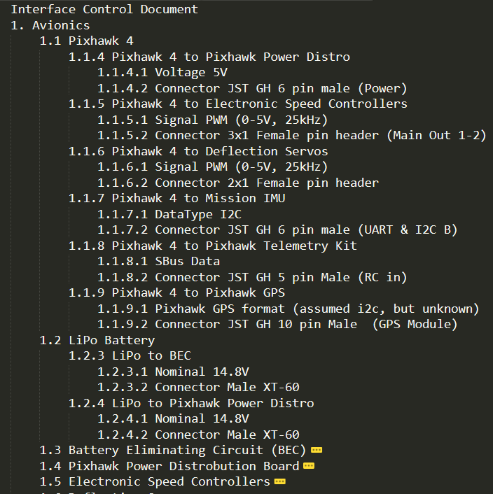
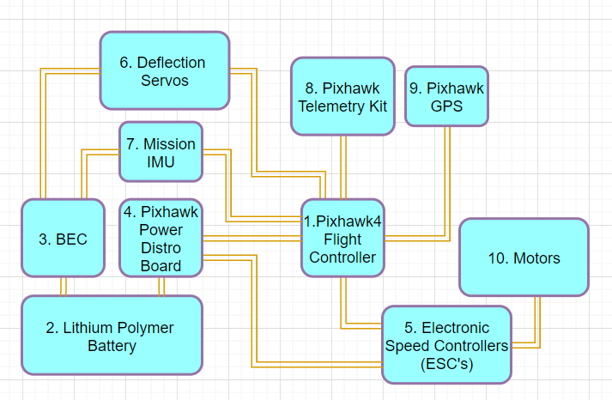
Systems Engineering: Interface Control
Roughly based on SysML
Based on hierarchy by subsystem
Graphically derived from FBD shown above
Specific interfaces detailed in text document
See Avionics Example:
Avionics Subsystem Interfaces Graphical Representation
Avionics Subsystem Interfaces Description and Specs

Slide 37
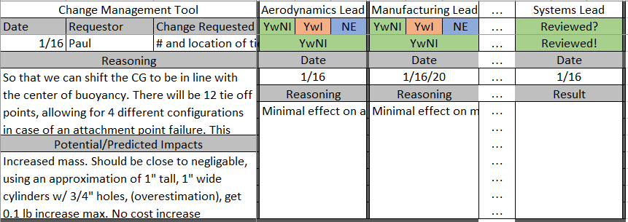
Systems Engineering: Key Takeaways and Lessons Learned
Change management is essential
A tool was implemented for the design
Would have been useful in other aspects (Git or similar)
All code
LaTeX documents
Presentations
Communication is key
Utilize ICD software, the above method was cumbersome and prone to errors
Creating a systems engineering plan laid out before beginning work is important
Example Row of Change Management tool used by NESSIE

Slide 38
Project Management: Approach
Approach
Be transparent
Let the team make decisions
Interject or add commentary when appropriate/necessary
Be a guide
Introduce topics of discussion
Spur the conversation
Be a contributor and not a ‘boss’
Get buy-in from group before proceeding with ideas
Successes
Ability of team to work under pressure and strict timelines
Interpersonal/team related work and support
Challenges
Adequately scoping project
Nothing goes according to plan
College level bureaucracy
Lessons Learned
Avoid scoping/descoping during initial requirements meeting with customer
If possible, take requirements, discuss with team afterwards, schedule follow-up meeting shortly after
Know capabilities going into meeting with customer
Helps with scoping project

Slide 39
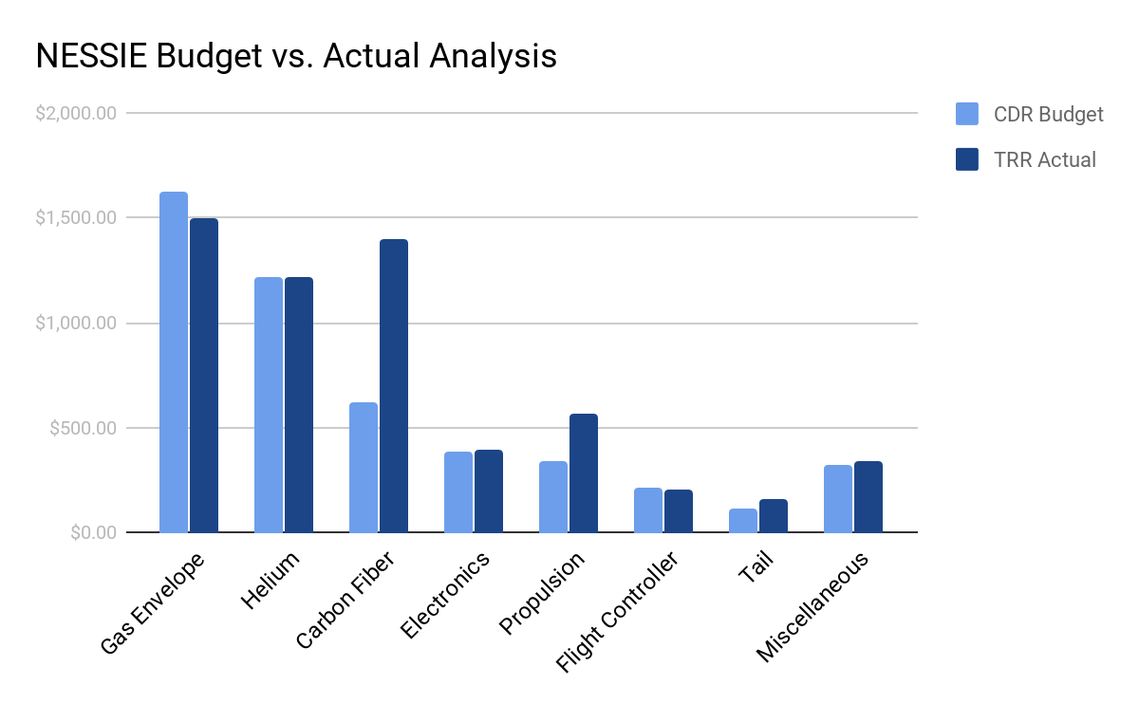
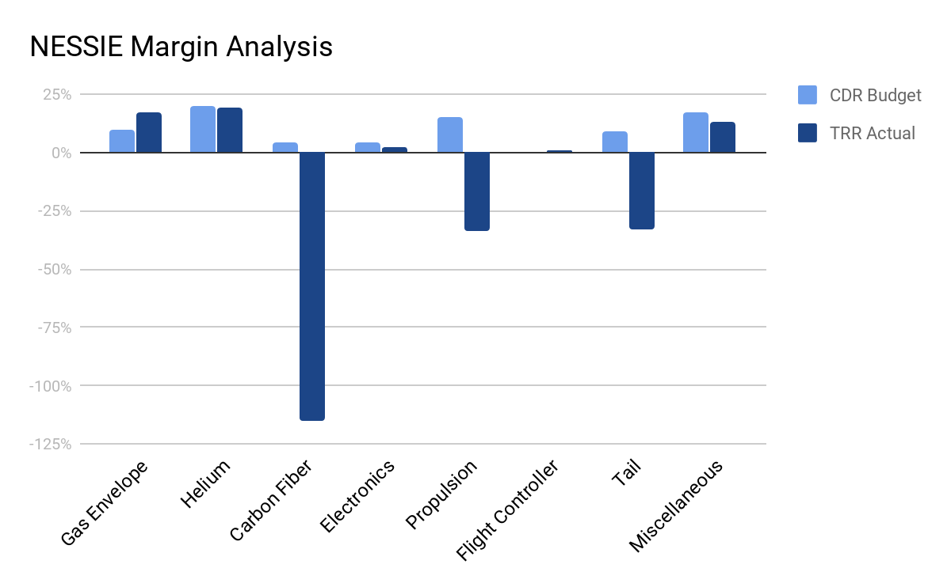
Project Management: Budget Analysis
Notes:
Discuss reasons for major changes from CDR budget to FFR actual

Slide 40
Project Management: Budget Analysis
CDR Budget
TRR Actual
Component | Cost | Estimated Shipping | Cost + Shipping | Budget | Margin
Gas Envelope | $1375 | $250 | $1625 | $1804 | ~10%
Helium (1882 cuft) | $1215 | $0 | $1215 | $1500 | ~20%
Carbon Fiber | $424 | $200 | $624 | $650 | ~4.5%
Batteries/Charger | $362.64 | $20 | $382.64 | $400 | ~4%
Propulsion | $341.8 | $0 | $341.8 | $421 | ~15%
Flight Controller | $210 | $0 | $210 | $210 | 0%
Tail and Pins | $110.97 | $0 | $110.97 | $120 | ~9%
MISC. |  |  | $325.99 | $395 | ~17%
Totals |  |  | $4835.24 | $5500 | ~12%
Component | Final Cost | Budget | Margin
Gas Envelope | $1500.00 | $1804 | ~17%
Helium (1882 cuft) | $1215.00 | $1500 | ~19%
Carbon Fiber | $1396.21 | $650 | ~-115%
Batteries/Charger | $393.08 | $400 | ~2%
Propulsion | $566.18 | $421 | ~-34%
Flight Controller | $207.95 | $210 | 1%
Tail and Pins | $159.30 | $120 | ~-33%
MISC. | $342.49 | $395 | ~13%
Remaining Budget: | -$72.26 |  | ~-1%
Totals | $5572.26 | $5500 | ~12%
Notes:
Discuss reasons for major changes from CDR budget to FFR actual

Slide 41
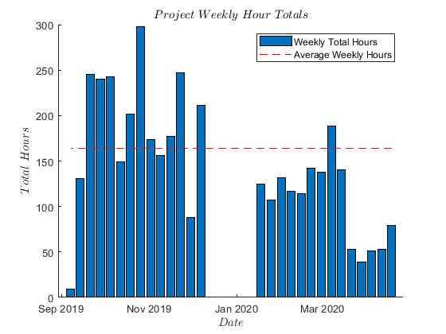
Project Management: Industry Project Cost Analysis
 | Fall 2019 Semester | Spring 2020 Semester
Hours Worked | 3051 | 1981*
Hourly Cost | $95,353.75 | $61,906.25*
Materials Cost | $ 5,772.26
Overhead Rate (200%) | $190,707.50 | $123,812.50
Total Industry Cost | $477,552.26
* Average used for last 6 weeks due to Covid-19 impact

Slide 42
Thank You!!
Questions?

