Slide 1
TEST READINESS REVIEW
FEBRUARY 15TH, 2022
ASEN 4028-011
Customer:
Richard Schaden
Faculty Advisor:
Dr. Donna Gerren
Presenters:
Emerson Beinhauer, Finn Bailis, Tristan Martinez,
Jake Pendergast, Julia Tucker, Fernando Chavez
Additional Team Members:
Nathan Braunstein, Finn Bailis, Christl Haley,
Carlin Hornbostel, Tomaz Remec

Slide 2
OVERVIEW
Presented by:
Emerson Beinhauer, Finn Bailis
Project Purpose and Objectives
CONOPS
FBD
Baseline Design
CPEs
Levels of Success
Project Updates

Slide 3
PROJECT PURPOSE & OBJECTIVES
Generate novel design of a fully-electric 6-passenger aircraft that outperforms similar market competitors while being capable of production within the next
5 years
Demonstrate this design can achieve the customer’s requested mission profile through well established heritage models
Utilize the capability of the PILOT wind tunnel to extrapolate small-scale data for full-scale applications via comparative models
Same scale Cessna-206 vs. NELDA’s Design due to Wind Tunnel limitations
Analysis via aircraft dynamic models demonstrate that the aircraft design is statically and dynamically stable
OVERVIEW | SCHEDULE | TEST READINESS | BUDGET | BACK UP
Notes:
Utilize the capability of the PILOT wind tunnel to extrapolate small-scale data for full-scale applications via comparative models
Same scale Cessna-206 vs. Nelda’s design

Slide 4
CONOPS (MISSION PROFILE)
OVERVIEW | SCHEDULE | TEST READINESS | BUDGET | BACK UP
Notes:
On the aircraft design portion of this project the following mission outline and concept of operations have been identified. Our client would like an aircraft that can carry 6 passengers at a speed of 150kts for 2 hours with ….
Mission CONOPS is good, but for our specific class CONOPS we want to go for more of the final validation and tests that we have to do
Second phase is more of a testing plan / project plan
We'll be testing both models, each warrant their own conops? Then what does it look like when we test our WTAV model, then Glider
Need to state in the mission CONOPS that these parameters are what our full fledged aircraft is designed to accomplish, not necessarily what our project is going to do

Slide 5
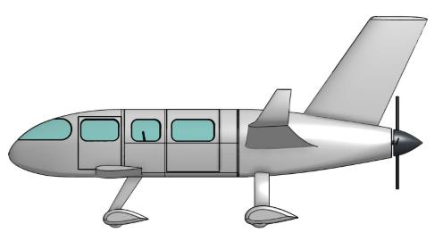
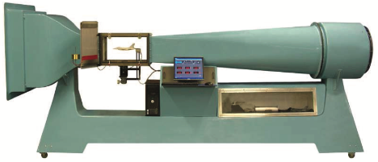
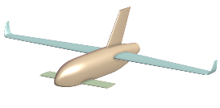
CONOPS (PROJECT)
Full Scale Design
MATLAB Performance Models
1st Semester
2nd Semester
Glider Models
Characteristic Stability Demonstration (CSD)
Wind Tunnel Aerodynamic Validation (WTAV)
Analysis for V&V
OVERVIEW | SCHEDULE | TEST READINESS | BUDGET | BACK UP
Notes:
In order to be successful…

Slide 6
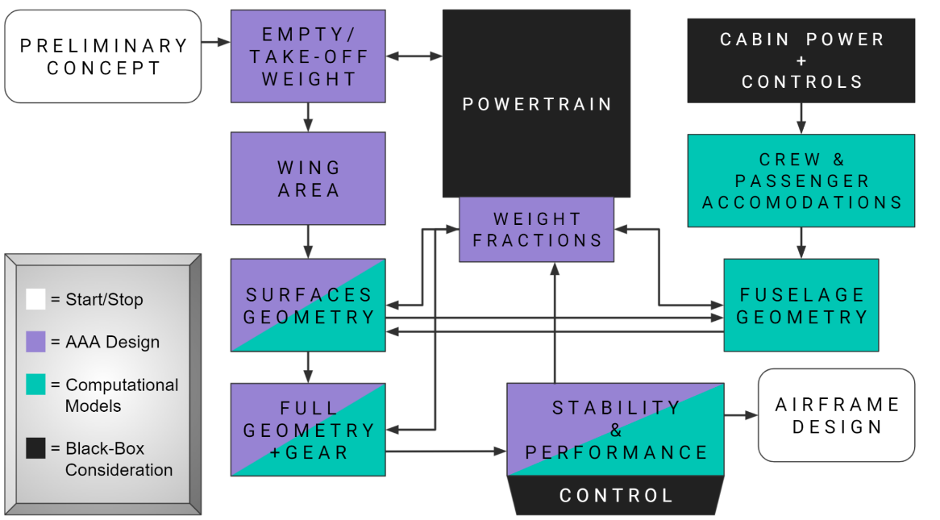
FUNCTIONAL BLOCK DIAGRAM
T E S T I N G/
V A L I D A T I O N
OVERVIEW | SCHEDULE | TEST READINESS | BUDGET | BACK UP

Slide 7
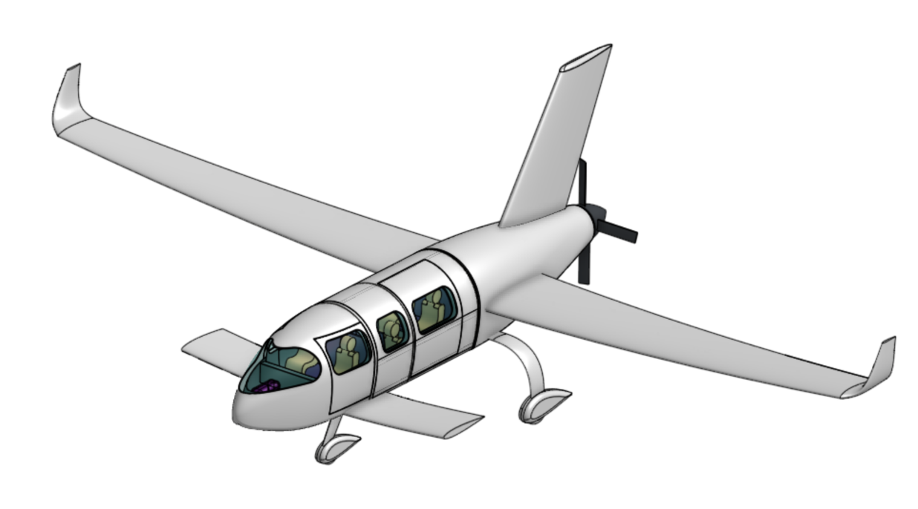
BASELINE DESIGN
VERTICAL STABILIZER
WINGLETS
AFT PROP (4 BLADES)
AFT, MID- MOUNTED WING
CANARD
TRICYCLE LANDING GEAR
OVERVIEW | SCHEDULE | TEST READINESS | BUDGET | BACK UP
Notes:
NATE - CAD with Dimensions

Slide 8
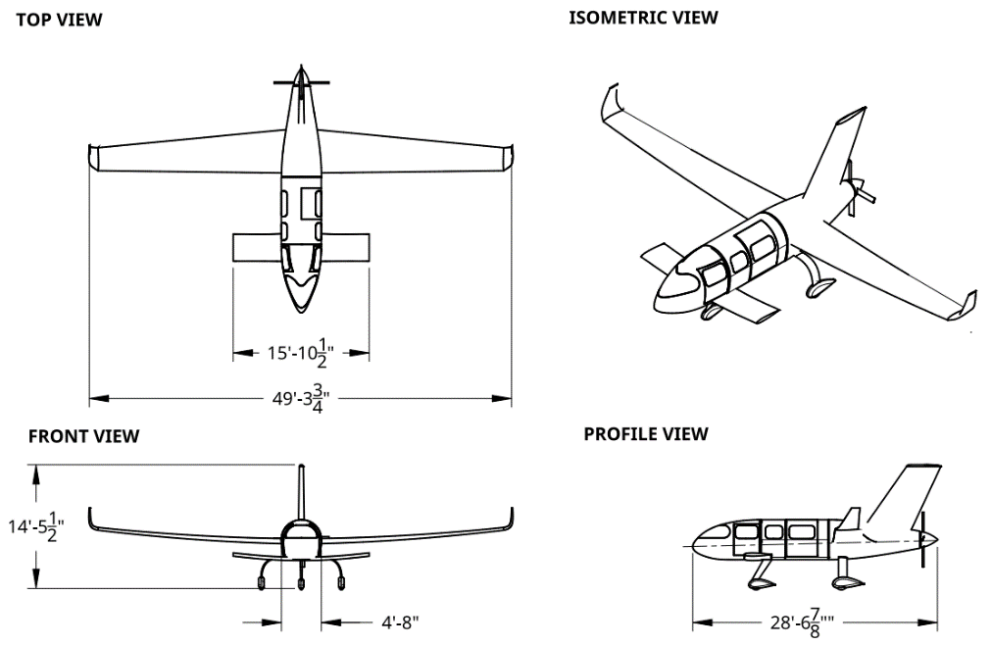
BASELINE DESIGN
Table of major baseline specs on following page , when time allows this will be a full scale drw of complete model
OVERVIEW | SCHEDULE | TEST READINESS | BUDGET | BACK UP
Notes:
Say wingspan/length in feet

Slide 9
CRITICAL PROJECT ELEMENTS
Element | Description | Functional Req
Electrical Powertrain System (EPS) | All performance parameters of the electrical powertrain system (batteries, motor, avionics) are demonstrably feasible within ~5 years. | FR1 - Classification
Airframe Design (AIRD) | Aerodynamically efficient; 6 passengers; 150 kias cruise; fully electric, performance enables 2 hr endurance, 150 nautical mile range. | FR1 - Classification FR2 - Crew FR3 - Performance
Computational Simulation + Stability Models (CSM) | MATLAB, AAA, and dynamic stability models will serve as a guide for analysis, prediction, verification, and design/model iteration. | FR3 - Performance FR6 - Stability
Small Scale Testing (SST) | Wind Tunnel Aerodynamic Validation (WTAV): comparative data collection, and Characteristic Stability Demonstration (CSD): stability visualization | FR4 - WTAV (Wind Tun.) FR5 - CSD (Glider)
Manufacturing (MFCT) | Scale models will need to be constructed for the WTAV and CSD tests | FR4 - WTAV (Wind Tun.) FR5 - CSD (Glider)
Budget (BUD) | Course funding limitation has a limit of $5,000; will drive SST model quality | Course
OVERVIEW | SCHEDULE | TEST READINESS | BUDGET | BACK UP
Notes:
Jake

Slide 10
LEVELS OF SUCCESS - TESTING
Project Element |  | Level 1 | Level 2 | Level 3 | Level 4
Small Scale Testing (SST) | WTAV (WT Models) C206 vs. NELDA | L/D underperforms C206 | Similar L/D comparison; (± 5%) | Increased L/D (> 5%) | Increased L/D (> 10%)
 | CSD (Gliders) | No usable measurements obtained | Predicted modes not demonstrated | Qualitative demonstration of predicted modes (visual) | Quantitative demonstration of predicted modes (data)
OVERVIEW | SCHEDULE | TEST READINESS | BUDGET | BACK UP

Slide 11
LEVELS OF SUCCESS - MANUFACTURING
Project Element |  | Level 1 | Level 2 | Level 3 | Level 4
Manufacturing (MFCT) | WTAV (WT Models) | Low fidelity models | Safe for AeroLab WT Testing (≥ 130 ft/s) | Precise to ± 0.01 in | Precise to ± 0.001 in
 | CSD (Gliders) | Trimmed prototype (foam) | Trimmed prototype (foam w/gear + winglets) | 3D Printed Fuselage | Onboard Sensors
 | Glider CG | Precise to ± 0.7 in | Precise to ± 0.5 in | Precise to ± 0.3 in | Precise to ± 0.1 in
 | Glider Dimensions
OVERVIEW | SCHEDULE | TEST READINESS | BUDGET | BACK UP

Slide 12
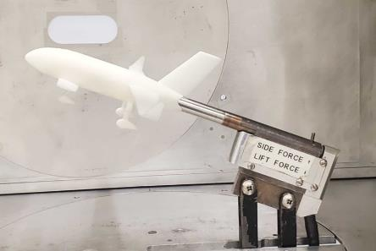
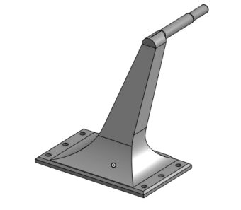
PROJECT UPDATES
(WTAV) Wind Tunnel Aerodynamic Validation
NELDA model complete
Interfaces smoothly with the Sting EWT Sensor
Usable Cessna 206 CAD unavailable
Solution: Outsourced 3D printed model
Status: 3D printed adapter for Sting sensor required (CAD in progress)
Auxiliary Components (Post IDR)
A “car-top” test of the WTAV (wind tunnel) models will be required to demonstrate wind tunnel safety
Solution: 3D printed car sting mount
Status: CAD complete
Table of major baseline specs on following page , when time allows this will be a full scale drw of complete model
OVERVIEW | SCHEDULE | TEST READINESS | BUDGET | BACK UP
Notes:
Say wingspan/length in feet

Slide 13
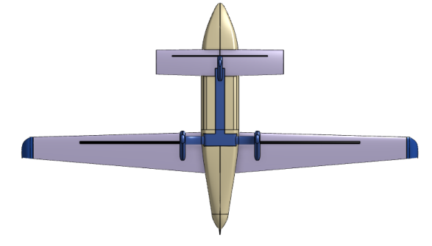
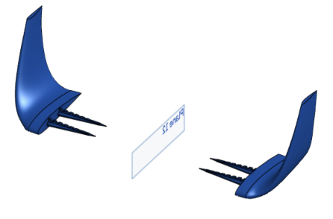
PROJECT UPDATES (CONT.)
(CSD) Foam Glider Prototype
Wings and canard cannot be CNC machined
Solution: Hot-wire cutting
Status: CAD complete
Contingency Plans: Airfoil Cutter; Outsourcing (MohrComposites)
Auxiliary Components (Post IDR)
The CSD (Glider) model winglets cannot be machined or cut from foam
Solution: SLA 3D printing
Status: CAD complete
OVERVIEW | SCHEDULE | TEST READINESS | BUDGET | BACK UP
Notes:
Say wingspan/length in feet

Slide 14
SCHEDULE
Presented by:
Jacob Pendergast
GANTT Chart
Wind Tunnel Models
Glider Models
Risk Off-Ramps
Notes:
Jake

Slide 15
PROJECT SCHEDULE - GANTT
High Level Project Gantt Chart
OVERVIEW | SCHEDULE | TEST READINESS | BUDGET | BACK UP
Notes:
Quick overview of full schedule
Emphasis on testing schedule
Margin defined with reason
Critical path shown

Slide 16
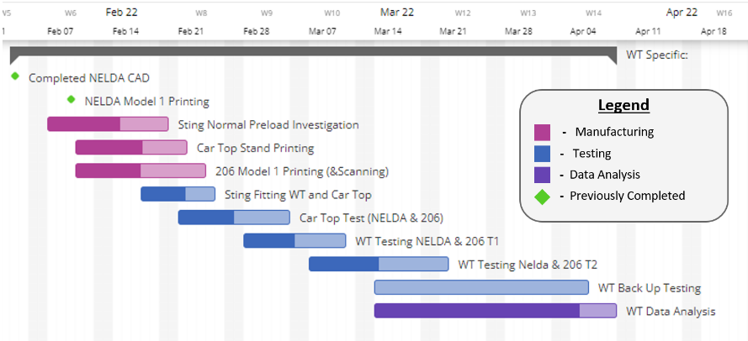
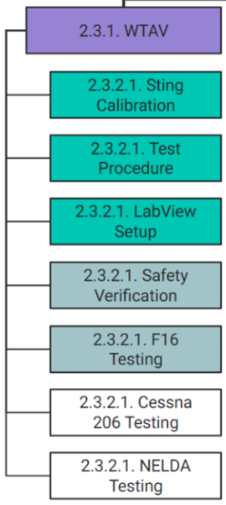
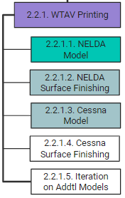
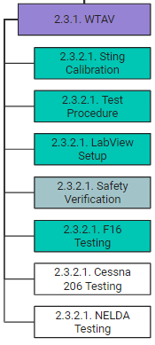
PROJECT SCHEDULE - WT Models
Planned | In Progress | Complete
OVERVIEW | SCHEDULE | TEST READINESS | BUDGET | BACK UP
Notes:
Jake
Quick overview of full schedule
Emphasis on testing schedule
Margin defined with reason
Critical path shown

Slide 17
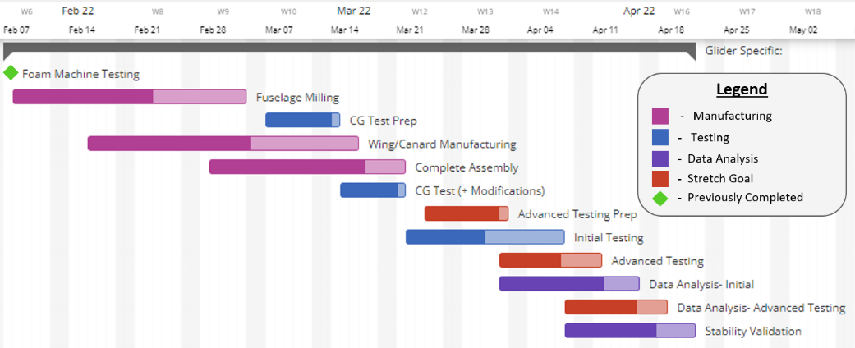
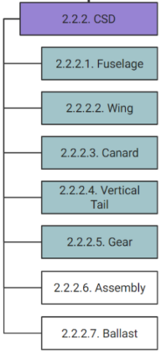
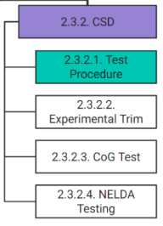
PROJECT SCHEDULE - GLIDER MODELS
Planned | In Progress | Complete
OVERVIEW | SCHEDULE | TEST READINESS | BUDGET | BACK UP
Notes:
Jake
Quick overview of full schedule
Emphasis on testing schedule
Margin defined with reason
Critical path shown

Slide 18
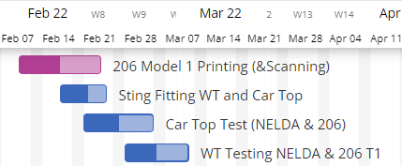
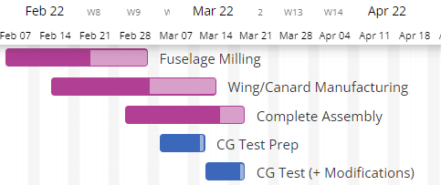
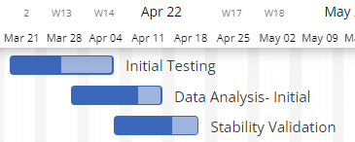
SCHEDULING: RISK OFF-RAMPS
Wind Tunnel Model Tolerances
Risk: 3D Printed Models improperly toleranced to STING fitting requirements
Mitigation: Construction / Iteration upon multiple NELDA and CESSNA models w/ additional allocated budget
Glider Manufacturing Risks
Risk: Inability to manufacture fuselage and/or wings to appropriate tolerances
Mitigation: Sourcing of additional manufacturing methods
3D Printed Fuselage
CNC Cut Wings (Using UAV Lab Machine)
Glider Testing Suitability
Risk: Multiple days of unfavorable testing conditions (high winds, muddy ground, inclement weather)
Mitigation: Appropriate scheduling margin, expedited manufacturing of initial models
OVERVIEW | SCHEDULE | TEST READINESS | BUDGET | BACK UP
Notes:
Jake

Slide 19
TEST READINESS
Presented by:
xxx
Testing Limitations
Testing Overview
WTAV
Preloading Verification Test
Car Top Safety Test CSD
CG Testing
Notes:
Emerson

Slide 20
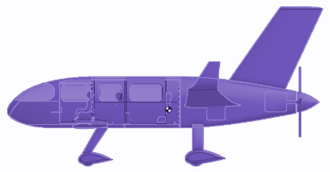
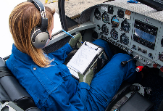
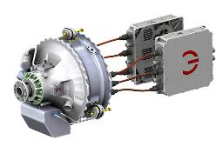
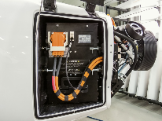
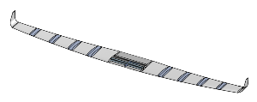
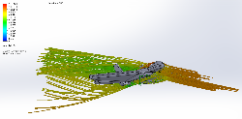
TESTING LIMITATIONS
Stability and Control Flight Testing
Powertrain
Testing
Battery Performance Testing
Crew/Human
Factors Studies
Avionics & Controls Testing
Structural Analysis
Aerodynamics
OVERVIEW | SCHEDULE | TEST READINESS | BUDGET | BACK UP
Notes:
Emerson

Slide 21
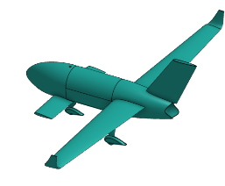
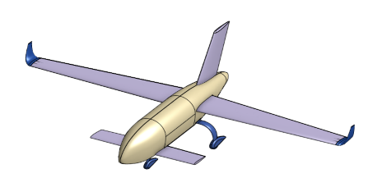
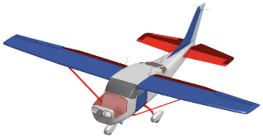
TESTING LIMITATIONS
Going to focus on main customer requirements:
Aerodynamics & Stability
Wind Tunnel
Glider
Small-scale comparative testing
Characteristic Stability Demonstration
1/64 Scale
1/14 Scale
OVERVIEW | SCHEDULE | TEST READINESS | BUDGET | BACK UP
Notes:
Emerson

Slide 22
TESTING OVERVIEW
Element | Requirement | Test | Description
Small Scale Testing (SST) | FR 4.0 | Wind Tunnel Testing (WTAV) | Comparative Aerodynamic Validation in the Wind Tunnel
Small Scale Testing (SST) | DR 4.2.2 | Preloading Verification Test | Verify Preloading Methodology
Manufacturing (MFCT) | DR 4.1.3 | “Car-top” Safety Test | Ensure structural safety of the WT models
Small Scale Testing (SST) | FR 5.0 | Glider Testing (CSD) | Characteristic Stability Demonstration
Manufacturing (MFCT) | DR 5.1.1 | CG Test | Ensure accurate CGs in glider models
OVERVIEW | SCHEDULE | TEST READINESS | BUDGET | BACK UP
Notes:
Jake

Slide 23
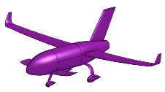
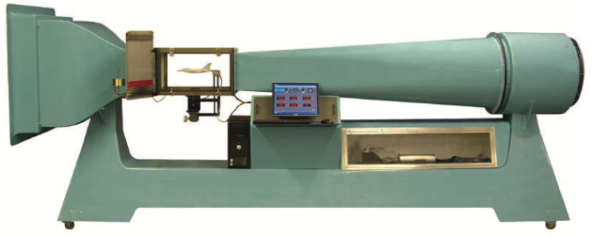
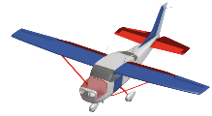
(SST) WIND TUNNEL TESTING
FR 4.0: A non-powered, scale model of the airframe design will be constructed for the purpose of practical wind tunnel
analysis in the PILOT Lab Wind Tunnel
Rationale/Motivation:
Validate NELDA aerodynamic performance with L/D comparisons to Cessna 206
Satisfy customer requirement
Test Section Dimensions
12” x 12” x 24”
Model Scale: 1⁄64
Input
Airflow Speed Voltage
(Max = 10 Volts)
Desired Data
N = Normal Force [± 0.1 N]
A = Axial Force [± 0.1 N]
Aerolab Educational Wind Tunnel
OVERVIEW | SCHEDULE | TEST READINESS | BUDGET | BACK UP
Notes:
Nando

Slide 24
(SST) WIND TUNNEL TESTING
FR 4.0: A non-powered, scale model of the airframe design will be constructed for the purpose of practical wind tunnel
analysis in the PILOT Lab Wind Tunnel
Rationale/Motivation:
Validate NELDA aerodynamic performance with L/D comparisons to Cessna 206
Satisfy customer requirement
Expected Results (Scale = 1/64):
AoA Test Range
 | C206 | NELDA | % Diff
L/D | TBD | TBD | Levels of Success
+5°
-5°
Desired Data
Lift-to-Drag % Similarity
L1. Underperforms
L2. Similar (± 5% margin)
L3. > 5% Improvement
L4. > 10% Improvement
Sting ⅜ EWT
Aerodynamic Forces
Lift - Normal [± 0.1N]
Drag - Axial [± 0.1 N]
L = Ncos(⍺) - Asin(⍺)
D = Nsin(⍺) + Acos(⍺)
OVERVIEW | SCHEDULE | TEST READINESS | BUDGET | BACK UP
Notes:
Nando

Slide 25
(SST) WIND TUNNEL TESTING - FBD
FR 4.0: A non-powered, scale model of the airframe design will be constructed for the purpose of practical wind tunnel
analysis in the PILOT Lab Wind Tunnel
Inlet
Fan
Diffuser
Dynamic Pressure
Pitot Tube
Power
Command (speed)
= Start/Stop
= Measurement
= Environment
Control
LabView Console - GUI
LabView
Data (pressure)
Command
(speed)
Data
(forces)
-Normal Force
-Axial Force
-Pitching Moment
Data
(load cell voltages)
Sting ⅜ EWT Sensor
Experimental Load Outputs
OVERVIEW | SCHEDULE | TEST READINESS | BUDGET | BACK UP
OVERVIEW | SCHEDULE | TEST READINESS | BUDGET | BACK UP
Notes:
Nando

Slide 26
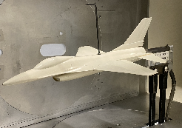
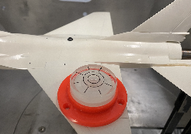
(SST) WIND TUNNEL TESTING - PROCEDURE
FR 4.0: A non-powered, scale model of the airframe design will be constructed for the purpose of practical wind tunnel
analysis in the PILOT Lab Wind Tunnel
Pre-Test Actions
Reserve Wind Tunnel
Install Sting ⅜ EWT
Mount & Secure model to Sting Sensor
Test Setup
Adjust angle of attack AoA = 0° (bullseye level)
Initialize LabVIEW
Mount safety net
Pre-Test Safety Run
Input airflow speed voltage
Confirm data collection
Check for unstable attachments
Test
Dismount Safety Net
Input airflow speed voltage
Vary angle of attack (AoA)
Post-Test
Save and export datafile
Remove test set-up
Clean room and store hardware
Emergency Procedure
Press master shutoff button if:
Fan overspeeds
Debris/unstable/broken artifacts
Failed attachments
OVERVIEW | SCHEDULE | TEST READINESS | BUDGET | BACK UP
Notes:
Nando

Slide 27
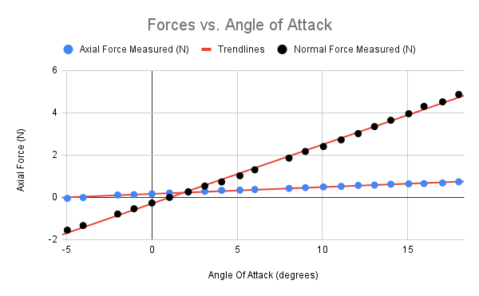
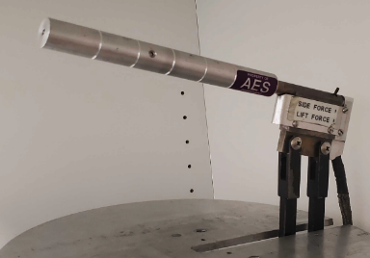
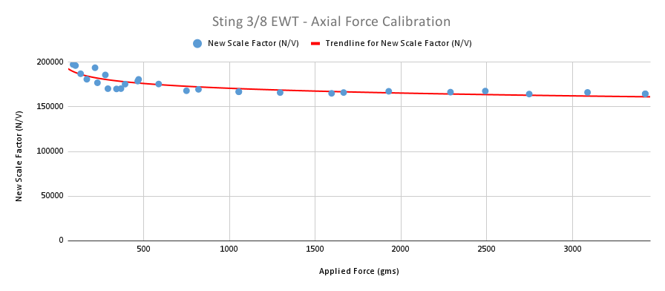
(SST) WIND TUNNEL TESTING - SENSOR
 | Erroneous Region
 | Desired Region
Sting ⅜ EWT Sensor
Scale factor below 500 grams
(5 Newtons) highly variant
Need to exceed this minimum to get more accurate data
NELDA expects to achieve less than 100 grams (1 Newton) of axial force
OVERVIEW | SCHEDULE | TEST READINESS | BUDGET | BACK UP
Notes:
Tristan

Slide 28
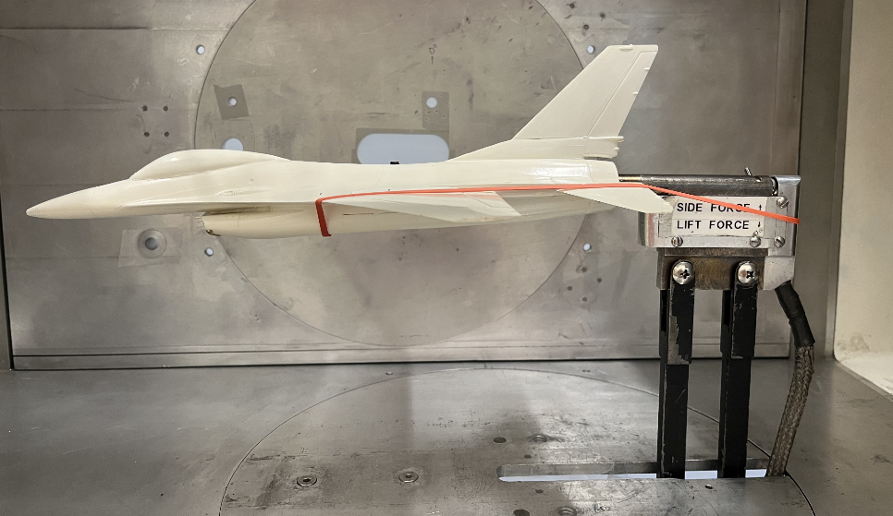
(SST) PRELOADING VERIFICATION TEST
DR 4.2.2: The test instruments should be capable of capturing aerodynamic forces above
the minimum resolution inherent to such instruments
OVERVIEW | SCHEDULE | TEST READINESS | BUDGET | BACK UP
Notes:
Tristan

Slide 29
(SST) PRELOADING VERIFICATION TEST
DR 4.2.2: The test instruments should be capable of capturing aerodynamic forces above
the minimum resolution inherent to such instruments
Rationale/Motivation:
Demonstrate and verify preloading methodology
Procedures:
Control: Run Wind Tunnel at varied voltages and AoAs for assembly
(no preload)
Wrap rubber band around prefabricated F-16 model and back of Sting sensor
Run Wind Tunnel at varied voltages and AoAs for preloaded assembly
Compare preloaded data with control (no preload)
Establish baseline expectations for data accuracy and precision
OVERVIEW | SCHEDULE | TEST READINESS | BUDGET | BACK UP
Notes:
Tristan

Slide 30
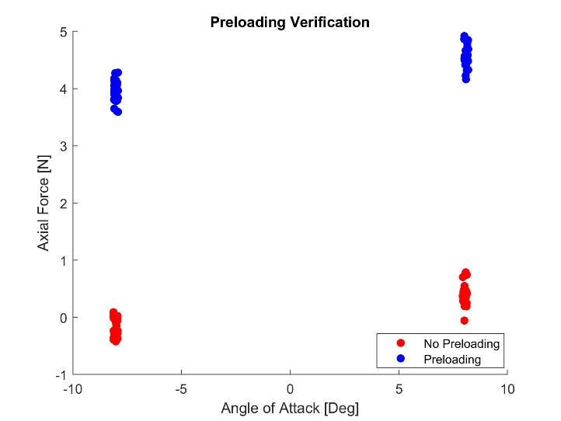
(SST) PRELOADING VERIFICATION TEST - RESULTS
DR 4.2.2: The test instruments should be capable of capturing aerodynamic forces above
the minimum resolution inherent to such instruments
Expected Results:
Proof that we can achieve 5 N of constant preloading force and collect data
Status: In Progress
See a statistically significant improvement in RMS error
Status: In Progress
OVERVIEW | SCHEDULE | TEST READINESS | BUDGET | BACK UP
Notes:
Tristan
With the F-16 test, the preloading method has been validated to give the desired forces

Slide 31
(SST) PRELOADING VERIFICATION TEST - RISKS / SAFETY
DR 4.2.2: The test instruments should be capable of capturing aerodynamic forces above
the minimum resolution inherent to such instruments
Risks:
3D Printed Models structurally fail during WT experiment(s)
Addressed with “Car-top” Testing
Rubber band breaks
External Sting ⅜ EWT Preloading Test
Pre-Testing with net in place
Emergency Procedures
Deactivate wind tunnel using master shut-off switch
OVERVIEW | SCHEDULE | TEST READINESS | BUDGET | BACK UP
Notes:
Tristan

Slide 32
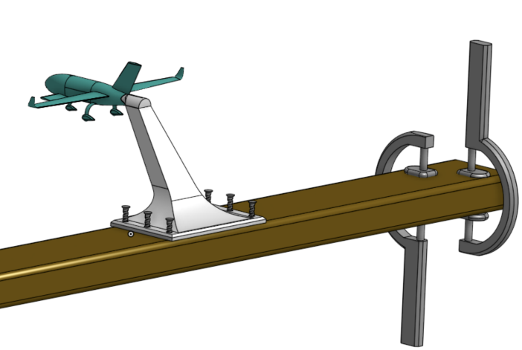
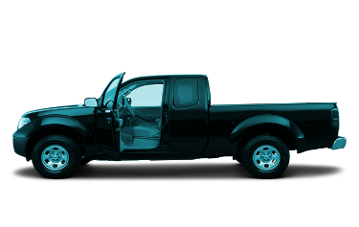
(MFCT) CAR TOP SAFETY TEST
DR 4.1.3: The scaled models of each aircraft shall be capable of withstanding relative air velocities up to 55 mph
Rationale/Motivation:
Verify structural integrity of WT models
(NELDA + C206)
Risk: Unproven model could break inside WT and damage the equipment
Procedure:
Manufacture Sting sensor replica mount
Mount assembly to car sunroof
Run slow car test (~20 mph)
Step to higher speed car tests (40+ mph) with video recording (~5 mph increments)
Establish FOS > 1.2x WT Test Speed
3D-PRINTED STING MOUNT REPLICA
CLAMPS TO ROOFTOP
OVERVIEW | SCHEDULE | TEST READINESS | BUDGET | BACK UP
Notes:
Jake
Ensure the wind tunnel model is structurally sound
(Describe test fixture. Are we holding it, making “fake” sting?)
(Diagram of test fixture)
Procedures:
Start on slower roads (30-40 MPH)
Work up to faster speeds (40-50 MPH)
Test on highway (50+ MPH)

Slide 33
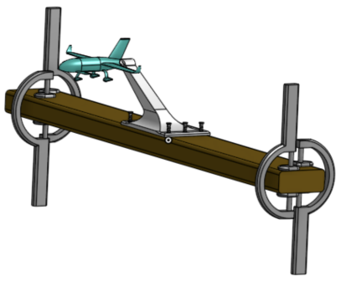
(MFCT) CAR TOP SAFETY TEST
DR 4.1.3: The scaled models of each aircraft shall be capable of withstanding relative air velocities up to 55 mph
Expected Results
Pass: Models withstand up to 1.2x the maximum
expected WT speeds (~55mph X 1.2 = 66mph)
Fail: Models fail at speeds < 66 mph
Video recording to provide failure point
Safety
Risks
Cannot have any loose / lost articles in test
Need to avoid other vehicles
Mitigation
Apparatus is snug - Inspect mount and fasteners
Test on a private or closed road
Safety net attached behind model
NETTING AFIXED BEHIND MODEL
OVERVIEW | SCHEDULE | TEST READINESS | BUDGET | BACK UP
Notes:
Jake

Slide 34
(SST) GLIDER TESTING
FR 5.0: A non-powered, larger scale glider model of the airframe design will be constructed for the purpose of stability
analysis and verification
Rationale/Motivation:
Validate airframe stability
Practical demonstration of configuration feasibility and performance when in an unpowered glide
Desired Data
Position, Velocity, Time (3 dimensions)
Expected Results
Qualitative demonstration of longitudinal/lateral dynamic modes
Limitations: Lightweight model, variable conditions, reduced dynamic similarity
NELDA’s most important test for design validation
OVERVIEW | SCHEDULE | TEST READINESS | BUDGET | BACK UP
Notes:
Tristan/Julia

Slide 35
(SST) GLIDER TESTING
FR 5.0: A non-powered, larger scale glider model of the airframe design will be constructed for the purpose of stability
analysis and verification
Procedure:
Manufacture foam prototype
Start with low altitude low velocity launches
(Experimental Trim)
Progress to launch from roof of Aerospace Engineering Building (with faculty assistance)
Film each launch from two angles, side and front for post processing via LoggerPro
Measure distance traveled using a rangefinder (Bushnell Medalist: +/-1m Precision)
OVERVIEW | SCHEDULE | TEST READINESS | BUDGET | BACK UP
Notes:
Tristan/Julia

Slide 36
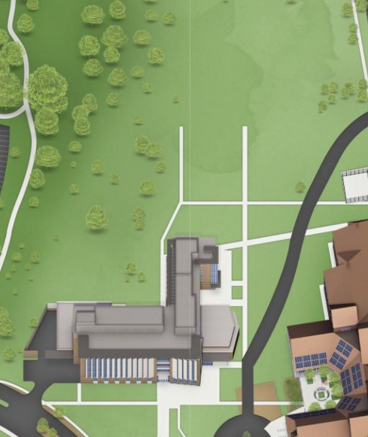
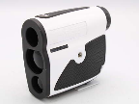
(SST) GLIDER TESTING
FR 5.0: A non-powered, larger scale glider model of the airframe design will be constructed for the purpose of stability
analysis and verification
Test Day Procedure:
Camera Operators Ready
Timer Ready
Flight Path Cleared
Launch Glider
Record Data (video of flight, time of flight, and distance traveled using rangefinder)
Repeat as necessary
Camera 2
Camera 1
Timer
Flight path
Launch point
Rangefinder
OVERVIEW | SCHEDULE | TEST READINESS | BUDGET | BACK UP
Notes:
Tristan/Julia

Slide 37
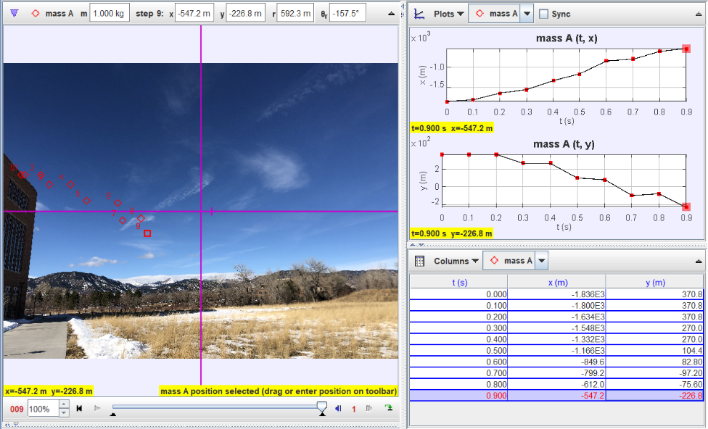
(SST) GLIDER TESTING - LOGGERPRO
Track glider flight in two separate orthogonal planes (X-Z, Y-Z)
EXAMPLE
Z
FLIGHT PATH
Obtain position,
velocity, time data
X
Analyze data and compare
to stability models
Validation of predicted
stability characteristics via comparison to 1st Semester stability models
OVERVIEW | SCHEDULE | TEST READINESS | BUDGET | BACK UP
Notes:
Tristan/Julia

Slide 38
(SST) GLIDER TESTING - SAFETY
FR 5.0: A non-powered, larger scale glider model of the airframe design will be constructed for the purpose of stability
analysis and verification
Testing Logistics
Risk of impact with personnel if landing zone not clear
Mitigation: Rope off expected flight test area, clearance from AES Building Manager
Glider Model Structures (expected points of failure)
Risks | Mitigation Strategies
Foam fuselage failure | Multiple foam gliders constructed
Wing/Canard failures | Carbon Fiber spar reinforced wings
 | High strength foam adhesive
Gear/Winglet failures | Replacement 3D printed parts
OVERVIEW | SCHEDULE | TEST READINESS | BUDGET | BACK UP
Notes:
Finn:

Slide 39
(MFCT) GLIDER TESTING - SCALING
DR 5.1.1: A larger scaled model of the aircraft design shall be constructed on a 1/14th scale
Geometry (Linear scaling)
CSD glider models must be accurately scaled
Wingspan = 3.5 ft → Scale Factor: 1/14
Weight (Non-linear scaling)
Scale Factor: (1/14)³ → Assembly weight = 1.5 lbs
CG must be implemented with properly scaled geometry
Required for stability demonstration
OVERVIEW | SCHEDULE | TEST READINESS | BUDGET | BACK UP
Notes:
Finn:

Slide 40
[MFCT] CG TESTING
DR 5.1.1: A larger scaled model of the aircraft design shall be constructed on a 1/14th scale
Rationale/Motivation
Ensure the glider models are properly scaled for stability demonstration
Risk: Misaligned CG will yield inaccurate (unusable) data
Mitigations:
Highly accurate predictions from CAD
Experimental Verification with CG Tests
High Level Approach
Model the Predicted CG and required CG for scaling (Complete)
Create a model to determine required Ballast location to ensure proper CG (Complete)
Experimentally Verify Glider CG location (Planned)
Update Ballast model to reflect results of CG location
OVERVIEW | SCHEDULE | TEST READINESS | BUDGET | BACK UP
Notes:
Finn

Slide 41
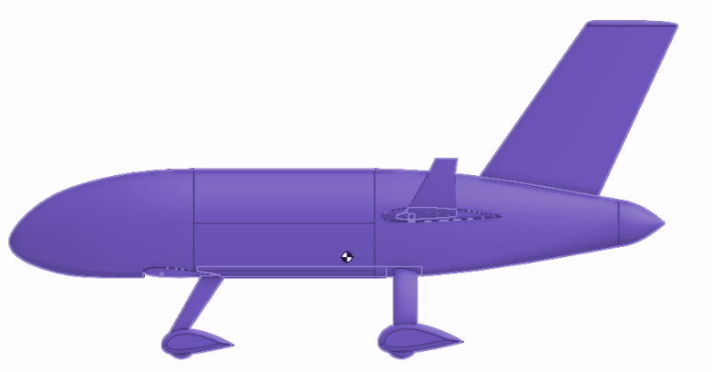
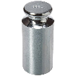
[MFCT] CG TESTING - EXPECTED RESULTS
DR 5.1.1: A larger scaled model of the aircraft design shall be constructed on a 1/14th scale
Required Glider CG:
X: 12.6 ± 0.1 in
Y: 0.0 in
Z: 1.6 in ± 0.1
Expected Glider CG:
X: 12.6 ± 0.1 in
Y: 0.0 in
Z: 0.8 ± 0.1 in
Expected Weight (No Ballast):
0.8 lbs
Required Weight:
1.5 lbs [ k = (1/14)³ ]
→ Ballast of 0.7 lbs
Expected Ballast Coordinates:
X: 12.6 ± 0.1 in
Y: 0.0 in
Z: 2.5 ± 0.1 in
OVERVIEW | SCHEDULE | TEST READINESS | BUDGET | BACK UP
Notes:
Required CG from Scaling
Predicted CG from CAD
Predicted Weight from CaD
Required Weight from Scaling
Predicted Ballast from Comp Models
Mention that if the test does not meet our predicted CG, then the process is iterated on to find the new Ballast Location

Slide 42
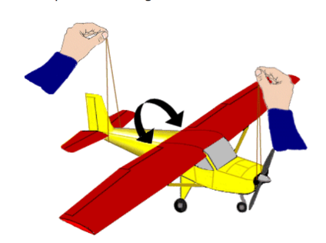
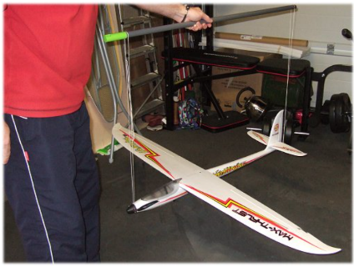
[MFCT] LATERAL CG TEST
DR 5.1.1: A larger scaled model of the aircraft design shall be constructed on a 1/14th scale
Procedures:
Attach two looped strings to a rigid pole or structure which have a distance equivalent to the length of the NELDA CSD Model
Hang the first looped string from the tail of the CSD model
Hang the second looped string to the push pin inserted in the nose of the aircraft
If needed, add small increments ballast weights to the lighter wing ~20% span from the fuselage until weight is laterally symmetric
OVERVIEW | SCHEDULE | TEST READINESS | BUDGET | BACK UP
Notes:
Finn
https://www.scienceworld.ca/resource/finding-centre-gravity/
https://www.rc-airplane-world.com/balancing-rc-airplanes.html
Motivation/Rationale:
Ensure the model’s center of gravity is consistent with the full-scale model
Procedure:
Hang looped sting from the propeller of CSD
Hang second looped string in front of canard
Or insert small rod/screw into nose of aircraft and hang string from there
Add ballast to lighter (higher) wing in small increments to the wings until the CSD is horizontally balanced
Finn:

Slide 43
[MFCT] LATERAL CG TEST
DR 5.1.1: A larger scaled model of the aircraft design shall be constructed on a 1/14th scale
Level Stick
String
> 8”
Approx. CG Location
* Not to scale
OVERVIEW | SCHEDULE | TEST READINESS | BUDGET | BACK UP
Notes:
Finn
https://www.scienceworld.ca/resource/finding-centre-gravity/
https://www.rc-airplane-world.com/balancing-rc-airplanes.html
Motivation/Rationale:
Ensure the model’s center of gravity is consistent with the full-scale model
Procedure:
Hang looped sting from the propeller of CSD
Hang second looped string in front of canard
Or insert small rod/screw into nose of aircraft and hang string from there
Add ballast to lighter (higher) wing in small increments to the wings until the CSD is horizontally balanced
Finn:

Slide 44
[MFCT] LONGITUDINAL CG TEST
DR 5.1.1: A larger scaled model of the aircraft design shall be constructed on a 1/14th scale
Procedures*:
Attach two looped strings to a rigid pole or structure which have a distance equivalent to the length of the fuselage for the NELDA CSD Model
Hang the first looped string to the push pin located at the desired center of gravity on the left side of the CSD fuselage
Hang the second looped string to the push pin located at the desired center of gravity on the left side of the CSD fuselage
If needed, add small increments ballast weights near the nose of the aircraft or move the ballast behind the CG to correct erroneous static margin
Ballast
T Pins
Ballast
*Longitudinal CG Test performed AFTER Lateral
OVERVIEW | SCHEDULE | TEST READINESS | BUDGET | BACK UP
Notes:
Finn
https://www.scienceworld.ca/resource/finding-centre-gravity/
https://www.rc-airplane-world.com/balancing-rc-airplanes.html
Motivation/Rationale:
Ensure the model’s center of gravity is consistent with the full-scale model
Procedure:
Hang looped sting from the propeller of CSD
Hang second looped string in front of canard
Or insert small rod/screw into nose of aircraft and hang string from there
Add ballast to lighter (higher) wing in small increments to the wings until the CSD is horizon tally balanced
Ballast:
Heavier layers of material to wrap the fuselage with (i.e thin sheet lead,etc)
Metals balls fixed with epoxy glue
Finn:

Slide 45
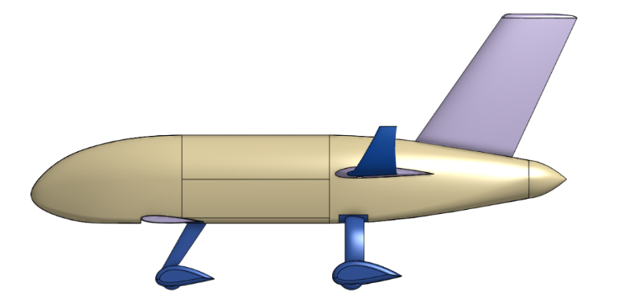
[MFCT] LONGITUDINAL CG TEST
DR 5.1.1: A larger scaled model of the aircraft design shall be constructed on a 1/14th scale
Level Stick
Table
String
Table
> 8”
Approx. CG Location
* Not to scale
OVERVIEW | SCHEDULE | TEST READINESS | BUDGET | BACK UP
Notes:
Finn
https://www.scienceworld.ca/resource/finding-centre-gravity/
https://www.rc-airplane-world.com/balancing-rc-airplanes.html
Motivation/Rationale:
Ensure the model’s center of gravity is consistent with the full-scale model
Procedure:
Hang looped sting from the propeller of CSD
Hang second looped string in front of canard
Or insert small rod/screw into nose of aircraft and hang string from there
Add ballast to lighter (higher) wing in small increments to the wings until the CSD is horizon tally balanced
Ballast:
Heavier layers of material to wrap the fuselage with (i.e thin sheet lead,etc)
Metals balls fixed with epoxy glue
Finn:

Slide 46
(SST) GLIDER TESTING - 3D PRINTED MODEL
DR 5.1.1: A larger scaled model of the aircraft design shall be constructed on a 1/14th scale
Stretch Goal (Higher Level of Success)
Generate 3D Printed Model pending results of Foam Prototype testing
More precise geometry
Stronger Assembly
OVERVIEW | SCHEDULE | TEST READINESS | BUDGET | BACK UP
OVERVIEW | SCHEDULE | TEST READINESS | BUDGET | BACK UP
Notes:
Tristan/Julia

Slide 47
BUDGET
Presented by:
Julia Tucker
Budget
Budget Breakdown
Glider Budget
WTAV Budget

Slide 48
BUDGET
OVERVIEW | SCHEDULE | TEST READINESS | BUDGET | BACK UP
Notes:
https://www.scienceworld.ca/resource/finding-centre-gravity/
https://www.rc-airplane-world.com/balancing-rc-airplanes.html
Motivation/Rationale:
Ensure the model’s center of gravity is consistent with the full-scale model
Procedure:
Hang looped sting from the propeller of CSD
Hang second looped string in front of canard
Or insert small rod/screw into nose of aircraft and hang string from there
Add ballast to lighter (higher) wing in small increments to the wings until the CSD is horizontally balanced
Finn:

Slide 49
BUDGET BREAKDOWN
 | Spent
 | Planned
 | Margin
OVERVIEW | SCHEDULE | TEST READINESS | BUDGET | BACK UP
Notes:
https://www.scienceworld.ca/resource/finding-centre-gravity/
https://www.rc-airplane-world.com/balancing-rc-airplanes.html
Motivation/Rationale:
Ensure the model’s center of gravity is consistent with the full-scale model
Procedure:
Hang looped sting from the propeller of CSD
Hang second looped string in front of canard
Or insert small rod/screw into nose of aircraft and hang string from there
Add ballast to lighter (higher) wing in small increments to the wings until the CSD is horizontally balanced
Finn:

Slide 50
GLIDER BUDGET
Risks:
Glider will break in testing
Safety Margin:
Purchased enough materials for three glider models
OVERVIEW | SCHEDULE | TEST READINESS | BUDGET | BACK UP
Notes:
https://www.scienceworld.ca/resource/finding-centre-gravity/
https://www.rc-airplane-world.com/balancing-rc-airplanes.html
Motivation/Rationale:
Ensure the model’s center of gravity is consistent with the full-scale model
Procedure:
Hang looped sting from the propeller of CSD
Hang second looped string in front of canard
Or insert small rod/screw into nose of aircraft and hang string from there
Add ballast to lighter (higher) wing in small increments to the wings until the CSD is horizontally balanced
Finn:

Slide 51
WTAV BUDGET
Risks:
WTAV models will break in car-top testing
WTAV models will break in wind tunnel testing
Safety Margin:
Abundant materials for further iterations
Abundant budget for further printing
OVERVIEW | SCHEDULE | TEST READINESS | BUDGET | BACK UP
Notes:
https://www.scienceworld.ca/resource/finding-centre-gravity/
https://www.rc-airplane-world.com/balancing-rc-airplanes.html
Motivation/Rationale:
Ensure the model’s center of gravity is consistent with the full-scale model
Procedure:
Hang looped sting from the propeller of CSD
Hang second looped string in front of canard
Or insert small rod/screw into nose of aircraft and hang string from there
Add ballast to lighter (higher) wing in small increments to the wings until the CSD is horizontally balanced
Finn:

Slide 52
ACKNOWLEDGEMENTS
Dr. Jelliffe Jackson
Dr. Kathryn Wingate
Dr. Brian Argrow
Dr. Donna Gerren
Dr. John Farnsworth
Professor John Mah
Matt Rhode
Katie-Rae Williamson
Project Advisory Board
Colin Claytor
Emma Markovich
Richard Schaden
Bobby Hodgkinson
Josh Mellin
Trudy Schwartz
Michael Rhodes

Slide 53
REFERENCES
Center of Gravity Tests
https://www.scienceworld.ca/resource/finding-centre-gravity/
https://www.rc-airplane-world.com/balancing-rc-airplanes.html

Slide 54
BACK UP SLIDES
WBS |  |  | Glider |  | Static Margin
Gantt |  |  | Onboard Sensors
 |  |  |  |  | Stability
OVERVIEW | SCHEDULE | TEST READINESS | BUDGET | BACK UP

Slide 55
(SST) GLIDER TESTING - ONBOARD SENSORS?
DR 5.1.1: A larger scaled model of the aircraft design shall be constructed on a 1/14th scale
Stretch Goal (Higher Level of Success)
Implement onboard sensors and electronics
Obtain more precise position, velocity, time data
Accelerometers, Pickhawk, ArduPilot
ArduPilot Software is very plug and play
Accelerometers can be obtained from AES Department
(no further financial risk)
As of TRR, not fully prepared to complete this test, would have to be incorporated if everything else goes right
OVERVIEW | SCHEDULE | TEST READINESS | BUDGET | BACK UP
Notes:
Tristan/Julia

Slide 56
PROJECT SCHEDULE - GANTT
OVERVIEW | SCHEDULE | TEST READINESS | BUDGET | BACK UP
Notes:
Quick overview of full schedule
Emphasis on testing schedule
Margin defined with reason
Critical path shown

Slide 57
PROJECT SCHEDULE - SPRING WBS
OVERVIEW | SCHEDULE | TEST READINESS | BUDGET | BACK UP
Notes:
Quick overview of full schedule
Emphasis on testing schedule
Margin defined with reason
Critical path shown

Slide 58
(SST) GLIDER TESTING PROCEDURES
FR 5.0: A non-powered, larger scale glider model of the airframe design will be constructed for the purpose of stability
analysis and verification
OVERVIEW | SCHEDULE | TEST READINESS | BUDGET | BACK UP
Notes:
Tristan/Julia

Slide 59
Glider Structures - Deflection
OVERVIEW | SCHEDULE | TEST READINESS | BUDGET | BACK UP

Slide 60
(MFCT) GLIDER TEST - SCALING
OVERVIEW | SCHEDULE | TEST READINESS | BUDGET | BACK UP
Notes:
Finn:

Slide 61
Glider Structures - Spar
OVERVIEW | SCHEDULE | TEST READINESS | BUDGET | BACK UP

Slide 62
CESSNA 206 3D SCANNING
OVERVIEW | SCHEDULE | TEST READINESS | BUDGET | BACK UP
Notes:
Finn:

Slide 63
FULL SCALE AIRCRAFT SECTION VIEW
20.1”
48”
AVIONICS PACKAGE
MOTOR
BATTERY #1
BATTERY #2
25.7”
20.8”
30.0”
19.0”
20.0”
29.7”
20.0”
35.3”
43.4”
OVERVIEW | SCHEDULE | TEST READINESS | BUDGET | BACK UP
Notes:
Finn:

Slide 64
FULL SCALE AIRCRAFT FLOOR PLAN
NOSE
TAIL
BATTERY #1
BATTERY #2
FIREWALL
OVERVIEW | SCHEDULE | TEST READINESS | BUDGET | BACK UP
Notes:
Finn:

Slide 65
FULL SCALE AIRCRAFT INTERIOR LAYOUT
OVERVIEW | SCHEDULE | TEST READINESS | BUDGET | BACK UP
Notes:
Finn:

Slide 66
BASELINE DESIGN: CG
OVERVIEW | SCHEDULE | TEST READINESS | BUDGET | BACK UP

Slide 67
SCALED COMPONENT WEIGHTS - AAA
Element | Weight Factor | Full Scale Weight (lbs) | CSD Weight (lbs)
Wings | 0.1093 | 447.3 | 0.163
Fuselage | 0.1457 | 596.6 | 0.217
Canard | 0.0165 | 67.5 | 0.025
Vertical Tail | 0.0125 | 51.1 | 0.019
Fixed Equipment | 0.0506 | 207.0 | 0.075
Passengers | 0.2786 | 1,140.0 | 0.416
Landing Gear | 0.0543 | 222.3 | 0.081
Power Plant | 0.0600 | 245.8 | 0.090
Propeller | 0.0409 | 167.4 | 0.061
Batteries | 0.2318 | 949.0 | 0.346
Totals | 1.000 | 4,094 lbs | 1.492 lbs
OVERVIEW | SCHEDULE | TEST READINESS | BUDGET | BACK UP
Notes:
Finn:

Slide 68
[MFCT] FOAM GLIDER WEIGHT BUDGET
Component | Weight [lbs] | CG Location (X, Y, Z) [in]
Fuselage | 0.258 | (10.971, 0, 1.873)
Foam Wing (x2) | 0.033 | (15.589, 0, 2.305)
Wing Spar | 0.080 | (14.949, 0, 2.243)
Winglet (x2) | 0.055 | (15.558, 0, 2.700)
Foam Canard (x2) | 0.007 | (6.130, 0, 0.168)
Foam Tail | 0.008 | (20.925, 0, 6.099)
Gear | 0.372 | (12.536, 0, -0.830)
Ballast
Total | 1.5 | (12.686, 0, 1.603)
OVERVIEW | SCHEDULE | TEST READINESS | BUDGET | BACK UP
Notes:
Finn:

Slide 69
[MFCT] FOAM GLIDER ASSEMBLY CG
CG Location | Full Scale | CSD
X | 177.6 in | 12.686 in
Y | 0 in | 0 in
Z | 22.44 in | 1.603 in
OVERVIEW | SCHEDULE | TEST READINESS | BUDGET | BACK UP

Slide 70
CSD MANUFACTURING PRECISION ANALYSIS
Key Characteristics | Full Scale Value | Target Value | Allowed Margin
Wing Span | 47.38 ft = 568.56 in | 40.6114 in | +/- 0.01 in
Wing Root Chord | 5.26 ft = 63.12 in | 4.5086 in | +/- 0.01 in
Wing Tip Chord | 2.63 ft = 31.56 in | 2.2543 in | +/- 0.01 in
Canard Span | 6.43 ft = 77.16 in | 5.5114 in | +/- 0.01 in
Canard Root Chord | 3.34 ft = 40.08 in | 2.8629 in | +/- 0.01 in
Canard Tip Chord | 3 ft = 36 in | 2.5714 in | +/- 0.01 in
Fuselage Diameter | 5 ft = 60 in | 4.2857 in | +/- 0.01 in
Fuselage Length | 26.5 ft = 318 in | 22.7143 in | +/- 0.01 in
Vertical Tail Root Chord | 5.78 ft = 69.36 in | 4.9543 in | +/- 0.01 in
Vertical Tail Tip Chord | 4.05 ft = 48.6 in | 3.4714 in | +/- 0.01 in
Vertical Tail Span | 7.37 ft = 88.44 in | 6.3171 in | +/- 0.01 in
Landing Gear | 3.590 ft = 43.077 in | 3.0769 in | +/- 0.01 in
OVERVIEW | SCHEDULE | TEST READINESS | BUDGET | BACK UP
Notes:
Finn:

Slide 71
CSD MANUFACTURING ASSEMBLY PROCEDURE
Fuselage Joining
Utilizing a foamboard adhesive or general epoxy, glue the left and right fuselage components together.
Use sign extrusions for alignment, clamp and let dry for 24 hours.
Wing/Canard Joining and attachment
Join the left, right wing and spar together with an epoxy adhesive, let dry for 24 hours
Insert wing into fuselage, pin into place, glue and let dry for 24 hours.
Repeat steps 2.a & 2.b for the Canard
Landing gear attachment
Using a loctite polyurethane adhesive, fill the landing gear channel with a bead of glue, insert the 3D printed part, clamp and let dry for 4 hours.
Vertical tail attachment
Insert vertical tail into fuselage slot, pin into place, glue and let dry for 24 hours
Winglet attachment
Finally, using the loctite adhesive, glue the tip chord profile face and insert each winglet, gold in place for 5 minutes then let dry for 4 hours
OVERVIEW | SCHEDULE | TEST READINESS | BUDGET | BACK UP
Notes:
Finn:

Slide 72
Sub Test to Center of Gravity Tests
Procedures:
Cut out a block of foam with a weight of 1.5 lbs. Determine the center of gravity of this foam block. Mark the CG on each side of the block.
Insert a push pin straight into one side of the block at the location of the CG. Insert the other push pin into the foam block on the side parallel to the face with the push pin in it.
Tie the two ends of the fishing wire that has a length of approximately 40” in order to make a looped string.
Attach one end of the looped string to one of the push pins, wrap the string over the leveler on the tables, place the block underneath the leveler, and connect the other end of the wool string to the push pin on the other side.
OVERVIEW | SCHEDULE | TEST READINESS | BUDGET | BACK UP

Slide 73
(SST) WIND TUNNEL TESTING - PROCEDURE
FR 4.0: A non-powered, scale model of the airframe design will be constructed for the purpose of practical wind tunnel
analysis in the PILOT Lab Wind Tunnel
OVERVIEW | SCHEDULE | TEST READINESS | BUDGET | BACK UP
Notes:
Nando
Mandolorian

Slide 74
WTAV Cessna 206 Sting Adapter
OVERVIEW | SCHEDULE | TEST READINESS | BUDGET | BACK UP
Notes:
Nando
Mandolorian

Slide 75
TESTING LIMITATIONS
Wind Tunnel Testing: Scope and access both limited
3ft x 3 ft unavailable for use and lacks instrumentation for our models
Reynold’s Numbers dissimilar, so relying on comparative testing
Specific Customer Requirement
Powertrain considerations are not the focus of the project
Aerodynamic models rely on black-box assumptions for the powertrain
Not feasible to run thermal tests (batteries), powertrain, or full-scale tests (structures)
Powered models are out-of-scope
OVERVIEW | SCHEDULE | TEST READINESS | BUDGET | BACK UP
Notes:
Emerson

Slide 76
PROJECT SCHEDULE - GANTT
Dont delete anything
OVERVIEW | SCHEDULE | TEST READINESS | BUDGET | BACK UP
Notes:
Quick overview of full schedule
Emphasis on testing schedule
Margin defined with reason
Critical path shown

Slide 77
(SST) WIND TUNNEL TESTING
FR 4.0: A non-powered, scale model of the airframe design will be constructed for the purpose of practical wind tunnel
analysis in the PILOT Lab Wind Tunnel
Rationale/Motivation:
Demonstrate drag reduction in NELDA model compared to a Cessna 206 model
Satisfy customer requirement
AoA Test Range
Test Section Dimensions
12” x 12” x 24”
+5°
Lift-to-Drag % Similarity
L1. Unreadable
L2. > 25% margin
L3. ±15%
L4. ± 10%
-5°
Aerolab Educational Wind Tunnel
Sting ⅜ EWT
Model Scale: 1⁄65
Desired Data
Expected Results
Input
Airflow Speed Voltage
(Max = 10 Volts)
Aerodynamic Forces
Lift - Normal [± 0.1N]
Drag - Axial [± 0.1 N]
L/D | C206 | NELDA | % Diff
WT Model | unpredictable | unpredictable | Levels of Success
OVERVIEW | SCHEDULE | TEST READINESS | BUDGET | BACK UP
Notes:
Nando
25% is level 4: Notes other levels and corresponding percentages
Post Processing:
Drag Comparison
NELDA vs. Cessna 206
Check what specific design requirement this is
What and why ( possible 2 slides)
Rubric:
Describe the scope of the testing tasks in the project: what tests are being planned, specifically:
what is being tested for (your rationale for performing the test),
the design of the test fixtures,
what test equipment and facilities are needed, and
an overview of the test procedures.
Describe how the test(s) will reduce risk to your project, what results do you expect, and what
models will be validated.
Describe the status of the testing tasks, showing engineering details as needed to convey a solid
understanding of the design (and the ability to reduce risk), requirements to be verified or validated,
and what V&V is most important for project success.

Slide 78
Dynamic Stability
PURPOSE | DESIGN | CPEs | DESIGN REQs | RISKS | V&V | PLANNING | BACK UP

Slide 79
DYNAMIC STABILITY
Show predicted longitudinal response times and matrices from our dynamic stability code.
PURPOSE | DESIGN | CPEs | DESIGN REQs | RISKS | V&V | PLANNING | BACK UP
Notes:
Split slides gen response/ind modes OR lon/lat depending on Rl/Sr
A
1: lon/lat GR, description of modes and motion of plane
2: selected modes (probably sp,ph,dr) w/ damp/ts, more in depth descriptions
B
1: lon modes, damp/ts for each, longer description of modes
2: lat modes, damp/ts for each

Slide 80
DYNAMIC STABILITY
Show predicted longitudinal response times and matrices from our dynamic stability code.
PURPOSE | DESIGN | CPEs | DESIGN REQs | RISKS | V&V | PLANNING | BACK UP
Notes:
Split slides gen response/ind modes OR lon/lat depending on Rl/Sr

Slide 81
DYNAMIC STABILITY
Show predicted longitudinal response times and matrices from our dynamic stability code.
PURPOSE | DESIGN | CPEs | DESIGN REQs | RISKS | V&V | PLANNING | BACK UP
Notes:
Split slides gen response/ind modes OR lon/lat depending on Rl/Sr

Slide 82
DYNAMIC STABILITY
Show predicted longitudinal response times and matrices from our dynamic stability code.
PURPOSE | DESIGN | CPEs | DESIGN REQs | RISKS | V&V | PLANNING | BACK UP
Notes:
Split slides gen response/ind modes OR lon/lat depending on Rl/Sr

Slide 83
DYNAMIC STABILITY
Show predicted longitudinal response times and matrices from our dynamic stability code.
PURPOSE | DESIGN | CPEs | DESIGN REQs | RISKS | V&V | PLANNING | BACK UP
Notes:
Split slides gen response/ind modes OR lon/lat depending on Rl/Sr

Slide 84
DYNAMIC STABILITY
PURPOSE | DESIGN | CPEs | DESIGN REQs | RISKS | V&V | PLANNING | BACK UP

Slide 85
DYNAMIC STABILITY
PURPOSE | DESIGN | CPEs | DESIGN REQs | RISKS | V&V | PLANNING | BACK UP

Slide 86
DYNAMIC STABILITY
PURPOSE | DESIGN | CPEs | DESIGN REQs | RISKS | V&V | PLANNING | BACK UP

Slide 87
DYNAMIC STABILITY
PURPOSE | DESIGN | CPEs | DESIGN REQs | RISKS | V&V | PLANNING | BACK UP

Slide 88
DYNAMIC STABILITY
PURPOSE | DESIGN | CPEs | DESIGN REQs | RISKS | V&V | PLANNING | BACK UP

