Slide 1
CRITICAL DESIGN REVIEW
DECEMBER 1ST, 2021
ASEN 4018-011
Customer:
Richard Schaden
Faculty Advisor:
Dr. Donna Gerren
Presenters:
Emerson Beinhauer, Nathan Braunstein, Tristan Martinez, Jake Pendergast, Julia Tucker, Tomaz Remec
Additional Team Members:
Fernando Chavez, Finn Bailis, Christl Haley, Carlin Hornbostel

Slide 2
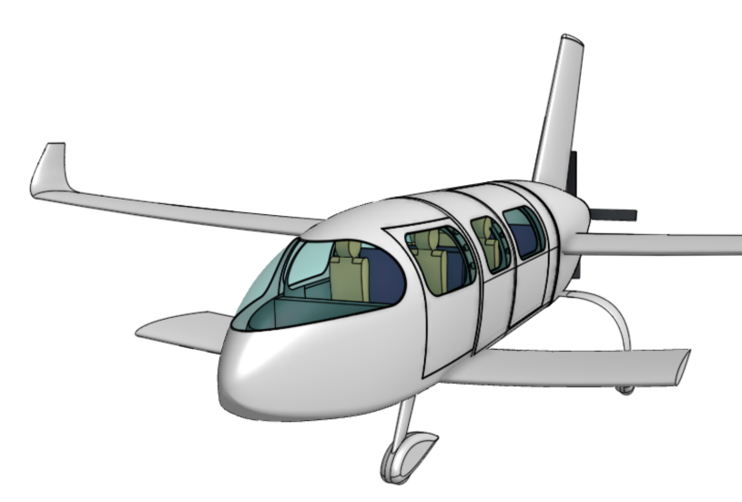
PRESENTATION OUTLINE
Project Purpose and Objectives
Design Solution
Critical Project Elements
Design Requirements and Their Satisfaction
Project Risks
Verification and Validation
Project Planning
PURPOSE | DESIGN | CPEs | DESIGN REQs | RISKS | V&V | PLANNING | BACK UP
Notes:
We can always change this -- but we do need to decide for sure at some point

Slide 3
PROJECT PURPOSE AND OBJECTIVES
Presented by:
Emerson Beinhauer
Background & Motivation
Mission Statement
Project Objectives
CONOPS (Mission Profile)
CONOPS (Project)

Slide 4
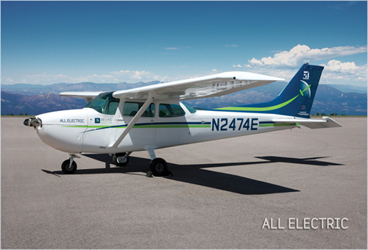
BACKGROUND & MOTIVATION
Customer Richard Schaden has requested a feasibility analysis for a 6-passenger, zero-emission aircraft
Gap in the market for fully electric, mid-sized transport aircraft (6 people)
Motivation: Aviation industry’s contribution to Global Warming, AvGas production concerns, exploration of novel design space
Beyond Aviation: All Electric, 4-Passenger Cessna 172
PURPOSE | DESIGN | CPEs | DESIGN REQs | RISKS | V&V | PLANNING | BACK UP
Notes:
2 hour endurance and 75 nautical mile range should be discussed here since they were mission specs
It's no surprise that air travel is a very popular form of transportation which continues to grow over the years. Unfortunately though air travel is one of the more environmentally damaging activities as it is responsible for various amounts of carbon dioxide and greenhouse gas emissions which contribute to things like global warming. For this reason transportation industries have been looking at different alternatives for gas for quite some time and this is no different for the aviation industry. The desire for a zero emissions aircraft would be valuable and alot of research has gone into solutions for both large scale commercial operations as well as small scale trainers. There is a bit of a niche market where the design space has been left a bit unexplored in the mid size general aviation industry which is where our project comes into play.

Slide 5
MISSION STATEMENT
No Emission, Low Drag Airframe (NELDA), will provide the customer, Richard Schaden, a clean-sheet airframe design concept for a general aviation airplane which includes drawings, scale models, test data analysis, and aircraft performance parameters.
The design will emphasize fully-electric powertrain considerations and aerodynamic efficiency.
Customer Specified NGO’s
Need: Clean-sheet design
Goal: Explore design parameter space to estimate performance of an optimized clean-sheet design
Objective: Airframe design; model test; analysis
PURPOSE | DESIGN | CPEs | DESIGN REQs | RISKS | V&V | PLANNING | BACK UP
Notes:
To summarize this our mission statement is as follows.No Emission, Low Drag Airframe (NELDA), will provide the customer, Richard Schaden, a clean-sheet airframe design concept for a general aviation airplane, which includes drawings, scale models, and a feasibility analysis. The design will emphasize fully-electric powertrain considerations and aerodynamic efficiency.

Slide 6
PROJECT OBJECTIVES
Generate novel design of a 6-passenger aircraft that outperforms similar market competitors while being capable of production within the next
5 years
Demonstrate this design can achieve the customer’s requested mission profile through well established heritage models
Characterize the capability of the PILOT wind tunnel to extrapolate small-scale data for full-scale applications via comparative models
Same scale Cessna-206 vs. NELDA’s Design
Analysis via aircraft dynamic models demonstrate that the aircraft design is statically and dynamically stable
PURPOSE | DESIGN | CPEs | DESIGN REQs | RISKS | V&V | PLANNING | BACK UP
Notes:
b/c we cant close the loop with a full aircraft design we need to demonstrate the design can achieve the customers requested mission profile through well established heritage models

Slide 7
CONOPS (MISSION PROFILE)
PURPOSE | DESIGN | CPEs | DESIGN REQs | RISKS | V&V | PLANNING | BACK UP
Notes:
On the aircraft design portion of this project the following mission outline and concept of operations have been identified. Our client would like an aircraft that can carry 6 passengers at a speed of 150kts for 2 hours with ….
Mission CONOPS is good, but for our specific class CONOPS we want to go for more of the final validation and tests that we have to do
Second phase is more of a testing plan / project plan
We'll be testing both models, each warrant their own conops? Then what does it look like when we test our WTAV model, then Glider
Need to state in the mission CONOPS that these parameters are what our full fledged aircraft is designed to accomplish, not necessarily what our project is going to do

Slide 8
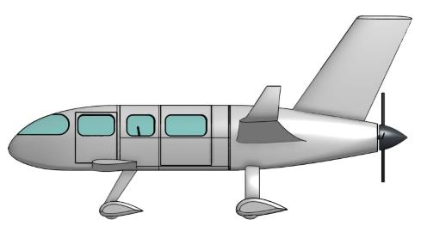
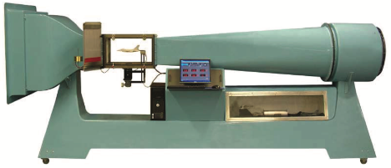
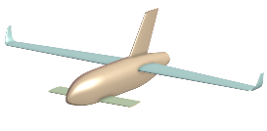
CONOPS (PROJECT)
Full Scale Design
MATLAB Performance Models
1st Semester
2nd Semester
Wind Tunnel Aerodynamic Validation (WTAV)
Glider Model
Characteristic Stability Demonstration (CSD)
Polished Data
PURPOSE | DESIGN | CPEs | DESIGN REQs | RISKS | V&V | PLANNING | BACK UP
Notes:
Short summary Emerson - first semester models / sizing / requirements drive our design, then second semester we use two different models to help V&V our initial design

Slide 9
DESIGN SOLUTION
Presented by:
Nathan Braunstein
Baseline Design
Key Parameters
Functional Block Diagram

Slide 10
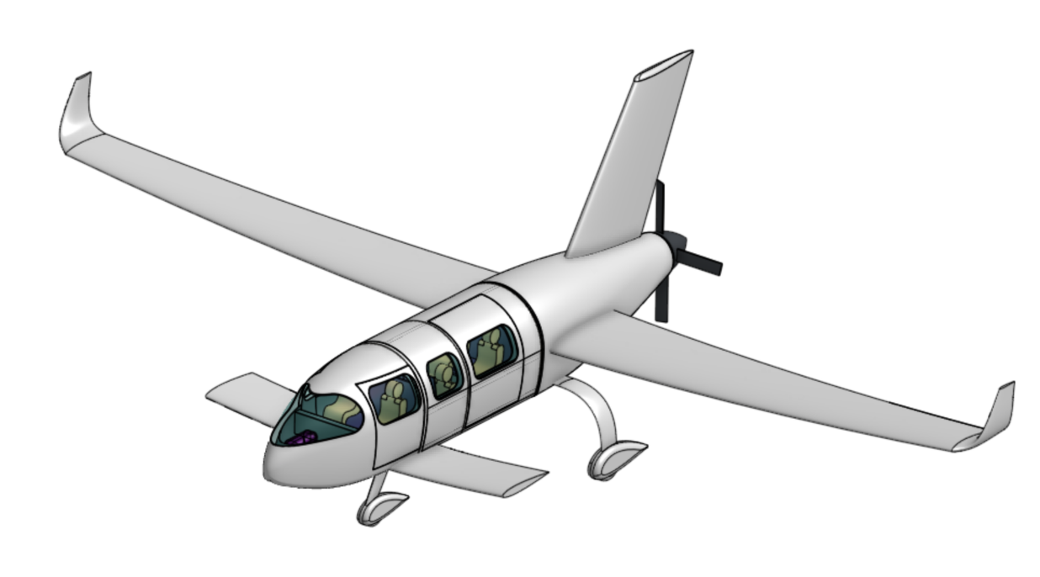
BASELINE DESIGN
VERTICAL STABILIZER
WINGLETS
AFT PROP (4 BLADES)
AFT, MID MOUNTED WING
CANARD
TRICYCLE LANDING GEAR
PURPOSE | DESIGN | CPEs | DESIGN REQs | RISKS | V&V | PLANNING | BACK UP
Notes:
NATE - CAD with Dimensions

Slide 11
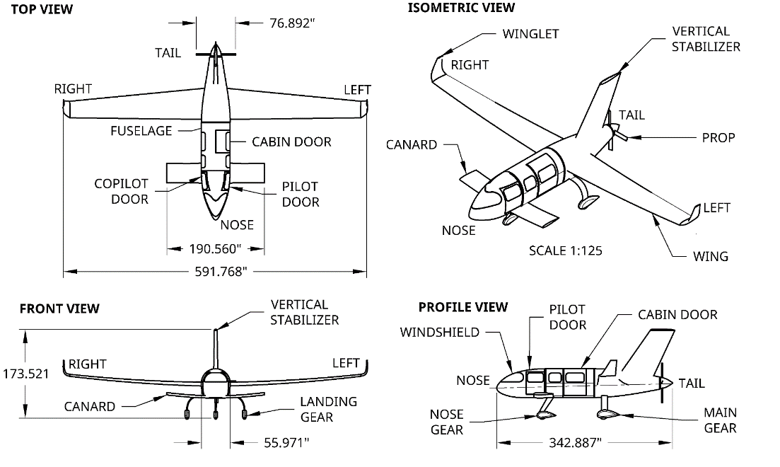
BASELINE DESIGN
Table of major baseline specs on following page , when time allows this will be a full scale drw of complete model
PURPOSE | DESIGN | CPEs | DESIGN REQs | RISKS | V&V | PLANNING | BACK UP
Notes:
NATE - CAD with Dimensions

Slide 12
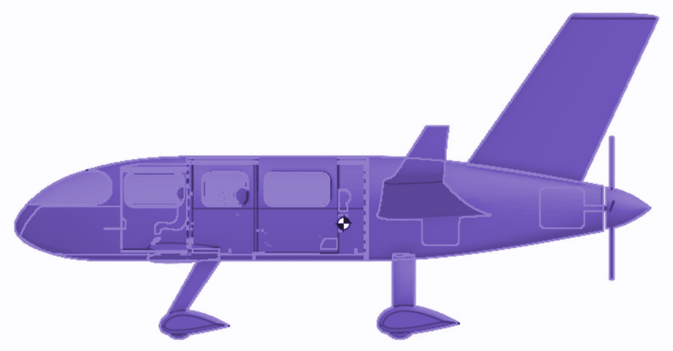
BASELINE DESIGN: CG
Center of Gravity Location
Z
Direction | Coordinate
X | 14.8 ft
Y | 0 ft
Z | 1.87 ft
X
Y
Neutral Point Location
Direction | Coordinate
X | 15.2 ft
Y | 0 ft
Z | 2.35 ft
Table of major baseline specs on following page , when time allows this will be a full scale drw of complete model
Longitudinal Reference Axis
Vertical Reference Axis
PURPOSE | DESIGN | CPEs | DESIGN REQs | RISKS | V&V | PLANNING | BACK UP
Notes:
NATE - CAD with Dimensions

Slide 13
KEY PARAMETERS
Component | AR | b [ft] | S [ft²] | Airfoil | Taper Ratio | Sweep [degree] | Volume Coefficient | Moment Arm to Wing [ft]
Wing | 12 | 47.38 | 187.1 | NACA 2412 | 0.5 | None | N/A | N/A
Canard | 5 | 15.87 | 50.39 | NACA 0012 | 0.9 | None | V_{H} = 0.5197 | 10.65
Tail | 1.5 | 7.37 | 36.22 | NACA 0012 | 0.7 | 35 | V_{V} = 0.0426 | 4.4
Batteries | Weight | Specific Energy | Energy Density | Volume
Solid State Lithium-Metal | 949 lbs | 580 W-h/kg | 1377 Wh/L | 6.4 ft³
PURPOSE | DESIGN | CPEs | DESIGN REQs | RISKS | V&V | PLANNING | BACK UP

Slide 14
KEY PARAMETERS
Component | Weight [lbs] | Weight Fraction | C_{D0} | C_{DL} | e | C_{f}
Whole Aircraft L/D = 9.99 | 4094 | 100% | 0.038 | N/A | 0.738 | N/A
Wing | 447 | 10.9% | 0.0061 | 0.2978 | 0.856 | 0.0025
Canard | 67.5 | 1.6% | 0.0011 | 0.0004 | 0.887 | 0.0026
Fuselage | 473.5 | 11.5% | 0.0077 | 0 | N/A | 0.0025
Vertical Tail | 51.14 | 1.2% | 0.0011 | N/A | 0.9723 | 0.0023
PURPOSE | DESIGN | CPEs | DESIGN REQs | RISKS | V&V | PLANNING | BACK UP
Notes:
May need 2 slides here?
Cdo
Induced Drag
E
Skin friction
Can take out the fuselage row

Slide 15
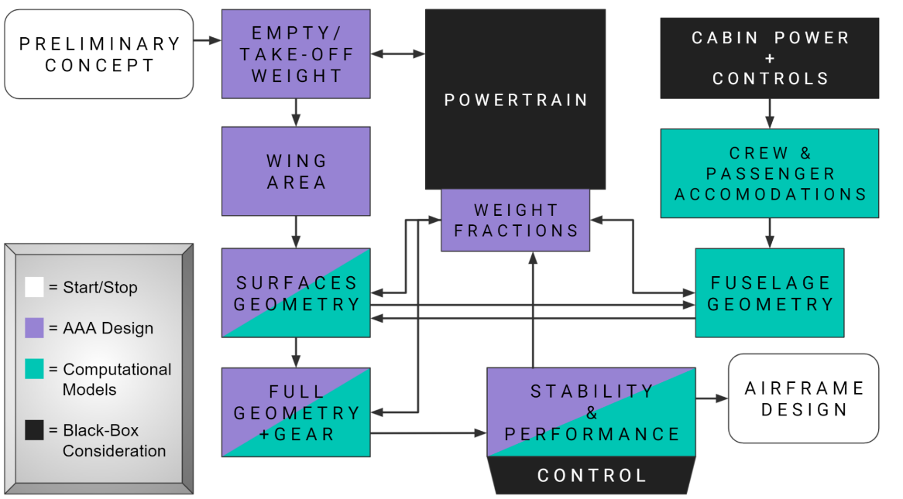
FUNCTIONAL BLOCK DIAGRAM
T E S T I N G/
V A L I D A T I O N
PURPOSE | DESIGN | CPEs | DESIGN REQs | RISKS | V&V | PLANNING | BACK UP

Slide 16
CRITICAL PROJECT ELEMENTS
Presented by:
Jake Pendergast
CPEs
Notes:
Jake

Slide 17
CRITICAL PROJECT ELEMENTS
Element | Description | Functional Req
Electrical Powertrain System (EPS) | All performance parameters of the electrical powertrain system (batteries, motor, avionics) are demonstrably feasible within ~5 years. | FR1 - Classification
Airframe Design (AIRD) | Aerodynamically efficient; 6 passengers; 150 kias cruise; fully electric, performance enables 2 hr endurance, 150 nautical mile range. | FR1 - Classification FR2 - Crew FR3 - Performance
Computational Simulation + Stability Models (CSM) | MATLAB, AAA, and dynamic stability models will serve as a guide for analysis, prediction, verification, and design/model iteration. | FR3 - Performance FR6 - Stability
Small Scale Testing (SST) | Wind Tunnel Aerodynamic Validation (WTAV): comparative data collection, and Characteristic Stability Demonstration (CSD): stability visualization | FR4 - WTAV (Wind Tun.) FR5 - CSD (Glider)
Manufacturing (MFCT) | Scale models will need to be constructed for the WTAV and CSD tests | FR4 - WTAV (Wind Tun.) FR5 - CSD (Glider)
Budget (BUD) | Course funding limitation has a limit of $5,000; will drive SST model quality | Course
PURPOSE | DESIGN | CPEs | DESIGN REQs | RISKS | V&V | PLANNING | BACK UP
Notes:
Jake

Slide 18
DESIGN REQUIREMENTS AND THEIR SATISFACTION
Presented by:
Jake Pendergast, Tomaz Remec, Tristan Martinez
Driving Requirements
AIRD - Power Requirements
AIRD - Flight Envelope
AIRD - Performance
SST - Wind Tunnel Testing
SST - Glider
CSM - Stability Modes
Notes:
Jake

Slide 19
DRIVING REQUIREMENTS
FR’S | Description | CPE | Satisfied?
1, 2 | Aircraft Classification and Power Requirements | Airframe Design (AIRD) | ✅ OR 🗙
3 | Aircraft Performance |  | ✅ OR 🗙
4 | WTAV Testing | Small Scale Testing (SST) | ✅ OR 🗙
5 | CSD Testing |  | ✅ OR 🗙
6 | Stability Requirements | Stability Models (CSM) | ✅ OR 🗙
PURPOSE | DESIGN | CPEs | DESIGN REQs | RISKS | V&V | PLANNING | BACK UP
Notes:
Jake

Slide 20
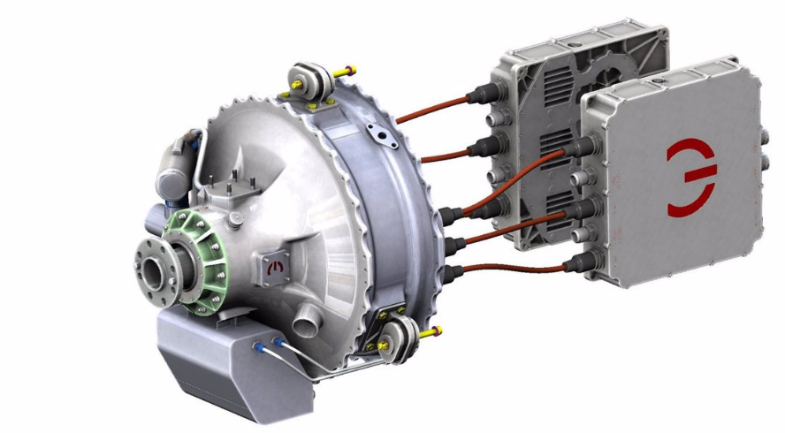
(AIRD) POWER REQUIREMENTS
DR1.2: The propulsion system shall be capable of producing enough thrust for the full flight envelope
DR1.2.1: The propulsion system shall be capable of producing enough thrust for a cruising velocity of 150 knots
DR1.2.2: The propulsion system shall be capable of achieving a R.O.C. of 1500 ft/min at sea level
Parameter | MagniX 350 | Design Requirement
Continuous Power Output | 280 kW (381 Hp) | 259 Hp (from AAA)
Max. Power Output | 350 kW (476 Hp) | 346 Hp (from AAA)
Output RPM | 1200 - 2300 RPM | N/A
Dry Weight | 112 kg (246 lbs) | N/A
Operating Volt. | 500-800 VDC | N/A
INVERTER AND MOTOR CONTROLLER
DIRECT MOTOR TO PROP
LIQUID COOLING SYSTEM
PURPOSE | DESIGN | CPEs | DESIGN REQs | RISKS | V&V | PLANNING | BACK UP
Notes:
JAKE - post PDR we knew weight, power req, wing area, tell where story left off and how we got to our designs in CDR *JAKE - I need to insert that other weighting plot from Hupperte equations showing rough weight, then looking at similar aircraft to do trade studies on where we need more / less weight for individual sections and what we want to optimize

Slide 21
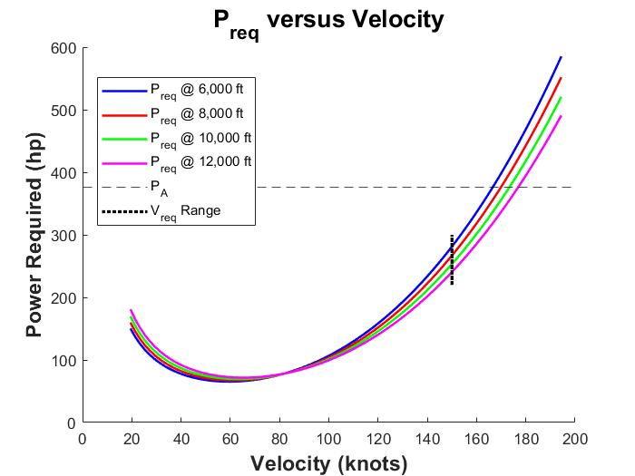
(AIRD) POWER REQUIREMENTS
DR1.2: The propulsion system shall be capable of producing enough thrust for the full flight envelope
DR1.2.1: The propulsion system shall be capable of producing enough thrust for a cruising velocity of 150 knots
DR1.2.2: The propulsion system shall be capable of achieving a R.O.C. of 1500 ft/min at sea level
Sufficient
Power
Margin
ASSUMPTIONS
1. The aircraft cruises steady, level, unaccelerated flight
2. AAA estimation of e (Oswald’s efficiency)
PURPOSE | DESIGN | CPEs | DESIGN REQs | RISKS | V&V | PLANNING | BACK UP
Notes:
JAKE

Slide 22
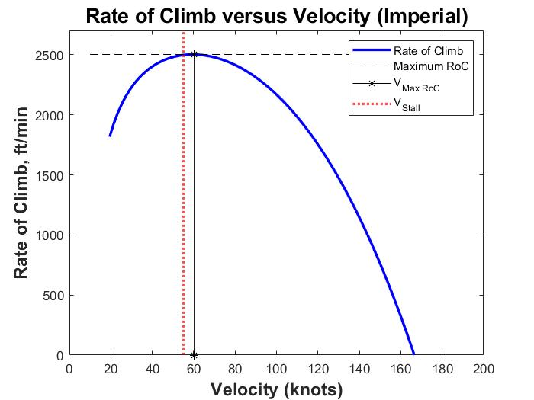
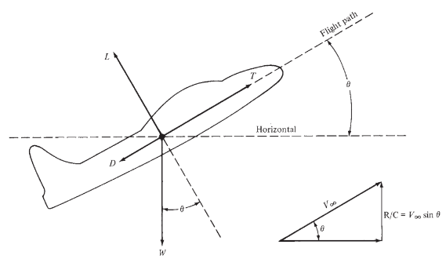
(AIRD) FLIGHT ENVELOPE
DR1.2.2: The propulsion system shall be capable of achieving a R.O.C. of 1500 ft/min at sea level
PURPOSE | DESIGN | CPEs | DESIGN REQs | RISKS | V&V | PLANNING | BACK UP
Notes:
JAKE

Slide 23
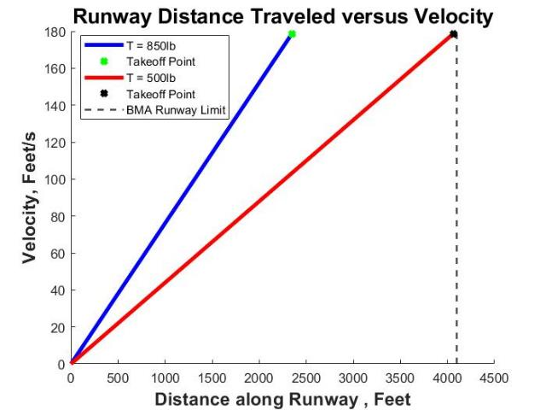
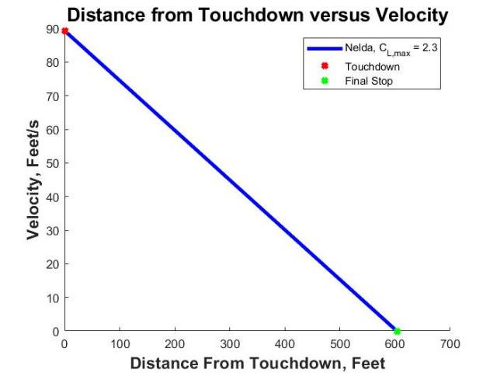
(AIRD) TAKEOFF/LANDING
DR1.2.3: The aircraft must be capable of takeoff and landing at airports possessing runways greater than or equal to 4,000 feet in length.
PURPOSE | DESIGN | CPEs | DESIGN REQs | RISKS | V&V | PLANNING | BACK UP
Notes:
JAKE

Slide 24
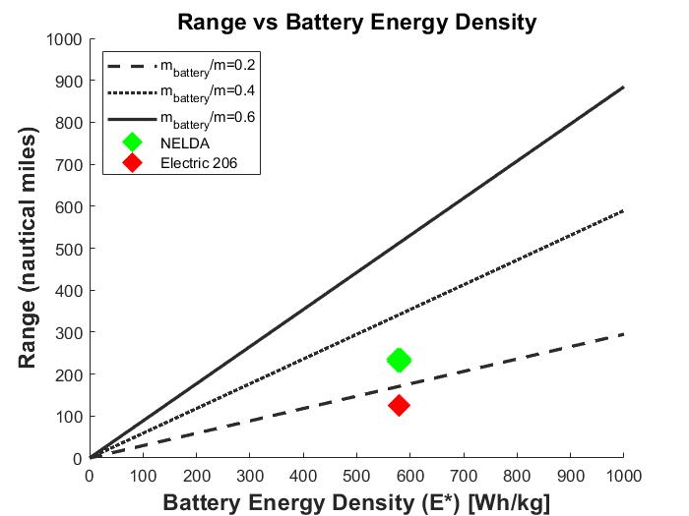
(AIRD) PERFORMANCE - RANGE 1
DR3.1: The Aircraft shall have a minimum Range of 150 nautical miles
*Full derivation in BackUp Slides
Variable | Name
R | Range
E | Energy
𝜂_{total} | Efficiency
L/D | Lift-to-Drag ratio
m | Mass
g | Acceleration due to gravity
233 NM
125 NM
PURPOSE | DESIGN | CPEs | DESIGN REQs | RISKS | V&V | PLANNING | BACK UP
Notes:
JAKE

Slide 25
(AIRD) PERFORMANCE - ENDURANCE
DR3.1: The Aircraft shall have a minimum Range of 150 nautical miles
DR3.2: The Aircraft shall have a minimum Endurance of 2 hours
Parameter | Value
Max Takeoff Weight (W) | 1850 kg
Wing Area (S) | 17.2 m²
Air Density (𝜌) | 1.1 kg/m³
Total System Efficiency (𝜂) | 0.8
Parasitic Drag (C_{D,0}) | 0.048
Induced Drag Coefficient (K) | 0.0298
Initial Charge (Q₀) | 431 Amp-hours
Motor Operating Voltage (U_{nom}) | 580 Volts
ASSUMPTIONS
The aircraft cruises at constant altitude
The angle of attack α is small
Constant and averaged motor voltage draw
The component of the thrust perpendicular to the velocity vector is small compared to lift and weight
The acceleration of the aircraft is small due to steady flight, and so v_ ≈ 0.
Parameter | Final Value
Endurance | 3.7 Hours
Range | 244 nm
PURPOSE | DESIGN | CPEs | DESIGN REQs | RISKS | V&V | PLANNING | BACK UP
Notes:
JAKE - more time on this slide than the previous, make sure to compare Range results!

Slide 26
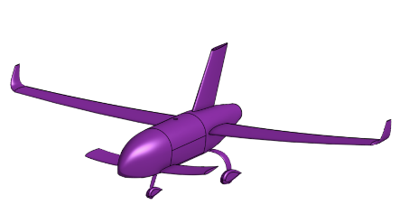
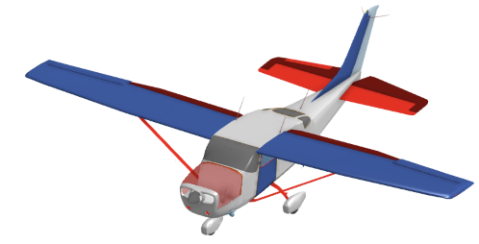
(SST) WIND TUNNEL TESTING
DR4.1: A scaled down model of both the NELDA aircraft and the CESSNA 206 shall be constructed for comparative testing
DR4.1.1: The scaled model shall have a wingspan no greater than 8.8”
DR4.1.2: The scaled models shall be built out of the same material to the same size scale
Pre-Test Calculation Summary
*WT Max Vel: 131.234 ft/s
Parameter | NELDA Design | Cessna 206
Full Scale Wingspan [in] | 568.56 | 432
1/65 Model Wingspan [in] | 8.75 | 6.65
Full Scale Reynolds # | 4,894,083.34 | 5,539,322.24
1/65 Model Reynolds # | 46,207.13 | 55,245.2
Full Scale Cruise Velocity [ft/s] | 253.17 | 239.67
Required WT Airflow Velocity to Match Reynolds # [ft/s] | 13,904.9 | 13,158.69
PURPOSE | DESIGN | CPEs | DESIGN REQs | RISKS | V&V | PLANNING | BACK UP
Notes:
What full scale airspeed does our test correspond to?
Cessna: 2.39 ft/s
NELDA: 2.39 ft/s

Slide 27
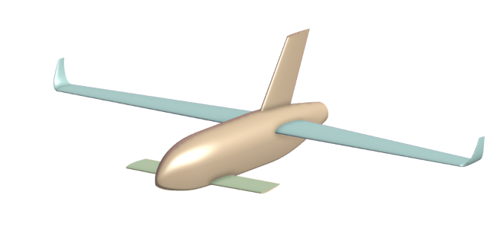
(SST) GLIDER TESTING
DR4.1: A larger scale, gliding model of the airframe shall be constructed for the purpose of evaluating longitudinal stability parameters
Parameter | NELDA Design
Full Scale Wingspan [ft] | 47.38
1/14 Model Wingspan [ft] | 3.4
Full Scale Cruise Velocity [ft/s] | 253.17
Glider Velocity [ft/s] | 20.6
Plan for CG/weight + skin friction scaling, construction, and basic structural analysis
PURPOSE | DESIGN | CPEs | DESIGN REQs | RISKS | V&V | PLANNING | BACK UP
Notes:
ADD WHY WE’RE GOING WITH THROWING GLIDER INSTEAD OF BUNGEE TEST: IMPOSSIBLE REYNOLDS NUMBER, ADDED RISK, ADDED COMPLEXITY, INCREASED VARIATION WILL LEAD TO POSSIBLE INSTABILITY

Slide 28
(CSM) STATIC STABILITY REQS
DR6.1: The aircraft shall be statically stable in steady level flight
What Does it Mean to be
Statically Stable?
DR 6.1.1 - C_{m⍺} negative
DR 6.1.2 - C_{l𝛽} negative
DR 6.1.2 - C_{n𝛽} positive
DR 6.1.4 - Static Margin positive
Parameter | Value
C_{m⍺} | -0.4464 [rad⁻¹]
C_{l𝛽} | -0.0316 [rad⁻¹]
C_{n𝛽} | 0.0201 [rad⁻¹]
Static Margin | 9.75%
PURPOSE | DESIGN | CPEs | DESIGN REQs | RISKS | V&V | PLANNING | BACK UP
Notes:
STATIC STABILITY
Static Margin positive: 10.54 percent
Cm_alpha negative
Cl_beta negative
Cn_beta postivie

Slide 29
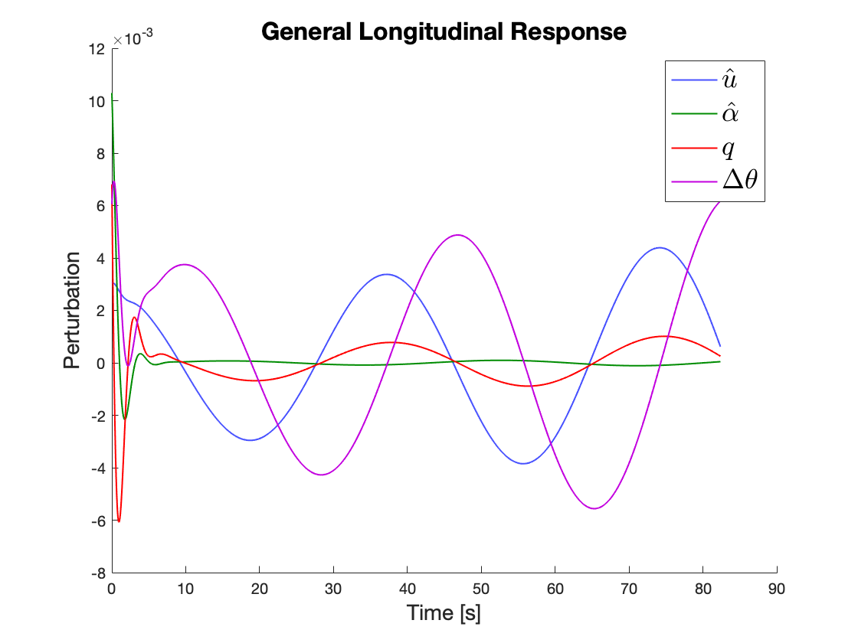
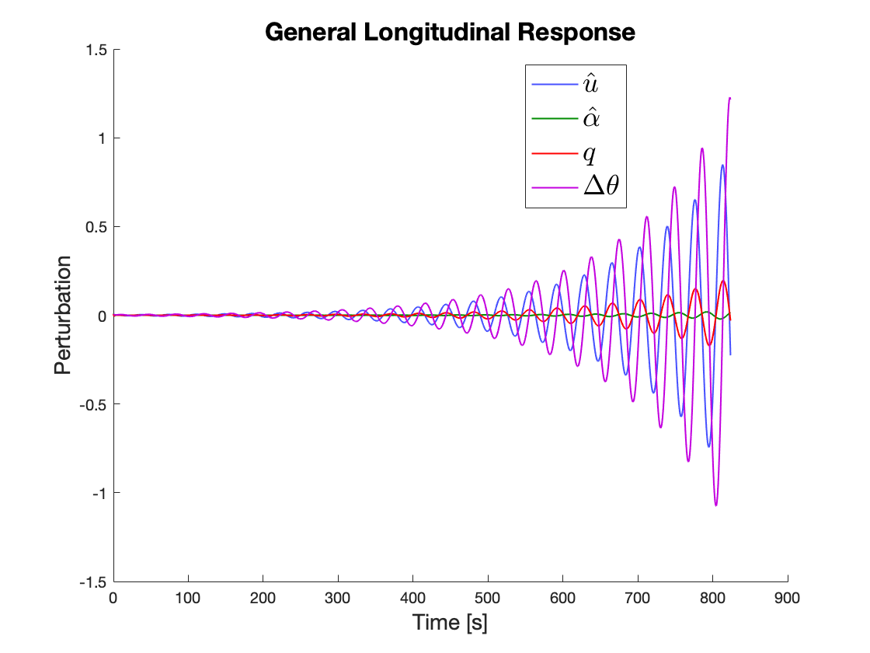
(CSM) DYNAMIC STABILITY REQS
DR6.1: The aircraft shall be statically stable in steady level flight
DR6.2: The aircraft shall be dynamically stable
Show predicted longitudinal response times and matrices from our dynamic stability code.
PURPOSE | DESIGN | CPEs | DESIGN REQs | RISKS | V&V | PLANNING | BACK UP
Notes:
Split slides gen response/ind modes OR lon/lat depending on Rl/Sr
A
1: lon/lat GR, description of modes and motion of plane
2: selected modes (probably sp,ph,dr) w/ damp/ts, more in depth descriptions
B
1: lon modes, damp/ts for each, longer description of modes
2: lat modes, damp/ts for each

Slide 30
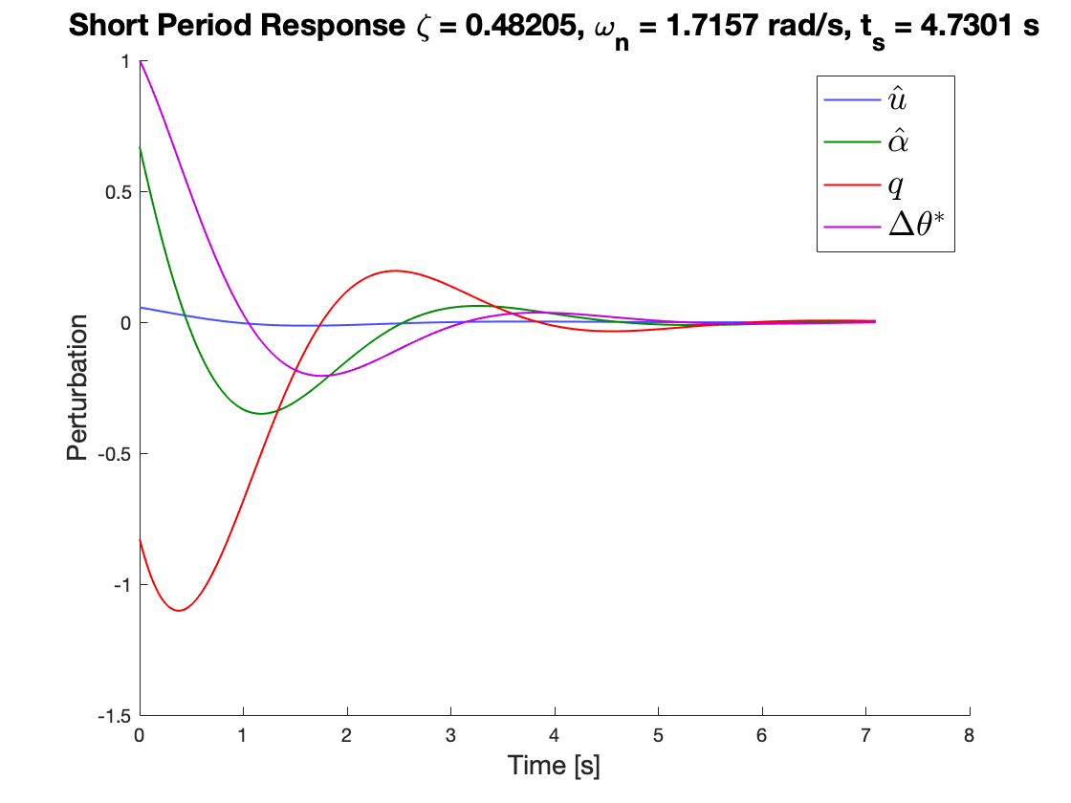
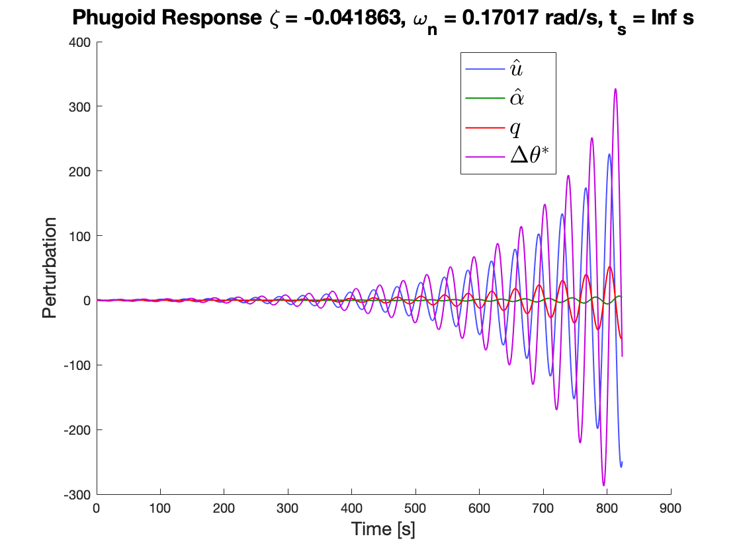
(CSM) DYNAMIC STABILITY REQS
DR 6.2.1: The aircraft shall have a minimum short period damping ratio 𝜻 _{SP} of 0.20 and a maximum of 2.00 in steady flight.
DR 6.2.2: The aircraft shall have a minimum phugoid damping coefficient 𝜻 _{Ph} of 0 OR be sufficiently controllable in flight.
Show predicted longitudinal response times and matrices from our dynamic stability code.
PURPOSE | DESIGN | CPEs | DESIGN REQs | RISKS | V&V | PLANNING | BACK UP
Notes:
Split slides gen response/ind modes OR lon/lat depending on Rl/Sr

Slide 31
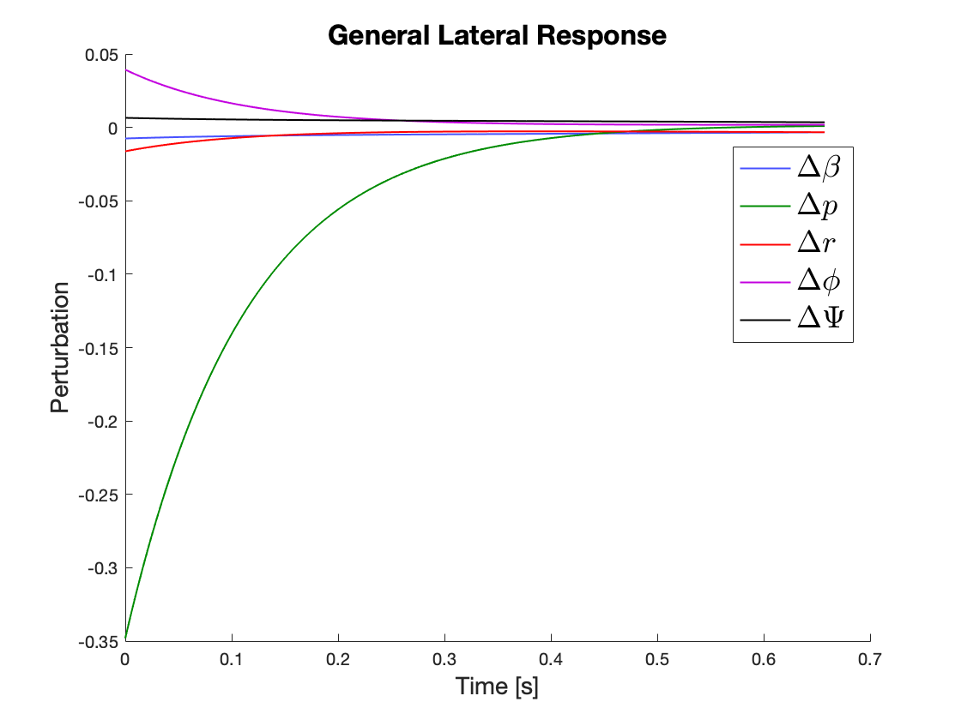
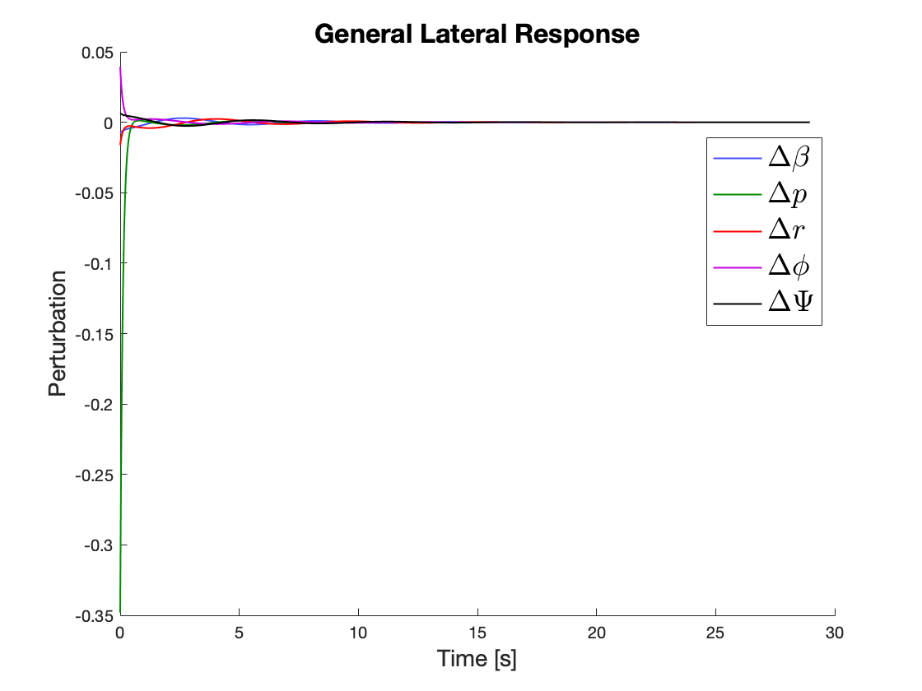
(CSM) DYNAMIC STABILITY REQS
DR6.1: The aircraft shall be statically stable in steady level flight
DR6.2: The aircraft shall be dynamically stable
Show predicted longitudinal response times and matrices from our dynamic stability code.
PURPOSE | DESIGN | CPEs | DESIGN REQs | RISKS | V&V | PLANNING | BACK UP
Notes:
Split slides gen response/ind modes OR lon/lat depending on Rl/Sr

Slide 32
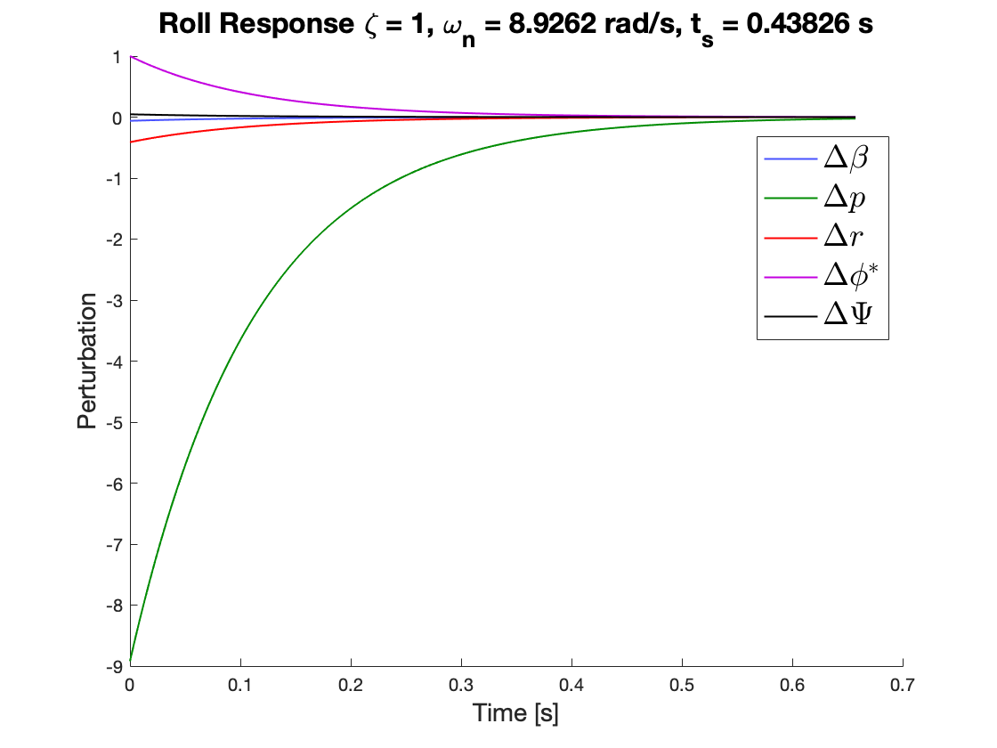
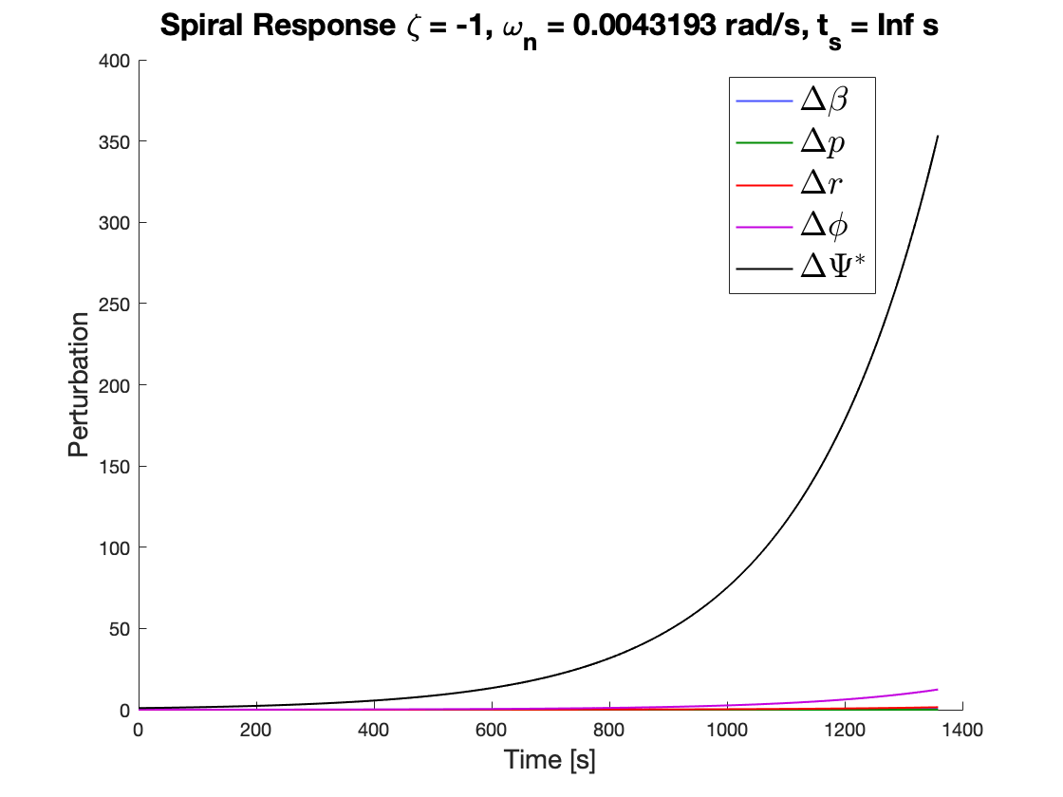
(CSM) DYNAMIC STABILITY REQS
DR6.1: The aircraft shall be statically stable in steady level flight
DR6.2: The aircraft shall be dynamically stable
Show predicted longitudinal response times and matrices from our dynamic stability code.
PURPOSE | DESIGN | CPEs | DESIGN REQs | RISKS | V&V | PLANNING | BACK UP
Notes:
Split slides gen response/ind modes OR lon/lat depending on Rl/Sr

Slide 33
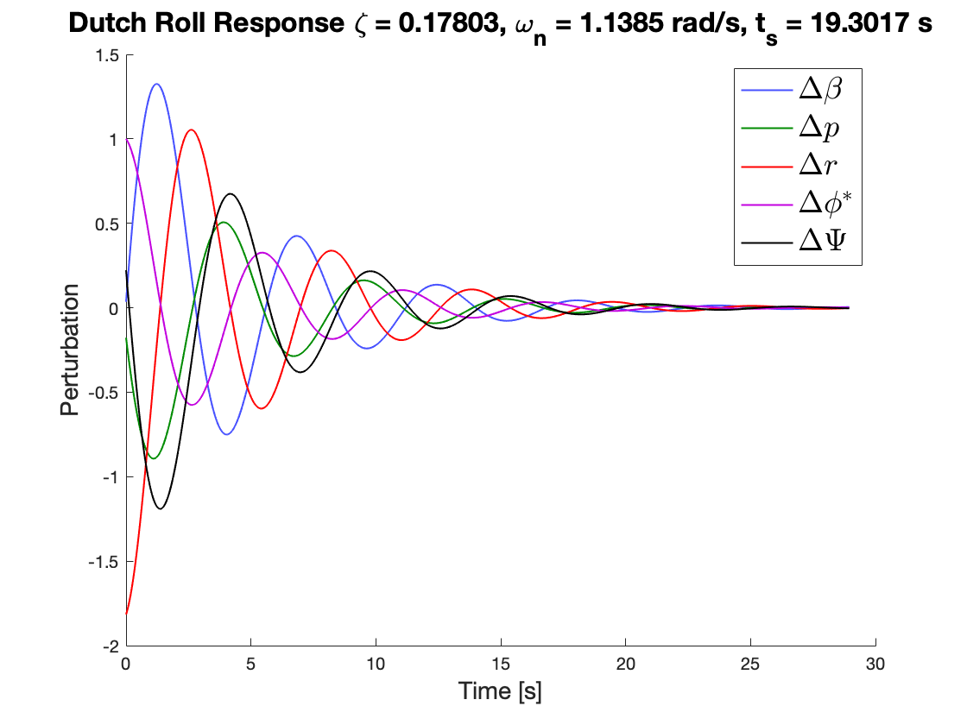
(CSM) DYNAMIC STABILITY REQS
DR 6.2.3: The aircraft shall have a Dutch Roll damping ratio such that 𝜻 _{DR} > 0.15.
Show predicted longitudinal response times and matrices from our dynamic stability code.
PURPOSE | DESIGN | CPEs | DESIGN REQs | RISKS | V&V | PLANNING | BACK UP
Notes:
Split slides gen response/ind modes OR lon/lat depending on Rl/Sr

Slide 34
(CSM) DYN. STABILITY REQUIREMENTS
DR6.1: The aircraft shall be statically stable in steady level flight
DR6.2: The aircraft shall be dynamically stable
Mode | Damping Ratio 𝜁 [-] | Natural Frequency 𝜔_{n} [rad/s] | Settling Time t_{s} [s] | Stability
Short Period | 0.482 | 1.716 | 4.73 | STABLE
Phugoid | -0.042 | 0.170 | N/A | DIVERGENT*
Roll | 1 | 8.926 | 0.438 | STABLE
Spiral | -1 | 0.004 | N/A | UNSTABLE*
Dutch Roll | 0.178 | 1.139 | 19.302 | STABLE
PURPOSE | DESIGN | CPEs | DESIGN REQs | RISKS | V&V | PLANNING | BACK UP
Notes:
Split slides gen response/ind modes OR lon/lat depending on Rl/Sr

Slide 35
DRIVING REQUIREMENTS
FR’S | Description | CPE | Satisfied?
1 | Aircraft Classification and Power Requirements | Airframe Design (AIRD) | ✅
3 | Aircraft Performance |  | ✅
4 | WTAV Testing | Small Scale Testing (SST) | ✅
5 | CSD Testing |  | ✅
6 | Stability Requirements | Stability Models (CSM) | ✅
PURPOSE | DESIGN | CPEs | DESIGN REQs | RISKS | V&V | PLANNING | BACK UP
Notes:
The selected design requirements demonstrate that the critical DR’s satisfied along with dozens of others allow us to fulfill these FR’s
The emphasis here needs to be that we can design our models and test based off of our design requirements - not necessarily that the data provided by these tests will be good.

Slide 36
PROJECT RISKS
Presented by:
Julia Tucker
Risk Matrix
Risk Mitigation Strategies
Post Mitigation Matrix

Slide 37
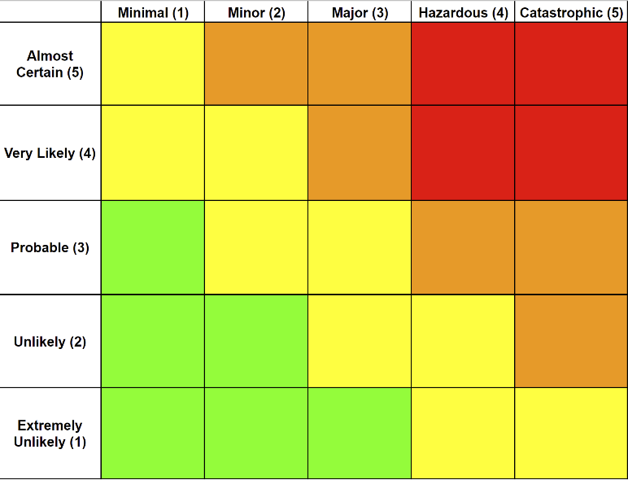
RISK MATRIX
1 | Budget exceeds $5,000
2 | Severe structural failure in CSD
3 | Wind tunnel is set up improperly
4 | Inconclusive NELDA vs 206 WTAV
5 | Structural failure during WTAV
3
4
2
5
1
PURPOSE | DESIGN | CPEs | DESIGN REQs | RISKS | V&V | PLANNING | BACK UP
Notes:
Julia - cannot take longer than 30 seconds here. Summarize instead of just reading from the slide - stability, WT testing, manufacturing, testing

Slide 38
RISK MITIGATION STRATEGIES
Risk 1: Budget exceeds $5,000
Risk 1 Associated Risks:
Late design changes
Material shortages
Manufacturing mistakes
Testing failures
Risk 1 Mitigation:
Thoroughly budget before ordering materials
Quote confidence
Confidence in manufacture processes
Thorough testing plans
1
1
PURPOSE | DESIGN | CPEs | DESIGN REQs | RISKS | V&V | PLANNING | BACK UP
Notes:
Julia - summarize - the PAB can read - no need to just read straight from the slide

Slide 39
RISK MITIGATION STRATEGIES
Risk 2: Severe structural failure in CSD
Risk 2 Associated Risks:
Fragile CSD model components too weak to sustain multiple test flights
“Torqued” hand-launch
The cameras will fail to capture evidence of stability
Unexpected environmental interaction
Risk 2 Mitigation:
Build individual components
Practice launching techniques
Ensure camera quality and operators are trained
Small scale progressive testing process
Basic structural analysis
Schedule testing based on low-wind forecasts and fair weather (early mornings)
2
2
PURPOSE | DESIGN | CPEs | DESIGN REQs | RISKS | V&V | PLANNING | BACK UP
Notes:
Julia

Slide 40
RISK MITIGATION STRATEGIES
Risk 3: Wind tunnel is set up improperly
Risk 3 Associated Risks:
Wind Tunnel may be occupied
LABVIEW code ineffective for desired data output
Incorrect preload set up causing test subject to be unstable or loose
Test subject not secured properly may fall off and break wind tunnel
Risk 3 Mitigation:
Ensure reservations made well in advance
Consult lab staff before testing / verify LABVIEW code up to date with proper outputs
Ensure Set-Screw model adaptation is properly applied
First test precaution safety net
Create thorough testing plans / checklists
3
3
PURPOSE | DESIGN | CPEs | DESIGN REQs | RISKS | V&V | PLANNING | BACK UP
Notes:
Julia

Slide 41
RISK MITIGATION STRATEGIES
Risk 4: Inconclusive NELDA vs 206 WTAV
Risk 4 Associated Risks:
3D printed model has unnecessary drag due to manufacturing inconsistencies
Test unable to produce 500g of axial force
Errors associated with preloading
Risk 4 Mitigation:
Preform multiple trial tests to confirm data
Ensure consistent manufacturing practices
Error reduced by appropriately pre-loading the STING ⅜ EWT
Thoroughly check computational models before manufacturing, ensure sizing and model scaling before testing
4
4
PURPOSE | DESIGN | CPEs | DESIGN REQs | RISKS | V&V | PLANNING | BACK UP
Notes:
Julia

Slide 42
RISK MITIGATION STRATEGIES
Risk 5: Structural failure during WTAV
Risk 5 Associated Risks:
Unpredictable wind tunnel forces through testing cycles
Compromised rear structure associated with STING ⅜ EWT insert
Manufacturing structural limitations
Risk 5 Mitigation:
High velocity car free stream air test
Compare construction to other wind tunnel models
Thorough manufacturing analysis before purchase
5
5
PURPOSE | DESIGN | CPEs | DESIGN REQs | RISKS | V&V | PLANNING | BACK UP
Notes:
Julia

Slide 43
PRE / POST MITIGATION MATRICES
1 | Budget exceeds $5,000
2 | Severe structural failure in CSD
3 | Wind tunnel is set up improperly
4 | Inconclusive NELDA vs 206 WTAV
5 | Structural failure during WTAV
3
4
2
5
4
2
1
5
3
1
PURPOSE | DESIGN | CPEs | DESIGN REQs | RISKS | V&V | PLANNING | BACK UP
Notes:
Julia

Slide 44
VERIFICATION AND VALIDATION
Presented by:
Julia Tucker and Tristan Martinez
Verification - Whole Aircraft
Verification - CSD
Validation - WTAV
Notes:
Describe how the design will be verified against predictive models through characterization testing.
Use diagrams to convey the test set up, the facilities and equipment needed, and how the test works.
Describe the measurements to be made, and key measurement issues (resolution, sampling rate, etc.)
Show how the selected sensors, instruments, data acquisition, test fixtures, etc. provide the required
capabilities.
Describe how the design will be validated against functional requirements and overall project success
criteria.
Model development is appropriate, experiments to verify the design and validate model are clearly
described, and characterization test objectives and methods are well-defined (17-20 pts)
Some key modeling aspects are missing or poorly developed, or some tests are poorly motivated
or defined (say which) (14-17 pts)
Many verification and validation aspects are missing or ill-conceived (say which) (10-14 pts)
Verification and validation plans are inadequate for a successful project (0-10 pts)

Slide 45
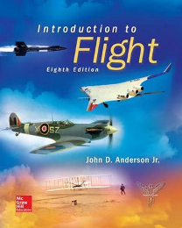
MODEL VERIFICATION - WHOLE A/C
Objective: Verify performance characteristics and FAA regulation requirements
Plan: Multiple reliable and time-tested models to computationally verify the full-scale design
*Potential extrapolation of small-scale testing to full-scale model if applicable*
Reasoning: Must demonstrate satisfaction of customer specified requirements and mission completion
Results: Entire flight profile; FAA Airworthiness satisfaction
PURPOSE | DESIGN | CPEs | DESIGN REQs | RISKS | V&V | PLANNING | BACK UP
Notes:
Jake

Slide 46
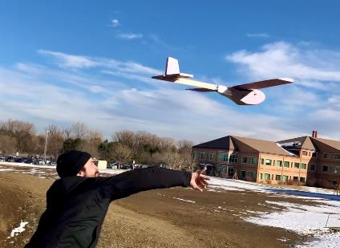
MODEL VERIFICATION - CSD (GLIDER)
FR 6.0: The full-scale aircraft shall be designed to be statically and dynamically stable.
Objective: Verify computational stability analysis with physical model
Plan: Appropriately scale and manufacture a foam NELDA glider model
Reasoning: First order physical stability analysis for NELDA
Measurements: Gliding L/D, stability behavior, Range
Results: First order stability model will aid in verifying
computational models
PURPOSE | DESIGN | CPEs | DESIGN REQs | RISKS | V&V | PLANNING | BACK UP
Notes:
Jake

Slide 47
MODEL VALIDATION - WTAV (WIND TUNNEL)
FR 3.0: The aircraft shall have a maximum range and endurance comparable to or exceeding the performance of 6-passenger electric aircraft currently under certification.
Objective: Comparison of lift and drag data between NELDA and the Cessna-206, verify performance improvements
Plan: Verify WT instrument calibration, test at varying AoA’s
Reasoning: Flow testing on same scale models to verify performance improvements in NELDA’s design
Measurements: Lift, drag, moments
Results: Small scale drag polar comparison will enable us to extrapolate to full scale data and AAA models, then evaluate their usefulness
Aerolab Educational
Wind Tunnel
PURPOSE | DESIGN | CPEs | DESIGN REQs | RISKS | V&V | PLANNING | BACK UP
Notes:
Nate

Slide 48
MODEL VALIDATION - WTAV
DR 4.2.2: The test instruments should be capable of capturing aerodynamic forces above the minimum resolution inherent to such instruments.
Expected Wind Tunnel Forces: Based on Previous Data (Boeing 787)
Well below maximum allowable loads on selected sensor (Sting EWT)
Parameter | Max. Load Capability of Sting EWT |  | Max. Measured Force |  | Percentage of Load Capacity Used
Normal Force | 25 lbs | 111.21 N | 1.09 lbs | 4.87 N | 4.4%
Axial Force | 10 lbs | 44.48 N | 0.17 lbs | 0.74 N | 1.7%
Pitching Moment | 50 lb-in | 5.65 Nm | 0.80 lb-in | 0.09 Nm | 1.6%
PURPOSE | DESIGN | CPEs | DESIGN REQs | RISKS | V&V | PLANNING | BACK UP
Notes:
Expected Wind Tunnel Forces:
Based on previous data (Boeing 787)

Slide 49
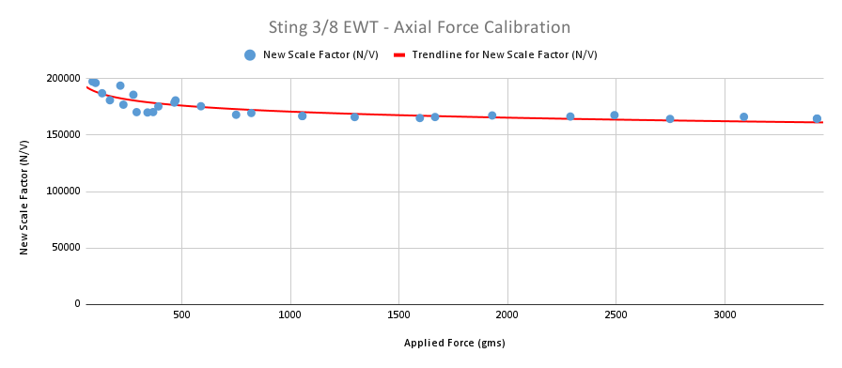
MODEL VALIDATION - WTAV
DR 4.2.2: The test instruments should be capable of capturing aerodynamic forces above the minimum resolution inherent to such instruments.
Sensor Resolution and Calibration:
Scale factor below 500 grams (5 Newtons) highly variant
Need to exceed this minimum to get more accurate data
NELDA expects to achieve less than 100 grams (1 Newton) of axial force
PURPOSE | DESIGN | CPEs | DESIGN REQs | RISKS | V&V | PLANNING | BACK UP
Notes:
Sensor Resolution and Calibration:
Resolution graph
Calibration Graphs (Normal and Axial Forces) + Ask Trudy for Regression Lines
Include Sting ⅜ EWT Resolution and Range Chart

Slide 50
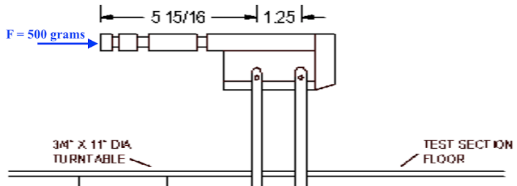
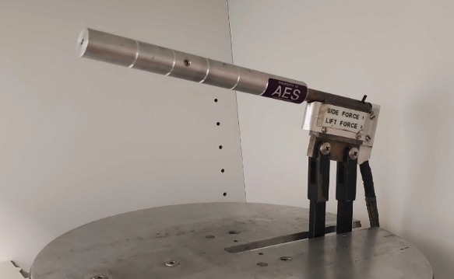
MODEL VALIDATION - WTAV
Pre-Loading Sting EWT:
Need to apply at least 500 grams of force to get accurate data
Apply Force to Set Screw
String (kite or fishing wire)
Turn buckle (apply desired force)
Will test models both with and without pre-loading to assess effects
(F_{PRELOAD} + F_{AXIAL}) > 500 grams
Set Screw
PURPOSE | DESIGN | CPEs | DESIGN REQs | RISKS | V&V | PLANNING | BACK UP
Notes:
Need at least 500 grams
Pre-Loading STING EWT:
Methods?
String
Spring?
Other?
Show figure with fishing wire drawing

Slide 51
PROJECT PLANNING
Presented by:
Emerson Beinhauer
Team Organization
Work Breakdown Structure
Gantt Chart
Cost Plan
Test Planning

Slide 52
TEAM ORGANIZATION
Richard Schaden
Sponsor
Donna
Gerren
Fac. Adv
Emerson Beinhauer
PM
Jake
Pendergast
Systems
Julia
Tucker
Financial
Christl
Haley
AD (AAA)
Carlin
Hornbostel
Aerodyn.
Nathan
Braunstein
CAD/Drws
Fernando
Chavez - Arroyo
Testing/Safety
Finn
Bailis
Manuf.
Tristan Martinez
Materials
Tomaz Remec
Comp. Anlys
PURPOSE | DESIGN | CPEs | DESIGN REQs | RISKS | V&V | PLANNING | BACK UP

Slide 53
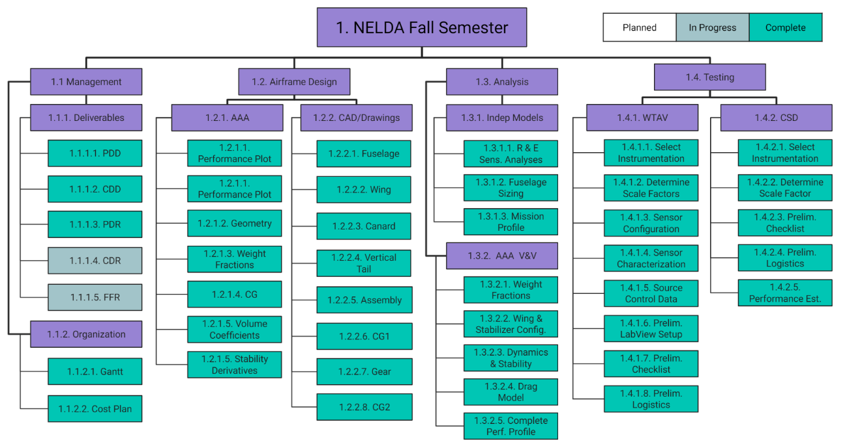
WORK BREAKDOWN STRUCTURE (FALL)
PURPOSE | DESIGN | CPEs | DESIGN REQs | RISKS | V&V | PLANNING | BACK UP

Slide 54
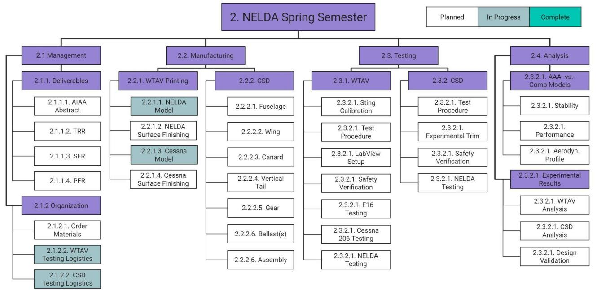
WORK BREAKDOWN STRUCTURE (SPRING)
PURPOSE | DESIGN | CPEs | DESIGN REQs | RISKS | V&V | PLANNING | BACK UP

Slide 55
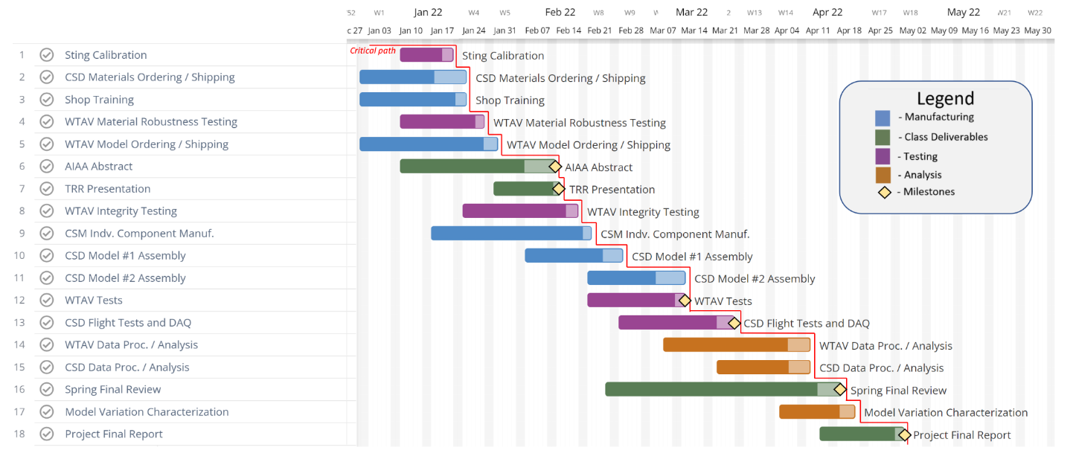
GANTT CHART
PURPOSE | DESIGN | CPEs | DESIGN REQs | RISKS | V&V | PLANNING | BACK UP

Slide 56
COST PLAN
Item | Unit Cost | Quantity | Total Cost | Margin | Notes
Toolbox | $200 | 1 | $200.00 | $0.00 | Required
InstaGantt | $5/month/user | 8 | $40.00 | $0.00 | Gantt software
3D Printed Models | $120 MAX | 2 | $240.00 | $480.00 | NELDA & c206
Aluminum Stock | $50 | 2 | $100.00 | $100.00 | For sting test insert
Epoxy resin | $65 | 1 | $65.00 | $0.00 | For foam coating
High density foam | $200 | 6 | $1,200.00 | $500.00 | 3' x 6' x 6'' blocks
Carbon fiber rods | $14 | 10 | $140.00 | $280.00 | 6 mm x 400 mm
Miscellaneous | $500 | 1 | $500.00 | $0.00 | Glue, balsa, workshop fees, etc.
Spring Presentation Materials | $350 | 1 | $350.00 | $150.00 | Poster, presentation model, etc.
Gross Expected Cost |  |  | $2,835.00 | $4,345.00
PURPOSE | DESIGN | CPEs | DESIGN REQs | RISKS | V&V | PLANNING | BACK UP
Notes:
Julia

Slide 57
TESTING SUMMARY
Consideration | WTAV | CSD
 | Comparative wind tunnel test test of lift and drag between the NELDA aircraft and the Cessna 206 | Demonstration of stability of the NELDA aircraft without control systems
Required Equipment | Sting ⅜ EWT Sensor | Cameras / Visuals /DME
Facilities | Aerolab Educational Wind Tunnel (PILOT Lab) w/ online scheduler | Outdoors: Either behind Aero building, from balcony of Aero building (with faculty assistance), or CU South Boulder
Biggest Safety Risk | Scale model not attached properly to sensor | Model is severely damaged
Safety Risk Mitigation | Initial test performed with safety net in place | Materials analysis before testing
PURPOSE | DESIGN | CPEs | DESIGN REQs | RISKS | V&V | PLANNING | BACK UP

Slide 58
ACKNOWLEDGEMENTS
Dr. Jelliffe Jackson
Dr. Kathryn Wingate
Dr. Brian Argrow
Dr. Donna Gerren
Dr. John Farnsworth
Professor John Mah
Matt Rhode
Katie-Rae Williamson
Project Advisory Board
Colin Claytor
Emma Markovich
Richard Schaden
Bobby Hodgkinson
Josh Mellin
Trudy Schwartz
Michael Rhodes
PURPOSE | DESIGN | CPEs | DESIGN REQs | RISKS | V&V | PLANNING | BACK UP

Slide 59
REFERENCES
FAA Part 23 regulations: Small Airplanes – Regulations, Policies & Guidance (faa.gov)
Airfoil Data: http://airfoiltools.com/
Range and Endurance Modeling: https://www.jstage.jst.go.jp/article/tjsass/63/2/63_T-18-55/_pdf
General Design Process: https://www.sjsu.edu/ae/docs/project-thesis/Viral.Rathod-S18.pdf
Tail Design: http://www.aero.us.es/adesign/Slides/Extra/Stability/Design_Tail/Chapter%206.%20Tail%20Design.pdf
Airfoil Analysis: http://www.aerospaceweb.org/question/airfoils/q0259c.shtml
Weight and Balance: http://www.aerodynamics4students.com/aircraft-performance/weight-and-balance.php
Materials: Online Materials Information Resource - MatWeb
Canard Design: https://booksite.elsevier.com/9780123973085/content/APP-C2-DESIGN_OF_CANARD_AIRCRAFT.pdf
Conventional Airframe Design: https://booksite.elsevier.com/9780123973085/content/APP-C1-DESIGN_OF_CONVENTIONAL_AIRCRAFT.pdf
Stability and Control: http://home.eng.iastate.edu/~shermanp/AERE355/lectures/Nelson%20Chapter%202.pdf
Finite Flow: https://web.stanford.edu/~cantwell/AA200_Course_Material/AA200_Course_Notes/AA200_Ch_12_Wings_of_Finite_Span_Cantwell.pdf
PURPOSE | DESIGN | CPEs | DESIGN REQs | RISKS | V&V | PLANNING | BACK UP

Slide 60
QUESTIONS?
PURPOSE | DESIGN | CPEs | DESIGN REQs | RISKS | V&V | PLANNING | BACK UP

Slide 61
BACK UP SLIDES
Flowchart | WTAV | WTAV Sizing | Dynamic Stability | Stability Derivatives | Wing Deflection
Powertrain | WT Logistics | WTAV Weight | Wing | Tail Design | Canard Deflection
Range | WT Test Plan | Re # | Aileron | Canard Design | Landing Gear
Risk | Scale Factors | WTAV CG | Canard | Fuselage Design | Mechanical Drawings
CSD | Sting EWT | WTAV Velocity | Canardvator | Wing Structure
CSD Stability | 787 Data | WTAV FBD | Vertical Tail | Rudder

Slide 62
PROJECT FLOWCHART
PURPOSE | DESIGN | CPEs | DESIGN REQs | RISKS | V&V | PLANNING | BACK UP
Notes:
Short summary Emerson - first semester models / sizing / requirements drive our design, then second semester we use two different models to help V&V our initial design

Slide 63
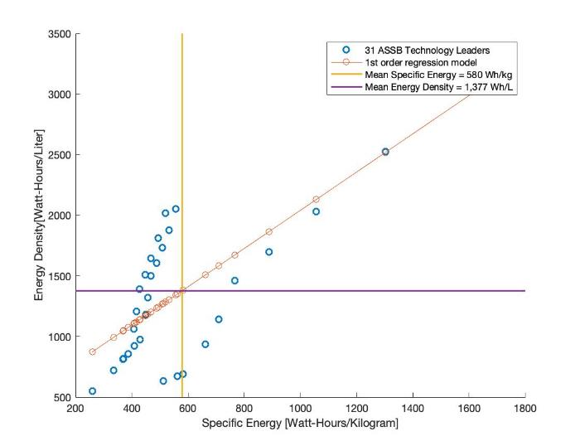
POWERTRAIN (SOLID STATE BATTERIES)
Why is NELDA only an airframe design?
NELDA’s goal is to design a particularly low-drag airframe capable of housing a cutting edge battery bank
However, known weight, volume, and power output of this battery bank is crucial to the aircraft design
In-depth battery chemistry/performance analysis is outside of the project scope
Specific Energy | Volumetric Energy Density
580 Wh/kg | 1377 Wh/L
PURPOSE | DESIGN | CPEs | DESIGN REQs | RISKS | V&V | PLANNING | BACK UP
Notes:
Tomaz

Slide 64
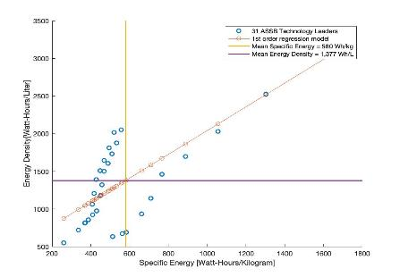
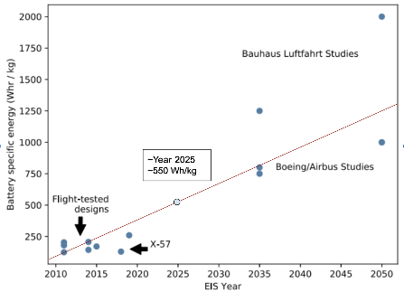
LI - METAL SOLID STATE BATTERIES
Specific Energy | Volumetric Energy Density
580 Wh/kg | 1377 Wh/L
Necessary Assumptions:
Composition: Anode Lithium metal (β-Li), solid electrolyte (β-Li3PS4) and active cathode (Li(Ni0.6Co0.2Mn0.2)O2
Efficiency: 90 percent Efficiency was assumed for all battery types
Formability: The Cathode, Electrolyte and Anode layers are not only sufficiently thin but also pliable to configure in most simple Geometries (i.e. a wing)
-Benjamin J. Brelje∗
Joaquim R.R.A. Martins
University of Michigan, Department of
Aerospace Engineering, MI, USA
PURPOSE | DESIGN | CPEs | DESIGN REQs | RISKS | V&V | PLANNING | BACK UP

Slide 65
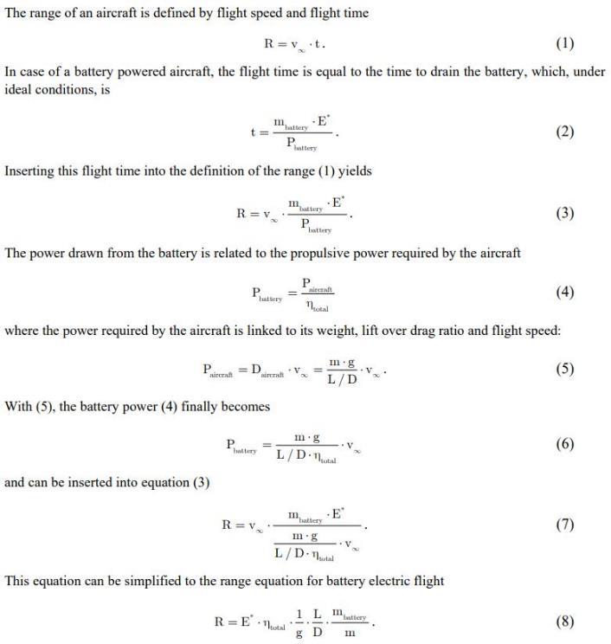
ELECTRIC AIRCRAFT
RANGE EQUATION 1
Source: Electric Flight – Potential and Limitations, Martin Hepperle, German Aerospace Center
Full Source: Microsoft Word - MP-AVT-209-09.doc (dlr.de)
Back
PURPOSE | DESIGN | CPEs | DESIGN REQs | RISKS | V&V | PLANNING | BACK UP

Slide 66
MODEL VERIFICATION
Glider model predicted to travel maximum of 88.96 m if launched at velocity of 7.82 m/s and angle of attack of 4.0 degrees
Determined using MATLAB code that utilized NACA 2412 airfoil data and geometry of scaled airframe design to calculate L/Dmax
PURPOSE | DESIGN | CPEs | DESIGN REQs | RISKS | V&V | PLANNING | BACK UP

Slide 67
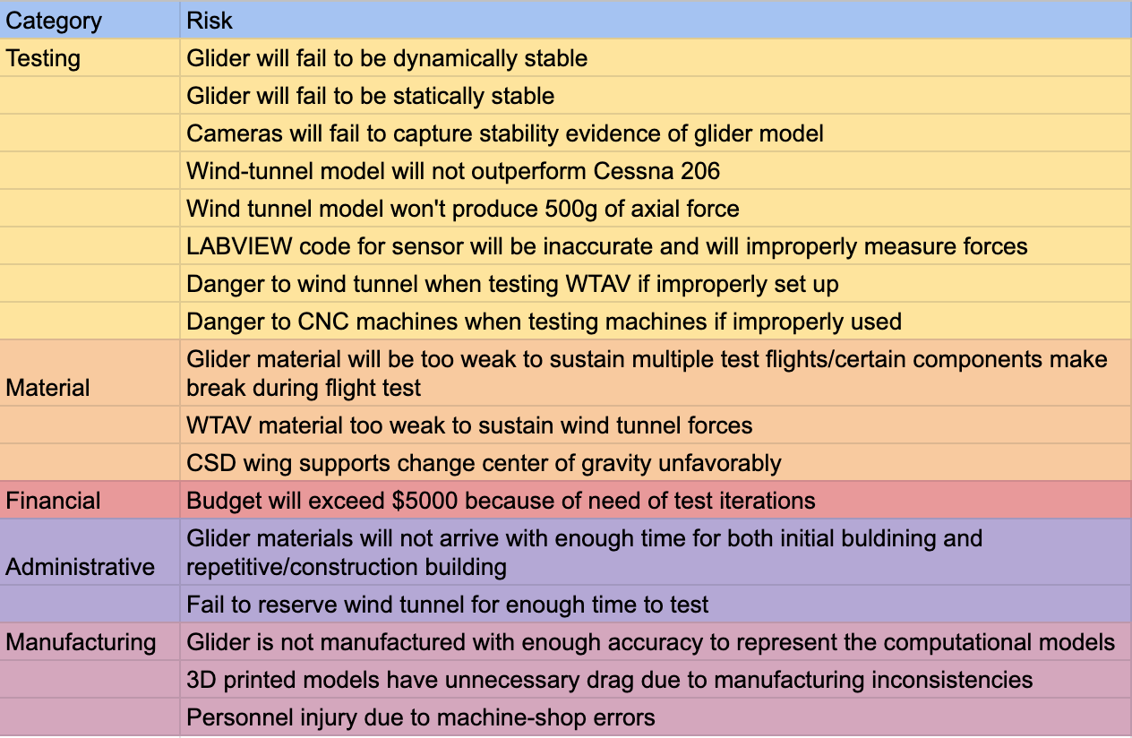
Full Risk Profile
PURPOSE | DESIGN | CPEs | DESIGN REQs | RISKS | V&V | PLANNING | BACK UP

Slide 68
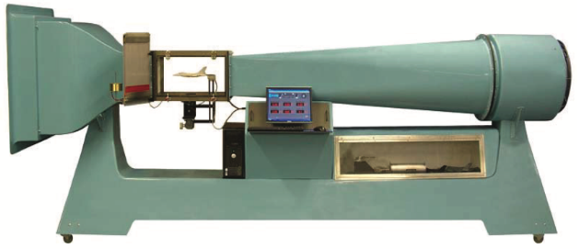
WIND TUNNEL TESTING
Desired Data
Aerodynamic Forces
Lift Force
Drag Force
Minimize boundary layer effects
Minimize downwash due to wingtip vortices
Moments
Post Processing
MATLAB
Directly compare lift (NELDA model vs. Cessna 206 model)
Build and compare drag polar
Compare Lift/Drag Ratio
Aerolab Educational Wind Tunnel
PURPOSE | DESIGN | CPEs | DESIGN REQs | RISKS | V&V | PLANNING | BACK UP
Notes:
Aerodynamic Forces
Lift will be obtained by extracting the Normal force measured by one of the three sensors discussed in the following slide.
This force will be calculated at the Cp, CG, and AC of the model with simple corrections
Drag will be obtained by extracting the Axial force measured by one of the three sensors discussed in the following slide.
Test subject shall not exceed a wingspan of 80% of the test section
Moments will be obtained by extracting them directly from one of the three sensors discussed in the following slide
Pitching moment will help characterize longitudinal stability (only as supplemental data)
Will be able to tell of aircraft model is stable and/or trimmable
Post Processing
Drag Polar
Goal is to demonstrate improvement in drag polar through direct comparison (our design model vs Cessna 206 model)
Skin Friction and Drag due to Flow Separation (C_D0)
Form Drag
Parasite Drag (C_Dp)
Induced Drag (C_Di)
Lift/Drag Ratio
Help characterize range and endurance (only as supplemental data)

Slide 69
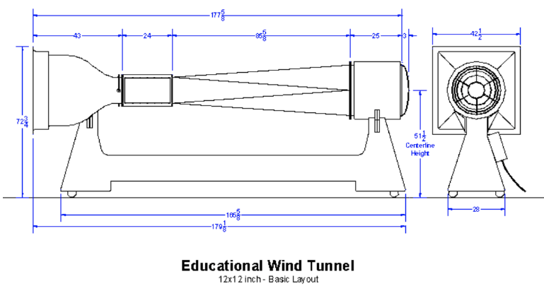
(SST) WIND TUNNEL TESTING
Test Section Dimensions:
12” x 12” x 24”
Max Nominal Airspeed: 131.234 ft/s
Model Wingspan Limit: 8.8 in
(less than 80% of test section width)
Must accurately model downwash due to wingtip vortices while avoiding test section boundary layer
Model Scaling: 1/65
Aerolab Educational Wind Tunnel
PURPOSE | DESIGN | CPEs | DESIGN REQs | RISKS | V&V | PLANNING | BACK UP
Notes:
Downscaling of Cessna 206 and NELDA Design:
Test Section
NELDA wingspan bigger than Cessna(?) so that constrains
Scaling Factors:
Scaling factor to fit into the test section based on above

Slide 70
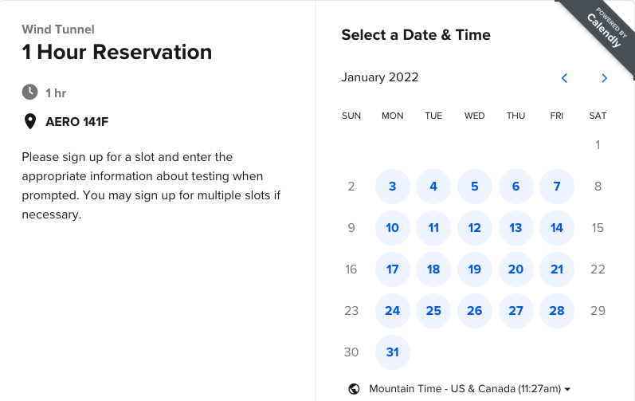
AEROLAB WIND TUNNEL - RESERVATIONS
PURPOSE | DESIGN | CPEs | DESIGN REQs | RISKS | V&V | PLANNING | BACK UP

Slide 71
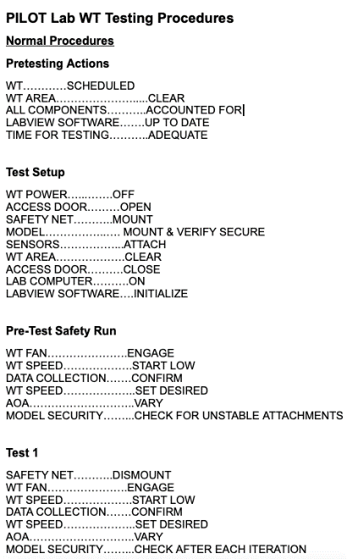
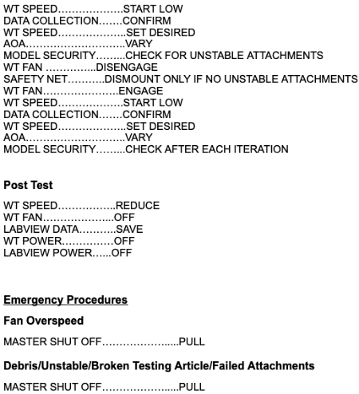
AEROLAB WIND TUNNEL - TEST PLAN
PURPOSE | DESIGN | CPEs | DESIGN REQs | RISKS | V&V | PLANNING | BACK UP

Slide 72
MODEL VALIDATION - CSD
Intended to qualitatively verify stability of design and steady, level flight capabilities
Use one camera parallel to flight path and one camera perpendicular to flight path
Avoid stall and excessive roll, pitch, and yaw
Prove restoring pitch and roll moment, weather vaning
Hand-throw test because of complexity of bungee launch system
Possibly launching at CU Boulder South, North of Aero building, or from Aero building balcony (with faculty assistance)
Camera 2
Flight path
Camera 1
Launch point
PURPOSE | DESIGN | CPEs | DESIGN REQs | RISKS | V&V | PLANNING | BACK UP
Notes:
Restoring pitch and roll moment
Weather vaning
Flight time
Another estimate on cl

Slide 73
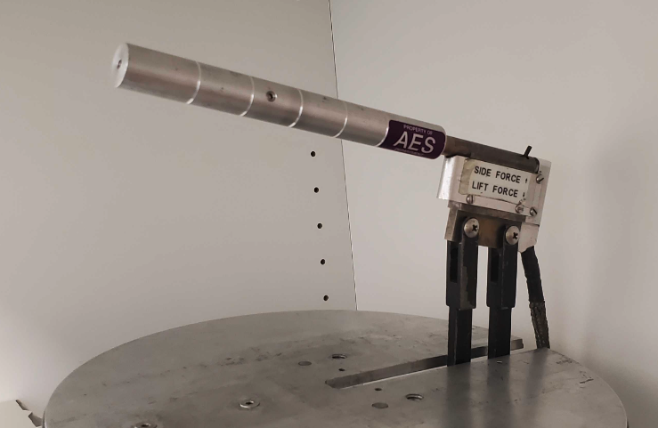
WTAV - SENSOR SELECTION
Sting ⅜ EWT
Pros | Cons
Can compute all three forces High force and moment limits Integrated Hardware & Software | Pre-set blockage area Lack of roll moment
PURPOSE | DESIGN | CPEs | DESIGN REQs | RISKS | V&V | PLANNING | BACK UP

Slide 74
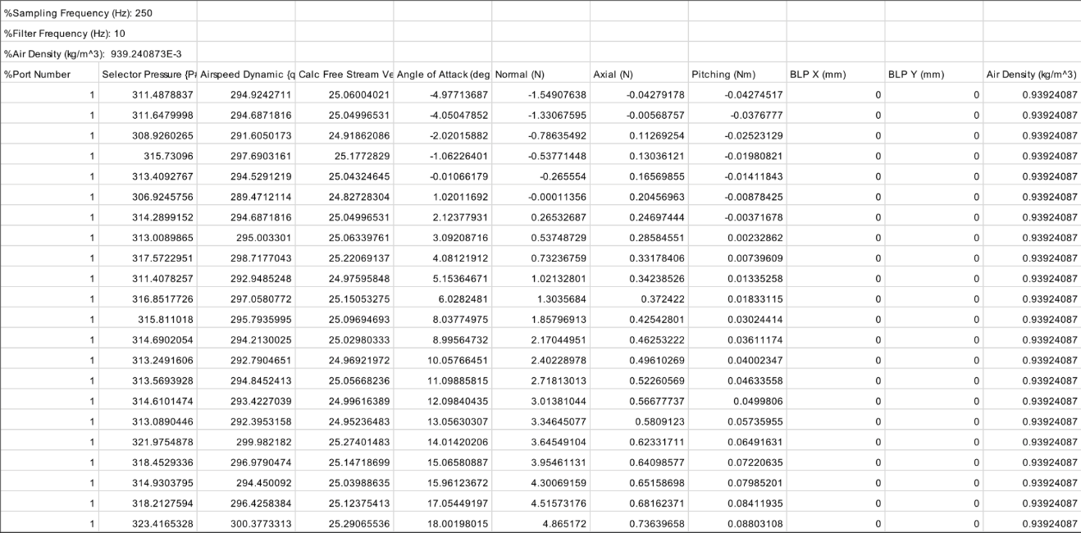
BOEING 787 WIND TUNNEL DATA
PURPOSE | DESIGN | CPEs | DESIGN REQs | RISKS | V&V | PLANNING | BACK UP

Slide 75
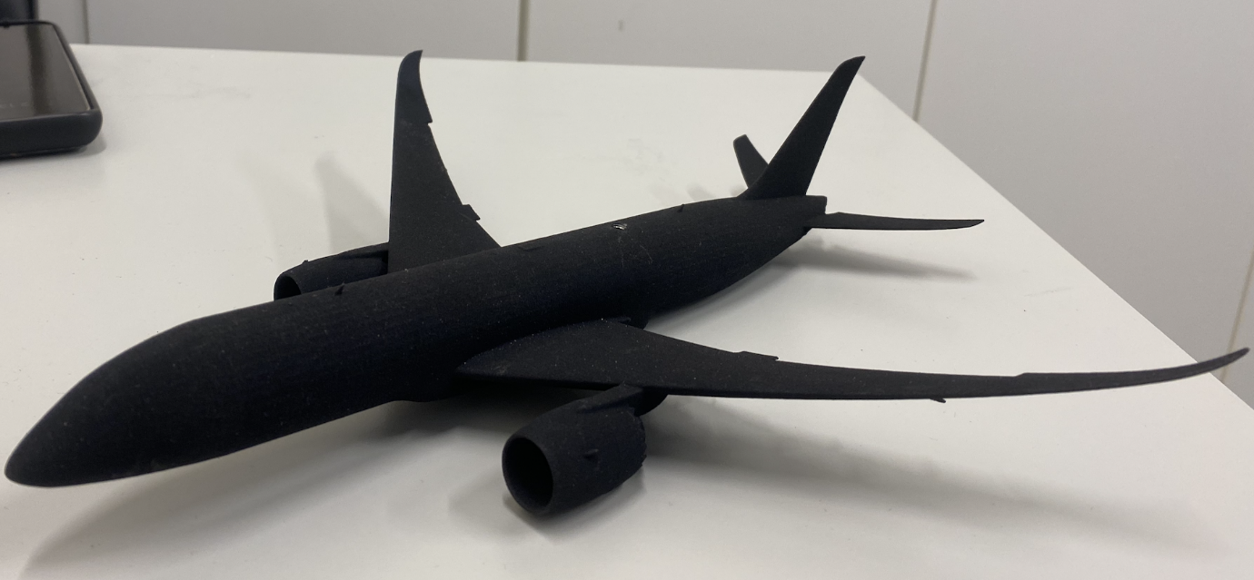
BOEING 787 - WITH FLAPS
PURPOSE | DESIGN | CPEs | DESIGN REQs | RISKS | V&V | PLANNING | BACK UP

Slide 76
BOEING 787 WITHOUT FLAPS
PURPOSE | DESIGN | CPEs | DESIGN REQs | RISKS | V&V | PLANNING | BACK UP

Slide 77
Model Aircraft Scale Factors
PURPOSE | DESIGN | CPEs | DESIGN REQs | RISKS | V&V | PLANNING | BACK UP

Slide 78
Wind Tunnel - Supporting Data
Can we determine stability using the wind tunnel?
No, the data we use may only be considered supporting data
Pitch stiffness may be determined for both the NELDA design model and the Cessna 206 model. This may be computed by directly extracting the pitch moment measured by any of the three sensors under consideration
Lateral stability couples roll and yaw moments which falls beyond the scope of the wind-tunnel test
PURPOSE | DESIGN | CPEs | DESIGN REQs | RISKS | V&V | PLANNING | BACK UP

Slide 79
Downscaling NELDA & Cessna 206
PURPOSE | DESIGN | CPEs | DESIGN REQs | RISKS | V&V | PLANNING | BACK UP

Slide 80
1/65 Model Scale Factors
PURPOSE | DESIGN | CPEs | DESIGN REQs | RISKS | V&V | PLANNING | BACK UP

Slide 81
Reynolds # Calculations
PURPOSE | DESIGN | CPEs | DESIGN REQs | RISKS | V&V | PLANNING | BACK UP

Slide 82
Testing: Model Size and Blockage Area
PURPOSE | DESIGN | CPEs | DESIGN REQs | RISKS | V&V | PLANNING | BACK UP

Slide 83
Testing: Model Weight Requirement
PURPOSE | DESIGN | CPEs | DESIGN REQs | RISKS | V&V | PLANNING | BACK UP

Slide 84
Testing: Model Center of Gravity
PURPOSE | DESIGN | CPEs | DESIGN REQs | RISKS | V&V | PLANNING | BACK UP

Slide 85
Testing: WT Velocity Uncertainty
PURPOSE | DESIGN | CPEs | DESIGN REQs | RISKS | V&V | PLANNING | BACK UP

Slide 86
Sting EWT: Axial Force Calibration 1/2
PURPOSE | DESIGN | CPEs | DESIGN REQs | RISKS | V&V | PLANNING | BACK UP

Slide 87
Sting EWT: Axial Force Calibration 2/2
PURPOSE | DESIGN | CPEs | DESIGN REQs | RISKS | V&V | PLANNING | BACK UP

Slide 88
Sting EWT: Normal Force Calibration
PURPOSE | DESIGN | CPEs | DESIGN REQs | RISKS | V&V | PLANNING | BACK UP

Slide 89
MODEL VERIFICATION - WTAV
PURPOSE | DESIGN | CPEs | DESIGN REQs | RISKS | V&V | PLANNING | BACK UP
Notes:
Expected Wind Tunnel Forces:
Based on previous data (Boeing 787)

Slide 90
WIND TUNNEL TESTING FBD
PURPOSE | DESIGN | CPEs | DESIGN REQs | RISKS | V&V | PLANNING | BACK UP

Slide 91
WIND TUNNEL TESTING FBD
Aerolab Wind Tunnel Electric Fan
Dynamic Pressure
Pitot Tube
= Start/Stop
= Measurement
= Environment
Control
Command (speed)
LabView Console Inputs
LabView
Data (pressure)
Power
Command
(speed)
Data
(forces)
-Normal Force
-Axial Force
-Pitching Moment
Data
(load cell voltages)
Sting EWT Sensor
Experimental Load Outputs
PURPOSE | DESIGN | CPEs | DESIGN REQs | RISKS | V&V | PLANNING | BACK UP

Slide 92
Glider Test - Stability Demonstration
1/14 Glider Scaled Factors
Characteristic Stability Demonstration
Qualitative Demonstration of Stability in NELDA design
Verification & Validation for Mathematical/computational models
Demonstrate endurance based on glider ratio
Team decided against accelerometers to measure flight data because of risk of added scope
One camera parallel to flight path, one camera perpendicular to flight path to qualitatively measure stability
Rangefinder to determine practical glide ratio
Launch from roof of aero building (with faculty assistance)
Use table bungee launch system provided by IRISS
PURPOSE | DESIGN | CPEs | DESIGN REQs | RISKS | V&V | PLANNING | BACK UP

Slide 93
Aerolab Wind Tunnel - Test Plan
PURPOSE | DESIGN | CPEs | DESIGN REQs | RISKS | V&V | PLANNING | BACK UP

Slide 94
IRISS Bungee Launch Checklist
PURPOSE | DESIGN | CPEs | DESIGN REQs | RISKS | V&V | PLANNING | BACK UP

Slide 95
Dynamic Stability
PURPOSE | DESIGN | CPEs | DESIGN REQs | RISKS | V&V | PLANNING | BACK UP

Slide 96
Short Period Phasor
PURPOSE | DESIGN | CPEs | DESIGN REQs | RISKS | V&V | PLANNING | BACK UP

Slide 97
Phugoid Phasor
PURPOSE | DESIGN | CPEs | DESIGN REQs | RISKS | V&V | PLANNING | BACK UP

Slide 98
Roll Phasor
PURPOSE | DESIGN | CPEs | DESIGN REQs | RISKS | V&V | PLANNING | BACK UP

Slide 99
Spiral Phasor
PURPOSE | DESIGN | CPEs | DESIGN REQs | RISKS | V&V | PLANNING | BACK UP

Slide 100
Dutch Roll Phasor
PURPOSE | DESIGN | CPEs | DESIGN REQs | RISKS | V&V | PLANNING | BACK UP

Slide 101
Linear Model Matrices
A_{lon}
A_{lat}
PURPOSE | DESIGN | CPEs | DESIGN REQs | RISKS | V&V | PLANNING | BACK UP

Slide 102
Wing Data
PURPOSE | DESIGN | CPEs | DESIGN REQs | RISKS | V&V | PLANNING | BACK UP

Slide 103
MAIN WING GEOMETRY
PURPOSE | DESIGN | CPEs | DESIGN REQs | RISKS | V&V | PLANNING | BACK UP

Slide 104
Main Wing Geometry
PURPOSE | DESIGN | CPEs | DESIGN REQs | RISKS | V&V | PLANNING | BACK UP

Slide 105
Main Wing Drag Inputs
PURPOSE | DESIGN | CPEs | DESIGN REQs | RISKS | V&V | PLANNING | BACK UP

Slide 106
Main Wing Drag Outputs
PURPOSE | DESIGN | CPEs | DESIGN REQs | RISKS | V&V | PLANNING | BACK UP

Slide 107
Main Wing Weight Calculations
PURPOSE | DESIGN | CPEs | DESIGN REQs | RISKS | V&V | PLANNING | BACK UP

Slide 108
Main Wing Center of Gravity
PURPOSE | DESIGN | CPEs | DESIGN REQs | RISKS | V&V | PLANNING | BACK UP

Slide 109
Aileron Data
PURPOSE | DESIGN | CPEs | DESIGN REQs | RISKS | V&V | PLANNING | BACK UP

Slide 110
Aileron Calculation Inputs
PURPOSE | DESIGN | CPEs | DESIGN REQs | RISKS | V&V | PLANNING | BACK UP

Slide 111
Aileron Calculation Outputs
PURPOSE | DESIGN | CPEs | DESIGN REQs | RISKS | V&V | PLANNING | BACK UP

Slide 112
Aileron and Flap Visualization
PURPOSE | DESIGN | CPEs | DESIGN REQs | RISKS | V&V | PLANNING | BACK UP

Slide 113
Canard Data
PURPOSE | DESIGN | CPEs | DESIGN REQs | RISKS | V&V | PLANNING | BACK UP

Slide 114
Canard Volume Coefficient
PURPOSE | DESIGN | CPEs | DESIGN REQs | RISKS | V&V | PLANNING | BACK UP

Slide 115
Canard GEOMETRY
PURPOSE | DESIGN | CPEs | DESIGN REQs | RISKS | V&V | PLANNING | BACK UP

Slide 116
Canard Drag Inputs
PURPOSE | DESIGN | CPEs | DESIGN REQs | RISKS | V&V | PLANNING | BACK UP

Slide 117
Canard Drag Outputs
PURPOSE | DESIGN | CPEs | DESIGN REQs | RISKS | V&V | PLANNING | BACK UP

Slide 118
Canard Weight Inputs
PURPOSE | DESIGN | CPEs | DESIGN REQs | RISKS | V&V | PLANNING | BACK UP

Slide 119
Canard Weight Outputs
PURPOSE | DESIGN | CPEs | DESIGN REQs | RISKS | V&V | PLANNING | BACK UP

Slide 120
Canard Center of Gravity
PURPOSE | DESIGN | CPEs | DESIGN REQs | RISKS | V&V | PLANNING | BACK UP

Slide 121
Canardvator Data
PURPOSE | DESIGN | CPEs | DESIGN REQs | RISKS | V&V | PLANNING | BACK UP

Slide 122
Canardvator Geometry Inputs
PURPOSE | DESIGN | CPEs | DESIGN REQs | RISKS | V&V | PLANNING | BACK UP

Slide 123
Canardvator Geometry Outputs
PURPOSE | DESIGN | CPEs | DESIGN REQs | RISKS | V&V | PLANNING | BACK UP

Slide 124
Canardvator Visualization
PURPOSE | DESIGN | CPEs | DESIGN REQs | RISKS | V&V | PLANNING | BACK UP

Slide 125
Vertical Tail Data
PURPOSE | DESIGN | CPEs | DESIGN REQs | RISKS | V&V | PLANNING | BACK UP

Slide 126
Vertical Tail Geometry
PURPOSE | DESIGN | CPEs | DESIGN REQs | RISKS | V&V | PLANNING | BACK UP

Slide 127
Vertical Tail Geometry
PURPOSE | DESIGN | CPEs | DESIGN REQs | RISKS | V&V | PLANNING | BACK UP

Slide 128
Vertical Tail Drag Inputs
PURPOSE | DESIGN | CPEs | DESIGN REQs | RISKS | V&V | PLANNING | BACK UP

Slide 129
Vertical Tail Drag Outputs
PURPOSE | DESIGN | CPEs | DESIGN REQs | RISKS | V&V | PLANNING | BACK UP

Slide 130
Vertical Tail Weight Calculations
PURPOSE | DESIGN | CPEs | DESIGN REQs | RISKS | V&V | PLANNING | BACK UP

Slide 131
Vertical Tail Center of Gravity
PURPOSE | DESIGN | CPEs | DESIGN REQs | RISKS | V&V | PLANNING | BACK UP

Slide 132
Vertical Tail Volume Coefficient
PURPOSE | DESIGN | CPEs | DESIGN REQs | RISKS | V&V | PLANNING | BACK UP

Slide 133
Rudder Data
PURPOSE | DESIGN | CPEs | DESIGN REQs | RISKS | V&V | PLANNING | BACK UP

Slide 134
Rudder Geometry Inputs
PURPOSE | DESIGN | CPEs | DESIGN REQs | RISKS | V&V | PLANNING | BACK UP

Slide 135
Rudder Geometry Outputs
PURPOSE | DESIGN | CPEs | DESIGN REQs | RISKS | V&V | PLANNING | BACK UP

Slide 136
RUDDER GEOMETRY VISUALIZATION
PURPOSE | DESIGN | CPEs | DESIGN REQs | RISKS | V&V | PLANNING | BACK UP

Slide 137
Stability Derivatives
PURPOSE | DESIGN | CPEs | DESIGN REQs | RISKS | V&V | PLANNING | BACK UP

Slide 138
C_{L⍺} Inputs
PURPOSE | DESIGN | CPEs | DESIGN REQs | RISKS | V&V | PLANNING | BACK UP

Slide 139
C_{L⍺} Outputs
PURPOSE | DESIGN | CPEs | DESIGN REQs | RISKS | V&V | PLANNING | BACK UP

Slide 140
C_{m⍺} Inputs
PURPOSE | DESIGN | CPEs | DESIGN REQs | RISKS | V&V | PLANNING | BACK UP

Slide 141
C_{m⍺} Outputs
PURPOSE | DESIGN | CPEs | DESIGN REQs | RISKS | V&V | PLANNING | BACK UP

Slide 142
C_{l𝛽} Inputs
PURPOSE | DESIGN | CPEs | DESIGN REQs | RISKS | V&V | PLANNING | BACK UP

Slide 143
C_{l𝛽} Outputs
PURPOSE | DESIGN | CPEs | DESIGN REQs | RISKS | V&V | PLANNING | BACK UP

Slide 144
C_{n𝛽} Inputs pt. 1
PURPOSE | DESIGN | CPEs | DESIGN REQs | RISKS | V&V | PLANNING | BACK UP

Slide 145
C_{n𝛽} Outputs
PURPOSE | DESIGN | CPEs | DESIGN REQs | RISKS | V&V | PLANNING | BACK UP

Slide 146
C_{y𝛽} Inputs
PURPOSE | DESIGN | CPEs | DESIGN REQs | RISKS | V&V | PLANNING | BACK UP

Slide 147
C_{y𝛽} Outputs
PURPOSE | DESIGN | CPEs | DESIGN REQs | RISKS | V&V | PLANNING | BACK UP

Slide 148
C_{lp} Inputs pt. 1
PURPOSE | DESIGN | CPEs | DESIGN REQs | RISKS | V&V | PLANNING | BACK UP

Slide 149
C_{lp} Outputs
PURPOSE | DESIGN | CPEs | DESIGN REQs | RISKS | V&V | PLANNING | BACK UP

Slide 150
C_{np} Inputs
PURPOSE | DESIGN | CPEs | DESIGN REQs | RISKS | V&V | PLANNING | BACK UP

Slide 151
C_{np} Outputs
PURPOSE | DESIGN | CPEs | DESIGN REQs | RISKS | V&V | PLANNING | BACK UP

Slide 152
C_{yp} Inputs
PURPOSE | DESIGN | CPEs | DESIGN REQs | RISKS | V&V | PLANNING | BACK UP

Slide 153
C_{yp} Outputs
PURPOSE | DESIGN | CPEs | DESIGN REQs | RISKS | V&V | PLANNING | BACK UP

Slide 154
C_{yr} Inputs
PURPOSE | DESIGN | CPEs | DESIGN REQs | RISKS | V&V | PLANNING | BACK UP

Slide 155
C_{yr} Outputs
PURPOSE | DESIGN | CPEs | DESIGN REQs | RISKS | V&V | PLANNING | BACK UP

Slide 156
C_{lr} Inputs
PURPOSE | DESIGN | CPEs | DESIGN REQs | RISKS | V&V | PLANNING | BACK UP

Slide 157
C_{lr} Outputs
PURPOSE | DESIGN | CPEs | DESIGN REQs | RISKS | V&V | PLANNING | BACK UP

Slide 158
C_{nr} Inputs
PURPOSE | DESIGN | CPEs | DESIGN REQs | RISKS | V&V | PLANNING | BACK UP

Slide 159
C_{nr} Outputs
PURPOSE | DESIGN | CPEs | DESIGN REQs | RISKS | V&V | PLANNING | BACK UP

Slide 160
C_{L𝛿cv} Inputs
PURPOSE | DESIGN | CPEs | DESIGN REQs | RISKS | V&V | PLANNING | BACK UP

Slide 161
C_{L𝛿cv} Outputs
PURPOSE | DESIGN | CPEs | DESIGN REQs | RISKS | V&V | PLANNING | BACK UP

Slide 162
C_{m𝛿cv} Inputs
PURPOSE | DESIGN | CPEs | DESIGN REQs | RISKS | V&V | PLANNING | BACK UP

Slide 163
C_{m𝛿cv} Outputs
PURPOSE | DESIGN | CPEs | DESIGN REQs | RISKS | V&V | PLANNING | BACK UP

Slide 164
C_{y𝛿a} Input and Output
PURPOSE | DESIGN | CPEs | DESIGN REQs | RISKS | V&V | PLANNING | BACK UP

Slide 165
C_{l𝛿a} Inputs
PURPOSE | DESIGN | CPEs | DESIGN REQs | RISKS | V&V | PLANNING | BACK UP

Slide 166
C_{l𝛿a} Outputs
PURPOSE | DESIGN | CPEs | DESIGN REQs | RISKS | V&V | PLANNING | BACK UP

Slide 167
C_{n𝛿a} Inputs
PURPOSE | DESIGN | CPEs | DESIGN REQs | RISKS | V&V | PLANNING | BACK UP

Slide 168
C_{n𝛿a} Outputs
PURPOSE | DESIGN | CPEs | DESIGN REQs | RISKS | V&V | PLANNING | BACK UP

Slide 169
C_{y𝛿a} Input and Output
PURPOSE | DESIGN | CPEs | DESIGN REQs | RISKS | V&V | PLANNING | BACK UP

Slide 170
C_{y𝛿r} Outputs
PURPOSE | DESIGN | CPEs | DESIGN REQs | RISKS | V&V | PLANNING | BACK UP

Slide 171
C_{l𝛿r} Inputs
PURPOSE | DESIGN | CPEs | DESIGN REQs | RISKS | V&V | PLANNING | BACK UP

Slide 172
C_{l𝛿r} Outputs
PURPOSE | DESIGN | CPEs | DESIGN REQs | RISKS | V&V | PLANNING | BACK UP

Slide 173
C_{y𝛿r} Inputs
PURPOSE | DESIGN | CPEs | DESIGN REQs | RISKS | V&V | PLANNING | BACK UP

Slide 174
C_{n𝛿r} Inputs
PURPOSE | DESIGN | CPEs | DESIGN REQs | RISKS | V&V | PLANNING | BACK UP

Slide 175
C_{n𝛿r} Outputs
PURPOSE | DESIGN | CPEs | DESIGN REQs | RISKS | V&V | PLANNING | BACK UP

Slide 176
C_{m0} Calculations
PURPOSE | DESIGN | CPEs | DESIGN REQs | RISKS | V&V | PLANNING | BACK UP

Slide 177
C_{L0} Calculations
PURPOSE | DESIGN | CPEs | DESIGN REQs | RISKS | V&V | PLANNING | BACK UP

Slide 178
C_{Lmin} Calculations
PURPOSE | DESIGN | CPEs | DESIGN REQs | RISKS | V&V | PLANNING | BACK UP

Slide 179
Tail Design Process
PURPOSE | DESIGN | CPEs | DESIGN REQs | RISKS | V&V | PLANNING | BACK UP

Slide 180
Canard Design
Single Propellor Horizontal Volume Coefficients
PURPOSE | DESIGN | CPEs | DESIGN REQs | RISKS | V&V | PLANNING | BACK UP

Slide 181
Canard Design
Based on previous records, V_{H} chosen as 0.7
With the wing’s quarter chord located 65% along the length of the fuselage, optimal location of canard chosen at 25% of the fuselage length (40% moment between quarter chords)
Canard area found using following equation:
PURPOSE | DESIGN | CPEs | DESIGN REQs | RISKS | V&V | PLANNING | BACK UP

Slide 182
Canard Design
The following design choices were made based on traditional engineering practice (see below)
Aspect Ratio: 5
Dihedral: 0
Taper: 0.9
Airfoil: NACA 0012
Sweep: 0 degrees
PURPOSE | DESIGN | CPEs | DESIGN REQs | RISKS | V&V | PLANNING | BACK UP

Slide 183
Canard Design
The incidence angle was determined mathematically:
First the Wing-Fuselage moment was determined
The lift and lift curve slope was used to determine the AOA required of canard
The AOA of the canard and wing and the downwash was used to determine the required incidence angle:
Incidence angle: -3 degrees
PURPOSE | DESIGN | CPEs | DESIGN REQs | RISKS | V&V | PLANNING | BACK UP

Slide 184
Vertical Tail Design
Single Propellor Vertical Volume Coefficients
PURPOSE | DESIGN | CPEs | DESIGN REQs | RISKS | V&V | PLANNING | BACK UP

Slide 185
Vertical Tail Design
Based on previous records, V_{V} chosen as 0.018
Although this is low, additional vertical area is accounted for in winglets
The length between the wing quarter chord and vertical tail quarter chord was determined through iteration with the area and clearance requirements with the propellor
Vertical Tail area found using following equation:
PURPOSE | DESIGN | CPEs | DESIGN REQs | RISKS | V&V | PLANNING | BACK UP

Slide 186
Vertical Tail Design
The following design choices were made based on traditional engineering practice (see below)
Aspect Ratio: 1.5
Dihedral: 90
Taper: 0.7
Airfoil: NACA 0012
Sweep: 35 degrees
PURPOSE | DESIGN | CPEs | DESIGN REQs | RISKS | V&V | PLANNING | BACK UP

Slide 187
Basic Fuselage Layout
PURPOSE | DESIGN | CPEs | DESIGN REQs | RISKS | V&V | PLANNING | BACK UP

Slide 188
Basic Fuselage Layout
PURPOSE | DESIGN | CPEs | DESIGN REQs | RISKS | V&V | PLANNING | BACK UP

Slide 189
(AIRD) SIZING - COCKPIT/CABIN
Cockpit Sizing Accommodates 99th Percentile (RAF Data)
PURPOSE | DESIGN | CPEs | DESIGN REQs | RISKS | V&V | PLANNING | BACK UP
Notes:
NATE - be BRIEF - dimensions fulfill FAA requirements

Slide 190
Wing Spar Structural Analysis
Assumed Spar Width: 5 cm
PURPOSE | DESIGN | CPEs | DESIGN REQs | RISKS | V&V | PLANNING | BACK UP

Slide 191
Canard Spar Structural Analysis
Assumed Spar Width: 1.5 cm
PURPOSE | DESIGN | CPEs | DESIGN REQs | RISKS | V&V | PLANNING | BACK UP

Slide 192
Wing Deflection
Assumed Spar Width: 5 cm
PURPOSE | DESIGN | CPEs | DESIGN REQs | RISKS | V&V | PLANNING | BACK UP

Slide 193
Canard Deflection
Assumed Spar Width: 1.5 cm
PURPOSE | DESIGN | CPEs | DESIGN REQs | RISKS | V&V | PLANNING | BACK UP

Slide 194
(AIRD) SIZING - LANDING GEAR
The Landing gear was sized around two primary constraints, avoidance of prop strikes and wing tip strikes.
In order to meet these constraints the main landing gear must be precisely placed longitudinally as well as be sufficiently wide.
The aircraft must be able to rotate in pitch (angle of attack) about the contact point of the main gear to generate sufficient lift for takeoff without causing the propeller to strike the runway
PURPOSE | DESIGN | CPEs | DESIGN REQs | RISKS | V&V | PLANNING | BACK UP
Notes:
NATE - be BRIEF again - dimensions shown fulfill FAA requirements

Slide 195
(AIRD) SIZING - LANDING GEAR
PURPOSE | DESIGN | CPEs | DESIGN REQs | RISKS | V&V | PLANNING | BACK UP
Notes:
NATE - be BRIEF again - dimensions shown fulfill FAA requirements

Slide 196
(AIRD) SIZING - LANDING GEAR
PURPOSE | DESIGN | CPEs | DESIGN REQs | RISKS | V&V | PLANNING | BACK UP
Notes:
NATE - be BRIEF again - dimensions shown fulfill FAA requirements

Slide 197
Mechanical Drawings
PURPOSE | DESIGN | CPEs | DESIGN REQs | RISKS | V&V | PLANNING | BACK UP

Slide 198
WTAV Model
Assumed Spar Width: 1.5 cm
PURPOSE | DESIGN | CPEs | DESIGN REQs | RISKS | V&V | PLANNING | BACK UP

Slide 199
CSD MODEL
Assumed Spar Width: 1.5 cm
PURPOSE | DESIGN | CPEs | DESIGN REQs | RISKS | V&V | PLANNING | BACK UP

Slide 200
OUTER NOSE DRAWING
Assumed Spar Width: 1.5 cm
PURPOSE | DESIGN | CPEs | DESIGN REQs | RISKS | V&V | PLANNING | BACK UP

Slide 201
INNER NOSE DRAWING
Assumed Spar Width: 1.5 cm
PURPOSE | DESIGN | CPEs | DESIGN REQs | RISKS | V&V | PLANNING | BACK UP

Slide 202
OUTER FUSELAGE DRAWING
Assumed Spar Width: 1.5 cm
PURPOSE | DESIGN | CPEs | DESIGN REQs | RISKS | V&V | PLANNING | BACK UP

Slide 203
INNER FUSELAGE DRAWING
Assumed Spar Width: 1.5 cm
PURPOSE | DESIGN | CPEs | DESIGN REQs | RISKS | V&V | PLANNING | BACK UP

Slide 204
MAIN LANDING GEAR DRAWING
Assumed Spar Width: 1.5 cm
PURPOSE | DESIGN | CPEs | DESIGN REQs | RISKS | V&V | PLANNING | BACK UP

Slide 205
FRONT LANDING GEAR DRAWING
Assumed Spar Width: 1.5 cm
PURPOSE | DESIGN | CPEs | DESIGN REQs | RISKS | V&V | PLANNING | BACK UP

