Slide 1
PRELIMINARY DESIGN REVIEW
OCTOBER 20TH, 2021
ASEN 4018-011
Customer:
Richard Schaden
Faculty Advisor:
Dr. Donna Gerren
Presenters:
Fernando Chavez, Finn Bailis, Emerson Beinhauer, Christl Haley, Carlin Hornbostel, Tomaz Remec
Additional Team Members:
Nathan Braunstein, Jake Pendergast, Tristan Martinez, Julia Tucker

Slide 2
PRESENTATION OUTLINE
Project Overview Emerson Beinhauer
Feasibility: Design Christl Haley, Carlin Hornbostel, Tomaz Remec
Feasibility: Testing Fernando Chavez
Feasibility: Manufacturing Finn Bailis
Feasibility: Budget Finn Bailis
Feasibility Conclusions Emerson Beinhauer
Future Work Emerson Beinhauer
OVERVIEW | DESIGN | TESTING | MANUFACTURING | BUDGET | CONCLUSIONS | FUTURE WORK | BACK UP
Notes:
We can always change this -- but we do need to decide for sure at some point

Slide 3
PROJECT OVERVIEW
Presented by:
Emerson Beinhauer
Background
Mission Statement
Concept of Operations
Functional Requirements
Critical Project Elements
Feasibility Elements

Slide 4
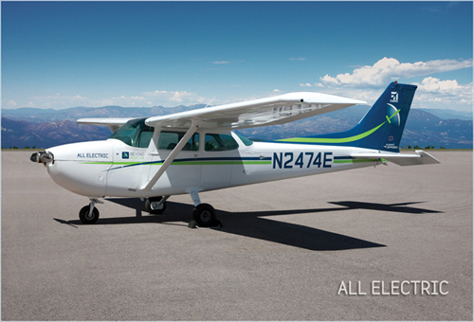
PROJECT BACKGROUND
Customer Richard Schaden sees need for clean-sheet, zero-emission aircraft
Gap in the market for fully electric mid-sized transport aircraft
Concern: General Aviation industry’s contribution to Global Warming, 100LL production, future travel, nonrenewable propulsion source
Beyond Aviation: All Electric Cessna 172
OVERVIEW | DESIGN | TESTING | MANUFACTURING | BUDGET | CONCLUSIONS | FUTURE WORK | BACK UP
Notes:
2 hour endurance and 75 nautical mile range should be discussed here since they were mission specs
It's no surprise that air travel is a very popular form of transportation which continues to grow over the years. Unfortunately though air travel is one of the more environmentally damaging activities as it is responsible for various amounts of carbon dioxide and greenhouse gas emissions which contribute to things like global warming. For this reason transportation industries have been looking at different alternatives for gas for quite some time and this is no different for the aviation industry. The desire for a zero emissions aircraft would be valuable and alot of research has gone into solutions for both large scale commercial operations as well as small scale trainers. There is a bit of a niche market where the design space has been left a bit unexplored in the mid size general aviation industry which is where our project comes into play.

Slide 5
MISSION STATEMENT
No Emission, Low Drag Airframe (NELDA), will provide the customer, Richard Schaden, a clean-sheet airframe design concept for a general aviation airplane which includes drawings, scale models, and aircraft performance parameters. The design will emphasize fully-electric powertrain considerations and aerodynamic efficiency.
Customer Specified NGO’s
Need: Clean-sheet design
Goal: Explore design parameter space to estimate performance of an optimized clean-sheet design
Objective: Airframe design; model test; analysis
OVERVIEW | DESIGN | TESTING | MANUFACTURING | BUDGET | CONCLUSIONS | FUTURE WORK | BACK UP
Notes:
To summarize this our mission statement is as follows.No Emission, Low Drag Airframe (NELDA), will provide the customer, Richard Schaden, a clean-sheet airframe design concept for a general aviation airplane, which includes drawings, scale models, and a feasibility analysis. The design will emphasize fully-electric powertrain considerations and aerodynamic efficiency.

Slide 6
CONCEPT OF OPERATIONS
OVERVIEW | DESIGN | TESTING | MANUFACTURING | BUDGET | CONCLUSIONS | FUTURE WORK | BACK UP
Notes:
On the aircraft design portion of this project the following mission outline and concept of operations have been identified. Our client would like an aircraft that can carry 6 passengers at a speed of 150kts for 2 hours with ….
Increase words in CONOPS on bottom (Font Size?)

Slide 7
FUNCTIONAL REQUIREMENTS
Number | Name | Description
FR1 | Classification | The designed aircraft shall be classified as a Class I Light, General Aviation aircraft that emits zero greenhouse gases during standard operation.
FR2 | Crew | This General Aviation aircraft shall accommodate one crew member and five passengers.
FR3 | Mission Performance | The aircraft shall have a maximum range and endurance comparable to or exceeding the performance of six-passenger electric aircraft currently under certification.
FR4 | Wind Tunnel Model (WTAV) | A non-powered, scale model of the airframe design will be constructed for the purpose of comparative wind tunnel analysis in the PILOT Lab Wind Tunnel.
FR5 | Glider Model (CSD) | A non-powered, larger scale glider model of the airframe design will be constructed for the purpose of stability analysis and verification.
FR6 | Stability | The full-scale aircraft shall be designed to be statically and dynamically stable.
OVERVIEW | DESIGN | TESTING | MANUFACTURING | BUDGET | CONCLUSIONS | FUTURE WORK | BACK UP
Notes:
For this reasons the following functional requirements have been identified…
Scaling CG and adjusting weight
Emphasize how we are using the wind tunnel for comparative analysis only
WTM - comparative analysis

Slide 8
CRITICAL PROJECT ELEMENTS
Number | Name | Description
CPE1 | Electric Aircraft Design Space Analysis | Similar aircraft must be researched to establish baselines and bases of comparison
CPE2 | Airframe Design | Aerodynamically efficient; six passengers; 150 kias; fully electric
CPE3 | Computational Simulation | MATLAB, SolidWorks CFD, and AAA will serve as a guide for analysis, prediction, verification, design/model iteration
CPE4 | Manufacturing | Scale models will need to be constructed for Practical Testing
CPE5 | Practical Testing | Wind Tunnel Aerodynamic Validation (WTAV), and Characteristic Stability Demonstration (CSD)
CPE6 | Budget | Course funding limitation: $5,000 (Not a customer requirement)
OVERVIEW | DESIGN | TESTING | MANUFACTURING | BUDGET | CONCLUSIONS | FUTURE WORK | BACK UP

Slide 9
FEASIBILITY ELEMENTS
Section | CPEs | Requirements | Feasibility
Design | CPE1, CPE2, CPE3 | FR1, FR2, FR3, FR6 | ✅ or ✖?
Testing | CPE5 | FR4, FR5, FR6 | ✅ or ✖?
Manufacturing | CPE4 | FR4, FR5 | ✅ or ✖?
Budget | CPE6: Course funding limitation is $5,000 |  | ✅ or ✖?
D
T
M
B
Feasibility will be tracked through each section with this bar on the bottom right (green = feasible)
OVERVIEW | DESIGN | TESTING | MANUFACTURING | BUDGET | CONCLUSIONS | FUTURE WORK | BACK UP

Slide 10
DESIGN FEASIBILITY
Presented by:
Carlin, Christl, and Tomaz
Powertrain
Clean-Sheet Design Motivation
Baseline Configuration
AAA Weight Analysis
Computational Analysis
Aerodynamic Analysis
Computational Fluid Dynamics (CFD)
Notes:
Based on the entire scope of the project and after meeting with PAB, engineers, etc we have determined the following are critical project feasibility elements

Slide 11
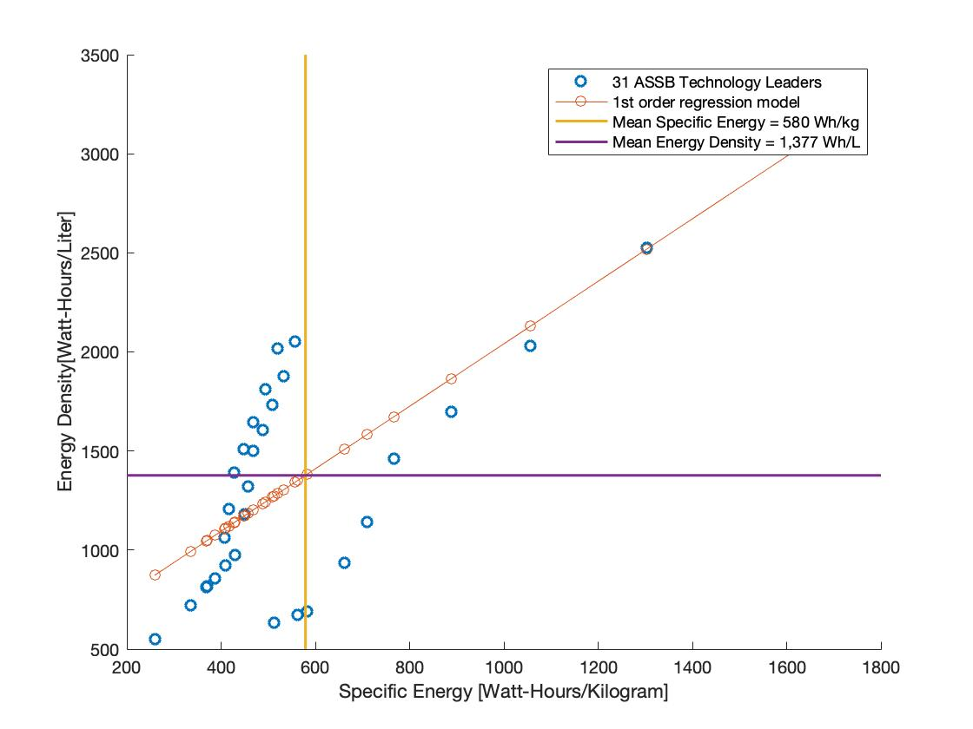
POWERTRAIN (SOLID STATE BATTERIES)
Why is NELDA only an airframe design?
NELDA’s goal is to design a particularly low-drag airframe capable of housing a cutting edge battery bank
However, known weight, volume, and power output of this battery bank is crucial to the aircraft design
In-depth battery chemistry/performance analysis is outside of the project scope
Volumetric Energy Density | Specific Energy
580 Wh/kg | 1377 Wh/L
OVERVIEW | DESIGN | TESTING | MANUFACTURING | BUDGET | CONCLUSIONS | FUTURE WORK | BACK UP

Slide 12
CLEAN-SHEET DESIGN MOTIVATION
FR1: The designed aircraft shall be classified as a Class I Light, General Aviation aircraft that emits zero greenhouse gases during standard operation.
FR3: The aircraft shall have a maximum range and endurance comparable to or exceeding the performance of six-passenger electric aircraft currently under certification.
Why not retrofit an existing airframe for zero-emissions capability?
Mr. Schaden retrofitted a Cessna 172 Skyhawk with lithium ion batteries equal in weight and volume to the fuel it would have otherwise carried
While successful, the newly electric aircraft was far from optimal
Low endurance/range stemming from substantial drag
Airframe was not designed around efficiency, rather ease of manufacture
Design space was poorly understood due to limited diversity with limited experience
D
T
M
B
OVERVIEW | DESIGN | TESTING | MANUFACTURING | BUDGET | CONCLUSIONS | FUTURE WORK | BACK UP
Notes:
Design space CASE STUDY- Most aircraft are designed around engines, the current design space accounts for fuel and in order to be most effective to our client we need to look at all options available. I.e. if we don't need to account for fuel how does the design space open up - by looking at all options we could find something a design point a designer/engineer overlooked when designing an aircraft which needs fuel.
Most general aviation aircraft are designed safe in the knowledge that engines with an abundance of power are available, and thus efficiency is not truly optimized. Our customer tasked us with reevaluating the

Slide 13
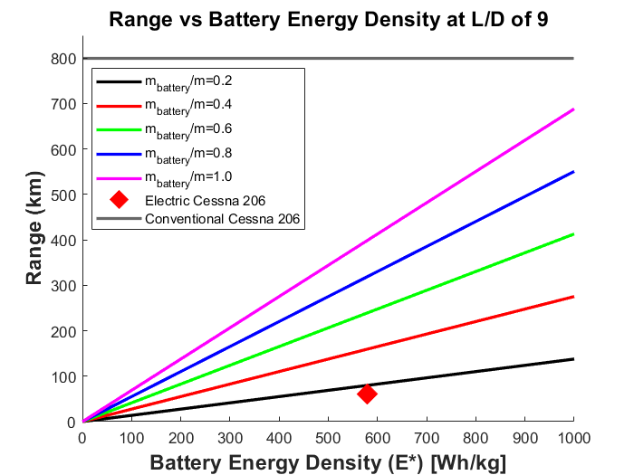
CLEAN-SHEET DESIGN MOTIVATION
FR1: The designed aircraft shall be classified as a Class I Light, General Aviation aircraft that emits zero greenhouse gases during standard operation.
FR3: The aircraft shall have a maximum range and endurance comparable to or exceeding the performance of six-passenger electric aircraft currently under certification.
*Full derivation in BackUp Slides
R | Range
E | Energy
𝜂_{total} | Efficiency
L/D | Lift-to-Drag ratio
m | Mass
g | Acceleration due to gravity
Adapted version of Breguet Range Equation with no decrease in induced drag due to fuel loss
D
T
M
B
OVERVIEW | DESIGN | TESTING | MANUFACTURING | BUDGET | CONCLUSIONS | FUTURE WORK | BACK UP
Notes:
Describe variables and talk through it and go through why it was used
Put this before and justify motivation so AAA goes after
Still need to describe the equation

Slide 14
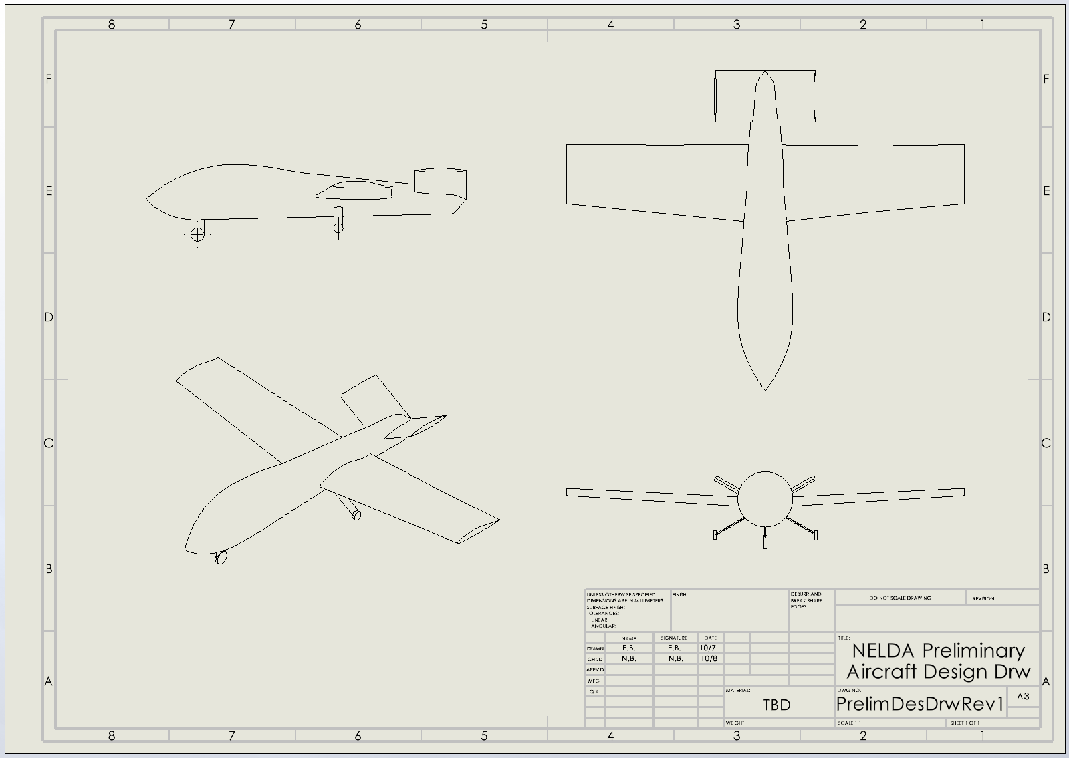
BASELINE CONFIGURATION
Trade | Baseline Selection
Wing Vertical Mount | Mid Mounted
Wing Horizontal Mount | Aft
Wing Shape | Rectangular
Aspect Ratio | 10-14
Wing Airfoil Shape | N-22
Wing Dihedral | Positive Dihedral (Γ > 0)
Tail Configuration | V-Type
Landing Gear | Fixed Tricycle Configuration
Power Source | Solid State Batteries
Primary Material | Carbon Fiber Reinforced Plastic
Independent Trade Studies → Not final design decisions
D
T
M
B
*** Just Preliminary Reference
OVERVIEW | DESIGN | TESTING | MANUFACTURING | BUDGET | CONCLUSIONS | FUTURE WORK | BACK UP
Notes:
Baseline design from CDD
Describe Canard in this slide
Why those are in there
Midmounted wing, aft,
WHY each parameter is chosen

Slide 15
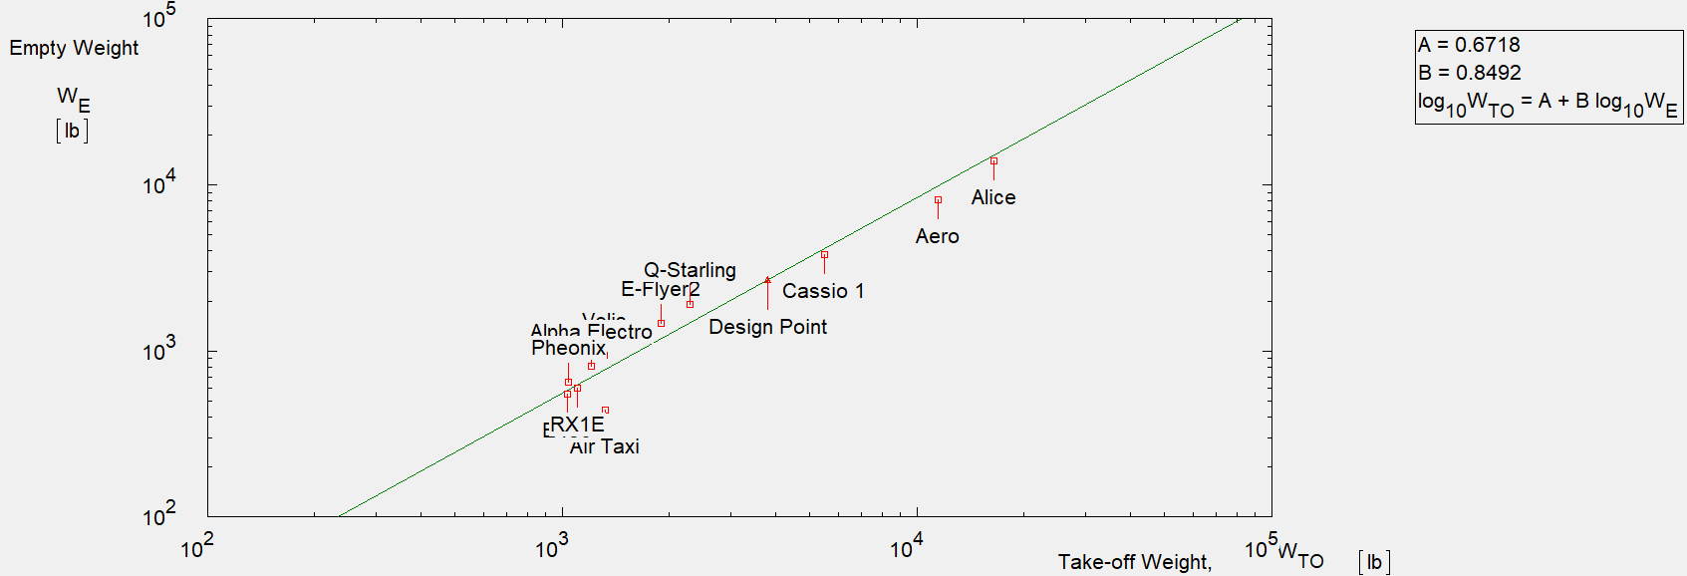
AAA WEIGHT ANALYSIS
FR3: The aircraft shall have a maximum range and endurance comparable to or exceeding the performance of six-passenger electric aircraft currently under certification.
D
M
T
B
D
T
M
B
OVERVIEW | DESIGN | TESTING | MANUFACTURING | BUDGET | CONCLUSIONS | FUTURE WORK | BACK UP
Notes:
Circle design point ✅
HOW TO DESCRIBE THE GRAPH
1.) Where did the data come from?
2.) Point and state axes
3.) Describe the legend 4.) Describe the trends
5.) Results
6.) Conclusions

Slide 16
AAA WEIGHT ANALYSIS
Comparison of Two Linear Relationships
Summation of Empty, Payload, and Crew Weight to determine Takeoff Weight
Logarithmic Regression of Relationship Between Takeoff and Empty Weight
D
T
M
B
OVERVIEW | DESIGN | TESTING | MANUFACTURING | BUDGET | CONCLUSIONS | FUTURE WORK | BACK UP
Notes:
Does empty weight include batteries?
HOW TO DESCRIBE THE GRAPH
1.) Where did the data come from?
2.) Point and state axes
3.) Describe the legend 4.) Describe the trends
5.) Results
6.) Conclusions

Slide 17
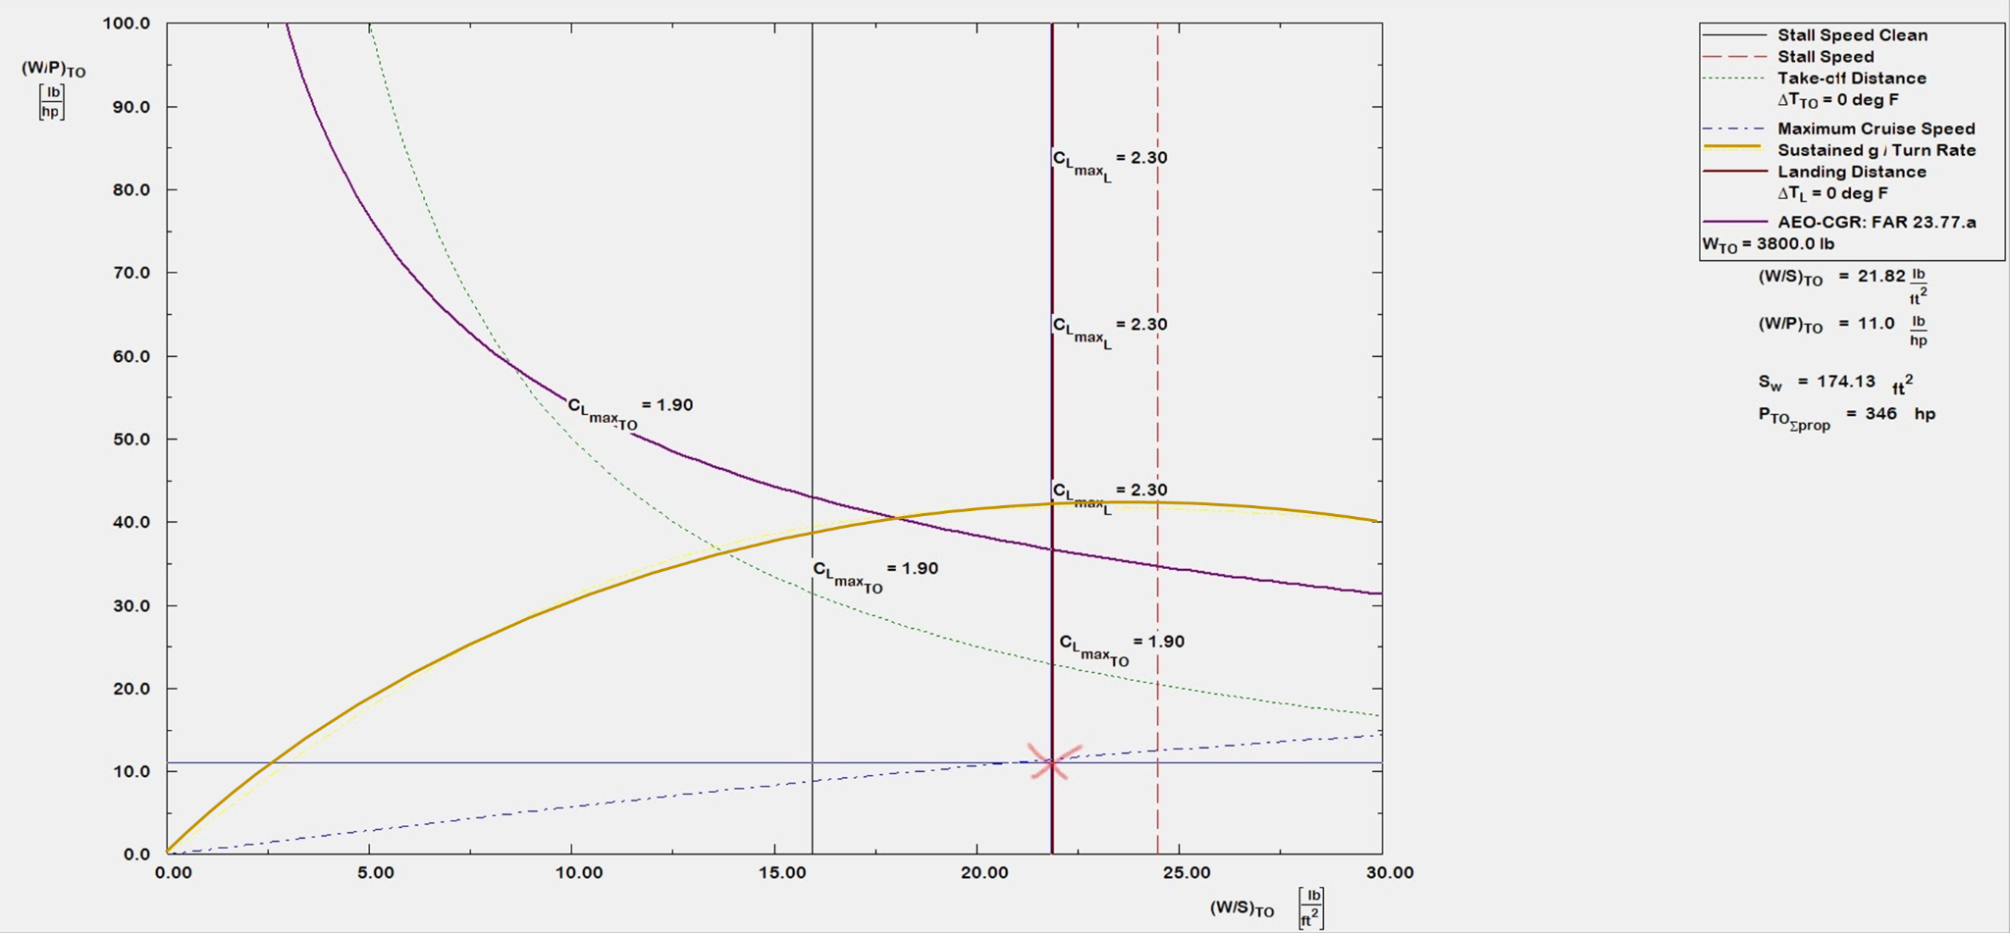
AAA WEIGHT ANALYSIS
Performance Plot
D
M
T
B
D
T
M
B
OVERVIEW | DESIGN | TESTING | MANUFACTURING | BUDGET | CONCLUSIONS | FUTURE WORK | BACK UP
Notes:
HOW TO DESCRIBE THE GRAPH
1.) Where did the data come from?
2.) Point and state axes
3.) Describe the legend 4.) Describe the trends
5.) Results
6.) Conclusions

Slide 18
AAA PERFORMANCE VERIFICATION
FR3: The aircraft shall have a maximum range and endurance comparable to or exceeding the performance of six-passenger electric aircraft currently under certification.
Variable | NELDA | Cessna 206 | Percent Difference
Takeoff Weight [lbs] | 3,800 | 3,600 | +5.5%
Empty Weight [lbs] | 2,650 | 2,116 | +25%
Power Required [hp] | 346 | 310 | +11.6%
Oswald’s Efficiency | 0.8908 | 0.75 | +14%
Wing Span [ft] | 45.7 | 34.9 | +31%
Wing Area [ft²] | 174 | 174 | 0%
D
M
T
B
D
T
M
B
AAA Range and Endurance Estimates Verified with Computational Models
OVERVIEW | DESIGN | TESTING | MANUFACTURING | BUDGET | CONCLUSIONS | FUTURE WORK | BACK UP

Slide 19
COMPUTATIONAL ANALYSIS
FR3: The aircraft shall have a maximum range and endurance comparable to or exceeding the performance of six-passenger electric aircraft currently under certification.
MATLAB Models
Started with baseline weights, wing area, and AR used in AAA
Capable of returning aerodynamic characteristics including Lift-to-Drag Ratio, Span Efficiency Factor, C_{L}, C_{D} , and C_{L}/C_{D} vs 𝛂 plots, C_{Do} and Range Estimates
Assist the design team with independently verifying and validating AAA results
Gives the team insight into the interdependencies of design choices
D
M
T
B
D
T
M
B
OVERVIEW | DESIGN | TESTING | MANUFACTURING | BUDGET | CONCLUSIONS | FUTURE WORK | BACK UP
Notes:
1 sentence explanation of vortex panel/pllt
Vortex panel: ideal flow over thick airfoils using
Pllt:

Slide 20
COMPUTATIONAL ANALYSIS
RANGE
Range estimated computationally using extrapolated battery efficiency and energy density estimates
Range = 150 NM
R | Range | e_{bat} | Battery Energy Density
E_{0,tot} | Total Energy at takeoff | W_{OE} | Empty Weight
𝜂₂ | Propulsive Efficiency | W_{PL} | Payload Weight
𝜂₃ | Battery Efficiency | L/D | Lift-to-Drag Ratio
g | Acceleration due to gravity
D
T
M
B
OVERVIEW | DESIGN | TESTING | MANUFACTURING | BUDGET | CONCLUSIONS | FUTURE WORK | BACK UP
Notes:
Carlin
Eta 1 and eta 1 are propulsive and battery efficiency, L/D is lift to drag
ebat is energy density of the battery, E,tot is total energy at takeoff, and Woe and Wpl are the operating empty and payload weights respectively

Slide 21
AERODYNAMIC ANALYSIS
AAA vs. Computational model comparison
Variable | AAA | Matlab Model | Percent Difference
L/D | 9.79 | 8.67 | -12.9%
C_{D0} | 0.0391 | 0.01828 | -113.9%
Oswald’s Efficiency | 0.8908 | 0.9728 | +8.2%
D
M
T
B
D
T
M
B
AAA Range and Endurance Estimates Verified with Computational Models
OVERVIEW | DESIGN | TESTING | MANUFACTURING | BUDGET | CONCLUSIONS | FUTURE WORK | BACK UP
Notes:
Compare matlab results to AAA results
Comment from Jake: Maybe add tiny bit of verbiage here about the differences in models, emphasize why these 3 parameters are the most important, and maybe why we don't have other variables in this table
Under estimation
Under estimation of Cd0 due to:
Over estimation of Oswalds due to:

Slide 22
COMPUTATIONAL FLUID DYNAMICS
FR3: The aircraft shall have a maximum range and endurance comparable to or exceeding the performance of six-passenger electric aircraft currently under certification.
Limitations
Precision
Design team cannot be confident in results due to lack of knowledge in the models underlying CFD software
Different programs/models vary in precision due to a variety of factors
Requires intricate understanding of the models to account for inconsistencies
Practical Utility
Limited due to complex geometries, aforementioned limitations, etc.
D
T
M
B
OVERVIEW | DESIGN | TESTING | MANUFACTURING | BUDGET | CONCLUSIONS | FUTURE WORK | BACK UP

Slide 23
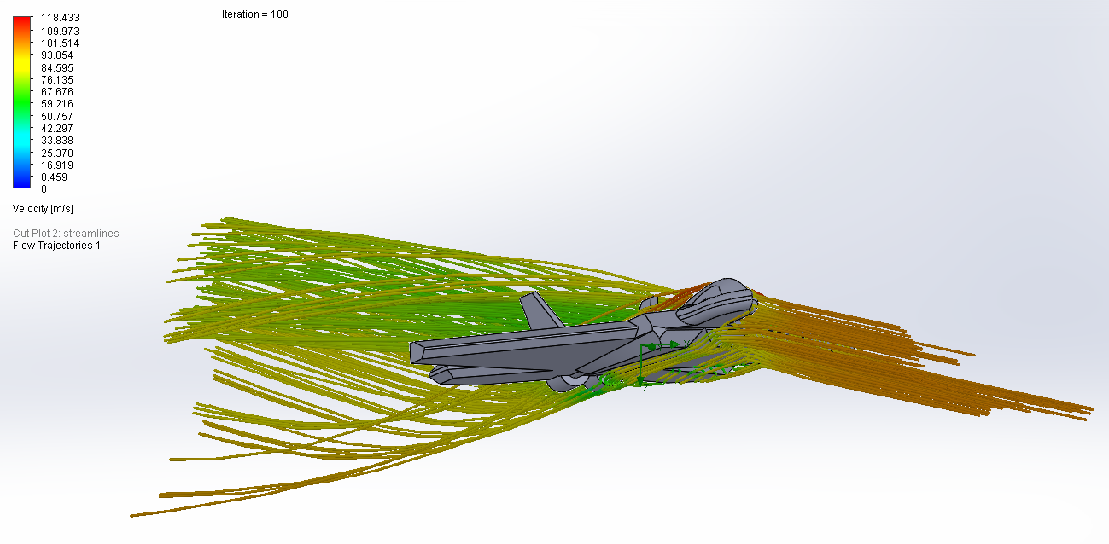
COMPUTATIONAL FLUID DYNAMICS
FR3: The aircraft shall have a maximum range and endurance comparable to or exceeding the performance of six-passenger electric aircraft currently under certification.
Value
Qualitative analysis of flow
Flow visualization
Can observe general trends such as localized
Relative velocity/pressure hotspots
Individual component modeling
Effect of wingtips/winglets on downwash vortices
Aerodynamic fairings on landing gear
D
T
M
B
OVERVIEW | DESIGN | TESTING | MANUFACTURING | BUDGET | CONCLUSIONS | FUTURE WORK | BACK UP

Slide 24
FEASIBILITY TRACKING: DESIGN
Section | CPEs | Requirements | Feasibility
Design | CPE1, CPE2, CPE3 | FR1, FR2, FR3, FR6 | ✅
Preliminary Concern | CPEs | Addressed? | Feasibility
AAA Baseline Weight/Performance | CPE1, CPE2 | Yes: Work Needed | ✅
Computational Analysis | CPE1, CPE2 | Yes: Work Needed | ✅
Aerodynamic Analysis | CPE2 | Yes: Work Needed | ✅
CFD | CPE3 | Yes: Very Limited Utility | ✅
D
T
M
B
OVERVIEW | DESIGN | TESTING | MANUFACTURING | BUDGET | CONCLUSIONS | FUTURE WORK | BACK UP
Notes:
provide evidence that the project objectives, is feasible, i.e. can be accomplished within the constraints of technology and the senior projects course (time, skills, money, facilities, etc.).

Slide 25
TESTING FEASIBILITY
Presented by:
Fernando Chavez
Wind Tunnel Testing
Wind Tunnel Testing Sensors
Glider Testing
Notes:
Put testing before manufacturing

Slide 26
WIND TUNNEL TESTING
FR3: The aircraft shall have a maximum range and endurance comparable to or exceeding the performance of six-passenger electric aircraft currently under certification.
FR4: A non-powered, scale model of the airframe design will be constructed for the purpose of comparative wind tunnel analysis in the PILOT Lab Wind Tunnel.
Wind Tunnel Aerodynamic Validation (WTAV)
Quantitative aircraft model comparison between NELDA & Cessna 206
Limited precision due to test section size and airflow speeds
Verification and validate computational models
Evaluate design decisions to predict full scale efficacy (i.e. wing shape, winglets, gear)
Rationale emphasis:
Prove aerodynamic efficiency against an existing six-passenger GA aircraft (Cessna 206)
D
T
M
B
OVERVIEW | DESIGN | TESTING | MANUFACTURING | BUDGET | CONCLUSIONS | FUTURE WORK | BACK UP
Notes:
What do you specifically mean by “still a need for verification and validation’???

Slide 27
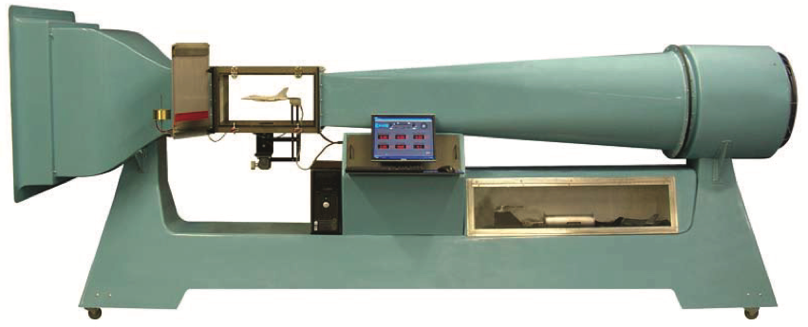
WIND TUNNEL TESTING
FR3: The aircraft shall have a maximum range and endurance comparable to or exceeding the performance of six-passenger electric aircraft currently under certification.
FR4: A non-powered, scale model of the airframe design will be constructed for the purpose of comparative wind tunnel analysis in the PILOT Lab Wind Tunnel.
Wind Tunnel Specifications
Test Section Dimensions:
12” x 12” x 24” (30.5cm x 30.5cm x 61cm)
Airspeed:
10 → 145 mph (4.5 → 65 m/s)
Nominal speed of 25 → 40 m/s with test subject (rough estimate)
Aerolab Educational Wind Tunnel
D
T
M
B
OVERVIEW | DESIGN | TESTING | MANUFACTURING | BUDGET | CONCLUSIONS | FUTURE WORK | BACK UP
Notes:
It is important to note that NELDA will have priority access to Wind Tunnel
Airspeed will be maximized by reducing blockage area in test section
Depends on hardware (sensor + test-stand) setup and selection
Depends on Size of NELDA or Cessna 206 models (i.e Test Subject)
Depends on Variation in AoA of test subject

Slide 28
WIND TUNNEL TESTING
FR3: The aircraft shall have a maximum range and endurance comparable to or exceeding the performance of six-passenger electric aircraft currently under certification.
FR4: A non-powered, scale model of the airframe design will be constructed for the purpose of comparative wind tunnel analysis in the PILOT Lab Wind Tunnel.
Desired Data
Aerodynamic Forces
Lift Force
Drag Force
Minimize boundary layer effects
Minimize downwash due to wingtip vortices
Moments
Post Processing
MATLAB
Directly compare lift (NELDA model vs. Cessna 206 model)
Build and compare drag polar
Compare Lift/Drag Ratio
Aerolab Educational Wind Tunnel
D
T
M
B
OVERVIEW | DESIGN | TESTING | MANUFACTURING | BUDGET | CONCLUSIONS | FUTURE WORK | BACK UP
Notes:
Aerodynamic Forces
Lift will be obtained by extracting the Normal force measured by one of the three sensors discussed in the following slide.
This force will be calculated at the Cp, CG, and AC of the model with simple corrections
Drag will be obtained by extracting the Axial force measured by one of the three sensors discussed in the following slide.
Test subject shall not exceed a wingspan of 80% of the test section
Moments will be obtained by extracting them directly from one of the three sensors discussed in the following slide
Pitching moment will help characterize longitudinal stability (only as supplemental data)
Will be able to tell of aircraft model is stable and/or trimmable
Post Processing
Drag Polar
Goal is to demonstrate improvement in drag polar through direct comparison (our design model vs Cessna 206 model)
Skin Friction and Drag due to Flow Separation (C_D0)
Form Drag
Parasite Drag (C_Dp)
Induced Drag (C_Di)
Lift/Drag Ratio
Help characterize range and endurance (only as supplemental data)

Slide 29
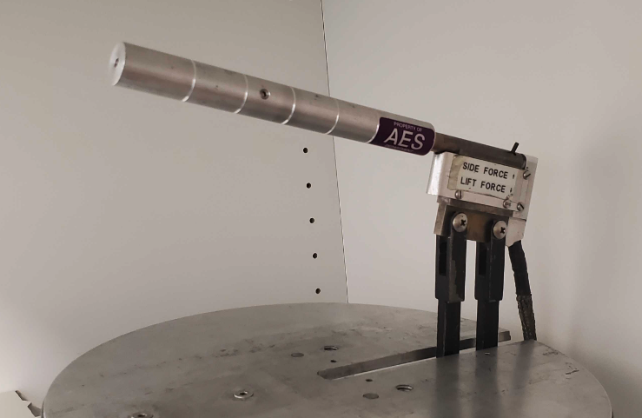
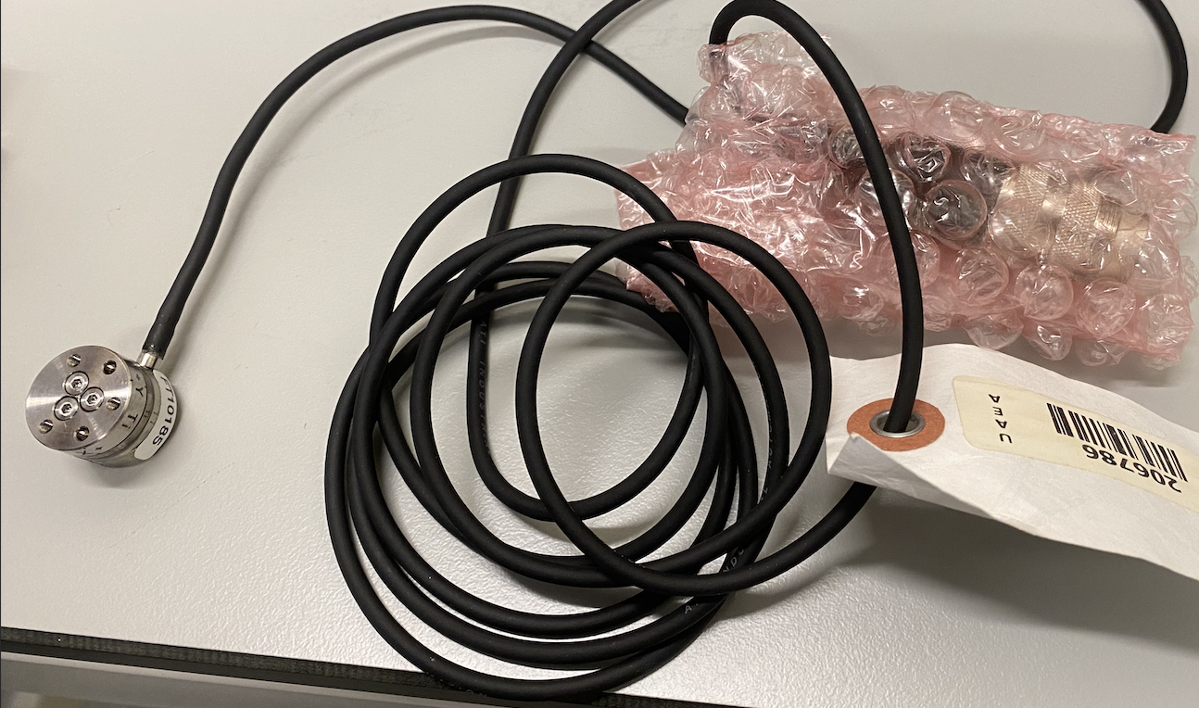
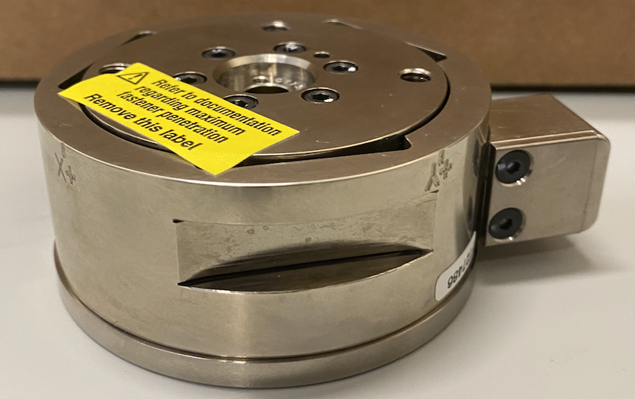
WIND TUNNEL TESTING SENSORS
FR3: The aircraft shall have a maximum range and endurance comparable to or exceeding the performance of six-passenger electric aircraft currently under certification.
FR4: A non-powered, scale model of the airframe design will be constructed for the purpose of comparative wind tunnel analysis in the PILOT Lab Wind Tunnel.
Sting ⅜ EWT
ATI Nano17
ATI Gamma
Maximum Load Capacities
D
T
M
B
OVERVIEW | DESIGN | TESTING | MANUFACTURING | BUDGET | CONCLUSIONS | FUTURE WORK | BACK UP
Notes:
Sting ⅜ EWT
Test Process:
Vary AoA by 10 degrees (-5 < 0 < 5 degrees)
Compute Total Lift and Drag
Drag Polar
C_D0 will be calculated at zero lift AoA
All other drag will be calculated when varying AoA
Side Force (Y) and Rolling Moment (Tx) can be calculated with a switch
ATI Nano17 Titanium
Test Process:
Requires platform integration, test stand, and a mechanical way to vary AoA
Note the Force and Moment Limitations
ATI Gamma
Test Process:
Same as ATI Nano but note the Forces/Moment Magnitudes
We would need to collaborate with Josh and LA’s to develop LabView Code adaptation

Slide 30
WIND TUNNEL TESTING SENSORS
Sensor | Pros | Cons
Sting ⅜ EWT | Can compute all three forces High force and moment limits Integrated Hardware & Software | Pre-set blockage area Lack of roll moment
ATI Nano17 Titanium | Can compute all forces and moments LabView code is already available Was recently calibrated (see backup slide) | Force and moment magnitude is highly limited Requires platform integration, test-stand, and a mechanical way to vary angle of attack
ATI Gamma | Can compute all forces and moments Very high force and moment limits | Would require collaboration with Josh Mellin and LA’s to develop LabView code adaptation Requires platform integration, test-stand, and a mechanical way to vary angle of attack
D
T
M
B
OVERVIEW | DESIGN | TESTING | MANUFACTURING | BUDGET | CONCLUSIONS | FUTURE WORK | BACK UP
Notes:
Sting ⅜ EWT
Pros:
We can flip an adjuster to get side force (Y) and yaw moment (Tz)
Hardware is ready to use (can easily vary AoA)
LabView Code is already available
Cons:
Force and Moment magnitude limitations (which are too bad)
Sensitivity < ATI Instrumentation
ATI Nano17 Titanium
Pros:
Hardware adaptation will be more simple than ATI Gamma
Cons:
Force and Moment magnitude limitations ***Seems very low so it will depend on models
ATI Gamma
Pros:
Most expensive → best accuracy
Cons:
Labview adds another level of complexity to the testing-team
Requires a more complex physical adaptation than ATI Nano
Conclusions
Using Sing ⅜ EWT will be very useful to compute C_D0 and C_Di (by varying AoA)
ATI Nano17 Titanium may fall short on force and moment magnitude capabilities
ATI Gamma would be great for computing C_D0 but requires significant hardware and software development. This may be something we can consider for a higher level of success.

Slide 31
GLIDER TESTING
FR3: The aircraft shall have a maximum range and endurance comparable to or exceeding the performance of six-passenger electric aircraft currently under certification.
FR5: A non-powered, larger scale glider model of the airframe design will be constructed for the purpose of stability analysis and verification.
FR6: The full-scale aircraft shall be designed to be statically and dynamically stable.
Characteristic Stability Demonstration (CSD)
Qualitative demonstration of stability in NELDA design
Verification & Validation for mathematical/computational models
Demonstrate endurance based on glide ratio
D
T
M
B
OVERVIEW | DESIGN | TESTING | MANUFACTURING | BUDGET | CONCLUSIONS | FUTURE WORK | BACK UP
Notes:
Using a glider test to qualitatively measure stability, and quantitatively measure range and endurance by extrapolating data from a rangefinder.
This test will also serve to verify and validate the mathematical and computational models
This test will accomplish functional requirements 3, 5, and 6, which demonstrate the improved performance over current electric aircraft and verification of stability

Slide 32
GLIDER TESTING
FR3: The aircraft shall have a maximum range and endurance comparable to or exceeding the performance of six-passenger electric aircraft currently under certification.
FR5: A non-powered, larger scale glider model of the airframe design will be constructed for the purpose of stability analysis and verification.
FR6: The full-scale aircraft shall be designed to be statically and dynamically stable.
Characteristic Stability Demonstration (CSD)
Team decided against accelerometers to measure flight data because of risk of added scope
One camera parallel to flight path, one camera perpendicular to flight path to qualitatively measure stability
Rangefinder to determine practical glide ratio
Launch from roof of aero building (with faculty assistance)
Use table bungee launch system provided by IRISS
D
T
M
B
OVERVIEW | DESIGN | TESTING | MANUFACTURING | BUDGET | CONCLUSIONS | FUTURE WORK | BACK UP
Notes:
For the stability test, accelerometers were considered to determine exact pitch, yaw, and roll forces. The team decided against this because of the extensive addition to the scope that this would create
Instead, the team will use cameras to qualitatively measure stability, using visual evidence of dutch roll, etc.
An on-board rangefinder will be used to determine the the range and endurance by measuring the launch height, distance travelled, and time of flight
The test will be conducted at the aero building, and will be launched from the roof with faculty assistance. The glider will be launched from the same launch mechanism every test
Garmen camera was trash, so look into better sensors

Slide 33
FEASIBILITY TRACKING: TESTING
Section | CPEs | Requirements | Feasibility
Testing | CPE5 | FR4, FR5, FR6 | ✅
Value
Qualitative analysis of flow
Flow visualization
Can observe general trends such as localized
Relative velocity/pressure hotspots
Individual component modelling
Effect of wingtips/winglets on downwash vortices
Aerodynamic fairings on landing gear
Preliminary Concern | Addressed? | Feasibility
WTAV Logistics | Yes: Work Needed | ✅
WTAV Data Utility | Yes | ✅
CSD Logistics | Yes: Work Needed | ✅
CSD Data Utility | Yes | ✅
D
T
M
B
OVERVIEW | DESIGN | TESTING | MANUFACTURING | BUDGET | CONCLUSIONS | FUTURE WORK | BACK UP
Notes:
provide evidence that the project objectives, is feasible, i.e. can be accomplished within the constraints of technology and the senior projects course (time, skills, money, facilities, etc.).

Slide 34
MANUFACTURING FEASIBILITY
Presented by:
Finn Bailis
Models Overview
Construction Processes

Slide 35
MANUFACTURED MODELS
FR4: A non-powered, scale model of the airframe design will be constructed for the purpose of comparative wind tunnel analysis in the PILOT Lab Wind Tunnel.
FR5: A non-powered, larger scale glider model of the airframe design will be constructed for the purpose of stability analysis and verification.
Wind Tunnel Aerodynamic Validation Models (Nelda and 206) (WTAV) | Characteristic Stability Demonstration Model (CSD)
Geometrically scaled to maximum b = 8.8” Requires geometry within 1% accuracy Must be sufficiently smooth (Print/Mill layers < 100 microns) | Geometrically scaled to maximum b = 3’ (MTOW scaled by the same factor) Requires geometry within 5% accuracy of CAD model Must have all CG locations within 5% accuracy of full-scale airframe
D
T
M
B
OVERVIEW | DESIGN | TESTING | MANUFACTURING | BUDGET | CONCLUSIONS | FUTURE WORK | BACK UP
Notes:
Geometry with 1% accuracy might be hard

Slide 36
WTAV MODEL CONSTRUCTION
FR4: A non-powered, scale model of the airframe design will be constructed for the purpose of comparative wind tunnel analysis in the PILOT Lab Wind Tunnel.
3D Printed: Uniform composition,
SLA print on Form 3 or Form 3L
Typical lead times, 2-3 weeks
Typical cost, $100-$200 per print (f-22 quote)
Full completion time estimate: 3-4 weeks
Sting Test insert must also be machined and assembled
Required Materials:
Form 3L SLA printer:
2 prints, 3 wk. lead time, ~$120 each
DLMS aluminum printer:
2 prints, 1 wk. lead time, ~$680 each
Sting Test Insert:
2 columns, Lathe Machined 1 wk. ~$50 each
D
T
M
B
OVERVIEW | DESIGN | TESTING | MANUFACTURING | BUDGET | CONCLUSIONS | FUTURE WORK | BACK UP

Slide 37
CSD MODEL CONSTRUCTION
FR5: A non-powered, larger scale glider model of the airframe design will be constructed for the purpose of stability analysis and verification.
Complex foam, strut and laminate composition
General structure to be CNC milled out of high density foam
Then manually reinforced with carbon fiber rods and epoxy coated
Full construction completion time estimate: 3 weeks/unit
Required Materials:
Carbon fiber struts:
4, 5 and 6 mm x 400 mm, ~$13 each
High Density foam:
3’ x 3’ x 6” blocks, ~$200
Epoxy Resin:
1 Liter, ~$65
D
T
M
B
OVERVIEW | DESIGN | TESTING | MANUFACTURING | BUDGET | CONCLUSIONS | FUTURE WORK | BACK UP
Notes:
Cost estimates because estimated earlier

Slide 38
FEASIBILITY TRACKING: MANUFACTURING
Section | CPEs | Requirements | Feasibility
Manufacturing | CPE4 | FR4, FR5 | ✅
Value
Qualitative analysis of flow
Flow visualization
Can observe general trends such as localized
Relative velocity/pressure hotspots
Individual component modelling
Effect of wingtips/winglets on downwash vortices
Aerodynamic fairings on landing gear
Preliminary Concern | Addressed? | Feasibility
WTAV Materials | Yes | ✅
WTAV Construction | Yes: Work Needed | ✅
CSD Materials | Yes | ✅
CSD Construction | Yes: Work Needed | ✅
D
T
M
B
OVERVIEW | DESIGN | TESTING | MANUFACTURING | BUDGET | CONCLUSIONS | FUTURE WORK | BACK UP
Notes:
provide evidence that the project objectives, is feasible, i.e. can be accomplished within the constraints of technology and the senior projects course (time, skills, money, facilities, etc.).

Slide 39
BUDGET FEASIBILITY
Presented by:
Finn Bailis
Bills of Materials

Slide 40
BILL OF MATERIALS
D
T
M
B
OVERVIEW | DESIGN | TESTING | MANUFACTURING | BUDGET | CONCLUSIONS | FUTURE WORK | BACK UP
Notes:
Instrumentation and materials
Look at what materials Finn uploads tonight

Slide 41
FEASIBILITY CONCLUSIONS
Presented by:
Emerson Beinhauer
Feasibility Summary

Slide 42
FEASIBILITY CONCLUSIONS
Section | CPEs | Requirements | Feasibility
Design | CPE1, CPE2, CPE3 | FR1, FR2, FR3, FR6 | ✅
Testing | CPE5 | FR4, FR5 | ✅
Manufacturing | CPE4 | FR4, FR5 | ✅
Budget | CPE6: Course funding limitation is $5,000 |  | ✅
D
T
M
B
OVERVIEW | DESIGN | TESTING | MANUFACTURING | BUDGET | CONCLUSIONS | FUTURE WORK | BACK UP
Notes:
Ask the question what do we want from this slide? Given the fact that we haven't had the opportunity to design an airplane and we have previously discussed what is feasible in all of the feasibility slides does the PAB just want us to reiterate what was previously discussed here. (ex: we showed that we had three ways of testing in the wind tunnel but we haven't decided on one yet). This is a very important slide per the rubric we just dont know how to approach this

Slide 43
FUTURE WORK
Presented by:
Emerson Beinhauer
Design
Manufacturing
Testing
Logistics

Slide 44
FUTURE WORK
Aircraft Design
Additional models & more rigorous model testing
Model modification
Sensitivity analyses on each design parameter
Stability Model Generation and Testing
Validation of different design iterations with computational models
Finalize aircraft design parameters
Drawings → CAD
Testing
Test plan selection and testing procedures documentation
Manufacturing
Workshops, specific requirements, materials → WTAV, CSD
Finance & Project Management
Finalized budget, Gantt chart, Work Breakdown Structure
OVERVIEW | DESIGN | TESTING | MANUFACTURING | BUDGET | CONCLUSIONS | FUTURE WORK | BACK UP

Slide 45
ACKNOWLEDGEMENTS
Dr. Jelliffe Jackson
Dr. Kathryn Wingate
Dr. Brian Argrow
Dr. Donna Gerren
Dr. John Farnsworth
Professor John Mah
Matt Rhode
KatieRae Williamson
Project Advisory Board
Colin Claytor
Emma Markovich
Richard Schaden
Instructor Bobby Hodgkinson
Josh Mellin
Trudy Schwartz
Michael Rhodes
OVERVIEW | DESIGN | TESTING | MANUFACTURING | BUDGET | CONCLUSIONS | FUTURE WORK | BACK UP

Slide 46
BACK UP SLIDES
Similar Aircraft | Aero Analysis Method | WTAV Testing | CSD Testing
AAA Nomenclature | Powertrain | WTAV Manufacturing | CSD Manufacturing
AAA Drag Polars | Range | Wind Tunnel Specs | Trade Studies
AAA Performance | Baseline Code | N-22 Airfoil | References
OVERVIEW | DESIGN | TESTING | MANUFACTURING | BUDGET | CONCLUSIONS | FUTURE WORK | BACK UP

Slide 47
AERODYNAMIC ANALYSIS
Methodology
Drag:
Utilized PLLT to obtain Cd_i
Utilized skin friction drag coefficient method to obtain CD0
Incorporated C_di, Cd0, and landing gear into final model of Drag
Utilized PLLT to find e
Lift:
Utilized PLLT and Vortex Pannel to obtain C_L
OVERVIEW | DESIGN | TESTING | MANUFACTURING | BUDGET | CONCLUSIONS | FUTURE WORK | BACK UP
Notes:
Carlin: good job describing why we have these models (double check AAA, understand where those results come from)
Run through both plots as well as zero lift AOA
Consistency with AOA and alpha
Equations
HOW TO DESCRIBE THE GRAPH
1.) Where did the data come from?
2.) Point and state axes
3.) Describe the legend 4.) Describe the trends
5.) Results
6.) Conclusions

Slide 48
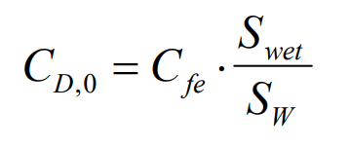
AERODYNAMIC ANALYSIS
Cd0 Derivation
Empirical Data used to determine Skin Friction Coefficient
Cfe: 0.0045
Sw: Wing Area
S_wet,W: Wetted area of wing
Approximated with 2*S
S_wet,F: Wetted area of Fuselage
df: Fuselage Diameter
lf: Length of Fuselage
λ_F = lf/df
Cd0: 0.01828
OVERVIEW | DESIGN | TESTING | MANUFACTURING | BUDGET | CONCLUSIONS | FUTURE WORK | BACK UP
Notes:
Carlin: good job describing why we have these models (double check AAA, understand where those results come from)
Run through both plots as well as zero lift AOA
Consistency with AOA and alpha
Equations
HOW TO DESCRIBE THE GRAPH
1.) Where did the data come from?
2.) Point and state axes
3.) Describe the legend 4.) Describe the trends
5.) Results
6.) Conclusions

Slide 49
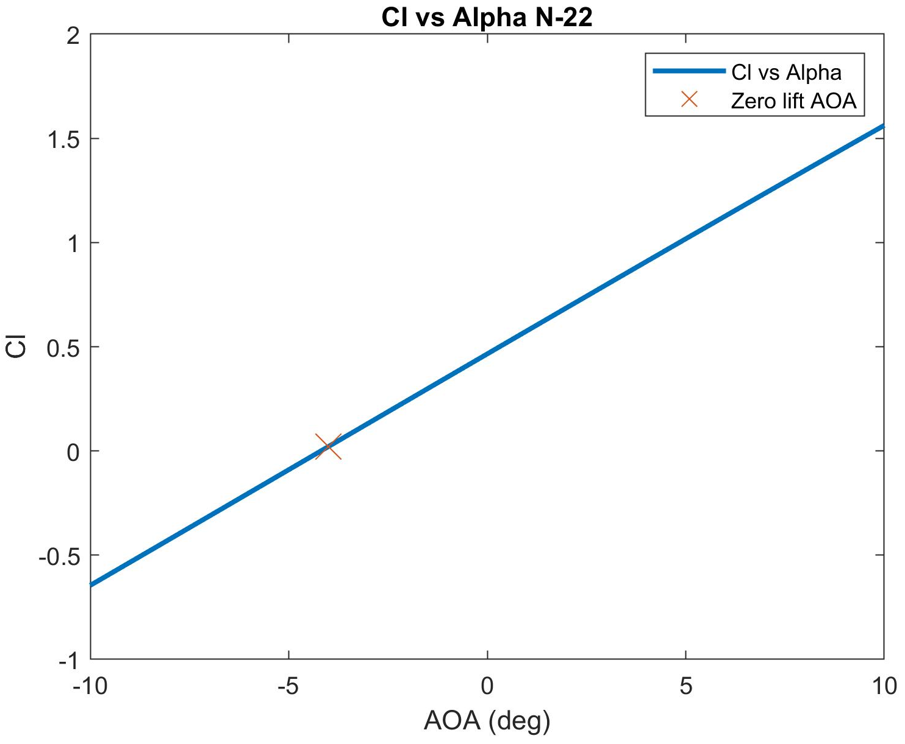
AERODYNAMIC ANALYSIS
N-22 Airfoil Cl vs Alpha
Assumptions:
N-22 airfoil
Compressibility and Viscous effects considered negligible
Cl obtained using Vortex Panel Method
Input Variables:
Root chord: 5 feet
Airspeed: 150 knots
OVERVIEW | DESIGN | TESTING | MANUFACTURING | BUDGET | CONCLUSIONS | FUTURE WORK | BACK UP
Notes:
Carlin: good job describing why we have these models (double check AAA, understand where those results come from)
Run through both plots as well as zero lift AOA
Consistency with AOA and alpha
Equations
HOW TO DESCRIBE THE GRAPH
1.) Where did the data come from?
2.) Point and state axes
3.) Describe the legend 4.) Describe the trends
5.) Results
6.) Conclusions

Slide 50
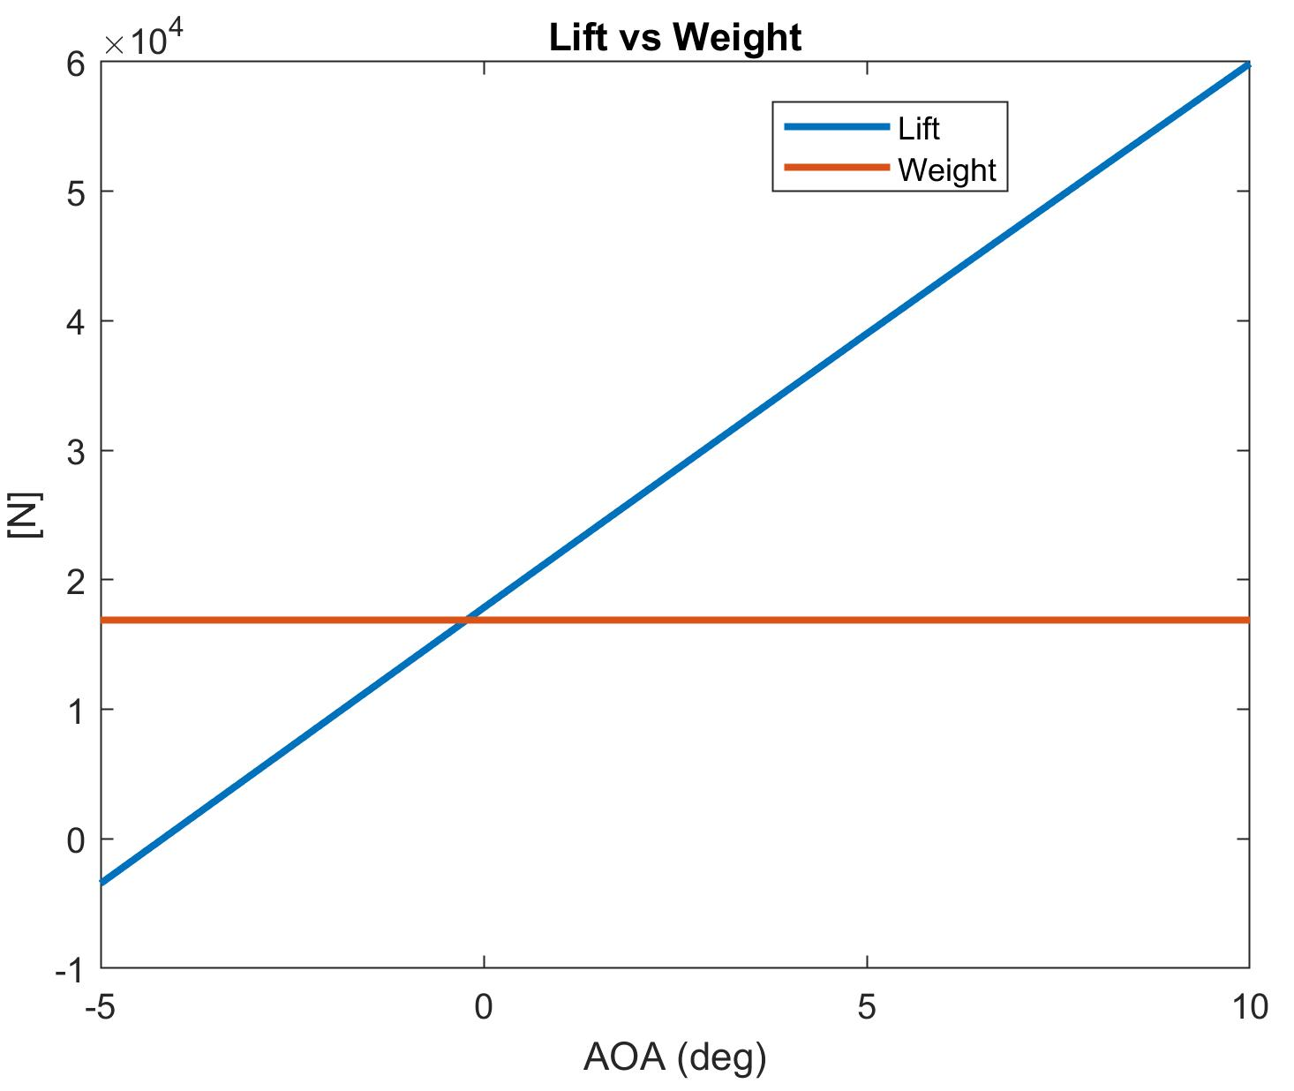
AERODYNAMIC ANALYSIS
N-22 Airfoil Lift vs Weight:
Assumptions:
N-22 airfoil
C_l obtained using PLLT
Wing is represented by single finite strength vortex
Input Variables:
Root chord: 5 feet
Tip chord: 2.5 feet
Airspeed: 150 knots
Wing Span: 45 feet
Lift Slope and Zero Lift AOA
Density
OVERVIEW | DESIGN | TESTING | MANUFACTURING | BUDGET | CONCLUSIONS | FUTURE WORK | BACK UP
Notes:
Carlin: good job describing why we have these models (double check AAA, understand where those results come from)
Run through both plots as well as zero lift AOA
Consistency with AOA and alpha
Equations
HOW TO DESCRIBE THE GRAPH
1.) Where did the data come from?
2.) Point and state axes
3.) Describe the legend 4.) Describe the trends
5.) Results
6.) Conclusions

Slide 51
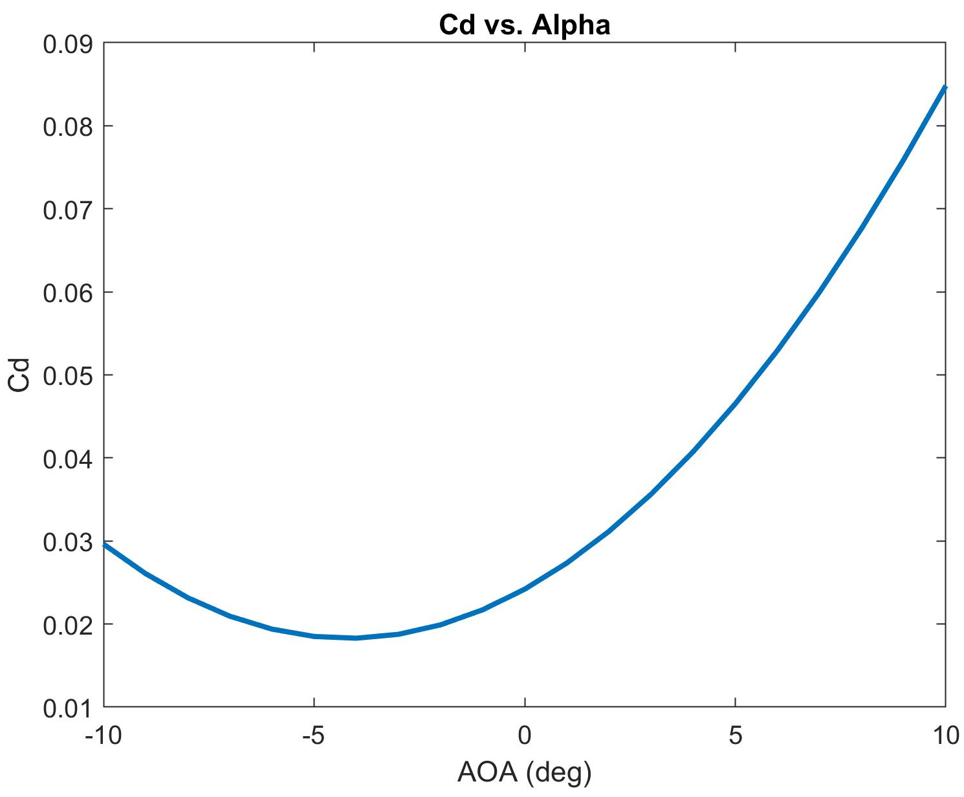
AERODYNAMIC ANALYSIS
N-22 Airfoil Cd vs. Alpha:
Assumptions:
N-22 airfoil
C_l, e: obtained using PLLT
Input Variables:
C_l vector from Vortex Panel
Aspect Ratio: 12
e: 0.9728
Cd0: 0.01828
OVERVIEW | DESIGN | TESTING | MANUFACTURING | BUDGET | CONCLUSIONS | FUTURE WORK | BACK UP
Notes:
Carlin: Run through both plots
HOW TO DESCRIBE THE GRAPH
1.) Where did the data come from?
2.) Point and state axes
3.) Describe the legend 4.) Describe the trends
5.) Results
6.) Conclusions

Slide 52
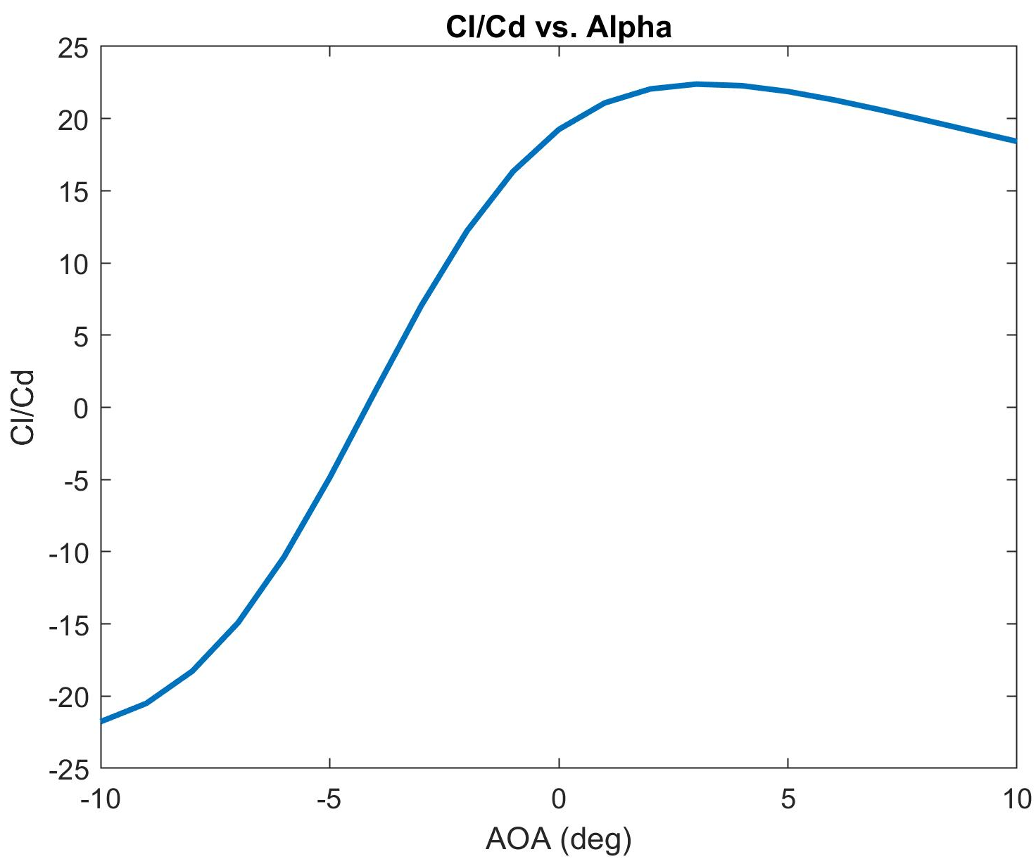
AERODYNAMIC ANALYSIS
N-22 Airfoil Cl/Cd:
Assumptions:
N-22 airfoil
C_l: obtained using PLLT
C_d derivation on previous slide
OVERVIEW | DESIGN | TESTING | MANUFACTURING | BUDGET | CONCLUSIONS | FUTURE WORK | BACK UP
Notes:
Carlin: Run through both plots
HOW TO DESCRIBE THE GRAPH
1.) Where did the data come from?
2.) Point and state axes
3.) Describe the legend 4.) Describe the trends
5.) Results
6.) Conclusions

Slide 53
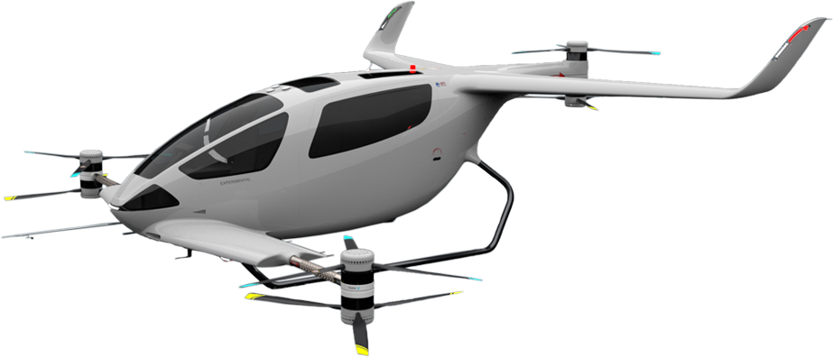
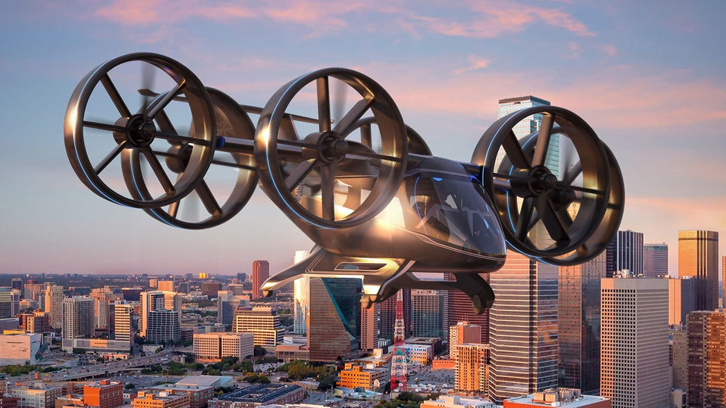
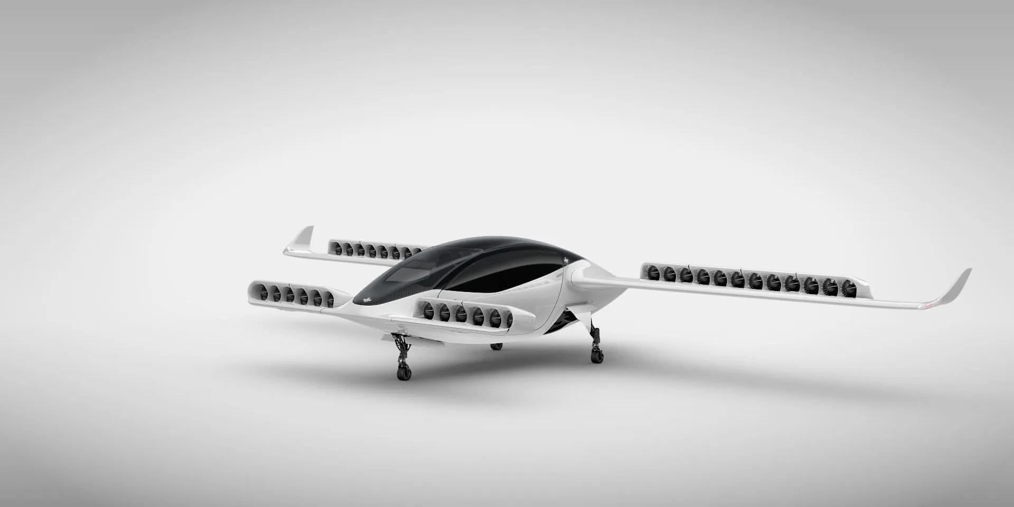
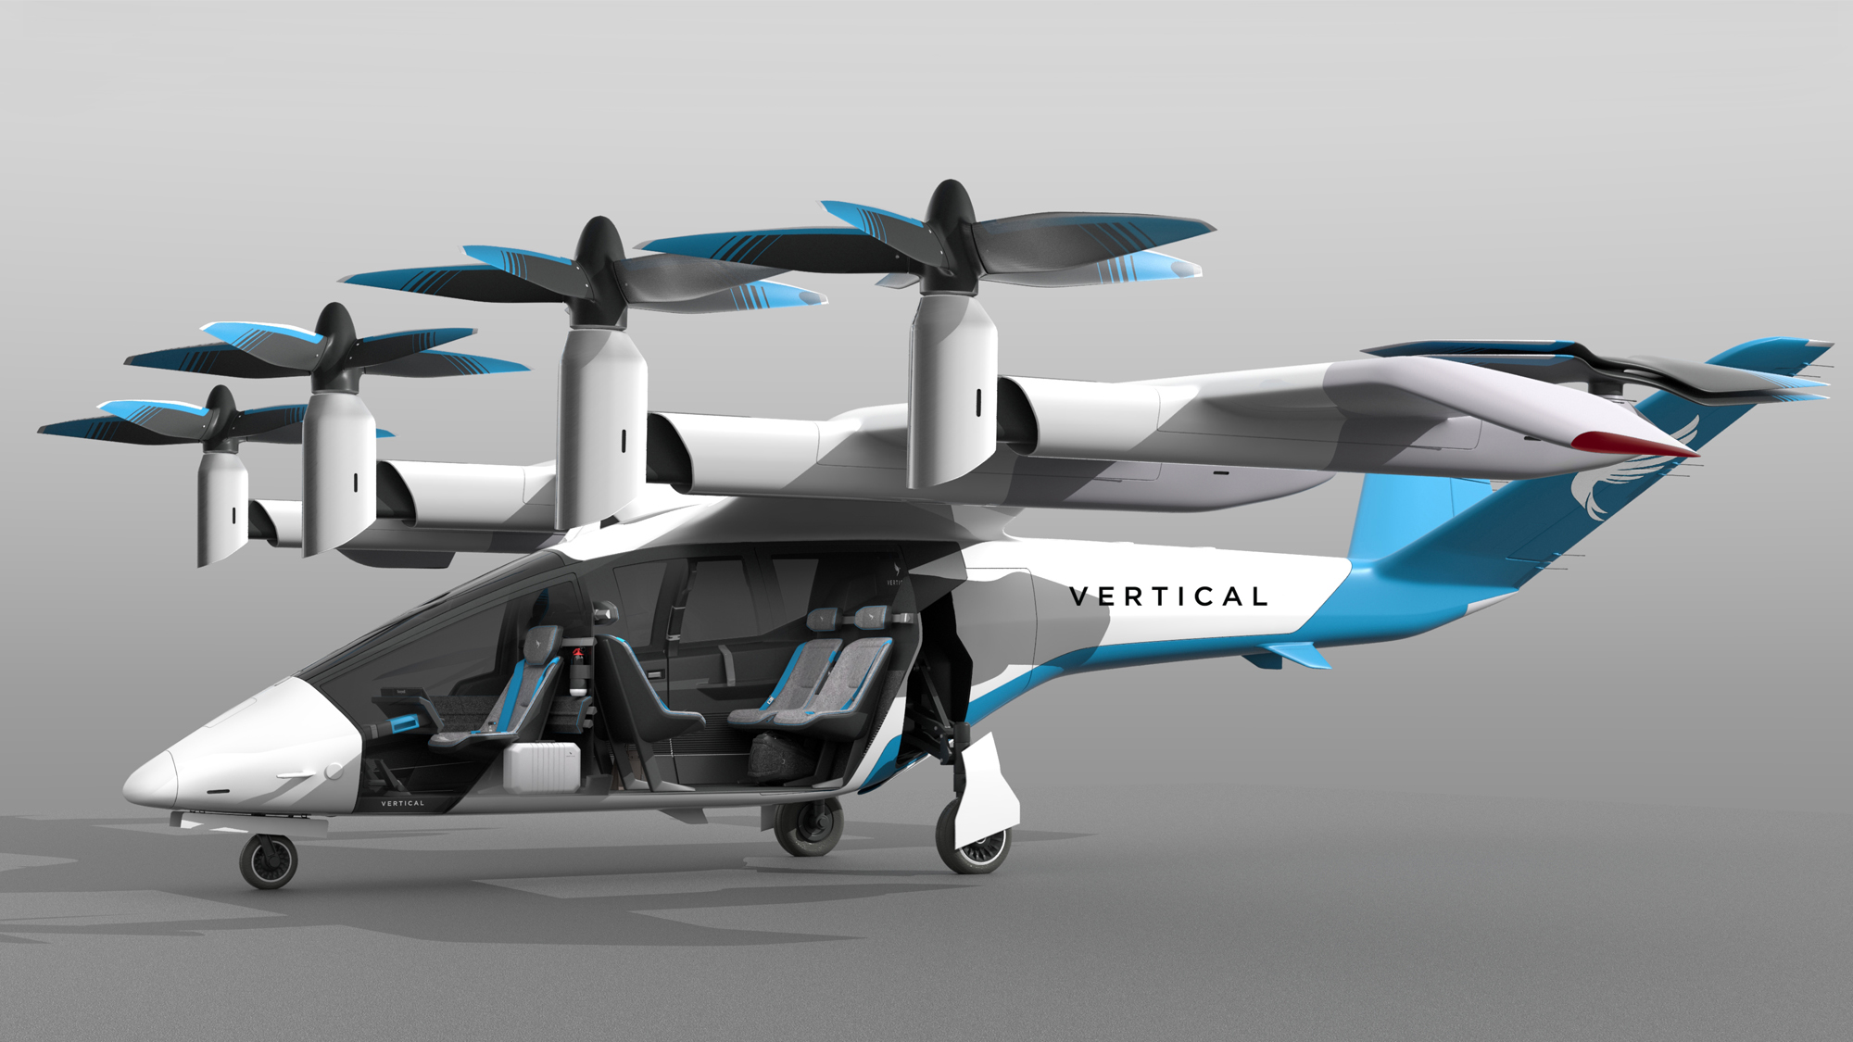
SIMILAR ELECTRIC AIRCRAFT (6-P)
A summary
Variable | Y6SPlus | Bell Nexus 6HX | Lilium Jet | VA-X4
Cruise Speed [kts] | 110 | 155 | 152 | 130
Endurance [min] | 60 | 50.5 | 53 | 40
Range (nm) | 70 | 130 | 135 | 87
Passengers | 6 | 6 | 6 | 5
Wing Span [ft] |  | 40 | 45.6 | 49.2
Y6S Plus
Bell Nexus 6HX
Lilium Jet Air Taxi
VA-X4
OVERVIEW | DESIGN | TESTING | MANUFACTURING | BUDGET | CONCLUSIONS | FUTURE WORK | BACK UP
Notes:
This slide to be referenced if the PAB has questions about FR3 - comparative range and performance for electric “aircraft”, even though these are all VTOLs

Slide 54
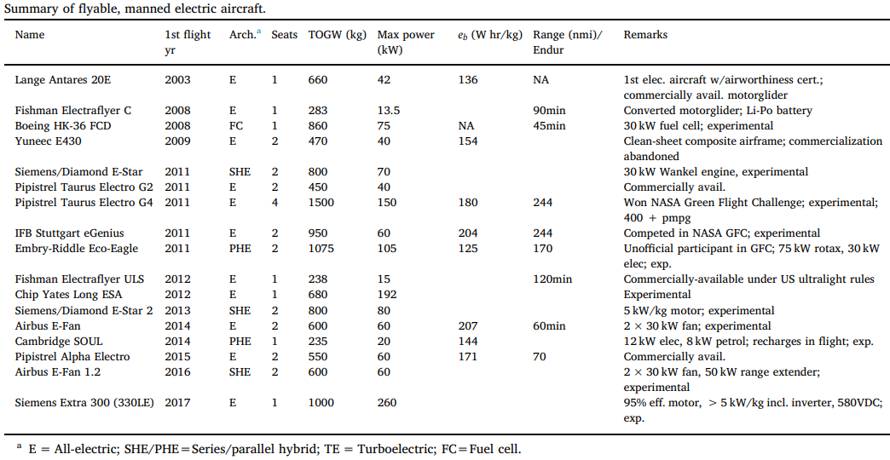
Summary of Flyable, Manned A/C
Source: https://www.sciencedirect.com/science/article/abs/pii/S0376042118300356

Slide 55
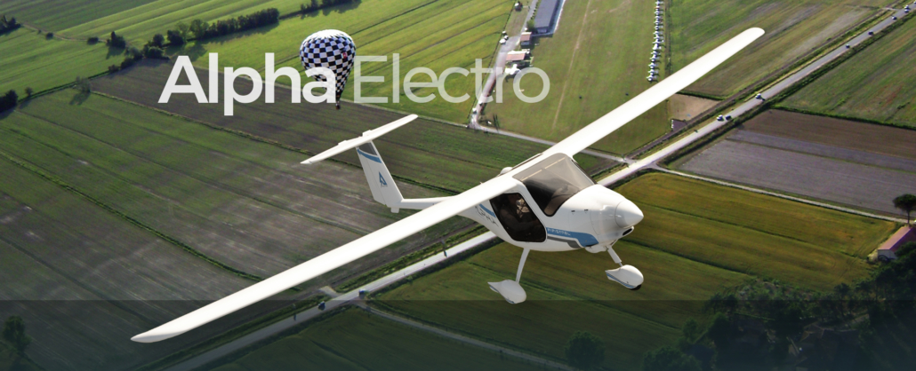
SIMILAR ELECTRIC AIRCRAFT
Pipistrel Alpha Electro
Variable | Alpha Electro
Takeoff Weight [lbs] | 1,213
Empty Weight [lbs] | 811
Power Required [hp] | 67
Cruise Speed [kts] | 85
Endurance [min] | 60
Passengers | 2
Wing Span [ft] | 34.5
Wing Area [ft²] | 102.4
OVERVIEW | DESIGN | TESTING | MANUFACTURING | BUDGET | CONCLUSIONS | FUTURE WORK | BACK UP

Slide 56
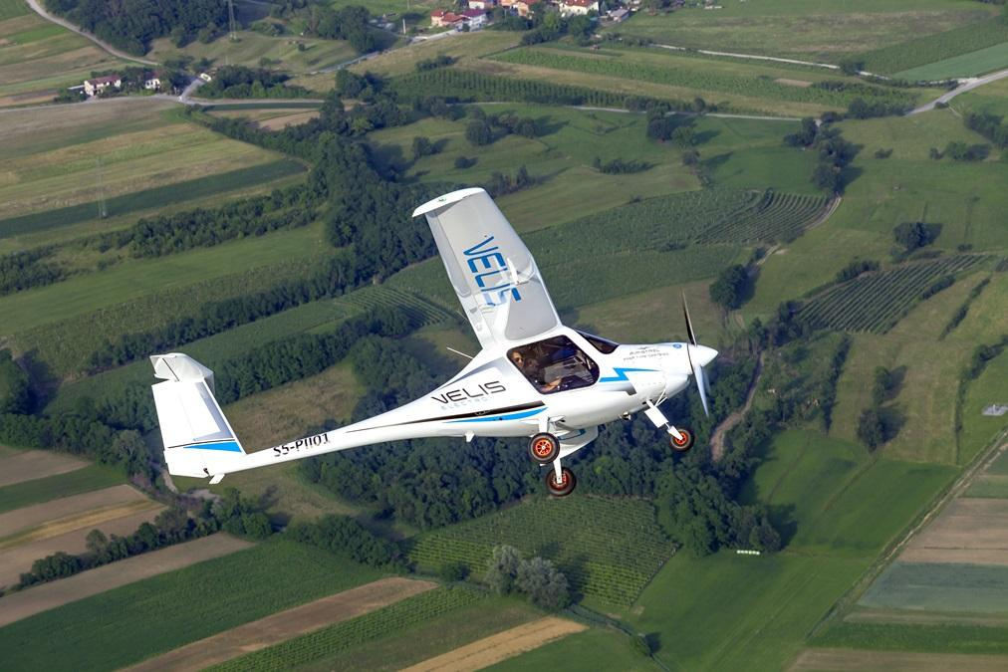
SIMILAR ELECTRIC AIRCRAFT
Pipistrel Velis
Variable | Velis
Takeoff Weight [lbs] | 1,320
Empty Weight [lbs] | 941
Power Required [hp] | 77
Cruise Speed [kts] | 90
Endurance [min] | 50
Passengers | 2
Wing Span [ft] | 102.4
Wing Area [ft²] | 35
OVERVIEW | DESIGN | TESTING | MANUFACTURING | BUDGET | CONCLUSIONS | FUTURE WORK | BACK UP

Slide 57
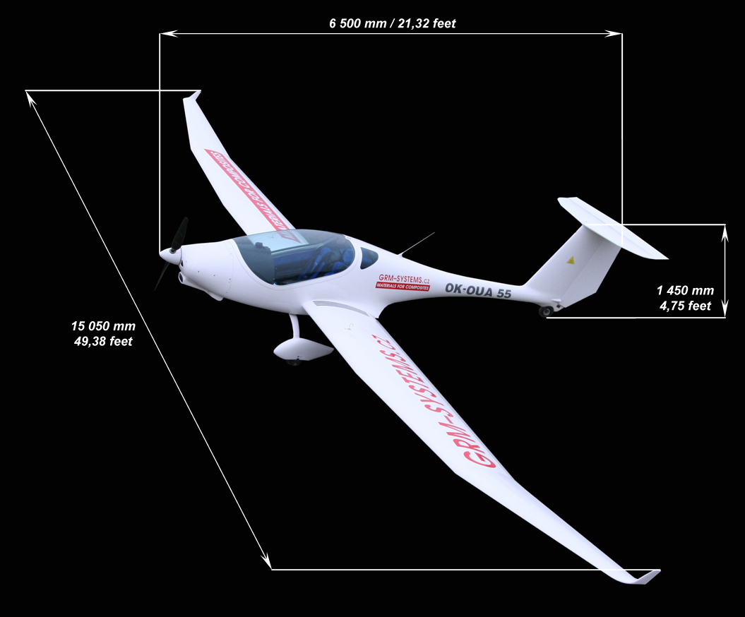
SIMILAR ELECTRIC AIRCRAFT
Phoenix Air Phoenix
Variable | Air Phoenix
Takeoff Weight [lbs] | 1,042
Empty Weight [lbs] | 650
Power Required [hp] | 100
Cruise Speed [kts] | 130
Endurance [min] | -
Passengers | 2
Wing Span [ft] | 49
Wing Area [ft²] | -
OVERVIEW | DESIGN | TESTING | MANUFACTURING | BUDGET | CONCLUSIONS | FUTURE WORK | BACK UP

Slide 58
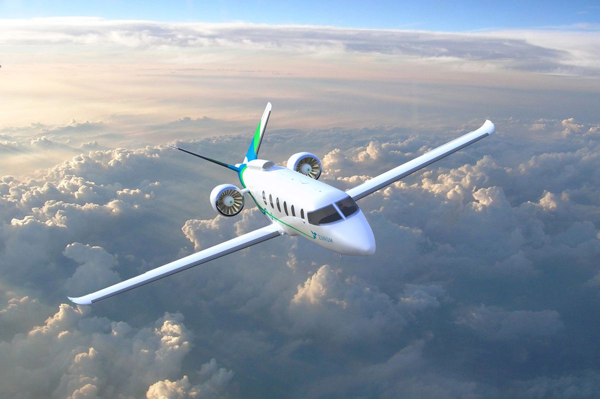
SIMILAR ELECTRIC AIRCRAFT
Zunum Aero
Variable | Aero
Takeoff Weight [lbs] | 11,500
Empty Weight [lbs] | 8,200
Power Required [hp] | 1,341
Cruise Speed [kts]
Endurance [min] | 120
Passengers | 12
Wing Span [ft] | 52
Wing Area [ft²] | -
OVERVIEW | DESIGN | TESTING | MANUFACTURING | BUDGET | CONCLUSIONS | FUTURE WORK | BACK UP

Slide 59
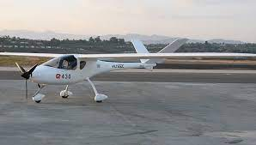
SIMILAR ELECTRIC AIRCRAFT
Yuneec International E430
Variable | E430
Takeoff Weight [lbs] | 1,037
Empty Weight [lbs] | 551
Power Required [hp] | 54
Cruise Speed [kts] | 49
Endurance [min] | 150
Passengers | 2
Wing Span [ft] | 45
Wing Area [ft²] | 122
OVERVIEW | DESIGN | TESTING | MANUFACTURING | BUDGET | CONCLUSIONS | FUTURE WORK | BACK UP

Slide 60
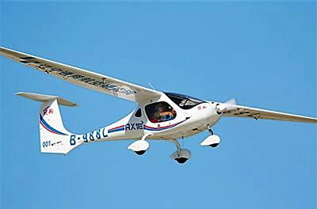
SIMILAR ELECTRIC AIRCRAFT
Liaoning Ruixiang RX1E
Variable | RX1E
Takeoff Weight [lbs] | 1,102
Empty Weight [lbs] | 595
Power Required [hp] | 40
Cruise Speed [kts] | 59
Endurance [min] | 60
Passengers | 2
Wing Span [ft] | 47.5
Wing Area [ft²] | 130
OVERVIEW | DESIGN | TESTING | MANUFACTURING | BUDGET | CONCLUSIONS | FUTURE WORK | BACK UP

Slide 61
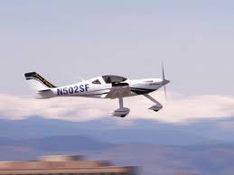
SIMILAR ELECTRIC AIRCRAFT
Bye Aerospace EFlyer 2
Variable | EFlyer 2
Takeoff Weight [lbs] | 1,900
Empty Weight [lbs] | 1,460
Power Required [hp] | 121
Cruise Speed [kts] | 55-120
Endurance [min] | 210
Passengers | 2
Wing Span [ft] | 38
Wing Area [ft²] | 129
OVERVIEW | DESIGN | TESTING | MANUFACTURING | BUDGET | CONCLUSIONS | FUTURE WORK | BACK UP

Slide 62
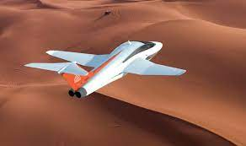
SIMILAR ELECTRIC AIRCRAFT
Samad Q-Starling
Variable | Q-Starling
Takeoff Weight [lbs] | 2,300
Empty Weight [lbs] | 1,920
Power Required [hp] | 241
Cruise Speed [kts] | 250
Endurance [min] | 100
Passengers | 2
Wing Span [ft] | 26
Wing Area [ft²] | 936.5
OVERVIEW | DESIGN | TESTING | MANUFACTURING | BUDGET | CONCLUSIONS | FUTURE WORK | BACK UP

Slide 63
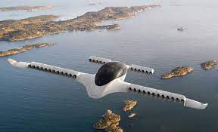
SIMILAR ELECTRIC AIRCRAFT
Lilium Air Taxi
Variable | Air Taxi
Takeoff Weight [lbs] | ~3,112
Empty Weight [lbs] | ~2,867
Power Required [hp] | 1,300
Cruise Speed [kts] | 151
Endurance [min] | 54
Passengers | 7
Wing Span [ft] | 45.6
Wing Area [ft²] | -
OVERVIEW | DESIGN | TESTING | MANUFACTURING | BUDGET | CONCLUSIONS | FUTURE WORK | BACK UP

Slide 64
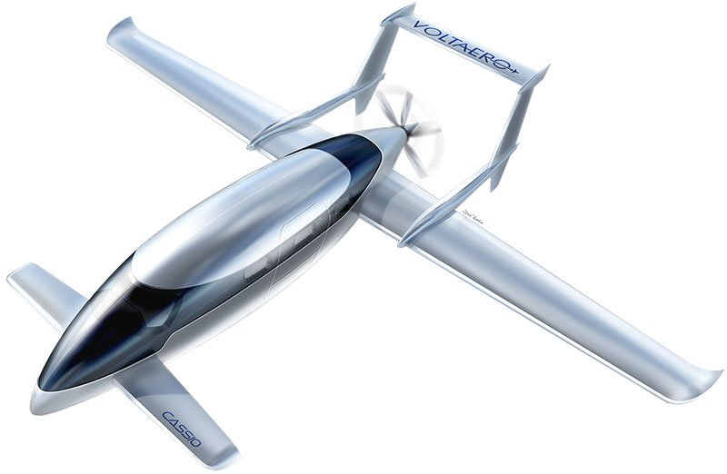
SIMILAR ELECTRIC AIRCRAFT
Voltaero Cassio 1
Variable | Cassio 1
Takeoff Weight [lbs] | 5,511
Empty Weight [lbs] | 3,800
Power Required [hp] | 400
Cruise Speed [kts] | 200
Endurance [min] | 210
Passengers | 9
Wing Span [ft] | -
Wing Area [ft²] | -
OVERVIEW | DESIGN | TESTING | MANUFACTURING | BUDGET | CONCLUSIONS | FUTURE WORK | BACK UP

Slide 65
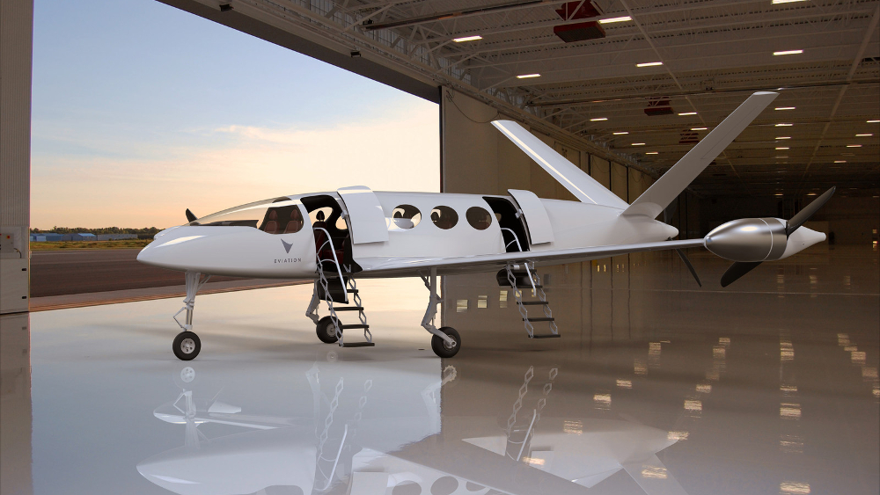
SIMILAR ELECTRIC AIRCRAFT
Eviation Alice
Variable | Alice
Takeoff Weight [lbs] | 16,500
Empty Weight [lbs] | 14,000
Power Required [hp] | 1,716.5
Cruise Speed [kts] | 250
Endurance [min] | 106
Passengers | 9
Wing Span [ft] | 63
Wing Area [ft²] | -
OVERVIEW | DESIGN | TESTING | MANUFACTURING | BUDGET | CONCLUSIONS | FUTURE WORK | BACK UP

Slide 66
AAA NOMENCLATURE
Variable | Name | Determination
𝜆_{W} | Taper Ratio | Chosen to be 0.5 from trade studies
A_{DP} | Coefficient for Total Drag Polar | Chosen to be 0
B_{DP} | Coefficient for Total Drag Polar | = 1/(𝝿*AR*e)
A_{DP_clean} | Coefficient for Drag Polar with Clean Configuration | Chosen to be 0
B_{DP_clean} | Coefficient for Drag Polar with Clean Configuration | = 1/(𝝿*AR*e_{clean})
A_{DP_L_dwn} | Coefficient for Drag Polar when Landing with Gear Down | Chosen to be 0
B_{DP_L_dwn} | Coefficient for Drag Polar when Landing with Gear Down | = 1/(𝝿*AR*e_{L})
A_{DP_TO_dwn} | Used to determine Drag Polar when Taking Off with Gear Down | Chosen to be 0
B_{DP_TO_dwn} | Used to determine Drag Polar when Taking Off with Gear Down | = 1/(𝝿*AR*e_{TO})
OVERVIEW | DESIGN | TESTING | MANUFACTURING | BUDGET | CONCLUSIONS | FUTURE WORK | BACK UP

Slide 67
AAA NOMENCLATURE
Variable | Name | Determination
AR_{W} | Wing Aspect Ratio | Chosen from trade studies
a | Regression Coefficient used to determine Parasite Area from Wetted Area | Based on desired skin drag coefficient of 0.008
b | Regression Coefficient used to determine Parasite Area from Wetted Area | Based on desired skin drag coefficient of 0.008
c | Regression Coefficient used to determine Wetted Area From Takeoff Weight | Roskam’s research on single engine propeller aircraft
d | Regression Coefficient used to determine Wetted Area From Takeoff Weight | Roskam’s research on single engine propeller aircraft
f | Parasite Area based on Wetted Area [ft²] | log(f) = a + b*log(S_{Wet})
CGR_{23.77} | FAR 23.77 (All Engines Operative) Climb Gradient | FAR 23 Requirement
C_{fe} | Equivalent Skin Friction Coefficient | = 0.0055 because Light Aircraft Single Engine
OVERVIEW | DESIGN | TESTING | MANUFACTURING | BUDGET | CONCLUSIONS | FUTURE WORK | BACK UP

Slide 68
AAA NOMENCLATURE
Variable | Name | Determination
C_{D0} | Zero Lift Drag Coefficient | = C_{fe} * (S_{wet}/S_{w}) considers current flight configuration
C_{D0_1} | Class 1 Zero Lift Drag Coefficient | = C_{fe} * (S_{wet}/S_{w}) considers entire aircraft
ΔC_{D0_1} | Change in Class 1 ZeroLift Drag | Chosen for design considerations and trade studies
C_{D0_clean} | Clean Configuration Zero Lift Drag | = C_{fe} * (S_{wet}/S_{w}) considers clean configuration
C_{D0_clean,M} | Clean Configuration Parasite Drag corrected for Mach Effects
C_{D_min} | Class 1 Minimum Drag Coefficient | = C_{D0} + B_{DP}*C_{L_min}²
C_{D_1} | Airplane Steady State Drag Coefficient | = C_{D0_1} + B_{DP}*C_{L_1}²
C_{D0_L_dwn} | Landing with Landing Gear Down and Flaps Zero Lift Drag | = C_{fe} * (S_{wet}/S_{w}) considers landing gear and flaps while landing
OVERVIEW | DESIGN | TESTING | MANUFACTURING | BUDGET | CONCLUSIONS | FUTURE WORK | BACK UP

Slide 69
AAA NOMENCLATURE
Variable | Name | Determination
ΔC_{D0_L_dwn} | Change in C_{D0} with landing gear down while landing with flaps | Chosen for design considerations and trade studies
C_{D0_TO_dwn} | Takeoff with Landing Gear Down and Flaps Zero Lift Drag | = C_{fe} * (S_{wet}/S_{w}) includes landing gear and flaps during takeoff
ΔC_{D0_TO_dwn} | Change in C_{D0} with landing gear down during takeoff | Chosen for design considerations and trade studies
C_{L_plot_min} | Minimum coefficient of lift for constraint plots | Chosen for design considerations and optimization of plots
C_{L_plot_max} | Maximum coefficient of lift for constraint plots | Chosen for design considerations and optimization of plots
ΔC_{L_Cl-max} | Change in Maximum Lift Coefficient During Climb | Chosen for design considerations and trade studies
OVERVIEW | DESIGN | TESTING | MANUFACTURING | BUDGET | CONCLUSIONS | FUTURE WORK | BACK UP

Slide 70
AAA NOMENCLATURE
Variable | Name | Determination
ΔC_{L_max} | Change in Maximum Lift Coefficient | Chosen for design considerations and trade studies
C_{L_max_clean} | Maximum Lift Coefficient for Clean Configuration | Roskam’s research on single engine propeller aircraft
C_{L_max_L} | Maximum Lift Coefficient at Landing | Roskam’s research on single engine propeller aircraft
C_{L_max_S_cln} | Maximum Lift Coefficient at Stall for Clean Configuration | Roskam’s research on single engine propeller aircraft
C_{L_max_S} | Maximum Lift Coefficient at Stall with Flaps | Roskam’s research on single engine propeller aircraft
C_{L_max_TO} | Maximum Lift Coefficient at Takeoff | Roskam’s research on single engine propeller aircraft
C_{L@C_D_min} | Maximum Lift Coefficient at Min drag coefficient | = sqrt((C_{D_Min} - C_{D0})/B_{DP})
C_{L_1} | Airplane Steady State Lift Coefficient | = (n*W_{current})/(q₁*S_{W})
OVERVIEW | DESIGN | TESTING | MANUFACTURING | BUDGET | CONCLUSIONS | FUTURE WORK | BACK UP

Slide 71
AAA NOMENCLATURE
Variable | Name | Determination
e | Total Span Efficiency Factor | Roskam’s research on single engine propeller aircraft
e_{clean} | Clean Configuration Span Efficiency Factor | Roskam’s research on single engine propeller aircraft
e_{L} | Landing Span Efficiency Factor | Roskam’s research on single engine propeller aircraft
e_{TO} | Takeoff Span Efficiency Factor | Roskam’s research on single engine propeller aircraft
F_{TO} | Power Ratio at Takeoff | Power at Takeoff/Max Power
F₅₀₀₀ | Power Ratio at 5000 ft Altitude | Power @ 5000 ft/Maximum Power
F_{Cr} | Power Ratio at Cruise | Power at Cruise/Maximum Power
F_{M} | Power Ratio During Maneuver | Power at Maneuver/Maximum Power
F_{MaxCont} | Power Ratio for Maximum Continuous Thrust | Maximum Continuous Power/ Maximum Power
OVERVIEW | DESIGN | TESTING | MANUFACTURING | BUDGET | CONCLUSIONS | FUTURE WORK | BACK UP

Slide 72
AAA NOMENCLATURE
Variable | Name | Determination
h_{cr} | Cruise Altitude | Chosen from current electric aircraft competition
h_{L} | Altitude at Landing | Altitude at Rocky Mountain Regional Airport
h_{M} | Altitude for Maneuver | Altitude at Rocky Mountain Regional Airport, assuming maneuver during takeoff in case of emergency
h_{S} | Altitude at Stall Out | Altitude at Rocky Mountain Regional Airport, assuming stall during takeoff in case of emergency
h_{TO} | Altitude at Takeoff | Altitude at Rocky Mountain Regional Airport
L/D | Lift to Drag Ratio for the Aircraft | = C_{L_1}/C_{D_1}
M_{Cr_Max} | Critical Mach Number During Cruise | = V_{Cr_Max}/628.27 (628.27 kts = Speed of Sound @ 14,000 ft)
M_{M} | Maneuver Mach Number | = V_{M}/648.26 ( 648.26 kts = Speed of Sound @ 5,673 ft)
ƞ_{⅀prop} | Propeller Efficiency Factor | Determined from current propeller market
OVERVIEW | DESIGN | TESTING | MANUFACTURING | BUDGET | CONCLUSIONS | FUTURE WORK | BACK UP

Slide 73
AAA NOMENCLATURE
Variable | Name | Determination
n_{M} | Number of g’s pulled during maneuver | = 1/cos(15°) [15° is a FAR 23 Requirement for banked turns]
q₁ | Dynamic Pressure [lbs/ft²] | = 0.5*⍴*V_{Cr_max}²
RC/V_{s}² | FAR 23.67 Requirement | Rate of Climb/(Stall Speed)²
S_{L} | Landing Distance | = 0.6 * S_{TO}
S_{TO} | Takeoff Distance | Runway at Rocky Mountain Regional Airport
S_{TOG} | Ground Roll Distance | = S_{TO}/1.66
S_{W} | Wing Area [ft²] | Optimal design point on performance plot
S_{WET} | Aircraft Wetted Area [ft²] | log(S_{WET}) = c + d*log(W_{TO})
ΔT | Change Temperature | Chosen for design considerations and trade studies
ΔT_{TO} | Change Temperature @ Takeoff | Chosen for design considerations and trade studies
OVERVIEW | DESIGN | TESTING | MANUFACTURING | BUDGET | CONCLUSIONS | FUTURE WORK | BACK UP

Slide 74
AAA NOMENCLATURE
Variable | Name | Determination
TurnRate | Turn Rate during Maneuver [rad/s] | = g*sqrt(n_{M}² - 1)/V_{M}
U₁ = V_{Cr_Max} | Cruise Speed [kts] | Provided by customer
V_{L} | Landing Approach Velocity [kts] | = 1.4 * S_{L}
V_{M} | Maneuver Speed [kts] | = 1.4 * V_{S}
V_{S} | Stall Speed with Flaps [kts] | FAR 23 requirement to have stall speed of 61 kts
W_{E} | Empty Weight [lbs] | Intersection of regression and sum
W_{Cr}/W_{TO} | Mid Cruise to Takeoff Weight Ratio | Equal to 1 because no weight lost during mission
W_{L}/W_{TO} | Landing to Takeoff Weight Ratio | Equal to 1 because no weight lost during mission
W_{M}/W_{TO} | Maneuver to Takeoff Weight Ratio | Equal to 1 because no weight lost during mission
OVERVIEW | DESIGN | TESTING | MANUFACTURING | BUDGET | CONCLUSIONS | FUTURE WORK | BACK UP

Slide 75
AAA NOMENCLATURE
Variable | Name | Determination
W_{S}/W_{TO} | Stall to Takeoff Weight Ratio | = 1 because no weight lost during mission
W_{TO} | Takeoff Weight [lbs] | Intersection of regression and sum
(W/S)_{TO_S_cln} | Wing Loading for Takeoff Weight at Stall for Clean Configuration | = 0.5 * C_{L_max_S_cln} * ⍴ * V_{S_Clean}²
(W/S)_{L} | Wing Loading for Landing with Flaps | = 0.5 * C_{L_max_L} * ⍴ * V_{L}²
(W/S)_{TO_S} | Wing Loading for Takeoff Weight at Stall with Flaps | = 0.5 * C_{L_TO} * ⍴ * V_{Cr_max}²
V_{S_clean} | Stall Speed with Clean Configuration [kts] | FAR 23 Requirement of 61 kts for a stall speed
OVERVIEW | DESIGN | TESTING | MANUFACTURING | BUDGET | CONCLUSIONS | FUTURE WORK | BACK UP

Slide 76
AAA DRAG POLAR CALCULATIONS
Takeoff, Flaps, Gear Down Drag Polars:
OVERVIEW | DESIGN | TESTING | MANUFACTURING | BUDGET | CONCLUSIONS | FUTURE WORK | BACK UP

Slide 77
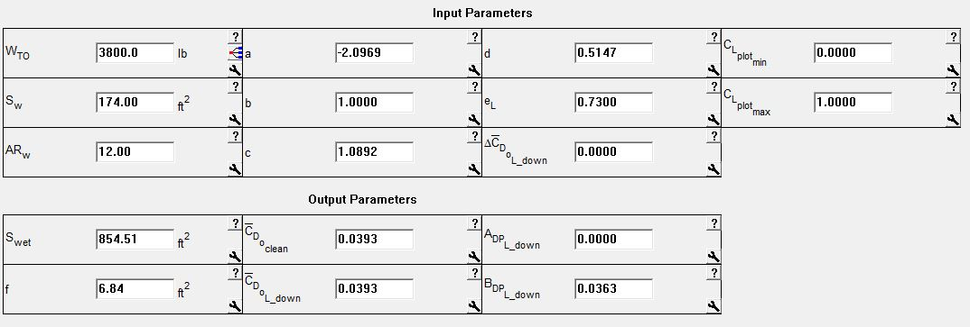
AAA DRAG POLAR CALCULATIONS
Landing, Flaps, Gear Down Drag Polars:
OVERVIEW | DESIGN | TESTING | MANUFACTURING | BUDGET | CONCLUSIONS | FUTURE WORK | BACK UP

Slide 78
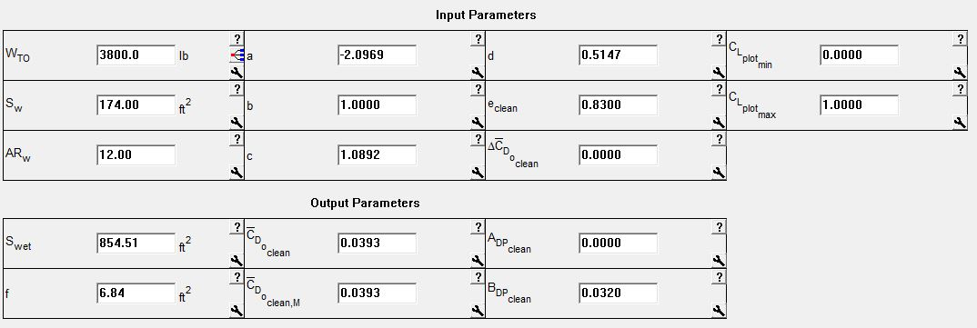
AAA DRAG POLAR CALCULATIONS
Clean Configuration Drag Polars:
OVERVIEW | DESIGN | TESTING | MANUFACTURING | BUDGET | CONCLUSIONS | FUTURE WORK | BACK UP

Slide 79
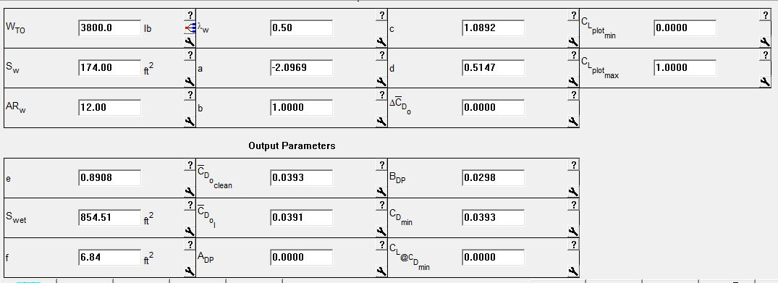
AAA DRAG POLAR CALCULATIONS
Current Flight Condition Drag Polars:
OVERVIEW | DESIGN | TESTING | MANUFACTURING | BUDGET | CONCLUSIONS | FUTURE WORK | BACK UP

Slide 80
AAA DRAG POLAR CALCULATIONS
All Drag Polar Inputs:
OVERVIEW | DESIGN | TESTING | MANUFACTURING | BUDGET | CONCLUSIONS | FUTURE WORK | BACK UP

Slide 81
AAA DRAG POLAR CALCULATIONS
All Output Drag Polars:
OVERVIEW | DESIGN | TESTING | MANUFACTURING | BUDGET | CONCLUSIONS | FUTURE WORK | BACK UP

Slide 82
AAA FLIGHT REQUIREMENTS AND PERFORMANCE
Takeoff Requirements:
OVERVIEW | DESIGN | TESTING | MANUFACTURING | BUDGET | CONCLUSIONS | FUTURE WORK | BACK UP

Slide 83
AAA FLIGHT REQUIREMENTS AND PERFORMANCE
Climb Requirements:
OVERVIEW | DESIGN | TESTING | MANUFACTURING | BUDGET | CONCLUSIONS | FUTURE WORK | BACK UP

Slide 84
AAA FLIGHT REQUIREMENTS AND PERFORMANCE
Cruise Requirements:
OVERVIEW | DESIGN | TESTING | MANUFACTURING | BUDGET | CONCLUSIONS | FUTURE WORK | BACK UP

Slide 85
AAA FLIGHT REQUIREMENTS AND PERFORMANCE
Maneuver Requirements:
OVERVIEW | DESIGN | TESTING | MANUFACTURING | BUDGET | CONCLUSIONS | FUTURE WORK | BACK UP

Slide 86
AAA FLIGHT REQUIREMENTS AND PERFORMANCE
Stall Speed Requirements:
OVERVIEW | DESIGN | TESTING | MANUFACTURING | BUDGET | CONCLUSIONS | FUTURE WORK | BACK UP

Slide 87
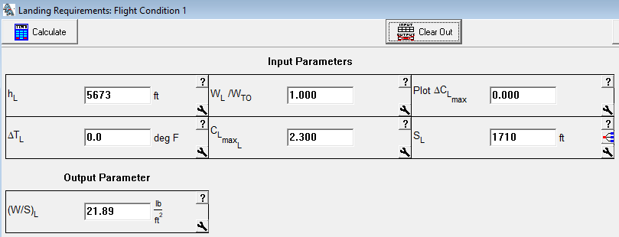
AAA FLIGHT REQUIREMENTS AND PERFORMANCE
Landing Requirements:
OVERVIEW | DESIGN | TESTING | MANUFACTURING | BUDGET | CONCLUSIONS | FUTURE WORK | BACK UP

Slide 88
AAA FLIGHT REQUIREMENTS AND PERFORMANCE
1st Iteration Wing Geometry:
OVERVIEW | DESIGN | TESTING | MANUFACTURING | BUDGET | CONCLUSIONS | FUTURE WORK | BACK UP

Slide 89
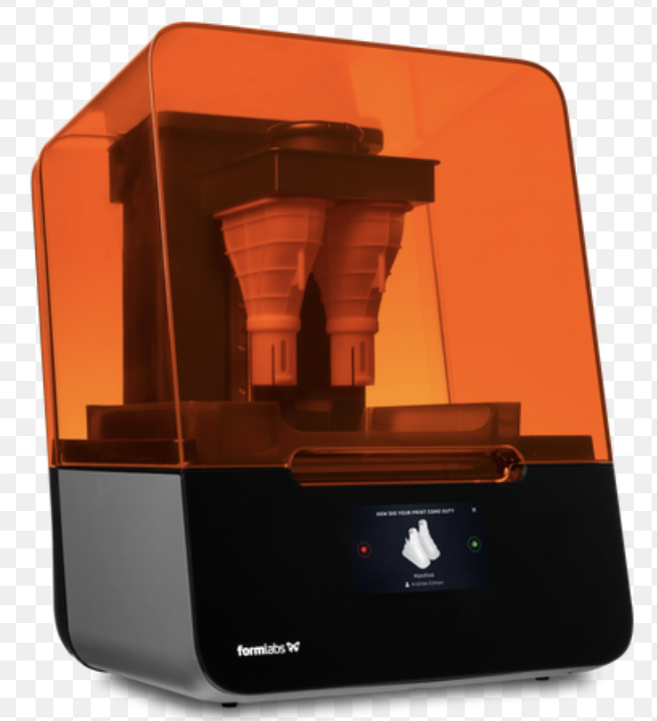
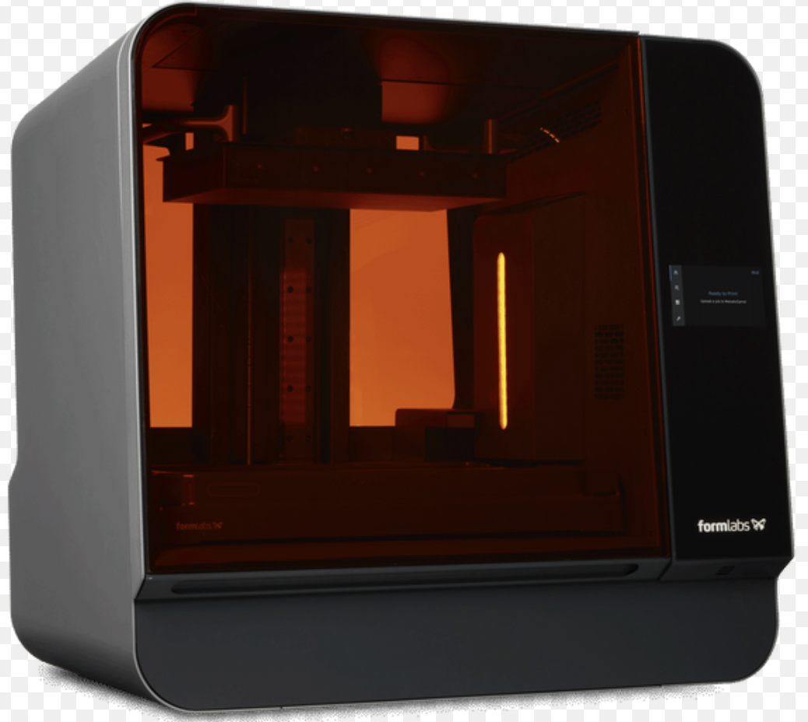
WTAV MODEL CONSTRUCTION
 | Form 3 | Form 3L
Build Volume | 14.5 × 14.5 × 18.5 cm (5.7 × 5.7 × 7.3 in) | 33.5 × 20 × 30 cm (13.2 × 7.9 × 11.8 in)
Resolution | 25 μm | 25 μm
Access | ITLL | Outsourced
Cost | ~$25 | ~$100
Print Time | 10-15 hours | 2-3 weeks
OVERVIEW | DESIGN | TESTING | MANUFACTURING | BUDGET | CONCLUSIONS | FUTURE WORK | BACK UP

Slide 90
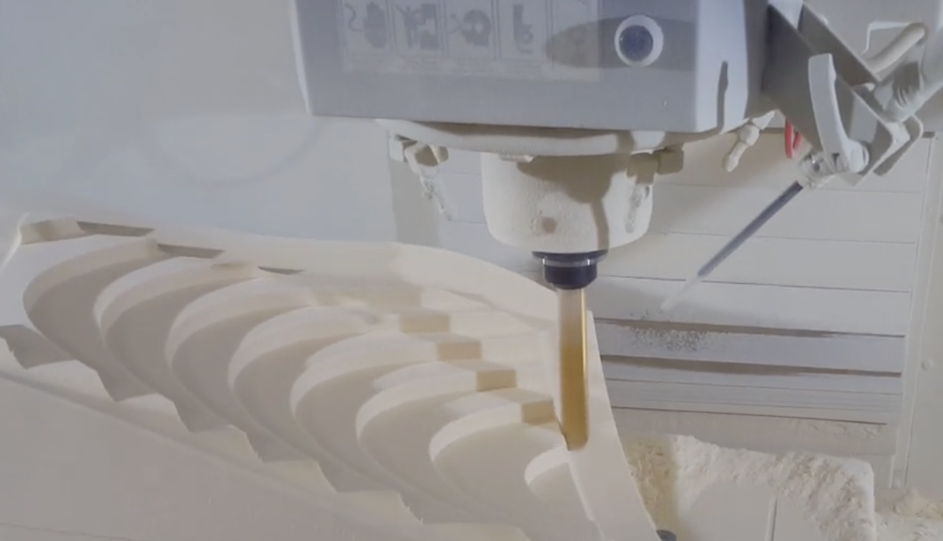
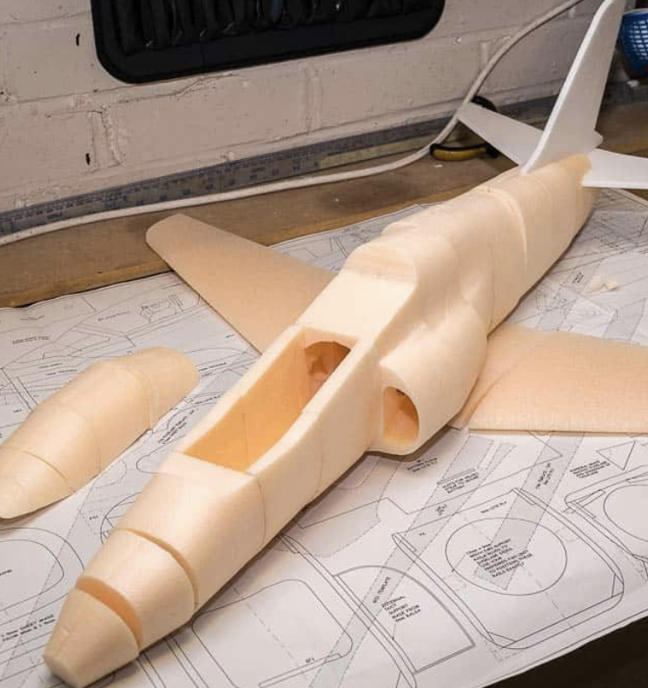
CSD MODEL CONSTRUCTION
CNC Machining of high density foam is feasible with the mills available to us at both the ITLL and Aerospace manufacturing center.
Extensive work with learning SolidCam and Solid Works will be crucial in achieving these models.
Components such as the tail and wings can be manufactured several times for replacements.
Each piece will be assembled using glue and struts when applicable
OVERVIEW | DESIGN | TESTING | MANUFACTURING | BUDGET | CONCLUSIONS | FUTURE WORK | BACK UP

Slide 91
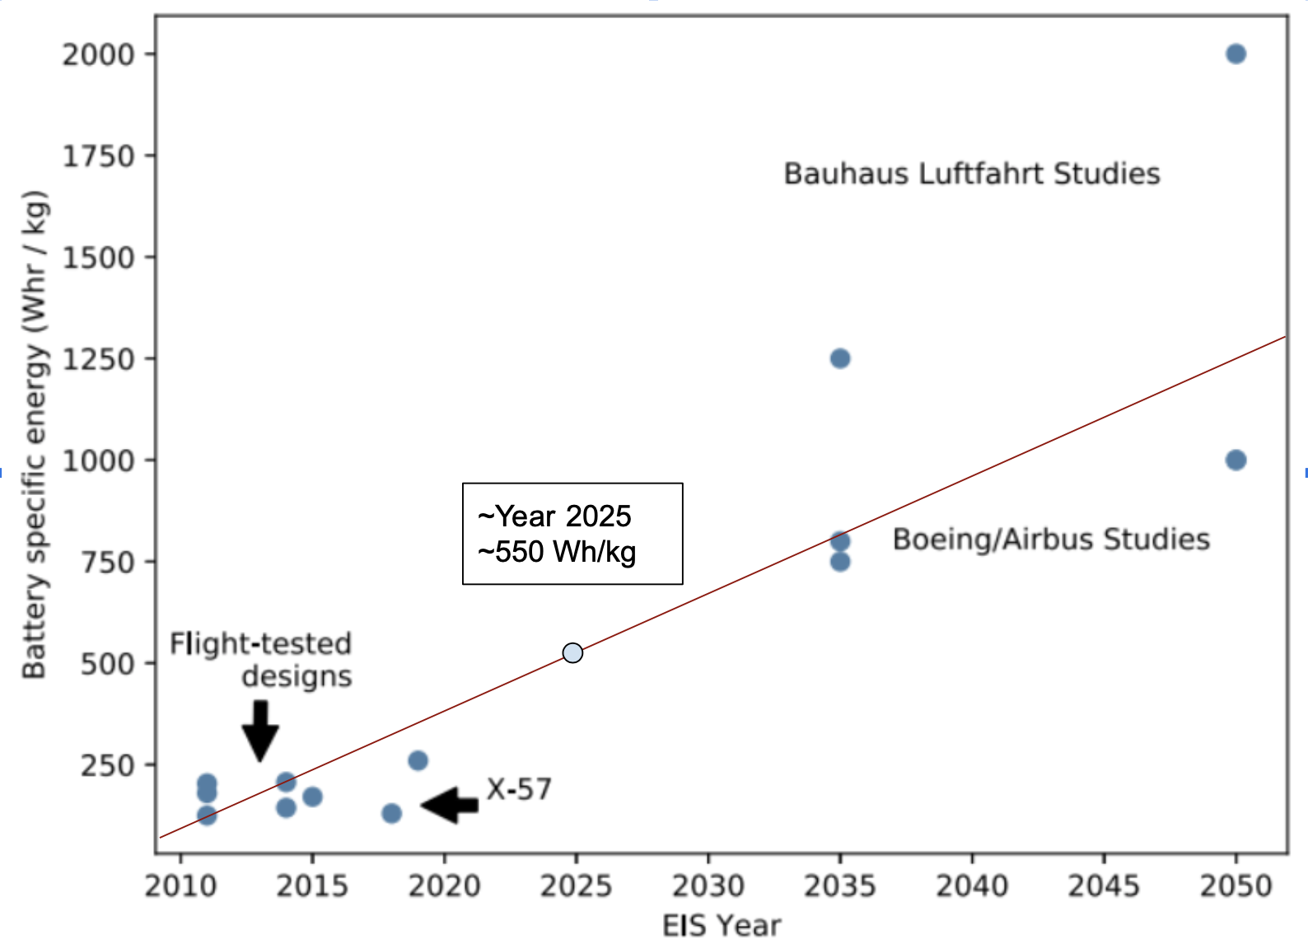
LITHIUM METAL SOLID STATE BATTERIES
Volumetric Energy Density | Specific Energy
580 Wh/kg | 1377 Wh/L
Necessary Assumptions:
Composition: Anode Lithium metal (β-Li), solid electrolyte (β-Li3PS4) and active cathode (Li(Ni0.6Co0.2Mn0.2)O2
Efficiency: 90 percent Efficiency was assumed for all battery types
Formability: The Cathode, Electrolyte and Anode layers are not only sufficiently thin but also pliable to configure in most simple Geometries (i.e. a wing)
-Benjamin J. Brelje∗
Joaquim R.R.A. Martins
University of Michigan, Department of
Aerospace Engineering, MI, USA
OVERVIEW | DESIGN | TESTING | MANUFACTURING | BUDGET | CONCLUSIONS | FUTURE WORK | BACK UP

Slide 92
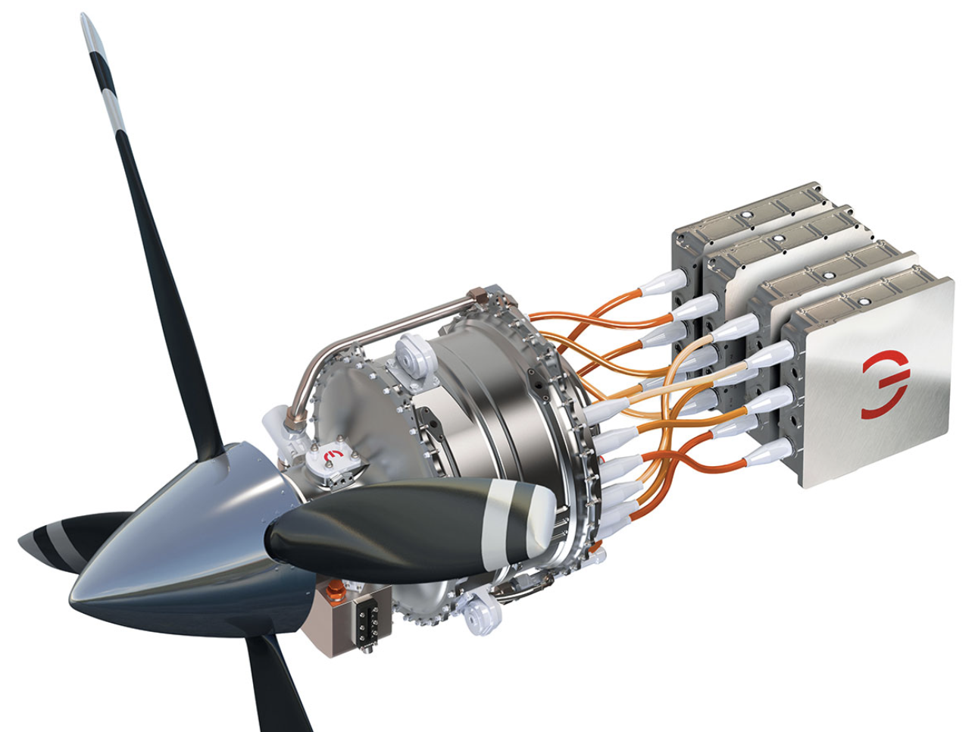
BRUSHLESS ELECTRIC PROPULSION UNIT
 | MagniX 350 | Design Requirement
Continuous Power Output | 280 kW / 381 Hp | 346 Hp -AAA
Max. Power Output | 350 kW / 476 Hp | ~
Continuous Torque | 1410 Nm | ~
Max. Torque | 1610 Nm | ~
Output RPM | 1200-2300 RPM | ~
Dry Weight | 112 kg / 246 lbs | TBD
Operating Volt. | 500-800 VDC | ~
Service Ceiling | 35,000 ft | 20,000 ft
OVERVIEW | DESIGN | TESTING | MANUFACTURING | BUDGET | CONCLUSIONS | FUTURE WORK | BACK UP

Slide 93
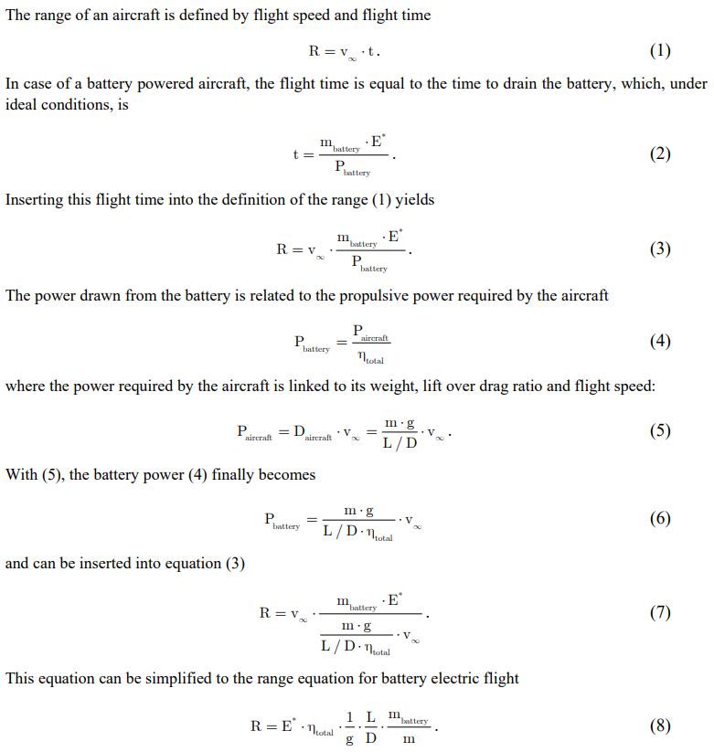
ELECTRIC AIRCRAFT
RANGE EQUATION 1
Source: Electric Flight – Potential and Limitations, Martin Hepperle, German Aerospace Center
Full Source: Microsoft Word - MP-AVT-209-09.doc (dlr.de)
Back
OVERVIEW | DESIGN | TESTING | MANUFACTURING | BUDGET | CONCLUSIONS | FUTURE WORK | BACK UP

Slide 94
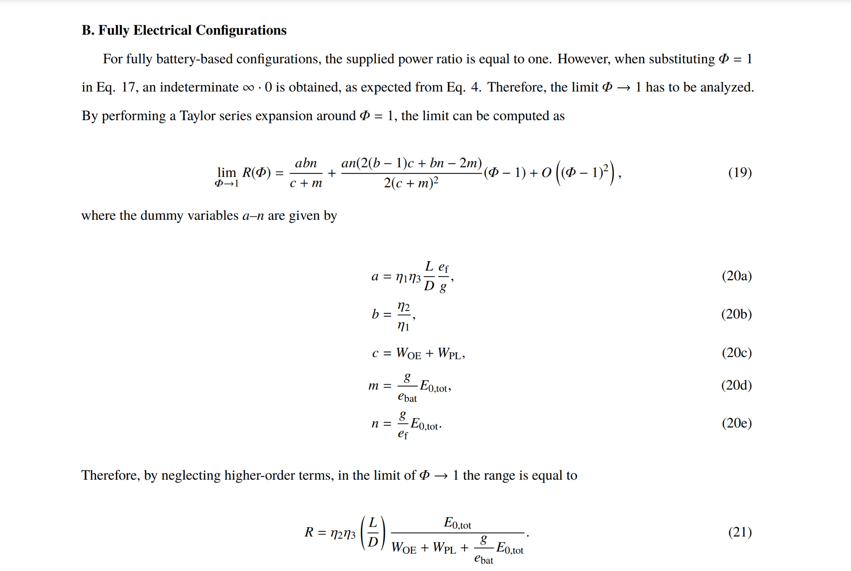
ELECTRIC AIRCRAFT
RANGE EQUATION 2
Source: Range Equation for Hybrid-Electric Aircraft with Constant Power Split
Full Source: Electric Range
OVERVIEW | DESIGN | TESTING | MANUFACTURING | BUDGET | CONCLUSIONS | FUTURE WORK | BACK UP

Slide 95
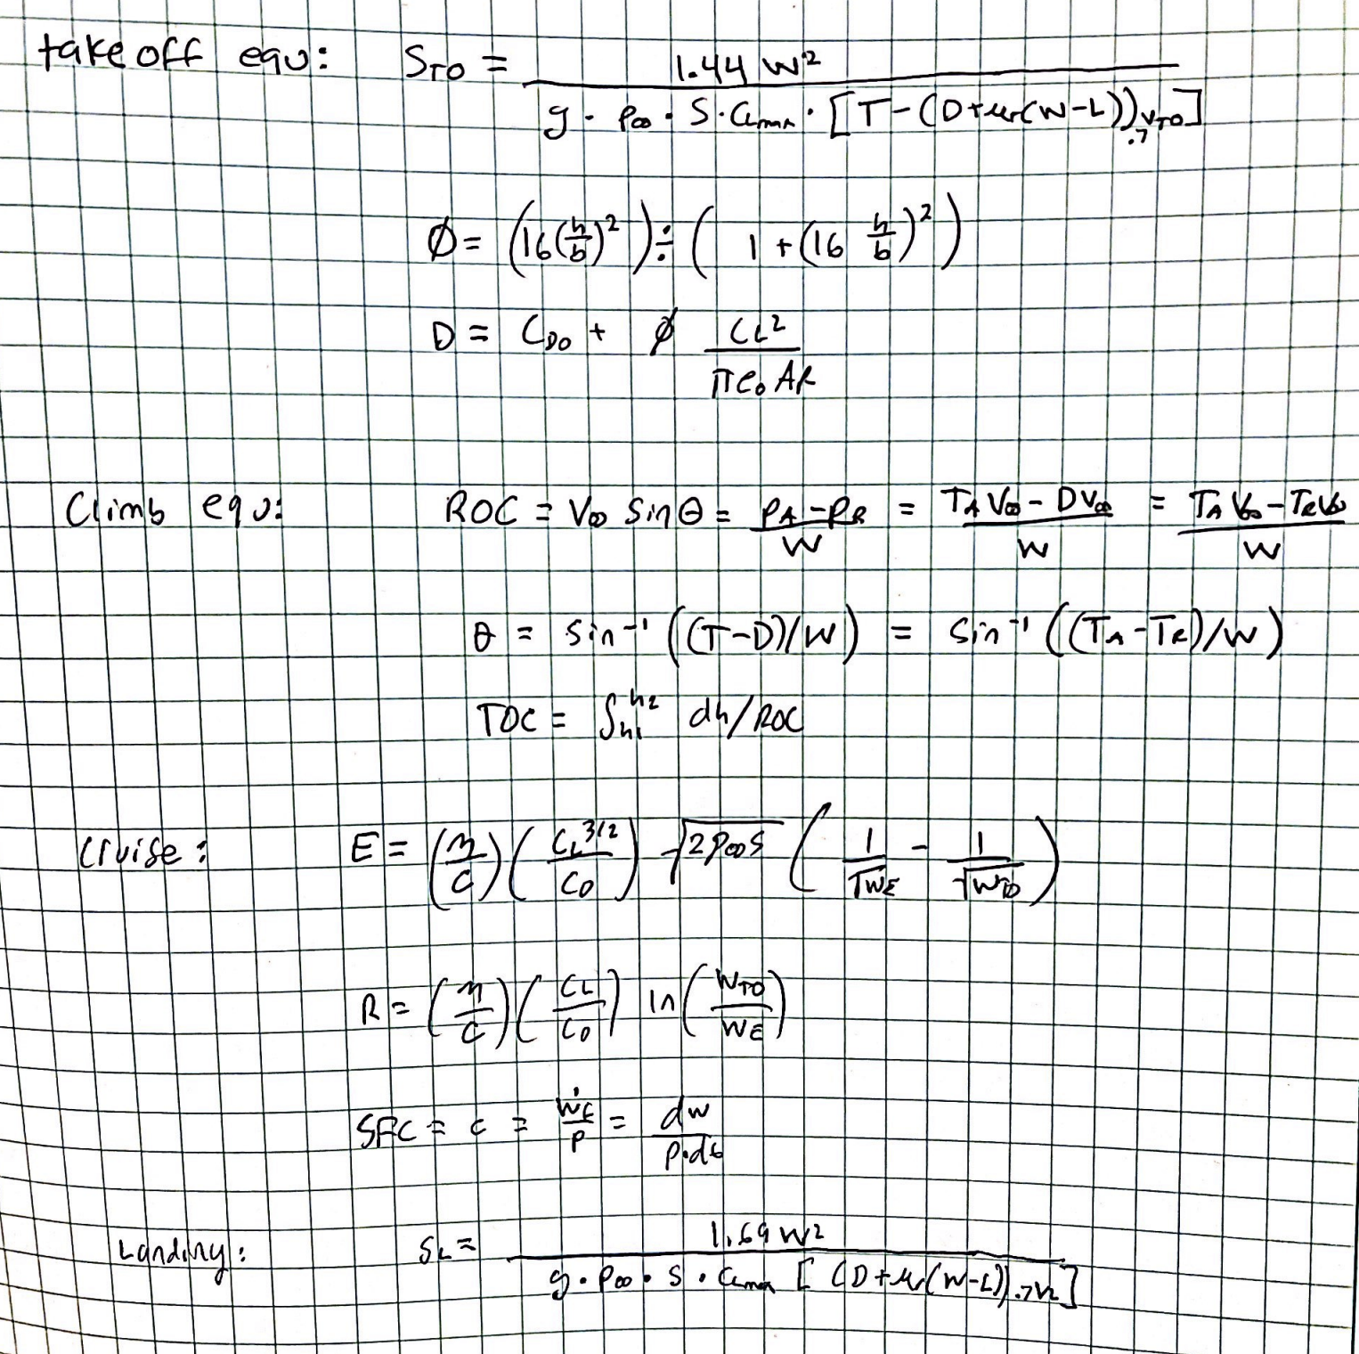
BASELINE METHODOLOGY CODE
OVERVIEW | DESIGN | TESTING | MANUFACTURING | BUDGET | CONCLUSIONS | FUTURE WORK | BACK UP

Slide 96
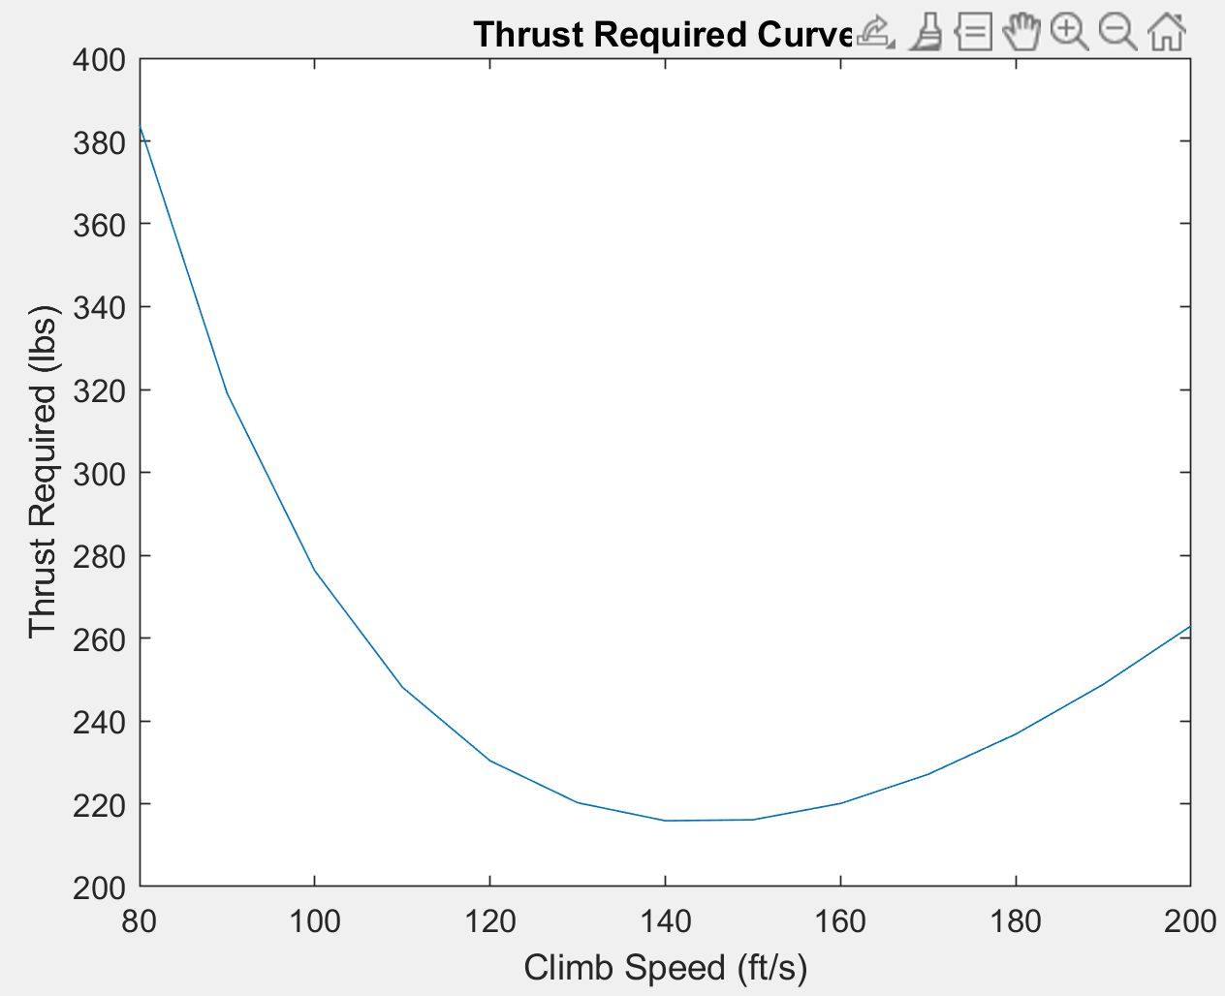
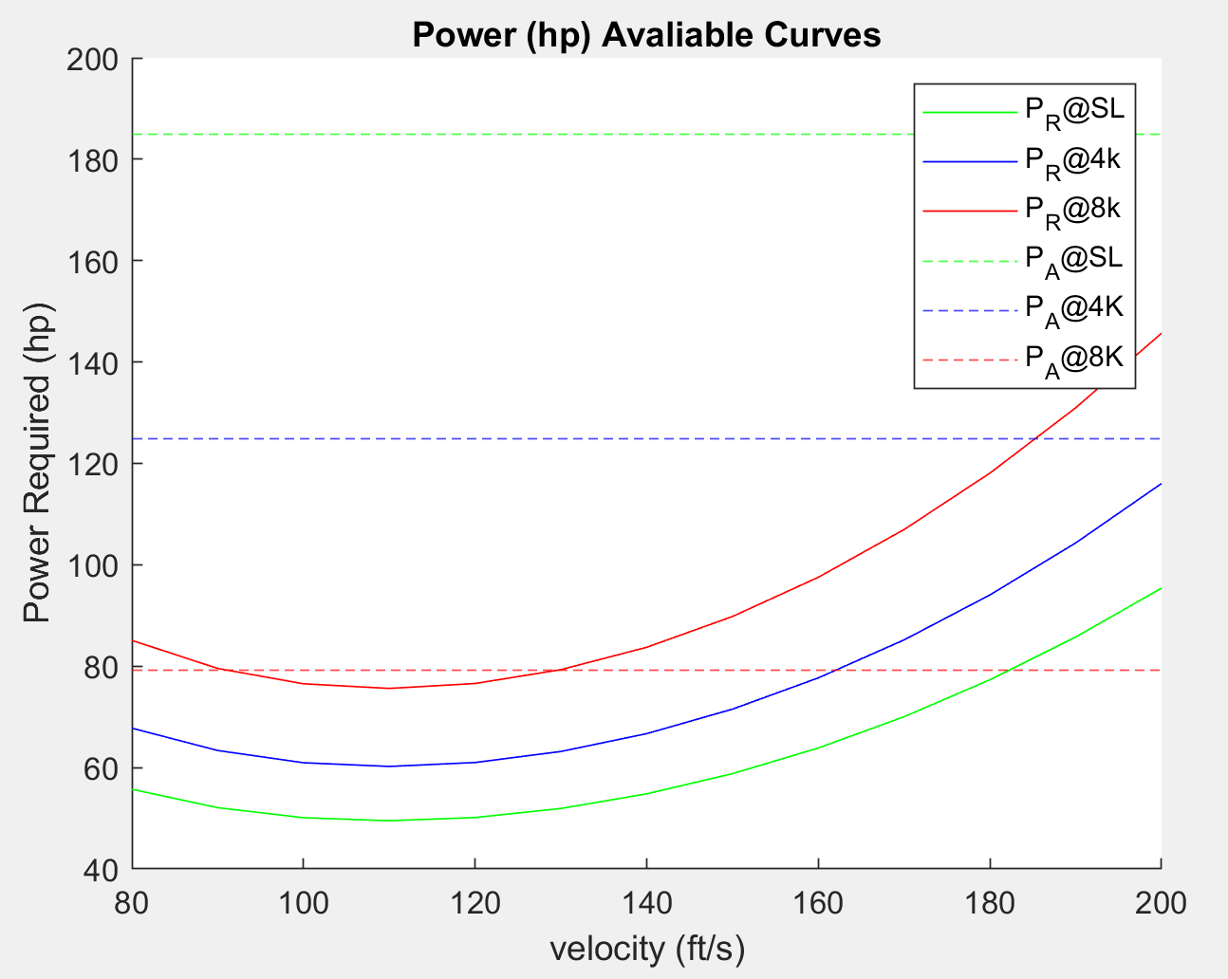
BASELINE METHODOLOGY CODE
OVERVIEW | DESIGN | TESTING | MANUFACTURING | BUDGET | CONCLUSIONS | FUTURE WORK | BACK UP

Slide 97
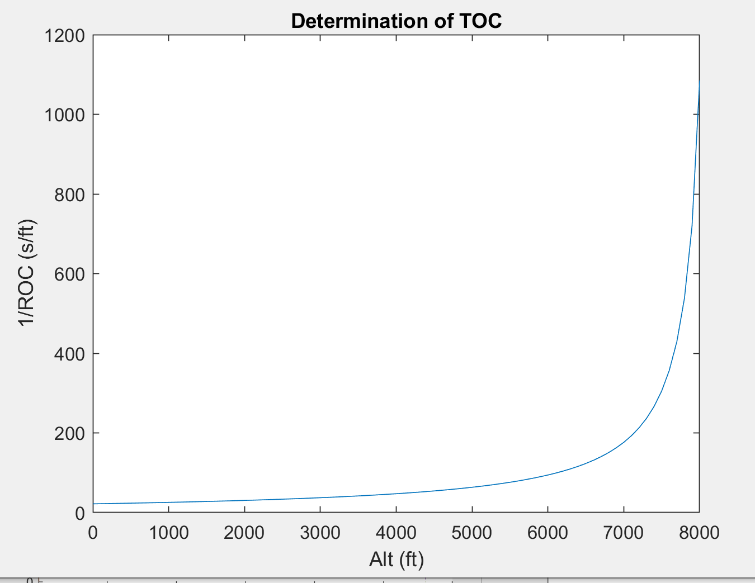
BASELINE METHODOLOGY CODE
OVERVIEW | DESIGN | TESTING | MANUFACTURING | BUDGET | CONCLUSIONS | FUTURE WORK | BACK UP

Slide 98
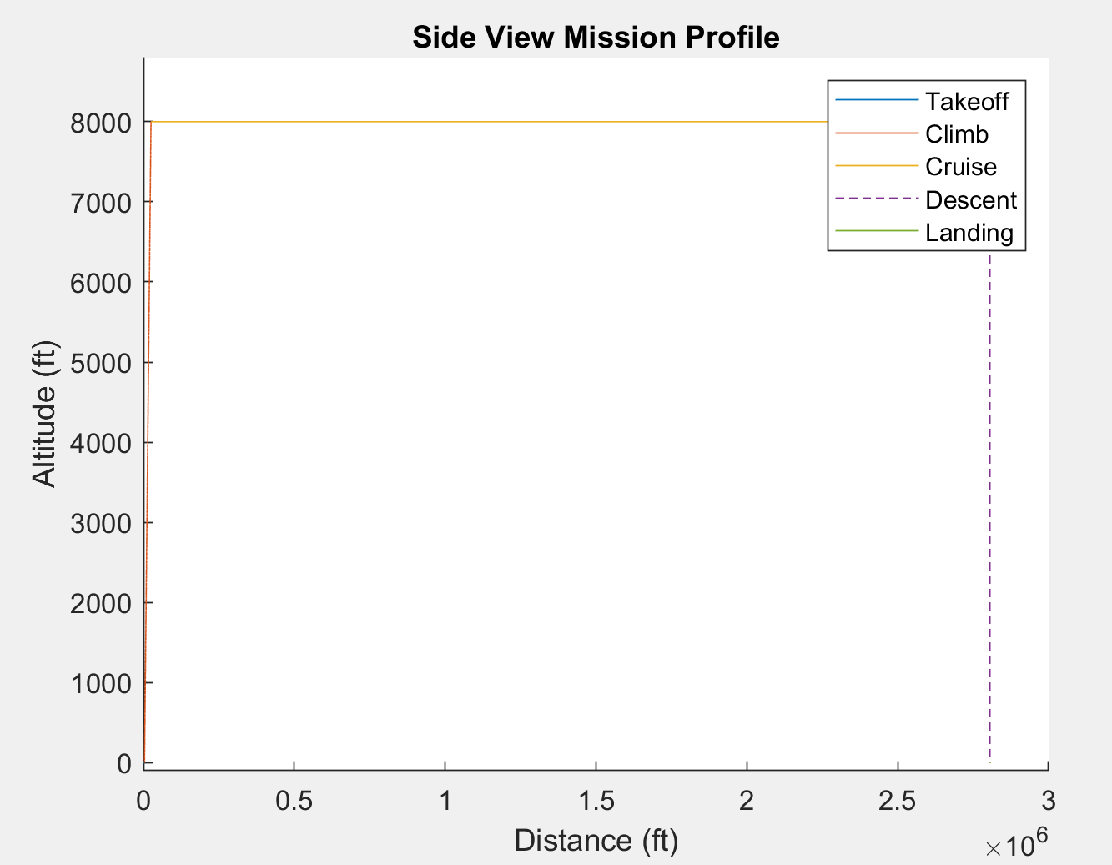
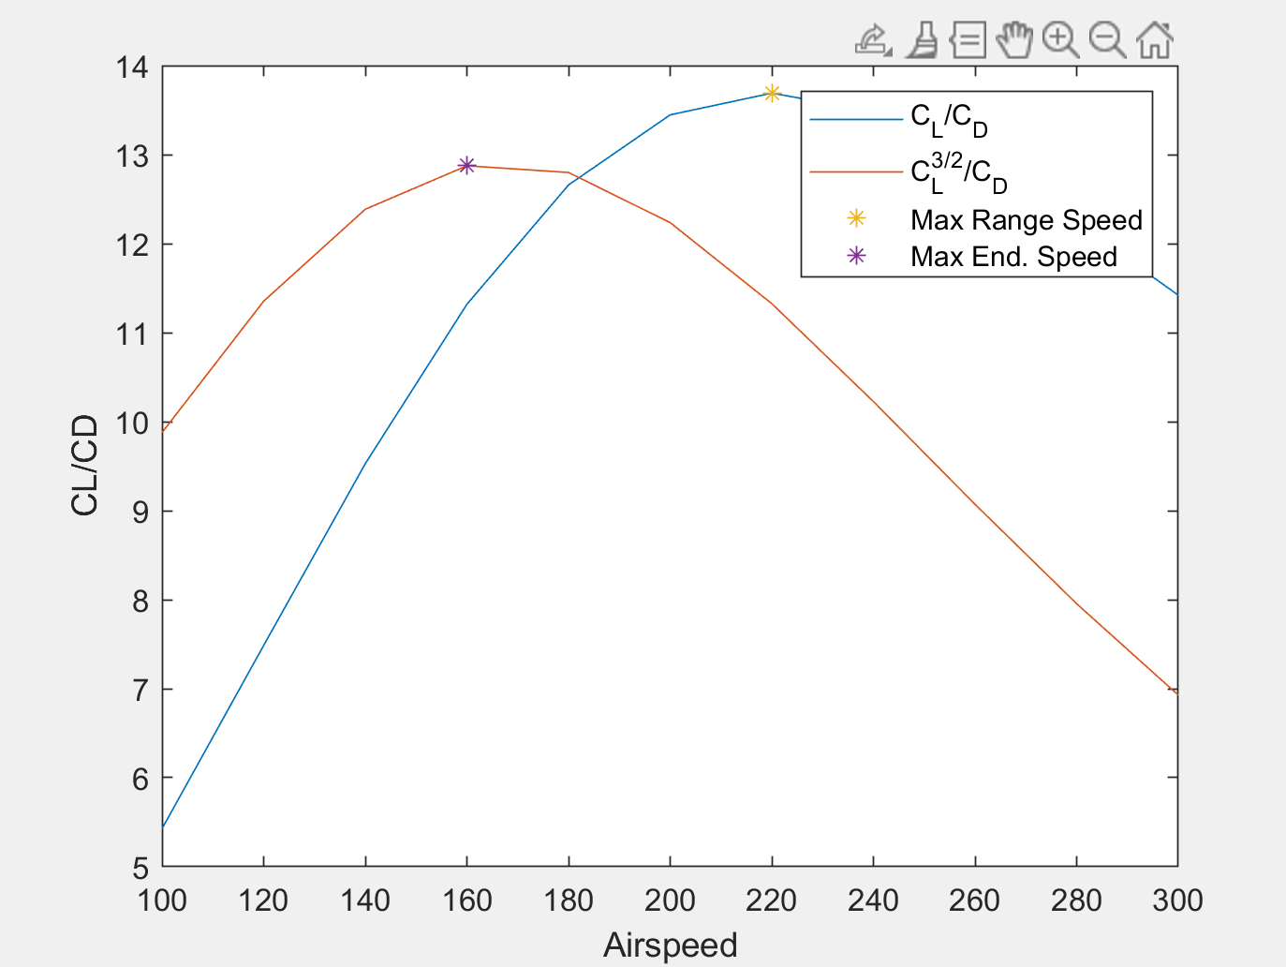
BASELINE METHODOLOGY CODE
OVERVIEW | DESIGN | TESTING | MANUFACTURING | BUDGET | CONCLUSIONS | FUTURE WORK | BACK UP

Slide 99
WIND TUNNEL SPECIFICATIONS
OVERVIEW | DESIGN | TESTING | MANUFACTURING | BUDGET | CONCLUSIONS | FUTURE WORK | BACK UP

Slide 100
WIND TUNNEL - SUPPORTING STABILITY DATA
Can we determine stability using the wind tunnel?
No, the data we use may only be considered supporting data
Pitch stiffness may be determined for both the NELDA design model and the Cessna 206 model. This may be computed by directly extracting the pitch moment measured by any of the three sensors under consideration
Lateral stability couples roll and yaw moments which falls beyond the scope of the wind-tunnel test
OVERVIEW | DESIGN | TESTING | MANUFACTURING | BUDGET | CONCLUSIONS | FUTURE WORK | BACK UP

Slide 101
ATI SIX-AXIS FORCE/TORQUE SENSOR
Calibrated Ranges (+ or -)
Measurement Uncertainty (95% confidence Level, percent of full-scale load)
OVERVIEW | DESIGN | TESTING | MANUFACTURING | BUDGET | CONCLUSIONS | FUTURE WORK | BACK UP

Slide 102
SCALABILITY
Reynold’s Number
𝜌uL
𝜌 = density u = airspeed L = chord length 𝜇 = viscosity
Calculate at cruising altitude for our design
Use same Re to backsolve for u (flow speed)
Can also backsolve for L based on approximate u
Used for getting appropriate scale based on wind tunnel airspeed approximation
𝜇
= Re
OVERVIEW | DESIGN | TESTING | MANUFACTURING | BUDGET | CONCLUSIONS | FUTURE WORK | BACK UP

Slide 103
CHARACTERISTIC STABILITY DEMONSTRATION MODEL
The CSD model will be constructed to proportionally identical geometry of both the Wind Tunnel model as well as full scale airframe
It’s purpose is to deliver a physical validation of both stability and aerodynamics.
With lack of higher quality instrumentation (wind tunnels) and sufficient confidence in computational analysis (CFD), the design team has no physical validation of stability and weak physical validation of aerodynamics.
Although glide ratios, L/D, mode analysis, and other quantitative values could be extrapolated from this test, the team does not find them sufficiently useful and therefore exempt this model from the levels of success. However, thorough, qualitative analysis will be done on the testing of the CSD model
OVERVIEW | DESIGN | TESTING | MANUFACTURING | BUDGET | CONCLUSIONS | FUTURE WORK | BACK UP

Slide 104
GLIDER TEST LAUNCH SYSTEM
WAITING TO HEAR BACK FROM DEPT PEOPLE
IRISS bungee launch system
OVERVIEW | DESIGN | TESTING | MANUFACTURING | BUDGET | CONCLUSIONS | FUTURE WORK | BACK UP

Slide 105
MATERIALS TRADE STUDY METRICS
OVERVIEW | DESIGN | TESTING | MANUFACTURING | BUDGET | CONCLUSIONS | FUTURE WORK | BACK UP

Slide 106
MATERIALS TRADE STUDY RESULTS
OVERVIEW | DESIGN | TESTING | MANUFACTURING | BUDGET | CONCLUSIONS | FUTURE WORK | BACK UP

Slide 107
LANDING GEAR TRADE STUDY METRICS
OVERVIEW | DESIGN | TESTING | MANUFACTURING | BUDGET | CONCLUSIONS | FUTURE WORK | BACK UP

Slide 108
LANDING GEAR TRADE STUDY RESULTS
OVERVIEW | DESIGN | TESTING | MANUFACTURING | BUDGET | CONCLUSIONS | FUTURE WORK | BACK UP

Slide 109
TAIL CONFIGURATION TRADE STUDY METRICS
OVERVIEW | DESIGN | TESTING | MANUFACTURING | BUDGET | CONCLUSIONS | FUTURE WORK | BACK UP

Slide 110
TAIL CONFIGURATION TRADE STUDY RESULTS
OVERVIEW | DESIGN | TESTING | MANUFACTURING | BUDGET | CONCLUSIONS | FUTURE WORK | BACK UP

Slide 111
DIHEDRAL TRADE STUDY METRICS
OVERVIEW | DESIGN | TESTING | MANUFACTURING | BUDGET | CONCLUSIONS | FUTURE WORK | BACK UP

Slide 112
DIHEDRAL TRADE STUDY RESULTS
OVERVIEW | DESIGN | TESTING | MANUFACTURING | BUDGET | CONCLUSIONS | FUTURE WORK | BACK UP

Slide 113
ASPECT RATIO TRADE STUDY METRICS
OVERVIEW | DESIGN | TESTING | MANUFACTURING | BUDGET | CONCLUSIONS | FUTURE WORK | BACK UP

Slide 114
ASPECT RATIO TRADE STUDY RESULTS
OVERVIEW | DESIGN | TESTING | MANUFACTURING | BUDGET | CONCLUSIONS | FUTURE WORK | BACK UP

Slide 115
AIRFOIL TRADE STUDY METRICS
OVERVIEW | DESIGN | TESTING | MANUFACTURING | BUDGET | CONCLUSIONS | FUTURE WORK | BACK UP

Slide 116
AIRFOIL TRADE STUDY RESULTS
OVERVIEW | DESIGN | TESTING | MANUFACTURING | BUDGET | CONCLUSIONS | FUTURE WORK | BACK UP

Slide 117
REFERENCES
OVERVIEW | DESIGN | TESTING | MANUFACTURING | BUDGET | CONCLUSIONS | FUTURE WORK | BACK UP

Slide 118
SIMILAR AIRCRAFT REFERENCES
Pipistrel Alpha Electro: Pipistrel
Pipistrel Velis: AOPA
Phoenix Air Phoenix: Phoenix Air, Phoenix Air USA
Zunum Aero: Zunum
Yuneec International E430: Avia.Pro
Voltaero Cassio 1: Future Flight, Voltaero
Liaoning Ruixiang RX1E: All Aero
Bye Aerospace EFlyer 2: Aerospace Technology
OVERVIEW | DESIGN | TESTING | MANUFACTURING | BUDGET | CONCLUSIONS | FUTURE WORK | BACK UP

Slide 119
SIMILAR AIRCRAFT REFERENCES
Converted Cessna 172: Beyond Aviation
Samad Q-Starling: Samad Aerospace
Lilium Air Taxi: Lilium
Eviation Alice: Eviation
OVERVIEW | DESIGN | TESTING | MANUFACTURING | BUDGET | CONCLUSIONS | FUTURE WORK | BACK UP

Slide 120
MANUFACTURING REFERENCES
3D prints: Xoemetry©
Machinable Foam: General Plastics Manufacturing©
Tooling/ Mills: Aerospace Manufacturing center & ITLL Machine Shop
Required CNC mills:
OVERVIEW | DESIGN | TESTING | MANUFACTURING | BUDGET | CONCLUSIONS | FUTURE WORK | BACK UP

Slide 121
AERODYNAMIC MODELING REFERENCES
206 Parameters1, 206 Parameters2
Drag Prediction
Electric Range
Airfoil Data
Iterative Design Methods
Landing Gear Drag
Wing Geometry 101
OVERVIEW | DESIGN | TESTING | MANUFACTURING | BUDGET | CONCLUSIONS | FUTURE WORK | BACK UP

