Slide 1
NanoSAM III
Test Readiness Review
Company Customer: Ball Aerospace
Jaykob Velasquez & Jim Baer
Advisor: Chris Roseman
Presenters: Evan Hiemstra, Robert MacFarland, Amanda Nelson, Donny Wolfe, Andrew Haskett, Raymie Fotherby
Not Presenting: Austin Bathgate, Peter DiCerbo, Alex Israel
Notes:
All of us

Slide 2
Presentation Outline
Project Overview
Schedule
Test Readiness
Optical Alignment
Vibration Testing
Electronics and Software
Budget
Overview Schedule Test Readiness Budget
Notes:
Amanda

Slide 3
Overview

Slide 4
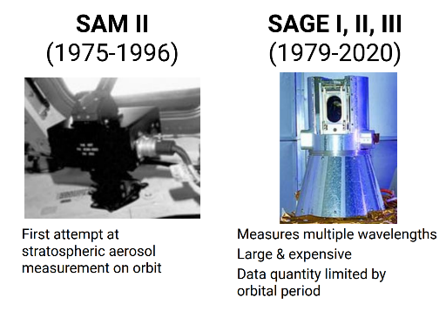
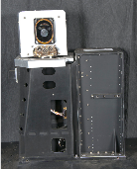
Aerosol Density Measurement Background
SAM 1975 (ASTP)
SAM-II 1978
SAGE-I, -II, -III 1981-
(1978-1993)
[6]
Overview Schedule Test Readiness Budget

Slide 5
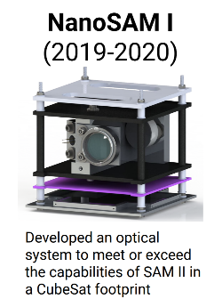
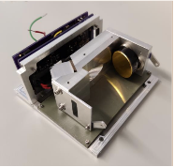
NanoSAM Project Background
NanoSAM II
(2020-2021)
Reduced size to 0.5U, split electronics board and initial vibration and thermal analysis
[6]
Description Requirements Risks V&V Planning
Notes:
Merge slides 4 & 5

Slide 6
NanoSAM III Goal From the Customer
Preserve instrument performance through vibration testing
Improve structure of the NanoSAM II 0.5U design
Optimize mirror mounting bolt torque
Create vibe-proof filter mounts
Iterate on NanoSAM II electronics board
Overview Schedule Test Readiness Budget
Notes:
Baer: Goal: Preserve performance through vibration testing
How: Improve Structure of NanoSAM 2 0.5 U design
Add mirror registration features
Optimize mirror mounting bolt torque
Create vibe-proof filter mounts
Build vibe-proof “null optic” for testing
Iterate NanoSAM 2 electronics board

Slide 7
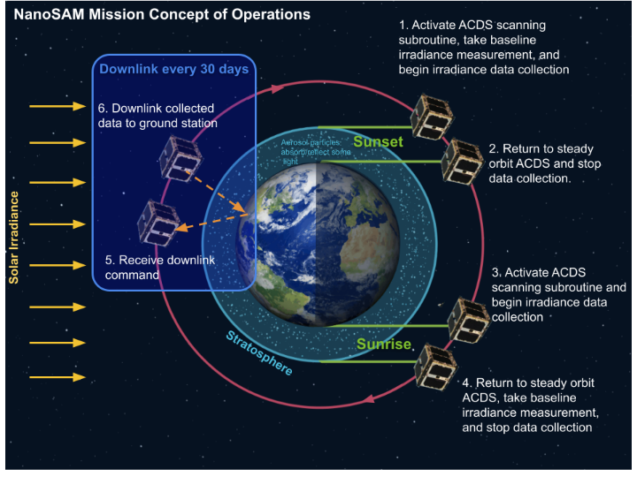
Notes:
Clean this up
This video takes a long time. Is it really necessary. The board has seen this before. How about a still with a brief reference to the previous presentation.
The hardest thing to do is to throw out good material once the time limit is exceeded.

Slide 8
Project CONOPs
Overview Schedule Test Readiness Budget
Notes:
This excellent video takes a lot of the limited time.

Slide 9
Objectives
Objective | Level 1 | Level 2 | Level 3
Payload Integration | Electronics interface with COTS CubeSat. | Same as Level 1. | Electronics and structure interface with COTS CubeSat.
Vibration Testing | No predicted resonant frequencies within test range. Vibe test performed, and resonant frequencies ID’d. | Same as Level 1. | Full 3-axis random vibe test performed & analyzed. No resonant frequencies within test range.
Optics | Optics designed to achieve 0.74 MTF pre and post L1 Vibration Testing. | Thermal study conducted to minimize deformation from temperature fluctuation. | Optics designed to achieve 0.74 MTF post L3 Vibration Testing and thermal vacuum testing.
Overview Schedule Test Readiness Budget
Notes:
“Pertubation” or “deformation” instead of “distortion” which has a technical definition in optics

Slide 10
Objectives
Objective | Level 1 | Level 2 | Level 3
Launch Ready | All systems functional and MTF of 0.74 post L1 vibe test. | Same as Level 1. | All systems functional and MTF of 0.74 post L3 vibe test and thermal vacuum test.
Electronics Boards | Provides all power and control functions from NS II without white wire fixes. | Same as Level 1. | Includes thermal control system to regulate bus temperature.
Data Capture | Electronics and software system correctly captures and stores data. | Required memory and data budget determined from downlink study. | Data can be transferred from payload to standard bus RF/Comms system.
Overview Schedule Test Readiness Budget

Slide 11
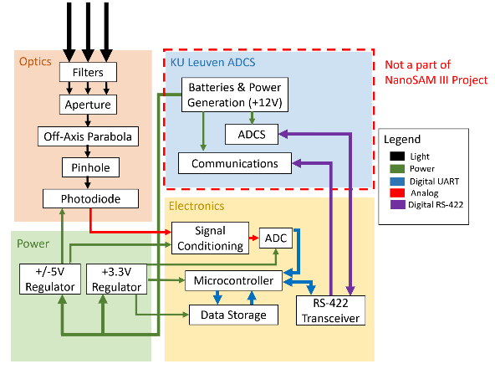
FBD
Overview Schedule Test Readiness Budget
Notes:
Evan
Baer:

Slide 12
Baseline Design Updates
Notes:
Evan

Slide 13
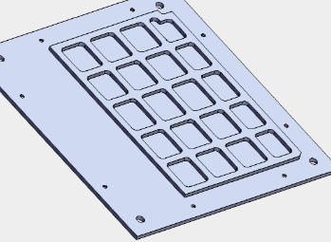
Major Design Changes
Orthogrid walls* to prevent drumming in structure walls
Aligned aperture plate with mirror to 75 ㎛tolerance
Resized bus mount holes to fit standard CubeSat interface
Designed tool to aid in shimming process
*Orthogrid panels are hollowed-out structures, similar to isogrid, which utilize rectangular patterns instead of triangular patterns to maintain strength while reducing weight
Overview Schedule Test Readiness Budget

Slide 14
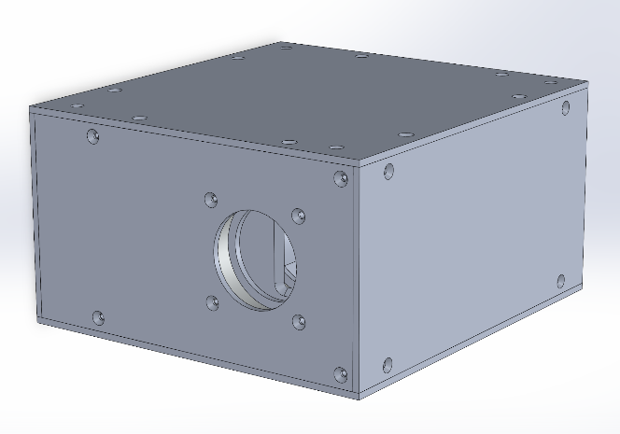
5.32 cm
9.91 cm
9.33 cm
Overview Schedule Test Readiness Budget
Notes:
Evan - dimensions, remove sides, structure

Slide 15
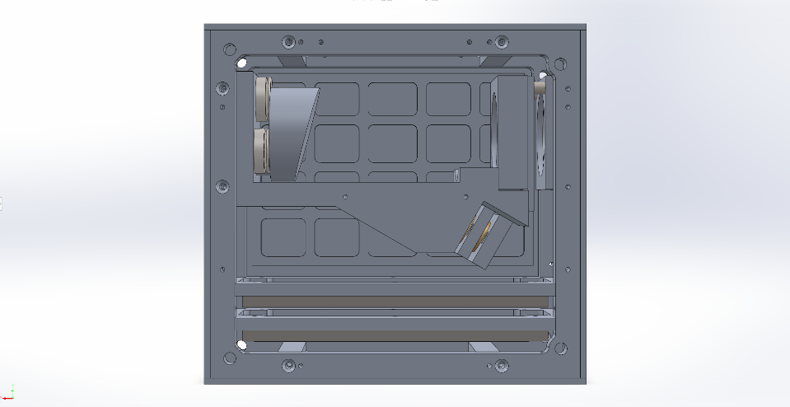
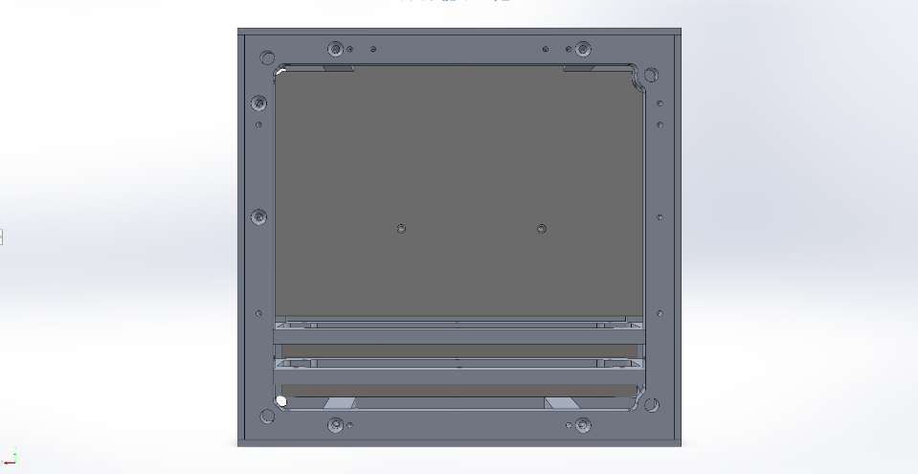
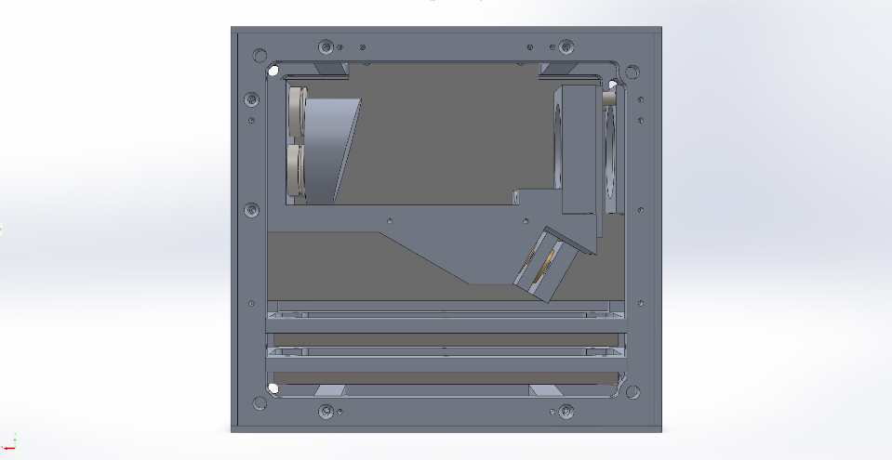
Orthogrid walls
Resized bus mount holes
Overview Schedule Test Readiness Budget
Notes:
Evan - dimensions, remove sides, structure

Slide 16
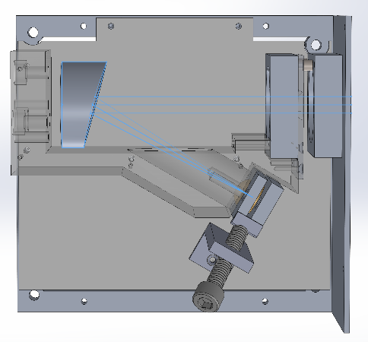
Filter Mounts
OAP Pins
Centered Aperture
Return Sphere
Holding Tool
Overview Schedule Test Readiness Budget

Slide 17
Major Design Changes - Electronics
Large electrical overhaul of “white wire” fixes
Retained:
Microcontroller
Software Structure
Flash Memory Configuration
Photodiode Measurement Circuit Topography
Current Sense Monitor w/ Small Configuration Changes
Eliminated:
Additional 16 bit ADC (redundant data and only require 12 bit resolution from Teensy)
Overview Schedule Test Readiness Budget

Slide 18
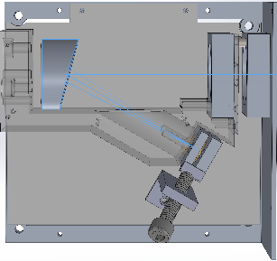
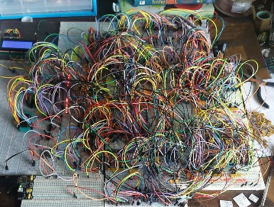
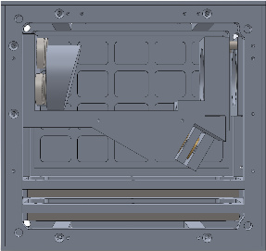
Critical Project Elements
CPE | Rationale
Structure - robust to vibration | Instrument must function after launch and be aligned to collect quality data
Optics - match SAM-II instrument performance | NanoSAM can provide SAM-II quality data at smaller cost & size
Electronics & Software | Electronic boards must communicate with COTS bus to correctly collect mission data
Overview Schedule Test Readiness Budget

Slide 19
Schedule

Slide 20
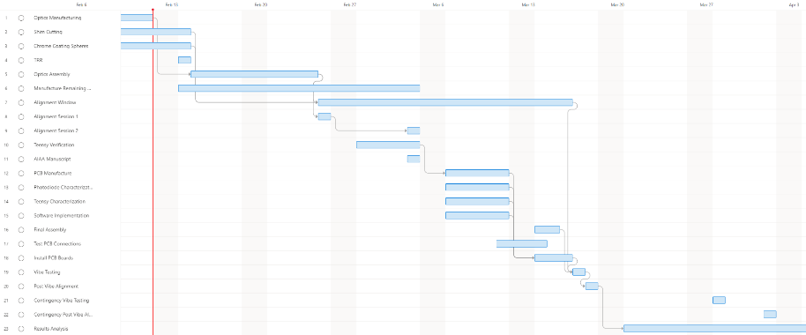
Schedule - Build and Testing
Overview Schedule Test Readiness Budget
Notes:
1st alignment Feb 25, next March 4, another week of margin
First vibe test March 17, Alignment check test March 18th
Contingency dates: March 28th, Alignment Check April 1st

Slide 21
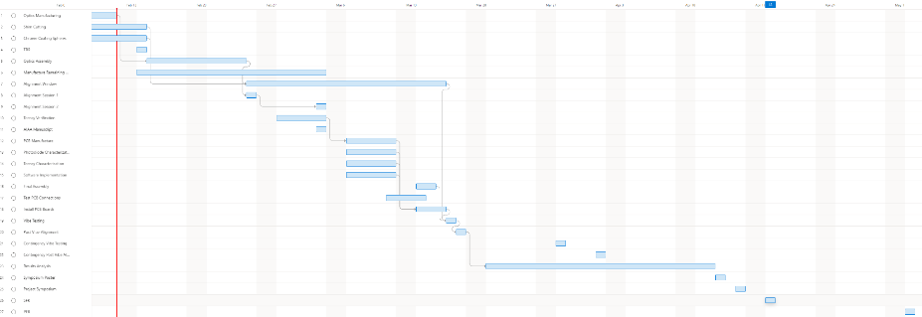
Full Schedule
Overview Schedule Test Readiness Budget

Slide 22
Test Readiness

Slide 23
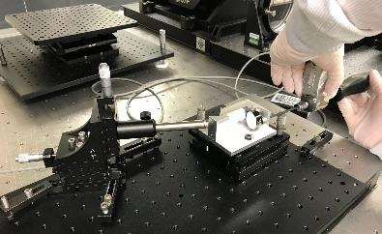
Optical Alignment Testing - Purpose
Requirements: 4 (4.0, 4.2, 4.2.2, 4.2.3)
4.0/4.2 : NS3 will have optical performance equivalent to or surpass that of SAM-II’s idealized optical performance in alignment verification tests
4.2.2: The optical alignment must be within the allowable max displacement error
Align optics system with interferometer, conduct vibration testing, then conduct alignment testing again to determine and resolve the performance of the optical system due to vibration effects
Overview Schedule Test Readiness Budget
Notes:
Optical alignment will be conducted to measure and reduce the misalignment of the system
Characterize adequate performance to resolve vibration effects

Slide 24
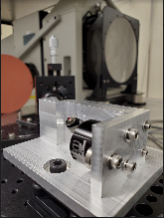
Optical Alignment Testing - Overview
Initial alignment of NS3 bench on Feb. 25th, March 4th
Reduce Zernike Coefficients using interferometer using newly manufactured optical bench (including coated sphere, OAP with optimized 2 in-lb of torque)
Two four hour sessions
Vibrational Testing either March 17th or 28th
Final alignment testing March 18th or April 1st
Confirm optical requirements hold after vibration testing
Repeat alignment procedure driving down Zernike Coefficients and RMS
Only one session predicted to be needed
Overview Schedule Test Readiness Budget
Notes:
the test is measuring how much degradation is induced by vibration exposure.

Slide 25
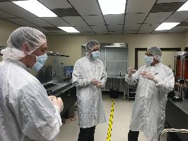
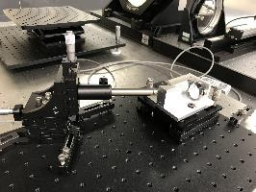
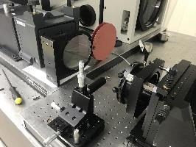
Optical Alignment Testing - Facilities
Optical Testing Lab at Ball Aerospace, Boulder campus
Sessions are coordinated with our customer, Jaykob Velasquez
Overview Schedule Test Readiness Budget

Slide 26
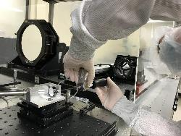
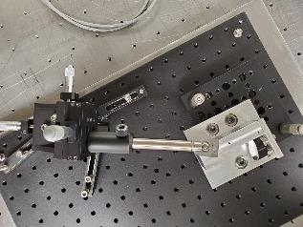
Optical Alignment Testing - Test Fixtures
Three Axis Mount
Reflecting sphere
Tip-tilt Stage
Torque Wrench
Note - Mounting plate will be replaced with NanoSAM III side wall for alignment of the full system with the pressure mount.
Optical Breadboard
Ball Aerospace Equipment
NanoSAM III Equipment
OAP, Mounting Plate, Optical Bench
Notes:
It isn't so much that the force is reproducible as it holds the stack in two directions while the force is applied to hold the third and fix those two by friction.

Slide 27
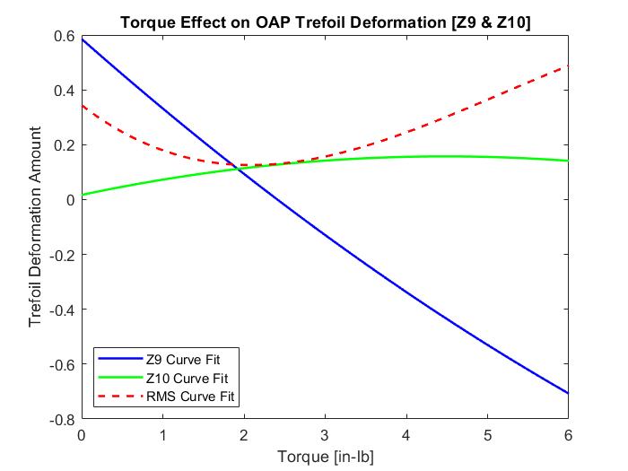
Optical Alignment - Previous Alignment Sessions
Optics team has conducted 3 previous alignment sessions
All sessions with previous optics bench
3rd session determined relationship between torque and deformation of OAP
Experimentally determined 2 in-lb as the ideal torque amount for the OAP
Notes:
Slide 26 Suggestion: Simplify and make text larger. Include only Z9 Z10 and RMS in big legend in open space on graph. Minimum RMS is the goal

Slide 28
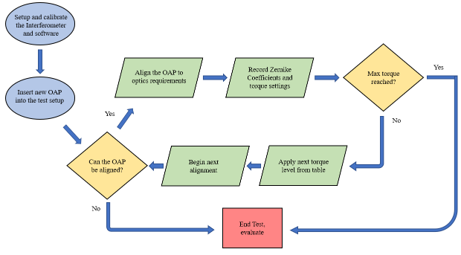
Optical Alignment - Risk Reduction
Detailed alignment procedure and calculations created to streamline testing process while in lab

Slide 29
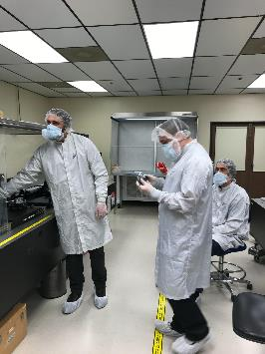
Optical Alignment Testing - Risk Reduction
Full clean room garb is required for testing in Ball facilities
Optimal torque specifications determined will reduce deformation risk in alignment.
Overview Schedule Test Readiness Budget

Slide 30
Vibration Testing - Purpose
Requirements: 1.0 (1.1.1, 1.1.2), 3.0 (3.2, 3.4), 4.0 (4.2)
1.0: System will survive (i.e. components will remain intact, in place, and functional) through a 20-2000 Hz random vibration range simulating a launch
3.0: Electronics components will survive random vibrations simulating a launch
4.0: Optical components will survive random vibrations simulating a launch
Overview Schedule Test Readiness Budget

Slide 31
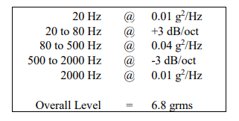
Vibration Testing - Purpose
Testing will be conducted after alignment of the optical systems and prior to a second test ascertaining whether alignment has been retained post-vibration and that the optical instrument will survive
Ensure the subsystems and overall system can survive a launch-like environment
NASA-STD-7001b Random Vibration
Overview Schedule Test Readiness Budget

Slide 32
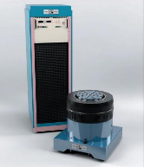
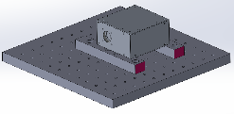
Vibration Testing - Test Fixtures
Designing mounting bracket specifically for simulating the mounting configuration the NanoSAM III instrument would be in when integrated with COTS systems
Mounting bracket attaches to vibration table and to NanoSAM III instrument
Overview Schedule Test Readiness Budget

Slide 33
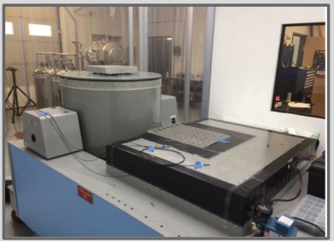
Vibration Testing - Facilities
Utilizing the vibration tables in the Aerospace building and accelerometers provided
May team up with other teams to share costs of testing and of any additional accelerometers that could be needed
Altius Space Systems’ Vibration Table used by NS-II
Overview Schedule Test Readiness Budget

Slide 34
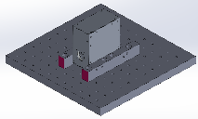
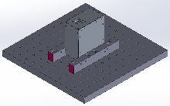
Vibration Testing - Overview
Perform baseline sine sweep vibration on mounting bracket so we can isolate, remove natural frequency of bracket in analysis
3 random vibration tests - once per axis
Accelerometers will be placed in areas of interest and areas of concern due to possible resonance from modeling (filter mount, thermal isolators, side walls, PCBs, diode block)
Performed at intervals from NASA-STD-7001b
Accelerometer output will be put through a Fast Fourier Transform (FFT)
Looking for frequencies in 20 - 2000 Hz random vibration range
Overview Schedule Test Readiness Budget
Notes:
Vibe table is unidirectional so have to vibrate on each axis

Slide 35
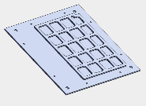
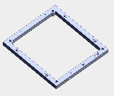
Vibration Testing - Risk Reduction and Results
Iterative modeling allows better understanding of system behavior during vibration
Redesigned components based on CDR feedback to increase natural frequencies of components, overall system
ANSYS results from last year were fairly accurate in modeling real results, can satisfy our requirements even with 30% error
NS-II: 7.3% error at location of ω_{n,1} (840 Hz ANSYS, 901.1 Hz actual)
NS-III: ω_{n,1} = 2930 Hz = 1.465*ω_{max_range} worst sim
NS-III: ω_{n,1} = 5736.5 Hz = 2.868*ω_{max_range} best sim
Overview Schedule Test Readiness Budget
Notes:
Orthogrid walls
Hole size change - my bad!
Wider isolator panels?

Slide 36
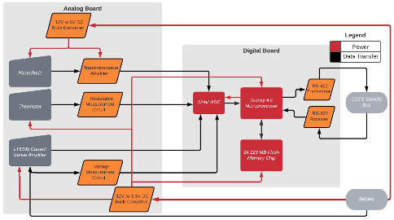
Electronics and Software Testing - Purpose
Major design requirements:
2.0: Electronics and software will collect and store data
3.0: Electronics system will control and power all payload subsystems, while remaining resilient to launch (vibration) and operation (thermal) environment.
Overview Schedule Test Readiness Budget
Notes:
Electronics system will control and power all payload subsystems, while remaining resilient to launch and operation environment.
Picture idea: show electronics design/FBD, picture of teensy, pcb design pic, icons for thermal testing(fire),
At CDR we showed our that conceptual design satisfied these requirements, now we will explain the testing process proposed to verify them
At CDR we showed our that conceptual design satisfied these requirements, now we will explain the testing process proposed to verify them

Slide 37
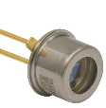
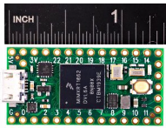
Electronics and Software - Test Breakdown
← Photodiode (THOR Labs FD11A)
Subcategories:
E-TEST1: Photodiode Characterization
E-TEST2: Teensy 4.0 Standalone Verification
E-TEST3: Analog Subcircuit Verification / PCB Integration
E-TEST4: Digital I/O and Flash Storage Testing
Tests 1 & 2 performed prior to PCB arrival (can begin early as Feb. 23)
Tests 3 & 4 conducted after PCB arrival (estimated March 11)
PCBs installed in payload and run after vibration testing to verify continued functionality
Teensy 4.0 Microcontroller ↓
Overview Schedule Test Readiness Budget
Notes:
STAR: Placed to let PAB know we won’t really dive into vibration testing in this electronics section

Slide 38
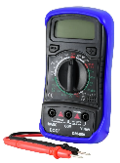
Electronics and Software - Photodiode Characterization
Photodiode response varies with temperature and reverse bias voltage
NanoSAM III operates 0 - 50 °C with 5 V reverse bias
Datasheets only have response at 25 °C with 10 mV reverse bias
Equipment:
5V Power Supply ✔ | Assorted Passive Components ✔
Multimeter ✔ | Breadboard ✔
Laser (power and wavelength well characterized) ⍻ | Photodiode ✔
Overview Schedule Test Readiness Budget
Notes:
For the laser, our teammate Raymie has spoken with the EE department about securing a He-Ne laser for use
Concern: not yet sure if we can access laser outside of lab to apply testing at various temperatures
General trend of doubled response for every 10 °C temperature increase
-Must know response variation to counteract it with software and record proper solar attenuation measurements

Slide 39
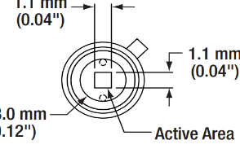
Electronics and Software - Photodiode Characterization
Setup
Photodiode placed in breadboard with -5V bias
Photodiode current output sent to transimpedance amplifier to create voltage
He-Ne (632.8 nm) laser beam with A_{beam} < A_{diode} aligned incident with the photodiode active area
Active area smallest dimension = 1.1mm
Typical beam diameter = 0.48 - 0.52 mm
Overview Schedule Test Readiness Budget
Notes:
Transimpedance setup required as current is ~pA which generally cannot be measured with standard multimeter
Transimpedance setup will use the same R and C values as in actual design.
Datasheet value is at 25degC
Most beams have 0.5 mm diameter, so no area problem

Slide 40
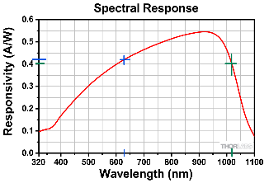
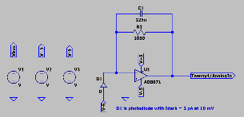
Electronics and Software - Photodiode Characterization
Process
Measure output voltage at:
3 temperatures
3 well characterized laser power levels
Verify linear current to optical power relation
Extrapolate to mission wavelength (1020 nm)
Results
Known photodiode response variation with temperature
Known relation between incident optical power and output voltage (current) to compare to datasheet
TEST
(632, 0.44)
MISSION
(1020, 0.4)
Overview Schedule Test Readiness Budget
Notes:
Nano SAM II did not perform this characterization and used thermal data from a completely different photodiode
Transimpedance setup required as current is ~pA which generally cannot be measured with standard multimeter
Transimpedance setup will use the same R and C values as in actual design.
Datasheet value is at 25degC
Most beams have 0.5 mm diameter, so no area problem
Will have 0.4/0.44 = 90.9% current produced per optical watt compared to test wavelength
If needed, adjust R and C in amplifier

Slide 41
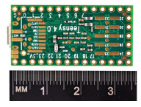
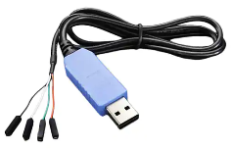
Electronics and Software Testing - Teensy 4.0 Standalone Verification
Microprocessor collects analog data and sends data to storage and communications
Can identify software bugs and microprocessor issues before PCB arrives
Equipment:
Teensy 4.0 Underside 🡱
Adafruit 954 Adapter 🡳
5 V Power Supply ✔ | Breadboard ✔
Variable Power Supply ✔ | Computer ✔
TTL UART to USB converter (Adafruit 954) ✔ | Assorted Passive Electronic Components ✔
Overview Schedule Test Readiness Budget
Notes:
Adafruit adapter most important for data to board through pins as it steps down 5 V to 3.3 V to not damage board

Slide 42
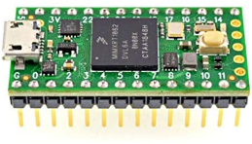
Electronics and Software Testing - Teensy 4.0 Standalone Verification
Analog Input Pins A0 - A9 (6 req.)
Setup
Power Teensy 4.0 with 5V and connect to computer through USB during analog testing
Variable power supply used to simulate voltages for analog testing
Process - Analog
Simulate 3 voltages for each analog subcircuit
Compare recorded measurements to actual values
-
+
Overview Schedule Test Readiness Budget
Notes:
Or to CPU via digital out pin and GND during TTL UART testing setup
Adafruit Adapter allows read in of 3.3 V TTL UART to a 5 V CPU input
We use 6 Ain pins: 3 for the three thermocouples, 1 for battery voltage, 1 for bus current, 1 for photodiode
I.e. Send some voltages corresponding to photodiode incident optical power and ensure the Teensy 4.0 returns optical power values as characterized in E-TEST 1 for the test voltages

Slide 43
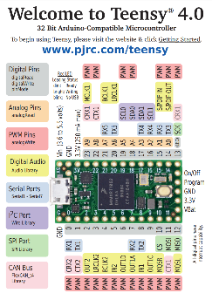
Electronics and Software Testing - Teensy 4.0 Standalone Verification
Process - Digital
Load mock data file to Teensy via USB
Output data via D_{x} (referenced to ground) to computer via probe
Repeat for 3 files
Compare sent and received data, count any bit mismatches
Repeat, but input through D_{y} pin and output via USB
Results
Analog input testing verifies the microcontroller can process analog data
Digital testing confirms the microprocessor is set up to send and receive TTL UART signaling
Overview Schedule Test Readiness Budget
Notes:
Intermediate test to ensure we can send proper UART data to the RS-422 transceiver - this is why we’re doing it
Adafruit Adapter allows read in of 3.3 V TTL UART to a 5 V CPU input
** Possibly use Arduino language instead of MATLAB for read in.
through the TTL UART USB adapter - removed from bullett 3 but just know we have an adapter to accomplish this

Slide 44
Electronics and Software Testing - Analog Subcircuit Verification and PCB Integration
By the time the PCB arrives, we have already:
Verified the photodiode response
Verified the Teensy 4.0 correctly reads analog voltages
Need to verify PCB connections and voltages
Repeat E-TEST3 after integration and vibration testing
Equipment:
12V Bus
PCB
Multimeter
Populated PCBs w/ Test Ports ⍻ | USB Cable ✔
12V Power Source ✔ | Computer ✔
Multimeter with small probes ⍻
*Subcircuit Schematics in Backup Slides
Overview Schedule Test Readiness Budget
Notes:
Speak with Trudy to confirm access to needle probes
PCB is in creation so I left it marked yellow (intermediate status)

Slide 45
Electronics and Software Testing - Analog Subcircuit Verification and PCB Integration
Setup
Power PCB stack with 12V power supply
Connect Teensy 4.0 to computer for data verification
Process
Verify all PCB power lines on both boards (+/- 5 and 3.3 V) using the multimeter
Verify expected voltages are produced by all analog subcircuits
Bus Current
Bus Voltage
Photodiode Circuit
Thermal Measurement
Thermal Management
12V Bus
PCB
Multimeter
Overview Schedule Test Readiness Budget
Notes:
IMPORTANT***”Let’s expand on the thermal measurement & management circuit, as the photodiode circuit testing will be analogous to E-TEST1 and the remaining analog circuits of item 2 are trivial to test”

Slide 46
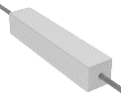
Electronics and Software Testing - Thermal Circuits
Thermal Measurement
Place PCB stack and all 3 thermocouples in temperature controlled environment until steady state is reached
Record temperature from thermocouple
Repeat for 3 temperatures
Thermal Regulation
Verify that the three heaters turn on at temperatures below 2.5°C and off above 5.5°C
Place outside or in freezer with T < 2.5°C and monitor thermocouples and digital state of heater
System verified if heaters switch on and temperature increases
10 W Photodiode Heater (L)
1.5W Board Heating Resistor (R) [X4]
Overview Schedule Test Readiness Budget
Notes:
Adjust thermocouple R - T relation if necessary
Code will be written to pull a thermal measurement after a user specified time, allowing the Teensy to remain in oven and collect measurement
Could get a very accurate 0C thermal measurement if placed in sealed container in ice water - I’m scared to do this however
Useful notes:
Bounds are set to allow hysteresis and ensure we never drop below acceptable operating temperatures
No concern regarding over temperature
If can head outside where we have convection - system should be validated for vacuum application

Slide 47
Electronics and Software Testing - Analog Subcircuit Verification and PCB Integration
Results
Following success of E-TEST3 pre vibration testing, the team can confirm:
All analog subcircuits (including the power system) are functioning as expected
PCB layout / continuity is confirmed
Teensy 4.0 is fully integrable with analog subcircuits on the PCB
The items of E-TEST3 will be repeated following vibration of the entire payload
Will confirm PCB and electronic components are launch ready
If E-TEST3 is successful, we have verified FR 3.0
Overview Schedule Test Readiness Budget

Slide 48
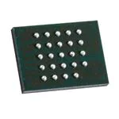
Electronics and Software Testing - Digital I/O and Flash Storage
Expansion on E-TEST2 Software testing
Process
Activate data collection mode
Disconnect from computer and wait 2 hours for data capture
Reconnect RS-422 output to computer USB
Initiate data transfer mode and analyze collected data
Results
E-TEST4 will verify that the electronics system can capture, store, and transfer data from each sensor (FR 2.0)
128 Mb Flash Memory Chip
Overview Schedule Test Readiness Budget

Slide 49
Electronics and Software Testing - Risk Reduction and Results
E-TEST1 and E-TEST2 allow software debugging and photodiode characterization to occur in parallel with PCB assembly
Iterative software development will allow fast turnaround
Most critical electronics components have already arrived
Remaining testing devices are being sourced
Overview Schedule Test Readiness Budget

Slide 50
Budget

Slide 51
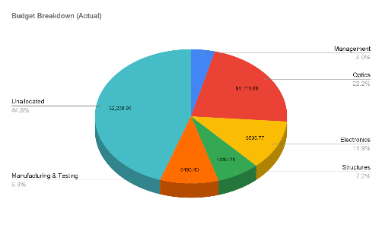
Cost Plan as of TRR
Current Budget (2/13/22):
$2,238.94 remaining
22.2% of the budget are Optical components - this is due to the high cost of the off-axis parabolas and windows
Lower costs overall since CDR estimate due to shipping over-estimate
Overview Schedule Test Readiness Budget

Slide 52
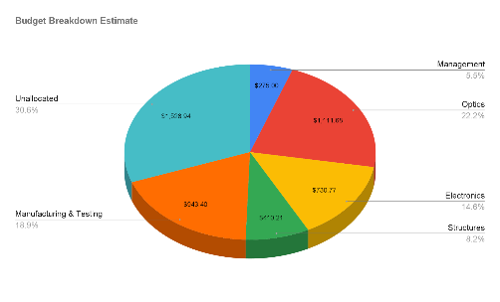
Cost Plan as of TRR
Largest expected expense will be E-board manufacturing and return sphere coating, causing a 9% increase for Manufacturing & Testing
Increase in Electronics, estimate for remaining small unordered components (resistors)
Still plenty of funds for additional materials/components or higher manufacturing costs
Overview Schedule Test Readiness Budget

Slide 53
Critical Components
All of our critical components have already arrived!
This includes enough major electronic components for 4 boards (2 extra)
Extra optical components in case of anomaly
Raw materials for the structure were relatively cheap, and usually arrive within 3 business days if more is ever needed
Overview Schedule Test Readiness Budget

Slide 54
Pending Components
Only approximately $45 worth of passive electronic components have yet to be ordered
Now only limited by manufacturing of structure and special components (return sphere chrome coating and E-boards)
Extra budget in place for additional purchases if needed
Overview Schedule Test Readiness Budget

Slide 55
Questions?

Slide 56
Vibration/Design ANSYS Results - Backup Slides
Orthogrid Patte
Orthogrid Pattern 1 Results - 2929.9 Hz
Orthogrid Pattern 2 Results - 3428.3 Hz
Orthogrid Pattern 3 Results - 3468.9 Hz

Slide 57
Vibration/Design ANSYS Results - Backup Slides
Orthogrid Pattern 4 Results - 4686.4 Hz
Orthogrid Pattern 5 Results - 5736.5 Hz

Slide 58
Optics Backup Slides - Cut Shims
Focus shim (top)
In-plane shim (bottom right)
Out-of-plane shim
(bottom left)
1 - 8, 1.5, 10, 12, 15 mil widths, 7 of each width for each shim type

Slide 59
Major Design Changes - Electronics
Power System - Efficiency and Noise
Current calculations ensure our system is not current deficient on any line ✓
Largest issue of last year’s design
Switching converters → LDO regulators to greatly improve power efficiency (91% vs 42%)
Theoretical noise reduced to < 0.1*LSB = 86 uV
Theoretical 5.62 uV on noisiest line (LTSpice)
Use of SHDN / RUN pins on -5V line and ICs to further reduce power draw
Fine Tuned Thermal Measurement Circuit (w/ Zero Drift Op-Amps)
12 V Thermal Management System
Battery Voltage Monitor
Characterize Photodiode (I vs T)
RS-422 Compatibility
Vibration Resilient PCB & Mounting Scheme
*Subcircuit Schematics in Backup Slides 55 - 60
Overview Schedule Test Readiness Budget

Slide 60
Electronics Backup Slides - Photodiode Characterization
Setup
Photodiode is placed in breadboard with -5V bias
Photodiode current output sent to transimpedance amplifier setup to create voltage
He-Ne (632.8 nm) laser beam with A_{beam} < A_{diode} is aligned incident with the photodiode active area to be switched on
Process
At 3 different & well spaced thermal values measure:
The output voltage due to reverse bias and extrapolate to the dark current value
The voltage produced when the laser is incident at three well characterized power levels
Extrapolate to mission wavelength (1020 nm)
Results
We now know how photodiode response varies with temperature
We have an accurate relation between incident optical power and output voltage (current) to compare against the datasheet value
TEST
(632, 0.44)
MISSION
(1020, 0.2)
Overview Schedule Test Readiness Budget
Notes:
Transimpedance setup required as current is ~pA which generally cannot be measured with standard multimeter
Transimpedance setup will use the same R and C values as in actual design.
Datasheet value is at 25degC
Most beams have 0.5 mm diameter, so no area problem

Slide 61
Electronics Backup Slides - Power System

Slide 62
Electronics Backup Slides - Current Sense Monitor

Slide 63
Electronics Backup Slides - Battery Voltage

Slide 64
Electronics Backup Slides - Thermal Measurement

Slide 65
Electronics Backup Slides - Thermal Management

Slide 66
Electronics Backup Slides - Photodiode Circuit

Slide 67
Budget Spreadsheet
https://docs.google.com/spreadsheets/d/1B1svmDuzSfzn3HrgvEBAslalyRTiLjUBkwg8rXMZBvw/edit#gid=0

