Slide 1
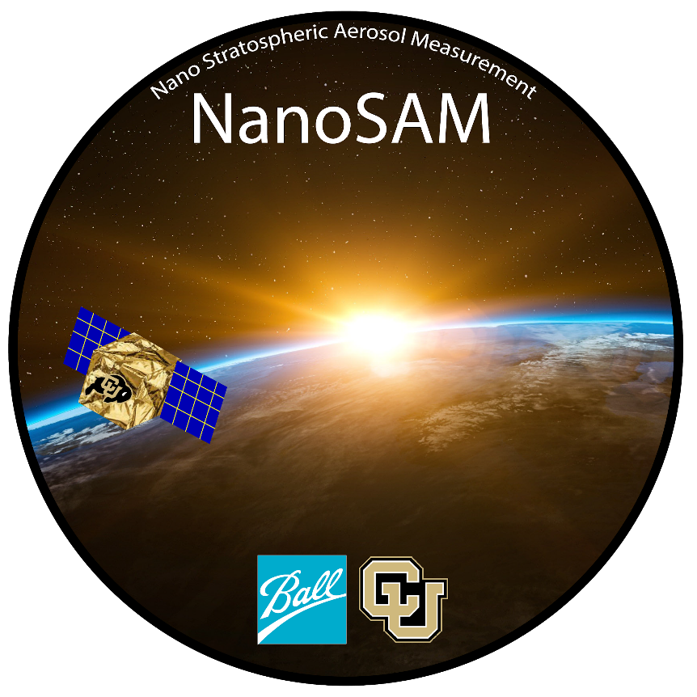
ASEN 4028 Senior Projects, Spring 2020
Final Oral Review
TAKEAWAY BOX FORMAT
Jaykob Velasquez, Matt Weber, Jessica Harris, Hui Min Tang, Quinn LaBarge,
Conner McLeod, Aanshi Panchal, Jared Cantilina, Sara Reitz, Jacob Romero, Josh Horst
Customer: Jim Baer
Advisor: Dr. Zoltan Sternovsky
Notes:
Josh

Slide 2
Agenda
Project Purpose
Design Description
Test Overview
Test Results
Systems Engineering
Project Management
Backup Slides
Mechanical
Electronics & Software
Optics
Integration
Systems Engineering
Project Management
Notes:
Josh

Slide 3
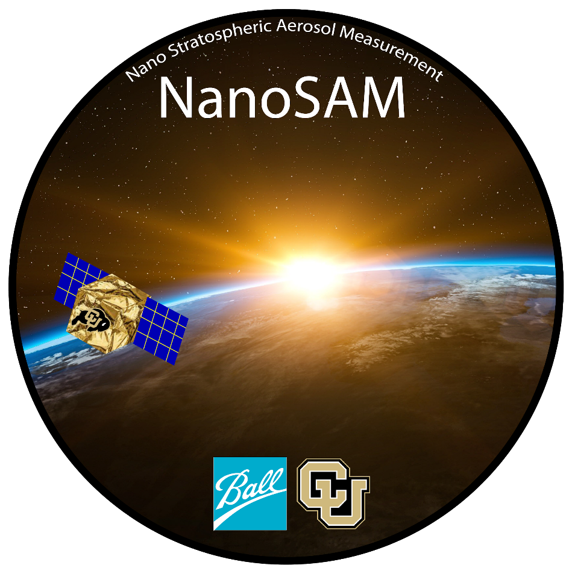
Project Purpose
Notes:
Josh

Slide 4
Project Statement
The NanoSAM team will collaborate with engineers at Ball Aerospace Corporation to design, construct, and test a functioning optics system that is capable of measuring solar irradiance in a narrow spectral band around 1.02 𝜇m to obtain stratospheric aerosol concentrations data. An accompanying electronics system will also be produced for the purpose of collecting, packetizing, and outputting irradiance data.
Notes:
The Project Statement for NanoSAM is “...”
~ 1min
Josh

Slide 5
Motivation
Field of Application
Aerosol changes due to seasonal & short-term meteorological variations
Atmospheric chemistry
Cloud microphysics
Volcanic activity
Problem Addressed
Downsizing
Increase spatial coverage
Economical
Notes:
Josh

Slide 6
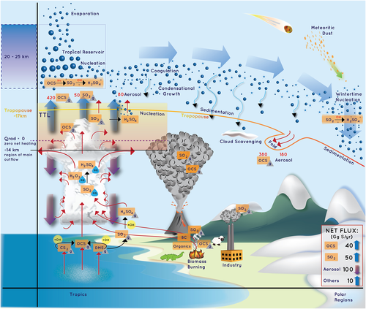
Potential Impact
Potential climatic effect caused by stratospheric aerosols
Provide better understanding of atmosphere
Energy Budgets
Notes:
Jess

Slide 7
Specific Objectives
Objectives | Level 1 | Level 2 | Level 3
Solar Irradiance Data | Stable, minimal fluctuations | Level 1, Repeatable | Level 1, Level 2, Linear data independent of temperature
Instrument SNR | SNR ≥ 2800 | SNR ≥ 3150 | SNR ≥ 3500
Vertical Resolution | FOV facilitates a vertical resolution that produces accurate data | Same as Level 1 | FOV facilitates 1km vertical resolution of atmosphere
Data Capture | ADC converts light into readable electrical current | Electronics and software acquires, digitizes, packetizes, & downloads raw data from photodetector to computer | Level 2 Incorporates synthetic data to simulate spacecraft health, slew rate, etc.
Payload Instrumentation Size | Radiometer & electronics fits in 2U or greater | Radiometer & electronics fits in 2U or smaller | Radiometer & electronics fits in 1U or smaller
Mechanical Structure | Arrange on lab bench | Unsecured components fit into 2U or smaller | All components secured to mock 1U CubeSat footprint
Notes:
Highlight the level we’ve reached. Bold title objective
Jess

Slide 8
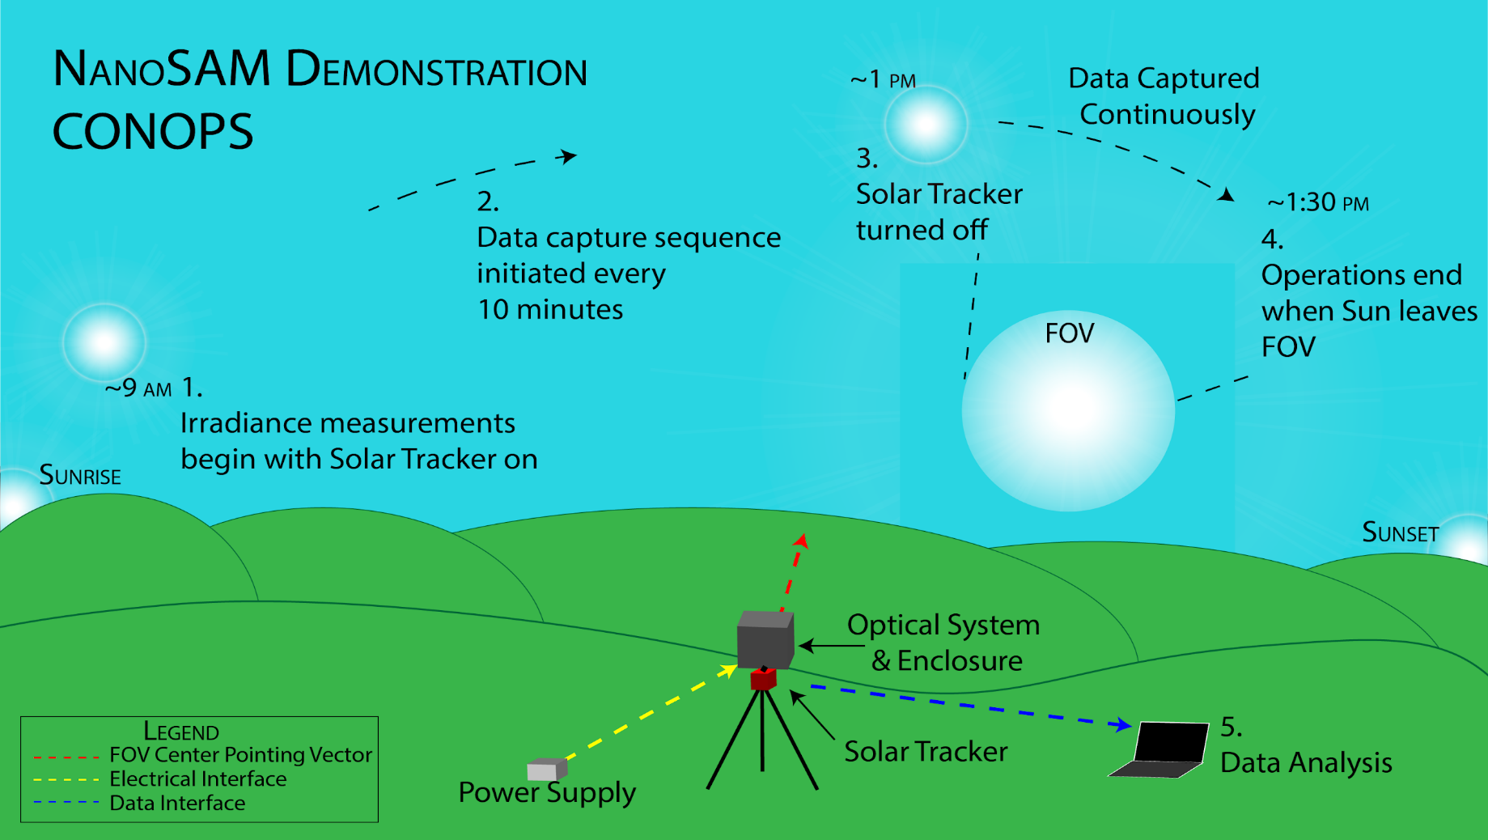
Notes:
Start with GSE, Begin taking irradiance measurements with Solar Tracker on, after solar noon turn the tracker off, wait for the FOV to move off of the sun, Analyze data
~1.5 min
Jess

Slide 9
Design Description
Notes:
Sara

Slide 10
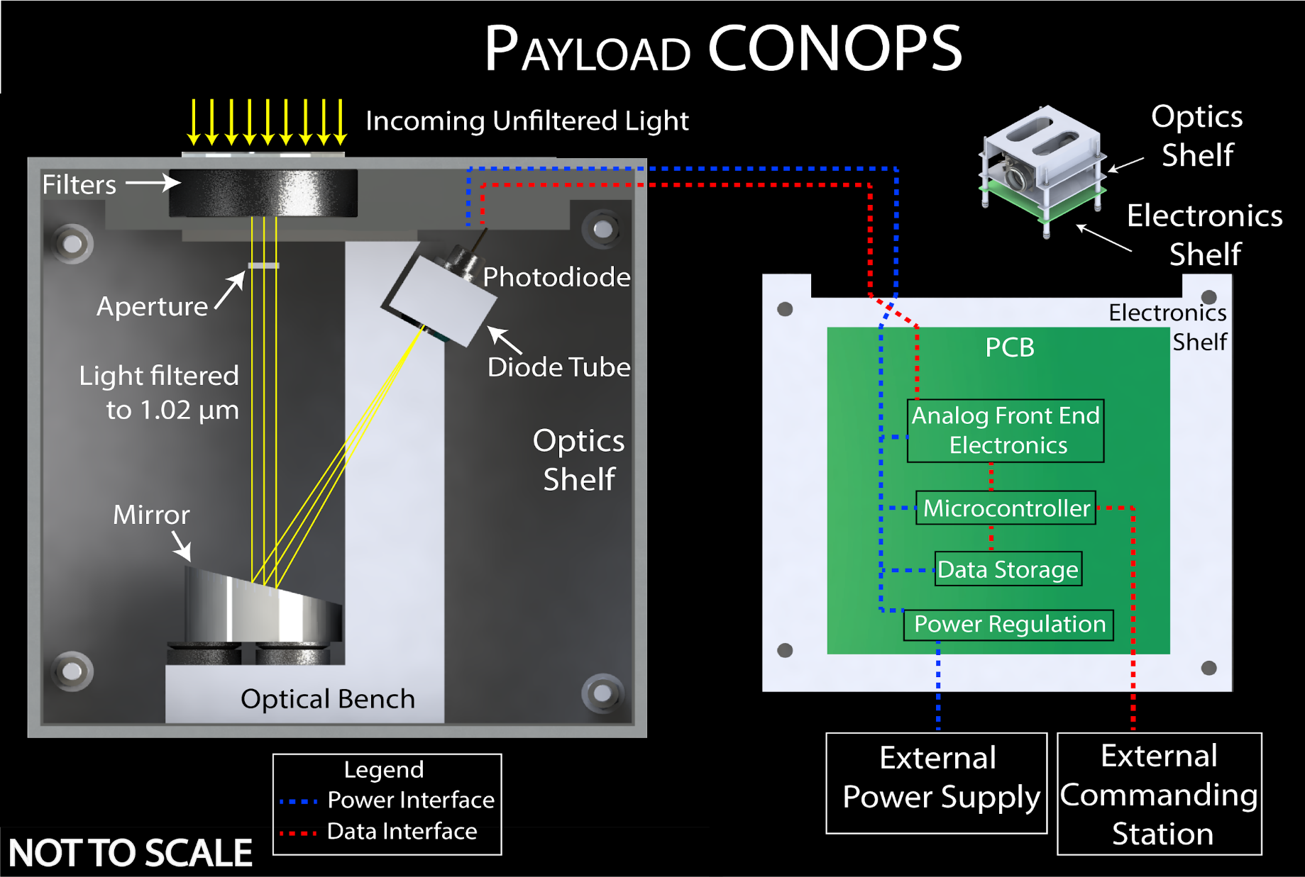
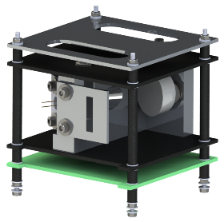
Notes:
Sara

Slide 11
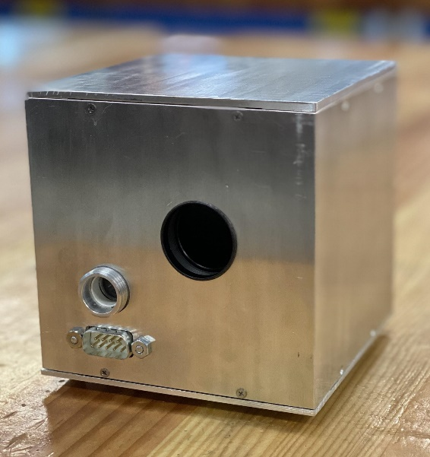
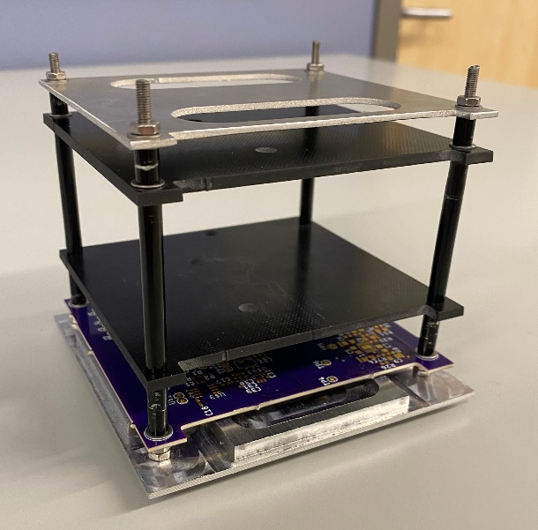
Structural Design
Material: 6061 Aluminum, G10 Fiberglass, Stainless Steel
Outer Dimensions: 10.00 x 10.00 x 10.00 cm
Payload Mass: 1.10 kg
Filter Mount
Sighting Window
Electronics Port
No changes since TRR
Notes:
Sara
Stainless steel rods, fiberglass plate mounts, aluminum everything else

Slide 12
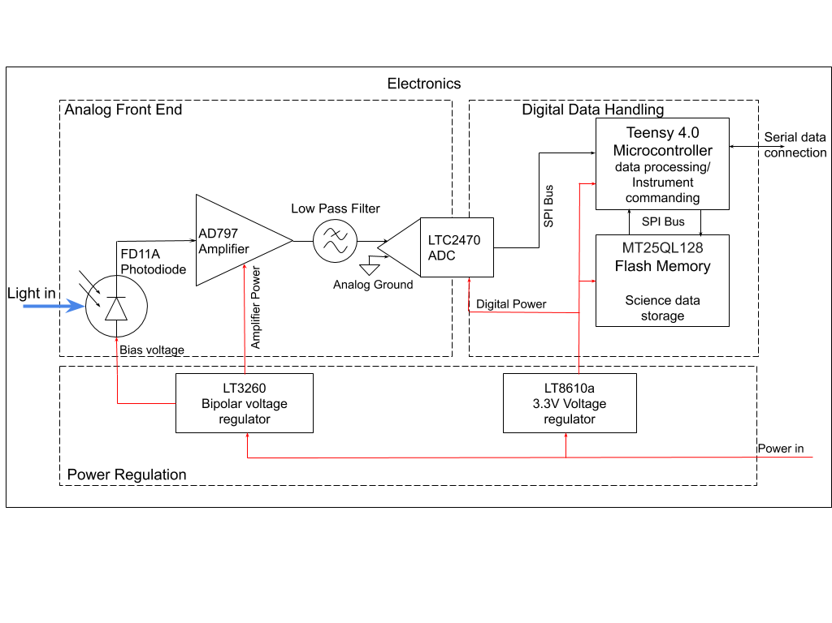
Electronics Design
Key Electronics Parameters
Analog Power Supply: +/- 5V
Digital Power Supply: 3.3V
Photodiode:
Low dark current
High responsivity in 1.02 micron range
Data Storage: 256 Mb
Processing: Teensy Microcontroller
No changes since TRR
Notes:
Sara

Slide 13
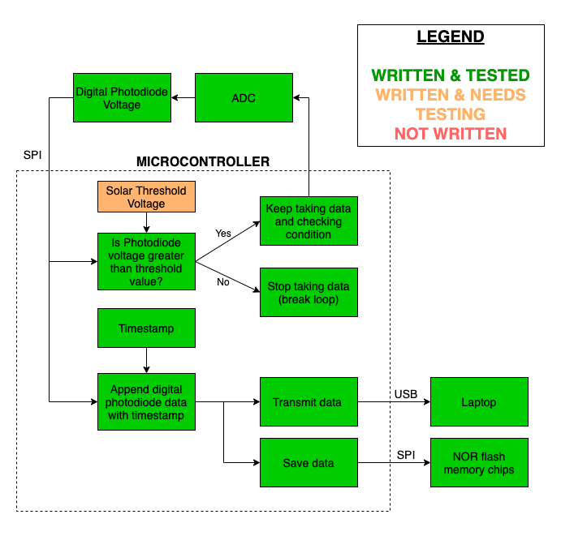
Software Design
Unable to obtain Solar Threshold Voltage without integration test
Key Software Parameters
Data capture rate: 50 Hz
Data storage speed: 50 Hz
Flash chip memory size: 256 MB
No changes since TRR
Notes:
Matt

Slide 14
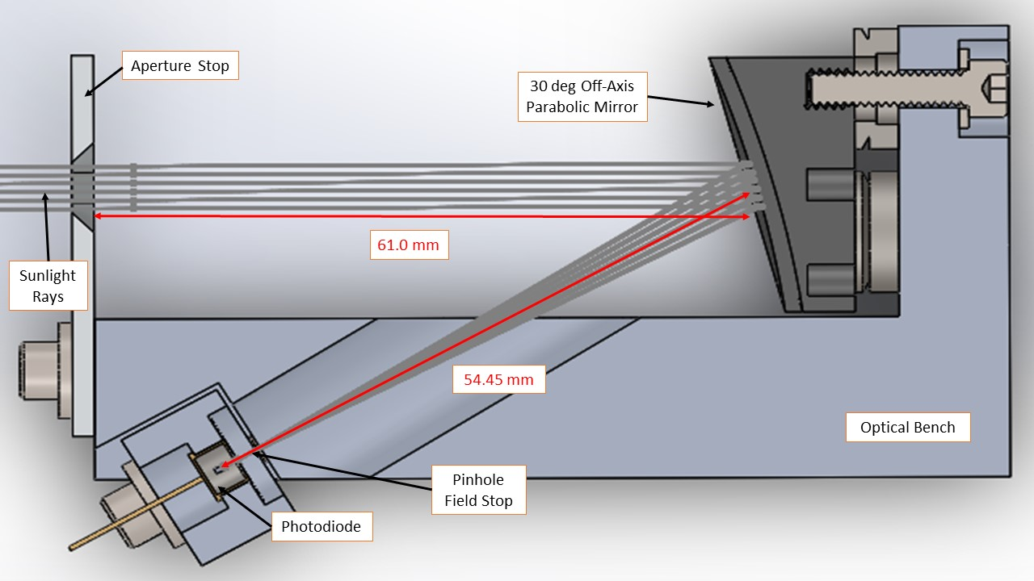
Optical Design
Key parameters
Focal length = 54.45 mm
Aperture stop = 20mm x 5mm
OAP Mirror = 1 in. ⌀
Field stop = 15 µm ⌀
Wavelength = 1.02-1.04 µm
No changes since TRR
Notes:
Matt

Slide 15
Critical Project Elements
ID | Description
E.1 | Radiometer detects solar irradiance in a narrow near-infrared band to measure atmospheric aerosol concentrations.
E.2 | The instrument SNR and sample rate are the same as SAM-II or better.
E.3 | The instrument field-of-view facilitates a vertical resolution of 1 km or less for the solar occultation method to perform as intended.
E.4 | When the detector stays within its operating temperature, the baseline measurements remain stable over the duration of data collection for the collected data to remain accurate.
E.5 | The optical instrument aligns with the pinhole field stop so that majority of the allotted wavelength of light can reach the detector for accurate measurements.
Notes:
Matt
Updates on critical issues from CDR, FFR, MSR
Test design maps to these CPEs.

Slide 16
Test Overview
Notes:
Aanshi
Add diagrams, point out parts that require testing, label requirement ID and test name, add check mark if successful, link to CPE, specific objectives,
Link Req id to table
Include integration testing, stability test pictures,

Slide 17
Structural Test Overview
Test Description | Relevant Requirement | Location | Equipment/ Method | Result
Optical, mechanical, and electronics systems fit within a 1U CubeSat | 2.1: Payload Volume 2.3: Enclosure | Manufacturing Shop | Caliper | Success
Mass of payload is less than the standard 1U mass budget | 2.2: Payload Mass |  | Weighing Scale | Success
Payload is sealed from external environment | 2.3.1: Sealed Enclosure |  | Inspection | N/A
Notes:
Aanshi
Mass Budget: ~1.4 kg
Sealed enclosure: dust + stray light

Slide 18
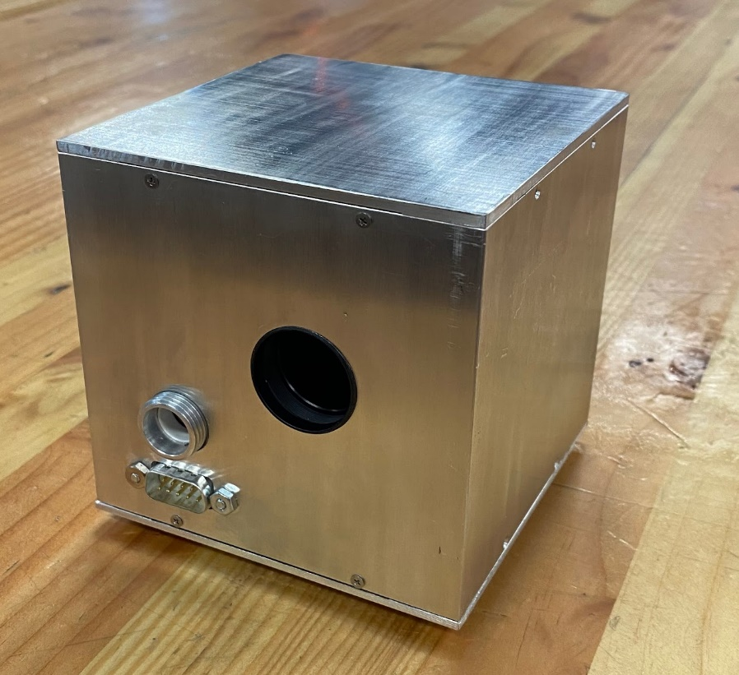
Structural Test Overview
Sealed Enclosure
Payload Volume
Payload Mass
Notes:
Aanshi

Slide 19
Electronics Test Overview
Test Description | Relevant Requirement | Location | Equipment | Result
Transimpedance amplifier converts current to voltage with expected gain | 1.5: Dynamic range | Electronics Lab | Resistors, Multimeter | Success
Digital power plane is regulated to 3.3V | 3.0: Electronics System |  | Multimeter | Success
Analog power plane is regulated to +/- 5V | 3.0: Electronics System |  | Multimeter | Success
Microcontroller interfaces with a PC | 3.3.1: Data Output Method |  | PC | Success
Notes:
Jared

Slide 20
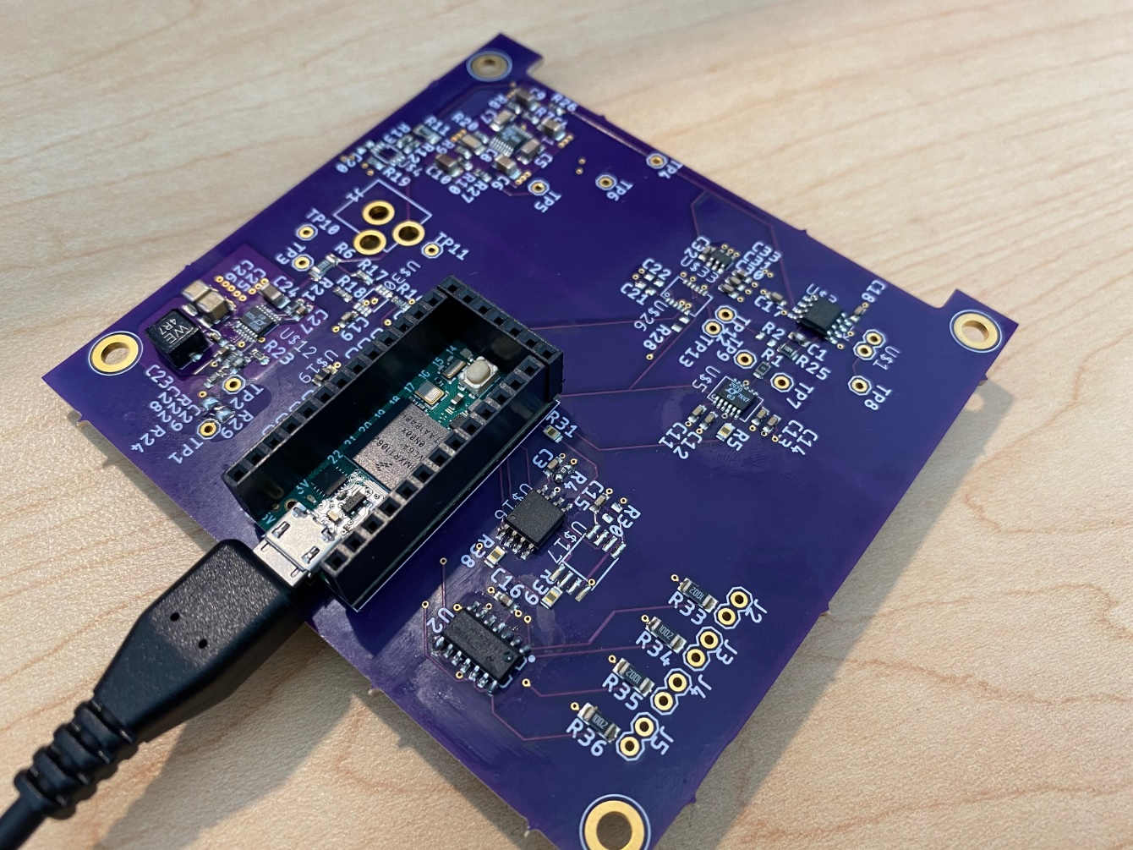
Electronics/Software Components Tested
Digital Power Supply Voltage
Analog Power Supply Voltage
Microcontroller interfaces with peripheral electronics
Amplifier Gain
Digital ADC data is stored in flash memory
Notes:
Jared

Slide 21
Software Test Overview
Test Description | Relevant Requirement | Location | Equipment | Result
Gather digital data from ADC & store on memory chips | 3.4: Software | Electronics Lab | PC, PCB, photodiode | Success
Dark Current and Dark Noise are less than LSB | 1.4: SNR | Dark Room | PC | Success
Stability & Noise Test | 3.1: Data Collection |  | PC, Calibrated light source, power supply, GNC filter | N/A
System can detect when FOV is off solar disk | 3.1: Data Collection | Outside | Integrated system | N/A
Dynamic Range | 1.5: Dynamic Range |  | Integrated system | N/A
Notes:
Jared
what tests were conducted or planned to be
conducted, specifically what each test was designed to determine (relate to
requirements), and how and where the tests were conducted or were to be conducted.

Slide 22
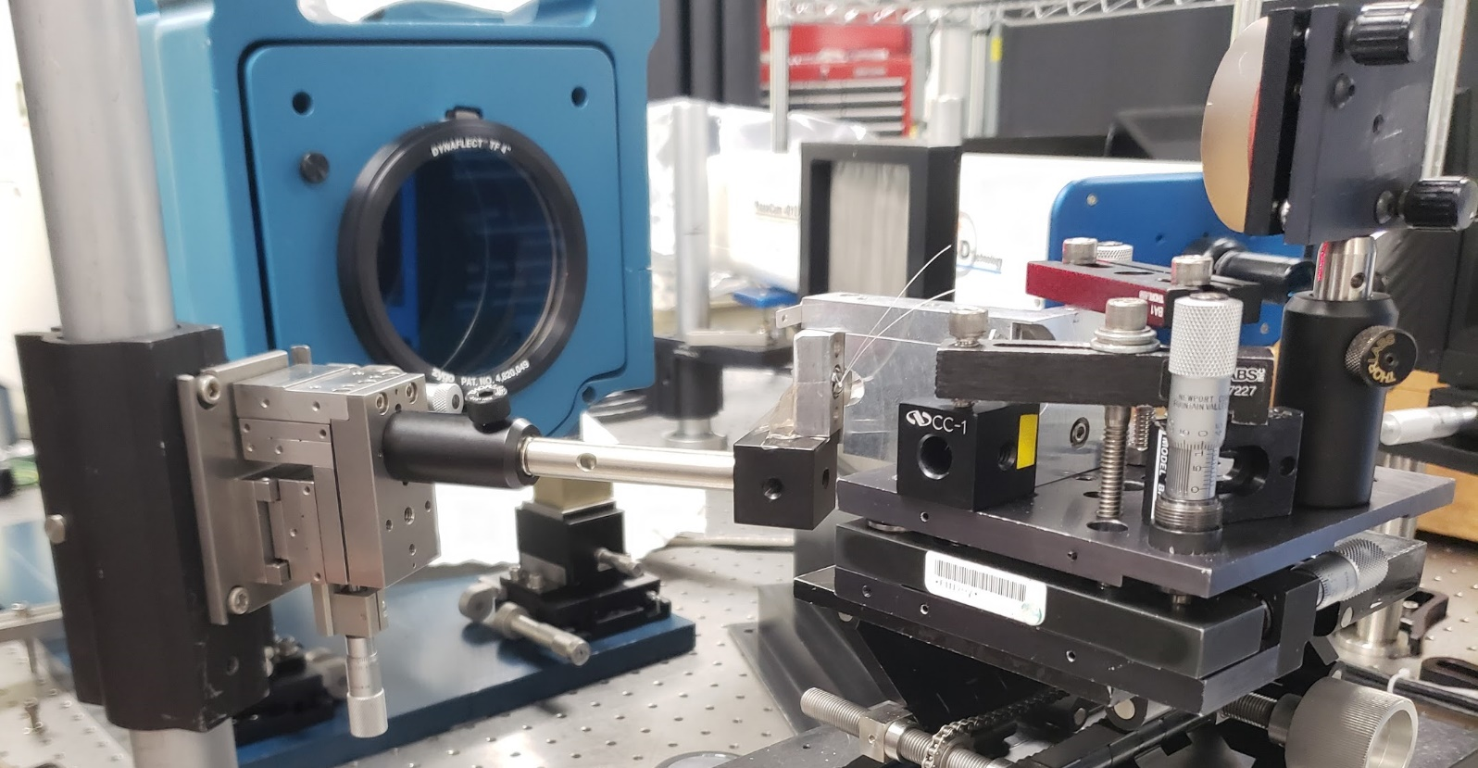
Optics Test Overview
Zygo Interferometer
Tip/Tilt Ref. Flat
Optical Bench
Tip/Tilt Micrometers
3-axis Stage
Diode Block w/Half Sphere
X,Y,Z Micrometers
Tip/Tilt Stage
Notes:
Presentor: Jaykob

Slide 23
Optics Test Overview
Test Description | Relevant Requirement | Location | Equipment | Result
1 km Vertical Resolution | 1.1: Vertical Resolution | CU Boulder Campus | Analysis | Success
Diode Block Integration | 1.3: Optical Alignment |  | Epoxy, Syringes, Diode Block, 15 μm Pinhole, Photodiode | Revised ↓ Success
Optical Bench Integration | 1.3: Optical Alignment | Ball Aerospace | Hex Key | Success
Optical Mounting System | 1.3.1: MTF |  | 2-Axis Tilt Stage, 3-Axis Translation Stage | Success
Mirror to Interferometer Alignment Methodology | 1.3.1: MTF |  | Optical Bench, Ball Facilities | Success
Notes:
Presentor: Jaykob

Slide 24
Optics Test Overview
Test Description | Relevant Requirement | Location | Equipment | Result
Alignment Methodology w/ 50 μm Pinhole | 1.3.1: MTF | Ball Aerospace | 50 μm Pinhole, Ball Facilities | Revised ↓ Success
Final Mirror to Interferometer Alignment |  |  | Optical Bench, Ball Facilities | Success
Initial Shim Stack Derivation w/ Chrome Half Sphere |  |  | Optical Bench, Half Sphere, Ball Facilities | Success
Final Pinhole Alignment w/ 15 μm Pinhole |  |  | Optical Bench, OAP, Diode Block, Ball Facilities | Revised ↓ N/A
FOV 1.3 arcmins (or less) | 1.1.1: FOV |  | Interferometer, Ball Facilities | N/A
Notes:
Presentor: Jaykob

Slide 25
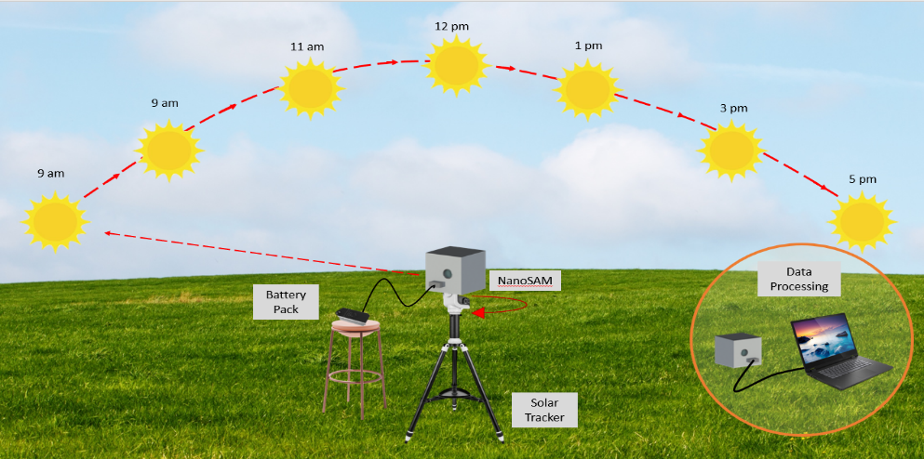
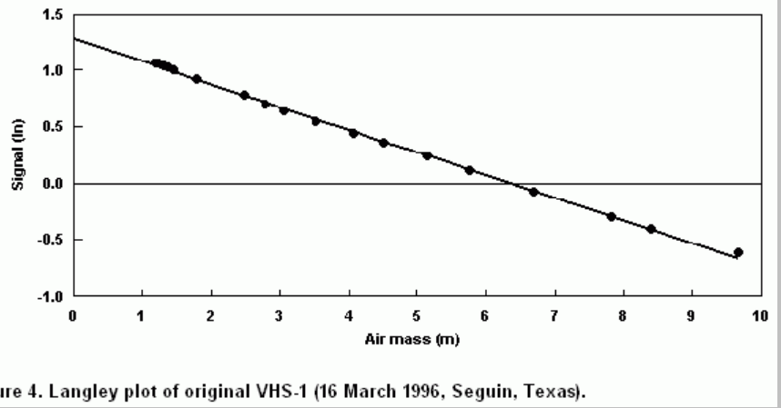
Final Integration Test Overview
Test Description | Relevant Requirement | Location | Equipment
Langley plot of irradiance data | 1.0: Radiometry | AERO Building | Battery Pack, Laptop, Solar Tracker, Tripod, Cables
Threshold voltage | 3.1.3: Termination
Data retrieved without disassembling payload | 3.3: Data Output
Perform test over multiple clear days
In front of AERO
Mount NanoSAM on solar tracker & tripod
Powered by battery pack
Turn off solar tracker after solar noon
Data downloaded to laptop for post-processing
Use Langley extrapolation method to determine irradiance for zero air mass
Use 1st test to determine threshold voltage for data capture loop condition
Notes:
Use beer’s law. Find optical depth to calculate irradiance
Sara

Slide 26
Test Results
Notes:
Jared

Slide 27
Results: Electronics/Software
Microcontroller interfaces with peripheral electronics
Yes
Amplifier Gain
1V/nA
Digital ADC data is stored in flash memory
Yes
Photodiode dark current
<0.8nA
Digital Power Supply Voltage
3.3V
Analog Power Supply Voltage
+5V/-5V
Notes:
Jared

Slide 28
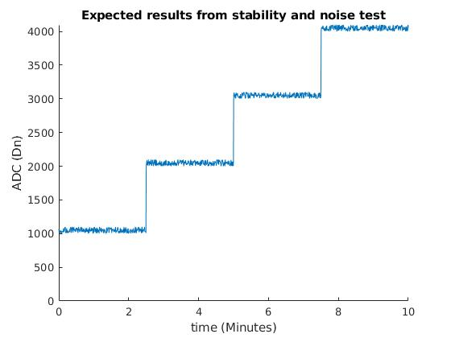
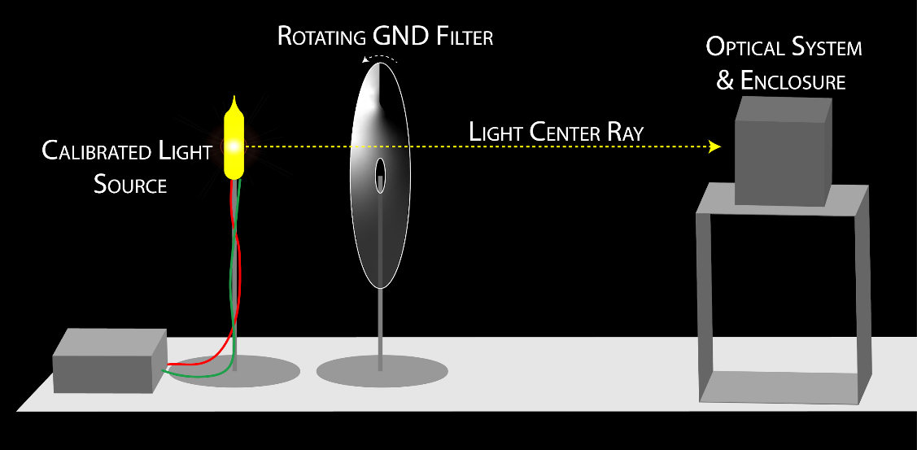
Expected Results: Stability & Noise Verification
Uses tungsten filament bulb and regulated power source to check stability of system measurements
Checks noise of system, including shot noise
Noise
Stability
Notes:
Jared
Is there a thermal element to this test? Can we make one?
Use a calibrated light source (available from Ball) and rotating circular Graduated Neutral Density (GND) Filter to simulate attenuation
Compare gathered data to expected results over multiple tests
Stability - reproducibility
Error- standard deviation

Slide 29
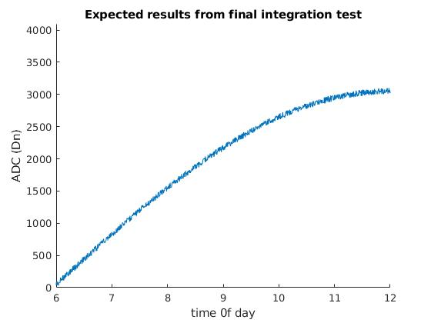
Expected Results: Dynamic Range
Data from final integration range will be used to verify dynamic range requirements are met.
Langley plot used to extrapolate signal from unattenuated sunlight.

Slide 30
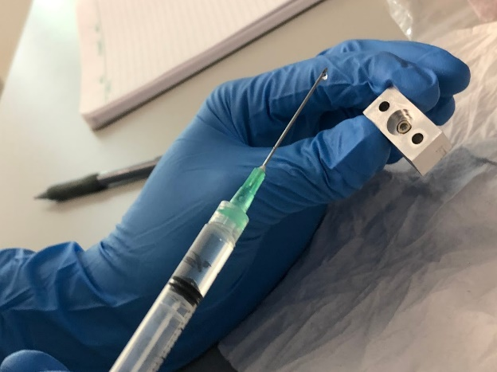
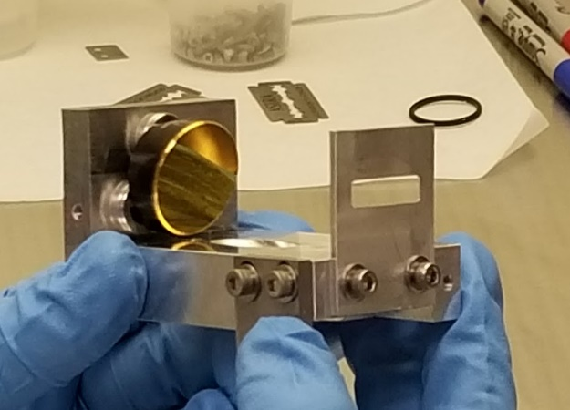
Results: Optics Component Integration
Component interfaces qualitatively checked:
Diode Block with
Photodiode
Pinhole Disk
Optical Shims
Chrome Half Sphere
Component integration issues:
OAP perfomance sensitive to torque on mounting screws
The tooling plate screw requires a precise compound angle
The pinhole is very fragile, mishandling warps the material
Optical Bench with
Aperture Stop
Tooling Plate
OAP Mirror
Tooling plate remachined, less torque applied to OAP mounting screws, pinhole adhesive applied with needle point
Notes:
Quinn
These qualitative checks are necessary to ensure the alignment process is feasible. Slight modifications are made to ensure that the alignment is attainable.

Slide 31
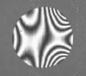
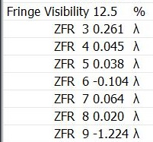
Results: Optomechanics and Zernike Model
Zernike Model Validation
Nonzero Zernike coefficients (ZFR) indicate misalignment and optical aberrations
Zernike model outputs tip/tilt micrometer adjustments required to drive the ZFRs to zero
3-axis mount (with micrometer adjustment knobs) controls the tip/tilt of the OAP
Zernike model validated via ZFR response to micrometer adjustments at Ball optics lab
Example interferometer software output used to test alignment.
Notes:
Quinn
For this to be a test, it needs to validate the Zernike coefficient vs. angle displacement model.
During this step, the example output is not concerned with defocus, which is included in the ZFR 3 and 9 coefficients

Slide 32
Results: Mirror Alignment Verification
OAP
Interferometer Rays
Return sphere used to return rays back through the system
Diode block not present
Align optical axis of OAP (Z) to interferometer rays
Highest possible MTF performance from mirror
Sighting tabs set to allow for recovery of the pointing direction
Y
Z
X
Y’
Z’
Return Sphere
Results: In-plane Astigmatism Y’: 0.045 λ ∝ .13 mrad
Out-of-plane Astigmatism X’: 0.038 λ ∝ .11 mrad
X’
Notes:
Presentor: Jaykob
Mention driving Zernike coeff to zero after align bullet point.

Slide 33
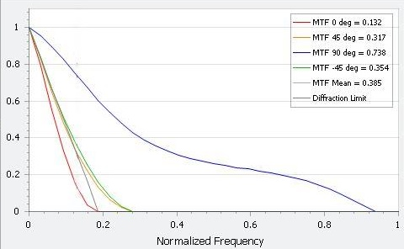
Results: MTF Characterization of the Mirror
MTF of the OAP mirror was measured using a ZYGO DynaFiz interferometer
MTF value taken at 1 cycle/km (0.08 normalized frequency) spatial frequency
Actual Mirror MTF is approx. 0.85
MTF
Notes:
Quinn
Notes:
The MTF 90 deg curve corresponds to the 20mm aperture dimension.
The values in the legend correspond to a normalized frequency of 0.13.
This does not include pinhole displacement degradations, or degradations due to the filter!

Slide 34
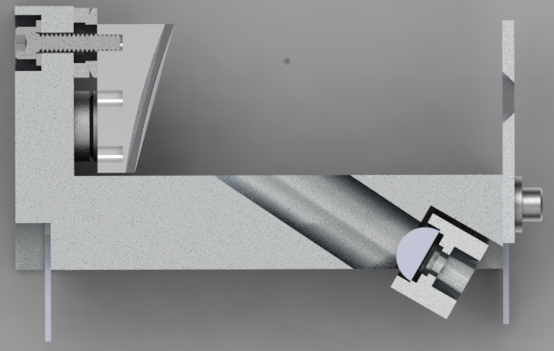
Results: Initial Shim Stack Thickness
OAP
Interferometer Rays
Secure Diode Block with the Half Sphere to 3-axis stage
Align stage translation axes along X’,Y’, and Z’
“Zero” position of block (shimming faces in contact)
Translate block to minimize tip, tilt, and power Zernike coefficients
Replicate translated distance via shim stack thicknesses
Y’
Y
Z’
Z
X’
X
Focus shims [Z’]: 1.783 mm
Results In-plane shims [Y’]: .315 mm
Out-of-plane shims[X’]: .725 mm
Diode Block
Chrome Half Sphere
Notes:
Presentor: Jaykob
0-2mm acceptable shim stack range
Describe “zero”
Convert micrometer distances from three axis stages to shim stack thickness

Slide 35
Methodology: Pinhole Displacement Characterization
OAP
Interferometer Rays
Mount Diode Block w/ shims and remove Half Sphere
Read return from pinhole surface to determine focus displacement
Add/remove shims until focus (Z’), in-plane (Y’), and out-of-plane (X’) error satisfy MTF budget
Lock Diode Block position and verify light is still passing through pinhole
Y
Y’
Z
Z’
X
X’
False interferogram return observed from pinhole surface!
Diode Block
Pinhole Disk
Notes:
Presentor: Jaykob

Slide 36
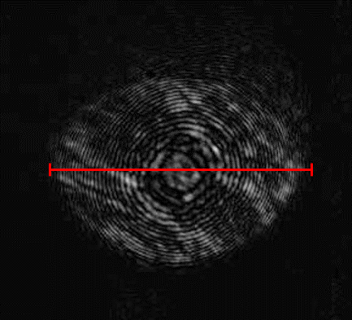
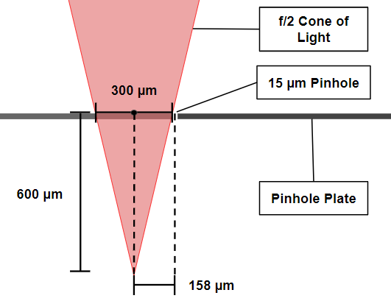
Results: Pinhole Displacement
False interferogram return from pinhole disk
Visualization of focused interferometer beams at pinhole disk
Y’
Z’
29 defocus rings
X’
= 600 μm
: focus displacement error (600 μm)
f/N : F-number of the system (f/2)
m : number of defocus rings across the aperture (29)
λ : wavelength of the interferometer beam (633 nm)
Focus displacement: 600 μm
Results In-plane displacement: 158 μm
Out-of-plane displacement: 158 μm
Notes:
Conner McLeod

Slide 37
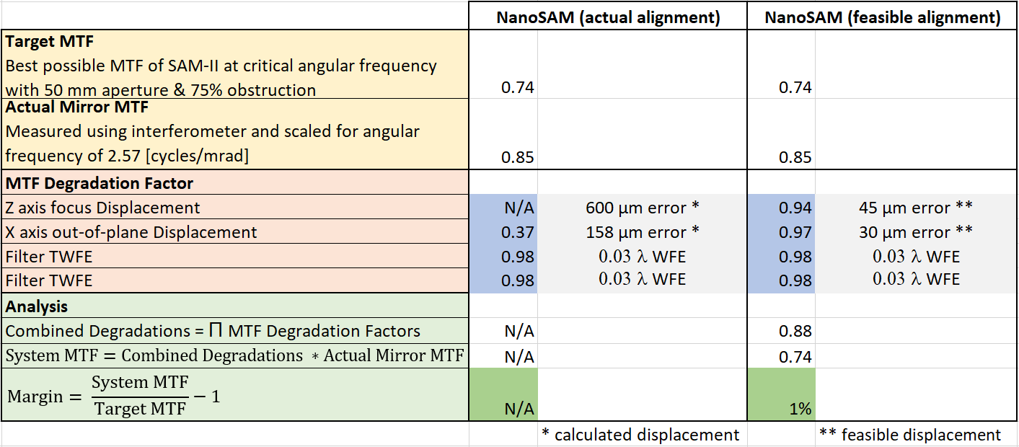
Results: Final MTF of Optics System
Displacement results can be used to predict MTF at the pinhole
≈
1 km vertical resolution is achievable with off the shelf optical components!
Notes:
Conner McLeod

Slide 38
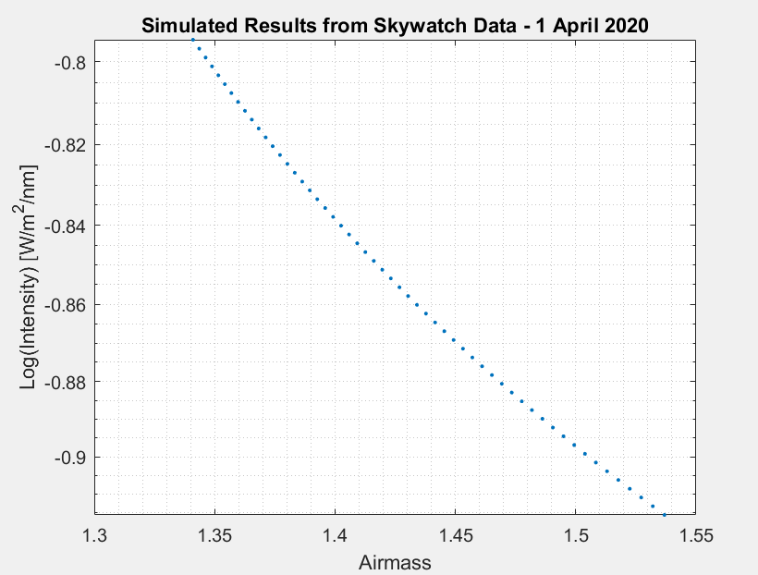
Simulated Results: Final Integration Test
Comparison: ATOC Skywatch Observatory Photometric Data
Same latitude, longitude, and season as integration testing
1 min. sample frequency matches NanoSAM requirements
Photometric data propagated through optical system to produce Langley Plot
Demonstrates anticipated correlation of intensity to airmass
Extrapolation to 0-airmass calibration condition possible
Notes:
Sara

Slide 39
Systems Engineering
Notes:
Sara

Slide 40
Systems Engineering Summary
Verification & Validation
Meetings with customer to scope project
CONOPS
Review of Project Performance
Handoff to Customer
Functional Requirements
Final Integration Test
Payload Requirements
Subsystem Verification
Project Definition
Trade Studies
Test & Integration
Subsystem Component Testing
Detailed Design
Manufacturing Changes
Manufacturing & Implementation
Incomplete
Completed
Time
Notes:
Jacob
what tests were conducted or planned to be
conducted, specifically what each test was designed to determine (relate to
requirements), and how and where the tests were conducted or were to be conducted.
During trade studies and detailed design FMEA was performed
I would change ‘understand’ project to like ‘scope’ project

Slide 41
Systems Engineering Issues
Defining requirements
Separating payload requirements and properties of system
How to define requirements for a flexible project
Alignment process took more resources than expected
More resources need to be allocated to critical components of the project to minimize delays on rest of the project
How to determine critical parts of the project at specific times
Notes:
Jacob
what tests were conducted or planned to be
conducted, specifically what each test was designed to determine (relate to
requirements), and how and where the tests were conducted or were to be conducted.
-

Slide 42
Project Management
Notes:
Min

Slide 43
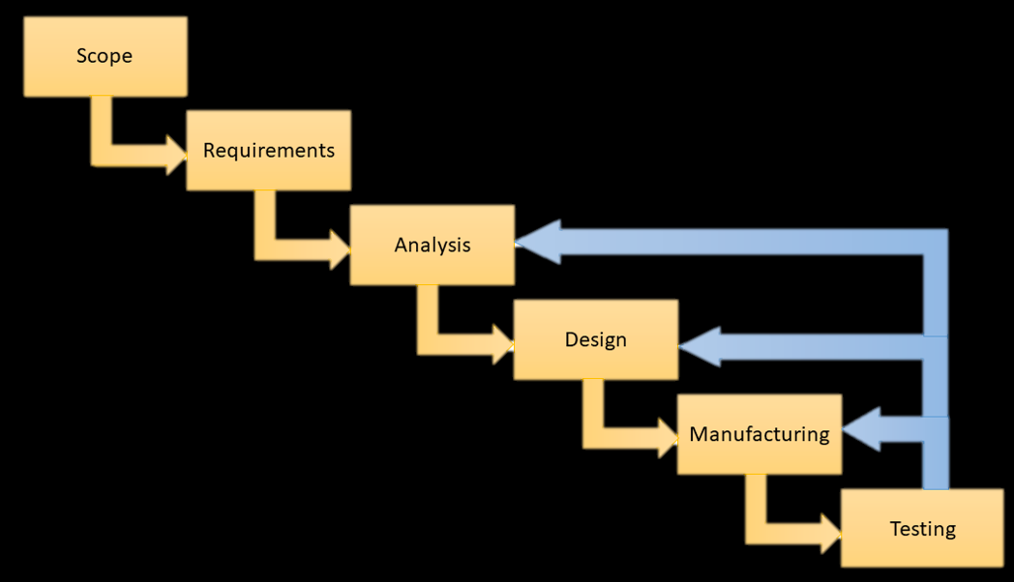
Summary
Success
On schedule
Teamwork
Positive Environment
Lessons Learned
Communication
Expectations vs. Reality
Stakeholder Engagement
Waterfall & Agile Hybrid
Efficient
Complete Documentation
Flexible
Notes:
Min

Slide 44
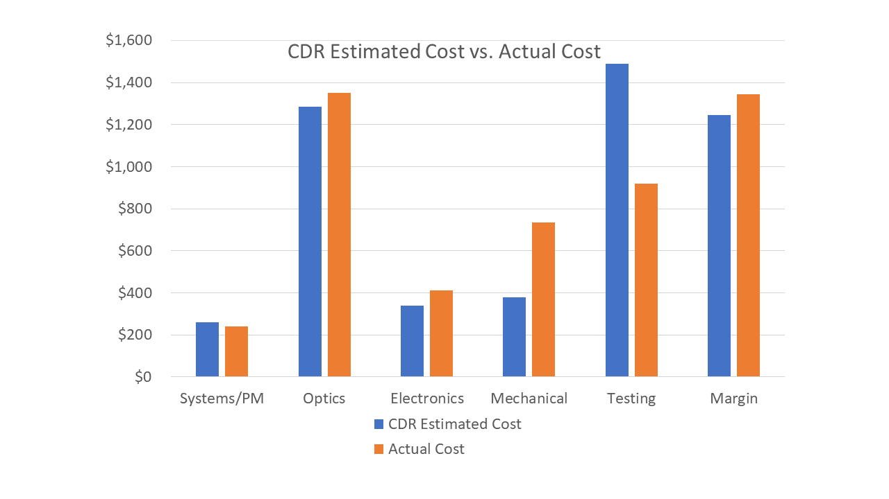
Finance
Actual Cost: $3040
Notes:
Min

Slide 45
Industrial Cost Breakdown
 | 25 Weeks |  |  | 30 Weeks
Item | Quantity | Per Cost | Total | Quantity | Per Cost | Total
Materials and Hourly Services | - | - | $3,657 | - | - | $3,657
Salary | 3861 hrs | $31.25 | $120,656 | 4393.8 hrs | $31.25 | $137,306
Overhead rate | 200% above cost | - | $248,626 | 200% above cost | - | $281,926
 |  | Total Cost | $372,939 | Total Cost |  | $422,889
Notes:
Min

Slide 46
Acknowledgements
Jim Baer - Ball Aerospace Corp
Joe Lopez - Ball Aerospace Corp
Dr. Cora Randall - LASP
Matt Rhode - CU Boulder
Zoltan Sternovsky - CU Boulder
Haley Knapp - Ball Aerospace Corp
Notes:
Min

Slide 47
Resources
https://www.thorlabs.com/newgrouppage9.cfm?objectgroup_id=10773
http://www.mpia.de/~mathar/public/mathar20151213.pdf
https://www.atmos-meas-tech.net/9/215/2016/amt-9-215-2016.pdf
https://www.edmundoptics.com/?gclid=EAIaIQobChMIn6yV7fuZ5QIV9yCtBh34GwFBEAAYASAAEgLHv_D_BwE
Sigma Delta ADC Datasheet
AD8012 Transimpedance Amplifier Datasheet
FD11A Si Photodiode Datasheet
http://www.cubesat.org/
“15 Wave-Front Aberrations and MTF.” Modern Optical Engineering: the Design of Optical Systems, by Warren J. Smith, 4th ed., McGraw Hill, 2008.
“Chapter 11 Transfer Functions; Hubble Space Telescope.” Astronomical Optics, by Daniel J. Schroeder, 2nd ed., Academic Press, 2000.
“CHAPTER 1 MTF IN OPTICAL SYSTEMS.” Modulation Transfer Function in Optical and Electro-Optical Systems, by Glenn D. Boreman, vol. TT52, SPIE Press, 2001.
POAM III retrieval algorithm and error analysis (SNR value)
https://www.nasa.gov/mission_pages/sdo/science/solar-irradiance.html
https://www.ioccg.org/groups/Thuillier.pdf
Notes:
Min

Slide 48
Backup Slides

Slide 49
Mechanical
Notes:
CAD models, diagrams,
schematics, flowcharts, etc.

Slide 50
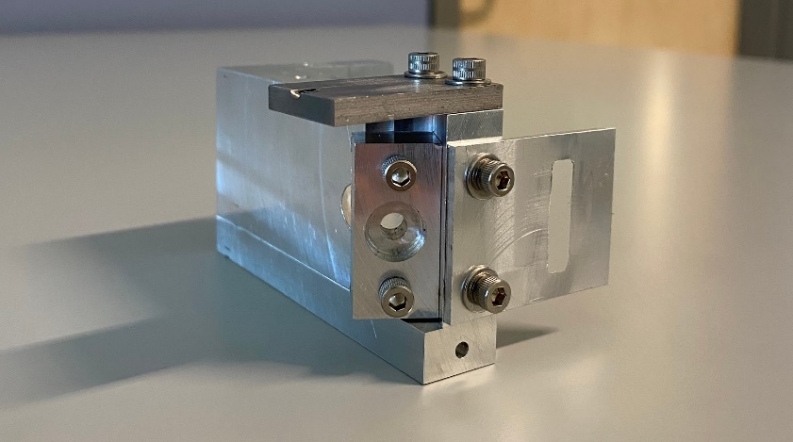
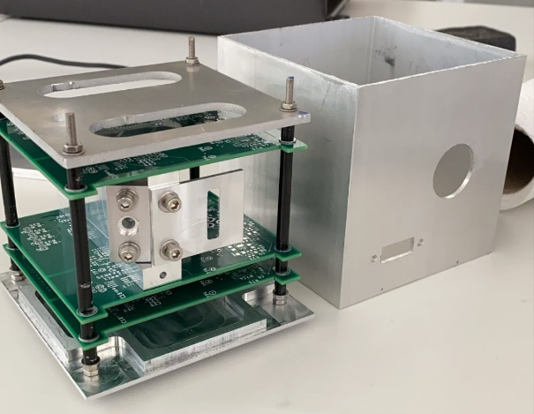
Mechanical Tests Performed
Test Performed | Relevant Requirement | Result
Mass of payload is less than 1.33 kg | 2.2: Payload Mass | Success
Payload is removable from the enclosure | 2.3.2: Removable Enclosure | Success
Notes:
Needs a little revising: No “No”
Add requirement ID

Slide 51
Electronics
Notes:
CAD models, diagrams,
schematics, flowcharts, etc.

Slide 52
Example Table
Test Description | Relevant Requirement | Location | Equipment | Result
 | 1.0: name |  |  | Success
 |  |  |  | Success
 |  |  |  | Success
 |  |  |  | Success
 |  |  |  | Success

Slide 53
Electronics Subsystem Tests Performed 1/2
FR 3.0: The electronics system of the payload shall be capable of collecting, packetizing, and outputting radiometry data.
Test Performed | Relevant Requirement | Result
Transimpedance amplifier converts current to voltage with expected gain | 1.5: Dynamic range | Success
Noise in electronics is less than ADC’s LSB | 1.4: SNR | Success
ADC has at least 10 bits | 3.1.2: Data Collection Bit Size | Success
ADC samples at 50Hz | 3.1.1: Sampling Rate | Success
Microcontroller interfaces with a PC | 3.3.1: Data Output Method | Success
Notes:
Needs a little revising: No “No”
Add requirement ID

Slide 54
Electronics Subsystems Test Performed 2/2
Test Performed | Requirement Verified | Result
Digital Power supply produces 3.3 V | 3.0: Electronics System | Issue with buck converter IC. Using regulator on microcontroller instead
Microcontroller reads and writes at least 100Mb of data to flash | 3.2.1: Data storage | Success
External ADC can read voltage from transimpedance amplifier | 3.1: Data collection | Issue with PCB footprint. Using ADC on microcontroller instead
Analog Power Supply produces +/- 5V | 3.0: Electronics System | Success

Slide 55
Electronics Subsystem Tests to be Performed
Test | Relevant Requirement | Date Planned | Support Equipment
Dark current measurement | 1.4: SNR | Week of 03/09/20 | Dark room or enclosure
Dark noise measurement | 1.4: SNR | Week of 03/09/20 | Dark room or enclosure
Measurement stability | 1.3.1.1: Measurement stability | Week of 03/13/20 | GND Filters, Calibrated Light Source
Saturation Test | 1.5: Dynamic Range | Week of 04/01/20 | Solar Tracker, integrated electronics, optics, and structure
Notes:
Do we have the equipment yet or when will we procure it
Will we have the procedures by specified dates
All supporting equiment and document will be ready by xxx, or how to get it done by that date

Slide 56
Software
Notes:
CAD models, diagrams,
schematics, flowcharts, etc.

Slide 57
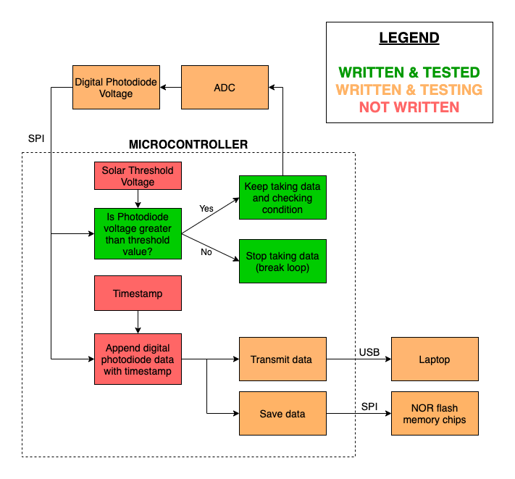
Software Progress
MSR
TRR

Slide 58
Hardware & Software Interaction Tests
Software Element | Status | Result
Write/read data to flash memory via SPI | Completed 2/15/20 | Successful
Serial print data to laptop via USB | Completed 2/14/20 | Successful
Receive data from external ADC via SPI | Completed 2/26/20 | Could not read voltage from ADC
Create timestamp and append to data output | Completed 2/26/20 | Success
External ADC
Flash Memory
Notes:
Timestamp = 16-bit integer that we append to end of data integer for storage. Timestamp is counter after we turn on Teensy (need to note real time)
Needs some work

Slide 59
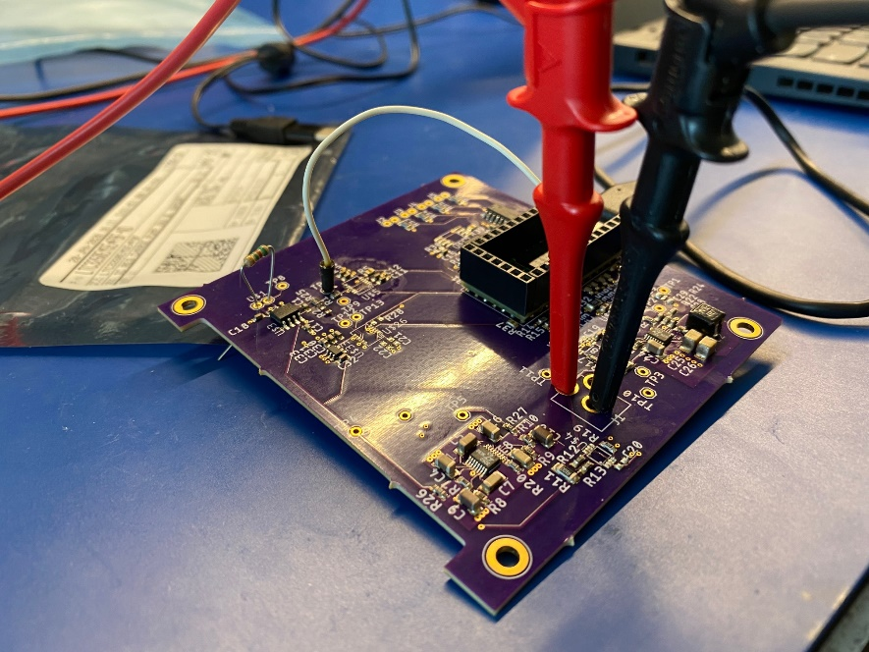
Software Tests to be Performed
Tests to be performed | Date Planned | Support Equipment
Integrated test with photodiode to estimate threshold voltage for data capture loop condition
Testing software with powered PCB bypassing external ADC
(2/26/20)
Notes:
Move this slide. Not software

Slide 60
Optics
Notes:
CAD models, diagrams,
schematics, flowcharts, etc.

Slide 61
Optics Alignment Tests Performed 1/2
FR 1.0: The optical system of the payload shall be capable of collecting radiometry data.
Test | Status | Result
Req. 1.1.1: FOV 1.3 arcmins (or less) and 1 km Vertical Resolution | Completed Fall 2019 | Successful
Optical Bench Integration | Completed 2/28/2020 | The angle of the tooling plate screw is off. (Re-machining in progress)
Diode Block Integration | Completed 2/20/2020 2/28/2020 | Successful Adjust pinhole handling and glue application

Slide 62
Optics Alignment Tests Performed 2/2
FR 1.0: The optical system of the payload shall be capable of collecting radiometry data.
Test | Status | Result
Optomechanical Mounting System | Completed 2/21/2020 | Successful
Alignment Methodology with 50 μm Pinhole | Completed 2/28/2020 | Not able to align to the pinhole during the scheduled lab session (not enough time).
Final Alignment of Optics System | 3/6/2020 | TBD

Slide 63
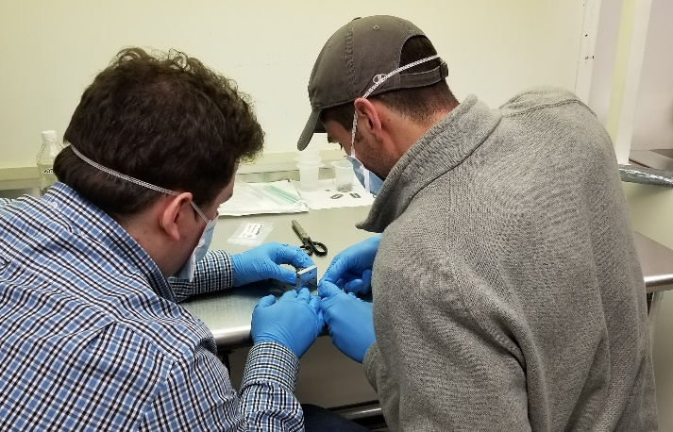
Optical Bench Integration
Components and features tested:
Optical Bench
Aperture Stop
OAP Mirror
Component integration experience gained:
Working with shims is a lengthy process
Scheduling more lab time for alignment
Adding/removing shims requires removal of optical bench from mount
Additional optomechanics were added to preserve orientation of optical bench and allow for repeated removal
Diode Block
Precision Cut Optical Shims
Tooling Plate
Notes:
Change title to takeaway

Slide 64
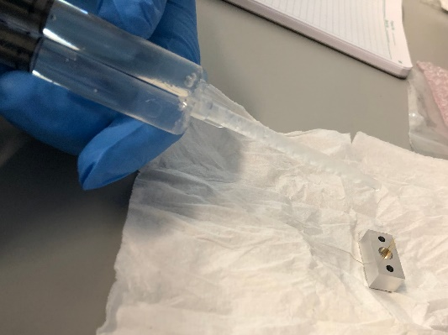
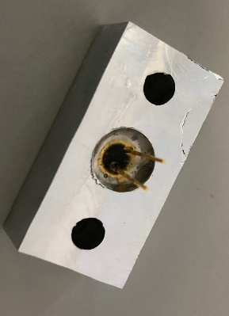
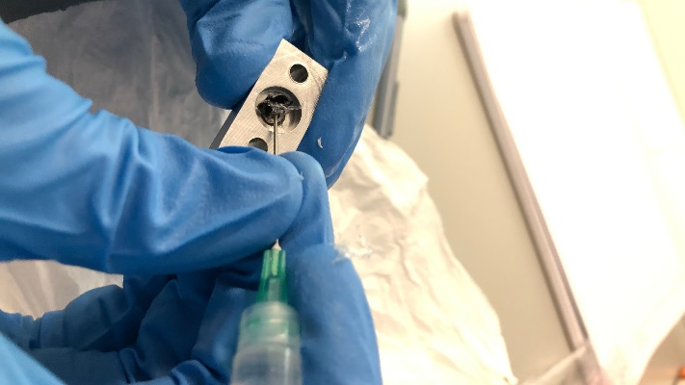
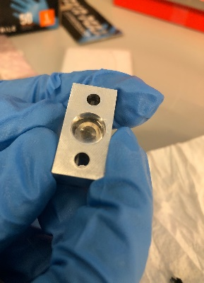
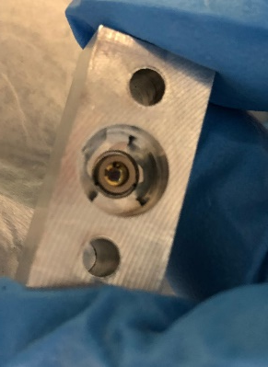
Diode Block Integration
Components and features tested:
Diode press fit
Pinhole handling
Half sphere removal
Component integration experience gained:
Glue application, Pinhole disk handling
Successful!
2/28/2020
Notes:
Change title to takeaway

Slide 65
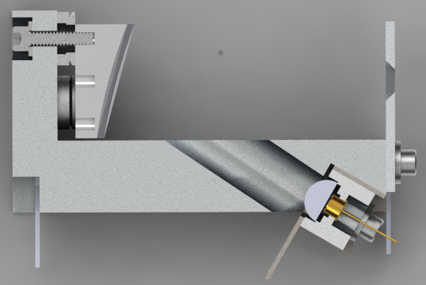
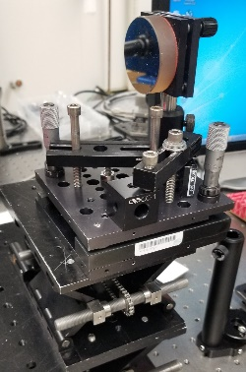
Optics Test Overview
Vertical Resolution
Mounting System
MTF
Component Integration
FOV
Y
Y’
Alignment Methodology
Z
Z’
X
X’
Notes:
Jaykob
what tests were conducted or planned to be
conducted, specifically what each test was designed to determine (relate to
requirements), and how and where the tests were conducted or were to be conducted.

Slide 66
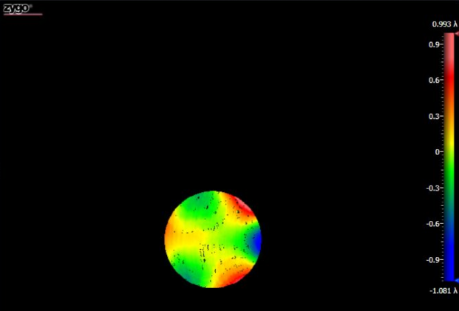
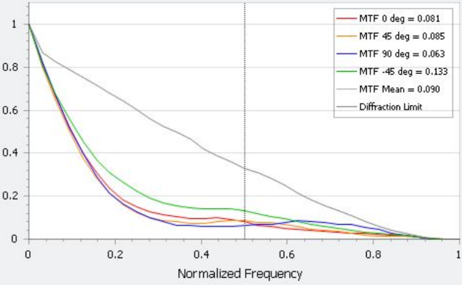
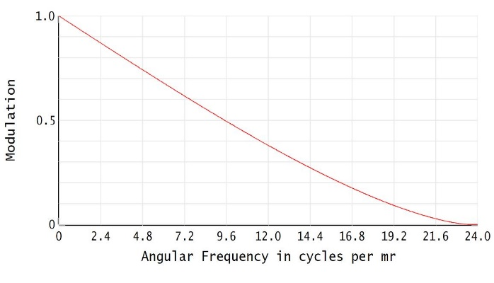
Optics Expected Results & Model Verification
Preliminary test results indicate surface quality the OAP mirror is near manufacturers claimed performance
MTF measured by DynaFiz interferometer compared to MTF predicted by Zemax
ZEMAX MTF Model Closely Approx. Interferometer Measurements
Left - OAP Wavefront Error Center - Preliminary Test MTF Output Right - Zemax MTF Comparison
Notes:
Use the yellow, green, light orange region for the clear aperture.

Slide 67
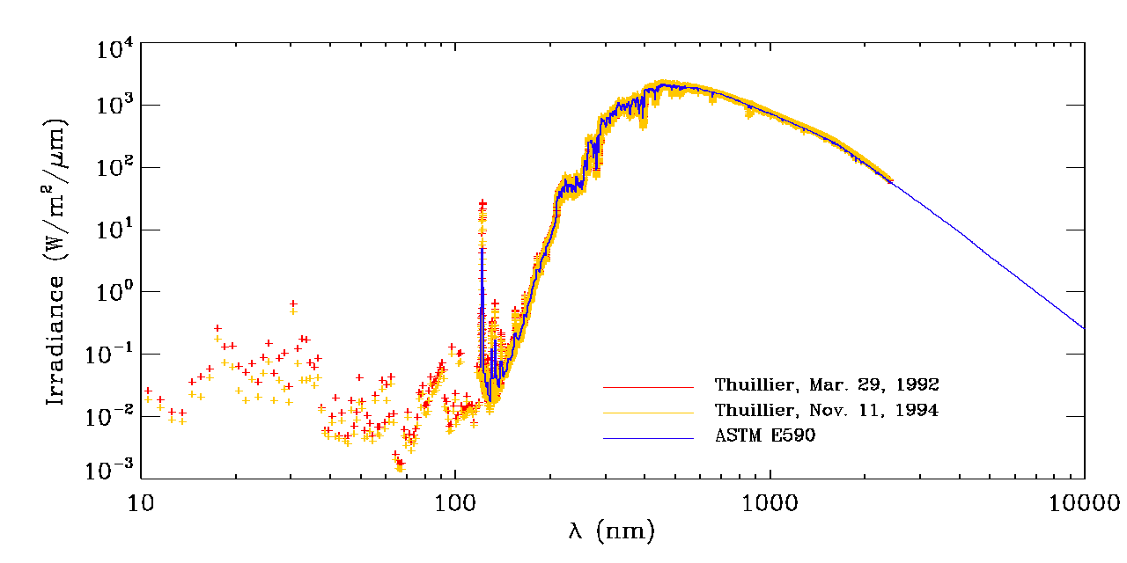
Integration Testing
Spectral Irradiance
Testing wavelength: 1020 nm
Compare max value to literature
Validate value with scientists
Verifies FR 1
Notes:
Combine with 36. Move graph o backup slides
Solar tracker

Slide 68
Reproducibility, SNR, & Temperature Verification
Simulate attenuation of source signal
Compare gathered data to expected results for multiple tests
Check that data is stable over time and monitor the temperature of the system
Notes:
Is there a thermal element to this test? Can we make one?
Use a calibrated light source (available from Ball) and rotating circular Graduated Neutral Density (GND) Filter to simulate attenuation
Compare gathered data to expected results over multiple tests
Stability - reproducibility
Error- standard deviation

Slide 69
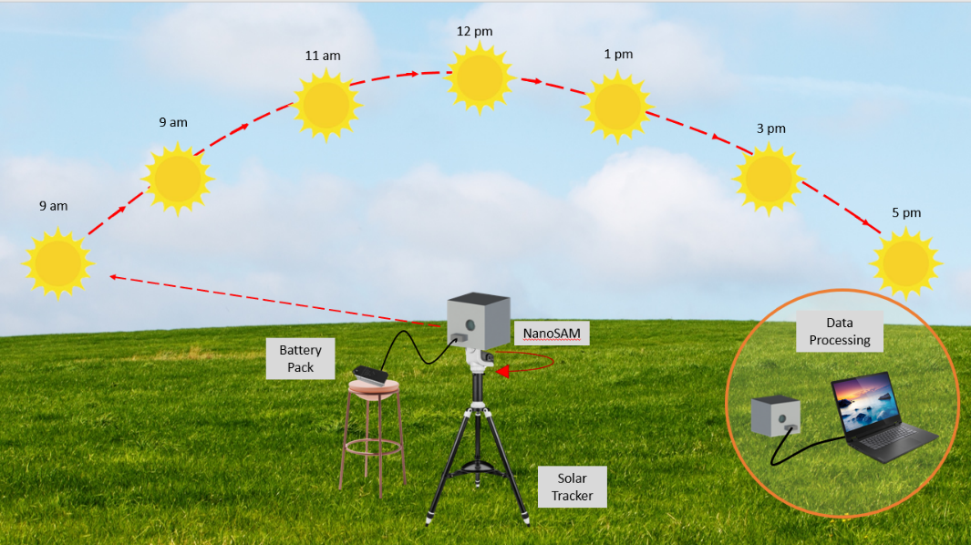
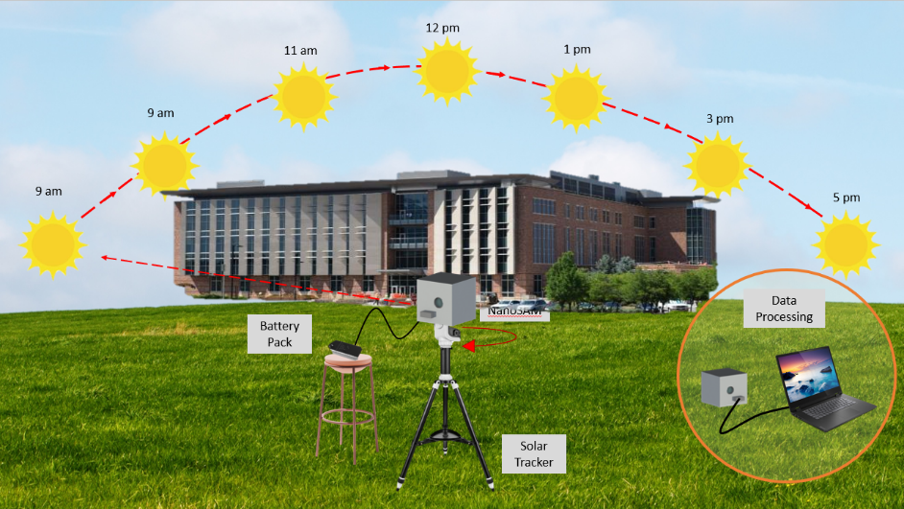
Final Integration Testing
Perform test over multiple clear days
In front of AERO
Mount NanoSAM on solar tracker & tripod
Powered by battery pack
Turn off solar tracker after solar noon
Data downloaded to laptop for post-processing
Use Langley extrapolation method to determine irradiance for zero air mass
Use 1st test to determine threshold voltage for data capture loop condition
Notes:
Use beer’s law. Find optical depth to calculate irradiance

Slide 70
Budget
Notes:
Josh

Slide 71
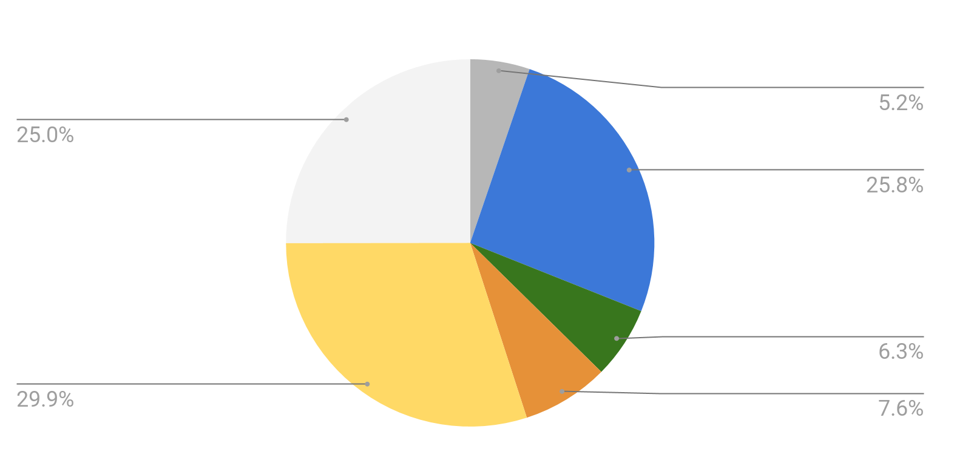
Predicted Cost Plan
Balance: $3,755
Available Budget: $1,245
Notes:
Margin. Bar chart for comparison. Change “unassigned” to “margin”. WHat can we use the money to push the project forward? Buy more stuff. No penalty. Shorten budget to 2 slides max.

Slide 72
Updated Cost Plan
Balance: $3,657
Margin: $1,343
Testing budget decreased
Mechanical budget increased
Notes:
Josh

Slide 73
Conclusion
Volume, Mass, and Portability Requirements of the Instrument and Enclosure have been Verified
PCB Populated and Components Tested - Microcontroller Taking on Additional Tasks
Software Testing Ongoing - Working on Threshold Voltage and Data Packetization Codes
Optical Alignment in Progress - OAP Aligned to Interferometer - Shimming Continuing this Week

Slide 74
Mechanical

Slide 75
Structural Design Overview
10 cm
10 cm
Sealed enclosure
Exterior electronics port
Threaded filter mount
10 cm
Satisfies Functional RQMT 2
Mass: 1094 g
Volume: 1000 cm³
Notes:
Josh

Slide 76
Mechanical Geometric Design and Tolerances
Available movement of light from nominal distance: (.506/2) - (.015)/2 = 0.2455 mm
Allowed deviation in angle: ΔⲐ = arctan(0.2455/54.54) = 0.5752818° from nominal angle of OAP
Therefore, the “L” on the optical bench must be 90° 土 0.5752818° as a cumulative error
We can get accurate within 2 orders of magnitude more in the AERO Machine shop - feasible
Ale to test this with either measurement tools or alignment with our interferometer & Zernike Coefficients
OAP Angle:
30°
Effective Focal Length: 54.54 mm
Pinhole Diameter: 0.015 mm
Notes:
Josh

Slide 77
UNC 6 AL6061-T6 Bolts
UNC 6 Bolt
5.3 in-lbs torque
0.0001 in elongation of diameter for +20K temperature change
Notes:
Not complete

Slide 78
Optics

Slide 79
Optical Bench: Preliminary Geometric Tolerance
For CNC mill tolerance of 5 mils
Nominal Shim Stack 1.5 mm
Tolerances
Worst case image plane contributions used
Allowable angle deviation of the mirror: .4 degrees

Slide 80
Optical Design Overview
ZEMAX OpticStudio Model diagram
Notes:
Sara
NOTES: This is a to scale Zemax rendering of the NanoSAM Optics system. Give overview of optical system design and purpose of each component (filters-get desired wavelength, aperture stop-meet MTF and allow desired amount of light into the system, off-axis parabolic mirror-focus light through field stop onto photodetector, field stop-meet vertical resolution/FOV requirement). Mention key dimensions allow the system to fit within a 1U cubesat.

Slide 81
Other Factors Degrading MTF
MTF Losses of NanoSAM
lambda /4 SFE for 30 deg off axis parabolic mirror ~ 80% degradation
lambda/8 WFE for both long pass and band pass filter ~ 50% degradation
-XX% margin
MTF Losses of Flight Ready NanoSAM
lambda/16 SFE custom off-axis mirror ~ 10% degradation
lambda/? WFE for both long pass and band pass filter ~ XX% degradation
+XX% margin
NanoSAM will not meet MTF requirement due to mirror and filter irregularities however given a better mirror and filter the MTF requirement can be met

Slide 82
Thermal Effects on MTF
Thermal expansion can shift the mirror with respect to other aluminum components
Shifting the mirror is equivalent to shifting the pinhole
Athermal system is composed of a single material
Thermal expansion of steel washers is different than the thermal expansion of the Al-6061 components
A significant temperature change (~20K) is required to shift the mirror 1μm
Note: The plot shows the required 𝛥T for a 1μm difference in the thermal expansion for steel washers for a given coefficient of thermal expansion.

Slide 83
Pinhole Alignment and Allowable Error
MTF Analysis
NanoSAM Diffraction Limited MTF = 0.8622, 𝜈 = 2.574 [cycles/mrad] (Zemax)
SAM Diffraction Limited MTF = 0.74
NanoSAM MTF should not degrade below 85.6 percent from 100 percent in order to meet or exceed SAM performance
NanoSAM MTF Versus Angular Frequency
(2.574, 0.8622)
Satisfies MTF Requirement
Notes:
NOTES: NanoSAM is allowed 85.6% MTF degradation in order to meet or exceed SAM MTF. Explain what MTF is. Show scaled MTF vs defocus/lateral image plane displacements plots with visual diagram. Give acceptable displacement for each direction (defocus, lateral image plane displacements). State shim thickness required to meet MTF alignment requirements.
Zoltan: need to introduce MTF

Slide 84
Pinhole Alignment and Allowable Error
+Defocus
+Image Plane x-axis
+Image Plane y-axis
Displacement Range: ±138 μm
Displacement Range: ±138 μm
Displacement Range: ±520 μm
Ranges allow adjustments to mitigate MTF degradation
Shim Stock Options Available

Slide 85
Pinhole Alignment and Allowable Error
+ Image Plane x-axis
+ Image Plane y-axis
+ Defocus

Slide 86
Zernike Coefficients
Zernike polynomials are mutually orthogonal on the unit disk.
Each Zernike polynomials corresponds to an optical aberration/irregularity
The order of Zernike coefficients is not universal
Driving each Zernike coefficient toward zero decreases the measured wavefront error
The lower order Zernike modes have a ‘linearized’ relationship with respect to angular displacement
The decrease in wavefront error is visible in the fringe pattern output by the interferometer software
A null fringe pattern (as few waves as possible) corresponds to the best optical performance
The Zernike modes - increasing in order from top to bottom
Notes:
Procedure supervised by ball engineer and customer

Slide 87
Zemax Zernike Coefficients Model Verification
Zernike coefficients measured from interferometer compared to Zernike coefficients modeled by Zemax
Notes:
Procedure supervised by ball engineer and customer

Slide 88
Pinhole Alignment and Allowable Error
Summary of MTF Budget Analysis
Defocus Displacement Range = 138 μm (0.00543”)
Image Plane x-axis Displacement Range = 138 μm (0.00543”)
Image Plane y-axis Displacement Range = 520 μm (0.0205”)
Shim Stock Thickness Recommendations
1x 12.7μm (0.0005”) shim stock McMASTER-CARR 9502K56
1x 25.4μm - 254μm (0.001” - 0.01”) shim stock set McMASTER-CARR 9300K5
Notes:
NOTES: NanoSAM is allowed 85.6% MTF degradation in order to meet or exceed SAM MTF. Explain what MTF is. Show scaled MTF vs defocus/lateral image plane displacements plots with visual diagram. Give acceptable displacement for each direction (defocus, lateral image plane displacements). State shim thickness required to meet MTF alignment requirements.

Slide 89
Alignment Setup Stability
Optomechanical mounting system
Stability of Test Environment
Interferometer laser stabilization after ~30 min of instrument being turned on
Isolator table not set up, but visual inspection of effects of vibration on fringe pattern is minimal.
Notes:
Backup slide

Slide 90
Alignment to the Sun
The system will need to be aligned to the Sun during the final day in the life test
From the Earth’s surface, the apparent size of the Sun is around 0.5 degrees
Our optic system must be aimed somewhere on the solar disk near the center
So, the pointing accuracy must be less than 0.5 degrees (~0.1 degrees is reasonable)
2 tabs are aligned to the optimal axis of the OAP during the alignment procedure
The bright spot projected through a hole in the first tab is aimed at a crosshair which denotes the center of a hole in the second tab
The shadow cast by this crosshair is centered on the bright spot to align the enclosed system
This requires a window on the Sun facing side of the enclosure as well as one on the opposite side
The tabs being approx. 77mm apart means that 0.1 degree rotations result in the projected bright spot translating slightly more than ⅛ mm.
The shadow of the crosshair will disappear at a distance around 100x the width of the ‘hairs’
A ⅛ mm thick crosshair will disappear around 1.25 cm passed the second tab
Notes:
Procedure supervised by ball engineer and customer

Slide 91
Electronics/Software

Slide 92
Electronic Design Keys
Built-in contingency plans
Power supplies can be replaced
Analog power supply replaced with battery
Digital power supply replaced with microcontroller power
Op-amp footprint is standard to a large variety of op-amps
Separate digital and analog power supplies
LT3260 bipolar analog power supply
Built in low noise linear regulators
LT8610 3.3V switching regulator digital power supply
Separate digital and analog grounds
Continuous ground planes
Payload power draw: 0.806 W
Satisfies Power Requirement!
Notes:
Remind here that we are meeting the power requirement
Might want to make this a power draw slide from each component.

Slide 93
Schematic

Slide 94
Schematic

Slide 95
Software Flowchart
Notes:
Chart is in NanoSAM/Software for edits

Slide 96
Software Flowchart

Slide 97
Sample SPI Communications Code

Slide 98
Systems/PM

Slide 99
Specific Objectives
Objectives | Level 3
Solar Irradiance | Linear The solar irradiance data exhibits approximately linear trends that will be independent of temperature variation .
Instrument SNR | The optical instrument has a SNR above 3.5E3. The level three goal shall be determined from the instrumental errors used in the Chu and McCormick sensitivity simulation with input from atmospheric scientists.
Vertical Resolution | The optical instrument's FOV facilitates a vertical resolution of 1 km of atmosphere when placed in a 500x500 km circular orbit.
Data Capture | Supporting electronics and software acquires, digitizes, packetizes, and downloads raw data from the photodiode to a laptop computer. The software also incorporates synthetic data that simulates the spacecraft health, slew rate, and other housekeeping (if applicable) digital outputs to represent actual operating conditions.
Payload Instrumentation Size | The payload consisting of a radiometer and supporting electronics is compatible with a 1U CubeSat bus.
Mechanical Structure | The payload will be secured into a mock 1U CubeSat bus architecture. The instrument and supporting electronics will be secured into place along with "black boxes" that represent items that will be present in the final mission but that are not present in this year's project such as the ADCS.
Notes:
Should we add alignment into this

Slide 100
Design Requirements
RQMT ID | RQMT Title | RQMT Text | Verification Approach | Verification Method
1.2 | MTF | The MTF of the optical system shall be at least 0.74. | THe MTF of the optical system will be obtained from an interferometer. | T
1.1 | SNR | The payload shall have an SNR of 3500 or greater for irradiance values of 50% maximum anticipated irradiance and above. | An analytical model of the SNR will be produced with worst case scenarios in mind to ensure the minimum SNR remains above the specified value. | A
1.3 | Measurement Stability | The irradiance measurements of the system shall remain stable to within 1% across at least 5 number of tests. | A calculation of the expected signal will be used to verify the gains setting that allows the irradiance measurements to be stable. | A/T
1.4 | Dynamic Range | The Payload shall not saturate for a radiance input of 120% of the maximum anticipated solar radiance in the operational band. | A light source with 120% of the anticipated solar radiance will be measured to verify the instrument does not become saturated. | T
1.5 | Allowable Measurement Error | The irradiance measurements of the system shall remain accurate to within 5% of theoretical signal. | A calculation of the theoretical signal will be compared with the experimental results to ensure accuracy of measurements. | T
1.6 | Optical Heating | The optical system focal length shall remain stable over the anticipated operating temperature range of 4C to 26C. | The optical system focal length will be compared to an expected value in temperature range. | A/T

Slide 101
Design Requirements
RQMT ID | RQMT Title | RQMT Text | Verification Approach | Verification Method
1.7 | FOV | The optical system FOV shall be less than 1.2 arcminutes. | The FOV will be calculated analytically and checked to ensure conformity. | A
1.8 | Pointing Accuracy | The pointing accuracy of the payload shall be 30 arcseconds or less. (Solar tracker for test) | The pointing accuracy of the payload will be analytically determined from the solar tracker properties. | A
1.9 | Band pass Filter | The optical system shall utilize a band pass filter with a theoretical center wavelength of 1.02 micron with a bandwidth of 40 nm. The filter used must have an actual bandwidth of at least 25 nm and include the 1.02 micron wavelength. | A light source with no wavelengths in the specified range will be applied through the filter and tested to ensure no light has passed through. | T
1.10 | Average Power Draw | The payload shall draw an average of less than 4.5 W over one orbit. | The maximum power required by all electronic components that require power will be calculated and measured. | A/T
1.11 | Sampling Rate | The irradiance data shall be sampled at a rate of at least 50 Hz. | The payload will be tested to show that it collects data at a rate of 50 Hz or more. | T
1.12 | Data Collection Bit Size | The irradiance data shall be collected using 10 or more bits. | The payload will be tested to show that it collects data at 10 or more bits. | T
1.13 | Data Storage | The payload shall be able to collect and store at least 100 Mb of data for 24 hours. | 120 Mb of experimental data will be collected and stored during overall system testing. | T

Slide 102
Design Requirements
RQMT ID | RQMT Title | RQMT Text | Verification Approach | Verification Method
2.1 | Payload Mass | The payload and bus architecture combined shall have a mass of 1.33 kg or less. | The mass of all components will be weighed before and after assembly to ensure the total mass is less than 1.33 kg. | I
2.2 | Payload Volume | The optics and electronics system shall fit within a volume of 10x10x10 cm. | The optics and electronics systems will be placed into the housing with the specified dimensions. | I
2.3 | Housing | The system shall be housed in an enclosure with external dimensions of 10x10x15 cm. | The optics and electronics systems will be placed into the housing with the specified dimensions. | I
3.1 | Data Transmission | The system shall be able to transmit all recorded data to an external source. | Data will be taken and transmitted to an external source. | T
3.2 | Communication Timing | The system shall be able to receive timing and duration information from an external source. | Data will be taken and transmitted to an external source. | T

Slide 103
Test Plan
Test Phase | Location | Support Equipment | Requirements Verified
Optical System Alignment (2/20-3/7) | JILA | Interferometer, Optical shims, Precision half-sphere, torque wrench | MTF, FOV (Vertical Resolution)
Stability Testing (3/8-3/21) | Ball | Gradient filter and associated equipment, highly regulated power source, tungsten bulb, oscilloscope | SNR, Stability, Error, Dynamic Range, Band pass filter, Sampling rate, Data bits, Data transmission
Integration Testing (3/22-4/10) | CU Business Field | Solar tracker, tripod, GPS, solar tracker to NanoSAM mount | Optical heating, Pointing accuracy, Power draw, Data storage, Payload mass and volume, Housing, Timing communication
Notes:
Joe: Take to front of section

Slide 104
Test Plan
RQMT Verifying | Test Description | Support Equipment
1.1 | An analytical model of the SNR will be produced with worst case scenarios in mind. Physical measurements of noise of the electronics will be made to incorporate into the model. The value derived from this model will be compared with the required value to ensure the SNR is met. | Electronics system, photodiode, oscilloscope
1.2 | During alignment of the system using the interferometer the MTF of the system will be output by the interferometer. | Interferometer, precision half sphere, half sphere removal tools
1.3 | A regulated light source will be increased from 0% radiation to 120% maximum expected solar radiation and irradiance measurements will be taken to ensure the photodiode does not become saturated. | Regulated light source, optics system
1.4 | A regulated light source will be measured for irradiance with the optics system and compared to the theoretical value over the anticipated operating temperature. | Regulated light source, optics system
1.5 | Using an interferometer with a regulated light source held at a constant irradiance value the focal length of the optical system will be determined and evaluated for conformance over the anticipated operating temperature. | Regulated light source, optics system, interferometer
1.6 | The FOV will be determined analytically using measurements of the system's actual aperture diameter. | Optical system, ruler

Slide 105
Test Plan
RQMT Verifying | Test Description | Support Equipment
1.7 | The pointing accuracy of the solar tracker will be analytically determined using data from the solar tracker specifications. | Solar tracker
1.9 | A power budget for the system will be analytically formulated and the electronics system will be tested to ensure the power draw conforms to the required value. | Electronics system, electronics measurement equipment
1.10 | Data will be captured by the system for a set amount of time and analyzed to ensure sampling of at least 50 Hz. | Electronics system, oscilloscope
1.11 | Data will be captured by the system and specific packets of information will be examined to ensure 10 bit data transmission. | Electronics system, oscilloscope
1.12 | During various tests data will be taken, including 120 Mb of experimental data during overall demonstration. | Payload, external computer source
2.1 | The overall system will be weighed using a scale. | Payload, scale
2.2 | The optics and electronics system will be placed into the external housing and inspected to ensure a proper fit. | Payload, external housing
2.3 | The optics and electronics system will be placed into the external housing and inspected to ensure a proper fit. | Payload, external housing
3.1 | During various tests data will be taken and captured, the presence of all recorded data will be checked for. | Payload, external computer source
3.2 | During various tests the payload will be commanded by the external computer source. The implementation of these commands and subsequent data capture will be monitored for. | Payload, external computer source

Slide 106
Stack Plate
90.17 mm
75.00 mm
5.00 mm
95.00 mm
PC/104 thru hole specification
0.5 mm spacing b/w plate and enclosure
Notes:
Version 1

Slide 107
Alignment Verification
Optical Bench
Fizeau
Interferometer

Slide 108
Optical Integration Preparation
Confirmed Fizeau interferometer access at JILA
Facility will be used for practice alignment
Confirmed Fizeau interferometer access at Ball Aerospace
Facility will be used for final alignment
Optomechanical mounting hardware on site
Precision reference sphere on site

Slide 109
Alignment Integration
Practice alignment sessions at JILA
Diode Tube and Reflective Half Sphere
Final alignment at Ball Aerospace
DinaFiz Fizeau interferometer
Precision reference sphere
Optomechanical hardware on site
Zemax aberration model preparation
Final integration of optical bench components during alignment phase
Notes:
Talking points: To aid in alignment Zemax is being used to model astigmatism and coma aberrations as functions of in-plane and out of plane tilt using the full 1-inch aperture of the off-axis parabolic mirror.

