Slide 1
NanoSAM III
Critical Design Review
Company Customer: Ball Aerospace
Jaykob Velasquez & Jim Baer
Advisor: Chris Roseman
Presenters: Evan Hiemstra, Robert MacFarland, Amanda Nelson, Donny Wolfe, Peter DiCerbo, Alex Israel
Not Presenting: Austin Bathgate, Andrew Haskett, Raymie Fotherby
Notes:
All of us

Slide 2
Presentation Outline
Project Purpose and Objectives
Design Solution
Critical Project Elements
Design Requirements and Satisfaction
Project Risks
Verification and Validation
Project Planning
Description Requirements Risks V&V Planning
Notes:
Amanda

Slide 3
Purpose and Objectives

Slide 4
Mission CONOPs
Description Requirements Risks V&V Planning

Slide 5
Project CONOPs
Description Requirements Risks V&V Planning

Slide 6
NanoSAM III Goals From the Customer
Iterate on the NanoSAM II design
Keep 0.5U size
Correct white wire fixes from NanoSAM II electronics board
Achieve optical alignment
Survive launch simulation vibration tests
Description Requirements Risks V&V Planning

Slide 7
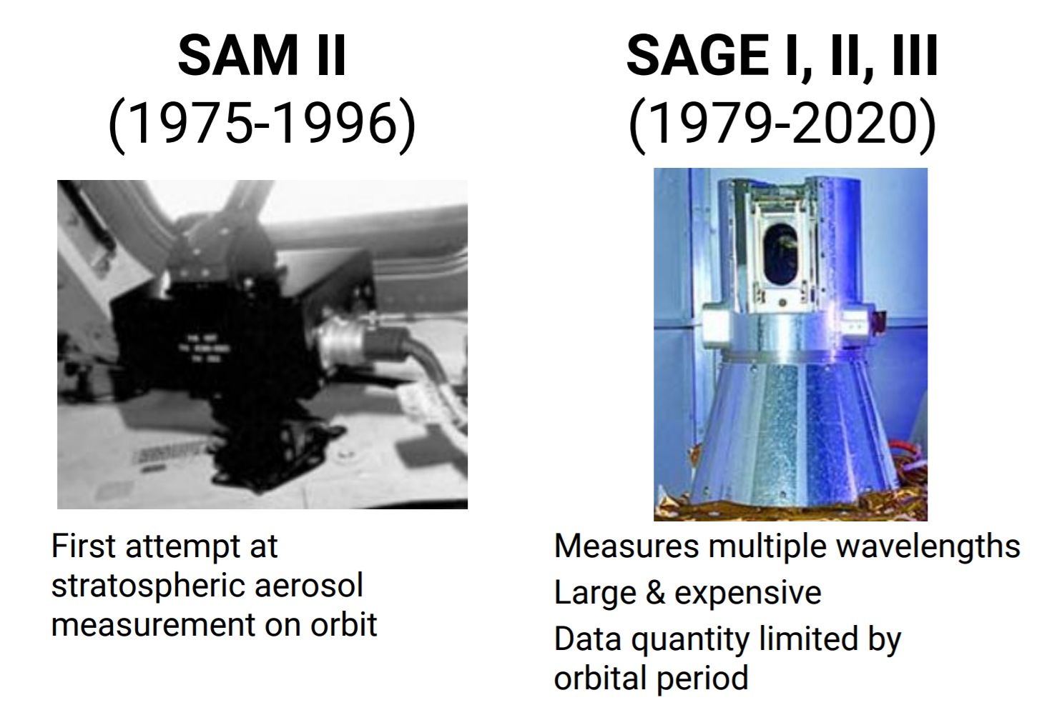
Aerosol Density Measurement Background
[6]
Description Requirements Risks V&V Planning

Slide 8
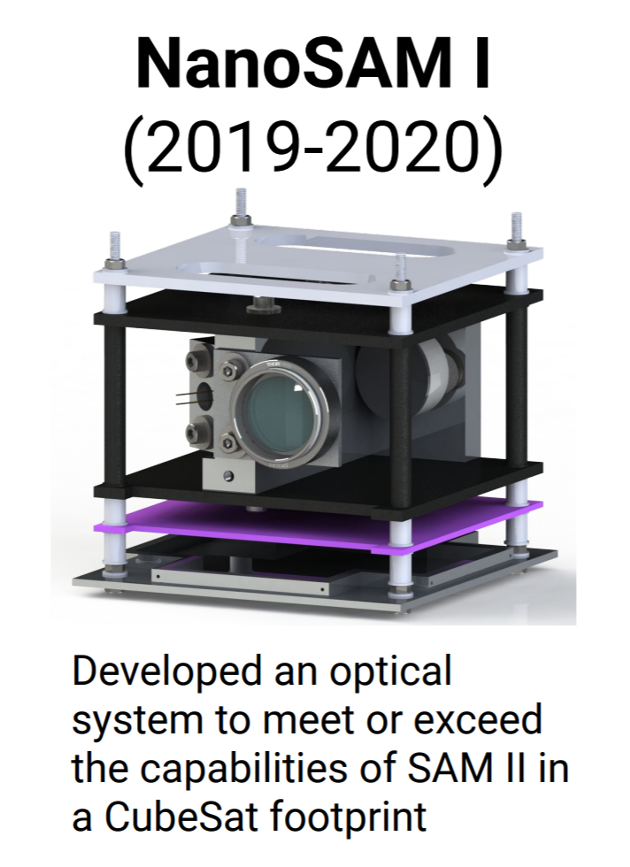
NanoSAM Project Background
NanoSAM II
(2020-2021)
Reduced size to 0.5U, split electronics board and initial vibration analysis
[6]
Description Requirements Risks V&V Planning
Notes:
Merge slides 4 & 5

Slide 9
Functional Requirements
NanoSAM III shall survive launch simulation vibration testing
The electronics and software system shall collect analog photodiode data, filter, digitize, and store the digital data. Housekeeping, position, pointing, and time data will also be collected and processed by the data capture system.
The electronics system shall control and power all payload subsystems and will be designed to operate through the expected vibration and temperature environments. Industry standard flight ready connectors will be utilized.
NanoSAM III shall have optical performance capabilities that are equivalent to or surpass that of SAM-II as determined by the modular transfer function value
NanoSAM III shall have dimensions and connectors to allow for integration with an industry standard CubeSat bus
The total cost of all materials, tests, and other project needs shall be less than $5000
Description Requirements Risks V&V Planning

Slide 10
Overall Design
Notes:
Evan

Slide 11
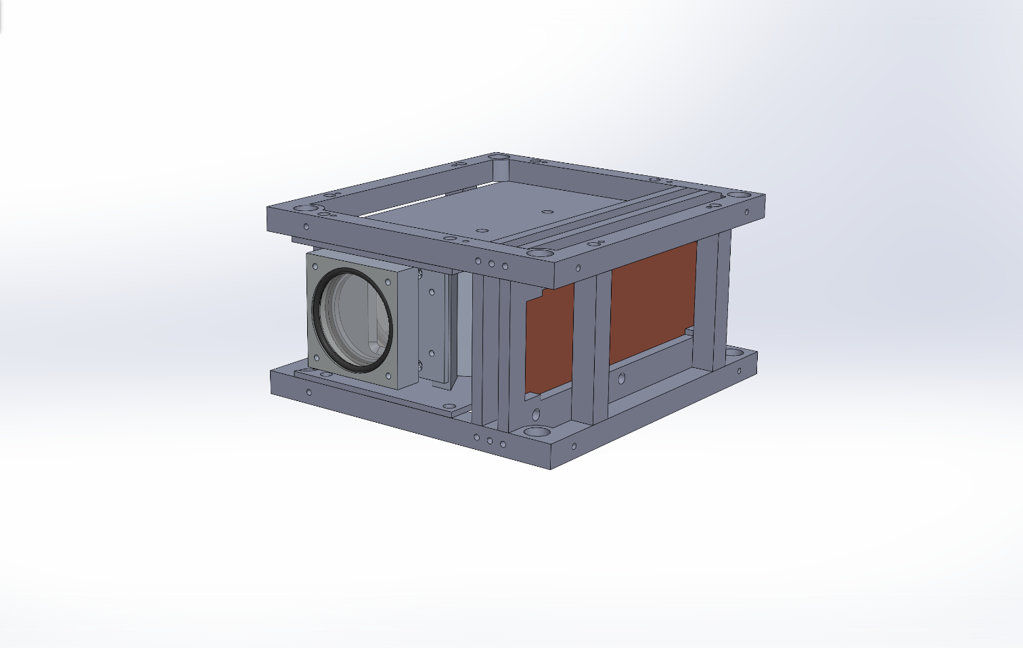
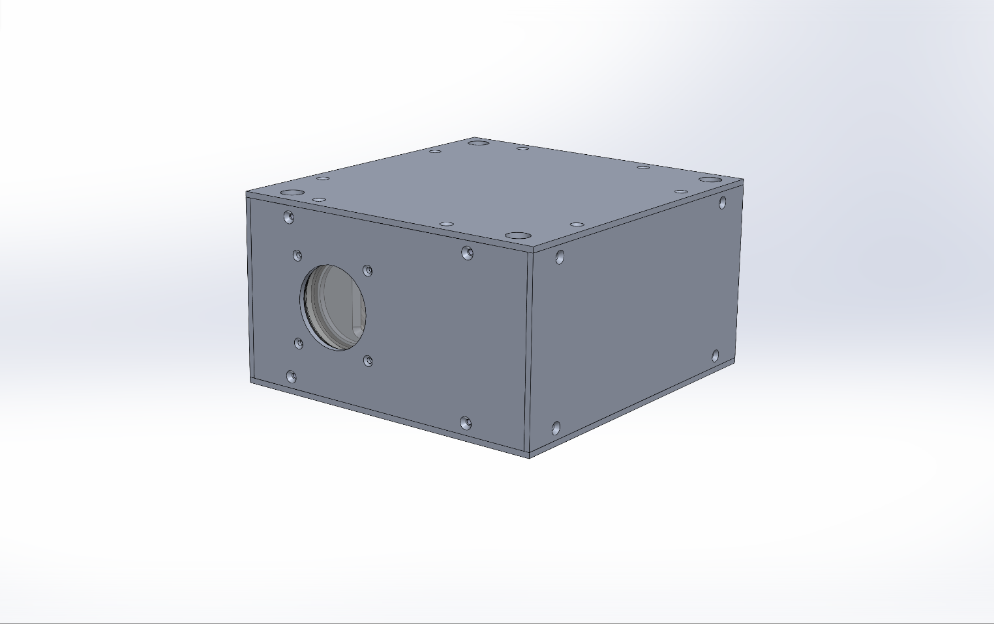
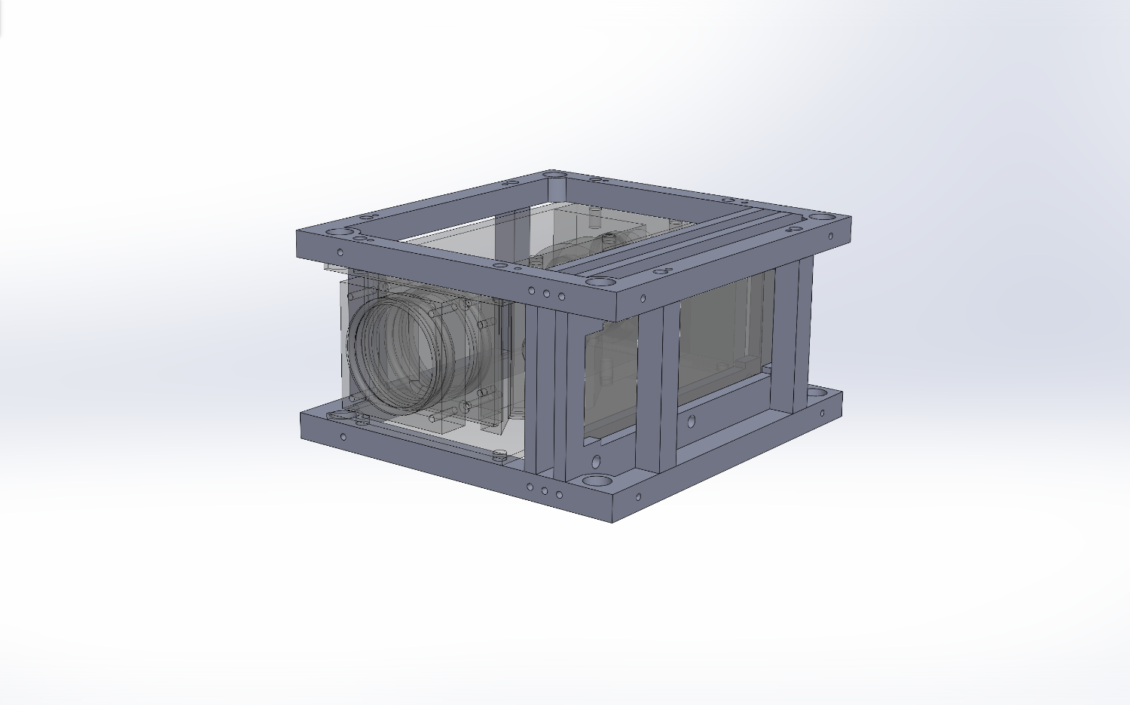
5.32 cm
9.91 cm
9.33 cm
Description Requirements Risks V&V Planning
Notes:
Evan - dimensions, remove sides, structure

Slide 12
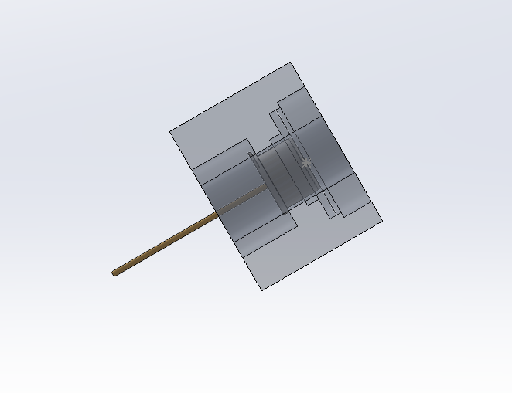
Description Requirements Risks V&V Planning
Notes:
Evan

Slide 13
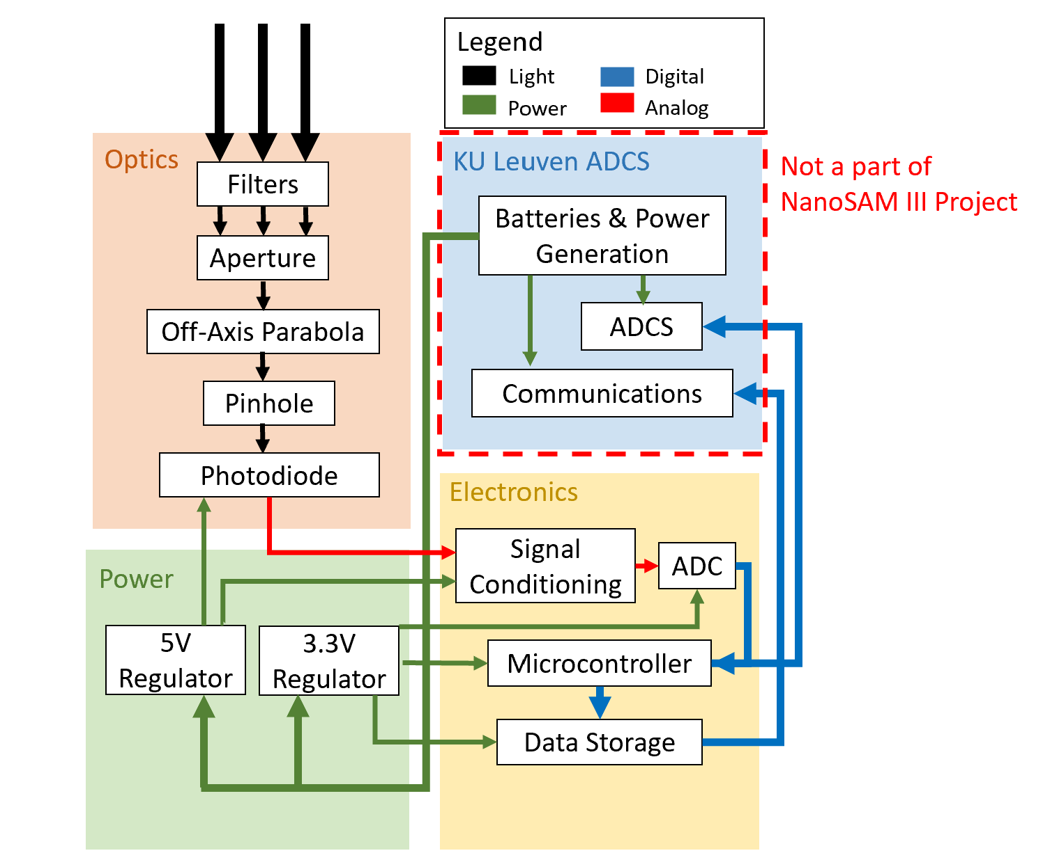
FBD
Description Requirements Risks V&V Planning
Notes:
Evan

Slide 14
Critical Project Elements
Notes:
Evan

Slide 15
Critical Elements Summary
Maintain sufficient optical alignment per the SAM-II instrument specs
Instrument frame - robust to vibration
Optics - alignment tolerancing and mirror deformation
Electronics boards - data collection and downlinking
Description Requirements Risks V&V Planning
Notes:
This is a description of what is most important to success of the project, and why these elements were chosen to focus on in this presentation. This discussion should convey your understanding of how the system works and what design features, attributes, or characteristics are most important to that functionality.

Slide 16
Vibration Modeling

Slide 17
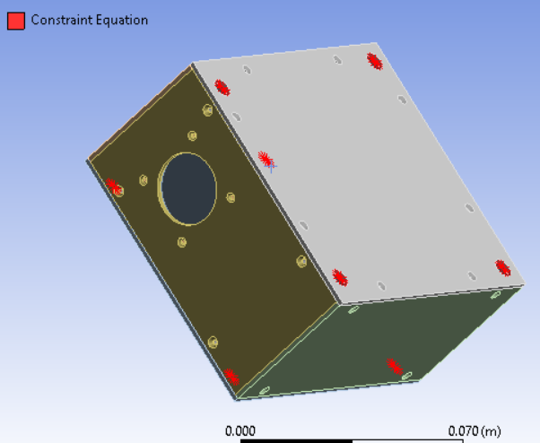
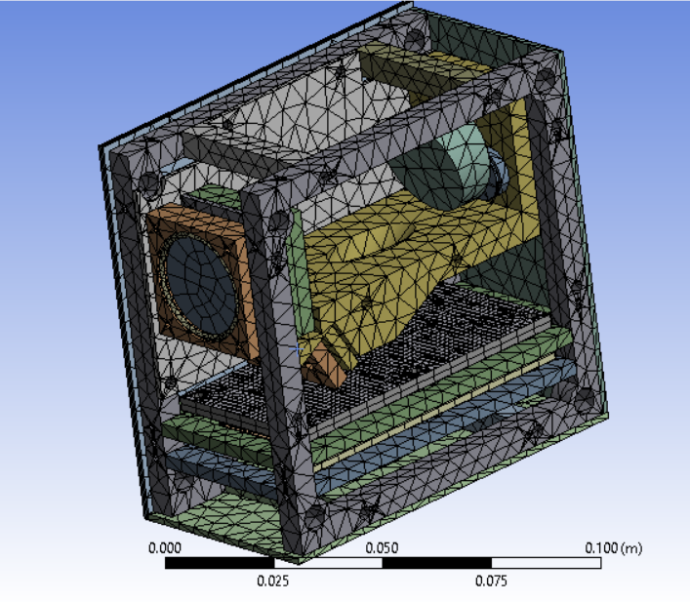
Specifications for FEA Modal Analysis
Boundary Conditions (fixed) Meshing (0.0055m, 0.001524m)
Project Description Baseline Design Feasibility Design Summary
Description Requirements Risks V&V Planning

Slide 18
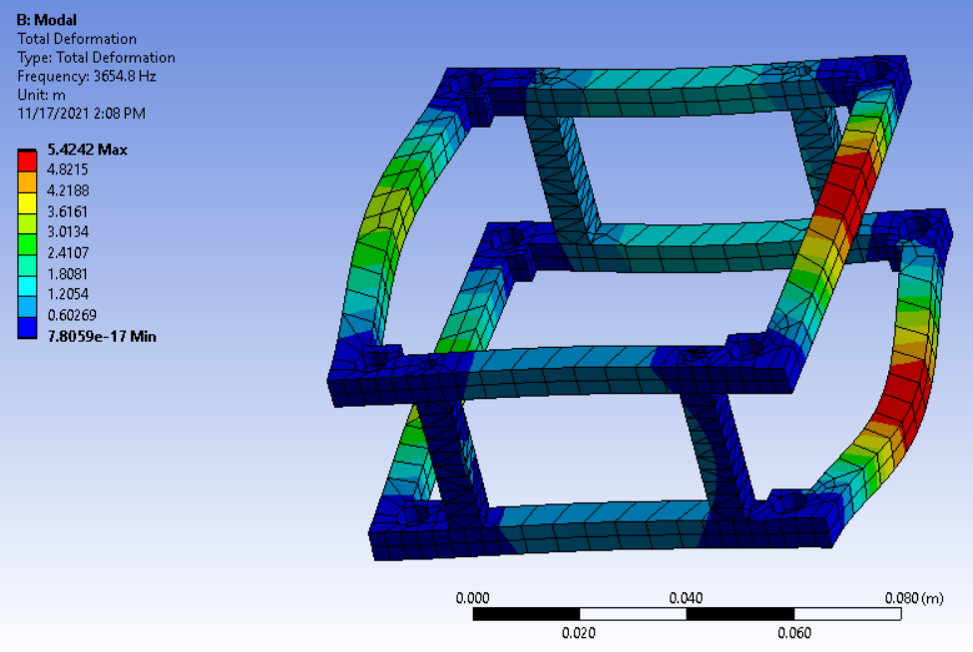
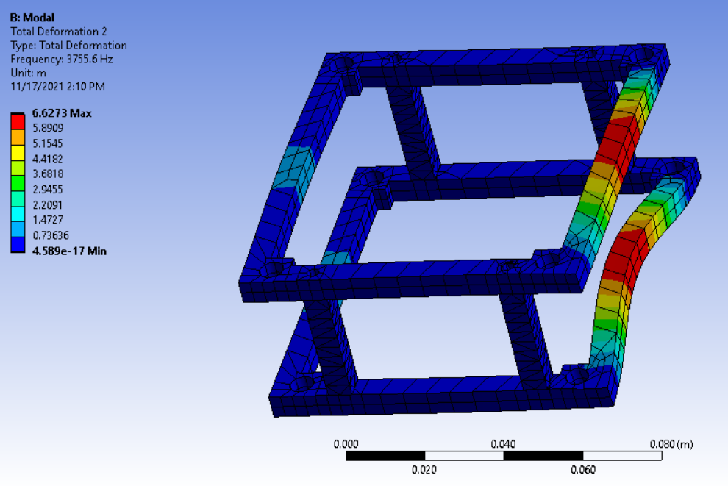
Vibration Analysis
Materials: | Aluminum
Analysis: | ANSYS Modal
Method: | Linear
Element type: | Tetrahedron
Frame only
* Very preliminary analysis
Description Requirements Risks V&V Planning

Slide 19
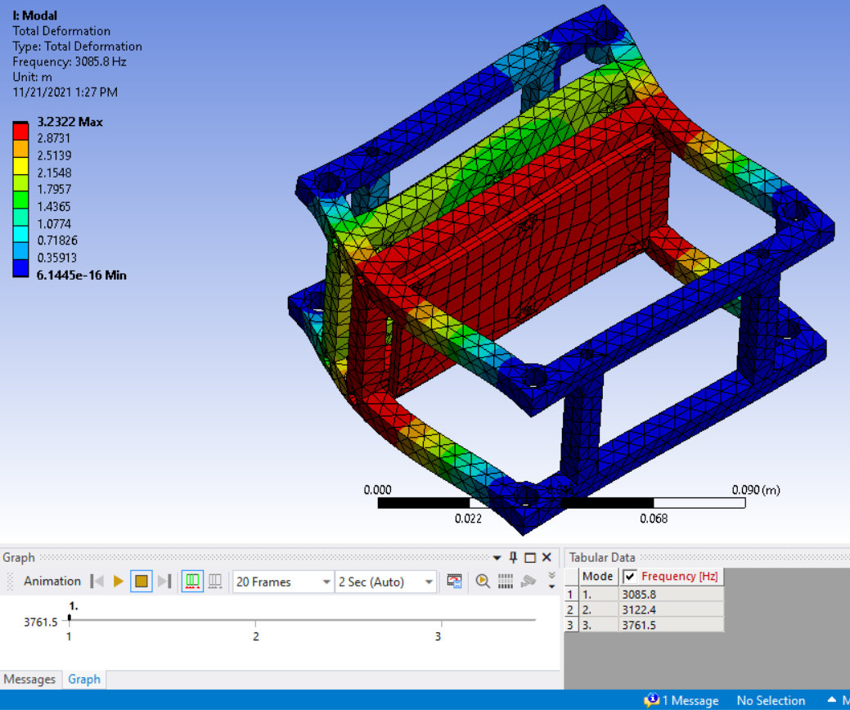
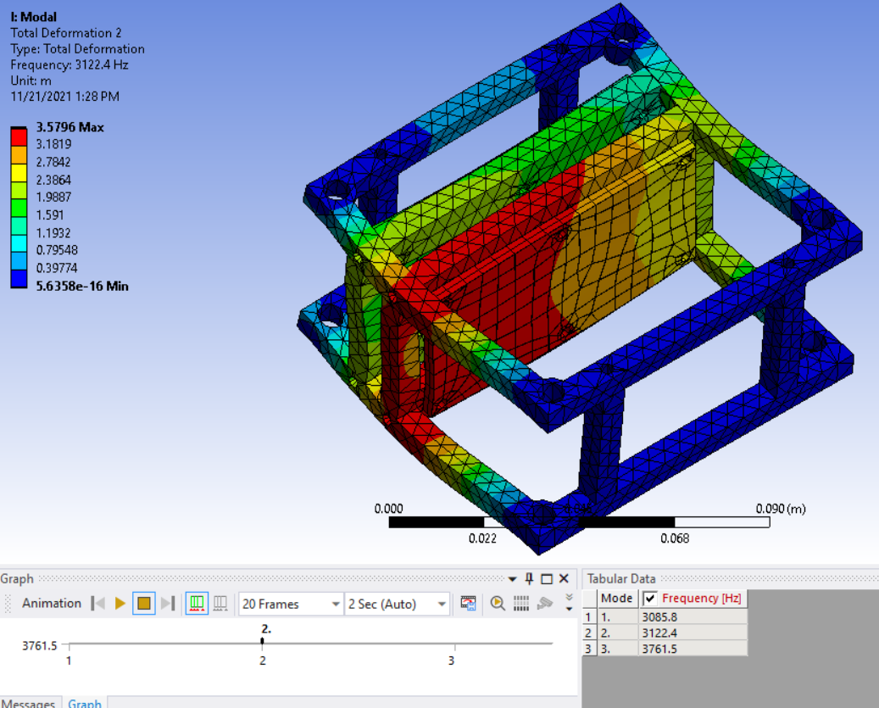
Vibration Analysis
Materials: | Aluminum, Copper, Silicon
Analysis: | ANSYS Modal
Method: | Linear
Element type: | Tetrahedron
Added PCB with ribs
* Very preliminary analysis
Description Requirements Risks V&V Planning

Slide 20
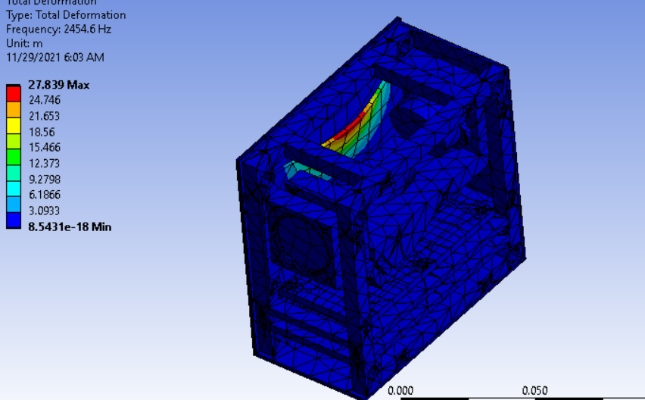
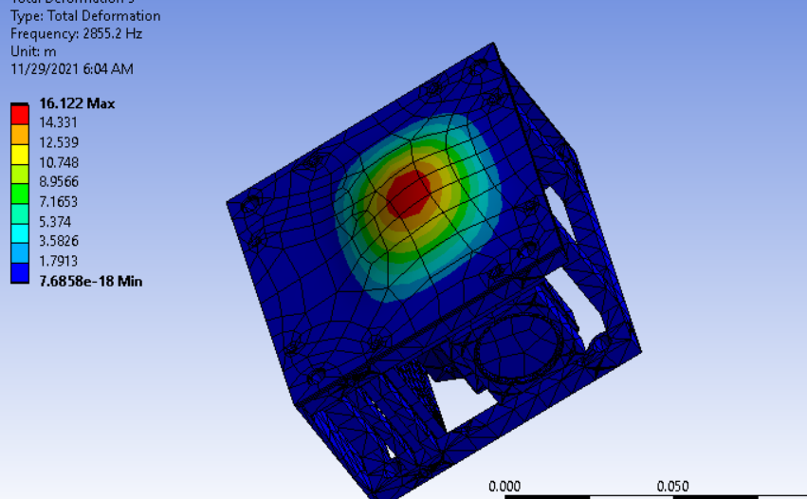
Vibration Analysis
Materials: | Aluminum, Copper, Silicon, Steel, Fused Silica
Analysis: | ANSYS Modal
Method: | Linear
Element type: | Tetrahedron
Draft Full Assembly
* Modes 1 and 2 have similar shape
Description Requirements Risks V&V Planning

Slide 21
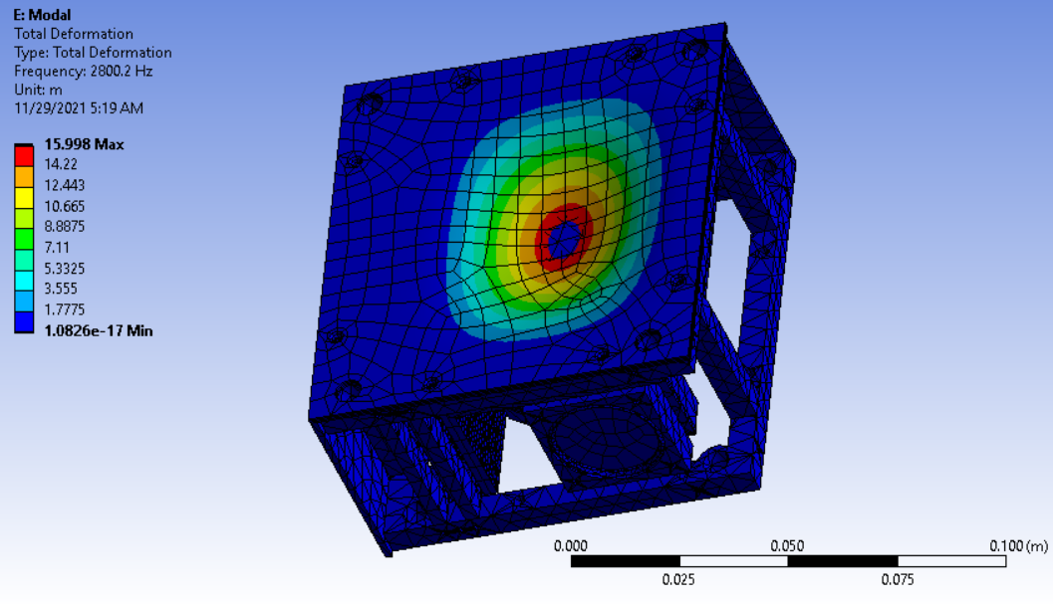
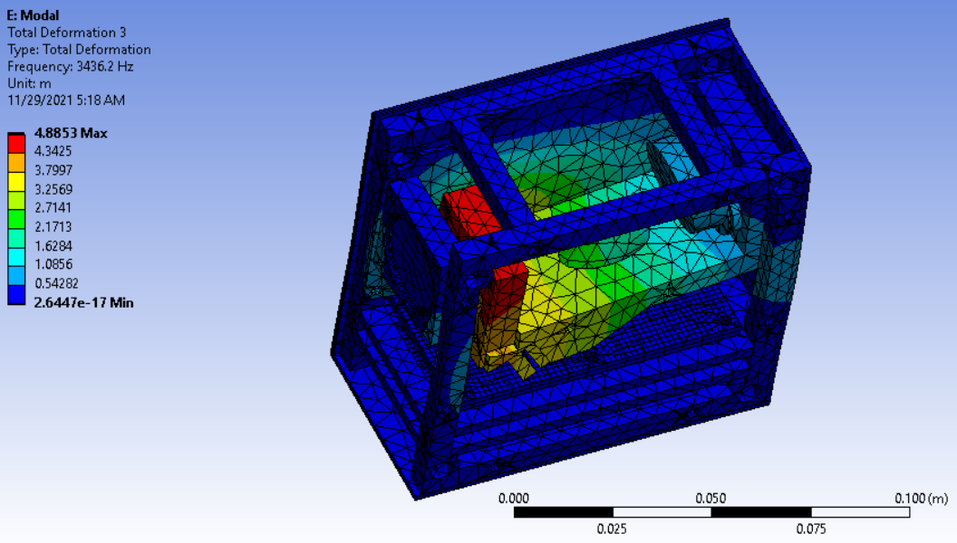
Vibration Analysis
Materials: | Aluminum, Copper, Silicon, Steel, Fused Silica
Analysis: | ANSYS Modal
Method: | Linear
Element type: | Tetrahedron
Full Assembly
* Modes 1 and 2 have similar shape
Description Requirements Risks V&V Planning

Slide 22
Alignment Testing Block / Photodiode Block

Slide 23
Applicable Functional Requirements
1.0: NanoSAM III shall survive launch simulation vibration testing
Alignment retention
4.0: NanoSAM III shall have optical performance capabilities that are equivalent to or surpass that of SAM-II as determined by the modular transfer function value
Initial alignment
Description Requirements Risks V&V Planning

Slide 24
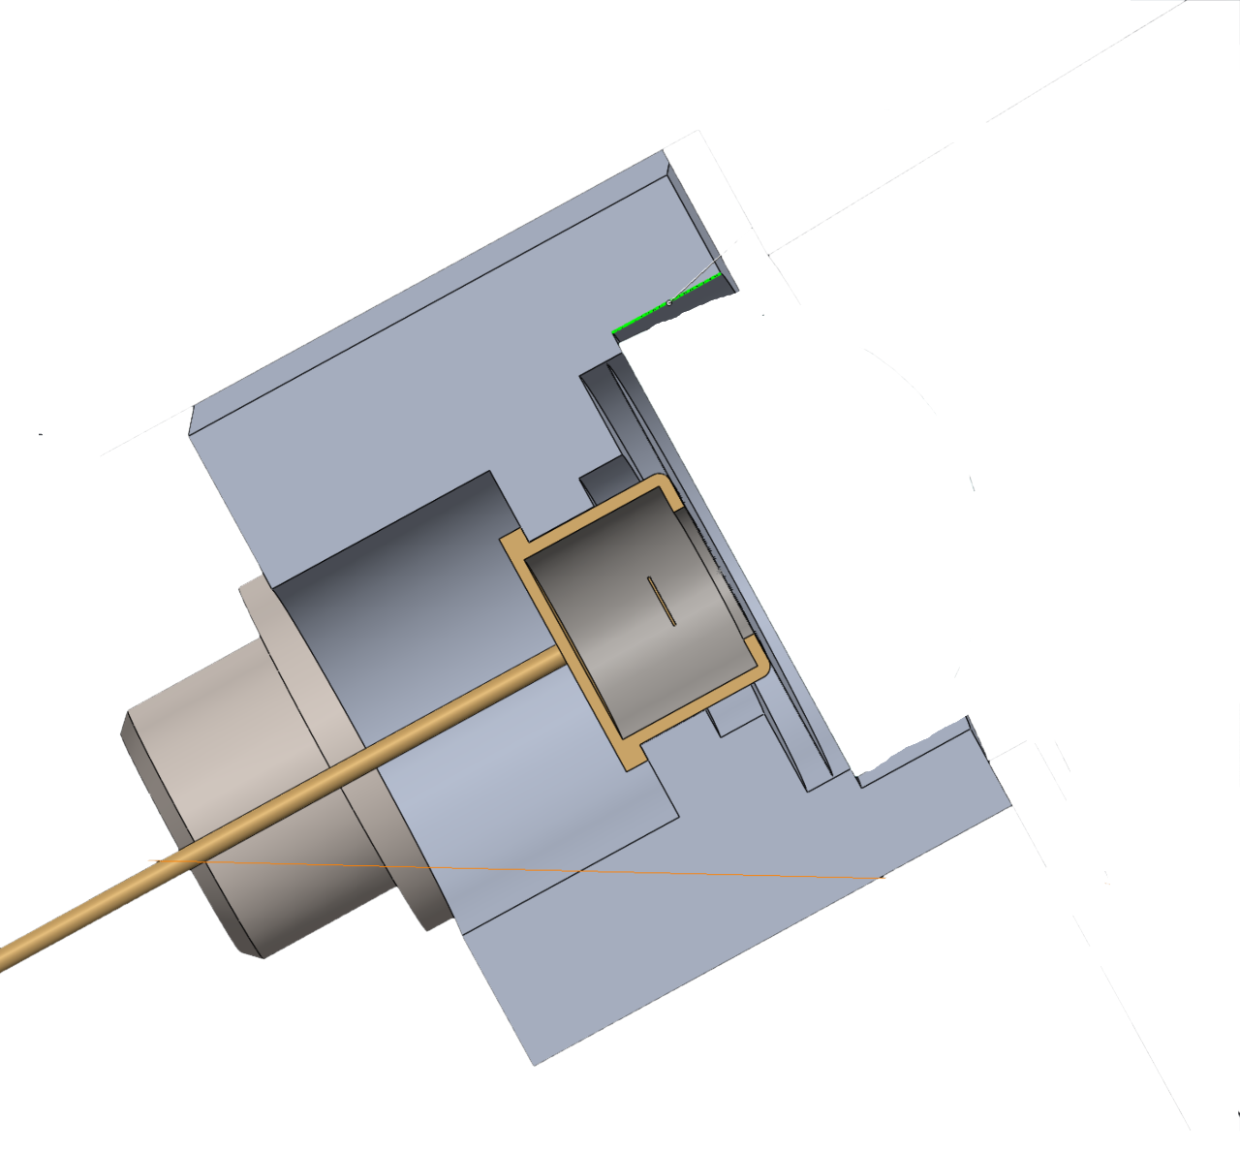
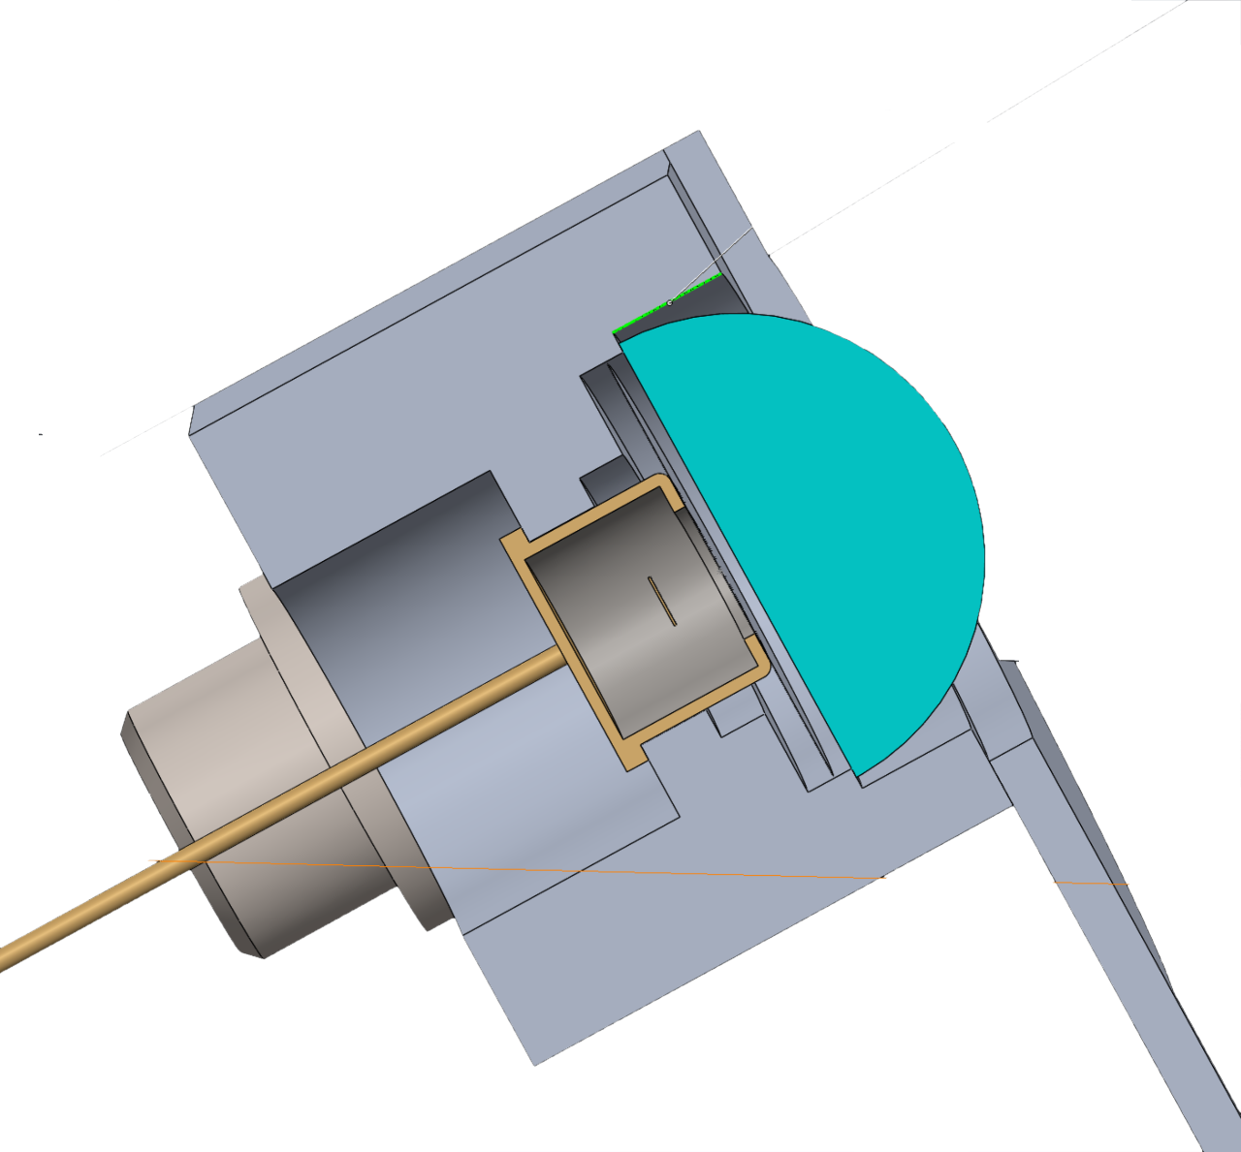
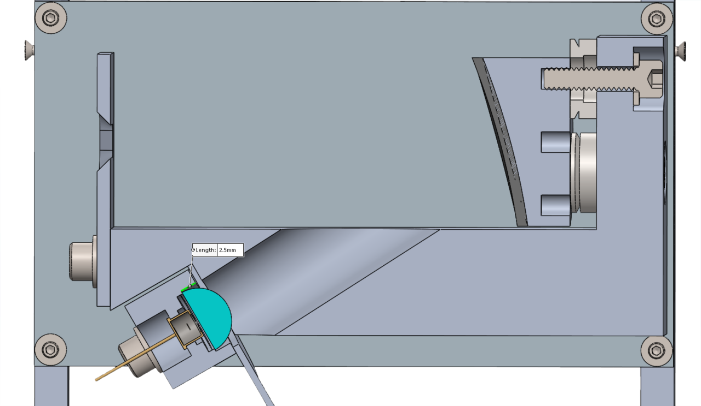
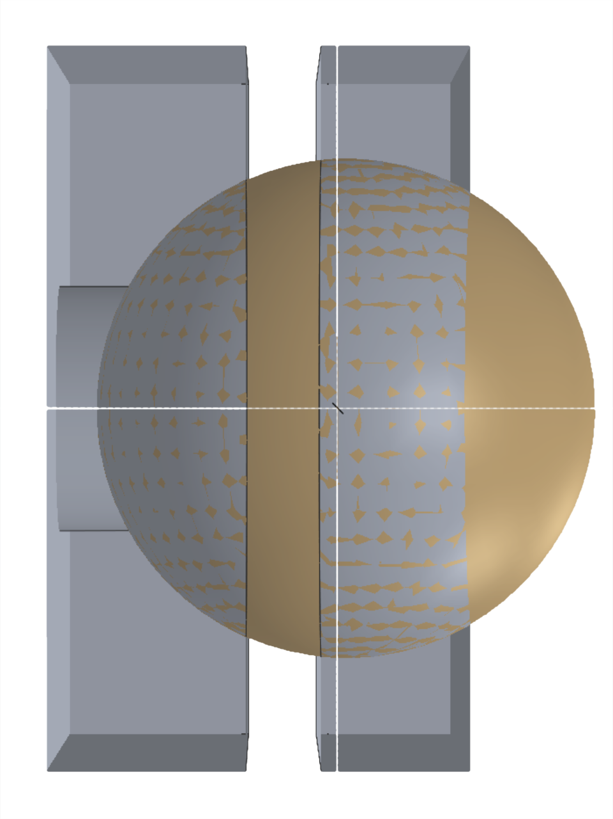
Testing Block Photodiode Block
y
CHANGE THE REFERENCE AXIS ORIENTATION
x
z
2.5 mm
2.5 mm

Slide 25
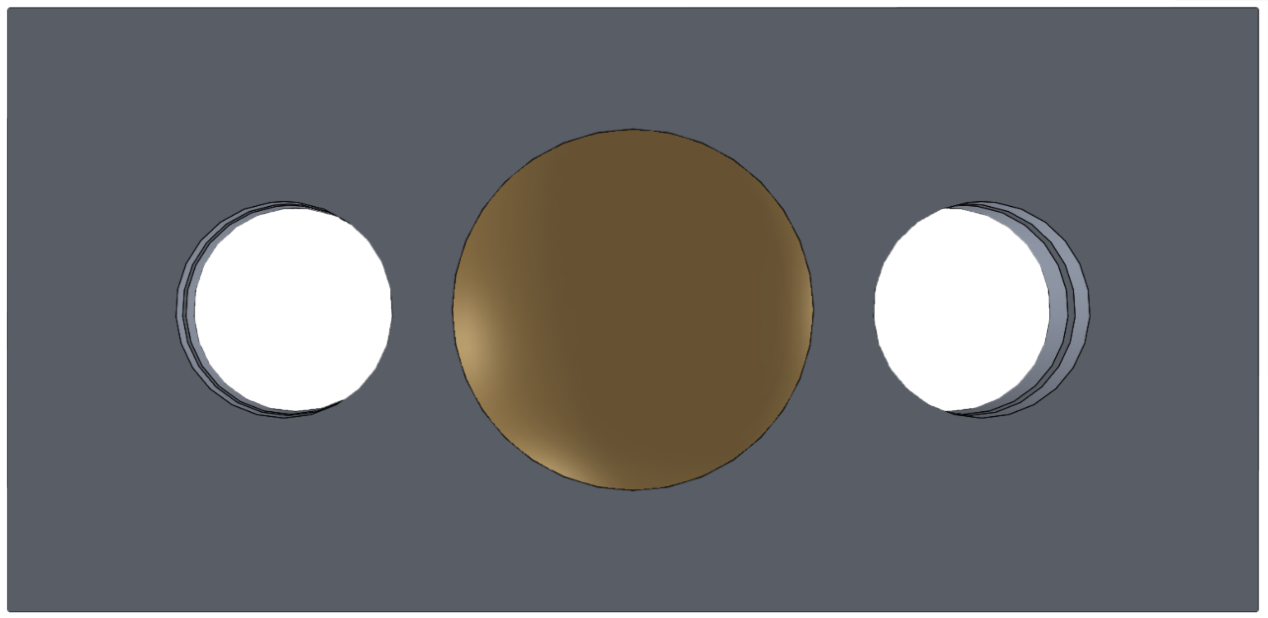
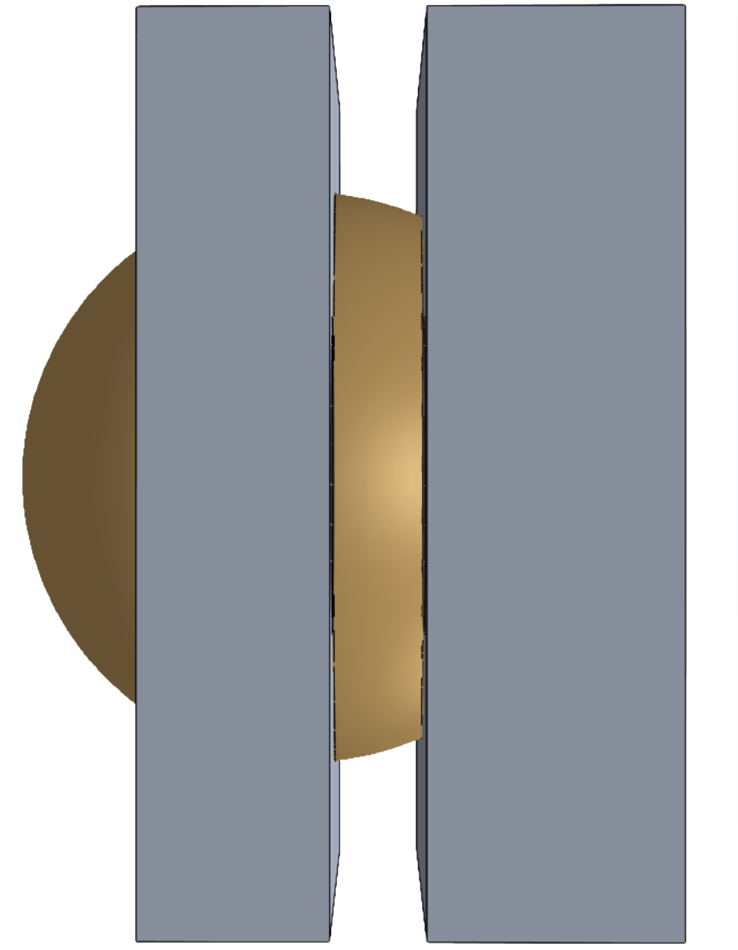
Testing Block / Diode Block CAD
y
NBK7 fused silica return sphere, chrome coated, 10 mm diameter
x
1.5 mm
z
5.2 mm
8.66 mm
3.2 mm
0.46 mm
30mm
3.0 mm
4.0 mm
Total mass = 7.81g

Slide 26
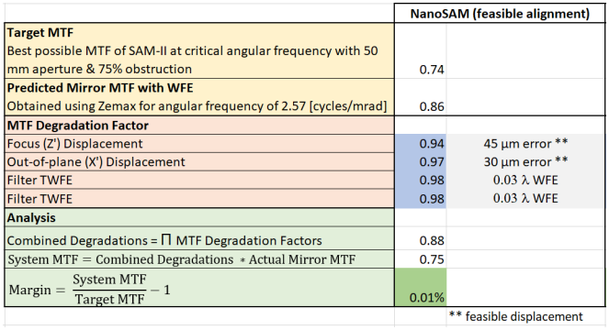
MTF Modeling - Initial Alignment
Can shims be used to achieve required MTF value?
Shim stock available at 0.0005 inch thickness = 12.7 μm
[3]
Description Requirements Risks V&V Planning
Notes:
The MTF of a lens, as the name implies, is a measurement of its ability to transfer contrast at a particular resolution from the object to the image. In other words, MTF is a way to incorporate resolution and contrast into a single specification. We are using MTF as a measure of how close our system is to perfect alignment.

Slide 27
Vibration Functional Requirements
1.0: NanoSAM III shall survive launch simulation vibration testing
Alignment retention
4.0: NanoSAM III shall have optical performance capabilities that are equivalent to or surpass that of SAM-II as determined by the modular transfer function value
Initial alignment ✔
Description Requirements Risks V&V Planning

Slide 28
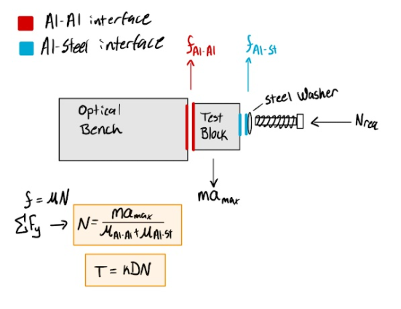
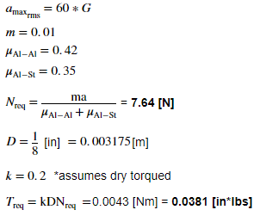
Friction Modeling - Vibration Resistance
Can friction keep the testing / diode block in place through vibration?
[4], [5]
Description Requirements Risks V&V Planning
Notes:
Finger tight is ~15-20 in*lbs of torque

Slide 29
Vibration Functional Requirements
1.0: NanoSAM III shall survive launch simulation vibration testing
Alignment retention ✔
4.0: NanoSAM III shall have optical performance capabilities that are equivalent to or surpass that of SAM-II as determined by the modular transfer function value
Initial alignment
1.0: NanoSAM III shall survive launch simulation vibration testing
Alignment retention ✔
4.0: NanoSAM III shall have optical performance capabilities that are equivalent to or surpass that of SAM-II as determined by the modular transfer function value
Initial alignment ✔
Description Requirements Risks V&V Planning

Slide 30
Electronics Design

Slide 31
Electronics Design Requirements
2.0: The electronics and software system shall collect analog photodiode data, filter, digitize, and store the digital data. Housekeeping, position, pointing, and time data will also be collected and processed by the data capture system.
3.0: The electronics system shall control and power all payload subsystems and it will be designed to operate through the expected vibration and temperature environments. Industry standard flight ready connectors will be utilized to prepare for interfacing with a COTS (commercial off the shelf) cube satellite
Vibration analysis conducted at PDR, hardware passes ✔ - information retained in backup slides
1st order thermal study from PDR confirms Satellite remains in operating T range with heater implementation
Description Requirements Risks V&V Planning
Notes:
All of 3.0 except flight connectors was satisfied at PDR. These flight connectors are not focused on as they are very easy to implement. If I have time over break I will come back
Last time, requirement 3.0 was focused on dealing with the hardware’s ability to withstand the space and launch environment… This time we focus on requirement 2.0 to see how the electrical system operates

Slide 32
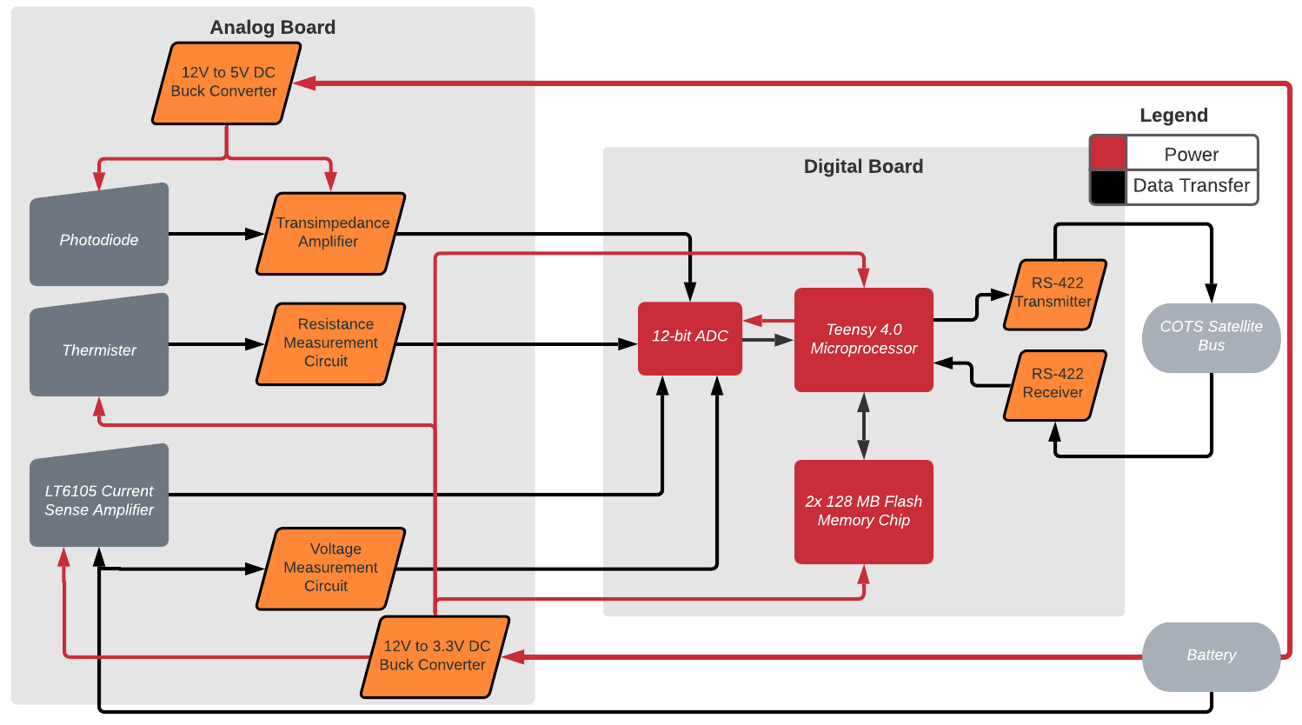
Electronics Design
Description Requirements Risks V&V Planning

Slide 33
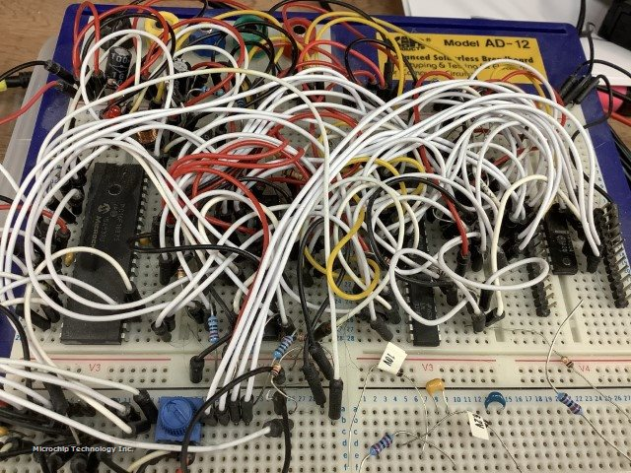
Electronics: A Note on Focus Shift
This year, the NS III team had ambitious electronics goals
We believed the electronics system was in almost perfect condition, so we aimed to modify the hardware primarily for vibrations and thermal stability
A Master Electronics Summary was found after PDR with much more detailed information
“White wire” fixes much larger than first expected
Detailed vibration analysis and a first order thermal study shows that the electronics system can survive launch and will remain in operating thermal bounds (0 - 50) °C
The detailed electronics thermal study has been dropped and replaced with a full reworking of the analog and digital electronics system
Description Requirements Risks V&V Planning
Notes:
Since we’re knocking NS II a bit here, we may want to give a thank you to the previous electronics team for their awesome documentation and transparency

Slide 34
Electronics: System Data Collection Overview
Three primary types of data are collected and processed by the electronics system
Photodiode data: The data used by the customer to complete atmospheric studies
Collected only during measurement period at 50 Hz sample rate_{[REQ 2.1.1]}
Housekeeping data: Temperature, instantaneous power, and battery voltage data
Collected at 1 min intervals during standby, 50 Hz during measurement period
External Data: Data read in from the external COTS Cube Satellite - time, attitude, orbital position
Same collection periods as housekeeping data
Description Requirements Risks V&V Planning

Slide 35
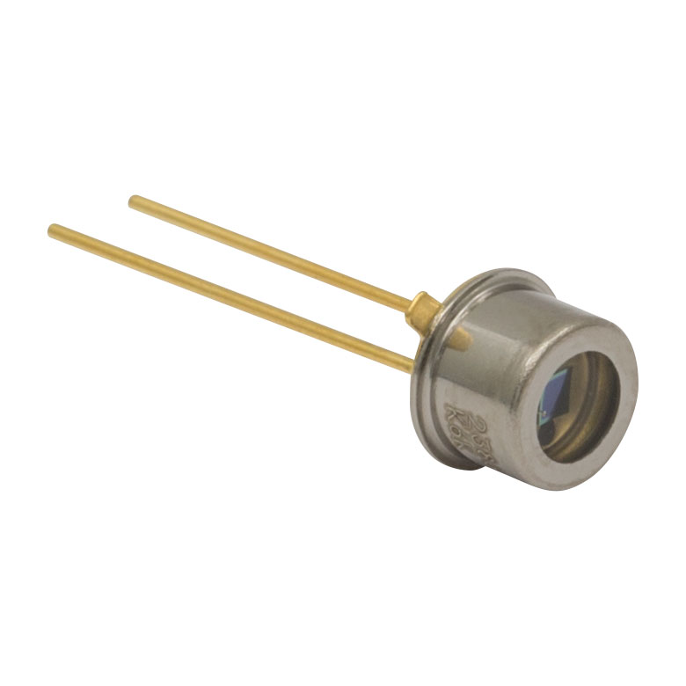
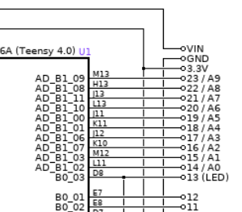
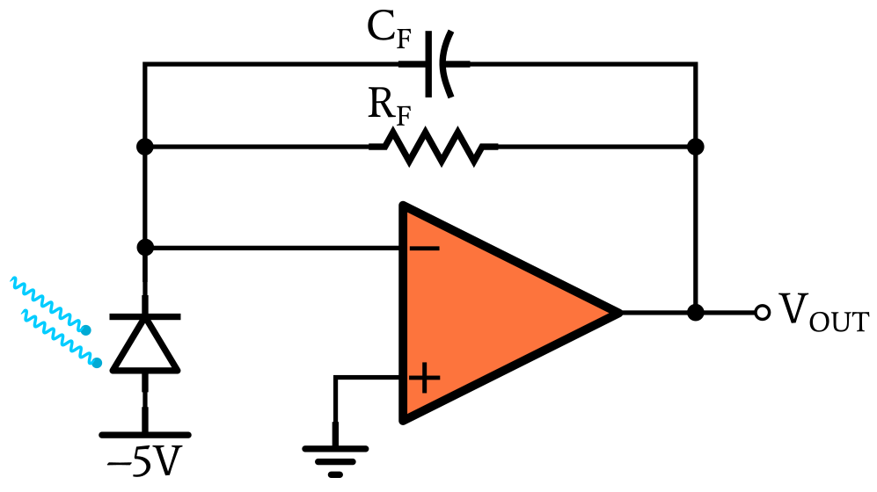
Electronics Design: Photodiode Data Collection
A photodiode, Figure 1, is used to convert the optical intensity at the diode into an electrical current
A photoconductance circuit is used instead of a photovoltaic setup
This is done to increase responsivity of the photodiode
After the photodiode, a transimpedance amplifier, Figure 2, converts the current to a voltage
The voltage is finally sent to an analog pin of the Teensy 4.0 to digitize the signal with a 12 bit ADC, Figure 3
Figure 1: Photodiode
*More details on this analog system in backup slides including component choices
*Further details on digitization presented later
Figure 3: Analog in to Teensy 4.0
Figure 2: Transimpedance amplifier
Notes:
In photoconductance mode, photodiode is reverse biased to generate a faster response time from a wider depletion region

Slide 36
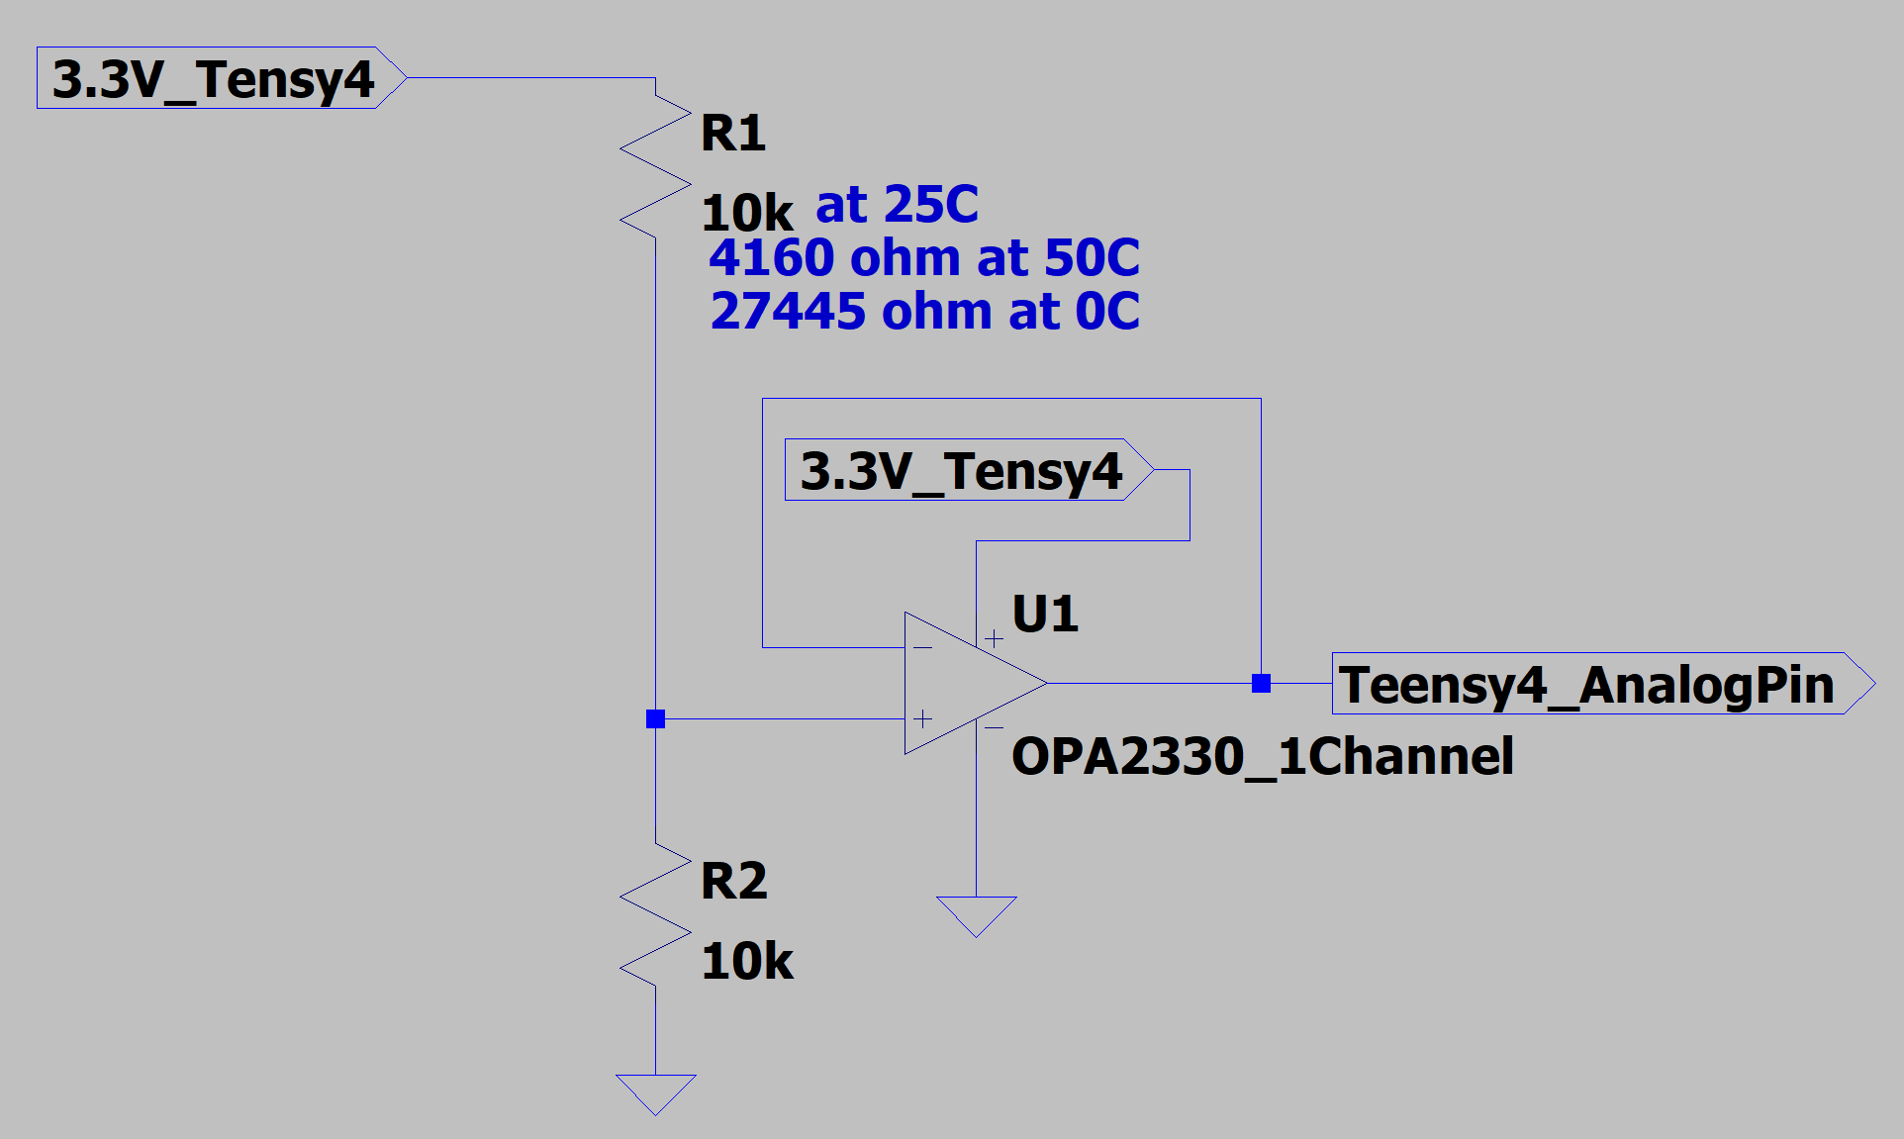
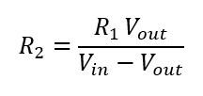
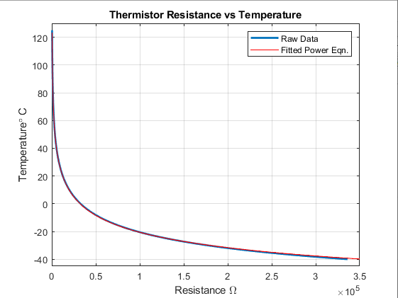
Electronics Design: Thermal Data Collection
Thermal data collection is conducted with the circuit in Figure 1
The Teensy 4.0 activates both the op amp and provides current at 3.3 V to the measurement circuit only during measurements to save power
The measurement circuit is simply a voltage divider with a voltage follower
R2 changes with temperature
Its value is found from Equation 1
The output of the voltage divider is fed to an analog in pin on the Teensy 4.0
I_{CircuitIn_ 25° C} = 0.681 mA << 10 mA maximum of a Teensy 4.0 digital pin
Once R2 is calculated, the temperature is found from matching the resistance value to a best fit curve in the form of a power match (Figure 2)
Figure 1: Thermal measurement circuit
(1)
*Detailed calculations and IC selection considerations in backup slides
Figure 2: T vs R raw data and best fit curves

Slide 37
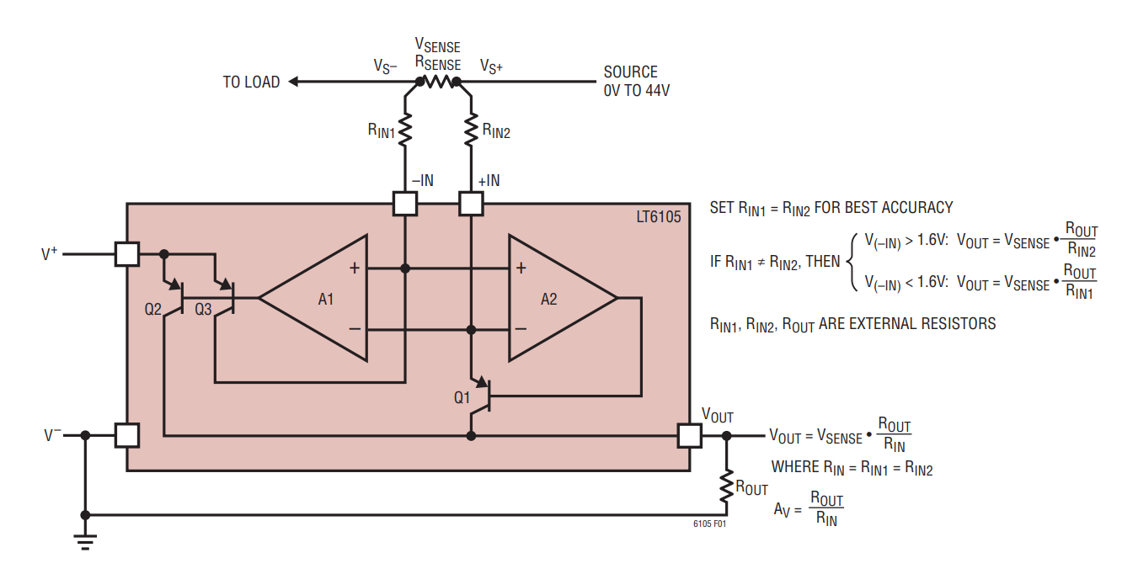
Electronics Design: Bus Current Monitor
A LT6105 is used as a precision current sense monitor (Figure 1)
Operating Current = 150 uA activated through V₊ pin
Only on when measuring activated by 3.3V digital pin on Teensy 4.0 minimizing power use
The circuit of Figure 1 senses current through a sub-ohm resistor, delivering a voltage difference to the op amp input
This difference is multiplied to extend from (0-3.3) V, then digitized
Figure 1: LT6105 Current Sense Monitor
But where’s the power?? →
Description Requirements Risks V&V Planning
Notes:
Must match range to V range of ADC (3.3V)
Teensy needs up to 350 mA!! Must redo power to provide 500 mA

Slide 38
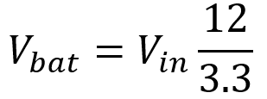
Electronics Design: Battery Voltage Monitor and Power
Separate from the current, the battery voltage is monitored
The voltage is stepped down from 12 V to 3.3 V to match the voltage range of the Teensy 4.0
The battery voltage is then found via Equation 1
The circuit is only active during measurement
Approximately 0.1 s per 1 min
This reduces power use
Power usage is found from both this voltage measurement and the bus current measurement
(1)
External data is simply read in from the external COTS cube satellite and stored in flash memory
Description Requirements Risks V&V Planning

Slide 39
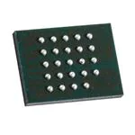
Digital Signal Processing and Storage
Signal input from digital board
4 analog input pins alternatively utilize 12-bit Teensy 4.0 ADC
Digitized orbit info from COTS system input as digital signal
To satisfy Req. 2.1.1 optical data are be collected at 50 Hz
Housekeeping data collected at 0.16 Hz when passive
Data copied to flash memory
Downlink
Data sent via RS-422 standard to COTS data transmission system
After each downlink all of flash memory will be wiped
Figure 1: Micron Flash Memory Chip
Description Requirements Risks V&V Planning

Slide 40
Data Transmission and Software
The electronics system will generate 298 kB/orbit of data
49.5 kB optical data, 247 kB housekeeping data
Data will be transferred to ground once every 23 days
Software will build on NanoSAM II heritage with modifications
Rewrite in Arduino language
Compatible with Teensy 4.0 microcontroller and limited scope of processing needs
Implement change in data collection frequency
Description Requirements Risks V&V Planning

Slide 41
Electronics Design: Power System
The power system involved 3 major concerns:
Minimize quiescent current and maximize power conversion efficiency
Battery powered device
Reduce system noise below 1 LSB of the 12 BIT ADC
Provide enough current to each converted line (1 A except -5 V line)
Teensy 4.0 has a 1 A linear regulator on board and is the largest consumer of power
The NS II power system only satisfied #2
5 V conversion efficiency ~28 %
3.3 V conversion efficiency ~ 20 %
12 V converter on bus only capable of 50 mA current
The full analysis of this legacy system is presented in slides backup slides
Description Requirements Risks V&V Planning

Slide 42
Power System Summary
All conversion chips have micro amp quiescent current to reduce wasted power
Switching converter: 6.2 uA | LDO regulators: 50 uA
Power efficiency has been greatly increased
𝜂_{TTL} = 𝜂₁𝜂₂...𝜂_{N}
𝜂_{5V} = 77.3 % | 𝜂_{3.3V} = 73.8 %
𝜂_{5V-OLD} = 29.2 % | 𝜂_{3.3V-OLD} = 19.3 %
System can support up to 1 A on both regulated positive power lines
LT8650S can output 6A total from both channels combined
LT1529 can support 3A each
Noise has been greatly reduced below 1 LSB
V_{RIPPLE} = 5.62 uV ~ 1% of LSB
*Detailed analysis of power system in backup slides
Description Requirements Risks V&V Planning

Slide 43
Risks

Slide 44
Risk Matrix (Pre-Mitigation)
 | Insignificant | Negligible | Moderate | Extensive | Significant
Near Certain
Likely |  |  | OAP deformed from mounting | Components fail vibration testing | Cannot meet alignment reqs
Possible |  |  | Components fail thermal testing |  | Components not manufacturable
Unlikely |  |  |  |  | Cannot access alignment facility
Improbable
Description Requirements Risks V&V Planning
Notes:
Provide a risk matrix, showing identified risks and an assessment of their likelihood and severity of consequences to the success of the project. These risks must be credible and specific to your project. A cogent discussion of risks is one of the ways that your understanding of the project and how it works is conveyed to the review board.

Slide 45
Risk Mitigation
Risk | Mitigation Strategy | Outcome
Components not manufacturable | Review structure with manufacturing lab to ensure manufacturability | Likelihood reduced
Components fail vibration testing | Run a variety of vibrations simulations, use previous years’ results to improve models | Likelihood reduced
Components fail thermal testing | Model thermal profile of system and interfaces throughout orbit | Likelihood reduced
Description Requirements Risks V&V Planning

Slide 46
Risk Mitigation
Risk | Mitigation Strategy | Outcome
Cannot meet alignment requirements | Consult Ball optics specialists to create test plan, determine acceptable misalignment through modelling | Severity and likelihood reduced
OAP deforms from mounting | Add alignment pins to mount so bolts can be torqued less | Likelihood and severity reduced
Cannot access alignment facility | Schedule multiple alignment sessions at Ball | Likelihood and severity reduced
Description Requirements Risks V&V Planning

Slide 47
Risk Matrix (Post-Mitigation)
 | Insignificant | Negligible | Moderate | Extensive | Significant
Near Certain
Likely
Possible |  | OAP deforms from mounting |  | Cannot meet alignment reqs
Unlikely |  |  | Components fail thermal testing | Components fail vibration testing | Components not manufacturable
Improbable |  |  |  | Cannot access alignment facility
Description Requirements Risks V&V Planning

Slide 48
Verification and Validation

Slide 49
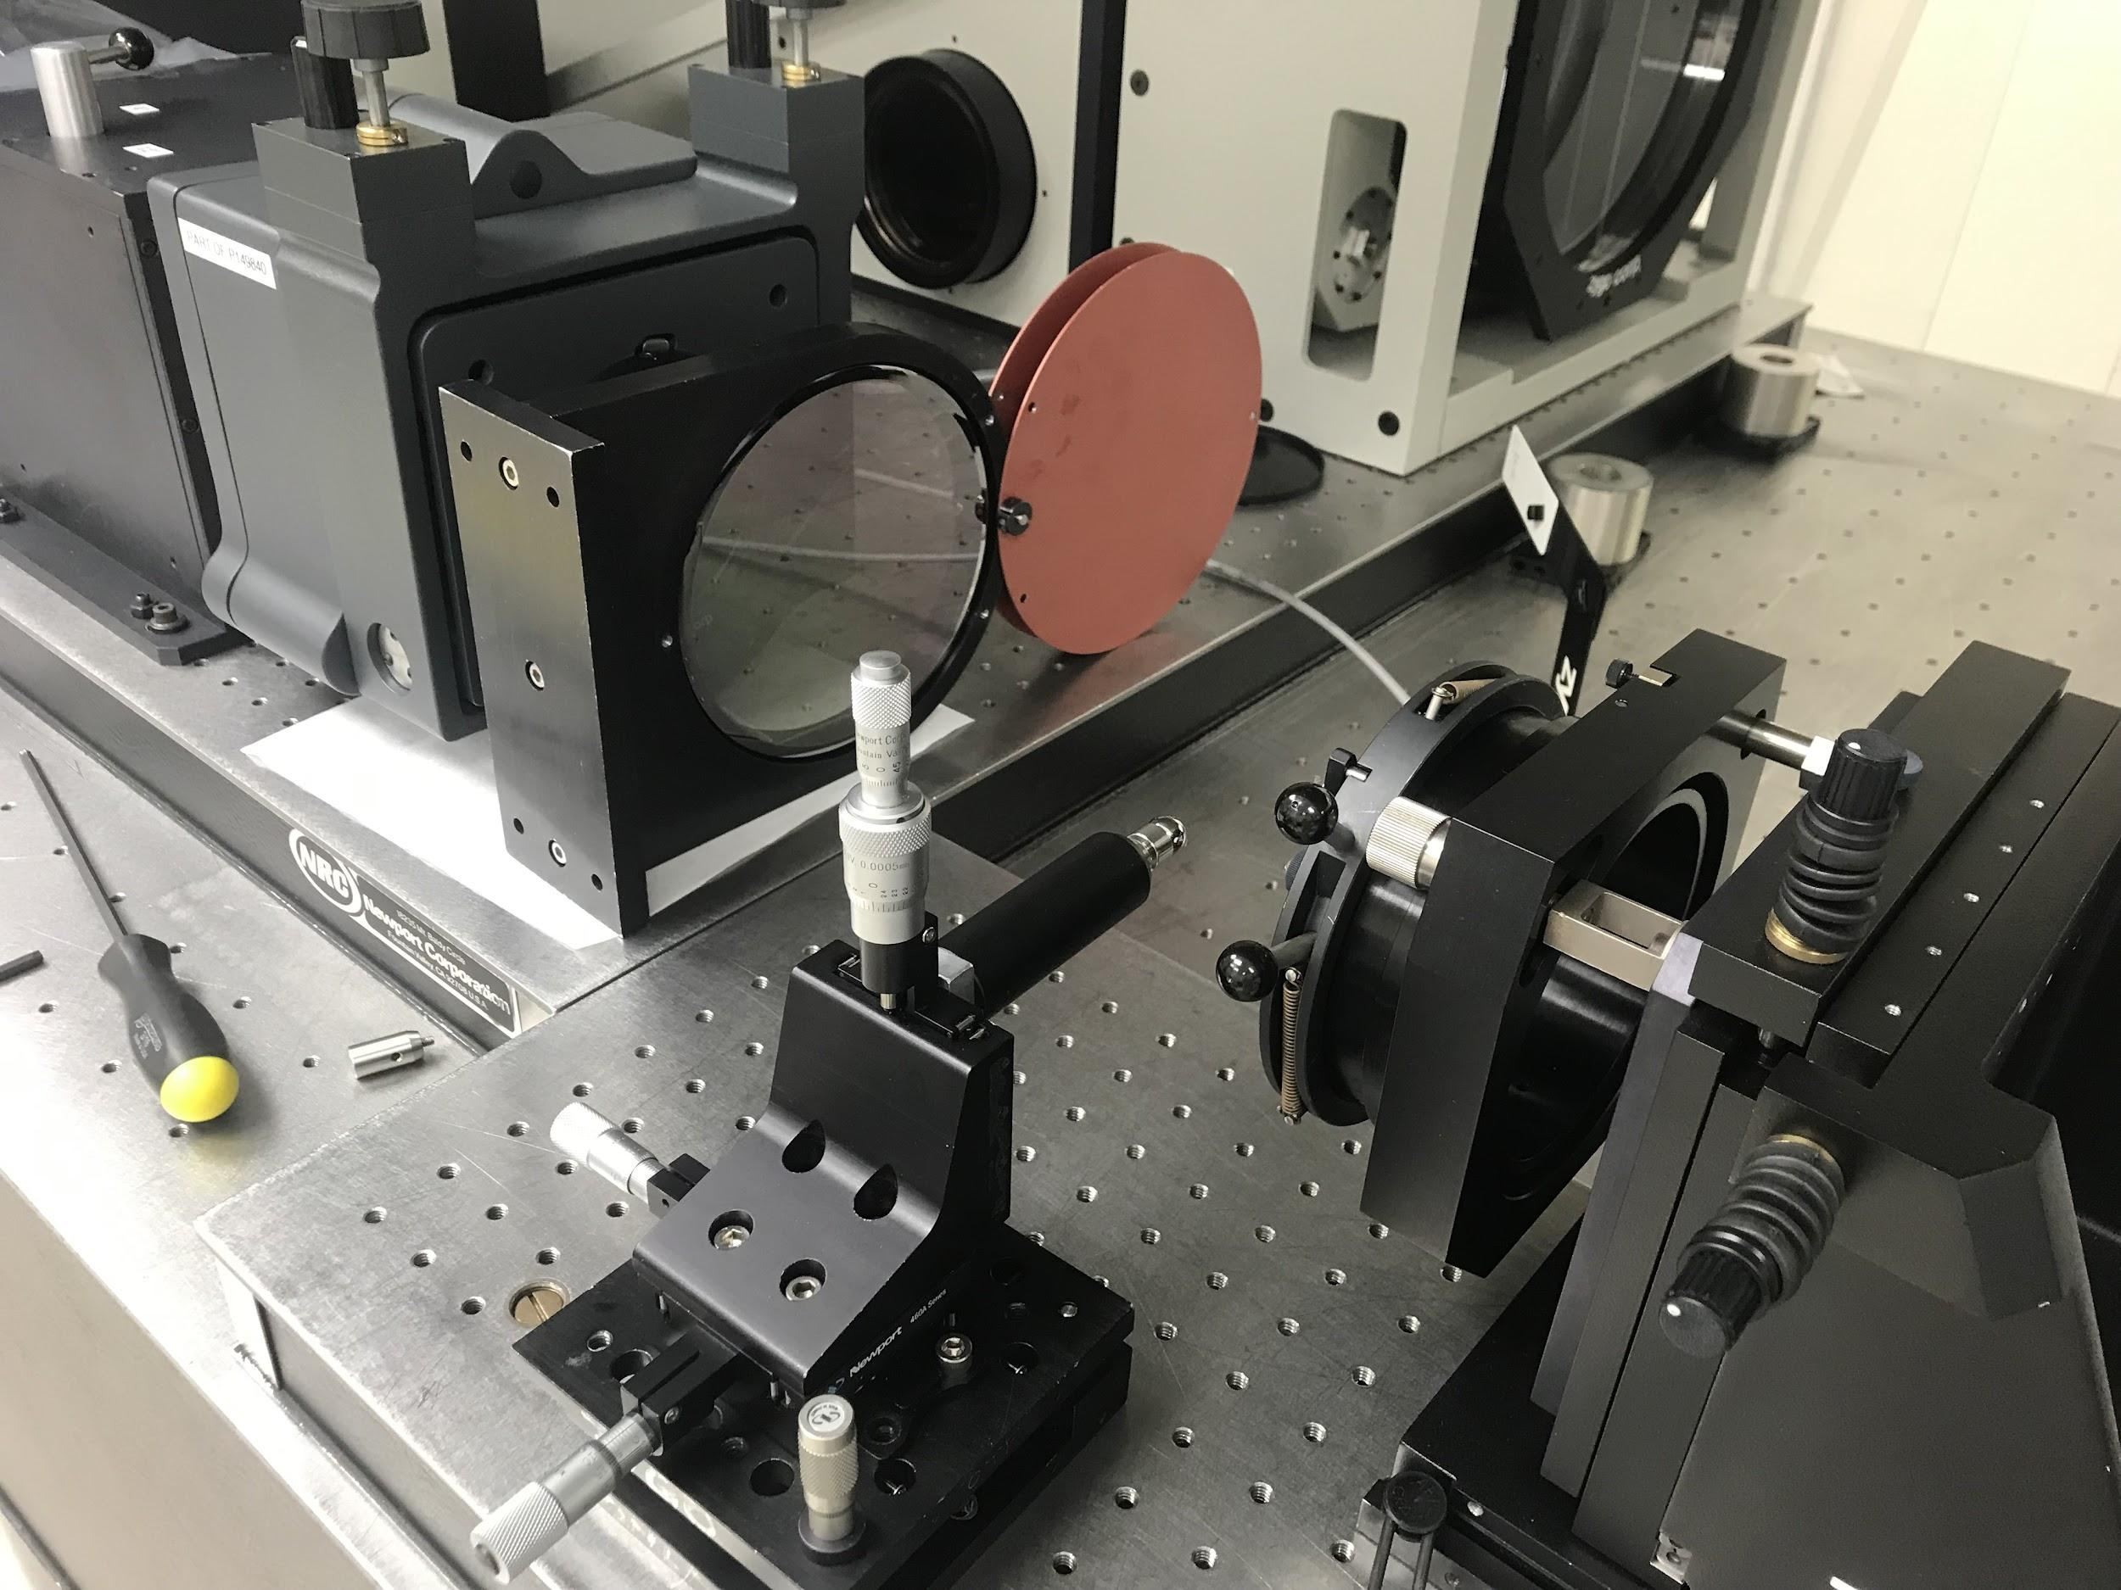
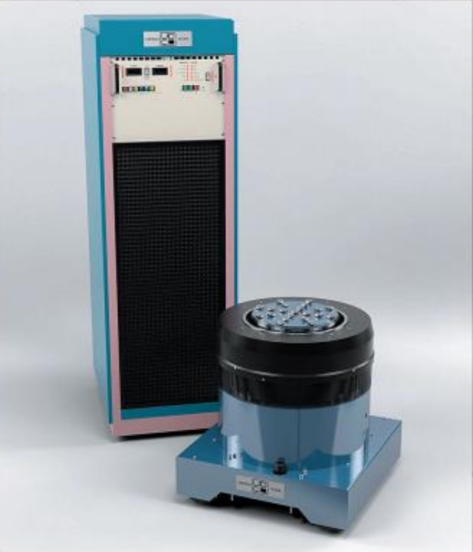
List of Tests
Initial first alignment to verify optics requirements have been met; experimentally test OAP torque specifications
Conduct a vibration test of the NanoSAM III system to confirm survival through typical launch vibrations
Perform a second alignment to confirm the optics requirements hold after vibration testing
Electronics testing to verify that components are functional and meet the electronics requirements
Description Requirements Risks V&V Planning

Slide 50
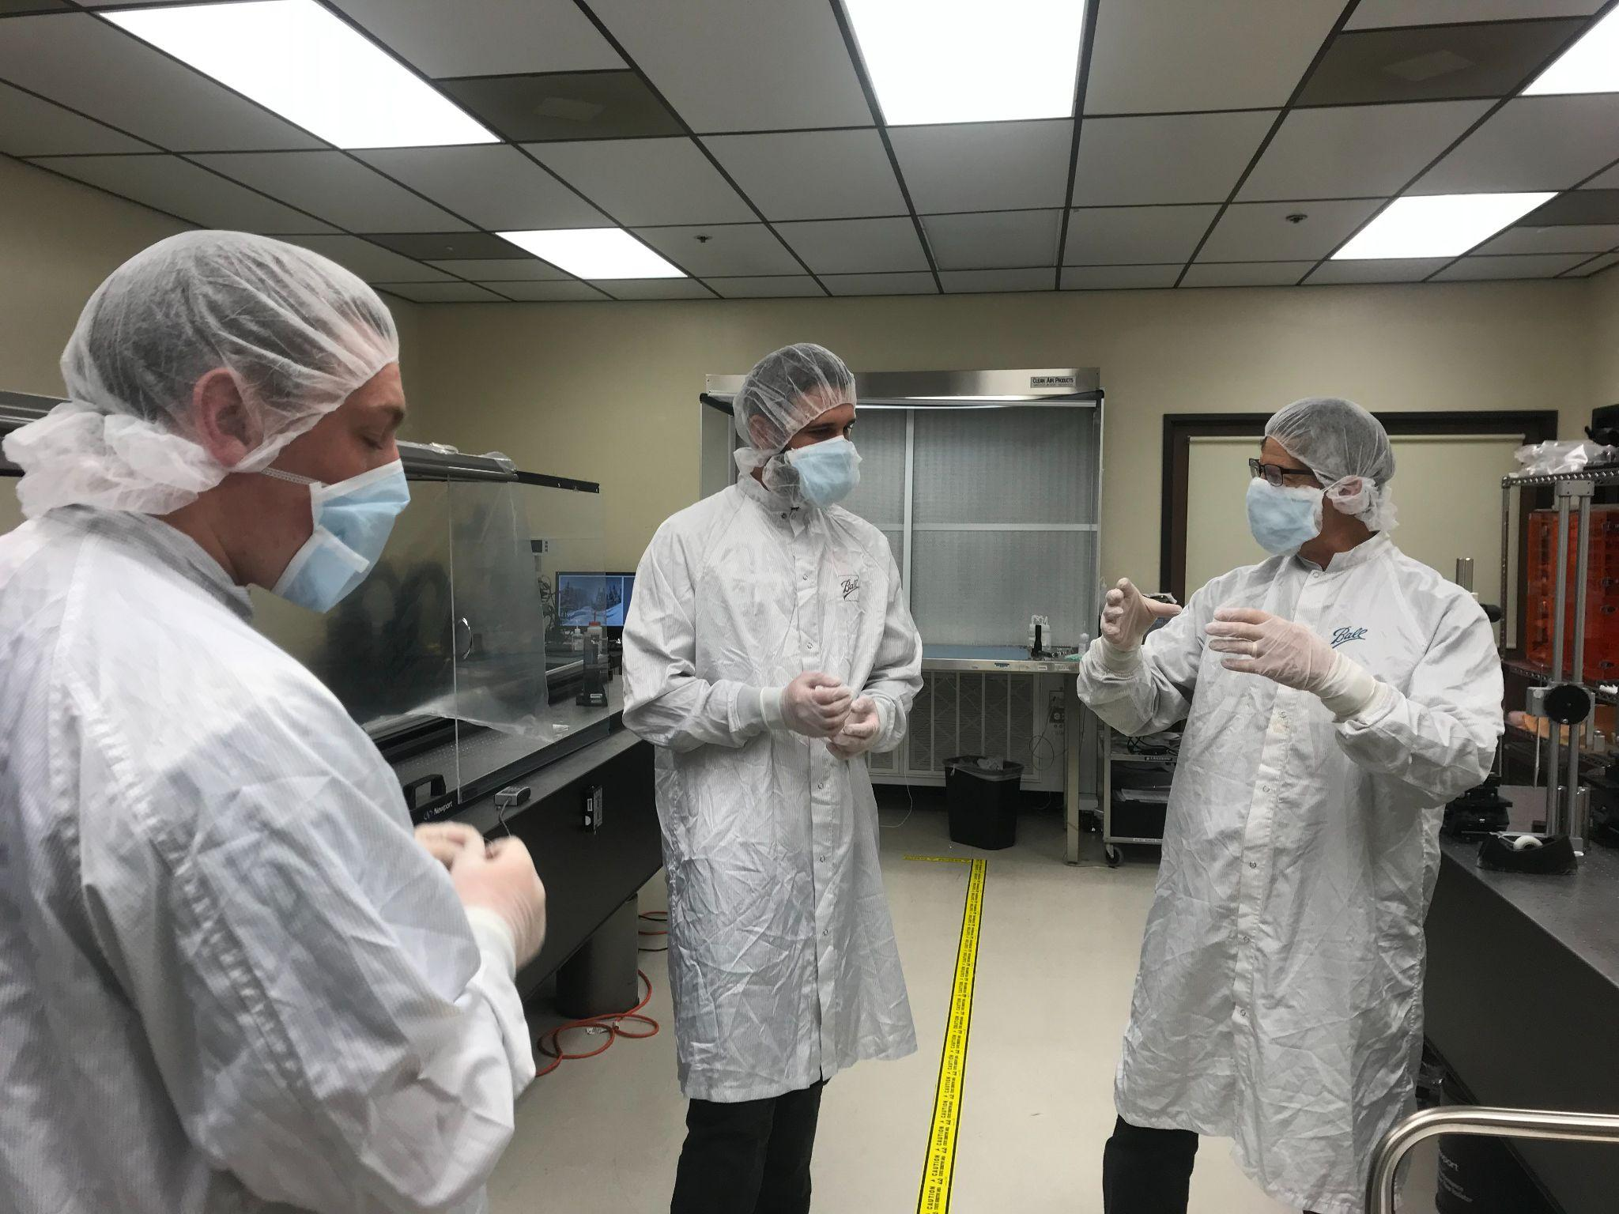
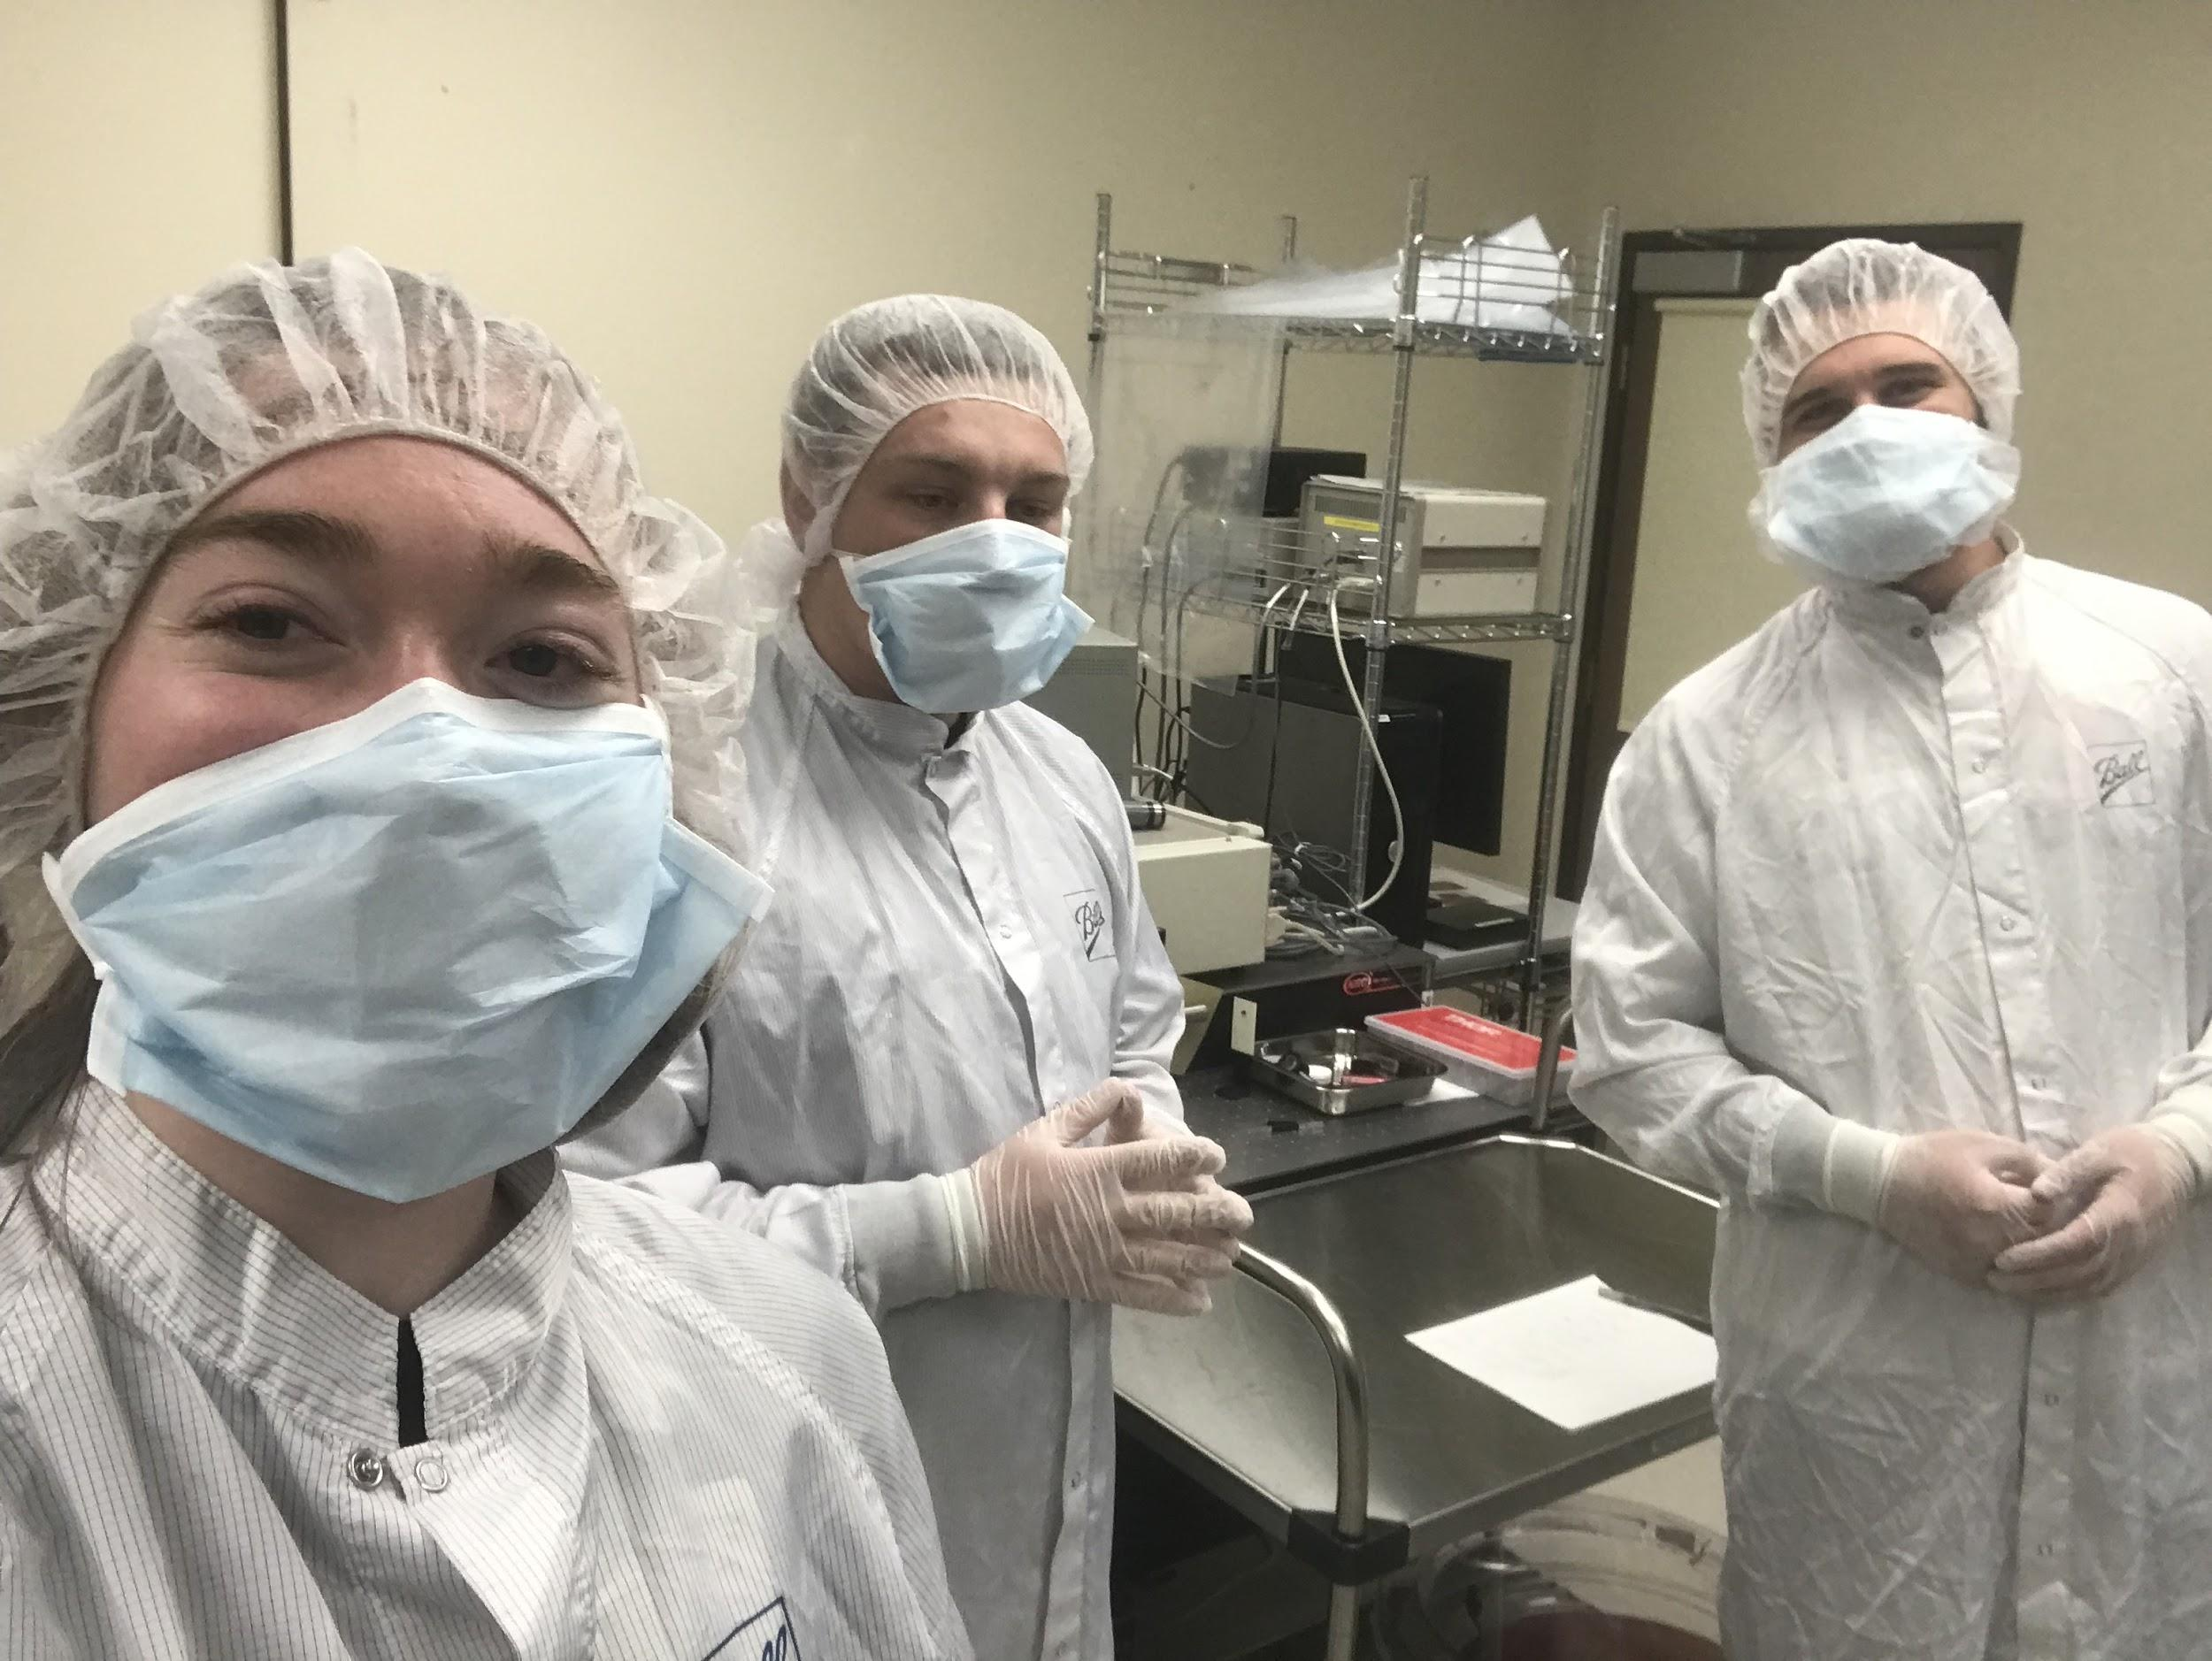
Ball Alignment Testing
Three team members went to the Boulder Ball facility to learn about interferometry and were able to successfully align a practice OAP and high quality reflecting sphere
The procedure and results were documented to establish an efficient alignment procedure for future testing
Thanks to customer (and NS1 team member) Jaykob V., technician Tyler, and advisor Jim Baer
Description Requirements Risks V&V Planning

Slide 51
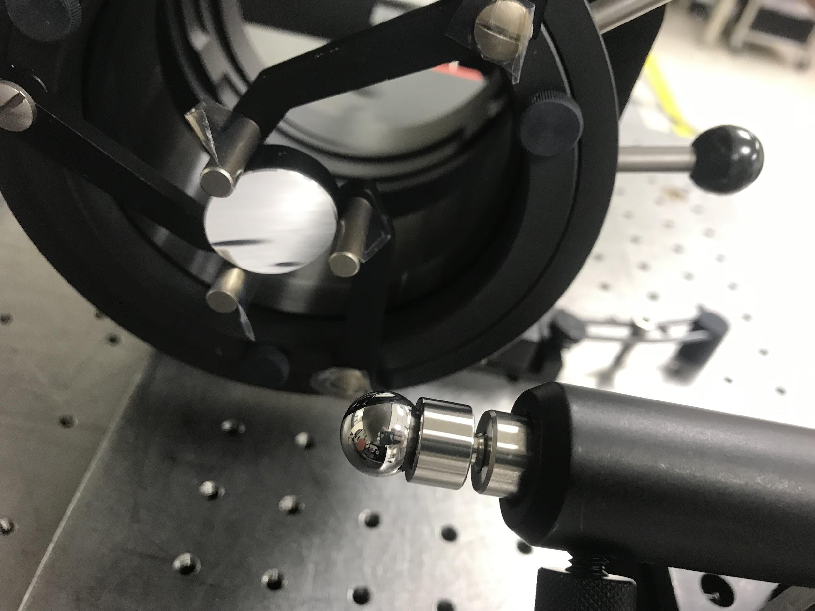
Ball Alignment Testing - Procedure
Overview
Interferometer beam passes through the pellicle attenuator (normalizes the light to near zero amplitude to increase contrast)
Beam reflects off the OAP and focuses at the reference sphere
Beam is returned along the same optical path and the interference is measured by Zernike coefficients and an image of fringes.
Description Requirements Risks V&V Planning

Slide 52
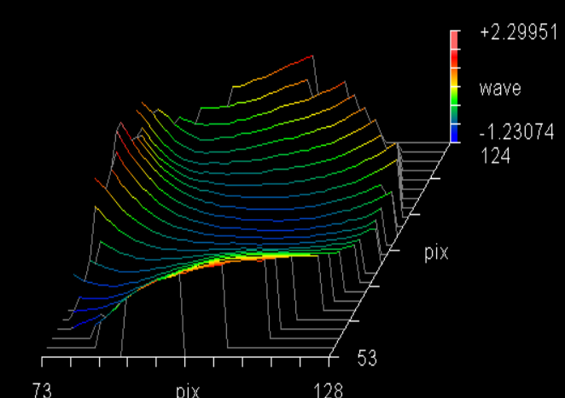
OAP Torque Specifications
The OAP torque specifications will be determined experimentally by relating the OAP bolt torque to the increase in trefoil seen in the Zernike coefficients.
Testing done on 12/1/21 using the NanoSAM II optical bench as it remains relatively the same (excluding dowel pins)
NanoSAM II OAP Distortion
NanoSAM III test OAP Distortion
Description Requirements Risks V&V Planning

Slide 53
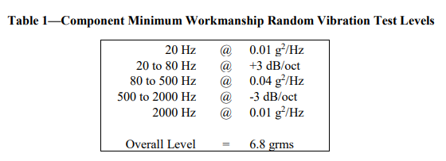
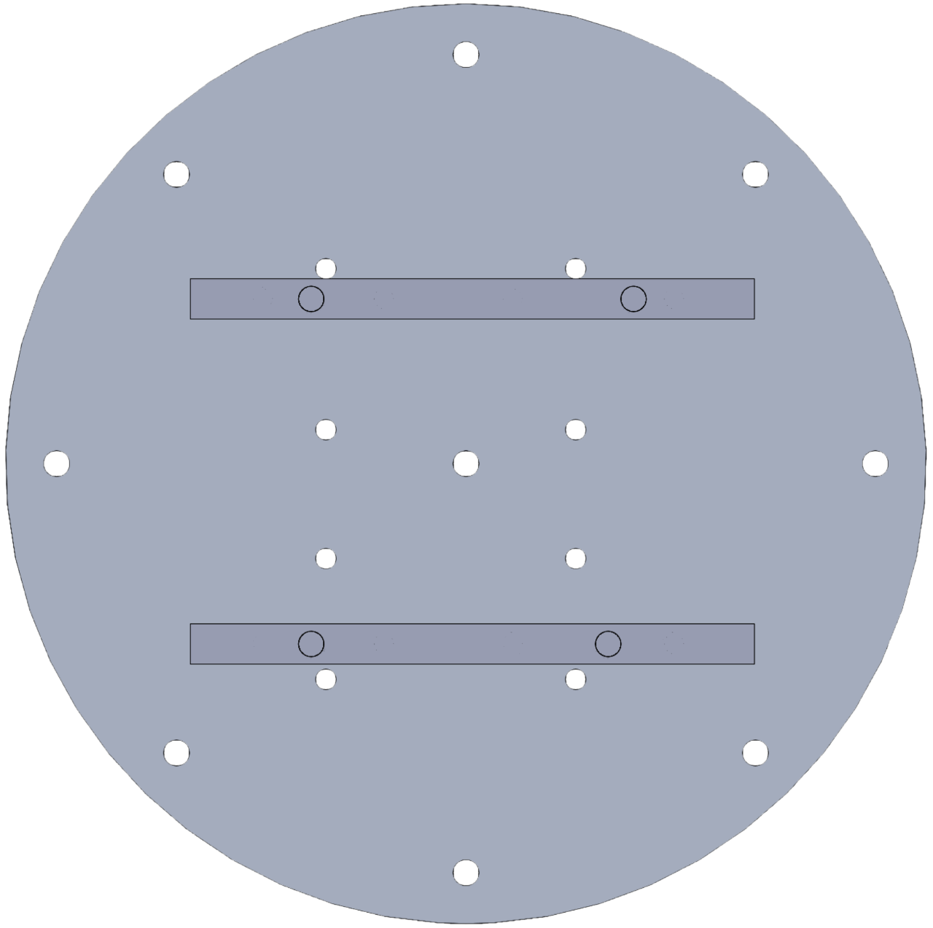
Vibration Testing
Analysis of the frequency test region outlined in PDR (20 - 2000 Hz)
Full NanoSAM III structure run through vibration testing on an interface plate to analyse the system response to typical launch vibrations
Conduct a minimum of 4 vibration tests, one for each axis direction as the vibration table is unidirectional and the 4th test to verify the survival of the photodiode.
Description Requirements Risks V&V Planning

Slide 54
Vibration Testing (Continued)
Accelerometers will be placed at locations of interest or potential low resonant frequency areas
The accelerometer output will be put through a Fast Fourier Transform (FFT) to analyze the acceleration data in the frequency domain, looking for natural frequencies in the given 20 - 2000 Hz random launch vibration range
Based on the preliminary Solidworks analysis, no peaks in the amplitude response data for the NanoSAM III system are expected
Description Requirements Risks V&V Planning
Notes:
Accelerometers will be placed at long and/or high mass components, high displacement regions in the solidworks vibration analysis, optical bench.

Slide 55
Electronics functionality testing
Placeholder data will be copied from flash memory to computer via RS-422 cable to verify data transfer functionality
Sensors will be calibrated against known temperatures, voltages, currents
Assembled electronics subsystem will demonstrate complete functionality of data capture and storage
Description Requirements Risks V&V Planning

Slide 56
Planning
Notes:
Evan

Slide 57
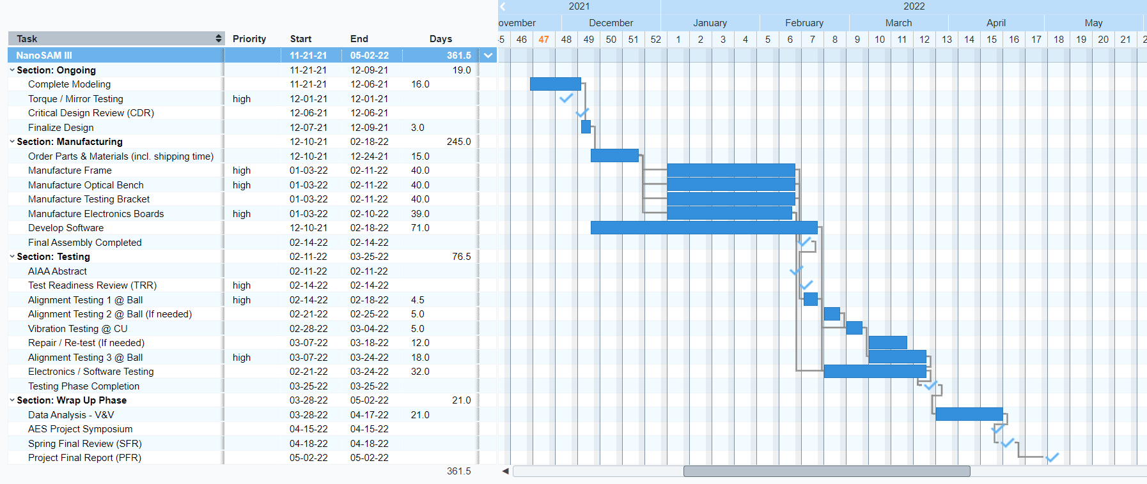
Work Plan - Gantt Chart
Description Requirements Risks V&V Planning
Notes:
Blue - Time allocated to task
Red - Margin
Checkmarks - Milestones and due dates

Slide 58
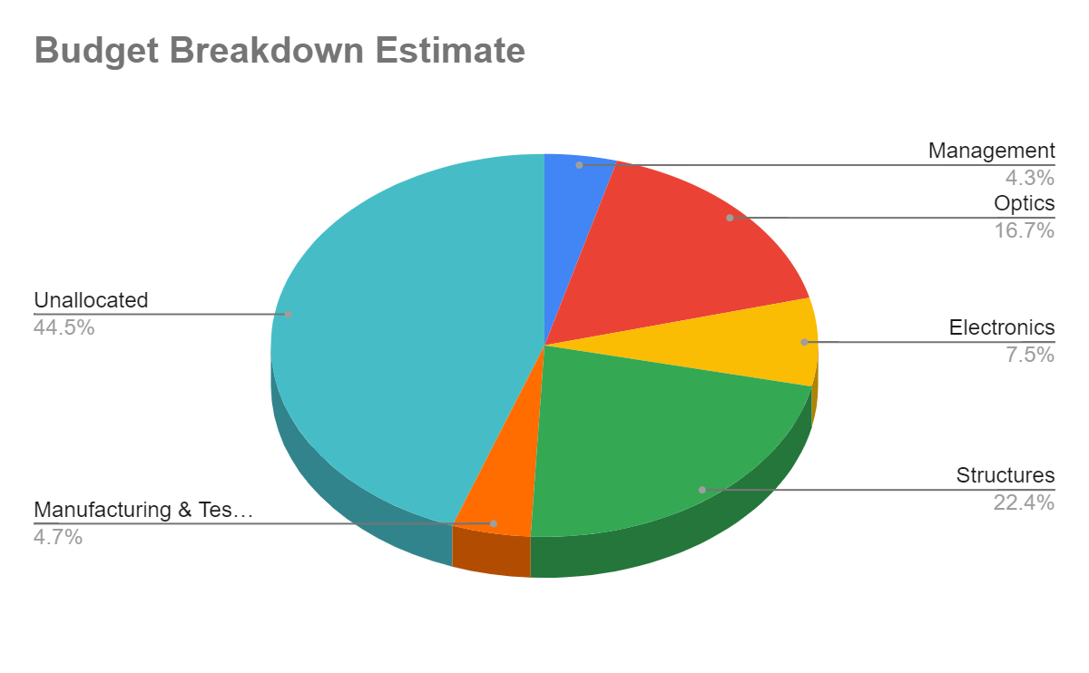
Cost Plan
Optics components have been chosen
Electronics Digikey order is being consolidated, ready to order soon
Current plan for structural materials is to buy extra even though there is plenty left over from previous years
50% margin added for shipping where applicable
Management | $275
Optics | $1,077
Electronics | $480
Structures | $1,440
Manufacturing & Testing | $300
Unallocated | $2,868
Description Requirements Risks V&V Planning

Slide 59
Questions?

Slide 60
References
[1] NASA. (2017). Payload Vibroacoustic Test Criteria. NASA Technical Standard-7001B.
[2] Damadeo, R., Leckey, J., Obland, M., & Hill, C. (n.d.). The Stratospheric Aerosol and Gas Experiment (SAGE) IV Pathfinder - NASA Technical Reports Server (NTRS). NASA. Retrieved November 29, 2021, from https://ntrs.nasa.gov/citations/20205011684.
[3] Tang, H. M., et. al. (2020). (rep.). NanoSAM - Project Final Report. Boulder, CO.
[4] Ghosh, S. (2011, September 1). Static and kinetic coefficient of friction reference table for COF values of common materials. mechGuru. Retrieved November 29, 2021, from https://mechguru.com/machine-design/typical-coefficient-of-friction-values-for-common-materials/.
[5] Calculate torque to tighten bolts. American Belleville. (2021, June 3). Retrieved November 29, 2021, from https://americanbelleville.com/blog/calculate-bolt-torque/.
[6] Brown et al., "Guideline for Bolted Joint Design and Analysis: Version 1.0," Sandia Report SAND2008- 0371, Sandia National Laboratories, 2008.
[7] Abbott, Richard. Analysis and Design of Composite and Metallic Flight Vehicle Structures 2nd Edition, 2017
[8] Analog Technologies “LT3093
[9] Analog Technologies “LT8650s”
[10] Analog Technologies “LT1617”
[11] Analog Technologies “LT3260”
[12] Analog Technologies “DN507”
[13] Analog Technologies “LT1529”

Slide 61
Backup Slides

Slide 62
Management

Slide 63
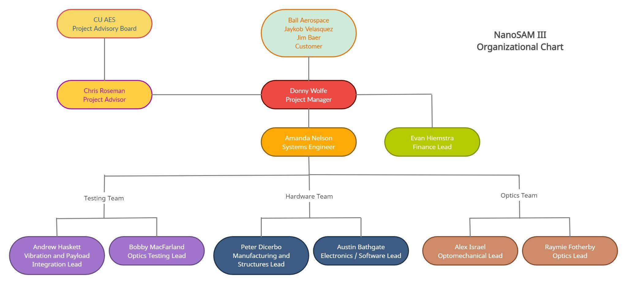
Org Chart

Slide 64
Gantt Chart - Ongoing Work
Project Description Baseline Design Feasibility Design Summary
Description Requirements Risks V&V Planning

Slide 65
Gantt Chart - Manufacturing Phase
Project Description Baseline Design Feasibility Design Summary
Description Requirements Risks V&V Planning

Slide 66
Gantt Chart - Testing Phase
Project Description Baseline Design Feasibility Design Summary
Description Requirements Risks V&V Planning

Slide 67
Gantt Chart - Wrap Up Phase
Project Description Baseline Design Feasibility Design Summary
Description Requirements Risks V&V Planning

Slide 68
Task Tracking
https://docs.google.com/spreadsheets/d/1WkQhB-fEWyW0sTUUyLpFU4V5gEomYjjaZP1JXtwmvLY/edit#gid=0

Slide 69
PCB Mounting Ribs

Slide 70
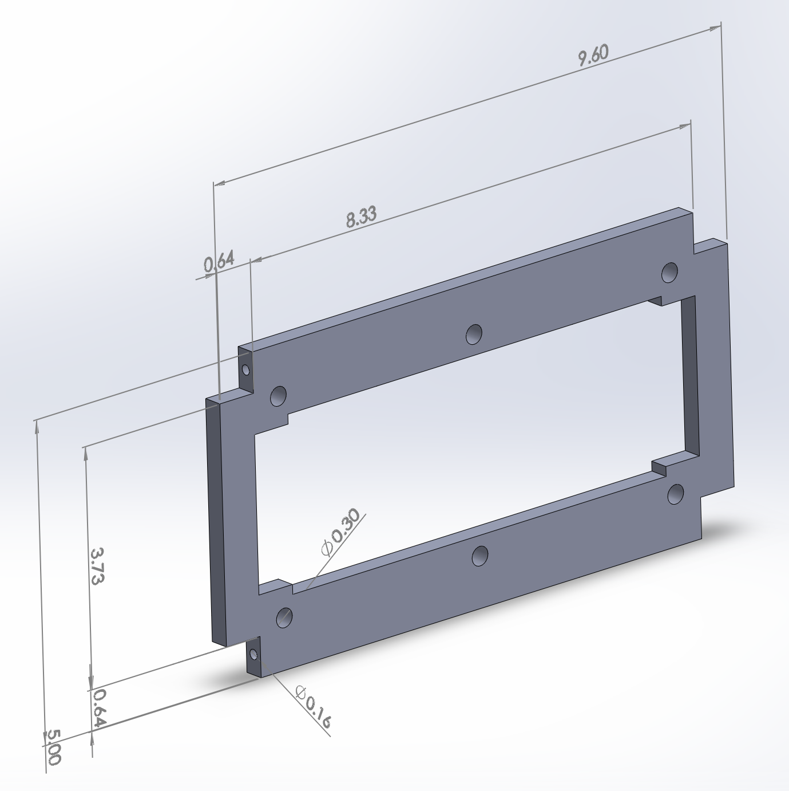
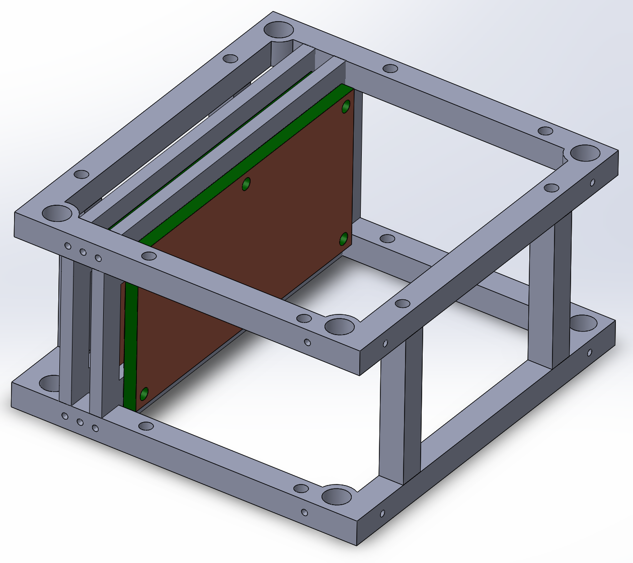
PCB Mounting CAD
Two of these ⅛” thick ribs hold PCBs, screw into horizontal ribs
Project Description Baseline Design Feasibility Design Summary
Description Requirements Risks V&V Planning
Notes:
Vibration modeling presented last time and Chris advised against representing information
Might be able to combine with next slide for Electronics Ribs Analysis
It needs to be the cad model showing how the boards mount to the ribs and potentially how those ribs mount to the frame. We need to explain the physical design here since we don’t have an electronics schematic to walk through. It doesn’t have to be super in depth though. Just how the electronics mount.

Slide 71
Electronics Mounting Ribs Analysis
Mounting PCBs to two separate ribs should stiffen overall frame and therefore reduce vibrations through the frame and on the PCBs
PCBs now have size mounting holes instead of 4 for extra rigidity
PCB screws are not susceptible to tearout or bending, screws attaching to horiz ribs have large margin against tearout/shearing - FOS: E_{rib}A_{rib}/F_{screw@30g} ~ 3400
Project Description Baseline Design Feasibility Design Summary
Description Requirements Risks V&V Planning

Slide 72
Testing Block / Photodiode

Slide 73
𝛃
L = 54.5mm
𝛃
h = 2.5 mm
X = ?
r = 5mm

Slide 74
Filter Mounts CAD
Vertical Dimension Driven by O-ring compression
3 cm

Slide 75
Filter Mount Modeling
Bolt shear analysis from Diode Block applies here, so not worried about shear failure
Performed analysis on whether the filters/windows would shatter in vibration
Similar to PCB Vibration Analysis (See next slide)
1st / lowest mode: 5.57 kHz
FOS: 2.79
Blevins, Robert D.. (2016). Formulas for Dynamics, Acoustics and Vibration - 5.1.2 Boundary Conditions. John Wiley & Sons. Retrieved from
https://app.knovel.com/hotlink/pdf/id:kt00CR5CF5/formulas-dynamics-acoustics/boundary-conditions
http://accuratus.com/fused.html

Slide 76
PCB Vibration Analysis
The PCB in plane dimensions will be 4 cm X 8 cm
The thickness of the PCB support (FR4) is primarily based on avoidance of resonance within launch frequencies
Standard FR4 thickness = 1.60mm and extends to 3.20 mm before becoming requiring custom thickness
Using the thickest standard board - ω_{N-FR4} = 5.91 kHz
Adding 0.0694 mm of copper to each side of the board for greater thermal conductivity raises this natural frequency to ω_{N-PCB} = 6.20 kHz _{[12]}
This is the first mode that appears and corresponds to the lowest resonant frequency encountered
[5]
[5]
Recall the launch profile ➙
The resonant frequency is out of the launch range, but it is fairly close_{[5]}
Notes:
Bullet 1: Payload is maximum 5 X 10 cm - maximize surface area for thermal radiation / spreading while leaving room for mounting, other components, and frame
Launch profile notes: upper end = 2kHz which is ~⅓ the resonant frequency of the first mode - small resonance may occur ideally want to be 1 dec away
Very attenuated at 2kHz so resonance

Slide 77
Hardware

Slide 78
Bolt Shear Modeling
What is the minimum bolt diameter needed to avoid bolt shear failure?
Single Shear Model
Assumes:
τ = 0.55𝜎 [10]
a = 30*G_rms [10]
Worst case loading conditions
Notes:
1/64” to ½” considered
Ultimately selected ⅛” bolt. 5.2mm hole. Bolt is 3.2mm. Gives about 1mm to adjust the vertical and horizontal orientation of the test block.

Slide 79
Hardware - Staking
Epoxy Staking the heads of all screws
JB Weld epoxy:
Tensile strength: 30.34 MPa (4400 psi)
Screws loosen if torque exceeds friction (and strength of any epoxy added)
M_{L} = M_{K} + M_{G} - M_{TP} (+ M_{E})
Loose condition: M_{TP} > M_{K} + M_{G} (+ M_{E})
M_{E} = E*A*t
DO NOT DELETE THIS SLIDE, THIS IS FOR CDR!
Notes:
Fv = preload
a = slip factor
P = thread pitch
D_km = effective diameter of head
D2 = diameter threads

Slide 80
Hardware - Staking
Actual values for torque can only be obtained through doing actual vibration test
Evaluated screw deemed most vulnerable based on equations (short, large thread pitch)
Approximation suggests staking heads nearly halves the likelihood of screws loosening
(M_{K} + M_{G})/M_{TP} ≥ 2.6
(M_{K} + M_{G} + M_{E})/M_{TP} ≥ 4.8

Slide 81
Hardware - Tearout
All screws are made of 18-8 Stainless steel and all manufactured components in concern will be Aluminum 6061, sources recommend surrounding screws with 2*diameter of screw on either side for Aluminum
Thread tearout or “stripping” is not possible, Tens. Strength 18-8 SS = 2*Al6061
Material perpendicular to screw needed for up to 30g acceleration:

Slide 82
Manufacturing & Tolerancing

Slide 83
Manufacturing - Frame
Purchasing and using leftover ¼” and ⅛” thick Aluminum 6061 sheets and 18-8 Stainless Steel Screws necessary for the frame
CNC Milling for more complex geometries and higher tolerances
Tolerances up to 1/1000” are possible but for most of the frame nothing more than 5/1000” should be necessary.

Slide 84
Manufacturing - Fiberglass Panels
Fiberglass Reinforced Polyester is brittle which necessitates using laser cutters
Design choice to switch to High-Temp FRP from Structural FRP to reduce frame manufacturing complexity since High-Temp is thinner
Tolerancing is super important, used laser cutting last year and tolerances were still not good enough
Manufacturer’s thickness tolerance: +/- 0.008”

Slide 85
Electronics

Slide 86
Electronics: Main Elements of the System
The electronics system has four primary elements of focus:
Collect all required data
Provide power at +5V, -5V, and 3.3V from a single 12V bus input
Transmit data in the standard RS-422 form
Regulate the temperature of the electronics system and photodiode
Description Requirements Risks V&V Planning
Notes:
First 2 points are primary focus of CDR

Slide 87
Electronics Backup Slide
Thermal Measurement Design
3 Thermal sensors on board
A thermocouple on the diode block
A thermistor on the analog electronics board
An integrated thermal sensor on the digital board via the Teensy 4.0
Thermal measurements are taken through the use of a voltage divider with a thermistor as R2
NTC thermistor
This measurement is fed through a OPA2330A rail to rail precision, zero drift, micropower operational amplifier configured as a buffer
Dual op-amp chip to minimize cost and space
V_{out} is sent to an analog pin on the Teensy 4.0 for processing
Circuit is only active during measurement plus a 1 ms second transient startup time chosen for accuracy
op-Amp turn on time = 100 us
Electrically isolated thermistor for diode (left) and surface mount thermistor for analog board (right)
Thermal measurement circuit - powered only during measurement and startup
Notes:
Diode block measurement motivated by need for linear relation - tolerance of 0.5% base T value and 0.7% of beta value (table matchup)
Thermal board measurements motivated by need to remain in operating temperature range
The dual op amp chip allows for both the diode and analog board measurement to be followed by 1 chip
Electrically insulated thermistor for diode thermal measurement to not change electrical characteristics due to chassis
NTC thermistor - resistance decreases with temperature as valence electrons become more active with increasing temperature

Slide 88
Electronics Backup Slide
Thermal measurement Processing
By rearranging the voltage divider equation, we can derive a formula to solve for R2 from our known components, applied V_{in}, and resulting V_{out}
With the resistance value know, it can be compared to thermocouple specific tables or a best fit equation from them:
A power fit was used
T = a*R^{b} + c
Surface Mount Thermistor:
a = 720.3; b = -0.1533; c = -150.6 → R² = 1!
Diode Thermocouple:
a = 597.1; b = -0.1392; c = -140.9 → R² = 1!
Notes:
Best fit equations used as they are more accurate to the non-linear curve estimation from beta

Slide 89
Electronics Backup Slide - OLD DESIGN
+/- 5V Low Noise Dual Supply Inverting Charge Pump Overview
Required to generate +/- 5 V from the 12 V battery supply voltage
Low Noise (Constant f) or Low Power (Burst Mode) operation
Low Power chosen as: I_{Q,LowP} = 100 uA vs I_{Q,LowN} = 3500 uA reducing power by 35X
Additional precautions taken to lower noise in this operation
Will noise be a problem? No!
Figure 1 shows the noise characteristics for V_{out} (an intermediate stage) when I_{out} = 1 mA total between 2 output channels
Signal becomes less noisy as I_{out} is increased - Figure 2 shows I_{out} = I_{out,Max} = 100 mA
We use LDO (low dropout) outputs instead for a smoother waveform, let’s look at these
Figure 1: V_{out,pp} = 270 mV ; I_{out} = 1 mA; f = 170 Hz
Figure 2: V_{out,pp} = 5 mV ; I_{out} = 100 mA; f = 500 kHz
Notes:
Burst mode: charged Vout to

Slide 90
Electronics Backup Slide - OLD DESIGN
+/- 5V Low Noise Dual Supply Inverting Charge Pump Output Noise
The LDO outputs attenuate this switching noise drastically
For the large V_{PP} of 270 mV at 170 Hz, the attenuation is -51.5 dB (2.66E-3 X linear) resulting in 718 uV of noise on the +/- 5 V supplies - V_{PP,Noise} / 5 V = 0.014%
The noise is further attenuated using bypass capacitors and larger decoupling capacitors
From the simulation results, no noise can be seen on the 10 uV level!
A 12 bit ADC ranging from 0 - 3.3 V has an LSB = 806 uV
This is ~80 X the 10 uV resolution of the simulation showing the power supply will not corrupt the ADC
The noise to the ADC is further reduced using a linear regulator for ultra low noise performance
Notes:
Burst mode: charged Vout to

Slide 91
Electronics Design: Full Power Schematic

Slide 92
Power System: Initial Switching Converter
The 12 V bus supply is first stepped down to two intermediate voltages using a LT9650s switching converter

Slide 93
Power System: Initial Switching Converter
This converter was chosen because:
Converter is ~ 85% efficient
Allows two positive voltage choices (5.5 V and 3.8 V)
Silent Switcher 2: low EMI emissions and low noise
V_{ripple} < 10 mV_{PP}
Burst mode operation for 6.2 uA of quiescent current
Note the voltages chosen for output are higher than the final voltages to allow use of a LDO linear regulator
*Similar efficiency between 3.3 - 6 V

Slide 94
Power System: Cleaning the Power
Following the switching converter, LDO linear regulators are implemented to greatly reduce ripple voltage
The LT1529-3.3 and LT1529-5 chips were used for this purpose
This strategy maximizes efficiency for a low noise supply as the loss associated with the linear regulator is calculated by:
This is because for a linear regulator I_{IN} = I_{OUT}
𝜂_{5V-LDO-NSIII} = 5/5.5 = 91% 𝜂_{3.3V-LDO-NSIII} = 3.3/3.8 = 87%
Compare this to last year where the LDO was implemented on the 12 V supply
𝜂_{5V-LDO-NSII} = 5/12 = 42% 𝜂_{3.3V-LDO-NSII} = 3.3/12 = 28%

Slide 95
Power System: Cleaning the Power
The linear regulator circuit for the 3.3 V output is shown below
V_{IN-RIPPLE} < 10 mV_{PP} → -65 dB ripple rejection → V_{OUT-RIPLE} = 5.62 uV
Since a 3.3 V range is used by our 12 bit ADC:
3.3 V LDO circuit - same setup as 5 V but with LT1529-5 chip
As we can see out ripple voltage is < 1% of a single LSB!! 5.62 uV << 806 uV
Again, quiescent current was considered and the LT1529-X only consumes 50 uA
Many competitors use I_{Q} = 1 mA

Slide 96
Electronics Power Budget Calculation
Thermal measurement power use:
P_{startup} = P_{Q} + P_{VD} = 660 uW → 3 circuits → P_{startup} = 1.98 mW
P_{measure} = P_{startup} + P_{out} = 750.8 mW → X3 → P_{measure} = 2.25 mW
*Valid at 25°C, includes quiescent current in both calculations to account for non-ideal nature

Slide 97
Eboards Analysis
Separate Digital and Analog boards to minimize ground noise
Boards connected by single star ground
Digital Board:
ADC
Teensy 4.0 Microcontroller and Flash Memory
Communications to satellite bus
Analog Board:
Signal conditioning
Thermal feedback control
Voltage Regulation
Description Requirements Risks V&V Planning
Notes:
Bobby

Slide 98
Electronics Data Budget
Housekeeping data at 0.16 Hz
Temperature sensing: 2 locations, 6 bits each
Total Power: 7 bits
Battery Voltage: 9 bits
Orbital data: 32 bits
All data collected at 50 Hz during optics collection window (240 s)
Optical Data: 12 bits
Total of 298 kB/orbit, or 4.3 MB/day
Data stored on 128 MB flash chip, with backup in case of failure
Allows 23 days between downlink, with 25% margin on storage
Notes:
Thermal data must extend from 0-50 minimum for 50 bins (6 bits minimum for 1 deg resolution over range). If we want 0.1deg precision need 9 bits
Battery voltage needs at least 0.01 precision, if using integer math must go from 688-1200 = 512 bins needs >>> 9 bits
Power range 0-8 W with 0.1 precision needs 80 bins - 7 bits

Slide 99
Vibration Analysis

Slide 100
Frame Modeling
new vibe model (talk about motivation for study)
m₁ -> electronics, ½ vertical support, ½ cross-beam
m₂ -> optical bench, ½ vertical support, ½ cross-beam
k₁, k₃, k₅ -> bending stiffness of cross-beam
k₂, k₄ -> compressive stiffness of vertical supports
sensitivity analysis to confirm expected phenomena

Slide 101
Bolted Joint Stiffness Calculations
(Axial)

Slide 102
Bolted Joint Stiffness Calculations
(Shear)

Slide 103
Vibration Analysis
Materials: | Al 6061-T6
Analysis: | Modal
Solver: | ANSYS
Method: | Linear
Additions: PCB ribs
Description Requirements Risks V&V Planning

Slide 104
Full Vibration Analysis
mesh (shrink mesh to converge to results)
show iterations and process (talk about expectations / compare to BOTE)
Notes:
Peter

Slide 105
Vibe Table Bracket

Slide 106
CAD - Wide Orientation

Slide 107
CAD - Close Orientation

Slide 108
Strength Analysis

Slide 109
Optics

Slide 110
Optical Design
Photodiode block (replaced w/ reference sphere during interferometry alignment)
Window
15um Pinhole
Light
Optical Bench
Longwave & Bandpass Filters
OAP
Rectangular Aperture
Notes:
Purpose of Longwave filter: filter out wavelengths of light below 1000 nm
Purpose of Bandpass filter: filter our wavelengths outside of 1030 nm
Rectangular Aperture: collimate light

Slide 111
Ball Alignment Testing - Setup
OAP
ZYGO interferometer
Pellicle attenuator
Reference Sphere
Description Requirements Risks V&V Planning

Slide 112
Zernike Coefficients
Zernike polynomials are used to describe wavefront aberrations of the lens from an ideal spherical shape, which result in refraction errors

Slide 113
Ball Alignment Testing - Results
Were able to drive Zernike Coeff’s down for high quality images in 3 most important directions
Can see trefoil pattern
Additional testing 12/1 to determine torque vs. Zernike
Description Requirements Risks V&V Planning
Notes:
Move image to next slide

Slide 114
Zernike to Displacement Code
Use existing solns to be able to determine what displacement is needed from how far from 0 Zernike Coeff’s are

Slide 115
Tolerancing
Each Shim corresponds to a distance the reference sphere/photodiode can be moved
Zernike vs. distance MATLAB code developed by previous teams, will continue to be updated
Description Requirements Risks V&V Planning
Notes:
Alex

Slide 116
Tolerancing (Continued)
NanoSAM I team derived a relationship between Focus [mm], in-plane tilt [deg], and out-of-plane tilt [deg] with the Zernike coefficients.
Description Requirements Risks V&V Planning

Slide 117
NBK7 Borosilicate Glass Reference Sphere
Substrate of reference sphere matters only that it can survive vibe testing
Will be chrome coated at COSNIC lab at CU, so the surface is opaque regardless of the index of refraction
Chosen b/c:
Inexpensive ($45) and readily available from Edmund
Lower mass
Std diameter of 10mm was available
Borosilicate is a strong glass that won’t shatter or crack easily

Slide 118
Thermal Model
Cold Case, Beta Angle = 0

Slide 119
Thermal Model
Hot Case, beta angle = 75 deg
(v hot - management needed)

Slide 120
Orbit Parameterization
Notes:
Alex

Slide 121
Orbit Parameterization

Slide 122
Orbit Parameterization

