Slide 1
HERMES Hazard Examination and Reconnaissance Messenger for Extended Surveillance
Manufacturing Status review
February 4, 2019
Presenters: Brindan Adhikari, Brandon Santori, Michely Tenardi, Marcos Mejia
Customer: Barbara Streiffert and Jet Propulsion Laboratory (JPL)
Advisor: Dr. Kathryn Anne Wingate
Team: Alexander Sandoval, Alexis Sotomayor, Ashley Montalvo, Brandon Santori, Brindan Adhikari, Chase Pellazar, Colin Chen, Junzhe He, Katelyn Griego, Marcos Mejia, Michely Tenardi, Quinter Nyland
Notes:
Intro: conops: design

Slide 2
Project Purpose and Objectives
Project Purpose and Objectives
Design Requirements and their Satisfaction
Project Risks
Design Solutions
Critical Project Elements
Verification and Validation
Backup Slides
Project Planning
Notes:
2 minutes, 28 mins left

Slide 3
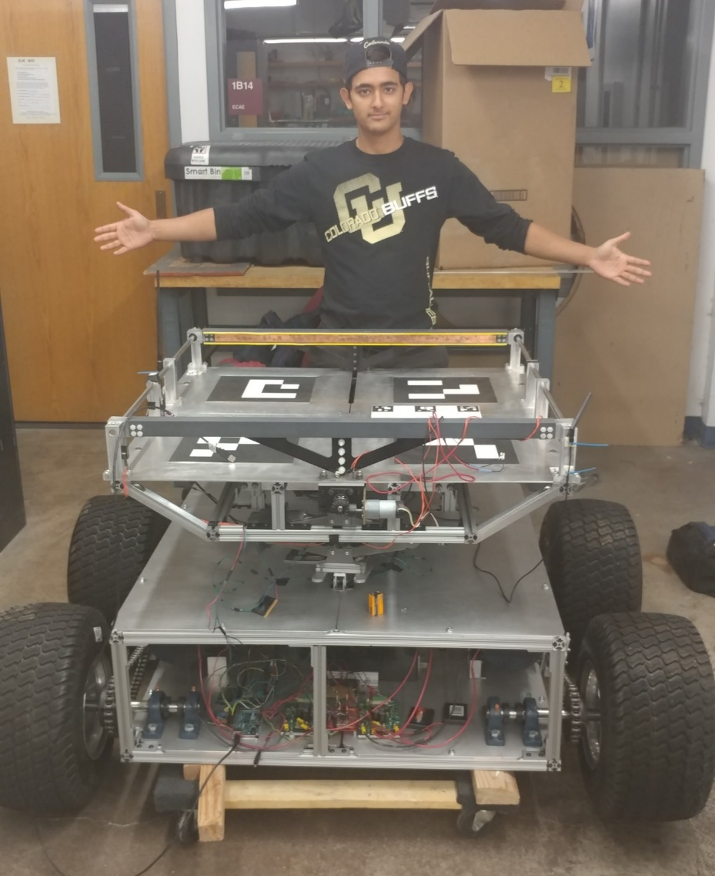
Project Motivation and Statement
The mother rover created by DRIFT is large and difficult to navigate through forest like areas.
The HERMES team will design, build and test a child scout rover (CSR) that will deploy, take images/videos of the surrounding terrain, determine a viable path to a location of interest (LOI), and upon arrival to the LOI, the CSR will send the viable path to the mother rover.
CHIMERA
DRIFT
Note: Blue used for emphasis

Slide 4
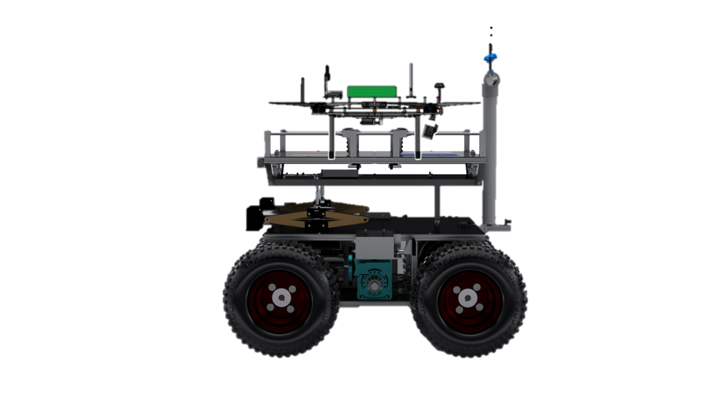
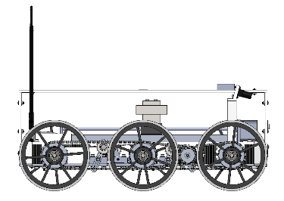
CONOPS: Arriving to Location of Interest
1
2
3
4
5
Deploy from Ground Station and drop a pathpoint
Receive Location of Interest (LOI) from GS
User commands CSR to point towards LOI
User commands CSR to travel towards the LOI in semi autonomous mode. The CSR will travel until it reaches the LOI.
Upon arrival it will stop, and notify the GS and drop a pathpoint
Ground
Station
Mother Rover
2
3
5
LOI
1
4
Child Scout Rover
En route to the LOI, the CSR may encounter one or more of the following:
Obstacles
Discontinuities
Slopes
Loss of communications
Legend
Mission Terrain
Pathpoint
Stop and request user intervention
Requirements
Comm between GS and MR
Functions
Comm between GS and CSR
Comm between CSR and MR
October 2018
Manually controlled path
Up to 250 m radius (820 ft)
4
Autonomously controlled path
4
Notes:
Fix picture,

Slide 5
CONOPS: Other Terrain
Non-Traversable Obstacles
Discontinuities
Slopes
If the CSR detects an obstacle, the CSR will stop
The user will take control, and manually control the CSR around the obstacle
Every time the CSR turns, a pathpoint is recorded
After traveling around the obstacle, the user commands the CSR to point towards the LOI, and command it into semi- autonomous mode
If the CSR detects a discontinuity, the CSR will stop
The user will then send a command to the CSR to enter the discontinuity traversal mode
Then the CSR autonomously crosses the discontinuity
A pathpoint is recorded since a mobility command was received and executed
After crossing the discontinuity, the CSR stops and requests user intervention
If the CSR detects a slope, the CSR will stop
The user will control the CSR to get onto the slope and command the CSR into semi autonomous mode
The CSR will travel on the slope in semi autonomous mode
Once the CSR detects flat ground, it will stop
The user will control the CSR to return to flat ground
1
1
1
2
2
2
3
3
3
4
4
5
Obstacle
1
1
3
CSR crosses autonomously
3
1
4
2
4
2
5
User sends command to change mode
Greater than 2.4 in deep
Operator manually controls the CSR onto or off-of slope
Up to a 20° slope
3
2
Up to 9 inches wide
Operator manually controls CSR around obstacle
= Point where sensor detects
obstacle or discontinuity
= Pathpoint
= Stop and request
user intervention
= Manual Control
5
= Autonomous Control
Notes:
Fix picture

Slide 6
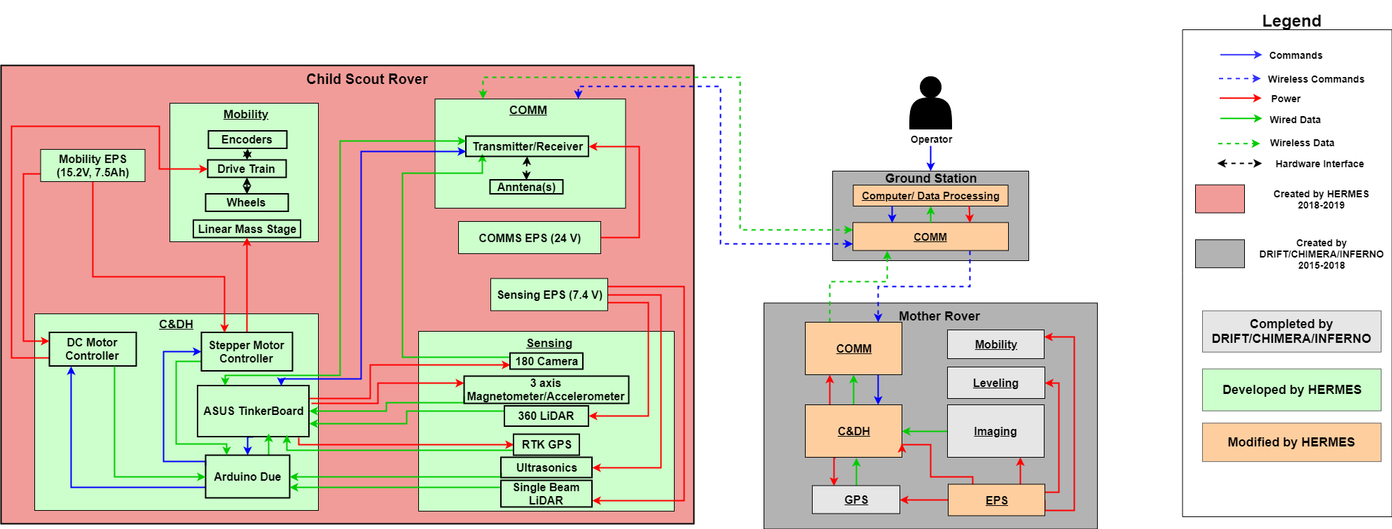
Functional Block Diagram
Notes:
Needs linear mass stage, fix eps for each. Talk to chase how to present best

Slide 7
Functional Requirements
Requirement ID | Description
CSR.1 | The CSR shall receive commands from the GS
CSR.2 | The CSR shall send video, GPS coordinates, and sensor data to the GS through mission defined terrain
CSR.3 | The CSR shall drive to a location of interest through mission defined terrain
CSR.4 | The CSR shall travel back to the last reported pathpoint upon loss of communications with the GS
CSR.5 | The CSR shall take video in position hold
Notes:
CSR.2 – specify sensor data

Slide 8
Critical Project Elements
Critical Project Element (CPE) | Rationale | Relation to Manufacturing
Mobility | The CSR must be able to travel forward and backwards and perform 360° turns. | The main needs are : Drivetrain Chassis Linear mass stage assembly.
Software | The CSR software must read in, process, and execute commands from the GS. The CSR must also process data on-board to react to obstacles and discontinuities. | The main needs are: Arduino – ASUS Integration Development of Driving functions Sensing software
Guidance, Navigation, and Control (GNC) | The CSR must be controlled remotely by one operator, and must read its own attitude accurately. | The main needs are: Manual control of the rover
Environment Sensing | The CSR must accurately sense the terrain and obstacles around it to navigate around them. | The main needs are: Data processing of sensors
Communications | The CSR must communicate with the GS to send the viable path, images and videos to the GS. | The main needs are: Integration between the GS and the CSR communication
= Emphasis for this presentation

Slide 9
Primary Success Levels
Criteria | Level 1 | Level 2 | Level 3
Environment | The CSR shall traverse the following: Open areas Up to 20 degree incline slopes | The CSR shall traverse the following: Type A underbrush Roots up to a 2.4 inch(6 cm) diameter | The CSR shall traverse the following: Type D underbrush Up to a 9 inch wide discontinuities with depths greater than 2.4 inches (6 cm)
Control | The CSR shall navigate by receiving control commands from the GS The CSR shall perform a 360° turn The CSR shall drive forward and reverse | The CSR shall navigate to a LOI and shall detect obstacles en route to the LOI, but manual control is needed to circumvent the obstacles. | The CSR shall autonomously return to the last known GPS location if connection to the GS is lost.
Other Success Levels: Communication, Range, Video/Image

Slide 10
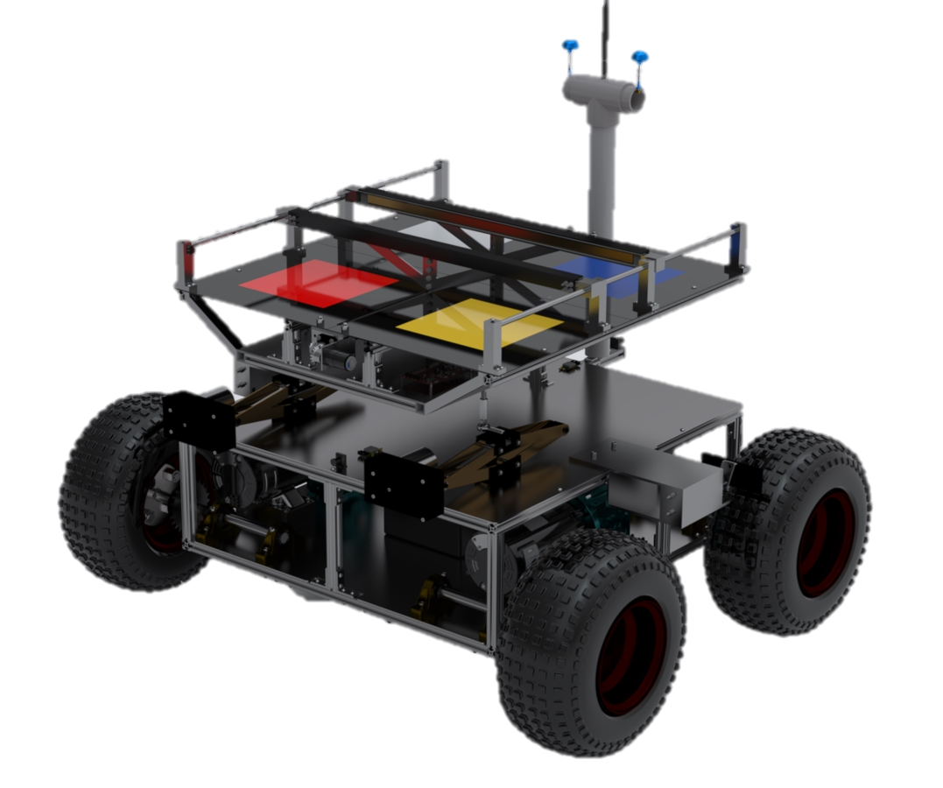
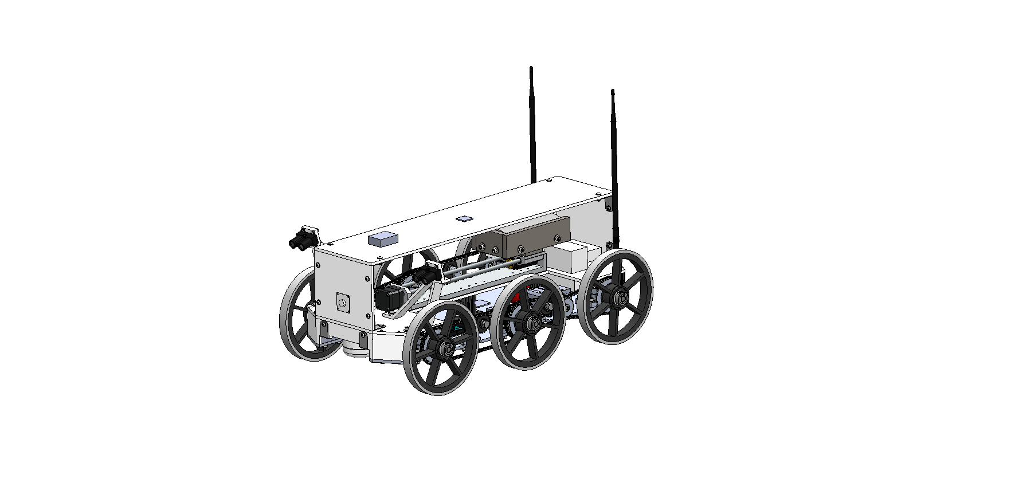
Design Recap: System Interface
MR Comm System
1 6.5W 900MHz Ubiquiti Radio
Command Options
CSR Status
MR
GS Software System
Function: ROS Slave Machine
Displays a GUI for operation
Mission Log
Video Feed
GS
MR Comm System
1 6.5W 900MHz Ubiquiti Radio
MR Comm System
1 6.5W 900MHz Ubiquiti Radio
CSR
MR Software System
Function: ROS Slave Machine
CSR Software System
Function: ROS Host Machine
= Wireless Comms.
= Outlines components
Notes:
I’d say emphasize less on comms and expand more on software. Fix, and talk better. Animate

Slide 11
Design Recap: CSR Hardware
Drivetrain:
Design
One drivetrain per side
Composed of 6 wheels, 2 chains, chain tensioners, sprockets, 1 motor + gearbox
Chassis:
Design
Top housing is 0.25” laser cut acrylic
Bottom Chassis is 0.25” CNC’ed 6061 Aluminum
Linear Mass Stage:
Why?
The COM is shifted as necessary using the linear mass stage to cross discontinuities. The mass is shifted when the ultrasonic sensors detect ground under a certain set of wheels.
Design
A COTS linear mass stage is utilized which is controlled by a stepper motor controller. The mass being used is 5 kg.
CSR Physical Properties Summary:
Overall Dimensions: 28 in x 15 in* 11 in
Total Mass: 17 kg
20.2 in
28 in
15.5 in
Notes:
Don't assume anyone knows what everything is for. Why is the linear mass stage there? Why are we using ROS in the first place? Why do we need to operate in different modes? We need to make sure to build our presentation in such a way that everything has a purpose when it is presented.

Slide 12
Design Recap: CSR Hardware
Single Beam LiDAR Sensors:
Why?
To detect discontinuities
360 Degree Lidar Sensor:
Why?
To detect obstacles
Ultrasonic Sensor:
Why?
Used for crossing discontinuities to determine what position the mass
from the linear mass stage should be in
Placed on the bottom on the CSR (not shown in diagram)
GPS – RTK Sensor:
Why?
To determine the CSR’s position up to a 0.025 m accuracy
Magnetometer/ 3 Axis Accelerometer:
Why?
Magnetometer used for determining the CSR’s heading
Accelerometer used to determine if the CSR is on level ground or a slope
Notes:
Don't assume anyone knows what everything is for. Why is the linear mass stage there? Why are we using ROS in the first place? Why do we need to operate in different modes? We need to make sure to build our presentation in such a way that everything has a purpose when it is presented.

Slide 13
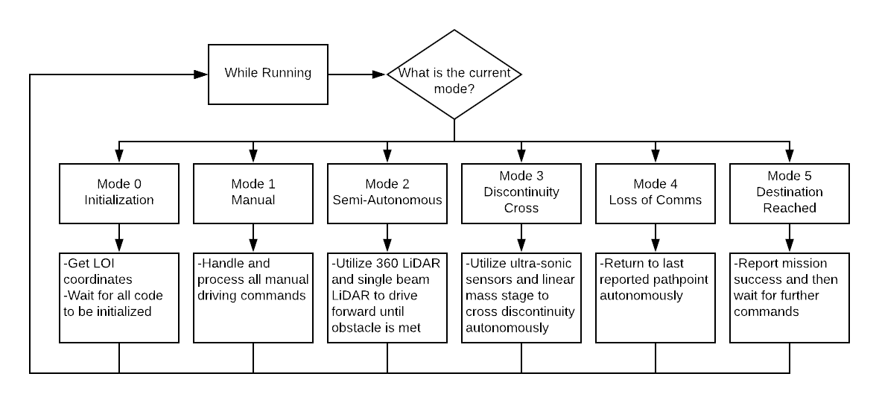
Design Recap: Software Architecture
CSR can run in 6 different modes:
- Initialization
- Manual
- Semi-Autonomous
- Discontinuity Cross
- Loss of Comms
- LOI Reached
Benefits of the Mode Architecture:
- Allows for a reduction in the amount of code running at any point in time
- Allows for data to only be processed from sensors when needed
Notes:
She expects us to explain why ROS is being used in a previous slide somewhere so that when we see the software diagram, it is not shocking to people looking at it.

Slide 14
Scheduling

Slide 15
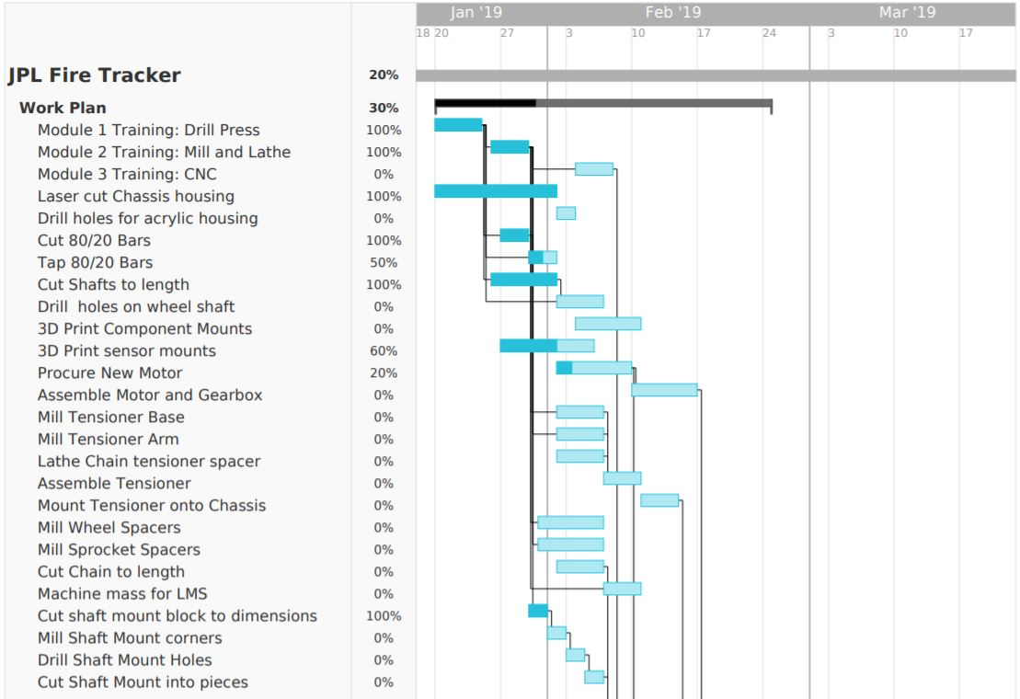
Mechanical Schedule
Hours
Current Day. Feb, 4 2019
Module Training
2/2
2/2
0/5
= Completed
2/2
Chassis Housing
0/1
= Future Work
2/2
0/1
Wheel Shaft
2/2
0/1
= In Progress
3D Printed Mounts
0/4
2/5
= Margin
0/1
0/4
= Milestone
Tensioner
0/2
0/1
0/1
= Critical Path
0/1
Spacers
0/2
0/2
0/2
0/2
Shaft Mounts
2/2
0/2
0/2
0/2
0/4
Chassis Integration
0/1
1/3
0/2
1/4
Feb 24. Finish manufacturing

Slide 16
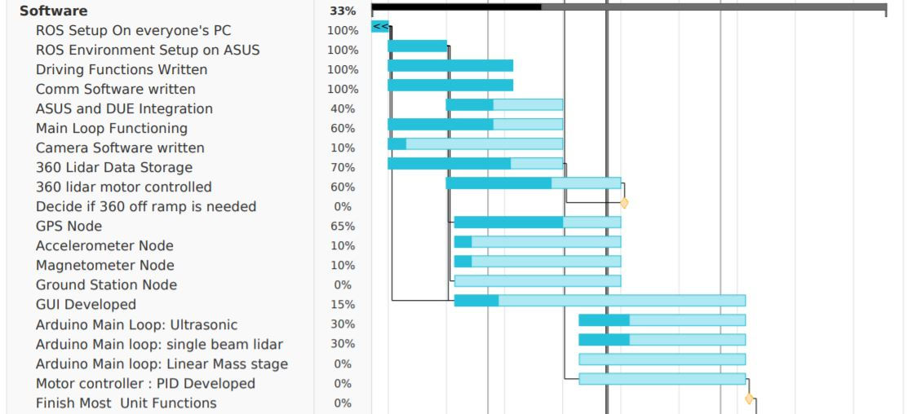
Software Schedule
Hours
5/5
Current Day. Feb, 4 2019
Basic Setup
5/5
5/5
= Completed
5/5
Fundamental software
3/8
= Future Work
6/10
1/10
= In Progress
3/5
Feb. 17 Take 360 offramp
360 Degree Lidar
12/18
= Margin
10/15
= Milestone
Navigation Sensors
1/5
= Critical Path
1/5
Ground Station and GUI
0/5
2/6
Obstacle and Discontinuity Software
2/6
2/6
March 4. Finish Unit Software
0/5
0/5
Integrated Functions
0/7
0/5
0/7

Slide 17
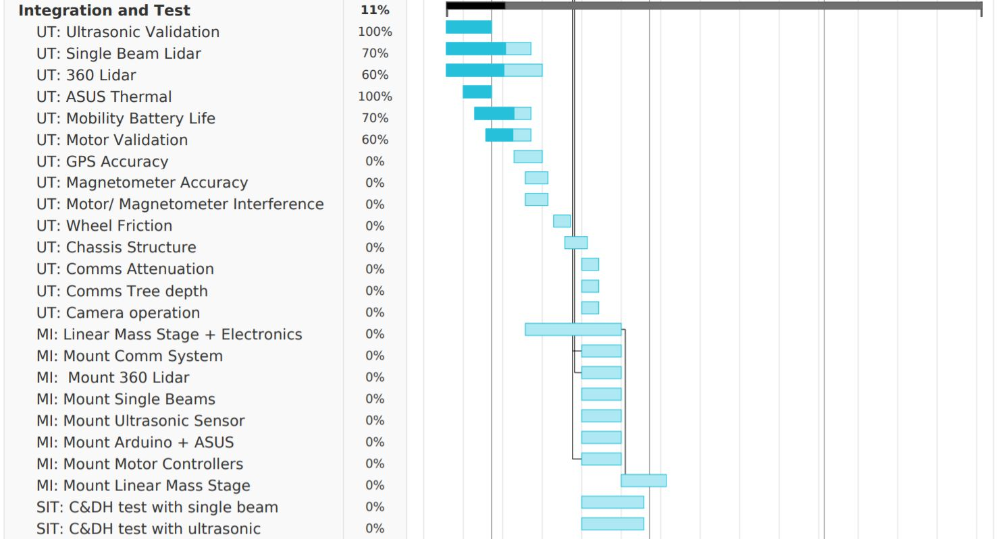
Integration & Test Schedule
Current Day. Feb, 4 2019
= Completed
= Future Work
UT: Unit Tests
= In Progress
= Margin
= Milestone
= Critical Path
MI: Mechanical Integration
SIT: Subsystem Integrated Tests

Slide 18
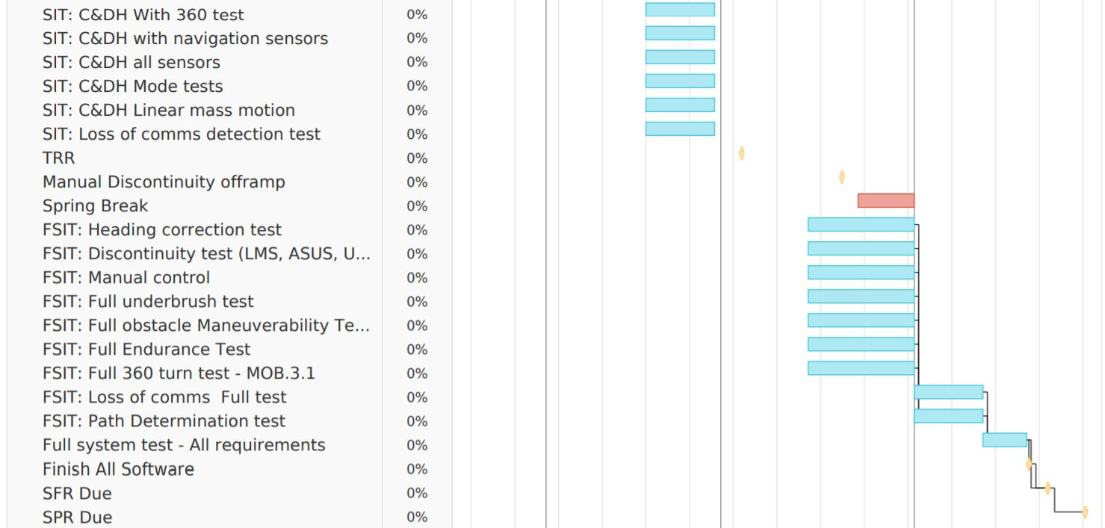
Integration & Test Schedule
SIT: Subsystem Integrated Tests
= Completed
= Future Work
= In Progress
Spring Break
= Margin
= Milestone
= Critical Path
FSIT: Full System Integrated Tests
Finish System
Friday April 19, 2019

Slide 19
Manufacturing

Slide 20
Mobility

Slide 21
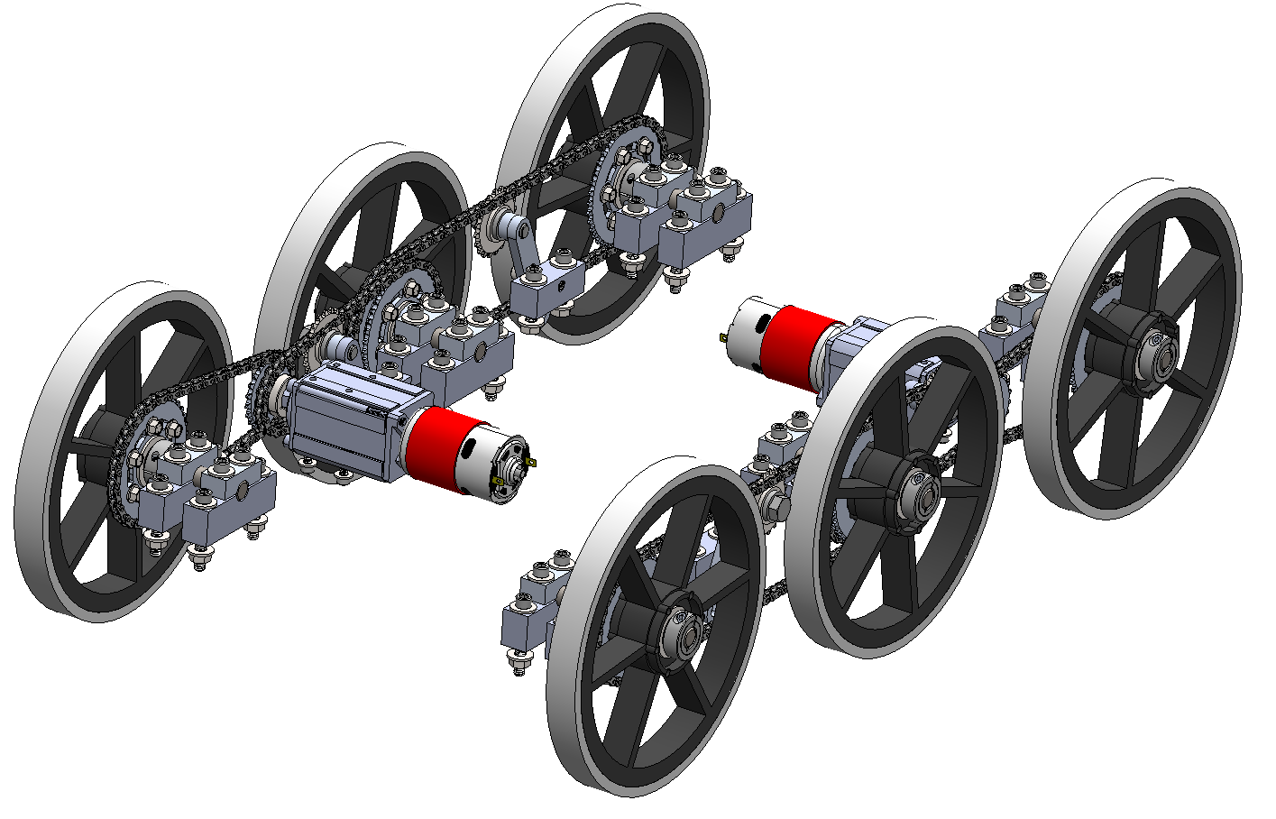
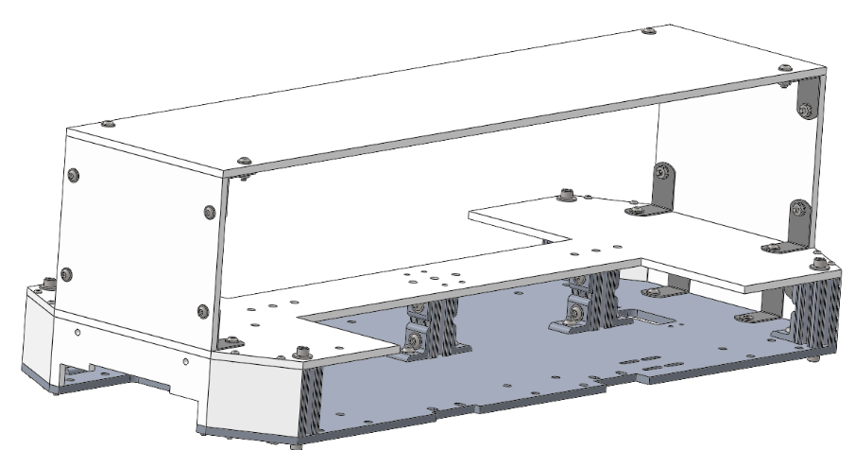
Overview and Scope
Drivetrain
Status:
Will be discussed next
Remaining Work:
Will be discussed next
20.2”
15.5”
28”
Linear Mass Stage
Status:
Parts have been procured
Electronics developed
Remaining Work:
Mass must be machined
Everything must be integrated
Chassis
Status:
Top housing has been laser cut out of acrylic
Remaining Work:
Base must be CNC’ed
22.25”
= Emphasis for this presentation
* Detailed information for Chassis and Linear Mass Stage in backup Slides
Notes:
Precision manufacturing
It’s the most complex system of the chassis
Required to have it for the minimum success level for our mission
Color code subsystems, blow up design, add labels, then emphasize why drivetrain only. Integration of drivetrain is critical because schedule will change if not completed
Drivetrain integration is critical for the schedule

Slide 22
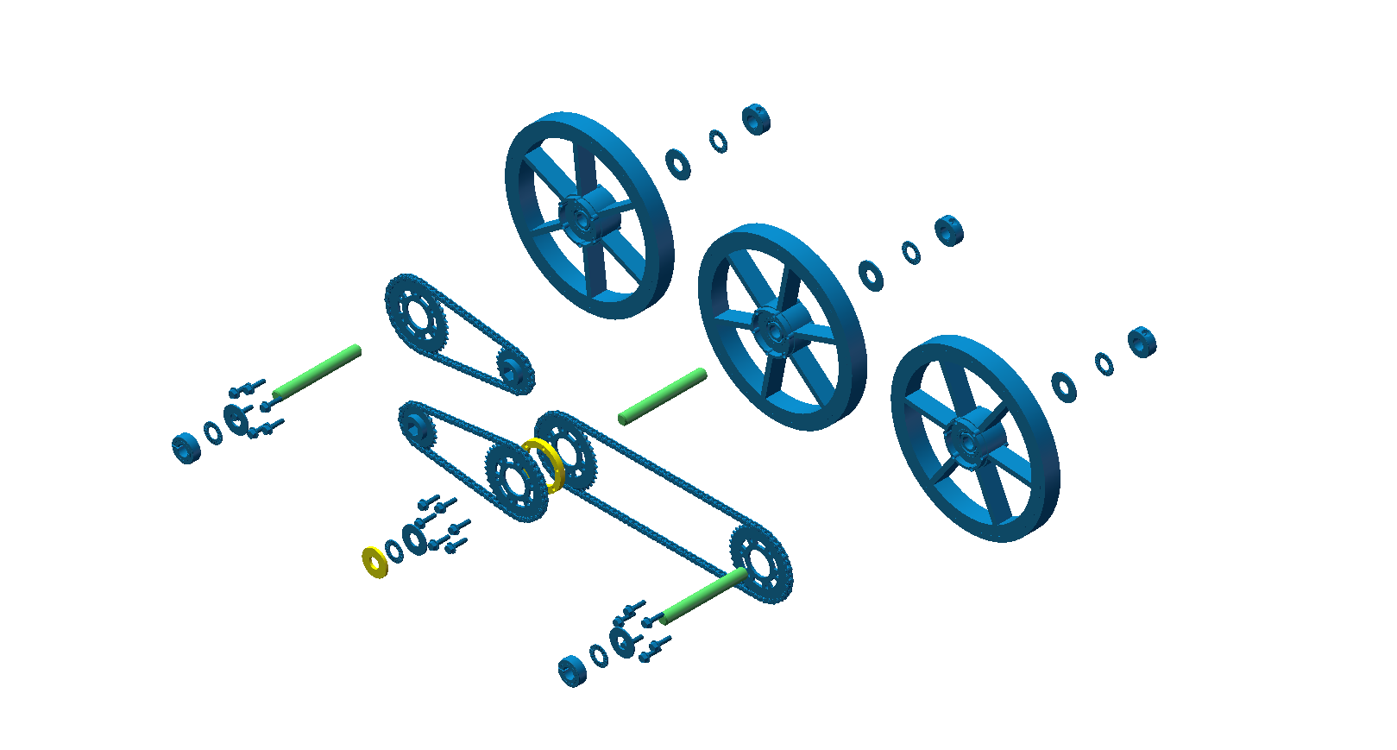
Manufacturing Status: Drivetrain
Legend
8” Diameter Rubber Treaded Wheel with press fit 1/2 ID Radial Ball Bearing 1/2”
0.4’’ thick Shaft Collar
= COTS Parts
= Completed
Flat Washer
= In Progress
Gearbox Sprocket
= Future Work
Needle Thrust Bearing
Rotary Shaft with Retaining Ring Grooves. 303 Stainless Steel, ½” Diameter
Status: All shafts have been cut to length (4.5’’)
Remaining Work: All shafts need to have pin hole drilled
Hours: 0/1
Completion Date: 2/6/19
0.25’’ thick Spacer
Status: Laser Cut Prototype has been made
Remaining Work: Aluminum spacers need to be lathed
Hours: 0/4
Completion Date: 2/6/19
Grade 5 Steel Serrated Flange Head Cap Screws
38t Aluminum Plate Sprockets
Roller Chain ANSI #25, 1/4 “ Pitch
Notes:
Needs dimensions + more specific on the screws, spacers, sprockets. Add un exploded view and then explode

Slide 23
Manufacturing Status: Shaft Mounts
Status:
All 12 pieces have been cut to dimensions
Remaining Work:
Need to mill out corner pieces
Need to drill 6 holes (pin, 4 screws, shaft)
Need to cut to divide part
Shaft Mounts: 6 per side
1’’ long 0.125’’ diameter Alloy Steel Dowel Pin
1.75’’ long Steel Socket Cap Screws
Legend
= COTS Parts
0.5’’
= Completed
= In Progress
0.9’’
= Future Work
0.75’’
Aluminum Bar
Hours: 2/10
Completion Date: 2/6/19
Wheel Assembly: 3 per side
2.875’’
Notes:
Pin > to hold the shaft from the torque
Put the picture of the whole CSR and zoom the shaft mount part.
Talk about the critical dimensions (tolerances, etc, GD&T stuff). How much can they be off?
Point out the pin on the exploded view shaft
Clearance, tolerance, .501

Slide 24
Overview and Scope
Subsystem | Manufactured Parts | Means of Manufacturing | Quantity Needed | Quantity Completed | Expected Time [completed/total hours] | Completion Date
Chassis | Aluminum Baseplate | CNC | 1 | 0 | 0 / 4 | 2/14/19
Chassis | Housing | Laser Cut | 1 | 1 | 2 / 2 | 2/1/19
Chassis | 80/20 Struts | Bandsaw/mill | 6 | 6 | 2 / 2 | 1/29/19
Drive Train | Rotary Shafts | Bandsaw/mill | 6 | 6 | 2 / 2 | 2/6/19
Drive Train | Shaft Mounts | Bandsaw/mill | 12 | 12 complete with bandsaw, 0 complete with mill | 2 / 10 | 2/6/19
Drive Train | Spacers | Lathe | 4 | 0 | 0 / 4 | 2/6/19
Drive Train | Tensioner Mount/Base | Mill | 4 | 0 | 0 / 4 | 2/6/19
Drive Train | Tensioner Arm | Mill | 4 | 0 | 0 / 2 | 2/6/19
Drive Train | Drive Train | Assembly | 2 | 0 | 0 / 5 | 2/24/19
Remaining Hours for Drive Train + Chassis = 27 hours

Slide 25
Mobility Electronics
Power
Ground
PWM
Digital
The Mobility System Runs through the DUE
15.2V Battery utilized to power the motors and the linear actuator (requires a 24 V step-up regulator)
11 digital pins and 6 analog pins
This is one example of the electrical schematic. There are more in the backup slides.
Arduino DUE Shield
Linear Mass Stage Motor Controller
Motor Controller
Redline Encoder
AndyMark 775 Redline Motor
= Completed
Linear Actuator
= In Progress
= Future Work
LIPO 15.2 V/ 7500 MAH
Step- up Regulator (24 Vout)
Notes:
Label main components. Power source, controller, battery, etc. with bigger text to show how connections are going from where to where. Also mention this is only one of many. Have another slide discussing wire dimensions, connection type, voltage, amperage, etc. Also thinking about physical connection of harnessing, cabling, etc. As well as how it’ll fit in the chassis

Slide 26
Software

Slide 27
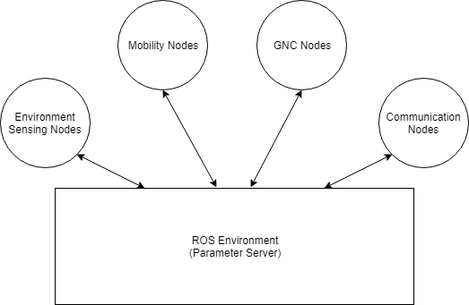
Why ROS?
Integration Needs
Communication
Communicating over TCP/IP protocols between different machines
Environment Sensing
Detecting objects using LiDAR and Ultrasonic
GNC
Remote user control, video stream, and GPS accuracy
Mobility
Motor control, linear mass stage, and speed controller
Implementation
Mode architecture
Different states of operation
Modular node development
Independent process for single dedicated purpose
Parameter Server
Shares same parameters across nodes
Parallel execution of nodes
Multiple tasks occur at once
Notes:
What is the Robotic Operating System (ROS)?
Collection of tools, libraries, and conventions to simplify integration among different software functionality

Slide 28
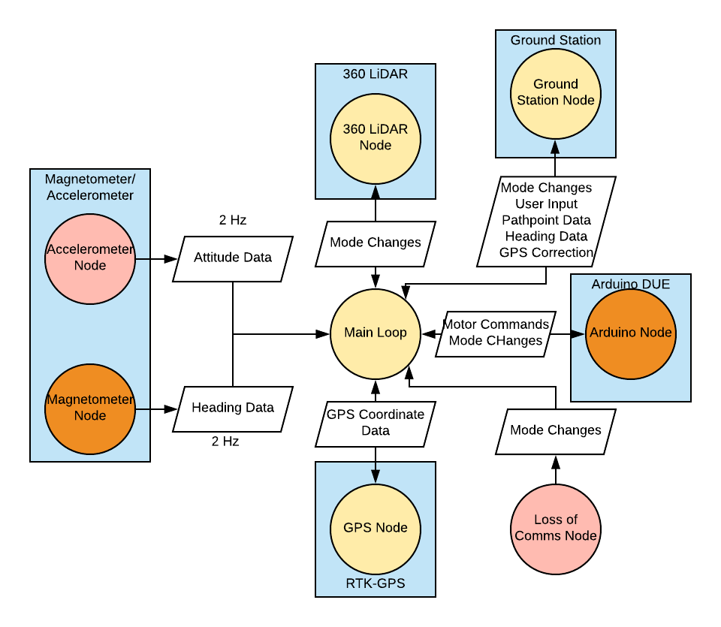
Software Status
Quick Recap:
Nodes written in Python or C++, then ROS is used to integrate them
All nodes run in parallel
Each node has checks to determine if mode change is necessary.
Dependent on thresholds, flags, etc.
All nodes are constantly checking for mode changes
Main Concerns:
360 LiDAR Node
Driving Function
Hours: 2/10
Completion Date: 2/16/19
Hours: 1/5
Completion Date: 2/16/19
Hours: 15/23
Completion Date: 2/19
Hours: 3/8
Completion Date: 3/3/19
Hours: 1/5
Completion Date: 2/16/19
Hours: 10/15
Completion Date: 2/6/19
Hours: 0/7
Completion Date: 3/20/19
Notes:
She wants us to still indicate progress like we are, but she wants us to verbally explain this progress more. We need to indicate software pieces that will take more/less time than others and how far along we are when we say they are "in progress.“
Need to show that data going to ASUS will not overload it. Add data budget in the backup slide. Look at bit rates, memory, etc.

Slide 29
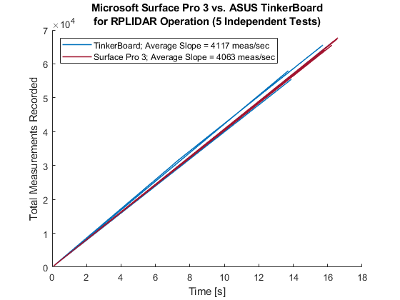
Status: 360° LIDAR Sensor
General Status:
RPLIDAR software successfully integrated to run sensor in basic operation
Off-ramp decision date (Feb 17) relies on 2 critical aspects of 360° LIDAR software development
Can the ASUS Tinker Board process the RPLIDAR data fast enough?
Can the RPLIDAR achieve a low enough angular resolution to satisfy requirement SENS.3.1.2 (required < 1.54°)
1. Data Processing Speed
2. Angular Resolution
Comparative test between Microsoft Surface Pro 3 (overly capable machine) versus ASUS Tinker Board (onboard computer)
In basic operation, RPLIDAR achieves angular resolution of ~ 1.00° but will likely increase with larger data load on the ASUS
Possibility of requirement failure if motor control is not implemented
Tinker Board outperformed Surface Pro 3
Slightly less consistent
No motor control implemented
General Takeaway:
Currently planning to take off-ramp on February 17
About 8 expected hours remaining
Have put in 15 hours
Notes:
She wants the 360 lidar slide to revolve around the off-ramp. What are the conditions of the off-ramp? Why have we evaded those conditions? When do we expect to be certain that we don't need to take the off-ramp? Very busy slide. Need to animate and mayb cut down if possible. Talk about main concerns, and more on the status

Slide 30
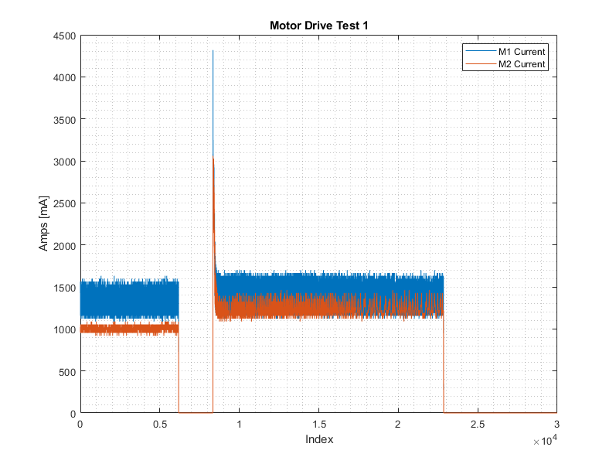
Status: Driving Functions
General Status:
Serial Driven Driving and Semi-Autonomous (Cruise) Driving Complete
Speed defined as –400 to 400
Remaining Work:
Integrate motor linear speed from encoders
Write PID controller
Expect to Finish March 4, 2019
Hours: 0/5
Main Concerns:
Discrepancy between power supply amperage draw and motor controller current sensor readings
Mitigations:
Characterize current error
Hard code offset
Serial Control
Encoder Read-In
PID Controller
Current readings from the motor controller when commanding both motors
Notes:
Expand on PID information, talk about how it’s not necessary, but it is improving the performance. How we plan on getting values. Try to meet with Ahmed, Lawrence, or Holzinger about controlling stuff.

Slide 31
Budget

Slide 32
Cost Plan
Subsystem Expenses
Mobility - $1519.02
Sensing - $490.92
Comms - $859.25
CDH - $173.30
Power - $401.21
Misc/Printing ~ $1000.00 (estimated)
Expenses to Date: $3,443.70
Original Budget: $5000.00
Budget w/ EEF Funds: $6000.00
Remaining Funds: $1556.30
Notes:
Fix red, add misc

Slide 33
Major Procurements
Mobility: Chassis, Wheels, Motor, Shafts, Drivetrain
Sensing: Lidar, Ultrasonic, Magnetometer/Accelerometer, GPS
Comms: Radios, Antennas, POE Adapters
C&DH: ASUS Computer, Arduino Due, Motor Controller, Encoder
Power: Mobility Battery, Sensing Batteries, Comms Batteries, C&DH Batteries
Items left to order: 3D Printing, Spare Motors, Voltage Regulator

Slide 35
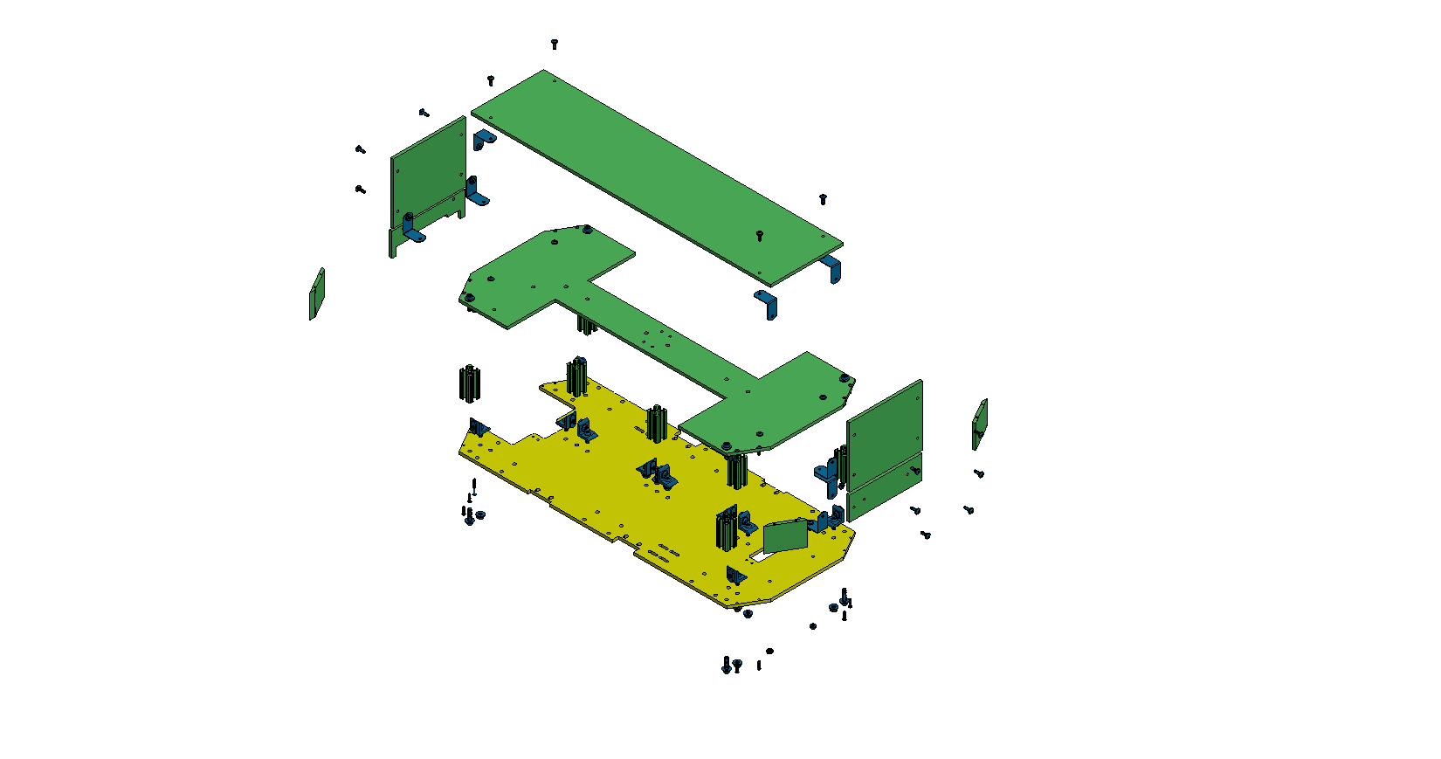
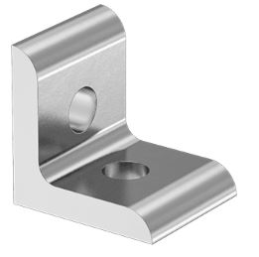
Manufacturing Status: Chassis
Legend
.25” Laser Cut Acrylic Sheet
Status: Completed
= COTS Parts
= Completed
= In Progress
= Future Work
1” Long Silver Corner Bracket for High Rail T-Slotted Framing
CNC Aluminum
Status: Acrylic prototype has been made
Remaining Work: The real aluminum still need to be made using CNC
1”x1” T-Slotted Framing Single Rail 6105 Aluminum (80/20)
Status: Completed

Slide 36
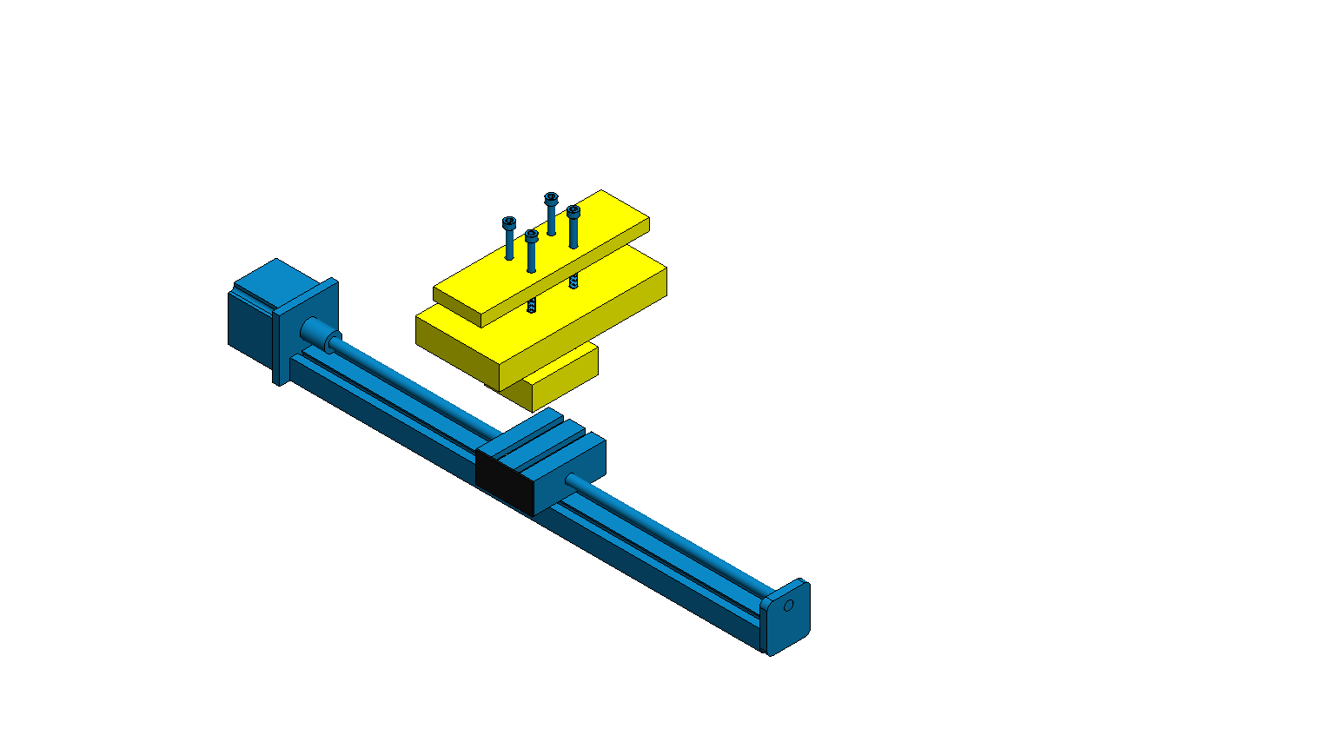
Manufacturing Status: Linear Mass Stage
Legend
M4x70mm Screws
= COTS Parts
= Completed
7"
= In Progress
Low-Carbon Steel Bars.
Status: Material has been procurred.
Remaining Work: Bars must be cut and drilled.
= Future Work
3.5"
Linear Stage Actuator
500 mm (19.7")
500 mm (2.125")

Slide 37
Project Heritage
The Jet Propulsion Laboratory’s Fire Tracker System is a system that is designed to be a low-cost, hands-off approach to forest fire identification.
There have been three previous years of heritage:
INFERNO (2015-2016)
- Built a semi-autonomous drone capable of transporting and deploying sensor packages
CHIMERA (2016- 2017)
- Built a landing, securing, and deployment system for the inherited semi-autonomous drone from INFERNO
DRIFT (2017-2018)
- Developed a mother rover to secure, carry, and level the semi-autonomous drone from INFERNO using the landing platform from CHIMERA
Note: Blue used for emphasis
Notes:
Wingate: take this out

Slide 38
Definitions
Pathpoint – A point after a mobility command is received and executed by the CSR.
This point is recorded onboard the CSR and sent to the GS as a GPS coordinate.
An operator from the ground station initially issues the command.
Previously referred to as ‘waypoint’, and changed for clarity
Obstacle – Roots, trees, rocks, shrubs, and inclined slopes with type A terrain (only leaves are present on type A terrain)
Traversable Obstacles
Any root or rock less than 2.4 inches (6 cm) - (6 cm is based on average root diameter from ‘Tree Root Systems’ from the Arboricultural Advisory and Information Service)
Non-Traversable Obstacles
All trees
All shrubs
All roots and rocks greater than 2.4 inches
Discontinuity – A 9 inch wide gap with a depth larger than 2.4 inches. The width was previously 12 inches, however a model proved that the MR could only cross a 9 inch discontinuity (.229 m).
Note: Blue used for emphasis

Slide 39
Terrain Definition

Slide 40
Success Levels
Criteria | Level 1 | Level 2 | Level 3
Video/ Image | The imaging system on the CSR shall capture a FOV greater than 100° The imaging system shall send time-stamped images to the MR/GS | The CSR shall send videos to the MR/GS The MR shall toggle the video capture from the CSR on or off | The CSR shall send continuous video feed to the MR and GS
Control | The CSR shall navigate by receiving control commands from the GS The CSR shall perform a 360° turn The CSR shall drive forward and reverse | The CSR shall navigate to a LOI and shall detect obstacles en route to the LOI, but manual control is needed to circumvent the obstacles. | The CSR shall autonomously return to the last known GPS location if connection to the GS and MR is lost.
Note: Blue used for emphasis
Note: Only main success levels are shown, the rest are in backup slides
Notes:
If sensing system is not used, we can reach control 2

Slide 41
Success Levels
Criteria | Level 1 | Level 2 | Level 3
Control | The CSR shall navigate by received control commands from the GS The CSR shall perform a 360 degree turn The CSR shall drive forward and reverse | The CSR shall navigate to a LOI and shall detect obstacles en route to the LOI, but manual control is needed to circumvent the obstacles. | The CSR shall autonomously return to the last known GPS location if connection to the GS and MR is lost.
Communication | The CSR shall verify connection to the MR/GS. The CSR shall send at least one GPS data packet to MR/GS upon command. The CSR shall have functional communication up to a 250 meter radius from the deployment point in an open area. The CSR shall be able receive control commands from MR/GS | The CSR shall record and send waypoint locations after encountering an obstacle | The CSR shall transmit continuous video feed. The CSR shall verify its location from the LOI within +/- 5 meters The CSR shall communicate through type D terrain up to a 250 meter radius from the deployment point
Note: Blue used for emphasis

Slide 42
Success Levels Continued
Criteria | Level 1 | Level 2 | Level 3
Environment | The CSR shall traverse the following: Open areas Up to 20 degree incline slopes | The CSR shall traverse the following: Type A underbrush Roots up to a 2.4 inch(6 cm) diameter | The CSR shall traverse the following: Type D underbrush Up to a 9 inch wide discontinuities with depths greater than 2.4 inches (6 cm)
Range | The CSR shall drive up to a 250 meter radius from the deployment point on flat terrain | The CSR shall drive up to a 250 meter radius from the deployment point on flat terrain with obstacles present | The CSR shall be able to drive in a 250 meter radius from the deployment point at a 20 degree inclined slope
Video/ Image | The imaging system on the CSR shall capture a FOV greater than 100 degrees The imaging system shall send time-stamped images to the MR/GS | The CSR shall send videos to the MR/GS The MR shall toggle the video capture from the CSR on or off | The CSR shall send continuous video feed to the MR and GS

Slide 43
CONOPS: Loss of Comms
1
2
3
4
5
6
CSR detects no comms
CSR initiates last recorded pathpoint as a new temporary LOI
CSR turns to point towards new temporary LOI
CSR proceeds to travel towards new LOI
Upon arrival it will stop, and wait for acquisition of communications
Upon acquisition of signal, the operator takes control of the CSR
Ground
Station
6
2
Last recorded Pathpoint
=
Temporary location of Interest
5
1
=
4
Front of CSR
Front of CSR
Front of CSR
Child Scout Rover
Legend
3
Mission Terrain
Pathpoint
Stop and request user intervention
Requirements
Comm between GS and MR
Functions
Comm between GS and CSR
Comm between CSR and MR
October 2018
Manually controlled path
43
Autonomously controlled path

Slide 44
Design Recap: Child Scout Rover
Guidance & Navigation:
GPS Antenna
GPS Module
Magnetometer
Mobility:
2 Motors with a Drive Train
Linear Mass Stage
Note: Internal component placement are subject to change
Section Cut View
CSR Physical Properties Summary:
Overall Dimensions: 28 in x 15 in x 11 in
Total Mass: 17 kg
Controls:
ASUS Tinker Board
Arduino Due
= Outlines components
Note: Blue indicates component being outlined

Slide 45
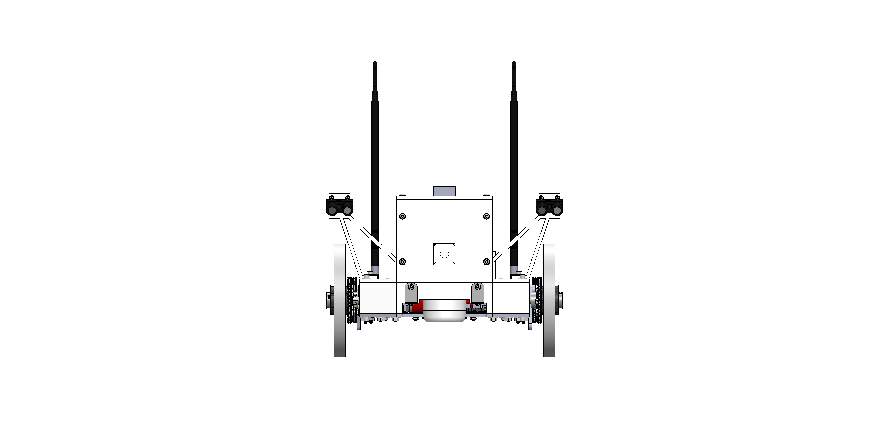
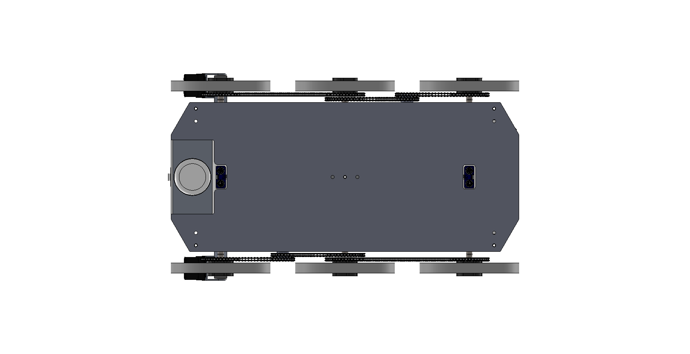
Design Recap: Child Scout Rover
20.2 in
Single beam LiDARs are fixed at the same angle and height
Front View
Mobility:
2 Motors with a Drive Train
Linear Actuator with 5 kg Mass Stage
11 in
Diagonal View
Environmental sensing:
Single beam LiDAR (right above front wheels)
Fisheye Lens Camera
Ultrasonic Sensors
360° RP LiDAR
2.4 in
15.5 in
10in
28 in
Guidance & Navigation:
GPS Module
GPS Antenna
Magnetometer/Accelerometer
15.5 in
Bottom View
= Outlines components
8 in
Note: Blue indicates component being outlined

Slide 46
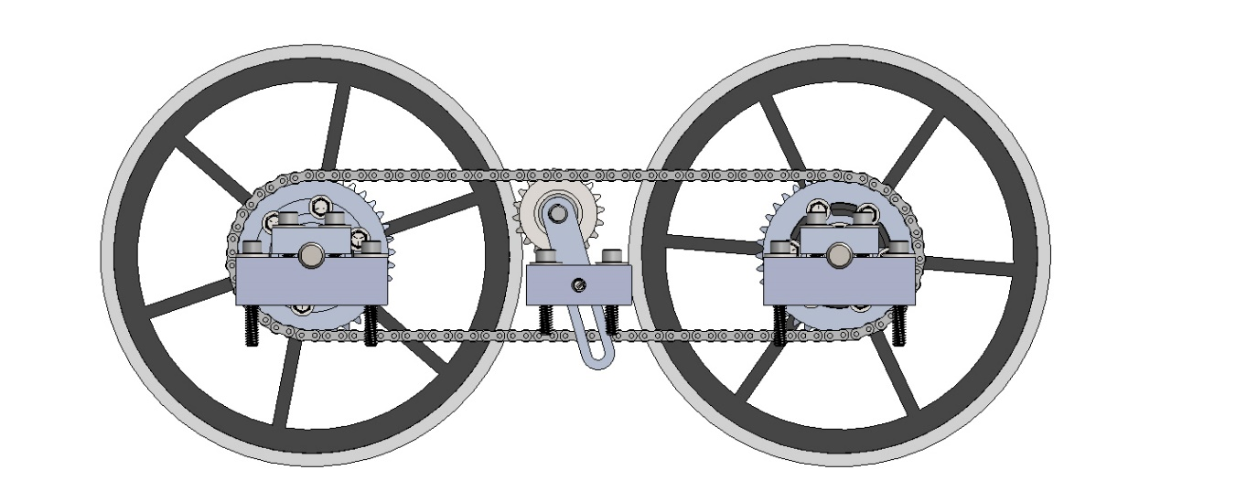
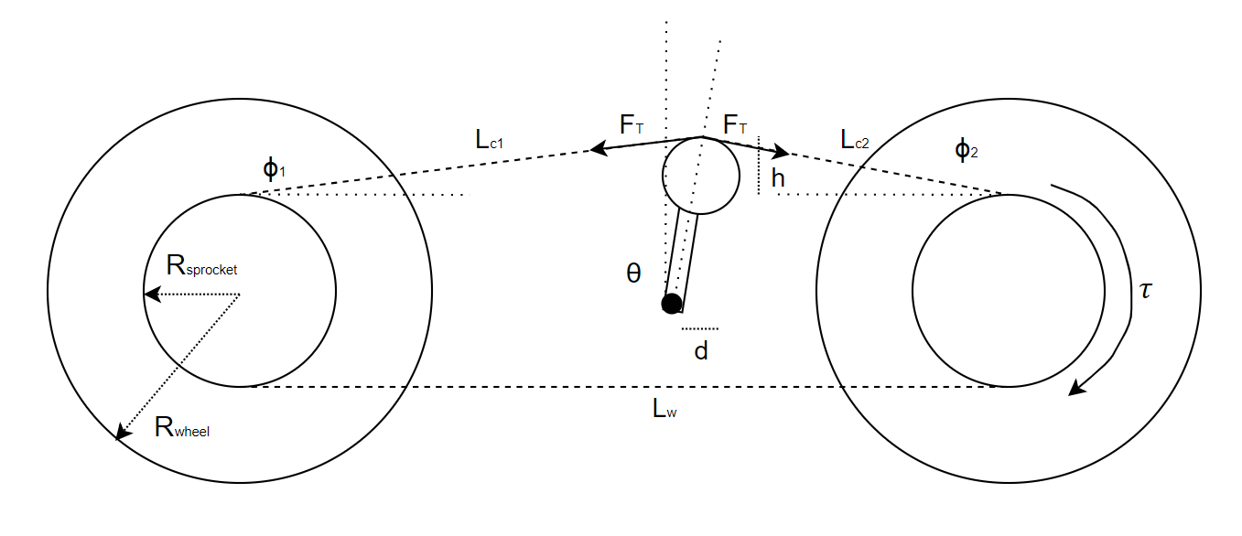
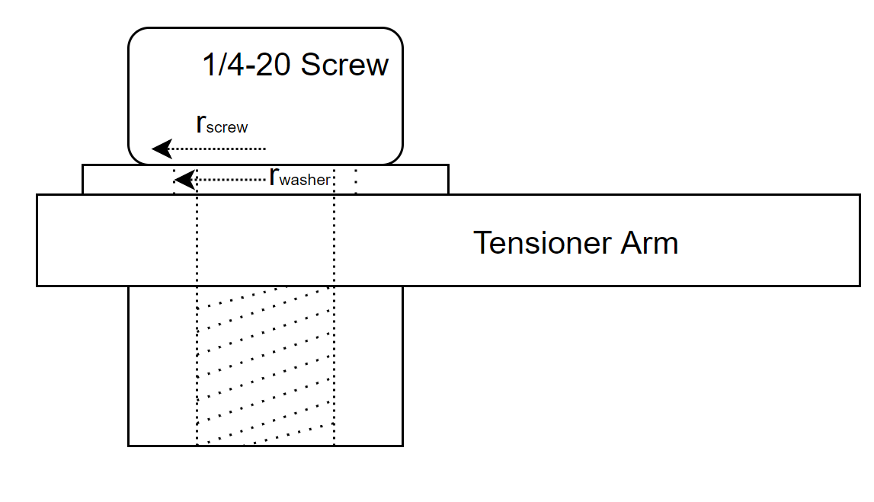
Mobility – Chain Tensioner "Slip" Analysis
Purpose:
Will a moment arm acting on the chain tensioner from the chain cause the tensioner arm to slip?
Baseline Assumptions:
Right wheel is driving the chain counter-clockwise
Offset angle of tensioner, θ, will go up to 10 degrees
Slack in chain is caused by two extra ¼” chain links
(Shigley’s Mechanical Engineering Design, 10th Ed.)
(Shigley’s Mechanical Engineering Design, 10th Ed.)
Helicoiled ¼-20 screw has the same preload as a non-helicoiled ¼-20 screw.
Worst case of 13.2 Nm of torque acting on the wheel, as per obstacle analysis model
Known:
Project Overview
Summary
Backup Slides
Baseline Design
Feasibility Studies

Slide 47
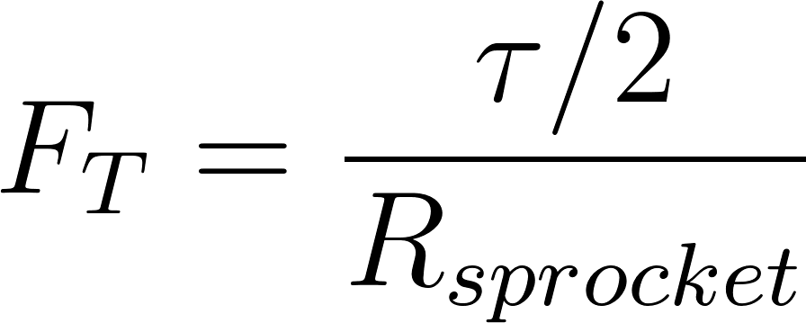
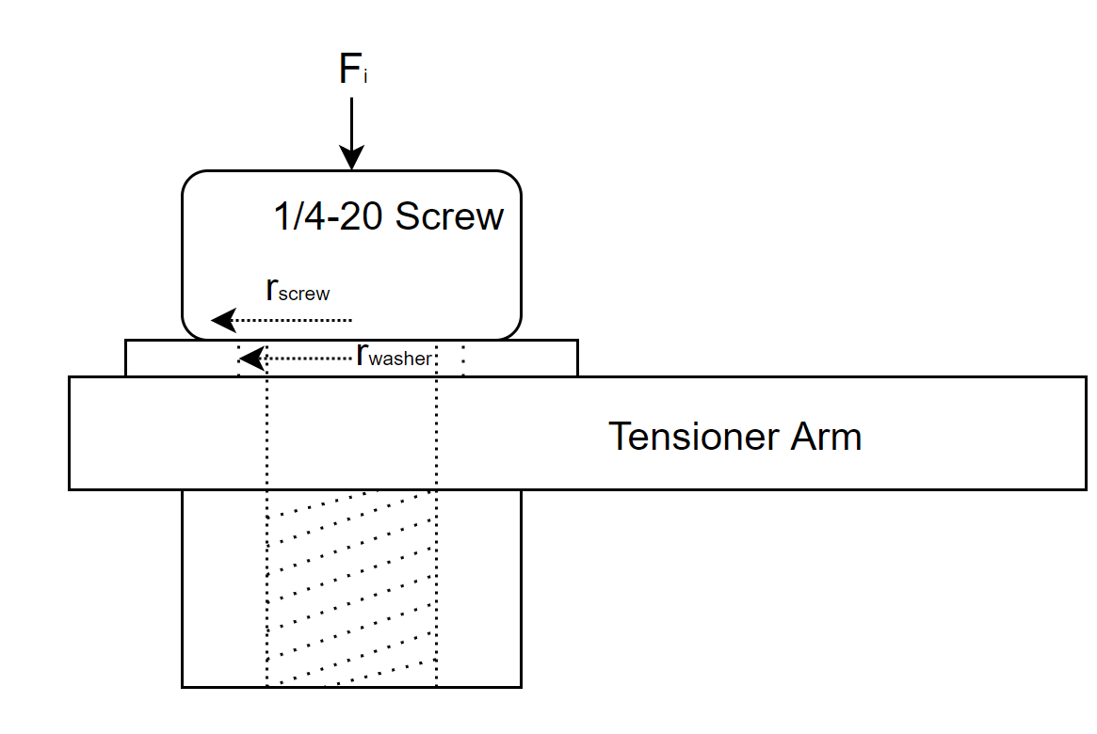
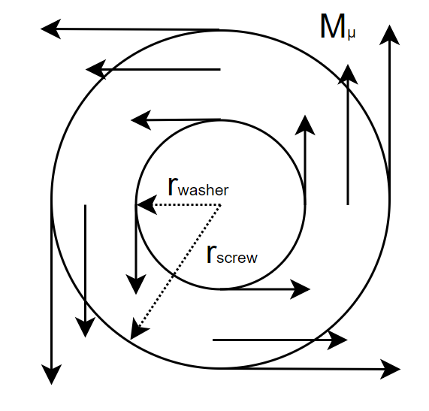
Mobility – Chain Tensioner "Slip" Analysis (cont.)
Solving (moment about mounting screw):
Solving (holding strength of screw):
Project Overview
Summary
Backup Slides
Baseline Design
Feasibility Studies

Slide 48
Mobility – Shaft Mount Drawing
Purpose:
The shaft mount is the only component with a critical dimension.
Project Overview
Summary
Backup Slides
Baseline Design
Feasibility Studies

Slide 49
Communication

Slide 50
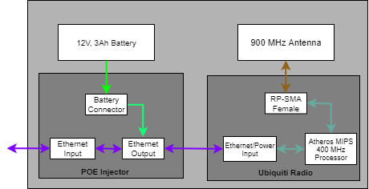
Overview and Scope
Mechanical:
Parts being manufactured: Mount
All mounts are being 3D printed
Parts being purchased: All parts: POE Injector, Ubiquiti Radios, Antennas, Batteries
Software:
Software being written: ROS Nodes for the ground station and for the CSR’s main computer.
Software integration: ROS Nodes must be integrated with the greater main loop
ASUS Ethernet Port
1 of 1
Notes:
what parts are being manufactured vs. purchased, what is involved in their manufacture, where and how they are being manufactured).

Slide 51
Local Area Network Comm Setup
General Status:
Established communication between GS laptop and CSR controller
Able to publish and subscribe messages via radio link
Remaining Work:
Conduct radio link over 250m
Record latency and receiver power levels
Main Concerns:
Self interference
Latency (Time Synchronization)
Mitigations:
Establish CSR controller as time server
Replace one antenna port with dummy resistance

Slide 52
GPS Setup
General Status:
Created the GPS RTK Base Station
Outputs RTCM messages from GS deployment
Remaining Work:
Receive RTCM messages at 500 bytes/sec at the CSR deployment
Compare GPS accuracy between RTK and no RTK data
Main Concerns:
CSR GPS module will not receive RTCM messages at the rate that is demanded
Mitigations:
Buffer RTCM messages in case speed is not met

Slide 53
Electronics

Slide 54
Sensing System Electronics
Power
Ground
Analog
Digital

Slide 55
GNC System Electronics
Power
Ground
UART

Slide 56
Communications System Electronics
Power
Ground
Ethernet

Slide 57
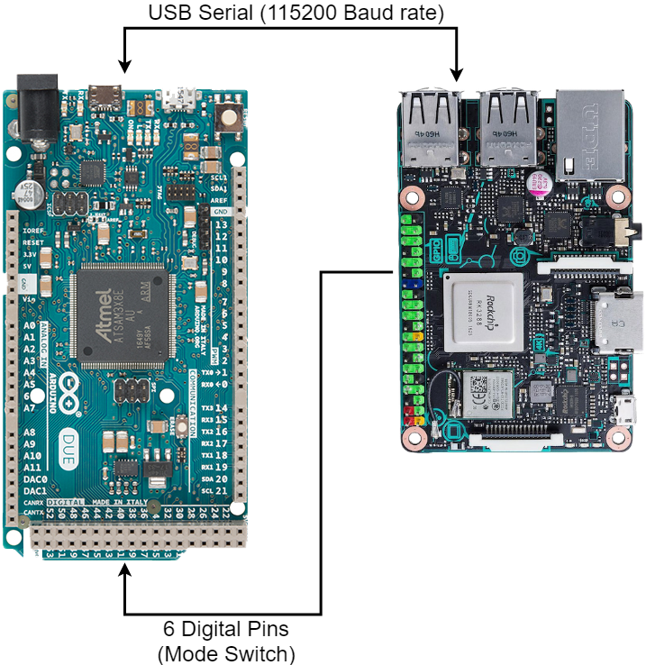
Arduino Due - ASUS Integration
ASUS Tinker Board
RK3288 ARM Cortex-A17
3.3V Max (Mode Change)
6 Output Pins
USB Serial Communication (Data)
Transmit/Receive
Arduino Due
Atmel ARM Cortex-M3
3.3V Max (Mode Change)
6 Input Pins
USB Serial Communication (Data)
Transmit/Receive
Notes:
Mainly to show that asus and Arduino are switching modes at the same time. Put in backup

Slide 58
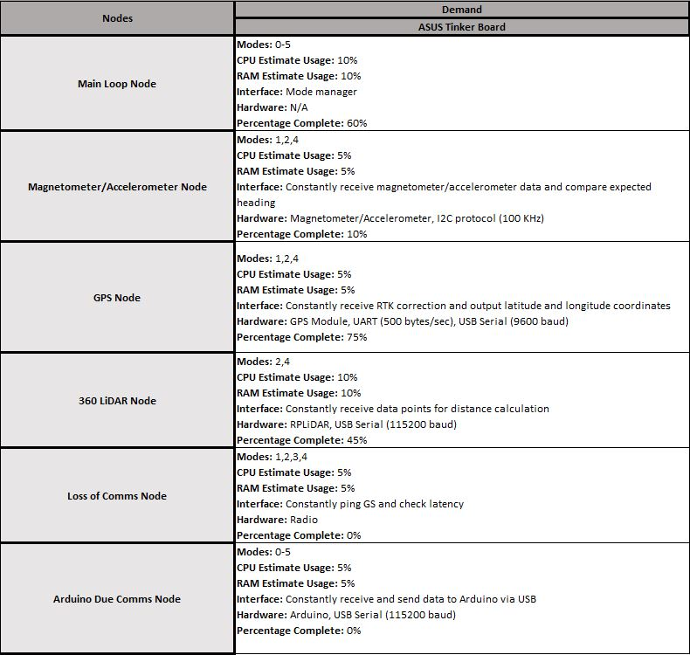
Controller Data Usage
System Monitoring Tool (Glances)
Free software that monitors operating system management
CPU usage, RAM usage, Disk space usage, Network usage, etc.
Notes:
Data budget showing what each mode requires and what the controller can provide during each state.

Slide 59
Test Results

Slide 60
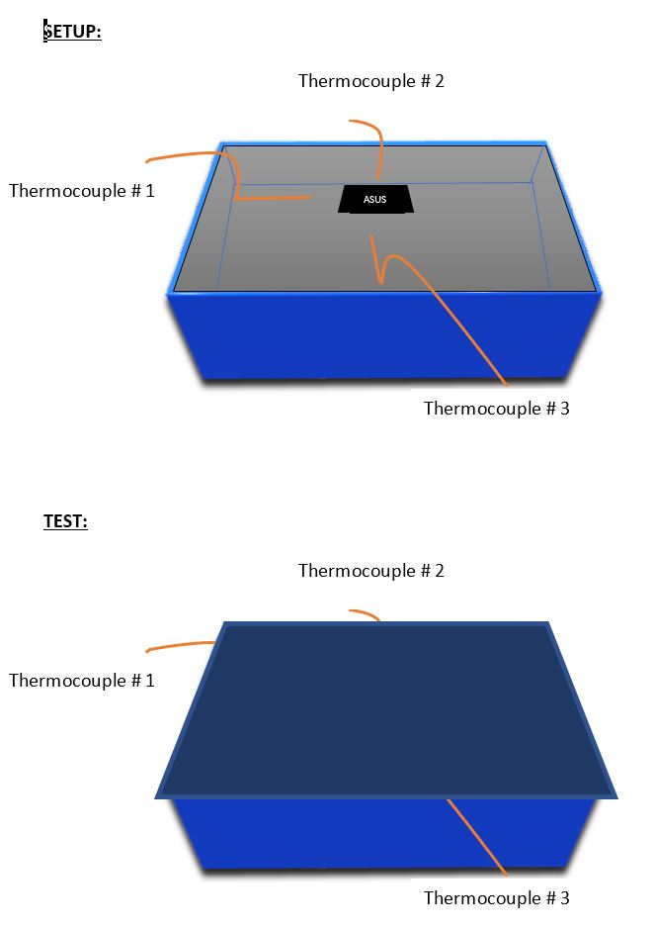
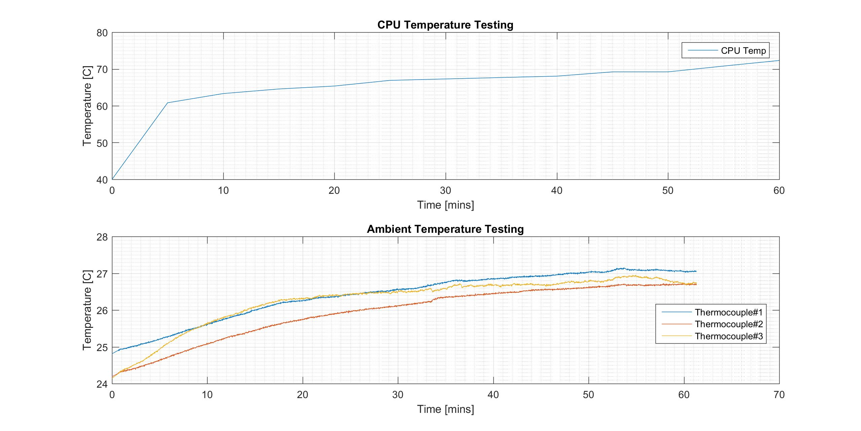
ASUS Thermal Test
Setup: Results:
This test has determined the maximum ambient temperature that components surrounding the ASUS will have to face. Since the chasis will not be completely sealed, these results are characteristic of a worst case scenario. For precaution, a heat sink or fan may be added to the system, so surrounding components do not overheat

Slide 61
HC-SR04 Ultrasonic Component Test
Results:
This test has determined the accuracy of the ultrasonic sensor is less than 2 cm, which is characteristic of the accuracy we will need to successfully detect the presence of a discontinuity
Notes:
Add x axis

Slide 62
Off Ramp Option- Ultrasonic Sensors
Deadline 02/17/2018
Integration Specifications:
3 Parallax Inc PING))) Ultrasonic Distance Sensors
1 Digital I/O PWM pin required per sensor
Data Processing in Arduino Sketch on Arduino Due
Detection Area
$$\sim 40°$$
Front of CSR
$$9.85 ft (3 m)$$
 | Required Specifications | Achieved Specifications | Requirements Satisfied
In-Plane Object Detection Parallax PING))) Ultrasonic Distance Sensor | Range – 3.125 ft (0.9525 m) Field of View – 103.5° Smallest Detectable Object – 1 in | Range – 9.85 ft (3 m) Field of View – 40*3 = 120° Smallest Detectable Object – 0.25 – 0.75 in (determined from tests from manufacturer) | SENS.3.1 SENS.3.1.1 SENS.3.1.2

Slide 63
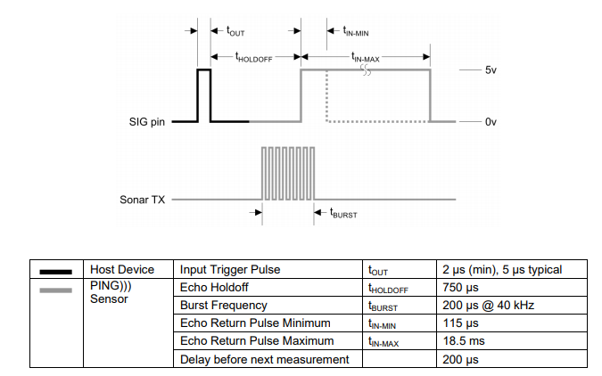
Off Ramp Option – Ultrasonic Sensors
PWM Integration:
Utilizes 1 I/O pin per device for PWM control
Does not require specific digital PWM pins on the Arduino
Digital PWM is controlled with one trigger and sensor has its own procedure
Detection Area
$$\sim 40°$$
Front of CSR
$$9.85 ft (3 m)$$

Slide 64
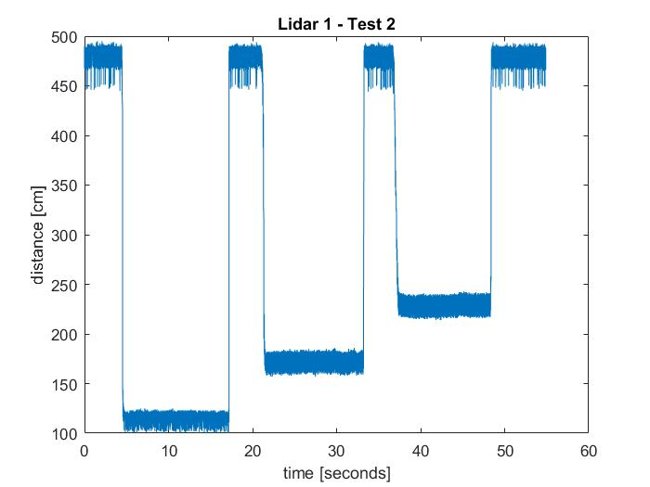
Single Beam LiDAR Component Test
Results:

Slide 65
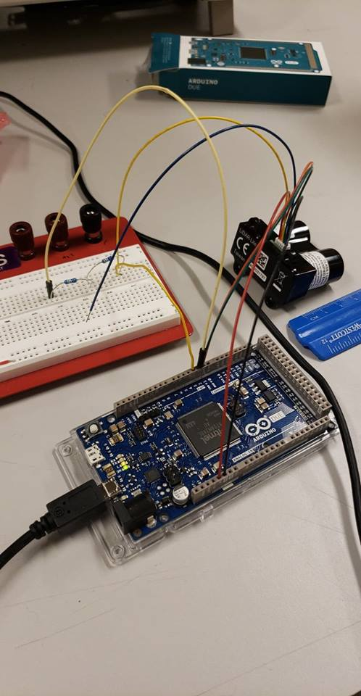
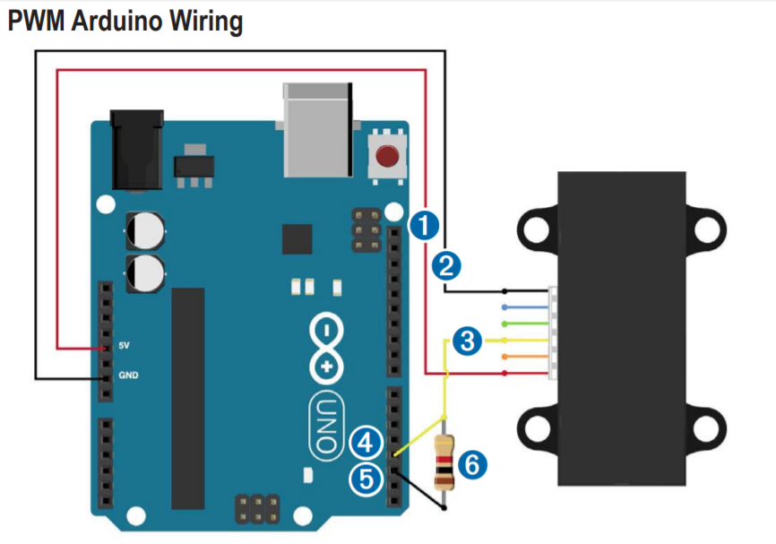
Single Beam LiDAR Component Test
Setup:
Results Analysis:
The LiDAR inaccuracies were found to be too great and may be attributed to the test setup rather than the LiDAR itself
Reducing Error
The power supply from the Arduino was suspected to be noisy, so the setup was altered so the power supply and ground were switched to the breadboard, but this had no effect on the results
Further attempts to eliminate the noise/error will include additional tests with a filter (1 µF capacitor) located in between the ground and PWM input
If this filter has no effect on the results, the circuit components may be soldered to eliminate breadboard losses

