Slide 1
ASEN 4018 Senior Projects Spring 2018 Manufacturing Status Review
TEAM: Omar Alshamsi, Meer Baker, Eric Bergman, Jack Lambert, Eli Landers, Quentin Moore, Alex Mulvaney, Donald Palomino, Wyatt Raich, Brody Rosipajla, Aytac Teker, Eric Zhao
Customer: Robert Leben
Advisor: John Mah

Slide 2
Project Objectives
Mission Statement: BEACAN will design, build, and test a miniaturized ocean drifter. The drifter shall be capable of collecting positional coordinates and transmitting coordinates to a communications satellite. Secondary, the team will develop a drifter deployment mechanism.
Final Customer Deliverables:
1 deployment mechanism, 2 drifters (1 for testing)
Notes:
- Add edited levels of success

Slide 3
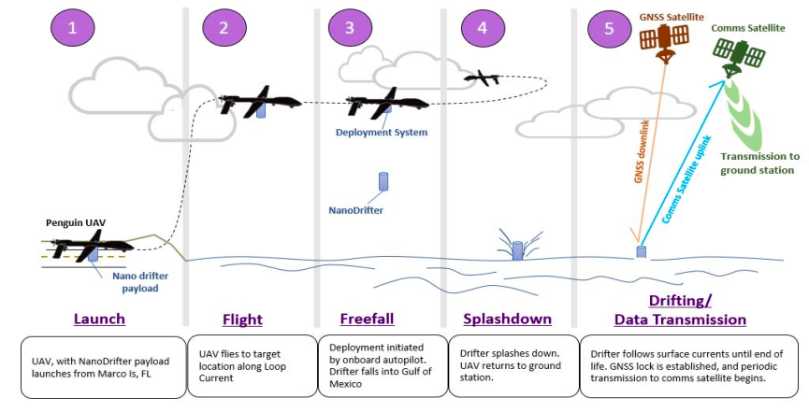
Customer CONOPS
1
2
3

Slide 4
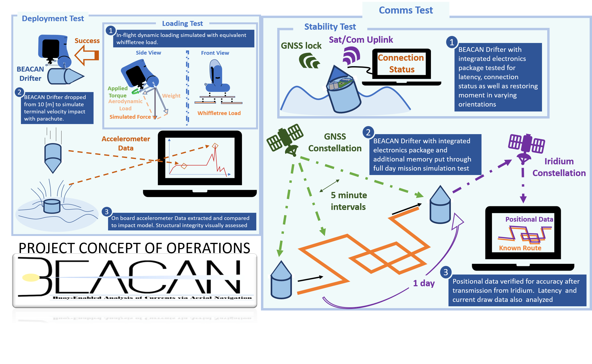
Testing CONOPS

Slide 5
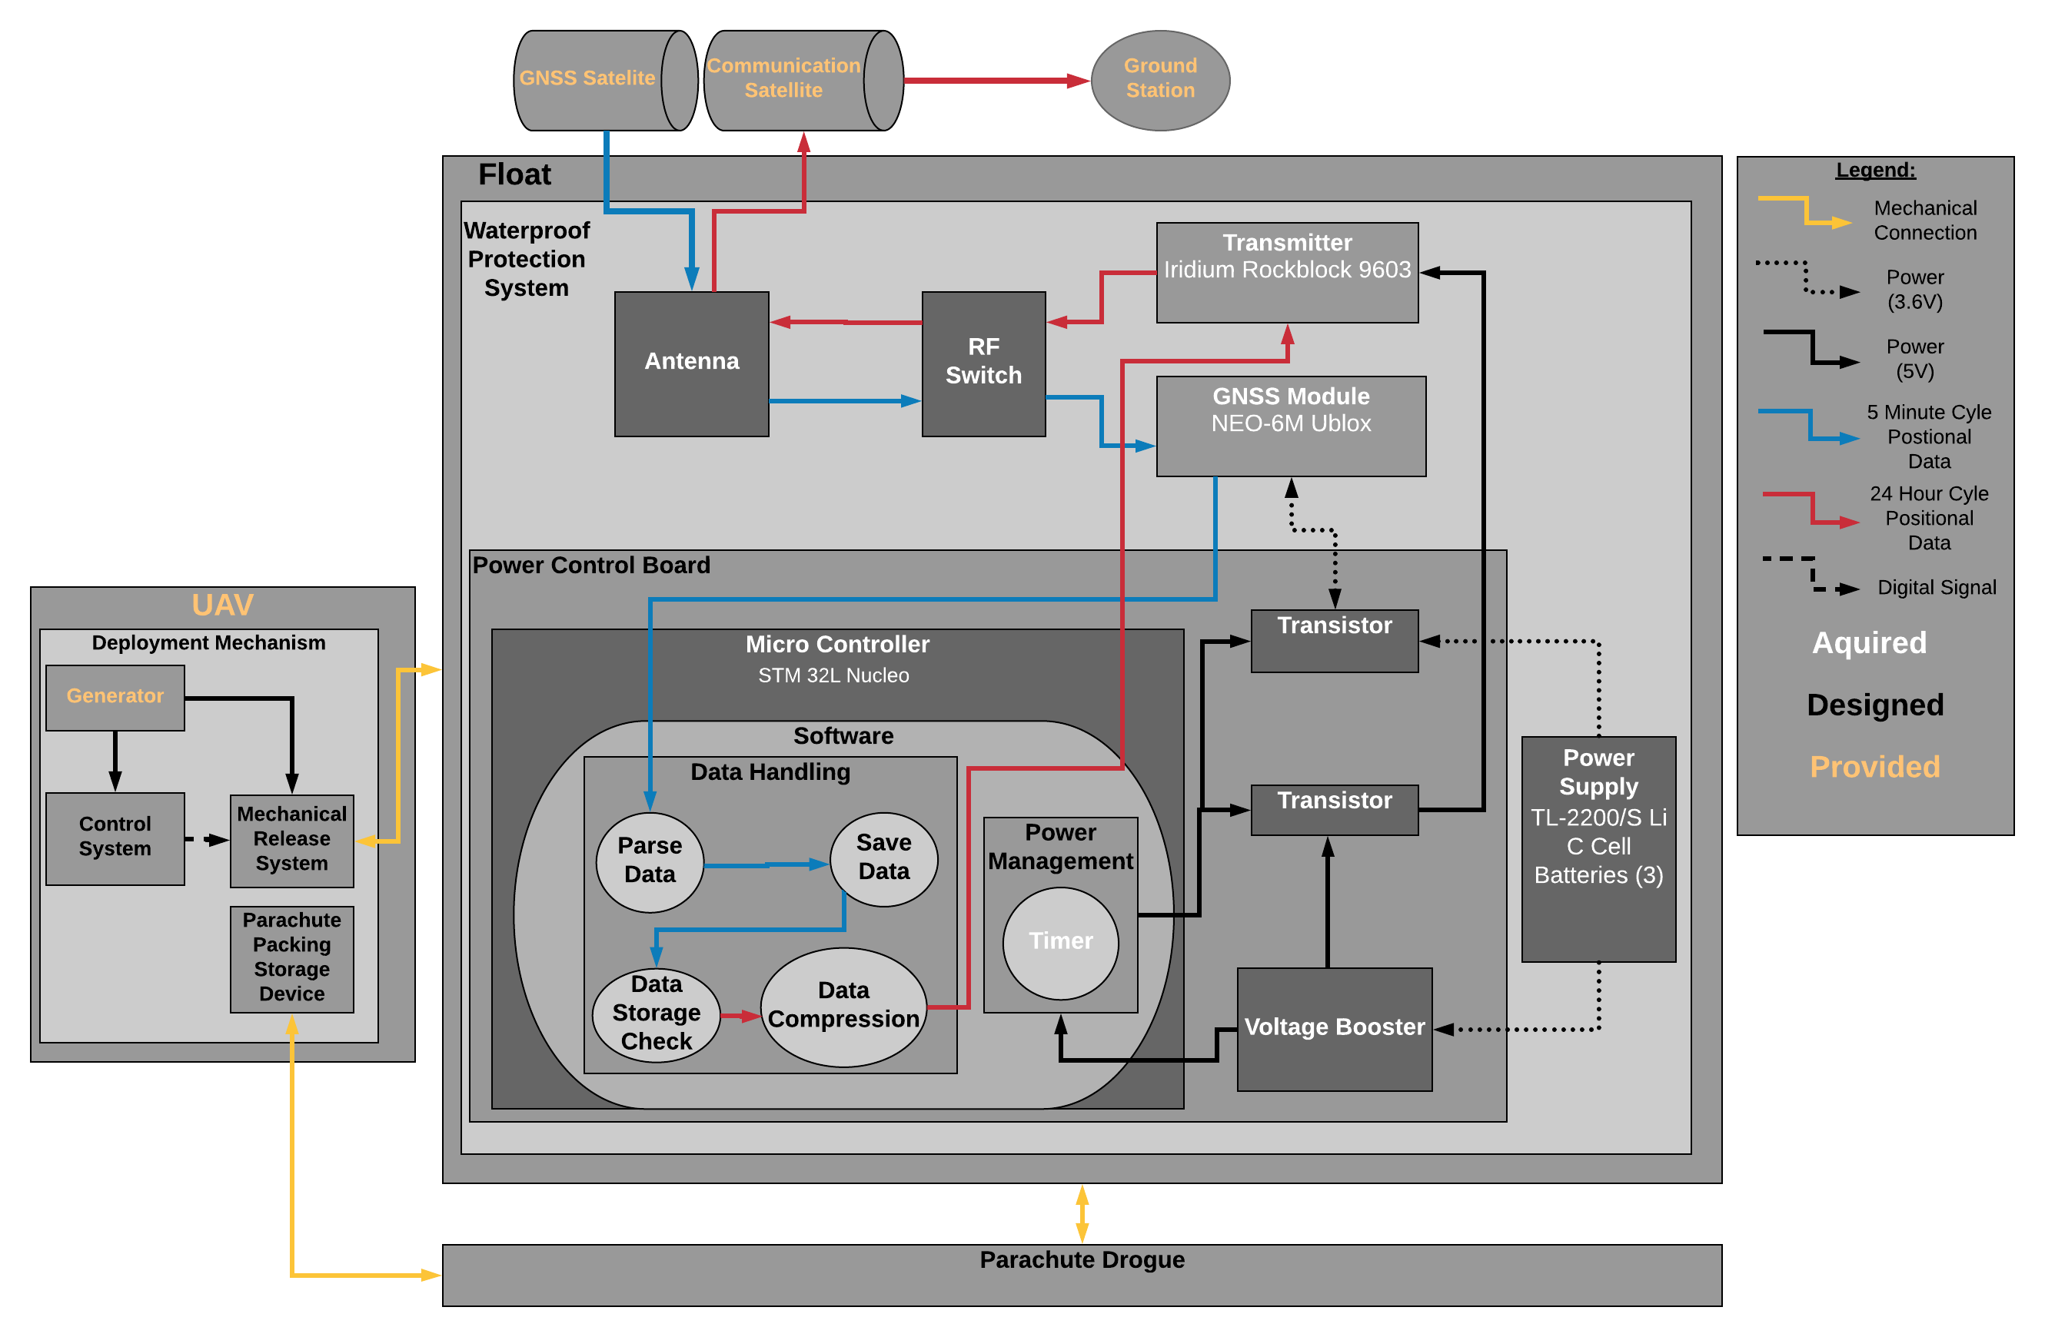
Design Solution: Functional Block Diagram
Notes:
Here we have the deployment mechanism. A external power source will supply a load to motor. This will release the float and parachute. Within the float we have the Power Control Board with power supply indicated by black lines. The blue lines indicate a 5 minute cycle which you can see run down from the GNSS satellite to our antenna, into the GNSS module and finally to the microcontroller where the data will be parsed and stored. Notice that we have only one antenna which will operate for both the reception and transmission of which the red lines indicate. The red lines show the process that will happen every 24 hours. The data will be compressed, sent to the transmitter which will communicate the data to the Iridium satellite who will finally send the data to the ground station.

Slide 6
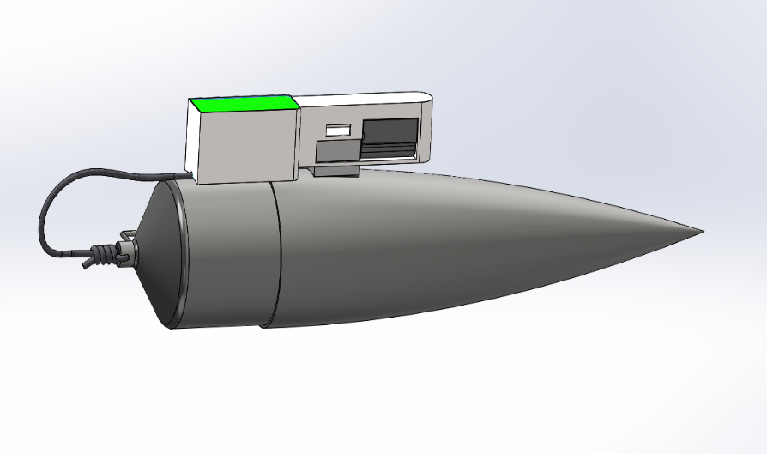
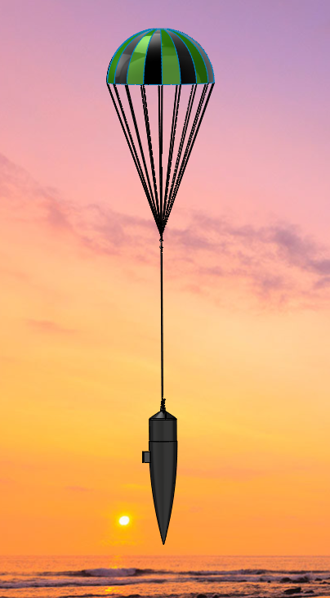
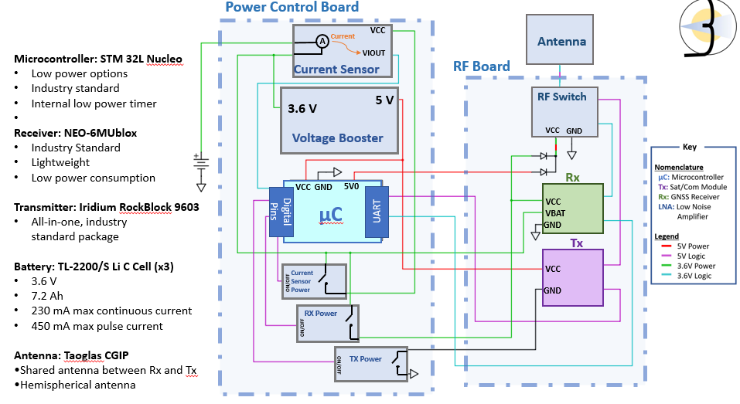
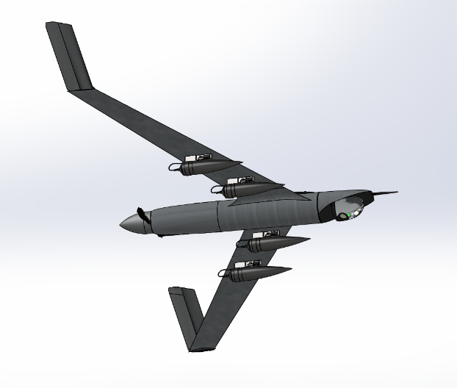
CDR Baseline Design
Deployment Mechanism | Structure | Electronics
Total Mass: 32 [g] Total Cost: $115 | Total Mass: 273.5[g] Total Cost: $90.92 | Total Mass: 290 [g] Total Cost: $401.49
Parachute
16 [cm]
30 [cm]
Antenna
3.4 [cm]
2.6 [cm]
46 [cm]
Polystyrene Packing
Linear Motor
100 [cm]
RF COM Boards
38 [cm]
Power Control Board
8 [cm]
C-Cell Batteries

Slide 7
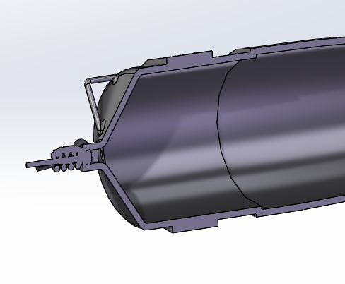
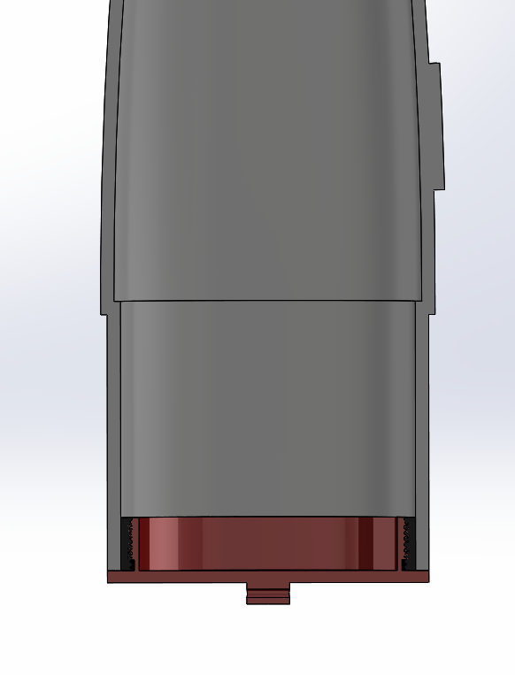
Major Design Changes
Float Seal | Microcontroller
Design Requirements: Mass: +21.6 [g] Cost: +$11.00 | Mass: +21 [g] Cost: +12.39$
Original Design: Glued Band Connection
Current Design: Internal Threaded Insert and Threaded End Cap
Reason for Change:
Create mechanical seal using gasket, does not rely on glue for waterproofing
Reduce testing and component installation complexities
Closer resemblance to customer’s final ideal product
Injection molded with threaded end cap
Original Design: STM 32L Nucleo
Cross Sectional Zoom View
Current Design: STM32L0538-DISCO
Reason for Change:
Nucleo only supported one USART connection
DICSO utilizes the same STM 32L microprocessor, but is incorporated onto a board that allows for two USART connections
Glue
Glue
Nosecone cut along line

Slide 8
Levels of Success Overview
Level 1: Individual Component Selection | Level 2: Prototype | Level 3: Integration
Individual design components have been selected for each component along with validation methodology. | Individual component manufactured and pass individual component validation. | Individual components integrated together and successfully pass integrated component testing.

Slide 9
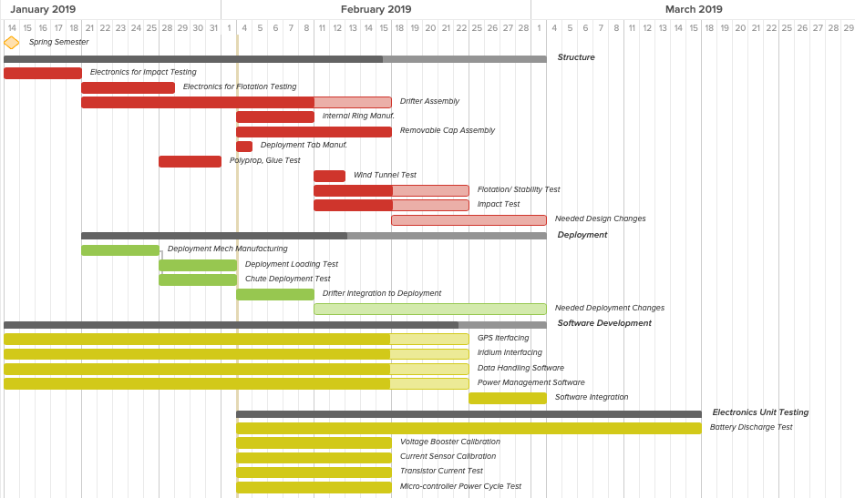

Slide 10
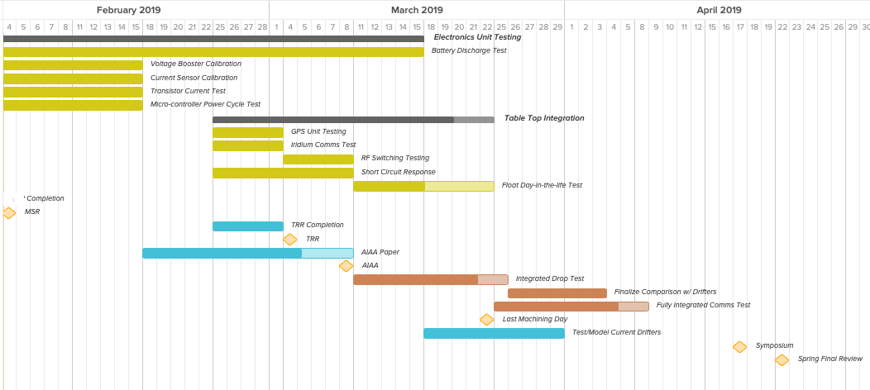

Slide 11
Deployment Mechanism
FR 8.0 – The deployment mechanism system shall deploy each drifter individually
Manufacturing
Component | Manufacturing Method | Status
Logic Board | Purchased | In-Progress
Servo Mechanism | Purchased | Received
Servo Housing | 3D Printed | Complete
Parachute Housing | Wire frame | In-Progress
Deployment Tab | 3D Printed | In-Progress
Testing
Test | Objective(s) | Risk(s) Mitigated | Status
Drifter Simulated Load | Ensure DM successfully deploys drifter with expected aerodynamic and weight loads | Shearing of release pin Housing fracture | Completed
Friction Analysis | Ensure actuator overcomes friction | Pin cannot be pulled | Not Started
Adhesive Test | Ensure that adhesive keeps tab and drifter together during flight | Shearing of adhesive | Not Started
Tab Deployment Test | Ensure that tab can naturally separate from DM after release | Separation failure | Not started
Integration
Component | Process | Status
Logic Board | Software required to activate servo with “high” input signal | Complete
Servo Mechanism & Servo Housing | Servo mechanism must be installed in housing | Complete

Slide 12
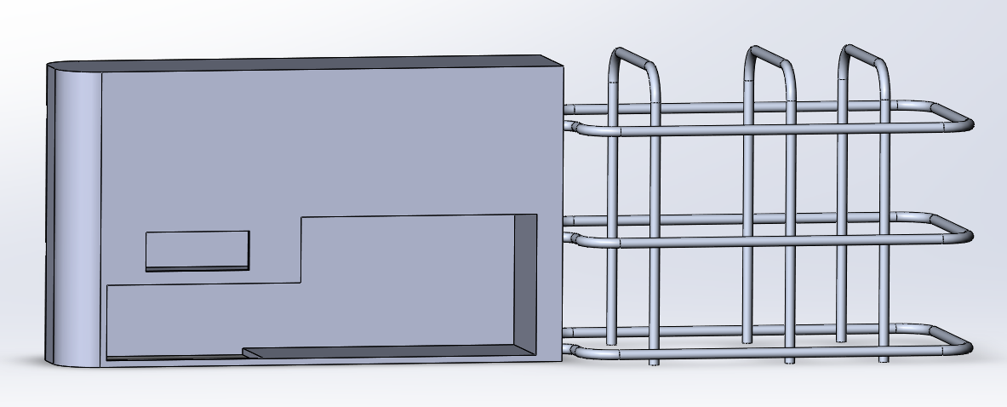
Deployment Mechanism
18 [mm]
35.5 [mm]
45 [mm]
77.5 [mm]
62 [mm]

Slide 13
Structure
FR 1.0 – Drifter shall be capable of following water current flow
FR 3.0 – Drifter shall be deployed from an altitude of 300 [m]
Manufacturing
Component | Manufacturing Method | Status
LOC Nose Cone | Purchased | Received
Threaded Insert | Machine Shop | Received
End Cap | Machine Shop | Complete
12” CFC-12 Parachute | Purchased | Received
Parachute Cabling | Purchased | Not Started
Testing
Test | Objective | Risk(s) Mitigated | Status
Drop Test | Measure impact acceleration at waterline | Electronic component survivability Structural survivability | Not Started
Stability Test | Verify the drifter’s restoring ability when exposed to disturbances | Loss of RX and TX capability when subjected to waves | In-Progress
Cable Tension Test | Verify thread and glue strength | Structural failure at parachute deployment Structural failure at water impact | In-Progress
Integration
Component | Process | Status
Nose Cone, Insert, and End Cap | Insert will be glued to Nose Cone internal structure. End cap will attach to insert with threads. | In-Progress
Parachute, Cabling, and End Cap | Parachute will attach to end cap through a weighted cabling system. | Not Started

Slide 14
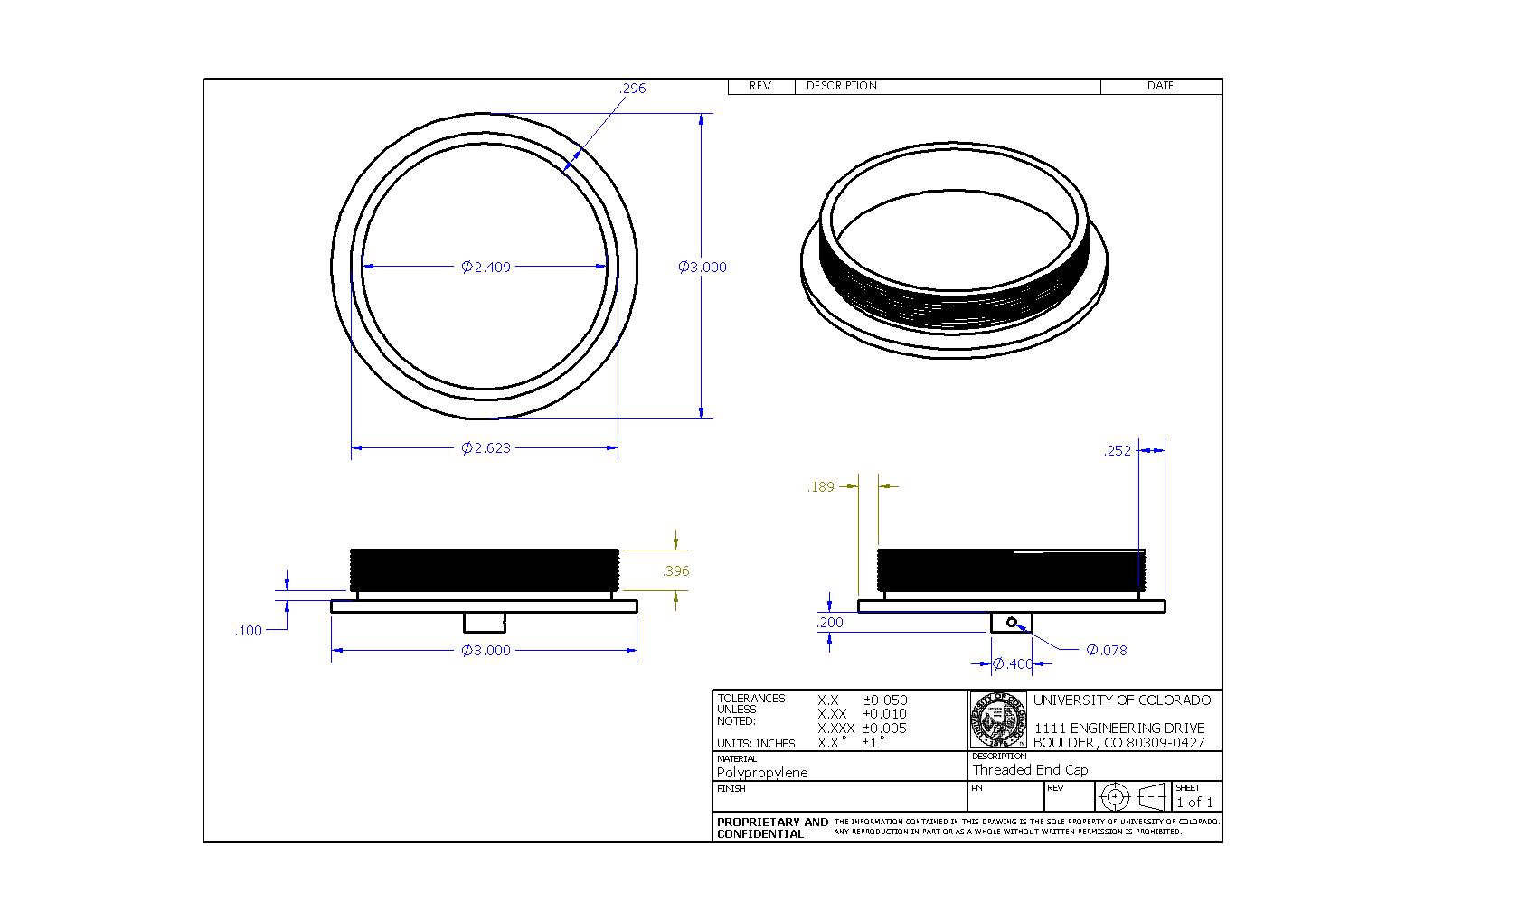
Structures Technical Drawing
Thread Pitch: 0.05”
Thread Height: 0.043"

Slide 15
Electronics & Software
Software
Code | Objective | Status
GPS Interfacing | USART Communication with Ublox GPS | Completed
Data Handling | Parsing, compressing, storing and managing data | In-Progress
Power Management | Regulating power to the devices, initiating sleep mode, monitoring current draw | In-Progress
Transmitter Interfacing | USART Communication with RockBlock Transmitter | Not Started
Unit Testing
Test | Objective | Status
GPS Test | Acquire fix from Ublox GPS and output data | Completed
Transmit Test | Send data via USART communication to Iridium RockBlock and receive from Iridium constellation | Not Started
Current Sensor Calibration | Establish relationship between output voltage and current | Not Started
Voltage Booster Calibration | Determine efficiency and ripple voltage characteristics | Not Started
Transistor Current Test | Verify performance of transistors (ie. Negligible leakage current) | Not Started
Microcontroller Power Cycle Test | Record current demands of microcontroller over power cycle | Not Started
Battery Discharge Test | Record voltage discharge of battery at expected average current draw | Not Started

Slide 16
Electronics & Software
Tabletop Integration
Component | Objective | Status
Integrated GPS Test | Verify successful lock inside nose-cone and successful data interfacing and storage. | Not Started
Integrated Iridium Test | Verify successful transmission inside nose cone as well as transmission of data. | Not Started
RF Switching Test | Verify performance of RF switch with acceptable attenuation | Not Started
Short Circuit Response | Verify response of system to a current spike | Not Started
Flat Day-in-the-life Test | Run entire electronics system through day-in-the-life test | Not Started

Slide 17
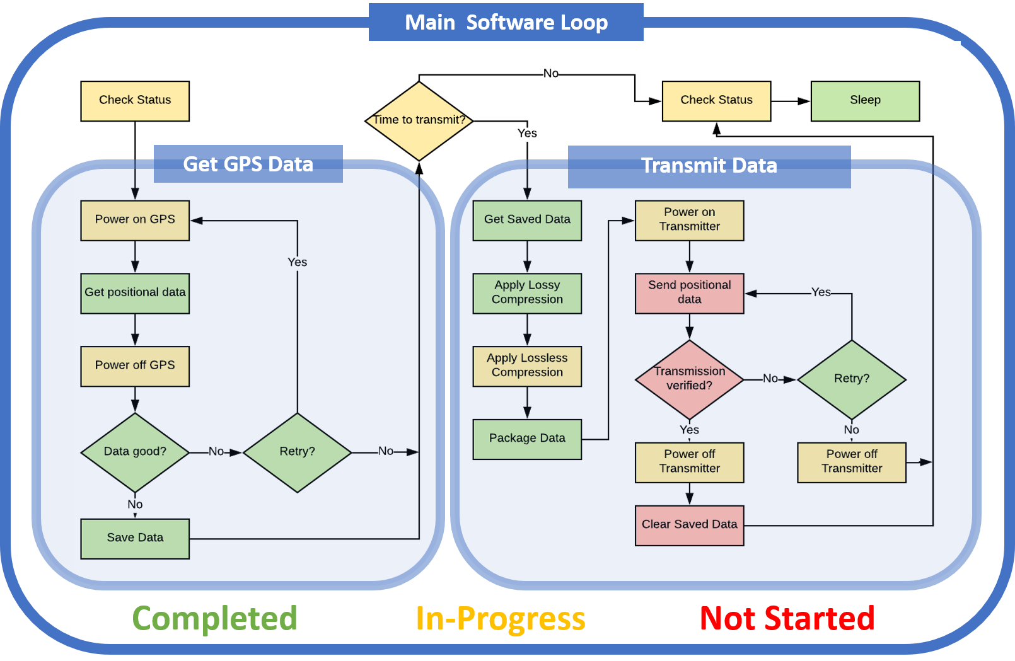
Electronics & Software

Slide 18
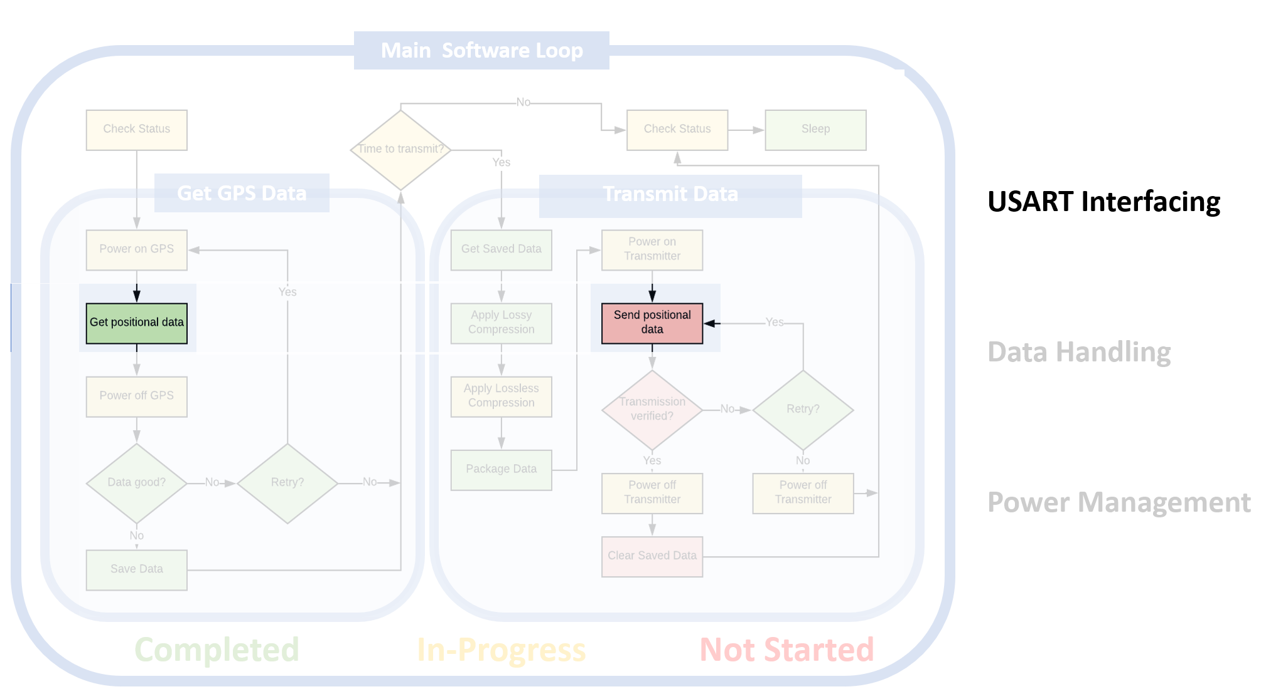
Electronics & Software

Slide 19
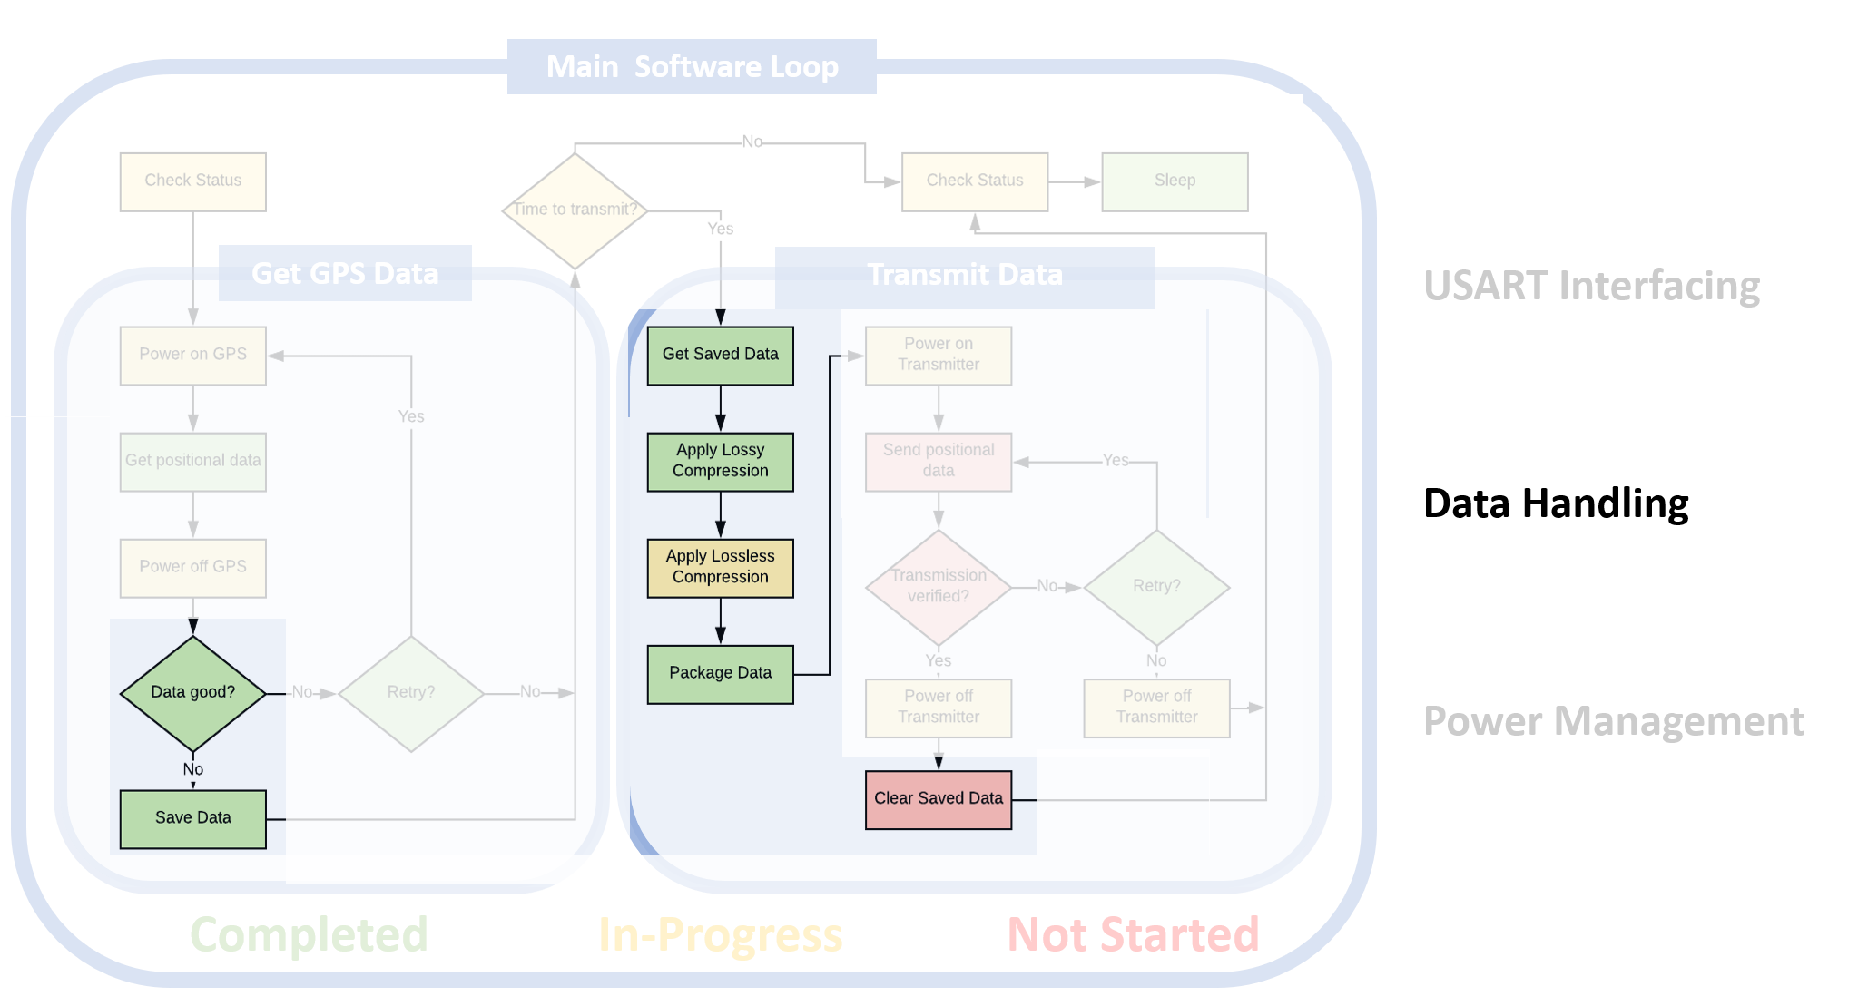
Electronics & Software

Slide 20
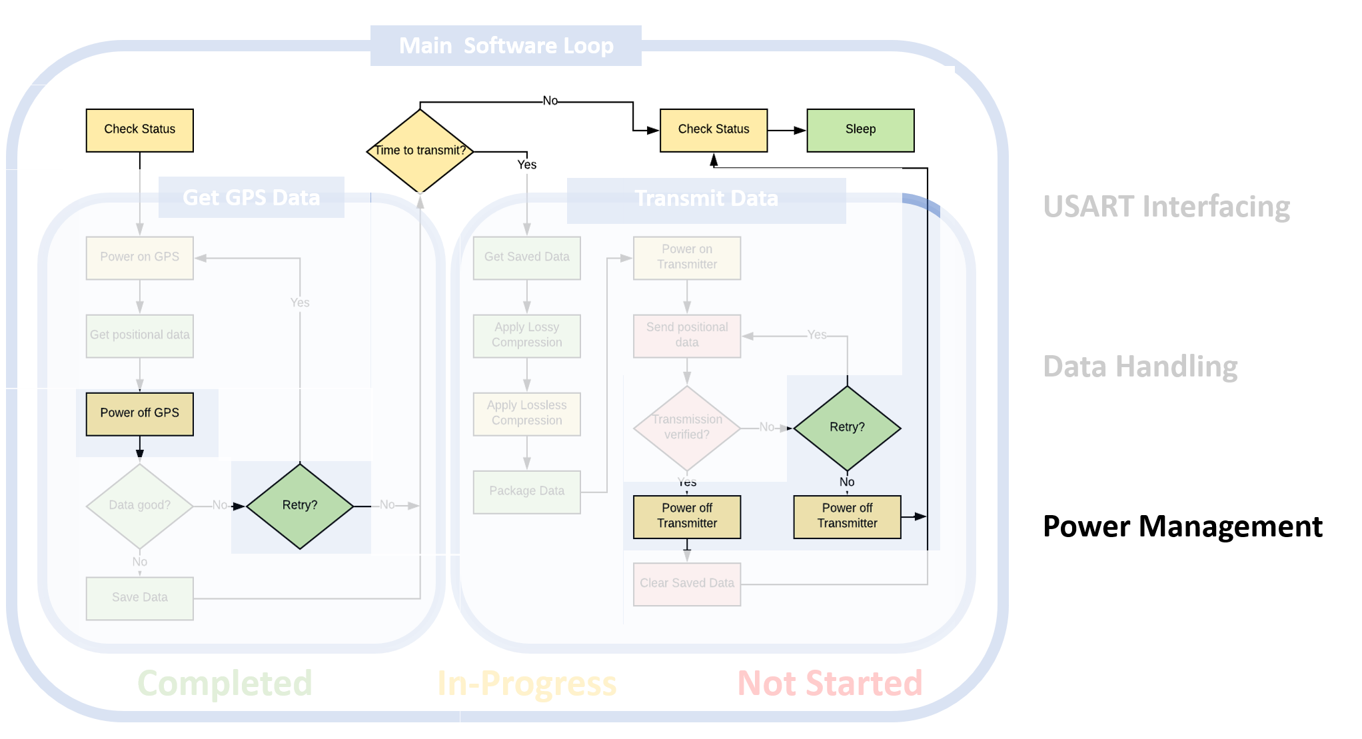
Electronics & Software

Slide 21
Electronics & Software

Slide 22
Structural Component | Original Mass [g] | Updated Mass [g] | Obtained
Nose Cone Float | 130 | < 120.2 | Yes
12” CFC-12 Parachute | 24 | 41.3 | Yes
Nylon Shroud Lines & Swivel | 31.2 |  | Yes
Adhesive | 16.7 | 16.7 | Yes
Band-Connection | 9.6 | -- | Yes
End Cap | -- | 31 | Yes
Threaded Insert |  | 10 | Yes
Gimbal Joint | 30 | 10 | Yes
Gasket | 10 | 4 | Yes
Packing Peanuts (Full Vol.) | 3 | 3 | No
(1/16”) Steel Cable (100 [cm] in length) | 15 | 15 | Yes
Crimp | 2 (x2) | 4 | Yes
Deployment Mechanism | 139 (x2) | 32(x4) | Yes
DM Logic Board | 25 | 25 | Yes
Electronic Component | Original Mass [g] | Updated Mass [g] | Obtained
Toaglass CGIP | 5 | 9.5 | YES
Iridium RockBlock 9603 | 26 | 39 | YES
NEO-6M Ublox | 4.5 | 4.5 | YES
PCB | 5 | 5 | YES
RF Switch | 2.5 | 2.5 | YES
SMA Cord | 13.6 (x4) | 8.8 (x4) | YES
SMA Adapter | 2.1 | 2.1 | YES
Diode | 0.1 (x2) | 0.1 (x2) | YES
TL-2200/S Battery | 50.5 (x3) | 50.5 (x3) | YES
Current Sensor | 1.3 | 1.3 | YES
Capacitor | 0.1 (x4) | 0.1 (x4) | YES
STM 32L Nucleo | 7.5 | -- | YES
STM32L0538-DISCO | -- | 21 | YES
BJT Transistor | 0.1 (x3) | 0.1 (x3) | YES
Resistor | 0.1 (x5) | 0.1 (x5) | YES
Bipolar Transistor | 0.1 (x2) | 0.1 (x2) | YES
Inductor | 0.1 | 0.1 | YES

Slide 23
Structural Component | Unit Cost | Amount Purchase | Total
Nose Cone Float | $20.74 | 3 | $62.22
12” CFC-12 Parachute | $50.00 | 2 | $100
Adhesive | $4.99 | 3 | $14.97
Band-Connection | $2.99 | 1 | $2.99
End Cap Material | $33.43 | 1 | $33.43
Threaded Insert | " | " | "
Gasket Material | $3.25 | 1 | $3.25
Packing Peanuts (Full Vol.) | $4.95 | 1 | $4.95
(1/16”) Steel Cable (100 [cm] in length) | $6.99 | 3 | $20.97
Linear Actuator | $70 | 1 | $70.00
Electronic Component | Unit Cost | Amount Purchased | Total
Toaglass CGIP | $6.88 | 2 | $13.76
Iridium RockBlock 9603 | $249.95 | 2 | $499.98
NEO-6M Ublox | $24.99 | 2 | $49.98
PCB | $2.49 | 2 | $4.98
RF Switch | $111.38 | 2 | $222.64
SMA Cord | $11.44 | 6 | $68.84
SMA Adapter | $0.79 | 2 | $1.58
Diode | $0.40 | 4 | $1.60
TL-2200/S Battery | $13.13 | 6 | $78.78
Current Sensor | $5.30 | 2 | $10.60
Capacitor | $1.12 | 4 | $4.48
STM 32L Nucleo | $10.99 | 2 | $21.98
STM32L0538-DISCO | $23.38 | 2 | $46.76
BJT Transistor | $4.95 | 1 | $4.95
Resistor | $0.75 | 4 | $3.00
Inductor | $1.76 | 2 | $3.52
Step Up Converter | $.75 | 10 | $7.50
Future Data Package | $570
Electronics | $1044.93
Structures | $312.78
Total | $1357.71

Slide 24
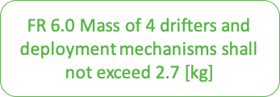
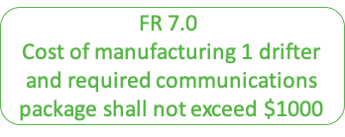
Total Mass Limit [g] | 2,700
Original Mass Projection [g] | 2,393
Current Mass Projection [g] | 2,319
Unit Cost Limit | $1,000
Electronics/ Communications | $1030.00
Structures/ Deployment | $127.36
Total | $1157.36

