Slide 1
Manufacturing Status Review
Mechanically Engineered Grappling Arm to Capture Litter and Atmospheric Waste
Presenters:
Team: Luke Beasley, Joseph Beightol, Benjamin Elsaesser, Sheridan Godfrey, Caleb Inglis, Jack Isbill, Andy Kain, Cedric Leedy, Chris Leighton, Daniel Mastick, Bailey Topp
Customer: TJ Sayer - Sierra Nevada Corporation (SNC) Advisor: Francisco Lopez Jimenez
Notes:
THOUGHTS:
We really need to make sure that we're clear about what we're doing for Holzinger and Wingate, e.g. we need to explictly mention what ROS is and what we're using it for, carefully explain how we use (and switch between) each camera, etc

Slide 2
Overview

Slide 3
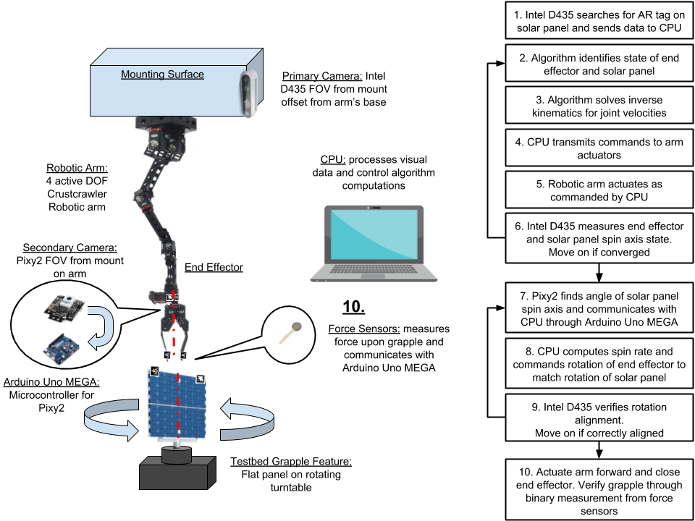
Updated CONOPS

Slide 4
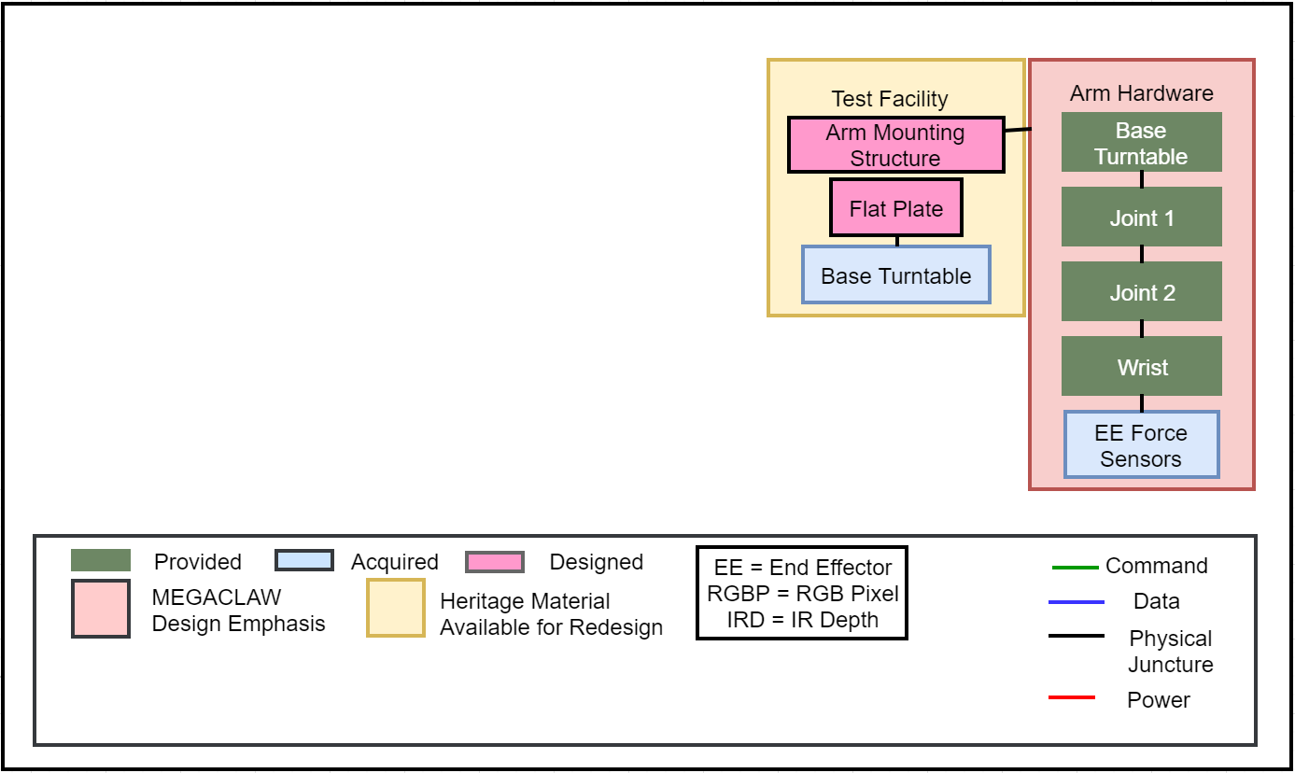
FBD
Notes:
Create: Bailey

Slide 5
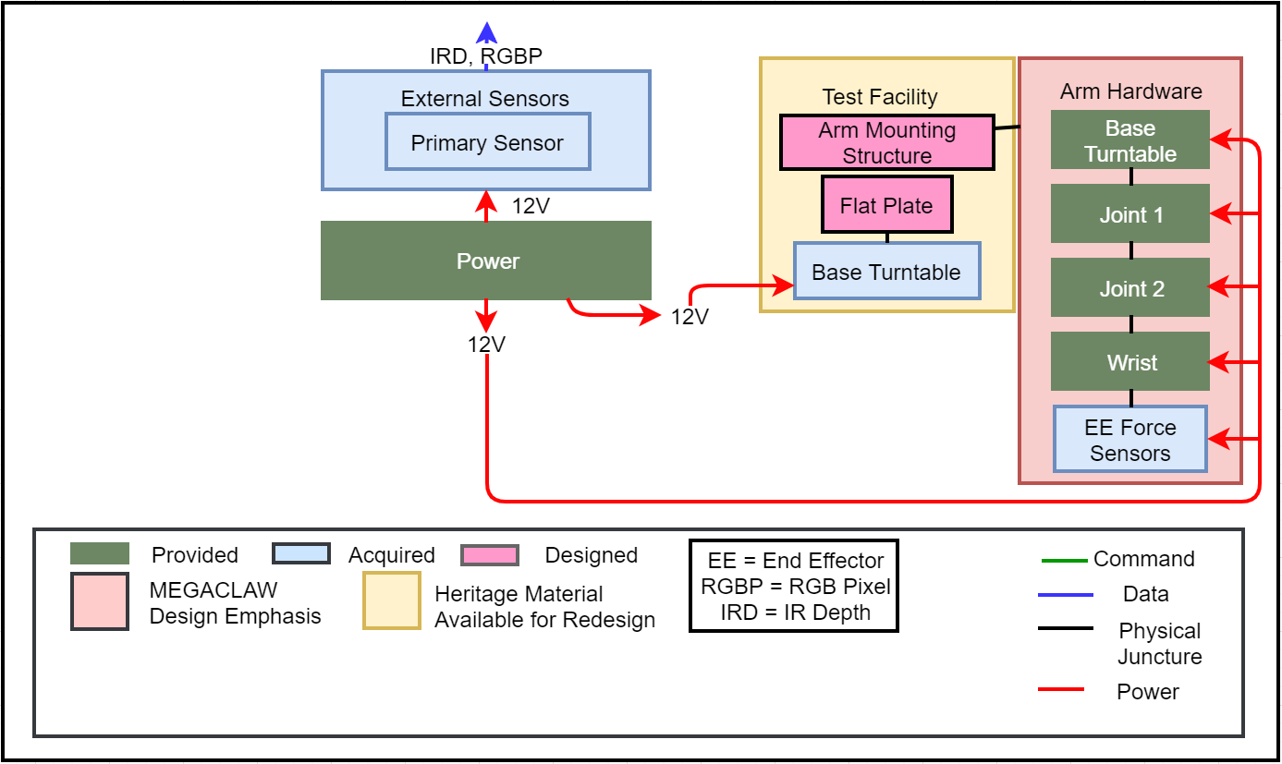
FBD
Notes:
Create: Bailey

Slide 6
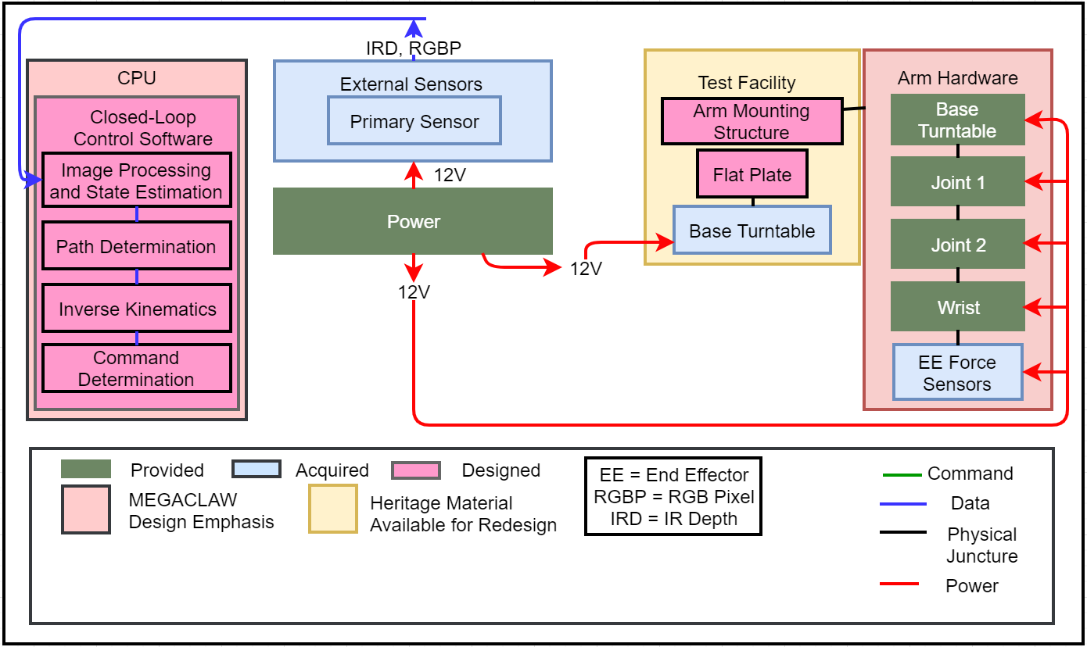
FBD
Notes:
Create: Bailey

Slide 7
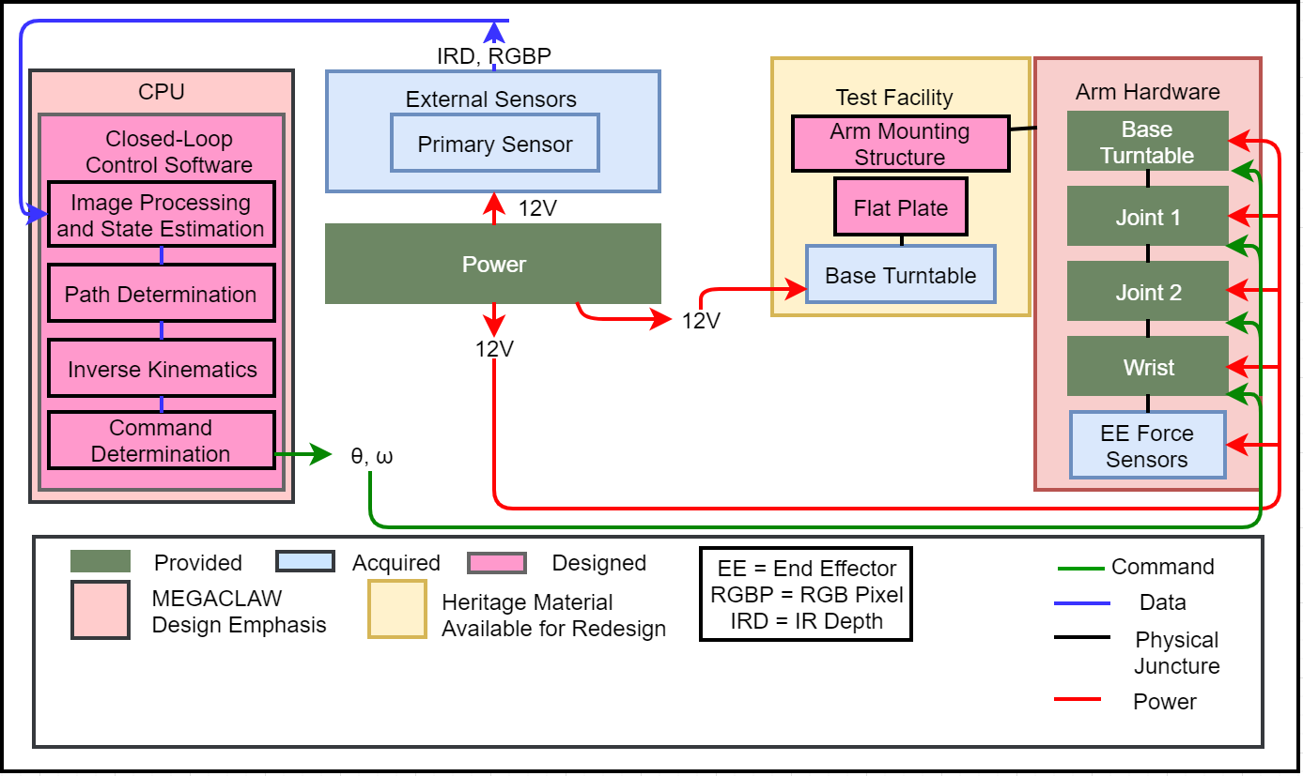
FBD
Notes:
Create: Bailey

Slide 8
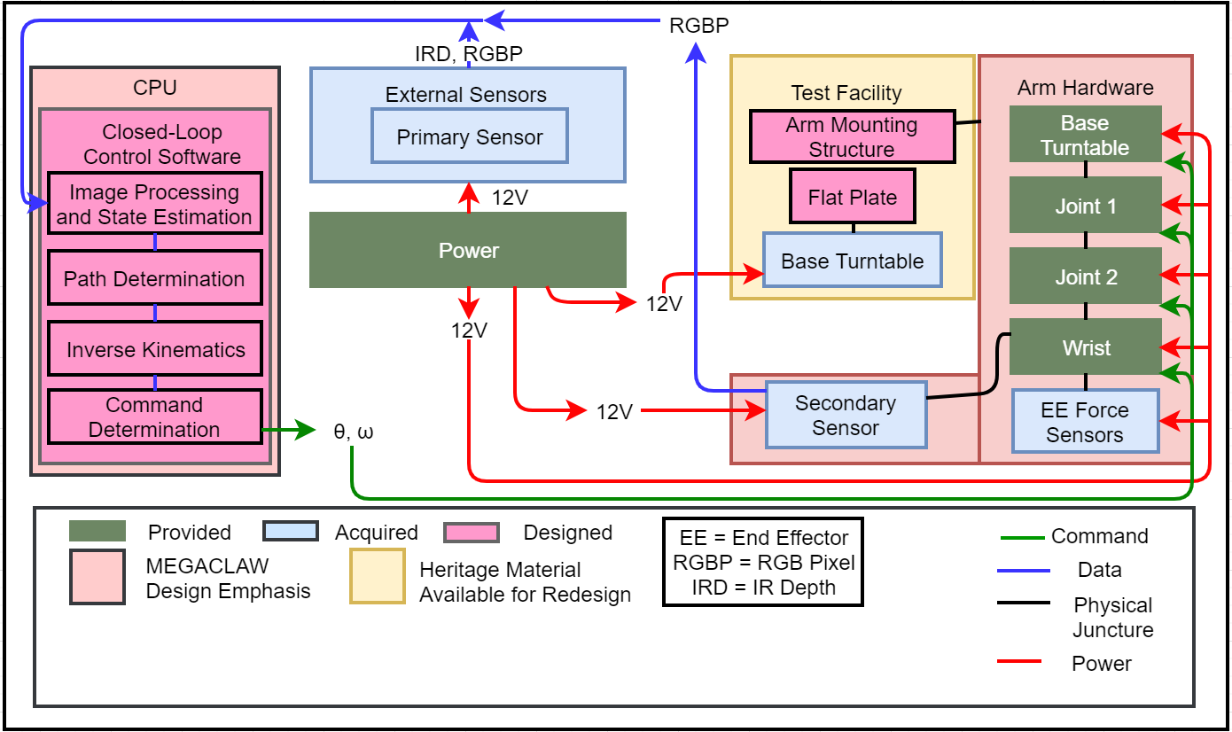
FBD
Notes:
Create: Bailey

Slide 9
Levels of Success
 | Control Loop Input | Control Loop Execution
Level 1 Success | Identify and report EE location at a rate of 0.916 [Hz] with a tolerance of 1.5 [cm] | EE responds to given controlled input position, converging within 1.5 [cm]
Level 2 Success | Identify and report EE location, and location of stationary GP at a rate of 0.916 [Hz] with a tolerance of 1.5 [cm] | EE makes arbitrary contact with stationary GP on object within 255 [s]
Level 3 Success | Identify and report EE location (with a tolerance of 1.5 [cm]) and angle (with a tolerance of 10 degrees), as well as rotating GP revolving at 0.578 [rad/s], at 0.916 [Hz] rate within 1.5 [cm] | Successful grapple of rotating GP at 0.578 [rad/s], confirmed using force sensors on EE

Slide 10
Component Baseline Design Overview

Slide 11
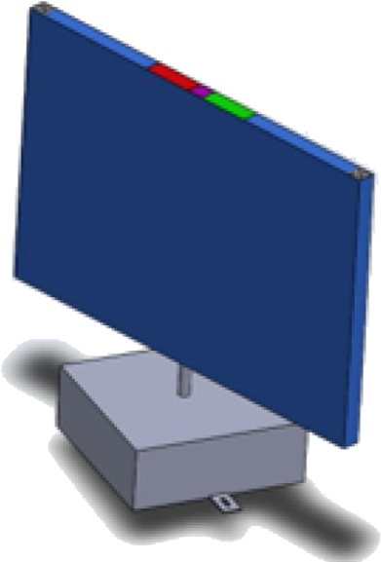
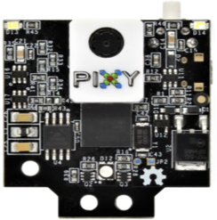
Hardware
Pixy 2
Robotic Arm, Slip Ring and EE with AR tags to be sensed by the Intel D435 (Located on GSE Base)
GP on rotating turntable with AR tags as well as colored markers to be sensed by the Pixy 2
Depth Sensors
RGB
Notes:
Create: Sheridan
- update; account for slip ring
-Working on Solidworks model of arm with slip ring and mount, ball joints on ends, will update pic when complete

Slide 12
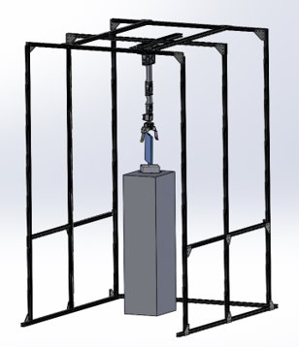
Ground Support Equipment: Testbed
Primary Sensor: Intel D435
Arm
Secondary Sensor: Pixy2
Solar Panel
Notes:
Create: Sheridan
- update; account for slip ring
-Working on Solidworks model of arm with slip ring and mount, ball joints on ends, will update pic when complete

Slide 13
Software Overview
Control Loop represented in a software block diagram
Each function block is a software manufacturing deliverable
Notes:
Ben
- full software block diagram

Slide 14
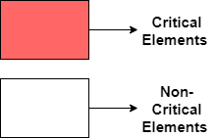
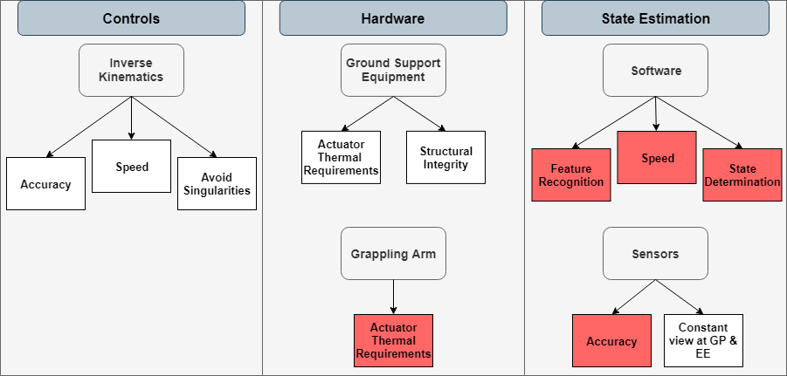
Project Elements
Notes:
Dan

Slide 15
Project Elements
Software | Hardware | Software + Hardware
​CPE​​ | ​Justification​ | Relation to Manufacturing
Sensors – Accuracies​​ | Error tolerance is very small, multiple components contribute​ | Sensor mounts must be stable, interpretation software must be accurate
Sensors – Feature Recognition | Inability to find AR tags prevents closed loop operation | Software must be reliable enough to find AR tags in view
Software – State Determination | Converting sensor information to state information is sensitive | All implemented software must be accurate enough to grapple target
Actuator Thermal Requirements | Any damage to components in the project can cause week long delays​ | Emergency stop button and actuator limits must be understood and utilized
Software – Speed​​ | Image processing and 3D modeling are time intensive processes; minimum GP angular velocity sampling rate​ | All implemented software must be fast to meet time requirements
Notes:
Dan

Slide 16
Slip Ring Change from CDR
 | MX-64T | MX-64T | MX-28T Single Axis | MX-28T Dual Axis
Stall Torque [Nm] | 6 | 6 | 2.5 | 2.5
CDR Torque | 0.854 | 0.522 | 0.236 | 0.139
MSR Torque | 3.072 | 1.238 | 0.539 | 0.355
CDR FOS | ~7 | ~11 | ~10 | ~18
MSR FOS | ~2 | ~5 | ~4.5 | ~7
Slip Ring mass: 0.44 Kg
FOS decreased, but still acceptable
Notes:
Ben
- full software block diagram
FOS changed from CDR

Slide 17
Schedule
Notes:
Caleb

Slide 18
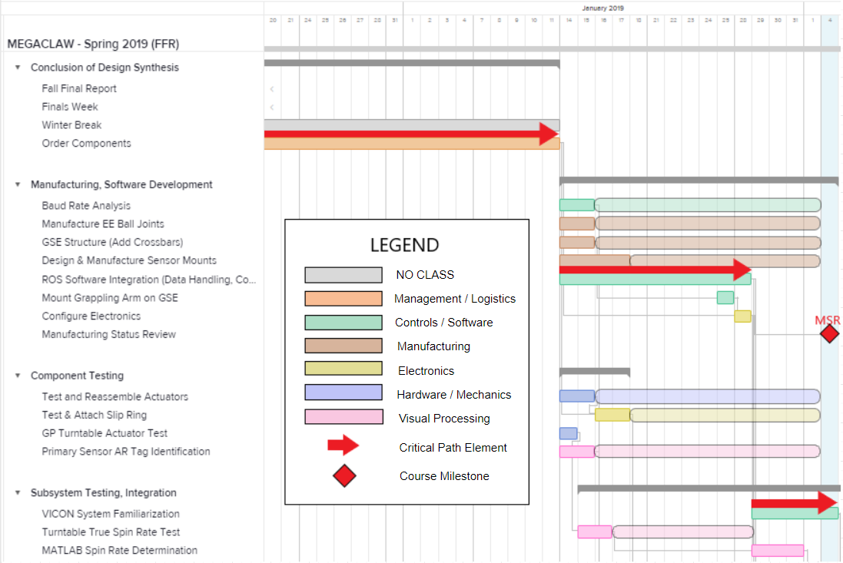
Spring 2019 Work Plan (from FFR)
Notes:
Caleb

Slide 19
(Pre-) MSR Tasks – Progress Update
Completed | In Progress
Task | Hours Left | Est. Completion Date | Notes
Procurement of all hardware components and sensors | 0 | Completed
Conduct baud rate analysis | 0 | Completed
Manufacture EE ball joint grippers | 0 | Manufactured
Machine & assemble full GSE structure | 4 | 2/5 | Parts took longer than expected to ship
Design & manufacture primary and auxiliary sensor mounts | 20 | 2/11 | Design is complete, 20-hour 3D printing time
Test all CrustCrawler actuators | 0 | Completed
Test Moog AC4598-6 slip ring | 15 | 2/8 | Waiting on arm assembly
Write primary sensor state estimation code | 10 | 2/8 | Alternative options were tested and considered
Convert and integrate GP spin axis estimation simulation | 2 | 2/5 | Should be completed by MSR
Notes:
Create: Sheridan, Daniel

Slide 20
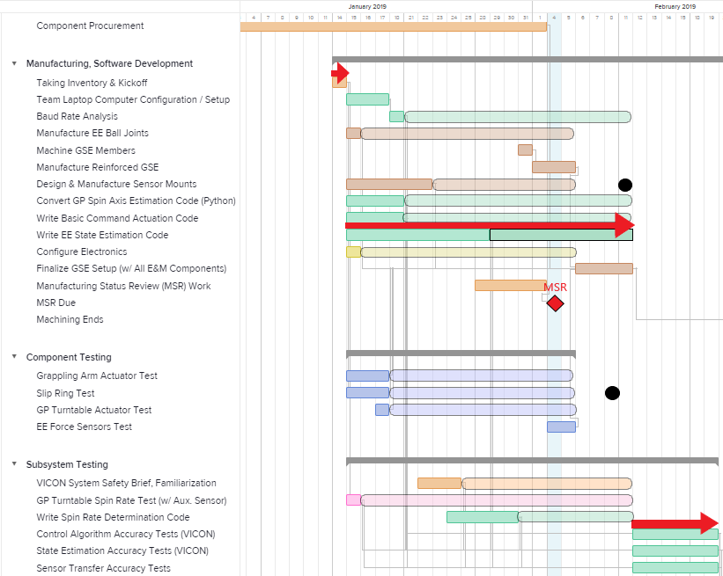
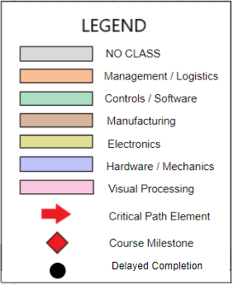
Spring 2019 Work Plan (Updated)
Up to MSR
Notes:
Caleb – finishing diagram in Paint

Slide 21
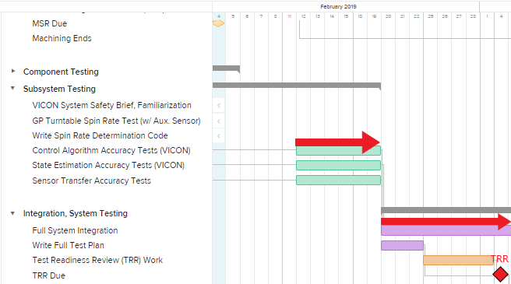
Spring 2019 Work Plan (Updated)
MSR to TRR
Notes:
Caleb – finishing diagram in Paint

Slide 22
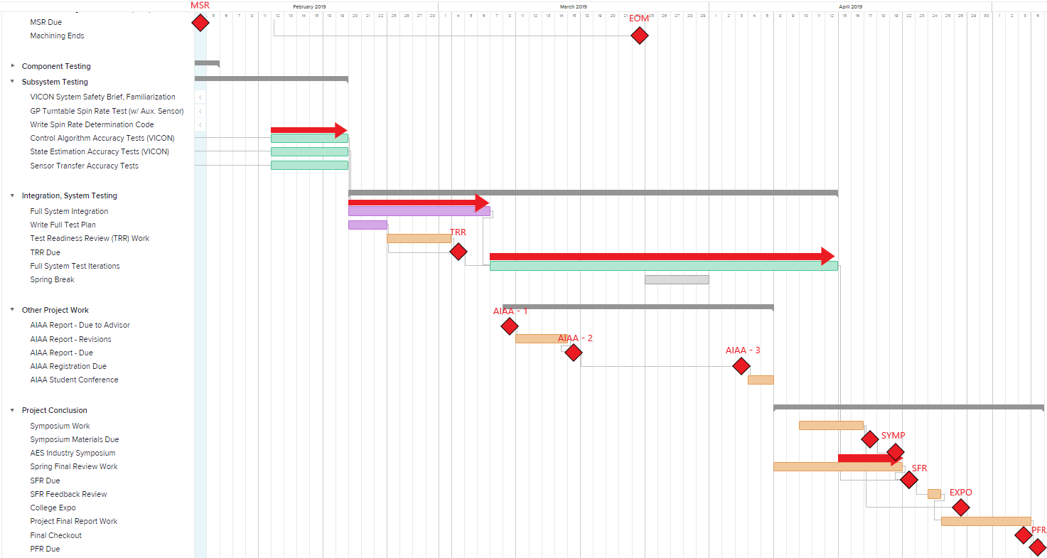
Spring 2019 Work Plan - FULL (Updated)
Notes:
Caleb – finishing diagram in Paint

Slide 23
Manufacturing

Slide 24
Hardware: Arm Assembly
Slip Ring
Pixy2
Slip Ring Mount
Ball Joint Grippers
Manufactured, assembled
Manufactured, Not assembled
Not Manufactured
Slip ring mount designed, still to be 3-D printed. Assembly remaining ~3 hrs

Slide 25
Hardware Components Status
Manufactured / Purchased | Manufacturing In Progress
Components of Project | Hours Left | Est. Completion Date
Test Bed | 2 | 2/5
Pixy2 and Intel D435 | 0 | Arrived
Camera Mounts | 20 | 2/11
Ball Joint Grippers | 0 | Manufactured
Robotic Arm and EE | 2 | 2/8
AR Tags and Mounts | 20 | 2/11
GP and Turntable Base | 3 | 3/1
Slip Ring Mount | 15 | 2/8
Emergency Off Switch | 15 | 3/1
Notes:
Test Bed 60% complete – still waiting on parts to be delivered
Create: Sheridan, Daniel
Purchased/In progress – number of hours left. Ranked tasks by completion time – green on top TODO on bottom
-include graphics of each
Click through animation for each image

Slide 26
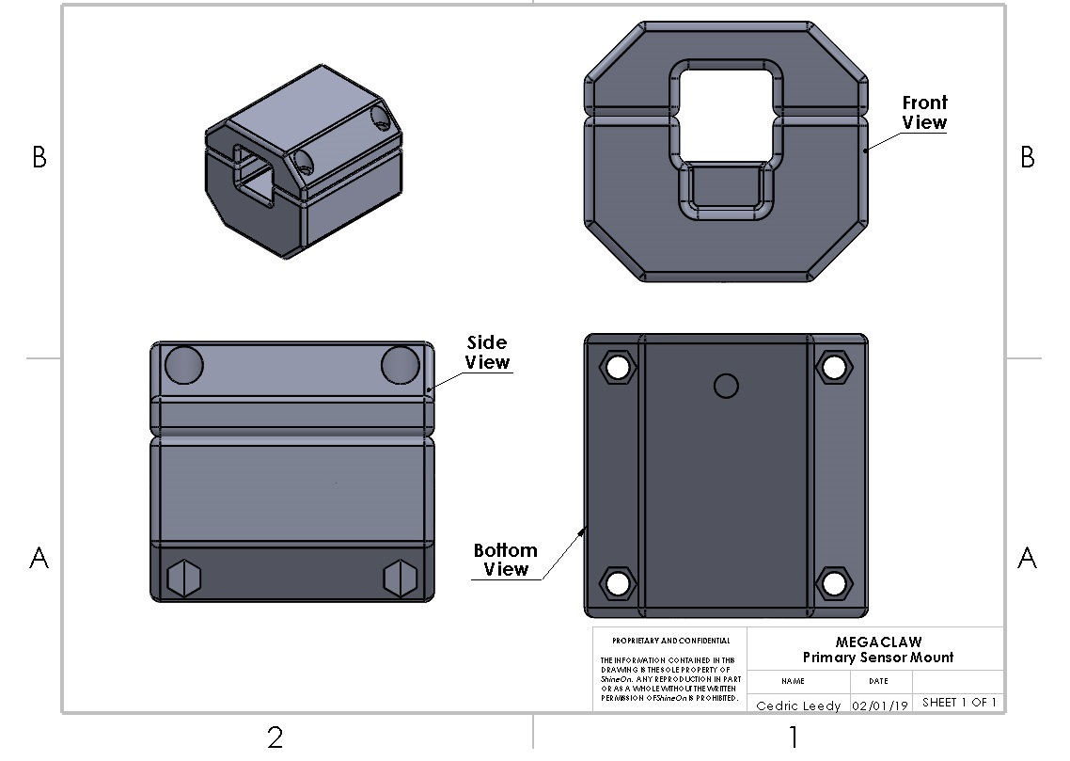
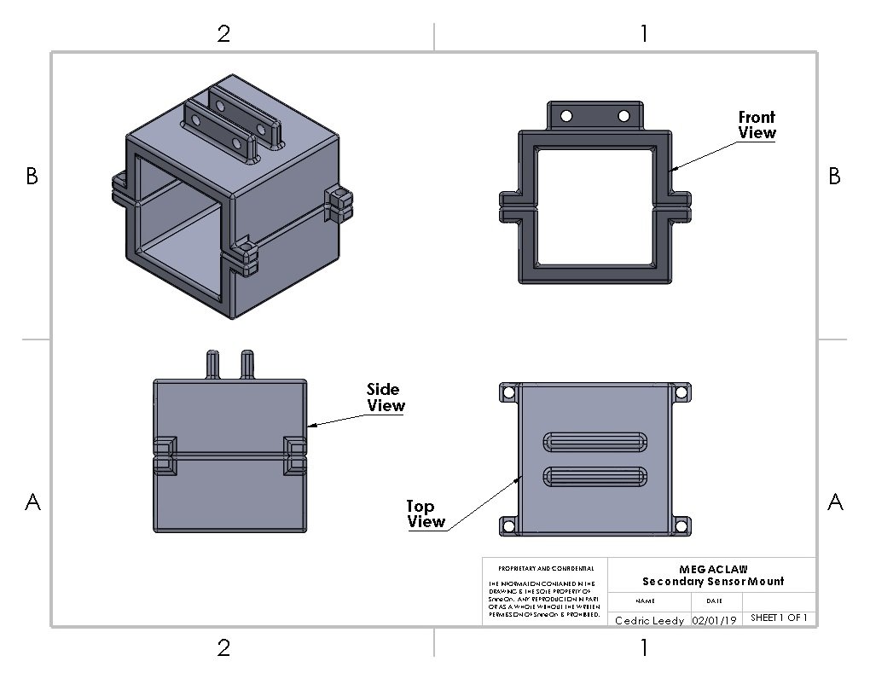
Hardware Components Status
Manufactured / Purchased | Manufacturing In Progress
Components of Project | Hours Left | Est. Completion Date
Test Bed | 2 | 2/5
Pixy2 and Intel D435 | 0 | Arrived
Camera Mounts | 20 | 2/11
Ball Joint Grippers | 0 | Manufactured
Robotic Arm and EE | 2 | 2/8
AR Tags and Mounts | 20 | 2/11
GP and Turntable Base | 3 | 3/1
Slip Ring Mount | 15 | 2/8
Emergency Off Switch | 15 | 3/1
Notes:
Will talk about in more detail later
Create: Sheridan, Daniel
Purchased/In progress – number of hours left. Ranked tasks by completion time – green on top TODO on bottom
-include graphics of each
Click through animation for each image

Slide 27
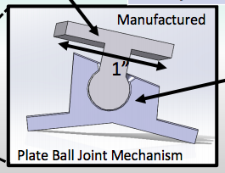
Hardware Components Status
Manufactured / Purchased | Manufacturing In Progress
Components of Project | Hours Left | Est. Completion Date
Test Bed | 4 | 2/5
Pixy2 and Intel D435 | 0 | Arrived
Camera Mounts | 20 | 2/11
Ball Joint Grippers | 0 | Manufactured
Robotic Arm and EE | 2 | 2/8
AR Tags and Mounts | 20 | 2/11
GP and Turntable Base | 3 | 3/1
Slip Ring Mount | 15 | 2/8
Emergency Off Switch | 15 | 3/1
Notes:
Create: Sheridan, Daniel
Purchased/In progress – number of hours left. Ranked tasks by completion time – green on top TODO on bottom
-include graphics of each
Click through animation for each image

Slide 28
Hardware Components Status
Manufactured / Purchased | Manufacturing In Progress
Components of Project | Hours Left | Est. Completion Date
Test Bed | 4 | 2/5
Pixy2 and Intel D435 | 0 | Arrived
Camera Mounts | 20 | 2/11
Ball Joint Grippers | 0 | Manufactured
Robotic Arm and EE | 2 | 2/8
AR Tags and Mounts | 20 | 2/11
GP and Turntable Base | 3 | 3/1
Slip Ring Mount | 15 | 2/8
Emergency Off Switch | 15 | 3/1
Mount design still in progress
Notes:
Create: Sheridan, Daniel
Purchased/In progress – number of hours left. Ranked tasks by completion time – green on top TODO on bottom
-include graphics of each
Click through animation for each image

Slide 29
Hardware Components Status
Manufactured / Purchased | Manufacturing In Progress
Components of Project | Hours Left | Est. Completion Date
Test Bed | 4 | 2/5
Pixy2 and Intel D435 | 0 | Arrived
Camera Mounts | 20 | 2/11
Ball Joint Grippers | 0 | Manufactured
Robotic Arm and EE | 2 | 2/8
AR Tags and Mounts | 20 | 2/11
GP and Turntable Base | 3 | 3/1
Slip Ring Mount | 15 | 2/8
Emergency Off Switch | 15 | 3/1
Notes:
Create: Sheridan, Daniel
Purchased/In progress – number of hours left. Ranked tasks by completion time – green on top TODO on bottom
-include graphics of each
Click through animation for each image

Slide 30
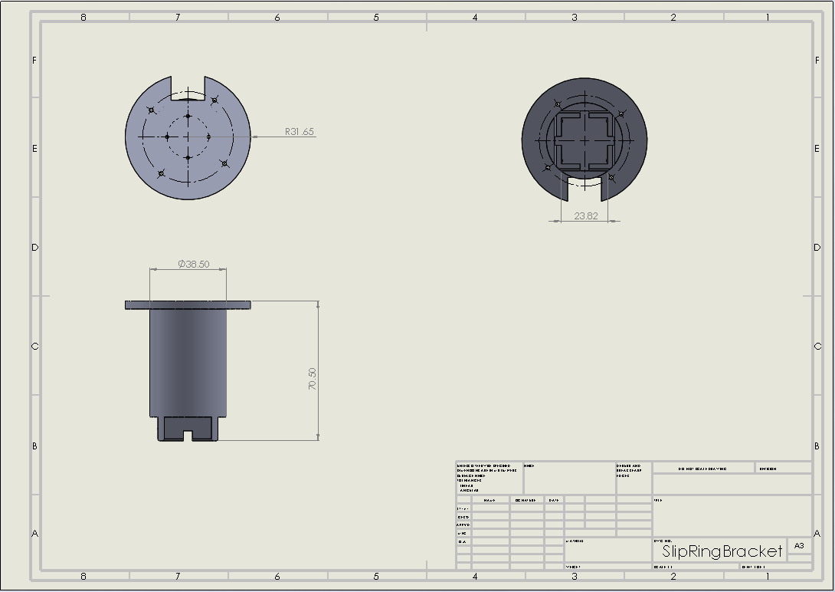
Hardware Components Status
Manufactured / Purchased | Manufacturing In Progress
Components of Project | Hours Left | Est. Completion Date
Test Bed | 4 | 2/5
Pixy2 and Intel D435 | 0 | Arrived
Camera Mounts | 20 | 2/11
Ball Joint Grippers | 0 | Manufactured
Robotic Arm and EE | 2 | 2/8
AR Tags and Mounts | 20 | 2/11
GP and Turntable Base | 3 | 3/1
Slip Ring Mount | 15 | 2/8
Emergency Off Switch | 15 | 3/1
Notes:
Create: Sheridan, Daniel
Purchased/In progress – number of hours left. Ranked tasks by completion time – green on top TODO on bottom
-include graphics of each
Click through animation for each image

Slide 31
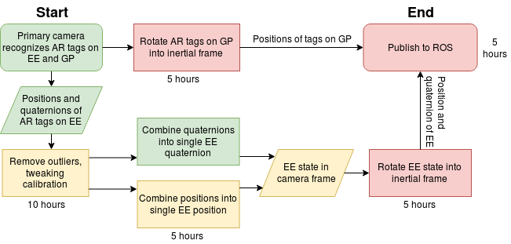
Primary Camera – EE State Determination
Estimated time remaining: 30 hours
Notes:
- state estimation: Chris (combined uncertainties: sensor mounting stability, sensor uncertainty, calibration uncertainty, error induced by FPS, (potential) error created when translating between single tags and full EE state)
Reformat as a flow chart where things like "have AR tag quaternions" flows into "get EE quaternion"
Use more detailed colors that indicate how much "in progress" a certain item is
Try to get some time estimates on each box

Slide 32
Primary Camera – GP State Determination
1 hour
1 hour
Code has already been implemented and tested in MATLAB
It is being converted to Python for ease of integration with ROS.
Estimated time remaining: 2 hours
Notes:
- state estimation: Chris (combined uncertainties: sensor mounting stability, sensor uncertainty, calibration uncertainty, error induced by FPS, (potential) error created when translating between single tags and full EE state)
Reformat as a flow chart where things like "have AR tag quaternions" flows into "get EE quaternion"
Use more detailed colors that indicate how much "in progress" a certain item is
Try to get some time estimates on each box

Slide 33
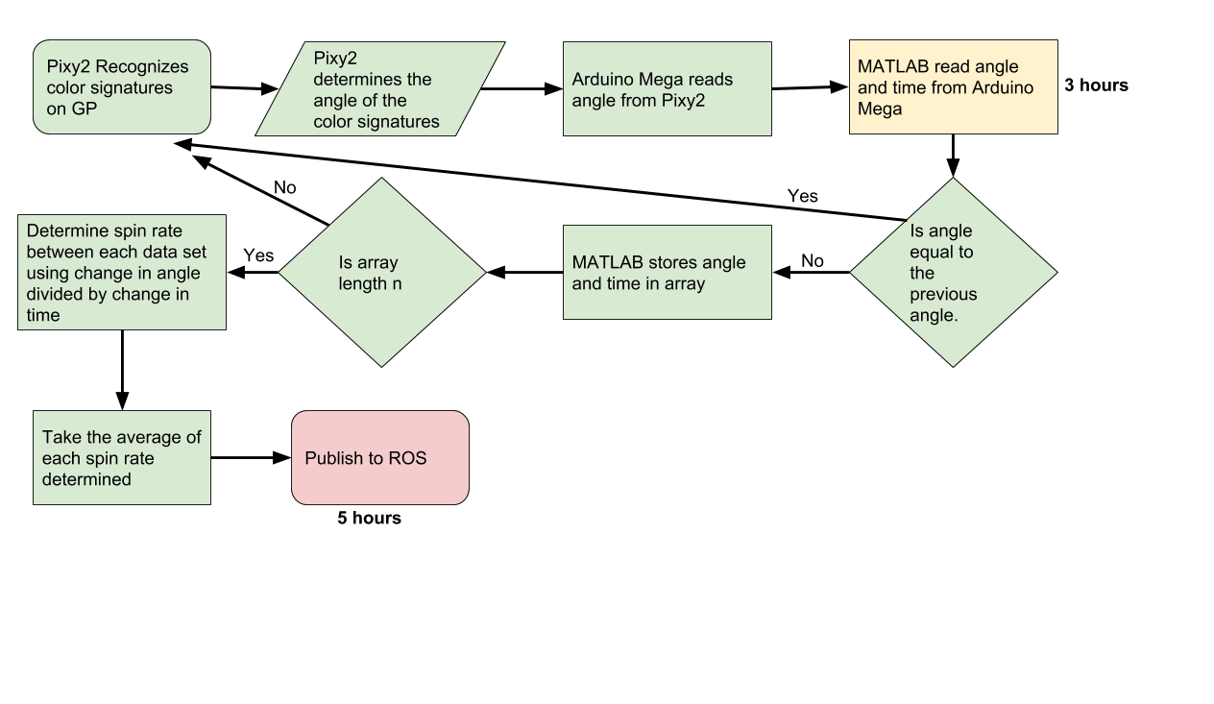
Secondary Camera – Spin Rate Determination
Estimated time remaining: 8 hours
Notes:
Andy
Will include a flow chart of the pixy2 software

Slide 34
Control Software
Task | Hours Remaining
Write publishers and subscribers | 4
Write logic | 4
Test Code | 4
Write control logic | 0
Tune gains | 4
Generate URDF of the arm | 1
Implement Moveit! ROS package | 0
Test on hardware | 2
Implement dynamixel_controller ROS package | 0
Write and test publisher | 0
Write and test arm controller | 3
Total | 22
Legend
Done
In Progress
To Do
Notes:
Caleb

Slide 35
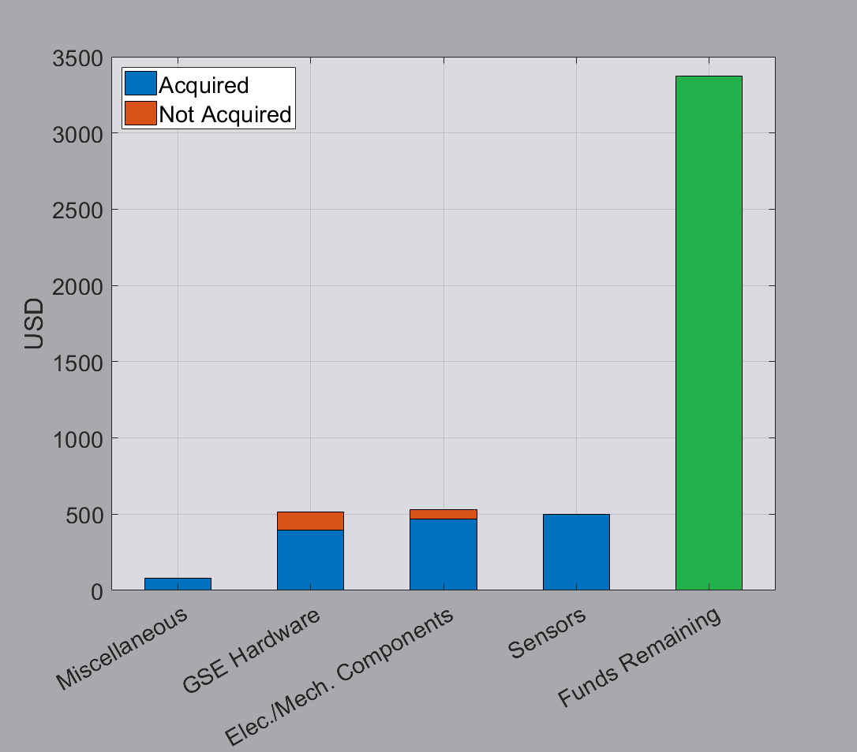
Budget Updates
Total projected costs: $1596.43
Remaining Items to Procure:
3D printing material for D435, Pixy2, and AR tag mounts:
$50 allotted
Lighting source:
$100 allotted
Notes:
Not sure how you guys will like the lone green bar, I can change it if you think I should

Slide 36
Back-Up Slides

Slide 37
Primary Camera – EE/GP State Determination
DR 2.4 | State determination error between GP and EE shall be <1.45 cm
DR 2.5 | Spin axis offset during grapple shall be <10°
At the end of Fall:
measurements of individual AR tags met requirements (errors of 5mm, 2°).
Current work: combining data from multiple AR tags, filtering outlier data, coordinate transformations
Biggest concerns: eliminating outlier data/fine tuning calibration enough that subsystem works with all others in practice
DR 1.1.1 | Image processing shall operate at five times the Nyquist frequency of the target motion: 0.916 Hz (5*Fn)
Subsystem consistently running at 15-20 Hz – speed no longer a concern.
Notes:
- state estimation: Chris (combined uncertainties: sensor mounting stability, sensor uncertainty, calibration uncertainty, error induced by FPS, (potential) error created when translating between single tags and full EE state)
Just put a quick recap of our design on this slide and how it relates to the CPEs – maybe what do we need to accomplish, what did we do last semester toward achieving those goals
Tie in how the Pixy works, how it contributes to the CPEs, what stage of the operation it kicks in during, and how we decide to switch over to it
Put in backup slides

Slide 38
Supporting Software Block Diagrams

Slide 39
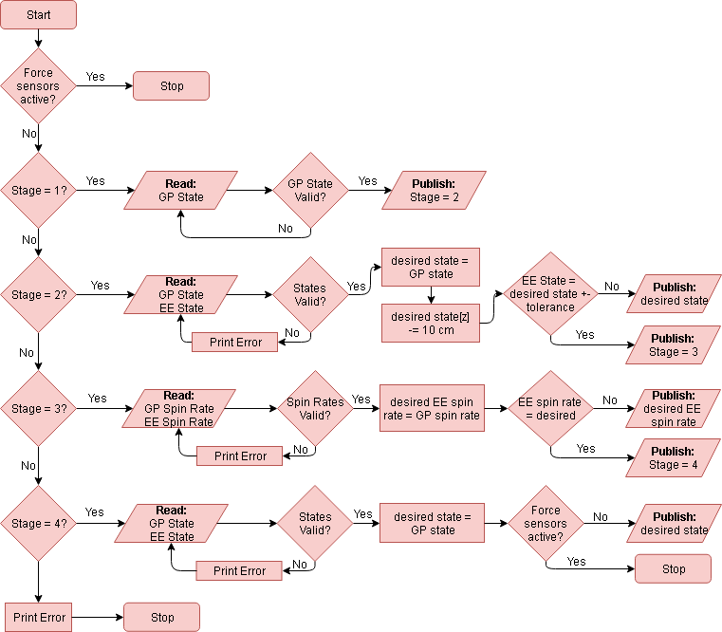
Planner
Notes:
Many of the blocks in this diagram identical and can be reused.
Writing and testing this code is expected to take ~12 hours.

Slide 40
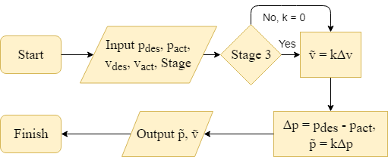
Control Block

Slide 41
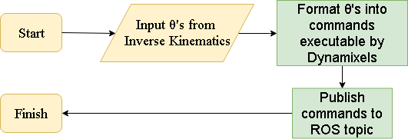
Joint Controller and Publisher

Slide 42
Hardware – CAD Components
Primary Camera
Adapting Mounting
Notes:
Cedric
- CAD drawing files

Slide 43
Hardware – CAD Components
Secondary Camera
Adapting Mounting
Notes:
Cedric
- CAD drawing files

Slide 44
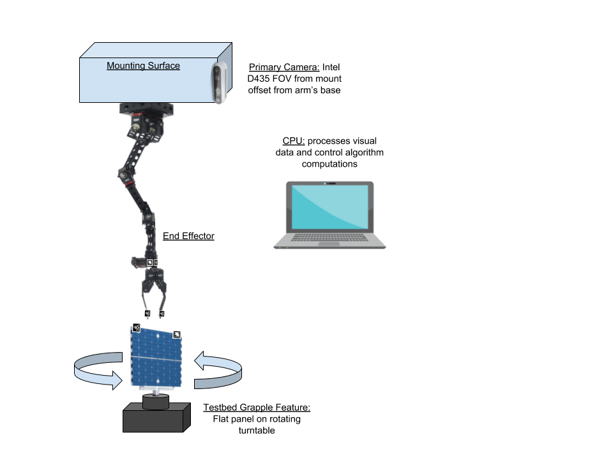
Updated CONOPS
Notes:
Create: Cedric
Present: Chris
"Our arm will initially be hanging from its mount. The target will be located below it and will be initially rotating about one of its axes"

Slide 45
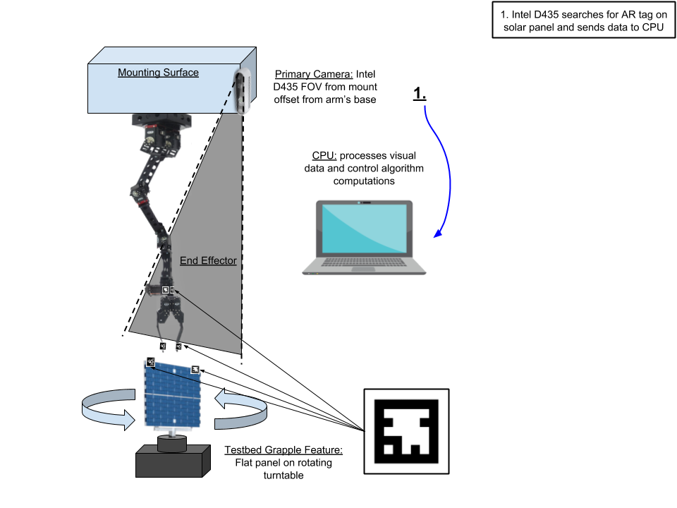
Updated CONOPS
AR tag (fiducial marker)
Notes:
Create: Cedric
Present: Chris
"Our primary vision system, which is an IR depth camera, looks down on the system from a fixed position and identifies markers like these placed on arm and target"

Slide 46
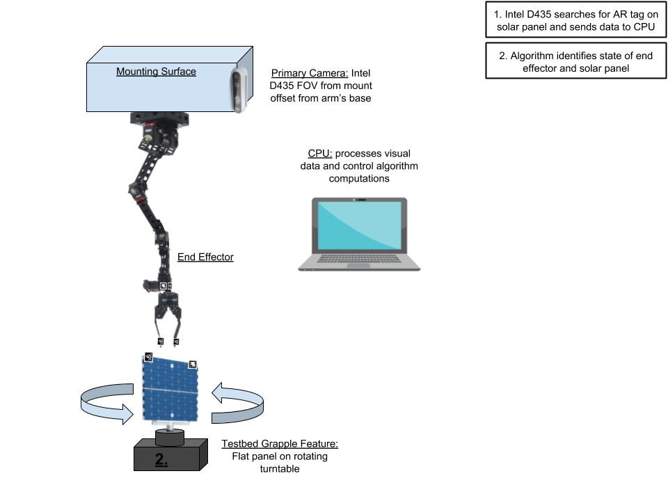
Updated CONOPS
Notes:
Create: Cedric
Present: Chris
"From the state of each marker, we reconstruct the full position and orientation of the EE and GP"

Slide 47
Updated CONOPS
Notes:
Create: Cedric
Present: Chris
"The control system then calculates a path for arm to follow to reach target and solves the inverse kinematics that determine appropriate joint angles"

Slide 48
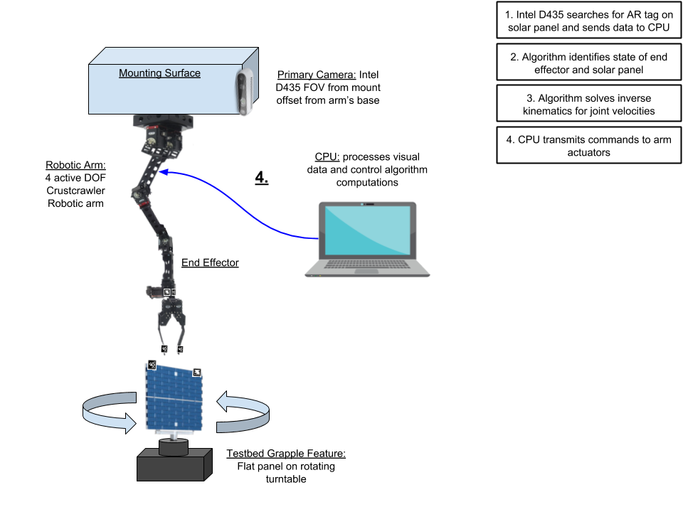
Updated CONOPS
Notes:
Create: Cedric
Present: Chris
"Next, the CPU transmits the commands to the actuators..."

Slide 49
Updated CONOPS
Notes:
Create: Cedric
Present: Chris
"...And the arm responds as commanded"

Slide 50
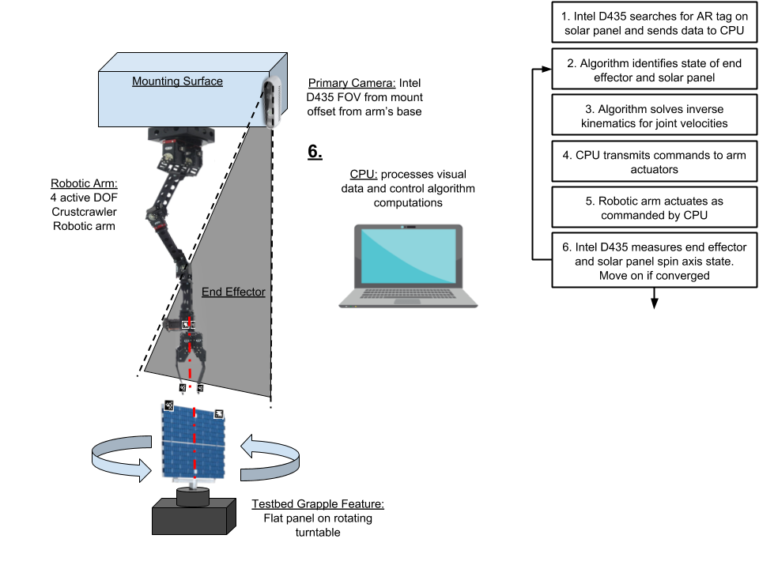
Updated CONOPS
Notes:
Create: Cedric
Present: Chris
"Next, while the arm is still actuating, the depth camera re-measures the states of the arm and target and feeds the new state of the system back into the control system, which calculates an updated path, thereby making the control system closed-loop. This loop continues until..."

Slide 51
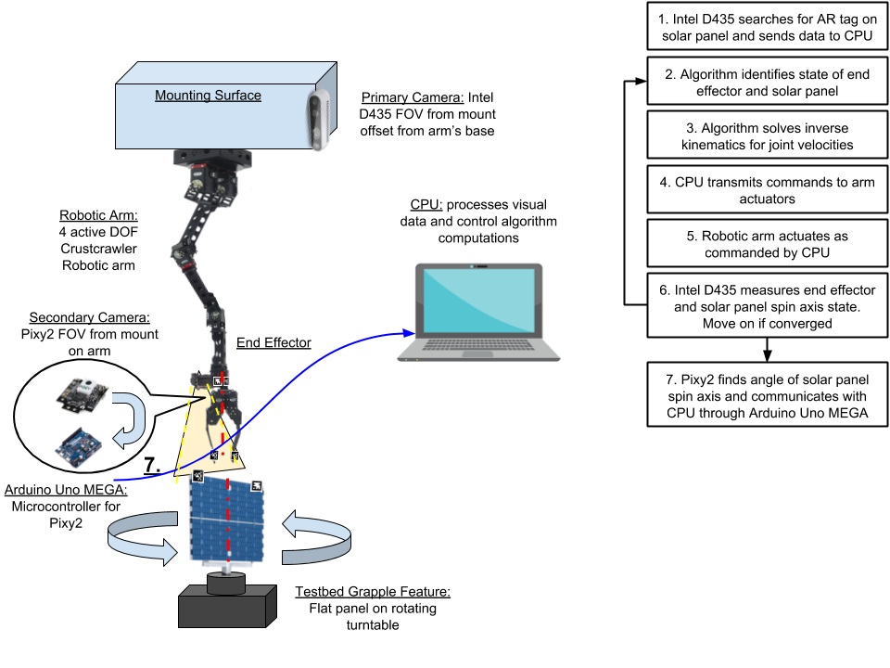
Updated CONOPS
Notes:
Create: Cedric
Present: Chris
"...The arm has converged to within 3 inches of the target. At this point, our secondary camera located just behind the end effector on a non-rotating arm segment then kicks in and determines the spin rate of the target"

Slide 52
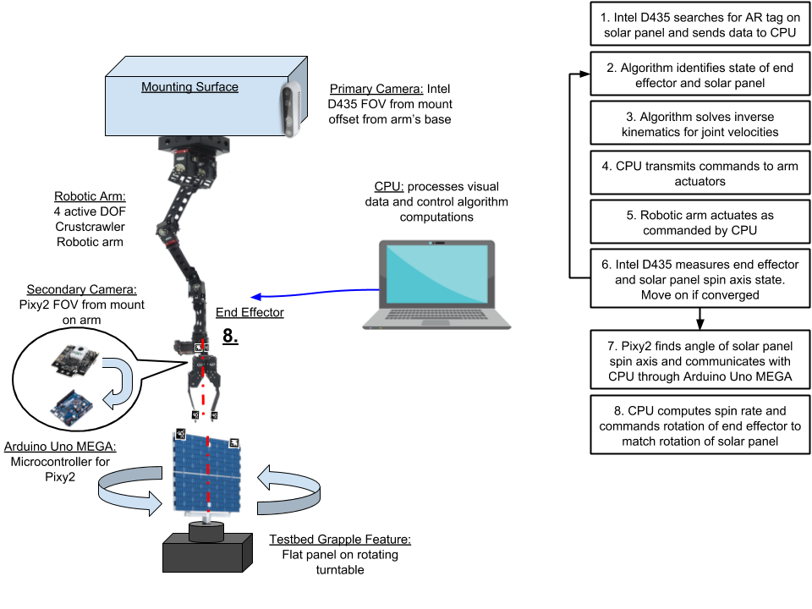
Updated CONOPS
Notes:
Create: Cedric
Present: Chris
"The CPU then commands the actuator at the end of the arm to spin up and match the spin rate and angle of the target"

Slide 53
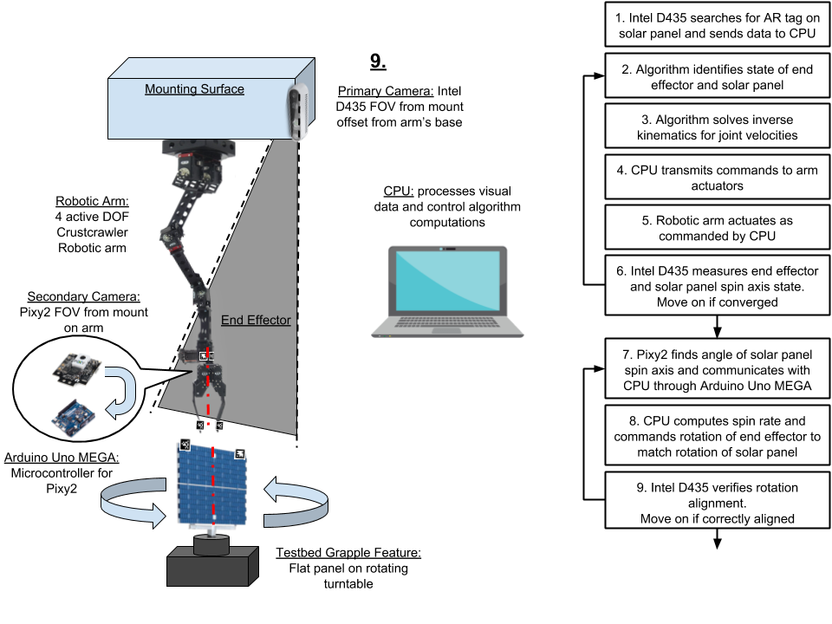
Updated CONOPS
Notes:
Create: Cedric
Present: Chris
"The primary depth camera then kicks back in and verifies that the end effector and target are aligned and then..."

Slide 54
Updated CONOPS

Slide 55
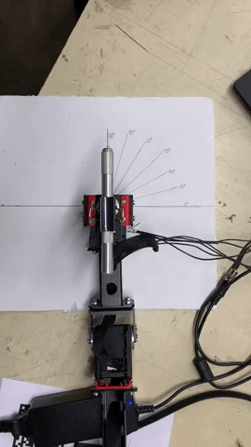
Actuator Testing
All inherited actuators tested for commanded accuracy
Notes:
Ben
- full software block diagram

Slide 56
Stall Torque With New Design
 | MX-64T | 12.7cm Girder | MX-64T | 6.35cm Girder | MX-28T Single Axis | MX-28T Dual Axis | Slip Ring | AX-12A Dual Gripper
Mass [kg] | 0.126 | 0.037 | 0.126 | 0.022 | 0.072 | 0.072 | 0.44 | 0.187
Length [m] | 0.061 | 0.127 | 0.061 | 0.0635 | 0.051 | 0.0355 | 0.054102 | 0.1516
Stall Torque [Nm] | 6 | N/A | 6 | N/A | 2.5 | 2.5 | N/A | N/A
Torque Applied [Nm] | 3.072 | N/A | 1.238 | N/A | 0.539 | 0.355 | N/A | N/A
FOS | 1.95 | N/A | 4.85 | N/A | 4.64 | 7.05 | N/A | N/A
Notes:
Ben
- full software block diagram
FOS changed from CDR

Slide 57
Item | Cost (USD)
GitHub Pro | 7.00
FFR printing | 73.87
Moog AC4598 slip ring | 380.95
Arduino Mega Rev3 | 38.50
Ball joint 3D printing material | 15.60
Polulu force sensors (×4) | 35.30
80/20 72" aluminum bars (×7) | 163.03
80/20 2-hole corner bracket (×10) | 35.30
Hex screws / T-nuts (×30) | 18.26
5-hole T joining plates (×10) | 107.90
5-hole corner joining plates (×10) | 69.90
PixyCam Pixy2 (×2) | 119.80
Intel RealSense D435 (×2) | 381.02
Total | 1446.43
Remaining Items to Procure
3D printing material
Lighting source
Notes:
Things left to buy
3D printing material for D435, Pixy, tag mounts

Slide 58
Manufacturing Tasks
Done | In Progress | To Do
Components of Overall Project | Status
Slip Ring Adapting Mount | Manufactured
AR Tag Mountings | Manufactured
GSE (Testbed) | Assembled
Notes:
Luke, Cedric, Jack, Joe

Slide 59
Electronics Tasks
Done | In Progress | To Do
Task | Notes / Updated Plan
Integrate Force Sensors with the Arduino Mega | Use Arduino to read the voltage from the Force Sensors.
Determine voltage to be used as a binary switch for successful grapple.
Solder Force Sensors and Actuators to Slip Ring

Slide 60
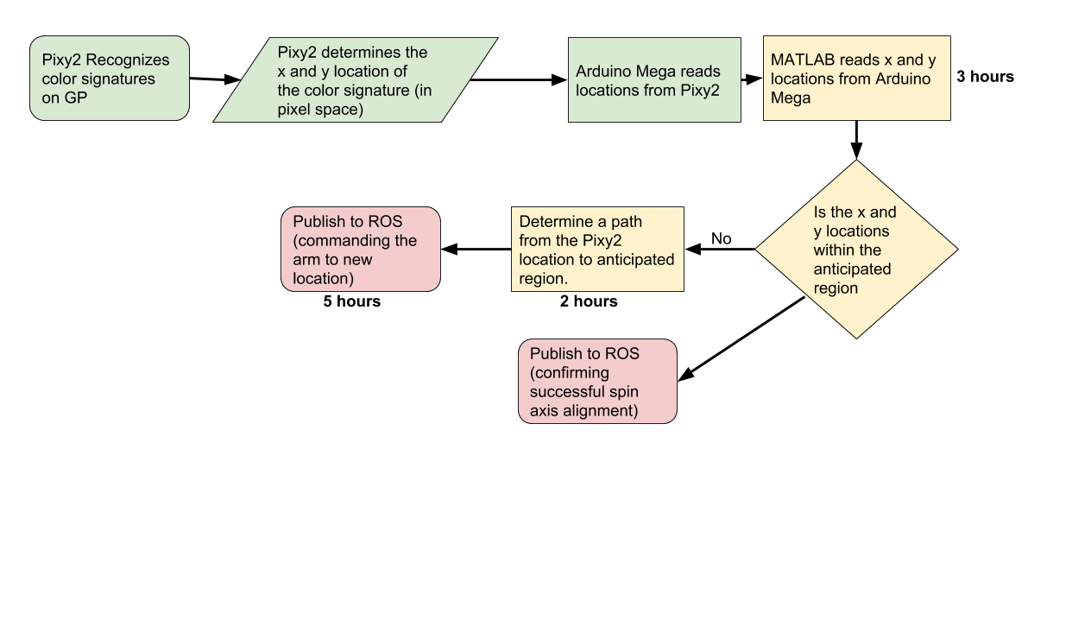
Secondary Camera – Spin Axis Alignment
Estimated time remaining: 10 hours
Notes:
Andy
Will include a flow chart of the pixy2 software

