Slide 1
ARGOS
Autonomous Rover for Ground-based Optical Surveillance
Critical Design Review
November 23, 2020
Presenters: Niko de Boucaud, Nick Kuljis, Margaux McFarland, Thomas Noll, Dan Stojsavljevic, Jarrod Teige
Customer: Barbara Streiffert and Jet Propulsion Laboratory
Advisor: Dr. Donna Gerren
Team: Niko de Boucaud, Henry Felstiner, Harrison Fitch, Victoria Gonzales, Nick Kuljis, Luca Kushner, Margaux McFarland, Thomas Noll, Trevor Slack, Dan Stojsavljevic, Jarrod Teige

Slide 2
Presentation Outline
Project Overview
Design Solution
Drivetrain
Mast
Surveillance Camera
Temperature Sensor
Electronics/Communications
Critical Project Elements
Design Requirements/Satisfaction
Navigation
Data Acquisition
Mast
Communications
Project Risk
Verification and Validation
Project Planning
Project Purpose and Objectives
Design Solution
Critical Project Elements
Design Requirements & their Satisfaction
Project Risks
Verification and Validation
Project Planning
Backup Slides

Slide 3
Project Overview
Project Purpose and Objectives
Design Solution
Critical Project Elements
Design Requirements & their Satisfaction
Project Risks
Verification and Validation
Project Planning
Backup Slides

Slide 4
Mission Statement / Objectives
The ARGOS team shall design, build, and test a child rover that will :
Navigate to a fireline via commands from a ground station (GS) and mother rover (MR)
Collect ambient temperature data throughout the duration of the mission
Record photos/video of a flame front from the top of an extendable/retractable mast
Communicate temperature data, photos, and video to the GS/MR
Project Purpose and Objectives
Design Solution
Critical Project Elements
Design Requirements & their Satisfaction
Project Risks
Verification and Validation
Project Planning
Backup Slides

Slide 5
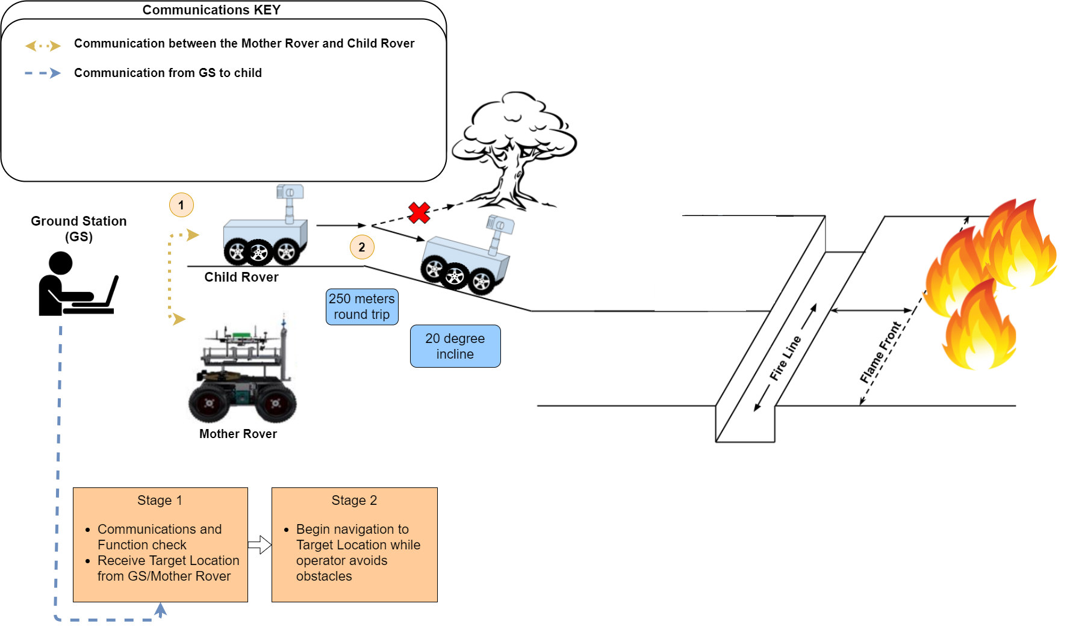
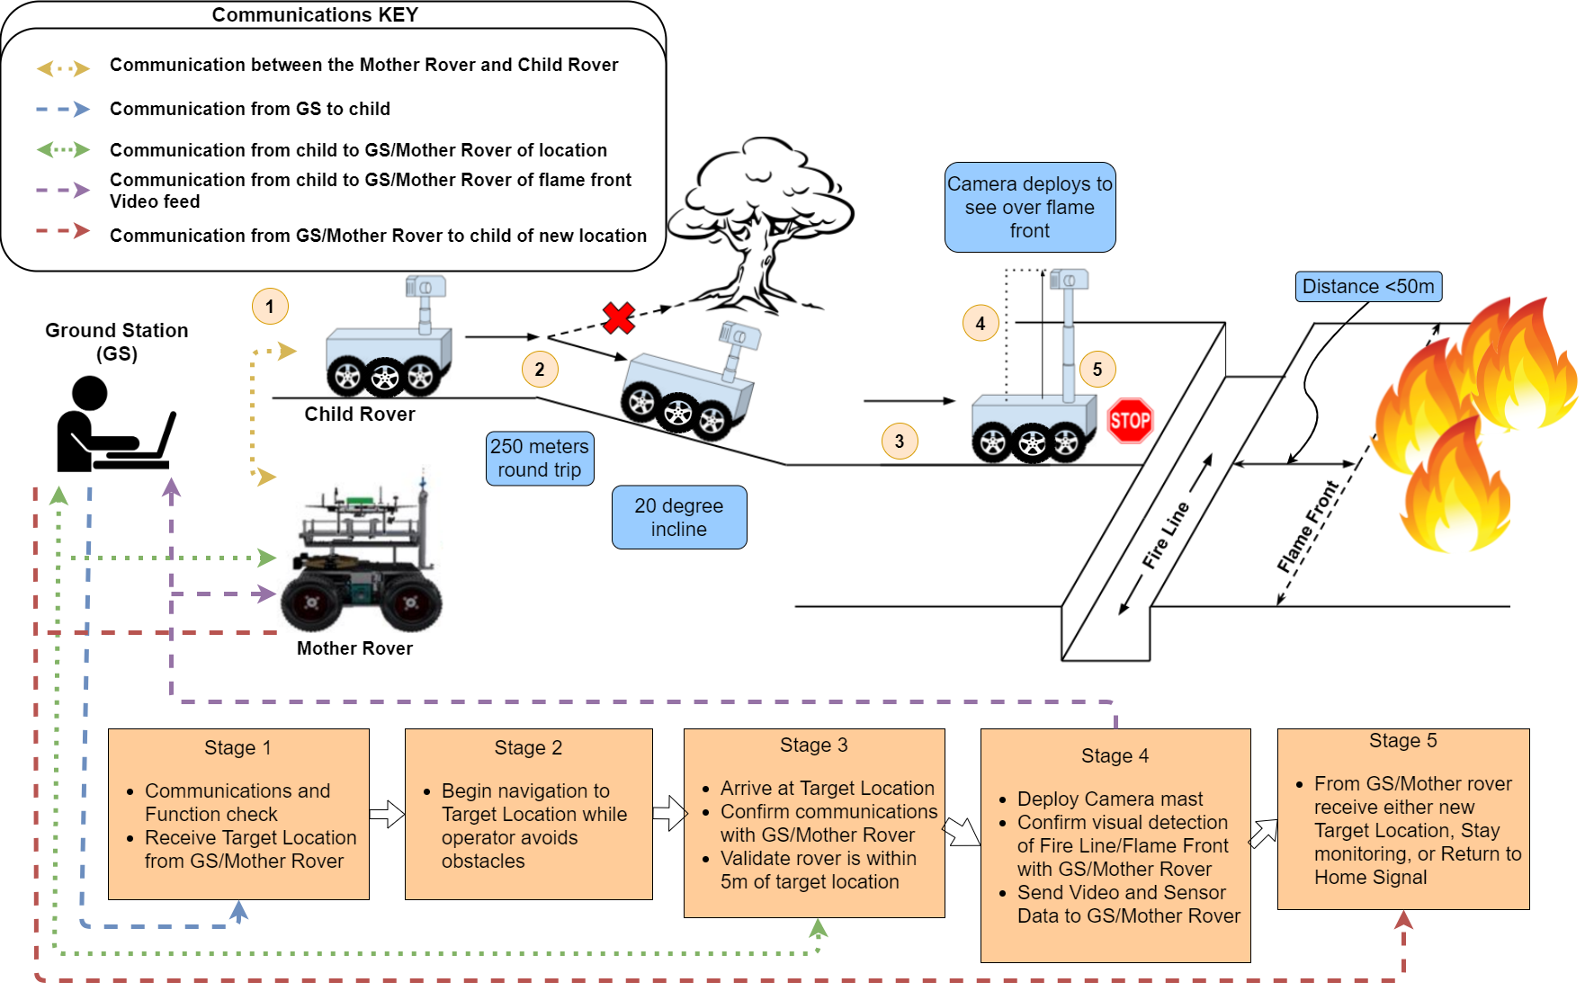
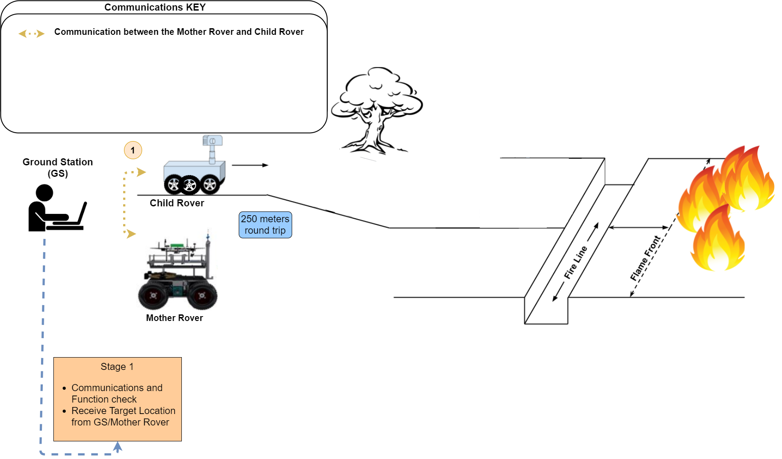
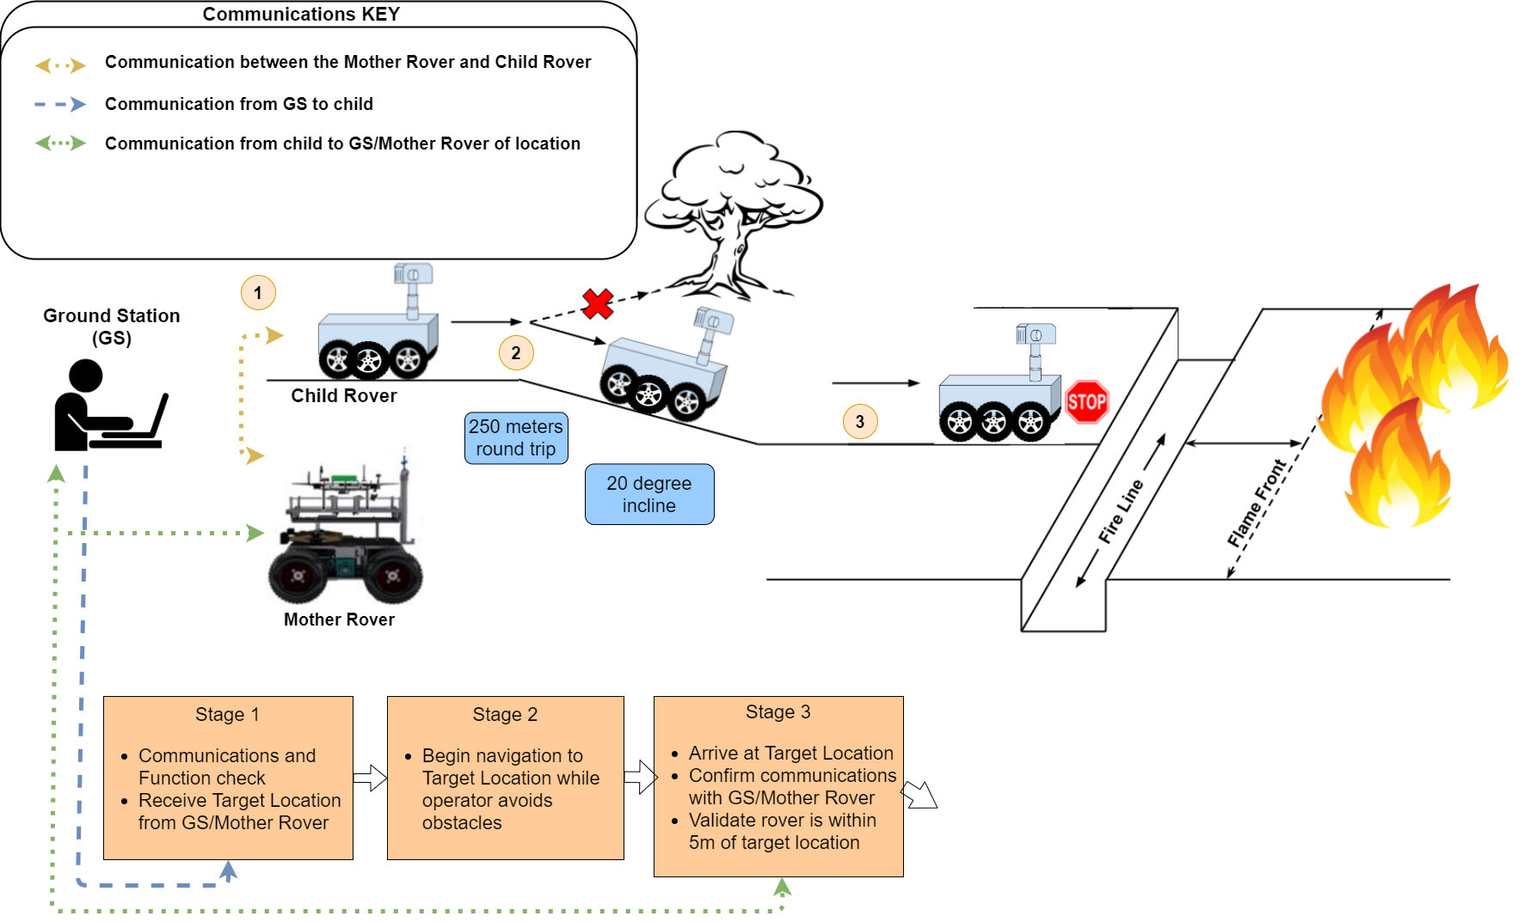
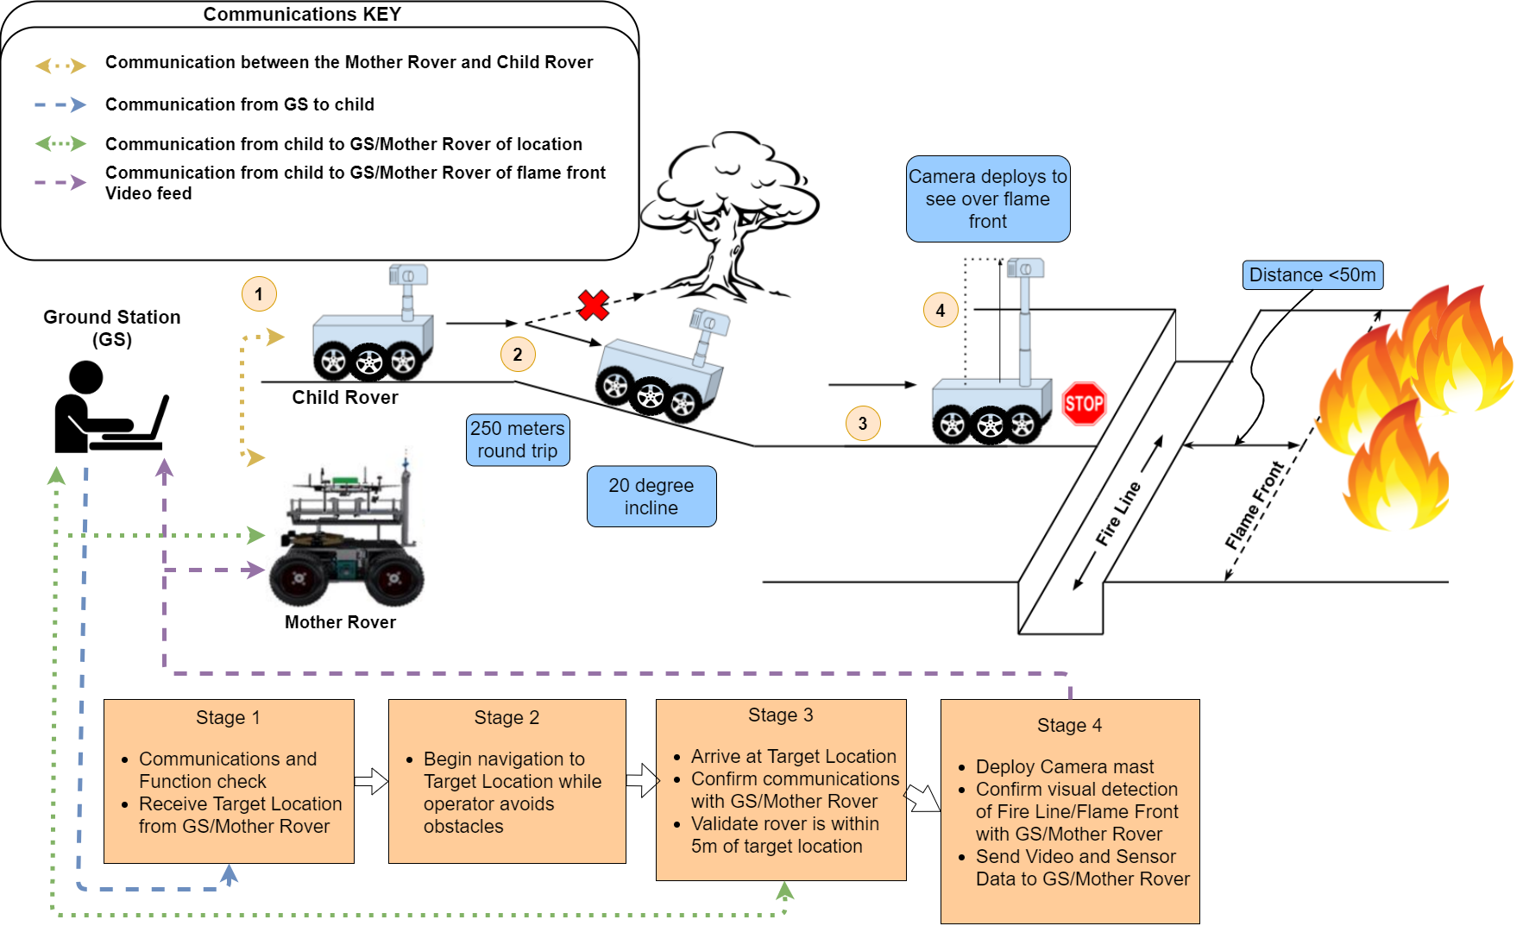
CONOPS
Project Purpose and Objectives
Design Solution
Critical Project Elements
Design Requirements & their Satisfaction
Project Risks
Verification and Validation
Project Planning
Backup Slides
Notes:
Emphasize manual control

Slide 6
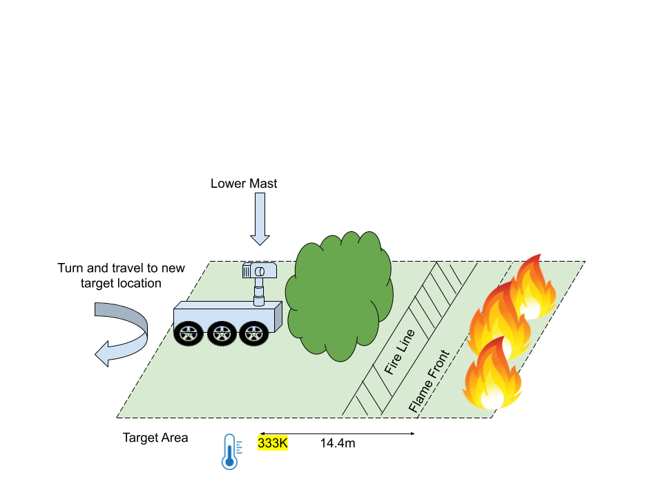
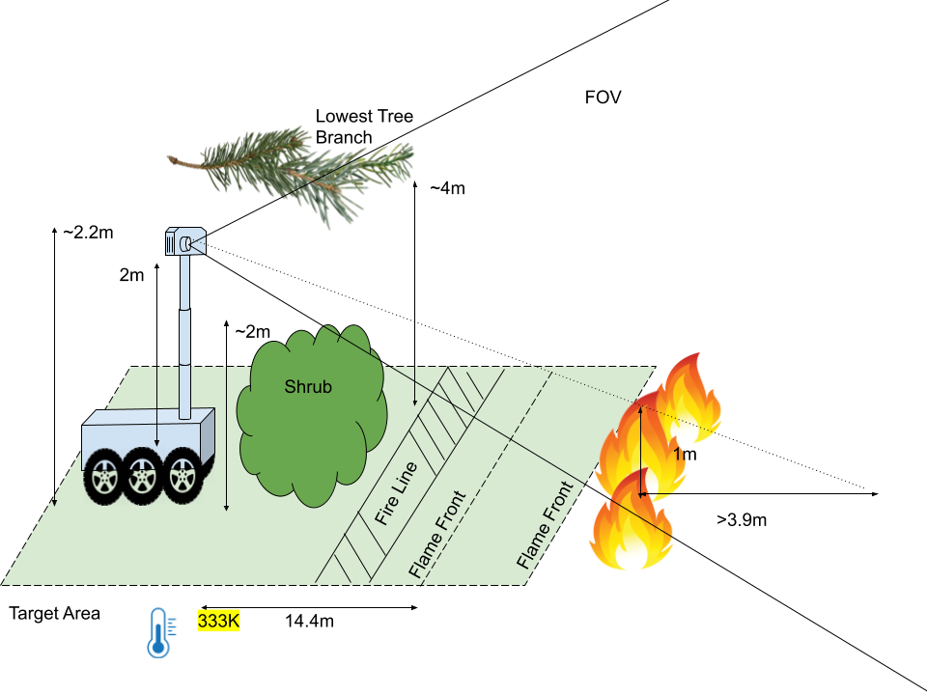
CONOPS: Stage 4 and 5
Stage 4
Stage 5
Project Purpose and Objectives
Design Solution
Critical Project Elements
Design Requirements & their Satisfaction
Project Risks
Verification and Validation
Project Planning
Backup Slides

Slide 7
Functional Requirements
Requirement ID | Requirement Description
FR.1 | The child rover shall move from a starting location to a commanded location of interest and return back to the starting location.
FR.2 | The child rover shall take pictures, videos and ambient temperature data to be sent to the ground station.
FR.3 | The child rover shall use a mast to take photos and video from a vantage point above the rover’s body.
FR.4 | The child rover shall receive commands from both the ground station and the mother rover and transmit captured data back to the ground station and the mother rover.
Project Purpose and Objectives
Design Solution
Critical Project Elements
Design Requirements & their Satisfaction
Project Risks
Verification and Validation
Project Planning
Backup Slides

Slide 8
Design Solution
Project Purpose and Objectives
Design Solution
Critical Project Elements
Design Requirements & their Satisfaction
Project Risks
Verification and Validation
Project Planning
Backup Slides
Notes:
Clear what all major elements of the design are, and how the design works at a top level (8-10 pts)

Slide 9
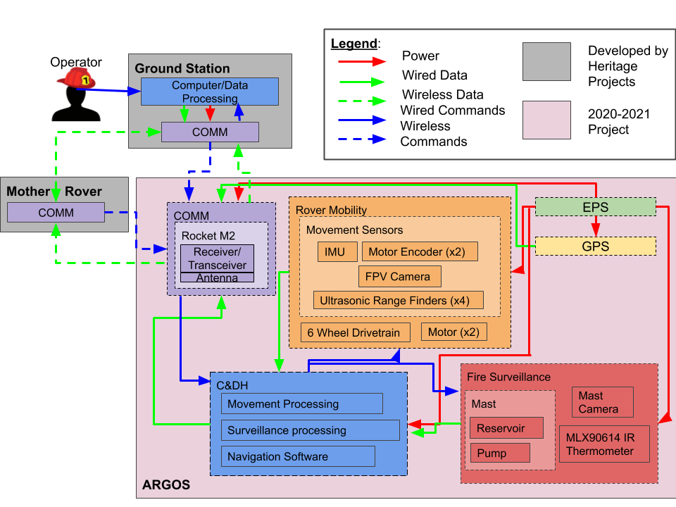
Functional Block Diagram
Note: Acknowledgements are also sent following every command.
Project Purpose and Objectives
Design Solution
Critical Project Elements
Design Requirements & their Satisfaction
Project Risks
Verification and Validation
Project Planning
Backup Slides

Slide 10
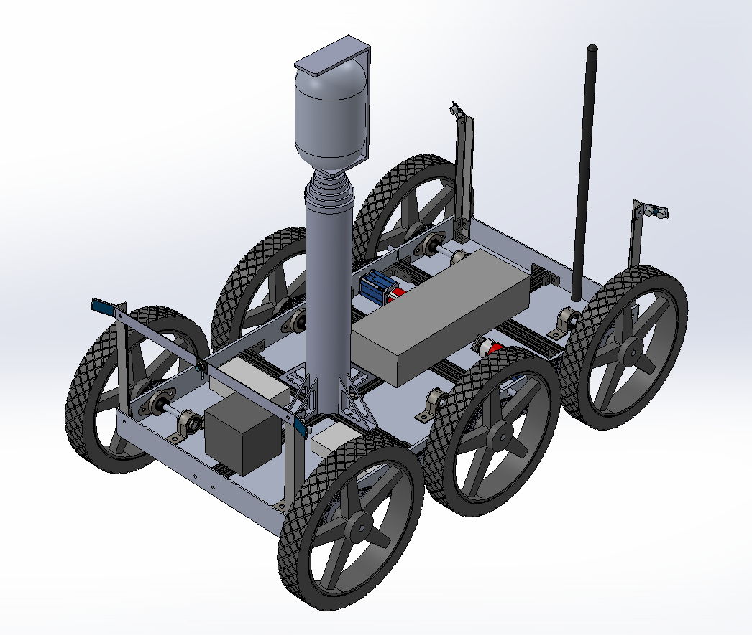
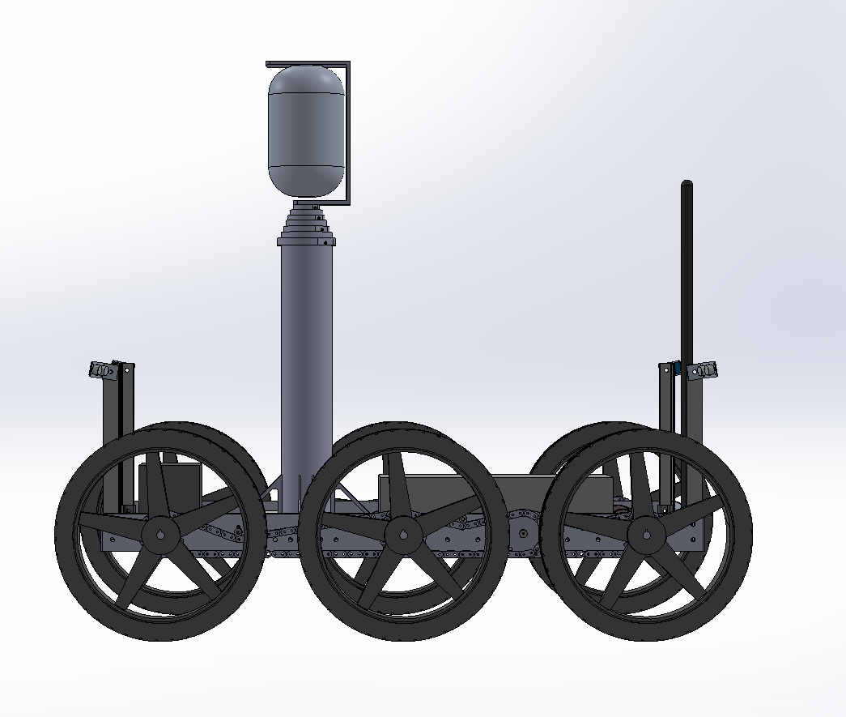
Final Design: Overview
Total Extended Height: 2.28m
Camera Height: 2.10m
Total Width: 0.65m
Total Length: 1.15m
Total Unextended Height: 0.98m
Project Purpose and Objectives
Design Solution
Critical Project Elements
Design Requirements & their Satisfaction
Project Risks
Verification and Validation
Project Planning
Backup Slides

Slide 11
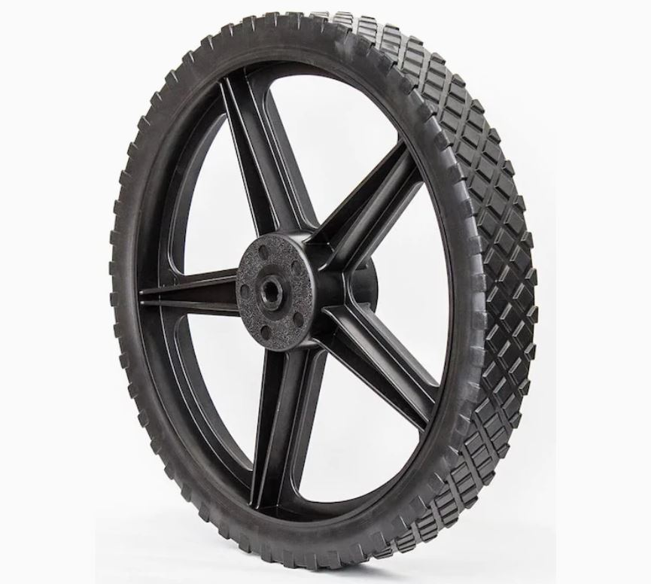
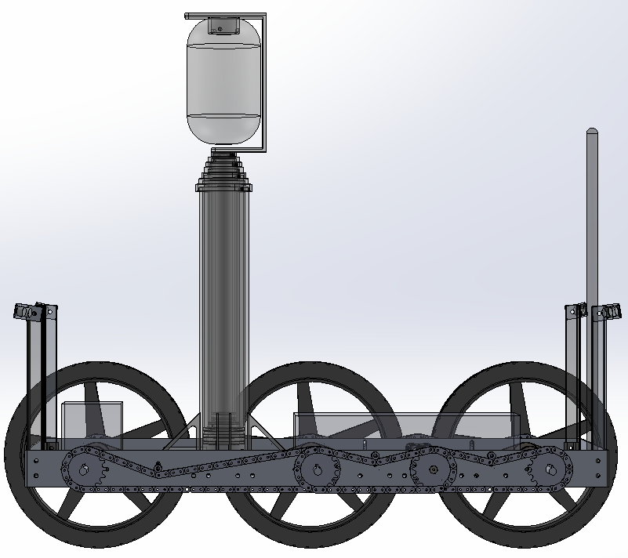
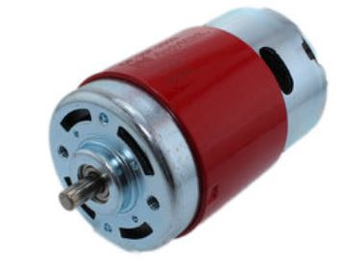
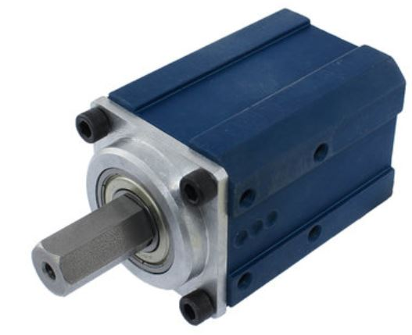
Final Design: Drivetrain
Swisher Wheels
34.925 cm Diameter
AndyMark 775 Redline Motor
57 Sport Gearbox
64:1 Gear Ratio
Project Purpose and Objectives
Design Solution
Critical Project Elements
Design Requirements & their Satisfaction
Project Risks
Verification and Validation
Project Planning
Backup Slides
Notes:
Note: 2 motors total with 6 wheels, motors attached between middle and back wheels, wheels and motors connected through gear train

Slide 12
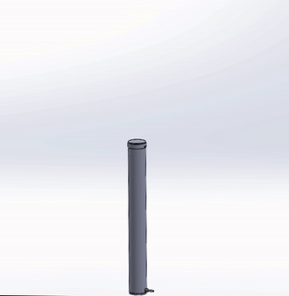
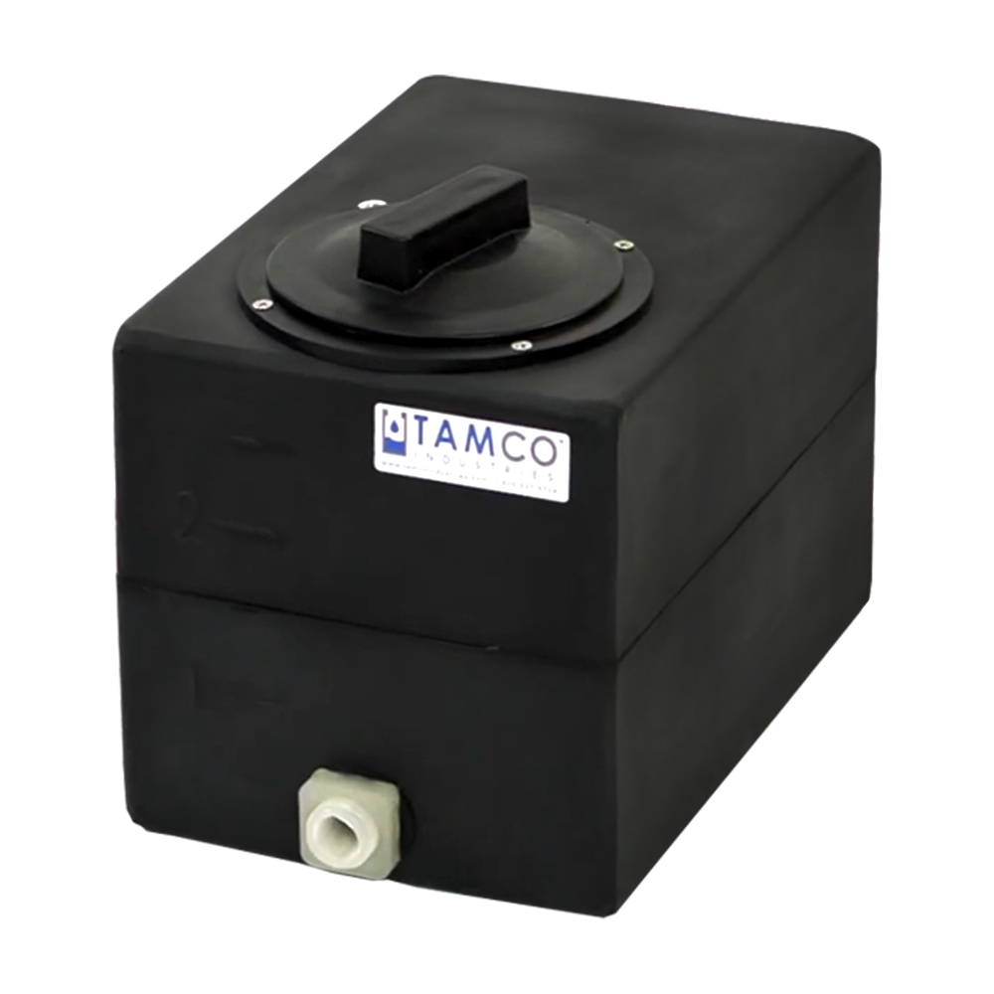
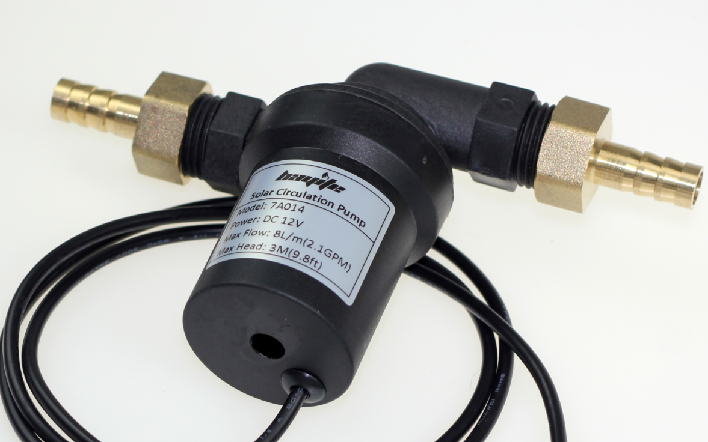
Final Design: Mast
Hydraulic Mast
Operator controls raise/lower sequence (GUI camera view)
Multiple manufacturing concerns → test rig
Test rig failure? →Off-Ramp: COTS pneumatic mast
Decision required by 1/22/2021
Hydraulic Test Rig
Tests for manufacturability and functioning of full mast
More details in Verification and Validation
Hydraulic Test Rig Operation
 | Integration Complexity | Manufacturing Complexity | Operation Complexity | Cost | Power Consumption
Hydraulic Mast | Low (est. 5 hrs) | High (est. 50 hrs) | Low (operator) | $600 | 50 W
COTS Pneumatic Mast | High (est. 50 hrs) | Low (est. 10 hrs) | High (closed loop control) | $900 | 210 W
Tank
Pump
Details on off-ramp pneumatic mast setup in backup slides
Project Purpose and Objectives
Design Solution
Critical Project Elements
Design Requirements & their Satisfaction
Project Risks
Verification and Validation
Project Planning
Backup Slides
Notes:
Final design of the mast
It is a 4 stage single acting hydraulic system which connects to a two-way pump and a tank
We do have multiple manufacturing concerns with this design though and that’s why we decided to first build a hydraulic test rig
The test rig will consist of the top two sections of the full size mast and we’ll use it to check the fuctioning of the seals and wear rings
We will go into more detail on this in the verification and validation section
If the test rig fails in operation, we do have an off-ramp mast but it was placed in the backup slides due to time constraints

Slide 13
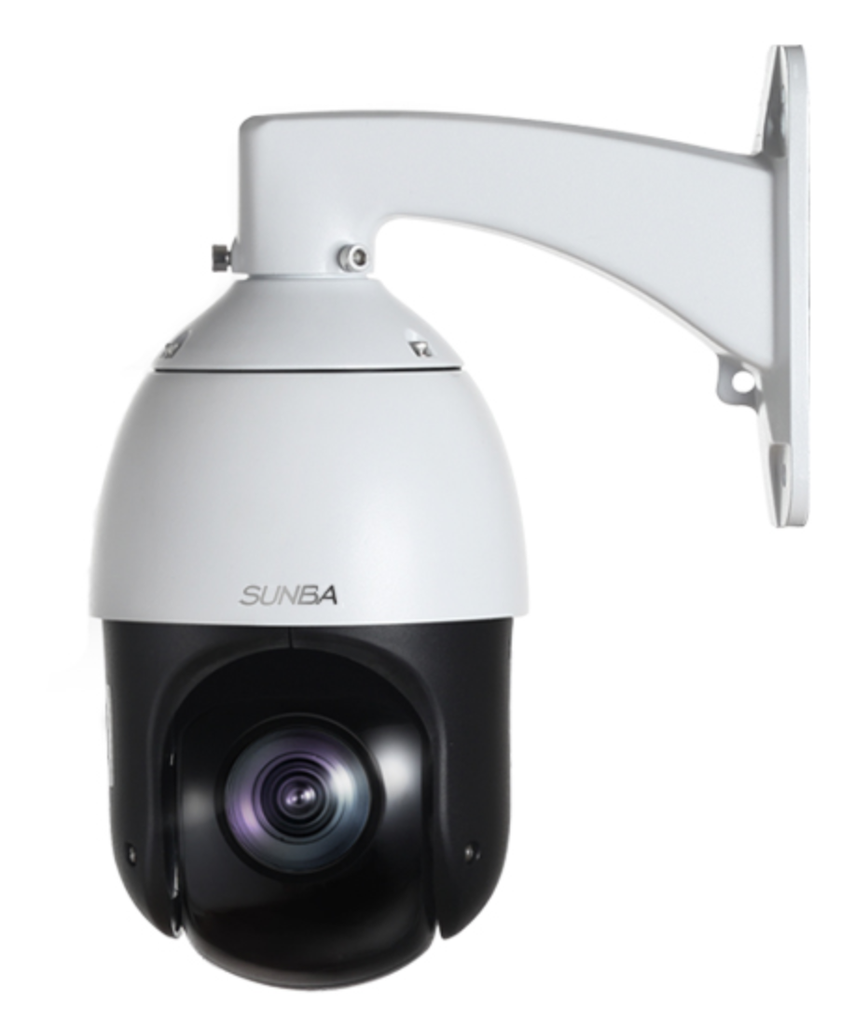
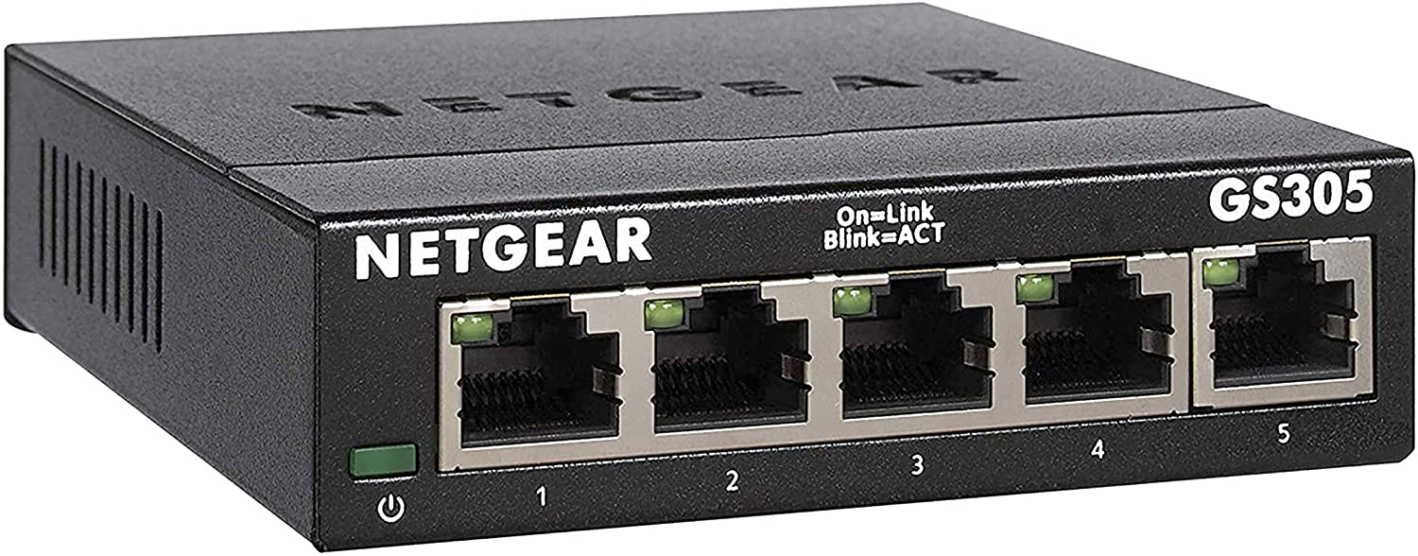
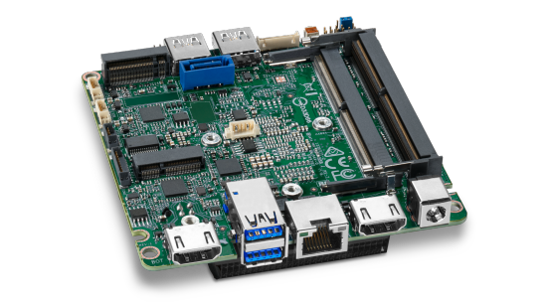
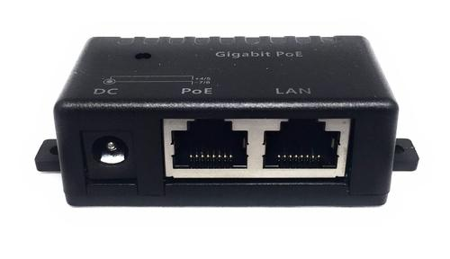
Final Design: Surveillance
Surveillance Camera
Operator controls Pan and Tilt from GS using VMS software
Camera accessed via IP on closed coms network
POE+ (802.3at)
Sunba 405-D20X V2 Surveillance Camera
Coms
Switch
Intel Nuc
Ethernet CAT 6A
USB 3.0
Analog
POE+ Injector
MOSFET
Arduino
Bat
Project Purpose and Objectives
Design Solution
Critical Project Elements
Design Requirements & their Satisfaction
Project Risks
Verification and Validation
Project Planning
Backup Slides
Notes:
The final design for the surveillance camera is this sunba 405 series that sits at the top of the mast
It is controlled manually from the ground station operator to pan, tilt and turn on and off when it’s time to deploy or collapse the mast
You can see a simplified diagram of the camera’s wiring to the rover system on the right and the main item to note is that the camera sends data and receives power through a single power over ethernet cable

Slide 14
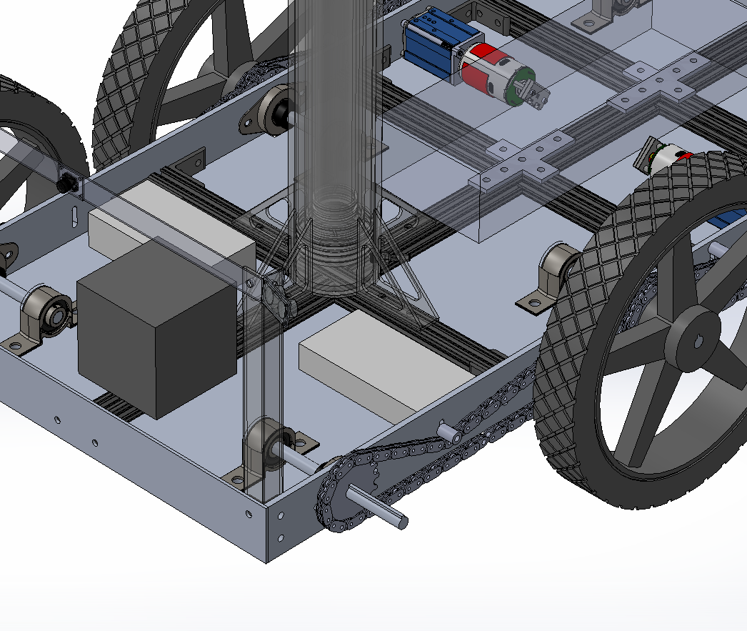
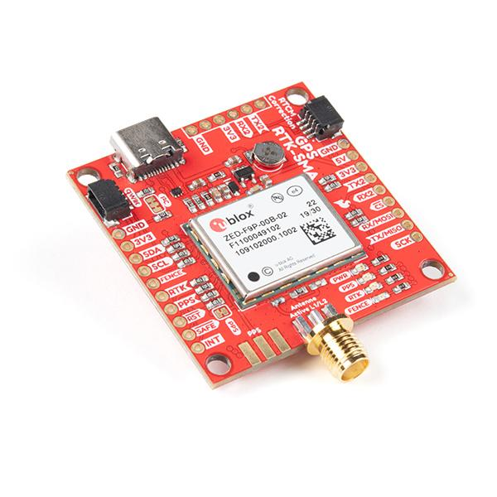
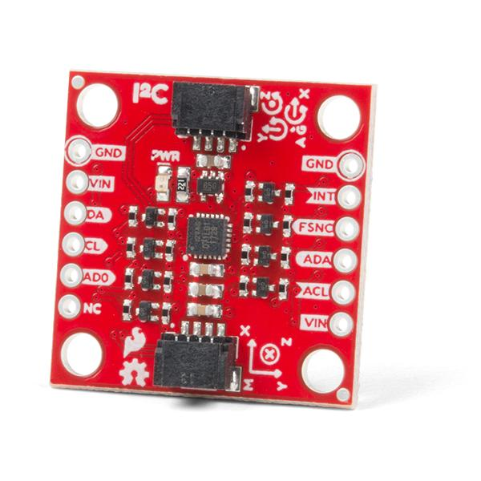
Final Design: Electronics / Communication
Intel Nuc
Sparkfun ZED-F9P
Arduino
Sparkfun BNO080
12V LiPo Battery
Rocket M2
Project Purpose and Objectives
Design Solution
Critical Project Elements
Design Requirements & their Satisfaction
Project Risks
Verification and Validation
Project Planning
Backup Slides

Slide 15
Critical Project Elements
Project Purpose and Objectives
Design Solution
Critical Project Elements
Design Requirements & their Satisfaction
Project Risks
Verification and Validation
Project Planning
Backup Slides

Slide 16
Critical Project Elements (CPEs)
CPE | Description | Reasoning
Maneuverability | Traversing obstacles/inclines without tipping | Failure results in tipping, damaged rover FR.1
Control | Manual control Autonomous control in event of comm loss | Failure results in possible crash, loss of rover FR.1
Sensors | Video Temperature Movement sensors | Failure results in no useful data FR. 2
Communications/Integration with Heritage Projects | Source of all commands and data transfer MR, GS and ARGOS comm systems | Failure results in not receiving any useful data, loss of rover FR.1 and FR.4
Project Purpose and Objectives
Design Solution
Critical Project Elements
Design Requirements & their Satisfaction
Project Risks
Verification and Validation
Project Planning
Backup Slides

Slide 17
Critical Project Elements (CPEs)
Design Requirement Focus for CDR
CPEs
1. Navigation
Maneuverability
Control
2. Data Acquisition
Sensors
3. Mast
Communications
Integration with Heritage Projects
4. Communications
Project Purpose and Objectives
Design Solution
Critical Project Elements
Design Requirements & their Satisfaction
Project Risks
Verification and Validation
Project Planning
Backup Slides

Slide 18
Design Requirements
 | Design Requirements | Focus for CDR
Navigation | Travel over obstacles as tall as 7cm Travel up and down slopes of 20° inclination 250m round trip | Mobility - drivetrain
Data Acquisition | The surveillance camera shall have >100° FOV Determine the ambient temperature within +/- 1°K | Electronics + software integration Surveillance Camera FOV
Mast | Capable of extending to a height of 2m +/- 0.2m and retracting back down to its original height Capable of supporting 10kg at its top | Pressure needed
Communications | Send time stamped video, image, and temperature data at a data rate up to 25Mbps Upon loss of communication, the child rover shall return to its last known GPS location | Data Rate Loss of Comm.
Project Purpose and Objectives
Design Solution
Critical Project Elements
Design Requirements & their Satisfaction
Project Risks
Verification and Validation
Project Planning
Backup Slides
Notes:
Note: not a full list of design requirements

Slide 19
Navigation Design Requirements and their Satisfaction
FR. 1 The child rover shall move from a starting location to a commanded location of interest and return back to the starting location.
Project Purpose and Objectives
Design Solution
Critical Project Elements
Design Requirements & their Satisfaction
Project Risks
Verification and Validation
Project Planning
Backup Slides
Notes:
Add functional requirement here

Slide 20
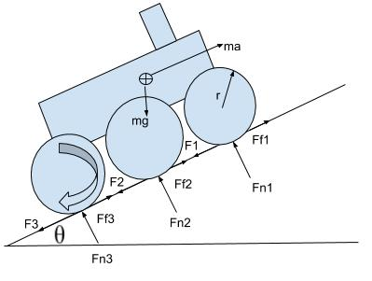
Drivetrain
Design Requirement: The child rover shall travel over obstacles with heights as tall as 7cm
Wheel Diameter needed derived from obstacle maneuvering study: 33.0 cm
Wheel Diameter achieved from Swisher Wheels: 34.93 cm
Maximum torque needed from motor: 17.98 Nm
Torque achieved from AndyMark 775 Redline Motor: 33.04 Nm
Design Requirement: The child rover shall be able to travel up and down slopes of 20° inclination
Torque from motor needed derived from incline study: 8.11 Nm
Design Requirement: The child rover shall be able to travel 250m round trip in any direction from it’s starting location
Power needed to supply drivetrain components with average velocity of 1.02 m/s: 60.48 Wh
Power achieved from battery selected: 150 Wh
Project Purpose and Objectives
Design Solution
Critical Project Elements
Design Requirements & their Satisfaction
Project Risks
Verification and Validation
Project Planning
Backup Slides
Notes:
Detailed circuit diagram?
Repeat what each design requirement was
Mention studies were done with updated assumptions
Mention three cases for obstacles: collision on front, middle, and back wheels
Expand on how power study was done if a diagram doesn’t make sense
Might need a separate slide for power study if you think that would work better
Verbally describe the power study
Needed radius is already taking into account a factor of safety of around 1.35

Slide 21
2. Data Acquisition Design Requirements and their Satisfaction
FR. 2 The child rover shall take pictures, videos and ambient temperature data to be sent to the ground station.
Project Purpose and Objectives
Design Solution
Critical Project Elements
Design Requirements & their Satisfaction
Project Risks
Verification and Validation
Project Planning
Backup Slides
Notes:
Add functional requirement here

Slide 22
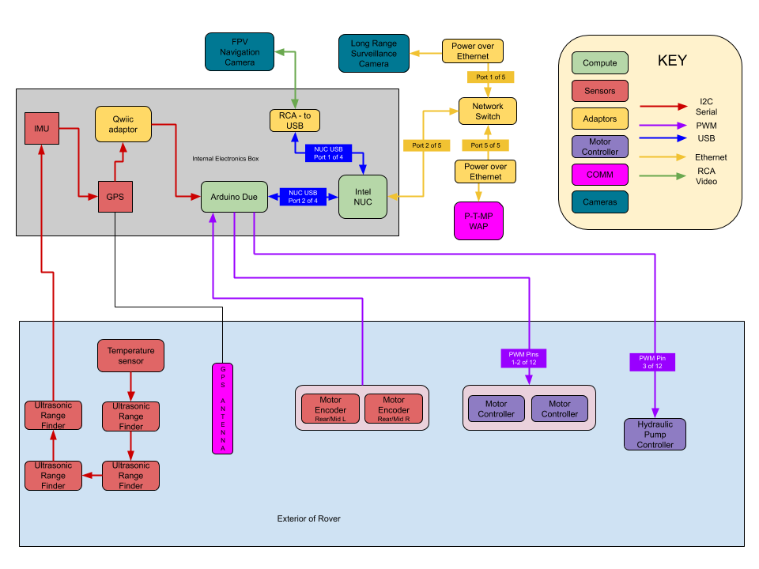
Electronics Diagram
Off Ramp Electronics Diagram in Backup
Project Purpose and Objectives
Design Solution
Critical Project Elements
Design Requirements & their Satisfaction
Project Risks
Verification and Validation
Project Planning
Backup Slides
Notes:
Detailed circuit diagram?

Slide 23
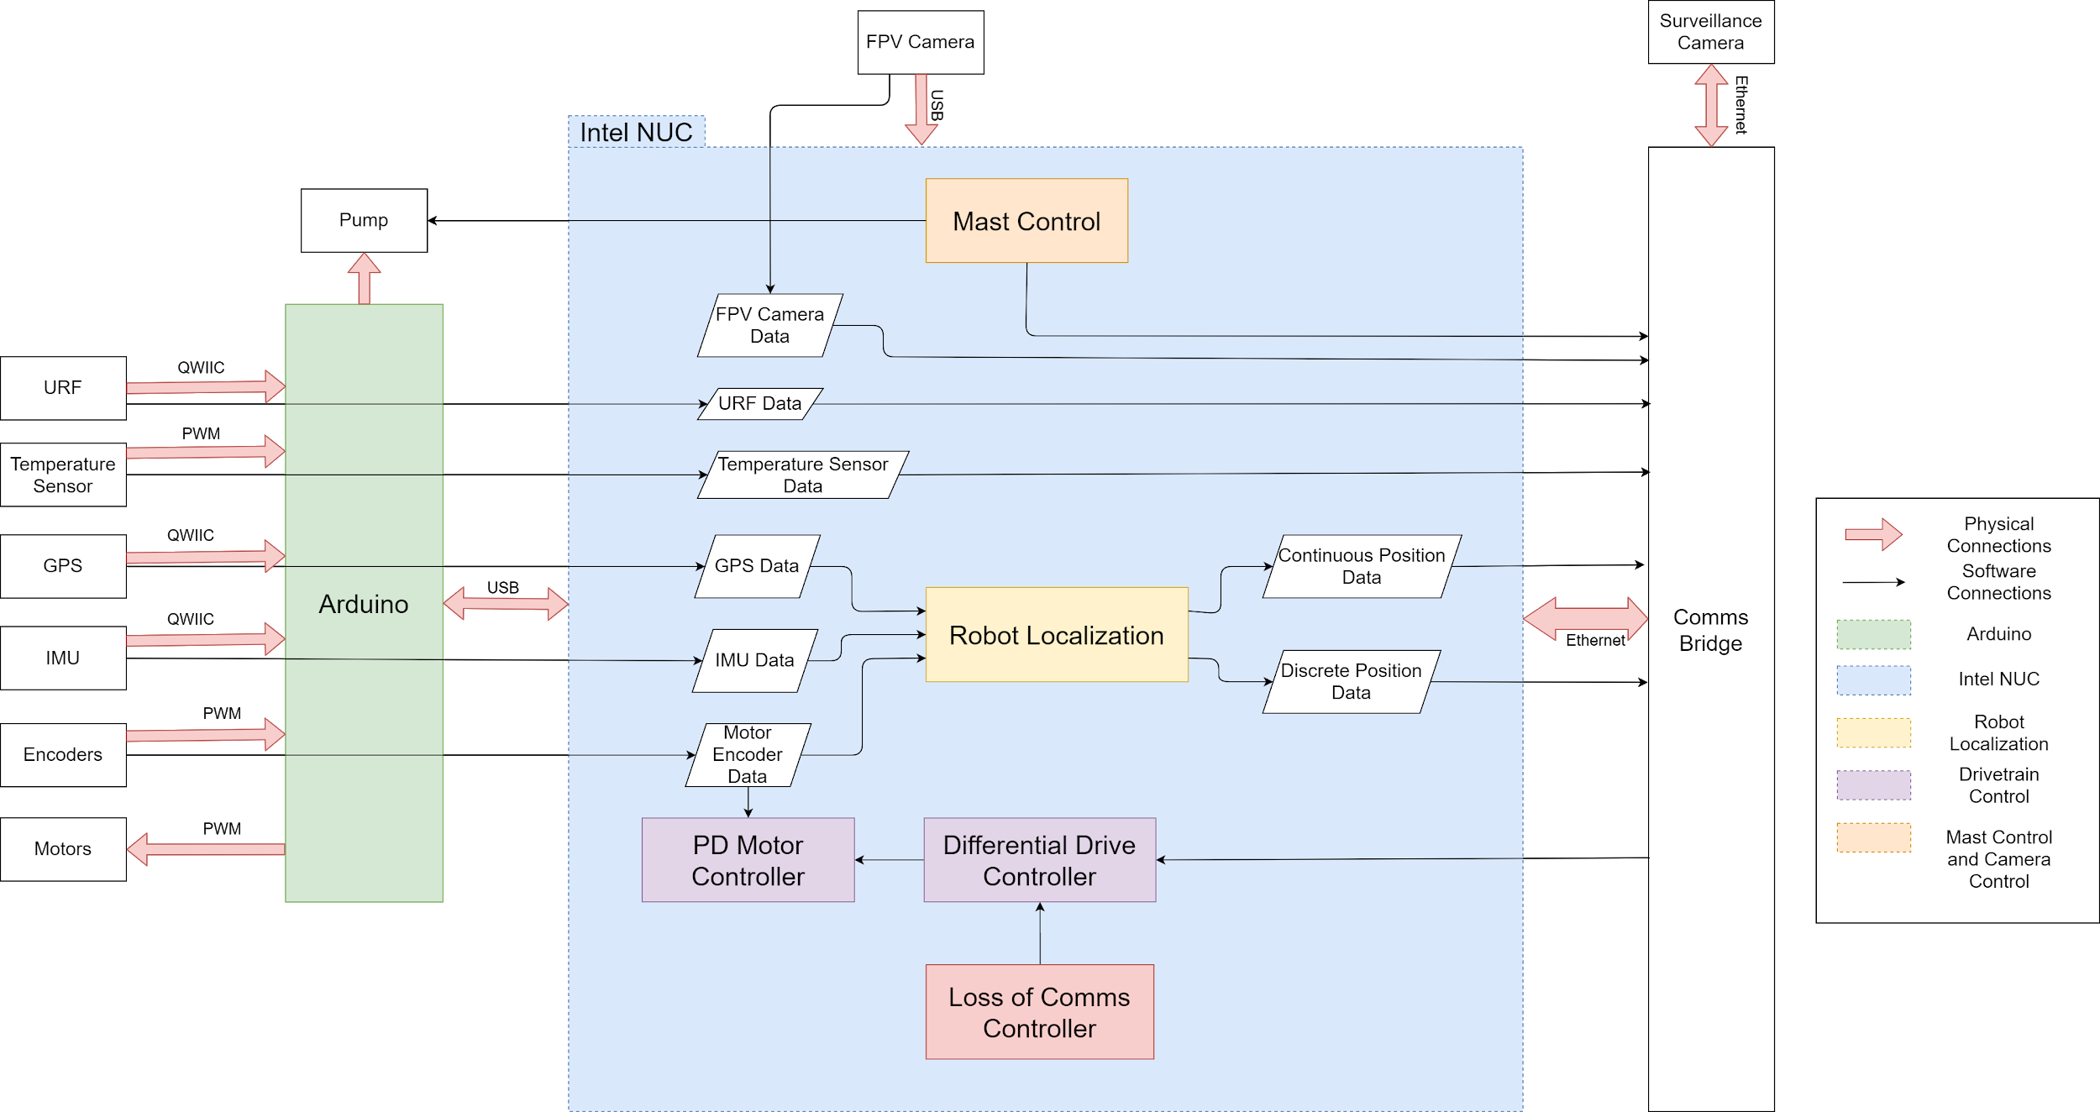
Integrated Software Diagram
Project Purpose and Objectives
Design Solution
Critical Project Elements
Design Requirements & their Satisfaction
Project Risks
Verification and Validation
Project Planning
Backup Slides
Notes:
Detailed circuit diagram?

Slide 24
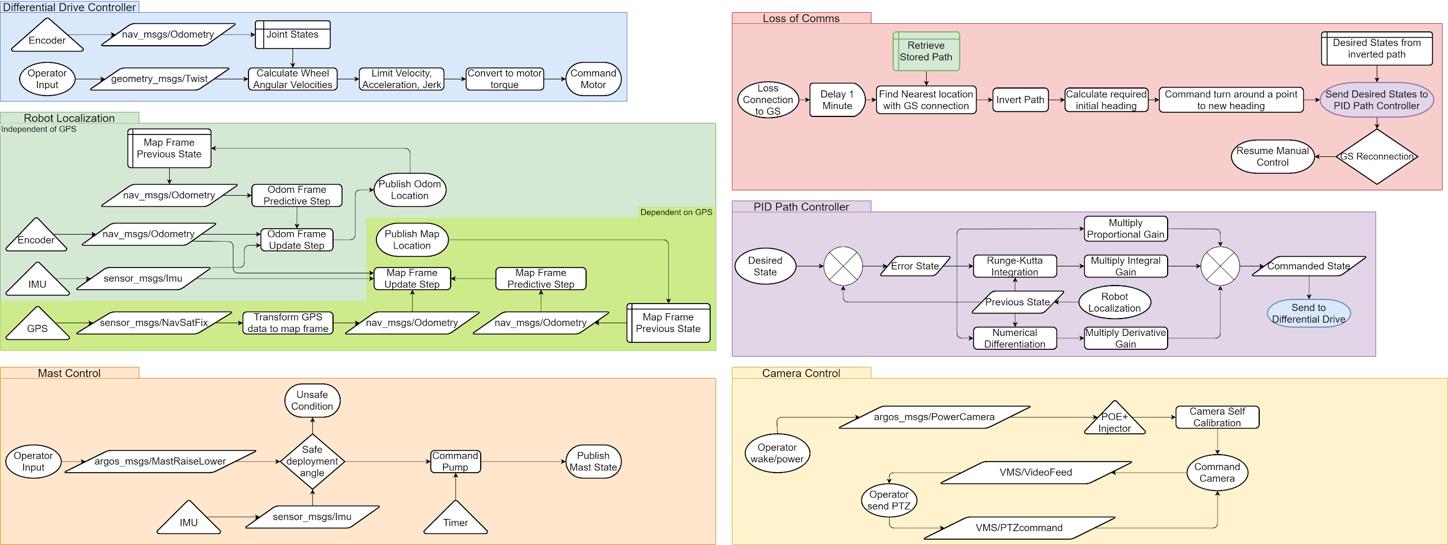
Software Diagram
Project Purpose and Objectives
Design Solution
Critical Project Elements
Design Requirements & their Satisfaction
Project Risks
Verification and Validation
Project Planning
Backup Slides
Notes:
Mention that the kalman filter gets us a mean distance from the true position of 3.61 m

Slide 25
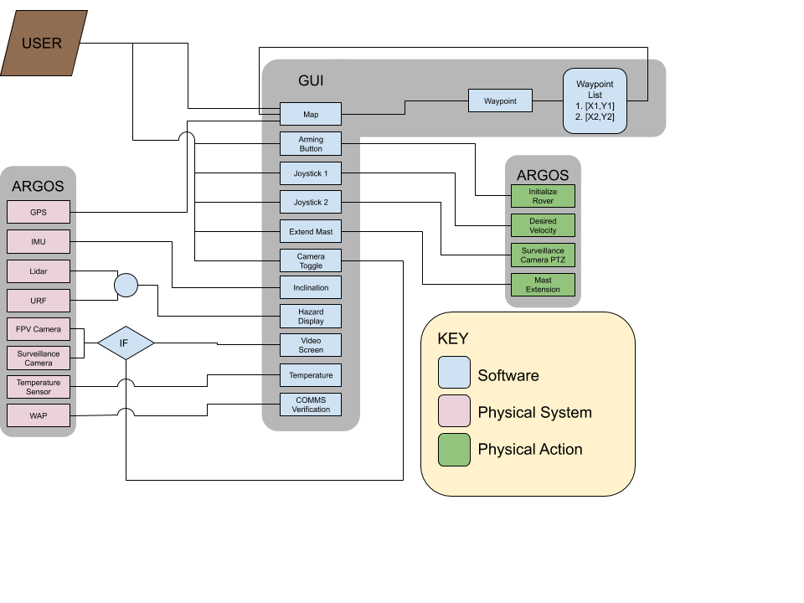
Ground Station UI
User Functions
Pick Waypoints
Arm Rover
Control Rover Movement
Command Surveillance PTZ
Extend/Retract Mast
Select Camera
GUI Displays
Map
Rover location
Waypoints
Video Feed
Hazards
Temperature
Inclination
Communication Verification
Project Purpose and Objectives
Design Solution
Critical Project Elements
Design Requirements & their Satisfaction
Project Risks
Verification and Validation
Project Planning
Backup Slides
Notes:
Various user functions that will be controlled through the graphical user interface. The graphical user interface will also display sensor information such as:

Slide 26
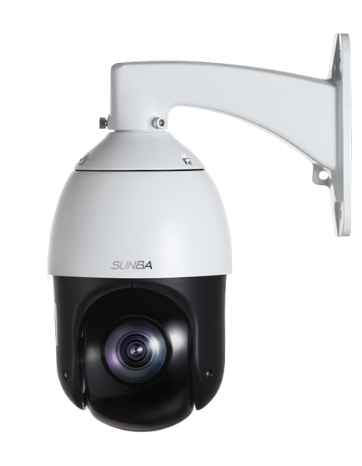
Surveillance Camera
Design Requirement: The surveillance camera shall have >100° field of view
Vertical sensor size 4.826mm from camera selection
Focal length 4.7 to 94mm ----> 41.44° to 2.17° FOV
Tilt 5° to -90°
Total FOV achieved: 136.44°
Horizontal sensor size 3.556mm from camera selection
Focal length 4.7 to 94mm ----> 54.35° to 2.94° FOV
Pan 360°
Total FOV achieved: 315°
Design Requirement: The camera shall provide operator with pictures and video of fire that occupy at least 20% of the vertical image.
Image Height needed for a 1m flame height is 5m
Distance achieved from camera selection 132m
5m
1m
Project Purpose and Objectives
Design Solution
Critical Project Elements
Design Requirements & their Satisfaction
Project Risks
Verification and Validation
Project Planning
Backup Slides
Notes:
Here we investigate the design requirement satisfaction of the surveillance camera
The first design requirement is that the camera needs to have greater than 100 degrees of field of view, allowing for pan and tilt to achieve this total field of view
With our 95 degrees of vertical tilt range we calculated that the camera’s total vertical field of view is about 136 degrees
Likewise with our 360 degree horizontal pan range we calculated that the camera’s total horizontal field of view is about 315 degrees
The other design requirement that was investigated was that the 1 meter fire front take a minimum of 20% of the vertical range of image
And this camera was calculated to be able to achieve that from anywhere up to 132 meters from the flame front

Slide 27
3. Mast Design Requirements and their Satisfaction
FR. 3 The child rover shall use a mast to take photos and video from a vantage point above the rover’s body.
Project Purpose and Objectives
Design Solution
Critical Project Elements
Design Requirements & their Satisfaction
Project Risks
Verification and Validation
Project Planning
Backup Slides
Notes:
Add functional requirement here

Slide 28
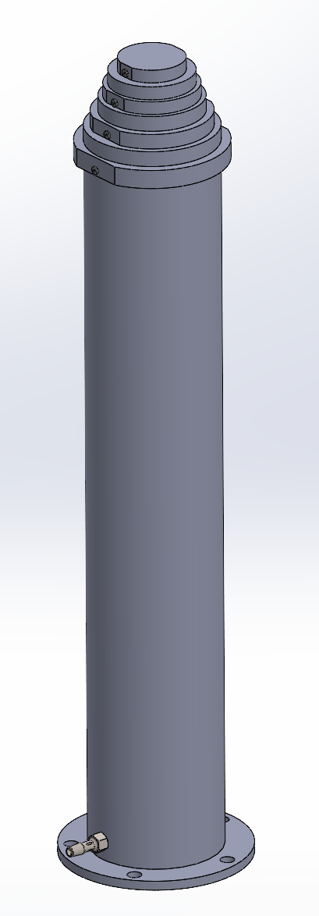
Hydraulic Telescoping Mast
1.86 m
Design Requirement: The child rover shall have a mast capable of extending to a height of 2m +/- 0.2m and retracting back down to its original height
Satisfied through model geometry:
Extension height = 1.86m
Compacted height = 0.56m
Design Requirement: The child rover shall have a mast capable of supporting 10kg of weight on the top
Satisfied through required pressure study
Assume:
Pressure force on top cap alone
Sliding friction force negligible
Result:
Pressure required: 265 kPa ~ 38 psi
Pump pressure: 145 psi
Mast rupture study result:
Pressure to rupture mast: 400 psi (FOS = 1.5)
0.56 m
Top Cap
F_{press} = P_{top}x A_{top}
F_{press} = W_{mast} + W_{cam}
Project Purpose and Objectives
Design Solution
Critical Project Elements
Design Requirements & their Satisfaction
Project Risks
Verification and Validation
Project Planning
Backup Slides
Notes:
So the mast has to satisfy first the design requirement that is can extend up to 2m and collapse down to less than half of its height within an error range of 0.2m
This is satisfied by the hydraulic mast design through the model’s geometry which results in an extension height of 1.86m and a compacted height of 0.56m
The other design requirement that the mast has to satisfy is it must support a load of 10kg at its top
This is satisfied by the internal fluid pressure balancing the force of gravity
We determined that the mast requires 38 psi to support a 10kg payload and the selected hydraulic pump pressure is

Slide 29
4. Communications Design Requirements and their Satisfaction
FR. 4 The child rover shall receive commands from both the ground station and the mother rover and transmit captured data to the ground station and the mother rover.
Project Purpose and Objectives
Design Solution
Critical Project Elements
Design Requirements & their Satisfaction
Project Risks
Verification and Validation
Project Planning
Backup Slides
Notes:
Add functional requirement here

Slide 30
Communications Design
Design Requirement: The child rover shall send time stamped video, image, and temperature data at a data rate up to 25Mbps
Comms (Rocket M2):
PtP and PtM bridging
Reduces Attenuation
Data Rate: 6-24Mbps w/ Modulation: 802.11g
Power Draw: 6.5 W
Monitors Data Rate & Signal Strength
POE-1 Injector:
24V output
12-56VDC input
Omni-Directional Antenna:
-2.4 GHz Frequency
-12 dBi Gain
2.4 GHz Omni-Directional Antenna
Interface
Data In/Out
Power Out
Rocket M2
POE Injector
MIPS 24Kc Processor
Data In/out
Power In
12V DC Data In/Out
Switch
Battery
KEY
Ethernet Internals Power Coaxial
Intel Nuc
Project Purpose and Objectives
Design Solution
Critical Project Elements
Design Requirements & their Satisfaction
Project Risks
Verification and Validation
Project Planning
Backup Slides
Notes:
-Not really the actual bandwidth ( probably around 10Mbs)
-one DC Male to open ends supple

Slide 31
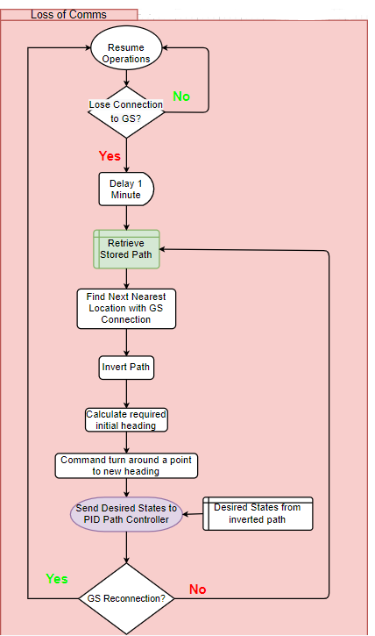
Communications - Loss of Connection
Design Requirement: Upon loss of communications, the child rover shall return to the last known GPS coordinate.
Assume:
The path ARGOS took to its current location is safe when reversed
Connectivity is location dependent
PID Controller
Built on existing ROS move_base package
Simulated in Gazebo
Result:
Maximum distance from path: 0.34 m < 0.65 m, one rover width
Project Purpose and Objectives
Design Solution
Critical Project Elements
Design Requirements & their Satisfaction
Project Risks
Verification and Validation
Project Planning
Backup Slides

Slide 32
Project Risks
Project Purpose and Objectives
Design Solution
Critical Project Elements
Design Requirements & their Satisfaction
Project Risks
Verification and Validation
Project Planning
Backup Slides
Notes:
Risks were specific and credible for this project, and reflect a good understanding of the issues of concern (9-10 pts)

Slide 33
Risk Introduction
Severity Risk Levels
Levels | Technical | Schedule
1 | Minimal or no impact | Minimal or no impact
2 | Slightly below expectations but still in operational requirements | More time required to complete task but still able to be completed by time deadline
3 | Slightly below operational requirements, needs minimal modification to design | Minimal schedule slip and completion deadline needs to be moved back
4 | Performance is at an unacceptable level, off ramp design or redesign of subsystem is necessary | Schedule is pushed back to an extent that the critical path of the project is delayed
5 | Unacceptable performance that does not have a solution | Key milestones in the project are unachievable
Risk Likelihood
Level | Likelihood
1 | Improbable
2 | Remote
3 | Ocasional
4 | Probable
5 | Frequent
Project Purpose and Objectives
Design Solution
Critical Project Elements
Design Requirements & their Satisfaction
Project Risks
Verification and Validation
Project Planning
Backup Slides

Slide 34
Risk Descriptions
Before Mitigation
Risk | Type | Description | Effect
1 | S | Software development will be time consuming and complex | System integration of subsystems will not be possible. Functional requirements cannot be met and verified. Key milestones will not be met.
2 | T | Design of hydraulic mast is complex and requires seals connecting each section to have tight manufacturing tolerances | If connecting points between sections have over pressurization fluid will leak and the mast will fail to stay extended. Off ramp or redesign of subsystem required
3 | T | Attenuation of signal causing loss of communication with GS | Unable to send live photos/videos back to GS. Redesign of subsystem required
4 | T | Motor failure due to overheating from stalling | Motors do not function properly and cannot complete mission. Redesign of subsystem required
 |  |  |  | Risk 1
 |  |  | Risk 2
 |  |  | Risk 3 Risk 4
Likelihood
1 2 3 4 5
1 2 3 4 5
Severity
Project Purpose and Objectives
Design Solution
Critical Project Elements
Design Requirements & their Satisfaction
Project Risks
Verification and Validation
Project Planning
Backup Slides
Notes:
Add risk matrix and remove totals

Slide 35
Risk Mitigation
After Mitigation
Risk | Mitigation Strategy
1 | Allocate enough time for code development with a sufficient time margin. Assigned four team members to development and frequent code reviews.
2 | Test rig has been designed and planned for testing next semester. If the test is not successful by 1/22/21 the off ramp design shall be used.
3 | Test attenuation early, utilize high gain antennas and ensure that the rover has the ability to return to the last known GPS point.
4 | Design for sufficient airflow to reach the motor and use vent plate spacers or heat sinks to achieve this.
 | Risk 2 |  | Risk 1
 | Risk 4
 | Risk 3
Likelihood
1 2 3 4 5
1 2 3 4 5
Severity
Project Purpose and Objectives
Design Solution
Critical Project Elements
Design Requirements & their Satisfaction
Project Risks
Verification and Validation
Project Planning
Backup Slides

Slide 36
Verification and Validation
Project Purpose and Objectives
Design Solution
Critical Project Elements
Design Requirements & their Satisfaction
Project Risks
Verification and Validation
Project Planning
Backup Slides
Notes:
Model development is appropriate, experiments to verify the design and validate model are clearly described, and characterization test objectives and methods are well-defined (17-20 pts)

Slide 37
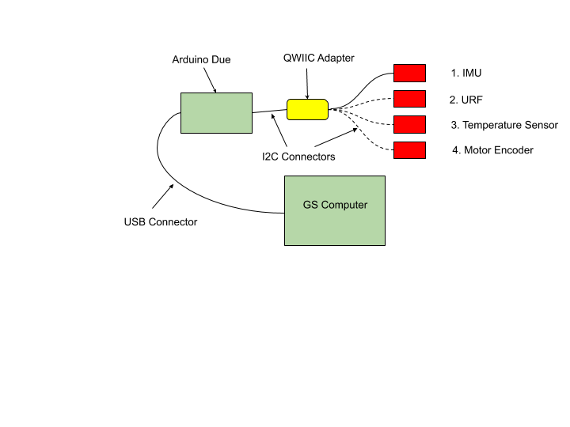
Verification and Validation: Sensors
Objective
Determine accuracy of each individual sensor and also data throughput for each sensor
Test Plan
Using the Arduino Due connect the IMU, Ultrasonic Range Finders, temperature sensor, and the motor encoders individually. When connected check for data throughput and complete sensor specific tests to look at sensor accuracy.
Requirements Verified
FR. 1 The child rover shall move from a starting location to a commanded location of interest and return back to the starting location.
The child rover shall be able to determine the ambient temperature within ± 5° C at the location of interest
Required Hardware
Sensors: IMU, 2 URF, Temperature Sensor, Motor Encoder
Arduino Due, Qwiic Adapter, I2C Serial Cable, USB connecter cable
GS Computer
Required Measurements
Data throughput of each sensor and total data throughput
Individual Sensor Measurements
IMU: Degree measurement is within ± ½ °
URF: Minimum detectable obstacle width ~0.5m
Temperature Sensor: Temperature is within 1K
Motor Encoder: Minimum detectable angle of 0.5237°
Test Location
AERO Building
Test Errors
Noise in the signals
Project Purpose and Objectives
Design Solution
Critical Project Elements
Design Requirements & their Satisfaction
Project Risks
Verification and Validation
Project Planning
Backup Slides

Slide 38
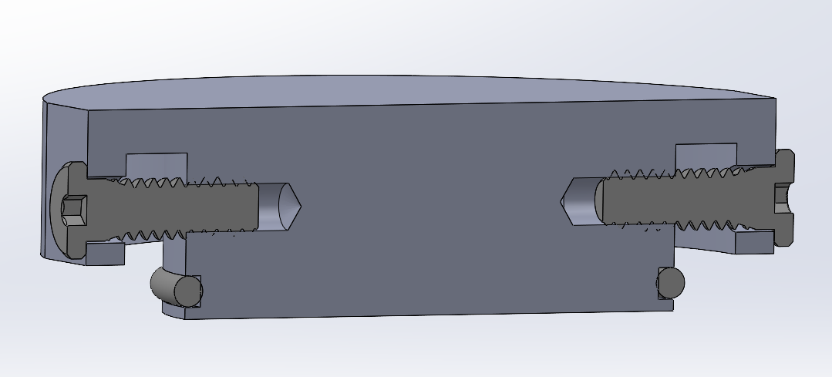
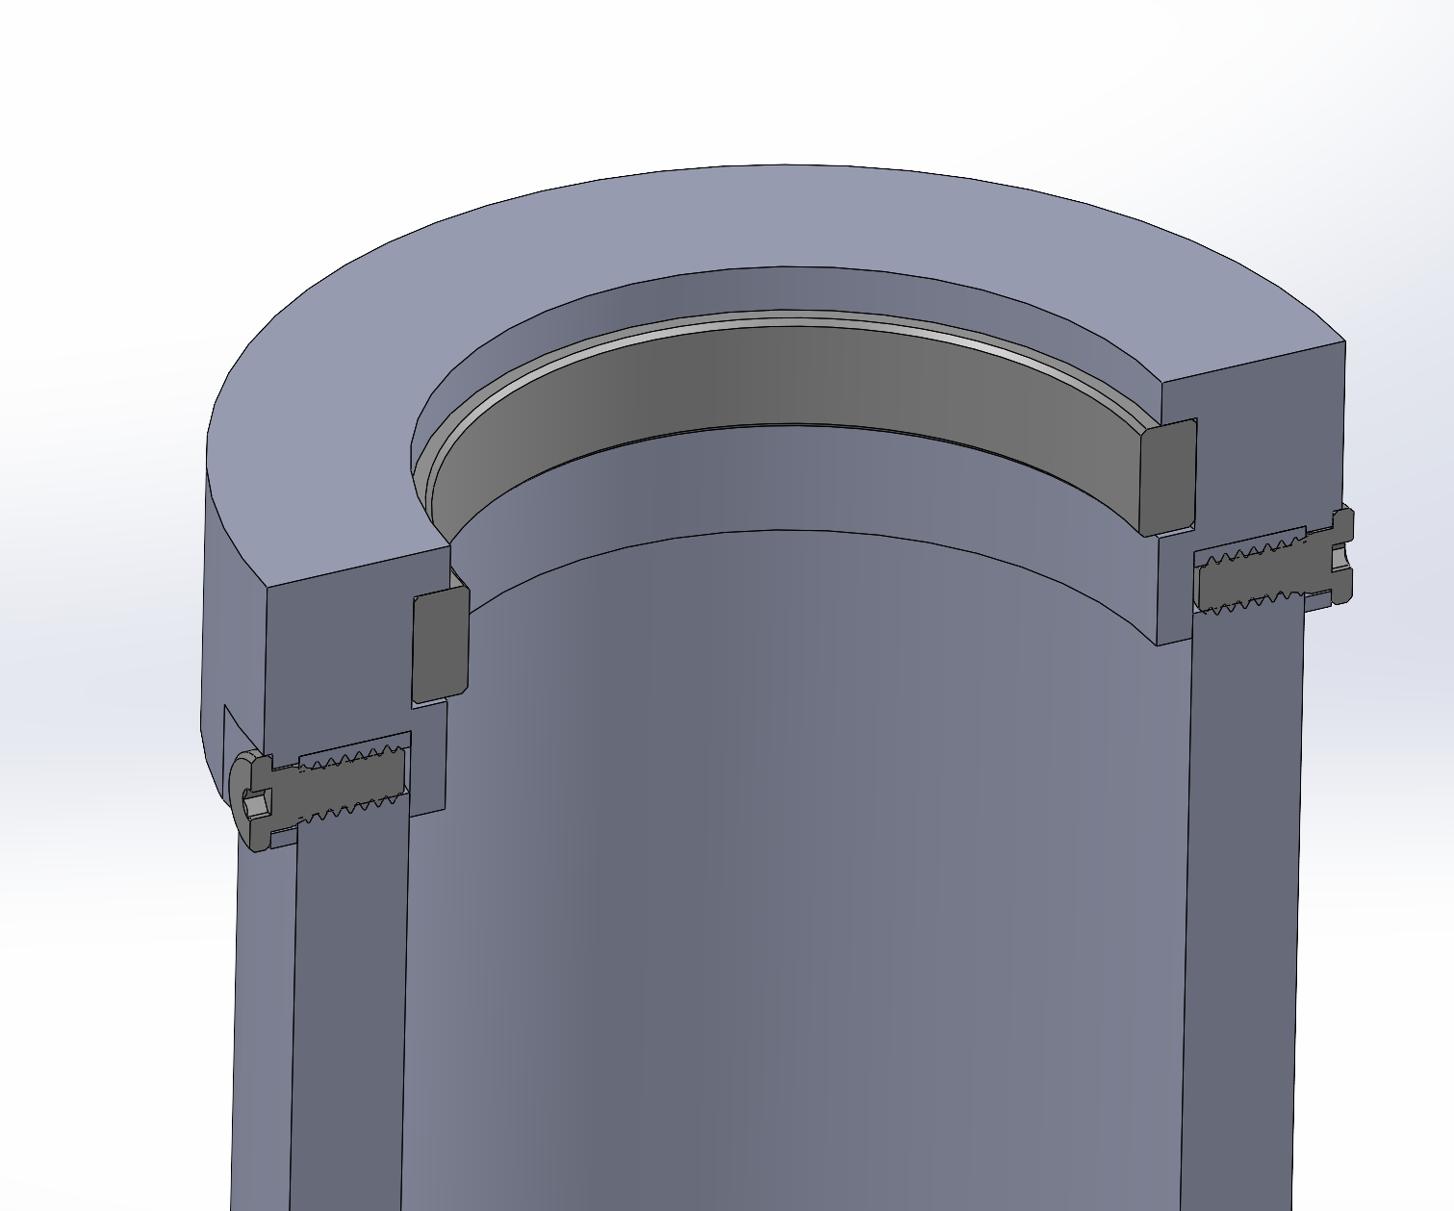
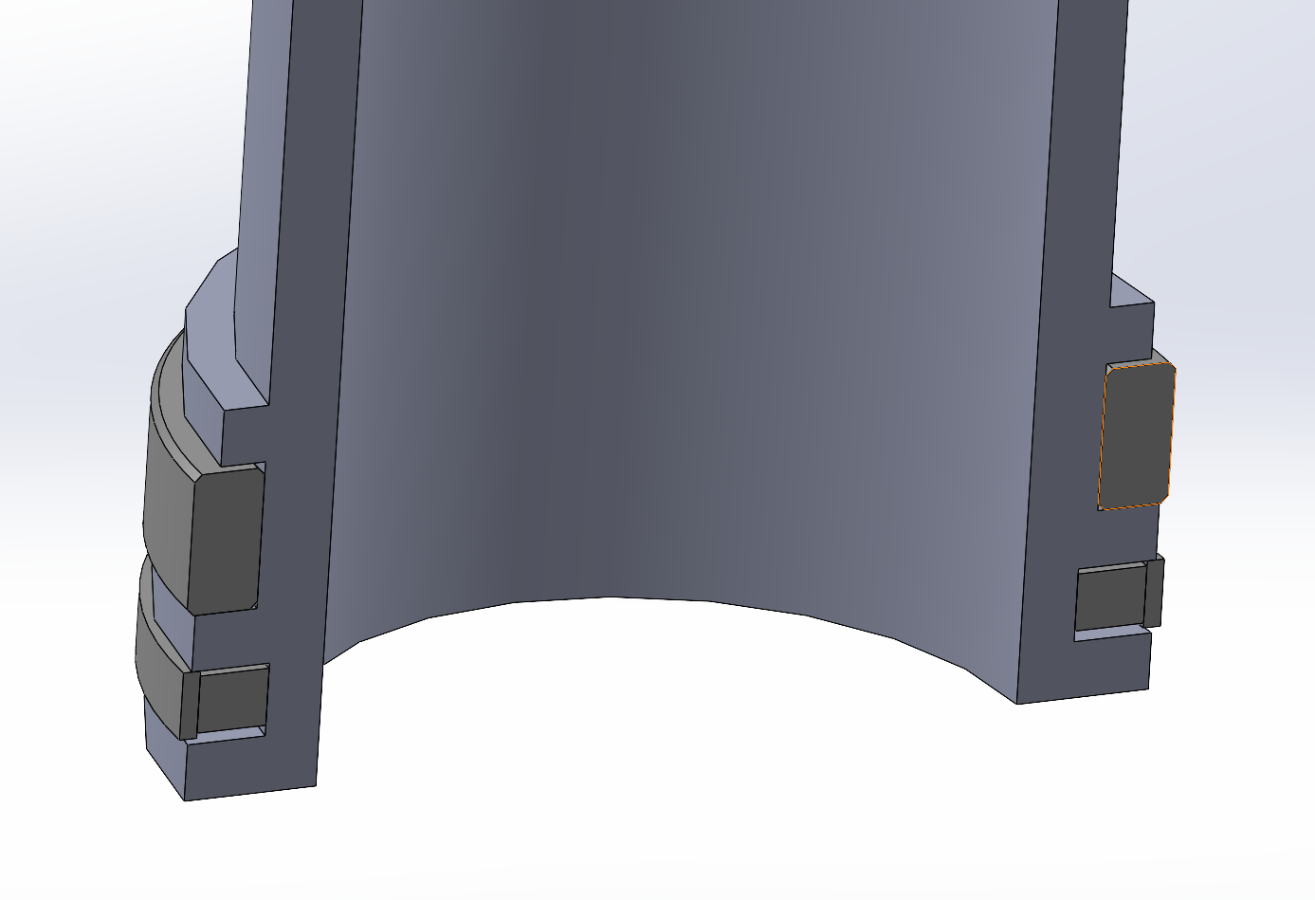
Verification and Validation: Mast Test Rig
Objective
Determine if small scale rig of the hydraulic mast can properly extend to full height.
Test Plan
Fill unextended mast with hydraulic oil, connect the mast to a reservoir filled with more hydraulic oil and connect the reservoir to pressurized air. Pressurize the reservoir to push the mast up until it reaches full extension and check for binding during extension. Depressurize and repeat cycle 20 times. Take apart the mast and check for degradation of the seals.
Requirements Verified
FR. 3 The child rover shall use a mast to take photos and video from a vantage point above the rover’s body.
Required Hardware
Two stage hydraulic mast
Air compressor
Oil reservoir
Two connector fittings
Hydraulic fluid
Required Measurements
Pressure inside of the mast
Test location
AERO Machine Shop
Test Errors
Scaling up from small scale mast to final mast design
Stage 1
Stage 2
O-Ring
Wear Ring
Wear Ring
Inlet Fitting
Dynamic Seal
Project Purpose and Objectives
Design Solution
Critical Project Elements
Design Requirements & their Satisfaction
Project Risks
Verification and Validation
Project Planning
Backup Slides

Slide 39
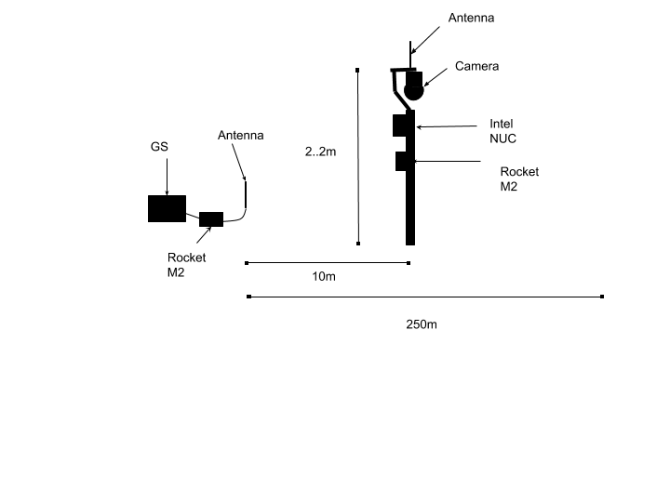
Verification and Validation: Live Video Feed
Objective
Determine if surveillance camera/FPV camera connected to Intel NUC and Rocket M2 through the network switch can send live video feed to GS at varying distances.
Test Plan
Connect 405-D20X PoE surveillance camera, Intel NUC, and point to multipoint transmitter through the network switch. Then move the camera from 10m to 250m by 30m increments away from the GS receiver.
Repeat for FPV camera
Requirements Verified
The child rover shall send time stamped video at a data rate up to 25Mbps
Required Hardware
405-D20X PoE surveillance camera
Intel NUC
2 Rocket M2
Ground Station computer
2.2m Tripod
2 Radio Antennas
Required Measurements
Data rate of communication system and camera at varying distances
Test Location
Outside(AERO Building Field)
Project Purpose and Objectives
Design Solution
Critical Project Elements
Design Requirements & their Satisfaction
Project Risks
Verification and Validation
Project Planning
Backup Slides

Slide 40
Project Planning
Project Purpose and Objectives
Design Solution
Critical Project Elements
Design Requirements & their Satisfaction
Project Risks
Verification and Validation
Project Planning
Backup Slides
Notes:
A clear plan for carrying out the project in the Spring term is required. Your presentation should include the following planning components: • Organizational Chart (OC), showing the leadership roles of all team members (2 pts) • Work Breakdown Structure (WBS), showing all the work products for the project (5 pts) • Work Plan (WP), showing the main tasks to accomplish the WBS products, along with their scheduling, in the form of a Gantt chart (5 pts) • Cost Plan (CP), in the form of a financial budget, for all major items in the project, highlighting uncertainties and corresponding budget margins. (4 pts)

Slide 41
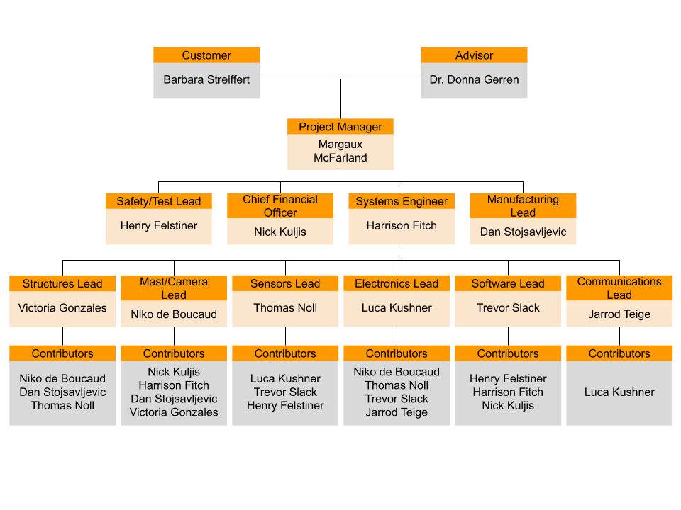
Organizational Chart
Project Purpose and Objectives
Design Solution
Critical Project Elements
Design Requirements & their Satisfaction
Project Risks
Verification and Validation
Project Planning
Backup Slides

Slide 42
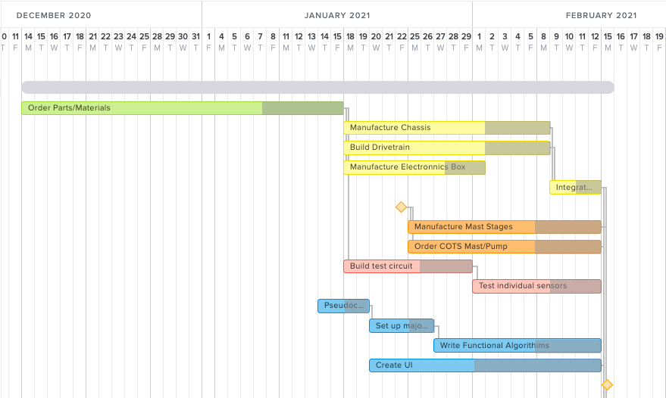
Work Plan
Decide on Mast Design
MSR
Project Purpose and Objectives
Design Solution
Critical Project Elements
Design Requirements & their Satisfaction
Project Risks
Verification and Validation
Project Planning
Backup Slides
Notes:
Add margins

Slide 43
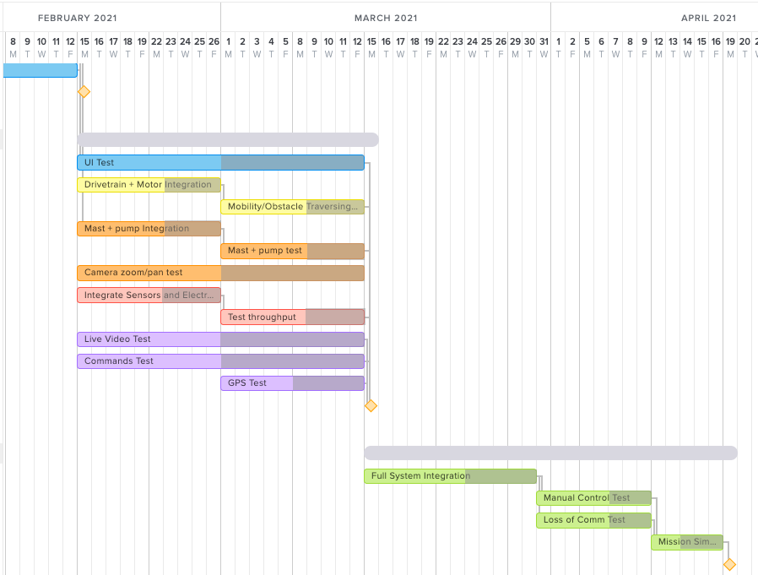
Work Plan
TRR
SFR
Project Purpose and Objectives
Design Solution
Critical Project Elements
Design Requirements & their Satisfaction
Project Risks
Verification and Validation
Project Planning
Backup Slides

Slide 44
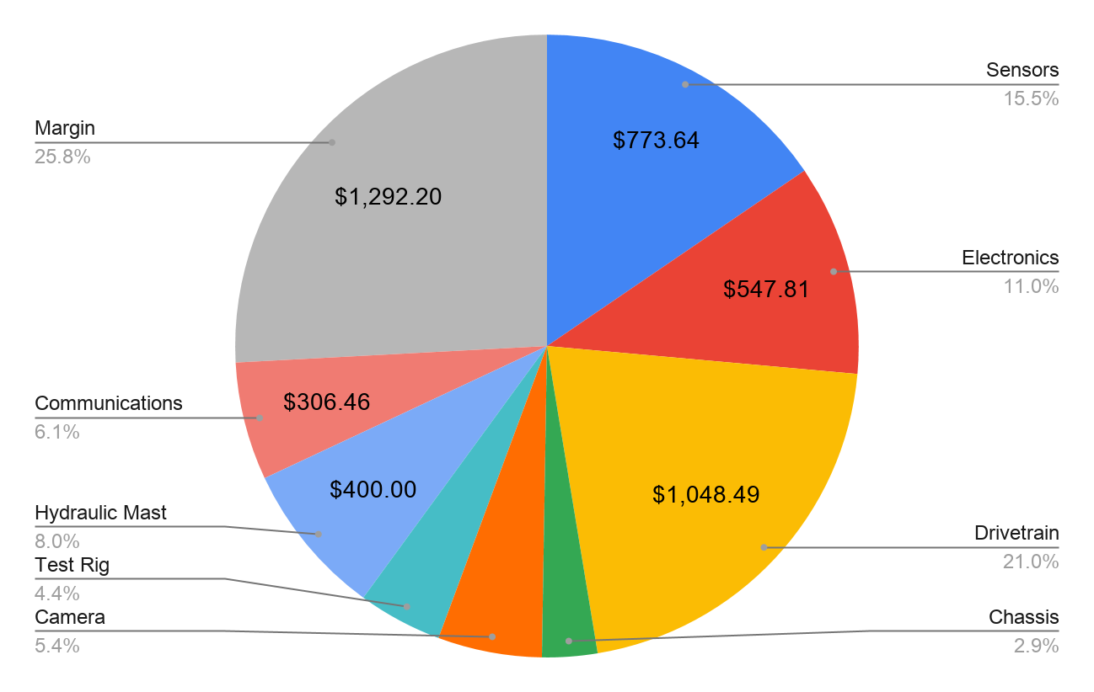
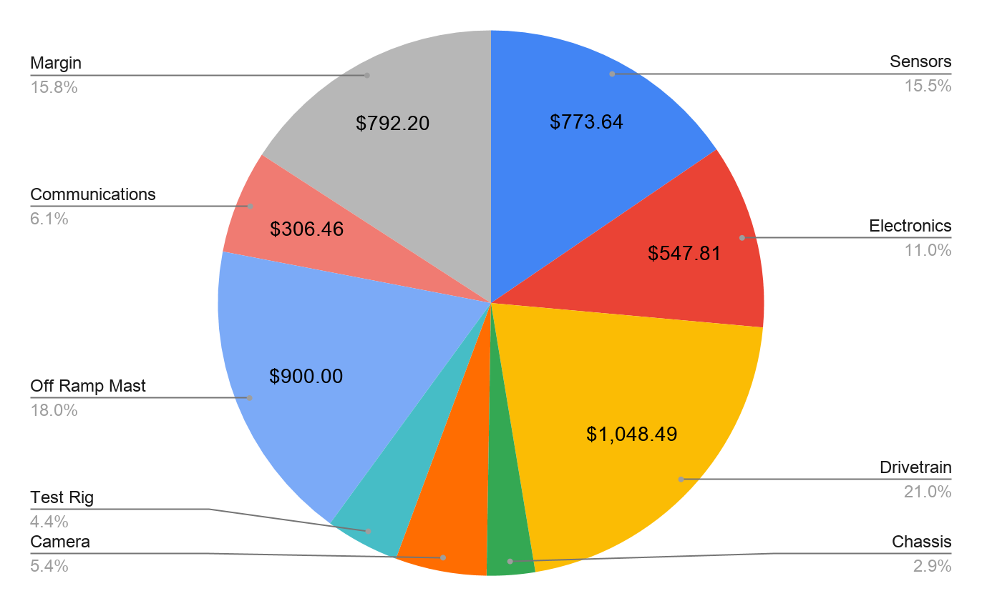
Cost Plan
Hydraulic Mast
Most expensive subsystems:
Drivetrain
Sensors
Estimated Total Cost = $3,707.80
Margin = $1,292.20
Off-Ramp COTS Mast
Most expensive subsystems:
Drivetrain
Mast
Estimated Total Cost = $4,207.80
Margin = $792.20
Project Purpose and Objectives
Design Solution
Critical Project Elements
Design Requirements & their Satisfaction
Project Risks
Verification and Validation
Project Planning
Backup Slides

Slide 45
Test Plan - Phase 1
Phase 1: pre-integration, all tests are independent
Phase 1
Subsystem(s) | Test | Date | Testing Facility | Equipment
Mast/Camera | Mast test rig - fit of tubes, leaks | 1/14/21 | Aero Machine Shop | Hydraulic fluid supply
Sensors | Individual sensor accuracy and throughput | 2/1/21 | Aero Building/at Home | Test circuit/controller
Software | UI of ground station with sample data | 2/15/21 | At Home | none
COMM | Live video Sample commands | 2/15/21 | Outside | Ground station
Project Purpose and Objectives
Design Solution
Critical Project Elements
Design Requirements & their Satisfaction
Project Risks
Verification and Validation
Project Planning
Backup Slides

Slide 46
Test Plan - Phase 2
Phase 2: somewhat integrated, depend on phase 1 tests
Phase 2
Subsystem(s) | Test | Date | Testing Facility | Equipment
Structures | Drivetrain + motor 360° turn 250m round trip Obstacle traversing | 3/1/21 | Aero Building/Outside | Power Supply, sample ~7cm tall obstacle
Mast/Camera | Pump + mast Camera zoom/pan | 3/1/21 | Aero Building/ at Home | Hydraulic fluid
Sensors/ Electronics/ Software | Throughput of all sensors UI of actual sensor data | 3/1/21 | Aero Building/at Home | Complete circuit
COMM/ Electronics | GPS + COMM | 3/1/21 | Outside | Ground station
Project Purpose and Objectives
Design Solution
Critical Project Elements
Design Requirements & their Satisfaction
Project Risks
Verification and Validation
Project Planning
Backup Slides

Slide 47
Test Plan - Phase 3
Phase 3: fully integrated, depend on phase 1 and 2 tests
Phase 3
Subsystem(s) | Test | Date | Testing Facility | Equipment
all | Manual control tests | 3/31/21 | Outside | N/A
all | Loss of communication - navigation test | 3/31/21 | Outside | N/A
all | Full mission simulation | 4/12/21 | Outside | N/A
Project Purpose and Objectives
Design Solution
Critical Project Elements
Design Requirements & their Satisfaction
Project Risks
Verification and Validation
Project Planning
Backup Slides

Slide 48
Questions?
Project Purpose and Objectives
Project Purpose and Objectives
Design Solution
Critical Project Elements
Design Requirements & their Satisfaction
Project Risks
Verification and Validation
Project Planning
Backup Slides
Backup Slides

Slide 49
References
“Appendix A: Flame Radiation Review.” Wiley Online Library, John Wiley & Sons, Ltd, 31 Jan. 2014, onlinelibrary.wiley.com/doi/pdf/10.1002/9781118903117.app1.
Belwariar, R., A* Search Algorithm Available: https://www.geeksforgeeks.org/a-search-algorithm/.
Chang, D L. Compressive Properties and Laser Absorptivity of Unidirectional Metal Matrix Composites. Aerospace Corporation, 30 Sept. 1986, apps.dtic.mil/dtic/tr/fulltext/u2/a176194.pdf.
Çengel Yunus A., and John M. Cimbala. Fundamentals of Thermal-Fluid Sciences. 4th ed., McGraw-Hill Higher Education, 2012.
“Estimating Winds for Fire Behavior.” National Wildfire Coordinating Group (NWCG), www.nwcg.gov/publications/pms437/weather/estimating-winds-for-fire-behavior.
Marder-Eppstein, E., “ROS Navigation,” ros.org Available: http://wiki.ros.org/navigation?distro=noetic.
“Materials Engineering,” Hydraulic oil ISO 68 [SubsTech] Available: https://www.substech.com/dokuwiki/doku.php?id=hydraulic_oil_iso_68.
N. Koenig and A. Howard, "Design and use paradigms for Gazebo, an open-source multi-robot simulator," 2004 IEEE/RSJ International Conference on Intelligent Robots and Systems (IROS) (IEEE Cat. No.04CH37566), Sendai, 2004, pp. 2149-2154 vol.3, doi: 10.1109/IROS.2004.1389727.
Project Purpose and Objectives
Project Purpose and Objectives
Design Solution
Critical Project Elements
Design Requirements & their Satisfaction
Project Risks
Verification and Validation
Project Planning
Backup Slides
Backup Slides
Notes:
Coms websites-https://agupubs.onlinelibrary.wiley.com/doi/pdf/10.1029/2002RS002758
https://www.ncbi.nlm.nih.gov/pmc/articles/PMC6572486/
https://ieeexplore.ieee.org/abstract/document/5751639
https://agupubs.onlinelibrary.wiley.com/doi/10.1029/2002RS002758

Slide 50
References (cont.)
Sandoval, Alexander, et al. “HERMES Manufacturing Status Review.” 4 Feb. 2019.
Stanford Artificial Intelligence Laboratory et al., 2018. Robotic Operating System, Available at: https://www.ros.org.
Storey, Theodore G, et al. “Crown Characteristics of Several Coniferous Tree Species.” U. S. Department of Agriculture Forest Service Division of Fire Research , Aug. 1955, doi:10.5962/bhl.title.122542.
“Trees and Shrubs for Mountain Areas - 7.423.” Colorado State University Extension, Colorado State University, 29 May 2018, extension.colostate.edu/topic-areas/yard-garden/trees-and-shrubs-for-mountain-areas-7-423/.
Wildland Fire Suppression Tactics Reference Guide. National Wildfire Coordinating Group, 1996.
“Wildfires: Interesting Facts and F.A.Q.” Natural History Museum of Utah.
Kim, A., 2019. Runcam Nano2 FPV Camera Review. [video] Available at: <https://www.youtube.com/watch?v=PvIURJ_74G0&t=203s> [Accessed 1 November 2020].
Maloney, S. (n.d.). Critical Seal Design Tolerance Charts. Retrieved from https://www.colonialseal.com/downloads/press-releases/Seal_tolerances.pdf
RPLIDAR A2 Introduction, Datasheet by Seeed Technology Co., Ltd. (n.d.). Retrieved November 20, 2020, from https://www.digikey.co.za/htmldatasheets/production/1984492/0/0/1/rplidar-a2-introduction-datasheet.html
Project Purpose and Objectives
Project Purpose and Objectives
Design Solution
Critical Project Elements
Design Requirements & their Satisfaction
Project Risks
Verification and Validation
Project Planning
Backup Slides
Backup Slides

Slide 51
Backup Slides
Project Purpose and Objectives
Design Solution
Critical Project Elements
Design Requirements & their Satisfaction
Project Risks
Verification and Validation
Project Planning
Backup Slides

Slide 52
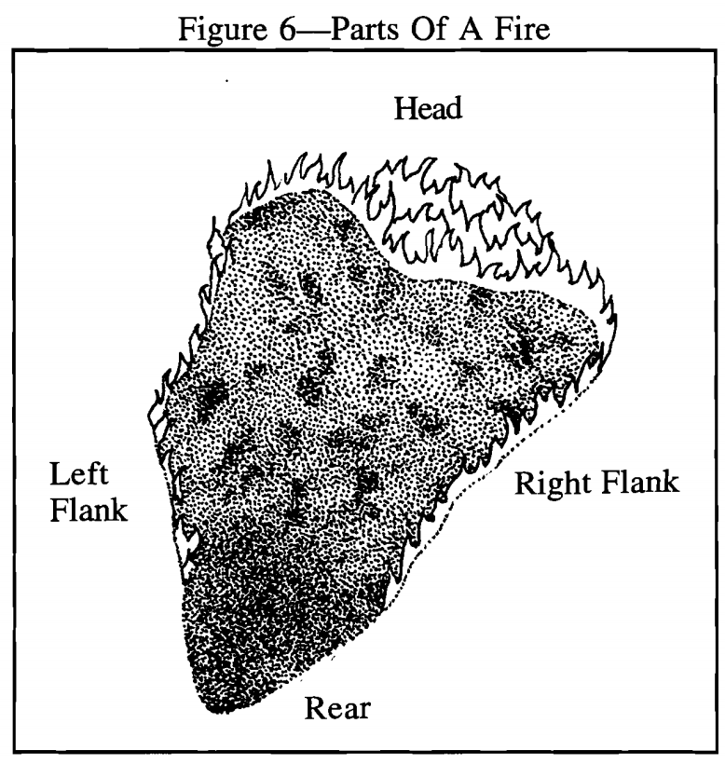
Definitions
Fireline : a trench cleared of any flammable material, dug at the edge of a forest or brush fire to halt the spread
Flame Front : the leading edge of the forest fire perimeter
Survey : to record video/take photos
Fire Surveillance : a subsystem of ARGOS consisting of the sensors and components needed to survey the fire line
Tipping Condition : condition when rover tips too far to the side or in the front or back and falls over
Obstacles : rocks, tree stumps, fallen branches, or other debris found on the forest floor which can have heights up to 7cm
Tree density : measure of how many trees will be in an area (# trees/acres )
Terrain : specification of the forest floor which ARGOS must traverse (detailed definition in backup slides)
Project Purpose and Objectives
Design Solution
Critical Project Elements
Design Requirements & their Satisfaction
Project Risks
Verification and Validation
Project Planning
Backup Slides

Slide 53
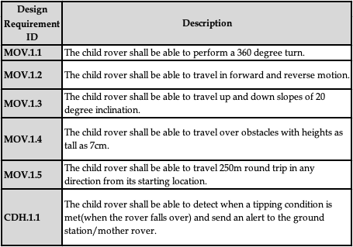
Design Requirements
FR. 1 The child rover shall move from a starting location to a commanded location of interest and return back to the starting location.
Project Purpose and Objectives
Design Solution
Critical Project Elements
Design Requirements & their Satisfaction
Project Risks
Verification and Validation
Project Planning
Backup Slides

Slide 54
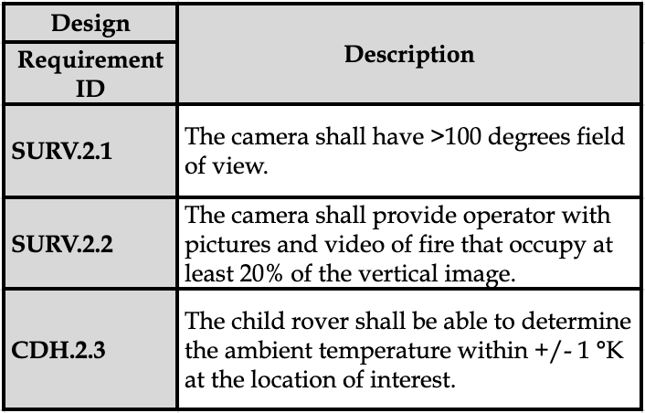
Design Requirements
FR. 2 The child rover shall take pictures, videos and ambient temperature data to be sent to the ground station.
Project Purpose and Objectives
Project Purpose and Objectives
Design Solution
Critical Project Elements
Design Requirements & their Satisfaction
Project Risks
Verification and Validation
Project Planning
Backup Slides
Backup Slides

Slide 55
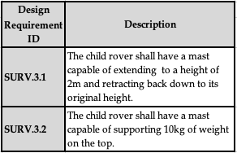
Design Requirements
FR. 3 The child rover shall use a mast to take photos and video from a vantage point above the rover’s body.
Project Purpose and Objectives
Project Purpose and Objectives
Design Solution
Critical Project Elements
Design Requirements & their Satisfaction
Project Risks
Verification and Validation
Project Planning
Backup Slides
Backup Slides

Slide 56
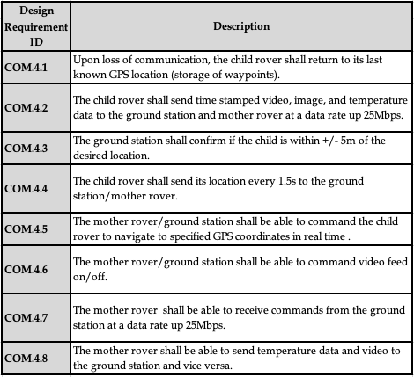
Design Requirements
FR. 4 The child rover shall receive commands from both the ground station and the mother rover and transmit captured data to the ground station and the mother rover.
Project Purpose and Objectives
Project Purpose and Objectives
Design Solution
Critical Project Elements
Design Requirements & their Satisfaction
Project Risks
Verification and Validation
Project Planning
Backup Slides
Backup Slides

Slide 57
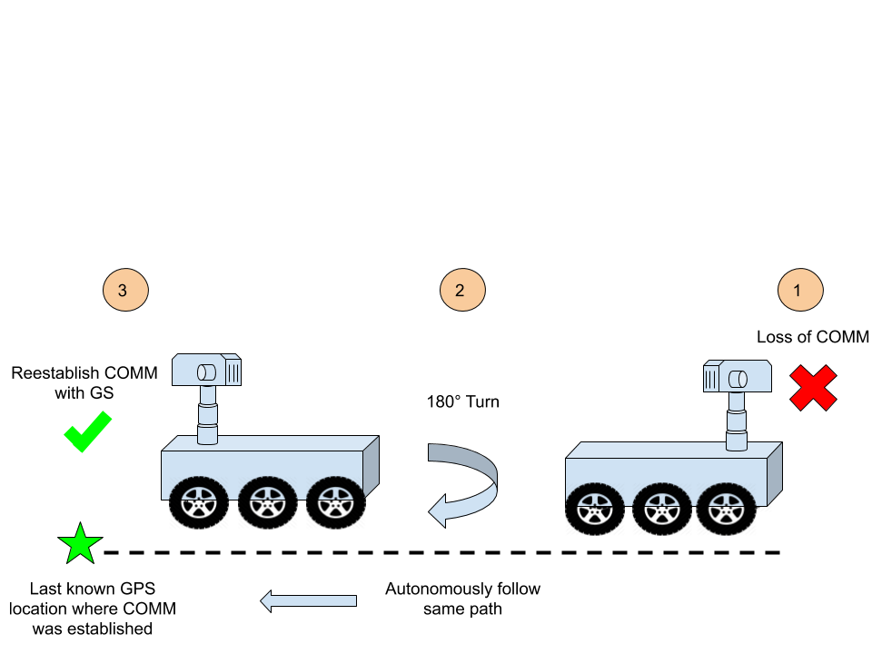
Loss of Communications CONOPS
Project Purpose and Objectives
Project Purpose and Objectives
Design Solution
Critical Project Elements
Design Requirements & their Satisfaction
Project Risks
Verification and Validation
Project Planning
Backup Slides
Backup Slides

Slide 58
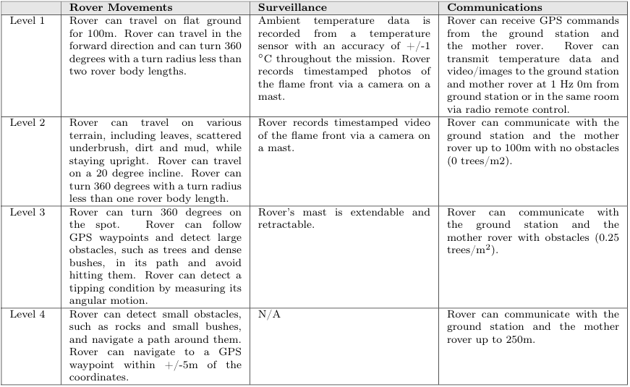
Levels of Success
Project Purpose and Objectives
Project Purpose and Objectives
Design Solution
Critical Project Elements
Design Requirements & their Satisfaction
Project Risks
Verification and Validation
Project Planning
Backup Slides
Backup Slides

Slide 59
Navigation Design Requirements
FR. 1 The child rover shall move from a starting location to a commanded location of interest and return back to the starting location.
Project Purpose and Objectives
Design Solution
Critical Project Elements
Design Requirements & their Satisfaction
Project Risks
Verification and Validation
Project Planning
Backup Slides
Notes:
Add functional requirement here

Slide 60
Obstacle Maneuvering
Validation:
What wheel radius is needed to maneuver a 7cm obstacle?
What is the max torque from the motors?
Given:
Total mass = 30 kg
𝜇 = 0.7 on ground and obstacle
Assumptions
Rolling without slipping
Negligible Roll Resistance
majority of mass Mass acting on front wheel
3 Cases
Torque:
F
Results:
Minimum Radius Required: 16.7 cm
Minimum Diameter Required: 33.4 cm
AndyMark 775 Motor and 57 Sport Gearbox
36:1 Gear Ratio
25.2 Nm Stall Torque
Swisher Wheels
34.925 cm Diameter
Project Purpose and Objectives
Design Solution
Critical Project Elements
Design Requirements & their Satisfaction
Project Risks
Verification and Validation
Project Planning
Backup Slides

Slide 61
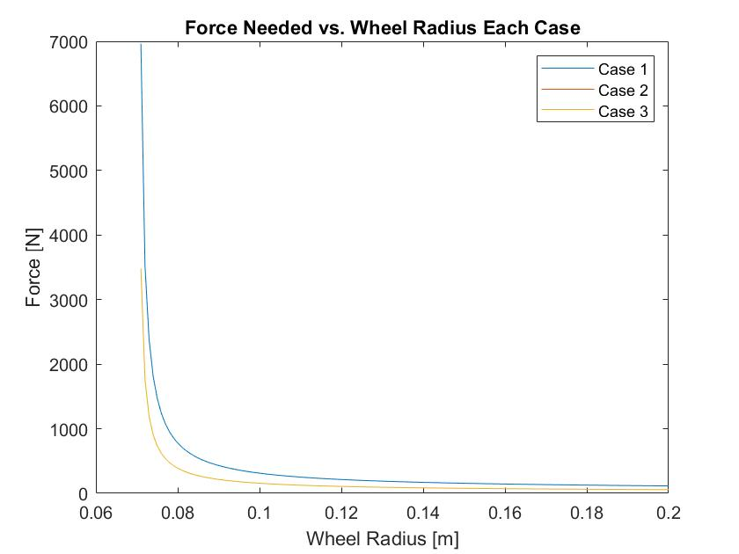
Drivetrain Feasibility - Obstacle Maneuvering
Project Purpose and Objectives
Design Solution
Critical Project Elements
Design Requirements & their Satisfaction
Project Risks
Verification and Validation
Project Planning
Backup Slides

Slide 62
Drivetrain - Incline Maneuvering
Validation:
Can this Child Rover maneuver up inclines of at least 20 degrees
Given:
Total mass = 30 kg
𝜇 = 0.7 for kinetic friction of the ground and Child Rover
Angle of incline is examined from 0° to 20°
Assumptions
Estimated center of mass is a fair approximation
2-Dimensional Rigid Body
Torque Needed For each Wheel To move up Incline
Ff=m*g(𝝁*cos(θ)-sin(θ))
𝛕=Ff*r
Project Purpose and Objectives
Design Solution
Critical Project Elements
Design Requirements & their Satisfaction
Project Risks
Verification and Validation
Project Planning
Backup Slides

Slide 63
Drivetrain - Power Study
Measurement | Level Ground | Inclined Slope | Obstacles (7 cm)
Time | 16.4 min | 6 min | 2 min
Torque | 6.4 Nm | 8.11 Nm | P17.98 Nm
Capacity needed | 7.05 Wh | 6.86 Wh | 6.25 Wh
Validation:
How much Power will the motors need to use?
How long will the motors be able to run?
Given:
250 m round trip
Assumptions
Motor Efficiency varies on Torque from specifications sheet
30 Obstacles present during trip (4 seconds tp drove over 1 obstacle)
6 total inclines of 20 degrees that take about 1 minute each to drive up
Equations: ⍵ = v*r while varying velocity we get a power
P = ⍵*𝛕 and the capacity C = P*time (in hours)
Project Purpose and Objectives
Design Solution
Critical Project Elements
Design Requirements & their Satisfaction
Project Risks
Verification and Validation
Project Planning
Backup Slides

Slide 64
2. Data Acquisition Design Requirements
FR. 2 The child rover shall take pictures, videos and ambient temperature data to be sent to the ground station.
Project Purpose and Objectives
Design Solution
Critical Project Elements
Design Requirements & their Satisfaction
Project Risks
Verification and Validation
Project Planning
Backup Slides
Notes:
Add functional requirement here

Slide 65
Camera FOV and Percentage
5m
1m
Project Purpose and Objectives
Project Purpose and Objectives
Design Solution
Critical Project Elements
Design Requirements & their Satisfaction
Project Risks
Verification and Validation
Project Planning
Backup Slides
Backup Slides

Slide 66
Software - Localization
Validation:
Can ARGOS determine its position to within +/- 5m
Given:
Extended Kalman Filter (EKF)
Encoders, IMU, GPS
Linear Velocity = [-1.75,1.75] m/s
Angular Velocity = [-1,1] rad/s
Assumptions:
Gaussian noise
No Slip
EKF filters out large deviations i.e. slip conditions
Study | Feasibility Outcome | Maximum Allowable Difference
Determine Position | ± 3.61 m | ± 5 m
Feasible
Project Purpose and Objectives
Design Solution
Critical Project Elements
Design Requirements & their Satisfaction
Project Risks
Verification and Validation
Project Planning
Backup Slides

Slide 67
Software Diagram
Study | Feasibility Outcome | Maximum Allowable Difference
Determine Position | ± 3.61 m | ± 5 m
Project Purpose and Objectives
Design Solution
Critical Project Elements
Design Requirements & their Satisfaction
Project Risks
Verification and Validation
Project Planning
Backup Slides
Notes:
Mention that the kalman filter gets us a mean distance from the true position of 3.61 m

Slide 68
Temperature Sensor
Design Requirement: The child rover shall be able to determine the ambient temperature within ±1 °K at the location of interest.
Temperature accuracy achieved ± 0.75° K
Study | Feasibility Outcome | Required Min/Max
Maximum Temperature | 370ºK | 306ºK
Accuracy | ± 0.75ºK | ± 1ºK
SparkFun Digital Temperature Sensor - TMP117 (Qwiic)
Project Purpose and Objectives
Design Solution
Critical Project Elements
Design Requirements & their Satisfaction
Project Risks
Verification and Validation
Project Planning
Backup Slides
Notes:
Detailed circuit diagram?
Repeat what each design requirement was
Mention studies were done with updated assumptions
Mention three cases for obstacles: collision on front, middle, and back wheels
Expand on how power study was done if a diagram doesn’t make sense
Might need a separate slide for power study if you think that would work better

Slide 69
3. Mast Design Requirements
FR. 3 The child rover shall use a mast to take photos and video from a vantage point above the rover’s body.
Project Purpose and Objectives
Design Solution
Critical Project Elements
Design Requirements & their Satisfaction
Project Risks
Verification and Validation
Project Planning
Backup Slides
Notes:
Add functional requirement here

Slide 70
Off-Ramp: COTS Pneumatic Mast
Pressure Sensor
Sensing Range: 0-1034 kPa (0-150 psi)
Outputs: 0.5-4.5V linear voltage
Cost: $25
Take off-ramp by 1/22/2021 w/ test rig result
Pneumatic Mast
Height Range: 1m - 2.2m
~321 kPa (46.6 psi) to lift 10 kg
Capacity: 13.6 kg
Cost: $640
Air Compressor
~1034 kPa (150 psi) Max
12V, 23 Amps max
Cost: $202
Solenoid Valve
12 V, 0.54 Amps
689 kPa (100 psi)
Cost: $10
Relief Valve
345 kPa (50 psi) blow off pressure
Cost: $8
Project Purpose and Objectives
Design Solution
Critical Project Elements
Design Requirements & their Satisfaction
Project Risks
Verification and Validation
Project Planning
Backup Slides
Notes:
What additional info should I have or take away from this slide (I ripped it straight from delta pdr)
Mention when we would switch to COTS
Oh ya thanks

Slide 71
Pneumatic Telescoping Mast
2.2 m
Design Requirement: The child rover shall have a mast capable of extending to a height of 2m +/- 0.2m and retracting back down to its original height
Satisfied through model geometry:
Extension height = 2.2m
Compacted height = 1m
Design Requirement: The child rover shall have a mast capable of supporting 10kg of weight on the top
Satisfied through manufacturer specifications
Result:
Pressure required: 324 kPa ~ 47 psi
Air compressor pressure: 150 psi
Maximum mast load capacity: 13.6 kg
Top Cap
F_{press} = P_{top}x A_{top}
F_{press} = W_{mast} + W_{cam}
Project Purpose and Objectives
Design Solution
Critical Project Elements
Design Requirements & their Satisfaction
Project Risks
Verification and Validation
Project Planning
Backup Slides
Notes:
Detailed circuit diagram?
Repeat what each design requirement was
Mention studies were done with updated assumptions
Mention three cases for obstacles: collision on front, middle, and back wheels
Expand on how power study was done if a diagram doesn’t make sense
Might need a separate slide for power study if you think that would work better

Slide 72
Hydraulic Mast Pressure Study
Design Requirement:
Validation:
Determine pump pressure required to fully extend mast
F_{press}
Given:
Maximum mass of camera: 10kg
Maximum mass of mast: 10kg
Assumptions:
Upward pressure force acts on top cap only
Sliding friction forces negligible
Top Cap
W_{cam}
W_{mast}
F_{press} = P_{top}x A_{top}
F_{press} = W_{mast} + W_{cam}
Result:
P_{req} = 264,810 Pa ~ 40 psi
P_{pump}= 725 psi
Bursting and shearing between sections analyzed in backup slides
Project Purpose and Objectives
Design Solution
Critical Project Elements
Design Requirements & their Satisfaction
Project Risks
Verification and Validation
Project Planning
Backup Slides
Notes:
Add functional requirement here

Slide 73
Mast Aerodynamic force
Validation
Can the mast sustain winds without tipping
Assumptions
Wind speeds at 7m/s
Drag ≈ 2.9N
Project Purpose and Objectives
Project Purpose and Objectives
Design Solution
Critical Project Elements
Design Requirements & their Satisfaction
Project Risks
Verification and Validation
Project Planning
Backup Slides
Backup Slides
Notes:
http://gyre.umeoce.maine.edu/data/gomoos/buoy/php/variable_description.php?variable=wind_speed
https://en.wikipedia.org/wiki/Reynolds_number

Slide 74
4. Communications Design Requirements
FR. 4 The child rover shall receive commands from both the ground station and the mother rover and transmit captured data to the ground station and the mother rover.
Project Purpose and Objectives
Design Solution
Critical Project Elements
Design Requirements & their Satisfaction
Project Risks
Verification and Validation
Project Planning
Backup Slides
Notes:
Add functional requirement here

Slide 75
Communications-Bandwidth
2.4 Ghz Radio Frequency
Data Rate: 6-24 Mbps
Validation
Has bandwidth to send/receive all data
Assumption
Data Rate will be on the lower end
Bandwidth
Video feed to GS(Mast Camera): 5.7 Mbps
Operator Commands from GS to ARGOS: ~16 bits
Sensor data from ARGOS to GS: ~115,320 bits
Maximum Bandwidth: 5.7115 Mbps
Insert GS,ARGOS,MR
Project Purpose and Objectives
Design Solution
Critical Project Elements
Design Requirements & their Satisfaction
Project Risks
Verification and Validation
Project Planning
Backup Slides
Notes:
GPS:~24 bits
Motor Encoder: 12x4 bits
IMU: ~16 bits
Lidar: 115200 bps
Ultrasonic range finder: 8x4 bit
User command: ~ 16 bits
Feedback control block diagram

Slide 76
Communications- Loss of Comms
Simulated in Gazebo
Distance travelled: 25 m
Linear Velocity: 0.5 m/s
Move_base package
Input: waypoints
Algorithm: PID control loop
Output: Geometry_msgs/Twist to the differential drive controller
Project Purpose and Objectives
Design Solution
Critical Project Elements
Design Requirements & their Satisfaction
Project Risks
Verification and Validation
Project Planning
Backup Slides
Notes:
GPS:~24 bits
Motor Encoder: 12x4 bits
IMU: ~16 bits
Lidar: 115200 bps
Ultrasonic range finder: 8x4 bit
User command: ~ 16 bits
Feedback control block diagram

Slide 77
Communications- Loss of Comms
Simulated in Gazebo
Distance travelled: 25 m
Linear Velocity: 0.5 m/s
Move_base package
Input: waypoints
Algorithm: PID control loop
Output: Geometry_msgs/Twist to the differential drive controller
Project Purpose and Objectives
Design Solution
Critical Project Elements
Design Requirements & their Satisfaction
Project Risks
Verification and Validation
Project Planning
Backup Slides
Notes:
GPS:~24 bits
Motor Encoder: 12x4 bits
IMU: ~16 bits
Lidar: 115200 bps
Ultrasonic range finder: 8x4 bit
User command: ~ 16 bits
Feedback control block diagram

Slide 78
Baseline Design: Sensors - FPV Camera
Meets Level of Autonomy 1
Runcam Nano 2 FPV Camera
Input 3V to 5V
1.8mm or 2.1mm lens
155 to 170 Degrees FOV
700 TVL Resolution or 976*494 pixels
Cost : $20
Allows Operator to have first person view of rover to allow for operator control
Project Purpose and Objectives
Project Purpose and Objectives
Design Solution
Critical Project Elements
Design Requirements & their Satisfaction
Project Risks
Verification and Validation
Project Planning
Backup Slides
Backup Slides

Slide 79
Baseline Design: Sensors - GPS
Meets Level of Autonomy 1
SparkFun GPS-RTK-SMA Breakout - ZED-F9P (Qwiic)
Input: 5V/3.3V @ 68mA to 130mA
Output: I2C
Receives both L1C/A and L2C bands
Horizontal Accuracy:
2.5m without RTK(Real Time Kinematic)
0.010m with RTK(Real Time Kinematic)
Cost: $219.95
Purpose
Detect rovers position for waypoint navigation
Sparkfun ZED-F9P
Project Purpose and Objectives
Project Purpose and Objectives
Design Solution
Critical Project Elements
Design Requirements & their Satisfaction
Project Risks
Verification and Validation
Project Planning
Backup Slides
Backup Slides

Slide 80
Baseline Design: Sensors - Motor Encoder
Meets Level of Autonomy 2
AndyMark 3749 Mag Encoder
Input: 5V @ 40mA
Output: 1024 bin PWM
Rating: 30,000 RPM
Cost: $47
Purpose
Determine angular velocity and position of each motor shaft to determine rover position and velocity.
Project Purpose and Objectives
Project Purpose and Objectives
Design Solution
Critical Project Elements
Design Requirements & their Satisfaction
Project Risks
Verification and Validation
Project Planning
Backup Slides
Backup Slides

Slide 81
Baseline Design: Sensors - IMU
Meets Level of Autonomy 1
SparkFun VR IMU Breakout - BNO080 (Qwiic)
Input: 1.65V-3.6V
Output: I2C
Rotation Vector
Dynamic Error: 2.5°
Static Error: 1.5°
Cost: $34.95
Purpose
Detect rovers inclination for possible tipping condition
Sparkfun BNO080
Project Purpose and Objectives
Project Purpose and Objectives
Design Solution
Critical Project Elements
Design Requirements & their Satisfaction
Project Risks
Verification and Validation
Project Planning
Backup Slides
Backup Slides

Slide 82
Baseline Design: Sensors - LiDAR
Meets Level of Autonomy 3
SLAMTEC RPLIDAR A2
Range: 0.2m to 8m ± 0.005m
FOV: 360º ± 0.25
Limited to <180º
Cost: $320
Purpose
Detect obstacles during autonomous navigation
SLAMTEC A2M8
Project Purpose and Objectives
Project Purpose and Objectives
Design Solution
Critical Project Elements
Design Requirements & their Satisfaction
Project Risks
Verification and Validation
Project Planning
Backup Slides
Backup Slides
Notes:
Sampling: 10 Hz - 8000 per time samples

Slide 83
Baseline Design: Sensors - Ultrasonic Range Finder
Meets Level of Autonomy 3
Zio Ultrasonic Distance Sensor HC-SR04 from Sparkfun
Range: 0.02m to 4m
FOV: 15º
Output: I2C
Cost: $14
Purpose
Detect obstacles in LiDAR blind spots during autonomous navigation
Sparkfun HC-SR04
Project Purpose and Objectives
Project Purpose and Objectives
Design Solution
Critical Project Elements
Design Requirements & their Satisfaction
Project Risks
Verification and Validation
Project Planning
Backup Slides
Backup Slides
Notes:
Output: I2C
Sampling: 60 kHz
Figure source: https://www.google.com/url?sa=i&url=http%3A%2F%2Fwww.kerrywong.com%2F2011%2F01%2F22%2Fa-sensitive-diy-ultrasonic-range-sensor%2F&psig=AOvVaw0UVOa2lOg5_UrfR0_aBsa6&ust=1604424042032000&source=images&cd=vfe&ved=0CA0QjhxqFwoTCPDKqLuv5OwCFQAAAAAdAAAAABAD

Slide 84
Navigation Sensors: FPV Camera
Validation
Can an operator detect an obstacle and send a stop command before colliding with it?
Assumptions
Velocity = 3m/s
Kinetic Friction coefficient 0.35
Full skid stop and turning not allowed
FOS = 1.5
7.6m
Source | Latency | Reference
Camera to GS | 50 ms | Similar components test
Operator reaction | 250 ms | Human Average
GS to Rover | 50 ms | Similar components test
Arduino To Motor | 100 ms | 5000 clock cycles
Total | 450 ms
Stopping distance from kinematics | 2m
Distance traveled during latency | 450ms x 3 m/s = 1.35m
Min distance from object with FOS | 5.03m
Feasible
Project Purpose and Objectives
Project Purpose and Objectives
Design Solution
Critical Project Elements
Design Requirements & their Satisfaction
Project Risks
Verification and Validation
Project Planning
Backup Slides
Backup Slides
Notes:
Not organized

Slide 85
Navigation Sensors: GPS
Validation
Can the GPS sensor confirm the rover is within 5m of some target location
Assumptions
FOS 1.5
RTK base station will exist
Horizontal Accuracy:
2.5m without RTK(Real Time Kinematic)
0.010m with RTK(Real Time Kinematic)
without RTK
with RTK
Study | Feasibility Outcome | Required Min/Max
Without RTK | 3.75m | 5m
With RTK | 0.015m | 5m
Feasible
Project Purpose and Objectives
Project Purpose and Objectives
Design Solution
Critical Project Elements
Design Requirements & their Satisfaction
Project Risks
Verification and Validation
Project Planning
Backup Slides
Backup Slides
Notes:
Our comms selection can provide RTK

Slide 86
Surveillance Sensors: Temperature Sensor
Validation
Can ARGOS take ambient temperature data with an accuracy of +/-1K?
Assumptions
Sensor Range: 233ºK to 398ºK
Accuracy: ±0.5ºK
Ambient temperature Max: 306ºK
Factor of Safety = 1.5
Study | Feasibility Outcome | Required Min/Max
Maximum Temperature | 370ºK | 306ºK
Accuracy | ± 0.75ºK | ± 1ºK
SparkFun Digital Temperature Sensor - TMP117 (Qwiic)
Feasible
Project Purpose and Objectives
Design Solution
Critical Project Elements
Design Requirements & their Satisfaction
Project Risks
Verification and Validation
Project Planning
Backup Slides
Notes:
-add where this is on rover
-picture of sensor
±0.15°C (max) from –40°C to 70°C

Slide 87
Navigation Sensors: Motor Encoder
Validation
Can the motor encoder accurately determine the angular velocity and position of the motor shaft
Assumptions
1.5 FOS on 30,000 RPM rating
1.5 FOS on 1024 bin accuracy
64:1 gearbox between motor and wheel
Maximum Rover Linear Speed
3.740 m/s > 3 m/s upper bound
Minimum Detectable Angle // Linear Distance
0.5273 deg // 0.9417 mm
1:1 Mag Encoder
64:1 Gearbox
0.1143 m wheel
Feasible
Project Purpose and Objectives
Project Purpose and Objectives
Design Solution
Critical Project Elements
Design Requirements & their Satisfaction
Project Risks
Verification and Validation
Project Planning
Backup Slides
Backup Slides

Slide 88
Navigation Sensors: IMU
Validation
Can the IMU detect angle of inclines for possible tipping conditions
Assumptions
Rover will not deploy the mast while moving
1.5 FOS on 1.5° static error
Mast is 2m with a 5kg mass on top
Feasible
Project Purpose and Objectives
Project Purpose and Objectives
Design Solution
Critical Project Elements
Design Requirements & their Satisfaction
Project Risks
Verification and Validation
Project Planning
Backup Slides
Backup Slides

Slide 89
Navigation Sensors: IMU
Validation
Can the IMU detect angle of inclines for possible tipping conditions
Assumptions
Rover will not deploy the mast while moving
1.5 FOS on 1.5° static error
Mast is 2m with a 5kg mass on top
Feasible
Project Purpose and Objectives
Project Purpose and Objectives
Design Solution
Critical Project Elements
Design Requirements & their Satisfaction
Project Risks
Verification and Validation
Project Planning
Backup Slides
Backup Slides

Slide 90
Navigation Sensors: Microcontroller and Computer
Validation
Can Arduino Due interface with the chosen sensors
Can the Arduino Due pass the measured data to the Computer at a high enough rate for navigation
Assumptions
Accurate datasheets
HERMES had success with electronics system
Required | Available
3 QWIIC I2C Connectors | 4 QWIIC I2C w/ Shield
10 PWM I/O | 12 PWM I/O Pins
Plausible
Project Purpose and Objectives
Project Purpose and Objectives
Design Solution
Critical Project Elements
Design Requirements & their Satisfaction
Project Risks
Verification and Validation
Project Planning
Backup Slides
Backup Slides

Slide 91
Navigation Sensors: Ultrasonic Range Finder
Validation
Can the URF detect obstacles in the LiDAR blind spots
Assumptions
Update Period = 0.06s
FOV = 15º
Turn 360º around midpoint
Factor of Safety = 1.5
Minimum detectable obstacle width = 0.33 m
Study | Feasibility Outcome | Required Min/Max
Maximum Angular Velocity | 2.9 rad/s | 1 rad/s
Minimum Object Width | 0.50 m | 0.61 m
Feasible
Project Purpose and Objectives
Project Purpose and Objectives
Design Solution
Critical Project Elements
Design Requirements & their Satisfaction
Project Risks
Verification and Validation
Project Planning
Backup Slides
Backup Slides
Notes:
Need to validate the 1 rad/s (took from PDR, is this value true)
1 rad/s, maximum achievable angular velocity for a 360 degree turn
0.61 m, the minimum obstacle width

Slide 92
Navigation Sensors: LiDAR
Validation
Can ARGOS detect an obstacle before colliding with it?
Assumptions
Maximum range = 8m
Angular resolution 0.9º
Update Period = 0.1s
μ = 0.07
Rolling Friction of rubber on dirt
Factor of Safety = 1.5
Study | Feasibility Outcome | Required Min/Max
Maximum Linear Velocity | 3.43 m/s | 3 m/s
Minimum Object Width | 0.20 m | 0.61 m
Feasible
Project Purpose and Objectives
Project Purpose and Objectives
Design Solution
Critical Project Elements
Design Requirements & their Satisfaction
Project Risks
Verification and Validation
Project Planning
Backup Slides
Backup Slides
Notes:
Worst case for stopping as there is no breaking

Slide 93
Navigation: Motor Controller
Validation
Can the PD motor controller command the motor to a desired rpm?
Assumptions
Disturbance Torque happens instantaneously
No slip
3 m/s linear velocity
64:1 gear ratio
Andymark 775 Redline Motor
Commands to within +/- 1.2 RPM in <1 second
Feasible
Project Purpose and Objectives
Project Purpose and Objectives
Design Solution
Critical Project Elements
Design Requirements & their Satisfaction
Project Risks
Verification and Validation
Project Planning
Backup Slides
Backup Slides

Slide 94
Navigation: Skid Steer EOM
Project Purpose and Objectives
Project Purpose and Objectives
Design Solution
Critical Project Elements
Design Requirements & their Satisfaction
Project Risks
Verification and Validation
Project Planning
Backup Slides
Backup Slides

Slide 95
Software - Localization
Project Purpose and Objectives
Project Purpose and Objectives
Design Solution
Critical Project Elements
Design Requirements & their Satisfaction
Project Risks
Verification and Validation
Project Planning
Backup Slides
Backup Slides

Slide 96
Sensors: Encoder
Project Purpose and Objectives
Project Purpose and Objectives
Design Solution
Critical Project Elements
Design Requirements & their Satisfaction
Project Risks
Verification and Validation
Project Planning
Backup Slides
Backup Slides

Slide 97
Sensors: URF Time Resolution
Δ𝜓 = maximum angle to object
Δt = maximum update rate of sensor
FOS = factor of safety
𝜓 = angular velocity
.
Project Purpose and Objectives
Project Purpose and Objectives
Design Solution
Critical Project Elements
Design Requirements & their Satisfaction
Project Risks
Verification and Validation
Project Planning
Backup Slides
Backup Slides

Slide 98
Sensors: LiDAR Time Resolution
D = Stopping distance [m]
= Initial linear speed [m/s]
g = 9.81, gravitational acceleration [m/s²]
μ = 0.07, coefficient of friction
G = [0,0.1763,0.364], grade (0º,10º,20º)
Δt = 0.1, update period of the LiDAR
Distance after detection
Distance before detection
Project Purpose and Objectives
Project Purpose and Objectives
Design Solution
Critical Project Elements
Design Requirements & their Satisfaction
Project Risks
Verification and Validation
Project Planning
Backup Slides
Backup Slides
Notes:
https://www.slamtec.com/en/Lidar/A2
https://www.webpages.uidaho.edu/niatt_labmanual/chapters/geometricdesign/theoryandconcepts/brakingdistance.htm

Slide 99
Sensors: LiDAR Cross-Section Resolution
L_{min} = minimum detectable obstacle cross-section
d = 8m, distance to obstacle
Θ = 0.9º, angular resolution
FOS = 2, factor of safety
Project Purpose and Objectives
Project Purpose and Objectives
Design Solution
Critical Project Elements
Design Requirements & their Satisfaction
Project Risks
Verification and Validation
Project Planning
Backup Slides
Backup Slides
Notes:
https://www.slamtec.com/en/Lidar/A2

Slide 100
Thermal Model
Q̇
Validation
What temperatures will the rover experience at various distances from the flame front?
Assumptions
Safety Factor (SF) : 2
Temp of Fire (Ts) : 1073K * SF
Fire Size : 1m x 100m
Wind Speed : 7m/s
All natural and forced convection is transferred to rover
View Factor : 0.003
Δx
Project Purpose and Objectives
Project Purpose and Objectives
Design Solution
Critical Project Elements
Design Requirements & their Satisfaction
Project Risks
Verification and Validation
Project Planning
Backup Slides
Backup Slides

Slide 101
Thermal Model
Melting Point of Al
Min allowable distance: 9m to 22m
Black body: 22m
Polished Al Body: <9m
Absorptivity of 6061-T6 Al < 0.1
Melting Point of Acrylic
Commercial Temp Limit
Project Purpose and Objectives
Project Purpose and Objectives
Design Solution
Critical Project Elements
Design Requirements & their Satisfaction
Project Risks
Verification and Validation
Project Planning
Backup Slides
Backup Slides

Slide 102
Camera wiring
NYCOIL® Cable Conduit
coiled hose used to house electrical wiring or antenna RF and positioner cable.
Project Purpose and Objectives
Project Purpose and Objectives
Design Solution
Critical Project Elements
Design Requirements & their Satisfaction
Project Risks
Verification and Validation
Project Planning
Backup Slides
Backup Slides
Notes:
https://www.willburt.com/products/accessories/cable-management/

Slide 103
Subsystem Breakdown
Hydraulic Mast
Off-Ramp Mast
Subsystem | Total
Sensors | $773.64
Electronics | $547.81
Drivetrain | $1,048.49
Chassis | $142.79
Camera | $269.99
Test Rig | $218.62
Hydraulic Mast | $400.00
Communications | $306.46
Total | $3,707.80
Remaining | $1,292.20
Subsystem | Total
Sensors | $773.64
Electronics | $547.81
Drivetrain | $1,048.49
Chassis | $142.79
Camera | $269.99
Test Rig | $218.62
Off Ramp Mast | $900.00
Communications | $306.46
Total | $4,207.80
Remaining | $792.20
Project Purpose and Objectives
Project Purpose and Objectives
Design Solution
Critical Project Elements
Design Requirements & their Satisfaction
Project Risks
Verification and Validation
Project Planning
Backup Slides
Backup Slides

Slide 104
Bill Of Materials
Component | Distributer | Quantity | Unit Price | Shipping | Total Price | Subsystem
GPS-RTK-SMA Breakout - ZED-F9P | Sparkfun | 1 | 219.95 | 0 | 219.95 | Sensors
RedLine Encoder Kit | AndyMark | 2 | 47 | 0 | 94 | Sensors
Zio Ultrasonic Distance Sensor - HC-SR04 (Qwiic) | Sparkfun | 4 | 13.95 | 0 | 55.8 | Sensors
SLAMTEC A2M8 | SAMTEC | 1 | 319 |  | 319 | Sensors
Runcam Nano 2 FPV Camera | Flight Test | 1 | 19.99 |  | 19.99 | Sensors
Infrared Thermometer - MLX90614 | Sparkfun | 1 | 29.95 | 0 | 29.95 | Sensors
SparkFun VR IMU Breakout - BNO080 (Qwiic) | Sparkfun | 1 | 34.95 | 0 | 34.95 | Sensors
Arduino Due | amazon | 1 | 39.9 | 0 | 39.9 | electronics
Intel NUc | Intel | 1 | 247 | 10 | 257 | electronics
Kingston A400 120G Internal SSD M.2 | amazon | 1 | 19.99 | 0 | 19.99 | electronics
GPS/GNSS Magnetic Mount Antenna | Sparkfun | 1 | 12.95 | 0 | 12.95 | electronics
SPARK Brushed DC Motor Controller | AndyMark | 2 | 50 | 10 | 110 | electronics
NETGEAR 5-Port Gigabit Ethernet Unmanaged Switch (GS305) | amazon | 1 | 15 | 0 | 15 | electronics
REDGO Video Audio VHS VCR USB Video Capture Card to DVD Converter Capture Card Adapter | amazon | 1 | 10.99 | 0 | 10.99 | electronics
SMAKN Waterproof DC/DC Converter 12V (10-30V) Step UP to 48V/4A 192W Power Supply Module | Amazon | 1 | 29.99 |  | 29.99 | electronics
12V 16Ah Deep Cycle LiFePO4 Battery | Amazon | 1 | 49.99 |  | 49.99 | electronics

Slide 105
Qwiic JST Connector - SMD 4-pin (Horizontal) | spark fun | 4 | 0.5 | 0 | 2 | electronics
2-Bolt Flange Bearing | Grainger | 6 | 19.35 | 12.83 | 128.93 | Drivetrain
Metal Gear | McMaster | 0 | 60.4 |  | 0 | Drivetrain
Standard Sprocket | Misuni | 10 | 8.19 | 13.4 | 95.3 | Drivetrain
Pillow Block Bearing | Grainger | 6 | 21 | 0 | 126 | Drivetrain
Talon SRX Speed Controller | AndyMark | 2 | 99 | 0 | 198 | Drivetrain
Ventilation Spacer | AndyMark | 2 | 5 | 0 | 10 | Drivetrain
1/2" Shaft | McMaster | 6 | 8.71 |  | 52.26 | Drivetrain
Chain | McMaster | 10 | 5.49 |  | 54.9 | Drivetrain
775 Redline Motor | AndyMark | 2 | 19 | 8.5 | 46.5 | Drivetrain
Swisher 13.75 in Rear Wheel | Lowe's | 6 | 24.1 | 0 | 144.6 | Drivetrain
57 Sport Gearbox | AndyMark | 2 | 96 | 0 | 192 | Drivetrain
6061 Aluminum Sheet 20x36.5 | MidWest Steel & Aluminum | 1 | 52.33 | 10.48 | 62.81 | Drivetrain - Chassis
Plexiglass Black Acrylic Plate 24inx36inx1/8in | Home Depot | 2 | 39.99 | 0 | 79.98 | Drivetrain - Chassis
1-3/4" Bore Wear Ring | McMaster | 2 | 4.73 |  | 9.46 | Mast

Slide 106
1/4 Machine Screws | McMaster | 2 | 2.83 |  | 5.66 | Mast
3/8 Machine Screws | McMaster | 2 | 2.74 |  | 5.48 | Mast
2" OD 1.25" ID Aluminum Tube | McMaster | 1 | 95.58 |  | 95.58 | Mast
2.25" OD 1.75" ID Aluminum Tube | McMaster | 1 | 78.26 |  | 78.26 | Mast
1-3/4" Bore Dynamic Seal | McMaster | 1 | 5.93 |  | 5.93 | Mast
O-ring 1.25" bore x100 for whatever reason | McMaster | 1 | 6.95 |  | 6.95 | Mast
Quick Disconnect Fitting | McMaster | 1 | 11.3 |  | 11.3 | Mast
SUNBA 601-D25X | Amazon | 1 | 269.99 |  | 269.99 | Camera
Rocket M2 | Ubiquiti | 2 | 80 |  | 160 | Communication
POE TP-DCDC-1224 Adapter | PoETexas | 2 | 5.49 |  | 10.98 | Communication
TRENDnet Reverse SMA Female to N-Type Male Weatherproof Connector Cable (6.5ft, 2M), TEW-L202 | Trendnet | 1 | 19 |  | 19 | Communication
Antenna 2.4GHz 12dBi Omni-Directional WiFi w/ RP-TNC | Data Alliance | 1 | 8.99 |  | 8.99 | Communication
1ft Cat6 550 MHz UTP Snagless Ethernet Network Patch Cable, Blue | Cable Leader | 2 | 0.77 |  | 1.54 | Communication
1 Foot Male to Male 2.1mm x 5.5mm Plug DC Power Adapter Cable 18GA | Valley Enterprises | 1 | 3.99 |  | 3.99 | Communication
Tupavco tp511 Panel Antenna 2.4 GHz 20 dBi directional antenna | Tupavco | 1 | 54.98 |  | 54.98 | Communication
TP-Link 5 Port Fast Ethernet 10/100Mbps PoE Switch | Amazon | 1 | 34.99 |  | 34.99 | Communication
USB 2.0 Audio/Video Converter | Amazon | 1 | 11.99 |  | 11.99 | Communication
Total |  |  |  |  | 3307.8

Slide 107
Forest Research : Trees
Project Purpose and Objectives
Project Purpose and Objectives
Design Solution
Critical Project Elements
Design Requirements & their Satisfaction
Project Risks
Verification and Validation
Project Planning
Backup Slides
Backup Slides

Slide 108
Forest Research : Shrubs/Bushes

Slide 109
Power Diagram

Slide 110
Arduino Pinout and Serial Ability
Pin Number | Device | I/O | Additional | Sensor | Speed(KHZ) | number of sensors | total
3 | MC 1 | O | PWM | GPS | 25 | 1 | 25
4 | MC 2 | O | PWM | IMU | 3.00E+06 | 1 | 3.00E+06
5 | PC | O | PWM | Encoder | 512 | 4 | 2048
7 | MOSFET | O |  | URF | 0.00017 | 4 | 0.00068
20 | Serial Chain | I | SCL | Motor Controller | 100 | 4 | 400
21 | Serial Chain | O | SDA | Pump controller | 100 | 1 | 100
23 | MC 1 | O | DIR |  |  | Total: [MHz] | 3.002573001
24 | MC 2 | O | DIR |  |  | Available | 10 MHz
25 | PC | O | DIR
30 | ME 1 | I | PWM
31 | ME 2 | I | PWM

