Slide 1
ODDITY Critical Design Review
Members:
Alexander Larson, Anders Olsen, Emily Riley, Corey LePine, Thania Ruiz, Marcus Bonilla, Stephen Chamot, Elliott McKee, Michael McCuen, Steven Priddy

Slide 2
Project Purpose and Objectives
Purpose and Objectives
Design Solution
Critical Elements
Requirement Satisfaction
Project Risks
Verification & Validation
Project Planning

Slide 3
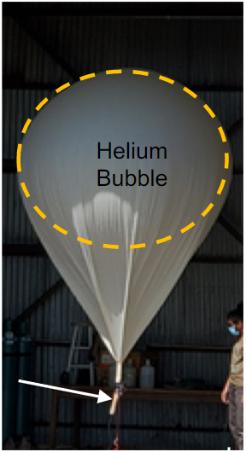
Mission Summary
Purpose and Objectives
Design Solution
Critical Elements
Requirement Satisfaction
Project Risks
Verification & Validation
Project Planning
Turbulence data is required for high altitude hypersonic aircraft design
Helium vent aids in proper high altitude turbulence data collection
Altitude conditions deform balloon canopy which forms an effectively trapped “helium bubble”
Active helium withdrawal is required due to this plastic deformation of the balloon
Notes:
Alex
Mission summary
Explain what gondola is
You can take out the picture I added if you want

Slide 4
Neck Tubing
Insulation and Electronics
Diffuser Neck Attachment
Axial Fan
1. Assemble ODDITY
Notes:
Alex

Slide 5
40 Km
20 Km
He
He
Legend
- Inactive ODDITY Unit
- Gondola Unit
- Physical Tether
- Active ODDITY Unit (Wireless communication with Gondola)
He
- Helium Gas
1. Assemble ODDITY
2. Attach ODDITY to Balloon
3. Fill Balloon with Helium
4. ODDITY receives command from Gondola
4.1. Command: Vent Helium
4.2. Command: Close Vent
4.3. Command: Cut Tether to Gondola
5. Balloon and ODDITY drift out of air traffic
6. New ODDITY assembled for next flight
Notes:
Alex

Slide 6
Levels of Success
Purpose and Objectives
Design Solution
Critical Elements
Requirement Satisfaction
Project Risks
Verification & Validation
Project Planning
 | Altitude Control | Balloon Attachment | Communications | Survivability
Level 1 | System is able to extract helium from balloon in conditions similar to those at 35km | ODDITY is able to attach to a 5cm neck diameter Kaymont balloon prior to being filled | ODDITY shares communication link with the Gondola via XBee radio | ODDITY is able to withstand pressures and temperatures similar to those seen at 35km
Level 2 | ODDITY and Gondola will match legacy system performance in flight testing (35km altitude) | ODDITY is able to be installed on 8cm neck diameter Hwoyee balloons prior to being filled | ODDITY is able to receive data and commands from the Gondola | ODDITY is able to withstand pressures and temperatures similar to those seen at 40km
Level 3 | ODDITY and Gondola are able to reach a target apogee of 40km |  | ODDITY is able to transmit data to the Gondola | ODDITY is able to abort the mission if conditions become undesirable
Notes:
Anders

Slide 7
Levels of Success
Purpose and Objectives
Design Solution
Critical Elements
Requirement Satisfaction
Project Risks
Verification & Validation
Project Planning
 | Altitude Control | Balloon Attachment | Communications | Survivability
Level 1 | System is able to extract helium from balloon in conditions similar to those at 35km | ODDITY is able to attach to a 5cm neck diameter Kaymont balloon prior to being filled | ODDITY shares communication link with the Gondola via XBee radio | ODDITY is able to withstand pressures and temperatures similar to those seen at 35km
Level 2 | ODDITY and Gondola will match legacy system performance in flight testing (35km altitude) | ODDITY is able to be installed on 8cm neck diameter Hwoyee balloons prior to being filled | ODDITY is able to receive data and commands from the Gondola | ODDITY is able to withstand pressures and temperatures similar to those seen at 40km
Level 3 | ODDITY and Gondola are able to reach a target apogee of 40km |  | ODDITY is able to transmit data to the Gondola | ODDITY is able to abort the mission if conditions become undesirable
Notes:
Anders

Slide 8
Design Solution
Purpose and Objectives
Design Solution
Critical Elements
Requirement Satisfaction
Project Risks
Verification & Validation
Project Planning

Slide 9
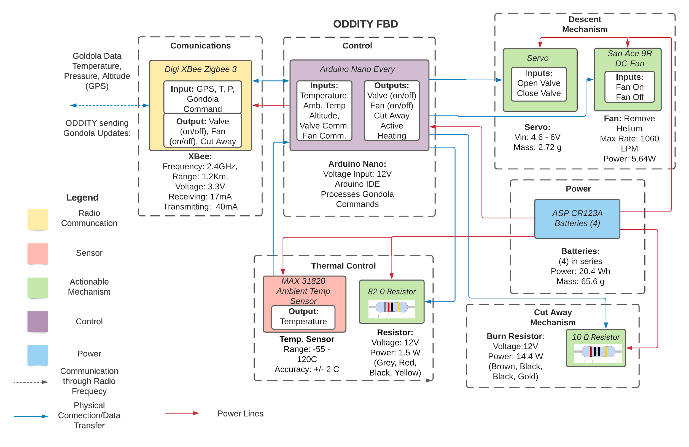
Functional Block Diagrams
Purpose and Objectives
Design Solution
Critical Elements
Requirement Satisfaction
Project Risks
Verification & Validation
Project Planning
Notes:
Alex

Slide 10
Circuit Diagram
Purpose and Objectives
Design Solution
Critical Elements
Requirement Satisfaction
Project Risks
Verification & Validation
Project Planning
I_{N}= 0.02A
P_{N}= 0.24W
P_{N, diss} = 0.384W
+12V
+12V
+12V
+12V
+12V
20.4 Wh
+5V
+3.3V
Imax = 1.98A
Imin = 0.064A
Inom = 0.78A
I_{TS}= 0.004A
P_{TS}= 0.013W
I_{Th}= 0.146A
P_{Th}= 1.755W
P_{Th, diss} = 1.505W
I_{C}= 1.2A
P_{C}= 14.443W
P_{C, diss} = 14.193W
I_{S}= 0.1A
P_{S}= 0.5W
I_{F}= 0.47A
P_{F}= 5.657W
P_{F, diss} = 1.427W
+3.3V
I_{XB}= 0.02A/0.04A
P_{XB}= 0.066W/0.132W
P_{XB, diss} = 0.007W/0.013W
Symbol Legend:
F = Fan
C = Cutaway
Th = Thermal
N = Nano
XB = XBee
S = Servo
TS = Temp Sensor
Color Legend:
Black => GND
Red => Battery Power
Orange => Nano Power
Blue => Communications
Green => MOSFET Signals
Pink => Component Control/Input
Notes:
Corey

Slide 11
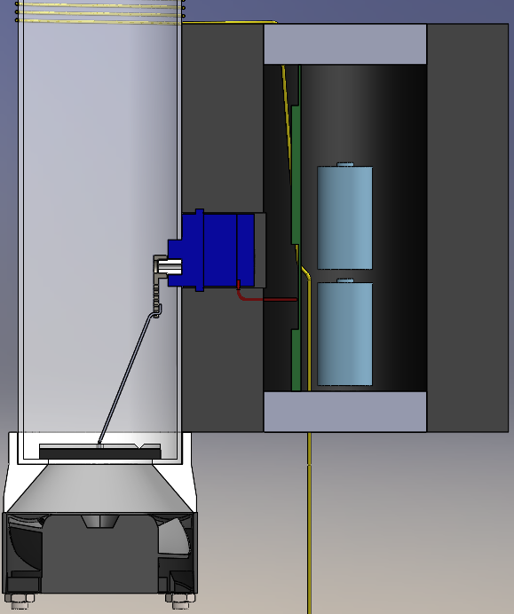
System Model
Purpose and Objectives
Design Solution
Critical Elements
Requirement Satisfaction
Project Risks
Verification & Validation
Project Planning
PCB
Batteries
Servo
Valve
Diffuser
Fan
Notes:
Anders
Questions about the teather, also everything is taped together basically

Slide 12
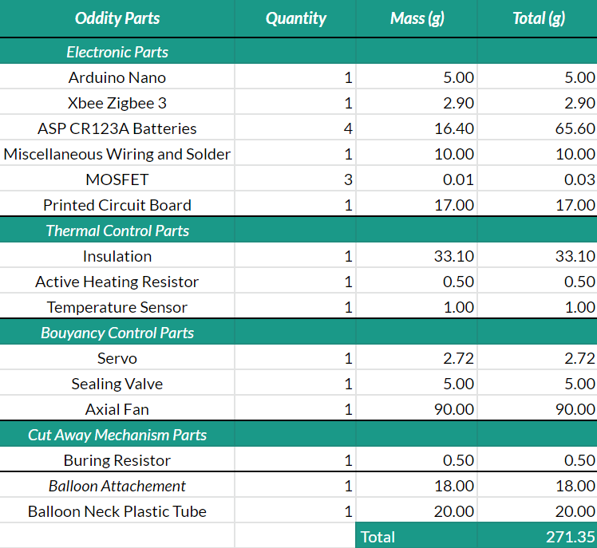
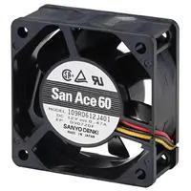
High Level Mass Budget and Flow Rates
Purpose and Objectives
Design Solution
Critical Elements
Requirement Satisfaction
Project Risks
Verification & Validation
Project Planning
Predicted Required Flow Rate @ 40 km: 100 LPM
Flow Rate @ 40 km According to CFD: 149 LPM
Notes:
-Alex
Mass plan

Slide 13
Critical Project Elements
Purpose and Objectives
Design Solution
Critical Elements
Requirement Satisfaction
Project Risks
Verification & Validation
Project Planning

Slide 14
Critical Project Elements
Purpose and Objectives
Design Solution
Critical Elements
Requirement Satisfaction
Project Risks
Verification & Validation
Project Planning
CPE 1: | Descent Control | Shall provide a means to control balloon descent rate so that it remains in the desirable range
CPE 2: | Comms, Power, & Control | Shall provide power and commands to the subsystems based off of conditions and Gondola commands
CPE 3: | Thermal Control | Shall control the temperature of critical components to ensure they remain functional
CPE 4: | Neck Attachment | Shall securely fasten ODDITY to the high altitude balloon
CPE 5: | Gondola Cutaway | Shall cut away Gondola when commanded
Notes:
Anders

Slide 15
Critical Project Elements
Purpose and Objectives
Design Solution
Critical Elements
Requirement Satisfaction
Project Risks
Verification & Validation
Project Planning
CPE 1: | Descent Control | Shall provide a means to control balloon descent rate so that it remains in the desirable range
CPE 2: | Comms, Power, & Control | Shall provide power and commands to the subsystems based off of conditions and Gondola commands
CPE 3: | Thermal Control | Shall control the temperature of critical components to ensure they remain functional
CPE 4: | Neck Attachment | Shall securely fasten ODDITY to the high altitude balloon
CPE 5: | Gondola Cutaway | Shall cut away Gondola when commanded
Notes:
Anders

Slide 16
Critical Project Elements
Purpose and Objectives
Design Solution
Critical Elements
Requirement Satisfaction
Project Risks
Verification & Validation
Project Planning
CPE 1: | Descent Control | Shall provide a means to control balloon descent rate so that it remains in the desirable range
CPE 2: | Comms, Power, & Control | Shall provide power and commands to the subsystems based off of conditions and Gondola commands
CPE 3: | Thermal Control | Shall control the temperature of critical components to ensure they remain functional
CPE 4: | Neck Attachment | Shall securely fasten ODDITY to the high altitude balloon
CPE 5: | Gondola Cutaway | Shall cut away Gondola when commanded
Notes:
Anders

Slide 17
Critical Project Elements
Purpose and Objectives
Design Solution
Critical Elements
Requirement Satisfaction
Project Risks
Verification & Validation
Project Planning
CPE 1: | Descent Control | Shall provide a means to control balloon descent rate so that it remains in the desirable range
CPE 2: | Comms, Power, & Control | Shall provide power and commands to the subsystems based off of conditions and Gondola commands
CPE 3: | Thermal Control | Shall control the temperature of critical components to ensure they remain functional
CPE 4: | Neck Attachment | Shall securely fasten ODDITY to the high altitude balloon
CPE 5: | Gondola Cutaway | Shall cut away Gondola when commanded
Notes:
Anders

Slide 18
Critical Project Elements
Purpose and Objectives
Design Solution
Critical Elements
Requirement Satisfaction
Project Risks
Verification & Validation
Project Planning
CPE 1: | Descent Control | Shall provide a means to control balloon descent rate so that it remains in the desirable range
CPE 2: | Comms, Power, & Control | Shall provide power and commands to the subsystems based off of conditions and Gondola commands
CPE 3: | Thermal Control | Shall control the temperature of critical components to ensure they remain functional
CPE 4: | Neck Attachment | Shall securely fasten ODDITY to the high altitude balloon
CPE 5: | Gondola Cutaway | Shall cut away Gondola when commanded
Notes:
Anders

Slide 19
Requirement Satisfaction
Purpose and Objectives
Design Solution
Critical Elements
Requirement Satisfaction
Project Risks
Verification & Validation
Project Planning
Notes:
-Elliott I guess?

Slide 20
Functional Requirements
Purpose and Objectives
Design Solution
Critical Elements
Requirement Satisfaction
Project Risks
Verification & Validation
Project Planning
 | Requirement | Satisfied?
FR 1: | The system shall achieve descent rates between 2m/s and 10m/s from the target altitude until the gondola is cut away.
FR 2: | The system shall survive until the gondola is cut away from the balloon.
FR 3: | The device shall have a communication link with the gondola.
FR 4: | The system shall mount to the neck of a standard weather balloon.
Notes:
-Elliott

Slide 21
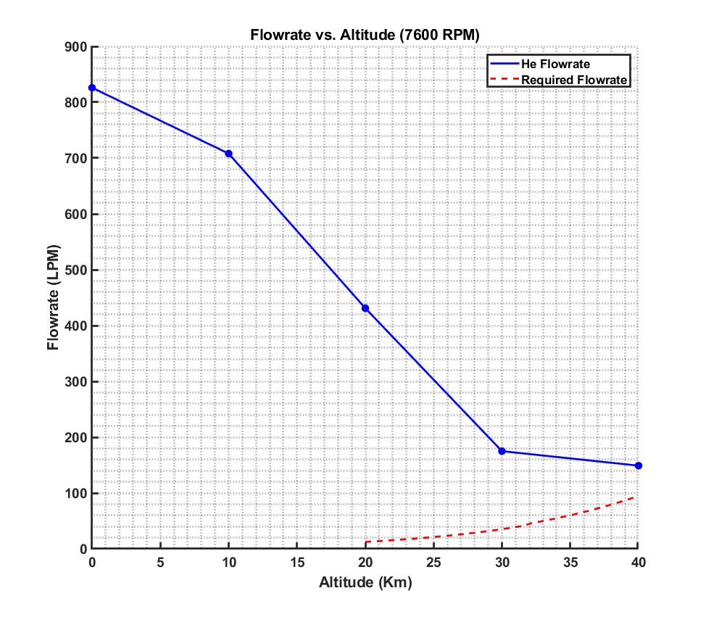
CFD Simulations/Results
Purpose and Objectives
Design Solution
Critical Elements
Requirement Satisfaction
Project Risks
Verification & Validation
Project Planning
Shown to the right:
-Simulated Flowrate vs. Altitude (Helium)
-- Calculated Required Flow rate
-In order to maintain descent rate
Key Takeaways:
-Volumetric flow rate appears to decrease to about 20-30% of sea level values
-Simulated flow rates remain above required flow rates for all flight regimes required, in order to satisfy descent rate requirements (37.5% Margin, @ 40 km)
-Anything CFD must be verified with experimental data before implementing in a final design
-Only sea-level, free-flow, air flow rates have verification/comparison data
-Free flow (no inlet tube) values saw ~10% error from datasheet
-Error is not quantifiable
-Acknowledged Errors
-Unacknowledged Errors*
Notes:
-Elliott

Slide 22
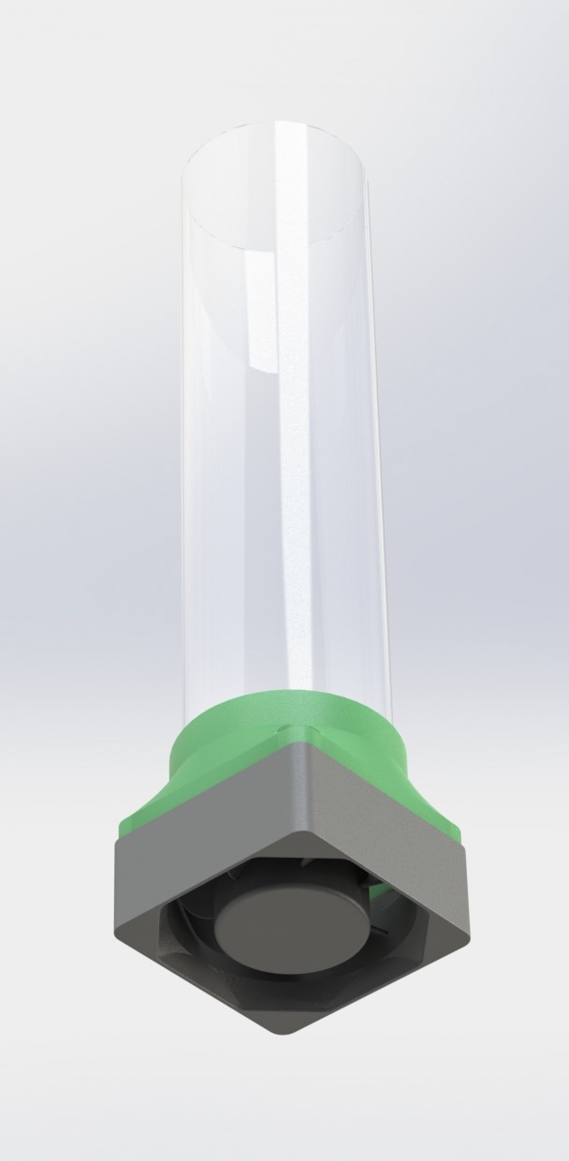
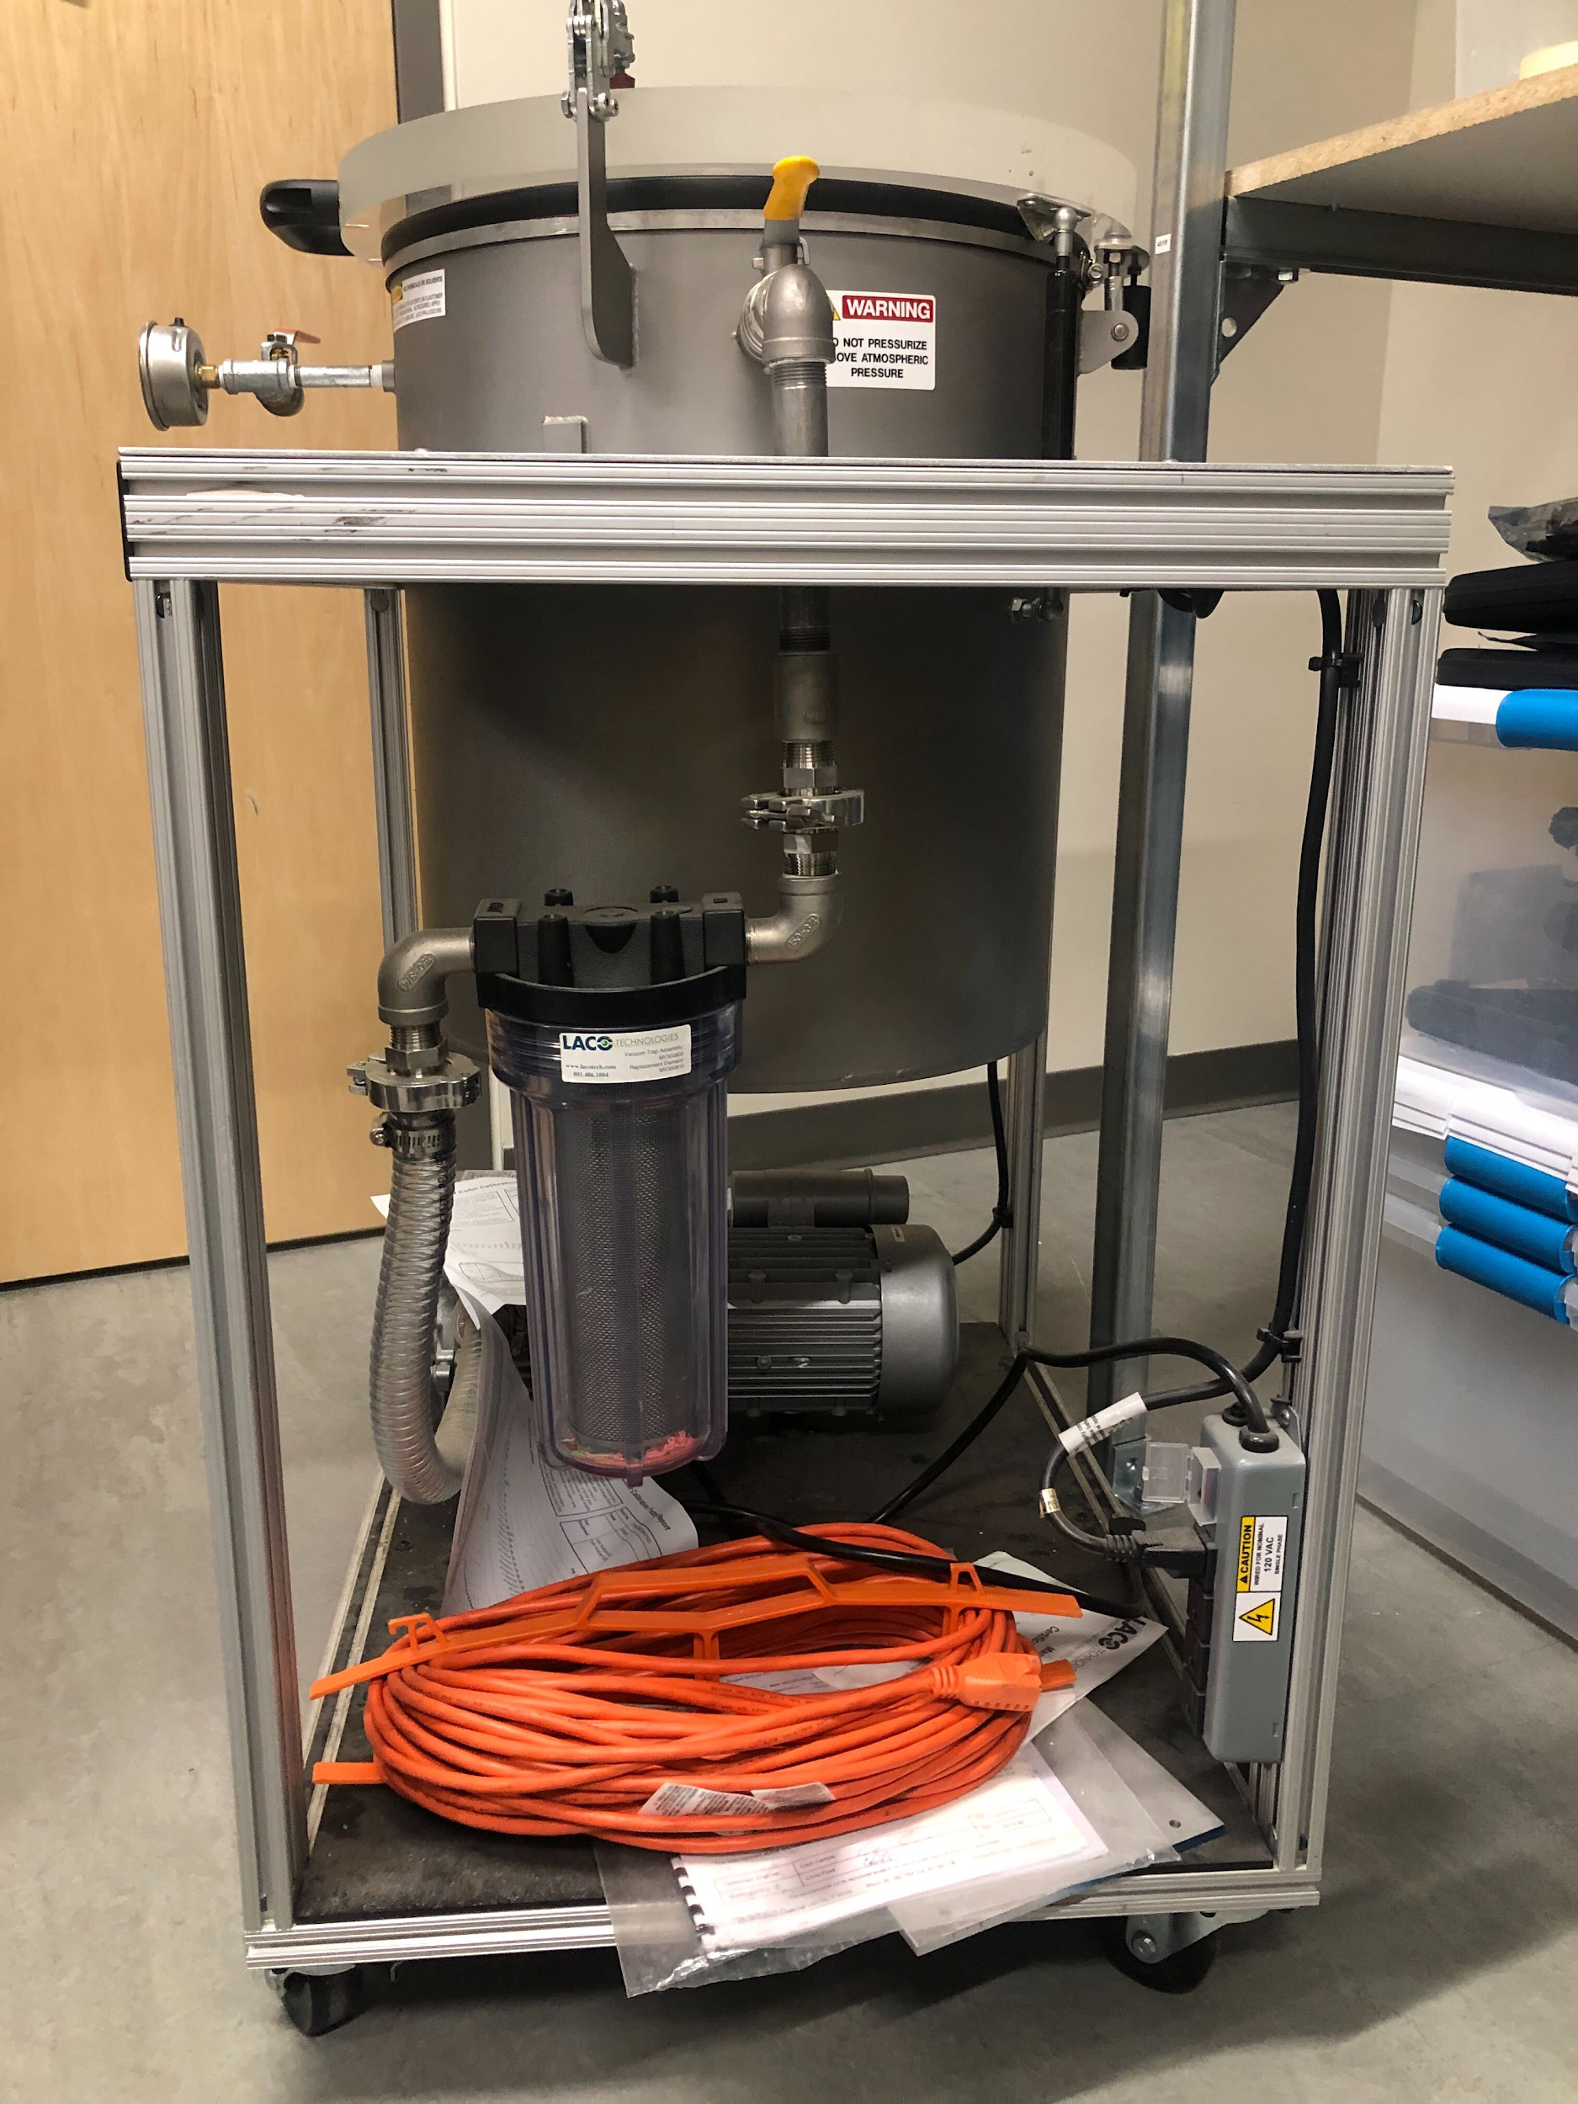
FR-1 Discussion
Purpose and Objectives
Design Solution
Critical Elements
Requirement Satisfaction
Project Risks
Verification & Validation
Project Planning
Due to the extremely off-design, extreme conditions that the system will experience, we cannot guarantee the flow rate will be high enough to satisfy this requirement, without additional system characterization.
Experimental Data is Required
Vacuum Chamber Testing:
Measurements of fan flow rates at simulated, high altitude conditions are required to determine whether or not this venting mechanism is sufficient
Cold-Temperature Testing:
The temperatures experienced are somewhat colder than guaranteed on manufacturer datasheets
~20-30C lower
Specifically with regards to the fan mechanism; other components have thermal management solutions
Notes:
-Elliott

Slide 23
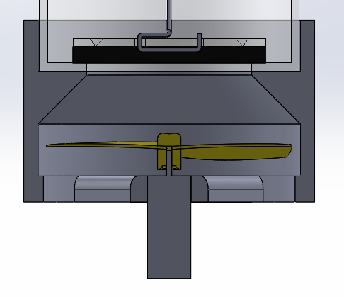
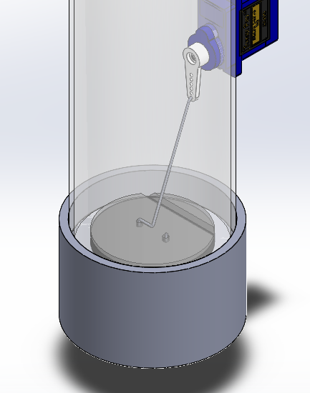
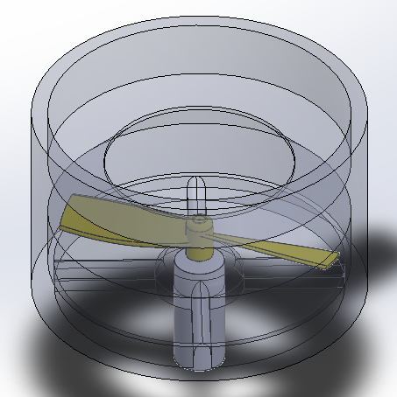
Offramp:
Purpose and Objectives
Design Solution
Critical Elements
Requirement Satisfaction
Project Risks
Verification & Validation
Project Planning
Given mass/size constraints, the only remotely feasible option remains some sort of fan.
Moving to quadcopter/RC motors as the actuator would open up the design space somewhat
Custom (Low Re) Propellers, Motor/Prop/Blade count, counter-rotating propellers, etc.
Notes:
Elliott

Slide 24
Functional Requirements
Purpose and Objectives
Design Solution
Critical Elements
Requirement Satisfaction
Project Risks
Verification & Validation
Project Planning
 | Requirement | Satisfied?
FR 1: | The system shall achieve descent rates between 2m/s and 10m/s from the target altitude until the gondola is cut away.
FR 2: | The system shall survive until the gondola is cut away from the balloon.
FR 3: | The device shall have a communication link with the gondola.
FR 4: | The system shall mount to the neck of a standard weather balloon.
Notes:
-Emily

Slide 25
Survival Temperatures of Components
Purpose and Objectives
Design Solution
Critical Elements
Requirement Satisfaction
Project Risks
Verification & Validation
Project Planning
Electronic Components | Temperature Ranges
Arduino Nano Every | -40 to 125 C
Digi XBee 3 | -40 to 85 C
Temperature Sensor (MAX31820) | -55 to 125 C
ASP CR 123A Batteries | -20 to 60 C
Transistors | Max 150 C
Servo | -20 - 60 C
Fan | -20 - 60 C
Within Insulation Cylinder
Ideal temperature for longer battery life and higher voltage is 20 C
Duration and voltage drop off significantly lower than 10 C
Notes:
-Emily
Within the insulation, the lowest operating temperature range are for the batteries. The discharge rate and voltage of the batteries is severely impacted by low temperatures. With continuous discharge, the battery voltage at 20 and 60 degrees can be held for a longer duration than -20

Slide 26
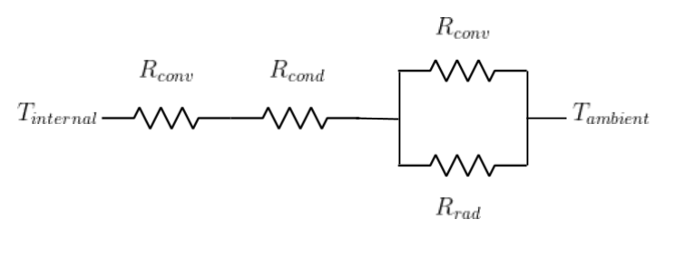
Thermal Control and Analysis
Purpose and Objectives
Design Solution
Critical Elements
Requirement Satisfaction
Project Risks
Verification & Validation
Project Planning
Active Temperature Control:
On-Off Control
Temperature Sensor:
Accuracy: +/- 2 C
82 ꭥ resistor turns on when temperature inside insulation is below 20 C
Servo is twitched during flight
Model:
Analyze temperature over time
Steady 1-D heat transfer
Step response
Notes:
-Emily
Needs uncertainty

Slide 27
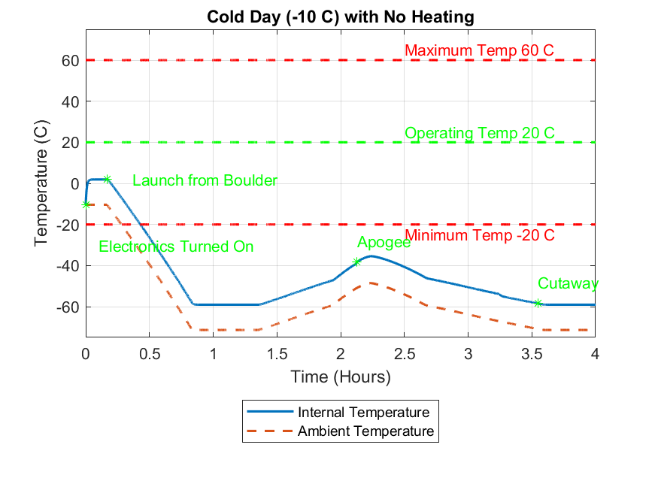
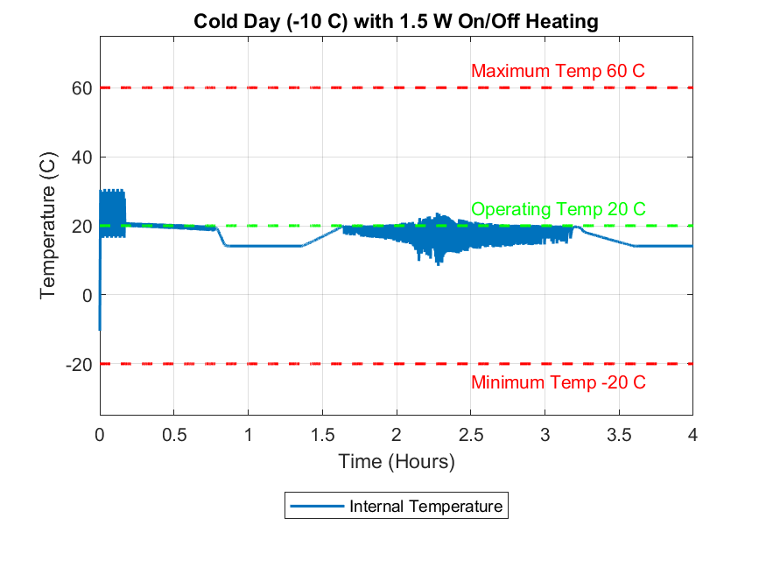
Temperature within Insulation Cylinder
Purpose and Objectives
Design Solution
Critical Elements
Requirement Satisfaction
Project Risks
Verification & Validation
Project Planning
Lowest temperature with heater is
Notes:
-Emily
10 degree margin on lower temperature, upper temperature doesn’t affect it as much, the difference between 20 C and 60 C is much less than the difference between -20 and 20
Noise is from Step function vs ramp function, realistically the electronics should be modeled with a ramp response to account for time taken to turn on and warm up
The first increase is the time it takes to warm up, the dips are due to the cooler temperatures at 20 km, the slight rise is due to the rise as in ambient temperature as we approach apogee. From apogee to 20 km the fan is turned on, and the transistor provides heat inside insulation. Then it turns off and

Slide 28
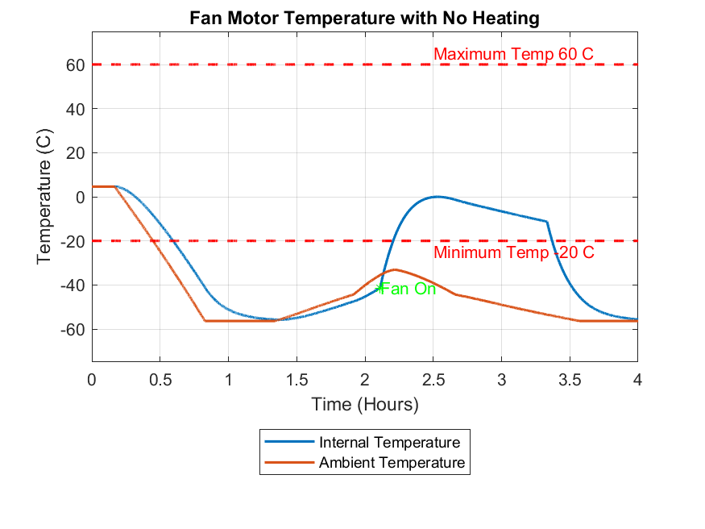
Temperature of Fan Motor
Purpose and Objectives
Design Solution
Critical Elements
Requirement Satisfaction
Project Risks
Verification & Validation
Project Planning
Difficult to model accurately
Will verify the temperature range through low temperature testing
There is some room in the power and mass budget to add thermal control for fan
Notes:
-Emily
Motor characteristics are hard to model
Emphasize manufacturing range vs actual - will be investigated through testing

Slide 29
Functional Requirements
Purpose and Objectives
Design Solution
Critical Elements
Requirement Satisfaction
Project Risks
Verification & Validation
Project Planning
 | Requirement | Satisfied?
FR 1: | The system shall achieve descent rates between 2m/s and 10m/s from the target altitude until the gondola is cut away.
FR 2: | The system shall survive until the gondola is cut away from the balloon.
FR 3: | The device shall have a communication link with the gondola.
FR 4: | The system shall mount to the neck of a standard weather balloon.
Notes:
-Corey

Slide 30
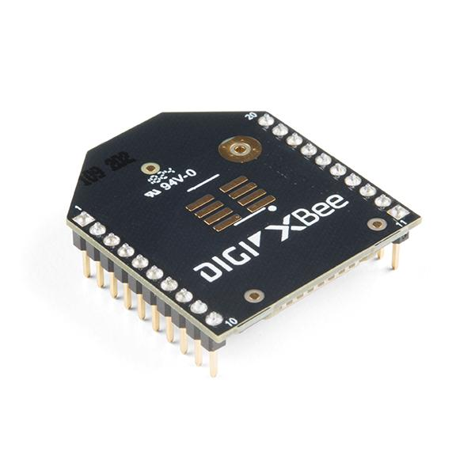
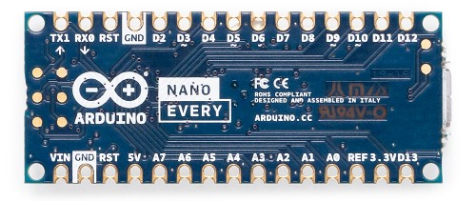
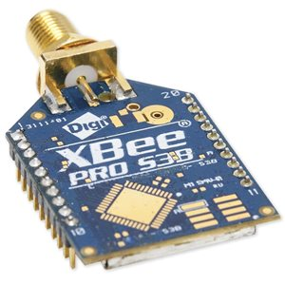
Communication Link
Purpose and Objectives
Design Solution
Critical Elements
Requirement Satisfaction
Project Risks
Verification & Validation
Project Planning
No issues with communication
Launch conditions favorable
Clear Day (no rain, fog, snow, etc)
Little to no wind
Local communication - 10m apart
Negligible interference from other components
Based on heuristics
Nano and XBee 3 will be able to handle gondola data packets
Will test communication link extensively in Spring Semester to verify functionality
Gondola
ODDITY
Gondola Housing
10m Link
Notes:
Corey

Slide 31
Functional Requirements
Purpose and Objectives
Design Solution
Critical Elements
Requirement Satisfaction
Project Risks
Verification & Validation
Project Planning
 | Requirement | Satisfied?
FR 1: | The system shall achieve descent rates between 2m/s and 10m/s from the target altitude until the gondola is cut away.
FR 2: | The system shall survive until the gondola is cut away from the balloon.
FR 3: | The device shall have a communication link with the gondola.
FR 4: | The system shall mount to the neck of a standard weather balloon.
Notes:
-Marcus

Slide 32
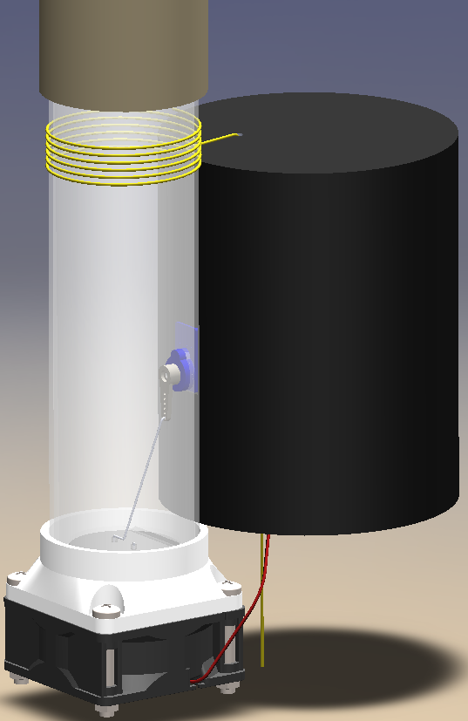
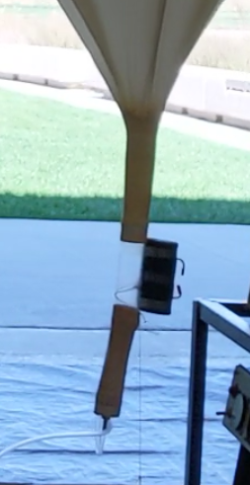
Neck Attachment
Purpose and Objectives
Design Solution
Critical Elements
Requirement Satisfaction
Project Risks
Verification & Validation
Project Planning
Tube provides a friction fit with the balloon
Adhesive Tape
Notes:
-Marcus

Slide 33
Neck Attachment Force Calculation
Purpose and Objectives
Design Solution
Critical Elements
Requirement Satisfaction
Project Risks
Verification & Validation
Project Planning
Friction Force
Assumptions
μ =0.1 FOS = 1.5 E= 2 MPa m = 1.1 Kg
External Pressure from Balloon Neck modeled with Hooke's law
Normal Force
h
Pressure
(from Balloon)
OVERLAP
Overlap required
Kaymont (5 cm) Hwoyee (8 cm)
h = 3cm h =2cm
Weight
Notes:
-Marcus
8 cm requires less overlap because the Balloon neck needs to be stretched more over the tube than the 5cm neck. therefore the 8cm neck exerts more pressure on to the tube than the 5cm
THESE CALCULATIONS ARE WITHOUT THE TAPE!!!

Slide 34
Functional Requirements
Purpose and Objectives
Design Solution
Critical Elements
Requirement Satisfaction
Project Risks
Verification & Validation
Project Planning
 | Requirement | Satisfied?
FR 1: | The system shall achieve descent rates between 2m/s and 10m/s from the target altitude until the gondola is cut away.
FR 2: | The system shall survive until the gondola is cut away from the balloon.
FR 3: | The device shall have a communication link with the gondola.
FR 4: | The system shall mount to the neck of a standard weather balloon.
Notes:
-Alex

Slide 35
Project Risks
Purpose and Objectives
Design Solution
Critical Elements
Requirement Satisfaction
Project Risks
Verification & Validation
Project Planning

Slide 36
How We Quantify Risk
Purpose and Objectives
Design Solution
Critical Elements
Requirement Satisfaction
Project Risks
Verification & Validation
Project Planning
Level | Likelihood | Impact
5 | Certain | Catastrophic: The entire flight will be rendered useless due to risk
4 | Highly Likely | Severe: Very little useable scientific data is able to be used from flight
3 | Likely | Major: Some data is able to be gathered, uncertain data accuracy
2 | Improbable | Minor: Issues prevent all data gathering, but still overall successful
1 | Extremely Improbable | Minimal: Mission is still able to be accomplished with minimal issues
Score (Impact * Likelihood) | Level of Risk
1 - 5 | Low
6 - 14 | Medium
15 - 25 | High
Notes:
-Anders

Slide 37
Project Risks
Purpose and Objectives
Design Solution
Critical Elements
Requirement Satisfaction
Project Risks
Verification & Validation
Project Planning
Impact
Minimal
Minor
Major
Severe
Catastrophic
 |  |  | 1
Number: | 1
Risk: | COVID-19 Closures
Effect: | Project testing and construction will become more difficult
Certain
Highly Likely
Likely
Likelihood
Improbable
Extremely Improbable
Notes:
-Anders

Slide 38
Project Risks
Purpose and Objectives
Design Solution
Critical Elements
Requirement Satisfaction
Project Risks
Verification & Validation
Project Planning
Impact
Minimal
Minor
Major
Severe
Catastrophic
 |  |  | 1
 |  |  | 1
Number: | 1
Risk: | COVID-19 Closures
Effect: | Project testing and construction will become more difficult
Mitigation: | Perform experiments as soon as possible, practice safe behavior
Certain
Highly Likely
Likely
Likelihood
Improbable
Extremely Improbable
Notes:
-Anders

Slide 39
Project Risks
Purpose and Objectives
Design Solution
Critical Elements
Requirement Satisfaction
Project Risks
Verification & Validation
Project Planning
Impact
Minimal
Minor
Major
Severe
Catastrophic
 | 2 |  | 1
Number: | 2
Risk: | Test Flight is not able to happen
Effect: | In-Situ data about ODDITY performance will not be able to be gathered
Certain
Highly Likely
Likely
Likelihood
Improbable
Extremely Improbable
Notes:
-Anders

Slide 40
Project Risks
Purpose and Objectives
Design Solution
Critical Elements
Requirement Satisfaction
Project Risks
Verification & Validation
Project Planning
Impact
Minimal
Minor
Major
Severe
Catastrophic
 | 2 |  | 1
 | 2
Number: | 2
Risk: | Test Flight is not able to happen
Effect: | In-Situ data about ODDITY performance will not be able to be gathered
Mitigation: | Begin talking to customer about test flights before the semester ends
Certain
Highly Likely
Likely
Likelihood
Improbable
Extremely Improbable
Notes:
-Anders

Slide 41
Descent Control Risks
Purpose and Objectives
Design Solution
Critical Elements
Requirement Satisfaction
Project Risks
Verification & Validation
Project Planning
Impact
Minimal
Minor
Major
Severe
Catastrophic
 |  | 3
Number: | 3
Risk: | Fan cannot remove helium fast enough
Effect: | Desired descent rate is not able to be achieved within the stipulated time period
Certain
Highly Likely
Likely
Likelihood
Improbable
Extremely Improbable
Notes:
-Elliott

Slide 42
Descent Control Risks
Purpose and Objectives
Design Solution
Critical Elements
Requirement Satisfaction
Project Risks
Verification & Validation
Project Planning
Impact
Minimal
Minor
Major
Severe
Catastrophic
 |  | 3
 |  | 3
Number: | 3
Risk: | Fan cannot remove helium fast enough
Effect: | Desired descent rate is not able to be achieved within the stipulated time period
Mitigation: | In depth CFD modeling of ODDITY along with low pressure testing to verify the CFD models and ensure flow rates
Certain
Highly Likely
Likely
Likelihood
Improbable
Extremely Improbable
Notes:
-Elliott

Slide 43
Descent Control Risks
Purpose and Objectives
Design Solution
Critical Elements
Requirement Satisfaction
Project Risks
Verification & Validation
Project Planning
Impact
Minimal
Minor
Major
Severe
Catastrophic
 |  |  | 4
 |  | 3
Number: | 4
Risk: | Fan Freezes
Effect: | Helium is unable to be actively removed from the balloon
Certain
Highly Likely
Likely
Likelihood
Improbable
Extremely Improbable
Notes:
-Elliott

Slide 44
Descent Control Risks
Purpose and Objectives
Design Solution
Critical Elements
Requirement Satisfaction
Project Risks
Verification & Validation
Project Planning
Impact
Minimal
Minor
Major
Severe
Catastrophic
 |  |  | 4
 |  | 3
 |  |  | 4
Number: | 4
Risk: | Fan Freezes
Effect: | Helium is unable to be actively removed from the balloon
Mitigation: | Low temperature testing of the fan to determine if active heating is required for the fan
Certain
Highly Likely
Likely
Likelihood
Improbable
Extremely Improbable
Notes:
-Elliott

Slide 45
Comms, Power, & Controls Risks
Purpose and Objectives
Design Solution
Critical Elements
Requirement Satisfaction
Project Risks
Verification & Validation
Project Planning
Impact
Minimal
Minor
Major
Severe
Catastrophic
 |  | 5
Number: | 5
Risk: | Insufficient battery power
Effect: | ODDITY subsystems will not function for their required duration
Certain
Highly Likely
Likely
Likelihood
Improbable
Extremely Improbable
Notes:
Corey

Slide 46
Comms, Power, & Controls Risks
Purpose and Objectives
Design Solution
Critical Elements
Requirement Satisfaction
Project Risks
Verification & Validation
Project Planning
Impact
Minimal
Minor
Major
Severe
Catastrophic
 |  | 5
 |  | 5
Number: | 5
Risk: | Insufficient battery power
Effect: | ODDITY subsystems will not function for their required duration
Mitigation: | Component and subsystem testing in addition to conservative calculations
Certain
Highly Likely
Likely
Likelihood
Improbable
Extremely Improbable
Notes:
Corey

Slide 47
Thermal Control Risks
Purpose and Objectives
Design Solution
Critical Elements
Requirement Satisfaction
Project Risks
Verification & Validation
Project Planning
Impact
Minimal
Minor
Major
Severe
Catastrophic
 |  | 6
Number: | 6
Risk: | Batteries get too cold
Effect: | Batteries are not able to deliver the current that is required to power the subsystems
Certain
Highly Likely
Likely
Likelihood
Improbable
Extremely Improbable
Notes:
-Emily

Slide 48
Thermal Control Risks
Purpose and Objectives
Design Solution
Critical Elements
Requirement Satisfaction
Project Risks
Verification & Validation
Project Planning
Impact
Minimal
Minor
Major
Severe
Catastrophic
 |  | 6
 |  | 6
Number: | 6
Risk: | Batteries get too cold
Effect: | Batteries are not able to deliver the current that is required to power the subsystems
Mitigation: | Cold weather testing will be performed to ensure that the batteries will not get too cold
Certain
Highly Likely
Likely
Likelihood
Improbable
Extremely Improbable
Notes:
-Emily

Slide 49
Thermal Control Risks
Purpose and Objectives
Design Solution
Critical Elements
Requirement Satisfaction
Project Risks
Verification & Validation
Project Planning
Impact
Minimal
Minor
Major
Severe
Catastrophic
 |  |  | 7
 |  | 6
Number: | 7
Risk: | Electronics and batteries get too hot
Effect: | Electronics and batteries fail, causing ODDITY to not function properly
Certain
Highly Likely
Likely
Likelihood
Improbable
Extremely Improbable
Notes:
-Emily

Slide 50
Thermal Control Risks
Purpose and Objectives
Design Solution
Critical Elements
Requirement Satisfaction
Project Risks
Verification & Validation
Project Planning
Impact
Minimal
Minor
Major
Severe
Catastrophic
 |  |  | 7
 |  | 6 | 7
Number: | 7
Risk: | Electronics and batteries get too hot
Effect: | Electronics and batteries fail, causing ODDITY to not function properly
Mitigation: | Heating system will only be active if needed instead of being on constantly
Certain
Highly Likely
Likely
Likelihood
Improbable
Extremely Improbable
Notes:
-Emily

Slide 51
Neck Attachment Risk
Purpose and Objectives
Design Solution
Critical Elements
Requirement Satisfaction
Project Risks
Verification & Validation
Project Planning
Impact
Minimal
Minor
Major
Severe
Catastrophic
 |  |  |  | 8
Number: | 8
Risk: | Neck attachment fails
Effect: | Neck attachment tube breaks causing failure, tube slips out of balloon neck causing failure
Certain
Highly Likely
Likely
Likelihood
Improbable
Extremely Improbable
Notes:
-Marcus

Slide 52
Neck Attachment Risk
Purpose and Objectives
Design Solution
Critical Elements
Requirement Satisfaction
Project Risks
Verification & Validation
Project Planning
Impact
Minimal
Minor
Major
Severe
Catastrophic
 |  |  |  | 8
 |  |  |  | 8
Number: | 8
Risk: | Neck attachment fails
Effect: | Neck attachment tube breaks causing failure, tube slips out of balloon neck causing failure
Mitigation: | Perform hoop stress analysis and friction calculations between tube and balloon, reinforce with tape
Certain
Highly Likely
Likely
Likelihood
Improbable
Extremely Improbable
Notes:
-Marcus

Slide 53
Mitigated Risk Matrix
Purpose and Objectives
Design Solution
Critical Elements
Requirement Satisfaction
Project Risks
Verification & Validation
Project Planning
Impact
Minimal
Minor
Major
Severe
Catastrophic
 |  |  | 1
 | 2 | 3
 |  | 5, 6 | 4, 7 | 8
1 | COVID-19 Closures
2 | Test Flight is not able to happen
3 | Fan cannot remove helium fast enough
4 | Fan freezes
5 | Insufficient battery power
6 | Batteries get too cold
7 | Electronics & batteries get too hot
8 | Neck attachment fails
Certain
Highly Likely
Likely
Likelihood
Improbable
Extremely Improbable
Notes:
-Anders

Slide 54
Verification & Validation
Purpose and Objectives
Design Solution
Critical Elements
Requirement Satisfaction
Project Risks
Verification & Validation
Project Planning

Slide 55
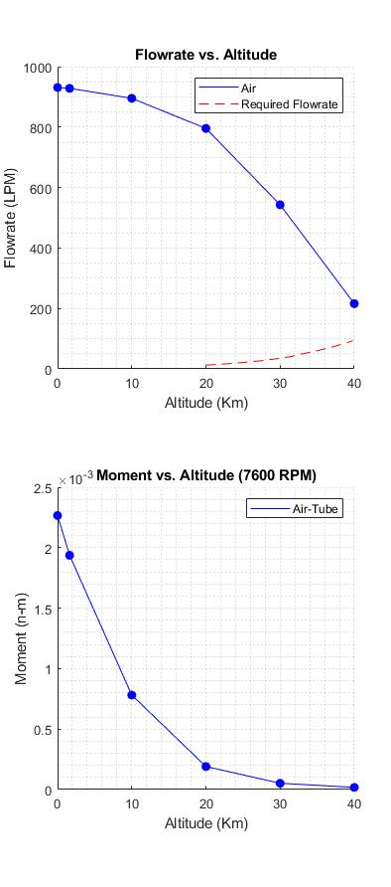
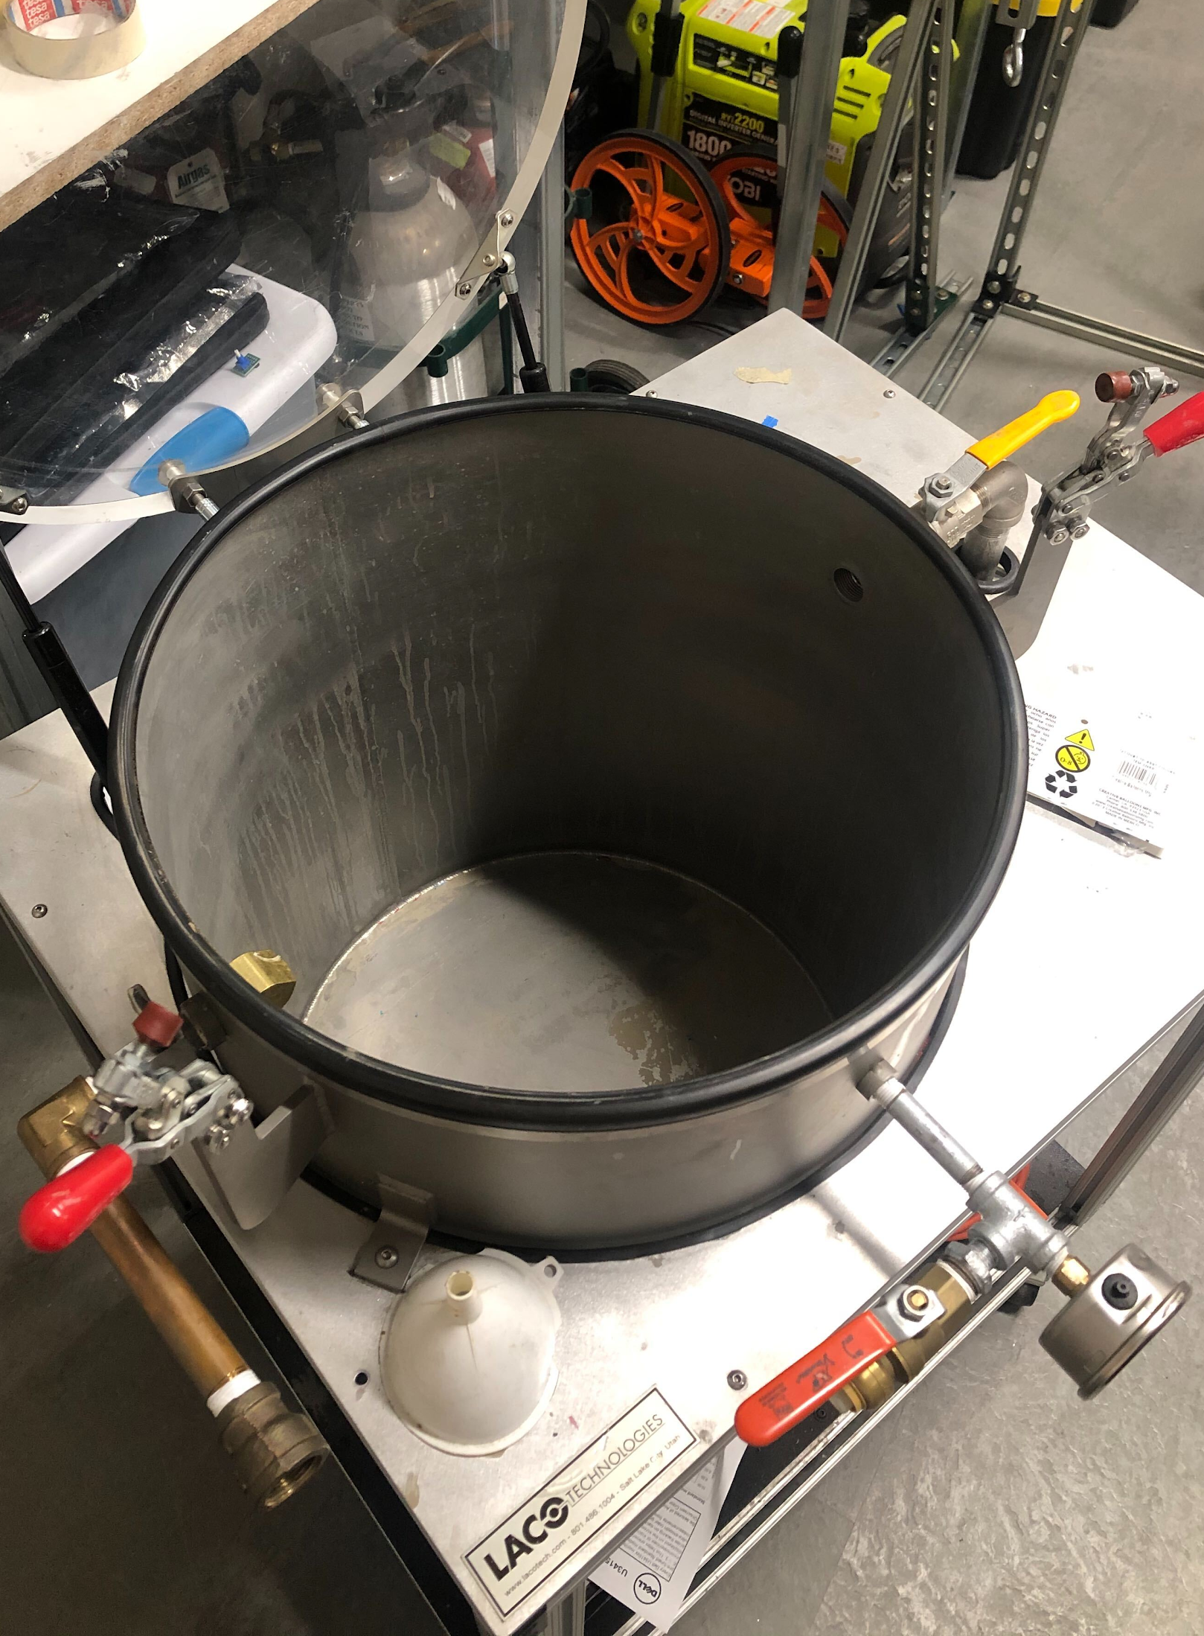
Axial Fan Low Pressure Testing
Purpose and Objectives
Design Solution
Critical Elements
Requirement Satisfaction
Project Risks
Verification & Validation
Project Planning
Volumetric flow rate testing will be conducted using the vacuum chamber provided by Prof. Rhode.
This testing will be used to verify the results of the high altitude CFD simulations.
This test will be crucial to determine whether an off-the-shelf axial fan can meet the requirements of this project.
Notes:
-Michael

Slide 56
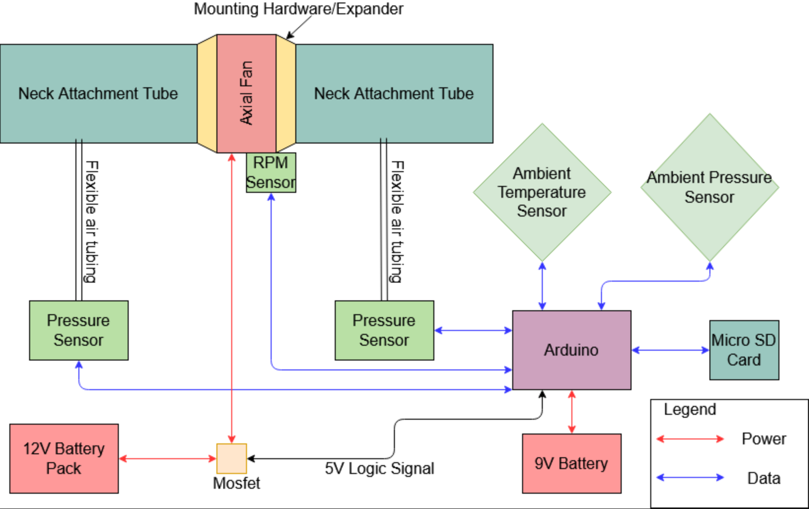
Vacuum Chamber Testing Diagram
Purpose and Objectives
Design Solution
Critical Elements
Requirement Satisfaction
Project Risks
Verification & Validation
Project Planning
Notes:
-Michael
May need to adjust this FBD depending on what Rhode says about powering the fan/NPT pass through
May not be able to include RPM sensor with double tube configuration

Slide 57
Volumetric Flow Rate Calculation
Purpose and Objectives
Design Solution
Critical Elements
Requirement Satisfaction
Project Risks
Verification & Validation
Project Planning
Bernoulli’s Equation:
Key Assumptions: Incompressible flow, Irrotational, uniform flow through neck tubes
Using Bernoulli with these assumptions, a flow velocity can be calculated.
Since we know the cross sectional area of the inlet, a volumetric flow rate can then be estimated.
These flow rates can then be compared to our CFD results to verify our models and increase confidence that the fan will remove helium at a sufficient rate.
Notes:
-Michael

Slide 58
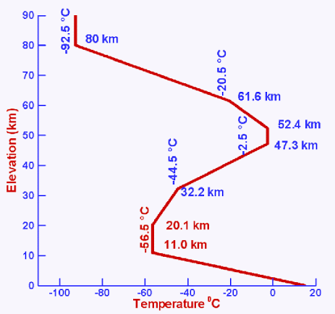
Axial Fan Low Temperature Testing
Purpose and Objectives
Design Solution
Critical Elements
Requirement Satisfaction
Project Risks
Verification & Validation
Project Planning
The fan will be tested in a dry ice cooler to simulate the cold temperatures that will be seen in flight.
Dry Ice Temperature: -78 C
Coldest in-Flight Temperature: -56.5 C
Fan Minimum Operational Temperature: -20 C
The test will hopefully prove that the fan can start and operate continuously at temperatures colder than it will see in flight.
Notes:
-Michael
Mention how Bobby expressed confidence in a dc brushless motor working at lower temperatures than listed on the data sheet

Slide 59
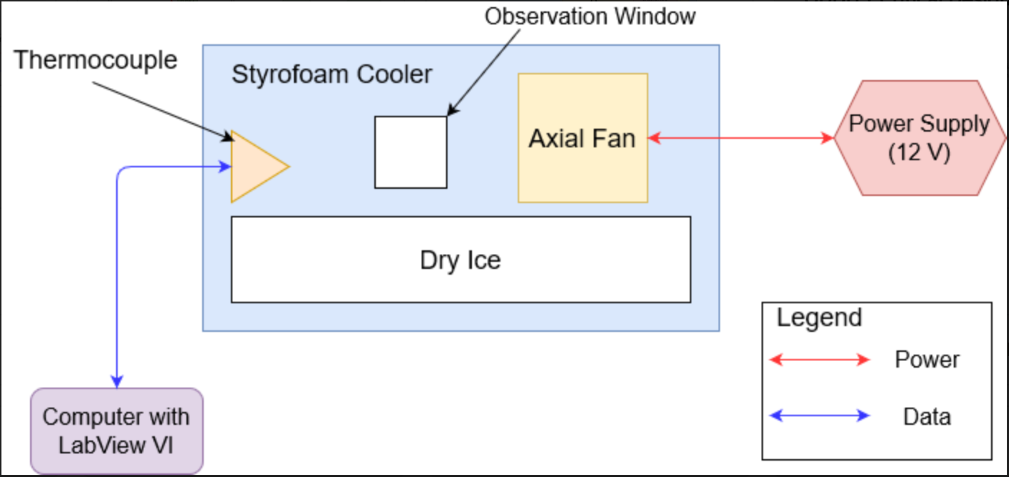
Low Temperature Test Details
Purpose and Objectives
Design Solution
Critical Elements
Requirement Satisfaction
Project Risks
Verification & Validation
Project Planning
Testing Procedure:
Allow fan to chill for at least 45 minutes, ensure cooler temperature has reached steady state
Turn on power supply
See if the fan will start running and continue to run for 1 hour
This test will be performed multiple times to ensure that the fan will start consistently.
Notes:
-Michael
Will position the thermocouple(s) close to the fan
Mention the turning the fan on and off to keep it warm idea, already being used for the servo motor
Icing is more likely to be a problem at Boulder altitudes, air will be very dry so icing shouldn’t be a problem
Will help us determine if/what kind of thermal solution is needed for the fan

Slide 60
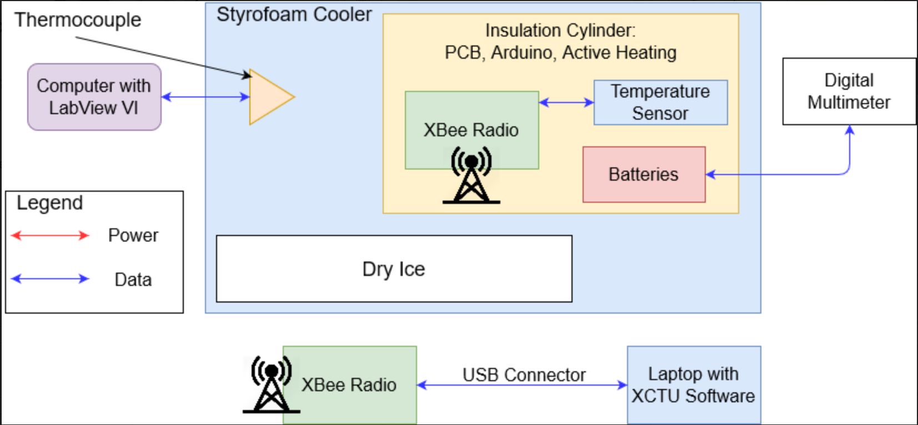
Electrical System Thermal Testing
Purpose and Objectives
Design Solution
Critical Elements
Requirement Satisfaction
Project Risks
Verification & Validation
Project Planning
Notes:
Similar dry ice cooler test but now we will be determining how the electronics will perform, monitoring temperature inside the insulation

Slide 61
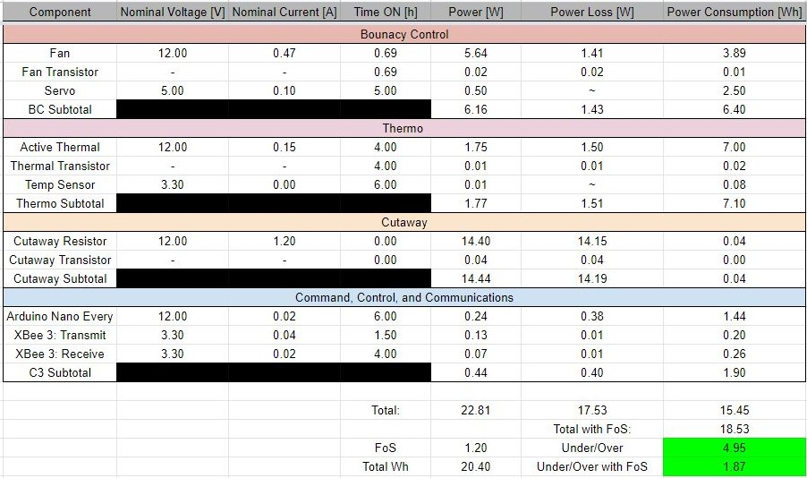
Power Budget
Purpose and Objectives
Design Solution
Critical Elements
Requirement Satisfaction
Project Risks
Verification & Validation
Project Planning
Notes:
Corey

Slide 62
Project Planning
Purpose and Objectives
Design Solution
Critical Elements
Requirement Satisfaction
Project Risks
Verification & Validation
Project Planning

Slide 63
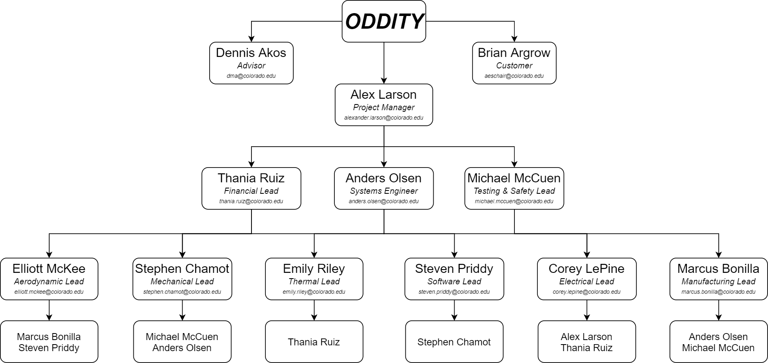
Organizational Chart
Purpose and Objectives
Design Solution
Critical Elements
Requirement Satisfaction
Project Risks
Verification & Validation
Project Planning
Notes:
-Alex

Slide 64
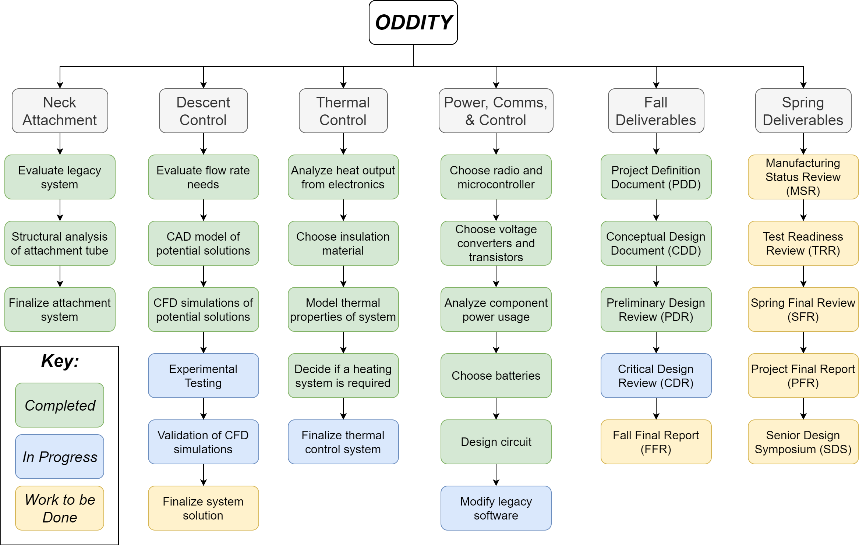
Work Breakdown Structure
Purpose and Objectives
Design Solution
Critical Elements
Requirement Satisfaction
Project Risks
Verification & Validation
Project Planning
Notes:
Anders

Slide 65
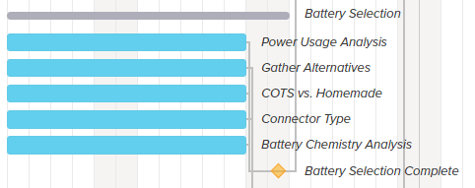
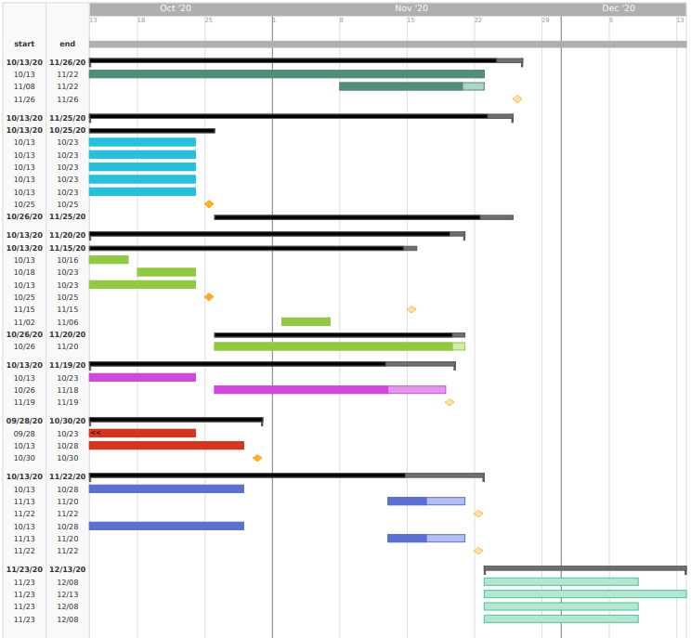
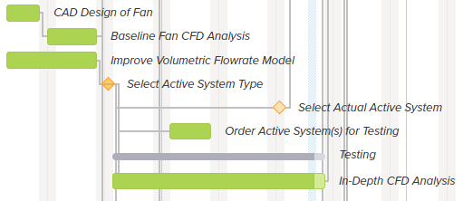
Gantt Chart - Fall Semester
Purpose and Objectives
Design Solution
Critical Elements
Requirement Satisfaction
Project Risks
Verification & Validation
Project Planning
Battery Research and Design
Descent Control Analysis and Selection
Thermal Control Research & Design
Component Final Selection and Purchasing
Hardware Design and Selection
Notes:
-Alex

Slide 66
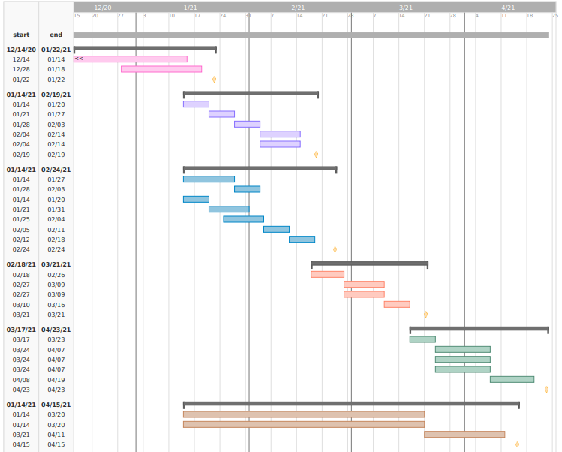
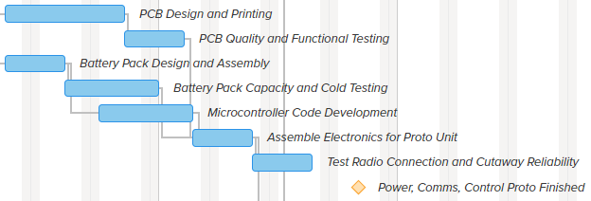
Gantt Chart - Spring Semester
Purpose and Objectives
Design Solution
Critical Elements
Requirement Satisfaction
Project Risks
Verification & Validation
Project Planning
Winter Break Testing/Contingency Design
Descent Control Manufacturing and Testing
Power, Comms and Control Manufacturing and Testing
Thermal Control Manufacturing and Testing
ODDITY Prototype Finalization and Final Testing
Notes:
-Alex

Slide 67
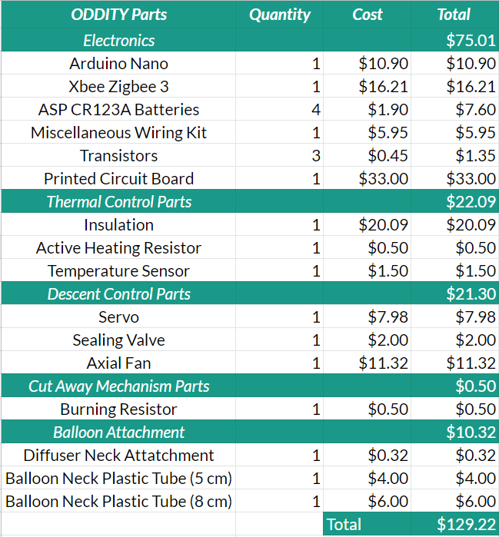
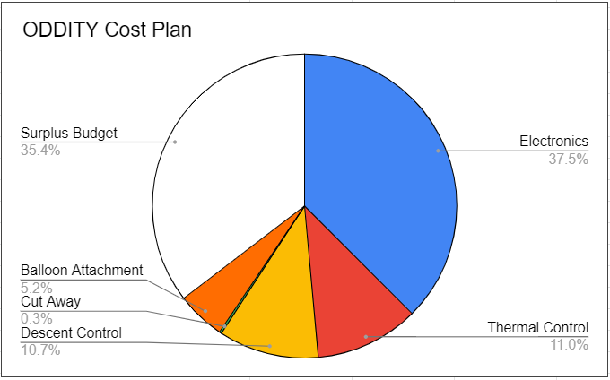
Cost Plan
Purpose and Objectives
Design Solution
Critical Elements
Requirement Satisfaction
Project Risks
Verification & Validation
Project Planning
Customer Requirement: $ 200.00
Project Cost: $129.22
Surplus Budget: $70.78
Notes:
-Thania

Slide 68
Test Plan
Purpose and Objectives
Design Solution
Critical Elements
Requirement Satisfaction
Project Risks
Verification & Validation
Project Planning
Date | Test | Description
11/30/20 - 1/14/21 | Fan testing: low pressure | Test fan systems at low pressures to verify their ability to move helium at these low pressures. Pressure chamber testing will be done with with Prof. Rhode and his low pressure chamber. Any helium testing will also be tested under his guidance.
11/30/20 - 1/14/21 | Fan testing: low temperature | Test fan systems at low temperatures to verify their ability to operate at these low temperatures. Dry ice handling and measurements will be guided and overseen by Prof. Hodgkinson and other lab staff.
2/12/21 - 2/25/21 | Code and Controls testing | Test code to ensure there are no bugs that will prevent mission success for ODDITY. The ability of the code to send commands will also be tested.
2/12/21 - 2/25/21 | Gondola Cutaway testing | Ensure the legacy tether cutting mechanism continues to be effective when used within ODDITY.
Notes:
-Michael

Slide 69
Test Plan Continued
Purpose and Objectives
Design Solution
Critical Elements
Requirement Satisfaction
Project Risks
Verification & Validation
Project Planning
Date | Test | Description
3/8/21 - 3/20/21 | Thermal Control System testing | Perform cold testing of the thermal control system to ensure it keeps all vital components at operable temperatures. (See cold temperature testing for equipment needs)
3/24/21 - 4/7/21 | Full System testing | Test the entire ODDITY system for functionality once fully assembled and flight ready to ensure all systems are functioning properly. (See low pressure and temperature testing for equipment needs)
? | Flight testing | Perform a flight test to collect data about the performance of ODDITY in a true mission situation.
Notes:
-Michael

Slide 70
Questions?

Slide 71
Resources
Team ATOMIC 2019-2020 for presentation formatting
Prof. Argrow’s Customer Presentation Fall 2020
Star CCM
MATLAB
SolidWorks
Google Drive, Sheets, Drawing, Slides
TeamGantt
PAB Members
Advisor, Prof. Akos
Prof. Lawrence
Prof. Argrow

Slide 72
Appendix
Why the Redesign?
Gondola Cutaway
Gondola Cutaway Risks
Neck Attachment Friction Calculations
Neck Attachment Hoop Stress
Spherical Balloon Stress
Stress on Balloon Neck
More CFD Plots
CFD Flow Domain
CFD Methods
CFD Rotating Reference Frame
CFD Boundary Conditions
Filling the Balloon
8cm Balloon ODDITY Design
Alternative Valve Options
Battery Discharge Rates vs. Temperature
Thermal Assumptions & Equations
Standard Day Thermal Analysis
Hot Day Thermal Analysis
Buck Converter
Arduino Nano Every
Digi XBee 3
Power Budget with Fan Heating
Anemometer Fan Testing
Balloon Burst Risk
Testing Materials Cost
Software FBD
Command Flow
Pin Assignment

Slide 73
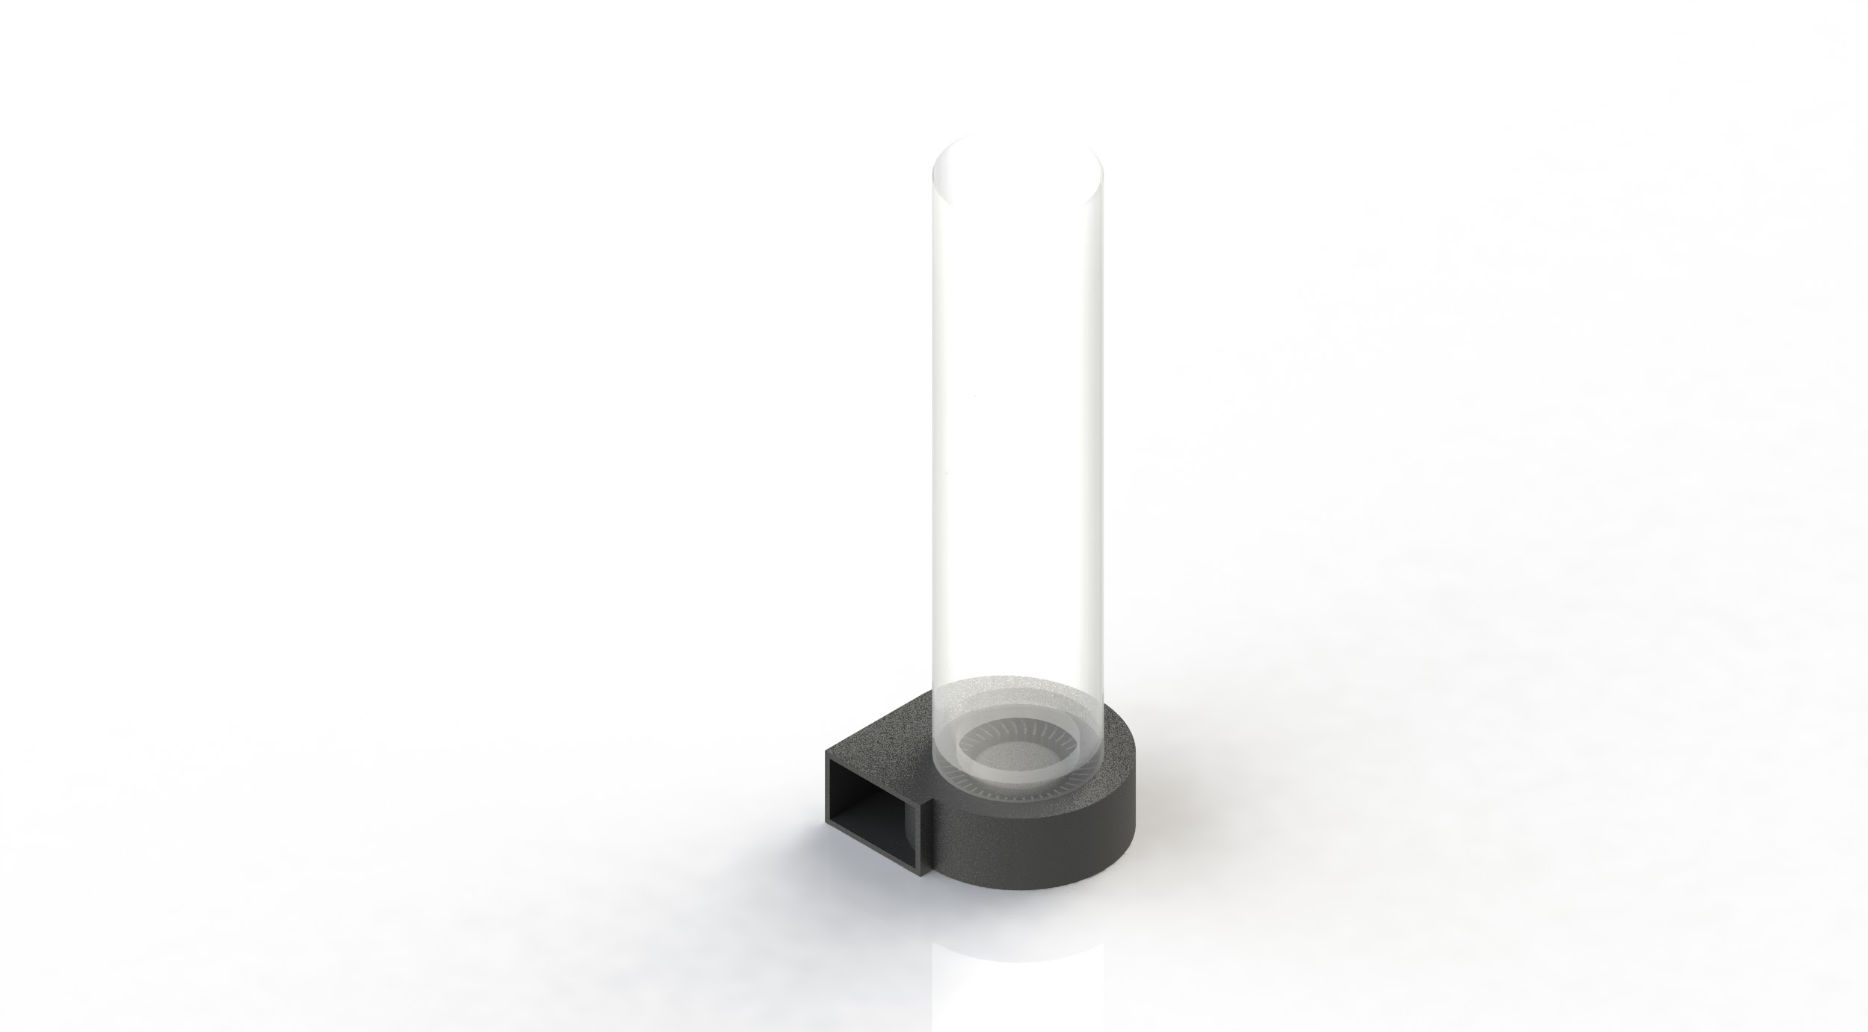
Why the Redesign?
Centrifugal vs. Axial Fan:
Axial fan is more mass-efficient
Axial fan has higher volumetric flow rates
Axial fan simplifies helium filling
Higher Pressure ratios afforded by centrifugal fans not required
Notes:
Anders

Slide 74
Gondola Cutaway
Cutaway system will consist of the same components and set-up as legacy system. Consists of:
One ¼W metal film resistor of 10 Ohms
Acts as heat source to start burn
12 Volts across resistor
Controlled by Arduino
Uses MOSFET for control
Tether is passed through the PCB and is secured against the resistor
The resistor is used to burn the teather and release the gondola from the system

Slide 75
Gondola Cutaway Risks
Risk | Effect | Mitigation
Tether ‘globs’ when cutaway is engaged | Tether is not successfully cut and the Gondola does not fall away from the balloon | PCB has been redesigned and flight tested. This redesign has not had any issues in its 10 flights
PCB cracks | Cutaway PCB is not able to operate due to broken connections | Design PCB to not be load bearing
Notes:
-Corey

Slide 76
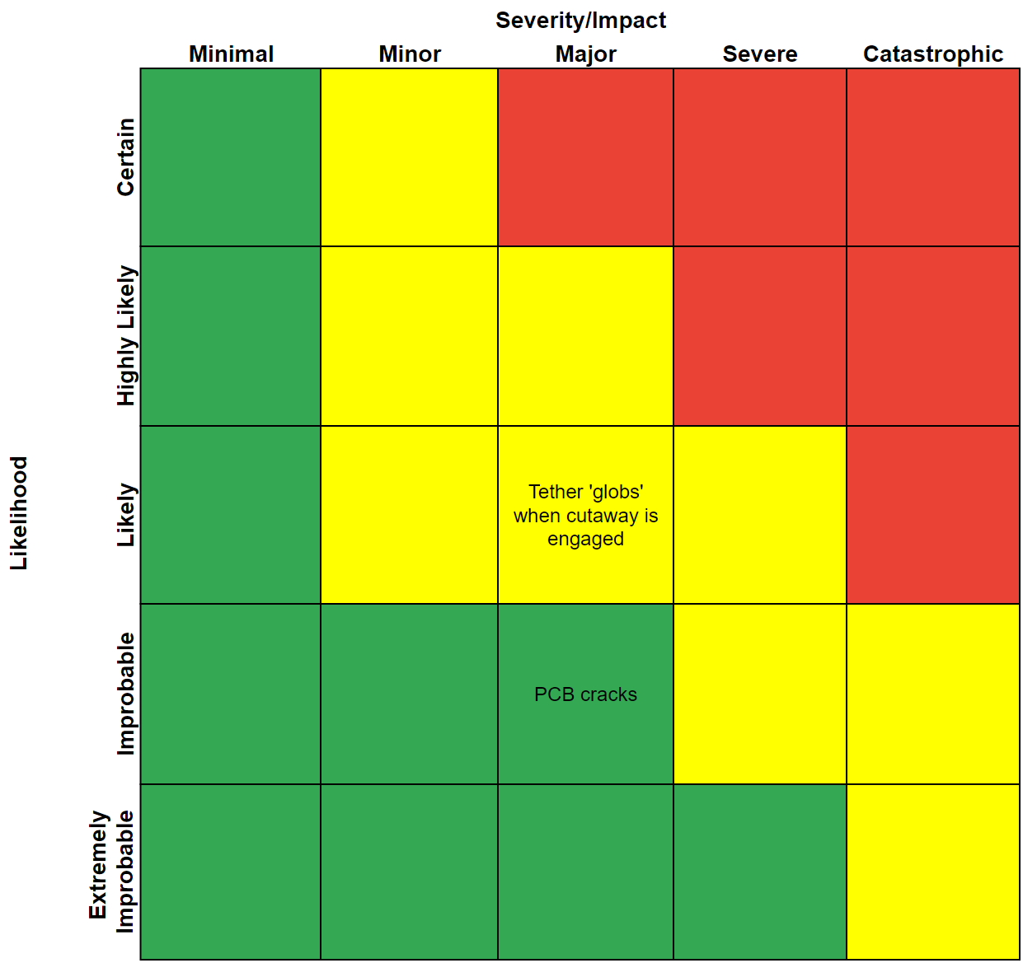
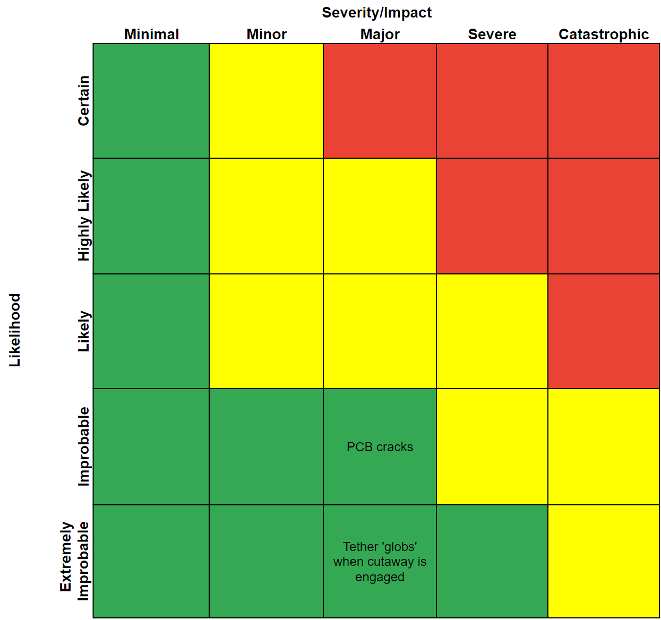
Gondola Cutaway Risks
Before Mitigation
After Mitigation
Notes:
-Corey
PCB cracking is improbable, but not sure how mitigation would look. That is why it is in the same place

Slide 77
Friction Tube Calculations
Friction Force
Normal Force
h
Pressure
(from Balloon)
OVERLAP
Weight

Slide 78
Neck Attachment Tube
y
Assumptions
τ =20 KPa E= 2 MPa m = 1.1 Kg
External Pressure from Balloon modeled with Hooke's law
x
z
y
Kaymont (5 cm) Hwoyee (8 cm)
z
Notes:
-Marcus

Slide 79
Neck Attachment Tube Calculations
y
x
z
y
z
Notes:
-Marcus

Slide 80
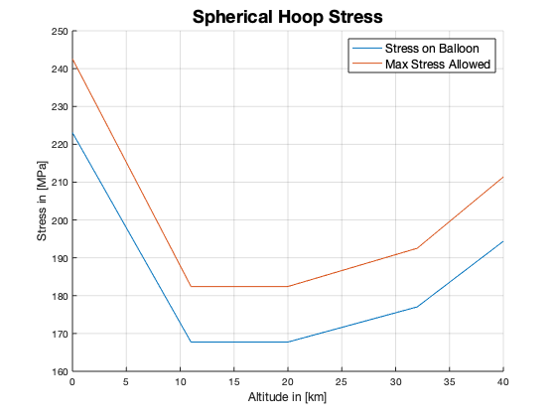
Stress Calculations - Spherical Balloon
The max spherical stressed is analysed at a payload of 2.2kg
Model analyzed at 1.1 kg
Assumptions
Perfect sphere
Radius of the balloon Sphere is proportional to altitude and temperature
Model represents Hwoyee and Kaymont Balloons
Internal busting pressure to be 370 Pa
Notes:
Model has 1.1 kg of payload -> less moles of heluim -> Less stress applied ont he balloon

Slide 81
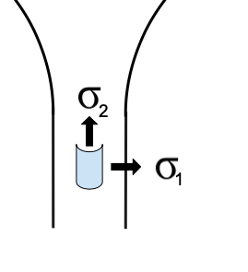
Stress Calculations - Cylindrical Neck
Stress on the Balloon Neck from the Tube
Assumptions
height of the overlapped section remains constant throughout the flight
Perfectly cylindrical vessel

Slide 82
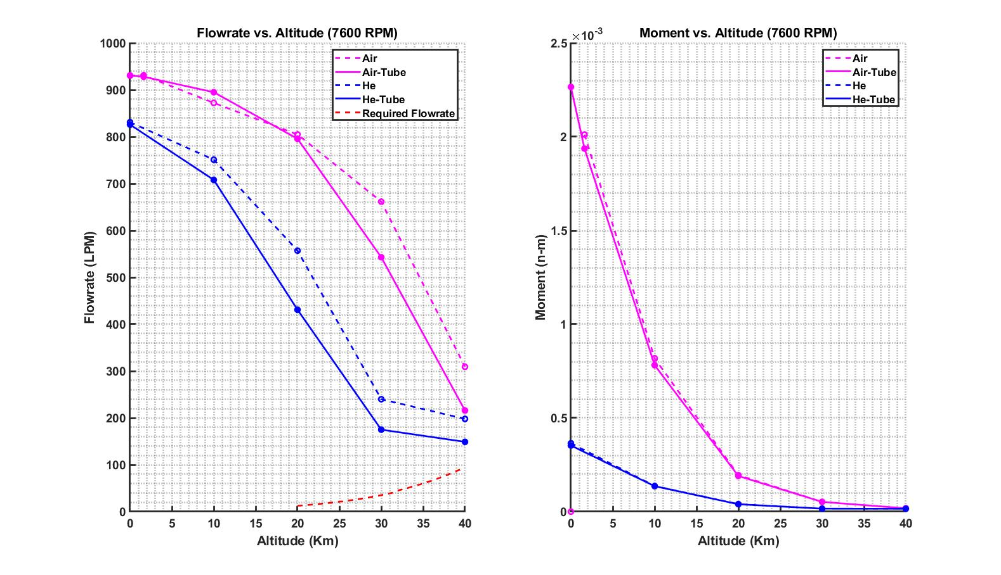
CFD Data
Notes:
-Elliott

Slide 83
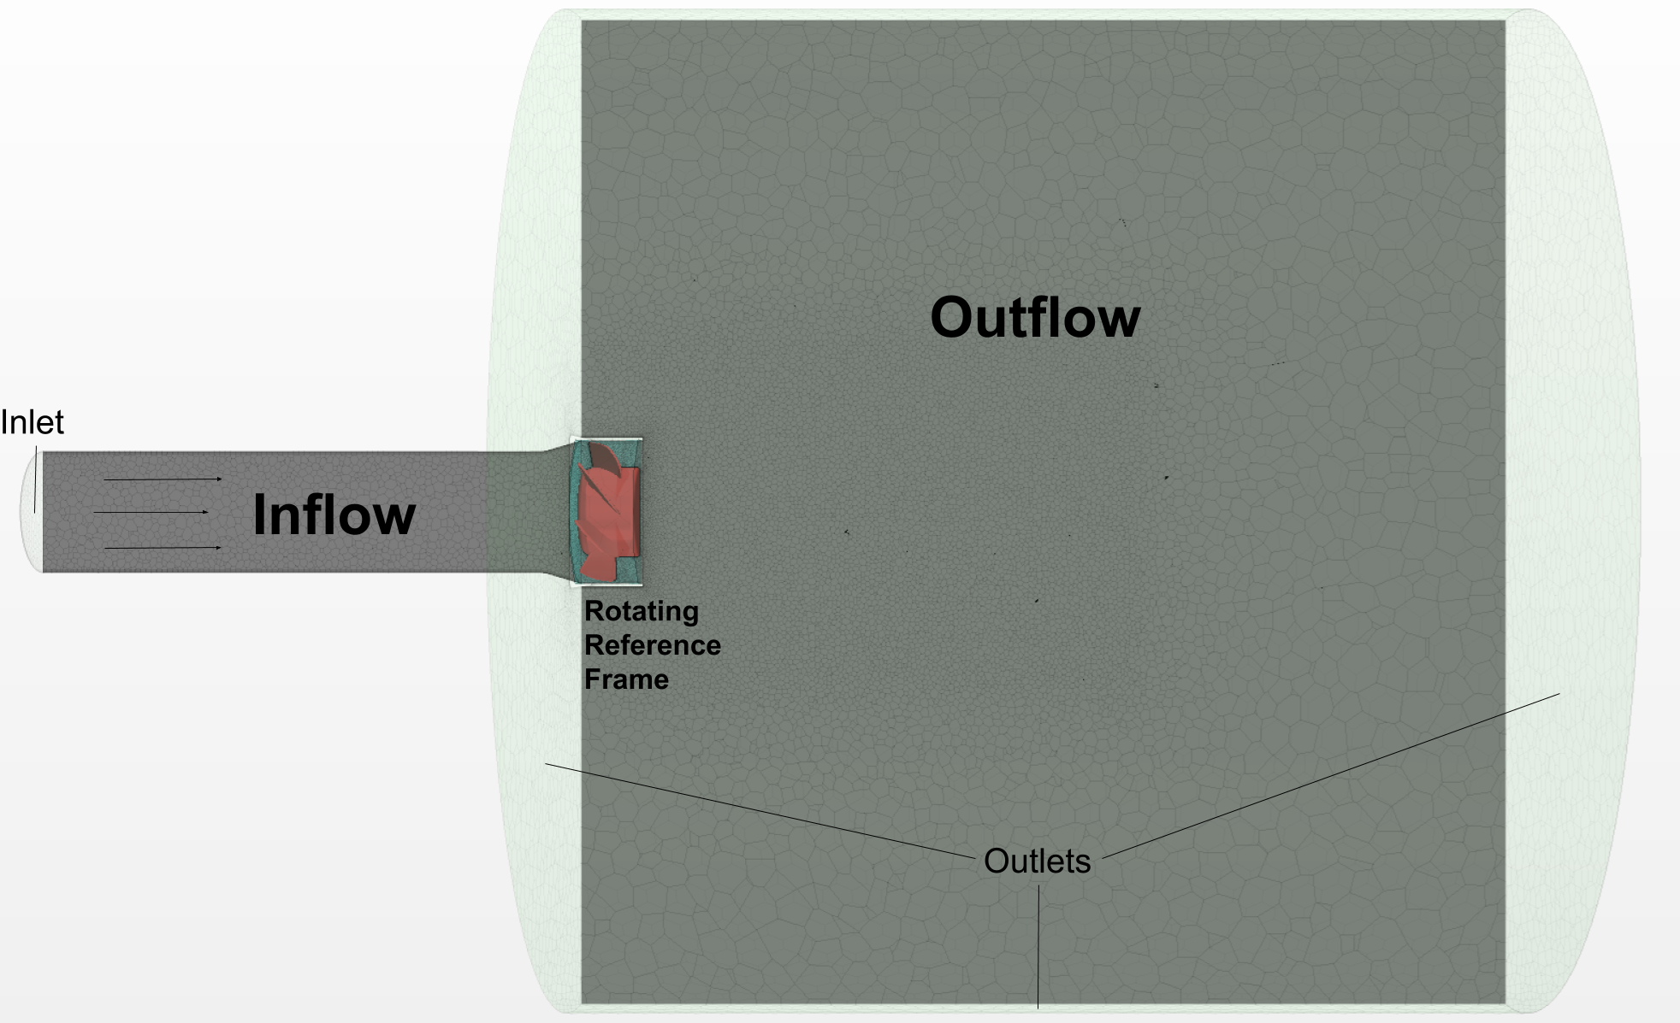
CFD Setup- Flow Domain
Inflow
-Inlet/Attachment tube
Rotating Fan Region
-Utilizes/Incorporates Fan Geometry
-Allows for time-steady solution to be computed
Outlet
-Provides/Simulates atmosphere to exhaust into
Notes:
-Elliott

Slide 84
CFD Setup- Methods
Density
-Incompressible Flow Solver
-Possibly less accurate, but likely well within the incompressible assumption range
Viscous/Turbulence
-SST-k-ധ Turbulent RANS Model
-Standard in turbomachinery applications
-Generally better performance under adverse pressure gradients*
-2 Equation Model, Solves Turbulent Kinetic Energy k and Dissipation Rate ധ
Steady
- w/ Rotating Reference Frame
Polyhedral Mesh
-w/ Prism layer to better resolve B.L
*As per STAR-CCM+ Documentation

Slide 85
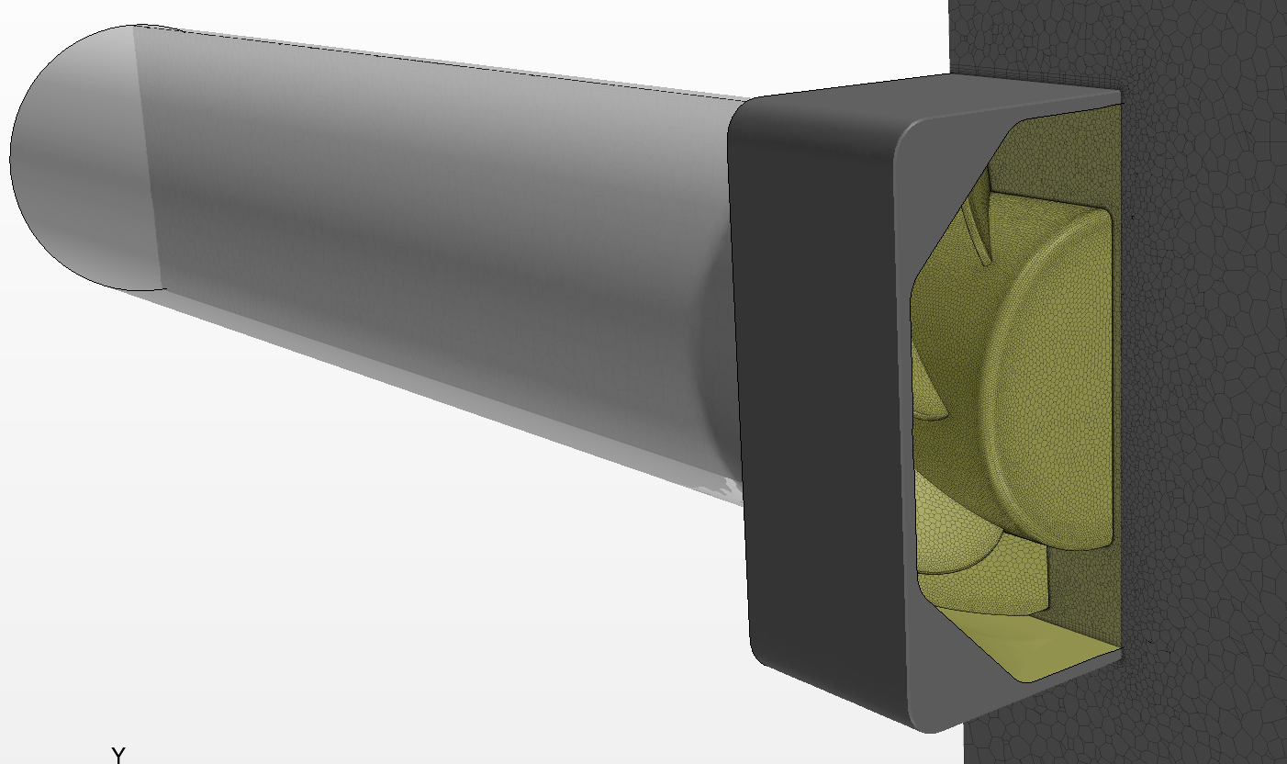
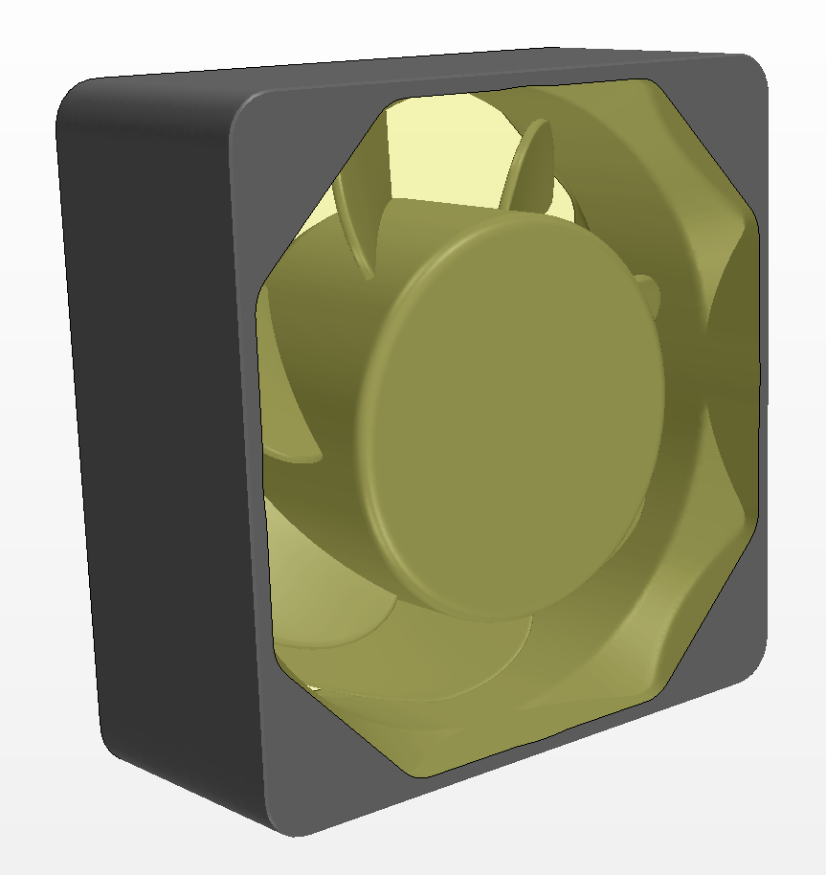
CFD Setup- Rotating Reference Frame
Pros:
Defining a rotating reference frame allows for time-steady solution to be solved for
Makes computation possible with given computational resources
No mesh-interaction/motion required
Cons:
Neglects transient flow effects (snapshot in time)
Only applicable to axisymmetric flow
*Process as detailed in STAR-CCM+ Documentation- “Moving Reference Frames Workflow”

Slide 86
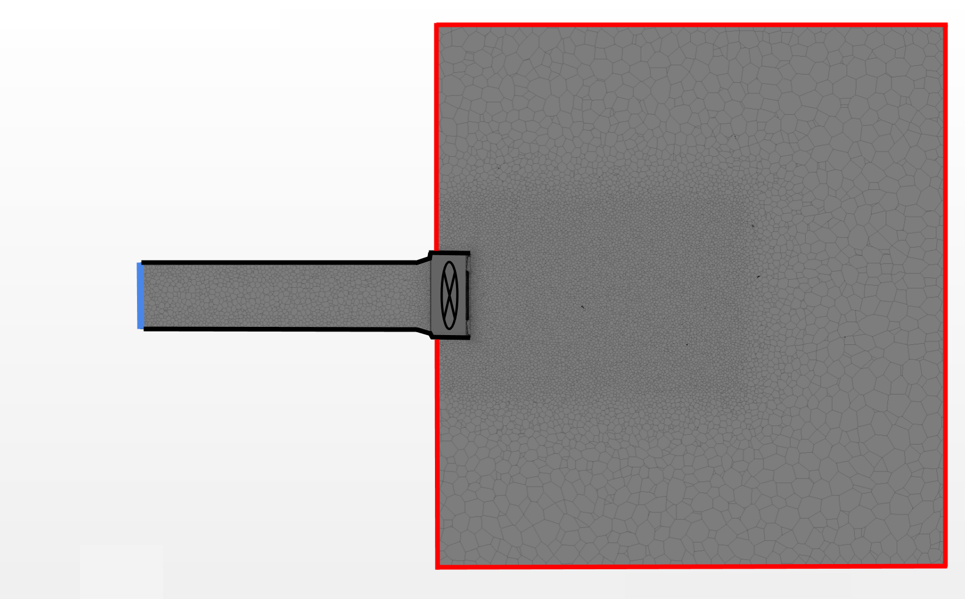
CFD Setup - Boundary Conditions
Wall:
-No-Slip
-Specified Wall Treatment Applied
Stagnation Inlet:
-Specified Total/Stagnation Pressure
Pressure Outlet:
-Specified Static Pressure
Notes:
-Elliott

Slide 87
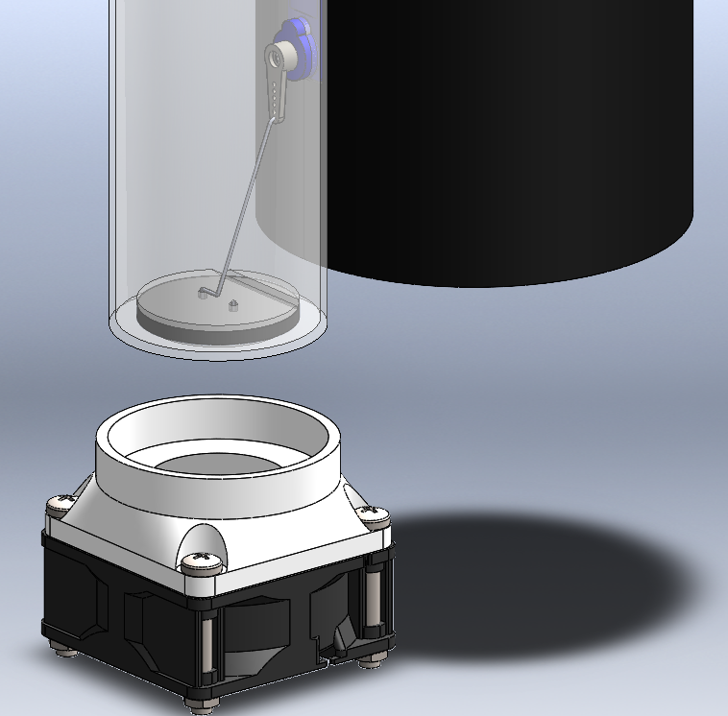
Filling the balloon

Slide 88
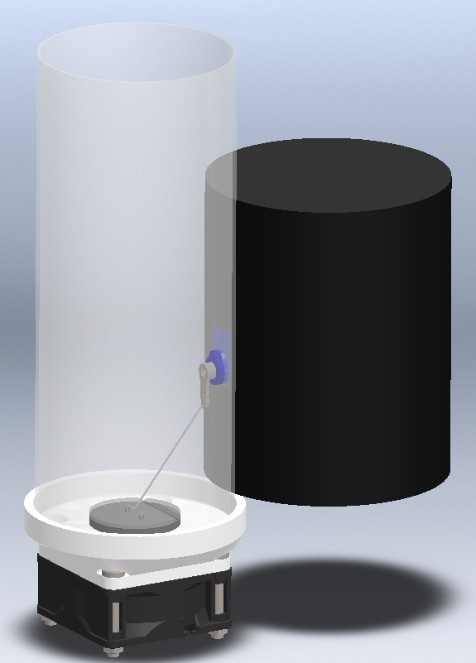
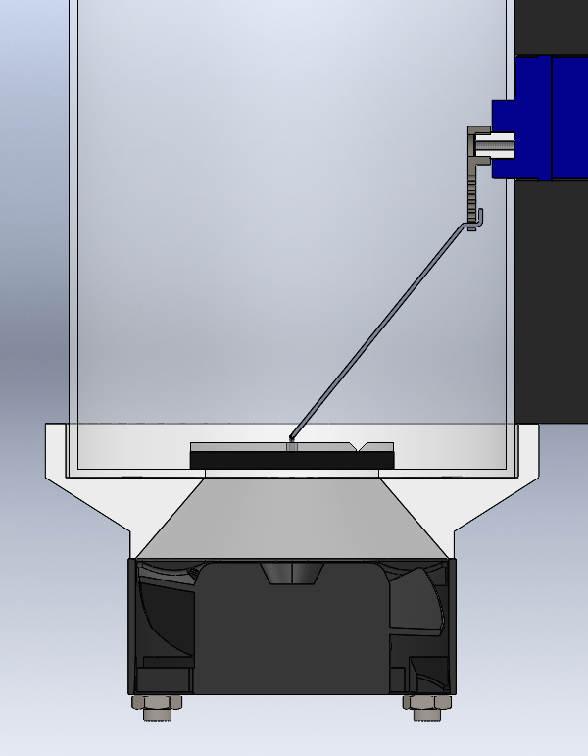
8cm Balloon ODDITY Design

Slide 89
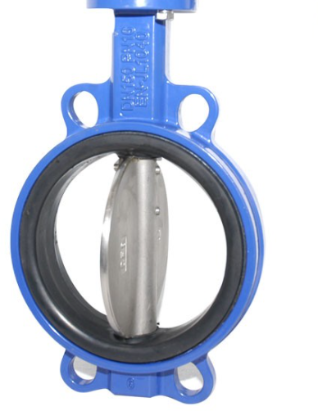
Alternative Valve options
The Legacy system may obstruct the flow too much, reducing flow rate.
Improved Legacy System
Diaphragm Iris Valve
Butterfly Valve

Slide 90
Battery Discharge Rates vs Temperature
From Panasonic

Slide 91
Thermal Assumptions & Equations
Assumptions:
Steady 1-D heat transfer
All material properties are uniform
Solid cylindrical insulation volume
Step response instead of ramp
Time and altitude based on balloon dynamics model
Heat dissipation from electronics are assumed to be constant and estimated from power efficiencies

Slide 92
Standard Day Analysis

Slide 93
Hot Day Analysis

Slide 94
CPC: Buck Converter
Details
Mass: 3.3g
Size: 0.7” x 0.8” x 0.35”
Input Voltage: 13V - 50V
Output Voltage: 12V
Temp Range: -30°C to 50°C
Max Output Current: 3.3A
Efficiency: 95%
Power Loss: 2.1W
Purpose

Slide 95
CPC: Arduino Nano Every
Details
Power Required: 7V - 12V
Mass: 5g
Size: 0.7” x 1.8”
Operational Temperature Range: -40°C to 125°C
20 Pins
20 Digital
5 PWM
8 Dual Digital/Analog
TX and RX pins used for XBee
Time On:
Purpose
Sole microcontroller for ODDITY
Slave to gondola based on received packages

Slide 96
CPC: Digi XBee 3
Digi XBee 3 Module
Frequency: 2.4 GHz
Line of sight range: 1.2 km
Transmit Power: +8 dBm
Receiver Sensitivity: -103 dBm
Will be used onboard ODDITY with gondola
Digi XBee Pro SX Module
Frequency: 902 - 928 MHz
Line of sight range: 105 km
Transmit Power: +30 dBm
Receiver Sensitivity: -103 dBm
Will be used onboard gondola with ODDITY and GND station

Slide 97
CPC: Power Budget with Fan heating

Slide 98
Anemometer Fan Testing
The team has done some rough anemometer testing to determine the volumetric flow rate of our axial fan.
The anemometer is not a precise enough tool for us to place much confidence in this test.
Results: Flow rate ~20% higher than datasheet flow rate

Slide 99
Descent Control Risks
Impact
Minimal
Minor
Major
Severe
Catastrophic
Number: | 3
Risk: | Balloon bursts
Effect: | The target altitude may not be able to be reached and/or the system descends faster than desired
 |  | 1 |  | 3
 |  |  | 2
Certain
Highly Likely
Likely
Likelihood
Improbable
Extremely Improbable
Notes:
-Anders

Slide 100
Descent Control Risks
Impact
Minimal
Minor
Major
Severe
Catastrophic
Number: | 3
Risk: | Balloon bursts
Effect: | The target altitude may not be able to be reached and/or the system descends faster than desired
Mitigation: | Ensure that we remain below the maximum allowable stress in the balloon
 |  | 1 |  | 3
 |  |  | 2 | 3
Certain
Highly Likely
Likely
Likelihood
Improbable
Extremely Improbable
Notes:
-Anders

Slide 101
Testing Materials Cost
Materials:
Most of the Testing materials can be used for several tests.

Slide 102
Software FBD

Slide 103
Command Flow
Purpose and Objectives
Design Solution
Critical Elements
Requirement Satisfaction
Project Risks
Verification & Validation
Project Planning
Notes:
- Corey

Slide 104
Pin Assignment
Arduino Nano
All transistors
Servo
Fan control
Temperature sensor
XBee
Purpose and Objectives
Design Solution
Critical Elements
Requirement Satisfaction
Project Risks
Verification & Validation
Project Planning
Notes:
Corey

