Slide 1
Test Readiness Review: iMagpie
A Mobile, Person-Portable, SSA Platform
Sponsors: Dr. Marcus Holzinger and Samuel Wishnek
Team Members: Ashkan Bafti, Michael Dynakowski, Frasier Feight, Nathan Herr, Idam Isnaeni, Alison Jarvis, Matthew Melby, Justin Miller, Alexander Pulliam, Charles Puskar, Jordan Reynolds, and Lucas Teigen
Advisor: Dr. Aaron Johnson
ASEN 4028: Senior Projects March 2, 2019

Slide 2
Presentation Overview
Overview
Schedule
Test Readiness
Budget

Slide 3
Presentation Overview
Overview
Schedule
Test Readiness
Budget

Slide 4
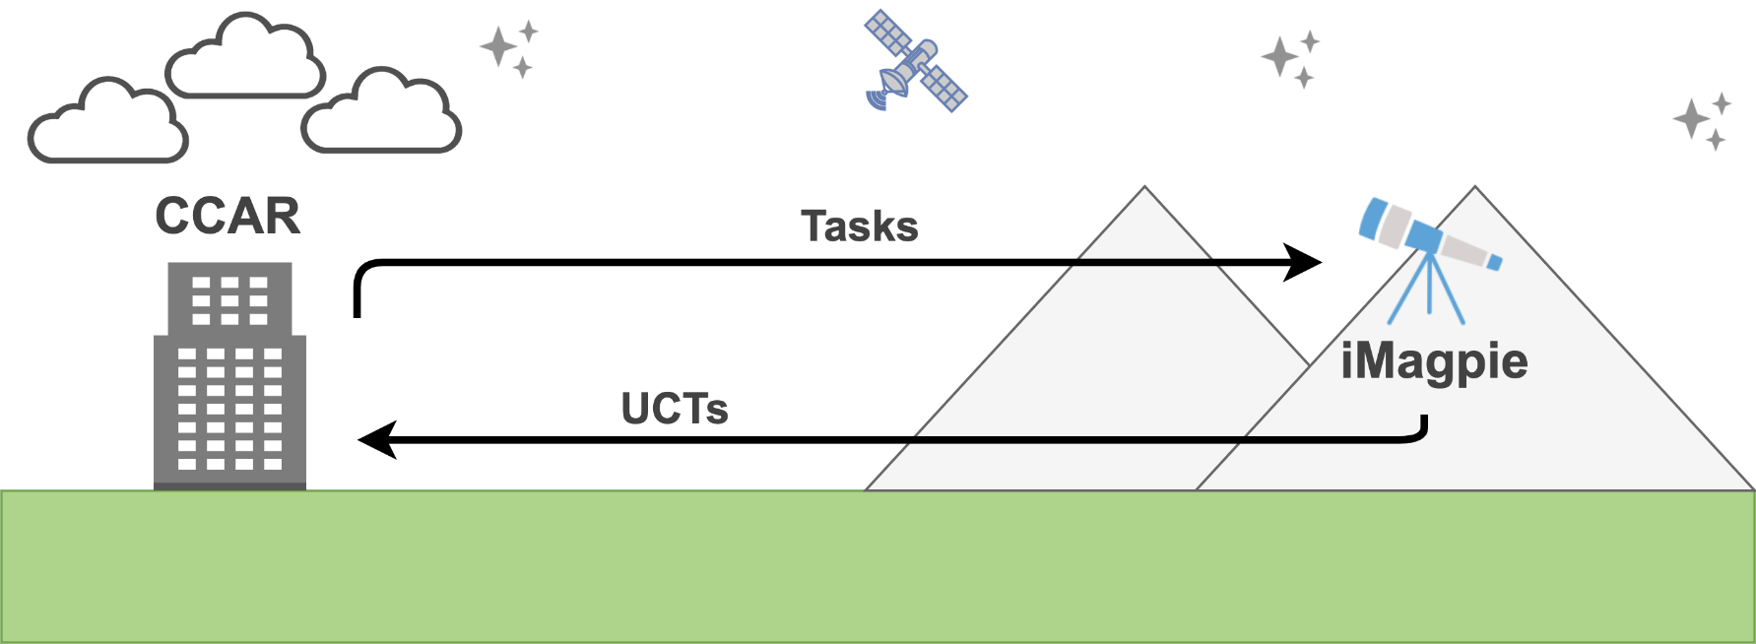
Project Purpose
iMagpie: A Mobile SSA Platform
Deployable to remote locations
Receives observation tasks from CCAR
Captures image, extracts uncorrelated tracks (UCTs)
Reports UCTs in real-time back to CCAR
UCTs used by CCAR for orbital estimation
UCTs = RA and Dec w/ time stamp
Notes:
Explain what uncorrelated tracks are
Clarify processed data
CCAR will also process the data

Slide 5
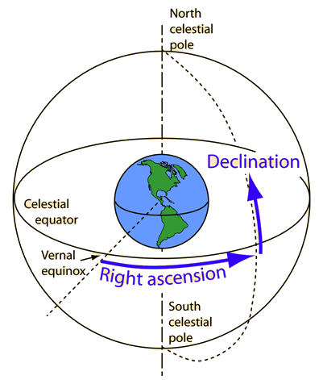
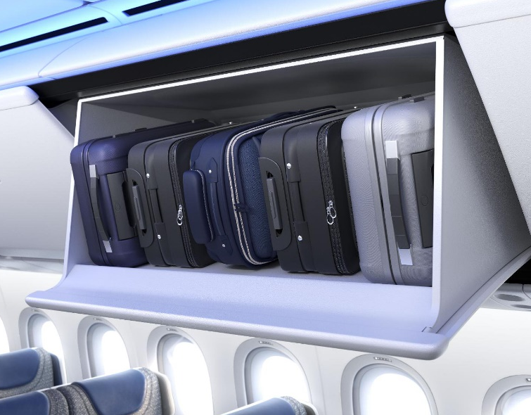
Customer Objectives and Constraints
Observations
GEO, MEO, LEO objects
Magnitude 13 or brighter
Reporting
System GPS location
Object RA, Dec, time stamp
10 arc-second (3σ) accuracy
Operation
10 hours/night at 3 tasks/min
Mobility
Weight: less than 20 kg
Volume: Airline carry-on
[1]
[2]
Notes:
http://hyperphysics.phy-astr.gsu.edu/hbase/eclip.html
https://twitter.com/boeingairplanes/status/1086672652150939649
Call this slide customer requirements

Slide 6
Concept of Operations
5. iMagpie actuates to task-specified attitude
1. Observation denied to traditional observatory
7. iMagpie processes image to obtain:
Attitude of 10 nearest stars
Attitude of streak start
Attitude of streak stop
6. iMagpie images object in transit, saves image locally
11. Night tasking and day recharging continue for mission duration
9. Pointing, imaging, and processing repeats for the rest of the night, up to three observations per minute
10. iMagpie solar panels recharge batteries during the day
3. iMagpie assembled and calibrated on-site
2. iMagpie deploys to off-grid site by hiking, flying, driving, etc.
4. Autonomous pointing enabled as human rests
12. iMagpie disassembled at end of mission and returned to CCAR
8. UCTs, exposure times, & GPS location sent to CCAR via SMS
Notes:
Add cadance
Plane/hiking/both

Slide 7
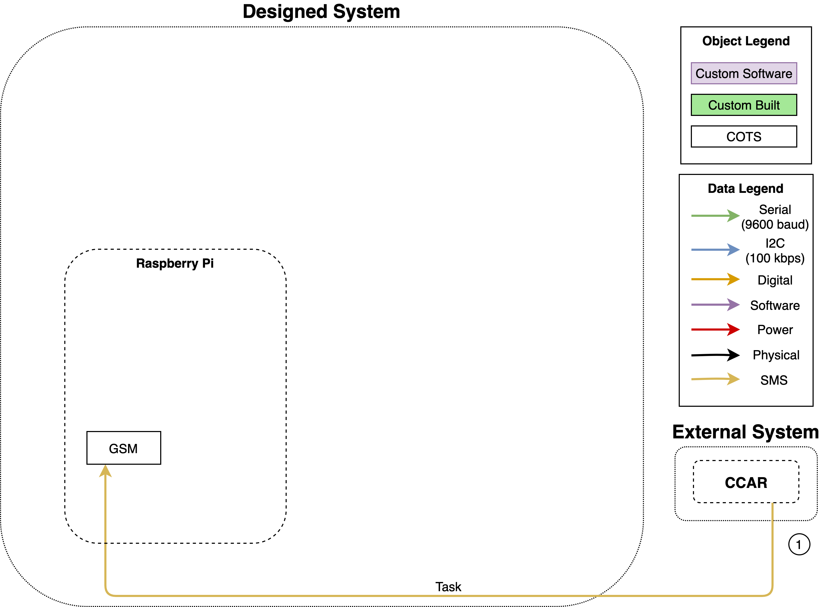
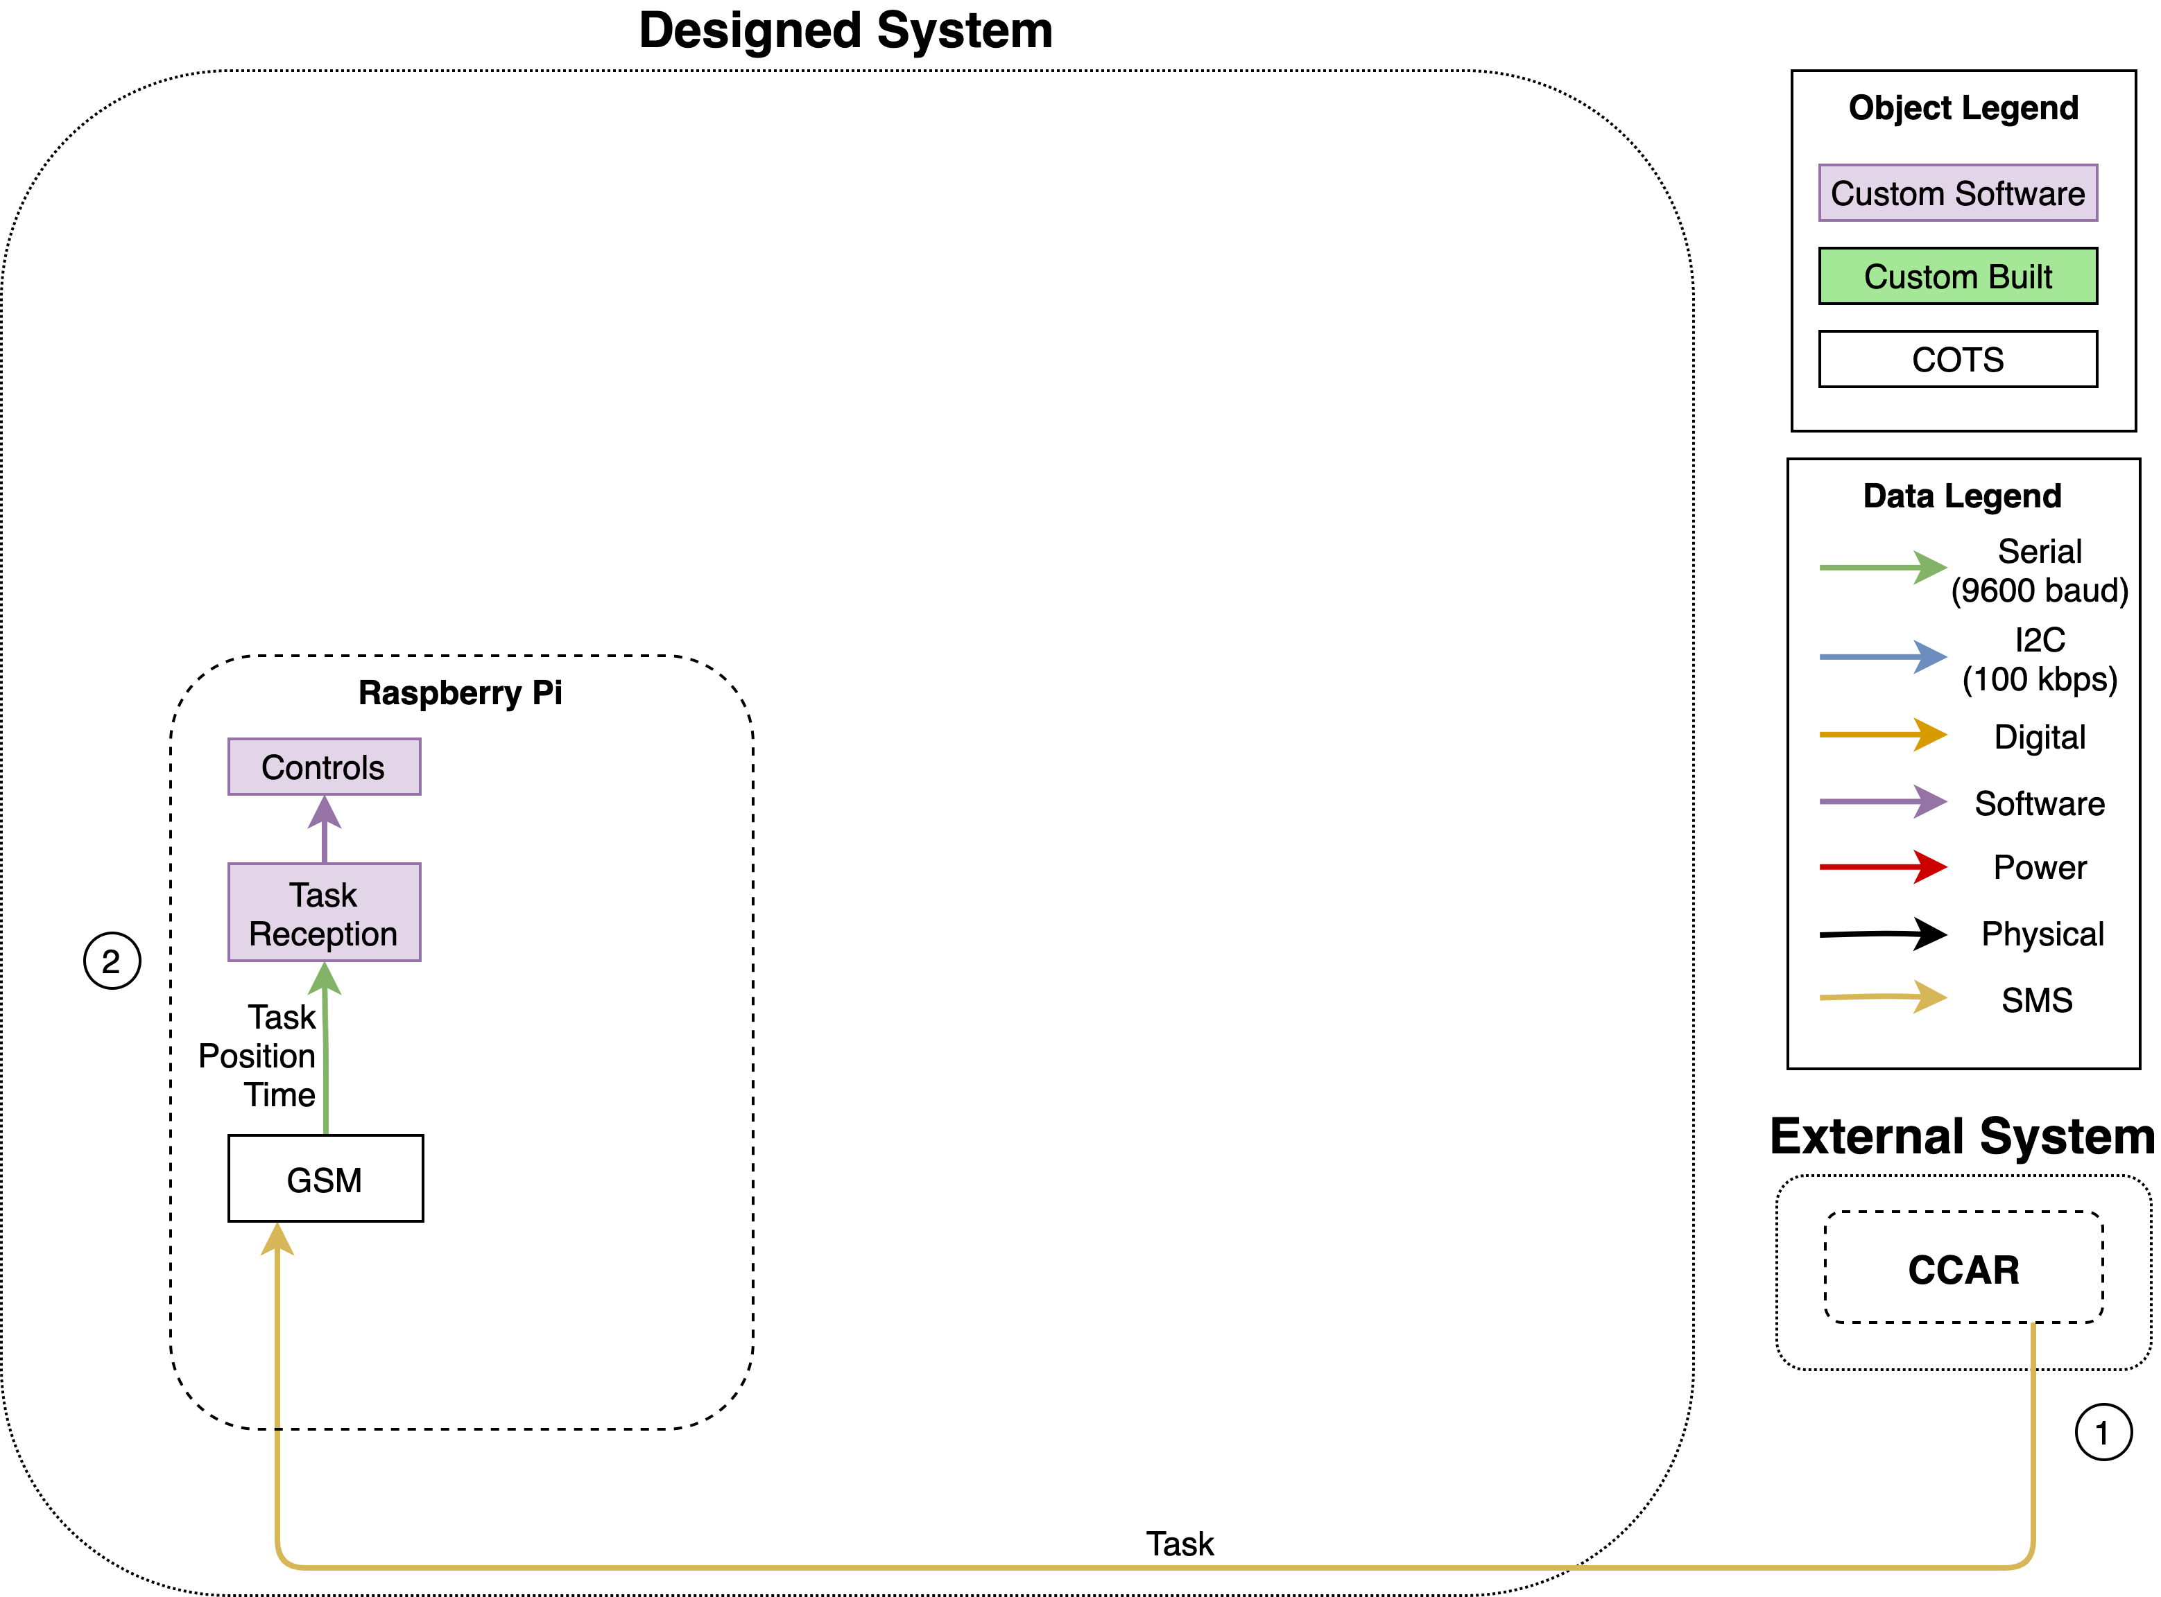
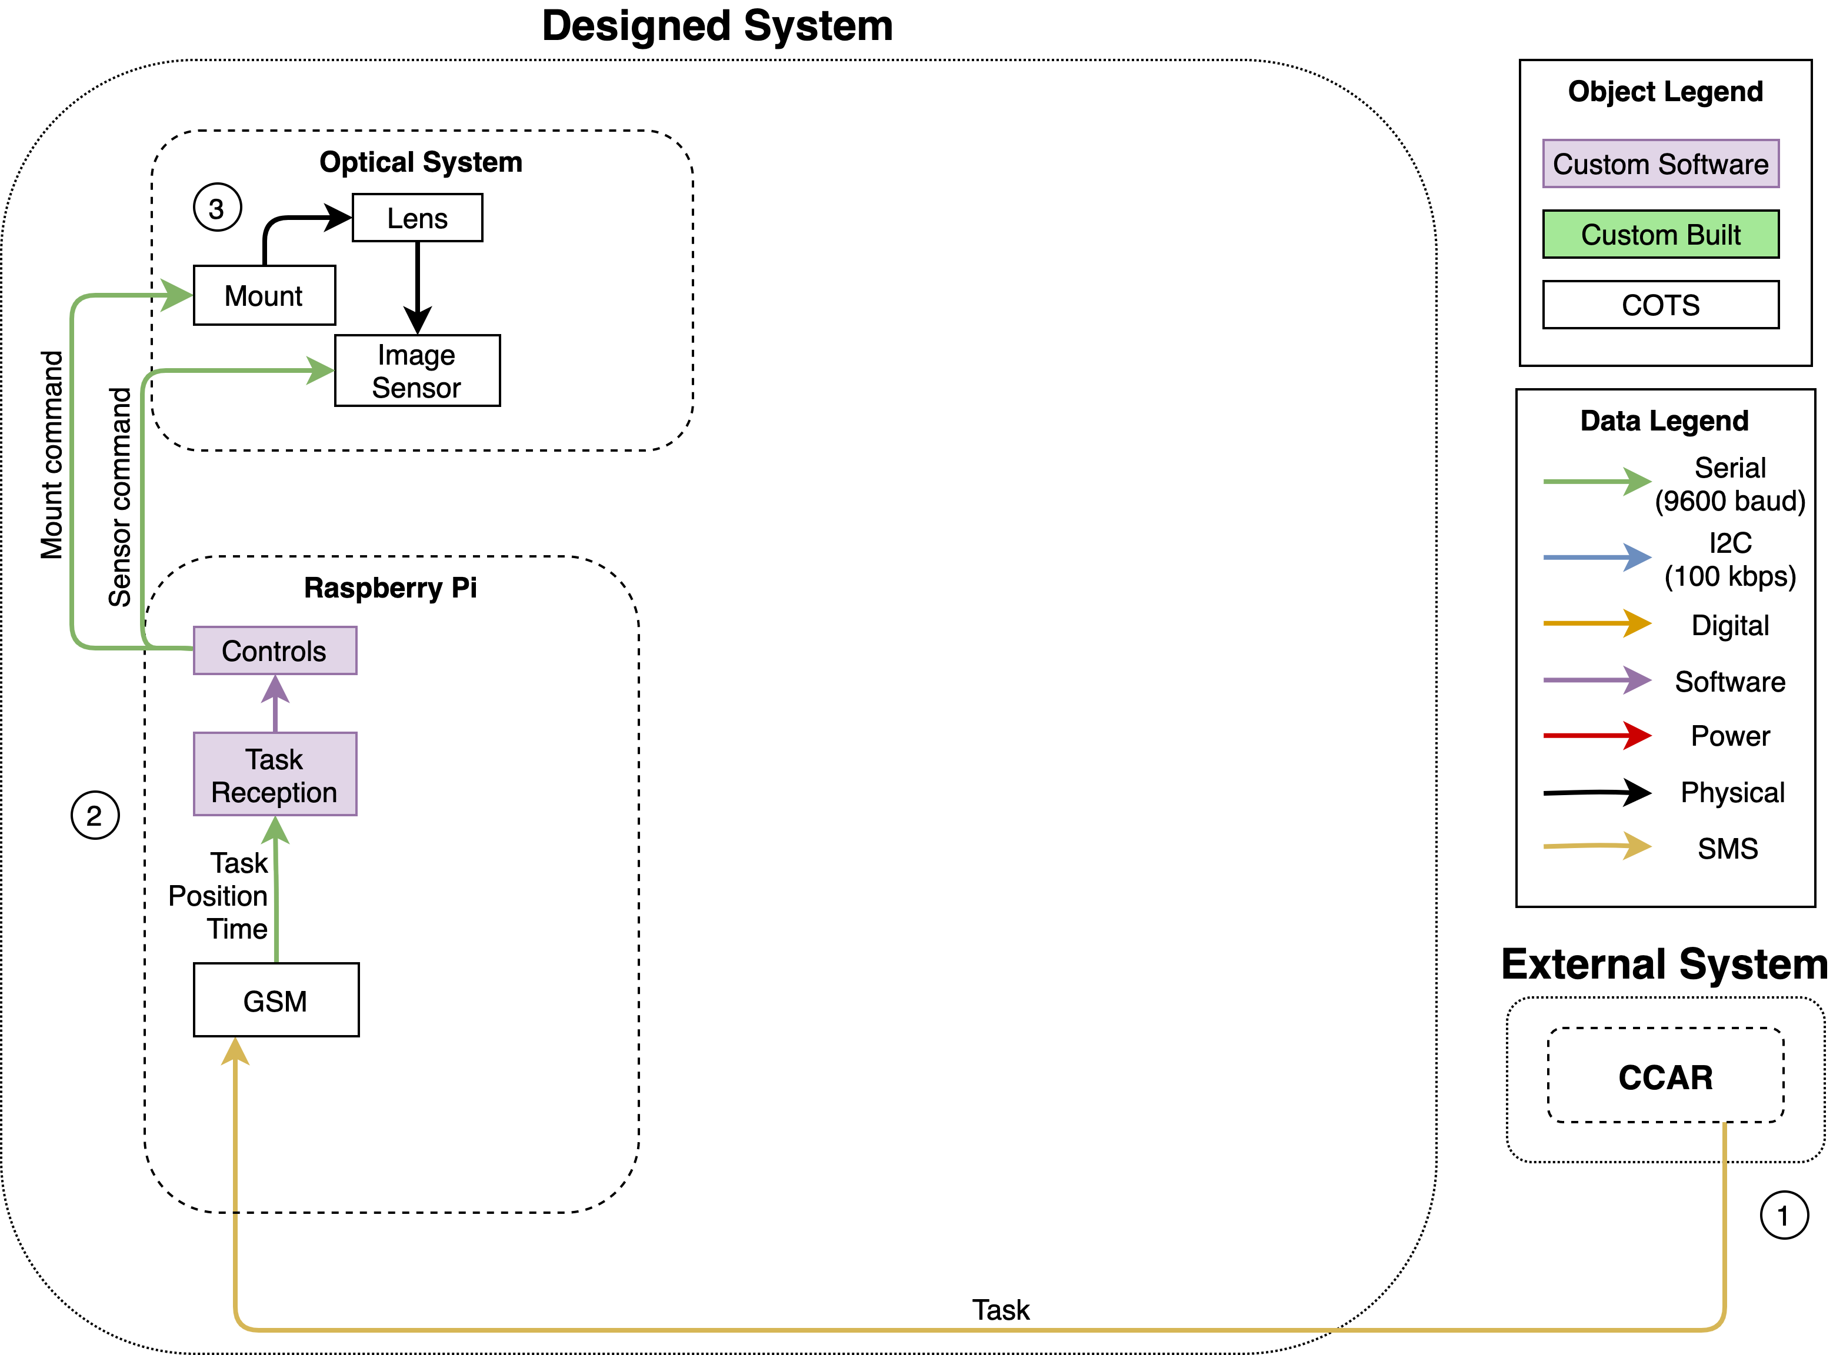
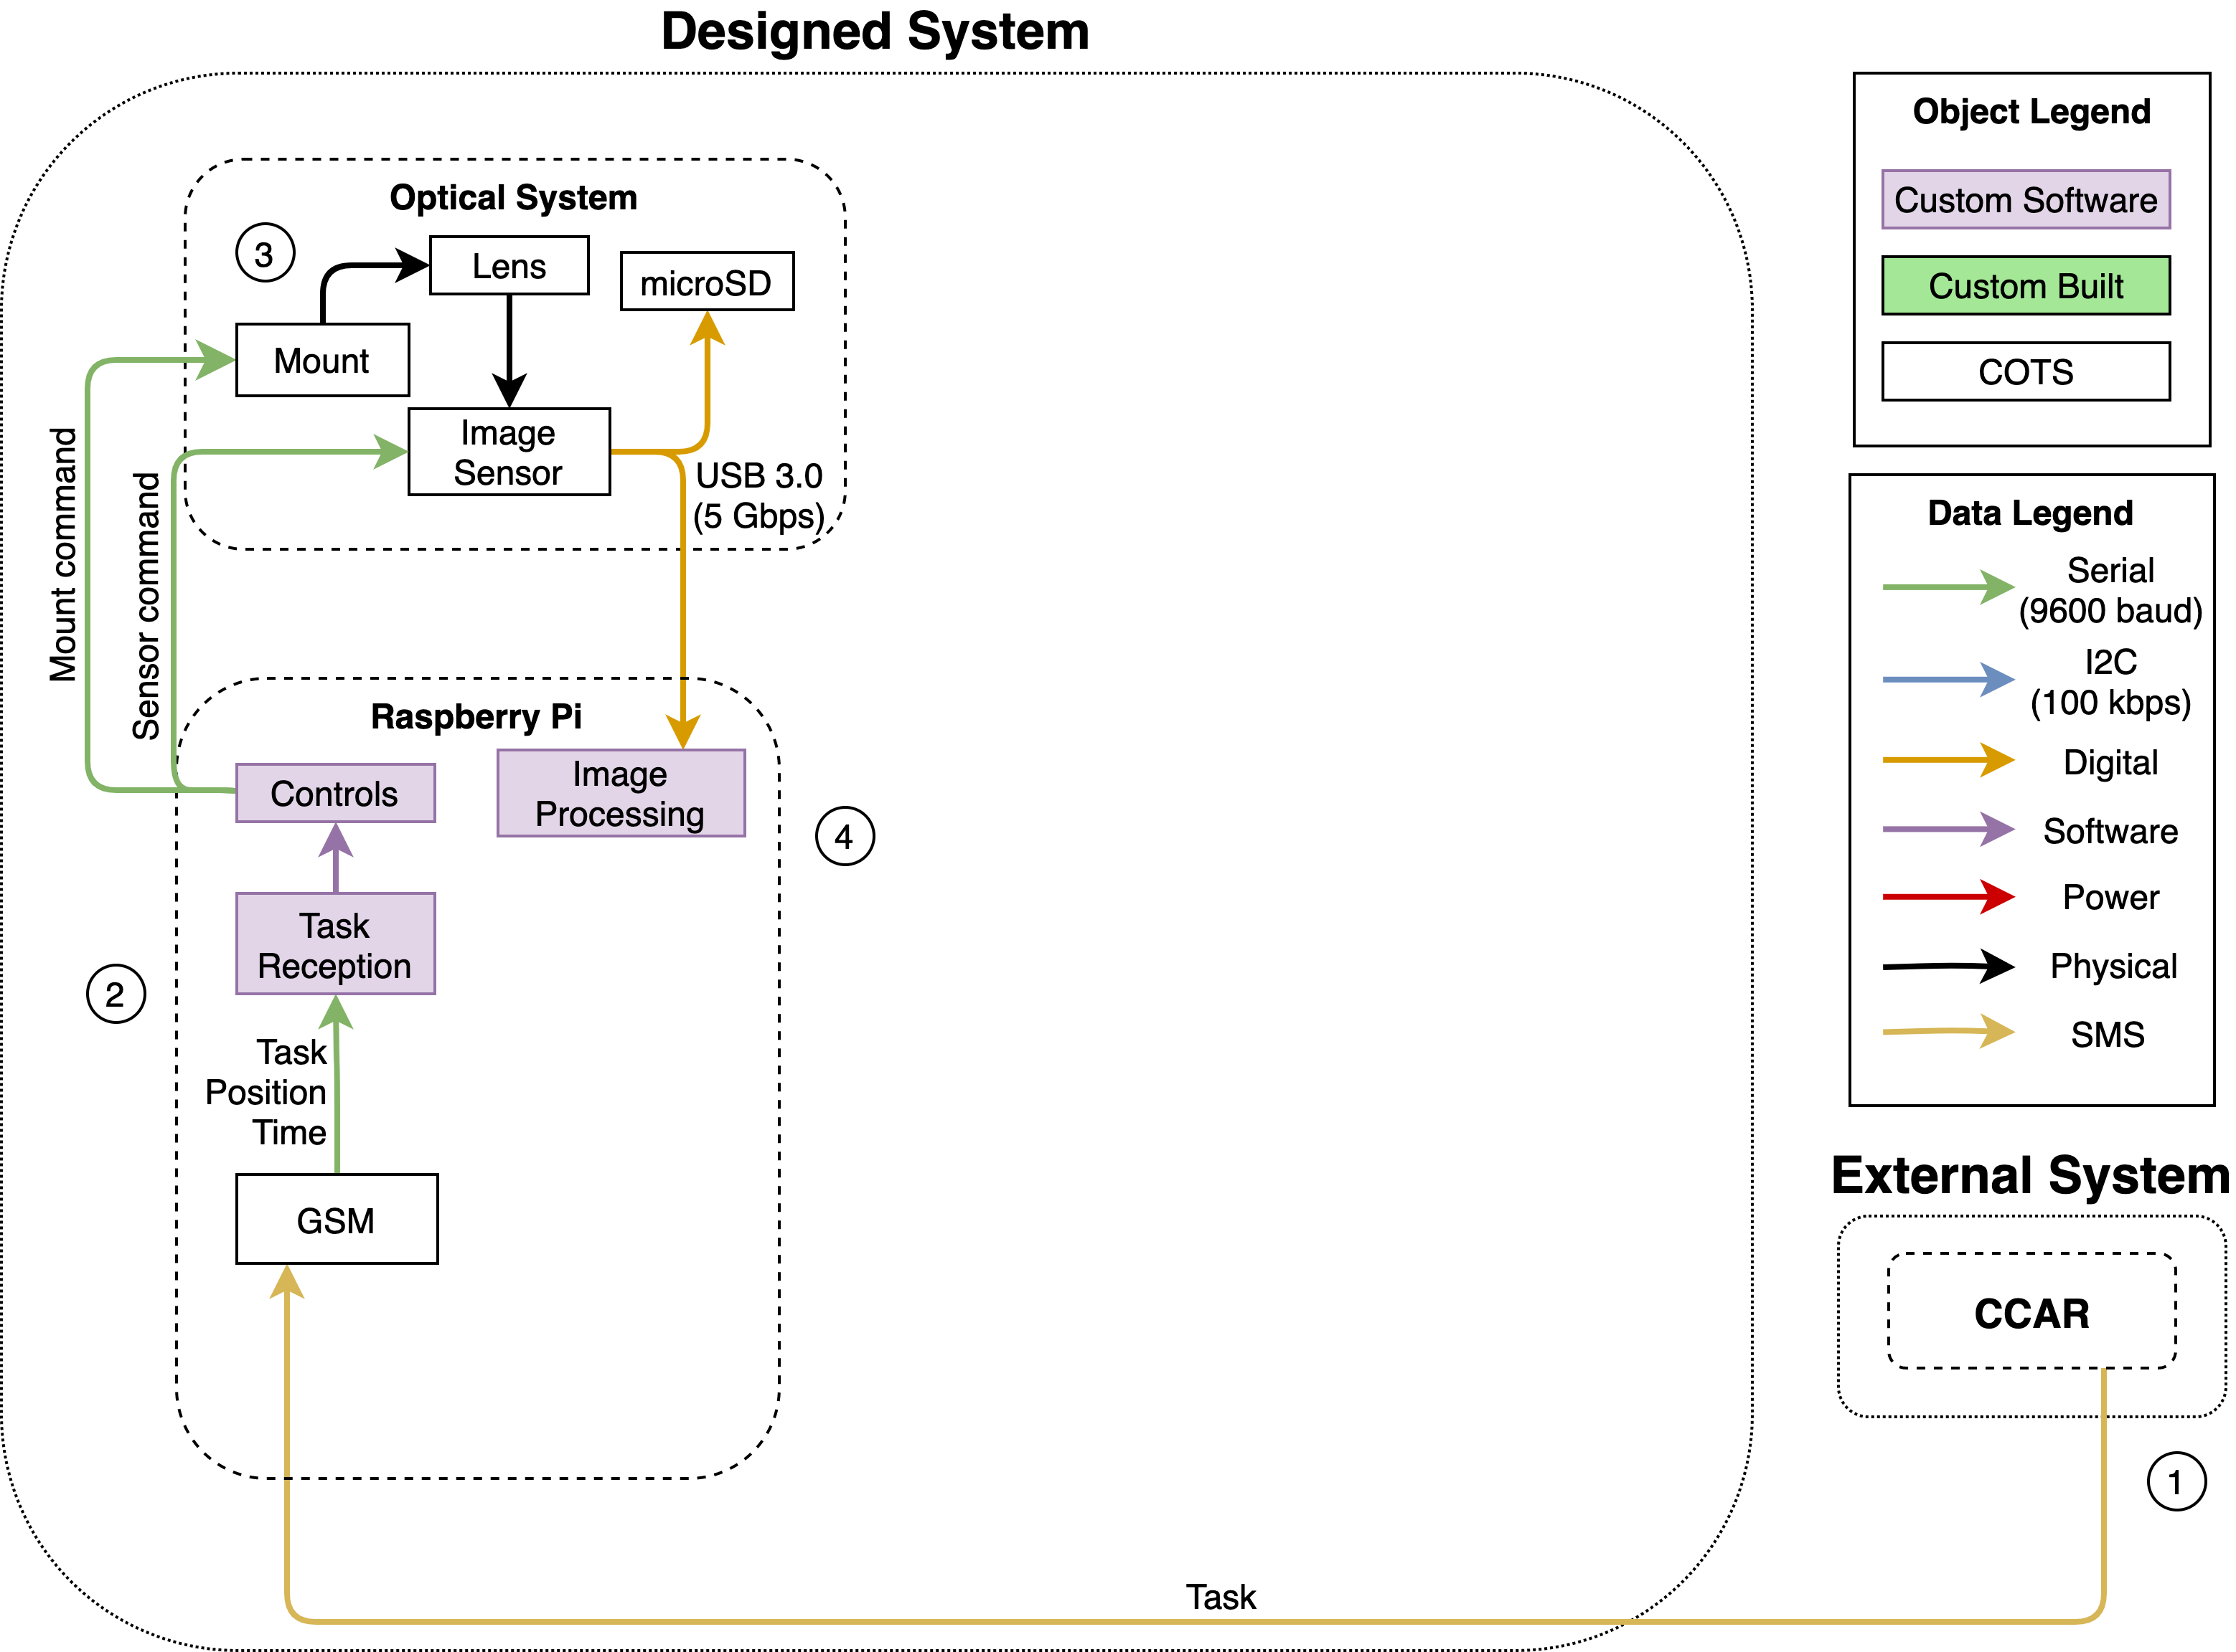
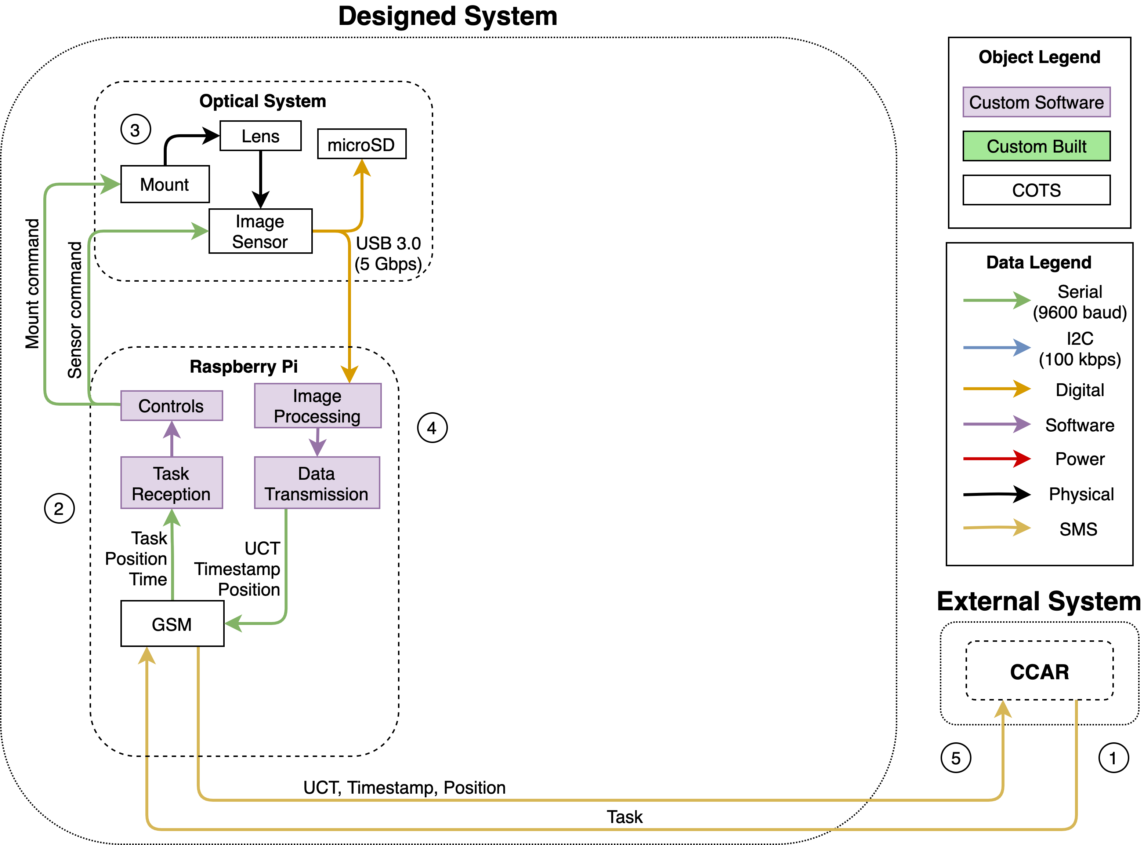
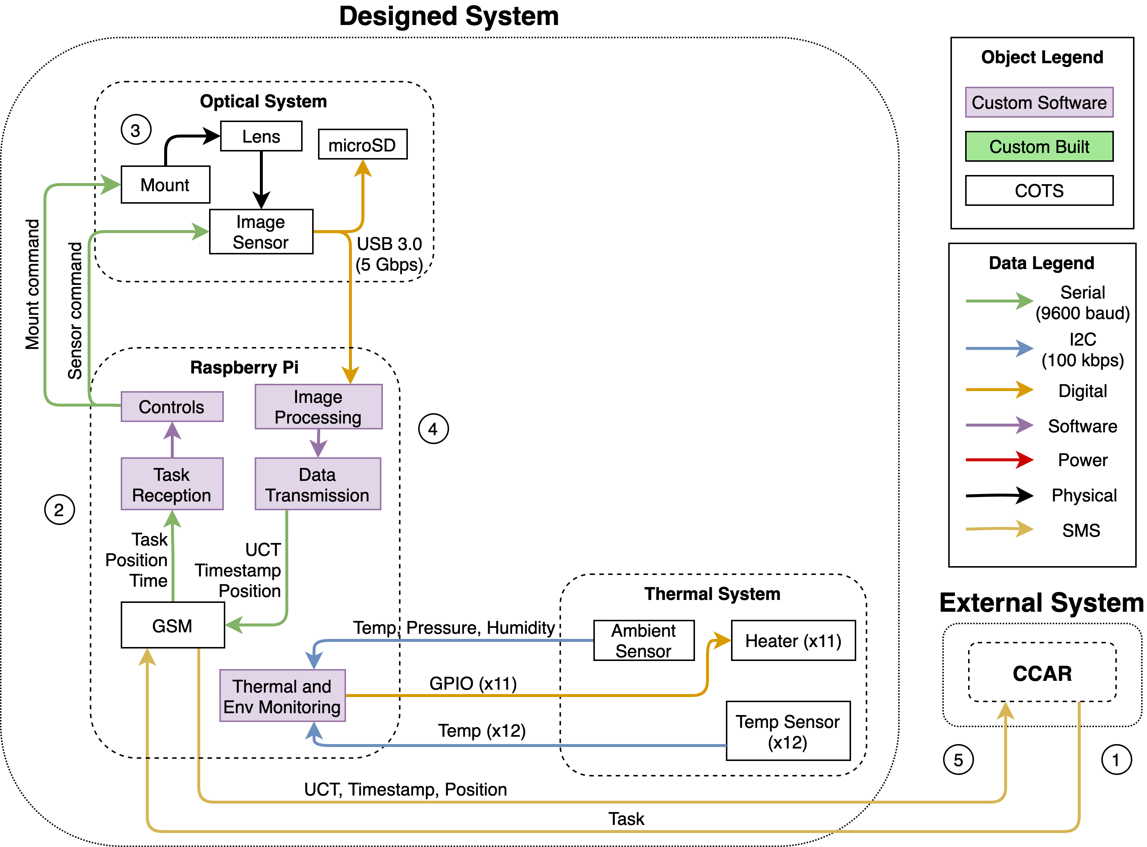
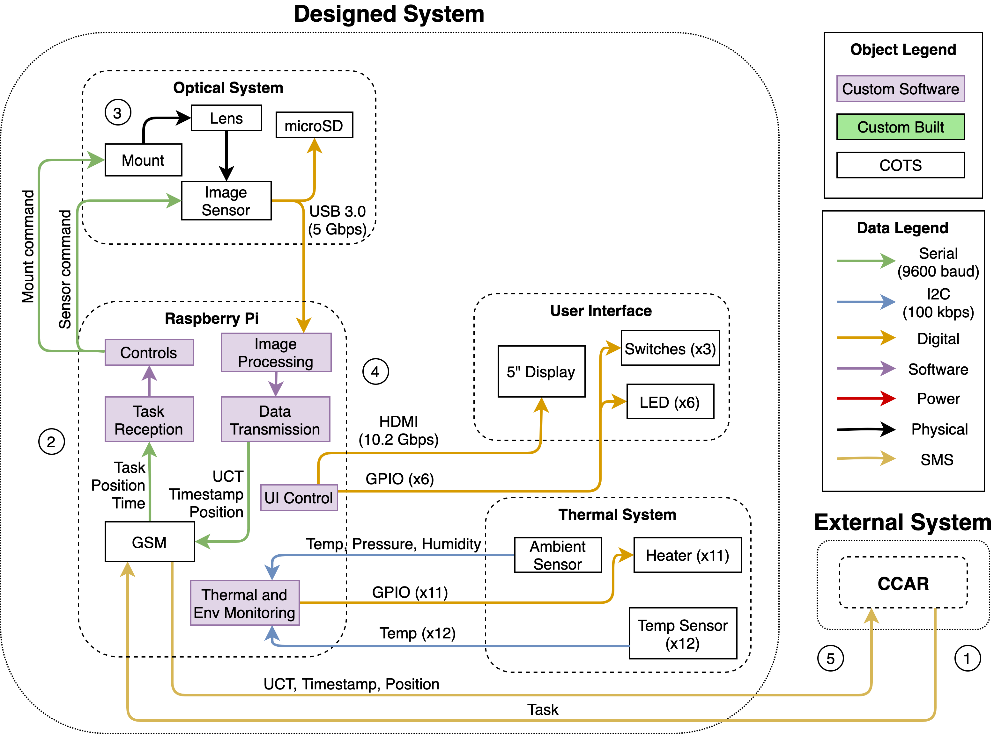
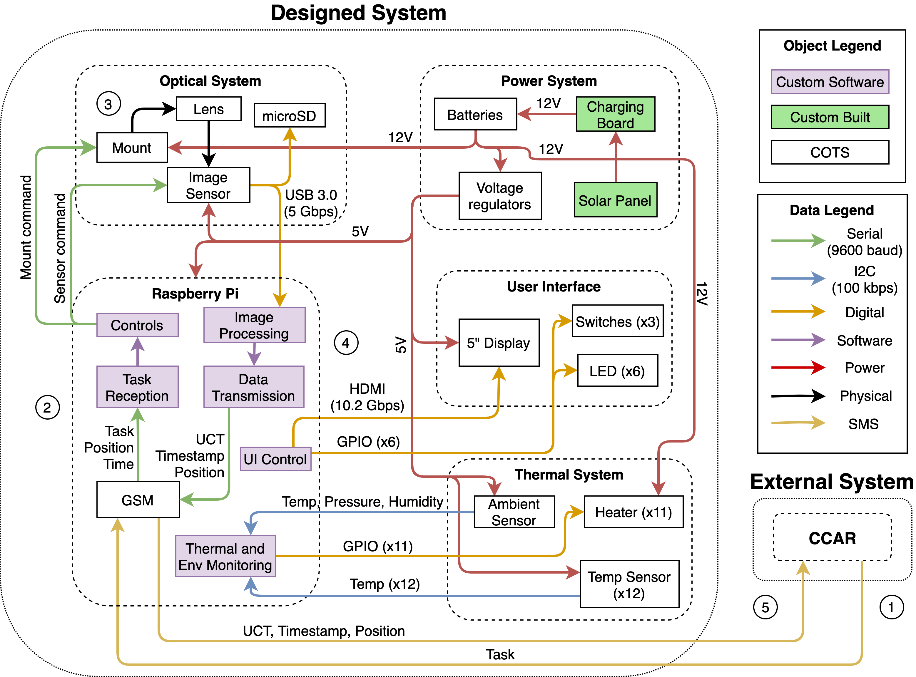
Functional Block Diagram
Notes:
Fix animation
Specify task – what is in the data being sent
What is being sent data transmission to processing
Exposure command, pointing command – degrees of freedom
Think through interfaces
FBD can reflect electronics schematic – ok to repeat

Slide 8
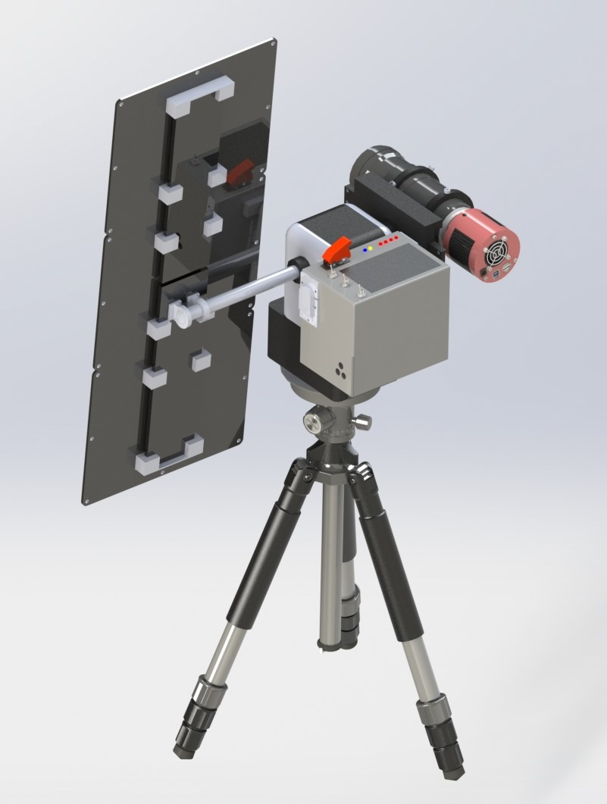
Design Overview
Image Sensor
Solar Panels
Lens
Processor Box
Mount Head
Tripod

Slide 9
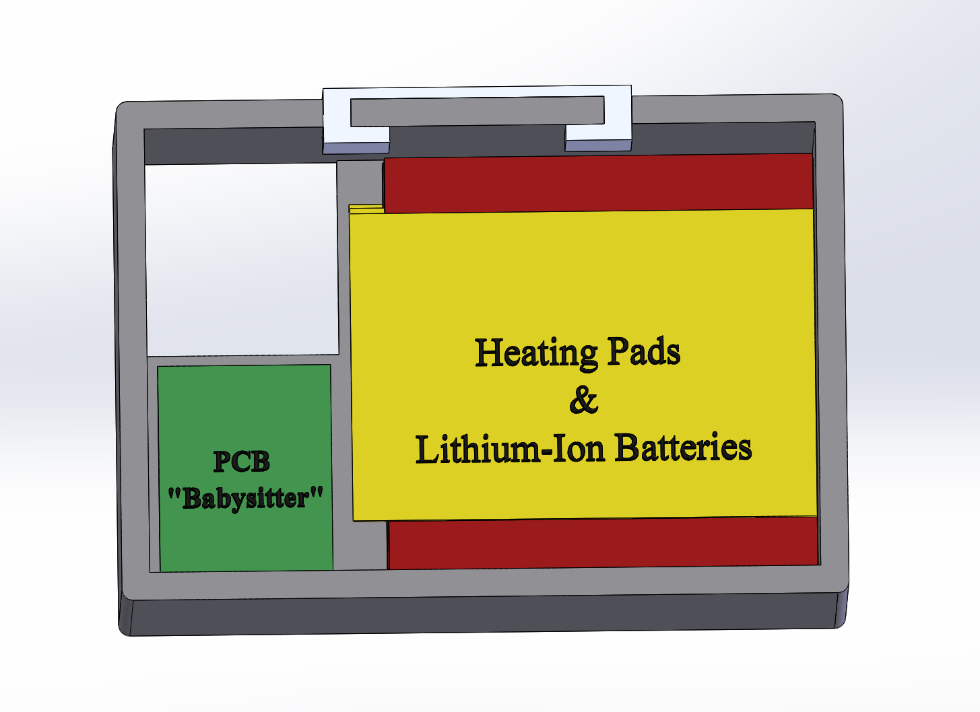
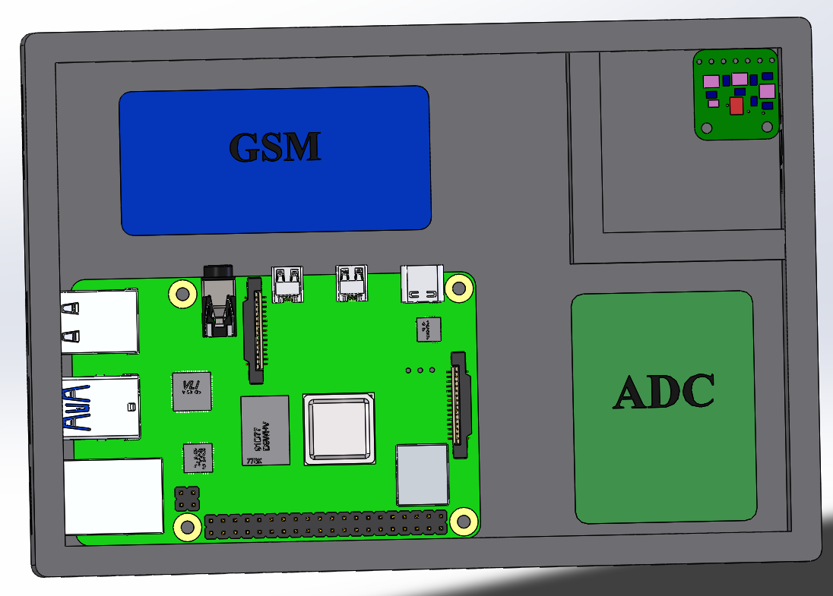
Processor Box Design
Dimensions: 16.5x11.4x14.6 cm
GSM
(GPS/SMS Board)
Ambient Sensor
Raspberry Pi 4B
Notes:
Specify that we're calling this out because it has particular requirements – thermal design

Slide 10
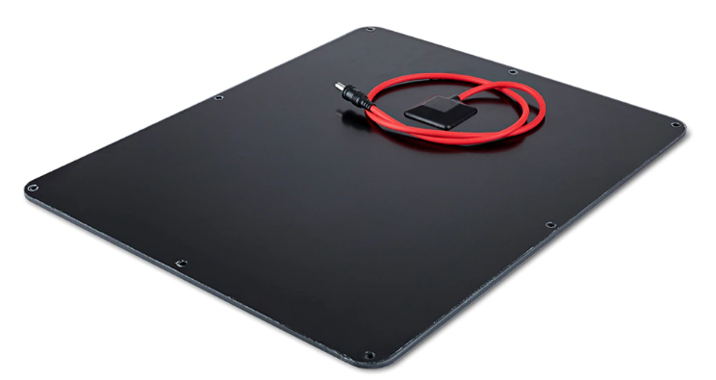
Solar Panel Design Changes
Voltaic solar panel - COTS
10 Watt
6 Volts
UV- and scratch-resistant ETFE coating
Waterproof
Quantity: 3
Notes:
https://voltaicsystems.com/10-watt-panel/

Slide 11
Solar Panel Design Changes
Materials:
Acrylic
PLA
Method
Epoxy
Laser cut
3D print

Slide 12
Battery Safety and Compliance
The BQ25703A IC being used in conjunction with our battery provides the following benefits:
Over-voltage protection
Under-voltage protection
Over-current protection
Thermal Shutdown Procedures

Slide 13
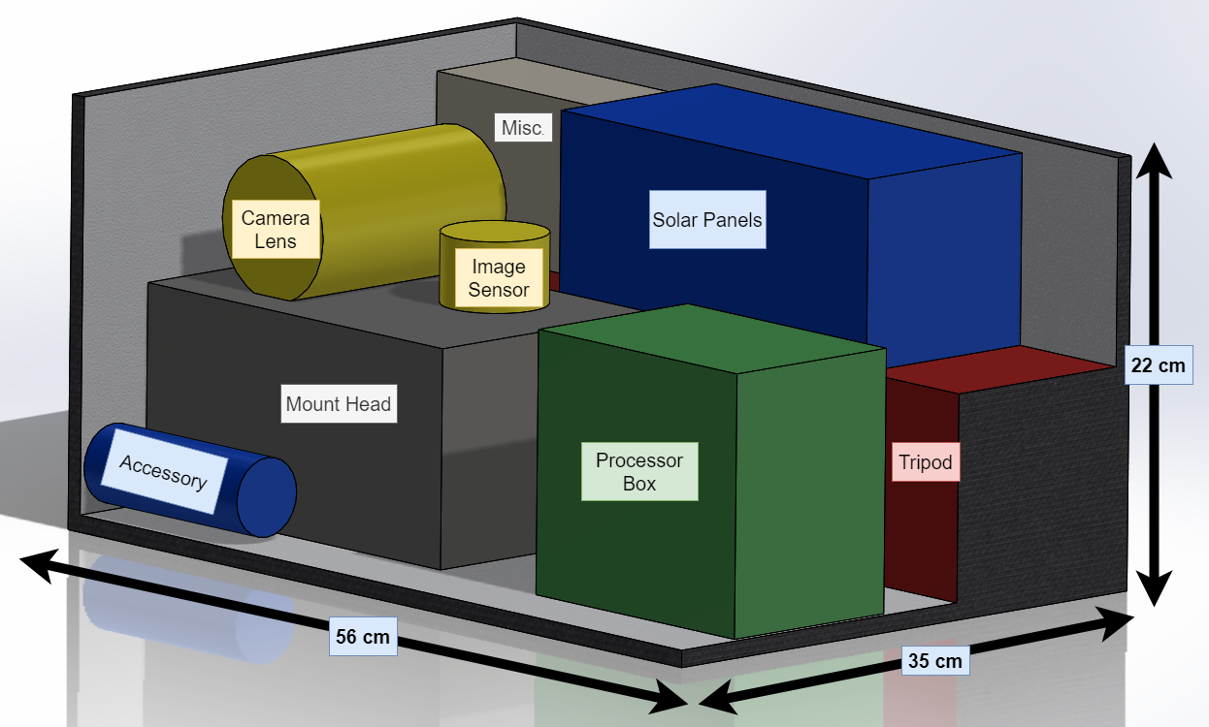
Design Mass and Volume
Metric | Design | Budget | Margin
Mass | 16.4 kg | 20.0 kg | 18%
Volume | 40.2 L | 44.3 L | 9.3%
Notes:
Add the 60 liter pack or state that it can fit within – include requirements, check that they are fulfilled
Numbers on figure are difficult to read
Get rid of margins – set dimensions
Mass is too precise (margin in mass)
Add electrical and data schematics
Label key components

Slide 14
Critical Project Elements
CPE | Motivation
1. Electronics | Tight, self-reliant power budget
2. Structures | Thermal regulation System stability during observations
3. Comms/Controls | Remote commands via SMS Precise observation requirements
4. Image Processing | 3 task/min cadence 10 arc-second (3σ) accuracy
Notes:
This is different from CDR
Most important aspect of manufacturing,

Slide 15
Presentation Overview
Overview
Schedule
Testing
Budget

Slide 16
Scheduling Gantt Chart
Administrative
Testing
Hardware
Software
Critical Path

Slide 17
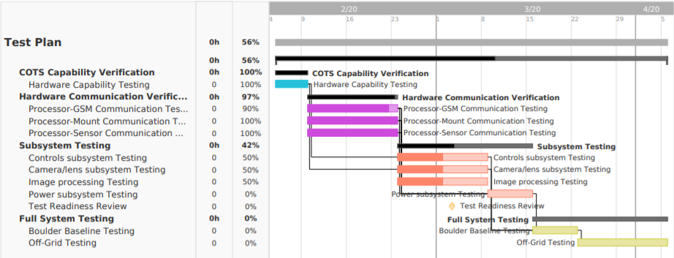
Test Schedule
Initial Hardware
Software/Hardware Communication
Integrated Subsystem
Full System

Slide 18
Presentation Overview
Overview
Schedule
Test Readiness
Budget

Slide 19
Test Status Overview
Already Complete
In Progress
Being Planned
Propagator Software
Astrometry Algorithm with Samples
Communication with Mount head
Communication with Camera Sensor
Communication with GSM module
Streak Detection with Samples
Sample Tasking for Real Captures
Streak Analysis on Real Captures
Initial Integrated System Testing
Battery Charging Test
Power System Testing
Thermal System Testing
Control System Testing
Full System Operational Testing

Slide 20
Propagator
Test Status
Complete
What's being tested?
Conversion from a task to mount commands
Propagation accuracy (Alt/Az)
Computation run time
Risk Reduction:
Lowers risk of streak not being contained in FOV
Lowers risk of overshooting time budget
Relevant Requirements
DR 3.3 | iMagpie shall be capable of performing observations at a cadence of up to 3 tasks per minute.
DR 4.1 | iMagpie shall incorporate a tasker to command the mount and image sensor to carry out observations.

Slide 21
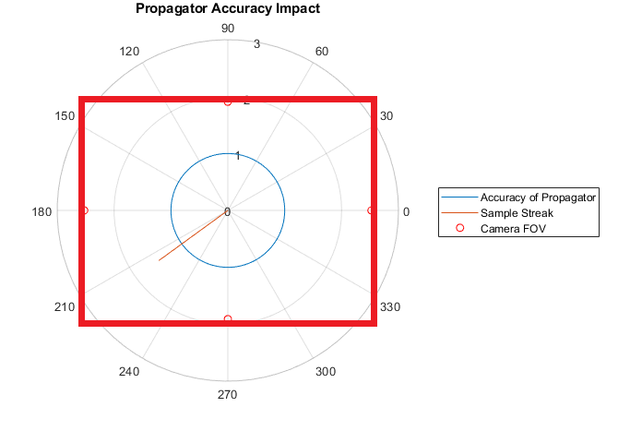
Propagator
Test Fixtures:
Python code and Sattrack
Test Procedure Overview:
Run code on known satellite
Check sat position on Sattrack
Verify results
Results:
Propagator predicts positions of LEO, MEO, and GEO satellites to within one degree of accuracy
Testing Facility
Anywhere
Required Equipment
Laptop

Slide 22
Sample Streak Detection
Test Status
In Progress
What's being tested?
Capability, accuracy, and timing of algorithm
Risk Reduction:
Quantify confidence in endpoint accuracy
Relevant Requirements
DR 5.1.3​ | Identify start and stop RA and Dec of streak​
DR 5.1.4​ | Determine RA/Dec w/ 10 arc-sec (3σ) accuracy​
DR 5.1.5​ | Process images at a rate of 3 images per minute​

Slide 23
Sample Streak Detection

Slide 24
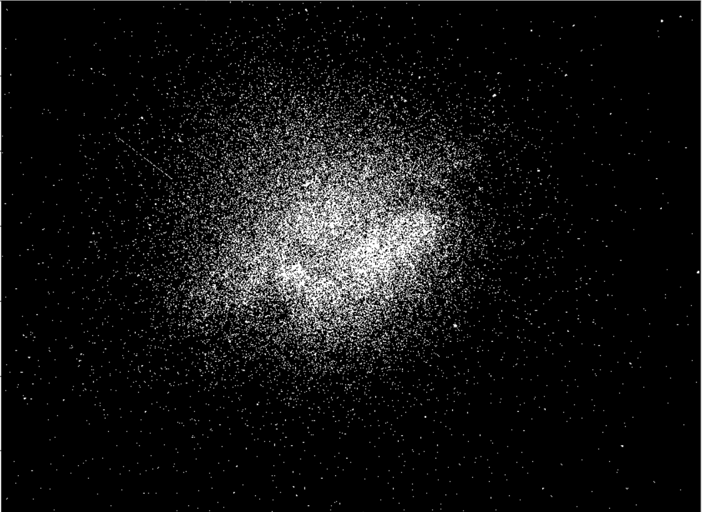
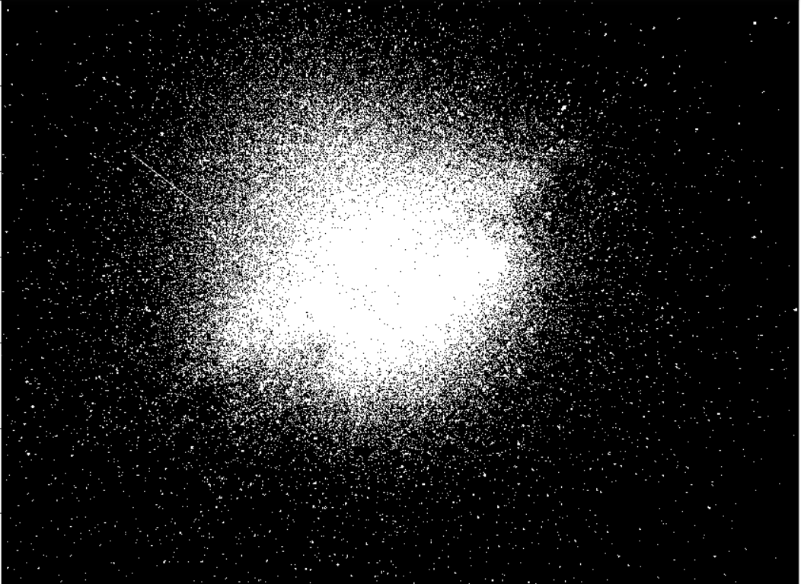
Sample Streak Detection

Slide 25
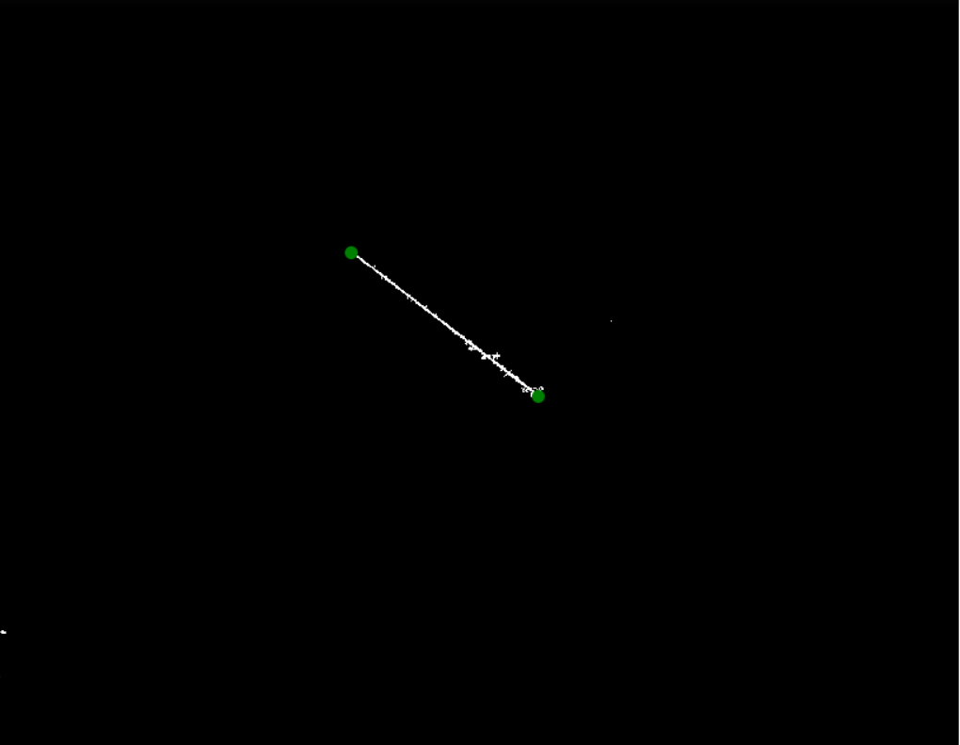
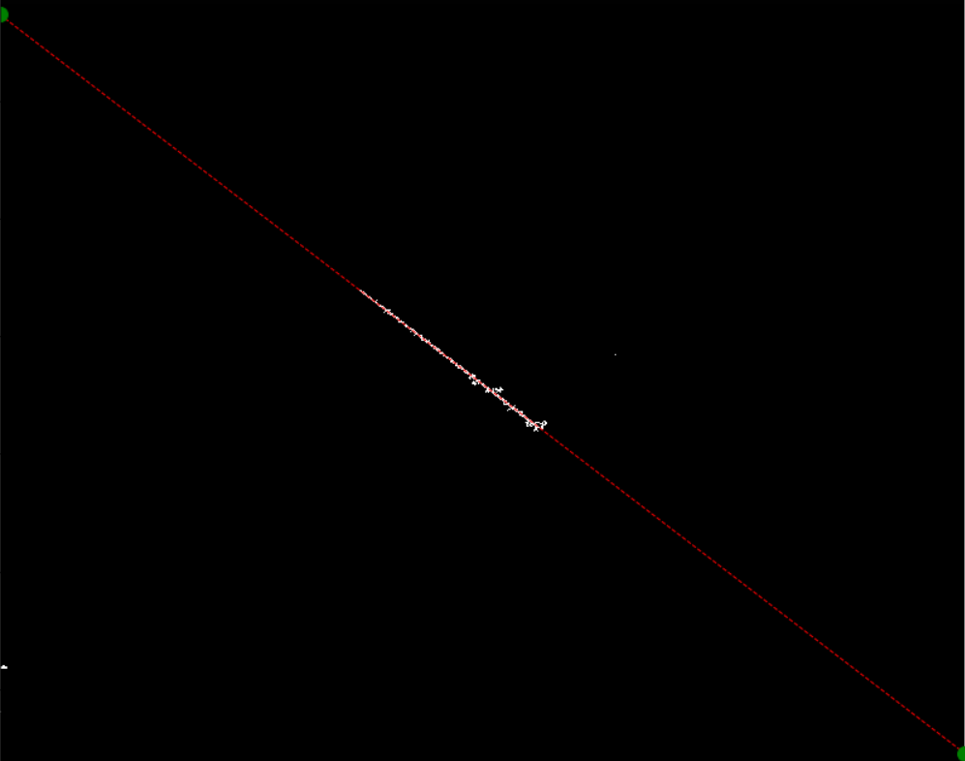
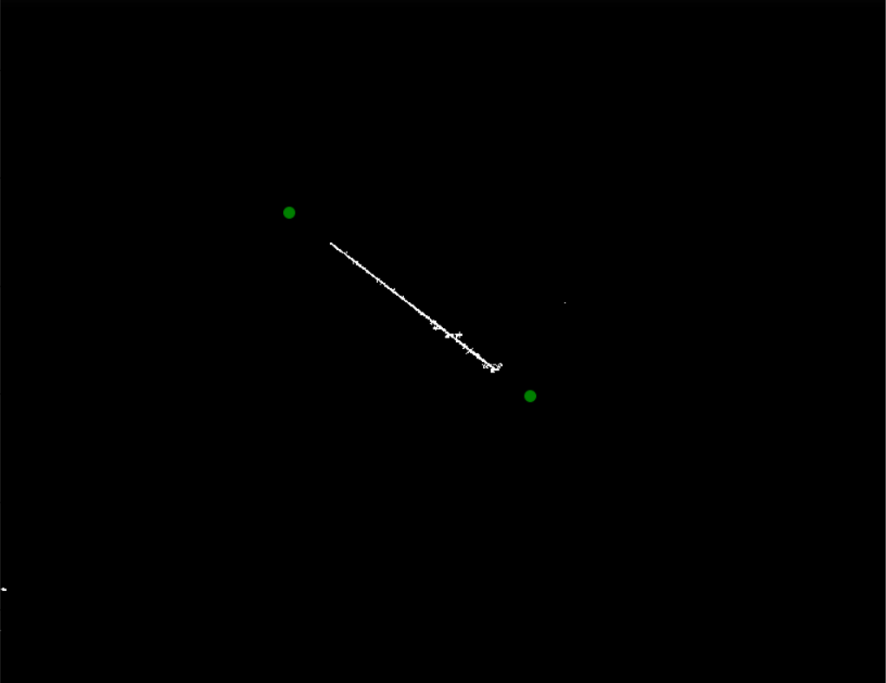
Sample Streak Detection

Slide 26
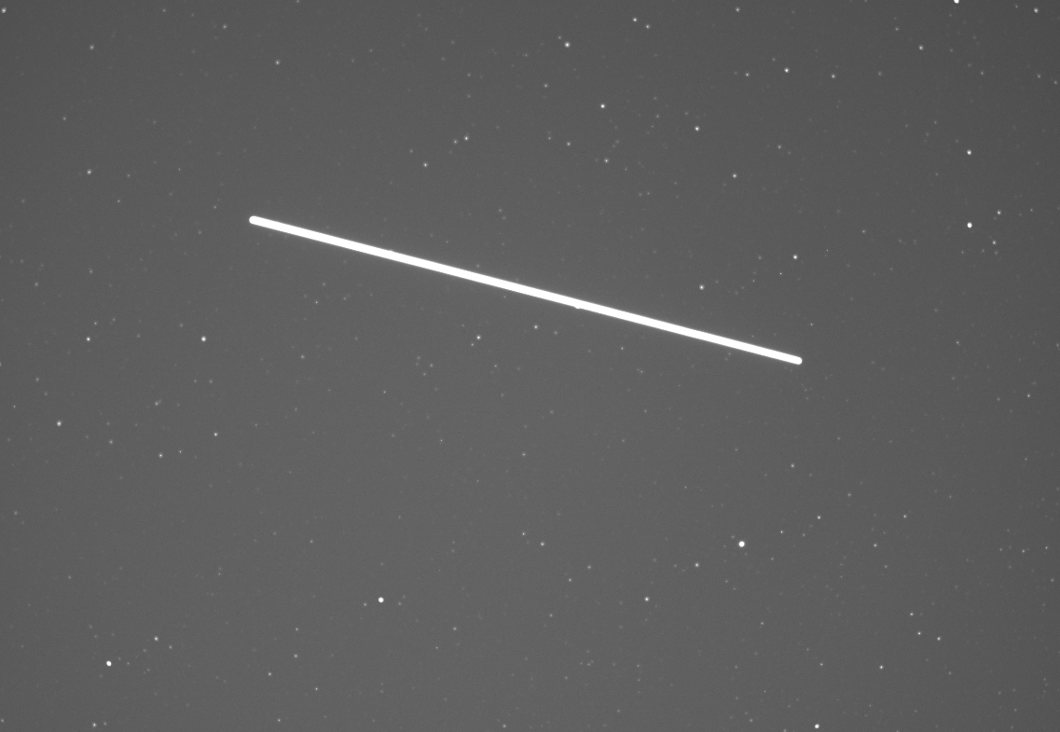
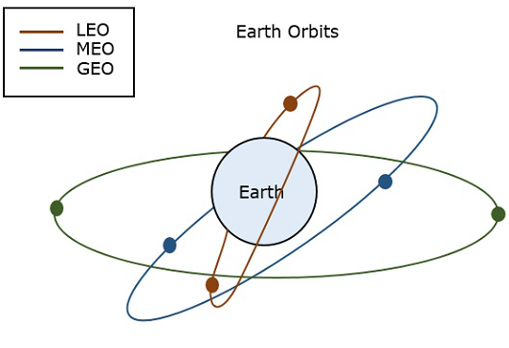
Sample Streak Detection
Algorithm to generate streak:
Magnitude
Altitude (LEO, MEO, GEO)
Background noise
Streak length
Generated ISS
Real ISS
Magnitude 13
ISS
Notes:
https://www.google.com/url?sa=i&url=https%3A%2F%2Fwww.tutorialspoint.com%2Fsatellite_communication%2Fsatellite_communication_earth_orbit_satellites.htm&psig=AOvVaw0v2GtNHgj_uzKelxZvzHX_&ust=1582913557602000&source=images&cd=vfe&ved=0CAIQjRxqFwoTCND0vOCq8ucCFQAAAAAdAAAAABAD

Slide 27
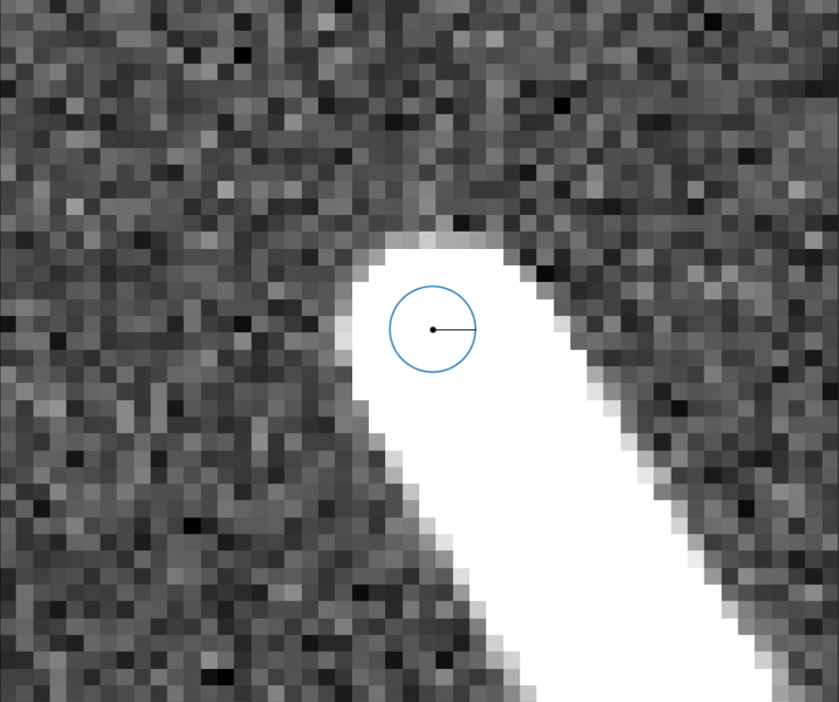
Sample Streak Detection
Quantify Error
10 arcsec 3 sigma accuracy
Notes:
https://www.google.com/url?sa=i&url=https%3A%2F%2Fwww.tutorialspoint.com%2Fsatellite_communication%2Fsatellite_communication_earth_orbit_satellites.htm&psig=AOvVaw0v2GtNHgj_uzKelxZvzHX_&ust=1582913557602000&source=images&cd=vfe&ved=0CAIQjRxqFwoTCND0vOCq8ucCFQAAAAAdAAAAABAD

Slide 28
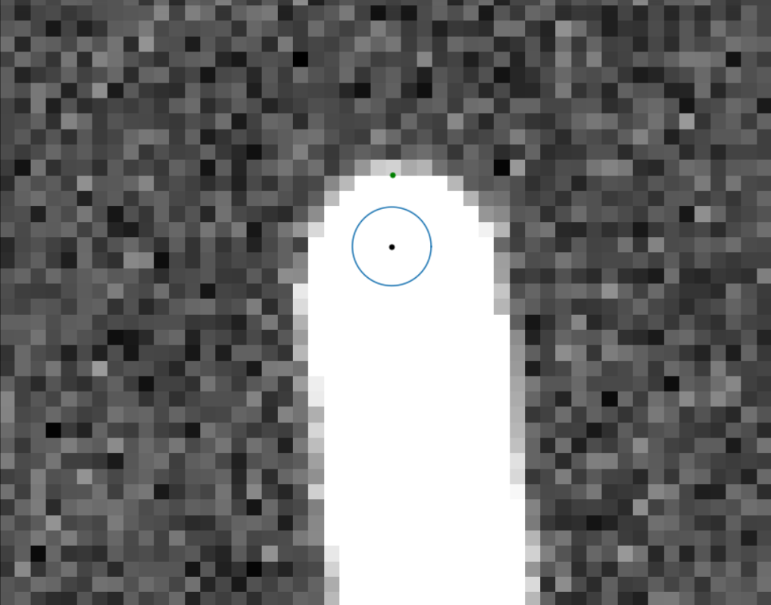
Sample Streak Detection
Accuracy: 20 +/- 5 arcsec
Notes:
https://www.google.com/url?sa=i&url=https%3A%2F%2Fwww.tutorialspoint.com%2Fsatellite_communication%2Fsatellite_communication_earth_orbit_satellites.htm&psig=AOvVaw0v2GtNHgj_uzKelxZvzHX_&ust=1582913557602000&source=images&cd=vfe&ved=0CAIQjRxqFwoTCND0vOCq8ucCFQAAAAAdAAAAABAD

Slide 29
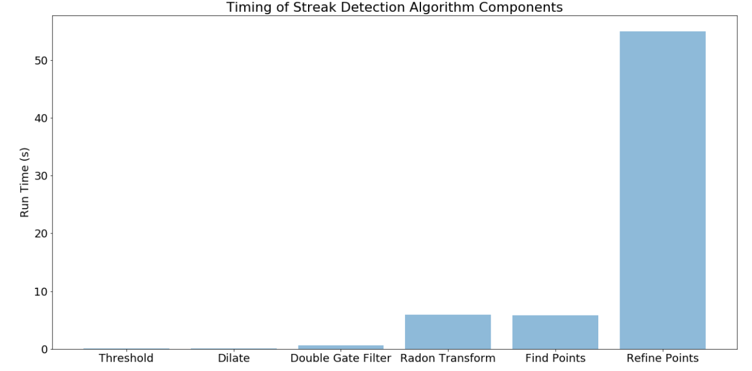
Sample Streak Detection
Timing: 67s total
Notes:
https://www.google.com/url?sa=i&url=https%3A%2F%2Fwww.tutorialspoint.com%2Fsatellite_communication%2Fsatellite_communication_earth_orbit_satellites.htm&psig=AOvVaw0v2GtNHgj_uzKelxZvzHX_&ust=1582913557602000&source=images&cd=vfe&ved=0CAIQjRxqFwoTCND0vOCq8ucCFQAAAAAdAAAAABAD

Slide 30
Sample Astrometry Software
What's being tested?
Right Ascension and Declination coordinates of stars
Risk Reduction:
Testing the accuracy of coordinate transforms provides insurance of usable data
Test Status
Complete
Relevant Requirements
DR 5.1.2 | Identify RA/Dec of 10 nearest stars
DR 5.1.5 | Process images at a rate of 3 images per minute

Slide 31
Sample Astrometry Software
Test Fixtures:
Offline Astrometry source & Python code
Test Procedure Overview:
Run sample images through Astrometry platform/transform matrix for comparison
Results:
Timing within cadence requirement (15s) & 10 arcsecond expected accuracy
Testing Facility
Anywhere
Required Equipment
Raspberry Pi 4

Slide 32
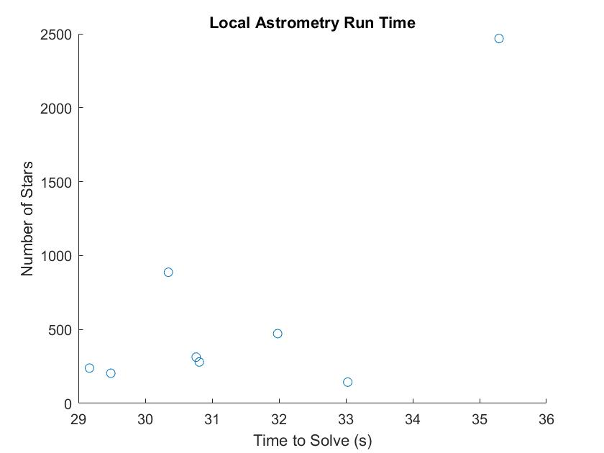
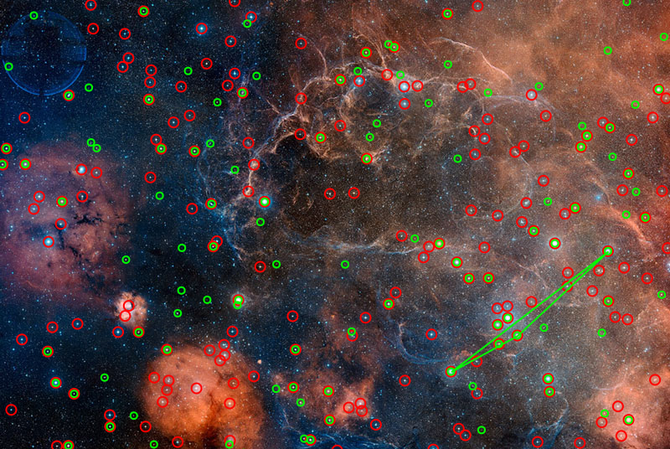
Astrometry Software Results
Vela Supernova Remnant Solved
Inputs:
Raw image w/ pointing information
Outputs:
Right ascension + declination of field center
Field rotation
Notes:
In work - Python function for providing images to astrometry's command line
-Python function for transforming field center RA/DEC to streak's RA/DEC

Slide 33
Real Capture Processing
Test Status
In Progress
What's being tested?
Ability to capture streaks (manual user control)
Ability to process real images
Accuracy of processing
Ability to capture magnitude 13 objects
Risk Reduction:
Ensures that iMagpie can accurately acquire/process the needed data
Relevant Requirements
DR 3.1.1 DR 5.1.3 DR 5.1.4 | Detect magnitude 13 objects Identify streak RA/Dec Report with 10 arcsec 3 sigma accuracy

Slide 34
Real Capture Processing
Test Fixtures:
Mount/Lens and Sensor
Test Procedure Overview:
Use propagator to find observation time
Point mount using controller
Manually take exposure
Attempt to process streak
Results:
Images of streaks
Processed streak information
Testing Facility
Outdoors in Boulder/Nederland
Required Equipment
Sensor/Lens Laptop Mount/Tripod

Slide 35
Control System Testing
Test Status
In Progress
What's being tested?
Basic Functionality of Remote System
Tasking and Control Software
Risk Reduction:
Minimizes likelihood of having unresponsive hardware in field
Relevant Requirements
FR 3 FR 4 FR 6 | Capture Images in LEO, MEO, GEO Process Tasks Remote Communication

Slide 36
Control System Testing
Test Fixtures:
Fully assembled system
Test Procedure Overview:
Implement system with tasking algorithm
Activate toggle switches
Send slew and capture commands via SMS
Results:
Confirmation that our assembled system is fully controllable
Testing Facility
Outside AERO building
Required Equipment
None

Slide 37
Power System Testing
Test Status
Being Planned
What's being tested?
Ability for batteries to supply the required power for mission duration
Ability for the project to be powered by non-ideal power source such as batteries
Risk Reduction:
Minimizes likelihood of failure due to power loss
Relevant Requirements
DR 2.1 | iMagpie shall be capable of operating under its own power for up to 10 hours.

Slide 38
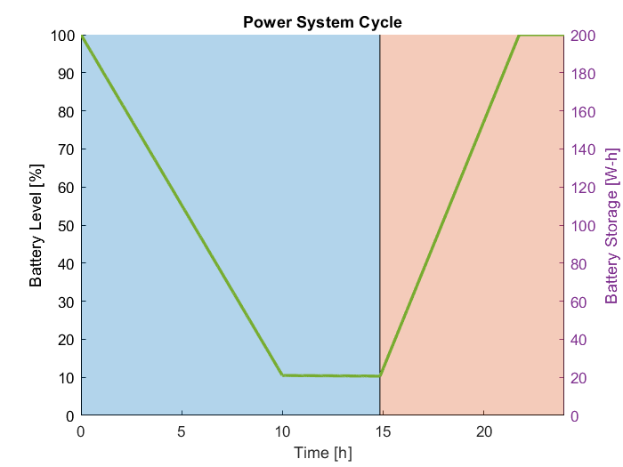
Power System Testing
Test Fixtures:
Fully assembled system
Test Procedure Overview:
Run system for 24h with appropriate monitoring tools
Results:
System should be able to discharge and recharge successfully over a 24h period
Testing Facility
Electronics Lab
Required Equipment
Multimeters

Slide 39
Full System Testing
Test Status
Planning
What's being tested?
Fully Assembled System Operability
Risk Reduction:
Minimize risk of any failure modes during remote operation
Relevant Requirements
FR 1 FR 2 FR 3 FR 4 FR 5 FR 6 FR 7 | System shall be person-portable. Independently Powered Capture Images in LEO, MEO, GEO Capable of Processing Tasks Capable of Processing Images Capable of communication with CCAR Capable of Operation in Boulder

Slide 40
Full System Testing
Test Fixtures:
Fully Assembled System at location
with SMS reception
Test Procedure Overview:
Deploy at remote location
Start system calibration
Implement CCAR tasking
Monitor system performance during and after operation
Results:
Confirmation that system meets all functional requirements
Insight to failure modes
Testing Facility
Outside Aero Building
Arestua Hut
Required Equipment
None

Slide 41
Presentation Overview
Overview
Schedule
Test Readiness
Budget

Slide 42
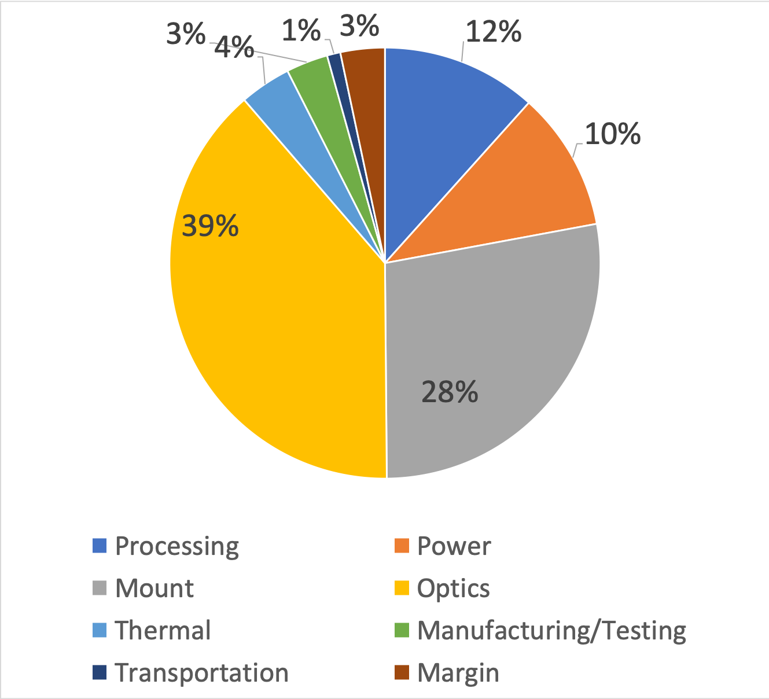
Predicted Financial Budget

Slide 43
Predicted Financial Budget
Subsystem | Expected Cost | Budget | Expected Margin
Processing | $580 | $625 | $45 | 7.2%
Power | $520 | $575 | $55 | 9.6%
Mount | $1,383 | $1,385 | $2 | 0.14%
Optics | $1,934 | $1,940 | $6 | 0.3%
Thermal | $210 | $225 | $15 | 6.7%
Manufacturing/ Testing | $156 | $200 | $44 | 22%
Transportation | $50 | $50 | $0 | 0%
Total | $4,834 | $5,000 | $167 | 3.34%

Slide 44
Part Procurement
Recently Ordered Items
Item(s) | Ordered | Delivered
Solar Panels
GSM Module
PCB Devices
Notes:
The Thermal and Transportation Subsystems are together because both have ordered all Needed items

Slide 45
Acknowledgements
Dr. Marcus Holzinger and Samuel Wishnek
Dr. Aaron Johnson
Project Advisory Board

Slide 46
Questions?

Slide 47
References
[1] “Ecliptic Plane”, Hyperphysics, http://hyperphysics.phy-astr.gsu.edu/hbase/eclip.html
[2] Boeing Airlines https://twitter.com/boeingairplanes/status/1086672652150939649
[3] PCBWAY IOTBITS LOGO http://iot-bits.com/iotbits/pcbway-iotbits-logo/
[4] "Lithium Ion Battery – 6Ah", Sparkfun https://www.sparkfun.com/products/13856
[XXI] AVM Standard https://www.virtualastronomy.org/AVM_DRAFTVersion12_rlh02.pdf

Slide 48
Apparent Magnitude
Measure of objects brightness as seen from Earth
Reverse logarithmic scale
Magnitude of 5 greater = brightness 100 times dimmer
Magnitude 13 is ~400 times dimmer than naked eye limit
iMagpie Design Goal
[xx]
Notes:
https://www.cambridge.org/core/books/question-and-answer-guide-to-astronomy/stars-and-stellar-systems/CFD8F55B5EF1FD7608CA2EDD8E1FCD3E

Slide 49
RA/Dec Coordinate Transform
Where CROT angles, Center Right Ascension, and Center Declination are provided from astrometry algorithm
XXI

Slide 50
Levels of Success

Slide 51
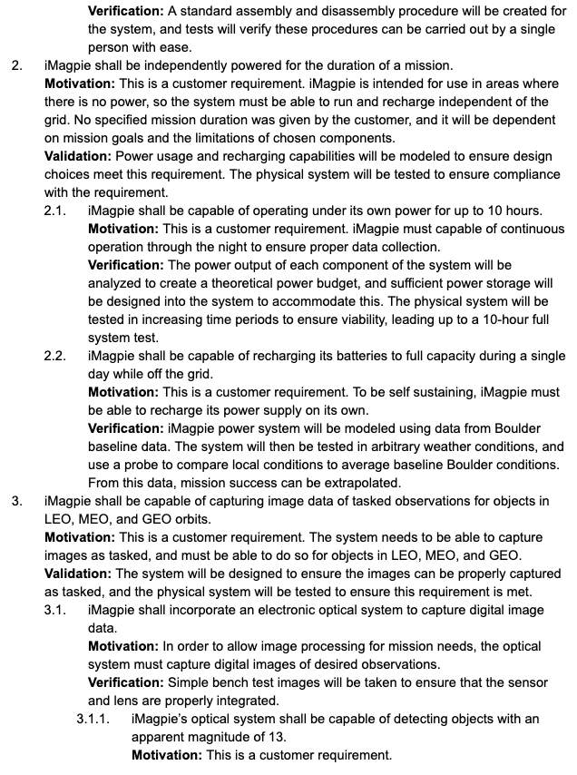
Design Requirements

Slide 52
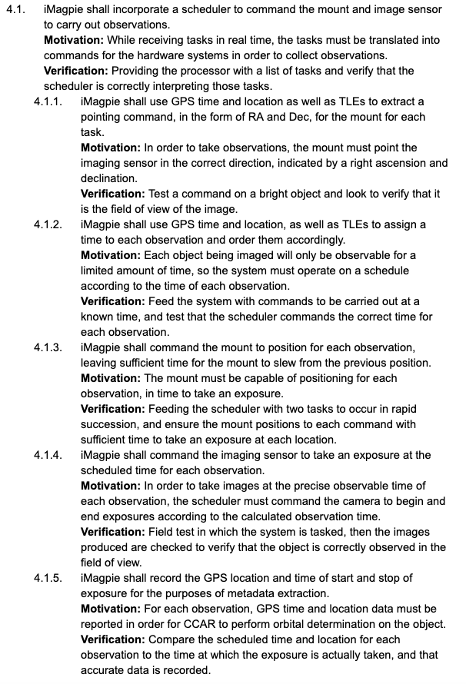
Design Requirements (cont.)

Slide 53
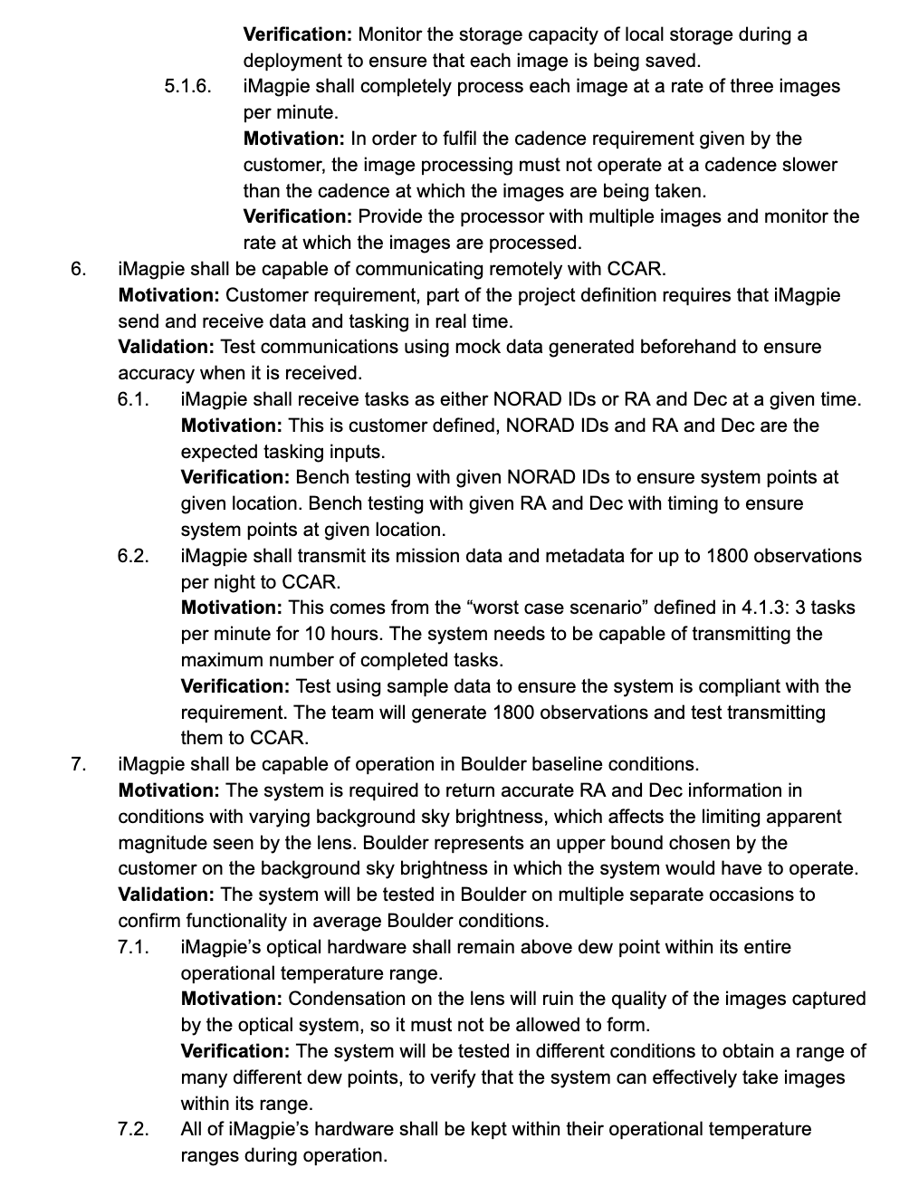
Design Requirements (cont.)

Slide 54
Design Requirements (cont.)

Slide 55
Test Backups

Slide 56
Camera Manufacturer Specifications
Resolution: 16Mega Pixels 4656×3520
Pixel Size: 3.8µm
Exposure Range: 32µs-2000s
Interface: USB3.0/USB2.0
Read Noise: 1.2e @30db gain
Full well: 20ke
Dimensions: φ62mm X 41mm
Weight: 140g
Working Temperature: -5°C—45°C
Working Relative Humidity: 20%—80%

Slide 57
Battery Charging Testing
Test Status
Being Planned
What's being tested?
Ability for batteries to recharge at required rate
Risk Reduction:
Ensures iMagpie will have the required margin to recharge batteries during a sunny day
Relevant Requirements
DR 2.2 | iMagpie shall be capable of recharging its batteries to full capacity during a single day while off the grid.

Slide 58
Battery Charging Testing
Test Fixtures:
Battery connected to charger IC, and then DC power supply
Test Procedure Overview:
Drain batteries to safe low voltage
Recharge at required rate to satisfy worst case charge times
Results:
Batteries should be able to recharge in approximately 7h, allowing margin for sub-ideal weather
Testing Facility
Electronics Lab
Required Equipment
Multimeter, DC power supply

Slide 59
Thermal Testing
Test Status
In Planning
What's being tested?
Ability of iMagpie's heating system/insulation
Characterization of heating to compare to model
Risk Reduction:
Ensures that iMagpie can prevent dew buildup and keep hardware above minimum temperatures
Relevant Requirements
DR 7.1 DR 7.2 | iMagpie's optics shall stay above dew point IMagpie's hardware shall be kept within operational ranges

Slide 60
Thermal Testing
Test Fixtures:
Lens/Sensor
Thermal camera or temperature probe
Test Procedure Overview:
Heat iMagpie at room temperature until steady state
Measure optics temperatures
Compare to modeling
Repeat outdoors in colder temps
Results:
Thermal profiling of system
Heating system verification
Testing Facility
Aero Building
Required Equipment
Sensor/Lens Thermal Camera Laptop

Slide 61
Timing Testing
Test Status
Re-Planning
What's being tested?
Characterization of exposure timing
Risk Reduction:
Ensures that iMagpie can report exposure start and stop times to 0.1 microseconds
Increases accuracy of streak data
Relevant Requirements
DR 4.1.4 DR 4.1.5 | iMagpie shall take exposures at the commanded time iMagpie shall record the start and stop times of exposures

Slide 62
Timing Testing
Test Fixtures:
12 Bit counting circuit connect to LEDs
Raspberry Pi with GSM
Waveform generator
Test Procedure Overview:
Raspberry Pi sends command to camera and timing circuit to begin
Timing circuit counts in binary with output displayed on LEDs
Camera takes exposure of LEDs
LEDs reveal exposure delay
Results:
Start and stop times of exposure precisely known
Testing Facility
Electronics Lab
Required Equipment
Sensor/Lens Timing Circuit Raspberry Pi GSM Waveform Generator

Slide 63
Electronics Schematics Backup

Slide 64
Electronic Schematic

Slide 65
Electronic Schematic (cont.)

Slide 66
Electronic Schematic (cont.)

Slide 67
Electronic Schematic (cont.)

Slide 68
Electronic Schematic (cont.)

Slide 69
Electronic Schematic (cont.)

Slide 70
Electronic Schematic (cont.)

Slide 71
Electronic Schematic (cont.)

Slide 72
Battery Charger IC Schematic

Slide 73
Team Photo

