Slide 1
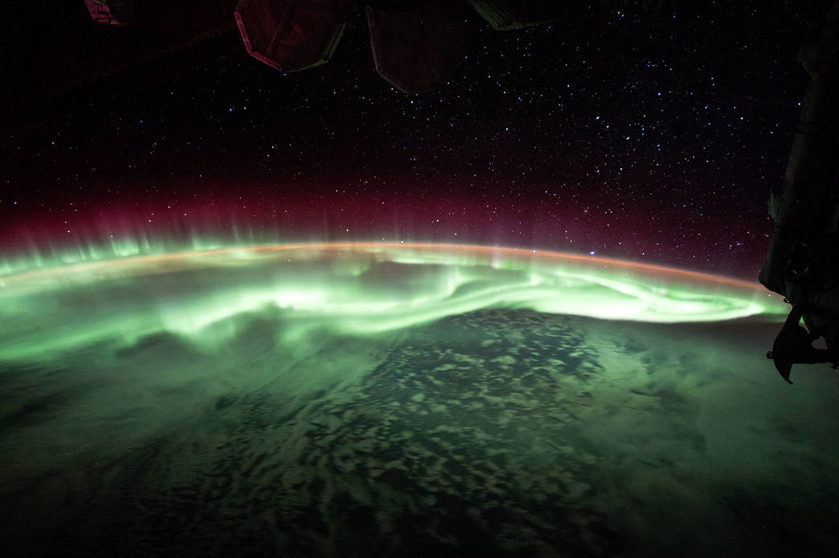
Project HEPCATS
Highly Elliptical Polar Constellation
for Auroral Transport Studies
Test Readiness Review
Presenters: Alexander Baughman, Colin Brown, Christopher Peercy & Vishranth Siva
Other Members: Hailee Baughn, Jordan Lerner, Valerie Lesser, Matthew Skogen, Braden Solt, Benjamin Spencer, Colin Sullivan & Kian Tanner
Customer: Neal Anderson (DigitalGlobe) & Tom Berger (CU Space Weather Center)
Advisor: Dr. Donna Gerren

Slide 2
Project Overview
Project Overview
Schedule
Test Readiness
Test Readiness: Imaging
Test Readiness: Magnetometer
Test Readiness: System Testing
Budget & Safety

Slide 3
Project Statement
The HEPCATS project will collaborate with DigitalGlobe and the CU Space Weather Center to design and implement a prototype of a 6U CubeSat capable of capturing, identifying, and filtering images of the auroras as well as collecting magnetic field data and downlinking the deliverables to a simulated ground station.
Notes:
-optical system to image auroras
-software to compress, filter, process, and map the images of the auroras
-magentometer to measure the magnetic field of the auroras
-the command and data handling system to receive commands and downlink collected data
-prototype bus structure to hold the payload

Slide 4
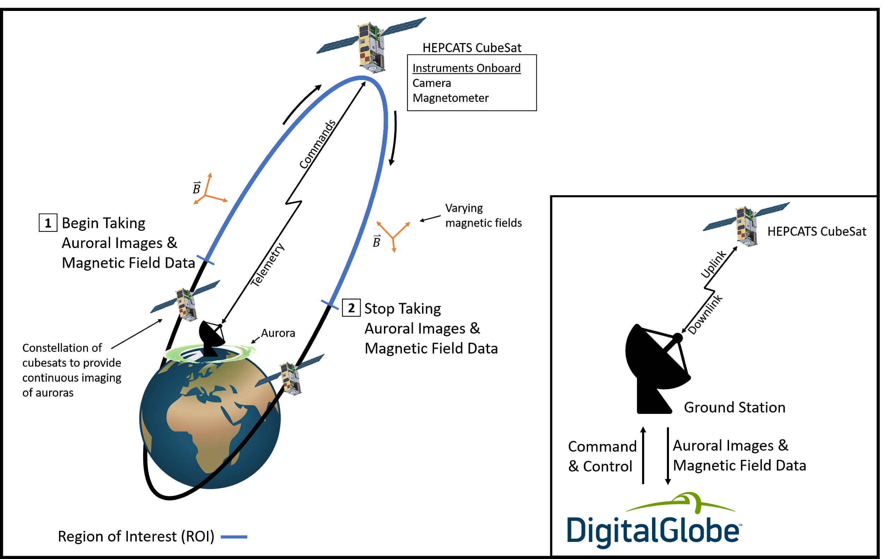
HEPCATS Mission ConOps
Notes:
A polar ground station is placed by DigitalGlobe to support the constellation by providing uplink and downlink capabilities.

Slide 5
Mission Elements NOT Implemented
Attitude Determination and Control System
A physical boom for the magnetometer
Onboard Electrical Power System
Flight-ready Hardware
Notes:
We are not designing the ADCS system nor will we be implementing a physical boom for the magnetometer
Overall Test Readiness Level of 4 is that the system is validated in a laboratory environment with performance predictions for the operating environment, but the system will not be tested in a relevant environment.
TRL of 4 (short version): Component and/or breadboard validation in laboratory environment.
TRL of 4 (long version): HARDWARE - A low fidelity system/component breadboard is built and operated to demonstrate basic functionality and critical test environments, and associated performance predictions are defined relative to the final operating environment. SOFTWARE - Key, functionally critical, software components are integrated, and functionality validated, to establish interoperability and begin architecture development. Relevant environments defined and performance in this environment predicted.
Be clear about the fact that this bus is not flight ready and is solely for the purpose of keeping the hardware together and visualizing the CubeSat as a whole

Slide 6
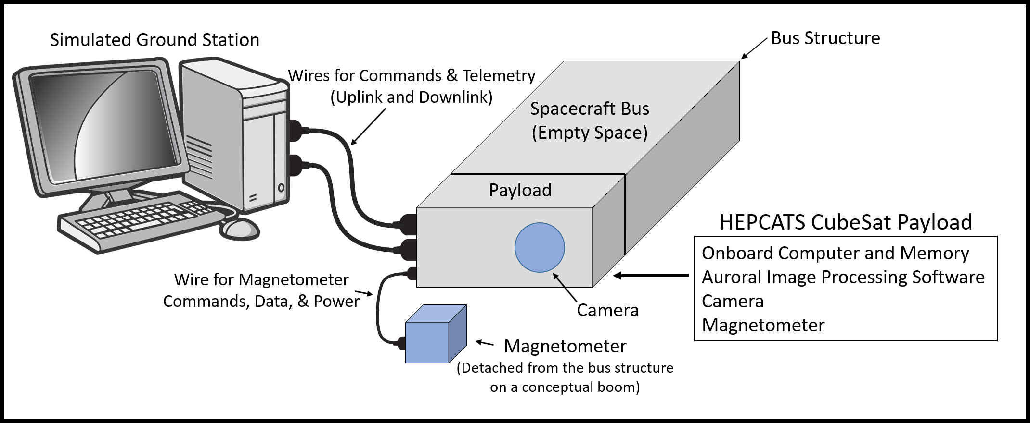
HEPCATS Project
Notes:
Here you can see the hepcats project. The project consists of the spacecraft bus, which will house onboard computer, image processing software, and imaging system. Attached you can see the magnetometer, which is attached to the payload, and the the simulated ground station which consists of a laptop computer which will be used to simulate a ground control station and receive telemetry from the bus.

Slide 7
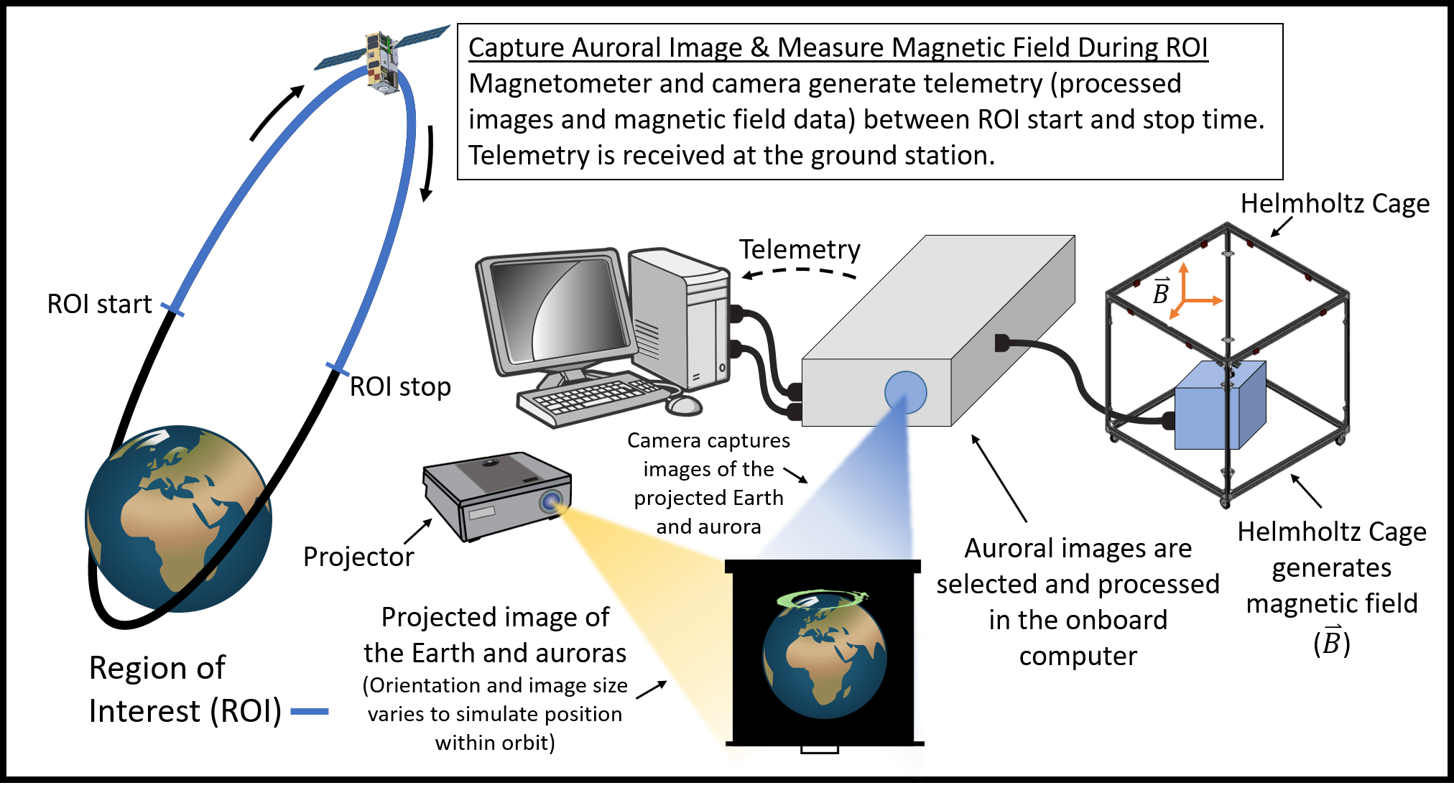
“Orbit in the Life” Simulation
Notes:
Part2
-will involve two separate procedures where we will capture auroral images and measure the magenetic field during the ROI start and stop times
-as well as downlink this information to the simulated groundstation

Slide 8
Levels of Success
 | Spacecraft Bus | Imaging System | Magnetometer System | Command & Data Handling
Level 1 | • Mounted within a manufactured stand-alone structure | • Take an image • Fixed FOV able to fit hemisphere of the Earth at apogee • Filter out backscatter from optical system • Crop image to TBD • Compress image to TBD | • Detect the scalar component of a constant magnetic field | • Manually commanded payload activation and deactivation • Receive, store and send magnetometer and image data at a rate of TBD
Level 2 | - | • Able to image at least once every minute to capture changing aurora • Fixed FOV able to image latitudes above TBD degrees north at apogee • Identify if aurora is present | • Detect the vector component of a constant magnetic field | • Command the payload autonomously from an on board absolutely timed sequence of commands
Level 3 | • Mounted within a manufactured mock CubeSat spacecraft bus | • Able to change rate of image capture if aurora is present • Unskew images to be useful • Filter out Earthshing • Identify lowest latitude of aurora | • Map magnitude and direction of magnetic field lines | -

Slide 9
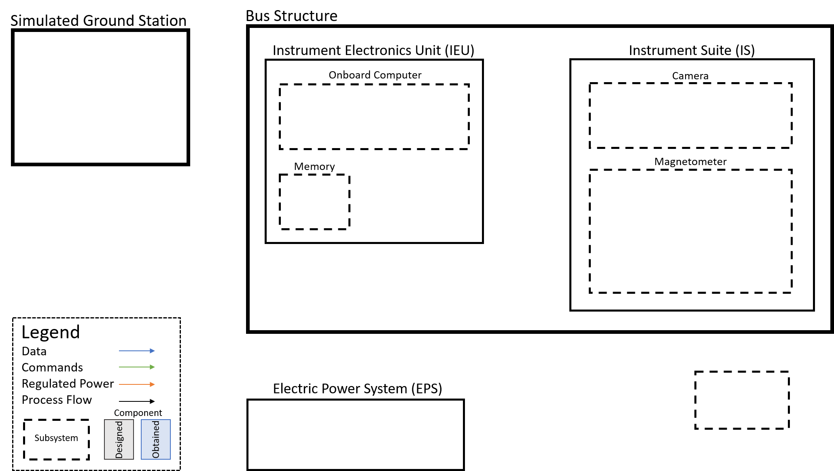
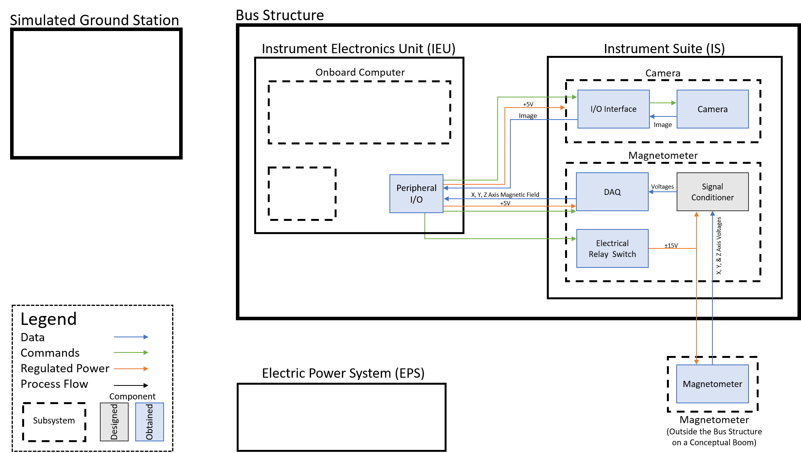
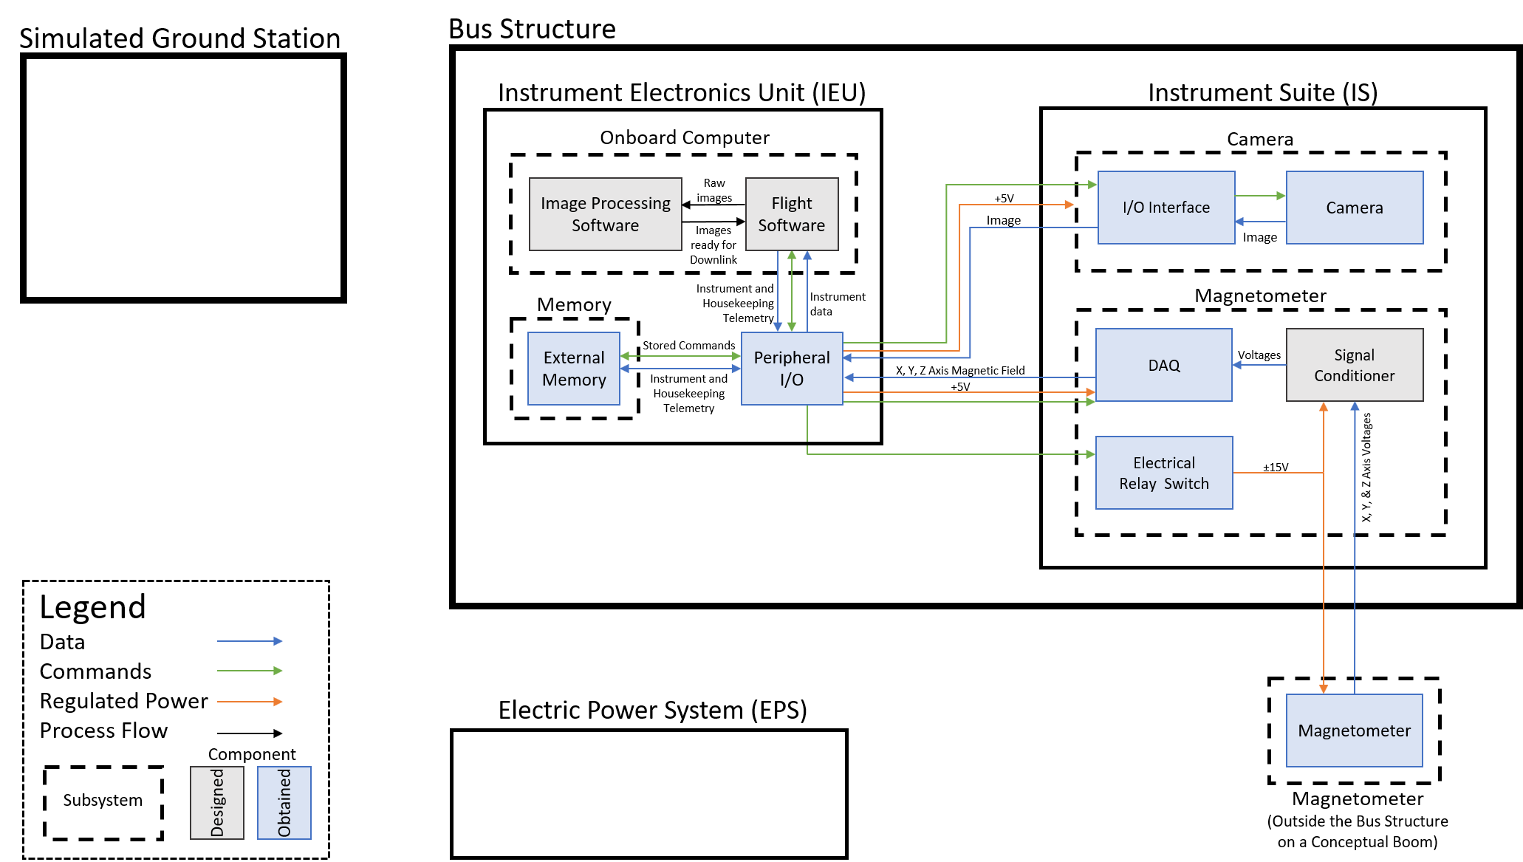
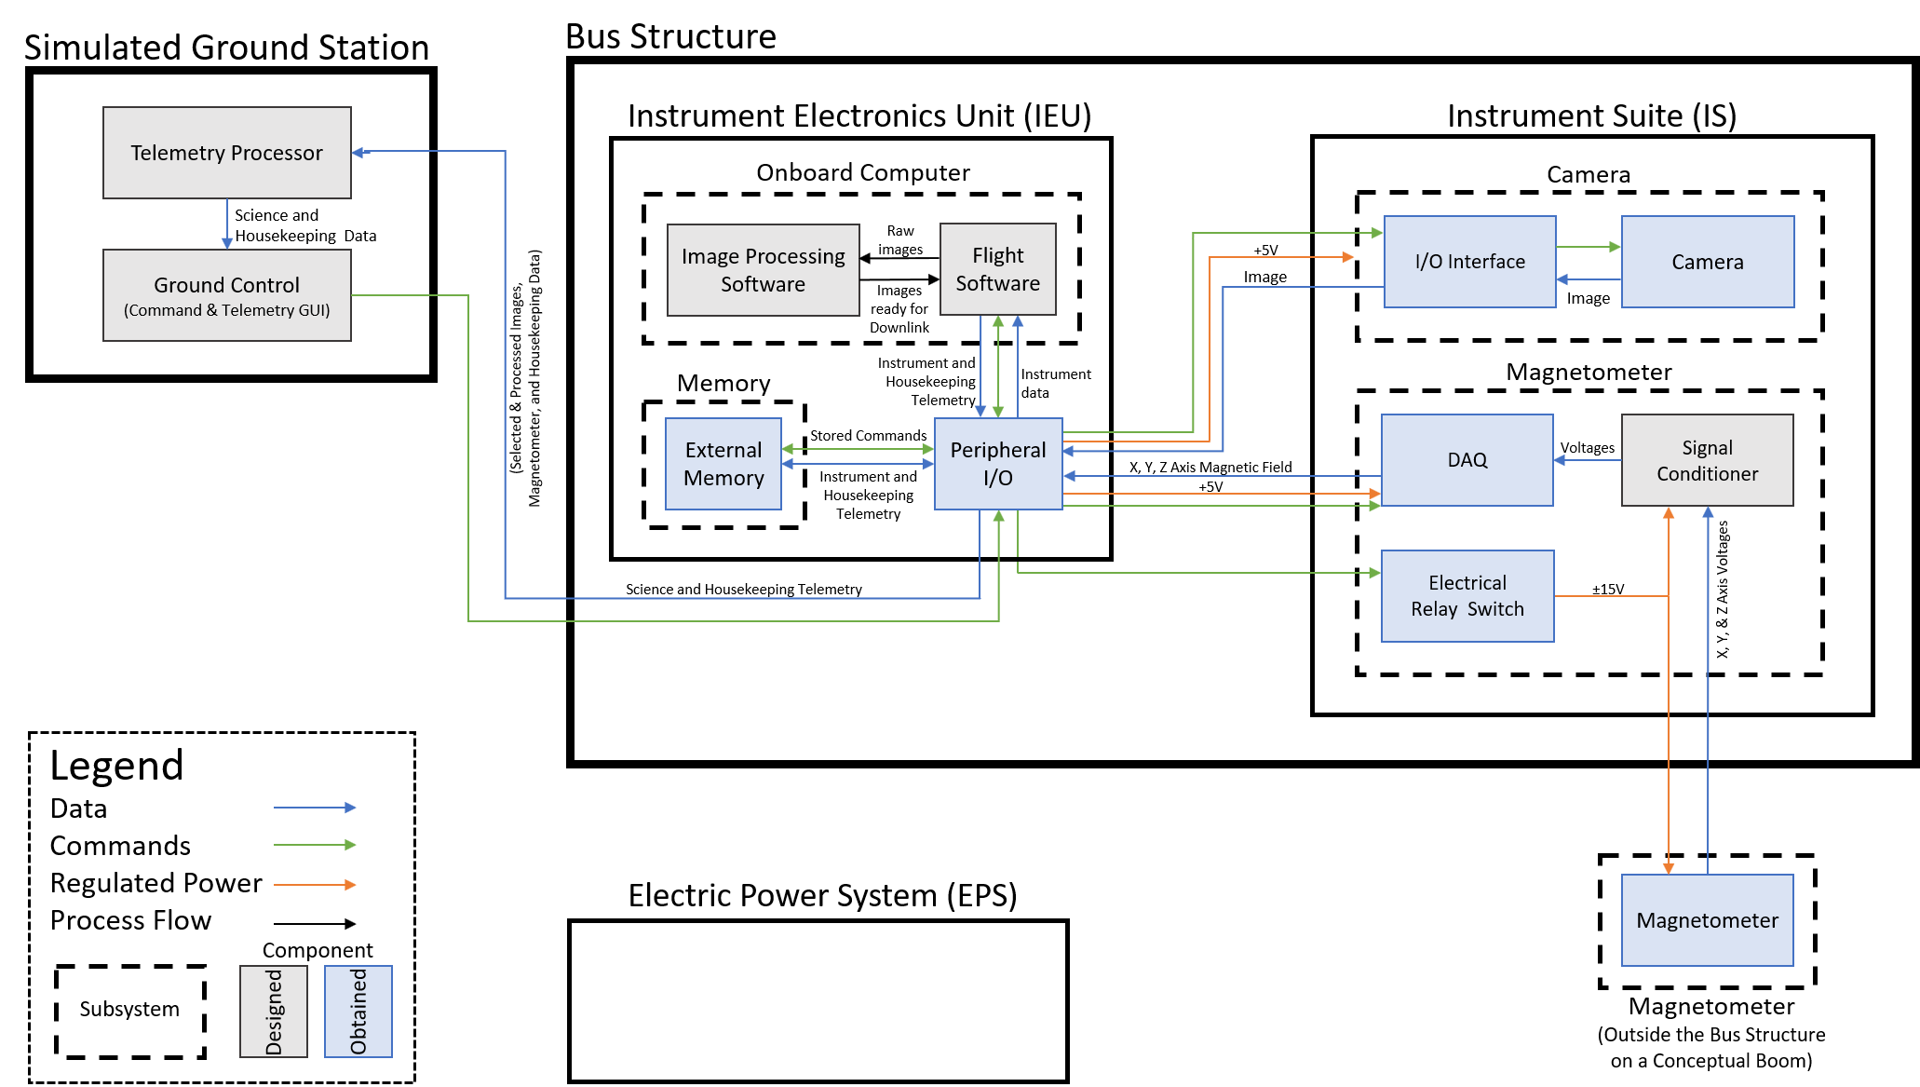
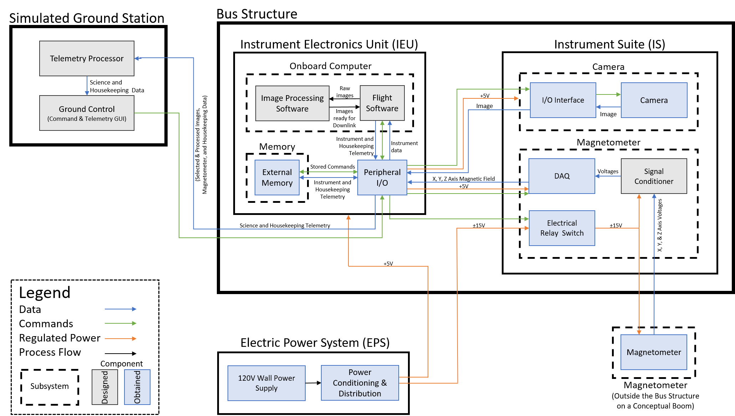
Functional Block Diagram

Slide 10
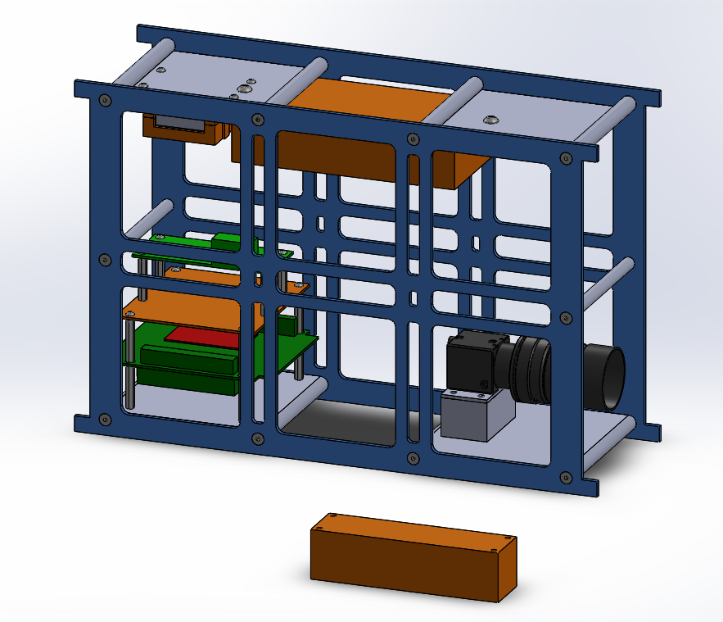
HEPCATS CubeSat
Magnetometer DAQ
Magnetometer
Signal Conditioning
22.6 cm
Imaging System
Instrument Electronics Unit (IEU)
11 cm
34 cm
Magnetometer

Slide 11
Critical Project Elements
 | Critical Project Elements | Relevance to Testing
I1 | Need to have proper FOV in order to have continuous coverage of polar crown | Camera specifications need to be tested to verify a proper FOV
I2 | Procurement of acceptable imagery and development of acceptable testing procedures | Acceptable imagery is needed to validate full system with an accurate model
P1 | Image processing should be able to identify if an aurora is present in each image | Classifier needs to be tested in order to verify it classifies auroras correctly
M1 | The magnetometer sensor needs to be placed away from the payload to reduce EMI | Magnetometer system bias and noise testing will determine location
D1 | Developing proper buffer size, simulating uplink and downlink, and collecting data | Component testing software will eliminate future problems during full system testing

Slide 12
Schedule
Project Overview
Schedule
Test Readiness
Test Readiness: Imaging
Test Readiness: Magnetometer
Test Readiness: System Testing
Budget & Safety

Slide 13
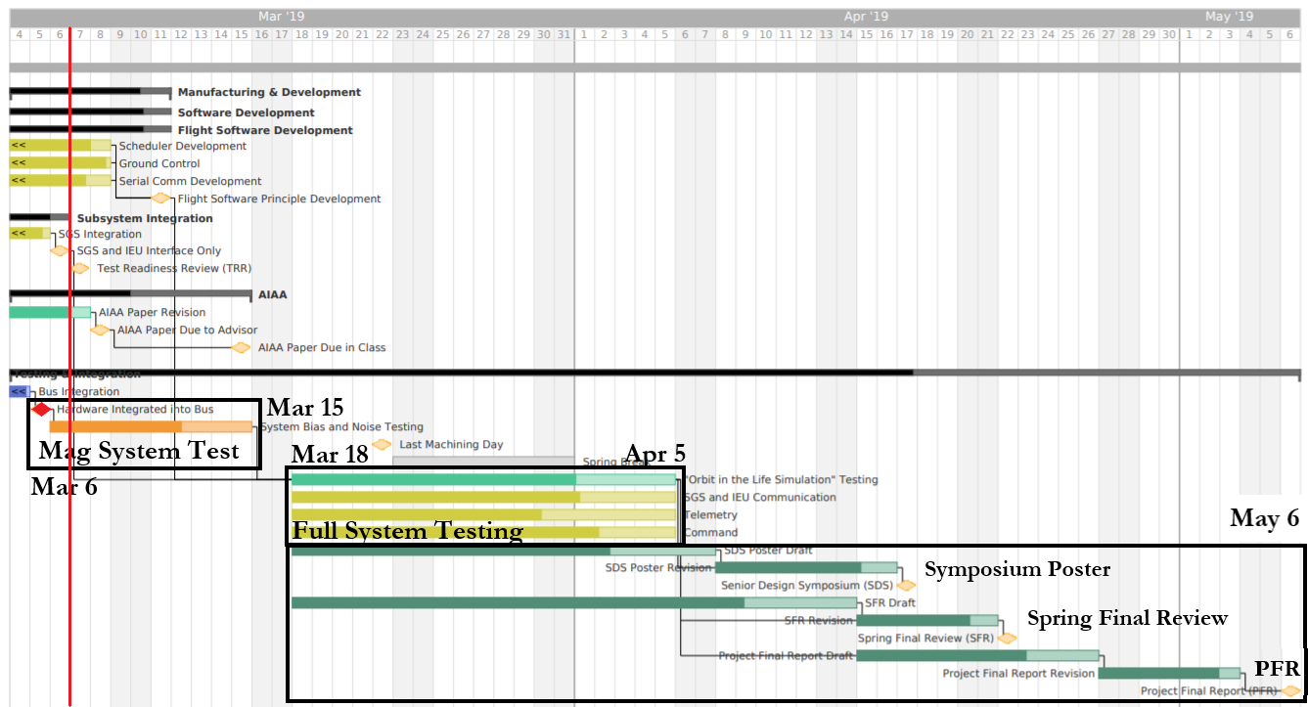
Schedule: TRR to PFR
Notes:
Discuss changes since MSR
Moved mag sys testing up a week, since bus was assembled/system integrated a week early
Gives an extra week for margin for either mag sys testing or full system testing

Slide 14
Test Readiness
Project Overview
Schedule
Test Readiness
Test Readiness: Imaging
Test Readiness: Magnetometer
Test Readiness: System Testing
Budget & Safety

Slide 15
Testing Updates
Subsystem | Requirements |  | Test/Verify | Status
Camera | 1.3 | Minimum S/N of 20 dB | Mercury vapor lamp test | Complete
Image Processing | 2.1 | Identify aurora | Evaluate performance post-process | In progress (Mar 15th)
 | 2.2 | Map aurora | Compare with orbit determination software | In progress (Mar 15th)
 | 2.3-4 | Crop and compress image | Evaluate performance post-process | In progress (Mar 15th)
Magnetometer | 3.1.1 3.1.2 | Noise < 10 nT System bias < 34000 nT | Magnetic shielding test | March 6th-15th
 | 3.1.3 3.2 | Measure range 100 - 66000 nT Measure vector field | Helmholtz cage testing | Complete
C&DH | 6.0 - 9.0 | IEU and simulated ground station can communicate with one another | Validate hardware and software integration through system testing | In progress (Mar 15th)

Slide 16
Test Readiness:
Imaging
Project Overview
Schedule
Test Readiness
Test Readiness: Imaging
Test Readiness: Magnetometer
Test Readiness: System Testing
Budget & Safety

Slide 17
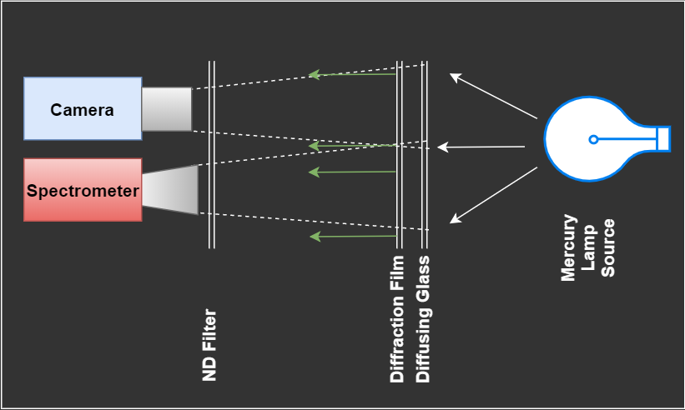
Imaging Testing: Mercury Vapor Lamp
Signal to Noise Test: Verify Requirement 1.3
Purpose: Prove that the camera system can capture a wavelength and magnitude of light similar to that of the Aurora (557 nm)
Facilities: Gwen Eccles, Duane Physics Learning Laboratories
Procedure:
Perform imaging tests of a 546 nm mercury line
Vary known source signal with Neutral Density (ND) filters.
Correlate source signal measured with spectrometer to counts on sensor
Notes:
Colin S
In Progress pending results of this weeks testing

Slide 18
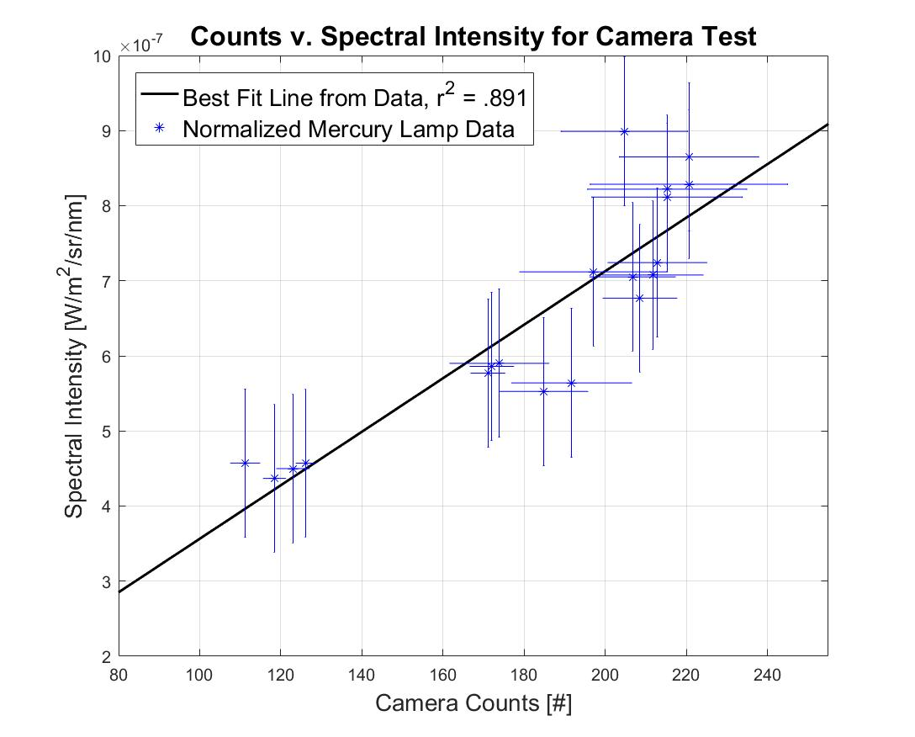
Imaging Test: Mercury Vapor Lamp
Signal to Noise Test: Verify Requirement 1.3
Results:
Show that regardless of gain, or exposure, sensor has linear response
Can use this knowledge along with properties of camera to extrapolate to auroral signal since mercury lamp signal is very close in camera response
Verified | DR | Requirement
 | 1.3 | The imaging subsystem shall have a signal to noise (S/N) ratio of no less than 20dB
Notes:
Colin S
In Progress pending results of this weeks testing
S/N predicted plot as well as current

Slide 19
Imaging Test: Mercury Vapor Lamp
S/N Test: Verify Requirement 1.3
Results:
Extrapolating to point where spectrometer can’t see yields:
Signal = 90 counts
Noise = 8 counts
Proves this system is capable of imaging the aurora with appropriate gain and exposure of sensor
Method | Signal to Noise
CDR S/N Model | 20dB
Mercury Vapor Lamp Test | 21.02dB
Verified | DR | Requirement
Verified | 1.3 | The imaging subsystem shall have a signal to noise (S/N) ratio of no less than 20dB
Notes:
Colin S
In Progress pending results of this weeks testing

Slide 20
Test Readiness:
Image Processing
Project Overview
Schedule
Test Readiness
Test Readiness: Imaging
Test Readiness: Magnetometer
Test Readiness: System Testing
Budget & Safety

Slide 21
IPS Testing: Cropping
Cropping Test: Verify Requirement 2.3
Current images are cropped with Earth centered in frame
Square image with a buffer equal to 20% of Earth’s radius in frame
Verified | DR | Requirement
Verified | 2.3 | Image processing shall be capable of performing cropping and other simple tasks on data
Notes:
Talk about how we still meet mission success by having adequate downlink rates, but we will continue to look at our compression for improvements because it means shorter telemetry times and less power consumption

Slide 22
Image Processing Testing: Classifier Test
Classifier Test: Verify Requirement 2.1
Purpose: Prove classifier can identify a simulated aurora
Procedure:
Train classifier on UV data from POLAR and IMAGE missions
Test classifier on simulated auroral images
Expected Results:
Each image is outputted with a classification
>95% of images are classified correctly
Example test image of simulated aurora
Example of training images used from POLAR (left) and IMAGE (right)
Verified | DR | Requirement
 | 2.1 | The image processing shall be capable of identifying auroras with an F1 score of 95%
22

Slide 23
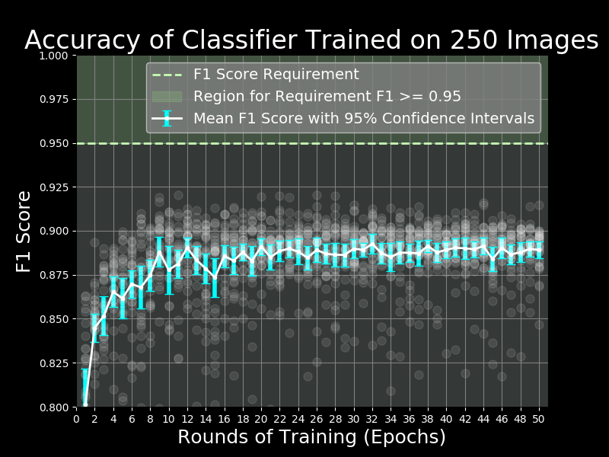
Image Processing Testing: Classifier Test
Classifier Test: Verify Requirement 2.1
Results: Currently identifies auroras with ~90% accuracy
Possible reasons why classifier is failing
Possible plateau for current training data
Current mitigation strategies
Train network on more images
Label more images for training
Fine-Tuning of pre-trained neural network
Improve training parameters or processes in another way
Verified | DR | Requirement
In progress | 2.1 | The image processing shall be capable of identifying auroras with an F1 score of 95%

Slide 24
IPS Testing: Compression
Compression Test: Verify Requirement 2.4
Current images are compressed by ~20%
Downlink rates are still met with current compression
Verified | DR | Requirement
In progress | 2.4 | In order to minimize downlink rates, compressed data shall be at least 35% smaller than raw data
Notes:
Talk about how we still meet mission success by having adequate downlink rates, but we will continue to look at our compression for improvements because it means shorter telemetry times and less power consumption

Slide 25
Test Readiness:
Magnetometer
Project Overview
Schedule
Test Readiness
Test Readiness: Imaging
Test Readiness: Magnetometer
Test Readiness: System Testing
Budget & Safety

Slide 26
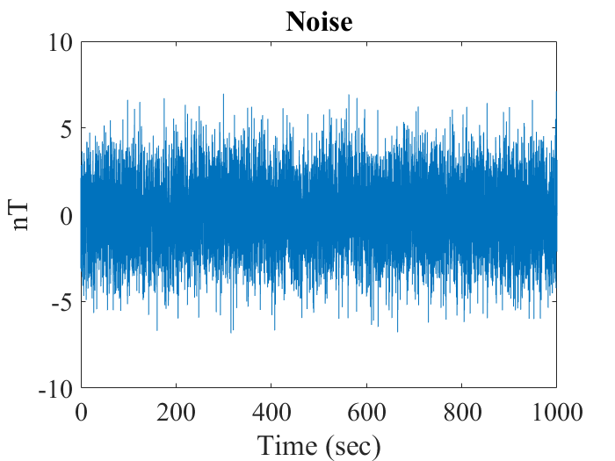
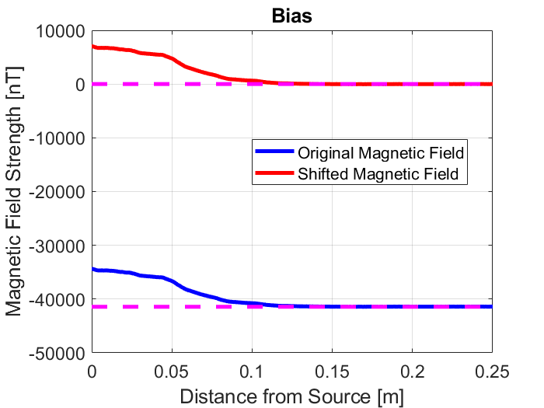
Magnetometer Noise vs Bias Examples
DR 3.1.1: Magnetometer shall measure noise less than 10 nT peak-to-peak
DR 3.1.2: The magnetic field bias from the spacecraft bus shall not exceed 34000 nT

Slide 27
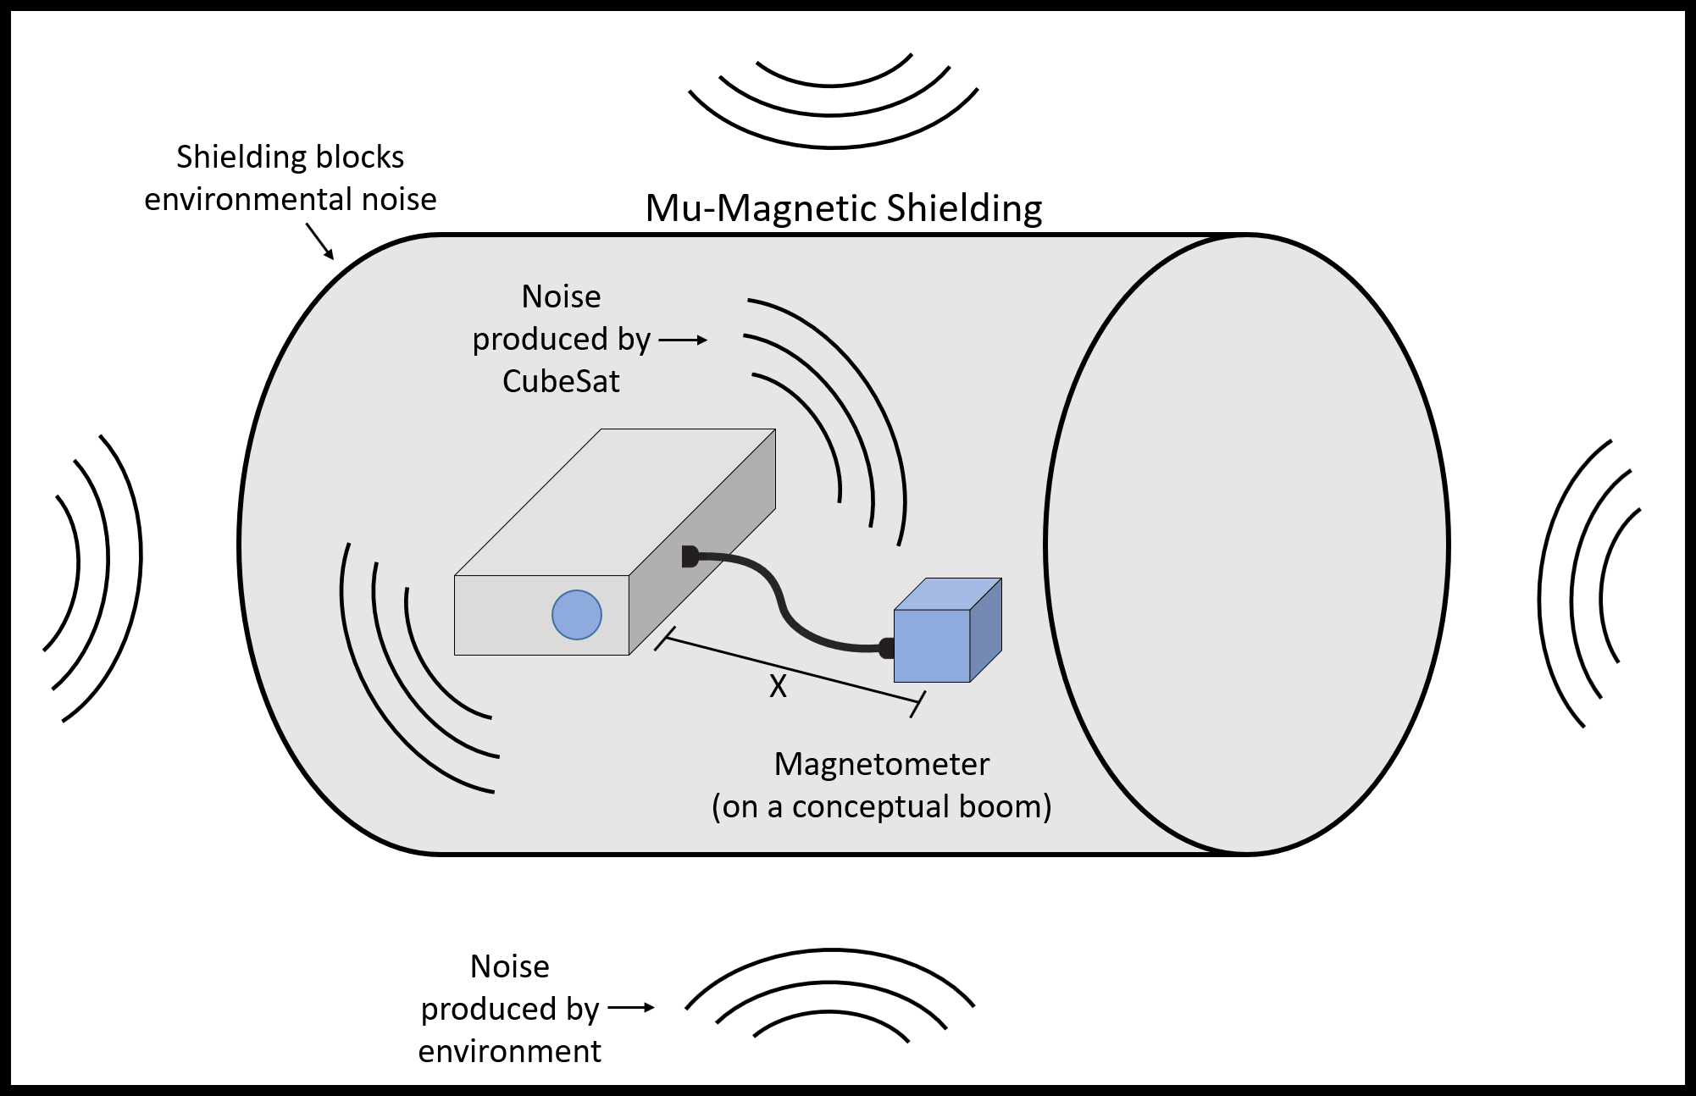
Magnetometer Testing: Noise Test
Noise Test: Verify Requirement 3.1.1
Purpose: To determine a conceptual boom length that will assure noise levels low enough to obtain useful data
Time: Week of March 10th
Procedure:
Place magnetometer and CubeSat inside magnetic shielding and take baseline noise reading
Turn CubeSat on and increase distance from magnetometer until noise reading meets requirement
Verified | DR | Requirement
 | 3.1.1 | Magnetometer shall measure noise less than 10 nT peak-to-peak
Notes:
Colin B

Slide 28
Magnetometer Testing: Bias Test
Bias Test: Verify Requirement 3.1.2
Purpose: To ensure that the magnetic bias from the CubeSat does not saturate the magnetometer
Time: Week of March 10th
Procedure:
Once noise test has been performed and conceptual boom length has been determined:
Take bias reading at this distance and confirm it is below 34000 nT
Verified | DR | Requirement
 | 3.1.2 | The magnetic field bias from the spacecraft bus shall not exceed 34000 nT at the determined boom length
Notes:
Colin B

Slide 29
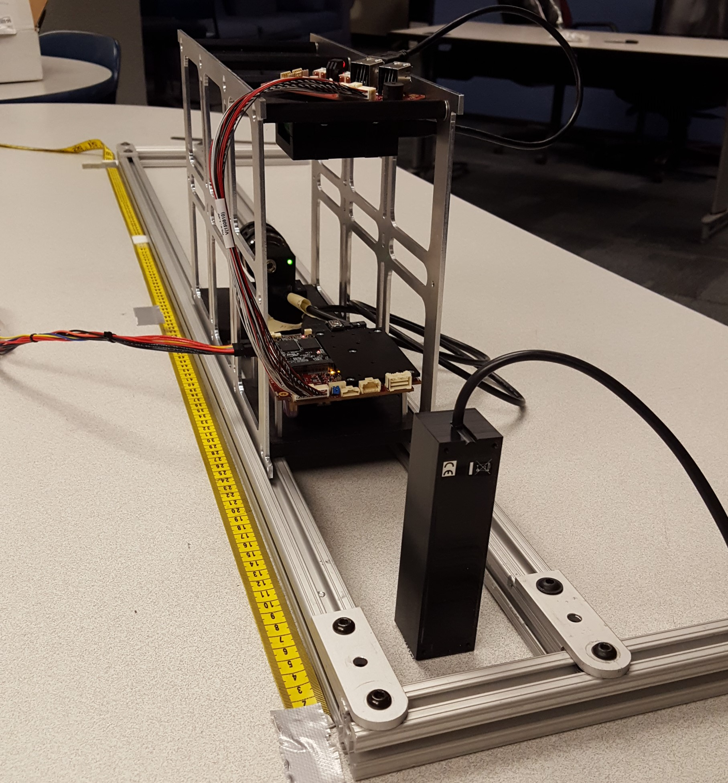
Preliminary Bias Test
Preliminary bias test performed outside of Magnetic Shielding
Purpose: Ensure main test goes smoothly and begin to analyze results
Procedure:
Measure magnetic field and vary the distance of the CubeSat bus from the magnetometer while powered
Verified | DR | Requirement
 | 3.1.2 | The magnetic field bias from the spacecraft bus shall not exceed 34000 nT at the determined boom length
Notes:
Colin B

Slide 30
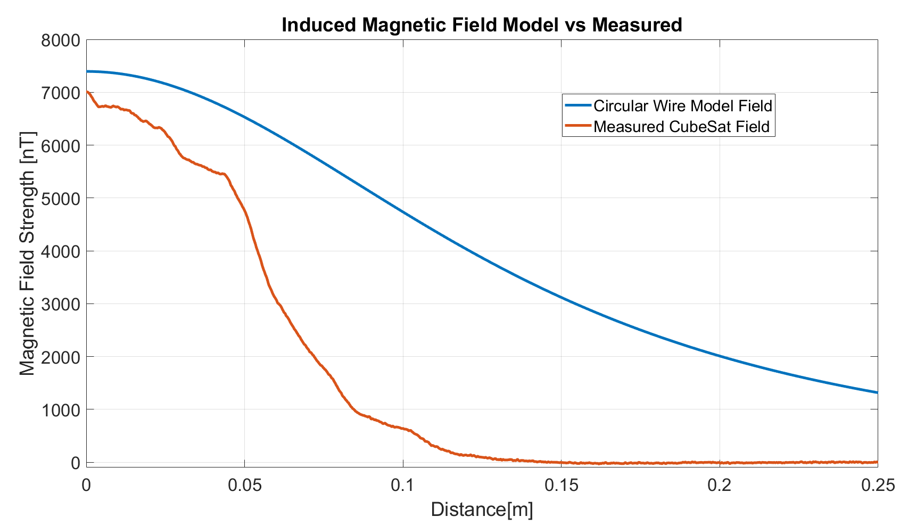
Preliminary Bias Test Results
Notes:
Colin B

Slide 31
Test Readiness:
System Testing
Project Overview
Schedule
Test Readiness
Test Readiness: Imaging
Test Readiness: Magnetometer
Test Readiness: System Testing
Budget & Safety

Slide 32
“Orbit in the Life” Simulations:
Purpose: Validate Functional Requirements 1.0 - 9.0 and overall project success
Verified | FR | Requirement
Ready for OITL | 1.0 | The imaging subsystem shall be capable of taking images of a simulated Aurora Borealis.
In progress | 2.0 | The on-board Image Processing Software shall convert raw imagery into image data that is capable of being sent to the Simulated Ground Station.
Ready for OITL | 3.0 | The magnetometer system shall be capable of measuring a magnetic field
Ready for OITL | 4.0 | The manufactured spacecraft bus shall be capable of housing the IEU and imaging system
Ready for OITL | 5.0 | The Electric Power System will provide regulated power to the instrument electronic unit and Instrument Suite for the duration of the “Orbit in the Life” simulation.
In progress | 6.0 - 9.0 | The Instrument Electronics Unit shall be able to send and receive commands from the simulated ground station and be capable of storing all on-board data
32
*OITL - “Orbit in the Life” simulation

Slide 33
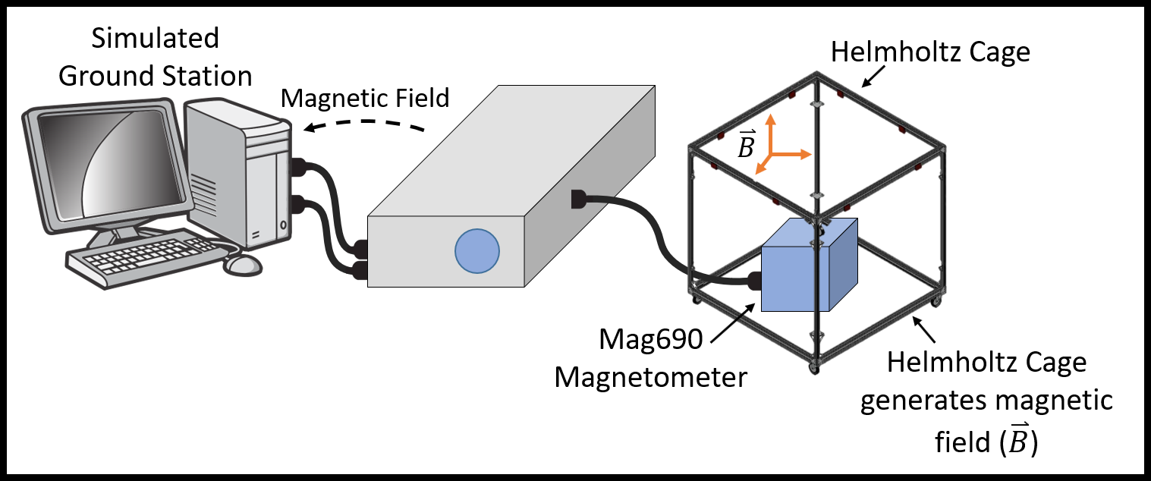
“Orbit in the Life” Simulation:
Magnetometer Integration Testing
Purpose:
Simulate expected magnetic field seen in-orbit to test system in conditions as similar to orbit as possible
Verify successful system integration
Procedure:
Mount magnetometer in Helmholtz Cage and power CubeSat
Command magnetic field values and record data
Process data and send to ground station
Expected Results:
Ability to properly read, process, and downlink expected magnetic field
“Orbit in the Life Simulation” Logistics
Location: CubeSat Lab
Time: March 18th to April 5th
Notes:
Colin B

Slide 34
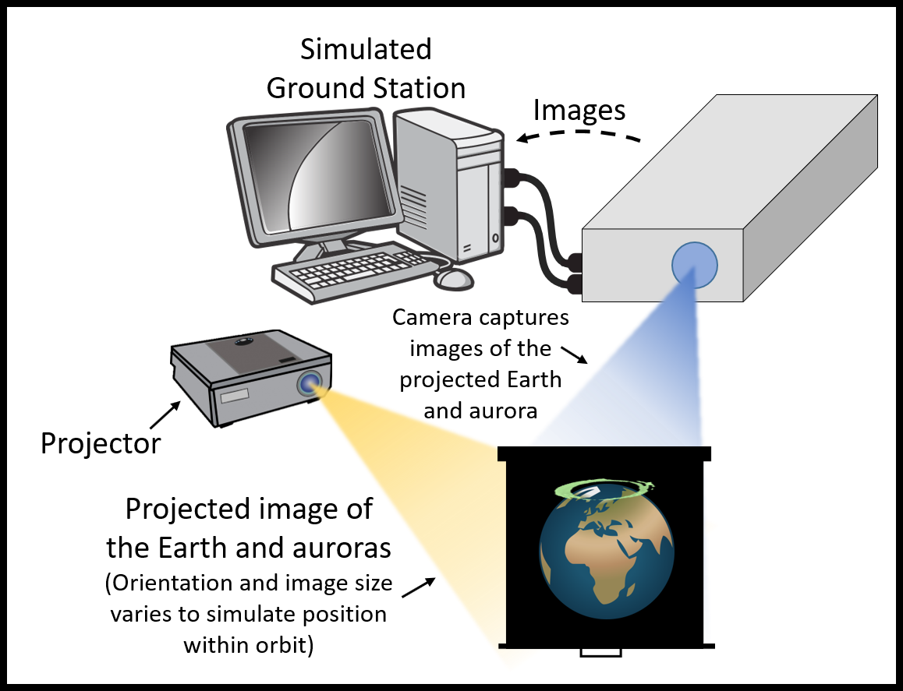
“Orbit in the Life” Simulation:
Imaging System Integration Testing
Purpose:
Verify imaging suite can classify and process images
Verify system is properly integrated and downlinking relevant imagery
Procedure:
Projected images are captured by imaging system
Images are processed and downlinked
Orbit determination software will provide expected on-orbit imagery
Expected Results:
Image captured every 60 seconds
Each image receives a classification
Images with aurora are received by simulated ground station
34
“Orbit in the Life Simulation” Logistics
Location: Lockheed Martin room Time: March 18th - April 5th

Slide 35
Verification and Validation:
Summary
Project Overview
Schedule
Test Readiness
Test Readiness: Imaging
Test Readiness: Magnetometer
Test Readiness: System Testing
Budget & Safety

Slide 36
V&V Summary
Subsystem | Requirements |  |  | Summary
Camera | 1.1.1-2 | 7° < FOV < 24° | ✔ (see backup) | • Selected camera meets design requirements • Camera can image a minimum G1 auroral storm from the HEPCATS orbit
 | 1.2 | Spatial resolution of 48 arcseconds per pixel | ✔ (see backup)
 | 1.3 | Minimum S/N of 20 dB | ✔
Image Processing | 2.1 | Identify aurora | In progress | • Current build can classify an aurora (~90% accuracy), crop and compress the image and send to IEU
 | 2.3-4 | Crop and compress image | In progress
 | 2.2 | Map aurora | In progress (see backup) | • Geolocation is 2/3 complete and will be finished before “Orbit in the Life” testing

Slide 37
V&V Summary
Subsystem | Requirements |  |  | Summary
Magnetometer | 3.1.2 3.1.3 | Noise < 10 nT System bias < 34000 nT | March 10th-15th | • Complete integration of s/c bus is required before system noise and bias testing can take place
 | 3.2 | Measure vector field | ✔ | • Magnetometer has been tested in Helmholtz cage with multiple models of expected magnetic fields
Bus | 4.0 - 5.0 | Manufactured s/c bus can securely house all electronics and provide regulated power | ✔ (see backup) | • Spacecraft bus is built and all components are securely fastened to structure • Voltage regulator circuit built and tested to provide correct power supply
C&DH | 6.0 - 9.0 | IEU and simulated ground station can communicate with one another | In progress (see backup) | • Simulated ground station and IEU can currently communicate via wired connection • IEU can currently communicate with all subsystems, smaller bugs still need to be worked out • System testing during March 18th - April 5th

Slide 38
Budget & Safety
Project Overview
Schedule
Test Readiness
Test Readiness: Imaging
Test Readiness: Magnetometer
Test Readiness: System Testing
Budget & Safety

Slide 39
Procurement Overview
Subsystem | Purchased & Received
Imaging | Camera, Lens, USB Type A to Micro B cable
CDH | Single Board Computer, Crucial RAM, Solid State Drive, Cable Kit, Power Supply, USB cables, Female to Female Adapter, Ethernet Patch Cable
Magnetometer | Magnetometer, DAQ, USB cables, USB Control Switch, Instrumentation Amplifier, PCB Wires
SC Bus | Aluminum Sheets, Aluminum Rod, 3D Printing Material, Bolts, Screws, Nuts
Not Yet Purchased: Administrative Items (Printing SFR/Poster etc…)

Slide 40
Updated Cost Plan
Financial Summary
System | Cost in MSR ($) | Cost Post MSR ($)
Imaging | 1,192.49 | 1,192.49
Command & Data Handling | 1,302.12 | 1,302.12
Magnetometer | 1,140.68 | 1153.61
S/C Bus Materials | 222.16 | 280.36
Miscellaneous | 59.88 | 64.09
Total Cost | $3,917.33 | $3,992.67
Margins | $1082.67 | $1007.33

Slide 41
Safety Plan
Main safety concerns deal with damaging hardware and electronics
Have enough funds to replace one subsystem’s major component, i.e. processing board for CDH or camera for imaging, magnetometer, etc.
Double check wire connections before connecting power as to not damage single board computer or other electronics
Maintain a safe testing environment by:
Clearing enough space so team members are not tripping over chords
Water and other liquids are cleared away so they don’t damage equipment
Following a procedural list

Slide 42
Acknowledgements
Special thanks to:
Dr. Gerren
Matt Rhode
Dr. Jackson
Andrew Dahir
Bobby Hodgkinson
Dr. Holzinger
Ian Cooke
Christine Reilly

Slide 43
Thank You!
Questions?

Slide 44
Backup Slide Directory
Imaging | Magnetometer | CDH
• Testing Plans • FOV/Spatial Res Verification • IPS Geolocation Testing | • Noise Estimation • Noise • Bias • Bias vs Noise • Helmholtz Cage • Bias Model • Magnetic Field Models | • IEU Overview • FSW Architecture • FSW Progress • GN Command FBD • GN Command Progress • GN Telemetry FBD • GN Telemetry Progress

Slide 45
Test Readiness Backup:
Imaging

Slide 46
Imaging System Testing Plan
FOV Test: Verify Requirement 1.1
Purpose: Ensure that the FOV of the imaging system is appropriate in order to maintain customer imposed imaging time requirements
Procedure:
Image projected grid
Known grid size
Calculate sensor FOV through simple geometry
Spatial Resolution Test: Verify Requirement 1.2
Purpose: Verify that the imaging system is capable of taking acceptable quality imagery
Procedure:
Same as above, requirements are interdependent
Notes:
Colin S
In Progress pending results of this weeks testing

Slide 47
Imaging System Testing Plan
FOV Test: Verify Requirement 1.1
Results:
Horizontal FOV Half Angle of system found to be 10.2 degrees
Vertical FOV Half Angle of systems found to be 8.13 degrees
Spatial Resolution Test: Verify Requirement 1.2
Results:
Spatial Resolution found to be __ arcseconds/pixel
Verified | DR | Requirement
Verified | 1.1 | The primary imaging system shall be capable of maintaining 95% imaging time of a G1 auroral storm using a constellation of three HEPCATS CubeSats.
Verified | 1.2 | The imaging subsystem shall maintain a spatial resolution less than 60 arcseconds/pixel.
Notes:
Colin S
In Progress pending results of this weeks testing

Slide 48
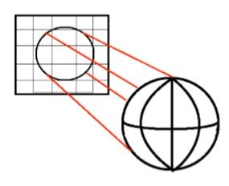
Image Processing Testing: Geolocation
Geolocation Test: Verify Requirement 2.2
Pseudo-code is written
Lower fidelity model based off NASA’s algorithm on the EPIC camera
Currently ~2/3 of code is complete and will be finished by systems testing beginning on March 18th
Depiction of transforming the 3D model into the 2D image
Verified | DR | Requirement
In progress | 2.2 | Image processing shall be capable of mapping longitude and latitude values to image data
Notes:
Backup slide

Slide 49
Test Readiness Backup:
Magnetometer

Slide 50
Magnetometer Noise Estimation
3.1.2 The magnetometer shall measure noise less than 10 nT(peak-to-peak).
COSMO
HEPCATS
Current ≈ 1 A
Current ≈ 2.5 A
Measured Noise vs. Distance
Approximated Noise vs. Distance
Distance (cm) | Noise (nT)
0 | 6.23
50 | 1.63
100 | 1.40
Distance (cm) | Noise (nT)
0 | 15.57
50 | 4.09
100 | 2.79
Notes:
Colin B
Our noise determined by factor of sqrt(2.5)

Slide 51
Design Requirement: Magnetometer Noise
3.1.1 The magnetometer shall measure noise less than 10 nT(peak-to-peak).
What Causes Magnetometer Noise?
Variations in current creating induced magnetic field from other hardware
Internal noise:
20pTrms/√Hz
0.1 nT @ 240 Hz Sampling Rate
How is Noise Determined?
Mean magnetic field strength subtracted from magnetometer readings
Root Mean Square
COSMO Magnetometer Noise Example
(1kHz Sampling Rate)
Notes:
Colin B
“A Bartinton Mag690 three axis magnetic fluxgate was used for these tests. This magnetometer has a noise level of between 10 and 20pTrms at 1 Hz, with measuring ranges up to +/- 1000 μT.”
“As can be noted from above the standard deviation of the magnetic field is never greater than 5.3 nT, which is promising as the noise that the World Magnetic Map can handle is 10 nT.”
-Carolina

Slide 52
Design Requirement: Magnetometer Bias
3.1.2 The magnetic field bias from the spacecraft bus shall not exceed 34000 nT
What is Bias for a Magnetometer Sensor?
Additional induced magnetic field from onboard electronics
Can be subtracted out from reading once bias is determined
Notes:
Colin B
“A Bartinton Mag690 three axis magnetic fluxgate was used for these tests. This magnetometer has a noise level of between 10 and 20pTrms at 1 Hz, with measuring ranges up to +/- 1000 μT.”
“As can be noted from above the standard deviation of the magnetic field is never greater than 5.3 nT, which is promising as the noise that the World Magnetic Map can handle is 10 nT.”
-Carolina

Slide 53
Magnetometer Bias vs Noise
Notes:
Colin B
“A Bartinton Mag690 three axis magnetic fluxgate was used for these tests. This magnetometer has a noise level of between 10 and 20pTrms at 1 Hz, with measuring ranges up to +/- 1000 μT.”
“As can be noted from above the standard deviation of the magnetic field is never greater than 5.3 nT, which is promising as the noise that the World Magnetic Map can handle is 10 nT.”
-Carolina

Slide 54
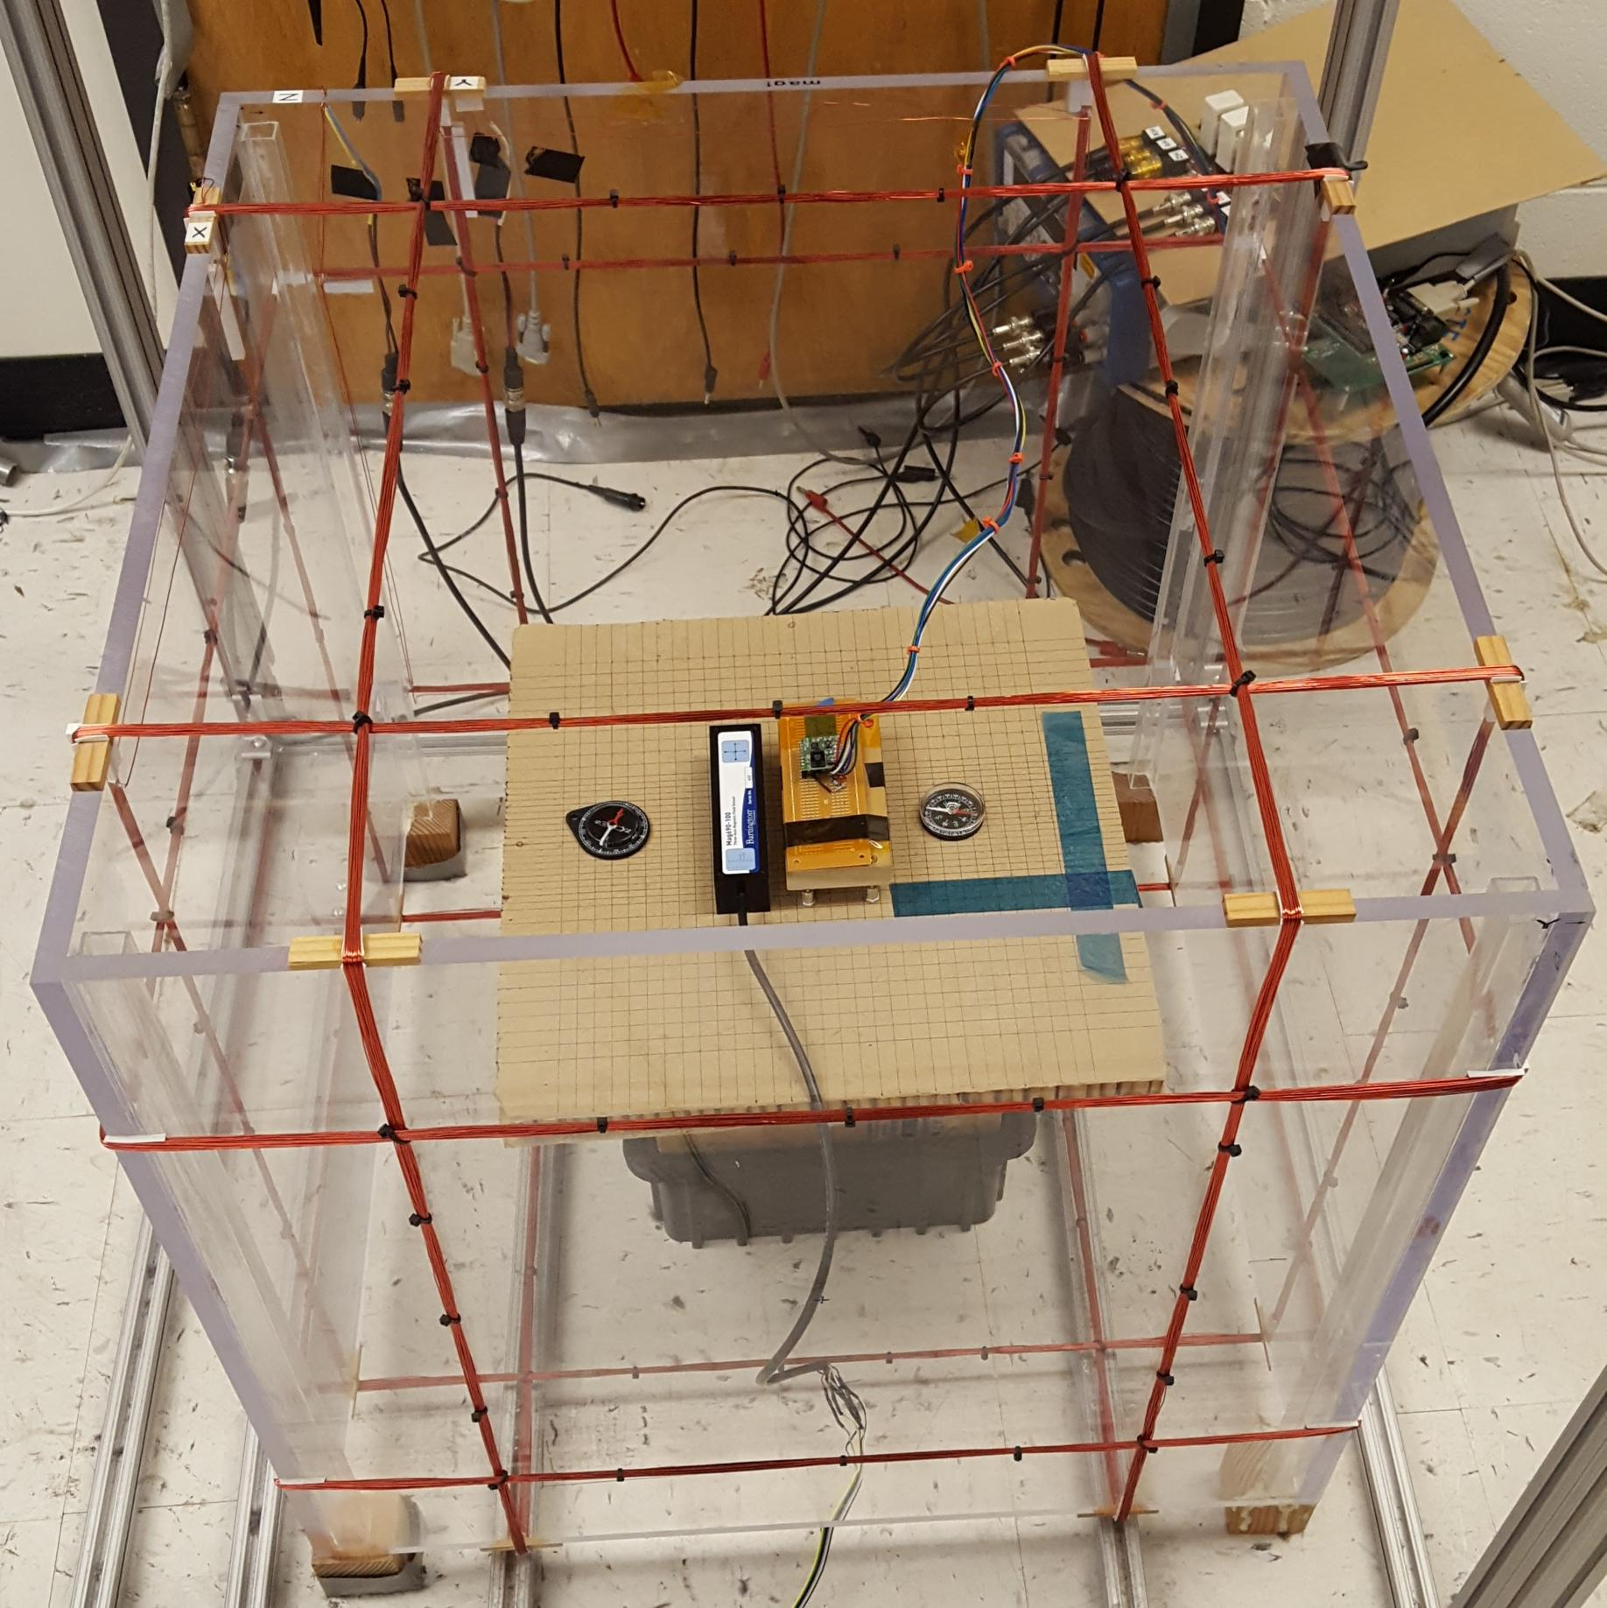
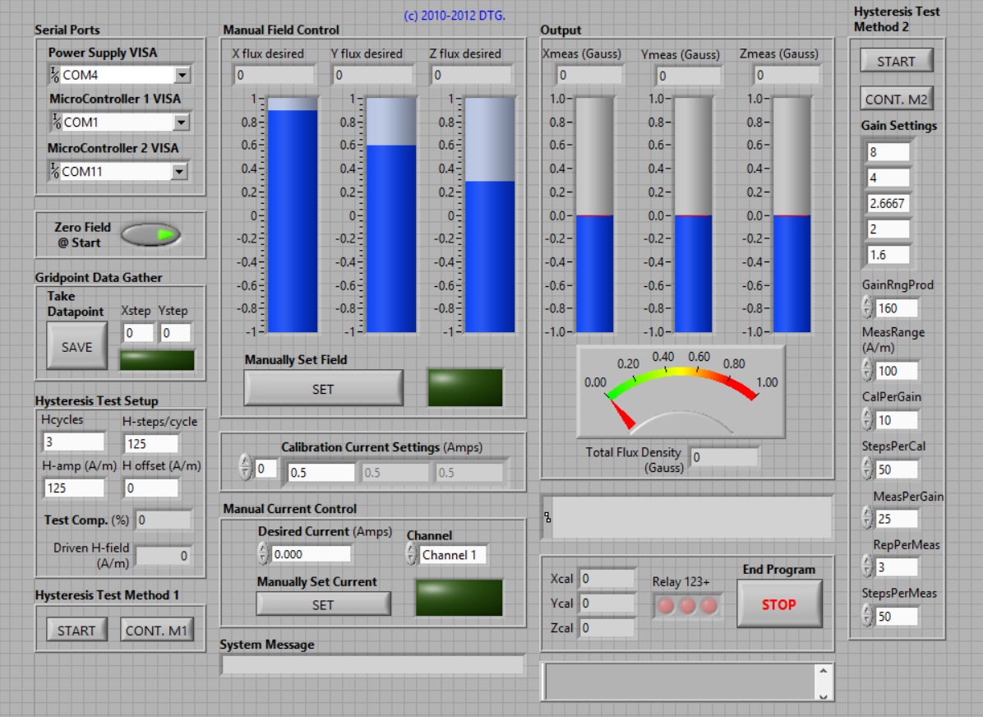
Helmholtz Cage

Slide 55
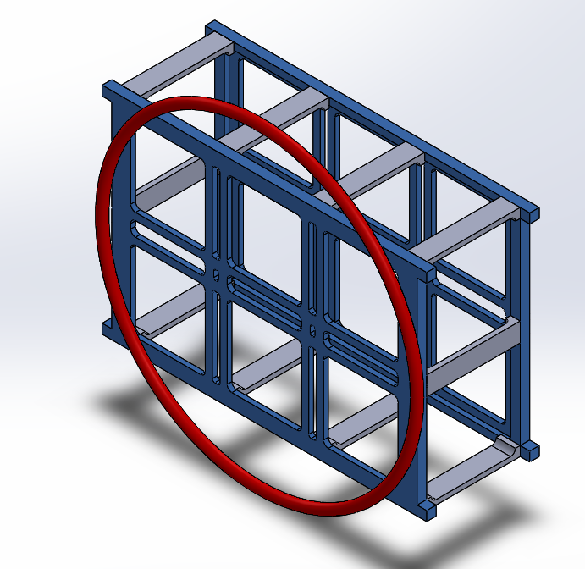
Magnetometer Bias Model
Treating the System as a Circular Loop:
Where:
x = distance from center of circle
R = radius of circle
Bx = magnetic field strength in x-direction
Equivalent
wire loop approximation
Boom distance from center of circle
Notes:
Jordan
By treating the system as a wire with diameter equal to the length of the bus, the EMI from the system can be approximated. In reality, the area would not be this large, making this an overapproximation. By using the Biot-Savart Law for this approximated circular wire, the noise of the system can be estimated as a function of distance from the center of the circle, where x is the distance from the center, R is the radius of the circle, and Bx is the magnetic field strength that will be present at this distance.

Slide 56
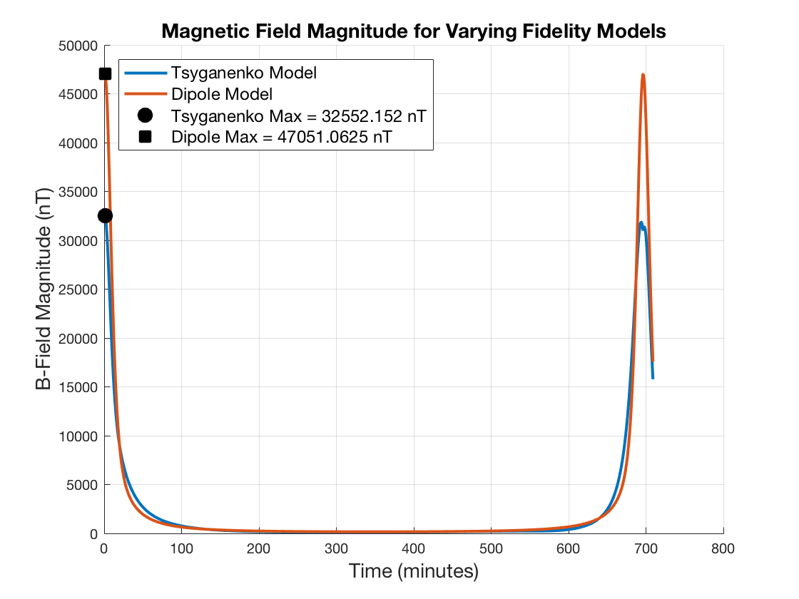
Magnetic Field Models for On Orbit Test
Two models were developed to simulate the magnetic field that will be experienced on orbit, with data captured at one minute intervals
Dipole model:
Low fidelity
Only based upon distance and angle from a dipole source
Tsyganenko Model:
Higher fidelity
Includes approximations for:
Solar wind pressure
IMF components
Disturbance Storm-Time index (DST)
Notes:
Colin B

Slide 57
Test Readiness Backup:
CDH

Slide 58
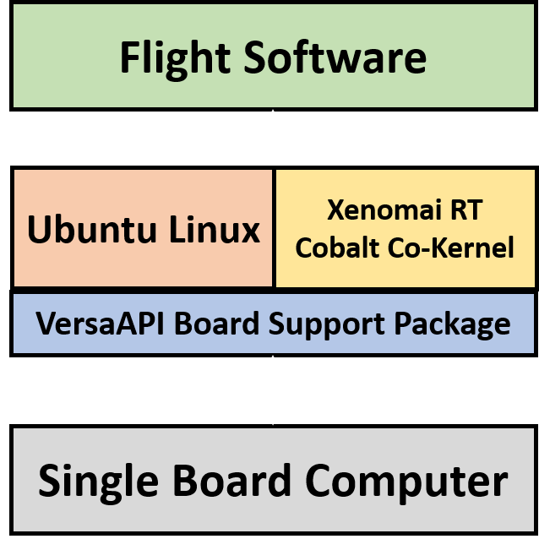
IEU Software Overview
Flight software runs on a real-time operating system (RTOS) written in C
Ubuntu 16.04 Linux with Xenomai 3.0.5 “Cobalt” and Linux 4.9.38 co-kernel configuration
Alchemy API
Current progress:
RTOS installed and configured on IEU and able to run working builds on FSW

Slide 59
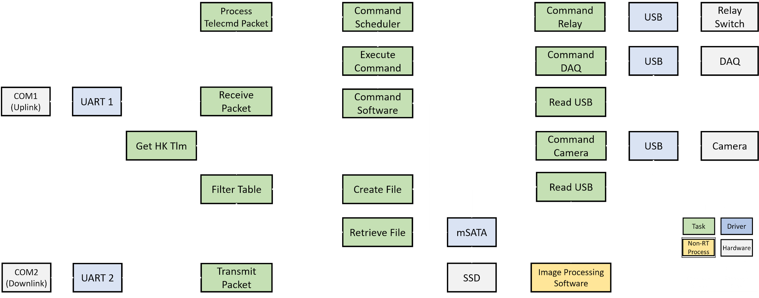
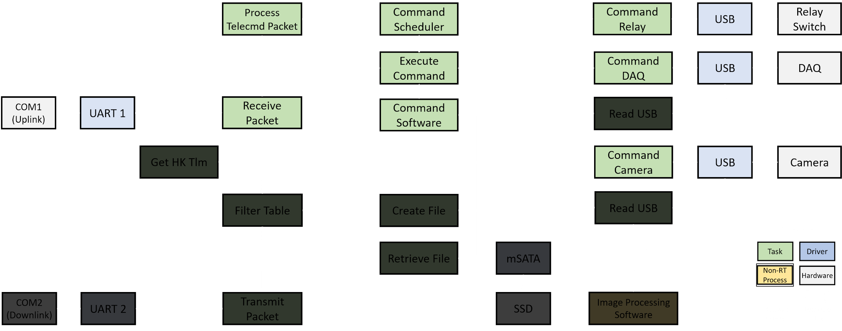
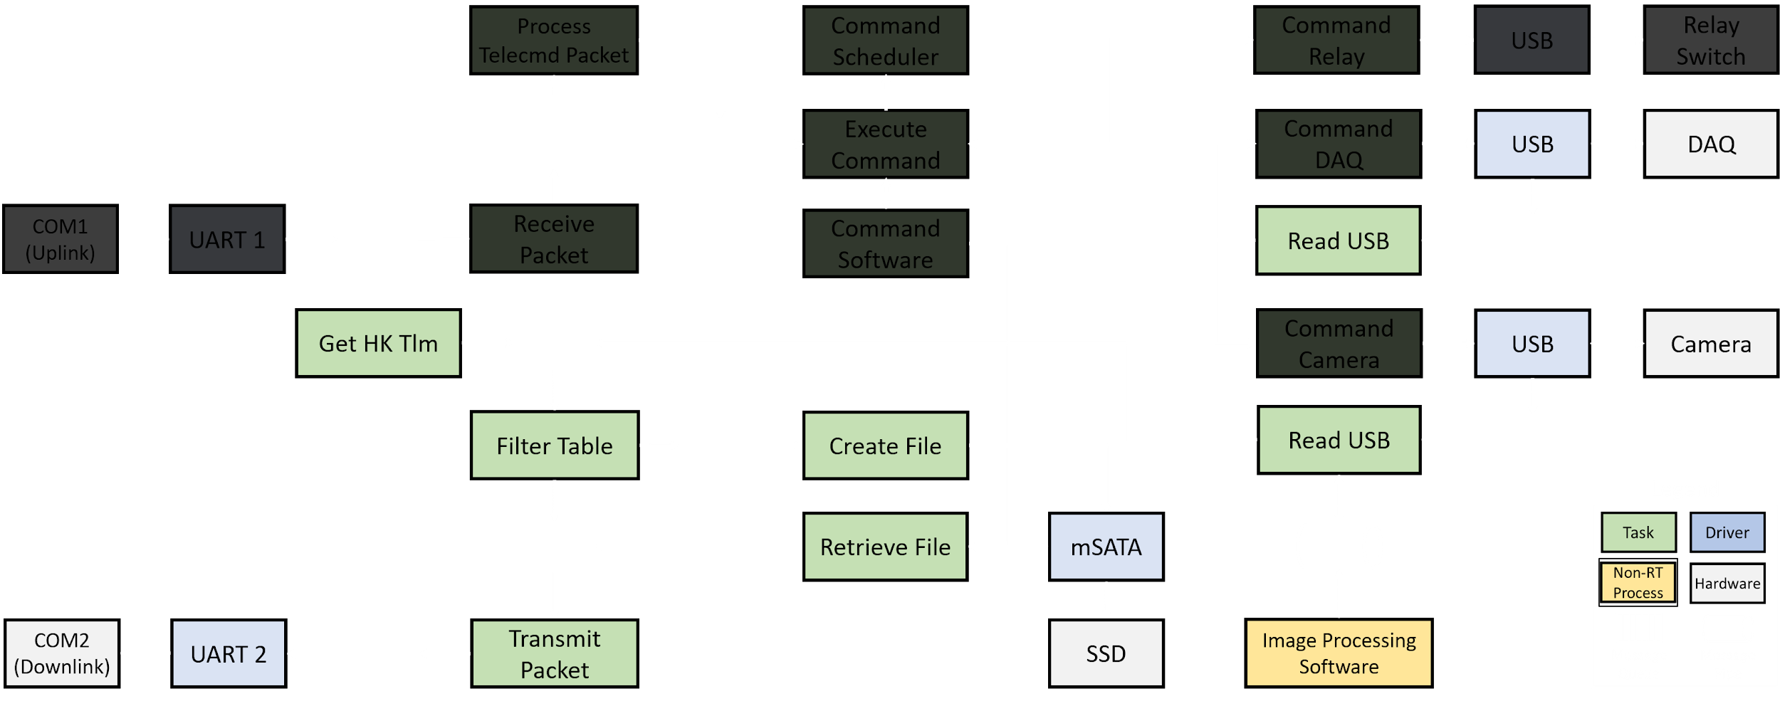
Flight Software Architecture

Slide 60
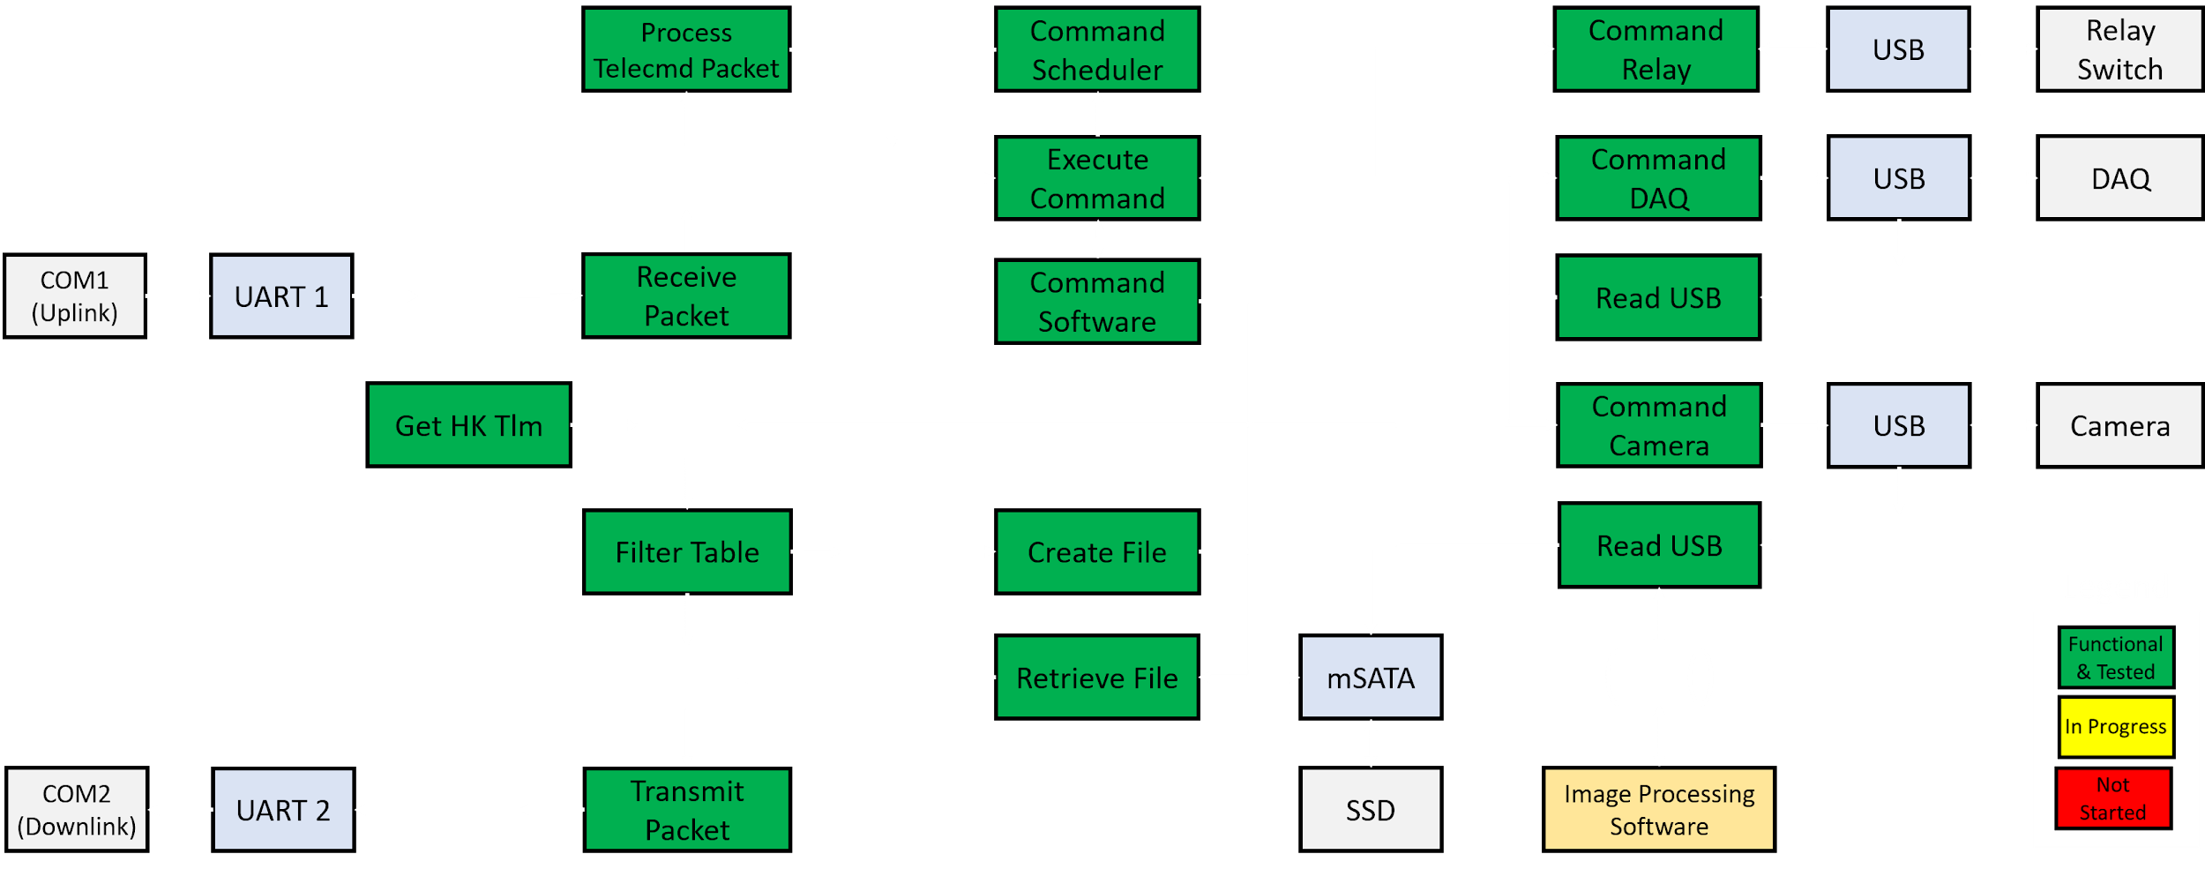
Flight Software Progress

Slide 61
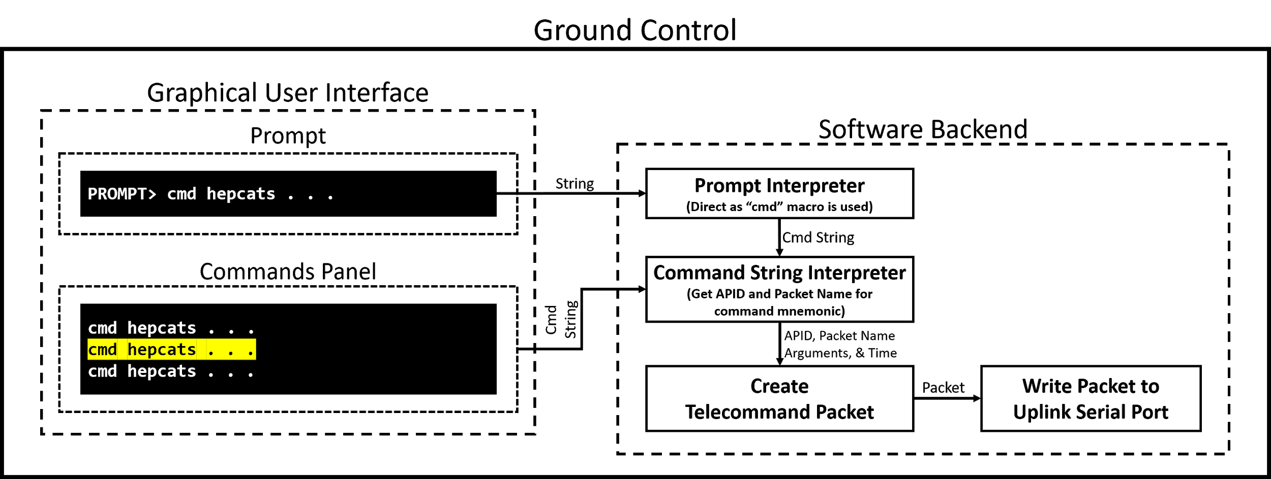
Ground Control: Command FBD

Slide 62
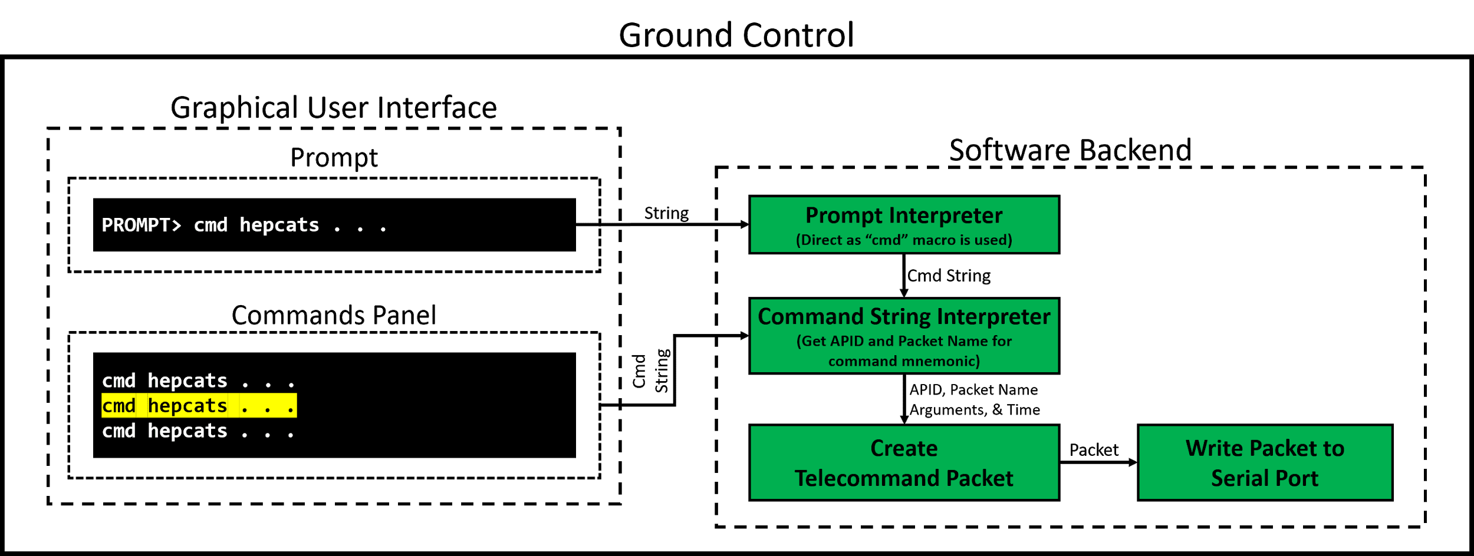
Ground Control: Command Progress

Slide 63
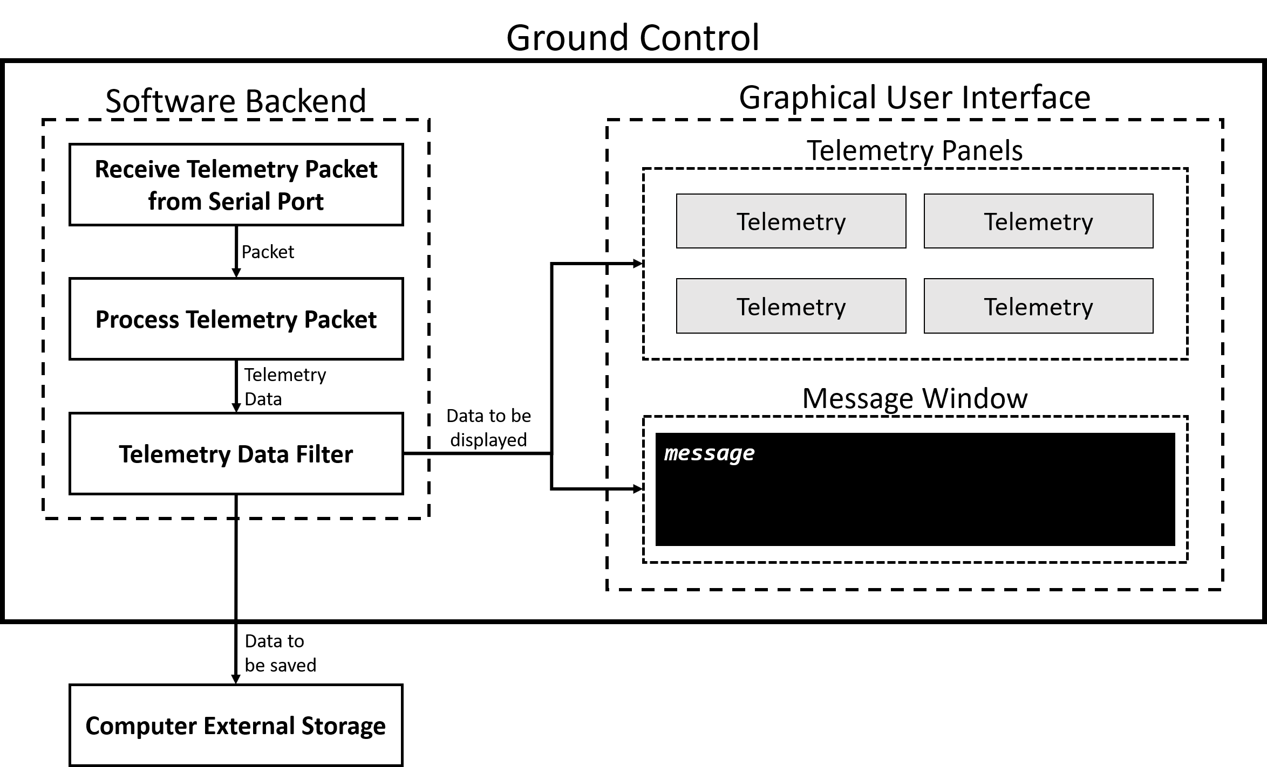
Ground Control: Telemetry FBD

Slide 64
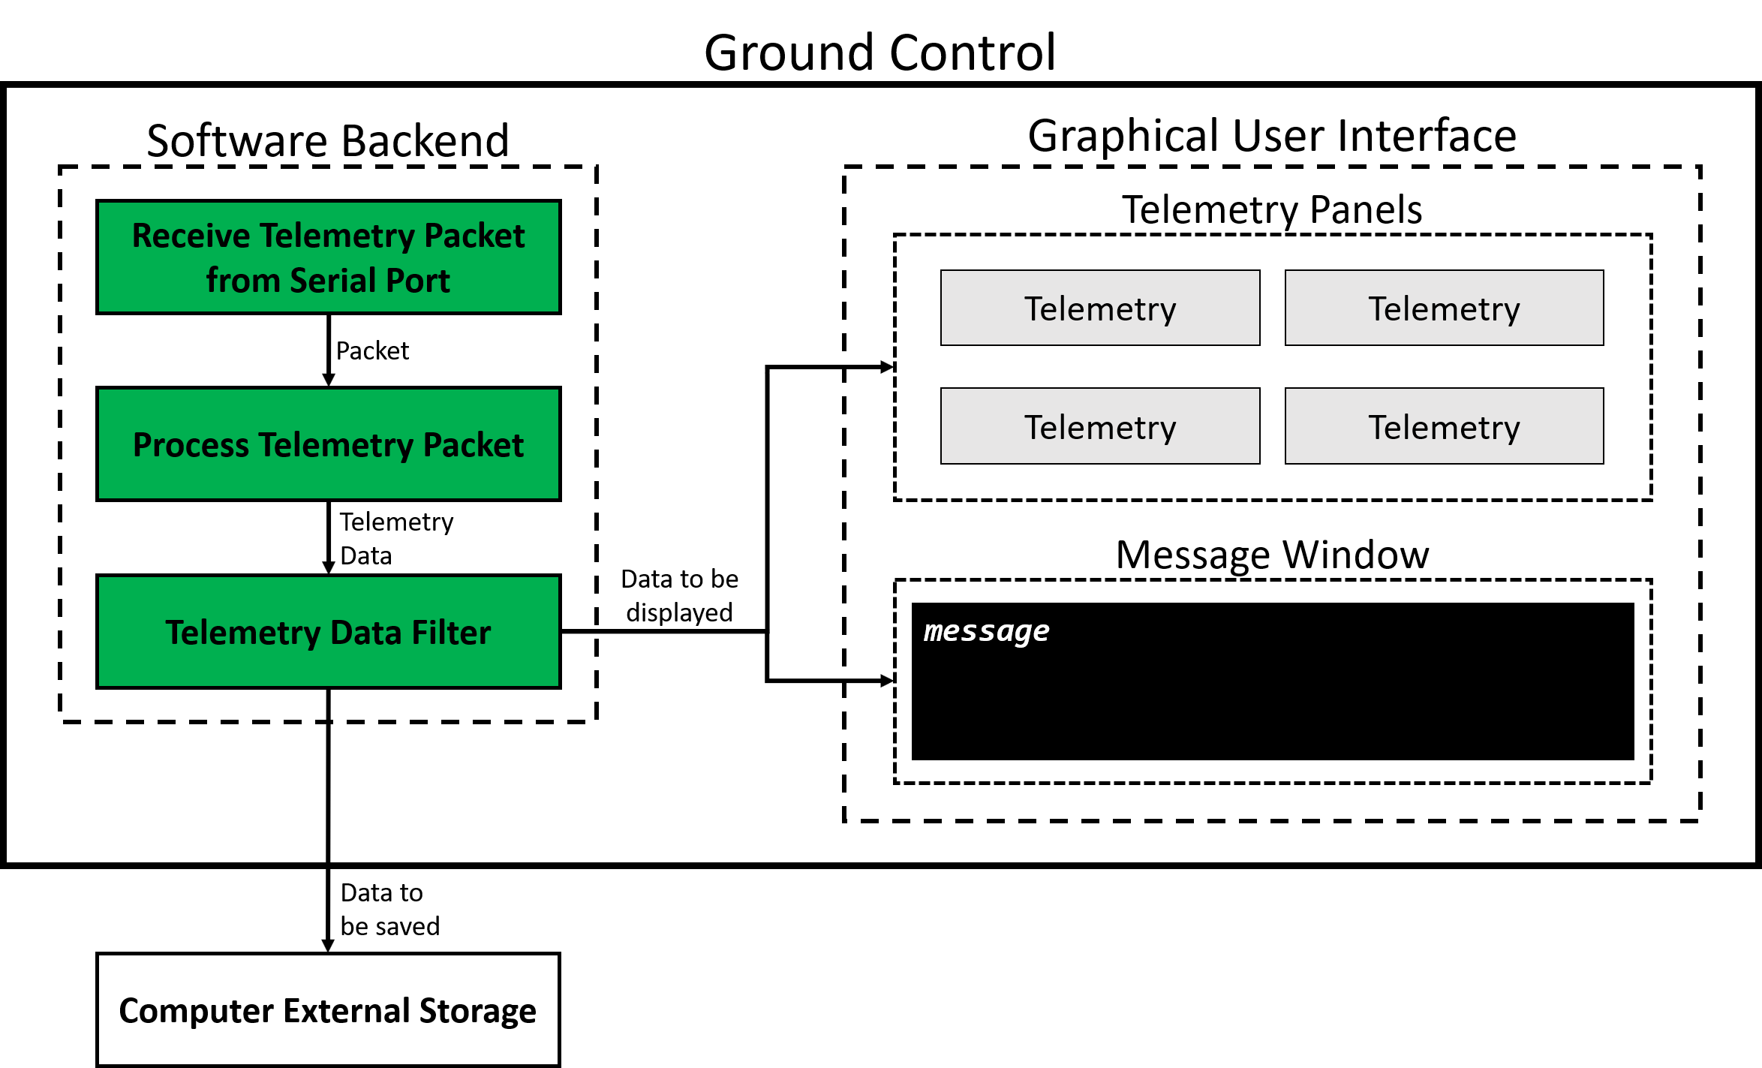
Ground Control: Telemetry Progress

