Slide 1
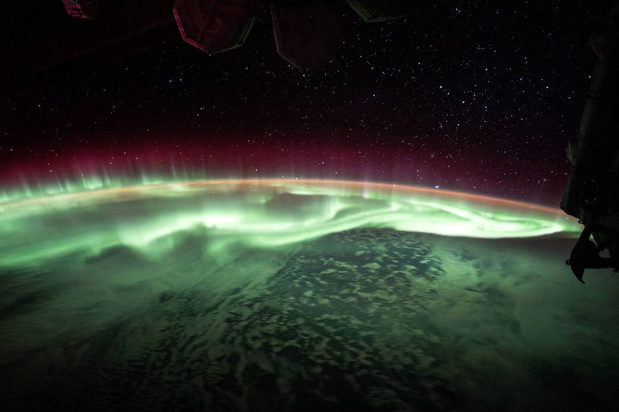
Project HEPCATS
Highly Elliptical Polar Constellation
for Auroral Transport Studies
Manufacturing Status Review
Presenters: Matthew Skogen, Benjamin Spencer, Colin Sullivan & Kian Tanner
Other Members: Alex Baughman, Hailee Baughn, Colin Brown, Jordan Lerner, Valerie Lesser, Christopher Peercy, Vishranth Siva & Braden Solt
Customer: Neal Anderson (DigitalGlobe) & Tom Berger (CU Space Weather Center)
Advisor: Dr. Donna Gerren
Notes:
Colin S

Slide 2
Project Overview
Project Overview
Schedule
Manufacturing: Software
Manufacturing: Mechanical
Manufacturing: Electrical
Budget & Safety
Notes:
Colin S

Slide 3
Project Statement
The HEPCATS project will collaborate with DigitalGlobe and the CU Space Weather Center to design and implement a prototype of a 6U CubeSat capable of capturing, identifying, and filtering images of the auroras as well as collecting magnetic field data and downlinking the deliverables to a simulated ground station.
Notes:
Colin S
-optical system to image auroras
-software to compress, filter, process, and map the images of the auroras
-magentometer to measure the magnetic field of the auroras
-the command and data handling system to receive commands and downlink collected data
-prototype bus structure to hold the payload

Slide 4
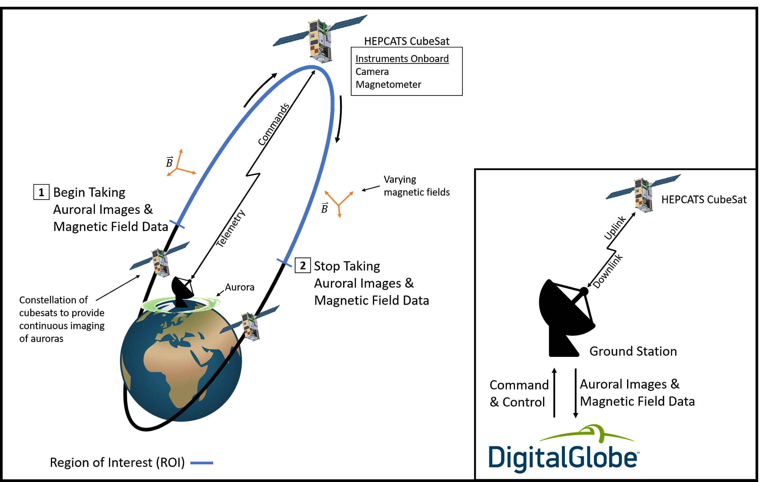
HEPCATS Mission ConOps
Notes:
Colin S
A polar ground station is placed by DigitalGlobe to support the constellation by providing uplink and downlink capabilities.

Slide 5
Mission Elements NOT Implemented
Attitude Determination and Control System
A physical boom for the magnetometer
Onboard Electrical Power System
Flight-ready Hardware
Notes:
Colin S
We are not designing the ADCS system nor will we be implementing a physical boom for the magnetometer
Overall Test Readiness Level of 4 is that the system is validated in a laboratory environment with performance predictions for the operating environment, but the system will not be tested in a relevant environment.
TRL of 4 (short version): Component and/or breadboard validation in laboratory environment.
TRL of 4 (long version): HARDWARE - A low fidelity system/component breadboard is built and operated to demonstrate basic functionality and critical test environments, and associated performance predictions are defined relative to the final operating environment. SOFTWARE - Key, functionally critical, software components are integrated, and functionality validated, to establish interoperability and begin architecture development. Relevant environments defined and performance in this environment predicted.
Be clear about the fact that this bus is not flight ready and is solely for the purpose of keeping the hardware together and visualizing the CubeSat as a whole

Slide 6
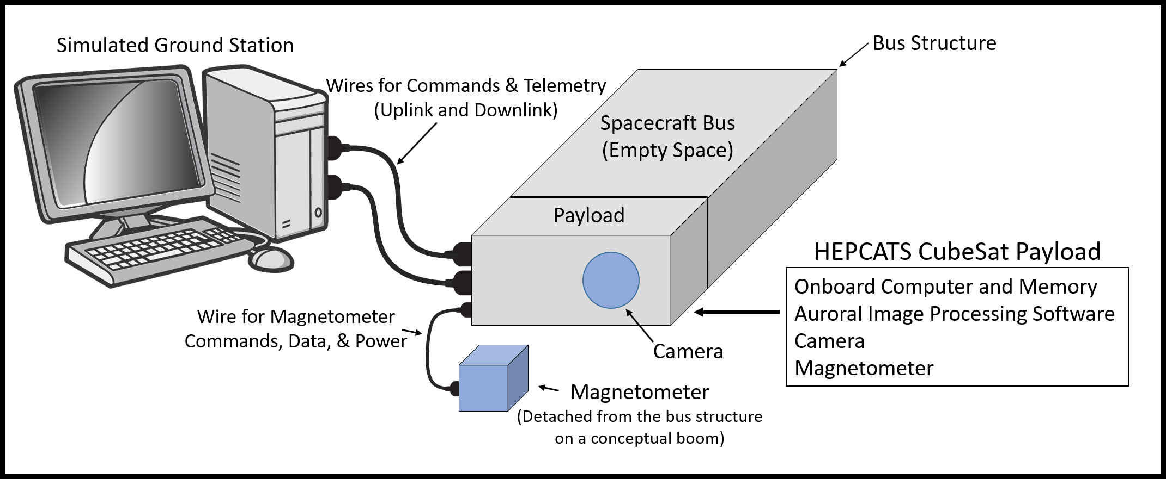
HEPCATS Project
Notes:
Colin S
Here you can see the hepcats project. The project consists of the spacecraft bus, which will house onboard computer, image processing software, and imaging system. Attached you can see the magnetometer, which is attached to the payload, and the the simulated ground station which consists of a laptop computer which will be used to simulate a ground control station and receive telemetry from the bus.

Slide 7
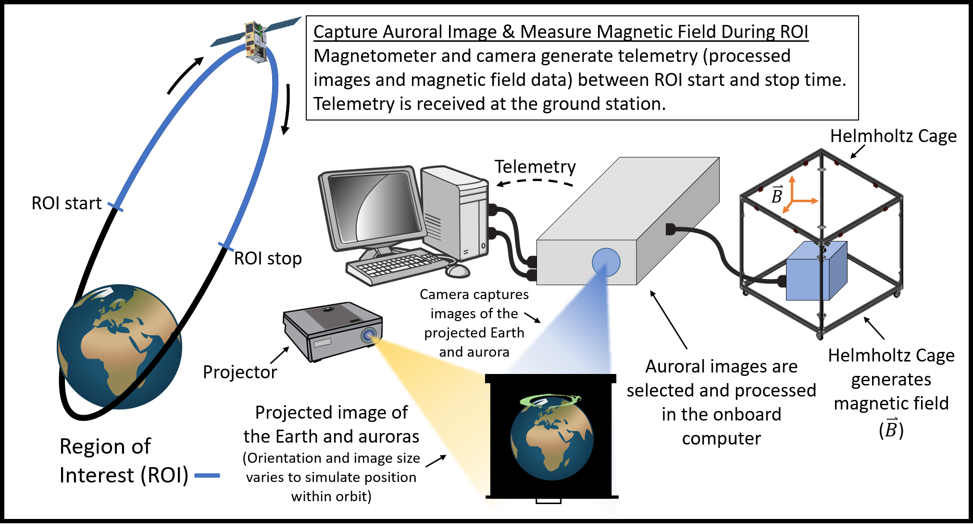
“Orbit in the Life” Simulation
Notes:
Colin S
Part2
-will involve two separate procedures where we will capture auroral images and measure the magenetic field during the ROI start and stop times
-as well as downlink this information to the simulated groundstation

Slide 8
Levels of Success
 | Spacecraft Bus | Imaging System | Magnetometer System | Command & Data Handling
Level 1 | • Mounted within a manufactured stand-alone structure | • Take an image • Fixed FOV able to fit hemisphere of the Earth at apogee • Filter out backscatter from optical system • Crop image to TBD • Compress image to TBD | • Detect the scalar component of a constant magnetic field | • Manually commanded payload activation and deactivation • Receive, store and send magnetometer and image data at a rate of TBD
Level 2 | - | • Able to image at least once every minute to capture changing aurora • Fixed FOV able to image latitudes above TBD degrees north at apogee • Identify if aurora is present | • Detect the vector component of a constant magnetic field | • Command the payload autonomously from an on board absolutely timed sequence of commands
Level 3 | • Mounted within a manufactured mock CubeSat spacecraft bus | • Able to change rate of image capture if aurora is present • Unskew images to be useful • Filter out Earthshing • Identify lowest latitude of aurora | • Map magnitude and direction of magnetic field lines | -
Notes:
Colin S

Slide 9
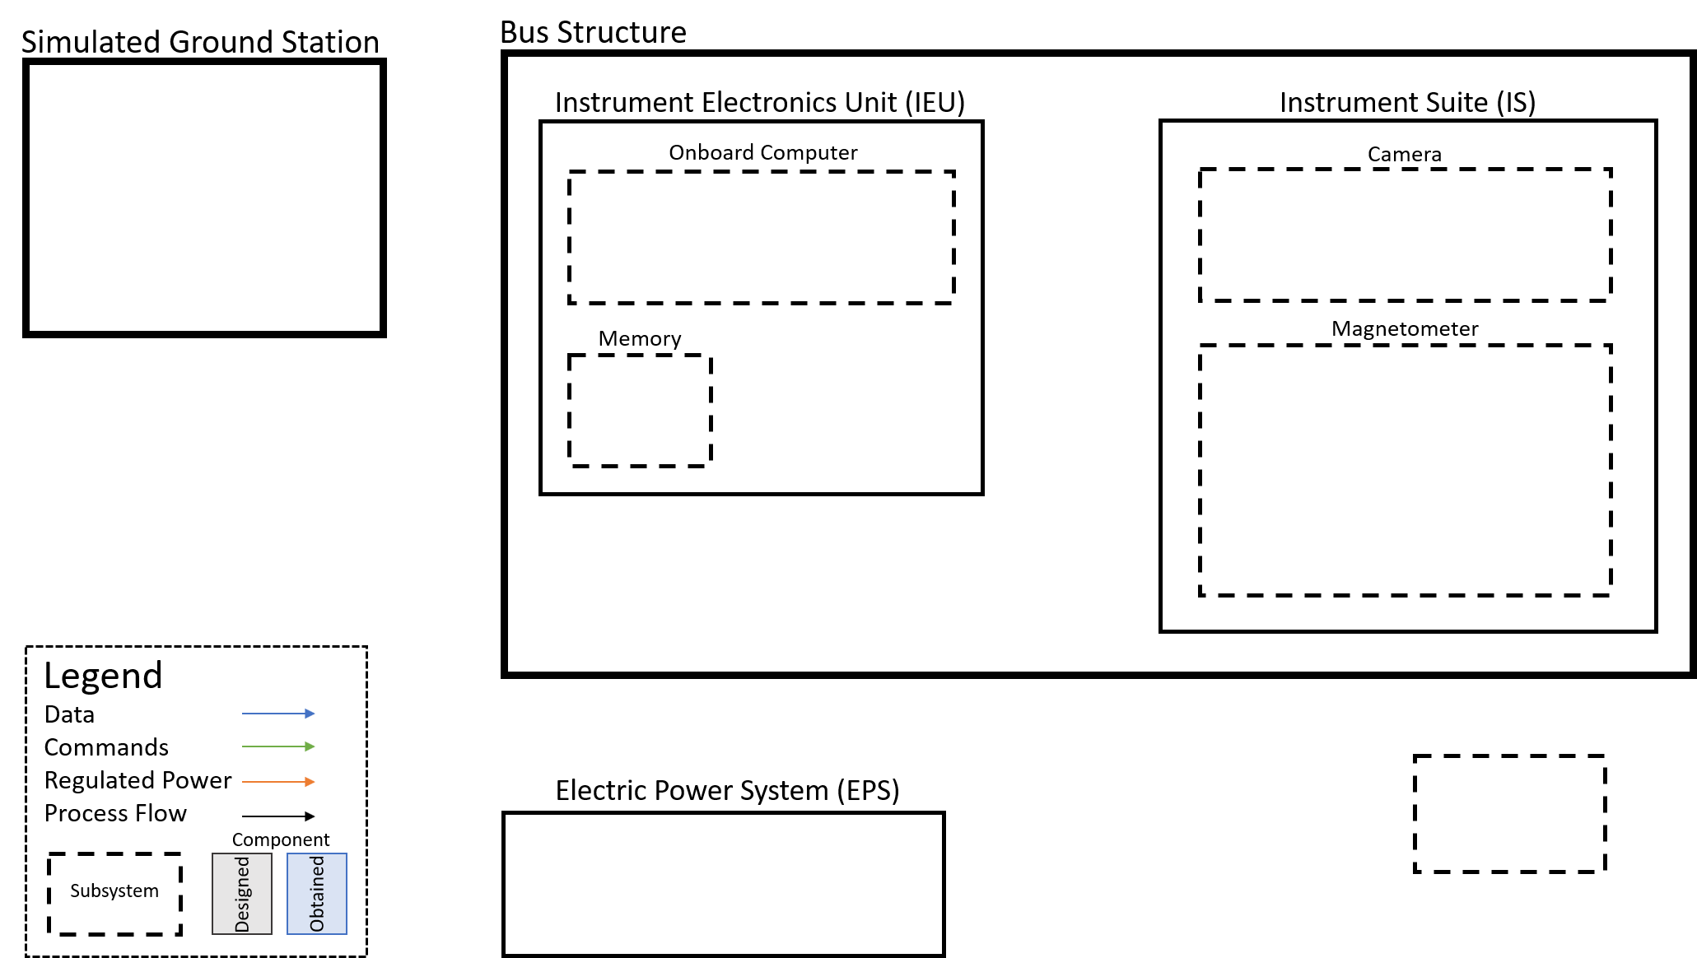
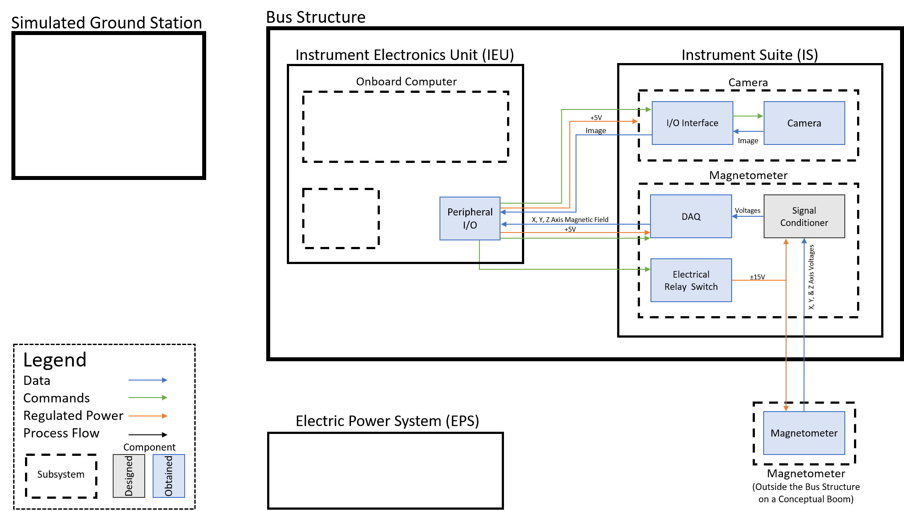
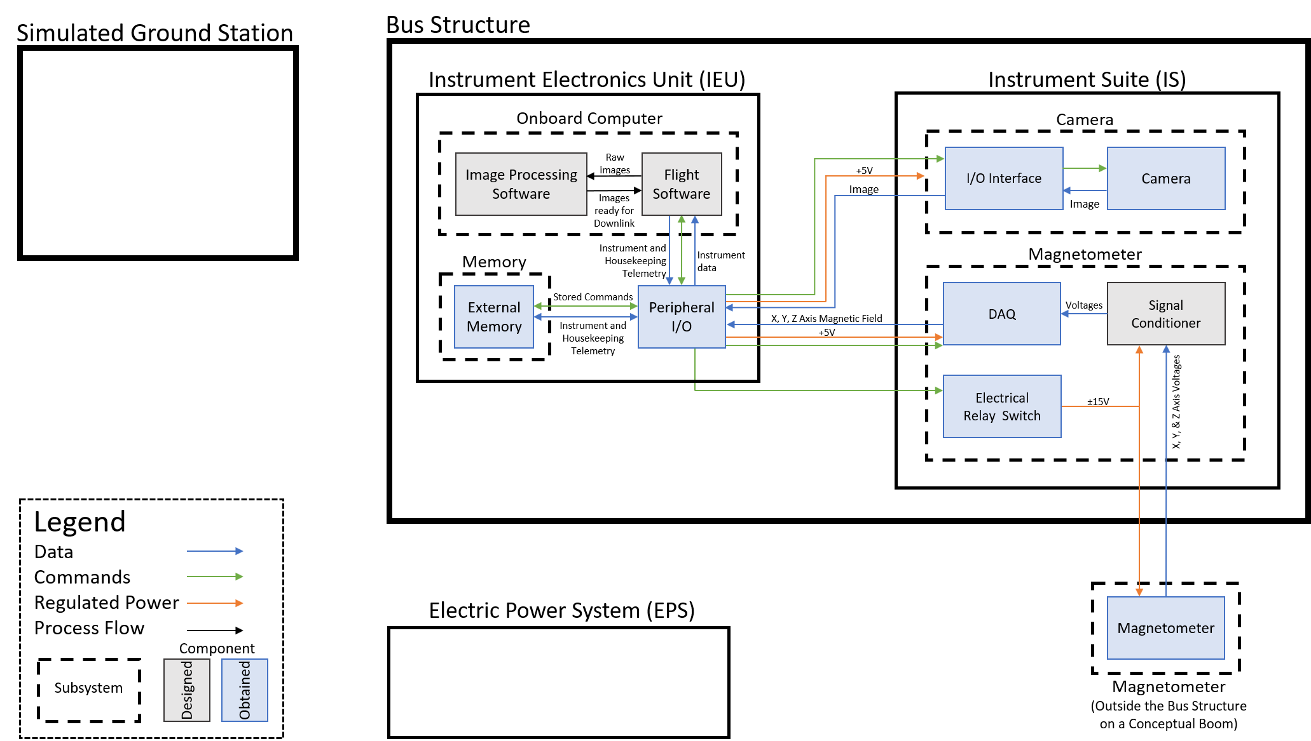
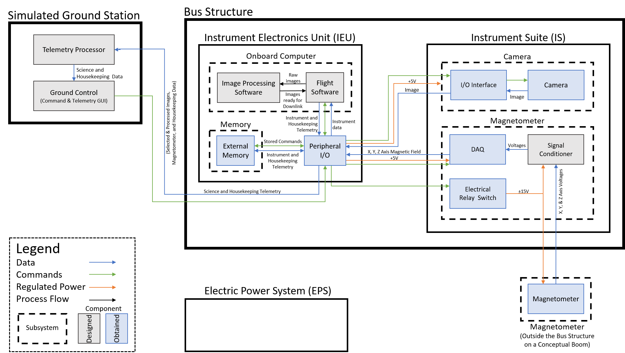
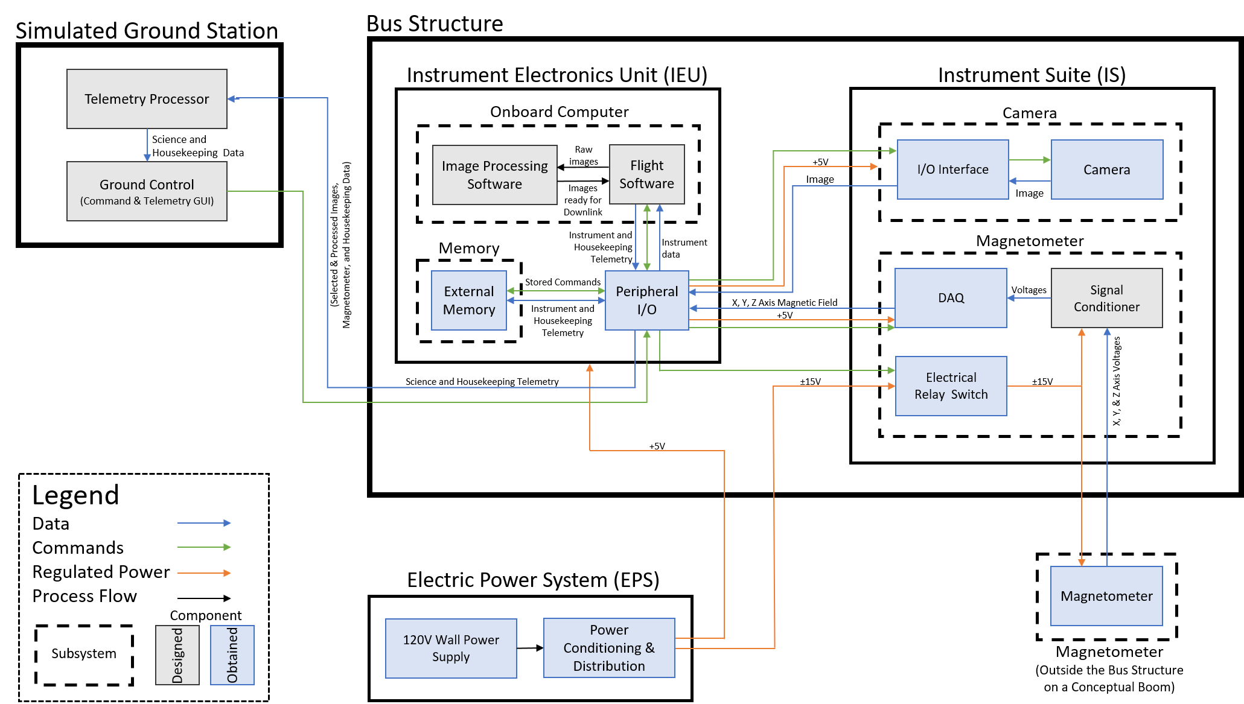
Functional Block Diagram
Notes:
Colin S

Slide 10
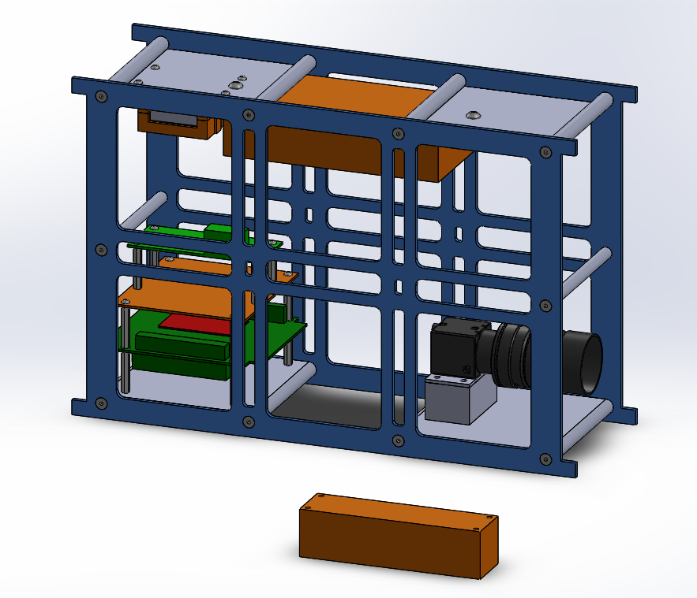
HEPCATS CubeSat
Magnetometer DAQ
Magnetometer
Signal Conditioning
22.6 cm
Imaging System
Instrument Electronics Unit (IEU)
11 cm
34 cm
Magnetometer
Notes:
Colin S

Slide 11
Critical Project Elements
 | Critical Project Elements | Relevance to Manufacturing
I1 | Need to have proper FOV in order to have continuous coverage of polar crown
I2 | Procurement of acceptable imagery and development of acceptable testing procedures
P1 | Image processing should be able to identify if an aurora is present in each image | A stable camera mount is required to produce acceptable imagery
M1 | The magnetometer sensor needs to be placed away from the payload to reduce EMI
D1 | Developing proper buffer size, simulating uplink and downlink, and collecting data | Proper development and implementation of commands and telemetry is necessary operate and communicate with S/C Bus
Notes:
Don’t read these

Slide 12
Schedule
Project Overview
Schedule
Manufacturing: Software
Manufacturing: Mechanical
Manufacturing: Electrical
Budget & Safety
Notes:
Matt

Slide 13
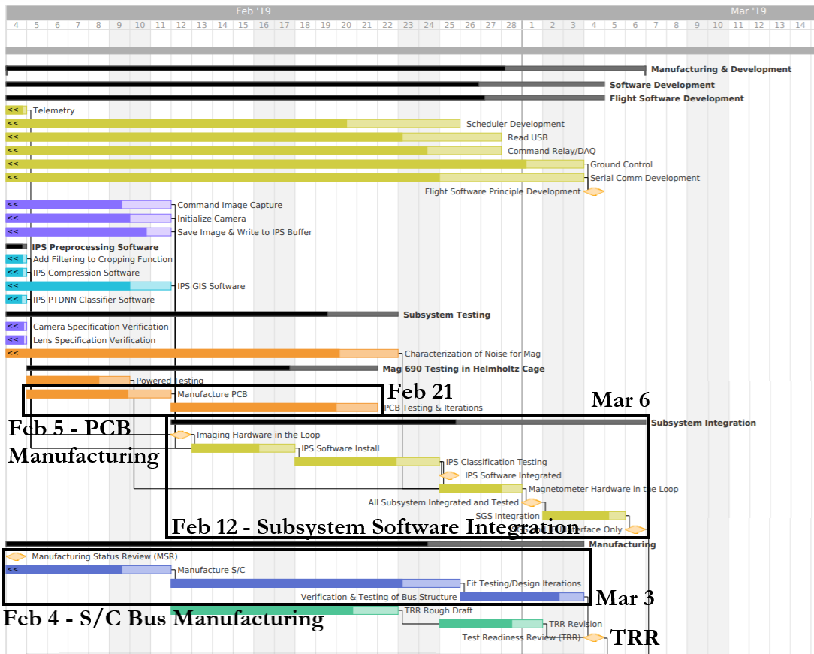
MSR to TRR
Notes:
Matt
Schedule for know until the AIAA paper is due
Critical path shown in red
This stage consists of subsystem integration and manufacturing

Slide 14
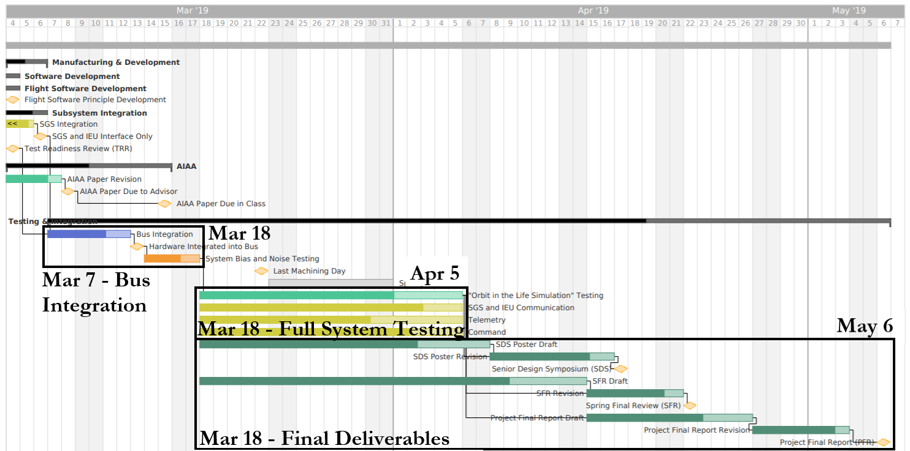
TRR to PFR
Notes:
Matt
This is the schedule from TRR to PFR which will consist of system testing and final writeups and presentations

Slide 15
Manufacturing:
Software
Project Overview
Schedule
Manufacturing: Software
Manufacturing: Mechanical
Manufacturing: Electrical
Budget & Safety
Notes:
Ben
To wrap up the manufacturing, here is our status review software CLICK

Slide 16
Command and Data Handling
Notes:
Ben
First starting off with command and data handling and specifically CLICK

Slide 17
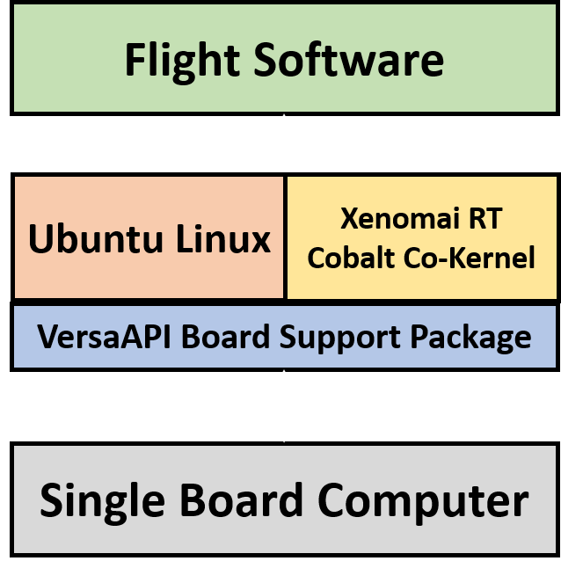
IEU Software Overview
Flight software runs on a real-time operating system (RTOS) written in C
Ubuntu 16.04 Linux with Xenomai 3.0.5 “Cobalt” and Linux 4.9.38 co-kernel configuration
Alchemy API
Current progress:
RTOS installed and configured on IEU and able to run working builds on FSW
Notes:
Ben
The IEU (our computer), runs FSW on a RTOS written in C. This RTOS is real-time linux and provides hard real-time support to user space applications being fsw. It’s current progress is that it has been installed on the IEU, configured, and able to run working builds of FSW.
CLICK

Slide 18
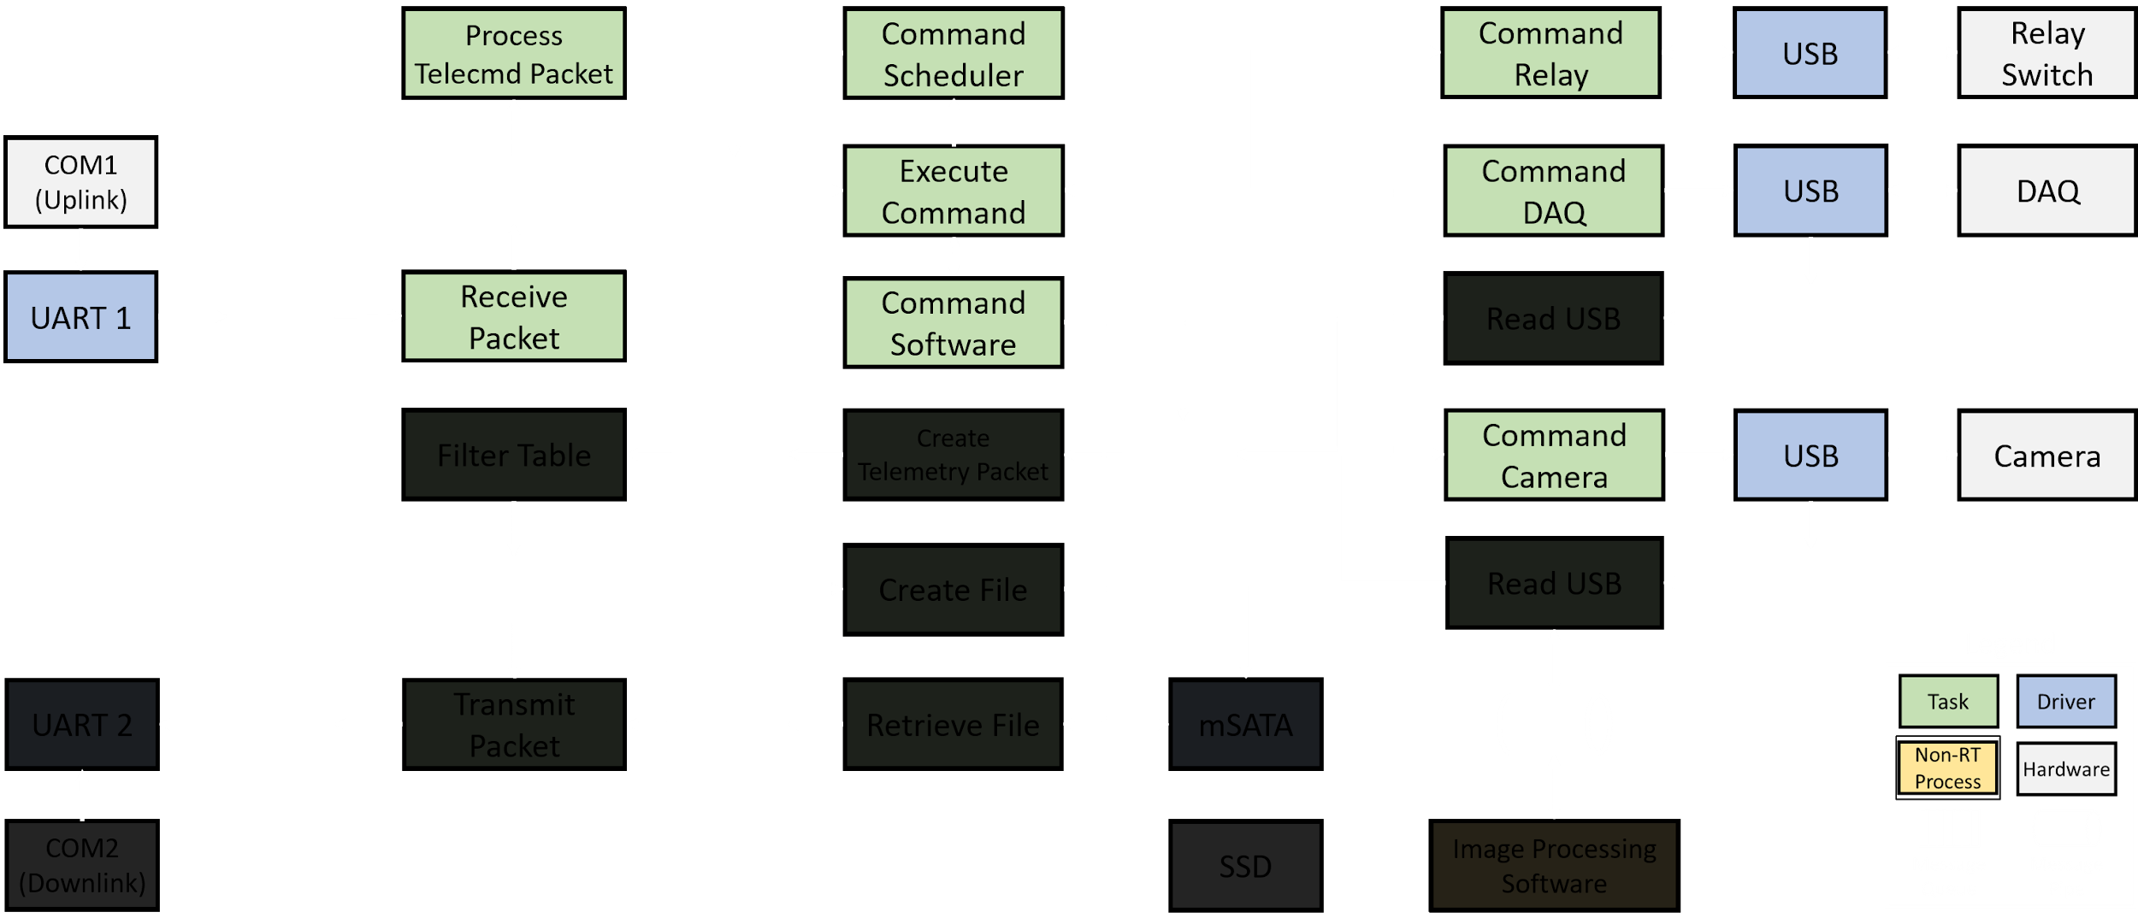
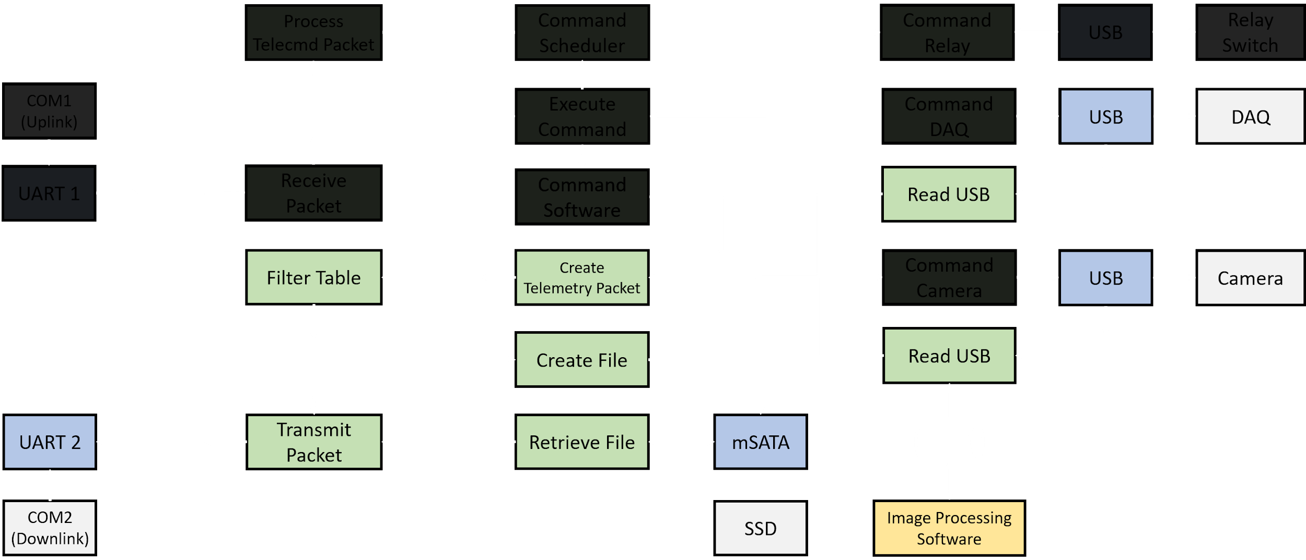
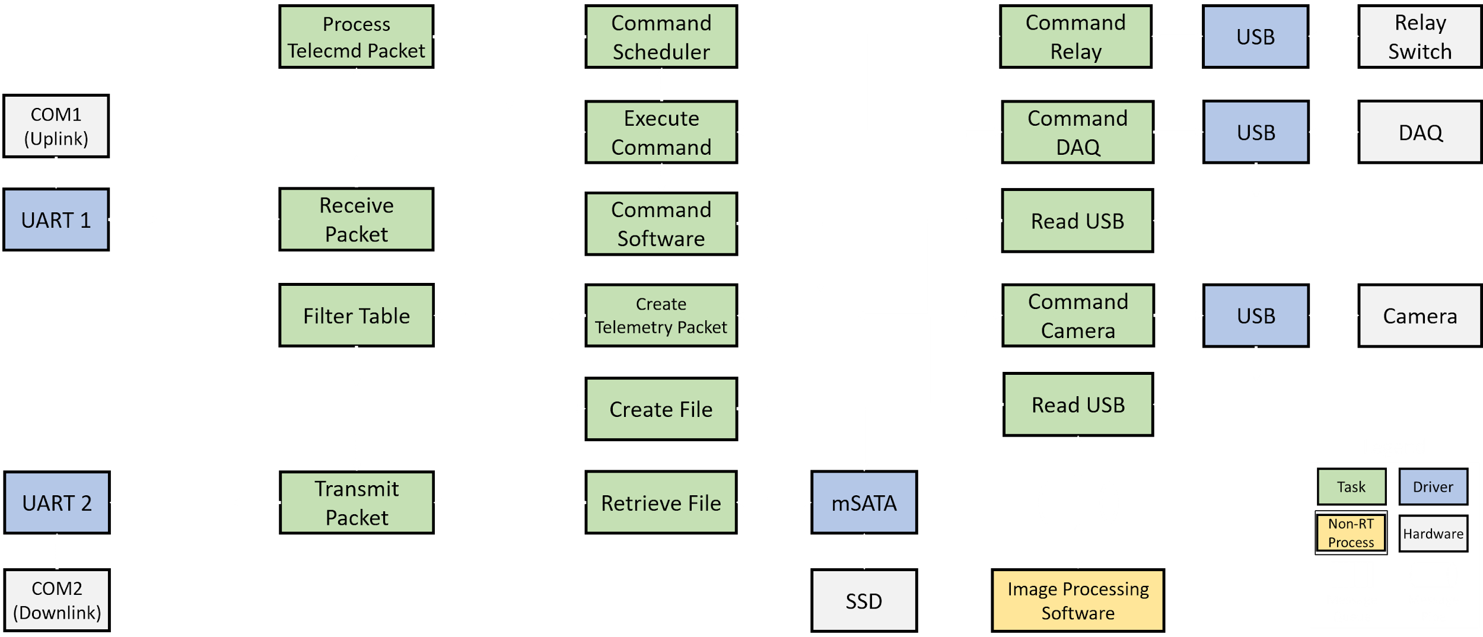
Flight Software Architecture
Notes:
Ben
Next, jumping into fsw itself, here is its high level architecture. FSW achieves command distribution and telemetry acquisition functionality starting and ending with uplink and downlink serial communication between itself and the simulated ground station. Most importantly, green boxes are real-time tasks, blue are drivers and grey is hardware. The drivers are pre existing and are not written by us.
The top half (CLICK) is concerned with command distribution: a telecommand packet is received from the uplink serial port, processed, and sent its final destination being the relay switch, DAQ, or camera. The bottom half (CLICK) is concerned with telemetry acquisition: source data is generated by the DAQ and camera, read via USB, placed into telemetry packets, and then either downlinked to the ground via the downlink serial port or stored on memory for later downlink.
CLICK

Slide 19
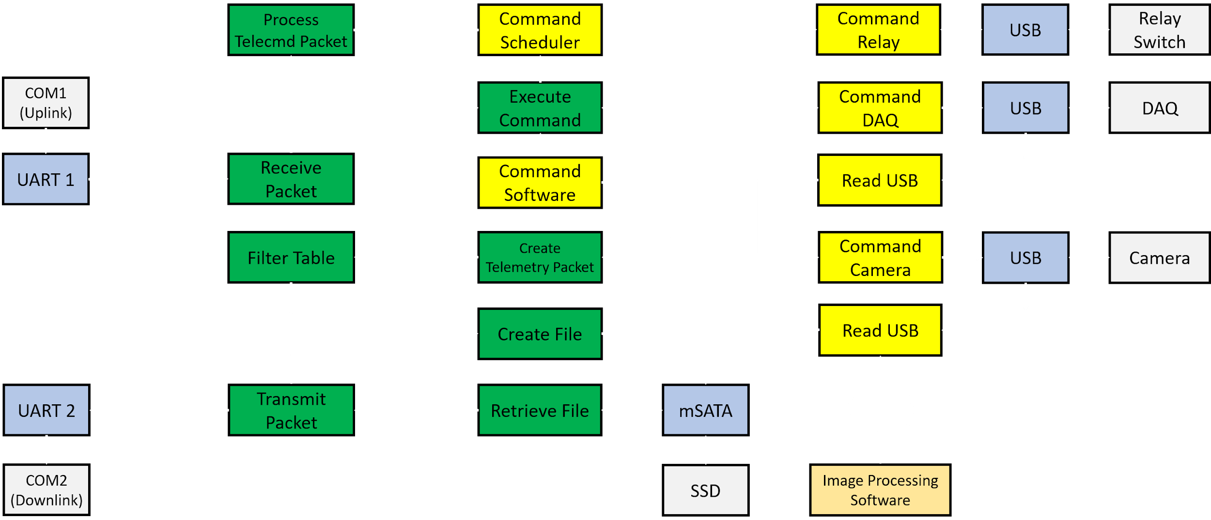
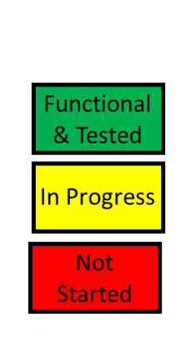
Flight Software Architecture Progress
Notes:
Ben
Here is the current progress of FSW. Green are tasks that are functional and tested using simulated commands and telemetry, and yellow are in progress tasks. The majority of yellow tasks are those tasks that directly interface with the hardware.
CLICK

Slide 20
Flight Software Progress
Difficulty | Task | Hours | Progress | Completion Date | Time Remaining
4 | Command Scheduler | 5 / 16 | Need to convert pseudocode, integration, and test | Feb 21 | 2.5 Weeks
2 | Command DAQ/Relay | 2 / 6 | Need to populate with hardware specific command definitions and executions | Feb 17 Feb 28 | 1.8 Weeks 3.5 Weeks
2 | Read USB Camera/DAQ | 2 / 6 | Need to test and integrate with hardware | Feb 17 Feb 28 | 1.8 Weeks 3.5 Weeks
1 - Least Difficult 5 - Most Difficult
Notes:
Ben
Here is a summary of those in progress tasks. Important to note that all of these in progress tasks are within our schedule as you can see with the due date and time remaining to complete. The hardware in progress tasks have only few remaining hours for work to be done to integrate with the hardware. This includes populating the task with hardware specific command definitions and executions, as with the command task, or testing with hardware, as seen with the read task. This work is scheduled to be done during hardware integration for each component in the coming weeks.
The command scheduler task, the task responsible for executing absolutely timed tasks, is ranked the most difficult and the most amount of hours remaining to work on in addition to a near future completion date. The work remaining is converting the pseudocode and testing within command distribution. The challenge here is implementing the algorithm to schedule absolutely timed command, but with the help of documentation on this algorithm, we are comfortable where we stand with this task.
CLICK

Slide 21
Simulated Ground Station
Notes:
Ben
Moving on to the simulated ground station (CLICK)

Slide 22
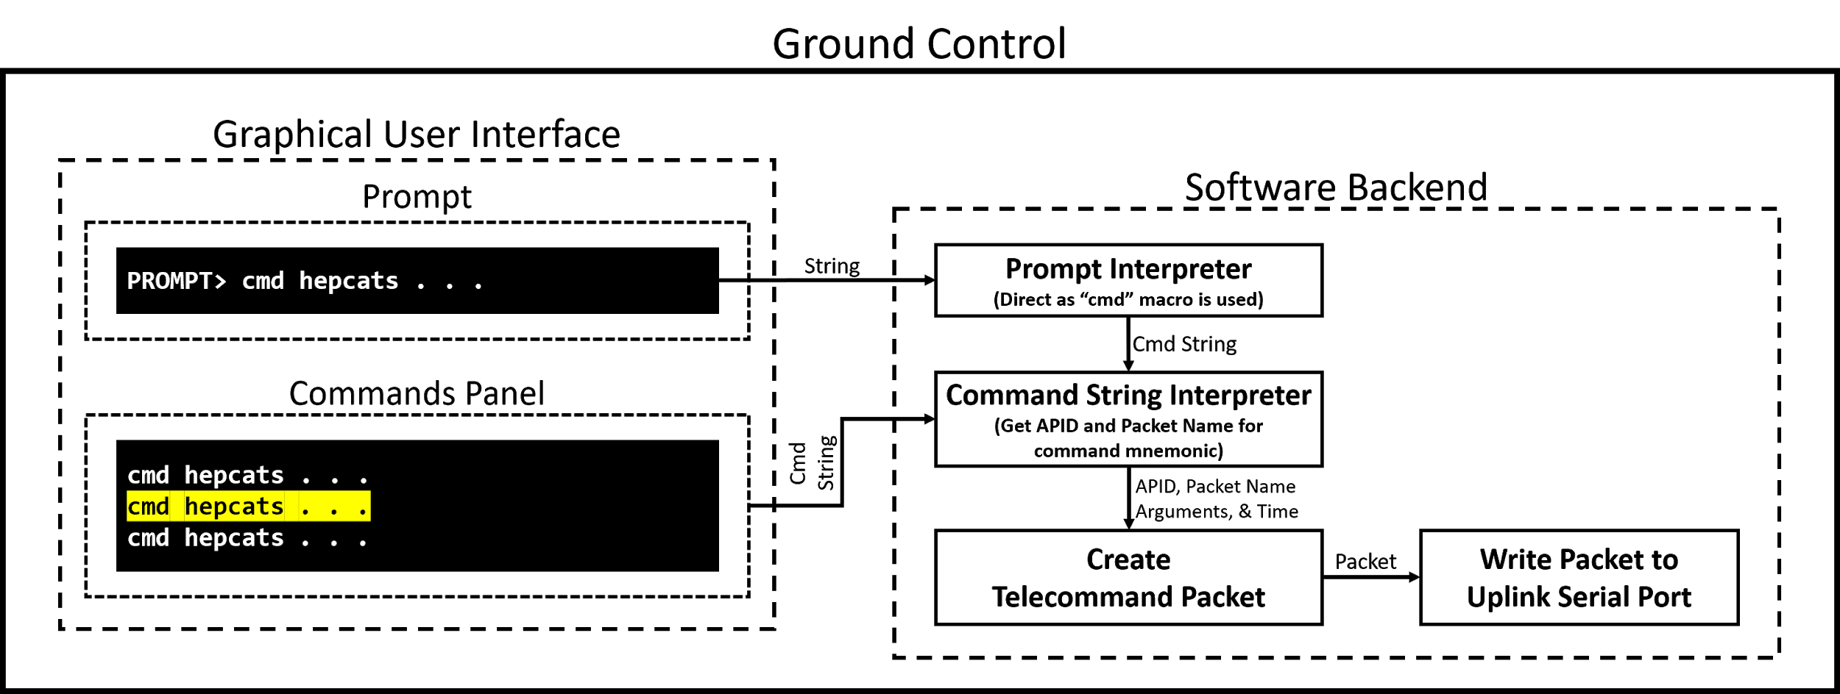
Ground Control: Command FBD
Notes:
Ben
Here is the software backend for the C&T user interface for commanding. Command strings are interpreted from either the prompt or command panel to telecommand packets and finally sent to the IEU via the uplink serial port.
CLICK

Slide 23
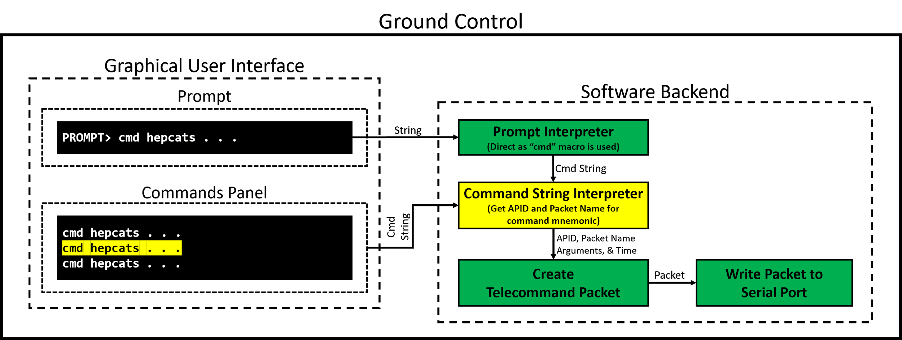
Ground Control: Command Progress
Notes:
Ben
This is the current progress for the command backend. The majority of tasks are written except for the command string interpreter, the task responsible for associating the command string with telecommand packet inputs.
CLICK

Slide 24
Flight Software Progress
Difficulty | Task | Hours | Progress | Completion Date | Time Remaining
2 | Command String Interpreter | 1 / 3 | Need to implement importable command database for command string interpretation | Mar 6 | 3.5 Weeks
1 - Least Difficult 5 - Most Difficult
Notes:
Ben
CLICK

Slide 25
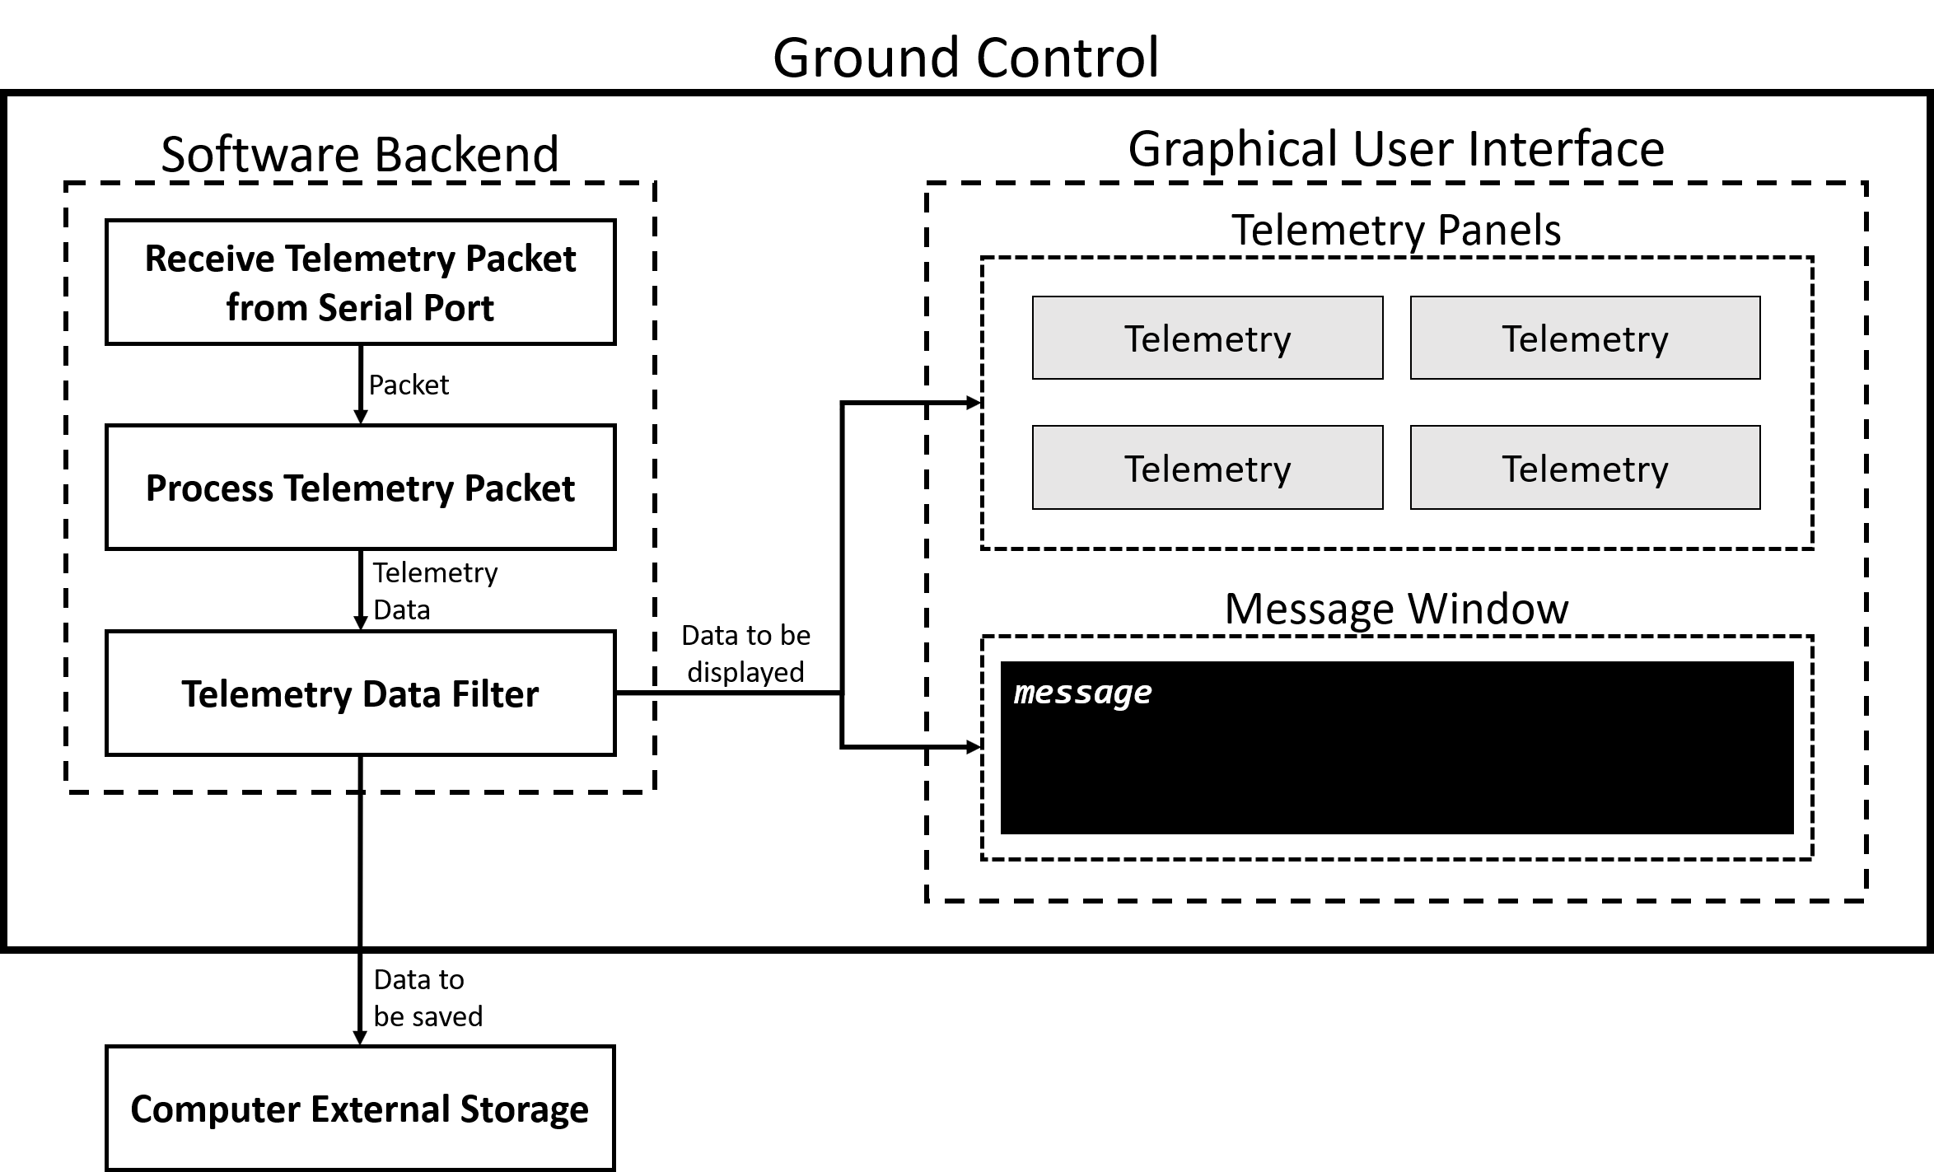
Ground Control: Telemetry FBD
Notes:
Ben
Switching gears, here is the software backend for telemetry. Telemetry packets are received from the downlink serial port, processed, and either displayed to the C&T user interface (i.e. housekeeping data) or saved to external storage (i.e. science data).
CLICK

Slide 26
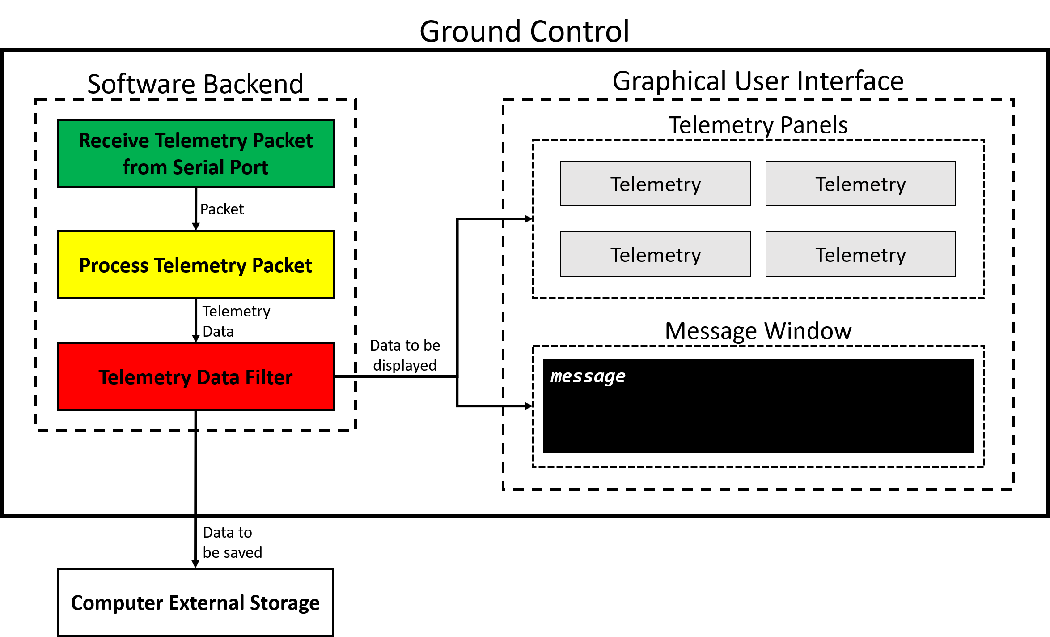
Ground Control: Telemetry Progress
Notes:
Ben

Slide 27
Flight Software Progress
Difficulty | Task | Hours | Progress | Completion Date | Time Remaining
3 | Process Telemetry Packet | 1 / 3 | Need to implement processing for grouped telemetry packets (i.e. images) | March 6 | 3.5 Weeks
2 | Telemetry Data Filter | 0 / 2 |  | March 6 | 3.5 Weeks
1 - Least Difficult 5 - Most Difficult
Notes:
Ben

Slide 28
Imaging
Notes:
Colin S

Slide 29
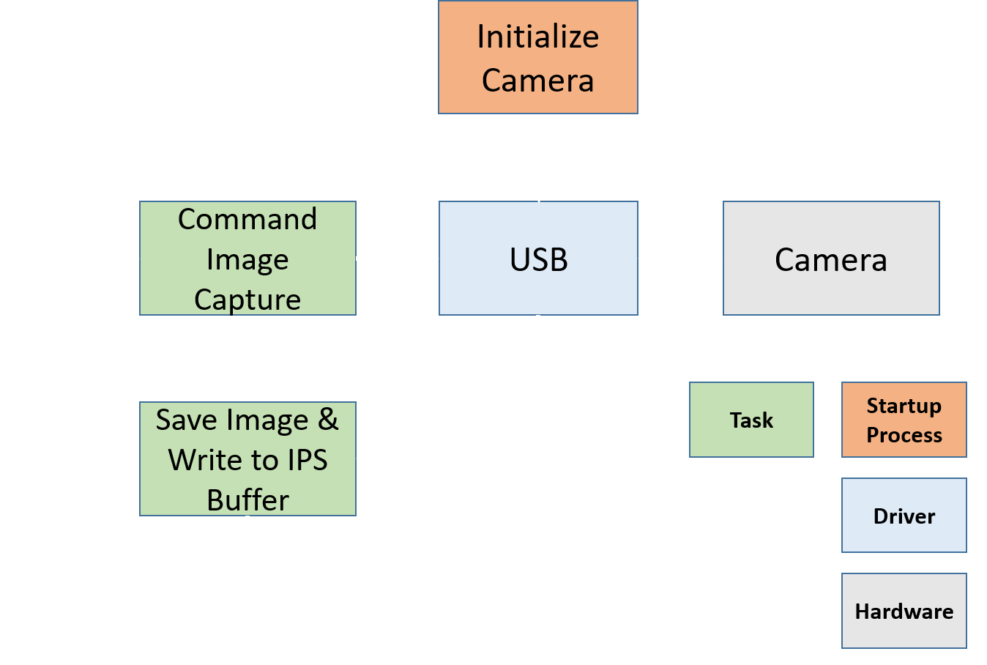
Imaging Software
Controls camera acquisition
Two primary tasks in FSW loop
One startup initialization process
Embedded C
Interfaces with IPS and CDH software for data flow
Notes:
Colin S

Slide 30
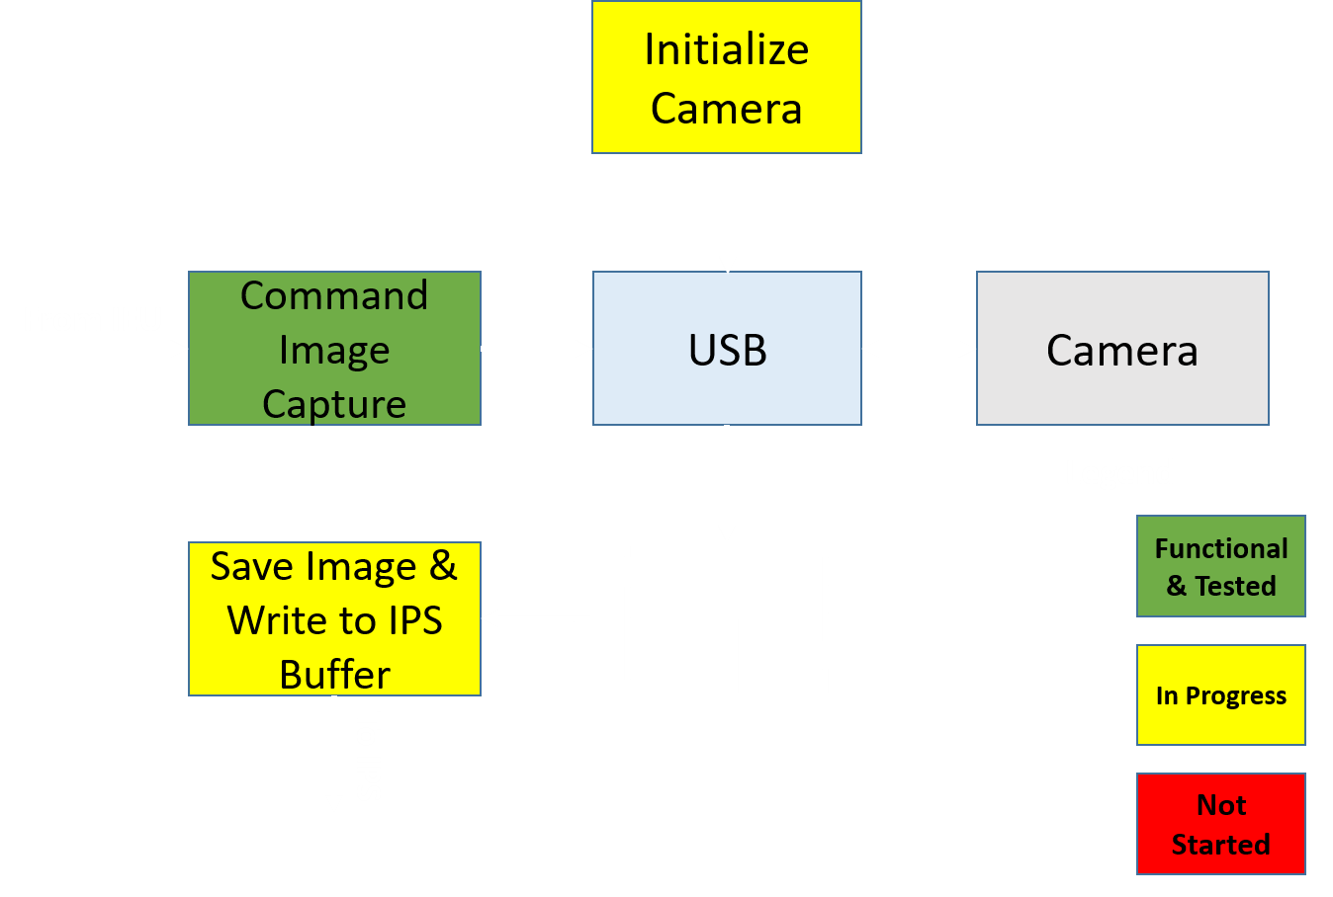
Imaging Software Progress
Controls camera acquisition
Two primary tasks in FSW loop
One startup initialization process
Embedded C
Interfaces with IPS and CDH software for data flow
Notes:
Colin S

Slide 31
Imaging Software: Progress
Difficulty | Task | Hours | Progress | Completion Date | Time Remaining
4 | Command Image Capture | 20/20 | Needs Integration onto IEU, debugging and tweaking | Feb 5th | < 1 Week
2 | Initialize Camera | 10/20 | Working with pre-written FLIR camera firmware | Feb 5th | < 1 Week
3 | Save Image and Write to Buffer | 5/10 | Need to test and integrate with hardware | Feb 12th | 1.5 Weeks
1 - Least Difficult 5 - Most Difficult
Notes:
Colin S

Slide 32
Imaging Processing Software
Notes:
Kian

Slide 33
Image Processing Software
All On-Board Code will be written in Python and C
Post-Processing will be executed on simulated ground station
Pre-Processing
Aurora Detection & Downlink
Image Cropping
Model Implementation
Model Loading
Image Loading
Compression
Data Saving
I/O to Flight Software
Data Pipe
Legend
Post-Processing
Task
I/O to Ground
Auroral Extent
Image Geolocation
Startup Process
Notes:
Kian
“First version of on-board software shall be complete by MSR”

Slide 34
Image Processing Software Progress
All On-Board Code will be written in Python and C
Post-Processing will be executed on simulated ground station
Pre-Processing
Aurora Detection & Downlink
Image Cropping
Model Implementation
Model Loading
Image Loading
Compression
Data Saving
I/O to Flight Software
Data Pipe
Legend
Post-Processing
Functional & Tested
I/O to Ground
Auroral Extent
Image Geolocation
In Progress
Not Started
Notes:
Kian
“First version of on-board software shall be complete by MSR”

Slide 35
Image Processing Software Progress
Difficulty | Task | Hours | Progress | Completion Date | Time Remaining
3 | Aurora Detection | 15/30 | The model is ready for implementation. Needs additional testing. | Feb 5th | N/A
4 | Loading and Cropping | 20/25 | Cropping function complete in MATLAB. Image Loading in progress | Feb 5th | 1 week
4 | Post- Processing | 10/30 | Compression algorithm chosen Auroral extent method in progress | Mar 6th | 5 weeks
1 - Low Difficult 5 - High Difficulty
Notes:
Kian
Model Loading
Preprocessing
Postprocessing

Slide 36
Manufacturing:
Mechanical
Project Overview
Schedule
Manufacturing: Software
Manufacturing: Mechanical
Manufacturing: Electrical
Budget & Safety
Notes:
Matt

Slide 37
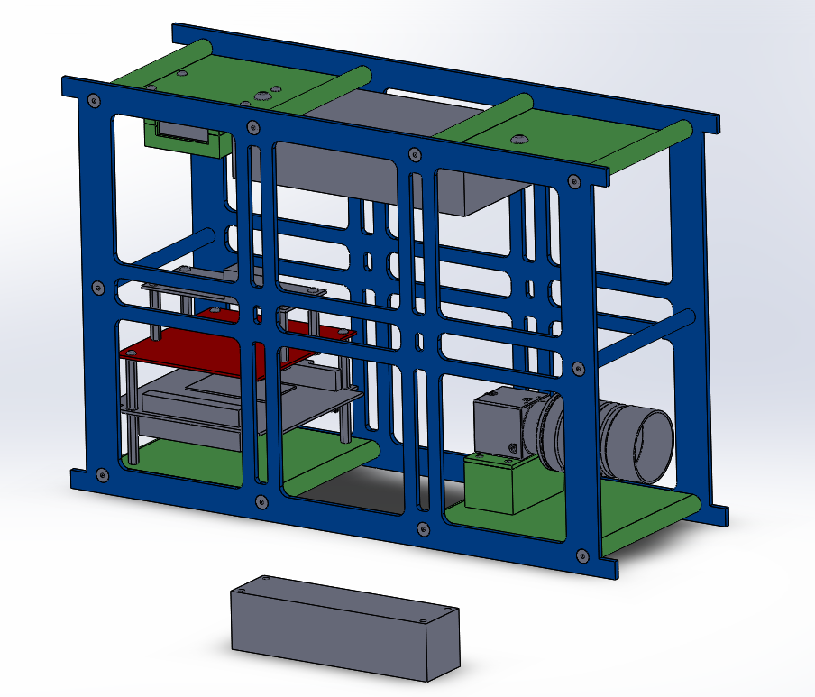
Manufacturing CubeSat Structure
Materials include Aluminum and PLA Plastic
Total of 13 parts being manufactured
8 of the parts are being 3D printed on Makerbot
4 of the parts are being manufactured in the Aero Machine Shop
1 of the parts will be made in the ITLL PCB lab
Notes:
Matt
Need to explain what is being manufactured vs. being purchased (items in grey)
-here is our cubesat design with all of the parts we plan to manufacture highlighted in yellow
-the materials for the spacecraft bus include aluminum and pla plastic where 8 parts are being 3D printed
-4 parts are being manufactured in the machine show, and 1 of the parts will be made in the ITLL PCB lab
-therefore we have a total of 13 parts which we are manufacturing

Slide 38
Manufacturing Progress
Difficulty | Task | Hours | Progress | Completion Date | Time Remaining
3 | 3D Printing | 35/50 | First Iterations of every 3D printed part are complete | Feb 22nd | 3 Weeks
5 | CNC Milling | 10/15 | CAD Model Complete. Need to finish the Shop tutorials | Feb 22nd | 3 Weeks
3 | System Integration | 30/35 | Everything is integrated fully in SolidWorks, need to verify as we manufacture | Mar 11th | 5 Weeks
1 - Least Difficult 5 - Most Difficult
Notes:
Matt
As far as tasks we have started and plan to do in the near future we have 3 larger tasks to watch closely with manufacturing the bus,
We need to tap holes into almost all of our parts, including a few of the 3D printed parts. This is important because everything needs to be securely fashioned to the bus and propery tapping the holes decides this
We need to manufacture the side panels of the bus still, the material is aquired and we just need to finish the CNC milling training in order to manufacture these parts
Finally we need to complete the hardware integration which will be completed once the bus manufacturing is completed, however we will need to verify that the manufactured parts will fit properly with the hardware on other systems before

Slide 39
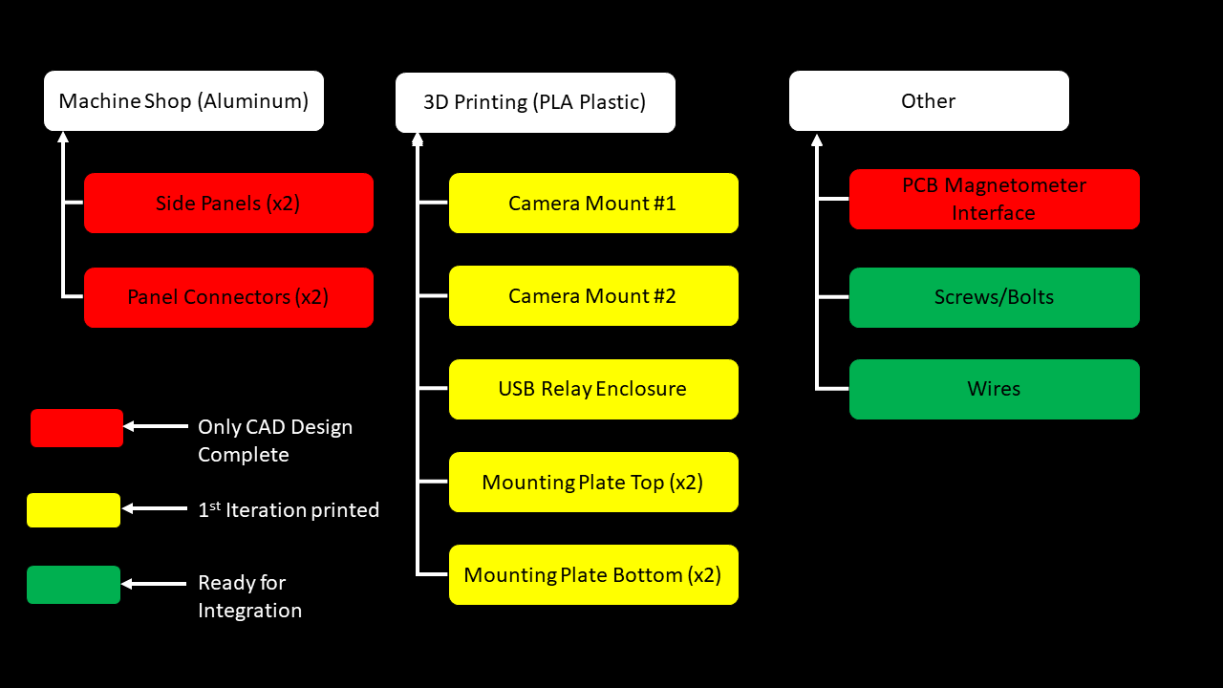
Manufacturing Work Breakdown Structure
Notes:
Matt
Here is the work breakdown structure for each of the parts we are manufacturing
We have not started manufacturing the aluminum parts in the machine shop since we are waiting until we have completed the final machine shop class so we can use the cnc mill
As of right now we have aquired all materials and have already begun working on printing out the plastic parts and we have begun manufacturing on the pcb board for our magnetometer which will be describing later

Slide 40
Manufacturing:
Electrical
Project Overview
Schedule
Manufacturing: Software
Manufacturing: Mechanical
Manufacturing: Electrical
Budget & Safety
Notes:
Kian

Slide 41
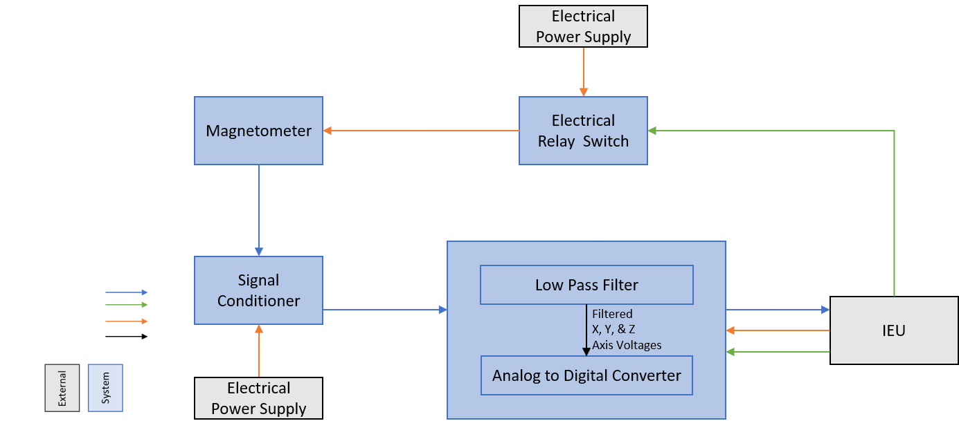
Magnetometer FBD
Procured
Manufactured
Notes:
Kian

Slide 42
Signal Conditioning Circuit - Diagram
Notes:
Kian

Slide 43
Signal Conditioning/PCB
Difficulty | Task | Hours | Progress | Completion Date | Time Remaining
1 | Construct Prototype Circuit | 5/5 | Complete | Jan 29th | N/A
3 | Test Circuit | 4/8 | Outputs correct test voltage from power supply. Need to integrate with magnetometer system | Feb 5th | <1 week
5 | Manufacture PCB | 0/10 | Learning to use foreign machinery to manufacture PCB will be challenging | Feb 22nd | 4 weeks
1 - Least Difficult 5 - Most Difficult
Notes:
Kian

Slide 44
Budget & Safety
Project Overview
Schedule
Manufacturing: Software
Manufacturing: Mechanical
Manufacturing: Electrical
Budget & Safety
Notes:
Matt

Slide 45
Procurement Overview
Subsystem | Purchased & Received | Purchased, Not Received
Imaging | Camera, Lens, USB Type A to Micro B cable
CDH | Single Board Computer, Crucial RAM, Solid State Drive, Cable Kit, Power Supply, USB cables, Female to Female Adapter, Ethernet Patch Cable
Magnetometer | Magnetometer, DAQ, USB cables, USB Control Switch, Instrumentation Amplifier
SC Bus | Aluminum Sheets, Aluminum Rod, 3D Printing Material, Bolts | Screws, Nuts
Not Yet Purchased: PCB Manufacturing & Administrative Items (Printing SFR/Poster etc…)
Notes:
Matt

Slide 46
Updated Cost Plan
Financial Summary
System | Expected Cost in Fall ($) | Actual Cost ($)
Imaging | 1,215 | 1,192.49
Command & Data Handling | 1,314 | 1,302.12
Magnetometer | 1,257.44 | 1,140.68
S/C Bus Materials | 285.75 | 222.16
Miscellaneous | 120 | 59.88
Total Cost | $4,192.19 | $3,917.33
Margins | $807.81 | $1082.67
Notes:
Matt
With $1000 left, Talk about s/c bus materials main uncertainty incase we need extra parts. As well as we still need some money for printing and stuff for end of semester.

Slide 47
Safety Plan
Main safety concerns deal with damaging hardware and electronics
Have enough funds to replace one subsystem’s major component, i.e. processing board for CDH or camera for imaging, magnetometer, etc.
Double check wire connections before connecting power as to not damage single board computer or other electronics
Maintain a safe testing environment by:
Clearing enough space so team members are not tripping over chords
Water and other liquids are cleared away so they don’t damage equipment
Following a procedural list
Notes:
Matt

Slide 48
Acknowledgements
Special thanks to:
Dr. Gerren
Matt Rhode
Dr. Jackson
Dr. Sternovsky
Dr. Marshall
Bobby Hodgkinson
Dr. Mah
Ian Cooke
Christine Reilly
Notes:
Matt

Slide 49
Thank You!
Questions?
Notes:
Matt

Slide 50
Backup Slides

Slide 51
Backup Slide Directory
Project Overview | Spacecraft B | Imaging System | Image Processing | Magnetometer | C&DH
 |  |  | What IPS Does IPS Critical IPS Other Neural Nets Convolutional Geolocation

Slide 52
Project Overview
Backup Slides

Slide 53
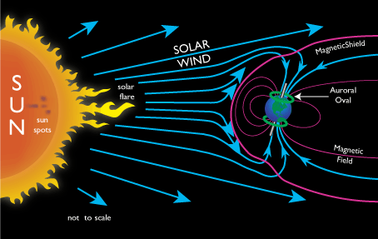
Project Motivation
The Aurora Borealis
is a result of space weather and is the visible part of a geomagnetic storm
is caused by the solar wind and high energized particles colliding with high altitude atmospheric atoms
affects radio, GPS reception and can cause power outages
is a tourist attraction
Visible light imaging of geomagnetic storms and collection of magnetometer data would
Validate current space weather prediction models
Drive auroral tourism
Notes:
Colin S
The motivation behind the project is the aurora borealis which is a result of space weather and is the visible part of a geomagnetic storm. The aurora is caused by solar wind and high energized particles colliding with the Earth’s atmosphere and affects radio, GPS reception and can also cause power outages. The aurora is also a tourist attraction and is the number one reason people visit the National Oceanic and Atmospheric Website. Thus visible light imaging of these geomagnetic storms paired with corresponding magnetometer data would help to validate current space weather prediction models that help to assess the effects of these storms. The images would also help to drive auroral tourism as they would provide an almost real time update to the current intensity and location of auroras over the north pole.

Slide 54
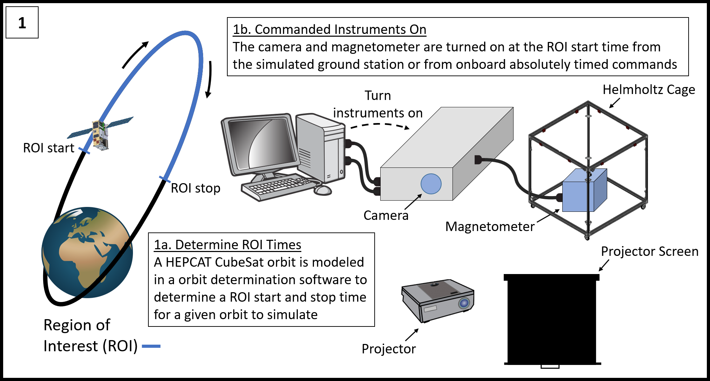
“Orbit in the Life” Simulation Part 1
Notes:
Colin S
-part 1 of orbit in life simulation
- determining the Region of Interest start and stop time
- commanding the intruments on at the ROI start time

Slide 55
“Orbit in the Life” Simulation Part 2
Notes:
Colin S
Part2
-will involve two separate procedures where we will capture auroral images and measure the magenetic field during the ROI start and stop times
-as well as downlink this information to the simulated groundstation

Slide 56
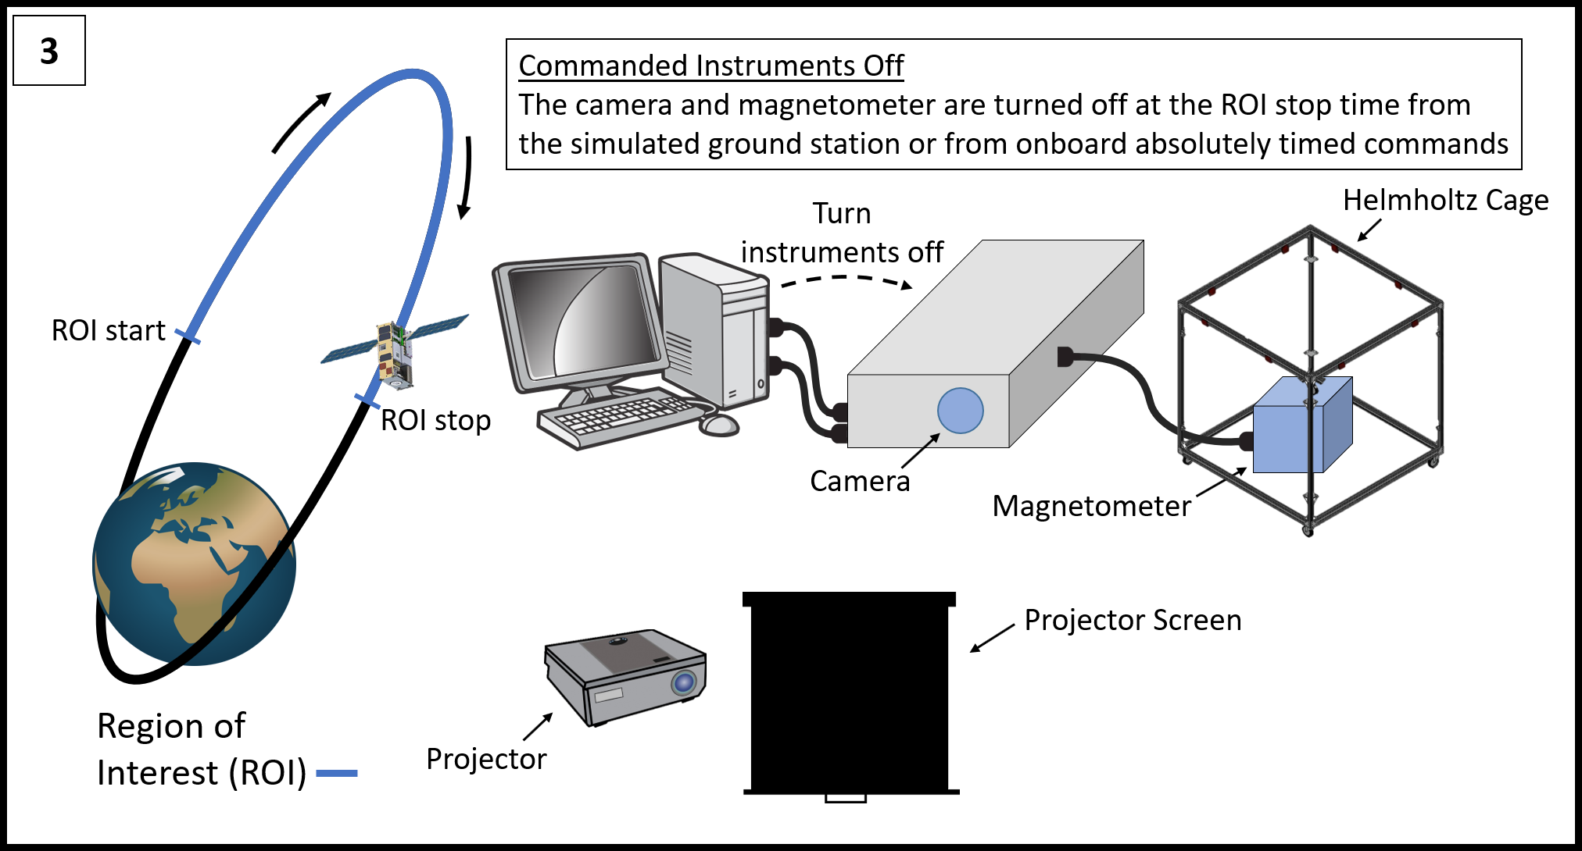
“Orbit in the Life” Simulation Part 3
Notes:
Colin S
Part3
-commanding instruments off using the simulated ground station

Slide 57
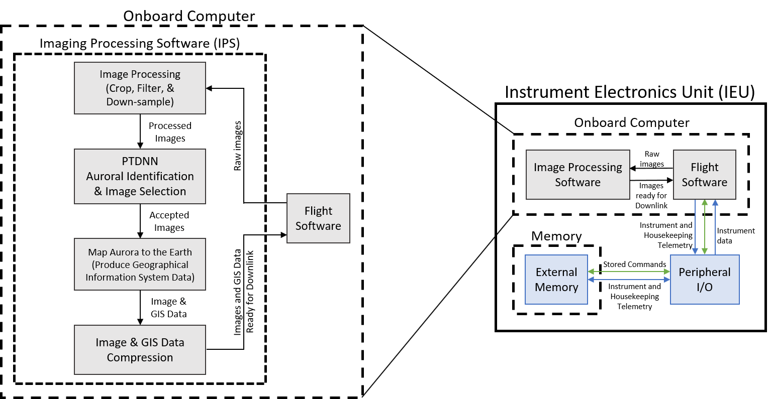
IPS Functional Block Diagram
Notes:
Chris
Expanding on that, you can see here the overall software flow for the image processing software. The flight software passes the raw images to the processing software where it is first cropped and down sampled. This is passed to the identification algorithm which determines if the image contains an aurora or not. Next the image is passed on to be mapped to the Earth’s surface, and is finally compressed and passed back to the flight software to be either downlinked or stored.

Slide 58
Magnetometer Back Up Slides
Notes:
Kian

Slide 59
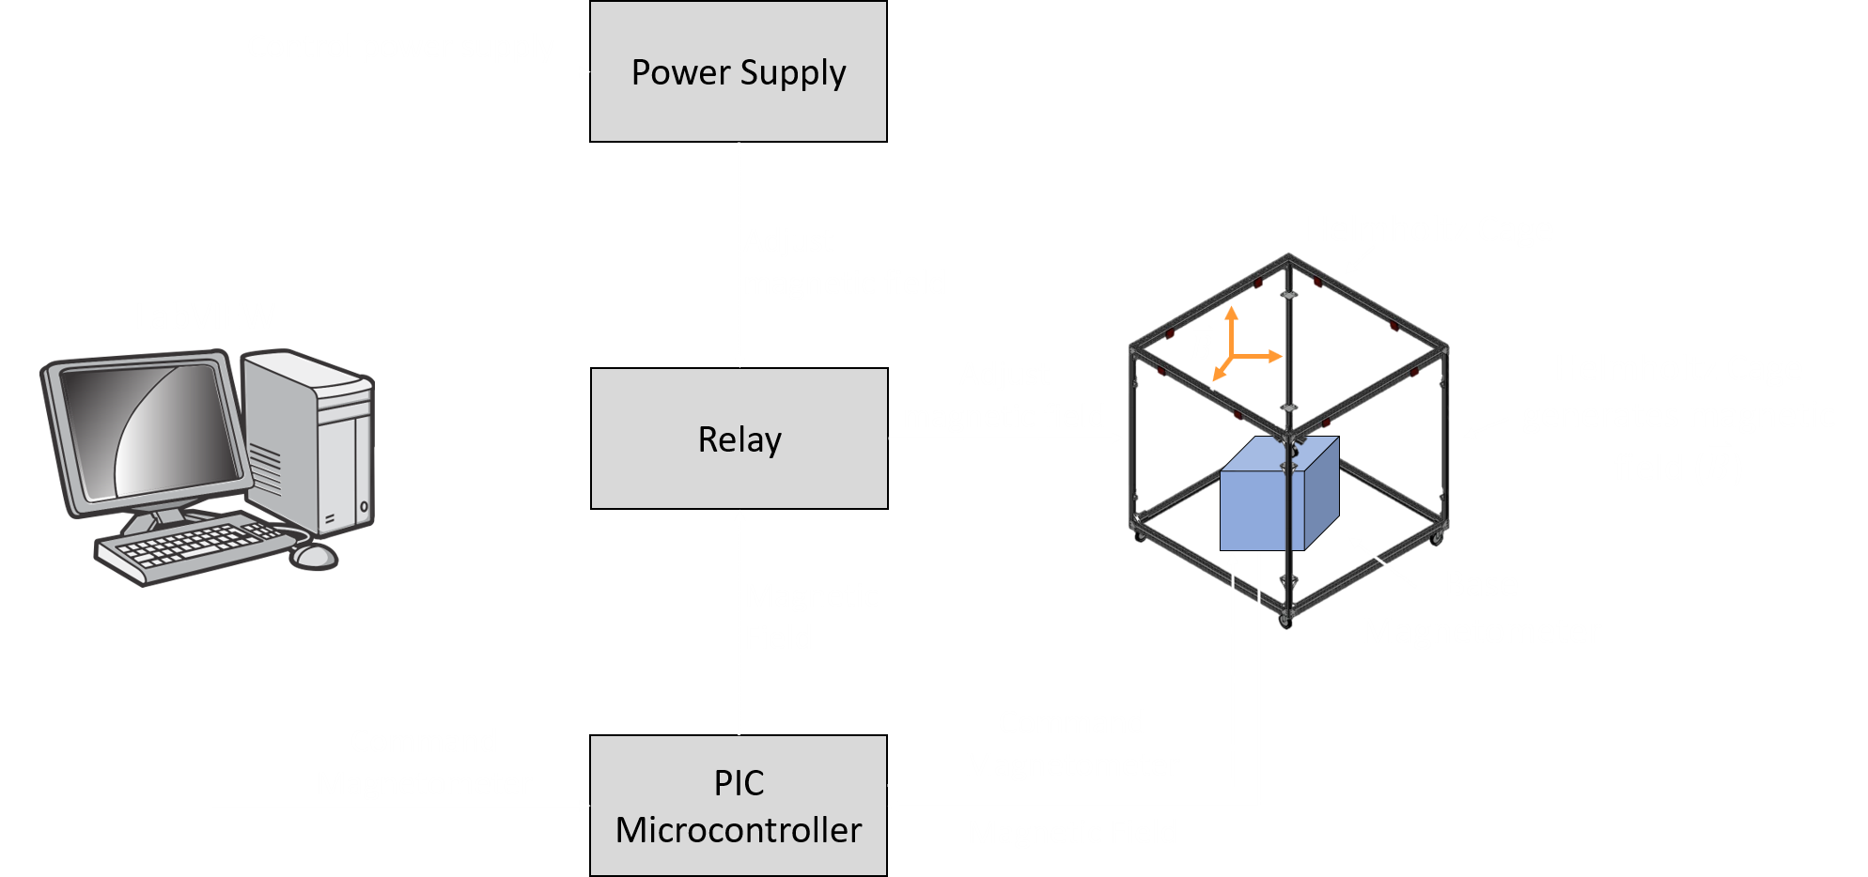
Magnetometer System Testing FBD
Notes:
Kian

Slide 60
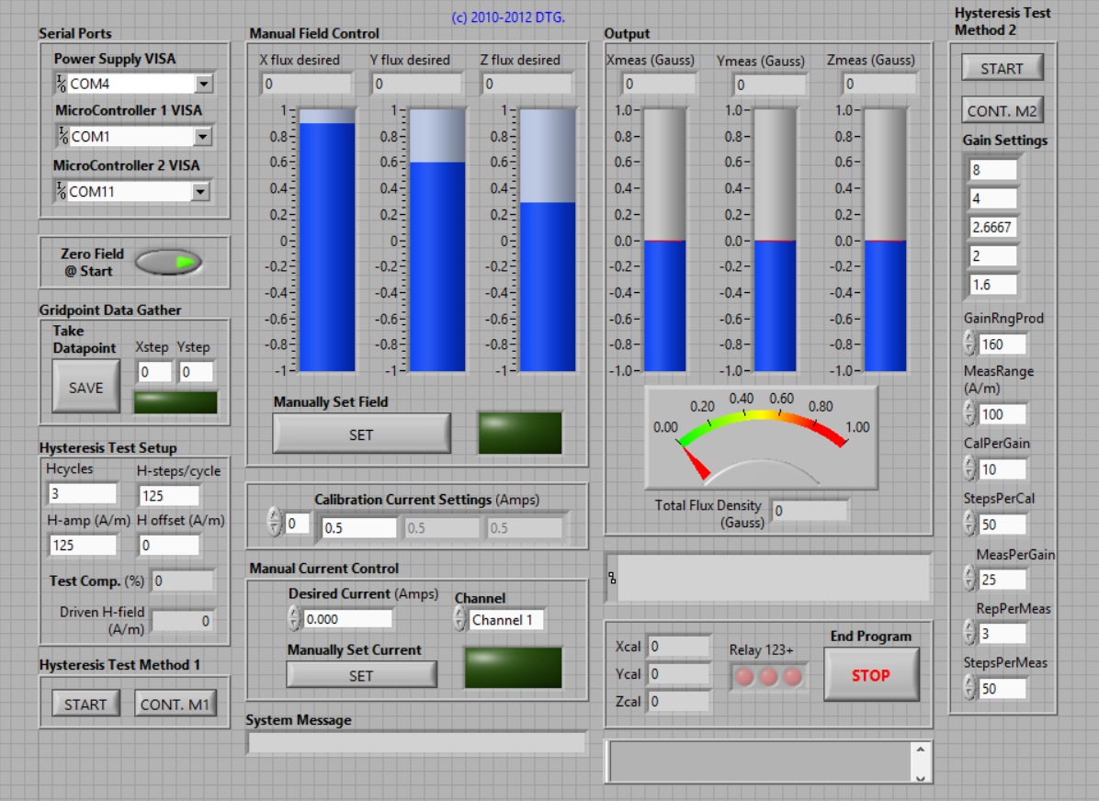
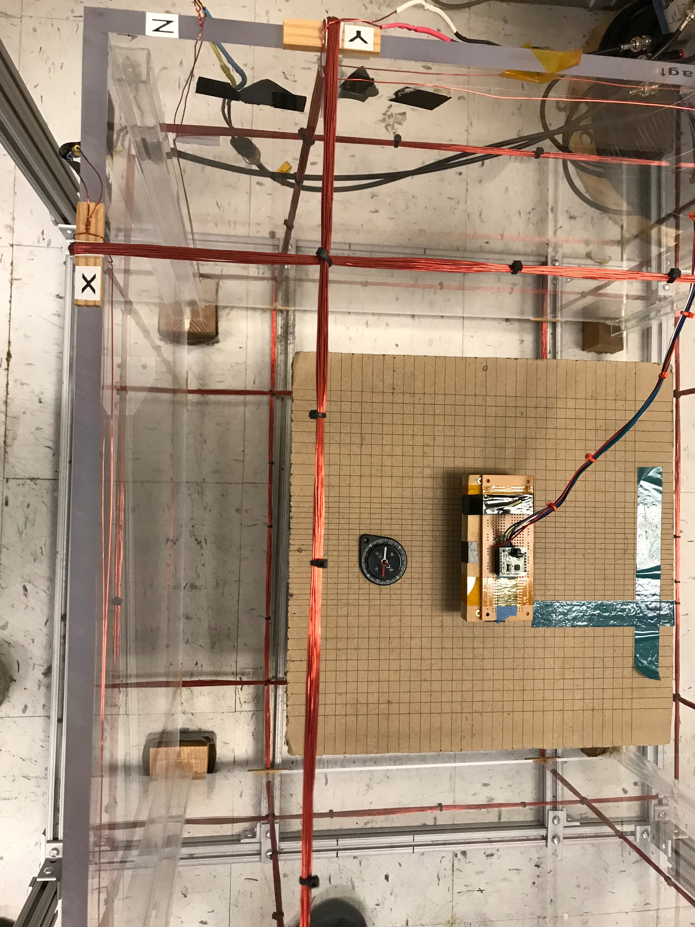
Commanding the Helmholtz Cage
+X
Notes:
Kian
XYZ values boxed

Slide 61
Magnetometer Software
Task | Status | Notes
Create Expected In-Orbit Magnetic Field Model | In Progress | Purpose: Ability to test magnetometer in conditions similar to orbit Current Status: First-order dipole model of Earth is complete Future Development: Verify current model and potentially create a higher fidelity model of magnetic fields in orbit
Input Model into LabVIEW for Helmholtz Cage | In Progress | Purpose: Test magnetometer in conditions similar to orbit Current Status: Capable of reading in text file Future Development: Integrate LabVIEW to command magnetic model values to Helmholtz Cage as a function of time
Notes:
Kian

Slide 62
Command & Data Handling
Backup Slides

Slide 63
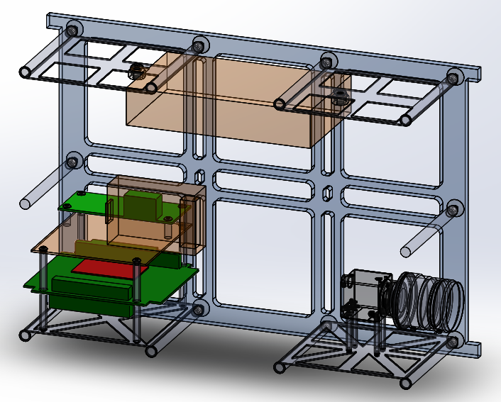
Instrument Electronics Unit (IEU)
Versalogic “Baycat” Single Board Computer
Runs flight software
Ubuntu Linux with realtime co-kernel
Functions:
Operates instruments
Runs image processing software
Communicates with the Simulated Ground Station
Specifications
1.4 GHz Intel Atom Processor
Dimensensions: 108mm x 96mm
Weight: 140 grams
Power: 5 watts

Slide 64
Instrument Electronics Unit (IEU)
Versalogic “Baycat” Single Board Computer
Specifications:
Intel Atom 1.4 Ghz Single Core Processor
Dimensions: 108 mm x 98 mm
Weight: 140 grams
Memory:
Main: 4 GB DDR3 SDRAM
External: 120 GB SSD
Interfaces:
m/SATA
4 USB 2.0 & 1 USB 3.0
RS-232/422/485 selectable serial port
Mini-PCIe expansion slot
Operating System:
Linux with a real-time co-kernel

Slide 65
IEU Operating System
Flight software runs on a real-time operating system (RTOS)
RTOS serves real-time applications as it ensures deterministic results
IEU operating system:
Ubuntu 16.04 Linux with Xenomai 3.0.5 “Cobalt” and Linux 4.9.38 co-kernel configuration
Cobalt kernel supplements Ubuntu kernel to ensure deterministic results

Slide 66
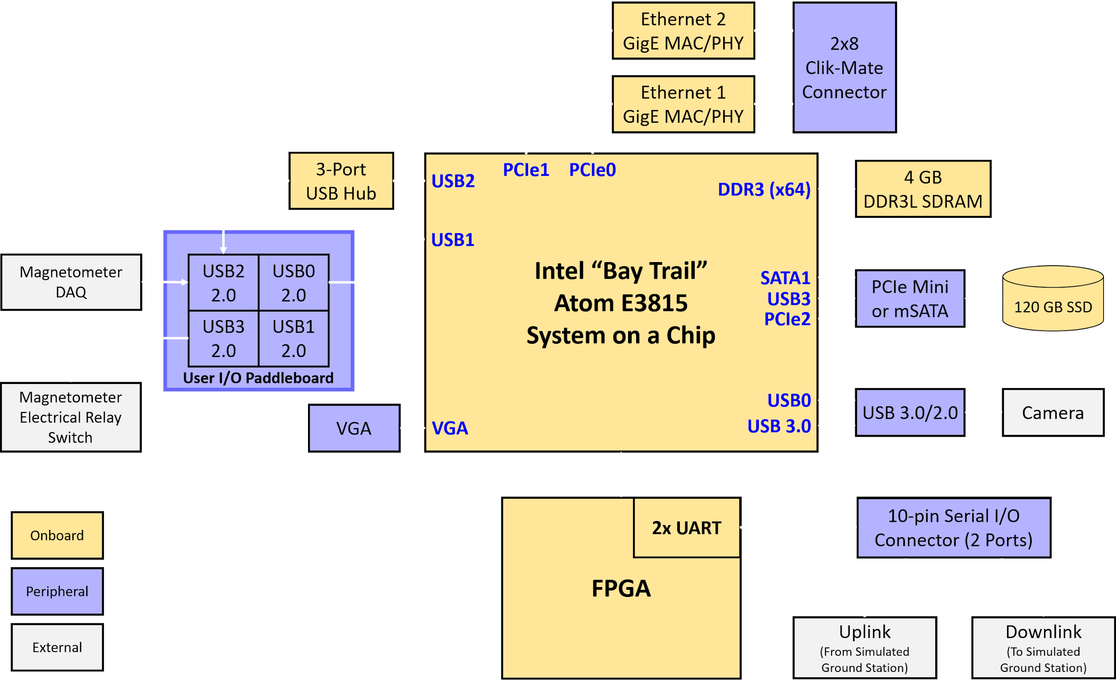
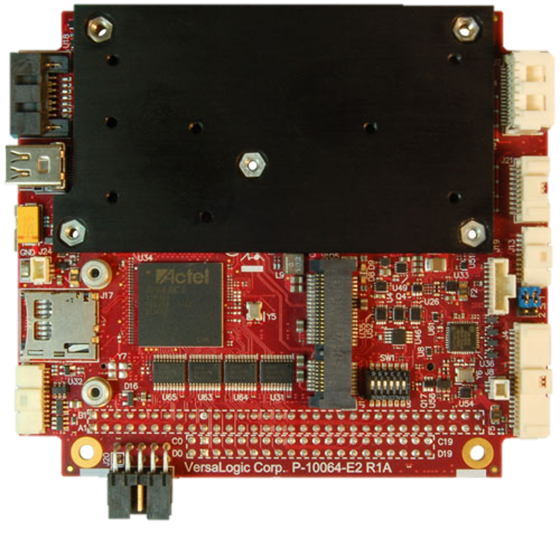
Instrument Electronics Unit FBD
Versalogic “Baycat”
Single Board Computer

Slide 67
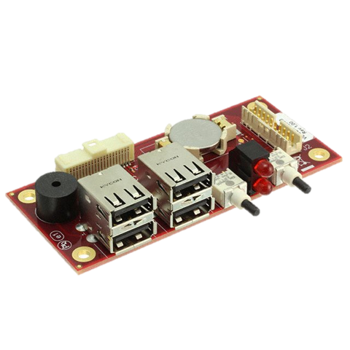
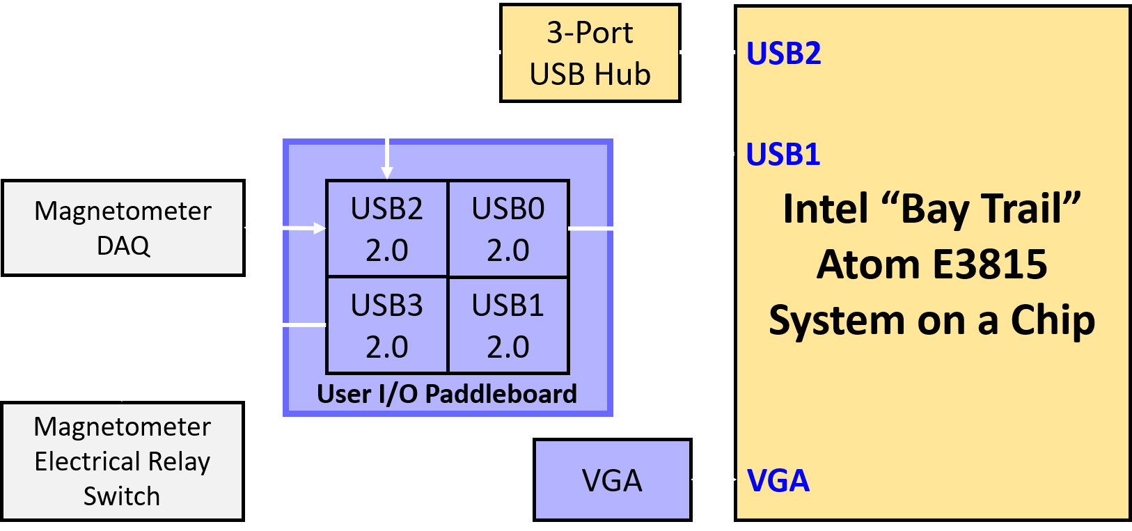
IEU User I/O Paddleboard
The four USB 2.0 ports are incorporated into the J4 user I/O connector, with standard USB Type A connectors located on the VL-CBR-4005B paddleboard.
User I/O Paddleboard

Slide 68
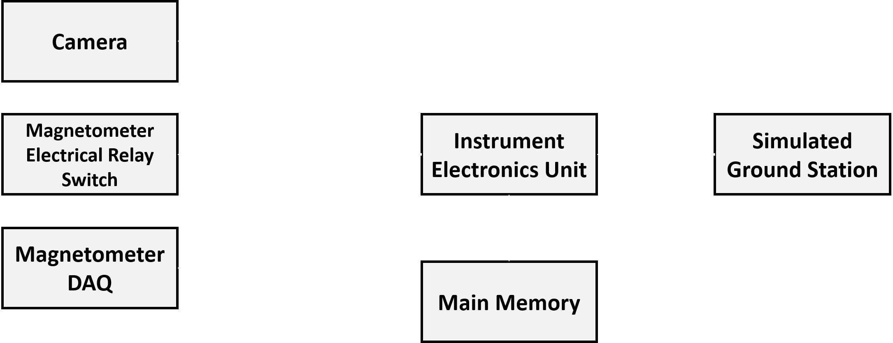
Command Distribution

Slide 69
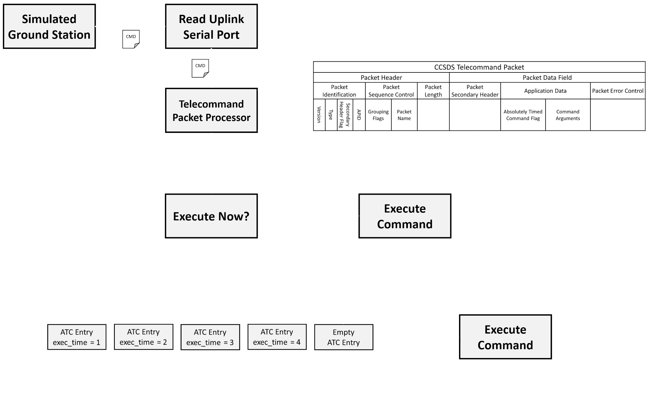
Command Distribution FBD

Slide 70
Absolutely Time Commands
Absolutely timed commands are commands stored onboard the IEU (in primary memory) that have a execution time set in the future
Absolutely timed commands are sent from the SGS to the IEU
Their execution time is specified in the telecommand packet secondary header.
The ATC flag is set to “1” or “0” (true or false)
Absolutely timed commands are placed in the command scheduler
The command scheduler is a task responsible for executing absolutely timed commands
Commands are placed in the command scheduler if the telecommand packet execution ATC flag is “1”

Slide 71
Command Scheduler
The command scheduler
16 MB statically allocated fixed size array that houses up to 1000 absolutely timed command (ATC) entries
The command entries are data structures that include execution time and command data
A software timer counts down between the next ATC entry exec_time and computer system time
When the timer expires, the command is executed and the timer is set again with the next ATC entry

Slide 72
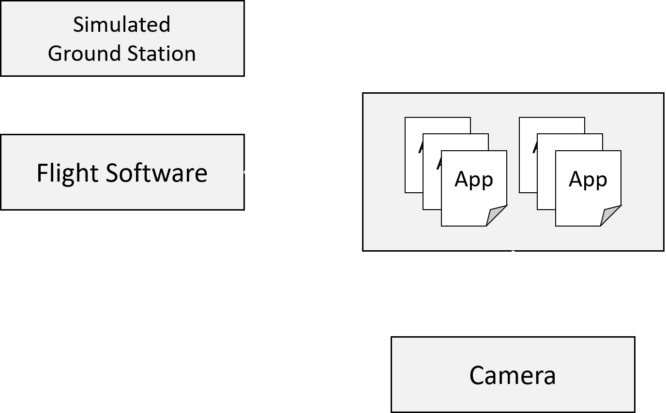
Instrument Commanding: Camera
Ground commands are required to operate all aspects of the camera
Turn the camera on or off
Set capture rate
Manage camera settings (i.e exposure, brightness, and gain)
Get housekeeping data
FLIR’s Spinnaker API will be used to create custom applications that operate the camera
Camera commands from the ground execute these applications
Notes:
Chris

Slide 73
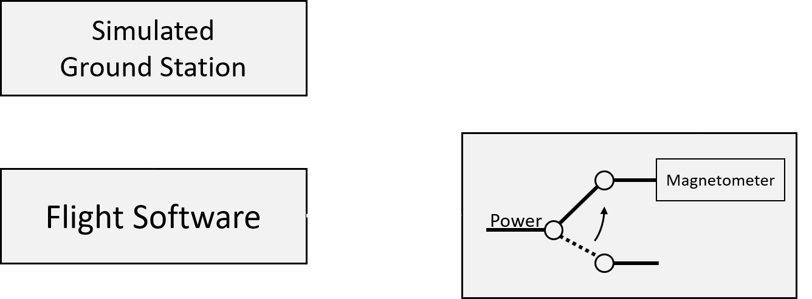
Instrument Commanding: Magnetometer
Ground commands are required to turn the magnetometer and signal conditioner on and off
Limited functionality as no software is provided by the manufacturer
USB electrical relay switch to power the magnetometer system on and off
A ASCII command is sent serially to switch the relay on and off
Notes:
Chris

Slide 74
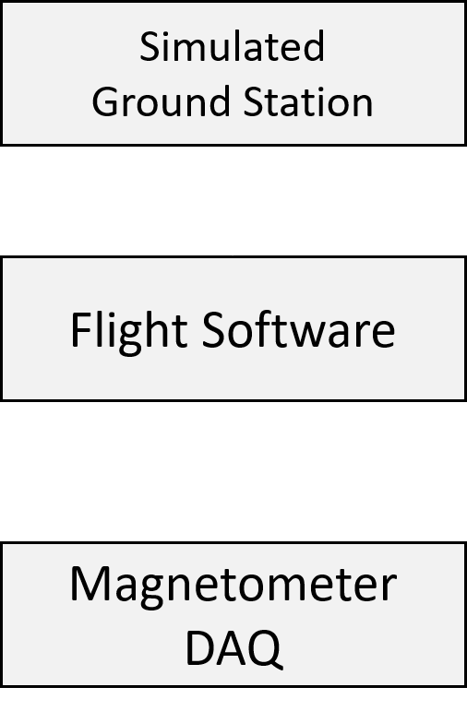
Instrument Commanding: Magnetometer DAQ
Ground commands are required to operate all aspects of the Magnetometer DAQ
Define scanning mode
Start and stop scanning (turn data collection on/off)
Manage data packet size
Change acquisition modes
Controlling the DAQ with DATAQ Instruments protocol-level programming will accomplish this
An ASCII command is sent serially to command the DAQ
libsub-1.0 API
Notes:
Chris

Slide 75
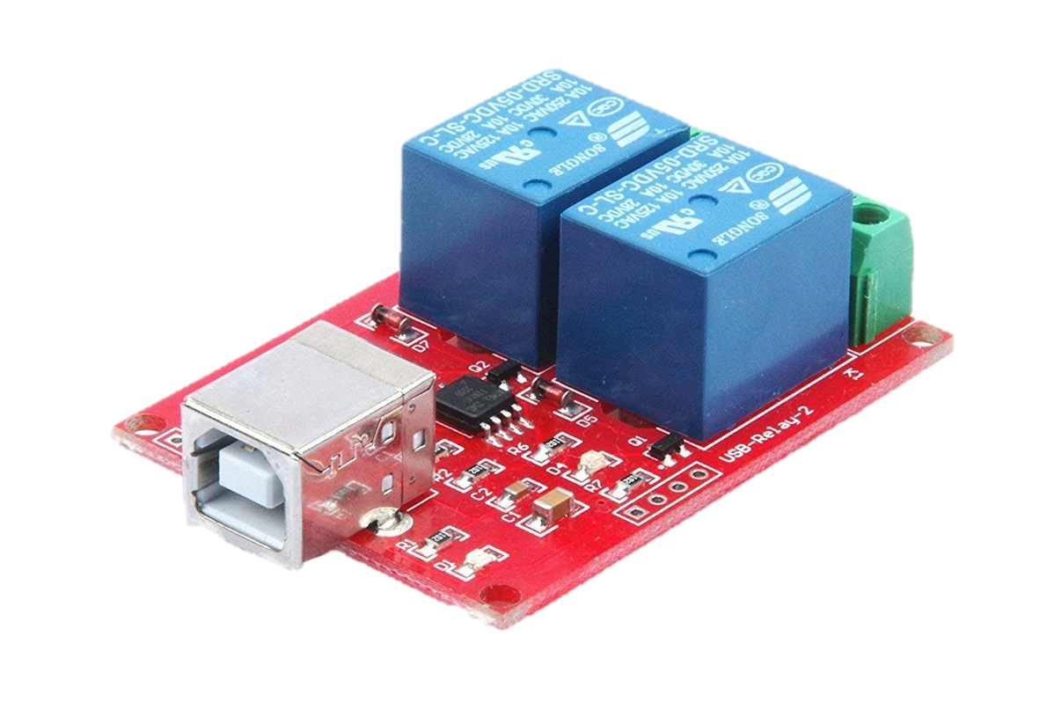
USB Electrical Relay Switch
KNACRO 2-Way 5V Relay Module Free Driver USB Control Switch PC Intelligent Control
USB interface
HID technology without any drivers
Use HDIAPI to send a 9 byte command to toggle the two relays on/off
Turns the magnetometer on/off
2-Way Relay Module

Slide 76
Ground Control: Command Definition
Command definition for Ground Control:
cmd hepcats mnemonic with parameter hold time
cmd
Macro indicating this is a command
hepcats
External element to specify destination of command
mnemonic
Command mnemonic (human readable) that associated with an APID and Packet Name
with
Flag that a command parameter follows
parameter
Command parameter mnemonic (human readable) that is associated with Application Data for a given APID and Packet Name
hold
Flag that a command execution time follows
time
Command execution time in CCS Time Code Format

Slide 77
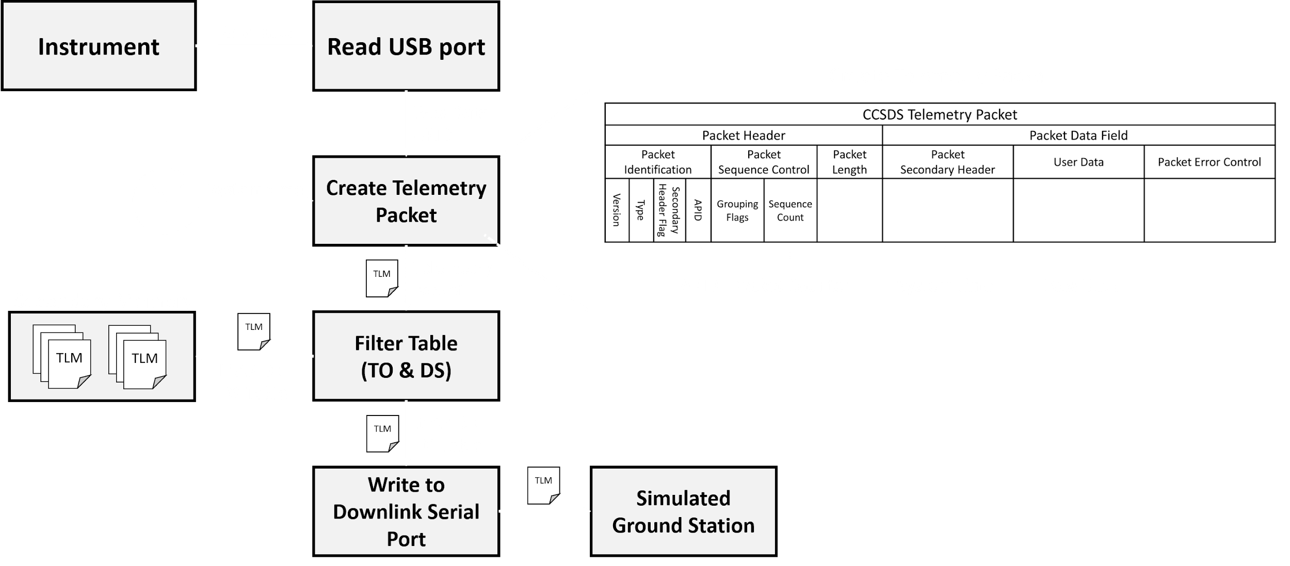
Telemetry Acquisition FBD

Slide 78
Telemetry Filter Table
Filter table controls what telemetry is recorded to secondary memory and what is downlinked real-time to the Simulated Ground Station
Two filter tables:
DS (Data Storage Filter Tables)
Controls which telemetry is recorded to memory
TO (Telemetry Output Tables)
Controls which telemetry is downlinked real-time
TO & DS are tables of APIDs
APID of telemetry packet it checked against TO & DS tables
If APID is an element of the TO or DS table, then it sent to the appropriate destination

Slide 79
Telemetry Filter Table Examples
Filter Table |  | Description
1 | Normal | Basic housekeeping telemetry, magnetometer telemetry, and camera telemetry
2 | Dump | Basic housekeeping telemetry and all memory dump
3 | Housekeeping | All housekeeping telemetry. No science telemetry
4 | Magnetometer | Basic housekeeping telemetry and magnetometer telemetry
5 | Camera | Basic housekeeping telemetry and camera telemetry

Slide 80
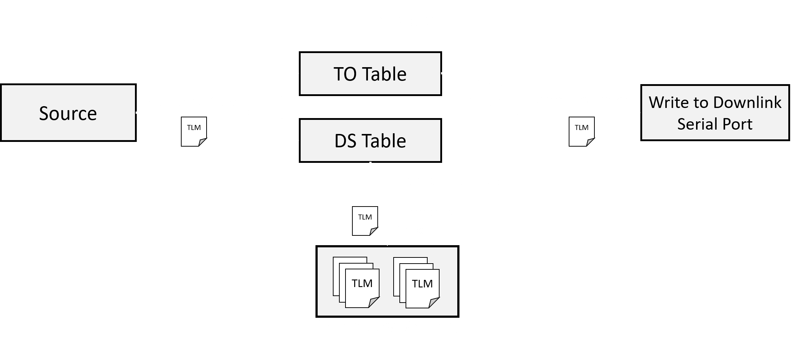
Telemetry Filter Table FBD

Slide 81
Data Storage Required for One Orbit
If all telemetry generated is recorded to secondary memory over the course of one orbit, then the data storage required would be 1.804 GB
Data Type | Size | Frequency | Time | Total amount
Magnetic Field Data | 1440 bytes | 1 Hz | Entire Orbit | 62.208 MB
Image Data | 3.6 x 10⁶ bytes | 1/60 Hz | ROI | 1.512 GB
Housekeeping Data | 1064 bytes | 1, 3, or 5 Hz | Entire Orbit | 229.824 MB
 |  |  | Final Total | 1.804 GB

Slide 82
Telemetry Playback Timings for
One Orbit’s Worth of Data
Divide amount of data by 1064 and round up (you cannot send a partial packet)
For one telemetry packet, 1064 bytes available for user data
Multiply number of packets by 1080 bytes (total packet size) and divide by 1 Mbps to get playback time in seconds
Data | Amount of Data | Number of Packets | Time to Playback
Magnetic Field Data | 62.208 MB | 58467 | 8.419 minutes
Image Data | 1.512 GB | 1421053 | 3.41 hours
Housekeeping Data | 229.824 MB | 216000 | 31.104 minutes

Slide 83
Housekeeping Telemetry
Housekeeping telemetry will be minimal as there are no temperature, pressure, voltage, current, and any other type of sensor data produced
Housekeeping telemetry will be limited to
Command counts
Camera diagnostics
Magnetometer DAQ diagnostics
Flight software states/settings
IEU diagnostics
In total, the amount of data would amount to one telemetry packet (1064 bytes)
The frequency in which housekeeping telemetry would fall at 1 Hz, 3 Hz, or 5 Hz depending on the telemetry point
For data storage estimation, use 1064 bytes at 5 Hz for worst case scenario

Slide 84
Telemetry Downlink Times
Data | Size | Number of Packets | Downlink Time
Image (worst case) | 3.6 x 10⁶ bytes | 3384 | 29.238 s
Magnetometer | 1044 bytes | 2 | 17.280 ms
Housekeeping | 1064 bytes | 1 | 8.640 ms

Slide 85
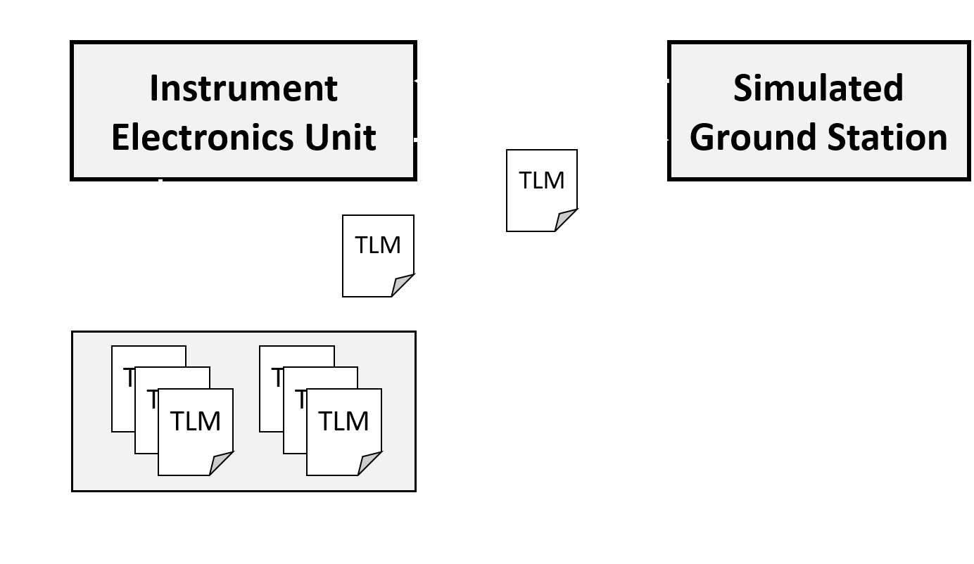
Stored Telemetry Playback
A ground command is issued to playback stored telemetry
Stored telemetry packets are
1. Pulled from secondary memory
2. Sent to the simulated ground station on the real-time stream
Command can specify type of stored telemetry
Notes:
Chris

Slide 86
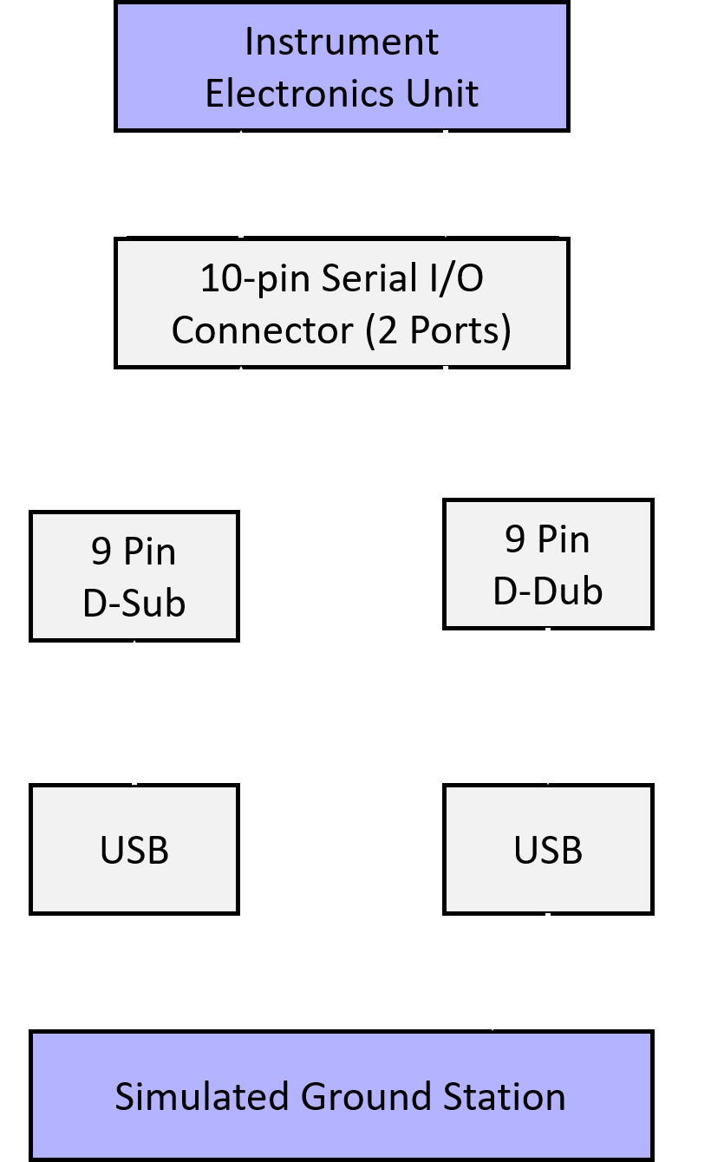
SGS and IEU Interface
Hardware
Instrument Electronics Unit
10-pin serial I/O connector (2 ports) to dual 9 pin d-sub connector for uplink and downlink
Simulated Ground Station
Personal computer has multiple USB ports for uplink and downlink
Interface
USB to RS-422 Adapter
Bridges SGS USB port and IEU 9-pin d-sub ports for uplink and downlink
USB to RS-422 adapter provides an extra serial comm port via USB connection

Slide 87
CCSDS
Consultative Committee for Space Data Systems (CCSDS)
Blue book to standardize space-related data and communications systems.
Currently composed of eleven member agencies, twenty-eight observer agencies, and over 140 industrial associates to define and maintain standards.
Over 900 space missions have utilized data and systems standards created by CCSDS
Project HEPCATS will adopt CCSDS recommendations to define our data systems
Focus of packet definition

Slide 88
Telecommand Packet Definition
Telecommand packet definition adhering to CCSDS recommendations
(Size in bits)

Slide 89
Telemetry Packet Definition
Telemetry packet definition adhering to CCSDS recommendations
(Size in bits)

Slide 90
CCSDS Packet Term Definitions
Packet Header
Packed Identification
Version
Indicates what variation of the packet structure is being used (if any)
Set to ‘000’
Type
Indicates whether the packet is a telecommand or telemetry packet
Set to ‘0’ for telemetry packet
Set to ‘1’ for telecommand packet
Secondary Header Flag
Indicates whether a telecommand or telemetry secondary header is included in the Packet Data Field
Set to ‘0’ if secondary header is not present
Set to ‘1’ if secondary header is present

Slide 91
CCSDS Packet Term Definitions
Packet Header
Packed Identification
Application Identification (APID)
Holds a unique value which corresponds to an onboard process or subsystem (this is the origin or final destination of the packet)
Mission specific
Packet Sequence Control
Grouping Flags
Indicates whether a packet belongs in a series of packets
Set to ‘00’ if the packet contains a continuation segment of User Data
Set to ‘01’ if the packet contains the first segment of User Data
Set to ‘10’ if the packet contains the last segment of User Data
Set to ‘11’ if the packet contains unsegmented User Data

Slide 92
CCSDS Packet Term Definitions
Packet Header
Packet Sequence Control
Sequence Count or Packet Name
Indicates the packet number or indicates a specific telecommand with reference to the APID
Sequence count
Continuously incrementing 14 bit sequence counter
Packet Name:
Mission specific
Packet Length
Indicates the length “C” of the packet data field in octets
C = Size of Packet Data Field [octets] - 1

Slide 93
CCSDS Packet Term Definitions
Packet Data Field
Packet Secondary Header
Contains the timecode of the packet in CCSDS Unsegmented Time Code (CUC) format
8 bit Protocol Field and 56 bit Time Field
User Data or Application Data
Contains application data (telecommand) of the packet or user data (source telemetry data)
Application data:
Absolutely timed command flag
Set to ‘0’ to indicate telecommand is to be executed now
Set to ‘1’ to indicate telecommand is absolutely timed
Arguments
Contains command argument

Slide 94
CCSDS Packet Term Definitions
Packet Data Field
User Data or Application Data
Contains the user data (source telemetry data) or application data (telecommand) of the packet
User data
Flexible structure and formatted specifically for the source data
Packet Error Control
Indicates an error detection code with the packet in order to verify its integrity upon arriving at its destination

Slide 95
CCSDS Unsegmented Time Code
CCSDS Unsegmented Time Code Format: Seconds since 1970/001-00:00:00 UTC (Unix time)
Composed of a 8 bit Protocol (P) Field and 56 bit Time (T) Field
P-Field:
P-Field extension
Set to ‘0’ for no extension
Timecode Identification
Set to ‘010’ for Agency-defined epoch
Unix time
P-Field:
Number of octets of the basic time unit minus one
Set to 3
Number of octets of the fractional time unit
Set to 2
(Size in bits)

Slide 96
Command Transfer Frame
Command transfer frame
Consists of 32 bit command identification, 56 bit execution time, and 32 bit arguments field
A>><<<
Transfers command from telecommand packet processor task to command executor task
Only generated and sent if valid telecommand packet is received and processed correctly
Does not check for valid command
(Size in bits)

Slide 97
FSW: Command Distribution Progress
Task | Status | Notes
Receive Telecommand Packet | Written | Current Status: Written and integrated with FSW Future Development: Testing with simulated ground station and commanding
Process Telecommand Packet | Written | Current Status: Written and integrated with FSW Future Development: Testing with simulated ground station and commanding
Execute Command | Written | Current Status: Written and integrated with FSW Future Development: Testing with simulated ground station and commanding
Notes:
Ben
The future development for the completed tasks--receive, process, and real-time execution--consists of only testing. CLICK

Slide 98
FSW: Telemetry Acquisition Progress
Task | Status | Notes
Transmit Telemetry Packet | Written | Current Status: Written and integrated with FSW Future Development: Testing with hardware and simulated ground station
Create File | Written | Current Status: Written and integrated with FSW Future Development: Testing with hardware and simulated ground station
Create Telemetry Packet | Written | Current Status: Written and integrated with FSW Future Development: Testing with hardware and simulated ground station
Notes:
Ben
Nor the transmite telemetry packet, create file, and retrieve file are started. The tasks will be started and at the progress level of fake data by the start of hardware integration starting next week.

Slide 99
FSW: Telemetry Acquisition Progress
Task | Status | Notes
Retrieve File | Written | Current Status: Written and integrated with FSW Future Development: Testing with hardware and simulated ground station
Filter Table | Written | Current Status: Written and integrated with FSW Future Development: Testing with hardware and simulated ground station
Notes:
Ben

Slide 100
Ground Control: Command Progress
Task | Status | Notes
Prompt Interpreter | Written | Current Status: Written and integrated into C&T software backend Future Development: Testing with IEU
Create CCSDS Telecommand Packet | Written | Current Status: Written and integrated into C&T software backend Future Development: Testing with IEU
Write Packet to Uplink Serial Port | Written | Current Status: Written and integrated into C&T software backend Future Development: Testing with IEU
Notes:
Ben
Here is the summary of completed tasks while (CLICK)

Slide 101
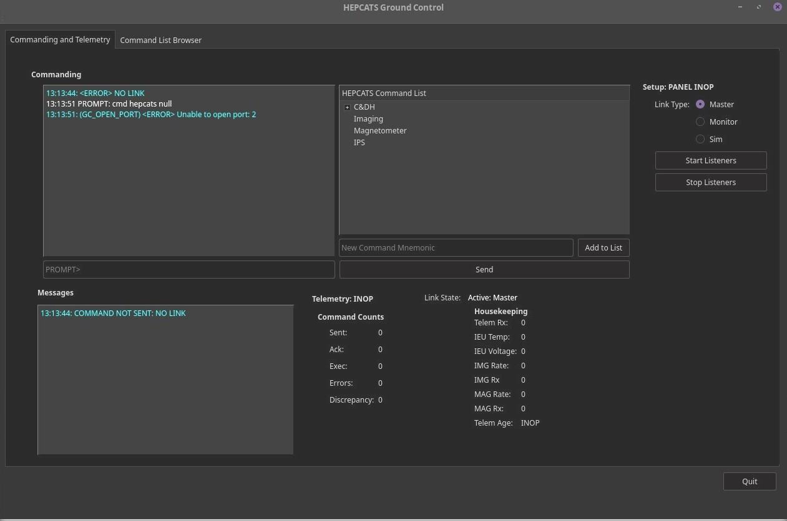
C&T GUI: Ground Control
Notes:
Ben
Here is the current status of the command & telemetry user interface. Here you can see the major functions--commanding and telemetry display--realized. Future development will be to implement final telemetry displays.

Slide 102
Image Processing Software
Backup Slides

Slide 103
What Image Processing Does
What We Do
Interpret raw image data format
Identify and crop the relevant part of the image
Determine if an auroral substorm is present
Compress images
How we do it
Convert raw format to arrays
Image segmentation detects Earth
Pre-Trained, Deep Neural Network
Compress images with zlib “DEFLATE” algorithm
1
2
3
4
Discard Images w/o Aurora
Notes:
Kian
Go through this really quickly. I don’t think you need to go over the “how,” but only the “what” verbally

Slide 104
Image Processing Software Critical Aspects
Task | Status | Notes
Image Cropping | In Progress 10/15 Hours | Current Status: Raw images can be cropped to specified dimensions centered on Earth. MATLAB routines are completed. Future Development: Needs to be converted to C Challenges: Need to ensure safe transfer of data between modules
Auroral Extent | In Progress 10/20 Hours | Current Status: Chosen algorithm is in code development Future Development: Integrate algorithm with ground station software Challenges: ... Kian
Image Geolocation | Not Started 0/## Hours | Current Status: Research of algorithm developed by NASA in progress Future Development: … Kian/Jordan Challenges: … Kian
Notes:
Kian
Model Loading
Preprocessing
Postprocessing

Slide 105
Image Processing Software Other Aspects
Task | Status | Notes
Image Loading and Saving | In Progress | Current Status: Code in development Future Development: Working version ready by MSR Challenges: Need to be able to handle read/write errors
Model Loading | Complete | Current Status: The model is trained and saved. Functions to load and use the model have been written. Future Development: Further model optimization Challenges: Impact on program startup may be prohibitive
Compression | In Progress | Current Status: Compression algorithm is chosen and in code development Future Development: Integrate the algorithm with the IPS and CDH software Challenges: Need to be ensure compression is lossless
Notes:
Kian
Purpose: Communicate with IEU for loading raw images and saving processed images
Purpose: Normalize extent of captured images
Purpose: Be able to detect Auroral substorms with pre-trained neural network

Slide 106
Requirement Reasoning and Binary Rates
Requirement is defined in terms of F₁ score, which is the harmonic mean of recall and precision
This formulation assures our algorithm will have high accuracy and roughly equivalent precision and recall
Recall and Precision are equivalent to False Negative rate and False Discovery rate, the respective rates add to 1

Slide 107
Xception PTDNN Architecture
The overall networks contains 36 convolutional layers and a total of 20.8M Parameters.
This is followed by a custom classifier made of fully connected layers.
The 2048 length vectors from the feature set are first reduced to 256 length by a dense, or fully connected layer.
These outputs are flattened and reduced again to a single sigmoid output.

Slide 108
Neural Networks (NNs)
Inputs are connected to the output by a series of hidden layers
Each connection has a weight which defines the strength of the connection
Each node, or neuron, computes a non-linear activation function on the weighted sum of its inputs and a given bias
A loss function is defined to quantify the error of the network compared to training values
Weights are adjusted through the gradient descent of the loss function in a process called backpropagation
Notes:
Braden:
This slide outlines the basic structure of a neural network, and how they are “trained.” Networks are typically conceptualized as layers of neurons, which are somewhat analogous to biological neurons. Connections between neurons have an adjustable strength, called weights. Each neuron calculates an activation value based on its input connections, a given bias, and a non-linear activation function such as sigmoid or ReLU.
Training of the network is done by systematically adjusting the value of the network’s weights and biases to minimize error of the network. This error is quantified by a certain loss function which basically compares the networks predicted output to known outputs for training data. The process of adjusting the network based on the loss function is called backpropogation.
The most useful type of neural networks for image processing are *Convolutional neural networks*. The term deep neural network implies a larger number of hidden layers is used. The pre-trained network we will be using is both deep and convolutional

Slide 109
Convolutional NNs
In the field of image processing, many operations operate on pixels based on a grid of surrounding pixels. These types of operations are called Convolutions and these are the type of operations used by Convolutional Neural Networks (CNNs).
CNNs learn hierarchical features by learning convolutions of convolutions
Example of a convolution on an image of size 5x5
Notes:
Braden

Slide 110
Image Processing GIS Plan
Mapping Tests
Purpose: Verify requirement 2.2
Procedure:
The geolocation algorithm will be based off that developed NASA’s EPIC spacecraft
Orbit ephemeral is used to inform a 3D Earth model which is then mapped to a 2D model of pixels

Slide 111
Trade Study - IPS Detection Algorithm

Slide 112
Training Data:
Missions Orbit Comparisons
HEPCATS orbit:
40000 km elliptical molniya orbit
Perigee has no precession rate
Inclination = 63.4°
Eccentricity = 0.74
POLAR orbit:
4200 x 54000 km elliptical polar orbit
Apogee has 16°/yr precession rate
Inclination = 86°
IMAGE orbit:
1000 x 45600 km elliptical, polar orbit
Apogee has 45°/yr precession rate
Inclination = 90°

Slide 113
Magnetometer
Backup Slides

Slide 114
Helmholtz Cage LabVIEW Dashboard

Slide 115
Helmholtz Cage Setup
Helmholtz Cage
Uniform 3-axis magnetic field
Able to command each axis
Up to 100000 nT/axis
Zeroes out desired magnetic field
Compass used to assure Helmholtz cage is properly inducing magnetic field in desired directions
+X
Notes:
Colin B

Slide 116
Magnetometer System FBD
Notes:
Colin B
Just remember the connection to the IEU is digital and serial (USB)

Slide 117
Helmholtz Cage FBD
Notes:
Colin B

Slide 118
Mu Magnetic Shielding
Purpose:
Determine noise at varying distances from cubesat to determine boom length
Procedure:
Place magnetometer and cubesat inside magnetic shielding
Turn cubesat on and vary cubesat distance from magnetometer
Expected Results:
Distance from cubesat where noise is less than 10 nT
Mu Magnetic Shielding Test Logistics
Point of Contact: Jeramy Hughes
Date/Times Available: March

Slide 119
Signal Conditioning Circuit - Breadboard
Wire Color Coding:
-Red = +15V to Op-Amps
-Black = -15V to Op-Amps
-Gray = 0V Reference
-Maroon = Signal Ground
-Orange = Input Signals
-Yellow = Output Voltages
Signal from each axis of the magnetometer passes through Op-Amps
Notes:
Kian

Slide 120
Budget
Backup Slides

Slide 121
Fall Cost Breakdown
Financial Summary
Imaging System | Cost ($)
Blackfly 2.3 MP Color USB3 Vision (Sony Pregius IMX249) | $495.00
Edmund Optics 16mm Focal Length Lens, 1" Sensor Format | $650.00
USB 3.1 Gen 1, 1m Type-A to Micro-B Locking Cable | $20.00
CDH System | Cost($)
Versalogic Baycat Single Board Computer | $808.00
Crucial 4GB DDR3/DDR3L RAM | $41.00
Msata SSD 120GB Dogfish 2D NAND Solid State Drive Mini Sata3 | $53.00
Baycat Cable Kit | $232.00
USB to RS-422 Adapter (x2) | $39.78
200W ATX-Style Development Power Supply | $80
Magnetometer System | Cost($)
Bartington Magnetometer (Mag 690-FL) | $820.00
DI-2108 8-channel High Speed USB DAQ | $259.00
USB 2.0 type A to Mini-B | $3.09
2-Way 5V Relay Module Free Driver USB Control Switch | $11.60
USB 2.0 A to B Cable | $5.69
INA121PA-ND Instrumentation Amplifier 1 Circuit 8-PDIP (x3) | $18.06
Signal Conditioning Circuit Printed Circuit Board | $40.00
S/C Bus | Cost($)
Aluminum plates + screws + PLA 3D printing spool | $235.75
Total Margins | $260.00
Total Cost | $ 4192.15

Slide 122
Actual Cost Breakdown to Date
Imaging | Quantity | Total Cost ($)
Blackfly 2.3 MP Color USB3 Vision (Sony Pregius IMX249) | x1 | $520
Edmund Optics 16mm Focal Length Lens, 1" Sensor Format | x1 | $627.49
USB 3.1 Gen 1, 1m, Type-A to Micro-B Locking Cable | x1 | $45.00
CDH | Quantity | Cost ($)
Versalogic Baycat Single Board Computer | x1 | $816.99
Crucial 4GB DDR3/DDR3L RAM | x1 | $38.95
Msata SSD 120GB Dogfish 2D NAND Solid State Drive Mini Sata3 | x1 | $72.43
Baycat Cable Kit | x1 | $240.99
USB to RS-422 Adapter | x2 | $42.77
200W ATX-Style Development Power Supply | x1 | $80.00
DB9 Female to Female Mini Gender Changer Coupler Adapter Connector Pack of 2 | x1 | $5.00
Monoprice Cat6 Ethernet Patch Cable | x1 | $4.99

Slide 123
Actual Cost Breakdown to Date (cont.)
Magnetometer | Quantity | Cost ($)
Barlington Magnetometer (Mag 690) | x1 | $829.56
DI-2108 8-channel High Speed USB DAQ | x1 | $273.72
USB 2.0 Type A to Mini-B | x1 | $3.09
2-Way 5V Relay Module Free Driver USB Control Switch | x1 | $11.60
USB 2.0 A to B Cable | x1 | $6.45
INA121PA-ND Instrumentation Amplifier 1 Circuit 8-PDIP | x3 | $16.26
Signal Conditioning Circuit Printed Circuit Board | x1

Slide 124
S/C Bus Materials | Quantity | Cost ($)
.125" 5086-H32 ALUMINUM SHEET Sheet PVC 1 side 0.125" | x3 | $91.60
1 ft Aluminum 2011-T3 Bare Cold Finish Round 0.3125" | x2 | $19.89
Black-Oxide Alloy Steel Hex Drive Flat Head Screw (pk of 100) | x1 | $10.40
18-8 Stainless Steel Button Head Hex Drive Screws (pk of 50) | x1 | $5.65
Low-Strength Steel Nylon-Insert Locknut (pk of 100) | x1 | $3.35
Passivated 18-8 Stainless Steel Phillips Flat Head Screw (pk of 100) | x1 | $4.29
Brass Heat-Set Inserts for Plastic (pk of 50) | x1 | $8.63
Passivated 18-8 Stainless Steel Phillips Flat Head Screw (pk of 100) | x1 | $4.34
Male-Female Threaded Hex Standoff (individual) | x16 | $10.72
Button Head Hex Drive Screw (pk of 25) | x1 | $11.82
Aluminum Hex Nut (pk of 100) | x1 | $4.59
Brass Heat-Set Inserts for Plastic (pk of 50) | x1 | $10.13
Button Head Hex Drive Screws (pk of 50) | x1 | $9.41
Button Head Hex Drive Screw (pk of 25) | x1 | $7.41
Button Head Hex Drive Screws (pk of 50) | x1 | $9.94
M3 Screws | x1 | $9.99

