Slide 1
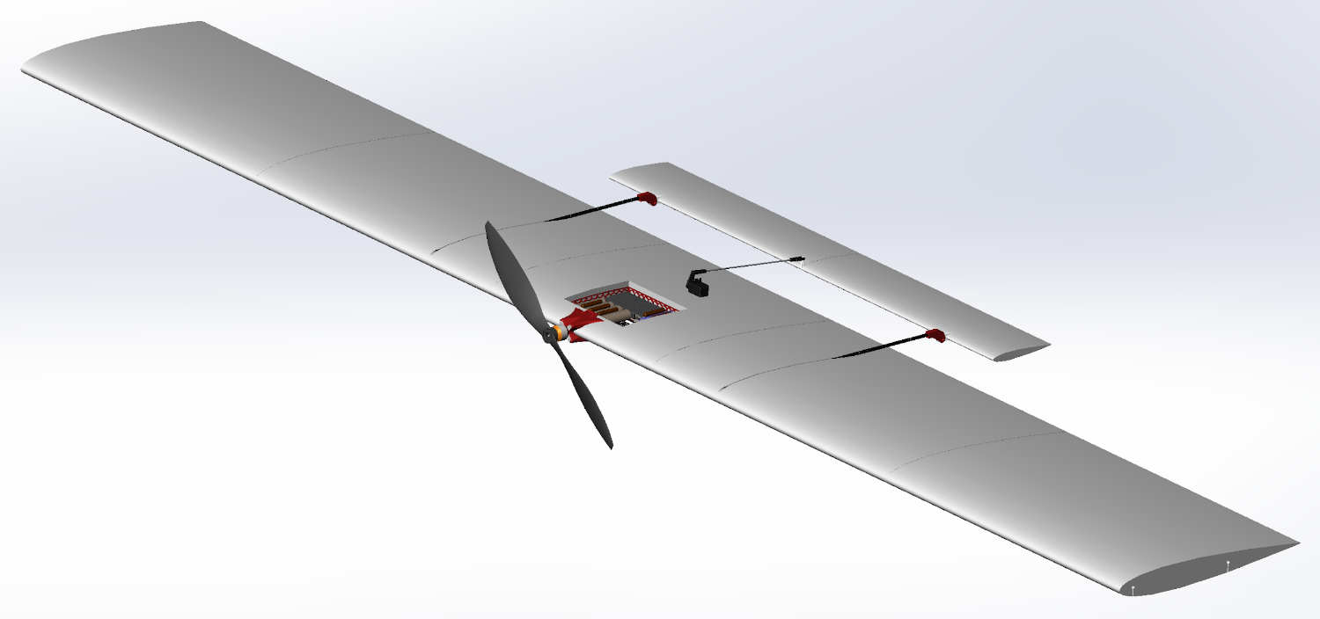
Final Oral Report:
High Altitude Lifting Orbiter (HALO)
By Braden Barkemeyer, David Cease, Kelly Crombie, Jared Dempewolf, Tyler Faragallah, Nolan Ferguson, Ryan Lansdon, Jacob Marvin, Kyle Mcgue, and Paolo Wilczak
Customer: Professor Lawrence
Advisor: Matt Rhode
Notes:
The Spring Final Review typically focuses on verification and validation, which would imply that team would have to finished with testing. In light of the current situation for teams who are not done with testing, the Spring Final Review will now focus on describing in detail the tests planned, the data that would have been gathered, and how the data were to be used to verify and validate the requirements, along with how the data were to be used to verify and refine the modeling done during the design phase. This review will take place via zoom (to be scheduled in the coming weeks) and any feedback given by the PAB must be addressed in the final report. This review will count for 20% of the grade.

Slide 2
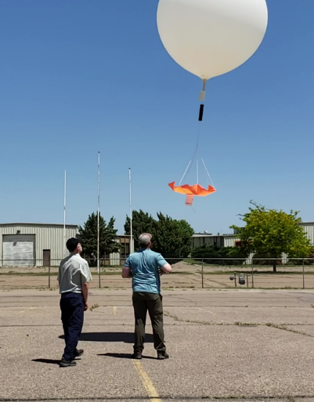
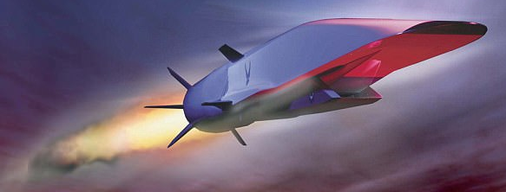
Motivation
Continuation of the Hypersonic Flight in the Turbulent Stratosphere (HYFLITS) mission
Measuring turbulence in stratosphere
Turbulence is not well understood in the stratosphere
United States Air Force (USAF) hopes to use turbulence data for development of hypersonic vehicles
USAF Hypersonic Concept
HYFLITS Launch
Project Purpose and Objectives
Design Description
Testing Overview and Results
Systems Engineering
Project Management
Backup Slides

Slide 3
Mission Statement
The High Altitude Lifting Orbiter (HALO) project will improve collection of turbulence data in the stratosphere.
HALO will create an autonomous tethered payload system capable of orbiting outside a balloon’s wake. A control surface will be used to induce altitude oscillations.
Project Purpose and Objectives
Design Description
Testing Overview and Results
Systems Engineering
Project Management
Backup Slides

Slide 4
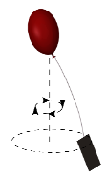
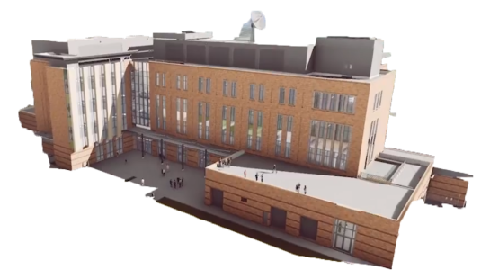
Concept of Operations
Concept of Operations
Altitude (km)
- Data transmission/acquisition
Multiple ascent/descent phase, payload continues orbiting outside wake
5
Payload begins orbiting outside balloon wake
6
40
4
Balloon begins venting toward neutral buoyancy
35
7
Low system battery. Flight arrest by venting
30
3
Tether passively extended
25
Telemetry/data transmission between 25 and 35 km. Range of 100 km
1
Ground setup by at most two people
2
Single-person balloon launch
Design
CPE’s
Reqts
Verification
Risks
Summary
Backups

Slide 5
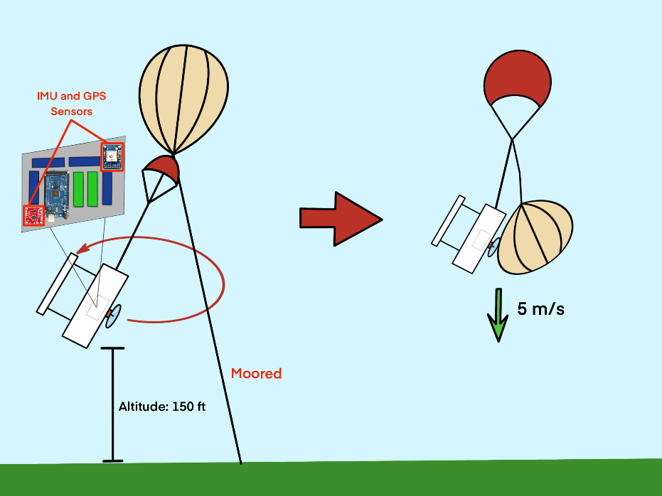
Levels of Success - Level 1
Project Purpose and Objectives
Design Description
Testing Overview and Results
Systems Engineering
Project Management
Backup Slides

Slide 6
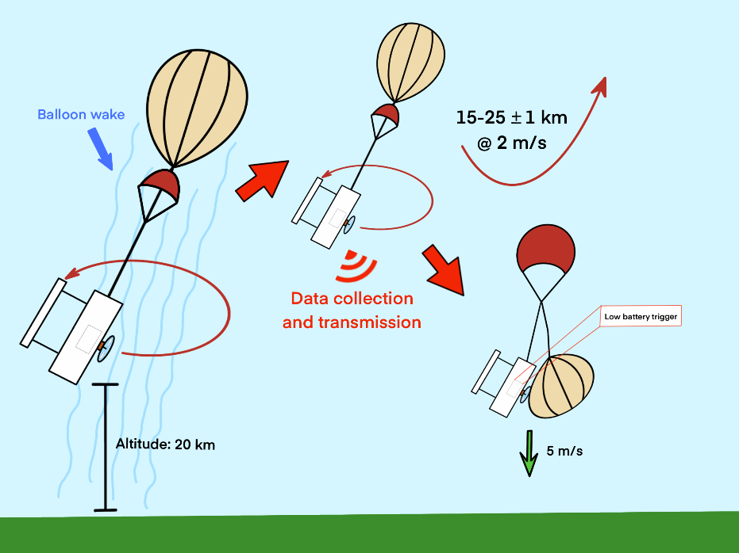
Levels of Success - Level 2
Project Purpose and Objectives
Design Description
Testing Overview and Results
Systems Engineering
Project Management
Backup Slides

Slide 7
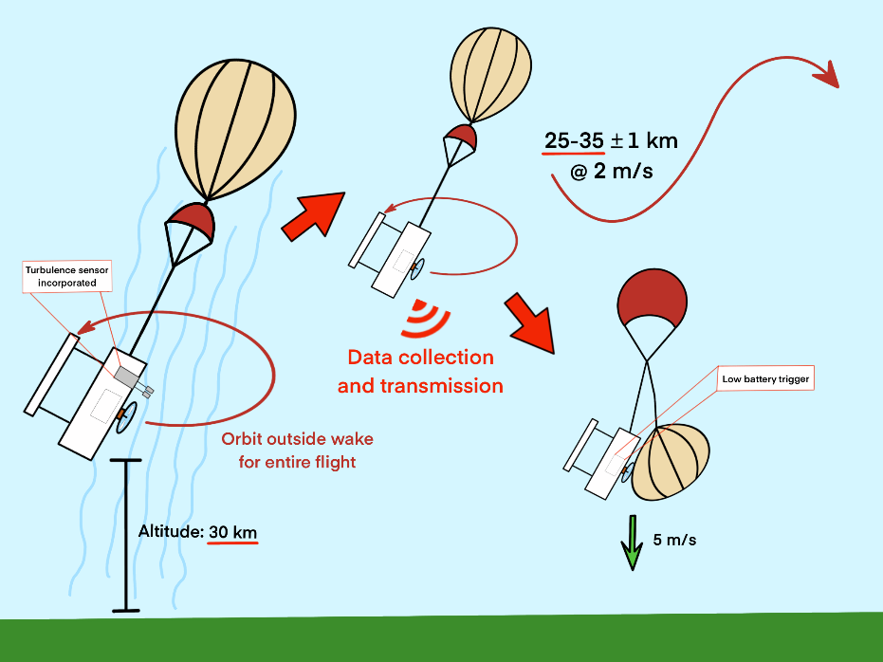
Levels of Success - Level 3
Project Purpose and Objectives
Design Description
Testing Overview and Results
Systems Engineering
Project Management
Backup Slides

Slide 8
Design Description - SubSystem & CPE Breakdown
0.48 kg helium
1.50 kg balloon
1.52 kg (not including balloon and helium)
Lifting Orbiter - 1.35 kg
Vent
Parachute (CDAS) - 0.06 kg
Tether Dataline
Electronics Bay
Braided Kevlar Tether
4.96 m
Project Purpose and Objectives
Design Description
Testing Overview and Results
Systems Engineering
Project Management
Backup Slides

Slide 9
Critical Project Elements
CPE | Why it is Critical?
Balloon | Must be able to reach the target altitude without bursting and handle the stresses on the neck due to the tether and payload.
Venting | Must be able to ensure venting can achieve neutral buoyancy, as well as act as a method to terminate flight.
Tether | Must have a launching tether design that will allow a maximum of 2 people to deploy (preferably 1 person), as well as have a tether that breaks under a 50 lbf (222.4 N) impulsive force.
Lifting Body | Must be able to maintain the sensor package outside of the balloon wake while orbiting at a maximum speed of 20 m/s. This system will then be able to induce an average ascent and descent speed of the entire system of 2.0 ᷾± 20% m/s.
CDAS | Must have a method to ensure a safe descent of the payload in case of catastrophic failure in order to not harm person or property.
Electronics | Must keep electronics in operating temperature range and ensure that there is enough power for the duration of the entire mission
Software | Must be able to account for altitude changes and actuate commands in order to initiate control surfaces, transmit data, and terminate the flight.
Project Purpose and Objectives
Design Description
Testing Overview and Results
Systems Engineering
Project Management
Backup Slides

Slide 10
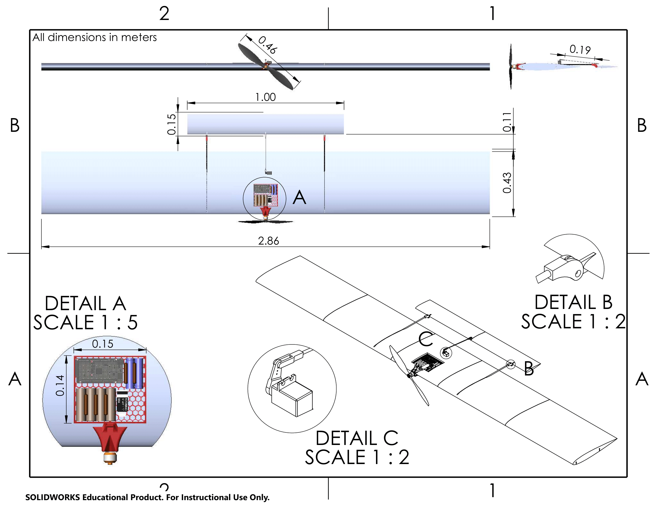
Design Description Critical Dimensions
Detail A
Payload Bay
Detail B
Tail connection/pivot
Detail C
Tail actuation servo and control linkage

Slide 11
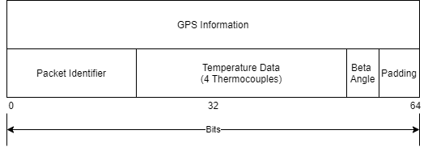
Design Description - Data Rates
Packets will consist of 128 bits
0.016 kB/s transmission rate
Incorporates 20 bit packet identifier to count lost packets
2 bit start and stop
5 bits padding in case of data overrun
Project Purpose and Objectives
Design Description
Testing Overview and Results
Systems Engineering
Project Management
Backup Slides
Notes:
Maybe we move this after CPE’s? Lends itself to be “critical”

Slide 12
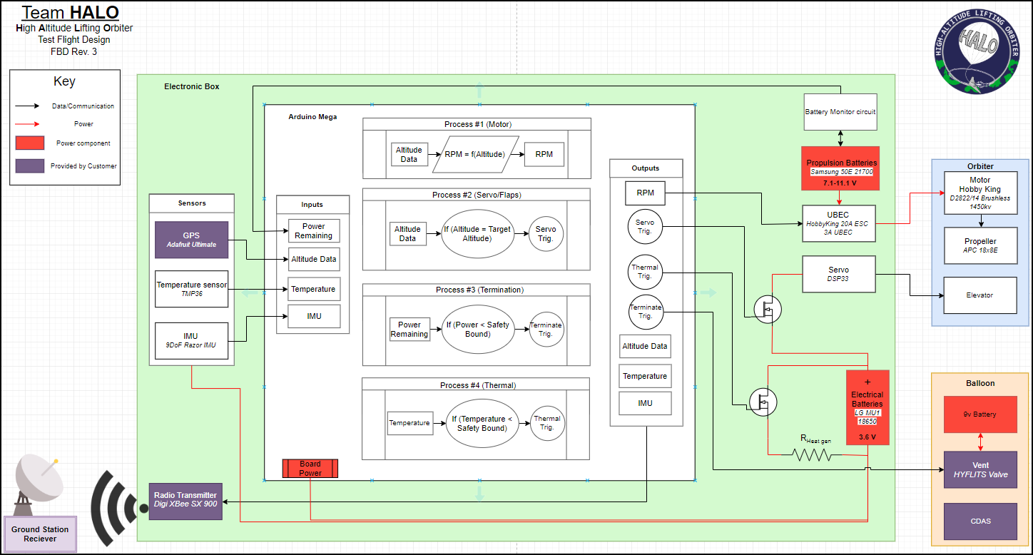
Design Description - Functional Block Diagram
10Hz

Slide 13
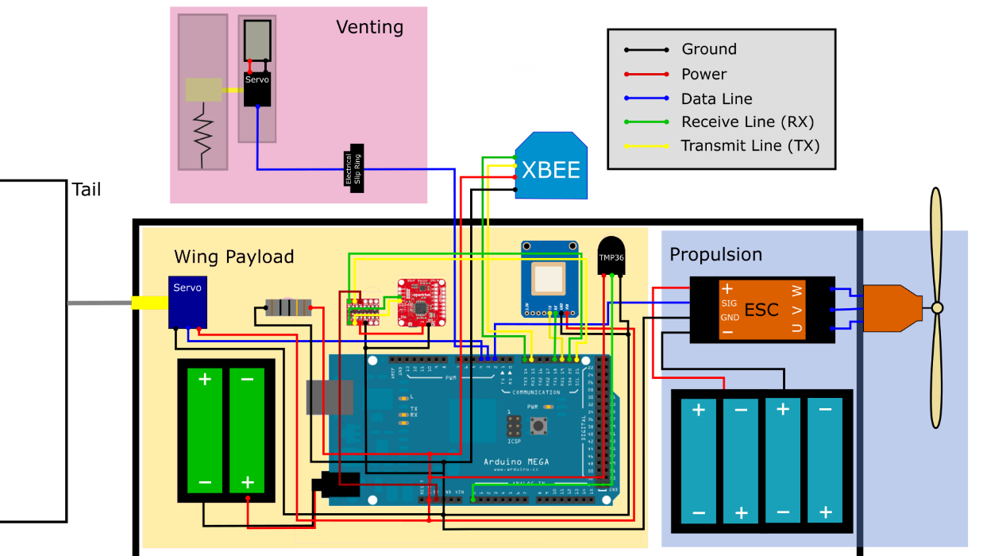
Wiring Schematic
Project Purpose and Objectives
Design Description
Testing Overview and Results
Systems Engineering
Project Management
Backup Slides

Slide 14
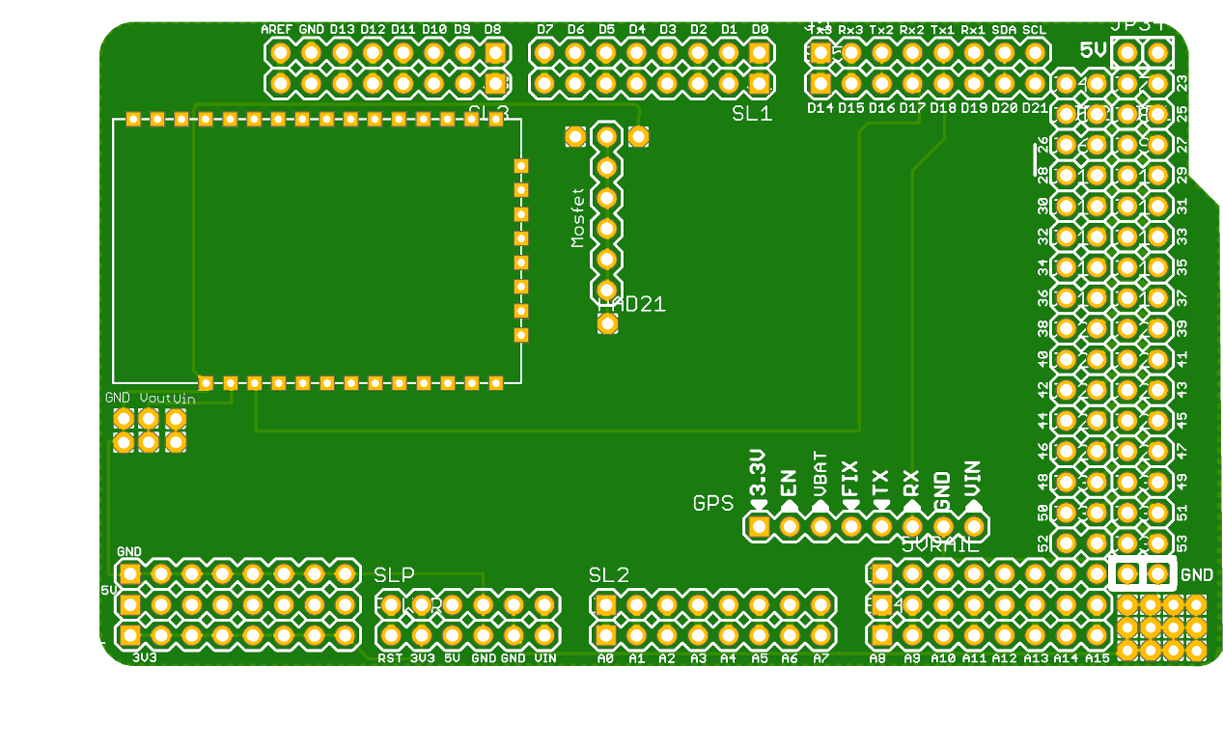
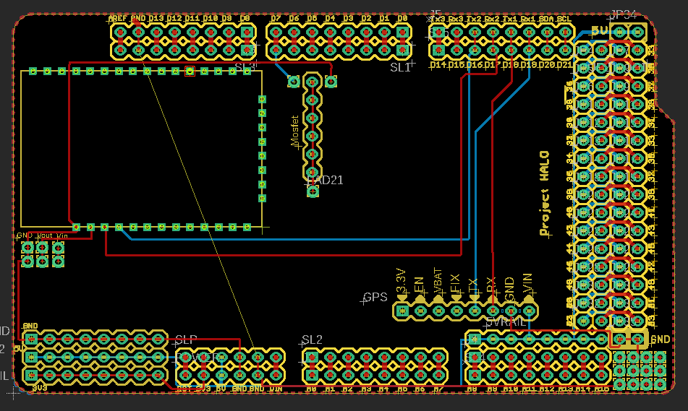
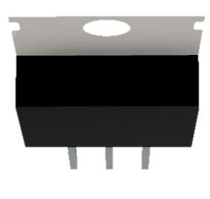
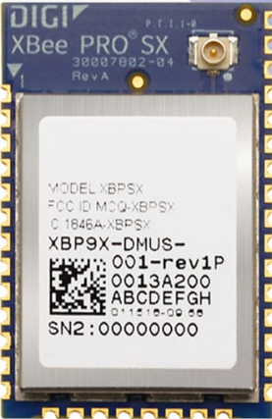
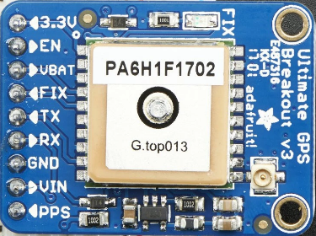
Custom Arduino Mega Shield

Slide 15
Plug & Play

Slide 16
Software: Overview
Transmit Data
Thermal Control
System
Level
Software
GPS
Motor Throttle
Component Operational Verification Tests
Terminate Flight
Launch
Neutral Buoyancy Acquisition
Orbit Acquisition
Actuate Tail Servos
Ground OP’s
Launch and Ascent
Neutral Buoyancy
Vertical Oscillations
Termination
CONOPs
-1.5
0
1
~8
Mission Duration (Hr)
Project Purpose and Objectives
Design Description
Testing Overview and Results
Systems Engineering
Project Management
Backup Slides
Notes:
Appendix the following software blocks? This may be the better overview slide, the software diagrams may be difficult.
What rates are our green blocks at. In addition, when they ask about controls for the motor acquisition , what do we say?

Slide 17
Testing Breakdown
Orbit Acquisition
Descent Arrest
Lift Generation
Neutral Buoyancy
Data Transmission
Survivability
Project Purpose and Objectives
Design Description
Testing Overview and Results
Systems Engineering
Project Management
Backup Slides
Notes:
Jared
To get a better understanding of what all of our tests are, and how they relate to the overall mission we broke each test down into 6 different categories.

Slide 18
Testing Breakdown
Orbit Acquisition
Descent Arrest
Lift Generation
IMU Test
Orbit Acquisition Test
Moored Test
Neutral Buoyancy
Data Transmission
Survivability
Project Purpose and Objectives
Design Description
Testing Overview and Results
Systems Engineering
Project Management
Backup Slides
Notes:
Jared
In the Orbit acq. Box we have 3 different tests that each correspond to acq. Orbit, these tests are the IMU test, the Orbit Acq. Test and the Moored Test.

Slide 19
Testing Breakdown
Orbit Acquisition
Descent Arrest
Lift Generation
IMU Test
Orbit Acquisition Test
Moored Test
CDAS Drop Test
Neutral Buoyancy
Data Transmission
Survivability
Project Purpose and Objectives
Design Description
Testing Overview and Results
Systems Engineering
Project Management
Backup Slides
Notes:
Jared
In the descent arrest box we only have the CDAS test as it was the only test that applied.

Slide 20
Testing Breakdown
Orbit Acquisition
Descent Arrest
Lift Generation
Software Dry Run Test
Propeller Thrust Test
IMU Test
Orbit Acquisition Test
Moored Test
CDAS Drop Test
Software Dry Run Test
Propeller Thrust Test
Neutral Buoyancy
Data Transmission
Survivability
Project Purpose and Objectives
Design Description
Testing Overview and Results
Systems Engineering
Project Management
Backup Slides
Notes:
Jared
In the lift gen. Box we have the software dry run test and propeller thrust test

Slide 21
Testing Breakdown
Orbit Acquisition
Descent Arrest
Lift Generation
Software Dry Run Test
Propeller Thrust Test
IMU Test
Orbit Acquisition Test
Moored Test
CDAS Drop Test
Software Dry Run Test
Propeller Thrust Test
Neutral Buoyancy
Data Transmission
Survivability
Neutral Buoyancy Test
Project Purpose and Objectives
Design Description
Testing Overview and Results
Systems Engineering
Project Management
Backup Slides
Notes:
Jared
To verify our neutral buoyancy test we have a neutral buoyancy test

Slide 22
Testing Breakdown
Orbit Acquisition
Descent Arrest
Lift Generation
Software Dry Run Test
Propeller Thrust Test
IMU Test
Orbit Acquisition Test
Moored Test
CDAS Drop Test
Software Dry Run Test
Propeller Thrust Test
Neutral Buoyancy
Data Transmission
Survivability
Neutral Buoyancy Test
Data Transmission Test
Project Purpose and Objectives
Design Description
Testing Overview and Results
Systems Engineering
Project Management
Backup Slides
Notes:
Jared
For data transmission we have a dedicated range test to verify accuracy and potential cutoff distances

Slide 23
Testing Breakdown
Orbit Acquisition
Descent Arrest
Lift Generation
Software Dry Run Test
Propeller Thrust Test
IMU Test
Orbit Acquisition Test
Moored Test
CDAS Drop Test
Software Dry Run Test
Propeller Thrust Test
Neutral Buoyancy
Data Transmission
Survivability
Tether Impulse Test
Electronics Survivability Test
Neutral Buoyancy Test
Data Transmission Test
Tether Impulse Test
Electronics Survivability Test
Project Purpose and Objectives
Design Description
Testing Overview and Results
Systems Engineering
Project Management
Backup Slides
Notes:
Jared
And finally we have our survivability tests which are the tether impulse test and electronics surv test.

Slide 24
Testing Breakdown
Completed Tests
Orbit Acquisition
Descent Arrest
Lift Generation
Software Dry Run Test
Propeller Thrust Test
IMU Test
Orbit Acquisition Test
Moored Test
CDAS Drop Test
Software Dry Run Test
Propeller Thrust Test
Neutral Buoyancy
Data Transmission
Survivability
Tether Impulse Test
Electronics Survivability Test
Neutral Buoyancy Test
Data Transmission Test
Tether Impulse Test
Electronics Survivability Test
Project Purpose and Objectives
Design Description
Testing Overview and Results
Systems Engineering
Project Management
Backup Slides
Notes:
Jared
To begin with, we will be taking an in depth look at the tests that we were able to complete prior to campus closure. We see that we were able to do the IMU test, Software dry run test, each of the survivability tests, and the CDAS drop test, which is what I will talk about next

Slide 25
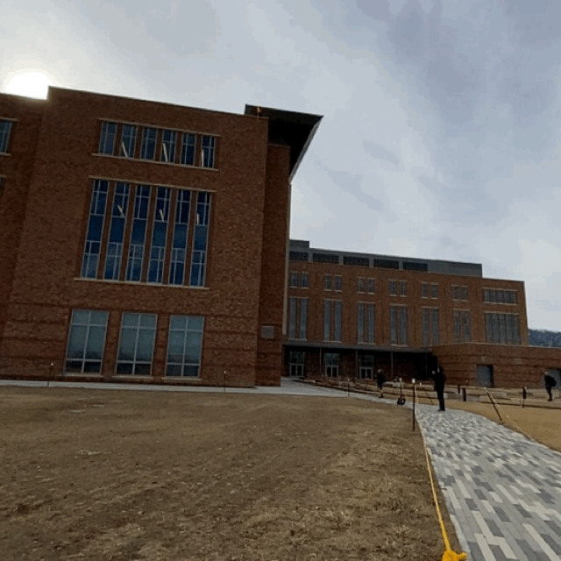
CDAS Deployment Test: Overview
Testing
FR 7.0: As specified by the customer, the balloon must contain a controlled descent arrest system (CDAS) to prevent harm to property or person upon balloon burst.
Successful deployment of the parachute
Successful arresting of descent speed
Procedure
Parachute tied to bottle mass
Thrown off roof
Radios for communication
Timed descent of about 3.8sec.
Conducted on 1/29/20 at CU Aerospace building
Project Purpose and Objectives
Design Description
Testing Overview and Results
Systems Engineering
Project Management
Backup Slides
Notes:
Jared
This test was the basic premise to show that our system would satisfy our 7th FR which would be that the our system must have a controlled descent arrest system. As such it must successfully deploy each time and that it adequately reduces the descent speed to a safe value.
To conduct this test we acquired the same parachute used on heritage flights, created a mass that was equivalent to our payload of 1.5 kg, and with Matt Rhode dropped it off the Aero Building
This test was able to be completed on Jan 29th relatively easily.

Slide 26
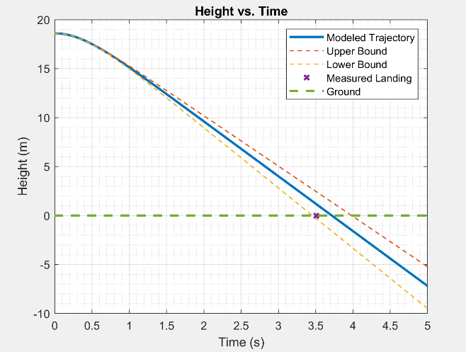
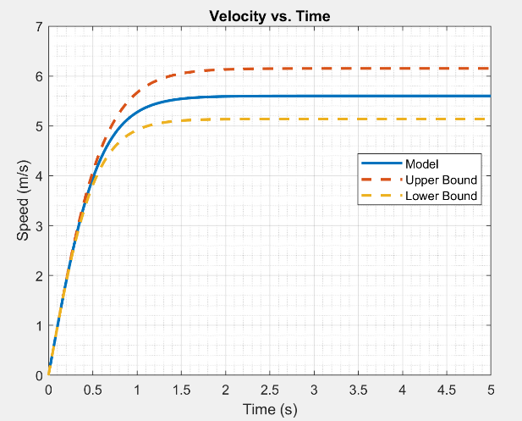
CDAS Deployment Test: Results
Measured descent duration: 3.51 sec
Maximum estimated velocity: 6.2 m/s
Experimental Velocity: 5.9 m/s
Project Purpose and Objectives
Design Description
Testing Overview and Results
Systems Engineering
Project Management
Backup Slides
Notes:
Jared
Basic kinematics was used to get the plots above, as we had the building height and time of drop. There were upper and lower bounds placed on these as obviously in real-life we won’t be able to perfectly reproduce results. It’s important to see that from this basic kinematic approach, we were able to reach terminal velocity after about 1 second and reach a estimated maximum velocity of 6.2 m/s.
Using the video of the drop on the previous slide, we were also able to use tracking software to follow the package and get actual location data of it. Using this Matlab was able to then polyfit the data and we find that the experimental velocity turned out to be about 5.9 m/s, about 5% off

Slide 27
CDAS Deployment Test: Implications
Verified FR 7.0: As specified by the customer, the balloon must contain a controlled descent arrest system (CDAS) to prevent harm to property or person upon balloon burst.
Drag force acting on orbiter is expected to be higher than the drag force experienced in this test
Orbiter has significantly higher surface area than the bottle used
Worst case-scenario test
Project Purpose and Objectives
Design Description
Testing Overview and Results
Systems Engineering
Project Management
Backup Slides
Notes:
Jared
From this we are able to verify each of the requirements for the descent arrest of the system and this particular case should be viewed as the worst case as the orbiter will have a higher surface area, therefore increasing drag and reducing descent velocity.

Slide 28
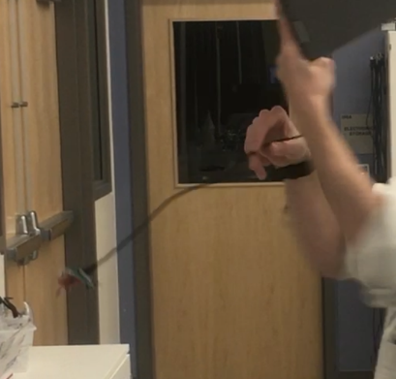
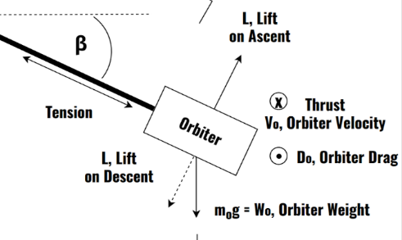
IMU - 𝛽 Angle Test: Overview
Testing
FR 1.0: There will be a method of controlling the altitude of the balloon and payload.
Determine if payload is within balloon wake using 𝛽 angle
Procedure
IMU was connected to a computer outputting to serial the angular rate
It was then spun in circles and collected data
The actual angle was found by taking a video and using similar triangles
Conducted on 2/15/20 at CU Aerospace building
𝛽
IMU
Project Purpose and Objectives
Design Description
Testing Overview and Results
Systems Engineering
Project Management
Backup Slides
Notes:
In order to check whether the orbiter is flying inside the balloon wake, we need to calculate its angle from the horizontal (indicated by beta). To verify this at a preliminary level, we conducted this beta angle test. We set up our IMU to output angular rates to a serial monitor on a laptop; we then treated the USB cord like the tether, and spun the IMU in a circular fashion. From the provided angular rates, we were able to calculate the corresponding beta angle through a simple force balance. We also video recorded this experiment to visually measure the beta angle as a reference for comparison.

Slide 29
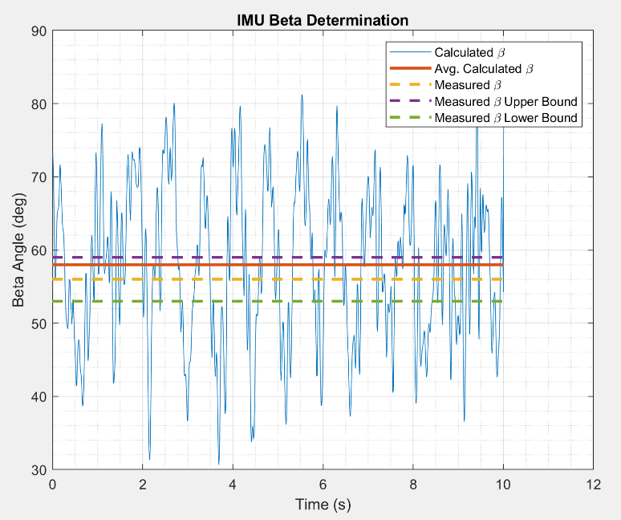
IMU - 𝛽 Angle Test: Results
Visually measured 𝛽 angle: 56°
Uncertainty in visually measured 𝛽 angle: ± 3°
Calculated 𝛽 angle: 57.98°
Project Purpose and Objectives
Design Description
Testing Overview and Results
Systems Engineering
Project Management
Backup Slides
Notes:
Looking at our data plot, we have beta angle on the y axis and time on the x axis. This blue line is the experimentally calculated beta angle, which includes significant noise due to manual rotations. The middle dotted line you see is the visually measured beta angle, and the other two dotted lines are its upper and lower bounds. Our uncertainty estimate of +-3 degrees here is a best guess; our video was slightly shaky, and the beta angle varied slightly throughout the video. That being said, the average calculated beta angle of ~58 deg (indicated by this red line) is only about 2 deg off from our visually measured beta angle

Slide 30
IMU - 𝛽 Angle Test: Implications
Preliminary test to be verified with orbit tests
Large noise due to manually spinning the IMU; steps generate noise
Results are promising
High accuracy even with large amount of noise
If results are not accurate enough, a higher resolution IMU will be tested and subbed in
Project Purpose and Objectives
Design Description
Testing Overview and Results
Systems Engineering
Project Management
Backup Slides
Notes:
The results from this test suggest that we chose an IMU that is suitable for our mission. While this was a preliminary, low level test, this was acceptable because the IMU’s beta angle calculation would be further validated with the Orbit Acquisition and Moored tests
__
We’re trusting our IMU to get angle well enough so we can give commands to control our package out of the wake → we’ve modeled it and proves IMU to accuracy we need it

Slide 31
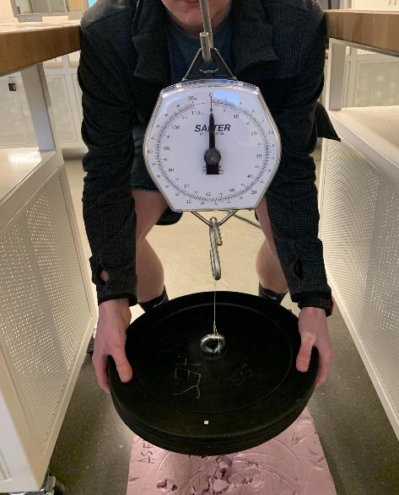
Tether Strength Test: Overview
Testing
FR 5.0: Balloon and its payload must meet all FAA guidelines, including those subjecting the balloon and its payload to designation as an unregulated balloon. In addition, Balloon and payload shall meet specifications set forth by customer.
The tether breaks under a 50lbf impulse
Procedure
Cut and configured shortened tethers
Used an analog loading device
Dropped 50lb of weights connected to tethers
Used a slow-motion camera to measure the breaking force
Conducted on 2/23 at CU Aerospace building
Project Purpose and Objectives
Design Description
Testing Overview and Results
Systems Engineering
Project Management
Backup Slides
Notes:
Testing what knots do for the material → testing that point of failure, if the knot makes a big difference. Verifying FAA reqt and that knot and whatnot isn’t going to be too weak

Slide 32
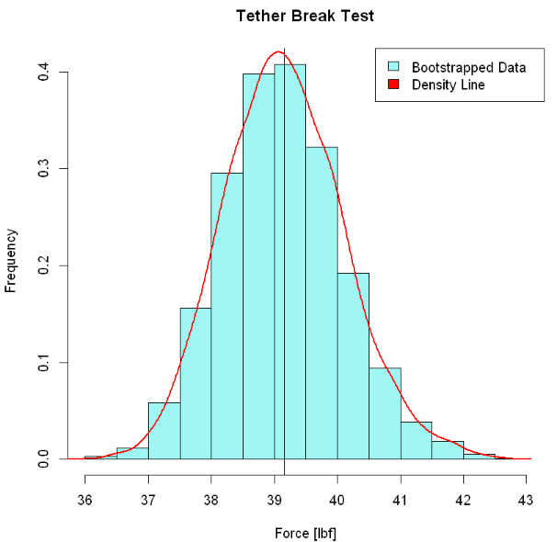
Tether Strength Test: Results
20 Samples Taken
Bootstrapping done to obtain simulated results
After 5,000 iterations we obtain:
95% Confidence Interval of ( 37.15 , 40.9 )
This is to say that a sample of data taken, no matter the size, the mean of the dataset will fall within the Confidence Interval 95% of the time
Project Purpose and Objectives
Design Description
Testing Overview and Results
Systems Engineering
Project Management
Backup Slides
Notes:
Say what bootstrapping is → technique used for small data → test to get specs or ensure our design still works with knots

Slide 33
Tether Strength Test: Implications
It can be said with certainty that the tether will break under a real-world 50lbf impactive force
In both testing and modelling there was no occurrence of breakage exceeding 43lbf
Per the tether breakage requirements set by the FAA, HALO can fly as an unregulated balloon
Project Purpose and Objectives
Design Description
Testing Overview and Results
Systems Engineering
Project Management
Backup Slides
Notes:
Our tether breaking force stress etc is changed by the knots. So we are testing the failure for FAA and our mission reasons.

Slide 34
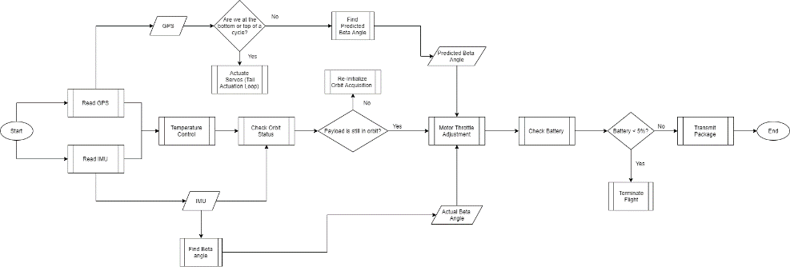
Software Dry Run Test: Overview
Testing
FR 1.0: There will be a method of controlling the altitude of the balloon and payload
All software should be working correctly
Procedure
Change servo angles for tail based on Beta angle
Control motor RPM
Actuate the vent based on altitude
Conducted on March 2nd
Notes:
Diagram of what is being done

Slide 35
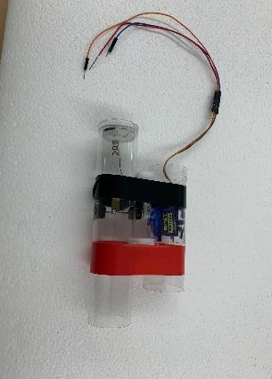
Software Dry Run Test: Vent & Tail Servos
Testing
Ability to open / close
Seal of vent
Procedure
Open / close vent based on altitude & Actuate tail Up/Down
Move between floor 1 & 4 of aerospace building
Visually inspect seal and attempt to blow air through vent
Results
Vent successfully open and closed numerous times
Proven ability to use altitude data & controls
Proved accuracy feasibility of gps
Implication
Need to hard-code the altitude values for open / close
Ensure the software has a storage for previous altitude, current, vent status
Large moment imparted on middle of spar causing servo to stick
Notes:
Kelly , did the servo deflect in the right direction?
For these next couple of slides, tell us what the next steps were, what else we would have liked to verify, etc.

Slide 36
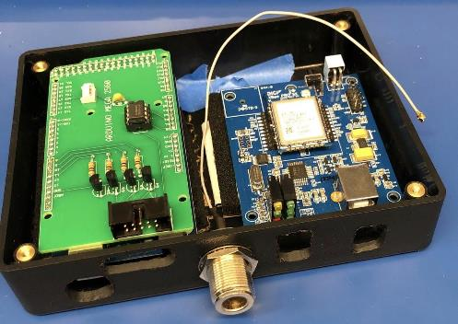
Software Dry Run Test: Radio
Testing
Ability to transmit structured strings of data
Ability to communicate 2 ways
Procedure
Send live temperature data every 5 seconds
Results
Received live, but comes in small chunks
Proven ability to process sensor data and transmit realtime
Proved short range feasibility
Implication
Need to prove feasibility of sending data in packets
Polarity alignment added into design criteria
Need to test ground station GUI

Slide 37
Thermal Model: Overview
FR 3.0: The payload must be able to survive the conditions presented throughout the entirety of the mission
Utilizes finite 3D grid but assumes electronics bay is uniform temperature (Hypobaric Chamber Test)
Model results indicate electronic survival at flight conditions (Thermal Chamber Test)
Need to validate model with real-world data
HALO Electronics Package (includes Temperature Sensors)
Arduino
Project Purpose and Objectives
Design Description
Testing Overview and Results
Systems Engineering
Project Management
Backup Slides
Notes:
Our thermal model
Where are the thermocouples, point them out

Slide 38
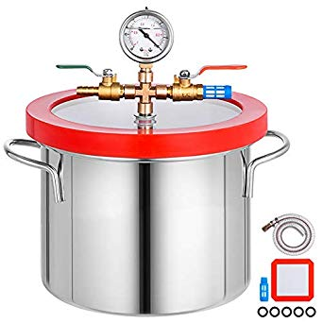
Hypobaric Chamber Test: Overview
Testing
Ability of heaters to dissipate heat to payload given low pressure (low density) air conditions
Conduction of air dominant method of heat transfer in electronics payload
FR 3.0: The payload must be able to survive the conditions presented throughout the entirety of the mission
Risks Mitigated: electronics failure, over/under heating
Procedure
Place the electronics housing package with select components active in pressure chamber (mimic flight P)
Use temperature sensors to monitor the heat conduction/convection in payload air
Analyze results
Conducted on 3/4/20 at CU Aerospace building
Project Purpose and Objectives
Design Description
Testing Overview and Results
Systems Engineering
Project Management
Backup Slides

Slide 39
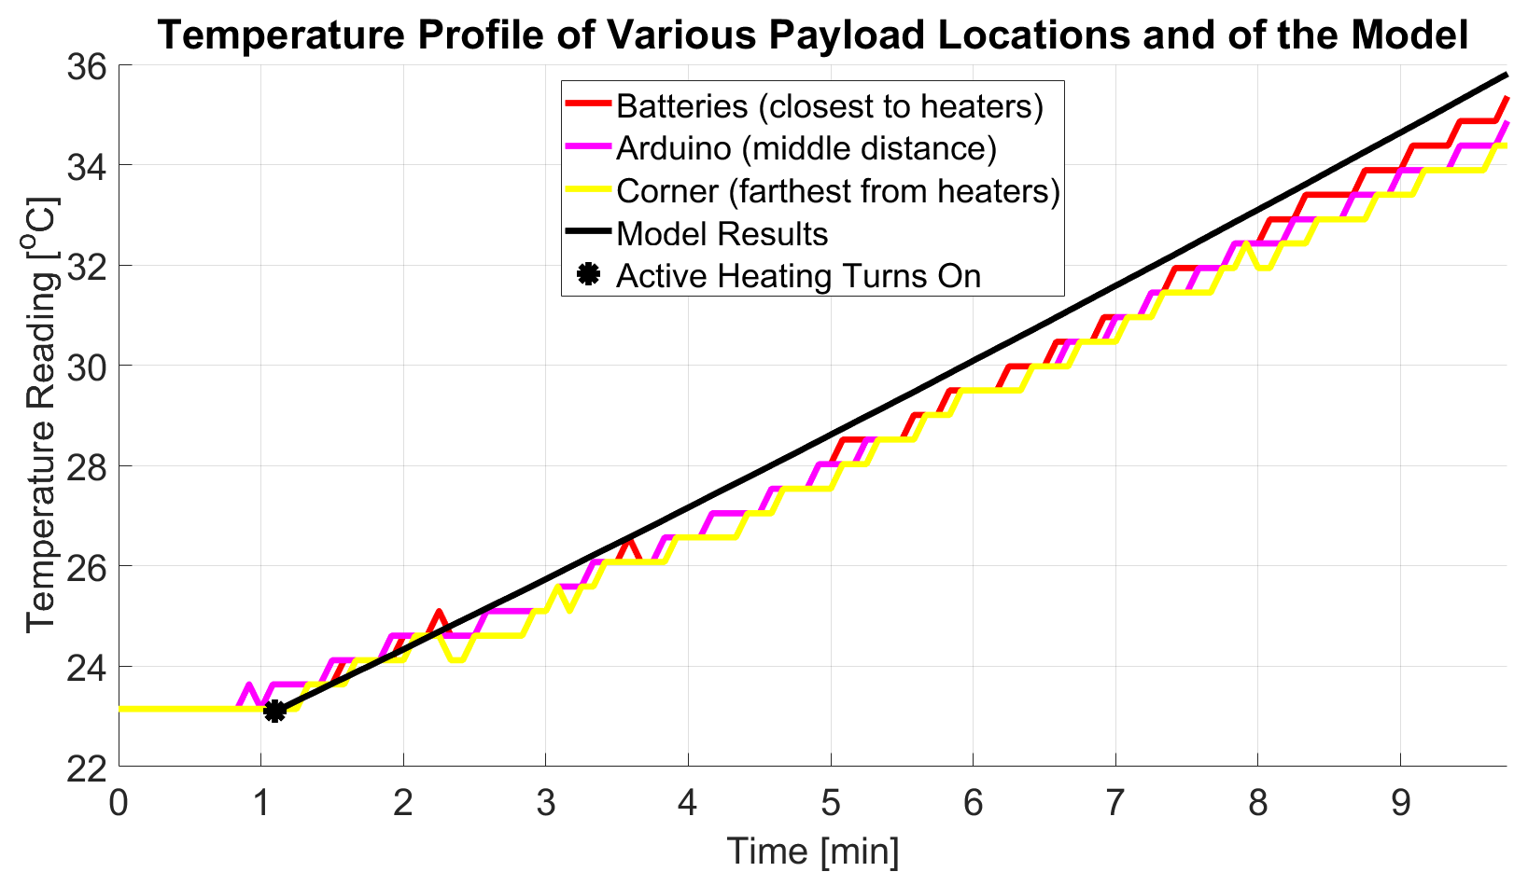
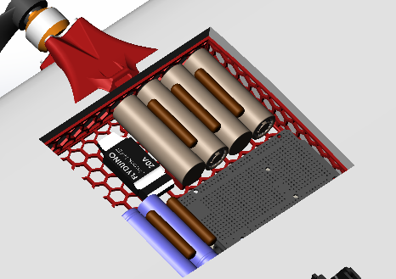
Hypobaric Chamber Test: Results
Little to no temperature gradient throughout payload verifies resistors are effectively dissipating heat
Narrow gap between data and model verifies that model’s reliance on air conduction is valid at altitude
Batteries
Arduino
Corner
Project Purpose and Objectives
Design Description
Testing Overview and Results
Systems Engineering
Project Management
Backup Slides
Notes:
Highlight more on theory → convection and conduction reduced but still there → need to verify assumptions on them, our assumptions were valid
Maybe think about: is conduction still the big player here? Yes but explain
Overall alot of matt’s comments are about the different scenarios: What are we expecting at different altitudes, what was our reasoning for different models and tests and how we conducted them, etc.
Could of compared to normal pressure

Slide 40
Hypobaric Chamber Test: Implications
Verifies heater ability to dissipate heat in the low density conditions
Validates the thermal model assumptions on conduction being dominant form of heat transfer in low density environment
Verifies FR 3.0: The payload must be able to survive the conditions presented throughout the entirety of the mission
Project Purpose and Objectives
Design Description
Testing Overview and Results
Systems Engineering
Project Management
Backup Slides

Slide 41
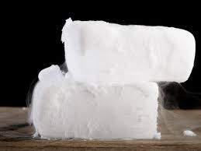
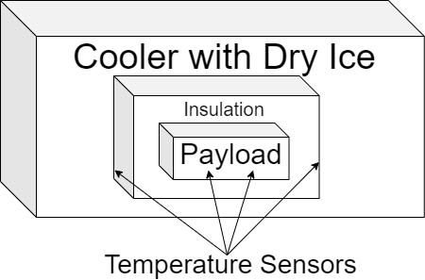
Thermal Chamber Test: Overview
Testing
FR 3.0: The payload must be able to survive the conditions presented throughout the entirety of the mission
Risks Mitigated: electronics failure, over/under heating
Procedure
Place foam box with insulation thickness (1.5 cm) similar to the airfoil in cooler with dry ice
Put/run all components in proper orientation to mimic a real flight (mimic heat generation)
Use the temperature sensors to monitor and transmit the temperatures near the batteries, near the edge of the payload, and in the cooler
Conducted on 3/4/20 at CU Aerospace building
HALO Electronics Package (includes Temperature Sensors)
Arduino
Project Purpose and Objectives
Design Description
Testing Overview and Results
Systems Engineering
Project Management
Backup Slides
Notes:
Maybe add a payload picture to show where the locations would correlate

Slide 42
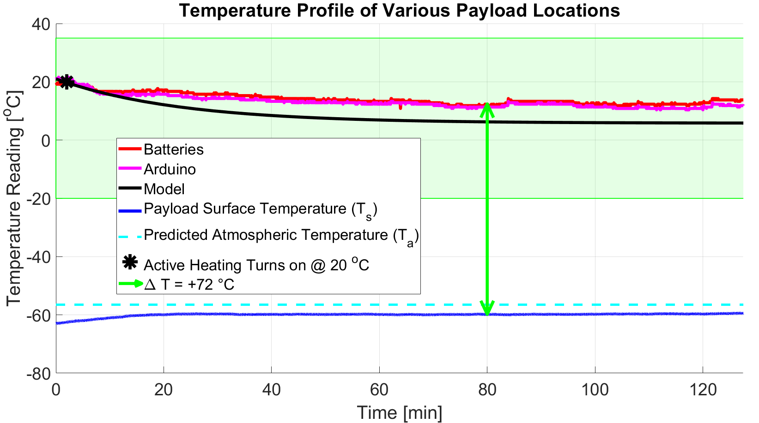
Thermal Chamber Test: Results
Active heating turns on at 20 ºC and remains on
Established temperature difference of 72 ºC
Model has slightly worse outcome (Cooler)
Batteries
HALO Electronics Package (includes Temperature Sensors)
Arduino
Payload Surface
Arduino
Project Purpose and Objectives
Design Description
Testing Overview and Results
Systems Engineering
Project Management
Backup Slides
Notes:
heating turned on at 20 C, it was continuously on, this was easier for testing purposes
Verify by adding in our model, how close we are to our model, yadda yadda. Also, matt wants to see again a diagram of where the thermocouples were.
Is this what your expected model with active heating showed? Did we expect the active heating to stay on the whole time? Why did we have active heating? Did we conduct this test with all the major heat generators (No in our case, no motor. This is next test)

Slide 43
Thermal Chamber Test: Implications
Data validates the thermal model results through real world observations at Boulder atmospheric conditions
Verifies FR 3.0: The payload must be able to survive the conditions presented throughout the entirety of the mission
HALO Electronics Package (includes Temperature Sensors)
Arduino
Project Purpose and Objectives
Design Description
Testing Overview and Results
Systems Engineering
Project Management
Backup Slides

Slide 44
Testing Breakdown
Completed Tests
In Progress Tests
Orbit Acquisition
Descent Arrest
Lift Generation
Software Dry Run Test
Propeller Thrust Test
IMU Test
Orbit Acquisition Test
Moored Test
CDAS Drop Test
Software Dry Run Test
Propeller Thrust Test
Neutral Buoyancy
Data Transmission
Survivability
Tether Impulse Test
Electronics Survivability Test
Neutral Buoyancy Test
Data Transmission Test
Tether Impulse Test
Electronics Survivability Test
Project Purpose and Objectives
Design Description
Testing Overview and Results
Systems Engineering
Project Management
Backup Slides

Slide 45
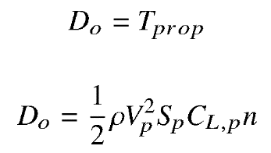
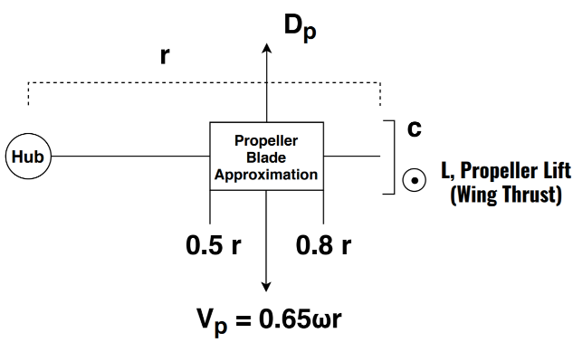
Propeller Thrust Test: Model
Thrust model must be verified to gain confidence we have the required thrust to orbit at altitude
Blade element theory
Propeller thrust must equal orbiter drag
Most propeller thrust is generated from middle of blade section
Project Purpose and Objectives
Design Description
Testing Overview and Results
Systems Engineering
Project Management
Backup Slides
Notes:
We also had to verify that our orbiter would be able to generate enough thrust to obtain the desired velocities, we needed a method to verify our propeller thrust model. This model consisted of a simple blade element theory method, treating the middle of the propeller blade as an airfoil section, calculating thrust using the aerodynamic lift equation.
____________

Slide 46
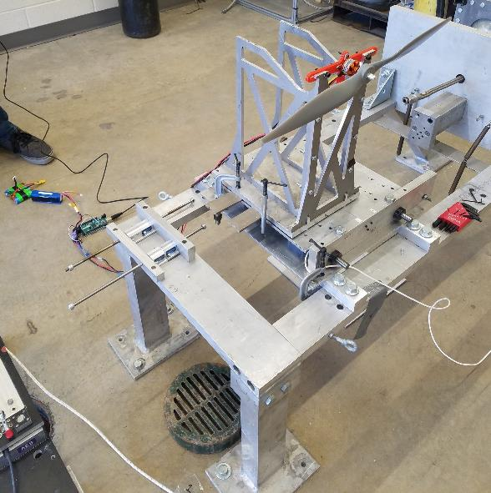
Propeller Thrust Test: Overview
Testing
FR 2.0: The payload must be capable of orbiting beneath the balloon
Risks Mitigated: not producing enough lift, not inducing predicted orbit
Ability to change motor speeds
Procedure
Attach motor to thrust sensor mount
Vary throttle from 10-100%, maintaining throttle input for 20 seconds each
Measure RPM with tachometer for each interval
Obtain thrust data through a wired connection
Conducted on 3/11/20 at CU Aerospace building
Project Purpose and Objectives
Design Description
Testing Overview and Results
Systems Engineering
Project Management
Backup Slides
Notes:
To test out our model, we attached our motor to a static thrust test stand. We varied our motor thrust from 10% to 100% in 10% increments, taking RPM measurements at each step. We were then able to compare this RPM-thrust relationship to that predicted from our model.

Slide 47
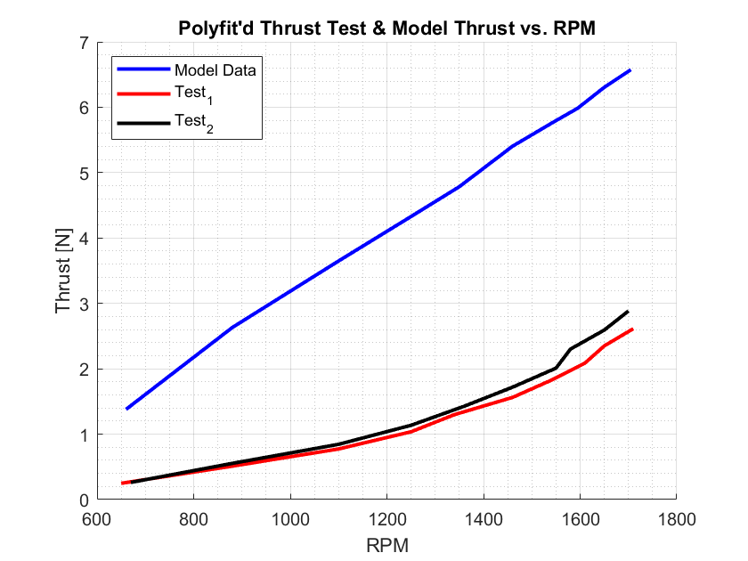
Propeller Thrust Test: Results
Thrust model overpredicts by roughly double
Project Purpose and Objectives
Design Description
Testing Overview and Results
Systems Engineering
Project Management
Backup Slides
Notes:
Thrust is on the y axis, and RPM is on the x axis. Here you can see the plot containing our model (blue) compared to the gathered experimental data (red/black). Our thrust model overpredicted the thrust generation by a factor of roughly 2, which potentially presents some problems. We would have liked to conduct further thrust tests with varying propeller sizes before drawing conclusions about the validity of our model,for now we’ll assume that our model was wrong
___
We need to show where our data and expected models area
Does this extrapolate at altitude
Torque curve not linear extrapolation

Slide 48
Propeller Thrust Test: Implications
Fails to verify Thrust Model
Doesn’t show that proper thrust can be generated at altitude
Fails to verify FR 2.0: The payload must be capable of orbiting beneath the balloon
Further testing with varying propellers is necessary
Thrust model may need to be tweaked
Possible solutions:
Increase motor RPM
Increase maximum orbital velocity
Reduce maximum system altitude
Project Purpose and Objectives
Design Description
Testing Overview and Results
Systems Engineering
Project Management
Backup Slides
Notes:
We didn’t verify thrust model or FR 2.0. These results were not ideal, but this shouldn’t cause our mission to fail. There are several possible solutions if these results end up being consistent: we could increase our designed motor RPM, increase the maximum allowed orbital velocity, or (worst case) reduce maximum system altitude. We haven’t decided on which solution to pursue, though we’re confident we have enough options to find success after conducting further experiments.

Slide 49
Testing Breakdown
Completed Tests
In Progress Tests
Incomplete Tests
Orbit Acquisition
Descent Arrest
Lift Generation
Software Dry Run Test
Propeller Thrust Test
IMU Test
Orbit Acquisition Test
Moored Test
CDAS Drop Test
Software Dry Run Test
Propeller Thrust Test
Neutral Buoyancy
Data Transmission
Survivability
Tether Impulse Test
Electronics Survivability Test
Neutral Buoyancy Test
Data Transmission Test
Tether Impulse Test
Electronics Survivability Test
Project Purpose and Objectives
Design Description
Testing Overview and Results
Systems Engineering
Project Management
Backup Slides

Slide 50
Data Range Test: Overview
Testing
FR 4.0: The payload will be able to transmit collected data to the ground receiver
Communication over long distances
Procedure
Have two radios on the ground
Attenuate signal from transmitting radio
Calculate predicted range based on received signal strength
Previously scheduled for March 24th
Project Purpose and Objectives
Design Description
Testing Overview and Results
Systems Engineering
Project Management
Backup Slides
Notes:
Diagram of vertical lateral distance

Slide 51
Data Range Test: Expected Results
Verification of data transmission range
Scale attenuation range to estimate real range
Count number of lost data packets to estimate max range
Verification of software implementation
Verify data transmitting at proper rate and sending full packets
Ensure radio is able to receive and process data in real time
System integration confirmation
Verifies transmitter is able to properly collect and packet all monitored data
Project Purpose and Objectives
Design Description
Testing Overview and Results
Systems Engineering
Project Management
Backup Slides

Slide 52
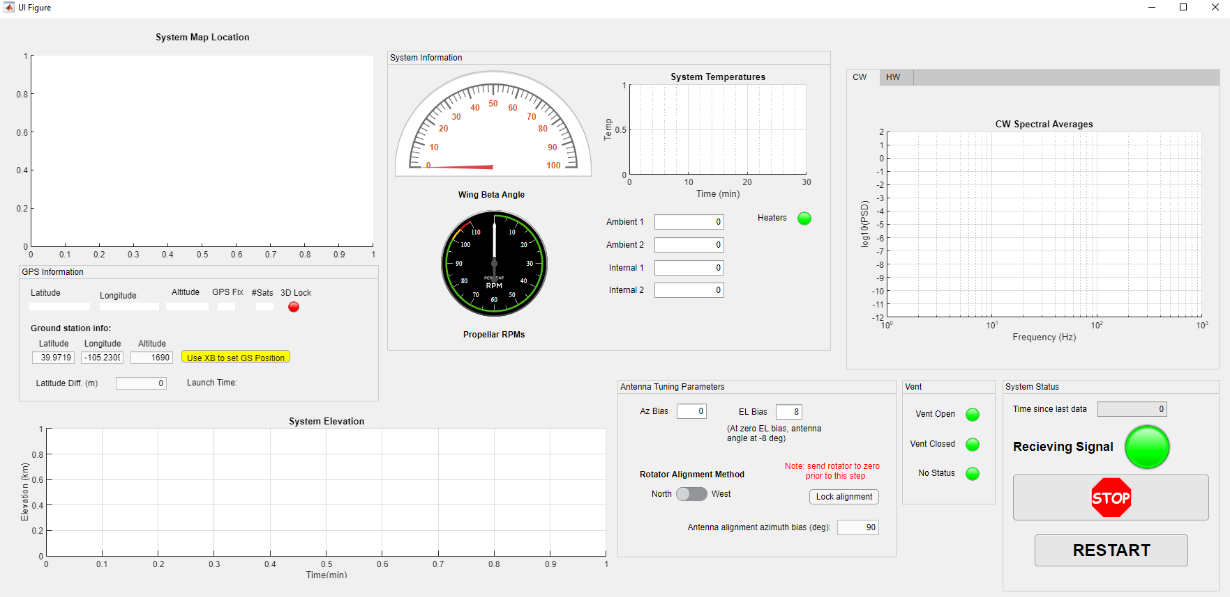
Data Range Test: Expected Results

Slide 53
Data Range Test: Implications
Will confirm or counter the model in place
Model will be adjusted for lower altitude density, etc.
All systems ready to incorporate balloon
Successful integration of different systems
Uncertainty in:
Wind effects
Atmospheric conditions to enter into model
Project Purpose and Objectives
Design Description
Testing Overview and Results
Systems Engineering
Project Management
Backup Slides

Slide 54
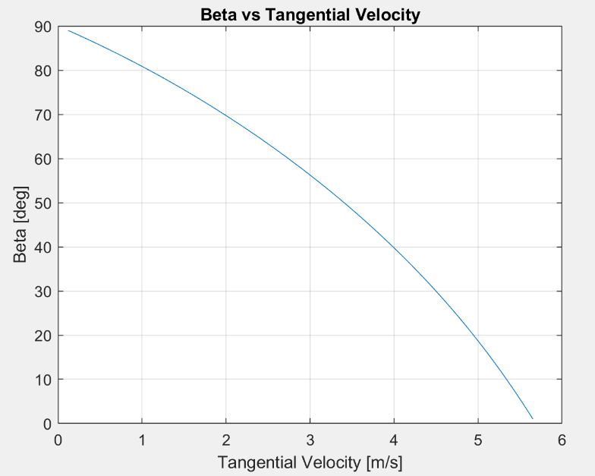
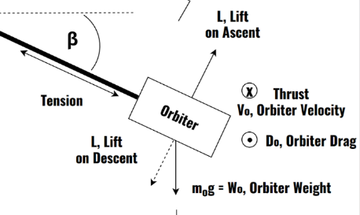
Orbit Model
Project Purpose and Objectives
Design Description
Testing Overview and Results
Systems Engineering
Project Management
Backup Slides

Slide 55
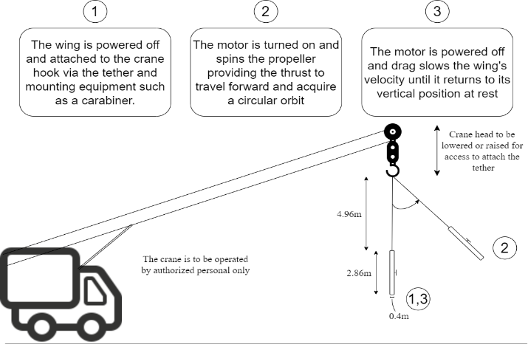
Orbit Acquisition Test: Overview
Testing
FR 2.0: The payload must be capable of orbiting beneath the balloon
Risks Mitigated: not acquiring orbit, no orbit stability
Ability to obtain orbit from vertical rest position
Further check the beta angle measurement
Test that the wing maintains the correct angle
Test the stability of the wing
Validate lift and drag coefficients
Scheduled for March 15th
Pending crane availability (currently in process)
Equations of Motion:
β
Project Purpose and Objectives
Design Description
Testing Overview and Results
Systems Engineering
Project Management
Backup Slides

Slide 56
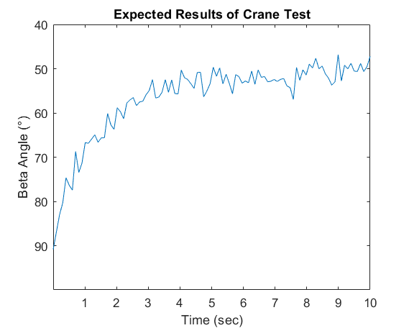
Orbit Acquisition Test: Expected Results
Verification of orbit acquisition
Start from vertical hang
Verification of software implementation
Arduino, ESC, motor, and servos
Throttle setting trimming
Experimentally find incremental throttling values
Lift model validation
Tension load cell in line
Equations of Motion:
Project Purpose and Objectives
Design Description
Testing Overview and Results
Systems Engineering
Project Management
Backup Slides

Slide 57
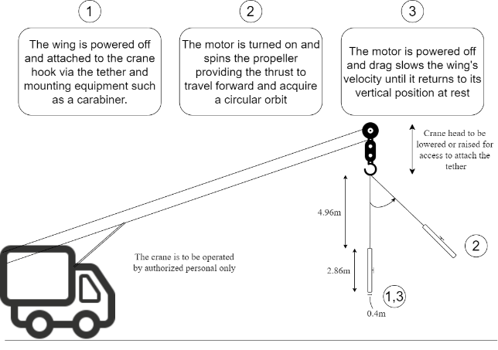
Orbit Acquisition Test: Implications
Will confirm or counter the model in place
Model will be adjusted for lower altitude density, etc.
All systems ready to incorporate balloon
Successful integration of different systems
Uncertainty in:
the load cell (0.1lb)
the servo angle precision
Wind effects
Atmospheric conditions to enter into model
Equations of Motion:
Project Purpose and Objectives
Design Description
Testing Overview and Results
Systems Engineering
Project Management
Backup Slides

Slide 58
Moored Test: Overview
Testing
FR 1.0: There will be a method of controlling the altitude of the balloon and payload
Risks Mitigated: can’t control altitude as predicted
Full functionality of all components
Ability to actuate tail to increase/decrease lift
Procedure
Moor the balloon and payload to the ground with a cable less than 150 ft and an anchor
Inflate the balloon with helium
Throttle the motor and reach a stable beta angle
Actuate the tail servos and measure changes in lift
Scheduled for March 22nd
150 ft.
β
Lift
+ y
Equations of Motion:
Weight
+ x
g
Load Cell
Anchor
Project Purpose and Objectives
Design Description
Testing Overview and Results
Systems Engineering
Project Management
Backup Slides

Slide 59
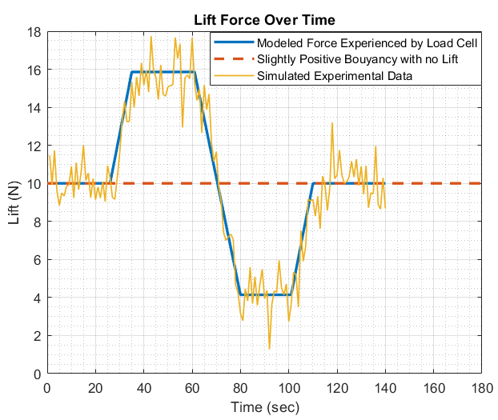
Moored Test: Expected Results
Further lift verification to relate with the model
Adjusted for lower altitudes
Changes in load cell would be noted when actuating the servo
This would assure that changing altitudes is possible
Balloon dynamics observed
Successful system integration
Equations of Motion:
Project Purpose and Objectives
Design Description
Testing Overview and Results
Systems Engineering
Project Management
Backup Slides
Notes:
How exactly is that affecting us

Slide 60
Moored Test: Implications
Full system validation - Final Test
Assurance of flight-ready system
Allow us to see balloon dynamics and make any adjustments
Allows correlation with previous test to verify lift changes
Uncertainty in:
the load cell (0.1lb)
the servo angle precision
Wind effects
Atmospheric conditions to enter into model
150 ft.
β
Lift
+ y
Equations of Motion:
Weight
+ x
g
Load Cell
Anchor
Project Purpose and Objectives
Design Description
Testing Overview and Results
Systems Engineering
Project Management
Backup Slides

Slide 61
Neutral Buoyancy Test: Model
We need to verify that we can vent to neutral buoyancy at a desired altitude of 30 km
Allows for orbiter to control system altitude
Project Purpose and Objectives
Design Description
Testing Overview and Results
Systems Engineering
Project Management
Backup Slides
Notes:
Nolan

Slide 62
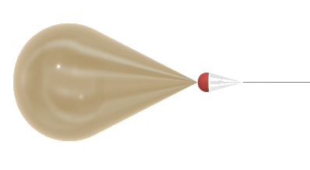
Neutral Buoyancy Test: Overview
Testing
FR 1.0: There will be a method of controlling the altitude of the balloon and payload
Risks Mitigated: can’t achieve neutral buoyancy
Vent and data transmission operates successfully
Procedure
Fill balloon with 3m³ of helium
Attach electronics package (no wing) with insulation for total mass equal to wing mass
Continuously record/transmit altitude data with GPS
Vent balloon to neutral buoyancy at 30km
Monitor balloon altitude to verify neutral buoyancy
Actuate vent until negatively buoyant (-2 m/s) to ensure safe system descent
Scheduled for March 29th
Electronics package
Project Purpose and Objectives
Design Description
Testing Overview and Results
Systems Engineering
Project Management
Backup Slides
Notes:
Nolan

Slide 63
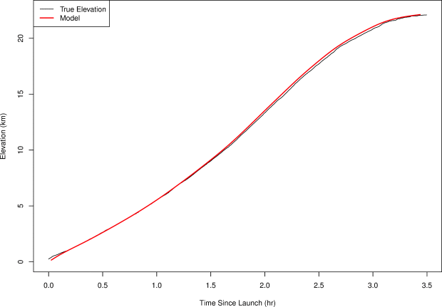
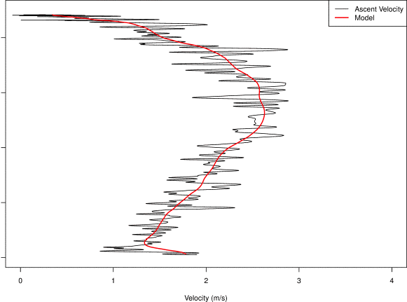
Neutral Buoyancy Test: Expected Results
Ascent to Neutral Buoyancy
GPS acts as main instrument indicator for neutral buoyancy
Models predicted venting should occur at 2.55 hr’s after flight initiated, or at ~21.5 km
Venting occurs until neutral buoyancy reached at ~30 km. Consistently venting (peak of parabola at 30 km)
(Models from Bovine Aerospace- Solar Balloon neutral buoyancy)
Project Purpose and Objectives
Design Description
Testing Overview and Results
Systems Engineering
Project Management
Backup Slides
Notes:
Nolan
https://bovineaerospace.wordpress.com/2015/11/02/predicting-the-flight-path-of-a-solar-balloon/

Slide 64
Neutral Buoyancy Test: Implications
Gained confidence in neutral buoyancy acquisition
Acquisition of neutral buoyancy ultimately would lead to altitude propagation between 25 and 35 km
Validation of an expected flight payload weight, despite not being able to fly a wing
Project Purpose and Objectives
Design Description
Testing Overview and Results
Systems Engineering
Project Management
Backup Slides
Notes:
Nolan

Slide 65
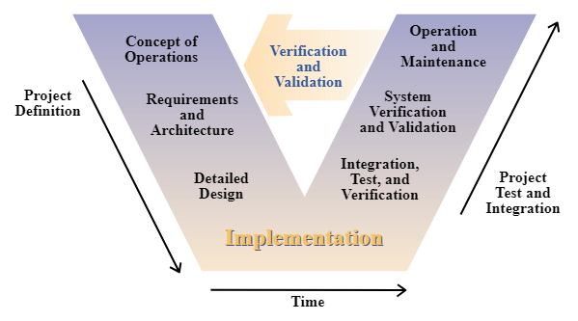
Systems Engineering - Overhead “V” Waterfall design
Initial Trade’s and Design
Wrap Up Operations
Functional and Design Req’s
System Test and Integration
Detailed Design
Unit Testing and Integration
System Integration stopping point:
Integration of Propulsion system with Electronics payload for Thermal testing
Project Purpose and Objectives
Design Description
Testing Overview and Results
Systems Engineering
Project Management
Backup Slides
Notes:
Make our own V

Slide 66
Systems Engineering - Functional Objectives
We aim to improve upon the longevity and data collecting capabilities of the current HYFLITS payload.
We aim to provide a product that provides ease of use and safety to both those involved and not involved with launch and mission duration.
The HALO system will be cost effective relative to the improved data collection capabilities of the system.
Project Purpose and Objectives
Design Description
Testing Overview and Results
Systems Engineering
Project Management
Backup Slides
Notes:
Nolan

Slide 67
Systems Engineering - Initial design and trade studies
Project Purpose and Objectives
Design Description
Testing Overview and Results
Systems Engineering
Project Management
Backup Slides
Notes:
Nolan

Slide 68
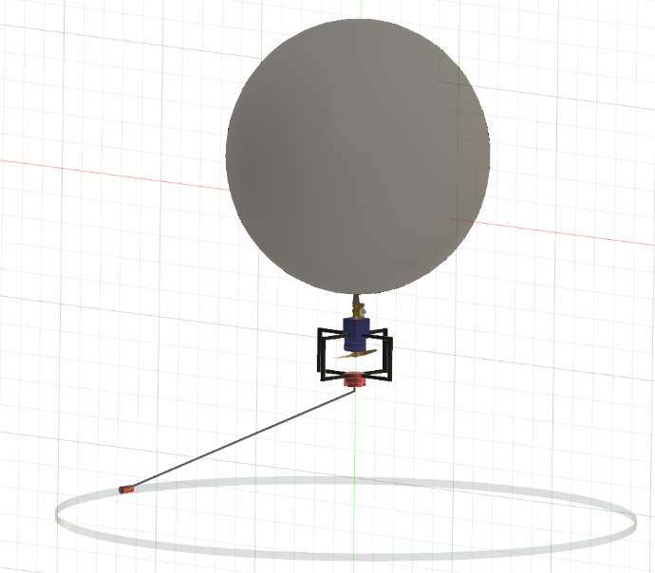
Systems Engineering - Initial design and trade studies
PDR Design:
V-model: Concept of Operations
Trades studies focuses
Balloon
Release valve for balloon neck
Lifting/orbiter type
Insulation Material
Tether design
Lifting Orbiter
Payload
Project Purpose and Objectives
Design Description
Testing Overview and Results
Systems Engineering
Project Management
Backup Slides
68
Notes:
Nolan

Slide 69
Systems Engineering - Requirements/Architecture
FR # |  | # of DRs
1.0 | There will be a method of controlling the altitude of the balloon and payload. | 2
2.0 | The payload must be capable of orbiting beneath the balloon. | 2
3.0 | The payload must be able to survive the conditions presented throughout the entirety of the mission. | 3
4.0 | The payload will be able to transmit collected data to the ground receiver. | 1
5.0 | Balloon and its payload must meet all FAA guidelines, including those subjecting the balloon and its payload to designation as an unregulated balloon. In addition, Balloon and payload shall meet specifications set forth by customer. | 4
6.0 | The balloon will terminate flight resulting in a controlled descent upon mission completion. | 1
7.0 | As specified by the customer, the balloon must contain a controlled descent arrest system (CDAS) to prevent harm to property or person upon balloon burst. | 2
8.0 | As specified by the customer, Launch setup must be able to be conducted by a maximum of two people, and launch must be able to be conducted by a single individual. | 2
9.0 | Project HALO will cost no more than $5,000 to develop, and no more than $2,000 per flight when components are purchased in quantities of 50. | --
Project Purpose and Objectives
Design Description
Testing Overview and Results
Systems Engineering
Project Management
Backup Slides
Notes:
Nolan
Maybe appendix this

Slide 70
Systems Engineering - Functional Objectives/Requirements
We aim to improve upon the longevity and data collecting capabilities of the current HYFLITS payload.
We aim to provide a product that provides ease of use and safety to both those involved and not involved with launch and mission duration.
The HALO system will be cost effective relative to the improved data collection capabilities of the system.
FR #
1.0 | There will be a method of controlling the altitude of the balloon and payload.
2.0 | The payload must be capable of orbiting beneath the balloon.
3.0 | The payload must be able to survive the conditions presented...
4.0 | The payload will be able to transmit collected data to the ground receiver.
5.0 | Balloon and its payload must meet all FAA guidelines, including those subjecting the balloon and its payload to designation as an unregulated balloon...
6.0 | The balloon will terminate flight resulting in a controlled descent upon mission completion.
7.0 | As specified by the customer, the balloon must contain a controlled descent arrest system…
8.0 | As specified by the customer, Launch setup must be able to be conducted by a maximum of two people…
9.0 | Project HALO will cost no more than $5,000 to develop, and no more than $2,000 per flight…
Project Purpose and Objectives
Design Description
Testing Overview and Results
Systems Engineering
Project Management
Backup Slides
Notes:
Nolan

Slide 71
Systems Engineering - Risk Assessment
5 step methodology
Identify, Predict Failure Modes, Asses Effects of Failure, Estimate Likelihood, Quantify Risk
How is HALO different?
Team conducted risk management
Project Purpose and Objectives
Design Description
Testing Overview and Results
Systems Engineering
Project Management
Backup Slides
Notes:
Nolan
Unfinished
No i’m pretty sure this is finished - dave

Slide 72
Systems Engineering - Key Challenges and Lessons Learned
Key Challenges
Functional Requirement pertaining to being an unregulated balloon payload
Designed payload to meet FAA requirements, without considering true nature of the payload
Under-assignment of members to Software-Electronics team
Software-Electronics team ultimately over assigned work with respect lead position roles, and as a result found deadlines difficult to meet
Reassignment of Hardware team members may have alleviated this
Work assignment to subteams occasionally fell to PM
Lessons Learned
FAA appeal earlier could have identified the payload sooner into design process, and did not consider it as a major risk
Prioritization of Systems work over individual research or work
Project Purpose and Objectives
Design Description
Testing Overview and Results
Systems Engineering
Project Management
Backup Slides
Notes:
Adding stuff to risk I reckon; faa req and bureaucracy change to risk matrix

Slide 73
Project Management
Approach: democratic
2 full team meetings per week
Progress reports, work as a group, plan ahead
Open discussions and voting on decisions whenever possible
Key Successes
Weekly meetings with Prof. Lawrence to discuss concerns and improvements
Maintaining positive team chemistry
Difficulties
Testing plans were typically too ambitious
Restriction on final flight test per CU administration
Major design changes after CDD
Lessons learned
Meetings with project customer & advisor are invaluable
Multiple layers of regulation need to be considered
Planning with margin is important, but being too ambitious can be counterproductive
Project Purpose and Objectives
Design Description
Testing Overview and Results
Systems Engineering
Project Management
Backup Slides
Notes:
My project management approach was typically democatic: I tried to facilitate open discussion and bring major decisions to a vote. We’re all peers on this project, so my opinion shouldn’t carry more weight than anybody else’s. One of our biggest sources of success came from our weekly meetings with Prof. Lawrence; this kept us on track with weekly deliverables and made sure we weren’t going down the wrong path. Our largest difficulty arose in terms of scheduling; our test plans were typically too ambitious, causing us to constantly generate new test plans - was counterproductive. One other significant difficulty was the major design change to our project after CDD which Nolan discussed previously; this left us pressed for time at the end of the Fall semester. Needless to say we learned a ton from this experience. Some main takeaways are that meetings with the project customer & advisor were incredibly valuable, all layers of regulation need to be considered when finalizing a design, and realistic planning is essential.

Slide 74
CDR Budget vs Final Budget
Estimated Spent: $1,510.57
Estimated margin: $3,489.43
Total spent: $2,862.97
Total margin: $2,137.03
Project Purpose and Objectives
Design Description
Testing Overview and Results
Systems Engineering
Project Management
Backup Slides
Notes:
Significant Differences
We used some of our extra margin to buy duplicate arduinos and IMU’s and Radios so that more people could be writing software simultaneously
Our customer had us build our own ground station even though we were originally supposed to be using his
We added some more tests which increased costs
Lastly, there were a bunch of small little things that we did not take into account at CDR. Simple things like x-acto knives and jumper wires and mounting hardware eventually added up to a few hundred dollars
Shipping costs
However, we knew we had so much extra margin so we prioritized building efficiency over cost.
Final Tests
Everything except the crane was paid for to do the final tests. We had the system built and already purchased the helium.

Slide 75
Effort Expended (needs update, see rubric)
Labor Hours | Labor Costs* | Materials | Total
3,196 | $299,625 | $2,862.97 | $302,487.97
*Assumes yearly salary of $65,000 for 2080 hours of work and 200% overhead
Project Purpose and Objectives
Design Description
Testing Overview and Results
Systems Engineering
Project Management
Backup Slides

Slide 76
Concept of Operations
Questions?
Altitude (km)
- Data transmission/acquisition
Multiple ascent/descent phase, payload continues orbiting outside wake
5
Payload begins orbiting outside balloon wake
6
40
4
Balloon begins venting toward neutral buoyancy
35
7
Low system battery. Flight arrest by venting
30
3
Tether passively extended
25
Telemetry/data transmission between 25 and 35 km. Range of 100 km
1
Ground setup by at most two people
2
Single-person balloon launch
Design
CPE’s
Reqts
Verification
Risks
Summary
Backups

Slide 77
References

Slide 78
References
Overview
Schedule
Test Readiness
Budget
Backups

Slide 79
References
Overview
Schedule
Manufacturing
Budget
Backups

Slide 80
References
Overview
Schedule
Test Readiness
Budget
Backups

Slide 81
Backup Slides
Overview
Schedule
Test Readiness
Budget
Backups

Slide 82
Testing Backup Slides
Overview
Schedule
Test Readiness
Budget
Backups

Slide 83
Software Dry Run Test: Motor
Testing
Ability to spin large properly
Ability to quickly change throttle
Procedure
Run throttle sequence 1-100 at 1% increment
Run throttle sequence 10% steps
Run throttle sequence 30% jumps up / down
Results
Motor output enough torque based on RPM
Motor able to meet specifications
Implication
When creating orbit throttle sequence there are no limitations
No Arduino & ESC interfacing problems
Notes:
Hmm this slide need kelly again. Did we get the torque? I honestly don’t remember if we did or how?? - Nolan
Anyway, add some graphics

Slide 84
Software: Main Block
Legend
10 Hz
10 Hz
Project Purpose and Objectives
Design Description
Testing Overview and Results
Systems Engineering
Project Management
Backup Slides
Notes:
Nolan

Slide 85
Software: Motor Control
Legend
β
Project Purpose and Objectives
Design Description
Testing Overview and Results
Systems Engineering
Project Management
Backup Slides
Notes:
Nolan

Slide 86
Software: Tail Actuation
Legend
10 Hz
Project Purpose and Objectives
Design Description
Testing Overview and Results
Systems Engineering
Project Management
Backup Slides
Notes:
Nolan

Slide 87
Software: Neutral Buoyancy Acquisition
Legend
10 Hz
Project Purpose and Objectives
Design Description
Testing Overview and Results
Systems Engineering
Project Management
Backup Slides
Notes:
Nolan

Slide 88
Software: Thermal Control
Using p-channel MOSFET as a relay switch
On/off Arduino pin control
Less than 0ºC will result in “on” command from Arduino
4-6 50 Ω resistors will be supplied with 3.6 V (1-1.5 W)
Project Purpose and Objectives
Design Description
Testing Overview and Results
Systems Engineering
Project Management
Backup Slides
Notes:
Nolan

Slide 89
Testing Breakdown
Orbit Acquisition
Descent Arrest
Lift Generation
Software Dry Run Test
Propeller Thrust Test
Orbit Acquisition Test
Moored Test
Propeller Thrust Test
Neutral Buoyancy
Data Transmission
Survivability
Tether Impulse Test
Electronics Survivability Test
Neutral Buoyancy Test
Electronics Survivability Test
Project Purpose and Objectives
Design Description
Testing Overview and Results
Systems Engineering
Project Management
Backup Slides

Slide 90
FAA Update
CU administration is requiring an FAA waiver to conduct final systems test
Potential for airship classification
Waiting on official response from FAA
Cannot conduct untethered flight until further notice
Likely will not hear back in time to conduct flight test
Project Purpose and Objectives
Design Description
Testing Overview and Results
Systems Engineering
Project Management
Backup Slides

Slide 91
Propeller Thrust Test: Results
There is a lot of noise and erratic behavior
Expected clearer “jumps” and less oscillations
Alludes to low resolution from load cell
Project Purpose and Objectives
Design Description
Testing Overview and Results
Systems Engineering
Project Management
Backup Slides
Notes:
Resolution was 0.1 lbf (only to tenths place) = 0.444822 N

Slide 92
Overview Backup Slides
Overview
Schedule
Test Readiness
Budget
Backups

Slide 93
Systems Engineering - Functional Objectives/Requirements
V-model: Requirements/Architecture
We aim to improve upon the longevity and data collecting capabilities of the current HYFLITS payload.
We aim to provide a product that provides ease of use and safety to both those involved and not involved with launch and mission duration.
The HALO system will be cost effective relative to the improved data collection capabilities of the system.
FR #
1.0 | There will be a method of controlling the altitude of the balloon and payload.
2.0 | The payload must be capable of orbiting beneath the balloon.
3.0 | The payload must be able to survive the conditions presented...
4.0 | The payload will be able to transmit collected data to the ground receiver.
5.0 | Balloon and its payload must meet all FAA guidelines, including those subjecting the balloon and its payload to designation as an unregulated balloon...
6.0 | The balloon will terminate flight resulting in a controlled descent upon mission completion.
7.0 | As specified by the customer, the balloon must contain a controlled descent arrest system…
8.0 | As specified by the customer, Launch setup must be able to be conducted by a maximum of two people…
9.0 | Project HALO will cost no more than $5,000 to develop, and no more than $2,000 per flight…
Project Purpose and Objectives
Design Description
Testing Overview and Results
Systems Engineering
Project Management
Backup Slides
Notes:
Nolan

Slide 94
TRR Work Plan
MSR
Legend
TRR
Deliverable
Software
Manufacturing
Manufacturing Focus
Testing
We are here
SFR
Critical Path
Testing Focus
PFR
Project Purpose and Objectives
Design Description
Testing Overview and Results
Systems Engineering
Project Management
Backup Slides

Slide 95
Work Breakdown Structure
Deliverables
Manufacturing
Software
Testing
Orbit acquisition test
CDR
Assemble orbit acquisition test wing
Outline control system pseudocodes
CDAS drop test
FFR
Acquire components for 3 wings
Tether breakage test
Preliminary Software Interfacing
Legend
MSR
Electronics survivability test
Complete
Assemble each wing
Develop data transmission automation
TRR
Software dry run tests
In Progress
Assemble Electronics Package
AIAA Paper
Propeller thrust test
Develop propulsion control system
Incomplete
Assemble deployment stand
Data transmission test
SFR
Assemble flight test system
Develop control surface automation
Orbit Acquisition Test
Project Final Report
Moored Test
Develop venting control system
Neutral Buoyancy test
Project Purpose and Objectives
Design Description
Testing Overview and Results
Test Results
Systems Engineering
Project Management
Backup Slides

Slide 96
TRR Test Plan
Test | Location | Special Equipment | Planned Date
CDAS Drop Test | CU Aerospace Building | Parachute | 1/29/20
Tether Impulse Test | CU Aerospace Building | Tether, Force Scale, Masses | 2/23/20
Electronics Survivability Tests | CU Aerospace Building | Electronics Package, Pressure Chamber, Dry Ice | 2/26/20
Software Dry Run Test | CU Aerospace Building | Electronics Package, Wing, Tail, Servo | 3/1/20
Propeller Thrust Test | CU Aerospace Building | Propeller, Force Scale | 3/1/20
Data Transmission Test | Surrounding Area | Transmitter, Receiver, Electronics Package | 3/8/20
Orbit Acquisition Test | CU Aerospace Building | Scaled Lifting Orbiter, Tether, Crane / Open area | 3/15/20
Moored Test | CU Boulder South | Tether, Lifting Orbiter, Balloon | 3/22/20
Neutral Buoyancy Test | Marshall Mesa Site | Balloon, Receiving Antenna | 3/29/20
Legend
Completed
Incomplete
Added
Project Purpose and Objectives
Design Description
Testing Overview and Results
Systems Engineering
Project Management
Backup Slides

Slide 97
Mission Statement
HALO aims to improve the process of collecting turbulence data in the stratosphere. This will be accomplished by designing a tethered payload system that will autonomously execute orbits outside of the balloon wake with the help of control surfaces. These surfaces will also help induce altitude oscillations, increasing the amount of data collection per flight.
Overview
Schedule
Test Readiness
Budget
Backups
Notes:
Paolo

Slide 98
Levels of Success
 | Tethered Orbiter | Altitude | Data Collection | Descent Arrest
Level I | The payload shall orbit below the balloon. This orbit will be stable and periodic. | The balloon and payload will achieve a target altitude of 150 ft and be neutrally buoyant via Moored test. The balloon will remain at this altitude until termination. | The orbiting payload will contain an IMU and GPS to verify a successful orbiter trajectory. This data will will be transmitted to a receiving antenna throughout the Moored test. | System will include a fail-safe descent arresting device in the event of balloon burst. The payload will then enter a controlled descent at a maximum speed of 5 m/s.
Level II | The payload will be in a stable orbit below the balloon, demonstrating the ability to remove itself from the wake. It will also generate enough lift or drag to bring the balloon and payload to a velocity of 2m/s +/- 20% in ascent and descent. | Controls will be implemented that will allow the tethered orbiter to change the balloon and payload altitude. The balloon will reach neutral buoyancy at 20 km, descend to 15 km, ascend to 25 km, and terminate. GPS measurements will be used to approximate the altitude of the balloon. These altitudes will be allowed an uncertainty of 1 km. | Temperature, GPS, and IMU data will be collected on the payload throughout its flight. This data will be transmitted to a receiving antenna during flight. | Controlled descent will be initiated autonomously as triggered by low battery notification on board.
Level III | The stable payload orbit will remain fully outside the balloon wake for the entire flight, ignoring occasional perturbations due to wind gusting. It also must be capable of generating lift or drag to bring the balloon system to a velocity of 2 m/s +/- 20% during ascent or descent. Orbiter speed will not introduce turbulence measurement bias. | The payload will reach a target altitude of 30 km and then oscillate between 25 km to 35 km until power depletion. GPS measurements will approximate the altitude of the balloon. These altitudes will be allowed an uncertainty of 1 km. | Turbulence sensors will be incorporated
Overview
Schedule
Manufacturing
Budget
Backups
Notes:
Want to split into 3 sections on this page, each section will represent the equivalent stages in each section as pictures → will describe them and have this table in the backup slides.

Slide 99
MSR Work Plan
MSR
Legend
Manufacturing Focus
Deliverable
Management
TRR
Software
Manufacturing
Testing
SFR
Testing Focus
Critical Path
PFR
Altered Tasks
Overview
Schedule
Test Readiness
Budget
Backups
Notes:
20%: Review the project schedule, showing overall progress toward goals including all major tasks, milestones and the critical path. Discuss any major changes in the project schedule since CDR.

Slide 100
Organizational Chart
Dale Lawrence
Customer
Matt Rhode
Advisor
David Cease
Project Manager
Jared Dempewolf
Testing and Verification
Nolan Ferguson
Systems Engineer
Paolo Wilczak
CFO
Jake Marvin
Safety
Kelly Crombie
Software
Kyle Mcgue
Thermal
Braden Barkemeyer
Aerodynamics
Tyler Faragallah
Manufacturing
Ryan Lansdon
Electronics
Overview
Schedule
Test Readiness
Budget
Backups
Notes:
David

Slide 101
Manufacturing Backup Slides
Overview
Schedule
Test Readiness
Budget
Backups

Slide 102
Manufacturing Overview
Manufactured
Testing
Wings/Booms
Motor Mount
Safety-System Connections
Balloon Vent
Drop Test assembly
Tether/Force scale assembly
Software
Electronics Assembled
Data Transmission Code
Orbit Acquisition Code
Motor Control Code
Tail Actuation Control Code
Venting Code
Thermal Control Code
Electronics Bay
Lifting Orbiter
Overview
Schedule
Test Readiness
Budget
Backups
Notes:
Hot wire cutting
3D printed payload bay
Electronics package
Miscellaneous
Describe the status of the manufacturing tasks, showing engineering details and analyses as needed to convey a solid understanding of the task and what is important for project success. Be sure to describe what items (software, hardware, assembly, testing, etc?) are left to "manufacture" and identify design components that you anticipate to be the most challenging or time consuming now that you have a better handle on what it will take to complete your project. Use engineering methods to convey project status with respect to manufacturing via CAD models, detailed dimensioned and tolerance drawings, calculation results (e.g. mechanical – analysis of tolerance stack up, electrical – results from circuit analysis or rationale for manufacturing strategy, etc.), detailed flowcharts and etc.

Slide 103
Purchased Components
Hardware
Electronics
Foam
3D Printing Filament
Carbon Spars
Kevlar Tether
Propeller
Balloon
Swivels and Slip Rings
Load Cell
Tether Deployment Spool
Battery
ESC
Motor
Arduino
Servos
Thermal Resistors
Relay Switch (p-MOSFET)
IMU
Transceivers
Motor Mount with ESC
Overview
Schedule
Test Readiness
Budget
Backups

Slide 104
Vent for Balloon Neck
Verified functional vent with improved servo actuation (24 Jan)
Vent has flight heritage
Verified to work up to 32.5 km
Vent affixed to balloon neck using fiber tape
Overview
Schedule
Test Readiness
Budget
Backups
Notes:
Nolan
We altered the vent from the customer. We ran a component test with communication from Arduino and feel good going forward.

Slide 105
Tether Connection
Slip ring and comm lines
Slip ring prevents comm lines from tangling with tether
Tether connected with fishing swivel
Tether wraps around wing
Tether attached to vent via hose-clamp
Overview
Schedule
Test Readiness
Budget
Backups
Notes:
Will also be discussed, no additional text needed beyond the images

Slide 106
Wings: Hot Wire Cutting
Completed training with current student
Operator (30 Jan)
Small test cuts completed on Monday (03 Feb)
Use Profili Pro 2 Program to create G-code
Prototype airfoil section scheduled for Friday (07 Feb)
Hot Wire Cutting Station
Overview
Schedule
Test Readiness
Budget
Backups
Notes:
What exactly is the plan for foam cutting?

Slide 107
Wings: Spar Alignment Sketch For Main Airfoil
95.5 cm
95.5 cm
95.5 cm
91.5 cm
91.5 cm
Carbon Fiber Spars
Overview
Schedule
Test Readiness
Budget
Backups
Notes:
Spar locations will be verified from a further structural analysis
They will be placed at points that have enough foam to support the holes
Holes are to be made after cutting the foam to shape
The holes will coincide with the holes on the other pieces
3 parts for the wing (electronics package in the middle part)

Slide 108
Tail Boom: Spar Attachment Sketch
Two carbon fiber rods
Placed on either side of the electronics package
Spar Attachment
Overview
Schedule
Test Readiness
Budget
Backups

Slide 109
Tail Boom: Spar Attachment Sketch
Overview
Schedule
Test Readiness
Budget
Backups

Slide 110
Tail Boom: Spar Attachment CAD
Payload Bay
Tail control servo
Tail control horn
NOTE: Control link between servo and control horn not shown
Overview
Schedule
Test Readiness
Budget
Backups

Slide 111
3D Printing: Payload Bay
3D printed chassis to keep electronics aligned
NOT a structural element
Electronics Bay
3D Printer
Overview
Schedule
Test Readiness
Budget
Backups

Slide 112
Software: Overview Status
Electronics Component | Status | Next Step
Arduino Mega | Completed Preliminary Interfacing | Integrate Main Functions
ESC | Completed Preliminary Interfacing | Develop Motor Control Loop
Motor | Completed Preliminary Interfacing | Develop Motor Control Loop
GPS | Completed Preliminary Interfacing | Data Transmission Test
IMU | Completed Preliminary Interfacing | Develop β Angle Determination
Vent | Completed Preliminary Interfacing | Develop Vent Control Loop
Temperature Sensors | Basic Wiring Complete, No Interfacing | Preliminary Arduino Interfacing
XBee Transceiver | No Interfacing | Preliminary Arduino Interfacing and Data Transmission Test
Overview
Schedule
Test Readiness
Budget
Backups
Notes:
Nolan

Slide 113
Drilling into Foam for Carbon Spar Mounting
Tools capable of drilling into foam for carbon spar mounting: Standard Spade Bit

Slide 114
Hot Wire Cutting G-Code
Overview
Schedule
Test Readiness
Budget
Backups

Slide 115
Servo Shot #2
Overview
Schedule
Test Readiness
Budget
Backups
Notes:
http://www.chem.hawaii.edu/uham/part101.html

Slide 116
Electronics
Component | Chosen | Voltage [V] | Current [mA] | Mass [g] | Powered by:
GPS | Adafruit Ultimate | 3.3 | 25 | 8.5 | 3.3V Arduino pin
Arduino | Arduino Mega | 7.6 | 100 | 53 | LG MU1 barrel connector
IMU | Sparkfun 9DoF Razor IMU | 5 | 10 | 15 | 5V Arduino pin
Radio Transceiver | Radio Transceiver | 3.3 | 150 | 3 | 3.3V Arduino pin
Arduino Battery | 2 x LG MU1 18650 | 7.6 | NA | 2 x 49 = 98 | NA
Temperature Sensor | TMP36 | 3.3 | 5 | 1 | 3.3V Arduino pin
Overview
Schedule
Test Readiness
Budget
Backups

Slide 117
Software Backup Slides

Slide 118
Software: Data Transmission
IMU, GPS, and temperature sensor measurements will be transmitted to ground receiver
Data transmission test will be held 2/15 to determine data rate, transmission rate, and transmission range
Overview
Schedule
Test Readiness
Budget
Backups

Slide 119
Software: Orbit Acquisition
Motor will be throttled to attain orbit
Throttle amount will be determined with scaled flight test
If orbit is not acquired, motor will turn off and try again after a minute
Motor has been successfully interfaced with Arduino Mega
Overview
Schedule
Test Readiness
Budget
Backups

Slide 120
Venting Backup Slides

Slide 121
Balloon Purpose
Balloon will transport the payload to maximum altitude of 35 km
Burst altitude/diameter is the most significant factor to consider
Balloon will be neutrally buoyant at 30 km
This will determine our mass budget
Customer Requirements
Balloon and its payload must meet all FAA guidelines
Per customer request, balloon will meet FAA criteria for remaining unregulated
FAA guidelines can be found in appendix
FR 5.0: Balloon and payload system must meet all FAA guidelines.
High Altitude Balloon
High Altitude Balloon
Overview
Schedule
Test Readiness
Budget
Backups
Notes:
Goal of this slide is to introduce potential problems with the balloon; we want to solve these with our models or math, walk them through it.

Slide 122
Venting Design
Reusing venting system from HYFLITS mission
Verified to operate in atmospheric conditions
Can be sufficiently mounted to balloon
Venting has been experimentally modelled for this vent
FR 6.0: System must be capable of mission termination at end-of-life, determined when battery has 5% remaining.
Overview
Schedule
Test Readiness
Budget
Backups
Notes:
Narrate quick explanation of how this thing works

Slide 123
Venting Control System
GPS, battery data fed into control system
Vent until desired altitude is reached
Add battery information into this control system (check battery info, vent if battery <5%)
FR 6.0: System must be capable of mission termination at end-of-life, determined when battery has 5% remaining.
Overview
Schedule
Test Readiness
Budget
Backups

Slide 124
Venting Model
Neutral buoyancy acquired after roughly 1 hour of venting
Overview
Schedule
Test Readiness
Budget
Backups

Slide 125
Tether Backup Slides

Slide 126
Venting Purpose and Concerns
Need to vent gas to become neutrally buoyant
Neutral buoyancy decreases force needed to lift balloon
Slip Ring Connector
Overview
Schedule
Test Readiness
Budget
Backups

Slide 127
Tether Connection
Slip ring and comm lines
FR 5.0: Balloon and payload system must meet all FAA guidelines.
FR 8.0: Launch setup must be able to be conducted by a maximum of two people, but ideally one person.
Overview
Schedule
Test Readiness
Budget
Backups
Notes:
Will also be discussed, no additional text needed beyond the images

Slide 128
Tether Deployment Method
Simple and reliable ground based passive deployment method
Suitable due to our low tether length of 4.96 m
FR 5.0: Balloon and payload system must meet all FAA guidelines.
FR 8.0: Launch setup must be able to be conducted by a maximum of two people, but ideally one person.
Tether Deployment System
Overview
Schedule
Test Readiness
Budget
Backups

Slide 129
Alternate Tether Deployment Method
Modelled after passive unspooling devices used in sounding balloon missions
With a deployment rate slower than the ascent rate of the balloon there is an increased likelihood to clear obstacles in the launch zone
FR 5.0: Balloon and payload system must meet all FAA guidelines.
FR 8.0: Launch setup must be able to be conducted by a maximum of two people, but ideally one person.
Radiosonde RS41 Deployment Spool
Overview
Schedule
Test Readiness
Budget
Backups

Slide 130
Notable Risks to the Project Success - cont.
Risk | Mitigation Plan | Pre-Mitigation Likelihood | Pre-Mitigation Impact
Tether breaks | Tensile testing Impulse Generator | Severe | Improbable
Vent too much | Pressure Tank Tests | major | High likely
Wing stalls | Tetherball Moored CFD Analysis | minor | likely
Stability | Tetherball RECUV Flight Room Testing | major | likely
Software talk/initiate control surfaces | Tetherball Moored Observational Studies | Severe | likely
Overview
Schedule
Test Readiness
Budget
Backups

Slide 131
Risk Backup Slides

Slide 132
Notable Risks to the Project Success
Risk | Mitigation Plan | Pre-Mitigation Likelihood | Pre-Mitigation Impact
Unable to do actual flight test due to external factors | Conduct early and manufacture early to allow more time allotted for launching | Likely | Catastrophic
Ground tests not accurate or don’t scale properly | Compare results to CFD programs (such as XFLR, Fluent) Compare results to hand computations | High Likely | Severe
Unable to initiate orbit at altitude | Tetherball test Moored test | Likely | Catastrophic
Data transmission error | Will test reliability around mountainous surroundings of Boulder | Likely | Severe
Balloon burst | Will purchase stronger balloon material (Totex) Adding a Factor of Safety to max. height | Likely | Severe
CDAS Failure | Conduct Drop tests | Likely | Major
Overview
Schedule
Test Readiness
Budget
Backups

Slide 133
Notable Risks to the Project Success - cont.
Risk | Mitigation Plan | Pre-Mitigation Likelihood | Pre-Mitigation Impact
Q_diss too hot/cold | Tvac Testing Dry Ice Testing | severe | Low likely
Propeller disturbances propagating to sensors | Place further apart | severe | Low likely
Unit system costs | Plan out material(s) bought prior to buying Budget Plan | major | improbable
Wing being in wake | Tetherball Test | severe | likely
Foam strength | Torsion Tests | severe | Low likely
Overview
Schedule
Test Readiness
Budget
Backups

Slide 134
Testing Backup Slides

Slide 135
Schedule: Old Test Plan
Test | Location | Special Equipment | Planned Date
Tether Break | CU Aerospace Building | Tether, load cell | 1/27/20
Balloon Neck | CU Aerospace Building | Balloon, tether, load cell | 2/1/20
Thermal | CU Aerospace Building | Thermal Vacuum, electronics package | 2/4/20
Vent Adhesion | CU Aerospace Building | Balloon, vent | 2/8/20
Venting | CU Aerospace Building | Balloon, vent, pressure tank | 2/11/20
CDAS | CU Aerospace Building | Balloon, tether, CDAS | 2/15/20
Tetherball | CU Aerospace Building/Courtyard, CU Boulder South | Tether, orbiter | 2/18/20
Moored | CU Aerospace Courtyard, CU Boulder South | Balloon, tether, orbiter | 2/25/20
Final Flight Test | CU Aerospace Courtyard, CU Boulder South | Full HALO System | 4/10/20
Overview
Schedule
Test Readiness
Budget
Backups

Slide 136
Parachute Deployment Drop Test
Controlled Descent Arrest System (CDAS)

Slide 137
FAA Backup Slides

Slide 138
FAA Regulations - General
Overview
Schedule
Manufacturing
Budget
Backups
Notes:
http://www.chem.hawaii.edu/uham/part101.html

Slide 139
FAA Regulations - Moored Balloons and Kites
Overview
Schedule
Manufacturing
Budget
Backups
Notes:
http://www.chem.hawaii.edu/uham/part101.html

