Slide 1
GUST
GUST
GUST
Guided UAS Supplemented by Timing
Test Readiness Review
Project Sponsors:
Professor Penina Axelrad,
Steve Borenstein
Faculty Advisor:
Professor Dennis Akos
Presenters:
Eric Cervantes, Alex Kenyon, Chris Krebs, Nic Mayhan, Anand Trehan, Billy Weigl
Additional Group Members:
Adam Buencamino, Luke Engelken, Jake Miles-Colthup
Notes:
Chris

Slide 2
Presentation Breakdown:
Project Overview
Schedule
Test Readiness
Ground Truth System
Hardware
Software
Budget
1
2
3
A
B
C
4
Notes:
Chris

Slide 3
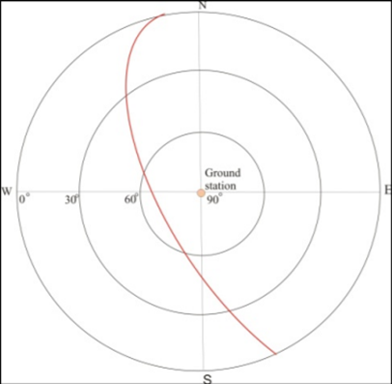
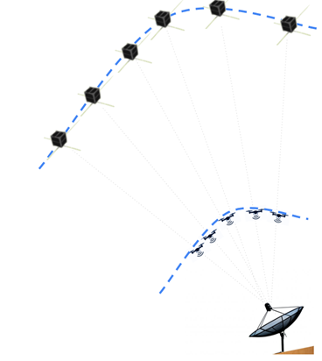
IRISS Methodology
Discretize Waypoints
Convert LEO satellite track into XYZ waypoints
Incorporate Timing
Calculate required UAS velocities to reach desired time
Upload
Send commanded XYZ waypoints and velocities to drone without closed loop timing control
Mission Execution and Termination
Vehicle flies along commanded path and completes mission
Post Processing
Vehicle Performance is validated
Project Overview
Schedule
Test Readiness:
A: GTS
B: Airframe
C: Software
Budget
Notes:
Chris
To give more context behind our project’s motivation, the IRISS research team was given the mission to emulate a low-earth orbit satellite track using a drone this past summer. In order to do this, their drone had to meet waypoints at a desired time to follow an accurate trajectory. The method to their approach is as follows:
STEP NUMBERS
-mention the 1-Hz

Slide 4
IRISS Previous Work and Motivation
Errors from IRISS flight test:
RMS Error North | RMS Error East | RMS Error Up | RMS Timing Error
3.2m | 2.7m | 9.3m | 8.2s
GUST Mission Goals:
Incorporate timing in a closed loop control algorithm used in UAS autopilot
Novel solution to current UAS autopilot software
Take in any mission specified waypoints in XYZ and time
Reach waypoints within 1-second of desired time
GPS payload: post-processed UAS positioning accuracy within 10cm
Project Overview
Schedule
Test Readiness:
A: GTS
B: Airframe
C: Software
Budget
Notes:
Chris
-We were able to obtain and analyze data from one of these summer tests and obtained the following RMS position and timing errors to compare IRISS’s true trajectory to commanded waypoints.
-Timing error is quantified as the timing differences between each commanded waypoint and true trajectory.
-These errors are …
-I will note that IRISS’s drone used Real-Time Kinematic GPS for its onboard navigation system which produces highly accurate flight trajectory measurements. This will be discussed further in later sections.
With our team, our mission goals are to
Use this novel solution to incorporate timing in a closed loop control algorithm used in UAS autopilot
Different from IRISS’s previous approach in which they had no timing feedback
Be able to take in XYZ and time waypoints. These waypoints should correspond to any given path, and IRISS’s LEO emulation trajectory is just a specific one use case example.
We also have a requirement that our post-processing evaluation system will be able to determine our drone’s trajectory with a position accuracy within 10 cm to accurately characterize our performance
Our approach of using closed-loop timing control will greatly reduce these errors, because timing errors can be fed back, allowing our drone to make in-flight corrections.
This would better accomplish IRISS’s original LEO emulation mission, but our solution will be able to fly a variety of given mission paths

Slide 5
Project Overview
Mission Statement:
The GUST team will work to modify existing autopilot software in order to implement a timing system which will enable UAVs to travel and transmit signals along a specified path in space and time
Project Overview
Schedule
Test Readiness:
A: GTS
B: Airframe
C: Software
Budget
Notes:
Chris
In short, this is our mission: to fly a UAS along a defined path, guided by a modified autopilot system which incorporates the parameter of time.
which is a novel solution to current UAV systems, as current UAS autopilots do not incorporate the parameter of time

Slide 6
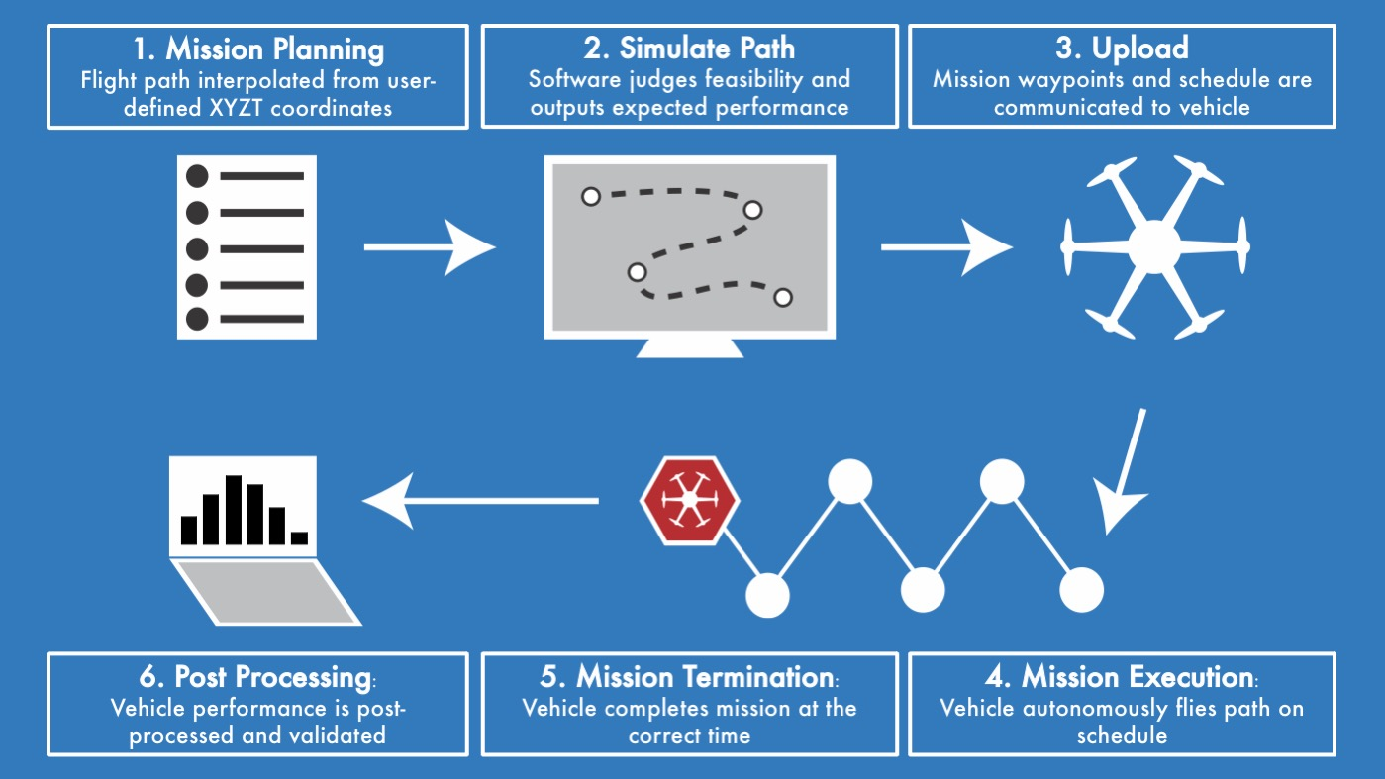
Concept of Operations (CONOPS)
Project Overview
Schedule
Test Readiness:
A: GTS
B: Airframe
C: Software
Budget
Notes:
Chris
Our projects first phase is in mission planning where in the user inputs XYZT coordinates, and a flight path is extrapolated
Of course, we need to make sure our chosen vehicle is capable of reaching each waypoint at the predetermined times, so our simulations software will judge the feasibility of the path
With feasibility confirmed, these waypoints, and crucially, the desired time to reach those waypoints, is communicated to the vehicle
Next, the vehicle flies along this path, and if successful, reaches each way point
and its destination, at the predetermined times
Finally, our ground truth system, which has tracked the location of the vehicle throughout, independently verifies the performance of our vehicle, essentially how well it followed the geographic path, and schedule

Slide 7
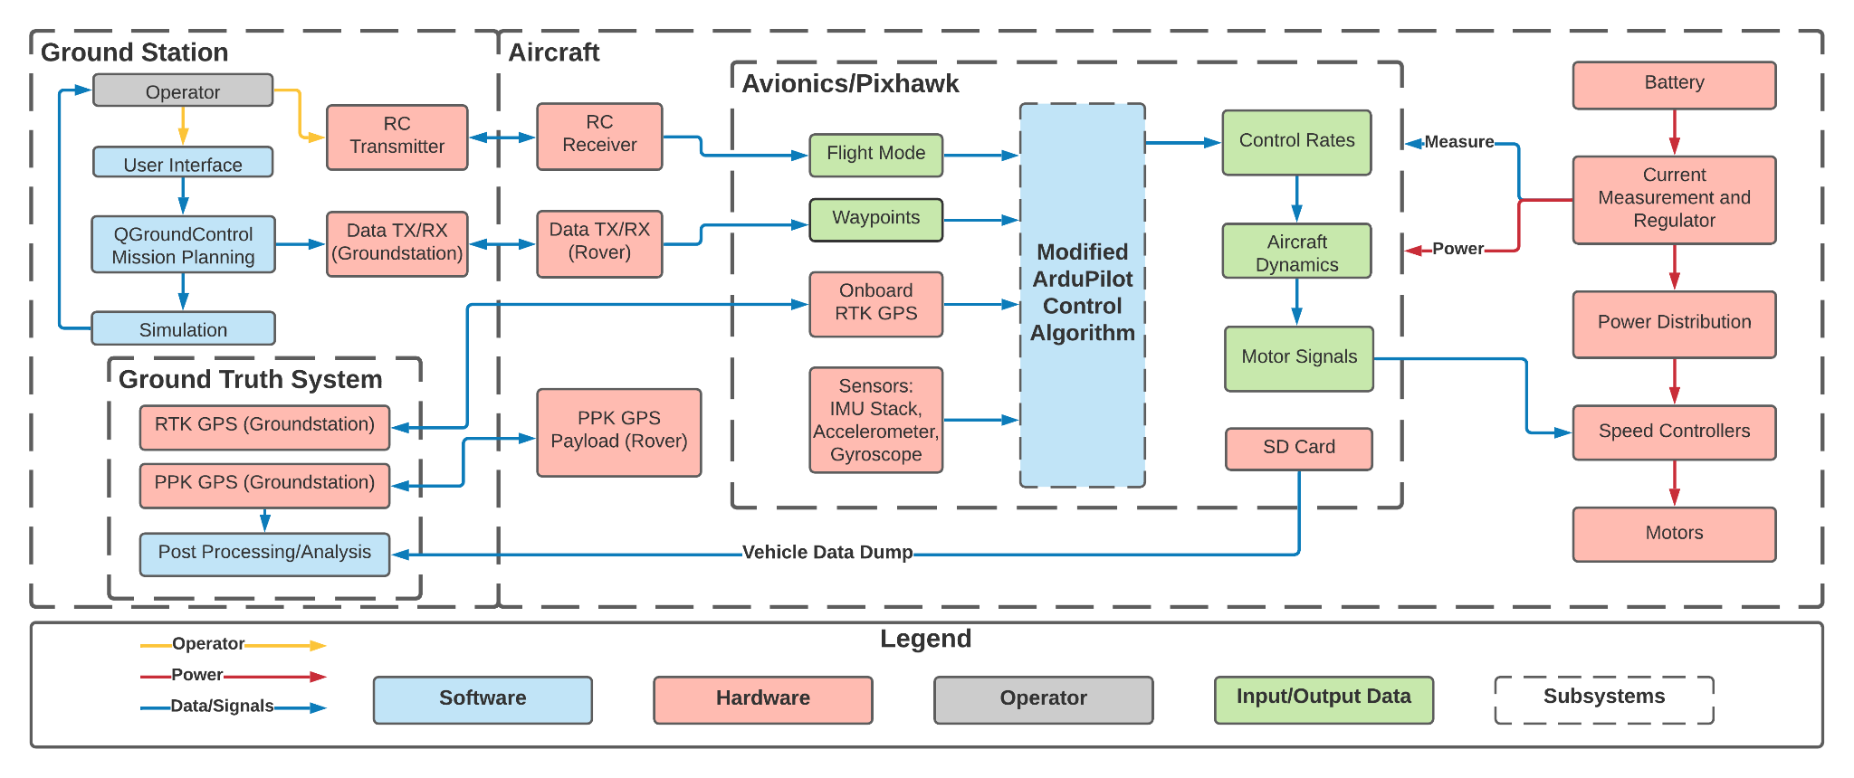
System Functional Block Diagram
Project Overview
Schedule
Test Readiness:
A: GTS
B: Airframe
C: Software
Budget
Notes:
Chris
Here is an overview of our functional block diagram. Our system interaction starts in the top left with the ground station and operator.
Here we have the functional block diagram encompassing the GUST project system interactions. Starting at the top left of the diagram we see the operator interaction with the system. Waypoint coordinates are created and passed into the QGroundControl mission planner which runs a simulation on mission feasibility before uploading the mission to the flight controller. The operator also has the ability to interact directly with the aircraft via radio link through a remote controller.
In the center of the FBD, the flight controller takes in the generated mission and various sensor and GPS data as inputs to a modified ardupilot control law which outputs the necessary control forces and moments which are passed through the aircraft dynamics to create the motor signals.
On the hardware side of things on the right of the diagram, we see power flow from the battery, through various regulators and eventually to the motors. This powertrain combines with the output motor signals to move the aircraft to the desired position.
Finally GPS data is being continuously logged by the operational payload. This is combined with ground data after the mission for post processed ground truth data to compare the vehicle’s performance against.

Slide 8
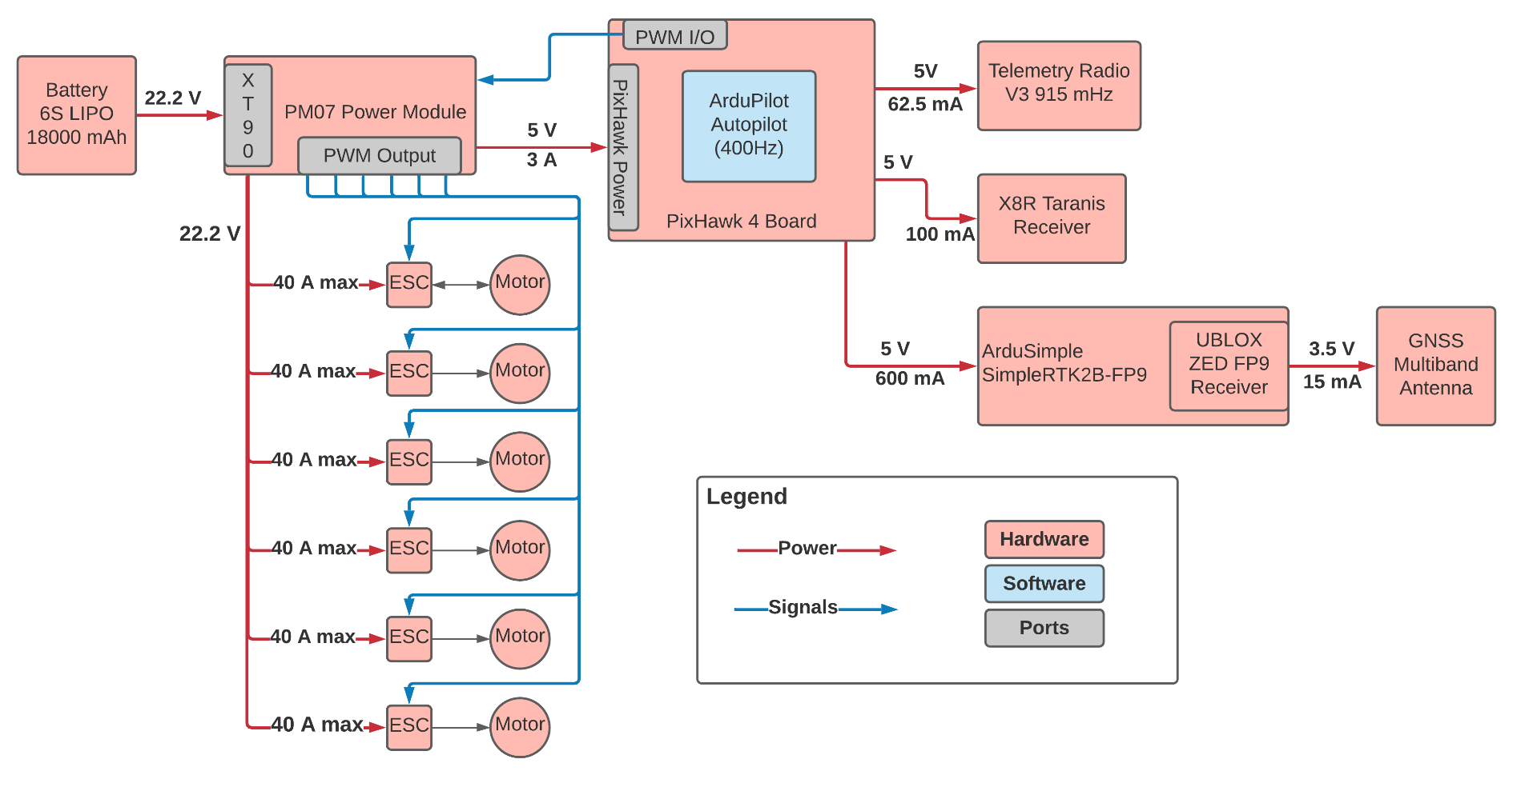
Aircraft/Avionics Functional Block Diagram
Project Overview
Schedule
Test Readiness:
A: GTS
B: Airframe
C: Software
Budget
Notes:
Jake
This block diagram goes a bit deeper into the functionality of the avionics and the integration with the aircraft. The entire system is powered by the 6S LIPO battery which sends power into the power control module. The pixhawk 4 flight controller receives power from here and regulates power out to various components including the telemetry radio, the radio receiver, and the GPS board. Additionally, the pixhawk outputs the pulse width modulation signals which are routed back through the power control module and out to the motors for flight control.

Slide 9
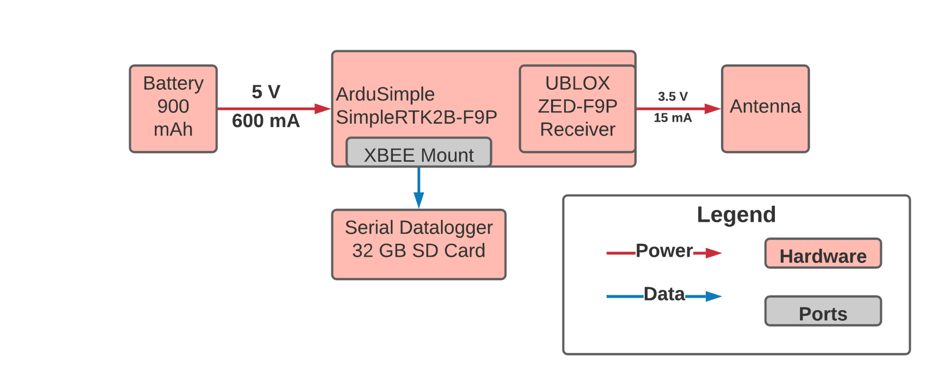
Payload Functional Block Diagram
Project Overview
Schedule
Test Readiness:
A: GTS
B: Airframe
C: Software
Budget
Notes:
Jake
Here we have a closer look at the GPS operational payload module. The payload is powered from its own 900 mAh battery and this power is sent through the ArduSimple board which contains the GPS receiver, data logger, and powers the GPS antenna system.

Slide 10
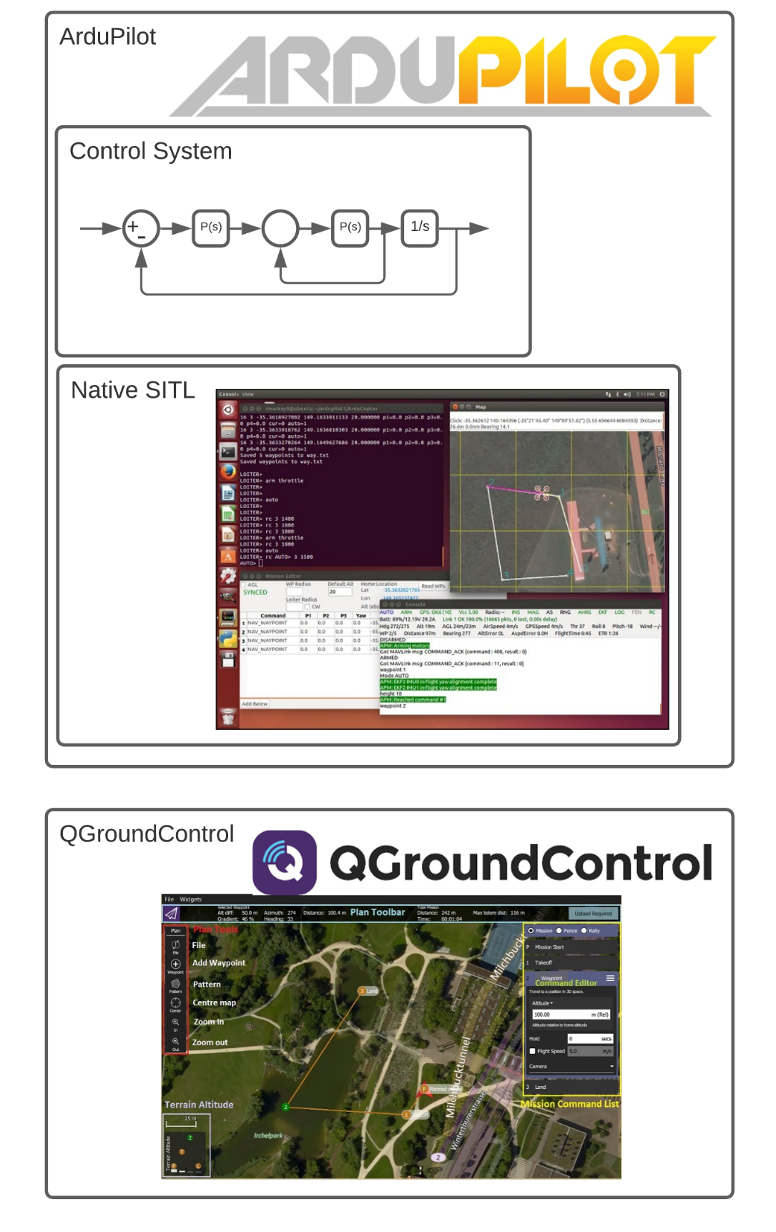
Software
Element | Selection | Reasoning
Autopilot | ArduPilot | Open source, successfully built, modifiable
Ardupilot Control System | Nested Feedback | Time and position control
Simulation | Native SITL | Builds ArduPilot code, exports logs, modifiable
Mission Planner | QGroundControl | Modifiable, takes in waypoint files
Project Overview
Schedule
Test Readiness:
A: GTS
B: Airframe
C: Software
Budget
Notes:
Jake
Moving on to the software aspects of our design solution for our autopilot, we have selected ArduPilot due to its open source and modifiable nature and have successfully built the code on the team’s machines.
For our control system to be implemented within ardupilot, we have chosen to use nested feedback loops with proportional, derivative, and integral gains for time and position control.
For the simulation aspect of our project we have chosen to use ardupilots native software in the loop simulation and have been able to successfully simulate missions.
Finally, for our mission planner we have selected QGroundControl because of its modifiable and adaptable nature as well as the ability to take in waypoint input files.

Slide 11
Critical Project Elements
CPE | Name | Description
E1 | Guidance | The multirotor mission planning software shall accept XYZT waypoints, and a feasible flight trajectory shall be passed to the control algorithm.
E2 | Control | The XYZT control algorithm shall be integrated into an already existing autopilot to adjust its flight velocity while maintaining XYZ accuracy to reach each waypoint within 1 second of the desired time.
E3 | Airframe | The UAS must be able to be controlled via an autopilot system containing the XYZT control system.
E4 | Simulation | The simulation software must be able to accurately determine whether the selected UAS is capable of completing the mission that is desired.
E5 | Ground Truth System | The Ground Truth System shall be capable of accurately determining the position of the UAS with respect to space and time and evaluating control algorithm performance.
E6 | Operations & Testing | The XYZT control system must be able to be implemented on a UAS.
Project Overview
Schedule
Test Readiness:
A: GTS
B: Airframe
C: Software
Budget
Notes:
Anand
guidance
control
airframe
Simulation
GTS
Operations and testing
The mission planner will interpolate a path from waypoints,
The control will ensure we stay on track in space and time,
The uas must be controllable via the autopilot,
The simulation will determine feasibility,
The GTS will determine the UAS position to evaluate performance,
And finally the control system must be implementable on the uas

Slide 12
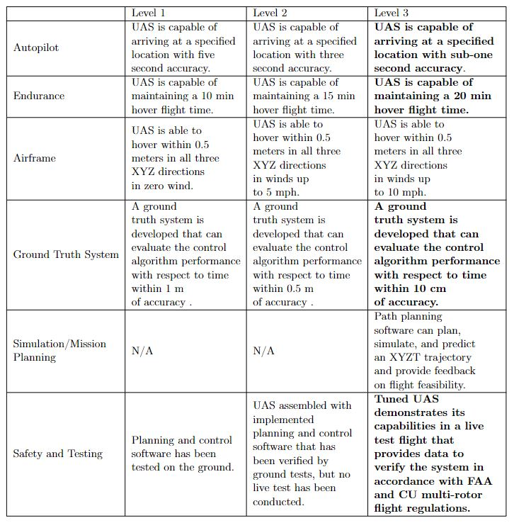
Levels of Success
Project Overview
Schedule
Test Readiness:
A: GTS
B: Airframe
C: Software
Budget
Notes:
Highlight following levels of success:
20 minute hover time, subsecond timing accuracy, GTS, safety

Slide 13
Schedule
Notes:
Anand

Slide 14
Progress Report
Subsystems
GTS/GPS | Airframe | Software/Control
- Post processing method fully tested and verified - RTK GPS system verified for basic integration with autopilot hardware - SD Data Logger is functional with PPK GPS | - All parts ordered - Nearly all parts received - Build in progress - Licenses/Memberships received | - Designed closed-loop time control algorithm and determined required code modifications - Discussed Algorithm with controls Professor Dale Lawrence - Began modifying code and added new flight submode
Project Overview
Schedule
Test Readiness:
A: GTS
B: Airframe
C: Software
Budget
Notes:
Anand

Slide 15
GANTT
Chart
Critical Deadline for testing, first integration of vehicle and software
Margin distributed to most tasks, with additional margin for the airframe build
Critical path: burden shifts from airframe to software
Project Overview
Schedule
Test Readiness:
A: GTS
B: Airframe
C: Software
Budget
Notes:
Anand

Slide 16
Testing GANTT:
- Planning to be done with GTS/GPS testing relatively early to accommodate time for software and hardware testing, keep them off the critical path
- Significant Margin for all tests/major deadlines to account for delays
- Critical Path Critical Points:
- complete airframe, preliminary testing
- ArduPilot modification/Control law for integration with airframe

Slide 17
Testing Readiness

Slide 18
Lower Level Subsystem Tests Completed
Ground Truth System
Housing: Payload enclosure designed and 3d printed
GPS Logging: ArduSimple boards configured and verified for Post Processed Kinematic (PPK) and Real Time Kinematic (RTK) functionality
Airframe
Build in progress
Software
Waypoint File Test: Create and run custom missions from text file without continuous operator input
SITL Post Processing Test: Evaluate SITL mission performance metrics
MAVLink Message Test: Communicate custom time waypoint commands to ardupilot repository
Project Overview
Schedule
Test Readiness:
A: GTS
B: Airframe
C: Software
Budget
Notes:
Input our newly created command (Command 26) that represents our timed waypoint command where the fourth input parameter is associated to the desired arrival times
Ardupilot controllers recognize time parameter
Mirroring the already implemented sub mode (waypoint auto) in our own sub mode (auto time waypoint) ardupilot was able to interpret the waypoint file

Slide 19
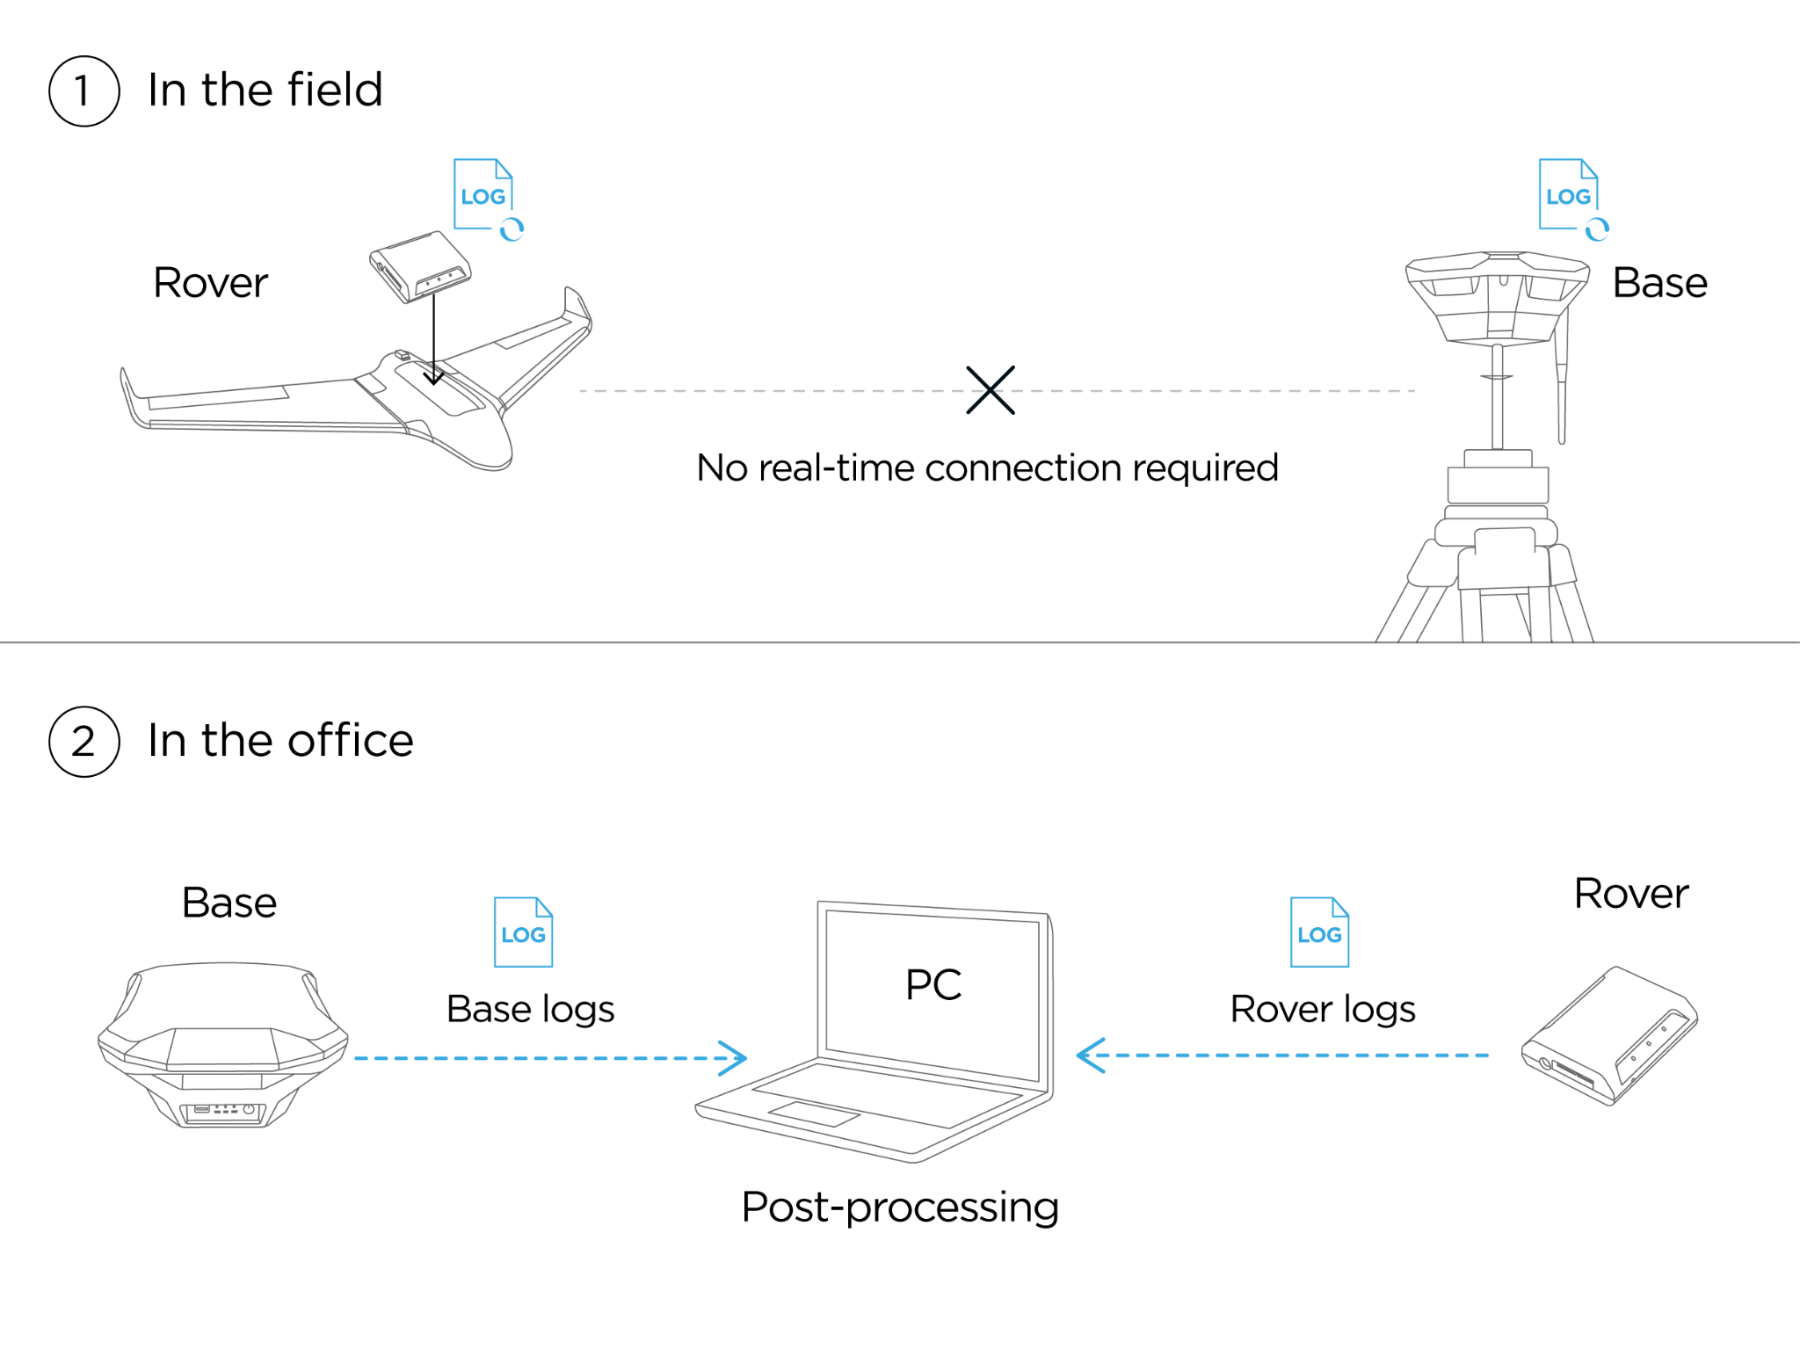
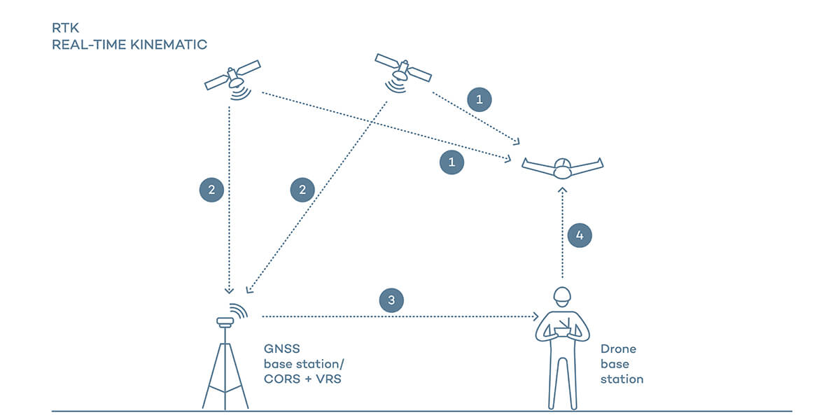
GPS Precision Verification
Status: Partial
Date: 2/9
Types of GPS Data
Standalone | Real-Time Kinematic (RTK) | Post-Processed Kinematic (PPK)
- Single receiver and antenna - Meter-level accuracy - Proves basic functionality | - More accurate than standalone - Used for onboard navigation system | - Robust and accurate, used for GTS
Project Overview
Schedule
Test Readiness:
A: GTS
B: Airframe
C: Software
Budget
Notes:
PPK is not subject to data dropouts and is listed to be able to achieve 1-3cm accuracy. Real time kinematic is what IRISS used for their onboard navigation system and a customer defined request for ours as well.

Slide 20
GPS Precision Verification
Status: Partial
Date: 2/9
Test:
Static PPK
Motivation:
Verification that GTS is capable of measuring and recording flight trajectory within 10cm
Reduce risk of vehicle position ambiguity
REQs | Description
CPE5 | Accurate drone position data from GTS
FR6 | Sufficient navigation data for control algorithm
FR7 | GTS accuracy within 10 cm
PPK Data Processing Procedure:
Configure receiver using u-center application
Enable navigation and RAW measurements
Begin collecting data from both base station and rover at same time for same duration
Save data, process as RINEX GPS files using Emlid Studio
Use either Emlid Studio or RTKlib to obtain PPK data
Resulting position file can be further analyzed in MATLAB
Project Overview
Schedule
Test Readiness:
A: GTS
B: Airframe
C: Software
Budget

Slide 21
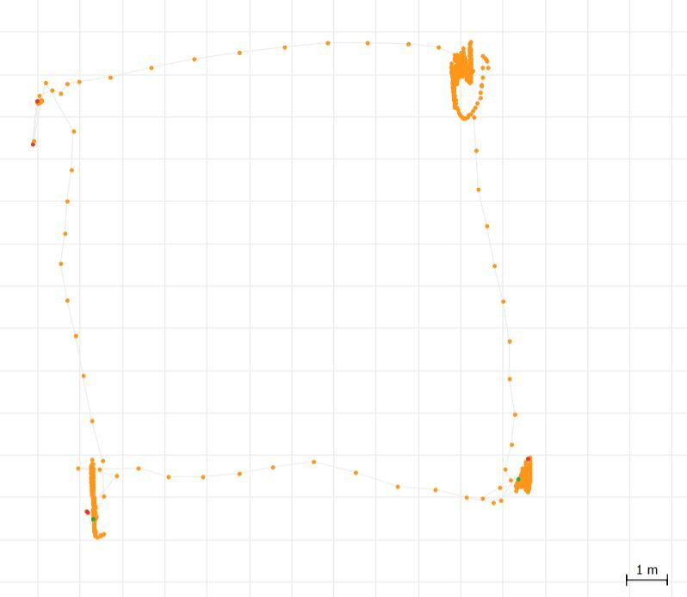
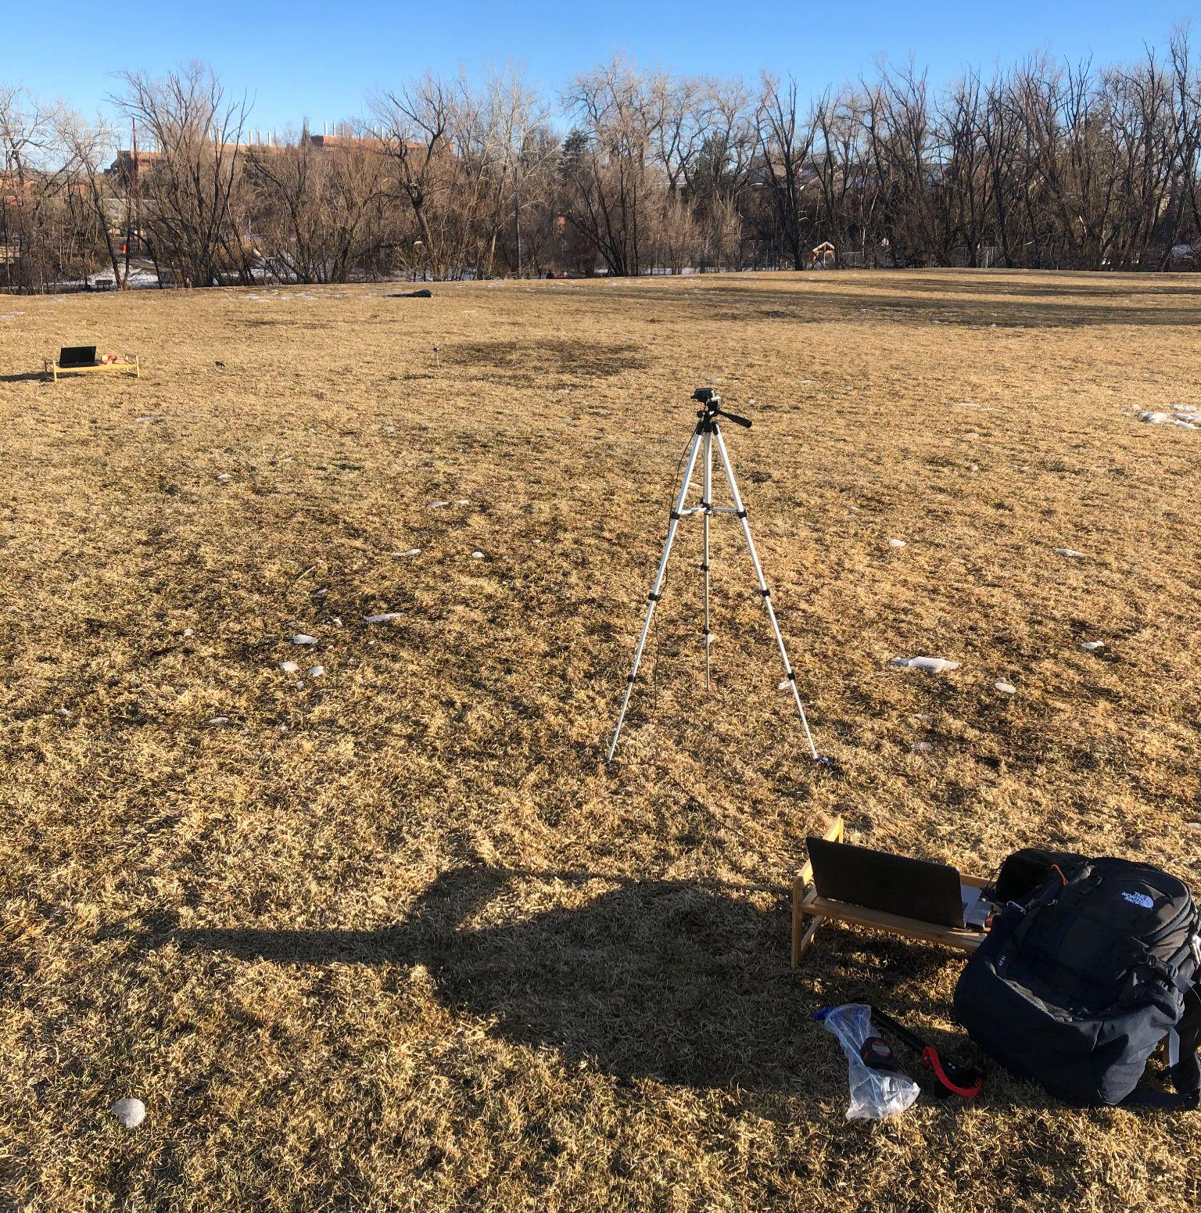
GPS Precision Verification
Status: Partial
Date: 2/9
Test:
Static PPK
Motivation:
Verification that GTS is capable of measuring and recording flight trajectory within 10cm
Reduce risk of vehicle position ambiguity
Test Procedure:
Ensure unobstructed sky for testing
Scott Carpenter Park
Set metal stakes 10 m apart in square pattern
Ensure boards are correctly configured
Begin recording data from base station
Place rover antenna on stake, record data for 5 minutes
Repeat for all stakes
Project Overview
Schedule
Test Readiness:
A: GTS
B: Airframe
C: Software
Budget

Slide 22
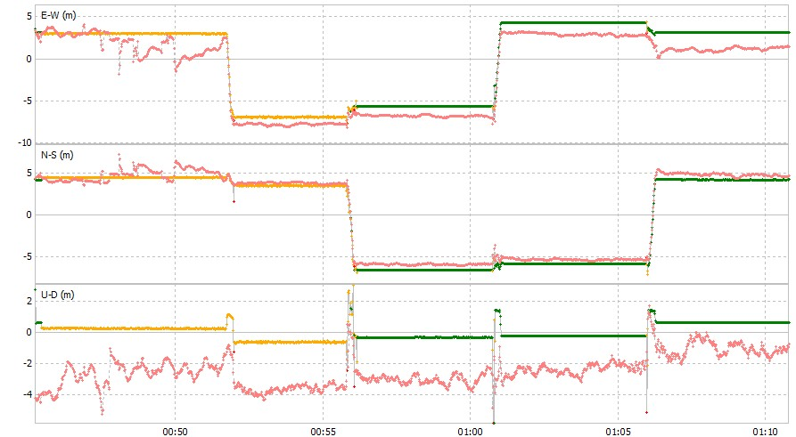
GPS Precision Verification Results
Status: Partial
Date: 2/9
PPK vs Standalone Preliminary Results:
Fixed
Float
Single
RTKlib Post Processing Software
Project Overview
Schedule
Test Readiness:
A: GTS
B: Airframe
C: Software
Budget
C: Software

Slide 23
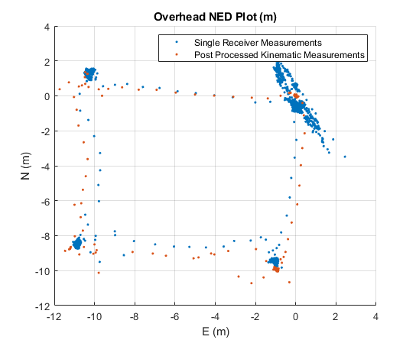
GPS Precision Verification Results
Status: Partial
Date: 2/9
PPK Preliminary Testing Results:
Summary:
Single receiver position data from ZED-F9P chip has ~0.5m precision
Adding base receiver corrections increases precision to <1cm for static case
RTK data for navigation will use similar correction process
RTK Post Processing Software
Project Overview
Schedule
Test Readiness:
A: GTS
B: Airframe
C: Software
Budget
C: Software

Slide 24
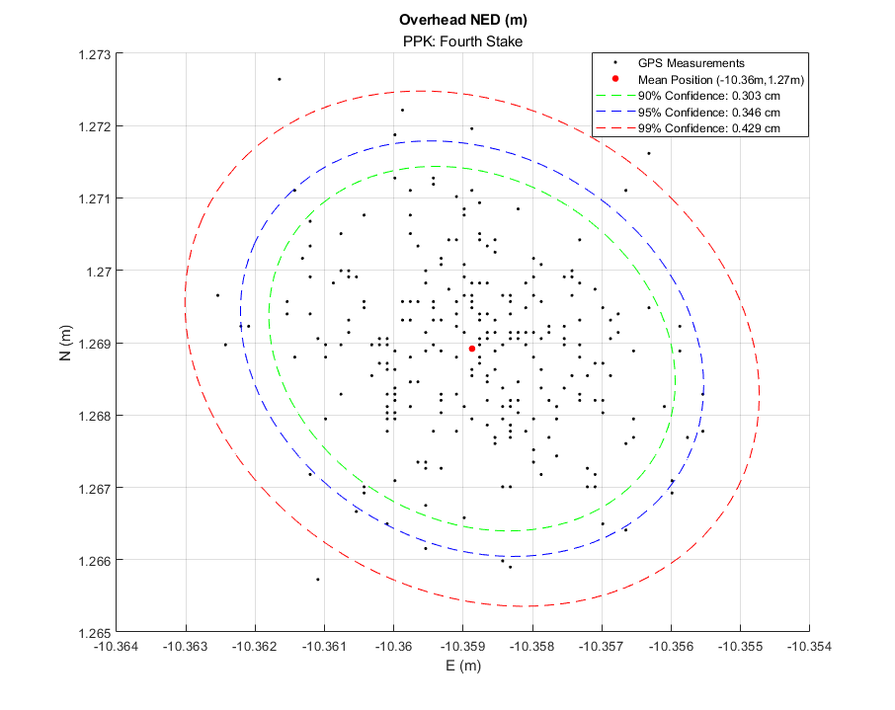
GPS Precision Verification Results
Status: Partial
Date: 2/9
Success Metrics:
Post processed (PPK) measurements shall be precise within 10cm
Success?
YES!
Next Steps:
PPK: Perform kinematic test at known velocity/times to verify timing accuracy
PPK: Perform additional static testing to ensure fix quality measurements
PPK: Perform static testing on full hardware to test for EMI effects
RTK: Complete autopilot hardware integration to save and evaluate RTK data
Project Overview
Schedule
Test Readiness:
A: GTS
B: Airframe
C: Software
Budget
C: GTS

Slide 25
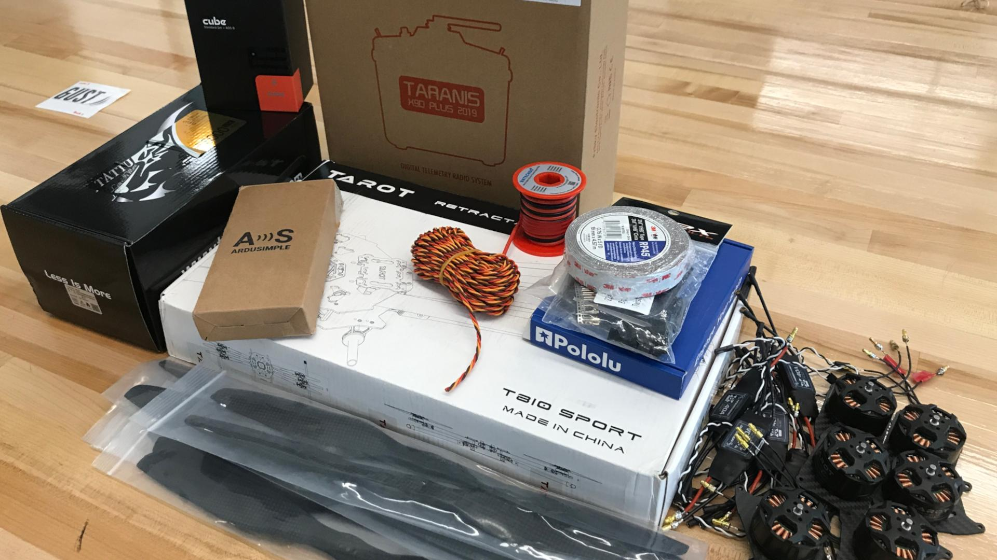
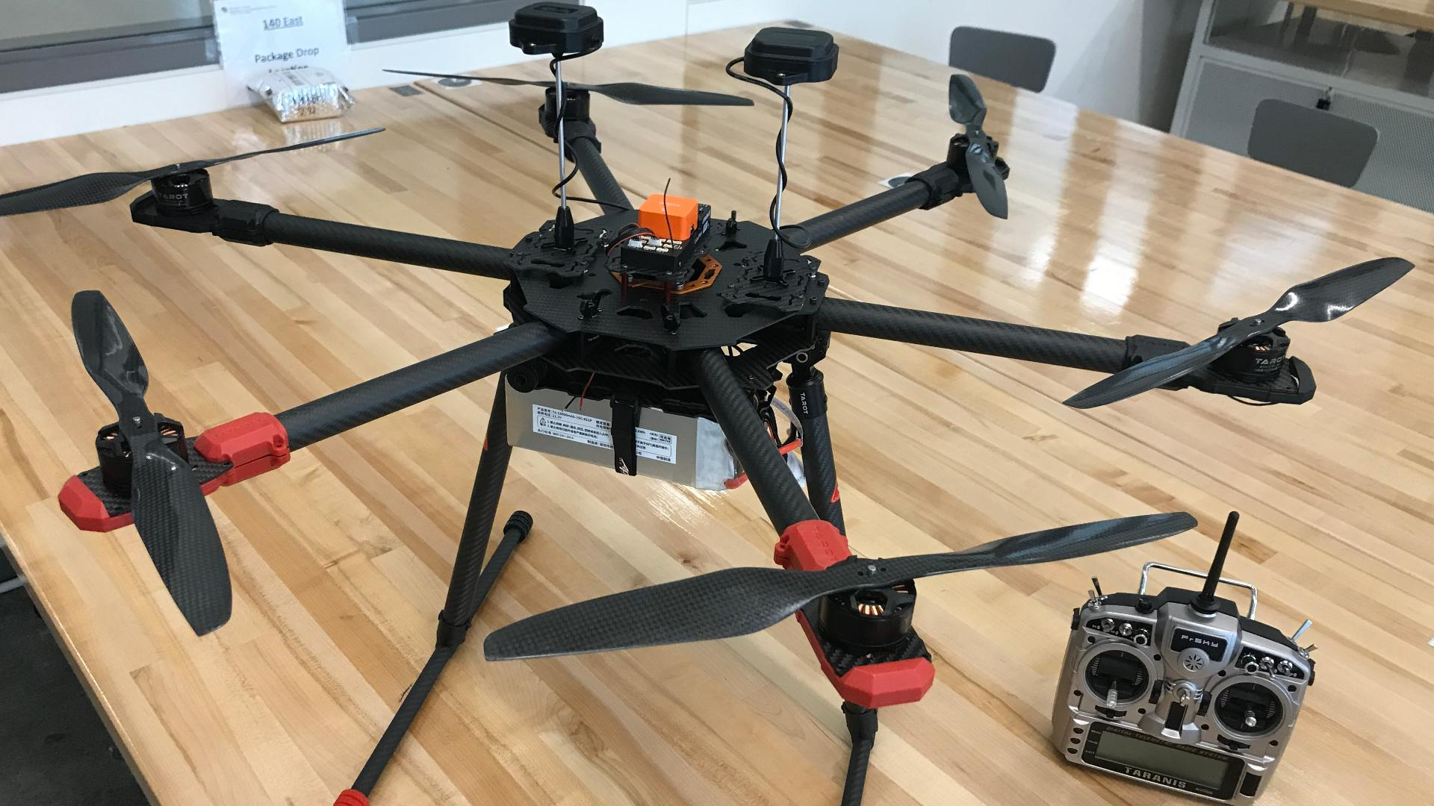
Airframe Integration
Status: In progress
Date: 2/14
Completed
Mock-up of airframe components
Top plate modifications for autopilot mounting
Bottom plate modifications for current sensor mounting
Wiring loom design finalized
Payload mounting finalized
In Progress
Wiring loom fabrication
Final airframe assembly
Next Steps
Autopilot calibration
Avionics configuration
Bench testing
Project Overview
Schedule
Test Readiness:
A: GTS
B: Airframe
C: Software
Budget

Slide 26
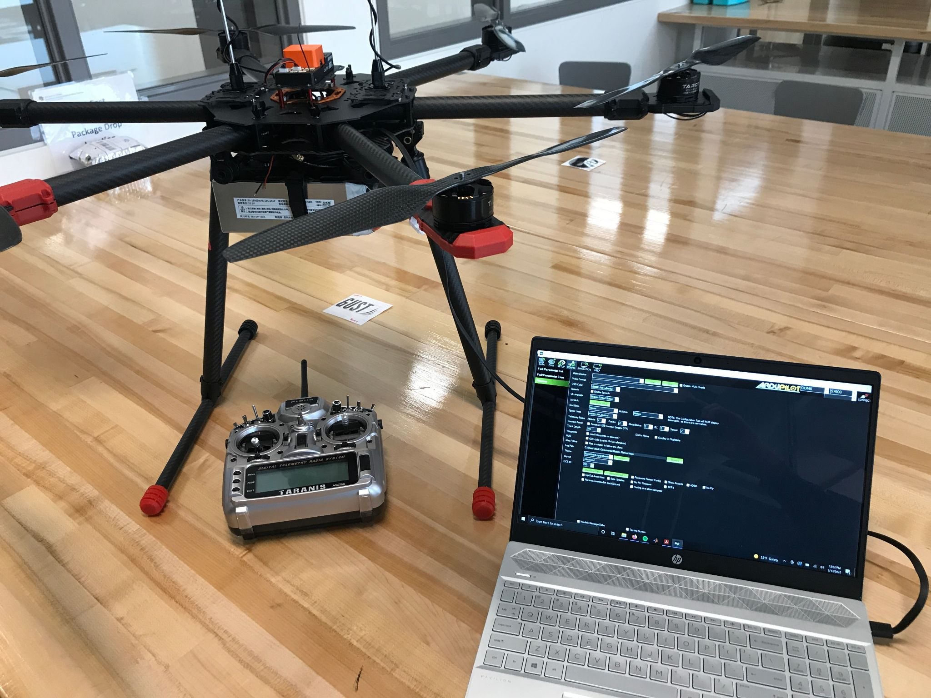
Airframe Bench Testing
Status: Pending
Date: 2/21
Purpose of Bench Testing
Configure avionics & validate features individually
Verify that avionics system is behaving as expected
Reduce risks involved with initial flight testing
Key Bench Testing Items
Current sensing
Telemetry
Pilot’s radio setup & calibration
Speed controller setup & calibration
Internal compass
Vehicle arming behavior
Failsafe triggers & responses
Motor mixing & response to manual control input
Motor mixing & response to autopilot corrections
Success
Vehicle is fully configured, calibrated, and ready to begin flight testing.
Project Overview
Schedule
Test Readiness:
A: GTS
B: Airframe
C: Software
Budget

Slide 27
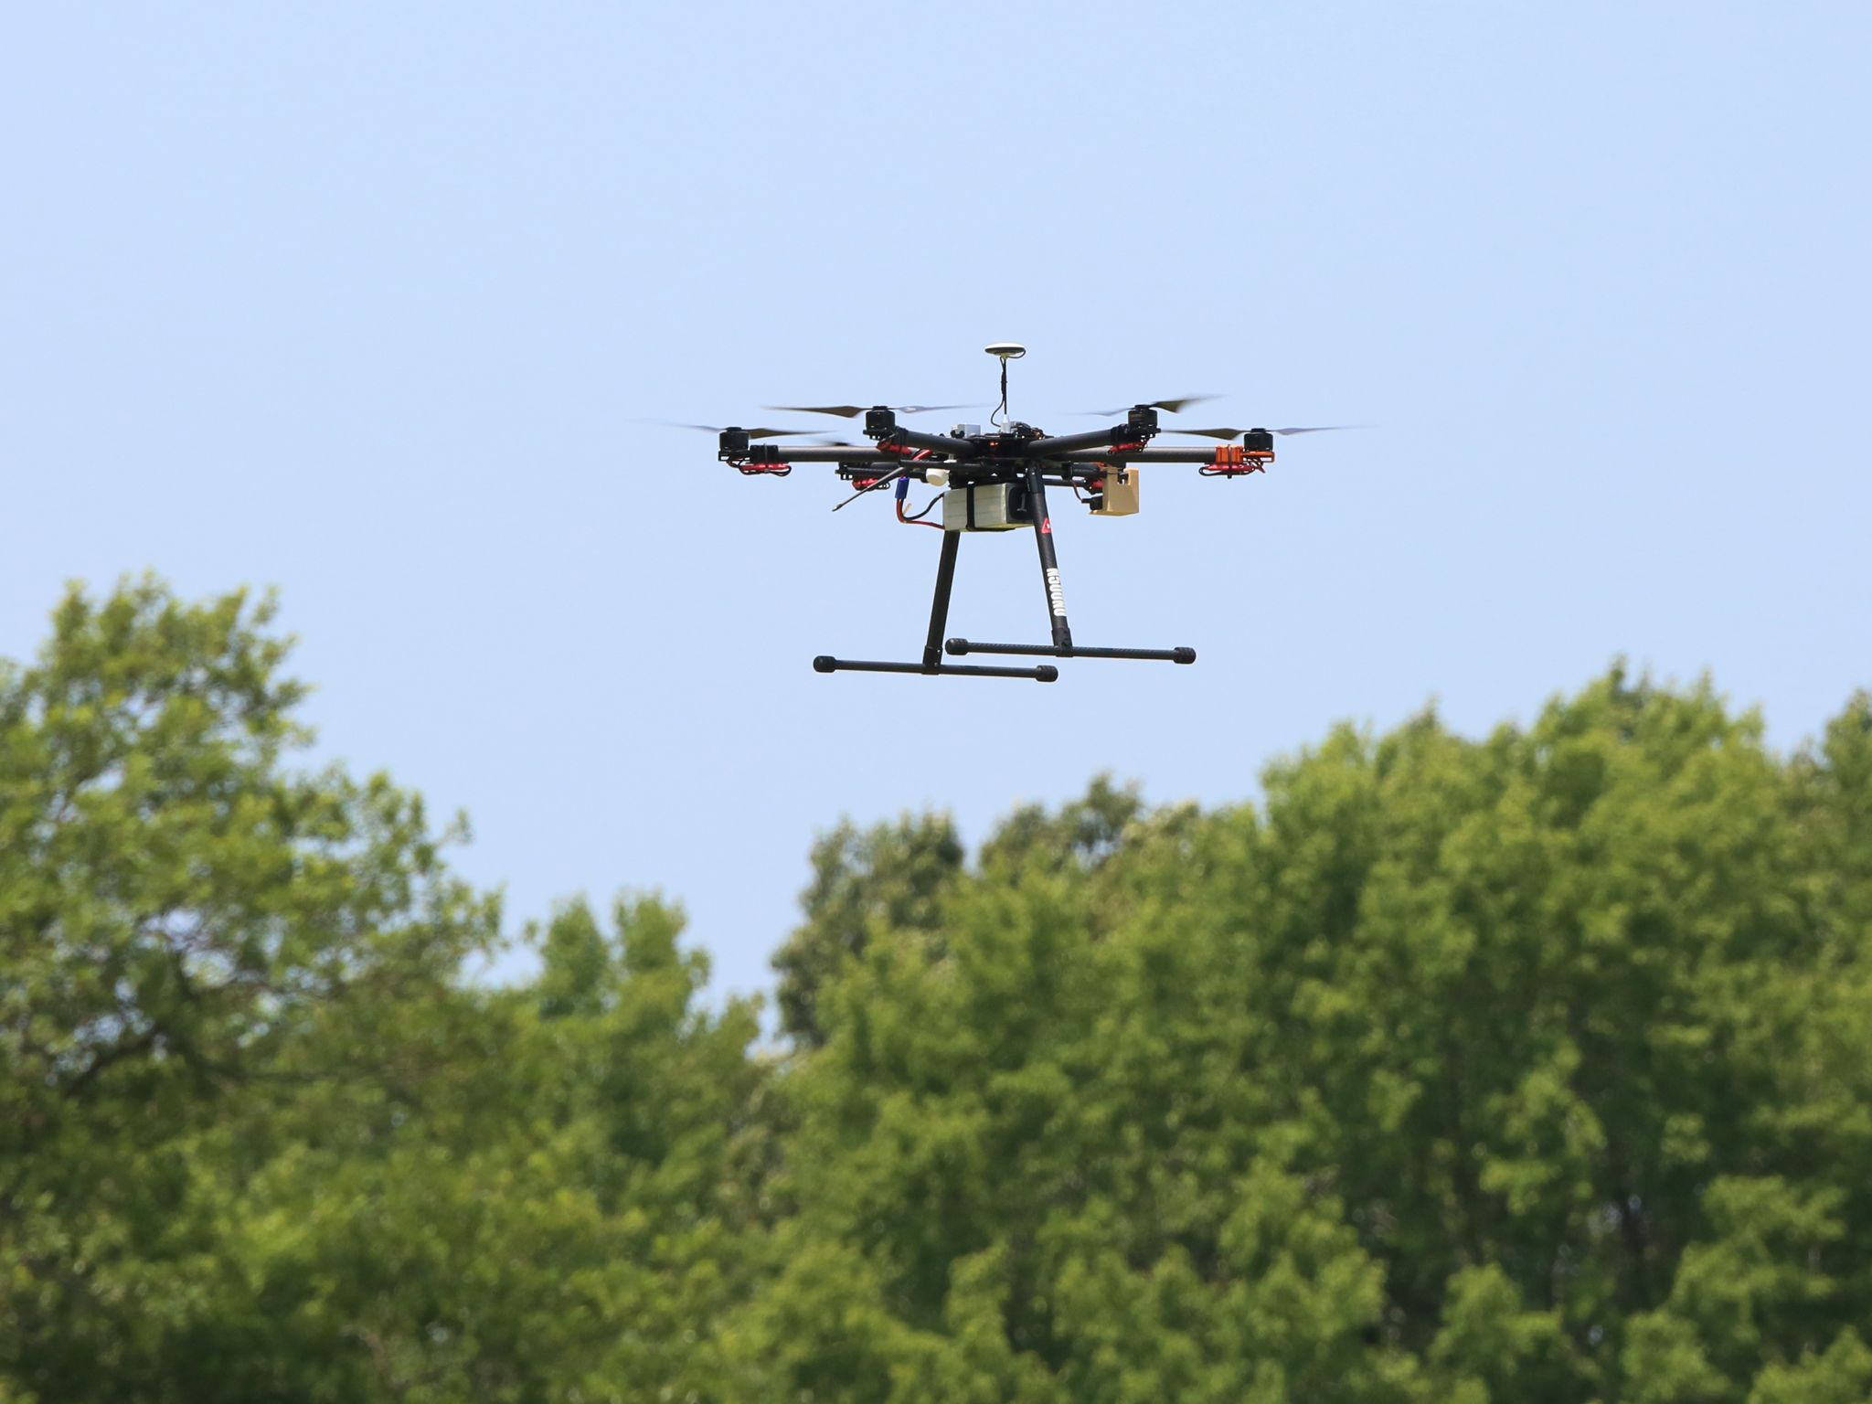
Airframe Initial Flight Testing
Status: Pending
Date: 3/1
Purpose of Initial Flight Testing
Establish vehicle functionality before adding GPS equipment
Resolve potential system issues prior to V & V testing
Reduce risk to airframe by introducing features gradually
Initial Testing Week 1
Prove vehicle is airworthy
Verify Stabilize, AltHold, and GPSHold flight modes operational
Begin tuning of vehicle control loops
Initial Testing Week 2
Add RTK GPS functionality
Add PPK GPS payload
Finalize tuning of vehicle control loops
Verify default AUTO mode is capable of waypoint missions
Image: NASA Langley
Success
Vehicle integration is complete, and vehicle is ready for verification & validation
Project Overview
Schedule
Test Readiness:
A: GTS
B: Airframe
C: Software
Budget

Slide 28
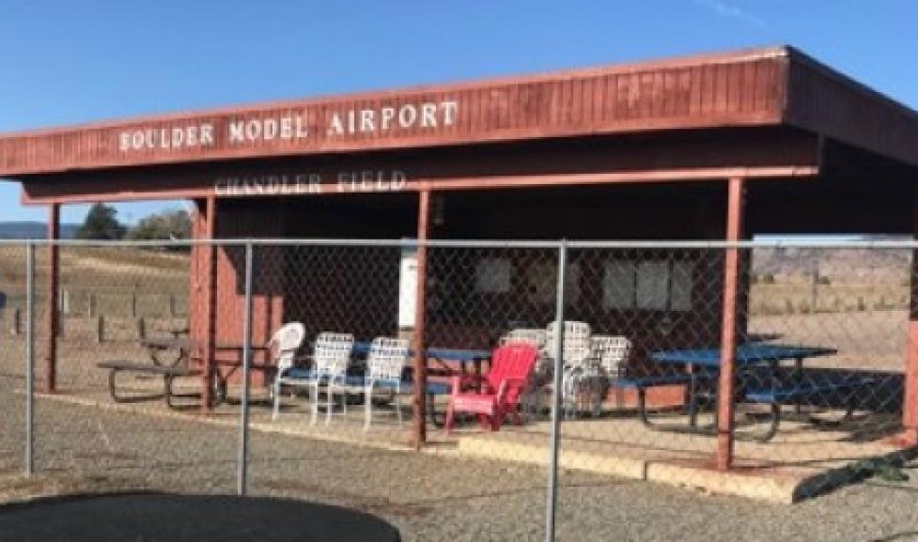
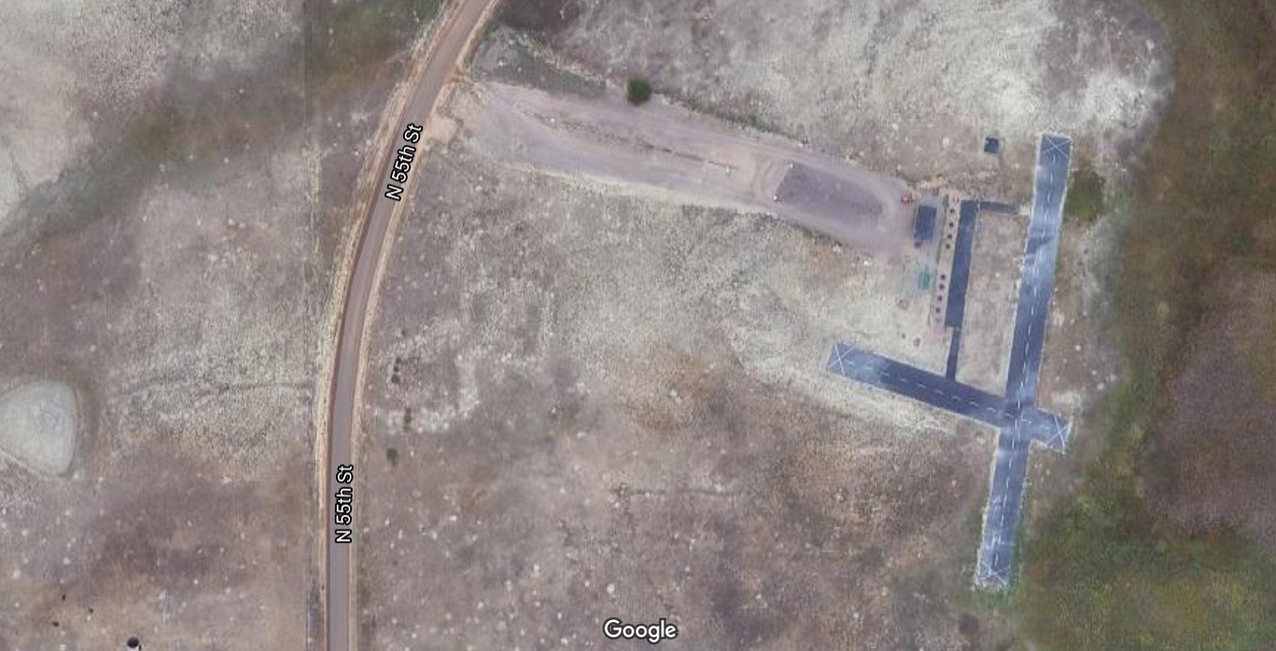
Primary Flight Testing Facility
Boulder Model Airfield
Private facility located at the Boulder reservoir.
Owned by the City of Boulder
Academy of Model Aeronautics (AMA) chartered club, operated by the Boulder AeroModelers Society (BAM)
CU students, faculty, and staff have an exemption for education-related use if operating under the CU Boulder UAS Flight operations manual.
Use of this facility allows for testing to occur under the FAA Part 107 exemption for recreational pilots.
Image:Boulder AeroModelers
Access Requirements (Completed as of 2/8/22)
Must be member of Boulder AeroModelers Society
Must be a member of the Academy of Model Aeronautics
Vehicle & pilot in command must be registered through FAA
Full FAA Part 107 certification has also been obtained
Project Overview
Schedule
Test Readiness:
A: GTS
B: Airframe
C: Software
Budget

Slide 29
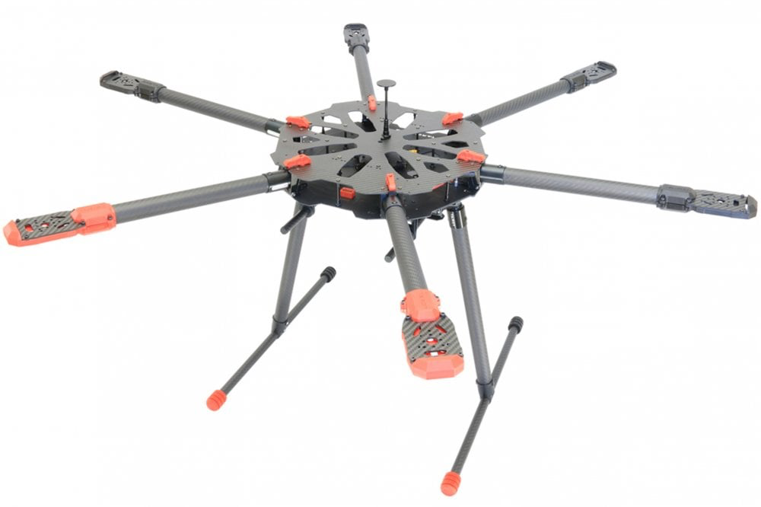
Airframe Verification: Endurance
Status: Pending
Date: 3/15
Objectives:
Verify that airframe is in compliance with DR 6.1
Collect power consumption data for comparison with flight time model
Collect baseline data on EKF2 wind estimation
Test Procedure:
Complete Preflight inspection
Mission planning & upload
Complete Pre-flight checklist
Arm vehicle & Take-off
Ascend to 5-10 m, altitude
Wait for battery low voltage
Descend & land
Download data for processing
1.
2.
3.
4.
REQs | Description
CPE3 | Capable airframe
FR3 | Adherence to guidelines
FR 6 | Sufficient flight capabilities
start
stop
Project Overview
Schedule
Test Readiness:
A: GTS
B: Airframe
C: Software
Budget

Slide 30
Trajectory Discretization Test
Status: Pending
Date: 4/08
Test:
Evaluate controller performance at various waypoint discretization rates
Motivation:
Determine the influence that waypoint discretization has on control algorithm performance due to controller limits
Optimize waypoint discretization frequency
Procedure:
Generate LEO trajectories defined by waypoints ranging from 0.1 to 10 Hz
Simulate vehicle ability to complete missions
Fly missions
Post process and evaluate performance
REQs | Description
FR1 | Waypoints within 1 second
FR4 | Acception of XYZT waypoints
FR7 | Ground truth analysis
Project Overview
Schedule
Test Readiness:
A: GTS
B: Airframe
C: Software
Budget
Notes:
This test is not pass/fail but rather optimization based and to determine controller limits

Slide 31
Trajectory Discretization (Expected) Results
Status: Pending
Date: 4/08
Success Metrics:
Time error between desired and actual waypoint arrival
Position error along trajectory
Success?
TBD
Next Steps:
Time Parameter Test
Controller Implementation Test
Develop multiple LEO trajectory files
Assemble the vehicle
Integrate code
Expected Results/Pass Requirements:
Infrequent waypoints will lead to decreased time error but a lower resolution trajectory
When waypoint frequencies exceed 10 Hz the controller will saturate and oversteer
Anticipate that 1 Hz updates will yield the best compromise between trajectory resolution and waypoint time error
Project Overview
Schedule
Test Readiness:
A: GTS
B: Airframe
C: Software
Budget
Notes:
The increased time error is minimal as the waypoints get closer together until the rate of 10 Hz is reached where the controller cannot compensate
Note: 10 Hz is the probable limit since that’s the sample rate of the GPS module

Slide 32
Control Algorithm Performance Test
Status: Pending
Date: 4/08
Test:
Comparison of controller performance in Simulink first principles model, SITL physics engine simulator, and physical vehicle behavior
Motivation:
Full system validation of the GUST solution to ensure it fulfills the necessary requirements
Compare Simulink and simulation expected results against the actual vehicle’s performance
Procedure:
Generate LEO emulation trajectory as XYZT waypoints
Run Simulink model
Run SITL simulator
Fly physical vehicle
Post process all results
Compare performance of models and vehicle
REQs | Description
FR1 | Waypoints within 1 second
FR5 | Simulation feasibility
FR7 | Ground truth analysis
Project Overview
Schedule
Test Readiness:
A: GTS
B: Airframe
C: Software
Budget

Slide 33
Control Algorithm (Expected) Results
Status: Pending
Date: 4/08
Success Metrics:
Time error between desired and actual waypoint arrival
Position error between desired and actual waypoint locations
Performance percent error between Simulink, SITL, and physical vehicle
Success?
TBD
Next Steps:
Time Parameter Test
Controller Implementation Test
Update Simulink model
Tune vehicle gains
Assemble Vehicle
Integrate code
Expected Results/Pass Requirements:
Vehicle reaches all waypoints within 1 second of desired time
First principles Simulink model will have the larger variation than SITL when compared to physical vehicle
SITL should be a strong predictor of physical performance yet will slightly overestimate physical capabilities
Project Overview
Schedule
Test Readiness:
A: GTS
B: Airframe
C: Software
Budget
Notes:
Simulink will have largest variation because it is purely mathematical of the hexacopter dynamics and control and does not take into account the environment
SITL will over perform because the simulation environment is ideal (No wind, no interferences)
Maybe mention that hitting a waypoint is defined as being within .5 m radius of the desired location?
Mention that in to-dos we have already performed a “waypoints file test”, “SITL post processing test”, and “MAVLINK message test”
Waypoints file: generate custom waypoints and pass through mission planning software
SITL post-processing: used the SITL to sim missions to log and analyze the results in MATLAB
MAVLINK message test: successfully passed the custom-built time waypoint message through mission planning software to the base of ardupilot’s source code
Time Parameter Test: ensuring successful pass of the time message to Ardupilot’s position controllers
Controller Implementation Test: preliminary test of the newly implemented control law in the SITL environment

Slide 34
Budget

Slide 35
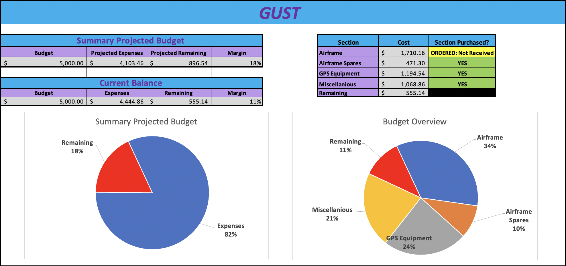
Budget Overview and Component Status
Project Overview
Schedule
Test Readiness:
A: GTS
B: Airframe
C: Software
Budget
Notes:
Nic
Important takeaways
After ordering all required parts the team is left with 11% budget or roughly $550
Slightly exceeded expected budget
Primary use of budget was to buy airframe components
All parts have been ordered yet some are still waiting to be received by the team
the only parts that have not arrived are in the airframe section
Next we can look at all the parts the team has ordered and is still waiting on

Slide 36
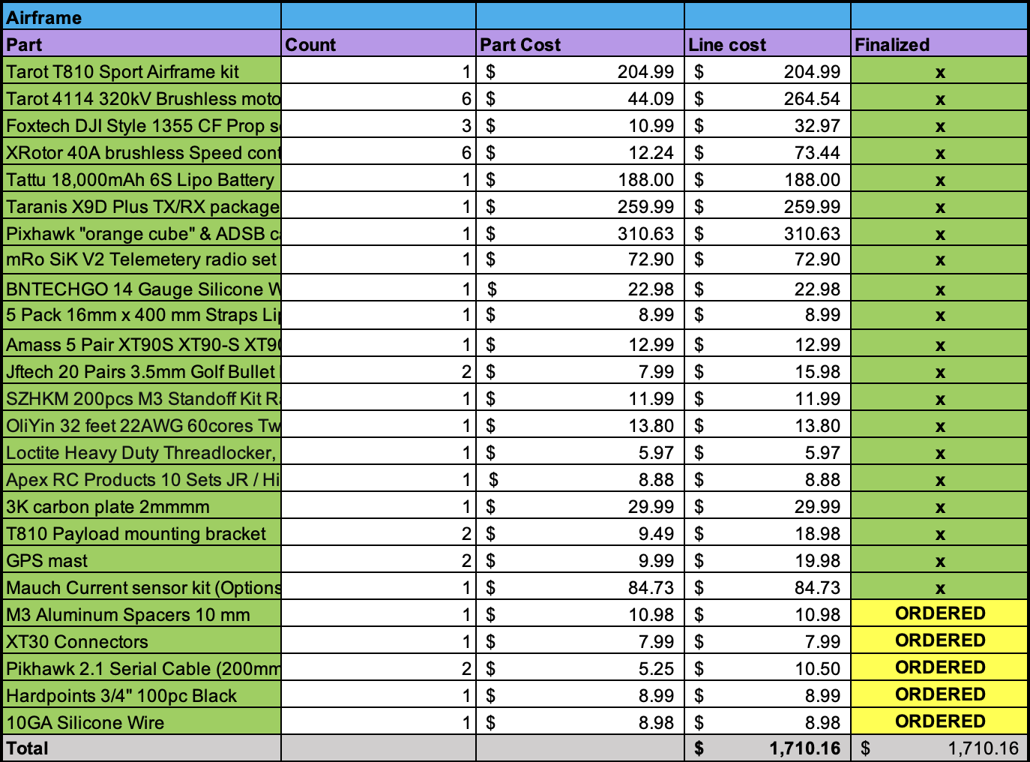
Procurement Status: Airframe
Items of Note:
Parts required to begin assembly are in-hand
ORDERED parts are expected to arrive on week of 2/14/2022
Building of drone has been started and preliminary tests can be done
Project Overview
Schedule
Test Readiness:
A: GTS
B: Airframe
C: Software
Budget
Notes:
Nic
Question for reviewer - Should the whole slide be the parts lists or would it be useful to include key notes on the side?

Slide 37
Procurement Status: Airframe Spares
Items of Note:
Built-in budget redundancy
Airframe spares are parts that if broken would need to be worked on immediately
Spare battery will be used to extend testing session duration
Project Overview
Schedule
Test Readiness:
A: GTS
B: Airframe
C: Software
Budget
Notes:
Nic

Slide 38
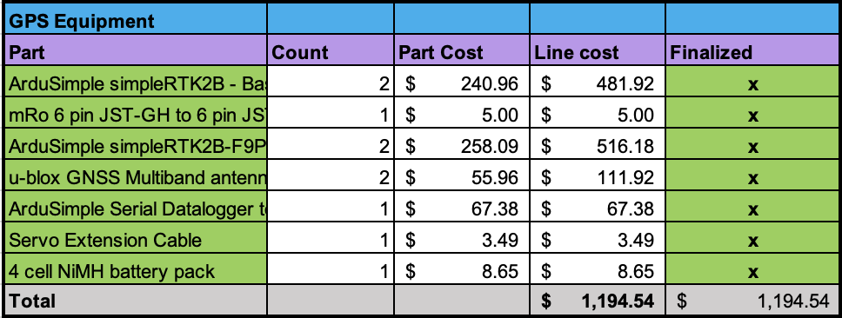
Procurement Status: GPS Equipment
Items of Note:
GPS equipment has been in-hand since the end of November
Project Overview
Schedule
Test Readiness:
A: GTS
B: Airframe
C: Software
Budget
Notes:
Nic

Slide 39
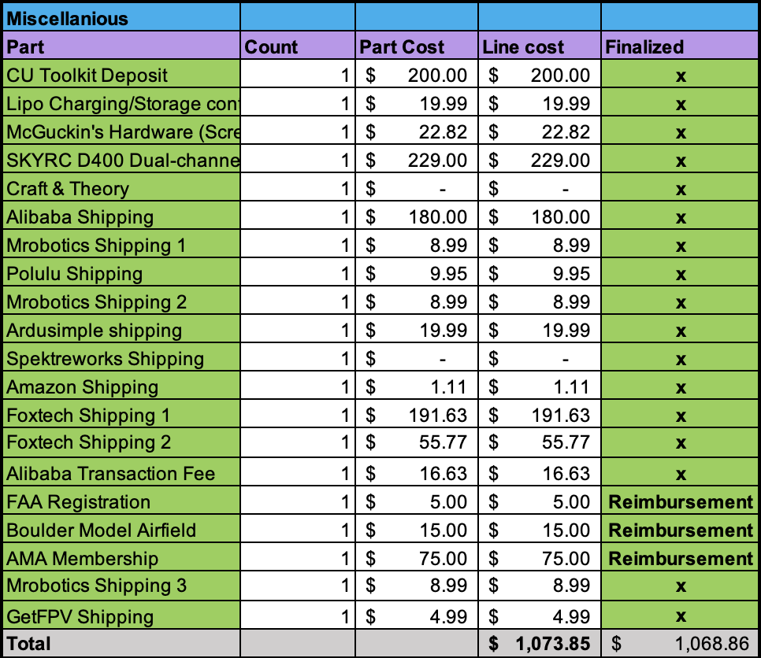
Procurement Status: Miscellaneous
Items of Note:
Miscellaneous primarily covers shipping and a few parts
Reimbursement is allocated for memberships utilized for flight testing locations of the UAS
Project Overview
Schedule
Test Readiness:
A: GTS
B: Airframe
C: Software
Budget
Notes:
Nic

Slide 40
Thank you for your attention, we will take questions now!

Slide 41
Supporting Materials Quick Links
Testing
Administrative
Trade Studies
Hardware
Controls
Software

Slide 42
Testing Material
Return to Supporting Materials Quick Links

Slide 43
(Test Here)
Status: Complete
Date: 9/99
Test:
Motivation:
filler
Procedure:
filler
REQs | Description
Project Overview
Schedule
Test Readiness:
A: Airframe
B: Software
C: GTS
Budget

Slide 44
(Test Here) Results
Status: Complete
Date: 9/99
Success Metrics:
Success?
YES!
Next Steps (if necessary):
Or here
Results/Criteria:
Pics go here
filler
Project Overview
Schedule
Test Readiness:
A: Airframe
B: Software
C: GTS
Budget

Slide 45
FAA Part 107 Exemption for recreational pilots
Overview of FAA Part 107 Exemption for Recreation Flyers
Applies to vehicles weighing up to, but not including 55lbs (24.9kg)
Vehicle must be registered with the FAA through the “Drone Zone”
Limits flight to visual Line of Sight (LOS) operations unless a dedicated visual observer (VO) is directly next to, and communicating with, the PIC.
Limits flight operations to below 400ft AGL in class G (uncontrolled) airspace
Give way to, and do not interfere with, manned aircraft
Must follow safety guidelines of community organization or those outlined in advisory circular 91-57B.
Must follow AMA safety code & regulations governing the use of “advanced flight systems” or automated flight controls.
Project Overview
Schedule
Test Readiness:
A: GTS
B: Hardware
C: Software
Budget

Slide 46
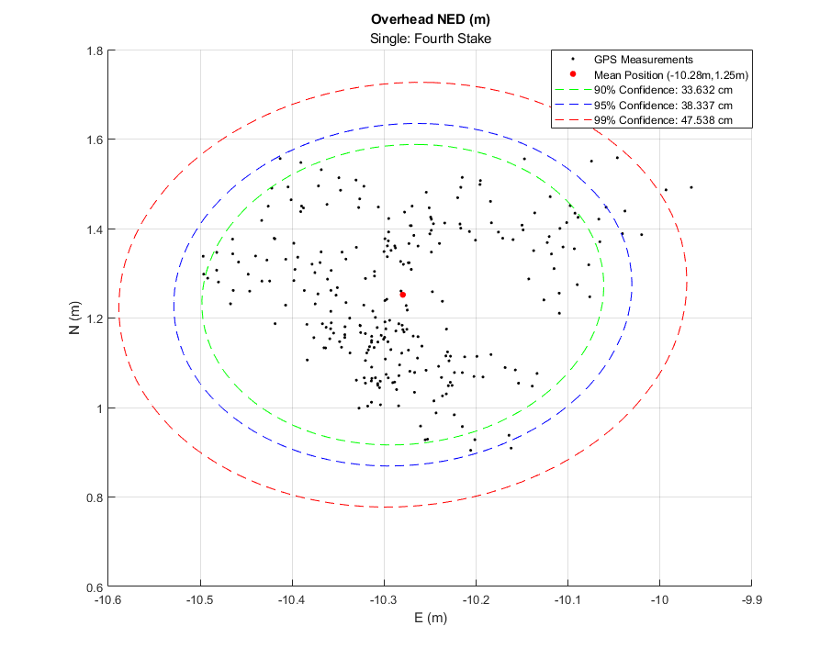
GPS Precision Verification Results
Status: Partial
Date: 2/9
Preliminary Static Testing Results:
Project Overview
Schedule
Test Readiness:
A: GTS
B: Airframe
C: Software
Budget
C: Software

Slide 47
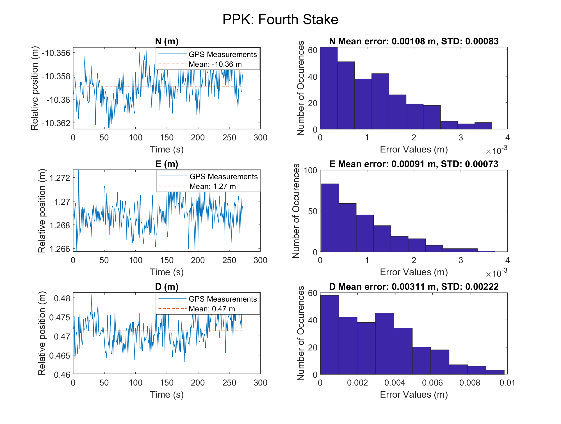
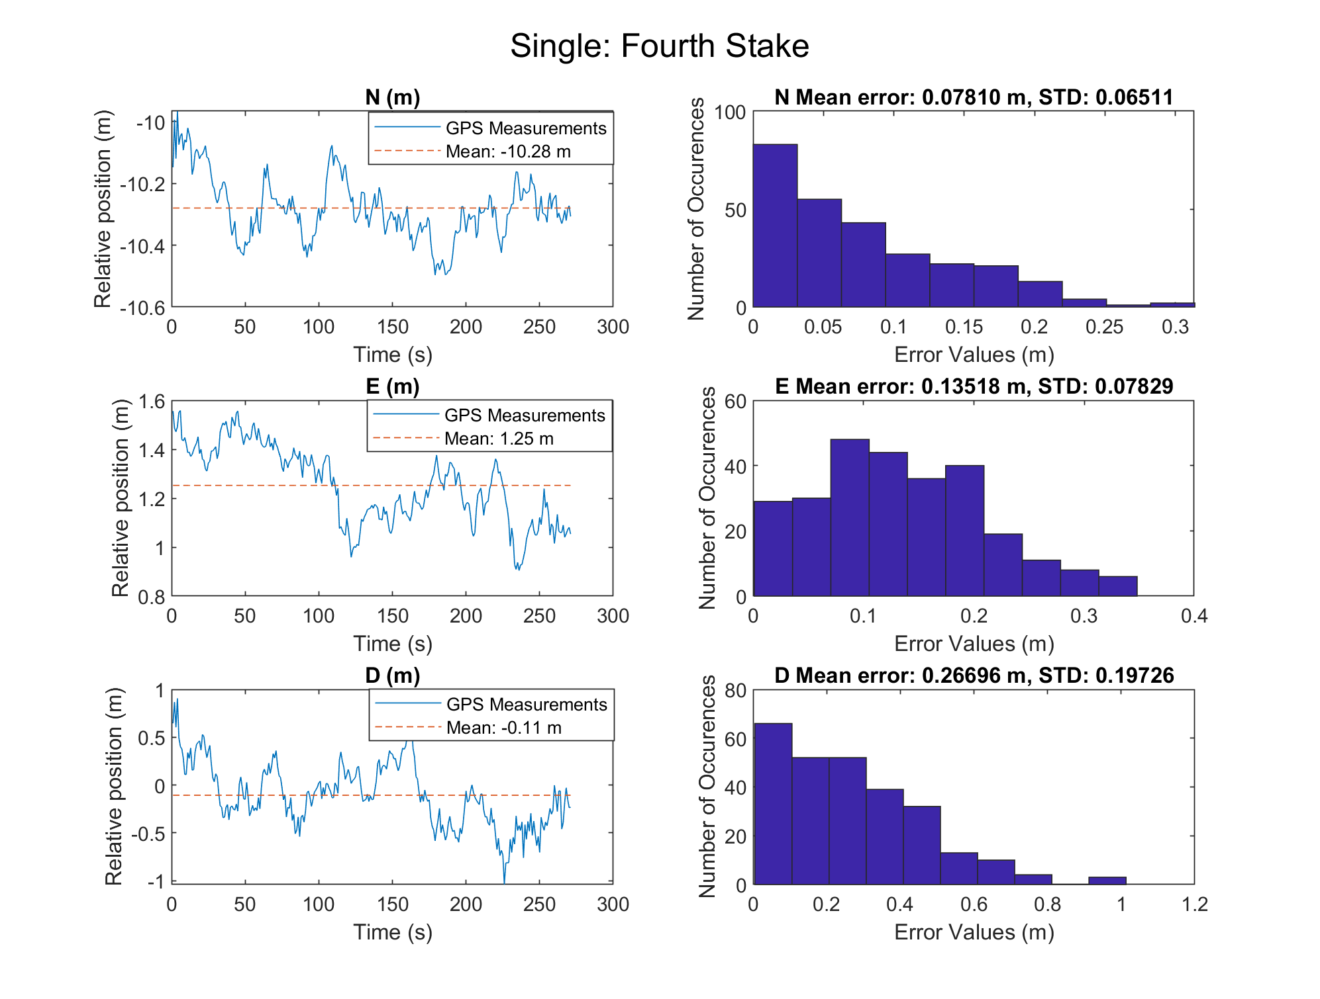
GPS Testing: Static Testing Results Pt. 1
Notes:
Input our newly created command (Command 26) that represents our timed waypoint command where the fourth input parameter is associated to the desired arrival times
Ardupilot controllers recognize time parameter
Mirroring the already implemented sub mode (waypoint auto) in our own sub mode (auto time waypoint) ardupilot was able to interpret the waypoint file

Slide 48
Software/Controls: Waypoint File Test
Test: Passing in a Waypoint File through QGroundControl/SITL
Motivation: To run a mission using a custom waypoint file
Procedure:
Construct a correctly outline text file that follows the format of default waypoint files
Run SITL or QGroundControl and load in the waypoint file using “load mission”
Run the mission on auto mode through QGC or SITL’s convention
Metrics of success:
No errors will output, the mission will run smoothly and as expected
Results: The waypoint files were interpreted correctly and the simulated vehicle reacted accordingly. Virtual vehicle successfully started and finished its mission as commanded
Notes:
Input our newly created command (Command 26) that represents our timed waypoint command where the fourth input parameter is associated to the desired arrival times
Ardupilot controllers recognize time parameter
Mirroring the already implemented sub mode (waypoint auto) in our own sub mode (auto time waypoint) ardupilot was able to interpret the waypoint file

Slide 49
Software/Controls: SITL Post Processing Test
Test: Ability to export log files from a completed SITL mission and interpret the results through MATLAB
Motivation: To be able to understand the temporal flight information given a simulated mission plan and evaluate overall mission performance
Procedure:
Run a mission to completion using the SITL simulation tool by passing in a waypoint file
Extract the associated binary file stored within the ardupilot/ArduCopter/logs
Convert the binary file into a .mat file under Mission Planner’s “Dataflash Logs” tab and then click the “Create MATLAB File” button
Input .mat file through the groups SITL_analysis_func() to output the desired graphs and times that the vehicle reached the waypoint
Metrics of success: Successful analysis of time and position error of the input mission
Results: Ardupilot’s baseline missions and the group’s custom missions were successfully post-processed

Slide 50
Software/Controls: MAVLink Message Test
Test: Ability to generate and pass a custom MAVLink message
Motivation: MAVLink is the communications layer between the mission planner and the ArduPilot flight code and needs to successfully pass new time based waypoints
Procedure:
Determine parameter structure of custom MAVLink message
Add message structure to ardupilotmega.xml mavlink module file
Add functions to main vehicle code to handle sending and receiving the command
Expand AP_Mission.cpp library to handle new messages in command structure
Define start() and verify() functionality for custom message
Metrics of success: Newly created MAVLink message command can be passed from waypoint file and recognized in ardupilot main code repository
Results: Generated TIME_WAYPOINT navigation command (ID 26) can be written in the waypoint file and recognized in the start() command function created in Ardupilot

Slide 51
Software/Controls: Time Parameter Test
Test: Passing in a Waypoint File with custom time command through QGroundControl/SITL
Motivation: Pass the time parameters into the controllers through a waypoint file
Procedure:
Construct a correctly outline text file that follows the format of default waypoint files
Input our newly created command (Command 26) that represents our timed waypoint command where the fourth input parameter is associated to the desired arrival times
Time command is passed through the Ardupilot’s library functions, eventually passed to the controllers found in the PositionControl.cpp file
Execute the mission using the SITL simulation and print desired time values
Metrics of success: The simulation is able to print out the desired time variable (parameter 4) successfully that is passed into the position controllers
Expected Results: Through the use of the cmd object, the waypoint time parameter will print out successfully

Slide 52
Software/Controls: Controller Implementation Test
Test: Closed-loop time control implementation
Motivation: Central aspect of project to modify existing controller to incorporate and test closed-loop time waypoint control
Procedure:
Replace gain block that converts position error to desired velocity with
Generate LEO emulation waypoint file with time component
Compile ardupilot code
Simulate mission
Post-process simulation results
Metrics of success: Time error of controller ( < 1 [s]), Position error of controller ( < 0.5 [m])
Results: We expect that this controller will perform to the expected standards due to the closed loop position and time approach to computing desired velocity

Slide 53
Administrative
Return to Supporting Materials Quick Links

Slide 54
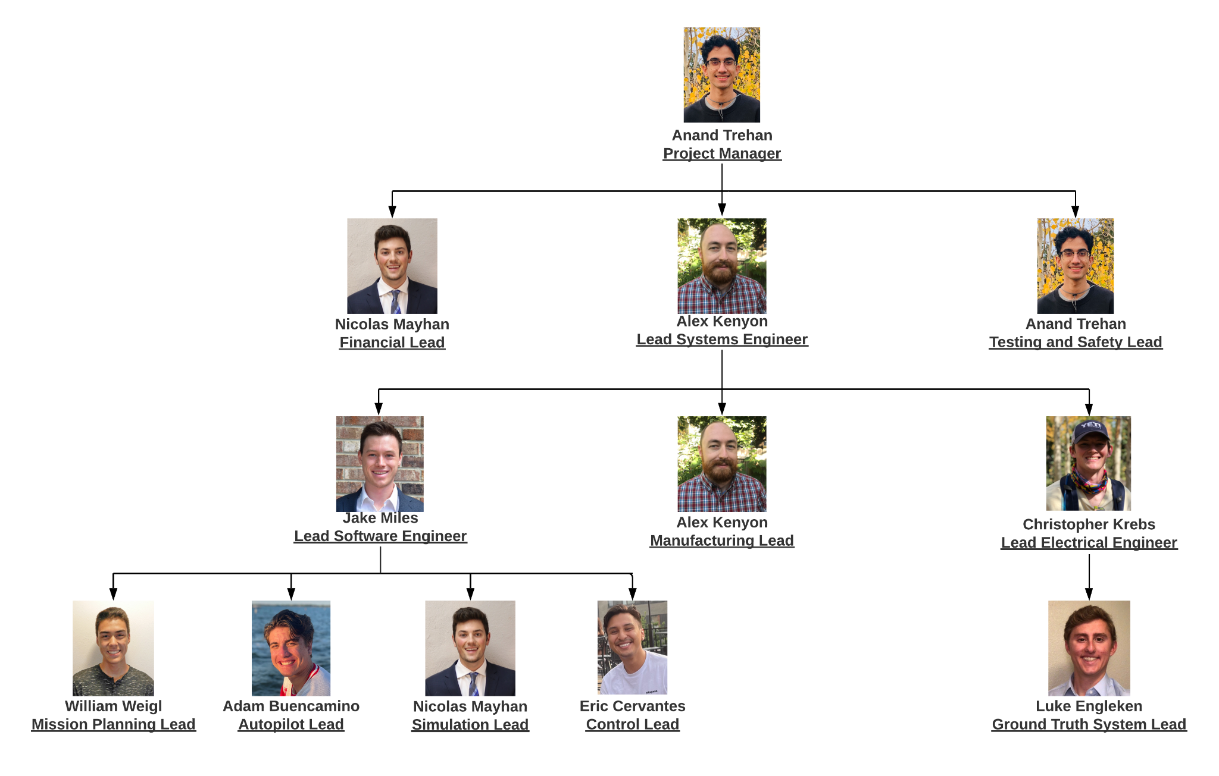
Organization Chart

Slide 55
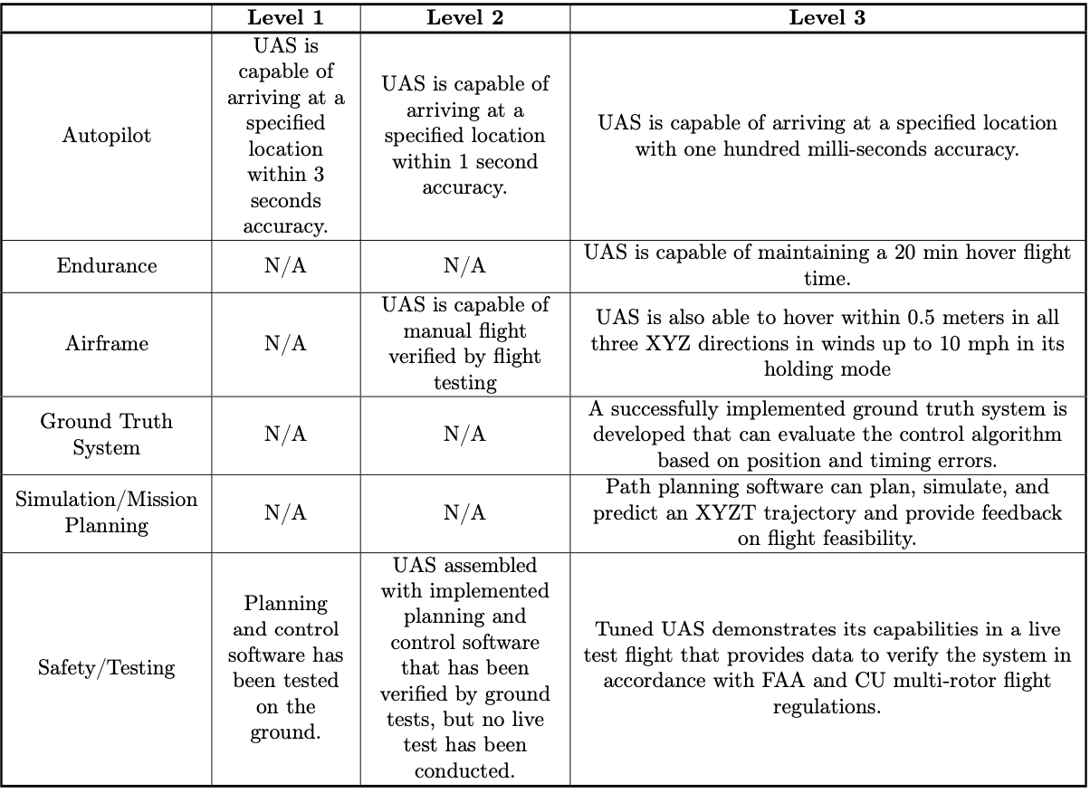
Specific Objectives

Slide 56
Functional Requirements
Functional Requirement: | Description:
FR1 | The control algorithm shall be able to command the multirotor to XYZT coordinates within 1 second.
FR2 | The control algorithm shall be integrated with an existing autopilot software.
FR3 | The UAS and its testing shall adhere to FAA and CU Boulder Guidelines.
FR4 | The modified mission planning software shall allow input XYZT coordinates that will support integration of the control algorithm.
FR5 | The simulation software shall be capable of simulating desired trajectory and determining its feasibility.
FR6 | Test vehicle shall have sufficient flight capabilities for use in demonstrating and evaluating control algorithm performance.
FR7 | Ground Truth System must be able to detect and record the flight trajectory of the test vehicle to 10cm and evaluate performance of control algorithm.
Project Overview
Schedule
Test Readiness:
A: GTS
B: Airframe
C: Software
Budget
Notes:
Anand
These are our functional requirements. In summary, they address:
The vehicle has to get to its destination when we want it
Our control algorithm will be built off an existing autopilot software
The user must be able to input XYZT coordinates of their choice
The simulation software must be able to determine feasibility
The vehicle must be competent
The GTS must have an accurate account of the vehicles path

Slide 57
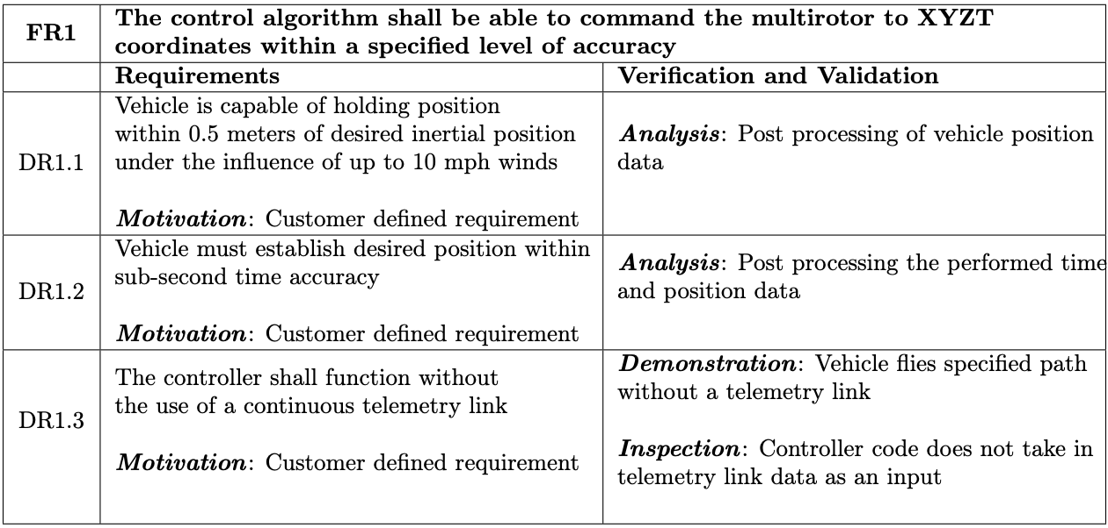
Design Requirements: FR 1

Slide 58
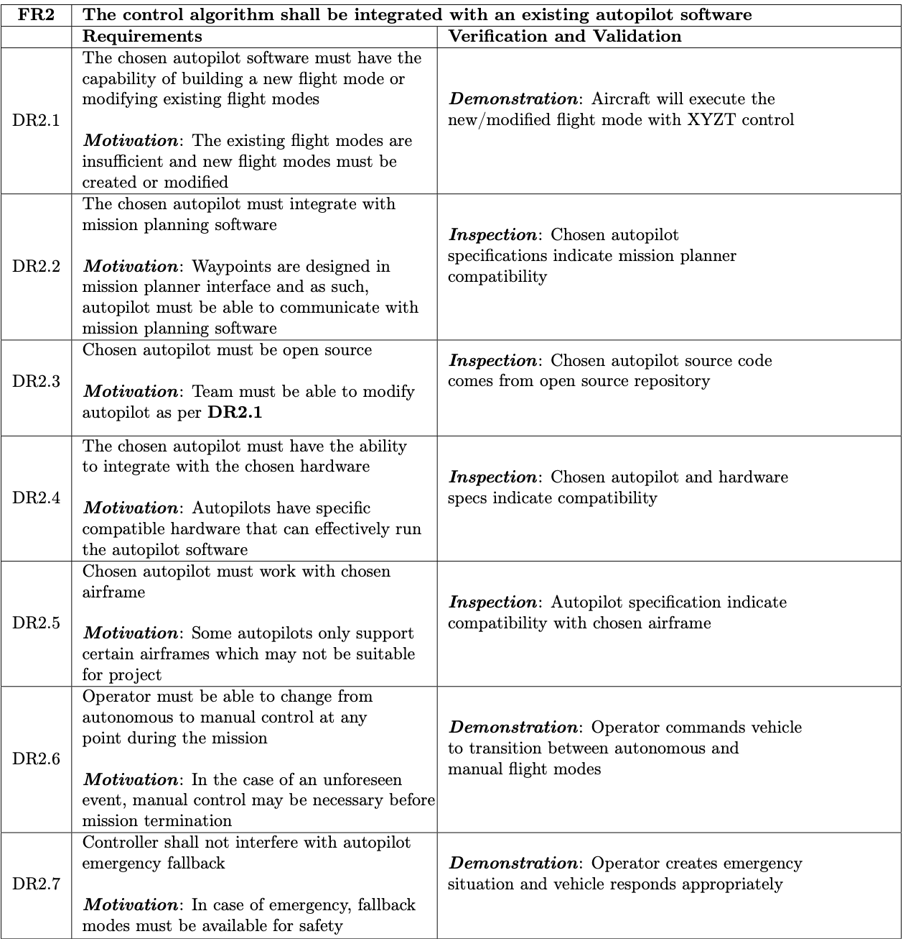
Design Requirements: FR 2

Slide 59
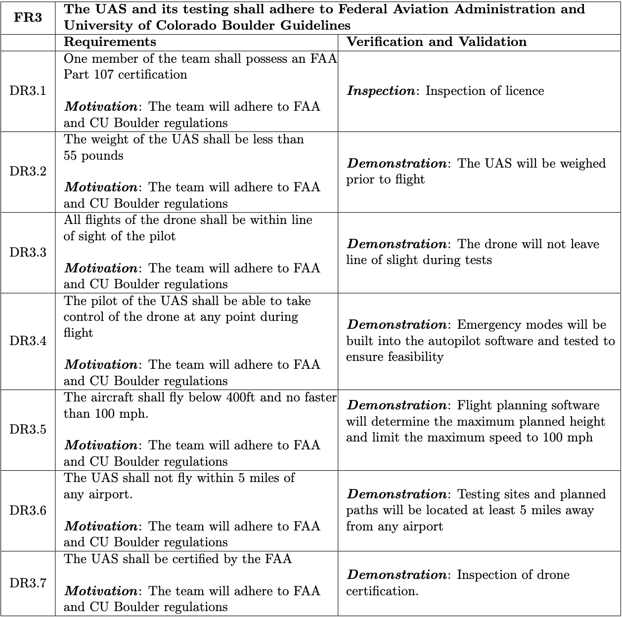
Design Requirements: FR 3

Slide 60
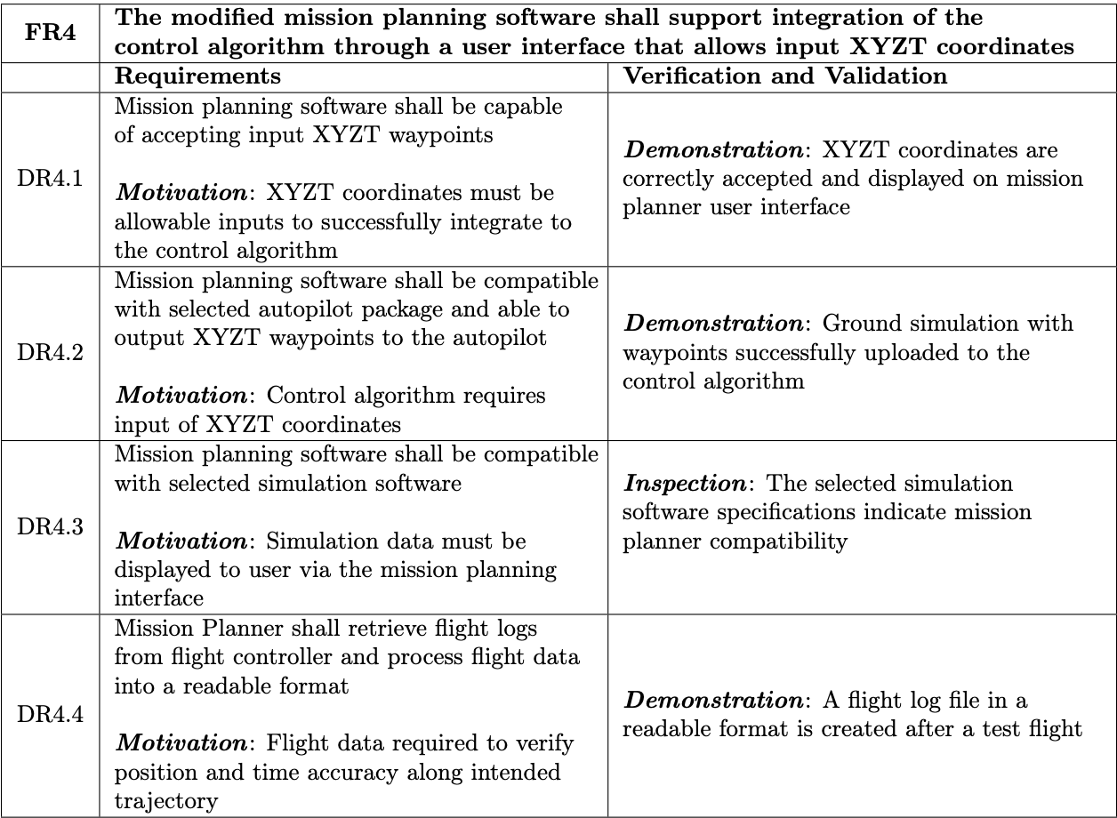
Design Requirements: FR 4

Slide 61
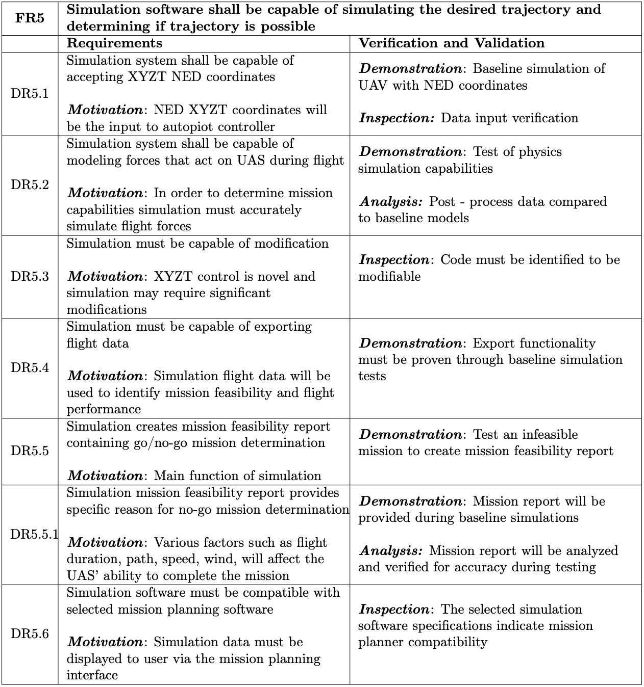
Design Requirements: FR 5

Slide 62
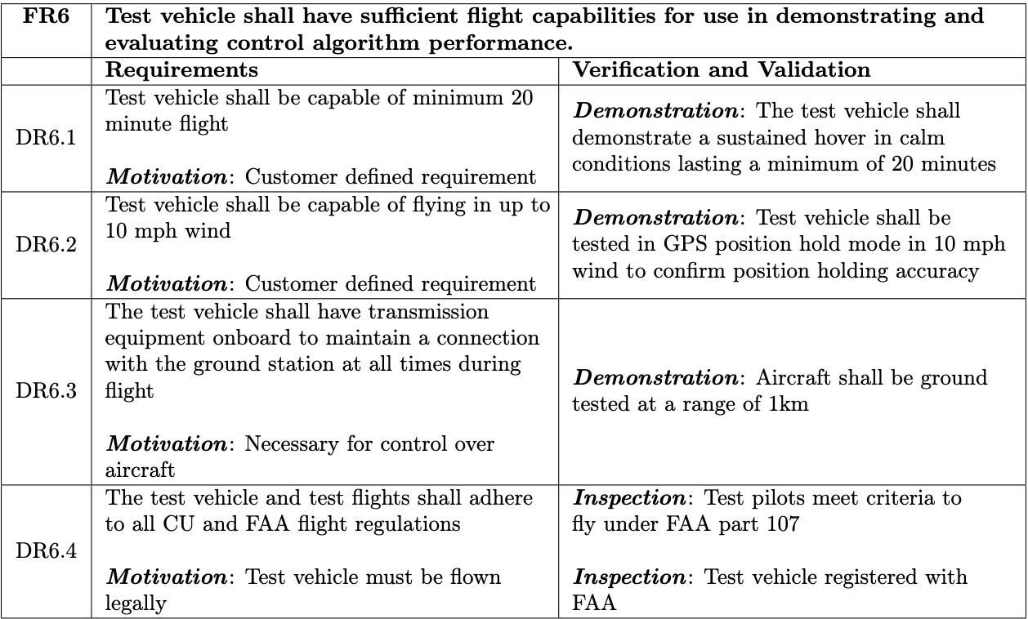
Design Requirements: FR 6
Notes:
DR6.1: Test vehicle shall be capable of minimum 20 minute flight
DR6.2: Test vehicle shall be capable of flying in up to 10 mph wind

Slide 63
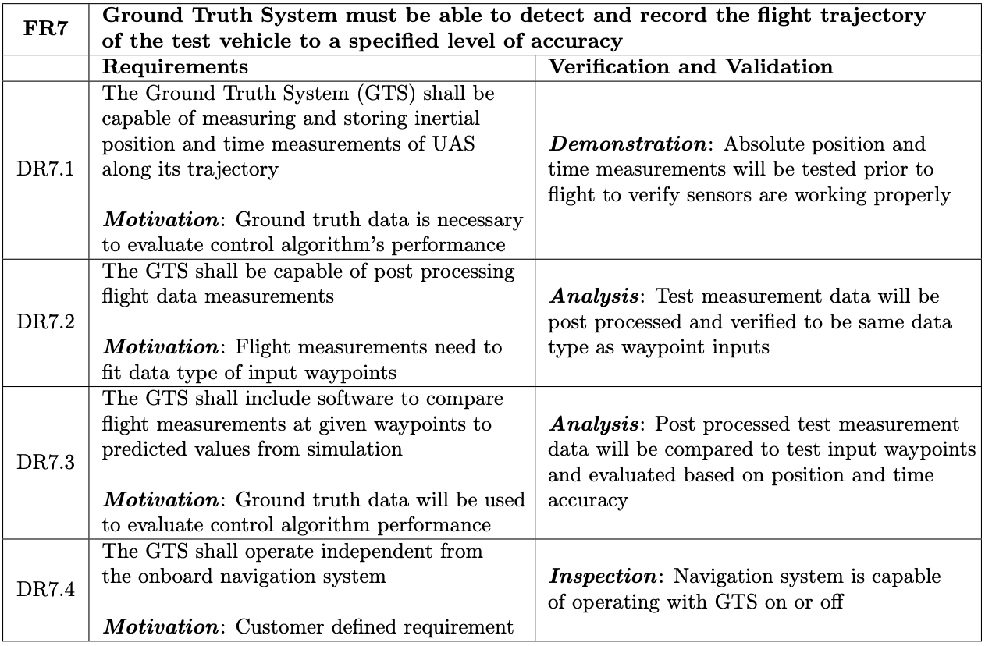
Design Requirements: FR 7

Slide 64
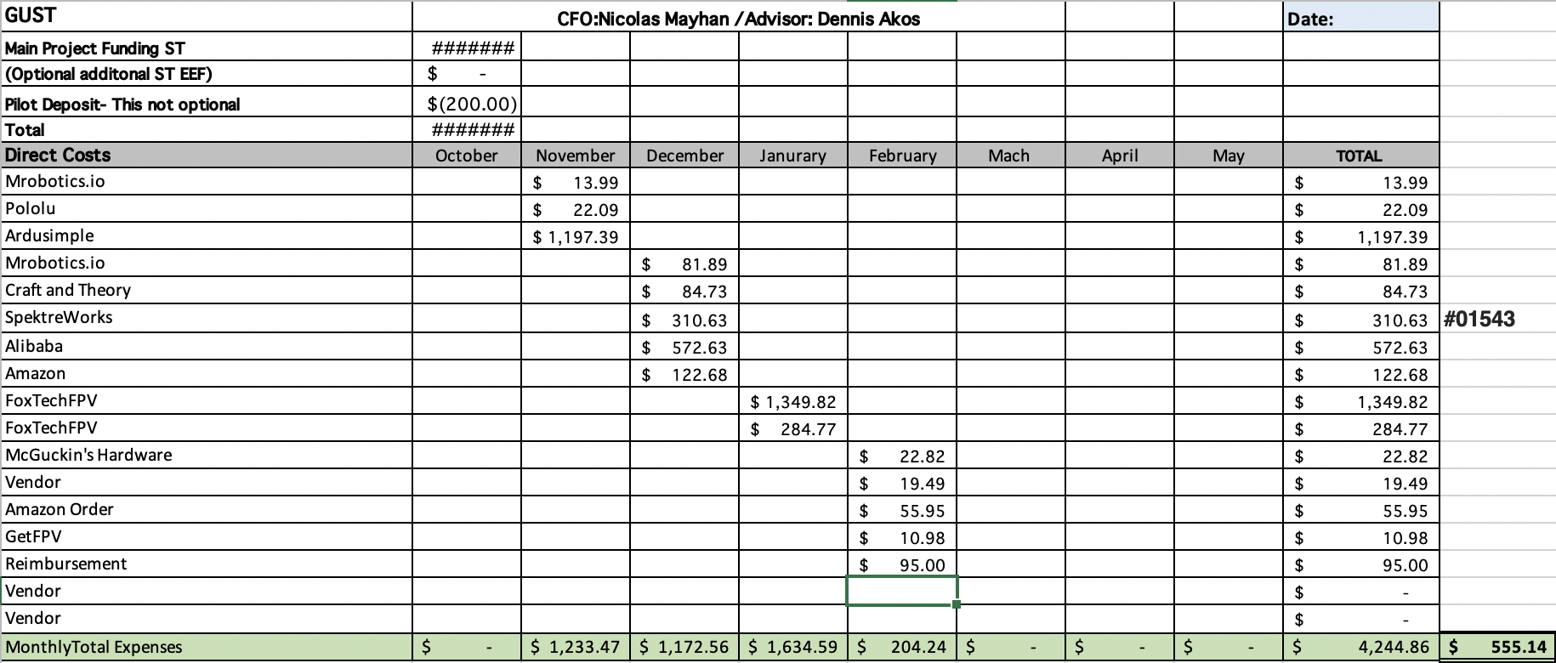
Budget Order Breakdown

Slide 65
Trade Studies
Return to Supporting Materials Quick Links

Slide 66
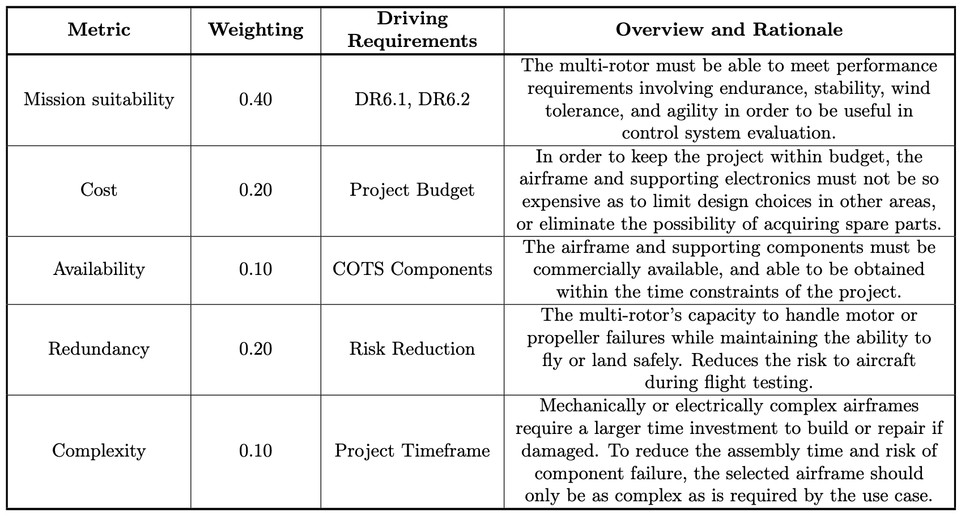
Trade Study: UAS
Notes:
Metric table for UAS trade study

Slide 67
Trade Study: UAS
Notes:
Trade matrix for UAS Trade Study

Slide 68
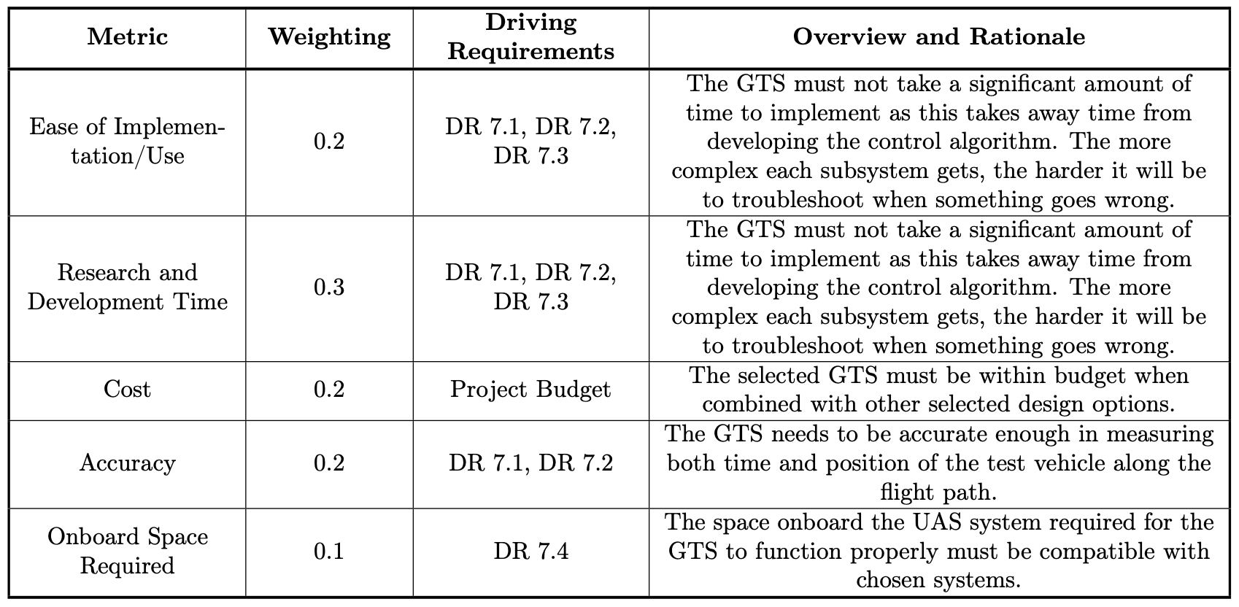
Trade Study: Ground Truth System
Notes:
Metric table for GTS trade study

Slide 69
Trade Study: Ground Truth System
Notes:
Trade matrix for GTS Trade Study

Slide 70
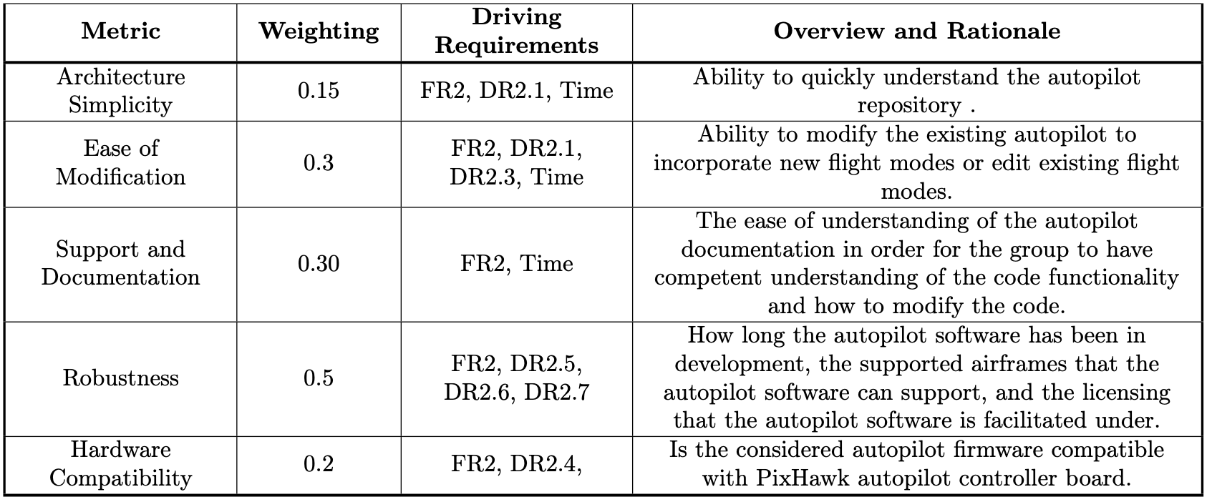
Trade Study: Autopilot Software
Notes:
Metric table for Autopilot Software trade study

Slide 71
Trade Study: Autopilot Software
Notes:
Trade matrix for Autopilot Software Trade Study

Slide 72
Trade Study: Simulation
Notes:
Metric table for Simulation trade study

Slide 73
Trade Study: Simulation
Notes:
Trade matrix for Simulation Trade Study

Slide 74
Trade Study: Mission Planner
Notes:
Metric table for Mission Planner trade study

Slide 75
Trade Study: Mission Planner
Notes:
Trade matrix for Mission Planner Trade Study

Slide 76
Hardware
Return to Supporting Materials Quick Links

Slide 77
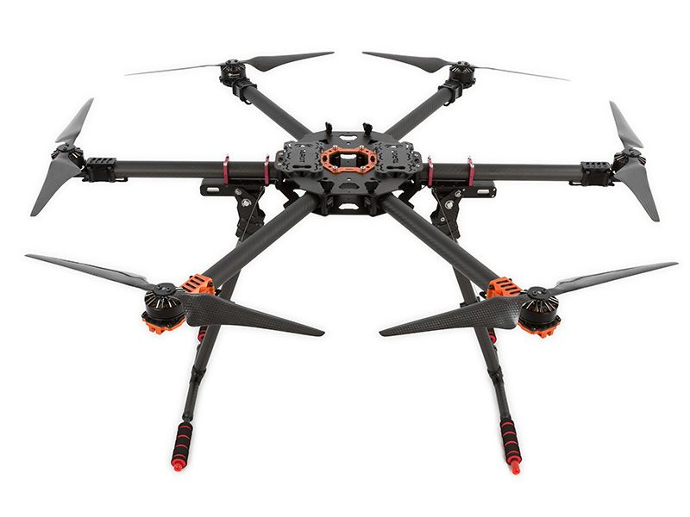
Design Solution: Airframe
Tarot T810 Sport Hexacopter
Specifications:
Frame Size: 810mm
Prop Size: up to 15 inch
Ready to fly weight: 6kg
Estimated flight time: 25.8 minutes
Features
Hex configuration for motor redundancy
Rail style payload & battery mounting for CG adjustment
Reasons for selection: Complete vehicle configuration meets flight time requirement DR6.1, wind requirement DR1.1, components available within project time frame, multiple payload mounting options.
Project Overview
Design Solution
CPE’s
Design Reqs.
Project Risks
Verification & Validation
Future Work

Slide 78
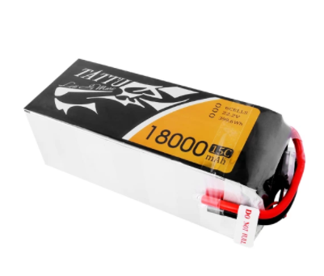
Design Solution: Vehicle Battery
TATTU 6S 18000mAh 22.2V 15C High Discharge Lipo Battery
Specifications:
Voltage: 22.2V
Capacity: 18000mAh
Cell Configuration 6S1P / 6 cells
Power Connector: XT-90
Max. Cont. discharge: 15C
Weight: 2030g
Dimensions: 190mm x 78mm x 68.5 mm
Reasons for selection: Meets power requirements, capacity allows for 20 min flight with margin
Project Overview
Design Solution
CPE’s
Design Reqs.
Project Risks
Verification & Validation
Future Work

Slide 79
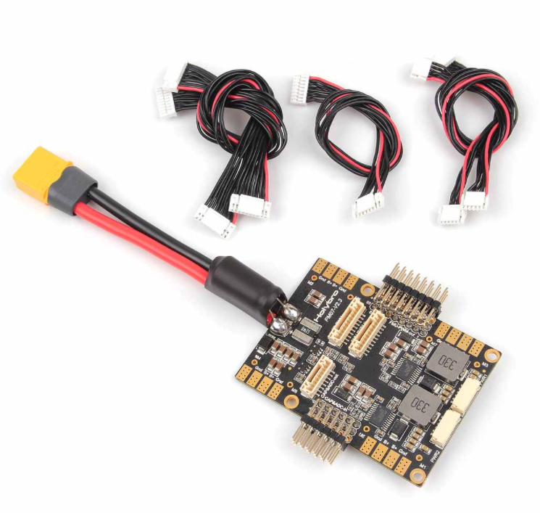
Design Solution: Power Distribution
Pixhawk 4 Power Module (PM07)
Specifications:
Voltage input: 7-51V (2-12s LiPo)
Regulated Output: 5V (3A max)
Current rating: 120A maximum output
Connector: XT90
Dimensions: 68 x 50 x 10 mm
Weight: 47.5g
Reasons for selection: Current measurement & power distribution in a single unit
Project Overview
Design Solution
CPE’s
Design Reqs.
Project Risks
Verification & Validation
Future Work

Slide 80
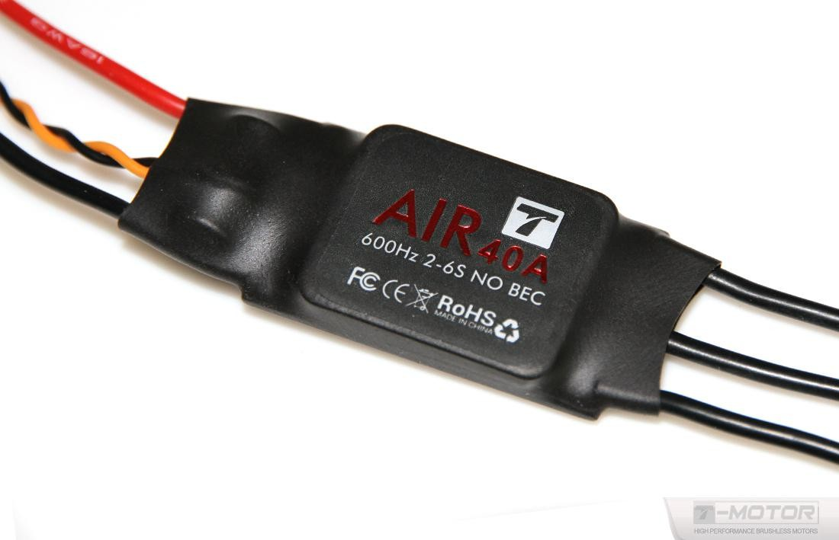
Design Solution: Speed Controller
T-Motor 40A Brushless Speed Controller
Specifications:
Dimensions: 68 x 25 x 8.7 mm
Weight: 26g
Continuous current: 40A
Peak Current: 60A (15 seconds)
Signal input: PWM (up to 600Hz)
Reasons for selection: Meets power requirements,
Project Overview
Design Solution
CPE’s
Design Reqs.
Project Risks
Verification & Validation
Future Work

Slide 81
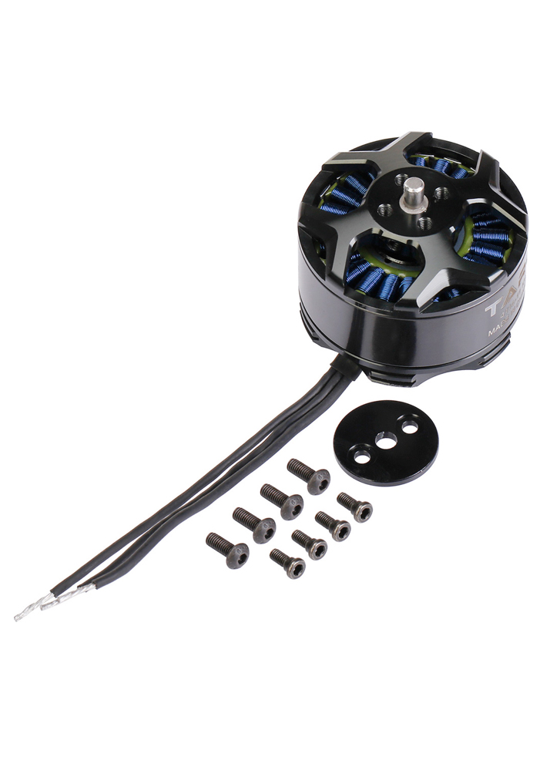
Design Solution: Lift motors
Tarot 4114/320KV brushless outrunner motor
Specifications:
Dimensions: 46 x 32 mm
Stator size: 41mm
Max power: 377 Watts
RPM/Volt: 320
Recommended prop: 15 inch
Maximum thrust: 2.5 kg
Weight: 148g
Reasons for selection: Manufacturer recommended component, compatible w/ frame & propeller selection.
Project Overview
Design Solution
CPE’s
Design Reqs.
Project Risks
Verification & Validation
Future Work

Slide 82
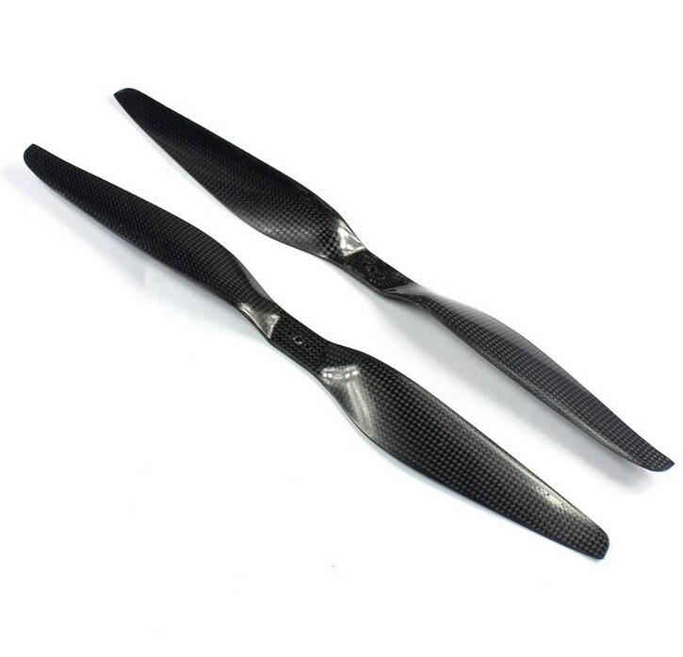
Design Solution: Propellers
Tarot 15 x 5.5 DJI style Carbon Propeller
Specifications:
Length: 15 inch
Pitch: 5.5 inches/revolution
Weight: 17g
Estimated Hover FOM: 0.55
Reasons for selection: Maximum prop size for airframe, compatibility with motor selection
Project Overview
Design Solution
CPE’s
Design Reqs.
Project Risks
Verification & Validation
Future Work

Slide 83
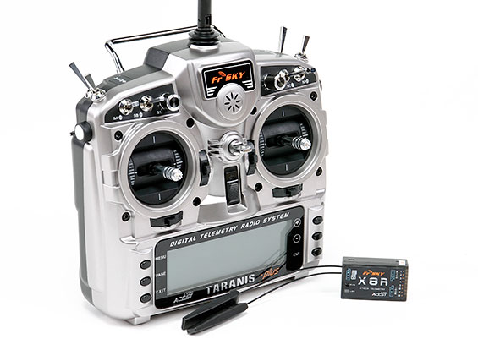
Design Solution: Pilots Transmitter
FrSky Taranis X9D Transmitter & X8R Receiver
Specifications:
Frequency: 2.4 GHz “Frequency hopping”
Range: 1km +
Channels: 16
Features:
Optional telemetry
Dedicated vehicle receiver
Low cost & high capability
No frequency conflicts with telemetry radios
3-wire connection with pixhawk using PPM or S-BUS communication protocols
Reasons for selection: Inexpensive, already proven with pixhawk autopilots, team familiarity
Project Overview
Design Solution
CPE’s
Design Reqs.
Project Risks
Verification & Validation
Future Work

Slide 84
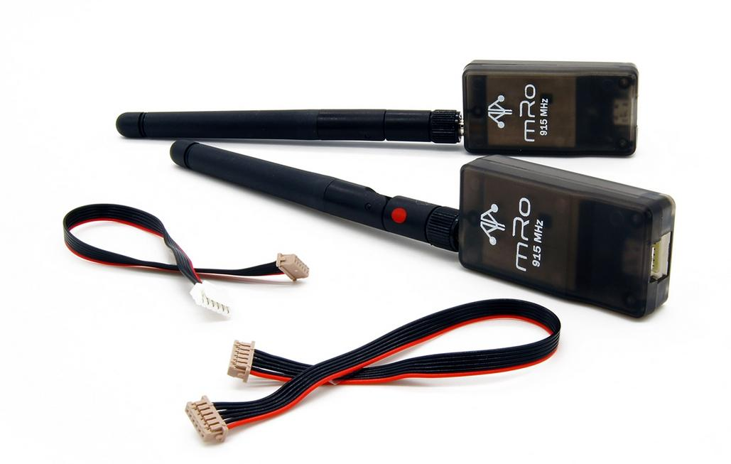
Design Solution: Telemetry Radio
mRo SiK V2 Telemetry Radio set
Specifications:
Frequency: 915 MHz
Range: 300m +
Air data rates up to 250Kbps
Features:
Sufficient bandwidth for telemetry downlink & Ardusimple RTK corrections data
Connects to Pixhawk over serial (Telem1 Port)
Reasons for selection: Already well proven with pixhawk autopilots, sufficient bandwidth for Telemetry & RTK corrections
Project Overview
Design Solution
CPE’s
Design Reqs.
Project Risks
Verification & Validation
Future Work

Slide 85
Design Solution: Power Connectors
Amass XT90S Anti-spark connectors (Battery)
Specifications:
Contact type: 4.5 mm gold plated “bullet” connector
Continuous current: 90A
Peak current 120A
Bullet connectors (ESC & Motor)
Specifications:
Contact type: 3.5 mm gold plated “bullet” connector
Peak current 80A
Reasons for selection: Commonly used, meet maximum current requirements
Project Overview
Design Solution
CPE’s
Design Reqs.
Project Risks
Verification & Validation
Future Work

Slide 86
Design Solution: Battery Charging
SKYRC D400 AC/DC Dual-port Charger
Charges 1-7 cell Lithium Polymer packs
Compatible battery chemistry: LiPo,LiFe,NiMh,NiCd,Pb
Channel 1: 400W output
Channel 2: 200W output
AC & DC power input
Cell balancing & computer data logging
Fireproof charging/storage containers
Specifically designed to contain battery fires
Used for safety during charging and storage
Project Overview
Design Solution
CPE’s
Design Reqs.
Project Risks
Verification & Validation
Future Work

Slide 87
Design Solution: PixHawk 4 Flight Controller
Notes:
PixHawk 4 Technical, Electrical, and Mechanical Specifications

Slide 88
Design Solution: PixHawk 4 Flight Controller
Notes:
PixHawk 4 Input/Output interfaces

Slide 89
Hardware: T810 Mass Budget
Project Overview
Design Solution
CPE’s
Design Reqs.
Project Risks
Verification & Validation
Future Work
Notes:
-Alex
Right; Photo of Taranis RC TX & X8R RX
Left; Quick Specs
range
16 Channels
Telemetry
Computer programmable
Narration;
The FrSky Taranis is a 16 Channel RC transmitter used by both hobbyists and UAS companies for its relatively low cost and high capability.
It has a proven track record, and is considered a reliable choice for use with many autopilot systems.
A Member of our group is also familiar with this particular handset, and has integrated it with the pixhawk previously.
For our project, it will be used to select the flight mode, and control pitch,roll,yaw, and throttle during flight testing and in certain backup flight modes.

Slide 90
Hardware: Vehicle Power Budget
Project Overview
Design Solution
CPE’s
Design Reqs.
Project Risks
Verification & Validation
Future Work
Notes:
-Alex
Right; Photo of Taranis RC TX & X8R RX
Left; Quick Specs
range
16 Channels
Telemetry
Computer programmable
Narration;
The FrSky Taranis is a 16 Channel RC transmitter used by both hobbyists and UAS companies for its relatively low cost and high capability.
It has a proven track record, and is considered a reliable choice for use with many autopilot systems.
A Member of our group is also familiar with this particular handset, and has integrated it with the pixhawk previously.
For our project, it will be used to select the flight mode, and control pitch,roll,yaw, and throttle during flight testing and in certain backup flight modes.

Slide 91
Flight Time Estimation: Process
Overview of flight time estimation process
Input vehicle parameters & manufacturer component data
Solve for required thrust per motor to satisfy the lift equals weight hovering condition
Solve for ideal power required per motor using a static thrust model for variable speed propellers
Process propeller data & estimate Figure Of Merit (FOM) as a function of RPM
Solve for estimated hovering RPM and predict hovering propeller FOM
Apply FOM at hover condition to solve for mechanical power required per motor
Apply motor & speed control efficiencies to solve for electrical power required per motor
Calculate total hovering power draw accounting for all motors & avionics
Apply battery discharge model over a loop until pack voltage drops below cutoff voltage
Calculate flight time from number of time steps before cutoff voltage is reached
Project Overview
Design Solution
CPE’s
Design Reqs.
Project Risks
Verification & Validation
Project Planning

Slide 92
Flight Time Estimation: Assumptions
Steady hovering flight condition.
Constant power draw during steady flight
Each arm contributes equally to the thrust produced.
Air velocity at infinity is effectively zero such that static thrust model for variable speed propellers applies
Colorado air density is 1.0373 kg/M^3 (1700m STD ATM value)
Constant avionics power draw
Constant ESC efficiency
Motor efficiency varies with RPM
Predictable battery discharge curve
Battery has 100% of rated capacity
Manufacturer propeller data captured at approximately sea level.
Flight time lasts until battery reaches a predetermined cutoff voltage.

Slide 93
Flight Time Estimation: Thrust model
Momentum Theory for Static-Thrust Calculation
1. Apply Conservation of momentum
2. Apply conservation of energy
3. Solve for lift power relation
(Assume V_{Z} = 0 for hover condition)
https://arxiv.org/pdf/1601.00733;Aerodynamics

Slide 94
Flight Time Estimation: Thrust Model
Momentum Theory for Static-Thrust Calculation Full Derivation
Conservation of Momentum:
Substitute T from (1) into (2), compare to (3):
(1)
(2)
Implies:
Kinetic power imparted into the air across the streamtube:
Mass flow rate defined:
(4)
(3)
(5)
Use (4) and (5) with assumption of zero z-Velocity (hover):
Notes:
(similar to how EMU did it on slide 19, but stopping at third Eq.)

Slide 95
Flight Time Estimation: Battery Model
Battery was modeled using a constant loading discharge curve for lithium polymer cells
Modeling pack using a discharge curve allows voltage & current to be calculated as they change due to voltage drop over the life of the pack.
worst case scenario of 10-20C was used as a conservative estimate of voltage drop.
Data collected during test flights will allow for refinement of battery model in the future.
Project Overview
Design Solution
CPE’s
Design Reqs.
Project Risks
Verification & Validation
Project Planning

Slide 96
Flight Time Estimation: Propeller Model
Figure of merit (FOM) is the propellers efficiency at a given flight condition
Manufacturers provide no aerodynamic data of FOM on their propellers, the only way is to estimate it from thrust stand data
Using the manufacturers data, hovering FOM was estimated at 0.5-0.6 which is in line with expected values [1]
Further thrust stand testing will allow for refinement of propeller model.
Project Overview
Design Solution
CPE’s
Design Reqs.
Project Risks
Verification & Validation
Project Planning

Slide 97
Vehicle Down-Selection
Flight time model was used to analyze 16 vehicle & battery combinations to identify viable combinations.
Project Overview
Design Solution
CPE’s
Design Reqs.
Project Risks
Verification & Validation
Project Planning
Notes:
Preliminary Trade study on specific vehicle hardware configurations
Visuals;
Narration;

Slide 98
Hardware: GPS Module Power Budget
Project Overview
Design Solution
CPE’s
Design Reqs.
Project Risks
Verification & Validation
Future Work
Notes:
-Alex
Right; Photo of Taranis RC TX & X8R RX
Left; Quick Specs
range
16 Channels
Telemetry
Computer programmable
Narration;
The FrSky Taranis is a 16 Channel RC transmitter used by both hobbyists and UAS companies for its relatively low cost and high capability.
It has a proven track record, and is considered a reliable choice for use with many autopilot systems.
A Member of our group is also familiar with this particular handset, and has integrated it with the pixhawk previously.
For our project, it will be used to select the flight mode, and control pitch,roll,yaw, and throttle during flight testing and in certain backup flight modes.

Slide 99
Hardware: Payload Mass Budget
Project Overview
Design Solution
CPE’s
Design Reqs.
Project Risks
Verification & Validation
Future Work
Notes:
-Alex
Right; Photo of Taranis RC TX & X8R RX
Left; Quick Specs
range
16 Channels
Telemetry
Computer programmable
Narration;
The FrSky Taranis is a 16 Channel RC transmitter used by both hobbyists and UAS companies for its relatively low cost and high capability.
It has a proven track record, and is considered a reliable choice for use with many autopilot systems.
A Member of our group is also familiar with this particular handset, and has integrated it with the pixhawk previously.
For our project, it will be used to select the flight mode, and control pitch,roll,yaw, and throttle during flight testing and in certain backup flight modes.

Slide 100
Hardware: GPS Module Battery Selection
Rechargeable NiMH Battery Pack
Specifications:
Voltage: 4.8V
Capacity: 900 mAh
Cell type: AAA NiMH
Connector: JR, 3-pin female
Size: 41mm x 11mm x 46mm
Weight: 1.77 oz
Project Overview
Design Solution
CPE’s
Design Reqs.
Project Risks
Verification & Validation
Future Work
Notes:
-Alex
Right; Photo of Taranis RC TX & X8R RX
Left; Quick Specs
range
16 Channels
Telemetry
Computer programmable
Narration;
The FrSky Taranis is a 16 Channel RC transmitter used by both hobbyists and UAS companies for its relatively low cost and high capability.
It has a proven track record, and is considered a reliable choice for use with many autopilot systems.
A Member of our group is also familiar with this particular handset, and has integrated it with the pixhawk previously.
For our project, it will be used to select the flight mode, and control pitch,roll,yaw, and throttle during flight testing and in certain backup flight modes.

Slide 101
PixHawk GPS Module
Notes:
Onboard ublox M8N GPS receiver
2.5 m accuracy

Slide 102
ublox ZED-F9P GNSS Receiver
Notes:
Onboard ublox M8N GPS receiver
2.5 m accuracy

Slide 103
Feasibility Analysis: Ground Truth System GPS Modules
GPS Module | Position Accuracy (with PPK) | Data Output Rate | Onboard Volume | Cost (rover only)
Here3 | +/-0.025m | Max 8Hz | 7.6cm x 7.6cm x 1.7cm | $125
CUAV C-RTK 9P | +/-0.01m | Max 20Hz | 3.15cm x 4.8cm x 1.2cm | $600
Holybro H-RTK F9P | +/-0.01m | Max 8Hz | 7.6cm x 7.6 cm x 2.0cm | $400
Notes:
Move to main presentation if time permits?

Slide 104
Controls
Return to Supporting Materials Quick Links

Slide 105
Simulink Modeling: Model Overview

Slide 106
Simulink Modeling: Trajectory Block

Slide 107
Simulink Modeling: Control System Block
Control Architecture
Takes in commanded trajectories
Outputs required control forces and moments

Slide 108
Simulink Modeling: Control System Block

Slide 109
Simulink Modeling: Z Control Block
Nested Feedback Loop
Inner loop controls rate of change of Z position
Outer loop controls Z position
Outputs required thrust

Slide 110
Simulink Modeling: Pitch/Roll Controller

Slide 111
Simulink Modeling: Position Control Block
Returns desired pitch and roll angles
arcsin(velocity/g)
Computation requires position controller

Slide 112
Simulink Modeling: Pitch/Roll Control Block
Take in desired pitch and roll angle
Get required pitch and roll moments
Dynamics are the same so controller is the same

Slide 113
Simulink Modeling: Yaw Control Block
Take in desired yaw angle
Return required yaw moment

Slide 114
Simulink Modeling: Body Force Block
Convert force of gravity to body frame of reference with DCM
Combine with thrust force to get total body force

Slide 115
Simulink Modeling: Newton-Euler Plant Block

Slide 116
Simulink Modeling: Cross Correlation Lag
Cross Correlation
Function determines how well two signals represent each other at various lags
The max correlation corresponds to the lag that sets the signals on top of eachother
Calculate the lag with timestep

Slide 117
Ardupilot General FBD
Notes:
First block is entering the ArduCopter(multi-rotor) directory
Second block sets the mode and update the flight modes to its most recent state
Third block instantiates the stabilization(hover) mode as the initial mode. This is the default mode
Fourth block is the bulk of the control algorithm code. Estimates attitude with the onboard sensors and calculates error between the desired attitude and current error. Takes error and sends a motor request to fix the error. The next slide has a lower level FBD of this block
Fifth block changes the motor request into individual motor inputs
Sixth and Seventh block pushes the outputs to the onboard electronic speed controller

Slide 118
Ardupilot Attitude Control FBD
Notes:
Angle —> Rate: Takes in the desired attitude parameters and converts to a quaternion and angular velocity using the functions stated in the box
Rate —> Motor: Up until this point the control has been independent of vehicle type and now using the overlying AC_PID library, higher level motor commands and sets general motor commands to be put into the specific motor matrix for the desired vehicle. In our case a hexacopter.

Slide 119
Modifying Control Law Feasibility (Line)
Native SITL Simulation of Default Control Algorithm
Takes off to 50 m
Travels to specified waypoint
Travels back to takeoff position
Lands at original position
Gain | Value
Pos P | 1.0
Vel P | 2.0
Vel I | 1.0
Vel D | 0.5
Notes:
Pos P: The horizontal proportional position gain
Vel P: The horizontal proportional velocity gain
Vel I: The horizontal integral velocity gain
Vel D: The horizontal derivative velocity gain
This test used the defaults gain values and the mission arrived at the waypoint and returned very effectively with minimal visual error.

Slide 120
Modifying Control Law Feasibility (Line)
Native SITL Simulation of Control Algorithm with minimal velocity control and exaggerated position proportional control
Same exact mission planned from the previous slide
Gain | Value
Pos P | 2.0 (Max)
Vel P | 0.1 (Min)
Vel I | 0.02 (Min)
Vel D | 0.0 (Min)
Notes:
Pos P: The horizontal proportional position gain
Vel P: The horizontal proportional velocity gain
Vel I: The horizontal integral velocity gain
Vel D: The horizontal derivative velocity gain
This test took away all velocity control leaving only proportional control in the XY plane. Visually, this test did not complete the mission as intended as the simulated copter overshot the waypoint and the return to home waypoint by a rather large margin.

Slide 121
Modifying Control Law Feasibility (Diamond)
Native SITL Simulation of Default Control Algorithm
Takes off to 20 m
Travels to specified waypoint
Travels back to takeoff position
Lands at original position
Same Gains as Shown in “Line”
Notes:
Pos P: The horizontal proportional position gain
Vel P: The horizontal proportional velocity gain
Vel I: The horizontal integral velocity gain
Vel D: The horizontal derivative velocity gain
This test used the defaults gain values and the mission arrived at the waypoint and returned very effectively with minimal visual error.

Slide 122
Modifying Control Law Feasibility (Diamond)
Notes:
Pos P: The horizontal proportional position gain
Vel P: The horizontal proportional velocity gain
Vel I: The horizontal integral velocity gain
Vel D: The horizontal derivative velocity gain
This test used the defaults gain values and the mission arrived at the waypoint and returned very effectively with minimal visual error.

Slide 123
Modifying Control Law Feasibility (Diamond)
Notes:
Pos P: The horizontal proportional position gain
Vel P: The horizontal proportional velocity gain
Vel I: The horizontal integral velocity gain
Vel D: The horizontal derivative velocity gain
This test used the defaults gain values and the mission arrived at the waypoint and returned very effectively with minimal visual error.

Slide 124
Modifying Control Law Feasibility (Diamond)
Native SITL Simulation of with minimal velocity control and exaggerated position proportional control Control Algorithm
Takes off to 20 m
Travels to specified waypoint
Travels back to takeoff position
Lands at original position
Same Gains as Shown in “Line”
Notes:
Pos P: The horizontal proportional position gain
Vel P: The horizontal proportional velocity gain
Vel I: The horizontal integral velocity gain
Vel D: The horizontal derivative velocity gain
This test used the defaults gain values and the mission arrived at the waypoint and returned very effectively with minimal visual error.

Slide 125
Modifying Control Law Feasibility (Diamond)
Notes:
Pos P: The horizontal proportional position gain
Vel P: The horizontal proportional velocity gain
Vel I: The horizontal integral velocity gain
Vel D: The horizontal derivative velocity gain
This test used the defaults gain values and the mission arrived at the waypoint and returned very effectively with minimal visual error.

Slide 126
Modifying Control Law Feasibility (Diamond)
Notes:
Pos P: The horizontal proportional position gain
Vel P: The horizontal proportional velocity gain
Vel I: The horizontal integral velocity gain
Vel D: The horizontal derivative velocity gain
This test used the defaults gain values and the mission arrived at the waypoint and returned very effectively with minimal visual error.

Slide 127
Extended Kalman Filter
Theory
IMU angular rates are integrated to calculate the angular position
IMU accelerations are converted to earth NED axes and corrected for gravity
Accelerations are integrated to calculate the velocity
Velocity is integrated to calculate the position
Estimated gyro and accelerometer noise (EKF_GYRO_NOISE and EKF_ACC_NOISE) are used to estimate the growth in error in the angles, velocities and position calculated using IMU data.
Difference between predicted position and GPS position
State correction from using calculations from 5) and 6)
Calculate uncertainty reduction return to step 1

Slide 128
Software
Return to Supporting Materials Quick Links

Slide 129
IRISS Previous Work and Motivation
Previous Method:
Take LEO sky track in Az-EL
Convert to XYZ waypoints
Pre-calculate velocities to reach waypoints at desired times
Project Overview
Design Solution
CPE’s
Design Reqs.
Project Risks
Verification & Validation
Future Work
Notes:
explain test card - make a second mission CONOPS to replace this?
show error numbers
emphasize on how current methods have high errors, want to close the loop of timing to obtain greater levels of accuracy.
smoothness is related to the discretatization of points given on an az-el plot at a 1-hz rate given the max distance allowed for flight

Slide 130
IRISS Summer Results
06/22/21 IRISS autonomous mode test 1
IRISS Methodology:
Take LEO sky track in Az-EL
Convert to XYZ waypoints
Pre-calculate velocities to reach waypoints at desired times

Slide 131
IRISS Summer Results

Slide 132
IRISS Summer Results
Note: Relative altitude is taken by subtracting the first GPS value from commanded data to compare to BARO and CTUN

Slide 133
IRISS Summer Results

Slide 134
IRISS Summer Results
Standard Error Calculation Methodology:
Convert commanded and flight data trajectory data to East(X), North(Y), and Up(Z) components from latitude, longitude, and altitude.
Interpolate flight data linearly to add points to increase resolution
Determine the position error between each commanded point to every flight data point.
Each flight data point associated with the minimum error between a respective commanded point is stored.
These are the points where the “waypoints are met”
RMS error of the East, North, and Up components are calculated
RMS error of time error is calculated
Note: these calculations were after extracting the flight trajectory data during the timespan of commanded data. This is true for both error calculation methodologies.

Slide 135
IRISS Summer Results - Standard Error
RMS Error North | RMS Error East | RMS Error Up | RMS Timing Error
3.2m | 2.7m | 9.3m | 8.2s

Slide 136
IRISS Summer Results
Alternate Error Calculation Methodology:
Convert commanded and flight data trajectory data to East(X), North(Y), and Up(Z) components from latitude, longitude, and altitude.
Interpolate flight data linearly to add points to increase resolution
Determine the timing error between each commanded point to every flight data point.
Each flight data point associated with the minimum error between a respective commanded point is stored.
These are the points where the “waypoints are met”
RMS error of the East, North, and Up components are calculated
RMS error of time error is calculated
This essentially shows what the drone’s positioning error is with time aligned.

Slide 137
IRISS Summer Results - Alternate Error
RMS Error North | RMS Error East | RMS Error Up
0.1m | 0.1m | 12.1m

Slide 138
LEO Track Simulation Plots

Slide 139
LEO Track Simulation Plots with Waypoints

Slide 140
Custom Track Simulation Plots

Slide 141
Simulating GPS Failure
Notes:
What is Going on In This Screenshot?
The copter is following the LEO trajectory and hitting waypoints as shown in the highlighted green messages in the MAVLINK console
At the instance where the copter is located in the screenshot is where the param set SIM_GPS_DISABLE 1 command was passed
At this instance the GPS failed as shown in the highlighted red messages in the MAVLINK console
The copter went into a failsafe mode and changed the mode to “LAND MODE”
The orange warning message tell the user that the EKF inertial sensors are no longer aiding the flight
At the end of the flight, the drone hits the ground at the normal 0.462115 m/s and disarms the motors appropriately

Slide 142
Modifying the Physical Vehicle within Ardupilot
Changed the default vehicle parameters to match that of our intended vehicle design
Located in ardupilot/libraries/SITL/SIM_Frame.h of the repository
Defines attributes such as vehicle diameter, mass, coefficient of drag, and disc area
Also defines battery/motor characteristics and limits
Also includes a physical test case of a drone to define drag

Slide 143
Modifying the Physical Vehicle within Ardupilot
Our vehicle’s parameters input into the “Model” struct to match our physical vehicle dynamics

Slide 144
ArduPilot Flight Modes
Basic Flight Modes Advanced Flight Modes
Stabilize
Self leveling roll and pitch axis
Alt Hold
Hold Altitude and self level roll and pitch
Loiter
Hold altitude and position, use GPS for movement
Return to launch
Return to take off location
Auto
Follow predetermined waypoints
Guided
Navigate to single points commanded by GCS
Auto tune
Automated pitch and bank maneuvers to improve control loops
Follow
Follows another vehicle
Land
Reduces altitude to ground level, goes straight down

Slide 145
Technical Sources
[1] “Static Testing of Micro Propellers” Selig, Michael et al., University of Illinois at Urbana-Champaign, August 2008.
[2] “Theory of Aerospace Propulsion”, Pasquale M. Sforza, Butterworth-Heinemann, 2017.
[3] “Calculation of Constant Power Lithium Battery Discharge Curves”, Lance W. Traub, Embry Riddle Aeronautical University, February 2016

