Slide 1
GUST
GUST
GUST
Guided UAS Supplemented by Timing
Critical Design Review
Project Sponsors:
Professor Penina Axelrad,
Steve Borenstein
Faculty Advisor:
Professor Dennis Akos
Presenters:
Adam Buencamino, Alex Kenyon, Anand Trehan, Chris Krebs, Eric Cervantes, Jake Miles-Colthup,
Additional Group Members:
Billy Weigl, Luke Engelken, Nic Mayhan
Notes:
Anand

Slide 2
Presentation Breakdown:
Project Overview
Design Solution
CPE’s
Design Requirements
Project Risks
Verification/Validation
Project Planning
1
2
3
4
5
6
7
Notes:
Anand

Slide 3
Project Overview
Mission Statement:
The GUST team will work to modify existing autopilot software in order to implement a timing system which will enable UAVs to travel and transmit signals along a specified path in space and time
Project Overview
Design Solution
CPE’s
Design Reqs.
Project Risks
Verification & Validation
Project Planning
Notes:
Anand
In short, this is our mission: to fly a UAS along a defined path, guided by a modified autopilot system which incorporates the parameter of time.

Slide 4
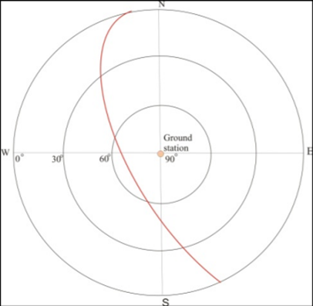
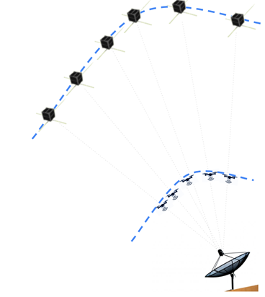
IRISS Methodology
Discretize Waypoints
Convert LEO satellite track into XYZ waypoints
Incorporate Timing
Calculate required UAS velocities to reach desired time
Upload
Send commanded XYZ waypoints and velocities to drone without closed loop timing control
Mission Execution and Termination
Vehicle flies along commanded path and completes mission
Post Processing
Vehicle Performance is validated
Project Overview
Design Solution
CPE’s
Design Reqs.
Project Risks
Verification & Validation
Project Planning
Notes:
explain test card - make a second mission CONOPS to replace this?
show error numbers
emphasize on how current methods have high errors, want to close the loop of timing to obtain greater levels of accuracy.
explain how smoothness is related to the discretatization of points given on an az-el plot at a 1-hz rate given the max distance allowed for flight

Slide 5
IRISS Previous Work and Motivation
Errors from IRISS flight test:
RMS Error North | RMS Error East | RMS Error Up | RMS Timing Error
3.2m | 2.7m | 9.3m | 8.2s
GUST Mission Goals:
Incorporate timing in a closed loop control algorithm used in UAS autopilot
Novel solution to current UAS autopilot software
Take in any mission specified waypoints in XYZ and time
Reach waypoints within 1-second of desired time
Have navigation and post processed UAS positioning accuracy within 10cm
Project Overview
Design Solution
CPE’s
Design Reqs.
Project Risks
Verification & Validation
Project Planning
Notes:
Emphasis that our approach is novel, current drone autopilots don’t have closed loop timing in their control
Different from IRISS’s previous approach in which they had no timing feedback
IRISS’s emulated of a LEO skytrack was just a ONE-USE mission case
Our goal is to take in any specified waypoints, whether it is LEO emulated or any other path, and be able to reach waypoints within accuracy
To ensure our drone achieve’s this accuracy and for us to be able to accurately characterize our mission performance, we desire our navigation and post processing UAS position accuracy to be within 10 cm
Narriate that closed loop timing should produce less errors for the drone can make corrections to its velocity when it gets off course in time and position

Slide 6
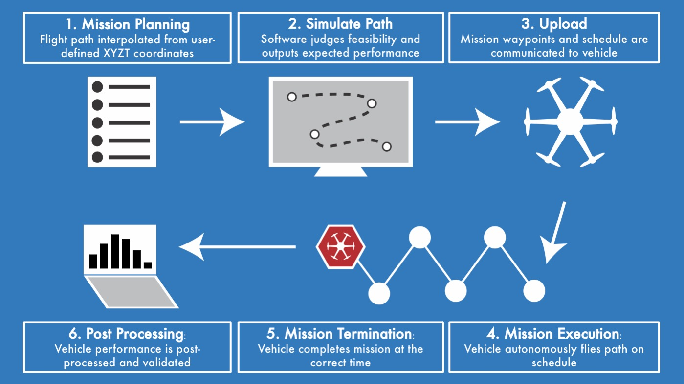
Concept of Operations (CONOPS)
Project Overview
Design Solution
CPE’s
Design Reqs.
Project Risks
Verification & Validation
Project Planning
Notes:
Anand
Our projects first phase is in mission planning where in the user inputs XYZT coordinates, and a flight path is extrapolated
Of course, we need to make sure our chosen vehicle is capable of reaching each waypoint at the predetermined times, so our simulations software will judge the feasibility of the path
With feasibility confirmed, these waypoints, and crucially, the desired time to reach those waypoints, is communicated to the vehicle
Next, the vehicle flies along this path, and if successful, reaches each way point
and its destination, at the predetermined times
Finally, our ground truth system, which has tracked the location of the vehicle throughout, independently verifies the performance of our vehicle, essentially how well it followed the geographic path, and schedule

Slide 7
Design Solution
Notes:
This is a top level description of the overall outcome of your design efforts. It should show what the
whole system looks like, its key parameters (dimensions, mass, data rates, etc.), what the major
elements or subsystems are, and most importantly, how it works. Include a functional block diagram.
This provides the context and terminology for more detailed descriptions later in the presentation.
Clear what all major elements of the design are, and how the design works at a top level (8-10 pts)
Some elements are vaguely defined or poorly explained (say which) (6-8 pts)
Key elements seem to be missing or were not explained (say which) (4-6 pts)
Can’t tell what the whole design is or how it basically works (0-4 pts)
Include power budget, link budget, full airframe kit selection with mass budget here?

Slide 8
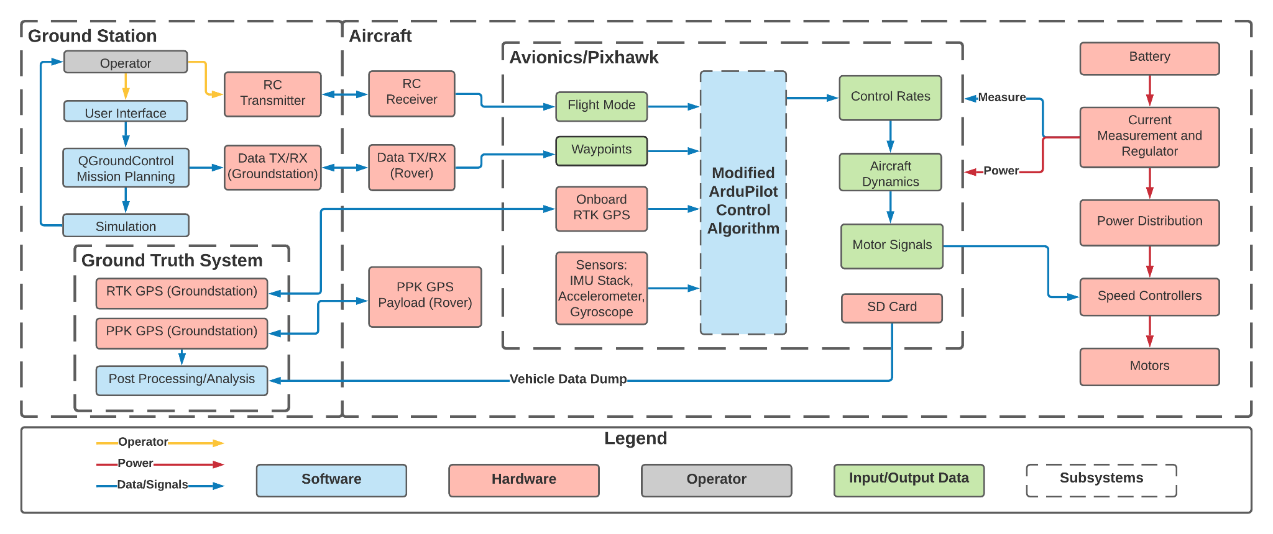
System Functional Block Diagram
Project Overview
Design Solution
CPE’s
Design Reqs.
Project Risks
Verification & Validation
Project Planning
Notes:
Jake

Slide 9
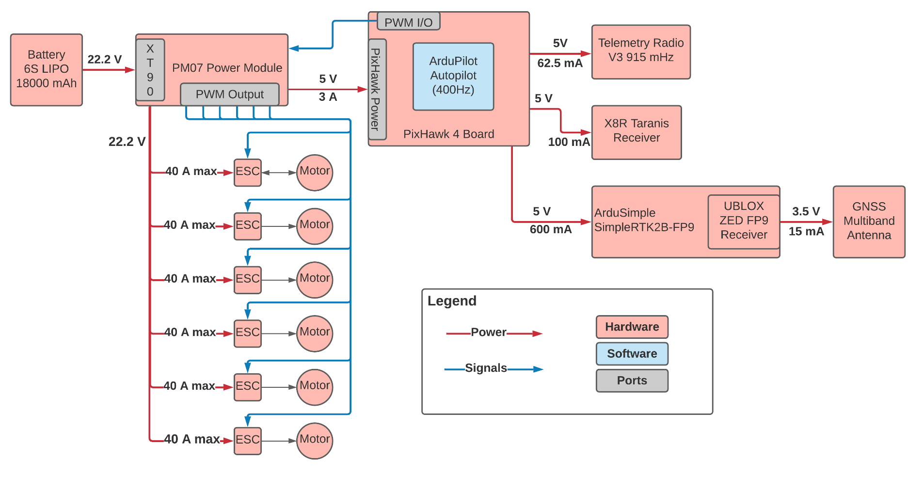
Aircraft/Avionics Functional Block Diagram
Project Overview
Design Solution
CPE’s
Design Reqs.
Project Risks
Verification & Validation
Project Planning
Notes:
Jake

Slide 10
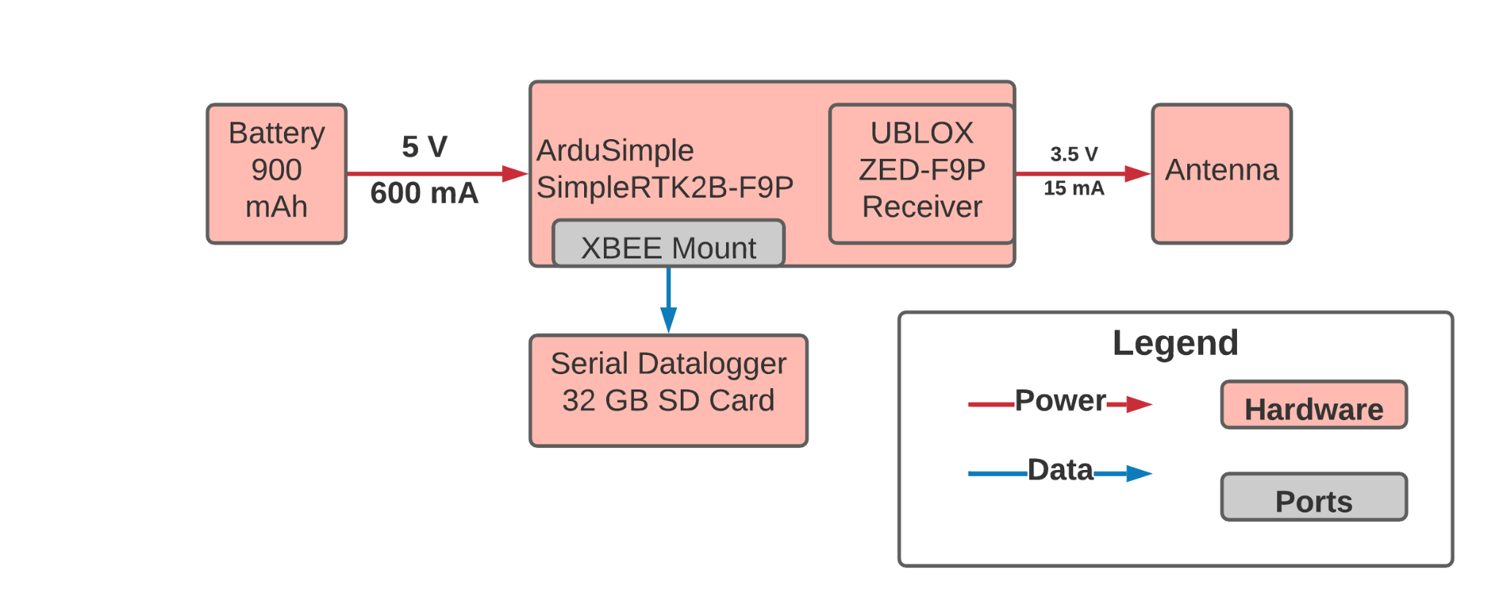
Payload Functional Block Diagram
Project Overview
Design Solution
CPE’s
Design Reqs.
Project Risks
Verification & Validation
Project Planning
Notes:
Jake

Slide 11
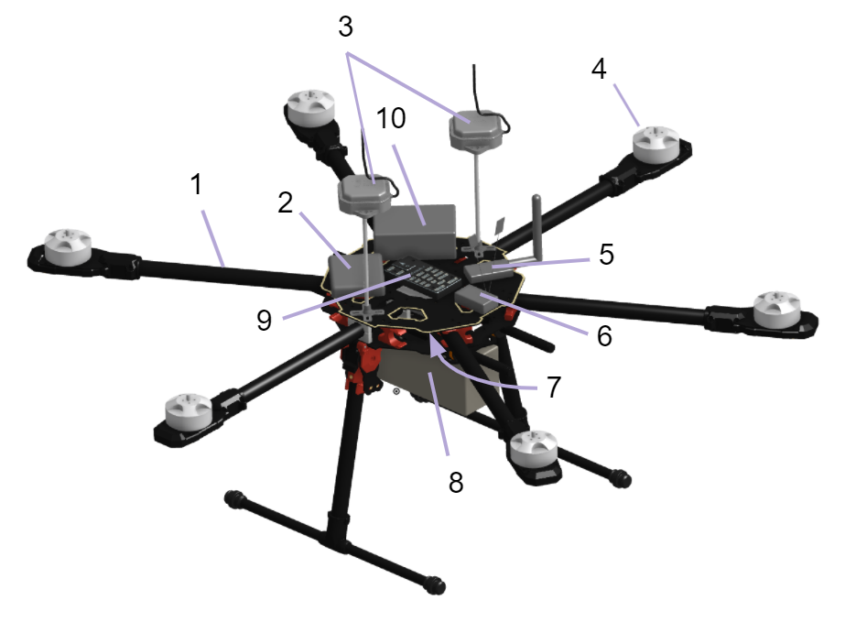
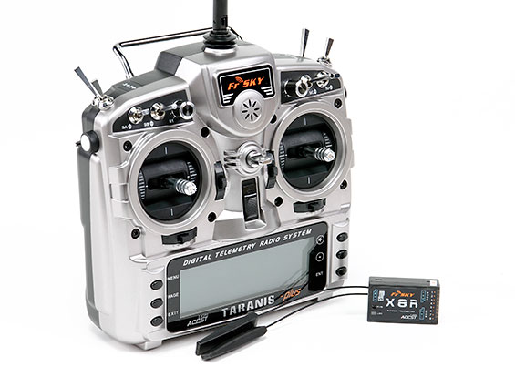
Hardware: UAS Onboard Components
Tarot 810 Sport Airframe
Ardusimple simpleRTK GPS module
u-blox GNSS antenna
Tarot 4114 320kV Brushless Motor
mRo SiK Telemetry Radio V2
FrSky X8R remote control receiver
Pixhawk 4 PM07 Power Module
Tattu 18,000mAh 6S Lipo Battery
Pixhawk 4 Flight Controller
Ground Truth System GPS Module
FrSky Taranis X9D Transmitter & X8R Receiver
11
Project Overview
Design Solution
CPE’s
Design Reqs.
Project Risks
Verification & Validation
Project Planning
Notes:
Maybe bring to top of design solution…?
Dimensions?
CAD model of Drone as main visual on left
Narration
Hexcopter unmanned aircraft system (UAS) was chosen.
Highlight general component layout
Lifting power distributed over six Arms
Each arm contains its own brushless motor & motor driver to swing the propellers providing lift force and control.
Main body if the UAS Contains all other equipment
Top Plate; Autopilot, Ground Station Telemetry Radio, RC receiver, GPS antennas for both ground truth and vehicle positioning
Center Plate; Power distribution & current monitoring.
Lower Rails;
Battery Pack
Ground truth payload
RTK GPS Board

Slide 12
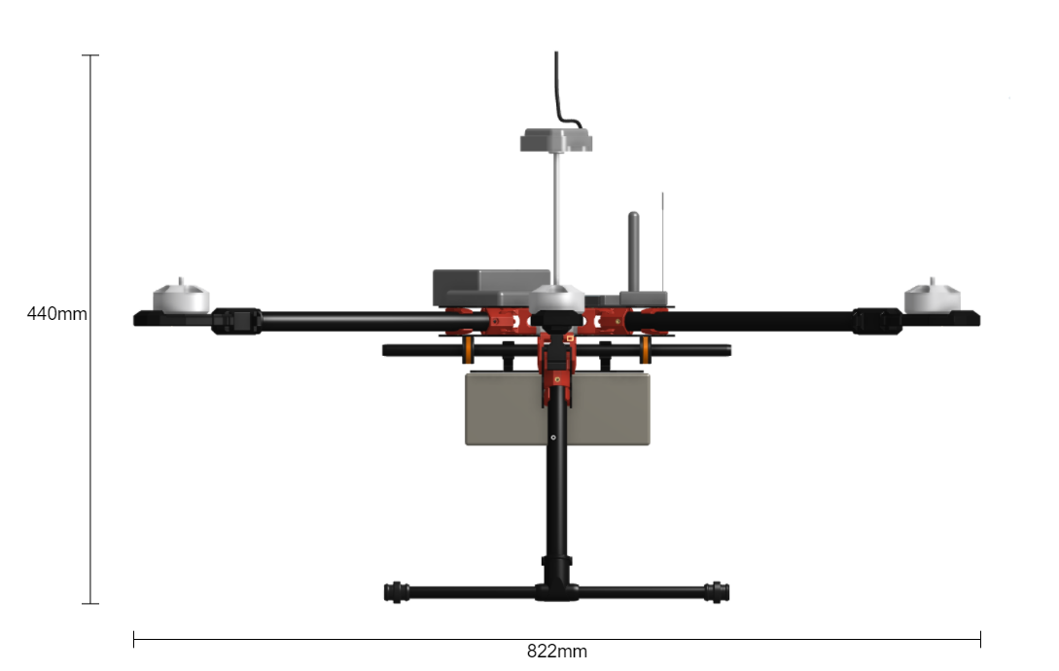
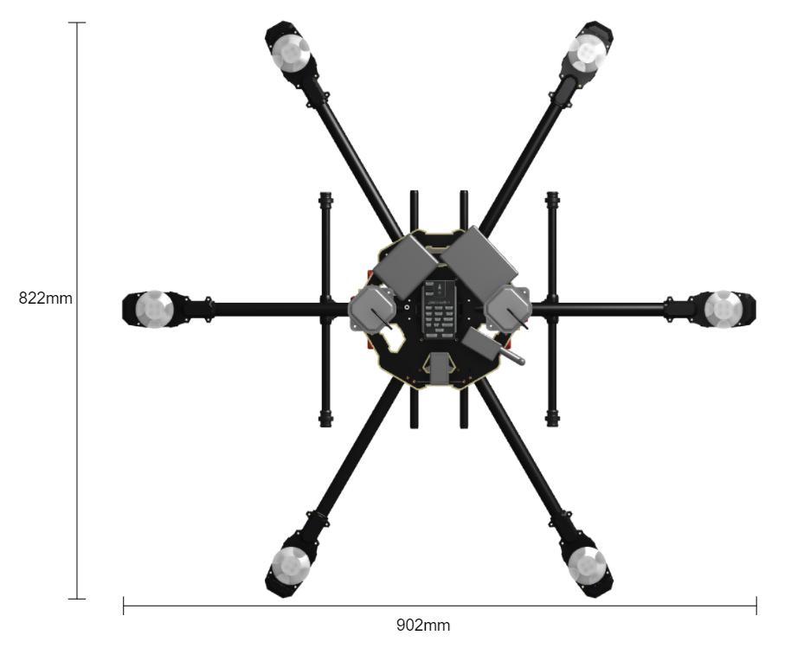
Hardware: UAS 3D View
Side View:
Top View:
Project Overview
Design Solution
CPE’s
Design Reqs.
Project Risks
Verification & Validation
Project Planning
Notes:
Maybe bring to top of design solution…?
Dimensions?
CAD model of Drone as main visual on left
Narration
Hexcopter unmanned aircraft system (UAS) was chosen.
Highlight general component layout
Lifting power distributed over six Arms
Each arm contains its own brushless motor & motor driver to swing the propellers providing lift force and control.
Main body if the UAS Contains all other equipment
Top Plate; Autopilot, Ground Station Telemetry Radio, RC receiver, GPS antennas for both ground truth and vehicle positioning
Center Plate; Power distribution & current monitoring.
Lower Rails;
Battery Pack
Ground truth payload
RTK GPS Board

Slide 13
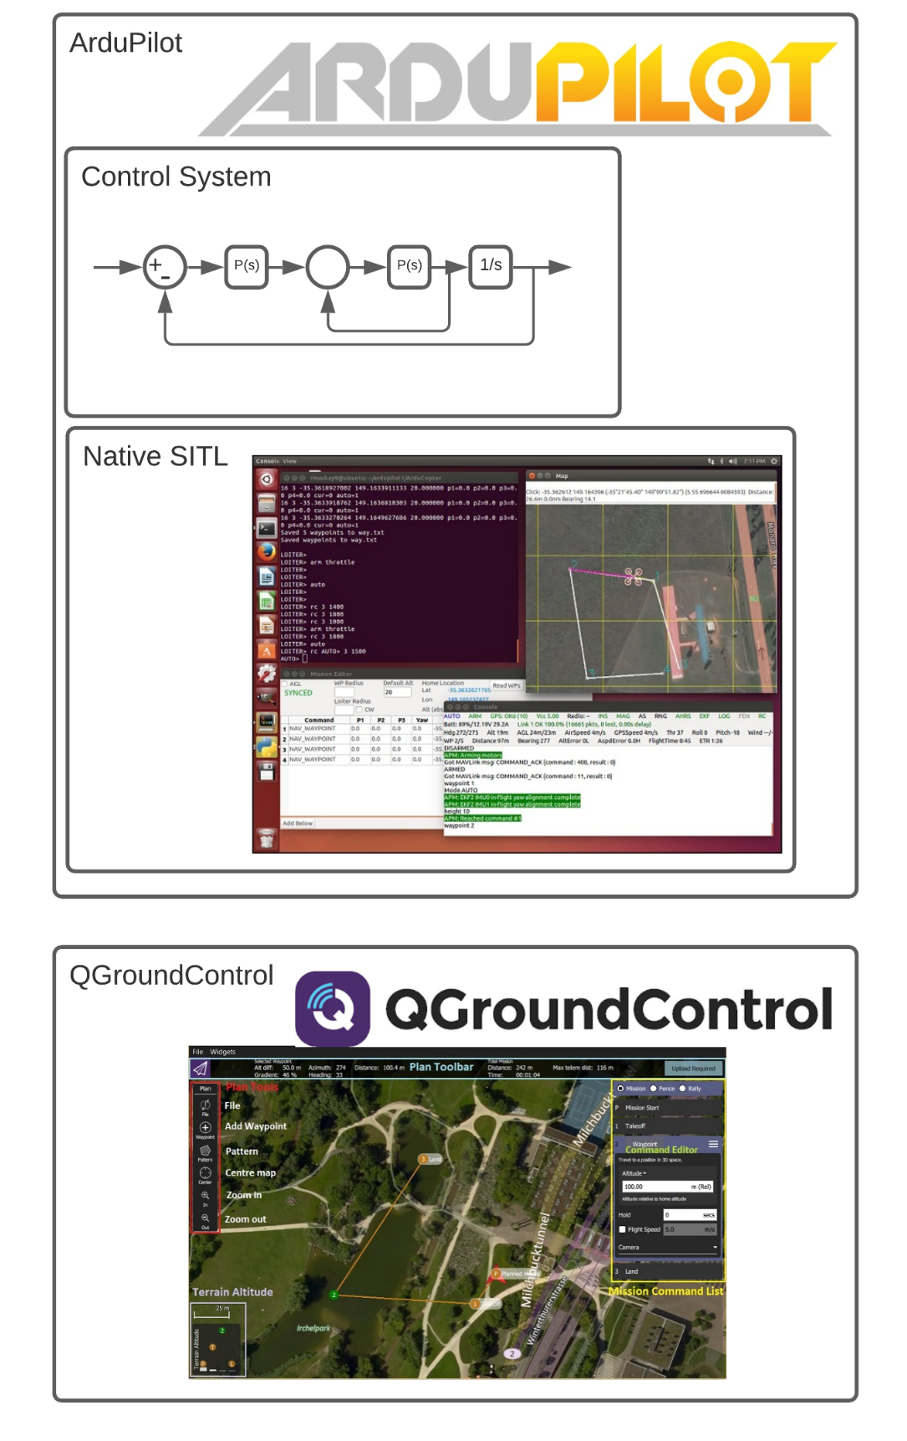
Software
Element | Selection | Reasoning
Autopilot | ArduPilot | Open source, successfully built, modifiable
Control System | Nested Feedback | Time and position control
Simulation | Native SITL | Builds ArduPilot code, exports logs, modifiable
Mission Planner | QGroundControl | Modifiable, takes in waypoint files
Project Overview
Design Solution
CPE’s
Design Reqs.
Project Risks
Verification & Validation
Project Planning

Slide 14
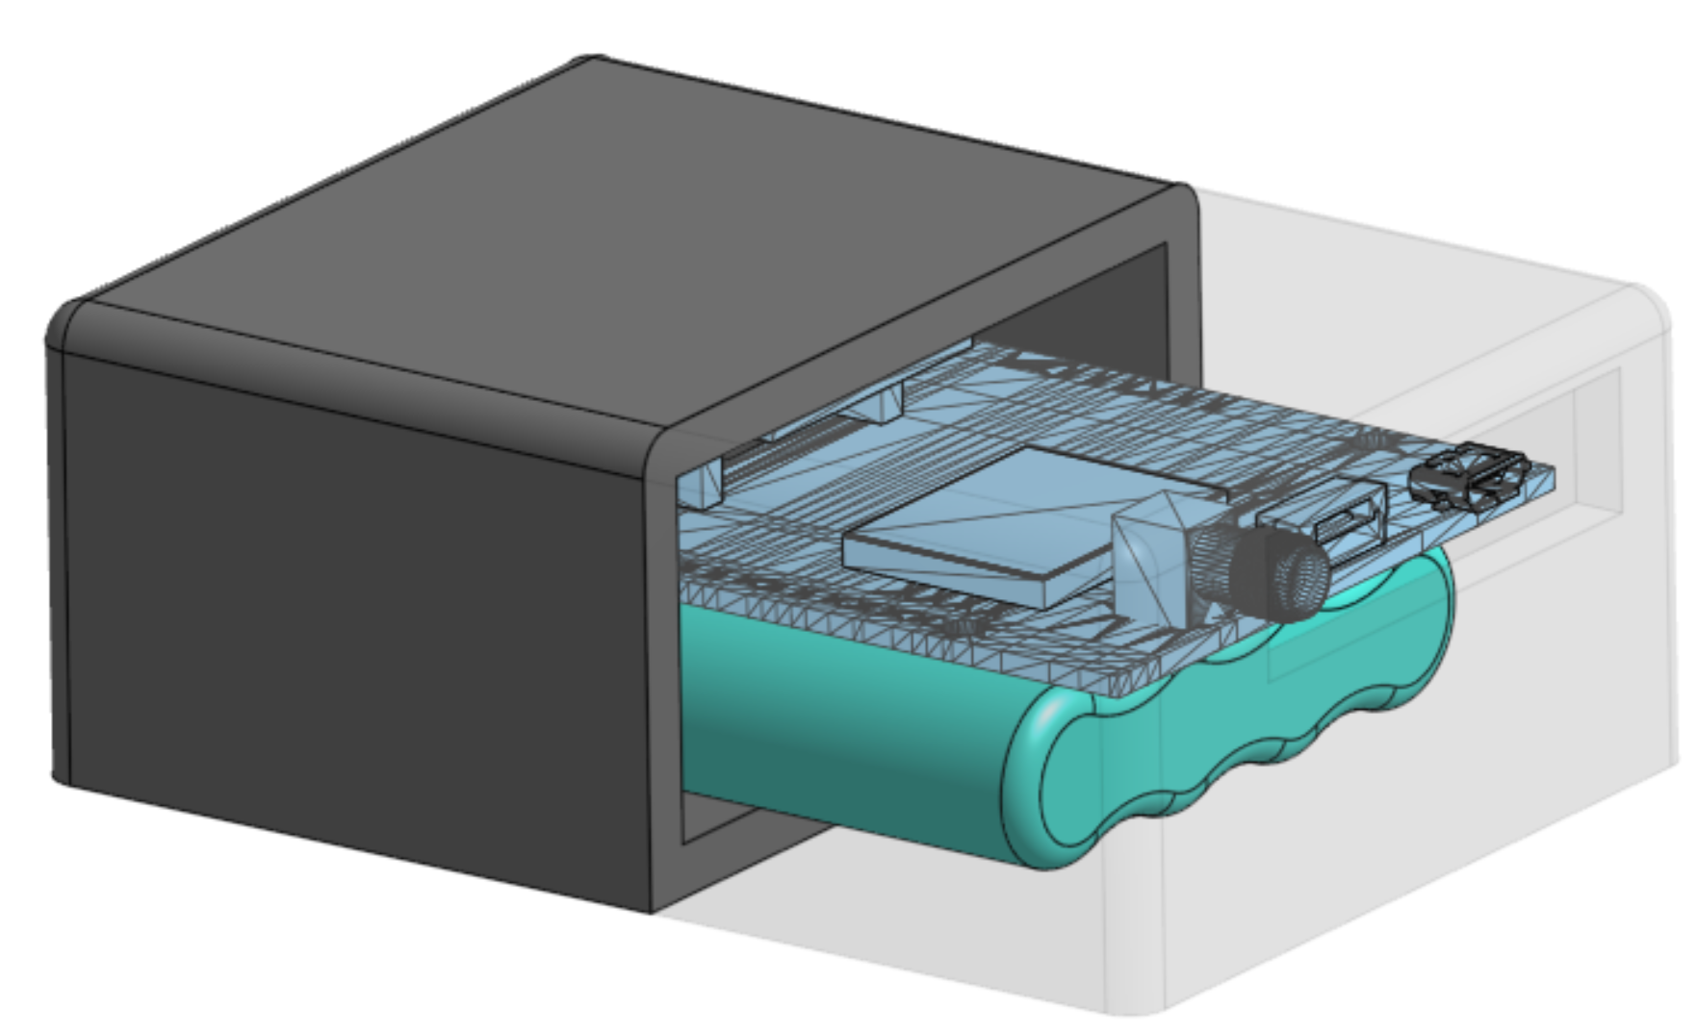
Payload: Ground Truth System
Dimensions: 6.7 x 9.6 x 3.6cm
Components:
Ardusimple simpleRTK2B GPS receiver
4.8V, 900mAh NiMH battery pack
3d printed plastic housing
Project Overview
Design Solution
CPE’s
Design Reqs.
Project Risks
Verification & Validation
Project Planning
Notes:
Instead of cad model, we could show plastic case bought from ardusimple, problem is there’s no dimensions and it doesn’t look like we could fit the batter inside. Might be worth it to list expected battery life also

Slide 15
CPE’s and FR’s

Slide 16
Critical Project Elements
CPE | Name | Description
E1 | Guidance | The multirotor mission planning software shall accept XYZT waypoints, and a feasible flight trajectory shall be passed to the control algorithm.
E2 | Control | The XYZT control algorithm shall be integrated into an already existing autopilot to adjust its flight velocity while maintaining XYZ accuracy to reach each waypoint within 1 second of the desired time.
E3 | Airframe | The UAS must be able to be controlled via an autopilot system containing the XYZT control system.
E4 | Simulation | The simulation software must be able to accurately determine whether the selected UAS is capable of completing the mission that is desired.
E5 | Ground Truth System | The Ground Truth System must be capable of accurately determining the position of the UAS with respect to space and time and evaluating control algorithm performance.
E6 | Operations & Testing | The XYZT control system must be able to be implemented on a UAS.
Project Overview
Design Solution
CPE’s
Design Reqs.
Project Risks
Verification & Validation
Project Planning
Notes:
E3 might need to be expanded to include flight performance
Anand
In order to properly define feasibility for our project, we turn to the Critical Project Elements outlined in this table. They are:
guidance
control
airframe
Simulation
GTS
Operations and testing
We have highlighted two especially critical, critical project elements
The control system that will really comprise the majority of our work, essentially augmenting an autopilot software to incorporate the parameter of time
Secondly, the airframe selection must be fully capable of demonstrating the capacity of our software

Slide 17
Functional Requirements
Functional Requirement: | Description:
FR1 | The control algorithm shall be able to command the multirotor to XYZT coordinates within 1 second.
FR2 | The control algorithm shall be integrated with an existing autopilot software.
FR3 | The UAS and its testing shall adhere to FAA and CU Boulder Guidelines.
FR4 | The modified mission planning software shall allow input XYZT coordinates that will support integration of the control algorithm.
FR5 | The simulation software shall be capable of simulating desired trajectory and determining its feasibility.
FR6 | Test vehicle shall have sufficient flight capabilities for use in demonstrating and evaluating control algorithm performance.
FR7 | Ground Truth System must be able to detect and record the flight trajectory of the test vehicle to 10cm and evaluate performance of control algorithm.
Project Overview
Design Solution
CPE’s
Design Reqs.
Project Risks
Verification & Validation
Project Planning
Notes:
Anand
These are our functional requirements. In summary, they address:
The vehicle has to get to its destination when we want it
Our control algorithm will be built off an existing autopilot software
The user must be able to input XYZT coordinates of their choice
The simulation software must be able to determine feasibility
The vehicle must be competent
The GTS must have an accurate account of the vehicles path

Slide 18
Design Requirements

Slide 19
Design Requirement Breakdown:
Mission Planner
Simulation
Simulation
Control Algorithm
Airframe/Operations and Testing
Ground Truth
A
B
C
D
E
Notes:
Anand

Slide 20
Mission Planner (E1,FR4)
Solution: QGroundControl
Key Design Solution Elements | Compliance
DR 4.1 Mission planning software shall be capable of accepting XYZT waypoints | ?
DR 4.2 Mission planning software shall be able to output XYZT waypoints to autopilot | ?
Design Requirements
Project Overview
Design Solution
CPE’s
A
B
C
D
E
Project Risks
Verification & Validation
Project Planning

Slide 21
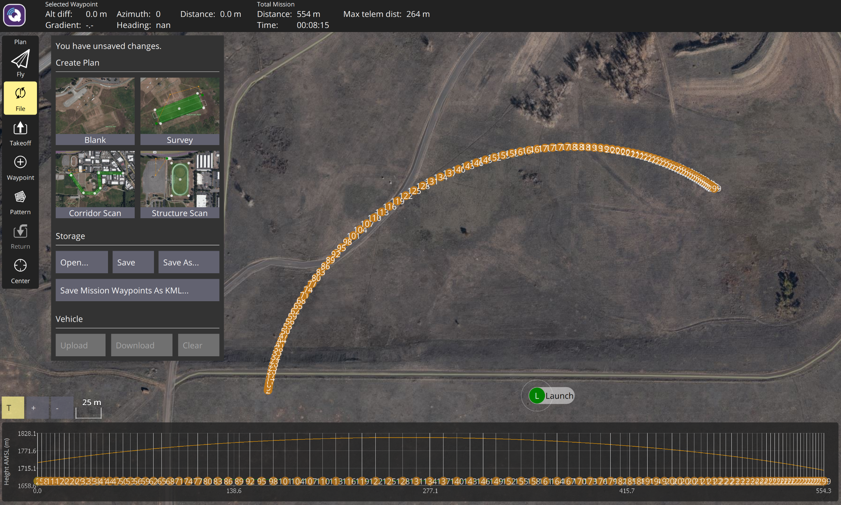
Mission Planner (E1,FR4)
DR4.1: Mission planning software shall be capable of accepting XYZT waypoints
DR4.2: Mission planning software shall be able to output XYZT waypoints to autopilot
Selected mission planning software: QGroundControl (QGC)
Responsible for accepting input waypoint flight path and collecting flight data
QGC accepts a list of waypoints and corresponding parameters with an input .waypoints file
One parameter will be modified to “Time”
Parameters will be flashed to the modified Ardupilot (autopilot) code via MAVLINK protocol
Design Requirements
Project Overview
Design Solution
CPE’s
A
B
C
D
E
Project Risks
Verification & Validation
Project Planning
Notes:
Speaker Notes:
In order to meet design requirements 4.1 and 4.2, mission planner will be modified to
*edit this

Slide 22
Mission Planner (E1,FR4)
Solution: QGroundControl
Key Design Solution Elements | Compliance
DR 4.1 Mission planning software shall be capable of accepting XYZT waypoints | In Compliance
DR 4.2 Mission planning software shall be able to output XYZT waypoints to autopilot | In Compliance
Design Requirements
Project Overview
Design Solution
CPE’s
A
B
C
D
E
Project Risks
Verification & Validation
Project Planning

Slide 23
Simulation (E4,FR5)
Solution: Native SITL Simulation Software
Key Design Solution Elements | Compliance
DR 5.2 Simulation system shall be capable of modeling forces that act on UAS during flight | ?
DR 5.4 Simulation must be capable of exporting data | ?
Design Requirements
Project Overview
Design Solution
CPE’s
A
B
C
D
E
Project Risks
Verification & Validation
Project Planning

Slide 24
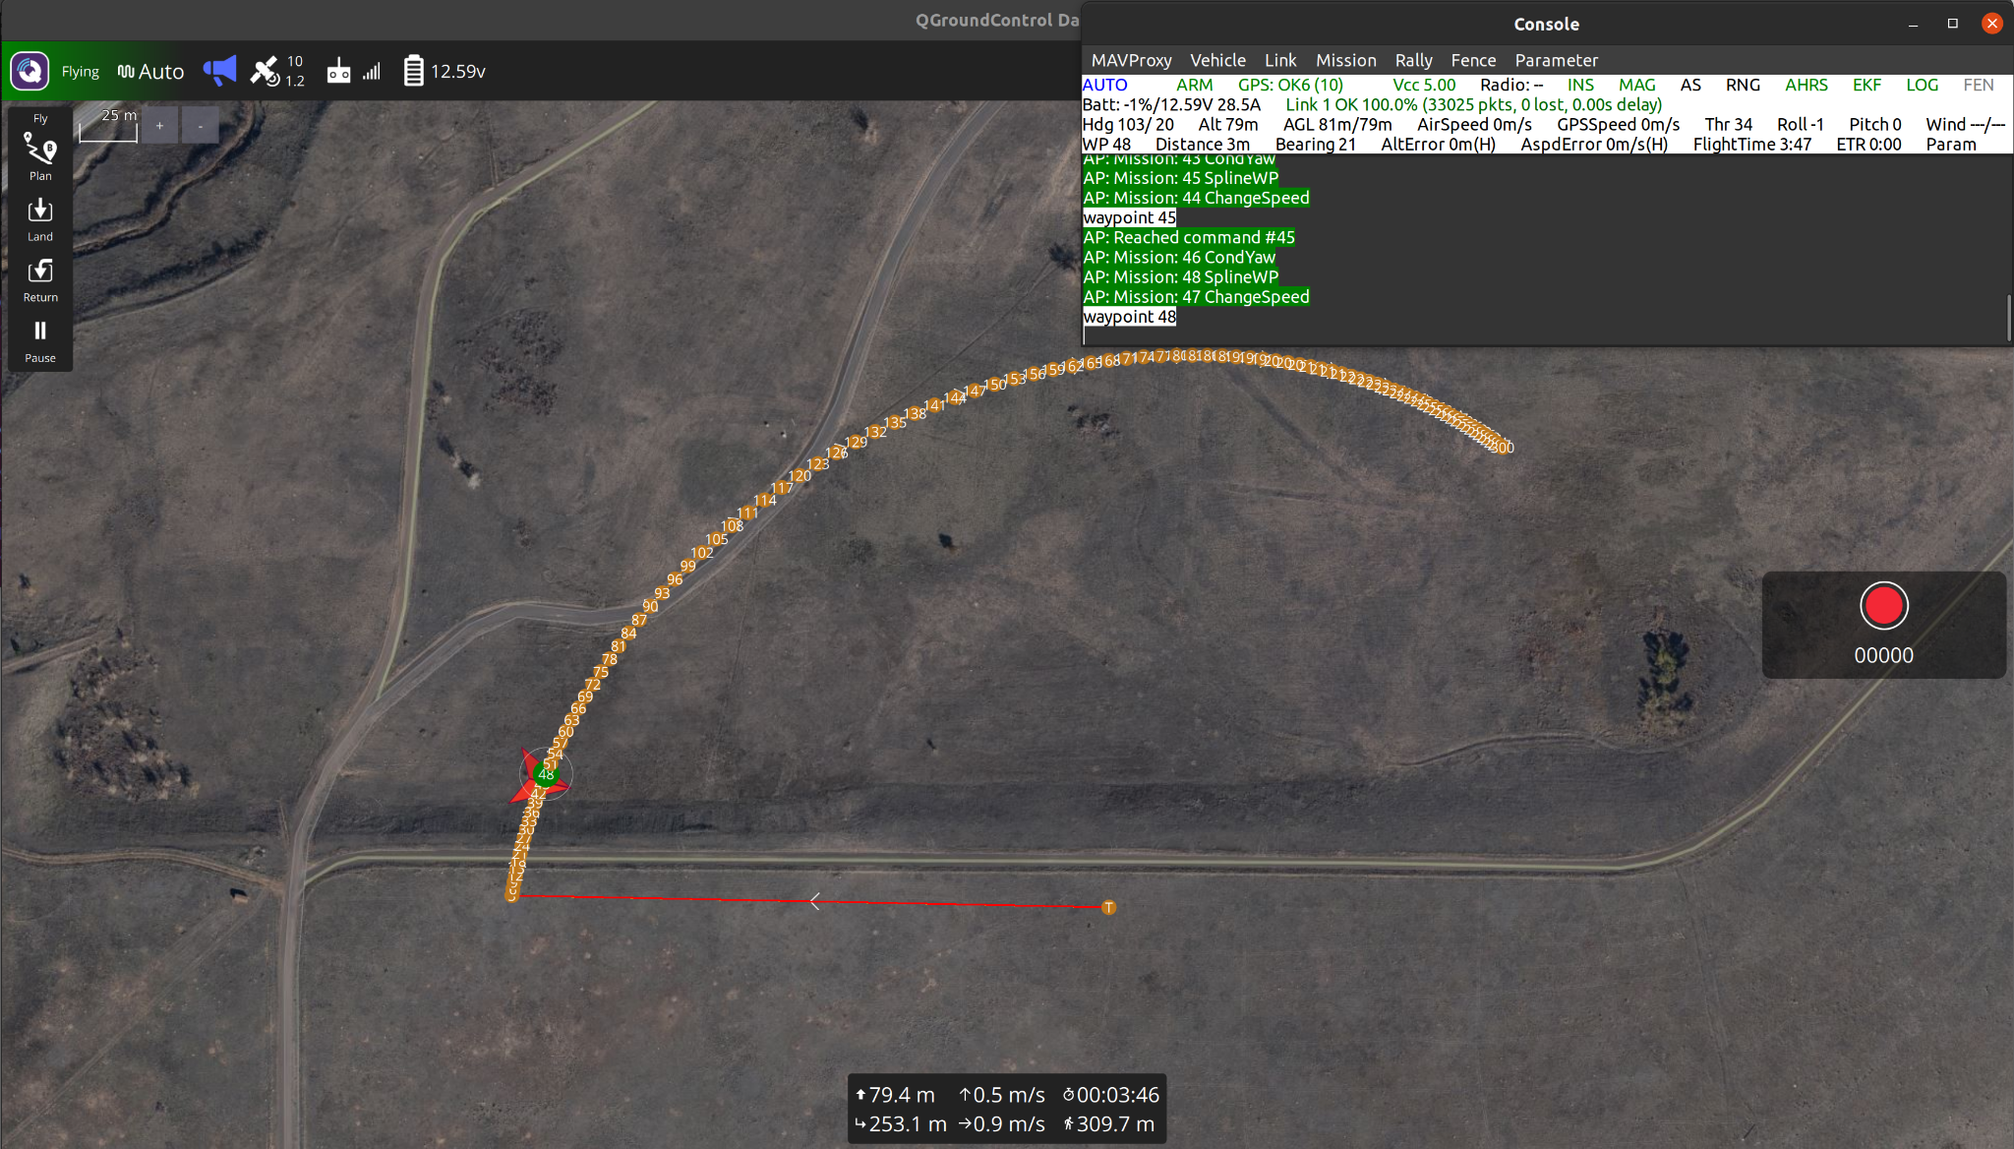
Simulation (E4, FR5)
DR5.2 Simulation system shall be capable of modeling forces that act on UAS during flight
DR5.4 Simulation must be capable of exporting data
Native SITL simulation paired with QGC and Ardupilot will be used to verify code and path
Simulation has been run with preliminary flight tests
Design Requirements
Project Overview
Design Solution
CPE’s
A
B
C
D
E
Project Risks
Verification & Validation
Project Planning
Notes:
Adam
The copter has been able to connect with our intended ground control station which is QGroundControl
Multiple custom missions have been inputted as well as the LEO path that was performed the past summer
Then using the current version of our autopilot built, the mission was able to be executed and completed through the software in the loop simulation

Slide 25
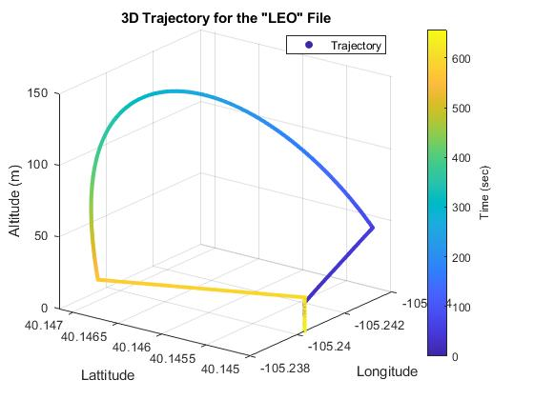
Simulation (E4, FR5)
DR5.2 Simulation system shall be capable of modeling forces that act on UAS during flight
DR5.4 Simulation must be capable of exporting data
Process
Create flight path in MATLAB
Import flight path to QGC
Upload flight path to virtual drone
Fly simulated mission
Export data to MATLAB and analyze
Design Requirements
Project Overview
Design Solution
CPE’s
A
B
C
D
E
Project Risks
Verification & Validation
Project Planning
Notes:
Adam
Given locations of waypoint, MATLAB was able to create the correctly formatted waypoint file
The software in the loop was then booted up separately, creating the virtual drone that is intended to fly the trajectory
QGroundControl then takes in the waypoint file that we have created
The virtual drone is put into the designated “AUTO MODE” which autonomously executes the desired mission
Once the drone has completed the trajectory and has landed the information of the flight is exported as a binary file
The binary file is then converted into a matlab file to further analyze the performance of drone (Such as when the drone arrived at a waypoint) and the onboard sensors

Slide 26
Simulation (E4,FR5)
Solution: Native SITL Simulation Software
Key Design Solution Elements | Compliance
DR 5.2 Simulation system shall be capable of modeling forces that act on UAS during flight | In Compliance
DR 5.4 Simulation must be capable of exporting data | In Compliance
Design Requirements
Project Overview
Design Solution
CPE’s
A
B
C
D
E
Project Risks
Verification & Validation
Project Planning

Slide 27
Control Algorithm (E2,FR1,FR2,FR4)
Solution: Closed Loop Nested Feedback
Key Design Solution Elements | Compliance
DR 1.2 The control algorithm must bring the vehicle to its desired position with sub second time accuracy | ?
DR 1.3 The controller shall function without the use of a continuous telemetry link | ?
Design Requirements
Project Overview
Design Solution
CPE’s
A
B
C
D
E
Project Risks
Verification & Validation
Project Planning

Slide 28
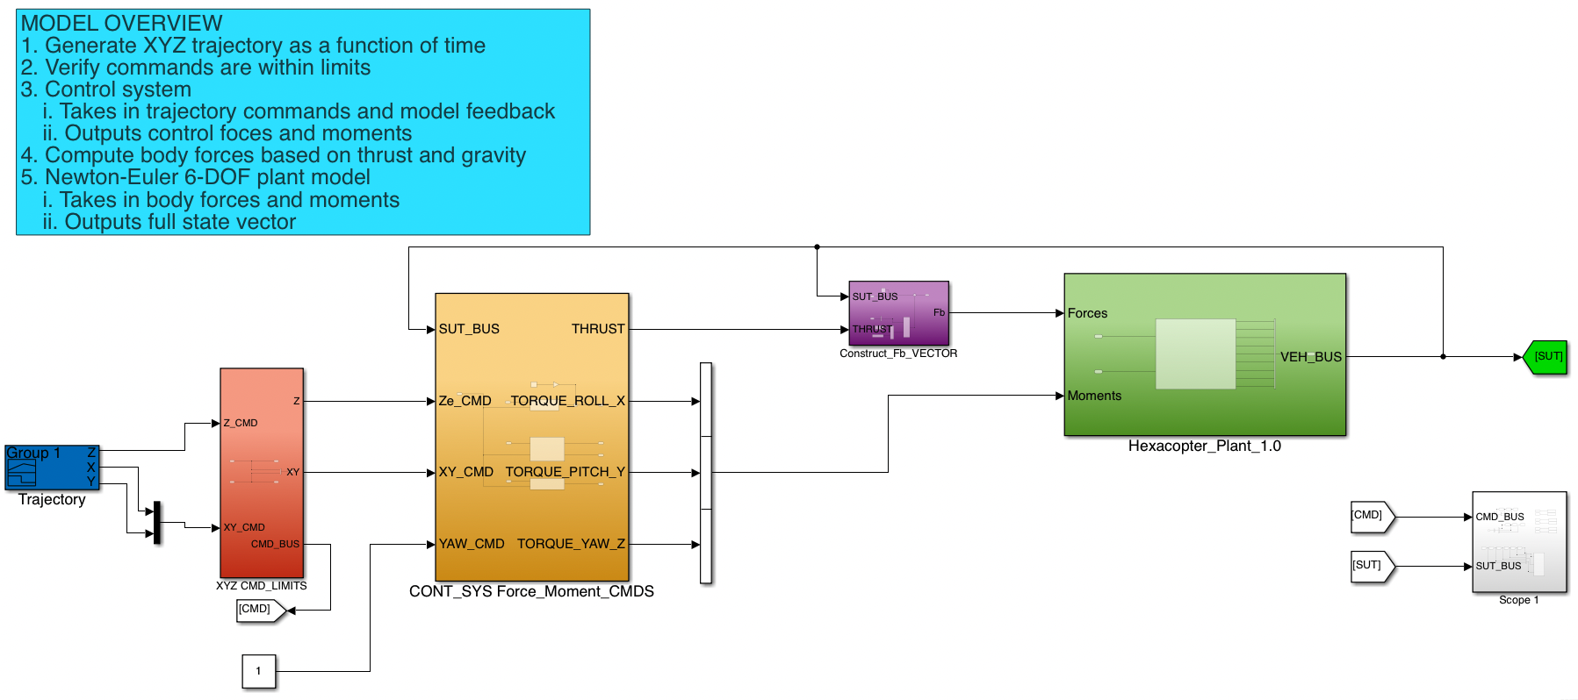
Control Algorithm: Simulink Model
Design Requirements
Project Overview
Design Solution
CPE’s
A
B
C
D
E
Project Risks
Verification & Validation
Project Planning

Slide 29
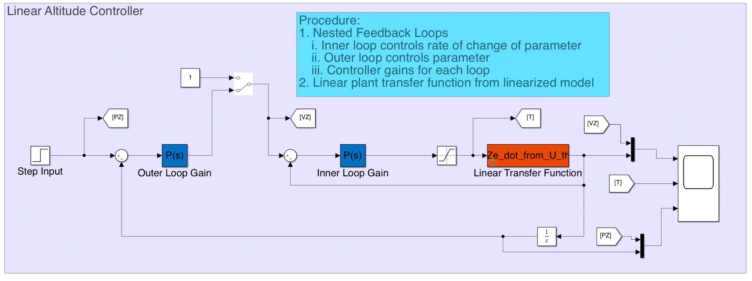
Control Algorithm: Linear Controller
Design Requirements
Project Overview
Design Solution
CPE’s
A
B
C
D
E
Project Risks
Verification & Validation
Project Planning

Slide 30
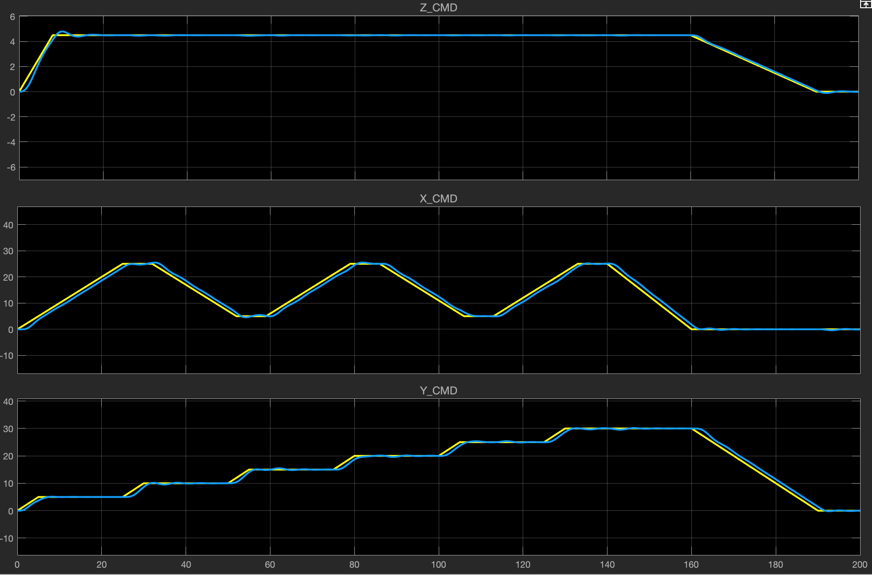
Control Algorithm: Simulation Results
Commanded Trajectory: Yellow
Actual Trajectory: Blue
Discussion:
Simplified Model (Outside effects, motors, proportional control)
Very good trajectory tracking
Error Analysis:
RMS position error
X: 1.1 m
Y: 0.8 m
Z: 0.1 m
Cross-correlation lag time error
X: 1.1215 s
Y: 1.1215 s
Z: 0.7477 s
Addition of full PID control and gain tuning for further improvement
Design Requirements
Project Overview
Design Solution
CPE’s
A
B
C
D
E
Project Risks
Verification & Validation
Project Planning

Slide 31
Control Algorithm (E2,FR1,FR2,FR4)
Solution: Closed Loop Nested Feedback
Key Design Solution Elements | Compliance
DR 1.2 The control algorithm must bring the vehicle to its desired position with sub second time accuracy | Partial Compliance
DR 1.3 The controller shall function without the use of a continuous telemetry link | In Compliance
Design Requirements
Project Overview
Design Solution
CPE’s
A
B
C
D
E
Project Risks
Verification & Validation
Project Planning

Slide 32
Airframe/Operations & Testing (E3,E6,FR6)
Solution: Tarot T810 Sport
Key Design Solution Elements | Compliance
DR1.1: Vehicle is capable of holding position within 0.5 m of desired position under the influence of up to 10 mph winds. | ?
DR6.1: Test vehicle shall be capable of minimum 20 minute static hover flight. | ?
Design Requirements
Project Overview
Design Solution
CPE’s
A
B
C
D
E
Project Risks
Verification & Validation
Project Planning
Notes:
Narration;
Next we will look at how the choice of vehicle satisfies the design requirements
The UAS hardware design is primarily driven by functional requirement 6, stating that the UAS must have sufficient flight capabilities for useful flight testing to take place. From this, there were two derived design requirements that the team focused on proving.
The first is design requirement 1.1, that the vehicle is capable of holding a position within 0.5m in winds up to 10mph. Meeting this requirement ensures that the vehicle will be suitable for missions flown in less than ideal conditions.
And design requirement 6.1, that the vehicle be capable of a 20 minute minimum flight time while in a hover. This ensures that the vehicle has sufficient endurance for control system evaluation, and flying the customer test cases.

Slide 33
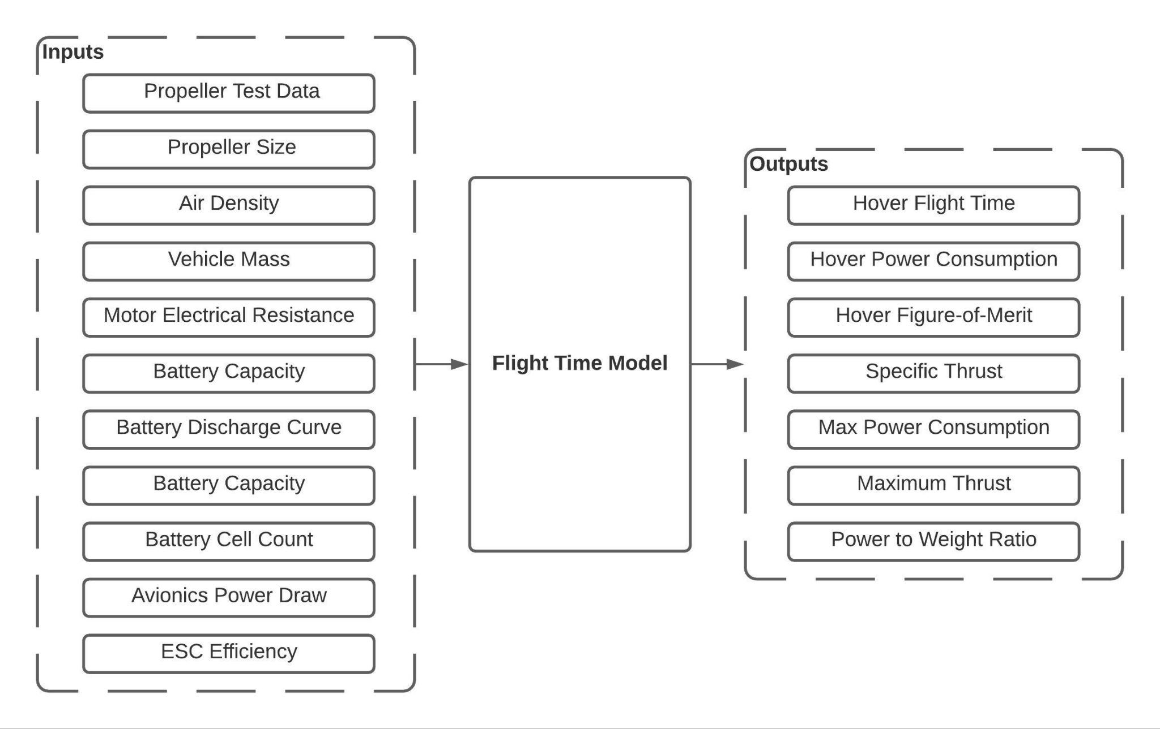
Airframe/Operations & Testing (E3,E6,FR6)
Flight Time Model Overview
Key Assumptions
Steady hovering flight condition
Constant avionics power draw
Static thrust model for lift applies
Each arm contributes equally to the thrust produced.
Predictable battery discharge curve
Flight time lasts until battery reaches a predetermined cutoff voltage.
Design Requirements
Project Overview
Design Solution
CPE’s
A
B
C
D
E
Project Risks
Verification & Validation
Project Planning
Notes:
Overview of flight time model
Visuals;
Visual of model inputs & outputs
List of model assumptions
Narration;
To prove satisfaction of requirement in DR 6.1, a model was created in Matlab to predict the flight performance for a specific vehicle configuration, based on mass, battery capacity, air density, and manufacturer component data.
At a high level, this flight time model uses a static thrust analysis for variable speed propellers to relate lifting power created by the propeller, to an ideal mechanical power from the motor. Individual component efficiencies are then applied for the propeller, motor, and speed controller to account for losses, and give an estimate of the electrical power required from each motor to maintain a hover.
The flight time is then estimated by taking into account the power draw from all motors and avionics, and applying it to a constant-loading battery discharge model until the battery falls below a predetermined cutoff voltage.
The figure here shows a summary of the inputs and outputs of the model, and the list on the right features some of the key assumptions that were used. The most important of which is the assumption that the electrical loading during a hover remains relatively constant.
(leave off)
This was deemed a reasonable assumption based on a preliminary experiment done using an existing quad-rotor, that showed that the power consumption stayed within approximately 5-7% of the average, even during gusty wind conditions.

Slide 34
Airframe/Operations & Testing (E3,E6,FR6)
DR6.1: Test vehicle shall be capable of minimum 20 minute static hover flight
Model used to estimate flight time with multiple complete vehicle configurations to narrow down vehicle selection.
T810 was selected as the best option to satisfy DR6.1 with sufficient margin.
Design Requirements
Project Overview
Design Solution
CPE’s
A
B
C
D
E
Project Risks
Verification & Validation
Project Planning
Notes:
Overview Slide for DR6.1
Visuals;
DR 6.1
Narration;
Using this flight performance model, 4 complete airframe configurations were evaluated with different battery options to determine which airframe choice would best meet the flight time design requirement.
Based on this analysis, the Tarot T810 airframe was selected for its ability to meet the endurance requirement using multiple battery options. We selected the 18Ah battery for our configuration, as it allowed for a 29% margin on the endurance, with only a small increase in mass over the other battery options. The T810 was also found to satisfy other design considerations such as budget, parts availability, battery & payload mounting, and compatibility with desired current sensing solution.
The table here shows a summary of the T810 configurations evaluated
The configuration shown in red was not able to meet the flight time requirement
The configurations in orange were able to meet this requirement with low margin
And the green configuration meets the requirement with greater than 20% margin

Slide 35
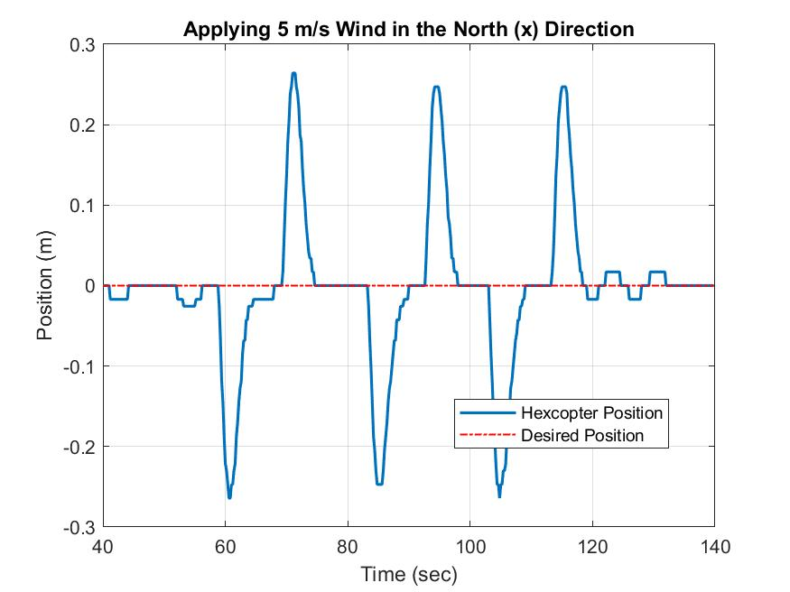
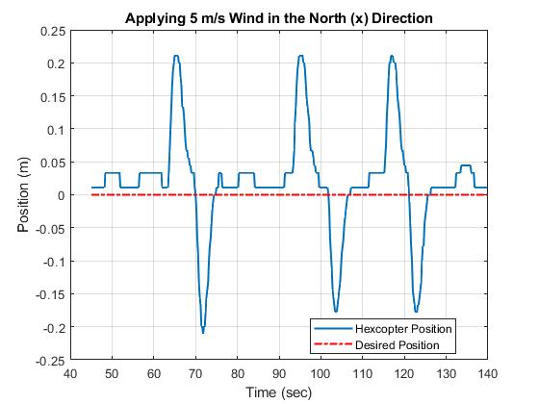
Airframe/Operations & Testing (E3,E6,FR6)
DR1.1: Vehicle is capable of holding position within 0.5 m of desired position under the influence of up to 10 mph winds
Tested vehicle in a “Loiter Mode” within the native SITL
Simulated three gusts of wind of 5 m/s (11.18 mph)
Maximum deviation from desired position was 0.26 meters
Design Requirements
Project Overview
Design Solution
CPE’s
A
B
C
D
E
Project Risks
Verification & Validation
Project Planning
Notes:
Narration;
To prove that the T810 satisfies the design requirement 1.1 concerning the wind performance, the software in the loop simulation was used to observe how the vehicle reacts to changes in the wind speed parameter.
For the simulation, the vehicle was placed in a position holding flight mode an altitude of 100m, and the wind velocity was repeatedly changed from 0 to 5 m/s, or approximately 11.2 miles per hour to simulate a wind gust.
The plot shown here shows the results of that simulation, with time plotted on the x axis, and the vehicle’s position along the same direction as the wind on the y axis.
What we can see is that in the worst case scenario, where the vehicle encounters a sharp gust exceeding 10mph, the drift in position stays well below the 0.5m requirement, and the vehicle is able to compensate and return to the desired position.
It is worth noting that the simulation uses experimentally determined reference values to model drag on the vehicle, exact parameters will not be known until preliminary flight testing is complete.

Slide 36
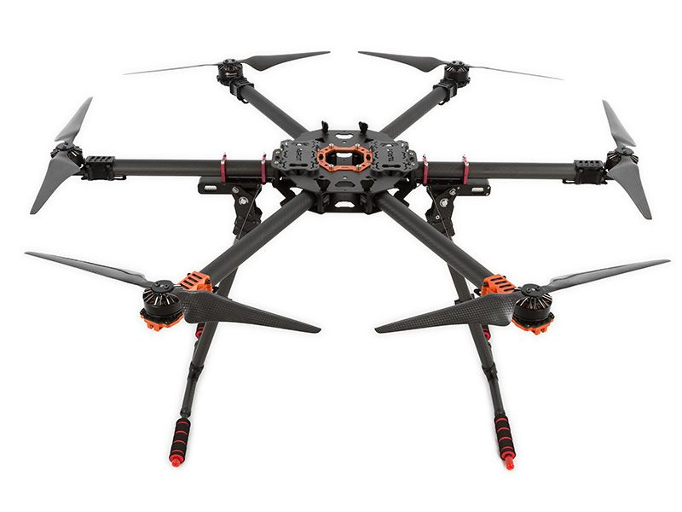
Airframe/Operations & Testing (E3,E6,FR6)
Tarot T810 Estimated Flight Performance
Total mass: 6kg
Flight time: 25.8 minutes
Hover power consumption: 772 Watts
Hovering power system efficiency: 0.86
Hovering propeller efficiency (FOM): 0.55
Specific thrust: 7.7 g/w
Thrust to weight ratio: 2.1:1
Wind performance (up to 10 mph): < 0.26 meters from desired hold location
Design Requirements
Project Overview
Design Solution
CPE’s
A
B
C
D
E
Project Risks
Verification & Validation
Project Planning
Notes:
Performance summary
Visuals;
Photo of T810 Airframe
Narration;
Here is a summary of the flight performance we expect from our vehicle. The key parameter being hovering flight time, is estimated at 25.8 minutes.
We were also able to estimate the thrust vs weight ratio, which gives an indication of overall vehicle performance and responsiveness. Typically 1.7:1 is considered a good value to aim for, and our hardware exceeds this at 1.9:1
As a preliminary check of the model’s accuracy, it was used to predict the flight time of another vehicle with with a known flight time. The results indicate that this flight time model is reasonably accurate, with actual flight times falling within 10% of that predicted by the model, giving us further confidence in our hardware selection.

Slide 37
Airframe/Operations & Testing (E3,E6,FR6)
Solution: Tarot T810 Sport
Key Design Solution Elements | Compliance
DR1.1: Vehicle is capable of holding position within 0.5 m of desired position under the influence of up to 10 mph winds. | In Compliance
DR6.1: Test vehicle shall be capable of minimum 20 minute static hover flight. | In Compliance
Design Requirements
Project Overview
Design Solution
CPE’s
A
B
C
D
E
Project Risks
Verification & Validation
Project Planning

Slide 38
Ground Truth (E5,FR7)
Solution: Ublox ZED-F9P Post-Processed Kinematic GPS
Key Design Solution Elements | Compliance
DR 7.1 The Ground Truth System (GTS) shall be capable of measuring time and position to within 10 cm accuracy | ?
Design Requirements
Project Overview
Design Solution
CPE’s
A
B
C
D
E
Project Risks
Verification & Validation
Project Planning

Slide 39
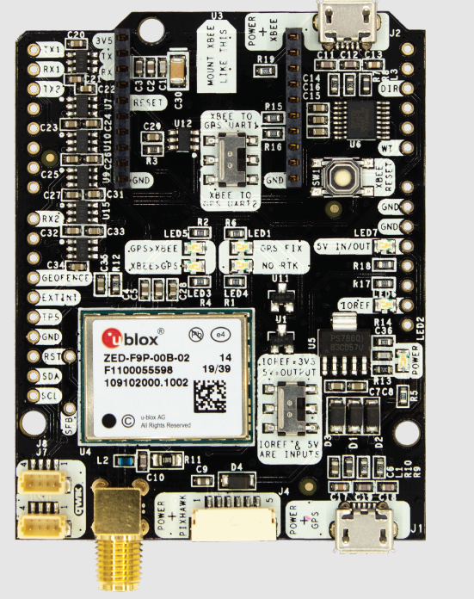
Ground Truth (E5,FR7)
DR7.1: The GTS shall be capable of measuring time and position to within 10 cm accuracy
GPS Module: Ublox ZED-F9P
Multi-band GNSS receiver delivers centimeter level accuracy in seconds
Position accuracy with RTK (Real-Time Kinematic) of 1 cm
2 modules for RTK GPS for onboard autopilot navigation
2 modules for PPK (Post-Processed Kinematic) GPS for the GTS
GTS Application Board: ArduSimple simpleRTK2B-F9P
Application board for the Ublox module
Allows for connection to Pixhawk and data storage
Need 2 boards and 2 antennas: one for rover, one for ground station
Design Requirements
Project Overview
Design Solution
CPE’s
A
B
C
D
E
Project Risks
Verification & Validation
Project Planning
Notes:
Eric
Guideline for making slides:
Ground truth presentation we have given as baseline
Run through how GTS will work and how we will process data
Provide short explanation of how GTS will satisfy requirements
Notes:
Proposed GTS with components labeled
Do we want to explain PPK first?
Add Eric’s slides about Ease of Post Processing

Slide 40
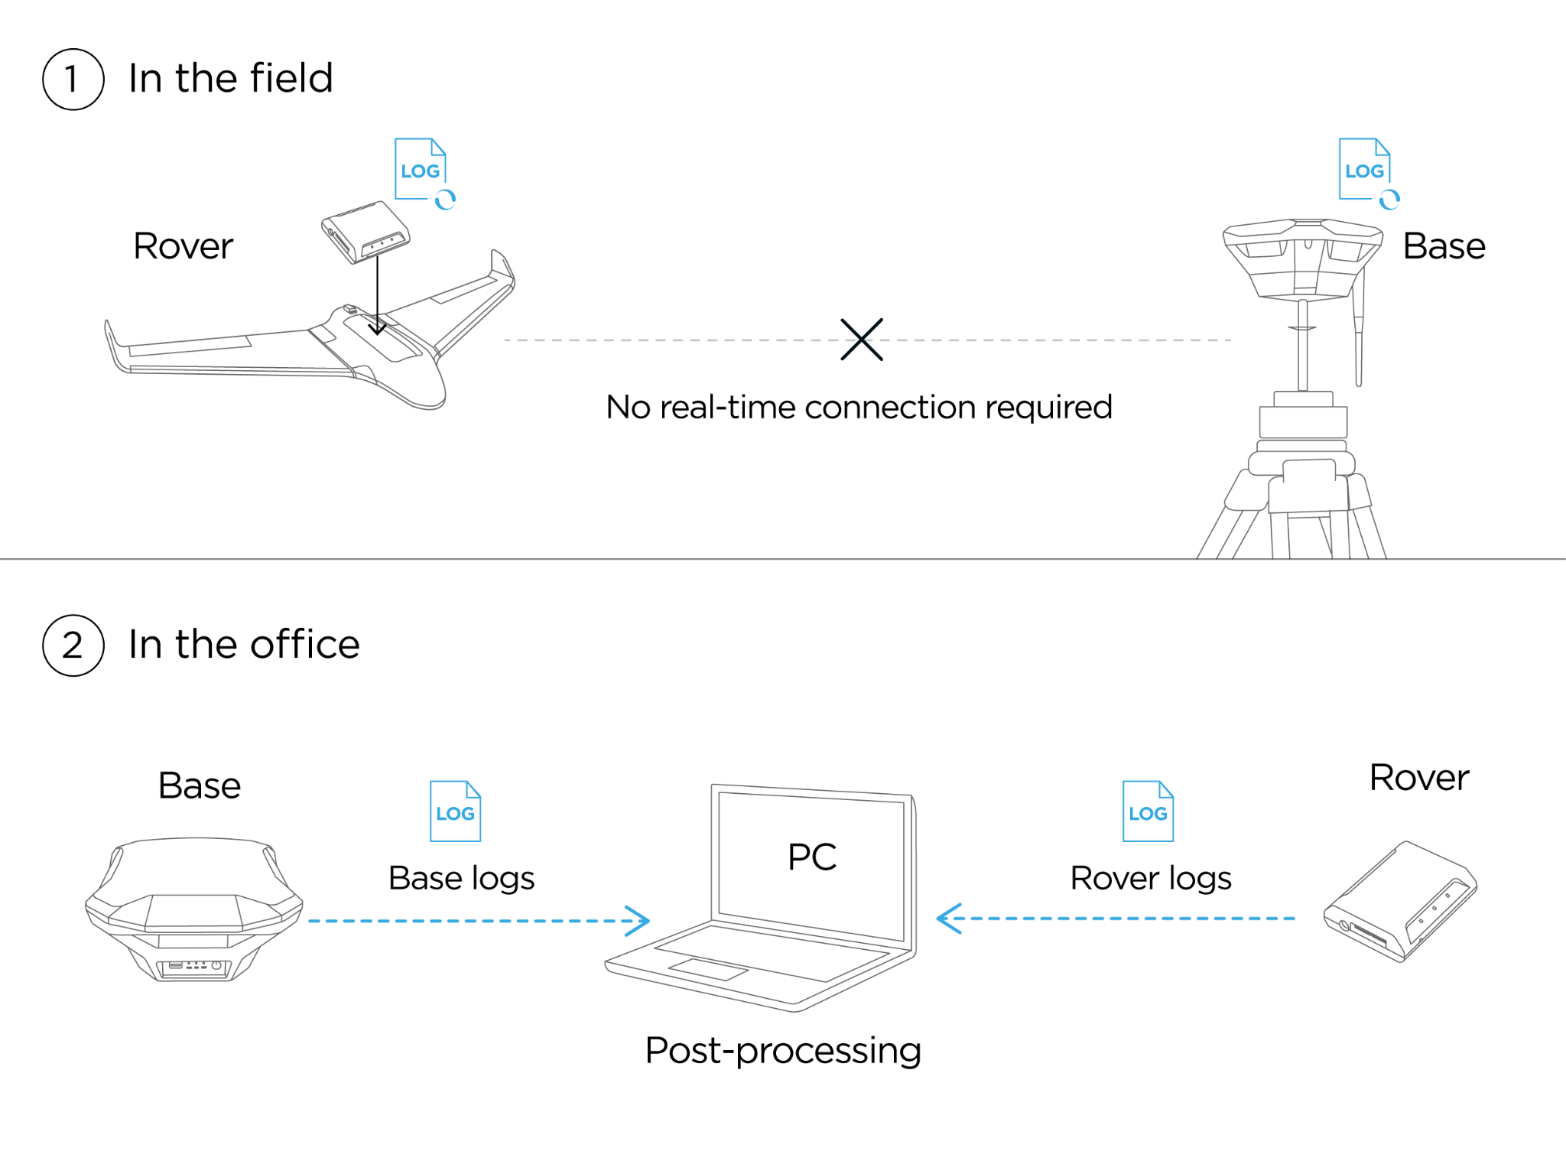
Ground Truth (E5,FR7)
DR7.1: The GTS shall be capable of measuring time and position to within 10 cm accuracy
Post-Processed Kinematic (PPK) GPS:
PPK allows for simpler and less-expensive hardware than a Real-Time Kinematic (RTK) GTS
Navigation system is RTK GPS
No need for real-time connections or calculations
PPK solutions are more robust than RTK:
Not subject to data dropouts
Solution techniques can take advantage of past and future observations
Design Requirements
Project Overview
Design Solution
CPE’s
A
B
C
D
E
Project Risks
Verification & Validation
Project Planning
Notes:
Eric
Speaker Notes: In order to verify the position and time accuracy of an executed mission, the ground truth system shall be able to verify the position of the uas with up to 10 cm accuracy and
Guideline for making slides:
Ground truth presentation we have given as baseline
Run through how GTS will work and how we will process data
Provide short explanation of how GTS will satisfy requirements
Notes:
Proposed GTS with components labeled
Do we want to explain PPK first?
Add Eric’s slides about Ease of Post Processing

Slide 41
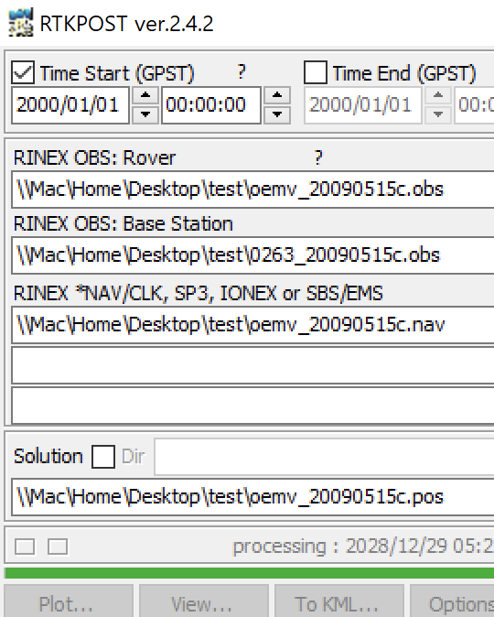
Ground Truth (E5,FR7)
DR7.1: The GTS shall be capable of measuring time and position to within 10 cm accuracy
Data Storage: ArduSimple Serial Datalogger
Pre-configured and compatible with Xbee socket on the application board
Files will be logged on 32 GB SD card
Post Processing: RTKLIB
RTKPOST
Generates a solution for PPK using rover and base station data that contains Lat, Long, Altitude, GPS time, and associated error
Design Requirements
Project Overview
Design Solution
CPE’s
A
B
C
D
E
Project Risks
Verification & Validation
Project Planning
Notes:
Eric
Guideline for making slides:
Ground truth presentation we have given as baseline
Run through how GTS will work and how we will process data
Provide short explanation of how GTS will satisfy requirements
Notes:
Proposed GTS with components labeled
Do we want to explain PPK first?
Add Eric’s slides about Ease of Post Processing

Slide 42
Ground Truth (E5,FR7)
Solution: Ublox ZED-F9P Post-Processed Kinematic GPS
Key Design Solution Elements | Compliance
DR 7.1 The GTS shall be capable of measuring time and position to within 10 cm accuracy | Partial Compliance
Design Requirements
Project Overview
Design Solution
CPE’s
A
B
C
D
E
Project Risks
Verification & Validation
Project Planning

Slide 43
Project Risks

Slide 44
Risk Scoring
Impact
Score | Level | Description
1 | Low | All FR’s Met
3 | Medium | FR at Risk
5 | High | FR Failed
Likelihood
Score | Level | Description
1 | Low | Unlikely
3 | Medium | Fairly Likely
5 | High | Very Likely
Project Overview
Design Solution
CPE’s
Design Reqs.
Project Risks
Verification & Validation
Project Planning

Slide 45
Risks
Risks
 | Description | Impact | Likelihood | Effect | Mitigation
A | Parts Delayed | 2 | 2 | - delayed build time - pushes back testing | - order parts before break starts
B | Unable to Fly (weather, regulation) | 4 | 2 | - delays testing | - plan for indoor testing early
C | Drone Crash/Component Failure | 4 | 3 | - delays testing - budgetary constraints | - keep existing emergency modes intact - ability for manual control
D | Drone Telemetry Link Loss | 2 | 3 | - lose GPS link, lose track of location - force drone off path | - ground range tests for link verifiability
Project Overview
Design Solution
CPE’s
Design Reqs.
Project Risks
Verification & Validation
Project Planning
Notes:
Table of failure modes that are in place
Potential Failure modes that we plan on adding
Include failure mode and messages or response to failure mode

Slide 46
Risk Matrix (pre-Mitigation)
 | Impact Level
 |  | 1 | 2 | 3 | 4 | 5
 | 1
 | 2 |  | A |  | B
 | 3 |  | D |  | C
 | 4
 | 5
Risk Key:
A . Parts Delayed
B. Unable to Fly
C. Drone Crash/Component Failure
D. Drone Telemetry Link Loss
Likelihood
Project Overview
Design Solution
CPE’s
Design Reqs.
Project Risks
Verification & Validation
Project Planning
Notes:
Table of failure modes that are in place
Potential Failure modes that we plan on adding
Include failure mode and messages or response to failure mode

Slide 47
Risk Matrix (post-Mitigation)
 | Impact Level
 |  | 1 | 2 | 3 | 4 | 5
 | 1 | A |  |  | B
 | 2 |  | A | C | B
 | 3 | D | D |  | C
 | 4
 | 5
Risk Key (Mitigation):
Parts Delayed
order parts before break starts
Unable to Fly
plan for indoor testing early
Drone Crash/Component Failure
keep existing emergency modes intact
ability for manual control
Drone Telemetry Link Lost
ground range tests for link verifiability
Likelihood
Project Overview
Design Solution
CPE’s
Design Reqs.
Project Risks
Verification & Validation
Project Planning
Notes:
Table of failure modes that are in place
Potential Failure modes that we plan on adding
Include failure mode and messages or response to failure mode

Slide 48
Verification/Validation

Slide 49
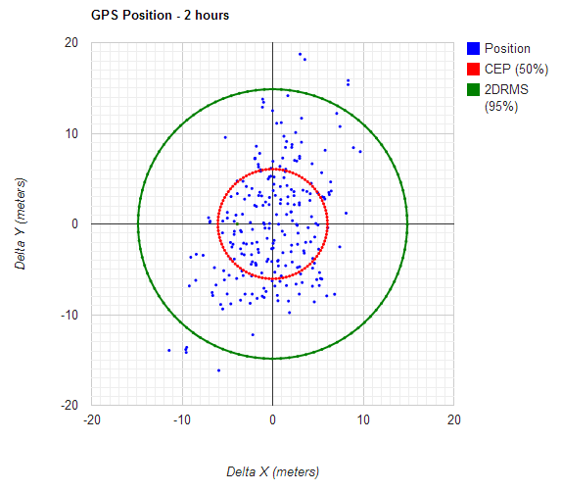
Ground Truth System Test
Objective:
Determine unbiased error for static GPS and distance error between two gps modules
Equipment:
Two Ublox ZED-F9P gps receivers
Objective Metrics:
Circular Error Probability
Average distance between modules and RMS Error
Sources of Error:
Position Error: 3 cm
Position Sampling Rate: 1-10 Hz
CPE’s Addressed: E5
FR’s Addressed: FR7
Project Overview
Design Solution
CPE’s
Design Reqs.
Project Risks
Verification & Validation
Project Planning

Slide 50
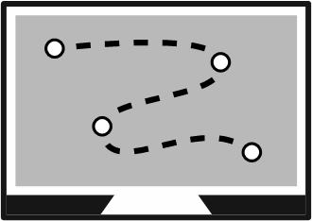
Ground Truth System Test
Test procedure
Place two gps modules 10 meters apart
Collect location data from both modules at a rate of 1 Hz for 10 minutes
Post process collected data to determine:
Circular Probability of Error
Average distance recorded between nodes
RMS Error for average distance
10m
Project Overview
Design Solution
CPE’s
Design Reqs.
Project Risks
Verification & Validation
Project Planning
Notes:
(Image/Diagram)
Facilities/Equipment needed
How the test works/will be conducted
Measurements to be make
Potential sources of error or measurement issues
Validation against functional requirements and which models we have used to verify

Slide 51
Vehicle Flight Time Verification
Objective:
Compare vehicle’s hovering flight time performance on mission ready hardware to model’s performance
Equipment:
Testing location following CU and FAA guidelines
Full UAS hardware, GPS module, and ground truth system
Cooperative weather
Objective Metrics:
Ground truth position (Z, Up)
Time
Sources of Error:
Position resolution: 3cm
Position sampling rate: 1-10Hz
CPE’s Addressed: E5
FR’s Addressed: FR3, FR6
Project Overview
Design Solution
CPE’s
Design Reqs.
Project Risks
Verification & Validation
Project Planning
Notes:
Chris
done outdoors to avoid ground effects, results are compared to the model not necessarily pass/fail only
Describe how the design will be verified against predictive models through characterization testing.
Use diagrams to convey the test set up,
the
f
acilities and equipment needed, and how the test works.
Describe the measurements to b
e made, and
key measurement issues (resolution, sampling rate, etc.)
Show how the selected sensors, instruments, data acquisition, test fixtures, etc. provide the required
capabilities.

Slide 52
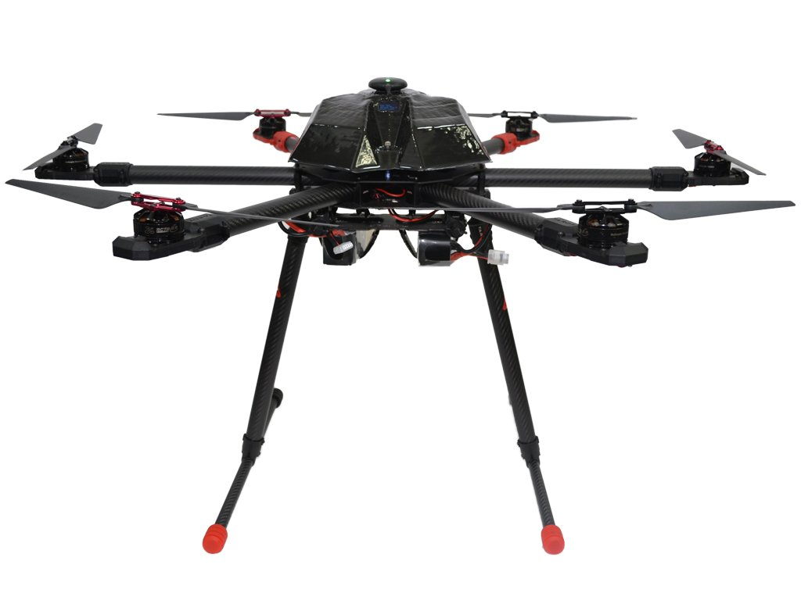
Vehicle Flight Time Verification
Test procedure
Verify payload is collecting data
Following ground truth system test
Place vehicle in GPS position hold mode
Takeoff and ascend to 5m altitude
Let vehicle hold position
Wait for battery low voltage Mavlink message
Land Drone
Flight time will be determined by time spent above home altitude as verified by ground truth payload
5m, hold mode
Project Overview
Design Solution
CPE’s
Design Reqs.
Project Risks
Verification & Validation
Project Planning
Notes:
Chris

Slide 53
Vehicle Position Hold Verification
Objective:
Compare vehicle’s ability to hold its position with wind effects on mission ready hardware to simulation’s performance
Equipment:
Testing location following CU and FAA guidelines
Full UAS hardware, GPS module, and ground truth system
Cooperative weather
Objective Metrics:
Ground truth position X,Y,Z
Wind speed (Anemometer or pixhawk estimation)
Pixhawk commanded hold position
Sources of Error:
Position resolution: 3cm
Position sampling rate: 1-10Hz
CPE’s Addressed: E5
FR’s Addressed: FR3, FR6
Project Overview
Design Solution
CPE’s
Design Reqs.
Project Risks
Verification & Validation
Project Planning
Notes:
Chris
done outdoors to avoid ground effects, results are compared to the model not necessarily pass/fail only
Describe how the design will be verified against predictive models through characterization testing.
Use diagrams to convey the test set up,
the
f
acilities and equipment needed, and how the test works.
Describe the measurements to b
e made, and
key measurement issues (resolution, sampling rate, etc.)
Show how the selected sensors, instruments, data acquisition, test fixtures, etc. provide the required
capabilities.

Slide 54
Vehicle Position Hold Verification
Test procedure
Verify payload is collecting data
Following ground truth system test
Place vehicle in GPS position hold mode
Takeoff and ascend to 5m altitude
Let vehicle hold position without any pilot input
Land once sufficient data has been collected
Process data
Characterize position hold performance against wind
5m, hold mode
Project Overview
Design Solution
CPE’s
Design Reqs.
Project Risks
Verification & Validation
Project Planning
Notes:
Change header as needed
Needs more development
Chris

Slide 55
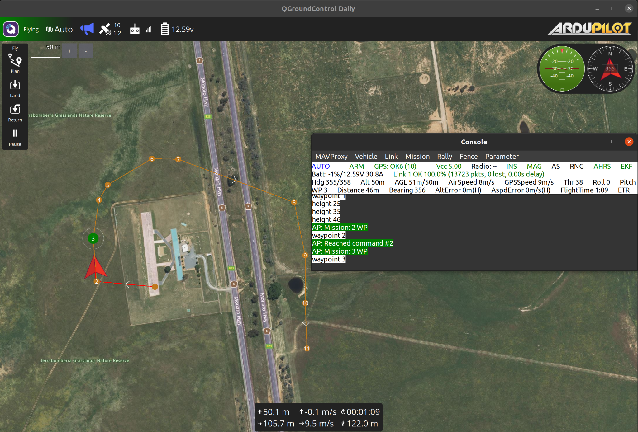
Timed Waypoint Simulation Verification
Objective:
To determine path feasibility and give baseline prediction of ardupilot performance
Equipment:
Machine capable of running the native SITL and QGroundControl (Preferably a machine with Linux operating system )
Objective Metrics:
Flight dataflash logs
Simulation position data X,Y,Z
Simulation GPS time data
Sources of Error:
Simulated GPS sampling rate: 5Hz
Simulated EKF solution sampling rate: 10 Hz
CPE’s Addressed: E1, E2, E3
FR’s Addressed: FR1, FR2, FR4, FR5
Project Overview
Design Solution
CPE’s
Design Reqs.
Project Risks
Verification & Validation
Project Planning

Slide 56
Timed Waypoint Simulation Verification
Test procedure
Build the intended ardupilot code onto the virtual drone
Load in the waypoint file with intended time constraints
Takeoff and change the mode to “AUTO”
Simulate the intended flight trajectory
Extract the flight log data after the flight has been completed
Process the flight log data to determine if the virtual drone hit the waypoints within 1 second
Project Overview
Design Solution
CPE’s
Design Reqs.
Project Risks
Verification & Validation
Project Planning

Slide 57
GUST System Validation Test
1. Setup Waypoints
Convert 1 Hz azimuth/elevation file to XYZT coordinate file
2. Mission Planning
Pass generated waypoint file into QGroundControl
3. Simulation
Use native SITL to simulate mission and generate feasibility
4. ArduPilot Interface
Sends mission to PixHawk flight controller from QGroundControl via MAVLINK
5. Mission Execution
Vehicle uses closed loop time control to execute commanded mission profile
6. Post Processing
Analyze ground truth system data for validation of GUST system timing control
Project Overview
Design Solution
CPE’s
Design Reqs.
Project Risks
Verification & Validation
Project Planning

Slide 58
Project Planning

Slide 59
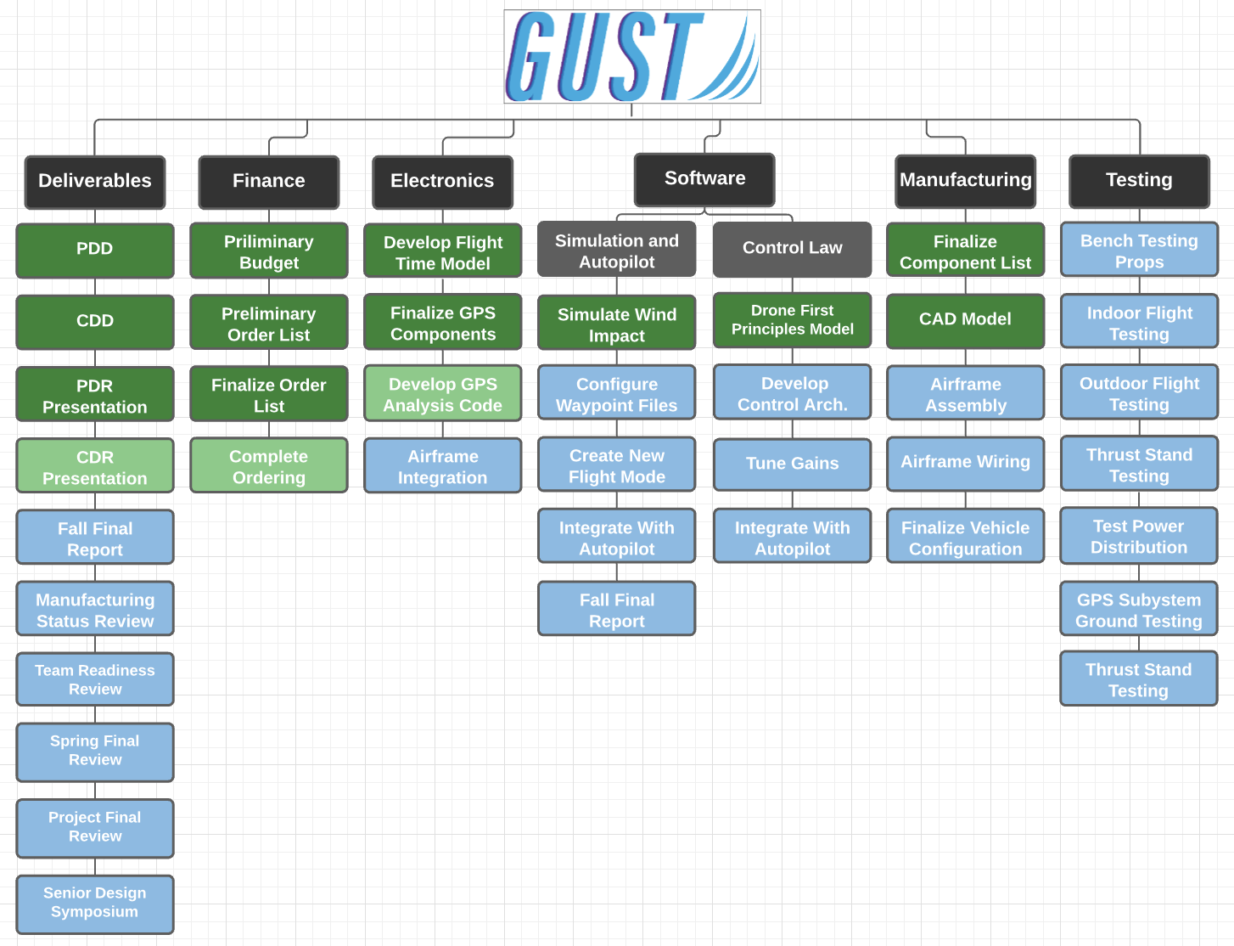
Work Plan
Project Overview
Design Solution
CPE’s
Design Reqs.
Project Risks
Verification & Validation
Project Planning

Slide 60
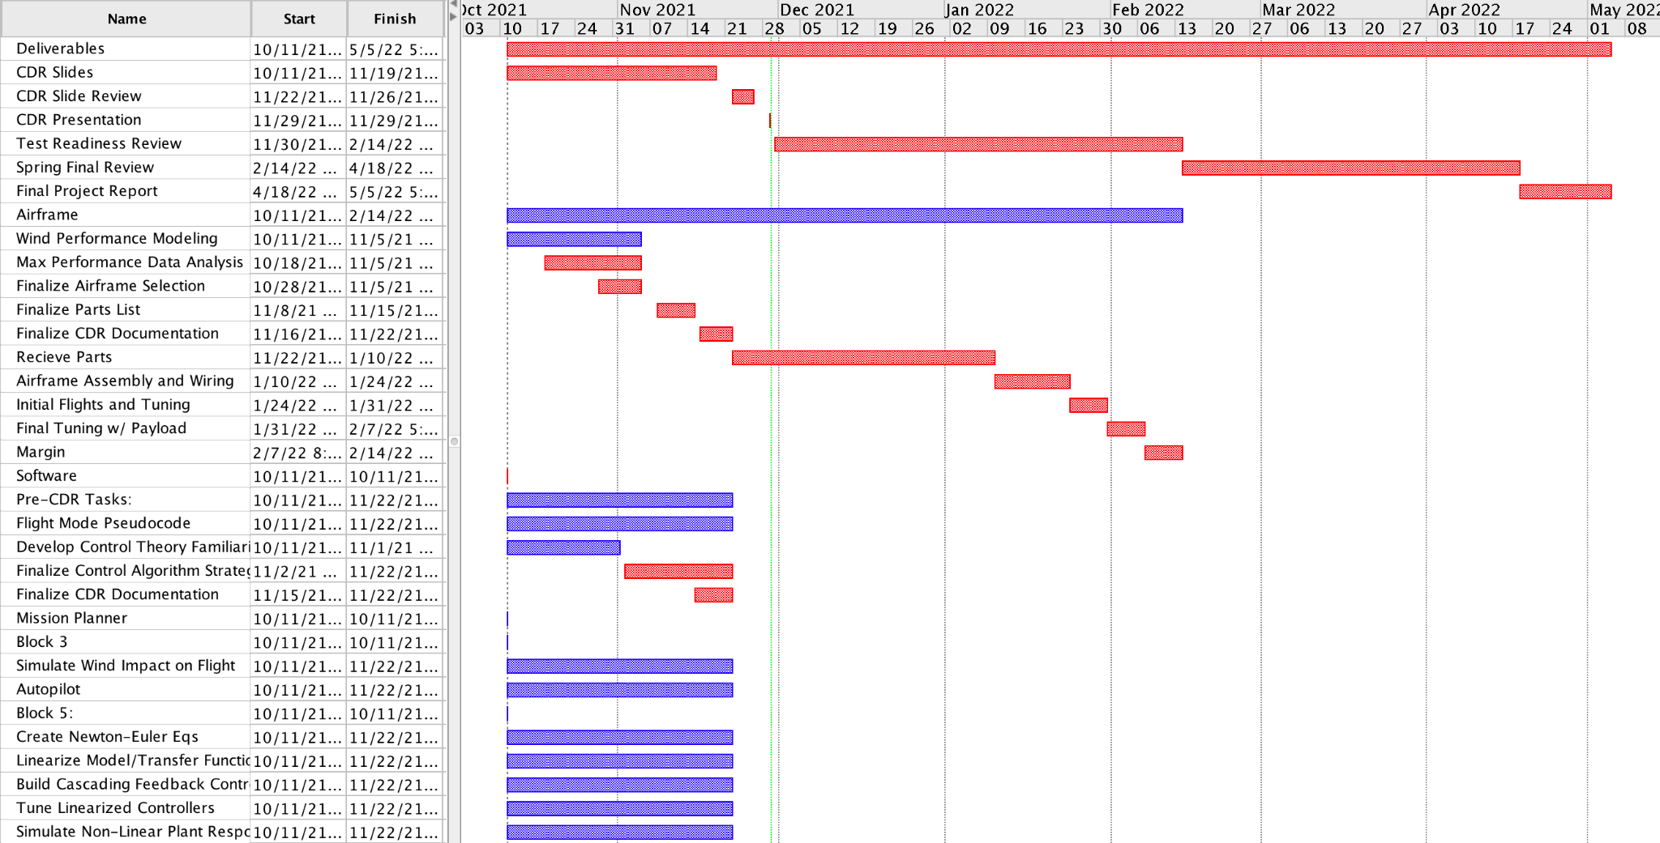
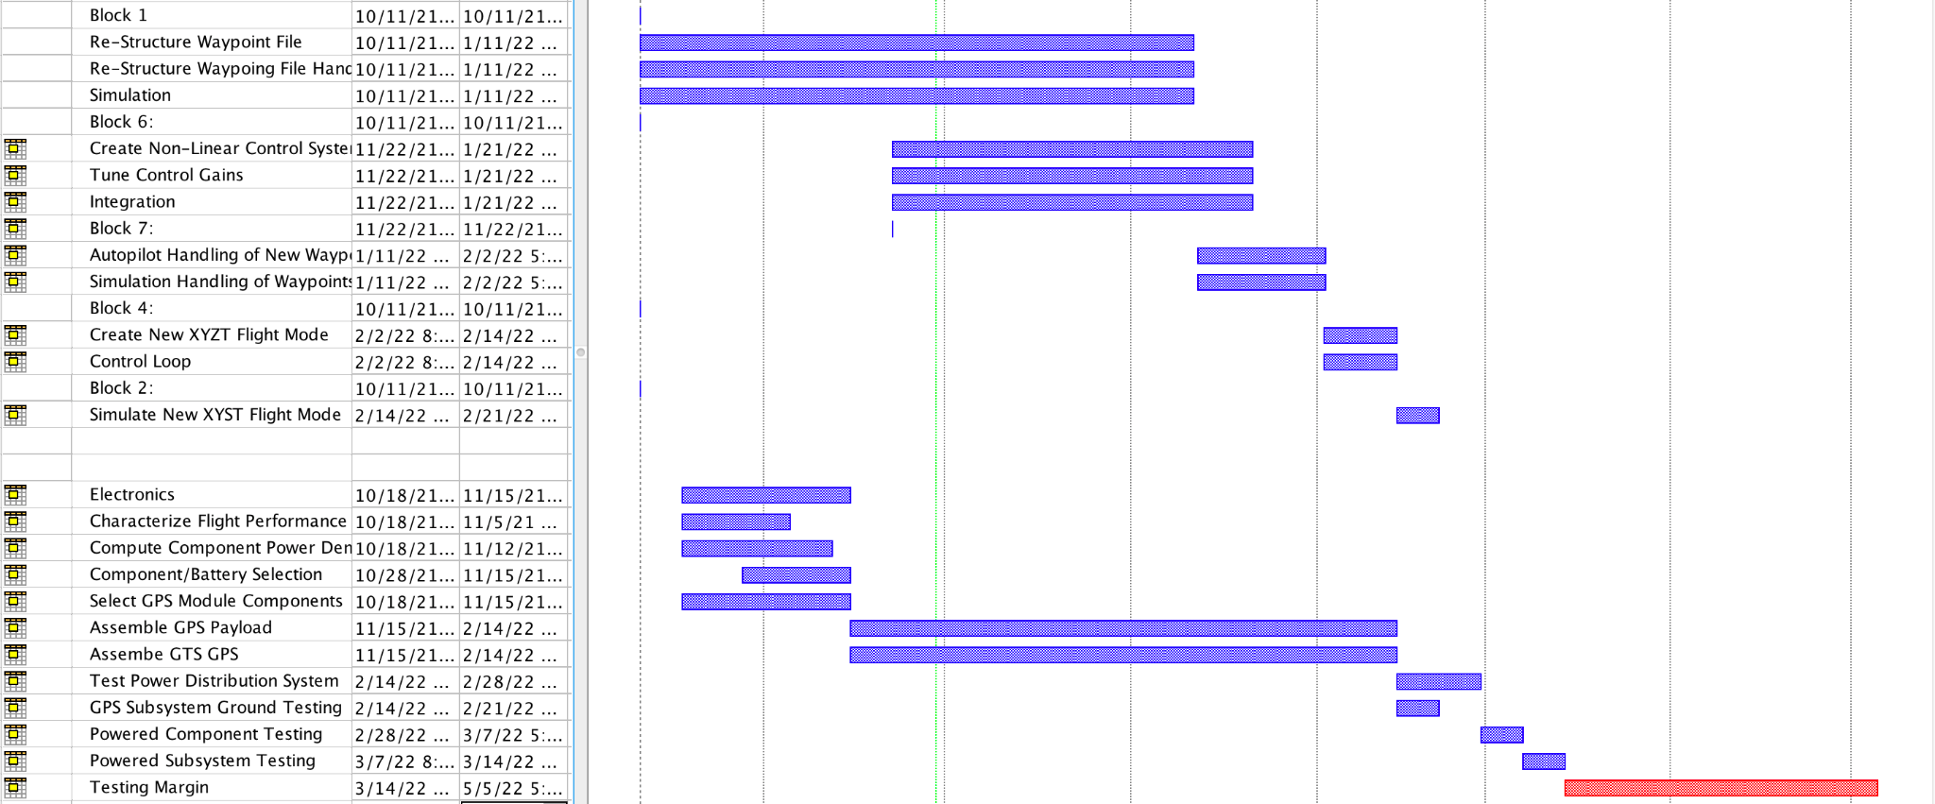
GANTT Chart
Items of Note:
Significant Testing Margin
Difficulty flying
Delays various subteams
In the short term:
Must ensure parts ordered
Early start on procedure for flying
Make steps towards ground test for GTS
Critical Path
Testing Margin
Project Overview
Design Solution
CPE’s
Design Reqs.
Project Risks
Verification & Validation
Project Planning

Slide 61
Major Tests to Be Conducted
Test | Location | Date | Hazard / Mitigation
System Bench Testing | Indoor Lab | January (end) | - Prop Safety - Battery/Power Safety - Attach props only when necessary - Electronics Safety
Indoor Flight Testing | Aspen Lab | First week of February | - Must adhere to- CU/FAA Regulations - Human safety - Ensure adequate space
Outdoor Flight Testing | Empty Field (TBD) | Third week of February | - Must adhere to CU/FAA Regulations - Human safety - Ensure adequate space/licenses
Thrust Stand Testing | Indoor Lab | February (end) | - Prop Safety - Power Safety
Project Overview
Design Solution
CPE’s
Design Reqs.
Project Risks
Verification & Validation
Project Planning

Slide 62
Thank you!

Slide 63
Supporting Materials

Slide 64
Supporting Materials Quick Links
Administrative
Trade Studies
Hardware
Controls
Software

Slide 65
Administrative
Return to Supporting Materials Quick Links

Slide 66
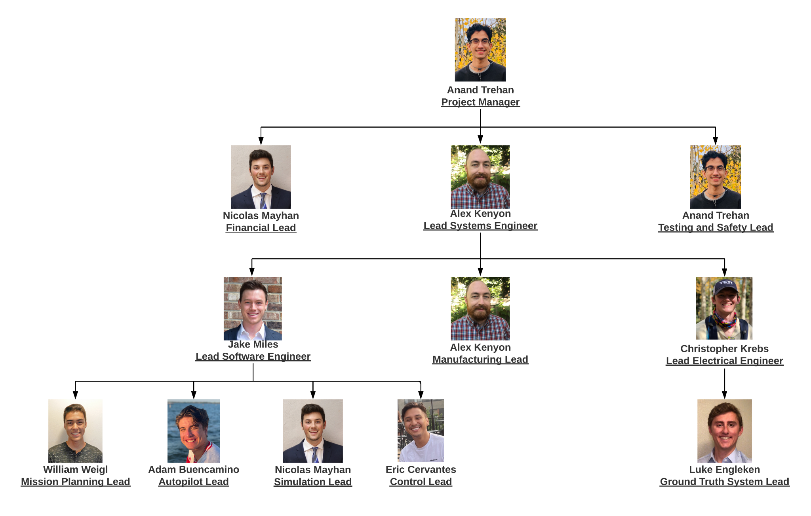
Organization Chart

Slide 67
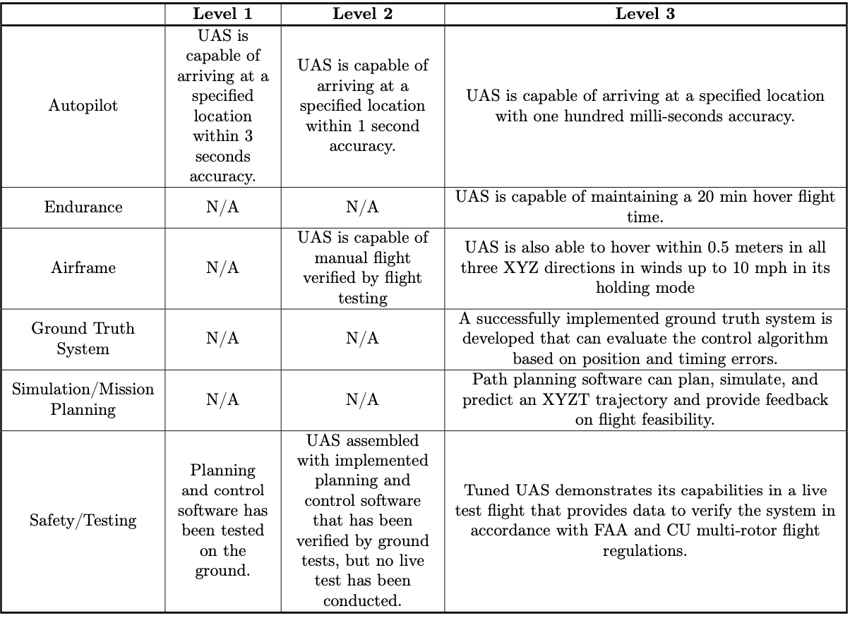
Specific Objectives

Slide 68
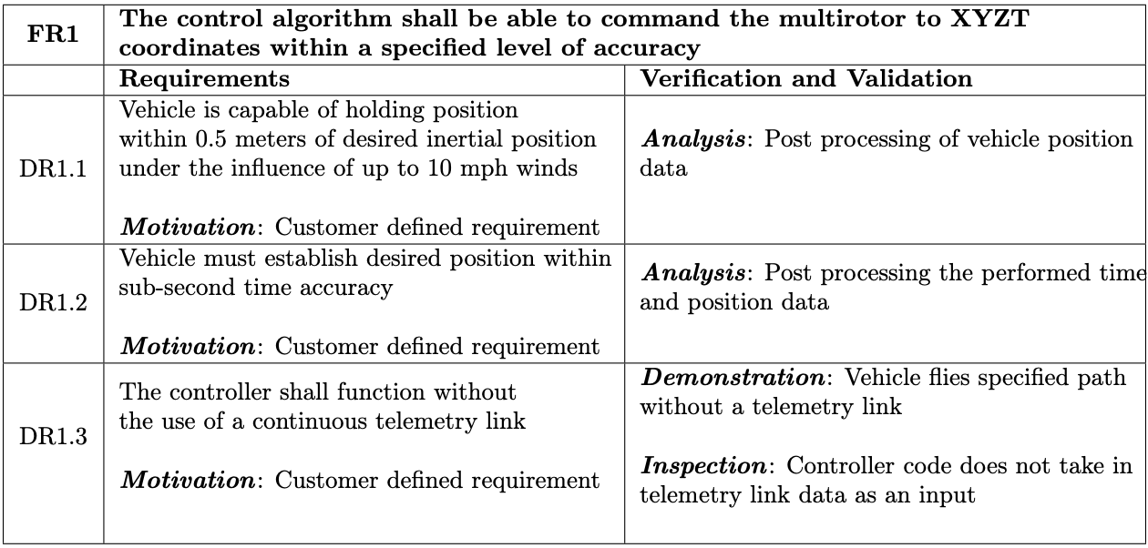
Design Requirements: FR 1

Slide 69
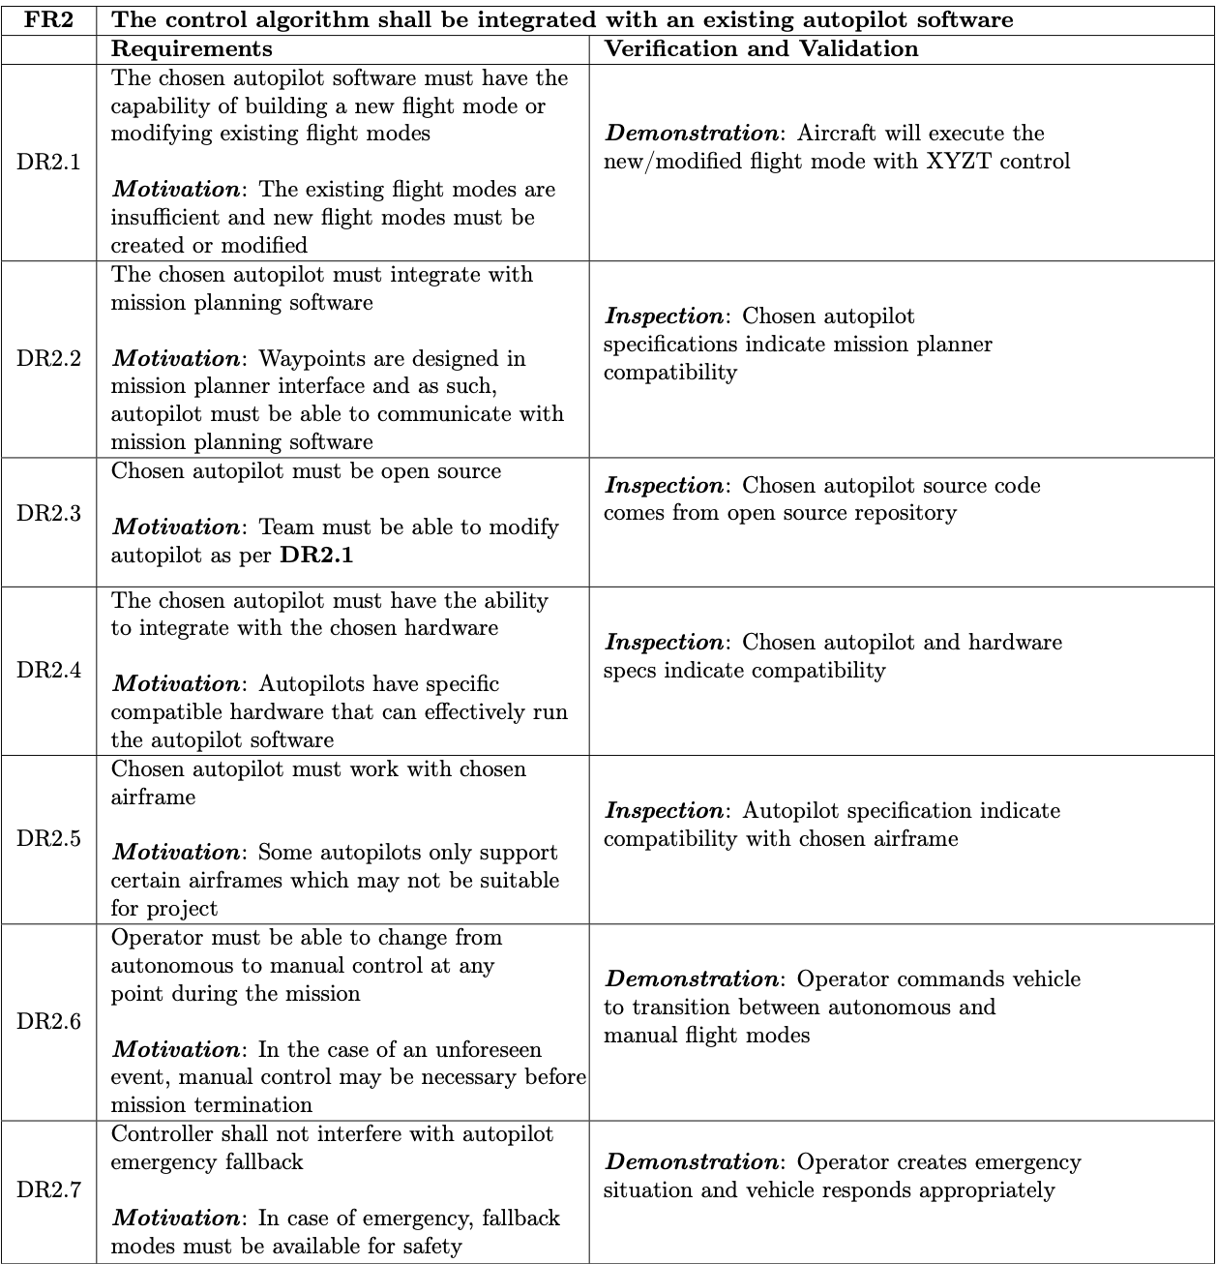
Design Requirements: FR 2

Slide 70
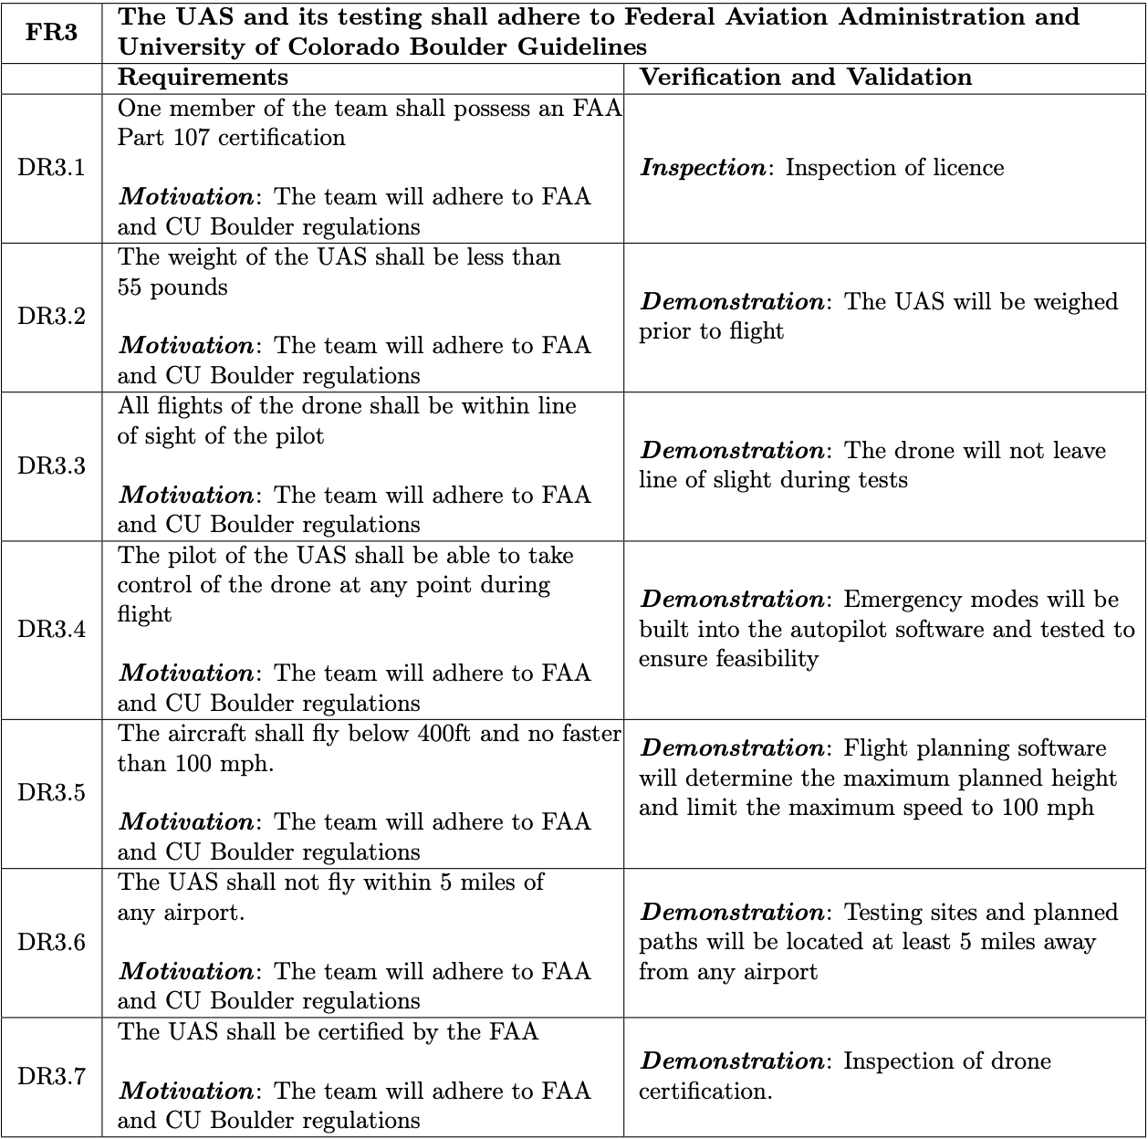
Design Requirements: FR 3

Slide 71
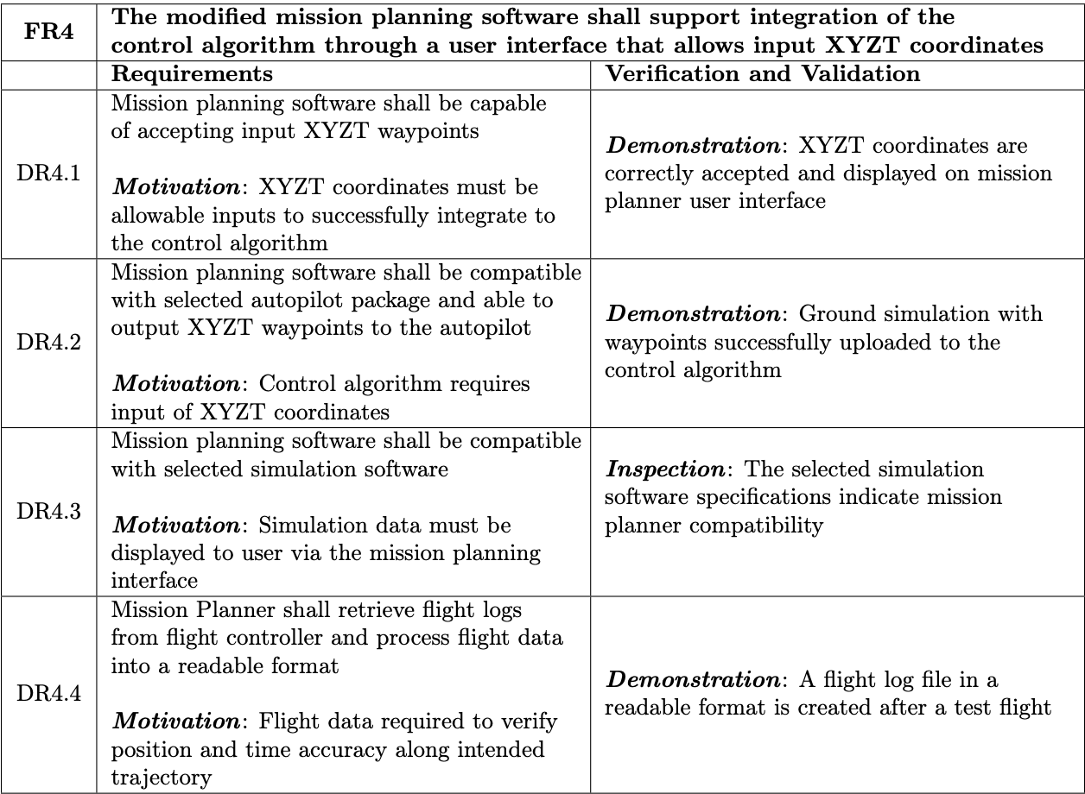
Design Requirements: FR 4

Slide 72
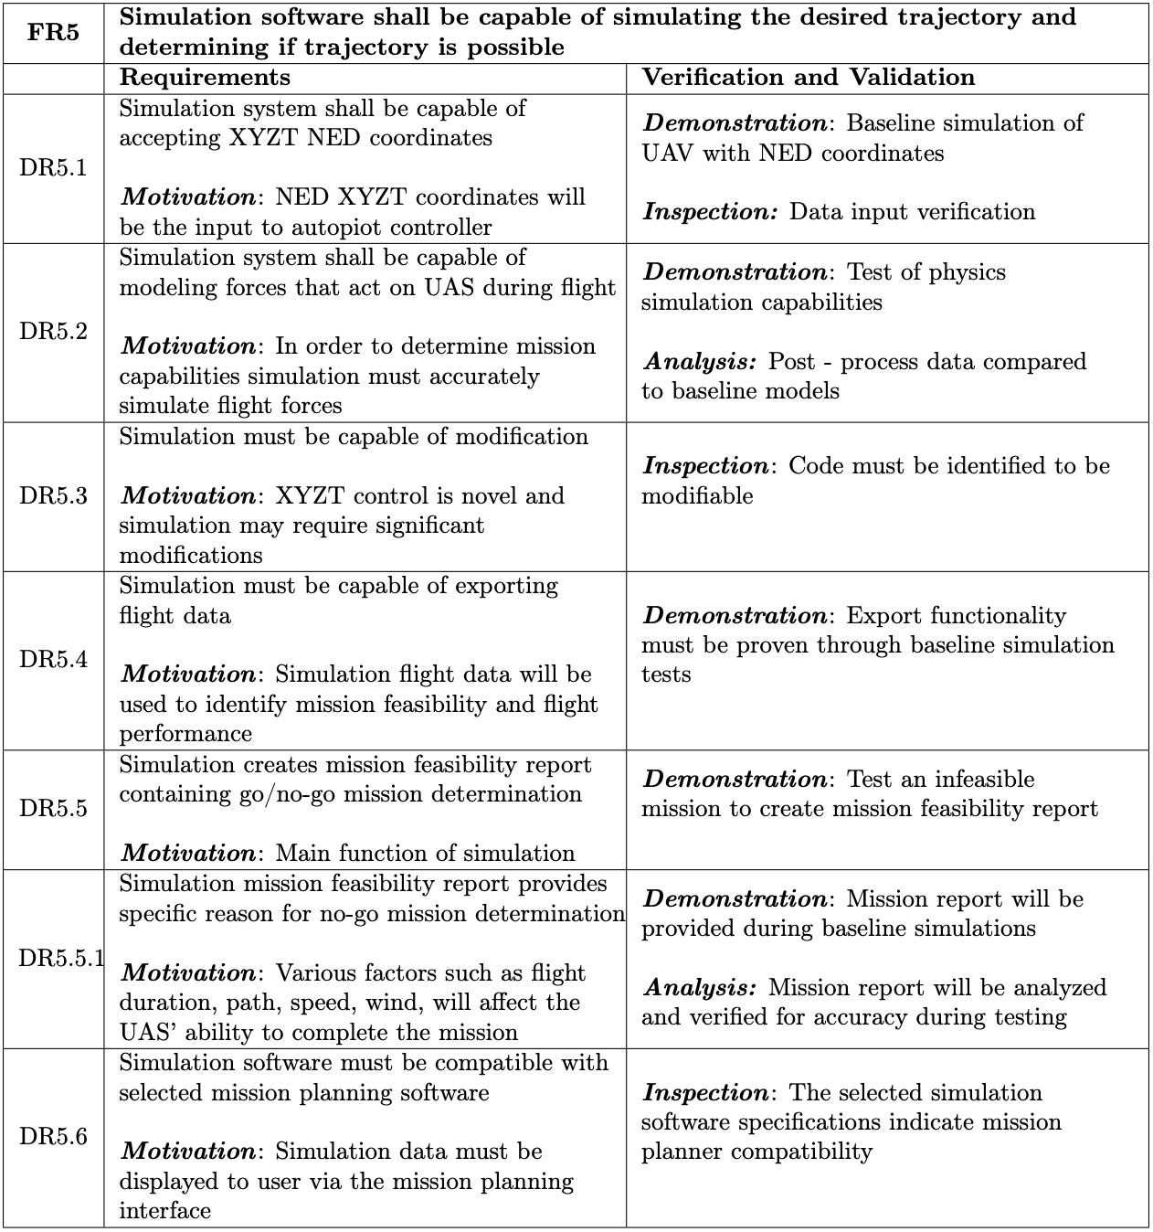
Design Requirements: FR 5

Slide 73
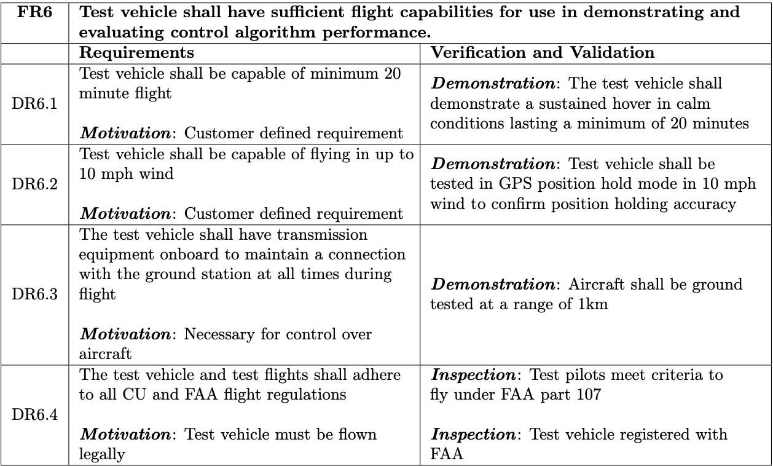
Design Requirements: FR 6
Notes:
DR6.1: Test vehicle shall be capable of minimum 20 minute flight
DR6.2: Test vehicle shall be capable of flying in up to 10 mph wind

Slide 74
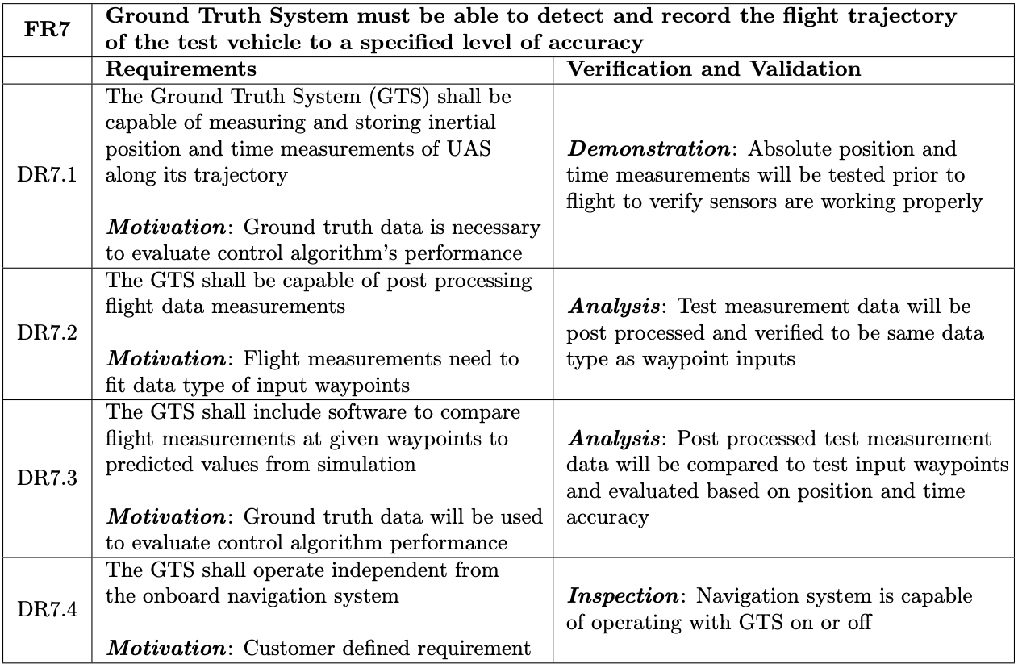
Design Requirements: FR 7

Slide 75
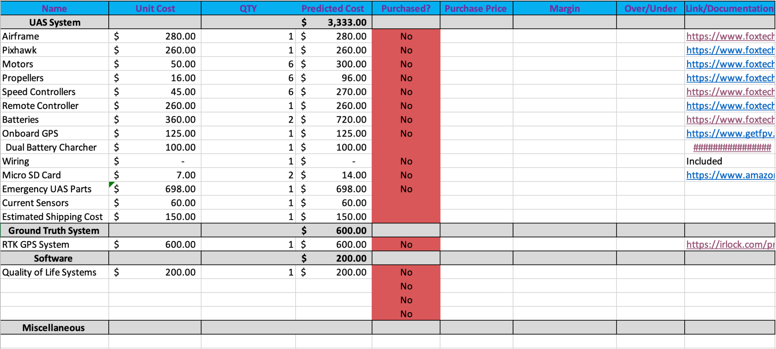
Budget Detailed Breakdown

Slide 76
Trade Studies
Return to Supporting Materials Quick Links

Slide 77
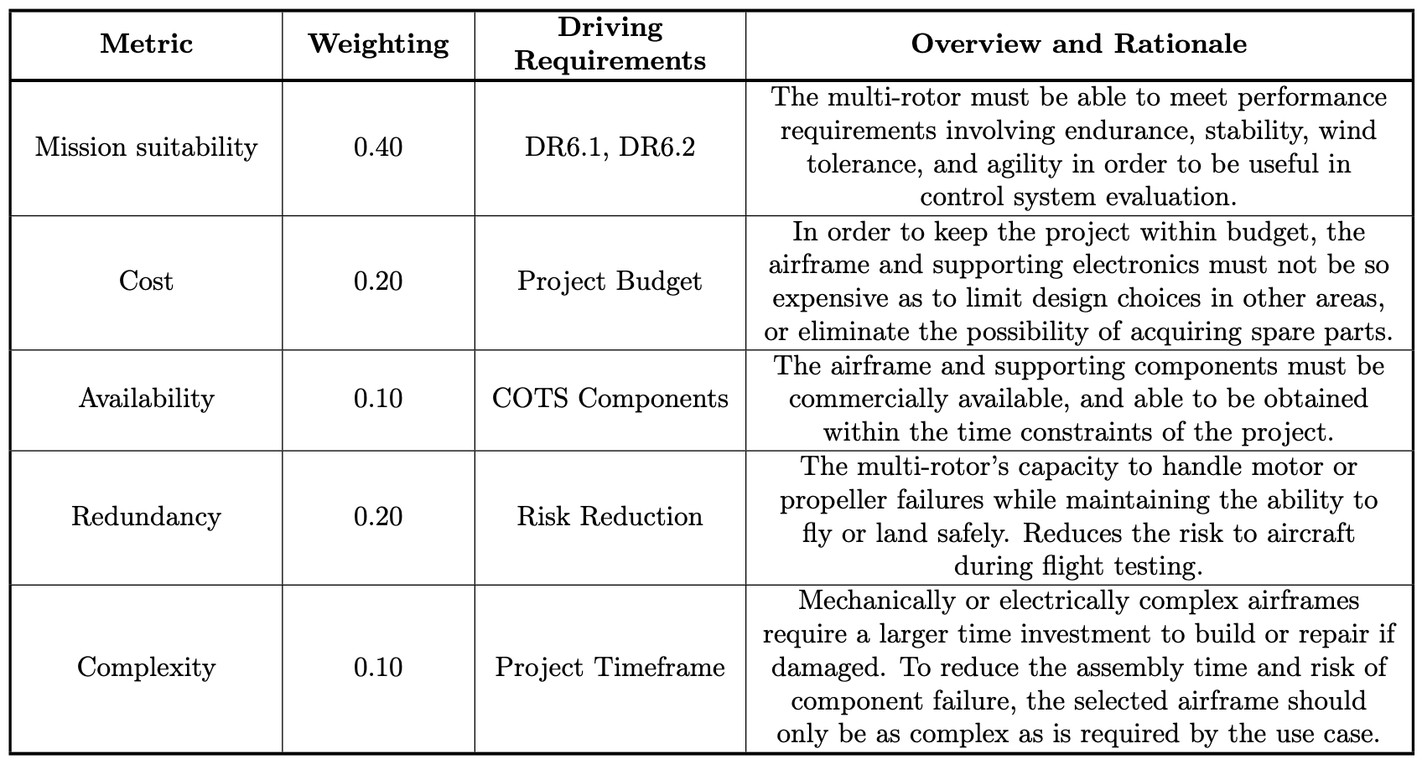
Trade Study: UAS
Notes:
Metric table for UAS trade study

Slide 78
Trade Study: UAS
Notes:
Trade matrix for UAS Trade Study

Slide 79
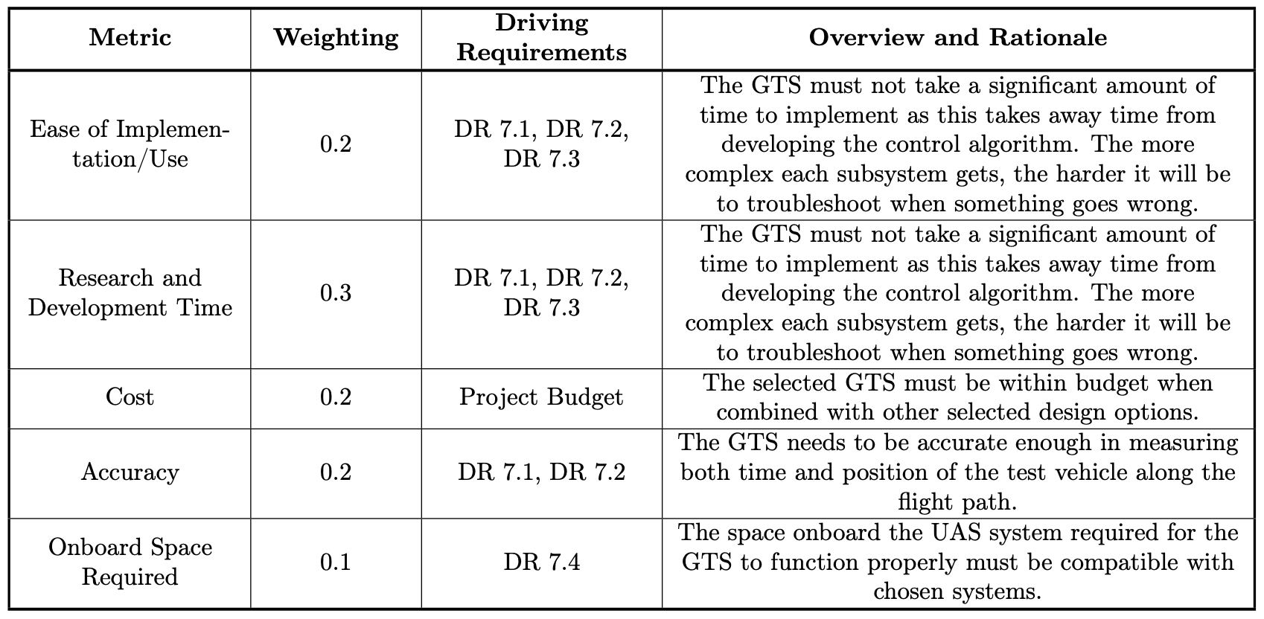
Trade Study: Ground Truth System
Notes:
Metric table for GTS trade study

Slide 80
Trade Study: Ground Truth System
Notes:
Trade matrix for GTS Trade Study

Slide 81
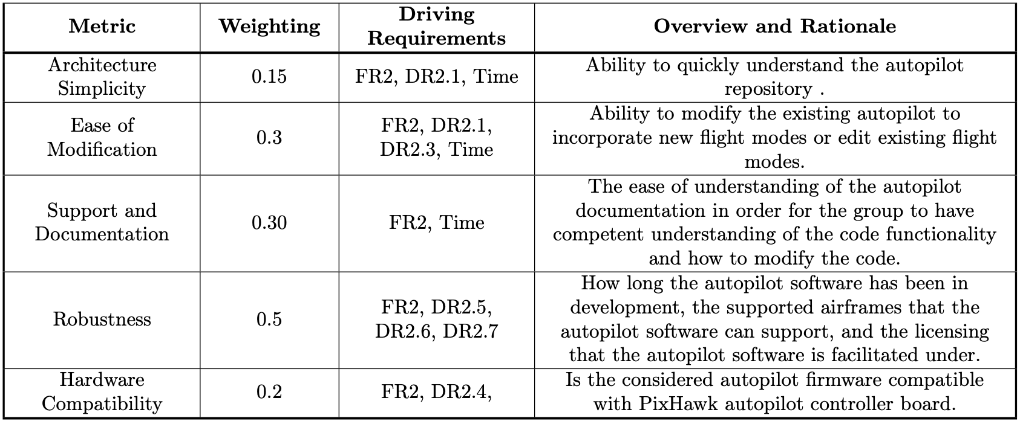
Trade Study: Autopilot Software
Notes:
Metric table for Autopilot Software trade study

Slide 82
Trade Study: Autopilot Software
Notes:
Trade matrix for Autopilot Software Trade Study

Slide 83
Trade Study: Simulation
Notes:
Metric table for Simulation trade study

Slide 84
Trade Study: Simulation
Notes:
Trade matrix for Simulation Trade Study

Slide 85
Trade Study: Mission Planner
Notes:
Metric table for Mission Planner trade study

Slide 86
Trade Study: Mission Planner
Notes:
Trade matrix for Mission Planner Trade Study

Slide 87
Hardware
Return to Supporting Materials Quick Links

Slide 88
Design Solution: Airframe
Tarot T810 Sport Hexacopter
Specifications:
Frame Size: 810mm
Prop Size: up to 15 inch
Ready to fly weight: 6kg
Estimated flight time: 25.8 minutes
Features
Hex configuration for motor redundancy
Rail style payload & battery mounting for CG adjustment
Reasons for selection: Complete vehicle configuration meets flight time requirement DR6.1, wind requirement DR1.1, components available within project time frame, multiple payload mounting options.
Project Overview
Design Solution
CPE’s
Design Reqs.
Project Risks
Verification & Validation
Future Work

Slide 89
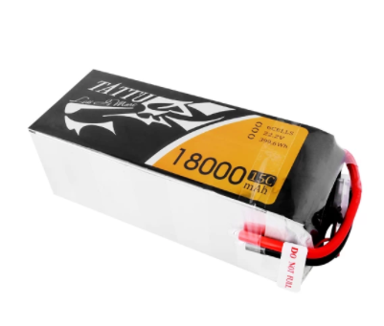
Design Solution: Vehicle Battery
TATTU 6S 18000mAh 22.2V 15C High Discharge Lipo Battery
Specifications:
Voltage: 22.2V
Capacity: 18000mAh
Cell Configuration 6S1P / 6 cells
Power Connector: XT-90
Max. Cont. discharge: 15C
Weight: 2030g
Dimensions: 190mm x 78mm x 68.5 mm
Reasons for selection: Meets power requirements, capacity allows for 20 min flight with margin
Project Overview
Design Solution
CPE’s
Design Reqs.
Project Risks
Verification & Validation
Future Work

Slide 90
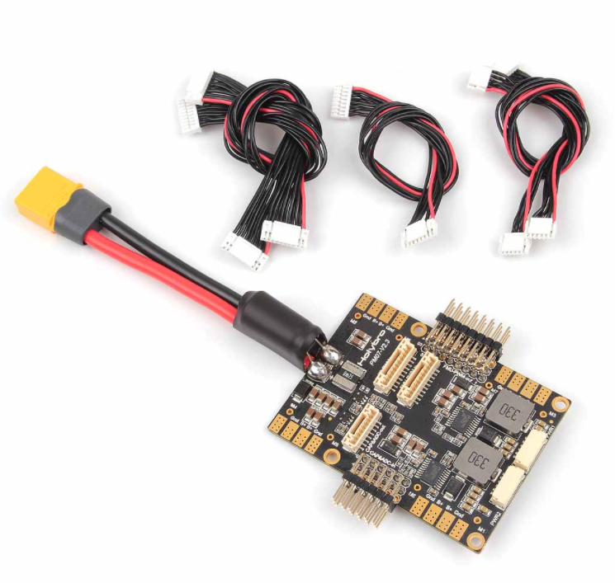
Design Solution: Power Distribution
Pixhawk 4 Power Module (PM07)
Specifications:
Voltage input: 7-51V (2-12s LiPo)
Regulated Output: 5V (3A max)
Current rating: 120A maximum output
Connector: XT90
Dimensions: 68 x 50 x 10 mm
Weight: 47.5g
Reasons for selection: Current measurement & power distribution in a single unit
Project Overview
Design Solution
CPE’s
Design Reqs.
Project Risks
Verification & Validation
Future Work

Slide 91
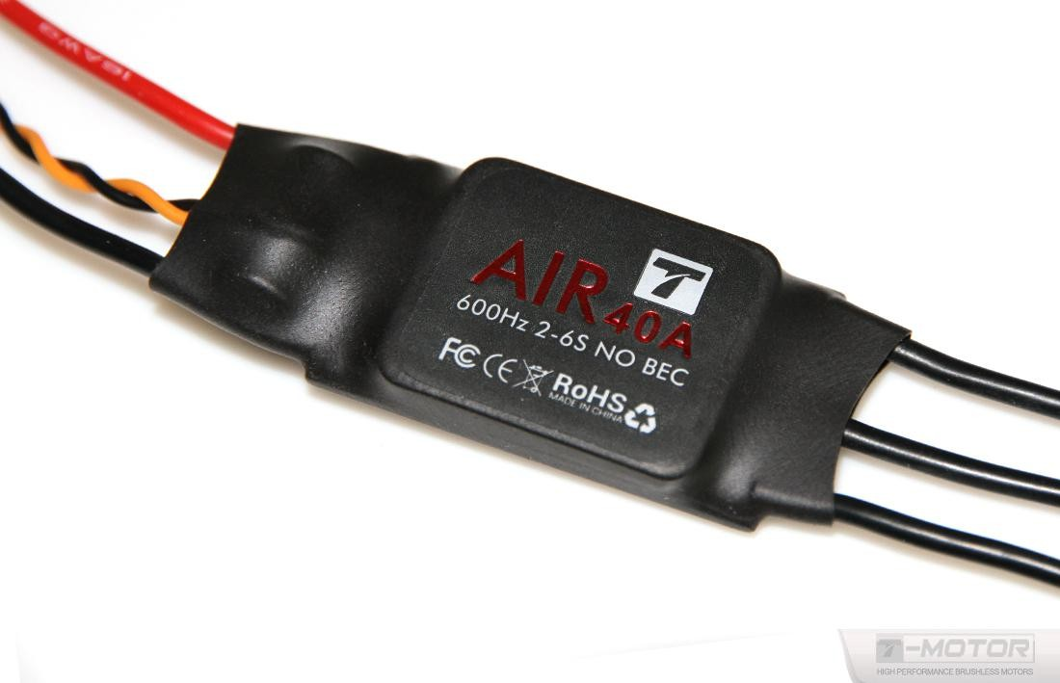
Design Solution: Speed Controller
T-Motor 40A Brushless Speed Controller
Specifications:
Dimensions: 68 x 25 x 8.7 mm
Weight: 26g
Continuous current: 40A
Peak Current: 60A (15 seconds)
Signal input: PWM (up to 600Hz)
Reasons for selection: Meets power requirements,
Project Overview
Design Solution
CPE’s
Design Reqs.
Project Risks
Verification & Validation
Future Work

Slide 92
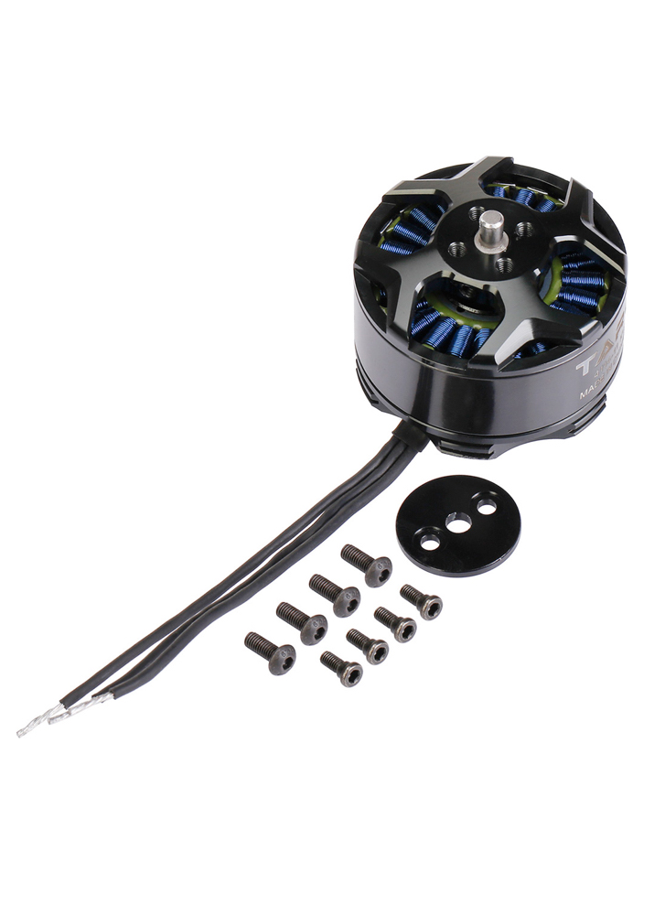
Design Solution: Lift motors
Tarot 4114/320KV brushless outrunner motor
Specifications:
Dimensions: 46 x 32 mm
Stator size: 41mm
Max power: 377 Watts
RPM/Volt: 320
Recommended prop: 15 inch
Maximum thrust: 2.5 kg
Weight: 148g
Reasons for selection: Manufacturer recommended component, compatible w/ frame & propeller selection.
Project Overview
Design Solution
CPE’s
Design Reqs.
Project Risks
Verification & Validation
Future Work

Slide 93
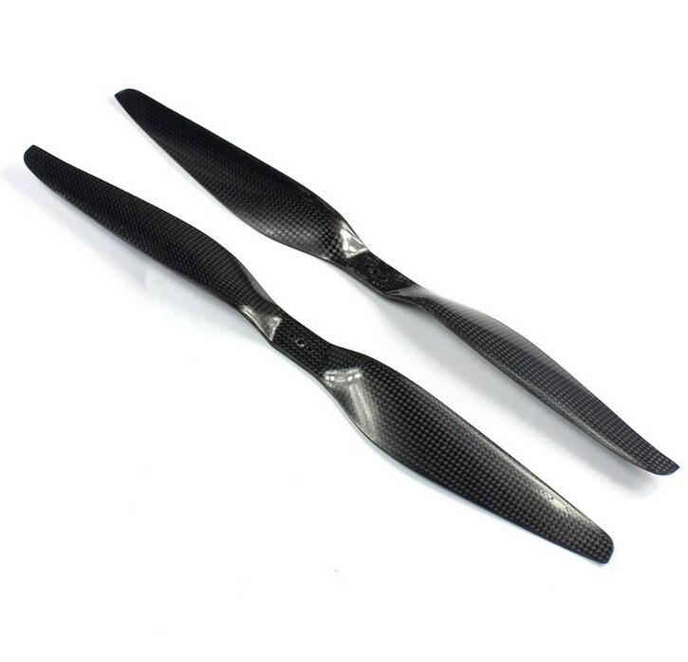
Design Solution: Propellers
Tarot 15 x 5.5 DJI style Carbon Propeller
Specifications:
Length: 15 inch
Pitch: 5.5 inches/revolution
Weight: 17g
Estimated Hover FOM: 0.55
Reasons for selection: Maximum prop size for airframe, compatibility with motor selection
Project Overview
Design Solution
CPE’s
Design Reqs.
Project Risks
Verification & Validation
Future Work

Slide 94
Design Solution: Pilots Transmitter
FrSky Taranis X9D Transmitter & X8R Receiver
Specifications:
Frequency: 2.4 GHz “Frequency hopping”
Range: 1km +
Channels: 16
Features:
Optional telemetry
Dedicated vehicle receiver
Low cost & high capability
No frequency conflicts with telemetry radios
3-wire connection with pixhawk using PPM or S-BUS communication protocols
Reasons for selection: Inexpensive, already proven with pixhawk autopilots, team familiarity
Project Overview
Design Solution
CPE’s
Design Reqs.
Project Risks
Verification & Validation
Future Work

Slide 95
Design Solution: Telemetry Radio
mRo SiK V2 Telemetry Radio set
Specifications:
Frequency: 915 MHz
Range: 300m +
Air data rates up to 250Kbps
Features:
Sufficient bandwidth for telemetry downlink & Ardusimple RTK corrections data
Connects to Pixhawk over serial (Telem1 Port)
Reasons for selection: Already well proven with pixhawk autopilots, sufficient bandwidth for Telemetry & RTK corrections
Project Overview
Design Solution
CPE’s
Design Reqs.
Project Risks
Verification & Validation
Future Work

Slide 96
Design Solution: Power Connectors
Amass XT90S Anti-spark connectors (Battery)
Specifications:
Contact type: 4.5 mm gold plated “bullet” connector
Continuous current: 90A
Peak current 120A
Bullet connectors (ESC & Motor)
Specifications:
Contact type: 3.5 mm gold plated “bullet” connector
Peak current 80A
Reasons for selection: Commonly used, meet maximum current requirements
Project Overview
Design Solution
CPE’s
Design Reqs.
Project Risks
Verification & Validation
Future Work

Slide 97
Design Solution: Battery Charging
SKYRC D400 AC/DC Dual-port Charger
Charges 1-7 cell Lithium Polymer packs
Compatible battery chemistry: LiPo,LiFe,NiMh,NiCd,Pb
Channel 1: 400W output
Channel 2: 200W output
AC & DC power input
Cell balancing & computer data logging
Fireproof charging/storage containers
Specifically designed to contain battery fires
Used for safety during charging and storage
Project Overview
Design Solution
CPE’s
Design Reqs.
Project Risks
Verification & Validation
Future Work

Slide 98
Design Solution: PixHawk 4 Flight Controller
Notes:
PixHawk 4 Technical, Electrical, and Mechanical Specifications

Slide 99
Design Solution: PixHawk 4 Flight Controller
Notes:
PixHawk 4 Input/Output interfaces

Slide 100
Hardware: T810 Mass Budget
Project Overview
Design Solution
CPE’s
Design Reqs.
Project Risks
Verification & Validation
Future Work
Notes:
-Alex
Right; Photo of Taranis RC TX & X8R RX
Left; Quick Specs
range
16 Channels
Telemetry
Computer programmable
Narration;
The FrSky Taranis is a 16 Channel RC transmitter used by both hobbyists and UAS companies for its relatively low cost and high capability.
It has a proven track record, and is considered a reliable choice for use with many autopilot systems.
A Member of our group is also familiar with this particular handset, and has integrated it with the pixhawk previously.
For our project, it will be used to select the flight mode, and control pitch,roll,yaw, and throttle during flight testing and in certain backup flight modes.

Slide 101
Hardware: Vehicle Power Budget
Project Overview
Design Solution
CPE’s
Design Reqs.
Project Risks
Verification & Validation
Future Work
Notes:
-Alex
Right; Photo of Taranis RC TX & X8R RX
Left; Quick Specs
range
16 Channels
Telemetry
Computer programmable
Narration;
The FrSky Taranis is a 16 Channel RC transmitter used by both hobbyists and UAS companies for its relatively low cost and high capability.
It has a proven track record, and is considered a reliable choice for use with many autopilot systems.
A Member of our group is also familiar with this particular handset, and has integrated it with the pixhawk previously.
For our project, it will be used to select the flight mode, and control pitch,roll,yaw, and throttle during flight testing and in certain backup flight modes.

Slide 102
Flight Time Estimation: Process
Overview of flight time estimation process
Input vehicle parameters & manufacturer component data
Solve for required thrust per motor to satisfy the lift equals weight hovering condition
Solve for ideal power required per motor using a static thrust model for variable speed propellers
Process propeller data & estimate Figure Of Merit (FOM) as a function of RPM
Solve for estimated hovering RPM and predict hovering propeller FOM
Apply FOM at hover condition to solve for mechanical power required per motor
Apply motor & speed control efficiencies to solve for electrical power required per motor
Calculate total hovering power draw accounting for all motors & avionics
Apply battery discharge model over a loop until pack voltage drops below cutoff voltage
Calculate flight time from number of time steps before cutoff voltage is reached
Project Overview
Design Solution
CPE’s
Design Reqs.
Project Risks
Verification & Validation
Project Planning

Slide 103
Flight Time Estimation: Assumptions
Steady hovering flight condition.
Constant power draw during steady flight
Each arm contributes equally to the thrust produced.
Air velocity at infinity is effectively zero such that static thrust model for variable speed propellers applies
Colorado air density is 1.0373 kg/M^3 (1700m STD ATM value)
Constant avionics power draw
Constant ESC efficiency
Motor efficiency varies with RPM
Predictable battery discharge curve
Battery has 100% of rated capacity
Manufacturer propeller data captured at approximately sea level.
Flight time lasts until battery reaches a predetermined cutoff voltage.

Slide 104
Flight Time Estimation: Thrust model
Momentum Theory for Static-Thrust Calculation
1. Apply Conservation of momentum
2. Apply conservation of energy
3. Solve for lift power relation
(Assume V_{Z} = 0 for hover condition)
https://arxiv.org/pdf/1601.00733;Aerodynamics

Slide 105
Flight Time Estimation: Thrust Model
Momentum Theory for Static-Thrust Calculation Full Derivation
Conservation of Momentum:
Substitute T from (1) into (2), compare to (3):
(1)
(2)
Implies:
Kinetic power imparted into the air across the streamtube:
Mass flow rate defined:
(4)
(3)
(5)
Use (4) and (5) with assumption of zero z-Velocity (hover):
Notes:
(similar to how EMU did it on slide 19, but stopping at third Eq.)

Slide 106
Flight Time Estimation: Battery Model
Battery was modeled using a constant loading discharge curve for lithium polymer cells
Modeling pack using a discharge curve allows voltage & current to be calculated as they change due to voltage drop over the life of the pack.
worst case scenario of 10-20C was used as a conservative estimate of voltage drop.
Data collected during test flights will allow for refinement of battery model in the future.
Project Overview
Design Solution
CPE’s
Design Reqs.
Project Risks
Verification & Validation
Project Planning

Slide 107
Flight Time Estimation: Propeller Model
Figure of merit (FOM) is the propellers efficiency at a given flight condition
Manufacturers provide no aerodynamic data of FOM on their propellers, the only way is to estimate it from thrust stand data
Using the manufacturers data, hovering FOM was estimated at 0.5-0.6 which is in line with expected values [1]
Further thrust stand testing will allow for refinement of propeller model.
Project Overview
Design Solution
CPE’s
Design Reqs.
Project Risks
Verification & Validation
Project Planning

Slide 108
Vehicle Down-Selection
Flight time model was used to analyze 16 vehicle & battery combinations to identify viable combinations.
Project Overview
Design Solution
CPE’s
Design Reqs.
Project Risks
Verification & Validation
Project Planning
Notes:
Preliminary Trade study on specific vehicle hardware configurations
Visuals;
Narration;

Slide 109
Hardware: GPS Module Power Budget
Project Overview
Design Solution
CPE’s
Design Reqs.
Project Risks
Verification & Validation
Future Work
Notes:
-Alex
Right; Photo of Taranis RC TX & X8R RX
Left; Quick Specs
range
16 Channels
Telemetry
Computer programmable
Narration;
The FrSky Taranis is a 16 Channel RC transmitter used by both hobbyists and UAS companies for its relatively low cost and high capability.
It has a proven track record, and is considered a reliable choice for use with many autopilot systems.
A Member of our group is also familiar with this particular handset, and has integrated it with the pixhawk previously.
For our project, it will be used to select the flight mode, and control pitch,roll,yaw, and throttle during flight testing and in certain backup flight modes.

Slide 110
Hardware: Payload Mass Budget
Project Overview
Design Solution
CPE’s
Design Reqs.
Project Risks
Verification & Validation
Future Work
Notes:
-Alex
Right; Photo of Taranis RC TX & X8R RX
Left; Quick Specs
range
16 Channels
Telemetry
Computer programmable
Narration;
The FrSky Taranis is a 16 Channel RC transmitter used by both hobbyists and UAS companies for its relatively low cost and high capability.
It has a proven track record, and is considered a reliable choice for use with many autopilot systems.
A Member of our group is also familiar with this particular handset, and has integrated it with the pixhawk previously.
For our project, it will be used to select the flight mode, and control pitch,roll,yaw, and throttle during flight testing and in certain backup flight modes.

Slide 111
Hardware: GPS Module Battery Selection
Rechargeable NiMH Battery Pack
Specifications:
Voltage: 4.8V
Capacity: 900 mAh
Cell type: AAA NiMH
Connector: JR, 3-pin female
Size: 41mm x 11mm x 46mm
Weight: 1.77 oz
Project Overview
Design Solution
CPE’s
Design Reqs.
Project Risks
Verification & Validation
Future Work
Notes:
-Alex
Right; Photo of Taranis RC TX & X8R RX
Left; Quick Specs
range
16 Channels
Telemetry
Computer programmable
Narration;
The FrSky Taranis is a 16 Channel RC transmitter used by both hobbyists and UAS companies for its relatively low cost and high capability.
It has a proven track record, and is considered a reliable choice for use with many autopilot systems.
A Member of our group is also familiar with this particular handset, and has integrated it with the pixhawk previously.
For our project, it will be used to select the flight mode, and control pitch,roll,yaw, and throttle during flight testing and in certain backup flight modes.

Slide 112
PixHawk GPS Module
Notes:
Onboard ublox M8N GPS receiver
2.5 m accuracy

Slide 113
ublox ZED-F9P GNSS Receiver
Notes:
Onboard ublox M8N GPS receiver
2.5 m accuracy

Slide 114
Feasibility Analysis: Ground Truth System GPS Modules
GPS Module | Position Accuracy (with PPK) | Data Output Rate | Onboard Volume | Cost (rover only)
Here3 | +/-0.025m | Max 8Hz | 7.6cm x 7.6cm x 1.7cm | $125
CUAV C-RTK 9P | +/-0.01m | Max 20Hz | 3.15cm x 4.8cm x 1.2cm | $600
Holybro H-RTK F9P | +/-0.01m | Max 8Hz | 7.6cm x 7.6 cm x 2.0cm | $400
Notes:
Move to main presentation if time permits?

Slide 115
Controls
Return to Supporting Materials Quick Links

Slide 116
Simulink Modeling: Model Overview

Slide 117
Simulink Modeling: Trajectory Block

Slide 118
Simulink Modeling: Control System Block
Control Architecture
Takes in commanded trajectories
Outputs required control forces and moments

Slide 119
Simulink Modeling: Control System Block

Slide 120
Simulink Modeling: Z Control Block
Nested Feedback Loop
Inner loop controls rate of change of Z position
Outer loop controls Z position
Outputs required thrust

Slide 121
Simulink Modeling: Pitch/Roll Controller

Slide 122
Simulink Modeling: Position Control Block
Returns desired pitch and roll angles
arcsin(velocity/g)
Computation requires position controller

Slide 123
Simulink Modeling: Pitch/Roll Control Block
Take in desired pitch and roll angle
Get required pitch and roll moments
Dynamics are the same so controller is the same

Slide 124
Simulink Modeling: Yaw Control Block
Take in desired yaw angle
Return required yaw moment

Slide 125
Simulink Modeling: Body Force Block
Convert force of gravity to body frame of reference with DCM
Combine with thrust force to get total body force

Slide 126
Simulink Modeling: Newton-Euler Plant Block

Slide 127
Simulink Modeling: Cross Correlation Lag
Cross Correlation
Function determines how well two signals represent each other at various lags
The max correlation corresponds to the lag that sets the signals on top of eachother
Calculate the lag with timestep

Slide 128
Ardupilot General FBD
Notes:
First block is entering the ArduCopter(multi-rotor) directory
Second block sets the mode and update the flight modes to its most recent state
Third block instantiates the stabilization(hover) mode as the initial mode. This is the default mode
Fourth block is the bulk of the control algorithm code. Estimates attitude with the onboard sensors and calculates error between the desired attitude and current error. Takes error and sends a motor request to fix the error. The next slide has a lower level FBD of this block
Fifth block changes the motor request into individual motor inputs
Sixth and Seventh block pushes the outputs to the onboard electronic speed controller

Slide 129
Ardupilot Attitude Control FBD
Notes:
Angle —> Rate: Takes in the desired attitude parameters and converts to a quaternion and angular velocity using the functions stated in the box
Rate —> Motor: Up until this point the control has been independent of vehicle type and now using the overlying AC_PID library, higher level motor commands and sets general motor commands to be put into the specific motor matrix for the desired vehicle. In our case a hexacopter.

Slide 130
Modifying Control Law Feasibility
Native SITL Simulation of Default Control Algorithm
Takes off to 50 m
Travels to specified waypoint
Travels back to takeoff position
Lands at original position
Gain | Value
Pos P | 1.0
Vel P | 2.0
Vel I | 1.0
Vel D | 0.5
Notes:
Pos P: The horizontal proportional position gain
Vel P: The horizontal proportional velocity gain
Vel I: The horizontal integral velocity gain
Vel D: The horizontal derivative velocity gain
This test used the defaults gain values and the mission arrived at the waypoint and returned very effectively with minimal visual error.

Slide 131
Modifying Control Law Feasibility
Native SITL Simulation of Control Algorithm without velocity control and exaggerated position proportional control
Same exact mission planned from the previous slide
Gain | Value
Pos P | 2.0 (Max)
Vel P | 0.1 (Min)
Vel I | 0.02 (Min)
Vel D | 0.0 (Min)
Notes:
Pos P: The horizontal proportional position gain
Vel P: The horizontal proportional velocity gain
Vel I: The horizontal integral velocity gain
Vel D: The horizontal derivative velocity gain
This test took away all velocity control leaving only proportional control in the XY plane. Visually, this test did not complete the mission as intended as the simulated copter overshot the waypoint and the return to home waypoint by a rather large margin.

Slide 132
Extended Kalman Filter
Theory
IMU angular rates are integrated to calculate the angular position
IMU accelerations are converted to earth NED axes and corrected for gravity
Accelerations are integrated to calculate the velocity
Velocity is integrated to calculate the position
Estimated gyro and accelerometer noise (EKF_GYRO_NOISE and EKF_ACC_NOISE) are used to estimate the growth in error in the angles, velocities and position calculated using IMU data.
Difference between predicted position and GPS position
State correction from using calculations from 5) and 6)
Calculate uncertainty reduction return to step 1

Slide 133
Software
Return to Supporting Materials Quick Links

Slide 134
IRISS Previous Work and Motivation
Previous Method:
Take LEO sky track in Az-EL
Convert to XYZ waypoints
Pre-calculate velocities to reach waypoints at desired times
Project Overview
Design Solution
CPE’s
Design Reqs.
Project Risks
Verification & Validation
Future Work
Notes:
explain test card - make a second mission CONOPS to replace this?
show error numbers
emphasize on how current methods have high errors, want to close the loop of timing to obtain greater levels of accuracy.
smoothness is related to the discretatization of points given on an az-el plot at a 1-hz rate given the max distance allowed for flight

Slide 135
IRISS Summer Results
06/22/21 IRISS autonomous mode test 1
IRISS Methodology:
Take LEO sky track in Az-EL
Convert to XYZ waypoints
Pre-calculate velocities to reach waypoints at desired times

Slide 136
IRISS Summer Results

Slide 137
IRISS Summer Results
Note: Relative altitude is taken by subtracting the first GPS value from commanded data to compare to BARO and CTUN

Slide 138
IRISS Summer Results

Slide 139
IRISS Summer Results
Standard Error Calculation Methodology:
Convert commanded and flight data trajectory data to East(X), North(Y), and Up(Z) components from latitude, longitude, and altitude.
Interpolate flight data linearly to add points to increase resolution
Determine the position error between each commanded point to every flight data point.
Each flight data point associated with the minimum error between a respective commanded point is stored.
These are the points where the “waypoints are met”
RMS error of the East, North, and Up components are calculated
RMS error of time error is calculated
Note: these calculations were after extracting the flight trajectory data during the timespan of commanded data. This is true for both error calculation methodologies.

Slide 140
IRISS Summer Results - Standard Error
RMS Error North | RMS Error East | RMS Error Up | RMS Timing Error
3.2m | 2.7m | 9.3m | 8.2s

Slide 141
IRISS Summer Results
Alternate Error Calculation Methodology:
Convert commanded and flight data trajectory data to East(X), North(Y), and Up(Z) components from latitude, longitude, and altitude.
Interpolate flight data linearly to add points to increase resolution
Determine the timing error between each commanded point to every flight data point.
Each flight data point associated with the minimum error between a respective commanded point is stored.
These are the points where the “waypoints are met”
RMS error of the East, North, and Up components are calculated
RMS error of time error is calculated
This essentially shows what the drone’s positioning error is with time aligned.

Slide 142
IRISS Summer Results - Alternate Error
RMS Error North | RMS Error East | RMS Error Up
0.1m | 0.1m | 12.1m

Slide 143
LEO Track Simulation Plots

Slide 144
LEO Track Simulation Plots with Waypoints

Slide 145
Custom Track Simulation Plots

Slide 146
Simulating GPS Failure
Notes:
What is Going on In This Screenshot?
The copter is following the LEO trajectory and hitting waypoints as shown in the highlighted green messages in the MAVLINK console
At the instance where the copter is located in the screenshot is where the param set SIM_GPS_DISABLE 1 command was passed
At this instance the GPS failed as shown in the highlighted red messages in the MAVLINK console
The copter went into a failsafe mode and changed the mode to “LAND MODE”
The orange warning message tell the user that the EKF inertial sensors are no longer aiding the flight
At the end of the flight, the drone hits the ground at the normal 0.462115 m/s and disarms the motors appropriately

Slide 147
Gazebo Physics Engine and First Principles
1st Principles Quadrotor Dynamics
Assume Symmetrical Quadrotor
Assume point mass
F = f_grav + f_aero + f_cntrl
m = m_aero + m_cntrl
No lift force
Lift force is treated as thrust not an aerodynamic force
Drag is the only aerodynamic force
Drag acts exactly opposite of air-relative velocity
Approximates relative wetted area for drag
Idealizes rotors/mechanical systems
Would require rederivation of equations of motion if rotor configuration would change
Linearlized: Small Disturbance Theory
Defines variables wrt hover state
Does not accurately model each variable response to a disturbance
Gazebo UAS Dynamics
Extracts rotor configuration from ardupilot
Forces & moments are modeled directly from rotors and across the UAS
Lift and drag are treated as aerodynamic forces separate from motor forces
Drag is calculated from drone configuration as the UAS moves throughout simulated world
Able to adapt to various configurations/disturbances

Slide 148
Gazebo Physics Engine and First Principles Cont.
1st Principles EOM
Quadrotor Response to Disturbances Example

Slide 149
Gazebo Physics Engine and First Principles Cont.
Gazebo ODE Architecture
Uses a Physics SDK Engine to perform dynamics (rigid-body, flexible-body, fluid, particle) simulation
Simulation of Equations of Motion
Lagrange Multiplier - state space model which accounts for accounts for all body degrees of freedom and models forces explicitly
Reduced Coordinate - system of tracking bodies without tracking every variable of the body
Implements a hybrid system to take advantage of variables Lagrange tracks and the speed with the reduced coordinate system has
Integration of EOM
Solves the EOM over time using implicit integration
Acceleration as a function of future forces. Causes numerical dampling = more stable
Constraint Based Modeling
1st principles uses constraint force modeling - user calculated forces applied to bodies
Lots of parameters to tune, harder to achieve/model desired effects
Gazebo uses constraint based modeling - velocity/acceleration constraints for EOM
More versatile system that more accurately models the behavior of complex systems
Notes:
Physics SDK Presentation overview : http://ode.org/slides/parc/dynamics.pdf

Slide 150
ArduPilot Flight Modes
Basic Flight Modes Advanced Flight Modes
Stabilize
Self leveling roll and pitch axis
Alt Hold
Hold Altitude and self level roll and pitch
Loiter
Hold altitude and position, use GPS for movement
Return to launch
Return to take off location
Auto
Follow predetermined waypoints
Guided
Navigate to single points commanded by GCS
Auto tune
Automated pitch and bank maneuvers to improve control loops
Follow
Follows another vehicle
Land
Reduces altitude to ground level, goes straight down

Slide 151
Technical Sources
[1] “Static Testing of Micro Propellers” Selig, Michael et al., University of Illinois at Urbana-Champaign, August 2008.
[2] “Theory of Aerospace Propulsion”, Pasquale M. Sforza, Butterworth-Heinemann, 2017.
[3] “Calculation of Constant Power Lithium Battery Discharge Curves”, Lance W. Traub, Embry Riddle Aeronautical University, February 2016

