Slide 1
GRASS
Test Readiness Review (TRR)
February 21st, 2022 (12:50 - 1:40 PM)
ASEN 4018 - 012 Team 7
Customer
Raytheon Technologies
Faculty Advisor
Prof. Jade Morton
Presenters
Carter Mak, Madisen Purifoy-Frie, Trey Taylor, Addison Conzet, Eric Roeck, Wil Edwards, and Ruben Briones
Additional Team Members
Gavin O'Connell, Sam Packard, Cole Sechrist, Marissa Palamara, and Daniel Mathews
Notes:
Carter
Hello and welcome
We’re team GRASS presenting our test design review of our project for Raytheon Intelligence and Space

Slide 2
Presentation Outline - Example
Project Overview
Schedule
Test Readiness
Budget
Q&A
Backup Slides
Mission Statement
Software
RF Characterization
Overview
Conops
Electronics and RF
Power System Characterization
Cost Plan
Levels of Success
System-Level Testing
Purchase Plan
FBD
Design Solutions
Notes:
Carter
An outline with links for your convenience, but you already know what we’re going to talk about today

Slide 3
Project Overview
Project Overview
Schedule
Test Readiness
Budget
Notes:
Carter
Project Purpose and Objective (5%)

Slide 4
Mission Statement and Motivation
Ground station Ranged Assessment Satellite Simulator (GRASS) will provide Raytheon engineers with a high fidelity and configurable satellite simulator to act as a cooperative target for testing and demonstrating ground stations and ground data systems.
Motivation:
Realistic hardware interactions without testing on sensitive flight hardware
Configurable behavior to exercise ground stations and ground data systems
Notes:
Carter

Slide 5
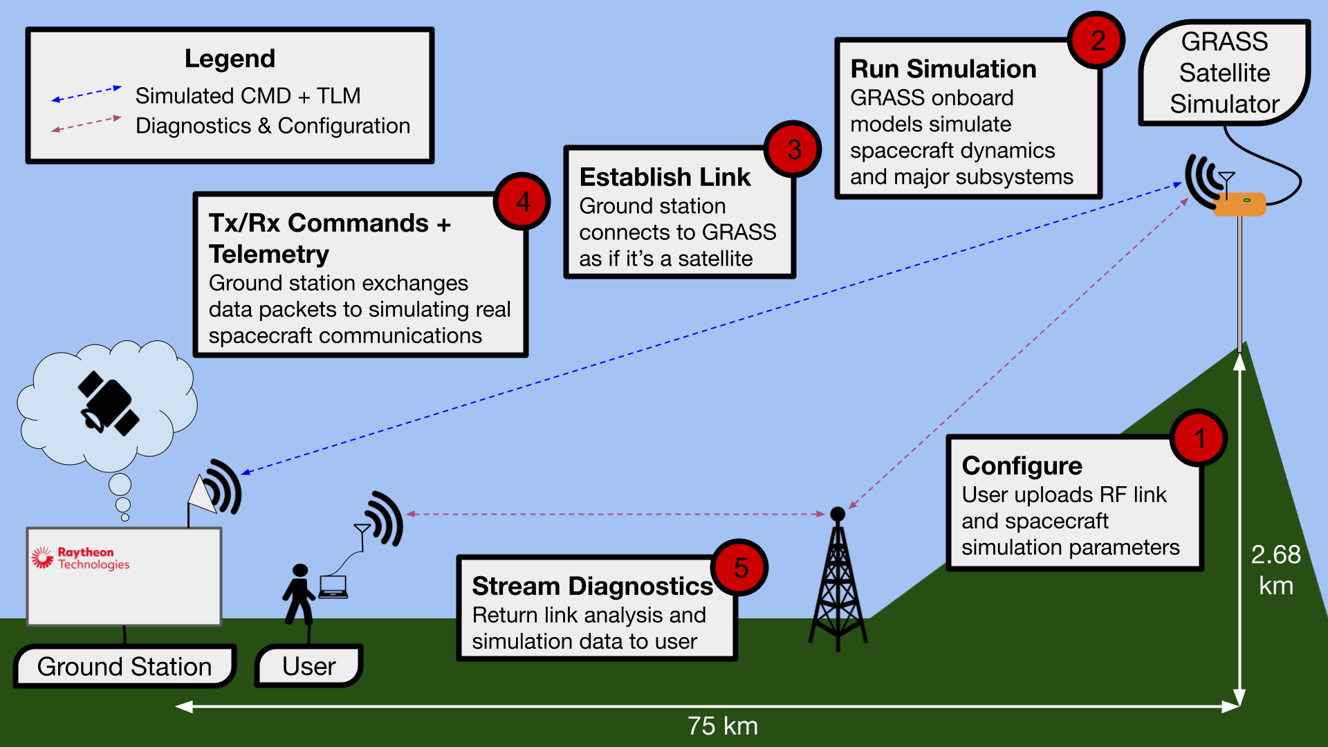
Concept of Operations - Overview
Notes:
Madisen

Slide 6
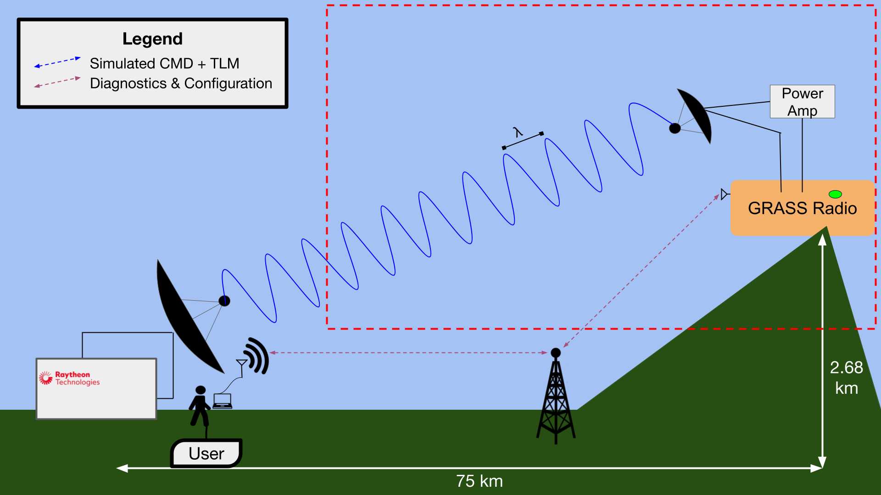
Concept of Operations - RF
Notes:
Madisen

Slide 7
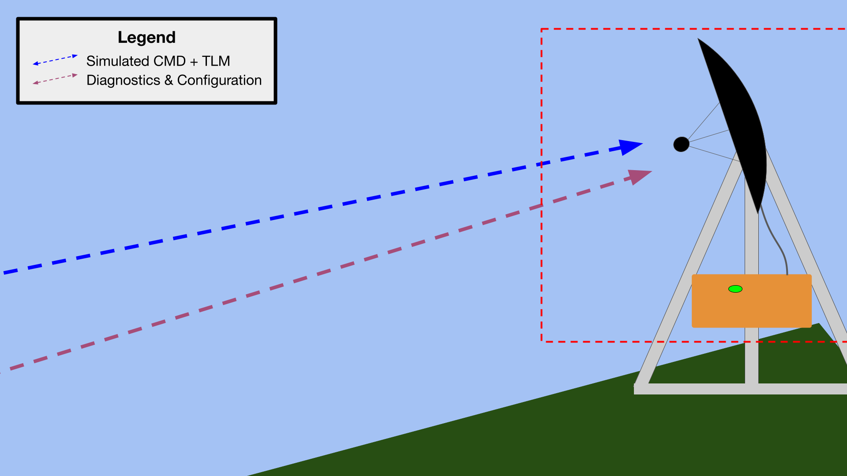
Concept of Operations - Mounting
Notes:
Madisen

Slide 8
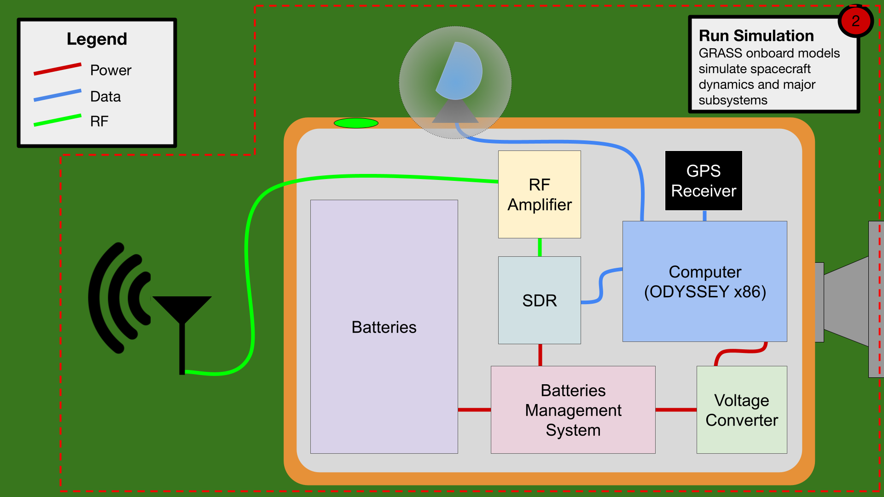
Concept of Operations - Enclosure
Notes:
Madisen

Slide 9
Primary Project Objectives (Levels of Success)
Link margin of 10 dB, range of 75 km, rate of 2 Mbps over main RF link (within FCC regulations)
GRASS shall be modeled and simulated to operate continuously in Front Range conditions for 6 months and tested to operate for 5 days.
A battery power system will be capable of powering GRASS for 2 days
Subsystem simulators for: Attitude, Orbit, Electrical/Power, Command and Data Handling, and Payload.

Slide 10
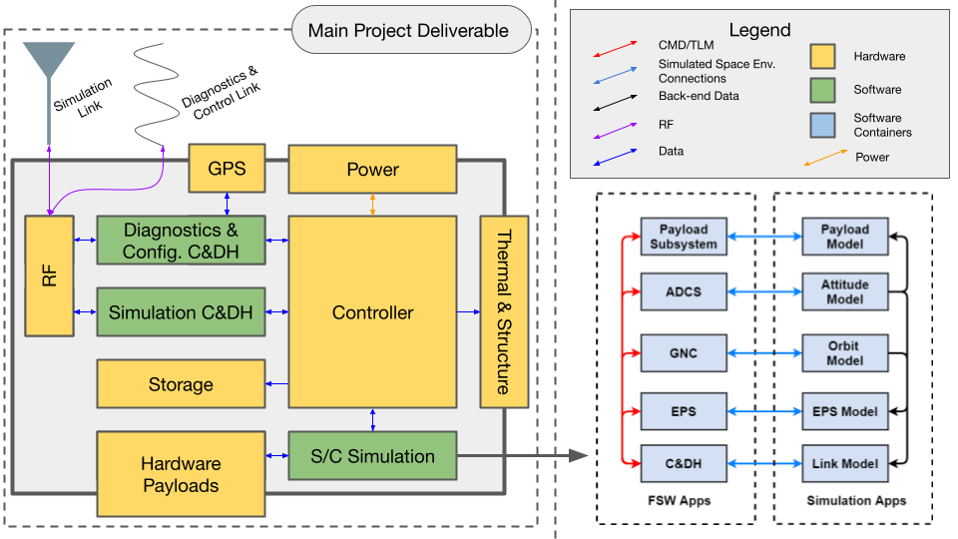
Functional Block Diagram - Full System
2 Mbps
Notes:
Madisen

Slide 11
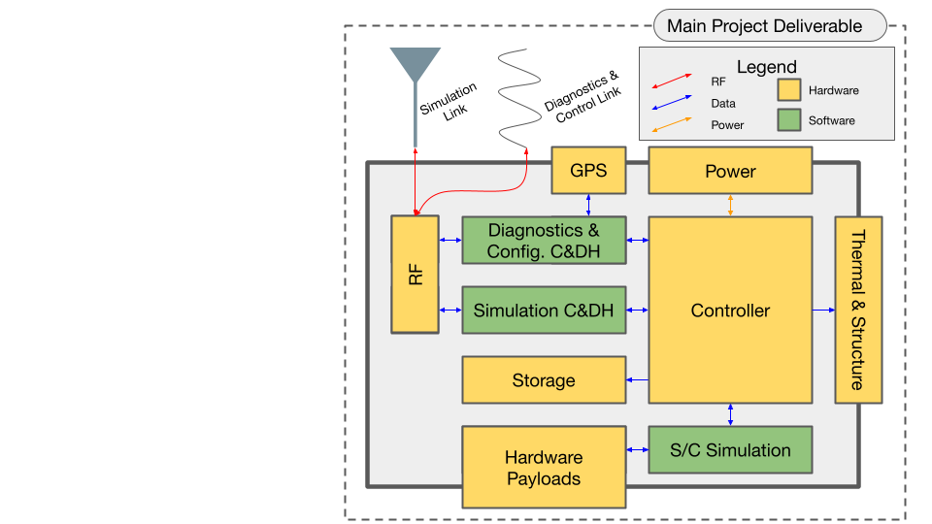
Structural Hardware Design Solution
Notes:
Madisen

Slide 12
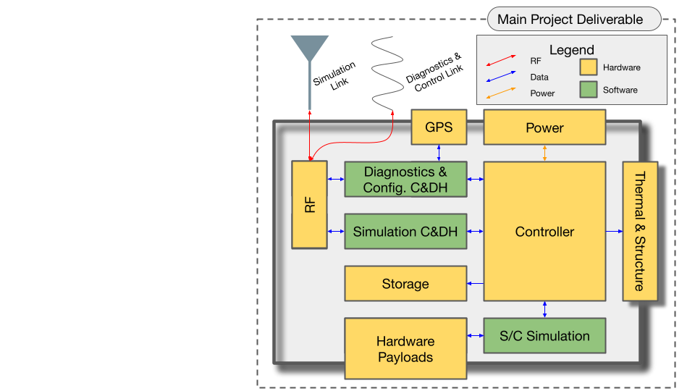
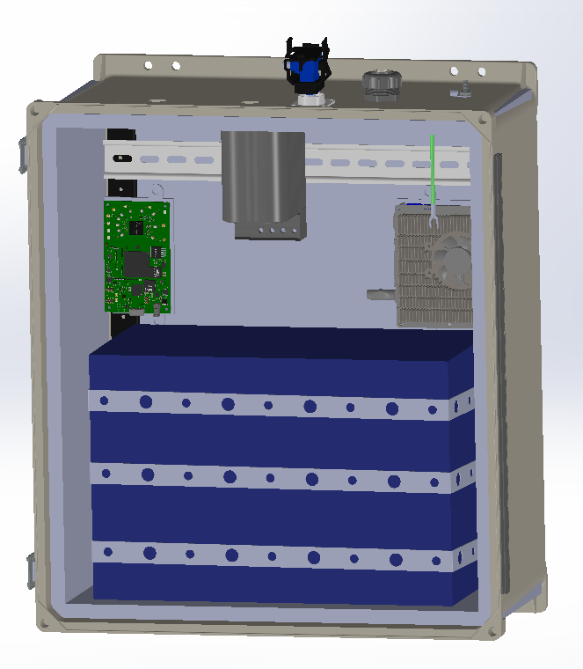
Structural Hardware Design Solution
0.23 m
0.46 m
0.38 m
Heated/insulated enclosure to hold all electronics except antenna
Notes:
Madisen

Slide 13
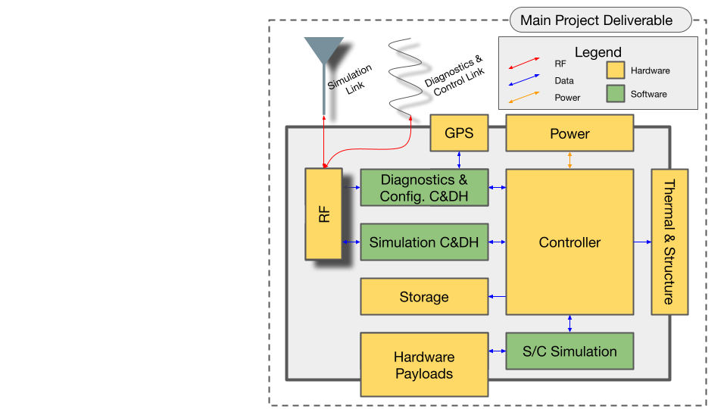
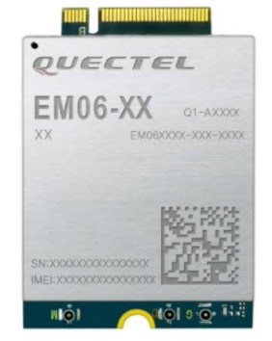
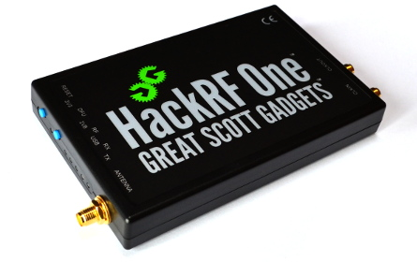
Electronics Design Solution
Parabolic Dish
Quectel EM06-A LTE Cat 6 M.2 Module - Cellular Modem and GPS receiver
Software Defined Radios (SDR)
LimeSDR and HackRF One
Notes:
Madisen

Slide 14
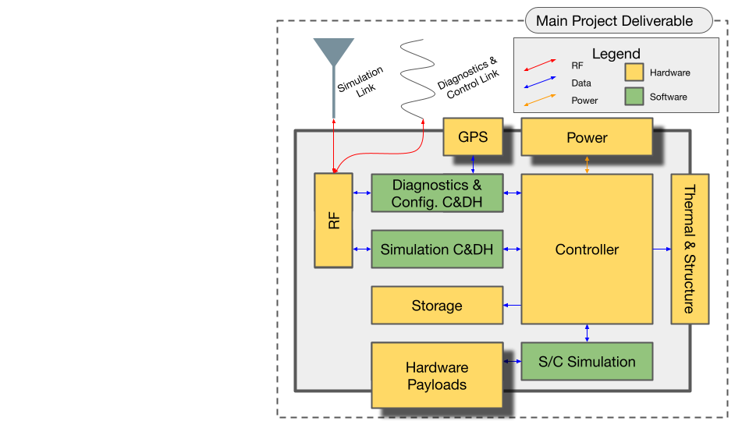
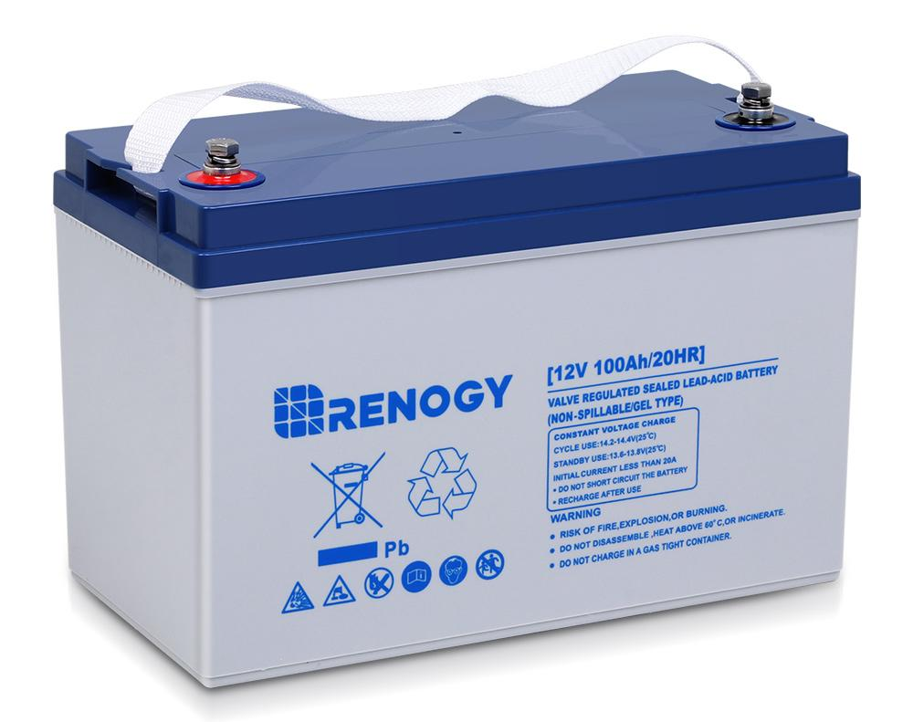
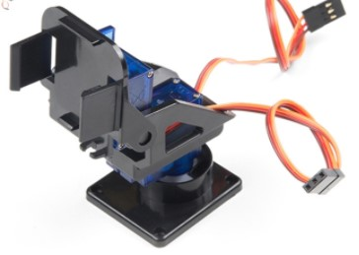
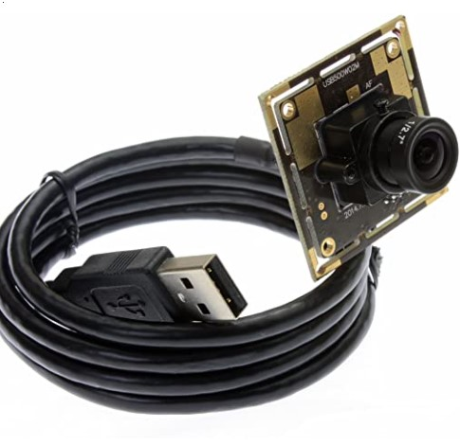
Electronics Design Solution
Renogy 12V 100Ah Battery
Sparkfun Electronics ROB - 14391
Small USB Webcam
Sparkfun Electronics ROB - 14391
Notes:
Madisen

Slide 15
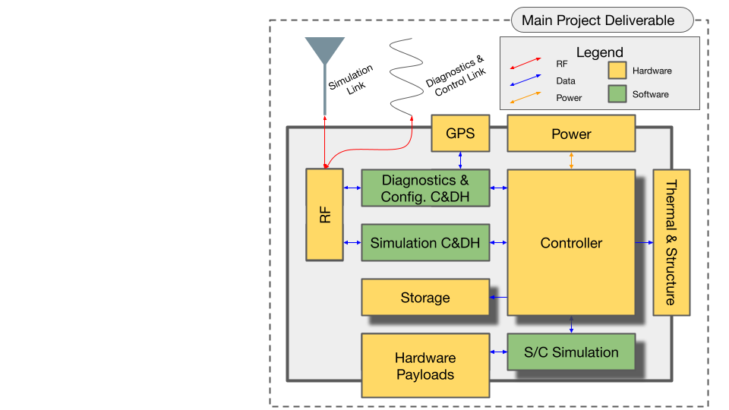
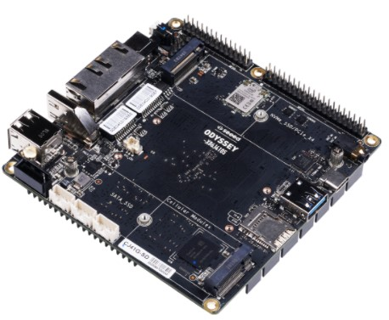
Electronics Design Solution
ODYSSEY X86J4105800
Storage
Spacecraft Simulator
Notes:
Madisen

Slide 16
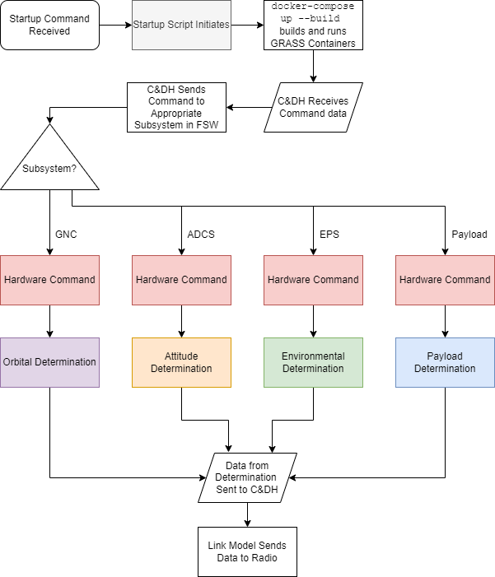
Software Flowchart
Software must include Flight Software (FSW)
Typically several major subsystems:
Guidance, Navigation, and Control
Attitude Determination and Control
etc.
Also must include simulation
Several behaviors to simulate:
Orbit
Attitude
etc.

Slide 17
Docker and Software Design Solutions
42
Software Solutions
Docker
KubOS
each has their own container
Systems
Tool Kit
Custom Code
(Python)
Notes:
Madisen

Slide 18
Container Communication
Legend
Docker
Output
Input
Docker
KubOS
Communication Service
42
Payload Subsystem, ADCS, GNC, EPS, and C&DH
EPS, ADCS, GNC, and Link Model
Docker
Docker
STK
Python
Attitude Model, Orbital Model, and Link Model
Payload Model, EPS Model, Link Model, and C&DH
(additional explanation in backup slides)
Notes:
Madisen

Slide 19
Orchestration - Docker Compose
Docker
Docker
KubOS
42
Docker
Docker Compose
Docker
STK
Python
Notes:
Madisen

Slide 20
Critical Project Elements (CPE)
ID | Summary | Motivation
E1 | Housing Unit and Mounting | A robust housing and mounting solution are necessary to protect the hardware when deployed.
E2 | Power and Electronics | Self-sufficiency requires robust and self-powered components.
E3 | RF Link | The link over which a ground station can connect to GRASS is the primary mode of use.
E4 | Software & Satellite Simulation | GRASS must emulate real satellite behavior, so robust and accurate software models are necessary.
E5 | Demo Ground Station | While GRASS will be communicating with Raytheon ground station in operations, a test ground station is necessary for project V&V.

Slide 21
Project Update
Project Overview
Schedule
Test Readiness
Budget

Slide 22
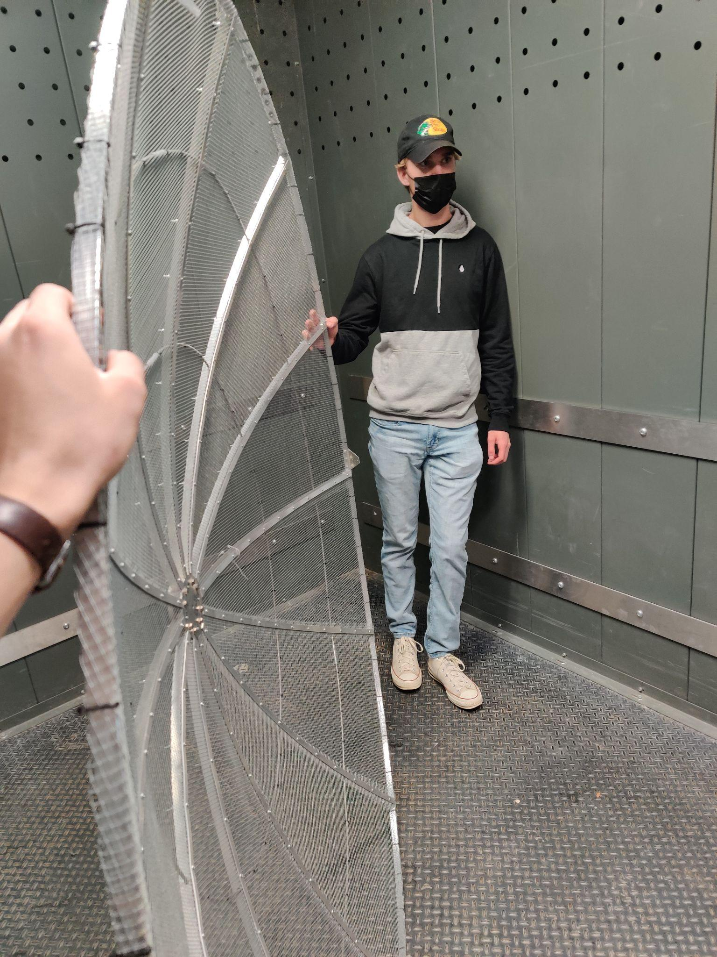
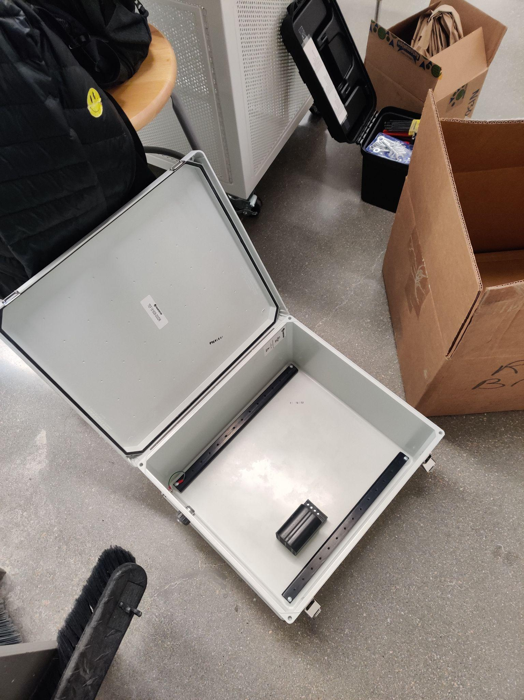
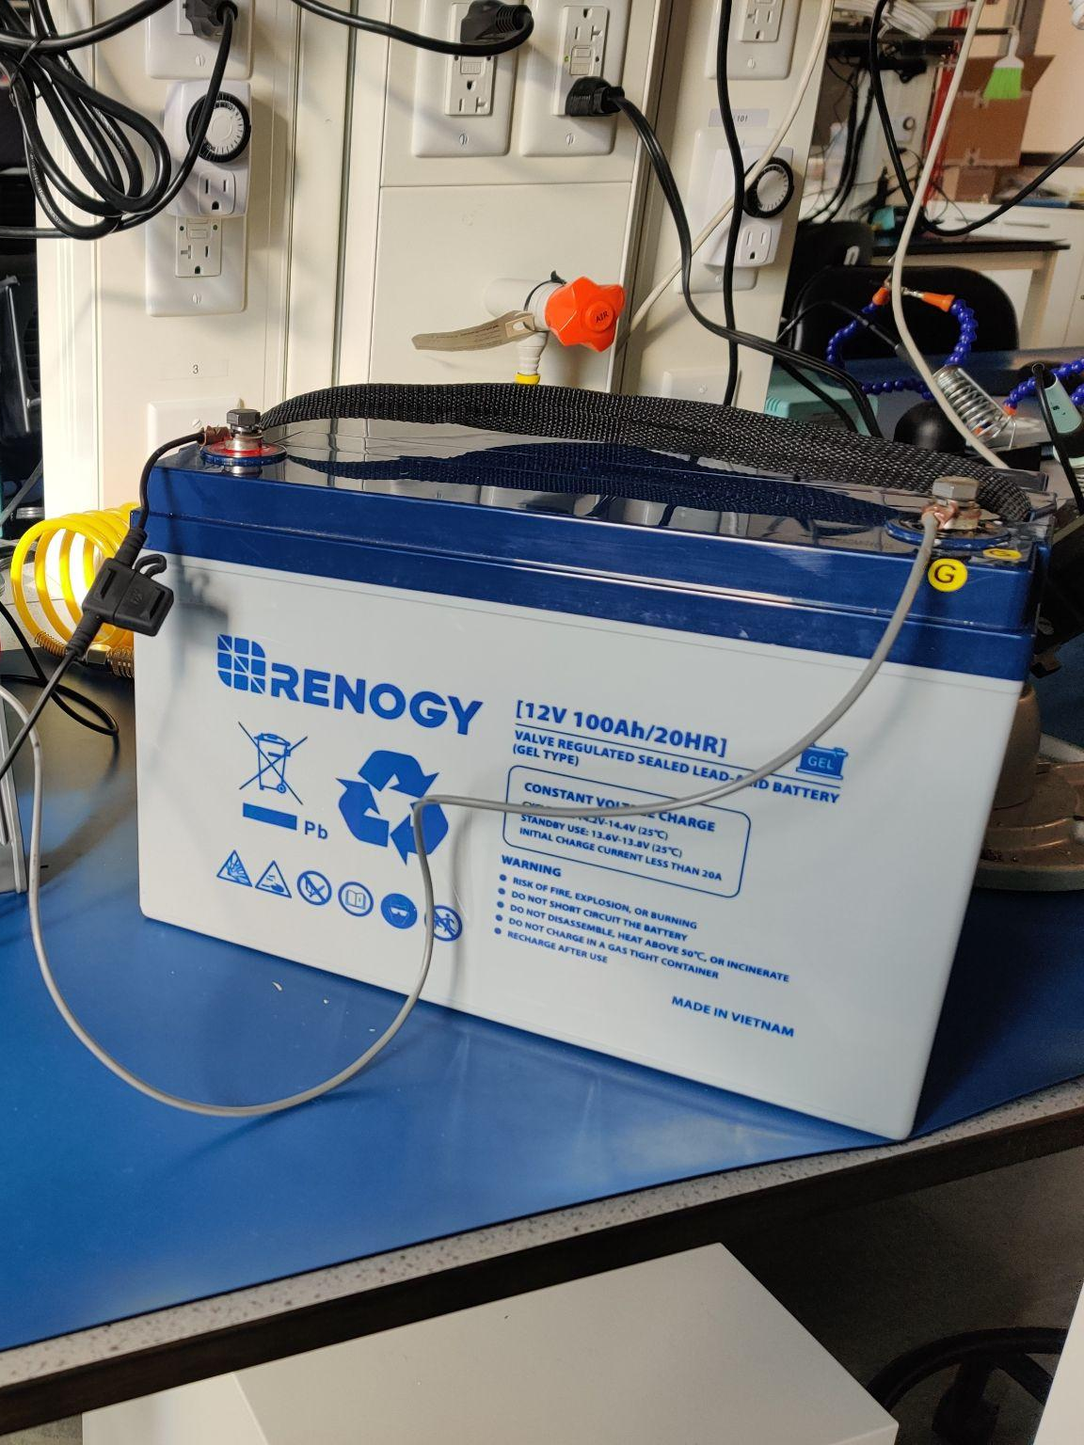
Major Hardware In Hand
2m Radio Dish
Project Enclosure
100Ah Battery
radios, test antenna, main computer, heater, miscellany, and more

Slide 23
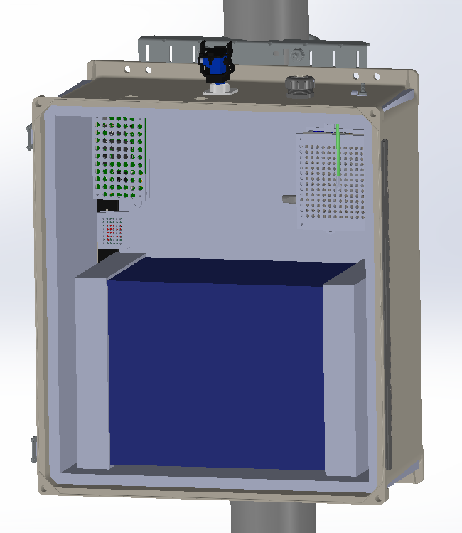
Update to Hardware Design
Minor design updates to component mounting solutions for ease of manufacturing

Slide 24
Schedule
Project Overview
Schedule
Test Readiness
Budget
Notes:
Carter
Project Purpose and Objective (5%)

Slide 25
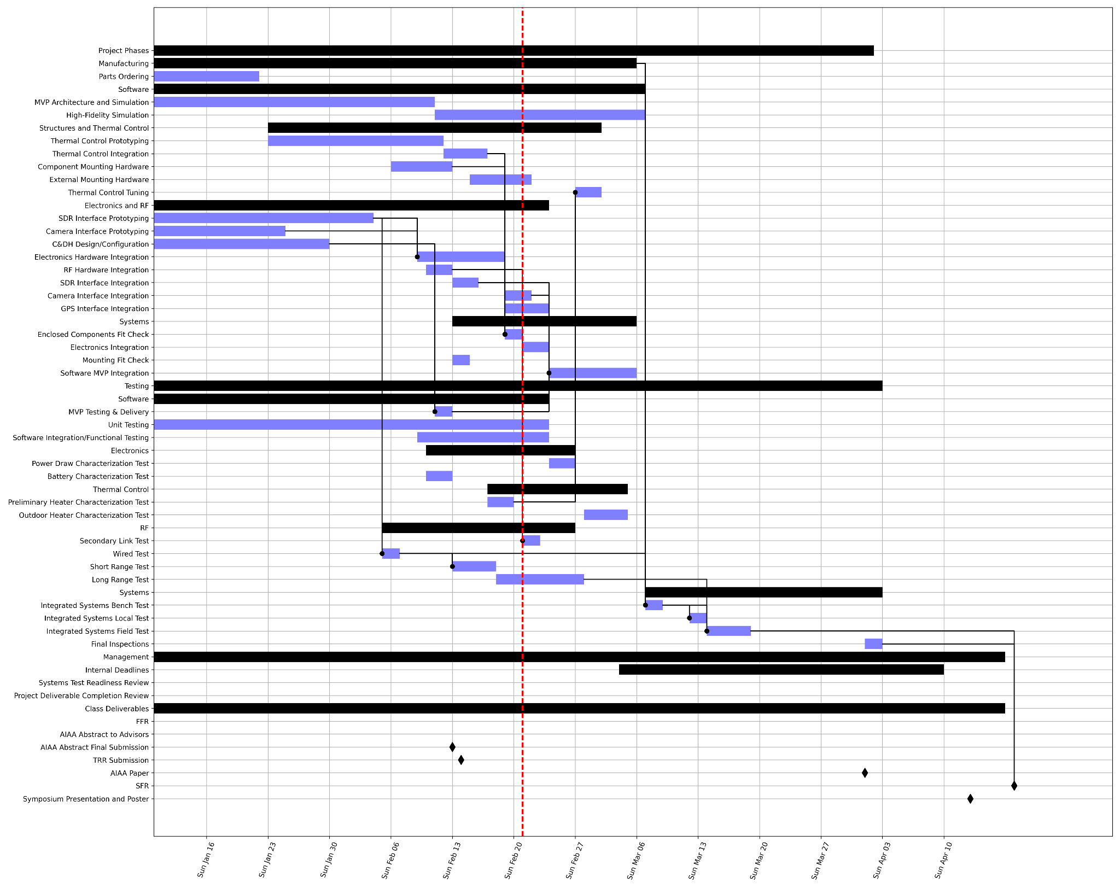
Schedule - All Tasks
Waited on hardware (unexpected delays, hardware we thought we’d have, etc.)
Shifted plans to prototype software before integrating hardware

Slide 26
Schedule - Software
⭐
Currently testing/delivering Minimum Viable Product for software
Constantly developing unit tests
Integration/Functional tests in progress (gate for software delivery)
Primary uncertainty is in how much we can complete past MVP

Slide 27
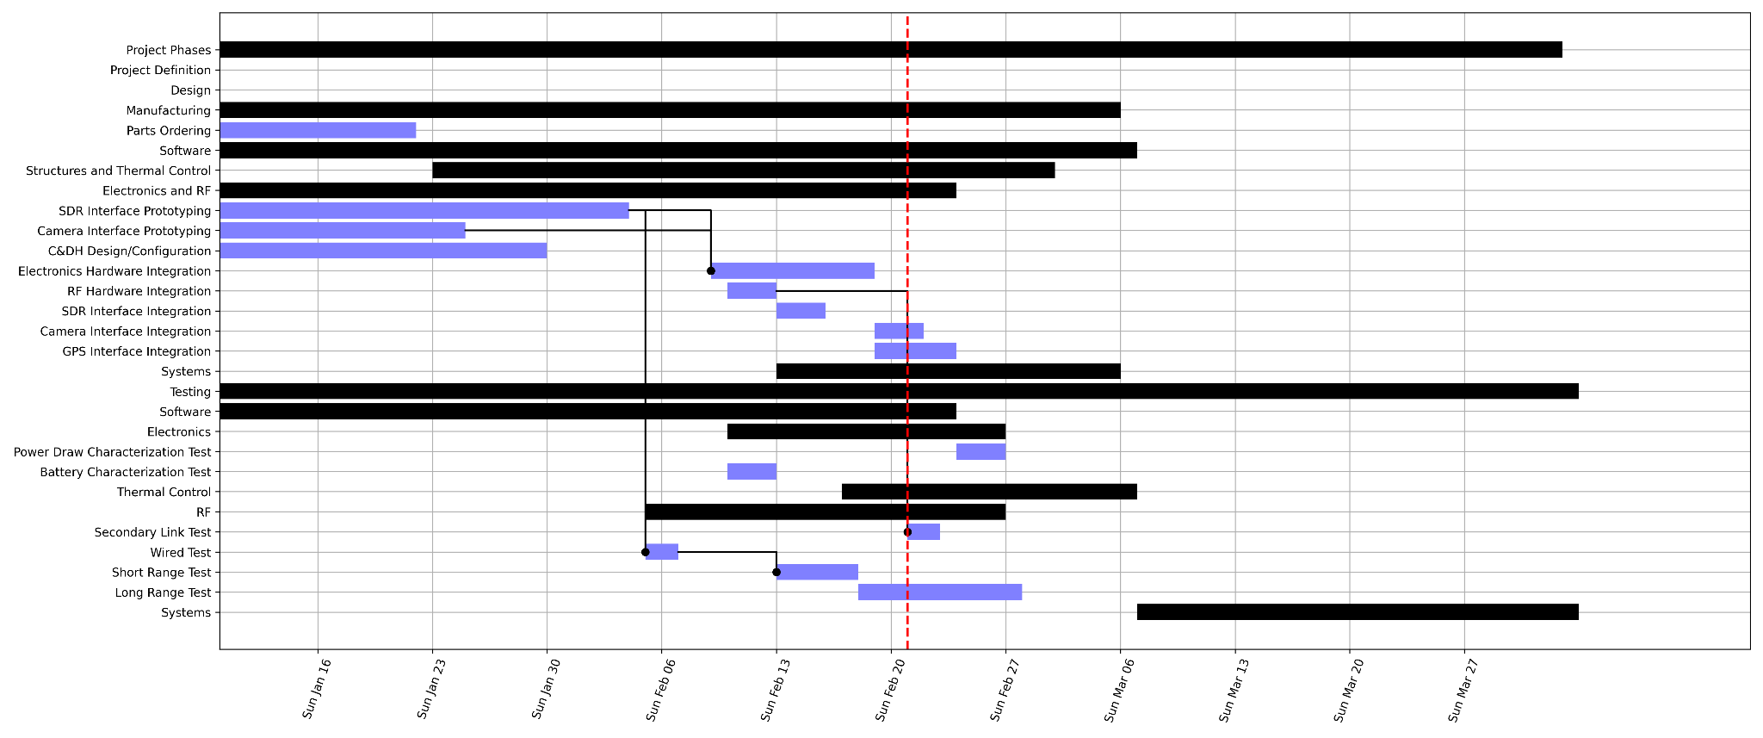
Schedule - Electronics and RF System
⭐
Already prototyped software for radios, camera/platform, commands/telemetry, etc.
Working through RF and power system characterization
Power system is low risk (no major dependencies)
RF testing is critical to getting to systems testing

Slide 28
Test Readiness
Project Overview
Schedule
Test Readiness
Budget

Slide 29
Major Tests - Subsystems
Test | Expected End Date | Status
Battery Characterization | Feb. 13 | Complete
Power Draw Characterization | Feb. 25 | Not Yet Started
Wired RF Test | Feb. 7 | Complete
Wireless RF Test - Short Range | Feb. 20 | In Progress
Wireless RF Test - Long Range | Feb. 28 | Net Yet Started
Heater Control Test | Feb. 21 | In Progress

Slide 30
Major Tests - Full System
Test | Expected End Date | Status
Bench Systems Test | Mar. 8 | Not Yet Started
Local Systems Test | Mar. 14 | Not Yet Started
Field Systems Test | Mar. 18 | Not Yet Started
Systems test schedule is aggressive and optimistic
Current plans have all major tests complete before Spring Break
Margin to push systems-level testing after Spring Break

Slide 31
RF Characterization
Project Overview
Schedule
Test Readiness
Budget
RF
Power
Systems

Slide 32
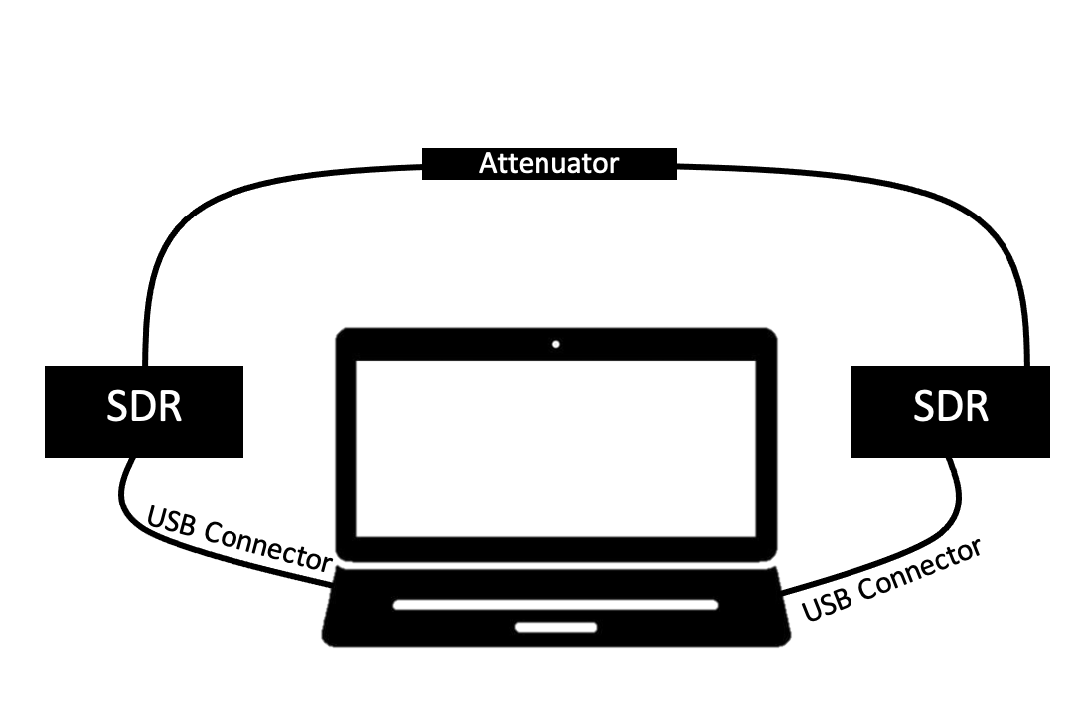
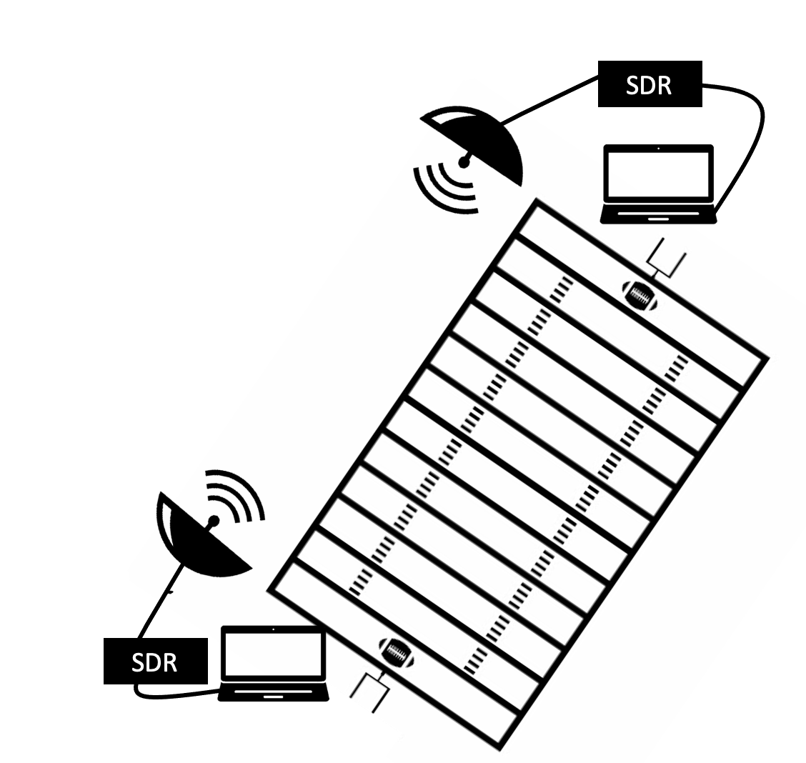
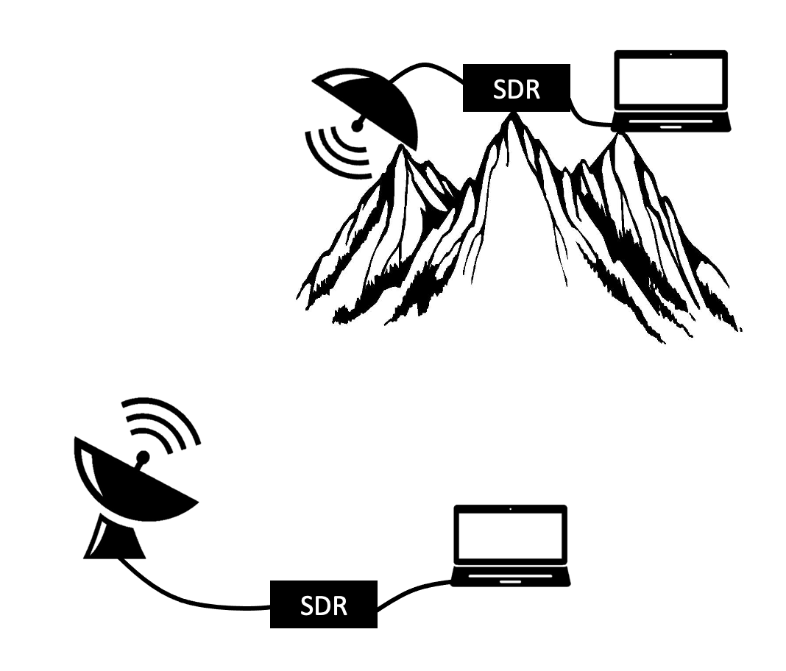
RF Testing - General Test Setup
Hardware
Two SDRs (HackRF One and LimeSDR) connected to computers via USB
GNURadio - an interface on computers which allows for configuration of SDRs
Recording incoming received data as in-phase and quadrature data
Variables are:
The medium between the radios
For wired testing this medium is an attenuator
For wireless testing this medium is the air between the two antennas
Transmitted power which is adjusted using sliders in GNURadio
Wired Test
Short Range Test
Long Range Test
Notes:
Reitrerate what an SDR is, mention GNUradio and what it is as well
Knowns
Losses through cables, connectors, and attenuators based on manufacturers/materials
Gains from antenna are known based on manufacturer or simple geometric equations

Slide 33
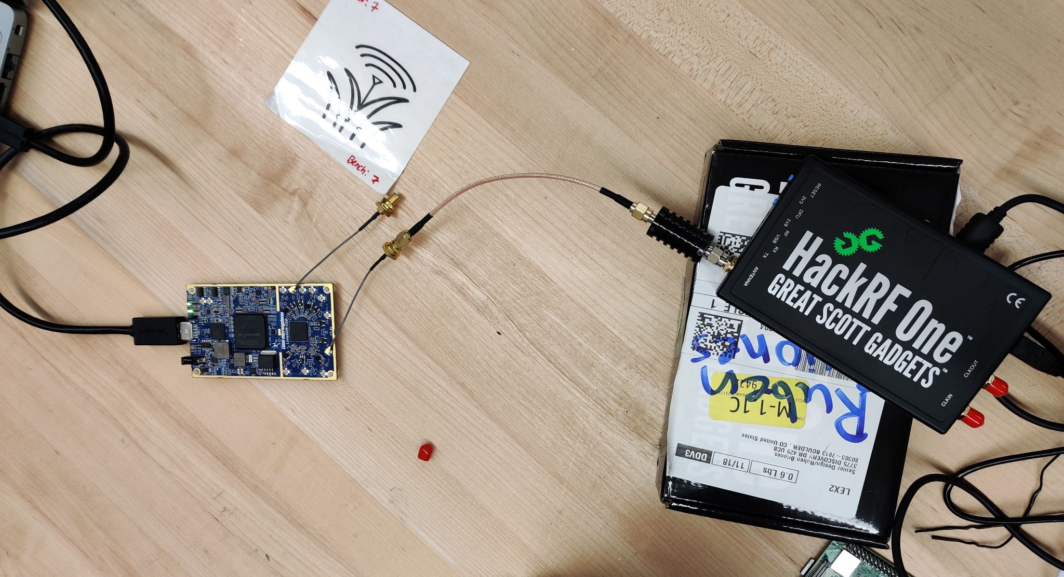
RF Wired Testing
DR3.1 GRASS shall have a dedicated half-duplex radio link able to send and received simulated spacecraft communications to/from Raytheon’s satellite ground station in Aurora, CO.
CPE 3: The link over which a ground station can connect to GRASS is the primary mode of use.
Deadline
Feb. 7th
Complete
Six tests with constant power source flowing in either direction sampling 100K samples per second
Originally set all receiver gains to 0 but the in order for the HackRF to receive any discernible power the RF amplifier had to be turned on and the LimeSDR needed some value for receiver gain
Incremented transmit gain by 5 dB recording each step for 1 second
Recorded power measurements in in-phase and quadrature binary data (processed in MATLAB)

Slide 34
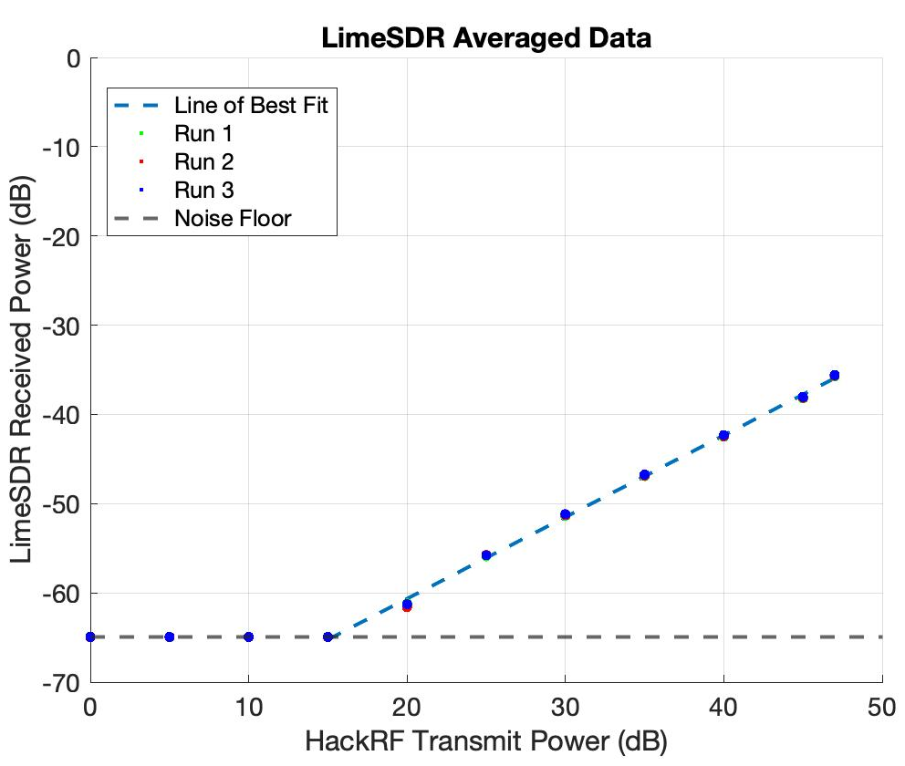
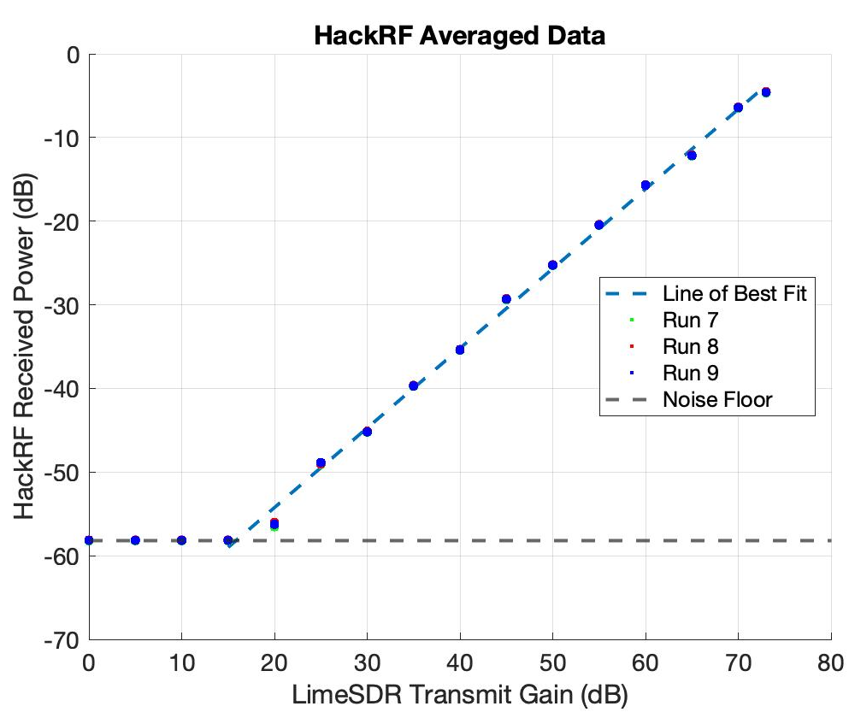
RF Wired Test Results
These plots show how the received power was related to the transmit power
Each point is the averaged received power based on 100000 samples vs the transmit power recorded at

Slide 35
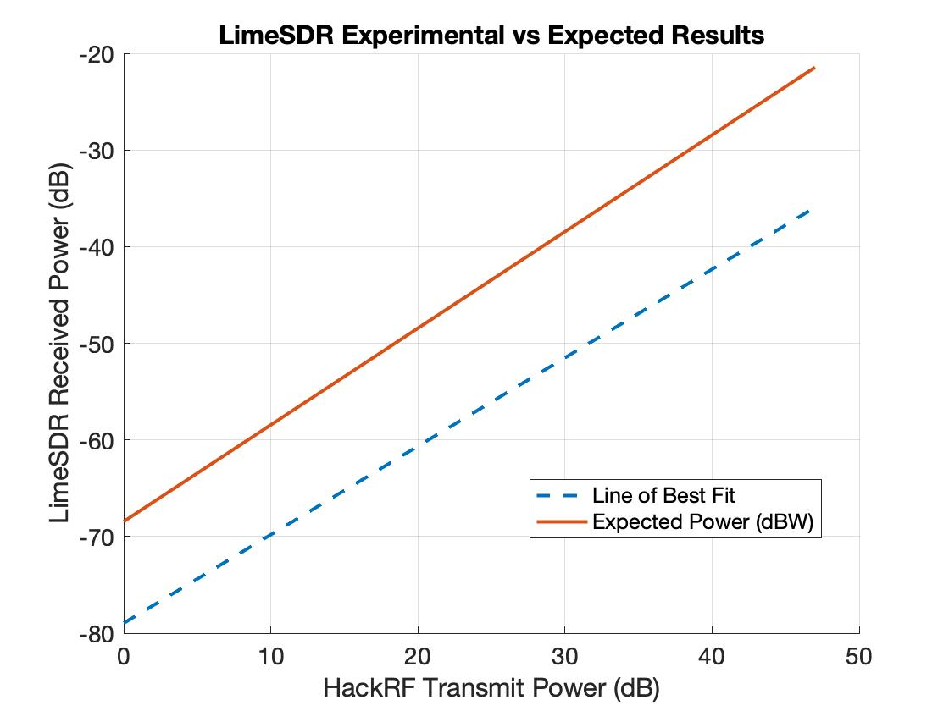
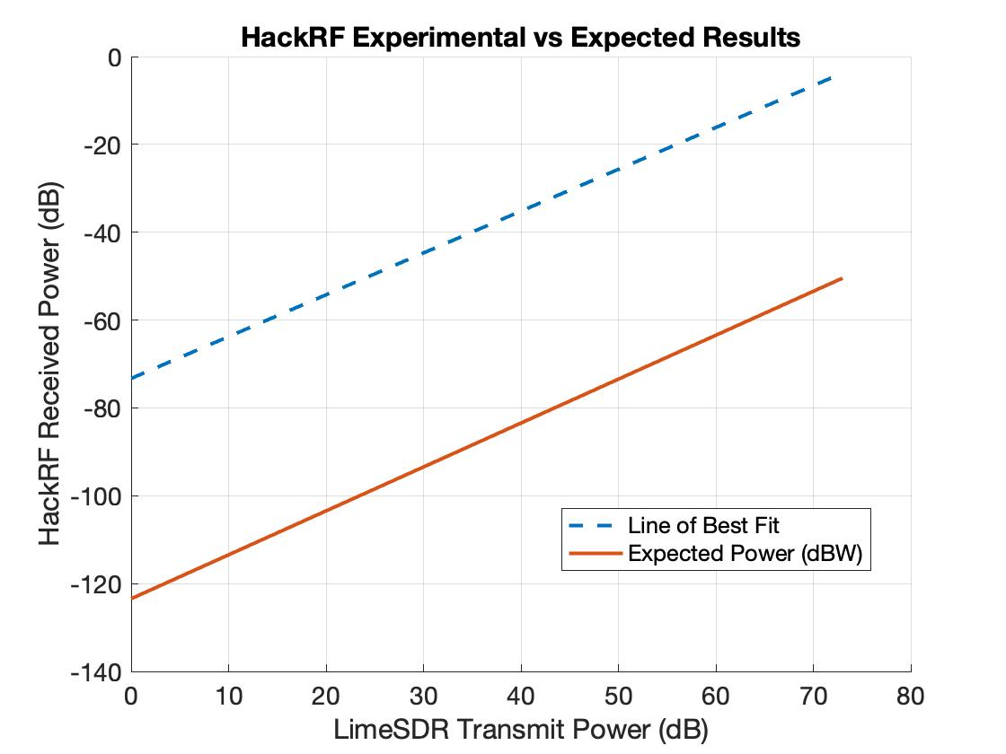
Comparison to Expected Power
Compare the relative power relationship in testing to expected power from model
GNURadio values are measured with respect to an arbitrary value as a result of the hardware that can be experimentally determined
P_{r} = P_{tr}- G_{attenuator} - L_{cable/connectors}

Slide 36
RF Wireless Testing
DR3.1: GRASS shall have a dedicated half-duplex radio link able to send and received simulated spacecraft communications to/from Raytheon’s satellite ground station in Aurora, CO.
DR3.2: A second telecommunications link shall support downlink of simulator diagnostics and uplink of simulator configuration.
CPE 3: The link over which a ground station can connect to GRASS is the primary mode of use.
Deadline
Feb. 28th
Not Started
Connect antennas and computers to SDRs
2 meter parabolic dish to LimeSDR
15 dB testing Yagi antenna to HackRF One
Short Range Milestone
100 meter line of sight transmission
Long Range Milestone
6700 meter line of sight transmission
6700 m
100 m

Slide 37
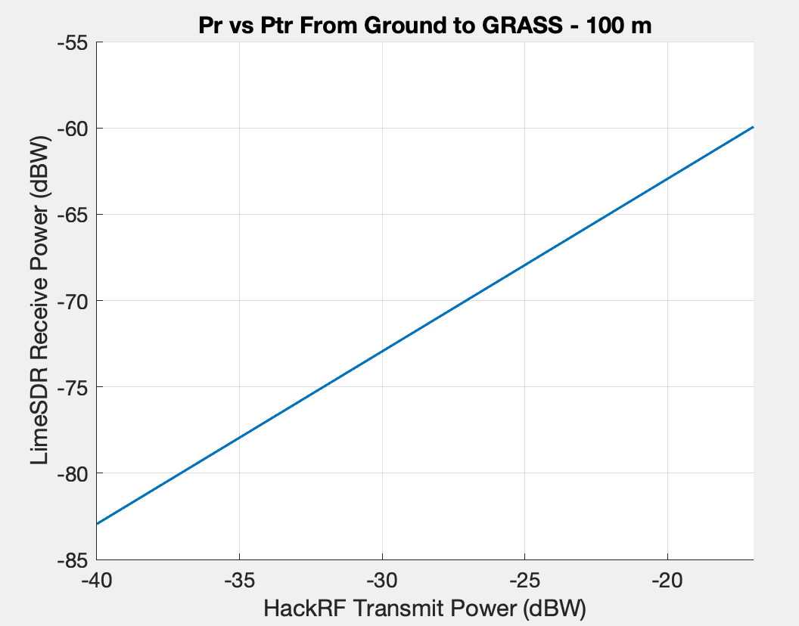
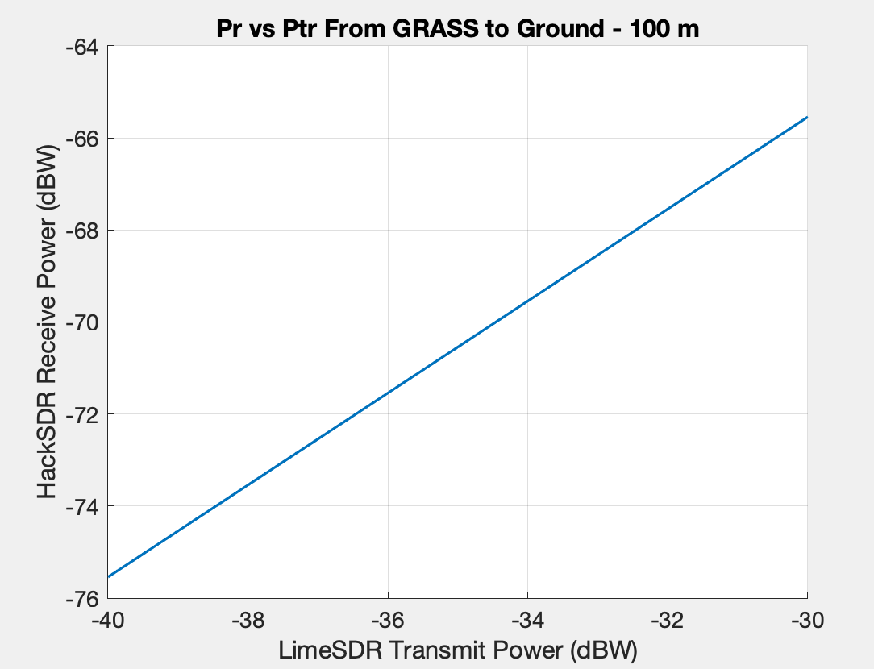
Short Range Test - Characterization
Expected received power (Pr) in dBW based on link budget vs transmit power (Ptr)

Slide 38
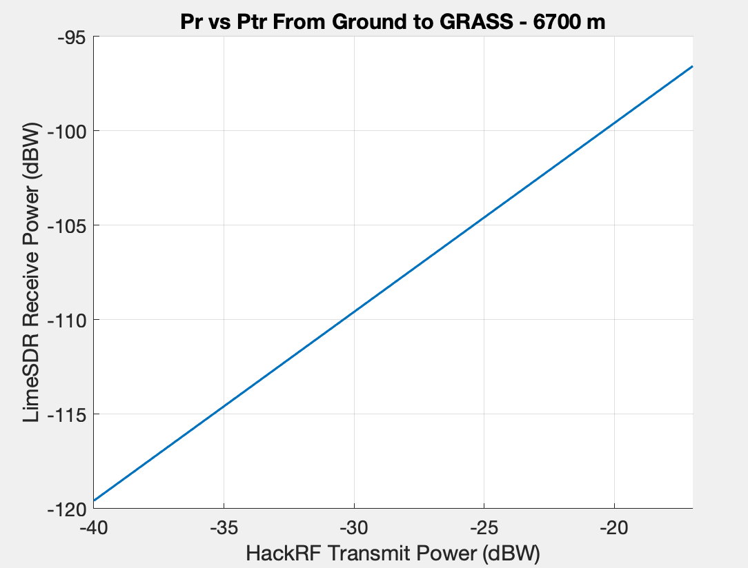
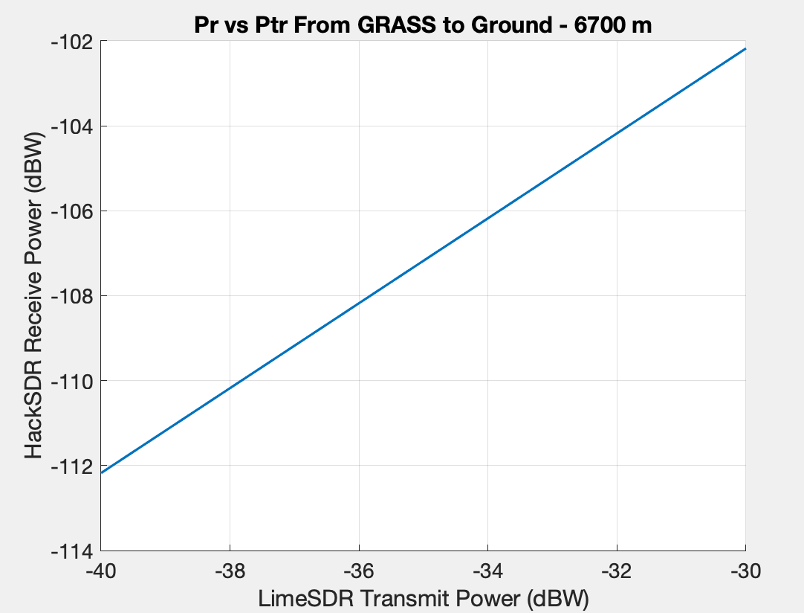
Long Range Test - Characterization
Expected received power (Pr) in dBW based on link budget vs transmit power (Ptr)

Slide 39
Power System Characterization
Project Overview
Schedule
Test Readiness
Budget
RF
Power
Systems

Slide 40
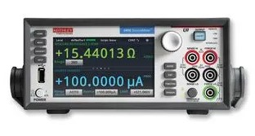
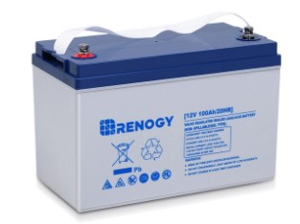
Battery Test - General Test Setup
Test Setup
Battery connected to Keithley sourcemeter
Battery is charged to 14.2V and then discharges into the sourcemeter at 4A
Source meter records terminal voltage and current until the voltage drops to 10.5V
Variables are:
The voltage of the battery over time
Battery capacity and voltage curve vs. manufacturer specifications
Measurements
Battery terminal voltage vs. time
Discharge current
10.5 - 14.2 V
4A
Dissipated heat

Slide 41
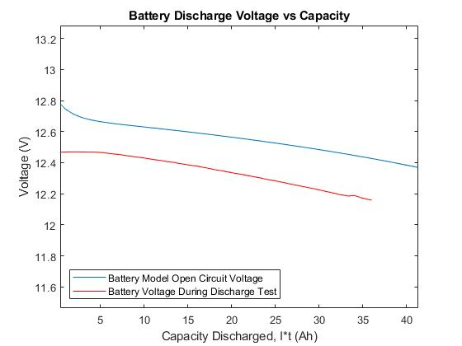
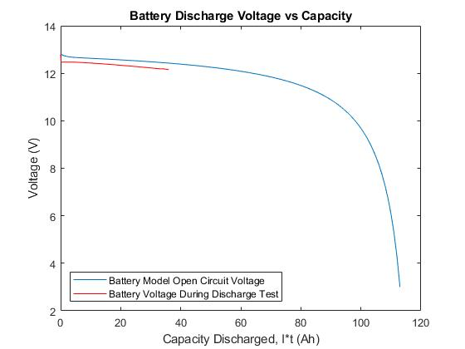
Electronics Characterization - Battery
Offset is believed to be linked to the difference between the open-circuit voltage and voltage under load
Likely correlates to 50 mΩ internal resistance in the battery
Data is still being processed

Slide 42
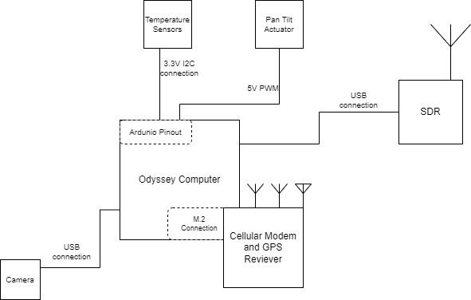
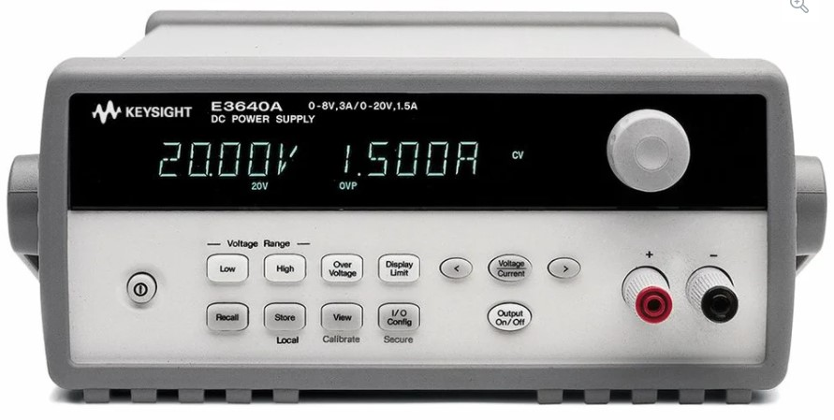
Power Draw Test - General Test Setup
Test Setup
Odyssey connected to benchtop power
All electronics are connected to the Odyssey and put under expected load
Current and voltage are measured over an hour and average power drawn is determined
Variables are:
The average power drawn dependent on the load

Slide 43
Systems-Level Testing
Project Overview
Schedule
Test Readiness
Budget
RF
Power
Systems

Slide 44
Overall Systems Test Plan
Purpose: Verify interactions between modules of containerized software in integrated hardware environments using a bottom-up approach
Phases:
Integrated Systems Bench Test
Integrated Systems Local Test
Integrated Systems Field Test
Notes:
O what is being tested for (your rationale for performing the test),
O the design of the test fixtures,
O what test equipment and facilities are needed, and
O an overview of the test procedures.
Describe how the test(s) will reduce risk to your project, what results do you expect, and what models will be validated.

Slide 45
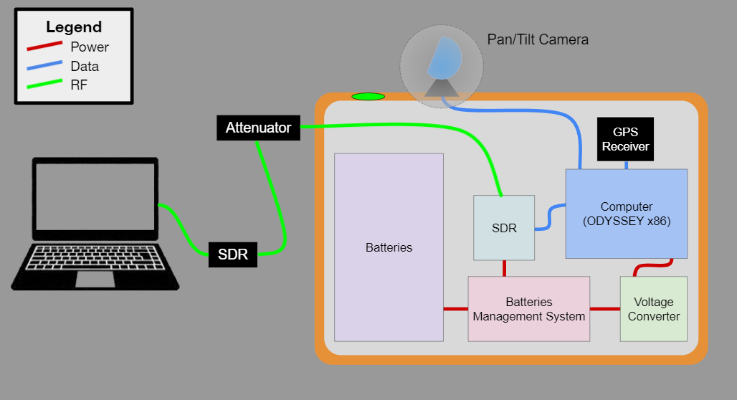
Integrated Systems Bench Test
DR1.1 GRASS shall support operation of all electrical equipment (in Front Range conditions)
DR1.2 GRASS shall accept external power and distribute it to all internal systems as needed
CPE 1: A robust housing and mounting solution is necessary to protect the hardware when deployed
CPE 2: Self-sufficiency requires robust and self-powered components
Deadline
Mar. 8
Not Started
Purpose:
Demonstrate the capability of all systems to work together coherently in a wired configuration
Plan / Procedures:
Send sample commands, check status of telemetry data throughput and for proper operation of environmental and payload components
Expectation:
Verify power distribution system and subsystem interactions
Notes:
Eric

Slide 46
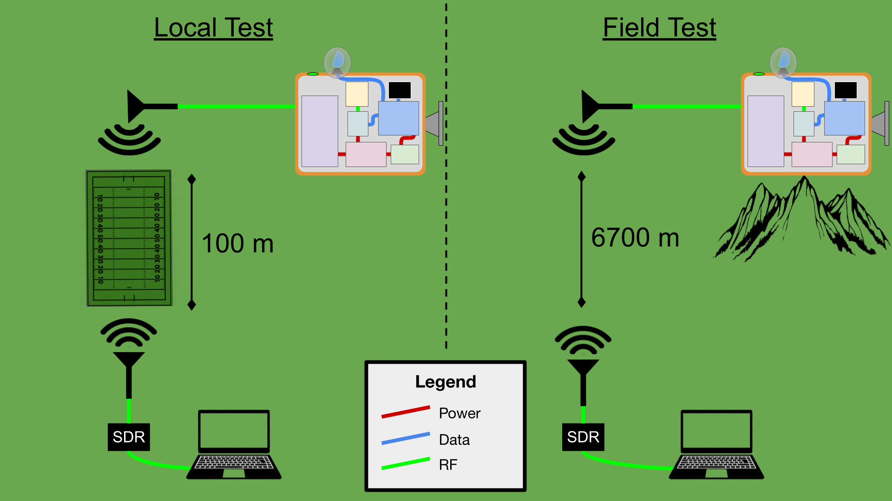
Integrated Systems Local and Field Tests
DR5.1 GRASS shall have a GPS receiver capable of determining its position with sufficient precision for antenna pointing
DR5.2 GRASS shall be deployable by 1-2 people
CPE 3: The link over which a ground station can connect to GRASS is the primary mode of use
Deadline Mar. 18
Not Started
Purpose:
Demo ability to connect and interact with GRASS from a ground station
Plan / Procedures:
Initiate connection from ground station
Send sample commands across a short-range, then a long-range radio link
Check status of telemetry data throughput and for proper operation of environmental and payload components
Expectation:
Verify and validate integrated system behavior, performance, and usability in an operational setting
Notes:
Eric

Slide 47
Budget
Project Overview
Schedule
Test Readiness
Budget
Notes:
Carter
Project Purpose and Objective (5%)

Slide 48
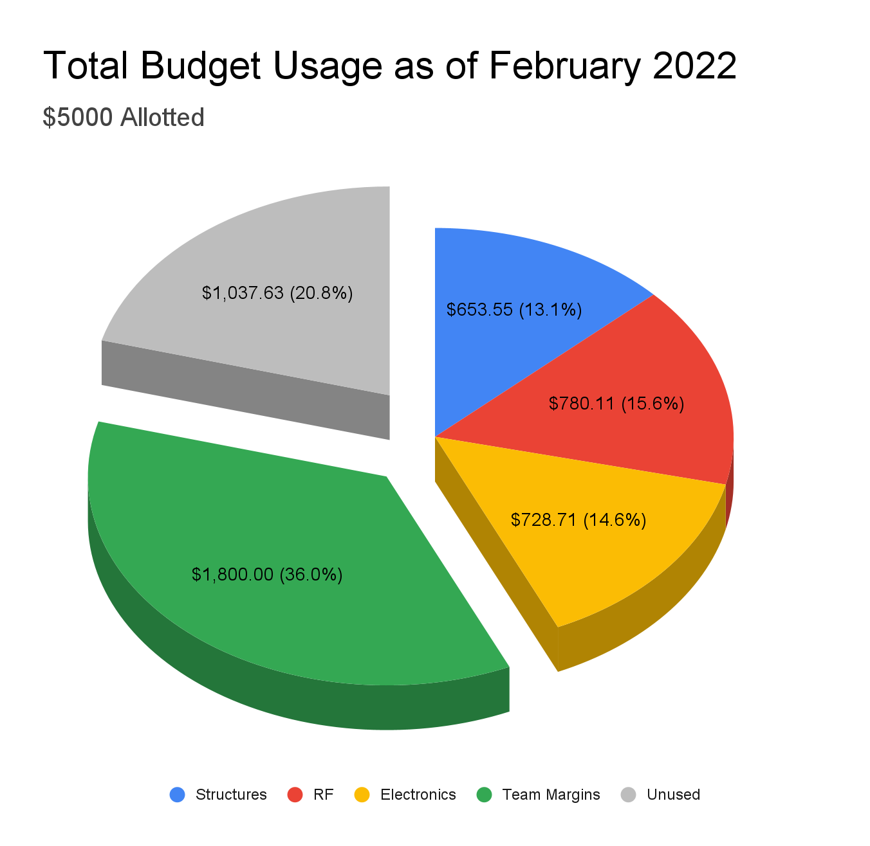
Cost Plan
36% dedicated to margin across expense categories and whole team
Borrowed hardware
LimeSDR, Antenna Dish, Antenna Stand
$2837.63 that can be used
$2162.37 spent so far in subteams
No margins needed yet
Notes:
Right where we expected to be

Slide 49
Purchase Plan/Status
Products Received
HackRF
Odyssey
Enclosure
Battery
Pending Products
Camera
Solid State Relay
Dish Feed
Cellular Modem
Planned Purchases
Wires
Screws
Connections
Rails
Worries: Antenna feed - logistical issues in ordering but fits in budget
Contingency: Use lower quality antenna feed and compensate in models
Notes:
What is DRIVING our cost? - Enclosure, HackRF, Battery/Odyssey respectively.

Slide 50
Acknowledgements
Raytheon Team:
Sheldon Clark and Martin Wilson
Ann & H.J. Smead Department of Aerospace Engineering Sciences:
Prof. Jade Morton, Steve Taylor, and Harrison Bourne
PAB Members
Trudy Schwartz, Katie Rae, Bobby Hodgkinson, Nicholas Rainville,
Chris Roseman, Prof. Xinlin Li
TRR Reviewers:
Prof. Jade Morton, SP4CE, and Emma Markovich
Notes:
Carter
We’d like to acknowledge:
our customers at Raytheon for their advice and support
Several folks in the department including our advisor, Prof. Morton, and the full advisory board
Other instructors and professors for their particular support and expertise
And the lovely folks who helped us prepare this presentation, namely Prof. Morton and Colin

Slide 51
Questions?
Notes:
Carter

Slide 52
Backup Slides

Slide 53
Table of Contents
Test Plan
Levels of Success
Software Diagrams: Design Requirements
Software Diagrams: Flowcharts
Manufacturing
C&DH
RF Characterization Testing
Software Testing
Thermal Characterization Testing
Budget
Electronics Schematics

Slide 54
Project Information

Slide 55
Levels of Success - More Detail
 | Housing Unit and Mounting | Power and Electronics | Radio Link | Software Architecture and Spacecraft Simulation
Level 1 | Support/protect payload and sensitive electrical components for 24 hours while mounted outdoors | Connected to bench power in order to power all subsystems, with an off the shelf pan tilt camera and a GPS receiver | Link margin of 10 dB, range of 75 km, rate of 9600 bps to send commands from virtual ground station and receive telemetry from GRASS (within FCC regulations) | Subsystem simulators for the following: Attitude, Orbital, EPS (battery charge and temperature), Link (CMD&TLM), and payload models
Level 2 | Support/protect payload and sensitive electrical components for 24 hours while mounted on the Front Range | Connected directly to grid power to power all components. | Second telecommunications interface over which supporting datta can be sent | Three-body orbit propagator capable of returning classical orbital elements
Level 3 | Capable of surviving Front Range winter conditions for 5 days | External solar panel battery power system to power GRASS indefinitely on Mount Evans | All data shall be passed by the RF system fully intact at an increased rate of 2 Mbps | Tunable parameters of satellite models shall be configurable via the secondary control link
Notes:
Madisen

Slide 56
Schedule - Full Project

Slide 57
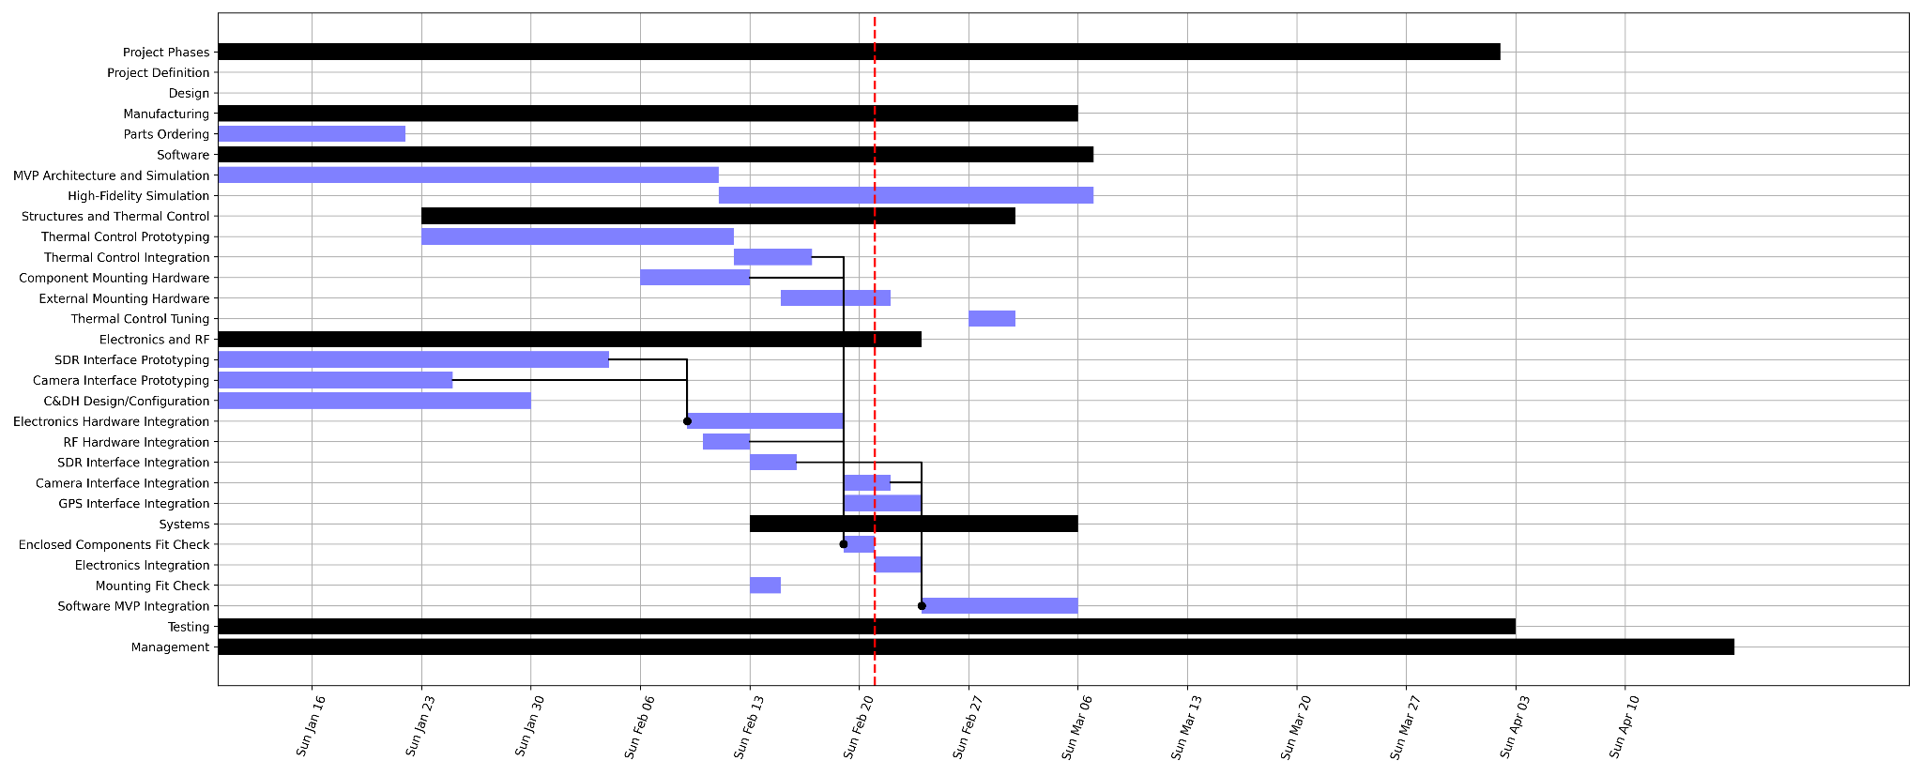
Schedule - Manufacturing

Slide 58
Schedule - Testing

Slide 59
Software Diagrams

Slide 60
Software Block Diagram: Design Requirements
Hardware Payload
Radio
Docker
42
Payload Model
Attitude Model
Orbit Model
EPS Model
Link Model
Simulation Apps
STK
Python
Payload
Subsystem
ADCS
GNC
EPS
C&DH
FSW Apps
KubOS
Notes:
Thanks Marissa ;)
Madisen still

Slide 61
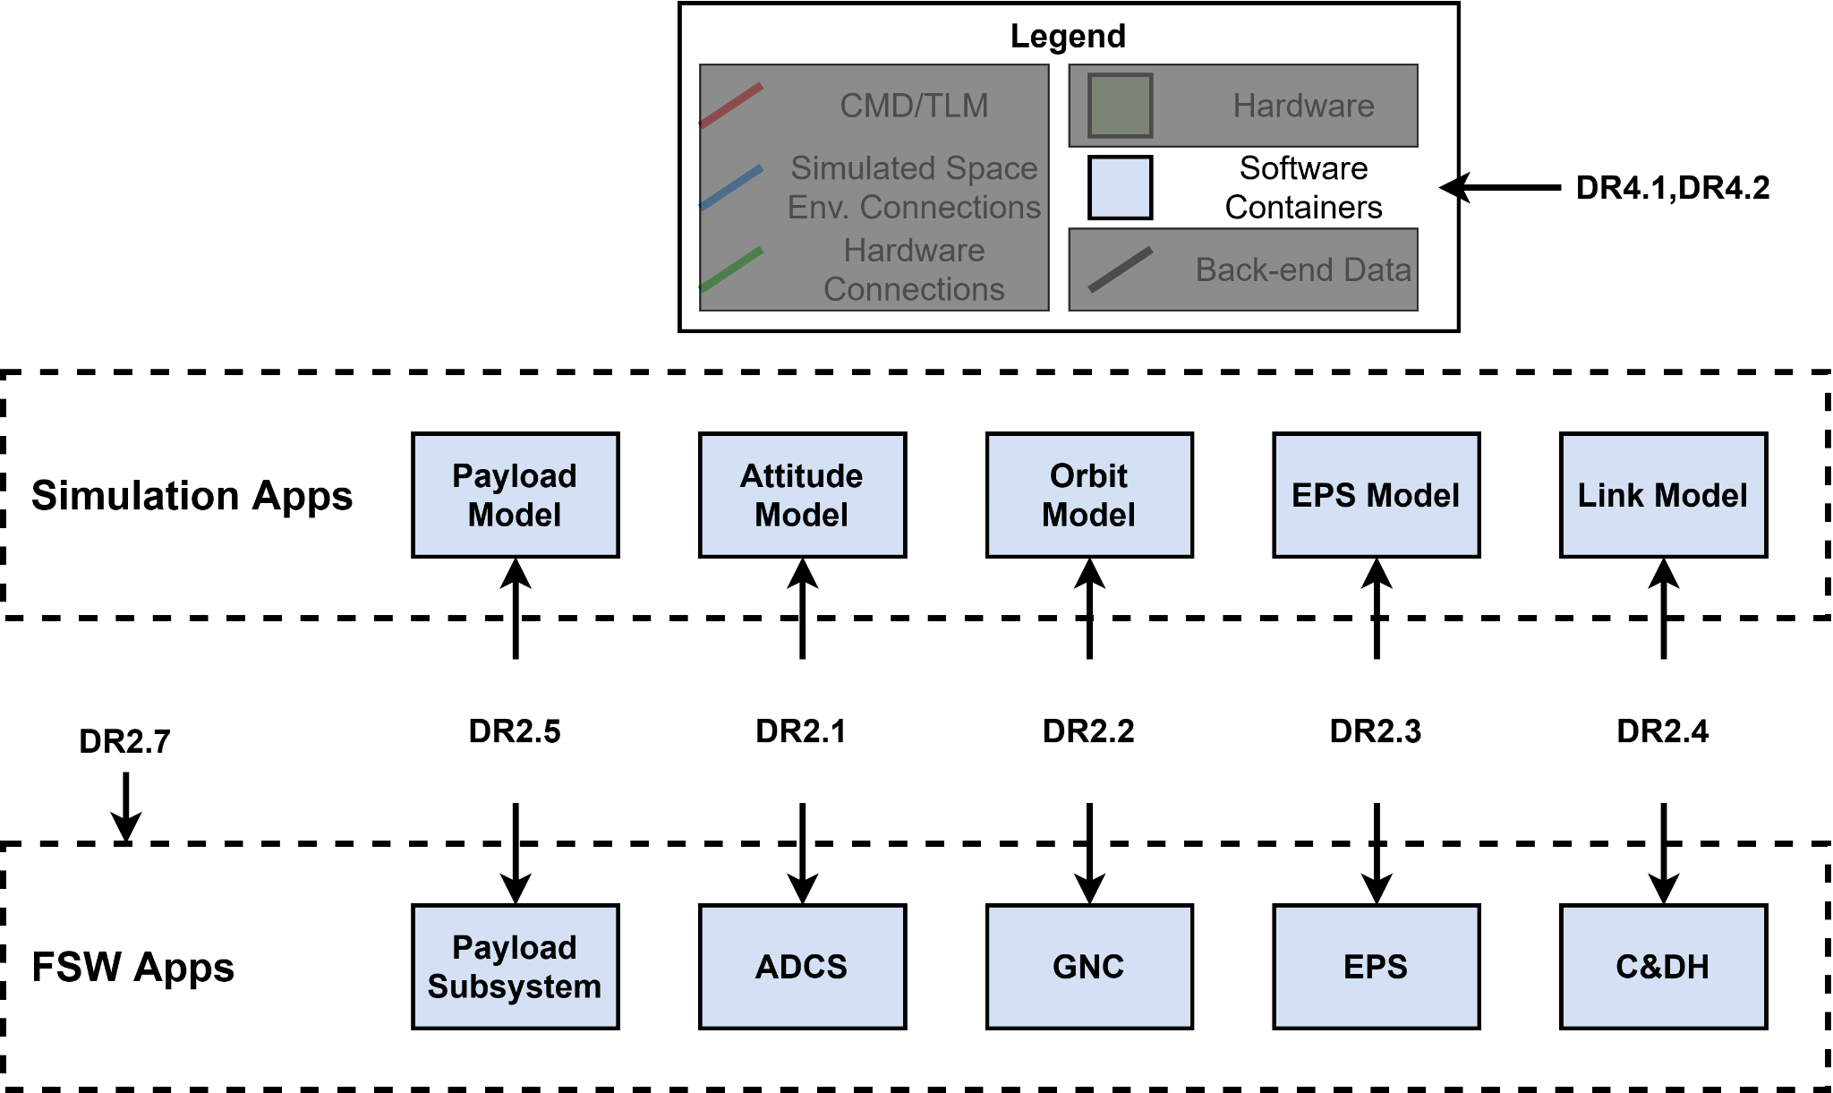
Software Block Diagram: Design Requirements
42
KubOS
STK Components
Custom Code
Docker

Slide 62
Software Flowchart

Slide 63
Software Flowchart

Slide 64
Software Flowchart

Slide 65
Software Flowchart

Slide 66
Testing

Slide 67
Test Plan - Reminder of Tests
Verification Methods
System Validation
Analysis
ConOps, Objectives
Mestaa’ėhehe Mountain Field Test
Demonstration
System Verification
Inspection
High-Level FRs
Integrated Systems Test - Lab
Test
Subsystem Verification
Low-Level DRs
Software Integration Tests
Electronics Integration Tests
Ground Station Integration Tests
Assembly Fit Checks
Unit Testing and Component Characterization
Individual Container Tests
Hardware Fit Checks
RF Characterization
Thermal Characterization
Electronics Characterization

Slide 68
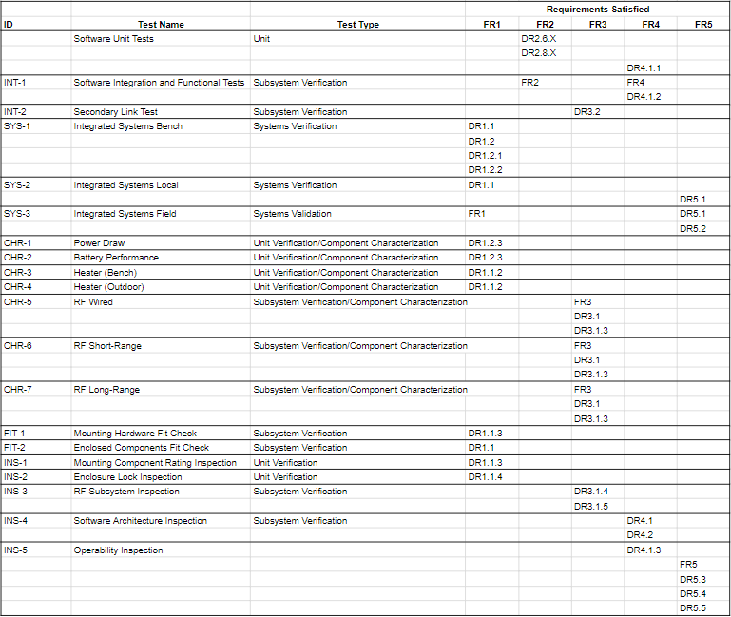
Master Test List

Slide 69
RF Characterization

Slide 70
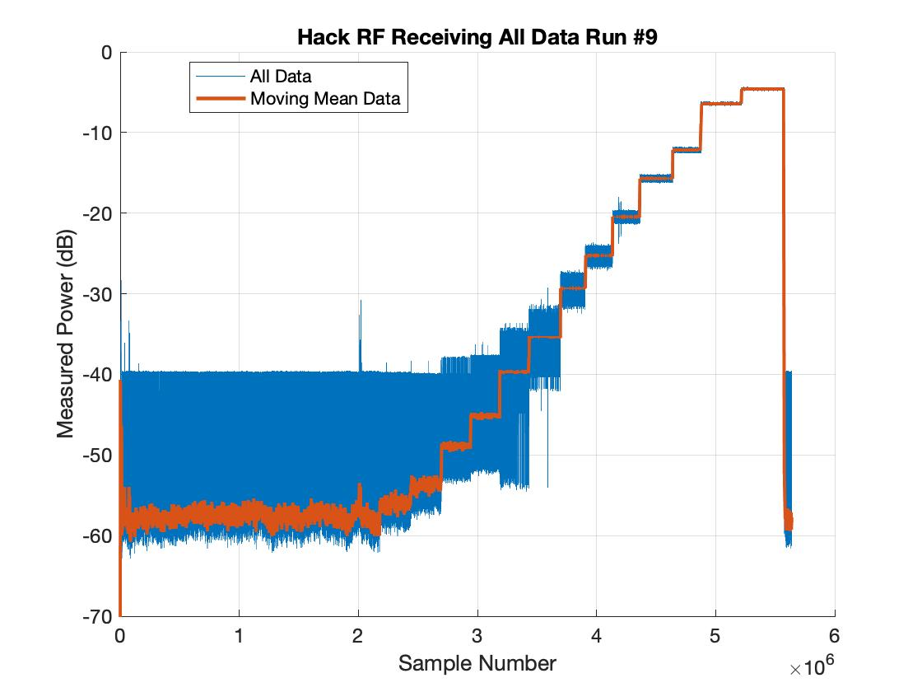
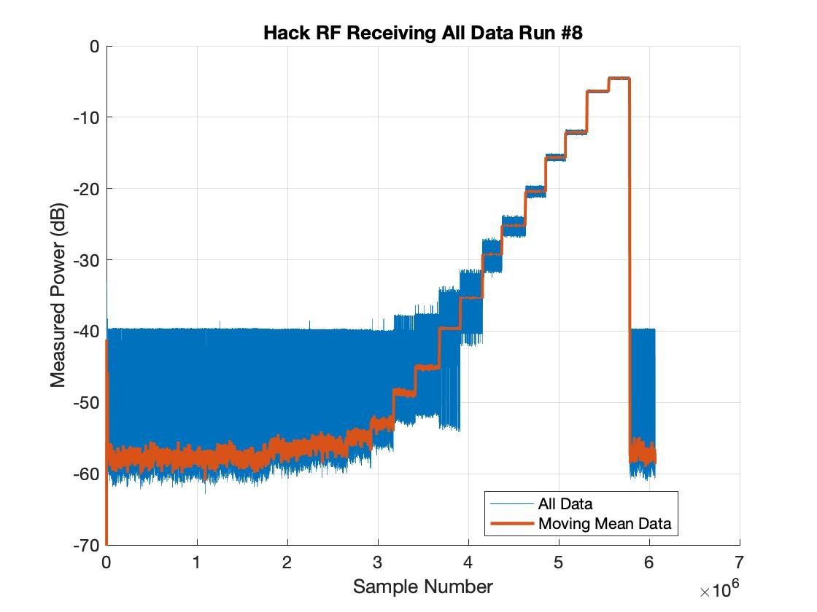
Graphs for each Wired RF Run - HackRF One

Slide 71
Graphs for each Wired RF Run - LimeSDR

Slide 72
RF Model - Lime Sweep and Received Power vs Distance

Slide 73
LimeSDR Researched Results

Slide 74
Software Testing

Slide 75
Unit Testing
All small “units” of code (class models as an example) are tested using small unit testing scripts based on Python’s unittest module
Tests expected behavior given inputs for small pieces of code
Verifies that the “building blocks” are correct

Slide 76
Integration Testing
Two levels of integration testing:
Software Only
Beginning with only one test case, verify software architecture as focus
Goal is to verify the individual units perform correctly when integrated in the larger system
No hardware in the loop
Second, for overall system
Many test cases, verify architecture and hardware interfacing, particularly C&DH software
On full test bench

Slide 77
Thermal Characterization

Slide 78
Thermal Model: MATLAB 3D Steady State
Driving Requirements: The box must be able to operate within expected environmental temperatures (per FR1.1 and DR1.1.2)
MATLAB Model (3D Steady-State)
Outputs: the Watts of heat produced given the surface temperature of the box
Accounts for: conduction, convection, ambient and solar radiation, altitude, etc.
Extreme Conditions: [-20,30]°C, 30mph (48.3 km/h) winds
Expected Conditions: [-10,15]°C, 15mph (24.1km/h) winds
Required Internal Conditions: must be within [0,45]°C
Conclusion:
Extreme Conditions: ~35 W of heating and ~35 W of cooling required
Testing Conditions: ~20 W of heating and no cooling required
MATLAB model closely matched previous SolidWorks thermal fluid simulations
Link to model details
Notes:
Eric

Slide 79
Thermal Model Plots
Expected Enclosure Temperature vs. Heat Flux
Notes:
Eric

Slide 80
MATLAB Thermal Model
The model provides a good estimate of what heating and cooling will be required, and it allows for quick changes to parameters of the box and the effects on thermal loads
The assumption of isothermal is not a good assumption as the temperatures of the inside and outside surfaces may vary and be used to simplify calculations
The amount of solar radiation included was a value typically used for determining power produced by solar panels and is a poor indication of infrared heat produced
The model is verified with SolidWorks simulations
3D thermal model using resistances
Assumes isothermal box, steady-state, no snow or rain, constant conductivity emissivity/absorptivity, perfect cube box, box is entirely enclosed by environment (Earth)
Includes forced and natural convection, and heat produced by electronics
Conservative model
Extreme Temperatures
Low end night with no electronics producing power, high winds
High end day with max power by electronics, maximum solar incident radiation

Slide 81
MATLAB Thermal Model - Cont.
Q̇_{solar}
Q̇_{gen} + Q̇_{thermal}
Q̇_{conv}
Q̇_{cond}
Q̇_{cond}
Q̇_{rad}
Q̇_{cond}
Q̇_{cond}

Slide 82
MATLAB Thermal Model - Cont.
Nusselt number of a cube: Simplified Analytical Models for Forced Convection Heat Transfer From Cuboids of Arbitrary Shape, Culham et. al.
Natural Convection
Forced Convection

Slide 83
SolidWorks Thermal Simulation
SolidWorks Simulation
SolidWorks Fluid Simulation
Used as supplement to thermal model
Same conditions as extreme model
More accurate with CAD model and solar radiation specific to Denver, CO
Hot Extremes Sim
30 W Electrical Heating
Internal Temperature 77°C
Result
Simulations show that need we both active heating and cooling to in extreme conditions
Cooling introduces complications, boxes with fans have lower ingress protection
Cold Extremes Sim
40 W Active Heating
Internal Temperature -3°C

Slide 84
Thermal Characterization Tests
Heater and thermal system characterization testing
Heater Lab Characterization Test
Compare models with heat produced in a controlled environment
Heater Outdoor Characterization Test
Compare models with varying external temperatures
Objective: Verify MATLAB thermal models
Heater PID control will use MATLAB models as a baseline for tuning
Improving thermal models based on test data allows for more efficient heater control
Gives confidence that the enclosure can protect components from thermal extremes
Notes:
Eric

Slide 85
Thermal Characterization Test - Controlled Environment
Deadline 02/18
Characterization of thermal system in a controlled environment
Measurements: Temperature sensors measure internal and external (room) temperature
Test Setup:
Arduino used to control heater
Bench power source
Procedure: Steadily provide power to heater until operational limits exceeded.
Heat produced to internal temperature recorded as primary point of interest
Verification: Compare with expected temperatures corresponding with heat produced from MATLAB model
Not Started
Notes:
Eric

Slide 86
Thermal Characterization Test - Outdoors
Deadline 02/21
Characterization of thermal system in an outdoors environment
Measurements: Temperature sensors measure internal and external temperatures
Test Setup:
Arduino computer used to control heater
Battery or bench power source
PID control to keep enclosure at a steady temperature
Procedure: Run PID-controlled heater through varied external conditions
Control law should maintain internal temperature
Heat required and external temperatures recorded as primary points of interest
Verification: Compare with expected heat required to maintain a steady internal temperature from MATLAB model
Not Started
Notes:
Eric

Slide 87
Budget

Slide 88
Purchase Plan
Products Received: HackRF, Odyssey Computer, Enclosure, Battery, Heater, SSD. Vital components with long lead times prioritized in ordering.
Pending Products: Camera, Solid State Relay, Dish Feed. Important for testing but expected to be in hand soon.
Planned Purchases: Wires, Screws, Connections, Rails. Mostly small components with short lead times and low priority.
Worries: Dish Feed - Ordering issues but fits in budget
Notes:
What is DRIVING our cost? - Enclosure, HackRF, Battery/Odyssey respectively.

Slide 89
Cost Plan
Highest estimate under $5000
Added increased margin per subteam
Reduced risks by borrowing components/ project descoping
$5000

Slide 90
Structures Cost Plan
Current budget plan breakdown for structures

Slide 91
RF Cost Plan
Current budget plan breakdown for RF

Slide 92
Electronics Cost Plan
Current budget plan breakdown for electronics

Slide 93
Electronics Schematics

Slide 94
Electronics Functional Block Diagram

Slide 95
Overview Schematic

Slide 96
Pan Tilt Servos
Camera
Parabolic antenna
Power
Data
Temp Sensor
Both
USB 2.0
5V PWM
I2C
Arduino Core
USB 3.0
Lime SDR
Voltage converter
12V .15 Vpp
Cellular antennas
Battery
Odyssey Computer
M.2
10.5 - 12V DC
Cellular modem
GPS antenna

Slide 97
Heater Control Circuit

Slide 98
Temperature Sensor Circuits

Slide 99
Hardware Software Interfaces
Arduino
USB 3.1 61.44 MSPS
SDR
Software
Camera
USB 2.0
8 MSPS

