Slide 1

GRASS
Critical Design Review (CDR)
December 1st, 2021 (12:50 - 1:40 PM)
ASEN 4018 - 012 Team 7
Customer
Raytheon Technologies
Faculty Advisor
Prof. Jade Morton
Presenters
Madisen Purifoy-Frie, Cole Sechrist, Eric Roeck, Gavin O'Connell, Marissa Palamara, Wil Edwards, and Carter Mak
Additional Team Members
Trey Taylor, Addison Conzet, Sam Packard, Ruben Briones, and Daniel Mathews

Slide 2
Presentation Outline
Project Overview
Design Solution
Critical Project Elements
Design Requirements & Satisfaction
Project Risk
Verification & Validation
Project Planning
Mission Statement
Electronic Hardware
Functional Requirement Table
Risk Table
Characterizati-on Testing
Q&A
Conops
Structural Hardware
Functional Requirement 2
Pre Mitigation Risk Matrix
RF V&V
Backup Slides
Software & Simulation
Functional Requirement 3
Post Mitigation Risk Matrix
Structures & Thermal V&V
System FBD
Functional Requirement 4

Slide 3
Project Overview
Project Overview
Design Solution
CPEs
DRS & Satisfaction
Project Risks
Verification & Validation
Project Planning

Slide 4
Mission Statement and Motivation
Ground station Ranged Assessment Satellite Simulator (GRASS) will provide Raytheon engineers with a high fidelity and configurable satellite simulator to act as a cooperative target for testing and demonstrating ground stations and ground data systems.
Motivation:
Realistic hardware interactions without testing on sensitive flight hardware
Configurable behavior to exercise ground stations and ground data systems

Slide 5
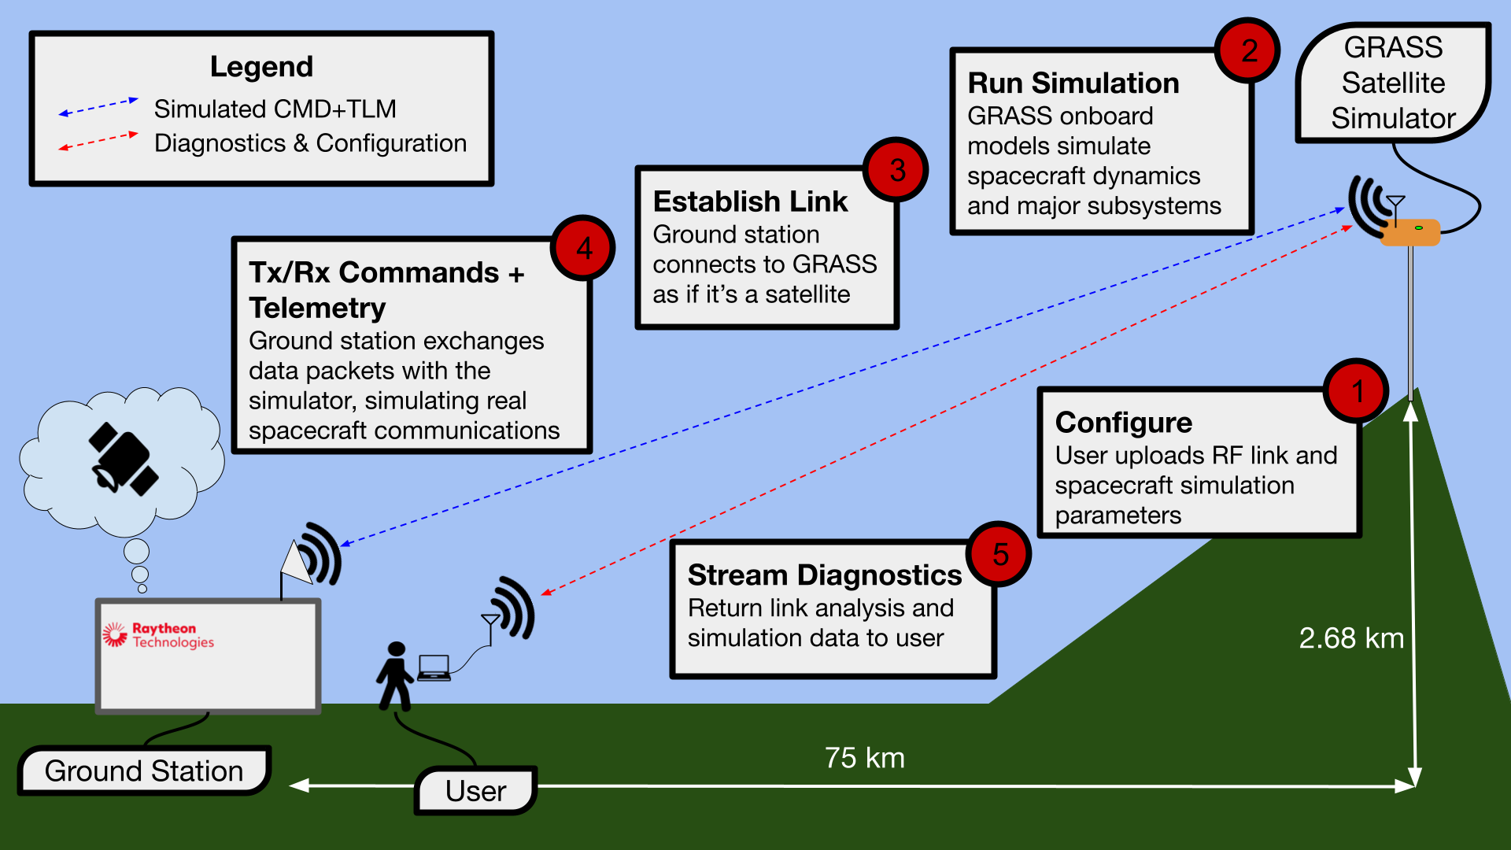
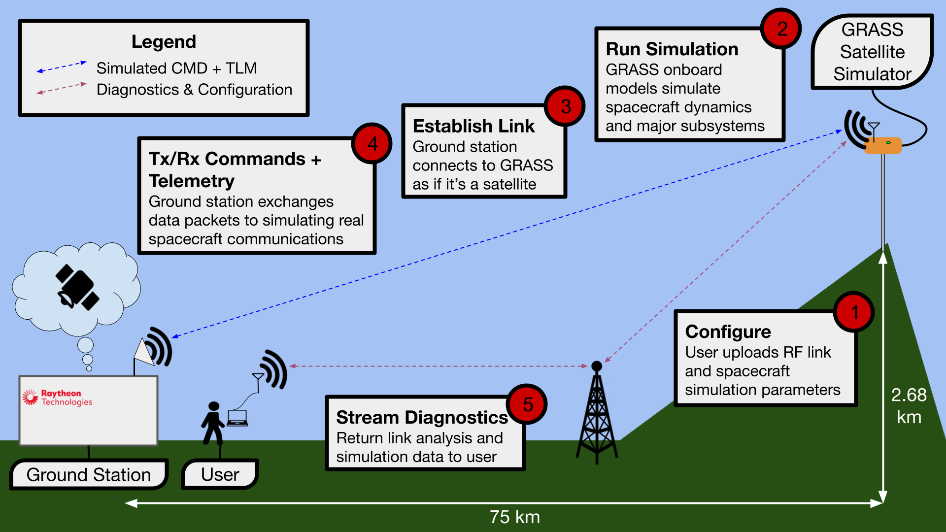
Concept of Operations - Overview

Slide 6
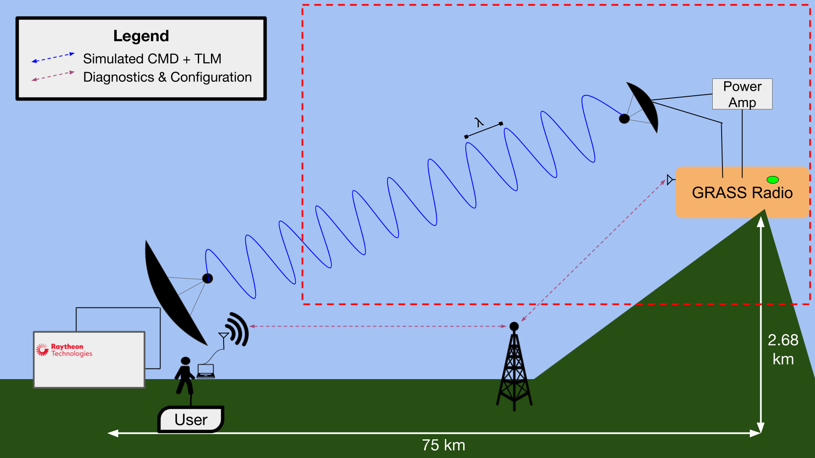
Concept of Operations - RF

Slide 7
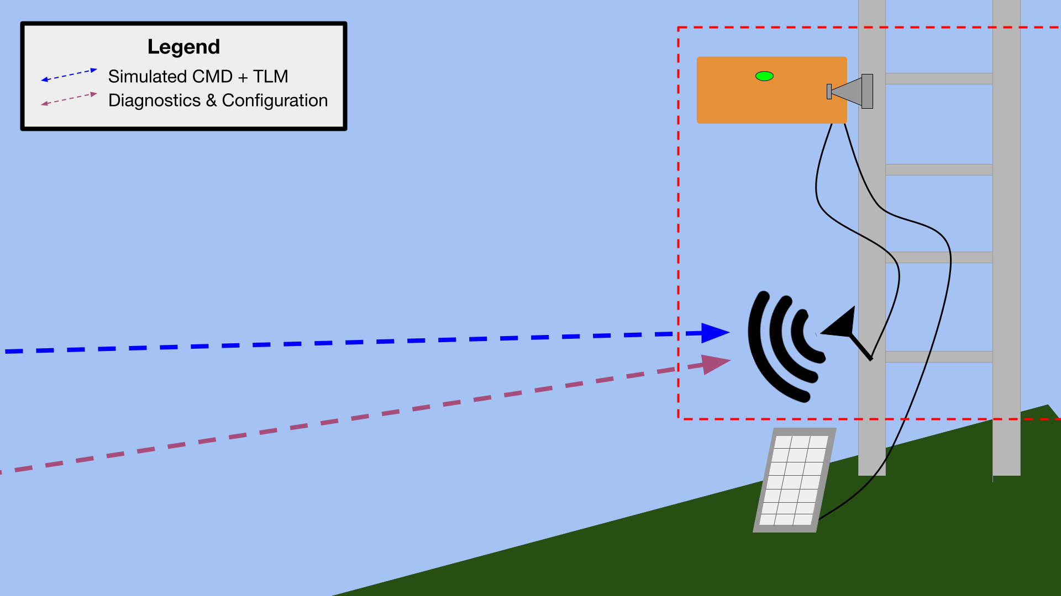
Concept of Operations - Mounting

Slide 8
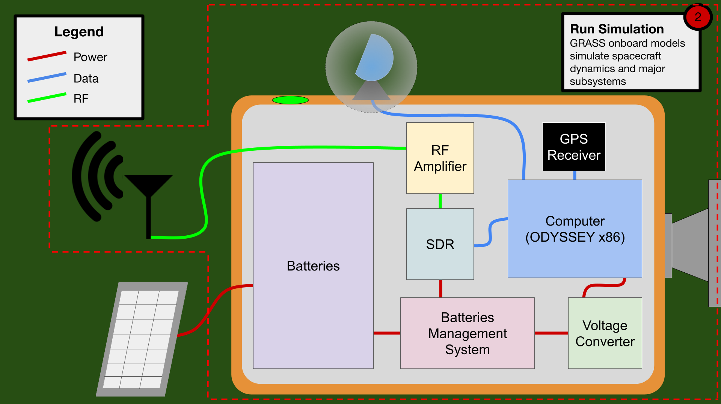
Concept of Operations - Structures

Slide 9
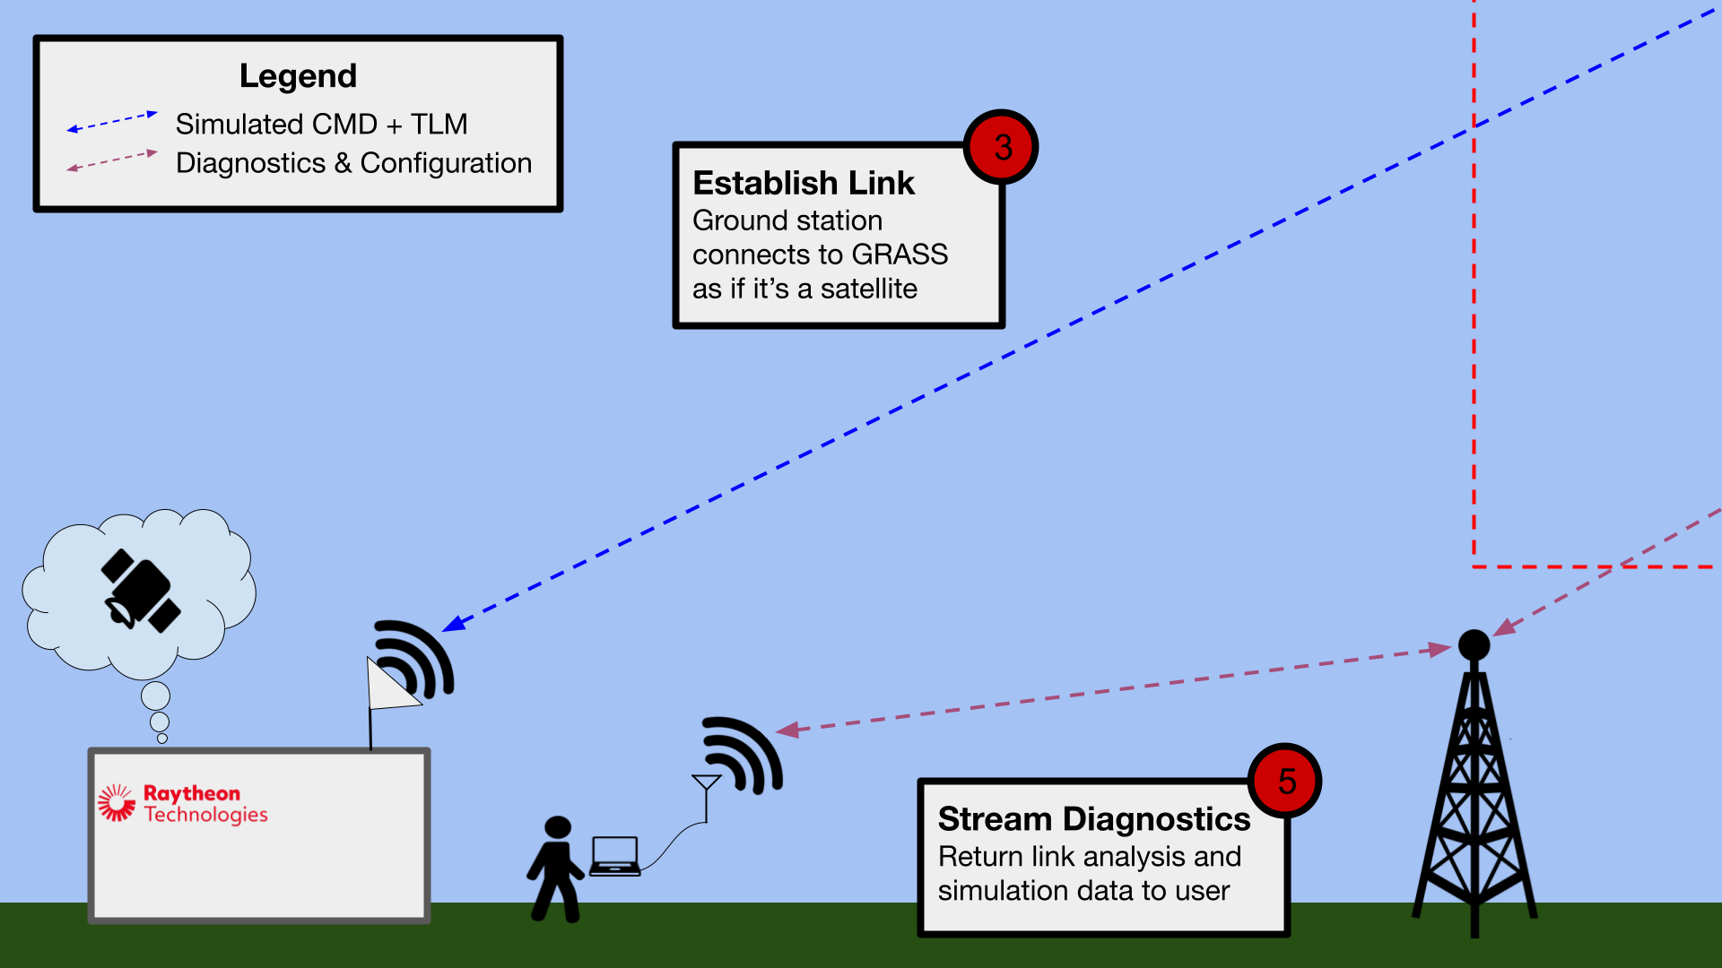
Concept of Operations - Ground Station

Slide 10
Design Solution
Project Overview
Design Solution
CPEs
DRS & Satisfaction
Project Risks
Verification & Validation
Project Planning

Slide 11
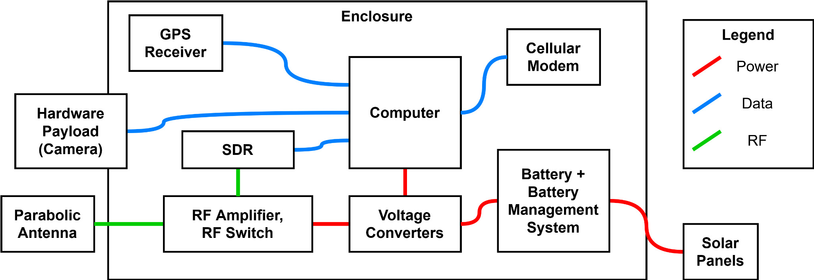
Functional Block Diagram - Electronic Hardware

Slide 12
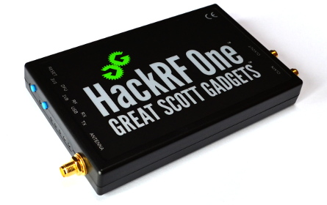
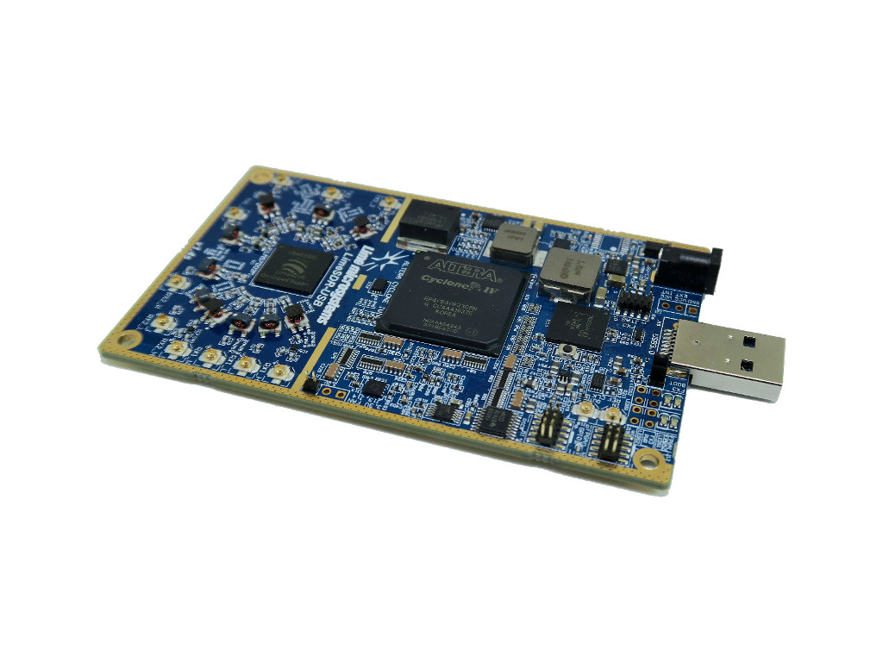
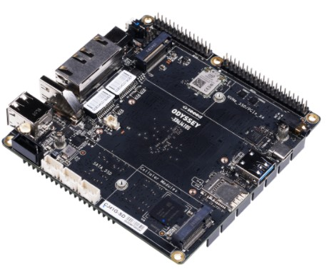
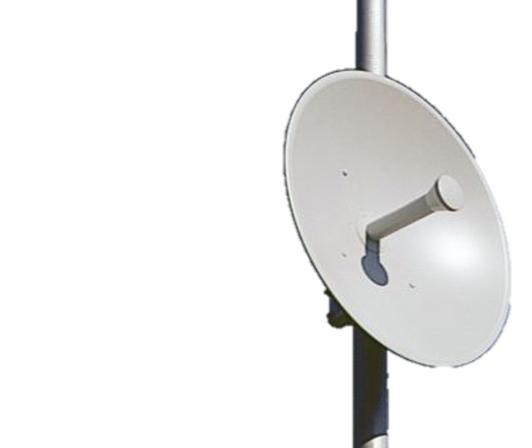
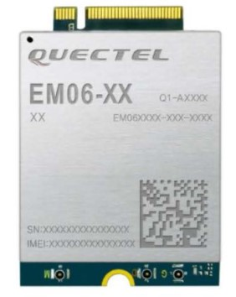
Electronic Hardware Solution
Hardware List | Product Details
Onboard Computer | ODYSSEY X86J4105800
Software Defined Radio | LimeSDR (GRASS) HackRF One (Demo Ground Station)
Antenna | 2m Parabolic Dish (SPID RAS Rotator)
Cellular Modem | Quectel EM06-A LTE Cat 6 M.2 Module
Software Defined Radios (SDR)
LimeSDR and HackRF One
ODYSSEY X86J4105800
Parabolic Dish
Quectel EM06-A LTE Cat 6 M.2 Module

Slide 13
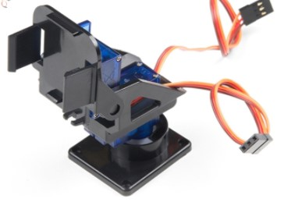
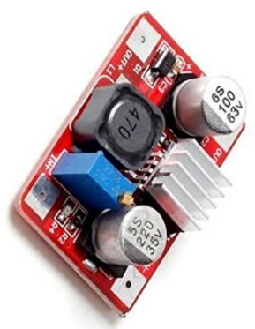
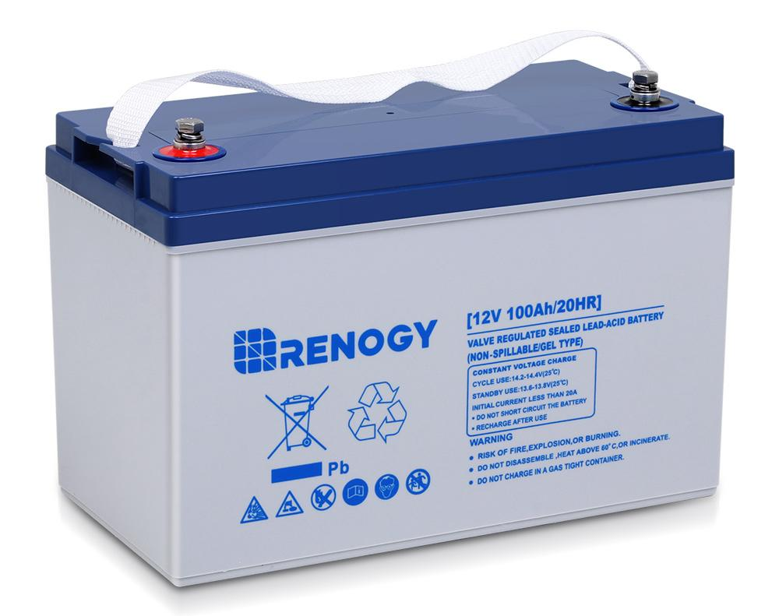
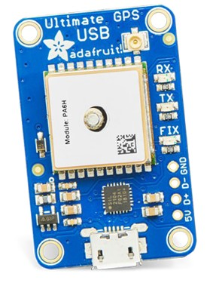
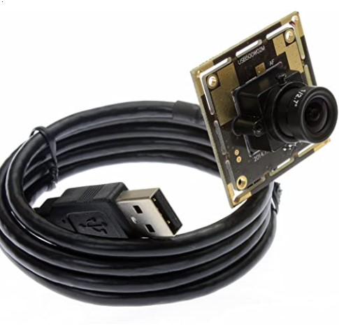
Electronic Hardware Solution
Hardware List | Product Details
Voltage Converter | LM2577 Boost Converter
GPS Sensor | Adafruit Ultimate GPS
Camera | Small USB webcam
Pan Tilt Actuator | Sparkfun Electronics ROB - 14391
Battery | Renogy 12V 100Ah gel battery
Sparkfun Electronics ROB - 14391
LM2577 Boost Converter
Renogy 12V 100Ah Battery
Adafruit Ultimate GPS
Small USB Webcam

Slide 14
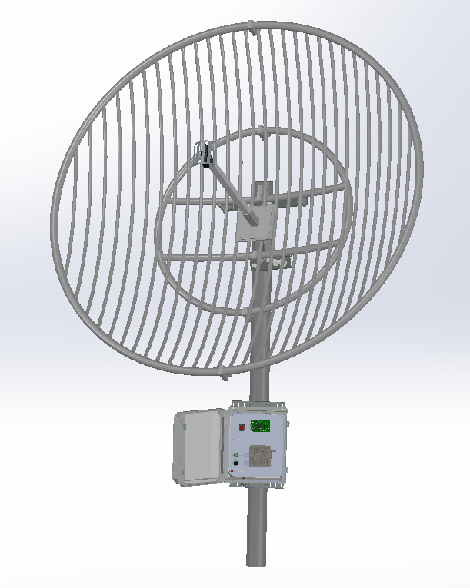
Structural Hardware Solution
Heated and insulated enclosure to hold all electronics except antenna and external power source
Two Design Solutions:
Battery Power - no grid access so enclosure must fit a battery
Grid Power - no battery included inside the box
Both designs have a heater and insulation, and no active cooling
3D-printed custom electronics mounts
All other components off-the-shelf
2 m
0.35 m
0.1 m

Slide 15
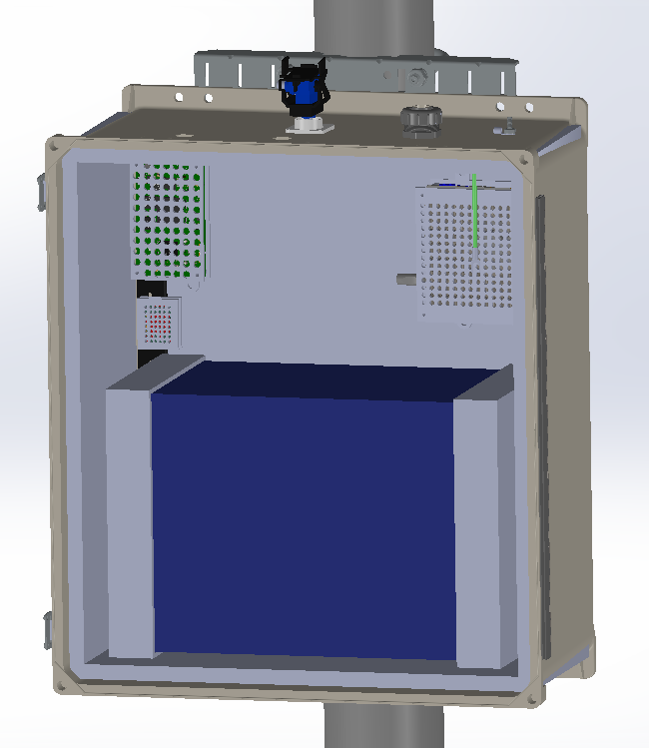
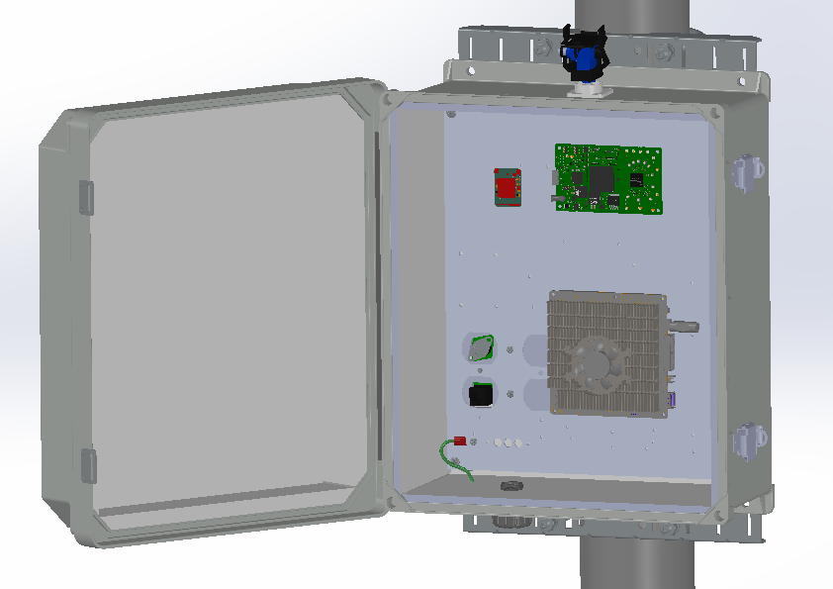
Enclosure CAD Models - Design Options
Battery Power
Grid Power
Battery inside box
Larger enclosure
No battery
Smaller enclosure
0.23 m
0.46 m
0.35 m
0.38 m
0.1 m

Slide 16
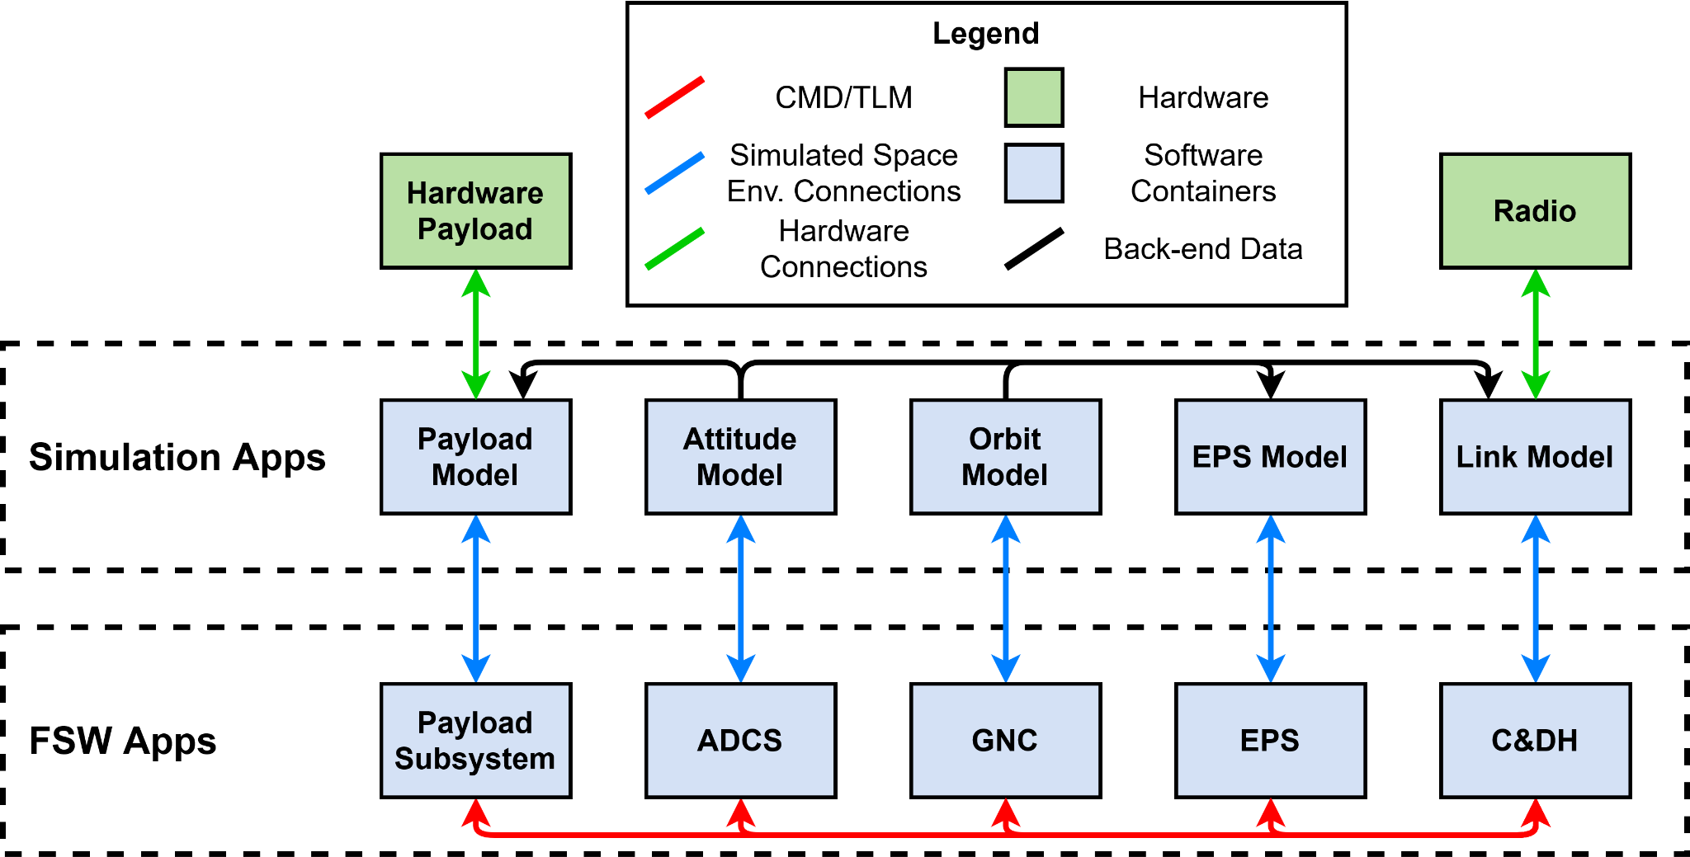
Functional Block Diagram - Software

Slide 17






Simulation and Software Solution
Software List | Product Name | Relevant Specifications
Simulation Applications | Systems Tool Kit (STK) Components 42 Spacecraft Simulator | .NET 2021r3 Latest Version
Flight Software Applications | KubOS 42 Spacecraft Simulator | V 1.21.0 Latest Version
C&DH | KubOS 42 Spacecraft Simulator Custom Code | V 1.21.0 Latest Version Written in Python
Containerization | Docker | Latest version
Ground Station | COSMOS | V 4.5.1
Python
Systems Tool Kit (STK)
42
KubOS
Docker
COSMOS

Slide 18
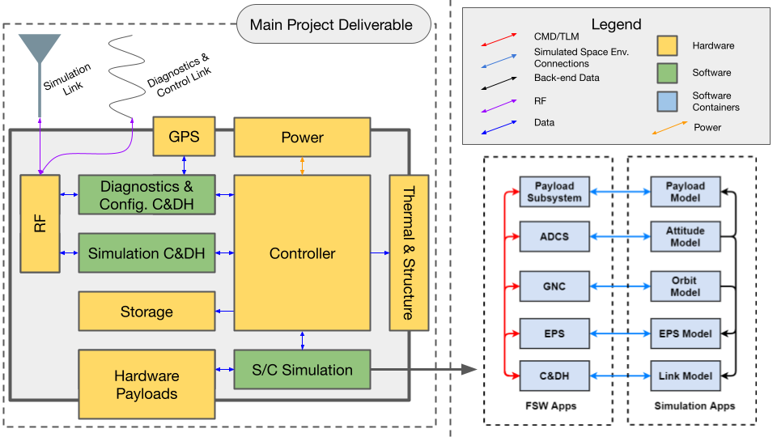
Functional Block Diagram - Full System
2 Mbps

Slide 19
Critical
Project Elements
Project Overview
Design Solution
CPEs
DRS & Satisfaction
Project Risks
Verification & Validation
Project Planning

Slide 20
Critical Project Elements (CPE)
ID | Summary | Motivation | FR
E1 | Housing Unit and Mounting | A robust housing and mounting solution are necessary to protect the hardware when deployed. | FR1
E2 | Power and Electronics | Self-sufficiency requires robust and self-powered components. | FR1, FR2
E3 | RF Link | The link over which a ground station can connect to GRASS is the primary mode of use. | FR3
E4 | Software & Satellite Simulation | GRASS must emulate real satellite behavior, so robust and accurate software models are necessary. | FR2, FR4
E5 | Demo Ground Station | While GRASS will be communicating with Raytheon ground station in operations, a test ground station is necessary for project V&V. | FR5

Slide 21
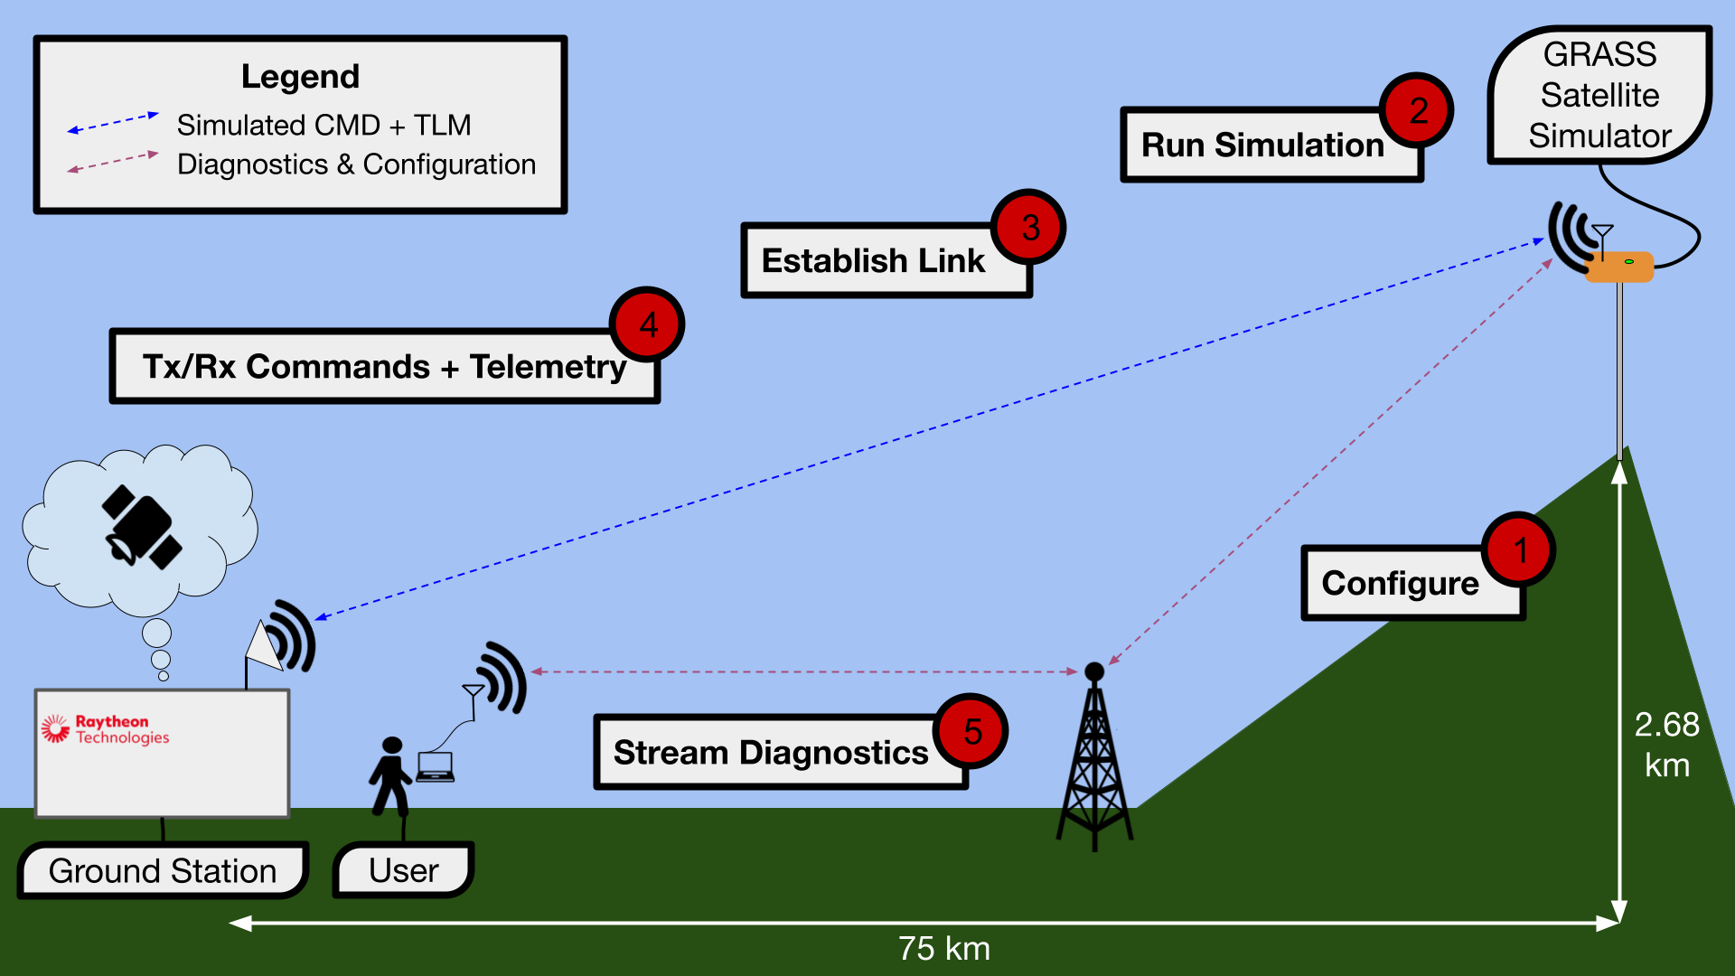
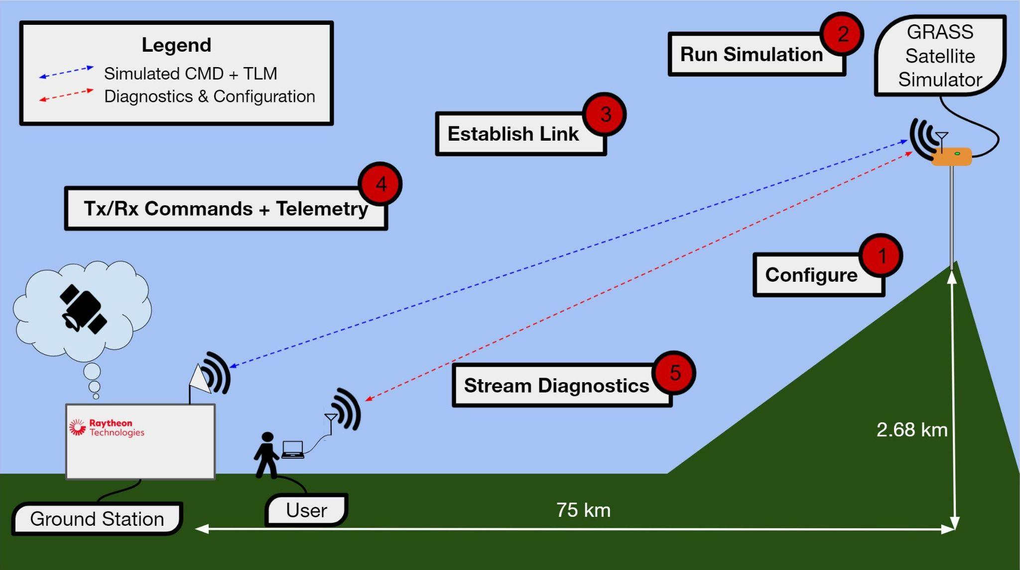
Critical Project Elements 3
RF Link:
The link over which a ground station can connect to GRASS is the primary mode of use.

Slide 22
Critical Project Elements 4
Software & Satellite Simulation:
GRASS must emulate real satellite behavior, so robust and accurate software models are necessary.

Slide 23
Design Requirements &
Satisfaction
Project Overview
Design Solution
CPEs
DRS & Satisfaction
Project Risks
Verification & Validation
Project Planning

Slide 24
Key Functional Requirements
Critical Project Elements
Functional Requirements
Simulator Housing Unit
Endurance
Power & Electronics
Software Components
FR2
RF Link
Communication
FR3
Software & Simulation
Modularity & Extensibility
FR4
Demo Ground Station
Operation

Slide 25
High-Level Functional Requirements (FR)
ID | Summary | CPE | Satisfied?
FR1 | Endurance - self-sustainably survive | E1, E2 | ❔
FR2 | Software Components - spacecraft software simulations and other software | E2, E4 | ❔
FR3 | Communication - capable of establishing communications links | E3 | ❔
FR4 | Modularity & Extensibility - modular and extensible software | E4 | ❔
FR5 | Operation - well-documented user interface | E5 | ❔

Slide 26
Software Block Diagram

Slide 27
Software Components (FR2)
DR2.1, 2.2, 2.3, 2.4, 2.5 - Simulation is capable of simulating an ADCS, GNC, EPS, Link Model, and mock payload subsystems.
Subsystem | Solution
ADCS (Attitude, Determination, and Control Subsystem)
GNC (Guidance, Navigation, and Control Subsystem)
EPS (Environment and Power Subsystem)
Link Model
Mock Payload
Subsystems must:
Operate realistic models for ground station
Be able to be commanded
Send telemetry in response to Status of Health command (SoH)
Store telemetry points in a log file
ADCS/GNC:
Be adjustable over secondary communication
STK
KubOS
STK
KubOS
Python
STK
Python
KubOS
Python

Slide 28
Software Components (FR2)
DR2.1, 2.2, 2.3, 2.4, 2.5 - Simulation is capable of simulating an ADCS, GNC, EPS, Link Model, and mock payload subsystems.
Subsystems must:
Operate realistic models for ground station
Be able to be commanded
Send telemetry in response to Status of Health command (SoH)
Store telemetry points in a log file
ADCS/GNC:
Be adjustable over secondary communication
Criteria | Solution
Telemetry SoH | “Healthy” or “unhealthy” status report
Commandability | C&DH Message Broker
Telemetry Logging | Python Docker Compose
ADCS/GNC | C&DH/ Configurable parameter files

Slide 29
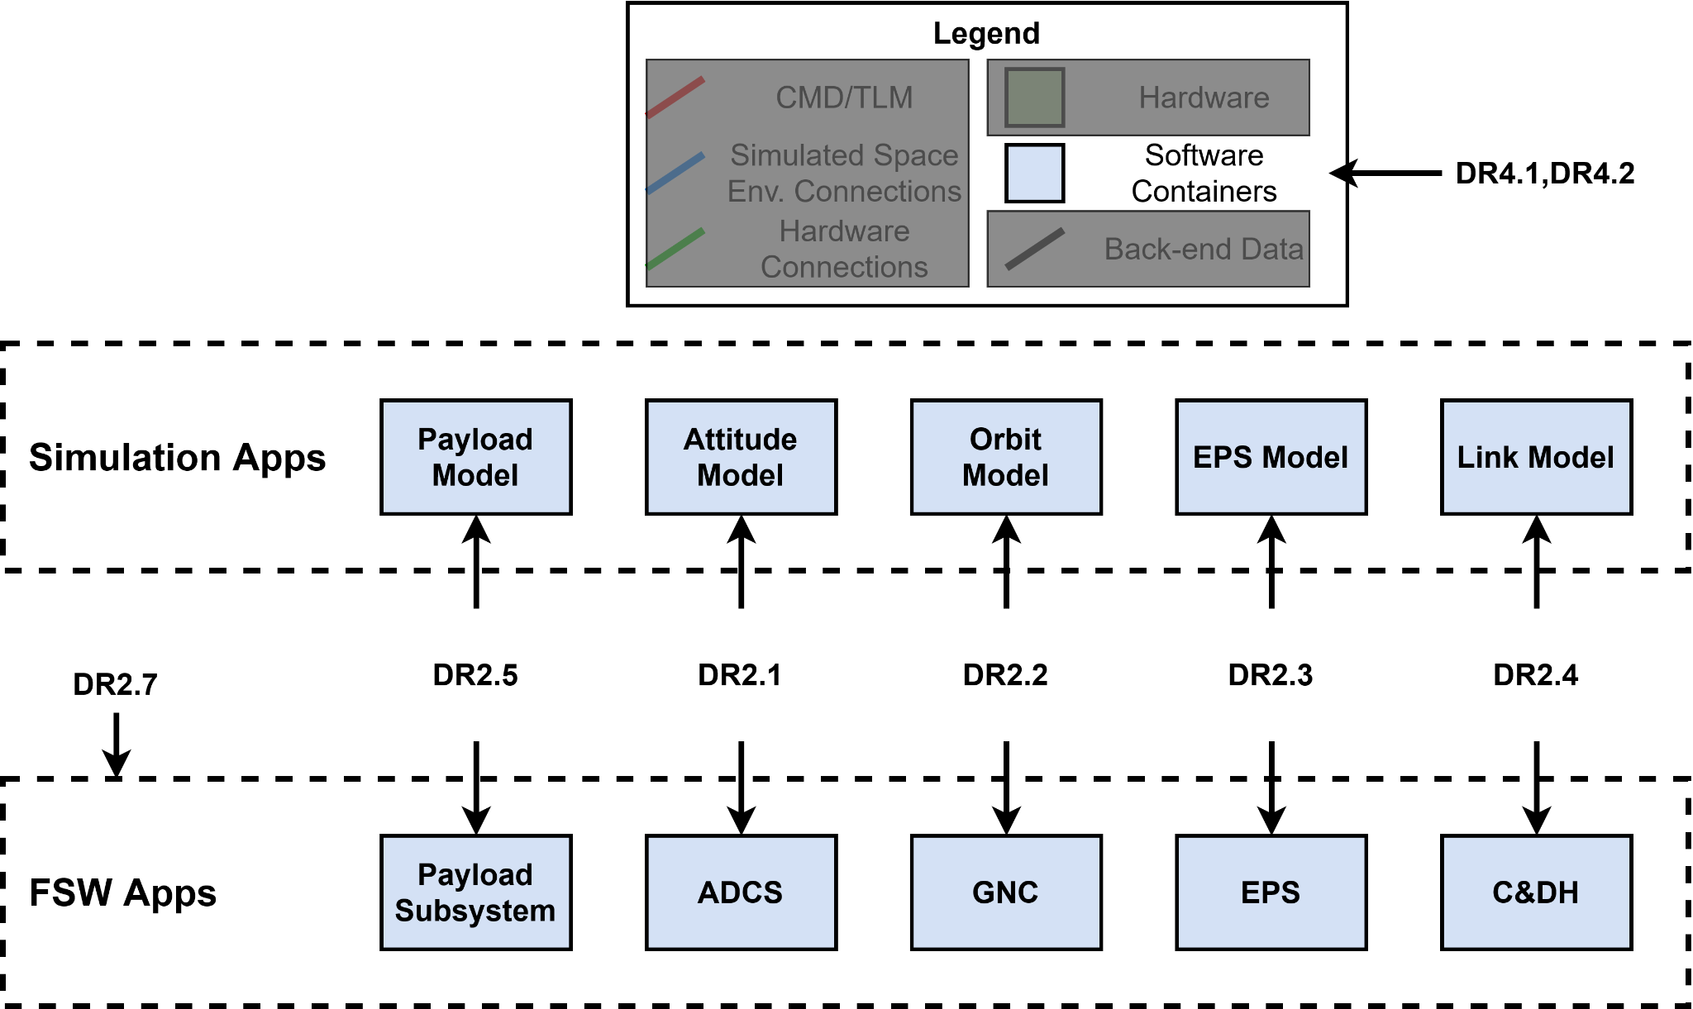
Software Block Diagram: Design Requirements
42
KubOS
STK Components
Custom Code
Docker

Slide 30

Communication (FR3)
DR3.1 - GRASS shall have a dedicated RF link able to send and receive simulated spacecraft communications over a half duplex radio link.
Key driving requirements:
Have a link margin of 10 dB
Transmit data at a rate of 2 Mbps (Minimal viable product rate of 9600 bps)
Communicate over a 75 km range
Link budget was developed as a model to approximate link characteristics

Slide 31
Link Budget Review
Link budget sums together station properties (antenna gain, radio output power, etc.) and losses (free space, cable, pointing, etc.) in the decibel scale to compute received power
Decibel scale converts equation into a linear sum of terms
The radio equation is given below where P is power, G is gain, and L is losses
Many quantities, namely gain and losses, are geometry or material dependent and so they can be held constant
Transmit power is controllable and L_{path} is a function of distance [d] so
P_{recieved} = EIRP + G_{received} - L_{sum}

Slide 32
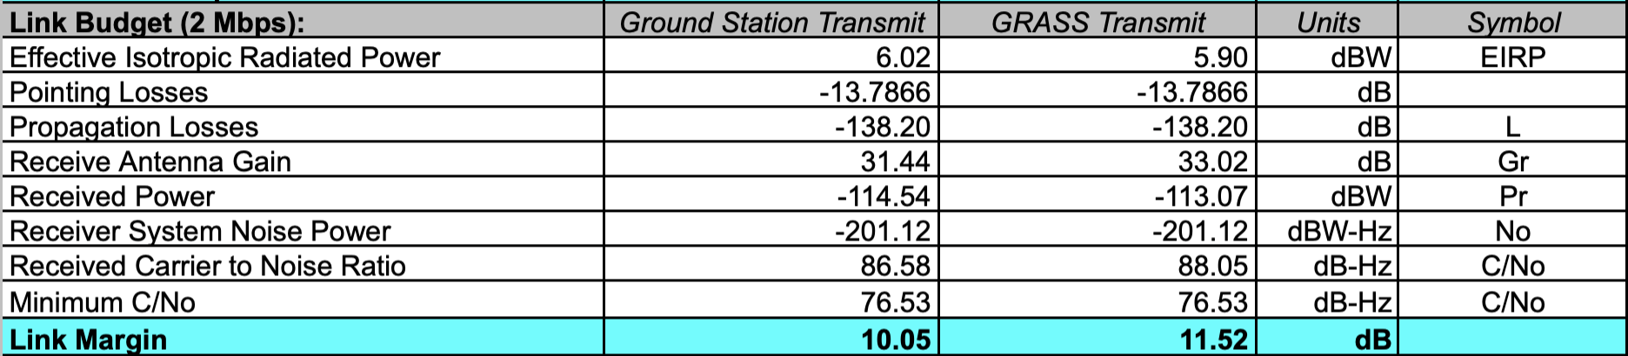
Updated Link Budget - 2 Mbps
Updated to include pointing losses, more accurate line losses, and numbers relating to chosen SDR’s and known antennas (2m dish at GRASS, 2.4m dish at Raytheon)

Slide 33
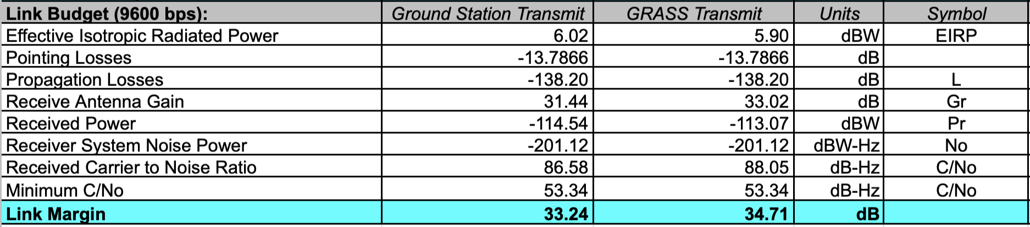
Updated Link Budget - 9600 bps
Updated to include pointing losses, more accurate line losses, and numbers relating to chosen SDR’s and known antennas (2m dish at GRASS, 2.4m dish at Raytheon)
Requirement: 10 dB
Margin: 23.24 dB
> 100x greater than requirements

Slide 34
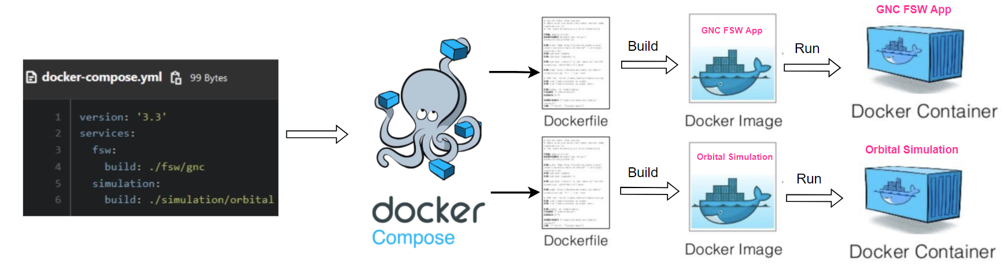
Modularity & Extensibility (FR4)
DR4.1 - GRASS’ subsystems shall be composable using containers.
What has been done: Proof of Concept Container Integration
In other words: prove that the containers can communicate
Communication Protocols
Publish/Subscribe
Sending and receiving data in each container
Defining Data Flow
What data will be sent or received by subsystems
Container and COSMOS
Determined format of commands and telemetry being sent
Communication protocol is determined feasible
Container Orchestration
Docker Compose
Passed data between two containers
Conditionals executed from this data

Slide 35
High-Level Functional Requirements (FR)
ID | Summary | CPE | Satisfied?
FR1 | Endurance - self-sustainably survive | E1, E2 | ✅ (in backup slides)
FR2 | Software Components - spacecraft software simulations and other software | E2, E4 | ✅
FR3 | Communication - capable of establishing communications links | E3 | ✅
FR4 | Modularity & Extensibility - modular and extensible software | E4 | ✅
FR5 | Operation - well-documented user interface | E5 | ✅ (in backup slides)

Slide 36
Project Risks
Project Overview
Design Solution
CPEs
DRS & Satisfaction
Project Risks
Verification & Validation
Project Planning

Slide 37
Risk Table
# | Risk | Description | Effect
1 | Scope | Overcomplicated Scope for Given Time (Development) | Poorly Designed or Unfinished Product Safety Concerns
2 | Budget | Exceed Allotted $5000 Budget (Finance) | Delivery of Unfinished Product
3 | Reliable RF Link | Interference, multipath, etc. are very difficult to model (Environment, Hardware) | Long Development Time Delivery of Unfinished Product
4 | Test Facility Access | Access to a facility with line-of-sight to Raytheon's campus isn't guaranteed (Testing) | Delay in Schedule Incomplete Testing
5 | Hardware Failure | Sensitive electronics are critical to characterize and verify the design (Structures, Electronics, RF, Finance) | Functional Failure Safety Concerns
6 | Supply Chain | The chip shortage makes the necessary electronics difficult to source (Manufacturing) | Delay in Schedule Delivery of Unfinished Product

Slide 38
Pre-Risk Mitigation Matrix
 | Impact
 |  | Minimal | Minor | Major | Hazardous | Catastrophic
 | Certain |  |  |  | 2
 | Likely |  |  | 6 |  | 1
 | Possible |  |  |  | 4, 5 | 3
 | Improbable
 | Extremely Improbable
# | Risk
1 | Scope
2 | Budget
3 | RF Link
4 | Test Facility Access
5 | Hardware Failure
6 | Supply Chain
Likelihood

Slide 39
Risk Mitigation - Reducing Scope
Previous Scope
Considerations
Revised Scope
Outdoor Enclosure
What’s novel about the project?
Outdoor Enclosure
Off-Grid Power System
Off-Grid Power System
What is the customer really looking for?
Full-Duplex RF Link
Half-Duplex RF Link
Long-Duration Test for L1 Level of Success
Decoupled Tests for L1 Level of Success
What’s necessary to validate?
Modular Software
Modular Software

Slide 40
Risk Mitigation
# | Risk
1 | Scope
2 | Budget
3 | RF Link
4 | Test Facility Access
5 | Hardware Failure
6 | Supply Chain
 | Impact
 |  | Minimal | Minor | Major | Hazardous | Catastrophic
 | Certain |  |  |  | 2
 | Likely |  |  | 6 |  | 1
 | Possible |  |  | 3 | 4, 5 | 3
 | Improbable |  |  | 1
 | Extremely Improbable |  |  |  | 2
# | Mitigation
1 | De-Scope Project
2 | Reduce Deliverables, Borrow Hardware
3 | Revise Requirements, Increased Transmit Power, Margin for Testing
Likelihood

Slide 41
Risk Mitigation
# | Risk
1 | Scope
2 | Budget
3 | RF Link
4 | Test Facility Access
5 | Hardware Failure
6 | Supply Chain
 | Impact
 |  | Minimal | Minor | Major | Hazardous | Catastrophic
 | Certain |  |  |  | 2
 | Likely | 6 |  | 6 |  | 1
 | Possible |  | 4 | 3 | 4, 5 | 3
 | Improbable |  |  | 1, 5
 | Extremely Improbable |  |  |  | 2
# | Mitigation
4 | Revise Test Plan to Not Rely on Field Testing
5 | Manufacturing and Testing Margin
6 | Order Products Early
Likelihood

Slide 42
Post-Risk Mitigation Matrix
# | Risk
1 | Scope
2 | Budget
3 | RF Link
4 | Test Facility Access
5 | Hardware Failure
6 | Supply Chain
 | Impact
 |  | Minimal | Minor | Major | Hazardous | Catastrophic
 | Certain |  |  |  | 2
 | Likely | 6 |  | 6 |  | 1
 | Possible |  | 4 | 3 | 4, 5 | 3
 | Improbable |  |  | 1, 5
 | Extremely Improbable |  |  |  | 2
# | Mitigation
1 | De-Scope Project
2 | Reduce Deliverables, Borrow H/W
3 | Req.’s, Tx. Power, Testing
4 | Revise Test Plan
5 | Manufacturing and Testing Margin
6 | Order Products Early
Likelihood

Slide 43
Verification
and
Validation
Project Overview
Design Solution
CPEs
DRS & Satisfaction
Project Risks
Verification & Validation
Project Planning

Slide 44
Introduction to Characterization Testing
Models are used to design & verify major project components
To verify against predictive models, designs must be characterized in the metrics the which models output
System Validation
Squaw Mountain Field Test
System Verification
Integrated Systems Test - Lab
Subsystem Verification
Software Integration Tests
Electronics Integration Tests
Ground Station Integration Tests
Assembly Fit Checks
Unit Testing and Component Characterization
Individual Container Tests
Hardware Fit Checks
RF Characterization
RF Characterization
Thermal Characterization
Thermal Characterization
Electronics Characterization
Electronics Characterization

Slide 45
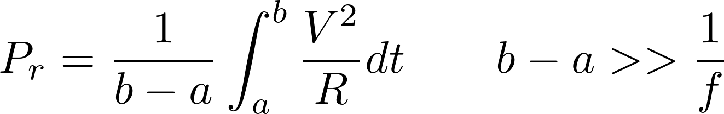
RF Testing - General Test Setup
Test Setup
Two SDRs connected to computers passing data
Allows for configuration of SDRs
Recording incoming received data
Variables are:
The medium between the radios (cables, antennas, atmosphere)
Transmitted Power
Measurements
Integrate receiving SDR voltage over time
Use Ohm’s law with known input impedance (50 Ω) to calculate average received power:

Slide 46
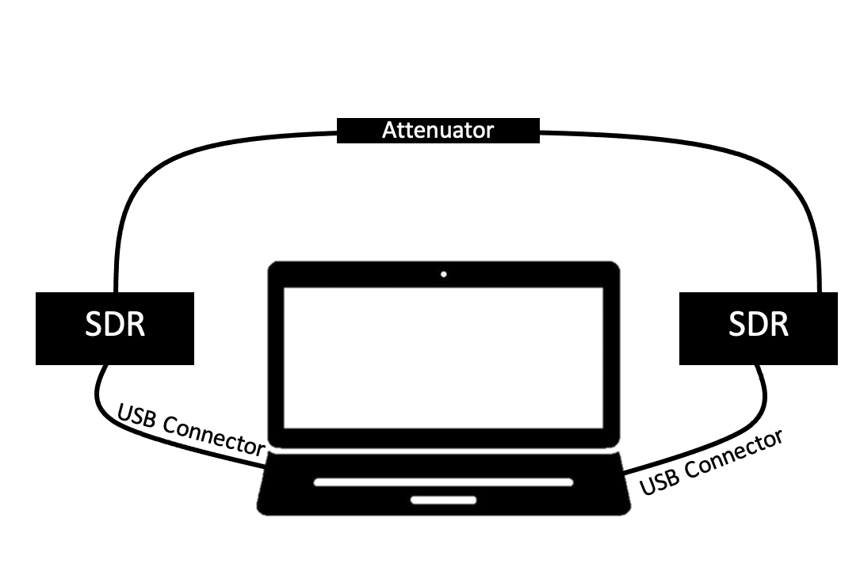
RF Testing - Wired Test Setup
Begin with wired testing in order to verify and characterize transmit power
1 mW max for LimeSDR
20 mW max for HackRF One
Connect receive and transport ports with an attenuator between them
Attenuator protects receive port
Transmit power can be computed as the sum of the received power, cable losses, and attenuator value
P_{tr} = P_{r} + G_{attenuator} + L_{cable}

Slide 47
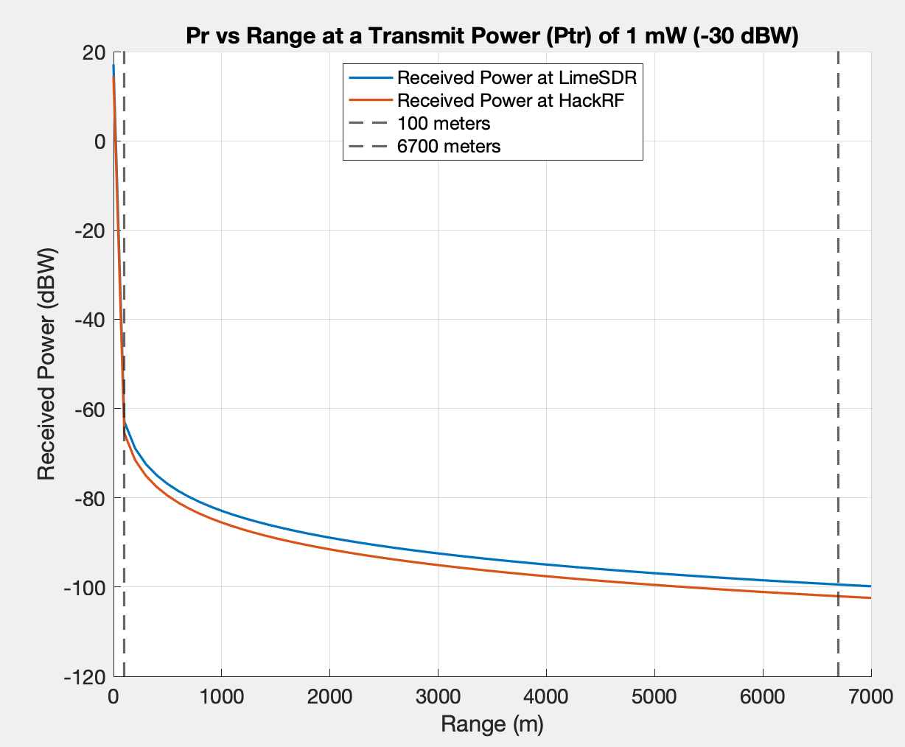
RF Wireless Testing
Connect antennas and computers to SDRs
2 meter parabolic dish to LimeSDR
15 dB testing Yagi antenna to HackRF One
Transmit from one system to the other, computing received power as transmit power is increased
Repeat process swapping the role of the systems
Introduce two ranged tests in this presentation
100 meters for short range
6700 meters for long range

Slide 48
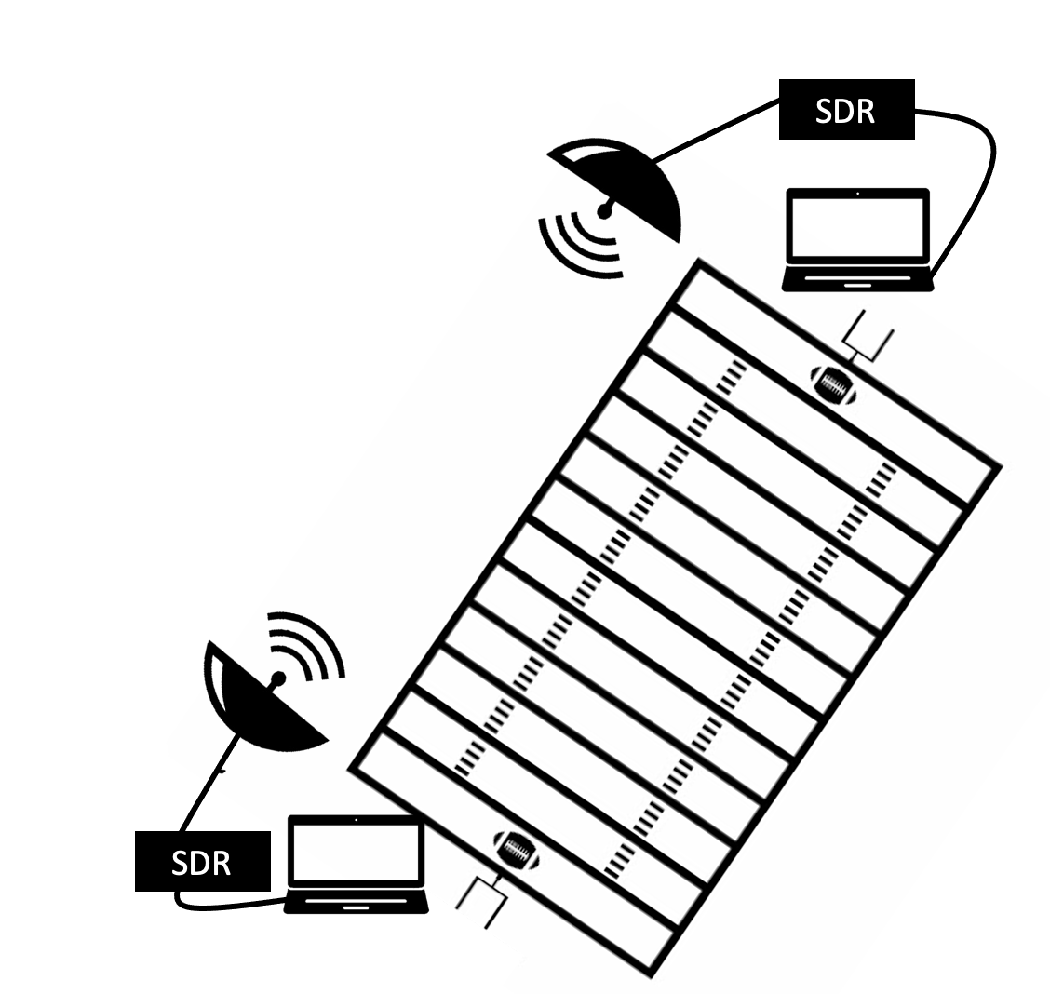
Short Range Testing Setup
With verified transmit power
100 meter line of sight transmission
Compare received power to expected values derived from link budget
100 m

Slide 49
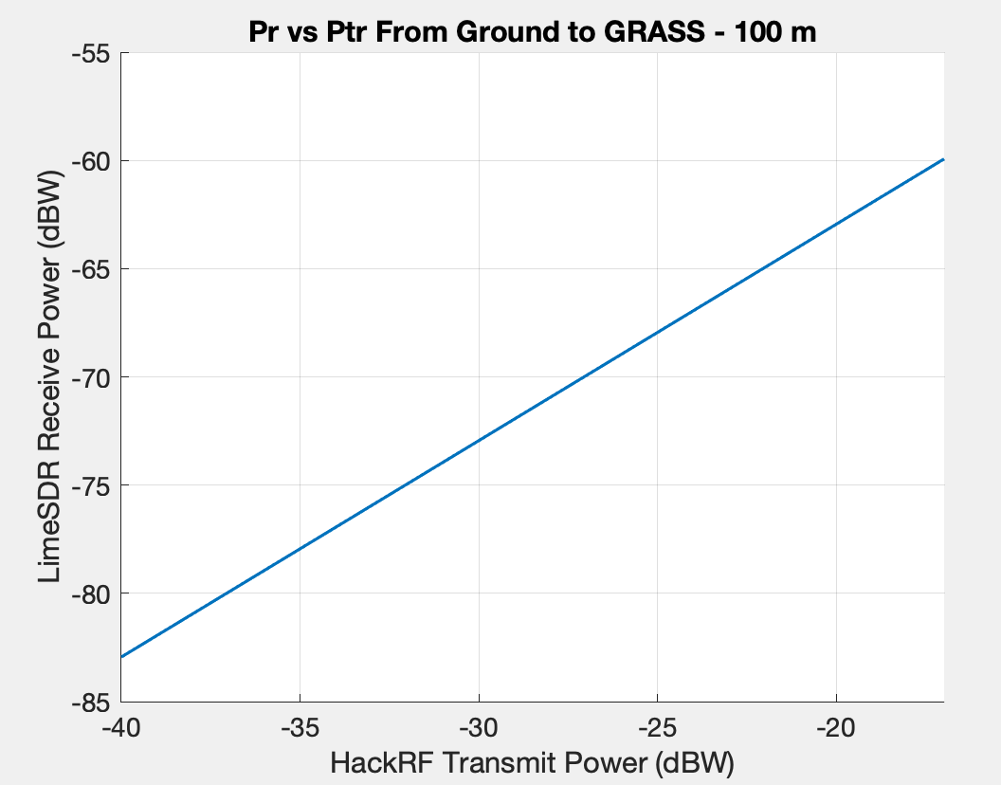
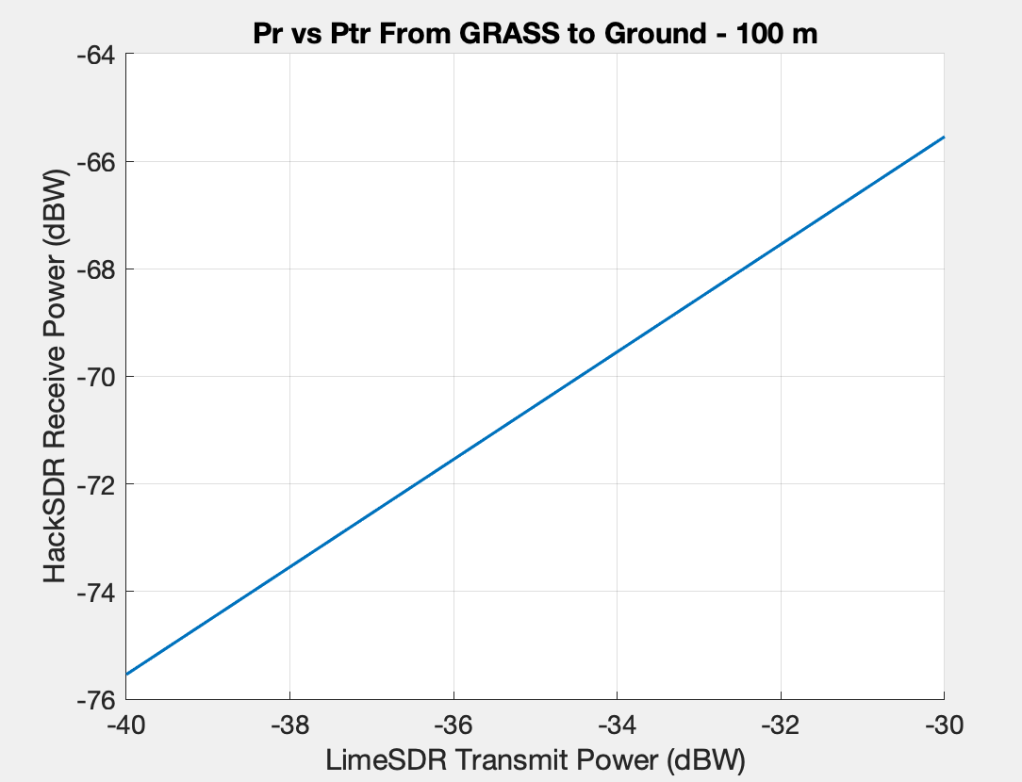
Short Range Test - Characterization
Expected received power (Pr) in dBW based on link budget vs transmit power (Ptr)

Slide 50
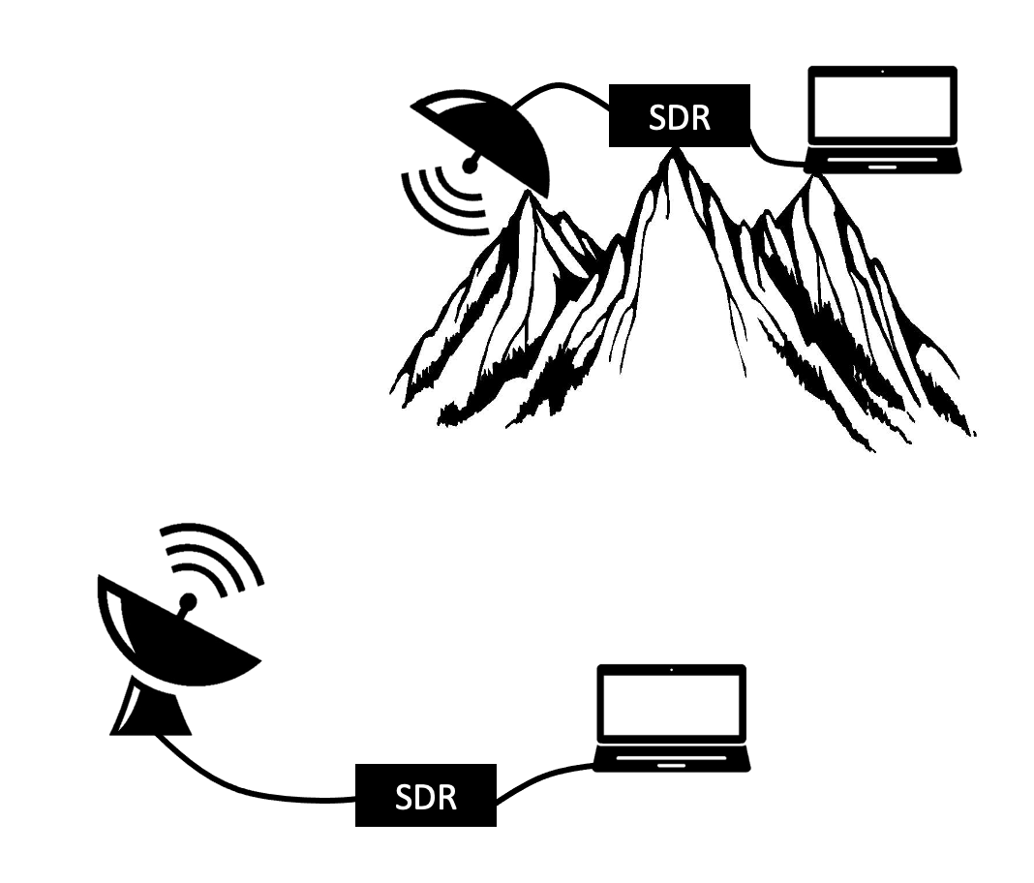
Long Range Testing Setup
Short Range Testing Setup
Move into long range testing using wireless test setup
6700 meter line of sight transmission from Flagstaff to Aerospace building
Compare estimated received power to expected received power from link budget
6700 m

Slide 51
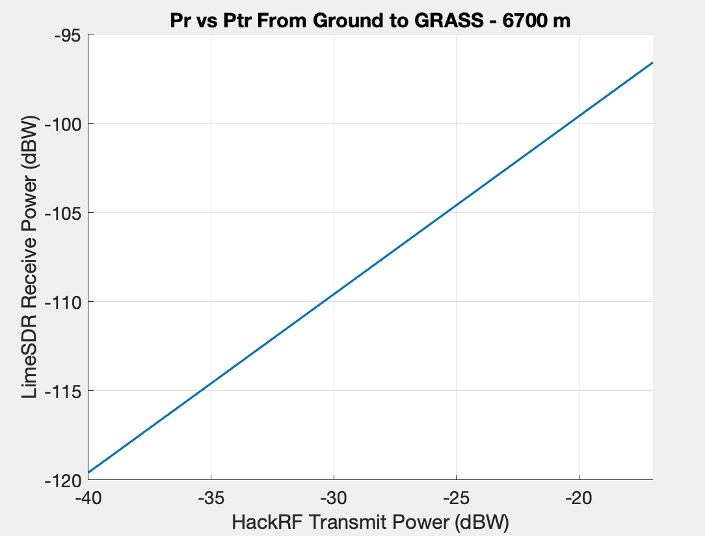
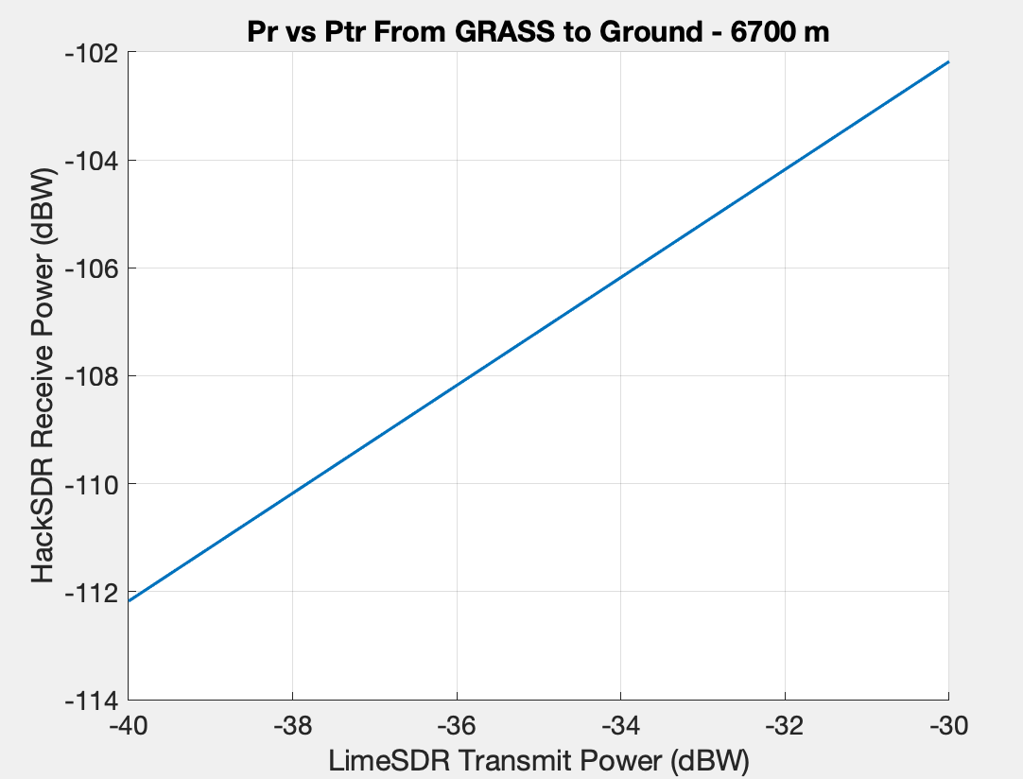
Long Range Test - Characterization
Expected received power (Pr) in dBW based on link budget vs transmit power (Ptr)

Slide 52
Thermal Model: MATLAB 3D Steady State
Driving Requirements: The box must be able to operate within expected environmental temperatures (per FR1.1 and DR1.1.2)
MATLAB Model (3D Steady-State)
Outputs: the Watts of heat produced given the surface temperature of the box
Accounts for: conduction, convection, ambient and solar radiation, altitude, etc.
Extreme Conditions: [-20,30]°C, 30mph (48.3 km/h) winds
Expected Conditions: [-10,15]°C, 15mph (24.1km/h) winds
Required Internal Conditions: must be within [0,45]°C
Conclusion:
Extreme Conditions: ~35 W of heating and ~35 W of cooling required
Testing Conditions: ~20 W of heating and no cooling required
MATLAB model closely matched previous SolidWorks thermal fluid simulations
Link to model details

Slide 53
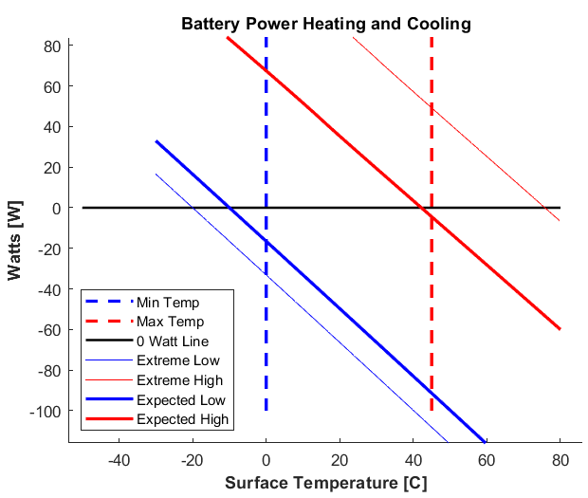
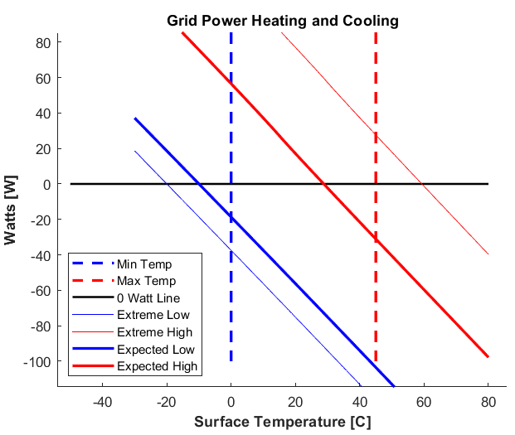
Thermal Model Plots
Expected Enclosure Temperature vs. Heat Flux

Slide 54
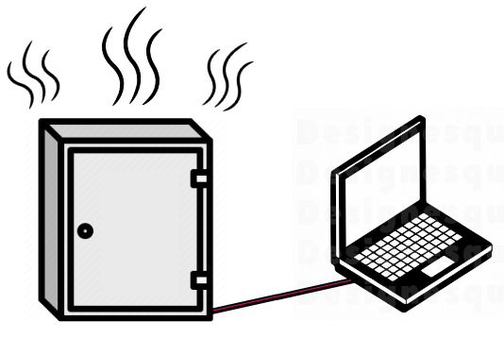
Thermal Characterization Tests
Heater and thermal system characterization testing
Heater Lab Characterization Test
Compare models with varying heat produced in a controlled environment
Heater Outdoor Characterization Test
Compare models with varying external temperatures
Objective: Verify MATLAB thermal models
Heater PID control will use MATLAB models as a baseline for tuning
Improving thermal models based on test data allows for more efficient heater control
Gives confidence that the enclosure can protect components from thermal extremes

Slide 55
Thermal Characterization Test - Controlled Environment
Characterization of thermal system in a controlled environment
Measurements: temperature sensors measure internal and external (room) temperature
Test Setup:
On Board Computer sealed within enclosure to control heater
Bench power source
Procedure: Steadily increase power supplied to heater in increments
Heat produced and steady-state temperatures recorded as primary points of interest
Verification: Compare with expected heat required to maintain steady-state internal temperatures from MATLAB model

Slide 56
Thermal Characterization Test - Outdoors
Characterization of thermal system in an outdoors environment
Measurements: Temperature sensors measure internal and external temperatures
Test Setup:
On Board Computer sealed within enclosure to control heater
Battery or bench power source
PID control to keep enclosure at a steady temperature
Procedure: Run PID-controlled heater through varied external conditions
Control law should maintain internal temperature
Heat required and external temperatures recorded as primary points of interest
Verification: Compare with expected heat required to maintain a steady internal temperature from MATLAB model

Slide 57
Project Planning
Project Overview
Design Solution
CPEs
DRS & Satisfaction
Project Risks
Verification & Validation
Project Planning

Slide 58
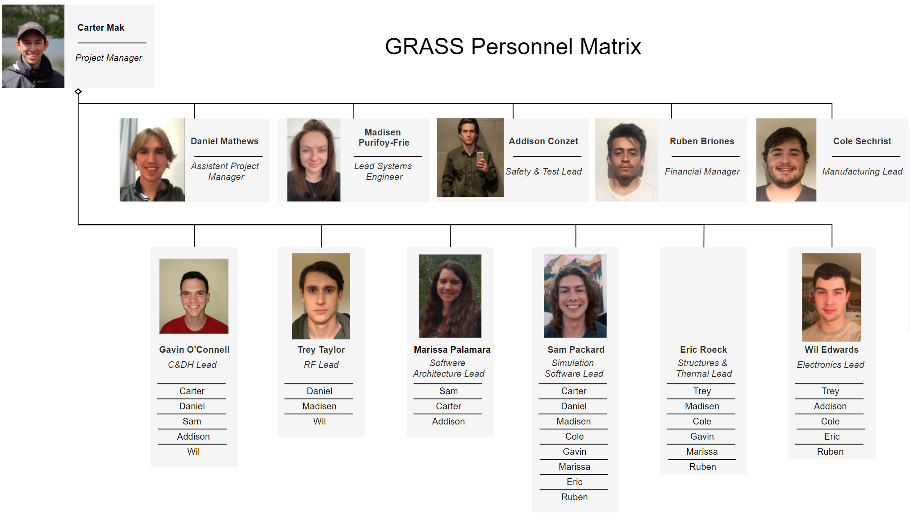
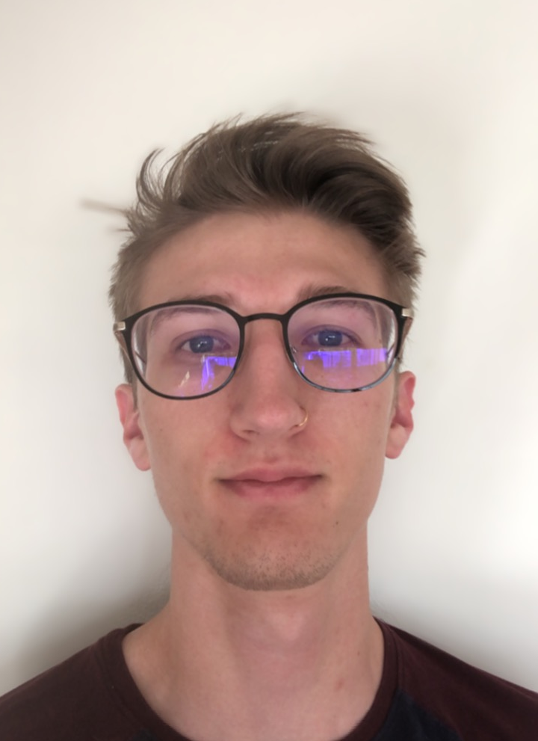
GRASS Personnel Matrix

Slide 59
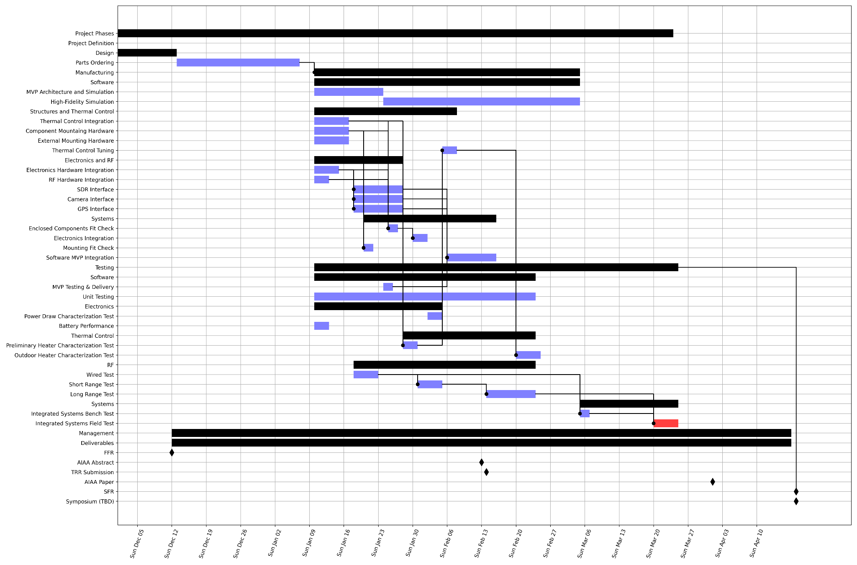
Work Plan: Gantt
Manufacturing
Testing
Now~End of Break
Pre-TRR
TRR~SFR

Slide 60
Work Plan: Gantt
Order Parts Early!
Manufacturing
Testing
Now~End of Break
Pre-TRR
TRR~SFR

Slide 61
Work Plan: Gantt
Deliver Software MVP For Testing
Manufacturing
Testing
Now~End of Break
Pre-TRR
TRR~SFR

Slide 62
Work Plan: Gantt
Subsystem Hardware Integration
Manufacturing
Testing
Now~End of Break
Pre-TRR
TRR~SFR

Slide 63
Work Plan: Gantt
S/W For Hardware Integration,
Hardware Integration and Fit Checks
Manufacturing
Testing
Now~End of Break
Pre-TRR
TRR~SFR

Slide 64
Work Plan: Gantt
Manufacturing
Characterization Testing: Electronics, Thermal, RF
Testing
Now~End of Break
Pre-TRR
TRR~SFR

Slide 65
Work Plan: Gantt
Manufacturing
Systems-Level
Verification and Validation
Testing
Now~End of Break
Pre-TRR
TRR~SFR

Slide 66
Work Plan: Gantt
Manufacturing
Highest-Risk Path:
RF Characterization
Systems Verification
Systems Validation
Testing
Now~End of Break
Pre-TRR
TRR~SFR

Slide 67
Work Plan: Gantt
Manufacturing
Testing
Total ~8 Weeks Margin Before SFR
Now~End of Break
Pre-TRR
TRR~SFR

Slide 68
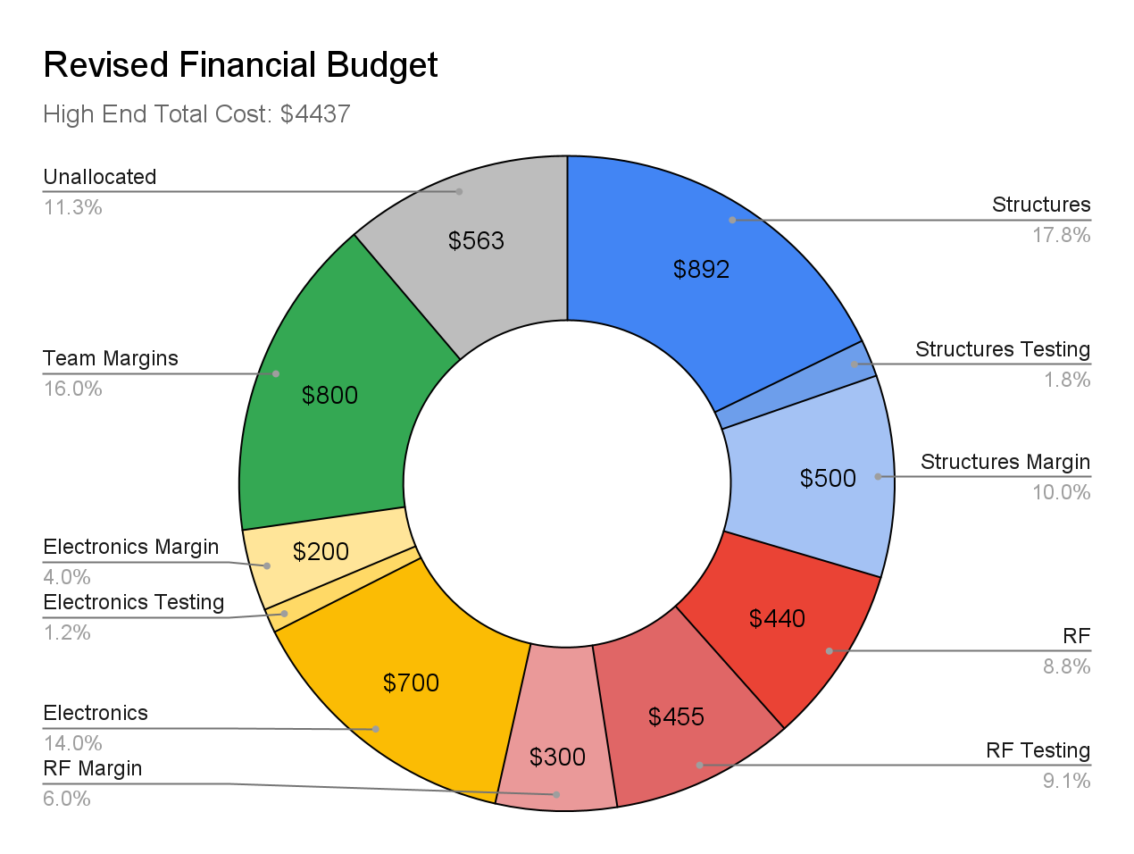
Cost Plan
Highest estimate under $5000
Added increased margin per subteam
Reduced risks by borrowing components/ project descoping
$5000

Slide 69
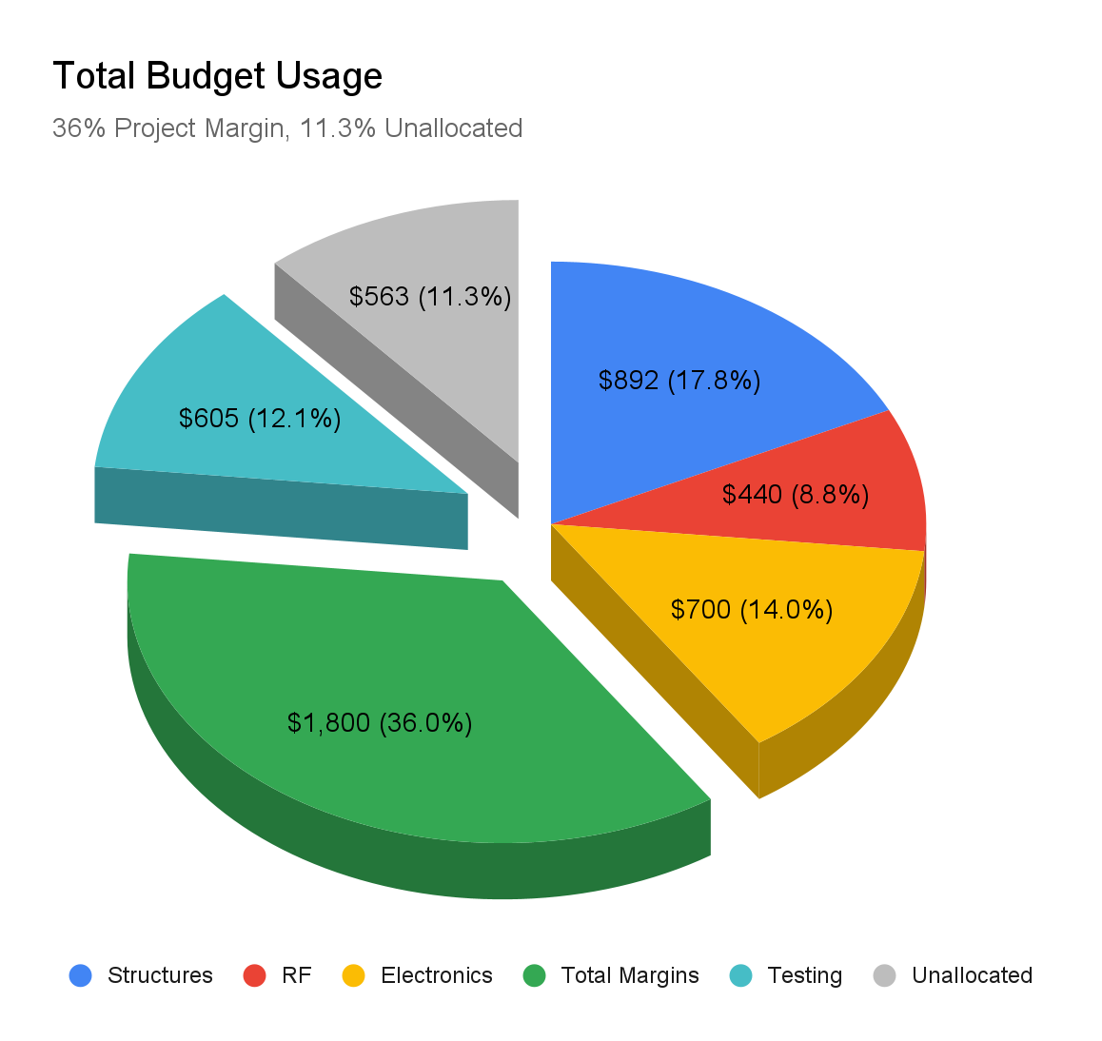
Cost Plan
Borrowing hardware + descoping gives confidence in budget feasibility
36% dedicated to margin across expense categories and whole team
11.3% unallocated margin
Useful because we don’t yet know what test facilities access may require

Slide 70
Test Plan
Low-Level DRs
Unit Testing and Component Characterization
Individual Container Tests
Hardware Fit Checks
RF Characterization
Thermal Characterization
Electronics Characterization

Slide 71
Test Plan
High-Level FRs
Subsystem Verification
Low-Level DRs
Software Integration Tests
Electronics Integration Tests
Ground Station Integration Tests
Assembly Fit Checks
Unit Testing and Component Characterization
Individual Container Tests
Hardware Fit Checks
RF Characterization
Thermal Characterization
Electronics Characterization

Slide 72
Test Plan
System Verification
High-Level FRs
Integrated Systems Test - Lab
Subsystem Verification
Low-Level DRs
Software Integration Tests
Electronics Integration Tests
Ground Station Integration Tests
Assembly Fit Checks
Unit Testing and Component Characterization
Individual Container Tests
Hardware Fit Checks
RF Characterization
Thermal Characterization
Electronics Characterization

Slide 73
Test Plan
System Validation
ConOps, Objectives
Squaw Mountain Field Test
System Verification
High-Level FRs
Integrated Systems Test - Lab
Subsystem Verification
Low-Level DRs
Software Integration Tests
Electronics Integration Tests
Ground Station Integration Tests
Assembly Fit Checks
Unit Testing and Component Characterization
Individual Container Tests
Hardware Fit Checks
RF Characterization
Thermal Characterization
Electronics Characterization

Slide 74
Test Plan
Verification Methods
System Validation
Analysis
ConOps, Objectives
Squaw Mountain Field Test
Demonstration
System Verification
Inspection
High-Level FRs
Integrated Systems Test - Lab
Test
Subsystem Verification
Low-Level DRs
Software Integration Tests
Electronics Integration Tests
Ground Station Integration Tests
Assembly Fit Checks
Unit Testing and Component Characterization
Individual Container Tests
Hardware Fit Checks
RF Characterization
Thermal Characterization
Electronics Characterization

Slide 75
Test Plan: Special Considerations
Test Facility Access
Field testing requires access to a facility with Line-of-Sight access to Raytheon’s Aurora campus
We’re in conversation with the Fire Service to access the Squaw Peak Communications Site
In the event we can’t field test, we can still achieve lower levels of success
Specialized Equipment
Many tests require common lab equipment such as multimeters, bench power supplies, etc.
RF characterization may benefit from advanced test hardware
Field testing may require solutions for power (e.g., generator)

Slide 76
Acknowledgements
Raytheon Team:
Sheldon Clark and Martin Wilson
Ann & H.J. Smead Department of Aerospace Engineering Sciences:
Prof. Jade Morton, Steve Taylor, and Harrison Bourne
PAB Members
Trudy Schwartz, Bobby Hodgkinson, Nicholas Rainville,
Chris Roseman, and Prof. Xinlin Li
CDR Reviewers:
Prof. Jade Morton and Colin Claytor

Slide 77
Questions?

Slide 78
Backup Slides

Slide 79
Table of Contents
Design Solution
Hardware
Full System - Key Characteristics
Critical Project Elements
Housing Unit and Mountain (CPE1)
Power and Electronics (CPE2)
RF Link (CPE3)
Ground Station (CPE5)
Design Requirements Satisfaction
High-Level Functional Requirements (FR)
Endurance (FR1)
Simulation (FR2)
Communication (FR3)
Modularity & Extensibility (FR4)
Operation (FR5)
V&V
Electronics - Power
Electronics - Battery
Simulation & Software
MATLAB Thermal Model
Testing Plans
Simulation & Software
Electronics
C&DH
Structures & Thermal
RF
Integration Tests
Manufacturing
Risks & Mitigation
RF
V&V/Test Plan
Software
Project Planning
Structures Cost Breakdown
RF Cost Breakdown
Electronics Cost Breakdown
Major Tests

Slide 80
Backup:
Design Solution

Slide 81
Functional Block Diagram - Hardware

Slide 82
Electronics Hardware Solution
Hardware List | Product Name | Relevant Specifications
Voltage Converter | LM2577 Boost Converter
GPS Sensor | Adafruit Ultimate GPS | 2m accuracy
Camera | Small USB webcam
Pan Tilt Actuator | Sparkfun Electronics ROB - 14391
Battery | Renogy 12V 100Ah gel battery | Battery for Testing
LM2577 Boost Converter
Adafruit Ultimate GPS
Sparkfun Electronics ROB - 14391
Smart USB Webcam

Slide 83
Hardware Solution
Hardware List | Product Name | Relevant Specifications
Onboard Computer | ODYSSEY X86J4105800 | Powerful computer with Arduino capabilities
Software Defined Radio | LimeSDR HackRF One | Lime: - Transmit power: 0.001 and 0.01 mW - Frequency range: 100 kHz - 3.8 GHz HackRF: - Transmit power: 0.001 mW and 0.030 mW - Frequency range: 1 MHz - 6 GHz
Parabolic Dish | - | 2 meter parabolic dish to transmit to ground station (≈ 31 dB)
Cellular Modem | Quectel EM06-A LTE Cat 6 M.2 Module | Compatible with Odyssey x86
ODYSSEY X86J4105800
Quectel EM06-A LTE Cat 6 M.2 Module
Parabolic Dish
Software Defined Radios
LimeSDR and HackRF One

Slide 84
Structures Hardware Solution - Grid Power
Product | Description/Function | Relevant Specifications
L-com Insulated Enclosure | An insulated enclosure with a heater built-in allows us to spend less time building the enclosure | Internal size 14x12x7 inches, foam insulation, 48VDC heater, NEMA 4X rated
Enclosure Pole Mounting Kit | A strong bracket sized for the box will attach the enclosure to the mounting pole | Universal mounting kit for 3-4” diameter poles
Antenna Bracket | A strong bracket to attach the antenna securely to the mounting pole | -

Slide 85
Structures Hardware Solution - Battery Power
Product | Description/Function | Relevant Specifications
Transtector FRP Enclosure | A pre-built enclosure large enough to fit a large battery | Size 18x16x08 inches, IP66 NEMA rated, DIN rail mount
Stego Enclosure Heater | A self-regulating heater as needed to maintain operating temperatures | 50W Heating Capacity, self-regulating
Polystyrene Foam | Insulation as required to put less stress on the heating system | Conductivity k = 0.034
Enclosure Pole Mounting Kit | A strong bracket to attach the box securely to the pole | Universal mounting kit for 3-4” diameter poles
Antenna Bracket | A strong bracket to attach the antenna securely to the pole

Slide 86
Full System - Key Characteristics
Line-of-sight RF system
9600 bps - 2 Mbps
Connects to a real ground station
Full spacecraft simulation
Flight Software
Simulated Space Environment
Integrated Hardware Payload
Hardware solution supports radios and computer

Slide 87
Backup:
Critical
Project
Elements

Slide 88
Critical Project Elements 1
Housing Unit and Mounting:
A robust housing and mounting solution is necessary to protect the hardware when deployed.

Slide 89
Critical Project Elements 1
Housing Unit and Mounting:
A robust housing and mounting solution is necessary to protect the hardware when deployed.

Slide 90
Critical Project Elements 2
Power and Electronics:
Self-sufficiency requires robust and self-powered components.

Slide 91
Critical Project Elements 2
Power and Electronics:
Self-sufficiency requires robust and self-powered components.

Slide 92
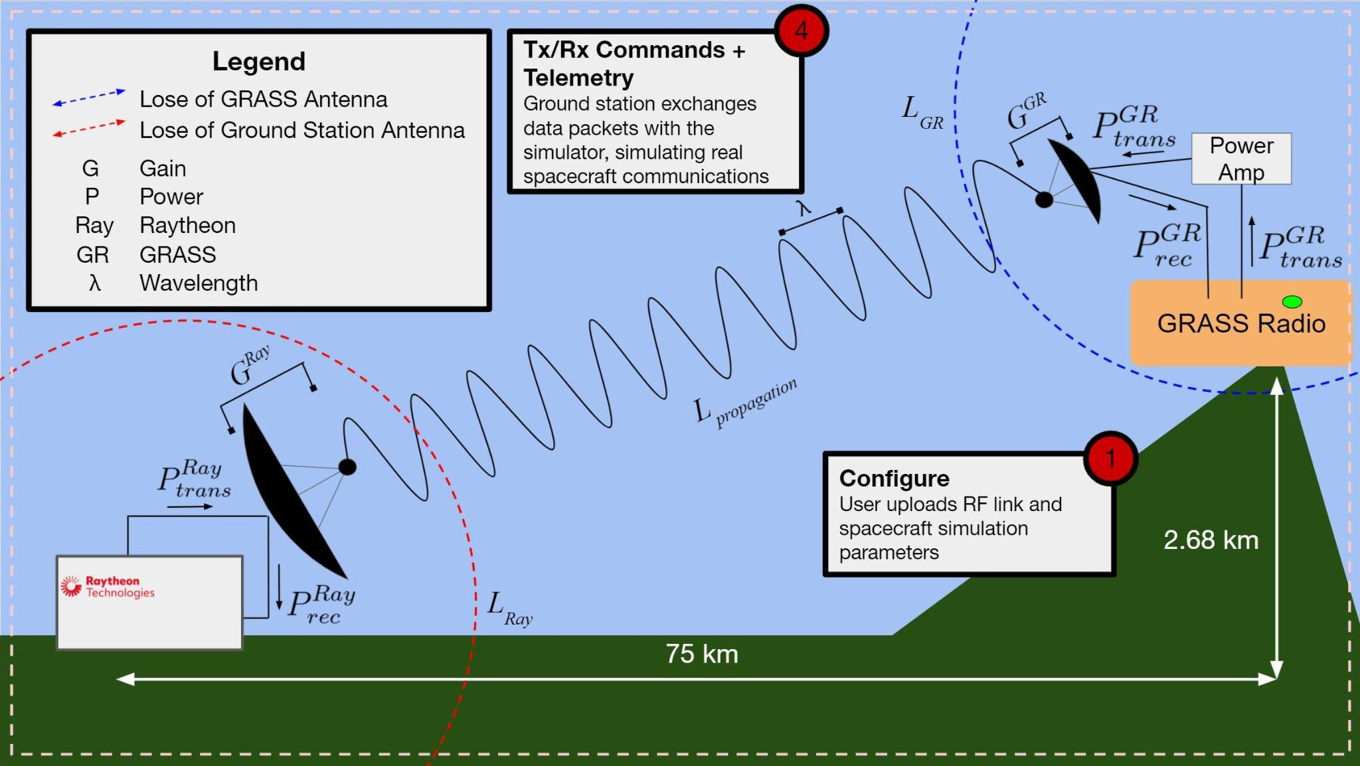
Critical Project Elements 3
RF Link:
The link over which a ground station can connect to GRASS is the primary mode of use.

Slide 93
Critical Project Elements 5
Ground Station:
While GRASS will be communicating with Raytheon ground station in operations, a test ground station is necessary for project V&V.

Slide 94
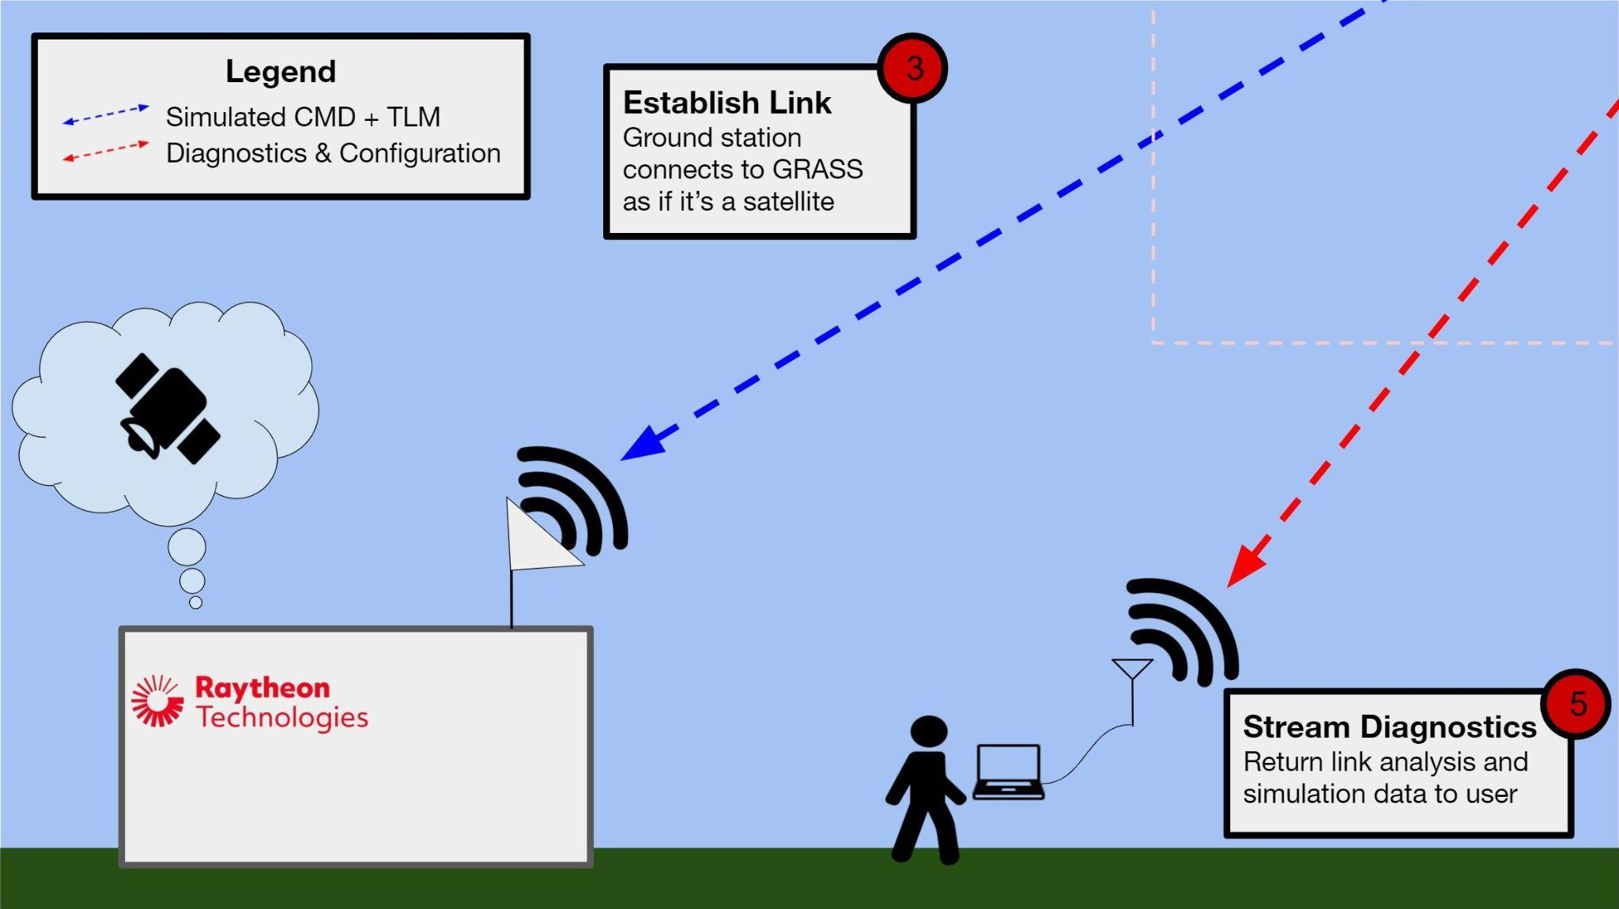
Critical Project Elements 5
Ground Station:
While GRASS will be communicating with Raytheon ground station in operations, a test ground station is necessary for project V&V.

Slide 95
Backup:
Design Requirements &
Satisfaction

Slide 96
Key Functional Requirements
Critical Project Elements
Functional Requirements
Simulator Housing Unit
Endurance
Power & Electronics
Simulation
FR2
RF Link
Communication
FR3
Software & Simulation
Modularity & Extensibility
FR4
Demo Ground Station
Operation

Slide 97
High-Level Functional Requirements (FR)
ID | Summary | CPE | Satisfied?
FR1 | Endurance - self-sustainably survive | E1, E2 | ❔
FR2 | Simulation - simulate modeled spacecraft | E2, E4 | ❔
FR3 | Communication - capable of establishing communications links | E3 | ❔
FR4 | Modularity & Extensibility - modular and extensible software | E4 | ❔
FR5 | Operation - well-documented user interface | E5 | ❔

Slide 98
Endurance (FR1)
FR1 - GRASS shall self-sustainably operate at the Squaw Mountain Communications Station
DR1.1 - Capable of protecting all electrical equipment in mountainous conditions
DR1.2 - Accept power from an external source
DR1.1.1 - Remain protected from dust and water to Ingress Protection Code standards (IP55)
DR1.1.2 - Capable of operating in all temperature ranges expected in the Colorado Front Range
DR1.1.3 - Mounted securely to a 1-8” pole
DR1.1.4 - A lock shall be integrated into GRASS
DR1.2.1 - Receive power from a battery
DR1.2.2 - Receive high voltage AC grid power and convert it as needed by internal systems

Slide 99
Endurance (FR1) - Satisfaction
FR1 - GRASS shall self-sustainably operate at the Squaw Mountain Communications Station
✅
DR1.1 - Capable of protecting all electrical equipment in mountainous conditions
DR1.1.1 - Remain protected from dust and water to Ingress Protection Code standards (IP55)
DR1.1.2 - Capable of operating in all temperature ranges expected in the Colorado Front Range
DR1.1.3 - Mounted securely to a 1-8” pole
DR1.1.4 - A lock shall be integrated into GRASS
DR1.2 - Accept power from an external source
DR1.2.1 - Receive power from a battery
DR1.2.2 - Receive high voltage AC grid power and convert it as needed by internal systems
DR1.1
DR1.1.1 - Chosen commercial enclosures are rated by Ingress Protection Code standards
DR1.1.2 - Thermal control system is modeled to maintain required temperatures
DR1.1.3 - Chosen bracket fits pole and is simulated to withstand expected forces
DR1.1.4 - A padlock will be installed on the box
DR1.2
DR1.2.1 - Chosen enclosures have cable conduit connections
DR1.2.2 - Voltage regulator will be integrated
CPEs Satisfied:
Housing Unit and Mounting: A robust housing and mounting solution is necessary to protect the hardware when deployed.
✅

Slide 100
Simulation (FR2) - Design Requirements
FR2 - GRASS shall simulate a satellite with ADCS, GNC, EPS, and C&DH subsystems, along with operating a mock payload.
DR2.1 - Simulation is capable of simulating ADCS subsystem
DR2.2 - Simulation is capable of simulating GNC subsystem
DR2.3 - Simulation is capable of simulating EPS subsystem
DR2.4 - Simulation is capable of simulating Link Model
DR2.5 - Simulation is capable of operating a payload
DR2.6 - Simulation shall have a centralized service to handle time
DR2.7 - Simulation shall operate under a flight software suite
DR2.1.1 - Attitude simulation is capable of realistic slew motion
DR2.1.2 - Attitude simulation is accurate within 0.1 percent error
DR2.2.3 - GNC simulation shall be integrated with a FOSS suite
DR2.2.6 - GRASS shall incorporate at least one commercially available model
DR2.3.3 - GRASS shall include an environmental model that gives solar temperature as a function of orbit position
DR2.4.2 - GRASS shall have a visibility feasibility constraint model that blocks communication if simulation constraints are not met
DR2.4.2.1 - This visibility feasibility constraint model feature must be able to be overridden by a configurable file
DR2.5.1- GRASS shall have a pan/tilt camera capable of sending a low level telemetry response and receive commands via C&DH
DR2.6.1 - GRASS shall simulate forward from some time zero from a given two line element set
DR2.6.2 - Centralized time service shall have a timestep of 1 microsecond
DR2.7.1 - Simulation implements CCSDS space communications protocol
DR2.7.2 - GRASS shall accept a configurable file that includes user-specific spacecraft parameters and environmental constraints
DR2.7.4 - C&DH shall have a diagnostic logging service
DR2.7.4.1 - Logging service shall be adaptable and have the capability to change frequency of subsystem logging time step as well as the information in the log
Requirements Common to Mulptiple DR2.x.x
Subsystem-specific Parameters are capable of being adjusted from the secondary communication link - 2.1.3, 2.2.1
GRASS is capable of sending live telemetry containing subsystem information - 2.1.4, 2.2.2
GRASS is capable of sending housekeeping telemetry from Status of Health command - 2.1.5, 2.2.4, 2.3.1, 2.4.1
GRASS shall be able to receive commands - 2.1.6, 2.2.5, 2.3.2, 2.7.3
GRASS shall store telemetry points in a log file at a configurable interval - 2.1.7, 2.2.7, 2.3.4, 2.4.3

Slide 101
Simulation (FR2) - Satisfaction
FR2 - GRASS shall simulate a satellite with ADCS, GNC, EPS, and C&DH subsystems, along with operating a mock payload.
✅
DR2.1 - Simulation is capable of simulating ADCS subsystem
DR2.1.1: Attitude simulation is capable of realistic slew motion
DR2.1.2: Attitude simulation is accurate within 0.1 percent error
DR2.2 - Simulation is capable of simulating GNC subsystem
DR2.2.3: GNC simulation shall be integrated with a FOSS suite
DR2.2.6: GRASS shall incorporate at least one commercially available model
DR2.3 - Simulation is capable of simulating EPS subsystem
DR2.4 - Simulation is capable of simulating a Link Model
DR2.5 - Simulation is capable of operating a payload
DR2.6 - Simulation shall have a centralized service to handle time
DR2.7 - Simulation shall operate under a flight software suite
DR2.1
Solution: 42, STK Components
Solution: STK Components
DR2.2
Solution: 42
Solution: STK Components
DR2.3 - 42, STK Components
DR2.4 - STK Components
DR2.5 - KubOS
DR2.6 - Custom for MVP
DR2.7 - KubOS, 42
CPEs Satisfied:
Power and Electronics: Self-sufficiency requires robust and self-powered components.
Software and Satellite Simulation - GRASS must emulate real satellite behavior, so robust and accurate software models are necessary.
✅

Slide 102
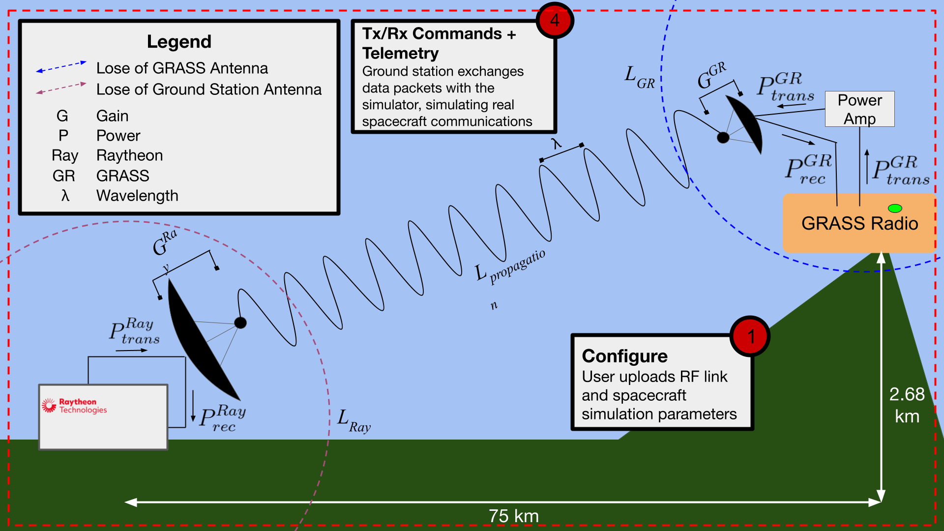
Radio Link - Concept of Operations (FR3)

Slide 103
Communication (FR3)
FR3 - GRASS shall be capable of establishing communications links over which it will be able to send/receive data and commands.
DR3.1 - GRASS shall have a dedicated RF link able to send and receive simulated spacecraft communications over a half duplex radio link
DR3.2 - A dedicated communication channel shall downlink simulator diagnostics and uplink simulator configuration
DR3.1.1 - Communication link shall have a link margin of at least 10 dB
DR3.1.2 - Establish a communication link at a minimum range of 75 kilometers
DR3.1.3 - Data shall be passed over the communication channel at 2 Mbps (9600 bps Minimum Viable Product)
DR3.2.1 - The communication channel will be capable of performing all necessary functions at a minimum range of 75 kilometers

Slide 104
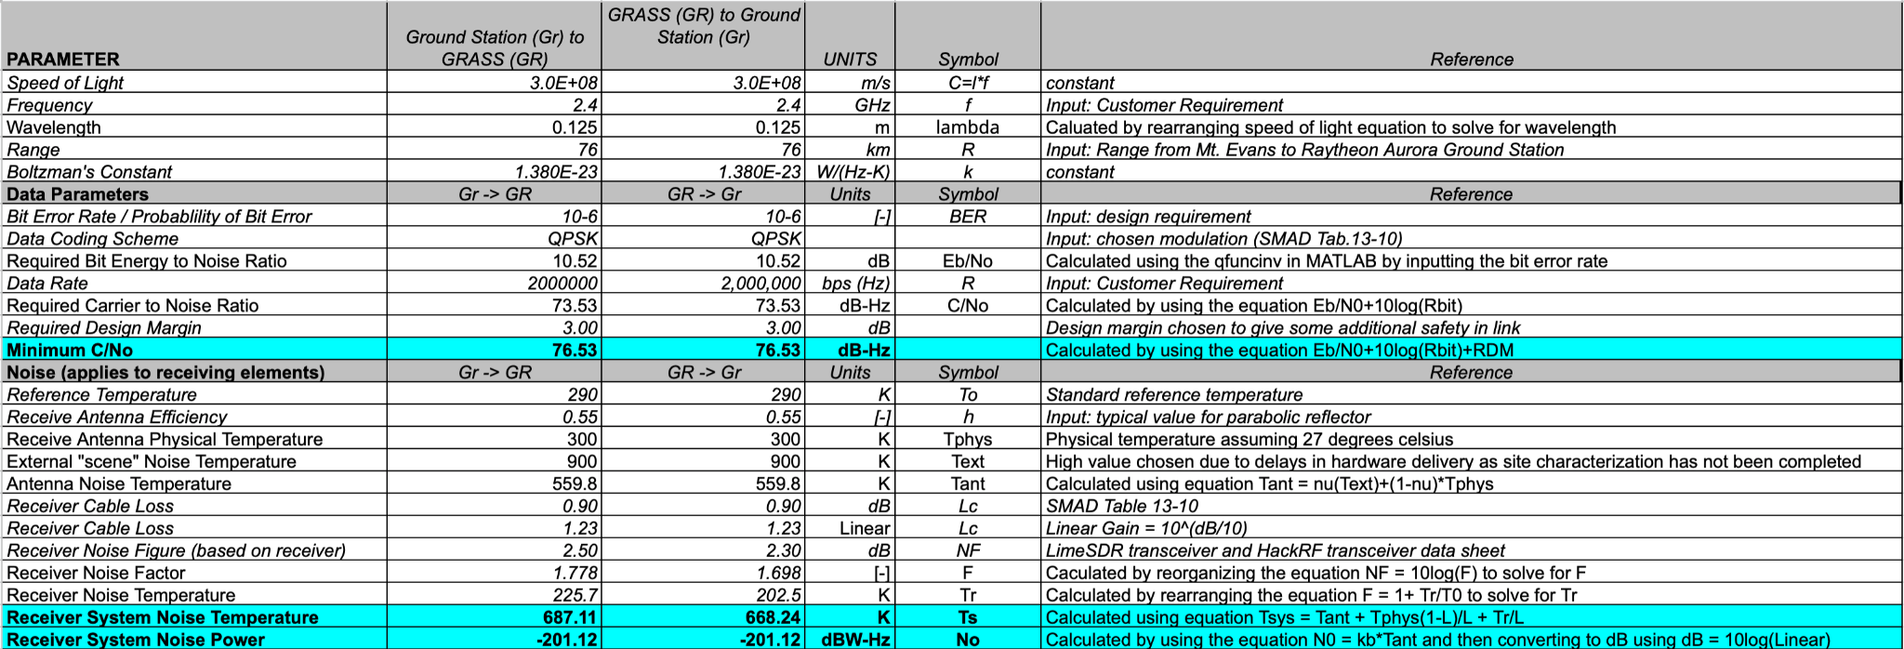
Communication (FR3) - Full Link Budget 2 Mbps

Slide 105
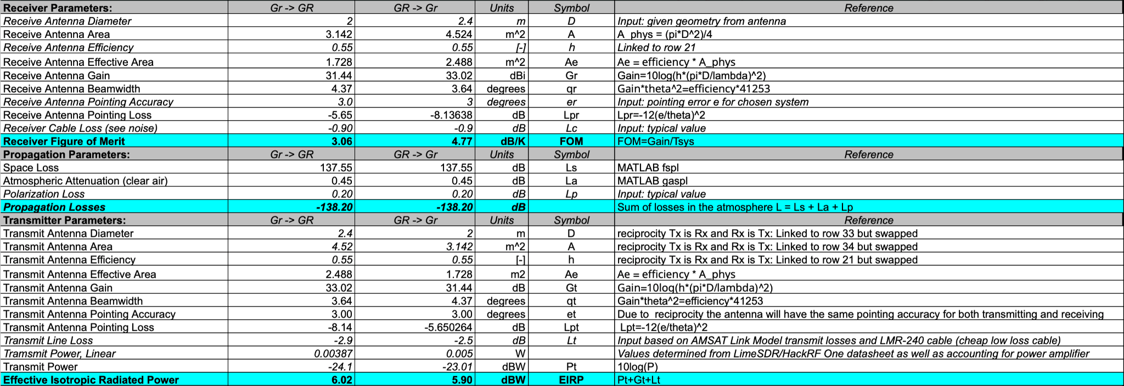
Communication (FR3) - Full Link Budget 2 Mbps cont.

Slide 106

Communication (FR3) - Full Link Budget 2 Mbps cont.

Slide 107
Communication (FR3) - Updated Link Budget - 2 Mbps
Updated to include pointing losses, more accurate line losses, and numbers relating to chosen SDR’s and known antennas (2m dish at GRASS, 2.4m dish at Raytheon)

Slide 108

Communication (FR3) - Full Link Budget 9600 bps

Slide 109

Communication (FR3) - Full Link Budget 9600 bps cont.

Slide 110

Communication (FR3) - Full Link Budget 9600 bps cont.

Slide 111
Communication (FR3) - Updated Link Budget, 9600 bps
Updated to include pointing losses, more accurate line losses, and numbers relating to chosen SDR’s and known antennas (2m dish at GRASS, 2.4m dish at Raytheon)
Requirement: 10 dB
Margin: 23.24 dB
> 100x greater than requirements

Slide 112
Communication (FR3) - Satisfaction
FR3 - GRASS shall be capable of establishing communications links over which it will be able to send/receive data and commands.
✅
DR3.1 - Dedicated RF link able to send and receive simulated spacecraft communications over a half duplex radio link
DR3.1.1 - Communication link shall have a link margin of at least 10 dB
DR3.1.2 - Establish a communication link at a minimum range of 75 km
DR3.1.3 - Data shall be passed over the communication channel at 2 Mbps (9600 bps Minimum Viable Product)
DR3.2 - A dedicated communication channel shall downlink simulator diagnostics and uplink simulator configuration
DR3.1 - SDR, Amplifier, Parabolic Antenna
DR3.1.1 - ...
DR3.1.2 - ...
DR3.1.3 - ...
DR3.2 - A 4G LTE modem will be attached to the computer and provide a cellular communication link for remote diagnostics and configuration
CPEs Satisfied:
RF Link: The link over which a ground station can connect to GRASS is the primary mode of use.
✅

Slide 113
Modularity & Extensibility (FR4)
FR4 - GRASS shall implement modular and extensible software containerization and interfaces for simulation and C&DH.
DR4.1 - Subsystems shall be composable using containers
DR4.2 - Follow a microservices architecture

Slide 114
Modularity & Extensibility (FR4) - Satisfaction
FR4 - GRASS shall implement modular and extensible software containerization and interfaces for simulation and C&DH.
✅
DR4.1 - Subsystems shall be composable using containers
DR4.2 - Follow a microservices architecture
DR4.1 - Docker
DR4.2 - Docker
CPEs Satisfied:
Software and Satellite Simulation: GRASS must emulate real satellite behavior, so robust and accurate software models are necessary.
✅

Slide 115
Operation (FR5)
FR5 - GRASS shall provide a well-documented user interface and can be easily operable.
DR5.1 - GRASS shall have a GPS receiver capable of determining its position
DR5.2 - GRASS shall be deployable with only 1-2 people
DR5.3 - GRASS shall include a setup procedure documenting how the simulation is configured and run
DR 5.4 - GRASS shall include documentation of the communications system including packet definition and RF link parameters

Slide 116

Operation (FR5) - DR 5.1 GPS Receiver BOTE
Quick calculation that GPS accuracy is sufficient for ground station to point antenna
Necessary outcome: Angular accuracy of position is much less than antenna beam width
Result: Precision is ~1000X greater than 3dB antenna beam width

Slide 117

Operation (FR5) - AT&T Cell Towers
Squaw Mountain
~ 8 km

Slide 118

Operation (FR5) - Verizon Cell Towers
Squaw Mountain
~8km

Slide 119
Operation (FR5) - Satisfaction
FR5 - GRASS shall provide a well-documented user interface and can be easily operable.
✅
DR5.1 - GRASS shall have a GPS receiver capable of determining its position
DR5.2 - GRASS shall be deployable with only 1-2 people
DR5.3 - GRASS shall include a setup procedure documenting how the simulation is configured and run
DR 5.4 - GRASS shall include documentation of the communications system including packet definition and RF link parameters
DR5.1 - Use Adafruit Ultimate GPS receiver in electronics
DR5.2 - Including batteries, the system will weigh less than 70 lbs, OSHA max 2 person lift is 100 lbs
DR5.3 - Set up process is known and well understood. Handbook will be handmade
DR 5.4 - COSMOS has a built in handbook creator, and the RF data is known and will be added to the handbook
CPEs Satisfied:
Ground Station: While GRASS will be communicating with Raytheon ground station in operations, a test ground station is necessary for project V&V.
✅

Slide 120
Operation (FR5)
FR5: GRASS shall provide a well-documented user interface and can be easily operable
DR 5.1: GRASS shall have a GPS receiver capable of determining its position
DR 5.2: GRASS shall be deployable with only 1-2 people
DR 5.3: GRASS shall include a setup procedure documenting how the simulation is configured and run
DR 5.4: GRASS shall include documentation of the communications system including packet definition and RF link parameters
Include small GPS receiver in electronic components
Less than 70 lbs including battery. OSHA max 2 person lift is 100 lbs.
Setup process is known and well understood
COSMOS has a built in handbook builder, RF parameters will be known.
Adafruit Ultimate GPS
Possible and Safe
Documentation will be written and published in a handbook
Packet definition and RF parameters will be published in an easy to use handbook

Slide 121
High-Level Functional Requirements (FR)
ID | Summary | CPE | Satisfied?
FR1 | Endurance - self-sustainably survive | E1, E2 | ✅
FR2 | Simulation - simulate modeled spacecraft | E2, E4 | ✅
FR3 | Communication - capable of establishing communications links | E3 | ✅
FR4 | Modularity & Extensibility - modular and extensible software | E4 | ✅
FR5 | Operation - well-documented user interface | E5 | ✅

Slide 122
Verification
and
Validation
Project Overview
Design Solutions
CPEs
DRS & Satisfaction
Project Risks
Verification & Validation
Project Planning

Slide 123
Verification And Validation
Verification
Product verification proves that an end product...for any element within the system structure conforms to its requirements or specifications,
Validation
System validation confirms that the integrated realized end products conform to the stakeholder expectations.
-NASA Systems Engineering Handbook

Slide 124
Electronics Characterization - Power
Objective:
Measure power draw of electronics
Graph battery discharge characteristics and compare to model
Plan:
Load Power Draw Test:
Connect electronics to grid power and measure power drawn with multimeter
Battery Source Characterization Test:
Connect electronics to the battery to and measure battery voltage and output current over time
Using Power drawn test to calibrate the model, compare the batteries expected and measured performances
Confirm upper boundary on power draw model

Slide 125


Electronics Characterization - Battery
Assumptions:
No peukert effect (pe = 1.1)
No temperature change
No self discharge
Reversible process
Constant internal resistance
Constant current drawn
Graph assumes 5A constant discharge current (current used for rating battery)

Slide 126
Simulation & Software Verification
Characterization tests
For simulation tests, this includes running with known inputs that have expected outputs, including ones that would break or fail
Example: GNC
Perform impossible maneuver
Perform nothing
Perform known maneuver and compare output with STK
Software Architecture tests
Send data and track data throughput
Example: GNC
Send command for GNC maneuver
Track through logging every container that is subscribed receives proper data, and in the right order

Slide 127
Simulation & Software Verification
FSW Tests
Verify that each FSW component operates and communicates with the simulation as needed
Verify that the FSW container can access dynamics and simulated information from the proper simulation containers
Verify that FSW can relay telemetry back to the communications subsystem
Verify that the FSW container can properly communicate with the communication subsystem and send hardware information
Microservices tests
Verify that containers can be swapped out with other similar containers and the system still runs, and that swapping with incompatible containers is handled gracefully.
Example: GNC
Verify that swapping out STK Component for 42 still allows for a full data throughput test
Verify that swapping out ADCS 42 for GNC 42 fails gracefully

Slide 128
MATLAB Thermal Model
The model provides a good estimate of what heating and cooling will be required, and it allows for quick changes to parameters of the box and the effects on thermal loads
The assumption of isothermal is not a good assumption as the temperatures of the inside and outside surfaces may vary and be used to simplify calculations
The amount of solar radiation included was a value typically used for determining power produced by solar panels and is a poor indication of infrared heat produced
The model is verified with SolidWorks simulations
3D thermal model using resistances
Assumes isothermal box, steady-state, no snow or rain, constant conductivity emissivity/absorptivity, perfect cube box, box is entirely enclosed by environment (Earth)
Includes forced and natural convection, and heat produced by electronics
Conservative model
Extreme Temperatures
Low end night with no electronics producing power, high winds
High end day with max power by electronics, maximum solar incident radiation

Slide 129


MATLAB Thermal Model - Cont.
Q̇_{solar}
Q̇_{gen} + Q̇_{thermal}
Q̇_{conv}
Q̇_{cond}
Q̇_{cond}
Q̇_{rad}
Q̇_{cond}
Q̇_{cond}

Slide 130


MATLAB Thermal Model - Cont.
Nusselt number of a cube: Simplified Analytical Models for Forced Convection Heat Transfer From Cuboids of Arbitrary Shape, Culham et. al.
Natural Convection
Forced Convection

Slide 131


SolidWorks Thermal Simulation
SolidWorks Simulation
SolidWorks Fluid Simulation
Used as supplement to thermal model
Same conditions as extreme model
More accurate with CAD model and solar radiation specific to Denver, CO
Hot Extremes Sim
30 W Electrical Heating
Internal Temperature 77°C
Result
Simulations show that need we both active heating and cooling to in extreme conditions
Cooling introduces complications, boxes with fans have lower ingress protection
Cold Extremes Sim
40 W Active Heating
Internal Temperature -3°C

Slide 132
Testing Plans

Slide 133

Testing Precedence Diagram

Slide 134
Unit and Subsystem Verification - Software
Logging Test
Unit Tests
Integration Tests
Objective | Verify that system changes are being received by C&DH and executed correctly
Plan | Create a logging module that reads and writes all telemetry and command data into files from all modules
Materials | Python Docker Computer COSMOS
Objective | Verify that all individual units of source code are fit for use
Plan | Create, or use pre-existing, unit tests which will test whether the source code is behaving as expected
Materials | Python Docker Computer COSMOS
Objective | Verify that all containers communicate with each other as defined
Plan | Create, or use pre-existing, integration tests to ensure that subsystems are integrating as expected
Materials | Python Docker Computer COSMOS

Slide 135
Subsystem Verification - Electronics
Load Power Draw Test
Battery Source Test
Objective | Power GRASS with grid power and to determine average power draw of all electronics
Plan | Connect electronics to grid power use USB multimeter to measure voltage and current drawn
Materials | All electronics components USB type c pd charger and cables USB multimeter Laptop to log information
Objective | Examine Battery discharge characteristics and compare to model
Plan | Connect electronics to battery and use USB multimeter to record battery discharge current and voltage.
Materials | All electronics components USB multimeter tester Laptop to log information

Slide 136
Subsystem Verification - C&DH
Single Command
Script Test
Objective | Verify that COSMOS and software are capable of interacting to successfully trade 1 command and respective telemetry
Plan | Send a single collect command to the ‘dumb code’
Materials | COSMOS Laptop Dummy code
Objective | Develop a test case to ensure code successfully runs
Plan | Send a test sequence to the ‘dumb code’
Materials | COSMOS Laptop Dummy code

Slide 137
Subsystem Verification - Structures & Thermal
Heater Control Test
Overnight Outdoor Test
Overnight Mountain Test
Objective | Characterize heater capability in a controlled environment
Plan | Run heating system in enclosure indoors with a benchtop power supply
Materials | Enclosure Heater Benchtop Supply Thermometer
Objective | Characterize heater capability in an outdoors environment
Plan | Run heating system in enclosure outdoors with a battery power supply
Materials | Enclosure Heater Battery Supply Thermometer
Objective | Verify heater capability at the intended location of operation
Plan | Run heating system overnight on Squaw Mountain with grid or battery power, compare with model
Materials | Enclosure Heater Grid/Battery Power Thermometer Squaw Mountain Access

Slide 138
Subsystem Verification - RF
Wired Test
Short Range Test
Long Range Test
Objective | Verify signal processing and SDR output power
Plan | Connect SDR’s with hard wired connector
Materials | LimeSDR HackRF Laptop Connector Cable
Objective | Verify ability to communicate between SDR wirelessly
Plan | Perform short-range test to begin testing wireless communication test (100 m - 3000 m)
Materials | LimeSDR HackRF Two Laptops Two Antennas
Objective | Verify link budget and ability to perform long range communication
Plan | Set-up a longer range line of sight test (>3000 m), performing a full communication test
Materials | LimeSDR HackRF Two Laptops Two Antennas

Slide 139


Subsystem Verification - RF

Slide 140
System Validation - Integration Tests
Electronics Mounting Test
Electronics System Test
Squaw Mountain Test
Objective | Verify that we can mount the electronics in the enclosure and that we can connect them together with external components
Plan | Mount the electronics in the enclosure and wire them together with external components
Materials | Enclosure All electronics Wires
Objective | Verify that we can successfully run the all the electronics together
Plan | Wire all electronics together and run them with integrated software
Materials | All electronics (Power Source) Wires Software
Objective | Verify that we can successfully mount all components at the mountain location and run all electronics
Plan | Mount enclosure with electronics at Squaw Mountain, run electronics system
Materials | Squaw Mountain Access Enclosure All electronics (Power Source)

Slide 141
Manufacturing

Slide 142
Structural Manufacturing Plan/Schedule
Day 1 (Jan 9)
Day 2 (Jan 10)
Day 3 (Jan 11)
Day 4 (Testing day)
Sizing and Drilling
3D Printing
Attaching components
Deploy GRASS and connect to power
Measure locations for holes to attach mounting solution and camera and drill them out
Print out the custom made housing units for internal electronics that mount to the rails within GRASS. (Can be started on Day 1 as well)
Attach components to their 3D printed housing units and affix to the inside of GRASS and then connect components to each other
Attach GRASS to 4-inch pole at Squaw mountain site. If grid power is available and/or required, connect to grid power.
LOREM

Slide 143


Integration of COTS and Custom Components
3D printed mounting solutions allow the COTS components to be attached to the rails with the enclosure securely
The design of these housing units allows for ample ventilation and access to the various ports and connections

Slide 144


Custom Housing Components
*Some components will have to be placed within their housing units and attached to the rails outside of the box. The rails will then be screwed back into the enclosure
From left to right: Lime housing, adafruit housing, left end of battery housing, right end of battery housing, and odyssey housing

Slide 145

Enclosure CAD Models - Design Options
Battery Power
Grid Power
Battery inside box
Larger enclosure
No battery
Smaller enclosure
0.46 m
0.35 m
0.1 m
0.1 m

Slide 146
Manufacturing Task List

Slide 147
Risks and Mitigation

Slide 148
RF Links
Secondary link didn’t need to be fully custom
Cellular networks provide the necessary connectivity and are much easier to use!
Full-duplex isn’t necessary to the core mission goals
Half-duplex is much easier to achieve and requires less advanced hardware
The hardware required for full-duplex is generally very frequency-specific, limiting the project’s flexibility in the future

Slide 149
V&V/Test Plans
Previous requirements needed a long-duration fully-integrated field test
New requirements allow decoupling of major areas of concern
No longer require access to Raytheon ground station or remote off-site test facilities to achieve minimum levels of success
Shorter tests coincide with removal of off-grid power solution
Still able to demonstrate the key functionality of the project and separately demonstrate mission endurance capabilities

Slide 150
Software
What has been done: Proof of Concept Container Integration
In other words: prove that the containers can communicate
Communication Protocols
The protocol with which containers will exchange data is defined
The pattern for specifying which containers provide what data is defined
A preliminary implementation of the interface software to manage sending and receiving data on each container
Defining Data Flow
Each subsystem has a list of defined data flowing from it.
Each subsystem has a list of data that it could need from other subsystems and a list of those corresponding systems.
Container Orchestration
Two containers are able to pass information to each other.
Functions or if statements execute based off of information from the other container.
Container and COSMOS
Format of information received is known.
Format of information sent is known.
Communication protocols tie-in is determined feasible or not.

Slide 151
Software
Done by end of Semester: Proof of Concept Full Simulation, FSW, and COSMOS Integration
In other words: integrate everything to be a fully working orbital system from ground station to orbital propagation and logging
Integration of Communication and Orchestration
The orbital simulation and orbital FSW containers communicate via pub/sub communication.
Variables are received and sent automatically based on each container's subscribed-to and published information.
Updating Orbital Simulation and Orbital FSW
Orbital simulation will have pre-defined initial state, will subscribe to changes from FSW, publish orbital state, and change orbital state based on information from FSW
Orbital FSW will receive and execute commands from COSMOS, subscribe to telemetry from the orbital simulation, publish changes to hardware, and make decisions based on orbital simulation telemetry
Creation of Start and Stop Script
Script to start, stop, and build GRASS
Create Logging System
A container that will log all telemetry and commands from orbital and FSW subsystems.
COSMOS Commands
Investigate exactly how the COSMOS commands are translated through the SDR. Figure out what format these commands in as. Figure out how the FSW systems will be able to read and interpret these commands.
First Unit Test
Unit test is created and passes for each orbital code file.

Slide 152
Project Planning

Slide 153

Structures Cost Breakdown
Combining the testing and subteam specific budget results in the shown total

Slide 154

RF Cost Breakdown
Combining the testing and subteam specific budget results in the shown total

Slide 155

Electronics Cost Breakdown
Combining the testing and subteam specific budget results in the shown total

Slide 156
Major Tests
Test Name | CPE Addressed
RF Wired Test | E3,E5
Software Test | E4,E5
RF Short Range Test | E3,E5
Structures Thermal Test | E1
RF Long Range Test | E3,E5
Electronics and Power Test | E2
GRASS Integration and Test | E1,E2,E3,E4,E5
Week Long Test | E1,E2,E3,E4,E5

Slide 157
Work Plan: Gantt
Order Parts Early!
Deliver Software MVP For Testing
Subsystem Hardware Integration
S/W For Hardware Integration,
Hardware Integration and Fit Checks
Manufacturing
Testing
Now~End of Break
Pre-TRR
TRR~SFR

Slide 158

Testing Precedence
Models Developed
Link Budget Modeling
Demonstrates that link budget works for varying ranges and transmit power
Thermal Model
Demonstrates that thermal control works for varying heat produced by GRASS and varying external heat

Slide 159
Test Plan
Verification Methods
System Validation
Analysis
ConOps, Objectives
Squaw Mountain Field Test
Demonstration
System Verification
Inspection
High-Level FRs
Integrated Systems Test - Lab
Test
Subsystem Verification
Low-Level DRs
Software Integration Tests
Electronics Integration Tests
Ground Station Integration Tests
Assembly Fit Checks
Unit Testing and Component Characterization
Individual Container Tests
Hardware Fit Checks
RF Characterization
Thermal Characterization
Electronics Characterization

Slide 160
Functional Block Diagram - Hardware

Slide 161
RF Hardware Solution
Hardware List | Product Name | Relevant Specifications
Software Defined Radio | LimeSDR HackFR One | Lime: - Transmit power: 0.001 and 0.01 mW - Frequency range: 100 kHz - 3.8 GHz HackRF: - Transmit power: 0.001 mW and 0.030 mW - Frequency range: 1 MHz - 6 GHz
Parabolic Dishes | - | 2 meter parabolic dish to transmit to ground station (≈ 31 dB)
Power Amplifiers | AVA-183P+ | Connect in line with LimeSDR to boost transmit power
Cellular Modem | Quectel EM06-A LTE Cat 6 M.2 Module | Compatible with Odyssey x86

Slide 162
RF Hardware Solution
Product | Description/Function | Relevant Specifications
LimeSDR | Software Defined Radio (SDR) for use on GRASS | Transmit power between 0.001 and 0.01 mW Frequency range 100 kHz - 3.8 GHz
HackRF One | SDR for use in Ground Station | Transmit power between 0.001 mW and 0.030 mW Frequency range 1 MHz - 6 GHz
Parabolic Dishes | 2 meter (on GRASS) and 2.4 meter (Raytheon) parabolic dish to direct signal | 2 meter gain ≈ 31 dB 2.4 meter gain ≈ 33 dB
Power Amplifiers | Connect in line with LimeSDR in order to boost transmit power | COTS widely, and cheaply available at different power level based on need

Slide 163
Simulation and Software Solution
Software List | Product Name | Relevant Specifications
ADCS & GNC Software | Systems Tool Kit (STK) - GNC 42 Spacecraft Simulation - ADCS & GNC Custom Code - GNC | Latest Version .NET 2021r3 Written in Python
C&DH | Custom Code | Written in Python
Containerization | Docker | Latest version
Ground Station | COSMOS | V 4.5.1
Python
Systems Tool Kit (STK)
Docker
COSMOS

Slide 164
Functional Block Diagram - Software

Slide 165
Simulation and Software Solution
Product | Description/Function | Relevant Specifications
Docker | Container tool which containerizes software into exchangeable modules | Latest Version
42 | Simulator of spacecraft attitude, orbit dynamics, and environmental models | Latest Version
STK Components | Simulator of spacecraft attitude, orbit dynamics, and environmental models | .NET 2021r3
KubOS | Flight software package | Latest Version
COSMOS | Simulated ground station | V 4.5.1
Python
Systems Tool Kit (STK)
Docker
COSMOS

Slide 166
Endurance (FR1)
FR1 - GRASS shall self-sustainably operate at the Squaw Mountain Communications Station.
Chosen Enclosures
Chosen commercial enclosures are rated by Ingress Protection Code standards
The thermal control system, which includes a heater and insulation, is modeled in MATLAB and simulated in SolidWorks to maintain required temperatures
The chosen bracket fits the mounting pole and is modeled to withstand the expected forced
A padlock will be installed on the box to avoid tampering on-site
Electrical System
The chosen commercial enclosures have cable conduit connections for external power
A voltage regulator will be integrated convert external voltage to levels needed for onboard electronics

Slide 167
Motivation - Verification & Validation
Functional Requirements
Critical Project Elements
Verification & Validation
Endurance
Simulator Housing Unit
Integration Tests
Simulation
Power & Electronics
Structures & Thermal
Communication
RF Link
RF Link
Modularity & Extensibility
Software & Simulation
Simulation and Software
Operation
Demo Ground Station
C&DH
Electronics

