Slide 1
Gravity Offloading and Tethering Somatosensory Enhancement System (GOATSES)
Test Readiness Review
Grace Antonucci, Ben Foehr, Jack Harrison, August Hauter, Quentin Morton, Elena Salgado, Nick Taylor, Isaac Timko, & Cody Wheel

Slide 2
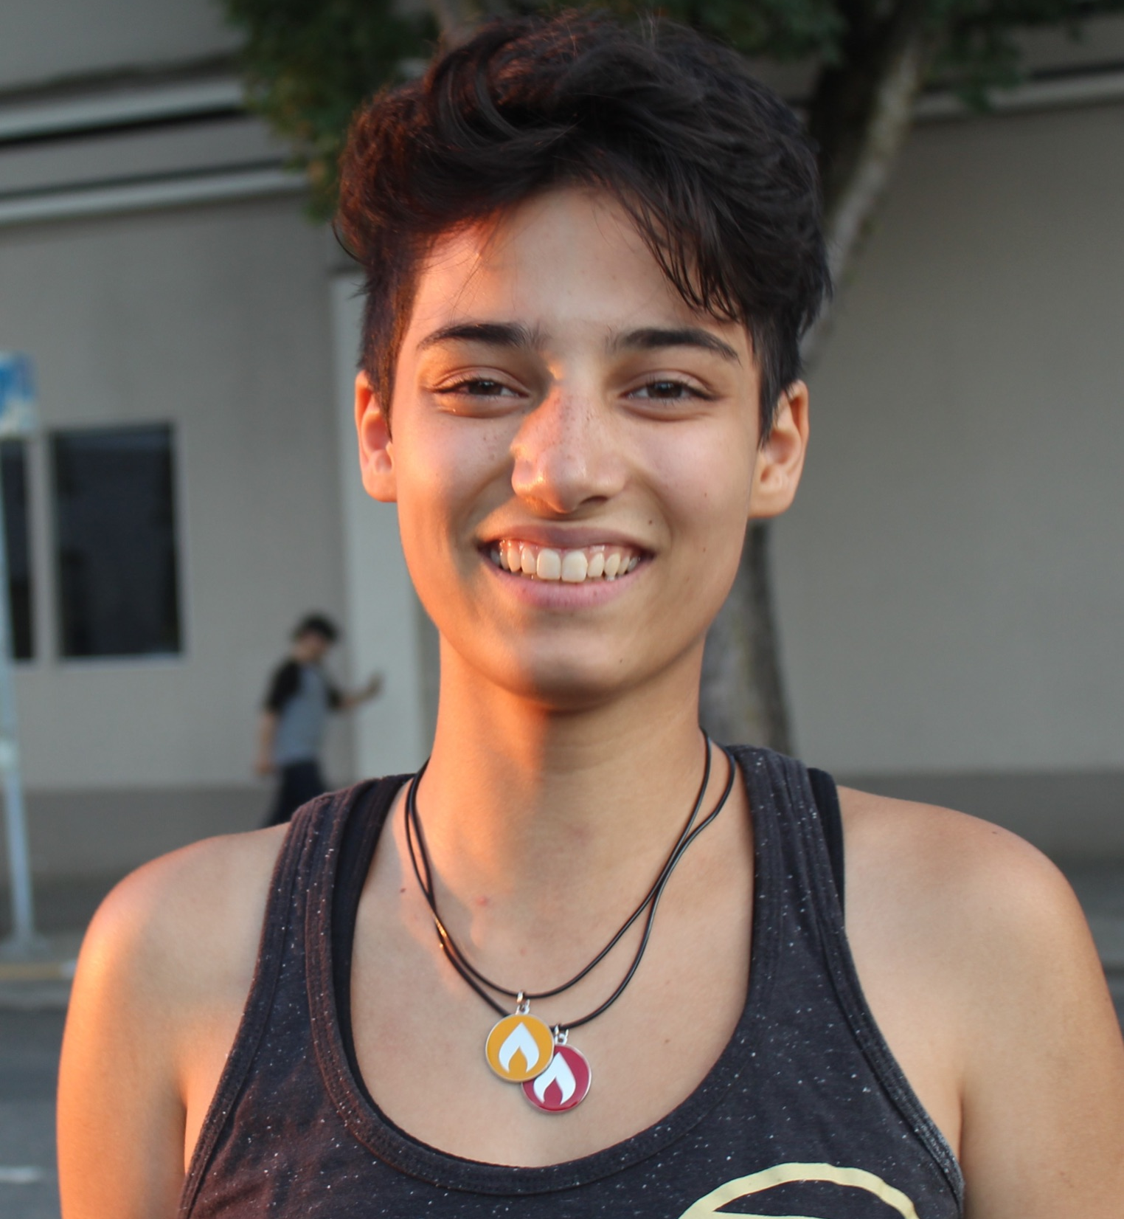
MEET THE TEAM
Cody Wheeler
Design Lead
Ike Timko Electronics Lead
August Hauter
Analysis Lead
CFO
Grace Antonucci
Project Manager
Elena Salgado
Safety Lead
Ben Foehr
Human Factors Lead
Nick Taylor Manufacturing Lead
Quentin Morton
Lead Systems Engineer
Jack Harrison
Testing Lead

Slide 3
Agenda
Project Overview
Schedule
Test Readiness
Load Magnitude
Load Direction
Friction
Budget

Slide 4
Project Overview
Notes:
WHY are we doing this project, HOW are we going to do this project, WHO is using this project, WHAT are we doing in this project

Slide 5
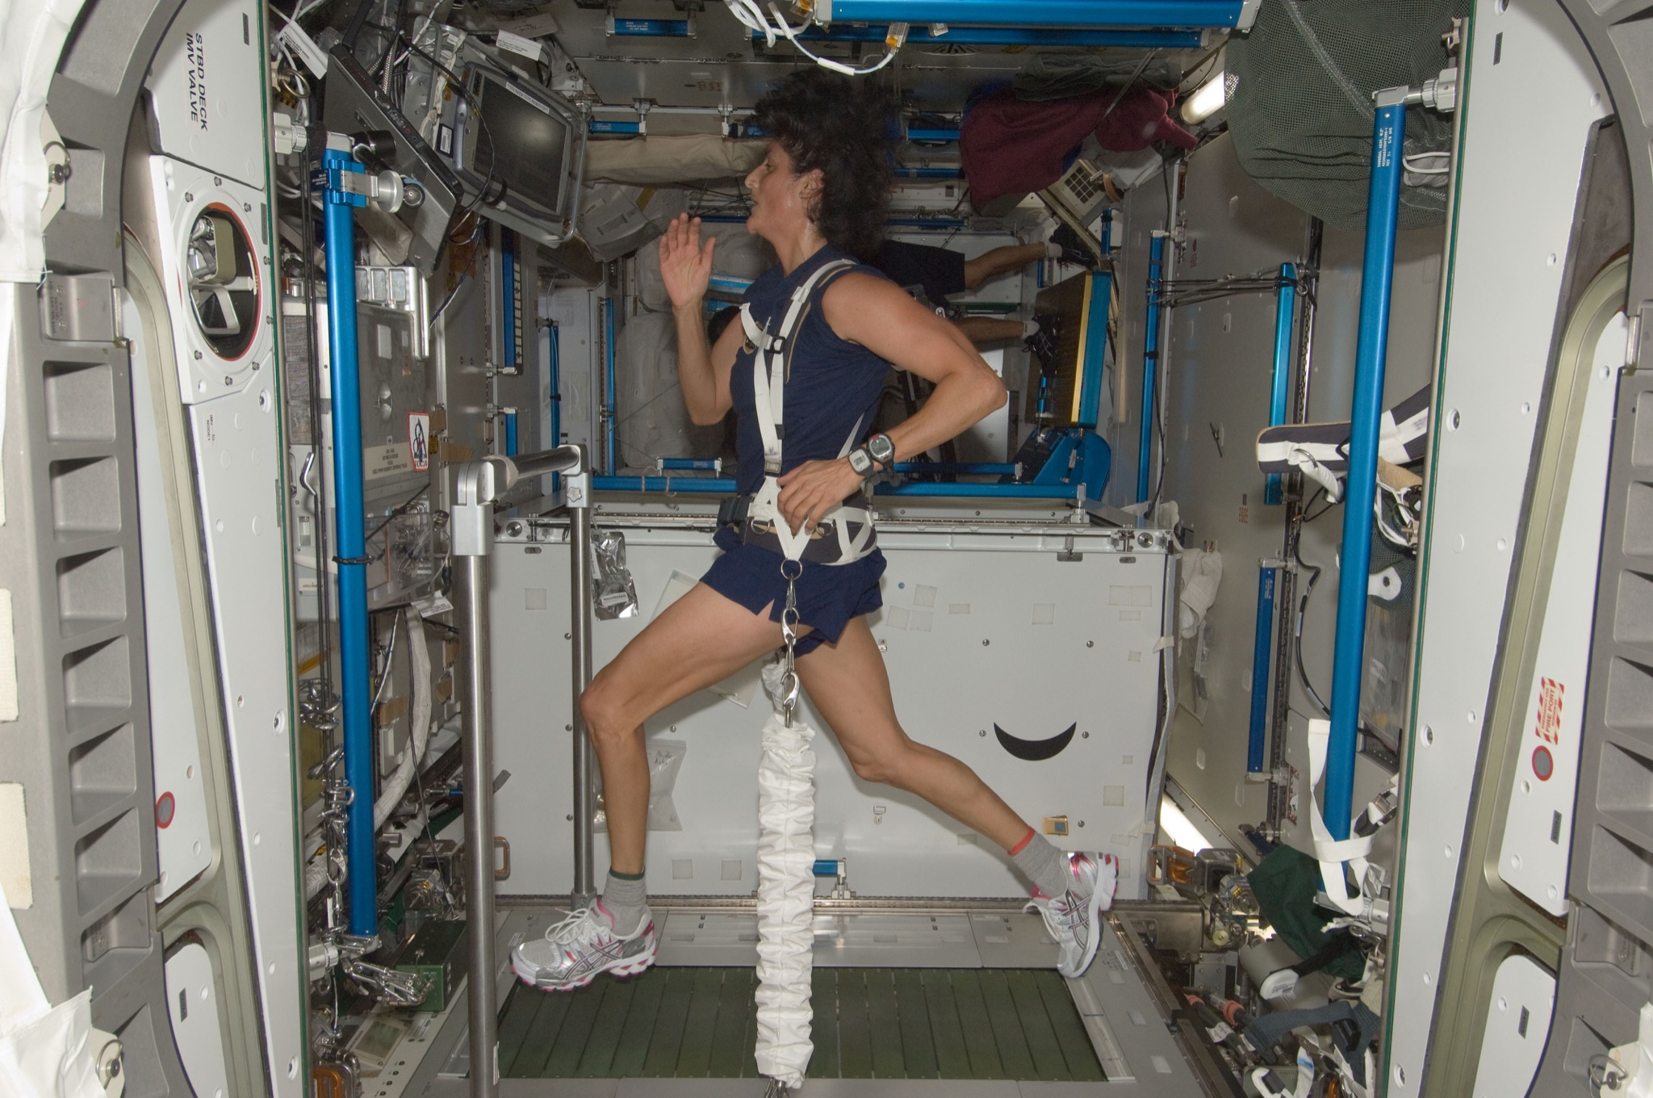
Project Objectives
Current axial loading is problematic
Hypothesis: More realistic gravitational loading = better proprioceptive functions
Device will provide a load that stays perpendicular to support service
Main user base will be bed rest patients which offer scientists a way to see how the body adapts to weightlessness
Notes:
Bed rest studies offer scientists ways to see how the body adapts to weightlessness. Volunteers spend up to 70 days in bed with a six-degree head-down tilt. They must eat, exercise, and even shower in the head-down position.
Our project aims to create a device in which maintains a force on the user that is perpendicular to their support surface regardless of postural sway.
This device will be used in laboratory studies to prove whether this improvement in loading direction yields better retention of proprioceptive functions.
Study requires a spaceflight analog such as bedrest.
Bedrest: volunteers spend up to 70 days in bed with a six-degree head-down tilt. They must eat, exercise, and shower in this position. [3]
Astronauts are currently loaded to a single fixed point and therefore they do not need to balance themselves.
It is hypothesized that if astronauts were loaded as if in a realistic gravitational field, it would help maintain proprioceptive function by requiring them to balance themselves.
Our project aims to create a device in which maintains a force on the user that is perpendicular to their support surface regardless of postural sway.
This device will be used in laboratory studies to prove whether this improvement in loading direction yields better retention of proprioceptive functions.
Study requires spaceflight analog such as bedrest.
Bedrest: volunteers spend up to 70 days in bed with a six-degree head-down tilt. They must eat, exercise, and shower in this position. [3]

Slide 6
Project Objectives
Number | Functional (Driving) Requirement | Verified By:
F1 | The device shall provide a force on the user not to exceed 1.3 kN | Force Measurement
F2 | The device shall generate a gravity vector that does not deviate greater than an angle of 2 degrees from the true perpendicular to the support surface | Angle Measurement
F3 | The device shall allow for user postural sway by limiting the coefficient of friction present opposite to the direction of sway to 0.3 | Friction Measurement
F4 | The device shall be able to load the user as they move within a 1.75 m² area | Design Dimensions
F5 | The artificial force should act between the hips and shoulders of the user | Biological Analysis
F6 | The device shall prevent the user from falling if the user enters an unrecoverable state | Simulated Fall
F7 | The device shall be compatible with a person with a height of 1.5-2 m, a weight not to exceed 113.4 kg, and a hip breadth of 31-46 cm [7] | Design Dimensions
F8 | The device shall accommodate Earth-based testing such that Earth gravity will not be a confounding variable | Testing Equipment
Notes:
F2 being the thing that separates us from existing technology, and F1 and F2 are the ones that can make it as effective as existing technology.

Slide 7
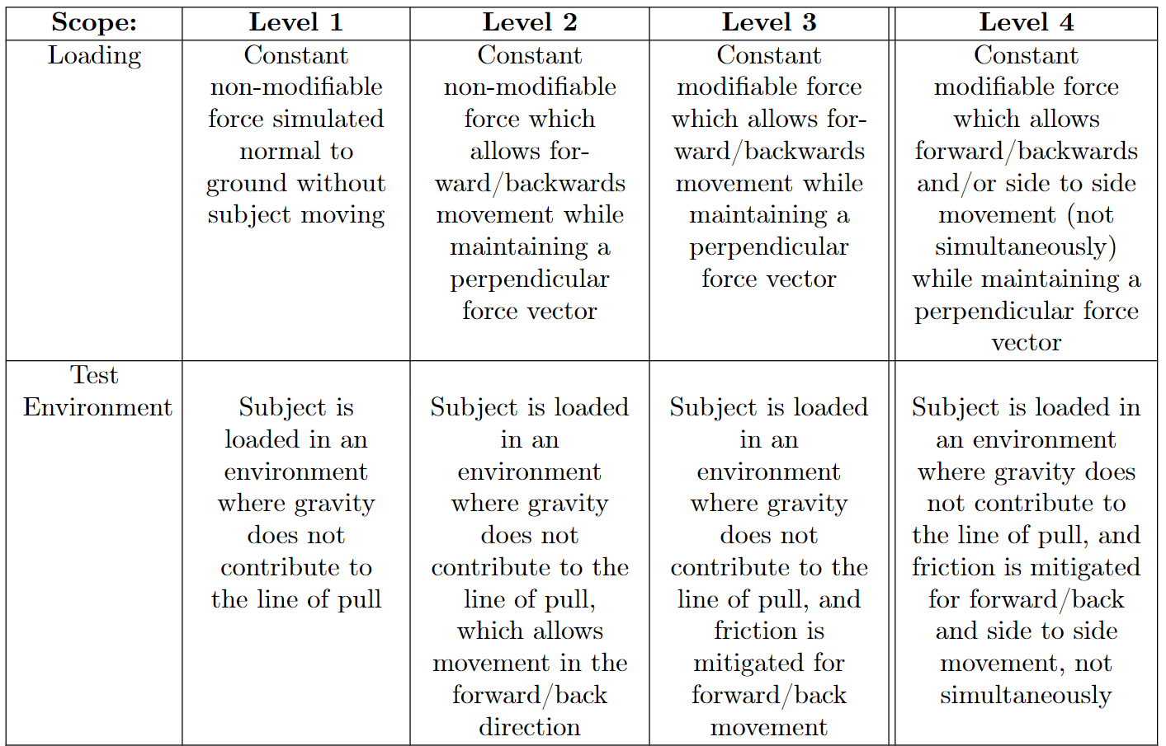
Levels of Success

Slide 8
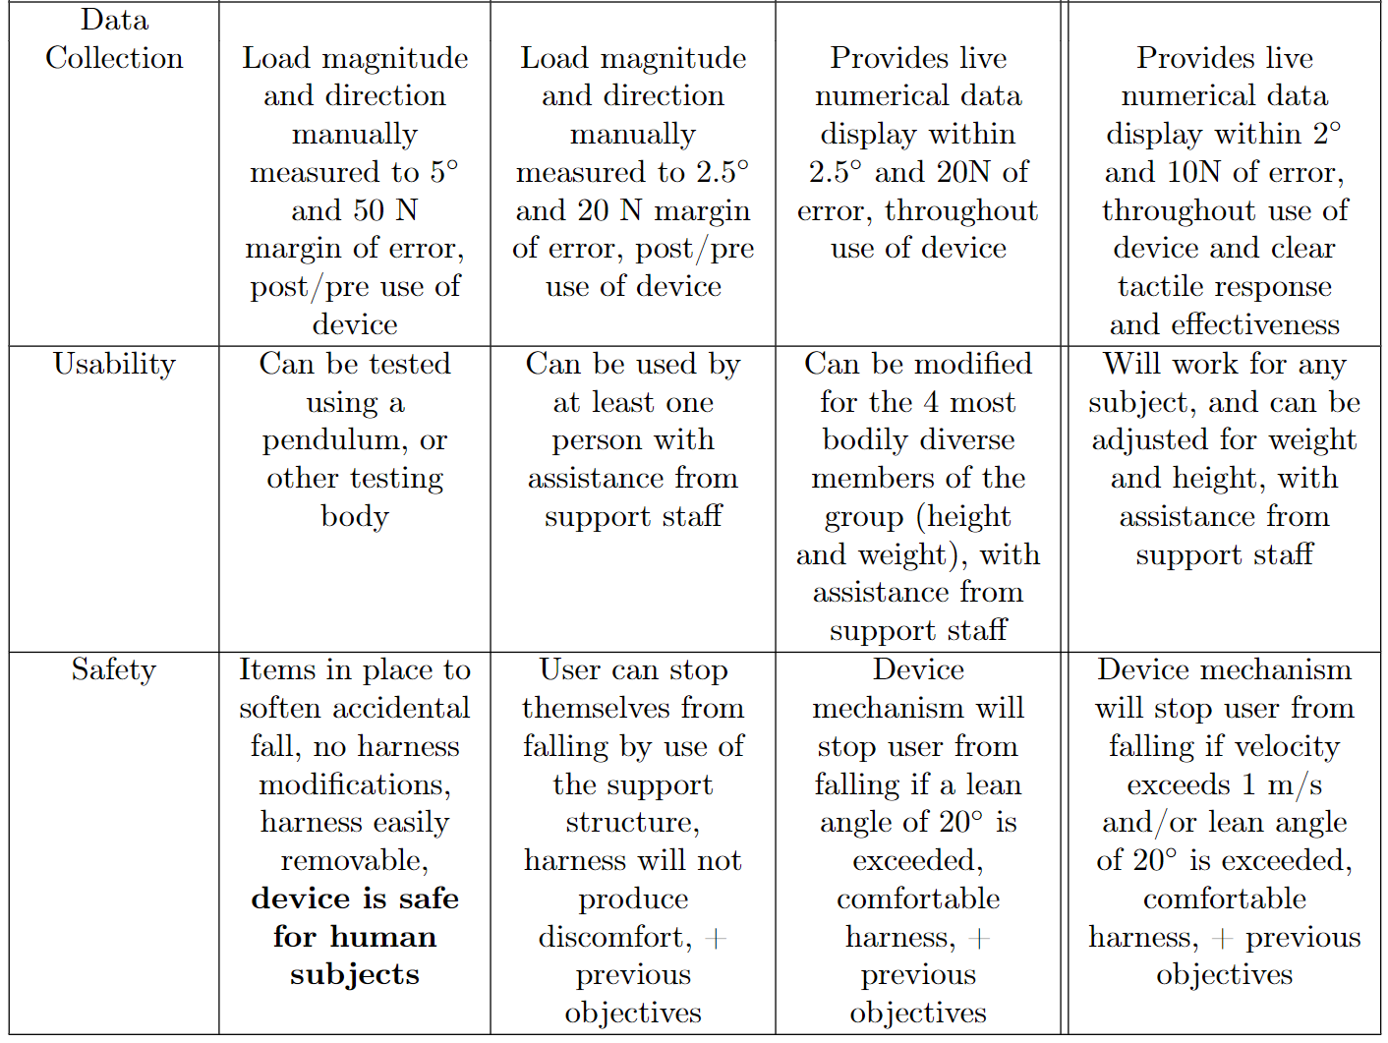
Levels of Success

Slide 9
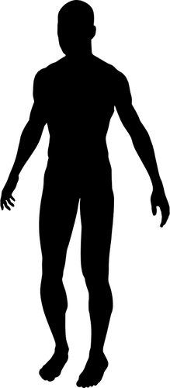
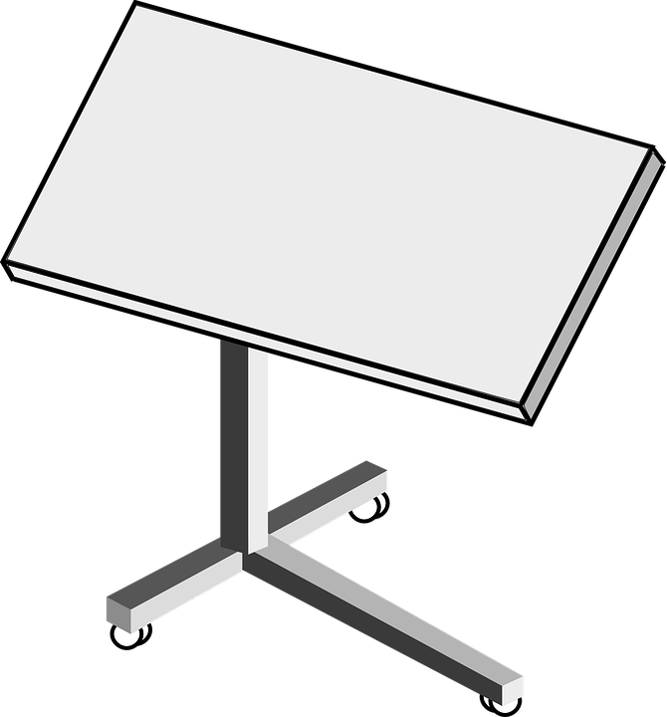
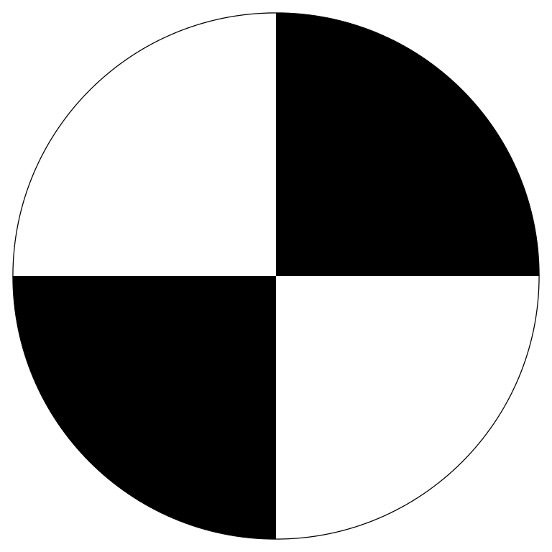
CONOPS
Prep
Ingress
Use
Egress
Top-Down View
User leans
Loading mechanism is assembled and modified to take into account user’s mass and anthropomorphic data
User can get into loading system without standing, laying on their back OR their side.
Harness is adjustable to user size.
Tether base pulls in a direction normal to the stationary base and moves with the user’s general center of gravity as the user leans.
Fail-safe mechanisms engage if user falls.
Body angle, tether angle, and tether tension data is stored and displayed.
Harness is easily removed without need for the user to stand.
= user lean direction
= net force direction
= harness
= tether
Repeat
= sliding attachment
= sliding direction
Notes:
User can be on their side (Leans front to back) OR User can be on their back (Leans side to side) → Trains proprioceptive function
Mention the details of things (yellow = actuator, tethers are connected to sand bags) and mention that the detail will be covered later.

Slide 10
Top-Level Overview
Top View
Test Environment
Loading Mechanism
Sliding Load Attachment
Safety/Human Factors
Front View
Iso View
Notes:
SAND BAGS ARE TENSIONING THE SYSTEM, actuators

Slide 11
Sensors and Controls
Arduino Portenta H7 and Stepper Motor Controllers (Placed behind Support Surface)
Actuators
BendLabs Angle Sensor
Server
6-axis IMU
Actuator Limit Switches
Wireless Network Connection
Tension Sensor

Slide 12
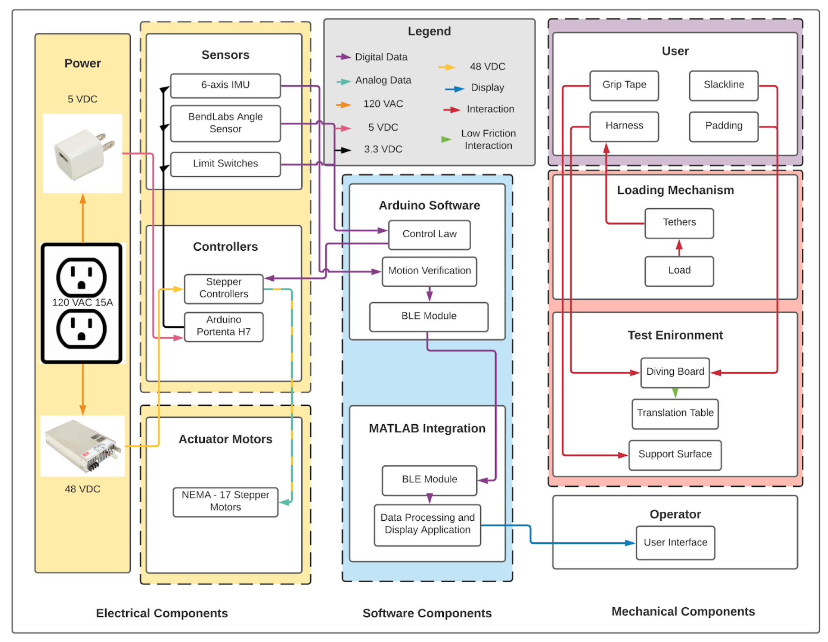
Functional Block Diagram

Slide 13
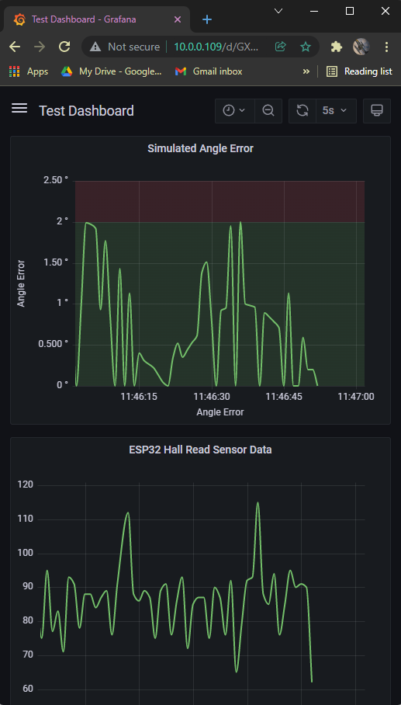
Design Changes
Data Communications
Wheel Placement
Server
Bendlabs Sensor
IMU
Sensor Data
Sensor Data
Webpage
120 VAC
Movement Command
Stepper Controller
Linear
Actuators
Motor Command
Notes:
Data is collected by the bendlabs sensors and IMU, then the Arduino uses a PID control loop to compute a required response form the linear actuators. The commanded response is passed to the stepper controller, and the linear actuators are moved. Meanwhile, the collected data is transmitted to the server via a wireless network connection and stored. The client can access the webpage via a computer or mobile device, to view and download the data

Slide 14
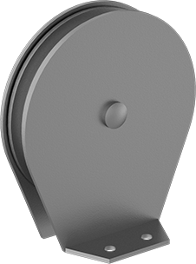
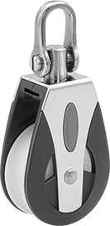
Critical Project Elements
Friction Mitigation
2) Sliding Load Attachment Speed
Pulleys
Ball Bearings
γ
α
Thrust Bearing
F3 | The device shall allow for user postural sway by limiting the coefficient of friction present opposite to the direction of sway to 0.3 | Friction Measurement
F2 | The device shall generate a gravity vector that does not deviate greater than an angle of 2 degrees from the true perpendicular to the support surface | Angle Measurement
Notes:
Talk about why these are critical:
The person will feel too much force in their lean and thus the test will not be accurate to seeing if a perpendicular gravity vector is a necessary change in ISS technology
If the sliding load does not keep up with the user, there will be slack in the cables, thus pulling the user in the opposite direction to the lean, and this will ruin the test to see if a perpendicular gravity vector is a necessary change in ISS technology (just like before)

Slide 15
Schedule

Slide 16
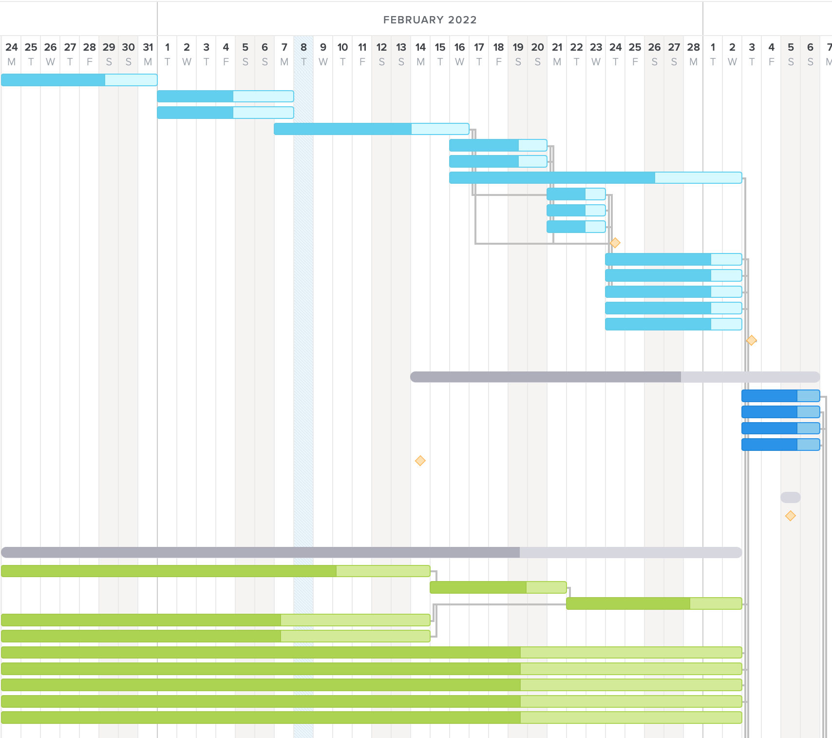
Phase 1: Manufacturing & Component Tests
Brackets
Aluminum Tubing
Plywood & Sheet Metal
Assembly
Structural Testing
TRR
AIAA
Linear Actuator Assembly & Testing
Sensors, Data Storage, Software, & User Interface

Slide 17
Phase 1: Manufacturing & Component Tests
Manufacturing Team:
Task | Status
Brackets | Complete
Aluminum Tubing | Complete
Plywood/Sheet Metal | Complete
Assembly | 3/2
Structural Testing | 3/7
Brackets
Aluminum Tubing
Plywood & Sheet Metal
Assembly
Structural Testing
TRR
AIAA
Linear Actuator Assembly & Testing
Sensors, Data Storage, Software, & User Interface

Slide 18
Phase 1: Manufacturing & Component Tests
Electronics & Software Team:
Task | Status
Machine Shop Submission | Complete
Arduino to Cloud Connection | Complete
Display GUI | Complete
Angle Sensor Reading | Complete
Load Sensor Testing | 3/7
Linear Actuator Control | 3/7
Brackets
Aluminum Tubing
Plywood & Sheet Metal
Assembly
Structural Testing
TRR
AIAA
Linear Actuator Assembly & Testing
Sensors, Data Storage, Software, & User Interface

Slide 19
Phase 2: System Integration & Test
Inspection
System Assembly
SFR
System Verification: Loads, Angle Margin, & Friction
Final Report
Symposium
System Assembly:
Join Structure & Electronics (3/6-3/14)
Install Linear Actuator Assembly
Install Tether through system

Slide 20
Phase 2: System Integration & Test
Inspection
System Assembly
SFR
System Verification & Validation: Loads, Angle Margin, & Friction
Final Report
Symposium
System Verification & Validation:
Verification by Inspection (3/15-3/20)
Functional Requirements 4-8
System Test (3/15-4/8)
Human Testing (Load & Angle)
Friction Test
To be completed 1-2 weeks before SFR

Slide 21
System Verification & Validation Schedule
 | Inspection (FR 4-8) | Load Direction & Magnitude (FR 1-2) | Friction (FR 3)
Week 1 (3/15-3/21) | Complete | Attempt test, expect roadblocks | Attempt test, expect roadblocks
Week 2 (3/22-3/28) |  | Resolve issues, attempt test | Resolve issues, attempt test
Week 3 (3/29-4/4) |  | Repeat test 5x with 3 different individuals and edge case | Repeat test 5x or more
Week 4 (4/5-4/8) |  | Margin | Margin

Slide 22
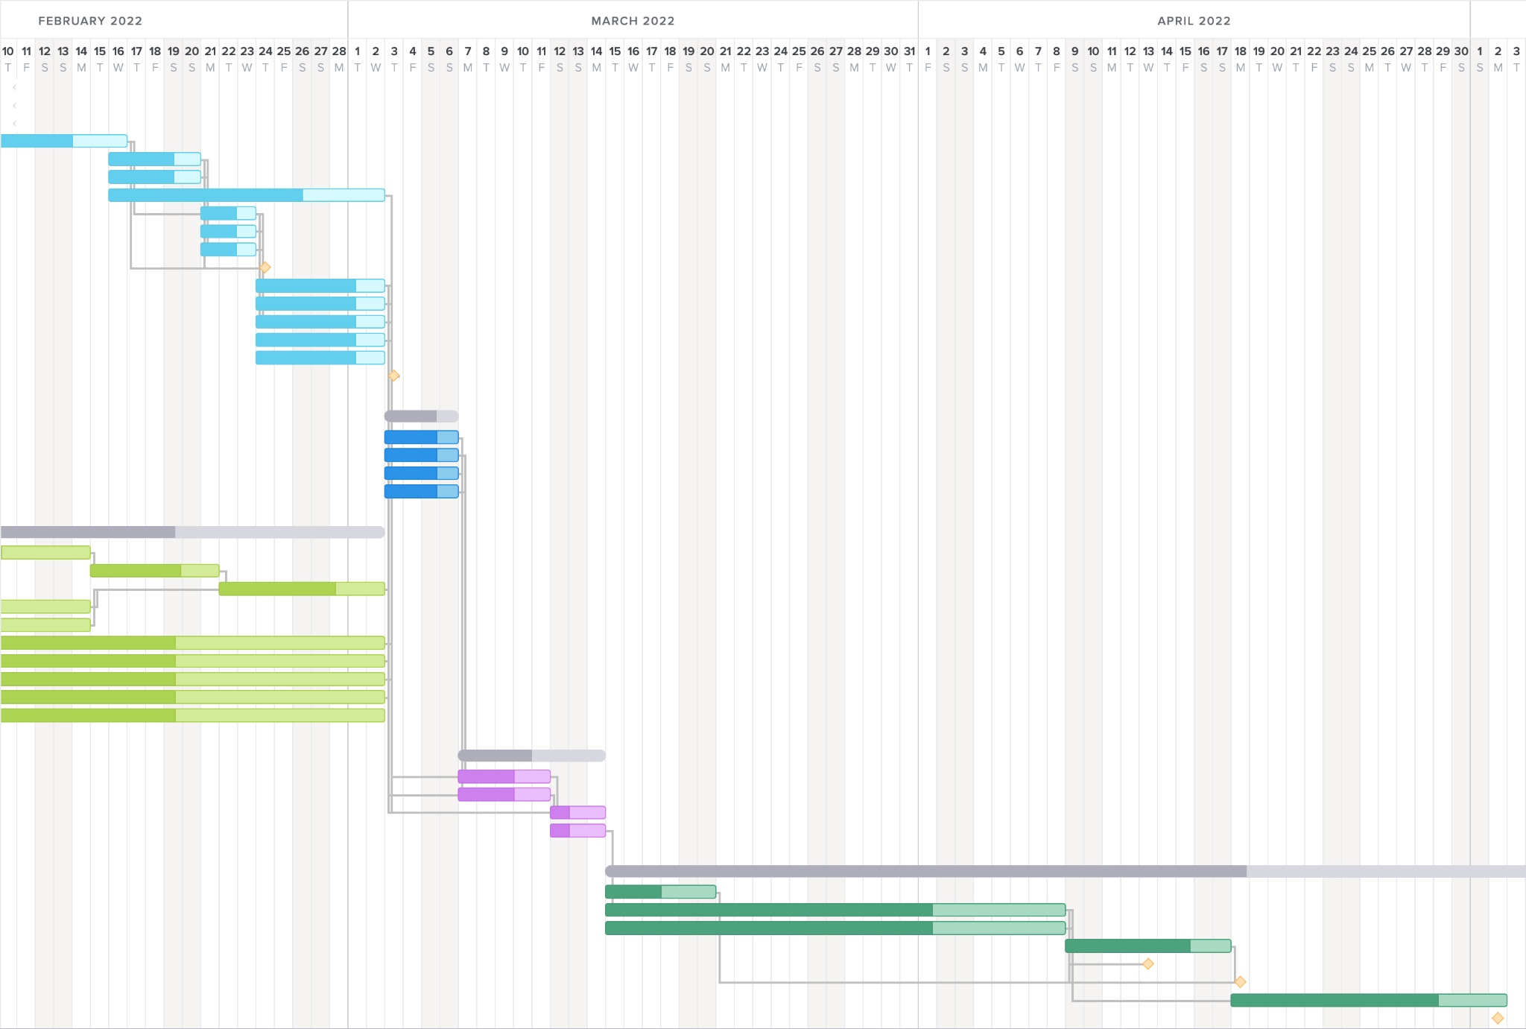
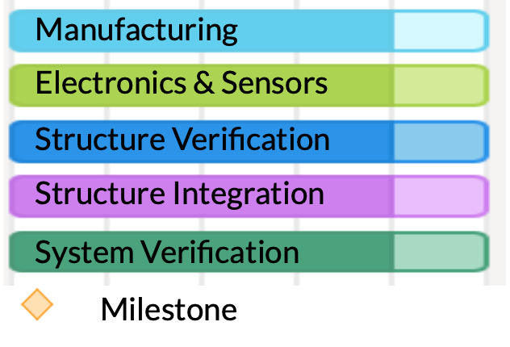
Critical Path
Mitigation:
Ordering components early
Front loading work week
Alternate procurement
Additional Brackets
Test Environment Fabrication
Test Environment Verification
Assembly
System Verification

Slide 23
Test Readiness

Slide 24
Testing Overview
Major System Verification Tests
Force Magnitude
Force Direction
Friction
Component Verification Tests (in Appendix)
BendLabs Angle Sensors
IMU Sensor
Hanging Scale
Software Motion Control
Minor System Verification Tests (in Appendix)
Structural Integrity
User Safety
Notes:
This is a simple overview of the tests we plan to conduct with the GOATSES device. The first three shown in bold are most important and will be covered shortly. The rest of the tests are covered in the appendix, but in the interest of time will not be covered in the main presentation.

Slide 25
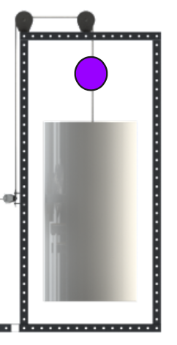
Force Magnitude
= F_{g} = m_{user}g ± 10 N
Direction of Earth gravity
Purpose: Validate customer need for simulated gravity force and verify requirement F1.4
F1.4: The net load on the user shall not deviate from its original value by more than ± 10 N
⍺
ꞵ
F₁
F₂
BendLabs Angle Sensor
Actuator Limit Switches
Crane Scale
6-axis IMU
Notes:
(WHY) Purpose: Our first requirement simply dictates that the device provides a simulated gravity force on the user not to exceed 1.3 kN. However, in order for the user to feel a consistent and true-to-reality gravity force, the simulated gravity force magnitude must stay within our required bounds as demanded by functional requirement F1.4. These bounds are as shown here, plus or minus 10 N from the user’s weight force.
Equipment: This test will be conducted upon complete assembly of the GOATSES device, and after the device’s safety has been verified. Additionally, it will take place in room N200 of the aerospace building and will require multiple team members to record data or stand in as the user.

Slide 26
Force Magnitude - Test Procedure
= F_{g} = m_{user}g ± 10 N
Direction of Earth gravity
Record known constants
Enter data into Arduino software
User performs multiple trials of postural sway
User position data is recorded throughout
Calculate and compare results to predicted model
⍺
ꞵ
F₁
F₂
BendLabs Angle Sensor
Actuator Limit Switches
Crane Scale
6-axis IMU
Notes:
(HOW)
First, known constants will be recorded. These include the user’s weight, the height at which the tethers attach to the harness, and the weight of both sand drums which are measured by in-line crane scales and contribute forces F₁ and F₂.
Next, these constants will be entered into the Arduino software to be used for calculations during test. Then, the device’s user will perform multiple trials of postural sway in both the forward-backward and side-to-side directions. The two angle sensors as well as the 6-axis IMU will capture data throughout the test duration which will be used in real-time to control the linear actuators which work to keep the force magnitude and direction both constant. Finally, upon completion of the test, the sensor data and calculated data will be compared to a model prediction of the device to measure how the device performs with regard to the plus or minus 10 Newton bounds.

Slide 27
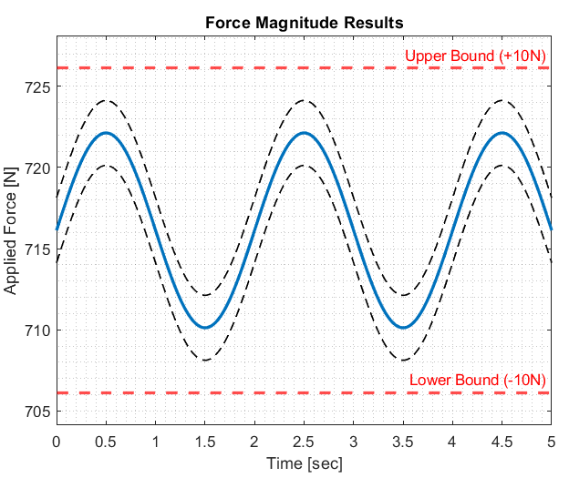
Force Magnitude - Results
= F_{g} = m_{user}g ± 10 N
F_{g} = F₁cos(⍺) + F₂cos(ꞵ)
Direction of Earth gravity
⍺
ꞵ
F₁
F₂
BendLabs Angle Sensor
Actuator Limit Switches
6-axis IMU
Crane Scale
Notes:
(WHAT WE GET, HOW WE GET IT, WHAT WE WANT)
The aforementioned angle sensors and IMU will provide the Arduino with angle data. First, we assume that the applied force is perfectly perpendicular to the support surface. Then, with this angle data, the Arduino performs a bit of trigonometry to determine these angles, alpha and beta, throughout the duration of the entire test. Then, since we know the constants F₁ and F₂ by measuring the weights of our sand drums that connect to the tethers, the Arduino simply uses this equation here for F_{g} to calculate our applied force magnitude throughout the entire test. Thus, our results for force magnitude shall look like this example graph on the left.

Slide 28
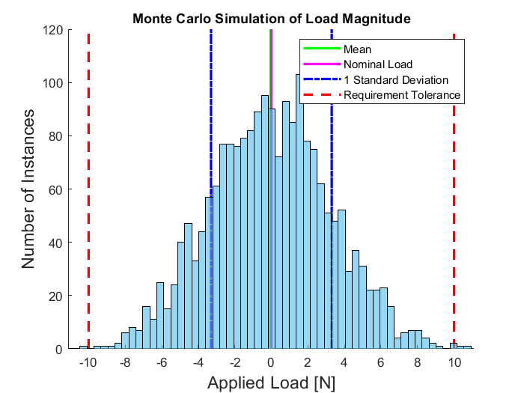
Force Magnitude - Error Quantification
Monte Carlo simulation (2000 runs) using derived uncertainties and the Universal Test Subject (73 kg, 108 cm) for user measurements
Force magnitude must remain within required +/- 2.25lbf (10 N) tolerance
Further accuracy pending component test values
Notes:
To quantify the errors associated with our Force Magnitude test, we designed and executed a MC sim for 2000 runs using derived uncertainties and Universal Test Subject measurements for the user. All uncertainties included in this Monte Carlo simulation were derived from physical measurement uncertainties, sensor sensitivities, and linear actuator worst case response times. Furthermore, compounding uncertainties were summed in quadrature. As I mentioned earlier, our F1.4 requirement dictates that the force magnitude remains within 10 Newtons of our desired load, and as you can see in the results shown here on the right, the load almost never strays from our bounds and even 1 standard deviation is still quite close to our desired load. Still, the accuracy of this error quantification can and will be improved upon completion of our scheduled component tests

Slide 29
Force Direction
Purpose: Validate customer need for simulated gravity force direction and verify Functional Requirement 2
F2: The device shall generate a gravity vector that does not deviate greater than an angle of 2 degrees from the true perpendicular to the support surface
Direction of Earth gravity
±2°
BendLabs Angle
Sensor
Actuator Limit Switches
6-axis IMU
Notes:
Purpose:
Ensure the system meets requirement F2
The applied force is within 2 degrees of normal to the support surface
Ensure proper integration of system electronics, software, and structure
Test Equipment:
Complete assembly of GOATSES
Humanoid dummy mass (anthropomorphic shape)

Slide 30
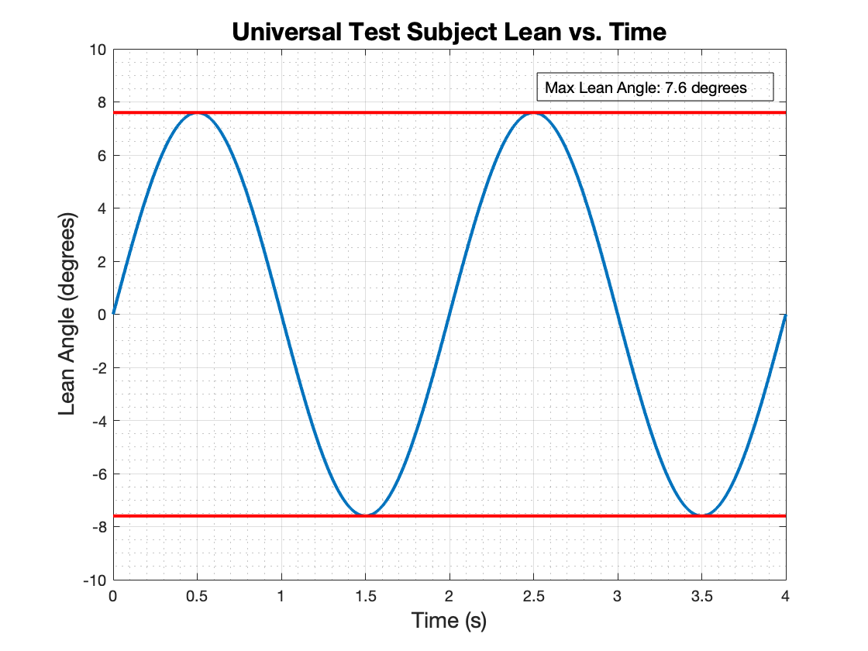
Force Direction - Result
Dummy motion will be compared to the modeled Universal Test Subject
0.5 hz sine wave motion (with a maximum lean angle of 7.6°)
F2: “The simulated gravity force must stay within 2 degrees of normal to the support surface at all times”

Slide 31
Force Direction - Test Procedure
Record known constants
Enter data into Arduino software
Load dummy into harness, attach tethers
Begin streaming IMU and BendLabs data
Collect 30s of baseline data
Swivel diving board in side-to-side lean motion for 30s
Repeat
Verify direction of force requirement
Direction of Earth gravity
±2°
BendLabs Angle
Sensor
Actuator Limit Switches
6-axis IMU

Slide 32
Force Direction - Error Sources
Device | Time Budget |  | Error Budget
Arduino Portenta H7 | 5 ms |  | 0°
Drylin ZLN-40 linear actuator | 30 ms |  | 0.1004°
Bendlabs 1-Axis Evaluation Kit | 5 ms |  | 0.18°
Total | 40 ms |  | 0.2804°
Required | 84.03 ms

Slide 33
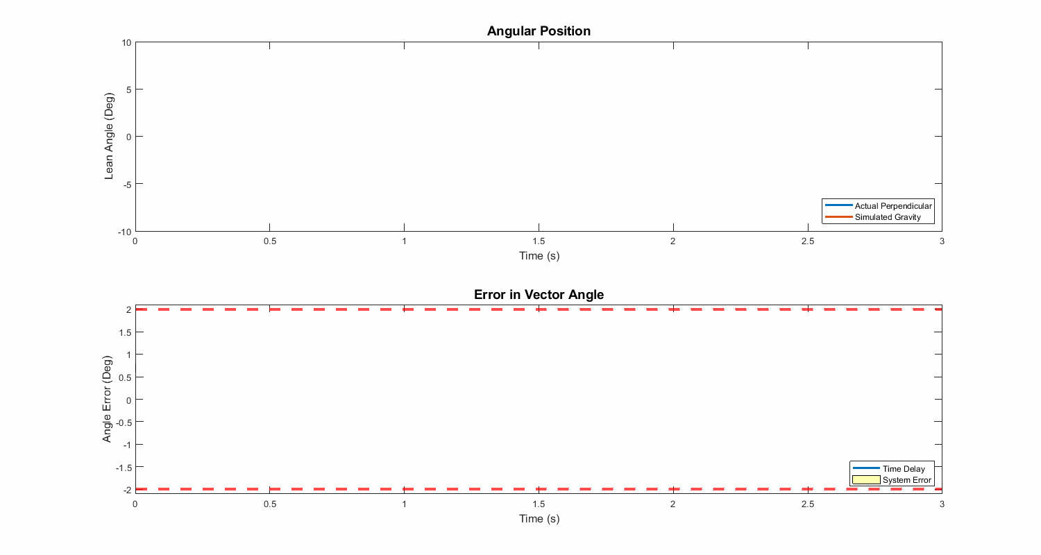
Force Direction - Test Success
θ
±2°
*Not actual collected data
Notes:
Actual user lean (theta) found with harness mounted 6-Axis IMU, this will be compared with the angle output by the Bendlabs angle sensors to determine the direction of the force vector applied to the user. The error, which is required to be within 2 degrees, will be found by analyzing and comparing the sensor values, and is a result of the previously discussed time delays and sensor inaccuracies.

Slide 34
Friction
Purpose: Validate analytical model and verify Functional Requirement 3
F3: The device shall allow for user postural sway by limiting the coefficient of friction present opposite to the direction of sway to 0.3
Ball Bearings
Thrust Bearing
Pulleys

Slide 35
Friction - Pulley Location
User leans
SLA translates and Tether adjusts via pulley system
Note location of pulleys
User Leans
35
Notes:
Note the 4 total pulleys for each respective tether

Slide 36
Pulley Friction
Build Test Stand
Install tether
Center tether so that buckets are at identical heights
Incrementally add weight to one side until system displaces
x+dx
x
Notes:
Introduce pulley testing and narrate the shiz out of it

Slide 37
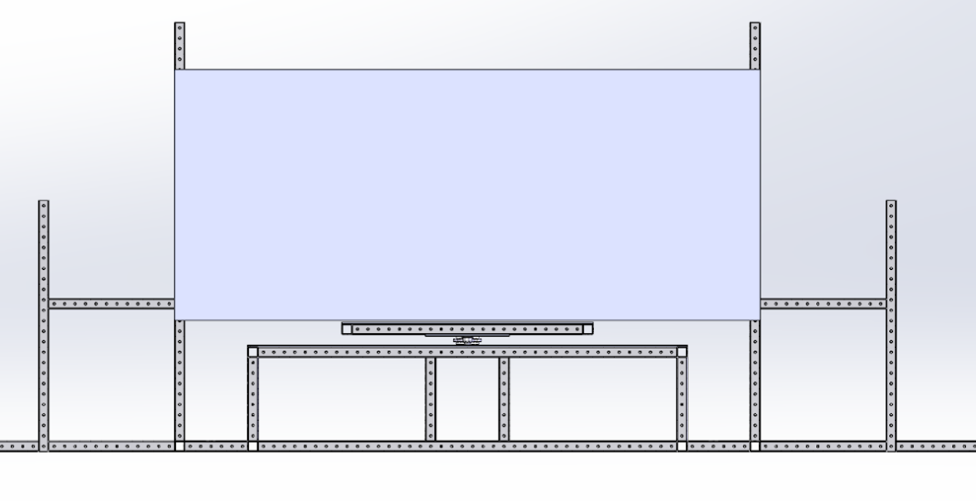
Friction - Test Setup
Testing fixture with 90 degree pulley
Tether connects to left side of diving board shown in RED
Other end of pulley connected to counter weight, labelled “X”
Dummy load placed on rotating diving board to simulate user’s weight
Tether
Dummy Load
X
Pulley
Testing Load

Slide 38
Friction - Testing
As we load the counterweight
Diving board rotates at some minimum testing load “X”
Then we have
Where W_{LOAD} is just the Dummy Load
Functional Requirement 3 requires this coefficient is always less than 0.3
Tether
Dummy Load
X
Pulley
Testing Load
Note: X represents the minimum input force from user required to overcome friction and “fall”
Notes:
This Functional requirement 3 is want we want to “verify”

Slide 39
Friction - Test Review
Potential Errors & Assumptions
Location / height of perpendicular tether connection is assumed to be the CG of user
Dummy load is a point load, whereas real users represent a distributed load
Testing Load error
Friction in the testing fixture pulley
Tether
Dummy Load
X
Pulley
Testing Load

Slide 40
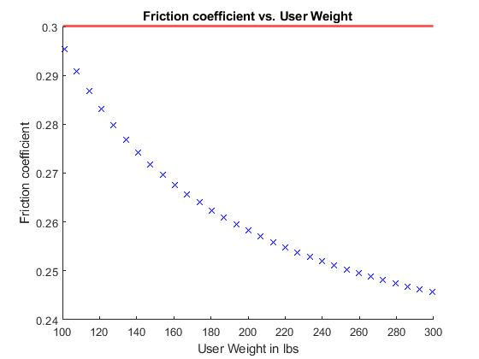
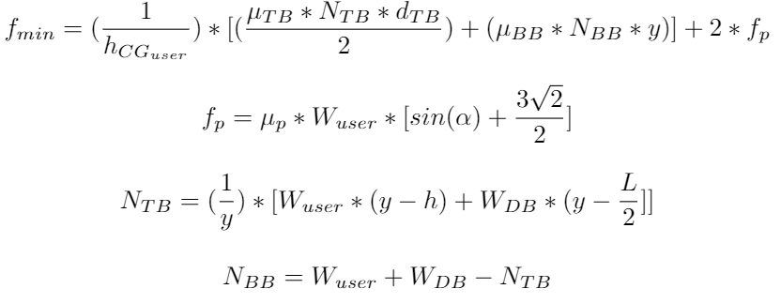
Friction - Model Review
We expect this test to validate the trend shown in this figure, derived from the model also shown
A successful test verifies Functional Requirement 3, where all data points taken have friction coefficients less than 0.3 for all tested user weights
Notes:
Analytical model predicts a higher friction coefficient for lighter users
From the model, describe which variables / knobs can be adjusted to help our FR (critical elements of design)

Slide 41
Budget

Slide 42
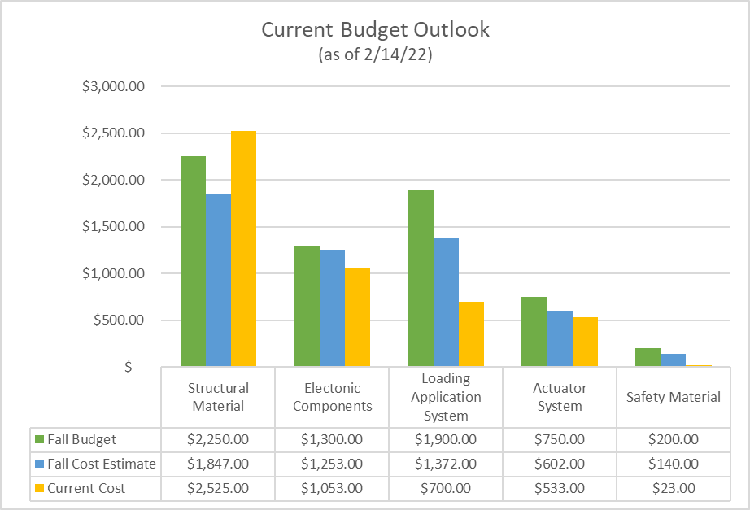
Current Budget Overview
Team is still under budget of with almost all structural material
Shipping costs have significantly increased from the estimates calculated in the Fall
Estimated $1,000 of items (w/ shipping) yet to be purchased with a current $1,600 of budget left
Remaining Margins:
Structural: -$275
Electrical: $247
Loading System: $1200
Actuator System: $217
Safety Systems: $227
Notes:
Key items yet to be purchased: All harness and safety equipment, Actuator carriage off the shelf items, Sandbags, Pulleys and rope, “Diving Board” material
Say when we’ll buy the stuff that we’ll need left.
State the current level of risk
Add in what’s still outstanding to purchased and lead times (key items

Slide 43
Appendix

Slide 44
Force Direction Test
Purpose:
Ensure the system meets FR 2
The applied force is within 2 degrees of normal to the support surface
Ensure proper integration of system electronics, software, and structure
Test Equipment:
Complete assembly of GOATSES
Humanoid dummy mass (anthropomorphic shape)
GOATSES Project space
Direction of Earth gravity
±2°
BendLabs Angle
Sensor
Actuator Limit Switches
6-axis IMU

Slide 45
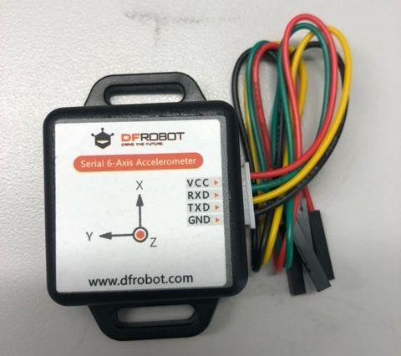
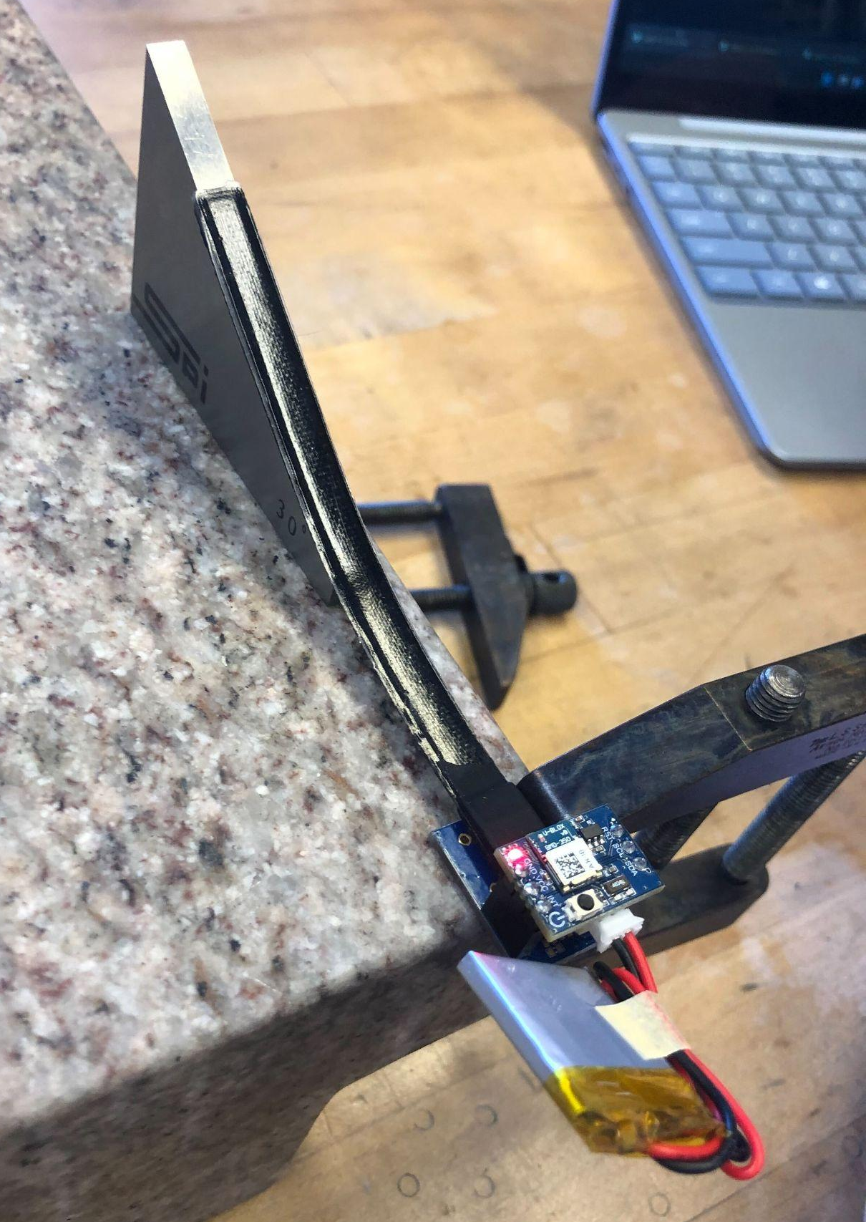
Sensor Verification
Confirming advertised sensor accuracy
Understanding sensor usage and implementation
6-Axis IMU:
Collect range of Gyroscope angle measurements at known angles, analyze error
BendLabs Angle Sensor:
Measure and collect data for incremental known angles using a high-tolerance granite flat surface and machinist angle blocks
30°

Slide 46
Motion Control Verification
Confirm software and circuitry is able to communicate with and control the motor driver such that the actuator translates accordingly
Ensure the actuator translates with expected delay, speed, and accuracy
Will feed pre-built lean profile angles into the PID control law and send output commands to the Actuator
Will measure the delay between data receival to command completion, actuator speed, and actuator translational accuracy (to PID output command)
*Not actual data

Slide 47
Crane Scale Verification
Purpose:
Ensure crane scale is accurate to within 0.1 pound so that force magnitude can be accurately calculated
Test Equipment:
Both crane scales, bucket, water, measuring cup
Test Procedure:
Hang up crane scale
Weigh bucket several times. Ensure weight is equal each time
Fill bucket with water in 1000 mL increments
Ensure weight value rises 2.2 pounds each time
Results:
Crane scale passes test if value rises a uniform 2.2 pounds with each addition of 1000 mL water
X.X

Slide 48
Structural Testing
Purpose:
Ensure weakest aspects of GOATSES assembly can withstand operating stresses
Test Equipment:
GOATSES test environment pre-final assembly
Sand drum (filled with sand)
Test Procedure:
Fill sand drum to max capacity (225 pounds)
Place sand drum on support surface
Check for any visible deformation
Repeat 3 & 4 for diving board and translation table
Results:
Weakest parts of assembly are plywood components. If these components show no sign of deformation under high stresses, structure passes test
1
2
3

Slide 49
Safety Verification
Purpose:
Ensure system meets requirement F6 and components providing user safety are robust
Test Equipment:
GOATSES harness, D-rings, and snap shackles
Crane scale
Sand drum (filled with sand)
Pulley
Cable
Test Procedure:
Fill sand drum to max capacity (225 pounds) and support it underneath
Connect cable to harness material
Release sand drum support
Check for visible deformation
Repeat for D-rings and snap shackles
Results:
If these components show no sign of deformation under high stresses, safety components pass test
Device tested
Static support
Sand drum (225 lbs)

Slide 50
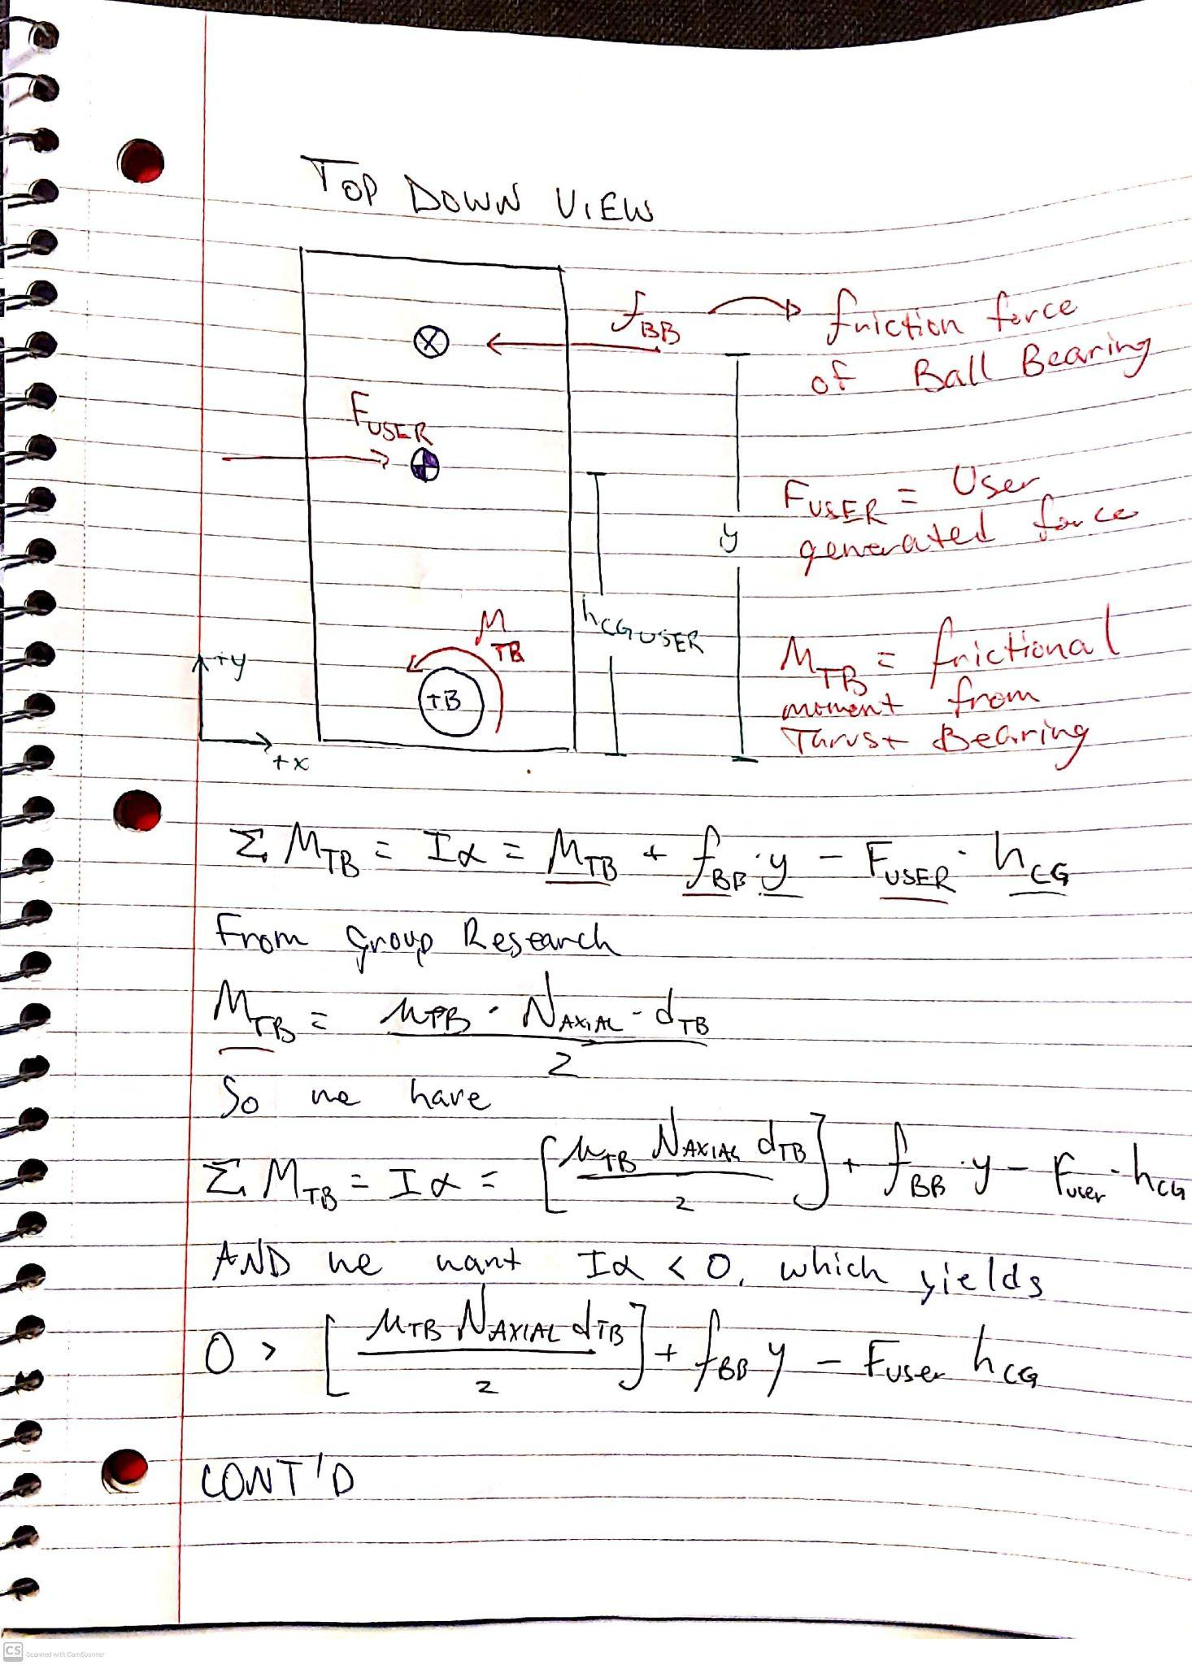
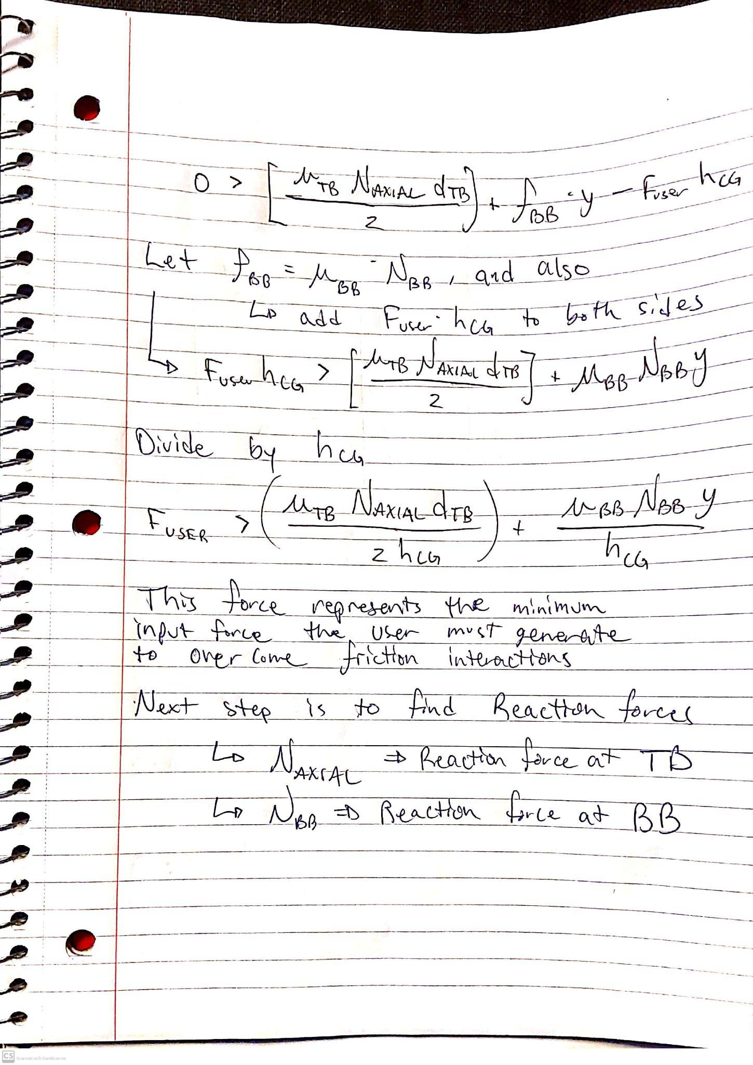
Friction Model Derivation - Bearings

Slide 51
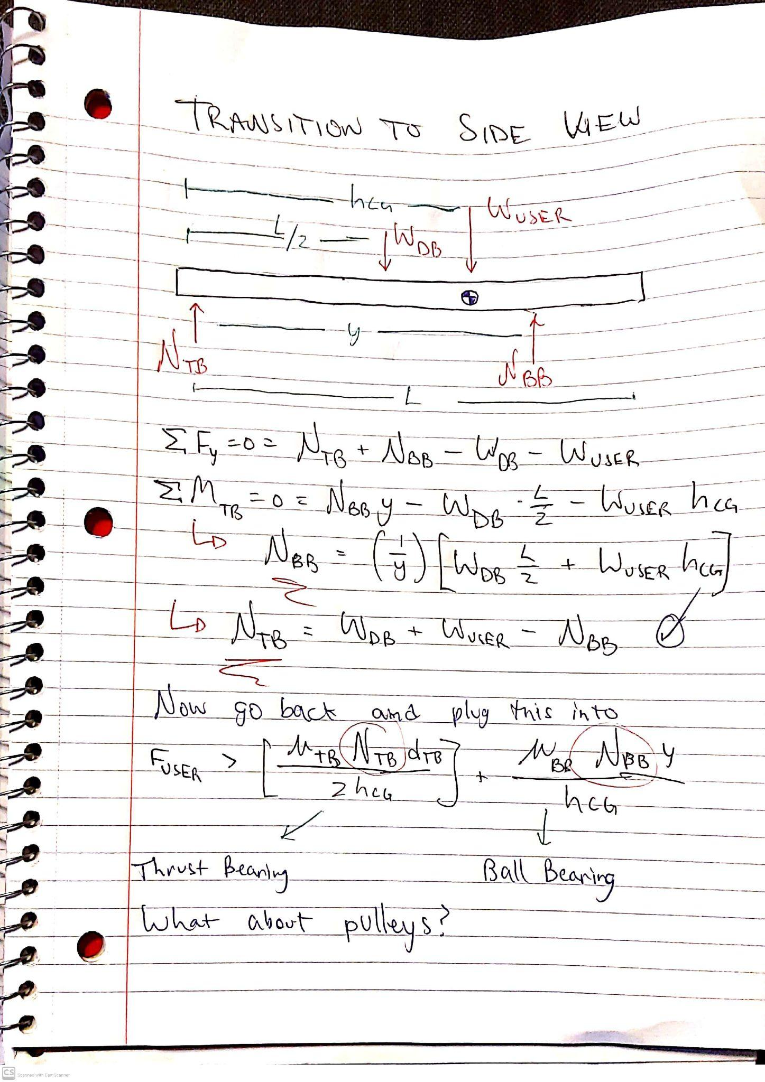
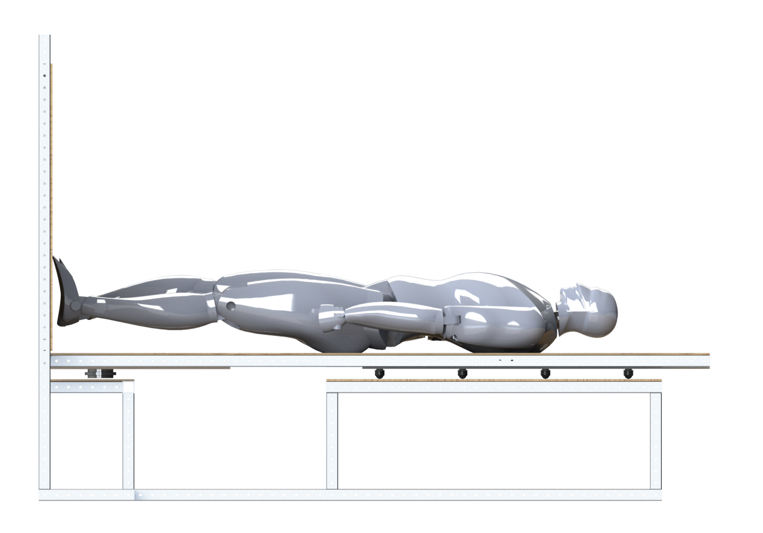
Friction Model Derivation - Bearings

Slide 52
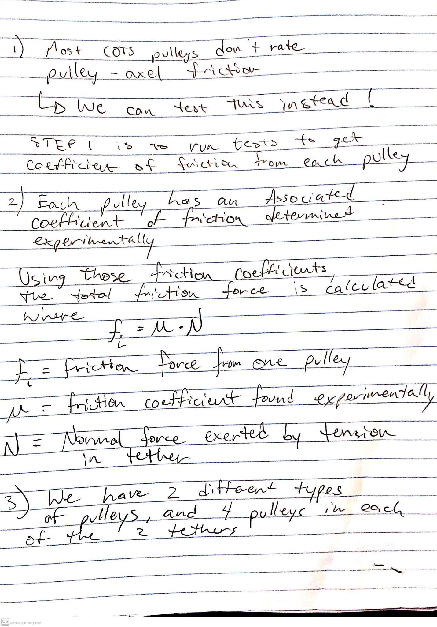
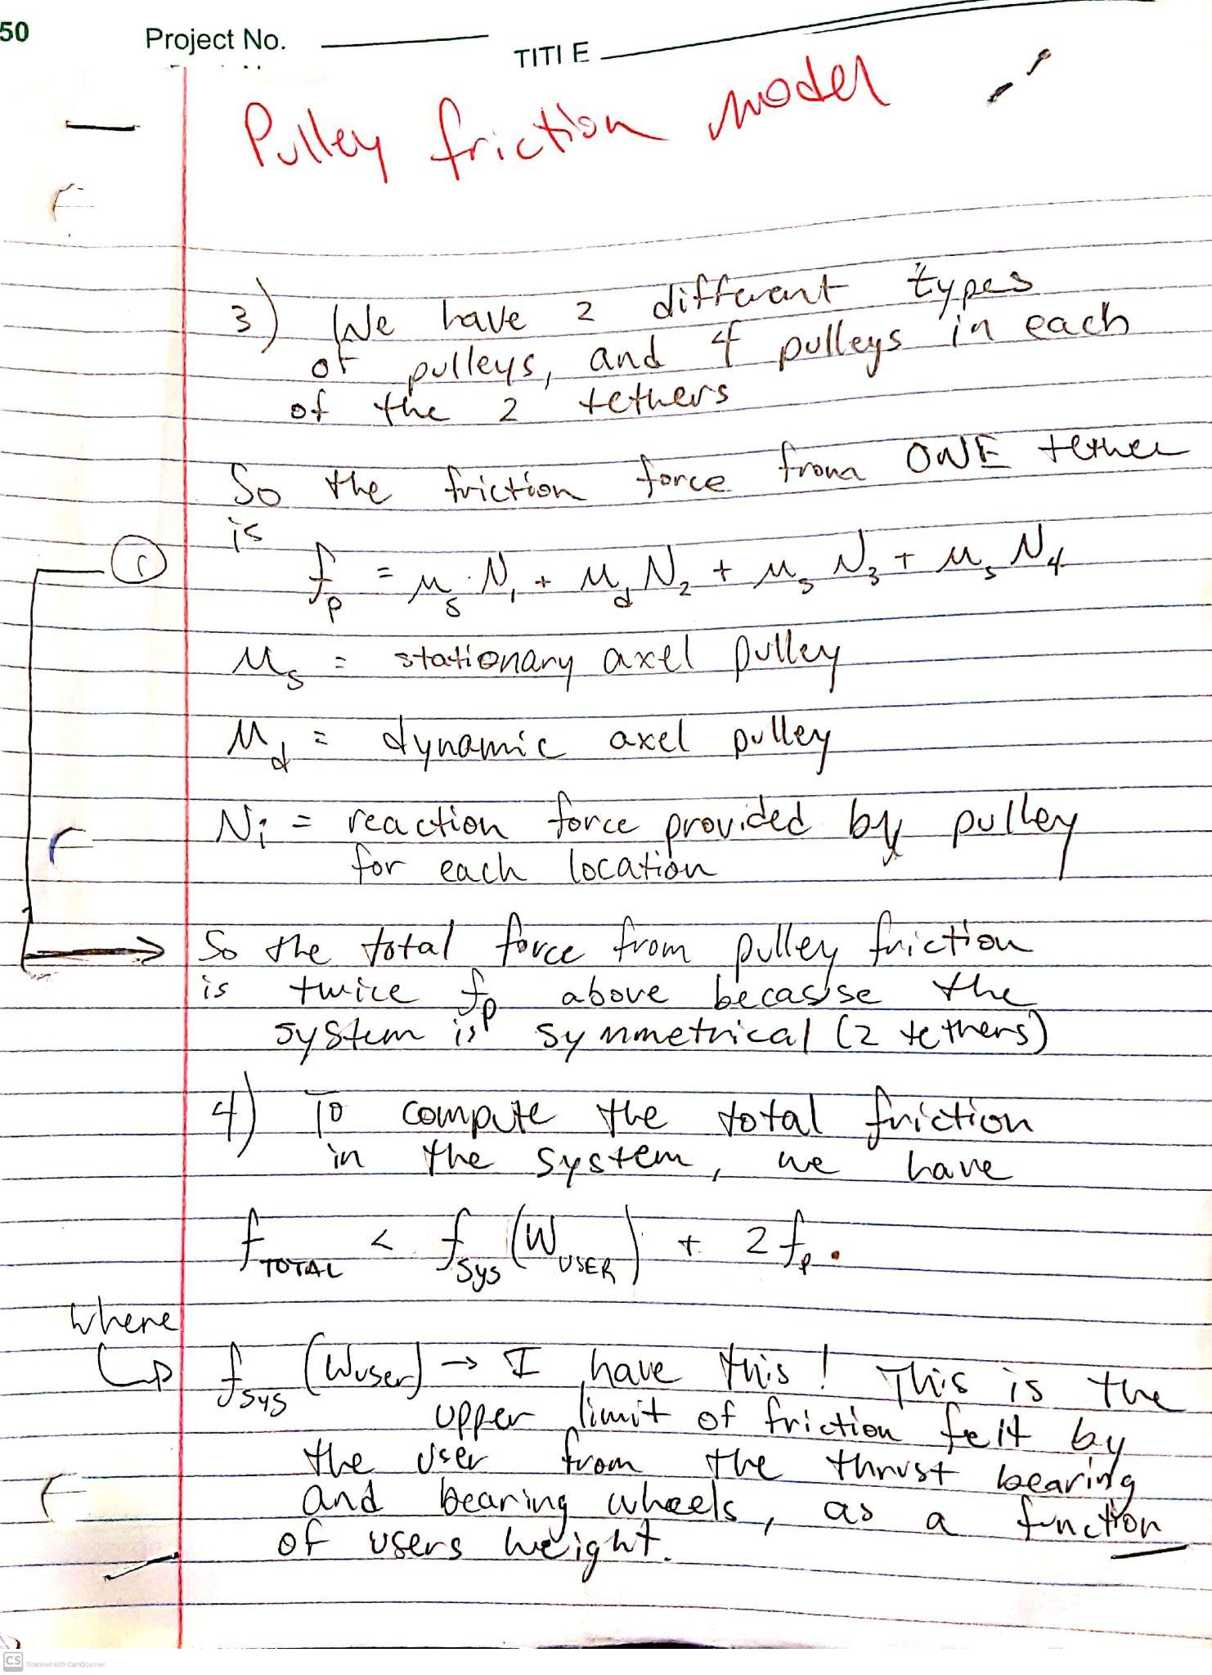
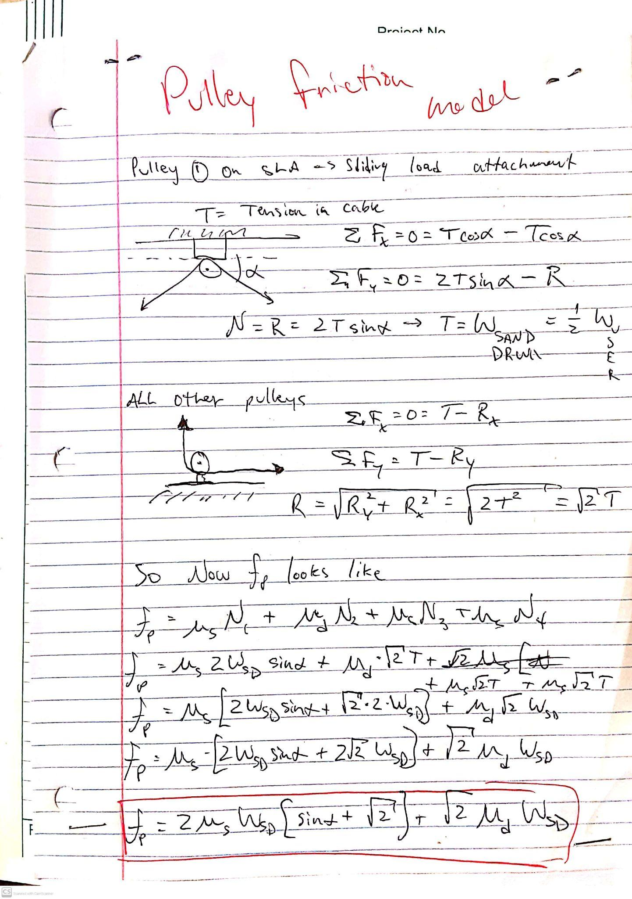
Friction Model Derivation - Pulleys

Slide 53
Universal Test Subject
50th Percentile American Male, NASA Handbook
(APPENDIX B) [7]
Height: 171.6 cm
Weight: 73 kg
CoM: 103.1 cm
Depth: 24.65 cm
Foot Size: 26.05 cm
Lean Max: 7.6º
Postural Sway of the Human Subject is modeled by 0.5 hz sine wave, as per Dr. Temple’s research.
Back/forth displacement of the Universal Test Subject is assumed to be modeled as a pendulum swing, modeled in MATLAB.
Notes:
dr clark used a pendulum w/ .5 hz sine wave with 10 degree amplitude. It’s an assumption: we want to do humans: we MODEL sway as pendulum sway. Mention that these are not worst case (except for the angle)

Slide 54
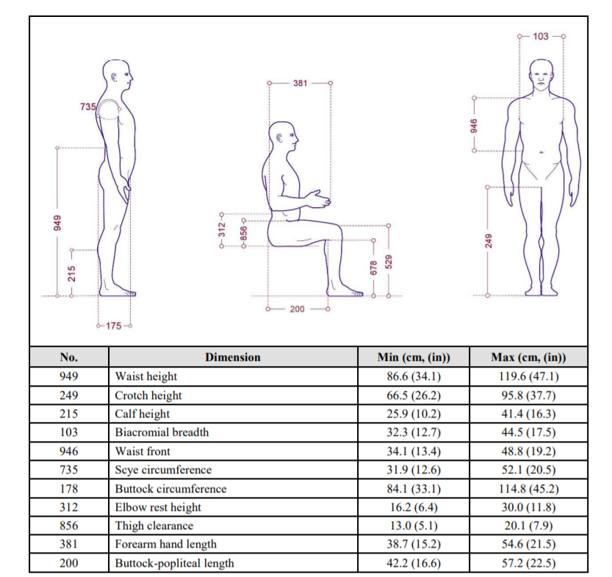
Universal Test Subject
50th Percentile American Male, NASA Handbook (APPENDIX B) [7]
Height: 171.6 cm
CoM: 103.1 cm (Up From Foot)
Shoulder Width: 46.95 cm
Torso Width: 38.4 cm
Depth: 24.65 cm
Foot Size: 26.05 cm
Lean Max: 7.6º
Sway Max: 5.4º
Weight: 73 kg
Notes:
Add in dr clark about the pendulum .5 hz sway assumption: we want to do humans: we MODEL sway as pendulum sway

Slide 55
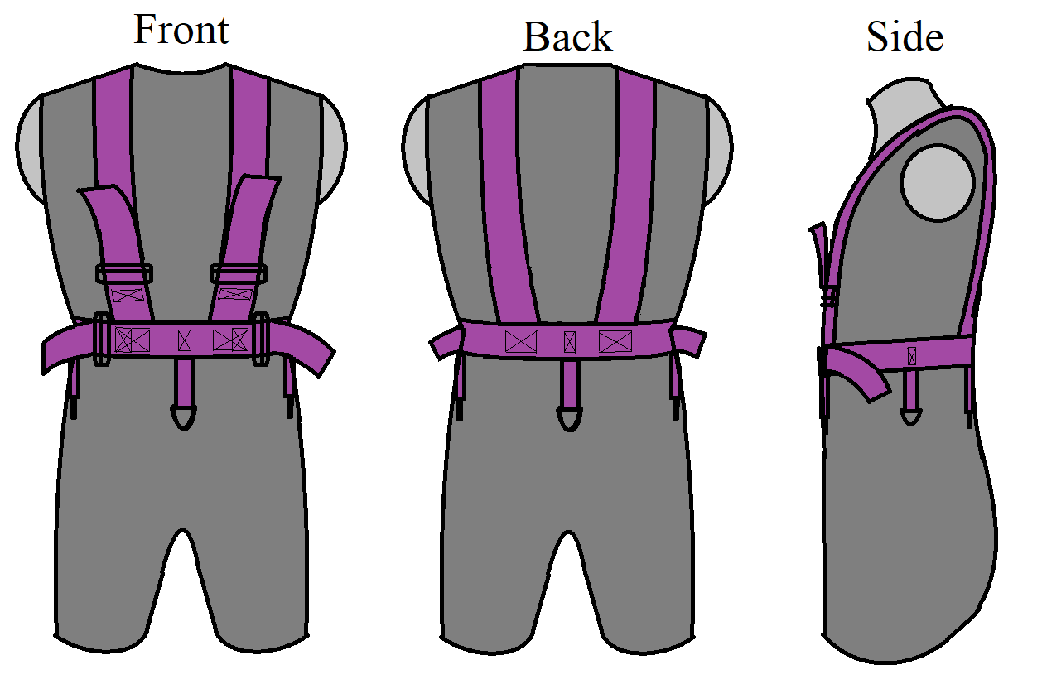
Safety - Harness and Padding
Harness:
Webbing: Polypropylene, 2”width, supporting 1080 lbs AND Nylon, 1”width, supporting 1415 lbs.
Sliders: Supporting 500 lbs, D-rings: Supporting 1000 lbs.
Slackline:
D-Ring: ¼” mounted D-rings, supports 1,200 lbs.
Tether: ¼” Vectran rope, supports 1,600 lbs.
Secondary visual (Eli ideas)
Padding:
Polyurethane foam, 2” thick
Notes:
Grip tape for foot support
Harness design/manufacturing methods
Harness load distribution + adjustability
Slackline system design
Padding for comfort overview

Slide 56
Loading Mechanism - CAD
Stationary Pulley
Force Application Tether
15.75”
50.875”
Sand-filled Barrel
30.5”
Swiveling Pulley
Motion
23.875”

Slide 57
Software Team Breakdown
Actuator Control Team
Develop encapsulated function(s) to control the linear actuator position given a desired position
Sensor Data Collection Team
Develop encapsulated function(s) to query and collect data from angle sensors and body mounted IMU
Software Systems Team
Coordinate the integration of all subsystems
GUI & Matlab Interface Team
Develop a Graphical User Interface in Matlab designed to display test data and develop a simple method for Matlab to Arduino Connection
Control Algorithm Team
Develop encapsulated function(s) to compute the required actuator movement given current measured angle
Notes:
We can clean up this diagram, but this is the idea

Slide 58
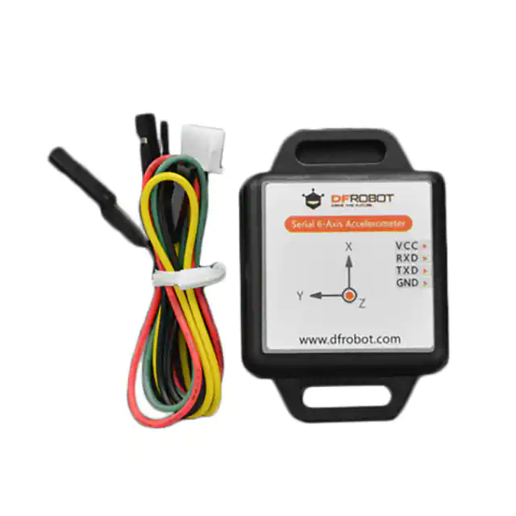
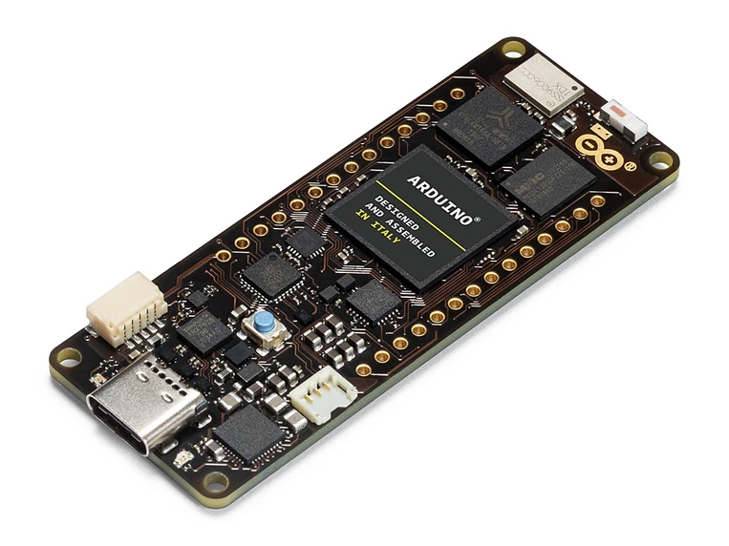
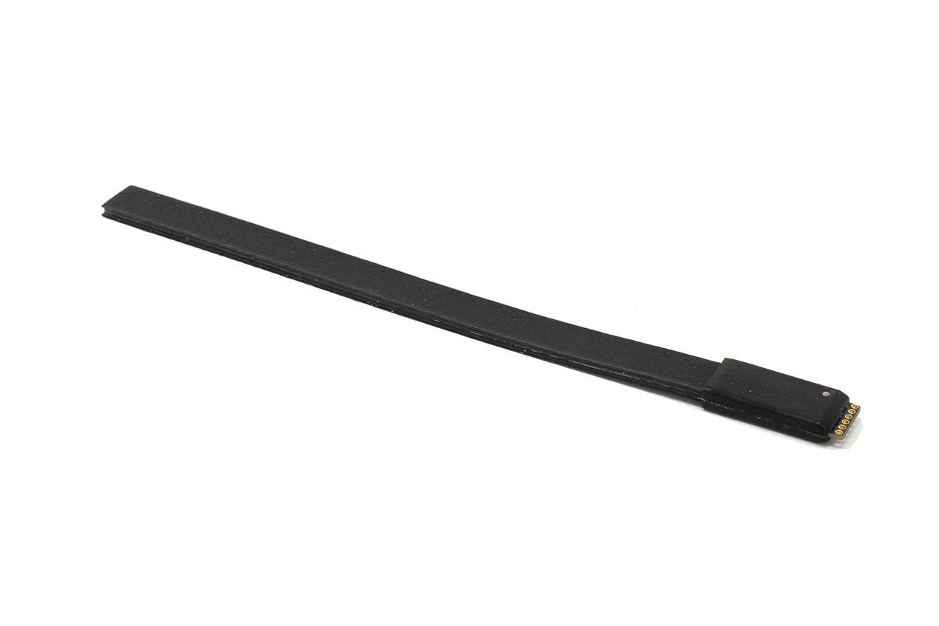
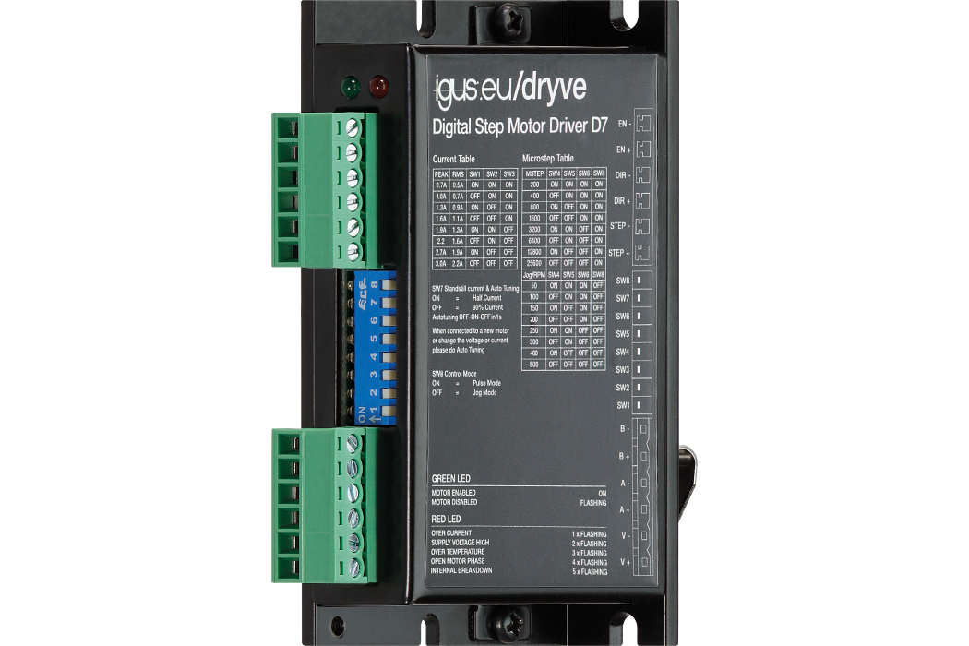
Sensors and Controls - Component Choices
Microcontroller
Angle Sensors
Actuator Motor Controller
Body IMU sensor
Arduino Portentia H7
Bendlabs 1-Axis Soft Flex Sensor
drylin D7 stepper motor output stage
DFRobot SEN0386
Notes:
We can clean up this diagram, but this is the idea

Slide 59
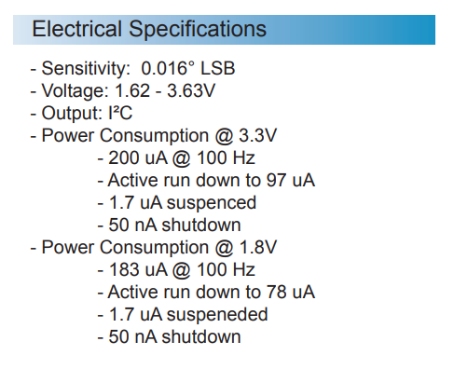
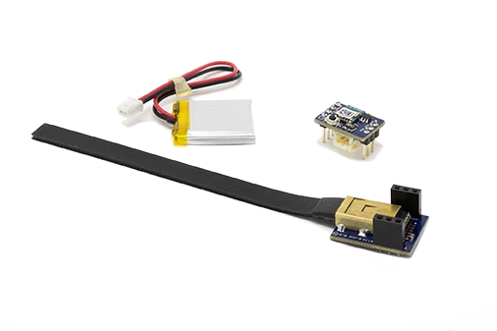
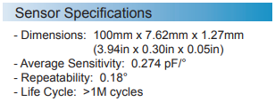
Chosen Sensor Specs
BendLabs 1-Axis Evaluation Kit
High precision
Low power
Wireless option
Interfaces with Arduino or LabView DAC
High Refresh rate
Relatively expensive

Slide 60
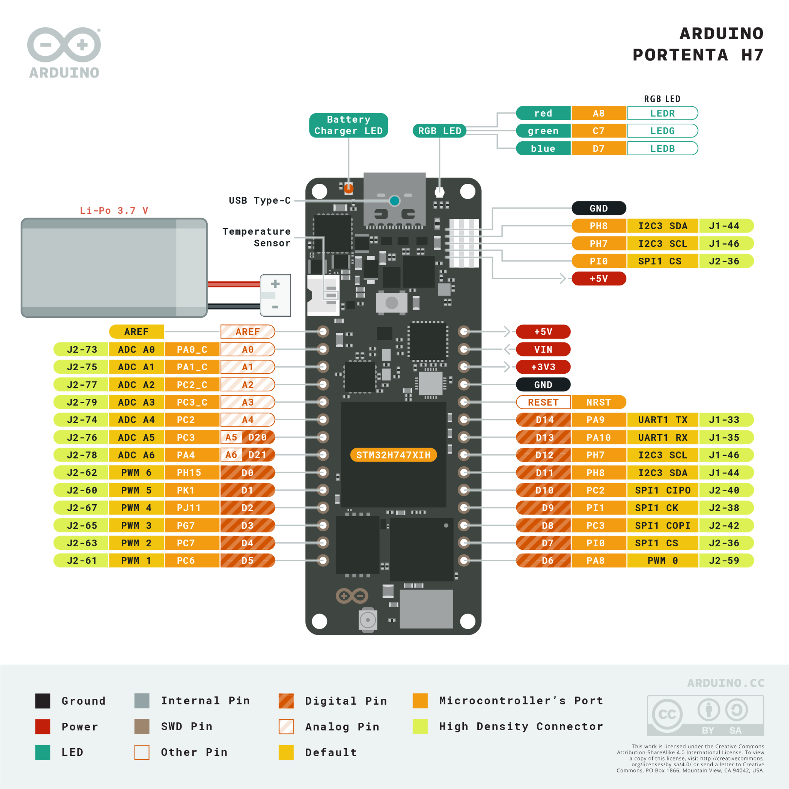
Chosen Sensor Specs
Arduino
Arduino Portentia H7 for computations and actuator command
Dual Cores for simultaneous Processing and command

Slide 61
Chosen Actuator Specs
Actuator Specs:
350mm stroke length
NEMA-17 Motor with torque of 0.5 Nm
Acceleration controlled by controllers
48 VDC power input at 1.8A
Capable of speeds greater than required

Slide 62
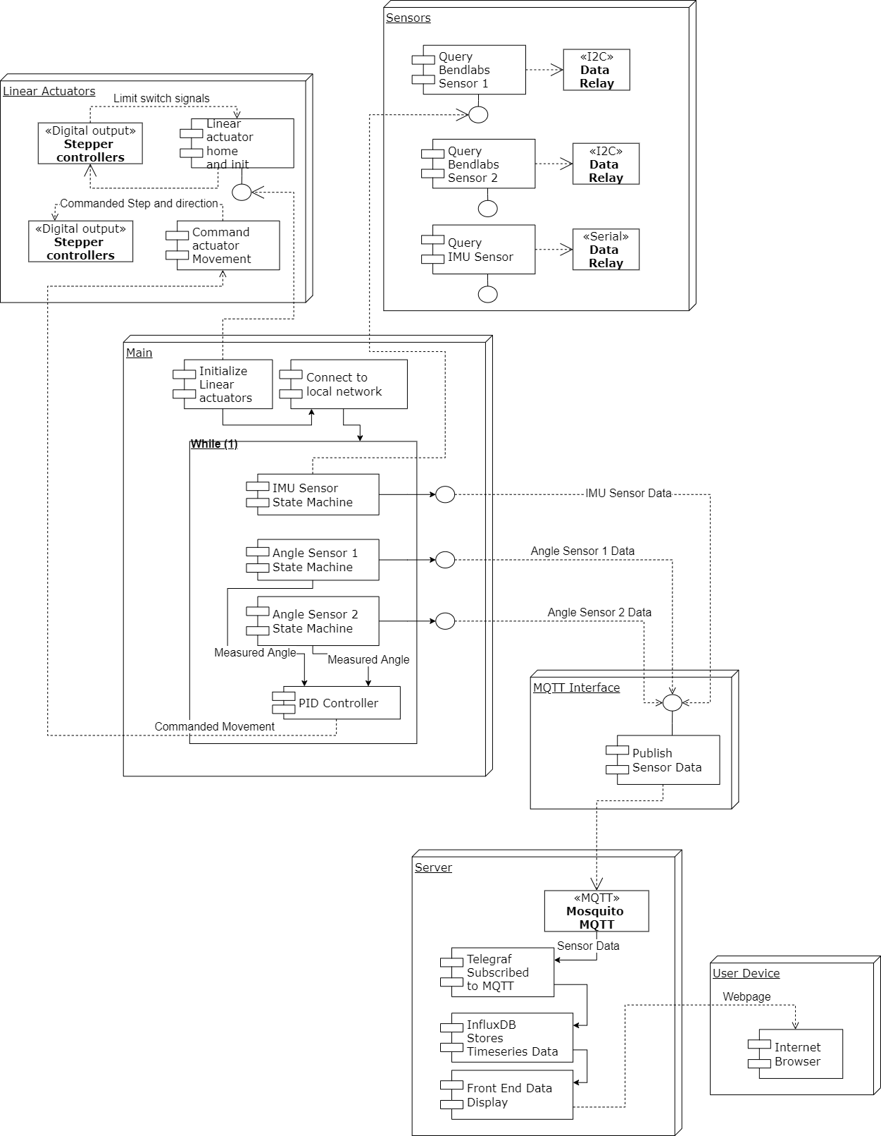
Software Control Block Diagram

Slide 63
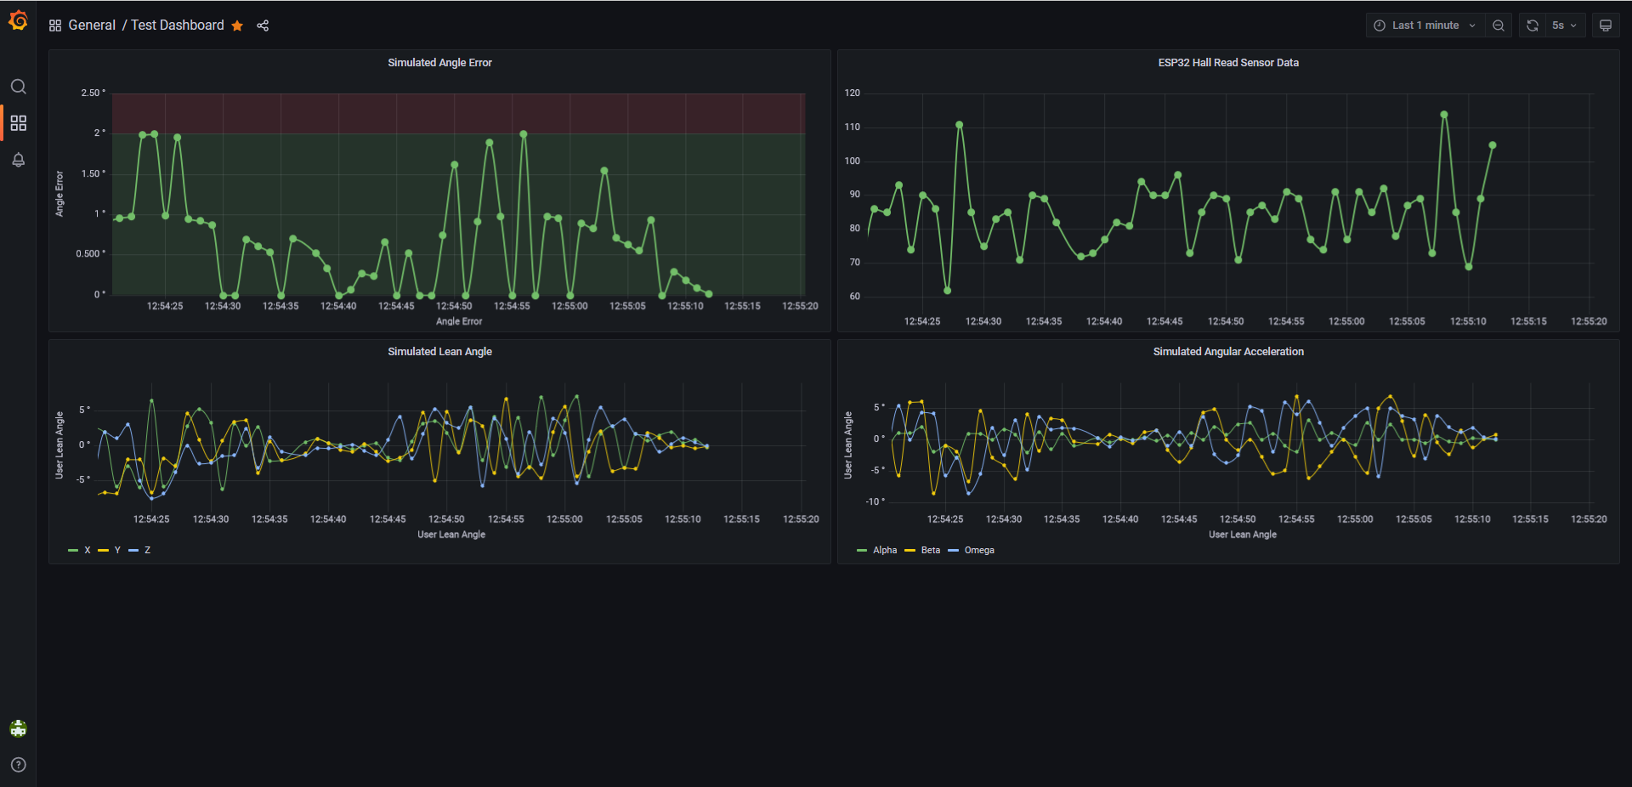
Server GUI
*Not actual data

Slide 64
Engineering Budgets
Component | Power (W)
6-Axis IMU | 0.132
BendLabs Angle Sensor | 0.00132
Stepper Controllers | 172.8
Total: | 172.93332
Subsystem | Mass (lb)
Loading Mechanism | ~100 (Unloaded), ~550 (Fully Loaded)
Test Environment | ~178
Sliding Load Attachment | ~18
Total System Mass: | 293 - 716

Slide 65
Cost Plan Major Items BOM (Structural and Mechanical)
Major Item: | Description | Quantity | Total Cost | Vendor
Structural Beams (10’ Long) | Aluminum 1.5"x1.5" square tubing. .125" Thick. 10’ Long | x20 | $1,290.00 | McMaster-Carr
Structural Beams (8’ Long) | Aluminum 1.5"x1.5" square tubing. .125" Thick. 8’ Long | x6 | $312.36 | McMaster-Carr
Angle Bar | Multipurpose 6061 Aluminum, .125” Thick, 90deg Angle with Round Edge, 1.5” Outside Height, 8’ Long | x2 | $76.98 | McMaster-Carr
Aluminum Bar #1 | .125”x4”x36” 6061 Aluminum | x1 | $18.00 | McMaster-Carr
Aluminum Bar #2 (6’ Long) | .125”x1.5” 6061 Aluminum | x1 | $13.28 | McMaster-Carr
Aluminum Bar #2 (3’ Long) | .125”x1.5” 6061 Aluminum | x1 | $7.57 | McMaster-Carr

Slide 66
Cost Plan Major Items BOM (Structural and Mechanical CONT.)
Major Item: | Description | Quantity | Total Cost | Vendor
Force Tethers | Low-Stretch Easy-Splice Rope—For Lifting | 1 x 25’ spool | $70.00 | McMaster-Carr
Weights | 50 lb Sandbags | x9 | $35.82 | Lowe’s
Platform Metal | 4’x8’, .032" thick, Aluminum | x1 | $137.23 | Armor Steel
Platform Wood | 4’x8’ Southern Yellow Pine | x2 | $74.36 | HomeDepot
Slewing Bearing | Ring Bearing: Aluminum,30mm Inside Dia,100mm Outside Dia, 29mm Wd | x1 | $238.00 | Grainger
Ball Bearing Castors | 286 lbs Heavy Duty Stainless Steel Ball Transfer Unit | x3 | $65.25 | VXB Ball Bearings

Slide 67
Cost Plan Major Items BOM (Electrical and Human Factors)
Major Item: | Description | Quantity | Total Cost | Vendor
Linear Actuators | ZLN-40 Linear Actuator | x2 | $354.22 | Drylin Drive Technology
Angle Sensors | 1-Axis Evaluation Kit, Flexible bidirectional sensor | x2 | $199.98 | Bendlabs
Arduino | Arduino Portenta H7 Dual Core Microcontroller | x1 | $103.40 | Arduino
Stepper Motors | TB67S249FTG Stepper Motor Driver Carrier - Full Breakout 47V at 1.7 A, NEMA 17 | x2 | $23.90 | Pololu
Mattress Topper | Polyurethane foam, 2”x 22” x 22” | x2 | $17.96 | HomeDepot
Support Surface Mat | Plywood Board | x1 | $37.00 | HomeDepot

Slide 68
Cost Plan Current Budget Outlook Spreadsheet
Category | Fall Budget | Fall Cost Estimate | Current Cost (as of 2/14/22) | Remaining Margin (as of 2/14/22)
Structural Material | $2,250 | $1,847 | $2,482 | -$232
Electronic Components | $1,300 | $1,253 | $1,053 | $247
Loading Application Systems | $1,500 | $1,372 | $700 | $800
Actuator System | $750 | $602 | $533 | $217
Safety Material | $200 | $140 | $23 | $117
Total | $6,000 | $5,214 | $4,791 | $1,209

Slide 69
References

Slide 70
Presentation References
[1] Garcia, Mark. “Astronaut David Saint-Jacques Is Carried to a Medical Tent.” NASA, NASA, 25 June 2019, https://www.nasa.gov/image-feature/expedition-59-canadian-space-agency-astronaut-david-saint-jacques-is-carried-to-a.
[2] Mulavara, Ajitkumar P., et al. “Locomotor function after long-duration space flight: effects and motor learning during recovery.” \emph{Experimental Brain Research} vol. 202, no. 3, 2010, pp. 649-659 doi: 10.1007/s00221-010-2171-0.
[3] Mars, Kelli. “Analog Missions: Bed Rest Faqs.” NASA, NASA, 26 Mar. 2019, https://www.nasa.gov/analogs/envihab/bed-rest-faqs.
[4] McMaster-Carr,“Fibrous Rope”,McMaster-Carr,https://www.mcmaster.com/fibrous-rope/
[5] Densities of materials. Engineering ToolBox. (n.d.). Retrieved October 5, 2021, from https://www.engineeringtoolbox.com/density-materials-d_1652.html.
[6] Tleto. “Polyurethane Coefficient of Friction.” Gallagher Custom Polyurethane Molding, 29 Oct. 2020, https://gallaghercorp.com/polyurethane-coefficient-of-friction/.
[7] NASA, “Human Integration Design Handbook (HIDH)”, NASA Special Publication SP-2010-3407-REV1, 2014.

Slide 71
Presentation References
[8] “Friction and Friction Coefficients.” Engineering ToolBox, https://www.engineeringtoolbox.com/friction-coefficients-d_778.html.
[9] “Measuring Stepper Motor holding torque” https://www.applied-motion.com/news/2015/10/dynamic-torque-step-motor-sizing
[10] Fryar CD, Carroll MD, Gu Q, Afful J, Ogden CL. “Anthropometric reference data for children and adults: United States, 2015–2018.” National Center for Health Statistics. Vital Health Stat 3(46). 2021.

