Slide 1
Gravity Offloading and Tethering Somatosensory Enhancement System (GOATSES)
Preliminary Design Review
Grace Antonucci, Ben Foehr, Jack Harrison, August Hauter, Quentin Morton, Elena Salgado, Nick Taylor, Isaac Timko, & Cody Wheeler

Slide 2
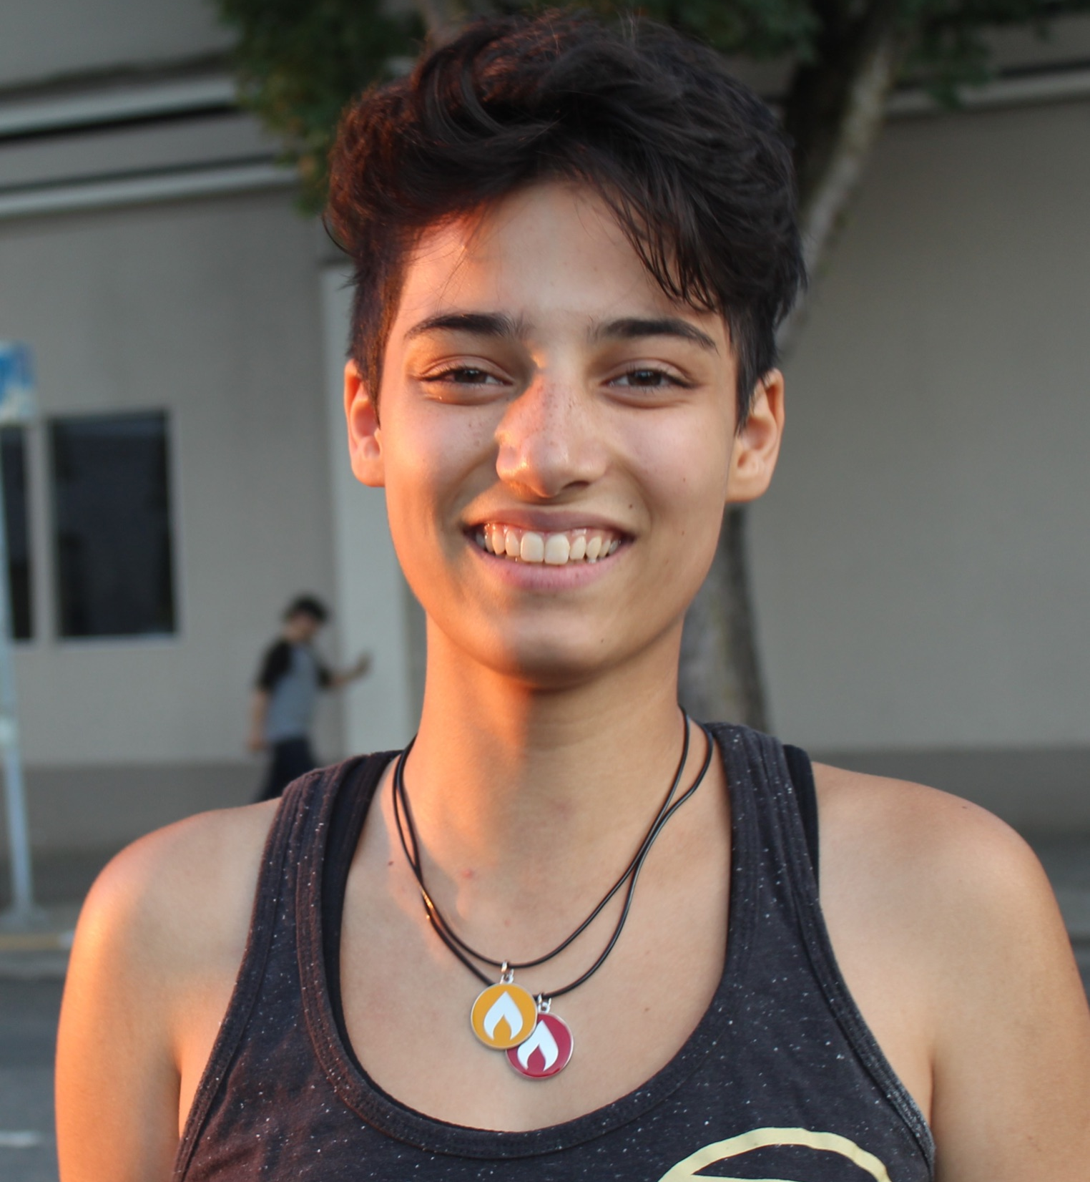
MEET THE TEAM
Cody Wheeler
Design Lead
Ike Timko Electronics Lead
August Hauter
Analysis Lead
CFO
Grace Antonucci
Project Manager
Elena Salgado
Safety Lead
Ben Foehr
Human Factors Lead
Nick Taylor Manufacturing Lead
Quentin Morton
Lead Systems Engineer
Jack Harrison
Testing Lead

Slide 3
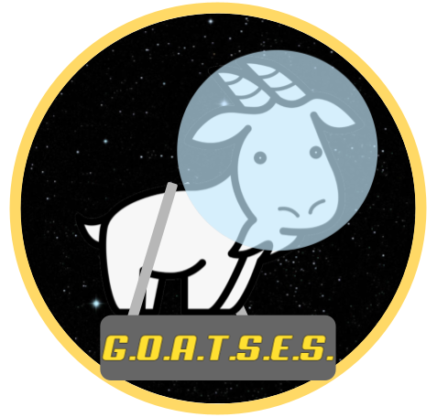
Agenda
Project Description
Baseline Design
Feasibility Studies
Loading Margin
Angle Margin
Friction Margin
Cost
Status & Strategy

Slide 4
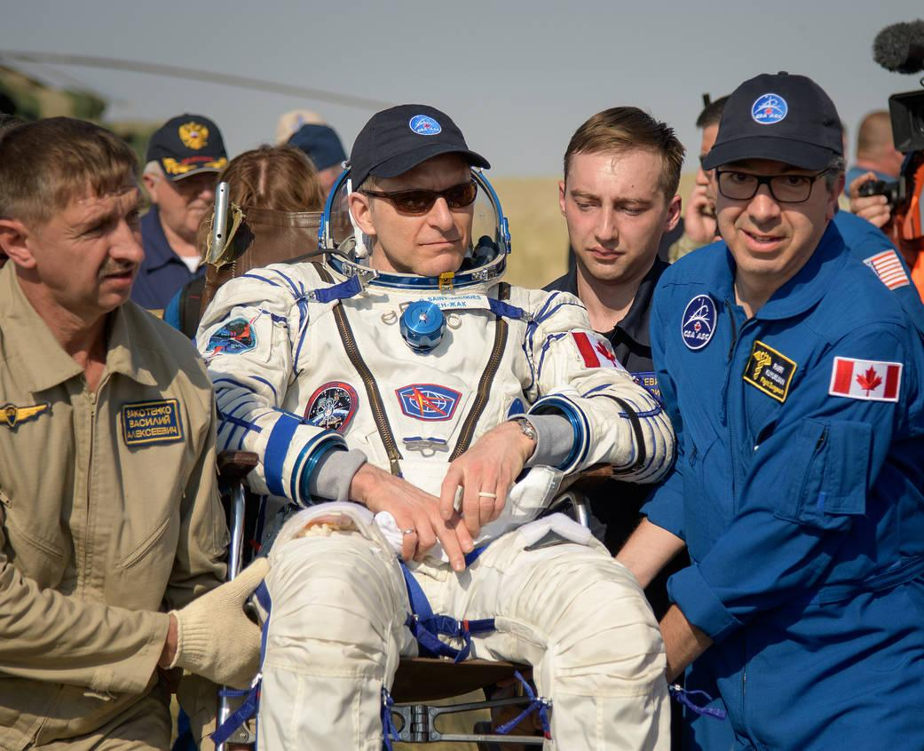
Project Need
Astronauts require, on average, 15 days to recover pre-flight levels of locomotive function required for egress (exiting the capsule). [2]
Astronauts experience loss of proprioceptive function in a microgravity environment.
Proprioceptive function relates to one’s understanding of how their body is positioned and how it is moving.
Retention of postural control is vital for long duration spaceflight missions.
Canadian astronaut, David Saint-Jacques, being carried to the medical tent after returning from 204 days in space. [1]
Notes:
Astronauts require, on average, 15 days to recover pre-flight levels of locomotive function required for egress. [2]
Astronauts sufficiently maintain muscular and cardiovascular strength, but typically experience loss of proprioceptive function.
Proprioceptive function relates to one’s understanding of how their body is positioned and how it is moving.
Loss of proprioceptive functions result in difficulty with tasks such as standing, walking, and balancing.
Retention of postural control is vital for long duration spaceflight missions.

Slide 5
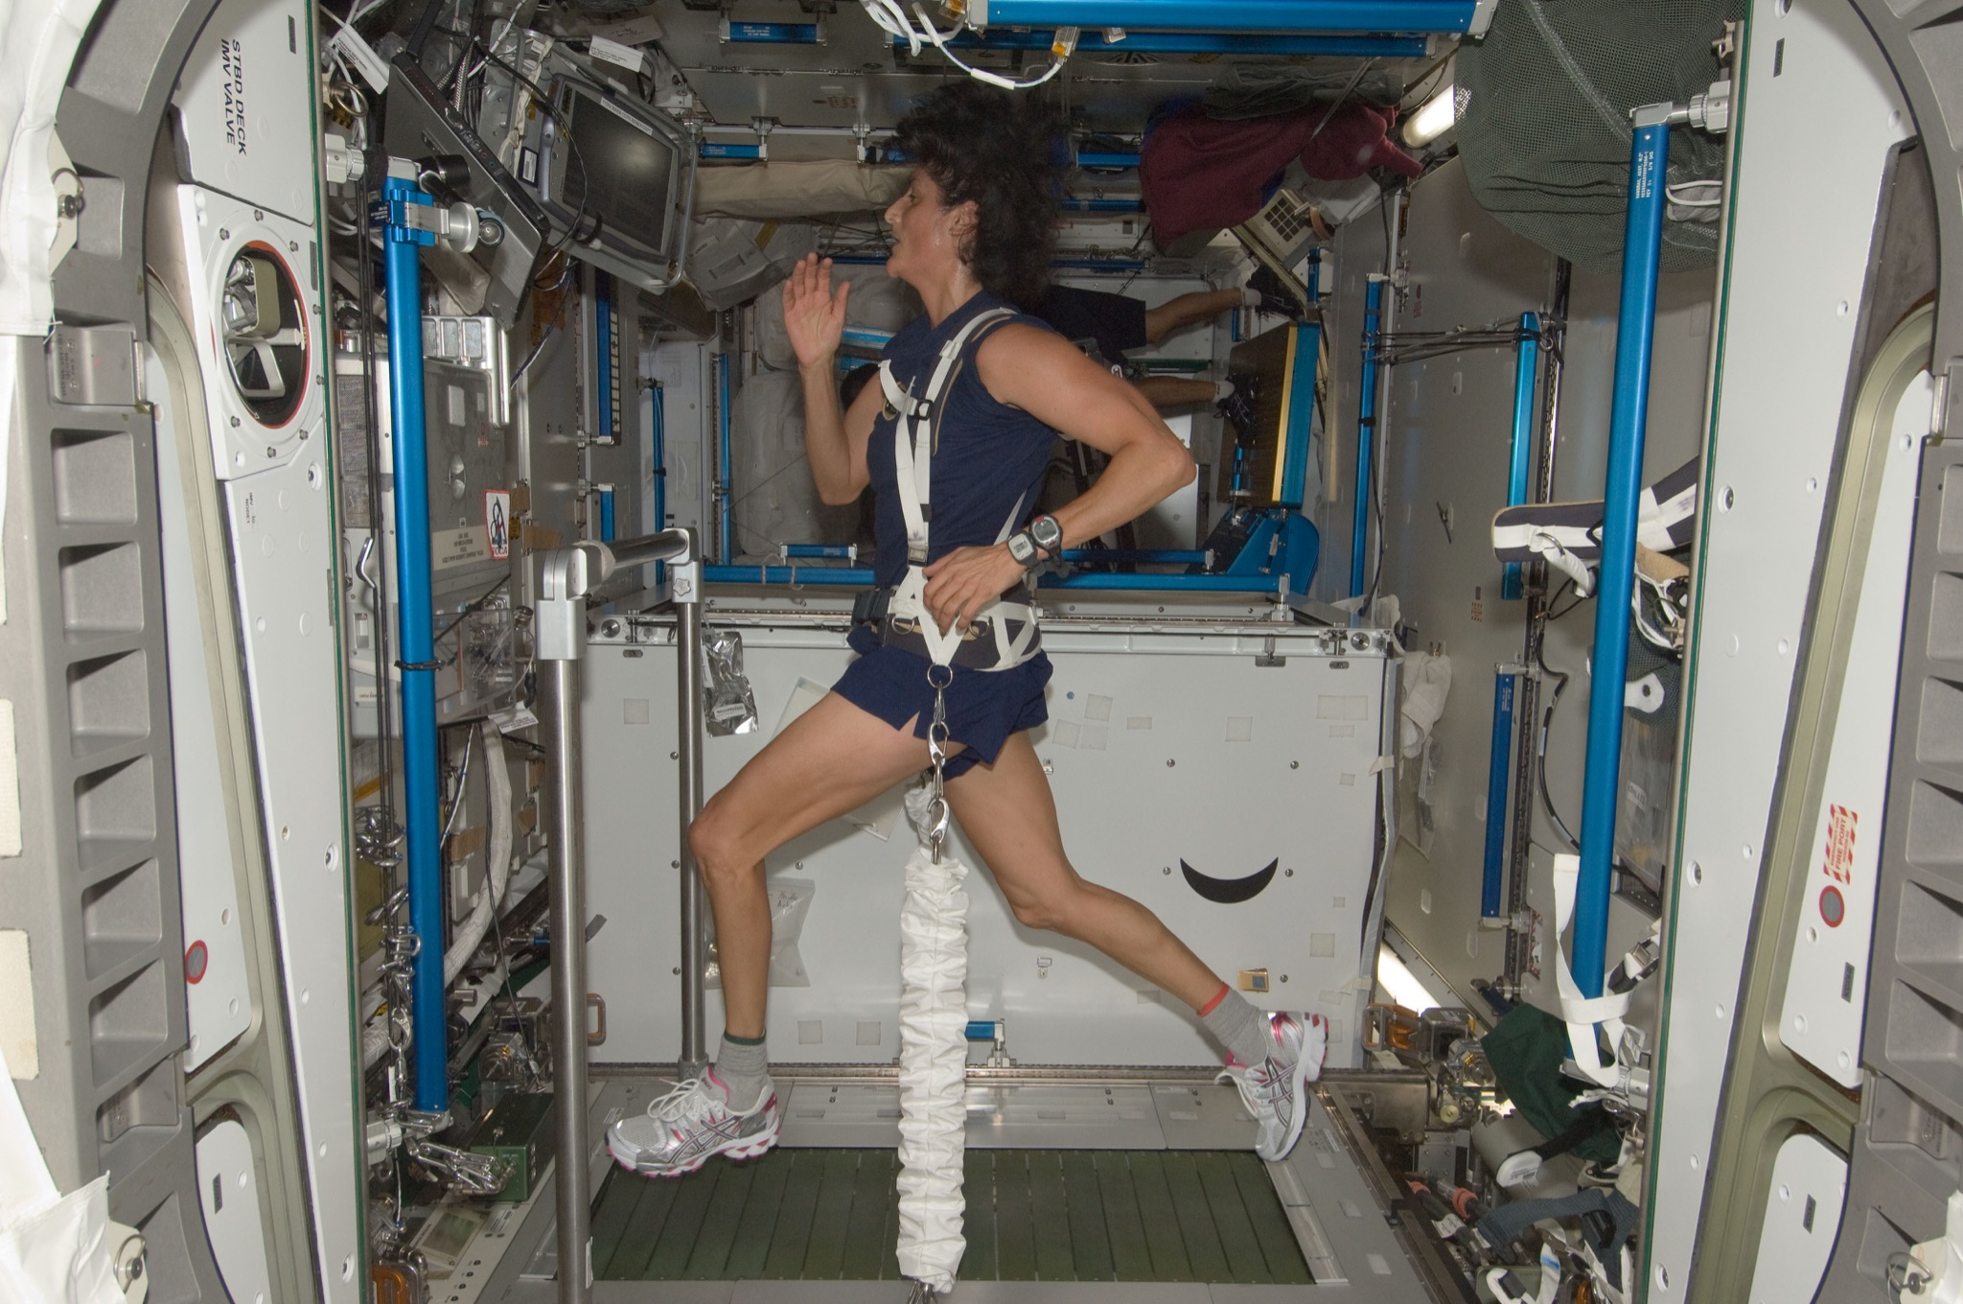
Project Objectives
Current axial loading is problematic
Hypothesis: More realistic gravitational loading = better proprioceptive functions
Device will provide a load that stays perpendicular to support service
Main user base will be bed rest patients
Notes:
Bed rest studies offer scientists ways to see how the body adapts to weightlessness. Volunteers spend up to 70 days in bed with a six-degree head-down tilt. They must eat, exercise, and even shower in the head-down position.
Our project aims to create a device in which maintains a force on the user that is perpendicular to their support surface regardless of postural sway.
This device will be used in laboratory studies to prove whether this improvement in loading direction yields better retention of proprioceptive functions.
Study requires a spaceflight analog such as bedrest.
Bedrest: volunteers spend up to 70 days in bed with a six-degree head-down tilt. They must eat, exercise, and shower in this position. [3]
Astronauts are currently loaded to a single fixed point and therefore they do not need to balance themselves.
It is hypothesized that if astronauts were loaded as if in a realistic gravitational field, it would help maintain proprioceptive function by requiring them to balance themselves.
Our project aims to create a device in which maintains a force on the user that is perpendicular to their support surface regardless of postural sway.
This device will be used in laboratory studies to prove whether this improvement in loading direction yields better retention of proprioceptive functions.
Study requires spaceflight analog such as bedrest.
Bedrest: volunteers spend up to 70 days in bed with a six-degree head-down tilt. They must eat, exercise, and shower in this position. [3]

Slide 6
Project Description

Slide 7
Functional Requirements
Number | Functional (Driving) Requirement | Verified By:
F1 | The device shall provide a force on the user not to exceed 1.3 kN | Force Measurement
F2 | The device shall generate a gravity vector that does not deviate greater than an angle of 2 degrees from the true perpendicular to the support surface | Angle Measurement
F3 | The device shall allow for user postural sway by limiting the coefficient of friction present opposite to the direction of sway to 0.3 | Material Properties
F4 | The device shall be able to load the user as they move within a 2 m² area | Design Dimensions
F5 | The artificial force should act between the hips and shoulders of the user | Biological Analysis
F6 | The device shall prevent the user from falling if the user enters an unrecoverable state | Simulated Fall
F7 | The device shall be compatible with a person with a height of 1.5-2 m, a weight not to exceed 113.4 kg, and a hip breadth of 31-46 cm [7] | Design Dimensions
F8 | The device shall accommodate Earth-based testing such that Earth gravity will not be a confounding variable | Testing Equipment

Slide 8
Functional Requirements
Number | Functional (Driving) Requirement | Verified By:
F1 | The device shall provide a force on the user not to exceed 1.3 kN | Force Measurement
F2 | The device shall generate a gravity vector that does not deviate greater than an angle of 2 degrees from the true perpendicular to the support surface | Angle Measurement
F3 | The device shall allow for user postural sway by limiting the coefficient of friction present opposite to the direction of sway to 0.3 | Material Properties
F4 | The device shall be able to load the user as they move within a 2 m² area | Design Dimensions
F5 | The artificial force should act between the hips and shoulders of the user | Biological Analysis
F6 | The device shall prevent the user from falling if the user enters an unrecoverable state | Simulated Fall
F7 | The device shall be compatible with a person with a height of 1.5-2 m, a weight not to exceed 113.4 kg, and a hip breadth of 31-46 cm [7] | Design Dimensions
F8 | The device shall accommodate Earth-based testing such that Earth gravity will not be a confounding variable | Testing Equipment

Slide 9
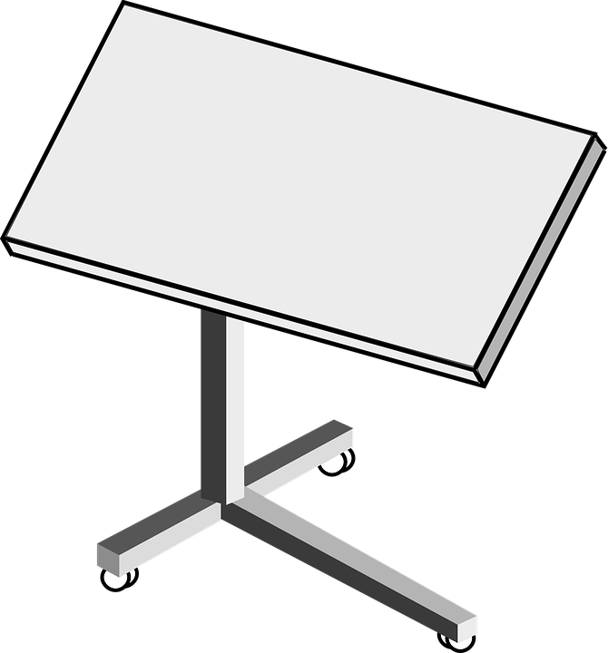
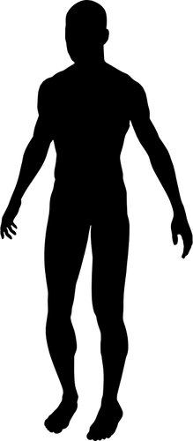
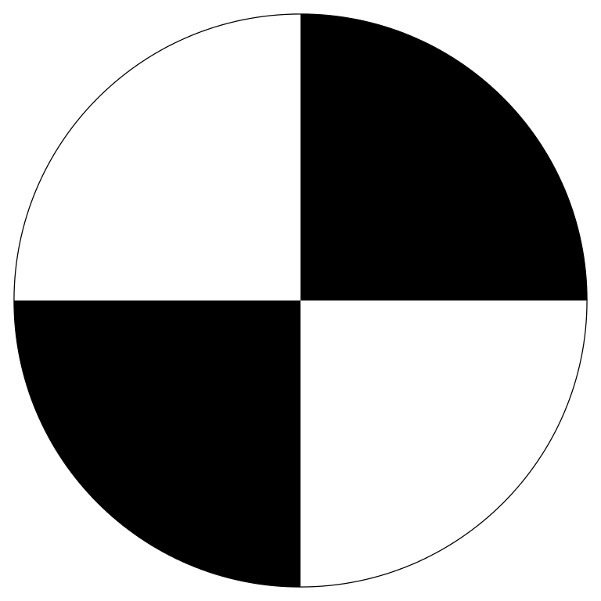
CONOPS
Loading Mechanism
Stage 1: Prep
Take anthropometric measurements
Mass
Distance between attachment point & feet
Test Environment
Support Surface
L
Bed rest Patient

Slide 10
CONOPS
Stage 2: Ingress
User is helped into loading mechanism
Patient cannot stand
Harness is adjusted to fit comfortably

Slide 11
CONOPS
Degree of Freedom
Stage 3a: Use
User can be on their side
Leans front to back
OR User can be on their back
Leans side to side
Trains proprioceptive function
F_{Net}
F_{Net}
User leans

Slide 12
CONOPS
Tether Angle ∠
Body Angle ∠
Tension
Stage 3b: Data Collection
Angle measurement
Body Angle
Tether Angles
Load measurement
Tether Tension
Tether Angle ∠
Tension

Slide 13
CONOPS
Stage 4: Egress
User is helped out of loading mechanism
Patient cannot stand

Slide 14
Baseline Design

Slide 15
Baseline Design Overview
Direction of Earth Gravity
Platform
Direction of Simulated Gravity
Project contains three components:
Test Environment to remove influence of Earth Gravity
Tensioning system to produce force in tether
Translating device (linear actuator) to adjust location of tether
Harness
F_{g}
Support Surface
Tensioning and Translating Systems:
Screw Drive Linear Actuator
Torque Motor
Angle Sensor
Notes:
Subject lays on their back or side on a rolling platform
Two tethers will produce a simulated gravity force perpendicular to Earth’s gravity
The tethers will be loaded via torque motors or sandbags on a pulley system
When the subject leans, the tether attachment points will be moved using a linear actuator to keep the net force perpendicular to the support surface as the subject moves

Slide 16
Test Environment Baseline Design
Direction of Simulated Gravity
A 90-degree test bed removes effect of Earth gravity in the direction of gravity simulation.
This setup will have some friction, which would not be present in a real zero-gravity environment
Coefficient of friction must be low (𝝻 < 0.3) to create most realistic environment
Direction of Earth Gravity
Support Surface
Platform
Low coefficient of friction between rollers and table
Table
N
Friction = 𝝻*N
Notes:
Mention that a feasibility study will be done later in the presentation to cover mu
Mention adjustable height?

Slide 17
Tensioning System Baseline Design
Direction of Earth Gravity
Active tensioning system
Torque motor winds end of tether to produce tension
Passive tensioning system
Load supplied by sandbag on a pulley system connected to each tether
Direction of Simulated Gravity
Tether
𝛂
𝜷
F₁
F₂
Earth Gravity
Motor
F_{g}= F₁+F₂
F₁
Direction of Simulated Gravity
Tether
F₁
Earth Gravity
Sandbag
Direction of Earth Gravity
Sandbag
m_{sand}g = F₁
Notes:
Two tethers connected to subject
F1 = F2 = constant
Not enough time. Both feasible. Team discretion. (Just taking notes)

Slide 18
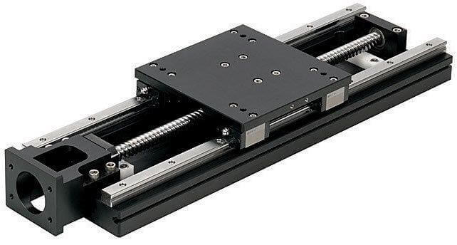
Translation System Baseline Design
Direction of Earth Gravity
The tensioning system is connected to a screw drive linear actuator.
When the angle sensors and accelerometer detect change in 𝛂 , 𝜷, and 𝛉, the actuators will adjust the location of connection points to keep 𝛂=𝜷.
Response time for the actuators determines whether force vector stays within 2° of normal
Accelerometer
Direction of Simulated Gravity
dx
Harness
𝛂
𝜷
F₁
F₂
𝛉
F_{g} = F₁+F₂
±2°
Support Surface
dx
dx
Screw drive
linear actuator

Slide 19
Safety System Baseline Design
Direction of Earth Gravity
Direction of Simulated Gravity
Safety:
An additional tether will be attached to a fixed point as a passive safety system
If the user falls and does not catch themself, this tether will be pulled tight and prevent them from falling
F₁
F₂
F₃
F₁
F₂

Slide 20
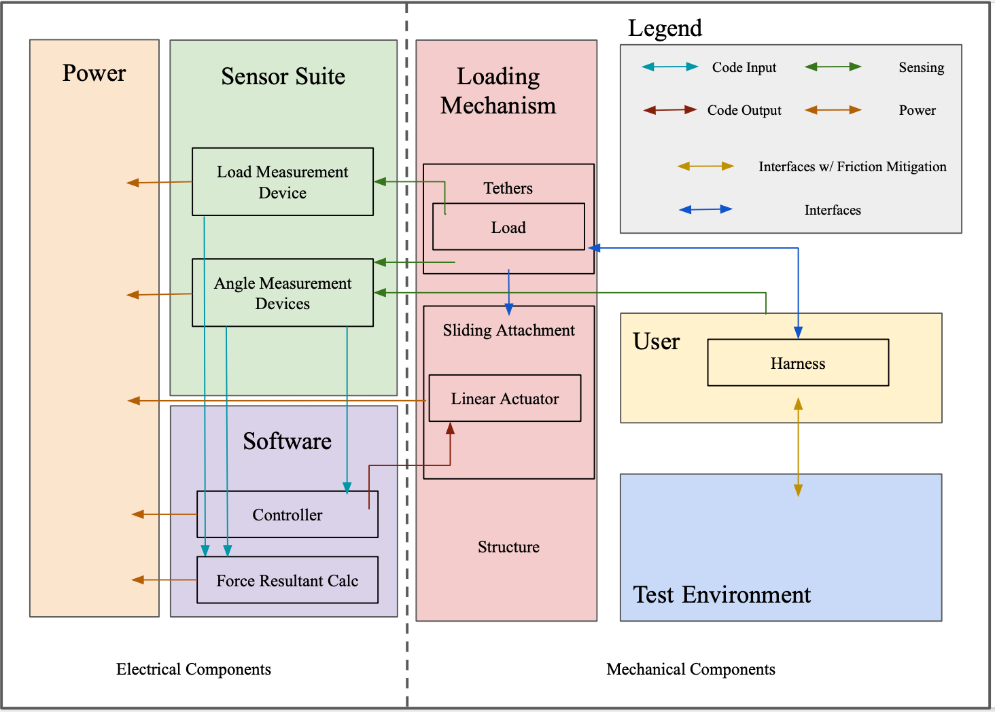
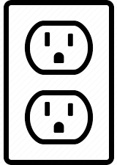
Functional Block Diagram

Slide 21
Feasibility Studies

Slide 22
Critical Project Elements - Feasibility Studies
Critical projects elements were selected for feasibility studies based on the foreseen “dealbreakers” of the project:
F1: Loading Margin: “The Device shall provide a force that does not exceed 1.3 kN” - Force vector strength must remain within needed range
F2: Angle Margin: “Gravity vector remains within 2° normal of support surface” - Force vector direction must act in specified direction
F3: Friction Margin: “Coefficient of friction in direction of postural sway minimized to 0.3” - Test Subject’s ability to displace and respond during testing
Cost Feasibility: How does the budget account for the components needed?
Notes:
SAFETY IS A CONCERN, BUT IS IN APPENDIX AND IS FEASIBLE: tHESE ARE OUR PROBLEMS

Slide 23
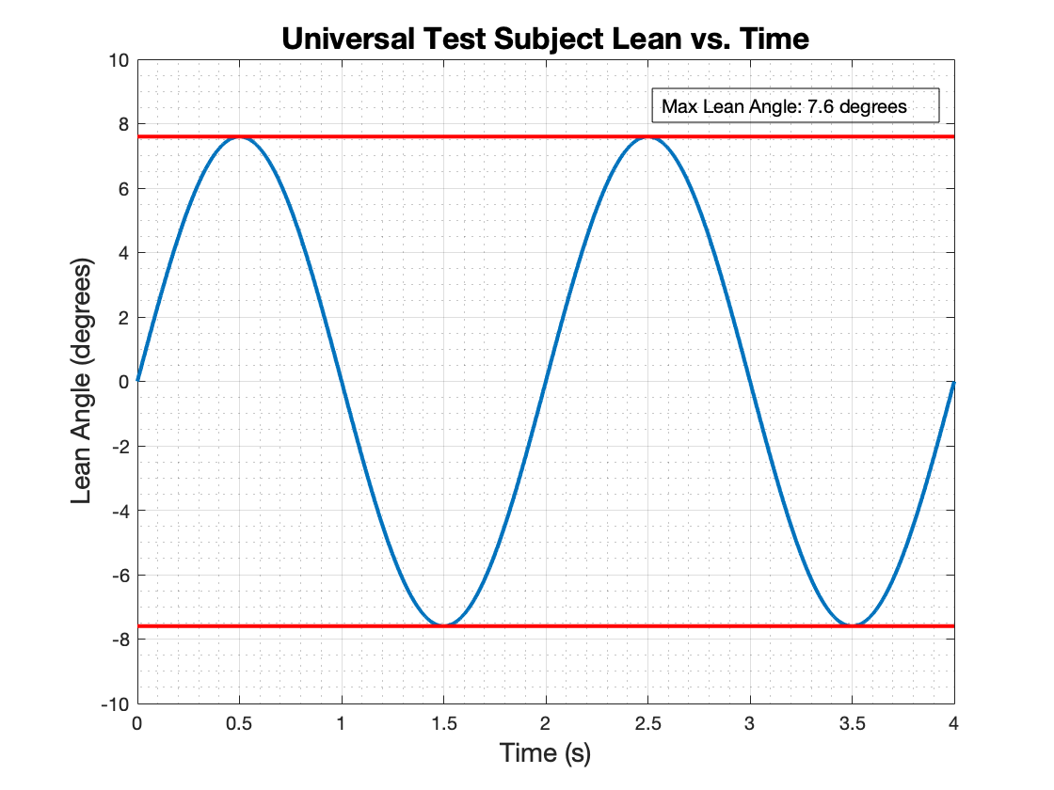
Universal Test Subject
50th Percentile American Male, NASA Handbook
(APPENDIX B) [7]
Height: 171.6 cm
Weight: 73 kg
CoM: 103.1 cm
Depth: 24.65 cm
Foot Size: 26.05 cm
Lean Max: 7.6º
Postural Sway of the Human Subject is modeled by 0.5 hz sine wave, as per Dr. Temple’s research.
Back/forth displacement of the Universal Test Subject is assumed to be modeled as a pendulum swing, modeled in MATLAB.
Notes:
dr clark used a pendulum w/ .5 hz sine wave with 10 degree amplitude. It’s an assumption: we want to do humans: we MODEL sway as pendulum sway. Mention that these are not worst case (except for the angle)

Slide 24
Feasibility Study 1 - Force Superposition
Will our baseline setup be analytically solvable so our active components can respond appropriately?
Our loading scheme is a fully determined system with us holding F1 = F2 & 𝛼 = 𝛽
F1 = F2 = const
𝛼 = 𝛽 = f(θ), tether-force triangle moves as one entity
Direction of Simulated Gravity
Direction of Earth Gravity
F₁
𝛂
𝜷
F₂
θ
F_{g} = F₁+F₂

Slide 25
Feasibility Study 1 - Force Superposition
Direction of Earth Gravity
In this study, we mainly focused on the derived loading requirements under our first functional requirement
Even as actuators move to account for load direction, the load magnitude will still vary
The quantity dy drives the magnitude of the load on the user
As the subject leans back-and-forth/side-to-side in a 1/2 Hz sinusoid motion, how much will dy change?
Direction of Simulated Gravity
dx = Lsinθ
dy = L - Lcosθ
dy
Harness
𝛂
𝜷
F₁
F₂
L
F_{g}= F₁+F₂
θ
±2°
Support Surface
dx
dx
dx
Linear Actuators

Slide 26
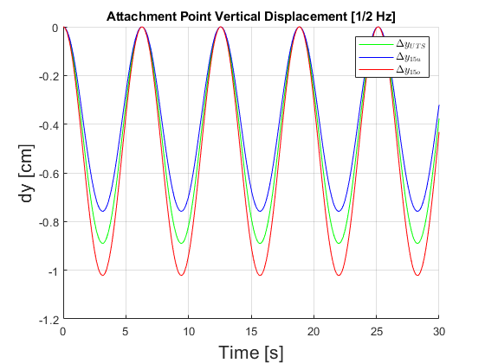
Feasibility Study 1 - Attachment Height Variation
As the subject leans back-and-forth/side-to-side in a 1/2 Hz motion, the change in attachment height was tracked
Between maximal angle variations of ±7.6 the change in attachment height was small
Note: The dy is tracked over three various user heights: the Universal Test Subject (UTS) height and ±15cm~6in (15o and 15u, respectively) the UTS height
**15cm~2.5 standard deviations of US adult male height [10]

Slide 27
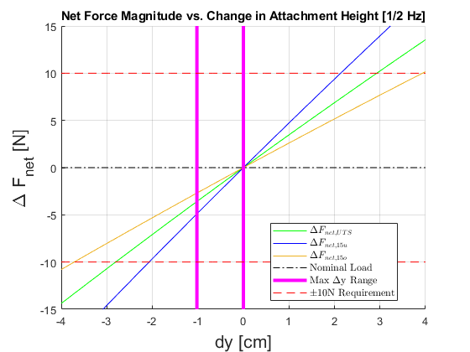
Feasibility Study 1 - Force Magnitude Variation
With each individual tether’s tension magnitude being held at a fixed value, the net load acting on the test subject will vary as the tether attachment angles vary.
It was found that the load variations under expected angle changes stayed within our design requirement bounds of ±10N of the applied load on the test subject.
Notes:
Notes: +/- 10 N bounds are because of 1 kilogram sensitivity. Client stressed correct angle is more important than correct force magnitude

Slide 28
Feasibility Study 1 - Load Magnitude
Direction of Simulated Gravity
Direction of Earth Gravity
The load will be transferred through human-rated cabling that can be bought off the shelf (OTS):
Rock climbing ropes
Low stretch, low wear lifting ropes [4]
Ratcheting seat belt straps
The actual load can come from multiple possible sources:
Electric motors (OTS)
Sandbags connected through a pulley system
Lowest density: 1522 kg/m^3 [5]
So for a universal test subject 2x ~36cm per side sandbags
F₁
𝛂
𝜷
F₂
F_{g} = F₁+F₂
dx
dx
dx
F₁
F₁
Torque Motor
OR
Sandbag
m_{sand}g = F₁

Slide 29
Feasibility Study 2 - (F2) Gravity Vector Deviation
Sliding Load System:
Screw Drive Linear Actuator
Angle Sensor
Direction of Earth Gravity
F_{g} = F₁+F₂
Direction of Simulated Gravity
Harness
𝛂
𝜷
F₂
F₁
F_{g} = F₁+F₂
±2°
±2°
Support Surface
dx
dx
dx

Slide 30
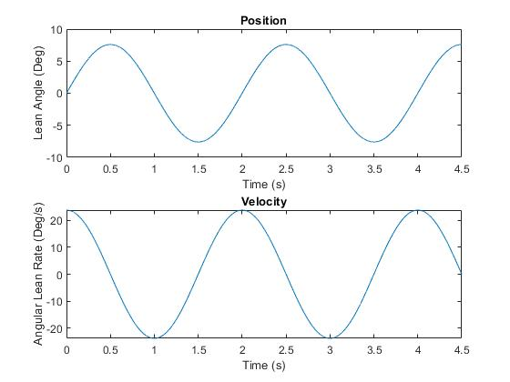
Feasibility Study 2 - (F2) Gravity Vector Deviation
Harness
𝛂
𝜷
F₂
F₁
±2°
Support Surface
dx
dx
dx

Slide 31
Feasibility Study 2 - (F2) Gravity Vector Deviation
“The device shall generate a gravity vector that does not deviate greater than an angle of 2 degrees from the true perpendicular to the support surface & Angle Measurement.”
Factors that Affect Angle deviation
Sensor Accuracy
Time Delay
Movement Accuracy
Tension Measurement Accuracy
Computational Time
Tension Motor Accuracy
Sensor Response Time
Angle Sensor Accuracy
Actuator Movement Time
Actuator Accuracy
Inertial Delay

Slide 32
Feasibility Study 2 - (F2) Gravity Vector Deviation
“The device shall generate a gravity vector that does not deviate greater than an angle of 2 degrees from the true perpendicular to the support surface & Angle Measurement.”
Factors that Affect Angle deviation
Sensor Accuracy
Time Delay
Computational Time
Sensor Response Time
Angle Sensor Accuracy
Actuator Movement Time
Notes:
Movement accuracy is neglected because motor and actuator precision is significantly higher than all of our positioning requirements
Current sensor accuracy and inertial forces are also neglected as they are insignificant compared to the other delays and accuracy

Slide 33
Feasibility Study 2 - (F2) Gravity Vector Deviation
Δt_{Sensors}
+
Δt_{Controller}
+
Δt_{Motor Response}
+
Δt_{Actuator Response}
Sensors
Controller
Tensioning Motors
Linear Actuators
Tether Angle Sensor 0
Motor controller
Motor 0
Actuator 0
Motor 1
Actuator 1
Tether Angle Sensor 1
Control Algorithm
Current Sensor 0
Data Output
Current Sensor 1
Key
Power
Data
Visual Display
Master Computer
Power Supply
𝜀_{Sensors}
+
𝜀_{Controller}
+
𝜀_{Motor Response}
+
𝜀_{Actuator Response}

Slide 34
Feasibility Study 2 - (F2) Gravity Vector Deviation
Trade Space Overview 1: Electronics Worst Case
Component Type | Component Name | Precision | Frequency Response | QTY | Unit Cost
Angle Sensor | SEN0386 6-Axis Accelerometer | 0.05° | 200 Hz (5 ms) | 2 | $25
Controller | Arduino Uno/Nano | N/A | 30 Hz (33 ms) | 2 | $25
Linear Actuator | Ball Screw Drive | 0.0203mm | 300 mm/s (speed) | 2 | $933
Notes:
These are the WORST case component selections that can meet our requirements

Slide 35
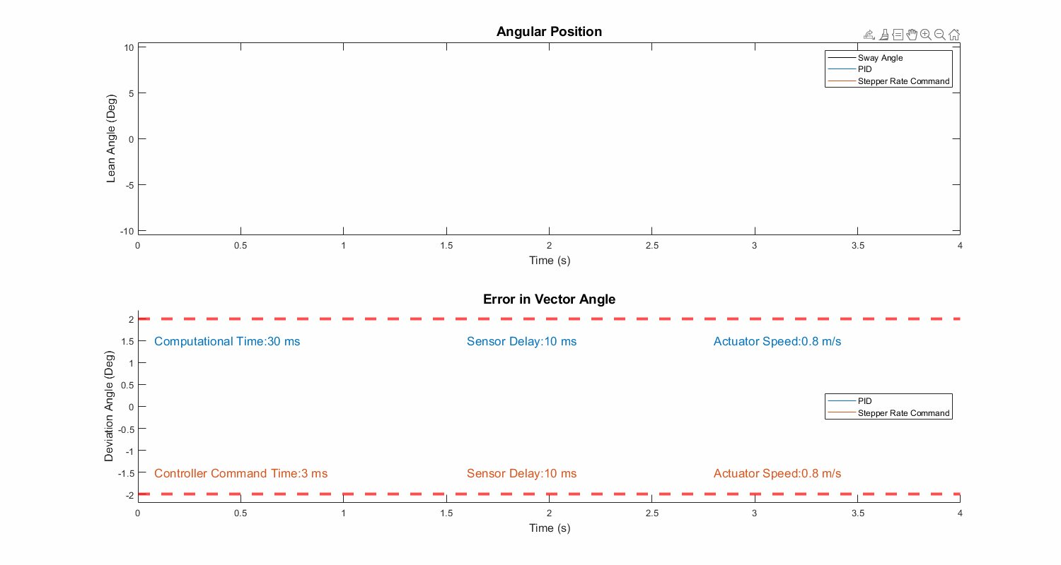
Feasibility Study 2 - (F2) Gravity Vector Deviation
±2°
Notes:
Thoroughly explain all lines on both plots

Slide 36
Feasibility Study 3 - (F3) Friction Margin
Direction of Postural Sway
“The device shall allow for user postural sway by limiting the coefficient of friction opposite to the direction of sway to 0.3.”
Direction of Simulated Gravity
Direction of Earth Gravity
Mobile Contact Surface Material | Static Co. of Friction | Reference Surface Material
Polyurethane - [C₃H₈N₂O] | 0.2 | Steel
Teflon - [C₂F₄] | 0.05 | Teflon (PTFE)
Support Surface
Platform
Friction interactions between mobile user and test bed surface
Table
N
Friction = 𝝻*N = 𝝻*mg

Slide 37
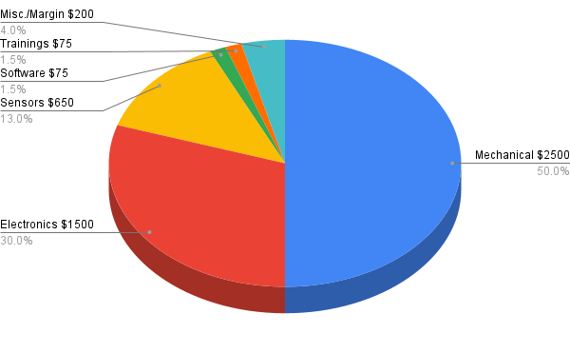
Cost Feasibility
Data
Raw material & Structure
Actuators/Motors
The customer has expressed a willingness to provide extra funding (of a non-agreed upon amount at the moment) in order to achieve project success if extra funds would be required.
Notes:
More initial budget given to mechanical and non-data driven electronic subsystems as the project is primarily mechanical:
The combined costs of tethers, structural materials, motors, etc. place an initial cost estimate of a few thousand dollars.
The Mechanical, Electronic, and Sensor categories were given $500, $250, and $250, respectively, of budget margins to account for needed part replacements and/or increasing design complexity.
Unaffiliated overall margin of $200 set aside for the whole of the project to be distributed as necessary.

Slide 38
Status Summary & Strategy

Slide 39
Status Summary
Primary Feasibility Studies:
Loading Feasibility
Angle Margin Feasibility
Friction within Test Environment Feasibility
Cost Feasibility
Secondary Feasibility Studies:
Safety Feasibility
Ingress/Egress Feasibility
Angle Detection Feasibility
Load Measurement Feasibility
Linear Actuator Feasibility
Tertiary Feasibility Studies (Future Work):
Load Application Selection
Harness Design Feasibility
Power Feasibility
Structural Feasibility
Monte Carlo Simulations

Slide 40
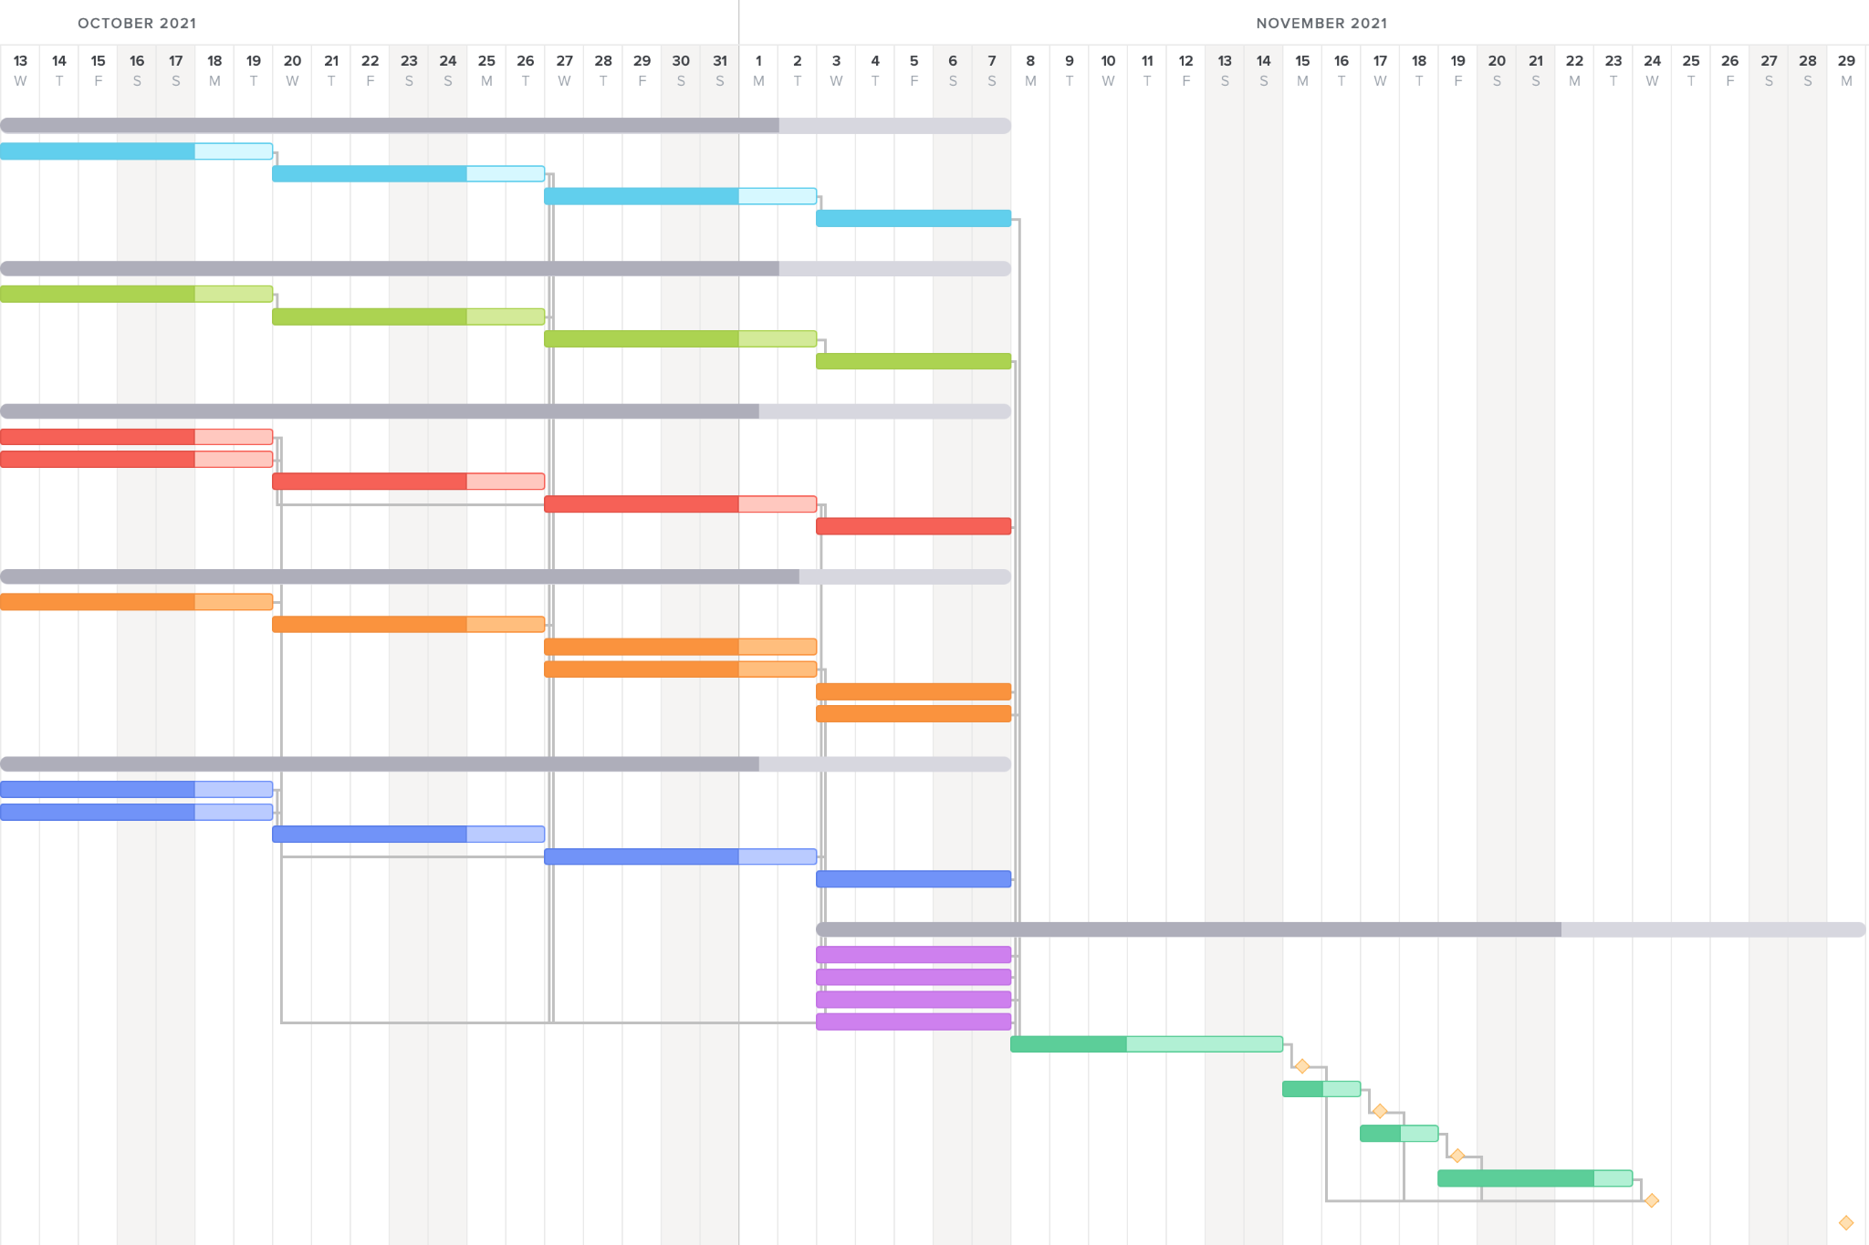
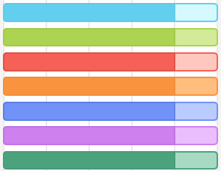
Next Steps (Future Work)
Key:
Margin
Phase 1: Feasibility & Trade Studies
Loading Mechanism
Phase 2: CAD & Design Finalization
Test Environment
Phase 3: System Analysis & Performance
Sliding Load Attachment
Phase 4: CDR Slide Creation
Phase 5: Internal & External Review
Safety & Human Factors
Sensors & Verification
Overview & Budget
Review
Milestone
Large Margin
External Deadline

Slide 41
Questions?

Slide 42
Appendix (Additional Studies)

Slide 43
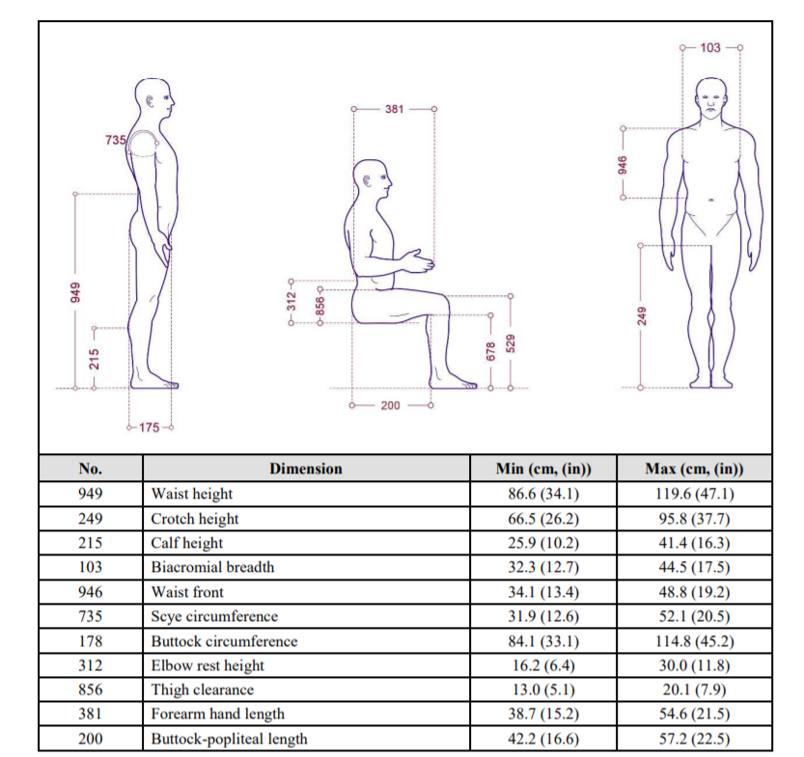
Universal Test Subject
50th Percentile American Male, NASA Handbook
(APPENDIX B) [7]
Height: 171.6 cm
CoM: 103.1 cm (Up From Foot)
Shoulder Width: 46.95 cm
Torso Width: 38.4 cm
Depth: 24.65 cm
Foot Size: 26.05 cm
Lean Max: 7.6º
Sway Max: 5.4º
Weight: 73 kg
Notes:
Add in dr clark about the pendulum .5 hz sway assumption: we want to do humans: we MODEL sway as pendulum sway

Slide 44
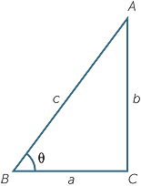
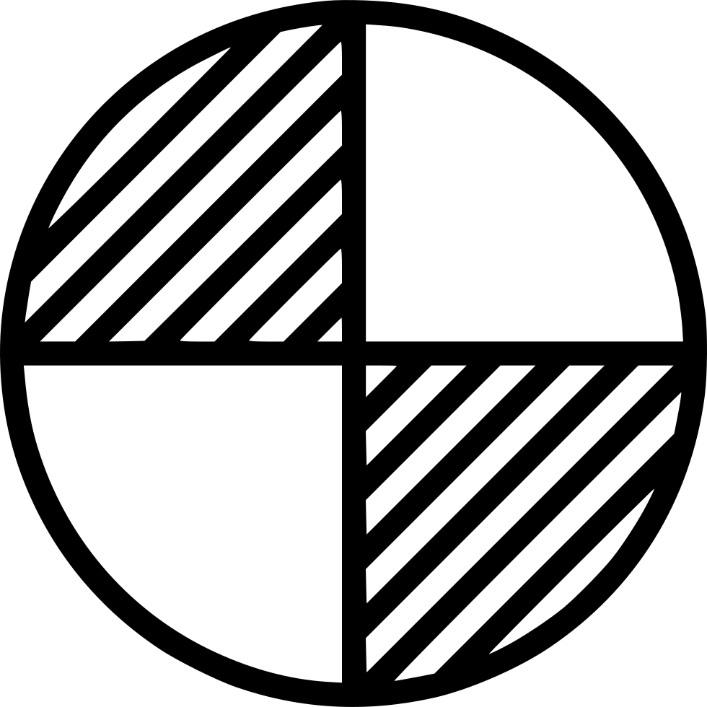
Max Lean Angle
c = CoM Height = 103.1 cm
Depth: 24.65 cm
Foot Size: 26.05 cm
a = Foot-Depth/2 = 13.725 cm
Arcsin(a/c) = 7.6º
MAX LEAN
Assumptions:
a = Section of body in front of CoM

Slide 45
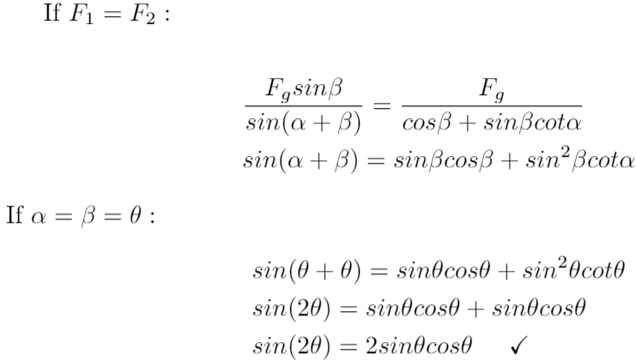
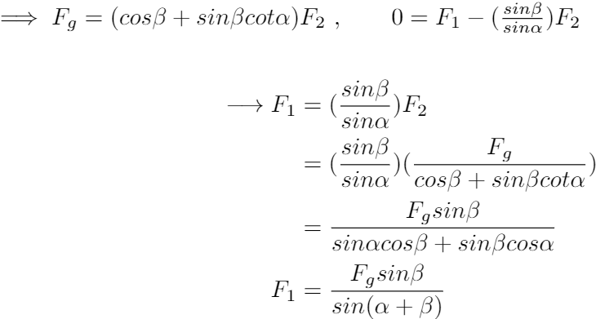
Feasibility Study 1 - (F1) Continued Proof

Slide 46
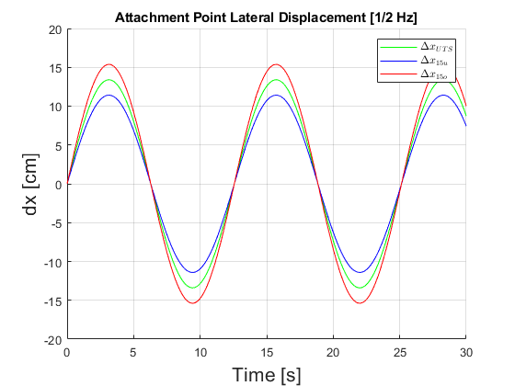
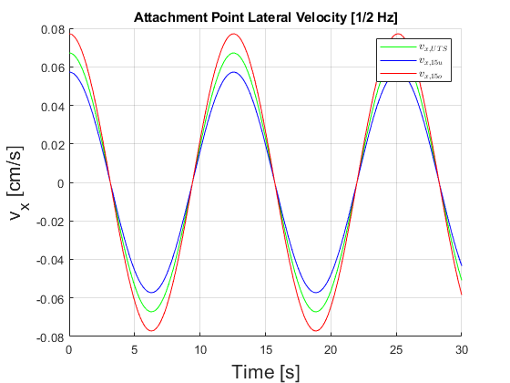
Attachment Movement Data (Lateral):

Slide 47
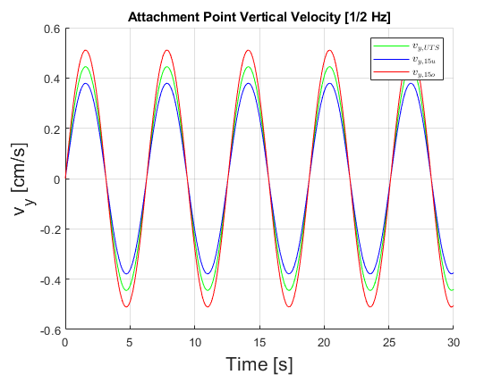
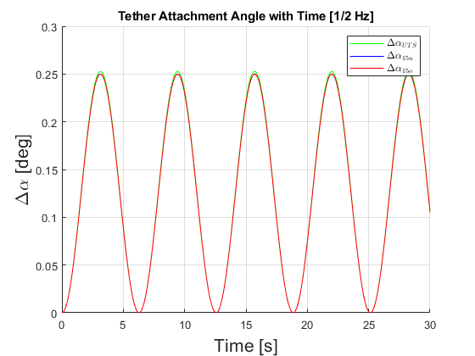
Attachment Movement Data (Vertical and Angle):

Slide 48
Feasibility Study - (F6) Safety
F6: The device shall prevent the user from falling if the user enters an unrecoverable state.
The device shall not continue the load if the user enters an unrecoverable state.
Unrecoverable: User is at an angle of > 20 degrees, COM position is < 75 cm above the ground, or the COM has a velocity > 1 m/s
.
Max lean angle of 10-20 degrees before people fall
Min COM position from ground at 10 deg lean is 85 cm
Max vel of COM at 10 deg sway at 0.5 Hertz is 65 cm/s
When one has reached 1 m/s, they have only moved 5 cm in 0.1 sec
1 m/s
75 cm
20º

Slide 49
Feasibility Study - (F6) Safety
HOW
Mechanical:
Using 1 or 2 slacklines to catch a user in case of a fall with a static length
Grigri auto belay stopping device/ seatbelt mechanism if tether velocity > 85 cm/s
Pin in tethers so it cannot have less than 75 cm of length out
The supporting surface is big enough for the user to step and catch their fall
Electrical:
Coding in when sensors measure an angle > 20 degrees to stop motor force
Coding in when accelerometer measures velocity > 85 cm/s to stop motor force

Slide 50
Feasibility Study - (F8) Ingress & Egress
F8: The device shall accommodate Earth-based testing such that Earth gravity will not be a confounding variable.
The 90-degree testing environment ensures that the user’s axis of postural sway is normal to Earth’s gravity. Thus, lean is neither hindered nor aided by gravitational force
Testing platform and table will be carefully constructed and assembled to remain parallel to Earth’s surface
Lab team will further negate any effects of gravity by assisting user ingress/egress
In practice, bed rest study patients can be loaded into device by staff in accordance with bed rest study guidelines

Slide 51
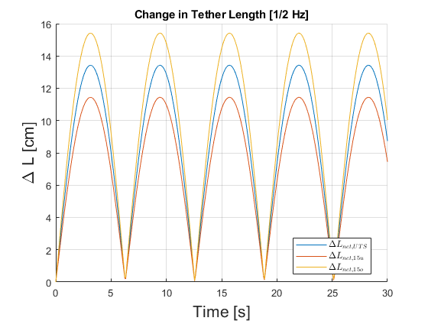
Feasibility Study - Tensioning Device
Maximum Lean Rate ~ 6 cm/s
Maximum Motor Force = 0 .91 kN
Motor Shaft Diameter = 4 cm
Motor Specs Required = 28.6 RPM with a torque of 36 N-m
F₁
F₁
Tensioning Motor
OR
Sandbag
m_{sand}g = F₁

Slide 52
Angle Sensors
For Person Angle:
https://www.mouser.com/ProductDetail/DFRobot/SEN0386?qs=DRkmTr78QAS3VaTwMlAopw%3D%3D

Slide 53
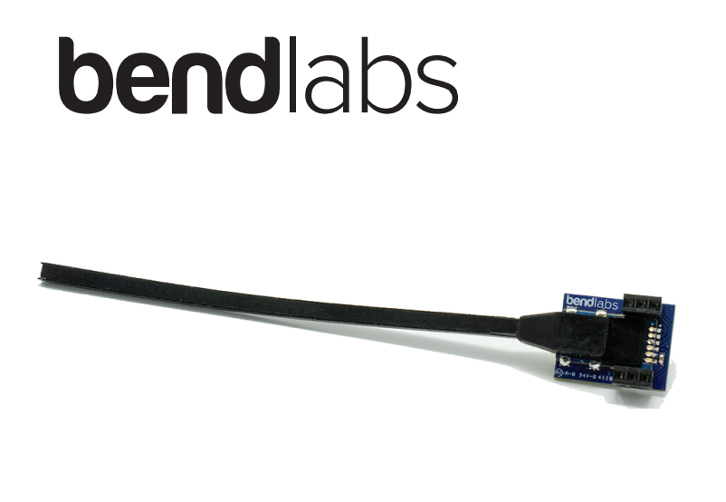
Angle Sensors
For Tether Angle:
Sliding Load System:
Screw Drive Linear Actuator
Angle Sensor
https://www.bendlabs.com/two_axis_datasheet.pdf

Slide 54
Actuation
Direction of Earth Gravity
Tether Tensioning Device Attachment Point
Attachment Point Guides/Track
Direction of Simulated Gravity
Screw Drive Powered by Motor
dx = Lcosθ
Harness
𝛂
𝜷
F₁
F₂
L
F_{net}= F₁+F₂
θ
±2°
Support Surface
dx
dx
dx
Linear Actuators
Actuator Motor And Control Attachment

Slide 55
Actuation Specifications
The actuation system requires a number of specifications in order to fulfill requirements:
Speed/Responsiveness: 0.10 m/s
Minimum Stroke (Using max COM height and lean): 13.7 mm
Maximum vertical load support required: 0.65 kN
Minimum vertical load required will be determined through further analysis for actuator sizing/cost optimization (force applied can be distributed through structural support)
Brake Required: No

Slide 56
Actuation Mechanics Trade
Method | Speed/Responsiveness (mm/s) | Stroke (mm) | Cost | Max Load (N)
Belt Drive Option 1 | N/A (Accuracy .001mm/25mm travel) | 50 | $344 | 1117.2
Screw Drive Option 1 | 300 | 100 | $933 | 294
Belt Drive Option 2 | 1270 | 184 | $888 | 1111.32
Screw Drive Option 2 Model: COLTW0000795760 | 52 | 100 | $662 | 1960

Slide 57
Feasibility Study 1 - (F1) Load Magnitude
Trade space Overview 1: Cable Force Sensors
Precision is dependent on analog-to-digital conversion. Can be very high precision
Torque motor: force sensor(s) data will be fed back into motor controller to keep tension constant
Sandbag: precise scale to measure weight and thus tension applied
Sensor Type | Sensor Name | Accuracy | Frequency Response | Cost
In-line Load Cell | Mini In-Line Load Cell | ± 0.68 kg | 16.2 kHz (0.06 ms) | $675
In-line Tension Gauge | Multi-Configuration Tension Sensor | ± 1.36 kg | 200 Hz (5 ms) | (need quote)
Precise Scale | Paddie Shipping Scale | ± 0.045 kg | N/A | $58

Slide 58
Feasibility Study 1 - (F1) Force Application
Trade space Overview 2: Force Application Devices
If mechanical route chosen, components will be weights, pulleys, containers
If electrical route chosen, components will be electric motors and motor driver
PID control to negate cable slack and keep tension constant
At 50 rpm, shaft tangential velocity = 3.325 cm/s >> 0.08 cm/s (slide 46)
Device | Name | Current Draw/Output | Voltage Draw/Output | Force Applied | Cost
Hybrid Stepper Motor | ML34HD2L4350 | 3-3.5 A | 48-160 VDC | Up to 1120 N at 50 rpm | $177 (x2)
Stepper Motor Driver | SR8-Plus | 2.4-7.8 A | 24-75 VDC | N/A | $119 (x2)
Notes:
Response time
Current does not need to be changing. Very small steps can be taken until the rope is taught enough for desired tension. Stepper motor can turn cw or ccw to respond to cable slack. Tension sensor data will be very important and fed back through the controller to keep tension constant at desired value

Slide 59
Feasibility Study 2 - (F2) Gravity Vector Deviation
Trade space Overview 3: Computation
Microprocessor Type | Device Name | PID Computation Frequency | Cost
ATmega328P | Arduino Uno/Nano | 30 Hz (33 ms) | $25
Cortex-A72 (ARM v8) | Raspberry Pi 4 | 55 Hz (18 ms) | $35
ARM Cortex-M4 72Mhz | LHI Pro Racing F3 Flight Controller | 115 Hz (8.7 ms) | $40

Slide 60
Feasibility Study 2 - (F2) Gravity Vector Deviation
Initialize the sway equations: θ(t) = A*sin(T*f*t) dθ_dt(t) = T*f*A*cos(T*f*t)
PID Control Simulation
Stepper Rate Command Simulation
While (t > simulation_time)
t += sensor_query_time;
Commanded_rate = K1* (movement_rate - actuator rate)
K2*dθ_dt(t);
t += rate_computation_time;
translation_speed = shoulder_height*sin(dθ/dt);
if ( max(translation_speed) > max_actuator_speed )
t += excess_move_time;
position_array_STEPPER.append(new_position);
STEPPER_difference = position_array_actual
- position_array_PID;
While (t > simulation_time)
t += sensor_query_time;
new_position = PID_control(current_position,t);
t += PID_computation_time;
translation_speed = shoulder_height*sin(dθ_dt(t));
if ( max(translation_speed) > max_actuator_speed )
t += excess_move_time;
position_array_PID.append(new_position);
PID_difference = position_array_actual - position_array_PID;
Plot results of both of the simulations and their deviations from the true position (error)
Notes:
Thoroughly explain all lines on both plots

Slide 61
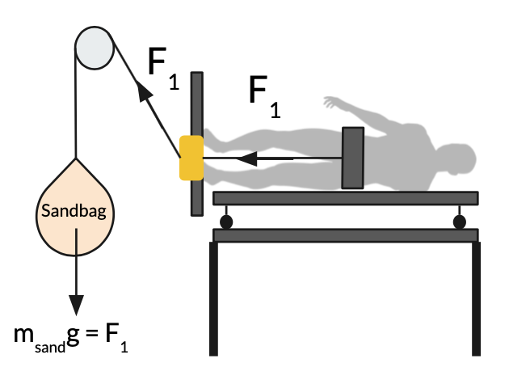
Why Not One Tether?
When the test subject leans forward, slack will be taken out of the system.
Sandbag goes down
Work is being done on the person
When test subject leans back to original position, slack will have to be given
Sandbag goes up
User has to do work on the system
If there are two tethers:
One sandbag goes down, one sandbag goes up
Net work = 0
dy
Work = m*g*dy

Slide 62
Post-CONOPS
Stage 5: Balance Tests
Out of scope of this project
After bed rest is complete (~70 days)
Test for retention of proprioceptive functions
Direction of Earth Gravity

Slide 63
References

Slide 64
Presentation References
[1] Garcia, Mark. “Astronaut David Saint-Jacques Is Carried to a Medical Tent.” NASA, NASA, 25 June 2019, https://www.nasa.gov/image-feature/expedition-59-canadian-space-agency-astronaut-david-saint-jacques-is-carried-to-a.
[2] Mulavara, Ajitkumar P., et al. “Locomotor function after long-duration space flight: effects and motor learning during recovery.” \emph{Experimental Brain Research} vol. 202, no. 3, 2010, pp. 649-659 doi: 10.1007/s00221-010-2171-0.
[3] Mars, Kelli. “Analog Missions: Bed Rest Faqs.” NASA, NASA, 26 Mar. 2019, https://www.nasa.gov/analogs/envihab/bed-rest-faqs.
[4] McMaster-Carr,“Fibrous Rope”,McMaster-Carr,https://www.mcmaster.com/fibrous-rope/
[5] Densities of materials. Engineering ToolBox. (n.d.). Retrieved October 5, 2021, from https://www.engineeringtoolbox.com/density-materials-d_1652.html.
[6] Tleto. “Polyurethane Coefficient of Friction.” Gallagher Custom Polyurethane Molding, 29 Oct. 2020, https://gallaghercorp.com/polyurethane-coefficient-of-friction/.
[7] NASA, “Human Integration Design Handbook (HIDH)”, \emph{NASA Special Publication SP-2010-3407-REV1}, 2014.

Slide 65
Presentation References
[8] “Friction and Friction Coefficients.” Engineering ToolBox, https://www.engineeringtoolbox.com/friction-coefficients-d_778.html.
[9] “Measuring Stepper Motor holding torque” https://www.applied-motion.com/news/2015/10/dynamic-torque-step-motor-sizing
[10] Fryar CD, Carroll MD, Gu Q, Afful J, Ogden CL. “Anthropometric reference data for children and adults: United States, 2015–2018.” National Center for Health Statistics. Vital Health Stat 3(46). 2021.

