Slide 1
Gravity Offloading and Tethering Somatosensory Enhancement System (GOATSES)
Critical Design Review
Grace Antonucci, Ben Foehr, Jack Harrison, August Hauter, Quentin Morton, Elena Salgado, Nick Taylor, Isaac Timko, & Cody Wheeler

Slide 2
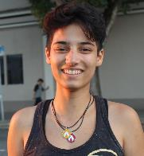
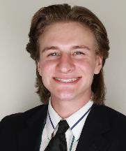
MEET THE TEAM
Cody Wheeler
Design Lead
Ike Timko Electronics Lead
August Hauter
Analysis Lead
CFO
Grace Antonucci
Project Manager
Elena Salgado
Safety Lead
Ben Foehr
Human Factors Lead
Nick Taylor Manufacturing Lead
Quentin Morton
Lead Systems Engineer
Jack Harrison
Testing Lead

Slide 3
Agenda
Project Overview
Design Solution
Design Requirement Satisfaction
Actuator Response Time
Motor Capabilities
Project Risks
Verification & Validation
Project Planning

Slide 4
Project Purpose and Objectives
Notes:
WHY are we doing this project, HOW are we going to do this project, WHO is using this project, WHAT are we doing in this project

Slide 5
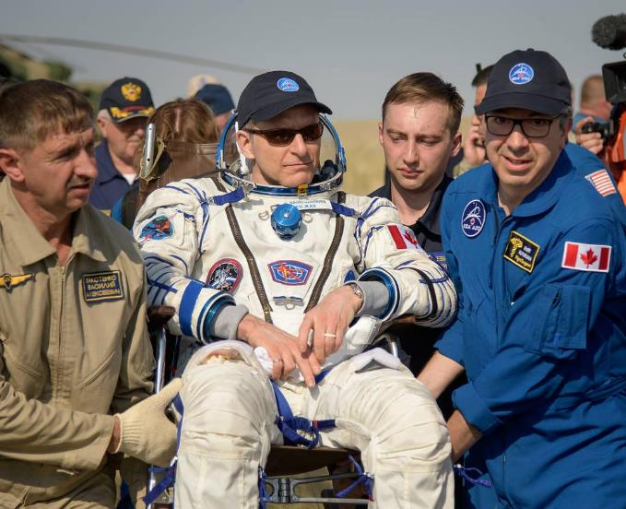
Project Purpose
Sponsored by the CU Bioastronautics department. Led by Dr. Torin Clark and Dr. David Temple.
Astronauts require, on average, 15 days to recover pre-flight levels of locomotive function required for egress (exiting the capsule). [2]
Astronauts experience loss of proprioceptive function in a microgravity environment.
Proprioceptive function relates to one’s understanding of how their body is positioned and how it is moving.
Retention of postural control is vital for long duration spaceflight missions.
Canadian astronaut, David Saint-Jacques, being carried to the medical tent after returning from 204 days in space. [1]
Notes:
Astronauts require, on average, 15 days to recover pre-flight levels of locomotive function required for egress. [2]
Astronauts sufficiently maintain muscular and cardiovascular strength, but typically experience loss of proprioceptive function.
Proprioceptive function relates to one’s understanding of how their body is positioned and how it is moving.
Loss of proprioceptive functions result in difficulty with tasks such as standing, walking, and balancing.
Retention of postural control is vital for long duration spaceflight missions.

Slide 6
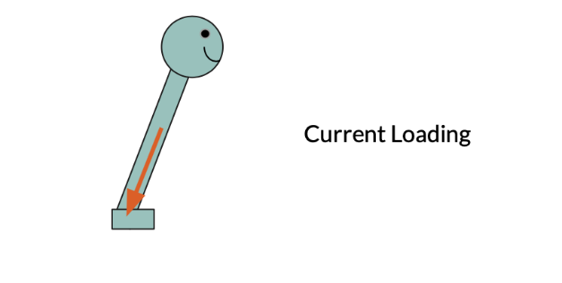
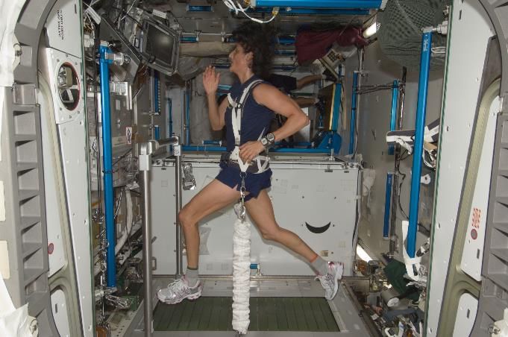
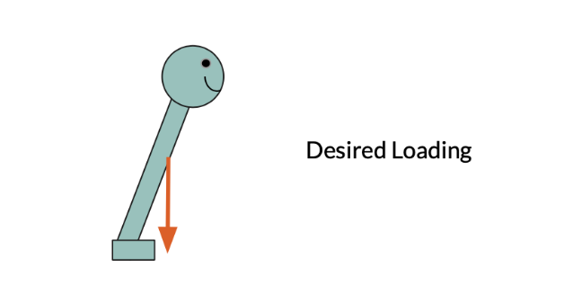
Project Objectives
Current axial loading is problematic
Hypothesis: More realistic gravitational loading = better proprioceptive functions
Device will provide a load that stays perpendicular to support service
Main user base will be bed rest patients which offer scientists a way to see how the body adapts to weightlessness
Notes:
Bed rest studies offer scientists ways to see how the body adapts to weightlessness. Volunteers spend up to 70 days in bed with a six-degree head-down tilt. They must eat, exercise, and even shower in the head-down position.
Our project aims to create a device in which maintains a force on the user that is perpendicular to their support surface regardless of postural sway.
This device will be used in laboratory studies to prove whether this improvement in loading direction yields better retention of proprioceptive functions.
Study requires a spaceflight analog such as bedrest.
Bedrest: volunteers spend up to 70 days in bed with a six-degree head-down tilt. They must eat, exercise, and shower in this position. [3]
Astronauts are currently loaded to a single fixed point and therefore they do not need to balance themselves.
It is hypothesized that if astronauts were loaded as if in a realistic gravitational field, it would help maintain proprioceptive function by requiring them to balance themselves.
Our project aims to create a device in which maintains a force on the user that is perpendicular to their support surface regardless of postural sway.
This device will be used in laboratory studies to prove whether this improvement in loading direction yields better retention of proprioceptive functions.
Study requires spaceflight analog such as bedrest.
Bedrest: volunteers spend up to 70 days in bed with a six-degree head-down tilt. They must eat, exercise, and shower in this position. [3]

Slide 7
Functional Requirements
Number | Functional (Driving) Requirement | Verified By:
F1 | The device shall provide a force on the user not to exceed 1.3 kN | Force Measurement
F2 | The device shall generate a gravity vector that does not deviate greater than an angle of 2 degrees from the true perpendicular to the support surface | Angle Measurement
F3 | The device shall allow for user postural sway by limiting the coefficient of friction present opposite to the direction of sway to 0.3 | Friction Measurement
F4 | The device shall be able to load the user as they move within a 2 m² area | Design Dimensions
F5 | The artificial force should act between the hips and shoulders of the user | Biological Analysis
F6 | The device shall prevent the user from falling if the user enters an unrecoverable state | Simulated Fall
F7 | The device shall be compatible with a person with a height of 1.5-2 m, a weight not to exceed 113.4 kg, and a hip breadth of 31-46 cm [7] | Design Dimensions
F8 | The device shall accommodate Earth-based testing such that Earth gravity will not be a confounding variable | Testing Equipment
Notes:
What is the purpose of the project and what are its specific objectives (measures of success)?

Slide 8
Functional Requirements
Number | Functional (Driving) Requirement | Verified By:
F1 | The device shall provide a force on the user not to exceed 1.3 kN | Force Measurement
F2 | The device shall generate a gravity vector that does not deviate greater than an angle of 2 degrees from the true perpendicular to the support surface | Angle Measurement
F3 | The device shall allow for user postural sway by limiting the coefficient of friction present opposite to the direction of sway to 0.3 | Friction Measurement
F4 | The device shall be able to load the user as they move within a 1.75 m² area | Design Dimensions
F5 | The artificial force should act between the hips and shoulders of the user | Biological Analysis
F6 | The device shall prevent the user from falling if the user enters an unrecoverable state | Simulated Fall
F7 | The device shall be compatible with a person with a height of 1.5-2 m, a weight not to exceed 113.4 kg, and a hip breadth of 31-46 cm [7] | Design Dimensions
F8 | The device shall accommodate Earth-based testing such that Earth gravity will not be a confounding variable | Testing Equipment
Notes:
F2 being the thing that separates us from existing technology, and F1 and F2 are the ones that can make it as effective as existing technology.

Slide 9
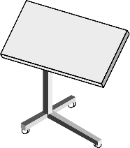
CONOPS
Prep
Ingress
Use
Egress
Top-Down View
User leans
Loading mechanism is assembled and modified to take into account user’s mass and anthropomorphic data
User can get into loading system without standing, laying on their back OR their side.
Harness is adjustable to user size.
Tether base pulls in a direction normal to the stationary base and moves with the user’s general center of gravity as the user leans.
Fail-safe mechanisms engage if user falls.
Body angle, tether angle, and tether tension data is stored and displayed.
Harness is easily removed without need for the user to stand.
= user lean direction
= net force direction
= harness
= tether
Repeat
= sliding attachment
= sliding direction
Notes:
User can be on their side (Leans front to back) OR User can be on their back (Leans side to side) → Trains proprioceptive function
Mention the details of things (yellow = actuator, tethers are connected to sand bags) and mention that the detail will be covered later.

Slide 10
Design Solution

Slide 11
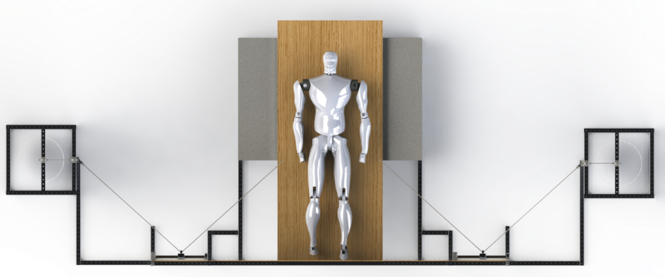
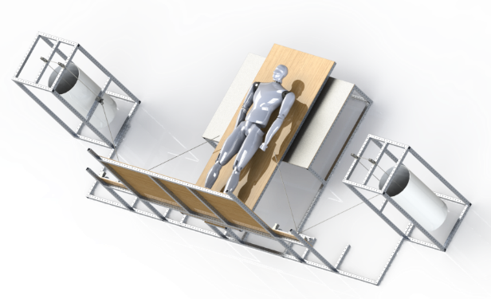
Top-Level Overview
System Mass (lb) | System Power (W)
~293 (Unloaded) | ~172.93
~716 (Loaded for 300lb Subject)
Top View
Test Environment
Loading Mechanism
83.875”
Sliding Load Attachment
Safety/Human Factors
221.75”
Front View
61.5”
Iso View

Slide 12
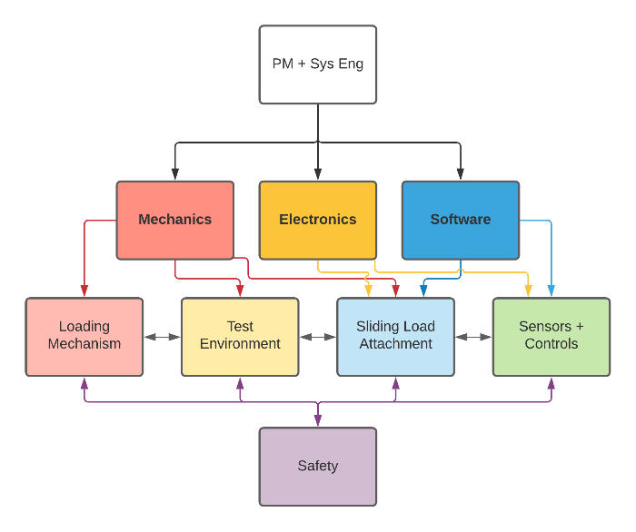
Subsystem Breakdown
Subsystem | Role
Test Environment | To ensure force of gravity due to the Earth is offloaded from the subject and that friction and drag is minimized in testing
Safety and Human Factors | To ensure the human subject is able to interact with the device with minimal risk and optimal effectiveness
Loading Mechanism | To ensure proper loading with a force equivalent to gravity
Sliding Load Attachment | To ensure the loading force remains normal to the support surface
Sensors and Controls | To ensure the proper data is collected to verify the design and drive control laws.

Slide 13
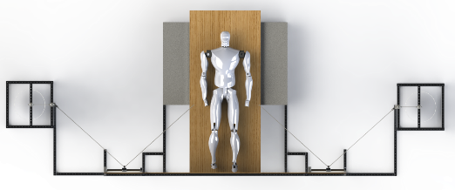
Design Breakdown
Support Surface
Stationary Pulleys
Snap Shackle Connections
Swiveling Pulleys
Diving Board
Harness
Padding
Bumpers
Slackline
Ball Bearing Castors
Actuator + Carriage Mounts
Weight Containers
Translation Table
Thrust Bearing
Loading Tethers

Slide 14
Design Function
Belt Drive Actuators Translate
User Leans
Loads are Raised/Lowered to Maintain Work Balance

Slide 15
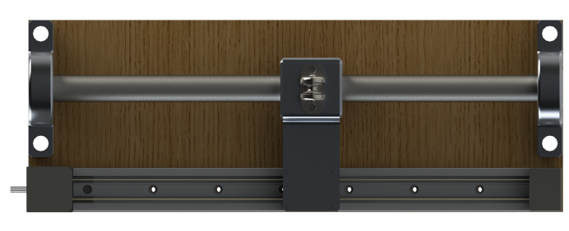
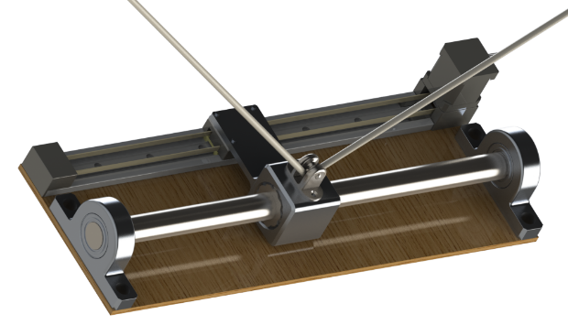
Sliding Load Attachment
Allows the tether to be translated in order to maintain the proper direction of simulated gravity
Designed to reduce friction/inertia to allow for quick, smooth translational motion
System comprised of two main components
Offloading Carriage
Linear Actuator
19.34”
Drylin ZLN-40 Belt Drive Actuator
Mounting Panel
Force Offloading Carriage
7”
Limit Switches
48 VDC NEMA-17 Stepper Motor
Direction of Motion

Slide 16
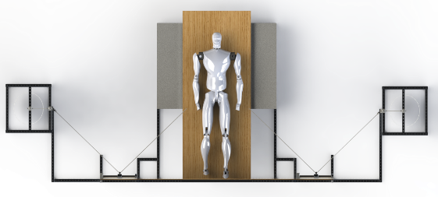
Sensors and Controls
Arduino Portenta H7 and Stepper Motor Controllers (Placed behind Support Surface)
Actuators
BendLabs Angle Sensor
6-axis IMU
Actuator Limit Switches
BLE Module Connection

Slide 17
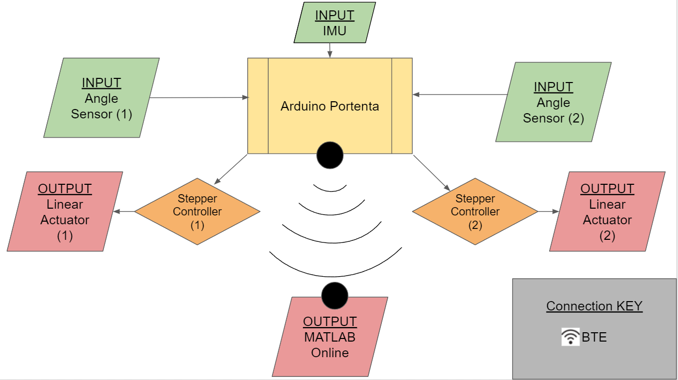
Sensors and Controls - Overview
Notes:
We can clean up this diagram, but this is the idea

Slide 18
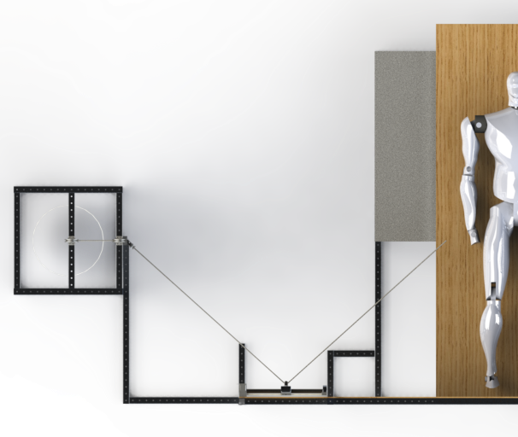
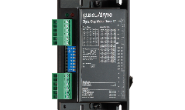
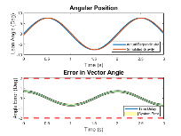
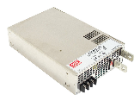
Sensors and Controls - UI
BendLabs Angle Sensor
BLE
6-axis IMU
Matlab Mobile
Actuator Limit Switches
Subject Mass:
>> 123 kg
Subject Height:
>> 1.2 m
SYSTEM CALIBRATED
---------- READY ----------
BLE
>>

Slide 19
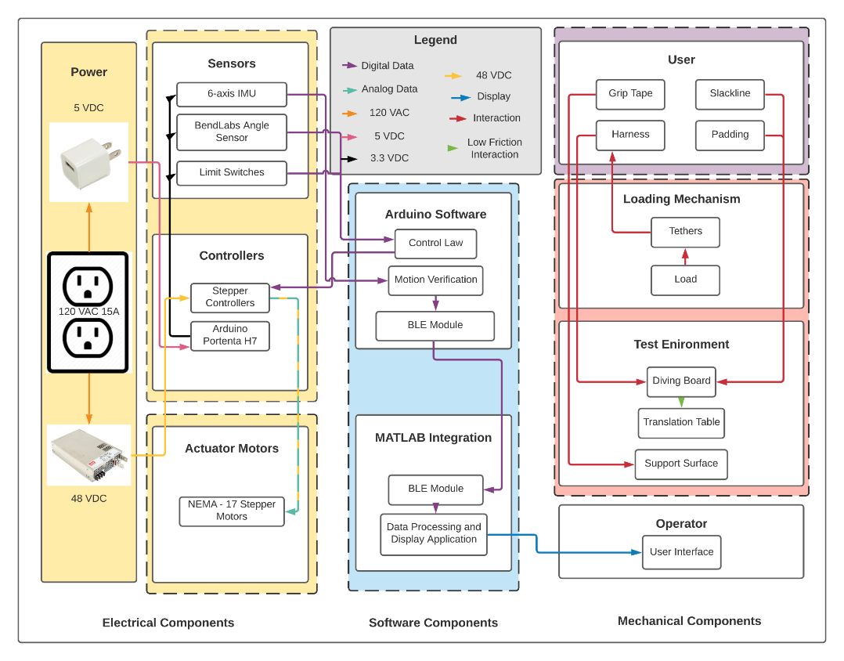

Slide 20
Critical Project Elements

Slide 21
Critical Project Elements
These are the most important functions for our project to work as intended:
F1 | The device shall provide a force on the user not to exceed 1.3 kN | Force Measurement
F2 | The device shall generate a gravity vector that does not deviate greater than an angle of 2 degrees from the true perpendicular to the support surface | Angle Measurement
F3 | The device shall allow for user postural sway by limiting the coefficient of friction present opposite to the direction of sway to 0.3 | Friction Force Measurement

Slide 22
Critical Project Elements
These are the most important functions for our project to work as intended:
F1 | The device shall provide a force on the user not to exceed 1.3 kN | Force Measurement
F2 | The device shall generate a gravity vector that does not deviate greater than an angle of 2 degrees from the true perpendicular to the support surface | Angle Measurement
F3 | The device shall allow for user postural sway by limiting the coefficient of friction present opposite to the direction of sway to 0.3 | Friction Force Measurement
This is the function that has not already been proven achievable by previous gravity simulation systems

Slide 23
Critical Project Elements
Maintaining a force vector normal to the support surface is the most critical and challenging part of this project. Its success depends on:
Actuator response time
Motor capabilities
“The simulated gravity force must stay within 2 degrees of normal to the support surface at all times”

Slide 24
Design Requirement Satisfaction

Slide 25
Critical Project Elements
Maintaining a force vector normal to the support surface is the most critical and challenging part of this project. Its success depends on:
Actuator response time
Motor capabilities
“The simulated gravity force must stay within 2 degrees of normal to the support surface at all times”

Slide 26
Critical Project Elements
Maintaining a force vector normal to the support surface is the most critical and challenging part of this project. Its success depends on:
Actuator response time
Motor capabilities
“The simulated gravity force must stay within 2 degrees of normal to the support surface at all times”

Slide 27
Actuator Response Time: Software Flowchart
Initialize and calibrate
Center actuators and save initial angle
Compute and return sand mass
Obtain user height and weight
Start
Query Angle Sensors
Read Data From Angle Sensors
Read Data from IMU
Stream data to Matlab display interface
CRITICAL LOOP
Actuator Movement response
Stepper Driver Commands Motor
Send Command to Stepper Driver
Compute Command to Actuators
“The simulated gravity force must stay within 2 degrees of normal to the support surface at all times”
Notes:
We can clean up this diagram, but this is the idea

Slide 28
Actuator Response Time: Software Flowchart
Query Angle Sensors
Δt = 5 ms
Read Data From Angle Sensors
Δt = 15 us
Actuator Movement response
Δt = 30 ms
Stepper Driver Commands Motor
Δt = 50 us
Send Command to Stepper Driver
Δt = 3 us
Compute Command to Actuators
Δt = 5 ms
“The simulated gravity force must stay within 2 degrees of normal to the support surface at all times”
Notes:
We can clean up this diagram, but this is the idea

Slide 29
Actuator Response Time: Software Flowchart
Query Angle Sensors
Δt = 5 ms
Read Data From Angle Sensors
Δt = 15 us
Actuator Movement response
Δt = 30 ms
Stepper Driver Commands Motor
Δt = 50 us
Send Command to Stepper Driver
Δt = 3 us
Compute Command to Actuators
Δt = 5 ms
“The simulated gravity force must stay within 2 degrees of normal to the support surface at all times”
Notes:
We can clean up this diagram, but this is the idea

Slide 30
Actuator Response Time: Delays and Errors
Device | Time Budget |  | Error Budget
Arduino Portenta H7 | 5 ms |  | 0°
Drylin ZLN-40 linear actuator | 30 ms |  | 0.1004°
Bendlabs 1-Axis Evaluation Kit | 5 ms |  | 0.18°
Total | 40 ms |  | 0.2804°
Required | 84.03 ms
“The simulated gravity force must stay within 2 degrees of normal to the support surface at all times”
Notes:
We can clean up this diagram, but this is the idea

Slide 31
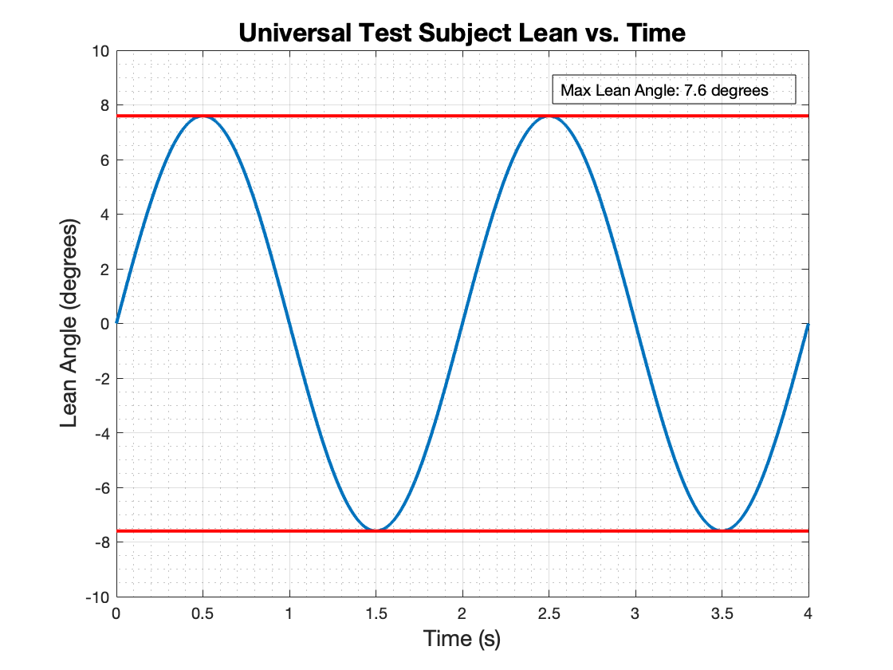
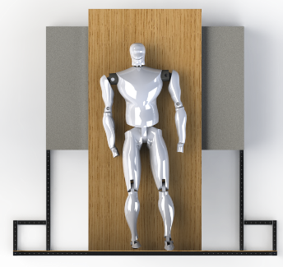
Actuator Response Time: Test Scenario
Postural Sway of the Human Subject is modeled by 0.5 hz sine wave with a maximum lean angle of 7.6°, per Dr. Temple’s research.
“The simulated gravity force must stay within 2 degrees of normal to the support surface at all times”

Slide 32
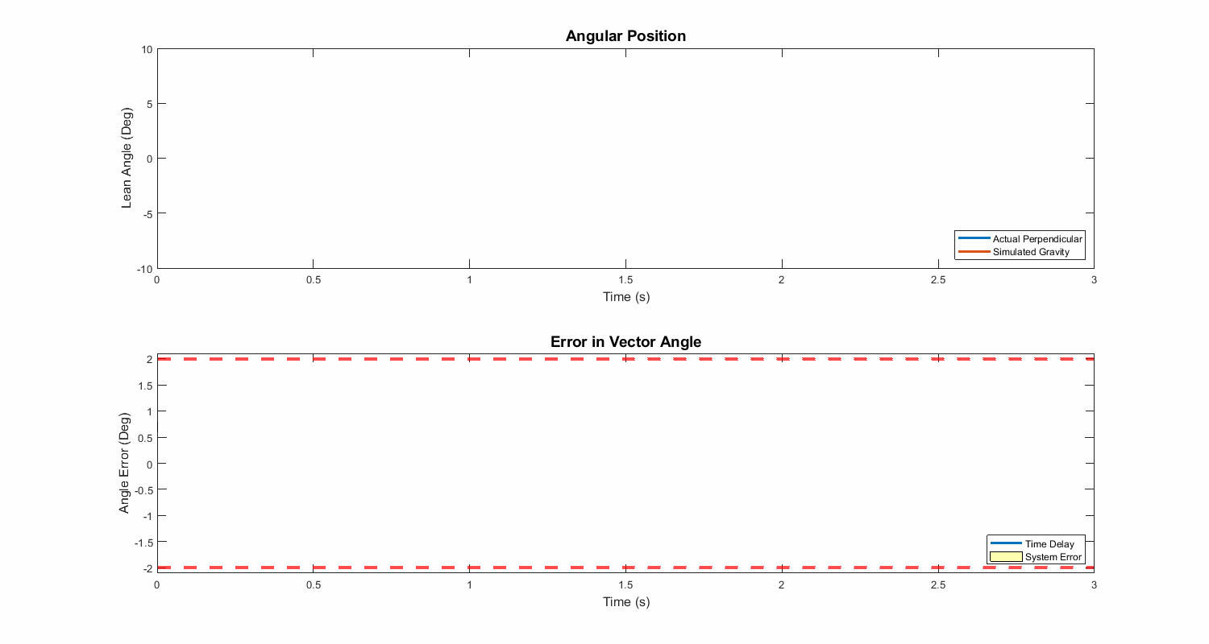
Actuator Response Time: Verification and Analysis
θ
±2°
“The simulated gravity force must stay within 2 degrees of normal to the support surface at all times”
Notes:
The blue line isnt the "actual perpendicular" its the actual users lean angle, and the orange line isnt "simulated gravity" its what the computer thinks the users angle is. So the legend in this plot should be changed to something like "actual" and "Computer Observed".
Also, we need to make the connection between user lean angle [first plot] and actuator distance that need to be traveled, and how that could cause error in the gravity vector angle [second plot]

Slide 33
Critical Project Elements
Maintaining a force vector normal to the support surface is the most critical and challenging part of this project. Its success depends on:
Actuator response time
Motor capabilities
“The simulated gravity force must stay within 2 degrees of normal to the support surface at all times”

Slide 34
Critical Project Elements
Maintaining a force vector normal to the support surface is the most critical and challenging part of this project. Its success depends on:
Actuator response time
Motor capabilities
“The simulated gravity force must stay within 2 degrees of normal to the support surface at all times”

Slide 35
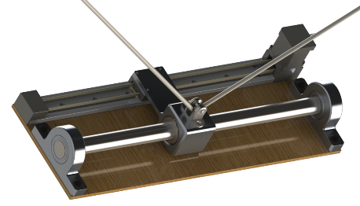
Motor Capabilities
NEMA 17 motor can handle up to 17.5 lbf at top speed and acceleration
Load is applied onto carriage/track instead of directly onto actuator
Eliminates off-axis load on actuator
On-axis force balances
Linear bearings with μ = 0.0022
Maximum loading results in 0.6 lbf on actuator
“Off-axis” Loading
“On-axis” Loading
“The simulated gravity force must stay within 2 degrees of normal to the support surface at all times”

Slide 36
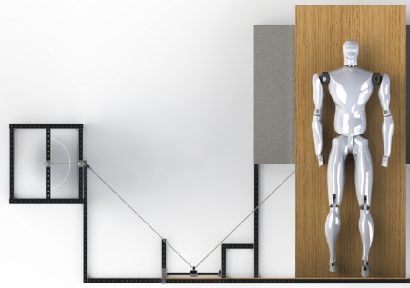
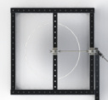
Motor Capabilities: Angle Deviation
α changes negligibly
γ changes
Must keep on-axis load < 17 lbf
γ
α
γ_{max}
γ
γ_{min}
“The simulated gravity force must stay within 2 degrees of normal to the support surface at all times”
Notes:
I will update this with actual diagrams using the CAD, I just don’t have time today.

Slide 37
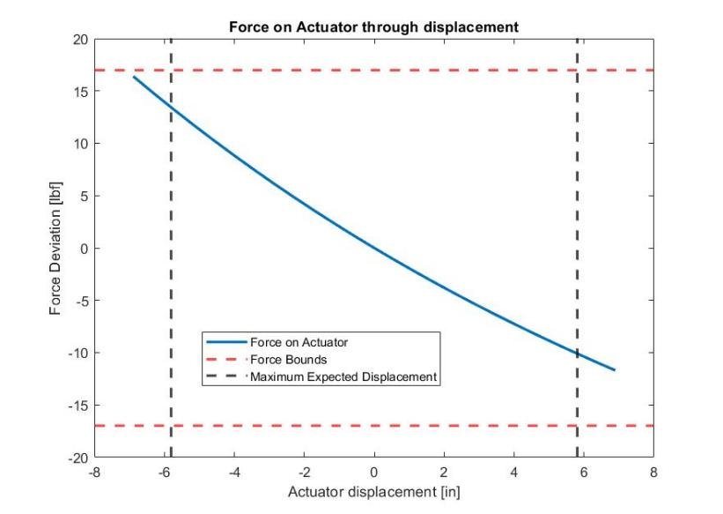
Motor Capabilities: Load Placement
Placing loading towers farther from actuator decreases force deviation
With towers at 36 inches, force does not exceed 17 lbf
“The simulated gravity force must stay within 2 degrees of normal to the support surface at all times”

Slide 38
Project Risks

Slide 39
Project Risks
Risk | Description | Mitigation
Force Impact on Actuator/Carriage | Concern over motor’s successful operation when heavy loads present | Analysis of loading weights, design consideration of motor carriage limits
Frictional Effects on Offloading Environment | Thrust Bearing, Platform Wheels rotation slowed by frictional effects, hurt approximation of postural sway | Careful component selection and platform construction, replace bearings and wheels if necessary
Budget | Parts and materials too expensive, critical elements fail and cannot be replaced | Pursue other funds, find cheaper sources, handle essential parts with care and caution, manufacture our own parts
Other risks include: compounding code/sensor errors, manufacturing issues, frame stability issues, and electronics failures
Force Impact on Sliding Motor
Tether attachment point moving on track affected by Pulley Weights
Concern over successful operation when heavy loads present
Frictional Effects on Offloading Environment
Thrust Bearing, Platform Wheels rotation slowed by frictional effects
Freedom of movement impared by nature of setup
Compounding Code/Sensor Errors
Feedback from sensors to computer suboptimal
Incorrect readings lead to incorrect force application
Manufacturing Issues
Parts too small, too large, hard to assemble to exact specifications
Frame Stability Issues
Pulley Weights pull mechanism, unbalanced testing environment
Electronics Failure
Budget
Compounding Code/Sensor Errors | Incorrect readings lead to incorrect force application. | Frequent testing and analysis
Manufacturing Issues | Parts too small, too large, hard to assemble to exact specifications | Training classes, faculty assistant
Frame Stability Issues | Pulley Weights pull mechanism, test environment | Force analysis and test area selection
Electronics Failure | Crossed wires, short circuited motor | Careful operation
Notes:
Make a table where i mention mitigations

Slide 40
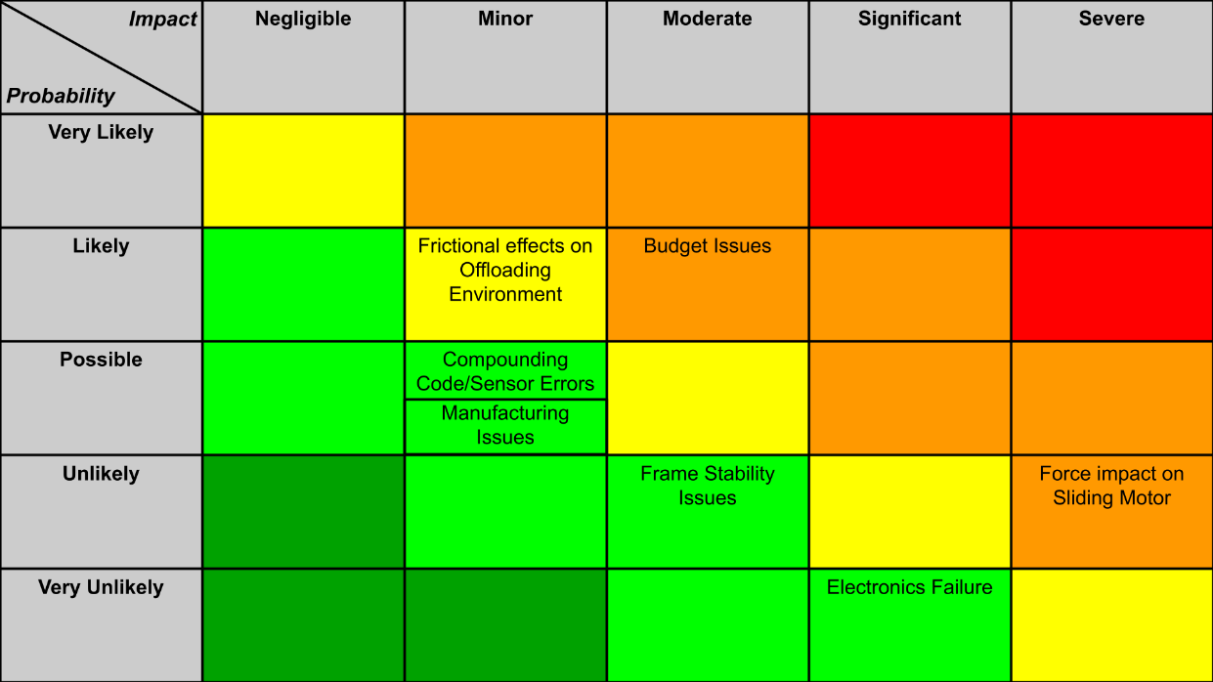
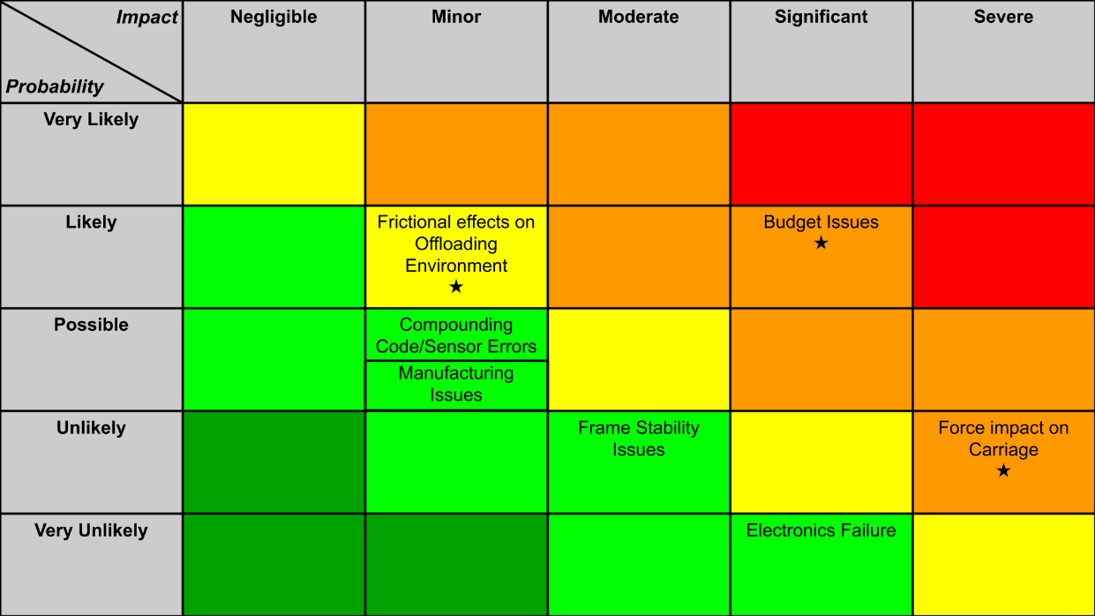
Notes:
OG One

Slide 41
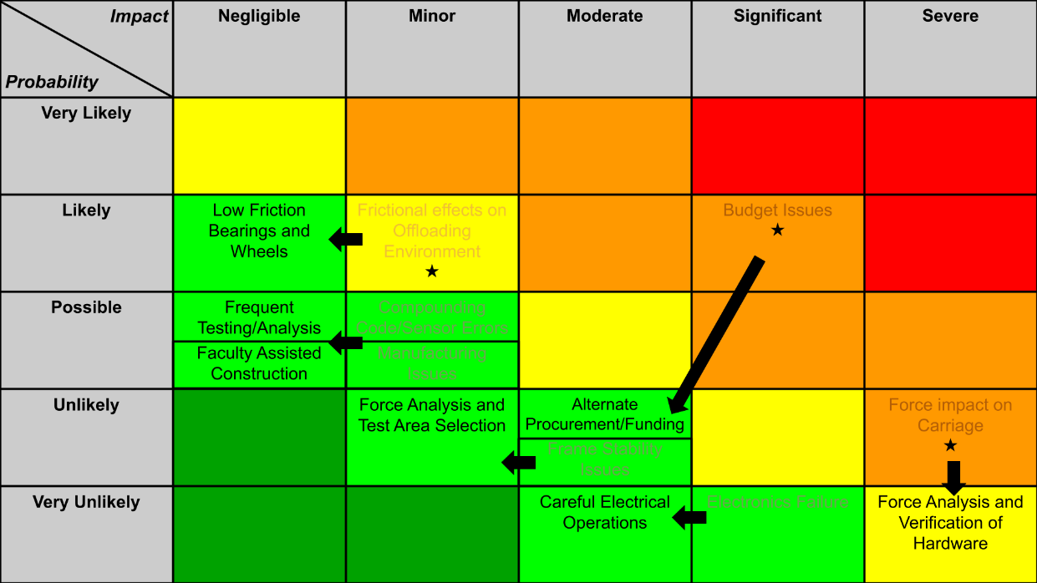
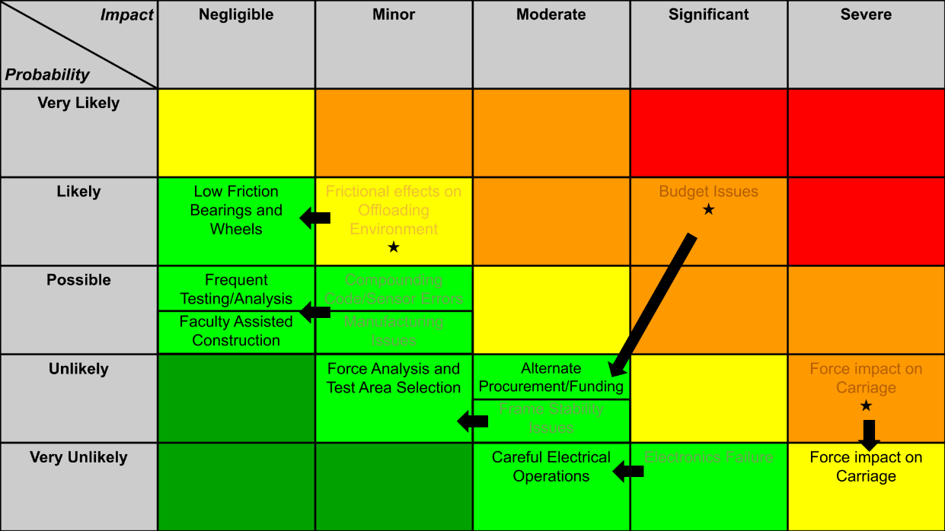
Notes:
OG One

Slide 42
Verification & Validation

Slide 43
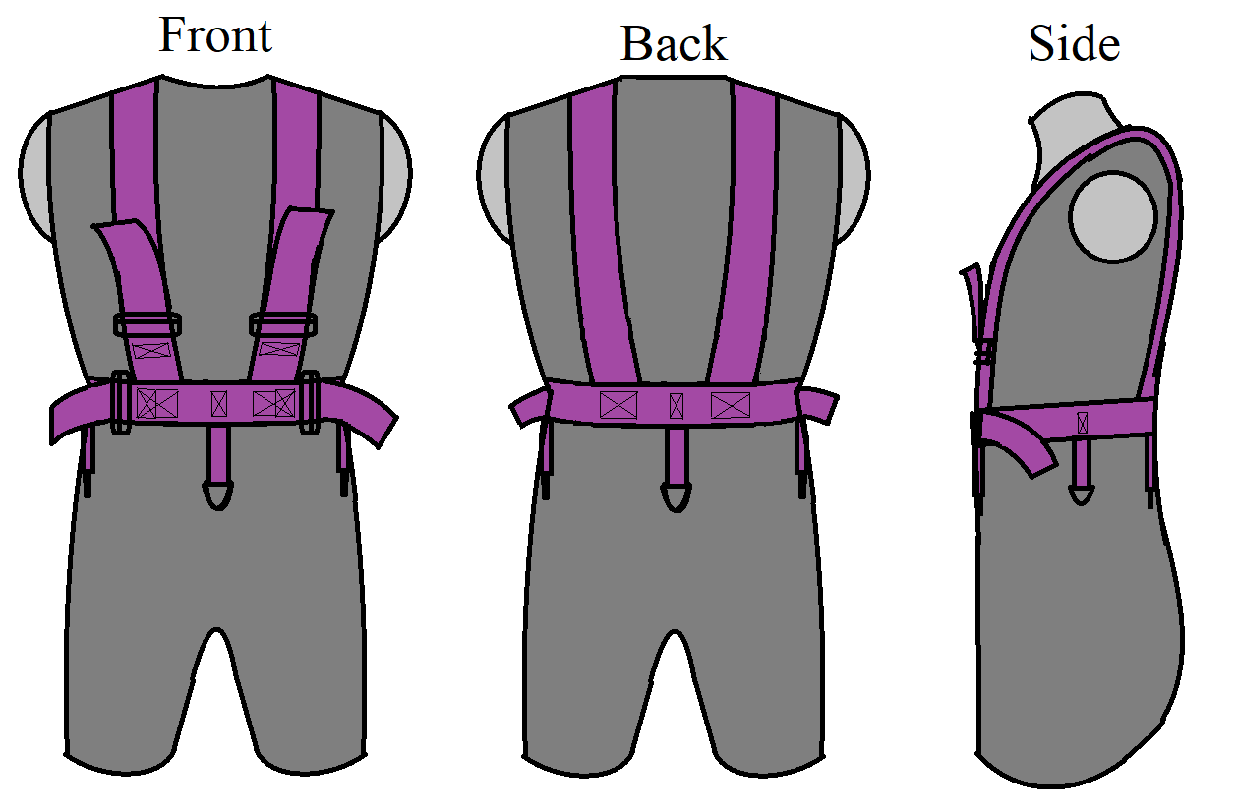
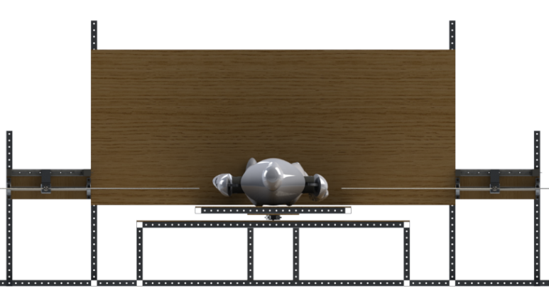
Validation - Meeting Customer Needs
Needs moving load to keep applied force perpendicular to support surface as user leans
Loading mechanism with sliding load attachment
Applied force magnitude and direction within required margins
Can be tested on Earth
90 degree test bed with low friction
Can be used by variety of sized people
Forward-backward lean and side-to-side lean supported
Adjustable harness with 4 rings
Direction of simulated gravity
Direction of Earth’s gravity
Sliding load attachment
and angle sensor
𝜽
Notes:
“Next, I will take you through our most important verification tests”

Slide 44
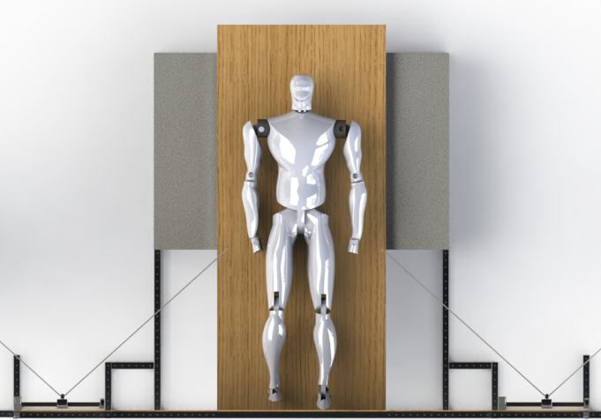
System Verification - F1 & F2 Margins
F1 Loading Margin: Applied force magnitude MUST stay within ± 10 N (2.25 lbf) of user weight
F2 Angle Margin: Applied force direction MUST stay within ± 2 degrees from true perpendicular to support surface
Both system margin requirements are verified with same test
F_{g} = m_{user}g ± 10 N
±2°
Notes:
Simulated gravity force must maintain constant magnitude and direction throughout user operation (say don’t include) Systematic how do we verify Spell out real experiment

Slide 45
System Verification - F1 & F2 Margins
Three different team members will perform postural sway testing
Inputs: user weight, sand drum weights, harness attachment height
Outputs: angle sensor and IMU data
Angle sensor data allows force magnitude and direction calculation over test duration
IMU
𝜽₁
𝜽₂
Angle sensors
Notes:
Simulated gravity force must maintain constant magnitude and direction throughout user operation (say don’t include) Systematic how do we verify Spell out real experiment

Slide 46
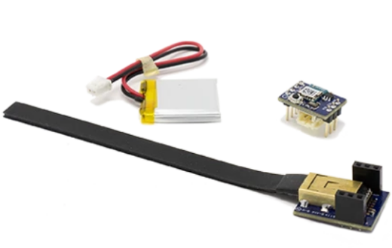
Component Verification - Angle Sensor
Angle sensor accuracy is important for verification
Team will verify angle sensor is accurate to within 0.2 degrees of correct measurement
Verification merely requires sensors, a protractor, and some wooden beams
Bendlabs 1-Axis Evaluation Kit
Notes:
Diagram of test setup. SIMPLE

Slide 47
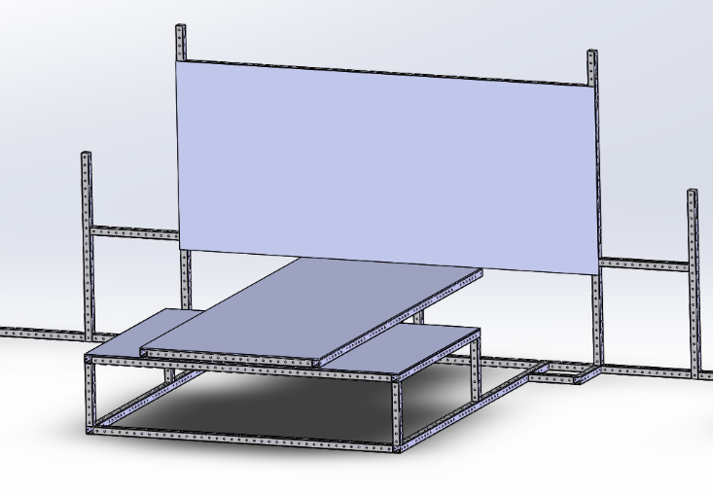
System Verification - F3 Friction Margin
F3 - The device shall allow for user postural sway by limiting the coefficient of friction present opposite to direction of sway to 0.3
Put weight on diving board
Pull to either side with spring scale
Spring scale reading = 𝝻*F_{N} = 𝝻*mg
Repeat experiment with increasing weights
Weight

Slide 48
Project Planning

Slide 49
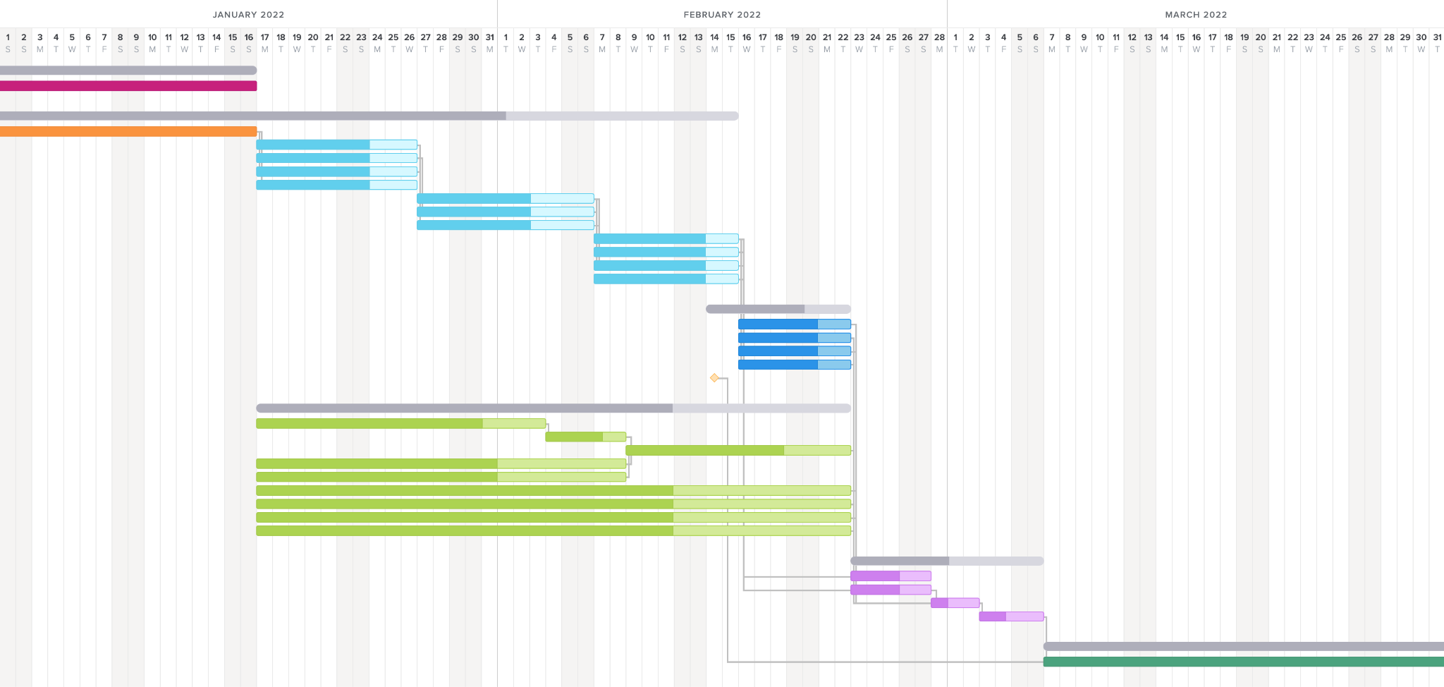
Work Plan
Procurement
Phase 1: Component Ordering & Training
Key:
Phase 2a: Manufacturing, Structure Assembly, & Verification
Margin
Training
Phase 2b: Electronics & Sensor Verification
Ordering
Holes
Phase 3: Structure Integration
Training
Cutting
Assembly
Manufacturing
Electronics & Sensors
Phase 4: System Verification
Structure Verification
Test
Structure Integration
System Verification
Milestone
TRR
Control Law, Verification Code, & Linear Actuator Testing
Functional Requirement Satisfaction
Integration

Slide 50
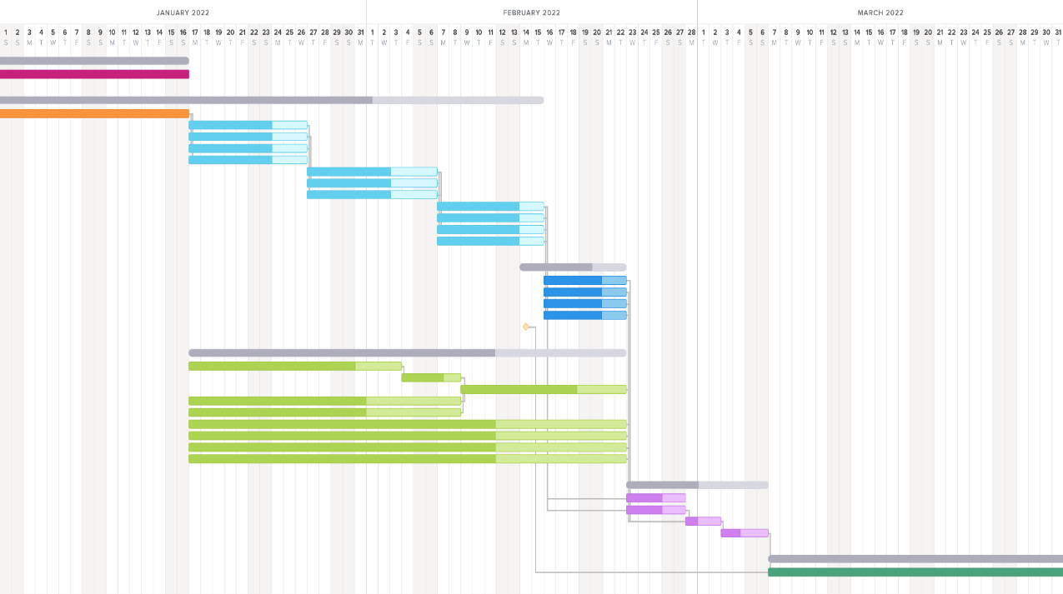
Critical Path
Key:
Margin
Ordering
Training
Training
Manufacturing
Electronics & Sensors
Structure Verification
Structure Integration
System Verification
Test Environment Fabrication
Test Environment Verification
Milestone
Assembly
System Verification

Slide 51
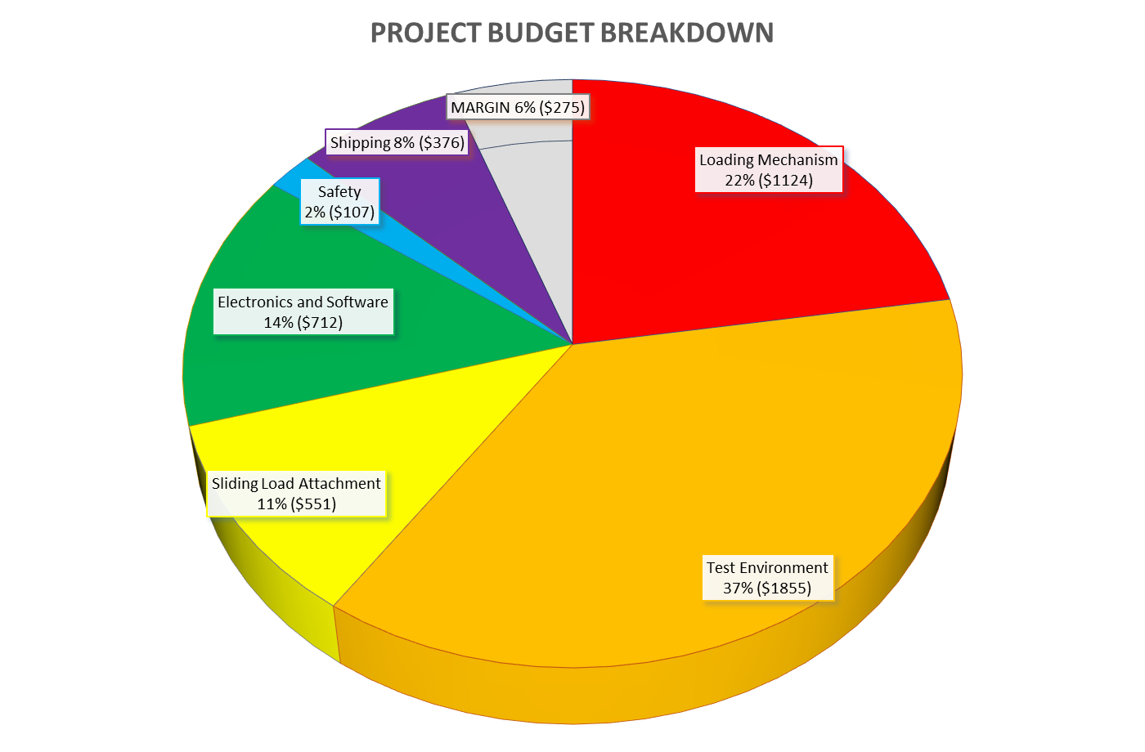
Cost Plan
We have a tight margin but with all necessary selections made we are under budget
Customer has expressed that they are willing to fund our project by an extra $500 in order to cover over budget costs if we don’t receive the extra EEF funding
All vendors for selections are U.S. based
All necessary cost quotes have been obtained from vendors presented here
Total Cost: $4,725

Slide 52
Major Tests
System requirement and component verification tests will take place March 8-31
We are supplied with adequate room for our test environment and loading structure
Test components are all either included in budget or available for use from aerospace department
System requirement and component verification tests are feasible
Notes:
Components for force vector magnitude and direction testing are included in budget Tools for friction analysis and angle sensor verification can be borrowed from aerospace department

Slide 53
Questions?

Slide 54
Appendix

Slide 55
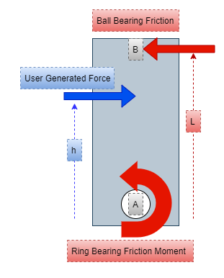
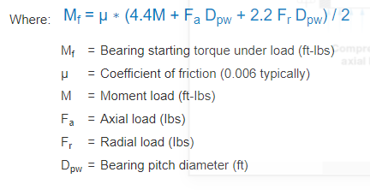
Friction Analysis - Top Down View

Slide 56
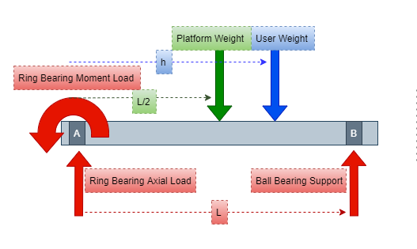
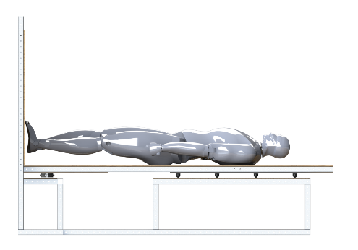
Friction Analysis - Side View

Slide 57
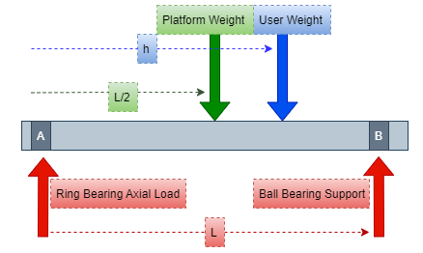
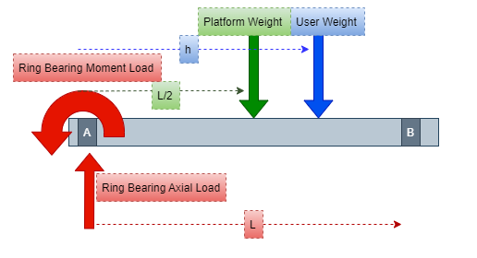
Friction Analysis
N_{B} Upper Limit
M_{RB} Upper Limit

Slide 58
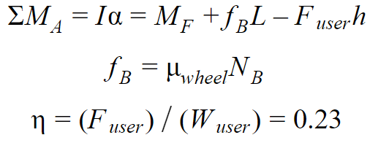
Friction Analysis
We now have enough information to evaluate M_{F}
Note
F_{r} = 0
F_{a} = N_{A} (from previous slide)
M = Ring Bearing Moment from previous slide

Slide 59
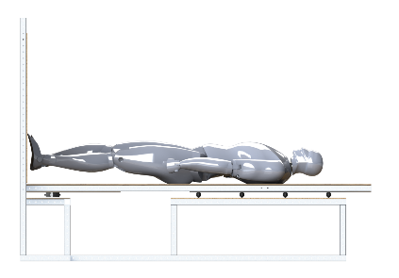
Friction Analysis
N_{A}= 135 lbs & N_{B} = 175 lbs for a ~330 lb. user weight and L = 6 feet
These are well within the capabilities of the hardware chosen
Thrust bearing has a dynamic axial load capacity of 1575 lbs
Spherical ball bearing caster has load capacity of 286 lbs

Slide 60
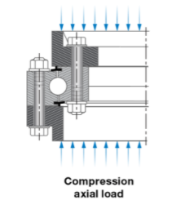
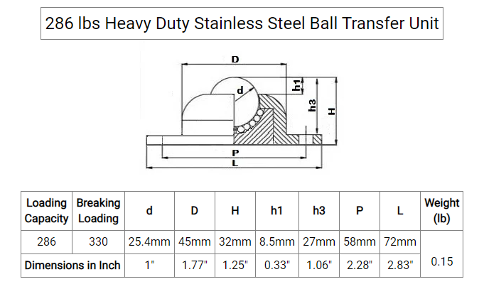

Slide 61
Manufacturing Plan
Manufacturing Event | Solution
Harness Construction | Industrial Sewing Machine (via Prof. Anderson or ITLL)
Lumber sizing | Basic Woodshop (Class offered by Prof. Rhode + Machine Shop)
Metal Sizing | Mills & Lathes [1+2] (Class offered by Prof. Rhode + Machine Shop)
Electronics Assemblies | Aerospace Electronics Shop (via Bobby & Trudy)
Notes:
Construction and Assembly of the device will take place in “LOCATION”

Slide 62
Cost Plan Major Items BOM (Structural and Mechanical)
Major Item: | Description | Quantity | Total Cost | Vendor
Structural Beams (10’ Long) | Aluminum 1.5"x1.5" square tubing. .125" Thick. 10’ Long | x20 | $1,290.00 | McMaster-Carr
Structural Beams (8’ Long) | Aluminum 1.5"x1.5" square tubing. .125" Thick. 8’ Long | x6 | $312.36 | McMaster-Carr
Angle Bar | Multipurpose 6061 Aluminum, .125” Thick, 90deg Angle with Round Edge, 1.5” Outside Height, 8’ Long | x2 | $76.98 | McMaster-Carr
Aluminum Bar #1 | .125”x4”x36” 6061 Aluminum | x1 | $18.00 | McMaster-Carr
Aluminum Bar #2 (6’ Long) | .125”x1.5” 6061 Aluminum | x1 | $13.28 | McMaster-Carr
Aluminum Bar #2 (3’ Long) | .125”x1.5” 6061 Aluminum | x1 | $7.57 | McMaster-Carr

Slide 63
Cost Plan Major Items BOM (Structural and Mechanical CONT.)
Major Item: | Description | Quantity | Total Cost | Vendor
Force Tethers | Low-Stretch Easy-Splice Rope—For Lifting | 1 x 25’ spool | $70.00 | McMaster-Carr
Weights | 50 lb Sandbags | x9 | $35.82 | Lowe’s
Platform Metal | 4’x8’, .032" thick, Aluminum | x1 | $137.23 | Armor Steel
Platform Wood | 4’x8’ Southern Yellow Pine | x2 | $74.36 | HomeDepot
Slewing Bearing | Ring Bearing: Aluminum,30mm Inside Dia,100mm Outside Dia, 29mm Wd | x1 | $238.00 | Grainger
Ball Bearing Castors | 286 lbs Heavy Duty Stainless Steel Ball Transfer Unit | x3 | $65.25 | VXB Ball Bearings

Slide 64
Cost Plan Major Items BOM (Electrical and Human Factors)
Major Item: | Description | Quantity | Total Cost | Vendor
Linear Actuators | ZLN-40 Linear Actuator | x2 | $354.22 | Drylin Drive Technology
Angle Sensors | 1-Axis Evaluation Kit, Flexible bidirectional sensor | x2 | $199.98 | Bendlabs
Arduino | Arduino Portenta H7 Dual Core Microcontroller | x1 | $103.40 | Arduino
Stepper Motors | TB67S249FTG Stepper Motor Driver Carrier - Full Breakout 47V at 1.7 A, NEMA 17 | x2 | $23.90 | Pololu
Mattress Topper | Polyurethane foam, 2”x 22” x 22” | x2 | $17.96 | HomeDepot
Support Surface Mat | Plywood Board | x1 | $37.00 | HomeDepot

Slide 65
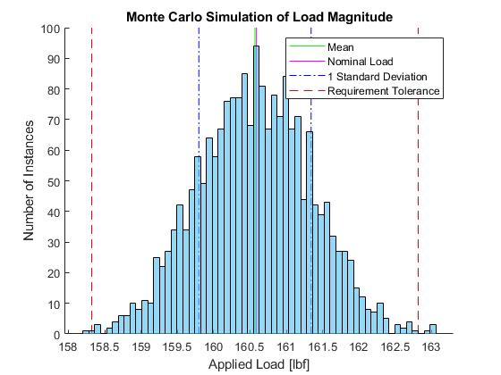
Monte Carlo of Load Magnitude
Result of simulation after 2000 runs using the Universal Test Subject for the nominal values
Load almost never deviates from required +/-2.25lbf (10N) tolerance and the average stays close to the desired load value
All uncertainties derived from sensor sensitivities, worst actuator response time, and uncertainty in the attachment point of the tethers
Compounding uncertainties were summed in quadrature

Slide 66
Structural Analysis For Loading Mech
Component | Purpose | FoS
Tether | Distributes the load to the user | ~7.11
Sand Container | Contains the sand used for loading | ~8.67
Aluminum Tubing | Structural Support | ~4.36*
Pulleys | Tether routing and friction reduction | ~3.56
Max Stress in Aluminum - 55 MPa
*Yield of anodized aluminum used = 240 MPa

Slide 67
Structural Analysis for Test Environment
Minimal stress and displacement in Support Surface when placed against a wall
Component | Purpose | FoS
Plywood | To provide rigidity | ~34.5
Aluminum Sheet | To reduce μ | ~44
Ball Castors | To support the diving board | ~4.9
Thrust Bearing | To allow rotation | 11.67
Aluminum Tubing | To provide structure | ~24
Minimal stress and displacement in Diving Board

Slide 68
Structural Analysis for Sliding Load Carriage

Slide 69
Structural Analysis for Safety
Safety Item | Working Load Limit (lbs) | FOS
Snap Shackle | 989 | 3.38
Webbing | 1080 and 1415 | 3.69 and 4.84
Webbing Slider | 1000 | 3.42
D-rings | 1000 | 3.42
Slackline | 1600 | 5.47
Mountable D-ring | 800 | 2.74
All factor of safety are above 2.5 → Safe

Slide 70
Test Environment
±20°
Component | Purpose
Plywood Sheet | To provide rigidity to the Diving Board
Aluminum Tubing | To create the structural skeleton
Aluminum Sheet | To reduce friction on Ball Bearings and provide additional support
Thrust Bearing | To allow rotation at ankle joint
Ball Bearings | To support the “Diving Board” and allow for frictionless translation
Notes:
Consists of a structural “Skeleton” and a “Diving Board”
Removes the force due to Earth gravity from the plane of study
Rotates about the ankle joint of the subject (with adjustability)
Mitigates friction to prevent interference with the study through bearings

Slide 71
Test Environment - CAD
36”
42”
61.375”
84”
18.40625”
63”
83.75”.

Slide 72
Safety - Harness and Padding
Harness:
Webbing: Polypropylene, 2”width, supporting 1080 lbs AND Nylon, 1”width, supporting 1415 lbs.
Sliders: Supporting 500 lbs, D-rings: Supporting 1000 lbs.
Slackline:
D-Ring: ¼” mounted D-rings, supports 1,200 lbs.
Tether: ¼” Vectran rope, supports 1,600 lbs.
Secondary visual (Eli ideas)
Padding:
Polyurethane foam, 2” thick
Notes:
Grip tape for foot support
Harness design/manufacturing methods
Harness load distribution + adjustability
Slackline system design
Padding for comfort overview

Slide 73
Safety - Adjustability
Verified for extreme case of 95th percentile weight and 50th percentile height
Maximum:
Waist circumference: 43.5”
Chest circumference: 46.7” → Waist strap length = 4ft
Buttock circumference: 45.2”
Maximum:
Buttock to shoulder height: 28”
Scye circumference: 20.5” → Shoulder strap length = 6.5ft total
28*2 + 20.5 = 76.5” per strap
Adjustable slider supports 1000 lbs

Slide 74
Safety - Diving Board Padding
Two sheets of 22” x 22” x 2” Polyurethane foam padding.
Total area: 968 in^2
Area needed: 876 in^2
Slits in the padding for the harness to slip into in order to attach the user to the diving board to prevent them from falling off while in use.

Slide 75
Safety - Additional Information
Secondary visual (Eli ideas)
Snap Shackle:
Primary attachment shackle for tethers
Supports 989 lbs
Open/Close Under Force
Emergency release if needed
Heritage on high tension rope aboard sailboats
Spliced Rope:
Rope looped back into itself
Holds up to 90% of Rope Strength, above 50% for other knots
Can be done with sewing machine/needle
Heritage on skydiver parachutes and CubeSats
Secondary visual (Eli ideas)
Notes:
Grip tape for foot support
Harness design/manufacturing methods
Harness load distribution + adjustability
Slackline system design
Padding for comfort overview
Materials + FoS overview

Slide 76
Loading Mechanism - Components
Sandbags
Passively loads the subject with a resultant force magnitude equivalent to their weight
Utilizes sand within a sealed container
This allows specific load control to remain within 10N
The subject will be weighed prior to use
The tether will be attached to the hanging scale (which will be attached to the sand containers), ran through a series of pulleys to the pulley on the Sliding Load Attachment, and then attached to the users harness
Sand Container
Swiveling Pulley
Tether
Mounted Pulley

Slide 77
Loading Mechanism - CAD
Stationary Pulley
Force Application Tether
15.75”
50.875”
Sand-filled Barrel
30.5”
Swiveling Pulley
Motion
23.875”

Slide 78
Sliding Load Attachment - Carriage
Designed to “offload” the force from the loaded tethers from the actuator
Allows actuator selection to be significantly downsized, reducing cost greatly and allowing for faster actuators
Is attached to and translated by the actuator
Pulley
Carriage Block
Steel Shaft
Linear Bearing
Fixtures

Slide 79
Carriage Breakdown
Component | Description
Linear Bearing | Steel, 𝛍 = ~.001 1130 lb Load Capacity
Steel Shaft | 1” 1566 Carbon Steel Rod YS = 84 ksi
Pulley Mount | Steel ¼” Mounted Pulley 800 lb load capacity
Carriage Block | Milled Aluminum Block
Fixtures | Milled Aluminum Blocks
Lowest FoS: ~3.56 (In the Pulley)
Linear Bearing Specs
Linear Shafting Shaft Specs

Slide 80
Controls
𝝰
Θ
+
Motor Controller
Stepper Motor
Actuator and Load
Δx
+
ΔΘ
PID
Notes:
We can clean up this diagram, but this is the idea

Slide 81
Software Team Breakdown
Actuator Control Team
Develop encapsulated function(s) to control the linear actuator position given a desired position
Sensor Data Collection Team
Develop encapsulated function(s) to query and collect data from angle sensors and body mounted IMU
Software Systems Team
Coordinate the integration of all subsystems
GUI & Matlab Interface Team
Develop a Graphical User Interface in Matlab designed to display test data and develop a simple method for Matlab to Arduino Connection
Control Algorithm Team
Develop encapsulated function(s) to compute the required actuator movement given current measured angle
Notes:
We can clean up this diagram, but this is the idea

Slide 82
Design Requirements & their Satisfaction
There is slight delay between electronic components and in motion of actuator
Need a delay of <80 ms
Motor driving actuator slows down with higher forces
Top speed necessary will be 19 in/s
Must keep force on actuator < 17.6 lbf
“The simulated gravity force must stay within 2 degrees of normal to the support surface at all times”

Slide 83
Sensors and Controls - Component Choices
Microcontroller
Angle Sensors
Actuator Motor Controller
Body IMU sensor
Display Interface
Arduino Portentia H7
Bendlabs 1-Axis Soft Flex Sensor
drylin D7 stepper motor output stage
DFRobot SEN0386
Matlab via Arduino onboard BLE module
Notes:
We can clean up this diagram, but this is the idea

Slide 84
Chosen Sensor Specs
BendLabs 1-Axis Evaluation Kit
High precision
Low power
Wireless option
Interfaces with Arduino or LabView DAC
High Refresh rate
Relatively expensive

Slide 85
Chosen Sensor Specs
Arduino + Matlab Interface
Arduino Portentia H7 for computations and actuator command
Dual Cores for simultaneous Processing and command
Interfaced with Matlab for a GUI and data collection
+

Slide 86
Chosen Actuator Specs
Actuator Specs:
350mm stroke length
NEMA-17 Motor with torque of 0.5 Nm
Acceleration controlled by controllers
48 VDC power input at 1.8A
Capable of speeds greater than required

Slide 87
Engineering Budgets
Component | Power (W)
6-Axis IMU | 0.132
BendLabs Angle Sensor | 0.00132
Stepper Controllers | 172.8
Total: | 172.93332
Subsystem | Mass (lb)
Loading Mechanism | ~100 (Unloaded), ~550 (Fully Loaded)
Test Environment | ~178
Sliding Load Attachment | ~18
Total System Mass: | 293 - 716

Slide 88
FBD

Slide 89
Example Joint

Slide 90
Assembly Dimensions (TOP)

Slide 91
Assembly Dimensions (FRONT)

Slide 92
Test Environment Dimensions (Top)

Slide 93
Test Environment Dimensions (FRONT)

Slide 94
Loading Tower Dimensions

Slide 95
Diving Board Dimensions

Slide 96
Wheel Table Dimensions (& Support)

Slide 97
Support Surface Dimensions (& Support)

Slide 98
Feasibility Study 2 - (F2) Gravity Vector Deviation
Initialize the sway equations: θ(t) = A*sin(T*f*t) dθ_dt(t) = T*f*A*cos(T*f*t)
PID Control Simulation
Stepper Rate Command Simulation
While (t > simulation_time)
t += sensor_query_time;
new_position = PID_control(current_position,t);
t += PID_computation_time;
translation_speed = shoulder_height*sin(dθ_dt(t));
if ( max(translation_speed) > max_actuator_speed )
t += excess_move_time;
position_array_PID.append(new_position);
PID_difference = position_array_actual - position_array_PID;
While (t > simulation_time)
t += sensor_query_time;
Commanded_rate = K1* (movement_rate - actuator rate)
K2*dθ_dt(t);
t += rate_computation_time;
translation_speed = shoulder_height*sin(dθ/dt);
if ( max(translation_speed) > max_actuator_speed )
t += excess_move_time;
position_array_STEPPER.append(new_position);
STEPPER_difference = position_array_actual
- position_array_PID;
Plot results of both of the simulations and their deviations from the true position (error)
Notes:
Thoroughly explain all lines on both plots

Slide 99
Universal Test Subject
50th Percentile American Male, NASA Handbook
(APPENDIX B) [7]
Height: 171.6 cm
Weight: 73 kg
CoM: 103.1 cm
Depth: 24.65 cm
Foot Size: 26.05 cm
Lean Max: 7.6º
Postural Sway of the Human Subject is modeled by 0.5 hz sine wave, as per Dr. Temple’s research.
Back/forth displacement of the Universal Test Subject is assumed to be modeled as a pendulum swing, modeled in MATLAB.
Notes:
dr clark used a pendulum w/ .5 hz sine wave with 10 degree amplitude. It’s an assumption: we want to do humans: we MODEL sway as pendulum sway. Mention that these are not worst case (except for the angle)

Slide 100
Universal Test Subject
50th Percentile American Male, NASA Handbook (APPENDIX B) [7]
Height: 171.6 cm
CoM: 103.1 cm (Up From Foot)
Shoulder Width: 46.95 cm
Torso Width: 38.4 cm
Depth: 24.65 cm
Foot Size: 26.05 cm
Lean Max: 7.6º
Sway Max: 5.4º
Weight: 73 kg
Notes:
Add in dr clark about the pendulum .5 hz sway assumption: we want to do humans: we MODEL sway as pendulum sway

Slide 101
Max Lean Angle
c = CoM Height = 103.1 cm
Depth: 24.65 cm
Foot Size: 26.05 cm
a = Foot-Depth/2 = 13.725 cm
Arcsin(a/c) = 7.6º
MAX LEAN
Assumptions:
a = Section of body in front of CoM

Slide 102
Feasibility Study - (F6) Safety
F6: The device shall prevent the user from falling if the user enters an unrecoverable state.
The device shall not continue the load if the user enters an unrecoverable state.
Unrecoverable: User is at an angle of > 20 degrees, COM position is < 75 cm above the ground, or the COM has a velocity > 1 m/s
.
Max lean angle of 10-20 degrees before people fall
Min COM position from ground at 10 deg lean is 85 cm
Max vel of COM at 10 deg sway at 0.5 Hertz is 65 cm/s
When one has reached 1 m/s, they have only moved 5 cm in 0.1 sec
1 m/s
75 cm
20º

Slide 103
Post-CONOPS
Stage 5: Balance Tests
Out of scope of this project
After bed rest is complete (~70 days)
Test for retention of proprioceptive functions
Direction of Earth Gravity

Slide 104
Why Not One Tether?
When the test subject leans forward, slack will be taken out of the system.
Sandbag goes down
Work is being done on the person
When test subject leans back to original position, slack will have to be given
Sandbag goes up
User has to do work on the system
If there are two tethers:
One sandbag goes down, one sandbag goes up
Net work = 0
dy
Work = m*g*dy

Slide 105
References

Slide 106
Presentation References
[1] Garcia, Mark. “Astronaut David Saint-Jacques Is Carried to a Medical Tent.” NASA, NASA, 25 June 2019, https://www.nasa.gov/image-feature/expedition-59-canadian-space-agency-astronaut-david-saint-jacques-is-carried-to-a.
[2] Mulavara, Ajitkumar P., et al. “Locomotor function after long-duration space flight: effects and motor learning during recovery.” \emph{Experimental Brain Research} vol. 202, no. 3, 2010, pp. 649-659 doi: 10.1007/s00221-010-2171-0.
[3] Mars, Kelli. “Analog Missions: Bed Rest Faqs.” NASA, NASA, 26 Mar. 2019, https://www.nasa.gov/analogs/envihab/bed-rest-faqs.
[4] McMaster-Carr,“Fibrous Rope”,McMaster-Carr,https://www.mcmaster.com/fibrous-rope/
[5] Densities of materials. Engineering ToolBox. (n.d.). Retrieved October 5, 2021, from https://www.engineeringtoolbox.com/density-materials-d_1652.html.
[6] Tleto. “Polyurethane Coefficient of Friction.” Gallagher Custom Polyurethane Molding, 29 Oct. 2020, https://gallaghercorp.com/polyurethane-coefficient-of-friction/.
[7] NASA, “Human Integration Design Handbook (HIDH)”, NASA Special Publication SP-2010-3407-REV1, 2014.

Slide 107
Presentation References
[8] “Friction and Friction Coefficients.” Engineering ToolBox, https://www.engineeringtoolbox.com/friction-coefficients-d_778.html.
[9] “Measuring Stepper Motor holding torque” https://www.applied-motion.com/news/2015/10/dynamic-torque-step-motor-sizing
[10] Fryar CD, Carroll MD, Gu Q, Afful J, Ogden CL. “Anthropometric reference data for children and adults: United States, 2015–2018.” National Center for Health Statistics. Vital Health Stat 3(46). 2021.

