Slide 1
Ground-based Hardware for Optical Space Tracking
Project Manager: Jack Toland
Hardware: Kira Altman, Lucas Calvert, Seth Hill, Duncan McGough, Jacob Vendl
Software: Ginger Beerman, Connie Childs, Blaine Covington, Rachel Mamich, Connor Ott
Sponsor: The Aerospace Corporation
Advisor: Marcus Holzinger

Slide 2
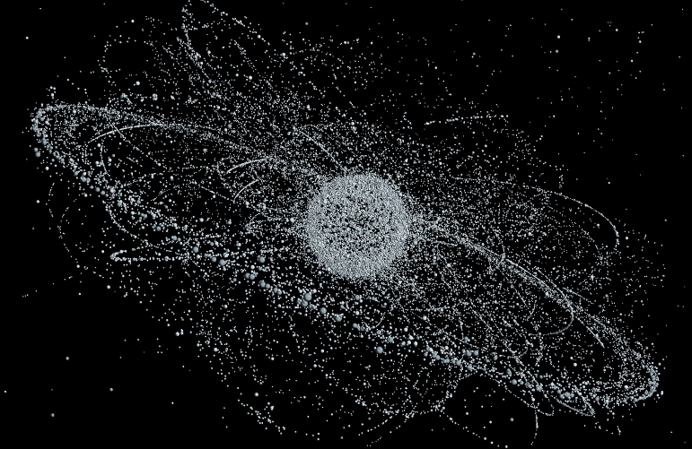
Project Overview
Motivation
Increasing number of space objects
CubeSats
Mega Constellations
Debris
International dependence on space
Communication
Weather
National Security
Solution
Design a low-cost, ground-based, optical tracking system for space situational awareness (SSA) and space traffic management (STM).
Estimated satellite distribution by 2040
*Courtesy of Daily Mail

Slide 3
CONOPS
($α_{1}$,$δ_{1},t_{1}$), ($α_{2}$,$δ_{2},t_{2}$)
Captured Image
($α_{3}$,$δ_{3},t_{3}$), ($α_{4}$,$δ_{4},t_{4}$)
Recorded Measurements
GHOST
($α_{5}$,$δ_{5},t_{5}$), ($α_{6}$,$δ_{6},t_{6}$)

Slide 4
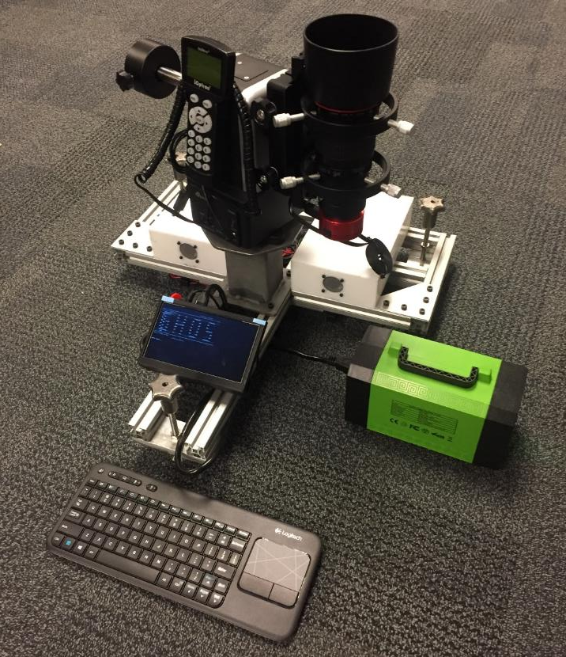
Baseline Design
Chassis
Leveling Feet
Power Supply
Computer and GPS
Actuation Mount
Camera and Lens
Pedestal
Monitor
Emergency Stop

Slide 5
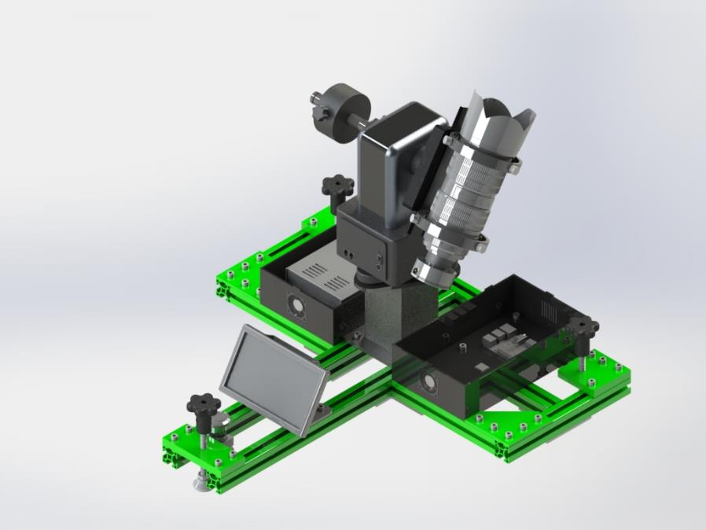
Baseline Design
Chassis
Leveling Feet
Power Supply
Computer and GPS
Actuation Mount
Camera and Lens
Pedestal
Monitor
Emergency Stop

Slide 6
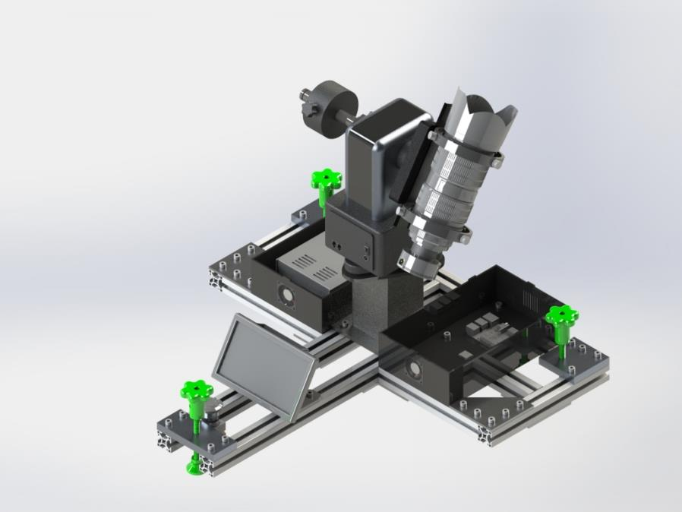
Baseline Design
Chassis
Leveling Feet
Power Supply
Computer and GPS
Actuation Mount
Camera and Lens
Pedestal
Monitor
Emergency Stop

Slide 7
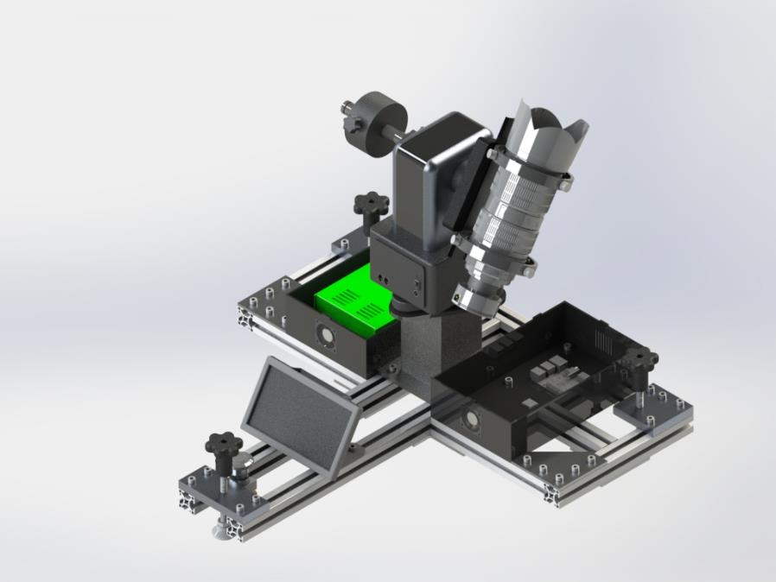
Baseline Design
Chassis
Leveling Feet
Power Supply
Computer and GPS
Actuation Mount
Camera and Lens
Pedestal
Monitor
Emergency Stop

Slide 8
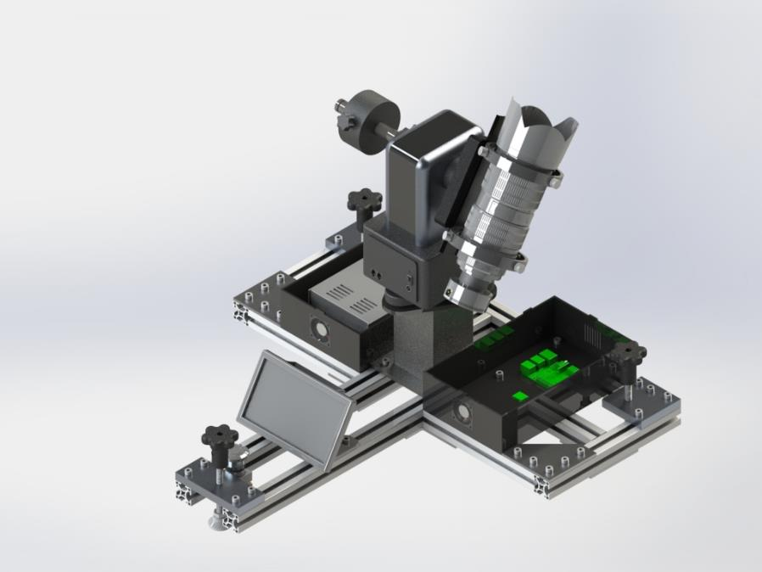
Baseline Design
Chassis
Leveling Feet
Power Supply
Computer and GPS
Actuation Mount
Camera and Lens
Pedestal
Monitor
Emergency Stop

Slide 9
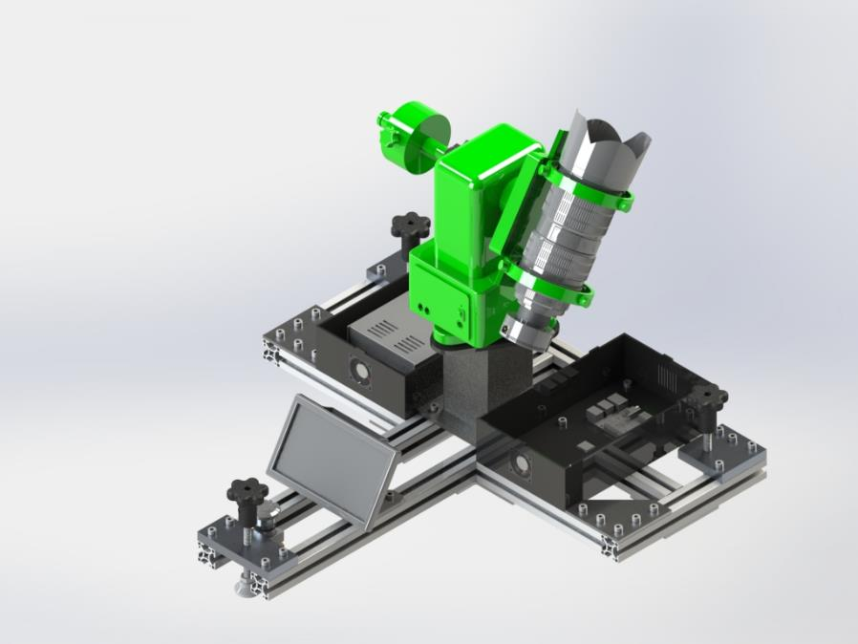
Baseline Design
Chassis
Leveling Feet
Power Supply
Computer and GPS
Actuation Mount
Camera and Lens
Pedestal
Monitor
Emergency Stop

Slide 10
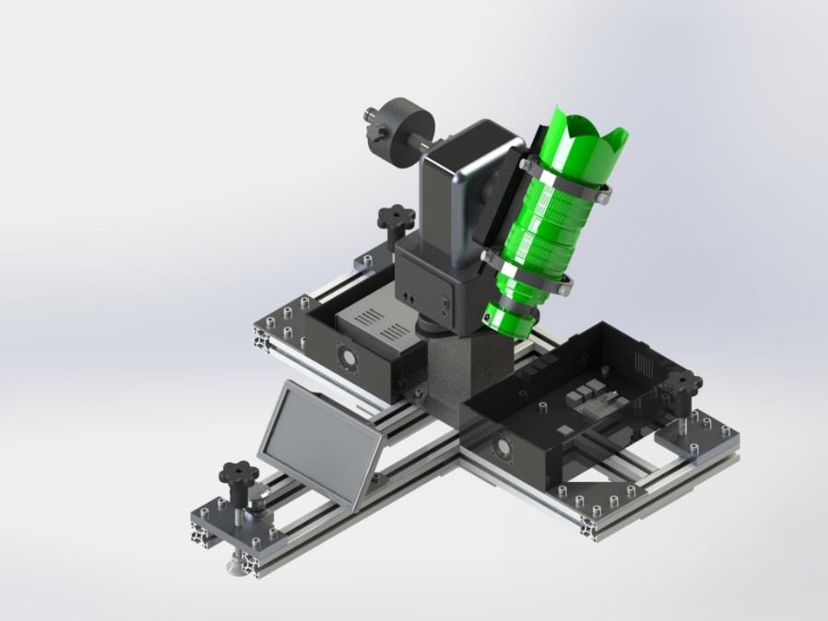
Baseline Design
Chassis
Leveling Feet
Power Supply
Computer and GPS
Actuation Mount
Camera and Lens
Pedestal
Monitor
Emergency Stop

Slide 11
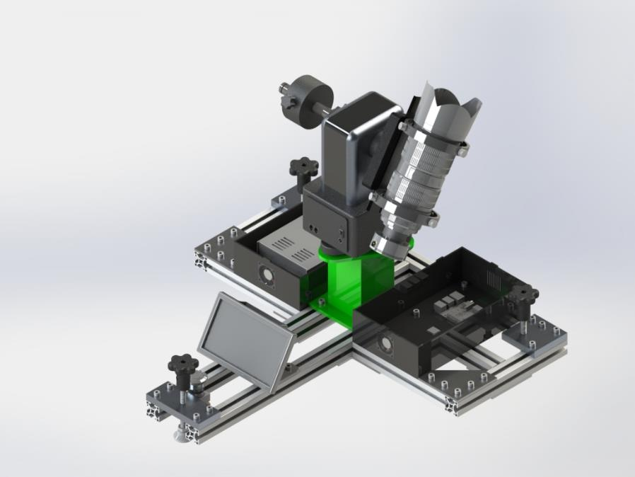
Baseline Design
Chassis
Leveling Feet
Power Supply
Computer and GPS
Actuation Mount
Camera and Lens
Pedestal
Monitor
Emergency Stop

Slide 12
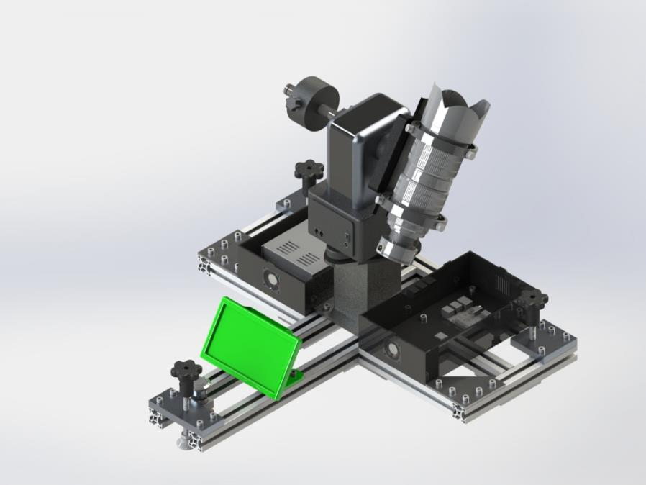
Baseline Design
Chassis
Leveling Feet
Power Supply
Computer and GPS
Actuation Mount
Camera and Lens
Pedestal
Monitor
Emergency Stop

Slide 13
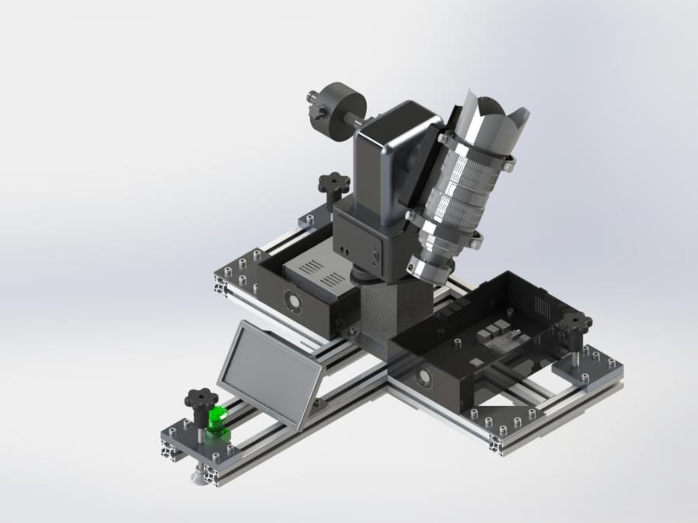
Baseline Design
Chassis
Leveling Feet
Power Supply
Computer and GPS
Actuation Mount
Camera and Lens
Pedestal
Monitor
Emergency Stop

Slide 14
Functional Block Diagram
Operator
Task List
Power In
NORAD ID List
LEGEND
Space-Track.org
Catalog
On-Board Processor
GPS
Input
Time + Position
Hardware
TLE Files
Power
Propagator
Pointing Software + Actuator API
Commands
Actuation System
External Sources
Ephemeris
Software
Scheduler
Capture Software + Camera API
Commands
Imaging System
Output
Task Lists
Images
Orbit Determination
Observations
Image Processing
Images
Other Sensors
Orbit State
Image Archive
Power
Commands
Cmd. Data
Obs. Data
Time & Positions

Slide 15
Levels of Success
 | Level 1 | Level 2 | Level 3
Scheduler | Basic horizon constraint | Multiple objects | Custom prioritization
Actuation Hardware (3+ observations per pass) | GEO | MEO | LEO
Imaging Hardware (Relative visual magnitude) | Brighter than 6.0 | Brighter than 8.0 | Brighter than 10.0
Image Processing (Exact streak endpoints) | Integer-level pixel accuracy | Photometric SNR of 30 or less | Subpixel-level accuracy
Orbit Determination | Object RA/Dec | Unfiltered IOD | Batch Least Squares OD

Slide 16
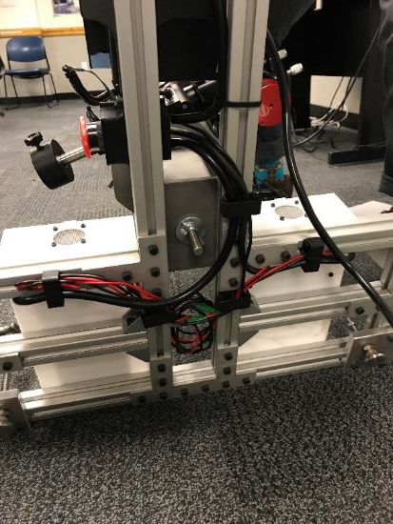
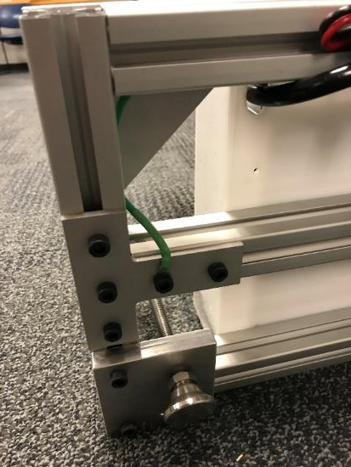
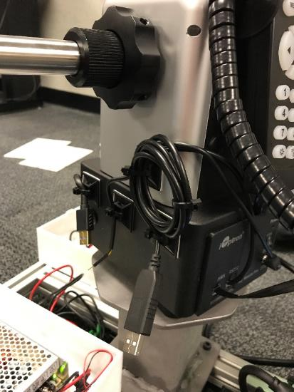
Hardware Progress since MSR
Grounded Chassis
Cable Wrap Mitigation
Cable Management

Slide 17
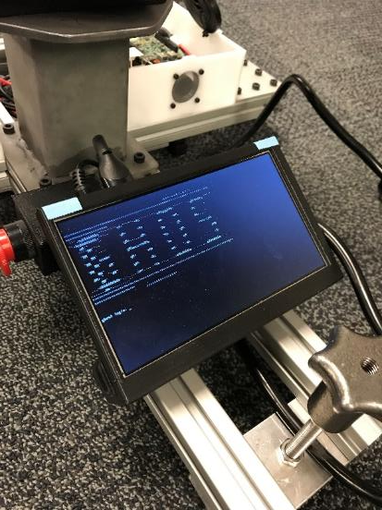
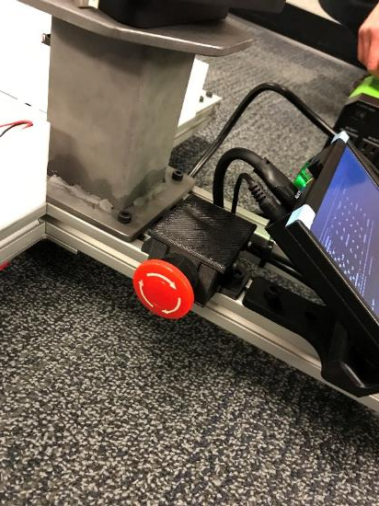
Hardware Progress since MSR
Emergency Stop
Connections Established
UDOO
iOptron
Zwo
Screen Enclosure

Slide 18
Critical Project Elements
Structure
Actuation Hardware
Imaging Hardware
Electronics
Software
Chassis
Actuation mount
Camera
& Lens
GPS
Scheduler
Onboard Processor
Image Processing
Critical Element
Non-Critical Element
Power Supply
Orbit Determination
Notes:
Review of the critical project elements, along with any updates on critical issues from CDR, FFR,
etc. These should directly relate to the manufacturing tasks that you will present.
Clear what all major elements of the project are, and how the baseline design works (5 pts)
Some elements are vaguely defined or the design was poorly explained (say which) (3-4 pts)
Key elements seem to be missing or the design not explained (say which) (2-3 pts)
Cannot tell what the baseline design is or how it works (0-2 pts)

Slide 19
Project Schedule

Slide 20
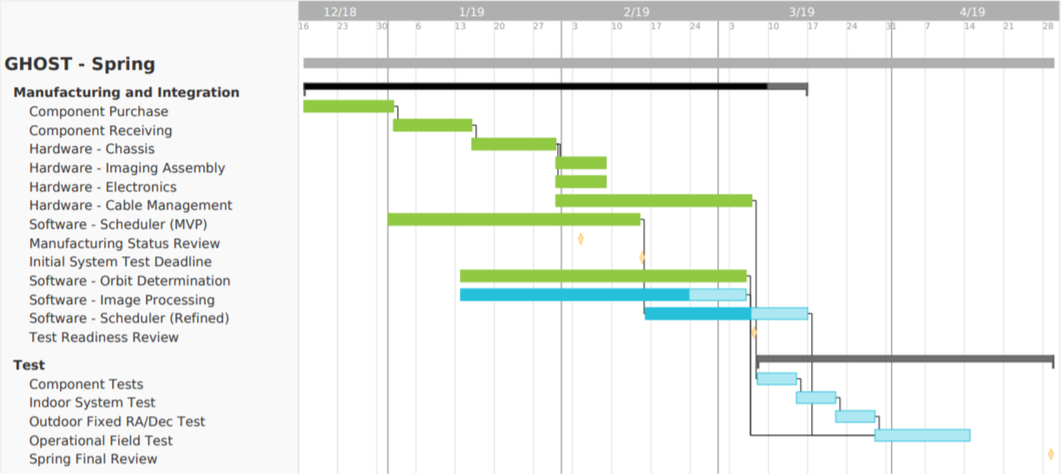
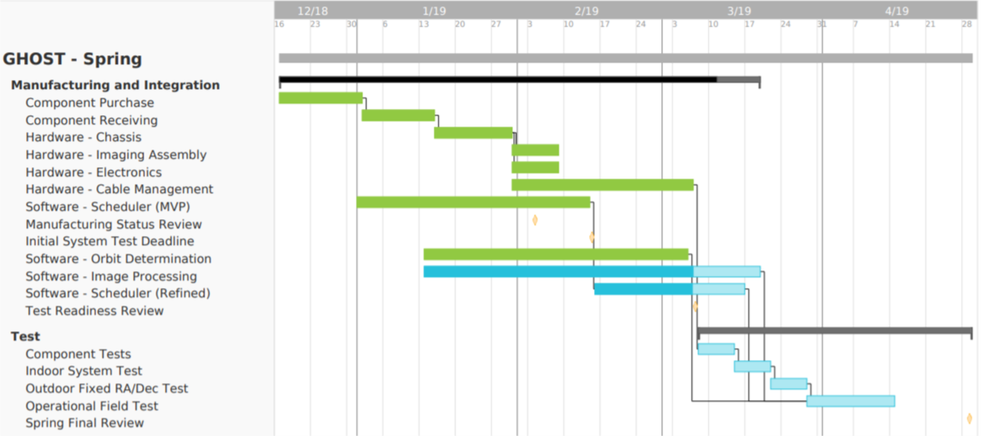
Project Schedule
Today
MSR
TRR
SFR
Critical Path
Complete
Complete
In Progress
Notes:
Image Processing – 40 hours remaining
2 dedicated software team members @ 15 hours per week
2 weeks to complete
Immediate dependency on Image Processing is

Slide 21
Test Flow
Component Tests
Integrated Tests
Hardware
Actuation Mount
Imaging System
Indoor
Command Camera
Command Mount
Electronics
Power Supply
Processor
Battery
Outdoor
Fixed
Mount Pointing Accuracy
Visual Magnitude Capability
Software
Scheduler
Image Processing
Orbit Determination
Outdoor
Multiple Observations per Pass
Multiple Space Objects per Session

Slide 22
Test Schedule
Complete
March 8
March 11
March 13
March 22
Power Distribution
Check supplied voltage and grounding at all hardware connections
Component Tests
Processor: Run software to develop timing benchmarks
Orbit Determination: Validate against prior OD cases
Indoor
Interfacing between actuation and image hardware through scheduler, assess hardware slew
Outdoor Fixed
Mount Pointing + Visual Capability, Full software pipeline for a single satellite
Outdoor Validation
Characterize full pipeline and hardware integration

Slide 23
Test Readiness

Slide 24
Test Safety
Hazard | Mitigation
Testing must occur in the dark | LED Utility light included with module
Hardware is expensive and must be transported to outdoor test location | Protective cases acquired for imaging and actuation hardware
Outdoor temperatures can drop to below freezing, especially at night | - Camera temperature will be monitored in software - Test operators will dress warmly and drink hot coco
System has high voltage systems | Module is grounded and all wiring junctions are insulated
Rotating hardware has possibility of cable wrap | Cable break-aways are installed
*Additional E-Stop to be added on 5ft extension remote for safety officer

Slide 25
CPE GPS
GPS communicates with Arduino IDE through serial between the CPU and microcontroller
Connect to that port and read the data on an OS-level
PPS signal into Arduino interface
Import GPS data into Python script
Timing information
Position information

Slide 26
CPE Image Processing
Matched filter identifies most prominent streak (only one)
Source extraction extracts GEO satellites
Thresholding matched filter results for multiple objects
Report measurements from multiple objects to OD

Slide 27
CPE Onboard Processor
Mount
Camera
Connect mount to indi server
Command desired position
Command multiple positions at desired times
Locate camera hardware from python
Command exposure
Access .fits data
Multi-Threading
Connect to mount and camera at same time
Multi-thread processes
Command a complete .cmd file

Slide 28
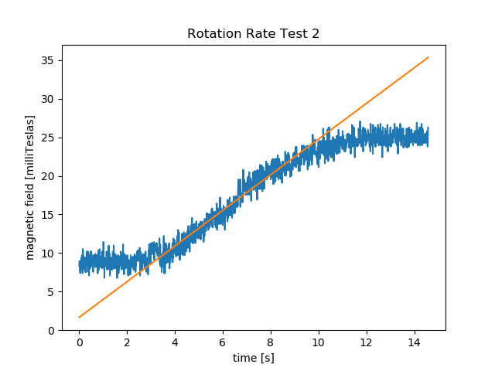
Actuation Mount Test
Magnetometer
Average slew rate from testing: 9.38 deg/s
Slew rate requirement: 2 deg/s

Slide 29
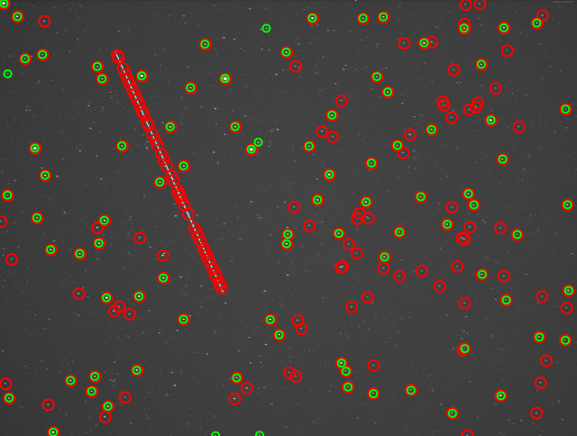
Camera Test
from Multi-objective design of optical systems for space situational awareness (Coder, Holzinger, 2015)
$$m_{v}(N,D,p)=−2.5\log_{10}\left[\frac{{SNR}_{alg}{\left[\sqrt{m_{i}}ωND (q_{p,sky}+q_{p,dark})]\right]}^{1/2}}{Φ_{0}τ_{atm}τ_{opt}\left(\frac{πD^{2}}{4}\right)QE\sqrt{p}}\right]$$
Predicted LSM Capability:
11.1
Processed using Astrometry.net to identify NGC-2500, which has $m_{v}$=12.2
and FOV of 5.23°x3.95° (diagonal of 6.55°)
Actual LSM Capability:
12.2
FR 1.2 Verified
$${FOV}_{effective}≥4°$$
FR 1 Verified
$${LSM}_{Max}≥10$$
Captured February 8th, 2019 with the GHOST system

Slide 30
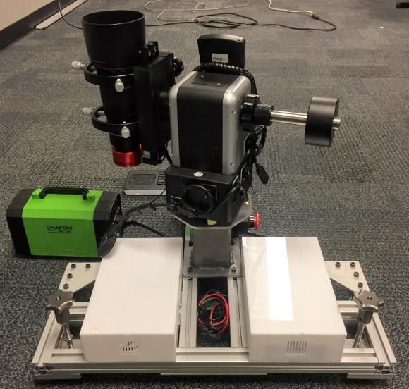
Indoor System Test Setup
Test Outline
Set up GHOST Module
Schedule Observation Session and start the Pipeline as if observing outdoors
Record actuation position, image time stamps and observe wire position
Compare with models
Actuation | Capture Time | Wire Wrap
Notes:
Key points:
Tests the interfacing between the scheduler and imager/mount systems
Verification by observation
is the module being set up right by someone who didn’t work on hardware?
check wire wrap
verify slews are moving in the expected direction, and at correct time
verify images being taken automatically

Slide 31
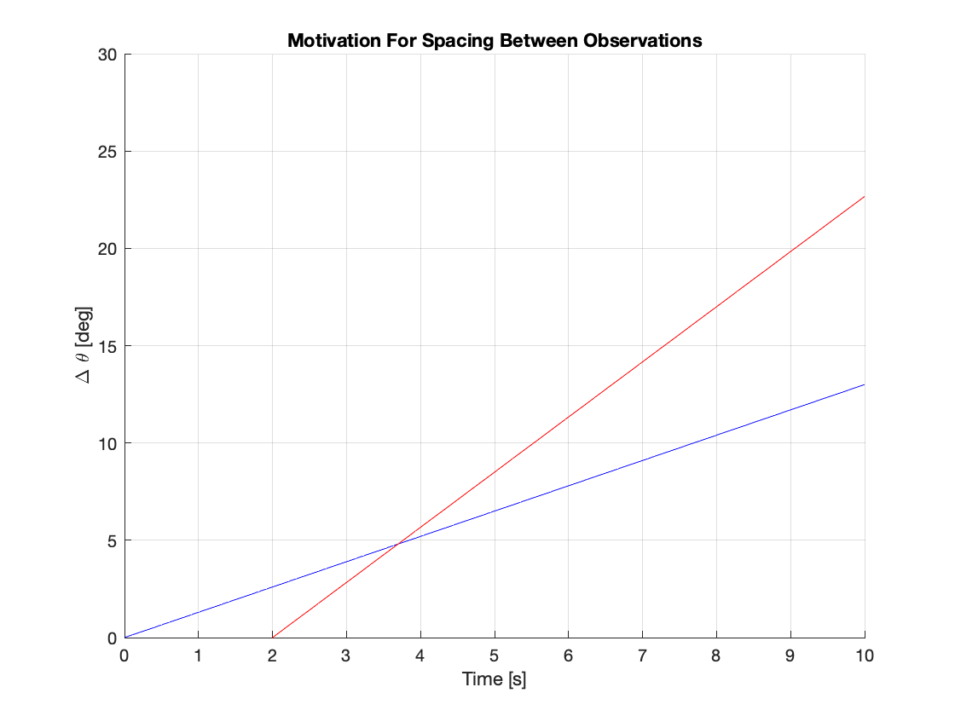
Indoor System Test Actuation
FR 2: Capture objects moving in LEO, MEO and GEO
Validate and Characterize:
Mount Movement Delay
Mount Movement Rate
Mount Settling Time
Commands:
Large Travel Distance
Small Travel Distance
Azimuth Intensive
Elevation Intensive
Record:
Self-reported Az/El of actuation system
Adequate distance between observations
S/O in Field of View
System Ready to Image.
Mount Settling Time
Mount Settling Time
S/O Motion
Mount Movement
Previous Angle
Mount Movement Delay

Slide 32
Indoor System Test Capture Time
DR 3.2: Timing precision of +/- 5 milliseconds
Validate and Characterize:
Camera Shutter Delay
Imaging system latency
Commands:
Short exposure
Known imaging command
Record:
Self-reported timestamp of imaging system
COMMAND SINGLE IMAGE
IMAGE
TIMESTAMP
00:00:03
00:00:05
Record difference (latency)

Slide 33
Indoor System Test Wire Wrap
DR 4.2: Slew between points without operator input
Validate and Characterize:
Wire Wrap Avoidance Algorithm
Implementation of Azimuth Boundary
Commands:
Point directly across Azimuth Boundary
Points close to 180⁰ apart
Record and Observe:
- Self-reported Az/El
- Wire position
Home
Intermediate home command to guide mount along longer path
t_{i+1}
t_{i}
Mount will take shortest path between commands
Boundary
Cable Wrap Risk
No Cable Wrap

Slide 34
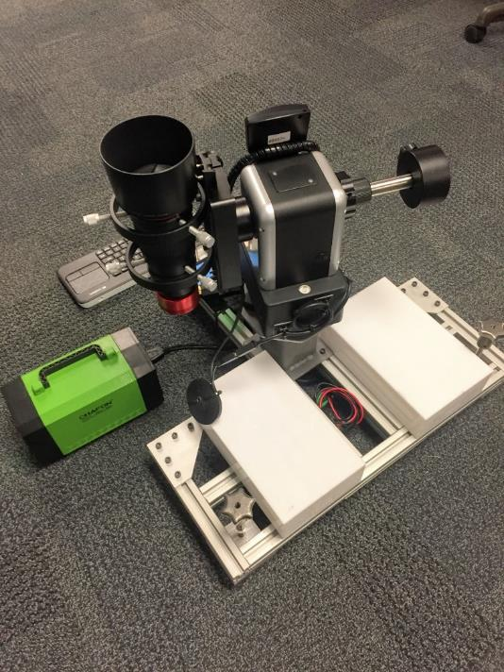
Operational Field Test Setup
Test Outline
Transport GHOST Module to test location (Flagstaff, observatory, etc.)
Setup GHOST Module
Level
Power On
Calibrate
Schedule Observation Session and start the Pipeline
Initial Calibration | Single Satellite | Operational

Slide 35
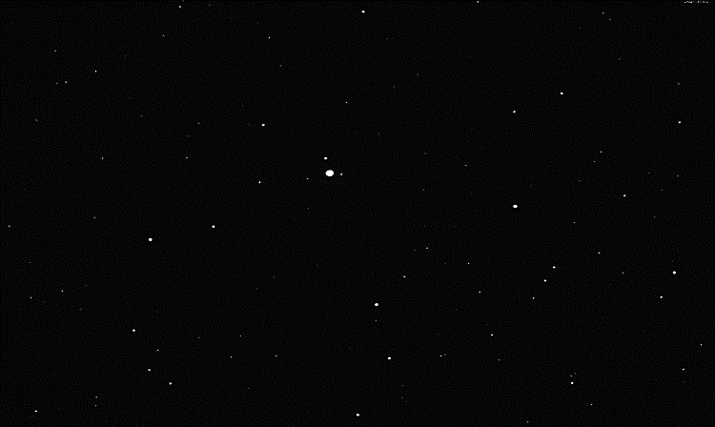
OFV Initial Calibration
BEFORE
AFTER
Mars
Error
Mars
Images from Feb. 24th observation night
Mount performs an initial, automated calibration
Operator centers the image boresight on Mars
The initial calibration must have an error of < 2º such that the object is within the field of view.
Notes:
(PUT SOME RESULTS ON THIS SLIDE)
Mount pointing accuracy before vs after calibration.
Errors in sidereal tracking (10 min exposure should still see no streaks)
This is important in order to correct errors in what position the mount thinks its pointing.

Slide 36
Operational Field Test
Test | Performance Requirement | Measurement | Verification
Actuation Capability | FR 2: Capable of motion for LEO, MEO, GEO objects | Self-reported mount Az/El Output Image Files (Captured? [y/n]) | Verify motion within set values Verify three space object captures
Streak Detection | DR 3.3: Provide streak RA/Dec at end points | Pixel x,y for streak end points Reported RA/Dec for streak end points | Verify reported pixel x,y visually with heavy crop Verify with nearby star of known RA/Dec
Orbit Determination | FR 3: Provide an orbit estimate | Output orbit state for known orbit space object (ISS, GPS, GOES) | Verify by comparing published orbit with output orbit state
Notes:
Full system, end to end test.
All requirements are expected to be met during this test.
TLE’s retrieved.
Scheduling successful.
Mount movement and timing successful.
Imaging on time.
Image processing successful.
Orbit estimate made and is accurate.
Comparing with STK (unit test)

Slide 37
Budget

Slide 38
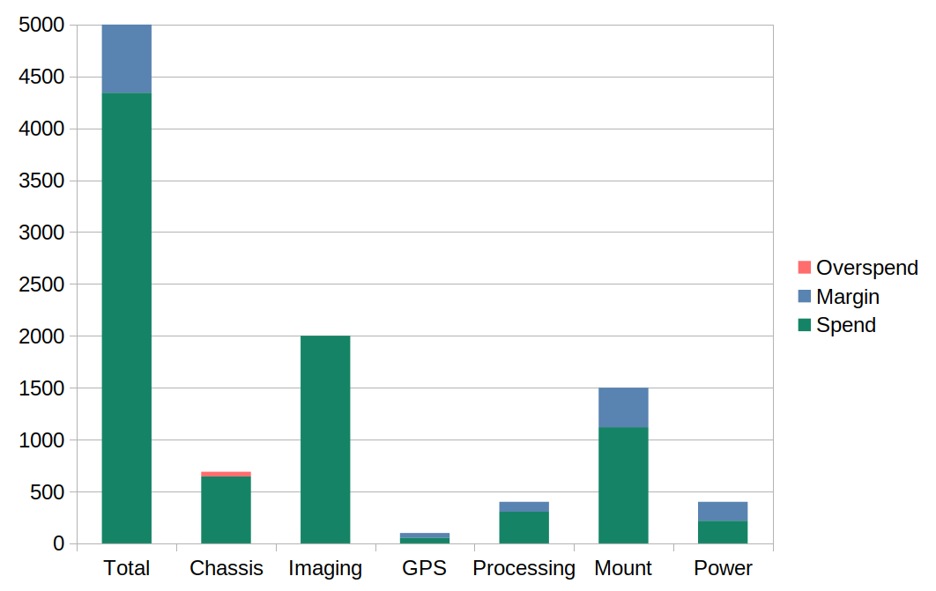
Account Update
$665.83
$4,334.17
($0.62)
$2,000.62
$381.12
$1,118.88
($45.03)
$645.03
$95.11
$181.65
$44.61
$304.89
$218.35
$55.39

Slide 39
Account Update
Component​ | Actual Cost​ | Budget Allocation​ | Margin​
Chassis​ | $645.03 | $600​ | (7.51%)
Actuation​ | $​1,118.88 | $1500​ | 25.4%
Imaging​ | $​2,000.62 | $2000​ | (0.03%​)
Processing​ | $​304.89 | $400​ | 23.8%​
GPS​ | $​55.39 | $100​ | 44.6%​
Power​ | $​218.35 | $400​ | 45.4%​
Total​ | $​4,343.16 | $5000​ | 13.1%​

Slide 40
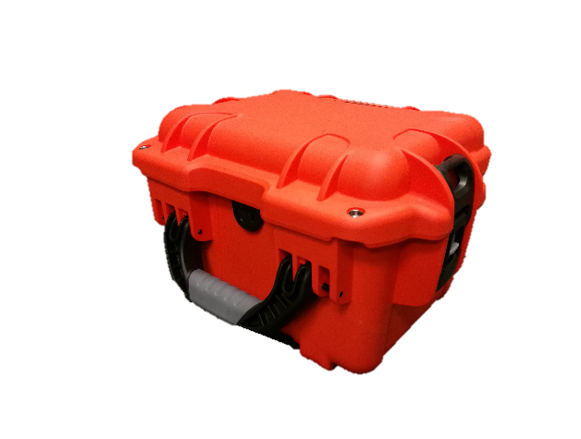
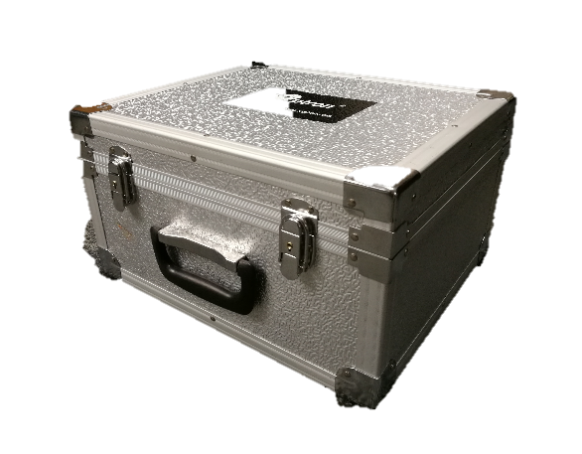
Budget Uncertainties
Procurement Status
Procurement Status
No margin for
large components
No margin for
large components
Notes:
Status: Everything purchased, and delivered.
Margin: No margin for replacing camera or mount --> consequently ordered hard cases with custom foam fittings

Slide 41
Questions?
Thank you to:
Professor Marcus Holzinger
Aerospace Corporation, Daniel Pachura
ASEN 4028 – TAs

Slide 42
Backup Slides

Slide 43
Test Flow
Hardware Component Tests
Software Component Tests
Electronics Component Tests
Component Tests
Actuation Mount
Imaging System
Power Supply
Scheduler
Image Processing
Orbit Determination
Processor
Battery
Integrated Tests
Indoor System Test
Outdoor Sidereal Tracking Test
Outdoor System Test
Commanding of Camera
Commanding of Mount
Accuracy of Mount Pointing
Visual Magnitude Capability
Multiple Observations per Pass
Multiple Space Objects per Session

Slide 44
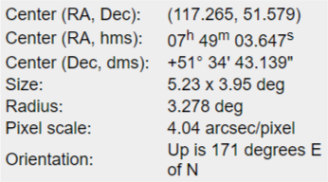
Imaging Hardware Test
NGC-2500
Barred Spiral Galaxy
Apparent Mag = 12.2
*NASA Extragalactic Database

Slide 45
Worst Case LEO Scenario
“Space Object Gantt Chart”
Time →
t_{s1}
t_{s2}
t_{b1}
t_{b2}
t_{b} : Time it takes mount to slew to next location
t_{s} : Time space object is between FOV’s of locations
$t_{si}≥t_{bi}=\frac{∆x}{\overline{v}}$ + t_{delay}
Worst case where ∆x = 180⁰, $\overline{v}$ = 10º/s

Slide 46
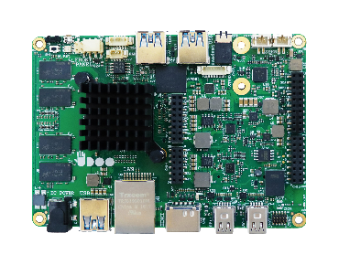
Mount Interfacing and Communication Test
RS232
USB A

Slide 47
Imaging Hardware Modeling
Limiting Stellar Magnitude (LSM)
D – aperture diameter
10mm - 100mm
p – pixel size
2.4µm - 8.3µm square
N – f-number
1.4 - 5.6
Physics-based model says system can be designed based on 3 parameters
from Multi-objective design of optical systems for space situational awareness (Coder, Holzinger, 2015)
$$m_{v}(N,D,p)=−2.5\log_{10}\left[\frac{{SNR}_{alg}{\left[\sqrt{m_{i}}ωND (q_{p,sky}+q_{p,dark})]\right]}^{1/2}}{Φ_{0}τ_{atm}τ_{opt}\left(\frac{πD^{2}}{4}\right)QE\sqrt{p}}\right]$$
Notes:
SNRalg = algorithm required Signal to Noise Ratio (worst case that can still be analyzed)
Tau = transmittance
QE = quantum efficiency (ability of sensor to convert photons into electric charge – dependent on sensor material)
Omega = angular velocity of the Earth
Qp,sky = electron flux of the sky
Qp,dark = dark current of camera (temperature dependent)
Phi0 = photon flux – irradiance

Slide 48
Hardware Component Tests
Test | Requirements V + V | Status
Chassis | Tilt 6 degrees | Incomplete
Actuation Mount | FR 2: Detecting moving space objects DR 2.1: >2 degree slew rate | In Progress
Imaging Hardware | FR 1: Visual magnitude ~10 DR 1.1: Field of view >4 deg DR 3.2: Camera timestamp | Incomplete
GPS | DR 4.4: Timing accuracy DR 4.5: Position accuracy | Incomplete
Safety Power Switch | Component failsafe | Incomplete

Slide 49
Electronics Component Tests
Test | Requirements V + V | Status
Power Supply | FR 6: 120V AC source, draw no more than 20 amps. | In Progress
UDOO – Image Processing Computation | DR 4.3.1: Process image set within 3 minutes | Incomplete
UDOO – Scheduler Processing Computation | DR 4.3: Allow 10 minutes for a space object to run entire pipeline | Incomplete
UDOO – Orbit Determination Computation | DR 4.3.2: Return state estimate within 1 minute | Incomplete
UDOO – Main Commands Computation | DR 4.2: Autonomous hardware commands | Incomplete
Power SupplyDR 4.3DR

Slide 50
Software Component Tests
Test | Requirements V + V | Status
Scheduler | DR 3.1, DR 4.1, DR 4.1.1, DR 4.1.3, DR 4.2 | In progress
Image Processing | DR 3.3 DR 3.3.1 DR 4.3.1 | In progress
Orbit Determination | DR 4.3 DR 4.3.2 | In progress
Communication with Mount | DR 4.2 DR 4.2.1 | Complete
Communication with Camera | DR | In progress

Slide 51
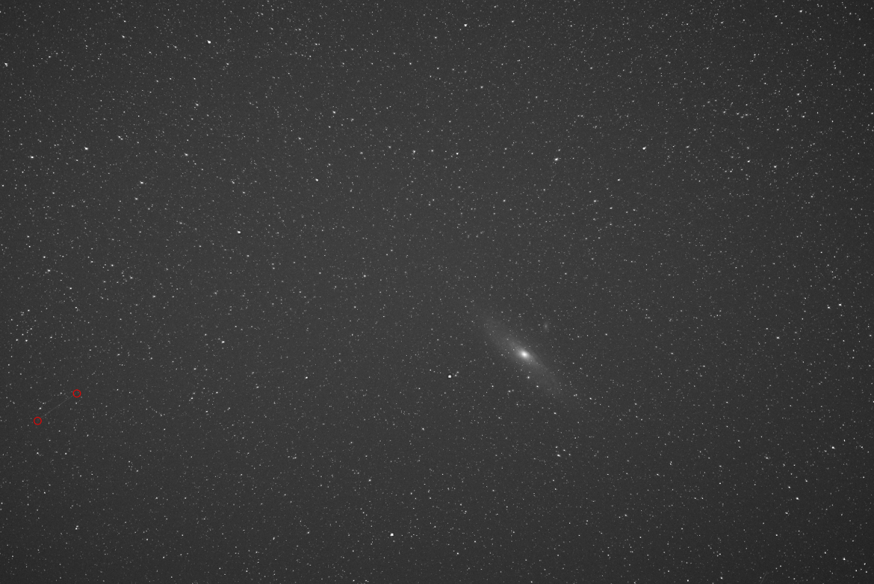
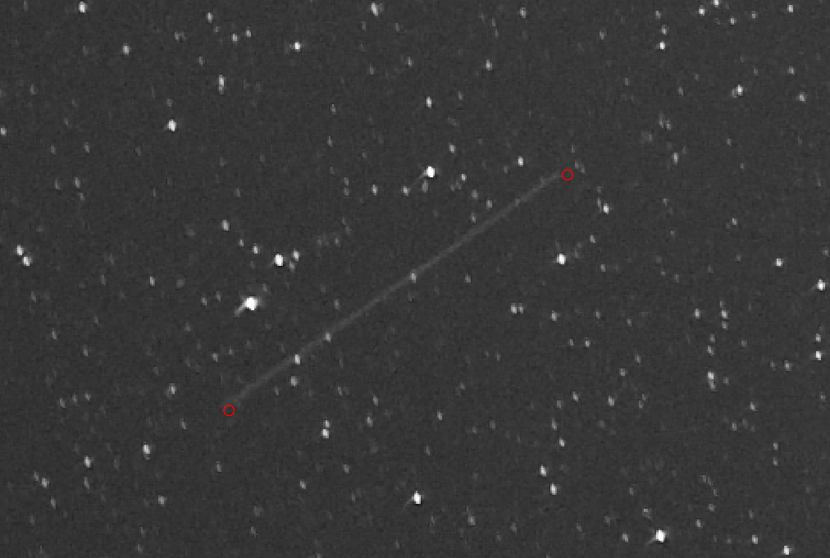
Image Processing since MSR

Slide 52
Image Processing since MSR

