Slide 1
FlOWeR
FlOWeR
Test Readiness Review
Flow Optimization & Weight Reduction Project
Presenters: Max Buchholz, Angelo Hristopoulos, Adriana Lysak, Nathan Portman, Eric Tate, Preston Tee
Additional Team Members: Anthony Gregg, Anand Kappagantu, Weston Luke
Advisor: Alexandra Le Moine
Customer: U.S. Air Force Research Laboratory

Slide 2
Project Overview
Overview
Schedule
Test Readiness
Budget

Slide 3
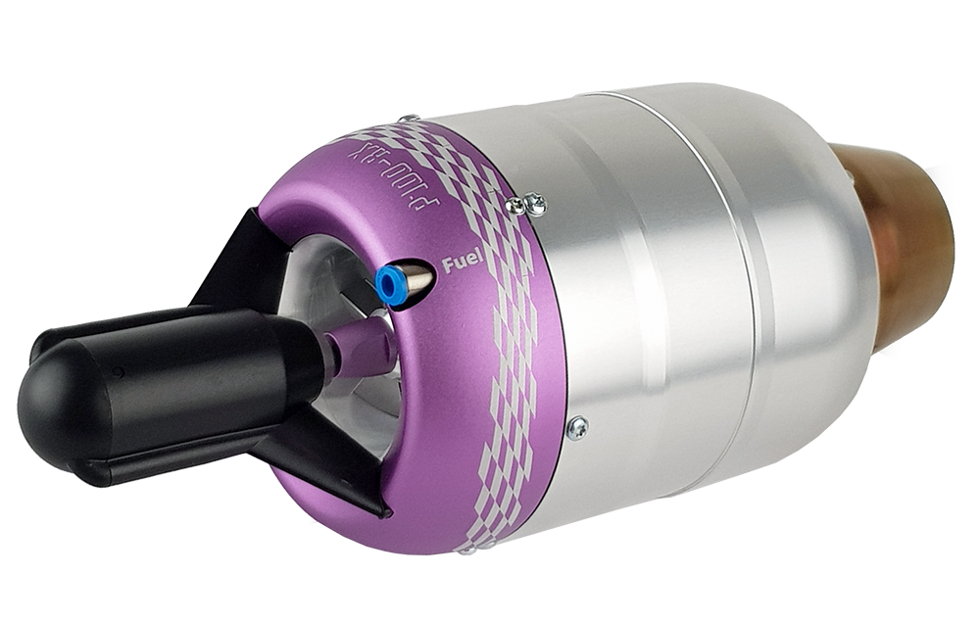
Purpose
Successfully compete in the Air Force Research Laboratory’s (AFRL) annual Aerospace Propulsion Outreach Program (APOP) competition
Improve performance of JetCat P100-RX hobbyist jet engine
Overview
Schedule
Test Readiness
Budget
Notes:
IN THIS SECTION: -iterative process
-ejector nozzle flow physics overview

Slide 4
Objectives
Increase the thrust-to-weight ratio of JetCat P100-RX hobbyist jet engine by 35% (Level 5)
Maintain or increase thermal efficiency
Maintain or decrease thrust specific fuel consumption (TSFC)
Create a thermodynamic model of the engine’s performance within 5% accuracy of data gathered (Level 3+)
Overview
Schedule
Test Readiness
Budget
Notes:
Add numerical levels of success to the objectives here rather than spend a lot of time on the success level table
3+ is highest level

Slide 5
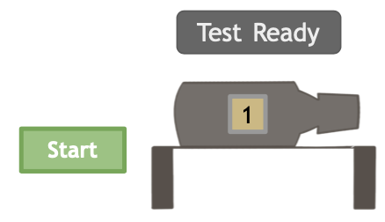
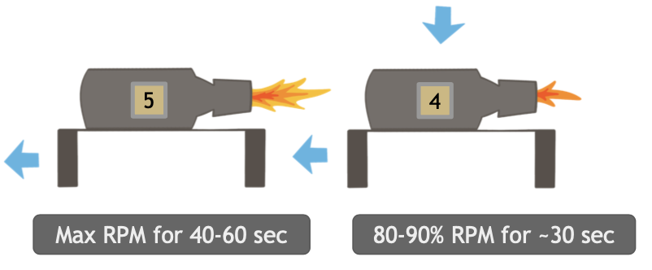
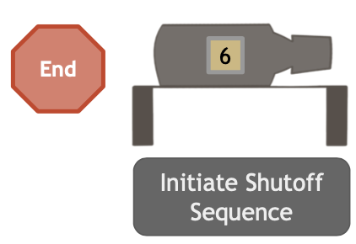
Concept of Operations (CONOPs): Static Test
Thrust data
Thrust data
Thrust data
Overview
Schedule
Test Readiness
Budget
Notes:
Idk who has the flipped around version but they should add it in
Indicate thrust data collection, include

Slide 6
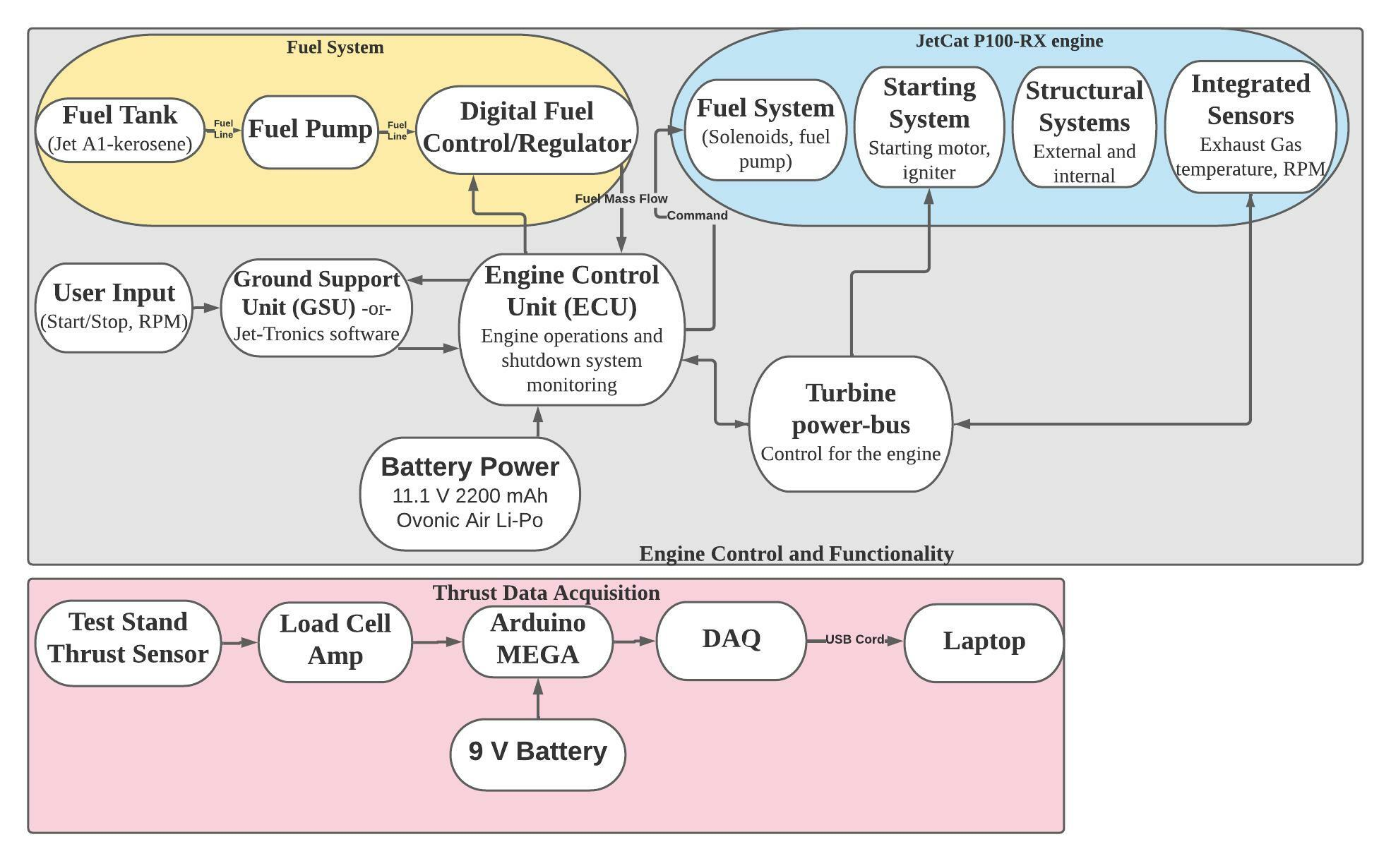
Operational Functional Block Diagram
Notes:
Replace with one anthony makes
Summarize prev year project, expand ours - put expanded old one into backup slide
Make it more clear what exactly we’re doing - not just box around name

Slide 7
Ejector Nozzle: Overview
Exhaust gasses from engine turbine exit through converging nozzle
Mass flow out of converging nozzle entrains mass flow from surrounding air and is forced out the back of the ejector nozzle
Primary mass flow (from engine)
Secondary mass flow (from surrounding air)
Combined mass flow
Overview
Schedule
Test Readiness
Budget
Notes:
Discuss in detail the picture shown, add labels
Add another slide with general ejector nozzle details
Change title. “Actual” solution doesn’t look good
Animations:
Red arrows to blue and yellow
Change arrow sizes

Slide 8
Baseline Design: CDR
Stock P100-RX Engine
FLOWeR Converging Nozzle
FLOWeR Mixing Chamber
195.25
202.17
Dimensions in mm
Overview
Schedule
Test Readiness
Budget
Notes:
Combine w/ 10 w/ animations
Start w stock - add piece by piece, text boxes for each specific thing
Keep everything prev on screen and add to it
UNITS

Slide 9
Baseline Design: Updated
Stock P100-RX Engine
FLOWeR Converging Nozzle
FLOWeR Mixing Chamber
195.25
418
Final ejector geometry will depend on cold testing results
Dimensions in mm
Overview
Schedule
Test Readiness
Budget
Notes:
Mixing chamber elongated due to new information found on mixing length requirements
Curvature - Inlet and diffuser flared to reduce risk of flow separation
Converging Nozzle material change

Slide 10
Critical Project Elements (CPEs)
Label | Critical Feasibility Element | FR
T/W | The T/W ratio of the engine shall increase and the TSFC shall decrease or remain constant. | 1,2
MODEL | Model accurately simulates thermodynamic properties of the engine, predicting increases in thrust and/or decreases in TSFC. | 3
INT-TEMP | All components can withstand temperatures throughout their section and can integrate with each other seamlessly. | 4
TEST | External sensors are integrated to augment engine’s internal sensors and gather necessary temperature and pressure data, and an off-engine testing setup is developed to validate nozzle design. | 4
Overview
Schedule
Test Readiness
Budget
Notes:
Describe major changes - mostly verbal with key visual aids (ie arrows or circles) as necessary
Verbally/text relate to testing

Slide 11
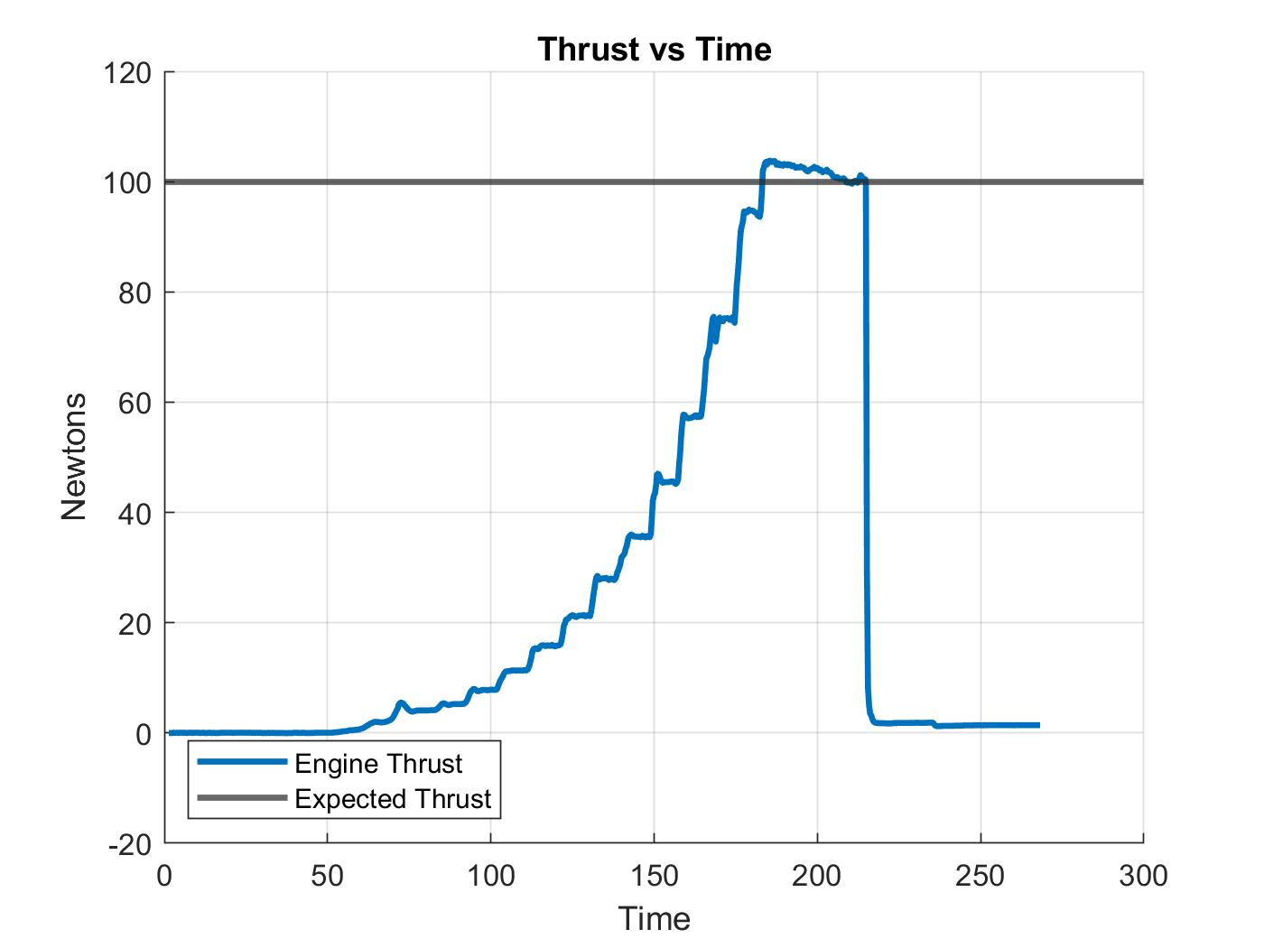
Engine Status Update
Engine returned from maintenance
Nominal thrust performance
Overview
Schedule
Test Readiness
Budget
Notes:
Potentially mention that the graph shows thrust vs time as rpm is increased (10k rpm steps, ~40k to 154k), hence the increases/leveling
Describe major changes - mostly verbal with key visual aids (ie arrows or circles) as necessary
Dotted line w max RPM edxpdect

Slide 12
Schedule
Overview
Schedule
Test Readiness
Budget
Notes:
Dont justify or explain changes just say what were doing

Slide 13
Spring Semester Schedule
Overview
Schedule
Test Readiness
Budget
Notes:
Critical path?
Milestones
Completion status - what is done, in progress, upcoming etc
Hard stop date if level 5 not reached

Slide 14
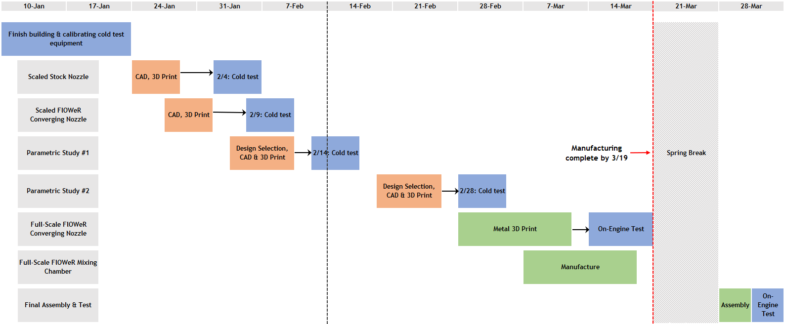
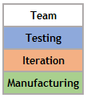
Testing and Manufacturing Plan
Today
✅
✅
Notes:
Add in check/show completed tests; line for today
Include some green in the iteration boxes to show there is manufacturing happening there (change “iteration” to “cold test manufacturing” or something?)
Change the color on equipment delay
Add ECD to address margin, talk about it
Boot off as to why we are doing parametric to later, just state that we are doing it for now

Slide 15
Test Readiness
Overview
Schedule
Test Readiness
Budget

Slide 16
Testing Overview
Static testing
Engine running
Thermodynamic model verification
Off-engine (“cold testing”)
Engine not required
Ejector model verification
Informs final design decisions before final manufacturing
Overview
Schedule
Test Readiness
Budget
Notes:
Include sketch up of test set up
Labelled sensors at the start
Specs in back up slides

Slide 17
Common Testing Needs
Facilities
All on- and off-engine test are performed in the test cell (room 169A) with personnel located in the control room (room 169)
Safety
Nate or Matt must always be notified prior to testing
Personnel must be located in the control room or outside bay doors during testing
All personnel must be familiar with emergency procedures checklist
Overview
Schedule
Test Readiness
Budget

Slide 18
Testing Overview
Static testing
Engine running
Thermodynamic model verification
Cold testing
Engine not required
Ejector model verification
Informs final design decisions before final manufacturing
Overview
Schedule
Test Readiness
Budget
Notes:
Include sketch up of test set up
Labelled sensors at the start
Specs in back up slides

Slide 19
Static Test Purpose
Pressure and temperature values measured for FlOWeR’s specific engine
Allows for highly accurate inputs to thermodynamic and ejector models
Verify thermodynamic model
Thrust measurements before and after modifications
Can quantify the improvements to engine thrust before going to competition
Overview
Schedule
Test Readiness
Budget
Notes:
Include sketch up of test set up
Labelled sensors at the start
Specs in back up slides

Slide 20
On-Engine Test: Data Acquisition
Measurement Device | Quantity of Interest
Static test stand | Thrust
Jet-tronics software, onboard sensors | RPM, exhaust gas temperature, fuel consumption
Additional sensors on test stand | Nozzle exit static and total pressures; nozzle inlet, exit, and surface temperature; cowling surface temperature
Given by AFRL | Combustion chamber temperature
Overview
Schedule
Test Readiness
Budget
Notes:
Emphasize thrust stand test setup was used previously, but we have our own analysis that we’ve performed at this point
More in depth into what data is collected

Slide 21
Static Test Stand Setup
JetCat P100-RX
Exhaust Instrumentation
Load Cell
Engine Wiring
Fuel Lines
Sensor Wiring
ECU
Fuel Tank
Arduino Mega
Pump
Overview
Schedule
Test Readiness
Budget
Notes:
Central picture of test stand, smaller pictures of each sensor around outside, lines/arrows pointing to where it goes
Add a legend w line colors

Slide 22
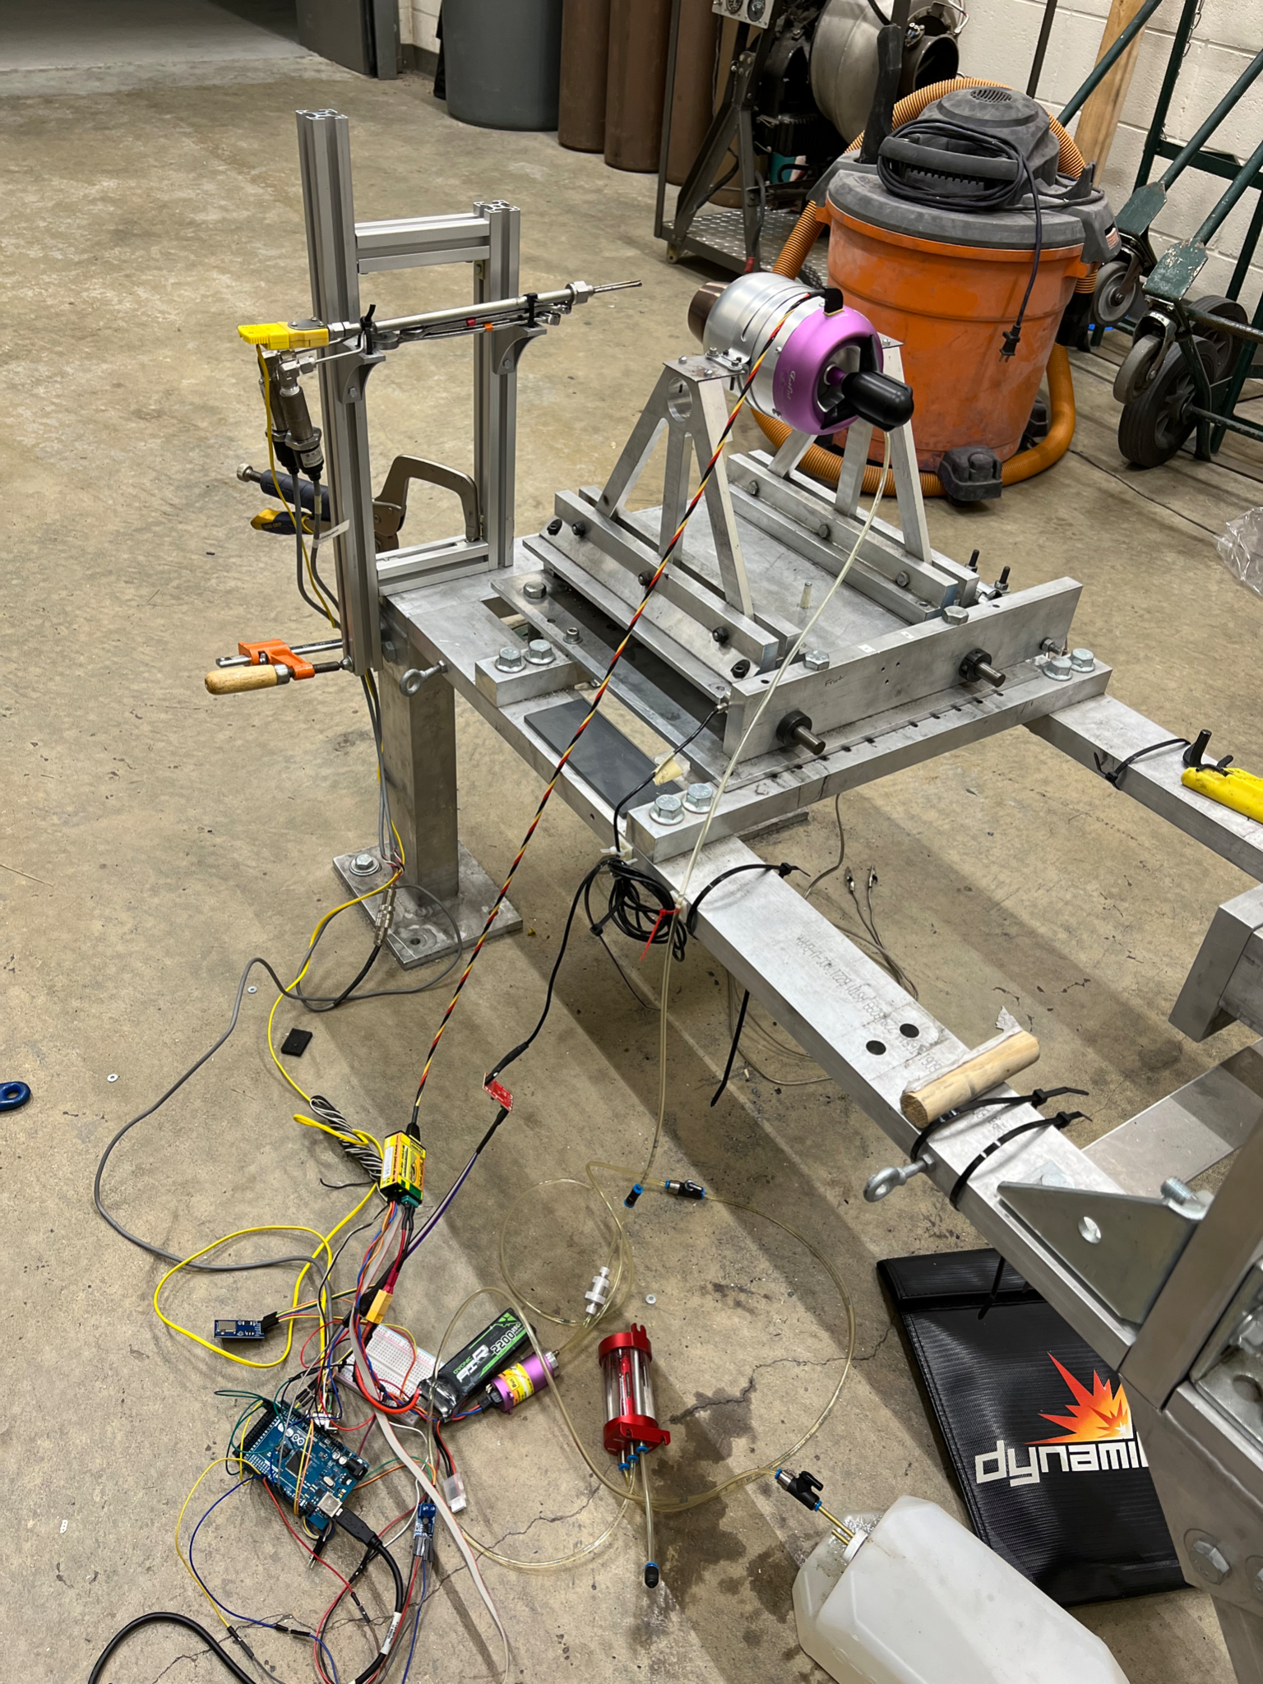
Facilities
JetCat P100-RX
Exhaust Instrumentation
Load Cell
ECU
Arduino Mega
Overview
Schedule
Test Readiness
Budget
Notes:
This is a really cluttered slide, maybe drop the picture on the left and just do the right
Actual pictures of room and sensors

Slide 23
Safety Procedures
Emergency contacts listed
Necessary emergency equipment on standby
Fire extinguishers
Fire blankets
All personnel are wearing PPE during testing
Engine operators are located in control room
Personnel located outside bay doors
Overview
Schedule
Test Readiness
Budget
Notes:
Not sure we have a fire blanket in the room at the moment
Mini conops
Put in back up slide and state priority

Slide 24
Testing Procedures
Preliminary Checklist
Ensures proper engine set-up
Includes safety prep, fuel set-up, electronics set-up, test cell arrangement, ventilation instructions, sensor set-up, and personnel instructions
Overview
Schedule
Test Readiness
Budget
Notes:
Mini conops with lots of info spending lots of time on it

Slide 25
Testing Procedures
Testing Procedures
Detail the engine run sequence
Procedures are derived from AFRL engine test and JetCat
Overview
Schedule
Test Readiness
Budget
Notes:
Mini conops with lots of info spending lots of time on it

Slide 26
Testing Procedures
Shut-Down Procedures
Ensures safe ventilation of room and dismantling of test set-up
Outlines storage of data
Overview
Schedule
Test Readiness
Budget
Notes:
Mini conops with lots of info spending lots of time on it

Slide 27
Outline of Engine Testing
Test | Purpose | Status
Stock Engine (Refurbished) | Ensure proper functioning engine, ensure expected thrust value, and gather model data | Complete
Improved Converging Nozzle | Verify improvement from converging nozzle, and gather model data | Incomplete
Ejector Nozzle | Test final modification, quantify thrust increase, and ensure competition readiness | Incomplete
Overview
Schedule
Test Readiness
Budget
Notes:
Maybe possible
See WASP presentation for 1-2 slide summary of all this info
“Verify” in second row-- is verify or validate?

Slide 28
Testing Overview
Static testing
Engine running
Thermodynamic model verification
Cold testing
Engine not required
Ejector model verification
Informs final design decisions before final manufacturing
Overview
Schedule
Test Readiness
Budget
Notes:
Include sketch up of test set up
Labelled sensors at the start
Specs in back up slides

Slide 29
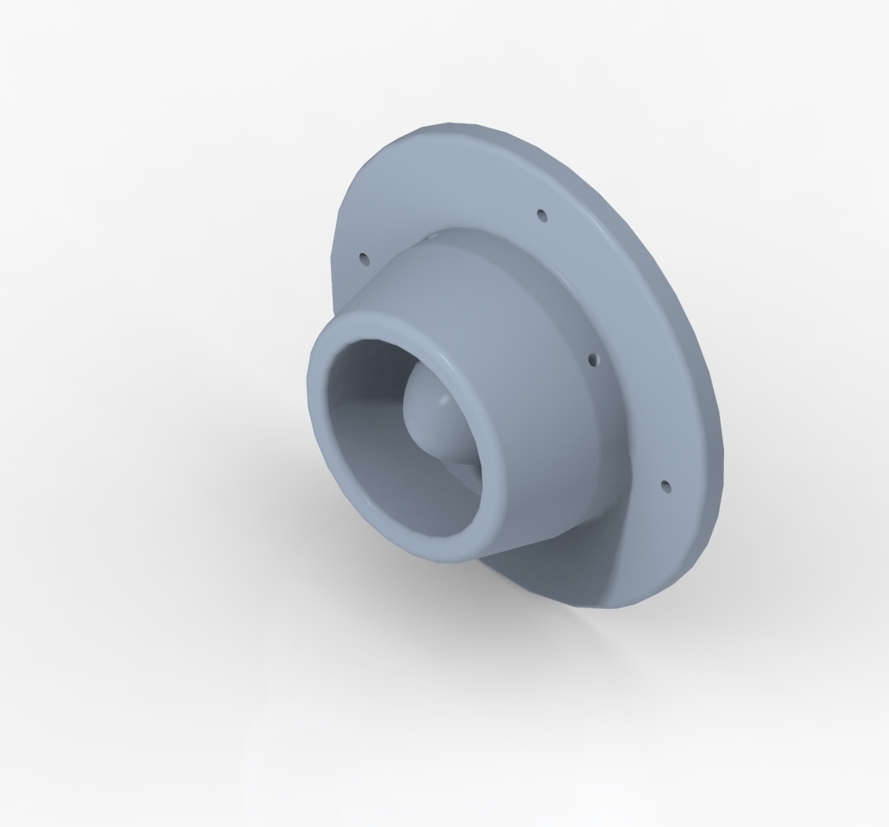
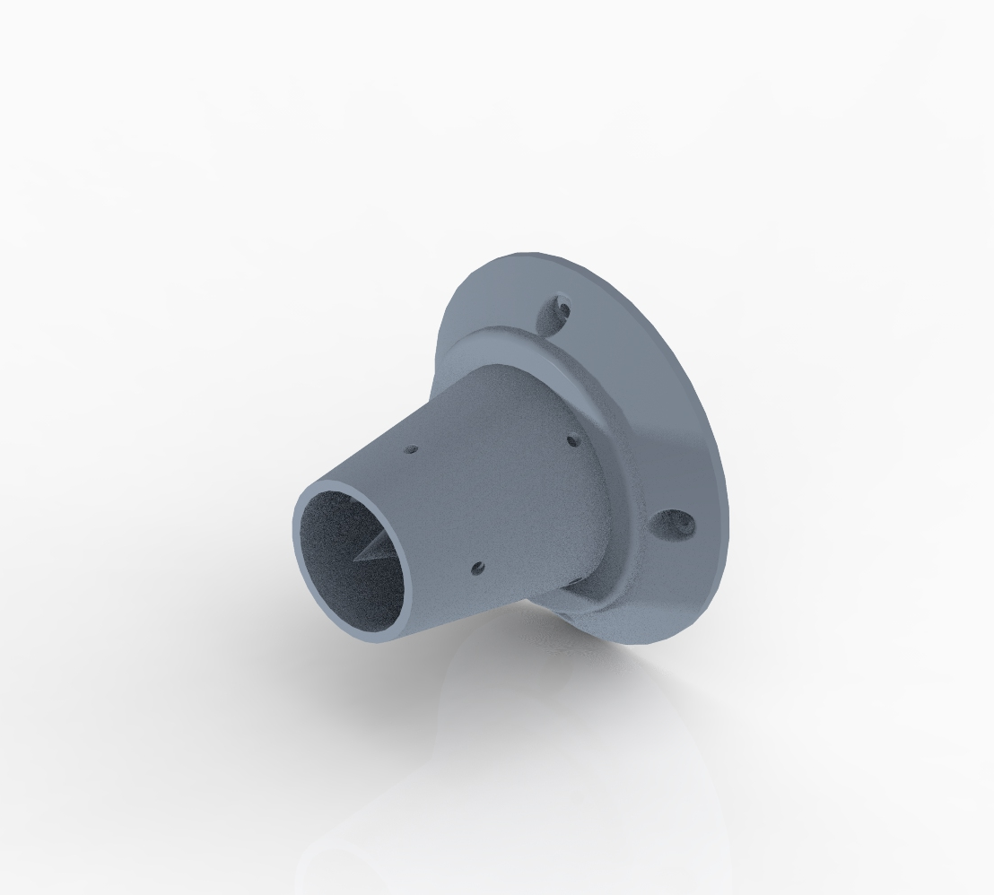
Cold Test - Purpose
Low risk method for validating aerodynamic models of various scaled nozzle configurations:
Stock nozzle (baseline)
Improved converging nozzle
Parametric study of ejector configurations
Real world data will help inform final design decisions
Overview
Schedule
Test Readiness
Budget
Notes:
Add converging nozzle and baseline nozzle as the “why”
Emphasize parametric study is reasoning to cold test
Talk about baseline test has .9 Mach from testing converging cone

Slide 30
Data Acquisition
Measurement Device | Quantity of Interest
Static pressure probe at settling chamber | Setting baseline pressure for desired Mach Test time
Total pressure probe at nozzle exit | Nozzle exit Mach
K-type thermocouple | Nozzle exit Temperature
Derived from mass flow rate and Mach | Thrust
Overview
Schedule
Test Readiness
Budget
Notes:
If we’re saying interest quantity for pressure at exit is mach, we should probably say the same for the k type thermocouple—they both feed into that
Emphasize thrust stand test setup was used previously, but we have our own analysis that we’ve performed at this point
More in depth into what data is collected

Slide 31
Cold Test Design
Pressure Tanks
Regulators
Manual Ball Valve
Electronic
Ball Valves
Settling Chamber
Converging Cone
Adapter
Overview
Schedule
Test Readiness
Budget

Slide 32
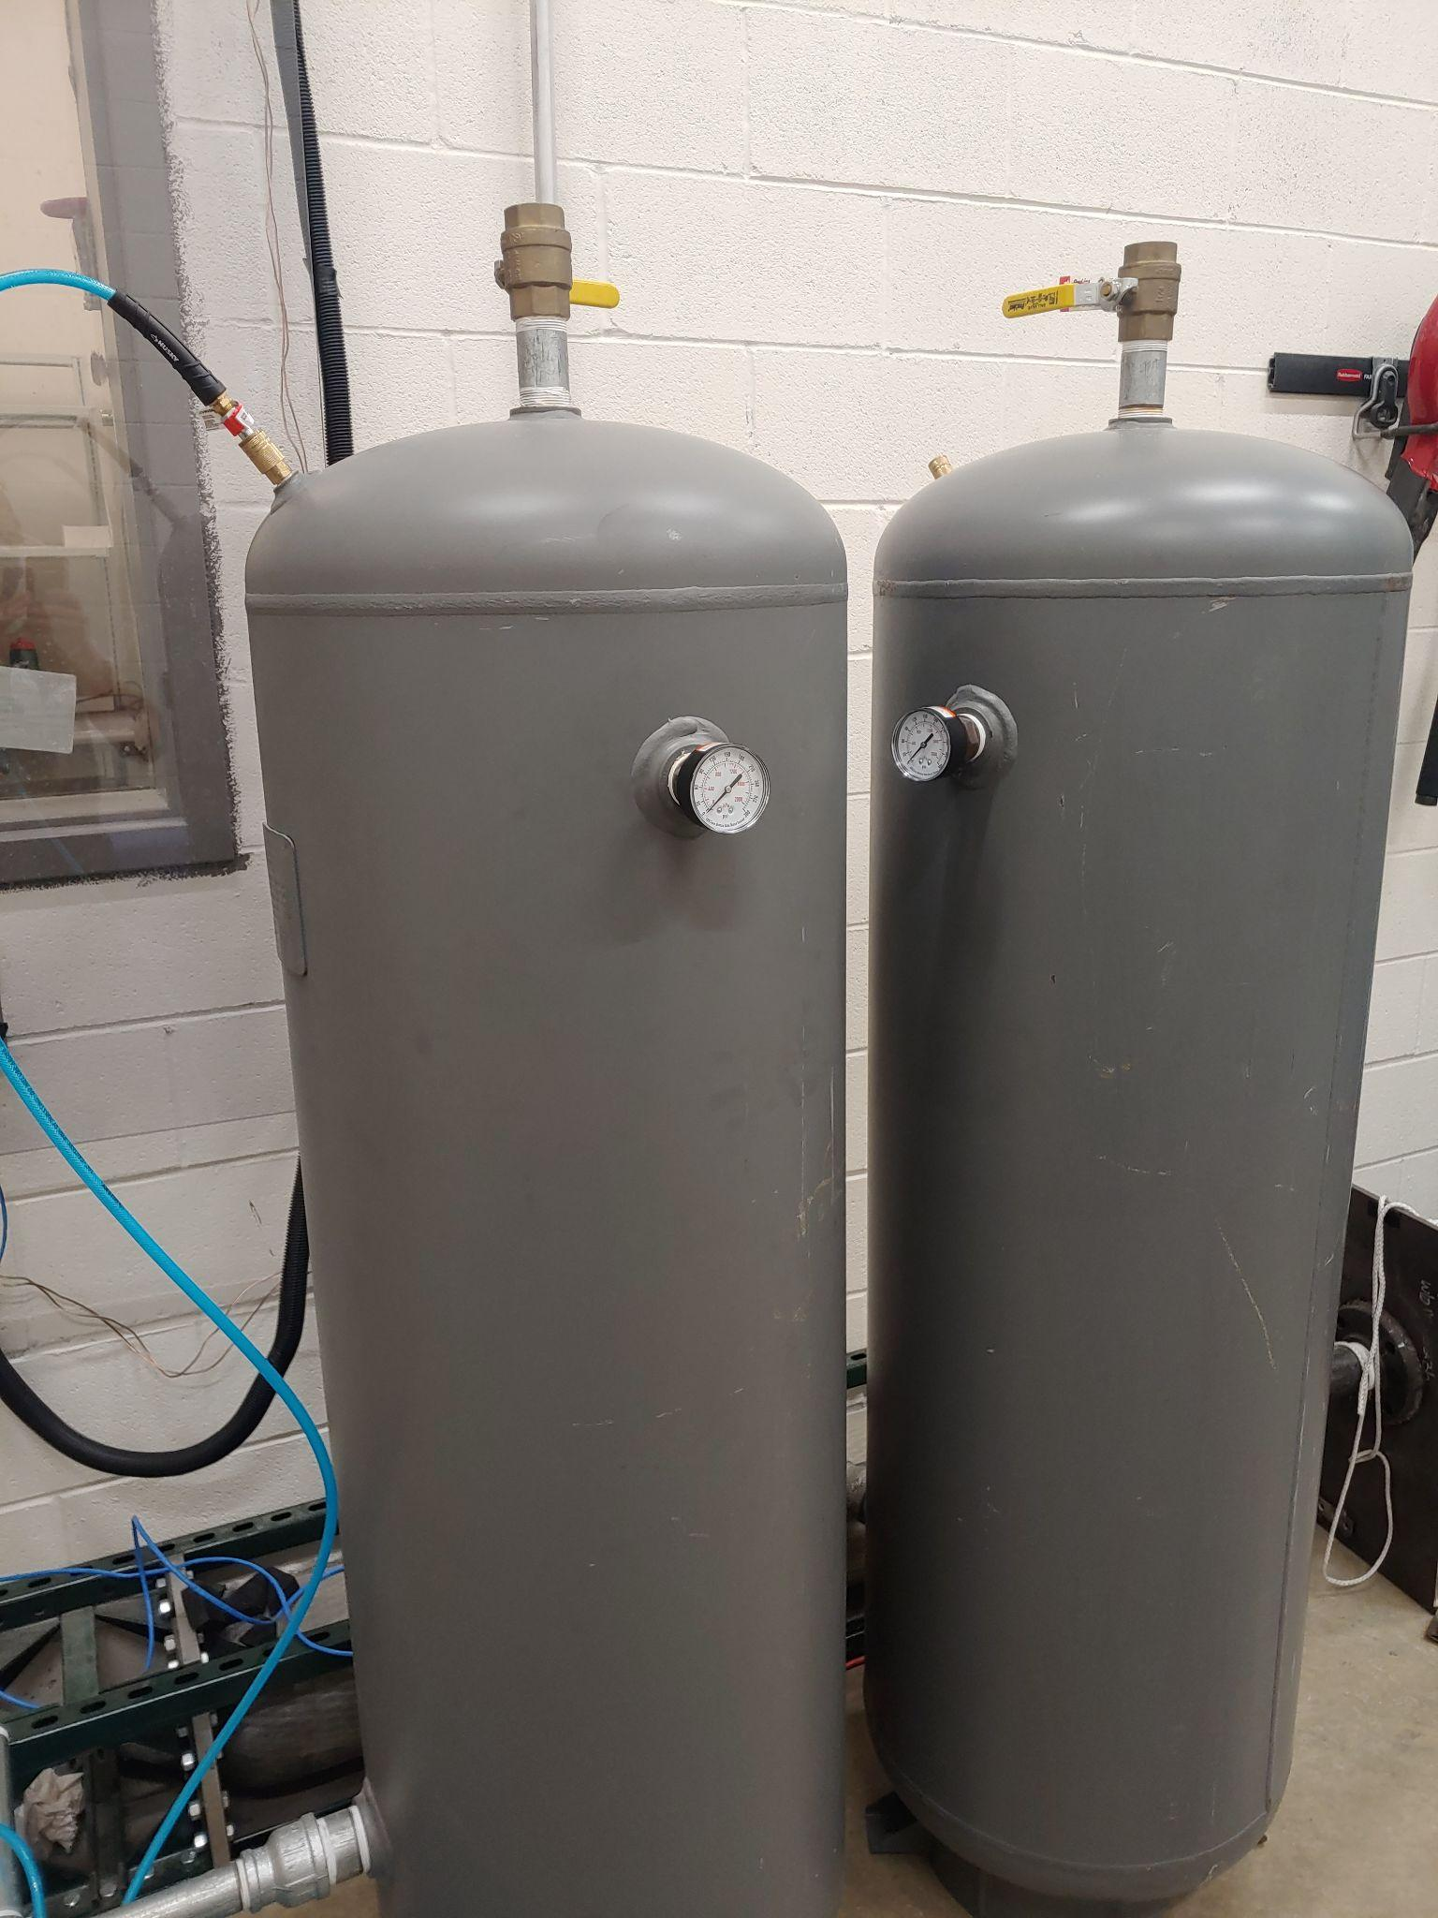
Cold Test Design - Pressure Tanks
Filled with building air supply
Filled to ~100 psi
Rated for 200 psi
Fill time: ~5 minutes per tank
Tanks have analog dial pressure gauge
Overview
Schedule
Test Readiness
Budget

Slide 33
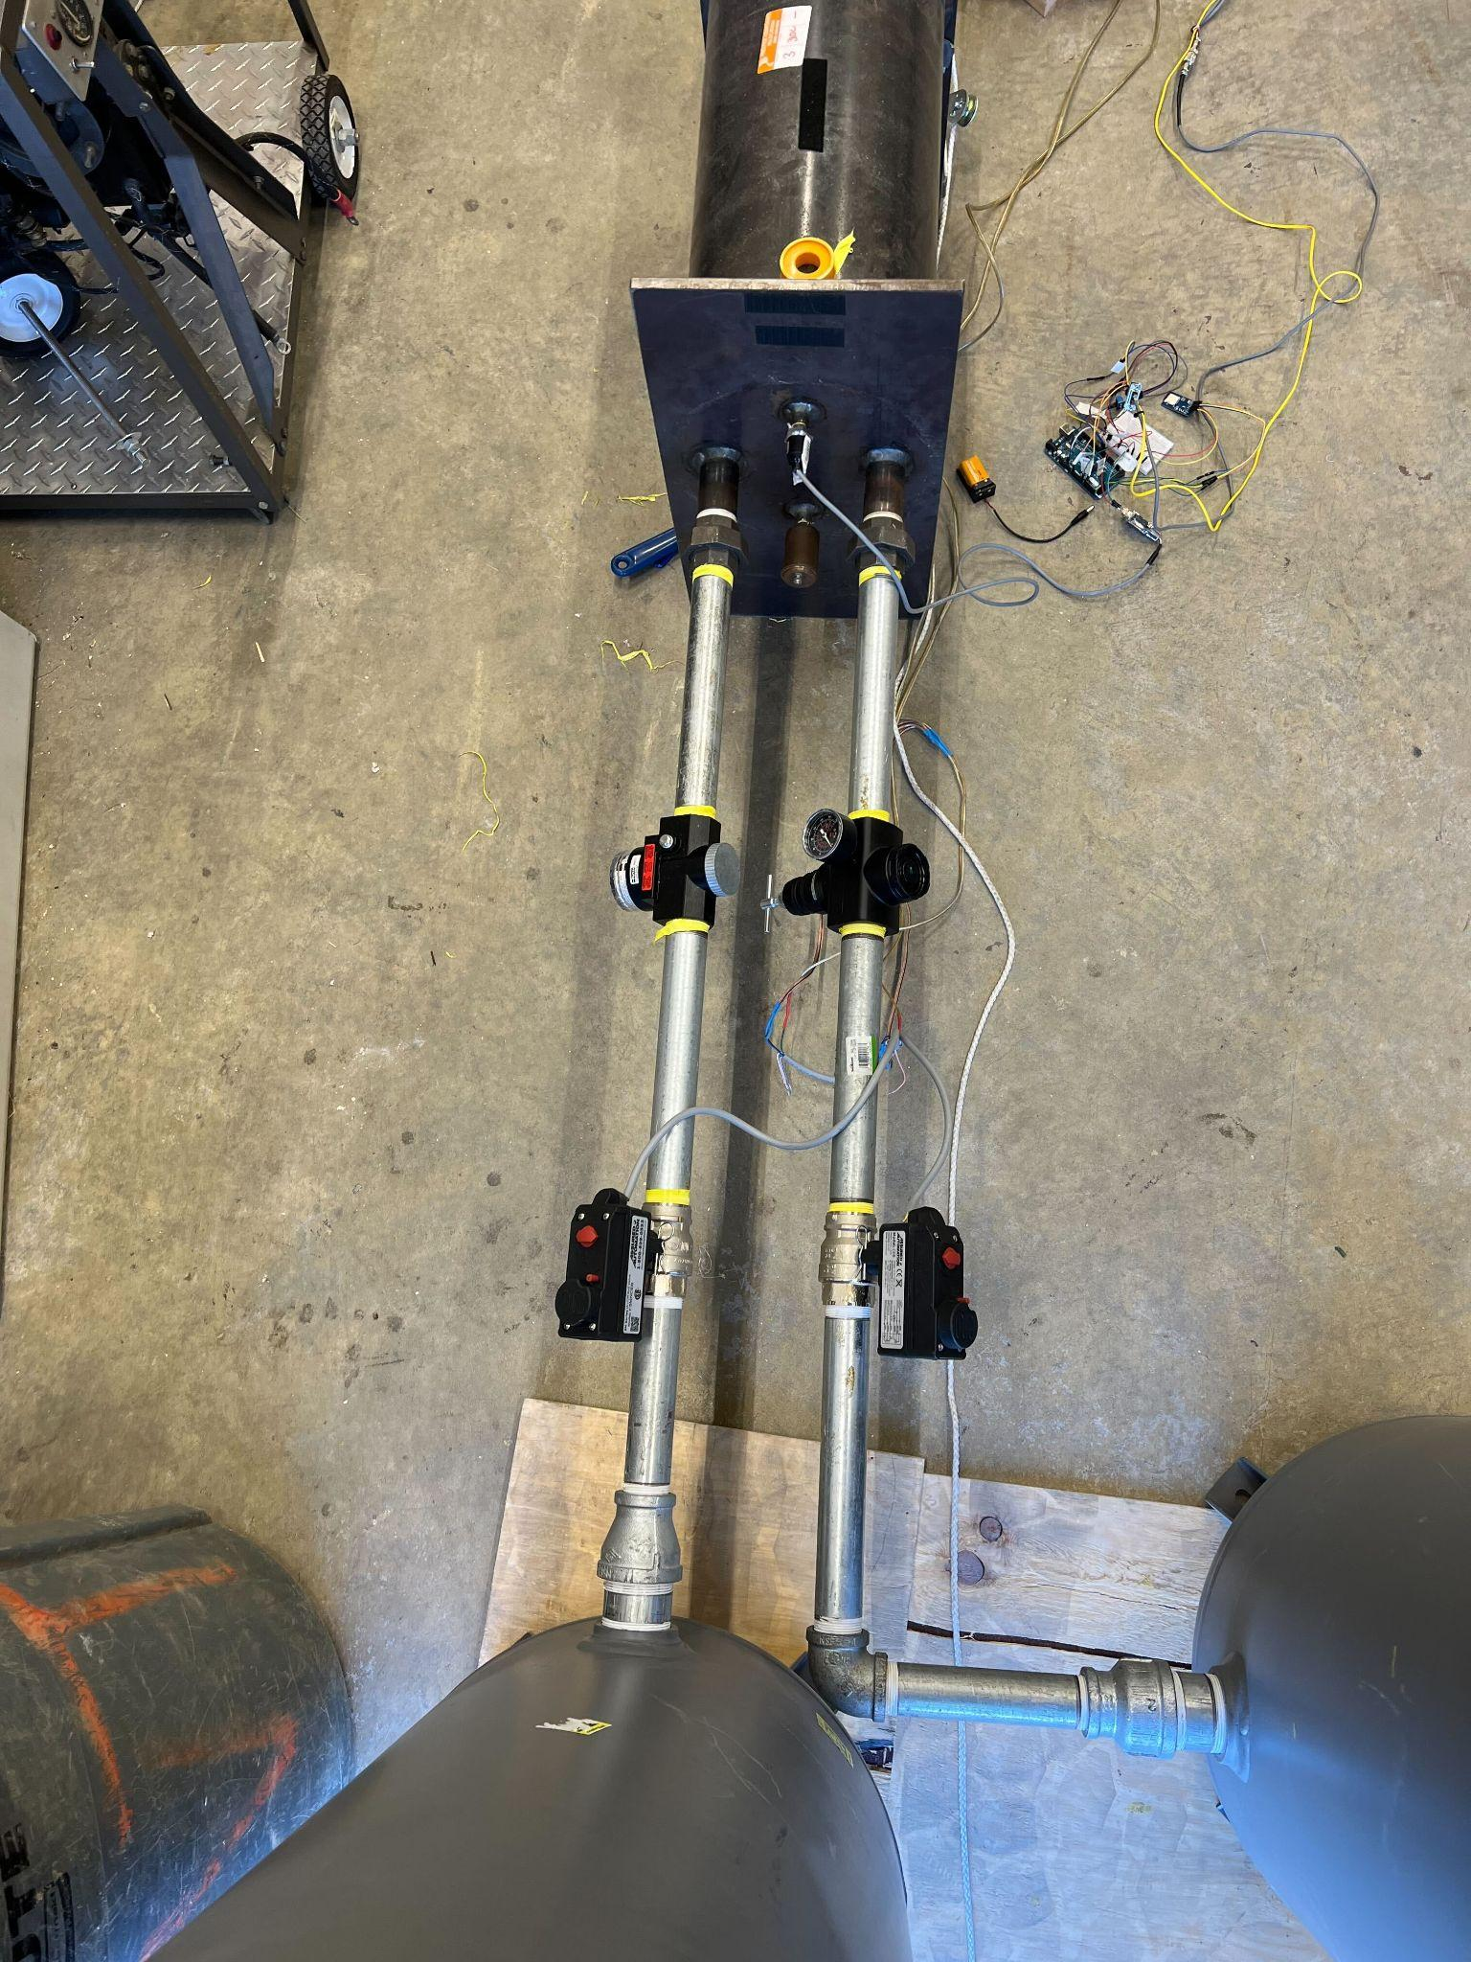
Cold Test Design - Flow Control
Electronically controlled ball valves
Switched from control room
Opened to prime settling chamber
Pressure Regulators
Controls pressure in settling chamber during test
Regulator
Electronic
Ball Valve
Overview
Schedule
Test Readiness
Budget

Slide 34
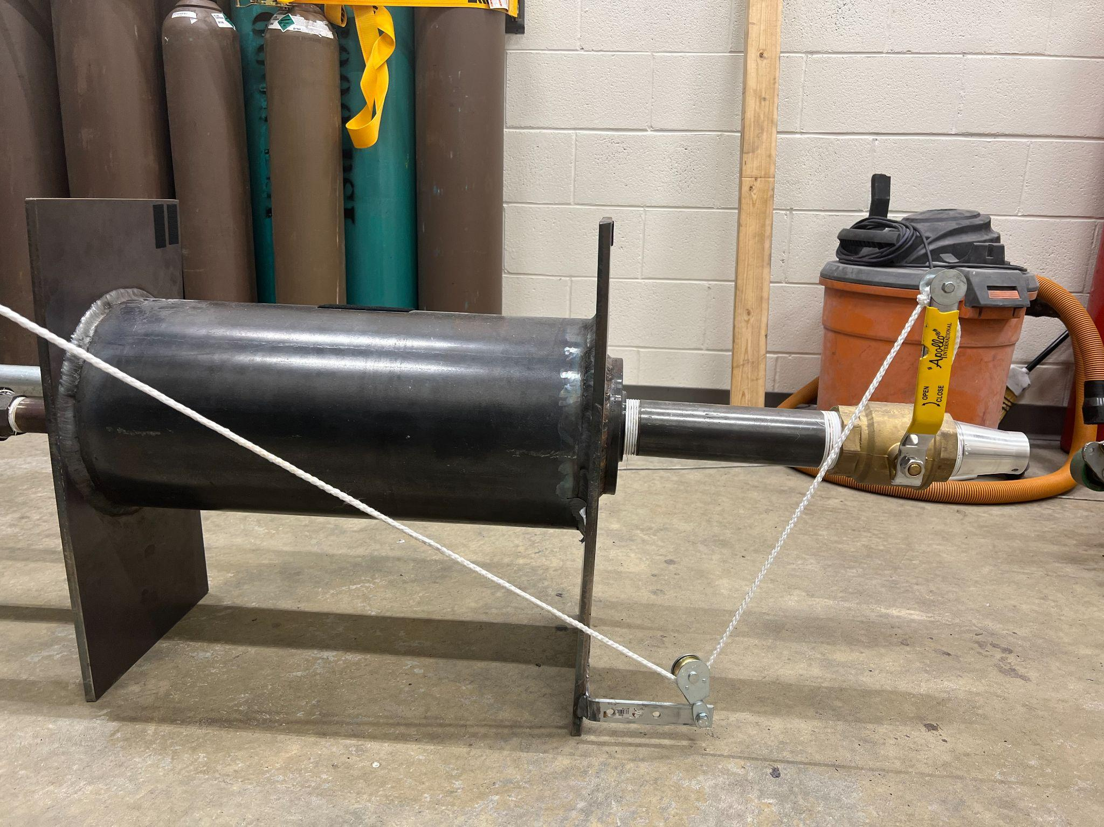
Cold Test Design - Settling Chamber
Settling chamber reduces turbulence to the test section
Pressure transducer to capture pressure input to test section and test time
Settling chamber FOS = 138
Manual ball valve operated to begin test
Actuated from a distance behind blast shield
Pulley and rope
Manual Ball
Valve
Settling Chamber
Overview
Schedule
Test Readiness
Budget

Slide 35
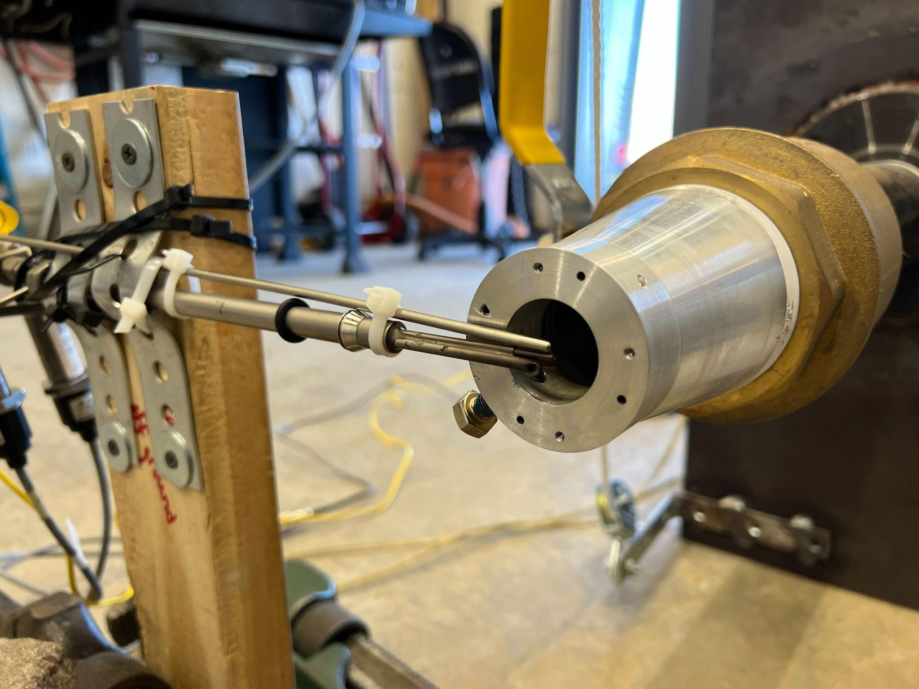
Cold Test Design - Test Section
K-Type Thermocouple
Adaptor with correct area ratio for the desired Mach
Nozzles screw into Converging Test Nozzle
Nozzle instrumentation goes behind the nozzle
USC Pressure Probe
Overview
Schedule
Test Readiness
Budget
Notes:
Add labels: converging flow cone, USC probe

Slide 36
Cold Test Procedure and Safety
All valves and nozzle checked before filling Supply Tanks
PPE must be worn once Supply Tanks begin to fill
Safety glasses and ear protection
No team members in Test Cell once test is ready
Communication done over 2-way radio
Team members opening the ball valve remain behind blast shield
Outside test team members let control room test members when to open and close valve
After test, team members can go into Test Cell to retrieve SD with data
Overview
Schedule
Test Readiness
Budget

Slide 37
Outline of Cold Testing
Test | Purpose | Status
Stock Nozzle | Obtain baseline of cold test setup performance | Complete
Improved Converging Nozzle | Verify improvement from stock nozzle and further verify testing and data analysis procedures | Complete
Ejector Nozzle Parametric Studies | Explore the design space in real world conditions in order to compare with expected results from model | Incomplete
Overview
Schedule
Test Readiness
Budget
Notes:
Maybe possible
See WASP presentation for 1-2 slide summary of all this info

Slide 38
Parametric Study - Purpose
Ejector nozzles contain aspects that are hard to model
Compressibility
Flow separation/diffuser stall
Incomplete mixing
Parametric study informs future design decisions
Overview
Schedule
Test Readiness
Budget
Notes:
Parametric study allows the current model to be validated and understood in the context of the current design, informing future design decisions

Slide 39
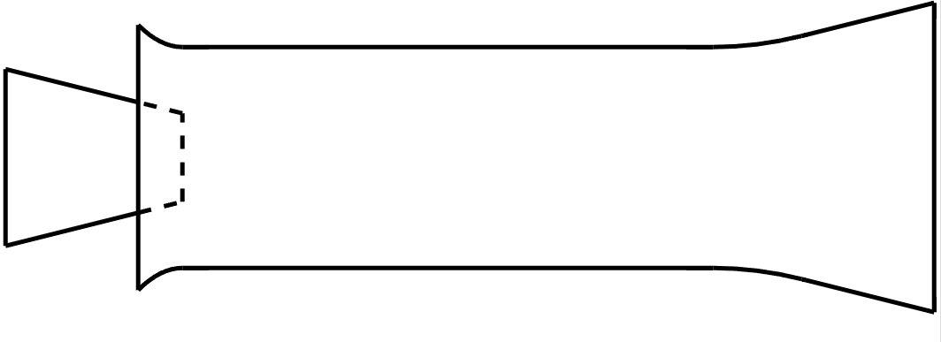
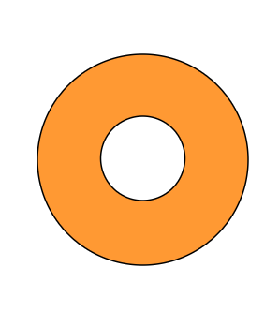
Key Design Variables
L
α_{E} = - Bypass Ratio
α_{D} = - Diffuser Area Ratio
L - Mixing Chamber Length
A_{s}
A_{p}
D
A_{d}
A_{mc}
A_{p}
A_{s}
A_{mc}
A_{d}
Overview
Schedule
Test Readiness
Budget

Slide 40
Parametric Study - Method
Each key design input variable will be varied in order to attempt to understand the models accuracy
α_{E} ± 1.0
α_{D} ± 0.5
L ± 1.0 D
Test | α_{E} | α_{D} | L
Current Design Point | 3.5 | 1.5 | 3 D
α_{E}+ | 4.5 | 1.5 | 3 D
α_{E}- | 3.5 | 1.5 | 3 D
α_{D}+ | 3.5 | 2.0 | 3 D
α_{D}- | 3.5 | 1.0 | 3 D
L+ | 3.5 | 1.5 | 4 D
L- | 3.5 | 1.5 | 2 D
Overview
Schedule
Test Readiness
Budget
Notes:
Need to introduce alphaE, alphaD, L (names on slides) before you talk about them
Include graphic showing what each one is

Slide 41
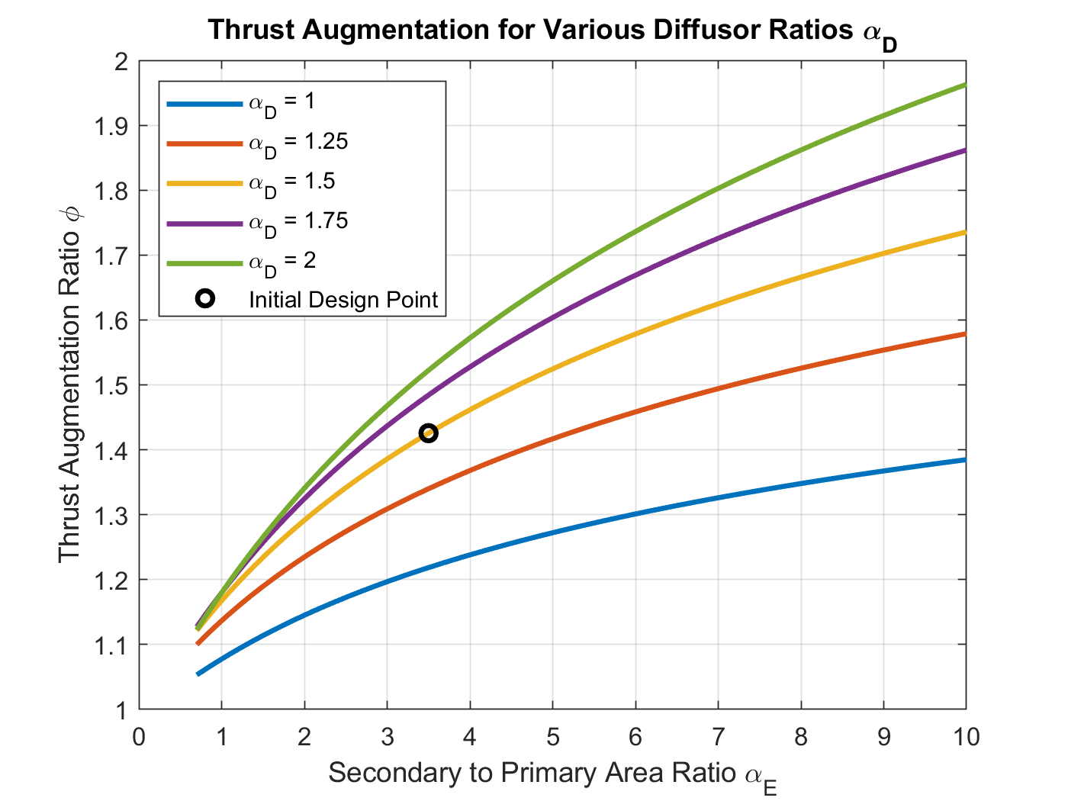
Validating Heiser’s Model
From J.W. Heiser^{[1]} modified with skin friction loss estimates^{[2]}
Overview
Schedule
Test Readiness
Budget

Slide 42
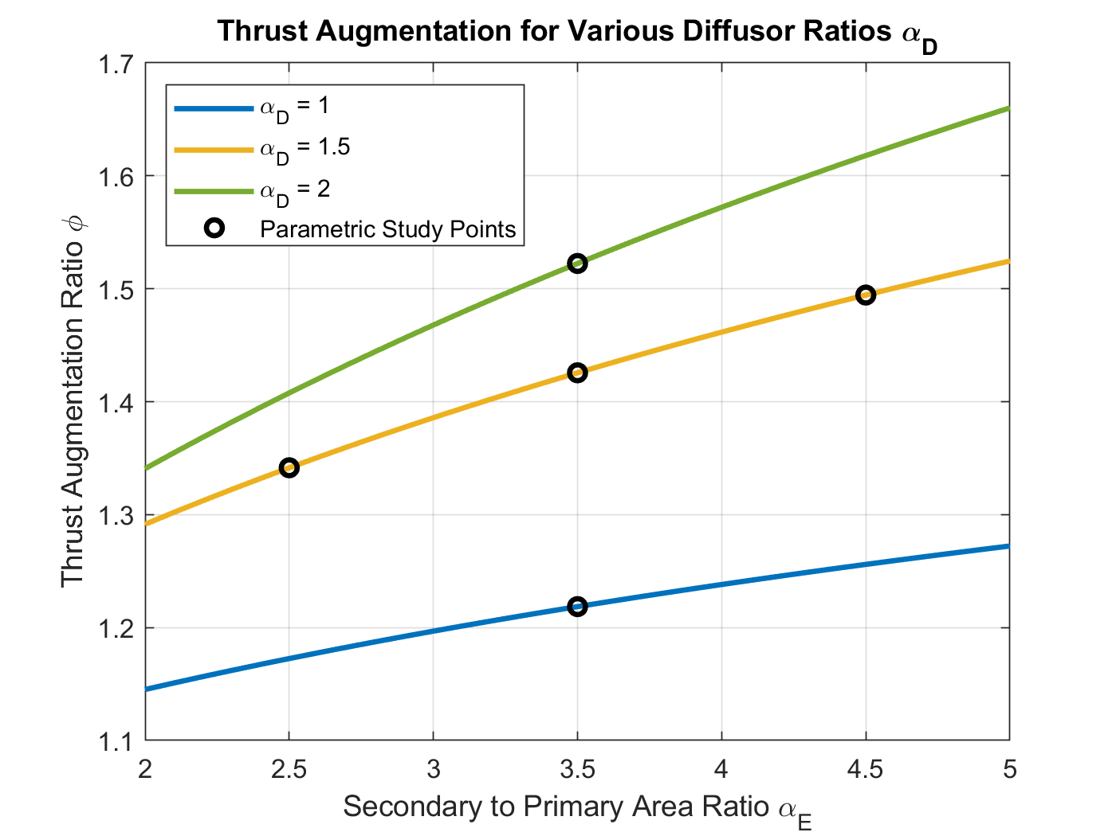
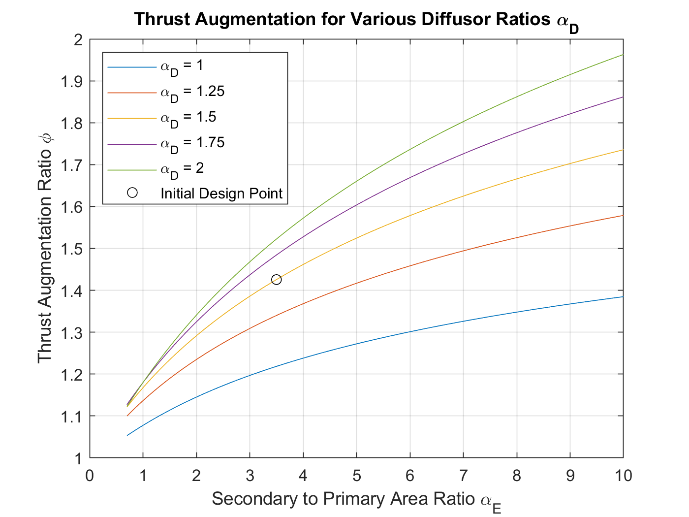
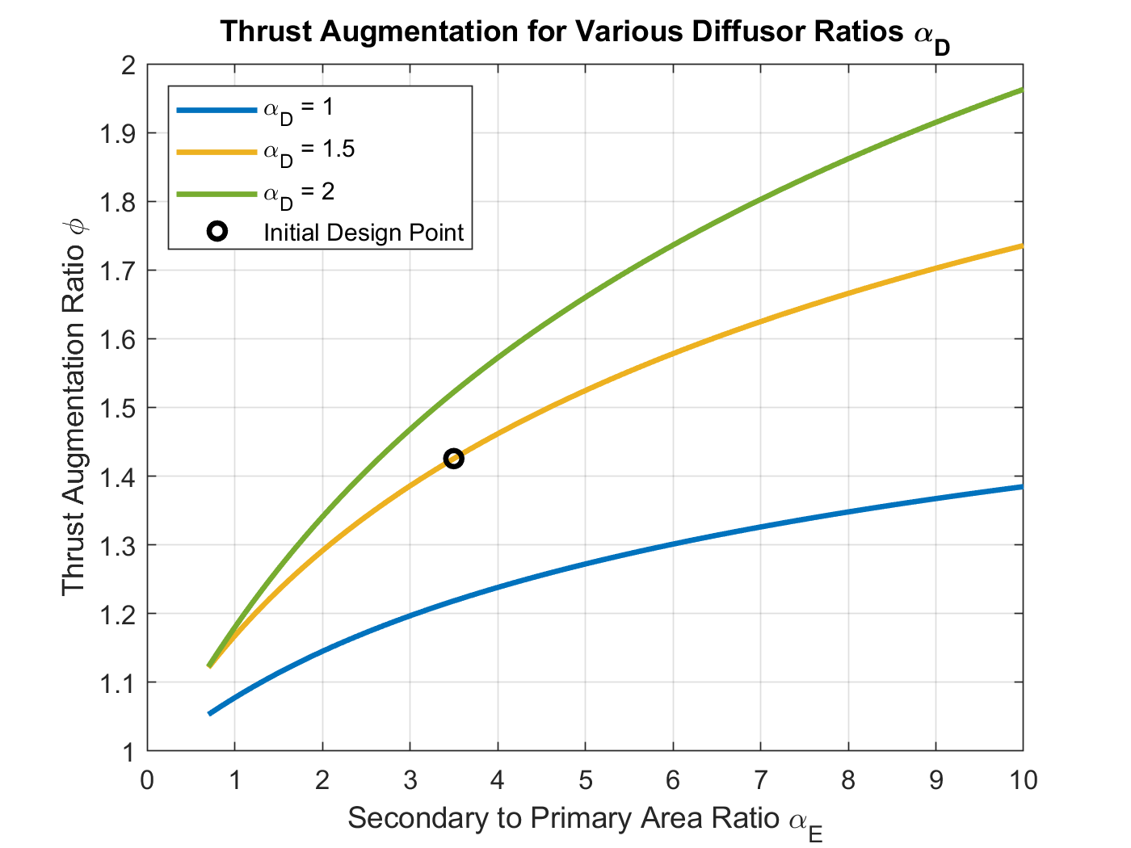
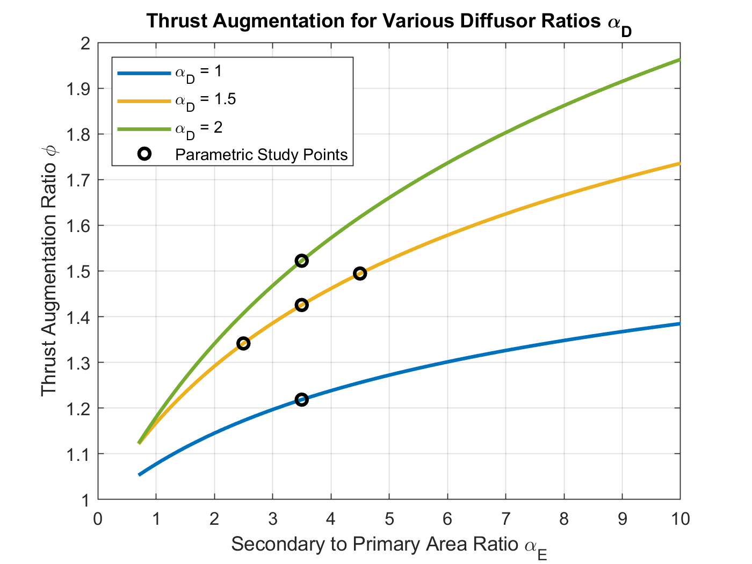
Validating Heiser’s Model
From J.W. Heiser^{[1]} modified with skin friction loss estimates^{[3]}
Variation of α_{E}:
Determine the offset of experimental φ values from theory
Quantify the spacing between the lines plotted
Variation of α_{D}:
Estimate the actual slope of the lines plotted
Overview
Schedule
Test Readiness
Budget
Notes:
In out machine from parametric study - This detailed stuff is probably going to be backups

Slide 43
Parametric Study - Data Collection
Radial total pressure distribution at nozzle exit:
3 data points
Used to calculate average velocity
Bypass inlet static pressure
Used to calculate secondary mass flow rate
Known primary mass flow rate plus this data can be used to calculate thrust
Overview
Schedule
Test Readiness
Budget

Slide 44
Parametric Study - Further Testing
Time permitting:
Combining best variations of design parameters
Validate that results are still as expected
Extend variations of certain parameters
If results from first experiments deem it necessary
Overview
Schedule
Test Readiness
Budget

Slide 45
Budget
Overview
Schedule
Test Readiness
Budget

Slide 46
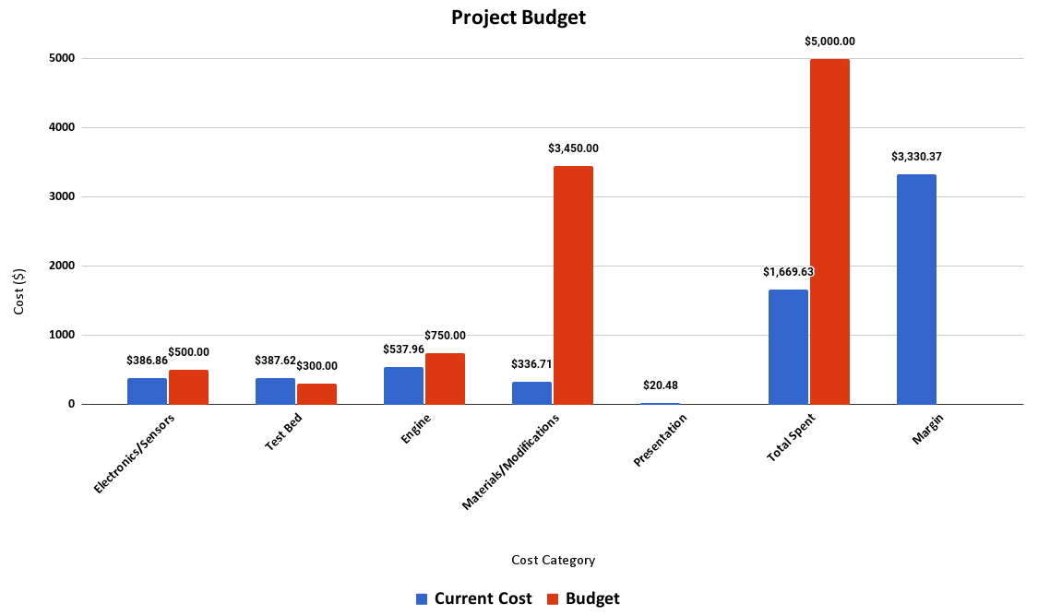
Overview
Schedule
Test Readiness
Budget
Notes:
Can we make the numbers bigger

Slide 47
Cost Plan, Current exp, budget, rem, etc
Of the planed $5,000 budget, $1,669.63 has been spent so far, leaving $3,330.37 remaining
Remaining planned costs cover modification manufacturing
$3,450 planned budget with $336.71 spent thus far for manufacturing proof of concept
Totals for manufacturing should be well below planned budget, as detailed in the following slides
Approximately $215 in reserve for unplanned hardware or electronics costs, with more likely available due to expected manufacturing costs
Overview
Schedule
Test Readiness
Budget

Slide 48
Converging Nozzle
In-house manufacturing of converging nozzle using MarkForged metal 3D printer
17-4 PH Stainless Steel is the current material selection
Expected costs between $650 and $950
Total manufacturing time 1-2 weeks for printing, curing, and finishing
Overview
Schedule
Test Readiness
Budget

Slide 49
Mixing Chamber and Diffuser
In-house manufacturing of mixing chamber and diffuser sections of ejector nozzle using mills/lathes
Manufactured out of Al6061-T6511 with UHMW polyethylene support during manufacturing
Expected costs of $190 per mixing chamber/diffuser for materials sourced through McMaster-Carr
Total manufacturing time 1-1.5 weeks for manufacturing and finishing
Overview
Schedule
Test Readiness
Budget

Slide 50
Acknowledgements
AFRL: Lt Kavi Muraleetharan, Lt Collin Parsons, and Mr. Tim Erdmann
Advisor: Alexandra Le Moine
TAs: Emma Markovich and Colin Claytor
Technical Advisors: John Mah, James Nabity, Matt Rhode, Bobby Hodgkinson, Trudy Schwartz, Kathryn Wingate

Slide 51
Supplemental Material

Slide 52
Table of Contents
On-Engine Testing
Cold Test
Material Selection
Ejector Model
Notes:
Variable geometry ruled out due to static conditions during testing
Nozzle weight is a small % of engine weight

Slide 53
References
Mattingly, J.D. and Boyer, K.M. Elements of Propulsion: Gas Turbines and Rockets. American Institute of Aeronautics and Astronautics, 2 edition, 2016
Huang, K.P, Kisielowski, E. “An investigation of the thrust augmentation characteristics of jet ejectors,” April 1967.
Frank, G., Piper, S., Chen, Y., FitzRandolph, P., Camacho, C., Knickerbocker, M., Junker, M., Oropeza, D.C., Cutler, J., Fuernkranz, M., and Harthan, D. Specialized propulsion engine control system critical design review, 2018.
Coulon, T., Johnson, R., Jones, L., Mines, M., Schumacher, G., and Swart, C. Thrust to weight improvement of jetcat p100-rx turbojet engine, 2019
Soars, C. Gas Turbines: A Handbook of Air, Land and Sea Applications. Butterworth-Heinemann, 1 edition, 2014.
Violett, B. A few reminders for safe turbine operations.
White, F.M. Viscous Fluid Flow. McGraw-Hill, 3 edition, 2011
Heiser, H. W. Ejector thrust augmentation. Journal of Propulsion and Power, 26(6), November-December 2010.
Huang, K. P and Kisielowski, E. An investigation of the thrust augmentation characteristics of jet ejectors
JetCat. Jetcat turbine datasheet, 2015
Razak, A.M.Y. Gas turbine combustion.
Aeronautics Guide. Aircraft turbine engine fuel system components
Erickson, D.M., Day, S.A., and Doyle, R. Design considerations for heated gas fuel.
Larson, G.C. The hotter the better.
Autonomous Manufacturing. A guide to 3d printing with titanium
Online Metals, URL: https://www.onlinemetals.com/en/buy/aluminum-round-bar-7075-t6-t651-cold-finish?q=%3Aprice-asc&page=1&pagesize=25&sort=price-asc
Dr. D. Lewis Abata, The Thermodynamics of Emptying a Pressure Vessel, South Dakota School of Mines and Technology.
Gibson, P. W., “Blast Overpressure and Survivability Calculations For Various Sizes of Explosive Charges”, Army Natick Research Development and Engineering Center MA, June 1994.

Slide 54
References
Heiser, H. W. Ejector thrust augmentation. Journal of Propulsion and Power, 26(6), November-December 2010.
Huang, K.P, Kisielowski, E. “An investigation of the thrust augmentation characteristics of jet ejectors,” April 1967.
White, F.M. Viscous Fluid Flow. McGraw-Hill, 3 edition, 2011

Slide 55
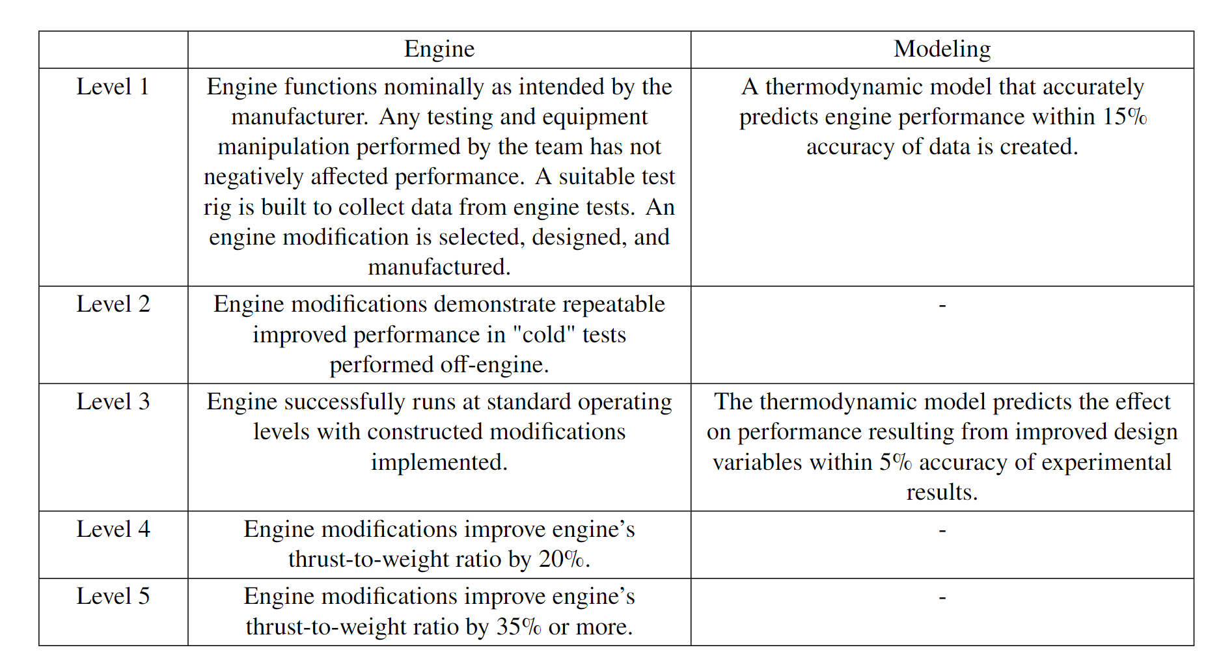
Levels of Success
Notes:
Split w prev slide - list concrete objectives w numerical values

Slide 56
Functional Requirements
Notes:
Split w prev slide - list concrete objectives w numerical values

Slide 57
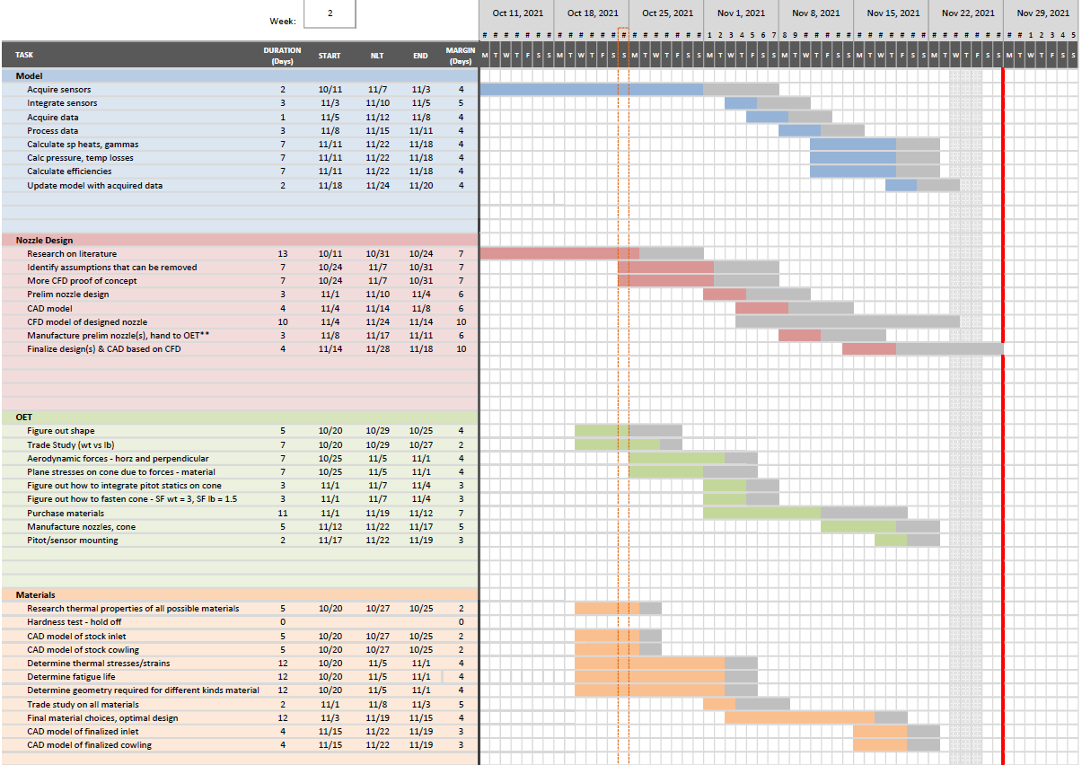
TOC

Slide 58
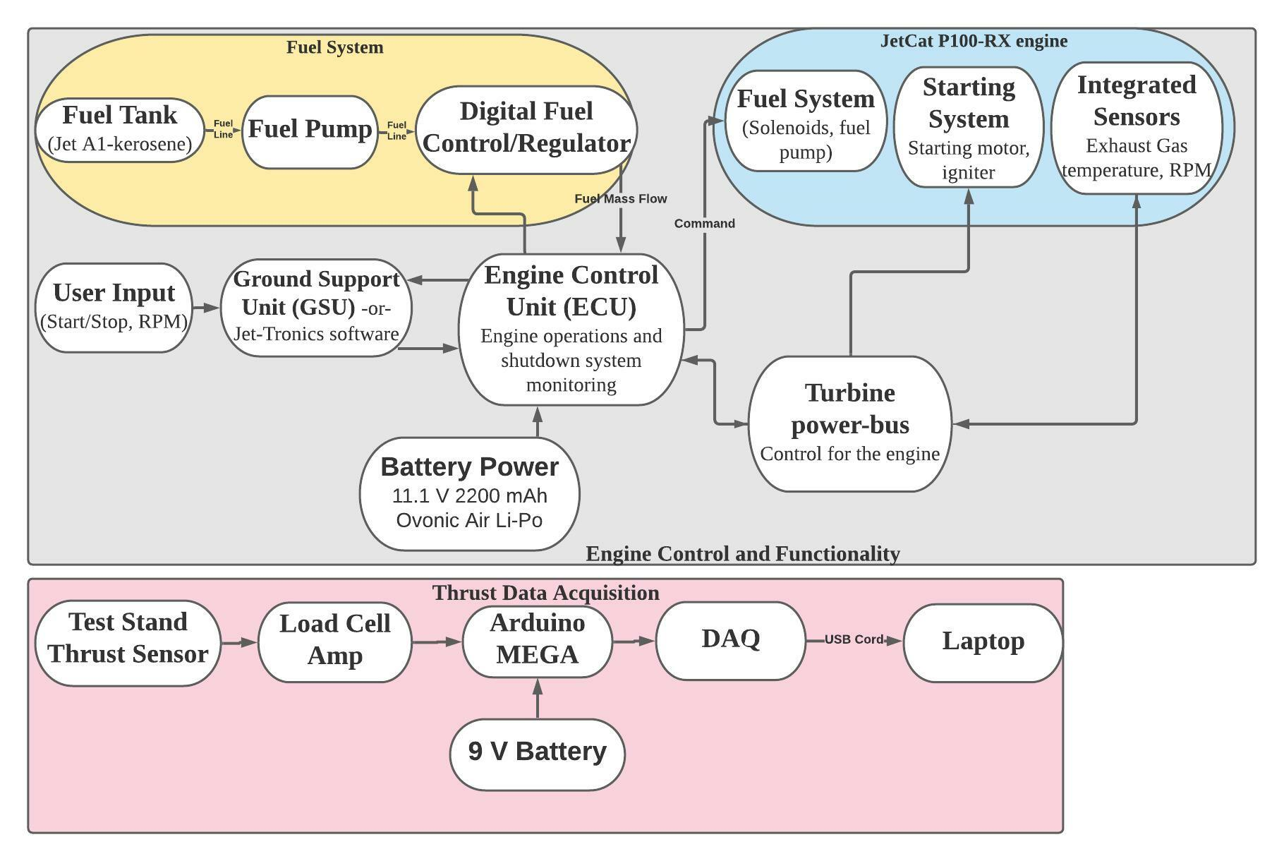
Operational Functional Block Diagram
Current Project
Previous Year’s Project
TOC

Slide 59
CDR Design Current Design
All units in mm
Overview
Schedule
Test Readiness
Budget
Notes:
Describe major changes - mostly verbal with key visual aids (ie arrows or circles) as necessary

Slide 60
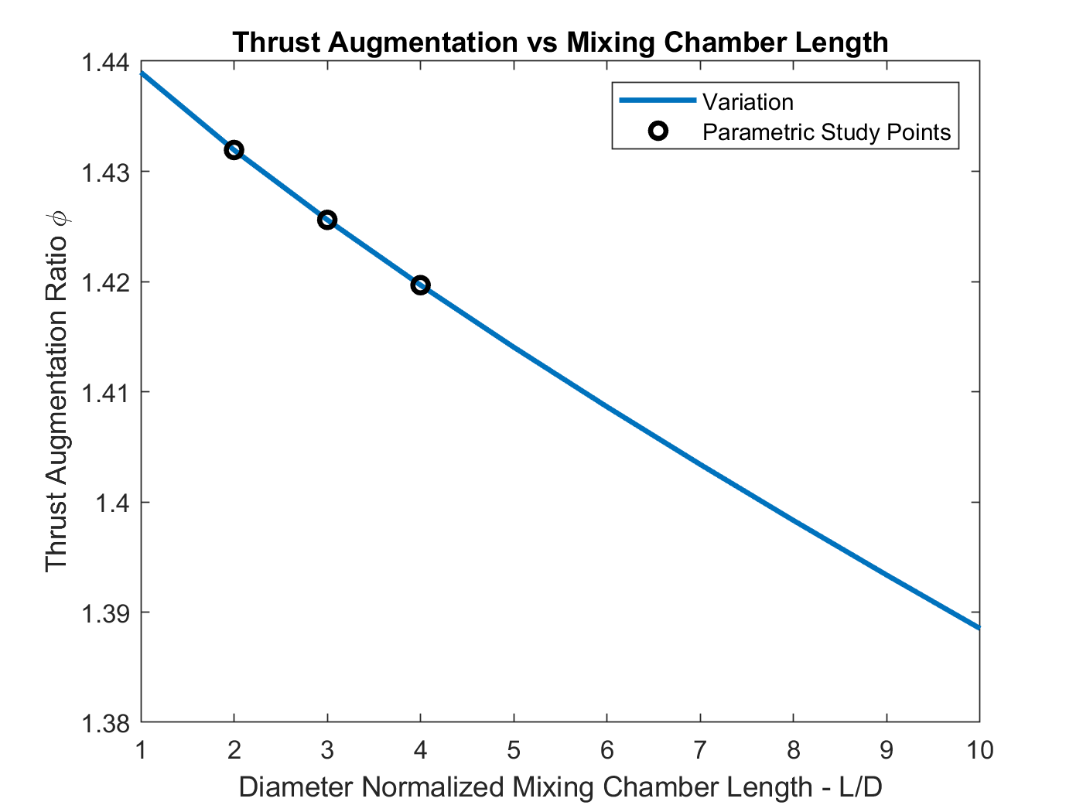
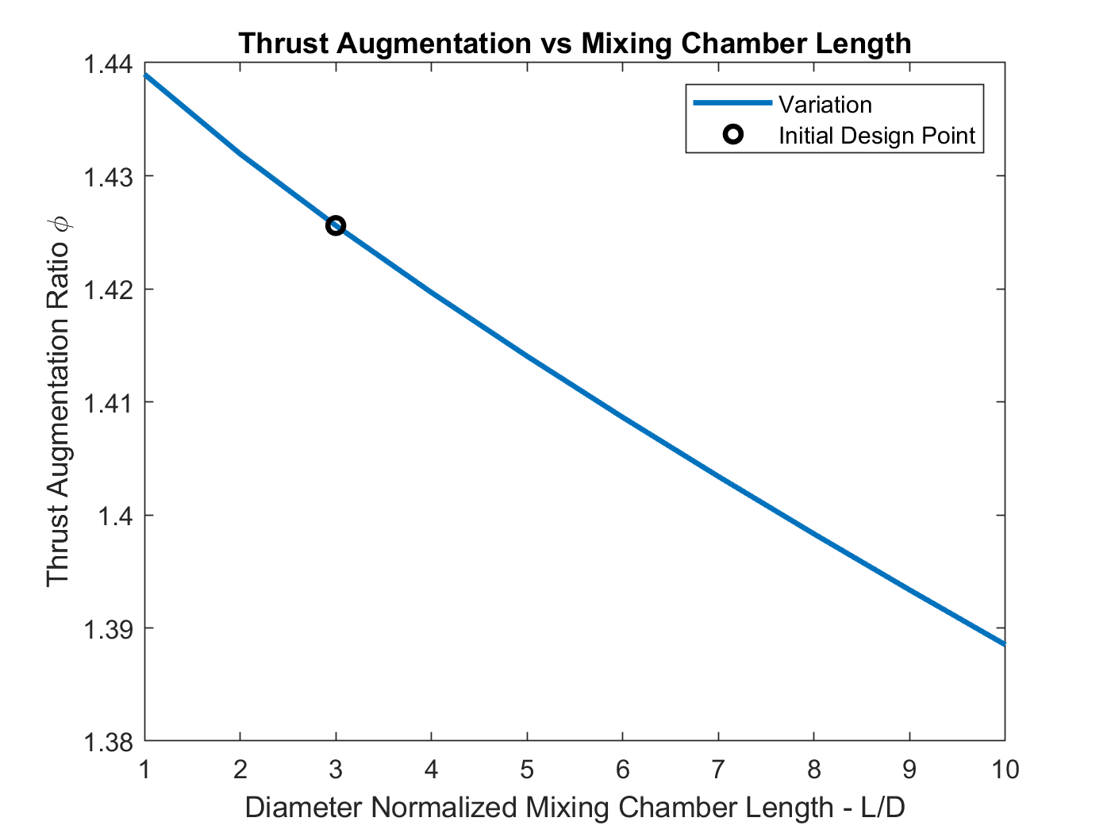
Understanding Mixing Chamber Length
Variation of L
Test skin friction losses modeling
Understand effects of incomplete mixing
Overview
Schedule
Test Readiness
Budget

Slide 61
On-Engine Testing
TOC

Slide 62
On-Engine Safety Procedures
Engine Testing Procedure and Safety - Google Docs
TOC

Slide 63
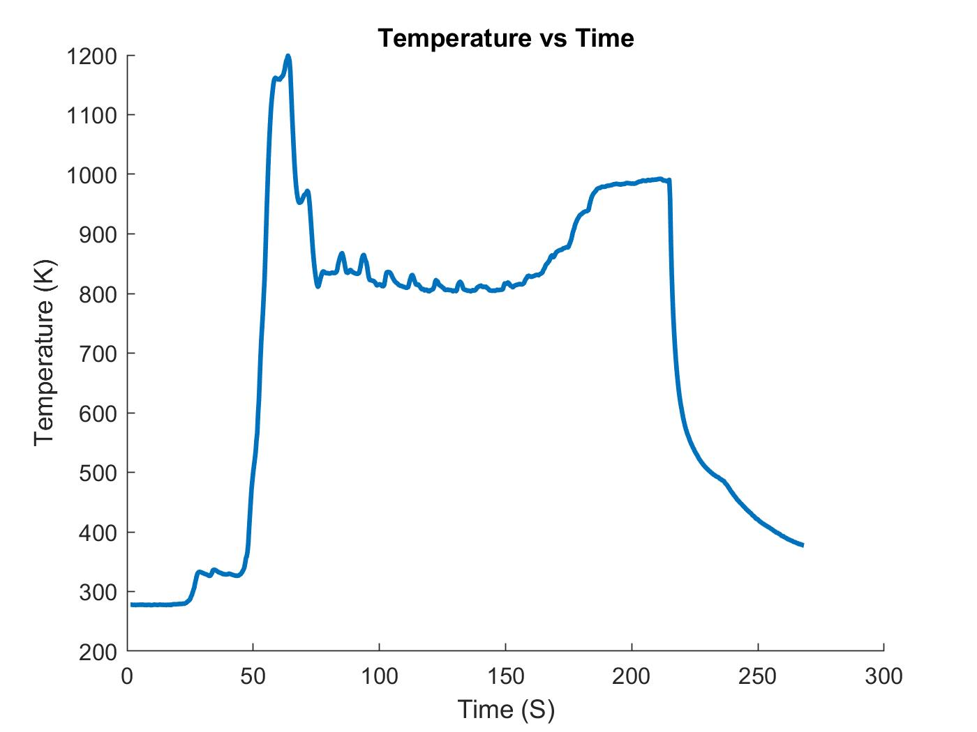
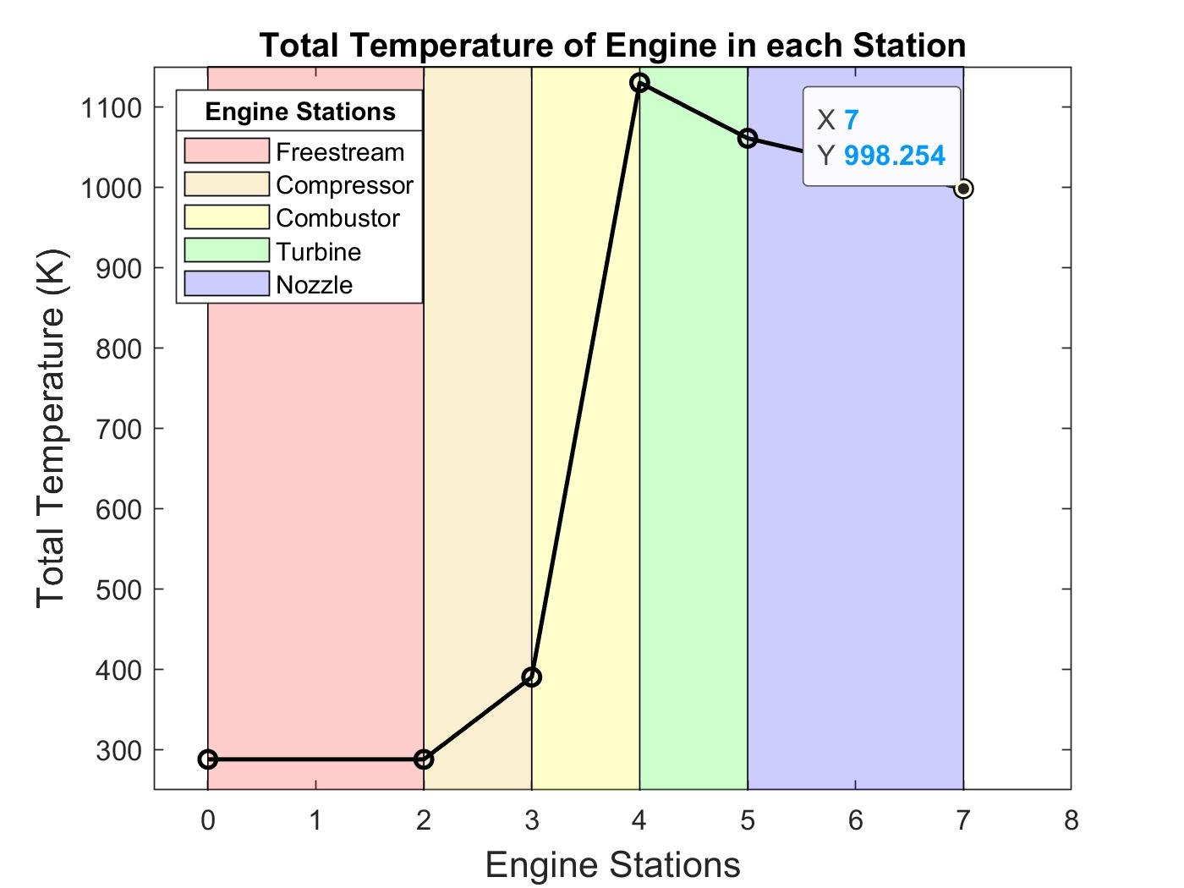
Temperature Data
Notes:
1% error

Slide 64
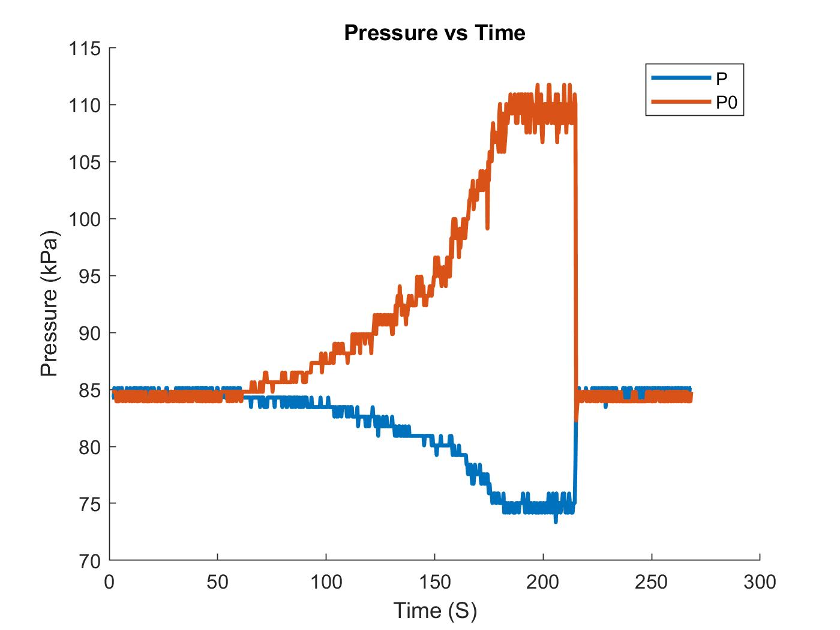
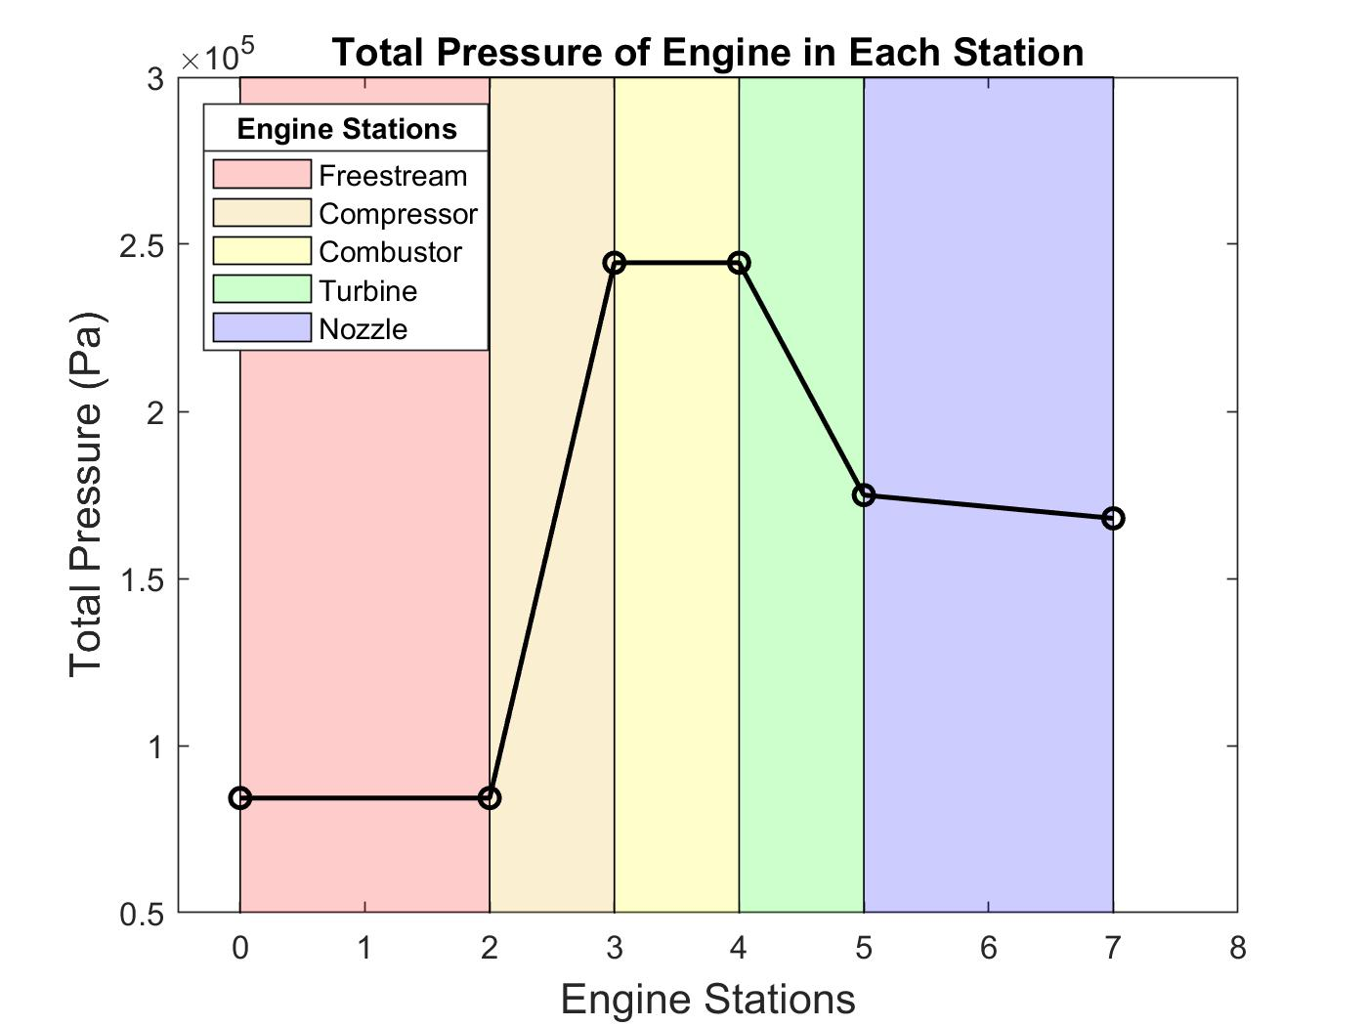
Pressure Data
Notes:
30% error

Slide 65
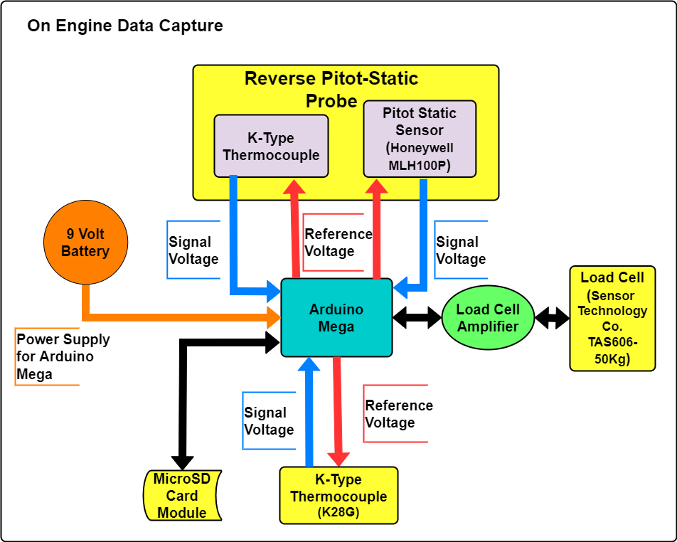
On-Engine Test: Electronics FBD
Notes:
If time needs to be cut, put this in backup
9V battery instead of AC/DC converter

Slide 66
Facilities
JetCat P100-RX
JetCat P100-RX
Exhaust Instrumentation
Load Cell
ECU
Arduino Mega
Overview
Schedule
Test Readiness
Budget
Notes:
This is a really cluttered slide, maybe drop the picture on the left and just do the right
Actual pictures of room and sensors

Slide 67
Cold Test
TOC

Slide 68
OET: Pressure Regulator and Tank Feasibility
Dimensions
Feed Tanks (2x)
1-¼” outlet
Feed Ball Valves (2x)
1-¼” inlet, outlet
53R Feed Regulators (2x)
1-¼” inlet, outlet
Settling Chamber:
1-¼” inlet (2x)
Outlet: Apollo 94A-109-01 full port brass ball valves
2.520” ID
Taper Cone:
1.8” inlet
1.075” outlet
TOC

Slide 69
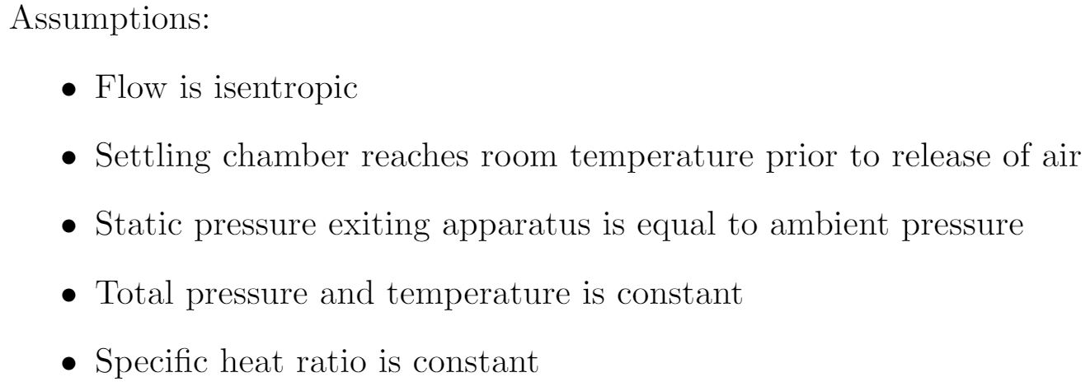
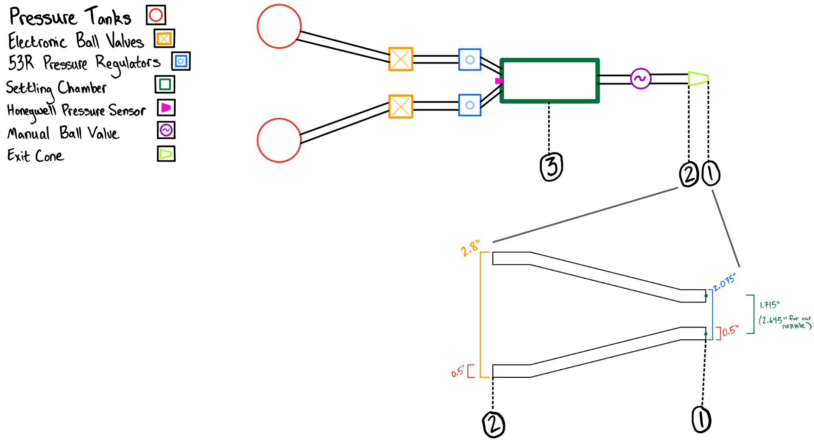
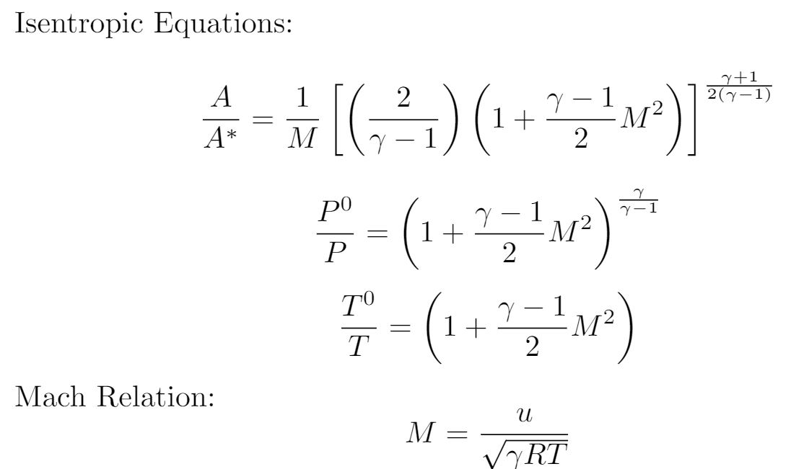
OET: Desired Settling Chamber Pressure
Content
TOC

Slide 70
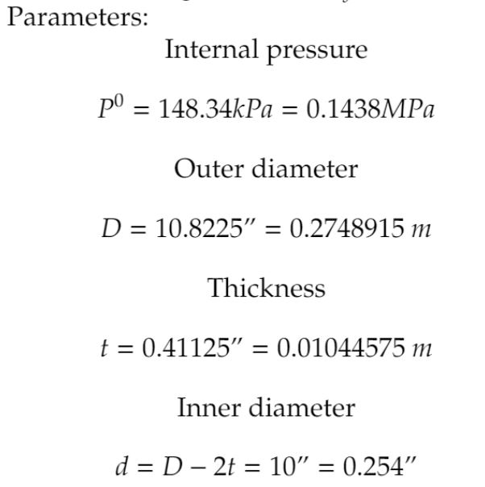
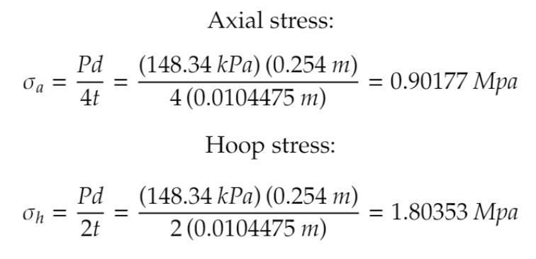
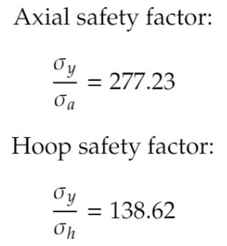
OET: Settling Chamber Structural Analysis
TOC

Slide 71
OET: Pressure Regulator and Tank Feasibility
Isentropic relations were used to calculate the mass flow rate out of the settling chamber
Mass flow rate out of the feed tanks was calculated using non-ideal relations with both choked and unchoked flow, following conservation laws
The pressure, temperature, mass, and mass flow within each tank was calculated and plotted in an to determine nominal test time
While feed tank pressures remain high, nominal test time is 11.69 seconds due to the combined feed tank mass flow rate dropping below the mass flow rate out of the settling chamber
This will reduce pressures in the settling chamber, decreasing nozzle test efficacy
Note this test time and the mass flow plotted on slide 72 is for two regulators---one regulator system can not keep up with the mass flow out of the settling chamber due to the choked flow in the feed pipe
TOC

Slide 72
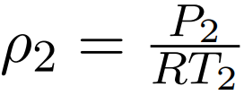
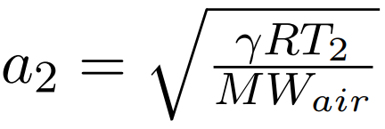
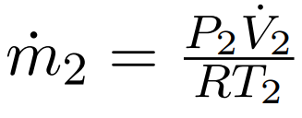
Mass Flow (Settling Chamber)
R = 8.3145 Pa-m³/K-mol = 286.5 J/kg-K
P₂ = 131.84 kPa
P₁⁰ = 145.34 kPa
𝜌₂ = 1.5931 kg/m³
MW_{air} = 28.97 g/mol
a₂ = 331.78 m/s
u₂ = 93.88 m/s
V̇ = .0743 m²/s
ṁ = .1184 kg/s
TOC

Slide 73
Mass Flow (Feed Tanks)
Known values:
P₀ = 758.42 kPa = 110 psi
P_{throat} = P_{settle} = 148.34 kPa
V_{tank} = 80 gal. = .3636 m³
T₀ = T = 293.15 K
R = 287 J/kg-K = 8.3145 Pa-m³/K-mol
A_{throat} = 1.227 in² = 7.9173x10⁻⁴ m²
m_{max} = 3.2780 kg
TOC

Slide 74
Mass Flow (Feed Tanks)
Choked Flow:
Non-Choked Flow:
Flow out of the feed tanks is initially choked due to small pipe diameter---this restricts mass flow rate from a single tank to relatively low values
TOC

Slide 75
Mass Flow (Feed Tanks)
Calculations are derived from the first law of thermodynamics
The second equation is the driving temperature calculations, as seen in the bottom right
Iterative models were used to determine the next mass value, allowing for pressure and temperature calculations
TOC

Slide 76
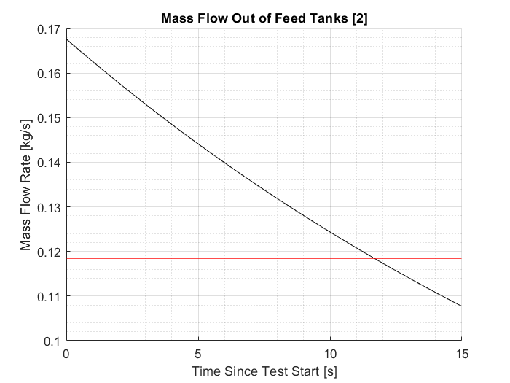
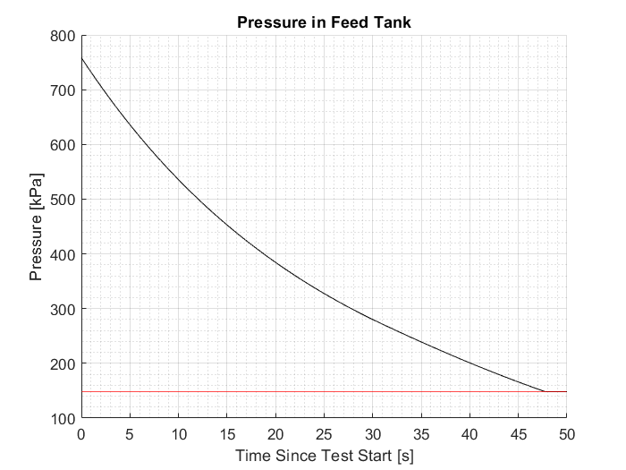
Mass Flow (Feed Tanks)
Maximum test time: 11.69 seconds
Pressure remains high, but mass flow rate out of feed tank drops below mass flow rate out of settling chamber
TOC

Slide 77
Cold Test Risk Mitigation
W_{settle} = 596 J
TNT EQ: 1.42 g
W_{feed} = 355,800 J
TNT EQ: 85.04 g
The blast and resulting pressures would not cause any physical damage given our test setup [17]
V_{settling} = .032175925 cubic meters
V_{feed} = .3636 cubic meters
P_{settling}= 148.34 kPa
P_{feed} = 758.42 kPa
P_{a} = 86 kPa
W=P₀V₀(ln(P₀/P_{a})-1)+P_{a}V₀
1kg TNT = 4.184*10^6 J
TOC

Slide 78
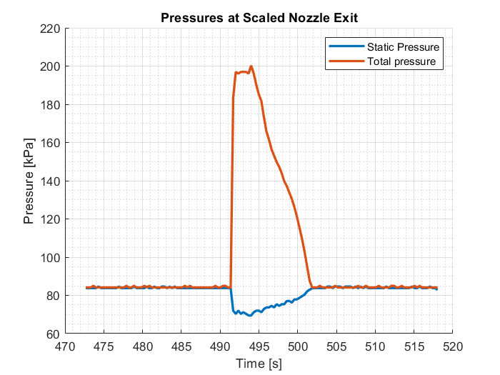
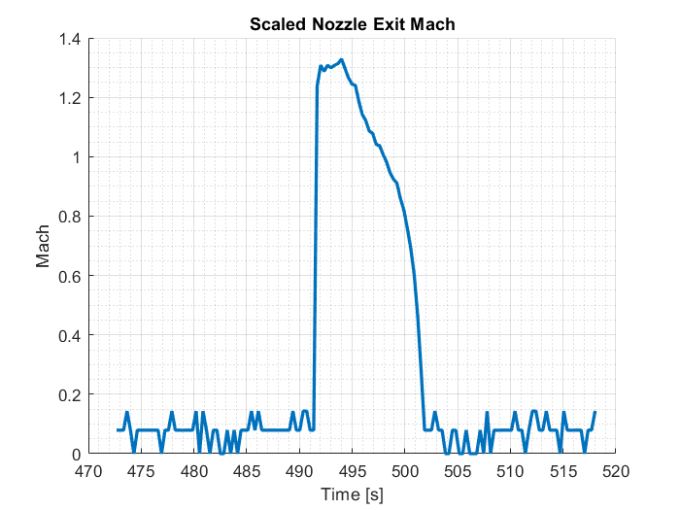
TOC
Notes:
Appendix potentially, here for now

Slide 79
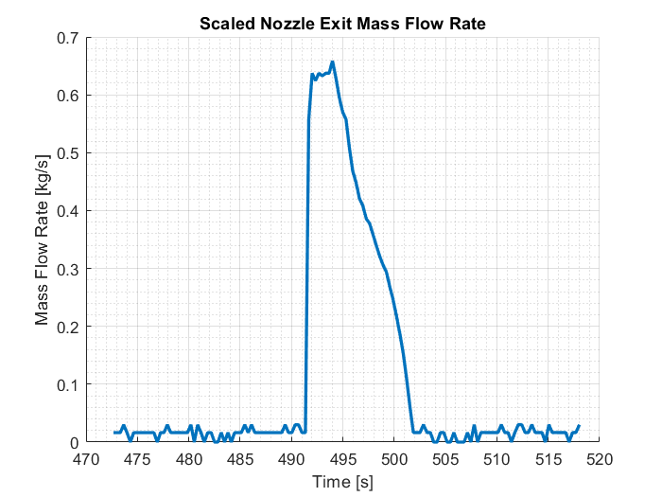
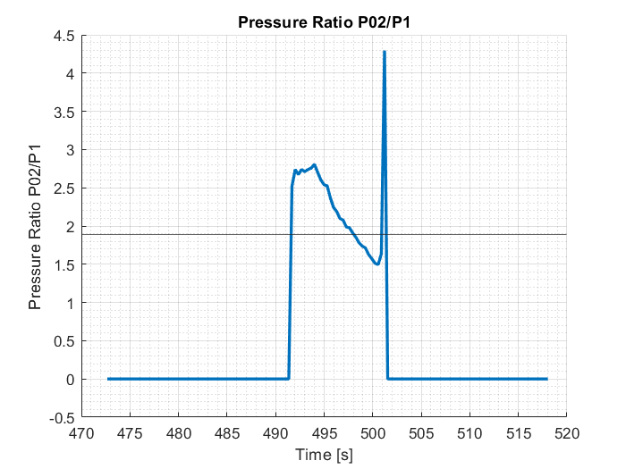
TOC

Slide 80
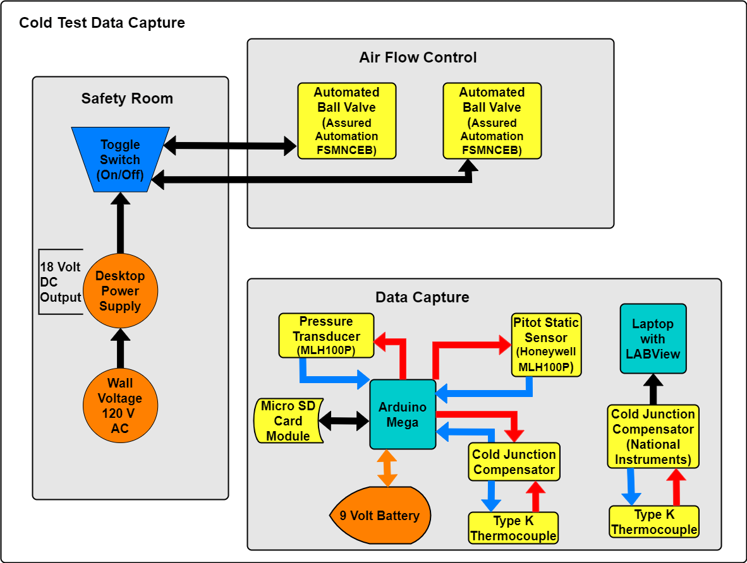
Cold Test Electronic Block Diagram
Overview
Schedule
Test Readiness
Budget
TOC
Notes:
Potentially put in backups

Slide 81
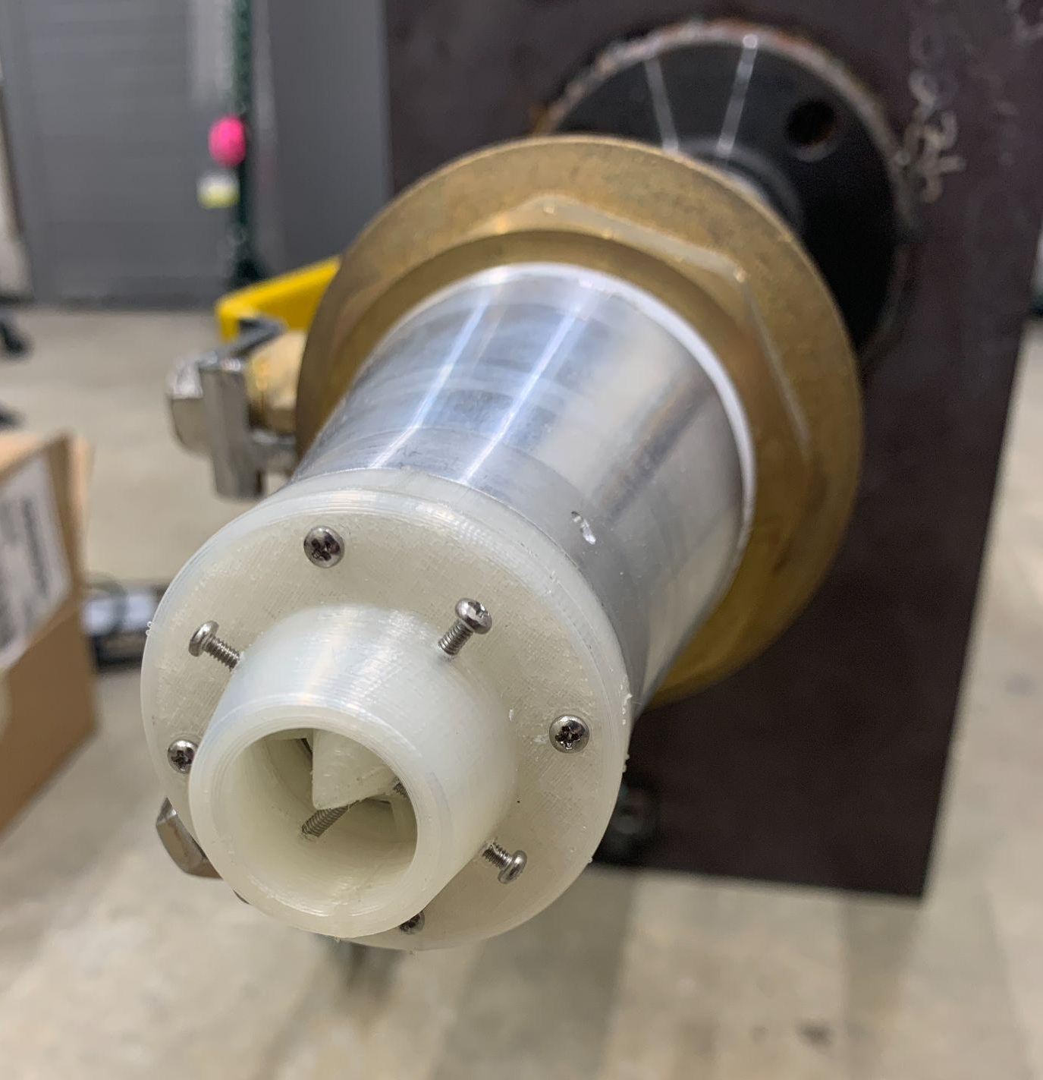
Cold Test Mounted Nozzle
Overview
Schedule
Test Readiness
Budget
TOC
Notes:
Potentially put in backups

Slide 82
Cold Test Safety Procedures
Cold Test Procedures - Google Docs
TOC

Slide 83
Material Selection
TOC

Slide 84
3D Printer Metal Ansys Results -0.66 mm Base
Material | Bolt Hole Stress (Pa) | Strut Stress (Pa) | Location of Max Stress
D2 tool steel | 2.4428E+09 | - | Bolt hole
17-PH4 | 3.6374E+08 | 8.3155E+08 | Strut
H13 tool steel | 1.7847E+09 | - | Bolt hole
A2 tool steel | 2.3591E+09 | - | Bolt hole
SS 304, annealed | 1.6279E+08 | 8.4944E+08 | Strut
SS 304, 1/2 hard | 7.4279E+08 | 1.6538E+09 | Strut
Inconel 625 | 4.7945E+08 | don't have | Strut
TOC

Slide 85
3D Printer Metal Ansys Results -0.8 mm Base
Material | Bolt Hole Stress (Pa) | Strut Stress (Pa) | Location of Max Stress
D2 tool steel | 2.3736E+09 | - | Bolt hole
17-PH4 | 3.6174E+08 | 6.9227E+08 | Strut
H13 tool steel | 1.7963E+09 | - | Bolt hole
A2 tool steel | 2.1126E+09 | - | Bolt hole
SS 304, annealed | 1.6126E+08 | 8.0251E+08 | Strut
SS 304, 1/2 hard | 8.1856E+08 | 1.4228E+09 | Strut
Inconel 625 | 4.8347E+08 | 8.1429E+08 | Strut
TOC

Slide 86
3D Printer Metal Ansys Results -1 mm Base
Material | Bolt Hole Stress (Pa) | Strut Stress (Pa) | Location of Max Stress
D2 tool steel | 2.4263E+09 | - | Bolt hole
17-PH4 | 3.6371E+08 | 7.0596E+08 | Strut
H13 tool steel | 1.8328E+09 | - | Bolt hole
A2 tool steel | 2.1495E+09 | - | Bolt hole
SS 304, annealed | 1.6384E+08 | 7.9846E+08 | Strut
SS 304, 1/2 hard | 8.3099E+08 | 1.4372E+09 | Strut
Inconel 625 | 4.7078E+08 | 8.2686E+08 | Strut
TOC

Slide 87
3D Printer Metal Ansys Results -1.2 mm Base
Material | Bolt Hole Stress (Pa) | Strut Stress (Pa) | Location of Max Stress
D2 tool steel | 2.2251E+09 | - | Bolt hole
17-PH4 | 3.8714E+08 | - | Bolt hole
H13 tool steel | 1.8583E+09 | - | Bolt Hole
A2 tool steel | 2.1512E+09 | - | Bolt Hole
SS 304, annealed | 1.9248E+08 | - | Bolt hole
SS 304, 1/2 hard | 7.9869E+08 | - | Bolt Hole
Inconel 625 | 4.6503E+08 | - | Bolt hole
TOC

Slide 88
Markforged Inconel 625 Properties
TOC

Slide 89
Markforged Inconel 625 Properties
TOC

Slide 90
Markforged 17-4PH Stainless Steel Properties
TOC

Slide 91
Markforged 17-4PH Stainless Steel Properties
TOC

Slide 92
Markforged 17-4PH Stainless Steel Properties
TOC

Slide 93
Ansys Simulations: Gap Width
TOC

Slide 94
Ansys Simulations: Pressure at Bolt Holes
TOC

Slide 95
Ansys Simulations: Penetration at Bolt Holes
TOC

Slide 96
Ansys Simulations: Nozzle Deformation
TOC

Slide 97
Ansys Simulations: Screw Deformation
TOC

Slide 98
Ansys Simulations: Deformation of Nozzle With Screws
TOC

Slide 99
Ansys Simulations: Nozzle Stress
TOC

Slide 100
Ansys Simulations: Stress With Screws
TOC

Slide 101
Ansys Simulations: Stress With Screws
TOC

Slide 102
Ejector Model
TOC

Slide 103
Ejector Model - Incompressible with Different Densities
Note notational differences from this presentation:
ɑ = ɑ_{e}
β = ɑ_{D}
m = ṁ
m_{s}/ m_{p} Needs to be solved for first before finding φ
TOC

Slide 104
Ejector Model - Thrust-to-Weight Predictions
Shows weight predictions for fixed L
TOC

Slide 105
Ejector Model - Thrust-to-Weight Predictions
Shows weight predictions for fixed α_{E} and α_{D} (baseline)

Slide 106
External Ejector Models - Compressible
Shows only a minor offset in a compressible vs incompressible analysis (~5% error at worst)^{[2]}
TOC

Slide 107
Ejector Models - Incompressible vs Mixed Densities
Shows the compressible vs incompressible plot^{[2]} vs the output from the chosen mixed densities model
Shows about a 2% error between mixed densities and compressible formulations
TOC

Slide 108
External Ejector Models - Losses
Shows losses in the thrust augmentation for too large of diffuser ratios^{[2]}
Does not account for varying mixing chamber lengths
TOC

Slide 109
External Ejector Models - Mixing Chamber Length
Shows the results from a computation for theoretical mixing chamber length for a given area ratio under incompressible and compressible conditions^{[2]}
TOC

Slide 110
Model Adjustments
Drag force on a surface^{[2]}
Relating wall shear stress to skin friction coefficient^{[2]}
Putting the two together

Slide 111
Model Adjustments
Skin friction relation for a ZPG turbulent flat plate
Reynolds number based on location along the plate
Estimate of the free stream velocity of the secondary

