Slide 1
FlOWeR
FlOWeR
Critical Design Review
Flow Optimization & Weight Reduction Project
Presenters: Adriana Lysak, Weston Luke, Preston Tee, Eric Tate, Max Buchholz
Additional Team Members: Anand Kappagantu, Angelo Hristopoulos, Anthony Gregg,
Nathan Portman
Advisor: Alexandra Le Moine
Customer: U.S. Air Force Research Laboratory

Slide 2
Project Overview
Overview
Design Solution
CPEs
Requirement Satisfaction
Risks
Verification & Validation
Planning

Slide 3
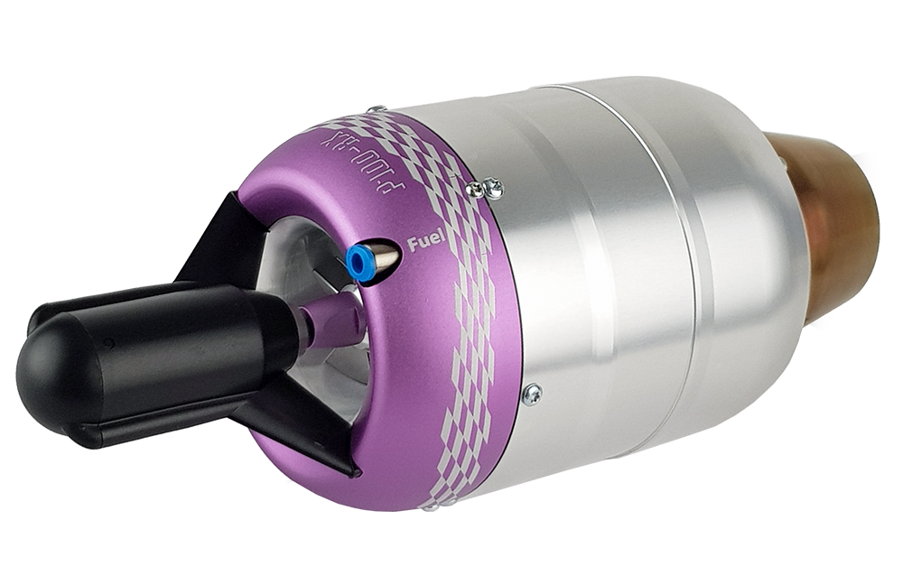
Purpose
Objectives
Successfully compete in AFRL’s annual Aerospace Propulsion Outreach Program (APOP) competition
Improve performance of JetCat P100-RX hobbyist jet engine
Increase T/W ratio
Maintain or increase thermal, propulsive efficiencies
Maintain or decrease thrust specific fuel consumption (TSFC)
Create a thermodynamic model of the engine
Overview
Design Solution
CPEs
Requirement Satisfaction
Risks
Verification & Validation
Planning

Slide 4
Concept of Operations (CONOPs): Competition
Overview
Design Solution
CPEs
Requirement Satisfaction
Risks
Verification & Validation
Planning
Notes:
Colin: Add stage numbers at each part of the conops
Animate to have one engine pop up at a time

Slide 5
Design Solution
Overview
Design Solution
CPEs
Requirement Satisfaction
Risks
Verification & Validation
Planning
Notes:
Dont justify or explain changes just say what were doing

Slide 6
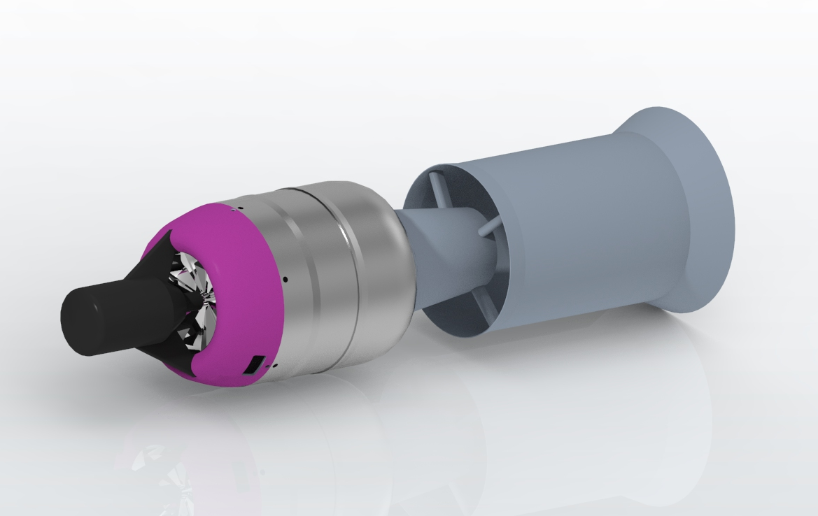
Our Solution: Ejector Nozzle
Objective: Maximize exit flow velocity by optimizing area ratio while avoiding shocks and flow separation
Purpose: Increase thrust through increase of exhaust momentum
Considerations:
Mass flow rate increase vs exit velocity decrease
Weight penalty for larger ejector
Optimizing converging nozzle
Overview
Design Solution
CPEs
Requirement Satisfaction
Risks
Verification & Validation
Planning
Notes:
Discuss in detail the picture shown, add labels
Add another slide with general ejector nozzle details
Change title. “Actual” solution doesn’t look good

Slide 7
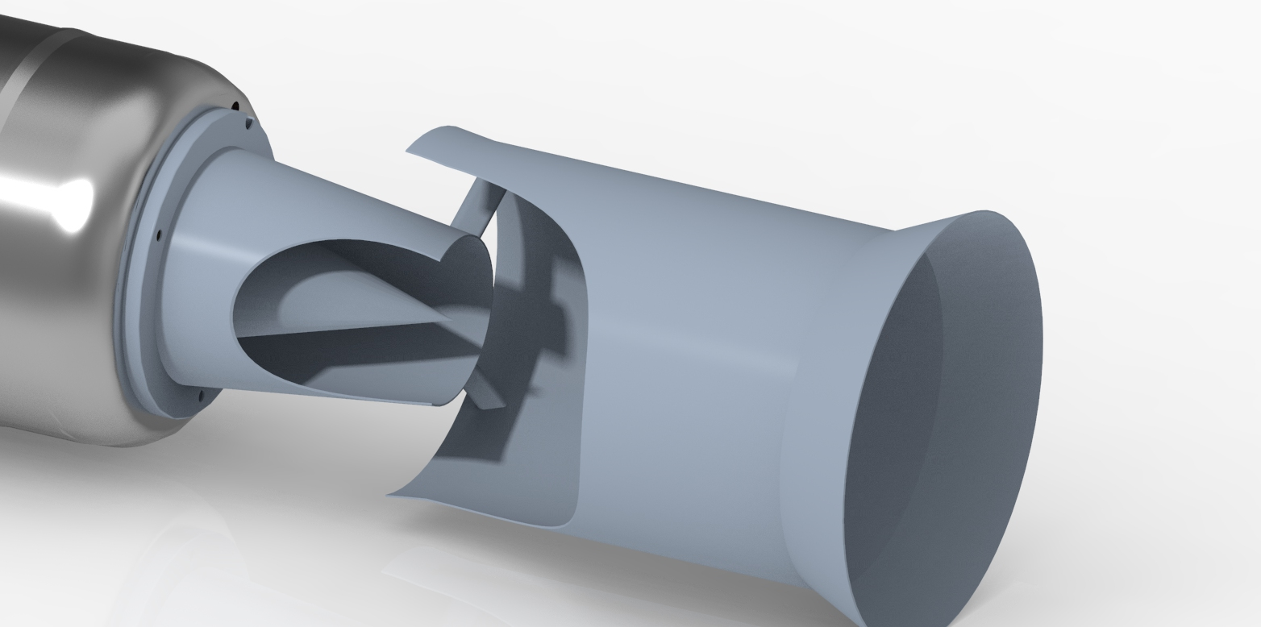
Ejector Nozzle: Overview
Exhaust gasses from engine turbine exit through converging nozzle
Mass flow out of converging nozzle entrains mass flow from surrounding air and is forced out the back of the ejector nozzle
Primary mass flow (from engine)
Secondary mass flow (from surrounding air)
Combined mass flow
Overview
Design Solution
CPEs
Requirement Satisfaction
Risks
Verification & Validation
Planning
Notes:
Discuss in detail the picture shown, add labels
Add another slide with general ejector nozzle details
Change title. “Actual” solution doesn’t look good
Animations:
Red arrows to blue and yellow
Change arrow sizes

Slide 8
Ejector Nozzle: Performance
Models show thrust to increase 82 newtons over the stock nozzle (182 newtons total)
Weight of ejector nozzle will increase by 91 grams over stock nozzle (1171 grams total)
Overall this leads to a predicted thrust to weight increase of 67.8%
Primary mass flow (from engine)
Secondary mass flow (from surrounding air)
Combined mass flow
Overview
Design Solution
CPEs
Requirement Satisfaction
Risks
Verification & Validation
Planning
Notes:
Discuss in detail the picture shown, add labels
Add another slide with general ejector nozzle details
Change title. “Actual” solution doesn’t look good
Animations:
Red arrows to blue and yellow
Change arrow sizes

Slide 9
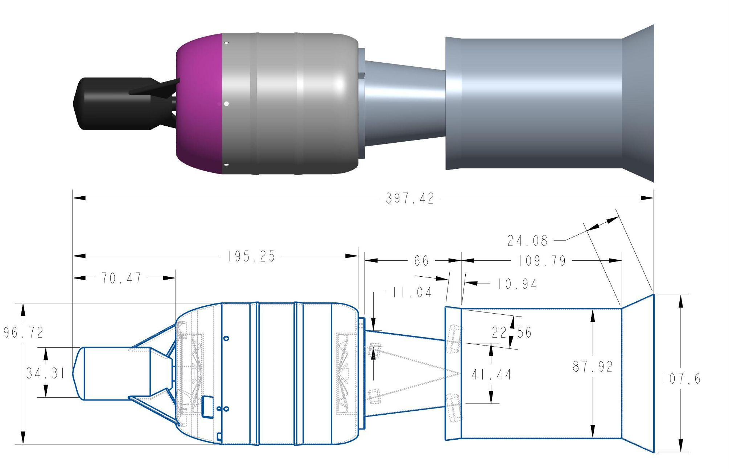
Orthographic Drawing: Integration
Units in mm
Notes:
Discuss in detail the picture shown, add labels
Add another slide with general ejector nozzle details
Change title. “Actual” solution doesn’t look good

Slide 10
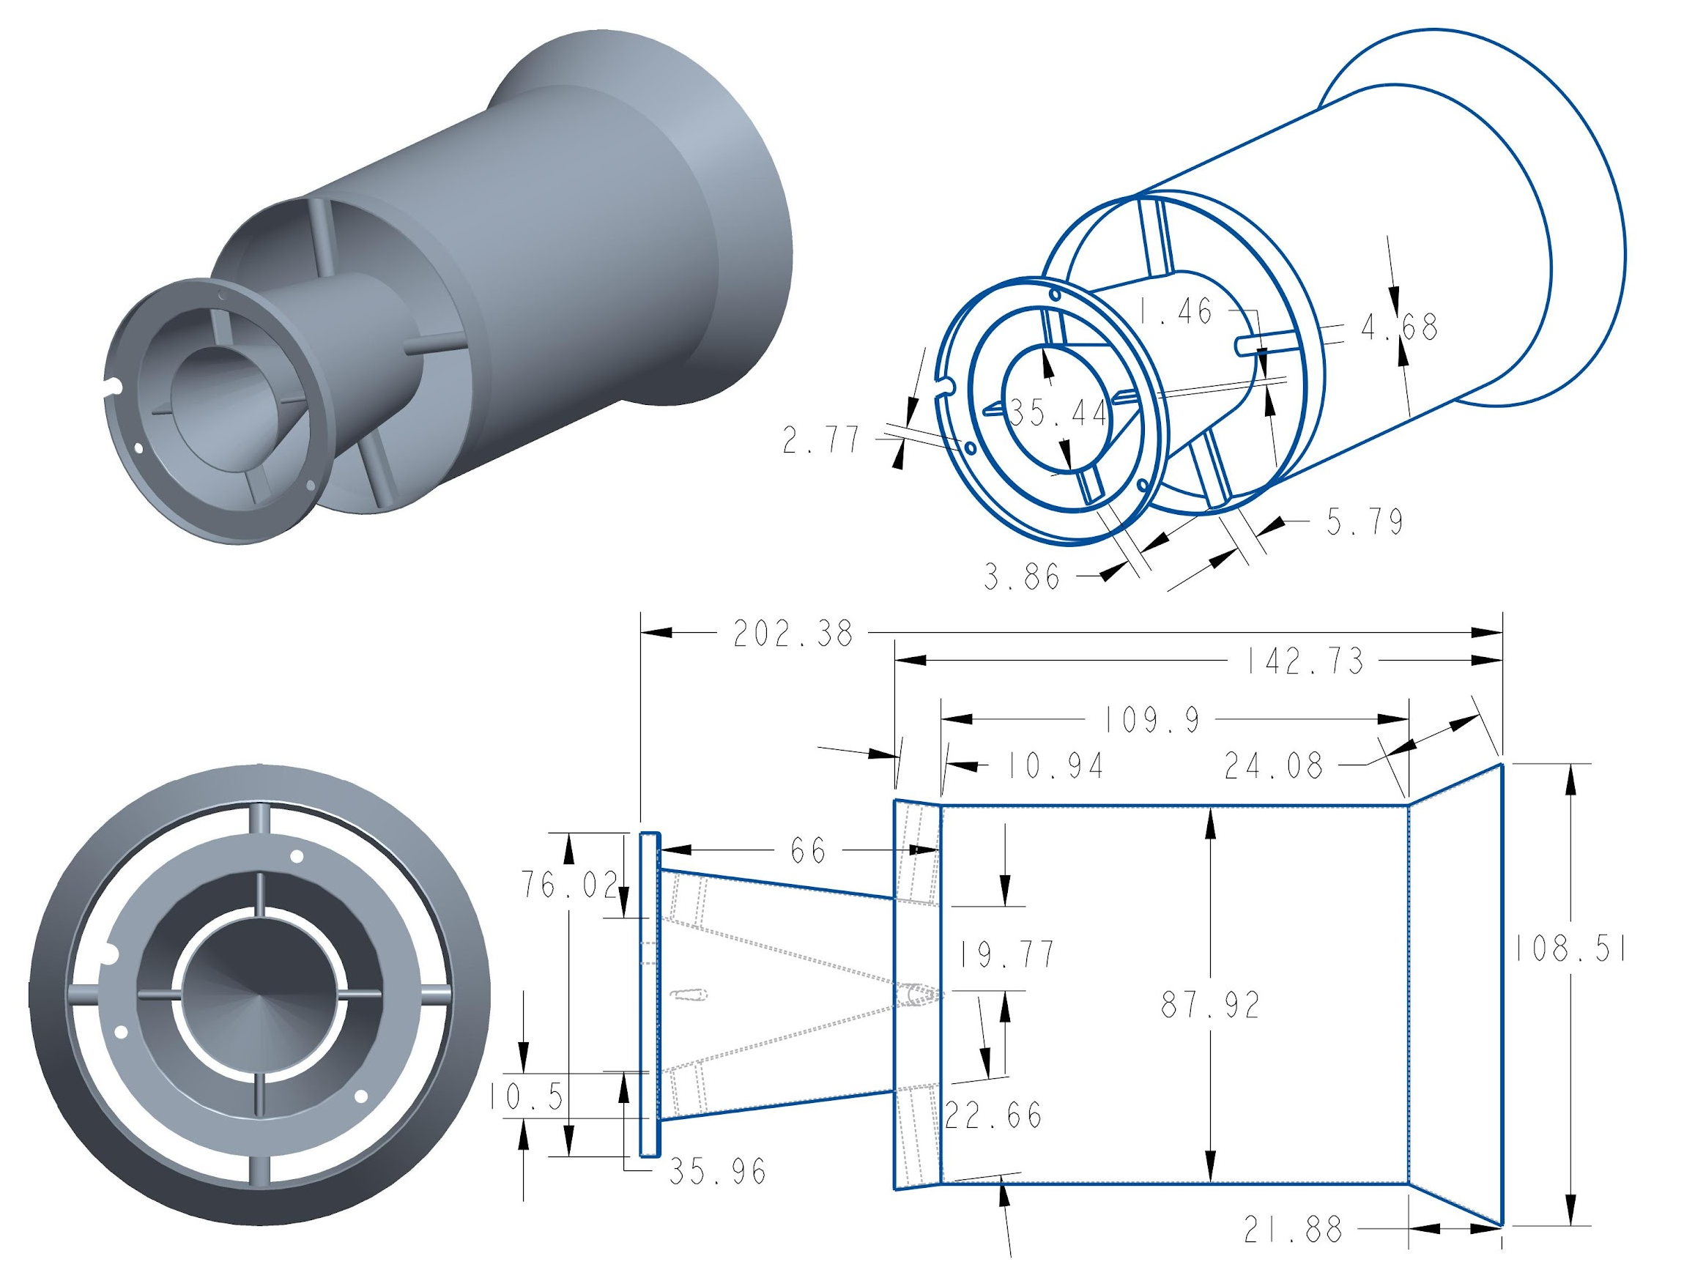
Orthographic Drawing: Ejector Nozzle
Units in mm
Notes:
Discuss in detail the picture shown, add labels
Add another slide with general ejector nozzle details
Change title. “Actual” solution doesn’t look good

Slide 11
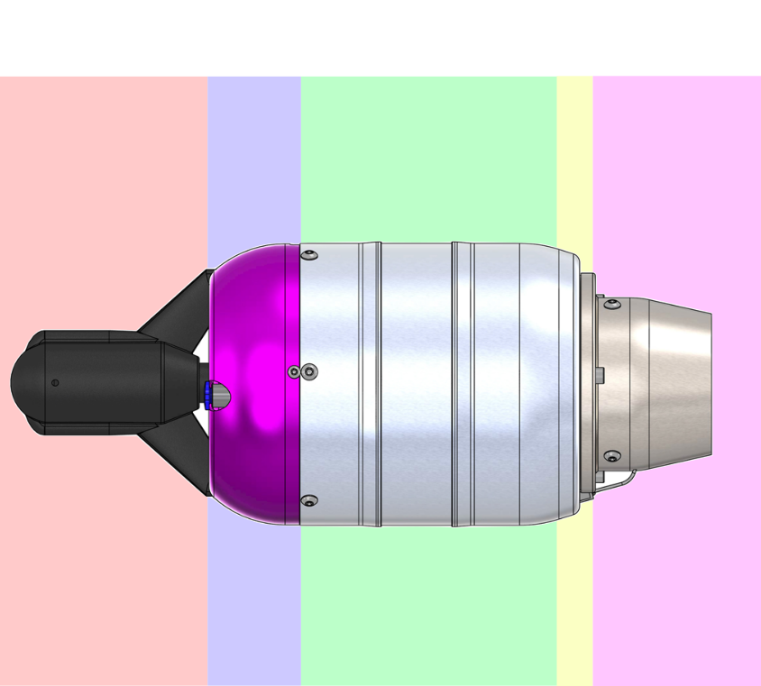
Model Design for Stock Engine
Derived from Brayton Cycle with isentropic stage efficiencies and variable specific heats included
Variable Cp and specific heat ratios through combustion chamber
Overview
Design Solution
CPEs
Requirement Satisfaction
Risks
Verification & Validation
Planning

Slide 12
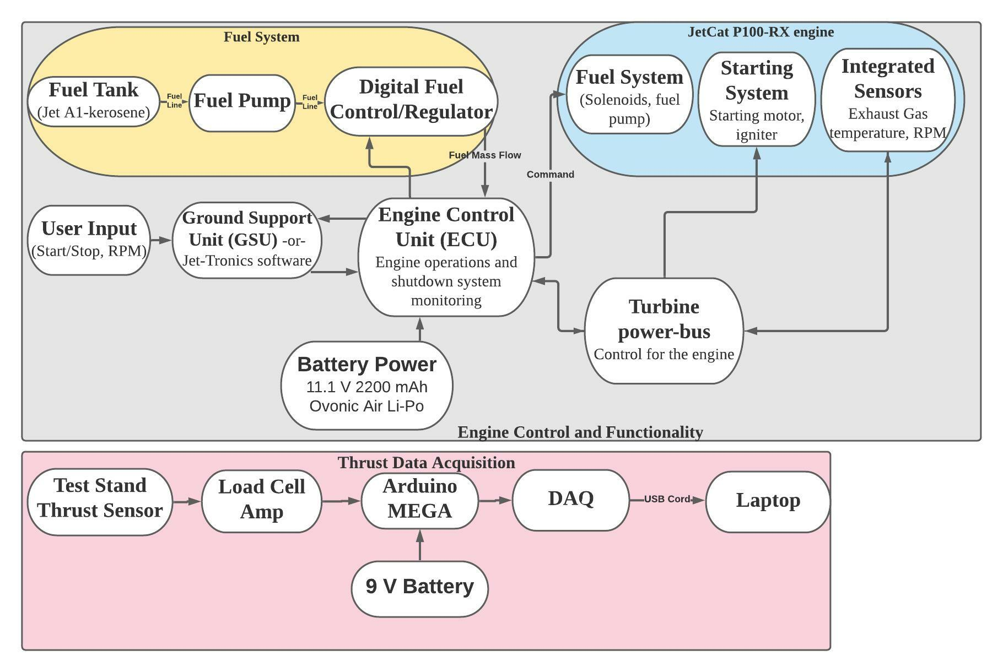
Operational Functional Block Diagram
Previous Project
Previous Project
Notes:
Colin: Increase font size
Add box with what is the scope of our project

Slide 13
Critical Project Elements (CPEs)
Overview
Design Solution
CPEs
Requirement Satisfaction
Risks
Verification & Validation
Planning

Slide 14
CPEs
Label | Critical Feasibility Element | FR
T/W | The T/W ratio of the engine shall increase and the TSFC shall decrease or remain constant. | 1,2
MODEL | Model accurately simulates thermodynamic properties of the engine, predicting increases in thrust and/or decreases in TSFC. | 3
INT-TEMP | All components can withstand temperatures throughout their section and can integrate with each other seamlessly. | 4
TEST | External sensors are integrated to augment engine’s internal sensors and gather necessary temperature and pressure data, and an off-engine testing setup is developed to validate nozzle design. | 4
Overview
Design Solution
CPEs
Requirement Satisfaction
Risks
Verification & Validation
Planning

Slide 15
Design Requirements & Satisfaction
Overview
Design Solution
CPEs
Requirement Satisfaction
Risks
Verification & Validation
Planning
Notes:
Colin: reference design requirements

Slide 16
Key Design Requirements
CPE | Related Design Requirement | Satisfied?
T/W | DR 1.1: Design a T/W-improving modification that increases thrust and/or decreases weight which does not trigger the fail-safes that shut the engine down.
MODEL | DR 3.1: A thermodynamic model is developed which predicts baseline and modified engine performance.
INT-TEMP | DR 2.4: The engine's weight increases by less than 25% or decreases.
TEST | DR 4.2: A method of testing modifications external to the engine is developed.
CPEs
Requirement Satisfaction
Risks
Verification & Validation
Planning
Overview
Design Solution
Requirement Satisfaction

Slide 17
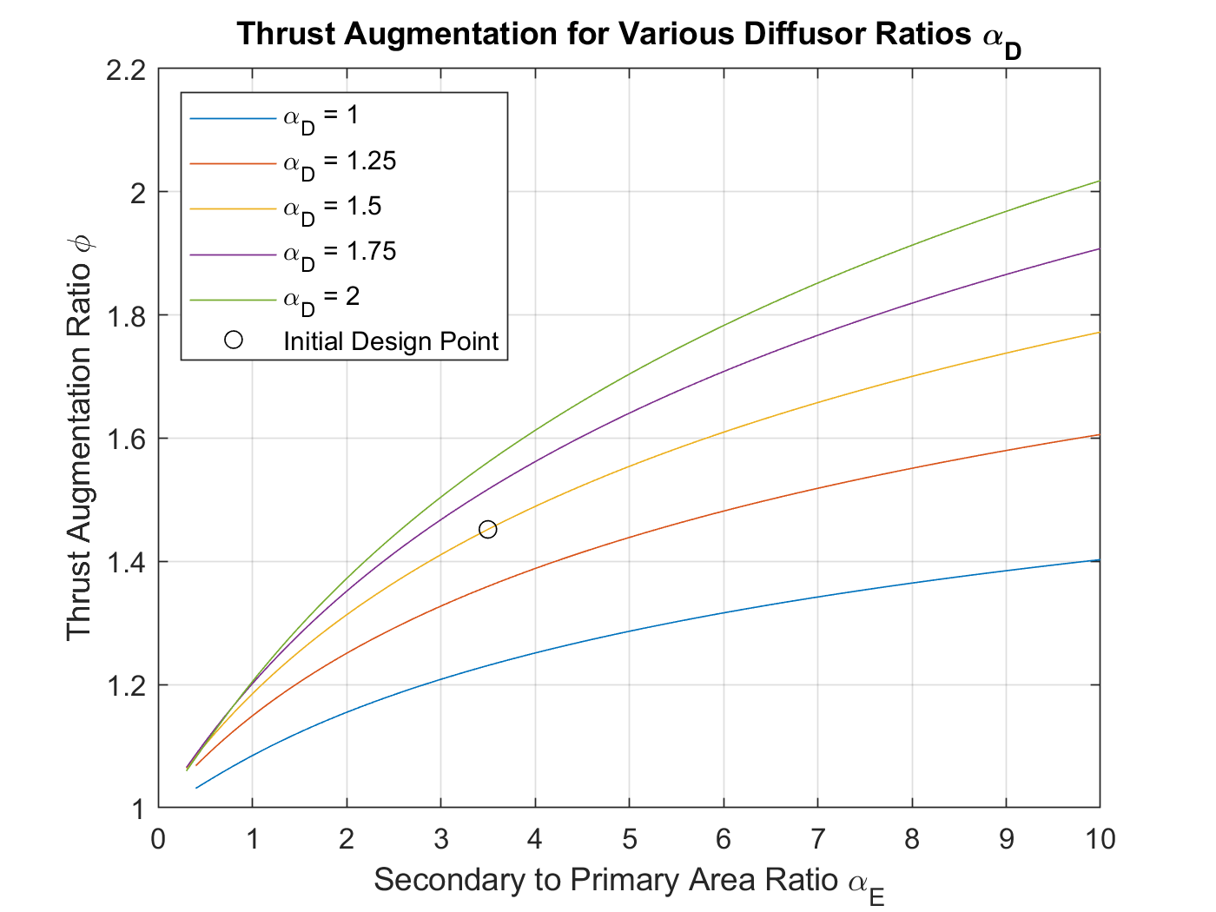
Chosen Ejector Nozzle Model
Using J.W. Heiser’s two-density, incompressible, inviscid thrust augmentation formulation
Accounts for different densities of the two streams of air entering the ejector and their mixing
Note: φ is multiplication factor for nozzle’s thrust
Overview
Design Solution
CPEs
Requirement Satisfaction
Risks
Verification & Validation
Planning
Notes:
Colin: increase plot label size
Change plot to T/W increase in comparison to STOCK nozzle, not improved conv nozzle
Explain why we didn’t pick bigger alpha E
Alpha e = 3.5, alpha D = 1.5, Phi = 1.45

Slide 18
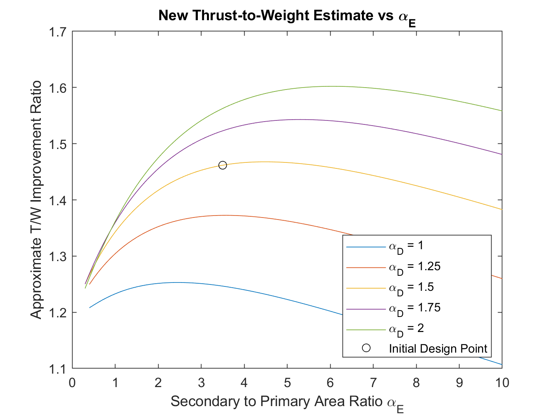
Design Point Selection
Accounting for:
Improved converging nozzle
Ejector thrust augmentation
Estimate of weight
The mixing chamber length = 4 times its diameter
Minimizes friction losses, but is expected to result in incomplete mixing
Diffuser size is a trade off between length and area ratio
Minimize weight without flow separation
Overview
Design Solution
CPEs
Requirement Satisfaction
Risks
Verification & Validation
Planning
Notes:
Slide 128 for model comparison

Slide 19
Ejector Nozzle Predicted Performance
 | Thrust [N] | Total Weight [g] | Thrust-to-Weight [N/g] | Thrust-to-Weight Increase [%]
Stock Nozzle | 100 | 1080 | 0.0926 | N/A
Improved Converging Nozzle | 126 | 1094 | 0.1152 | 24.4
Improved Nozzle with Ejector | 182 | 1171 | 0.1554 | 67.8
Overview
Design Solution
CPEs
Requirement Satisfaction
Risks
Verification & Validation
Planning
Notes:
These are exact weights now

Slide 20
Key Design Requirements
CPE | Related Design Requirement | Satisfied?
T/W | DR 1.1: Design a T/W-improving modification that increases thrust and/or decreases weight which does not trigger the fail-safes that shut the engine down. | ✔
MODEL | DR 3.1: A thermodynamic model is developed which predicts baseline and modified engine performance
INT-TEMP | DR 2.4: The engine's weight increases by less than 25% or decreases.
TEST | DR 4.2: A method of testing modifications external to the engine, is developed.
CPEs
Requirement Satisfaction
Risks
Verification & Validation
Planning
Overview
Design Solution
Requirement Satisfaction

Slide 21
Thermodynamic Model
Derived from Brayton Cycle with isentropic stage efficiencies and variable specific heats included
The model is not isentropic through any part of the engine
Current isentropic efficiencies are estimated from literature
Efficiencies specific to the P100-RX are pending engine repairs
Cp and γ vary only through the combustion chamber
The mass flow rate of fuel and the change in composition of the gasses in the engine due to combustion products are accounted for
Overview
Design Solution
CPEs
Requirement Satisfaction
Risks
Verification & Validation
Planning
Notes:
Assumptions currently using:
Subsonic Engine -- exit pressure is equal to atmospheric pressure
Inlet mach is 0

Slide 22
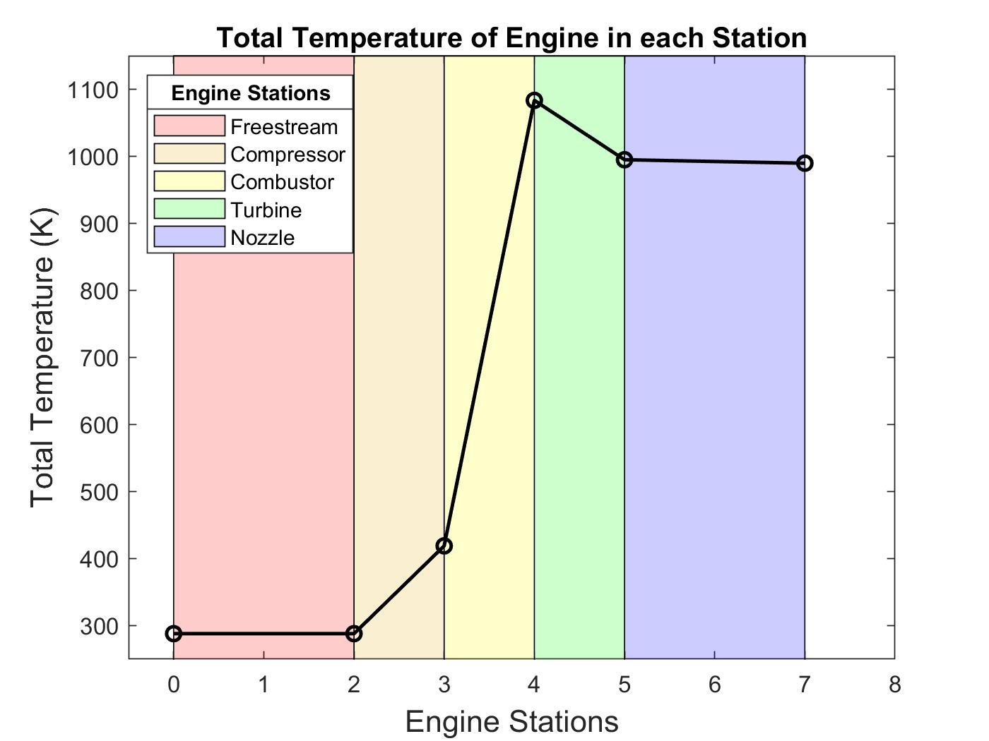
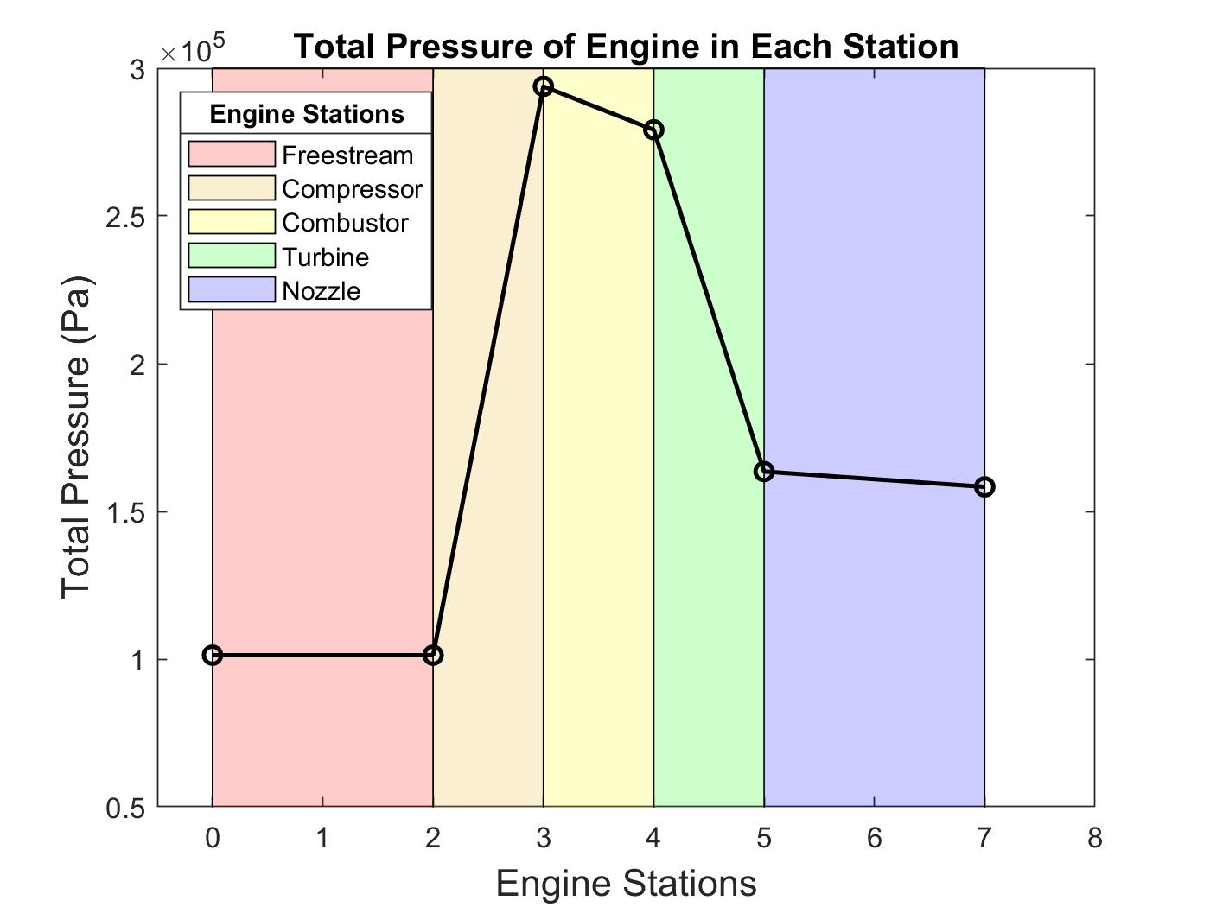
Thermodynamic Properties Through Stock Engine
Overview
Design Solution
CPEs
Requirement Satisfaction
Risks
Verification & Validation
Planning
Notes:
Colin: bigger font size again
Mention trends, why the plots make sense

Slide 23
Thermodynamic Model and On-Engine Testing
Temperature values inside combustor are difficult to measure safely
AFRL will send temperature at stations 3 and 4, can be used to calculate combustor efficiency
Remaining efficiencies: on-engine testing
Compressor, turbine, and nozzle efficiencies will be calculated from temperature measurements between each of the stations
To be completed upon return of engine from service
Temporary solution: SPECS (2018-2019) team efficiencies
Overview
Design Solution
CPEs
Requirement Satisfaction
Risks
Verification & Validation
Planning
Notes:
Dont forget that the engine is broke!

Slide 24
Key Design Requirements
CPE | Related Design Requirement | Satisfied?
T/W | DR 1.1: Design a T/W-improving modification that increases thrust and/or decreases weight which does not trigger the fail-safes that shut the engine down. | ✔
MODEL | DR 3.1: A thermodynamic model is developed which predicts baseline and modified engine performance | ✔
INT-TEMP | DR 2.4: The engine's weight increases by less than 25% or decreases.
TEST | DR 4.2: A method of testing modifications external to the engine, is developed.
Overview
Design Solution
CPEs
Requirement Satisfaction
Risks
Verification & Validation
Planning

Slide 25
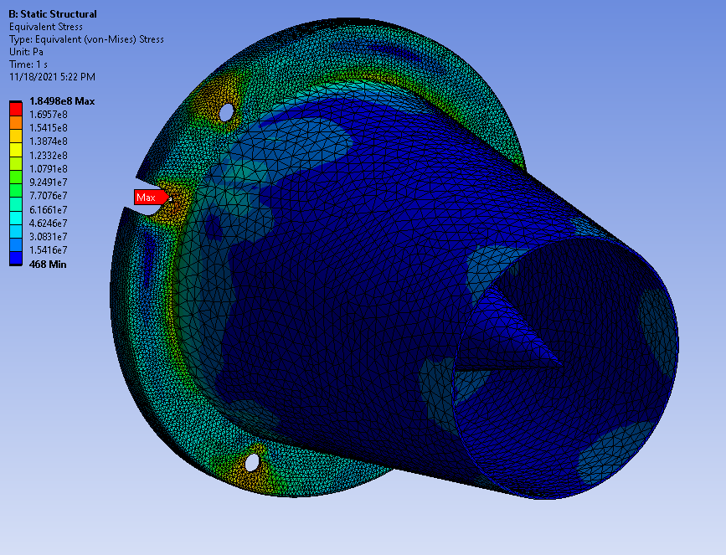
Converging Nozzle Material Selection
Material Choice: Stainless Steel 304
Expected Max Operating Temperature: 873 K
Yield Strength at 873 K: 4.4×10⁸ Pa
Maximum Equivalent Stress: 1.85×10⁸ Pa
Minimum Factor of Safety: 1.58
Overview
Design Solution
CPEs
Requirement Satisfaction
Risks
Verification & Validation
Planning
Notes:
This model contains thermal stresses and also stresses from joints

Slide 26
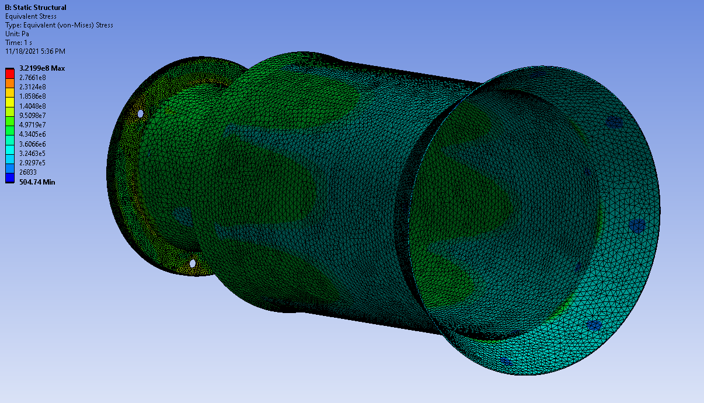
Mixing Chamber Material Selection
Material Choice: Aluminum 6061
Expected Max Operating Temperature: 473 K
Yield Strength at 473 K: 1.59×10⁸ Pa
Maximum Equivalent Stress: 5×10⁷ Pa
Minimum Factor of Safety: 3.18
Overview
Design Solution
CPEs
Requirement Satisfaction
Risks
Verification & Validation
Planning

Slide 27
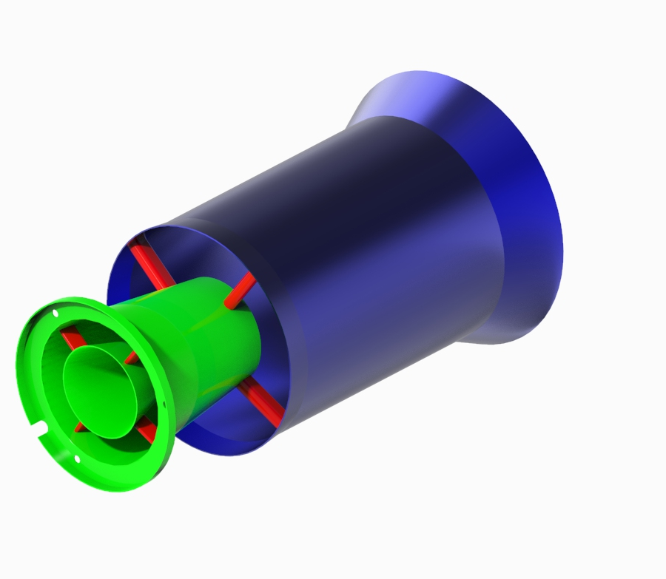
Manufacturing & Integration Plan
Converging nozzle (green) - metal 3D printed stainless steel 304 via Direct Metal Laser Sintering (DMLS)
Mixing chamber and diffuser (blue) - thin aluminum 6061 sheets on a roller and spot or tig welded together
Connecting struts (red) - DMLS printed with nozzle, stainless steel 304
Holes will be drilled in outer struts so bolts can attach the mixing chamber/diffuser to converging nozzle
Overview
Design Solution
CPEs
Requirement Satisfaction
Risks
Verification & Validation
Planning

Slide 28
Estimated Component Weights
Component | Volume [cm³] | Material | Density [g/cm³] | Weight [g] | Total Engine Weight Increase [%]
Improved Converging Nozzle | 9.21 | Stainless Steel 304 | 7.92 | 72.9 | 1.31
Mixing Chamber and Diffuser | 20.5 | Aluminum 6061 | 2.71 | 55.6 | 5.15
Interface struts | 2.68 | Stainless Steel 304 | 7.92 | 21.2 | 2.00
Total | - | - | - | 149.7 | 13.9
Overview
Design Solution
CPEs
Requirement Satisfaction
Risks
Verification & Validation
Planning
Notes:
Based directly on solidworks model. Can look into using just 3 interface struts if necessary to reduce weight

Slide 29
Key Design Requirements
CPE | Related Design Requirement | Satisfied?
T/W | DR 1.1: Design a T/W-improving modification that increases thrust and/or decreases weight which does not trigger the fail-safes that shut the engine down. | ✔
MODEL | DR 3.1: A thermodynamic model is developed which predicts baseline and modified engine performance | ✔
INT-TEMP | DR 2.4: The engine's weight increases by less than 25% or decreases. | ✔
TEST | DR 4.2: A method of testing modifications external to the engine, is developed.
Overview
Design Solution
CPEs
Requirement Satisfaction
Risks
Verification & Validation
Planning

Slide 30
Cold Test Purpose
Test is designed to replicate turbine exit Mach, pressure
Exhaust temperature conditions will not be reproduced
Test nozzle material: 3D-printed ABS (Acrylonitrile Butadiene Styrene)
Overview
Design Solution
CPEs
Requirement Satisfaction
Risks
Verification & Validation
Planning

Slide 31
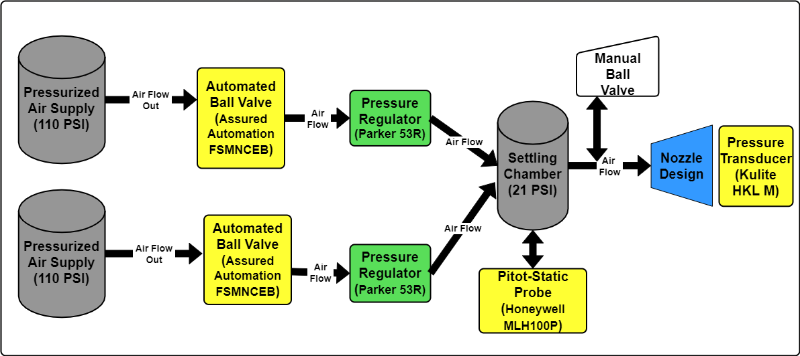
Cold Test Setup
Overview
Design Solution
CPEs
Requirement Satisfaction
Risks
Verification & Validation
Planning
Notes:
Go through this quickly, Eric will be adding more detail later in the presentation

Slide 32
Key Design Requirements
CPE | Related Design Requirement | Satisfied?
T/W | DR 1.1: Design a T/W-improving modification that increases thrust and/or decreases weight which does not trigger the fail-safes that shut the engine down. | ✔
MODEL | DR 3.1: A thermodynamic model is developed which predicts baseline and modified engine performance | ✔
INT-TEMP | DR 2.4: The engine's weight increases by less than 25% or decreases. | ✔
TEST | DR 4.2: A method of testing modifications external to the engine, is developed. | ✔
Overview
Design Solution
CPEs
Requirement Satisfaction
Risks
Verification & Validation
Planning

Slide 33
Risks
Overview
Design Solution
CPEs
Requirement Satisfaction
Risks
Verification & Validation
Planning

Slide 34
Identified Hazards
 | 1 - Minimal | 2 - Minor | 3 - Noticeable | 4 - Major | 5 - Catastrophic
5 - Almost certain
4 - Likely |  | 1 |  |  | 1
3 - Possible |  |  | 3 | 3
2 - Unlikely |  |  | 1 | 2 | 1
1 - Rare |  | 1 | 1 |  | 3
Acceptable
Acceptable with mitigation
Unacceptable
Overview
Design Solution
CPEs
Requirement Satisfaction
Risks
Verification & Validation
Planning

Slide 35
Risk Mitigation: Safety
Engine damage
No modifications to the internal parts of the engine
No test equipment in direct contact with the engine during tests
Essential personnel will be present for all engine tests
Test equipment damage
Phased approach slowly work up to max conditions
Ensurer test equipment has a large factor of safety
Human safety
All on and off engine test will be performed in the test cell (AERO 169A)
Non-essential personnel will be located outside of the test cell (AERO 169)
Essential personnel will operate equipment from a distance behind a protective shield
Overview
Design Solution
CPEs
Requirement Satisfaction
Risks
Verification & Validation
Planning

Slide 36
Risk Mitigation: Project Success
Predicted/real-world value discrepancies
Consulting with faculty to ensure fidelity of models
Design will be an iterative approach allowing for error removal
Manufacturing difficulties
Consulting with faculty to ensure manufacturability of proposed design
Performing structural analysis (FEA) to ensure functionality
Work distribution/scheduling conflict
Keeping in close contact to ensure that everyone is updated
Making sure multiple people can complete each task
Overview
Design Solution
CPEs
Requirement Satisfaction
Risks
Verification & Validation
Planning

Slide 37
Updated Risk Matrix
 | 1 - Minimal | 2 - Minor | 3 - Noticeable | 4 - Major | 5 - Catastrophic
5 - Almost certain
4 - Likely |  | 1
3 - Possible |  |  | 3
2 - Unlikely |  |  | 3 | 4
1 - Rare |  | 1 | 1 | 2 | 2
Acceptable
Acceptable with mitigation
Unacceptable
Overview
Design Solution
CPEs
Requirement Satisfaction
Risks
Verification & Validation
Planning

Slide 38
Verification & Validation
Overview
Design Solution
CPEs
Requirement Satisfaction
Risks
Verification & Validation
Planning
Notes:
Colin: Tie everything back into design requirements
Colin: Emphasize which tests are most important to reach design requirements
Colin: Final validation inclusion, i.e. full system tests - this is likely in planning section, mention it

Slide 39
Project Flow Chart
Overview
Design Solution
CPEs
Requirement Satisfaction
Risks
Verification & Validation
Planning
Notes:
Maybe edit some of these bubbles -- come back and check. Focus on iteration and why tests being done

Slide 40
On-Engine Test: Data Acquisition
Measurement Device | Quantity of Interest
Static test stand | Thrust
Jet-tronics software, onboard sensors | RPM, exhaust gas temperature, fuel consumption
Additional sensors on test stand | Nozzle exit static and total pressures; nozzle inlet, exit, and surface temperature; cowling surface temperature
Given by AFRL | Combustion chamber temperature
Overview
Design Solution
CPEs
Requirement Satisfaction
Risks
Verification & Validation
Planning
Notes:
Emphasize thrust stand test setup was used previously, but we have our own analysis that we’ve performed at this point

Slide 41
On-Engine Test Design
Pitot probes with pressure transducers at nozzle exit and engine inlet
USC pitot-static probe at nozzle exit with attached type K thermocouple
Type E/K thermocouples used to determine cowling temperature
Data Capture Sensors:
USC Reverse Pitot-Static Probe with Type K Thermocouple
Honeywell MLH100P Pressure Transducers
McMaster-Carr Bendable Type K Thermocouples
Arduino Mega
Micro SD Card for data storage
Overview
Design Solution
CPEs
Requirement Satisfaction
Risks
Verification & Validation
Planning
Notes:
Central picture of test stand, smaller pictures of each sensor around outside, lines/arrows pointing to where it goes

Slide 42
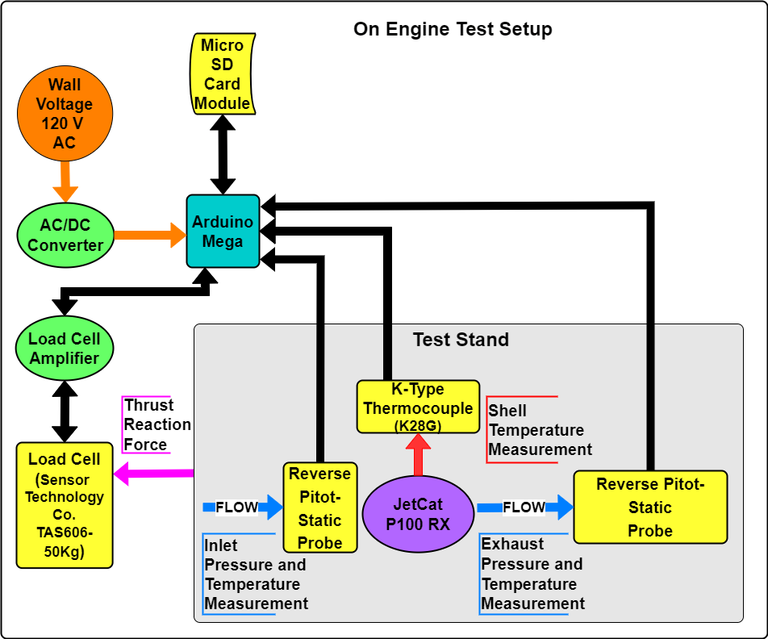
On-Engine Test: Electronics FBD

Slide 43
Thermodynamic Model Verification
Using data from on-engine testing to improve model
Compare theoretical values to actual engine temperature and pressure data
Calculate the efficiencies of each engine station
Use first law of thermodynamics and temperature losses through each engine station
Incorporate the calculated efficiencies into the model
Currently using AFRL 2018-19 SPECS Project efficiencies - P90-RXi Engine
Helps satisfy DR1.1 (T/W Improvement Modification)
Overview
Design Solution
CPEs
Requirement Satisfaction
Risks
Verification & Validation
Planning
Notes:
Like preston touched on, take data, feed to model, calc efficiency

Slide 44
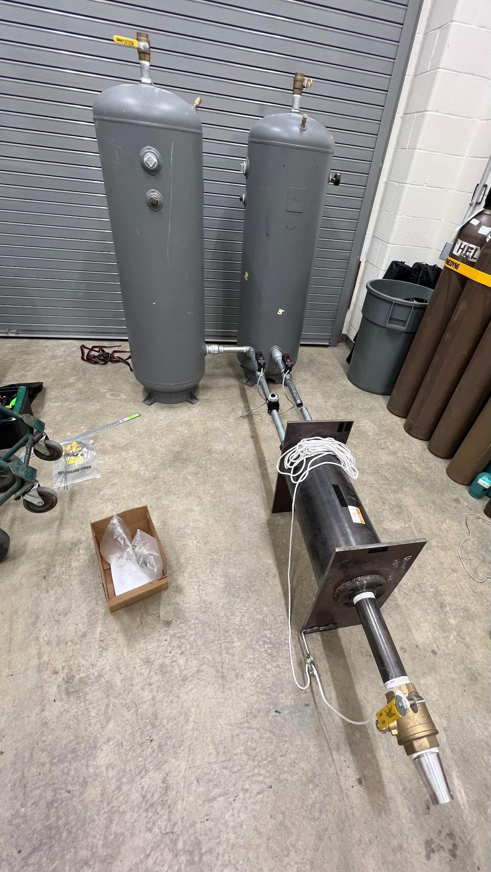
Nozzle Cold Test Design
Designed to replicate flow Mach number entering nozzle
Will manufacture intermediate iterations of nozzle out of ABS plastic
Two tanks and pressure regulators necessary to ensure adequate mass flow into settling chamber
11.69 second nominal test time
Overview
Design Solution
CPEs
Requirement Satisfaction
Risks
Verification & Validation
Planning
Notes:
State where we got it (2016-2017 SABRE Team)
State WHY we’re iterating nozzle design

Slide 45
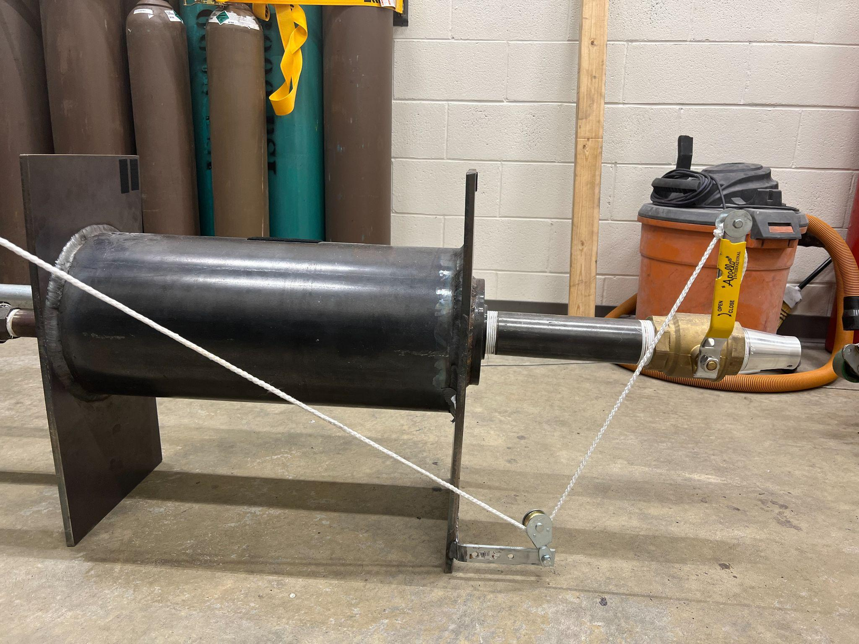
Nozzle Cold Test Design
Feed tanks opened by electronic ball valves
Flow out of settling chamber controlled by manual ball valve pulley system
Supply tanks rated for 200 psi
Maximum supply from building is 110 psi
Settling chamber minimum FOS = 138
Overview
Design Solution
CPEs
Requirement Satisfaction
Risks
Verification & Validation
Planning

Slide 46
Cold Test Design - Test Setup
Overview
Design Solution
CPEs
Requirement Satisfaction
Risks
Verification & Validation
Planning

Slide 47
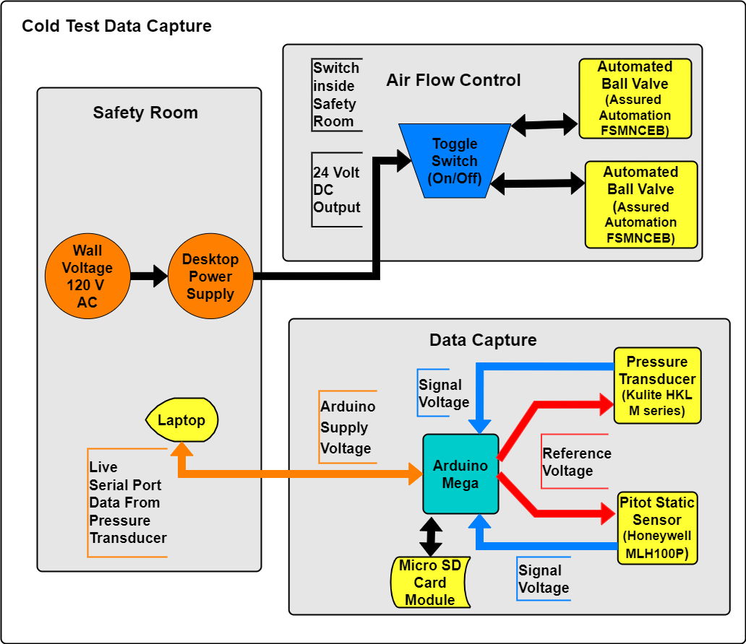

Slide 48
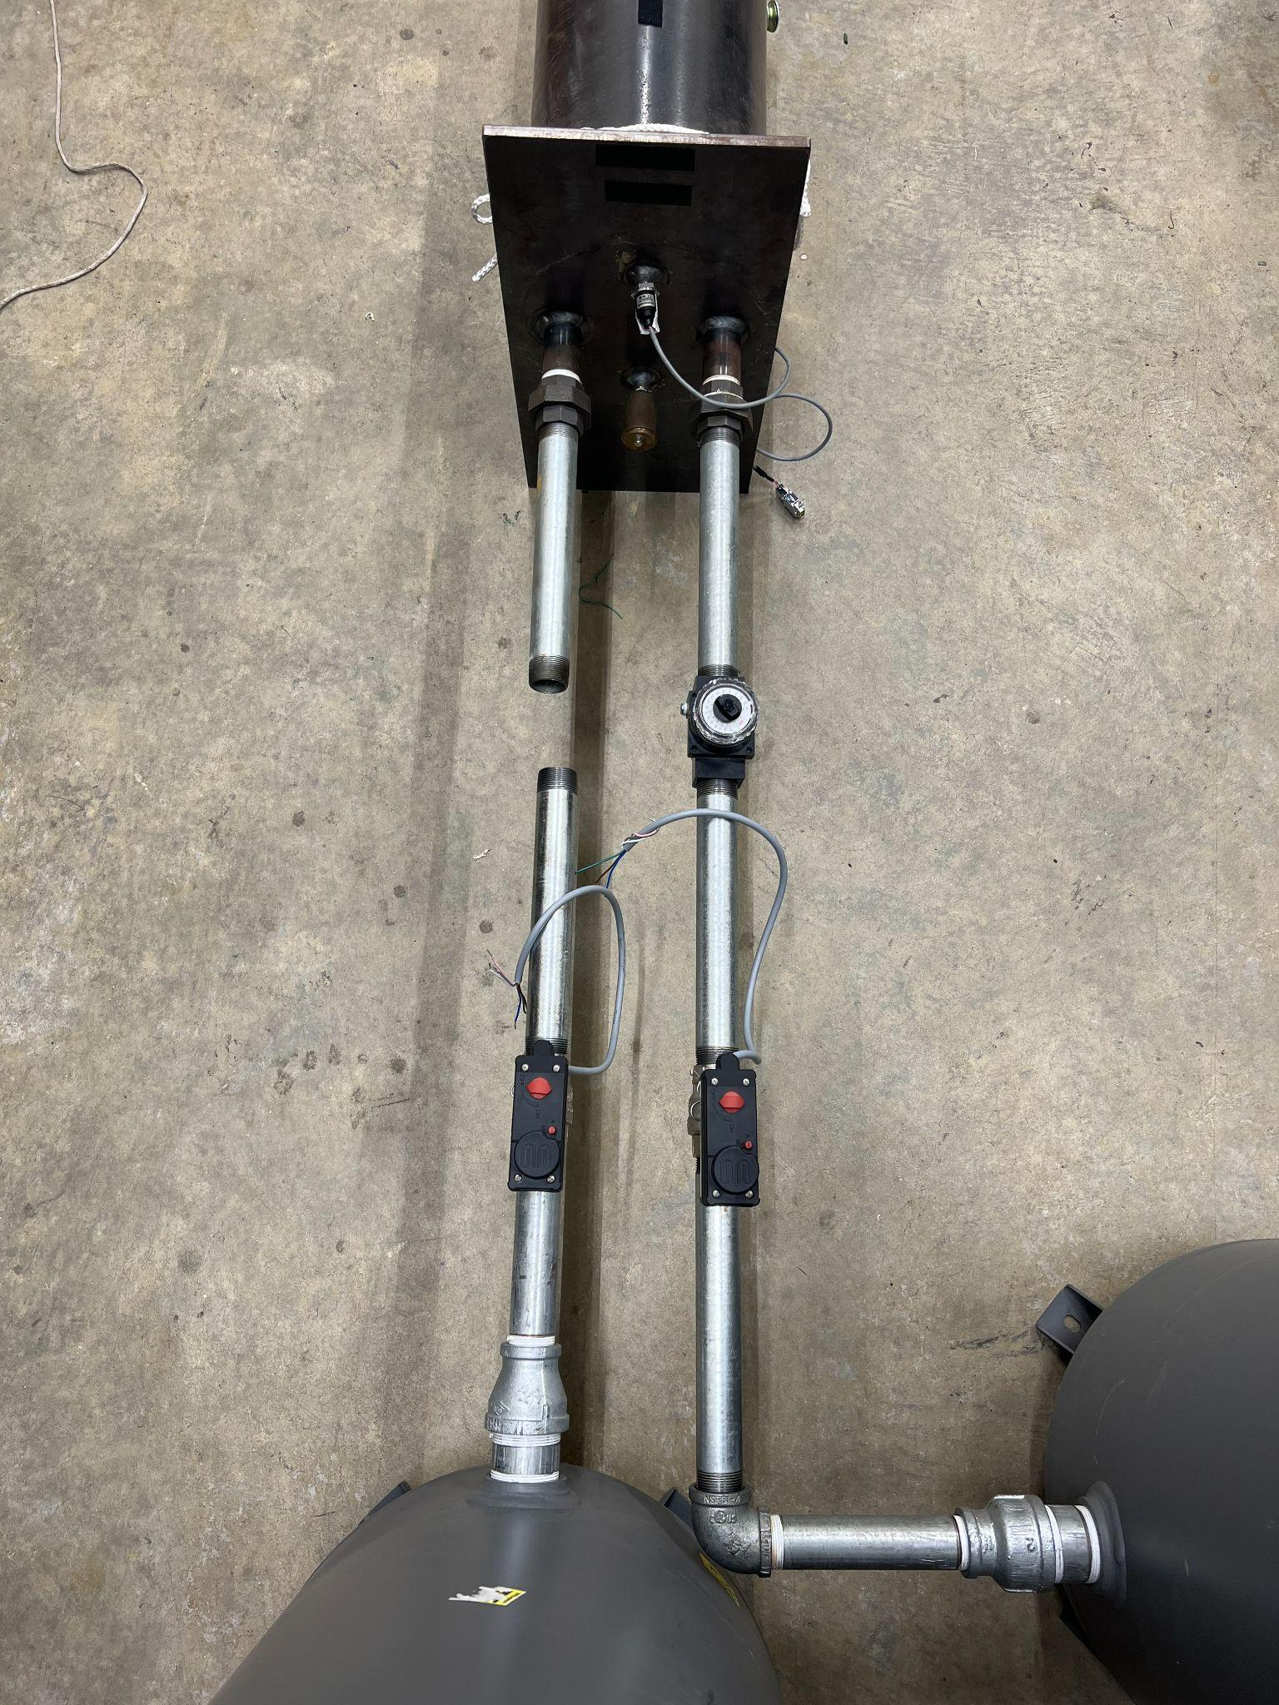
Nozzle Cold Test Design
Honeywell MLH100P Pressure Transducer
Parker 53R Pressure Regulator
Electronic Ball Valve
Kulite HKL-M Pressure Transducer
Overview
Design Solution
CPEs
Requirement Satisfaction
Risks
Verification & Validation
Planning
Notes:
smaller pictures/text boxes labeling what goes where

Slide 49
Cold Test Verification
Honeywell MLH100P pressure transducer will measure pressure inside settling chamber
Kulite HKL-M pressure transducer with integrated thermocouple will be placed at test nozzle exit to record temperature and pressure
Use recorded pressures and isentropic relations to determine exit flow velocity
Compare with stock nozzle to characterize any thrust improvements
Helps satisfy DR 1.1 (T/W Improvement Modification) and DR 4.2 (Off-Engine Testing Methods)
Overview
Design Solution
CPEs
Requirement Satisfaction
Risks
Verification & Validation
Planning

Slide 50
Project Planning
Overview
Design Solution
CPEs
Requirement Satisfaction
Risks
Verification & Validation
Planning

Slide 51
Work Breakdown
Deliverables
Materials
Model
Test
Manufacturing & Integration
PDD
Stress, Strain, & Fatigue Analyses
Brayton Cycle
Stock engine data
Design ejector attachment
CDD
PDR
On-engine test setup
Eliminate assumptions
Cold test nozzle
CDR
Cold test material
FFR
Calculate efficiencies
Cold test setup
Test final nozzle on engine
TRR
Final material
SFR
Finalize robust model
Nozzle: cold test
PFR
Legend
SDS
Nozzle: on-engine
Complete
AIAA
Ongoing
Upcoming
Overview
Design Solution
CPEs
Requirement Satisfaction
Risks
Verification & Validation
Planning

Slide 52
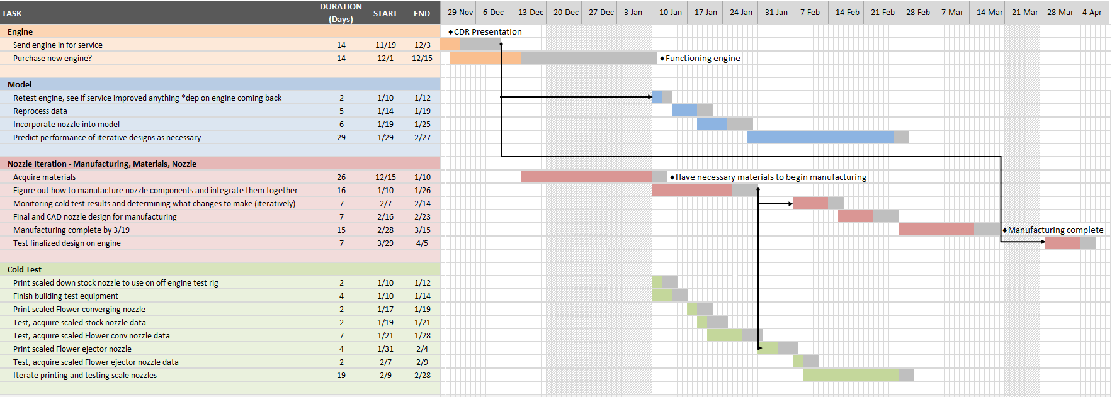
Work Plan
Overview
Design Solution
CPEs
Requirement Satisfaction
Risks
Verification & Validation
Planning
Notes:
Colin: red line of today.
Zoomed in view of immediate future - first couple weeks of next semester potentially

Slide 53
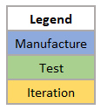
Manufacturing & Off-Engine Test Plan
Overview
Design Solution
CPEs
Requirement Satisfaction
Risks
Verification & Validation
Planning

Slide 54
Spring Semester Tests
Test | Purpose | Facility | Equipment | Week
Test engine | Determine stock properties | AERO 169A | Thrust test stand | 10-Jan
Scaled stock nozzle | Baseline for FlOWeR converging nozzle | AERO 169A | SABRE-Nozzle cold test setup | 17-Jan
Scaled FlOWeR converging nozzle | Compare to stock nozzle, get thrust increase without ejector | AERO 169A | SABRE-Nozzle cold test setup | 24-Jan
Scaled FlOWeR ejector nozzle | Compare to stock nozzle, calculate T/W increase for FlOWeR nozzle | AERO 169A | SABRE-Nozzle cold test setup | 7-Feb
On-engine FlOWeR nozzle test | Measure actual T/W increase from FlOWeR nozzle | AERO 169A | Thrust test stand | 28-Mar
Overview
Design Solution
CPEs
Requirement Satisfaction
Risks
Verification & Validation
Planning

Slide 55
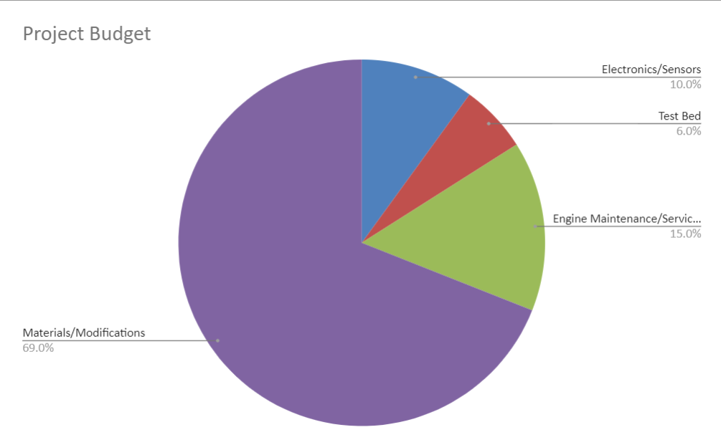
Overview
Design Solution
CPEs
Requirement Satisfaction
Risks
Verification & Validation
Planning

Slide 56
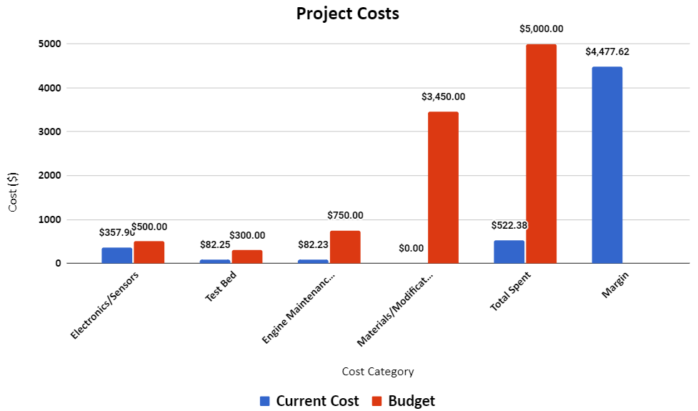
Overview
Design Solution
CPEs
Requirement Satisfaction
Risks
Verification & Validation
Planning

Slide 57
Cost Plan
Engine is out for service with an expected cost between $250 and $750
Al6061 Sheet Stock:
Necessary dimensions: 395.8mm x 338.6mm x 1mm (15.583” x 13.331” x .039”)
Grainger: $16.94 for 18” x 18” x .04”
Midwest Steel Supply: $36.10 for 18” x 18” x .04”
In-house DMLS is expected to cost ~$650 for necessary gases
SS304: $100/kg
Outsourced Nozzle costs here
Minimum order costs for forging/casting and machining range from $300 to $500
DMLS nozzle quotes have been requested and are under review
Overview
Design Solution
CPEs
Requirement Satisfaction
Risks
Verification & Validation
Planning

Slide 58
Acknowledgements
AFRL: Lt Kavi Muraleetharan, Lt Collin Parsons, and Mr. Tim Erdmann
Advisor: Alexandra Le Moine
TAs: Emma Markovich and Colin Claytor
Technical Advisors: John Mah, James Nabity, Matt Rhode, Bobby Hodgkinson, Trudy Schwartz, Kathryn Wingate

Slide 59
References
Mattingly, J.D. and Boyer, K.M. Elements of Propulsion: Gas Turbines and Rockets. American Institute of Aeronautics and Astronautics, 2 edition, 2016
Huang, K.P, Kisielowski, E. “An investigation of the thrust augmentation characteristics of jet ejectors,” April 1967.
Frank, G., Piper, S., Chen, Y., FitzRandolph, P., Camacho, C., Knickerbocker, M., Junker, M., Oropeza, D.C., Cutler, J., Fuernkranz, M., and Harthan, D. Specialized propulsion engine control system critical design review, 2018.
Coulon, T., Johnson, R., Jones, L., Mines, M., Schumacher, G., and Swart, C. Thrust to weight improvement of jetcat p100-rx turbojet engine, 2019
Soars, C. Gas Turbines: A Handbook of Air, Land and Sea Applications. Butterworth-Heinemann, 1 edition, 2014.
Violett, B. A few reminders for safe turbine operations.
White, F.M. Viscous Fluid Flow. McGraw-Hill, 3 edition, 2011
Heiser, H. W. Ejector thrust augmentation. Journal of Propulsion and Power, 26(6), November-December 2010.
Huang, K. P and Kisielowski, E. An investigation of the thrust augmentation characteristics of jet ejectors
JetCat. Jetcat turbine datasheet, 2015
Razak, A.M.Y. Gas turbine combustion.
Aeronautics Guide. Aircraft turbine engine fuel system components
Erickson, D.M., Day, S.A., and Doyle, R. Design considerations for heated gas fuel.
Larson, G.C. The hotter the better.
Autonomous Manufacturing. A guide to 3d printing with titanium
Online Metals, URL: https://www.onlinemetals.com/en/buy/aluminum-round-bar-7075-t6-t651-cold-finish?q=%3Aprice-asc&page=1&pagesize=25&sort=price-asc
FATHOM Advanced Manufacturing
Protolabs Manufacturing
Forecast 3D Manufacturing
SpecMaster, Inc.
Dynamic Design & Manufacturing, Inc.
SS Grade 316 / 316 L Technical Data. Action Stainless Steel KwaZulu Natal, URL: Grade 316 Stainless Steel Technical Data (askzn.co.za)
Dr. D. Lewis Abata, The Thermodynamics of Emptying a Pressure Vessel, South Dakota School of Mines and Technology.
Gibson, P. W., “Blast Overpressure and Survivability Calculations For Various Sizes of Explosive Charges”, Army Natick Research Development and Engineering Center MA, June 1994.

Slide 60
Supplemental Material

Slide 61
Table of Contents
PDR Material
On-Engine Testing
Real Turbojet Thermodynamic Model
Material Selection
Risk Mitigation
Ejector Design
Notes:
Variable geometry ruled out due to static conditions during testing
Nozzle weight is a small % of engine weight

Slide 62
Design Requirements
DR | Design Requirement | FR
1.1 | Design a T/W-improving modification that increases thrust and/or decreases weight which does not trigger the fail-safes that shut the engine down. | 1
2.1 | The engine’s TSFC increases by less than 5% of its nominal value or decreases by any amount | 2
2.2 | The engine’s propulsive efficiency decreases by less than 5% of its nominal value or increases by any amount | 2
2.3 | The engine’s thermal efficiency decreases by less than 5% of its nominal value or increases by any amount | 2
2.4 | The engine’s weight increases by less than 10% or decreases, unless an after-burner is implemented on the engine, in which case engine weight increases will be less than 30% | 2
2.5 | The cost of modifications is within the budget. Up to $5,000 may be spent on modifications to the engine and will be automatically provided to the group, while up to$14,000 may be used to fund project expenses not directly used for modification design and manufacturing | 2
TOC
Notes:
Variable geometry ruled out due to static conditions during testing
Nozzle weight is a small % of engine weight

Slide 63
Design Requirements, cont.
DR | Design Requirement | FR
2.6 | The fuel flow rate does not increase significantly; ideally, it decreases while maintaining engine performance | 2
2.7 | The engine’s max thrust decreases by less than 5%, or increases | 2
3.1 | A thermodynamic model based on the ideal Brayton cycle is developed and predicts baseline engine performance | 3
4.1 | The team’s engine test lead and an instructor or graduate student experienced with operating the P100-RX engine are present at all hands-on test events. | 4
4.2 | A method of testing modifications external to the engine, dependent on the type(s) of modification(s) designed, is developed | 4
TOC
Notes:
Variable geometry ruled out due to static conditions during testing
Nozzle weight is a small % of engine weight

Slide 64
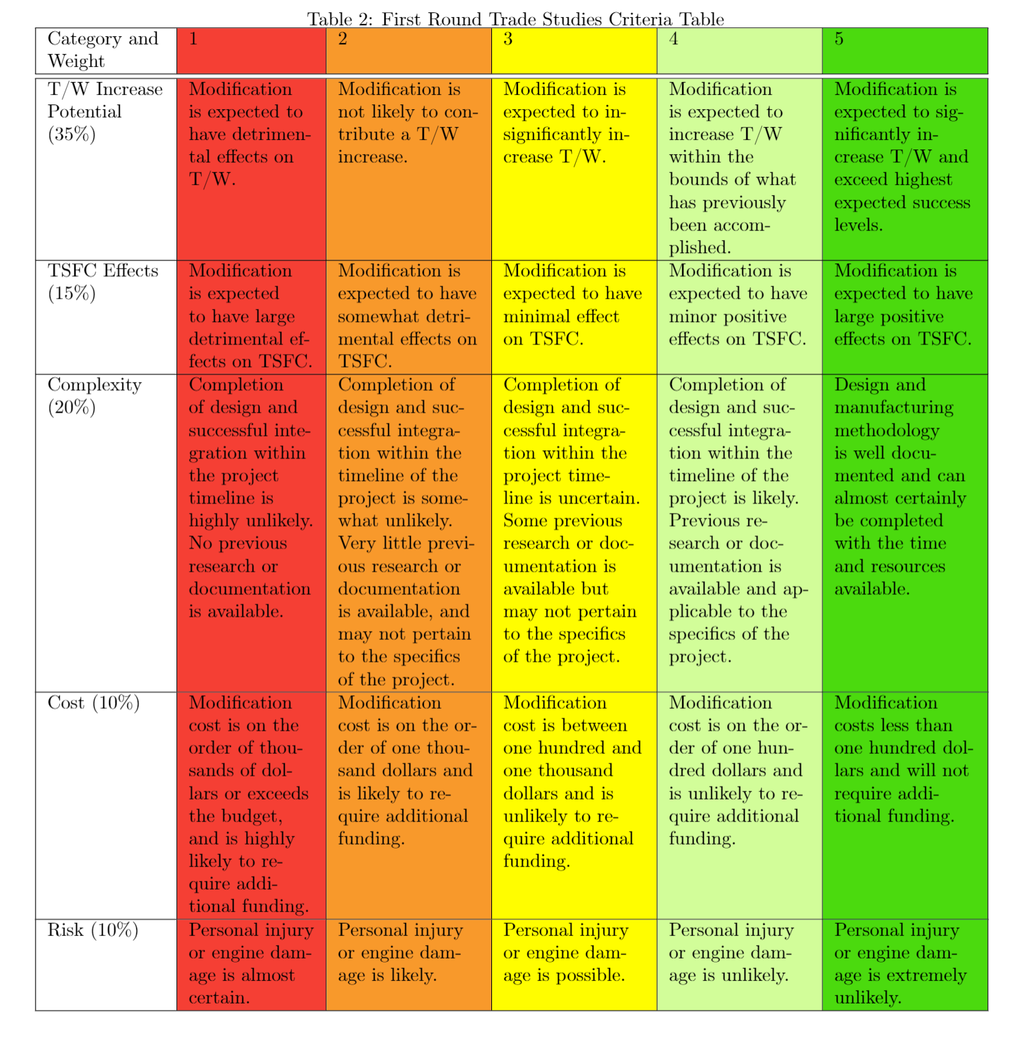
Trade Study Matrices
TOC

Slide 65
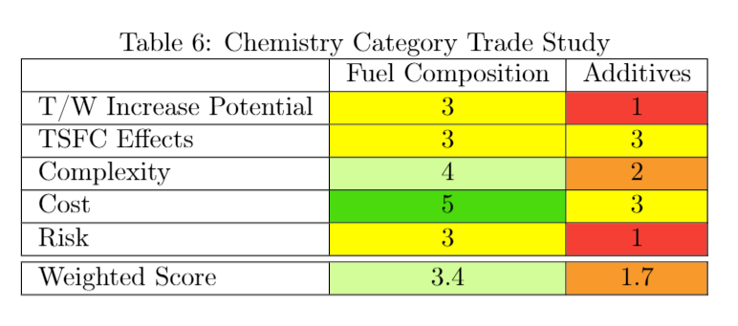
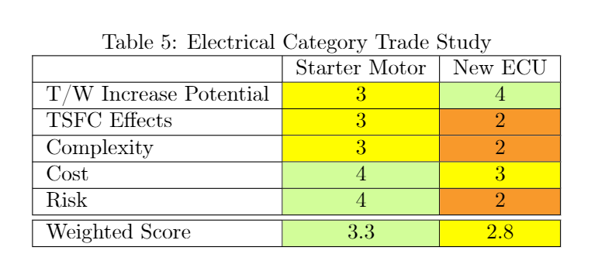
First Round of Trade Study
TOC

Slide 66
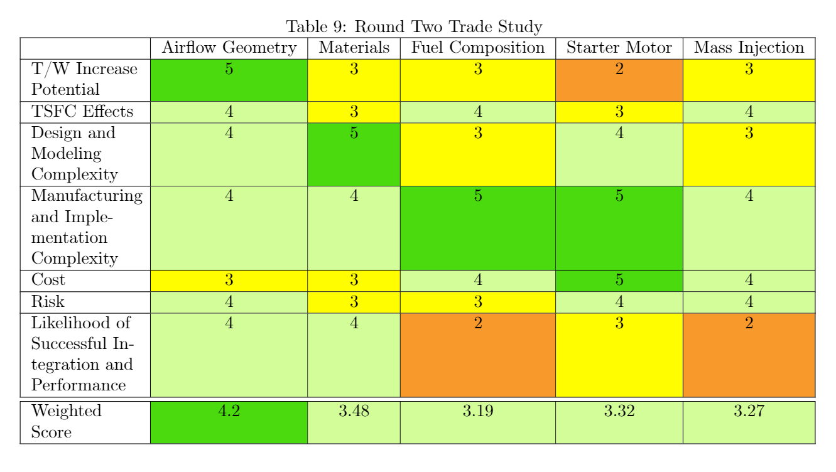
Second Round of Trade Study
TOC

Slide 67
Nozzle Trade Study
Criteria | 1 | 2 | 3 | 4 | 5
Thrust (45%) | Decrease in thrust | Little to no thrust improvement | Moderate increase in thrust | Significant increase in thrust within bounds of previous accomplishments | Significant increase in thrust that exceeds previous accomplishments
Weight of Nozzle (5%) | Significant Increase in weight | Small Increase in weight | No effect on weight | Small decrease in weight | Significant Decrease in weight
Modeling Complexity (20%) | Unable to model with desired accuracy | Able to model with desired accuracy with significant time and resources | Able to model with desired accuracy with moderate time and resources | Able to model with desired accuracy with little time and resources | Model requires little overall work to achieve desired accuracy
Likelihood of Success (30%) | Performance is highly sensitive to external parameters and meeting expected performance is highly unlikely | Performance is moderately sensitive to external parameters and meeting expected performance is unlikely | Performance is slightly sensitive to external parameters and meeting expected performance is likely | Performance is not sensitive to external parameters and meeting expected performance is likely | Performance is not sensitive to external parameters and meeting expected performance is likely. Design also includes contingencies
TOC
Notes:
All will have similar levels of manufacturing difficulty, depending on material chosen
CD nozzle depends highly on external factors

Slide 68
Nozzle Trade Study
 | Converging | Fixed Converging-Diverging | Ejector
Thrust (45%) | 4 | 4 | 5
Weight of Nozzle (5%) | 4 | 2 | 2
Modeling Complexity (20%) | 4 | 3 | 2
Likelihood of Success (30%) | 4 | 2 | 5
Total | 4 | 3.1 | 4.25
TOC
Notes:
Variable geometry ruled out due to static conditions during testing
Nozzle weight is a small % of engine weight

Slide 69
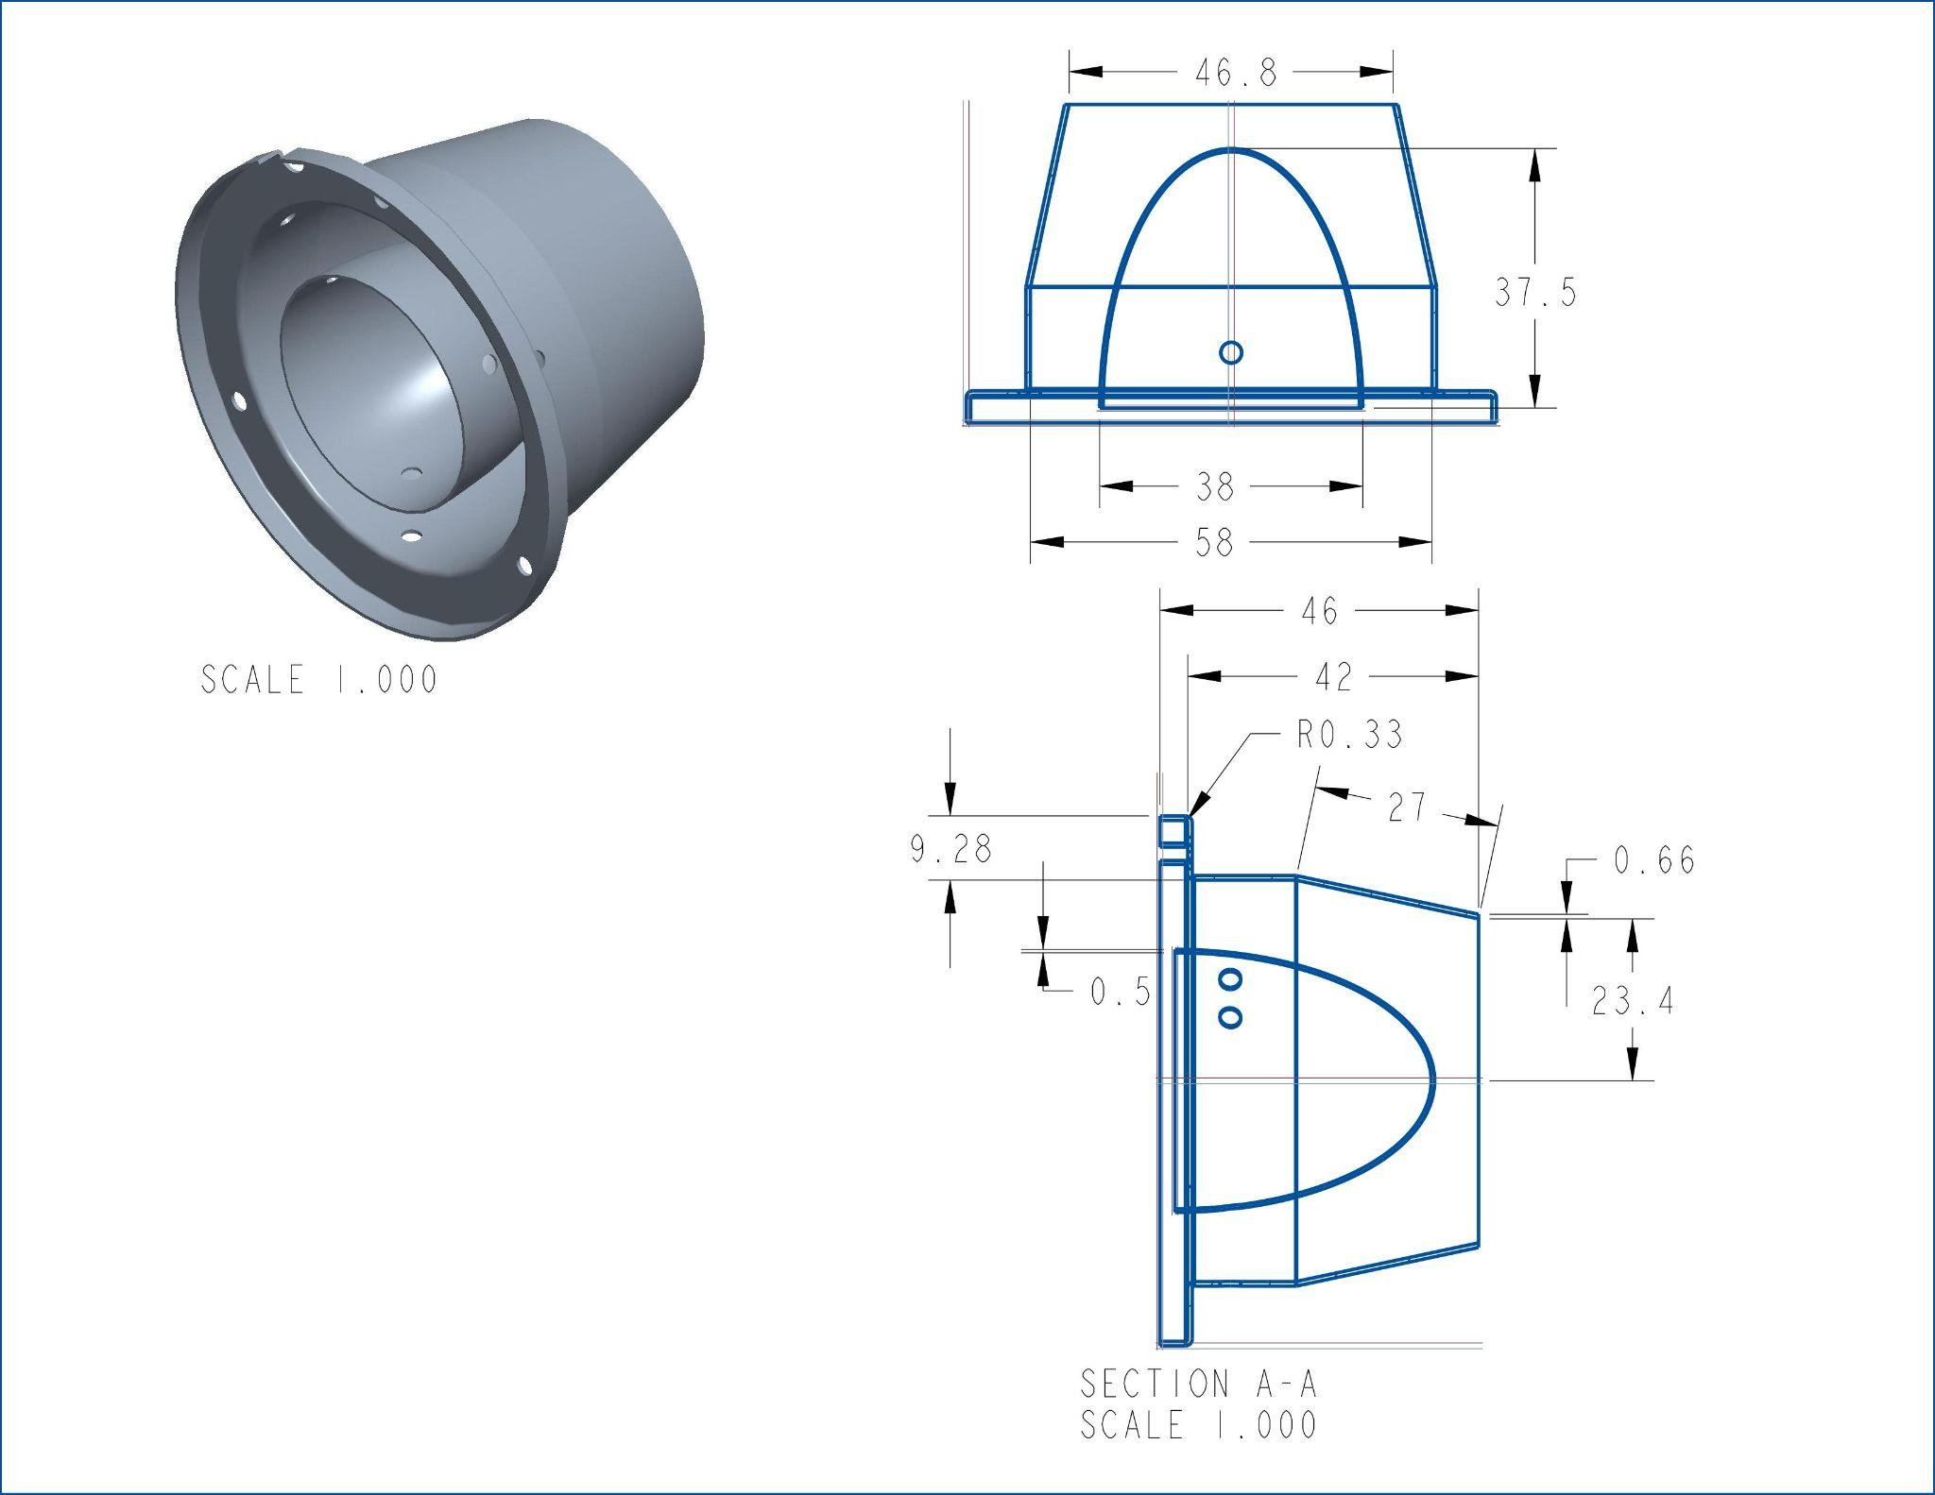
CAD model of stock nozzle
Inlet area = 15.6687cm^2
Exit area = 17.2021cm^2
TOC

Slide 70
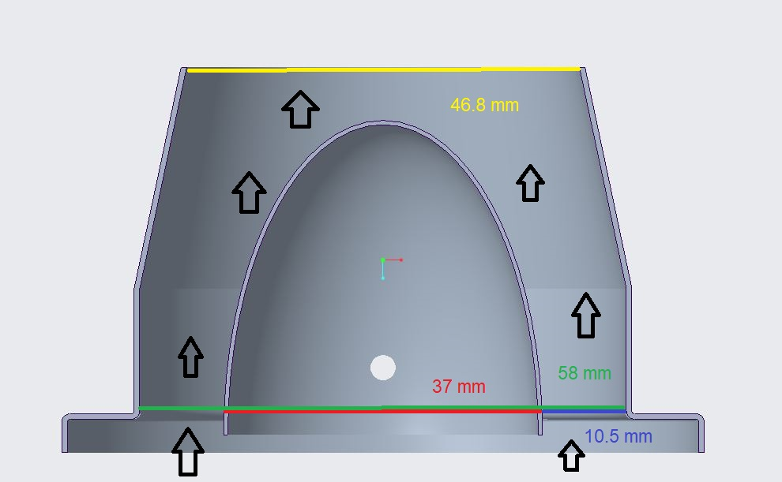
CAD model of stock nozzle 2
Inlet area = 15.6687cm^2
Exit area = 17.2021cm^2
TOC

Slide 71
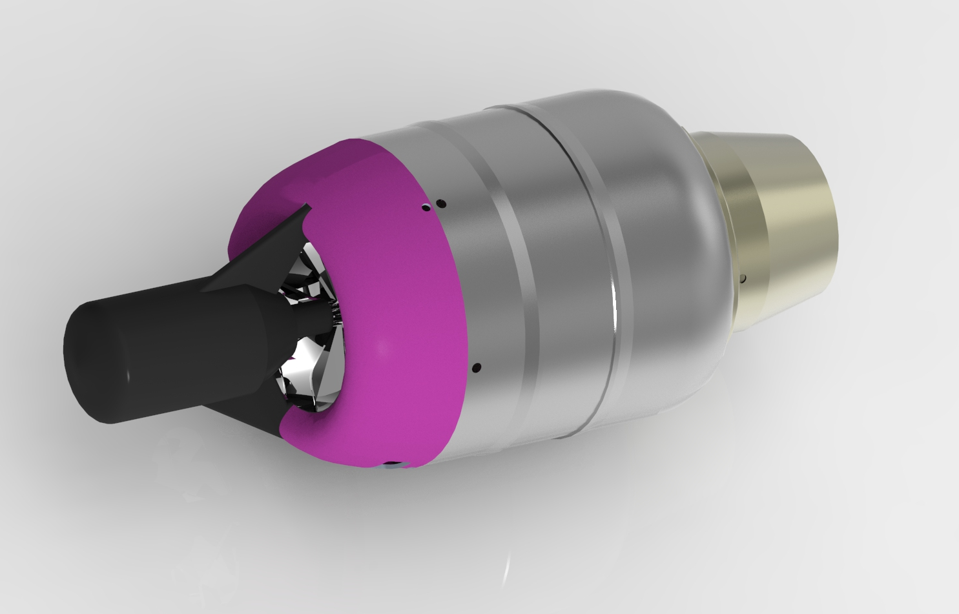
Stock Render 1
TOC

Slide 72
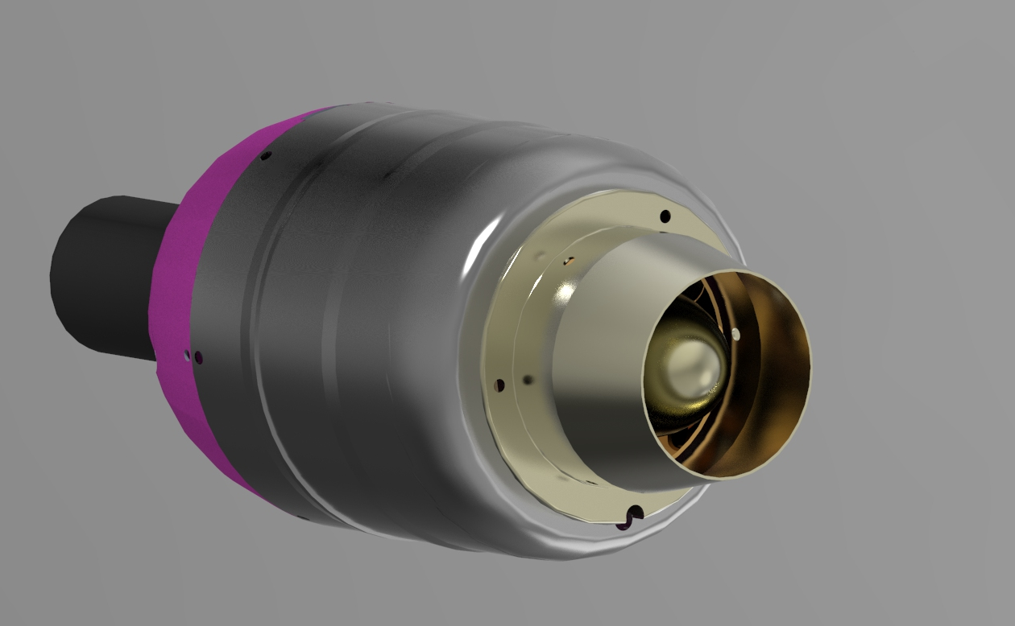
Stock Render 2
TOC

Slide 73
Material Replacement
Thermal Stresses
Maximum temperature reached is approximately 1100 K in combustor
T_{f} = 1100K and T_{i} = 293K
𝜎 = E𝛼(T_{f} - T_{i} )
Alloy | Elastic Modulus (GPa) | Yield Strength (MPa) | Tensile Strength (Mpa) | Density (g/cm³) | Thermal Expansion Coefficient (K⁻¹) | Thermal Stress (GPa)
Stainless Steel | 180 | 860 | 502 | 8.0 | 1.73e-5a | 2.51
Al 6061 | 69 | 35 | 42 | 2.7 | 2.34e-5 | 1.30
Al 2024 | 72.4 | 42 | 64 | 2.78 | 2.32e-5 | 1.36
Al 7075 | 71 | 70 | 78 | 2.81 | 2.36e-5 | 1.35
TOC
Notes:
Explicitly state which part has listed initial, final temps
material sourcing:
Stainless steel, aluminum:
grainger has aluminum rod stock, hollow rod stock, bar stock, plate stock, 3-14 days shipping upon order placement (better sourcing and reliability)
industrial metal supply also has current stock, can do custom cuts, 4-12 days for standard orders
Titanium:
tmstitaniun focuses on titanium bar, solid rod, hollow rod, etc., 4-12 days
titanium supply co is also an option

Slide 74
Material Properties
Material | Density (g/cm³) | Melting Point (K) | Cost (/kg)
Stainless Steel 304 | 8.00 | 1678-1728 | $18
Stainless Steel 316 | 7.99 | 1643-1672 | $23
Stainless Steel 410 | 7.80 | 1753-1803 | $25
Aluminum 7075-T6 | 2.81 | 750 - 908 | $58
Aluminum 6061-T6 | 2.70 | 850 - 925 | $28
Aluminum 2024-T4 | 2.78 | 775 - 911 | $45
Titanium Ti-6Al-4V | 4.43 | 1877 - 1933 | $50
Titanium Ti 3Al 2.5 | 4.48 | 1973 | $103
TOC
Notes:
Need to put nozzle weight considerations somewhere
More generic than specific alloys
Measure cowling again (more accurately, graduated cylinders)
Not sure water displacement volume is necessary on this slide

Slide 75
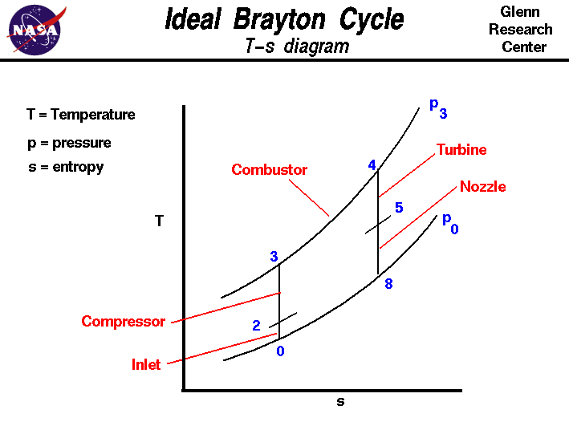
T-S Diagram of Jet Engines
TOC

Slide 76
OET: Pressure Regulator and Tank Feasibility
Dimensions
Feed Tanks (2x)
1-¼” outlet
Feed Ball Valves (2x)
1-¼” inlet, outlet
53R Feed Regulators (2x)
1-¼” inlet, outlet
Settling Chamber:
1-¼” inlet (2x)
Outlet: Apollo 94A-109-01 full port brass ball valves
2.520” ID
Taper Cone:
1.8” inlet
1.075” outlet
TOC

Slide 77
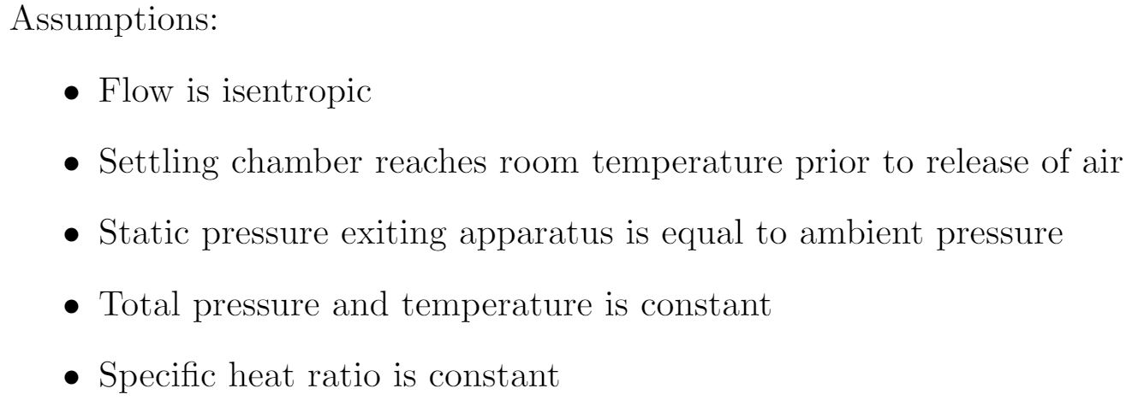
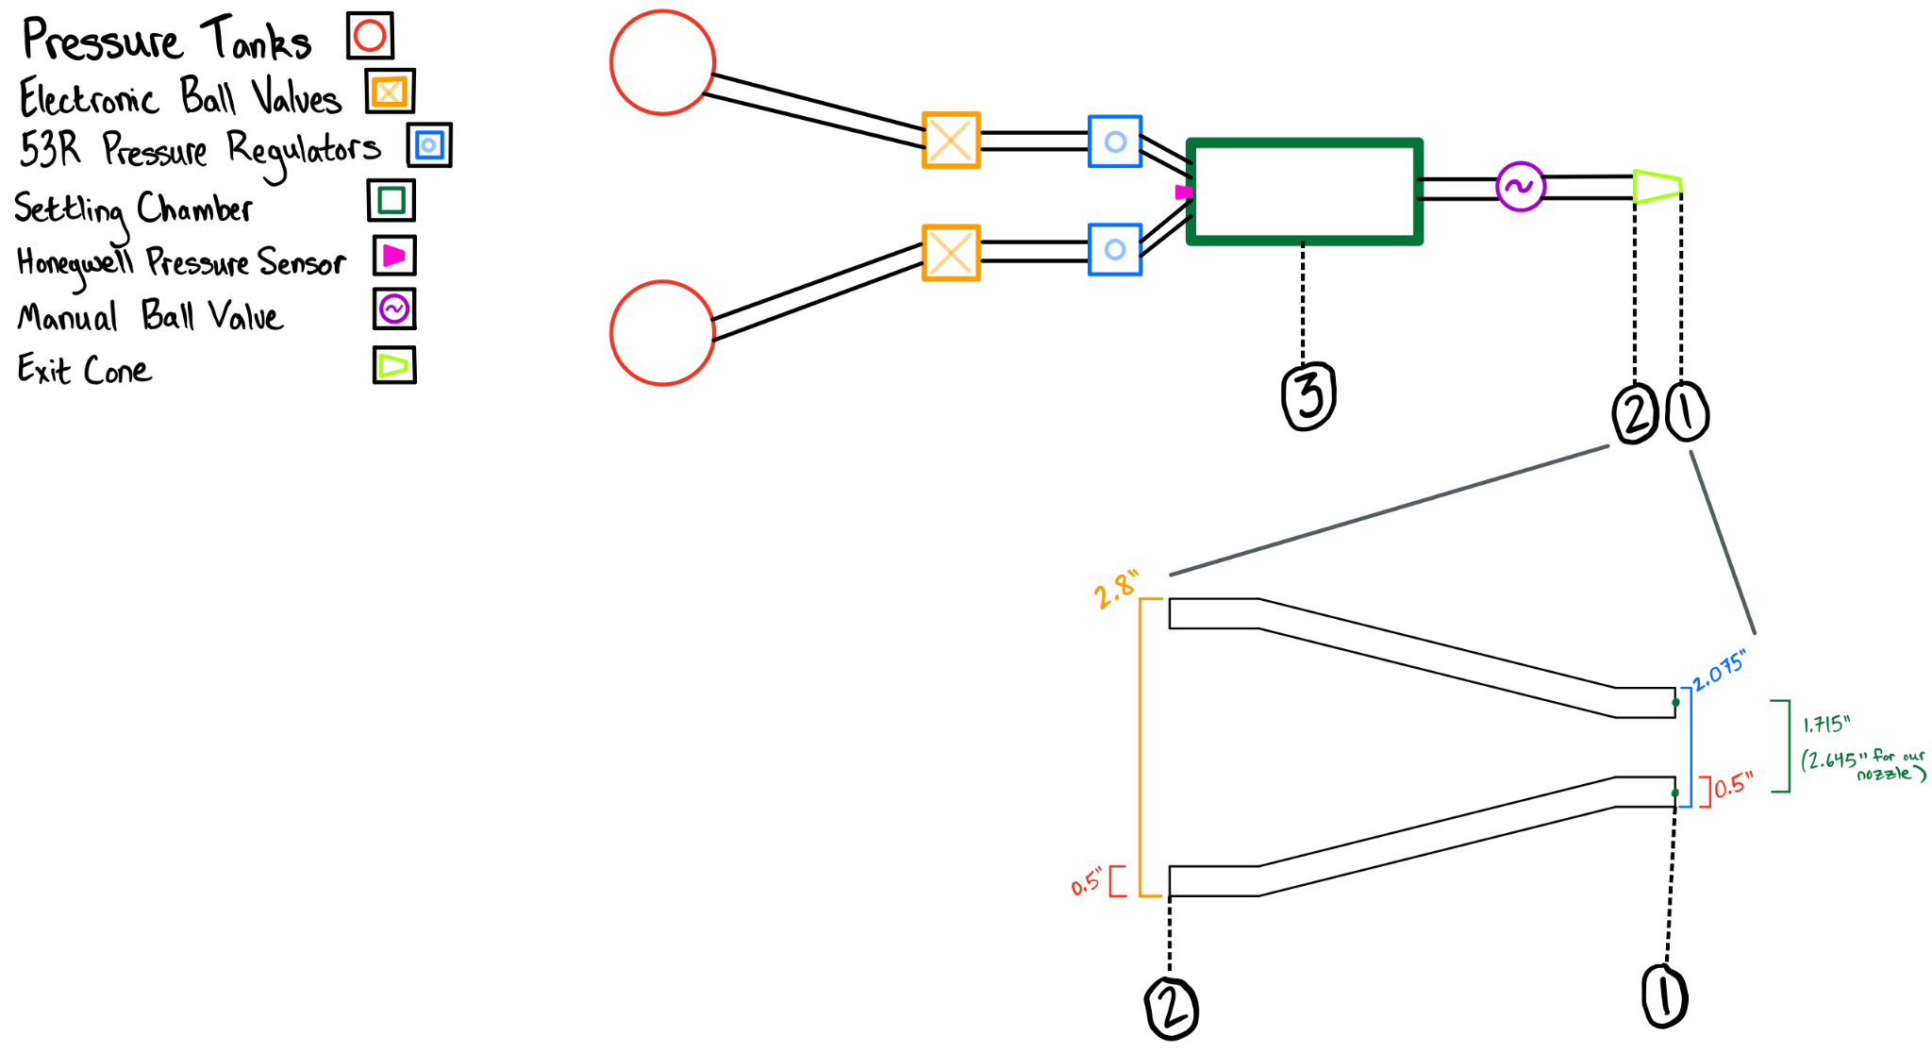
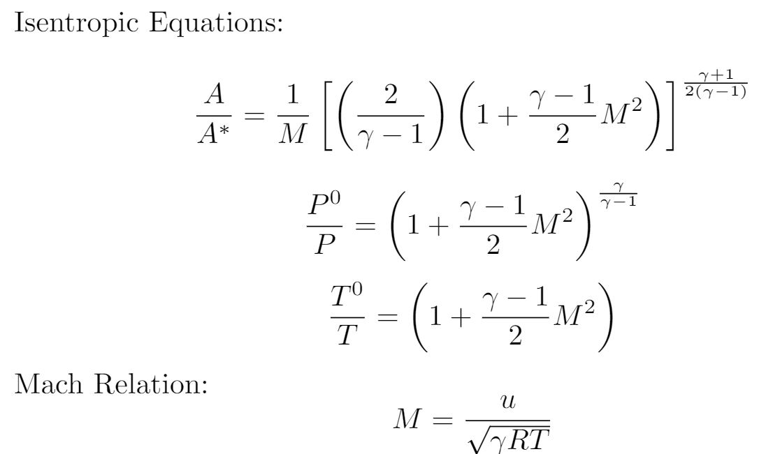
OET: Desired Settling Chamber Pressure
Content
TOC

Slide 78
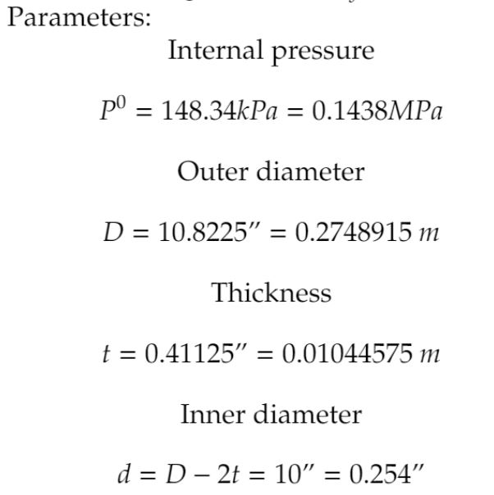
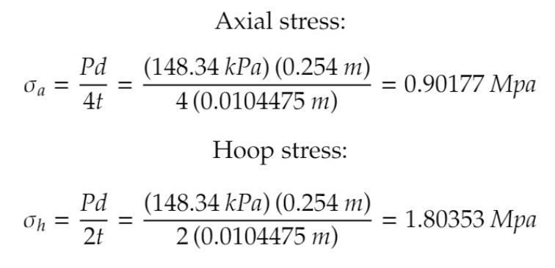
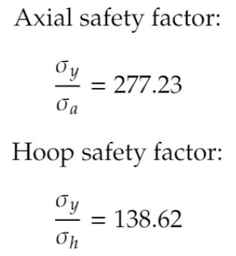
OET: Settling Chamber Structural Analysis
TOC

Slide 79
OET: Pressure Regulator and Tank Feasibility
Isentropic relations were used to calculate the mass flow rate out of the settling chamber
Mass flow rate out of the feed tanks was calculated using non-ideal relations with both choked and unchoked flow, following conservation laws
The pressure, temperature, mass, and mass flow within each tank was calculated and plotted in an to determine nominal test time
While feed tank pressures remain high, nominal test time is 11.69 seconds due to the combined feed tank mass flow rate dropping below the mass flow rate out of the settling chamber
This will reduce pressures in the settling chamber, decreasing nozzle test efficacy
Note this test time and the mass flow plotted on slide 72 is for two regulators---one regulator system can not keep up with the mass flow out of the settling chamber due to the choked flow in the feed pipe
TOC

Slide 80
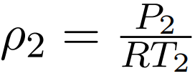
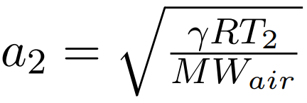
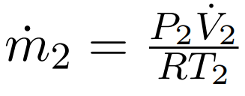
Mass Flow (Settling Chamber)
R = 8.3145 Pa-m³/K-mol = 286.5 J/kg-K
P₂ = 131.84 kPa
P₁⁰ = 145.34 kPa
𝜌₂ = 1.5931 kg/m³
MW_{air} = 28.97 g/mol
a₂ = 331.78 m/s
u₂ = 93.88 m/s
V̇ = .0743 m²/s
ṁ = .1184 kg/s
TOC

Slide 81
Mass Flow (Feed Tanks)
Known values:
P₀ = 758.42 kPa = 110 psi
P_{throat} = P_{settle} = 148.34 kPa
V_{tank} = 80 gal. = .3636 m³
T₀ = T = 293.15 K
R = 287 J/kg-K = 8.3145 Pa-m³/K-mol
A_{throat} = 1.227 in² = 7.9173x10⁻⁴ m²
m_{max} = 3.2780 kg
TOC

Slide 82
Mass Flow (Feed Tanks)
Choked Flow:
Non-Choked Flow:
Flow out of the feed tanks is initially choked due to small pipe diameter---this restricts mass flow rate from a single tank to relatively low values
TOC

Slide 83
Mass Flow (Feed Tanks)
Calculations are derived from the first law of thermodynamics
The second equation is the driving temperature calculations, as seen in the bottom right
Iterative models were used to determine the next mass value, allowing for pressure and temperature calculations
TOC

Slide 84
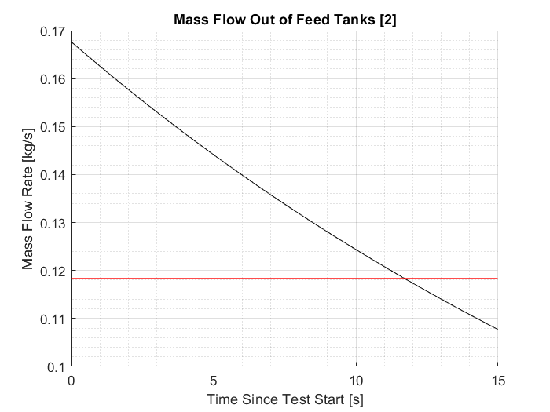
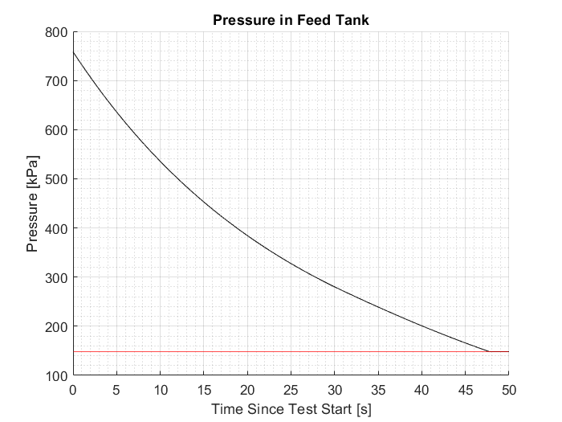
Mass Flow (Feed Tanks)
Maximum test time: 11.69 seconds
Pressure remains high, but mass flow rate out of feed tank drops below mass flow rate out of settling chamber
TOC

Slide 85
Cold Test Risk Mitigation
W_{settle} = 596 J
TNT EQ: 1.42 g
W_{feed} = 355,800 J
TNT EQ: 85.04 g
The blast and resulting pressures would not cause any physical damage given our test setup [17]
V_{settling} = .032175925 cubic meters
V_{feed} = .3636 cubic meters
P_{settling}= 148.34 kPa
P_{feed} = 758.42 kPa
P_{a} = 86 kPa
W=P₀V₀(ln(P₀/P_{a})-1)+P_{a}V₀
1kg TNT = 4.184*10^6 J
TOC

Slide 86
Assumptions for Ideal Model
Cp and 𝛾 are Constant
Due to the amount of fuel being used compared to air is really small, the specific heat and 𝛾 values change very little
EQL software has 𝛾 changing from 1.4 to 1.379
Isentropic through the compressor, turbine, and nozzle
Assumes that there is not heat loss, which due to high efficiencies of stations generally, means that there are very little losses 𝛾𝛾
Constant Pressure in combustor
Pressure losses in actual combustor are really small, so assuming constant pressure
Adiabatic
If all components(minus combustor) are assumed to be adiabatic
100% Efficiency
Ignores loses that would occur due to friction, heat transfer, etc. Most station efficiency are around 80-90% so little impact will be made on model.
Subsonic Jet Engine
Due to the absence of shocks and expansion waves, the exhaust gas will be perfectly expanded and the pressure equal to the atmospheric pressure
TOC

Slide 87
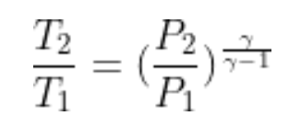
Baseline Model Calculations - Compressor
Use free stream, sea level, and room conditions to find temperature and pressure changes in compressor
Constant Total Pressure and Temperature
Pressure Ratio of Compressor
Isentropic Assumption
TOC

Slide 88
Baseline Model Calculations - Combustor
Use compressor exit temperature and pressure values to find change in temperature and pressure in the combustor
Constant Pressure
Constant Specific Heat
EQL to find enthalpy change
Find temperature change based off of first law of thermodynamics
TOC

Slide 89
Baseline Model Calculations - Turbine
Use nozzle inlet and combustor exit conditions to find pressure and temperature changes and
Isentropic
Constant Total Pressure and Temperature
Temperature entrance from combustor
TOC

Slide 90
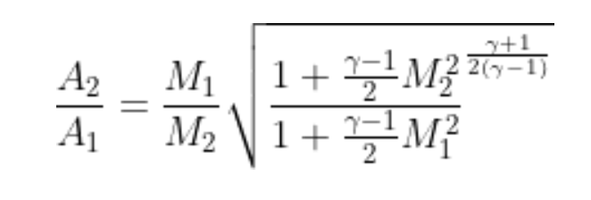
Baseline Model Calculations -Nozzle
Use given engine data from JetCat to find mach, temp, and pressure changes through the nozzle
Isentropic Assumptions
No change in Entropy
No friction losses
Adiabatic
Constant Total Pressure and Temperature
Area-Mach Relation
TOC

Slide 91
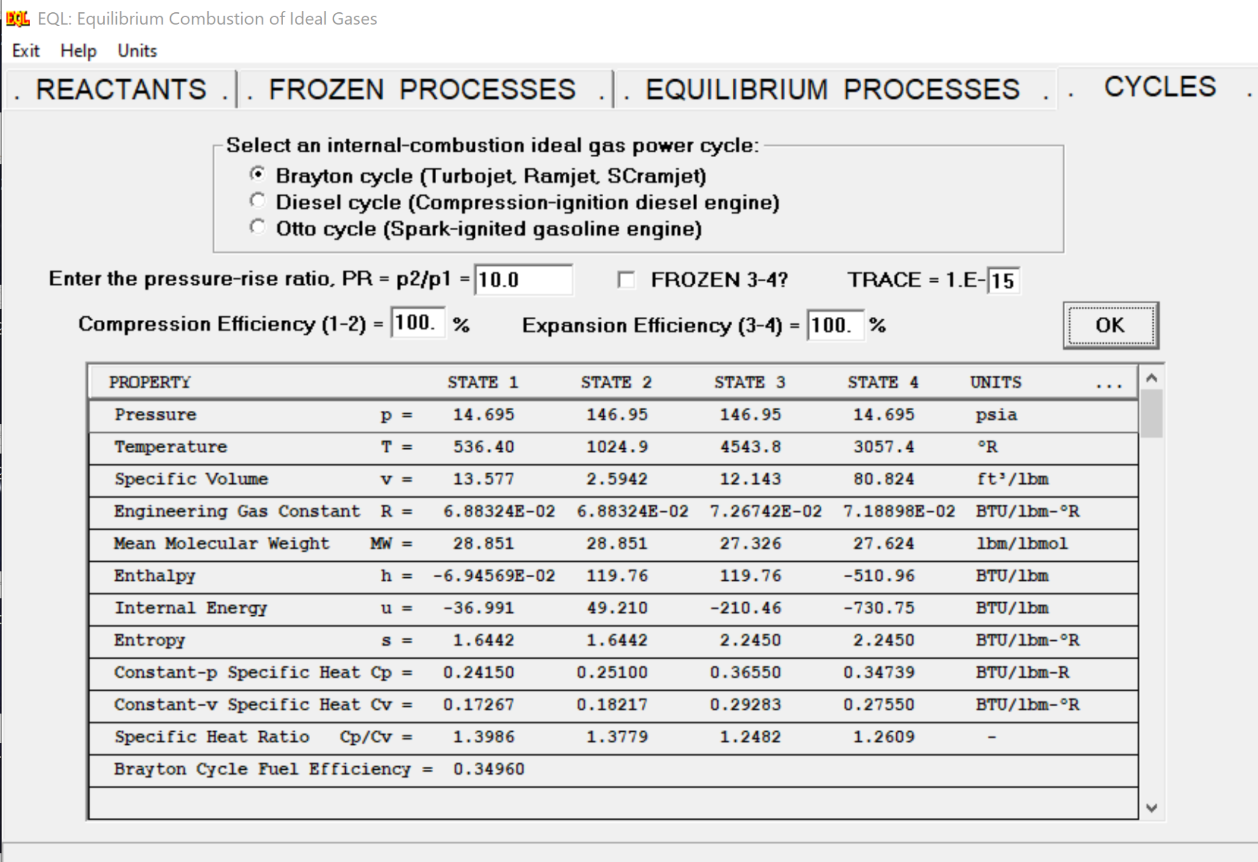
EQL Software
EQL is a NASA developed software that gives you thermodynamic properties of a combustion process based on the fuel to air ratios and the type of process being performed
Temperature, Entropy, Enthalpy, Pressure, Internal Energy,
Knows the energy required to create and break the bonds needed for the reaction
Knows enthalpy of reactants and products at certain temperatures
Uses change of energy from bond breaking/formering to calculate the change in enthalpy
Uses enthalpy to find temperature, entropy, and pressure changes at different stages in process
TOC

Slide 92
Model Improvement Plan
Steps to Improve current Model
Start to eliminate assumption
Acquire necessary sensors
Pitot tubes, thermocouples, IR Sensor/Camera
Attach sensors where measurements are needed
Pitot tube at the entrance and exit of engine,
Thermocouples before and after each station
IR sensor/Camera pointing at engine (Maybe)
Run engine and collect data
Verify that data makes sense compared to ideal model and follows similar trend
Rank assumptions based on biggest sources of errors
Remove assumptions that create significant errors
Use data obtained from engine, calculate total loses
Heat Transfer, Rayleigh flow losses, Efficiencies
Create new model
Design modifications based off of new model
TOC

Slide 93
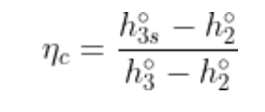
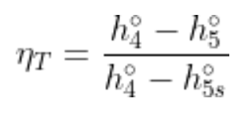
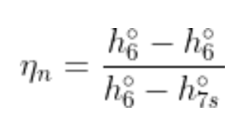
Calculating Efficiencies of Engine Stations
Compressor
Usually between 0.85 and 0.90
Combustor
Usually between on .97 and 0.99
Turbine
Usually between on .90 and on.955
Nozzle
Usually between 0.95 and 0.98
Key:
h_{xs}º = total enthalpy required to achieve P_{x}º if isentropic
ṁ = total mass flow rate
ṁ_{f} = mass flow rate of fuel
h_{PR} = Low heating value of fuel - 43 MJ/kg
hº = total enthalpy
TOC

Slide 94
TOC

Slide 95
On-Engine Testing
TOC

Slide 96
Combustor Testing- Thermocouple Stress from Aerodynamic Forces
Forces modeled perpendicular, with fastest airspeed in engine
Assumptions are:
Thermocouple is a solid stainless steel 316 rod fixed at one end
Worst conditions (velocity and temperature) are taken from current model
Will not be in contact with any part of combustor
Aero Forces:
Do not know exact velocity and temp in combustor
Velocity and temp are chosen from highest in engine, which take place at nozzle exit
Coefficient of drag is at worst 1.3, cylinder in flow is 1.2
Area is diameter time depth inserted
Density of air is average at Denver
Drag = 0.5 * rho * Cd * A * (V²)
Drag = 0.5 * 1.2[kg/m³] * 1.3 * 7.9e-6[m] * (564[m/s]²)
Drag = 15.76[N]
0.3175 cm
v_{air} = 564[m/s]²
2.0 cm
Thermocouple
Shell
Beam Equations: https://www.linsgroup.com
Drag Coefficient: https://sv.20file.org/up1/916_0.pdf
TOC
Notes:
Could be used in back up slides

Slide 97
Combustor Testing- Thermocouple Stress from Aerodynamic Forces
Modeled as beam with distributed load
I is area moment of inertia, Mmax is max bending moment, σ is bending stress, Vmax is max shear moment, A is cross sectional area, and 𝛕 is shear stress
I = pi * (d⁴) / 64
I = pi * (0.003175[m])⁴ / 64 = 4.99e-12 [m⁴]
M_{max} = F * (L²) / 2
M_{max} = 15.76[N] * (0.02[m])² / 2 = 0.0032[Nm²]
σ = -M_{max} / I
σ = - 0.0032[Nm²] / 4.99e-12 [m⁴] = -6.3e8[Pa]
V_{max} = F * L = 15.76[N] * 0.02[m] = 0.3135[Nm]
A = π * (d²) / 4 = π * (0.003175[m])² / 4 = 7.92e-6 [m²]
𝛕 = V_{max}/A = 0.3135[Nm] / 7.92e-6 [m²] = 3.98e4[Pa]
TOC

Slide 98
Combustor Testing- Thermocouple Stress from Aerodynamic Forces
Maximum bending stress is -6.3e8[Pa] or 63 MPa
Maximum shear stress is 3.98e4[Pa] or 40 Mpa
Operating temperature is a maximum of roughly 1100K or about 850C
The maximum stress from aerodynamic forces will not exceed the strength of the material at temperature (120 MPa minimum)
FOS = Allowed Stress / Max Stress
FOS = 120[MPa] / 63[MPa]
FOS = 2
Link to Data Charts: https://askzn.co.za/stainless-steel/tech-grade-316.htm
TOC

Slide 99
Combustor Testing-Part 2: Sealing Engine Shell and Thermocouple
Mechanical sealant is most removable, least invasive, and unlikely to break
Compression fittings designed for thermocouple sensors
Readily available and easy to use, found at McGuckins ect.
Much thicker and sturdy than thermocouple
Majority of fitting will be outside of engine
TOC

Slide 100
Cold Junction
Compensators
Inlet Thermocouple
Outlet Thermocouple
Load Cell
Arduino Pin Connect for Engine Testing
Arduino Mega
SD Module
Breadboard
TOC

Slide 101
Real Turbojet Thermodynamic Model
TOC

Slide 102
Equations for Total Pressure and Temperature - Inlet
Ratio of specific heats for before the combustor: γ = 1.4
Specific heat capacity for before the combustor: Cp_{c} = 1004 J/(kg-k)
Total pressure of room:P⁰= 101.325KPA
Total temperature of room: T⁰= 288 k
Initial Mach value: M₀ = 0
Temperature for Inlet:
Pressure for Inlet:
TOC

Slide 103
Equations for Total Pressure and Temperature - Compressor
Ratio of specific heats for before the combustor: γ = 1.4
Specific heat capacity for before the combustor: Cp_{c} = 1004 J/(kg-k)
Compression Pressure ratio: r_{c} = 2.9
Total pressure of compressor:P⁰₂= Inlet total pressure
Total temperature of compressor:T⁰₂= Inlet total temperature
Compressor Efficiency: η_{c} = 0.8
Temperature for Compressor:
Pressure for Compressor:
TOC

Slide 104
Equations for Total Pressure and Temperature - Combustor
Fuel Heat value: Q_{R}= 44*10⁶ J/(kg*K)
Specific heat capacity for before the combustor: Cp_{c} = 1004 J/(kg-k)
Specific heat capacity for after the combustor: Cp_{T} = 1445 J/(kg-k)
Total temperature of compressor:T⁰₃= compressor total temperature
Compressor Efficiency: η_{b} = 0.9
Fuel to air ratio: f = 0.0214
Temperature for Compressor:
TOC

Slide 105
Equations for Total Pressure and Temperature - Turbine
Ratio of specific heats for after the combustor: γ = 1.23
Specific heat capacity for before the combustor: Cp_{c} = 1004 J/(kg-k)
Specific heat capacity for before the combustor: Cp_{c} = 1445 J/(kg-k)
Fuel to air ratio: f = 0.0214
Total pressure of compressor:P⁰₄= Compressor total pressure
Total temperature of compressor:T⁰₂= Inlet total temperature
Total temperature of compressor:T⁰₃= Compressor total temperature
Total temperature of compressor:T⁰₄= Combustor total temperature
Compressor Efficiency: η_{c} = 0.85
Temperature for Compressor:
Pressure for Compressor:
TOC

Slide 106
Equations for Total Pressure and Temperature - Nozzle
Ratio of specific heats for after the combustor: γ = 1.23
Total pressure of compressor:P⁰₆= Turbine total pressure
Total pressure of compressor:P₇= Exit Pressure (Equal to atmospheric pressure)
Total temperature of compressor:T⁰₅= Combustor total temperature
Gas Constant: R = 274
Nozzle Efficiency: η_{c} = 0.92
Total temperature and pressure are same as the turbines total temperature and pressure
Exit Velocity of Nozzle:
TOC

Slide 107
Update Engine Properties
C₁₂H₂₆ + 18.5(O₂ + 3.78 N₂) -> 12 CO₂ + 13H₂O + 69.93 N₂
Chemical | Mass (g) | Mass % | Mass Fraction
12 CO₂ | 528.108 | 19.4% | .194
13 H₂O | 234.145 | 8.6% | .086
69.93 N₂ | 1959.016 | 71.9% | .719
Gas | Translation Mode | Rotational Mode | Vibrational Mode | ͠Cp Value (Universal Gas Constant Ru)
CO₂ | 3 | 2 | 8 | 7.5Ru
H₂O | 3 | 3 | 6 | 7Ru
N₂ | 3 | 2 | 2 | 4.5Ru
TOC

Slide 108
Calculation of Engine Properties
Using table values from previous slides we can calculate Cp and Gamma values
Find what the ͠cp_{mix} value is based on chemistry
͠cp_{mix} is the heat capacity of the mixture
Find the Molecular Weight of the mixture (MW_{mix})
TOC

Slide 109
Calculation of Engine Properties
Find Cp_{mix} from ͠cp_{mix}and MW_{mix}
Cp_{mix} is the specific heat capacity of the gas after the combustor
MW_{mix} is the molecular weight of the gas mixture
Use Cp_{mix} and Universal Gas constant to find R
Use Cp_{mix}and R to find gamma
TOC

Slide 110
Engine Properties
Mass flow rate of air: ṁ_{a} [kg/s] | Mass flow rate of fuel: ṁ_{f} [kg/s] | Fuel air ratio: f = ṁ_{f}/ṁ_{a}
0.2252 | 0.00481 | 0.0214
 | Specific Heat: C_{p} [J/kg-K] | Specific Heat Ratio: γ
Before Combustor | Cp_{c}= 1005 | γ_{c} = 1.4
After Combustor | Cp_{t} =1445 | γ_{t} = 1.233
Overview
Design Solution
CPEs
Requirement Satisfaction
Risks
Verification & Validation
Planning
Notes:
Put information into table if possible

Slide 111
Material Selection
TOC

Slide 112
Material Selection Trade Criteriation

Slide 113
Material Trade Study

Slide 114
Estimated Component Weights
Component | Volume [cm³] | Material | Density [g/cm³] | Weight [g] | Total Engine Weight Increase [%]
Improved Converging Nozzle | 9.21 | Stainless Steel 304 | 7.92 | 72.9 | 1.31
Mixing Chamber and Diffuser | 20.5 | Aluminum 6061 | 2.71 | 55.6 | 5.15
Interface struts | 2.68 | Stainless Steel 304 | 7.92 | 21.2 | 2.00
Total | - | - | - | 149.7 | 13.9
TOC
Notes:
Based directly on solidworks model. Can look into using just 3 interface struts if necessary to reduce weight

Slide 115
Heat Conduction through the interface bars
Since the rods are in contact with the converging nozzle, they will conduct heat.
Treating them as an adiabatic fin
Temperature at the ejector end of the bar = 490.4ºK
TOC

Slide 116
Extrapolated Yield Strength Data for Ti-6Al-4V
TOC

Slide 117
Extrapolated Yield Strength Data for Ti-5Al-2.5Sn
TOC

Slide 118
Extrapolated Yield Strength Data for Ti-6Al-2Sn-4Zr-2Mo
TOC

Slide 119
Extrapolated Yield Strength Data for Commercially Pure Titanium
TOC

Slide 120
Risk Mitigation
TOC

Slide 121
Identified Risks with mitigation
TOC
Notes:
Way too many risks

Slide 122
Cold Test Risk Mitigation
Supply tanks rated for 200 psi, building supplies maximum 110 psi
Pipe elbow fittings rated for 300 psi
Settling chamber safety factor of 138.62
Blast shield between team members and test apparatus at all times
No team member will be in the room when the settling chamber is above atmospheric pressure
Maximum feed tank energy is 355,800 J
No potential for injury to test personnel if a feed tank ruptures given our test setup
Blast shield picture/diagram here
TOC

Slide 123
Ejector Design
TOC

Slide 124
Ejector Thrust-to-Weight Modeling Considerations
Incompressible
Simplifies model
Inviscid flow
Neglects boundary layer effects and turbulent dissipation
Zero freestream velocity
Forward velocity of the engine adds complexity to the modeling of the secondary flow through the ejector
Overview
Design Solution
CPEs
Requirement Satisfaction
Risks
Verification & Validation
Planning
Notes:
Colin: increase plot label size
Change plot to T/W increase in comparison to STOCK nozzle, not improved conv nozzle
Explain why we didn’t pick bigger alpha E
While an Ejector has very complicated flow physics, a few common modeling assumptions are the most impactful

Slide 125
Updated Model - Compressible Failure
Unable to recreate the plots or follow the derivation for the equations for a compressible ejector from from “An Investigation of the Thrust Augmentation Characteristics of Jet Ejectors”
TOC

Slide 126
Ejector Model - Incompressible with Different Densities
Note notational differences from this presentation:
ɑ = ɑ_{e}
β = ɑ_{D}
m = ṁ
m_{s}/ m_{p} Needs to be solved for first before finding φ
TOC

Slide 127
Ejector Model - Incompressible with Different Densities
“Ejector Thrust Augmentation" By W. H. Heiser
Constant but different densities that uniformly mix
Isentropic
Constant Profiles
P_{e} = P_{atm}
Shows asymptotic behavior
TOC

Slide 128
External Ejector Models - Compressible
Plot is from “An Investigation of the Thrust Augmentation Characteristics of Jet Ejectors”
Shows only a minor offset in a compressible vs incompressible analysis (~5% error at worst)
TOC

Slide 129
Ejector Models - Incompressible vs Mixed Densities
Shows the compressible vs incompressible plot vs the output from the chosen mixed densities model
Shows about a 2% error between mixed densities and compressible formulations
TOC

Slide 130
External Ejector Models - Losses
Plot is from “An Investigation of the Thrust Augmentation Characteristics of Jet Ejectors”
Shows losses in the thrust augmentation for too large of diffuser ratios
Does not account for varying mixing chamber lengths
TOC

Slide 131
External Ejector Models - Mixing Chamber Length
Plot is from “An Investigation of the Thrust Augmentation Characteristics of Jet Ejectors”
Shows the results from a computation for theoretical mixing chamber length for a given area ratio under incompressible and compressible conditions
This indicates our mixing chamber may be too long, but this is balanced with other sources advocating for more complete mixing than used in this analysis
TOC

Slide 132
Improved Nozzle Calculation Setup
Using the listed exit temperature from JetCat of a nozzle temperature of 993 K, mass flow rate of 0.23 kg/s, R = 273 J/kg-K, and γ = 1.233
Along with the assumption that P_{exit} = P_{atm}
TOC

Slide 133
Improved Nozzle Calculations
Stock nozzle exit: Mach 0.75
Improve the converging nozzle by instead accelerating the flow to Mach 0.95
The area ratio required to achieve this can be separately calculated based off of measured engine properties
Current Nozzle Thrust:
100 N
Improved Nozzle Thrust:
126 N
Overview
Design Solution
CPEs
Requirement Satisfaction
Risks
Verification & Validation
Planning
Notes:
Colin: increase plot label size
Change plot to T/W increase in comparison to STOCK nozzle, not improved conv nozzle
Explain why we didn’t pick bigger alpha E

Slide 134
Preliminary CFD Work
TOC

Slide 135
Grid Refinement Study - Overview
Fine mesh has a y⁺ < 1 and max spacing of 0.2 mm (δ/10 or 1/330 l_{C})
Pseudo-structured meshes are being used
Refining in two separate areas:
y⁺ = 25 (~33x further from the wall)
max spacing of 0.4 mm (δ/5 or 1/165 l_{C})
All simulations have identical domains, initial conditions, and were run to 1e-6 residual
Pressure inlet and outlet boundary conditions used
Outlet
Inlet
22.3 mm
23.4 mm
66 mm
TOC

Slide 136
Grid Convergence - Near-Outflow Results
Purpose is to investigate the solutions sensitivity to max grid spacing
Max velocity is unchanged
Agreement generally throughout the profile
6 mm upstream of outflow (9% of the domain - 6 or 12 nodes)
TOC

Slide 137
Grid Convergence - Mid Domain Results
Purpose is to investigate the solutions sensitivity to max grid spacing
Max velocity is unchanged
Agreement generally throughout the profile
At the domain midpoint
TOC

Slide 138
Grid Convergence - Wall Results
Purpose is to investigate the solutions sensitivity to the first wall point distance
Fine mesh and coarser max grid spacing unsurprisingly agree well
y⁺ = 25 case shows a max error of around 5%
Interestingly, the coarser wall spacing handles the inflow much differently
TOC

Slide 139
Grid Convergence - Conclusions
There are large differences in the overall mesh sizes:
Fine - 43,677 nodes
Coarse wall - 38,361 nodes
Coarse max spacing - 13,210 nodes
Indicating that max spacing is of the greatest current concern to optimize
Other Notes:
The simulations converged much faster for the coarse wall spacing
TOC

