Slide 1
FlOWeR
FlOWeR
Preliminary Design Review
Flow Optimization & Weight Reduction Project
Presenters: Adriana Lysak, Max Buchholz, Anand Kappagantu, Angelo Hristopoulos,
Weston Luke, Anthony Gregg
Additional Team Members: Preston Tee, Eric Tate, Nathan Portman
Advisor: Alexandra Le Moine
Customer: U.S. Air Force Research Laboratory

Slide 2
Project Description
Project Description
Baseline Design
Baseline Feasibility
Status and Strategy

Slide 3
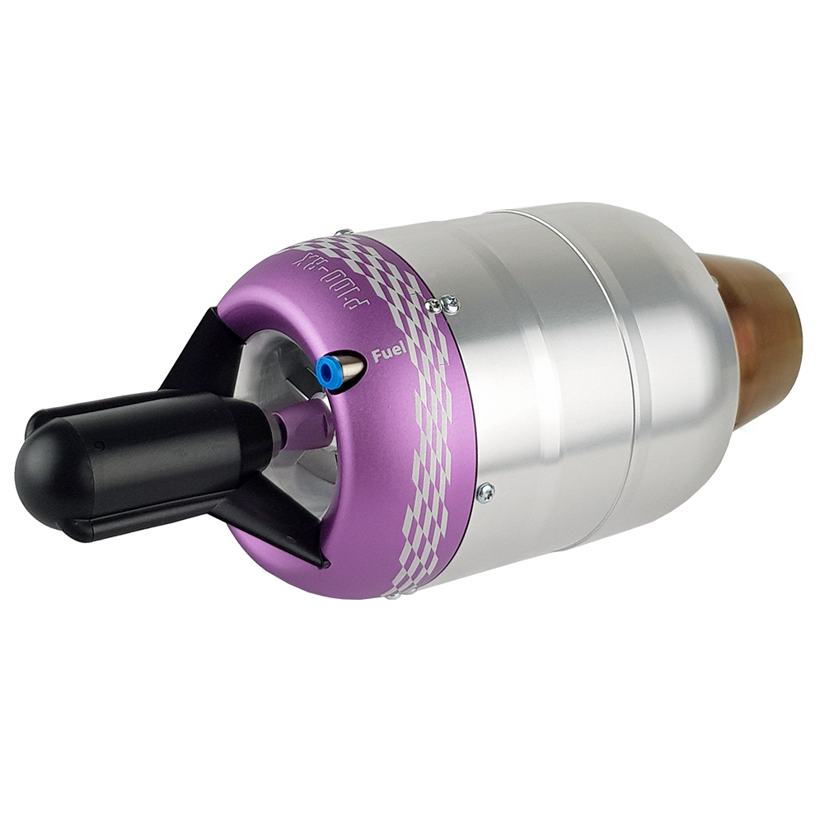
Project Overview
Objective:
Increase the thrust-to-weight ratio (T/W) of the JetCat P100-RX hobbyist engine without detriment to the engine’s efficiency
Develop a thermodynamic model that accurately predicts engine performance with and without modifications
Project Description
Baseline Design
Baseline Feasibility
Status and Strategy

Slide 4
Motivation
Performance:
Improvements may be applied to large-scale jet engines, applications to commercial, fighter aircraft
Increasing T/W = better rate of climb (RoC), maneuverability of the platform
Safety:
Thermodynamic model allows for study into engine modification with less personal, financial, and time risk
Project Description
Baseline Design
Baseline Feasibility
Status and Strategy

Slide 5
Functional Requirements
FR 1 | The thrust-to-weight ratio of the engine shall increase.
FR 2 | The engine’s thrust specific fuel consumption (TSFC), propulsive efficiency, and thermal efficiency are not negatively impacted.
FR 3 | An engine cycle analysis shall be developed that accurately predicts engine performance both nominally and after implementing selected modifications.
FR 4 | A functional, maintained engine is available for testing and data acquisition.
Project Description
Baseline Design
Baseline Feasibility
Status and Strategy

Slide 6
Concept of Operations (CONOPs)
Project Description
Baseline Design
Baseline Feasibility
Status and Strategy
Notes:
Why does this feel more like a flowchart? Describe the uniqueness of the project and why this CONOPS is the best representation of the project
Info is good, but this is more of a timeline than a conops. Need to see end result of what we are going for

Slide 7
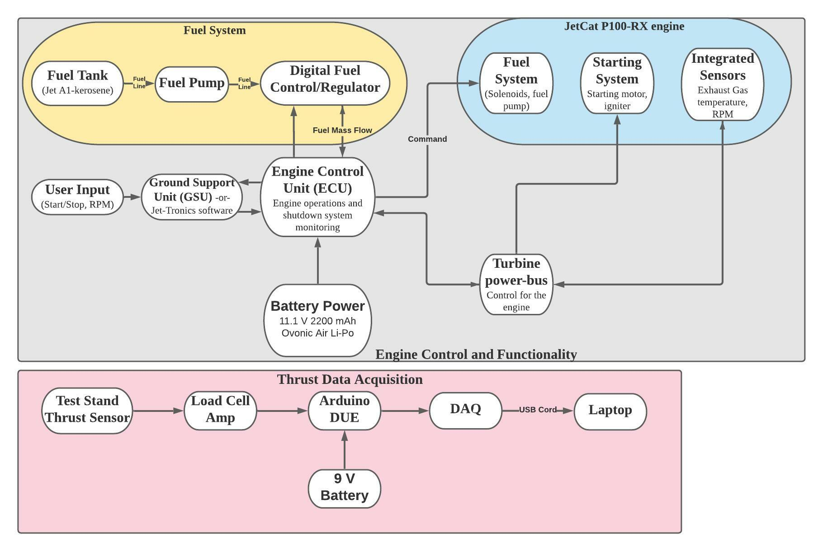
Functional Block Diagram (FBD)
Notes:
Remove TBD for the GSU. Reconsider the laptop software connections and potentially renaming the “Turbine Engine” box
Overall boxes of turbine engine and thrust test stand LABELS are misleading. Seeing the link between pink and grey boxes is important (or explaining why they are not connected?)
Increase font size (old professors)

Slide 8
Baseline Design
Project Description
Baseline Design
Baseline Feasibility
Status and Strategy

Slide 9
Nozzle
Project Description
Baseline Design
Baseline Feasibility
Status and Strategy
Notes:
We needa

Slide 10
Ejector Nozzle Design Overview
Objective: Maximize exit flow velocity by optimizing area ratio while avoiding shocks and flow separation
Purpose: Increase thrust through increase of exhaust momentum
Considerations:
Mass flow rate increase vs exit velocity decrease
Weight penalty for larger ejector
Optimizing converging nozzle
Project Description
Baseline Design
Baseline Feasibility
Status and Strategy
Notes:
We need a schematic of the engine with the part of the engine we are planning to modify, to give context to following diagrams (why is the flow going up here?)
Weight considerations need to be included in this presentation, not just flow considerations
Talk about what parameters specifically from the equation are modified.

Slide 11
Material Replacement: Inlet, Cowling, Nozzle
Objective: Replace mechanically simple parts with lighter materials, while maintaining structural integrity
Purpose: Decrease weight
Considerations:
Heat resistance
Structural analysis
Manufacturing
Rotary components and combustor too complex
Air Force recommends not to modify them
Project Description
Baseline Design
Baseline Feasibility
Status and Strategy
Notes:
Highlights of parts to replace on engine diagram

Slide 12
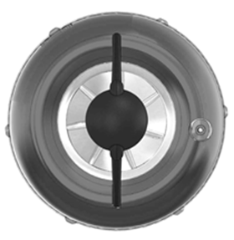
Inlet
Stock Properties:
Mass: 31.4 g
Volume: 4.29 cm³
Density: 7.32 g/cm³
Probable Material: Anodized stainless steel alloy
Considerations: Manufacturability
Replacement Material: Aluminum, Aluminum alloy
Project Description
Baseline Design
Baseline Feasibility
Status and Strategy

Slide 13
Cowling
Stock Properties:
Mass: 108.4 g
Volume: 13.6 cm³
Density: 7.45 g/cm³
Probable Material: Stainless steel (same material as inlet), not anodized
Considerations: Must withstand higher temperatures than inlet
Replacement Material: Aluminum, Aluminum alloy
Project Description
Baseline Design
Baseline Feasibility
Status and Strategy

Slide 14
Nozzle
Stock Properties:
Mass: 58.7 g
Volume: 8.34 cm³
Density: 7.04 g/cm³
Probable Material: Stainless steel
Considerations: Exit temperature, machinability
Replacement Material: Titanium
Decrease density → Decrease weight
Project Description
Baseline Design
Baseline Feasibility
Status and Strategy

Slide 15
Thermodynamic Model
Purpose: Provide analytical reference for comparison between theoretical and experimental values of engine station properties
Inputs: Entrance and Exit Pressures and Temperatures, Exit Velocity, Compression Pressure Ratio
Outputs:Temperature and Pressure at each station
Brayton Cycle
Modeling Software
Matlab
EQL (Equilibrium Combustion of Ideal Gases)
Assumptions
Cp and 𝛾 are constant
Isentropic through nozzle, turbine, and compressor
Constant pressure through combustor
Adiabatic
Excluding combustor
100% thermal efficiency
Subsonic Engine assumption
Atmospheric properties at sea level
Project Description
Baseline Design
Baseline Feasibility
Status and Strategy
Notes:
List inputs and outputs, and what we need to change to eliminate assumptions to make our model less idealistic
Baseline design: talk about what we have
Feasibility: talk about where we’re going to go, feasibility of that
Know how assumptions are accurate
Introduce assumption ranking to make a more robust model
Feasibility => where we’re taking the model
Explicitly state this is what we have now as a baseline, we will reduce the # of assumptions to make a more robust model going

Slide 16
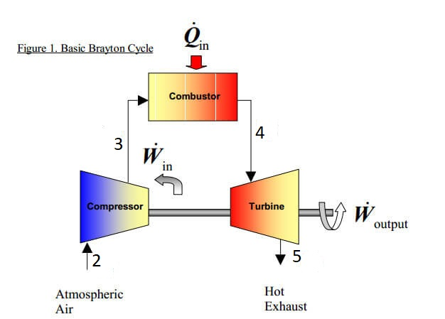
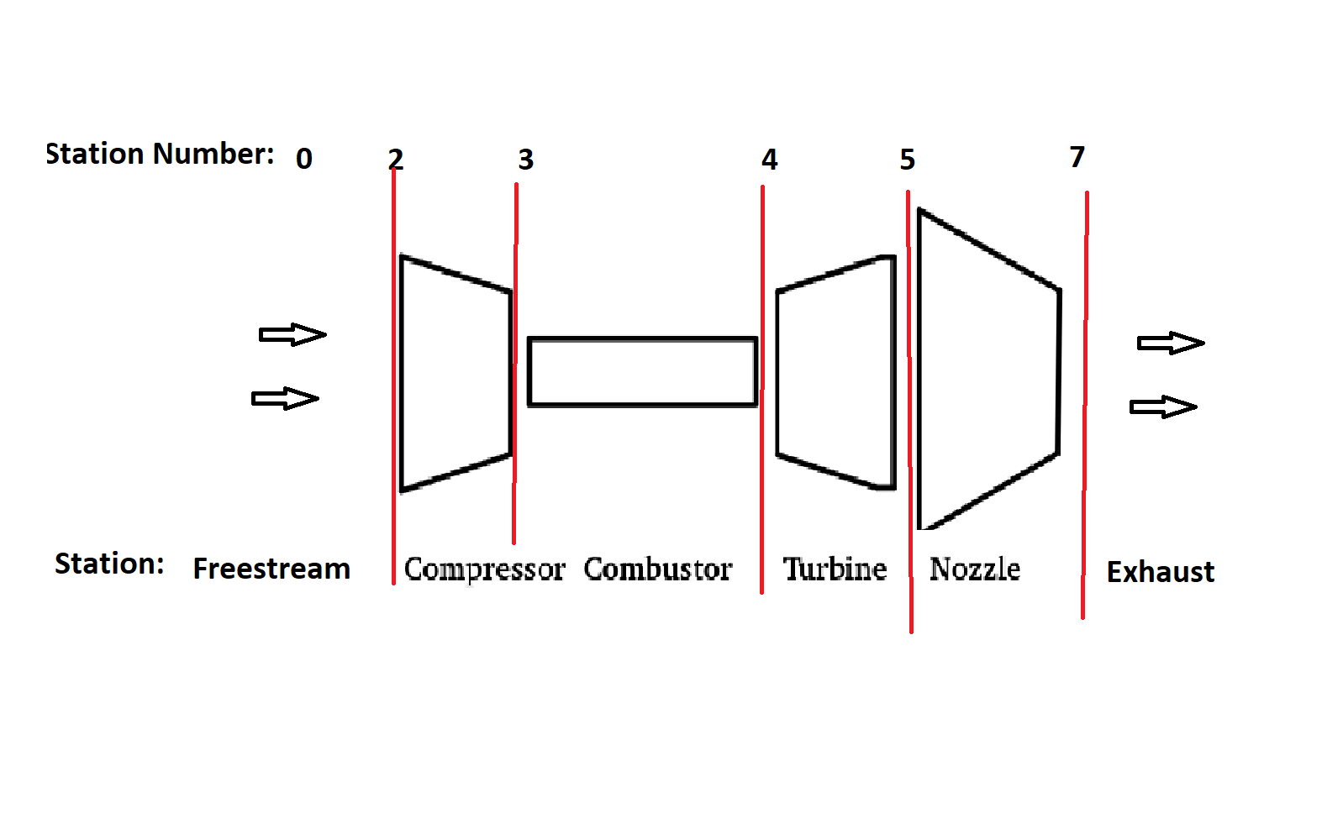
Brayton Cycle
Project Description
Baseline Design
Baseline Feasibility
Status and Strategy

Slide 17
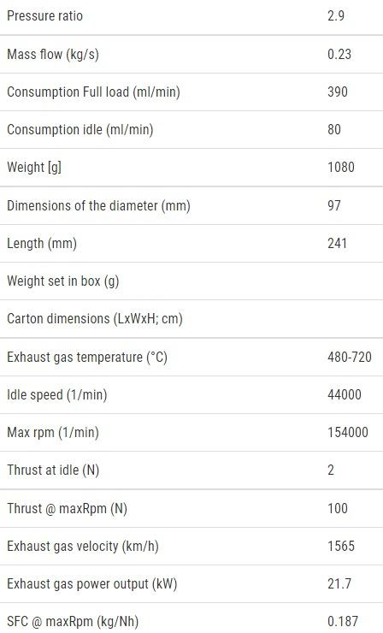
Known Engine Properties
Givens of Engine
Obtained from JetCat
Exit/Exhaust temperature, velocity,
Compression Ratio
Exit Pressure
Area ratio of nozzle
Measurements
Project Description
Baseline Design
Baseline Feasibility
Status and Strategy

Slide 18
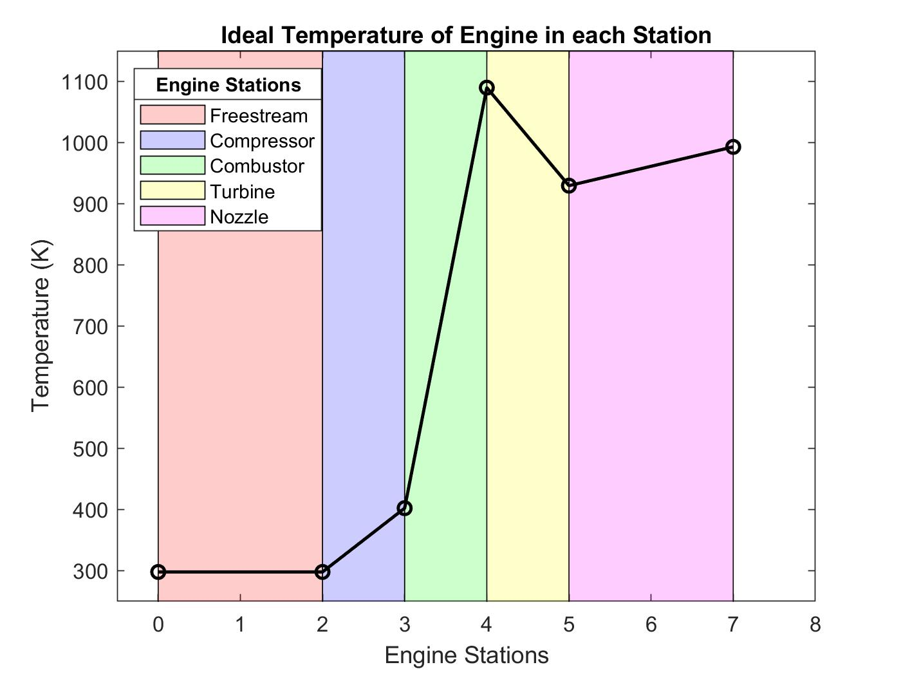
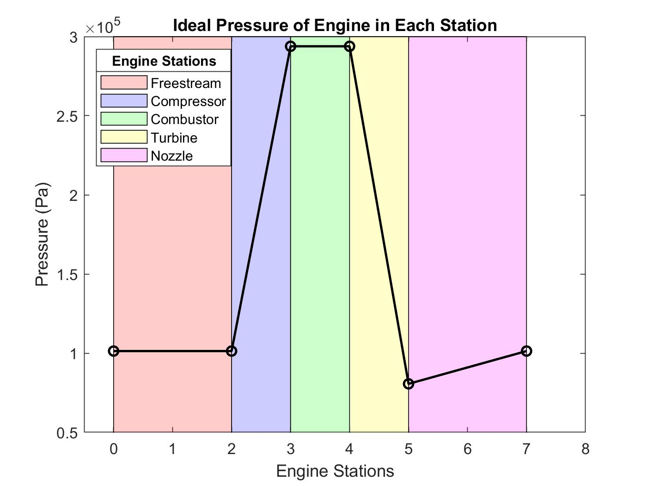
Ideal Temperature and Pressure Changes
Project Description
Baseline Design
Baseline Feasibility
Status and Strategy
Notes:
Color code boxes on plots to show where compressor is, etc.
Engine “stages” - turbine, compressor have multiple stages => change to stations or something like that
Add how we’re going to improve it by adding….
Specifically state what data will be gathered from engine tests to feed back into model
Introduce the fact that we will validate this model based on data acq from the engine, will go into it more later

Slide 19
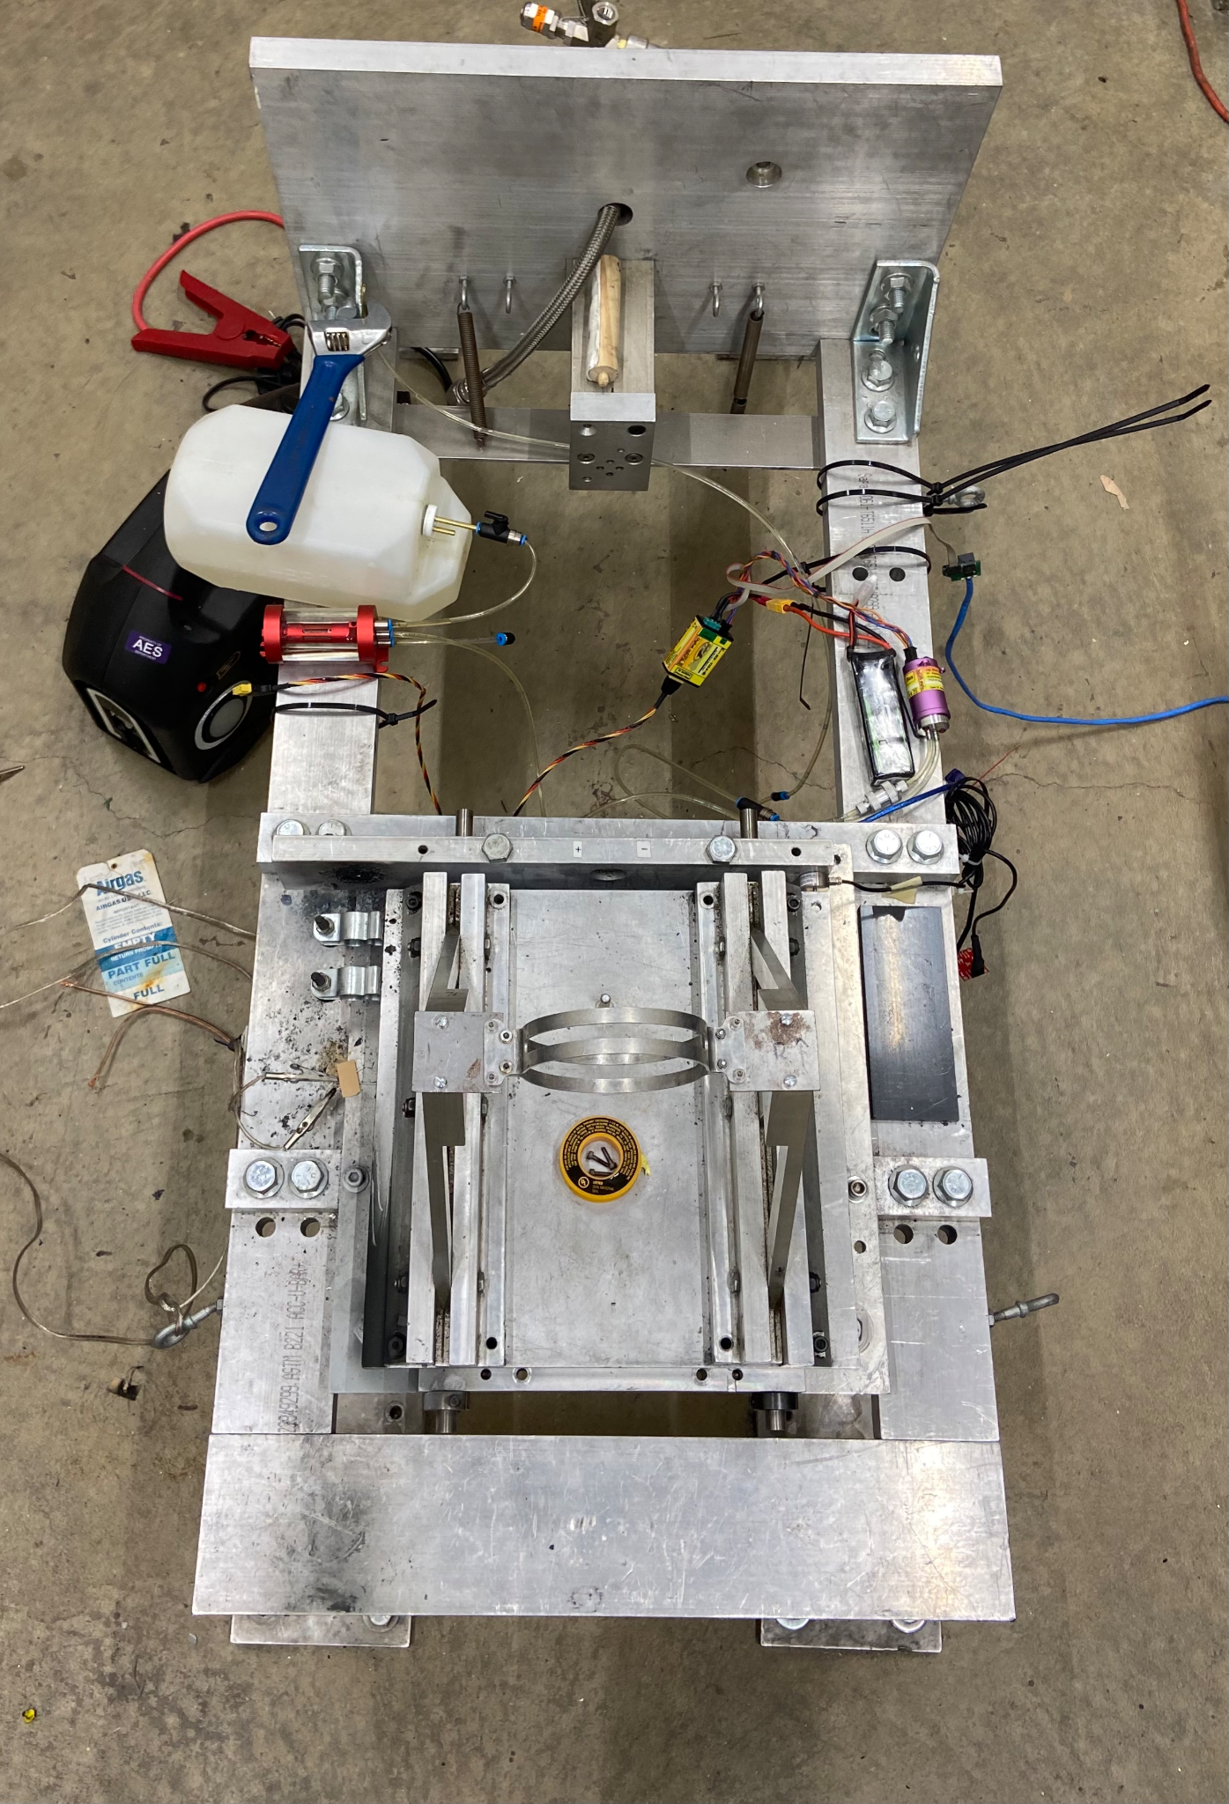
Baseline Design: Test Apparatus
Purpose: Design and implement test to gain sufficient data to verify model and verify improvements
Considerations:
Off-engine “dry” testing
On-engine testing
Data requirements
Outlet and combustor temperatures
Outlet and inlet pressures
Inlet and exit air velocities
Project Description
Baseline Design
Baseline Feasibility
Status and Strategy
Notes:
Test stand picture (no hairy legs)
Why do we need new test apparatus

Slide 20
Baseline Feasibility
Project Description
Baseline Design
Baseline Feasibility
Status and Strategy

Slide 21
Critical Project Feasibility Elements
Label | Critical Feasibility Element | FR
COST | The cost of all materials used for modification does not exceed $5,000, and the total cost of the project does not exceed $14,000. | N/A
WEIGHT | Weight of the engine shall not increase by more than 10%. | 1
THRUST | The maximum thrust shall increase and the TSFC shall decrease or remain constant. | 1,2
MODEL | Model accurately simulates thermodynamic properties of the engine, predicting increases in thrust and/or decreases in TSFC. | 3
DATA | The engine’s Electronic Control Unit (ECU) interfaces with an external computer to enable data acquisition and storage. | 4
INTTEMP | All components can sustain temperatures throughout their section and can integrate with each other seamlessly. | 4
Project Description
Baseline Design
Baseline Feasibility
Status and Strategy

Slide 22
Ejector Nozzle Overview
CPFEs: THRUST, INTTEMP
Assumptions:
Steady Flow
Isentropic
Adiabatic
Incompressible
Conservation Laws
Thrust Augmentation Factor (ø)
Improvement factor over converging nozzle
Project Description
Baseline Design
Baseline Feasibility
Status and Strategy

Slide 23
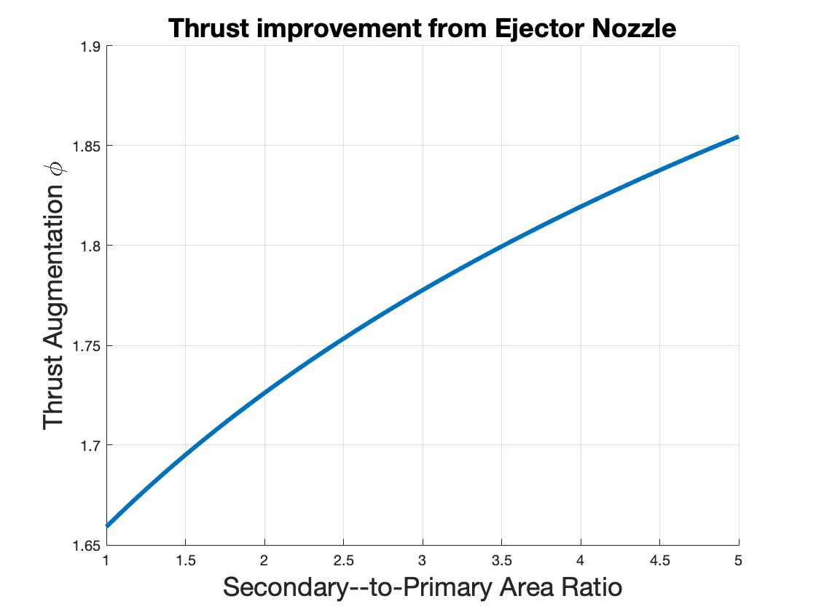
Ejector Nozzle
Manufacturability
Stamped vs 3D Printed
High temperatures at exit
Current Parameters:
Inlet Mach = turbine exit = 0.918
Area ratio (A_exit/A_inlet) = 1.097
Thrust Augmentation (ø):
ø increases with increasing area ratio
Reasonable approximation for lower area ratio
Accounting for losses will result in a peak on the graph
Project Description
Baseline Design
Baseline Feasibility
Status and Strategy
Notes:
Mention current nozzle is diverging
Address current assumptions
Can explain where eq came from, what assumptions are (steady flow, isentropic, adiabatic why are they ok), if asked; keep equations and assumps on same page
Add big circle to show Mach 1
Graph is constantly increasing. Assumptions breakdown at higher area ratio. Further study required to decide where this peaks in a non-ideal case.

Slide 24
Nozzle Feasibility
Label | Critical Feasibility Element | FR | Feasible?
THRUST | The maximum thrust shall increase and the TSFC shall decrease or remain constant. | 1,2 | ✔
INTTEMP | All components can sustain temperatures throughout their section and can integrate with each other seamlessly. | 4 | ✔
Project Description
Baseline Design
Baseline Feasibility
Status and Strategy

Slide 25
Material Replacement Feasibility Overview
CPFEs: COST, WEIGHT, INTTEMP
Material Cost
Cost per kg
Cost and ease to manufacture
Temperature
Internal engine temps are 1100 K at maximum
Around 300 K at inlet and 1000 K at exit
Project Description
Baseline Design
Baseline Feasibility
Status and Strategy
Notes:
Break out all acronyms

Slide 26
Material Replacement
Component | Current Density (g/cm³) | Temperature (K)
Inlet | 7.32 | 298
Cowling | 7.45 | 1100
Nozzle | 7.04 | 993
Material | Density (g/cm³) | Melting Point (K) | Cost ($/kg)
Aluminum Alloys | 2.78 - 2.81 | 750 - 925 | 28 - 58
Stainless Steel Alloys | 7.80 - 8.00 | 1643 - 1803 | 18 - 25
Titanium Alloys | 4.43 - 4.48 | 1877 - 1973 | 50 - 103
Project Description
Baseline Design
Baseline Feasibility
Status and Strategy
Notes:
Need to put nozzle weight considerations somewhere
More generic than specific alloys
Measure cowling again (more accurately, graduated cylinders)
Not sure water displacement volume is necessary on this slide

Slide 27
Material Replacement Options
Stock Component | New Material | Stock Weight (g) | New Weight (g) | Weight Reduction (%) | Temperature Range (K) | Cost
Nozzle | Titanium Ti-6Al-4V | 58.7 | 37.0 | 37.0 % | 930-993 | Up to $600
Inlet | Aluminum 6061-T6 | 31.4 | 11.6 | 63.1% | 298-400 | Up to $185
Cowling | Titanium Ti-6Al-4V | 108.4 | 65.6 | 39.6% | 400-1100 | Up to $1500
Project Description
Baseline Design
Baseline Feasibility
Status and Strategy
Notes:
Need to put nozzle weight considerations somewhere
More generic than specific alloys
Measure cowling again (more accurately, graduated cylinders)
Not sure water displacement volume is necessary on this slide

Slide 28
Material Replacement Feasibility
Label | Critical Feasibility Element | FR | Feasible?
COST | The cost of all materials used for modification does not exceed $5,000, and the total cost of the project does not exceed $14,000. | N/A | Further Research Required
WEIGHT | Weight of the engine shall not increase by more than 10%. | 1 | ✔
INTTEMP | All components can sustain temperatures throughout their section and can integrate with each other seamlessly. | 4 | ✔
Project Description
Baseline Design
Baseline Feasibility
Status and Strategy
Notes:
Need to put nozzle weight considerations somewhere
More generic than specific alloys
Measure cowling again (more accurately, graduated cylinders)
Not sure water displacement volume is necessary on this slide

Slide 29
Future Model Feasibility
CPFEs: THRUST, INTTEMP, MODEL
Test and gather engine data to improve current model
Thermocouples, Pitot tubes,etc
Rank assumptions on biggest decrement of results
Find efficiency of Engine stations
Find Pressure and temperature losses in stations
Rayleigh flow losses, Heat transfer, etc
Create New Model to model and analyze modifications
Thrust
Temperature and Pressure at each Station
Project Description
Baseline Design
Baseline Feasibility
Status and Strategy

Slide 30
Future Model Feasibility
Label | Critical Feasibility Element | FR | Feasible?
THRUST | The maximum thrust shall increase and the TSFC shall decrease or remain constant. | 1,2 | ✔
MODEL | Model accurately simulates thermodynamic properties of the engine, predicting increases in thrust and/or decreases in TSFC. | 3 | ✔
INTTEMP | All components can sustain temperatures throughout their section and can integrate with each other seamlessly. | 4 | ✔
Project Description
Baseline Design
Baseline Feasibility
Status and Strategy

Slide 31
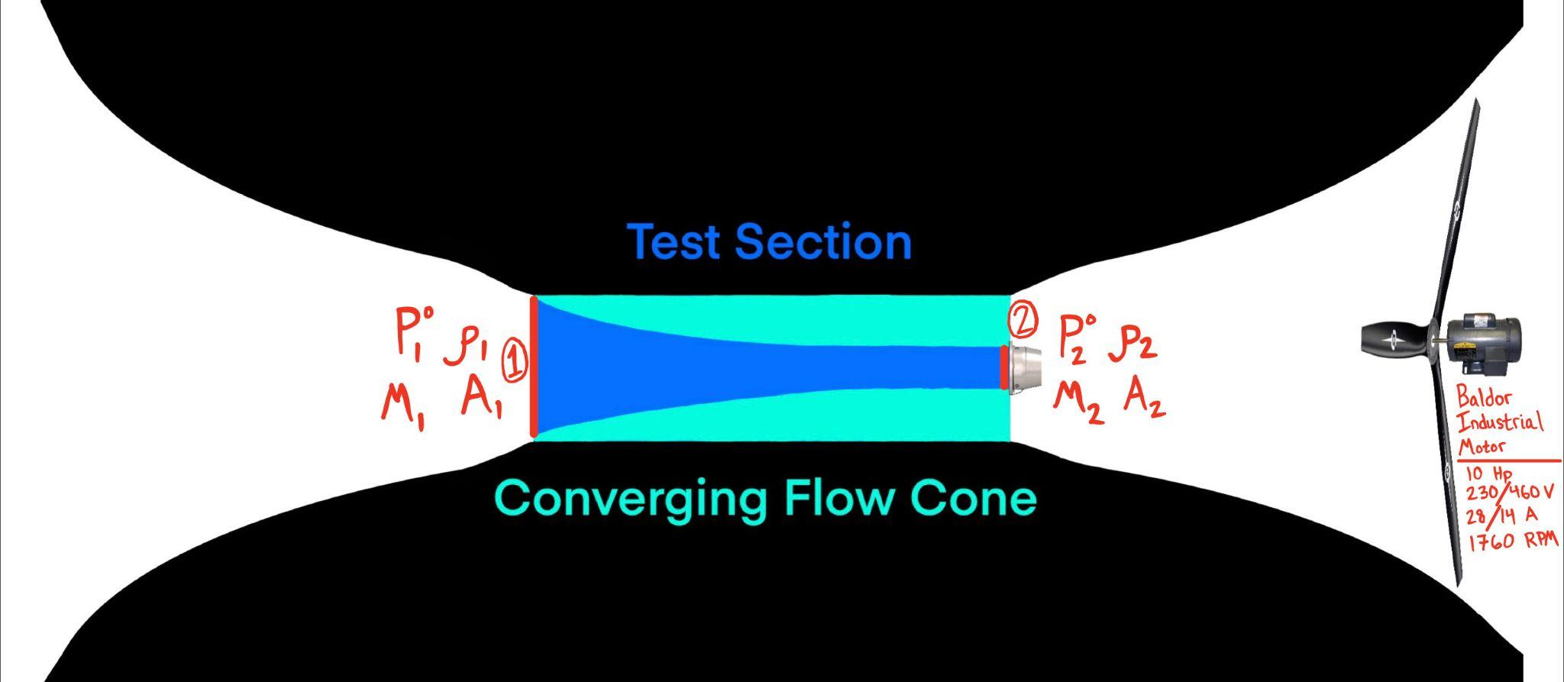
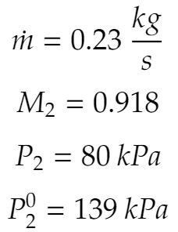
Off-Engine Testing Feasibility: Overview
CPFEs: COST, DATA, INTTEMP
Target Conditions
Entering Nozzle:
Flow Direction
Spec Sheet
Brayton Cycle
Analysis
Wind Tunnel Capability:
Project Description
Baseline Design
Baseline Feasibility
Status and Strategy
Notes:
Include known range of the test section --- need to see the numbers
CPFEs are: COST, DATA, INTTEMP - include these somewhere in these slides

Slide 32
Off-Engine Testing Feasibility: Analysis
Wind Tunnel Capability:
Assumptions:
Flow is isentropic
Ratio of specific heats is constant
Static pressure is constant (Standard atmosphere at 1500 m)
Static temperature is constant (room temperature at 295 K)
Target Condition Entering Nozzle:
FEASIBLE
FEASIBLE
Project Description
Baseline Design
Baseline Feasibility
Status and Strategy
Notes:
Feasible to what
Organize this and prev slides so they make a little more sense
Animation or reorganize
Make “feasible”s stand out

Slide 33
Off-Engine Testing Feasibility: Further Study Required
Unsure if PILOT Lab wind tunnel fan motor and blades are capable of providing the necessary torque
If the load is too heavy, a torque output will be demanded from the motor that exceeds the motor’s rating
Need to ensure (within some factor of safety) that the converging flow cone will not be ripped off of the test section walls
Calculate the force on area reduction cone and determine best way to fix the cone to test section walls
Ensure no air leakage around the cone to correctly model stagnated flow outside nozzle
Need to ensure (within some factor of safety) that the nozzle will not be ripped off of the converging flow cone
This will involve force calculations and structural analysis between the nozzle screws and the cone material
Project Description
Baseline Design
Baseline Feasibility
Status and Strategy
Notes:
Pictures of wind tunnel, point out areas talking about at any given point

Slide 34
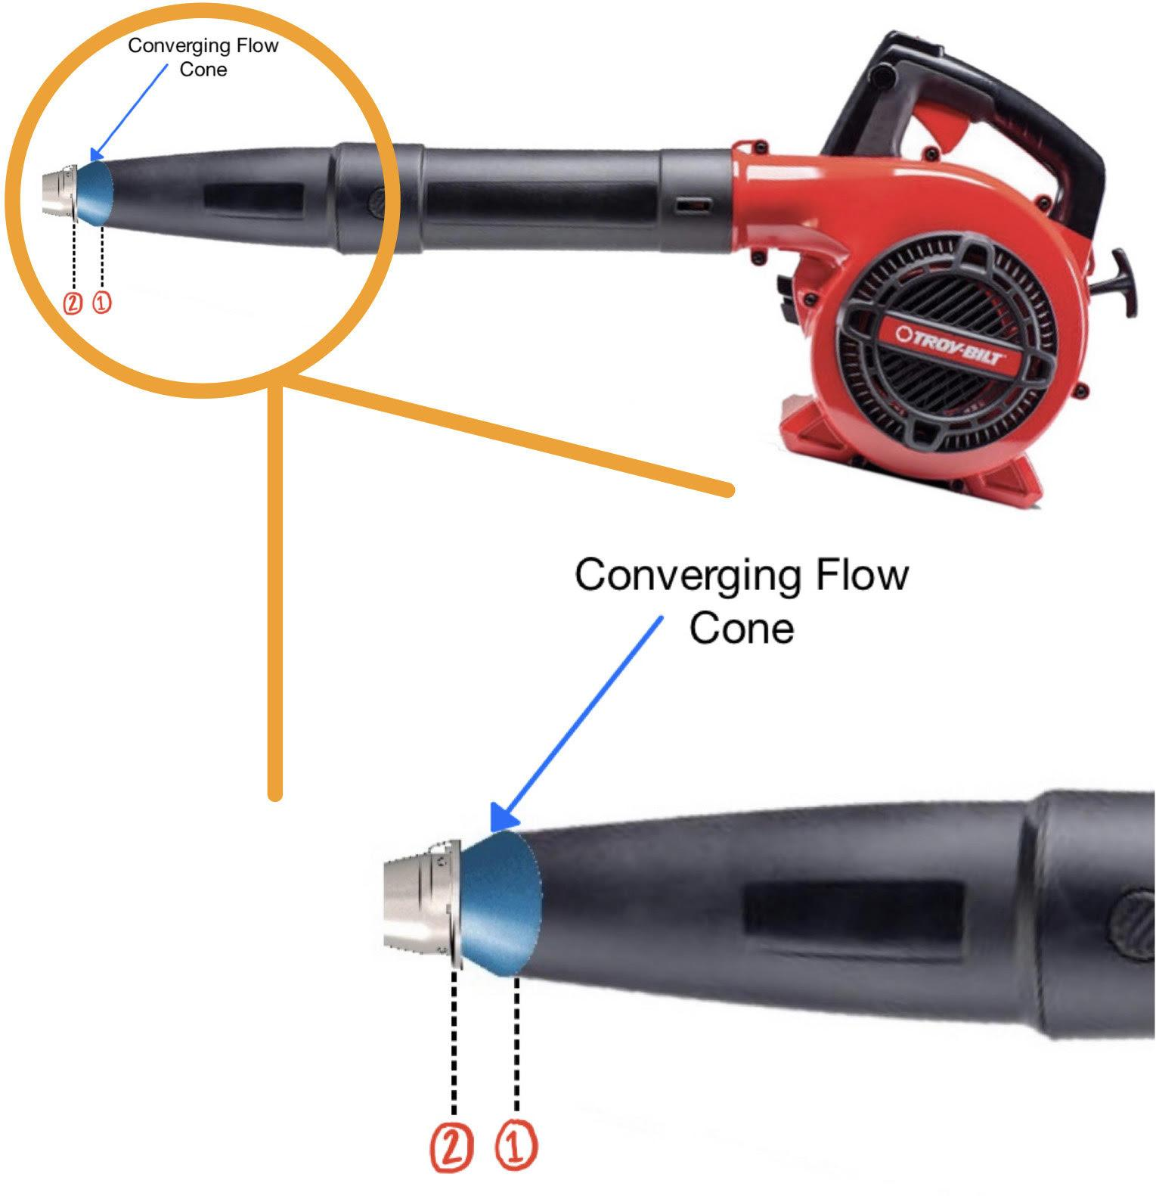
Alternative Off-Engine Testing Apparatus: Overview
Same assumptions and analysis as wind tunnel
Common leaf blower exit diameters: 3.5”, 2.75”, 2.625”
Exit Diameter | v_{1,req} (m/s) | V_{1,req} (mph)
3.5” | 61.4 | 137.36
2.75” | 102.28 | 228.8
2.625” | 113.37 | 253.6
Project Description
Baseline Design
Baseline Feasibility
Status and Strategy

Slide 35
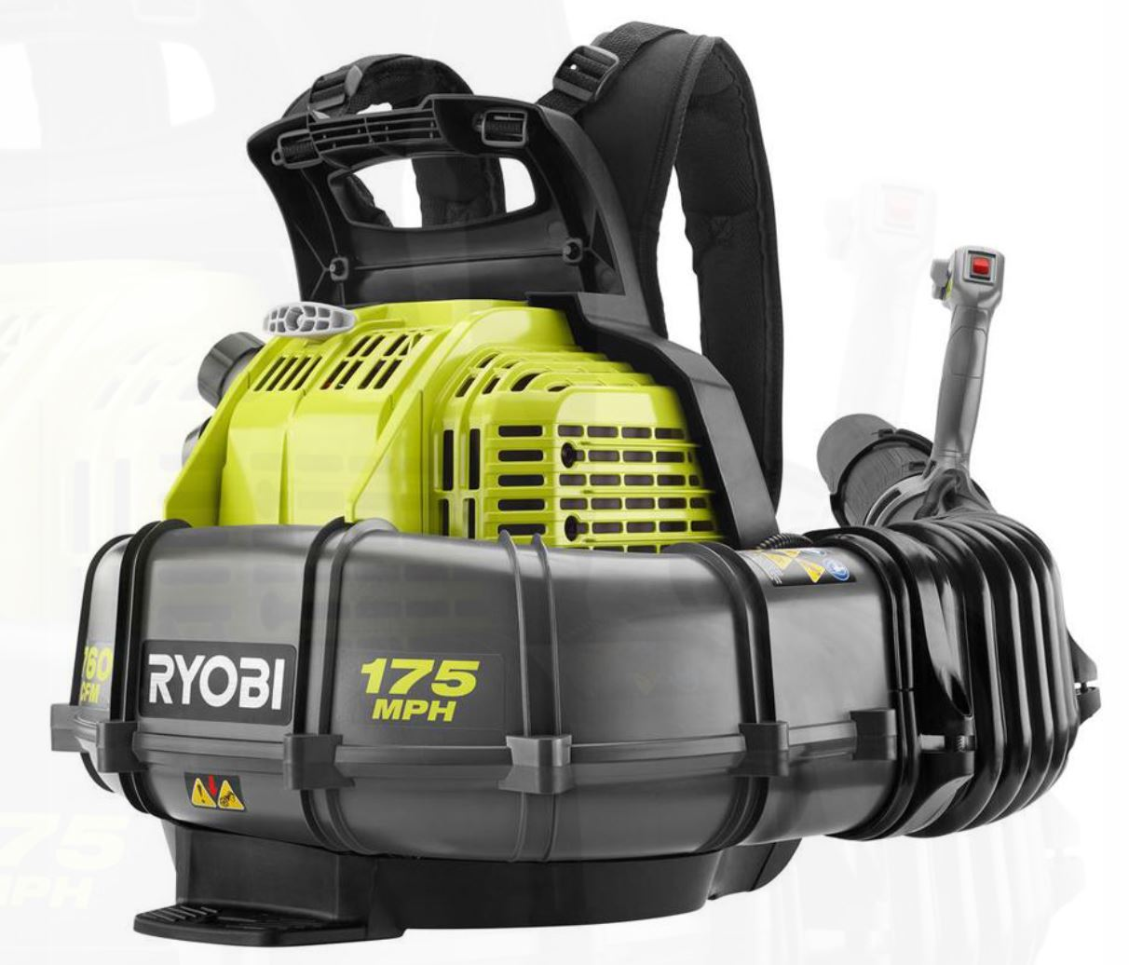
Alternative Off-Engine Testing Apparatus: Conclusion
Closest Match: RYOBI 175 MPH 760 CFM 38cc Gas Backpack Leaf Blower (3.5” diameter exit, $229 at Home Depot)
Maximum exit speed: 175 mph
Required exit speed: 137.36 mph
FEASIBLE
Project Description
Baseline Design
Baseline Feasibility
Status and Strategy

Slide 36
Alternative Off-Engine Testing Feasibility
Label | Critical Feasibility Element | FR | Feasible?
COST | The cost of all materials used for modification does not exceed $5,000, and the total cost of the project does not exceed $14,000. | N/A | Further Research Required
DATA | The engine’s Electronic Control Unit (ECU) interfaces with an external computer to enable data acquisition and storage. | 4 | ✔
INTTEMP | All components can sustain temperatures throughout their section and can integrate with each other seamlessly. | 4 | Further Research Required
Project Description
Baseline Design
Baseline Feasibility
Status and Strategy

Slide 37
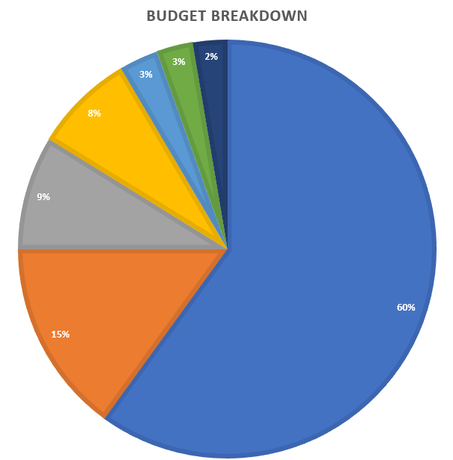
Financial Feasibility
Total Budget | $5000 | Legend
JetCat Type “K” Thermocouples (3) | $132.00
JetCat ECU USB Interface | $139.99
JetCat P100-RX Pitot Tubes (3) | $149.97
JetCat P100-RX Airspeed Sensors (2) | $439.98
Modification and Testing Costs | ~$3,000
JetCat-Certified Engine Service | ~$750
Funds Remaining | $388.06
Project Description
Baseline Design
Baseline Feasibility
Status and Strategy
Notes:
These costs are all through the U.S.-based distributor
We may not have to purchase sensors which would significantly decrease costs
These sensor costs include extras so we don’t have to wait in the event of damage
Service cost is highly variable
Modification costs aren’t really an estimate at this point, just allocating most of the remaining funds, and include material, manufacturing, testing, etc

Slide 38
Financial Feasibility
Sensors can potentially be acquired from the department, lowering costs
JetCat also provides the necessary sensors through a U.S. distributor
Certified engine service is necessary due to degradation and would cost an estimated $750 - this is highly variable and depends on inspection results
This leaves over $3000 for modifications, testing, or unseen costs
This should be adequate given the amount of in-house work that can be done
The team is also looking to purchase an extra JetCat P100-RX engine, which will cost $2662.00
This will only be done if support from the University's Engineering Excellence Fund is secured---our request is currently under review
Project Description
Baseline Design
Baseline Feasibility
Status and Strategy
Notes:
Secondary-distributor sensors lower cost and shipping wait
Engine service is highly variable, exact costs are very dependent on engine inspection and as such are hard to determine
In-house work will likely be done for most manufacturing, testing, etc. which significantly lowers costs
EEF requested funds are $3k, we may receive none (meaning no new engine) or less (potentially pulling some modifications/leftover funds to purchase new engine)

Slide 39
Status and Strategy
Project Description
Baseline Design
Baseline Feasibility
Status and Strategy

Slide 40
Summary of Feasibility Studies
 | Nozzle | Material Replacement | Model | Test Apparatus
Feasible Elements | THRUST INTTEMP | COST WEIGHT INTTEMP | THRUST TEMP MODEL | DATA COST INTTEMP
Further Study Required | Non-ideal conditions to find max area ratio | Identify type of titanium (sheet, bar, etc.) best suited for nozzle & cowling, associated cost |  | Trade between the cost of a leaf blower versus the risk of the wind tunnel
Project Description
Baseline Design
Baseline Feasibility
Status and Strategy
Notes:
Put a small bullet as to why each thing is feasible or why further study is required (add summary bullet points for each section that comes from the rest of the presentation)
Include which CPFE it verifies

Slide 41
Next Steps
Purchase, acquire, and integrate sensors for data acquisition
Thermocouples, pitot probes
Process data from engine tests and use to complete model
Calculate nozzle performance and simulate design
Develop 3D model of nozzle using visualization tools
CAD, CFD
Use 3D model of nozzle to analyze airflow
Project Description
Baseline Design
Baseline Feasibility
Status and Strategy
Notes:
Excel gantt chart

Slide 42
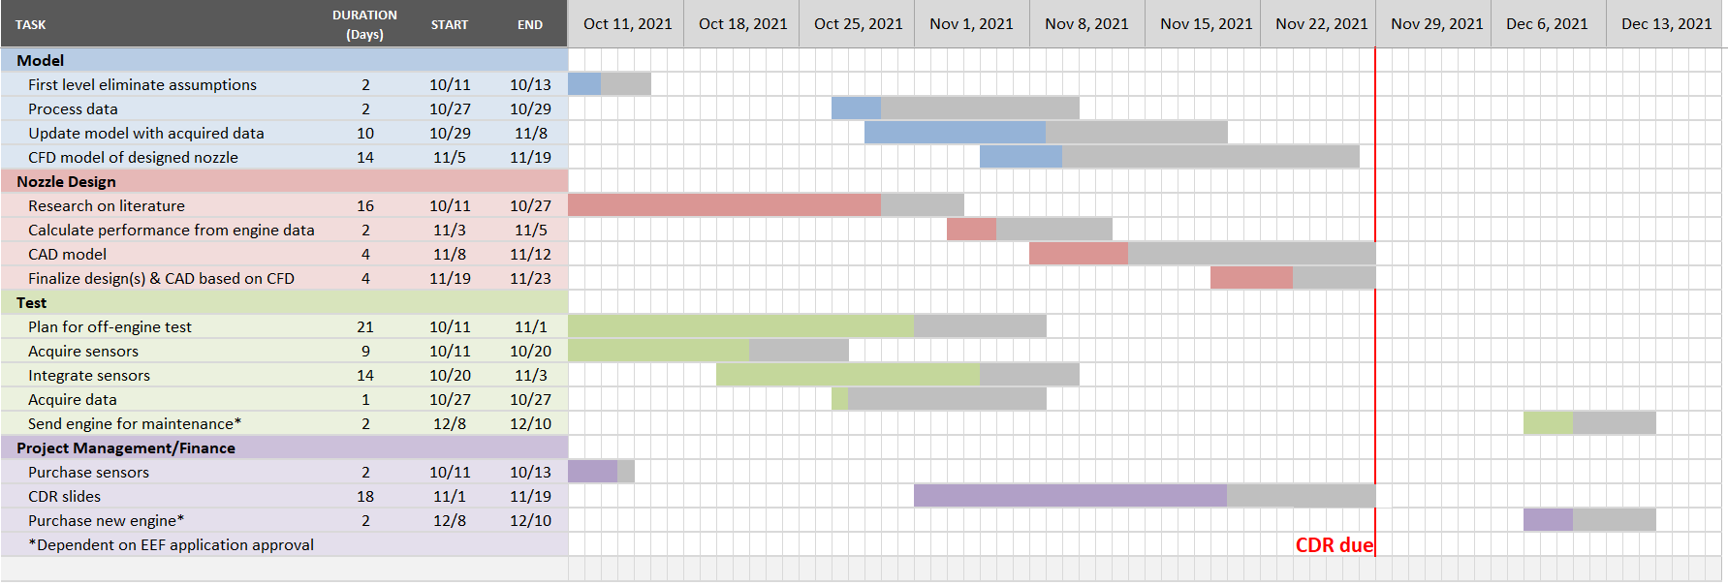
Next Steps
Project Description
Baseline Design
Baseline Feasibility
Status and Strategy
Notes:
Excel gantt chart

Slide 43
Acknowledgements
AFRL: Lt Kavi Muraleetharan, Lt Collin Parsons, and Mr. Tim Erdmann
Advisor: Alexandra Le Moine
TAs: Emma Markovich and Colin Claytor
Technical Advisors: John Mah, James Nabity, Matt Rhode, Bobby Hodgkinson, Trudy Schwartz

Slide 44
References
Mattingly, J.D. and Boyer, K.M. Elements of Propulsion: Gas Turbines and Rockets. American Institute of Aeronautics and Astronautics, 2 edition, 2016
Huang, K.P, Kisielowski, E. “An investigation of the thrust augmentation characteristics of jet ejectors,” April 1967.
Frank, G., Piper, S., Chen, Y., FitzRandolph, P., Camacho, C., Knickerbocker, M., Junker, M., Oropeza, D.C., Cutler, J., Fuernkranz, M., and Harthan, D. Specialized propulsion engine control system critical design review, 2018.
Coulon, T., Johnson, R., Jones, L., Mines, M., Schumacher, G., and Swart, C. Thrust to weight improvement of jetcat p100-rx turbojet engine, 2019
Soars, C. Gas Turbines: A Handbook of Air, Land and Sea Applications. Butterworth-Heinemann, 1 edition, 2014.
Violett, B. A few reminders for safe turbine operations.
White, F.M. Viscous Fluid Flow. McGraw-Hill, 3 edition, 2011
JetCat. Jetcat turbine datasheet, 2015
Razak, A.M.Y. Gas turbine combustion.
Aeronautics Guide. Aircraft turbine engine fuel system components
Erickson, D.M., Day, S.A., and Doyle, R. Design considerations for heated gas fuel.
Larson, G.C. The hotter the better.
Autonomous Manufacturing. A guide to 3d printing with titanium
Online Metals, URL: https://www.onlinemetals.com/en/buy/aluminum-round-bar-7075-t6-t651-cold-finish?q=%3Aprice-asc&page=1&pagesize=25&sort=price-asc

Slide 45
Supplemental Material

Slide 46
Design Requirements
DR | Design Requirement | FR
1.1 | Design a T/W-improving modification that increases thrust and/or decreases weight which does not trigger the fail-safes that shut the engine down. | 1
2.1 | The engine’s TSFC increases by less than 5% of its nominal value or decreases by any amount | 2
2.2 | The engine’s propulsive efficiency decreases by less than 5% of its nominal value or increases by any amount | 2
2.3 | The engine’s thermal efficiency decreases by less than 5% of its nominal value or increases by any amount | 2
2.4 | The engine’s weight increases by less than 10% or decreases, unless an after-burner is implemented on the engine, in which case engine weight increases will be less than 30% | 2
2.5 | The cost of modifications is within the budget. Up to $5,000 may be spent on modifications to the engine and will be automatically provided to the group, while up to$14,000 may be used to fund project expenses not directly used for modification design and manufacturing | 2
Notes:
Variable geometry ruled out due to static conditions during testing
Nozzle weight is a small % of engine weight

Slide 47
Design Requirements, cont.
DR | Design Requirement | FR
2.6 | The fuel flow rate does not increase significantly; ideally, it decreases while maintaining engine performance | 2
2.7 | The engine’s max thrust decreases by less than 5%, or increases | 2
3.1 | A thermodynamic model based on the ideal Brayton cycle is developed and predicts baseline engine performance | 3
4.1 | The team’s engine test lead and an instructor or graduate student experienced with operating the P100-RX engine are present at all hands-on test events. | 4
4.2 | A method of testing modifications external to the engine, dependent on the type(s) of modification(s) designed, is developed | 4
Notes:
Variable geometry ruled out due to static conditions during testing
Nozzle weight is a small % of engine weight

Slide 48
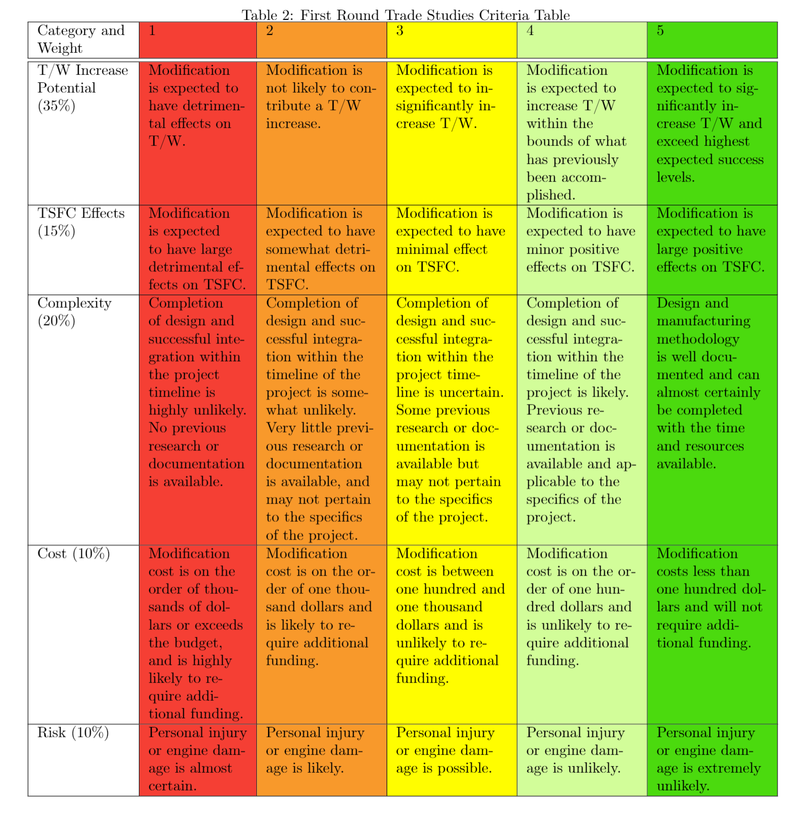
Trade Study Matrices

Slide 49
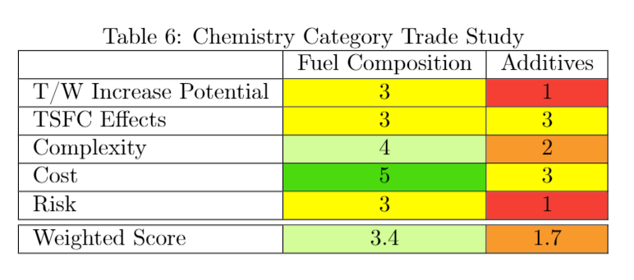
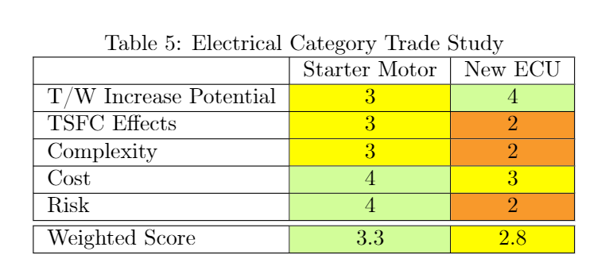
First Round of Trade Study

Slide 50
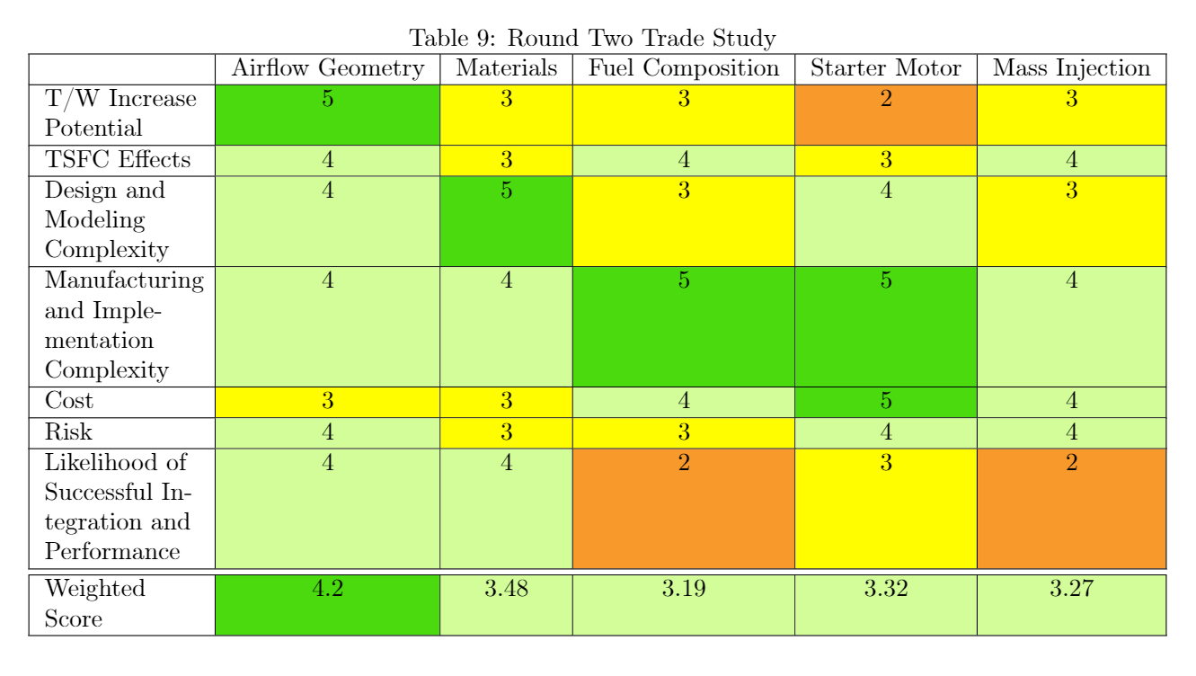
Second Round of Trade Study

Slide 51
Nozzle Trade Study
Criteria | 1 | 2 | 3 | 4 | 5
Thrust (45%) | Decrease in thrust | Little to no thrust improvement | Moderate increase in thrust | Significant increase in thrust within bounds of previous accomplishments | Significant increase in thrust that exceeds previous accomplishments
Weight of Nozzle (5%) | Significant Increase in weight | Small Increase in weight | No effect on weight | Small decrease in weight | Significant Decrease in weight
Modeling Complexity (20%) | Unable to model with desired accuracy | Able to model with desired accuracy with significant time and resources | Able to model with desired accuracy with moderate time and resources | Able to model with desired accuracy with little time and resources | Model requires little overall work to achieve desired accuracy
Likelihood of Success (30%) | Performance is highly sensitive to external parameters and meeting expected performance is highly unlikely | Performance is moderately sensitive to external parameters and meeting expected performance is unlikely | Performance is slightly sensitive to external parameters and meeting expected performance is likely | Performance is not sensitive to external parameters and meeting expected performance is likely | Performance is not sensitive to external parameters and meeting expected performance is likely. Design also includes contingencies
Notes:
All will have similar levels of manufacturing difficulty, depending on material chosen
CD nozzle depends highly on external factors

Slide 52
Nozzle Trade Study
 | Converging | Fixed Converging-Diverging | Ejector
Thrust (45%) | 4 | 4 | 5
Weight of Nozzle (5%) | 4 | 2 | 2
Modeling Complexity (20%) | 4 | 3 | 2
Likelihood of Success (30%) | 4 | 2 | 5
Total | 4 | 3.1 | 4.25
Notes:
Variable geometry ruled out due to static conditions during testing
Nozzle weight is a small % of engine weight

Slide 53
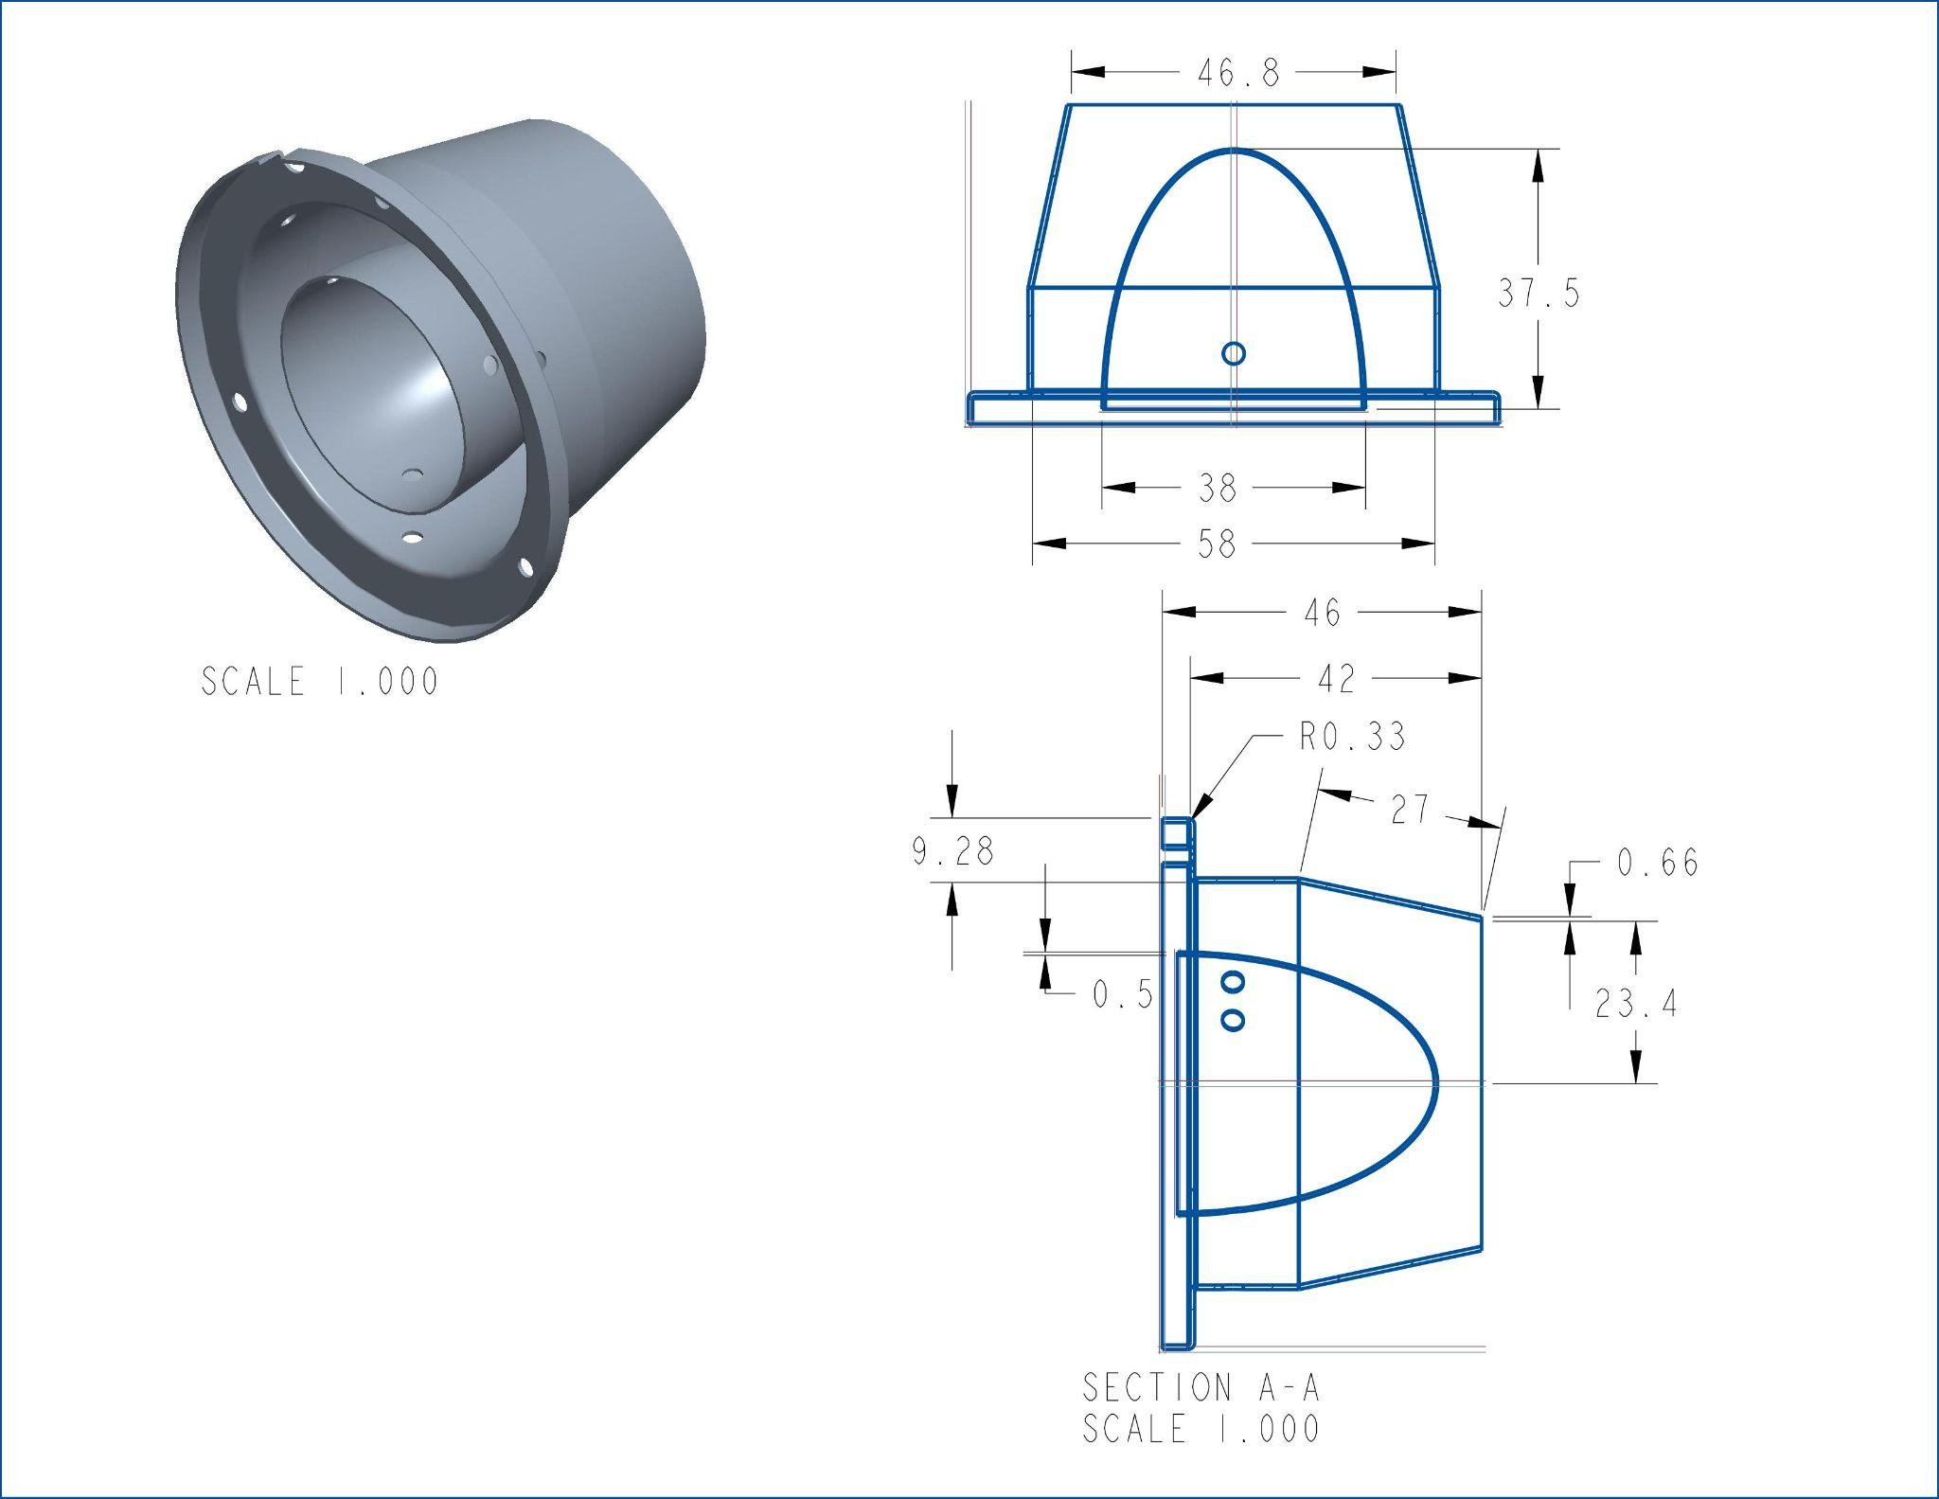
CAD model of current nozzle
Inlet area = 15.6687cm^2
Exit area = 17.2021cm^2

Slide 54
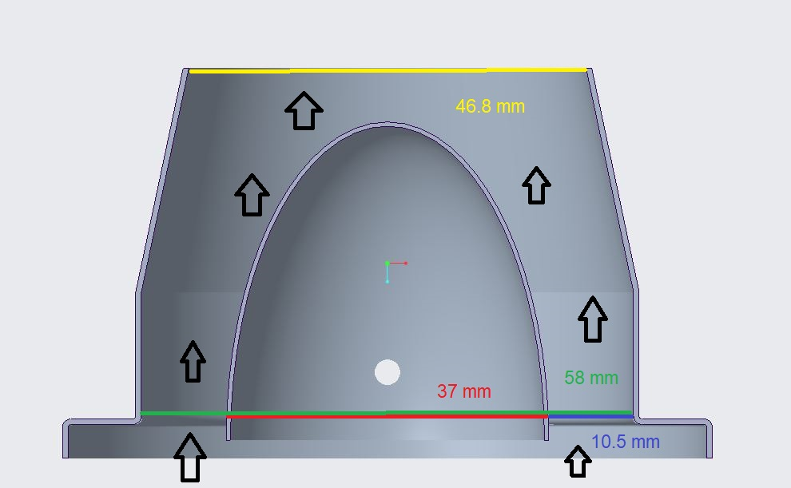
CAD model of current nozzle 2
Inlet area = 15.6687cm^2
Exit area = 17.2021cm^2

Slide 55
Material Replacement
Thermal Stresses
Maximum temperature reached is approximately 1100 K in combustor
T_{f} = 1100K and T_{i} = 293K
𝜎 = E𝛼(T_{f} - T_{i} )
Alloy | Elastic Modulus (GPa) | Yield Strength (MPa) | Tensile Strength (Mpa) | Density (g/cm³) | Thermal Expansion Coefficient (K⁻¹) | Thermal Stress (GPa)
Stainless Steel | 180 | 860 | 502 | 8.0 | 1.73e-5a | 2.51
Al 6061 | 69 | 35 | 42 | 2.7 | 2.34e-5 | 1.30
Al 2024 | 72.4 | 42 | 64 | 2.78 | 2.32e-5 | 1.36
Al 7075 | 71 | 70 | 78 | 2.81 | 2.36e-5 | 1.35
Notes:
Explicitly state which part has listed initial, final temps

Slide 56
Material Properties
Material | Density (g/cm³) | Melting Point (K) | Cost (/kg)
Stainless Steel 304 | 8.00 | 1678-1728 | $18
Stainless Steel 316 | 7.99 | 1643-1672 | $23
Stainless Steel 410 | 7.80 | 1753-1803 | $25
Aluminum 7075-T6 | 2.81 | 750 - 908 | $58
Aluminum 6061-T6 | 2.70 | 850 - 925 | $28
Aluminum 2024-T4 | 2.78 | 775 - 911 | $45
Titanium Ti-6Al-4V | 4.43 | 1877 - 1933 | $50
Titanium Ti 3Al 2.5 | 4.48 | 1973 | $103
Notes:
Need to put nozzle weight considerations somewhere
More generic than specific alloys
Measure cowling again (more accurately, graduated cylinders)
Not sure water displacement volume is necessary on this slide

Slide 57
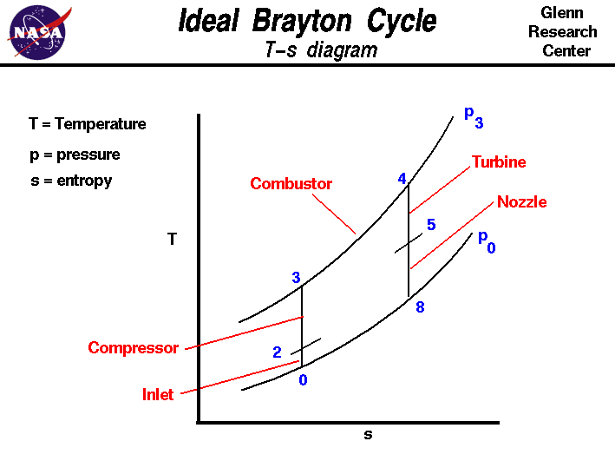
T-S Diagram of Jet Engines

Slide 58
Assumptions for Ideal Model
Cp and 𝛾 are Constant
Due to the amount of fuel being used compared to air is really small, the specific heat and 𝛾 values change very little
EQL software has 𝛾 changing from 1.4 to 1.379
Isentropic through the compressor, turbine, and nozzle
Assumes that there is not heat loss, which due to high efficiencies of stations generally, means that there are very little losses 𝛾𝛾
Constant Pressure in combustor
Pressure losses in actual combustor are really small, so assuming constant pressure
Adiabatic
If all components(minus combustor) are assumed to be adiabatic
100% Efficiency
Ignores loses that would occur due to friction, heat transfer, etc. Most station efficiency are around 80-90% so little impact will be made on model.
Subsonic Jet Engine
Due to the absence of shocks and expansion waves, the exhaust gas will be perfectly expanded and the pressure equal to the atmospheric pressure

Slide 59
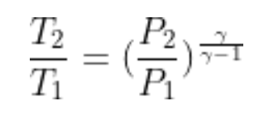
Baseline Model Calculations - Compressor
Use free stream, sea level, and room conditions to find temperature and pressure changes in compressor
Constant Total Pressure and Temperature
Pressure Ratio of Compressor
Isentropic Assumption

Slide 60
Baseline Model Calculations - Combustor
Use compressor exit temperature and pressure values to find change in temperature and pressure in the combustor
Constant Pressure
Constant Specific Heat
EQL to find enthalpy change
Find temperature change based off of first law of thermodynamics

Slide 61
Baseline Model Calculations - Turbine
Use nozzle inlet and combustor exit conditions to find pressure and temperature changes and
Isentropic
Constant Total Pressure and Temperature
Temperature entrance from combustor

Slide 62
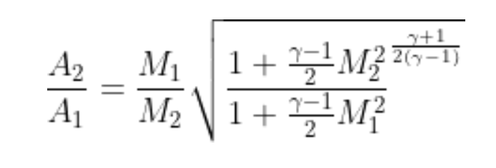
Baseline Model Calculations -Nozzle
Use given engine data from JetCat to find mach, temp, and pressure changes through the nozzle
Isentropic Assumptions
No change in Entropy
No friction losses
Adiabatic
Constant Total Pressure and Temperature
Area-Mach Relation

Slide 63
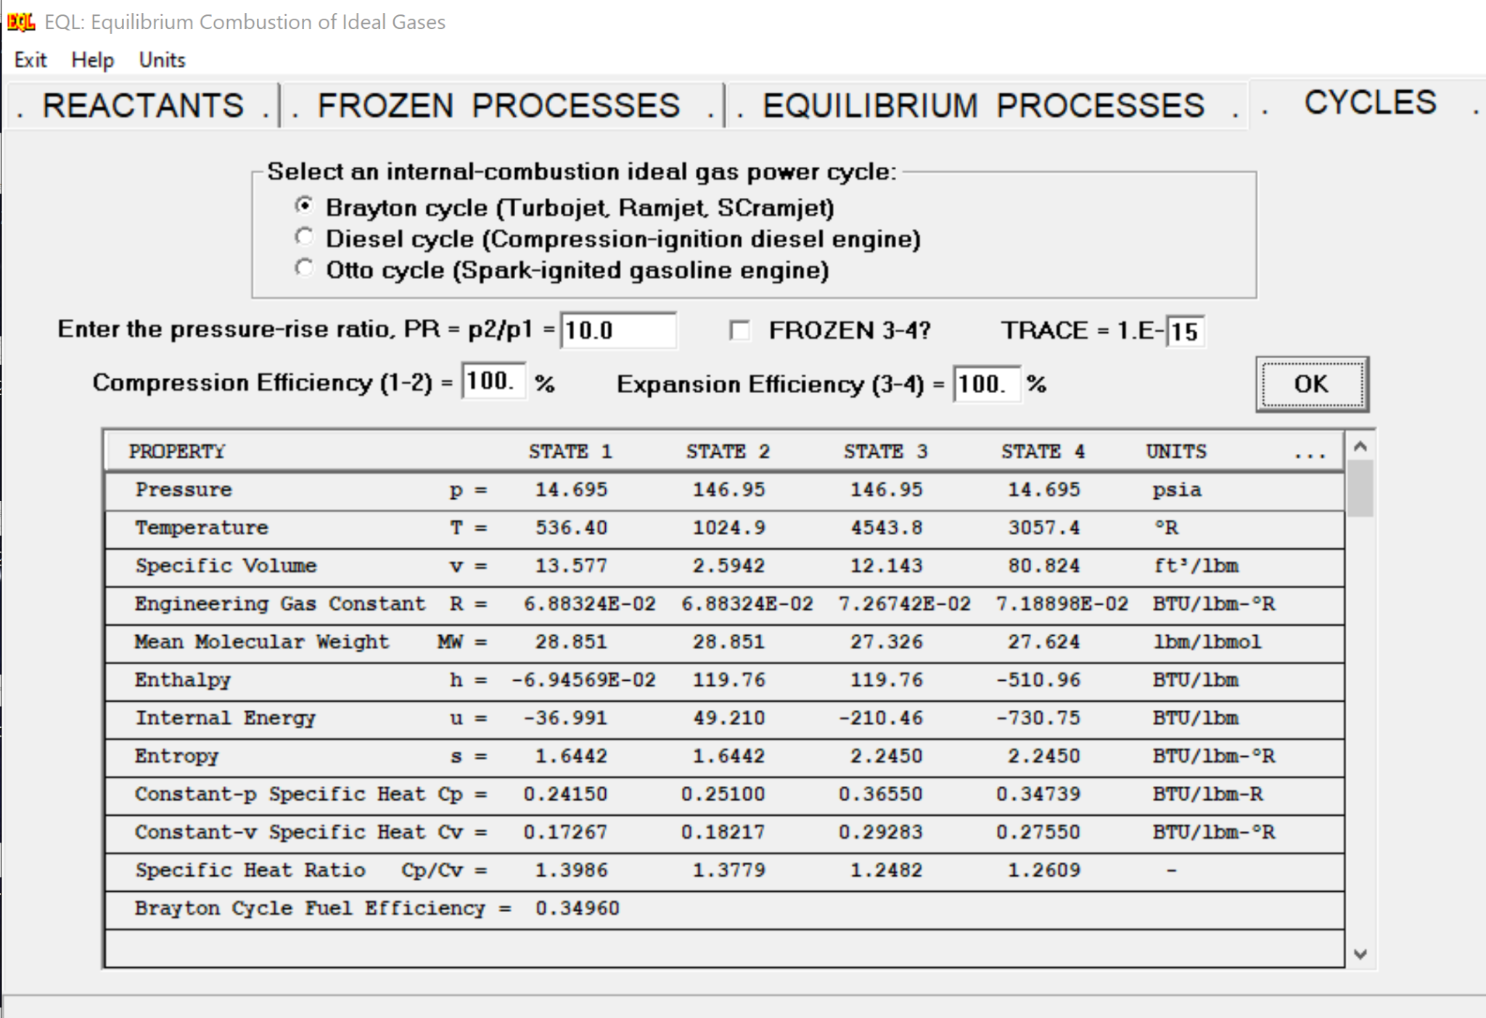
EQL Software
EQL is a NASA developed software that gives you thermodynamic properties of a combustion process based on the fuel to air ratios and the type of process being performed
Temperature, Entropy, Enthalpy, Pressure, Internal Energy,
Knows the energy required to create and break the bonds needed for the reaction
Knows enthalpy of reactants and products at certain temperatures
Uses change of energy from bond breaking/formering to calculate the change in enthalpy
Uses enthalpy to find temperature, entropy, and pressure changes at different stages in process

Slide 64
Model Improvement Plan
Steps to Improve current Model
Start to eliminate assumption
Acquire necessary sensors
Pitot tubes, thermocouples, IR Sensor/Camera
Attach sensors where measurements are needed
Pitot tube at the entrance and exit of engine,
Thermocouples before and after each station
IR sensor/Camera pointing at engine (Maybe)
Run engine and collect data
Verify that data makes sense compared to ideal model and follows similar trend
Rank assumptions based on biggest sources of errors
Remove assumptions that create significant errors
Use data obtained from engine, calculate total loses
Heat Transfer, Rayleigh flow losses, Efficiencies
Create new model
Design modifications based off of new model

Slide 65
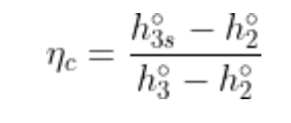
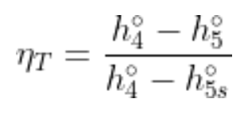
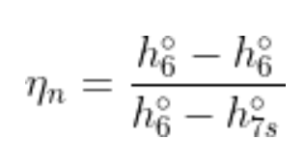
Calculating Efficiencies of Engine Stations
Compressor
Usually between 0.85 and 0.90
Combustor
Usually between on .97 and 0.99
Turbine
Usually between on .90 and on.955
Nozzle
Usually between 0.95 and 0.98
Key:
h_{xs}º = total enthalpy required to achieve P_{x}º if isentropic
ṁ = total mass flow rate
ṁ_{f} = mass flow rate of fuel
h_{PR} = Low heating value of fuel
hº = total enthalpy

Slide 66
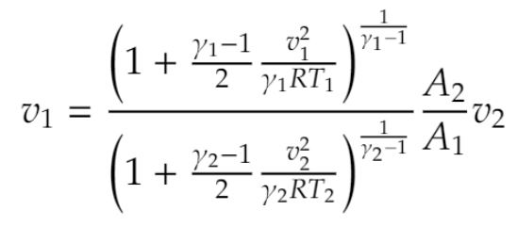
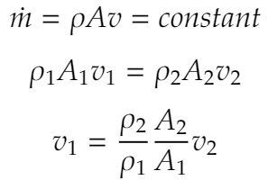
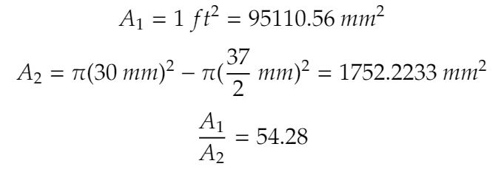
Wind Tunnel Calculations
Wind Tunnel Capability:
Assumptions:
Flow is isentropic
Ratio of specific heats is constant
Static pressure is constant (Standard atmosphere at 1500 m)
Static temperature is constant (Room temperature at 295 K)
Continuity:
target
velocity
Isentropic relation

Slide 67
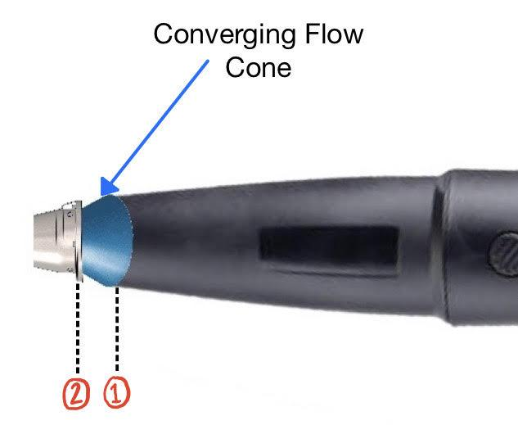
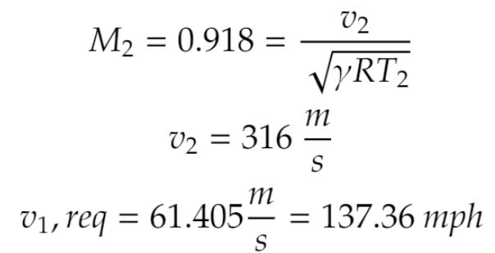
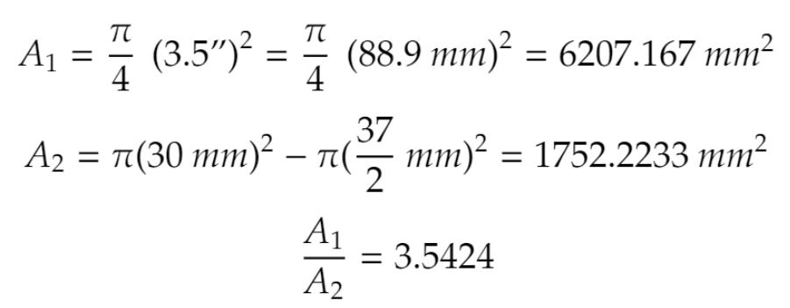
Leaf Blower Calculations
Assumptions:
Flow is isentropic
Ratio of specific heats is constant
Static pressure is constant (Standard atmosphere at 1500 m)
Static temperature is constant (Room temperature at 295 K)
Continuity:
Leaf Blower Capability:
target
velocity
Isentropic relation

Slide 68
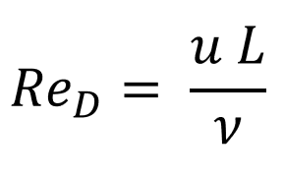
CFD Feasibility
Where:
u = fluid velocity
L = characteristic length (nozzle diameter)
ν = kinematic viscosity of the fluid
𝑅𝑒_{D}= 101,000 at the inlet; compare this to the generally accepted Reynolds number for completion of transition to turbulence of 𝑅𝑒_{D}= 4,000
Larger Reynolds numbers require finer near wall meshes due to the high near wall gradients
Using 2D axisymmetric domains can greatly reduce computational cost

Slide 69
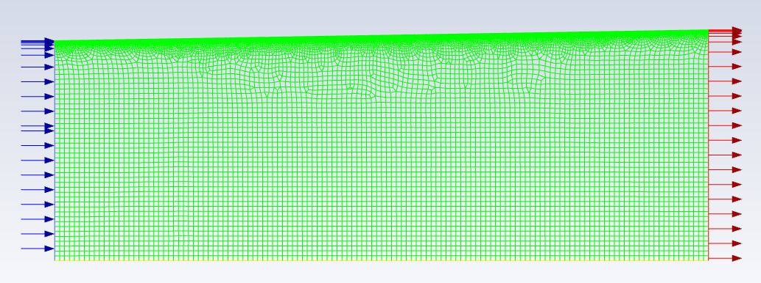
First Iteration Mesh and Boundary Conditions
First iteration matches inlet and outlet areas with a simple axisymmetric 2D domain

Slide 70
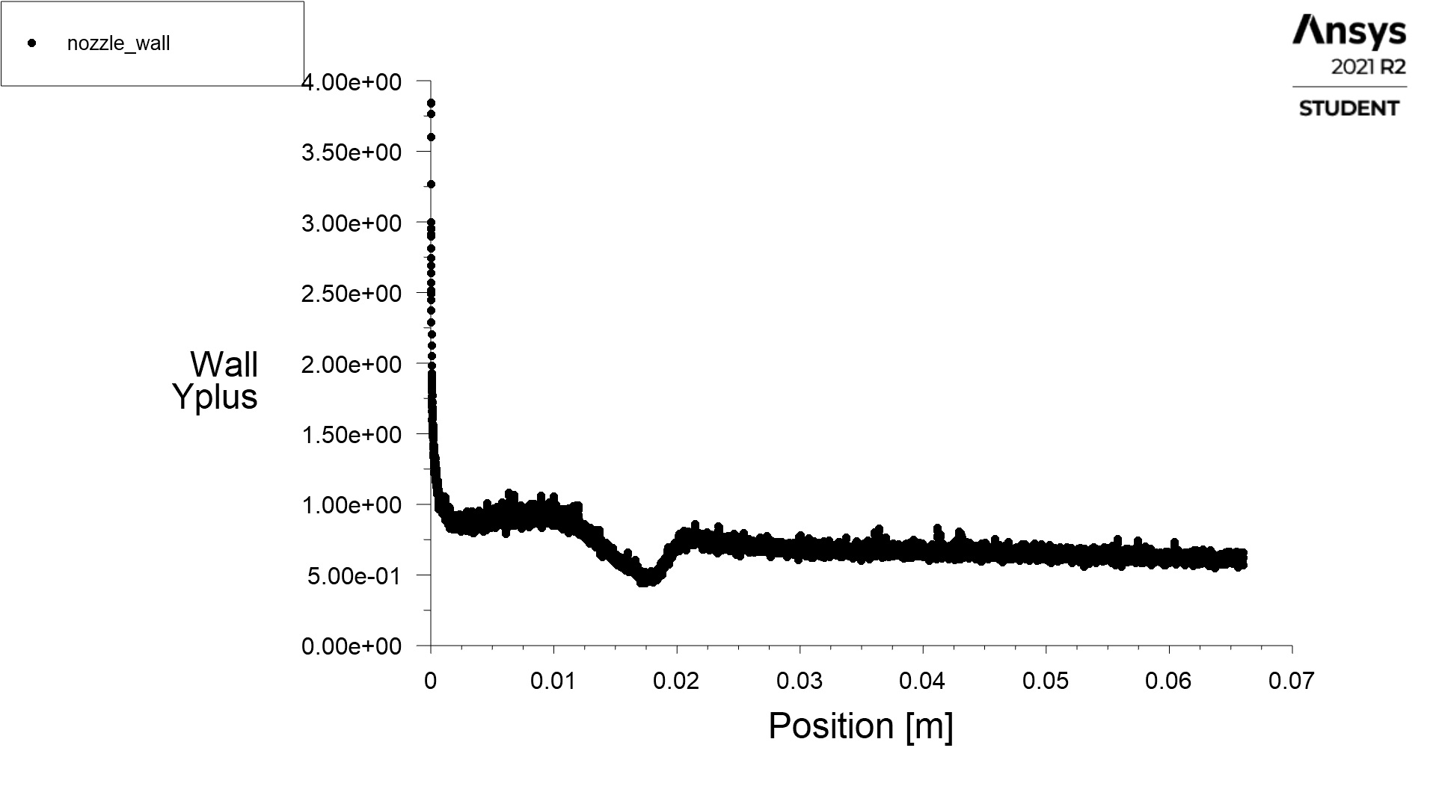
CFD Mesh Sizing
Unstructured grid
Iterated first gridpoint distance to get y⁺_{First} < 1
Mesh that satisfies y⁺_{First} < 1 for the first iteration domain
195,652 Nodes
188,673 Elements

