Slide 1
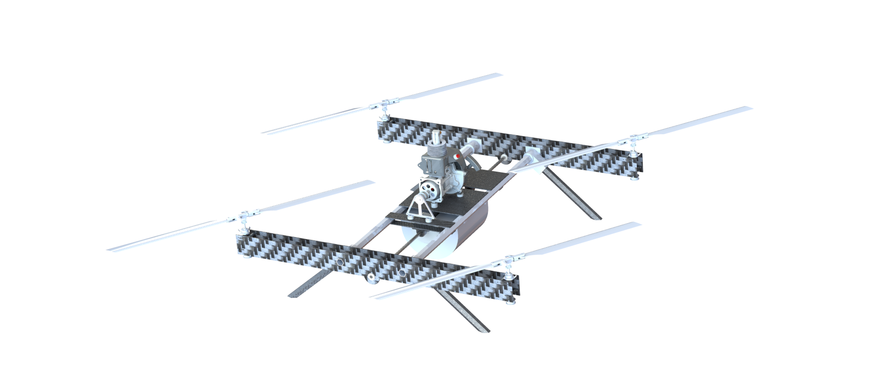
EMU
Test Readiness Review
Client:
Steve Borenstein
Team:
Alejandro Castillo, Becca Rivera, Dakota Labine,
Henry Moore, Libby Hasse, Matthew Lehmann,
Max Alger-Meyer, Michael Flores, Mitchell Spencer
Nathan Castille, Nathan Hetzel, Shawna McGuire
Advisor:
Jean Koster
Endurance Multirotor UAS
Project Manager:
Dakota Labine
Notes:
Dakota 10.45 s

Slide 2
Overview
Notes:
Dakota
1:33 Total

Slide 3
Project Motivation and Statement
Mission:
The EMU team will design a fully autonomous, 25 lb, multirotor UAS capable of completing long duration flight while supporting a 5 lb payload and streaming video
Motivation:
The IRISS team would benefit from a heavy lift, long duration UAS to expand their mission profiles
Create a chassis capable of being scaled to allow the IRISS team develop mission specific vehicles
Notes:
Dakota

Slide 4
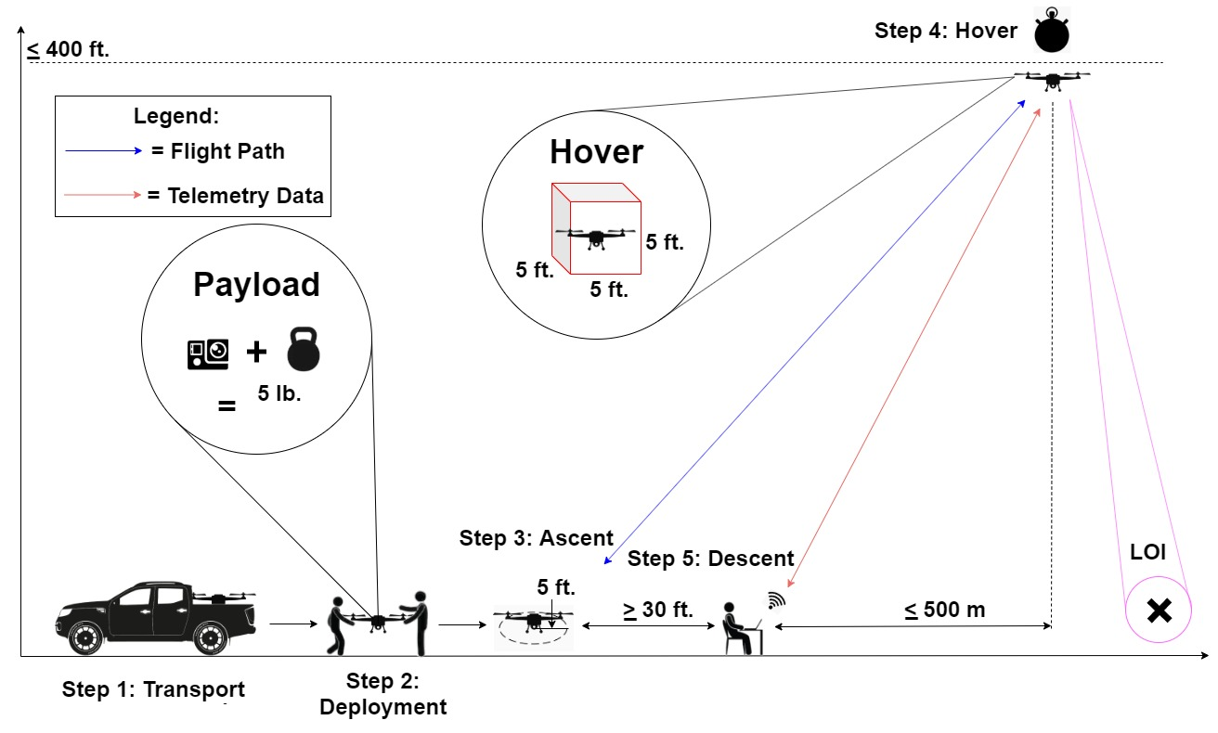
CONOPS
Notes:
Michael

Slide 5
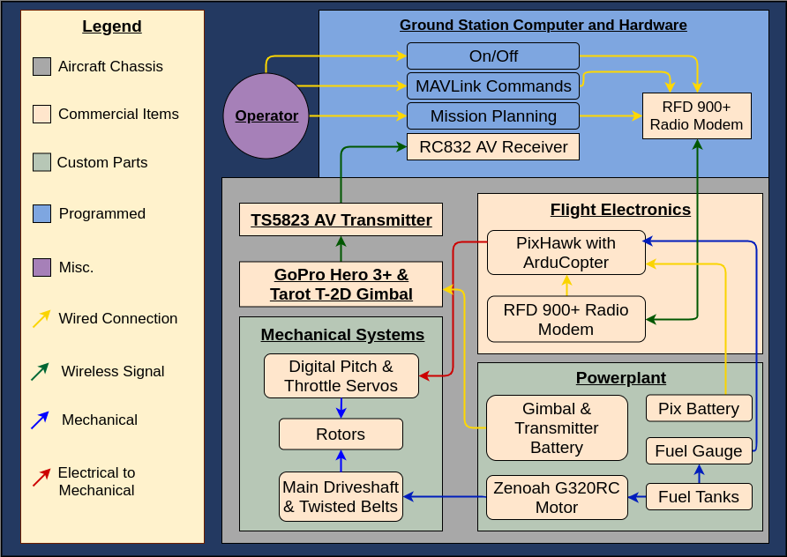
Functional Block Diagram
Notes:
Michael

Slide 6
Critical Project Elements (CPEs)
CPE | Rationale
Chassis | UAS chassis must withstand operational forces, support components, and allow component integration
Drivetrain | Drivetrain must safely transfer power to rotors in a stable configuration
Rotor Assembly | Rotor assembly must provide aerodynamic lift and control over the UAS
Power Plant | Power plant must provide enough power for all flight phases across a two hour hover operation
Flight Software | Flight software must enable UAS communication and manual or autonomous flight control

Slide 7
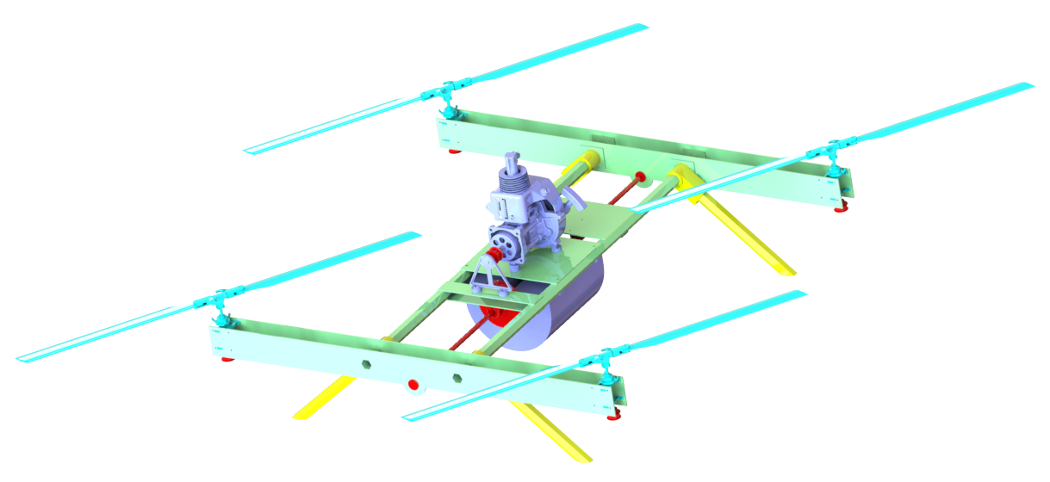
Design Recap: Mechanical Systems
Rotors
8 Rotor Blades & Assemblies
Power Plant
Gas Engine & Centrifugal Clutch
Landing Assembly
4 Carbon Fiber Legs & Shock Absorbers
Chassis
Carbon Fiber Prop Arms & Hex Tube Supports
Drivetrain
Drive Shaft Supporting Quarter-Turn Belt Drive

Slide 8
Project Progress: Requirements
64 Total Requirements
Verified
Verification in Progress
To Be Verified

Slide 9
Project Progress: Levels of Success
Controls
Flight Endurance
Power Plant
Chassis
Autonomy
Safety
Ground Station
Payload
27 Total Levels
11% Completed

Slide 10
Schedule
Notes:
Dakota

Slide 11
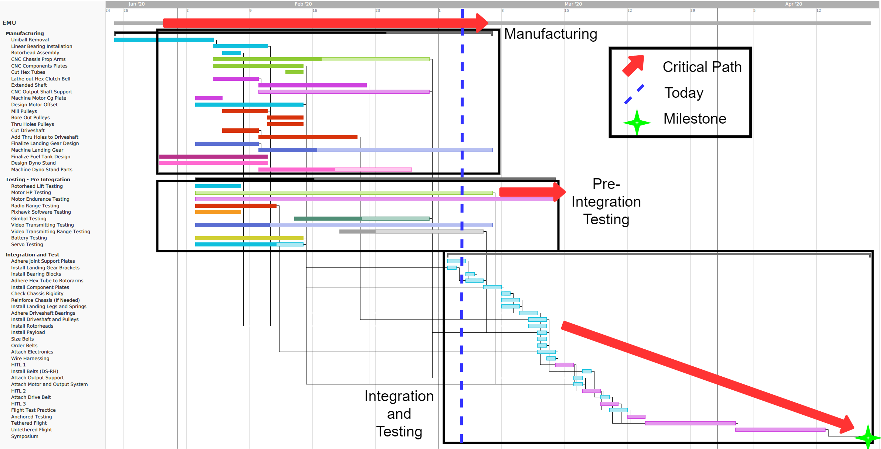
Schedule - Full
Notes:
Dakota

Slide 12
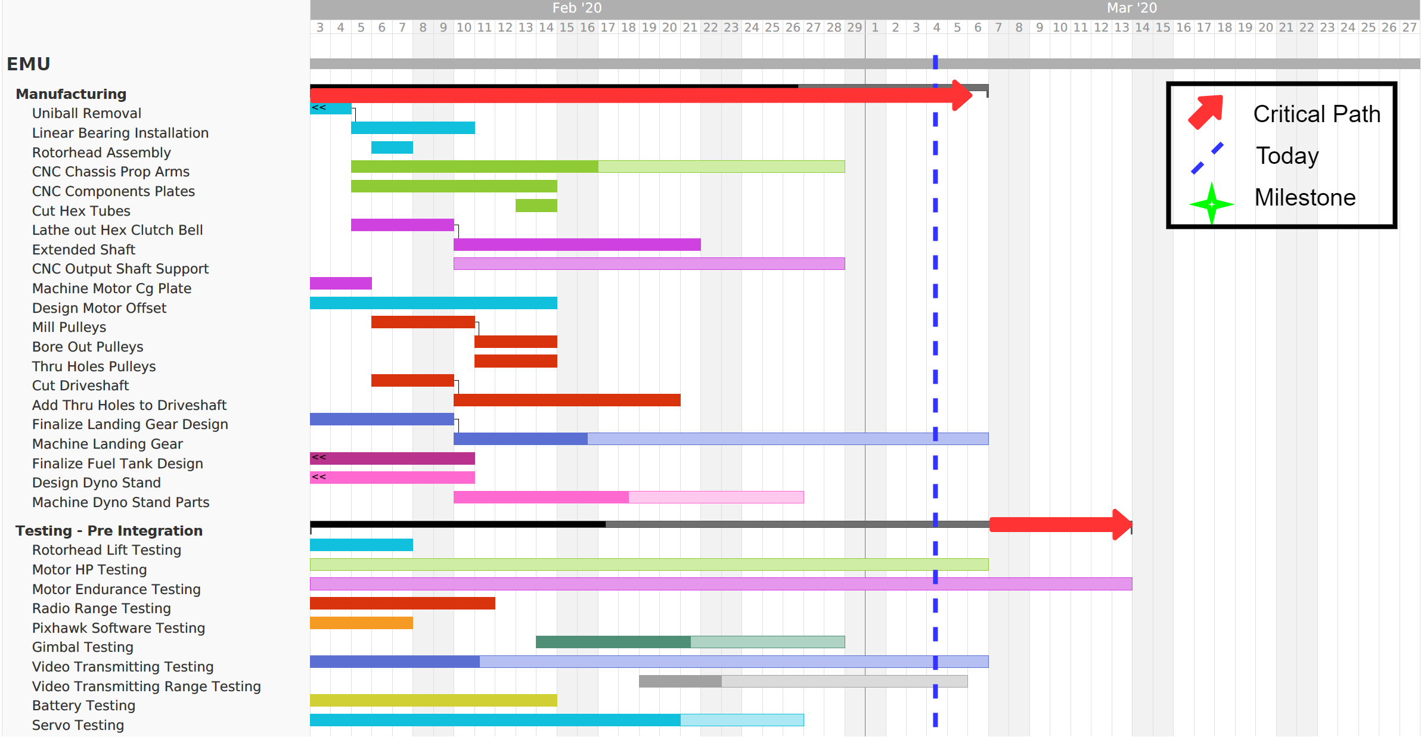
Schedule - Manufacturing and Testing
Notes:
Dakota

Slide 13
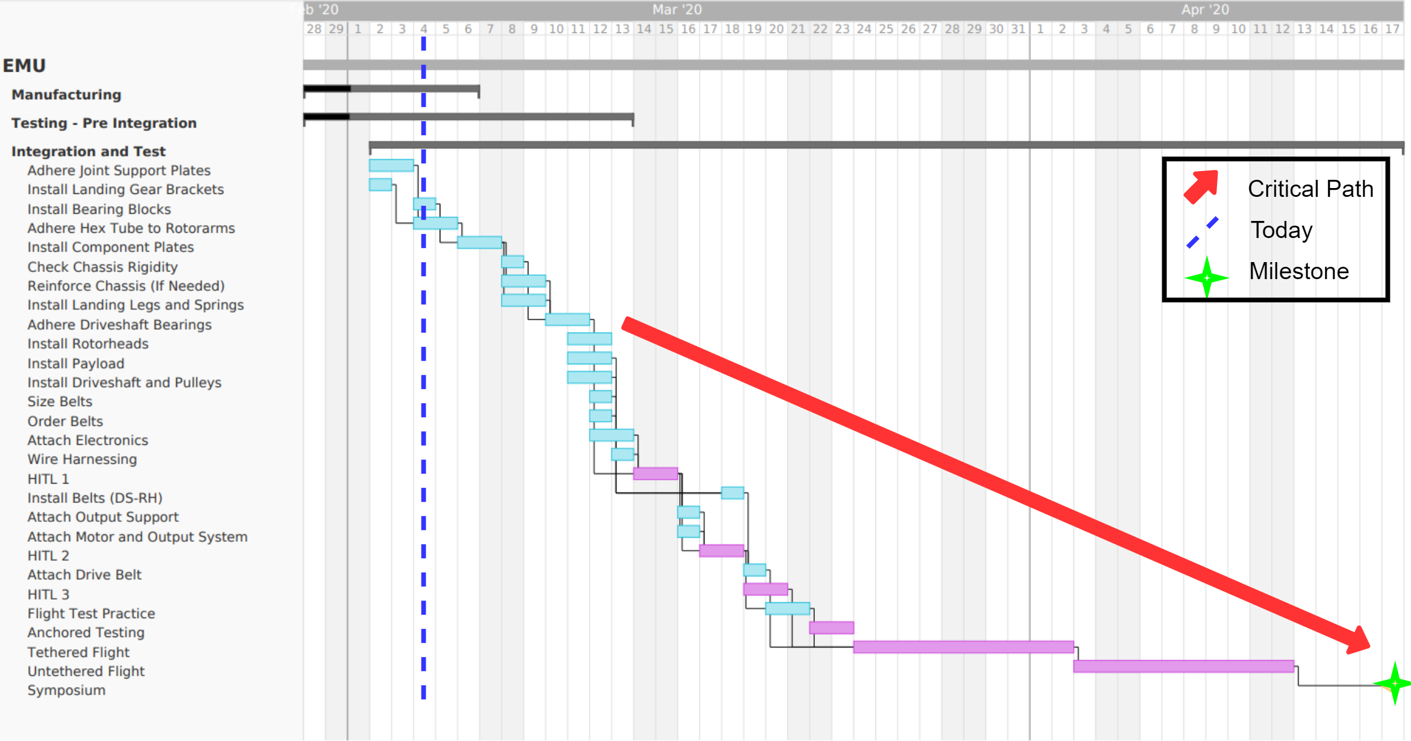
Schedule - Integration and Testing
Notes:
Dakota

Slide 14
Test Readiness

Slide 15
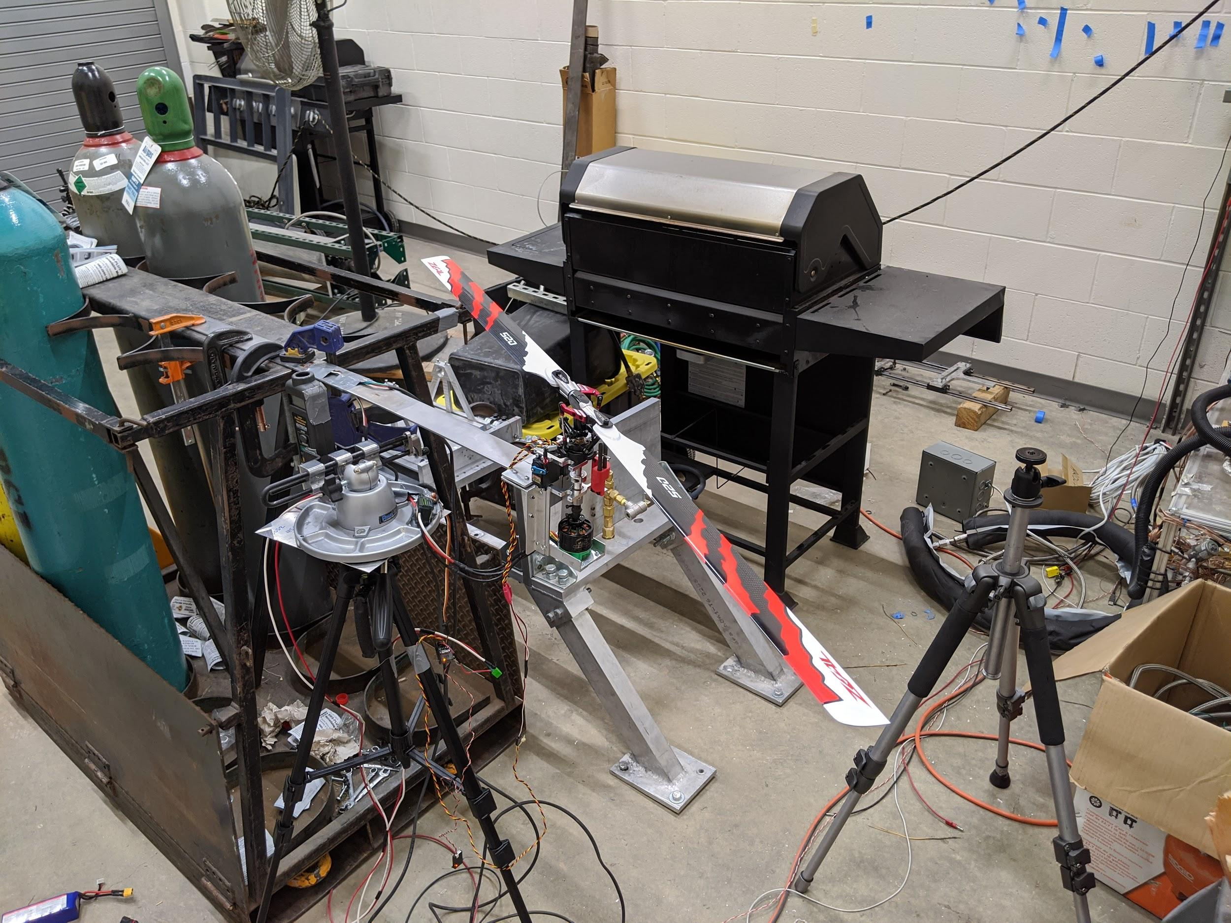
Rotor Thrust Testing
Rationale:
Validate the rotor thrust model to confirm correct blade selection
Equipment:
Engine Cell
Strain Sensors
Photo Tachometer
Electric Motor
Servos
Status:
The testing and data processing has been completed

Slide 16
Rotor Thrust Testing
Procedure:
Measure blade pitch and rotor RPM as model inputs
Compare recorded thrust to model predictions at given inputs
Mitigation:
Verify our lift predictions to ensure chosen propellers meet flight requirements
Theory:
Cantilever beam has a linear force/strain relation

Slide 17
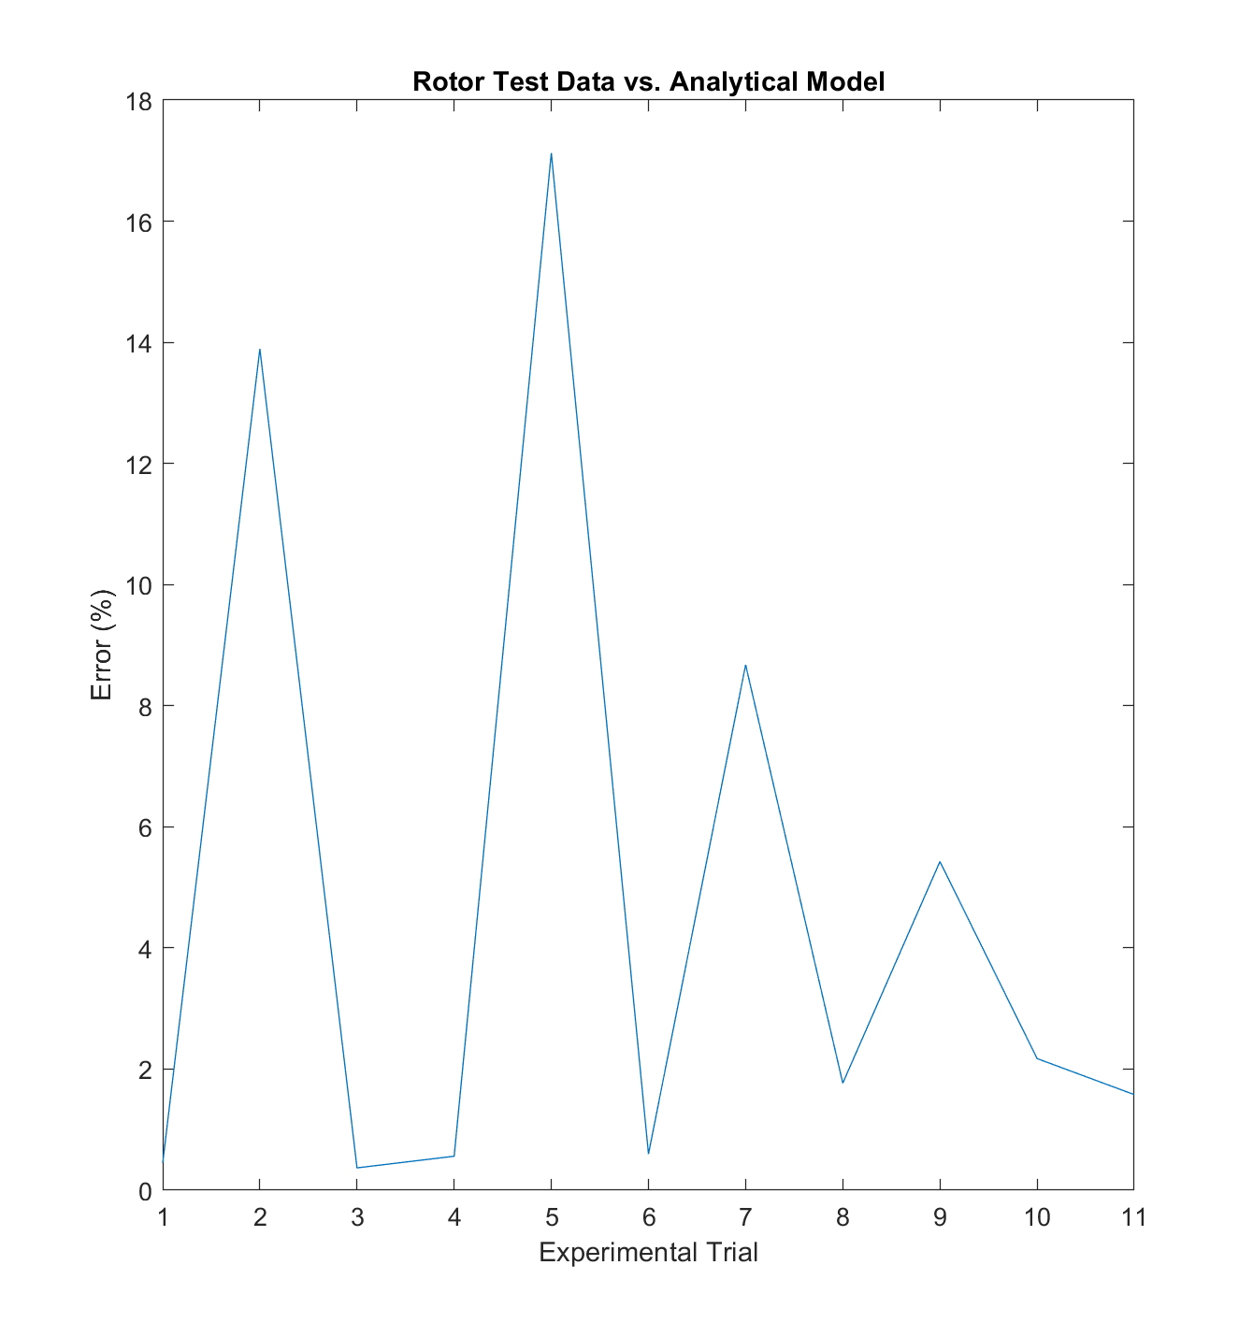
Rotor Thrust Testing
Rotor testing compared to analytical model
One removed outlier
Mean error 4.8%
Max error 17%
Further analysis in progress
Validates analytical model to necessary accuracy
Main error sources: energy lost to vibrations, sticky rotor head pitching.
Notes:
Low reynolds number likely cause of outlier
Possible harmonic effects of either test stand or aerodynamics causing periodicity of error
model errs on the low side of data, meaning that thrust is slightly *above* predicted value

Slide 18
Engine Dyno Testing
Engine Dyno Test Rationale
Engine Break-in:
Engine speeds reach up to 20,000 RPM so the dyno is the most practical safe manner to break in the engine
Other methods (propeller) would be unsafe at these speeds
Thermal Testing:
Exact engine operating temperatures are not clear prior to testing
Thermal testing using a FLIR camera and a laser thermometer will help quantify motor thermals and temperature ranges near the carbon fiber during operation.
Systems functionality:
Other systems such as the engine speed regulation, and the emergency ignition-kill system need to be tested prior to installation
Power Verification:
Allows for verification of advertised HP and torque at advertised RPM
Notes:
Rationale only on this slide

Slide 19
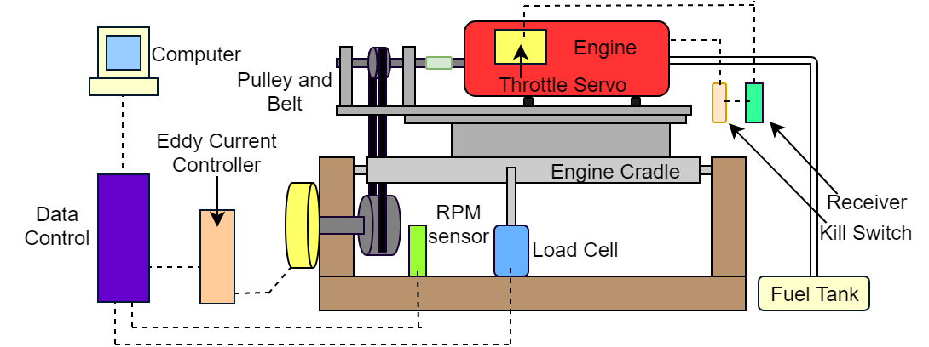
Engine Dyno Testing
Engine Test Design
Setup:
Eddy current dynamometer with custom motor mount and belt tensioner
Equipment:
Engine cell, dyno, tachometer, load cell, engine, kill switch, wireless receiver
Safety:
Throttle servo is powered by power supply in safe room
Throttle servo and kill switch are connected to wireless receiver
Data harness cables routed into safe room for live Dyno control on a PC
Notes:
Testing Design only on this slide

Slide 20
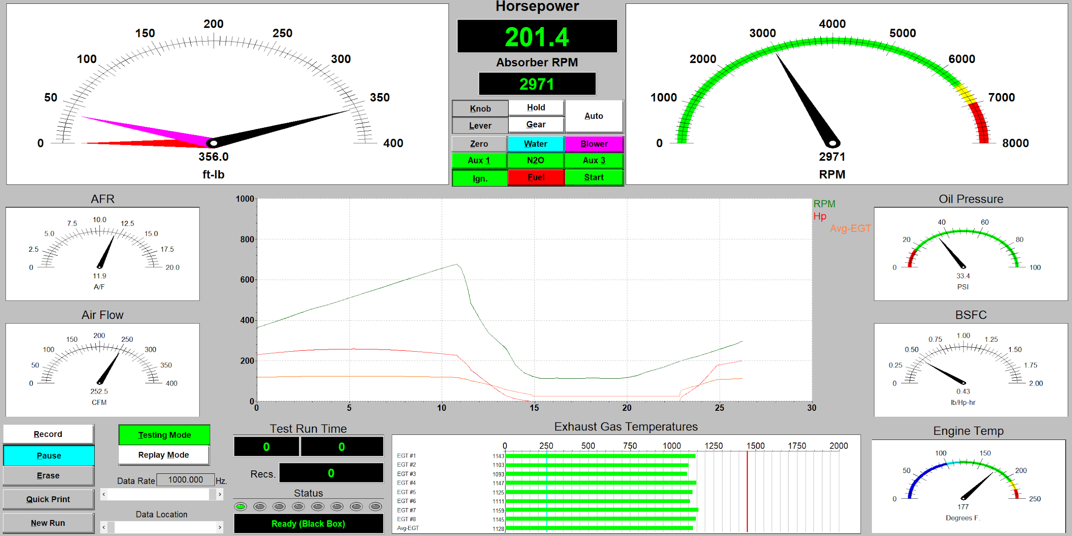
Engine Dyno Testing
Test Procedure:
Motor is installed on the dyno test stand within the engine cell, belt is tensioned
5 minutes of fuel in external tank
Motor is started and idles. Clutch doesn't engage until 6000 RPM
Cell is cleared
Motor throttle controlled from safe room ramps up RPM
Load on motor increased after clutch engages: torque, RPM, HP recorded live
Kill switch triggered to end test
DYNO-MAX software window
Theory:
Notes:
Equipment needed and Procedures on this slide

Slide 21
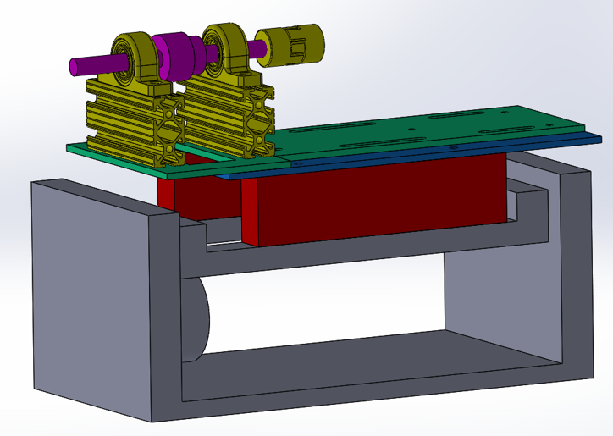
Engine Dyno Testing
Project Risk Mitigation and Task Status
Risk Mitigation:
Engine break-in will allow the piston ring to sit properly in the cylinder wall and prevent failure during flight
Thermal verification will ensure engine doesn’t output too much heat for the safe operation of the surrounding equipment or the engine itself
Endurance testing will allow us to more accurately predict fuel consumption and help with determining the ideal amount of fuel
Task Status:
Manufacturing: 70% done
Assembly: 50% done
Notes:
Project risk mitigation and Task status

Slide 22
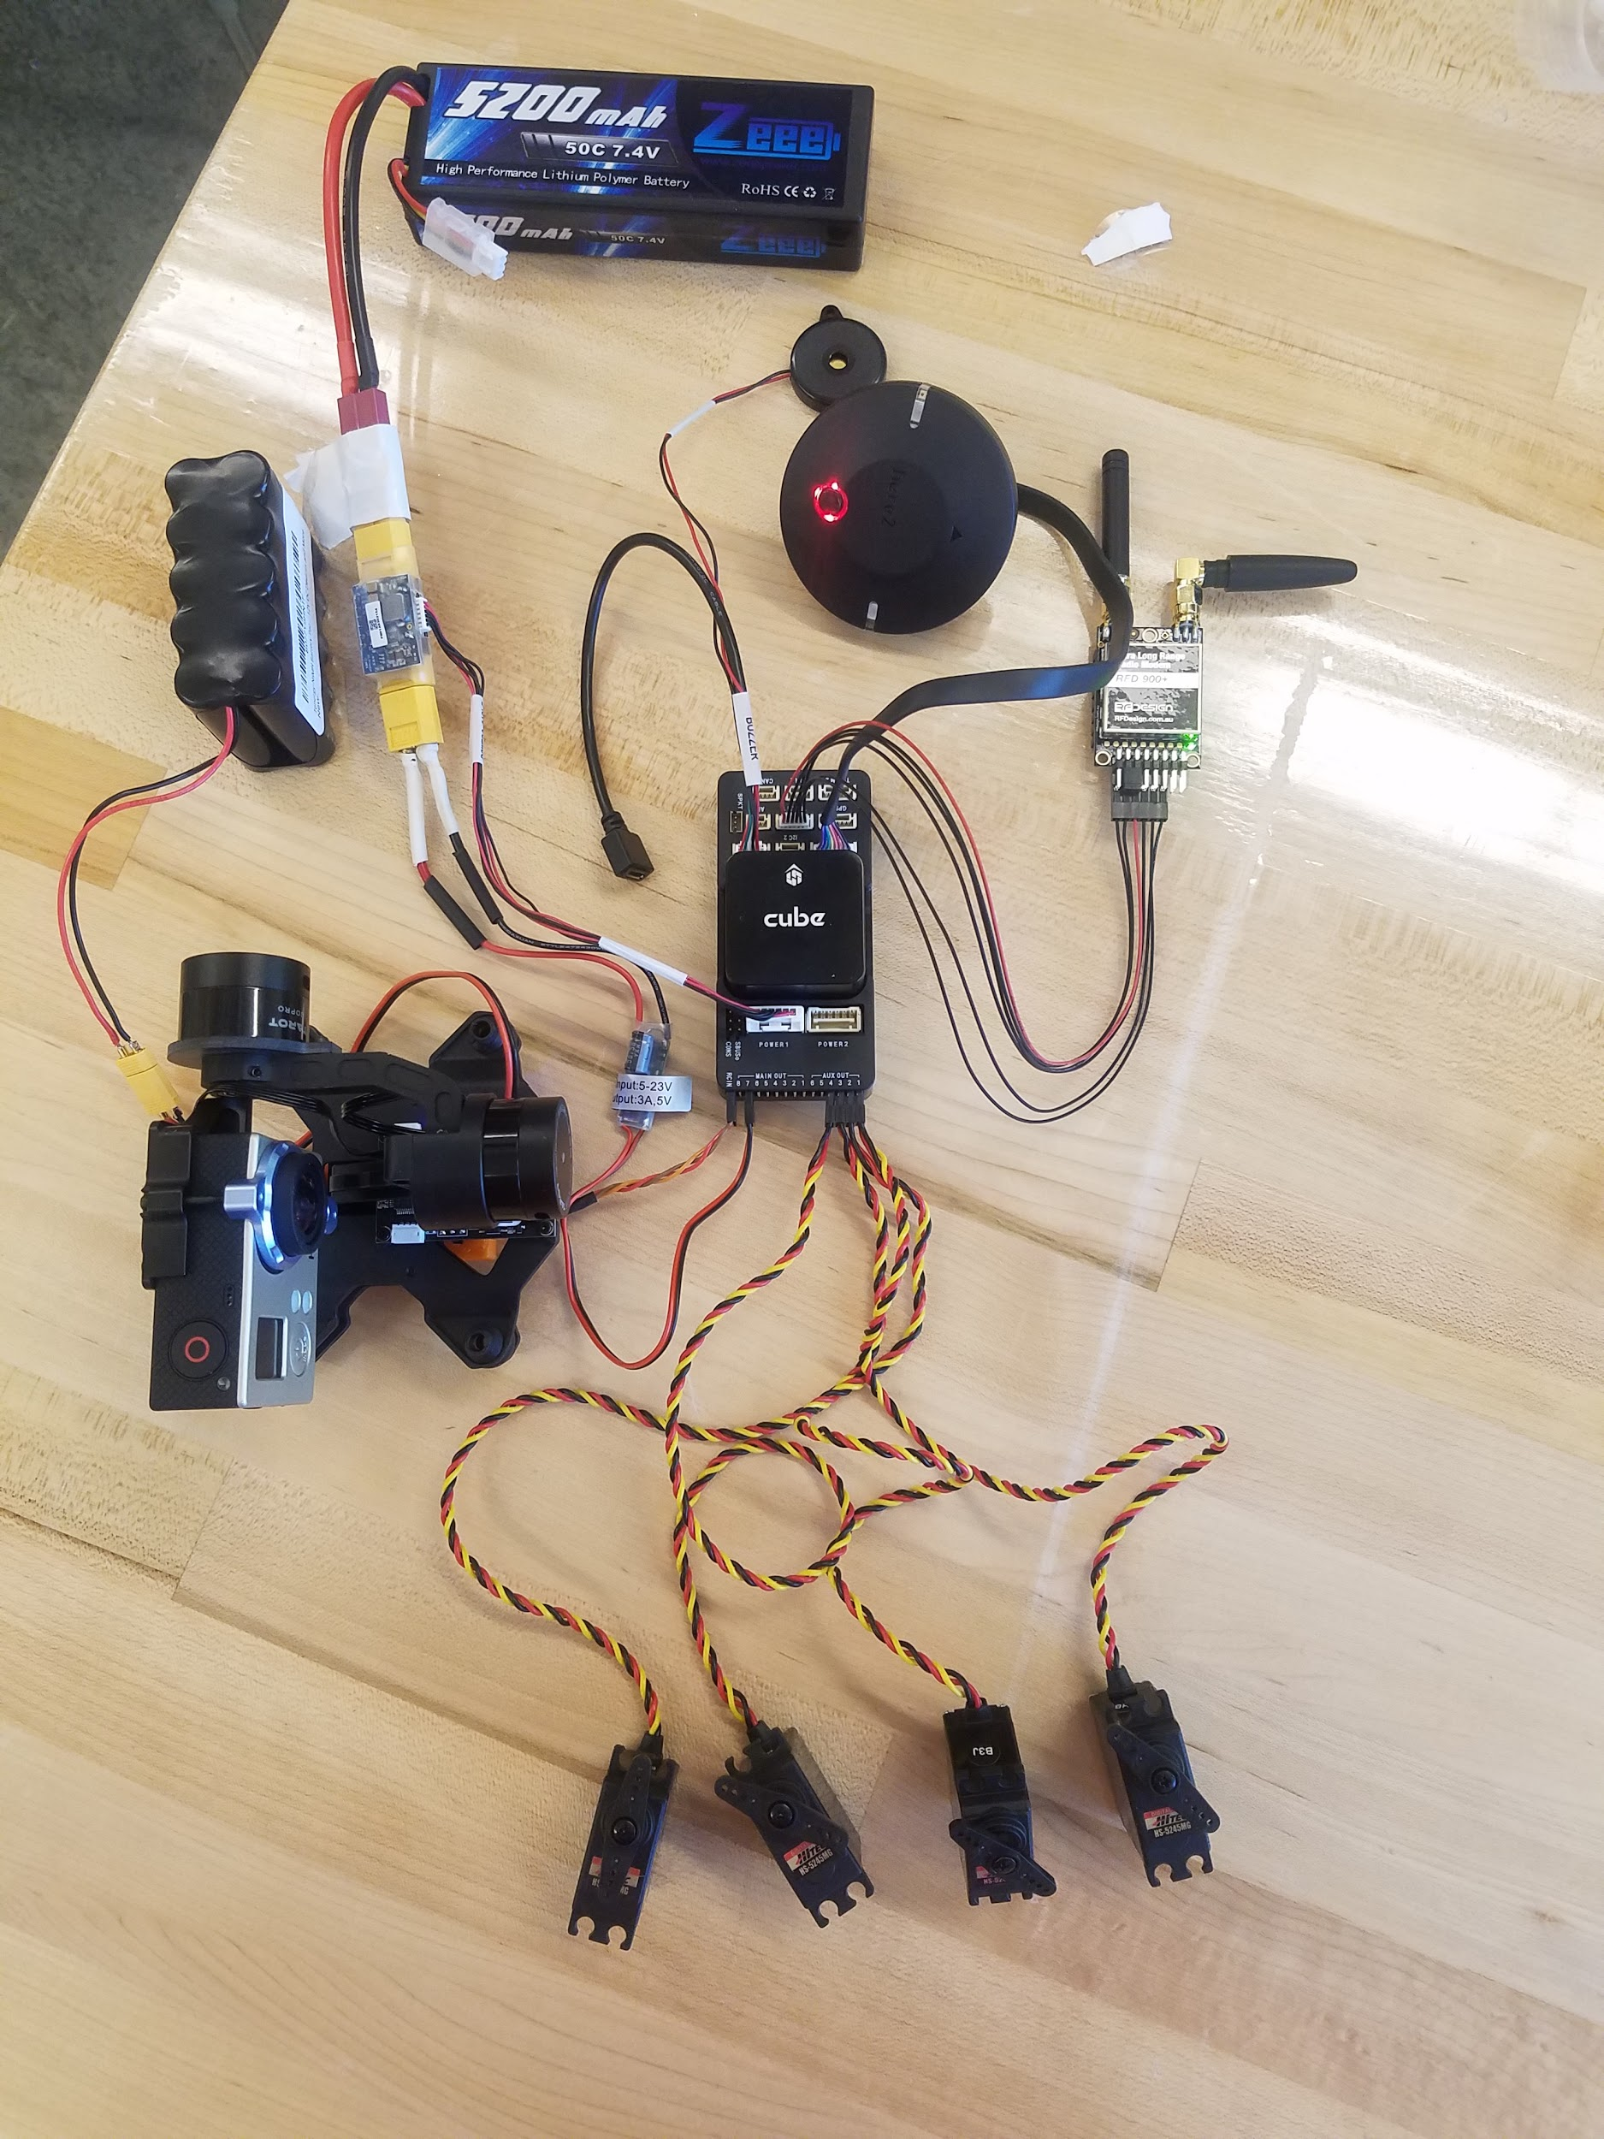
Flight Electronics
Pixhawk Setup
Radios in sync sending telem/commands
Here 2 GNSS (GPS system)
Servos connected and live
BEC to power servo rail
Battery to power Pixhawk
Throttle servo connected and live
Gimbal connected
Ground Station
HITL mode in Mission Planner
GPS location live
Test commands to servos
Set waypoints
Notes:
I’ll be getting a full image of everything we have electronics wise tomorrow (2/26) including a picture of the GS while the GPS is reading live

Slide 23
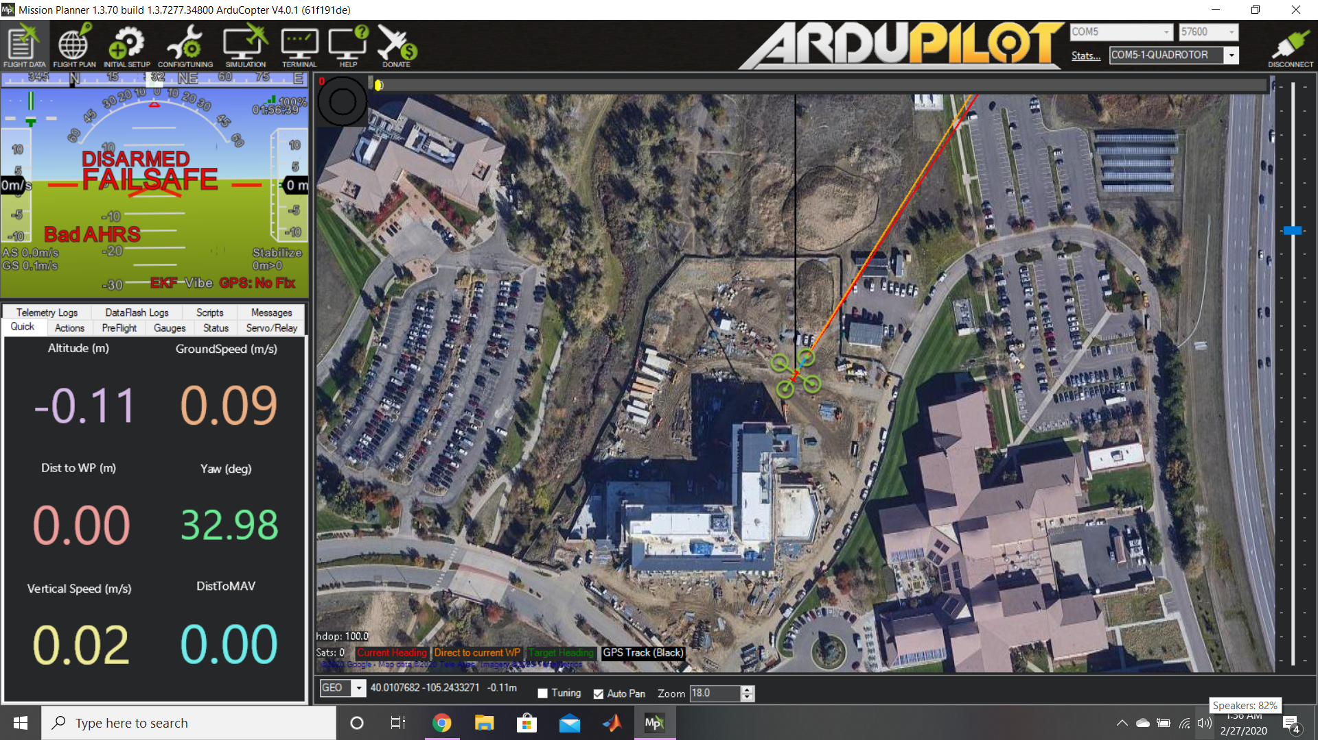

Slide 24
Quadcopter Hardware & Electronics Integration
HITL Demonstration 1 - No engine, no rotor blades spinning
Rationale: Verify the effectiveness of flight software to appropriately control copter components in response to transmitted commands
Test Equipment:
GCS
Flight electronics (PixHawk) on-board with appropriate firmware
Servos connected to rotor blades with PWM cables to PixHawk
Procedure:
Power all electronics and verify they respond to:
GCS commands
Changes in orientation/position
Check gimbal control and verify live video feed from payload
Check loss of connection and other safety commands from pixhawk

Slide 25
Quadcopter Hardware & Electronics Integration
HITL Demonstration 2 - Engine running, no engagement with drivetrain
Rationale: Verify ability of flight software to function and control appropriately with the added vibrations/disturbances of the running engine
Test Equipment:
HITL 1 equipment assembled on the chassis
Engine on chassis
Procedure:
Same fundamental checks and procedures as HITL 1
Check GS ability to send kill command to engine shutdown
Monitor telemetry from PixHawk with motor vibrations
Monitor for any communication interferences between GCS and PixHawk
Safety Risks: The UAS chassis disjointing or coming loose from vibrations
Mitigation: Loctite and appropriate fasteners in place

Slide 26
Quadcopter Hardware & Electronics Integration
HITL Demonstration 3 - Engine running, drivetrain delivering power, anchored
Rationale: Verify ability of flight software to function and control appropriately with the added vibrations/disturbances of engine, drivetrain, and rotors
Ensure rotors are spinning up securely
Test Equipment:
HITL 2 chassis assembly with functioning drivetrain
Anchors to lock the entire aircraft down to ensure no lift is generated
Procedure:
Same fundamental checks and procedures as HITL 2
Monitor belt integrity/performance
Confirm functional operation of kill switch by cutting engine power from GS
Confirm servo functionality by pointing servos to zero AoA

Slide 27
Quadcopter Hardware & Electronics Integration
HITL Demonstration 3 (cont.) - Engine running, drivetrain delivering power, anchored
Safety Risks: Flight of UAS, shearing of rotor blades, loss of communications
Mitigation:
Secure UAS to anchor with no slack
Motor will be limited 7200 rpm
Zero AoA of rotor blades ±5° AoA to keep lift minimal
Keep the total power supply in the safe room for easy emergency kill
Test crew will be a safe distance away from UAS in safe room

Slide 28
Budget
Notes:
Dakota

Slide 29
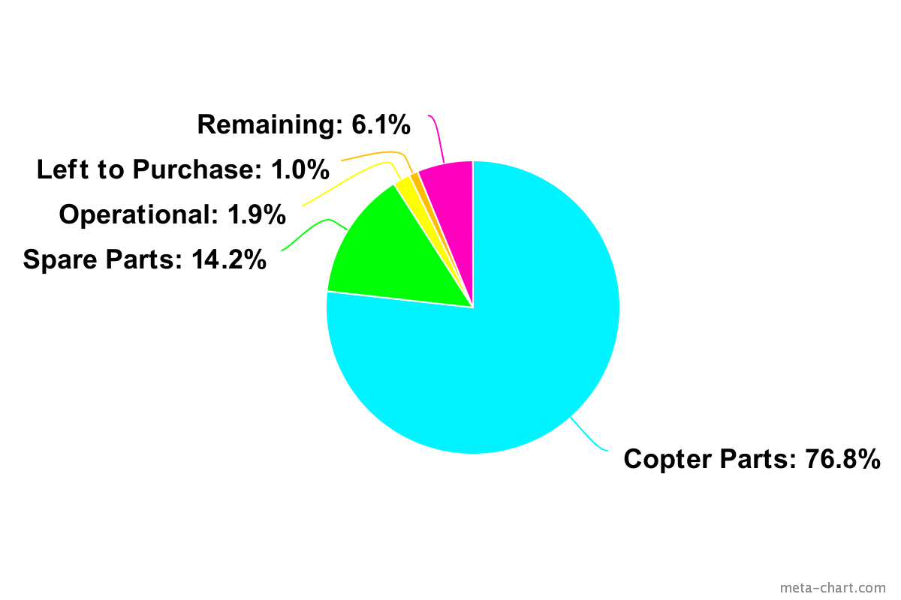
Cost Plan
Expense | Cost
Copter Parts | $3,838.73
Spare Parts | $709.10
Operational Expenses | $95.00
Left to Buy | $50.00
Total | $4,692.83
Remainder | $307.17
Notes:
Dakota

Slide 30
Major Procurements
System | Acquired | Need | Need Cost
Powerplant | All Parts | None | $0
Drivetrain | Driveshaft, Pulleys, Bearings. | Belts | $50
Rotorhead | All Parts | None | $0
Electronics | All Parts | None | $0
Payload | All Parts | None | $0
Chassis | All Parts | None | $0
Operational | 2-Stroke Oil, Servo Programmer | Fuel | $50
Notes:
Dakota

Slide 31
Closing Slide
Thank You

