Slide 1
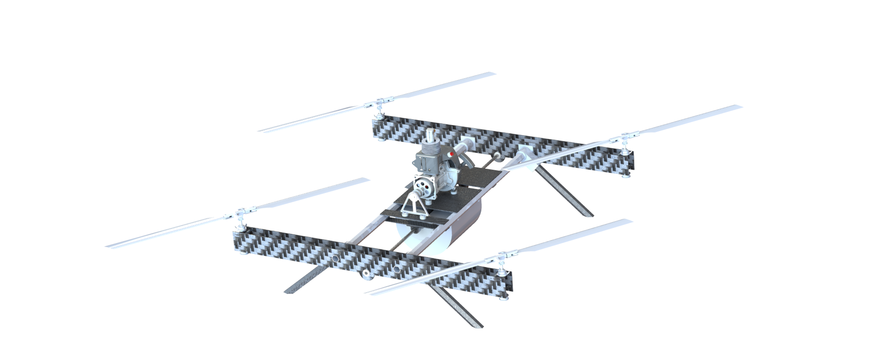
EMU
Final Oral Review
Client:
Steve Borenstein
Team:
Alejandro Castillo, Becca Rivera, Dakota Labine,
Henry Moore, Libby Hasse, Matthew Lehmann,
Max Alger-Meyer, Michael Flores, Mitchell Spencer
Nathan Castille, Nathan Hetzel, Shawna McGuire
Advisor:
Jean Koster
Endurance Multirotor UAS
Project Manager:
Dakota Labine
Notes:
Michael

Slide 2
Purpose and Objectives
Notes:
Michael

Slide 3
Mission Statement and Project Motivation
Mission:
Multirotor UAS
Fully autonomous
25 pound
Long duration ( 2 hour)
5 pound payload
Stream video
Motivation:
The IRISS team would benefit from a heavy lift, long duration, scalable UAS to expand their mission profiles
Notes:
Michael

Slide 4
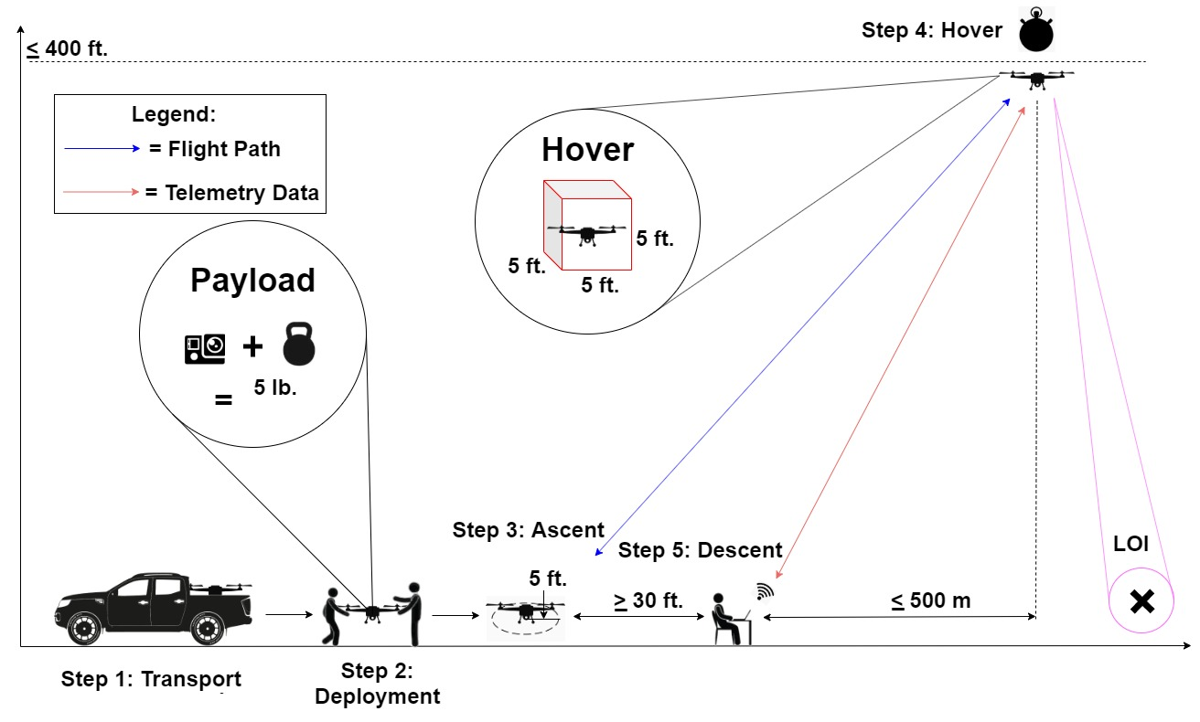
CONOPS
Notes:
Michael

Slide 5
Levels of Success
Power Plant Success Levels:
All power plant components functioning and integrated on a control board
Power plant components are integrated on the system and functioning
The system is capable of ﬂight without a payload for less than two hours
System capable of ﬂight for two hours with a payload
Controls | X
Flight Endurance | X
Power Plant
Chassis
Autonomy
Safety
Ground Station
Payload | X | X | X
Notes:
Michael

Slide 6
Design Description
Notes:
Speak to how requirements led to design decisions in subsystem slides
explain pictures orally

Slide 7
Critical Project Elements (CPEs)
CPE | Rationale
Chassis | UAS chassis must withstand operational forces, support components, and provide a platform for component integration
Drivetrain | Drivetrain must safely transfer power to rotors
Rotor Assembly | Rotor assembly must provide aerodynamic lift and control over the UAS
Power Plant | Power plant must provide enough power for all flight phases across a two hour hover operation
Flight Software | Flight software must enable UAS communication and manual or autonomous flight control
Notes:
Need to give context to what chassis, drivetrain, etc are. Go into detail on one example

Slide 8
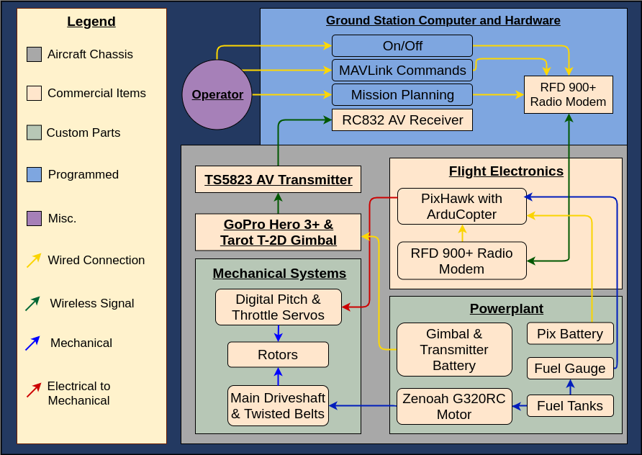
Functional Block Diagram
Notes:
Simplify to highlight big topics

Slide 9
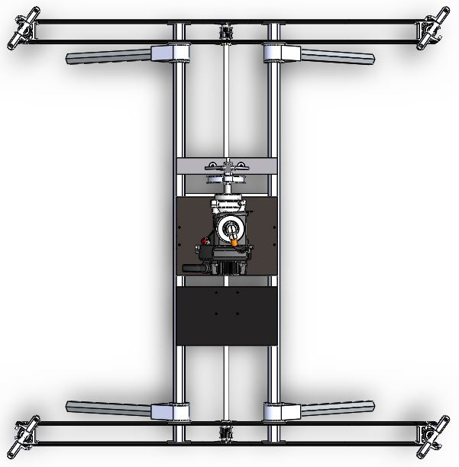
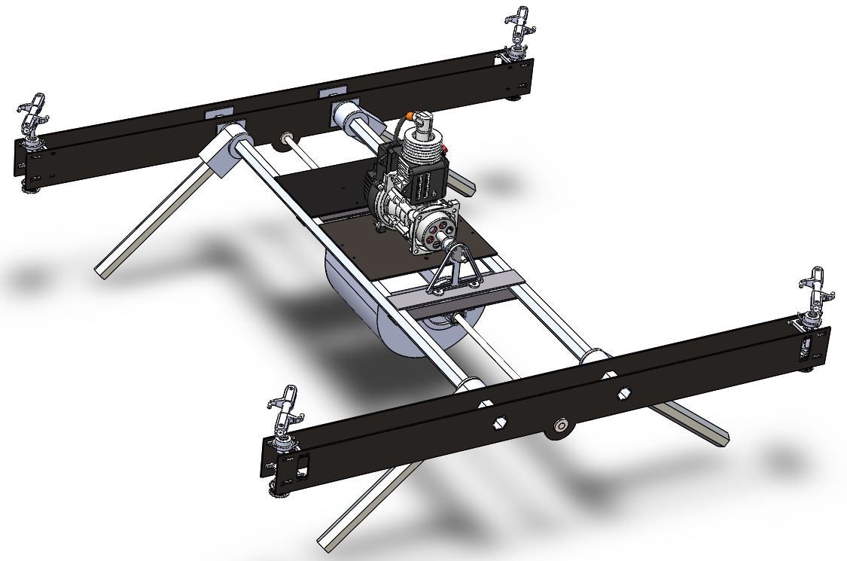
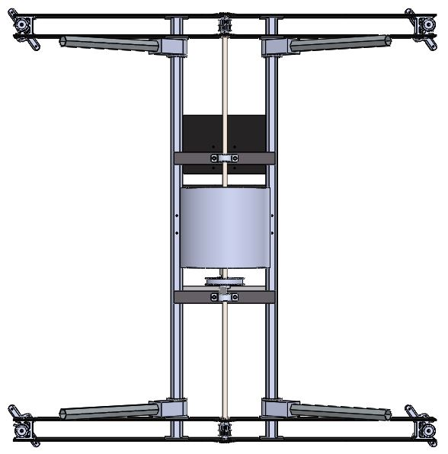
Chassis
Top
Bottom
Components | Dimensions [in] | Weight [lb]
Main beams, propeller arms, component plates, landing gear | 36 X 35 | 5.3
Notes:
Are we still adding picture of actual chassis?
Describe H frame and how it supports components

Slide 10
Drivetrain
Components | Changes | Mass [lb]
Main drive shaft, output shaft, pulleys, belts, support bearings | Main drive belts | 2.2
Notes:
General overview of the drivetrain system. Can be more specific for components verbally if needed.
Major Changes: Main belt types (CAD file didn’t show lack of hub, got new sizes & belt type)
Total Mass: 1,012.6g (8.31%)
Total Cost: $205.88 (5.12%)

Slide 11
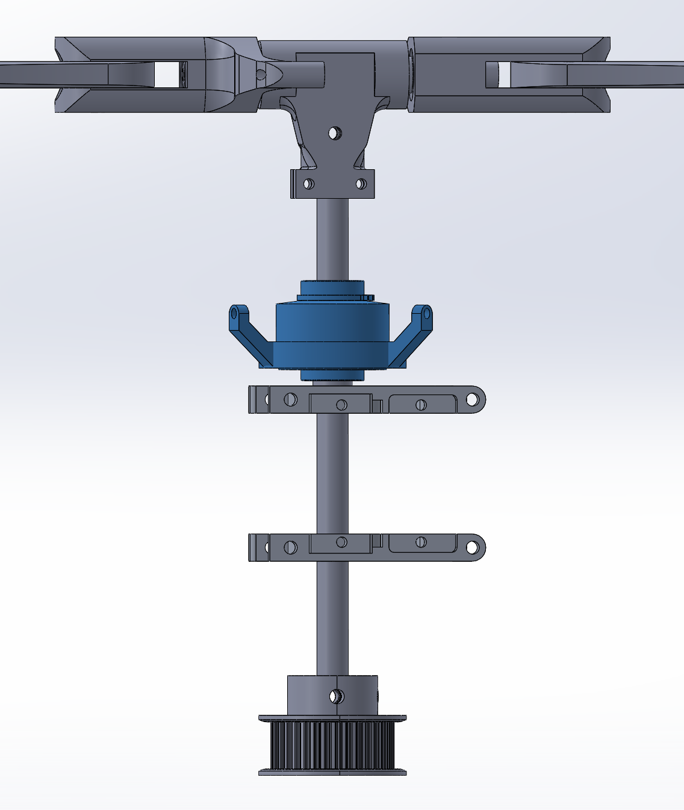
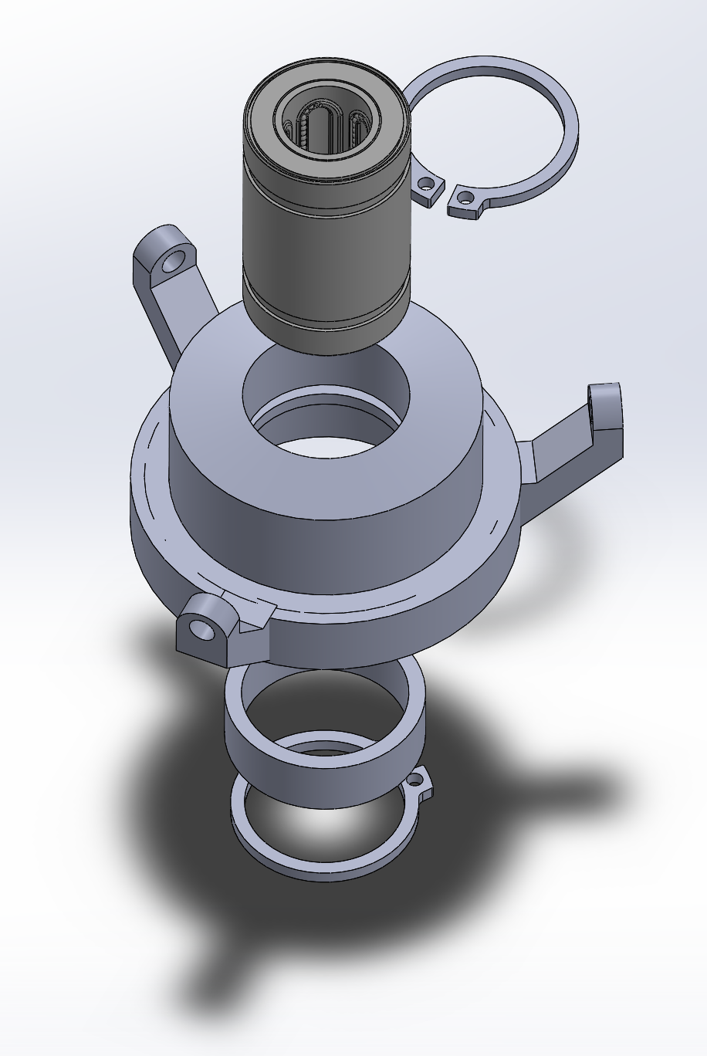
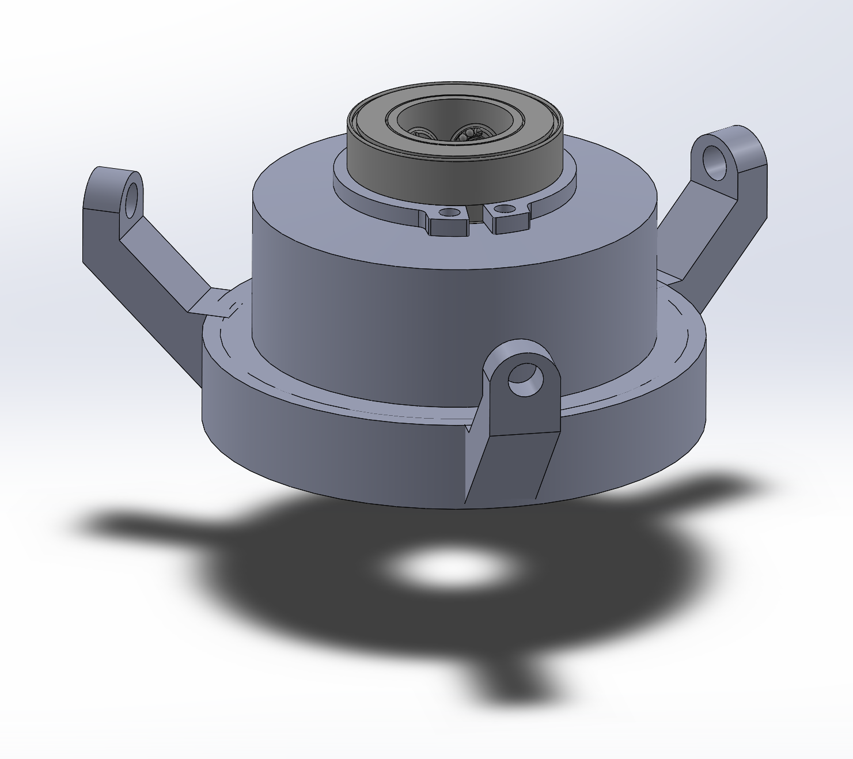
Rotor Assembly
Components | Specifications | Weight [lb]
Align 380mm Rotor Blades, Recirculating Linear Bearing | 7.5 lb/rotor, 2350 RPM | 2.5
Notes:
Libby please complete

Slide 12
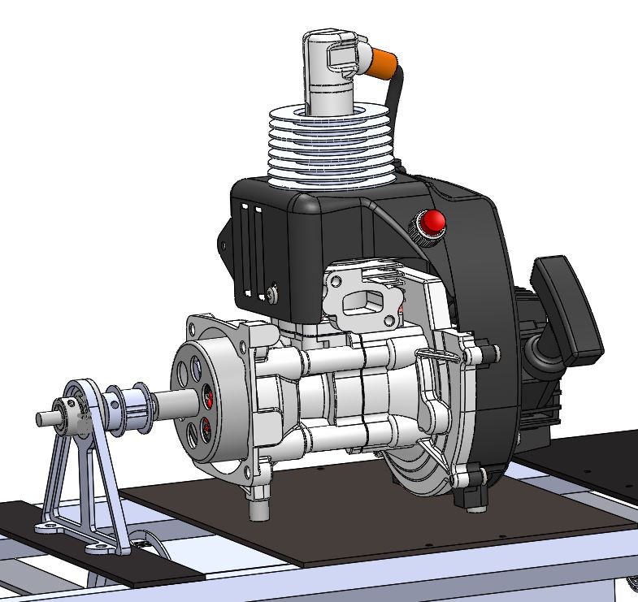
Power Plant
Key Parameters
Weight | 10.9 [lb]
Fuel Capacity | 100 [fl oz]
Max Power | 3.22 [hp]
Power During Flight | 2.65 [hp]
Engine Speed During Flight | 9500 [RPM]
Torque During Flight | 6.42 [Nm]
Fuel Consumption Rate | 2.26 [lb/h]
Components
Engine, fuel tank, clutch bell and housing, output support bracket
Notes:
Identify key elements in presentation (engine, clutch/drivetrain integration, fuel system)

Slide 13
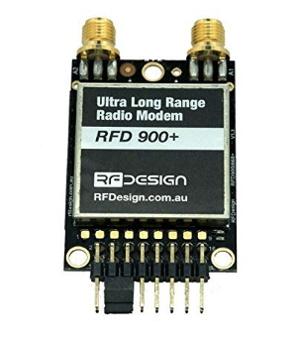
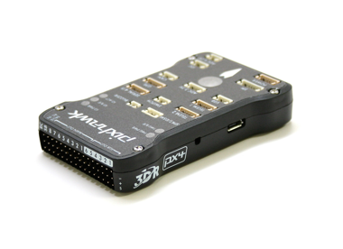
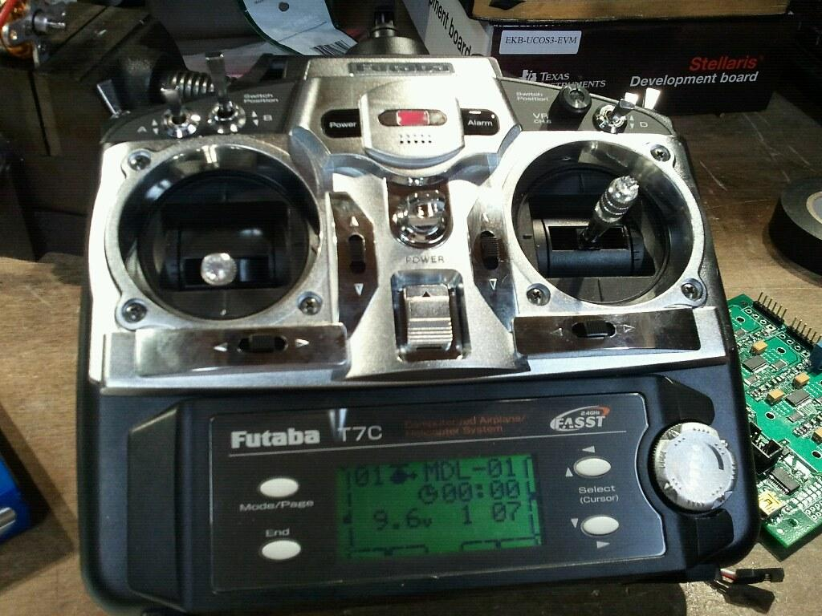
Ground Station
Components
Laptop, Mission Planner, RC controller
Notes:
I will make sure to explain things in good detail, I’m just going to focus on keeping words minimal. Yeah you better - Max

Slide 14
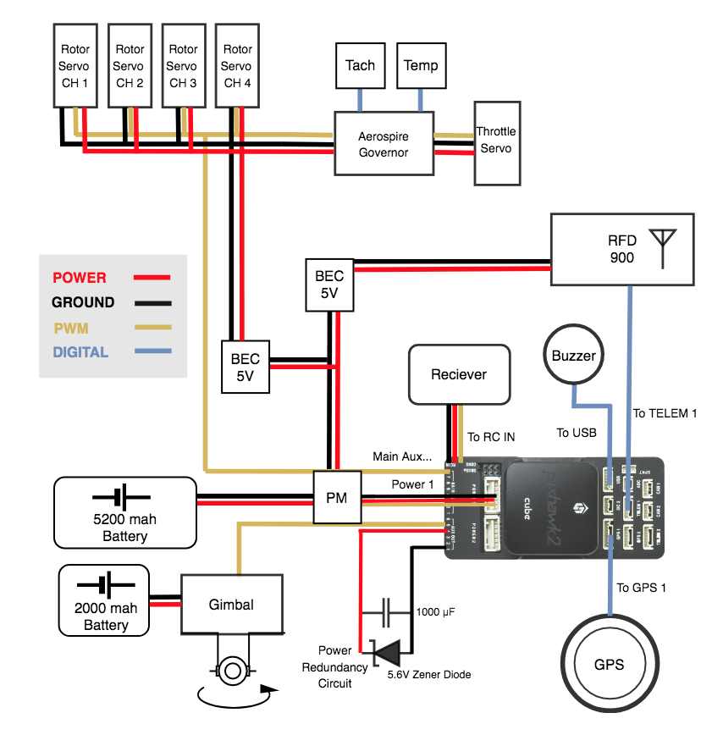
Electronics
Components
Batteries, Servos, Harnessing, Sensors/Peripherals, GPS

Slide 15
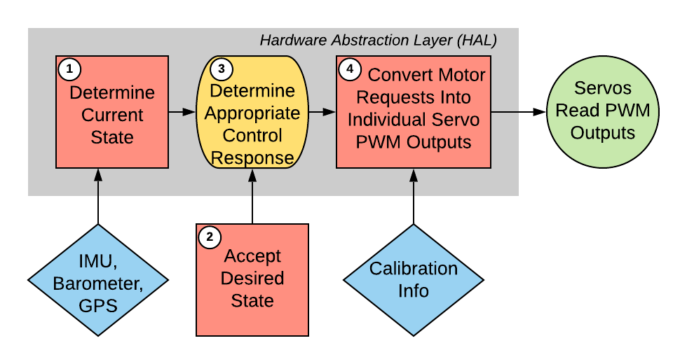
Avionics and Flight Software
Components | Weight [lb]
PixHawk 2.0 (Cube), ArduPilot Flight Software | 1.1
Notes:
In conjunction with GCS slide. PixHawk works with Mission Planner to accept commands to flight modes.

Slide 16
Test Overview
Notes:
Nate
Use one test as an example and move rest to backup
speak to most challenging/critical requirements

Slide 17
Test Summary
Functional Requirement | Summary
1 | Flight Envelope
2 | Autonomy
3 | Ground Station
4 | Power Plant
5 | Payload
6 | Safety
7 | Chassis
Tested Requirements | Test
3, 5 | Flight Electronics Testing
1 | Rotor Thrust Testing
4, 7 | Engine Dyno Testing
3, 6, 7 | HITL Testing 1-3
1, 2, 3, 4, 5 | Flight Testing
Notes:
Nate
flight electronics testing applicable requirements needs refinement ; HITL testing requirements needs refinement; at the moment, no electronics testing slide because it was more of a pass/fail checklist testing, can briefly talk about meeting all the electronic requirements we intended to
most challenging/critical reqs

Slide 18
Rotor Thrust Testing
Requirements | Summary
1.2.2,1.2.3 | Hover Thrust Maneuver Thrust
Status | Testing and data analysis completed
Notes:
Nate
Briefly give test details orally (how and where)

Slide 19
Engine Dyno Testing
Requirement | Summary
4.3 | Tanks shall support a 2 hour hover operation
4.4 | Motor shall produce necessary power & torque
Engine break-in:
Damage prevention
Power Testing:
Engine power verification
Endurance:
Mission duration and fuel consumption verification
Thermal Verification:
Engine cooling verification
Testing Status: Dyno assembly completed, testing canceled
Notes:
Nate
Briefly give test details orally (how and where)
2 bullets: power/torque, 2 hour hover

Slide 20
Hardware in the Loop Testing
Test | Test Details | Requirement
HITL 1 | No engine, no drivetrain engagement | 1.2.4: UAS shall have necessary control authority for required maneuvers
HITL 2 | Engine running, no drivetrain engagement | 3.4: GS shall send emergency commands to the UAS 3.5: GS shall have optional manual flight control capabilities over the UAS
HITL 3 | Engine running, drivetrain engaged, UAS anchored | 7.4.1: Drivetrain shall deliver power from engine to all rotors
Notes:
Nate
Emphasize how Demonstration 2 is for vibration verification, and how Demonstration 3 is the first full test of the UAS’s moving parts.

Slide 21
Flight Testing
Verification Section | Requirement Details | Requirements
Flight Envelope | Maneuver to location, 2 hour hover in 5 ft cube, and RTL | 1.1, 1.2, 1.3, 4.3
Autonomy | Autonomously take off, hover in 5 ft cube, and RTL | 2.1, 2.2, 2.3, 2.4
Ground Station and Payload | Launch UAS, update mission parameters during flight, camera control, RTL commands | 3.2.2, 3.3, 3.4.1, 5.4
Notes:
Nate

Slide 22
Flight Testing
Hop Test | Tethered Test | Untethered Test
Verify drivetrain operation at flight RPM Verify installed thrust requirements met | Verify controllability and hover accuracy Verify endurance Verify Autonomous functions | Verify flight range Verify payload range Verify flight ceiling
Purpose | Verify manual and autonomous flight
Location | NOAA Table Mountain Test Facility
Details | Steel tether, redundant ground anchors IRISS van as safety barrier Approved flight and safety checklist Matt Rhode present as safety officer
Notes:
Nate
additional details can be given orally
details->safety
keep style same as previous slide

Slide 23
Test Results

Slide 24
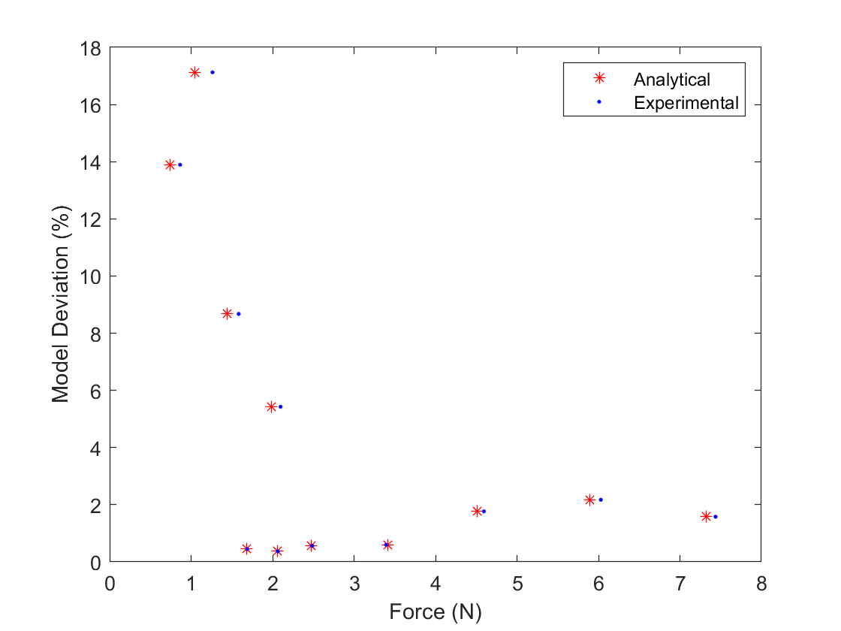
Rotor Thrust Test Results
Analysis
Graph shows the % error between the model and the experimentally recorded data Blade RPM and AoA varied over trials
Mean error of 4.8% after removing an outlier
Model underpredicted thrust, therefore the thrust design requirements have been satisfied
Notes:
Henry

Slide 25
Rotor Thrust Test Results
Model based on TAT
Utilizes MIT’s XFOIL
Agrees with existing data
Underestimates actual thrust
Utilized for engine and propeller sizing
Requirements | Summary
1.2.2,1.2.3 | Hover Thrust Maneuver Thrust
Notes:
Henry

Slide 26
Engine Dyno Planned Data Collection
Planned Tests
Engine Break-in Engine HP and Torque vs RPM Endurance and fuel consumption
Main Procedure Points
Engine cell Engine/Dyno control from safe room Physical power kill in safe room Data acquisition in safe room
Notes:
Nathan
For the engine dyno testing, we were able to complete integration of our motor onto the dyno, but we did not have time to perform live testing.
The three major tests we planned to perform were engine break-in, horsepower and torque testing, and endurance and fuel consumption testing.
For the procedure, we would performed the tests in the engine cell, with all major safety and data systems located in the safe room.
This includes the engine throttle control, the power supply for both the dyno and the motor, and the dyno data acquisition software.

Slide 27
Engine Dyno Planned Data Collection
Instruments
Eddy Current Dynamometer Load Cell Tachometer Thermocouples
Data
HP and Torque over RPM range ΔT at engine mounting location Fuel consumption
Notes:
Nathan
The critical instruments for the dyno testing include the eddy current dynamometer itself, which records both load cell and tachometer measurements, and thermocouples, which we would be installing on the base plate the motor mounts to on the dyno.
The load cell and tachometer data combined would provide horsepower and torque data as a function of RPM.
The thermocouple data would record the change in temperature at the engine mounting location over the duration of the tests.
We would also determine fuel consumption by measuring the weight of fuel consumed during the endurance test.

Slide 28
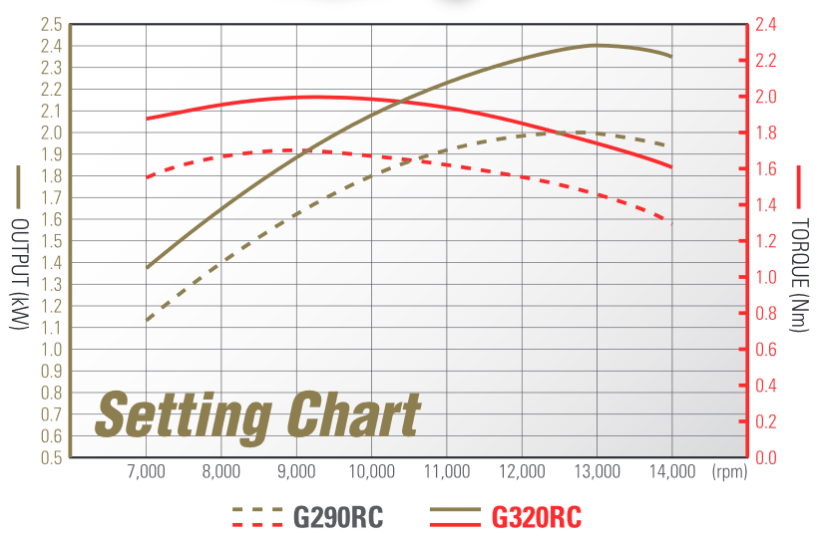
Engine Dyno Planned Analysis
HP and Torque
Altitude affects power output Experimental data would verify the motor meets power/torque requirements
Requirement 4.4
Motor shall produce necessary power and torque to support UAS’s entire flight envelope
Manufacturer HP/Torque chart at SSL
Each rotor requires 0.85ft*lb torque and 0.38 hp power at nominal conditions
Notes:
Nathan
For the engine analysis, we wanted to confirm that the motor is capable of producing the horsepower and torque required to support the UAS’s flight envelope.
The reason for this concern is that the manufacturer provides horsepower and torque curves at sea level, and so we expect these curves to drop slightly at our altitude.
We can see these curves in the graph on the right, with the solid lines representing our engine model. The red curve shows a peak torque of 1.48 foot-pounds at about 9000 rpm, and the tan curve shows a peak horsepower of 3.2 at 13,000 RPM.
Each rotor requires 0.85 ft-lbs of torque for hover at takeoff weight, so after the 4-to-1 gear ratio between the drivetrain and motor, and factoring in an estimated 75% efficient drivetrain, only about 77% of peak motor torque is required for flight, which gives us some breathing room considering we expect engine performance to drop slightly at our altitude.

Slide 29
Engine Dyno Planned Analysis
Temperature
Carbon fiber integrity adversely affected by temperature Experimental data would verify the mounting plate stays at a safe temperature
Requirement 7.3
Chassis structure shall rigidly support all components
Fuel Consumption
Fuel is a significant portion of the gross weight Experimental data would verify the fuel tank can supply fuel for a 2 hour hover without overburdening the UAS
Requirement 4.3
Tanks shall hold enough fuel to support a 2 hour hover operation
Should we have another slide talking about the fuel model?
Notes:
Nathan
Moving on, we wanted to perform a basic temperature analysis to ensure the carbon fiber motor mounting plate on the UAS would not be exposed to temperatures high enough to weaken the material and cause a chassis failure.
Thermocouple temperature data from the mounting plate would confirm whether additional thermal shielding would be necessary to keep the carbon fiber safe.
Due to the location of the motor standoffs in relation to the motor’s cylinder, we expect safe temperatures on the motor mount without needing additional shielding, but we wanted to confirm this hypothesis with hard data.
Due to the fuel being a significant portion of the gross weight of the UAS, we wanted to confirm our fuel consumption estimates that were based off of manufacturer data.
Having sufficient fuel is necessary to achieving the two hour hover requirement from our customer.
We expect the manufacturer provided fuel consumption to be a slight overprediction because at our altitude, less dense air means that less fuel is required to achieve the optimal fuel/air ratio for peak torque.

Slide 30
HITL Planned Data Collection and Analysis
Test | Engine(or rotor) RPM range | Expected Results
HITL 1 | N/A | Demonstrate pitch control, live video feed, safety commands
HITL 2 | N/A | Demonstrate pitch control, live video feed, safety commands under engine vibration
HITL 3 | N/A | Demonstrate functional drivetrain and pitch control, live video feed, safety commands with engine and drivetrain operating

Slide 31
HITL Planned Data Collection and Analysis
 | HITL 1: No engine/rotor blades | HITL 2: Engine, no drivetrain
Expected Results | Demonstrate pitch control, live video feed, safety commands | Demonstrate pitch control, live video feed, safety commands under engine vibration
Engine RPM | 0 | Max 7200 RPM
Procedure (Reqs.) | Verify onboard electronic response Gimbal verification (3.1, 3.2.3) COMM checks (3.7, 6.2) | Verify kill switch (3.4) Monitor for vibration or COMM disturbances
Notes:
“Test Overview” section already explains how these data were to be used to validate the project’s performance
-
Procedure: verify electronic response to GCS commands, changes in orientation/position
add expected rpm for rotor blades

Slide 32
HITL Planned Data Collection and Analysis
 | HITL 3: Engine with Drivetrain
Expected Results | Demonstrate functional drivetrain and pitch control, live video feed, safety commands with engine and drivetrain operating
Engine RPM | Max 7200 RPM
Procedure (Reqs.) | Verify servo functionality Monitor chassis performance (7.3, 7.4) Monitor belt performance

Slide 33
Test Flight Planned Data Collection
Objectives | Verify manual control of UAS Verify controllability and hover stability/accuracy Verify autonomous functions
Test Types | Hop (manual) Tethered (manual and autonomous) Untethered
Notes:
Nathan
Moving on to the full scale test flights, our main objectives are to verify: manual control of the UAS, controllability and hover stability and accuracy, and autonomous functionality.
To clarify, manual control implements a conventional handheld drone transceiver, while autonomous control is performed by entering flight commands into the ground station.
To achieve this, we have developed an incremental approach to flight tests.
The first test is a simple “hop” under manual control where the motor is brought up to operational RPM, and the blade angle of attack is raised just enough to get the UAS a few inches above the ground. The blades are then immediately dropped back to 0 degrees angle of attack and the UAS touches down. (the UAS is tethered during this test)
The next test is the tethered flight, where the UAS will be flow while attached to a 30 ft steel tether that has redundant ground anchors. The test will include both manual and autonomous control methods.
The final envisioned flight test would be untethered, where we would verify our max range and ceiling requirements.

Slide 34
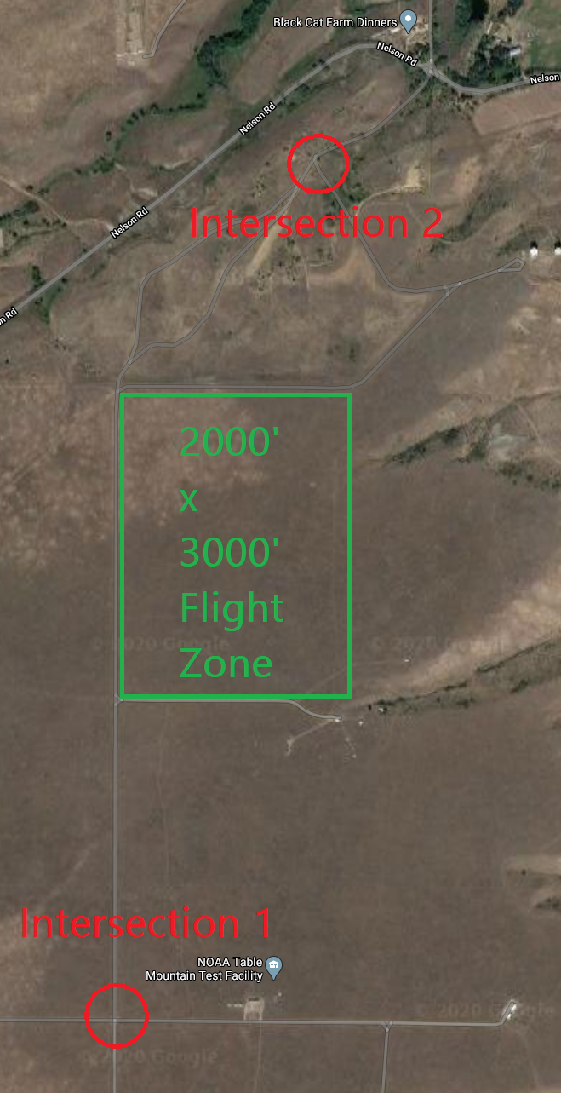
Test Flight Planned Data Collection
Location | NOAA Table Mountain Test Facility Ensure bystander safety with intersection control 2000 ft by 3000 ft flight zone
Instruments | Onboard UAS sensors IRISS provided drone tracking equipment
Data Collection | Downlinked UAS telemetry (ground station) Payload video stream (ground station) Positional data from IRISS equipment
Notes:
Nathan
The location for all flight tests would be at the NOAA table mountain test facility shown in the image on the right.
Our planned flight zone is an area of approximately 2000 by 3000 feet of flat ground with no structures.
We would ensure bystander safety

Slide 35
Test Flight Planned Analysis
Verification Section | Requirement Details | Requirements
Flight Envelope | UAS has the thrust and control authority for required maneuvers Hover in a 5 ft cube over 2 hour duration | 1.1, 1.2, 1.3
Autonomy | Launch Relocation to a set position and hover for set time RTL with 5 ft accuracy | 2 (all)
 | Results
Data | UAS filtered GPS and inertial sensor data High accuracy position data from IRISS sensors
Analysis | Compare recorded positional data to commanded target location
Notes:
Nathan
talk about range
link how data relates to requirements

Slide 36
Test Flight Planned Analysis
Verification Section | Requirement Details | Requirements
Powerplant | 2 hour hover duration with 5% fuel reserve after landing | 4.3, 4.3.1
Ground Station | Mission parameters can be updated in-flight In-flight camera control and video stream RTL/kill commands can be sent to interrupt mission | 3.2.2, 3.3, 3.4.1, 5.4
 | Results
Data | Fuel measurements before/after flight Downlinked video from the UAS
Analysis | Compare recorded fuel data to the model
Notes:
Nathan
results need to be connected to reqs
->add slide about fuel model

Slide 37
Untethered Test Flight
Verification Section | Untethered Requirement Details | Requirements
Flight Envelope | 500 m lateral range 400 ft AGL flight ceiling | 1.1.1, 1.1.2,
Payload | Video stream integrity at maximum range/altitude | 3.1.1, 5.4.4
 | Results
Data | UAS filtered GPS and inertial sensor data High accuracy position data from IRISS sensors
Analysis | Compare recorded positional data to commanded target location
Notes:
Nathan
emphasize cube reqs

Slide 38
Systems Engineering

Slide 39
System Concept
Take and transmit video
Carry and operate payload
UAS shall carry a camera payload
Lessons Learned:
Define and constrain the scope to essential functions.
Defining system environment and mission profile for the set requirements.
Payload shall weigh 5 lbs
Camera shall be HD video camera
Camera shall send live video at 30 fps
Camera shall save a copy of video

Slide 40
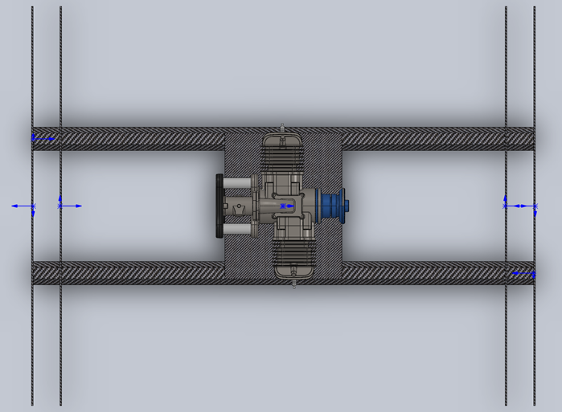
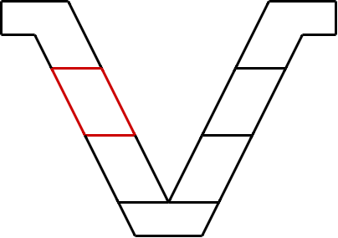
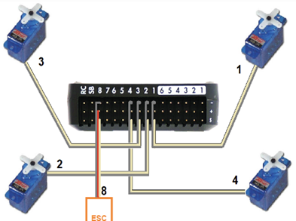
Preliminary Design
Essential Trade | Design Choice
Chassis Configuration | H-Frame
Rotor Number | 4 Rotors
Rotor Style | Variable Pitch
Firmware | Ardupilot
Camera/Gimbal Unit | COTS (Tarot 2D Gimbal)
Lessons Learned:
Perform impactful trades first to influence the rest of the design
Perform trade criteria sensitivities

Slide 41
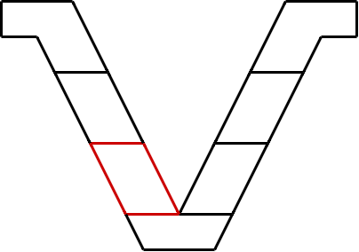
Detailed Design
Major issues encountered:
Inaccuracy in design hardware
Interface control
Up to date technical information
Lessons Learned:
Use a centralized model to focus design
Technical interchange meeting
Subsystem focused technical checkups

Slide 42
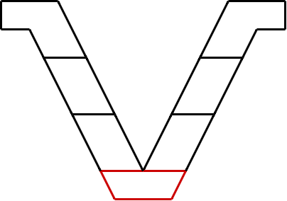
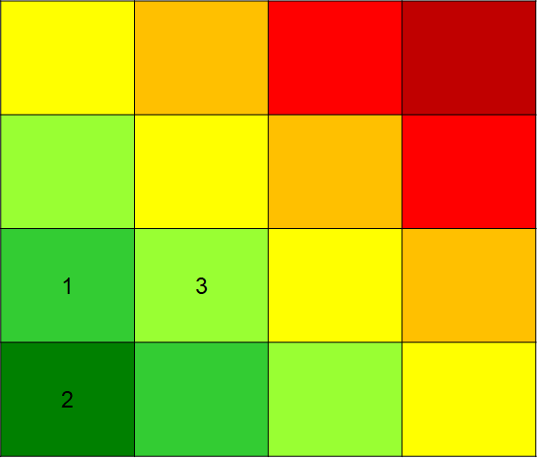
Manufacturing
Highest Risk Elements from CDR:
Fitting bearing into rotor assembly
Damaging carbon fiber
Manufacturing delays surrounding hardware
Lessons Learned:
Improve available skills based on a skill assessment of team and the preliminary design
Consequence

Slide 43
Subsystem Verification
Highest Risk Elements from CDR:
Motor damage
Rotor blade damage
Test days limited to poor weather
Lessons Learned:
Proper, up to date, tracking of tests and verification
Verification hierarchy to prioritize verification schedule
Consequence

Slide 44
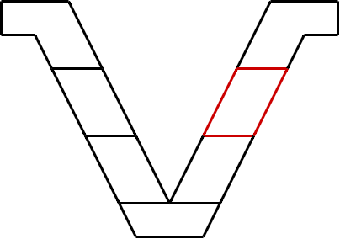
System Validation and Operation
System Validation:
Flight tests to validate performance and capabilities
System Operation:
Customer involved throughout validation
Drivetrain maintenance

Slide 45
Project Management

Slide 46
Project Management Approach
Authoritative/Pace-Setting Management Style | Matched project demand and group dynamic Drive to achieve and produce results Steers team towards a final product Set and maintained high standards
Lessons Learned | Personal project commitment Group Mentality What's best for the project vs the team Roles

Slide 47
Cost Plan
Expense | Planned Cost | Actual Cost
Copter Parts | $3,600 | $3,513
Spare Parts | $610 | $715
Operational Expenses | $132 | $177
Left to Buy | $0 | $300
Total | $4,342 | $4,705
Remainder | $658 | $595
Major Cost Differences
Shipping and Tax
Change in Design
Parts Not Purchased Yet
Lessons Learned
Part availability
Track purchasing
Ensure parts are needed

Slide 48
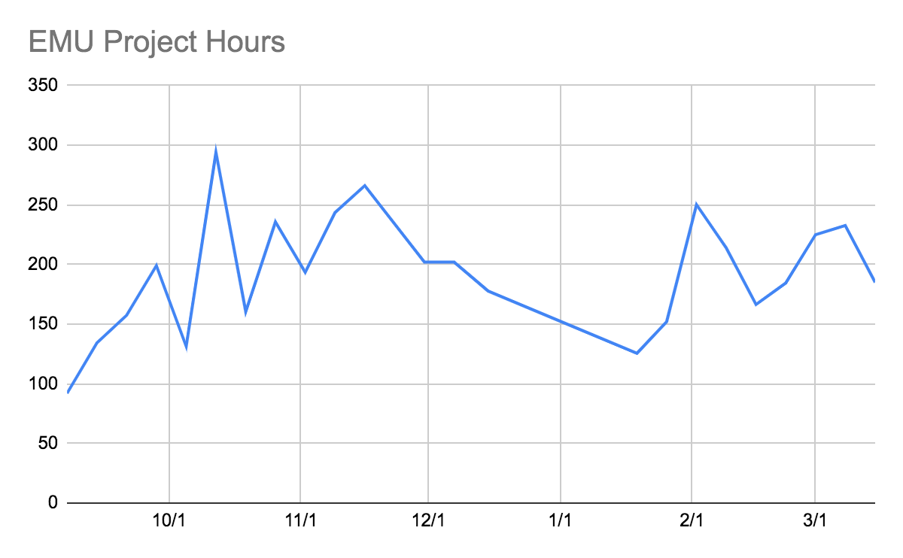
Project Cost
 | Amount
Individual Avg. Weekly Hours | 16
Team Avg. Weekly Hours | 192
Total Project Hours | 4,424
Total Labor Cost Plus Overhead | $275,000
Lessons Learned
Deadlines motivate Hours as predicted More consistent in Spring

Slide 49
Closing Slide
Thank You

Slide 50
Levels of Success
Level One Success (in Orange)
Subsystems verified independently
Virtual simulation of flight controls
Receive and transmit information and be manually controlled
Distributed payload with video
Final Level Success (in Green)
Subsystems integrated and validated
System can translate to any point in 3D space and maintain steady level flight for two hours
Fully autonomous with ability to update operator inputs mid-flight
HD video stream with pointing and gimbal
(Possible “X” for current status)
Controls | X | P
Flight Endurance | X
Power Plant | P | P
Chassis | P | P
Autonomy | P
Safety | P | P
Ground Station | P | P | P
Payload | X | X | X | P
Notes:
Use one example to demonstrate levels (powerplant) slide is too busy

Slide 51
Major Procurements
System | Acquired | Need | Need Cost
Powerplant | Fuel Tank | None | $200
Drivetrain | Driveshaft, Pulleys, Bearings. | Belts | $50
Rotorhead | All Parts | None | $0
Electronics | All Parts | None | $0
Payload | All Parts | None | $0
Chassis | All Parts | None | $0
Operational | 2-Stroke Oil, Servo Programmer | Fuel | $50

