Slide 1
Deployed RF Antennas for GPS-denied Optimization and Environmental Navigation
Test Readiness Review
Dawson Beatty, Christian Carmack, Jeremy Fie,
Chris Greer, Ross Kloetzel, Jack Maydan,
Kyle Nieukirk, Virginia Nystrom, Amanda Siirola,
Ryan Stewart, Luke Tafur, Ivan Yurkin

Slide 2
Project Overview
Project Overview
Schedule
Testing
Budget

Slide 3
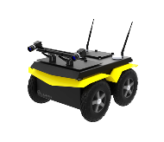
Project Purpose
Imagine a rover with an objective to explore a remote location, such as Martian deserts or urban canyons
Methods of Navigation:
GPS
Landmarks
Odometry
The DRAGON team pursues a solution using deployed RF beacons as an in-situ GPS network to correct inertial error
High Error

Slide 4
Specific Objectives
The DRAGON team will provide a fully autonomous method to navigate an unmanned rover in GPS-denied environments with 1m accuracy
This will be done by developing:
Pods which contain RF-Localization beacons.
Deployment mechanism to deploy pods to software-determined locations
Software to determine absolute position and navigate to waypoints
The pods will also have the demonstrational ability to collect and transmit environmental data.

Slide 5
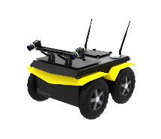
CONOPS
Mission Planning
Mission Execution
1 | Upload Mission Information Package
2 | Collect GPS Truth Position
3 | Generate Path
4 | Generate Pod Locations
5 | Deploy 3 Anchor Pods
6 | Deploy & Map Pods | or | Move & Localize Rover
7 | Repeat 6 Until Final Waypoint
MIP
Terrain Map
Waypoints
Obstacles
C
A
B

Slide 6
Levels of Success
 | Level 1 | Level 2 | Level 3
Rover Navigation | Localize rover to 1m with pod array for a 15m user-controlled path. | Correct rover position to 1m with closed-loop error correction. | Autonomously navigate SW-L1 path to within 1m of all 5-10 waypoints.
Pod Deployment | Pods are hand placed, in analytically predetermined locations. | Deploys pod to range > 10m. Internal electronics function after impact. | Rover software calculates trajectories and commands to deploy.
Scientific Data |  | Pods record pressure, temperature, and acceleration data. | Pods collect environmental data at 5 minute frequency.
Pod | Pods provide RF ranging measurements to the rover. | Pods communicate amongst themselves using a mesh network. | Pods toggle between high and low power modes.
Software | Find path for rover to reach 5-10 waypoints avoiding obstacles. | Software determines pod placement for best RF-ranging. | Pod placement software balances best science and best RF-ranging.
 | Level 1 | Level 2 | Level 3
Rover Navigation | Localize rover to 1m with pod array for a 15m user-controlled path. | Correct rover position to 1m with closed-loop error correction. | Autonomously navigate SW-L1 path to within 1m of all 5-10 waypoints.
Pod Deployment | Pods are hand placed, in analytically predetermined locations. | Deploys pod to range > 10m. Internal electronics function after impact. | Rover software calculates trajectories and commands to deploy.
Scientific Data |  | Pods record pressure, temperature, and acceleration data. | Pods collect environmental data at 5 minute frequency.
Pod | Pods provide RF ranging measurements to the rover. | Pods communicate amongst themselves using a mesh network. | Pods toggle between high and low power modes.
Software | Find path for rover to reach 5-10 waypoints avoiding obstacles. | Software determines pod placement for best RF-ranging | Pod placement software balances best science and best RF-ranging.
Verified on Rover
Verified on Laptop

Slide 7
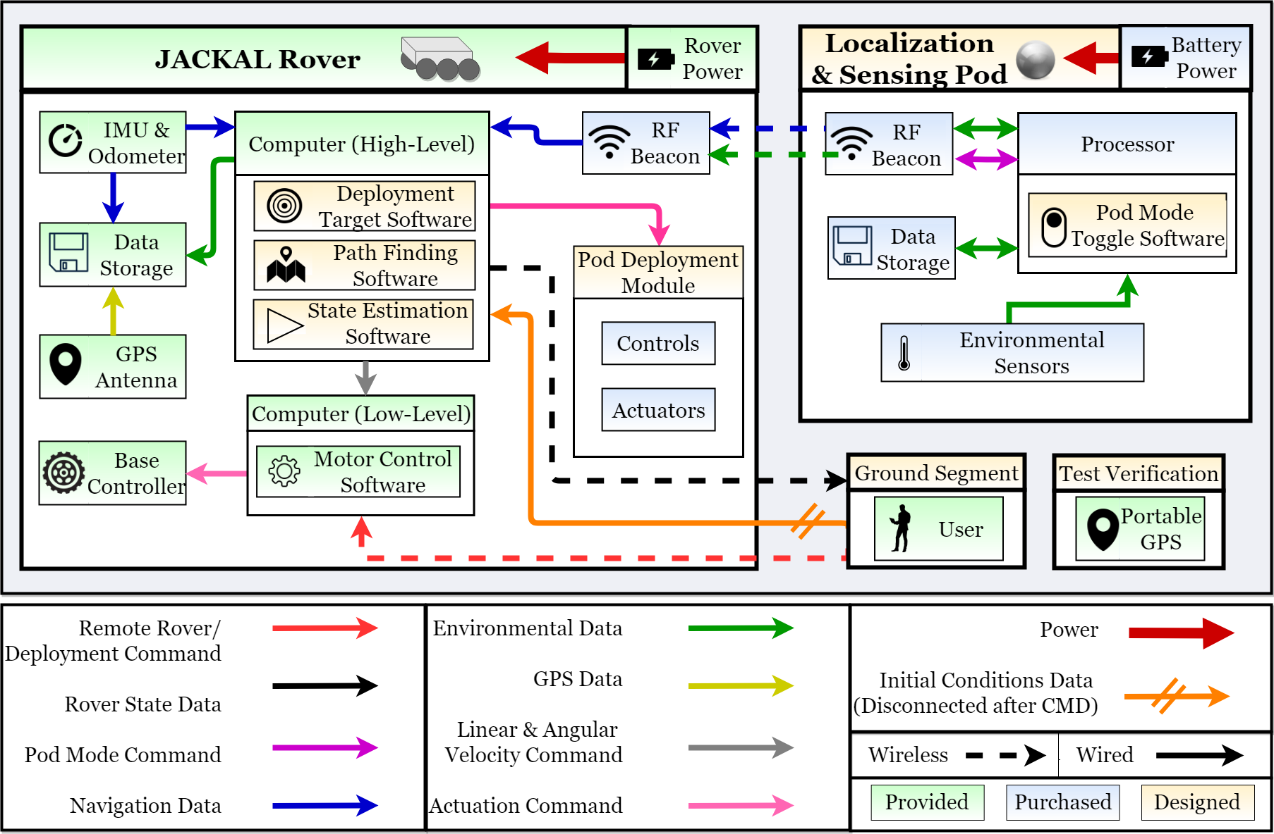
FBD

Slide 8
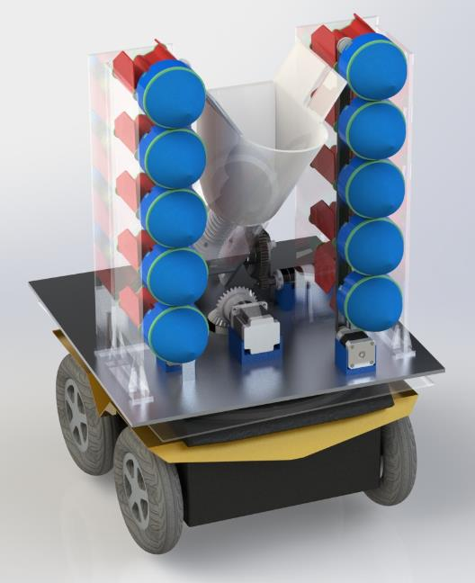
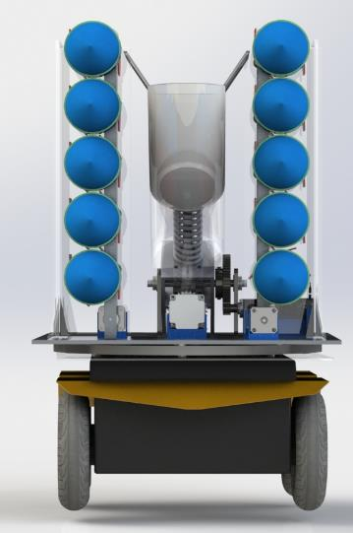
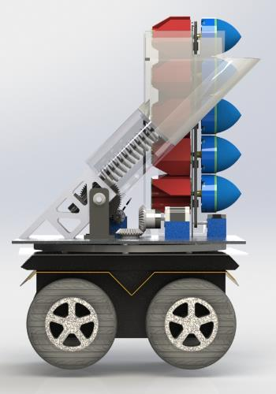
Deployment Module Design
30”
10”
17”
20”
Front View
Side View

Slide 9
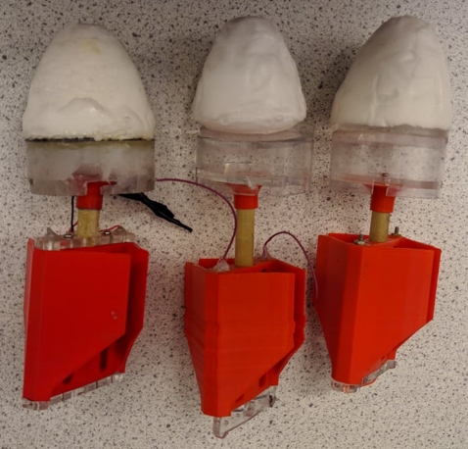
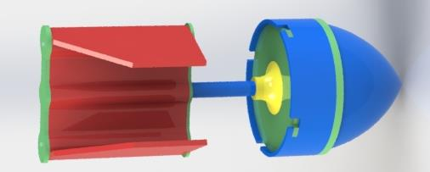
Pod Structure Design
Pod structure contains the ranging electronics: deployed from cannon
Contains batteries in tail for power, electronics are potted for resilience.

Slide 10
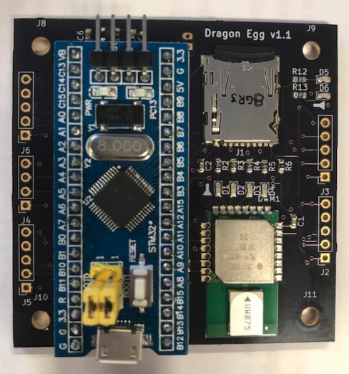
Pod Electronics Design
Capabilities:
Pod to Pod Ranging
Environmental data (pressure, temperature, and altitude)
Accelerometer data (+/- 100g’s)
SD card writing (Environmental and Accel. data)
Dragon Egg Shield [6cm x 6cm]

Slide 11
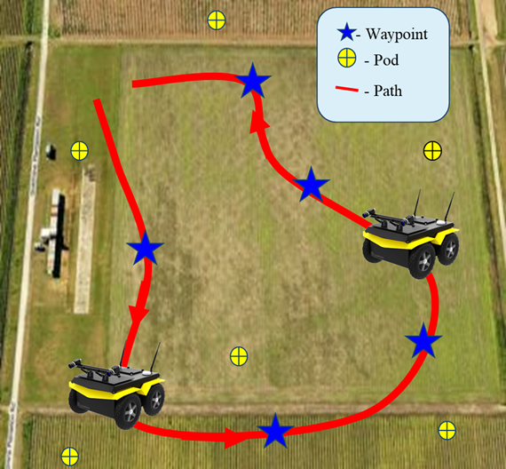
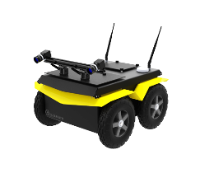
Navigation Software Design
Capabilities:
Generate path and pod deployment points to reach all 10 waypoints
Localize rover using RF ranging data to correct rover odometry
Generate closed-loop control routine to use localization data to keep rover within 1 m of path

Slide 12
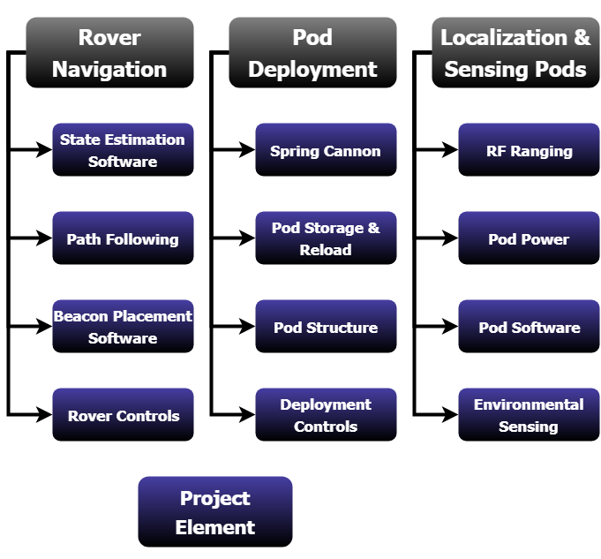
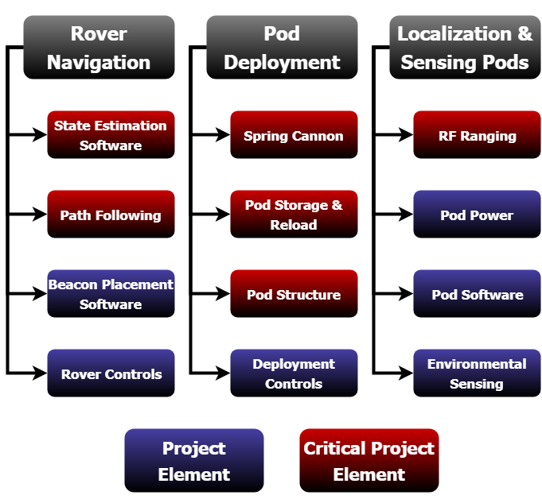
Critical Project Elements
CPE | Testing Status
State Estimation | 15m localization test successful
Path Following | Tested forward and yaw control
RF Ranging | 14/14 PCBs pass checkout test
Spring Cannon | Motor and gear safety demo complete
Pod Storage & Reload | Testing interface with pod structure
Pod Structure | 4 pod structures complete

Slide 13
Schedule
Project Overview
Schedule
Testing
Budget

Slide 14
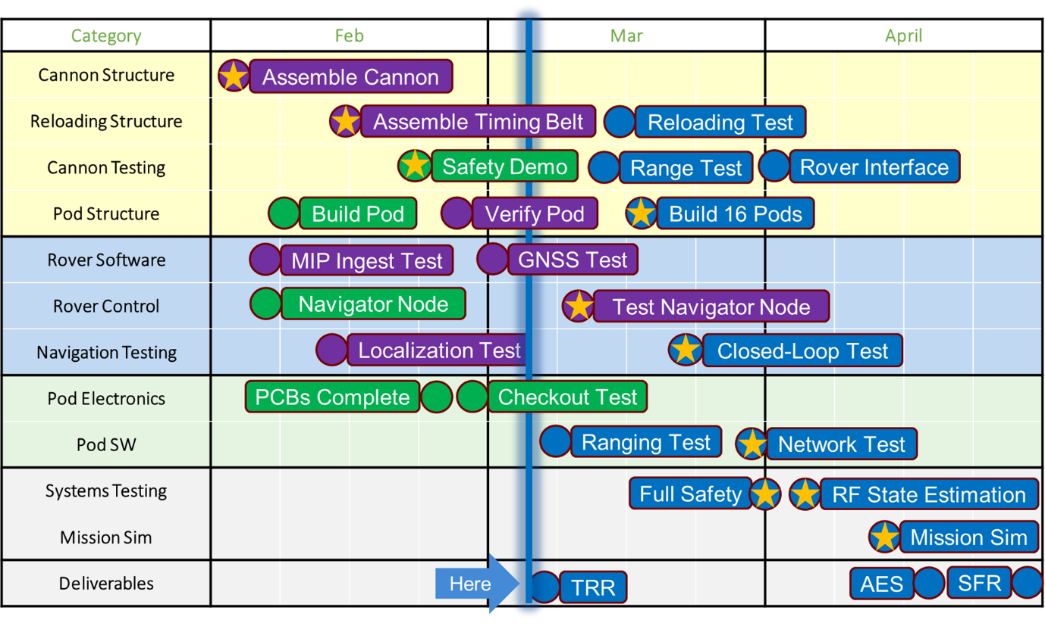
Gantt Chart
Complete
In Progress
Expected on Time
May Use Margin
Removed Task
Critical Task

Slide 15
Testing
Project Overview
Schedule
Testing
Budget

Slide 16
Testing Plan
Subsystem
Integration
System
Navigation
MIP Ingest Demo | 2/25
Rover Odometry Ctrl | 3/1
Rover GSLAM Demo | 3/7
Nav. + Electronics
Rover/Pod Cmd Test | 3/17
Mission-Length Ctrl | 3/24
Pod Electronics
Checkout Test | 2/25
Accuracy Test | 3/1
Mesh Network Test | 3/7
Full System
Safety Demo | 4/7
Mission Sim | 4/14
Struct. + Electronics
Pod Protection Test | 3/24
Pod Structure
Stability Test | 2/25
Drop Test | 3/1
Cannon + Rover
Cannon Interface Test | 3/31
Cannon
Reloading Demo | 3/8
Range Demo | 3/8
Complete
In Progress

Slide 17
Navigation Testing
 | Test | Purpose | Status
Localization | Localize Stationary Rover | Software determines position relative to any pod in range via RF-Localization | Results Verified 2/21
 | 15m Localization Test | Verify that localization results match model for 15m | Results Verified 2/28
 | Mission-Length Localization Test | Verify localization results match model & keep error under 1m in mission conditions | Test Scheduled 3/15
Control | Odometry Control Test | Characterize rover control error with odometry only | Test in Progress
 | RF + Odometry Control Test | Demonstrate that pods correct odometry error and match model for 15m | Test Scheduled 3/8
 | Mission-Length Control Test | Verify pod correction to under 1m in mission conditions | Test Scheduled 3/24
Risk Reduction: These tests generate internal heritage and allow for easy build up upon previous success

Slide 18
15m Localization Test
Objective: Localize rover during 15m tele-op’ed traversal with pods
Facility: Business/Kitt Field
Equipment:
Rover + beacon
3x Pods
Tape/measuring equipment
Procedure:
Distribute pods at known locations
Tele-op rover along path with estimation algorithm running
Requirements Verified
S2.1 | The software shall combine RF-Localization and inertial/odometry position estimates in order to enhance position estimation accuracy
S2.1.2 | The rover shall estimate position using onboard odometer and IMU
Additional: S2.1.1
Expected Result: Rover position estimate falls within model from CDR
Test Scheduled
Test Completed
Data Analyzed
Results Verified
Complete
In Progress
Notes:
Need to include status

Slide 19
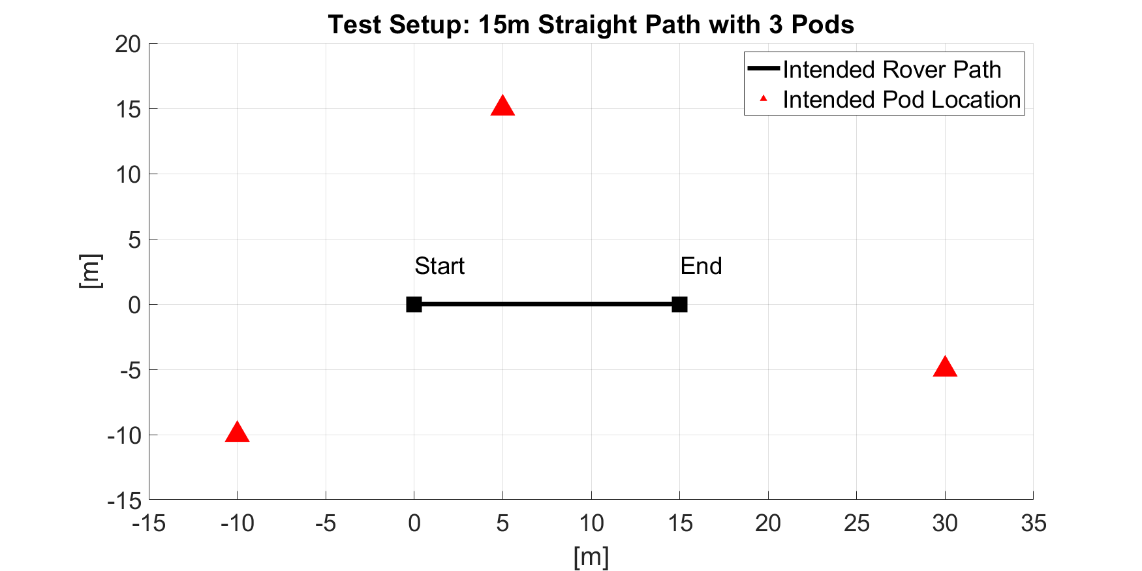
15m Localization Test Setup
Pod locations and rover path marked with tape
Tele-operate rover along path
Level One success criteria: within 1m of path at all times

Slide 20
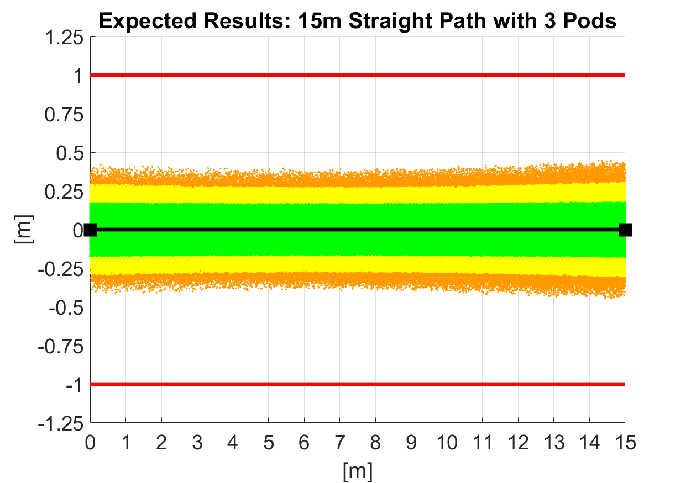
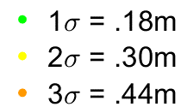
15m Localization Test Model
Model: 10,000 Monte Carlo simulations with 60cm sample error

Slide 21
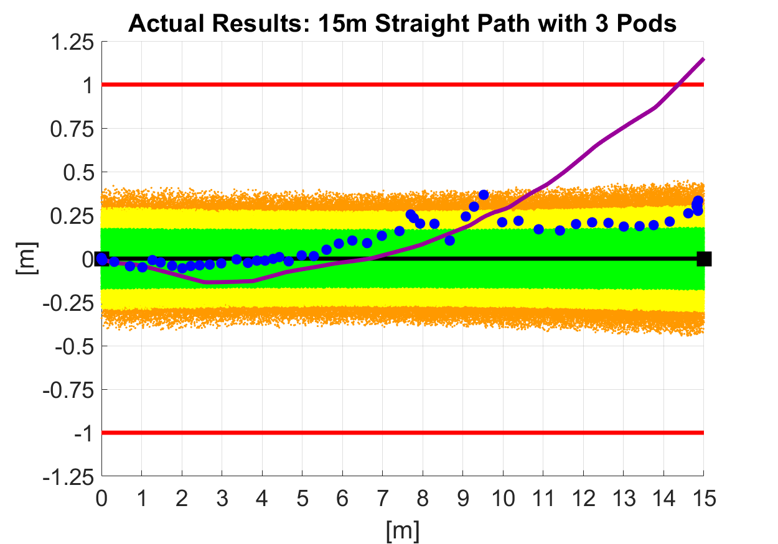
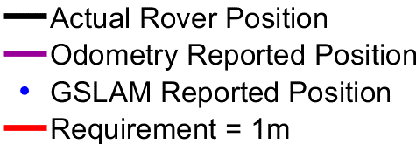
15m Localization Test Results
Odometry max error = 1.15 m
GSLAM max error = .35 m

Slide 22
Testing Plan
Subsystem
Integration
System
Navigation
MIP Ingest Demo | 2/25
Rover Odometry Ctrl | 3/1
Rover GSLAM Demo | 3/7
Nav. + Electronics
Rover/Pod Cmd Test | 3/17
Mission-Length Ctrl | 3/24
Pod Electronics
Checkout Test | 2/25
Accuracy Test | 3/1
Mesh Network Test | 3/7
Full System
Safety Demo | 4/7
Mission Sim | 4/14
Struct. + Electronics
Pod Protection Test | 3/24
Pod Structure
Stability Test | 2/25
Drop Test | 3/1
Cannon + Rover
Cannon Interface Test | 3/31
Cannon
Reloading Demo | 3/8
Range Demo | 3/8
Complete
In Progress

Slide 23
Pod Electronics Checkout Test
Objective: Verify the Hardware Capabilities of the Pod Electronics
Facility: ITLL
Equipment:
14 Fully Populated Pods (Electronics Only)
1 Rover Beacon
Power to boards (micro USB and Batteries)
Procedure:
Verify electrical connections
Test ranging and environmental data transfer
Verify current in high power mode
Verify current in low power mode
Requirements Verified
P6.1 | Pod shall have an environmental sensor package
P6.2 | Pod shall operate above 3.3V and under 20mA current in ‘low power mode’, refer to DR 5.3
P6.3 | Pod shall operate above 3.3V and under 300mA current in ‘high power mode’, refer to DR 5.3
P6.4 | Pod shall have ability to toggle between low power and high power modes
Additional: P6.1.1, P6.1.3, P6.1.4, P6.3.1.1, P6.3.1.2, P6.4.1, P6.4.2
Expected Result: Pod is able to transmit ranging and environmental data, verify power constraints
Test Scheduled
Test Completed
Data Analyzed
Results Verified
Complete
In Progress
Notes:
Need to include status

Slide 24
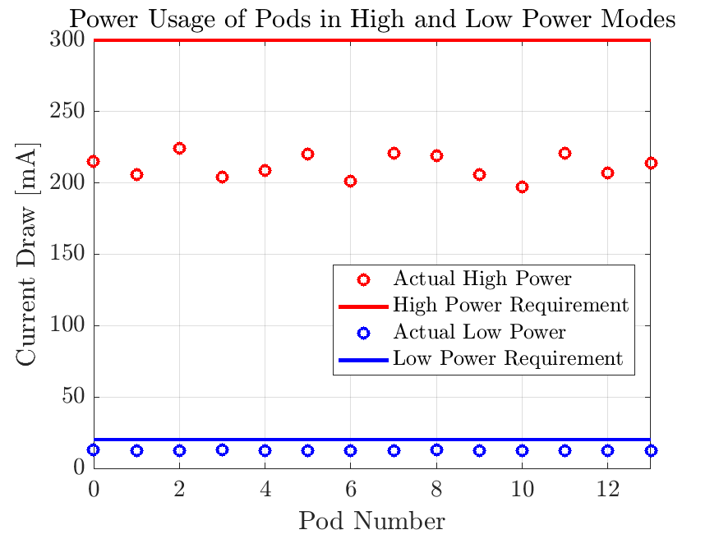
Pod Electronics Results
 | Requirement High/Low Power | Expected High/Low Power | Actual High/Low Power
Average | 300/20 [mA] | 290/17.5 [mA] | 211.7/12.44 [mA]
P6.2 | Pod shall operate above 3.3V and under 20mA current in ‘low power mode’, refer to DR 5.3
P6.3 | Pod shall operate above 3.3V and under 300mA current in ‘high power mode’, refer to DR 5.3
Each board was tested using a multimeter recording min/max for a full cycle (30 seconds)
Risk Reduction: Every single board proven to meet requirements

Slide 25
Pod Ranging Accuracy Test
Objective: Range and Accuracy of Pod Measurements
Facility: Business Field
Equipment:
14 Fully Populated Pod (Electronics Only)
1 Rover Beacon
Power to boards (micro USB and Batteries)
Tape Measure
Procedure:
Place the beacon and pods 60 m apart and take measurements to ensure precision between pods
Power 1 pod at a time verify that each pod can measure to at least 60 m
Using 1 pod and the beacon take measurements starting at 10 m up to max distance in 5 m increments
Requirements Verified
P6.5 | Pod shall have operational 'ranging' capability at distances no less than 60m.
P6.5.1 | Pods shall have range measurement errors no greater than 0.5m averaged over 30 samples.
Expected Result: Max range of pod ranging is >60 m and the measurements can be corrected to less than 0.5 m uncertainty
Test Scheduled
Test Completed
Data Analyzed
Results Verified
Complete
In Progress
Notes:
Need to include status

Slide 26
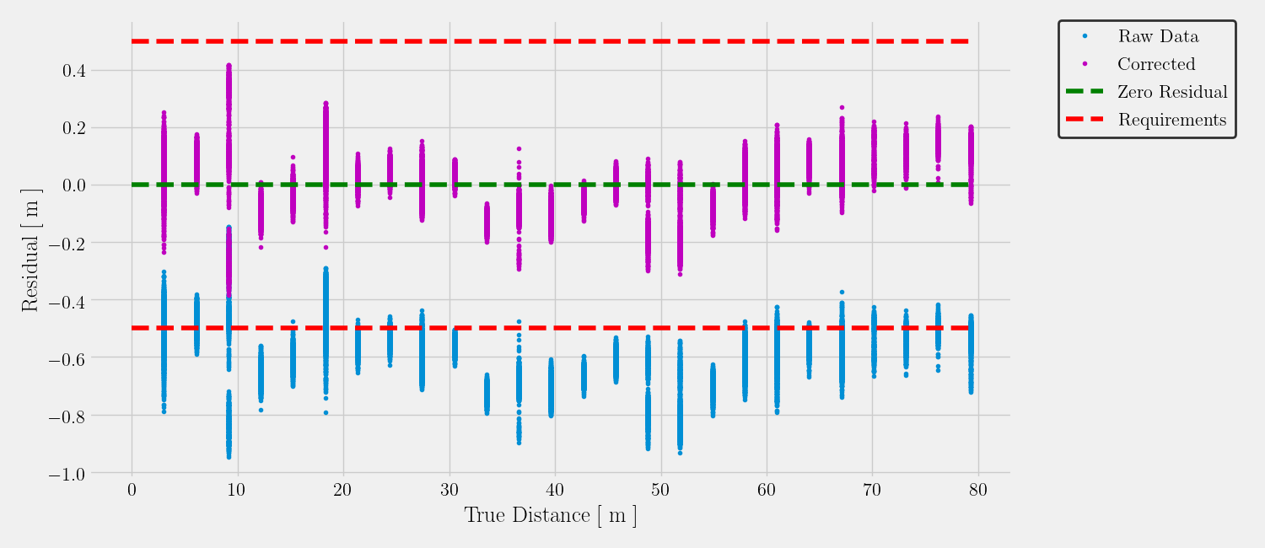
Pod Ranging Validation Test Results
Calibrated Distance = 0.9986*(Measured Distance) - 0.5511
Fi
Max Distance: 80 [m]
3σ Bound
CDR Test: 0.665 [m] Error
TRR Test:
0.319 [m] Error
Risk Reduction: Every single board is characterized for accuracy. Provides clear understanding of error and validates each board.

Slide 27
Testing Plan
Subsystem
Integration
System
Navigation
MIP Ingest Demo | 2/25
Rover Odometry Ctrl | 3/1
Rover GSLAM Demo | 3/7
Nav. + Electronics
Rover/Pod Cmd Test | 3/17
Mission-Length Ctrl | 3/24
Pod Electronics
Checkout Test | 2/25
Accuracy Test | 3/1
Mesh Network Test | 3/7
Full System
Safety Demo | 4/7
Mission Sim | 4/14
Struct. + Electronics
Pod Protection Test | 3/24
Pod Structure
Stability Test | 2/25
Drop Test | 3/1
Cannon + Rover
Cannon Interface Test | 3/31
Cannon
Reloading Demo | 3/8
Range Demo | 3/8
Complete
In Progress

Slide 28
Deployment Range Pretests
Objective: Ensure safety of cannon sub-system before full range testing
Pretests |  | Status
DT2.1 | Gear rotation with no load | Done
DT2.2 | Gear rotation with rack and applied load (no spring) | Done
 | Safety Demonstrations and Pre-tests | Done
DT2.3 | Partial spring compression | 3/5
DT2.4 | Full spring compression | 3/8
Risk Reduction: Electronics validated with no load first, then combined with load and additional mechanical components.
Complete
In Progress
Notes:
Need to include status

Slide 29
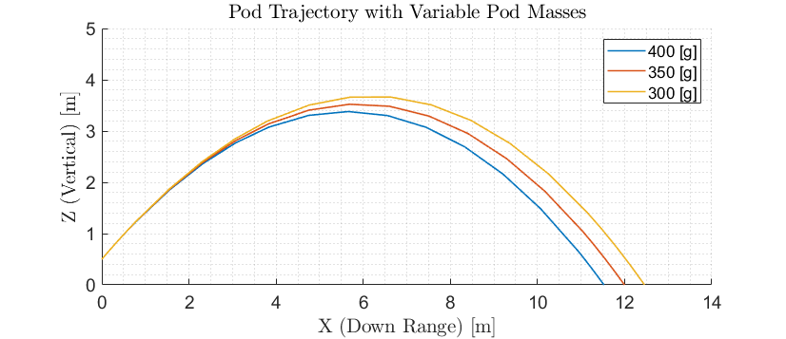
Updated Pod Trajectory Model
Objective: Verify cannon deploys to at least 10m
Gear Rack and Launch Plate Mass: 470 [g] (Up from 320 [g])
Pod Mass: 400 [g] (Down from 500 [g])
Predicted Distance: 11.52 [m]
Intend to verify model using measuring tape and video recording in RECUV Lab
Notes:
10.3 m/s is approx 23 mph

Slide 30
Deployment Range Test
Objective: Verify cannon deploys to at least 10m
Facility: Business Field or RECUV Lab
Equipment:
Fully built deployment module (gears, spring, support, launch tube, baseplate)
DC motor
At least one fully built pod
Procedure:
With safety procedures in place, load pod into launch tube
Send command to begin spring compression
Measure distance after pod is deployed
Repeat
Requirements Verified
D3.8.1 | DM shall have the following range: No less than 10m
Expected Result: Overall launch system works as designed and will allow for repeatable deployments to at least 10 m
Test Scheduled (3/8)
Test Completed
Data Analyzed
Results Verified
Complete
In Progress
Notes:
Need to include status

Slide 31
Testing Plan
Subsystem
Integration
System
Navigation
MIP Ingest Demo | 2/25
Rover Odometry Ctrl | 3/1
Rover GSLAM Demo | 3/7
Navigation + Electronics
Rover/Pod Cmd Test | 3/17
Mission-Length Ctrl | 3/24
Pod Electronics
Checkout Test | 2/25
Accuracy Test | 3/1
Mesh Network Test | 3/7
Full System
Safety Demo | 4/7
Mission Sim | 4/14
Pod Structure + Electronics
Pod Protection Test | 3/24
Pod Structure
Stability Test | 2/25
Drop Test | 3/1
Cannon + Rover
Cannon Interface Test | 3/31
Cannon
Reloading Demo | 3/8
Range Demo | 3/8
Complete
In Progress

Slide 32
Integration Plan
Navigation + Electronics
Challenge: Combining different software pieces software into main function
Estimated Work:
35 hours testing rover software
2 hour Rover/Pod Command Test
4 Hour Mission Length Control Test
Pod Structure + Electronics
Challenge: Consistency and fatigue testing
Estimated Work:
1 hour potting per board (x14)
2 hour Pod Protection Test 3/24
Ready for Full System Testing
62 Hours
Cannon + Rover
Challenge: Fit checks and tolerance stack up
Estimated Work:
2 hours for fit checks
1 hour for final install
2 hour Cannon Interface Test 3/31
System Integration
by April 1

Slide 33
Testing Plan
Subsystem
Integration
System
Navigation
MIP Ingest Demo | 2/25
Rover Odometry Ctrl | 3/1
Rover GSLAM Demo | 3/7
Nav. + Electronics
Rover/Pod Cmd Test | 3/17
Mission-Length Ctrl | 3/24
Pod Electronics
Checkout Test | 2/25
Accuracy Test | 3/1
Mesh Network Test | 3/7
Full System
Safety Demo | 4/7
Mission Sim | 4/14
Struct. + Electronics
Pod Protection Test | 3/24
Pod Structure
Stability Test | 2/25
Drop Test | 3/1
Cannon + Rover
Cannon Interface Test | 3/31
Cannon
Reloading Demo | 3/8
Range Demo | 3/8
Complete
In Progress

Slide 34
Full System Safety
Cannon Safety
Motor Reverse | User sends reverse motor direction mid-spring compression | To Be Tested: 3/31
Electrical Inhibit | Electrical inhibit prevents deployment electronics from working | To Be Tested: 3/22
LED Indicator | LED mounted on rover indicating safety state | To Be Tested: 3/31
Rover Safety
Deadman’s Switch | Button on PS4 controller required to be depressed or rover stops | Tested on: 2/22
User Takeover | Built-in multiplexer gives controller priority over any other commands | Tested on: 2/22
Remote Shutdown | User sends full shutdown command via Ground Station | To Be Tested: 3/15
Complete
In Progress
Notes:
Need to include status
Could be combined or replaced as Full System Safety Demo —-Needs to be done before ranging test!

Slide 35
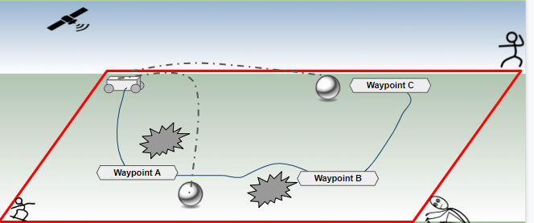
Full Mission Demo
Objective: Full mission completion and demonstration
Facility: Open flat grass field
Equipment:
Jackal rover, deployment system, pods, electronics
GPS
Final MIP
Requirements Verified
M1 | Project’s primary objective
- | Many subsequent requirements
Expected Result: GPS readings & rover internal estimates match within 1m at EOM
Test Scheduled (4/14)
Test Completed
Data Analyzed
Results Verified
Complete
In Progress
Notes:
Need to include status

Slide 36
Full Mission Demo
Testing Procedure:
Mark waypoints and rover obstacles
Place team members surrounding area for range safety
Begin GPS recording on rover, pre-verified
Perform all safety checks, check: remote kill, takeover
Load pods and zero cannon azimuth
Upload mission sequence
Perform initial deployment, collect pod readings
Rover builds pose estimate, proceeds with mission
Collect post data mission and verify mission success
Special Requirements:
Obtain permission for field operations
Mark out hazard zone for range safety
Weather cooperation
1e-2 m accuracy, 10Hz sample rate, record to ground station computer
5e-1 m accuracy, 30Hz sample rate per pod, closed loop control on rover
Success: GPS readings and rover internal estimates match within 1m at EOM

Slide 37
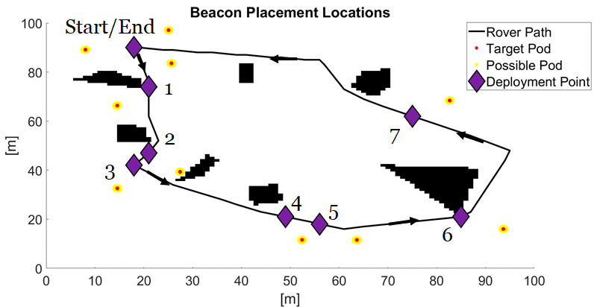
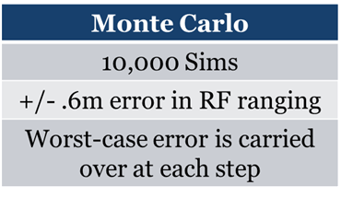
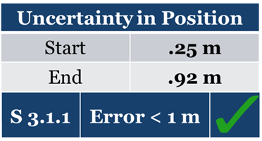
Full Mission Expected Results

Slide 38
Budget
Project Overview
Schedule
Testing
Budget

Slide 39
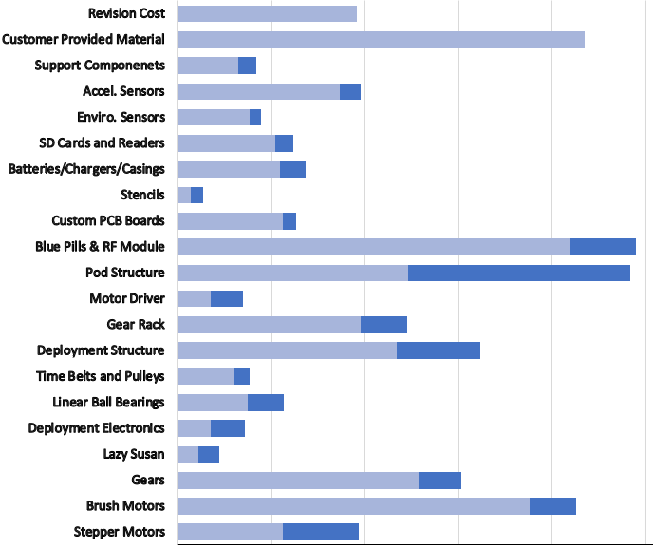
Budget
*Notes:
Budget based on estimated 12 pods + 4 pods for prototyping
Purchased
Margin
Total Cost: | $3,454.29
Total Spent: | $3,356.77
Margin (for replacements): | $830.77
Shipping: | $300.00
Reserve: | $414.94
 | $5000.00
Notes:
* Status of all procurements (color code: parts received, pending, and planned)
* Highlight parts with long-lead and most important parts to project success.
* Highlighting uncertainties and corresponding budget margins

Slide 40
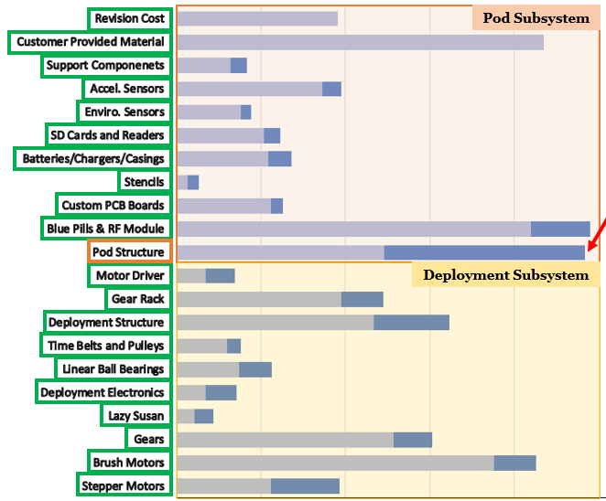
Budget
Left to Purchase:
Pod Booms
Wall Housing
Tail Cap
To be purchased after pod/cannon interface testing (3/12)
Purchased
Margin
All long lead time parts have arrived
Received
To Purchase
Long Lead Time
Critical Part
All critical parts have arrived except pod structure
Pod Structure parts in transit or can be purchased locally
Notes:
* Status of all procurements (color code: parts received, pending, and planned)
* Highlight parts with long-lead and most important parts to project success.
* Highlighting uncertainties and corresponding budget margins
How have we saved money:( I originally planned for a worst case scenario) Money saved by not doing third PCB revision, cheaper to buy blue pill than STM32 processors, deployment finding different company to purchase base plate to say money, reusing components during PCB testing (and buying the support components in bulk at once), minimizing shipping as much as possible, custom PCB through Osh Park rather than Advanced circuits which was originally planned.

Slide 41
Appendix

Slide 42
A. Navigation Tests

Slide 43
Testing Plan
Subsystem
Integration
System
Navigation
MIP Ingest Demo | 2/25
Rover Odometry Ctrl | 3/1
Rover GSLAM Demo | 3/7
Nav. + Electronics
Rover/Pod Cmd Test | 3/17
Mission-Length Ctrl | 3/24
Pod Electronics
Checkout Test | 2/25
Accuracy Test | 3/1
Mesh Network Test | 3/7
Full System
Safety Demo | 4/7
Mission Sim | 4/14
Struct. + Electronics
Pod Protection Test | 3/24
Pod Structure
Stability Test | 2/25
Drop Test | 3/1
Cannon + Rover
Cannon Interface Test | 3/31
Cannon
Reloading Demo | 3/8
Range Demo | 3/8
Complete
In Progress

Slide 44
Localize Stationary Rover
Objective: Show rover is able to localize using pods alone
Facility: N/A
Equipment:
Rover + beacon
3x Pods
Procedure:
Place pods a known distance from rover
Input the “deployment angle” of each pod to the rover
Range between pods and rover
Requirements Verified
S2.1.1 | Software shall be able to determine position relative to any pod in range via RF-Localization
Result: Algorithm estimate of rover/pod locations accurate to ~10cm
Test Scheduled
Test Completed
Data Analyzed
Results Verified
Complete
In Progress
Notes:
Need to include status

Slide 45
GNSS Accuracy Test
Objective: Demonstrate GNSS accuracy
Facility: Baseline
Equipment:
Rover
GNSS module
Procedure:
Walk GNSS unit along Baseline
Mount GNSS on rover, drive rover along the same path
Record data at 1m increments
Compare recorded data to truth
Requirements Verified
G1.1.1 | GNSS accuracy shall be 1m or less
S1.3.1 | Software shall record initial GNSS position of rover
S7.1 | Software shall be capable of recording GNSS data on the rover for the duration of the mission
Expected Result: GNSS accurate to <1m
Test Scheduled
Test Completed
Data Analyzed
Results Verified
Complete
In Progress
Notes:
Need to include status

Slide 46
MIP Upload Test
Objective: Verify MIP upload and start of mission capabilities
Facility: N/A
Equipment:
Rover
GNSS Unit
Sample valid and invalid MIP
Procedure:
Upload MIP
Rover collects GNSS truth
Generate path with A*
Determine pod locations
Requirements Verified
G9.4.1 | User shall upload MIP to Software
S1.3 | Software shall generate a path through the terrain to reach up to 10 waypoints
S3.1.1 | Software can determine pod location for placement for most effective ranging
Additional: S1.3.1, S1.3.2, S1.3.2.1, S1.3.3 S1.3.3.1
Expected Result: Able to complete mission-start procedure
Test Scheduled
Test Completed
Data Analyzed
Results Verified
Complete
In Progress
Notes:
Need to include status - if Christian fixes GPS we can test this but currently works w initial GPS guess -- RYAN

Slide 47
Pod Location Validity Test
Objective: Demonstrate ability to determine effective pod locations
Facility: N/A
Equipment:
Localization MC simulation
Pod ranging estimates
Procedure:
Simulate path traversal
Simulate pod deployment and ranging
Propagate pessimistic assumption of error
Requirements Verified
S3.1.1 | Software can determine pod location for placement for most effective ranging
S3.1.2 | Software can determine pod location for placement for for most valuable environmental data.
S3.1.3 | Software shall incorporate terrain obstacles into deployment location selection to avoid pre-defined obstacles
Additional: .S3.1, S3.1.4
Expected Result: Show localization error sufficiently low in theory
Test Scheduled
Test Completed
Data Analyzed
Results Verified
Complete
In Progress
Notes:
Need to include status

Slide 48
Time-on-Target
Objective: Rover follows path and meets time requirements
Facility: Business/Kitt Field
Equipment:
Rover + beacon
11x Pods
Tape/measuring equipment
Procedure:
Distribute pods at known locations
Rover drives autonomously along path, correcting deviations and adjusting velocity to meet time-on-target requirements
Requirements Verified
S1.3.3 | Rover shall meet MIP time requirements, ‘on-time, on-target’ for each waypoint
Expected Result: Rover arrives at waypoints within CHANGE_ME seconds of specified time
Test Scheduled
Test Completed
Data Analyzed
Results Verified
Complete
In Progress
Notes:
Need to include status

Slide 49
Full-Mission-Length Traversal
Objective: Localize rover during full-mission-length tele-op’ed traversal with pods
Facility: Business/Kitt Field
Equipment:
Rover + beacon
11x Pods
Tape/measuring equipment
Procedure:
Distribute pods at known locations
Tele-op rover along path with estimation algorithm running
Requirements Verified
M2 | The rover shall estimate its absolute position
S2.1.2 | The rover shall estimate position using onboard odometer and IMU
Additional: S2.1.1
Expected Result: Rover position estimate accurate to 1m along path
Test Scheduled
Test Completed
Data Analyzed
Results Verified
Complete
In Progress
Notes:
Need to include status

Slide 50
Rover Control Test
Objective: Rover follows a path with odometry alone
Facility: COHRINT Space
Equipment:
Rover + beacon
3x pods
Procedure:
Upload set of points to rover
Rover follows path using odometry alone
Requirements Verified
S1.2.1 | Software shall be capable of controlling rover’s physical motion through wheel actuators/ROS nodes
Expected Result: Able to direct rover to move autonomously
Test Scheduled
Test Completed
Data Analyzed
Results Verified
Complete
In Progress
Notes:
Need to include status

Slide 51
Closed-Loop Correction
Objective: Rover follows A* path with RF-corrected odometry
Facility: Business/Kitt Field
Equipment:
Rover
3x Pods
Tape/measuring equipment
Procedure:
Distribute pods at known locations
Rover drives autonomously along 15m path, correcting deviations
Requirements Verified
S1.2 | Rover shall have feedback control to correct for path deviance
S1.2.2 | Software shall have closed loop correction of inertial/odometry location measurement error by using pod RF-Localization
Expected Result: Rover navigates path deviating no more than CHANGE_ME cm
Test Scheduled
Test Completed
Data Analyzed
Results Verified
Complete
In Progress
Notes:
Need to include status

Slide 52
Deployment-Rover Interface
Objective: Rover commands deployment mechanism azimuth angle
Facility: N/A
Equipment:
Rover
Deployment mechanism with arduino control system
Procedure:
Command firing while rover moving
Verify rover stops
Verify deployment mechanism turns and fires at correct angle
Requirements Verified
S9.2.1 | Rover shall always stop before commanding a deployment
S9.2.2 | Software shall provide heading with respect to rover state to deployment
D3.4 | DM shall have interface with rover SW for commanding deployment mechanism to deploy pods
D8.3.1 | Deployment module shall be compatible with provided onboard power
Expected Result: Deployment mechanism interfaces with rover
Test Scheduled
Test Completed
Data Analyzed
Results Verified
Complete
In Progress
Notes:
Need to include status

Slide 53
RF State Estimation Test
Objective: Demonstrate pod network functionality to rover
Facility: Open flat grass field
Equipment:
Jackal rover and ranging boards
GPS
Weather cooperation
Procedure:
Begin GPS recording on rover (1e-2m accuracy)
‘Hand Place’ pods at desired locations
Upload mission sequence
Collect first pod readings, Build pose estimate
Tele-op rover to second known position
‘Hand Place’ additional pods, Build second pose estimate with rover
Requirements Verified
M2
M5
S2.1 S2.1.3 S2.1.1 S9.2.3
Additional:
Expected Result: Rover can range to pods, Calculate pose, Add new pods to network
Test Scheduled
Test Completed
Data Analyzed
Results Verified
Complete
In Progress
Notes:
Need to include status

Slide 54
B. Electronics Tests

Slide 55
Testing Plan
Subsystem
Integration
System
Navigation
MIP Ingest Demo | 2/25
Rover Odometry Ctrl | 3/1
Rover GSLAM Demo | 3/7
Nav. + Electronics
Rover/Pod Cmd Test | 3/17
Mission-Length Ctrl | 3/24
Pod Electronics
Checkout Test | 2/25
Accuracy Test | 3/1
Mesh Network Test | 3/7
Full System
Safety Demo | 4/7
Mission Sim | 4/14
Struct. + Electronics
Pod Protection Test | 3/24
Pod Structure
Stability Test | 2/25
Drop Test | 3/1
Cannon + Rover
Cannon Interface Test | 3/31
Cannon
Reloading Demo | 3/8
Range Demo | 3/8
Complete
In Progress

Slide 56
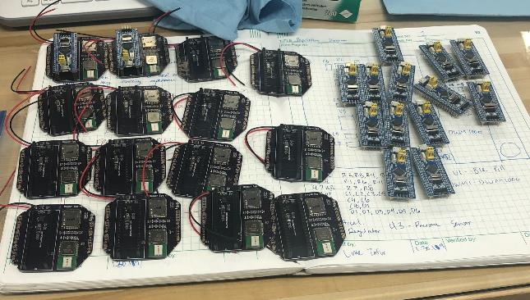
Pod Electronics Results
Pod | Requirement High/Low Power | Expected High/Low Power | Actual High/Low Power
Average | 300/20 [mA] | 290/17.5 [mA] | 211.7/12.44 [mA]
0 |  |  | 215/12.7 [mA]
1 |  |  | 206/12.5 [mA]
2 |  |  | 224/12.1 [mA]
3 |  |  | 204/12.8 [mA]
4 |  |  | 209/12.3 [mA]
5 |  |  | 220/12.6 [mA]
6 |  |  | 201/12.6 [mA]
7 |  |  | 221/12.3 [mA]
8 |  |  | 219/12.8 [mA]
9 |  |  | 206/12.3 [mA]
10 |  |  | 197/12.4 [mA]
11 |  |  | 221/12.1 [mA]
12 |  |  | 207/12.3 [mA]
13 |  |  | 214/12.4 [mA]
P6.2- Pod shall operate above 3.3V and under 20mA current in ‘low power mode’, refer to DR 5.3
P6.3- Pod shall operate above 3.3V and under 300mA current in ‘high power mode’, refer to DR 5.3
Each board was tested using a multimeter recording min/max for a full cycle (30 seconds)
Risk Reduction: Every single board proven to meet requirements

Slide 57
Pod Electronics Results
Requirements Verified |  | Verified By | Details
P6.1 | Pod shall have an environmental sensor package | Inspection | Each pod has an accelerometer and pressure/temperature sensor
P6.3.1.1 | Pod shall transmit ranging data | Software | Each pod was pinged for ranging and responded with 10 measurements when 10 were requested
P6.3.1.2 | Pod shall transmit environmental data | Software | Each pod was pinged for environmental data and responded with all the environmental data present on the SD card
P6.4 | Pod shall have ability to toggle between low power and high power modes | Measurement | Each pod transitioned from high power mode to low power mode
Additional: P6.1.1, P6.1.3, P6.1.4, P6.4.1, P6.4.2 |  | Software

Slide 58
Pod Initial Network Test
Objective: Intermediate test to verify that 5 pods do not interfere with each other
Facility: Business Field
Equipment:
5-6 fully populated pods (some with structure)
1 rover beacon
Power (micro USB and batteries)
Procedure:
Place pods at various locations on the field
Verify ranging data transmit between rover beacon and pods
Verify ranging data transmit between pods
Verify environmental data transmit between rover beacon and pods
Requirements Verified
P5.2 | The pods shall communicate data to the rover and amongst themselves
P5.2.1 | Pods shall have localization data transmit capability using DW1000
Additional:
Expected Result: Multiple pods are able to communicate to the rover beacon with no interference issues
Test Scheduled
Test Completed
Data Analyzed
Results Verified
Complete
In Progress
Notes:
Need to include status

Slide 59
Pod Initial Network Test Results
Currently this test has been performed with a laptop and a stationary rover
There were no issues in terms of pods interfering with each other in the stationary tests
There have been teleop issues with the rover so the test still has to be performed with a moving rover
The test can be performed as soon as teleop is working on the rover
Next Step -- Final Network Test
This test requires 11 pod structures
The test is currently scheduled for XX/XX/XXXX pending status of the pod structures
Since there are intermediate tests for this final test we are confident that on the success of the previous tests this one will also be successful

Slide 60
C. Pod Structure Tests

Slide 61
Testing Plan
Subsystem
Integration
System
Navigation
MIP Ingest Demo | 2/25
Rover Odometry Ctrl | 3/1
Rover GSLAM Demo | 3/7
Nav. + Electronics
Rover/Pod Cmd Test | 3/17
Mission-Length Ctrl | 3/24
Pod Electronics
Checkout Test | 2/25
Accuracy Test | 3/1
Mesh Network Test | 3/7
Full System
Safety Demo | 4/7
Mission Sim | 4/14
Struct. + Electronics
Pod Protection Test | 3/24
Pod Structure
Stability Test | 2/25
Drop Test | 3/1
Cannon + Rover
Cannon Interface Test | 3/31
Cannon
Reloading Demo | 3/8
Range Demo | 3/8
Complete
In Progress

Slide 62
Pod Structure Aero Test

Slide 63
D. Deployment Tests

Slide 64
Testing Plan
Subsystem
Integration
System
Navigation
MIP Ingest Demo | 2/25
Rover Odometry Ctrl | 3/1
Rover GSLAM Demo | 3/7
Nav. + Electronics
Rover/Pod Cmd Test | 3/17
Mission-Length Ctrl | 3/24
Pod Electronics
Checkout Test | 2/25
Accuracy Test | 3/1
Mesh Network Test | 3/7
Full System
Safety Demo | 4/7
Mission Sim | 4/14
Struct. + Electronics
Pod Protection Test | 3/24
Pod Structure
Stability Test | 2/25
Drop Test | 3/1
Cannon + Rover
Cannon Interface Test | 3/31
Cannon
Reloading Demo | 3/8
Range Demo | 3/8
Complete
In Progress

Slide 65
Reloading Test
Objective: Verify reloading capability and funnel design
Facility: ITLL or Project Depot
Equipment:
Power supply
Full assembled reloading system with stepper motor
At least 5 pods
Procedure:
Load 5 pods onto timing belt
Send reload command to turn the stepper motors
Repeat for all pods
Requirements Verified
D3.5 | DM shall be capable of deploying 10 pods within a 20 minute duration
D3.5.1 | DM shall be capable of reloading and deploying a new pod every 2 minutes
P5.1 | Pods are deployable and compatible with DM
Additional: None
Expected Result: Timing belt shown to support all loads, commanding is functional, no jamming in funnel, ideal reloading step count verified
Test Scheduled
Test Completed
Data Analyzed
Results Verified
Complete
In Progress
Notes:
Need to include status

Slide 66
Reloading Pretests
Objective: Verify reloading capability and funnel design
Pretests |  | Status
DT3.1 | Turn timing belt
DT3.2 | Reload one pod | 2/23
Complete
In Progress
Notes:
Need to include status

Slide 67
Cannon Safety Pretests
Objective: Verify safety procedure and remote kill switch
Pretests |  | Status
 | Serial command from computer → Arduino to reverse motor direction
 | Serial command from computer → Arduino to shut off motor
 | Command from kill switch → rover to cut power (no deployment module)
 | Command from kill switch → rover to shut off motor (no spring compression)
 | Command from kill switch → rover to reverse motor direction (no rack or spring compression)
Complete
In Progress
Notes:
Need to include status

Slide 68
Cannon Safety Demo

Slide 69
Manual Spring Safety
If the spring is slightly compressed and not in a fire sequence, the spring can be reversed and stopped using manual commands.

Slide 70
E. Integration Tests

Slide 71
Testing Plan
Subsystem
Integration
System
Navigation
MIP Ingest Demo | 2/25
Rover Odometry Ctrl | 3/1
Rover GSLAM Demo | 3/7
Nav. + Electronics
Rover/Pod Cmd Test | 3/17
Mission-Length Ctrl | 3/24
Pod Electronics
Checkout Test | 2/25
Accuracy Test | 3/1
Mesh Network Test | 3/7
Full System
Safety Demo | 4/7
Mission Sim | 4/14
Struct. + Electronics
Pod Protection Test | 3/24
Pod Structure
Stability Test | 2/25
Drop Test | 3/1
Cannon + Rover
Cannon Interface Test | 3/31
Cannon
Reloading Demo | 3/8
Range Demo | 3/8
Complete
In Progress

Slide 72
Cannon Integration Test
Objective: Verify that the cannon can accept heading/fire commands from the rover
Requirements Verified
Additional:
Facility: Cohirnt/Field
Equipment:
Rover
Cannon installed
Pod
Procedure:
Send various heading commands
Check zero-out and heading is accurate
Send fire command
Check deployment does not effect vehicle
Send reload command
Verify reload is successful, went to corresponding side and turn radius
Expected Result: Rover is able to command the deployment mechanism as expected via serial r/w to deployment microcontroller.
Test Scheduled
Test Completed
Data Analyzed
Results Verified
Complete
In Progress
Notes:
Need to include status

Slide 73
Pod Final Network Test
Objective: Verify that all 11 pods do not interfere with each other and are ready for integration with the navigation team
Facility: Business Field
Equipment:
11 fully populated pods with structure
1 rover beacon
Power (micro USB and batteries)
Procedure:
Place pods at various locations on the field
Verify ranging data transmit between rover beacon and pods
Verify ranging data transmit between pods
Verify environmental data transmit between rover beacon and pods
Requirements Verified
P5.2 | The pods shall communicate data to the rover and amongst themselves
P5.2.1 | Pods shall have localization data transmit capability using DW1000
Additional:
Expected Result: All pods are able to communicate to the rover beacon with no issues with a full scale test and are ready to be integrated with the navigation team
Test Scheduled
Test Completed
Data Analyzed
Results Verified
Complete
In Progress
Notes:
Need to include status

Slide 74
Overall System Safety Test
Objective: Demonstrate safety mechanisms, validate safe operation
Facility: Open flat grass field
Equipment:
Integrated deployment module w/ electronics
Completed reloading module w/ electronics
Completed azimuth module w/ electronics
Remote kill switch
10 pod structures w/ appropriate mass
Procedure:
Perform a vehicle traversal
using a known and basic path
Install deployment module and fully load 10 pods
Perform same path
Requirements Verified
M4
D4.4 D3.7 D4.1 D4.1.1 D3.6
Additional:
Expected Result: Rover can range to pods, Calculate pose, Add new pods to network
Test Scheduled
Test Completed
Data Analyzed
Results Verified
Complete
In Progress
Notes:
Need to include status

Slide 75
F: Full Gantt Chart

Slide 76
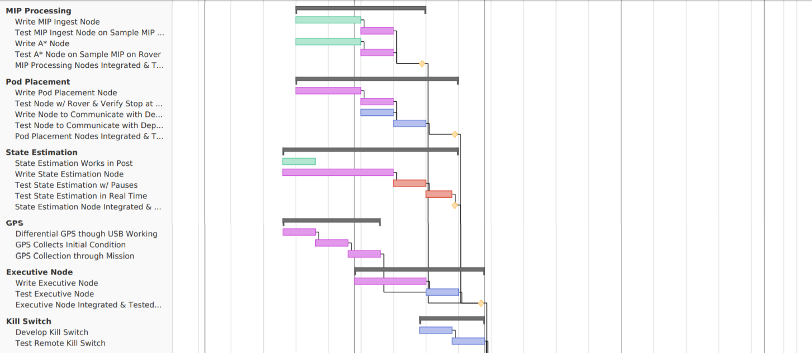
Gantt: Software & Electronics

Slide 77
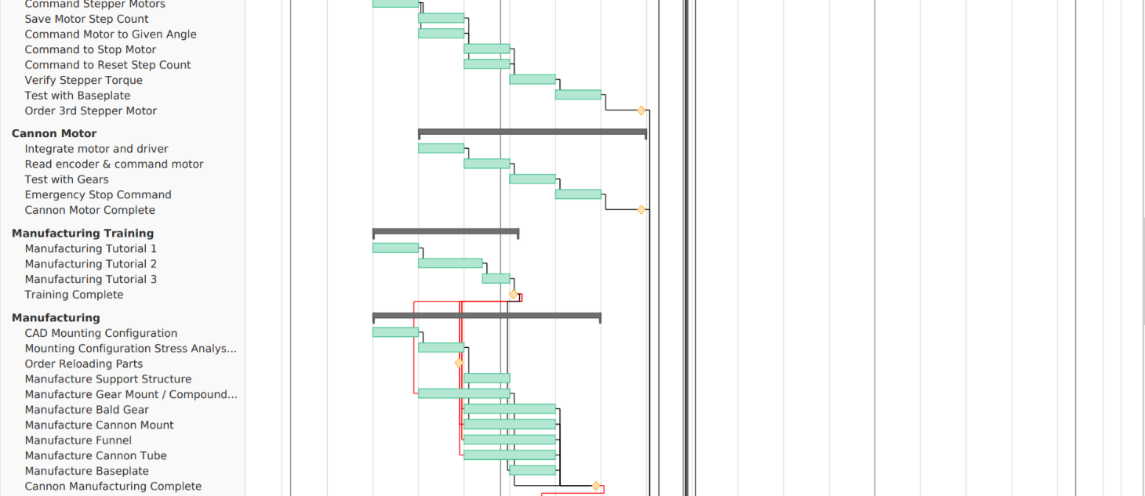
Gantt: Manufacturing

Slide 78
Gannt: Assembly & Integration

Slide 79
Gantt: Deliverables

Slide 80
G: Team Organization

Slide 81
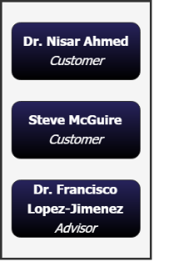
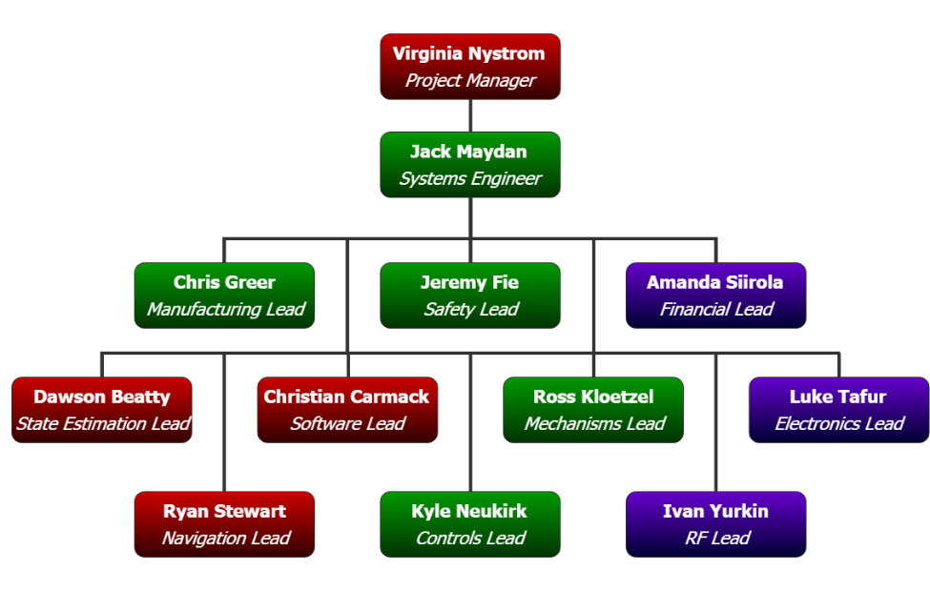
Organizational Chart: 09/18 – 02/19
4 Team Members
Progress: On Track
5 Team Members
Progress: Back on Schedule
3 Team Members
Progress: Ahead of Schedule

Slide 82
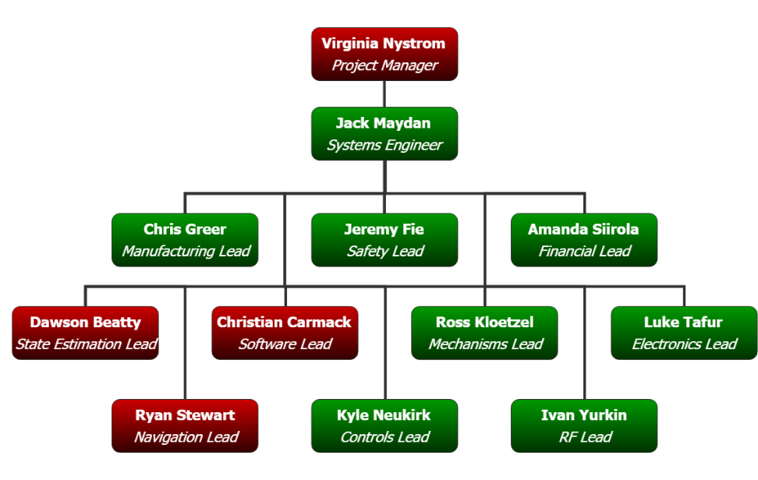
Organizational Chart: 03/19 – 05/19
* Pod Electronics Team moves to Deployment Team when their integration tasks are complete
4 Team Members
Progress: On Track
8 Team Members
New team members assist with motors & pod assembly
0 Team Members
PCB Complete
Pod SW Complete

