Slide 1
Deployed RF Antennas for GPS-denied Optimization and Environmental Navigation
Manufacturing Status Review
Dawson Beatty, Christian Carmack, Jeremy Fie,
Chris Greer, Ross Kloetzel, Jack Maydan,
Kyle Nieukirk, Virginia Nystrom, Amanda Siirola,
Ryan Stewart, Luke Tafur, Ivan Yurkin

Slide 2
Project Overview
Project Overview
Schedule
Electronics
Hardware
Software
Budget

Slide 3
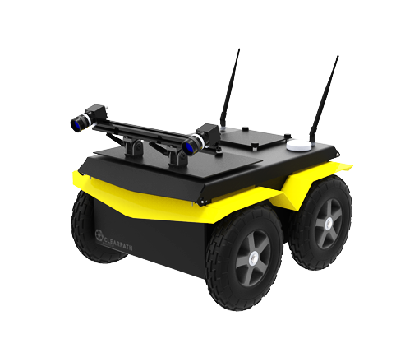
Project Purpose
Imagine a rover with an objective to explore a remote location, such as Martian deserts or urban canyons
Methods of Navigation:
GPS
Landmarks
Odometry
The DRAGON team pursues a solution using deployed RF beacons as an in-situ GPS network to correct inertial error
High Error

Slide 4
Specific Objectives
The DRAGON team will provide a fully autonomous method to navigate an unmanned rover in GPS-denied environments with 1m accuracy
This will be done by developing:
Pods which contain RF-Localization beacons.
Deployment mechanism to deploy pods to software-determined locations
Software to determine absolute position and navigate to waypoints
The pods will also have the demonstrational ability to collect and transmit environmental data.

Slide 5
CONOPS
Mission Planning
Mission Execution
1 | Upload Mission Information Package
2 | Collect GPS Truth Position
3 | Generate Path
4 | Generate Pod Locations
5 | Deploy 3 Anchor Pods
6 | Deploy & Map Pods | or | Move & Localize Rover
7 | Repeat 6 Until Final Waypoint
MIP
Terrain Map
Waypoints
Obstacles
C
A
B

Slide 6
Levels of Success
 | Level 1 | Level 2 | Level 3
Rover Navigation | Localize rover to 1m with pod array for a 15m user-controlled path. | Correct rover position to 1m with closed-loop error correction. | Autonomously navigate SW-L1 path to within 1m of all 5-10 waypoints.
Pod Deployment | Pods are hand placed, in analytically predetermined locations. | Deploys pod to range > 10m. Internal electronics function after impact. | Rover software calculates trajectories and commands to deploy.
Scientific Data |  | Pods record pressure, temperature, and acceleration data. | Pods collect environmental data at 5 minute frequency.
Pod | Pods provide RF ranging measurements to the rover. | Pods communicate amongst themselves using a mesh network. | Pods toggle between high and low power modes.
Software | Find path for rover to reach 5-10 waypoints avoiding obstacles. | Software determines pod placement for best RF-ranging. | Pod placement software balances best science and best RF-ranging.
 | Level 1 | Level 2 | Level 3
Rover Navigation | Localize rover to 1m with pod array for a 15m user-controlled path. | Correct rover position to 1m with closed-loop error correction. | Autonomously navigate SW-L1 path to within 1m of all 5-10 waypoints.
Pod Deployment | Pods are hand placed, in analytically predetermined locations. | Deploys pod to range > 10m. Internal electronics function after impact. | Rover software calculates trajectories and commands to deploy.
Scientific Data |  | Pods record pressure, temperature, and acceleration data. | Pods collect environmental data at 5 minute frequency.
Pod | Pods provide RF ranging measurements to the rover. | Pods communicate amongst themselves using a mesh network. | Pods toggle between high and low power modes.
Software | Find path for rover to reach 5-10 waypoints avoiding obstacles. | Software determines pod placement for best RF-ranging | Pod placement software balances best science and best RF-ranging.
Verified on Rover
Verified on Laptop

Slide 7
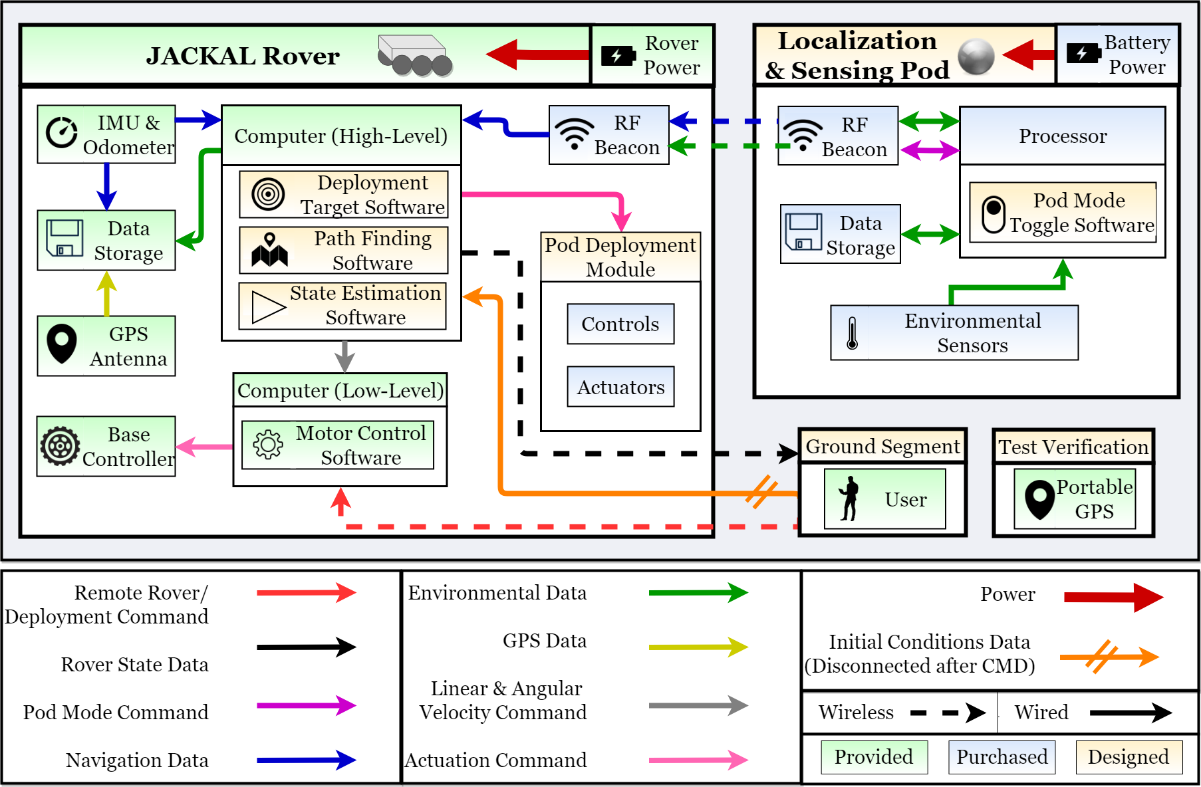
FBD

Slide 8
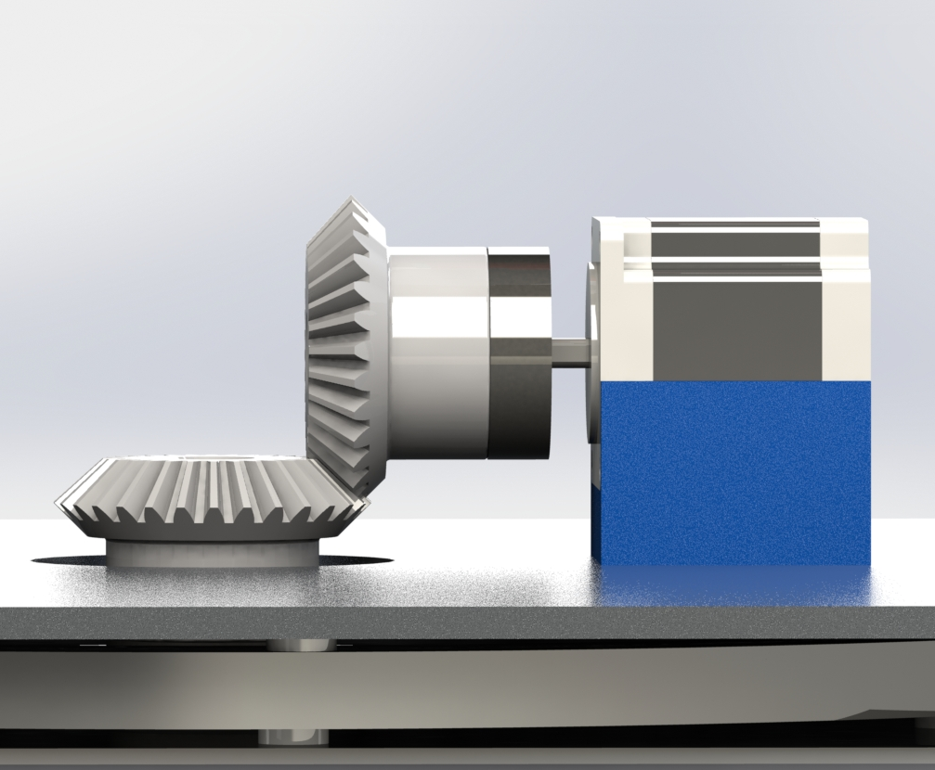
Deployment Module Design
30”
10”
17”
20”
Front View
Side View

Slide 9
Pod Structure Design
Pod structure contains the ranging electronics: deployed from cannon
Contains batteries in tail for power, electronics are potted for resilience.
95mm
Tail
Stability
Landing Orientation
Foam Nose: Impact crumple zone
220mm
Fuselage: Holds electronics

Slide 10
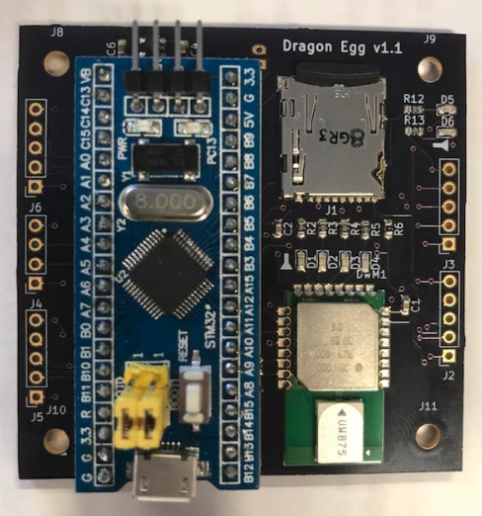
Pod Electronics Design
Capabilities:
Pod to Pod Ranging
Environmental data (pressure, temperature, and altitude)
Accelerometer data (+/- 100g’s)
SD card writing (Environmental and Accel. data)
Dragon Egg Shield [6cm x 6cm]

Slide 11
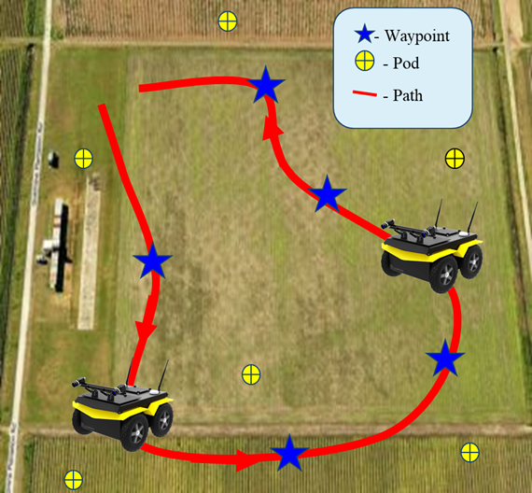
Navigation Software Design
Subsystem Goals:
Generate closed-loop path for rover through waypoints while avoiding obstacles
Communicate with pod mesh network
Use pod ranging data to algorithmically correct odometry error (gSLAM) and correct path deviance using onboard control

Slide 12
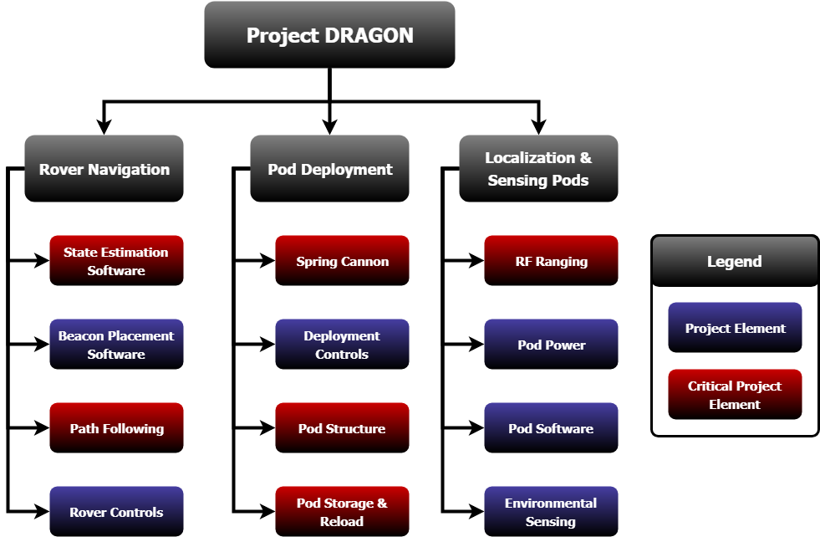
Critical Project Elements
CPE | Manufacturing Status
State Estimation | Verified with Rover/Pod Data Integrating in ROS on Rover
Path Following | Verified in ROS with Customer MIP Testing on Rover
RF Ranging | Verified Mesh Network Ranging on Rover Testing Environmental Data Transfer on Rover
Spring Cannon | Completed training Received raw materials Machining gear
Pod Storage & Reload | Tested motor software Machining support structure
Pod Structure | Assembled 1 pod according to manufacturing plans Validating pod design

Slide 13
Schedule
Project Overview
Schedule
Electronics
Hardware
Software
Budget

Slide 14
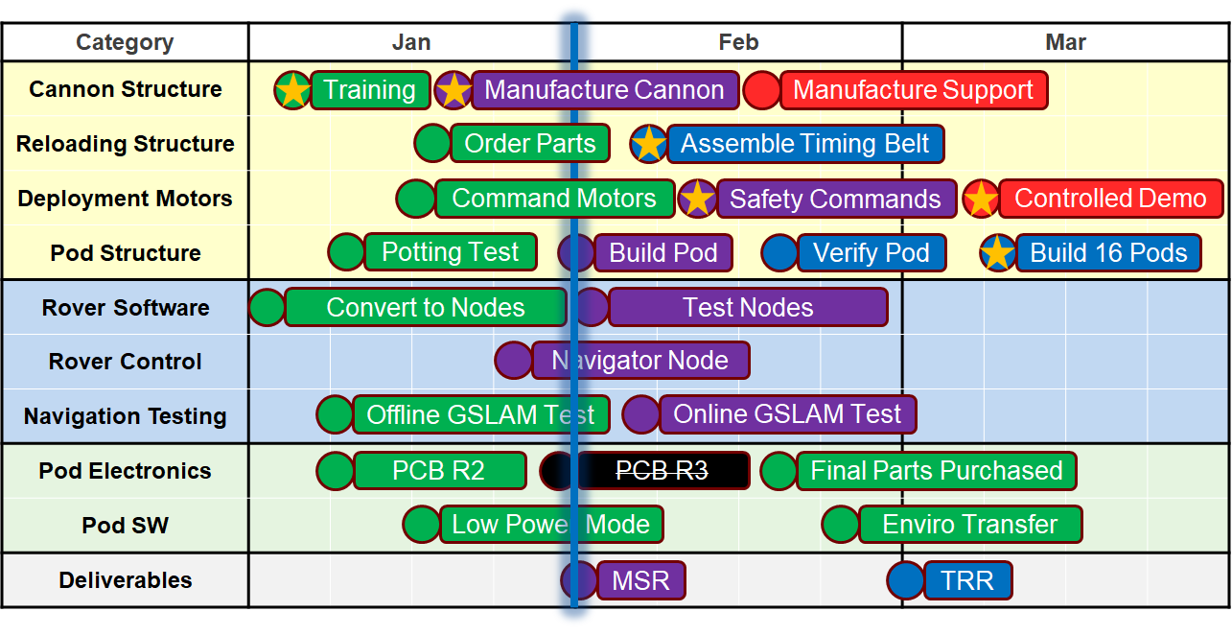
Gantt Chart
Here
Complete
In Progress
Expected on Time
May Use Margin
Removed Task
Critical Task

Slide 15
Electronics
Project Overview
Schedule
Electronics
Hardware
Software
Budget

Slide 16
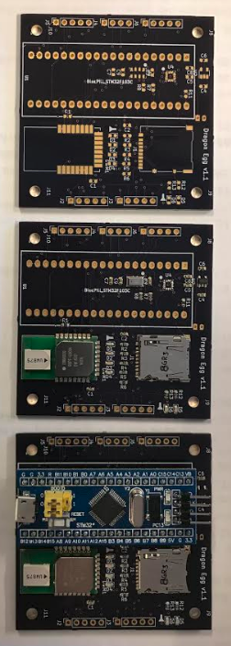
PCB Status
Unpopulated
Populated without processor
Fully Populated
Challenges:
Placing the 3 x 3 x 1 mm³ accelerometer to prevent shorting
Solution: Stencil and Pick-and-Place to also allow for more precise and controlled placement of solder and sensor
Notes:
Amanda

Slide 17
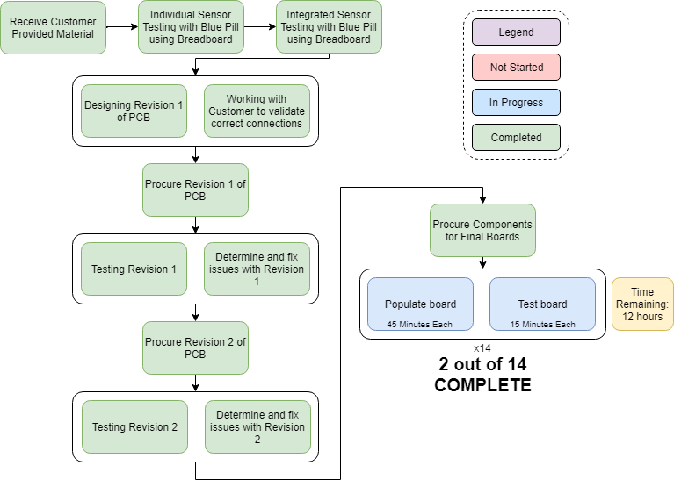
PCB Manufacturing Plan
Summary:
PCB Revisions complete
Third PCB Revision unnecessary
Populating will begin once procured parts arrive
Brunt of work will come from populating boards
Completion of PCB’s is necessary for pod structure and deployment
Notes:
Amanda

Slide 18
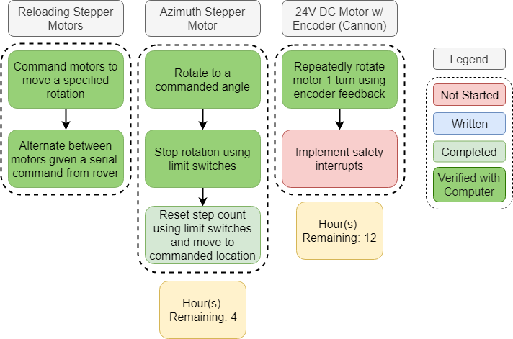
Deployment Control Motors
Summary:
Verify 24V DC motor will rotate exactly once
Implement safety interrupts
Reset step count for azimuth control and rotate to commanded location
Challenges:
Poor part documentation led to additional work for wiring and pinouts
Time Remaining:
16 hrs

Slide 19
Hardware
Project Overview
Schedule
Electronics
Hardware
Software
Budget

Slide 20
Cannon Manufacturing Plan
Mills/Lathes/ Saws | Time Remaining
Reload Support (x2) | 6 hr
Clevis Pin (x2) | N/A
Rack Support | 3 hr
Narrow Rack Support | 3 hr
Launch plate | 3 hr
Base plate | 4 hr
Gear Shaft | N/A
Shaft Adapter | 6 hr
Acrylics/ Plastics | Time Remaining
Funnel | 3 hr
Reloading Guard | 3 hr
Foundation Sheet | 2 hr
Motor Stand (x2) | 6 hr
COTS | Time Remaining
Bevel gears | N/A
Gear rack | N/A
Gear drive train | N/A
Lazy susan | N/A
Shaft Adapter | N/A
PVC barrel | 0.5 hr
Not started | In Progress | Completed/ Delivered
Summary:
Completion Deadlines:
Machined Parts: Feb 15
Plastics and Acrylics: Feb 22
Part Integration: March 1
Challenges
Shop availability and schedule conflicts
CNC | Time Remaining
Canon Support (x2) | 8 hr
Shaft Support | 6 hr
Notes:
What parts are being manufactured vs. purchased, what is involved in their manufacture, where and how they are being manufactured.
I could color code this slides as well

Slide 21
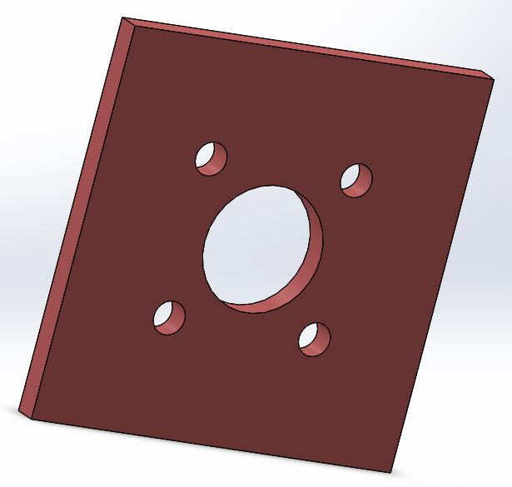
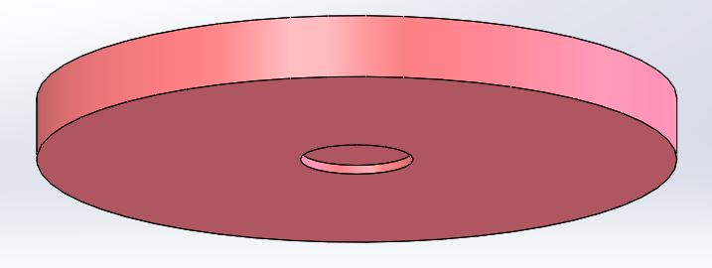
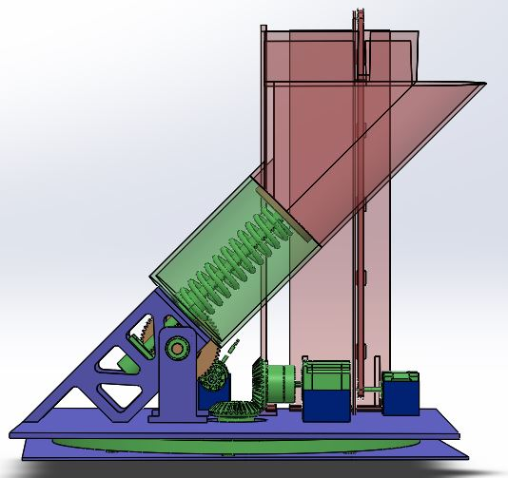
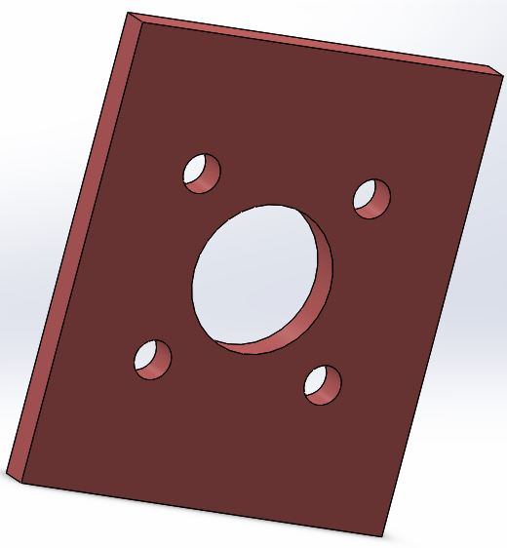
Cannon Manufacturing Status
Reloading Support
Rack Support
Launch
Plate
Reloading Belt
Gear Shaft
Legend
Cots
Narrow Rack Support
Completed
Currently Manufacturing
4 team members have completed first two tutorials
All metals have been obtained
Not Started
Notes:
Tried to break out parts that couldn’t be seen

Slide 22
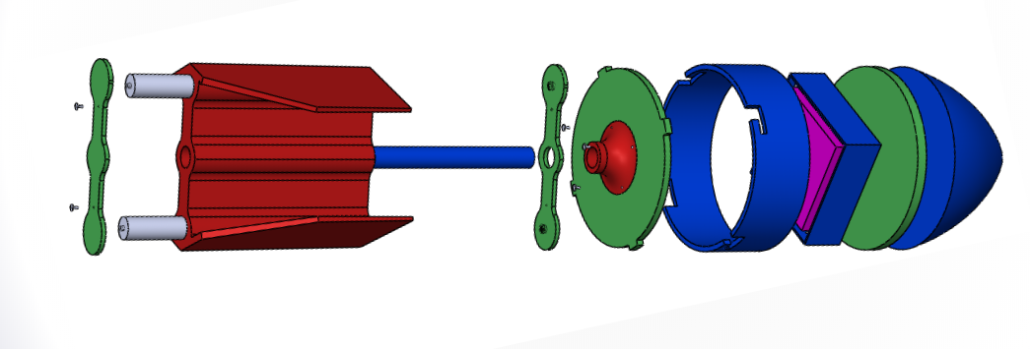
Pod Manufacturing Plan
COTS, mod
Boom: Dowel cut
Potting Tray: Add holes to hobby box for ports, mount switches
Fuselage: Cut tube,
make slots using bandsaw, drill press, and hand tools
Nose: Expanding foam
cots/3dp ‘cupcake tray’
Can produce sixteen
copies in:
10 hours
Where: ITLL
Status:
Power system = built and tested
Potting = drop tested
RF Interference = proven non-issue
Laser Cut
Polycarbonate Sheets Procured
Battery springs from cots
Can produce sixteen copies in:
30 min
3D Printed
Material available on campus
Designs to be finalized post testing, no major changes anticipated
Determining necessary printer fill
Can produce sixteen copies in:
2 weeks (6hrs/each)
Notes:
What parts are being manufactured vs. purchased, what is involved in their manufacture, where and how they are being manufactured.
I could color code this slides as well

Slide 23
Pod Manufacturing Status
Forward work:
One pod built, perform additional testing and validation
Update manufacturing procedures
Continue printing, prep subassemblies
Plan 1-2 full team assembly-line sessions
Challenges:
Demonstrating compatibility with deployment mechanism
Sub-to-Sub requirements on dimensions/mass
Fatigue/life cycle testing
Perform multiple drop tests, additional throwing of pod at anticipated range/angle
Once confident in final pod performance, sixteen pod production requires:
26 person-hours
divide by number of team members
Notes:
Ivan

Slide 24
Software
Project Overview
Schedule
Electronics
Hardware
Software
Budget

Slide 25
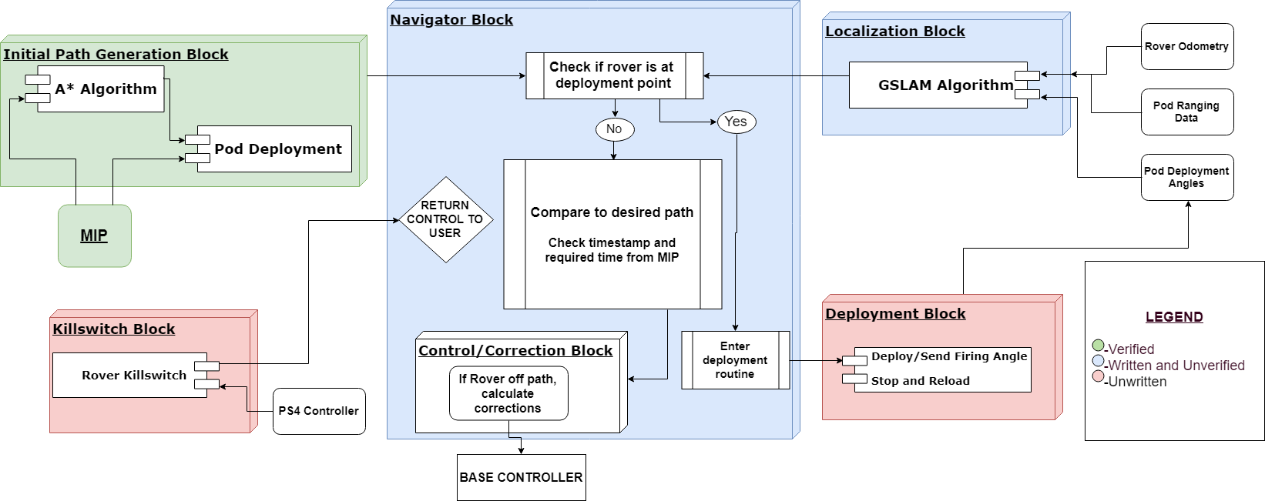
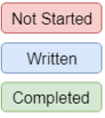
Navigation Software Status
Expected Time to Completion:
20 Hours
Next Steps:
Test completed blocks on rover
Challenges:
Working in rover’s unfamiliar programming environment

Slide 26
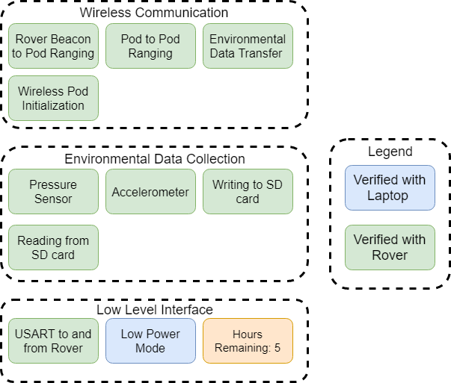
Pod Software
Status:
All Pod Software is written with most of it verified on the rover
Need to test sleep mode over a full mission duration using the rover
Challenges:
Lack of debug environment makes software development difficult
Testing more than 4 pods is incredibly difficult with a lack of mobile power sources
Overcoming Challenges:
Piecewise software development mitigates difficulty
Using multiple people to test a multipod setup with the rover
Notes:
Ivan

Slide 27
Integration Plan
Cannon
Cannon + Rover
Challenge: Time, shop access
Estimated Work:
55 hours machining
10 hours assembly
65 Hours
Challenge: Fit checks and tolerance stack up
Estimated Work:
2 hours for fit checks
1 hour for final install
Pod Structure
Challenge: Validating → mass producing
Estimated Work:
2 weeks for printing
26 hours to build all
5 hours for testing
Electronics + Pod
43 Hours
Challenge: Consistency and fatigue testing
Estimated Work:
1hr potting per board (x14)
Ready for Full System Testing
42 Hours
Pod Electronics
Challenge: Placing small accelerometer
Estimated Work:
12 hours to populate PCBs
Pod Software
Software + Rover
Interface Complete. Verified with Rover.
Challenge: Combining different software pieces software into main function
Estimated Work:
15 hour testing main
10 hours testing functions
Navigation Software
20 Hours
Subsystem Integration
by March 11
Challenge: Unfamiliar rover user interface
Estimated Work:
10 hour for main
10 hours for functions
System Integration
by March 29
Notes:
166 Hours Until Ready for Full System Testing

Slide 28
Budget
Project Overview
Schedule
Electronics
Hardware
Software
Budget

Slide 29
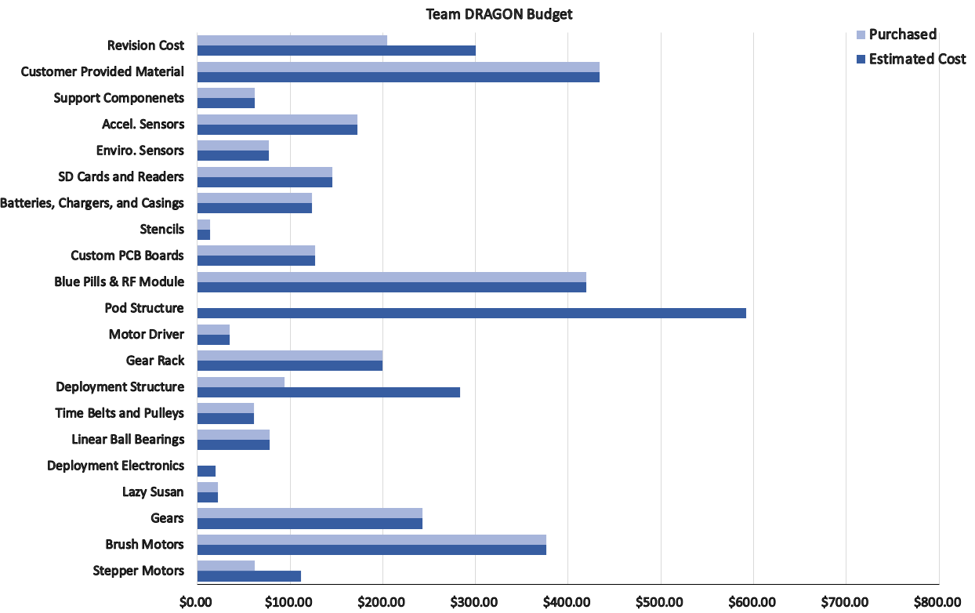
Budget
*Notes:
Budget based on estimated 12 pods + 4 pods for prototyping
Jackal Rover provided by customer
Total Spent: | $2991.58
Expected Total of Project: | $3999.29
Margin: | $695.62
Extra: | $305.09
 | $5000.00
Notes:
* Status of all procurements (color code: parts received, pending, and planned)
* Highlight parts with long-lead and most important parts to project success.
* Highlighting uncertainties and corresponding budget margins

Slide 30
Budget
POD SUBSYSTEM
Parts with Long Lead Times:
Motor Driver
Gear Rack
Time Belts and Pulleys
Brush Motors
Custom PCB Boards
(All long lead time components have arrived)
Critical Parts:
Custom PCB Boards
(In transit)
Blue Pills and RF Modules
Pod Structure (Not ordered)
Motor Driver
Gear Rack
Deployment Structure
24V DC Brush Motor
Stepper Motors (1 of 2 received)
DEPLOYMENT SUBSYSTEM
Parts Received
Parts Ordered (In Transit)
Parts Partially Received
Parts yet to be Ordered
Notes:
* Status of all procurements (color code: parts received, pending, and planned)
* Highlight parts with long-lead and most important parts to project success.
* Highlighting uncertainties and corresponding budget margins
How have we saved money:( I originally planned for a worst case scenario) Money saved by not doing third PCB revision, cheaper to buy blue pill than STM32 processors, deployment finding different company to purchase base plate to say money, reusing components during PCB testing (and buying the support components in bulk at once), minimizing shipping as much as possible, custom PCB through Osh Park rather than Advanced circuits which was originally planned.

Slide 31
Deployed RF Antennas for GPS-denied Optimization and Environmental Navigation
Manufacturing Status Review
Thank you for your time --
Come check out our testing progress at TRR!

Slide 32
Appendix

Slide 33
A: Schedule

Slide 34
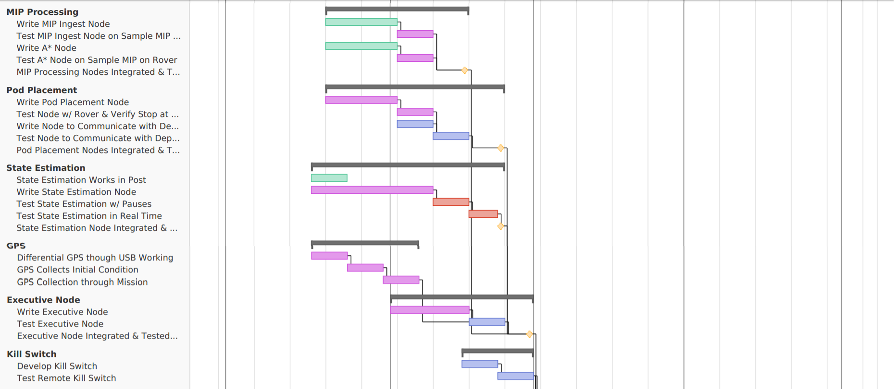
Gantt: Software & Electronics

Slide 35
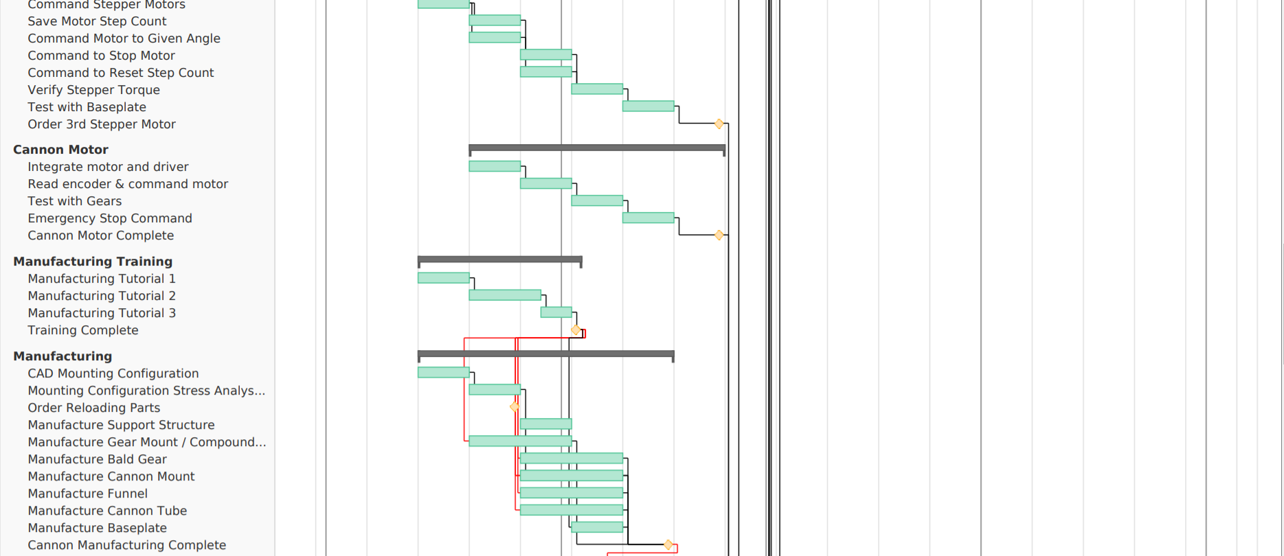
Gantt: Manufacturing

Slide 36
Gannt: Assembly & Integration

Slide 37
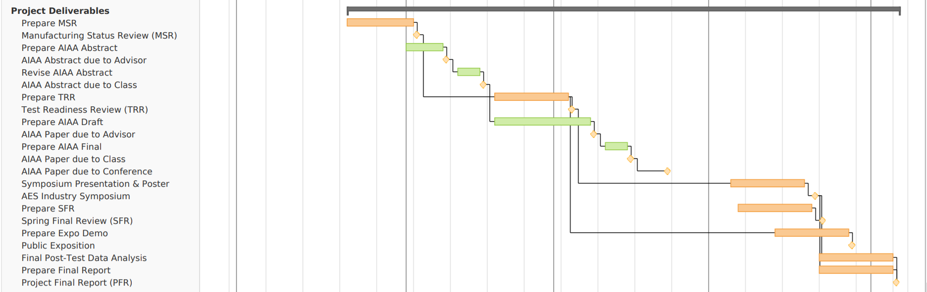
Gantt: Deliverables

Slide 38
B: Team Organization

Slide 39
Organizational Chart: 09/18 – 02/19
4 Team Members
Progress: On Track
5 Team Members
Progress: Falling Behind
3 Team Members
Progress: Ahead of Schedule

Slide 40
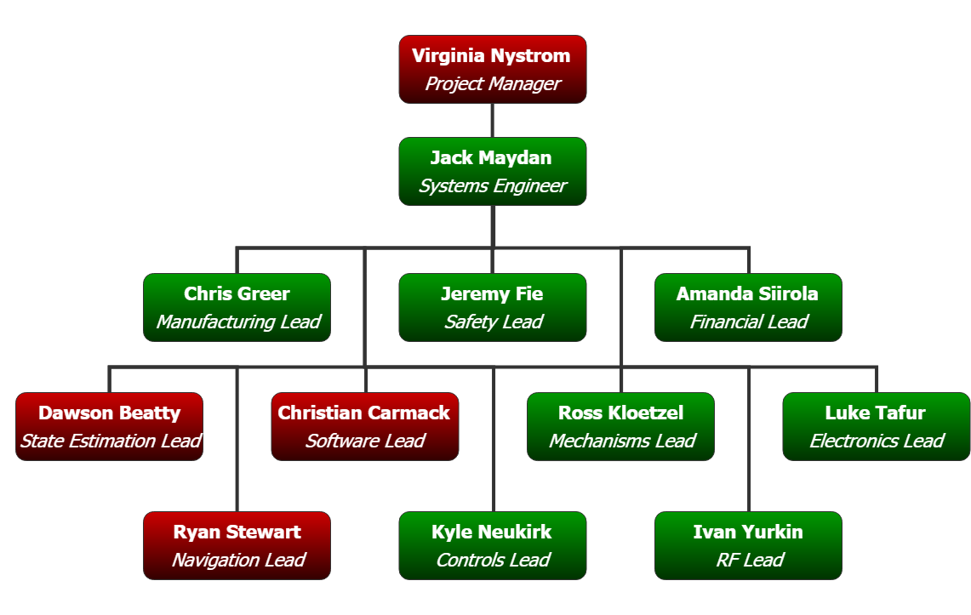
Organizational Chart: 03/19 – 05/19
* Pod Electronics Team moves to Deployment Team when their integration tasks are complete
4 Team Members
Progress: On Track
8 Team Members
New team members assist with motors & pod assembly
0 Team Members
PCB Complete
Pod SW Complete

Slide 41
C: Safety

Slide 42
Deployment Module Design: Safety
Purpose:
Establish deployment readiness state for safe pod deployment and abort
Design:
State | Description | Steps to abort | Notes
1 | Pod in tube, electrical inhibit OUT, spring compressing | Send software stop Send software command to reverse motor direction Proceed from State 2.2 | Front of rover clear at all times
2 | Pod in tube, electrical inhibit OUT, spring uncompressed | Send software stop Place electrical inhibit IN Remove pod from tube | Front of rover clear until after step 2
3 | No pod in tube, electrical inhibit OUT, spring uncompressed | Place electrical inhibit IN
4 | No pod in tube, electrical inhibit IN, spring uncompressed | None | Transport rover in this state. Safe state to unload tube.
*Azimuth control occurs between State 1 and 2. State 2 is considered fire-ready and full safety measures are to be in place.

Slide 43
Safety Status
Component | Time Remaining | Notes
Software stop from serial command | -- | Completed
Reverse motor direction from serial command | -- | Completed
Software stop from PS4 controller | 5 hrs | To be started: 2/18
Reverse motor direction from PS4 controller | 1 hr | To be started: 2/18
Electrical Inhibit | 5 hrs | To be started: 2/25

Slide 44
D: Pod Structure

Slide 45
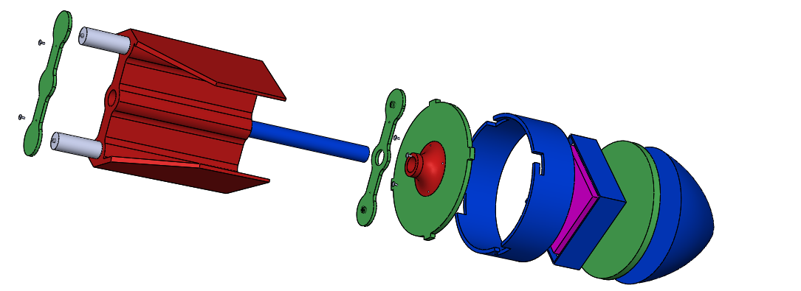
Integration: Pod Structure
All joints bonded with epoxy, sufficient strength due to majority of stress being compressive
A - Removable hardware for battery swap
B - Friction rotation slot-lock for electronics access, can pin if needed
A
Green: Laser Cut
Red: 3D Printed
Blue: COTS, modified
B
Notes:
Ivan
mention batteries in tail
fuselage is where electronics are housed
foam crumple zone for impact

Slide 46
Potting 1
Sylgard-184 potting material was used to test pot two processor boards
Drop test performed and post functionality validated
Procedure written with steps and lessons learned
Custom 3D printed housing modeled using latest boards
Will move to potting full custom PCB when enough are available for ‘one to go missing’.
Larger board and shield config should be stronger

Slide 47
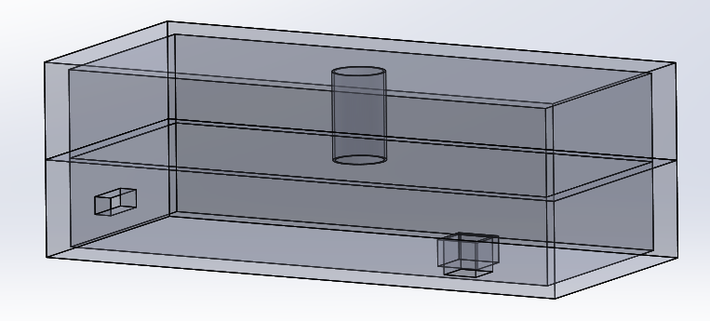
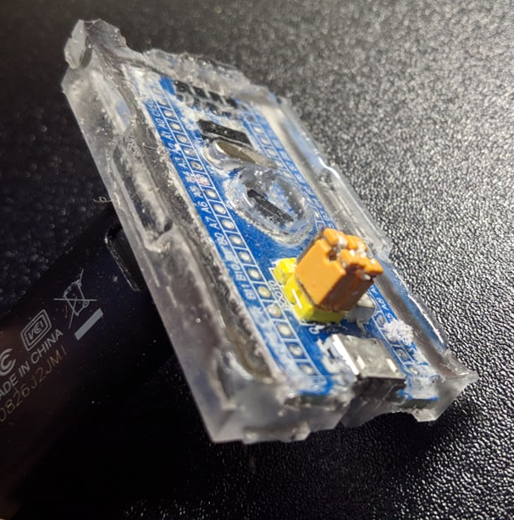
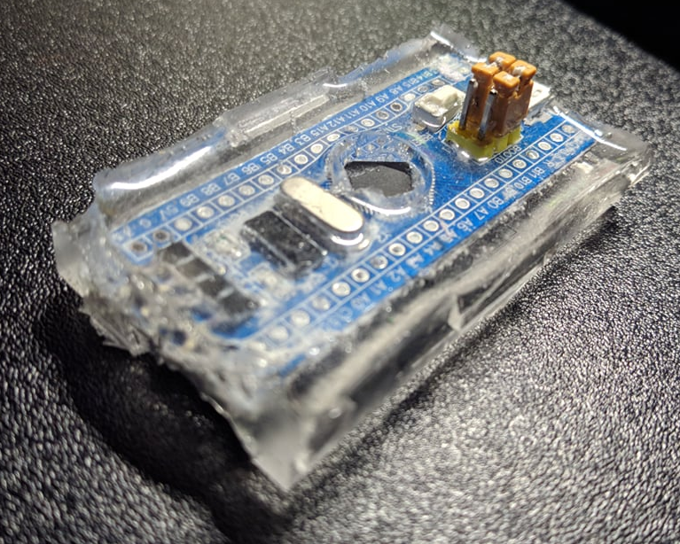
Potting 2

Slide 48
Pod Structure: Manufacturing Status
Forward work:
Test and validate pod, update written manufacturing procedures
Plan 1-2 full team assembly-line sessions
Parts will be prepped in advance, assembled using updated procedures
Parts | Time (conservative) | Quantity | Totals
Laser Cut Parts | 30 min | 1 | 30 min
Custom 3D Prints | 6hrs | 15 | 3 days nonstop, est ~2 wk
COTS Tail Boom & Fuselage | 5 min | 30 | 150 min
COTS Nose and Potting | 1hr | 8 | 480 min
Assembly For Whole Pod | 1hr | 16 | 960 min
Once confident in final pod performance, sixteen pod production requires:
26 person-hours
divide by number of team members
Challenges:
Demonstrating compatibility with deployment mechanism
Fatigue testing
Notes:
Ivan

Slide 49
E: Integration

Slide 50
Integration Plan
Navigation Software to Rover: Most algorithms written, to be ported over before TRR
Progress already made on porting some earlier versions of software
Deployment Mech to Rover: Deployment Mech operates independently using its own microcontroller, rover SW to send serial r/w commands
This interface is the same as rover-to-pod, which is complete
Pod Electronics to Pod: The PCB will be potted using NASA 8739-1b, the potting tray will be epoxied to fuselage base
Pod to Deployment Mech: Pods will installed, reloaded, and deployed
This is a basic mechanical interface which requires mass property and fit checks, 1-3 pods will be produced in advance if necessary for deployment testing, sub-to-sub requirements were previously drafted to ensure dimensional compliance

