Slide 1
CubeSat Integrated Star Tracker
CubIST | Test Readiness Review
February 23, 2022
Project Customer
Dr. Scott Palo
Project Advisor
Dr. Dennis Akos
Presenters: Chesney Boal, Maria Callas, Chava Friedman, Quaid Garton,
Cameron Humphreys, and Josie Johnson
Additional Team Members: Matthew Gedrich,
Natalie Link, Chad Pflieger, and Nicky Weber

Slide 2
Presentation Outline
1
3
Project Purpose & Objectives
2
11
Scheduling
3
15
Test Readiness
4
37
Budgeting

Slide 3
CubIST’s Overview
Notes:
Brief top level overview of your project purpose and specific, quantitative objectives (levels of success), including a brief overview of the project CONOPS and FBD.
Brief review of the baseline design with respect to CDR. Describe major changes to the design.
Review of the critical project elements, along with any updates on critical issues from CDR, FFR, IDR, etc.

Slide 4
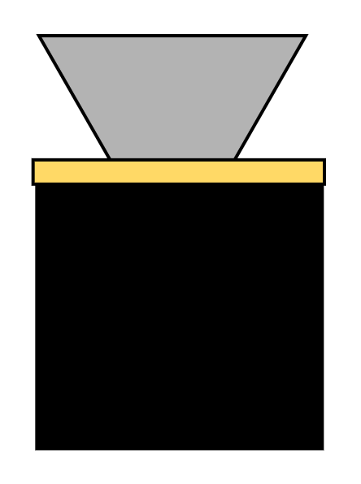
CubIST’s Purpose
Mission
CubIST aims to design, build, and test a prototypical star tracker for future testing and flight instrument development in house at CU.
Design
Action
Test
Build
Takes images of stars, processes these images to detect patterns based on relative brightness, and compares these patterns to a known catalog. CubIST delivers accurate attitude solutions for CubeSat missions.

Slide 5
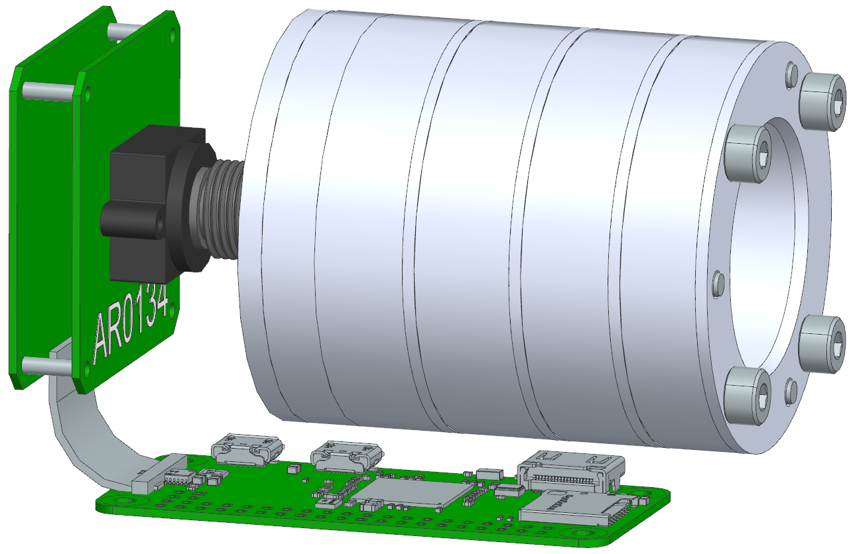
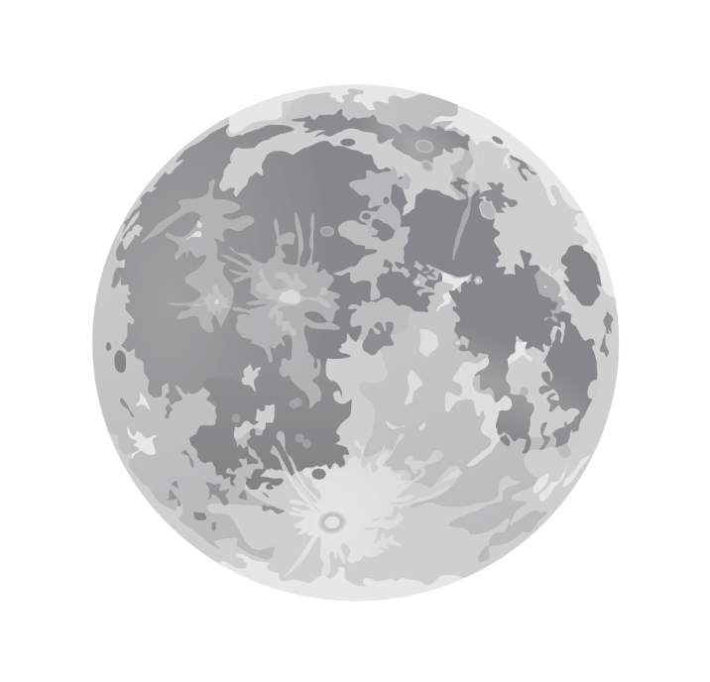
Current Detailed Design
1
Baffle - System must mitigate stray light to capture images
5.00cm
6061-T6 Anodized Aluminum Baffle
L1
Volume: 0.5U
L2
Mass: 300g
6.12cm
L1
Operate within 60° of the sun and 20° of the moon
9.39cm

Slide 6
Current Detailed Design
2
Image Acquisition - System must capture filtered images of stars to be processed.
DR
Each image shall contain at least 3 stars
Arducam AR0134 Camera Module
DR
The characteristics of the CM shall provide discernable images for centroiding and matching algorithms.
⅓” 35mm M12 Lens
USB2 Camera Shield
L3
The star tracker shall remain functional at a slew rate of 2°/s or less.

Slide 7
Current Detailed Design
3
Image Processing Software - System must process star images at baseline rates & accuracy to calculate attitude characteristics.
Lost In Space
Tetra3
L1
Attitude solutions shall be generated at a rate of 0.2 Hz or greater.
%% Config
match(img, YBSC)
centroid(x,y,’sigma’)
%% track SNR
SNR = x*noise
resolution
Read
%% sak
Find
Search
Right_A
Declina
Figure
plot(cen
title(Dfbv
Hold off
Tracking
#Create the dcm
def dcm_generator (phi, alpha, delta):
phi = math.radians(phi)
alpha = math.radians(alpha)
delta = math.radians(delta)
c1 = np.array([[1,0,0],[0,math.cos(delta),math.sin(delta)],[0,-1*math.sin(delta),math.cos(delta)]])
c3 = np.array([[math.cos(phi),math.sin(phi),0],[-1*math.sin(phi),math.cos(phi),0],[0,0,1]])
c3_2 = np.array([[math.cos(alpha),math.sin(alpha),0],[-1*math.sin(alpha),math.cos(alpha),0],[0,0,1]])
#multiply 313 sequence in 2 steps 3*1 then (3*1)*3_2
int = np.matmul(c3,c1)
c313 = np.matmul(int,c3_2)
#print(c313)
return c313
#Return the quaternion
def quat_generator (c313):
L3
The attitude solution shall have an absolute accuracy of less than 0.05°(1σ).
Custom
Software Details
Notes:
Either avoid or explain diff between LIS and tracking

Slide 8
Current Detailed Design
4
Image Processing Hardware - System processing must be accomplished at baseline rates & power consumption.
DR
The selected star catalog shall be stored in the on-board microcontroller
L1
Operate on maximum continuous power of 2W
Integrated Memory
Raspberry Pi Zero 2W

Slide 9
Detailed Functional Block Diagram
MICRO SD CARD
32 GB
CubIST Scope
MEMORY
512 MB
FLASH
2000 Mbps
20 Mbps
12 bits
ARDUCAM SENSOR SHIELD
ARDUCAM AR0134 MODULE
Pixel Size: 3.75μm
BAFFLE
Processor (CPU)
1GHz
Clock
Software
Tetra3 Processing Algorithm
LENS
1.88 Hz
SIGNAL OUTPUT PORT
DATA INPUT PORT
1000 fps
Quaternion
Raspberry Pi Zero 2W
54 fps
3.3 V
3.3 V
Baffle Optics
Processor Software
Power Data
CubeSat
ADCS
Power

Slide 10
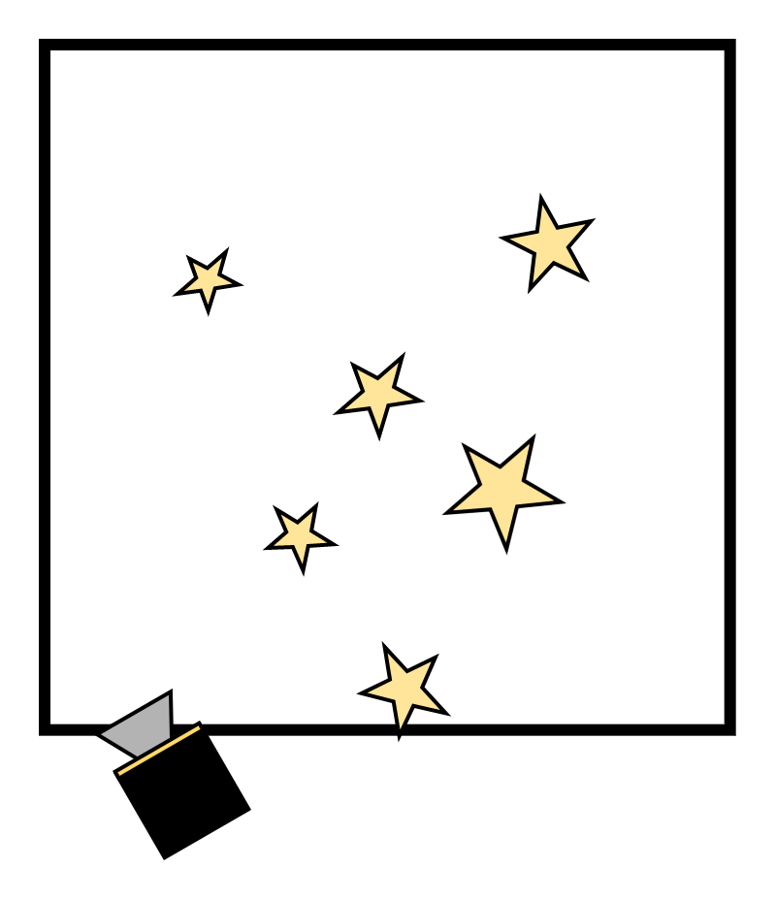
Concept of Operations
Day-In-Life (A)
4a. Compares To Star Catalog
5a. Determines Orientation
3a. Identifies Star Pattern
2. Captures Image
6. Compare Solutions
!
Verification (B)
θ₁
θ₂
4b. Upload to PC & Test in Truth Model
3b. Processes & Saves Image
5b. Output Orientation
1. Baffle Attenuation
Adtl ConOps
Boulder, CO

Slide 11
Scheduling
Notes:
Review the whole project schedule, showing overall progress toward goals. In this case, the status should be described with an emphasis on testing.
Highlight any major changes in the project schedule since CDR.
Include milestones and relates the critical path. Tasks potentially needing to use margin were described.

Slide 12
Critical Project Element Status
1
Baffle
3
Image Processing Software
Fabrication complete
Tracking algorithm implemented
Inspection complete
Quaternion output software in progress
Expected arrival: Feb 22nd
Outdoor images processed
Enclosure printing in progress
Need to develop manual control software
2
Image Acquisition
4
Image Processing Hardware
All components procured & assembled
All components procured & assembled
Sample images captured (indoor & outdoor)
Power consumption still a risk
IDR Sign-offs
AIAA Abstract
Testing Schedule Confirmed

Slide 13
Gantt Chart
FULL MOON
Duration
February
March
April
TRR
AIAA Paper
AIAA Conference
SFR
2 wk periods
Night Sky Testing
4 wks ± 1.0
Baffle Prototype Mfg
0.6 wks ± 0.2
Baffle Assy.
1 wk ± 0.2
HelioStat Testing
1
2 wks ± 1.0
Night Sky Testing
2
Observatory Testing
1 wk ± 0.6
3
Re-Asmt. & Modifications
2 wk ± 1.0
2 wks ± 0.6
Night Sky Testing
1 wk ± 0.6
Observatory Testing
Continual
Power Optimization Testing
4
Continual
Accuracy & Error Handling
SB

Slide 14
Staying On Critical Path
✓
Baffle must be in house & mounted to system
✓
3D printed enclosure must be complete & mountable
✓
Tracking software must be functioning
Configuration script must be complete to control CubIST during tests
Conditions of concern:
!
Cloud coverage, bad weather
!
Malfunctioning or broken components
!
Select component is insufficient, fails requirements unexpectedly

Slide 15
Test Readiness
Notes:
Describe the scope of the testing tasks in the project: what tests are being planned, specifically:
what is being tested for (your rationale for performing the test),
the design of the test fixtures,
what test equipment and facilities are needed,
And an overview of the test procedures.
Describe how the test(s) will reduce risk to your project, what results do you expect, and what models will be validated.
Describe the status of the testing tasks, showing engineering details as needed to convey a solid understanding of the design
(and the ability to reduce risk), requirements to be verified or validated, and what V&V is most important for project success.

Slide 16
Spring Semester Test Overview
1
Baffle Effectiveness and Sensitivity Testing STATUS: Dry Run Complete
Where: LASP HelioStat
When: Feb 28th-Mar4th
CPEs: Baffle
Roadblocks: NEED BAFFLE
2
Image Acquisition Effectiveness and Accuracy Testing STATUS: Started
Where: Outdoors
When: Now-April
CPEs: Optics
Roadblocks: NONE
3
Power Consumption and Update Rate Testing STATUS: Started
Where: Non-Specific
When: Now-April
CPEs: SW + HW
Roadblocks: NONE
4
Full System Testing STATUS: Not-Started
Where: Sommers Bausch Observatory
When: Mar-April
CPEs: ALL
Roadblocks: POC Out of Office
Notes:
Make sure to mention V&V dependency

Slide 17
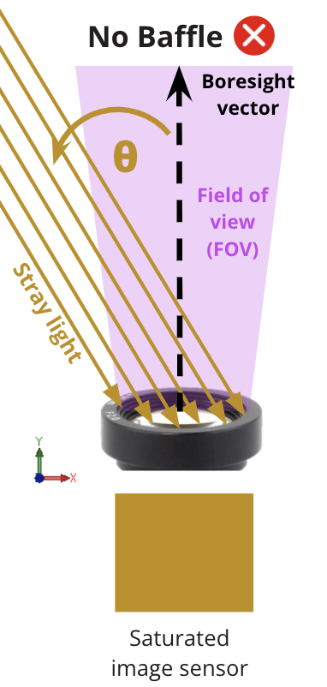
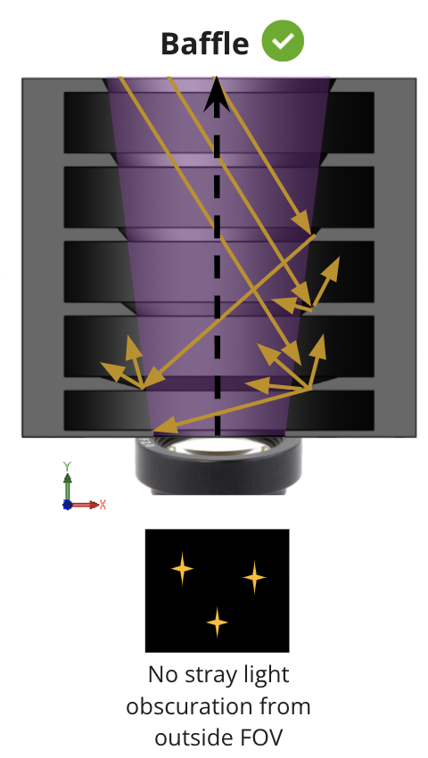
Test #1: Heliostat Test Introduction & Motivation
The star tracker shall operate within 60° of the sun and within 20° of the moon.
The baffle shall attenuate -25dB of the light at the sun exclusion angle and -5dB of light at the moon exclusion angle.
Notes:
Remind people what role of a baffle is → operating near sun and moon

Slide 18
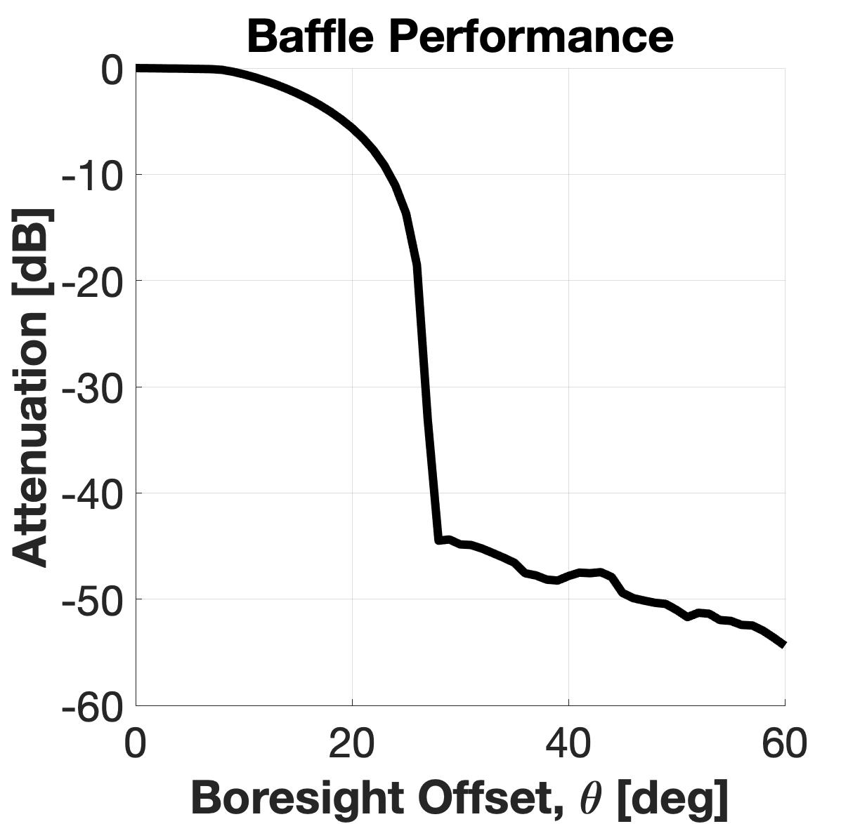
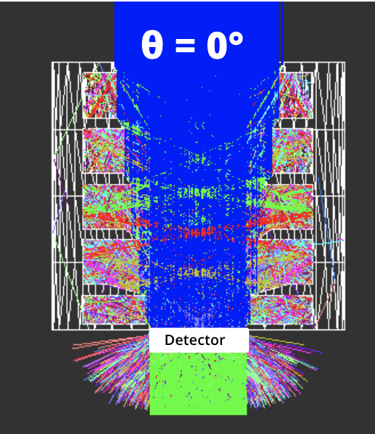
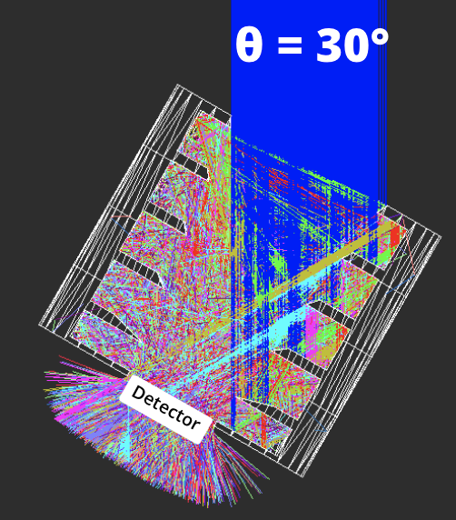
Test #1: Heliostat Test Introduction & Motivation
RESULTS: Attenuation Curve
MODEL: ZEMAX Stray Light
FOV
The star tracker shall operate within 60° of the sun and within 20° of the moon.
The baffle shall attenuate -25dB of the light at the sun exclusion angle and -5dB of light at the moon exclusion angle.

Slide 19
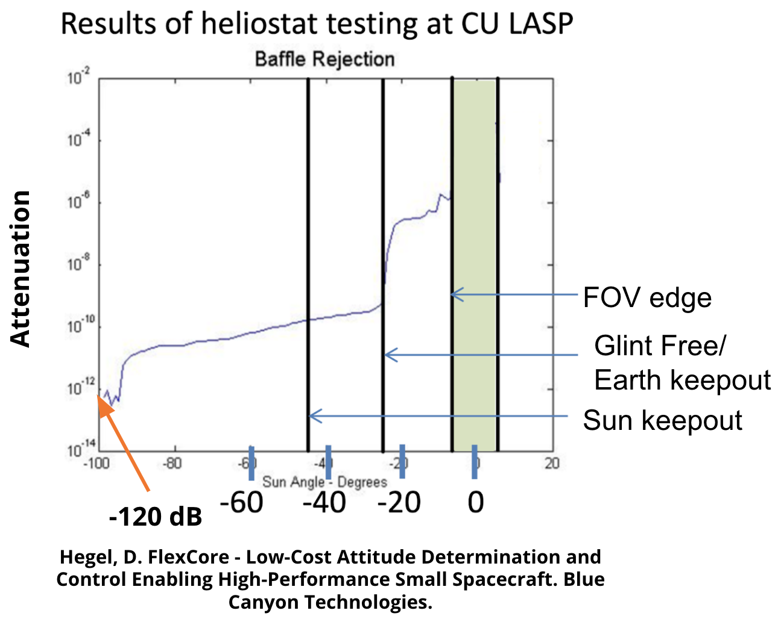
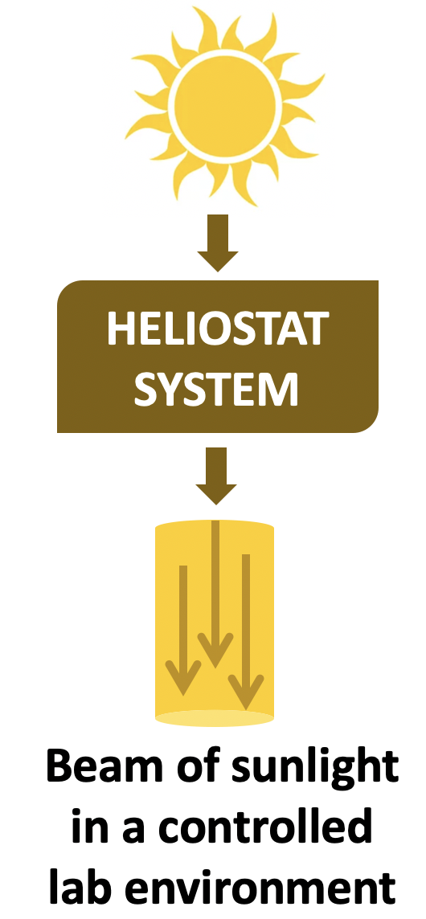
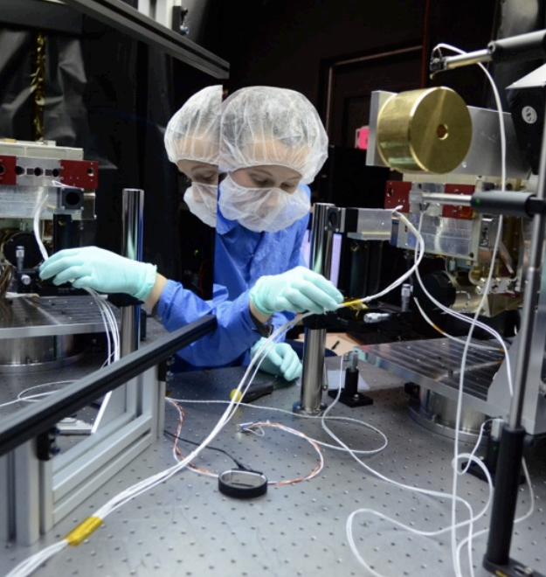
Test #1: Heliostat Test Introduction & Motivation
RESULTS: Attenuation Curve
MODEL: ZEMAX Stray Light
FOV
HARDWARE TEST: Heliostat
The star tracker shall operate within 60° of the sun and within 20° of the moon.
The baffle shall attenuate -25dB of the light at the sun exclusion angle and -5dB of light at the moon exclusion angle.
LASP Heliostat Lab

Slide 20
Test #1: Heliostat Test Introduction & Motivation
RESULTS: Attenuation Curve
System Element | ZEMAX Model | Heliostat Test
Baffle | ✔ | ✔
Lens |  | ✔
Image sensor and shield |  | ✔
Average Intensity of Image for attenuation | ✔ | ✔
MODEL: ZEMAX Stray Light
FOV
HARDWARE TEST: Heliostat
ZEMAX: Finite linear ray tracing, ideal system/geometry properties
HELIOSTAT: Full system, manufactured baffle, sources of stray light in lab
LASP Heliostat Lab
Notes:
Move 37 - 41 to backup, not clear
What are we doing with 2 curves on the right
Talking to comparison

Slide 21
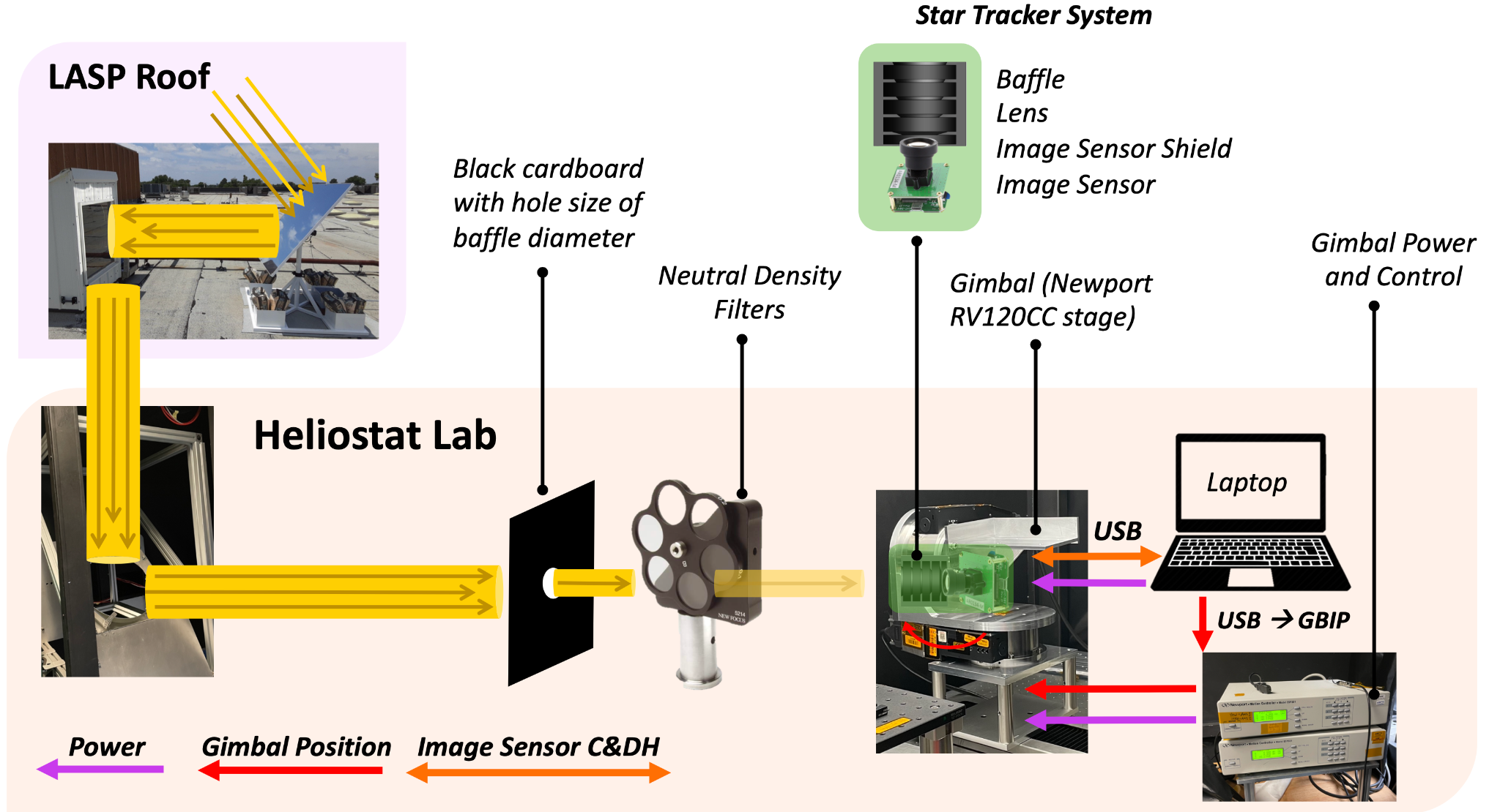
Test #1: Heliostat Test Block Diagram & Procedure
SETUP
→ Beam diameter (cardboard)
→ Beam intensity (ND filters)
→ Mount system to gimbal
→ Evaluate baseline stray light in room, capture dark image without beam
→ Capture Boresight Vector Image at 0° with beam
TEST
→ Rotate system by 2° via MATLAB script controlling Gimbal (Range: 2°-70°)
→ Capture/save image (.png) via image sensor shield GUI
Detailed Procedure
Notes:
Could add procedure steps on side of this slide, but having both visual and written procedure is necessary

Slide 22
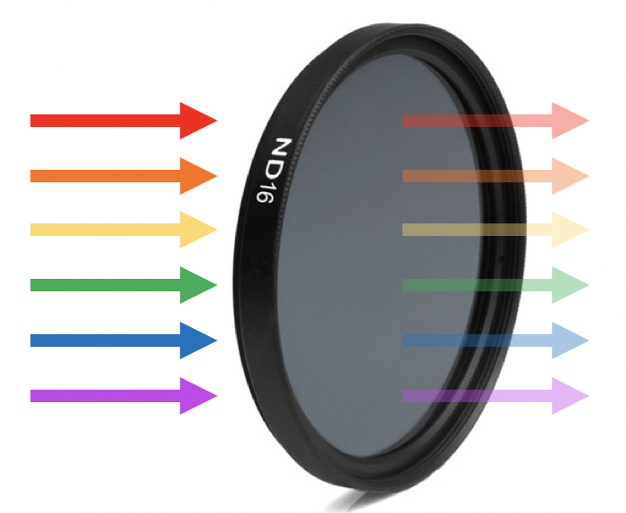
Test #1: Heliostat Risks/Reduction
Type | Heliostat Test Risk | Mitigation
Destruction of Image Sensor | Extreme oversaturation of image sensor | → ND filters to reduce transmission of sunlight, adjust camera settings
Destruction of Image Sensor | ESD | → ESD coats/straps required in Lab
Schedule | Takes 3-5 days to acquire data. Requires a sunny day, only get 5-6 hours in lab. Cannot use CubIST during this time | → Allocate extra time for heliostat in schedule
Test Data | Stray light in the lab | → Cover all surfaces with black fabric or cardboard → Ensure sunlight does not overfill baffle → Quantify stray light with dark images
Neutral Density Filter
“Sunglasses” for image sensor
VALIDATE SYSTEM REQUIREMENT
The baffle shall attenuate -25dB of the light at the sun exclusion angle and -5dB of light at the moon exclusion angle.
Notes:
OD of 5 → 1e-3 Tx
700 W/m^2 → 0.7 W/m^2

Slide 23
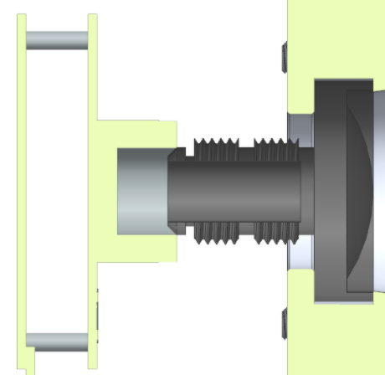
Test #2: Image Acquisition Testing → Motivation
Jan-April 2022
Multiple Locations
Arducam AR0134 Camera Module
How well does the system function under differing levels of light pollution?
The star tracker shall operate within at least 60° of the sun and within 20° of the moon.
USB2 Camera Shield
How well does the system function for different exposure times? (i.e. can we get an image from the optical system?)
The characteristics of the CM shall provide discernable images for centroiding and matching algorithms.
Each image shall contain at least 3 stars.
⅓” 35mm M12 Lens
Notes:
What is the true update rate of attitude solutions from real-time acquired images?
The image sensor shall output each image to the on-board processor.
Attitude solutions shall be generated at a rate of 0.2 Hz or greater.
set up full system (w/ and w/o baffle) in low-light pollution outdoor setting - take images, characterize overall success
Closest we can get to DITL test
Night sky testing evaluates the validity of the optical system (image sensor/lens) chosen for the project.
Taking images at night assures that our software can provide solutions from images of real stars with our camera module.
This test consists of taking images in high and low light polluted zones. In reality, for a CubeSat star tracker, only pollution will come from Sun, Moon, and Earth albedo.
what is being tested for (your rationale for performing the test),
the design of the test fixtures (diagrams)
what test equipment and facilities are needed,
Observatory test: sbo provides 12V/120AC power, micro-usb to usb adapters for mouse and keyboard control, and mini hdmi to hdmi cable for output to monitor (10ft cables)
night sky testing
- functionality of entire system
- can use in low light pollution areas
- will get a pass/fail from software
observatory testing
- verify alignment(?)
- functionality of entire system
- quantify accuracy with true RA/Dec from telescope
- want to take images in succession to quantify accuracy over time - can do that with both tests

Slide 24
Test #2: Image Acquisition Testing → Test Setup
Lens, Image Sensor, (Baffle)
5V Power
RPi Zero 2W
HDMI Display
Multiple locations with different Bortle scale (brightness) values
Keyboard/mouse
USB
USB
Similar to day-in-the-life test shown in CONOPS
Can test with or without baffle
System mounted to tripod for stability
Notes:
what is being tested for (your rationale for performing the test),
the design of the test fixtures (diagrams)
what test equipment and facilities are needed,
Observatory test: sbo provides 12V/120AC power, micro-usb to usb adapters for mouse and keyboard control, and mini hdmi to hdmi cable for output to monitor (10ft cables)

Slide 25
Test #2: Image Acquisition Testing → Procedure
Lens, Image Sensor, (Baffle)
5V Power
RPi Zero 2W
HDMI Display
Multiple locations with different Bortle scale (brightness) values
Keyboard/mouse
USB
USB
Set up full system on tripod at specified location/time
System mounted to tripod for stability
Notes:
what is being tested for (your rationale for performing the test),
the design of the test fixtures (diagrams)
what test equipment and facilities are needed,
Observatory test: sbo provides 12V/120AC power, micro-usb to usb adapters for mouse and keyboard control, and mini hdmi to hdmi cable for output to monitor (10ft cables)

Slide 26
Test #2: Image Acquisition Testing → Procedure
Lens, Image Sensor, (Baffle)
5V Power
RPi Zero 2W
HDMI Display
Multiple locations with different Bortle scale (brightness) values
Keyboard/mouse
USB
USB
2. Point optical subsystem (baffle/lens/camera module) toward target of choice
System mounted to tripod for stability
Notes:
what is being tested for (your rationale for performing the test),
the design of the test fixtures (diagrams)
what test equipment and facilities are needed,
Observatory test: sbo provides 12V/120AC power, micro-usb to usb adapters for mouse and keyboard control, and mini hdmi to hdmi cable for output to monitor (10ft cables)

Slide 27
Test #2: Image Acquisition Testing → Procedure
Lens, Image Sensor, (Baffle)
5V Power
3. Take photos, run through software at 1 Hz
4. Output solutions to external monitor and/or save to .csv file
5. Upload images to Astrometry.net and compare solutions
RPi Zero 2W
HDMI Display
Keyboard/mouse
USB
USB
System mounted to tripod for stability
Notes:
what is being tested for (your rationale for performing the test),
the design of the test fixtures (diagrams)
what test equipment and facilities are needed,
Observatory test: sbo provides 12V/120AC power, micro-usb to usb adapters for mouse and keyboard control, and mini hdmi to hdmi cable for output to monitor (10ft cables)

Slide 28
Test #2: Image Acquisition Testing → Procedure
6. Repeat steps 1-4 for varying exposure times at varying Bortle scale locations
Tests will be run three times at each location pointing at the same 3 specific constellations
Exposure times will vary from: 5-25ms
Exposure time required for a solution to be acquired will be logged
Multiple locations with different Bortle scale (brightness) values
What is the Bortle scale?
Nine-level numerical scale to quantify night-sky brightness and object observability due to light pollution
9 = brightest, 1 = darkest
Notes:
what is being tested for (your rationale for performing the test),
the design of the test fixtures (diagrams)
what test equipment and facilities are needed,
Observatory test: sbo provides 12V/120AC power, micro-usb to usb adapters for mouse and keyboard control, and mini hdmi to hdmi cable for output to monitor (10ft cables)

Slide 29
Test #2: Image Acquisition Testing → (Expected) Results
Verify detection from images taken (real-time) with hardware and software (LIS, Tracking): FR. 1 - 3
Light Pollution Interference
Successful Solution Acquisition
Understand interference with light pollution on system and solution (exposure vs Bortle)
Exposure Time (ms)
Qualify update rates based on images: DR 3.1 - 3.3
1
5
9
Bortle Scale
Notes:
Describe how the test(s) will reduce risk to your project, what results do you expect, and what models will be validated.
Characterize relationship between exposure time and Bortle scale values for solution success
Verify hardware/software functionality and compatibility: FR. 1 - 3
Will provide an accurate reflection of update rate on full integrated system: DR 3.1 - 3.3
A close substitute for day-in-the-life test
System effectiveness with real-time images
Baffle effectiveness with light pollution/stray light from the moon
See what fails, what succeeds image processing/solution
Atmospheric interference with scattered light

Slide 30
Test #2: Image Acquisition Testing → Status
Bortle Class
Exposure Time
Solved?
Time to Solve
Update Rate
Tools
Class 5: Boulder, CO
CubIST: NO Astrometry: NO
No
tripod
10 ms
UNK
UNK
1.25 Hz On laptop, using LIS
Tripod, Mount
Class 4: Vail, CO
CubIST: YES Astrometry: YES
24 ms
797 ms
5 ms 10 ms 20 ms
Expecting
>2 Hz using software
Class 3 or below:
Expecting Success
Expecting
<500ms
Tripod, Mount
✓
Lower class Bortle and tripod use increased stability and visibility of stars in image plane
Test lower class Bortle, variation of exposure, & use of tracking software to speed update rate
Test Results
Notes:
Images have been taken in Boulder (Class 5 Bortle)
Test failed both CubIST algorithms and Astrometry.net
Instability in camera (no tripod) may have resulted in a failure to acquire solution
Images have been taken in Vail (Class 4 Bortle) at 24 ms exposure time
Test provided a solution from CubIST algorithm and Astrometry.net
Laptop update rate of 1.25 Hz
Solution times on RPi in progress
Lower class Bortle and tripod use increased stability and visibility of stars in image plane
Lower class Bortles to be tested in the near future to potentially increase solution time via brightness and more recognizable stars in frame
Describe the status of the testing tasks, showing engineering details as needed to convey a solid understanding of the design
(and the ability to reduce risk), requirements to be verified or validated, and what V&V is most important for project success.
After baffle delivery/integration, we can test baffle effectiveness through solution
time/update rate at these varying Bortle levels and exposure times.
Have taken preliminary images without the baffle in Vail (Bortle class 5) at varying
exposure times with system mounted on a tripod.
Ran these images through software, verified with astrometry (RESULTS HERE)
Verified camera’s ability to successfully capture usable images: FR.1
Integration with baffle for night sky testing can be redundant in night sky testing due to atmospheric conditions. Thus, specific testing with the baffle is required to physically characterize the effectiveness.

Slide 31
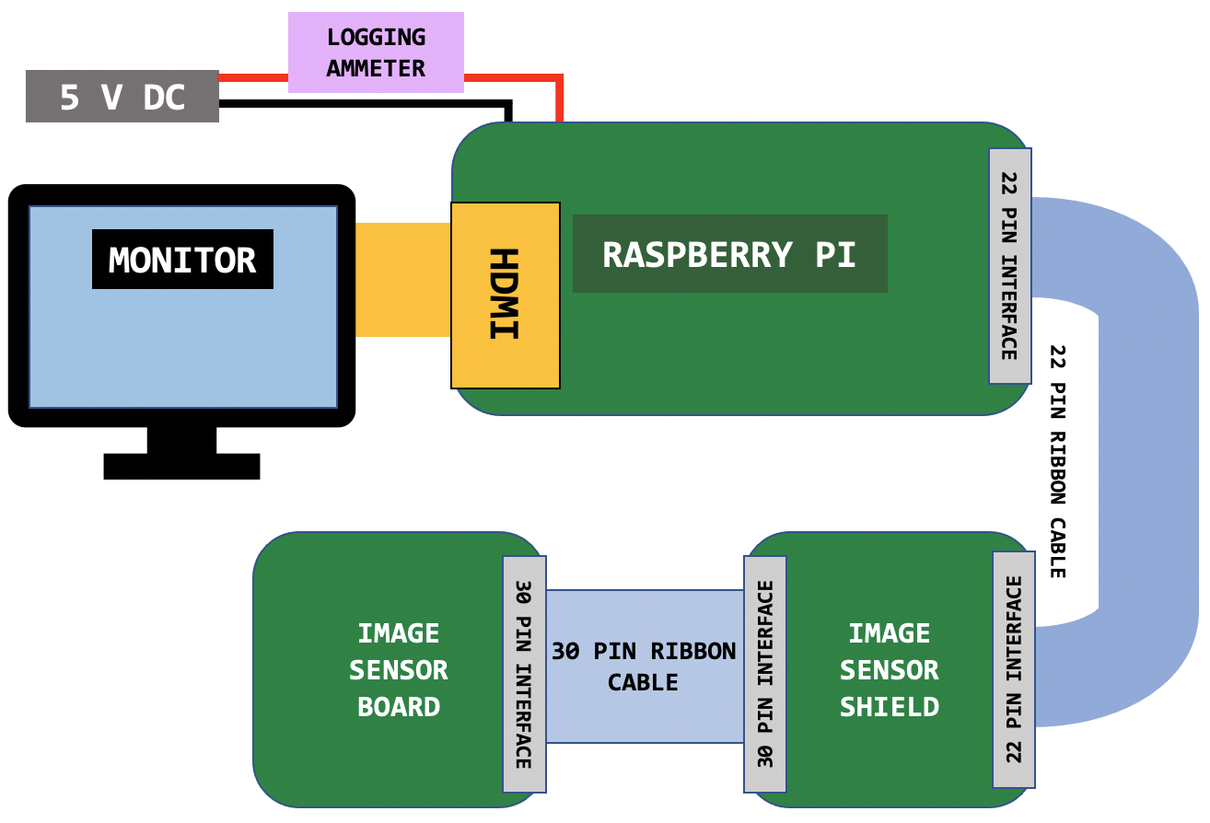
Test #3: Power Consumption
How do we verify the system’s operational power consumption?
The star tracker shall operate on a maximum continuous power of 2W
Expected Results
Image Sensor | < 400 mW
Image Sensor Shield | < 1.5 W
Raspberry Pi Zero 2W | < 1.25 W
Total | 3.15 W
Currently projected to exceed operational power requirement of 2W
Notes:
What is being tested for (your rationale for performing the test)
Meeting Level 3 design requirements for power, update rate, and accuracy
Tracking vs lost in space
How much memory is used (images, solutions, etc) if fully operational for X hours straight?
Design of the test fixtures (diagrams)
Show diagram from CDR
Measure current at inputs, outputs, and intermediate if possible
What test equipment and facilities are needed
Lens/camera module/Pi/SD card
Logging multimeter
HDMI and USB cables

Slide 32
Test #3: Power Consumption → Status
Completed:
✓
Tested Lost In Space Algorithm on Raspberry Pi Zero 2W
Gave upper limit on RP power consumption (used high res images and most power intensive algorithm)
Future Tasks
Driving down power consumption
Down-sampling images (decreasing resolution)
Test combination of LIS and tracking algorithms
Determining power consumption of optical module (img sensor & shield)
Monitor power and rates of specific testing functions using logging multimeter
Notes:
Describe the status of the testing tasks, showing engineering details as needed to convey a
solid understanding of the design (and the ability to reduce risk), requirements to be verified
or validated, and what V&V is most important for project success.
Explain methods/strategies to drive down power
What scenario/configuration is expected to use the most power?

Slide 33
Test #4: Observatory Testing→ Motivation
Full-System Test
March 2022
Sommers-Bausch Observatory
How do we verify optical system alignment, performance, and interfacing?
The image sensor shall output each image to the on board processor.
The characteristics of the CM shall provide discernable images for centroiding and matching algorithms.
The star tracker shall remain functional at a slew rate of 2°/s or less.
How do we verify attitude solution accuracy and characterize update rate?
Attitude solutions shall be generated at a rate of 0.2 Hz or greater.
The attitude solution shall have an absolute accuracy of less than 0.05°(1σ).
Notes:
Give more background here on what the test is doing and what the attitude “truth” solutions mean
Verify that camera system and software have sufficient performance to achieve desired accuracy
Update Rate
Verify system can meet update rate requirement
Attitude solutions shall be generated at a rate of 0.2 Hz or greater.
The attitude solution shall have an absolute accuracy of less than 0.05°(1σ).
Software Integration
Verify software subsystems function together if outputs are valid
The image sensor shall output each image to the on board processor.
The characteristics of the CM shall provide discernable images for centroiding and matching algorithms.
The star tracker shall remain functional at a slew rate of 2°/s or less.

Slide 34
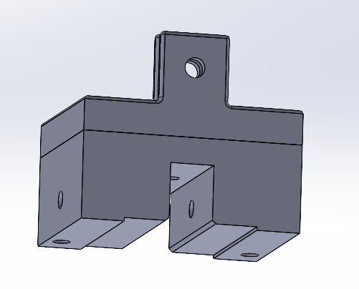
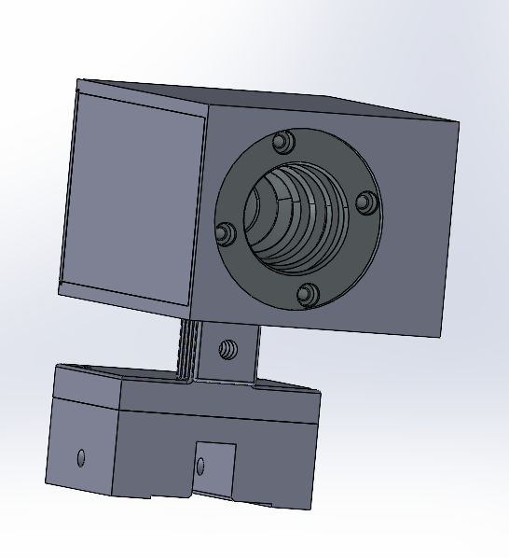
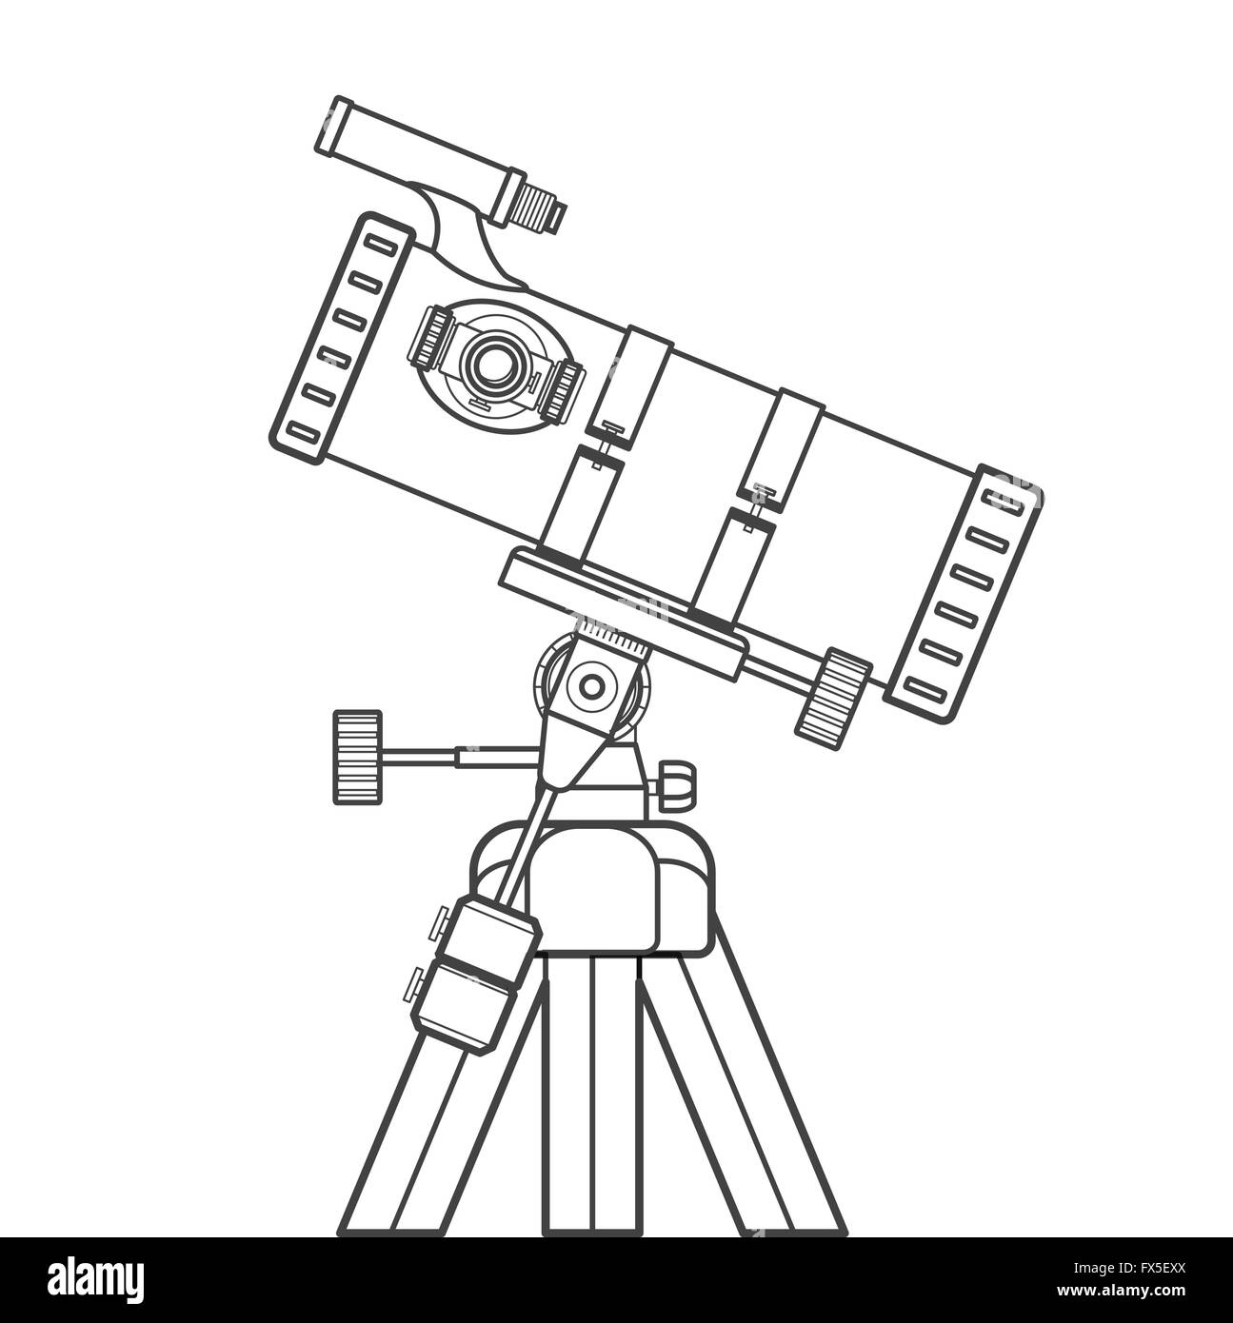
Test #4: Observatory Testing → Setup/Procedure
1
Mount CubIST to Observatory telescope using clip mount
Mount
CubIST
2
Attach cables and power on CubIST
3
Command Telescope to known star or specified location
4
Run CubIST config → capture images, run software, output solutions
5
Compare CubIST’s calculated RA/Dec to SBO software coordinates

Slide 35
Test #4: Observatory Testing → (Expected) Results
Can also operate CubIST while telescope is slewing to desired location to characterize performance.
Do images fail at certain slew rates?
How does exposure time relate to slew rate and solution success?
Is solution update rate affected?
CubIST Output: RA/Dec
Observatory Output: RA/Dec
Goal: accuracy within 0.05 degrees (DR 3.2)
Average difference over multiple images to characterize offset - how well is the optical system aligned?
Compare solutions to determine accuracy - provides a more accurate “truth” to measure against
The star tracker shall remain functional at a slew rate of 2°/s or less.
Notes:
Describe how the test(s) will reduce risk to your project, what results do you expect, and what
models will be validated.

Slide 36
Test #4: Observatory Testing → Status
!
Limitations:
→ POC: Rose Smith is OOO until 2nd week of March
→ Scheduling relies on clear nights
→ Possible mounting error during test that could offset calculations
Know | Don’t Know
General accuracy (arcsec) | Specific accuracy
Could utilize telescope slewing | Exact slew capabilities
Details of mount | Exact test setup
✓
Accessibility is flexible, lead time of ~4 hours
✓
Staff has completed testing for government developed star trackers in past
Notes:
Describe the status of the testing tasks, showing engineering details as needed to convey a
solid understanding of the design (and the ability to reduce risk), requirements to be verified
or validated, and what V&V is most important for project success.

Slide 37
Budgeting
Notes:
The team presented an update on status of all expenses including parts received, pending and planned with emphasis on long-lead and most important parts to project success.
An updated Cost Plan (CP) was presented, in the form of a financial budget, for all major items in the project,
highlighting uncertainties and corresponding budget margins. (9-10 pts)

Slide 38
Components purchased
Components: Name: Quantity: Tab:
Processors [6.02%] RP0 v1.2 & 1 11.95
RP0 2W 2 22.13 + 24.50
Optics [40.73%] Arducam 134 & 2 169.99 (x2)
35mm Lens 2 28.09 (x2)
Baffle [49.18%] Xometry machined Aluminum 6061-T6 Baffle 478.36
Additional: Quantity: Tab:
22-Pin Connectors 20 7.99
HDMI Extension 1 8.99
Micro USB Extension 1 11.59
USB 4-way Splitter 1 10.99

Slide 39
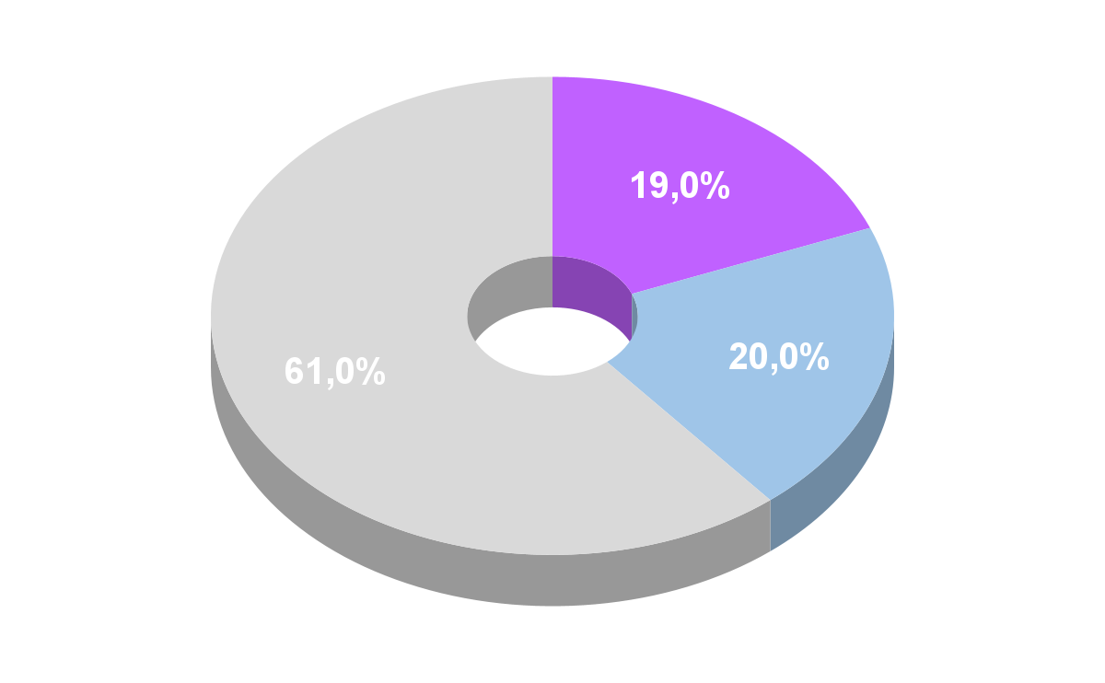
Budget Breakdown
Current Expenses
20%
$972.66 ~ 1,100.00
Baffle → $478.36
Optics → $396.16
Processors → $58.58
Misc → $100.00
Expected Labor
20%
20 Hours → $1,000.00 ± 250
60%
Remaining Budget
$2,650 ~ 3030.00
Notes:
What you have
Whats missing
Expected lead times

Slide 40
Acknowledgments
Thank you to our customer Dr. Palo, our advisor Dr. Akos, Colin for reviewing our presentation, and everyone else who has helped our team thus far!

Slide 41
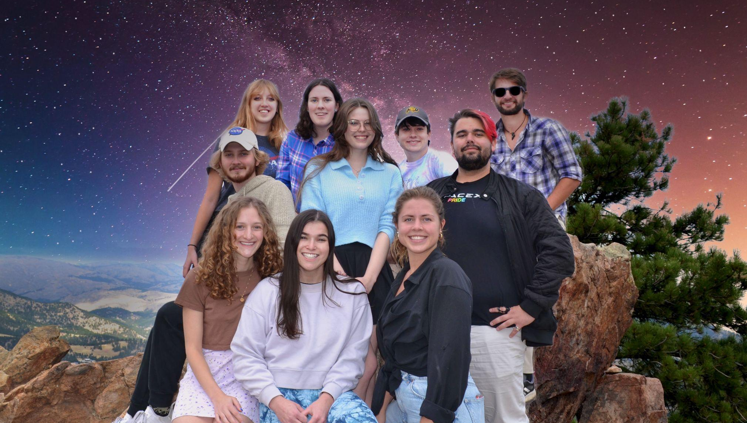
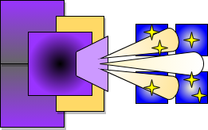
Questions?
Notes:
CHESNEY

Slide 42
Appendix
Accumulated Documentation of Subsystems:
[1] Baffle Technical Document: https://docs.google.com/document/d/1WwXZ3dmE4t2_mBjZ3s4tzEjJJWSP3C6wyox_JScZp10/edit?usp=sharing
[2] Optics Technical Document: https://docs.google.com/document/d/1ZhyTCVkR2t3Tr4r4GpJ2OpF3q-DwYyIeRW7NWn7Gdwg/edit?usp=sharing
[3] Software Technical Document: https://docs.google.com/document/d/1Q-_UHFDu2OuHukHIWtknz723jfdGDBnz7hESqHTJFzI/edit?usp=sharing
[4] Electrical System Hardware Technical Document: https://docs.google.com/document/d/1ciG65TJSJbB-Ew871nMCaLoUYqRjo-unH7c9CKo8GS0/edit?usp=sharing ** Accessible via CU Boulder email

Slide 43
Backup Slides

Slide 44
Primary Objectives
{
{
q
=
1
Attenuate light from bright objects that enter the lens using a baffle
2
Capture images of stars from ground location using an image sensor
3
Process these images and match to known star patterns in a star catalog
4
Derive three deterministic angles that describe the orientation of the star tracker

Slide 45
Specific Objectives
Specific Objective | Level 1 | Level 2 | Level 3
Image Acquisition | Operate within 60° of the sun and 20° of the moon | 45° of the sun & 15° of the moon | 30° of the sun and 10° of the moon
Power & Comm | Operate on minimum continuous power of 2W | 1W | 0.5W
Volume | 0.5U | 0.4U | 0.3U or less
Mass | 400g | 300g | 200g or less
Attitude Solution | Deliver a quaternion with 1.0° and 1σ absolute accuracy | 0.2° and 1σ | 0.05° and 1σ
Slew Rate | Camera will perform at maximum attitude rate of 0.1°/s | 0.5°/s | 2.0°/s
Duty Cycle | Initial solution produced within 120 s, then continuously at 0.2Hz | 60 seconds, 1 Hz | 30 seconds, 5 Hz

Slide 46
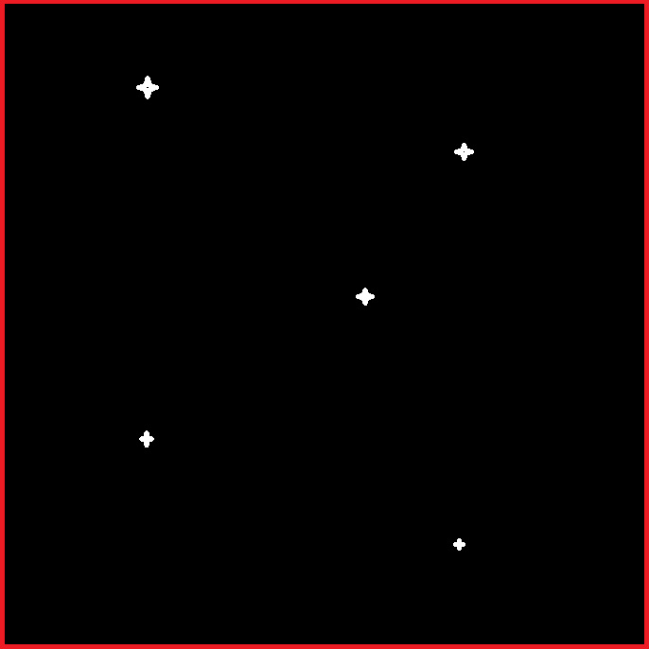
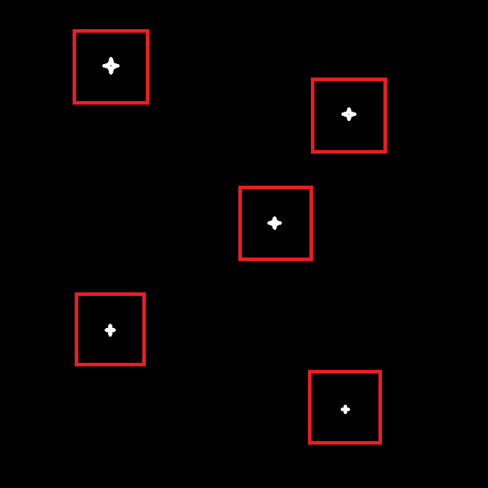
Software → Lost In Space Vs Tracking
Algorithms: Lost in Space:
Calculates solution with no prior attitude knowledge
Tracking:
Utilizes prior attitude and probability to narrow search field for centroiding
Costs | Benefits | Future Modifications
Update Rate | Accuracy Simple | Image down sampling Log Scaling
Complexity Accuracy | Approximately 10x faster than LIS | Will be implemented post-CDR Refinement of current model
Notes:
NICKY
With the addition of the tracking algo, we will be able to meet DR -- from preliminary testing around 10x faster not tested on project hardware yet
We plan to implement modification tactics for lost in space and tracking to meet DR
Tracking has the algorithm only search for stars around where they had been found previously
Only looks in the squares for stars

Slide 47
Testing Table
Test | CPE’s | Planning
 |  | Date | Facility | Equipment
Baffle Effectiveness | Baffle | Feb 28th-Mar 4th | LASP | HelioStat
Baffle Sensitivity | Baffle | Jan - Mar 2022 | [Simulation] | ZEMAX
Power Consumption | Processing SW + HW | Jan - Feb 2022 | Electronics Shop | Logging Multimeter, Oscilloscope, wires, toolbox
Full System | All | Mar 2022 | Sommers-Bausch Observatory | Mount, power and connection cables, monitor
 |  | Jan - April 2022 | Outdoor | Tripod, rotating motor, pwr src, verification tools

Slide 48
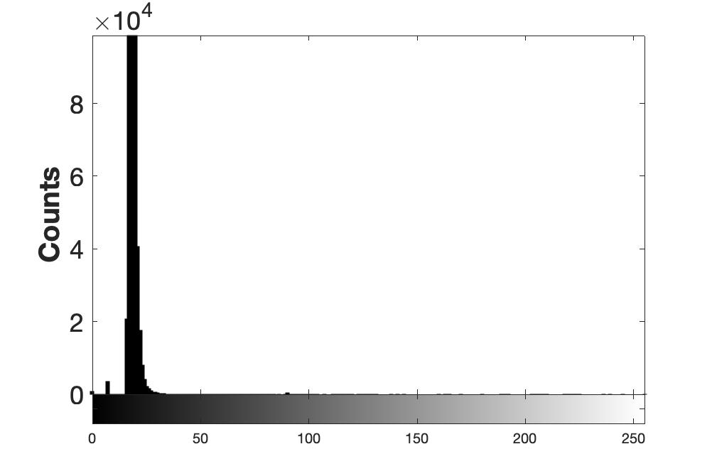
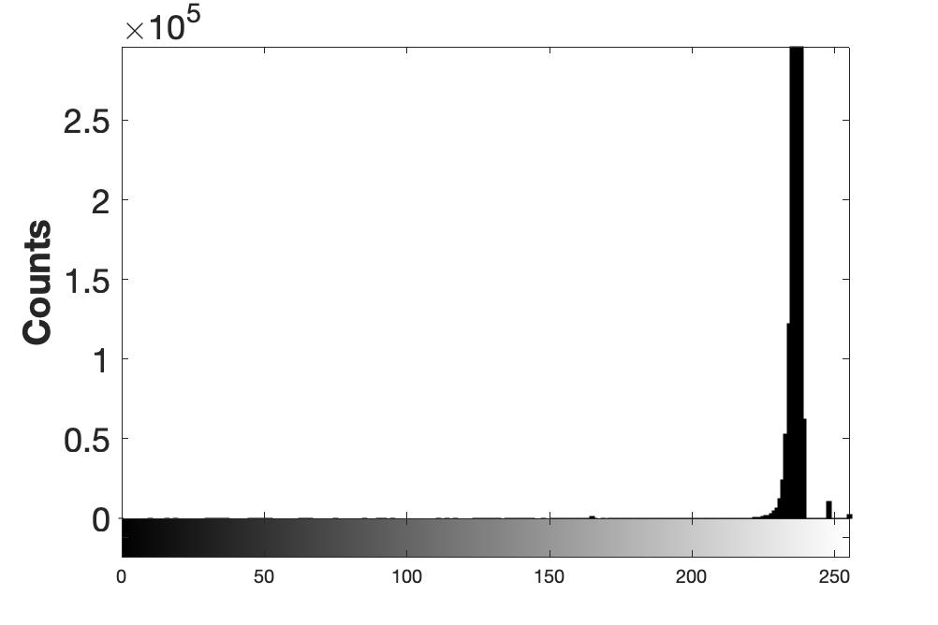
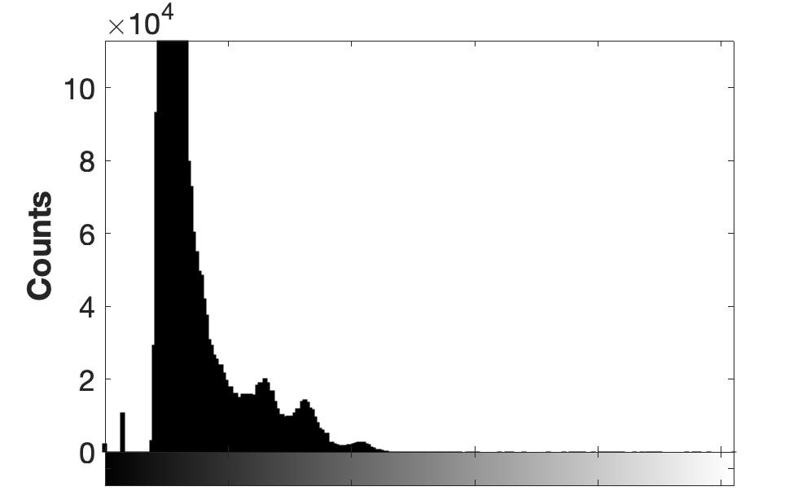
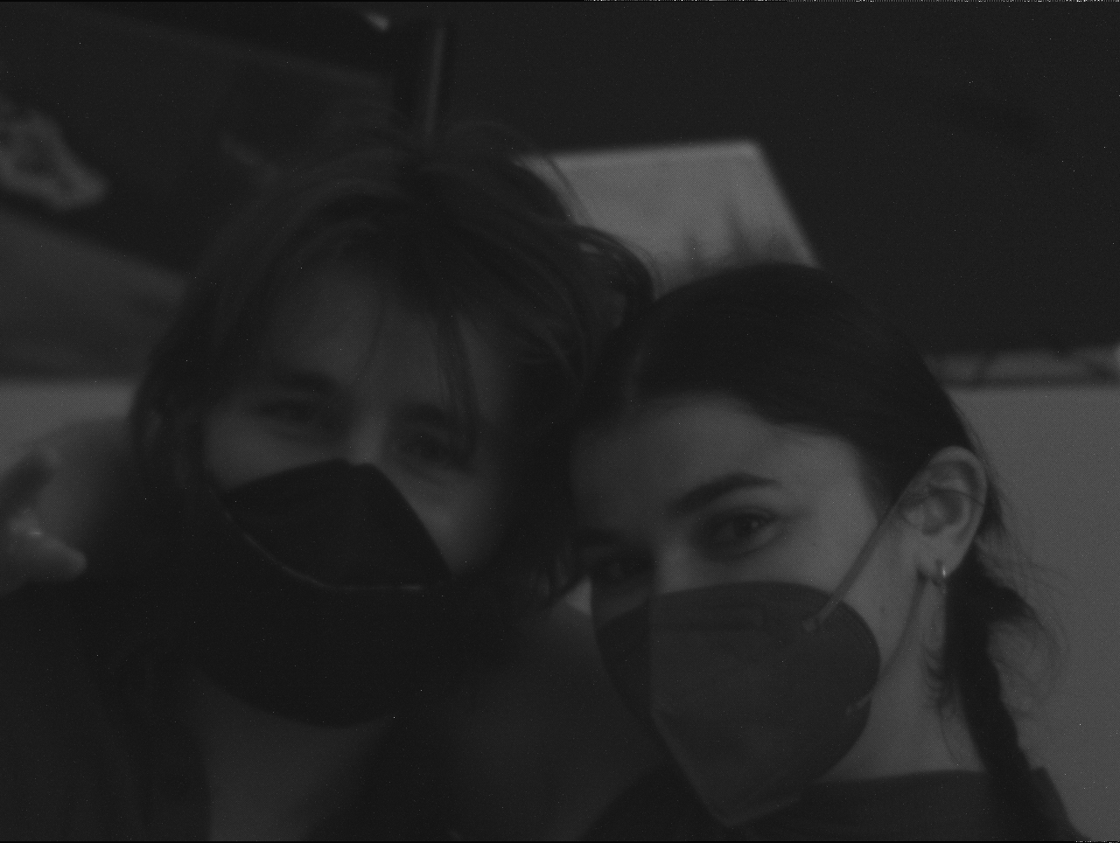
Test #4: Data Post-Processing
→ MATLAB Image Processing Toolbox
→ Average intensity of images and intensity distribution
→ Attenuation [dB] for each baffle angular position
(ratio of average intensity of an image compared to “0° Boresight” case)
→ Project risk reduction:
Baffle performance
→ Validate Requirement
Intensity Histogram
Image from camera
.png .jpg .bmp
“0° Boresight”
The baffle shall attenuate -25dB of the light at the sun exclusion angle. And -5dB of light at the moon exclusion angle.
Points on Attenuation Curve
-11dB
-8dB

Slide 49
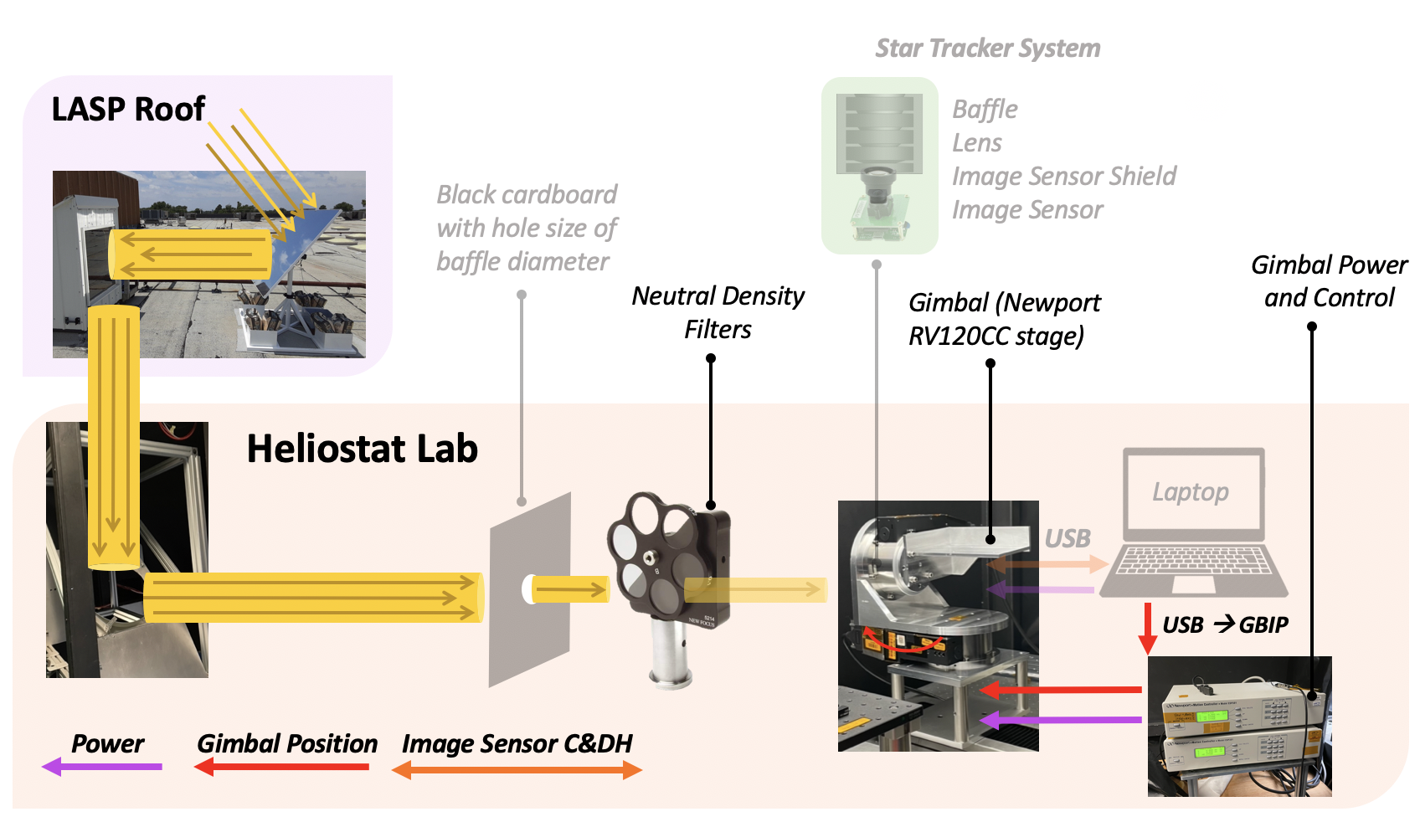
Test #4: Heliostat Test Block Diagram & Test Status
Bolded Item:
Provided by LASP
Transparent Item: Provided by CubIST
STATUS
→ Walk through 02/04
→ Reserved for 02/28-03/04
→ Fit Check 02/28
→ Receive Baffle from manufacturer
IN PROGRESS
→ Baffle/Gimbal mount
→ MATLAB code to control gimbal position
Notes:
Could add procedure steps on side of this slide, but having both visual and written procedure is necessary

Slide 50
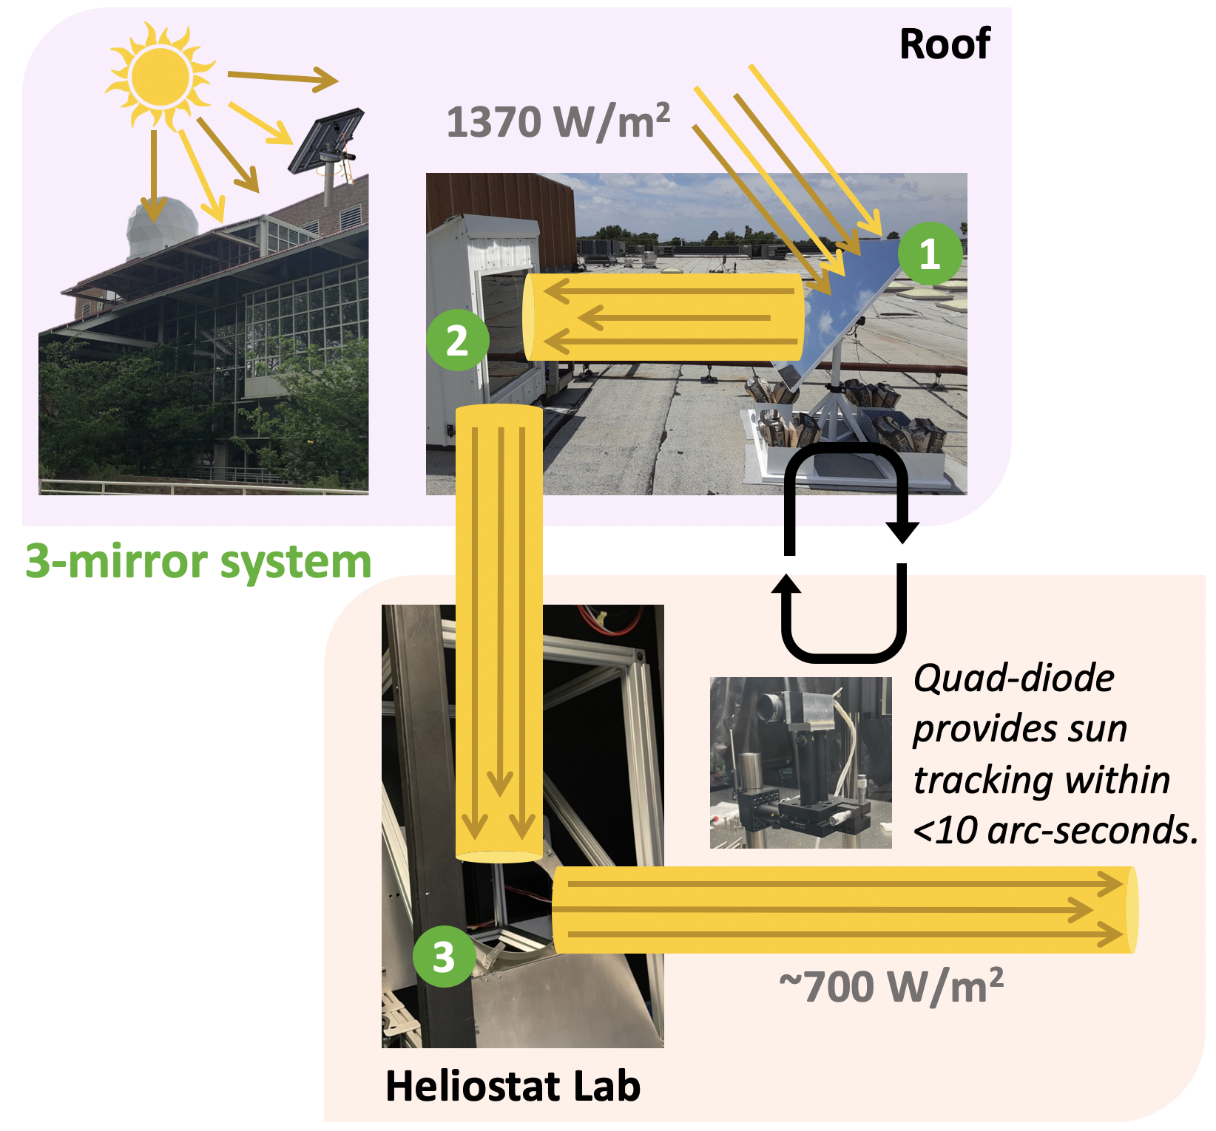
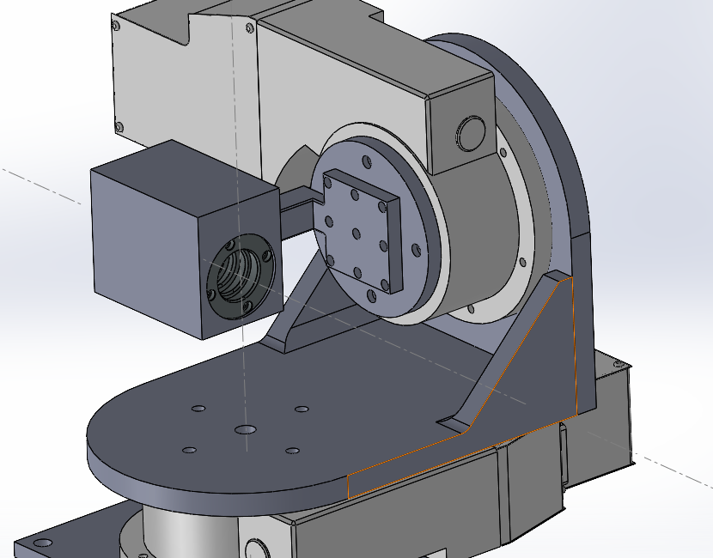
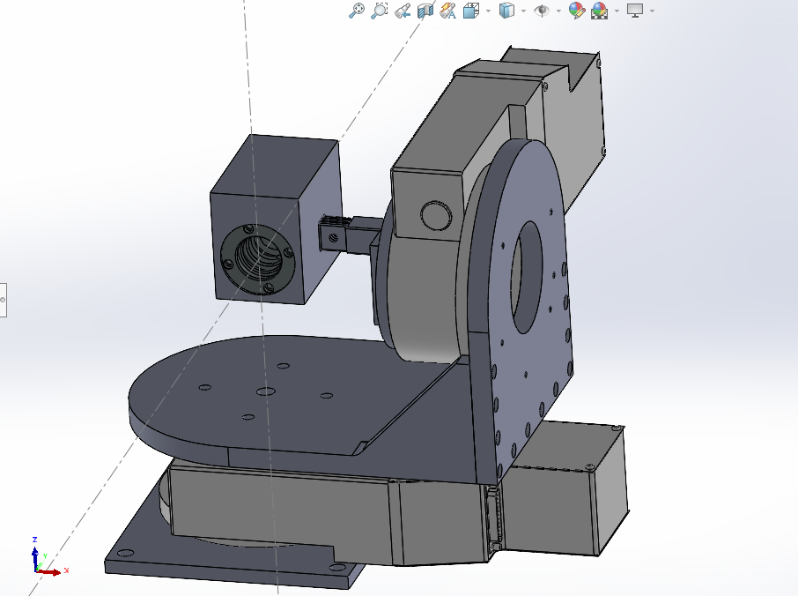
Test #4: Heliostat 101 & Star Tracker Interface
Rotation Axes
CubIST

Slide 51
Test #4: Heliostat Risks/Reduction
Type | Heliostat Test Risk | Mitigation
Schedule | Takes 3-5 days to acquire data. Cannot use CubIST during this time | → Allocate extra time for heliostat in schedule
Schedule | Requires a sunny day, only get 5-6 hours in lab | → Allocate extra time for heliostat in schedule
Test Data | Stray light in the lab | → Cover all surfaces with black fabric or cardboard → Ensure sunlight does not overfill baffle → Quantify stray light with dark images
Destruction of Image Sensor | Extreme oversaturation of image sensor | → ND filters to reduce transmission of sunlight, adjust camera settings
Destruction of Image Sensor | ESD | → ESD coats/straps required in Heliostat Lab
Baffle performance requirements | Light not evenly distributed on image sensor | → check alignment
Neutral Density Filter
“Sunglasses” for image sensor
% Transmission = 10^{-OD} x 100
OD = Optical Density of filter
Start with OD of 5 depends on gain and input light power (P=IA)
ONE PIXEL
Light (photons)
Charge (Electrons)
ADC
Saturation Capacity (e-)
Photodiode
Full Well Capacity (e-)
Amplifier
Notes:
OD of 5 → 1e-3 Tx
700 W/m^2 → 0.7 W/m^2

Slide 52
Heliostat → Neutral Density Filter
What is an ND filter?
Responsivity of detector: converting optical energy to signal generated
6.1 V/lux-s
Dynamic Range: saturation optical power / min detectable optical power
64dB
Lux and W/m^2 relationship depends on wavelength but for sunlight
1 Lux = 0.0079 W/m^2
Saturation Capacity (Well-depth) = 5542 e-
Full Well Capacity = 8000e-
Digital and Analog gain up to 8
12 bit camera

Slide 53
Test #1: Night Sky Testing
5 minutes —>
Notes:
what is being tested for (your rationale for performing the test),
the design of the test fixtures (diagrams)
what test equipment and facilities are needed,
Observatory test: sbo provides 12V/120AC power, micro-usb to usb adapters for mouse and keyboard control, and mini hdmi to hdmi cable for output to monitor (10ft cables)

Slide 54
Night Sky Test Findings - Test 1: FAIL
Outdoor Test 2-4-22
Class 4 Bortle (Light pollution level)
Higher Bortle has more light pollution on a scale from 1-9, 1 being completely dark and 9 being middle of a dense rural area
Boulder, in comparison, is class 5 on the Bortle scale
Test 1 - no tripod
ALL FAILED - Astrometry (Only one star visible to the eye, many dead pixels seen as stars)
9:15 https://nova.astrometry.net/user_images/5602604#original
9:20 https://nova.astrometry.net/user_images/5602601#original
9:25 https://nova.astrometry.net/user_images/5602600#original

Slide 55
Night Sky Test Findings - Test 2: SUCCESS
Outdoor Test 2-4-22
Test 2: high exposure (24.3ms) of Orion’s Belt
ALL PASSED - Astrometry
10:40 https://nova.astrometry.net/user_images/5602621#annotated
Software solution: [('RA', 84.85900063925229), ('Dec', -0.5716227169278444), ('Roll',
236.2472152895862), ('FOV', 7.774046285857805), ('RMSE', 8.48829629373073),
('Matches', 7), ('Prob', 3.748800916108931e-10), ('T_solve', 4.040999999999961),
('T_extract', 530.6629999999999)]
***Matches astrometry solution
With 7.8 degree database: {'RA': 84.858354930441, 'Dec': -0.5707963751821439, 'Roll':
236.22954055060035, 'FOV': 7.77403953114612, 'RMSE': 11.511081284580078, 'Matches': 13, 'Prob': 2.145925786490352e-22, 'T_solve': 23.749599999998594, 'T_extract': 815.878399999999}
10:45 https://nova.astrometry.net/user_images/5602625#annotated
Software solution: [('RA', 86.11140056769794), ('Dec', -0.5879866051262019), ('Roll',
236.2294665746022), ('FOV', 7.771450925716293), ('RMSE', 9.035660707301854),
('Matches', 9), ('Prob', 3.1199884494419435e-15), ('T_solve', 169.39249999999984), ('T_extract', 517.9789000000002)]
***Matches astrometry solution
With 7.8 degree database: {'RA': 86.11192035873441, 'Dec': -0.5877978208234548, 'Roll': 236.2295496524941, 'FOV': 7.769379933907241, 'RMSE': 12.037328365267916, 'Matches': 15, 'Prob': 7.805317695592083e-29, 'T_solve': 28.656399999999138, 'T_extract': 743.8491000000002}
10:50 https://nova.astrometry.net/user_images/5602622#annotated
PASSED with 7.8 degree database: {'RA': 87.4399939958123, 'Dec':
-0.5904853281931894, 'Roll': 236.24829357346613, 'FOV': 7.771056942423022, 'RMSE':
10.903925391234615, 'Matches': 11, 'Prob': 8.887415547589275e-19, 'T_solve':
50.07729999999988, 'T_extract': 732.0782000000002}
***Matches astrometry solution

Slide 56
Night Sky Test Findings - Test 3: P/F
Outdoor Test 2-4-22
Test 3: low exposure (4.9ms) of Orion’s Belt
ALL FAILED - Astrometry
11:00 https://nova.astrometry.net/user_images/5602707#original
Software Solution: [('RA', 84.82692850365792), ('Dec', -0.9039704731463848), ('Roll',
247.48170622930002), ('FOV', 7.770704908997107), ('RMSE', 11.758076100352733),
('Matches', 7), ('Prob', 2.864377591134488e-10), ('T_solve', 176.0681000000002),
('T_extract', 577.9709000000001)]
With 7.8 degree database: {'RA': 84.82688424282256, 'Dec': -0.9042002471229603,
'Roll': 247.48617275749035, 'FOV': 7.768753910227887, 'RMSE': 11.51085661000271,
'Matches': 8, 'Prob': 4.8111801179178224e-11, 'T_solve': 38.44270000000005,
'T_extract': 988.8798000000003}
Had all 3 of Orion’s belt stars, next two had only 2
11:05 https://nova.astrometry.net/user_images/5602706#original
11:10 https://nova.astrometry.net/user_images/5602730#original

Slide 57
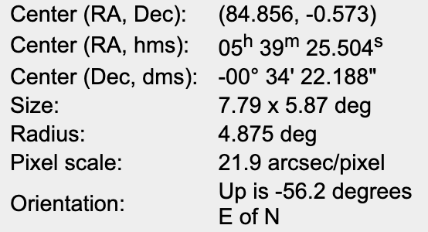
Astrometry Findings on Test 2
Grid Overlay
10:40pm Test:
24.3ms exposure
-5
+0
88
86
82
84

Slide 58
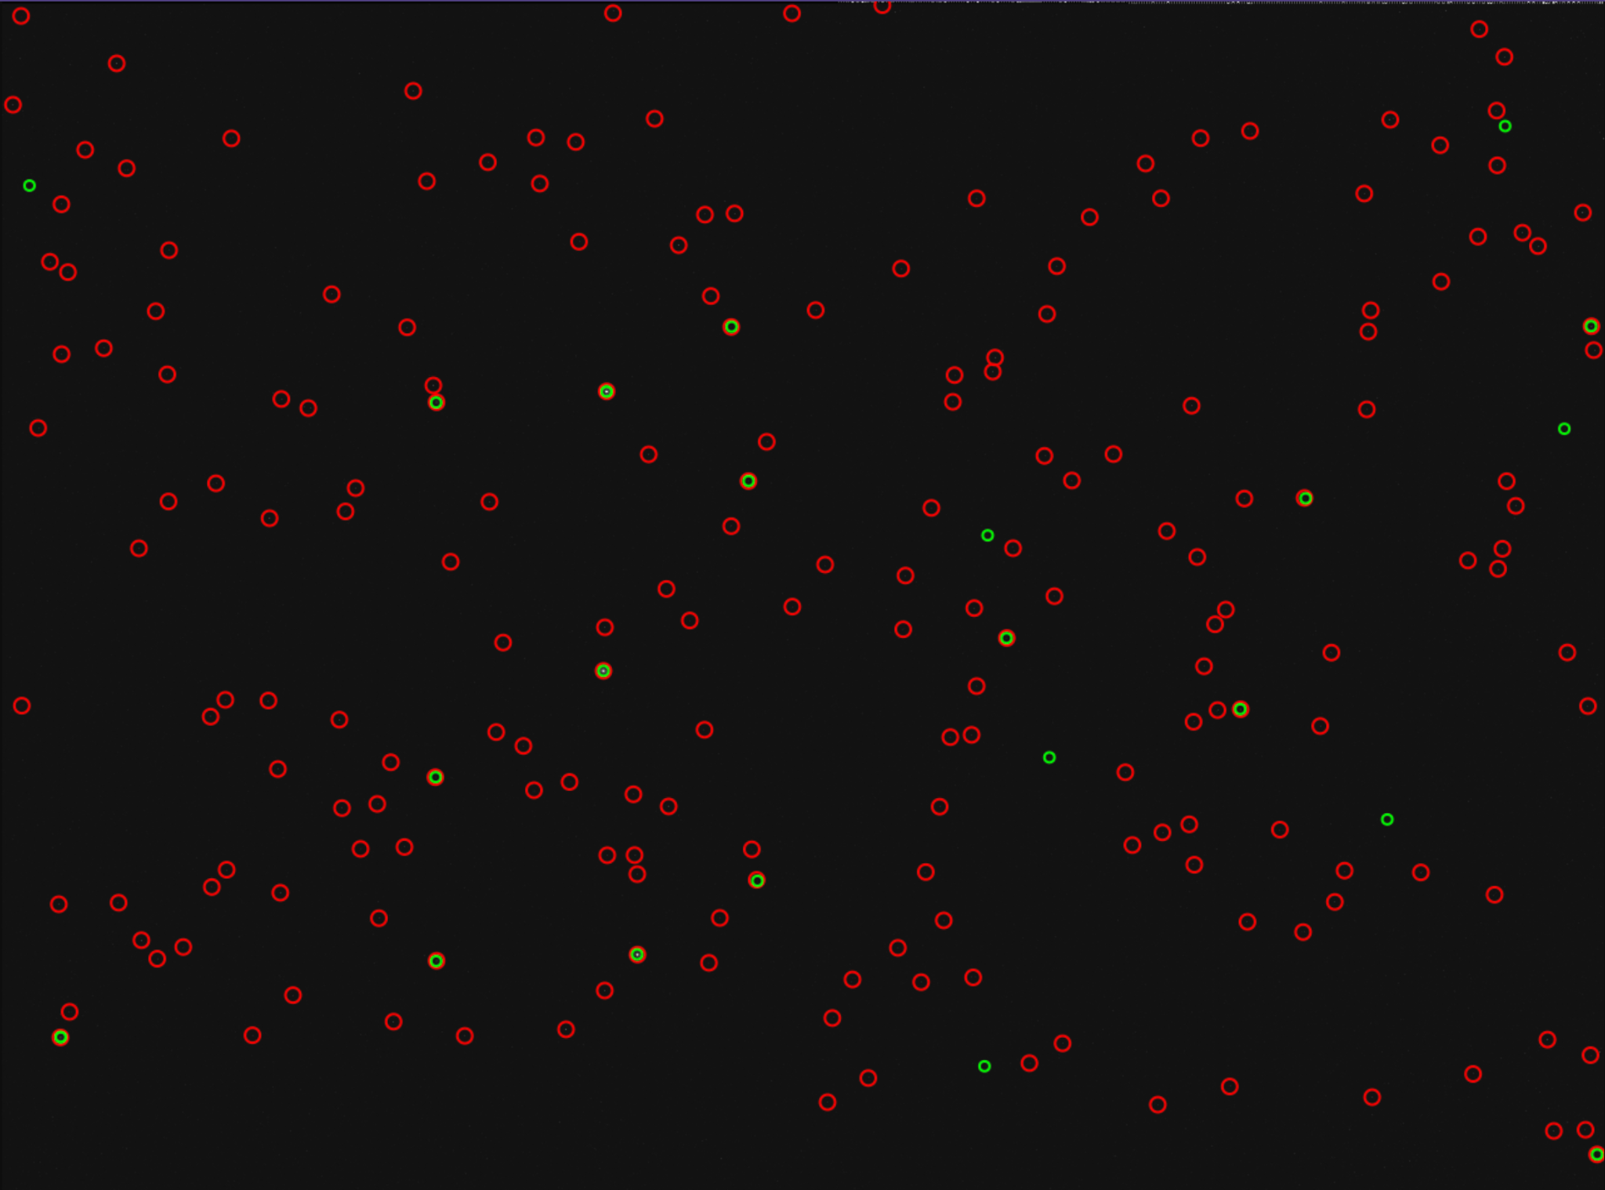
Astrometry Findings on Test 2
10:40pm Test:
*14/21 stars confirmed*
19
1
10
20
2
3
11
18
21
12
4
13
16
5
14
17
9
7
8
6
15

Slide 59
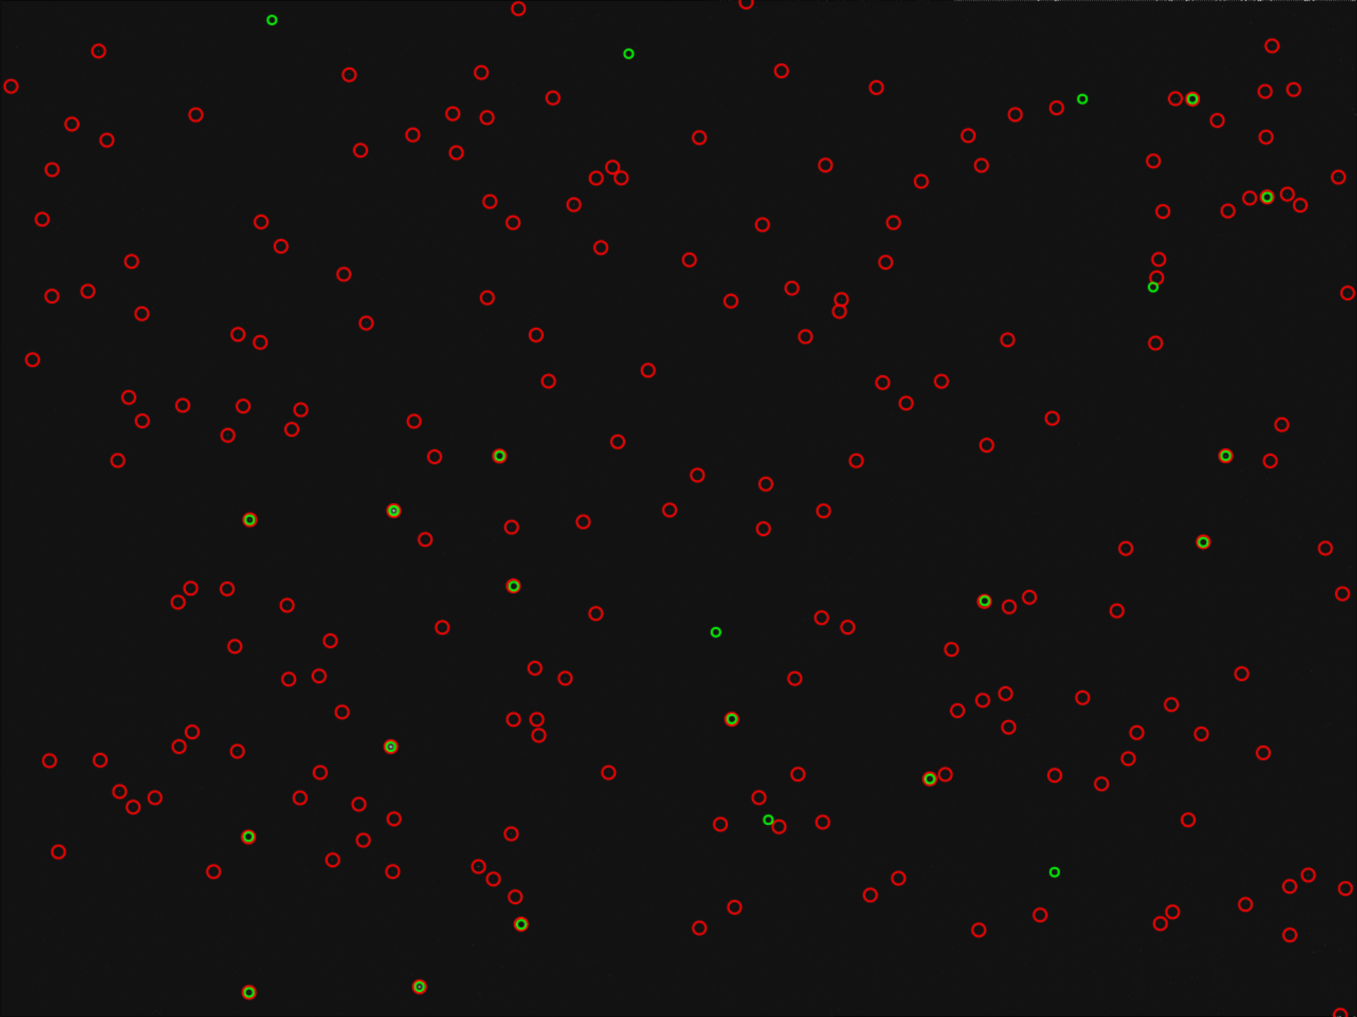
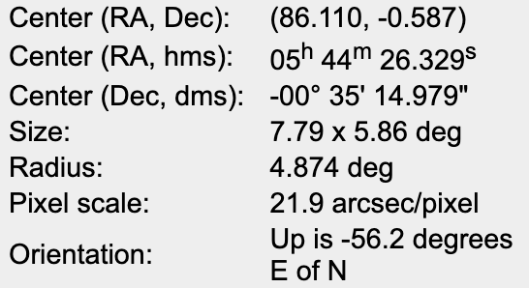
Astrometry Findings on Test 2
1
11
10:45pm Test:
*16/23 stars confirmed*
22
23
21
20
5
19
2
3
4
18
12
17
6
13
7
15
14
10
16
8
9

Slide 60
Comparison of SW Solution to Astrometry - Test 2
Parameter | CubIST | Astrometry
Right Ascension Angle (deg) | 84.858354930441 | 84.856
Declination Angle (deg) | -0.5707963751821439 | -0.573
Roll Angle (deg) | 236.22954055060035 | N/A
Field of View Angle (deg) | 7.8 | 7.79 x 5.87 deg
RMSE (arcsec) | 11.511081284580078 | N/A
Matches | 13 | 14
10:40 pm
10:45 pm
Right Ascension Angle | 86.11192035873441 | 86.110
Declination Angle | -0.5877978208234548, | -0.587
10:50 pm
Right Ascension Angle | 87.4399939958123 | 87.440
Declination Angle | -0.5904853281931894 | -0.589

Slide 61
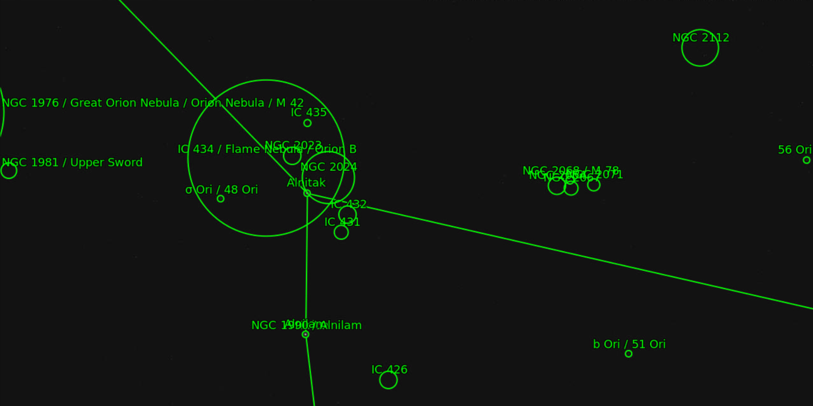
Astrometry Findings on Test 2
10:40 Test:
10:40pm Test:

Slide 62
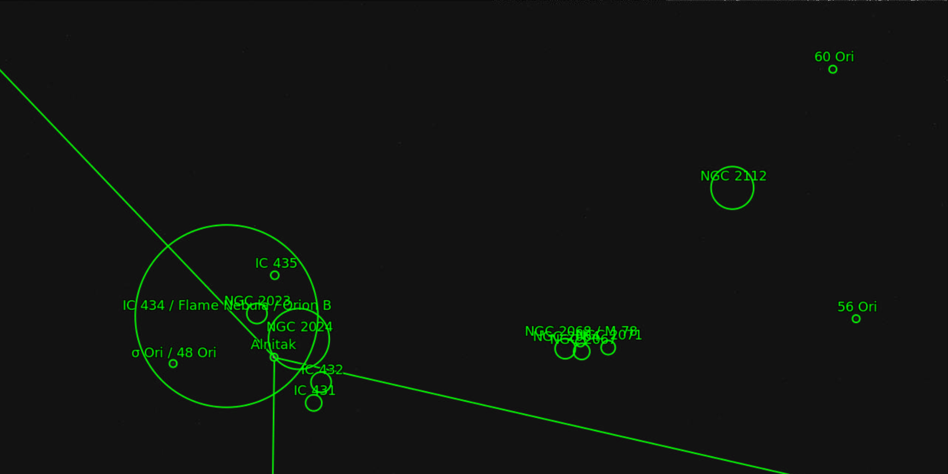
Astrometry Findings on Test 2
10:45pm Test:

Slide 63
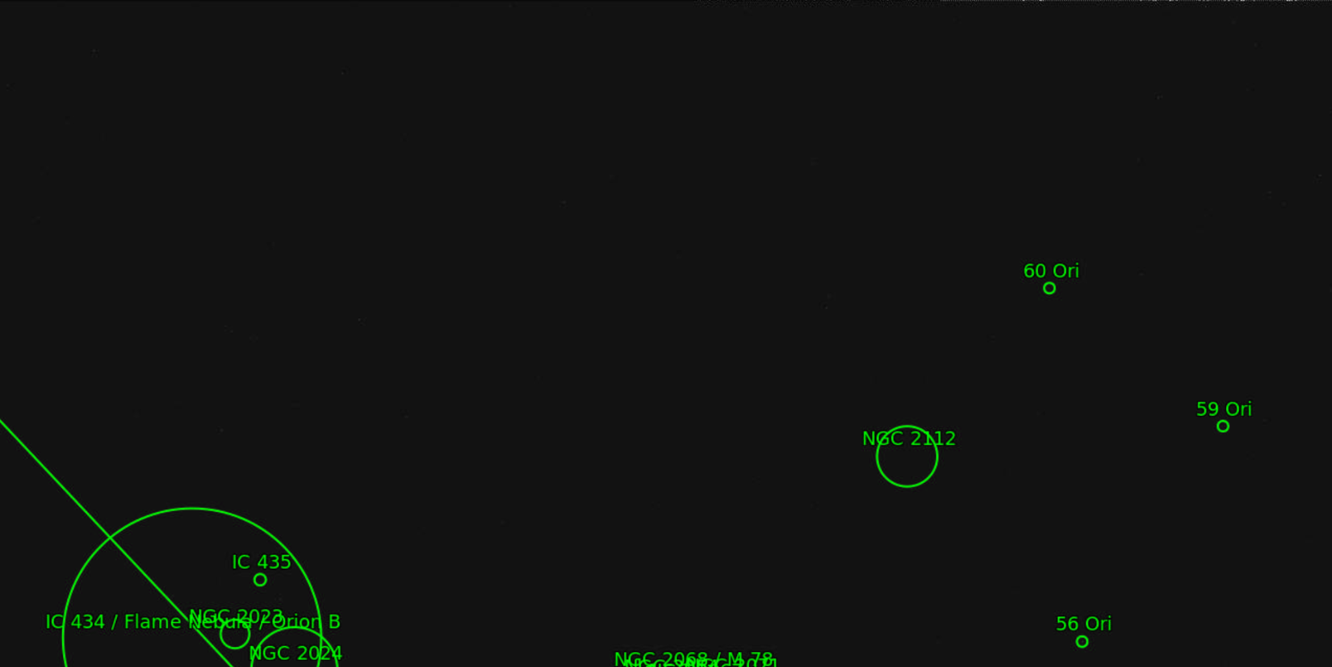
Astrometry Findings on Test 2
10:50pm Test:

Slide 64
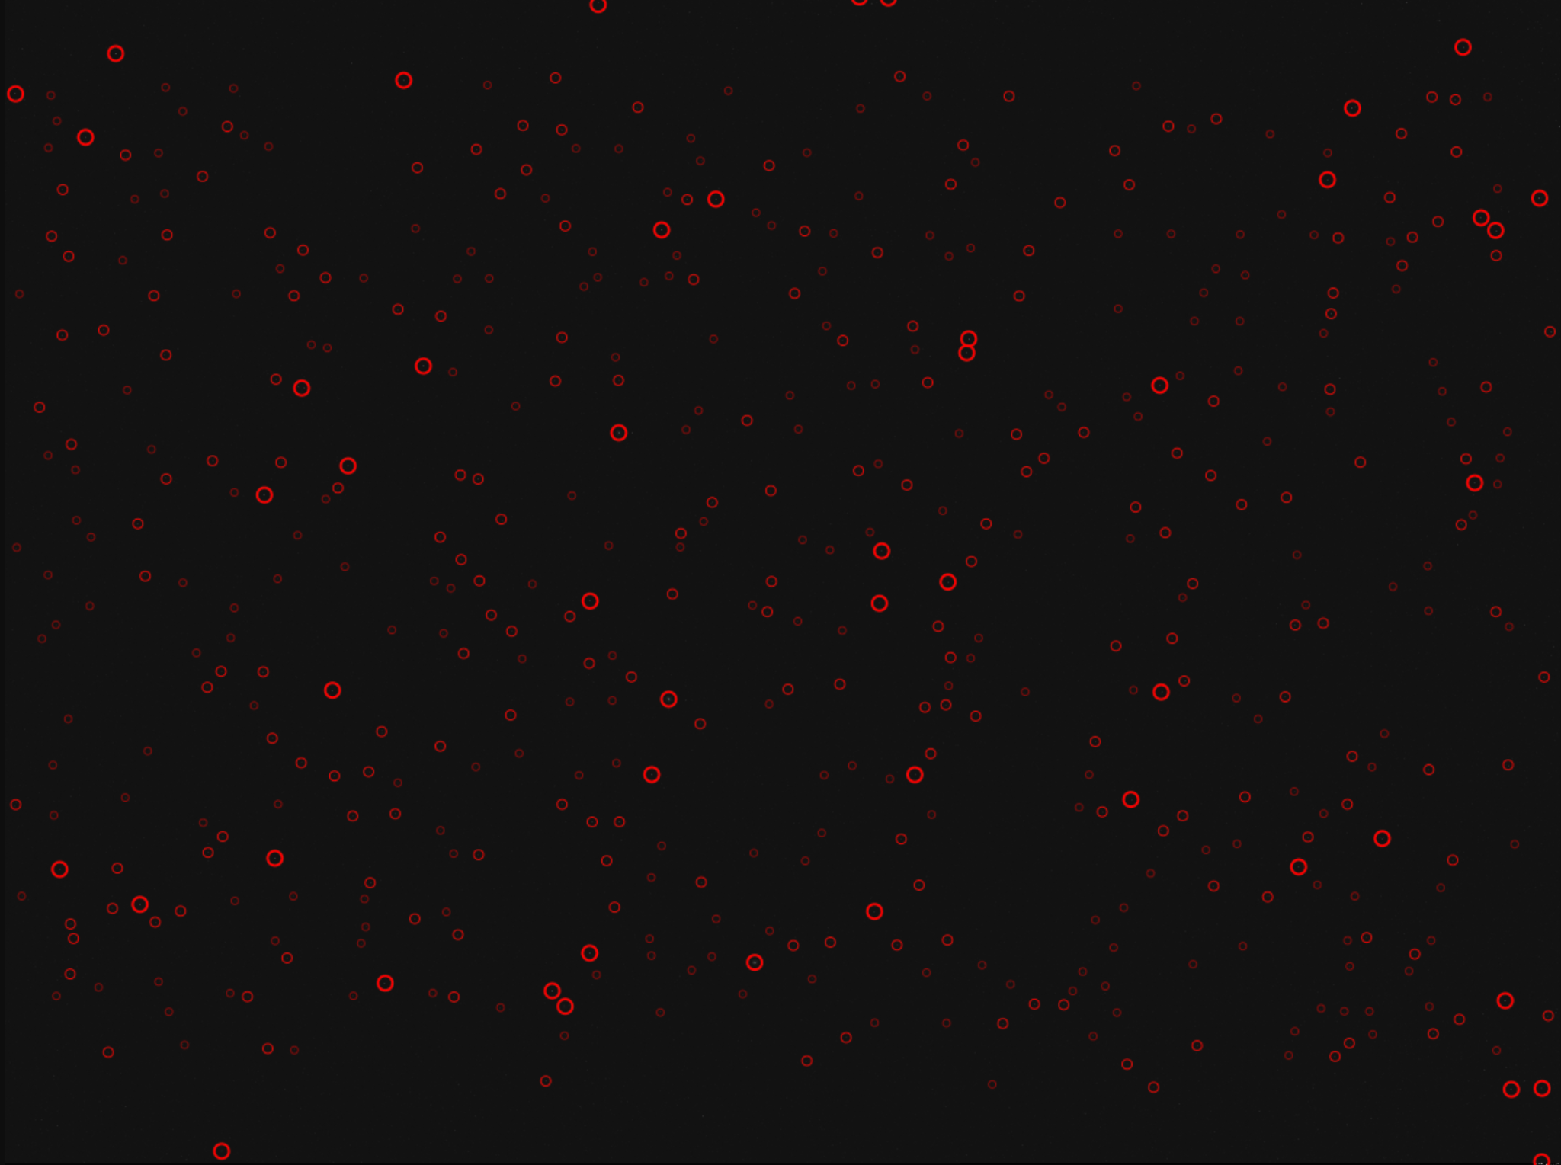
Astrometry Findings on Test 3
11:00pm Test:
4.9ms exposure
Example of Fail
No star match
Either too much light pollution
OR detecting dead pixels as light sources

Slide 65
Lens Cap ON Imaging - Full Img

Slide 66
Lens Cap ON Imaging - 400% Zoom

Slide 67
Lens Cap ON Imaging - 1000% Zoom
several dead pixels!!

Slide 68
Test #4: Observatory Testing → (Expected) Results
Can also operate CubIST while telescope is slewing to desired location to characterize performance.
Do images fail at certain slew rates?
How does exposure time relate to slew rate and solution success?
Is solution update rate affected?
Equipment Needed/Design | Verifying? | How it works
Enclosure | Alignment of full system | Comparing solution to known
Solutions output with timestamps | Precision of full system | Change in solution over time
Solution outputs from telescope | Accuracy of full system | Similarity to telescope solution
The star tracker shall remain functional at a slew rate of 2°/s or less.
Notes:
Describe how the test(s) will reduce risk to your project, what results do you expect, and what
models will be validated.

Slide 69
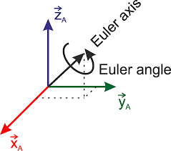
Quaternion Verification
Still in progress
Since the quaternion is a relative value it is difficult to define “truth”
Solutions to this problem are being explored
In the meantime:
Verification of the math involved!
From example 9.18 in ASEN 3200 textbook: Orbital Mechanics for Engineering Students (3rd E.), Howard E. Curtis
313 rotation sequence (Inertial to Body Fixed frames)
Algorithm for quaternion calculation is directly from the text
Quaternion conversion python function has been integrated into the main Tetra3 sequence and tested for accuracy against matlab script
Notes:
Adtl Tests include: (please add or edit this list!!!!) (Palo/Akos please add tests if you think we are missing something)
1) Power consumption
2) Rate testing
3) Software tracking tests
4) Simulated Images
5) binary/ noise backyard tests
6) outdoor testing
7) comparing all of these tests for accuracy

Slide 70
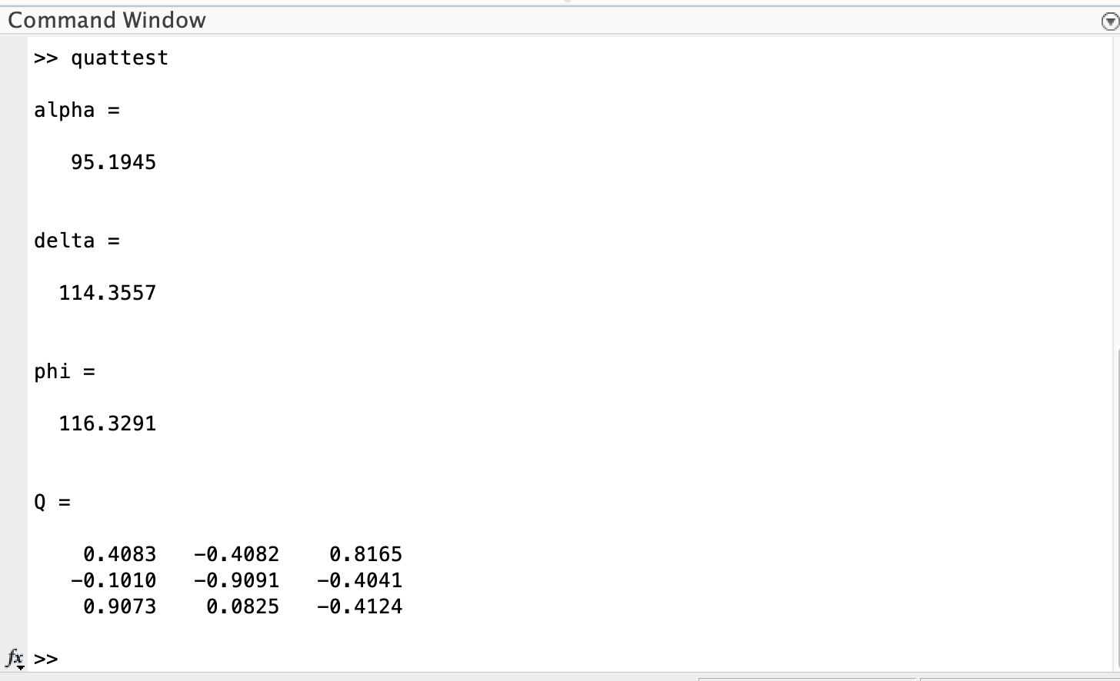
Quaternion Verification
Our Code
Book
For reference: our coordinate frame angles -- phi=alpha; theta=delta; psi = phi
Notes:
Adtl Tests include: (please add or edit this list!!!!) (Palo/Akos please add tests if you think we are missing something)
1) Power consumption
2) Rate testing
3) Software tracking tests
4) Simulated Images
5) binary/ noise backyard tests
6) outdoor testing
7) comparing all of these tests for accuracy

Slide 71
Testing Plan: Indoor Setup
Equipment: Darkroom, high resolution monitor, collimating lens to cause stars to appear far away, high-precision rotation DC motor, control center with live Astrometry outputs
Setup: CubIST mounted to rotating motor to emulate maximum allowable slew rate; operational for 2 hours straight.
Plan: CubIST views surroundings through collimating lens and takes images of the stars produced on LCD monitor. Quaternions printed to monitor and compared to online model.
Pass criteria: All attitude solutions are within 10% of Astrometry solutions at same angle and location.
Notes:
CHESNEY The problem with this test setup is that there is a ton of error involved with the setup. Specifically, the collimating optics will be very difficult to align perfectly (.1 degrees off automatically makes our system .1 degrees off) and also getting the light to become collimated is a very difficult task (Our only experience is Maria collimating a laser pointer and that was quite difficult in itself). I did find a possible resource from NASA to discuss the feasibility of us doing this test if I can get a meeting with him, and he should provide some great insight on testing our star trackers performance next spring.
Pros:
Controlled environment
Verification can be done against the actual image we are looking at (Accuracy of image sensor/lens can be tested)
Cons:
Collimation setup must be very precise for an accurate test
Many sources of error involved with equipment set up.

Slide 72
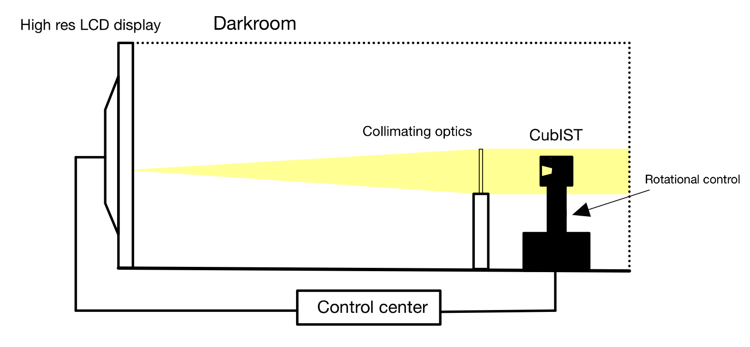
Testing Plan: Indoor Setup
Darkroom LCD Setup:
Notes:
CHESNEY The problem with this test setup is that there is a ton of error involved with the setup. Specifically, the collimating optics will be very difficult to align perfectly (.1 degrees off automatically makes our system .1 degrees off) and also getting the light to become collimated is a very difficult task (Our only experience is Maria collimating a laser pointer and that was quite difficult in itself). I did find a possible resource from NASA to discuss the feasibility of us doing this test if I can get a meeting with him, and he should provide some great insight on testing our star trackers performance next spring.
Pros:
Controlled environment
Verification can be done against the actual image we are looking at (Accuracy of image sensor/lens can be tested)
Cons:
Collimation setup must be very precise for an accurate test
Many sources of error involved with equipment set up.

Slide 73
Full-System Indoor Testing Feasibility
Benefits | Challenges
Image source and expected result are fully verifiable - no additional testing is needed to determine accuracy of optical hardware Controlled environment Perfectly run test is fully descriptive | Significant induced/propagated error from potential misalignment of collimating lens Almost perfect precision required in order for test to be useful Setup is difficult and requires expertise
Notes:
CHESNEY The problem with this test setup is that there is a ton of error involved with the setup. Specifically, the collimating optics will be very difficult to align perfectly (.1 degrees off automatically makes our system .1 degrees off) and also getting the light to become collimated is a very difficult task (Our only experience is Maria collimating a laser pointer and that was quite difficult in itself). I did find a possible resource from NASA to discuss the feasibility of us doing this test if I can get a meeting with him, and he should provide some great insight on testing our star trackers performance next spring.
Pros:
Controlled environment
Verification can be done against the actual image we are looking at (Accuracy of image sensor/lens can be tested)
Cons:
Collimation setup must be very precise for an accurate test
Many sources of error involved with equipment set up.

Slide 74
Sprint Schedule
Date | Important Milestones | School Holidays/Dates | Req Lectures
Jan 10th - Jan 21st | Cont Sftwr development Complete Optics & Electronics Assembly Begin Baffle Mfg Work on IDR & complete it | Virtual 2 weeks Jan 17th: MLK Day | Jan 13th Jan 18th
Jan 24th - Feb 4th | ZEMAX development Finish Software Optimization Finish baffle mfg Begin image accuracy testing Work on AIAA abs & complete it Begin TRR work | Jan 28th: IDR Signoffs Feb 4th: AIAA Abstract due to advisor | Jan 27th
Feb 7th - Feb 18th | 1st week: spare time for Baffle Mfg Finish Image accuracy testing OUTDOOR DRY-RUN Finalize AIAA Finalize TRR Present TRR | Feb 13th: AIAA Abstract final deadline Feb 14th: TRR final deadline Feb 18th: Peer Evals due

Slide 75
Sprint Schedule
Date | Important Milestones | School Holidays/Dates | Req Lectures
Feb 21st - Mar 4th | Assemble baffle/ mount it Continue Image Accuracy Testing now with baffle Run accuracy tests with software Check next weeks weather for outdoor testing Test to do: take 10 imgs with lens cap on, then 10 off and run comparisons to see if there are trends in dead pixels or such Begin and complete AIAA Manuscript | Mar 4th: AIAA Manuscript due Canvas
Mar 7th - Mar 18th | HelioStat Testing (Mar 7th or 9th) Review findings of the test Implement necessary changes FIRST OUTDOOR TEST: Mar 14th SECOND OUTDOOR TEST: Mar 16th Tune Manuscript | Mar 11th: AIAA Manuscript online due

Slide 76
Sprint Schedule
Date | Important Milestones | School Holidays/Dates | Req Lectures
Mar 21st - Apr 1st | Review outdoor test findings Implement necessary changes THIRD OUTDOOR TEST: Mar 28th Prep for Symposium Prep for AIAA Conference Prep SFR | Mar 21st - 25th: Spring Break | Mar 31st
Apr 4th - Apr 15th | Contune making final tuning adjustments (optional) FOURTH OUTDOOR TEST: Apr 4th/Apr 6th (ouptional) FIFTH OUTDOOR TEST: Apr 10th Prep for symposium Finish SFR | Apr 8-9: AIAA Conference Apr 13th: Symposium poster & pres due Apr 15th: Symposium
Apr 18th - Apr 29th | Work on final reports | Apr 18th: SFR due Apr 22nd: Peer Evals Apr 28th: last day of class Apr 29th: Reading Day
May 2nd - May 6th |  | Apr 30th - May 4th: Finals Week May 2nd: Final Reports & Checkout due May 5th: Graduation Day

Slide 77
Work Plan Spring 2022
Complete
In Progress
To-Do
Program Planning
Systems & Finance
Software
Baffle & Manufacturing
Processing
Optics
PDD
Defining Requirements
Select compatible software
Research fundamentals of baffles & configurations
Select best processor & feasibility
Research & discuss with technical experts
CDD
Defining CPEs
Determine necessary parameters for attenuation & volume constraints
Test sample images
Upload software
Determine requirements and baseline parameters
PDR
Outline PDR
Run software with selected images
Determine pass/fail thresholds
Design baseline prototypes
CDR
Select lens & CM, analyze feasibility
Purchase components for testing
Run ZEMAX simulations
Test microproc. pwr consumption
FFR
Assemble Lens, CM, shield
Test customizations
Manufacture prototypes
Research avenues to decrease pwr draw
AIAA Paper
Test baseline imaging capabilities
Finalize budget breakdown
Practice coating techniques
Implement tracking software
Assemble interface with shield
TRR
Refine baffle design
Test shield & CM pwr draw
SFR
Continue communication cross subteams
Optimize processing rates and accuracy
Test full system pwr and data transfer
Assemble baffle & mount to lens
Research eliminating shield
HelioStat & Full System Testing
Assess rates & pwr during day-in-life test
Test day-in-life images
Reassess post HelioStat testing

Slide 78
Design Requirements (FR.1)
Requirement Number | Requirement Description | Requirement Origin
DR 1.1 | The baffle shall block stray light with an exclusion angle of 30° or less. | FR.1
DR 1.2 | The baffle shall have an FOV of 15°. | FR.1
DR 1.3 | The star tracker shall remain functional within 60° of the sun. | FR.1
DR 1.4 | The star tracker shall remain functional within 20° of the moon. | FR.1
DR 1.5 | The baffle shall attenuate -25 dB of light at the solar exclusion angle. | FR.1
DR 1.6 | The baffle shall attenuate -5 dB of light at the lunar exclusion angle. | FR.1
Notes:
NATALIE

Slide 79
Design Requirements (FR.2)
Requirement Number | Requirement Description | Requirement Origin
DR 2.1 | Each image shall contain at least 3 stars. | FR.2
DR 2.2 | The characteristics of the camera module shall provide discernible images for centroiding and matching algorithms. | FR.2
DR 2.3 | The star tracker shall remain functional at a slew rate of 2°/s or less. | FR.2
Notes:
NATALIE

Slide 80
Design Requirements (FR.3/4)
Requirement Number | Requirement Description | Requirement Origin
DR 3.1 | The image sensor shall output each image to the on-board processor. | FR.3
DR 3.2 | The format of each image shall be compatible with the required input format of the processing algorithm. | FR.3
DR 3.3 | The selected star catalog shall be stored in the on-board microcontroller. | FR.3
DR 4.1 | Attitude solutions shall be generated at a rate of 0.2 Hz or greater. | FR.4
DR 4.2 | The attitude solution shall have an absolute accuracy less within 0.05° (1σ). | FR.4
Notes:
NATALIE

Slide 81
Design Requirements (FR.5)
Requirement Number | Requirement Description | Requirement Origin
DR 5.1 | The star tracker shall fit within a 100 x 100 x 50 mm volume. | FR.5
DR 5.2 | The star tracker shall operate on a maximum continuous power of 2W. | FR.5
DR 5.3 | The total mass of the star tracker shall not exceed 400g. | FR.5
Notes:
NATALIE

Slide 82
Risks Involved - from CDR
Region of Impact | ID | Risk Description | Effect
Baffle & Optics | BO.A | Team lacks in-depth knowledge of optical subsystems | Possibility that team is overlooking design concerns
Baffle & Optics | BO.B | Manufactured baffle does not meet desired solar exclusion angle | Unable to properly mitigate stray light -> Processing algorithm fails solution or increased solution time
Baffle & Optics | BO.C | Baffle, lens, and/or image sensor are misaligned | Images are defocused, have vignetting, accuracy not predictable
Testing | T.A | Representative images and “truth” validation are limited in current model. | Assumptions and solutions lack accuracy
CubeSat Compatibility | CSC.A | Balance between processing power and update rate is inadequate. | CubeSat cannot supply enough power, solutions too infrequent for CubeSat ADCS
Mitigation
Continue research & discussion with experts Prototyping & testing
Zemax simulation HelioStat testing Image manipulation
Store in undisturbed environment Develop calibration procedure Increase tolerance for diameter matching
Full system outdoor testing Frequent comparison with Astrometry
Resolution: blur/downsampling Log scaling of images Implement tracking techniques
Notes:
NATALIE
There are quite a few risks involved with Cubist’s ability to complete its mission, but what we have chosen to focus on here are those risks that ultimately have the largest effect on success. Specifically, optical parameters define key risks both because of the team’s overall lack of in-depth experience in this field, as well their propagated impact on the rest of the system, potentially causing failure to produce a solution at all. Another concern is the limited validity of the simulated images, as well as that of the truth model itself, in accurately representing Cubist’s operational environment. And finally, we must consider the possibility that the processing either takes too much time to produce a solution, or consumes more power than the CubeSat can supply it.
To ensure that these risks can be mitigated before the day-in-the life testing is conducted, we are continuing our simulation, testing, and analysis, and pursuing ways to improve our in-depth understanding via both research and contact with optical experts.
mention power draw, processing capabilities - electronics
Merge similar risks together, add other categories
Misalignment in manufacturing
See WASP slide 29 https://www.colorado.edu/aerospace/sites/default/files/attached-files/markovichemma_280520_26120477_wasp_cdr.pdf

