Slide 1
CubeSat Integrated Star Tracker
CubIST | Critical Design Review
November 29, 2021
Project Customer
Dr. Scott Palo
Project Advisor
Dr. Dennis Akos
Presenters: Chesney Boal (PM), Maria Callas, Chava Friedman, Josie Johnson, Natalie Link, and Nicky Weber
Additional Team Members: Quaid Garton, Matthew Gedrich, Cameron Humphreys, and Chad Pflieger
Notes:
CHESNEY

Slide 2
Presentation Outline
1
3
5
42
Project Purpose & Objectives
Project Risk Reduction
2
7
6
47
Detailed Design Solution
Verification & Validation
3
11
7
57
Critical Project Elements
Project Planning
4
13
8
64
Design Requirements’ Satisfaction
Backup Slides
Notes:
CHESNEY:
Proj Purp & Objs
Overview
Specific Objectives
ConOps
Design Solution:
CAD model design Overview
Optical component selection
Electrical / Software component selection
Critical Project Elements
List 3-4 main CPEs that drive the success of mission
Design Req & Satisfaction
CPE 1:
Introduce DRs associated with CPE
Slides with topics that prove that the component chosen to address CPE is capable of satisfying DRs (feasibility studies)
CPE 2:
CPE 3:
CPE 4:
Project Risks:
Choosing these components have risks if something could go wrong, keep to 4ish risks (others in backup)
1 slide that is table of current risks and how they are scored
1 slide of risk mitigation plan
1 slide of risk matrix showing outcome post risk mitigation
Verification & validation:
Risk 1:
Slide that includes:
Test description:
Objective: risk mitigation plan
Key elements/ variables
Expected outcome
Actual outcome if test has been done
Risk 2:
Risk 3:
Risk 4:
V&V plan for ones that have not been completed for next semester

Slide 3
Project Purpose and Objectives
Notes:
NATALIE:
Proj Purp & Objs:
Overview
Specific Objectives
ConOps

Slide 4
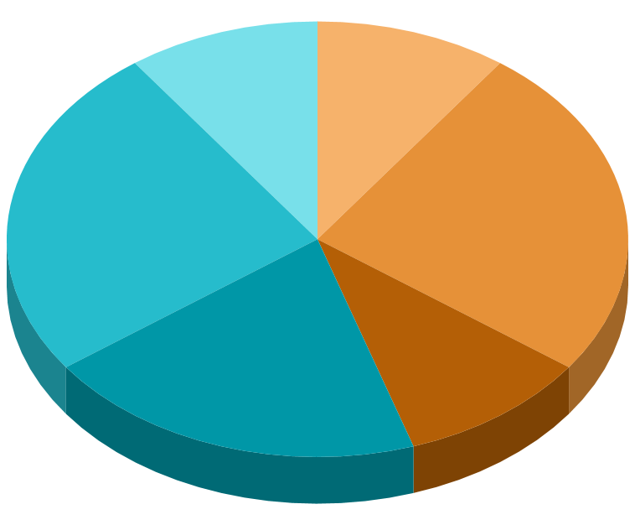
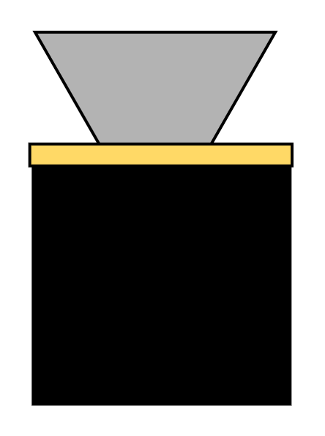
Project Overview
Motivation & Background
Design
CubIST is NOT intended to fly in space, instead:
Need for in house star tracker at CU Boulder
Functions as a learning element
Alternative to other orientation sensors
Customization for future CubeSat missions
Test
Build
Mission
CubIST’s purpose is to design, build, and test a prototype star tracker. CubIST will take images of stars and compare the patterns it detects to a star catalog.
CubIST will deliver an attitude solution for future CubeSat missions to use.
Notes:
NATALIE

Slide 5
Project Functional Requirements
Requirement Number | Requirement Description
FR.1 | The star tracker shall reduce stray background light.
FR.2 | The star tracker shall acquire images of star fields.
FR.3 | The star tracker shall match identified patterns to a known star catalog.
FR.4 | The star tracker shall produce attitude solutions at a constant rate.
FR.5 | The star tracker shall be compatible with CubeSat architecture.
Full DR breakdown
Notes:
NATALIE

Slide 6
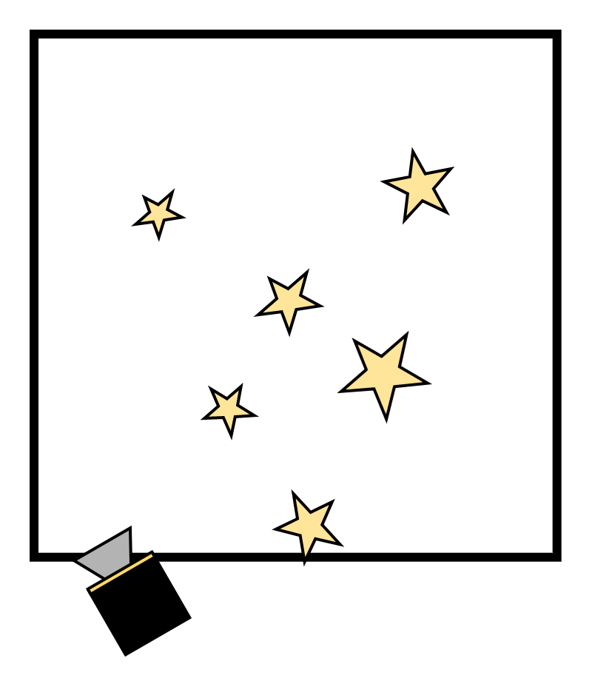
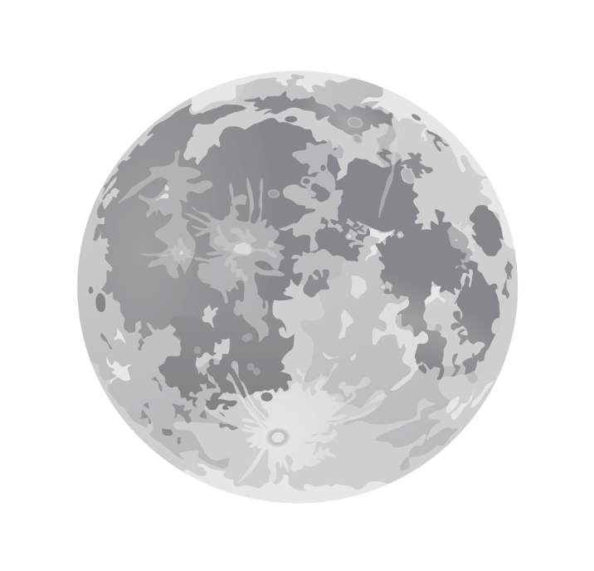
Concept of Operations (Project Specific)
Day-In-Life (A)
4a. Compares To Star Catalog
5a. Determines Orientation
3a. Identifies Star Pattern
2. Captures Image
6. Compare Solutions
!
Verification (B)
θ₁
θ₂
4b. Upload to PC & Test in Truth Model
3b. Processes & Saves Image
5b. Output Orientation
1. Baffle Attenuation
Adtl ConOps
Boulder, CO
Notes:
NATALIE
Notes for speaking:
Our Concept of Operations has been more clearly designed to be project specific. In the case of a day-in-the-life test, we will take our star tracker to a location of low light pollution and test at night. 1) The baffle will attenuate stray light and other bright objects including the Sun and Moon. It will capture an image (2) of the starfield which is processed for a pattern to be identified (3a) 4a) The pattern will be compared and matched to our onboard star catalog. 5a) Our software will process the pattern, determine the right ascension and declination angles that are translated to a quaternion. (state coord frame) Simultaneously with this, the star tracker’s solution shall be verified against a “truth” model. the first two steps are exactly the same. Images are stored on the onboard processor and later uploaded to a computer.
4b) The images are compared against our truth model, a software called Astrometry.net
5b) Astrometry.net processes these images and derives the same outputs to be compared for accuracy (6)

Slide 7
Design Solution
Notes:
NATALIE
Design Solution:
CAD model design Overview
Optical component selection:
Include the key specifications that component has that will be proved feasible & in line with requirements in the Detailed Requirements and Satisfaction section
Electrical / Software component selection
Include the key specifications that component has that will be proved feasible & in line with requirements in the Detailed Requirements and Satisfaction section

Slide 8
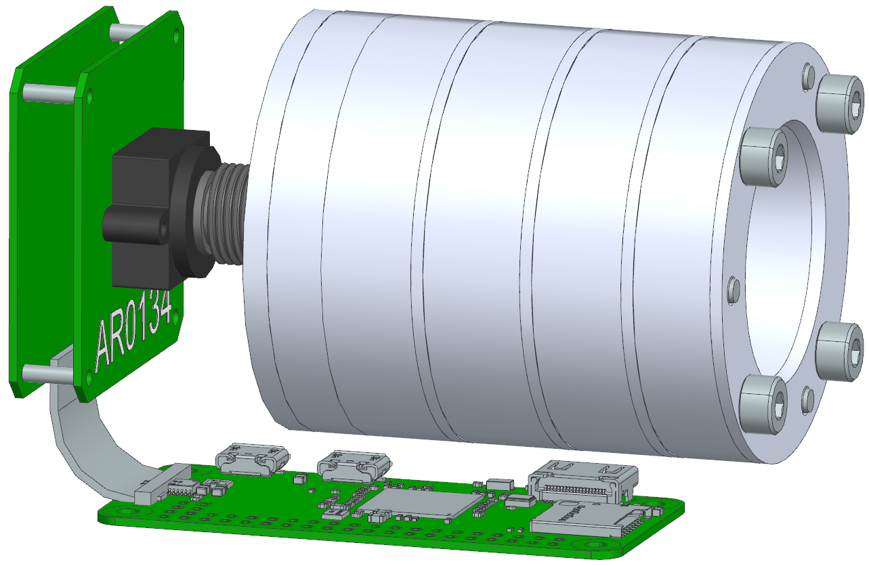
Detailed Design Breakdown (Mass & Volume)
5.00cm
6.12cm
Volume: Less than 0.5U
Mass: 305-325g
9.39cm
Additional Views
Mass Budget
Notes:
NATALIE

Slide 9
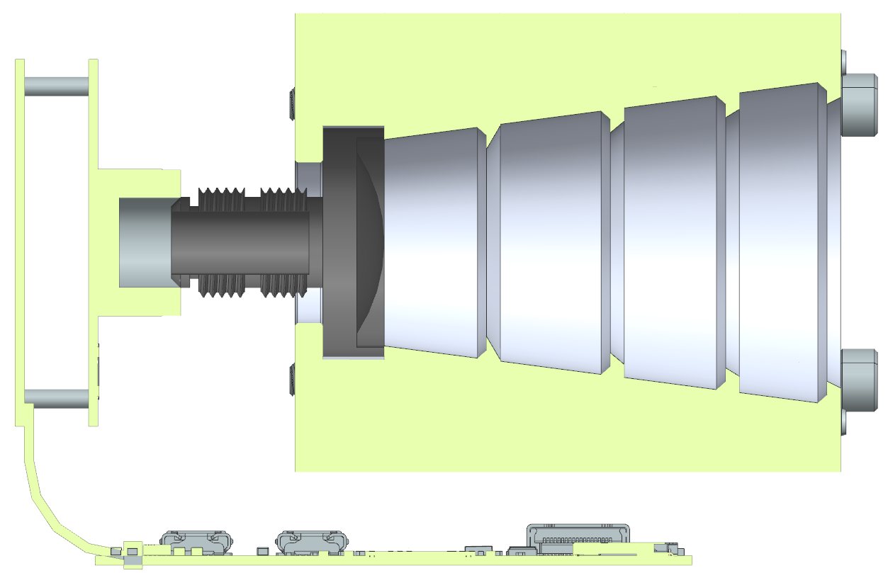
Detailed Design Breakdown (Selected Components)
Arducam AR0134 Camera Module
Baffle
Legend
Attenuate Light
Capture Image Data
Processing Hardware
USB2 Camera Shield
6.12 cm
⅓” 35mm M12 Lens
Raspberry Pi Zero 2W
Integrated Memory
9.39 cm
Additional Views
Notes:
NATALIE

Slide 10
System Functional Block Diagram
MICRO SD CARD
512 MB
CubIST Scope
MEMORY
512 MB
FLASH
2000 Mbps
20 Mbps
12 bits
ARDUCAM SENSOR SHIELD
ARDUCAM AR0134 MODULE
Pixel Size: 3.75μm
BAFFLE
Processor (CPU)
1GHz
Clock
Software
Tetra3 Processing Algorithm
LENS
1.88 Hz
SIGNAL OUTPUT PORT
DATA INPUT PORT
1000 fps
Quaternion
Raspberry Pi Zero 2W
54 fps
3.3 V
3.3 V
Baffle Optics
Hardware Software
Power Data
CubeSat
ADCS
Power
Notes:
NATALIE
Include other stuff like USB - be comprehensive in FBD
Update processing power, pixel size, resolution Slide description - Similar to the physical design, here is our functional block diagram.

Slide 11
Critical Project Elements
Notes:
CHESNEY
Critical Project Elements
List 3-4 main CPEs that drive the success of mission

Slide 12
Critical Project Elements
2: System must capture filtered images of stars to be processed.
E.1: Baffle
E.2: Image acquisition
E.3: Image processing software
E.4: Image processing hardware
1: System must mitigate stray light to capture images.
3: System must process star images at baseline rates & accuracy to calculate attitude characteristics.
4: Processing must be done at baseline rates & power consumption.
Table View, 74
Notes:
CHESNEY We have narrowed our CPEs down to 4 topics, the baffle, image acquisition, processing software, and processing hardware.
Our Star Tracker must have a baffle to attenuate stay light that could affect subsequent components and solutions
The tracker must also acquire images to be processed
No solution is achieved without processing which must be done at our required rates and accuracy.
Finally, the hardware involved must also support those rates using our maximum available power consumption.

Slide 13
Design Requirements & Satisfaction
Requirements
Notes:
CHESNEY Design Req & Satisfaction
CPE 1:
Introduce DRs associated with CPE
Slides with topics that prove that the component chosen to address CPE is capable of satisfying DRs (feasibility studies)
CPE 2:
CPE 3:
CPE 4:

Slide 14
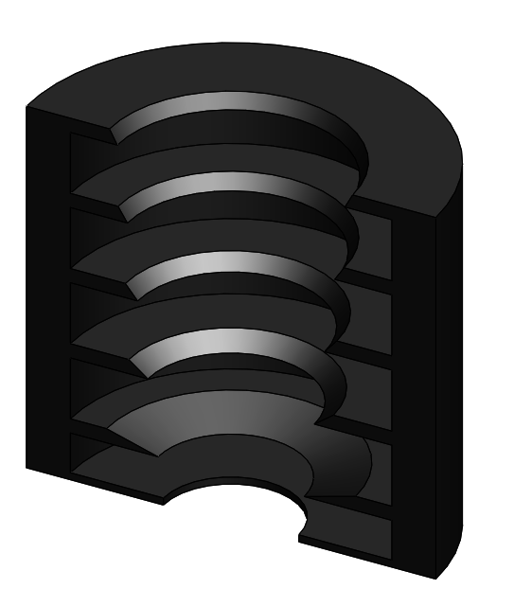
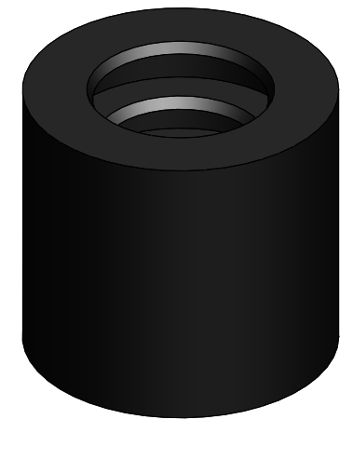
Critical Project Element: Baffle
Section Outline
Design Requirement
The star tracker shall fit within a 100x100x50mm volume
The baffle shall have an FOV of 15°
The star tracker shall operate within 60° of the sun and within 20° of the moon
The baffle shall attenuate -25dB of the light at the sun exclusion angle. And -5dB of light at the moon exclusion angle.
Baffle 101
Internal Baffle Geometry
Stray Light Analysis
Manufacturing & Tolerancing
Trimetric baffle section view
Requirements
Notes:
MARIA

Slide 15
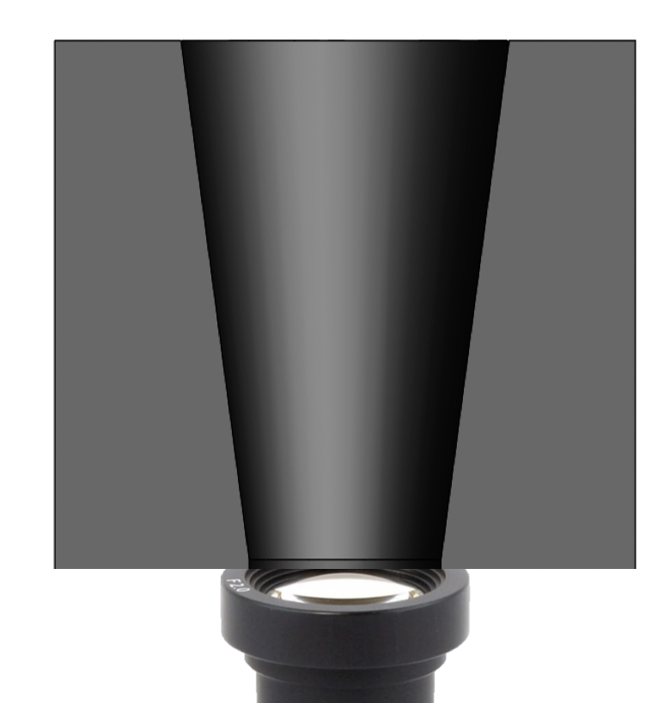
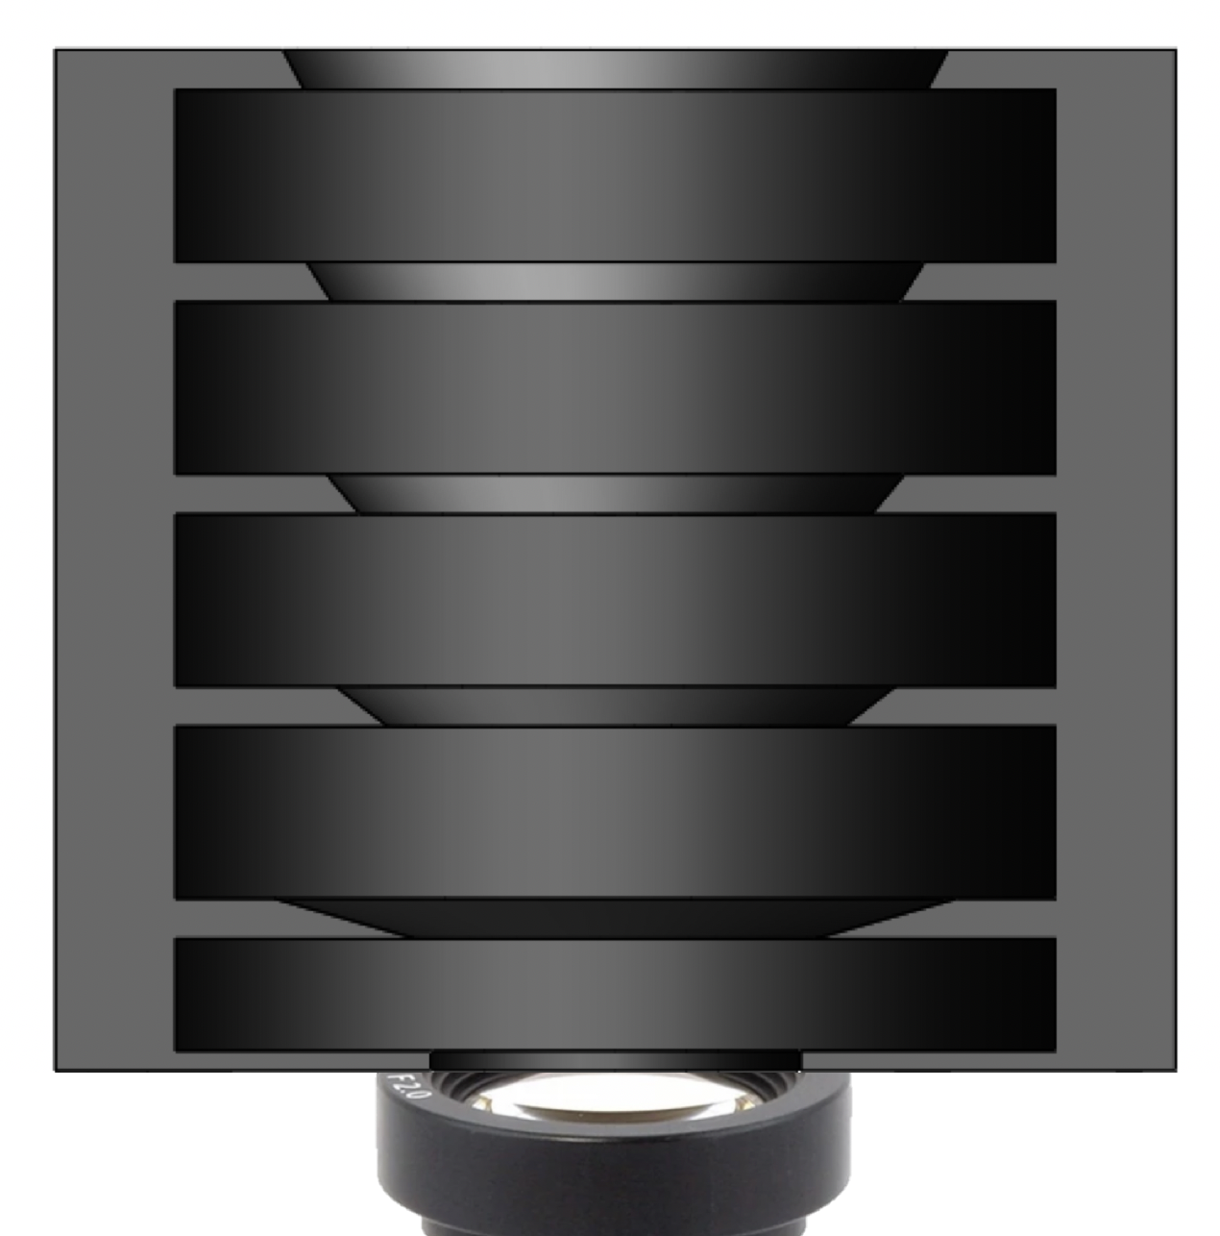
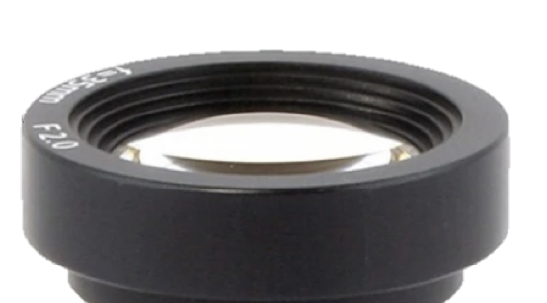
Baffle 101
No Baffle
Baffle Without Vanes
Baffle With Vanes
Boresight vector
θ
Field of view (FOV)
Stray light
The baffle shall attenuate -25dB of the light at the sun exclusion angle. And -5dB of light at the moon exclusion angle.
↑ Noise
Pixel Saturation
Ghost images/glare
Saturated image sensor
Partial obscuration by stray light
No stray light obscuration from outside FOV
Requirements
Notes:
Maria
Carry requirements on the top and bottom
Acknowledge progress from cdr
SUN: XX dB
MOON: XX dB
(some ideas: matt’s moon pic, explaining effect on SNR, examples of COTS/previous literate star tracker attenuation, last CU baffle project had an attenuation req of 99.99%)

Slide 16
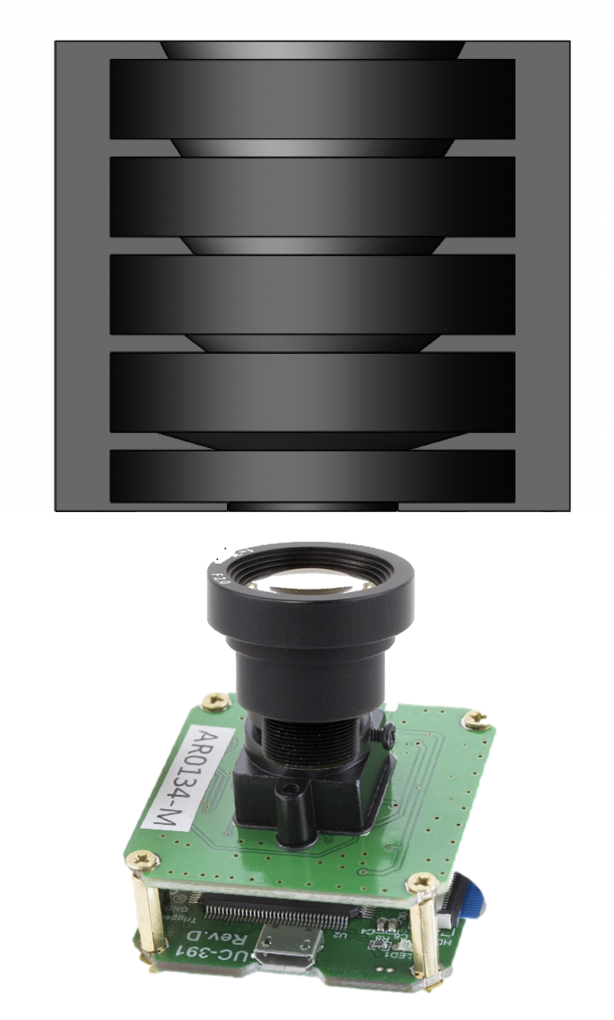
Baffle - Internal Geometry
31 mm
System Vertical Volume Allocation: 100mm
The star tracker shall fit within a 100x100x50mm volume.
α
β
Baffle: 50mm
100 mm
50 mm
The baffle shall have an FOV of 15° → α = 7.5°
Lens/Mount: 40mm
Sensor/Shield: 7mm
Margin: 3mm
Exclusion Angle β = 26.89°
18.5 mm
Requirements
Notes:
Maria
Carry requirements on the top and bottom
Acknowledge progress from cdr

Slide 17
Baffle - Internal Geometry
Stray light
θ
System Vertical Volume Allocation: 100mm
The star tracker shall fit within a 100x100x50mm volume.
α
β
Baffle: 50mm
100 mm
50 mm
The baffle shall have an FOV of 15° → α = 7.5°
Lens/Mount: 40mm
Sensor/Shield: 7mm
Margin: 3mm
Exclusion Angle β = 26.89°
Stray light will successfully be attenuated when θ ≥ β
18.5 mm
Requirements
Notes:
Maria
Carry requirements on the top and bottom
Acknowledge progress from cdr

Slide 18
Baffle → Internal Features
VANES
r
Sharpness of “knife edge vanes” drives baffle performance → minimize radius r
Rays will be reflected at least twice
Vane angle deflects rays away from lens
1
α
2
3
INTERNAL COATING
4
Krylon Ultra Flat Black Spray Paint
97-95% Absorptivity
5
Vane Angle Geometry
Requirements
Notes:
Maria
Carry requirements on the top and bottom
Acknowledge progress from cdr

Slide 19
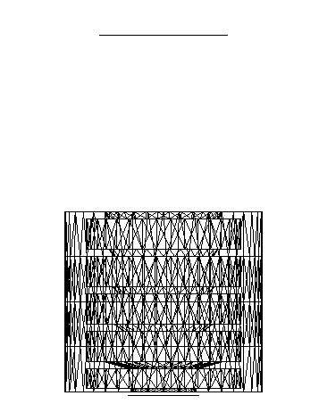
Baffle → Stray Light Analysis
ZEMAX Model Layout
Models the propagation of rays through an optical system.
Simulation mode that allows many interactions between rays and and an object.
# Analysis Rays: 100,000
Scatter Fraction: (0-1) Amount of reflected light that is scattered in a hemispherical distribution.
Baffle
Source
Coating: 95% absorptivity
Scatter fraction: 0.32
Collimated Ellipse
Visible Spectrum
“Specular” (shiny)
“Diffuse” (matte)
1
0
Detector
Requirements
Notes:
Maria
Verbally explain “collimated”

Slide 20
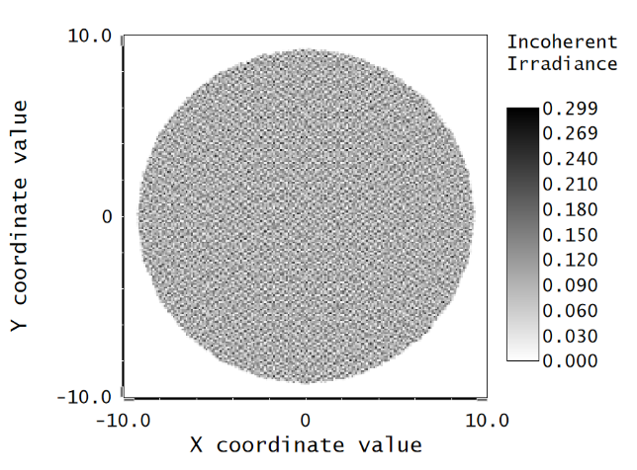
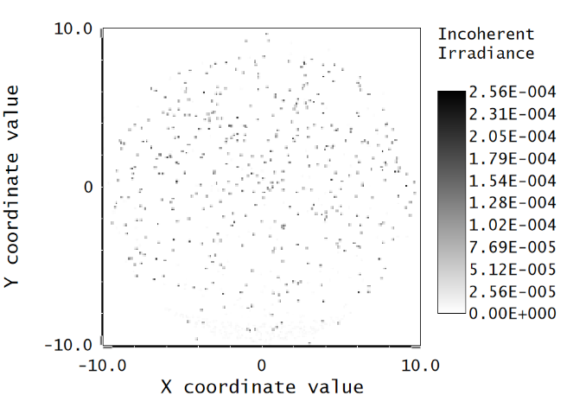
Baffle → Stray Light Analysis Performance Metric
The baffle shall attenuate -25dB of the light at the sun exclusion angle. And -5dB of light at the moon exclusion angle.
θ = 0°
θ = 30°
Simulation Detector View
Simulation Detector View
P_{θ=0}
P_{θ=30}
BAFFLE ATTENUATION [dB]
10*log10(P_{θ=0} / P_{θ=30}) = -44.36 dB → 99.99996%
Requirements
Notes:
Maria
Can test up to 140dB
Carry requirements on the top and bottom
Acknowledge progress from pdr

Slide 21
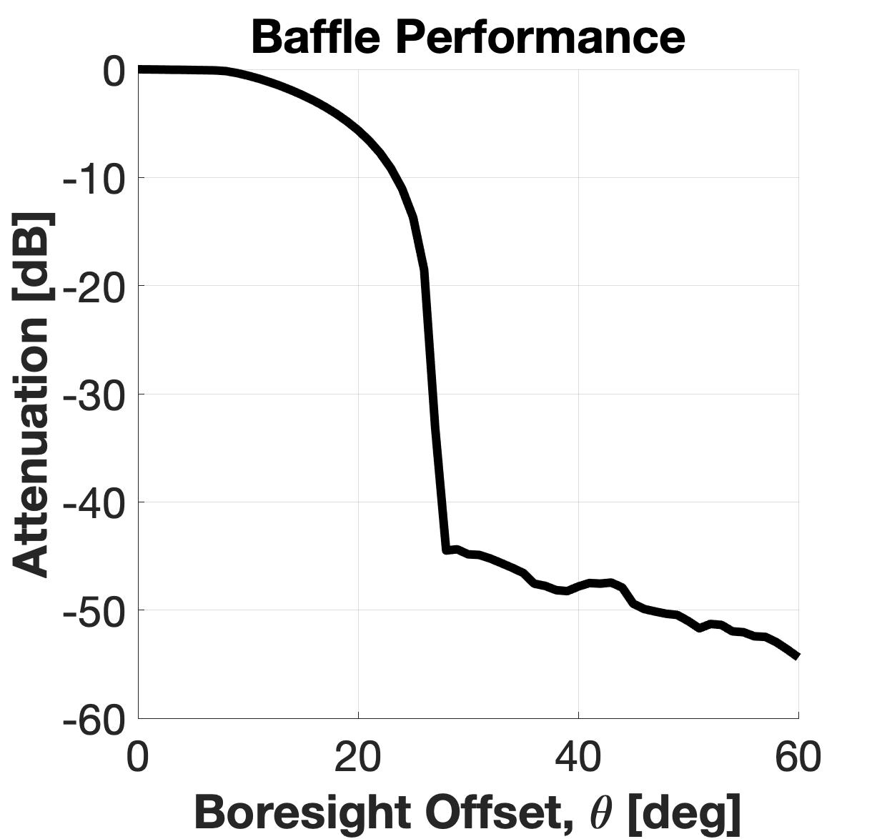
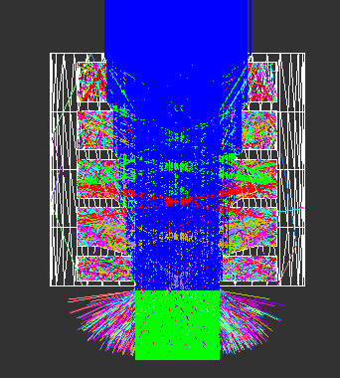
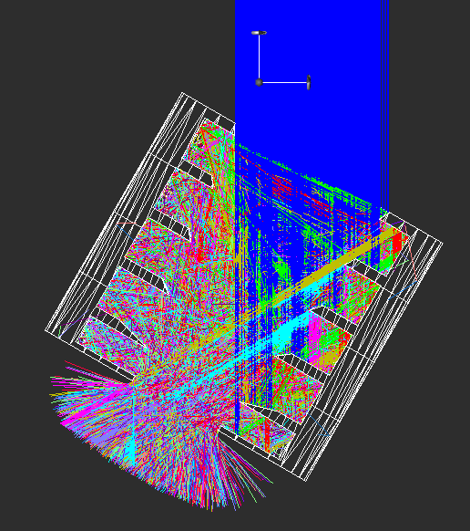
Baffle → Ideal Baffle Performance
Cross section view of ZEMAX stray light model
The star tracker shall operate within at least 60° of the sun and within 20° of the moon
-5 dB
θ = 0°
θ = 30°
FOV
The baffle shall attenuate -25dB of the light at the sun exclusion angle. And -5dB of light at the moon exclusion angle.
Level of Success: 3
Detector
Detector
-44 dB
Level of Success: 1
-54 dB
Segment #
0
1
2
3
4
5
Number of times a ray has hit a surface.
Requirements
Notes:
Maria
Why are we testing, hotels in the model

Slide 22
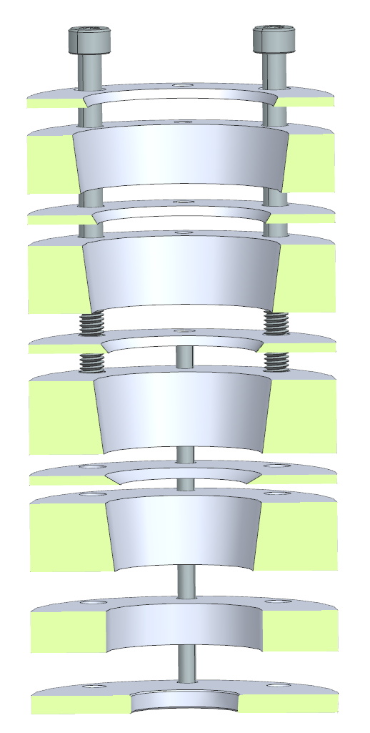
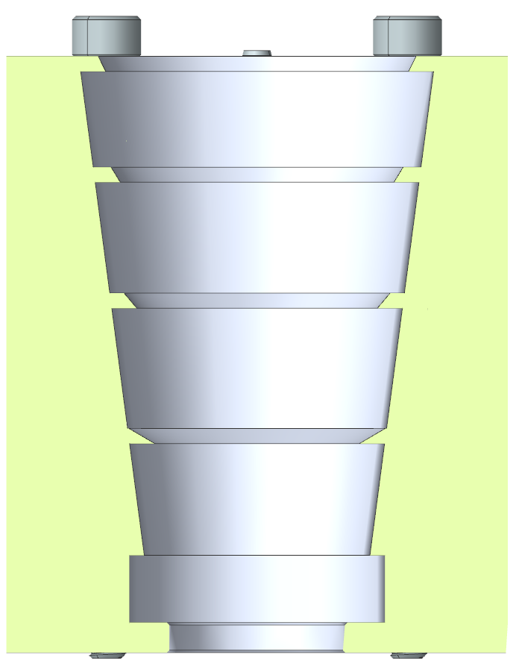
Baffle → Manufacturing and Assembly
Baffle composed of 5 types of components:
Conical sections
Vane sections
Spacing & mounting sections
Threaded fasteners
Locating pins
Items a-c will be waterjet cut
Items a & b will be finished on a CNC lathe
Items d & e are COTS
Final assembly requires press fitting of locating pins & torquing of fasteners
a
b
d
c
e
Requirements
Notes:
Maria (pres), Cam (slide)
Types of components listed
How each type is manufactured or COTS
Assembly is very straightforward
Image left: exploded section view
Image right: section view, final assembly config

Slide 23
Baffle → Manufacturability
Initial prototyping:
Final product:
3D Printing
Test exclusion angles
&
Test different configurations of vanes & stages
Machined Aluminum 6061
Hold tolerances & allow sharpest baffle & vane edges to maximize performance
Anodized for compatibility with Krylon coating
Requirements
Notes:
Maria (pres), Cam (slide)
Manufacturing for prototype and final
This slide is mostly exposition for next slide

Slide 24
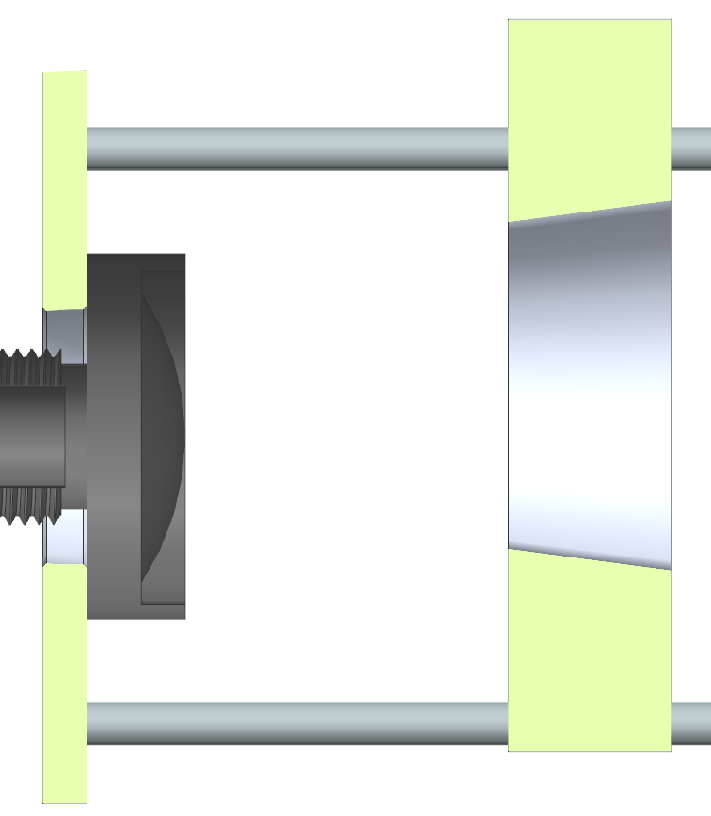
Baffle → Manufacturability
Tolerancing:
Stray light analysis has shown the following tolerances are acceptable:
5 thou concentricity tolerance for all vein and conical sections
10 thou radial tolerance for all vein section edges
10 thou profile tolerances for all vein and conical sections
Centerline of baffle section
±0.005”
Centerline of lens
**1 thou = 0.001in = 0.0254 mm
Requirements
Notes:
Maria (pres), Cam (slide)
Tolerancing for manufacturability
Maria: using numbers from your analysis per your email

Slide 25
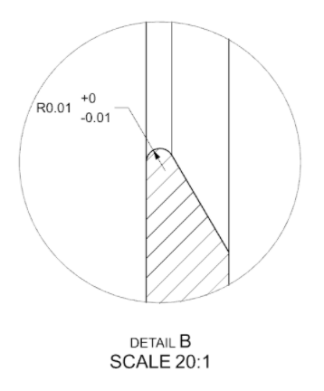
Baffle → Manufacturability
Tolerancing:
Stray light analysis has shown the following tolerances are acceptable:
5 thou concentricity tolerance for all vein and conical sections
10 thou radial tolerance for all vein section edges
10 thou profile tolerances for all vein and conical sections
**1 thou = 0.001in = 0.0254 mm
Requirements
Notes:
Maria (pres), Cam (slide)
Tolerancing for manufacturability
Maria: using numbers from your analysis per your email

Slide 26
Baffle → Manufacturability
Tolerancing:
Stray light analysis has shown the following tolerances are acceptable:
5 thou concentricity tolerance for all vein and conical sections
10 thou radial tolerance for all vein section edges
10 thou profile tolerances for all vein and conical sections
0.010
**1 thou = 0.001in = 0.0254 mm
Requirements
Notes:
Maria (pres), Cam (slide)
Tolerancing for manufacturability
Maria: using numbers from your analysis per your email

Slide 27
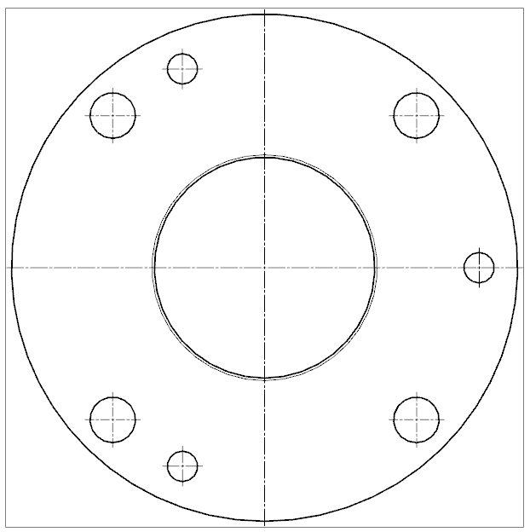
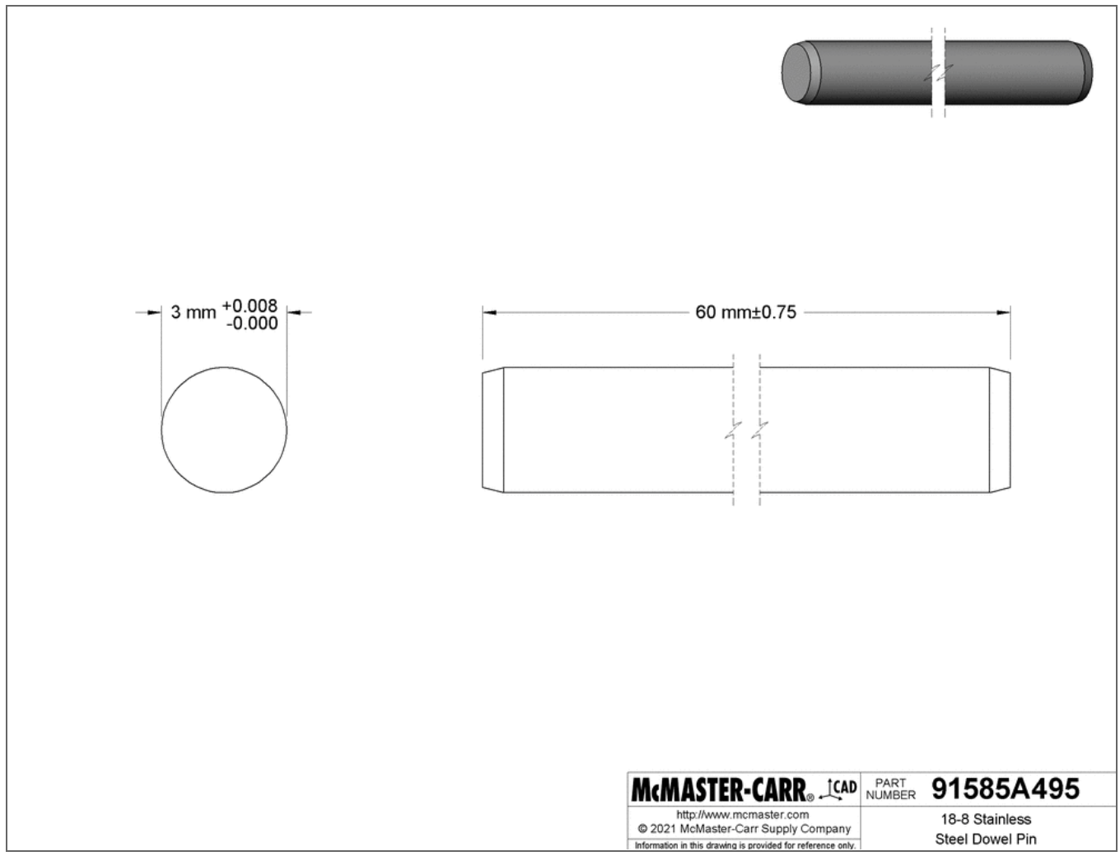
Baffle → Manufacturability
Tolerancing:
5 thou concentricity tolerance
Waterjet components with press-fit locating pins
10 thou radial & profile tolerances
CNC Lathe (5 thou std. from ProtoLabs)
3mm
+0.008
- 0.008
60mm±0.75
**1 thou = 0.001in = 0.0254 mm
Requirements
Notes:
Maria (pres), Cam (slide)
This slide is meant to show that the tolerances described on previous slides are achievable via waterjet + CNC
waterjet components (up to 1 thou positional tolerance) with press-fit locating pins (0.3 thou diametrical tolerance)

Slide 28
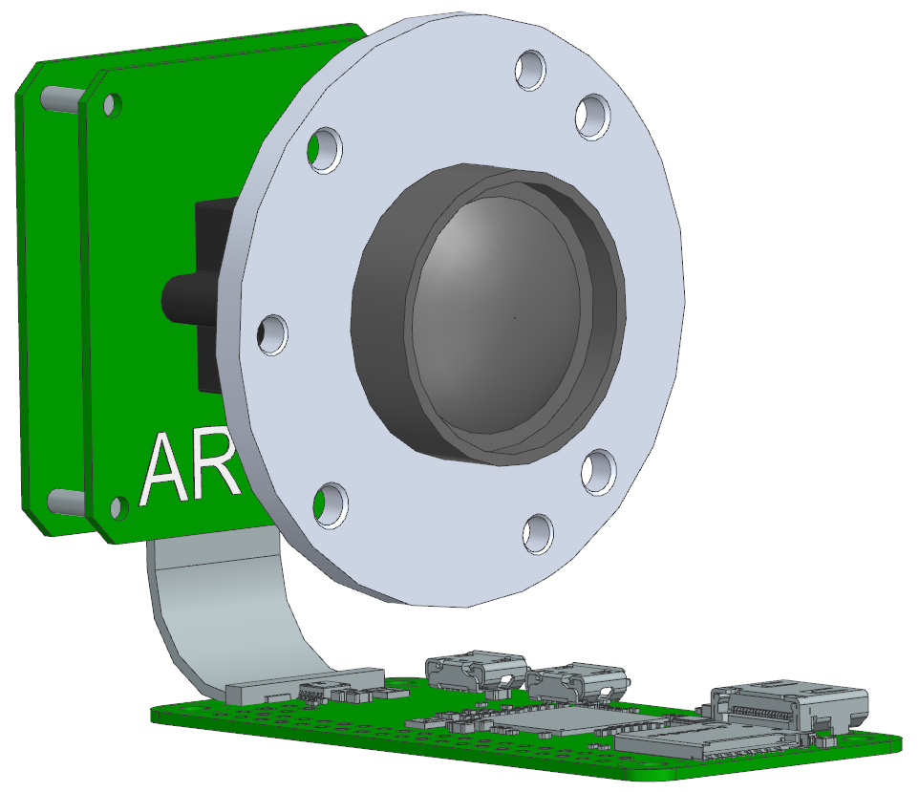
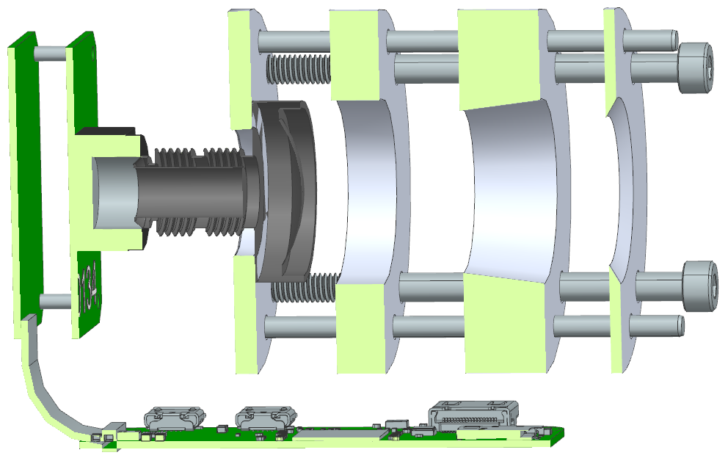
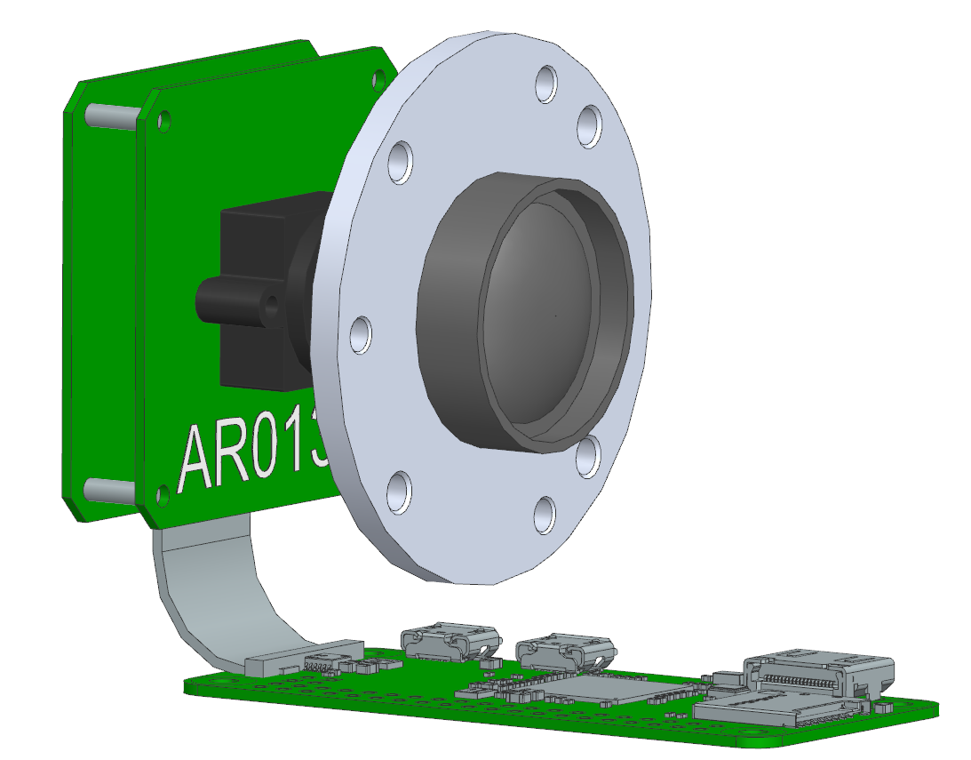
Baffle → Lens Interface
1. Collar attaches around neck of lens
2. Collar allows for interface into baffle with press-fit locating pins for alignment and threaded fasteners for assembly
3. Baffle sections connect, alignment held by locating pins, threaded fasteners preload stack and hold baffle onto lens
Requirements
Notes:
Maria (pres), Cam (slide)
Shows how baffle is assembled onto lens
Labels

Slide 29
Critical Project Element: Image Acquisition
Design Requirement
Each image shall contain at least 3 stars.
The image sensor shall output each image to the on board processor.
The format of each image shall be compatible with the required input format of the processing algorithm.
The characteristics of the CM shall provide discernable images for centroiding and matching algorithms.
The star tracker shall remain functional at a slew rate of 2°/s or less.
Section Outline
Image Sensor
Camera Module
Lens
Requirements
Notes:
JOSIE CPE XX:
Introduce DRs associated with CPE (this slide)
Slides with topics that prove that the component chosen to address CPE is capable of satisfying DRs (feasibility studies) (following slides)
**A complete list of requirements is not sought. Rather an explanation of which key requirements are driving the design, and how the current design satisfies them.**
Key design aspects were explained clearly and in detail, indicating a good grasp of the engineering issues, and the associated design choices were well justified.
Analysis or critical experiments presented to clearly establish that the design will work. (26-30pts)
Section Outline: Lens, Image Sensor, Camera Module, Shield:
List dependent functional and design reqs with section order: See slides 16-20 of Vortex https://www.colorado.edu/aerospace/sites/default/files/attached-files/chabotbill_290600_26120287_vortex_cdr_final.pdf

Slide 30
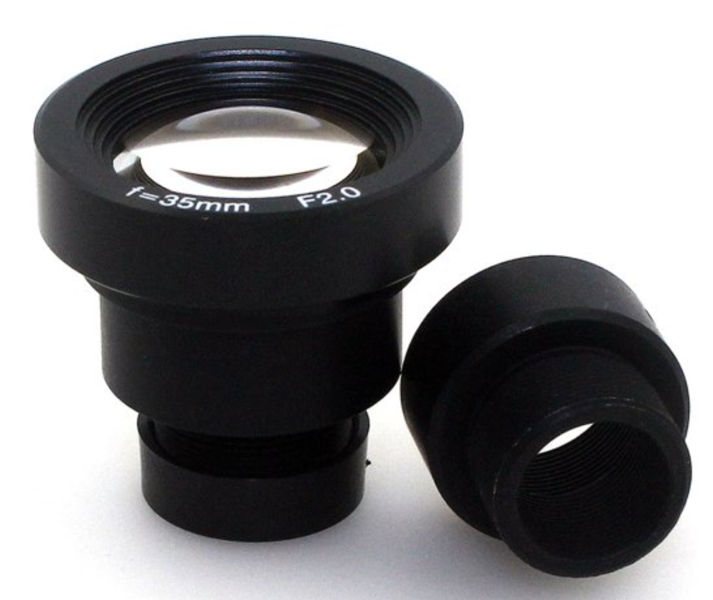
Lens → Lixida 1/3" 35mm M12 Mount CCTV Lens
This Lixida lens is the chosen lens for mission specific requirements:
Focal Length: 35mm
Aperture Diameter: 17.5mm, F2.0
With LSM (Limiting Stellar Magnitude) equation:
LSM: + 9.9 (Minimum required +6.5)
FOV: 15 degrees (averages over 12 cataloged stars seen in any image)
Focal Length: 35mm
Each image shall contain at least 3 stars.
Requirements
Notes:
JOSIE 6.5 target, visible eye
Important to note on this slide that with testing of 15 degrees, we seem to always well over 10 stars in the given image. Although this doesn’t have the same characteristic of the image sensor, but similar characteristics with lens focal length/aperture. We can justify that our lens is capable of picking up every minimum LSM star in the stellar catalog. The software pulls the brightest stars in the image, which if it can pick up all +6.5 stars but also picks up +9.9, it will be reading at the minimum +6.5 stars. Therefore we can say with high amounts of certainty without physical testing that we can achieve this requirement.

Slide 31
Image Sensor → Aptina AR0134 CMOS
T_{s} = 1 = ɸ
Tₛ = Time for 1 pixel movement [sec]
𝜙 = Star tracker FOV = 15°
nₚ = # of horizontal pixels = avg 720p
⍵= Angular velocity of star image = 2°/s
V_{star} ωn_{p}
Aptina AR0134 CMOS Specifications
1) Monochrome CMOS Global Shutter 2) Pixel Pitch: 3.75 microns 3) Resolution: 512p to 960p 4) 77% Quantum Efficiency @ 525 nm 5) Signal to Noise Ratio: 38.6dB 6) Abs. Sensitivity threshold: 9.30 photons
Integration time T_{s} = 10.4 ms (Achievable with image sensor)
}
Sensor resolution exceeds required resolution for processing of 1280x960p minimum.
Sensor SNR is greater than the required 23.11dB to achieve clarity of stars with background noise.
The star tracker shall remain functional at a slew rate of 2°/s or less.
The characteristics of the CM shall provide discernable images for centroiding and matching algorithms.
SNR Derivation
Requirements
Notes:
JOSIE
High SNR (Signal-to-Noise Ratio): 38.6 dB
Pixel size: 3.75 µm
Bit size: 12 bits
Range of Resolution: 512p - 960p Specs and what we need
CMOS (Complementary Metal-Oxide Semiconductor)
Global shutter images whole pixel array at once, where rolling shutter images pixel rows sequentially
SNR- minimum SNR required is ~15db, want as high as achievable
If mentioned
(Noise reduction strategies will likely be mentioned in risk analysis for slew rate with light intensity vs exposure time)
Absolute sensitivity threshold is the minimum number of photons needed to equal the noise level. The lower the number the less light is needed to detect useful imaging data.
whether we have time to mention it, the absolute sensitivity threshold is kinda important cause it basically states how many photons are required to match the noise from the image sensor, which is relatively low to a lot of similarly spec'd image sensors
AR0134 was chosen for specific parameters that meet our requirements, which include:
Global Shutter- Prevents image smear when capturing moving objects
CMOS - Low power consumption, immune to blooming
Monochrome - Color is unnecessary for software algorithms, singular peak QE
QE- 77% at 525 nm wavelength
High SNR- 38.6dB, which satisfies noise level requirements
Pixel pitch- 3.75 microns allows us to be closer to downselected lens’ spot size
Bit Size- 12 bit has large grayscale, very important for centroiding
Resolution- Can reach up to 960p, and down to 512p, which is variable based on efficiency
Absolute Sensitivity Threshold- 9.30 photons
These baseline parameters and noise reduction systems are desired to validate vital mission design requirements that include centroiding, quantity/quality of stars in image, and slew rate

Slide 32
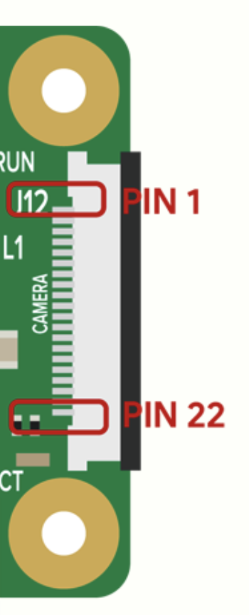
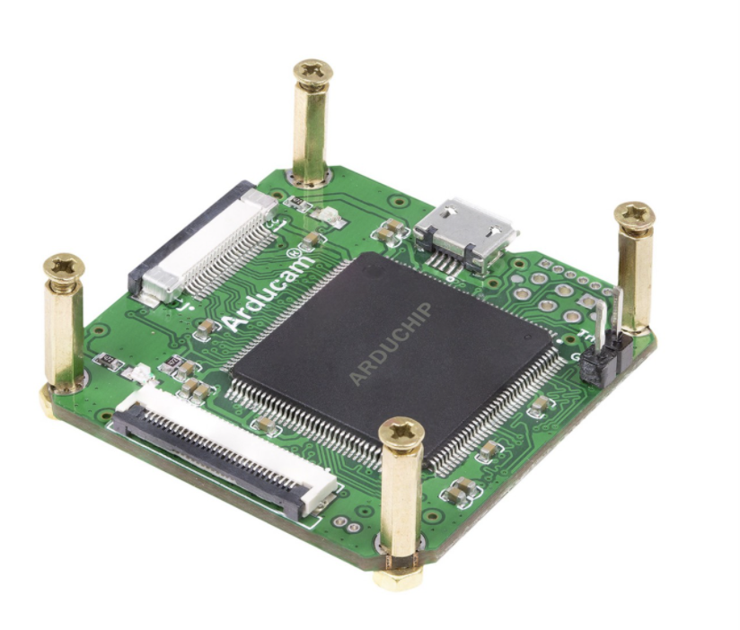
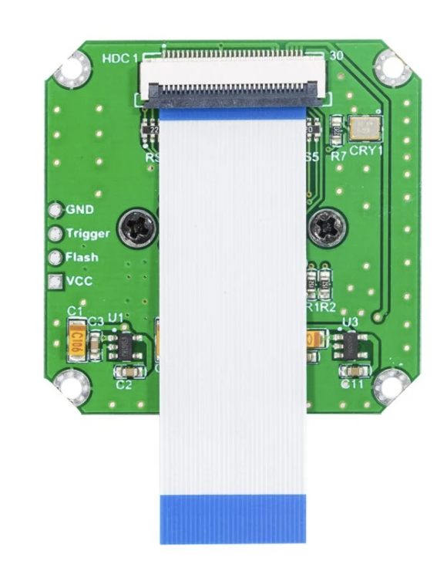
Camera Module → Lens + Arducam AR0134/USB2 Shield
22 pin interface
Micro-USB
Camera Module: 30 pin connector
RP0 2W: 22 pin connector
Shield: 30 pin for CM 22 pin / USB for RP0
Not compatible!
Both compatible!
30 pin interface
The format of each image shall be compatible with the required input format of the processing algorithm.
The image sensor shall output each image to the on-board processor.
Requirements
Notes:
JOSIE
We decided on a prebuilt camera module (to remain within the scope of the project) that sports an image sensor effective in low light regimes, while having software functionality that can be adapted to our electronics. It contains the AR0134 image sensor and has software interface that enables customization of image sensor characteristics and compatibility with Raspberry Pi’s
M12 mount has the ability to use lenses that fall within desired range for focal length/fstop/diameter, all while having ability to lock said lens and blur image for centroiding benefit. M12 mounts also come fabricated in metal, helping flight feasibility.
For the fact that this is a COTS star tracker, procuring a camera module that has already established breakout boards and FPGA and alignments for image sensor/mount to interface easily with raspberry pi seems to make the most sense while remaining within the scope of the project. With respect to objectives and end goals of this project, using the shield is feasible for now and ideally will be optimized to be removed and software interfaces can be transferred over to microprocessor pending further understanding of camera module to shield to RPzero interface.

Slide 33
Critical Project Element: Software
Section Outline
Design Requirement
Attitude solutions shall be generated at a rate of 0.2 Hz or greater.
The attitude solution shall have an absolute accuracy of less than 0.05°(1σ).
Star Tracking Algorithm
Runtimes on Hardware
Tracking vs. Lost-in-Space
Requirements
Notes:
NICKY CPE XX:
Introduce DRs associated with CPE (this slide)
Slides with topics that prove that the component chosen to address CPE is capable of satisfying DRs (feasibility studies) (following slides)
**A complete list of requirements is not sought. Rather an explanation of which key requirements are driving the design, and how the current design satisfies them.**
Key design aspects were explained clearly and in detail, indicating a good grasp of the engineering issues, and the associated design choices were well justified.
Analysis or critical experiments presented to clearly establish that the design will work. (26-30pts)
List dependent functional and design reqs with section order: See slides 16-20 of Vortex https://www.colorado.edu/aerospace/sites/default/files/attached-files/chabotbill_290600_26120287_vortex_cdr_final.pdf

Slide 34
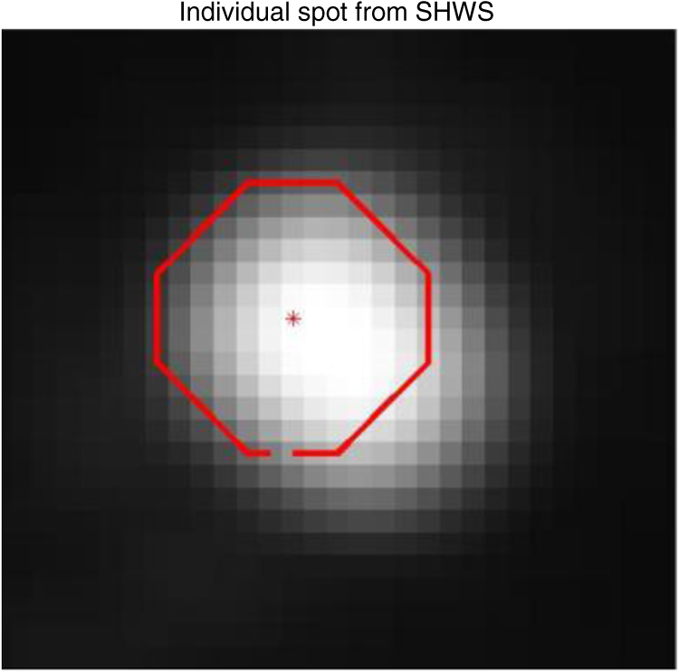
Software → Star Tracking Algorithm (Tetra3 + tracking)
(tracking)
Image Acquisition (hardware)
Image Processing
Solution Output
Star Pattern Identification
Database Creation
Match Pattern to Database
Find Attitude Solution
{
{
q
=
Requirements
Notes:
NICKY
Shown here is the general breakdown of how a star tracking software works.
First, it creates a database using the expected field of view and a known star catalog.
From there it enters the loop which begins with image acquisition.
With the image acquired the software begins image processing, the most essential step in which is centroiding.
As shown above, centroiding allows the software to determine the precise location of the star.
With that information the software is able to create a pattern which it then matches to the database created in step one.
From there the software is able to solve for the attitude, and output it before repeating the loop.

Slide 35
Software → Runtimes/Accuracy on Hardware (LIS)
Parameters | PC | RPi 3B (quad core, 2015) | RPi Zero (one core, 2015) | RPi Zero 2 (quad core, 2021)
Solve time (ms) | 10.77 | 99.68 | 520.2 | 152.5 190.5
Extraction time (ms) | 1012.4 | 3754.3 | 10641 | 4444.1 341.3
Total time (ms) | 1023.2 | 3854.0 | 11161 | 4596.6 531.9
Update Rate | 0.98 Hz | 0.26 Hz | 0.09 Hz | 0.22 1.88 Hz
Accuracy | 0.003 ° | 0.003 ° | 0.003 ° | 0.003 0.0035°
DR 3.4- accuracy 0.05°
DR 3.2 - speed 5 Hz
*With 2% blur and downsample factor of 4
Requirements
Notes:
NICKY
Started by testing times on a PC, then tested on a few different Raspberry Pis with differing processing speed and power consumption before finally testing on the desired design processor RPi Zero 2. Times in black are the original test images provided from the tetra3 software (1024x768), then the red times are after blurring and downsampling the image to improve centroiding/extraction time. blurring/downsampling does not sacrifice accuracy and decreases times significantly.
Lost-in-space numbers here (base software)
This is really just showing the breakdown of what times are being reduced and the differences between each processor. The Extraction time is what is really reduced by downsampling
Would it be important to mention non-representative images??
Plot of each individual image in backup slides 1.88

Slide 36
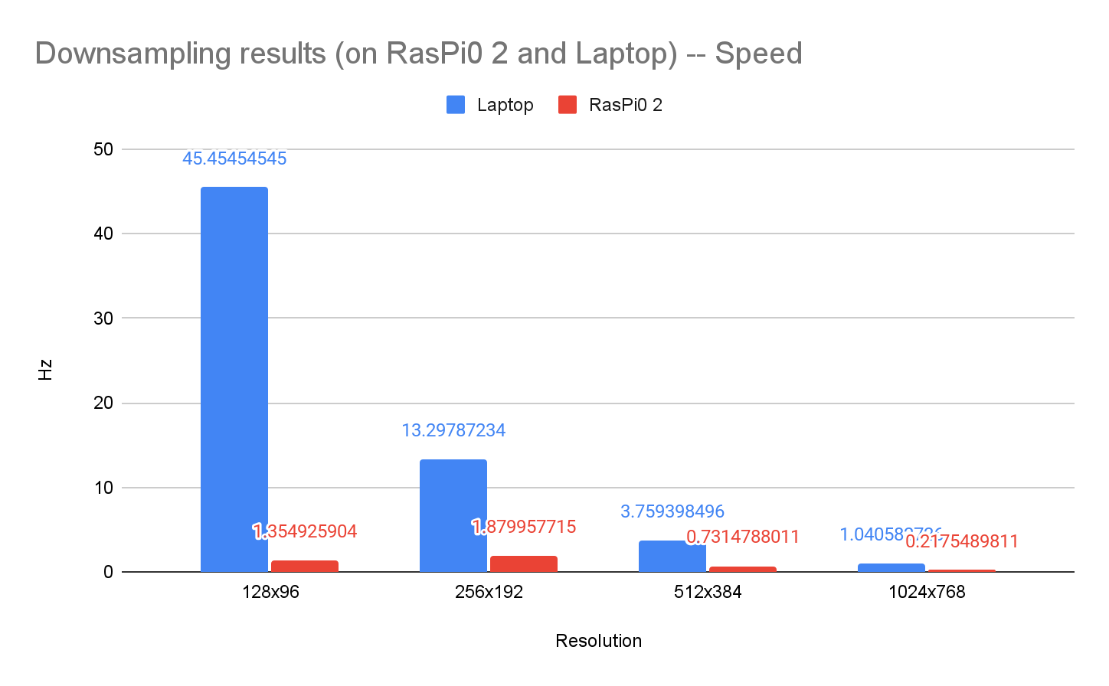
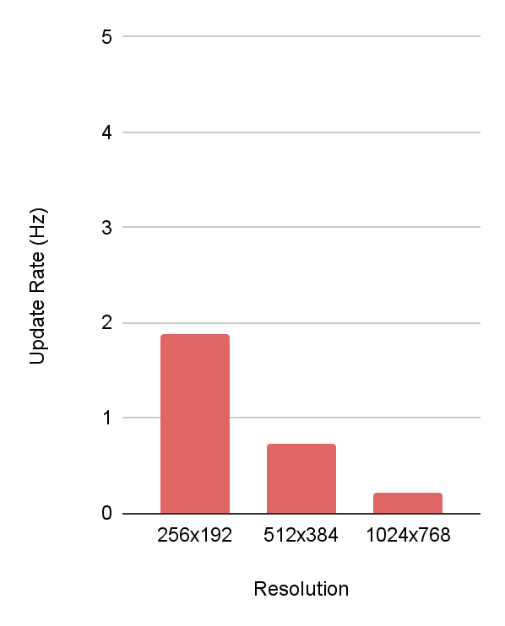
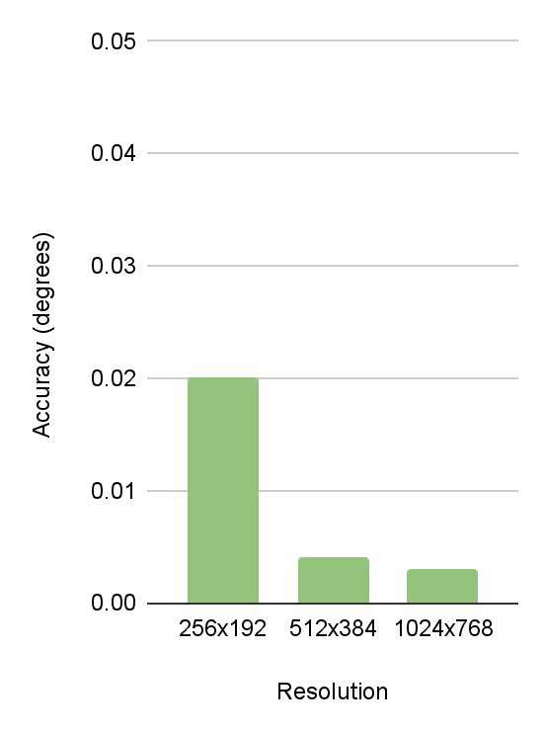
Software → Downsampling Test Results (Lost In Space)
Level 3: 5 Hz
DR 3.2 - speed 5 Hz
DR 3.2 - accuracy 0.05°
Downsampled resolutions do not reach 5Hz
Downsampled resolutions exceed accuracy of 0.05°(1σ)
Level 2: 1 Hz
Level 1: 0.2 Hz
Resolution Breakdown
Requirements
Notes:
NICKY
RasPi 2 is a lot slower but decreasing the resolution does greatly improved run time results
Recall level 1 success is 0.2 Hz, Level 2 is 1 Hz, level 3 is 5 Hz

Slide 37
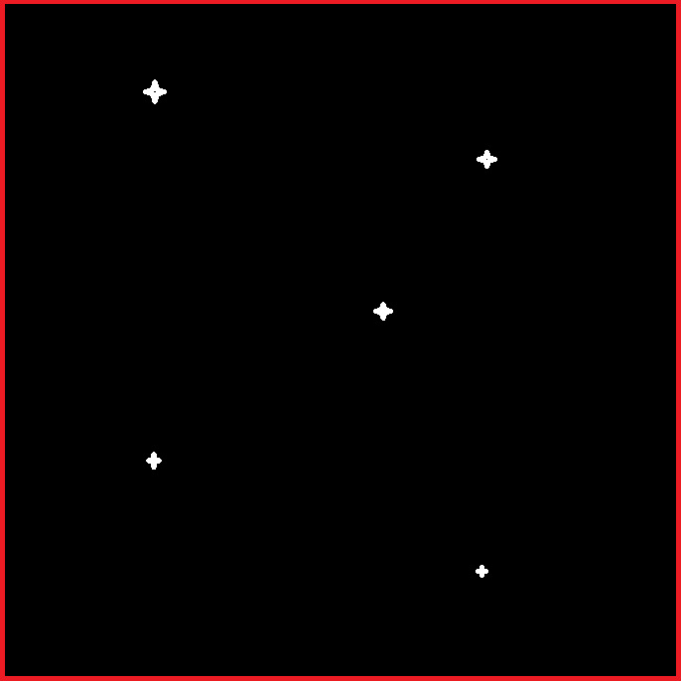
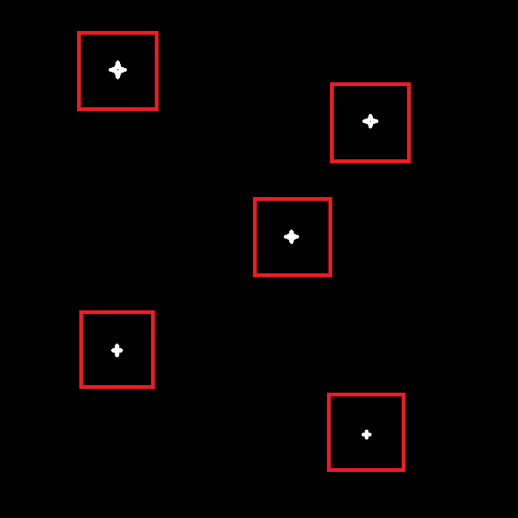
Software → Lost In Space Vs Tracking
Algorithms: Lost in Space:
Calculates solution with no prior attitude knowledge
Tracking:
Utilizes prior attitude and probability to narrow search field for centroiding
Costs | Benefits | Future Modifications
Update Rate | Accuracy Simple | Image downsampling Log Scaling
Complexity Accuracy | Approximately 10x faster than LIS | Will be implemented post-CDR Refinement of current model
DR 3.2
Attitude update rate of 0.2 Hz or greater
Requirements
Notes:
NICKY
With the addition of the tracking algo, we will be able to meet DR -- from preliminary testing around 10x faster not tested on project hardware yet
We plan to implement modification tactics for lost in space and tracking to meet DR
Tracking has the algorithm only search for stars around where they had been found previously

Slide 38
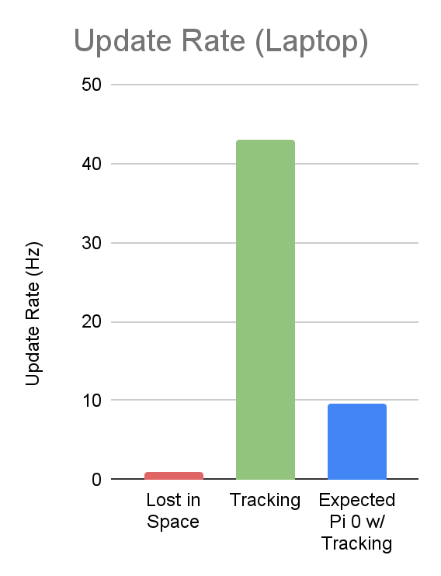
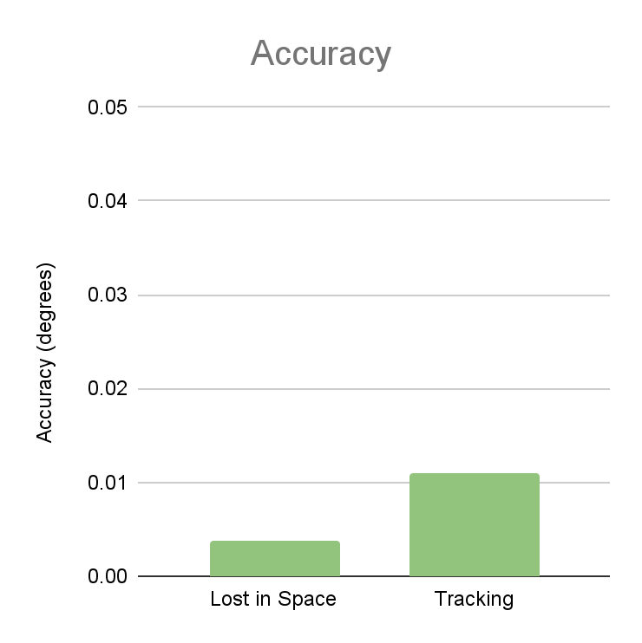
Software → Tracking vs Lost in Space Performance
Combination of LIS & tracking is expected to reach 5Hz
DR 3.4 - accuracy 0.05°
Both softwares exceed accuracy of 0.05°(1σ)
DR 3.2 - speed 5 Hz
(Laptop)
Requirements
Notes:
NICKY
Significant speed increase: 10 - 40 times
Error more than doubles: current lost in space accuracy at full resolution exceeds goals by factor of 23
Tracking accuracy exceeds goals by factor of 10 at full resolution
Also shown is the Root Mean Square Error of the data -- it slightly more than doubles, but our accuracy is still at 0.015 degrees so we are meeting our DR

Slide 39
Critical Project Element: Image Processing Hardware
Section Outline
Design Requirement
The selected star catalog shall be stored in the on-board microcontroller
Attitude solutions shall be generated at a rate of 0.2 Hz or greater
The star tracker shall operate on a maximum continuous power of 2W
Electrical Hardware
Interfaces & Specs
Power & Time to Solve Test
Requirements
Notes:
CHAVA CPE XX:
Introduce DRs associated with CPE (this slide)
Slides with topics that prove that the component chosen to address CPE is capable of satisfying DRs (feasibility studies) (following slides)
**A complete list of requirements is not sought. Rather an explanation of which key requirements are driving the design, and how the current design satisfies them.**
Key design aspects were explained clearly and in detail, indicating a good grasp of the engineering issues, and the associated design choices were well justified.
Analysis or critical experiments presented to clearly establish that the design will work. (26-30pts)
Section Outline: Camera module/shield, microprocessor, software
List dependent functional and design reqs with section order: See slides 16-20 of Vortex https://www.colorado.edu/aerospace/sites/default/files/attached-files/chabotbill_290600_26120287_vortex_cdr_final.pdf

Slide 40
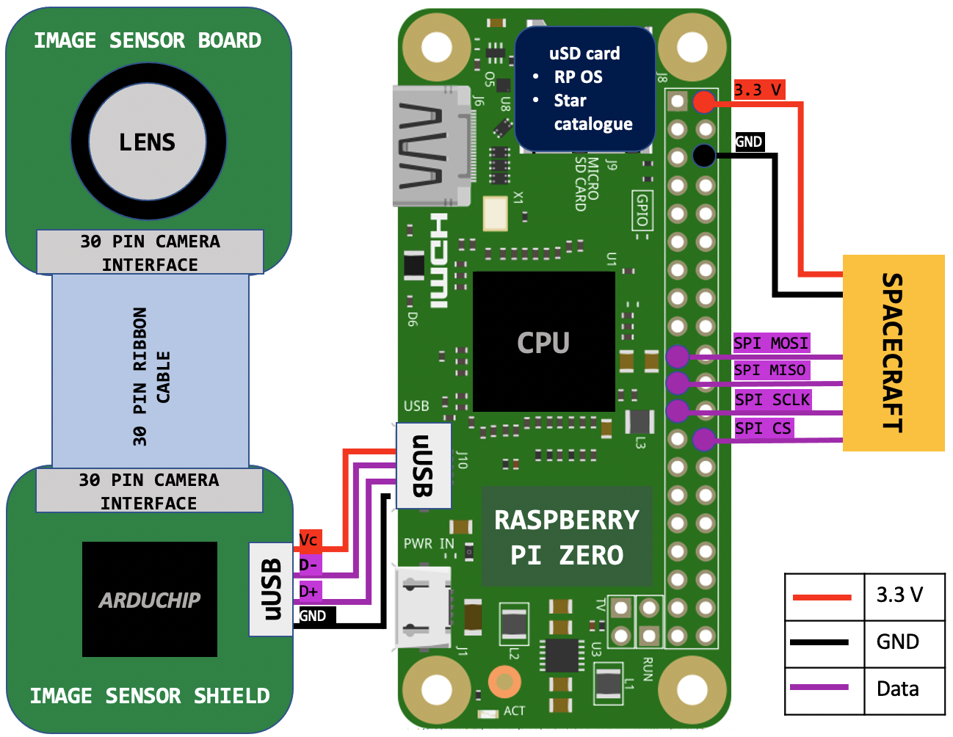
Electrical Hardware Interfaces
USB2 Camera Shield
1) Pwr: 1.5W max 2) Bandwidth: 480Mbps 3) Supports 32/64 bit HW
Raspberry Pi Zero 2W
1) Quad-core processor 2) Pwr: 12.5W max 3) CPU Freq: 1GHz 4) Mem: 512 MB
Star Catalog: 30MB
The star tracker before testing does not meet 2W maximum power draw
The selected star catalog shall be stored in the on-board microcontroller
Requirements
Notes:
CHAVA

Slide 41
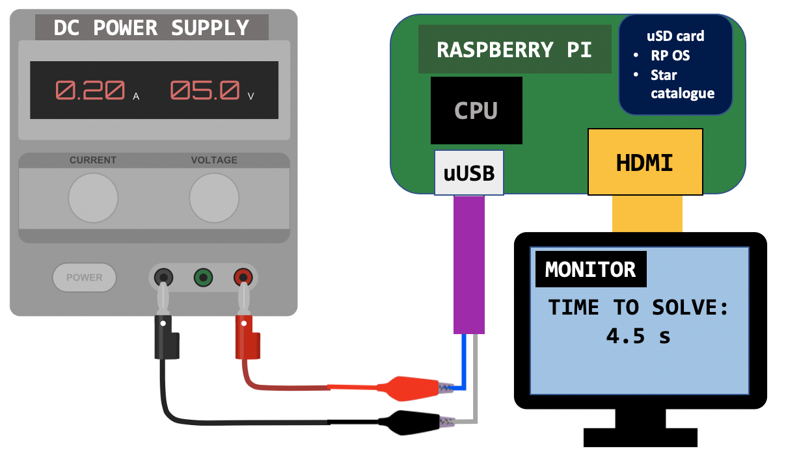
Processing Unit → Power & Time to Solution Test
 | RP3B | RP0 1.3 | RP0 2.0
Avg. Operating Power (while running CubIST software) | 1.9-2.3 W | 0.6-0.9W | 1.25W
Time to attitude solution (baseline images) | 3.7s | ~11 s | 4.5 s
The RPO 2W is under power budget of 2.0 W
Attitude solutions are generated at a rate near 0.2 Hz
Future plan of action to address the camera module & addition of the shield with power consumption
Adtl Tests
Requirements
Notes:
CHAVA
*****Unable to get hands on logging-multimeter (Trudy could not find) to be able to show pwr draw changes over time

Slide 42
Project Risks
Notes:
NATALIE Project Risks: Risks could include:
Not meeting requirements
Detrimental case to the system day-in-the-life
What are the unknowns that we still have
keep to 4ish risks (others in backup)
1 slide that is table of current risks and how they are scored
1 slide of risk mitigation plan
1 slide of risk matrix showing outcome post risk mitigation
Risks were specific and credible for this project, and reflect a good understanding of the issues of concern (9-10 pts)

Slide 43
Risks Involved
Region of Impact | ID | Risk Description | Effect
Baffle & Optics | BO.A | Team lacks in-depth knowledge of optical subsystems | Possibility that team is overlooking design concerns
Baffle & Optics | BO.B | Manufactured baffle does not meet desired solar exclusion angle | Unable to properly mitigate stray light -> Processing algorithm fails solution or increased solution time
Baffle & Optics | BO.C | Baffle, lens, and/or image sensor are misaligned | Images are defocused, have vignetting, accuracy not predictable
Testing | T.A | Representative images and “truth” validation are limited in current model. | Assumptions and solutions lack accuracy
CubeSat Compatibility | CSC.A | Balance between processing power and update rate is inadequate. | CubeSat cannot supply enough power, solutions too infrequent for CubeSat ADCS
Mitigation
Continue research & discussion with experts Prototyping & testing
Zemax simulation HelioStat testing Image manipulation
Store in undisturbed environment Develop calibration procedure Increase tolerance for diameter matching
Full system outdoor testing Frequent comparison with Astrometry
Resolution: blur/downsampling Log scaling of images Implement tracking techniques
Notes:
NATALIE
There are quite a few risks involved with Cubist’s ability to successfully complete its mission, but what we have chosen to focus on here are those risks that ultimately have the largest impact on success. Specifically, optical parameters define key risks both because of the team’s overall lack of in-depth experience in this field, as well as the fact that, without strong optical functionality, the processor may either take too much time, consume too much power, or even fail to produce a solution at all. We have framed these risks such that they are controllable and can be mitigated before the star tracker operates in its day-in-the-life testing.
mention power draw, processing capabilities - electronics
Merge similar risks together, add other categories
Misalignment in manufacturing
See WASP slide 29 https://www.colorado.edu/aerospace/sites/default/files/attached-files/markovichemma_280520_26120477_wasp_cdr.pdf

Slide 44
Pre-Mitigation Risk Scoring
Severity
 |  |  | CSC.A Power budget, processing time
 |  | BO.A Limited Knowledge | T.A Inaccurate representation
 |  |  | BO.C Misalignment | BO.B Exclusion angle
Likelihood
Notes:
NATALIE
Allocated based on a set of weighting criteria based on projected impact. All risks before mitigation lie in the upper right corner where there is high severity (i.e higher propagated impact, higher level of requirement not met) and higher likelihood during the operation of Cubist. Ultimately we want to drive these risks down towards the bottom left, where the impact is more localized and the failure is less drastic.
Bottom left is great, top right is awful
So bottom is good, left is good

Slide 45
Post-Mitigation Risk Scoring
Severity
 |  |  | CSC.A Power budget, processing time
 |  | BO.A Limited knowledge | T.A Inaccurate representation
 |  |  | BO.C Misalignment | BO.B Exclusion angle
Before
Likelihood
Notes:
NATALIE
Allocated based on a set of weighting criteria based on projected impact. All risks before mitigation lie in the upper right corner where there is high severity (i.e higher propagated impact, higher level of requirement not met) and higher likelihood during the operation of Cubist. Ultimately we want to drive these risks down towards the bottom left, where the impact is more localized and the failure is less drastic.
Bottom left is great, top right is awful
So bottom is good, left is good

Slide 46
Post-Mitigation Risk Scoring
Severity
 |  | T.A Inaccurate representation | CSC.A Power budget, processing time
 |  | BO.A Limited knowledge | BO.B Exclusion angle
 | BO.C Misalignment
Before
Likelihood
After
Notes:
NATALIE
Allocated based on a set of weighting criteria based on projected impact. All risks before mitigation lie in the upper right corner where there is high severity (i.e higher propagated impact, higher level of requirement not met) and higher likelihood during the operation of Cubist. Ultimately we want to drive these risks down towards the bottom left, where the impact is more localized and the failure is less drastic.
Bottom left is great, top right is awful
So bottom is good, left is good

Slide 47
Verification & Validation
Notes:
NATALIE
To show that our requirements are met and that all critical project elements are adequately sustained, we will now move into Verification and Validation, where we discuss both the analysis we have completed thus far to prove that we have successfully mitigated the impact of a given risk, as well as physical functional testing we plan to conduct moving forward.
Verification & validation:
Risk 1:
Slide that includes:
Test description:
Objective: risk mitigation plan
Key elements/ variables
Expected outcome
Actual outcome if test has been done
Risk 2:
Risk 3:
Risk 4:
V&V plan for ones that have not been completed for next semester
Rubric:
Describe how the design will be verified against predictive models through characterization testing.
Use diagrams to convey the test set up, the facilities and equipment needed, and how the test works.
Describe the measurements to be made, and key measurement issues (resolution, sampling rate, etc.)
Show how the selected sensors, instruments, data acquisition, test fixtures, etc. provide the required capabilities.
Describe how the design will be validated against functional requirements and overall project success criteria.
See example in Vortex slides 52-59, specifically slide 53 for table structure example:
https://www.colorado.edu/aerospace/sites/default/files/attached-files/chabotbill_290600_26120287_vortex_cdr_final.pdf

Slide 48
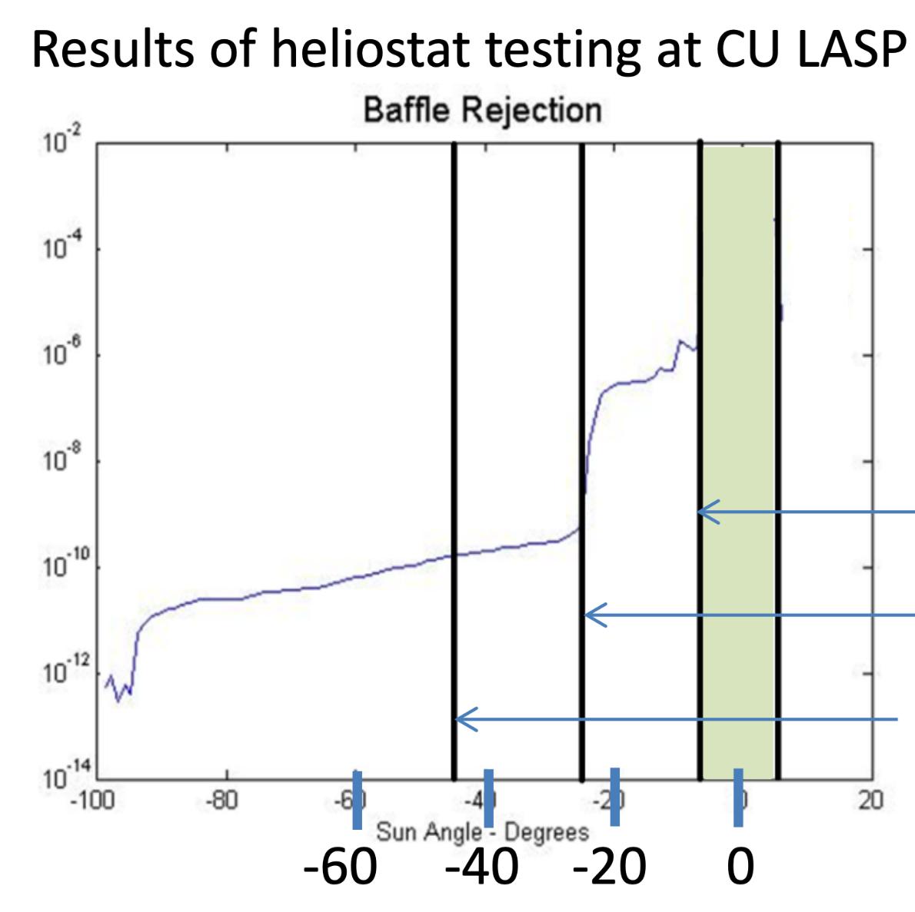
Baffle & Optics: HelioStat Testing
Spring 2022
LASP Boulder, CO
Example of Data: Blue Canyon Technologies Nano Star Tracker Baffle
Heliostat testing at LASP (March 2022)
Test: Mirror Sun at desired angles to test attenuation of baffle
Desired Results: Verify baffle is capable of reaching attenuation requirements
Attenuation
FOV edge
Glint Free/ Earth keepout
Sun keepout
-120 dB
Hegel, D. FlexCore - Low-Cost Attitude Determination and Control Enabling High-Performance Small Spacecraft. Blue Canyon Technologies.
Heliostat example set up
Notes:
Maria
Reiterate why this testing is important, what it helps us to see
LASP’s Heliostat test facility uses a series of three mirrors to focus light and emulate image reception by a curved lens. This test has been confirmed to be completely free for the team to use, requires the full star tracker system but no external equipment, and shall be conducted late March-early April to test the effectiveness of the baffle. Shown on the left is a generic diagram of the Heliostat functionality, and shown on the right is the actual Heliostat setup at LASP. This method has been proven useful for V&V for similar COTS star trackers such as those produced by Blue Canyon Technologies
Diagram:
https://www.sciencedirect.com/science/article/pii/S0038092X20306447#f0005
pic:
https://lasp.colorado.edu/home/wp-content/uploads/2013/04/LASP-ENG_Test-Cal.pdf

Slide 49
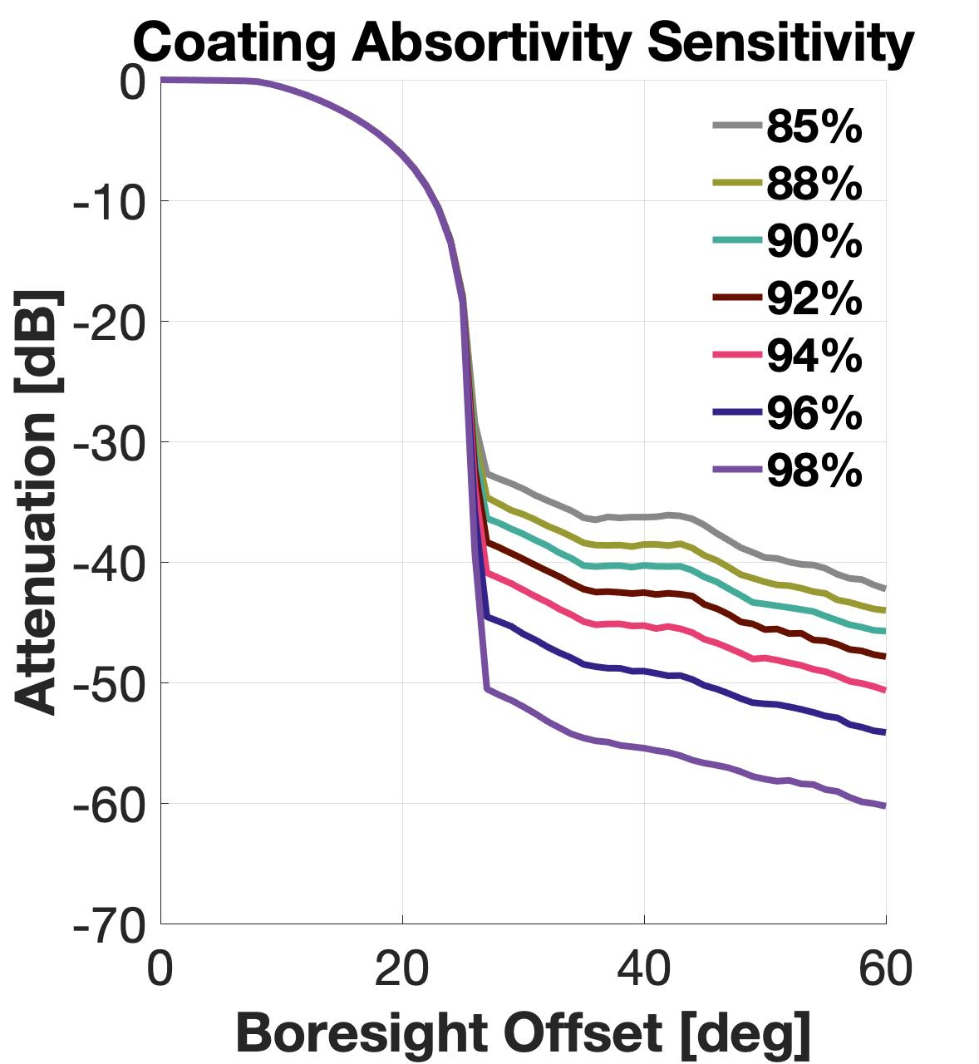
Baffle & Optics: Zemax Sensitivity Analysis
Coating
Lack of Krylon Black coating absorptivity literature
Scatter Fraction
Bidirectional Reflectance Distribution Function (measured empirically)
Vane Radius
Radial tolerance → 10 thou = 0.254mm
Radius ↑ with nonuniform paint application and chipping
FOV
Notes:
Maria
ZEMAX sensitivity: 3 plots w parameters that could vary from “idealized values” like vane knife edge, absorptivity, and scatter fraction (BSDF) which is an empirically quantified parameter based on material and geometry so we can only estimate it
Vary Vane radius: Angle vs PST
Vary Absorptivity: Angle vs PST
Scatter fraction: Angle vs PST

Slide 50
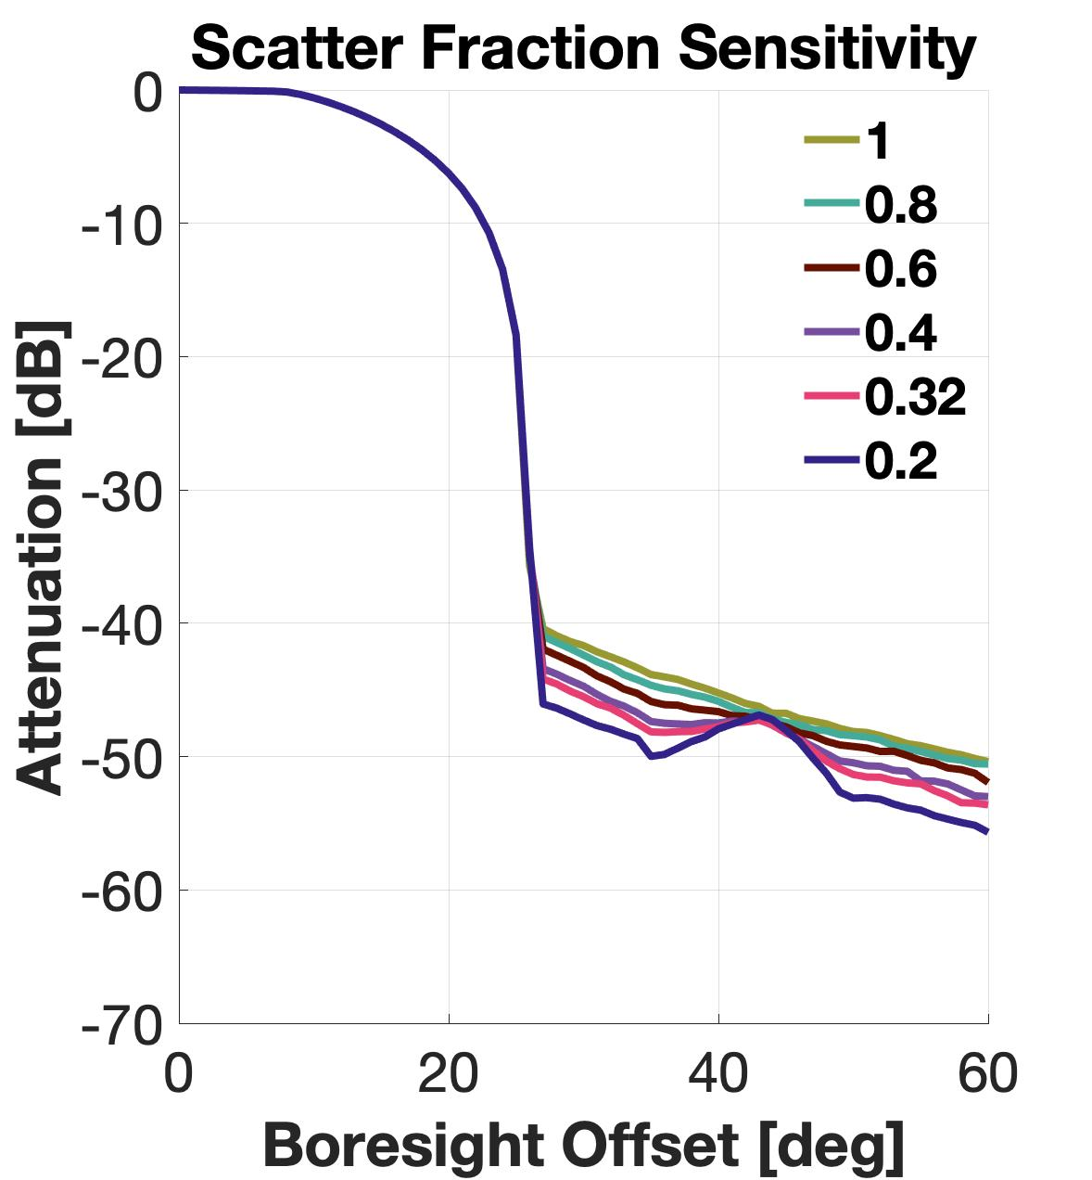
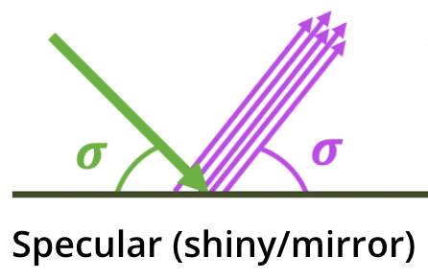
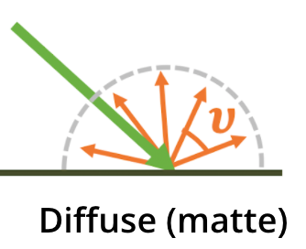
Baffle & Optics: Zemax Sensitivity Analysis
Coating
Lack of Krylon Black coating property literature
Scatter Fraction
Bidirectional Reflectance Distribution Function (measured empirically)
Vane Radius
Radial tolerance → 10 thou = 0.254mm
Radius ↑ with nonuniform paint application and chipping
FOV
Notes:
Maria
ZEMAX sensitivity: 3 plots w parameters that could vary from “idealized values” like vane knife edge, absorptivity, and scatter fraction (BSDF) which is an empirically quantified parameter based on material and geometry so we can only estimate it
Vary Vane radius: Angle vs PST
Vary Absorptivity: Angle vs PST
Scatter fraction: Angle vs PST

Slide 51
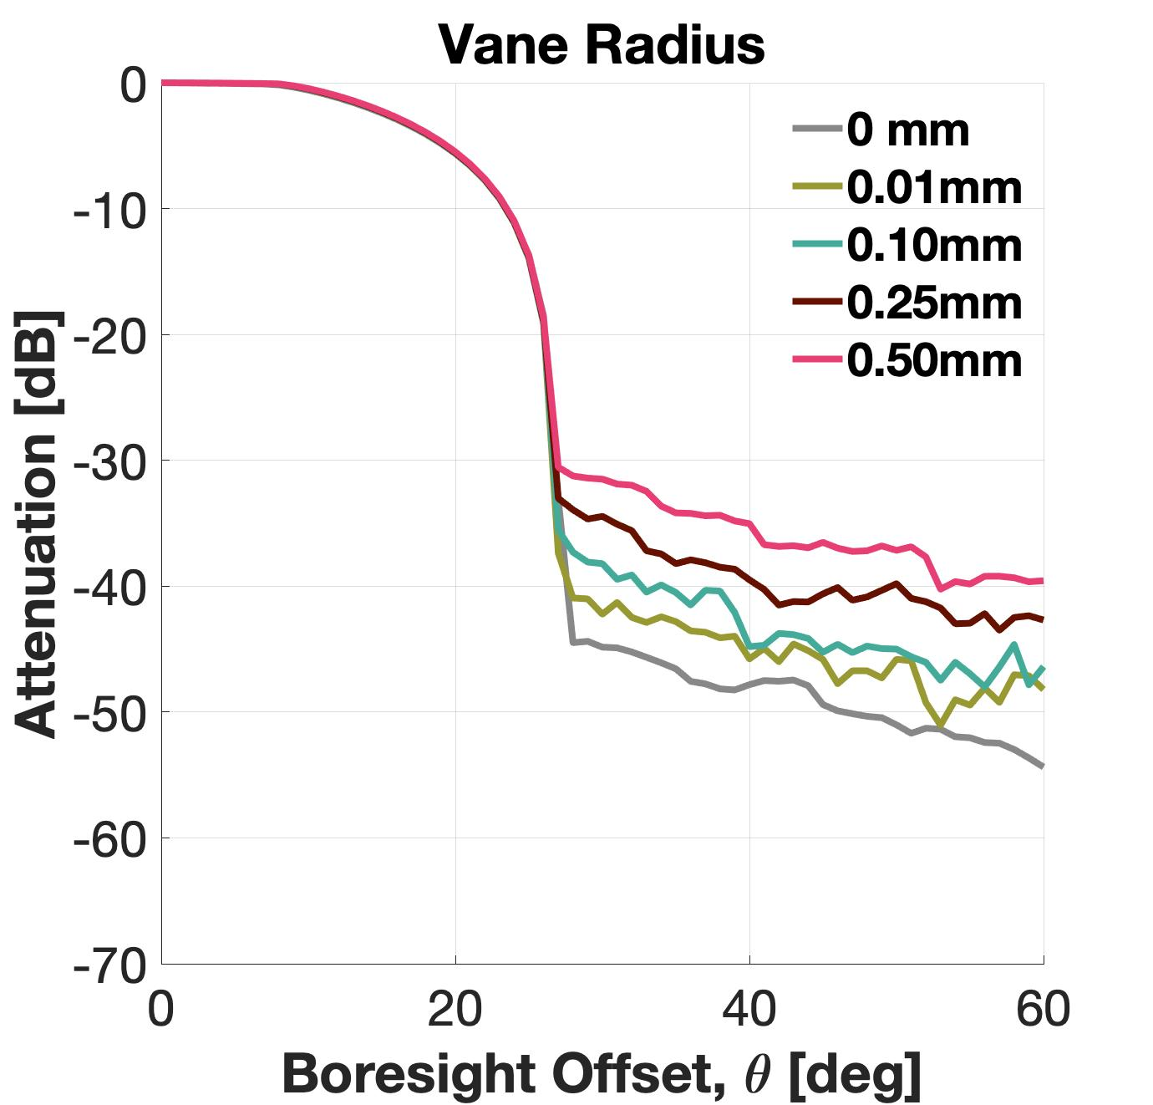
Baffle & Optics: Zemax Sensitivity Analysis
Coating
Lack of Krylon Black coating property literature
Scatter Fraction
Bidirectional Reflectance Distribution Function (measured empirically)
Vane Radius
Radial tolerance → 10 thou = 0.254mm
Radius ↑ with nonuniform paint application and chipping
FOV
Notes:
Maria
ZEMAX sensitivity: 3 plots w parameters that could vary from “idealized values” like vane knife edge, absorptivity, and scatter fraction (BSDF) which is an empirically quantified parameter based on material and geometry so we can only estimate it
Vary Vane radius: Angle vs PST
Vary Absorptivity: Angle vs PST
Scatter fraction: Angle vs PST

Slide 52
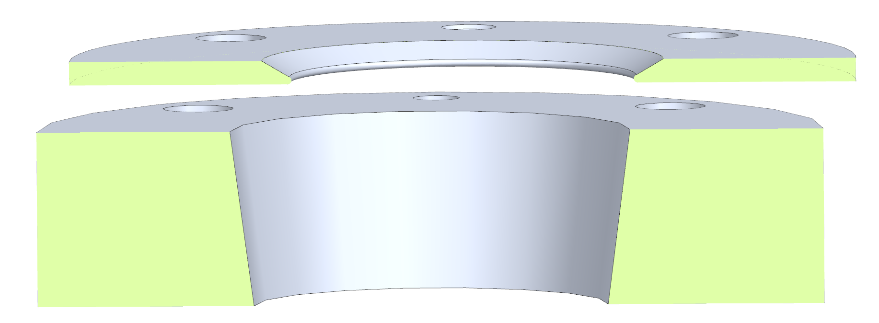
Baffle & Optics: Alignment Verification
Baffle concentric alignment held by press-fit locating pins
Positional tolerance of press-fit holes can be held to 1 thou or closer via waterjet
Tolerance stackup:
Maximum misalignment between two component holes = 2 thou (+/-1)
Maximum line-on-line misalignment between two components = 2 thou
5 thou is acceptable
±0.002”
Notes:
Maria (pres), Cam (slide)
Shows that 1 thou positional tolerances easily allows us to meet the 5 thou concentricity tolerance needed per Maria’s analysis

Slide 53
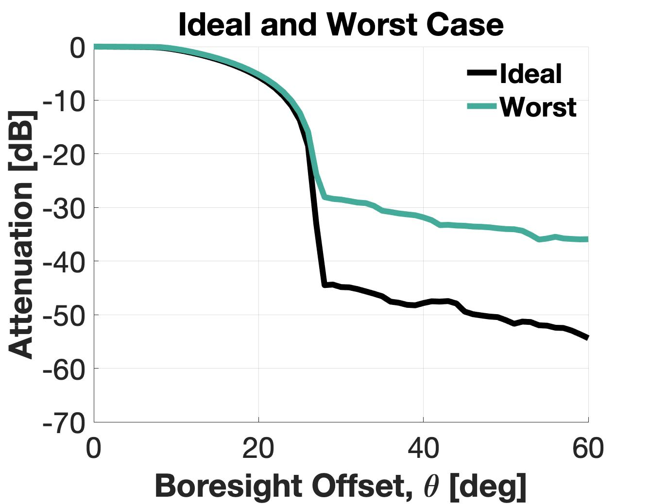
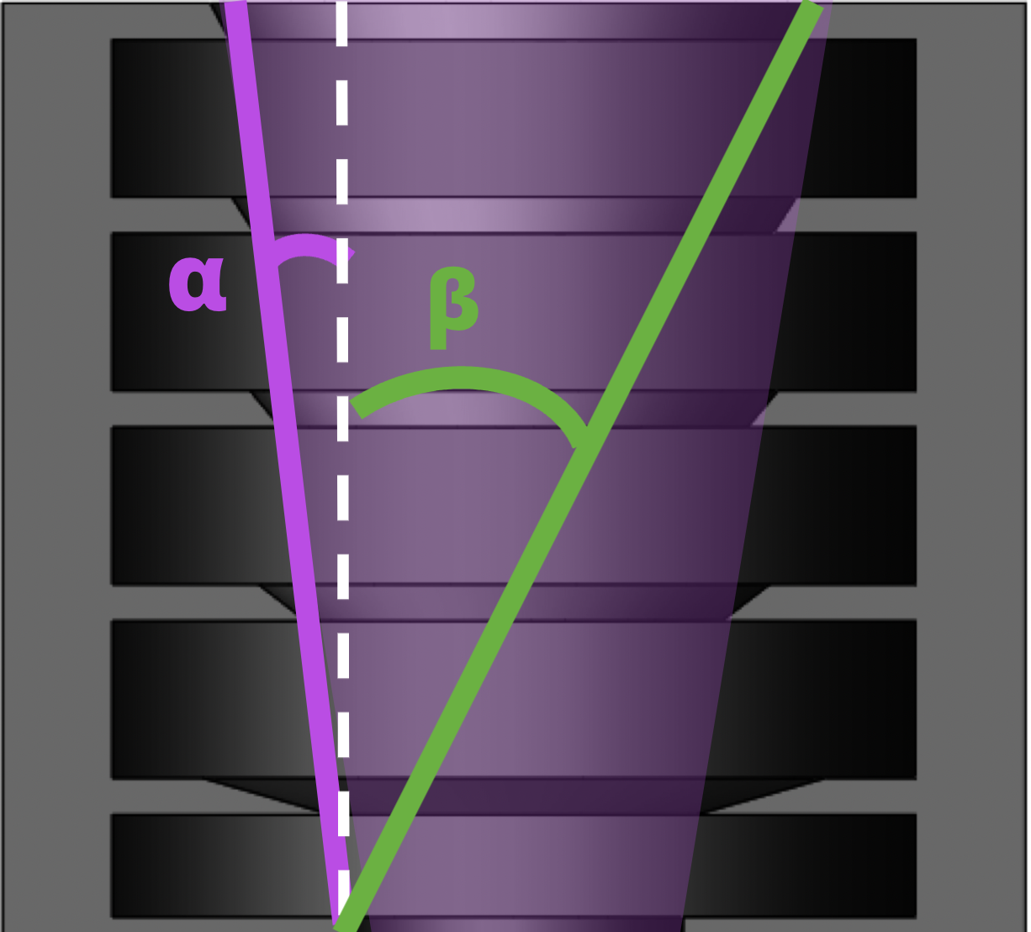
Baffle & Optics: Zemax Sensitivity Analysis
Parameter | Ideal | Worst
Coating Reflectivity | 95% | 88%
Scatter Fraction | 0.32 | 0.75
Vane Radius | 0mm | 0.50mm
Concentric Misalignment | 0mm | 0.254 mm
-5 dB
The star tracker shall operate within at least 60° of the sun and within 20° of the moon.
-28 dB
-35dB
FOV
The baffle shall attenuate -25dB of the light at the sun exclusion angle. And -5dB of light at the moon exclusion angle.
Ideal β = 26.9°
Worst β = 28.0°
Notes:
Maria
ZEMAX sensitivity: 3 plots w parameters that could vary from “idealized values” like vane knife edge, absorptivity, and scatter fraction (BSDF) which is an empirically quantified parameter based on material and geometry so we can only estimate it
Vary Vane radius: Angle vs PST
Vary Absorptivity: Angle vs PST
Scatter fraction: Angle vs PST

Slide 54
Baffle & Optics: Zemax Sensitivity Analysis
Parameter | Ideal | Worst
Coating Reflectivity | 95% | 88%
Scatter Fraction | 0.32 | 0.75
Vane Radius | 0mm | 0.50mm
Concentric Misalignment | 0mm | 0.254 mm
-5 dB
The star tracker shall operate within at least 60° of the sun and within 20° of the moon.
-28 dB
-35dB
FOV
The baffle shall attenuate -25dB of the light at the sun exclusion angle. And -5dB of light at the moon exclusion angle.
Mitigation
→ Professional coating application
→ Tight radius tolerance
Notes:
Maria
ZEMAX sensitivity: 3 plots w parameters that could vary from “idealized values” like vane knife edge, absorptivity, and scatter fraction (BSDF) which is an empirically quantified parameter based on material and geometry so we can only estimate it
Vary Vane radius: Angle vs PST
Vary Absorptivity: Angle vs PST
Scatter fraction: Angle vs PST

Slide 55
Baffle & Optics: Stray Light
How does stray light affect software performance?
Expect decreased speed due to less effective star identification.
Raspberry Pi Zero 2W (Lost In Space, without blur or downsample): 0.205 Hz
Accuracy: 0.003° (did not change)
Mitigation
Effective baffle
Utilize tracking
The attitude solution shall have an absolute accuracy of less than 1°(1σ).
Attitude solutions shall be generated at a rate of 0.2 Hz or greater.
Notes:
JOSIE OR NICKY Stray light from the Sun or Moon can make the centroiding algorithm more difficult, as it cannot subtract the background light evenly - this can cause stars to disappear entirely due to the similarity in brightness and increase the software runtime.
Preliminary testing took place on the RPi Zero 2 before adding blur/downsample/tracking, so expect to see this speed increase with further testing.

Slide 56
Project Planning
Notes:
CHESNEY

Slide 57
CubIST Organizational Chart: Fall → Spring
Chesney
Josie
Natalie
Cam
Quaid
Chava
Maria
Chad
Nicky
Matthew
Leads
Systems:
Natalie
Project Manager Chesney
Finance:
Quaid
Systems:
Natalie
Software: Matthew
Manufacturing/ Hardware: Cam
Processing: Chava
Testing: Quaid
Optics: Chad
Quaid Chad
Cam
Matt
Josie Nicky
Chava
Chesney
Chad
Maria Quaid
Natalie
Chesney
Josie
Quaid
Natalie
Maria
Chava
Cam
Nicky
Subteams
Chesney Chad
Cam
Matt
Notes:
CHESNEY

Slide 58
Second Semester Test Planning
Test | CPE’s | Planning
 |  | Date | Facility | Equipment
Baffle Effectiveness | Baffle | Mar 2022 | LASP | HelioStat
Baffle Sensitivity | Baffle | Jan - Mar 2022 | Non-specific | ZEMAX
Software Performance | Processing SW + HW | Jan - Apr 2022 | N/A | Monitor, keyboard/mouse
Electrical | Processing SW + HW | Jan - Feb 2022 | Electronics Shop | Logging Multimeter, Oscilloscope, wires, toolbox
Full System | All | Mar 2022 | Fiske Planetarium | UNK
 |  | April 2022 | Outdoor | Tripod, rotating motor, pwr src, verification tools
Notes:
CHESNEY

Slide 59
Spring Semester Scheduling
Duration
December
January
February
March
April
AIAA Paper
TRR
4 wks ± 1.0
Baffle ZEMAX Development
SFR
8 wks ± 1.0
Software Optimization
5 wks ± 0.2
Optics & Electronics Assy.
3.7 wks ± 0.6
Imaging Accuracy Testing
4.0 wks ± 2.0
Baffle Prototype Mfg
1 wk ± 0.6
Baffle Assy.
1 wk ± 0.6
HelioStat Testing
1.6 wks ± 0.6
Re-Asmt. & Modifications
1.6 wks ± 0.6
Outdoor Test
3 wks ± 0.0
Winter Break
SB
Reasmt. & Mods.
Legend | Milestones | Critical Path | Out of School
WBS Chart
Notes:
CHESNEY
AIAA abstracts will be due to the advisor on Feb 4th, and due to the conference submission on Feb 13th. Test Readiness Review will be an hour long review (same as CDR/PDR) and will be the weeks of Feb 14th and Feb 21st. Spring Final Review will be an hour long review and will be the weeks of April 18th and April 25th. There will be a AES Projects Symposium that is typically in mid April prior to SFR

Slide 60
Financial Planning
Testing Components
Optics Development
Hardware already purchased for risk mitigation
$247
$100
Testing & hardware necessary to validate optics components
25%
30%
Baffle Development
Full System Testing
Testing equipment & hardware necessary to prototype the baffle
$100
$200
Resources & equipment to run full system tests
10%
Electronics Development
5%
20%
Remaining Budget
10%
Testing equipment & hardware to optimize processor & software
Unused finances out of $1,000
$50
$300
$247 spent of the total $5,000 budget $750 expected total to spend of $5,000

Slide 61
Acknowledgments
Thank you to our customer Dr. Palo, our advisor Dr. Akos, Ryan Kingsbury, and Emma for reviewing our presentation, and everyone else who has helped our team thus far!
Notes:
CHESNEY

Slide 62
Questions?
Notes:
CHESNEY

Slide 63
Appendix
Accumulated Documentation of Subsystems:
[1] Baffle Technical Document: https://docs.google.com/document/d/1WwXZ3dmE4t2_mBjZ3s4tzEjJJWSP3C6wyox_JScZp10/edit?usp=sharing
[2] Optics Technical Document: https://docs.google.com/document/d/1ZhyTCVkR2t3Tr4r4GpJ2OpF3q-DwYyIeRW7NWn7Gdwg/edit?usp=sharing
[3] Software Technical Document: https://docs.google.com/document/d/1Q-_UHFDu2OuHukHIWtknz723jfdGDBnz7hESqHTJFzI/edit?usp=sharing
[4] Electrical System Hardware Technical Document: https://docs.google.com/document/d/1ciG65TJSJbB-Ew871nMCaLoUYqRjo-unH7c9CKo8GS0/edit?usp=sharing ** Accessible via CU Boulder email

Slide 64
Appendix
[1] Aboaf, A. P., “MAXWELL Mission Handbook, University of Colorado Boulder, Boulder, CO, May 2020, https://drive.google.com/file/d/1T7kUrAEUulwJxJCrwVGooyidulDczV7b/view.
[2] “Deformable Mirror Demonstration Mission.” eoPortal, https://directory.eoportal.org/web/eoportal/satellite-missions/d/demi#top.
[3] Dhraief, Y., and Hedayati, F., “Determining the Requirements for the Star Tracker on JEM-EUSO.” DivaPortal, 2015, http://www.diva-portal.org/smash/get/diva2:852504/FULLTEXT01.pdf.
[4] Dzamba, T., Enright, J., Marciniak, M., and Sinclair, D., “Microsatellite Star Tracker Baffles: Validation and Testing,” AIAA Paper SSC13-III-8, https://digitalcommons.usu.edu/cgi/viewcontent.cgi?article=2930&context=smallsat.
[5] “Raspberry Pi OS.” Raspberry Pi, https://www.raspberrypi.com/software/.
[6] “Raspberry Pi MIPI CSI Camera Pinout.” Arducam, https://www.arducam.com/raspberry-pi-camera-pinout/
[7] “Rolling Shutter, Global Shutter: Two Principles of Exposure.” Baumer, https://www.baumer.com/ca/en/service-support/technical-information-industrial-cameras/rolling-shutter-global-shutter-two-principles-of-exposure-/a/rolling-shutter-global-shutter.

Slide 65
Backup Slides

Slide 66
Design Requirements (FR.1)
Requirement Number | Requirement Description | Requirement Origin
DR 1.1 | The baffle shall block stray light with an exclusion angle of 30° or less. | FR.1
DR 1.2 | The baffle shall have an FOV of 15°. | FR.1
DR 1.3 | The star tracker shall remain functional within 60° of the sun. | FR.1
DR 1.4 | The star tracker shall remain functional within 20° of the moon. | FR.1
DR 1.5 | The baffle shall attenuate -25 dB of light at the solar exclusion angle. | FR.1
DR 1.6 | The baffle shall attenuate -5 dB of light at the lunar exclusion angle. | FR.1
Notes:
NATALIE

Slide 67
Design Requirements (FR.2)
Requirement Number | Requirement Description | Requirement Origin
DR 2.1 | Each image shall contain at least 3 stars. | FR.2
DR 2.2 | The characteristics of the camera module shall provide discernible images for centroiding and matching algorithms. | FR.2
DR 2.3 | The star tracker shall remain functional at a slew rate of 2°/s or less. | FR.2
Notes:
NATALIE

Slide 68
Design Requirements (FR.3/4)
Requirement Number | Requirement Description | Requirement Origin
DR 3.1 | The image sensor shall output each image to the on-board processor. | FR.3
DR 3.2 | The format of each image shall be compatible with the required input format of the processing algorithm. | FR.3
DR 3.3 | The selected star catalog shall be stored in the on-board microcontroller. | FR.3
DR 4.1 | Attitude solutions shall be generated at a rate of 0.2 Hz or greater. | FR.4
DR 4.2 | The attitude solution shall have an absolute accuracy less within 0.05° (1σ). | FR.4
Notes:
NATALIE

Slide 69
Design Requirements (FR.5)
Requirement Number | Requirement Description | Requirement Origin
DR 5.1 | The star tracker shall fit within a 100 x 100 x 50 mm volume. | FR.5
DR 5.2 | The star tracker shall operate on a maximum continuous power of 2W. | FR.5
DR 5.3 | The total mass of the star tracker shall not exceed 400g. | FR.5
Notes:
NATALIE

Slide 70
Project Specific Objectives (Pre-V&V)
Specific Objective | Level 1 | Level 2 | Level 3
Image Acquisition | Operate within 60° of the sun and 20° of the moon | 45° of the sun & 15° of the moon | 30° of the sun and 10° of the moon
Power & Comm | Operate on minimum continuous power of 2W | 1W | 0.5W
Volume | 0.5U | 0.4U | 0.3U or less
Mass | 400g | 300g | 200g or less
Attitude Solution | Deliver a quaternion with 1.0° and 1σ absolute accuracy | 0.2° and 1σ | 0.05° and 1σ
Slew Rate | Camera will perform at maximum slew rate of 0.1°/s | 0.5°/s | 2.0°/s
Duty Cycle | Initial solution produced within 120 s, then continuously at 0.2Hz | 60 seconds, 1 Hz | 30 seconds, 5 Hz
Notes:
NATALIE

Slide 71
Concept of Operations (Use Case)
<xi,yj,zk,θ>
θ₁
θ₂
1. Baffle Attenuation
Baffle reduces the amount of stray light entering the camera.
2. Image Acquisition
CubIST captures image of stars within field of view.
3. Pattern Detection
CubIST identifies bright object pattern from image.
4. Catalog Comparison
CubIST compares star pattern to known star catalog.
5. Attitude Solution
CubIST determines current orientation and returns quaternion.
Notes:
NATALIE (1.5-2min)
4th box: quaternion: describes rotation of body frame wrt inertial frame in terms of 1 single rotation axis (in terms of the body unit vectors), and 1 euler angle of rotation
Have sun or moon in here
5th col - talk about baffle
Can take a whole slide just for step 1 - baffle, sun, etc - want to talk about key elements
How does fov impact performance
What axis/frame - emphasize more

Slide 72
Detailed Design Overview (Not Animated)
Arducam AR0134 Camera Module
⅓” 35mm M12 Lens
Baffle
Threaded fasteners to join baffle sections
5.00cm
6.12cm
USB2 Camera Shield
9.39cm
Electromechanical Connections
Raspberry Pi Zero 2W
Integrated Memory
Additional Views
Notes:
NATALIE This slide presents the physical design of CubIST. This breakdown begins on the right with a scaled CAD model of our design including the outermost dimensions of XXxXXxXX cm
Moving to the left, the baffle that attenuates stray light is fastened to the ⅓” M12 Lens with a 35mm focal length and housing including the Arducam 134 Image sensor and Camera Module. The Module is fastened to a UBS2 Camera shield that processes the collected image data. The image is sent to the Raspberry Pi Zero 2W on the perpendicular wall of our set dimensions. The Tetra3 software processes the images and derives our desired attitude solution

Slide 73
Optics Subsystem Selection
Component | Baffle | Lens | Image Sensor + Camera Module
Description | Machined Aluminum 6061 | ⅓” 35mm F#: 2 M12 Lens | Arducam 134 Image Sensor + Module
Key Parameters | 1) Krylon Flat Black coating 2) Field of View: 15° 3) Solar Exclusion Angle: 26.8° 4) 5 vanes | 1) 25(D) x 23(H)mm 2) No IR Filter 3) Limiting Stellar Mag: 10.7 | 1) Monochrome CMOS Global Shutter 2) Resolution: 960p max 3) Signal to Noise Ratio: 38.6dB 4) Pwr: 0.4W max
Notes:
MARIA

Slide 74
Electronics & Software Subsystem Selection
Component | Camera Shield | Processor | Software
Description | USB2 Camera Shield | Raspberry Pi Zero 2W | Tetra3 Algorithm
Key Parameters | 1) Pwr: 1.5W max 2) Bandwidth: 480Mbps 3) Supports 32/64 bit H/W | 1) Quad-core processor 2) Pwr: 12.5W max 3) CPU Freq: 1GHz 4) Mem: 512 MB | 1) Lost In Space 2) Field of View: 12° 3) Star Catalog Size: 30MB
Notes:
CHAVA or NICKY/JOSIE

Slide 75
Critical Project Elements
CPE | Justification | FR’s
E.1: Baffle | System must mitigate stray light to capture images. | FR.5
E.2: Image Acquisition | System must capture filtered images of stars to be processed. | FR.1, FR.4
E.3: Image Processing Software | System must process star images to calculate attitude characteristics. Processing must be done at baseline rates & accuracy. | FR.2, FR.3
E.4: Image Processing Hardware | Processing must be done at baseline rates & power consumption. | FR.3 FR.6
Notes:
CHESNEY Show exploded version of design and group these together, make it more visual !! take out FR #
CPEs: 1) Image Acquisition 2) Image processing 3) Baffle / mitigating stray light 4) Storage 5) Output quaternion

Slide 76
Calculated minimum SNR requirement
N*=flux of electrons by star, e⁻/mm² (9.26 *10⁵e⁻/mm²)
τ= exposure time (10.4 *10⁻³s)
k=# of pixels saturated by star (4 Pixels)
N_{bg}=flux of background electrons in pixel (10e⁻)
σ_{rd}= Read Noise (e⁻) (6.58e⁻)
D=Usable Diameter (mm) (17.5mm)
f*=illumination of pixels (photons) (~5000 photons per star)
η= Quantum efficiency (77% at 525nm)
With all variables included, an minimum SNR requirement of 23.4dB is needed
Requirements

Slide 77
Optical Design Breakdown
Solving algorithm requires 3 stars to solve, and chooses the brightest stars in the image to position and match.
With FOV of 15 degrees, we will image at least 3 stars in any given image per testing of software given similar optical parameters of focal length, and FOV
If motionless, exposure time can be as long as necessary to saturate pixels with stellar photons for optimal centroiding ability.
With 2 deg/sec, exposure time shall be ~6ms, which is achievable with CM
Spot Size with current optical parameters: 2.78 microns
Tₛ = Time for 1 pixel movement (seconds)
𝜙 = Star tracker FOV (Radians)
nₚ = # of horizontal pixels
⍵= Angular velocity of star image (rad/sec)
Requirements
Notes:
PALO: I think it would be helpful here to have a slide here that shows the overall optical design and the resulting spot size on the CMOS detector. That high level picture is missing from your presentation and something that I would expect. You can save the detailed baffle discussion for later in the presentation. In the absence of stray light, show me that you system WILL WORK. You should also include some radiometry. How dim a star can you see and what is your image exposure time. I am missing some of the big picture with the design. Also with your field of view, how many stars do you expect to see in each image. Has such an analysis been conducted? This could also be considered a critical project element. If you don’t have good images in a non stray light environment than nothing else really matters. Do you have derived requirements for the quality, rate and size of this star image for your system?

Slide 78
Additional Risk/V&V Material

Slide 79
Risk Scoring: Severity Weight Criteria
1 | Low severity | 0 other components or subsystems impacted. All DRs met.
2 | Mild severity | 1-2 other components or subsystems impacted. Local DR not met.
3 | Moderate severity | Impact propagates forward to 2-3 other critical components or subsystems. “Compatibility” or interfacing DR not met.
4 | Moderate to high severity | Impact propagates forward to 2-3 other critical components or subsystems. Multiple DRs not met.
5 | High severity | All (or most critical) subsystems and components impacted. FR not met.
Notes:
Think about this like a matrix: req level vs # impacted -> high severity is both, low severity is neither, have more levels in between to have one or the other (e.g. DR not met, but only local impact, OR all DR’s met but propagated impact)
# of subsystems impacted
OR, importance of subsystems impacted
OR impact on level of success

Slide 80
Risk Scoring: Likelihood Weight Criteria
1 | Low likelihood | Out of scope of project and testing
2 | Mild likelihood | Could occur under specific circumstances
3 | Moderate likelihood | Occurs for less than half of operational time
4 | High likelihood | Occurs more than 70% of operation
5 | Extreme likelihood | Guaranteed to happen 100% of operation
Notes:
Bottom left is great, top right is awful
So bottom is good, left is good
# of subsystems impacted
OR, importance of subsystems impacted
OR impact on level of success

Slide 81
[OPT.A] Limited Knowledge of Optical System
Team members of CubIST have little to no experience with optical hardware, design and implementation, and is not taught in conventional aerospace courses. Learning curve on optical hardware is considerable, as level of depth that is involved with camera systems can easily be analyzed longer than allotted time for the project.
With that being said, we’ve been reaching to all accessible avenues for external guidance on the optical hardware, consistently analyzing research papers/textbooks and discussing our system with doctorate level students and faculty members that are well versed in the optical regime.
Research and analysis will be continued through next semester to further deepen what is needed to better test and validate our design with lower level understanding
Notes:
Optical systems have not been taught in conventional aerospace courses, and team members have limited to zero experience with optics, therefore underlying design issues may be apparent with experienced optical engineers.

Slide 82
Spot Size
Lens Spot Size vs. Aperture Trade and why we prioritized aperture over spot size creating the spot size risk
Pixel pitch: 3.75um
Spot Diameter = 2.78 → minimum spot size of 3.75um at 535 nm wavelength
Want minimum spot size → pixel (3.75um) but also want an F# as small as possible (i.e. an aperture as large as possible.) Trade between F# (which could be at the cost of decreasing aperture, letting less light into the system) or addressing the need for intentional blurring/defocus.
Mitigation
The most effective mitigation tactic for this risk to procure a locking adapter for the M12 mount will enable dethreading of the lens, adjusting position of the focal length and deblurring the image, increasing spot sizes
Notes:
Hard to test physically bc no representative envt, but have tested software
How representative is image we are putting into software to what will actually see
v&v - how compare with model? What are discrepancies? Why? What defines success of test?

Slide 83
Unsuitable Image Resolution
Image resolution can impact speed of star identification.
Optimize speed and accuracy with chosen resolution.
The image processing software on the micro-controller shall detect star patterns.
0.2 Hz
Attitude solutions shall be generated at a rate of 0.2 Hz or greater.
The attitude solution shall have an absolute accuracy of less than 1°(1σ).
All within accuracy requirements. Resolutions below 512x384 meet speed requirements.
Notes:
JOSIE OR NICKY Too-high image resolution can greatly increase runtime due to more complex centroiding.
Can cause a spot size that is too small, which can be mitigated through defocusing and decreasing the image resolution.
Recommended at least 512x512 by tetra3 docs
Intentionally blur/defocus the image, and downsample to a lower resolution. Optimization problem between speed and accuracy for differing levels of blur and resolutions

Slide 84
Bright Objects in image
Planets, satellites, or other objects in image could impact star identification and slow down processing speed.
Testing in progress and will continue in the spring.
Mitigation
Could exclude objects above a certain size from centroiding
Utilize tracking
The image processing software on the micro-controller shall detect star patterns.
Attitude solutions shall be generated at a rate of 0.2 Hz or greater.
The attitude solution shall have an absolute accuracy of less than 1°(1σ).

Slide 85
Resolution vs Rate Comparison

Slide 86
Software Runtimes: Individual Image Times
(without blur/downsampling)

Slide 87
CubeSat Compatibility: Hardware Power Consumption
DR: The star tracker shall operate on a maximum continuous power of 2W
Objective
Verify system operational power consumption is within 2W
Plan
Optimize Optics & Software needs
Supply 3.3 V to system
Execute image acquisition and attitude determination
Measurement
Current draw → P = I*V
Pass Criteria
System operational power consumption within 2 W
Notes:
CHAVA

Slide 88
Testing Plan: Outdoor Setup
Equipment: Stable tripod with high precision rotating DC motor, control center with live Astrometry outputs
Setup: Flagstaff Mountain, CubIST mounted to stationary tripod
Plan:
CubIST operational and taking images for 2 hours straight
Camera rotated by motor to emulate maximum allowable slew rate
Quaternions printed to monitor and compared to online model
Pass criteria: All attitude solutions within 5% of Astrometry result from same location/angle.
Notes:
CHESNEY Figure out absolute true - exact time, exact location, etc - what should see vs what SW gives?

Slide 89
Full-System Outdoor Testing Feasibility
Benefits | Challenges
Minimal equipment required Little to no error induced by setup Can model obstructive objects within FOV Controllable setup - predictable Minimal light pollution | Limited window to plan ahead (need clear sky) Verification requires CubIST image - need other testing to validate optical hardware Limited accuracy of validation software itself Not accurate representation of LEO
The outdoor test setup is deemed sufficient to test the accuracy of the software algorithm.
The outdoor test setup overall produces more benefits than challenges, and is thus deemed a feasible test for the team to conduct.
The outdoor test setup is deemed insufficient to test the functionality and accuracy of the image sensor/camera module, or its interface with other components.

Slide 90
Testing Plan: Indoor Setup
Equipment: Darkroom, high resolution monitor, collimating lens to cause stars to appear far away, high-precision rotation DC motor, control center with live Astrometry outputs
Setup: CubIST mounted to rotating motor to emulate maximum allowable slew rate; operational for 2 hours straight.
Plan: CubIST views surroundings through collimating lens and takes images of the stars produced on LCD monitor. Quaternions printed to monitor and compared to online model.
Pass criteria: All attitude solutions are within 10% of Astrometry solutions at same angle and location.
Notes:
CHESNEY The problem with this test setup is that there is a ton of error involved with the setup. Specifically, the collimating optics will be very difficult to align perfectly (.1 degrees off automatically makes our system .1 degrees off) and also getting the light to become collimated is a very difficult task (Our only experience is Maria collimating a laser pointer and that was quite difficult in itself). I did find a possible resource from NASA to discuss the feasibility of us doing this test if I can get a meeting with him, and he should provide some great insight on testing our star trackers performance next spring.
Pros:
Controlled environment
Verification can be done against the actual image we are looking at (Accuracy of image sensor/lens can be tested)
Cons:
Collimation setup must be very precise for an accurate test
Many sources of error involved with equipment set up.

Slide 91
Testing Plan: Indoor Setup
Darkroom LCD Setup:
Notes:
CHESNEY The problem with this test setup is that there is a ton of error involved with the setup. Specifically, the collimating optics will be very difficult to align perfectly (.1 degrees off automatically makes our system .1 degrees off) and also getting the light to become collimated is a very difficult task (Our only experience is Maria collimating a laser pointer and that was quite difficult in itself). I did find a possible resource from NASA to discuss the feasibility of us doing this test if I can get a meeting with him, and he should provide some great insight on testing our star trackers performance next spring.
Pros:
Controlled environment
Verification can be done against the actual image we are looking at (Accuracy of image sensor/lens can be tested)
Cons:
Collimation setup must be very precise for an accurate test
Many sources of error involved with equipment set up.

Slide 92
Full-System Indoor Testing Feasibility
Benefits | Challenges
Image source and expected result are fully verifiable - no additional testing is needed to determine accuracy of optical hardware Controlled environment Perfectly run test is fully descriptive | Significant induced/propagated error from potential misalignment of collimating lens Almost perfect precision required in order for test to be useful Setup is difficult and requires expertise
The indoor test setup is deemed sufficient to test the accuracy of the image sensor and camera module.
The inaccessibility of this test setup regarding team knowledge and experience, in addition to the significant uncertainty, renders the test infeasible for the team to conduct independently.
The indoor test setup, if performed correctly, is deemed sufficient to test full-system functionality.
Notes:
CHESNEY The problem with this test setup is that there is a ton of error involved with the setup. Specifically, the collimating optics will be very difficult to align perfectly (.1 degrees off automatically makes our system .1 degrees off) and also getting the light to become collimated is a very difficult task (Our only experience is Maria collimating a laser pointer and that was quite difficult in itself). I did find a possible resource from NASA to discuss the feasibility of us doing this test if I can get a meeting with him, and he should provide some great insight on testing our star trackers performance next spring.
Pros:
Controlled environment
Verification can be done against the actual image we are looking at (Accuracy of image sensor/lens can be tested)
Cons:
Collimation setup must be very precise for an accurate test
Many sources of error involved with equipment set up.

Slide 93
Mass Budget
Subsystem | Component | Mass
Optics | Lens | 6g
 | Camera Module + shield | 30g + 20g
Electronics | Micro-controller | 9g
Baffle | Baffle + coating | 200g + 10g
Additional | Wiring + solder | 30 - 50g
 | Additional components
TOTAL |  | ~305 - 325g
Mass goal, Level 1 |  | 400 g
Return

Slide 94
Work Plan Spring 2022
Complete
In Progress
To-Do
Program Planning
Systems & Finance
Software
Baffle & Manufacturing
Processing
Optics
PDD
Defining Requirements
Select compatible software
Research fundamentals of baffles & configurations
Select best processor & feasibility
Research & discuss with technical experts
CDD
Defining CPEs
Determine necessary parameters for attenuation & volume constraints
Test sample images
Upload software
Determine requirements and baseline parameters
PDR
Outline PDR
Run software with selected images
Determine pass/fail thresholds
Design baseline prototypes
CDR
Select lens & CM, analyze feasibility
Purchase components for testing
Run ZEMAX simulations
Test microproc. pwr consumption
FFR
Assemble Lens, CM, shield
Test customizations
Manufacture prototypes
Research avenues to decrease pwr draw
AIAA Paper
Test baseline imaging capabilities
Finalize budget breakdown
Practice coating techniques
Implement tracking software
Assemble interface with shield
TRR
Refine baffle design
Test shield & CM pwr draw
SFR
Continue communication cross subteams
Optimize processing rates and accuracy
Test full system pwr and data transfer
Assemble baffle & mount to lens
Research eliminating shield
HelioStat & Full System Testing
Assess rates & pwr during day-in-life test
Test day-in-life images
Reassess post HelioStat testing
Return

Slide 95
Additional Design Views
Return

Slide 96
Design - Additional Views
Return
Notes:
Return link in bottom corner will bring back to slide 10 - Detailed design overview

Slide 97
Design - Additional Views
Return
Notes:
Return link in bottom corner will bring back to slide 10 - Detailed design overview

Slide 98
Design - Additional Views
Maximum allocated volume (½ U)
10cm
10cm
5cm
Return
Notes:
Return link in bottom corner will bring back to slide 10 - Detailed design overview

Slide 99
Design - Additional Views
Return
Notes:
Return link in bottom corner will bring back to slide 10 - Detailed design overview

Slide 100
Design - Additional Views
Return
Notes:
Return link in bottom corner will bring back to slide 10 - Detailed design overview

Slide 101
Design - Additional Views
Return
Notes:
Return link in bottom corner will bring back to slide 10 - Detailed design overview

Slide 102
Miscellaneous

Slide 103
Feasibility Studies of PDR
Subsystem | Feasibility Statements | Status
Enclosure | Per Feasibility Analysis #1, the Machined Aluminum 6061 architecture meets Design. Requirements 6.2-6.4 for the CubIST Enclosure. | Feasible
Baffle | DR 5.2: The baffle shall reduce stray light with an exclusion angle of 30 deg or less. | Feasible
Optics | Lenses are compatible with stellar magnitudes. Sensors capable with QE, and SNR optimal for clear images for LSM detection. Optical and interface compatibility between camera module and lens. DR 4.2: Module can image stars “statically” with +2⁰/s. Further analysis with deliberate defocusing is required to prove centroiding feasibility. | In Progress
Electronics | DR 6.1 The star tracker shall operate on a maximum continuous power of 2W, the processor shall be compatible with the selected optical module, and will have the necessary storage and processing power to host and execute the star tracker software suite. | Feasible
Software | DR.2.1, 3.2, 3.4 (from FR.2, 3): Software is feasible for varying FOVs & can interface with processor. DR.2.1 (from FR.2): Software can interface with processor. | Feasible

