Slide 1
CubeSat Integrated Star Tracker
CubIST | Preliminary Design Review
October 13, 2021
Project Customer
Dr. Scott Palo
Project Advisor
Dr. Dennis Akos
Presenters: Chesney Boal (PM), Chava Friedman, Quaid Garton, Matthew Gedrich, Cameron Humphreys, Natalie Link, Chad Pflieger
Additional Team members: Maria Callas, Josie Johnson, and Nicky Weber
Notes:
Chesney Boal (15 sec)
Team 3, section 011
Presenters: Chesney, Quaid, Chad, Chava, Matt, Natalie

Slide 2
Presentation Outline
1.0 Project Overview
3-14
1.1 Project Definition
1.2 Baseline Design
2.0 Evidence of Baseline Feasibility
15-32
2.1 Critical Project Elements
2.2 First Level Feasibility Analyses
3.0 Status Summary and Updates
33-35
3.1 Feasibility Findings Summary
3.2 Future Analysis & Plan of Action
Project Description
Baseline Design
Feasibility Analysis
Status Summary
Notes:
Chesney (10 sec)
Might be a good idea to explicitly say “future work”
Align numbers

Slide 3
1.0 Project Overview
Project Definition
Project Description
Baseline Design
Feasibility Analysis
Status Summary
Notes:
NATALIE (5sec)
Project description
3.1.1 Brief project definition, using Objectives, CONOPS and FBD from PDD
3.1.2 Baseline design from CDD. Include diagrams and explanation sufficient to understand
the baseline design without having to read the CDD.
Brief project definition, using Objectives, CONOPS and FBD from PDD.
Clear what project is about and what it must accomplish to be successful (8-10 pts)

Slide 4
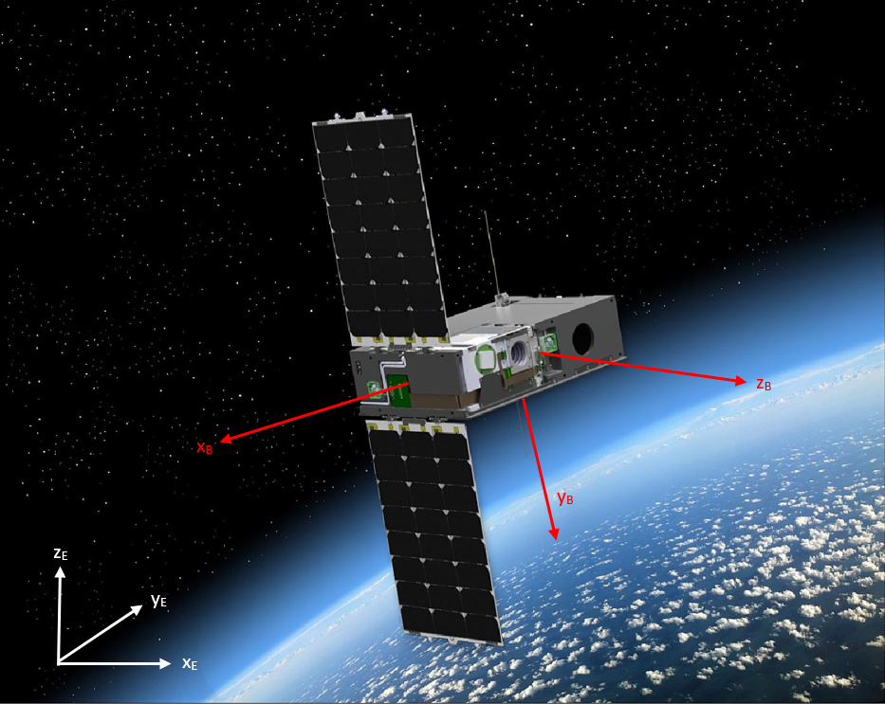
Motivation
Small satellites (CubeSats) need an accurate way to determine orientation in space.
Sun sensors and other devices produce only 2 attitude angles.
Existing COTS star trackers are high-cost, high-power.
@Blue Canyon Technologies, 08/15/2017 [2]
Ultimate desired basis: MAXWELL
6U CubeSat (CU Boulder) at LEO (to launch 2022)
Project Description
Baseline Design
Feasibility Analysis
Status Summary
Notes:
NATALIE (1 min)
A key component of celestial navigation is knowing orientation - sats need to know orientation (aka attitude)
Mention celestial coord frame
Needs to determine 3 attitude angles in space
Maxwell is a ref that customer is interested in integrating with, but cubist will not actually fly on it. Currently only has sun sensor - needs all 3 attitude angles, and more confidence in the cubesats orientation in the celestial coordinate frame.
Cubist aims to develop a star tracker that is competitive against existing solutions in regards to power, accuracy, and cost.
Introducing determining attitude solution for CubeSats in general Specific to our project, our customer has multiple CubeSats in development One specifically being MAXWELL which currently has a sun sensor that produces 2 attitude angles and is particularly sensitive to rotation
The importance of having a star tracker on board is to provide more confidence in terms of determining an attitude solution with a specific axis-angle rotation about an arbitrary axis
Additionally, current commercial star trackers are profoundly expensive and have restricted adaptability
Celestial navigation
MAXWELL Info: The Objective of this project is to mature CubeSat communications technology through a flight demonstration.
The key technologies we plan to demonstrate are:
High rate (20Mbps) data downlink at X-band (8300MHz)
Spread spectrum Code Division Multiple Access (CDMA) 2Mbps data downlink at X-band (8300MHz)
200kbps S-band uplink (2250MHz).
We ref maxwell too much
Not all STs are hi cost hi pwr
Describe in general how they work, use that to describe whats important in coming slides
Getting everyone on same page in 1st 5 min is critical
Emphasize competitive against cheap STs
What ref frame are quaternions in
Basic description of what its doing

Slide 5
Mission Statement
{
{
q
=
The CubeSat Integrated Star Tracker (CubIST) will design, build, and test an adaptable, accurate, low-cost star tracker to simulate determining a CubeSat’s orientation in 3D space.
Overall, the customization of CubIST’s optical system, in-house developed baffle intended to attenuate stray light, and unique optimization of both power and performance delivers an accessible solution for future nanosatellite missions such as MAXWELL.
Project Description
Baseline Design
Feasibility Analysis
Status Summary
Notes:
QUAID (30sec-1min)
CubIST
Could include pics in this slide
d/n know what a baffle
Show pic of standard star tracker
CubIST’s highest level objective is to output a quaternion which defines the satellite’s orientation about a single axis offset by a angle of rotation. CubIST also prioritizes a baffle which functions as a camera hood that attenuates stray light entering the optical system.

Slide 6
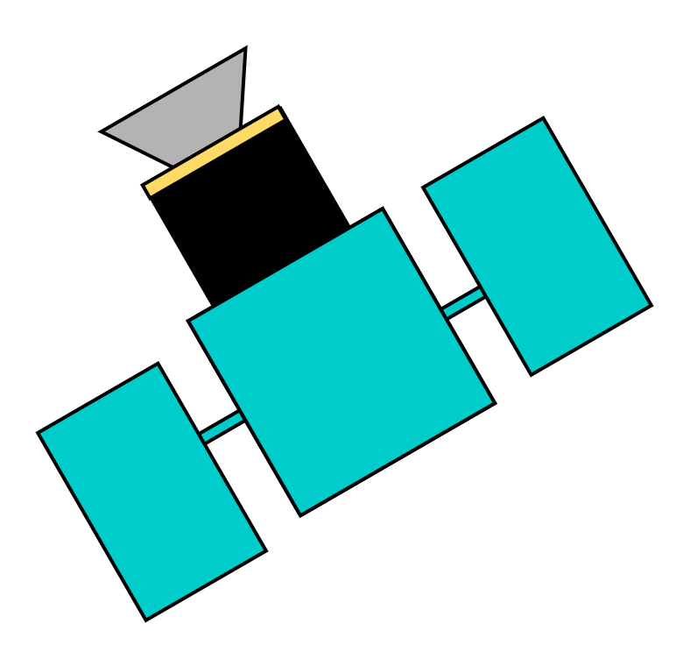
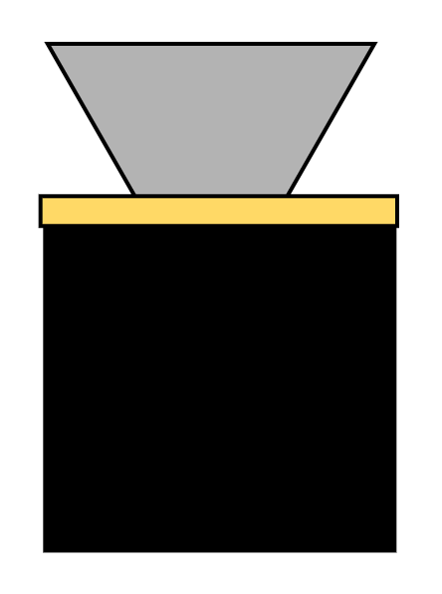
Concept of Operations
<xi,yj,zk,θ>
θ₁
θ₂
1. Baffle Attenuation
Baffle reduces the amount of stray light entering the camera.
2. Image Acquisition
CubIST captures image of stars within field of view.
3. Pattern Detection
CubIST identifies bright object pattern from image.
4. Catalog Comparison
CubIST compares star pattern to known star catalog.
5. Attitude Solution
CubIST determines current orientation and returns quaternion.
Notes:
NATALIE (1.5-2min)
4th box: quaternion: describes rotation of body frame wrt inertial frame in terms of 1 single rotation axis (in terms of the body unit vectors), and 1 euler angle of rotation
Have sun or moon in here
5th col - talk about baffle
Can take a whole slide just for step 1 - baffle, sun, etc - want to talk about key elements
How does fov impact performance
What axis/frame - emphasize more

Slide 7
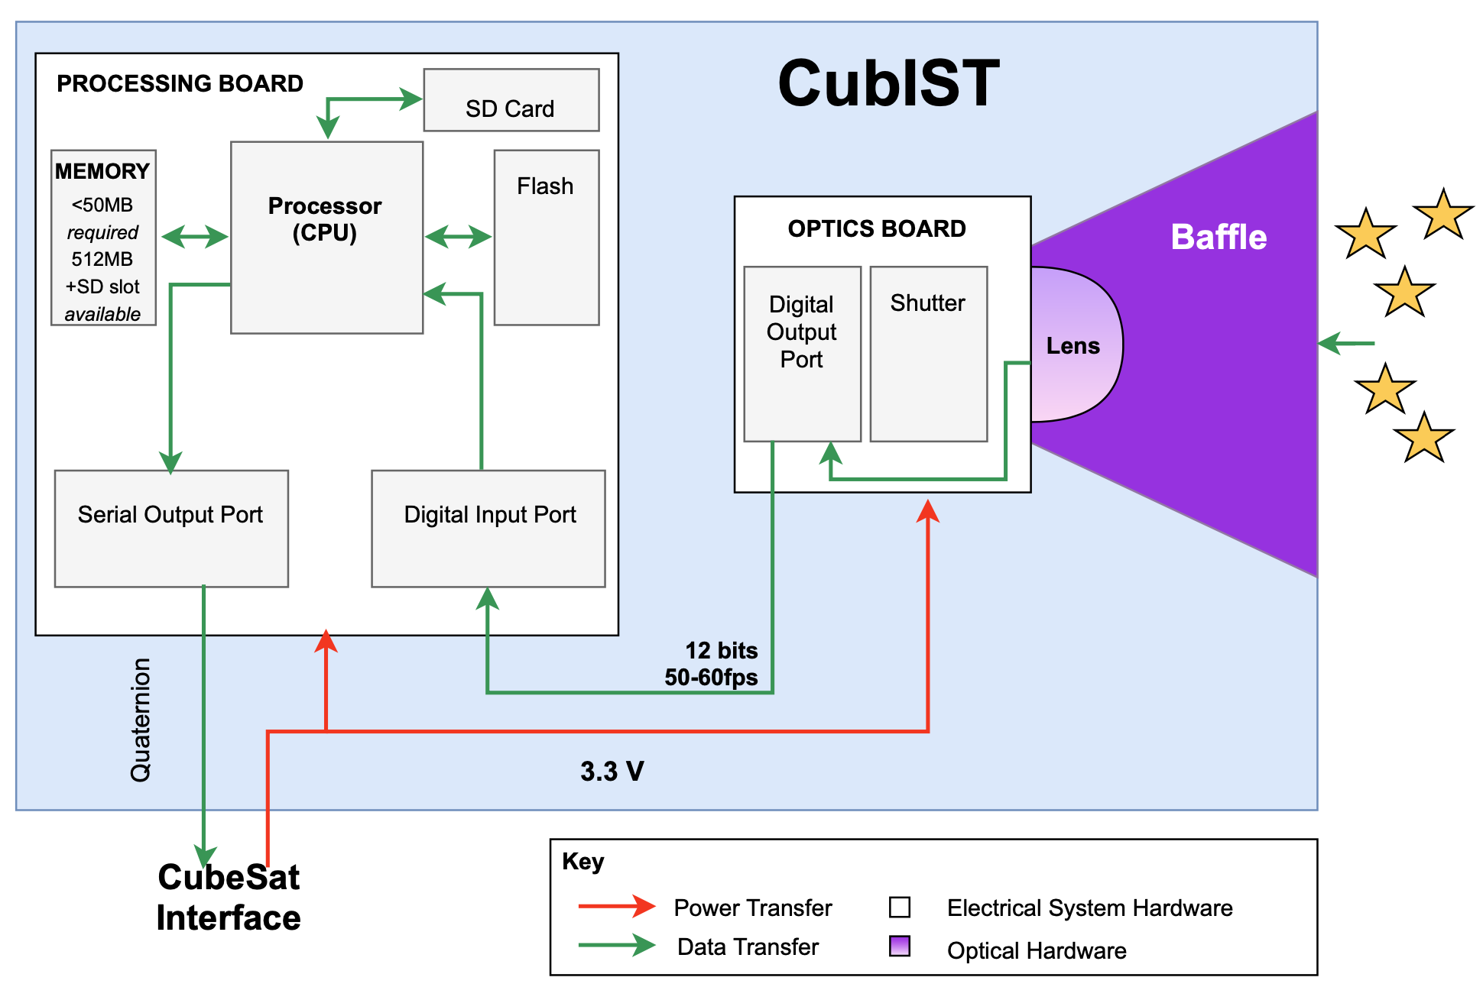
Functional Block Diagram
Project Description
Baseline Design
Feasibility Analysis
Status Summary
Notes:
NATALIE (1min)
Could be easier to do lower bit rate and sample rate
Absolute accuracy of pointing angle: 0.05 degrees
Important components, and why - emphasize, knowing steps of conops, which components are doing which tasks
Define what a baffle is - intended to reduce stray light s/t star tracker is able to adequately recognize patterns by comparing to mean brightness of background - bg cannot be too dominant
Anything tinted blue/turquoise is input/output
Anything purple is memory
Success heavily relies on image processing and pattern matching
Say something about pixel size here? 12 bits dn tell anything without pixel size
Be specific about what digital input port is
Numbers here vs at end
Clean up A vs V
Could have 1 fdb w/o info, show again later with numbers
We do not talk anywhere in pres about resolution of image sensor
Digital input port - ambiguous

Slide 8
Mission Functional Requirements
FR.1 | The star tracker shall acquire images of star fields.
FR.2 | The star tracker shall match identified star patterns to a known star catalog.
FR.3 | The star tracker shall produce attitude solutions at a constant rate of 1 Hz.
FR.4 | The star tracker shall operate with minimal change in attitude of the CubeSat.
FR.5 | The star tracker shall be equipped with a baffle to reduce stray light.
FR.6 | The star tracker shall be compatible with the CubeSat architecture.
FR.7 | The star tracker shall abide by all federal CubeSat regulations.
Project Description
Baseline Design
Feasibility Analysis
Status Summary
Notes:
QUAID (1min) might want to just say "this is what Natalie has already described, formalized as a list of requirements"
(Show levels of success and/or FR’s - what defines success?)

Slide 9
1.2 Project Description
Baseline Design
Project Description
Baseline Design
Feasibility Analysis
Status Summary
Notes:
NATALIE?
Thoughts on bringing up higher such that baseline design is

Slide 10
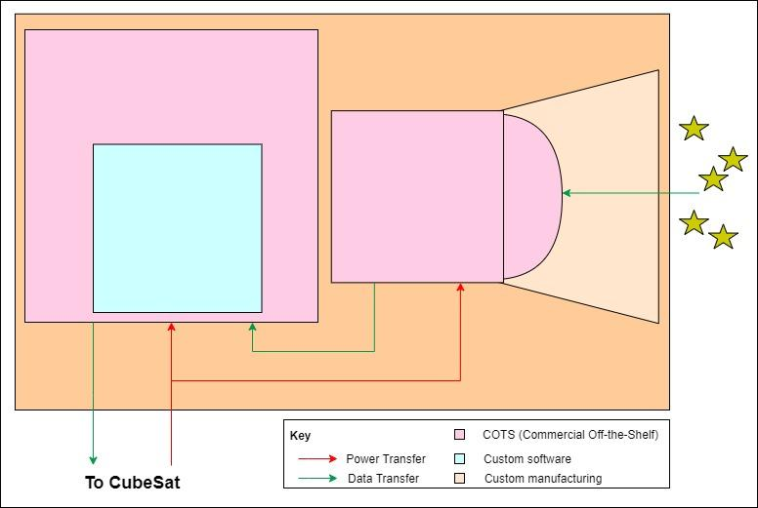
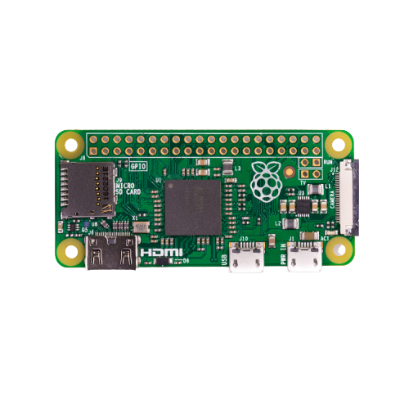
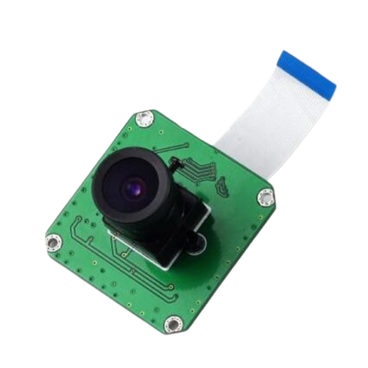
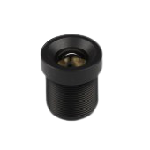
Component Overview
Integrated Circuit
Structural Enclosure
In-house manufactured:
Machined Aluminum 6061
Microcontroller:
Raspberry Pi Zero 1.3
Baffle
In-house manufactured:
Material:
Aluminum 6061-T6
Coating:
Aeroglaze Z306 Polyurethane Coating
Image Sensor
Processor (CPU)
Lens
Camera module:
ArduCam CMOS AR0134
Processing algorithm:
Basis: Tetra3
Method: Lost in space
Performance modifications:
FOV, operational conditions
Project Description
Baseline Design
Feasibility Analysis
Status Summary
Notes:
NATALIE (1-2min)
The uniqueness in this project comes from 1) modifying existing open source code to be adaptable to a wide range of fields of view, and output attitude solution in form compatible w/ CubeSat ADCS; 2) optimizing both power and accuracy simultaneously; and 3) manufacturing a baffle that is compatible with COTS optical components for a low cost

Slide 11
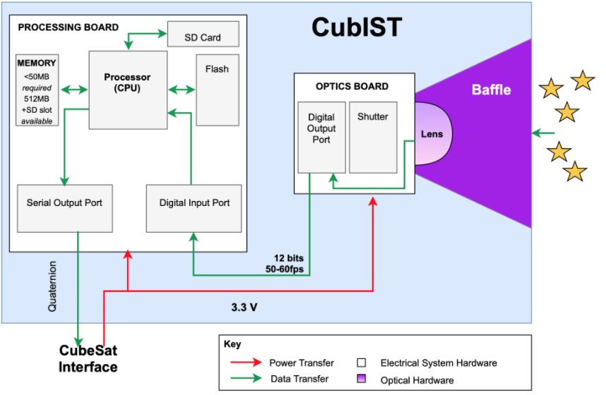
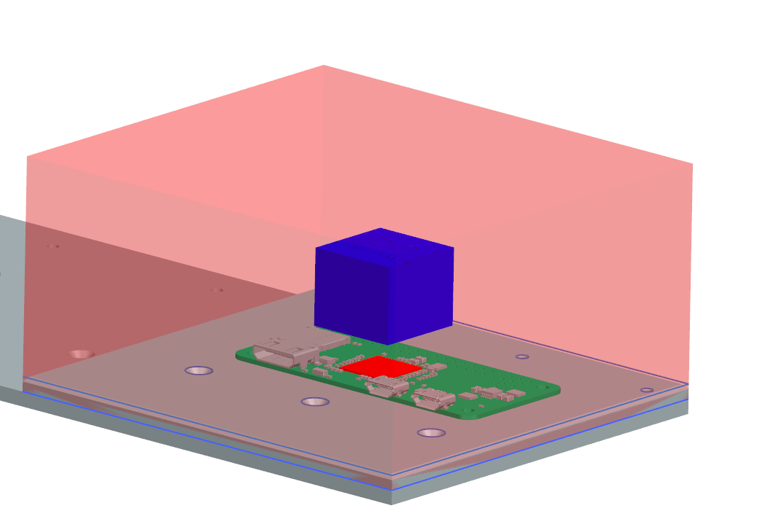
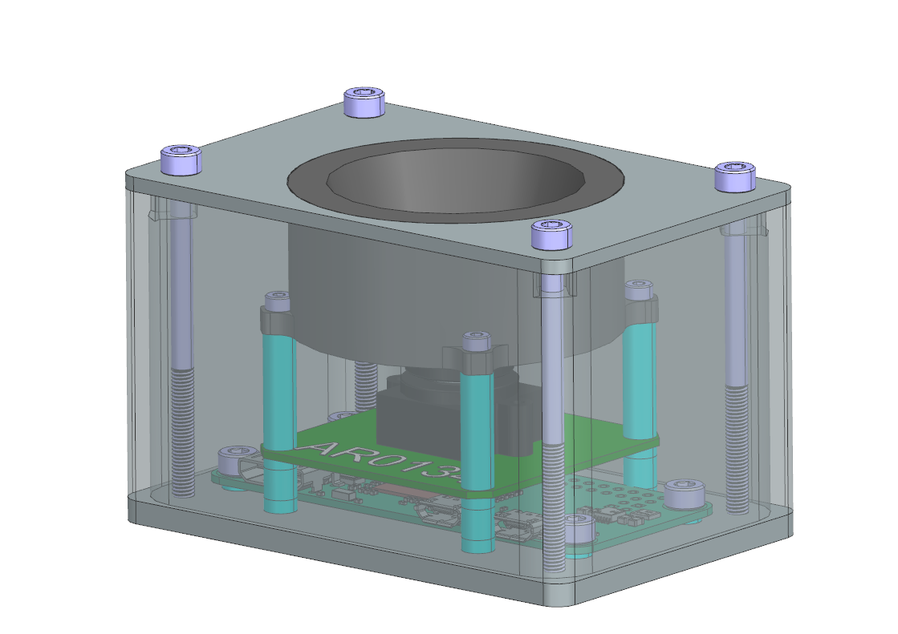
Hardware: Baffle & Enclosure
Raspberry Pi Zero
Camera Module
Working Volume (1/2U)
The enclosure shall:
Contain all components of the CubIST system
Be easily accessible for testing
Mount to a CubeSat chassis
Fit within 1/2U (10x10x5cm)
Support all components of CubIST during
testing, integration, and launch
The baffle shall:
Meet system stray light requirements
Meet system field of view requirements
Mount to enclosure/camera module
5cm
10cm
10cm
Above: Working volume visualization
Right: Notional enclosure design, to scale
Project Description
Baseline Design
Feasibility Analysis
Status Summary
Notes:
CAM (1min)
Design requirements for structure/optic integration
d/n need unreasonably sized outer aperture
Camera is 4x4x2 - make it bigger
Lots of refs to maxwell - d/n need
Do not put in chassis plate

Slide 12
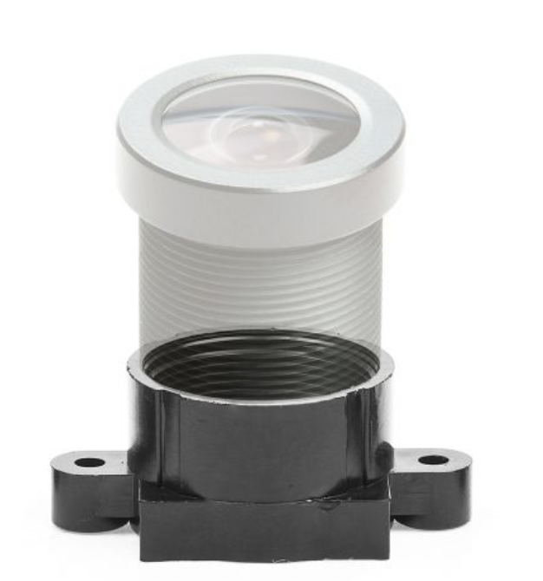
Hardware: Optics
The image sensor shall:
Be Effectiveness in low light: high signal to noise ratio (SNR), quantum efficiency (QE) in desired wavelengths (520-800 nm)
Low light conditions cause external noise and detector noise to be in high consideration for understanding potential error
Detector noise consists of: dark leakage current and temporal read noise
The lens shall:
Have optimal focal length and aperture diameter for detection of traceable stellar magnitudes provided by software (6.5) and will comply with FOV
The camera module shall:
Integrate lens and image sensor for minimal distortion, and to ensure compatibility with microcontroller
Lens
Image Sensor
Camera Module
Project Description
Baseline Design
Feasibility Analysis
Status Summary
Notes:
CHAD (1 min)
Because this is the component of the project for which
team members have the least experience, the development
of the optics system has been determined to be the most
critical element in terms of time.
• A primary function of a star tracker is to image a re-
gion of stars in order to find its orientation in space.
Finding lenses and detectors for image capture and
hand over to software is critically important for the
success of the instrument.
Read noise is a combination of noise from the pixel and from the ADC. The Read Noise (RN) of the sensor is the equivalent noise level (in electrons RMS) at the output of the camera in the dark and at zero integration time.
dark current is the relatively small electric current that flows through photosensitive devices such as a photomultiplier tube, photodiode
Need to introduce requirements and critical project elements - go back to that a couple times
This slide takes away from the overall goal of this presentation
Image Sensor Functionality
Step1: Photoelectric conversion. Step2:Charge Accumulation. Step3: Transfer Signal. Step4: Signal Detection, Step5: Analog to Digital Conversion
Image sensor captures photons from target view, then converts photons to electrons. With the electron, the sensor manipulates the harnessed charge to a signal charge. The signal charge is then sent to a detector node which converts into a voltage, which is sent to an ADC to become a usabe digital values.
The term quantum efficiency may apply to incident photon to converted electron ratio of a photosensitive device
Chesney Note: want a camera with low read-out noise, high red and NIR QE, poss flight heritage

Slide 13
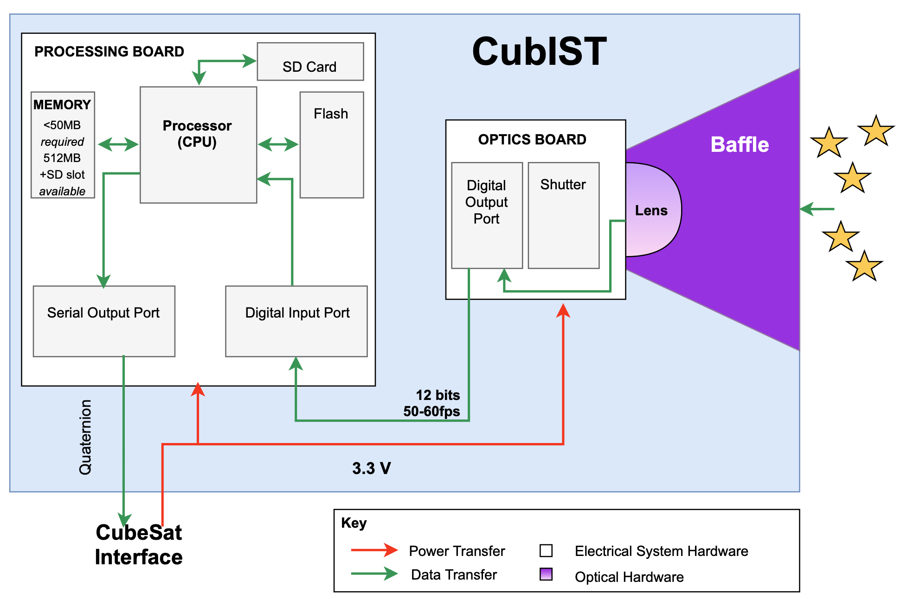
Hardware: Electrical System
ELECTRICAL SYSTEM HARDWARE
Image sensor interface
Microcontroller
Memory
Harnessing/ Connectors
Data
Power
Cubesat interface
Image Sensor - uc interface
Project Description
Baseline Design
Feasibility Analysis
Status Summary
Notes:
CHAVA (1min)
Specific design choices/components (section 4 and 6 from CDD)
Display port connectors/pinouts
Pixel dimensions
dimensions of just 2.6 x 1.2 x 0.2 inches
Group pics with labels (processor w processor, cam module with cam module)
Would be good to have dimensions
How many pixels is cam module

Slide 14
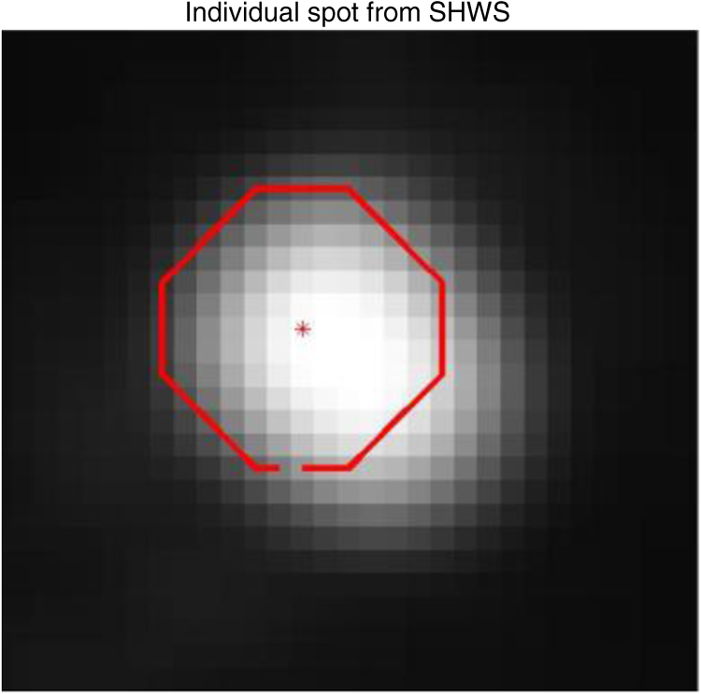
Software: Flow Chart
Database Creation
Image Acquisition
Image Processing
Star Pattern Identification
Solution Output
Find Attitude Solution
Match Pattern to Database
{
{
q
=
Project Description
Baseline Design
Feasibility Analysis
Status Summary
Notes:
Matthew (1min)
General Algorithm:
Based on Camera FOV : create database of stars from Yale Bright Star Catalogue (containing bit string “fingerprints” of stars). Only needs to be run once for the mission. There are different catalogs but they are all relatively similar in functionality.
Reads in image; identifies brightness of objects relative to background (centroiding algorithm)
Calculates distances between each pair of identified stars in image
Converts distances to a bit string of 5 numbers (a unique “fingerprint”)
Compares found fingerprint to catalogue and identifies a match
Match information corresponds to camera pointing direction; returns dec., RA, and roll angle
Break it down into image matching and star catalog
Higher level here - any software we are running
Higher level - basic what all softwares do
Star catalog - talk about why we chose this one
Mention other options

Slide 15
2.1 Baseline Feasibility
Critical Project Elements
Project Description
Baseline Design
Feasibility Analysis
Status Summary
Notes:
Natalie
Since review time is limited, students should focus on the key aspects of project feasibility, by identifying the critical elements to project success, and provide evidence that the most important of these elements are feasible.
It is expected that the key elements to be analyzed for feasibility are clearly defined, and reasoning about why they were chosen for analysis and presentation is provided. For each key element, a first-level feasibility analysis is expected. Some key elements may need a more in-depth treatment, depending on their importance to project success and the complexity or difficulty of the feasibility issues involved.
Evidence of baseline feasibility (50%)
Identification of critical project elements, choice of key elements to present
Critical elements make sense, and priority selection was related to project objectives (8-10 pts)
Evidence of baseline feasibility
3.2.1 Identification of critical project feasibility elements, choice of key elements to present
3.2.2 First-level feasibility analyses of all key critical project feasibility elements.
3.2.3 Other evidence (comparisons, simulations, experiments) as needed to show feasibility

Slide 16
Critical Project Elements
Project Description
Baseline Design
Feasibility Analysis
Status Summary
Notes:
Natalie
CPEs are what link functionality to requirements - should drive this whole presentation
Critical project elements for this project are those that 1) require a disproportionately large amount of resources, or 2) are most sensitive to parameter changes or subsystem compatibility.
Processing time/power - directly linked to design requirements for meeting CubeSat compatibility power draws
Accuracy - b/c this determines CubeSat controls, and also attitude calc is recursive - depends on previous solutions - do not want error to propagate
Absolute accuracy of pointing angle: 0.05 degrees
Storage - star catalog takes up a lot of memory, and also need to make sure data not lost or else could not carry out its main function
Image sensor/camera module - expensive
Light attenuation of baffle - directly determines what percentage of the time CubIST can be operational and have usable/meaningful outputs
Redundancy here to bring back FBD and drive home the fact that optics/software interfacing is most important part
Going to take longer on RP Zero
On desktop, takes ~1s per image

Slide 17
Critical Project Elements/Feasibility
Status:
Feasible
In Progress
Infeasible
Subsystem | Design Requirements
Enclosure | DR 6.2: The star tracker shall occupy less than half of a cubic rack unit (0.5 U) in volume. DR 6.4: The baffle structure shall align with the structural modes of the CubeSat.
Baffle | DR 1.2-3: The star tracker shall operate within 60° of the sun & 20° of the moon. DR 5.1: The baffle shall be mounted to the lens. DR 5.2: The baffle shall reduce stray light with an exclusion angle of 30° or less.
Optics | DR 1.1: The camera shall have a field of view (FOV) of 40°. DR 1.5: The camera shall output each image to the onboard processor. DR 4.2: The star tracker shall operate with a slew rate of 2°/s or less.
Electronics | DR 6.1: The star tracker shall operate on a maximum continuous power of 1W, the processor shall be compatible with the selected optical module, and will have the necessary storage and processing power to host and execute the star tracker software suite.
Software | DR.2.1, 3.2, 3.4 (from FR.2, 3): Software is feasible for varying FOVs and can interface with processor.
Project Description
Baseline Design
Feasibility Analysis
Status Summary
Notes:
NATALIE
Compatibility between components, and need to have a defined process that works every time - accuracy, baffle, store catalog
Bold stuff in here

Slide 18
2.2 Baseline Feasibility
Feasibility Analysis
Project Description
Baseline Design
Feasibility Analysis
Status Summary
Notes:
Cam - “Note from first-pass presentation: I think we all should have more clear transitions from "describing a component" to "*why* it is feasible"”
We are demonstrating that we can put them all together, but have not yet demonstrated that we can achieve the functionality of a star tracker
First-level feasibility analyses of all key critical project elements. Other evidence (comparisons,
simulations, experiments) as needed to show feasibility
All critical element feasibility evidence was credible and convincing (30-40 pts)
Next slide should be a table of all feasibility analyses

Slide 19
2.2.1 Hardware: Enclosure
Options considered:
Machined Aluminum 6061
Machined Ultra-High Molecular Weight Polyethylene (UHMW)
Selective Laser Sintering (SLS) Printing
Fused Deposition Modeling (FDM) Printing
Feasibility parameters:
Cost, mass, manufacturability, robustness
Selection:
Machined Aluminum 6061
Rationale: flight heritage, reasonable cost & mass, manufacturable in-house, can easily interface with electronics, camera, & baffle, and relatively high strength
Will utilize FDM for early prototyping & fit checks
Above: Blue Canyon Technologies Nano Star Tracker (NST), an example commercial star tracker with a machined metal enclosure
Right: Notional enclosure design
Per the information presented above, the Machined Aluminum 6061 architecture meets Design Requirements 6.2-6.4 for the CubIST Enclosure. | FEASIBLE
Backup
Project Description
Baseline Design
Feasibility Analysis
Status Summary
Notes:
CAM
(what options/types of options were considered?)
(What was the most important principle of the decision? relate to CPEs)
(show that the chosen option is feasible given the abilities of existing star trackers)
(show that the chosen option is feasible regarding compatibility with other subsystems)
(show that the chosen option is feasible in terms of functional requirements, design requirements, resources, and class time/money constraints)
(for each “chosen” element, explicitly state quantities like power, cost, mass, etc -> add up to show total budget tables at end)
Sources of error; safety margin

Slide 20
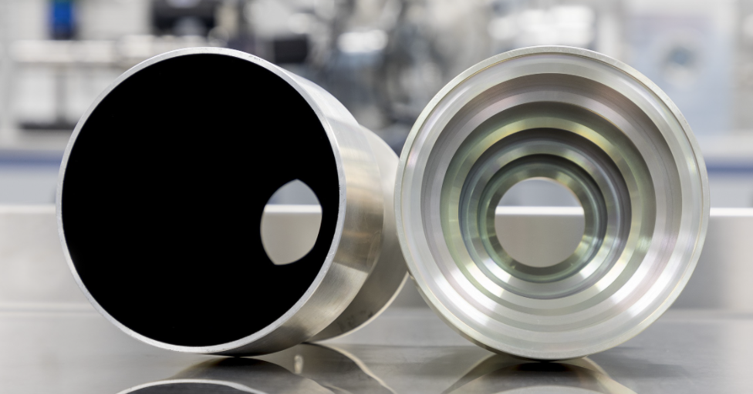
Optics: Baffle
Machined Aluminum 6061
Rationale: strength, flight heritage, cost & mass, manufacturable in-house with a CNC mill, same CTE as enclosure, and can easily be mounted to enclosure
Aeroglaze Z306 Polyurethane Coating
High solar absorptivity > 0.95
Emissivity = 0.9
Moisture-curing polyurethane coating which cures to flat black
Low outgassing
Widely used in optics and aerospace industry
CU Aerospace Senior Projects Heritage (Baffling Buffs 2017)
Professional application due to small geometry
Surrey NanoSystems baffle as an example of a machined aluminum baffle with internal light absorbing coating (Vantablack)
Project Description
Baseline Design
Feasibility Analysis
Status Summary
Notes:
QUAID CTE = coefficient of thermal expansion (good to think about when doing interface design)
Why these materials are good, and describe image slightly to give viewers an idea of what veins look like for later discussion (vanes are also on previous slide)

Slide 21
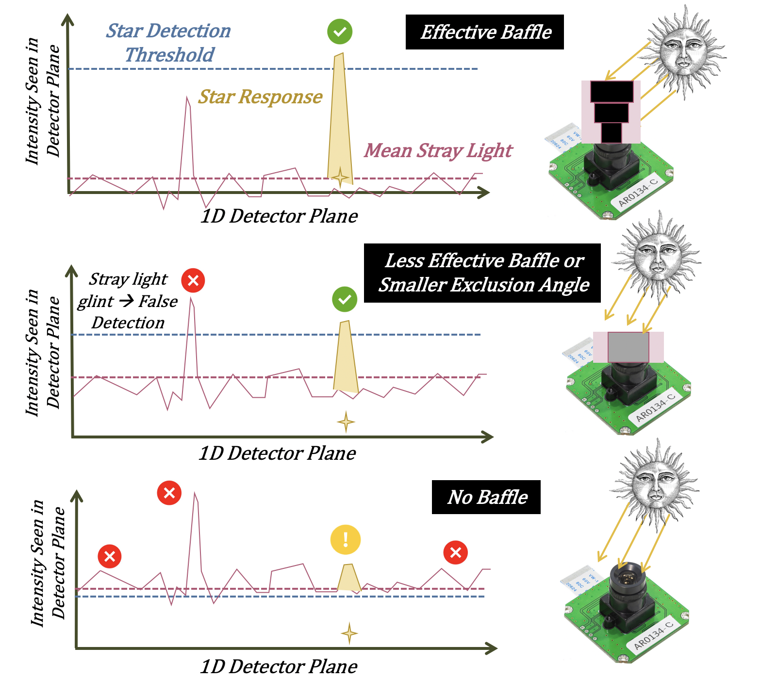
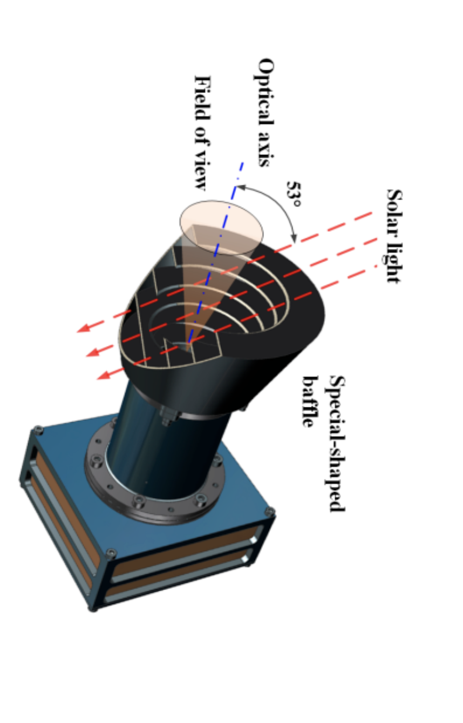
Optics: Baffle
Attenuate stray light from outside the system’s field of view (FOV)
Circular System FOV
FEATURES
Exclusion Angle
Geometry
Internal Features
Internal Coating
Vanes (knife edges)
Light from a bright source
PERFORMANCE
System Field of View (FOV)
Light absorbing inner coating
Point Source Transmittance (PST) at detector (from stray light outside of FOV)
Typical Stray Light Baffle
Project Description
Baseline Design
Feasibility Analysis
Status Summary
Notes:
QUAID Don’t say “block” say “reduce” or “attenuate” stray light
PST = ratio of stray light irradiance in the desired location to light irradiance at different angles relative to the optical axis at the entrance aperture of the optical system
Stray light exclusion angle is measured from boresight of the baffle
The baffle geometry drives the system field of view and dictates the exclusion angle, however internal features like vanes and a light absorbing coating drive baffle performance.
Description of a one dimensional slice of the detector and its logic
Top: Good stray light attenuation
Middle: Ok stray light attenuation
Bottom: Bad stray light attenuation
False detections could be caused by glints or bursts of stray light that will cause a spike on the detector like a star. In the bottom case, if the level of stray light is high the resulting image will be oversaturated and the sensor will be blinded and not able to detect stars, in the middle case a dimmer level of stray light to raise the background noise and contribute to the false detection rate. Starlight is overlapped on top of the stray light response so as you get closer to the sun or moon the attenuation of stray light weakens (shown in middle picture) and false detections or distortions are more likely.
The other curves are described as the stray light variation distributions and they describe the likelihood that a sample window containing stray light will deviate from the mean stray light level described in Figure 2.3. For weak attenuations (orientations closer to the stray light source), the area under the distribution curve that surpasses the star detection threshold is greater than the same area for a strong attenuation. It is far more likely to experience a false detection at weaker attenuations.

Slide 22
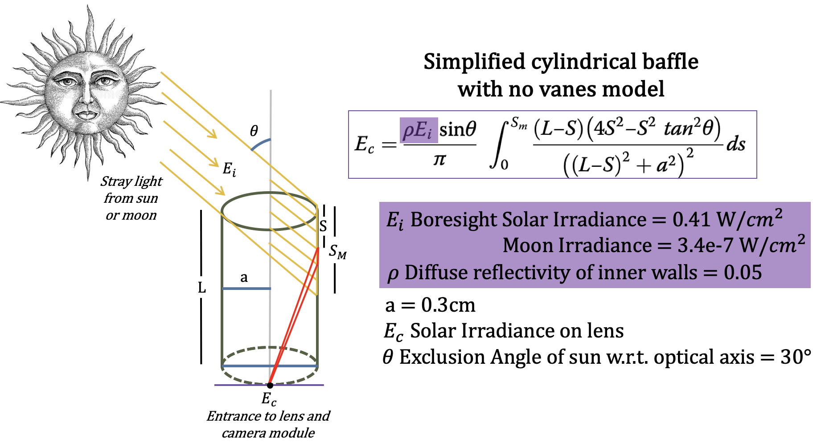
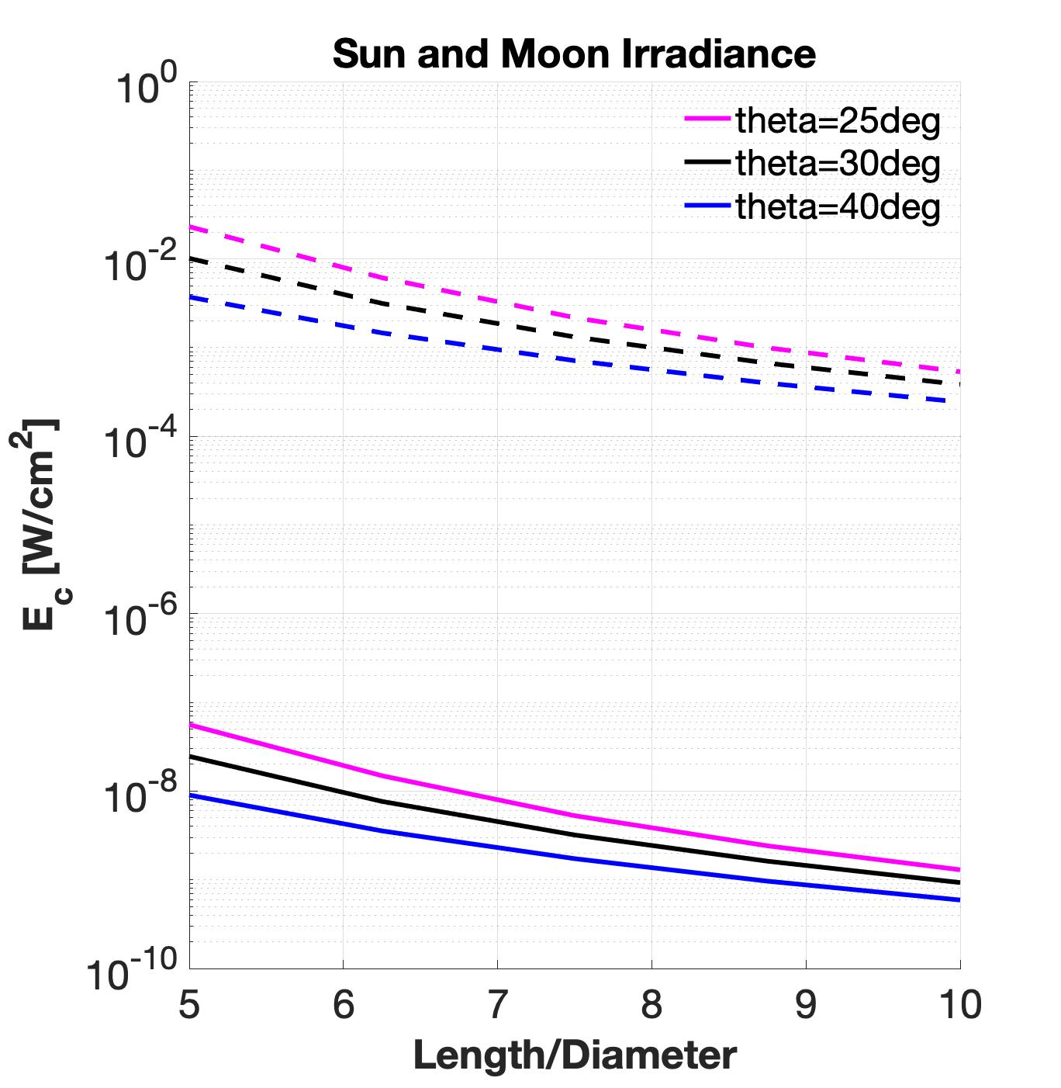
Optics: Baffle (Performance)
SUN
Baffle Length [cm]
Irradiance Ratio for Varying Sun Angle
MOON
DR 5.2: The baffle shall reduce stray light with an exclusion angle of 30 deg or less. | FEASIBLE
Project Description
Baseline Design
Feasibility Analysis
Status Summary
Notes:
QUAID Apparent brightness of sun and moon is a function of luminosity and distance

Slide 23
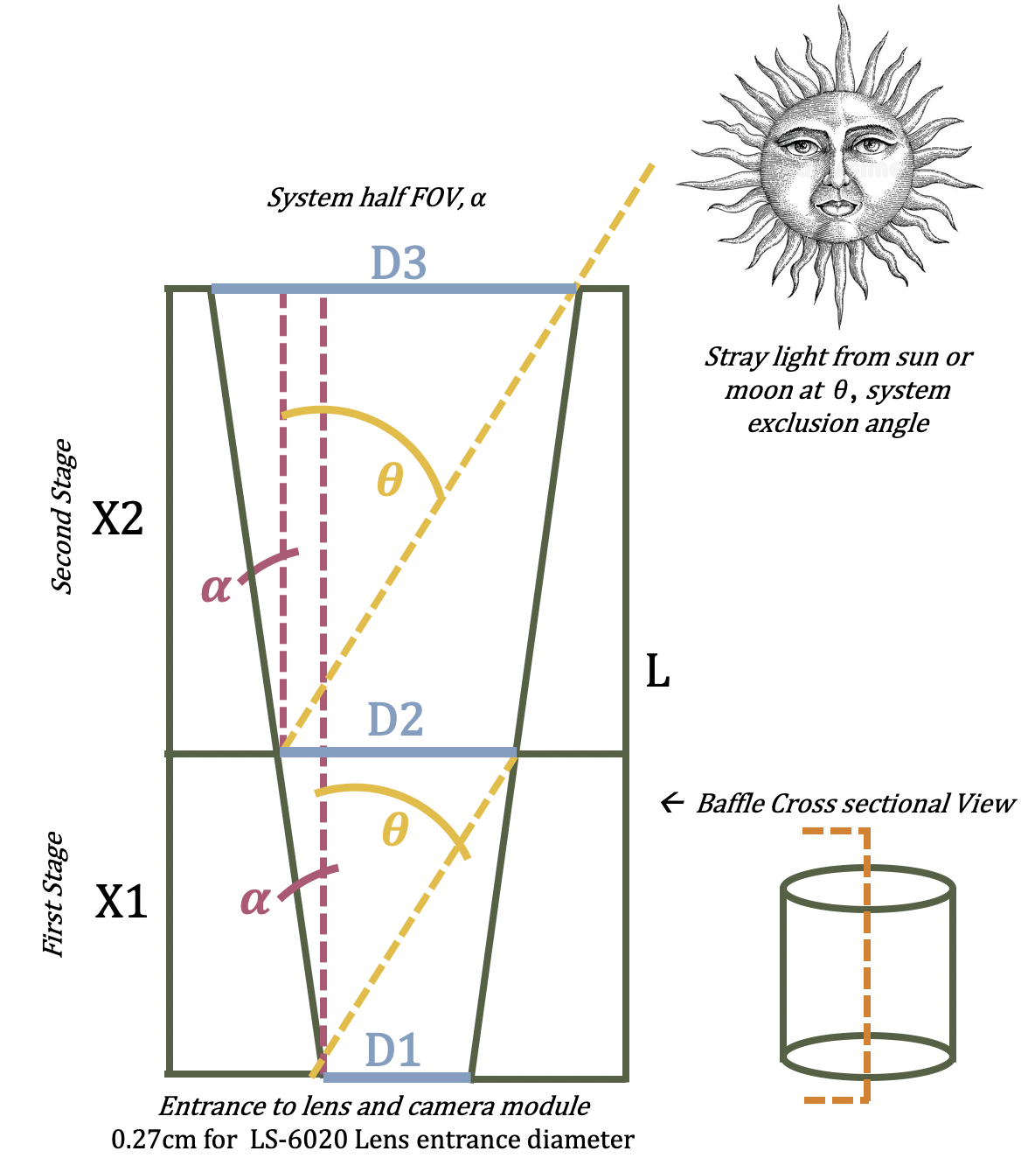
Optics: Baffle (Field of View)
ɑ | θ | X1 | X2 | D2 | D3 | L
5° | 30° | 0.55 | 0.75 | 0.36 | 0.50 | 1.30
11° | 30° | 0.71 | 1.43 | 0.54 | 1.10 | 2.14
17° | 30° | 1.00 | 3.25 | 0.88 | 2.87 | 4.25
5° | 25° | 0.71 | 1.49 | 0.39 | 0.58 | 1.76
11° | 25° | 1.00 | 2.43 | 0.66 | 1.6 | 3.43
Geometric dimensions in [cm] which fit within volume requirements for a range of half angle FOV and exclusion angles
DR 5.2: The baffle shall reduce stray light with an exclusion angle of 30 deg or less. | FEASIBLE
Project Description
Baseline Design
Feasibility Analysis
Status Summary
Notes:
QUAID?
Now we discuss the conical baffle shape. The angle alpha is measured from the baffles boresight
Fits within dimensions
Geometry analysis for a two stage baffle design. The geometry drives the field of view of the system and theoretical exclusion angle. For an exclusion angle of 30 degs per requirement DR 5.2 the following geometries f

Slide 24
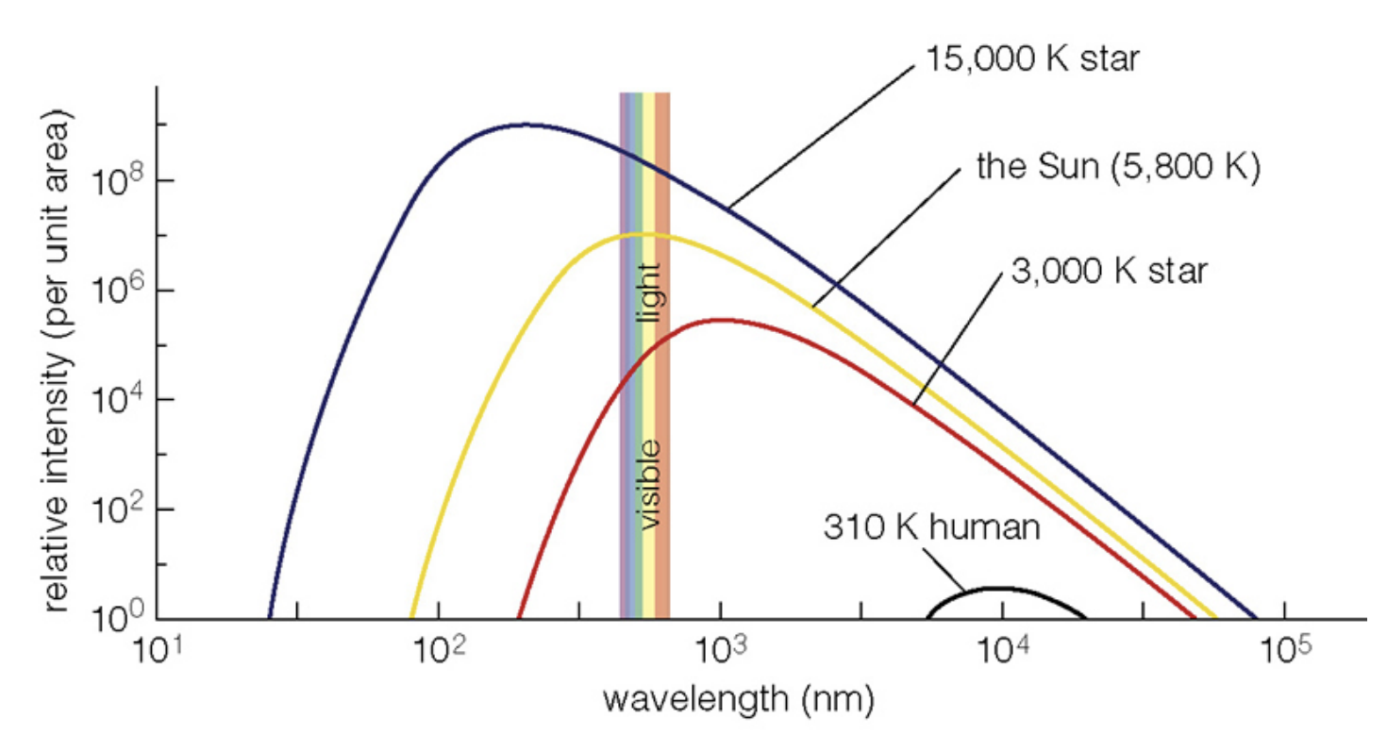
Lens: LSM Detection Capability
Focal Length, 𝑓, drives ability to detect optimal Limiting Stellar Magnitude (LSM)
For LSM of +6.5 requires minimum 𝑓 of 5mm
Ex. LS-6020
Lenses are compatible with star magnitudes. | FEASIBLE
F/# = 2.2
Focal Length = 6.0mm
Aperture = 2.72mm
Without IR Filter
Project Description
Baseline Design
Feasibility Analysis
Status Summary
Notes:
CHAD
Distortion is the displacement of the image from the paraxial position and is different from other aberrations. So it causes displacement of the star image, especially at the end of the FOV, and changes the center of the star. Therefore the distortion in the star sensor should be controlled.
The F# is one of the most important parameters of any optical system controlling the energy entering the detector through entrance aperture of the optical system. Since F# controls magnitude range of stars in the FOV, it plays an important role in star sensor. With a constant value of focal length, high amount of F# decreases aperture size, limiting the stellar magnitude.
A *good* lens will likely have lambda/D (the spot size in angular units) times the focal length for a point source (read star) smaller than a pixel. This is bad as it means you can only determine location to a pixel width / focal length, which is typically awful. They want the image of a star to cover 4 pixels so that a centroid gives them resolution of 1/20 pixel width. This may take deliberate blurring (defocus, spherical aberration, etc).
The focal length sets the field of view which is usually determined *first*. Then find the biggest lens with that focal length. This gives you the “F number” of the lens, it’s focal length over the diameter. Lenses faster than F/1 (where the diameter equals the focal length) are rare (but possible). Such lenses tend to have a lot of distortion etc.

Slide 25
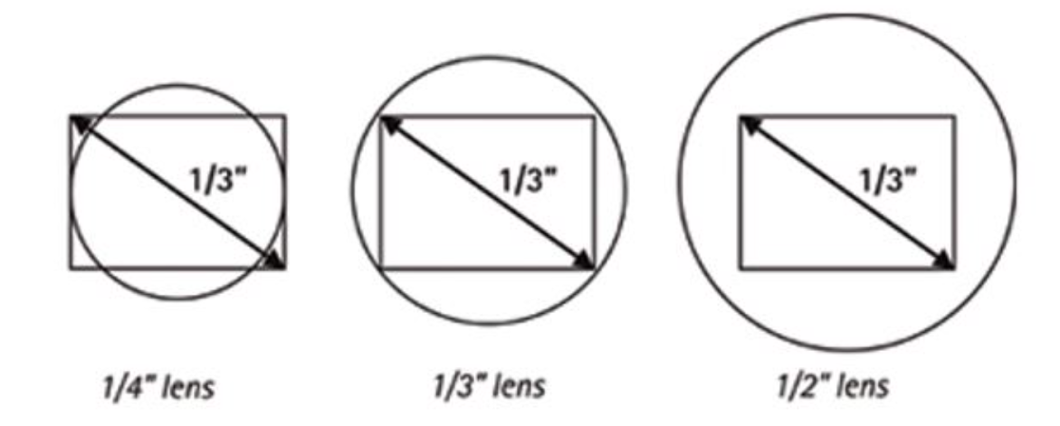
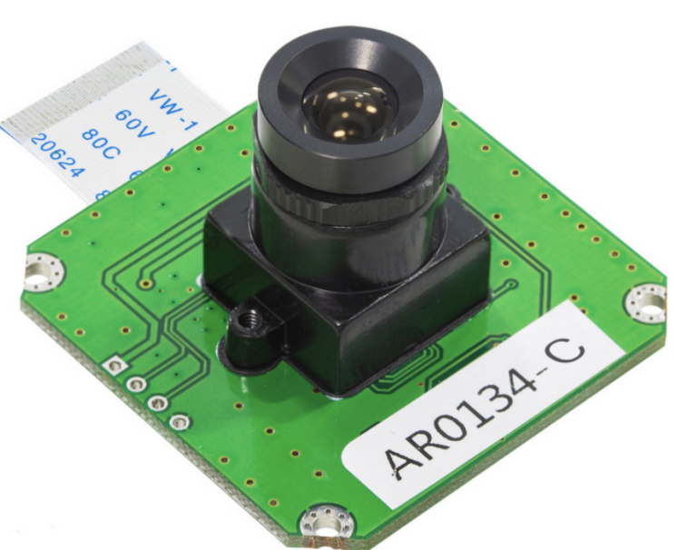
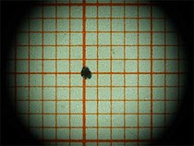
Lens: Optical Formats
Image Format
Sensor/Lens Interface
Vignetting Example
Standard M12 board Mount
Optical compatibility between camera module and lens. | FEASIBLE
Interface between camera module and lens. | FEASIBLE
Project Description
Baseline Design
Feasibility Analysis
Status Summary
Notes:
CHAD
Image sensor is placed underneath the m12 board mount. Thus optical format is imporant
Will wrap this slide up later --Maria
Lens (LS-6020 NoIR)
(what options/types of options were considered?)
(What was the most important principle of the decision? relate to CPEs)
(show that the chosen option is feasible given the abilities of existing star trackers)
(show that the chosen option is feasible regarding compatibility with other subsystems)
(show that the chosen option is feasible in terms of functional requirements, design requirements, resources, and class time/money constraints)
(for each “chosen” element, explicitly state quantities like power, cost, mass, etc -> add up to show total budget tables at end)
Sources of error; safety margin
Might be good to define vignetting

Slide 26
Image Sensor: Noise/Error Reduction
Image Sensor must be capable of detecting Limiting Stellar Magnitude (LSM) that is compliant with software (+6.5)
With optimal focal length, clarity of stars must be handled mostly by image sensor characteristics
Assumption: Most visible stars that are imaged are ~535 nm.
Ex. QE of AR0134 image sensor is 70% at 530 nm, SNR of 38.6 dB
Sensors capable with QE, and SNR optimal for clear images for LSM detection | FEASIBLE
Project Description
Baseline Design
Feasibility Analysis
Status Summary
Backup
Notes:
Chad
A star tracker with high resolution is able to determine the position of stars more accurately but the accuracy of this determination also depends on the resolution of the star tracker’s sensor and its size, the size of FOV and the accuracy of centroiding.
Optics: Stellar Abberation, Focal Plane Misalignments
Photon:

Slide 27
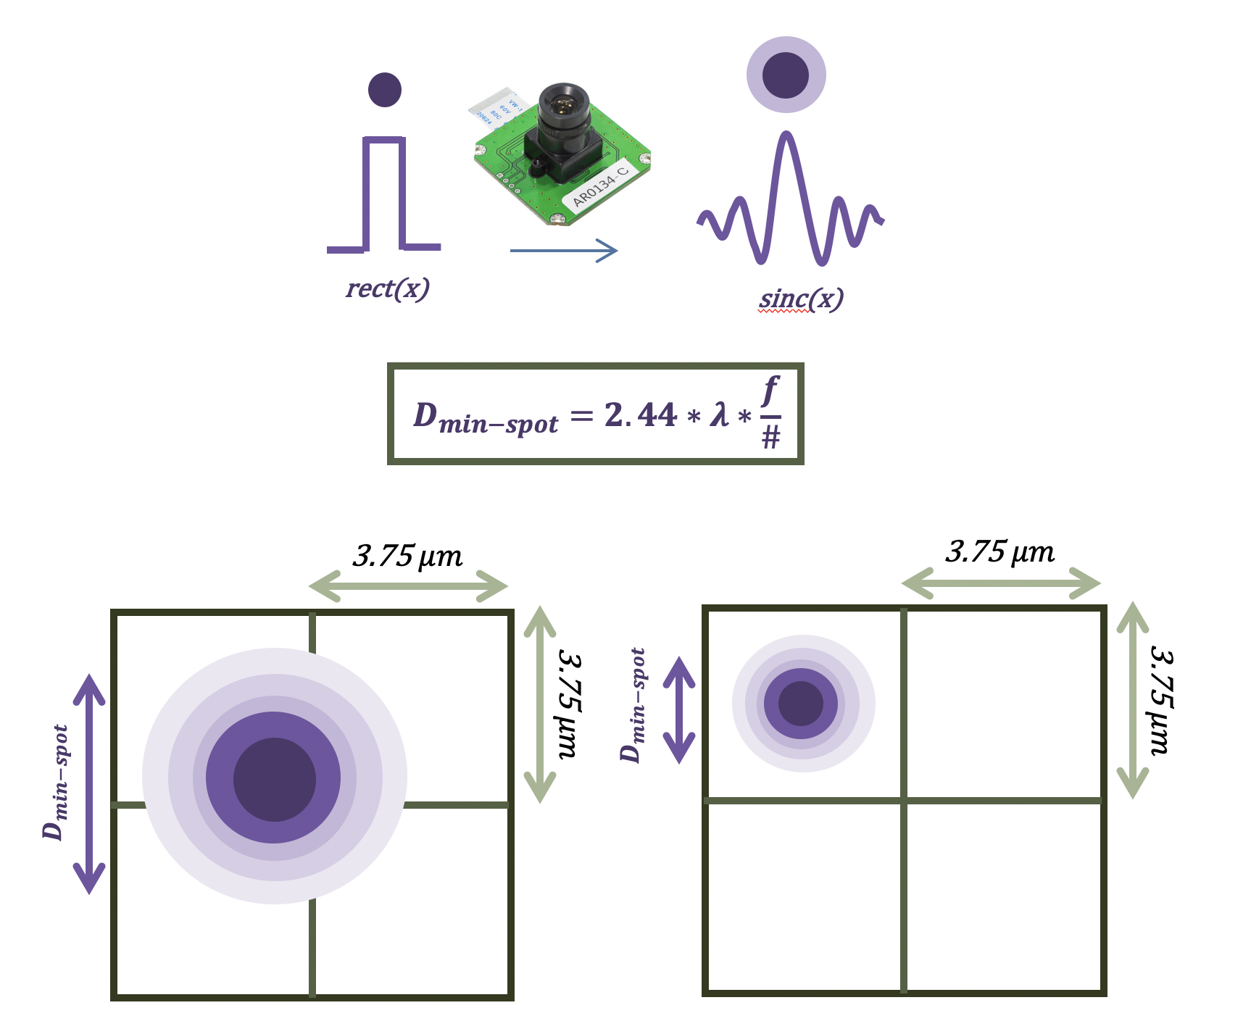
Camera Module: Centroiding
Centroiding is critical for star detection. Camera module parameters that drive this is this spot size with the pixel size
Spot size in this situation is the detectable size of each respective star
Bit will help provide deeper gradient of star brightness spanning over pixels
Spot size must be larger than pixel size
Centroid of the star ideally will be 1/20th of the pixel size
Project Description
Baseline Design
Feasibility Analysis
Status Summary
(INSERT FEASIBILITY STATEMENTS HERE) | INFEASIBLE
Notes:
CHAD
https://www.google.com/url?q=https://www.edmundoptics.com/knowledge-center/application-notes/imaging/limitations-on-resolution-and-contrast-the-airy-disk/&sa=D&source=editors&ust=1633930177504000&usg=AOvVaw01CL1T3GyoT9UhKr82iDbf

Slide 28
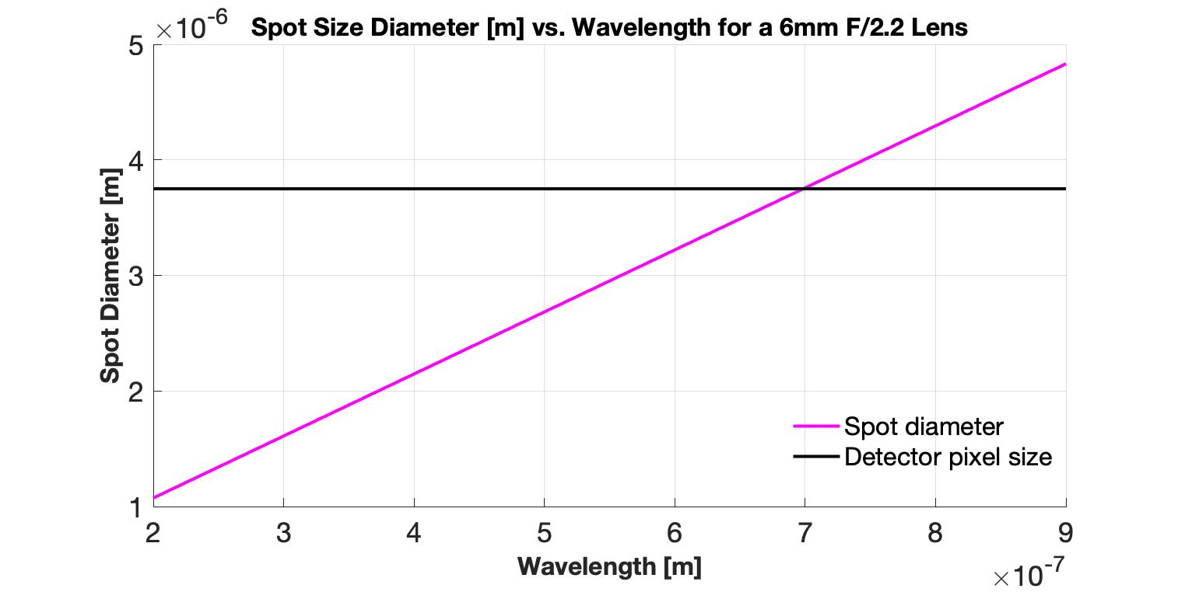
Image Sensor: Centroiding
Minimum spot diameter at 535 nm wavelength: 2.8 µm
Reference example: AR0134 has a pixel size of 3.75 µm
Locking adapter on the modules allows defocusing of the image to improve/increase spot size of the stars
Further testing is required for confident feasibility of defocusing by lens integration via adapter
Spot Diameter [m]
Wavelength [m]
Further analysis with deliberate defocusing is required to prove centroiding feasibility | IN PROGRESS
Project Description
Baseline Design
Feasibility Analysis
Status Summary
(INSERT FEASIBILITY STATEMENTS HERE) | INFEASIBLE
Notes:
CHAD Our lens is 6mm but can pick up 6.5 stellar magnitude - go to max of 7? Yes

Slide 29
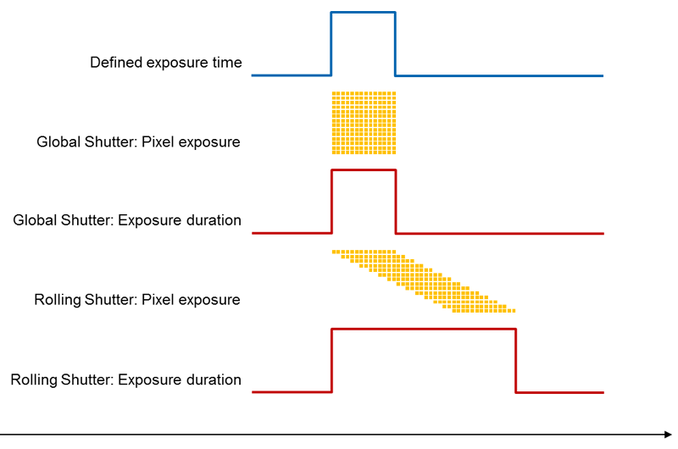
Camera Module: Slew Rate
Exposure time should be limited to time taken for star to move 1 pixel
Ex. Arducam has global shutter, shortest exposure time: 2.22 ms
With known parameters in the function, Tₛ can be determined to be: 5.73 ms
Defined exposure time
Global Shutter: Pixel exposure
Tₛ = Time for 1 pixel movement (seconds)
𝜙 = Star tracker FOV (Radians)
nₚ = # of horizontal pixels
⍵= Angular velocity of star image (rad/sec)
Global Shutter: Exposure duration
Rolling Shutter: Pixel exposure
Rolling Shutter: Exposure duration
Time [s]
DR 4.2: Module can image stars “statically” with +2⁰/s | FEASIBLE
Project Description
Baseline Design
Feasibility Analysis
Status Summary
(INSERT FEASIBILITY STATEMENTS HERE) | IN PROGRESS
(INSERT FEASIBILITY STATEMENTS HERE) | INFEASIBLE
Notes:
CHAD Say explicitly that camera module and slew rate are compatible - make it more clear - this is a great thing to point out
phi=fov (radians)=FOV of 11deg, 0.1919862177 rads( ~.2 rads)
Omega = angular velocity of star(rad/sec), 2 deg/sec, (0.03490658504 rad/sec)
N_p = number of pixels in horizontal array(pixels) = 960 pixels
V_star = velocity of star(velocity of star)
The exposure time should be limited to the time it takes the star to move 1 pixel. You will get elliptical spots but the centroid will be a measure of the mid-exposure time location. Staring longer to collect more light then requires dynamical binning image processing to integrate over the star trail.

Slide 30
Electrical System Hardware Feasibility
Embedded processor: Raspberry Pi Zero 1.3
ARM v7 @ 1 GHz (0.238 GFLOPS/W)
0.6 W Avg Power
512 MB Ram
uSD slot
16 Digital Input/Outputs
Dimensions: 65x30mm
Camera module: Arducam CMOS AR0134 1/3-Inch 1.2MP Monochrome Camera Module
Outputs 12-bit raw data, using parallel output ports.
54 FPS
Single 3.3V power input
5cm
Existing COTS components meet system functional reqs in terms of average operation power, processing power, storage, and dimensions | FEASIBLE
10cm
10cm
Project Description
Baseline Design
Feasibility Analysis
Status Summary
Notes:
CHAVA (1min)
Specific design choices/components (section 4 and 6 from CDD)
Display port connectors/pinouts
Pixel dimensions
dimensions of just 2.6 x 1.2 x 0.2 inches
Group pics with labels (processor w processor, cam module with cam module)
Would be good to have dimensions
How many pixels is cam module

Slide 31
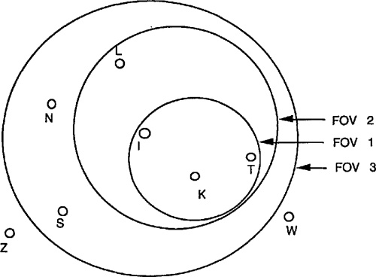
Software: Speed/Accuracy FOV Feasibility
Success is 0.05 degree accuracy
Baseline FOV of 11 degrees
Time to solve: 11 ms
0.003 degree accuracy
FOV of 22 degrees
Time to solve: 10 ms
285% less accurate, 0.01 degrees
FOV of 50 degrees
Time to solve: 12 ms
2200% less accurate, 0.069 degrees
** Note: Each FOV used images from a different imager
11
4
30
DR.3.2, 3.4 (from FR.2,3): Software is feasible for differing FOVs and imagers. | FEASIBLE
Project Description
Baseline Design
Feasibility Analysis
Status Summary
Notes:
MATTHEW 11 degree FOV is standard for star tracker so it was used to compare
Talk to trade space of FOV - why FOV should not go below 11 - Star Catalog
The image illustrates how FOV affects the pattern recognition capabilities of the software.
3 degree slow
Also concerned with capturing enough stars in image
Other considerations for FOV
Want to operate within at least 60 degree of sun
Highest level has within 30 degree
1 Hz Update Rate
57% faster, 2.4 Hz update rate
26% slower, 0.8 Hz

Slide 32
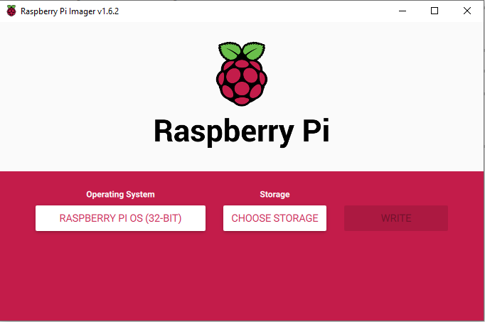
Software: Interfacing Feasibility
Raspberry Pi: Need to run Python scripts on the board
Use Raspberry Pi OS, installed on board’s microSD card via the OS imager
Memory usage is low (~32 MB); SD card memory availability at least double
Allows for C++, Python, etc. to be run
DR.2.1 (from FR.2): Software can interface with processor. | FEASIBLE
Project Description
Baseline Design
Feasibility Analysis
Status Summary
Notes:
MATTHEW
We have not tested this due to a lack of hardware. Theory is developed and possible.

Slide 33
3.0 Status Summary
Project Description
Baseline Design
Feasibility Analysis
Status Summary
Notes:
CHESNEY Status summary and Strategy for conducting remaining studies
Recap baseline design with aspects shown to be feasible vs. studies still needed
Status summary and strategy for conducting remaining studies (10%)
Recap baseline design with aspects shown to be feasible vs. studies still needed
Good summary of feasibility relative to project objectives, feasibility seems clear (8-10 pts)

Slide 34
Feasibility Analysis Summary
Subsystem | Feasibility Statements | Status
Enclosure | Per Feasibility Analysis #1, the Machined Aluminum 6061 architecture meets Design. Requirements 6.2-6.4 for the CubIST Enclosure. | Feasible
Baffle | DR 5.2: The baffle shall reduce stray light with an exclusion angle of 30 deg or less. | Feasible
Optics | Lenses are compatible with stellar magnitudes. Sensors capable with QE, and SNR optimal for clear images for LSM detection. Optical and interface compatibility between camera module and lens. DR 4.2: Module can image stars “statically” with +2⁰/s. Further analysis with deliberate defocusing is required to prove centroiding feasibility. | In Progress
Electronics | DR 6.1 The star tracker shall operate on a maximum continuous power of 2W, the processor shall be compatible with the selected optical module, and will have the necessary storage and processing power to host and execute the star tracker software suite. | Feasible
Software | DR.2.1, 3.2, 3.4 (from FR.2, 3): Software is feasible for varying FOVs & can interface with processor. DR.2.1 (from FR.2): Software can interface with processor. | Feasible
Project Description
Baseline Design
Feasibility Analysis
Status Summary
Notes:
CHESNEY
Specific studies that have been conducted
Subsystems - on track or not?
If not, % of completion?
Good visual representation for PDR might be progress bar from red to green
Have diagram showing that the feasibility passed: CPEs are feasible and specific requirements are met
Relate pixels to accuracy - 10x10 vs 100x100

Slide 35
Remaining Design/Feasibility Studies
In progress Feasibility Analyses
Future Tasks
Optics:
Further investigate feasibility with centroiding
Sensitivity testing of temporal read noise, dark current leakage, and harnessing to further develop the camera module’s absolute accuracy
Software:
Test modifications against edge cases
Simulate microprocessor processing rates
Explore implementing possible stretch goals
Team CDR preparation:
Continue research and development of subsystems
Re-assess verification and validation processes including testing procedures
Conduct Risk Assessment of subsystems, budgeting, and scheduling
Narrow down component selection
Project Description
Baseline Design
Feasibility Analysis
Status Summary
Backup
Notes:
CHESNEY From schedule:
Specific studies (trade/combination/software test/prototypes (?)) yet to do this semester
Justify why important
Major milestones per sub-team and overall
What is expected to take the most time
Anticipated challenges/plan to mitigate
Resources needed to complete
Camera calibration - image distortion
Testing low light conditions

Slide 36
Acknowledgments
Thank you to our customer Dr. Palo, our advisor Dr. Akos, Colin and the JPL team for reviewing our presentation, and everyone else who has helped our team thus far!
Project Description
Baseline Design
Feasibility Analysis
Status Summary
Notes:
CHESNEY

Slide 37
Questions?
Project Description
Baseline Design
Feasibility Analysis
Status Summary
Notes:
CHESNEY

Slide 38
Appendix A: References
[1] Aboaf, A. P., “MAXWELL Mission Handbook, University of Colorado Boulder, Boulder, CO, May 2020, https://drive.google.com/file/d/1T7kUrAEUulwJxJCrwVGooyidulDczV7b/view. Accessed 6 Oct. 2021.
[2] “Deformable Mirror Demonstration Mission.” eoPortal, https://directory.eoportal.org/web/eoportal/satellite-missions/d/demi#top. Accessed 1 Oct. 2021.
[3] Dhraief, Y., and Hedayati, F., “Determining the Requirements for the Star Tracker on JEM-EUSO.” DivaPortal, 2015, http://www.diva-portal.org/smash/get/diva2:852504/FULLTEXT01.pdf. Accessed Sept. 2021.
[4] Dzamba, T., Enright, J., Marciniak, M., and Sinclair, D., “Microsatellite Star Tracker Baffles: Validation and Testing,” AIAA Paper SSC13-III-8, August 2013. https://digitalcommons.usu.edu/cgi/viewcontent.cgi?article=2930&context=smallsat. Accessed 05 Oct. 2021.
[5] “Raspberry Pi OS.” Raspberry Pi, https://www.raspberrypi.com/software/. Accessed Sept. 2021.
[6] “Rolling Shutter, Global Shutter: Two Principles of Exposure.” Baumer, https://www.baumer.com/ca/en/service-support/technical-information-industrial-cameras/rolling-shutter-global-shutter-two-principles-of-exposure-/a/rolling-shutter-global-shutter. Accessed 05 Oct. 2021.
Project Description
Baseline Design
Feasibility Analysis
Status Summary
Notes:
3rd source: MAXWELL handbook

Slide 39
Appendix A: References Continued
[7] “The Effect of Camera Cooling on Signal to Noise Ratio.” Teledyne Photometrics, https://www.photometrics.com/wp-content/uploads/2019/10/Cooling-and-SNR-TechNote.pdf. Accessed 05 Oct. 2021.
[8] Tetra3. The European Space Agency, 2019, https://tetra3.readthedocs.io/en/latest/. Accessed Sept. 2021.
[9] “World’s Blackest Coating Material Makes its Debut in Space.” SpaceRef, 16 May 2016, http://spaceref.com/nanotechnology/worlds-blackest-coating-material-makes-its-debut-in-space.html. Accessed Sept. 2021.
Project Description
Feasibility Analysis
Status Summary
Baseline Design
Notes:
3rd source: MAXWELL handbook

Slide 40
Appendix C: Schedule
Project Description
Baseline Design
Feasibility Analysis
Status Summary

Slide 41
Appendix C: Schedule
Project Description
Baseline Design
Feasibility Analysis
Status Summary

Slide 42
Appendix C: Schedule
Project Description
Baseline Design
Feasibility Analysis
Status Summary

Slide 43
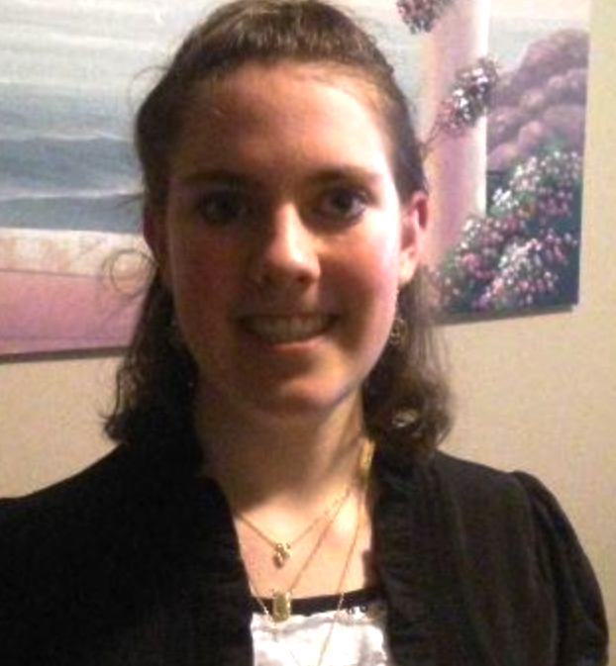
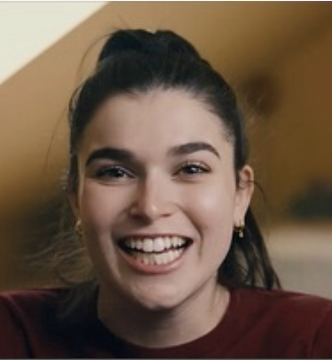
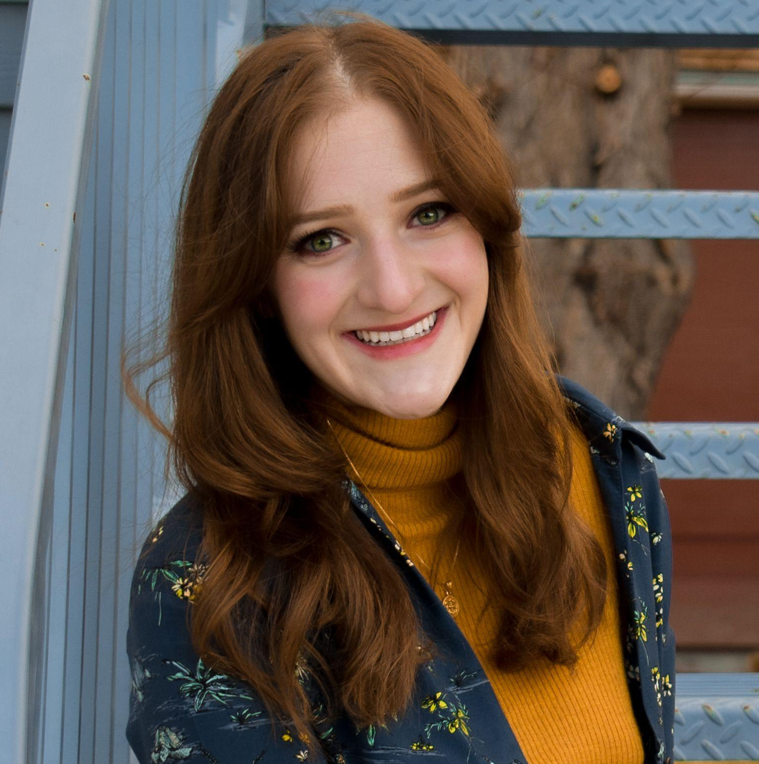
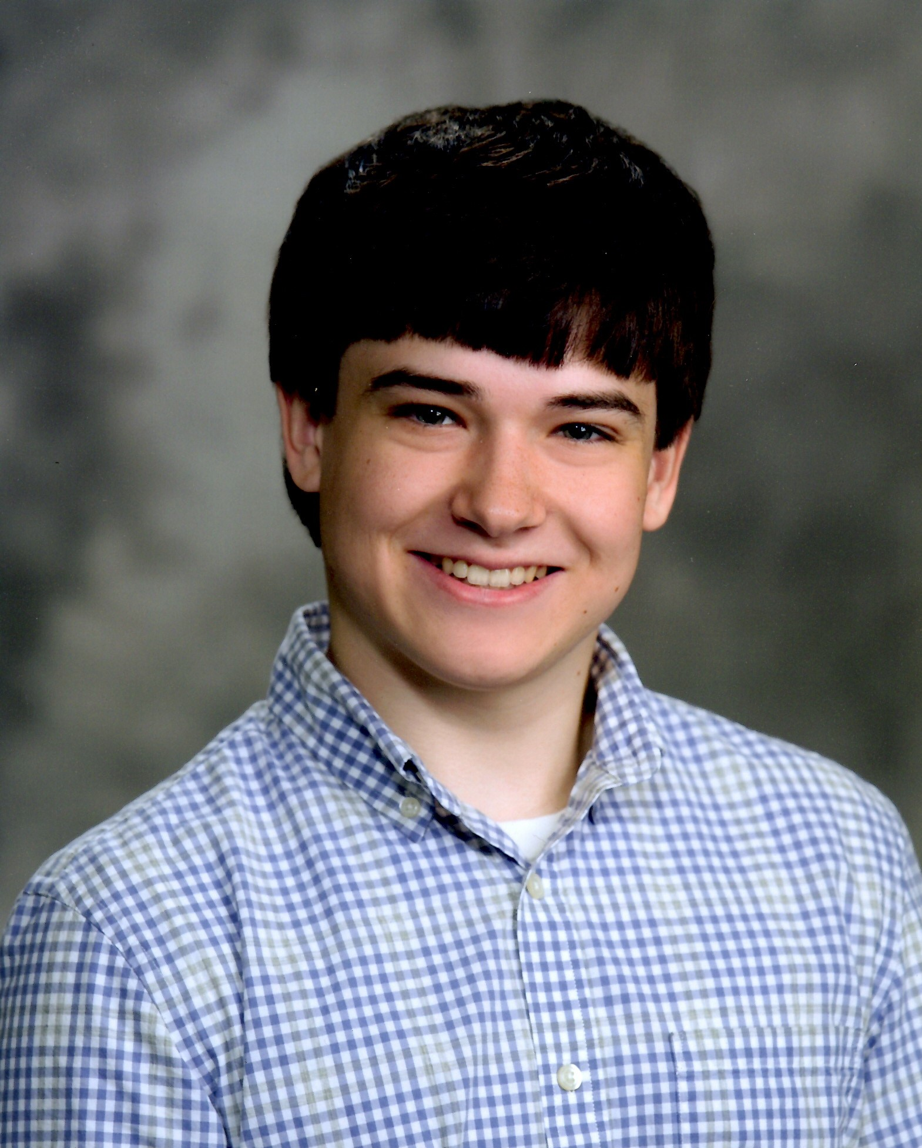
Appendix E: Team Breakdown
Chesney
Josie
Natalie
Cam
Quaid
Chava
Maria
Chad
Nicky
Matthew
Project Manager Chesney
Finance:
Quaid
Systems:
Natalie
Software: Matthew
Manufacturing/ Hardware: Cam
Processing: Chava
Optics: Chad
Quaid Chad
Cam
Matt
Josie Nicky
Chava
Chesney
Chad
Maria Quaid
Natalie
Chesney
Josie
Quaid
Natalie
Maria
Chava
Cam
Nicky
Project Description
Baseline Design
Feasibility Analysis
Status Summary

Slide 44
BACKUP SLIDES

Slide 45
Levels of Success
Specific Objective | Level 1 | Level 2 | Level 3
Image Acquisition | Operate within 60° of the sun and 20° of the moon | 45° of the sun & 15° of the moon | 30° of the sun and 10° of the moon
Power & Comm | Operate on minimum continuous power of 2W | 1W | 0.5W
Volume | 0.5U | 0.4U | 0.3U or less
Mass | 400g | 300g | 200g or less
Attitude Solution | Deliver a quaternion with 1.0° and 1σ absolute accuracy | 0.2° and 1σ | 0.05° and 1σ
Slew Rate | Camera will perform at maximum attitude rate of 0.1°/s | 0.5°/s | 2.0°/s
Duty Cycle | Initial solution produced within 120 s, then continuously at 0.2Hz | 60 seconds, 1 Hz | 30 seconds, 5 Hz
Project Description
Baseline Design
Feasibility Analysis
Status Summary
Notes:
d/n necessarily need this
Should all be at level 3, only go backwards if investigate enough to not think it’s feasible anymore

Slide 46
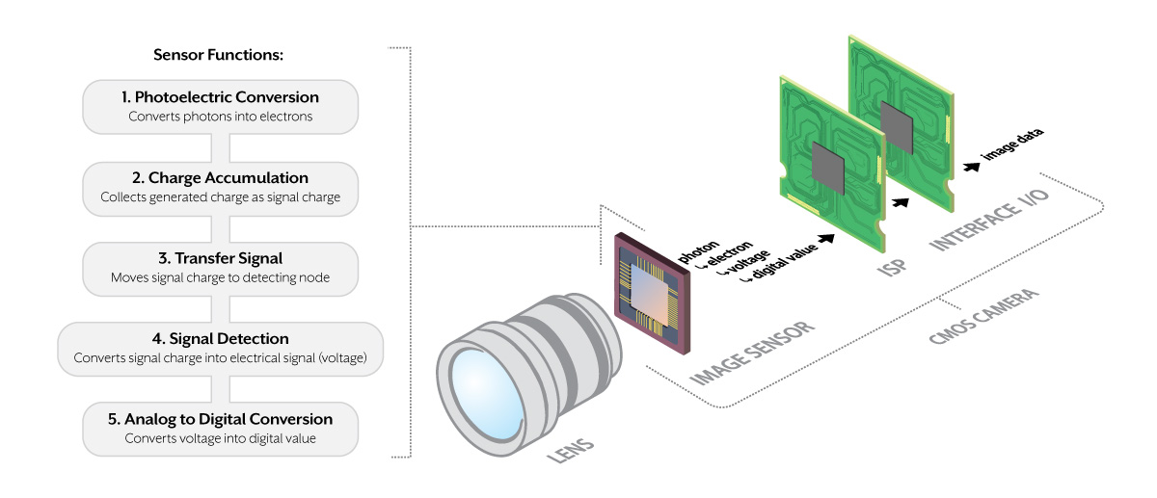
Optics: Image Sensor Block Diagram
https://thinklucid.com/tech-briefs/understanding-digital-image-sensors/
Project Description
Baseline Design
Feasibility Analysis
Status Summary
Notes:
This is not necessary in presentation, but a good backup slide
How many images? Image size, etc.
Image Sensor Functionality
Step1: Photoelectric conversion. Step2:Charge Accumulation. Step3: Transfer Signal. Step4: Signal Detection, Step5: Analog to Digital Conversion
Image sensor captures photons from target view, then converts photons to electrons. With the electron, the sensor manipulates the harnessed charge to a signal charge. The signal charge is then sent to a detector node which converts into a voltage, which is sent to an ADC to become a usabe digital values.
The resolution of the image sensor is not mentioned in either the maximise or minimise list. Maximising the resolution will maximise the star tracker's accuracy, but it will also maximise its power consumption due to the large amounts of memory and computation required to process the images. Therefore, a compromise for the resolution must be found. Very few modern star trackers have a resolution of less than 512 x 512 pixels.

Slide 47
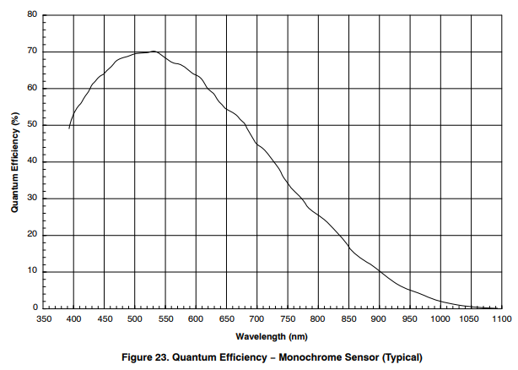
Camera Module:
AR0134 Image Sensor:
QE vs. Wavelength
Project Description
Baseline Design
Feasibility Analysis
Status Summary
Return
Notes:
Red line indicates peak QE, this happens to fall right in the range of our assumption of stellar wavelength

Slide 48
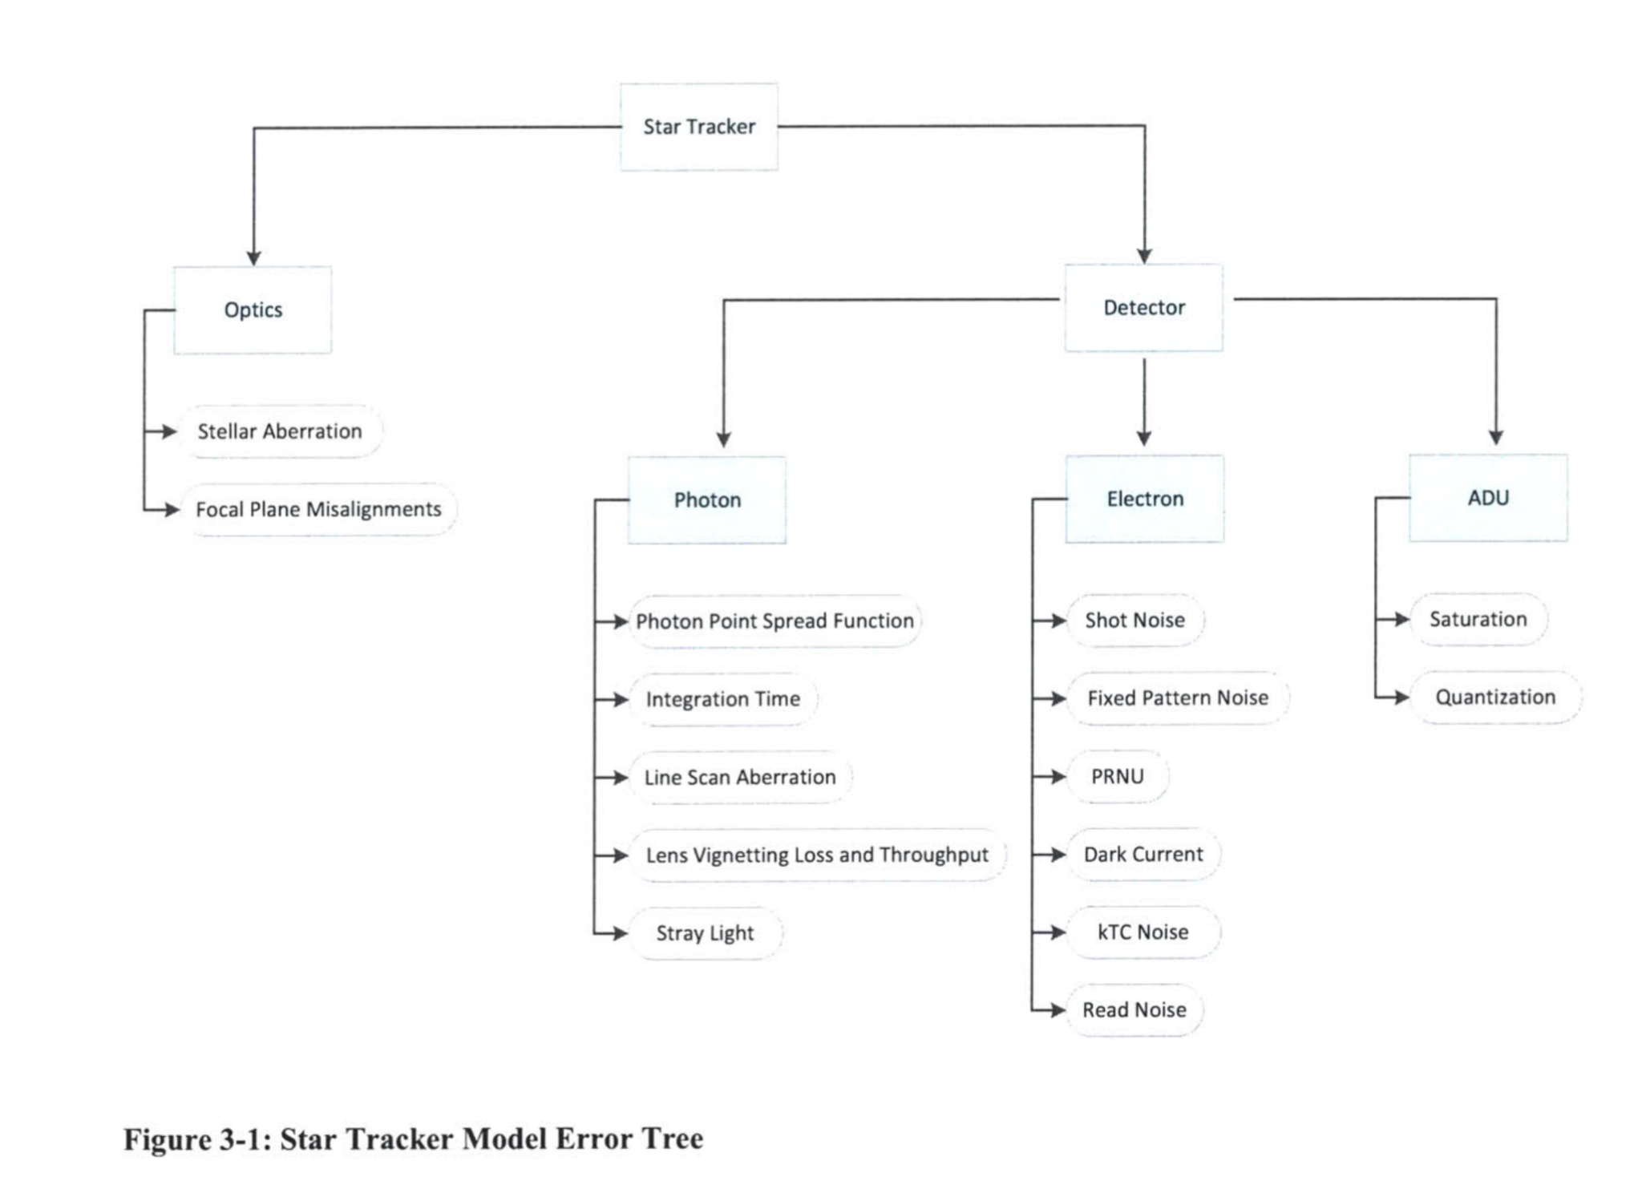
Star Tracker Error Tree
Project Description
Baseline Design
Feasibility Analysis
Status Summary
Return
Notes:
Red line indicates peak QE, this happens to fall right in the range of our assumption of stellar wavelength

Slide 49
Software: Overview
Tetra3 identifies stars in an image to get the corresponding direction (in the form of right ascension and declination); only dependent on camera FOV
In general, solutions will take 10 milliseconds with 10 arcsecond (50 microradian) accuracy
General Algorithm:
Based on Camera FOV : create database of stars from Yale Bright Star Catalogue (containing bit string “fingerprints” of stars). Only needs to be run once for the mission.
Reads in image; identifies brightness of objects relative to background (centroiding algorithm)
Calculates distances between each pair of identified stars in image
Converts distances to a bit string of 5 numbers (a unique “fingerprint”)
Compares found fingerprint to catalogue and identifies a match
Match information corresponds to camera pointing direction; returns dec., RA, and roll angle
Project Description
Baseline Design
Feasibility Analysis
Status Summary
Notes:
Matt
Tetra3 is open source -- this is how it works without any modifications

Slide 50
Software: Feasibility
Main driving requirements: FR.1, FR.2, FR.3 and their associated design requirements.
FR.1 | The star tracker shall acquire images of star fields.
FR.2 | The star tracker shall match all identified star patterns to a known star catalog. DR 2.1 The image processing software on the microcontroller shall detect star patterns DR 2.2 The selected star catalog shall be stored in the on-board microcontroller DR 2.3 The processor shall identify specific stars via comparison with the catalog
FR.3 | The star tracker shall produce attitude solutions at a minimum rate. DR 3.1 The star tracker shall produce an initial attitude solution in 120 seconds or less. DR 3.2 Subsequent attitude solutions shall be produced at a rate of 0.2 Hz or greater DR 3.4 The attitude solution shall have an absolute accuracy of less than 1◦(1σ). DR 3.6 The attitude solution shall be a quaternion
Project Description
Baseline Design
Feasibility Analysis
Status Summary
Notes:
(what options/types of options were considered?)
(What was the most important principle of the decision? relate to CPEs)
Speed
Interfacing
(show that the chosen option is feasible given the abilities of existing star trackers)
(show that the chosen option is feasible regarding compatibility with other subsystems)
Compatible with raspi
Can accommodate multiple image formats and FOVs
(show that the chosen option is feasible in terms of functional requirements, design requirements, resources, and class time/money constraints)
Meets all requirements
Accuracy
Speed
Open Source - free
Can easily be modified
(for each “chosen” element, explicitly state quantities like power, cost, mass, etc -> add up to show total budget tables at end)
Sources of error; safety margin

Slide 51
Software: Modifications
Current Modifications:
Future Modifications:
Loop the algorithm
Will continuously pull images (wrapper script)
Quaternion output
Add additional script to convert celestial coordinates to eulerian/a quaternion
Camera/Imager interaction
Microcontroller compatibility
Add condition-- software will fail solution if there is too much light (sun, moon, bright object)
Possible slew rate corrections
Save acquired images to memory for downlink (camera function, stretch goal)
Stretch Goals:
Add condition-- software will fail solution if there is too much light (sun, moon, bright object)
Possible slew rate corrections
Save acquired images to memory for downlink (camera function, stretch goal)
Project Description
Baseline Design
Feasibility Analysis
Status Summary
Notes:
Explicitly highlight what ours will do that others don’t - this is not a process, it is uniqueness - faster, more accurate, more compatible with cubesats
Matt
Ours will do these… tetra3 does not yet
Might be too detailed - move this to a backup or even future capabilities
Demonstrate how we can use the sw
Move to backup

Slide 52
Budget: Financial Feasibility
Subsystem | Component | Cost
Optics | Camera module | $70
 | Lens | $10
 | Baffle/Coating
Total |  | $80
Software | Open-sourced | $0
Total |  | $0
Hardware | Enclosure | <$50
 | Raspberry pi zero | $5
Total |  | ~$55
Shipping (Assuming average of $10 per item shipped) |  | ~$30
Total |  | $165
Project Description
Baseline Design
Feasibility Analysis
Status Summary
Notes:
Should I include testing materials?
https://dlscorp.com/shop/ls-6020-1-3-0-m12-mount-lens/

Slide 53
Budget: Testing
Subsystem | Component | Cost
Darkroom | Collimator | $6-$70
 | Rotation Device | ~$80-$200
 | Dark room materials | <$30?
 | Monitor: Likely/worst scenario | $0/$1000
Total (Excluding monitor) |  | <$300
Night Sky | Rotation Device | ~$80-$200
 | Outdoor trip and software for verification | ~$10 per trip (Gas)
Total (Excluding Rotation motor since it is purchased for the other method already) |  | <$50
Total |  | <$350
Project Description
Baseline Design
Feasibility Analysis
Status Summary
Notes:
Should I include testing materials?

Slide 54
Budget: Mass
Subsystem | Component | Weight
Optics | Lens | 6g
 | Camera Module | <5g
Electronics | Micro-controller | 9g
Baffle | Baffle + coating | 50g + 10g
Enclosure | Structure + Fasteners + Spacers | 97g
Additional | Wiring + solder | 30 - 50g
 | Vibrational dampers
 | Additional components
TOTAL |  | ~230 - 250g
BUDGETED GOAL |  | 200g
Project Description
Baseline Design
Feasibility Analysis
Status Summary
Notes:
Should I include testing materials?

Slide 55
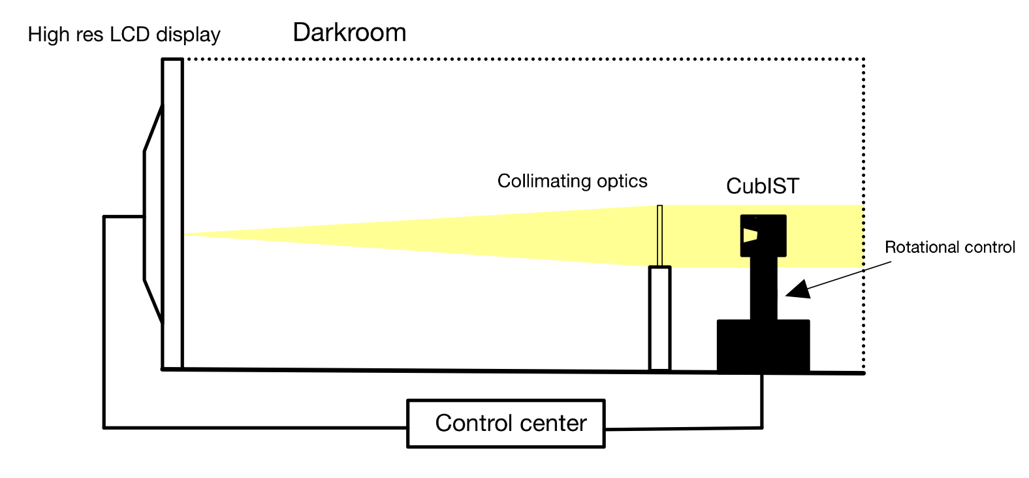
Testing of entire system: Indoor Setup
Equipment: Darkroom, high resolution monitor, collimating lense, high precision rotation device, control center
Project Description
Baseline Design
Feasibility Analysis
Test & Verification
Status Summary

Slide 56
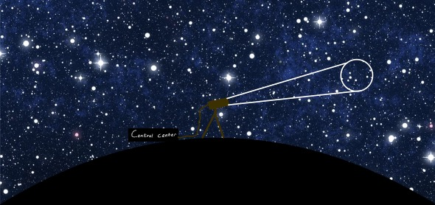
Testing of entire system: Outdoor Setup
Equipment: Stable tripod with high precision rotation capabilities, control center with verification tools (ie. astrometry.net)
Control Center
Project Description
Baseline Design
Feasibility Analysis
Test & Verification
Status Summary

Slide 57
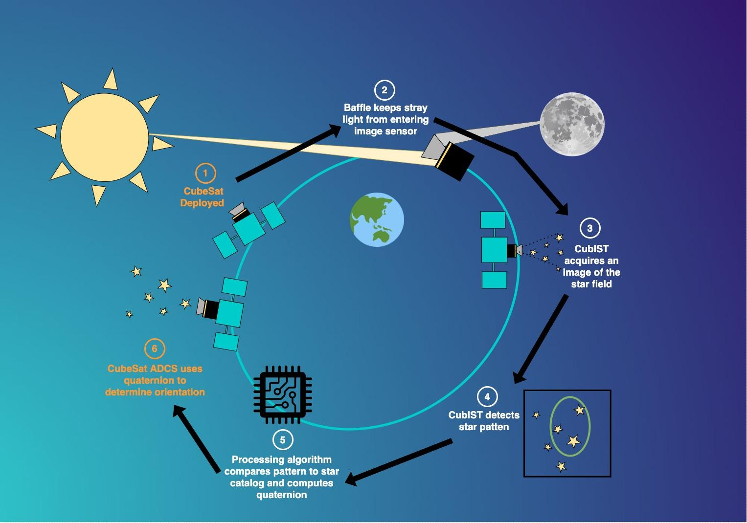
Concept of Operations - High Level
Notes:
Explain significance/meaning of orange vs white font
Want to delineate between ultimate operational goal, and what we will be doing with it to verify on the ground that it works
Have to make it clear what use case is, and what test on ground looks like
May ot be worth showing this version here

Slide 58
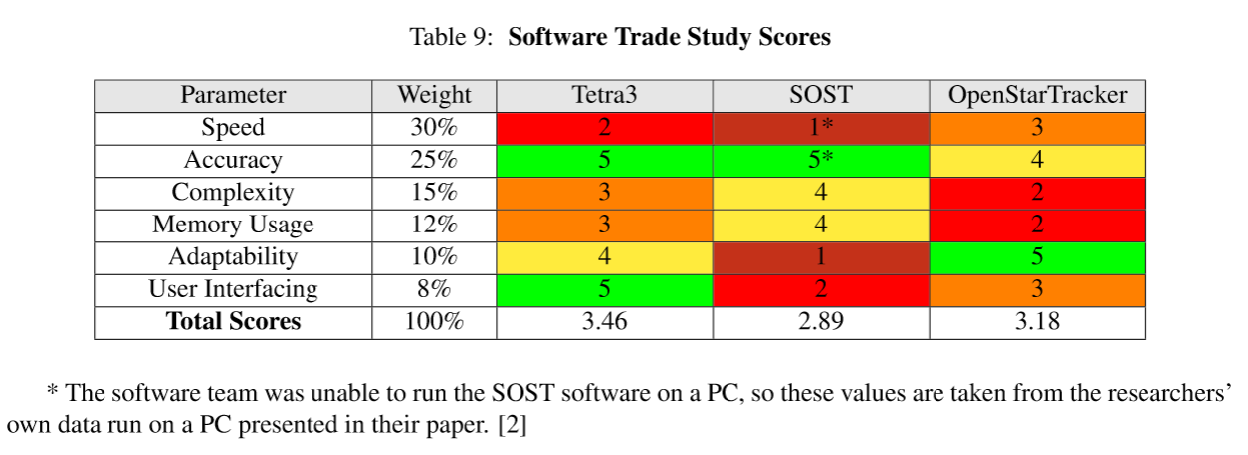
Software Trade Study
Project Description
Baseline Design
Feasibility Analysis
Status Summary

Slide 59
Image Sensor Trade Study
Project Description
Baseline Design
Feasibility Analysis
Status Summary

Slide 60
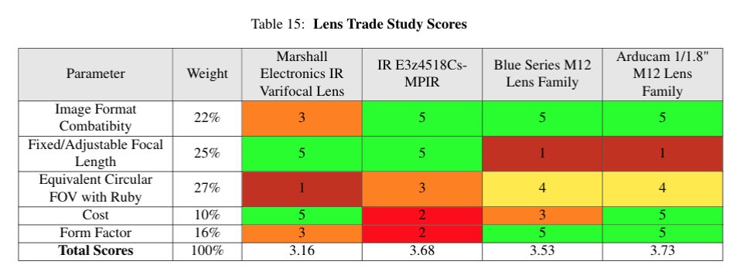
Lens Trade Study
Project Description
Baseline Design
Feasibility Analysis
Status Summary

Slide 61
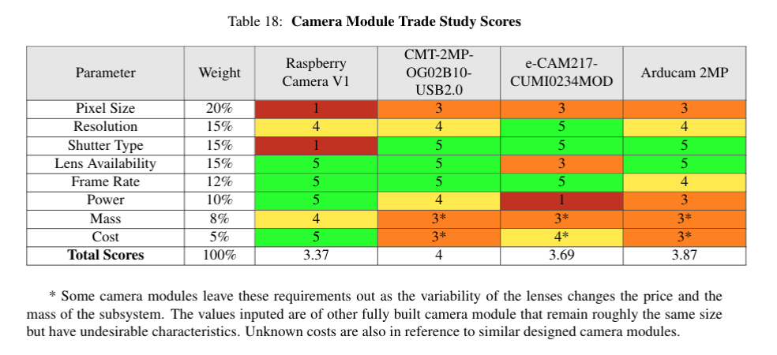
Camera Module Trade Study
Project Description
Baseline Design
Feasibility Analysis
Status Summary

Slide 62
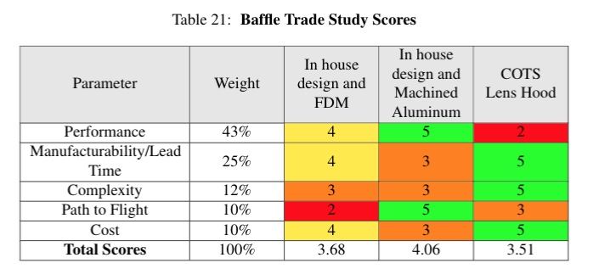
Baffle Trade Study
Project Description
Baseline Design
Feasibility Analysis
Status Summary

Slide 63
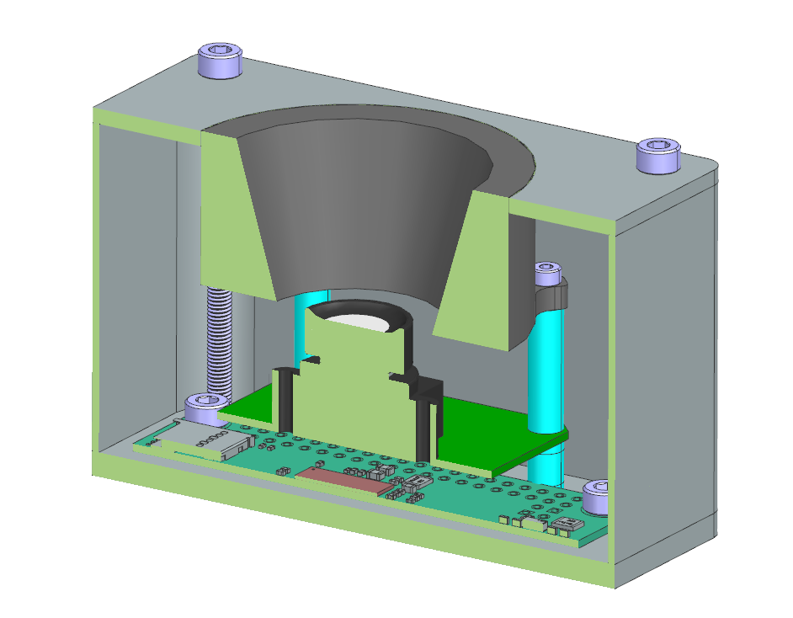
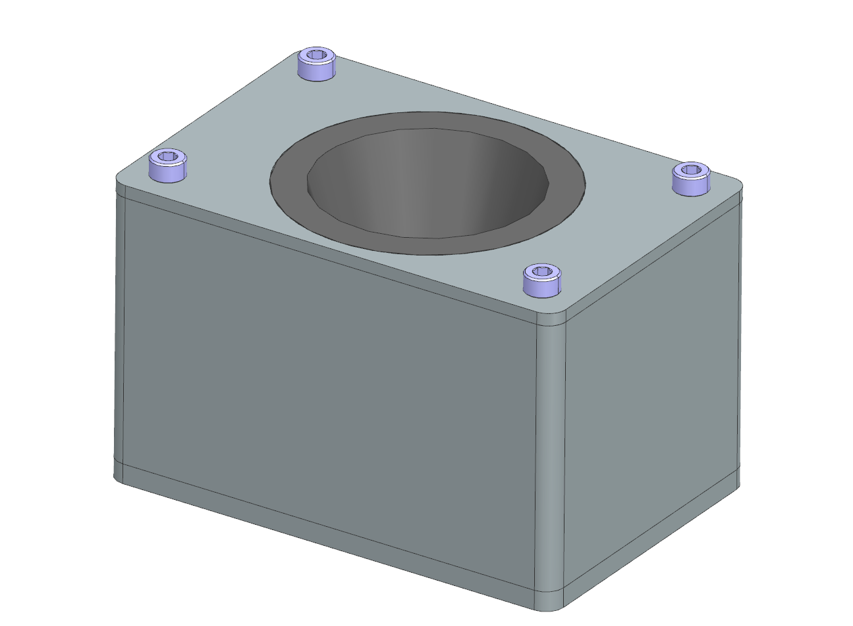
BACKUP: Enclosure Feasibility
Selection: Machined Aluminum 6061
Strength >> FDM and UHMW
Flight heritage and ease of manufacturing >> SLS
Cost and mass not prohibitive
Approx. mass of oversized enclosure: 106g (26.5% of total mass budget)
Not accounting for topology or other mass optimization
Raw stock for 6061 enclosure: $36 (0.072% of total monetary budget)
Above: LauncherOne Payload
User Guide Load Factors
Return
Project Description
Baseline Design
Feasibility Analysis
Status Summary

Slide 64
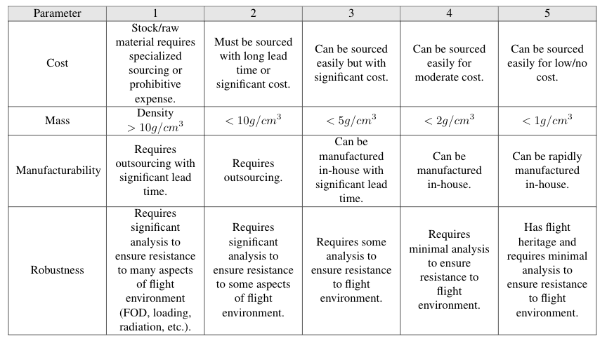
Enclosure Trade Study
Project Description
Baseline Design
Feasibility Analysis
Status Summary

Slide 65
Enclosure Trade Study
Project Description
Baseline Design
Feasibility Analysis
Status Summary

Slide 66
Microcontroller Trade Study
Project Description
Baseline Design
Feasibility Analysis
Status Summary

Slide 67
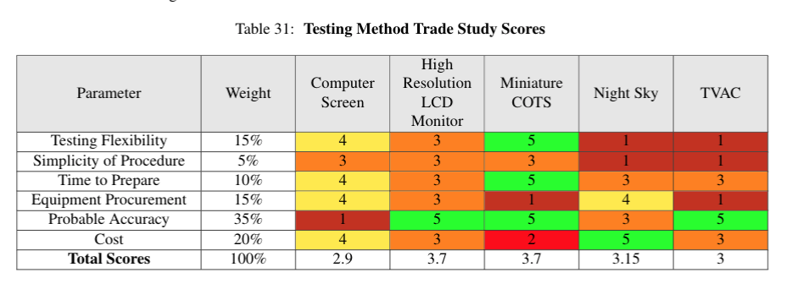
Testing Method Trade Study
Project Description
Baseline Design
Feasibility Analysis
Status Summary

