Slide 1
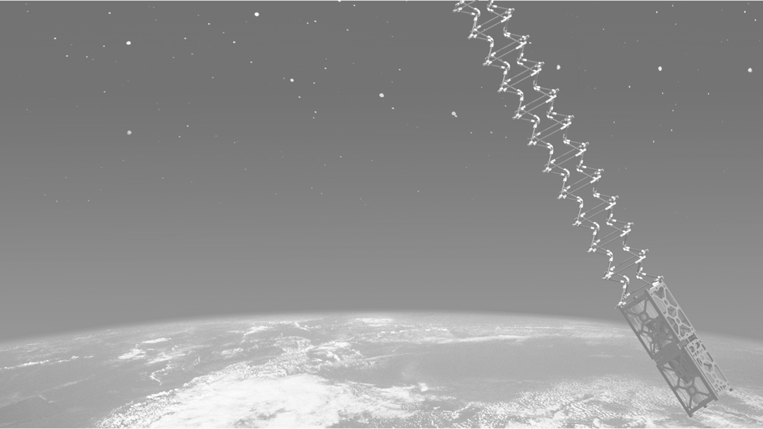
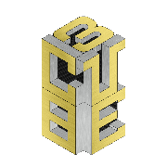
Test Readiness
Review
CUBE³
Customer:
Professor Robert Marshall
Advisor:
Professor Sanghamitra Neogi
CU Boulder Engineers Creating Universal Boom Extensions for CUBEsats

Slide 2
Overview
Overview
Schedule Update
Testing Update
Budget Update
Notes:
RH

Slide 3
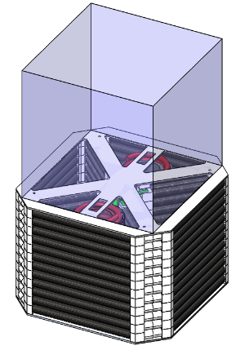
Project Overview
Instrument
(Notional)
8cm
The purpose of this project is to create an extendable CubeSat boom to separate a sensitive instrument from the cubesat bus
6.6cm
9.5cm
9.5cm
1.5 U
1.5 U
CubeSat
Bus
CUBE³
Overview
Project Schedule
Manufacturing Status
Budget
Notes:
Boom alignment

Slide 4
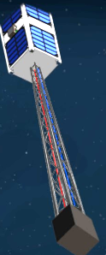
Project Objectives
Support a 500 g payload at the end of the boom
Extend a minimum distance of 60 cm
Fit within 1.5 U when undeployed (including payload)
Have a mass of less than 1.5 kg (not including payload)
Have a first resonant frequency over 2.5 Hz
Deploy on command in under 2 minutes
Provide routing for power and signal cabling to/from payload
Overview
Project Schedule
Manufacturing Status
Budget

Slide 5
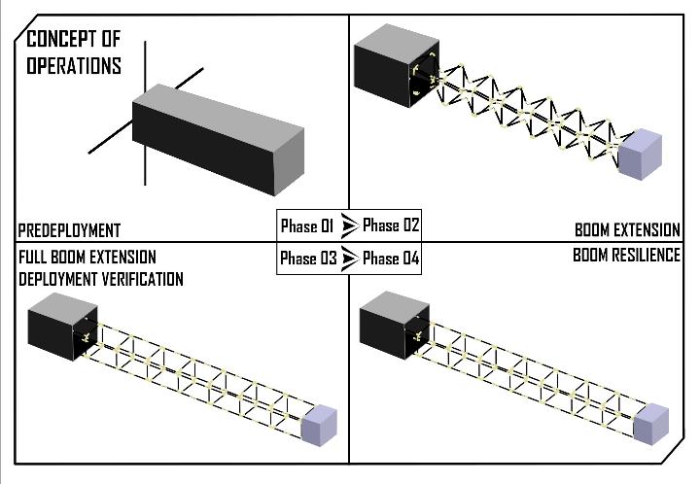
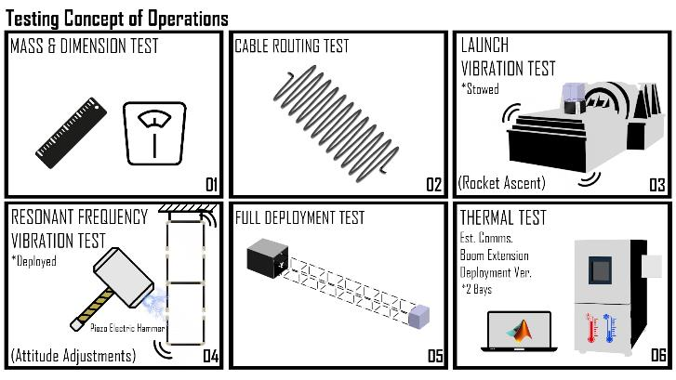
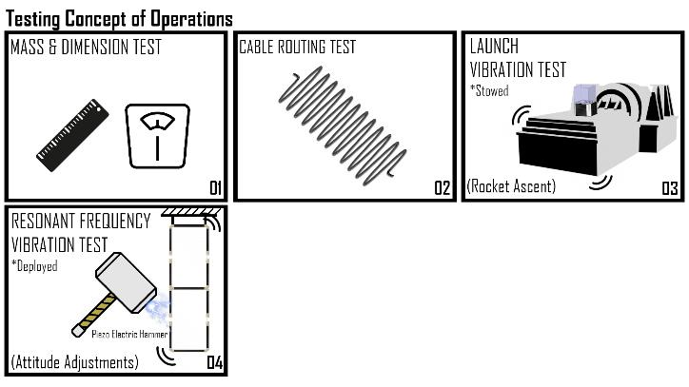
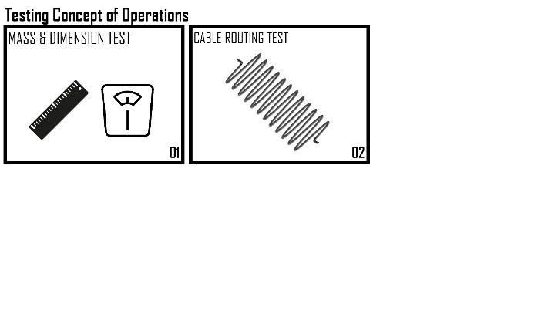
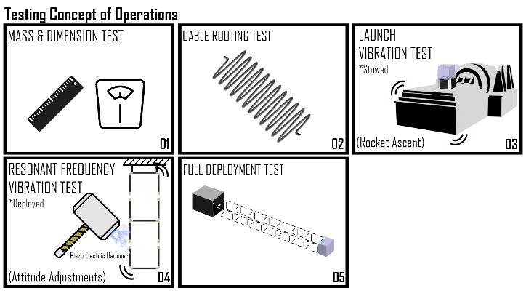
CONOPS
Overview
Project Schedule
Manufacturing Status
Budget

Slide 6
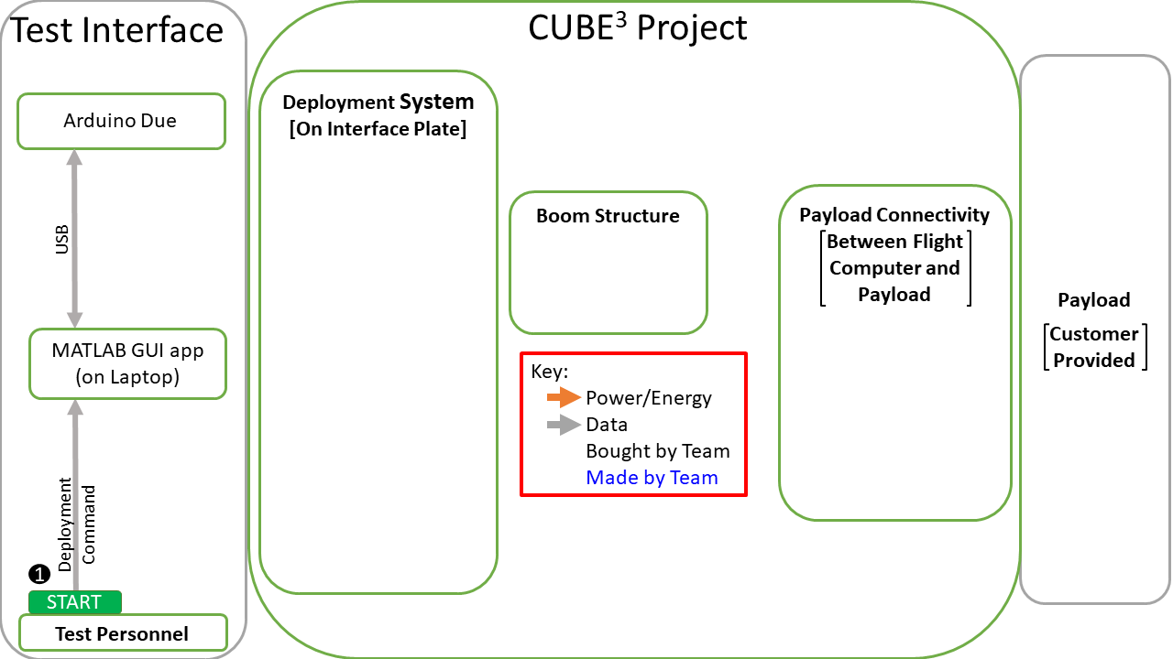
FBD
Overview
Project Schedule
Manufacturing Status
Budget

Slide 7
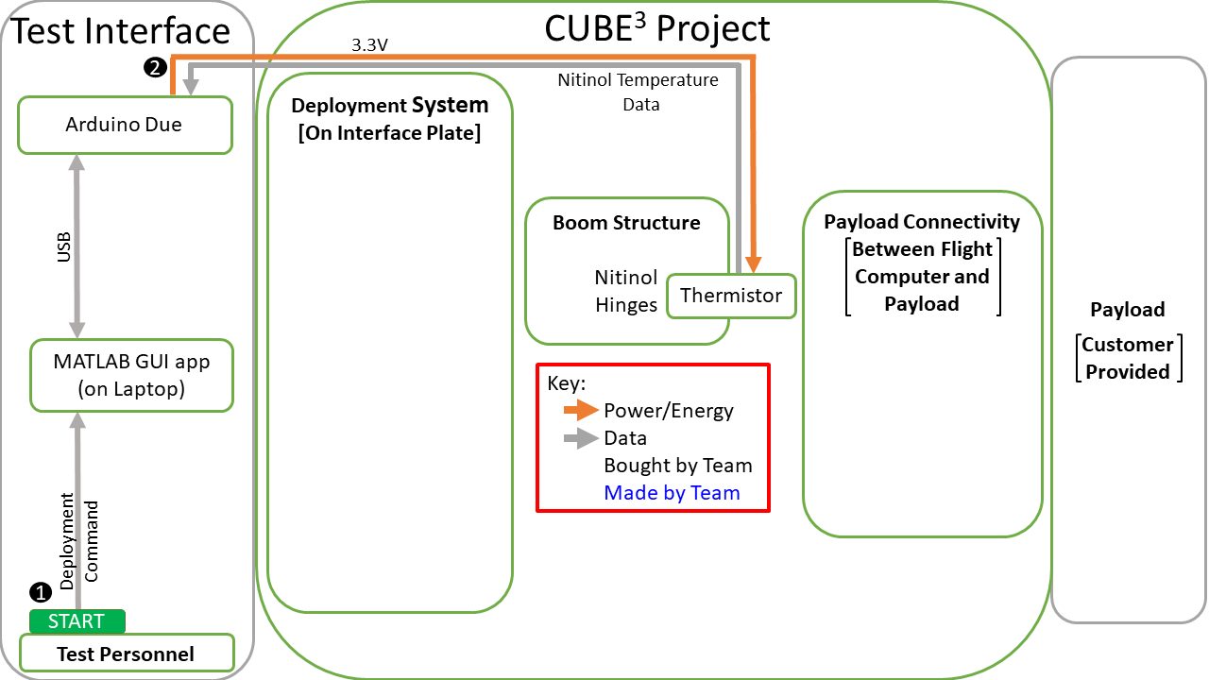
FBD
Overview
Project Schedule
Manufacturing Status
Budget

Slide 8
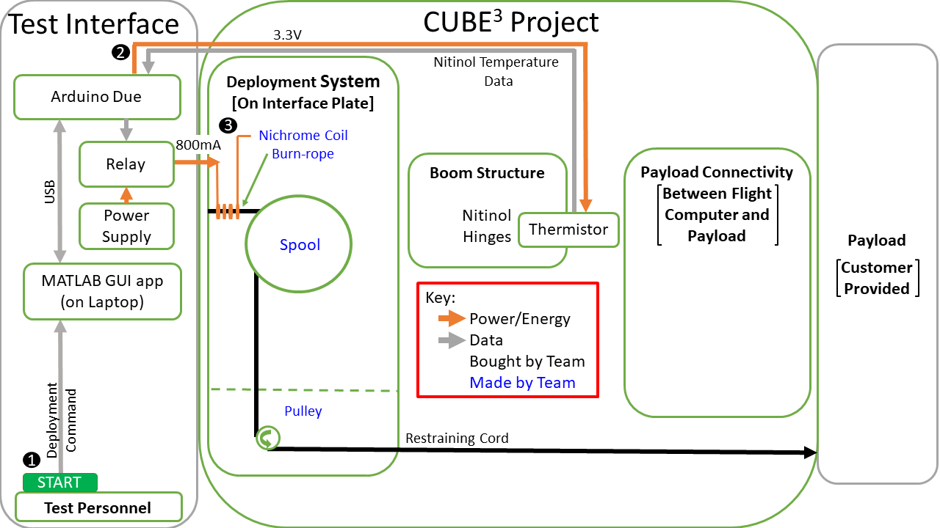
FBD
Overview
Project Schedule
Manufacturing Status
Budget

Slide 9
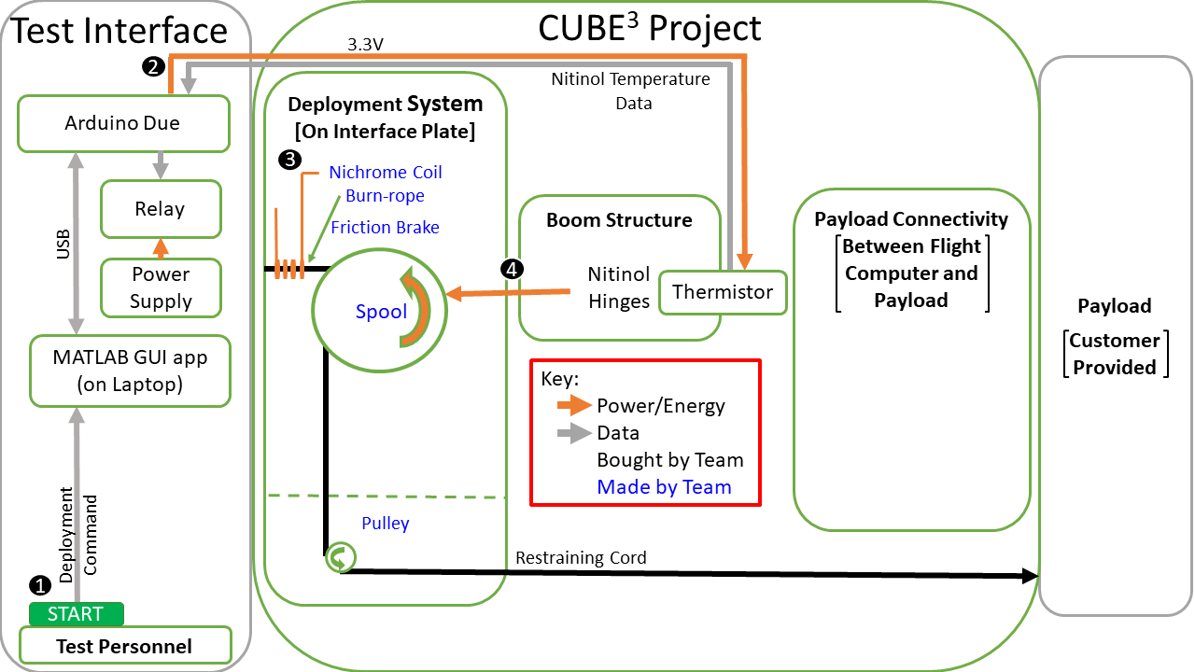
FBD
Overview
Project Schedule
Manufacturing Status
Budget

Slide 10
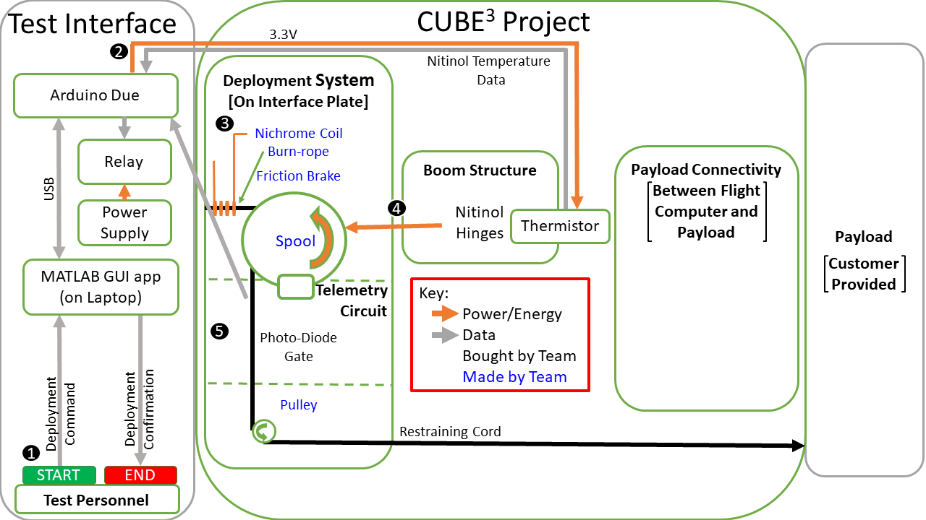
FBD
Overview
Project Schedule
Manufacturing Status
Budget

Slide 11
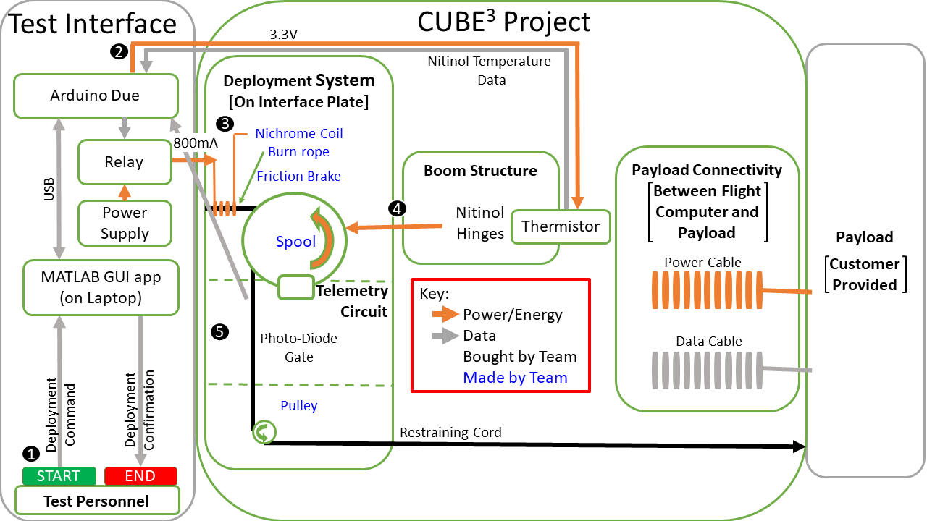
FBD
Overview
Project Schedule
Manufacturing Status
Budget

Slide 12
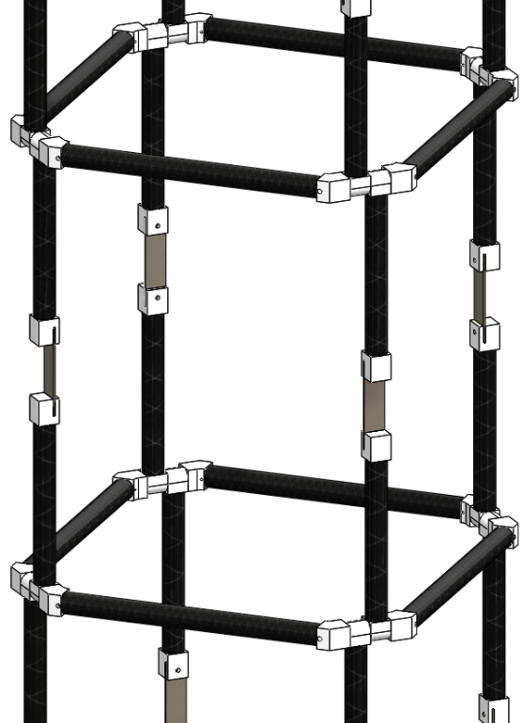
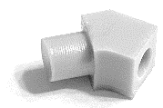
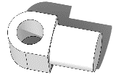
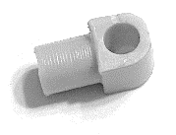
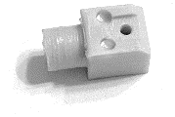
Baseline Design
1
2
1.
PEEK Connectors
Prior Design
Manufactured
1
11.2cm
5.5mm
3.
3
2
10mm
3
10mm
Overview
Project Schedule
Manufacturing Status
Budget
Notes:
Overview (10%) - BASELINE DESIGN & MAJOR CHANGES
Brief review of the baseline design with respect to CDR. Describe major changes to the design. (Clear what all major elements of the project are, and how the baseline design works (5 pts) )
This is a key design element that we put a lot of time and hours into ensuring the accuracy of manufacture

Slide 13
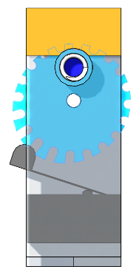
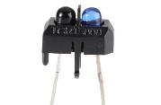
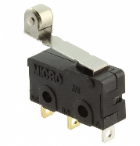
Baseline Design Change - IR sensor
Trade study performed based on MSR question
IR sensor better solution
No moving parts
Simplified spool manufacture
Smaller spool assembly
Full trade study in backup slides
IR absorptive half
IR reflective half
IR LED emitter
IR phototransistor
Baseline Telemetry Switch
Updated Telemetry Switch
Overview
Project Schedule
Manufacturing Status
Budget
Notes:
Overview (10%) - BASELINE DESIGN & MAJOR CHANGES
Brief review of the baseline design with respect to CDR. Describe major changes to the design. (Clear what all major elements of the project are, and how the baseline design works (5 pts) )
This is a key design element that we put a lot of time and hours into ensuring the accuracy of manufacture

Slide 14
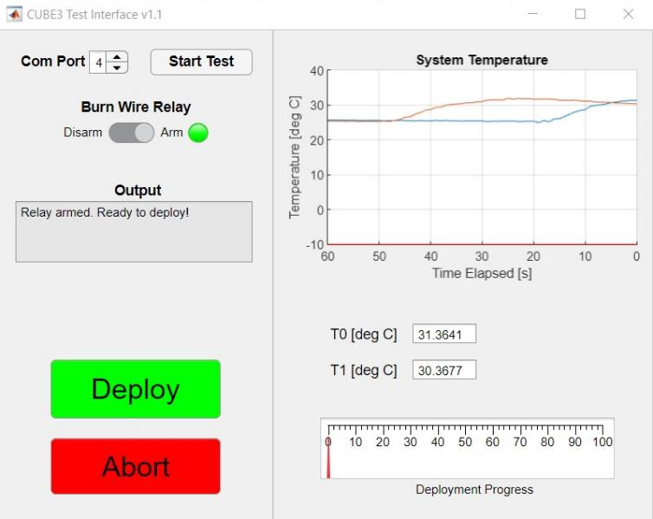
Software Baseline
Not for delivery
MATLAB GUI
Built in App Designer
Uses Arduino Hardware Support Package
v1.1 is released for use
Temperature display
Burn wire relay arm/control
IR spool revolution sensor telemetry
Overview
Project Schedule
Manufacturing Status
Budget
Notes:
Overview (10%) - BASELINE DESIGN & MAJOR CHANGES
Brief review of the baseline design with respect to CDR. Describe major changes to the design. (Clear what all major elements of the project are, and how the baseline design works (5 pts) )
This is a key design element that we put a lot of time and hours into ensuring the accuracy of manufacture

Slide 15
Critical Project Elements
Deployable Boom Structure
Stow in 1.5U with an 8x8x8 cm, 500 g payload
First resonant frequency ≥ 2.5 Hz
Payload Connectivity
Power/data cable provisions
</>
Software Interface
Command and telemetry
Deployment System
Deploy on command
Confirm deployment via telemetry
Environmental Resilience
LEO radiation/thermal environment
Vibrational launch environment
Overview
Project Schedule
Manufacturing Status
Budget

Slide 16
Schedule
Update
Overview
Schedule Update
Testing Update
Budget Update
Notes:
RH

Slide 17
Rest of Year Critical Path Timeline
LASP Thermal Chamber Testing on 3rd Boom Assembly
Launch Environment Test
SFR Presentation (est)
March 4
March 9
April 17
April 24
Analysis & Validation
March 6
March 16 (TBR)
April 20
Mass/Dimension Test
Full Deployment Test
Cable Routing Test
AES Industry Symposium
College Expo
Elements and Updates
Schedule Update
Manufacturing Status
Budget

Slide 18
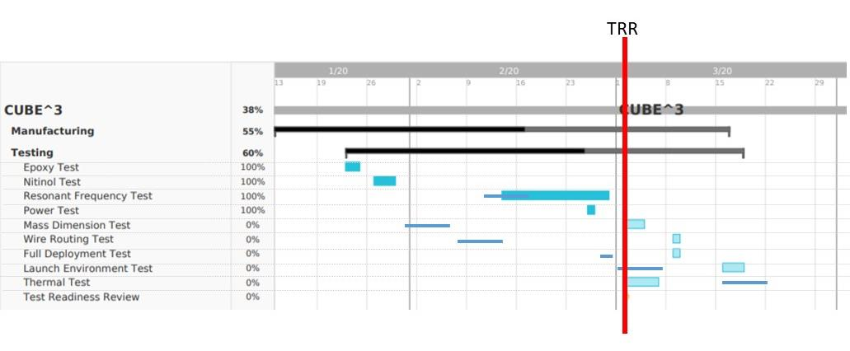
Schedule
Baselined at CDR
Planned
Complete
Elements and Updates
Schedule Update
Manufacturing Status
Budget

Slide 19
Testing
Update
Overview
Schedule Update
Testing Update
Budget Update
Notes:
MB/VG

Slide 20
Cable
Routing
Launch
Environment
Resonant
Frequency
Full
Deployment
Mass /
Dimension
LASP Thermal
Chamber
Planned
Scheduled
Completed
Processed
Planned
Scheduled
Completed
Processed
Planned
Scheduled
Completed
Processed
Planned
Scheduled
Completed
Processed
Planned
Scheduled
Completed
Processed
Planned
Scheduled
Completed
Processed
Elements and Updates
Project Schedule
Testing Update
Budget

Slide 21
Cable
Routing
Launch
Environment
Resonant
Frequency
Full
Deployment
Mass /
Dimension
LASP Thermal
Chamber
Planned
Scheduled
Completed
Processed
Planned
Scheduled
Completed
Processed
Planned
Scheduled
Completed
Processed
Planned
Scheduled
Completed
Processed
Planned
Scheduled
Completed
Processed
Planned
Scheduled
Completed
Processed
Elements and Updates
Project Schedule
Testing Update
Budget

Slide 22
Cable Routing Test
Motivation - Verify that the cable routing design allows for full deployment of the boom and cables are
still functioning after deployment
Facilities:
Electronics Lab, Pilot Room
Equipment:
Sorensen XPH 35-4D Power Supply set as Voltage Supply
Arduino Due microcontroller (as mock flight computer)
Keysight 34461A Digital Multimeter
Keysight 33220A Function/Arbitrary Waveform Generator
Oscilloscope
Requirements Under Test
DR_2.1
Boom shall have capability of routing three-wire power setup
DR_2.2
Boom shall have capability of routing 3 separate differential cables
General Procedure:
Attach the various equipment to the undeployed boom assembly
Send deployment command from mock flight computer.
Check for physical damage to boom and/or cables
Check for cable functionality with desired equipment
Restow boom
FR_2
Boom shall provide routing for power and signal cabling
Elements and Updates
Project Schedule
Testing Update
Budget
Notes:
Need to reword motivation

Slide 23
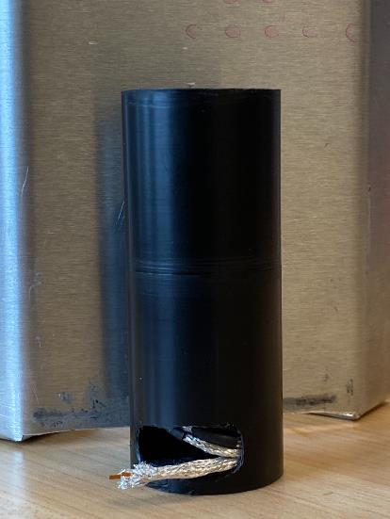
Cable Routing Test
IMAGES
Expected Key Outcomes:
There is no physical damage to either the 3 differential signal cables or 3-wire power setup
The differential signal cables and 3-wire power setup remains connected to boom structure during and after deployment
Differential signal cables can properly transfer data
3-wire power setup is capable of distributing power to instrument
All design requirements tied to FR 2 pass, therefore this FR passes.
Elements and Updates
Project Schedule
Testing Update
Budget

Slide 24
Cable
Routing
Launch
Environment
Resonant
Frequency
Full
Deployment
Mass /
Dimension
LASP Thermal
Chamber
Planned
Scheduled
Completed
Processed
Planned
Scheduled
Completed
Processed
Planned
Scheduled
Completed
Processed
Planned
Scheduled
Completed
Processed
Planned
Scheduled
Completed
Processed
Planned
Scheduled
Completed
Processed
Elements and Updates
Project Schedule
Testing Update
Budget

Slide 25
Launch Environment Test
Motivation - Verify that the boom assembly components can survive the vibrational loads experienced during
launch.
Facilities:
Vibe room
Equipment:
UD shaker table
8-Bay Structure
Requirements Under Test
FR_7
Survive 10 G vibrations in the undeployed state.
General Procedure:
Setup undeployed boom on shaker table
Qualification test
General Environmental Verification Standard
Remove boom from shaker table
Deploy boom structure
DR_7.1
Survive under the conditions of the launch environment in the undeployed state.
Elements and Updates
Project Schedule
Testing Update
Budget

Slide 26
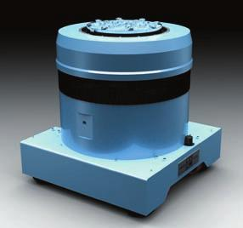
Launch Environment Test
IMAGES
Expected Key Outcomes:
There is no physical damage to the boom structure
Deployment mechanism functions as expected
All design requirements tied to FR 7 pass, therefore this FR passes.
Risk Reduction:
Ensure that the boom will survive the launch environment and function as expected afterwards
Elements and Updates
Project Schedule
Testing Update
Budget

Slide 27
Cable
Routing
Launch
Environment
Resonant
Frequency
Full
Deployment
Mass /
Dimension
LASP Thermal
Chamber
Planned
Scheduled
Completed
Processed
Planned
Scheduled
Completed
Processed
Planned
Scheduled
Completed
Processed
Planned
Scheduled
Completed
Processed
Planned
Scheduled
Completed
Processed
Planned
Scheduled
Completed
Processed
Elements and Updates
Project Schedule
Testing Update
Budget

Slide 28
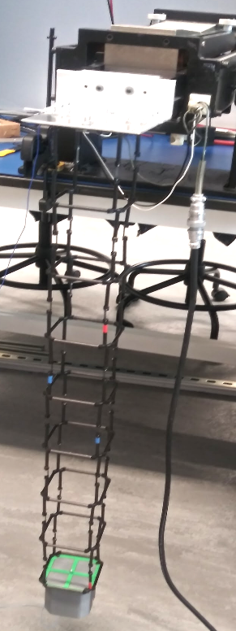
Resonant Frequency Tests
Motivation - Verify that the boom assembly resonant frequency falls within acceptable
ranges
Facilities:
Electronics shop
Requirements Under Test
Equipment:
Mallet
2 Teardrop accelerometers
Horizontal Shaker Table
8-Bay Structure
FR_6
Demonstrate a resonant frequency greater than 2.5 Hz when fully deployed.
General Procedure:
Setup deployed boom on shaker table with accelerometers
Sweep through low frequencies and measure the driven response
Data has been processed
Hit the boom with a mallet and measure the impulse response
Data not yet processed
Elements and Updates
Project Schedule
Testing Update
Budget

Slide 29
Impulse Resonant Frequency Test
Elements and Updates
Project Schedule
Testing Update
Budget

Slide 30
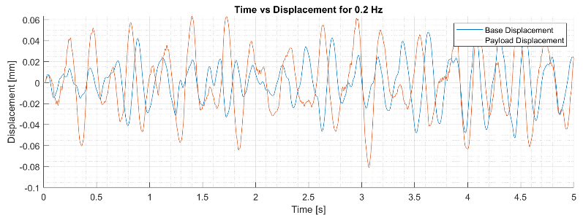
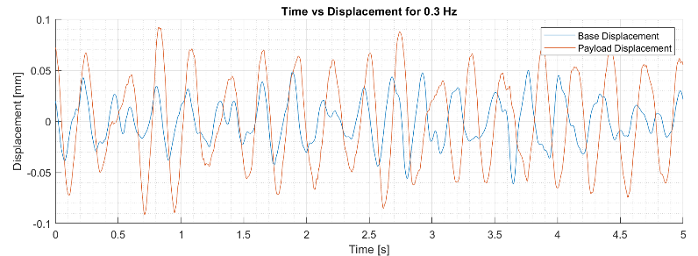
Driven Resonant Frequency Test
Elements and Updates
Project Schedule
Testing Update
Budget

Slide 31
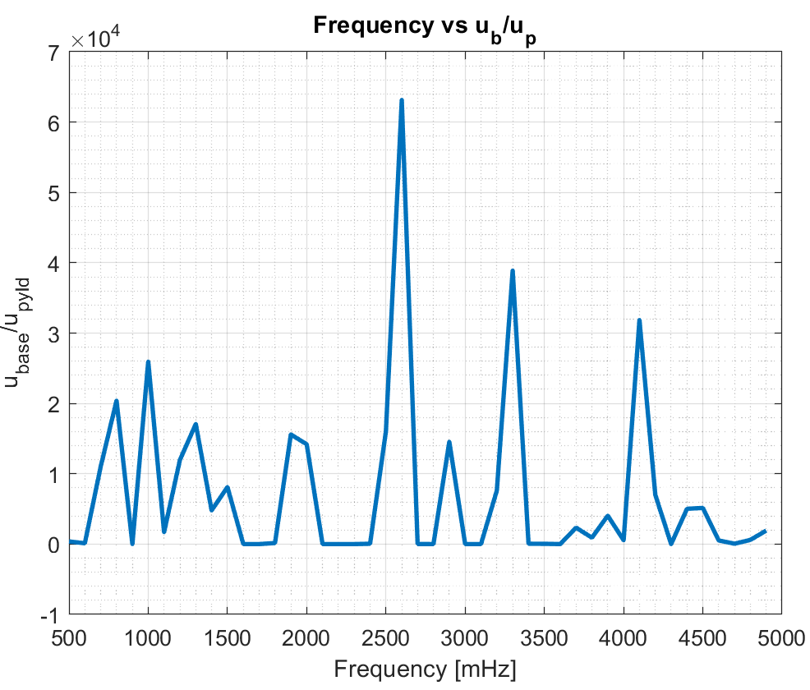
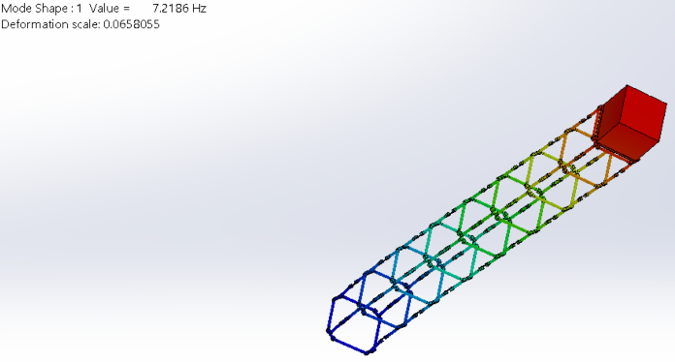
Preliminary Resonant Frequency Test
 | Analytical | Experimental
Resonance | 2.04-7.24 Hz | 2.6 Hz
Elements and Updates
Project Schedule
Testing Update
Budget

Slide 32
Cable
Routing
Launch
Environment
Resonant
Frequency
Full
Deployment
Mass /
Dimension
LASP Thermal
Chamber
Planned
Scheduled
Completed
Processed
Planned
Scheduled
Completed
Processed
Planned
Scheduled
Completed
Processed
Planned
Scheduled
Completed
Processed
Planned
Scheduled
Completed
Processed
Planned
Scheduled
Completed
Processed
Elements and Updates
Project Schedule
Testing Update
Budget

Slide 33
Full Deployment Test
Motivation - Verify the deployment capabilities of the fully assembled boom through a commanded
deployment and verify restow capability.
Facilities:
Electronics Lab, Pilot Room
Requirements Under Test
Equipment:
Sorensen XPH 35-4D Power Supply set as Current Supply
Arduino Due microcontroller (as mock flight computer)
Westward Tape Measure, +/- 1 cm
Teardrop Accelerometer
Timer
Roller
FR_1
Deploy an instrument of up to 500 g, with 8 x 8 x 8 cm dimensions
FR_4
The boom assembly can communicate with the flight computer
FR_5
Provide ability to re-stow for redeployment
General Procedure:
Attach the various equipment to the undeployed boom assembly such that gravity does not affect deployment
Send deployment command from mock flight computer
Confirm deployment telemetry is being received
Restow boom assembly
Additionally: DR_1.1, DR_1.2, DR_1.4, SR_1.4.1, DR_1.5, DR_4.1, DR_4.2, SR_4.2.1, DR_4.3, DR_5.1
Elements and Updates
Project Schedule
Testing Update
Budget

Slide 34
Deployment Test
STOWED
DEPLOYMENT COMMANDED
DEPLOYMENT IN PROGRESS
DEPLOYMENT COMPLETE
CUBE³ Shell
CUBE³ Shell
CUBE³ Shell
CUBE³ Shell
Elements and Updates
Project Schedule
Testing Update
Budget

Slide 35
Full Deployment Test
Expected Key Outcomes:
Deployment occurs on command
Deployment status can be identified and sent to the flight computer
After deployment power to the boom is halted
Fully extended the boom is 68.5 cm long with 8 bays
Maximum Instrument Acceleration: To be tested
Deployment Time: To be tested
All design requirements tied to FR 1, 4, and 5 pass, therefore these FR pass
Risk Reduction: Proves that the boom assembly fully deploys as intended and demonstrates designed capabilities
Elements and Updates
Project Schedule
Testing Update
Budget
Notes:
An instrument can be connected to the attachment plate.
Oscillations are damped out within 65 sec

Slide 36
Full Deployment Modeling
*see Nitinol Test backup slides
k₁
m
M
F₁
m
R
T_{R}
F₂
k₂
f
M - satellite bus
m - instrument
k₁ - boom structure equivalent spring
k₂ - power/data cable coils equivalent spring
R - restraining cable
Assume - M >> m, k₁ and k₂ modeled as linear springs, gravity is orthogonal to direction of motion, rolling resistance is negligible, mass of boom is negligible
F₁ - force due to Nitinol hinges in compression
T_{R} - tension in restraining cable (tunable)
F₂ - force due to cable coil in tension
f - friction
Kinematics and energy conservation analysis for unrestrained case yield a deployment time of
t = 0.38 s and final speed of v = 4 m/s*
⇒ Real system will be much slower
Elements and Updates
Project Schedule
Testing Update
Budget

Slide 37
Cable
Routing
Launch
Environment
Resonant
Frequency
Full
Deployment
Mass /
Dimension
LASP Thermal
Chamber
Planned
Scheduled
Completed
Processed
Planned
Scheduled
Completed
Processed
Planned
Scheduled
Completed
Processed
Planned
Scheduled
Completed
Processed
Planned
Scheduled
Completed
Processed
Planned
Scheduled
Completed
Processed
Elements and Updates
Project Schedule
Testing Update
Budget

Slide 38
Mass/Dimension Test
Motivation - Verify that the physical characteristics of the undeployed boom assembly fit within the
given requirements.
Requirements Under Test
Facilities:
Electronics Lab
DR_3.1
Stow with a length less than or equal to
15 cm, including instrument
Equipment:
Shars Aventor Calipers, +/- 0.01 mm
Acculab SV-50 Scale, +/- 10 g
DR_3.2
Stow with a height less than or equal to
10 cm, including instrument
General Procedure:
Measure the dimensions of the x-y-z axes
Measure the accommodation space for the guide rails
Weigh the full boom assembly
DR_3.3
Stow with a width less than or equal to
10 cm, including instrument
DR_3.4
Provide 6 mm by 6 mm accommodation space at each corner for NanoRacks guide rails
FR_9
The whole system, including instrument, will have a maximum total mass of 2kg
Elements and Updates
Project Schedule
Testing Update
Budget
Notes:
Success Criteria:
Length, width, and height dimensions fall at or below required value.
Accommodation space for guide rails meets NanoRack specification.
Mass of the full boom assembly lies within the required range.

Slide 39
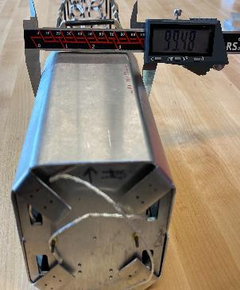
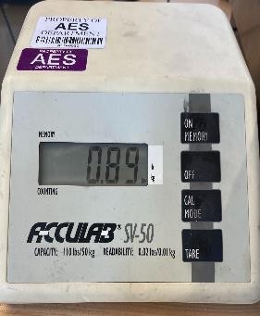
Mass/Dimension Test
Risk Reduction: Confirms that the manufactured boom assembly fits within the sizing and weight restraints set at the start of the project
Test Results
Req. ID
Expected Result
Preliminary Result
DR_3.1
Length = 15 cm
Length = 14.99 cm
DR_3.2
Height = 10 cm
Height = 9.95 cm
DR_3.3
Width = 10 cm
Width = 9.95 cm
DR_3.4
Guide Rail Space =
6 mm x 6 mm
Guide Rail Space =
6 mm x 6 mm
FR_9
Mass ≤ 2 kg
Mass = 0.89 kg
Elements and Updates
Project Schedule
Testing Update
Budget

Slide 40
Cable
Routing
Launch
Environment
Resonant
Frequency
Full
Deployment
Mass /
Dimension
LASP Thermal
Chamber
Planned
Scheduled
Completed
Processed
Planned
Scheduled
Completed
Processed
Planned
Scheduled
Completed
Processed
Planned
Scheduled
Completed
Processed
Planned
Scheduled
Completed
Processed
Planned
Scheduled
Completed
Processed
Elements and Updates
Project Schedule
Testing Update
Budget

Slide 41
LASP Thermal Chamber Test
Motivation - Verify that the boom assembly components can survive the thermal fluctuations
experienced in space and establish good deployment temperatures.
Facilities:
LASP Thermal Chamber Room
Equipment:
Big White Thermal Chamber
Thermocouples
2-Bay Structure
Requirements Under Test
DR_8.1
The boom assembly shall survive the thermal fluctuations of the space environment in both the deployed and undeployed configuration.
General Procedure:
Setup undeployed boom in thermal chamber
Ramp down to -60 °C
Ramp up to 10 °C
Deploy Boom
Ramp down to -60 °C
Return to ambient and repeat with different deployment temperatures
Elements and Updates
Project Schedule
Testing Update
Budget
Notes:
Success Criteria:
Length, width, and height dimensions fall at or below required value.
Accommodation space for guide rails meets NanoRack specification.
Mass of the full boom assembly lies within the required range.

Slide 42
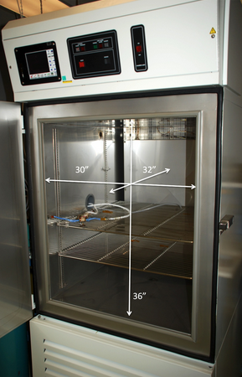
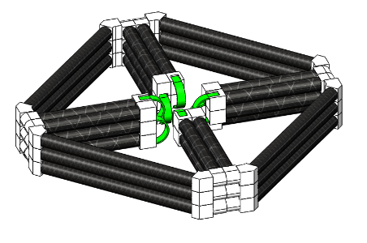
LASP Thermal Chamber Test
Big White
Thermal Chamber
Risk Reduction:
Establish feasibility of components not breaking due to extremely low temperatures
Establish adequate deployment temperatures for the Nitinol hinges
Thermocouple Locations
Expected Key Outcomes:
Components remain unbroken and functional at the extreme minimum temperature
Associate deployment times with deployment temperatures
Determine lowest possible deployment temperature of the Nitinol
2
1
Elements and Updates
Project Schedule
Testing Update
Budget
Notes:
Success Criteria:
Length, width, and height dimensions fall at or below required value.
Accommodation space for guide rails meets NanoRack specification.
Mass of the full boom assembly lies within the required range.

Slide 43
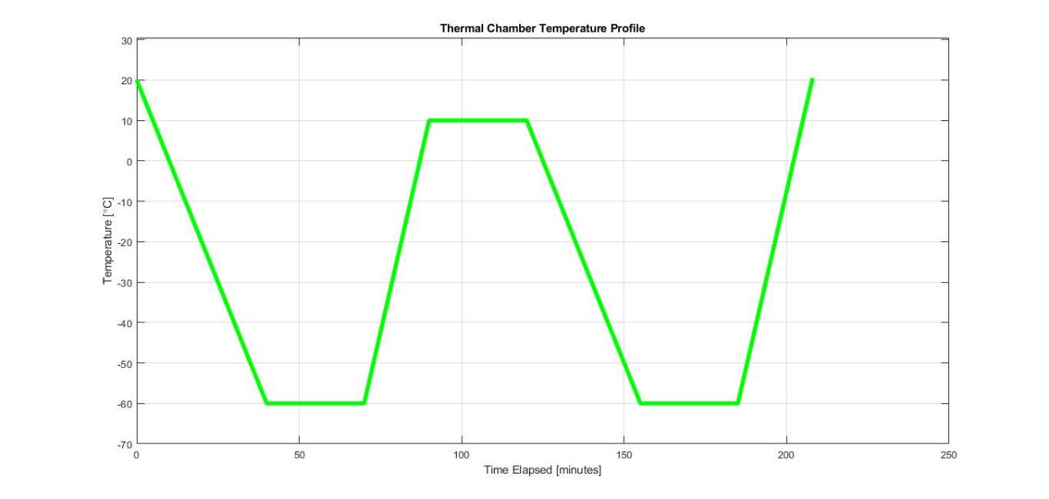
LASP Thermal Chamber Profile
Elements and Updates
Project Schedule
Testing Update
Budget
Notes:
Success Criteria:
Length, width, and height dimensions fall at or below required value.
Accommodation space for guide rails meets NanoRack specification.
Mass of the full boom assembly lies within the required range.

Slide 44
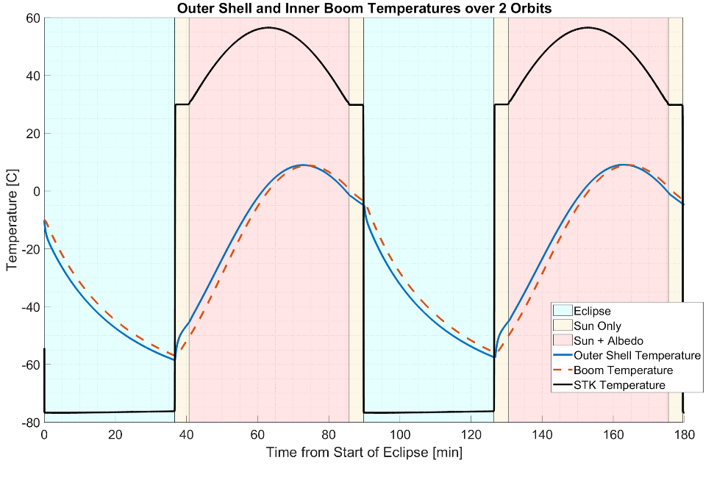
Thermal Model
Elements and Updates
Project Schedule
Testing Update
Budget
Notes:
Success Criteria:
Length, width, and height dimensions fall at or below required value.
Accommodation space for guide rails meets NanoRack specification.
Mass of the full boom assembly lies within the required range.

Slide 45
Budget
Update
Overview
Schedule Update
Testing Update
Budget Update
Notes:
MB

Slide 46
Budget - Parts/Materials Procurement Status
Area of Interest | Supplier | Cost | Status
Tooling | McMaster Carr | $322.44 | Delivered
Hardware | McMaster Carr | $260.71 | Delivered
Epoxy | Ellsworth | $90.58 | Delivered
PEEK | McMaster Carr | $770.66 | Delivered
Carbon Fiber | Goodwinds | $627.94 | Delivered
Nitinol | Confluent Medical | $295.80 | Delivered
Wiring/Electronics | DigiKey, Amazon | $255.55 | Delivered
Total | All | $2,623.68
Elements and Updates
Project Schedule
Manufacturing Status
Budget Update

Slide 47
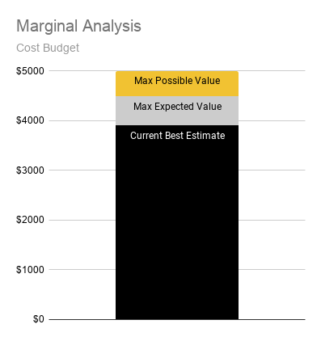
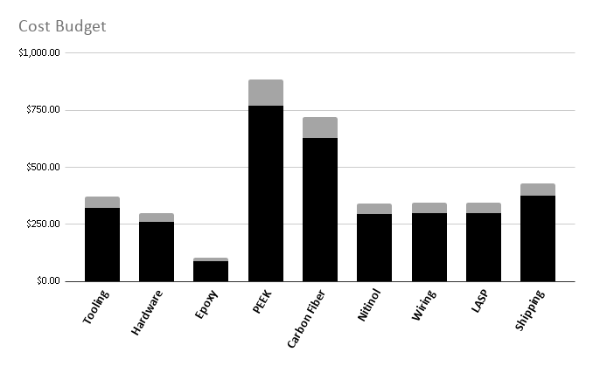
Budget - Financial Budget Status
10% Margin
15% Contingency
Elements and Updates
Project Schedule
Manufacturing Status
Budget Update
Notes:
Change TVAC to LASP
-Only costing $200 now

Slide 48
Questions?
</>
</>
Project Schedule
CUBE³
Manufacturing Status
Budget

Slide 49
Backup Slides
</>
</>
Project Schedule
Backup Slides
Manufacturing Status
Budget

Slide 50
Power Test
Motivation - Determine the power consumption of the Polyethylene-Burn Wire system. Used to verify
requirement DR_1.3
Facilities:
Electronics Lab
Equipment:
Sorensen XPH 35-4D Power Supply set as Current Supply
Keysight 34461A Digit Multimeter set as Ohmmeter
Mock Polyethylene-Burn Wire System
General Procedure:
Measure systems resistance
Set current to 0.8 Amps and start test
Record time taken to burn
Calculate Power consumption (P=I^2*R)
Risk Reduction: Confirms that the deployment mechanism uses less than the maximum allocated amount of power of 30 W.
Test Results
Test No.
Resistance
Current
Time of Burn
Power
1
3.59Ω
0.8 A
3 sec
2.30 W
2
3.59Ω
0.8 A
4 sec
2.30 W
3
3.59 Ω
0.8 A
3 sec
2.30 W
4
3.59 Ω
0.8 A
3 sec
2.30 W
5
3.59 Ω
0.8 A
2 sec
2.30 W
Avg.
3.59 Ω
0.8 A
3 sec
2.30 W
Project Schedule
Backup Slides
Manufacturing Status
Budget

Slide 51
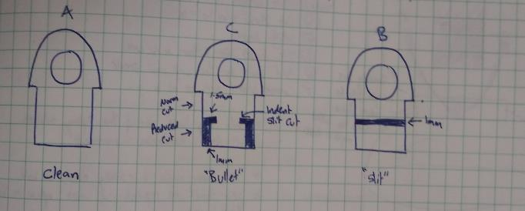
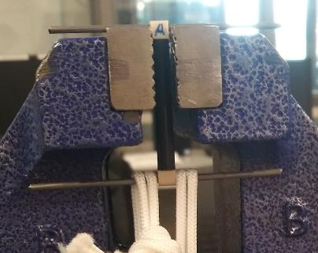
Epoxy Test
Axial stress test to failure
Three tests of each plug design,
Plug A held 12.1 +/- 1.96 kg
Plug B held 11.2 +/- 1.70 kg
Plug C held 7.9 +/- 3.73 kg
Project Schedule
Backup Slides
Manufacturing Status
Budget

Slide 52
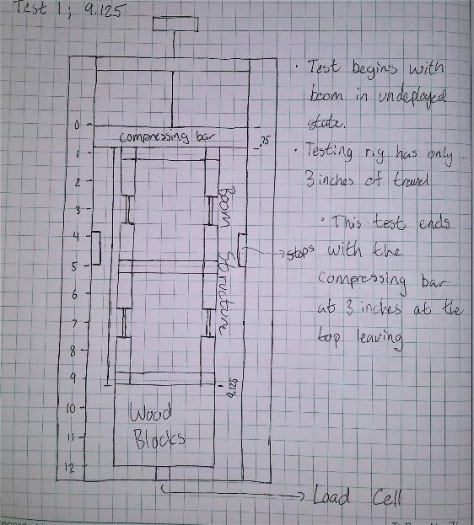
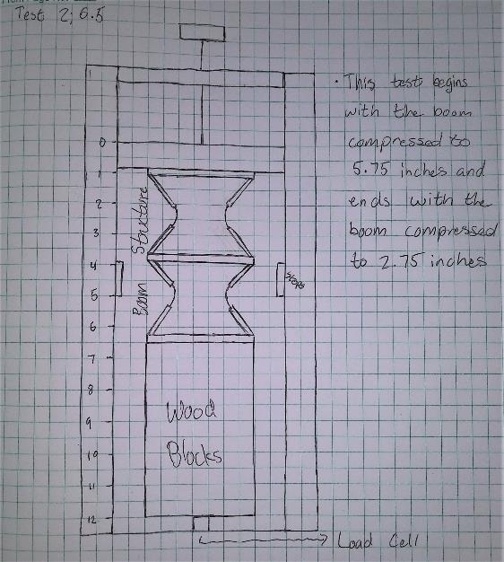
Nitinol Test
Project Schedule
Backup Slides
Manufacturing Status
Budget

Slide 53
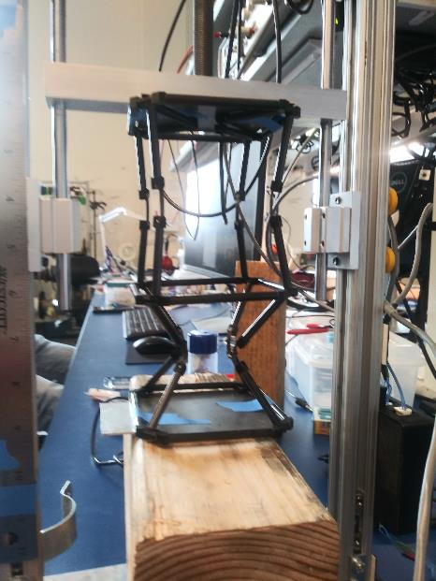
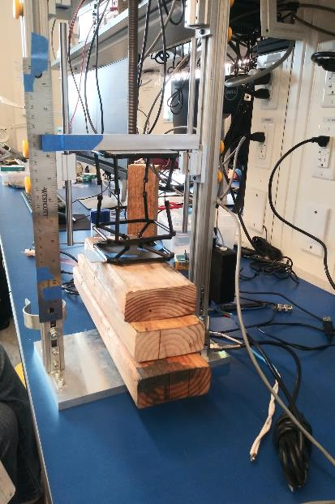
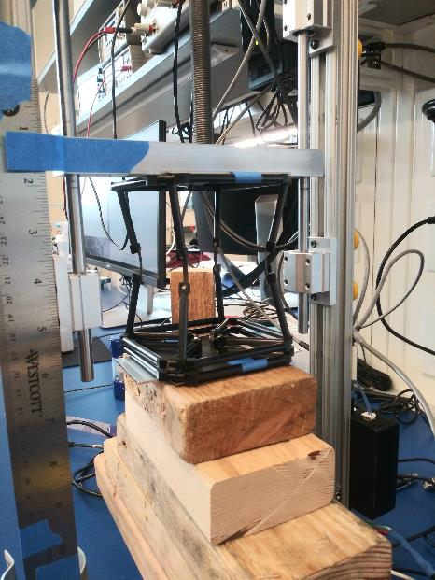
Nitinol Test
Project Schedule
Backup Slides
Manufacturing Status
Budget

Slide 54
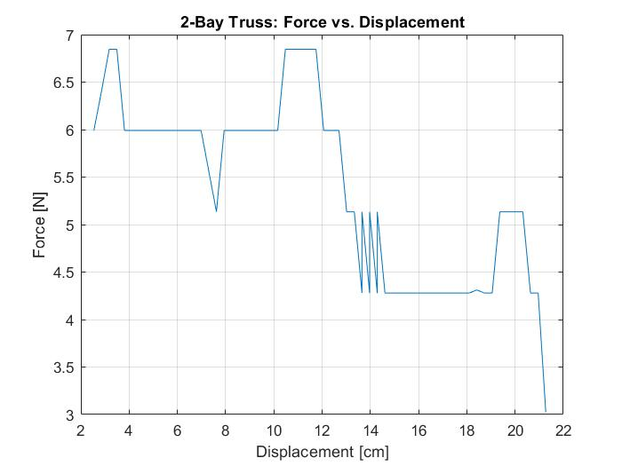
Nitinol Test Results
Mean force: 5.3 N
Total displacement: 18.7 cm
Total work: 4.05 J
Work-Energy Theorem implies that 2.0 J stored as potential energy in each truss bay
Conservation of energy for a massless boom yields a final velocity of the instrument
8-bay truss gives 4.0 m/s
Project Schedule
Backup Slides
Manufacturing Status
Budget

Slide 55
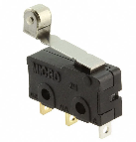
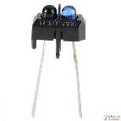
Telemetry Switch Trade Study
 | Weight | Snap Switch | IR Sensor | Optical Encoder
Mechanical Complexity (0-5) | 30% | 2 | 5 | 3
Redundancy Opportunity (0-1) | 10% | 0 | 1 | 1
Software Complexity (0-5) | 10% | 5 | 5 | 3
Power Draw (0-5) | 10% | 5 | 3 | 4
Size (0-5) | 40% | 1 | 5 | 4
Total | 100% | 40% | 96% | 74%
During MSR a valid point was brought up as to why an encoder was not considered to count rotations.
A viable option given manufacturing timeline and space available
A trade study was performed against the current baseline design option and optical encoder based options
Project Schedule
Backup Slides
Manufacturing Status
Budget

Slide 56
Project Schedule
Backup Slides
Manufacturing Status
Budget

Slide 57
Project Schedule
Backup Slides
Manufacturing Status
Budget

Slide 58
GEVS Standard
Project Schedule
Backup Slides
Manufacturing Status
Budget

Slide 59
Software FBD
Confirm Temp
MATLAB App
Sense Temp
Detect Spool Revolutions
Confirm Relay Arming
Open Relay
Deploy Boom
Power IR LED
Arduino Code
Report Deployment State
Close Relay
Arm Relay
Project Schedule
Backup Slides
Manufacturing Status
Budget

Slide 60
Circuit Board V1.0
Key
GND Layer
Top Layer
Project Schedule
Backup Slides
Manufacturing Status
Budget

Slide 61
Thermal Model MATLAB Equations
Project Schedule
Backup Slides
Manufacturing Status
Budget

Slide 62
Resonant Frequency Analytical Model
“The Solidworks vibration simulations have been run with accurate physical models, meaning that the physical assembly being meshed is fully compliant with what the team intends to produce in the end. Sixteen cases were run, made up of cases for one bay through eight bays, all with both an instrument case and a no instrument case. A max of only eight bays was run because any more than that is pushing the limit of what a laptop can do, and it’s the number of bays needed for 60cm extension. All sixteen simulations were run with the highest quality blended-curvature mesh, using the adaptive solver.”
Project Schedule
Backup Slides
Manufacturing Status
Budget

