Slide 1
TALON: Tactical Autopilot Long-Term Overwatch Network (HERD-CU)
Critical Design Review
02 December 2021
Customer: Professor John K. Mah
Selmo Almeida
Nicholas Boender
Anthony Danna
Ethan Fleer
Collin Kasunic
John Oliver
Jason Peloquin (Project Manager)
Vyacheslav Rychenko
Patrick Tippens
Zachary Vanlangendonck
Dante Vigil
Christian Williams
Notes:
Flip the slide template. Title on the left and make more space in general. Move the page numbers to the right side. Mka the timeline on the bottom of each slide to half the slide. Include transition slides to give a pause moment.

Slide 2
Presentation Outline
Overview
Design Solution
Critical Project Elements (CPEs)
Design Requirements
Project Risks
Verification and Validation
Project Planning
Overview
Design Solution
CPEs
Design Requirements
Project Risks
Verification & Validation
Project Planning
Notes:
Take our the abcd… from the project overview. Keep the baseline design details

Slide 3
Project Overview - Mission Statement
Project TALON’s purpose is to develop a high endurance, human-portable, rapidly deployable unmanned aerial vehicle. The aircraft will be capable of supporting multiple mission overwatch profiles that demand agility, low cost, high persistence, and broad coverage capability.
Overview
Design Solution
CPEs
Design Requirements
Project Risks
Verification & Validation
Project Planning
Notes:
Take our the abcd… from the project overview. Keep the baseline design details

Slide 4
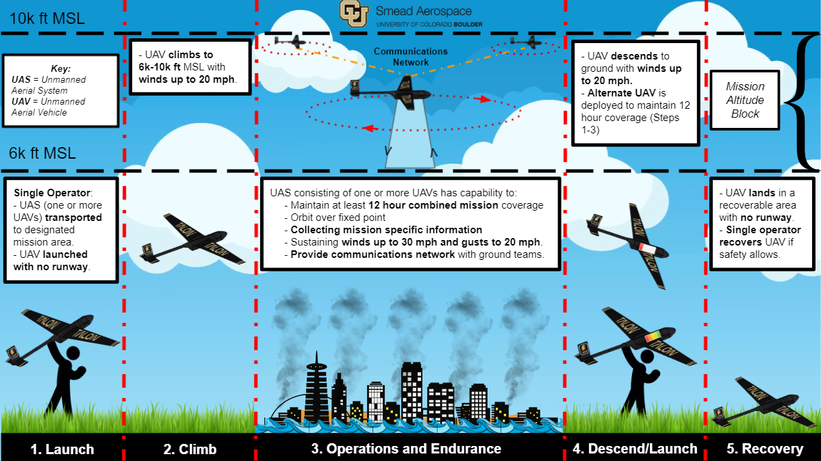

Slide 5
Design Solution
Overview
Design Solution
CPEs
Design Requirements
Project Risks
Verification & Validation
Project Planning

Slide 6
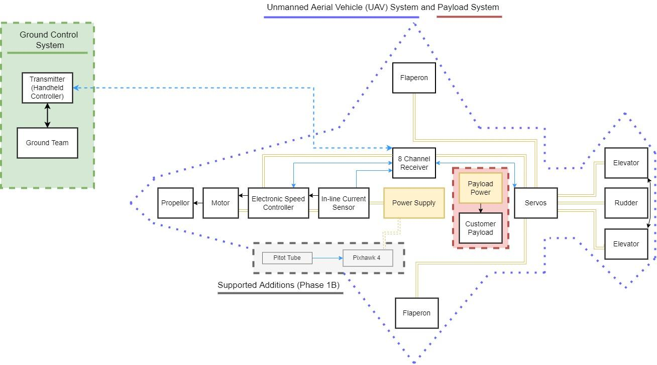
Design Solution - Functional Block Diagram
KEY:
Physical connections
Data Connections
Data Connections via wireless method
Power supply connections
(illustrate subsystem
complexity and importance)
Overview
Design Solution
CPEs
Design Requirements
Project Risks
Verification & Validation
Project Planning
Notes:
FBD is comprised of 4 sections: Ground, UAV, Payload, Supported Additions
Ground Team operates a transmitter
Received by 8 channel receiver Onbard UAV
Communicates to inline current sensor and electric speed controller which drive the motor and propellor, and servos which control the flaperons elevator and rudder.
All these systems run off our power supply solution
Payload is comprised of customer dictated system and power supply
In addition, we accommodate Phase 1bs integrate with a pitiot tube and pixhawk
Transmitter/Receiver in Ground Control System (Tx/Rx)

Slide 7
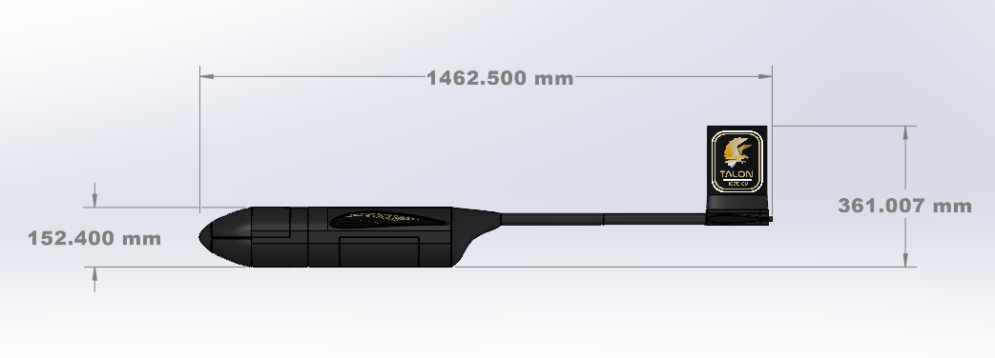
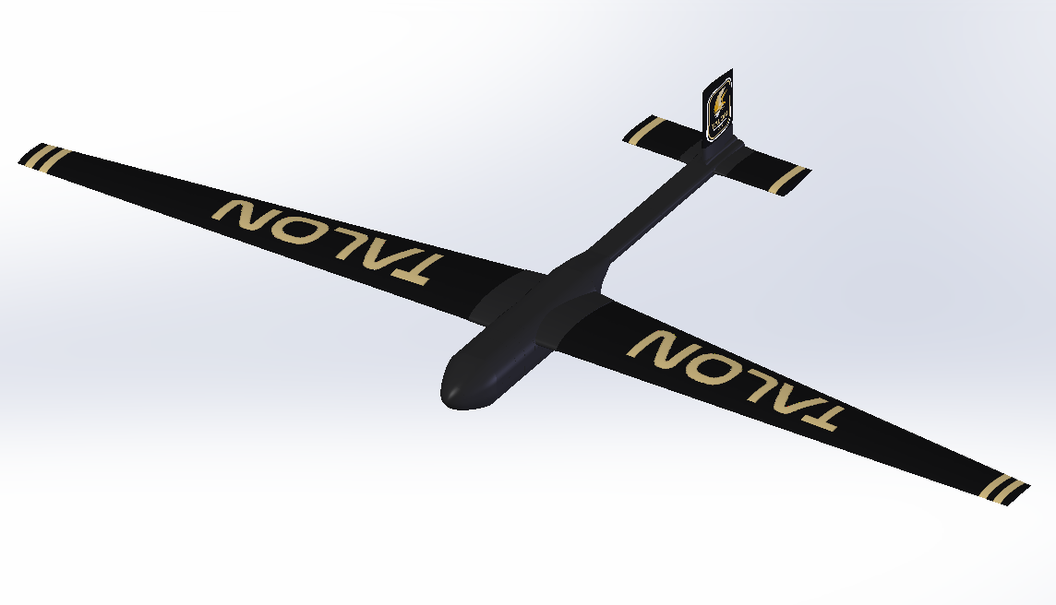
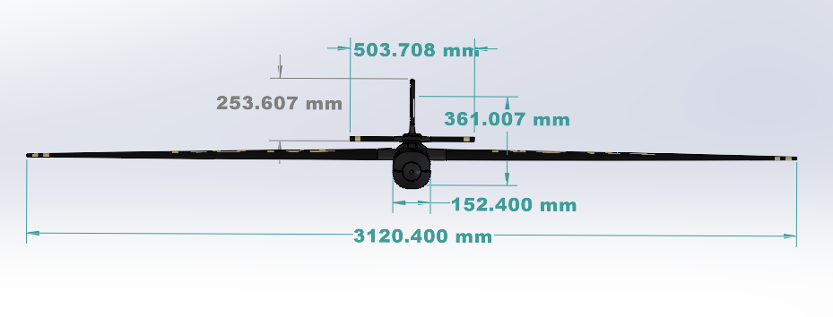
Design Solution - Final Design Overview
Overview
Design Solution
CPEs
Design Requirements
Project Risks
Verification & Validation
Project Planning
Notes:
- Streamlined/Aerodynamic
- Easily serviceable
- Small package footprint
High Wing mount
- Conventional Tail
1.46 m (5 ft) long
10 ft wing span

Slide 8
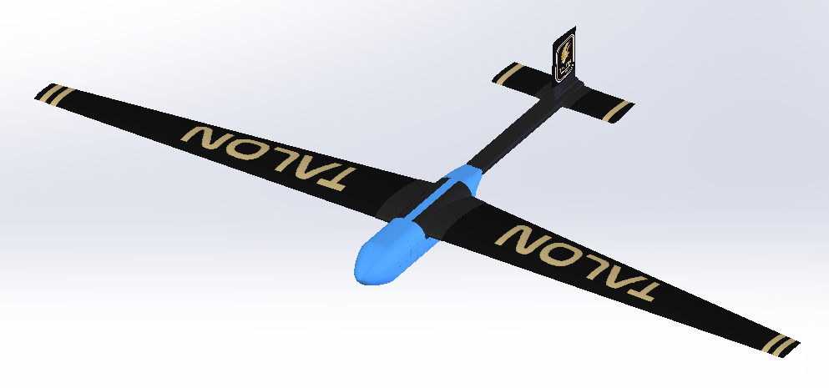
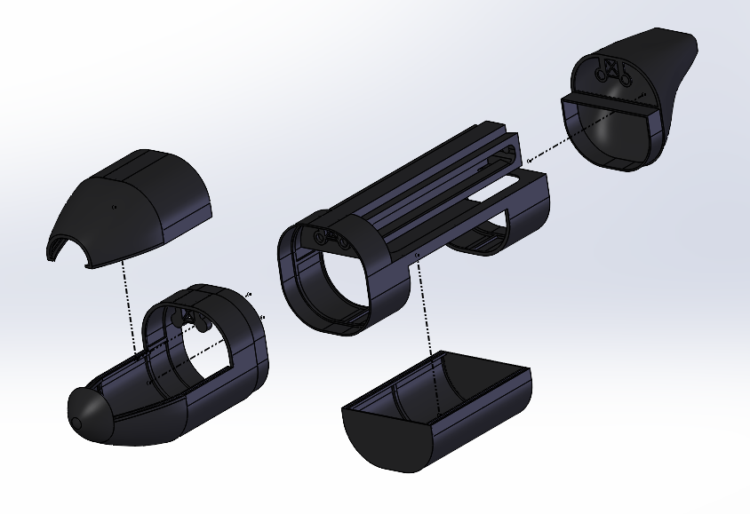
Design Solution - Fuselage
Focus: Provide seamless access to electrical components and a volume for a mission specific payload.
Features: Rapidly removable canopy for ease of access into electronics bay and interchangeability payload bay for various user defined payloads.
Overview
Design Solution
CPEs
Design Requirements
Project Risks
Verification & Validation
Project Planning
Notes:
Primary focus: Structurally supportive - Rapidly serviable
Features: - Removable canopy for electronics access - Removable payload bay for mission specific uses

Slide 9
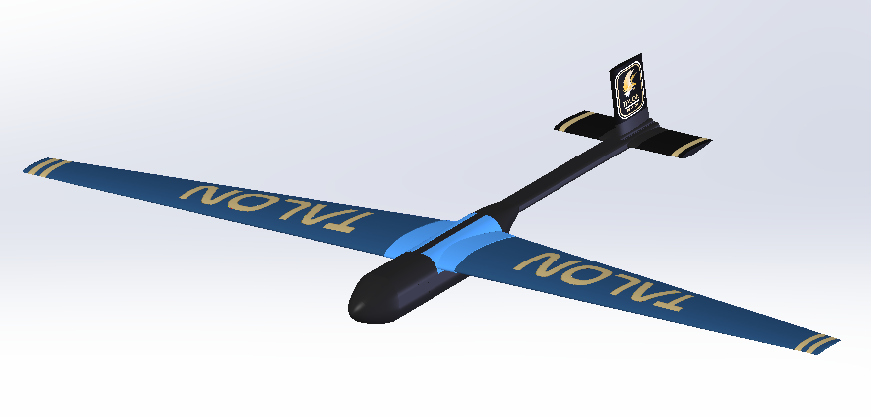
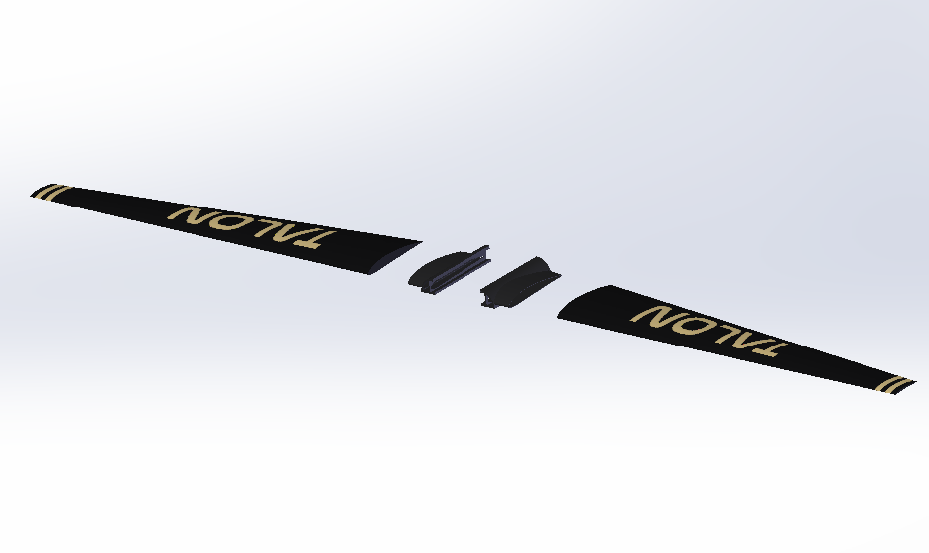
Design Solution - Wing Harness
Focus: Integrating the wing with fuselage while providing enhanced structural support.
Features: Three piece system based on dovetail connections for rapid interchangeability and servicing. Structural reinforcement for wings at critical shear point along the fuselage interface.
Other Concepts Considered: Integrated wing and FishBAC control surfaces.
Overview
Design Solution
CPEs
Design Requirements
Project Risks
Verification & Validation
Project Planning
Notes:
Focus: -Integration of high mounted wing design - Structural support
Features: -Three piece dovetail system - Structural support at critical shear point on fuseagle interface

Slide 10
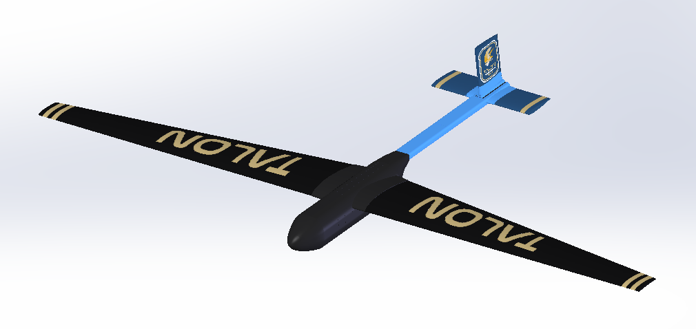
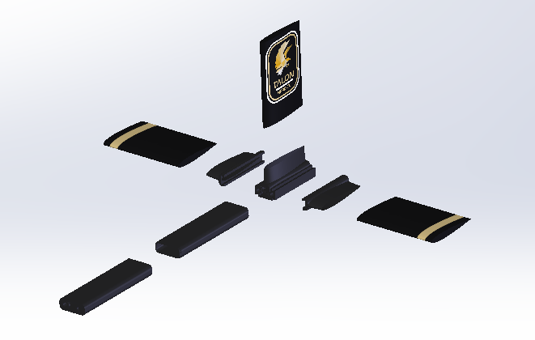
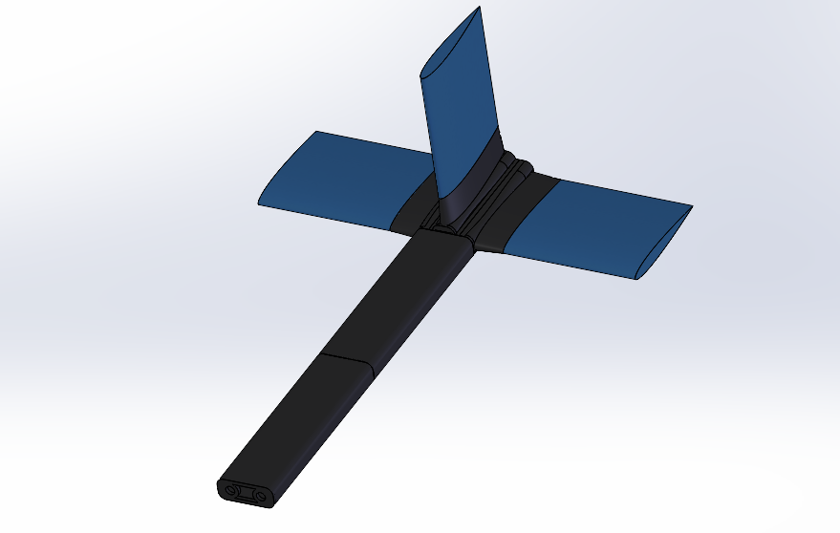
Design Solution - Tail
Focus: Providing pitch and yaw stability while minimizing flow disturbance.
Features: Aerodynamic sleeving leading up to the empennage decreases turbulent flow to tail. The three identical control surfaces provide rapid manufacturing and replacement, all acting on the same dovetail mounting platform.
Overview
Design Solution
CPEs
Design Requirements
Project Risks
Verification & Validation
Project Planning
Notes:
Focus: Inherent pitch/yaw stability - Min flow disturbance
Features Aerodynamic Sleeving - Three piece identical mount and control surfaces - Easy manufacturing and replacement

Slide 11
Design Solution - Wing
Span | 1524 mm
Taper Ratio | 0.40
AR | 14.25
Root Chord | 304.8 mm
Root Airfoil | NACA4412
Tip Chord | 121.9 mm
Tip Airfoil | NACA4406
Leading Edge
NACA4412
NACA4412
NACA4406
Overview
Design Solution
CPEs
Design Requirements
Project Risks
Verification & Validation
Project Planning
Notes:
Most critical component
Span of 1.52 m
Starting at root
At ⅗ span, beghin transition to NACA 4406
Tip
4:43

Slide 12
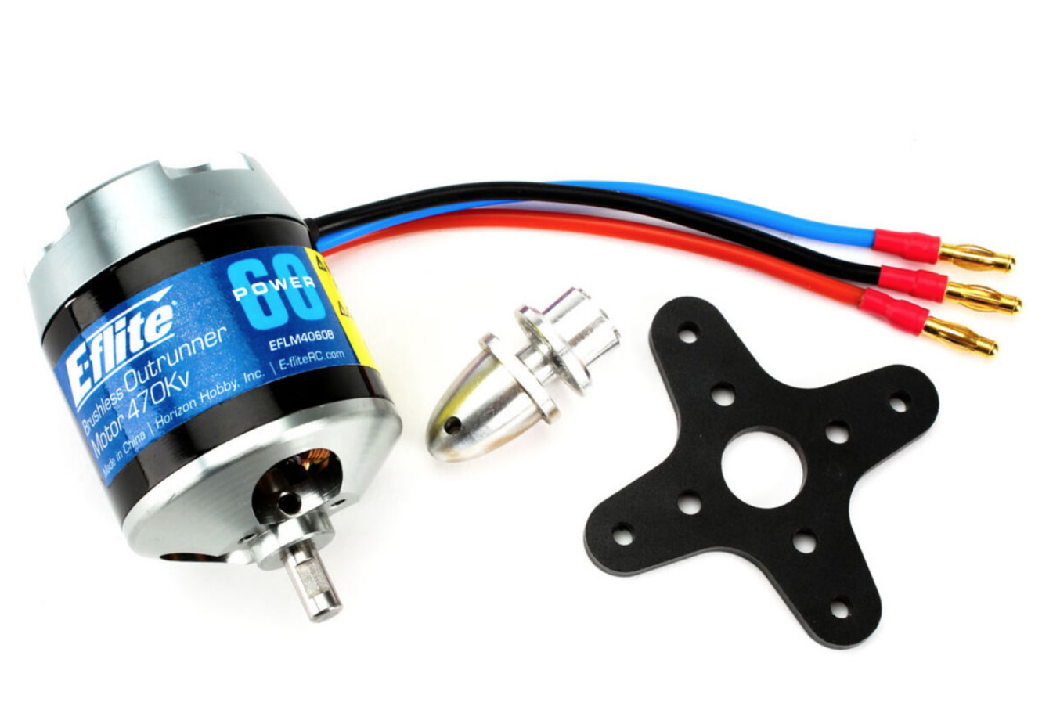
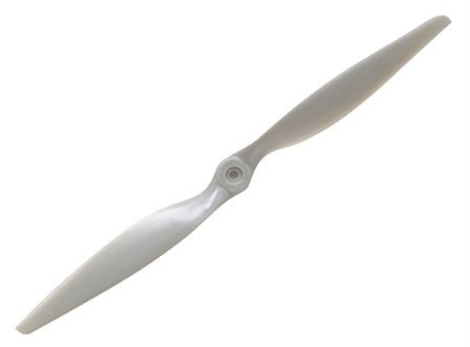
Design Solution - Propulsion
Motor:
470Kv (Kv=RPM per Volt)
Low Amp Draw
4S-6S compatible
Propeller:
17x7E
Maximum RPM = 8,529
Lightweight Plastic
Economical
Motor/Propeller Combination:
Capable of generating 16+ lbs of thrust
Propeller - 17X7E
Motor - 470Kv Brushless
Propeller - 17x7E
Diameter: | 17 in
Pitch | 7E
Max RPM: | 8,529
Input Voltage: | 14.8-22.2V
Idle Current: | 2.1A @ 20V
Current: | Up to 100A
Overview
Design Solution
CPEs
Design Requirements
Project Risks
Verification & Validation
Project Planning
Notes:
“The team selected a 470Kv brushless motor with a 17x7E propeller which is capable of efficiently generating over 16 lbs of thrust and is fully compatible with our battery”

Slide 13
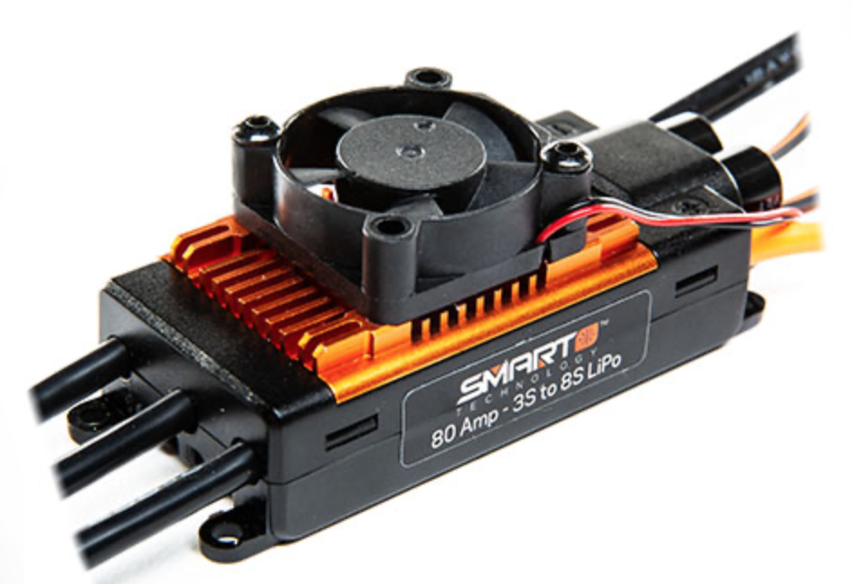
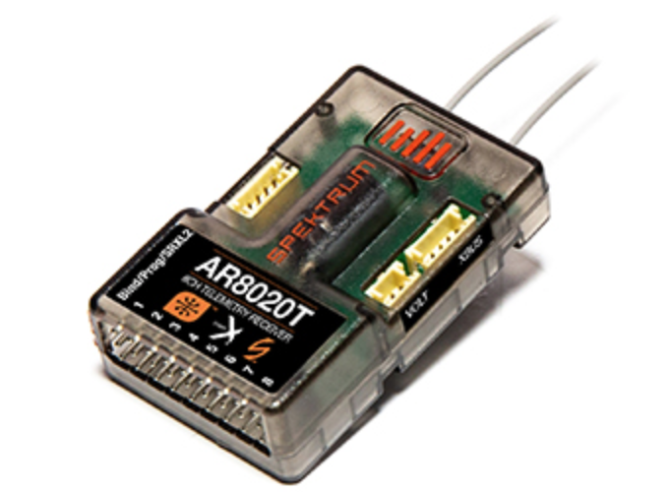
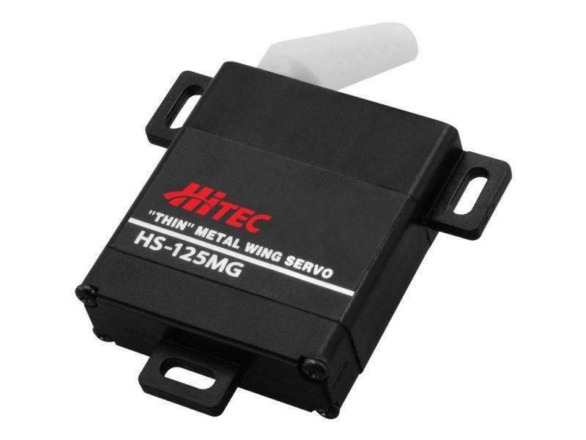
Design Solution - Electronics
Spektrum SPMXAE1100 - ESC
Spektrum 8020T Receiver - 8 Channel
HS-125MG Slim Wing Servo
Input Voltage: | 11.1-22.2V
BEC Voltage: | 6V, 7.4V, or 8.4V
Cont. Max Current: | 100A (120A Max Burst)
Input Voltage: | 3.5-9.0V
Band (Freq.): | 2.4GHz
Current: | 80mA
Input Voltage: | 6.0V
No Load Current: | 230mA
Stall Current | 1.2A
Overview
Design Solution
CPEs
Design Requirements
Project Risks
Verification & Validation
Project Planning
Notes:
Aircraft components that would achieve flight included Spektrum ESC and 8-Channel Receiver as well as a 4 servos that have been chosen primarily for 3 reasons:
These parts are readily available in the market
Spektrum offers data acquisition of in-flight telemetry
And these components can be interfaced with Phase 1b’s Pixhawk 4 flight controller.
Esc controls the motor, its wide range of use from 11.1 to 22.2 volts, which correlates to a 3s to 6s power source, means that we can use a variety of battery packs without requiring a change in ESC.This specific ESC can accommodate a continuous current of up to 100 amps.
Receiver allows for control up to 8 different channels corresponding to 8 control surfaces operating at the FAA approved frequency of 2.4 GHz.
In our case, the servos correspond to four control surfaces including a flaperon on each wing, which is effectively a hybrid flap and aileron, as well as the horizontal and vertical stabs also known as the elevator and rudder.

Slide 14
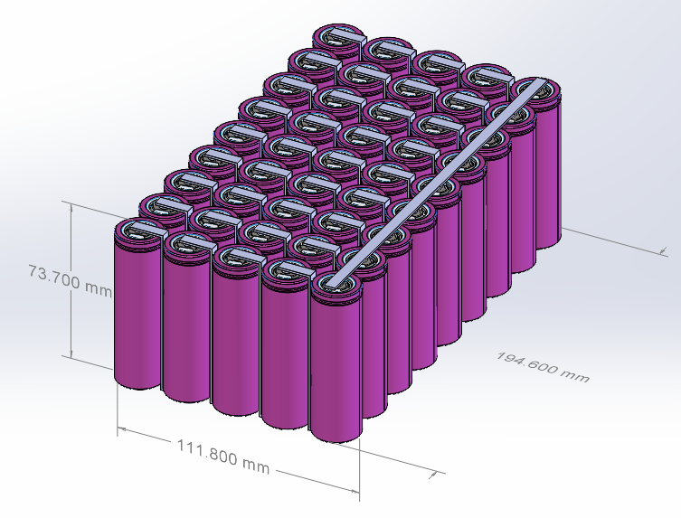
Design Solution - Battery
 | Single Cell |  | 9P-5S
Battery Characteristics | Value |  | Value
Nominal Voltage | 3.65 | V | 18.25 | V
Nominal Capacity | 5000 | mAh | 45000 | mAh
Usable Capacity | 4500 | mAh | 40500 | mAh
Continuous Discharge Rate | 9.60 | A | 86.40 | A
Continuous Power Capability | 35.04 | W | 1576.80 | W
Nominal Total Energy | 18.25 | Wh | 821.25 | Wh
Usable Total Energy | 16.43 | Wh | 739.13 | Wh
Mass | 68 | g | 3060 | g
Cell Type: Lishen 21700 5000mAh 9.6A Battery (LR2170SD)
Overview
Design Solution
CPEs
Design Requirements
Project Risks
Verification & Validation
Project Planning
Notes:
After conducting some trade studies, the Lishen 21700 battery was chosen to power the Talon due to its high capacity to mass ratio. To suit the voltage and current demands of the Talon, the cells were put into a 5 series and 9 parallel configuration boosting the voltage to 18.25 V, continuous discharge rate of 86.40 A, and a nominal capacity of 45000 mAh. However, since lithium based batteries cannot be safely discharged to their full capacity, we assumed that we could drain the battery to 10% of the nominal capacity bringing the total usable capacity to 40500 mAh. The model on the left is a crude mockup of the battery pack which has an estimated weight of 3.06 kg or 6.75 lbs.

Slide 15
Mass Budget
3D Printed Resin
Used for most structural components
High strength and rigid
3D Printed PLA Foam
Used for non-structural components to save weight
Proposed Payload
LilyGo LORA Radio
Allows long range communication without cell towers
Lightweight
Fits possible mission case for TALON
Allows meshing with other LORA radios
Overview
Design Solution
CPEs
Design Requirements
Project Risks
Verification & Validation
Project Planning

Slide 16
Critical Project Elements Driven By Functional Requirements
Overview
Design Solution
CPEs
Design Requirements
Project Risks
Verification & Validation
Project Planning

Slide 17
Project Overview - Critical Project Elements
CPE | Description | Importance to Success | Functional Requirement
Maximizing endurance through aerodynamics | Achieve high endurance through comprehensive aerodynamic design and modelling | Poor aerodynamics directly translates to decreased endurance | FR1
Maximizing endurance through electronics and battery configuration | Achieve high endurance through efficient battery design and power use | Poor electronics design greatly decreases endurance | FR1
Propulsion system optimization | Achieve high endurance through propulsion system optimization | Propulsion is key for climbout and endurance | FR1 & FR3
Structures | Ensure structural integrity of vehicle through various flight conditions while maintaining light weight and portability | Structural design is critical for landing survivability and portability but must be lightweight for endurance | FR2, FR3 & FR4

Slide 18
Primary Functional Requirements
Overview
Design Solution
CPEs
Design Requirements
Project Risks
Verification & Validation
Project Planning

Slide 19
Project Overview - Functional Requirements
FR1: The UAS shall provide a continuous overwatch window of 12 hours through the use of one or more UAVs (i.e. three UAVs each with 4 hours of endurance is acceptable).
FR2: UAS (including all UAVs and their supporting equipment) shall be transported, launched, recovered, and operated by a single person to satisfy Requirement 1 under a 10 minute launch window per UAV.
Overview
Design Solution
CPEs
Design Requirements
Project Risks
Verification & Validation
Project Planning
Notes:
FR1: overwatch of 12 hours
FR2: outlines aircraft portability through a single user

Slide 20
Project Overview - Functional Requirements
FR3: UAS shall have short takeoff and landing capabilities to deploy in areas with unprepared launch surfaces and obstructed climb windows as specified by the customer.
FR4: UAV shall provide a payload bay to house a sensor suite.
Overview
Design Solution
CPEs
Design Requirements
Project Risks
Verification & Validation
Project Planning
Notes:
FR3: Outlines short takeoff and landing
FR4: Read it off.

Slide 21
Design Requirement Satisfaction
Overview
Design Solution
CPEs
Design Requirements
Project Risks
Verification & Validation
Project Planning

Slide 22
Design Requirements - Key Drivers of TALON Success
1
Highly Efficient Wings
High AR
Taper
Aerodynamic twist
2
Optimized Propulsion
Optimized propeller & motor combination for low amperage draw
3
Efficient Electronics
Smart ESC
Appropriately sized servos
Capable of Phase B integration
4
High Capacity Battery
Maximized energy density per overall battery weight
Custom 5S configuration
5
Strong & Lightweight Materials
Utilize a composite/hybrid wing design to maximize strength and minimize weight
Overview
Design Solution
CPEs
Design Requirements
Project Risks
Verification & Validation
Project Planning

Slide 23
FR1 Endurance through Aerodynamics
Overview
Design Solution
CPEs
Design Requirements
Project Risks
Verification & Validation
Project Planning

Slide 24
Design Requirement - Endurance through Aerodynamics
Endurance of Propeller Driven Aircraft
Goals:
Design Highly Efficient Aerodynamic Bodies
Assumptions:
Steady Unaccelerated Flight
Limitations:
Ignores Propulsion System & Propeller Efficiency
TALON Design Elements:
Airfoil: NACA 4412 & NACA 4406
Taper Ratio: 0.40
Aspect Ratio: 14.25
Maximize C_{L}^{3/2}/C_{D} to Meet FR1 (Cruise) and L/D FR3 (Climbout)
Overview
Design Solution
CPEs
Design Requirements
Project Risks
Verification & Validation
Project Planning
Notes:
This is the Breguet Endurance Formula for a reciprocating propeller driven aircraft. While our a/c is electric, we understand that to maximize endurance we want to minimize the power required which is not influenced by the propulsion system. Thus we see that endurance, from an aerodynamic perspective is a function of CL over CD.
We used this heuristic in comparing airfoils and making design choices such as Airfoil, taper and AR.
For discussion tomorrow: It may be a problem that we don’t have a prediction for Endurance? Needed for validation stage.

Slide 25
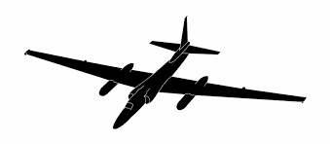
Design Requirement - Endurance through Aerodynamics
Predicted Aerodynamic Characteristics - Potential Flow Theory
Assumptions:
Steady-State
Incompressible Flow
No Side-Slip
Limitations:
No Compressibility
No Viscous Drag
Simple Geometry
Optimal L/D @ 4.8° AOA & 16.4 m/s
C_{L} | 0.7991
C_{D} | 0.0319
C_{L}/C_{D} | 25.06
Lift | 72.1 (N)
Drag | 5.9 (N)
Albatross (Bird)
20:1
U-2 (Spy Plane):
25.6:1 (12 Hrs)
Rutan Voyager
27:1 (216 Hrs)
Overview
Design Solution
CPEs
Design Requirements
Project Risks
Verification & Validation
Project Planning
Notes:
What is MAX? MAx AOA before Stall? Maximum achievable speed? Not sure why its worth talking about.
Albatross is highly efficient bird able to fly 100km /day without flapping wings, with 22:1 glide ratio
U-2 spyplane - prolific recon plane with 12 hr unrefueled endurance
Rutan Voyager: first plane to circumnavigate the globe unrefueled, non stop. 216 hours
Birds: Government Surveillance Drones?
Sources: https://en.wikipedia.org/wiki/Rutan_Voyager, https://en.wikipedia.org/wiki/Lift-to-drag_ratio

Slide 26
FR1 & FR3 Propulsion System Optimization
Overview
Design Solution
CPEs
Design Requirements
Project Risks
Verification & Validation
Project Planning

Slide 27
Design Requirement - Propulsion System Optimization
Goals
Solve propulsion requirements for 3 mission profiles
Max Endurance, Climbout, Headwind
Assumptions
All Flight Cases:
15 lb. total mass, Finite wing (Induced drag), 5,700 ft alt. conditions
Max Endurance
L=W, T=D, C_{D0} = (⅓)kC_{L}², No wind
Climbout
Adheres to Level 3 Req, C_{D0} = kC_{L}² , No wind
Headwind
No crosswind, constant headwind
Overview
Design Solution
CPEs
Design Requirements
Project Risks
Verification & Validation
Project Planning

Slide 28
Design Requirement - Propulsion System Optimization
Model Slides
Propulsion Model Calculates Thrust needed each flight phase [1]
Propulsion Optimization Findings:
Lower Amperage = More Endurance
Amp draw depends on:
Propeller
Motor
Thrust requirements
Flight Phase | Thrust Required [lbf] | Amps Desired [A]
Endurance | 0.9 | As low as possible
Climbout | 8.2 | As low as possible
Headwind | 0.78 | As low as possible
Overview
Design Solution
CPEs
Design Requirements
Project Risks
Verification & Validation
Project Planning
Notes:
FR3 is met if the thrust generated from propulsion system is greater than the model’s estimated required thrust for level 3 climbout.
FR1 is met if the thrust generated from the propulsion system is greater than the model’s estimated required thrust while simultaneously reducing current draw as much as possible.
P_req = Power required for steady level unaccelerated flight
Endurance Amp Draw driving motor and propellor combo

Slide 29
FR1 & FR3 Endurance through Electronics and Battery
Overview
Design Solution
CPEs
Design Requirements
Project Risks
Verification & Validation
Project Planning

Slide 30
Design Requirement - Endurance through Electronics
Goal
Efficient power usage through select component choices and custom battery
Power Budget Assumptions
High loading takeoff conditions
No adverse wind effects
No losses in wiring
Ideal battery
Ideal motor
Constant current draw
Servos
ESC = motor current draw
Solution
Account for all losses with the margin
20% contingency power
ESC
Motor
FET/Switch
Servos
Battery
Processor
Left Flaperon
Receiver
Right Flaperon
BEC
Rudder
Elevator
Overview
Design Solution
CPEs
Design Requirements
Project Risks
Verification & Validation
Project Planning
Notes:
CONDENSED:
Restate goal
Streamline the Functional Block Diagram (FBD)
Understanding that the power budget assumptions outline ideal conditions we have accounted for this with the use of 20 percent margin.
-------------------------------------------------------------------------------------------------------------------------------
Power Budget Assumptions:
Define high loading takeoff conditions: maximum flight angle of 21.8 degrees to meet level 3 success, sea level conditions (i.e. density of air at sea level), minimum takeoff distance of 50ft or 15.24 meters which will require high amperage demand from the battery.
Ideal flight: no adverse wind effects
Overall efficiency of the system is model to have no losses in the wiring, battery, and motor.
Although current draw to the servos and motor will vary on the flight conditions as well as aircraft configuration, but constant representative values have been chosen to model our aircraft power budget.
The ESC is modeled to be ideal, therefore the ESC will draw the same amount current that is required by the motor without any losses due to lack of manufacture provided efficiency data.
SOLUTION:
Since many of these assumptions and component efficiencies can not be easily verified without a full system test, a 20% contingency power cost was implemented to cover the differences that will result from the ideal cases

Slide 31
Design Requirement - Endurance through Electronics
Power Budget
 |  | Takeoff |  | Cruise
Component | Quantity | Max. Current Draw | Margin (20%) | Max. Current Draw | Margin (20%)
ESC | 1 | 50.00 | 60.00 | 6.00 | 7.20
Motor | 1
Servo | 4 | 0.71 | 0.85 | 0.43 | 0.51
Receiver | 1 | 0.08 | 0.10 | 0.08 | 0.10
Current Required: |  | 52.91A | 63.49A | 7.78A | 9.34A
Overview
Design Solution
CPEs
Design Requirements
Project Risks
Verification & Validation
Project Planning
Notes:
As previously mentioned, the ESC effectively behaves as a power valve, meeting the amperage demands of the motor. Given the lack of efficiency data, the 20% margin was implemented to cover the possibility of power losses and power consumption of the ESC.
Worst case scenario the receiver is expected to draw 80 milliamps, which appeared to be the upper threshold/worst case across RC industry standard receivers.
The servo is assumed to have 2 different power requirements for takeoff and cruise due to loading inherited from the level 3 success and conditions experienced for each stage of flight
HIghlight AMPERAGE requirements for TO at 52.91-63.49A and Cruise at 7.78-9.34A

Slide 32
Design Requirement - Endurance through Electronics
Custom Battery Pack
Parallel: 9 cells
Series: 5 cells
Total: 45 cells
 | Single Cell |  | 9P-5S
Battery Characteristics | Value |  | Value
Nominal Voltage | 3.65 | V | 18.25 | V
Nominal Capacity | 5000 | mAh | 45000 | mAh
Usable Capacity | 4500 | mAh | 40500 | mAh
Continuous Discharge Rate | 9.60 | A | 86.40 | A
Overview
Design Solution
CPEs
Design Requirements
Project Risks
Verification & Validation
Project Planning
Notes:
To quickly reiterate, the custom battery pack we are going with will have 45 cells with 5 cells in series and 9 cells in parallel. This in turn will supply us with 18.25 nominal voltage and a capacity of around 40500mAh with a maximum continuous discharge rate of 86.40 A which can not be exceed for prolonged periods of time. We can draw up to this threshold but can not exceed it otherwise the battery would be insufficient.

Slide 33
Design Requirement - Endurance through Electronics
Final values:
 | Without Margin |  | With Margin
Time to Altitude | 0.10 | hr | 0.10 | hr
Capacity Used For Takeoff | 5291.08 | mAh | 6349.30 | mAh
Capacity Left for Cruise | 35208.92 | mAh | 34150.70 | mAh
Time of Cruise | 4.53 | hr | 3.66 | hr
* Note: Time parameters based on motor run time not full aircraft estimates
Satisfies Cruise FR1 and Climbout FR3
Overview
Design Solution
CPEs
Design Requirements
Project Risks
Verification & Validation
Project Planning
Notes:
Given that the time required to climb to altitude is around 6 minutes or 0.1 of an hour, we multiplied the current used at takeoff by the time to altitude to find how much of the battery capacity was used for takeoff. Then we subtracted that from the usable capacity of 40500 mAh to find the capacity left for cruise. The next step was to divided the left over capacity by the current required to maintain cruise finally yielding the time of cruise you see in gray boxes. With that said, we are estimating a cruise time between 3.6 to 4.5 hours from the electronics alone which satisfies FR1 endurance of around 4 hours while also meeting the climbout requirements of FR3.

Slide 34
FR2 & FR3 Capability through Structures
Overview
Design Solution
CPEs
Design Requirements
Project Risks
Verification & Validation
Project Planning

Slide 35
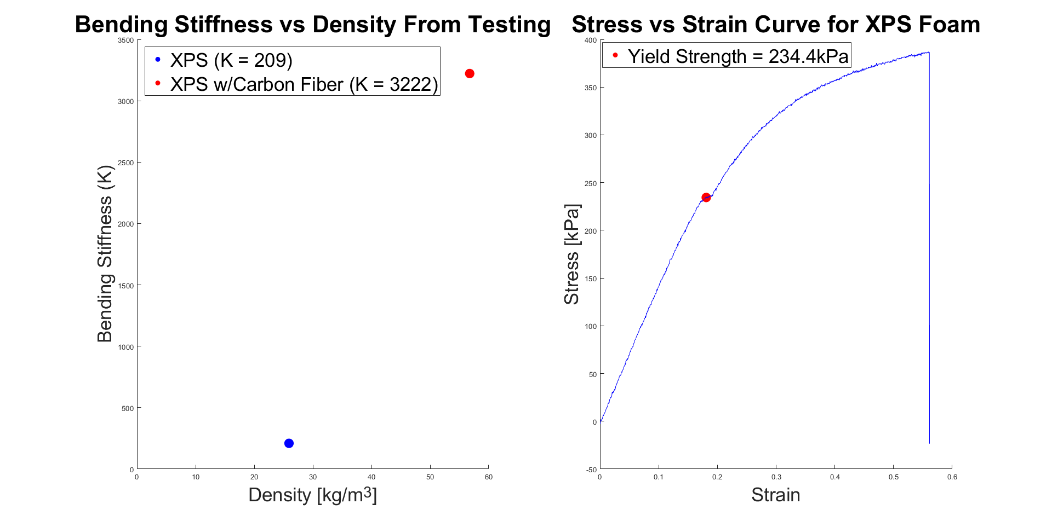
Design Requirement - Structures
Goals:
Develop a lightweight composite wing capable of surviving takeoff and landing
Takeoff Stress Assumptions:
Constant acceleration for climbout
Lift force split evenly between wings
Level ascent
Solution:
Yield Strength of XPS Foam: 234.4 kPa
Max Bending Stress During Takeoff: 298 kPa
XPS Foam Wings will be reinforced with carbon fiber rods and strips
Bending stiffness increases by around 15 times with introduction of carbon fiber
Overview
Design Solution
CPEs
Design Requirements
Project Risks
Verification & Validation
Project Planning
Notes:
How we cave man eliminated it without being able to quantify

Slide 36
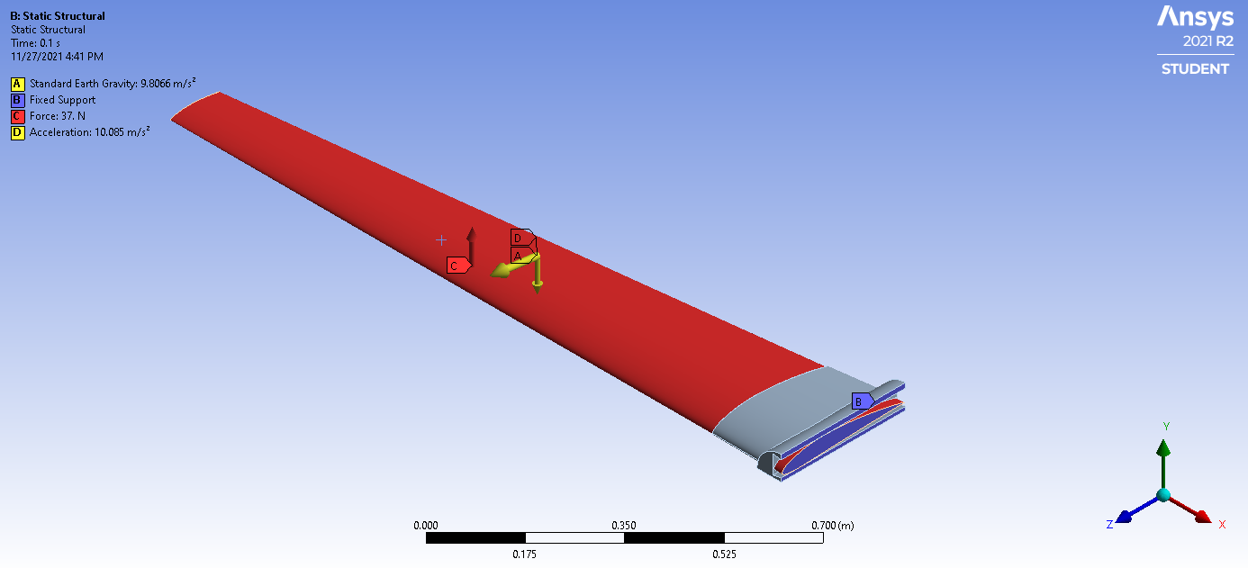
Design Requirement - Structures
ANSYS Wing Setup - Launch
Fixed support at wing harness
Acceleration determined to be:
1.31 m/s² (+y)
10.0 m/s² (+z)
Lift force of 37 N distributed over wing surface
Large deflections ON - account for nonlinear behavior
Stiffness changes as material deforms
Simulation run until 1% solution convergence
Limitations
Assumed entirely solid wing
Unable to test inclusion of carbon fiber supports
Meshing limitations with complex geometry
Used typical XPS foam values
⍴ = 48 kg/m³
E = 80.12 MPa
Wing harness set as ABS plastic
Exact 3D printed properties difficult to predict
Overview
Design Solution
CPEs
Design Requirements
Project Risks
Verification & Validation
Project Planning
Notes:
How we cave man eliminated it without being able to quantify

Slide 37
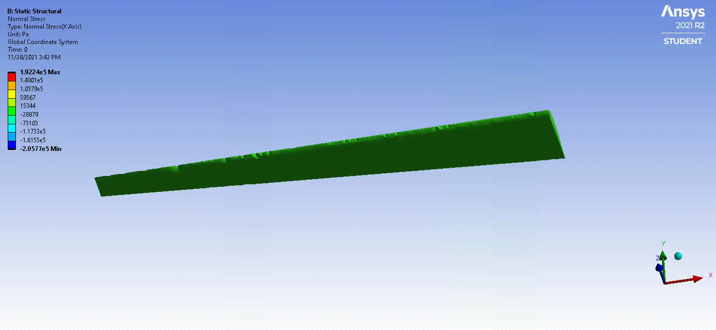
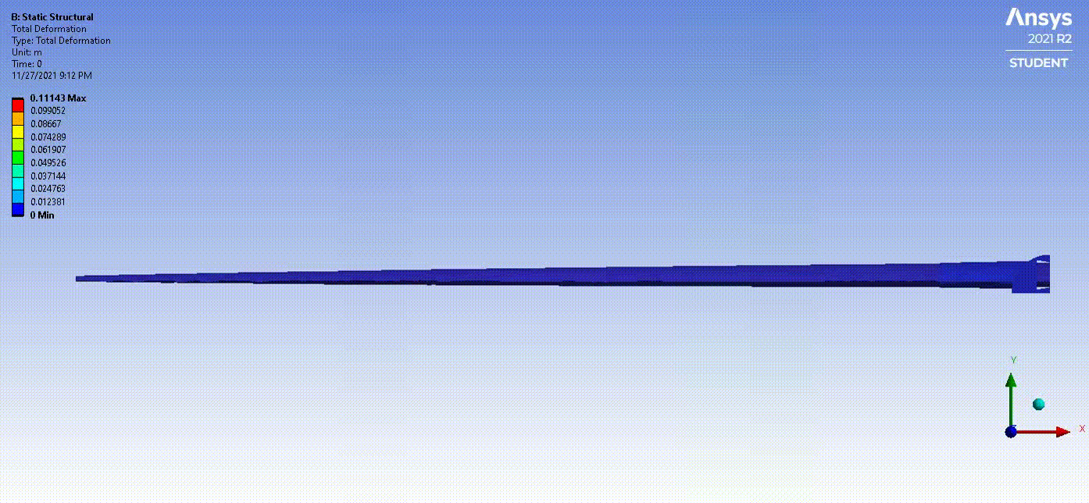
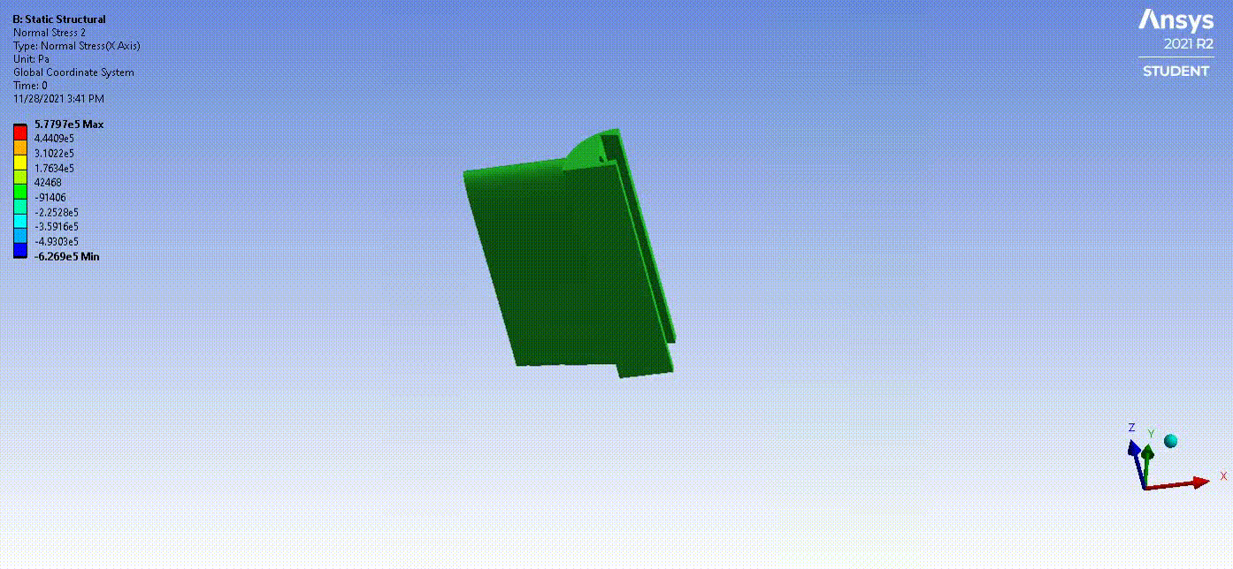
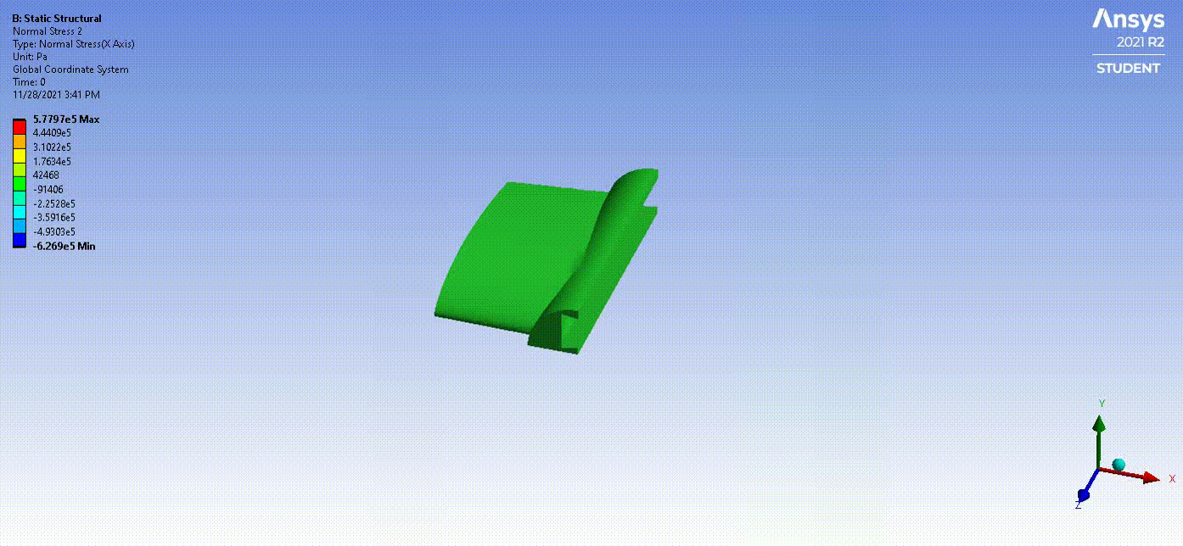
Design Requirement - Structures
Wing Launch - Wing Bending Stress [Top] / Total Deformation [Bottom] / Harness Bending Stress [Bottom-Right]
Wing Launch Simulation | XPS Wing Results | XPS Wing Allowed | ABS Harness Results | ABS Harness Allowed
Max. Tensile Bending Stress | 192.2 kPa | 234 kPa | 1.058 MPa | 14.85 MPa
Max. Compressive Bending Stress | 205.7 kPa | 234 kPa | 0.984 MPa | 14.85 MPa
Total Tip Deflection | 0.111 m 4.37 in | 0.08 - 0.2 m 3.0 - 7.8 in | N/A | N/A
Overview
Design Solution
CPEs
Design Requirements
Project Risks
Verification & Validation
Project Planning
Notes:
How we cave man eliminated it without being able to quantify

Slide 38
Risk & Mitigation
Overview
Design Solution
CPEs
Design Requirements
Project Risks
Verification & Validation
Project Planning

Slide 39
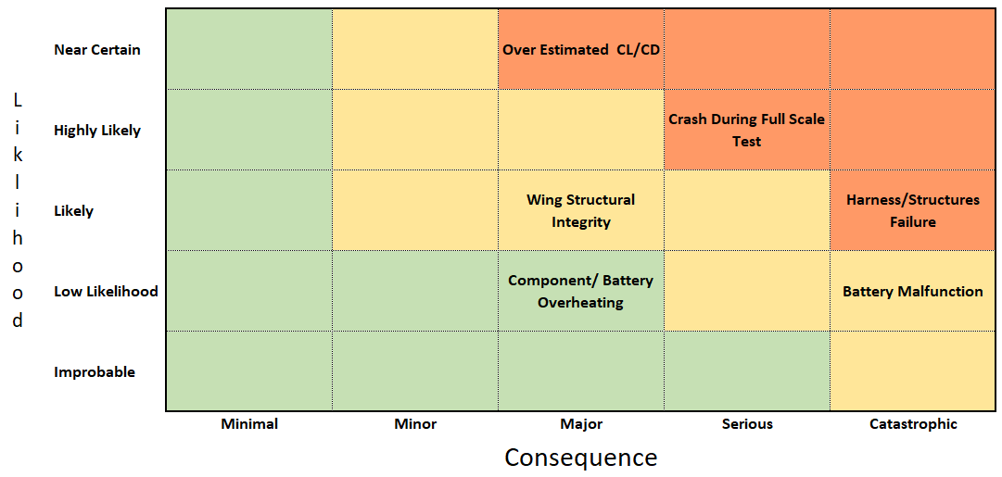
TALON - Risk Matrix Unmitigated
Talon Specific Risk Matrix
Dominant Risks:
Crash During Full Scale Test
Damage due to hard landing
Harness/Structures Failure
Total Loss of aircraft
Wing Structural Integrity
Wing durability
Excessive deflection
Battery
Total Loss of aircraft due to electronics fire
Inaccurate charging
CL/CD
Lift loss due to tip stall
Basic models do not quantify total drag rise
Overview
Design Solution
CPEs
Design Requirements
Project Risks
Verification & Validation
Project Planning

Slide 40
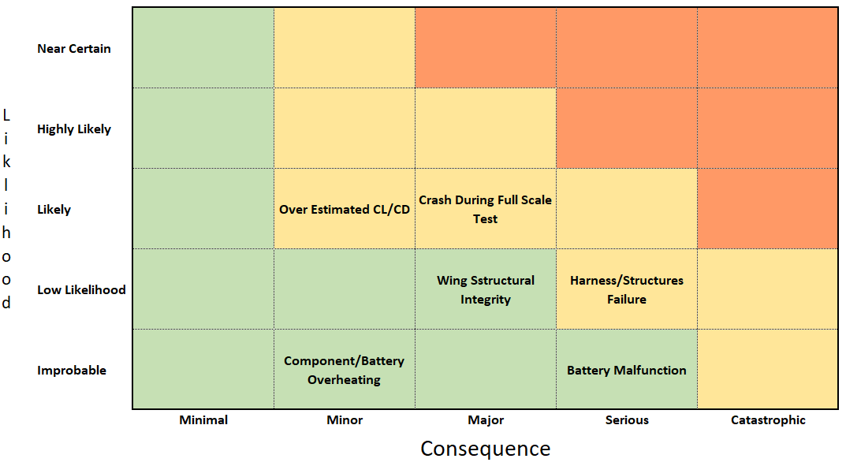
TALON - Risk Matrix Revised
Reducing Risk:
Talon Specific Risk Matrix
Crash During Full Scale Test
Individual component test/verification
Margin implemented across all subsystems
Ground based workup/pre-flight checklist
Margin to build multiple aircraft
Harness/Structures Failure
Load simulations performed in ANSYS
Conduct fatigue and failure testing
Incorporation of safety factor
Wing Structural Integrity
Load simulations performed in ANSYS
Integrated composite reinforcements
Fatigue and failure testing
Battery
Collaborate with IRISS on building and servicing custom batteries
Use of battery management system (BMS)
CL/CD
Excess thrust & design reduces tip stall
Overview
Design Solution
CPEs
Design Requirements
Project Risks
Verification & Validation
Project Planning

Slide 41
Verification and Validation
Overview
Design Solution
CPEs
Design Requirements
Project Risks
Verification & Validation
Project Planning

Slide 42
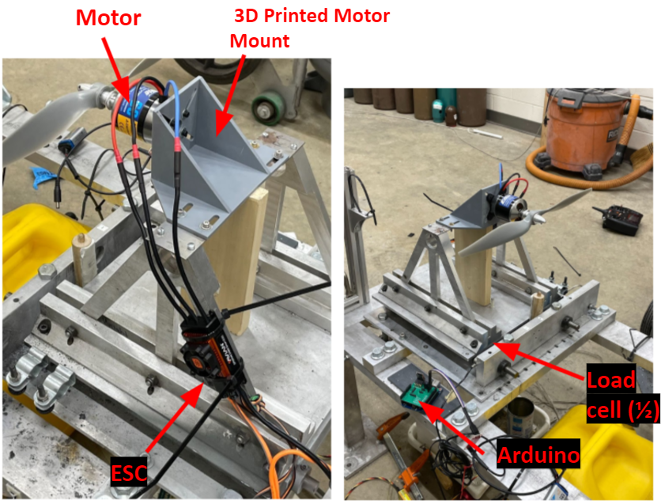
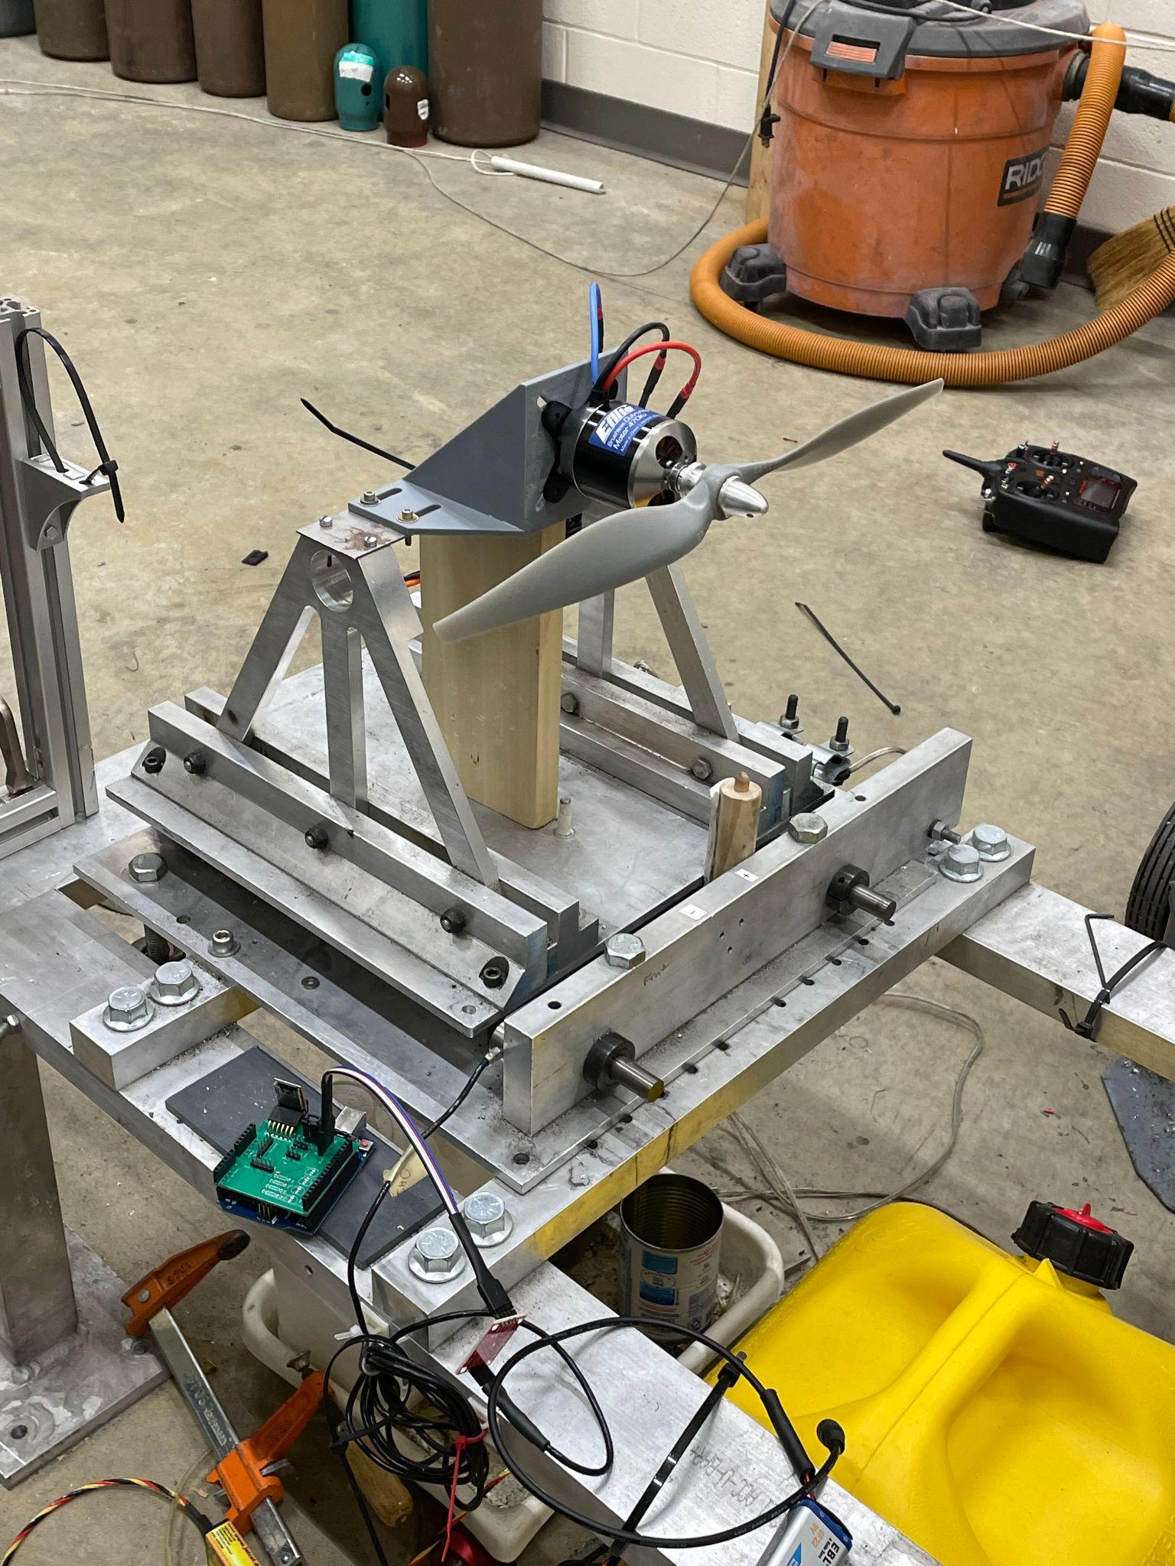
Verification and Validation - Propulsion
Propulsion - Thrust Validation
Objective | Obtain real data on propellor/motor combination to incorporate into full vehicle model
Description | Test propellor/motor combination with multiple battery packs to analyze thrust and current draw. Battery Packs: 6S 22.5V & 4S 14.5V
Model Comparison | Static thrust measured compared to manufacture data sheets and primary propulsion model
Expectation | Measured thrust to exceed 8.16 lbf. as required for climbout
Validation Against FRs | Perform full scale test at previously calculated climbout and cruise throttling for determination of inflight propulsion requirements, satisfying FR1 and FR3.
Load cell (½)
Arduino
Overview
Design Solution
CPEs
Design Requirements
Project Risks
Verification & Validation
Project Planning

Slide 43
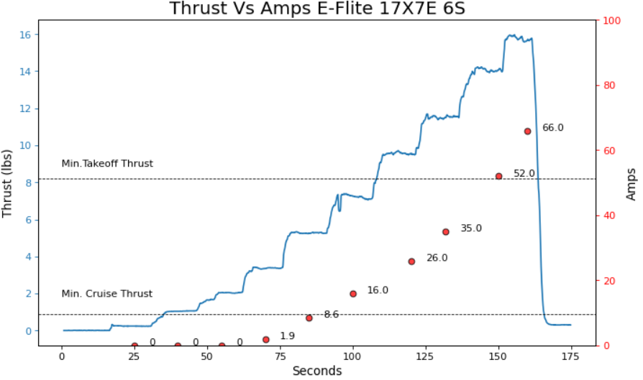
Verification - Propulsion
Propulsion Test Results
Propulsion Test 6S 22.5 V | Results | Required | Margin
Thrust (lbs) | 16.0 | 8.2 | 1.95X
Takeoff Amps | 66 | <100 | 1.5X
Cruise Amps | 8.6 | N/A | N/A
Future Validation - Full scale flight test
Overview
Design Solution
CPEs
Design Requirements
Project Risks
Verification & Validation
Project Planning
Notes:
Desire maximum Thrust per Amps during cruise conditions while simultaneously able to exceed climbout thrust performance requirements as this is most demanding part of mission.

Slide 44
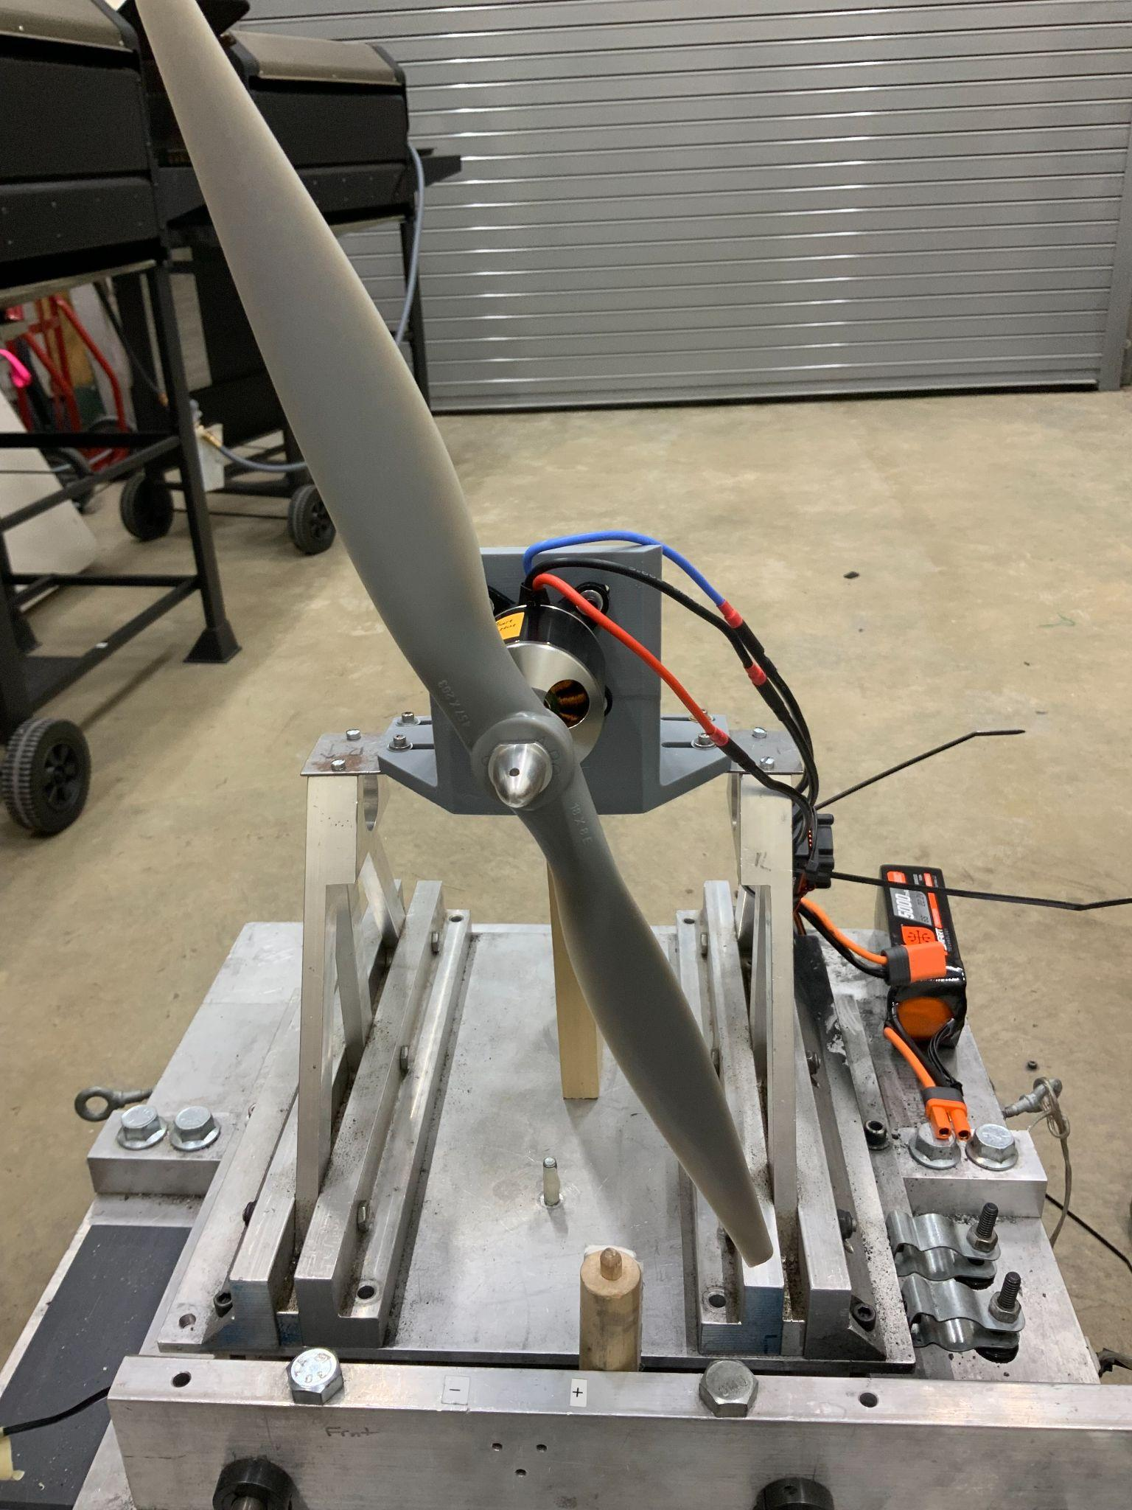
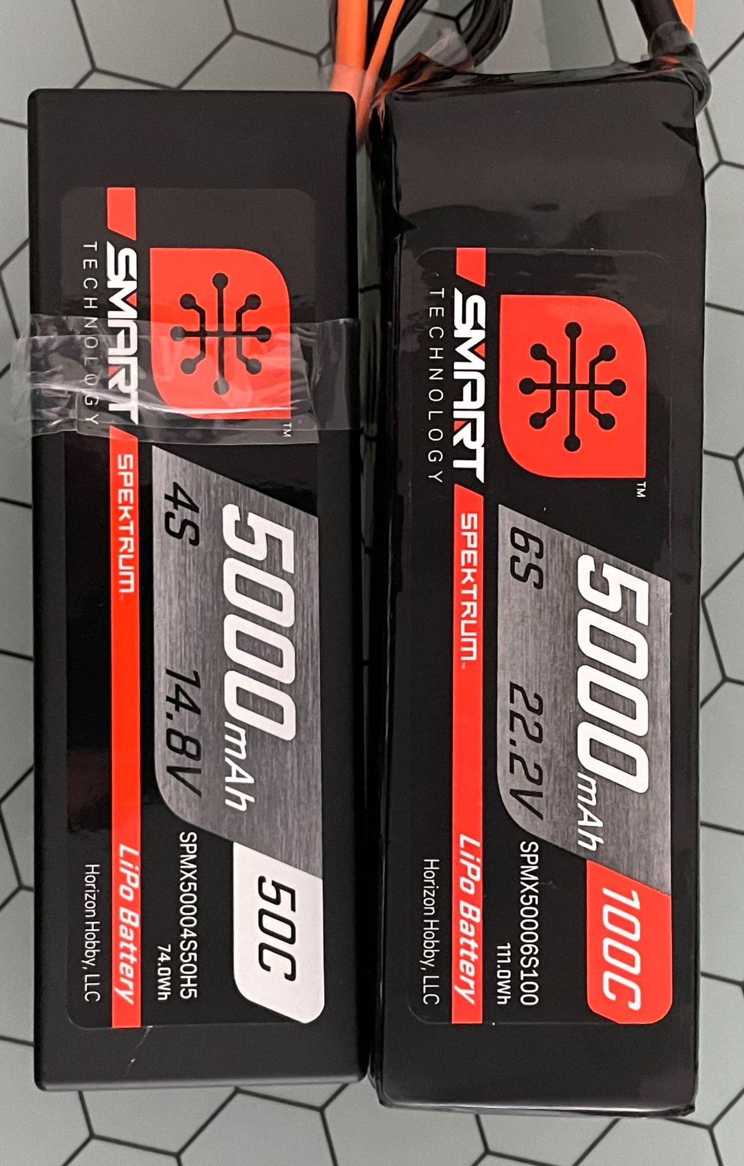
Verification and Validation - Battery
Battery - 5S Validation
Objective | Determine 5S viability for full UAV by testing using a 4S (14.5V) and 6S (22.5V) battery
Description | Test propellor/motor combination with 4S & 6S battery packs to analyze thrust and current draw
Model Comparison | Compare the 4S and 6S thrust and current draw test data to validate 5S
Expectation | 5S battery will supply enough amperage and voltage to achieve climbout requirements
Validation Against FRs | Perform static test at previously calculated climbout and cruise requirements with custom battery for validation of battery performance, satisfying FR1 and FR3.
Battery
Overview
Design Solution
CPEs
Design Requirements
Project Risks
Verification & Validation
Project Planning
Notes:
For the battery validation, we are going to determine the viability of a 5S battery by testing previously available 4S and 6S batteries with predetermined propellor and motor combination. This set up on a static test stand will allow us to analyze the thrust and current draw to ensure that we achieve the climbout requirements of our FR3 and maximize the cruise requirement of FR1.

Slide 45
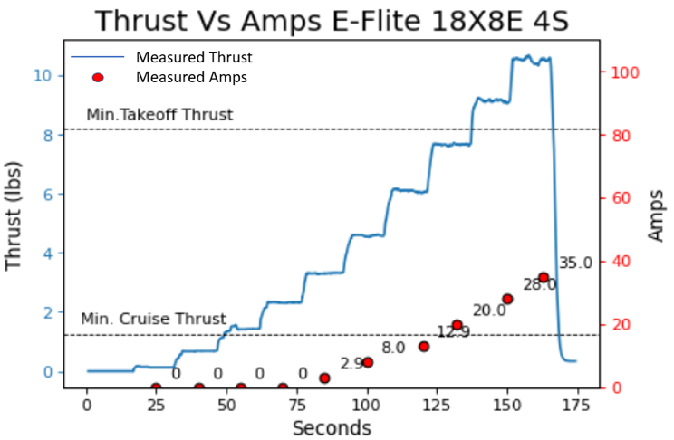
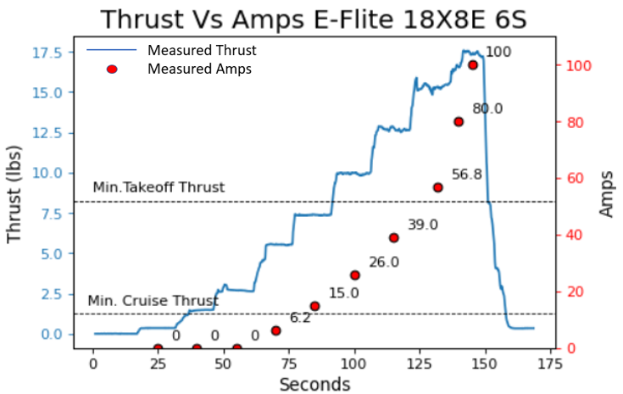
Validation - Electronics / 5S Battery Choice
Battery Sizing Results
18x8E propeller was chosen to maximize motor strain and amp draw
Thrust for 4S 14.8V = 10.7 lbs
Thrust for 6S 22.2V = 17.6 lbs
4S 14.8V
6S 22.2V
5S 18.5V
Overview
Design Solution
CPEs
Design Requirements
Project Risks
Verification & Validation
Project Planning
Notes:
We found that the 4s battery configuration provided a maximum of 10.7 lbs of thrust at 35 Amps while the 6s battery configuration provided 17.6 lbs of thrust but required upward of 100 amps of continuous current. Both of these cases, exceeded the thrust requirement for maximum climbout of 8.2 lbs. Using this data, we are confident that the 5s battery would supply us a solid middle ground to power the TALON system. However, we will continue to further examine motor and propellor combinations to potentially allow us to scale down to a 4s battery. This in turn would allow us to further scale the capacity of the battery and increase the cruise time of the aircraft.

Slide 46
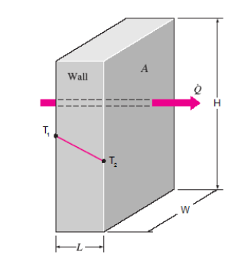
Initial Model - Electronics Heat Limitations
Goals:
A thermodynamic heat transfer model was developed to predict internal temperature building during climbout
Assumptions:
1D flow
Perfectly closed system
Instant electronics temperature
Ideal battery
Model Predictions:
Time to Electronics Maximum of 150° F: 2.4 min
Maximum Cruise Temp: 64.8° C (148.7° F)
Governing Equations:
Overview
Design Solution
CPEs
Design Requirements
Project Risks
Verification & Validation
Project Planning
Notes:
How we cave man eliminated it without being able to quantify. I NEED TO UPDATE THIS EQUATION for Delta T

Slide 47
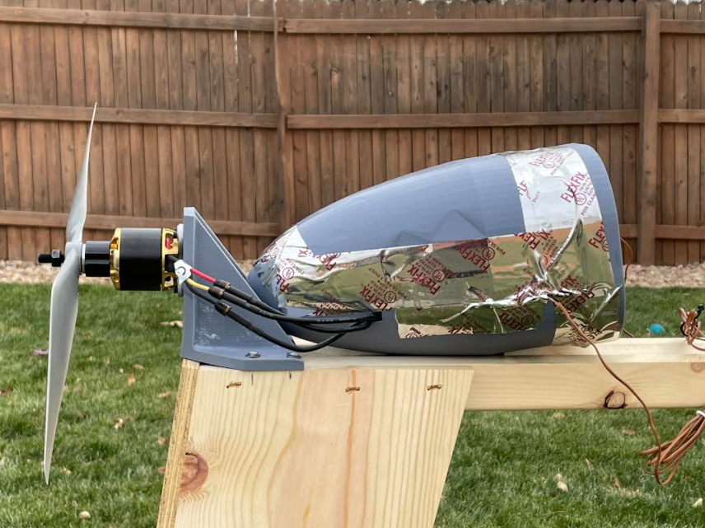
Verification and Validation - Electronics Heat Limitations
Thermodynamic Testing:
Electronics were sealed within a mock fuselage and a simulated flight test was performed
Test Conditions:
Simulated 4 minute climbout at 50A
Simulated 6 minute cruise at 6A
Sealed fuselage
Outside temperature: 3.9°C (39°F)
4 thermocouple internal configuration
Objective | Determine flight duration required to generate heat buildup in excess of electronic threshold of 65.5° C (150°F)
Description | Simulate heat buildup generated through initial takeoff and cruise to determine if sensors and resin can withstand internal heat buildup via DAQ and Simulink
Model Comparison | Thermodynamics energy balance equation
Expectation | Expected maximum temperature: 150°F
Validation Against FRs | High duration static flight simulations with custom battery and full scale flight test will be conducted to verify FR1 and FR3
Thermocouples
Overview
Design Solution
CPEs
Design Requirements
Project Risks
Verification & Validation
Project Planning
Notes:
How we cave man eliminated it without being able to quantify

Slide 48
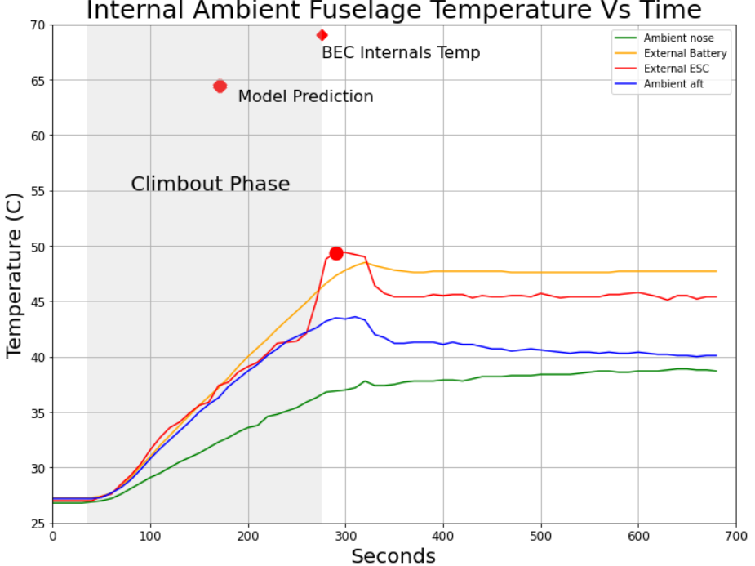
Validation - Electronics Heat Limitations
Thermodynamic Model Vs. Test Results:
Model predictions:
2.4 minutes to exceed electronics limit of 150° F
Maximum Cruise Temp: 64.8° C (148.7° F)
Thermodynamic Test | Results
Time to reach 150° F | Temp Not Achieved
Climbout Max Ambient Temperature | 48.9° C (120.0° F)
Cruise Max Ambient Temperature | 47.7° C (117.9° F)
Overview
Design Solution
CPEs
Design Requirements
Project Risks
Verification & Validation
Project Planning
Notes:
How we cave man eliminated it without being able to quantify
Lith poly is hotter than lithium ion.
Gen 1 fuselage is 3mm thicker
Full fuselage will have larger internal volume

Slide 49
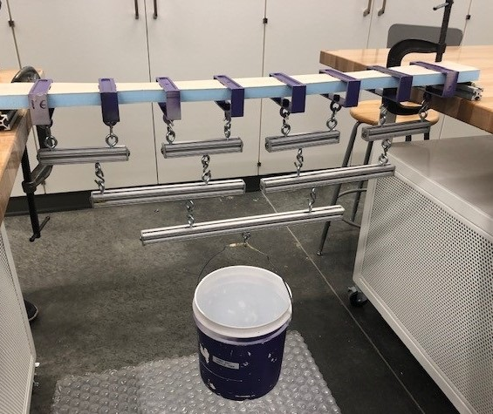
Verification and Validation - Structures
Structures - Wing Whiffletree Test
Objective | Accurately reflect wing loading conditions during climbout, flight, and descent
Description | Test bending, tension, and compression limits of full wing with added structural support of carbon fiber
Model Comparison | ANSYS Wing launch simulation, expected flight loads from lift, sharp-edged vertical gusts and banked turn
Key Results | Structural failure, wing deflection, permanent deformation, material separation, surface delamination
Validation Against FRs | Validates wing can support loading conditions for climbout, flight, and descent - satisfying FR3
Overview
Design Solution
CPEs
Design Requirements
Project Risks
Verification & Validation
Project Planning
Notes:
How we cave man eliminated it without being able to quantify

Slide 50
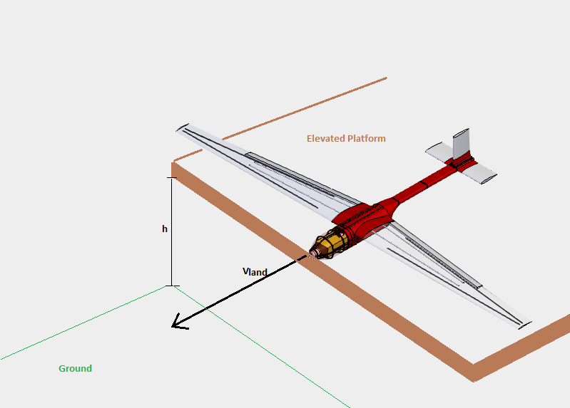
Verification and Validation - Structures
Structures - Aircraft Landing Test
Objective | Characterize forces experienced during landing
Description | Pull vehicle off of elevated surface at required landing velocity and impact ground using varying initial heights - record testing data using load cells
Model Comparison | 3D printed material limitations from ITLL testing of fuselage, ANSYS landing simulations
Key Results | Forces experienced by fuselage due to impact on landing, wing deflection on landing
Validation Against FRs | Aircraft can withstand impact upon landing, securely transporting payload with no structural failures - verifying FR3 & FR4
Overview
Design Solution
CPEs
Design Requirements
Project Risks
Verification & Validation
Project Planning
Notes:
How we cave man eliminated it without being able to quantify

Slide 51
Verification and Validation - Aerodynamics
Aero - Computational Fluid Dynamics
Objective | Verify/Improve aerodynamic estimates with CFD
Description | Computational Fluid Dynamics allow modeling of viscous effects and turbulence absent from previous modeling techniques.
Model Comparison | Potential Flow Estimates of Lift and Drag
Expectation | Increase in predicted drag. Decrease in lift due to flow separation.
Validation Against FRs | Aerodynamic surfaces optimize lift and minimize drag to meet FR1 & FR3
Setup
2D Wing
SST k-ω
Standard Sea Level
AOA: 0, 3, 6, 9
Velocity: 143.7 m/s
Boundary Conditions
Inlet: Freestream Velocity Vector
Outlet: 0 Gauge Pressure
Wall: No Slip
CFD Validation Method
Refine until C_{L} and C_{D} converge w/ experimental
Quantify Error
Apply same method to further studies
Overview
Design Solution
CPEs
Design Requirements
Project Risks
Verification & Validation
Project Planning
Notes:
FORMATTING
Notes for slide that is now in appendix:
2% error for CL vs. AOA between CFD and Experimental.
40% error for CL vs. CD between CFD and Experimental.

Slide 52
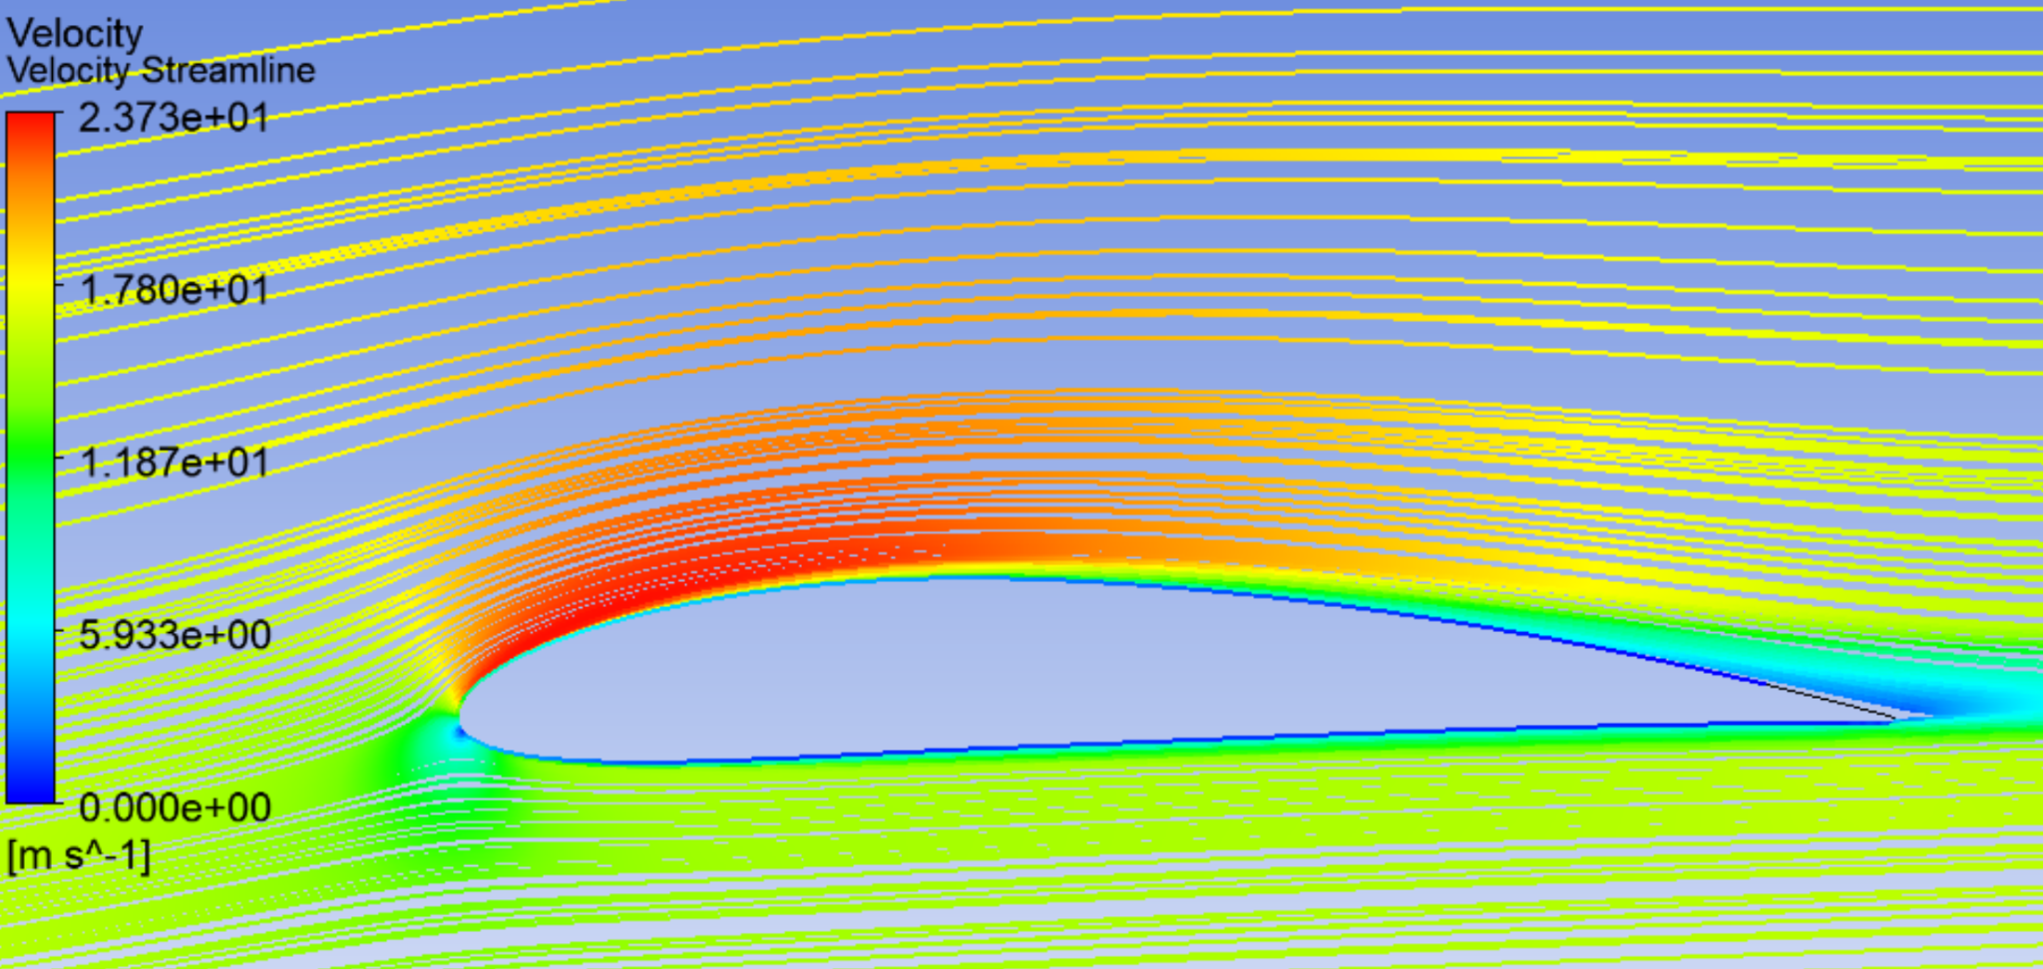
Verification and Validation - Aerodynamics
Velocity Streamlines - NACA 4412
Aero - 2D Airfoil
Parameter | Potential Flow | CFD (Composite)
CL | 0.7991 | 0.7917
CD | 0.0319 | 0.0289
Lift | 63.2 N | 62.4 N
Drag | 1.28 N | 2.9 N
Velocity Streamlines - NACA 4406
Overview
Design Solution
CPEs
Design Requirements
Project Risks
Verification & Validation
Project Planning
Notes:
Seen above are the streamlines of the flow directly around the NACA 4412 airfoil color coded according to velocity. This sim was run with an AOA of 4.8° and and inlet velocity of 16.4 m/s at standard atmospheric conditions of 10,000ft in altitude.

Slide 53
Verification and Validation - Full Scale Flight Testing
Flight Test Highlights
Objective | Validate Flight Performance Against Functional Requirement
Description | A series of increasingly complex test flight leading up to maximum duration flight at mission altitude with payload.
Model Comparison | Actual measured endurance will be contrasted against the predicted power budget endurance values
Expectation | Individual aircraft endurance exceeds 3.5 h
Validation Against FRs | Multiple high duration test flights will be conducted to prove fulfillment of FR1 & FR3
Test | Goals | Duration | Pass Criteria
Airworthiness | Demonstrate Launch and controlled landing | 30 s | 1. Powered flight 2. Statically Stable
Climb & Turn | Demonstrate A/C can climb to 100’ AGL | 5 min | 1. Climb to 100’ AGL 2. Returns to launch point.
Loiter | Demonstrate 30 minutes of powered flight at 500’ AGL | 30 min | 1. 30 minute flight 2. Orbit about a static ground location.
Max Climb / Max Endurance | Demonstrate climb to 10,000 ft MSL and sustained flight | +3.5 Hours | 1. Aircraft reaches 10,000 ft MSL 2. Aircraft maintains orbit for >3.5 hours
Overview
Design Solution
CPEs
Design Requirements
Project Risks
Verification & Validation
Project Planning
Notes:
Anthony to flesh out

Slide 54
Project Planning
Overview
Design Solution
CPEs
Design Requirements
Project Risks
Verification & Validation
Project Planning

Slide 55
Gantt Chart
Overview
Design Solution
CPEs
Design Requirements
Project Risks
Verification & Validation
Project Planning

Slide 56
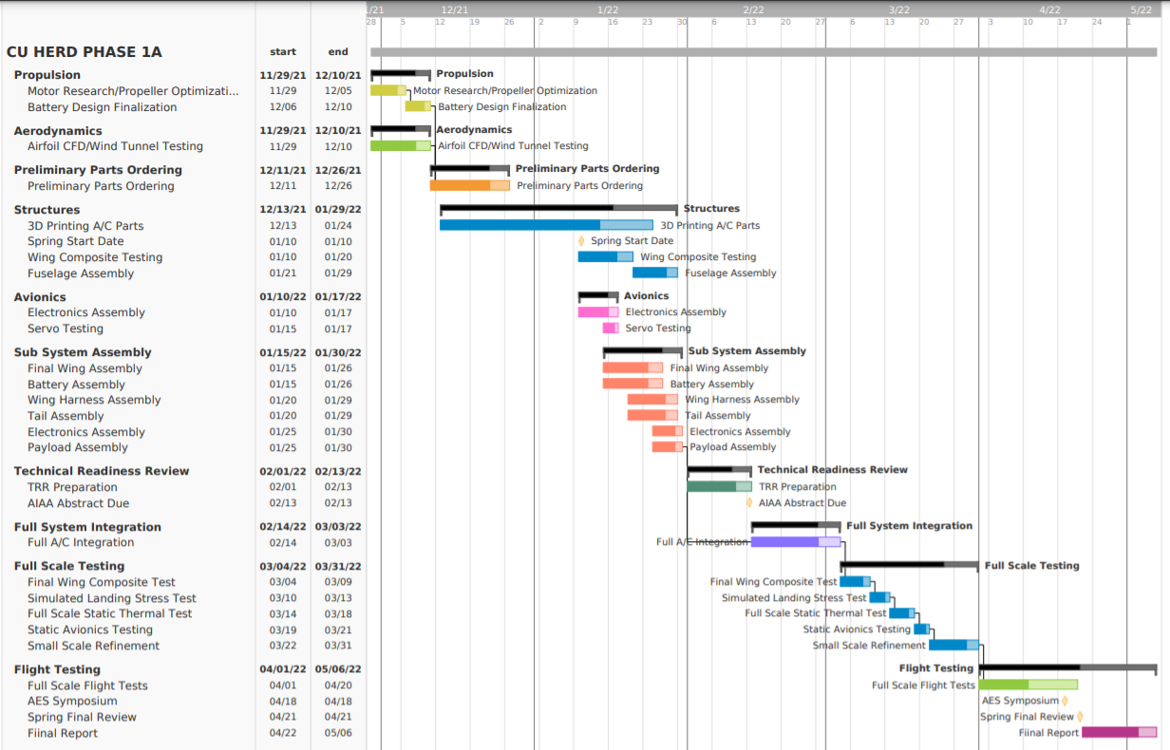
Critical Path
Keys to Success
Notes:
How we cave man eliminated it without being able to quantify

Slide 57
Cost Plan - Budget
Vehicle Cost
(with Margin)
$2,685.21
Electronics salvage means potential for 2-3 vehicle builds within $5,000 budget
Overview
Design Solution
CPEs
Design Requirements
Project Risks
Verification & Validation
Project Planning

Slide 58
Future Testing - Phase 1
Phase 1 - Pre Construction Further Testing/ Simulation
Subsystem | Test | Goals | Dates | Testing Location | Equipment | Safety
Propulsion | Thrust Testing on Static Test Stand | · Choose motor and Prop combo · Determine 4S Battery Viability · Determine motor thrust across flight envelope | 11/29/21 - 12/10/21 | Aerospace Building - Garage | Static Test Stand Motors (E-Flite, Scorpion) Propellers (15x8 → 18x8) Spektrum Avionics Equipment | Eye Protection Ear Protection Protective Barriers
Aerodynamics | 3D CFD/Wind Tunnel | · Analyze 3D wing Lift and Drag · Determine overall A/C drag coefficient | 11/29/21 - 12/10/21 | Aerospace Building - | Pilot Wind Tunnel | Eye Protection Ear Protection
Structures | Load Testing | · Determine Wing Material · Optimize Structural Reinforcements | 11/29/21 - 12/10/21 | ITLL / Aerospace Building | Printed Airframe Samples Wing Material Samples | Eye Protection Ear Protection
Notes:
How we cave man eliminated it without being able to quantify

Slide 59
Future Testing - Phase 2
Phase 2 - Large Scale Testing After Assembly
Subsystem | Test | Goals | Dates | Location | Equipment | Safety
Propulsion | Thrust Testing on Static Test Stand | · Choose motor and Prop combo · Determine 4S Battery Viability · Determine flight envelope | 11/29/21 - 12/10/21 | Aerospace Building - Test Cell | Static Test Stand Motors & Props Spektrum Avionics Equipment | Eye Protection Ear Protection Protective Barriers
Structures | Load Testing - Wiffle Test | · Analyze final wing structural/material properties | 3/4/22 - 3/9/22 | ITLL / Aerospace Building | ITLL material testing machines Full Scale Composite wing | Eye Protection Ear Protection
Structures | Landing Simulation | · Determine if the airframe can successfully belly land under normal conditions | 3/10/22- 3/13/22 | Aerospace Building/Parking Lot | Elevated Platform, support system, ropes and full A/C | Eye Protection Ear Protection
Thermal | Heat Analysis | · Determine internal fuselage & electronics temperature during simulated flight | 3/14/22- 3/18/22 | Aerospace Building or outside area | DAQ, Simulink, thermocouples & Fully configured A/C | Eye Protection Ear Protection
Notes:
How we cave man eliminated it without being able to quantify

Slide 60
Future Testing - Phase 3
Phase 3 - Full Scale Flight Testing
Subsystem | Test | Goals | Dates | Location | Equipment | Safety
Whole UAV | Initial Flight Test | · Confirm UAV airworthiness and analyze flight characteristics | 4/1/22 - 5/6/22 | Arvada Airpark Sod Farm Local Ranch | Entire UAS | Certified Pilot Ground Safety Officer Eye Protection + Protective Gear
Whole UAV | Environmental Testing | · Determine if Aircraft can fly in adverse conditions as specified by customer | 4/1/22 - 5/6/22 | Arvada Airpark Sod Farm Local Ranch | Entire UAS Spare Battery Packs | Certified Pilot Ground Safety Officer Eye Protection + Protective Gear
Whole UAV | Portability testing | · Determine if the aircraft can successfully be transported and operated by one person | 4/1/22 - 5/6/22 | Outside/Hiking Trails | Full UAS Hiking Boots and Pack | Outdoor Gear Comms/phones Water/Supplies
Whole UAV | Time to Assemble Testing | · Determine the time it takes to assemble a UAV in the field | 4/1/22 - 5/6/22 | Outside/Hiking Trails | Full UAS Hiking Boots and Pack | Outdoor Gear
Notes:
How we cave man eliminated it without being able to quantify

Slide 61
Questions?

Slide 62
Appendix

Slide 63
Aerodynamics - Backup

Slide 64
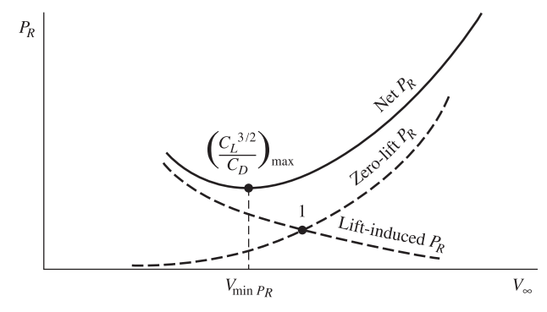
Design Requirement - Endurance through Aerodynamics
Endurance of Propeller Driven Aircraft
Goals:
Design Highly Efficient Aerodynamic Bodies
Assumptions:
Steady Unaccelerated Flight
Limitations:
Ignores Propulsion System & Propeller Efficiency
Design Elements:
Airfoil: NACA 4412 & NACA 4406
Taper Ratio: 0.40
Aspect Ratio: 14.25
Maximize L^{3/2}/L_{D} to Meet FR1 (Cruise) and L/D FR3 (Climbout)
Notes:
This is the Breguet Endurance Formula for a reciprocating propeller driven aircraft. While our a/c is electric, we understand that to maximize endurance we want to minimize the power required which is not influenced by the propulsion system. Thus we see that endurance, from an aerodynamic perspective is a function of CL over CD.
We used this heuristic in comparing airfoils and making design choices such as Airfoil, taper and AR.
For discussion tomorrow: It may be a problem that we don’t have a prediction for Endurance? Needed for validation stage.

Slide 65
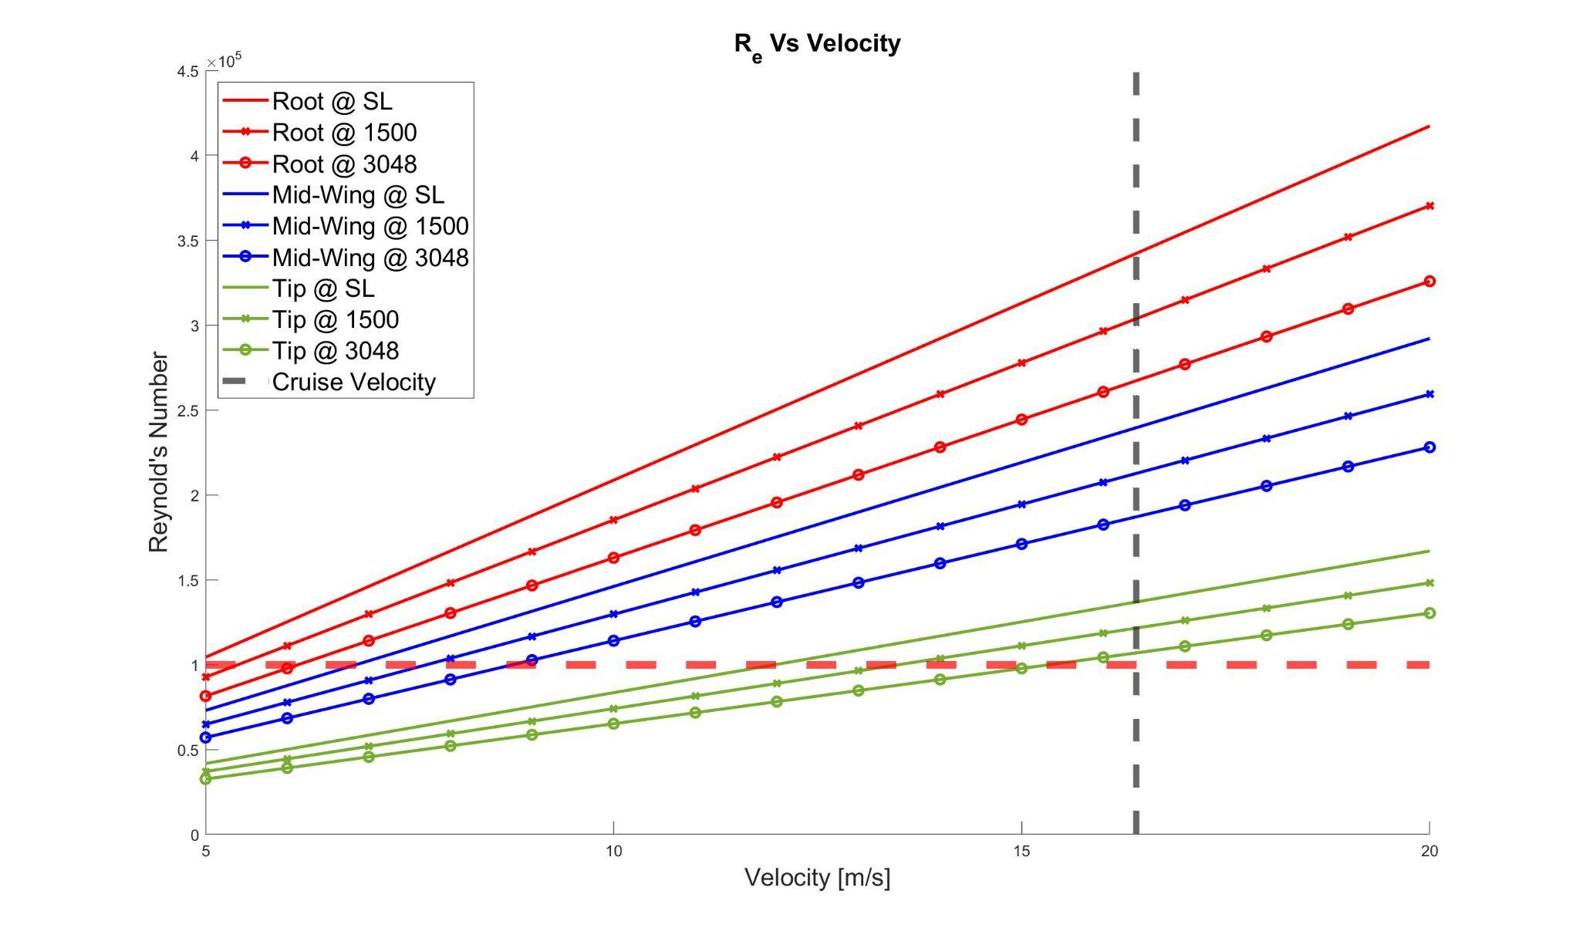
Design Requirement - Endurance through Aerodynamics
Wing Tip Stall:
Notes:
At low reynolds numbers (below 100,000) flow separation can cause decrease in lift and increase in drag reducing efficiency. Near the wing tips and at lower flight speeds this is a concern for the last ⅓ of the wing. To mitigate this
increasing chord, and add aerodynamic twist at the wing tips. The thinner airfoils should emulate rough airfoils or flat plate increasing efficiency vs the conventional NACA 4412. Additionally we will use advanced computational methods to better understand these flows.

Slide 66
Verification and Validation - Aerodynamics
Aero: Computational Fluid Dynamics
Objective | Qualitatively Understand Wing Tip Stall
Description | Extend 2D techniques to 3D, and create high fidelity simulation of wing tips including fine boundary layer resolution.
Model Comparison | Compare to literature on low R_{e} airfoils.
Expectation | Understand whether aerodynamic twist effectively mitigates separation and increases efficiency.
Validation Against FRs | Successfully mitigate wing tip stall increasing efficiency FR1 & increasing maximum lift FR3
Setup
3D Wing
SST k-ω
Atmosphere at 10,000ft cruise
AOA: 0, 3, 6, 9
Velocity: 12.2 m/s
Boundary Conditions
Inlet: Freestream Velocity Vector
Outlet: 0 Gauge Pressure
Wall: No Slip
Notes:
Slide 8 from aero junkyard

Slide 67
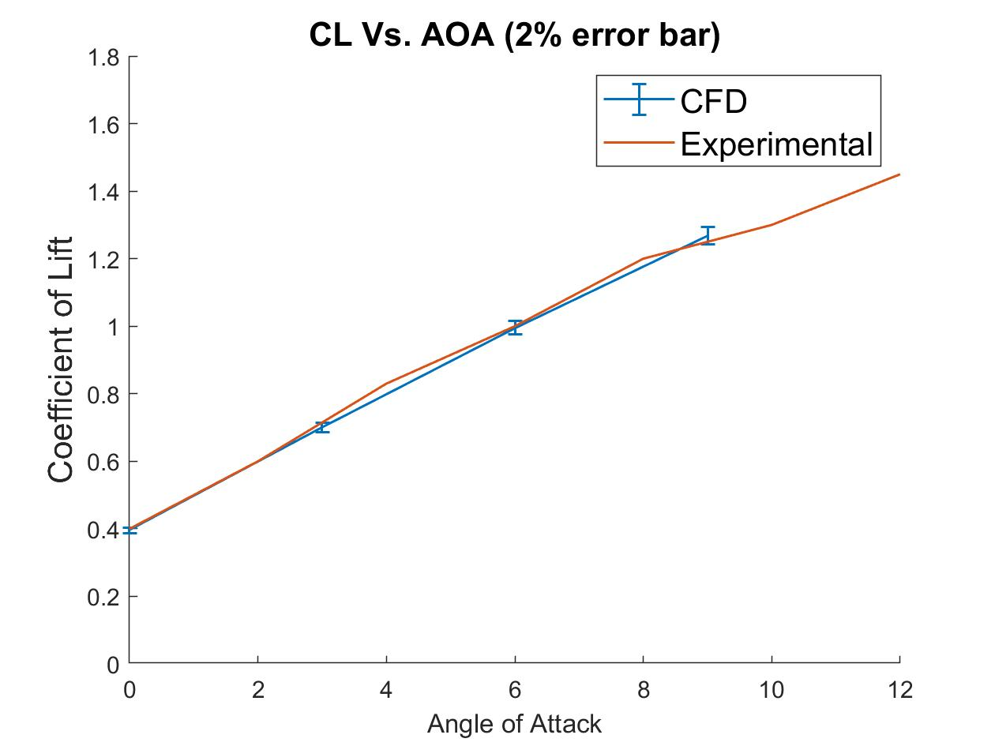
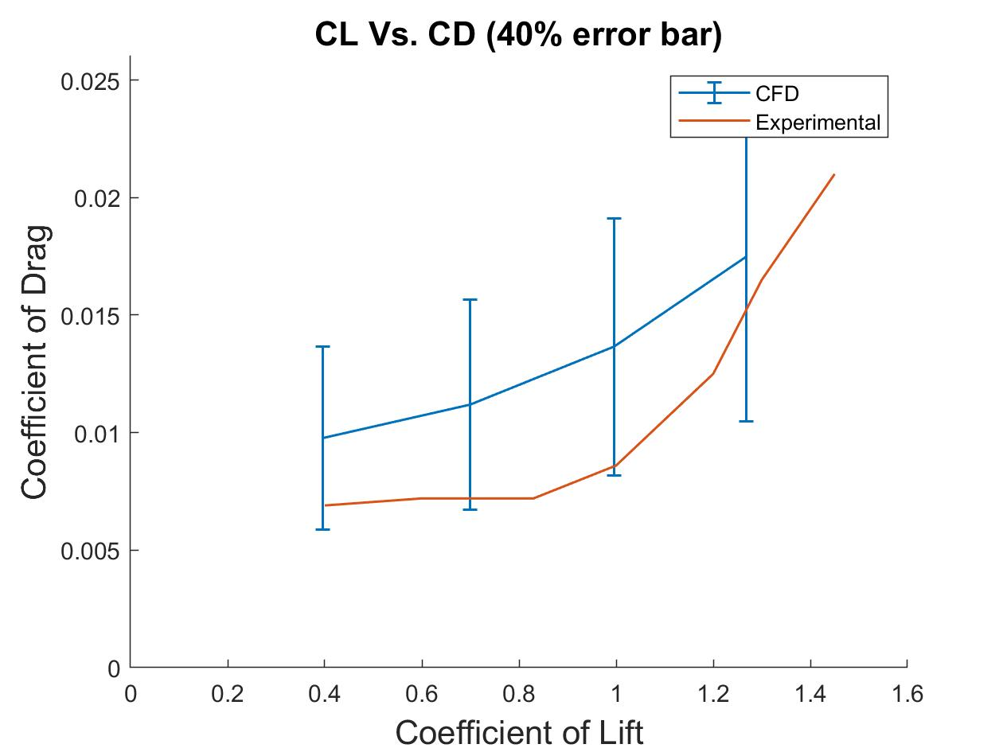
Verification and Validation - Aerodynamics
Aero - Computational Fluid Dynamics
Notes:
Talk about plots. State error in CL and CD vs wind tunnel

Slide 68
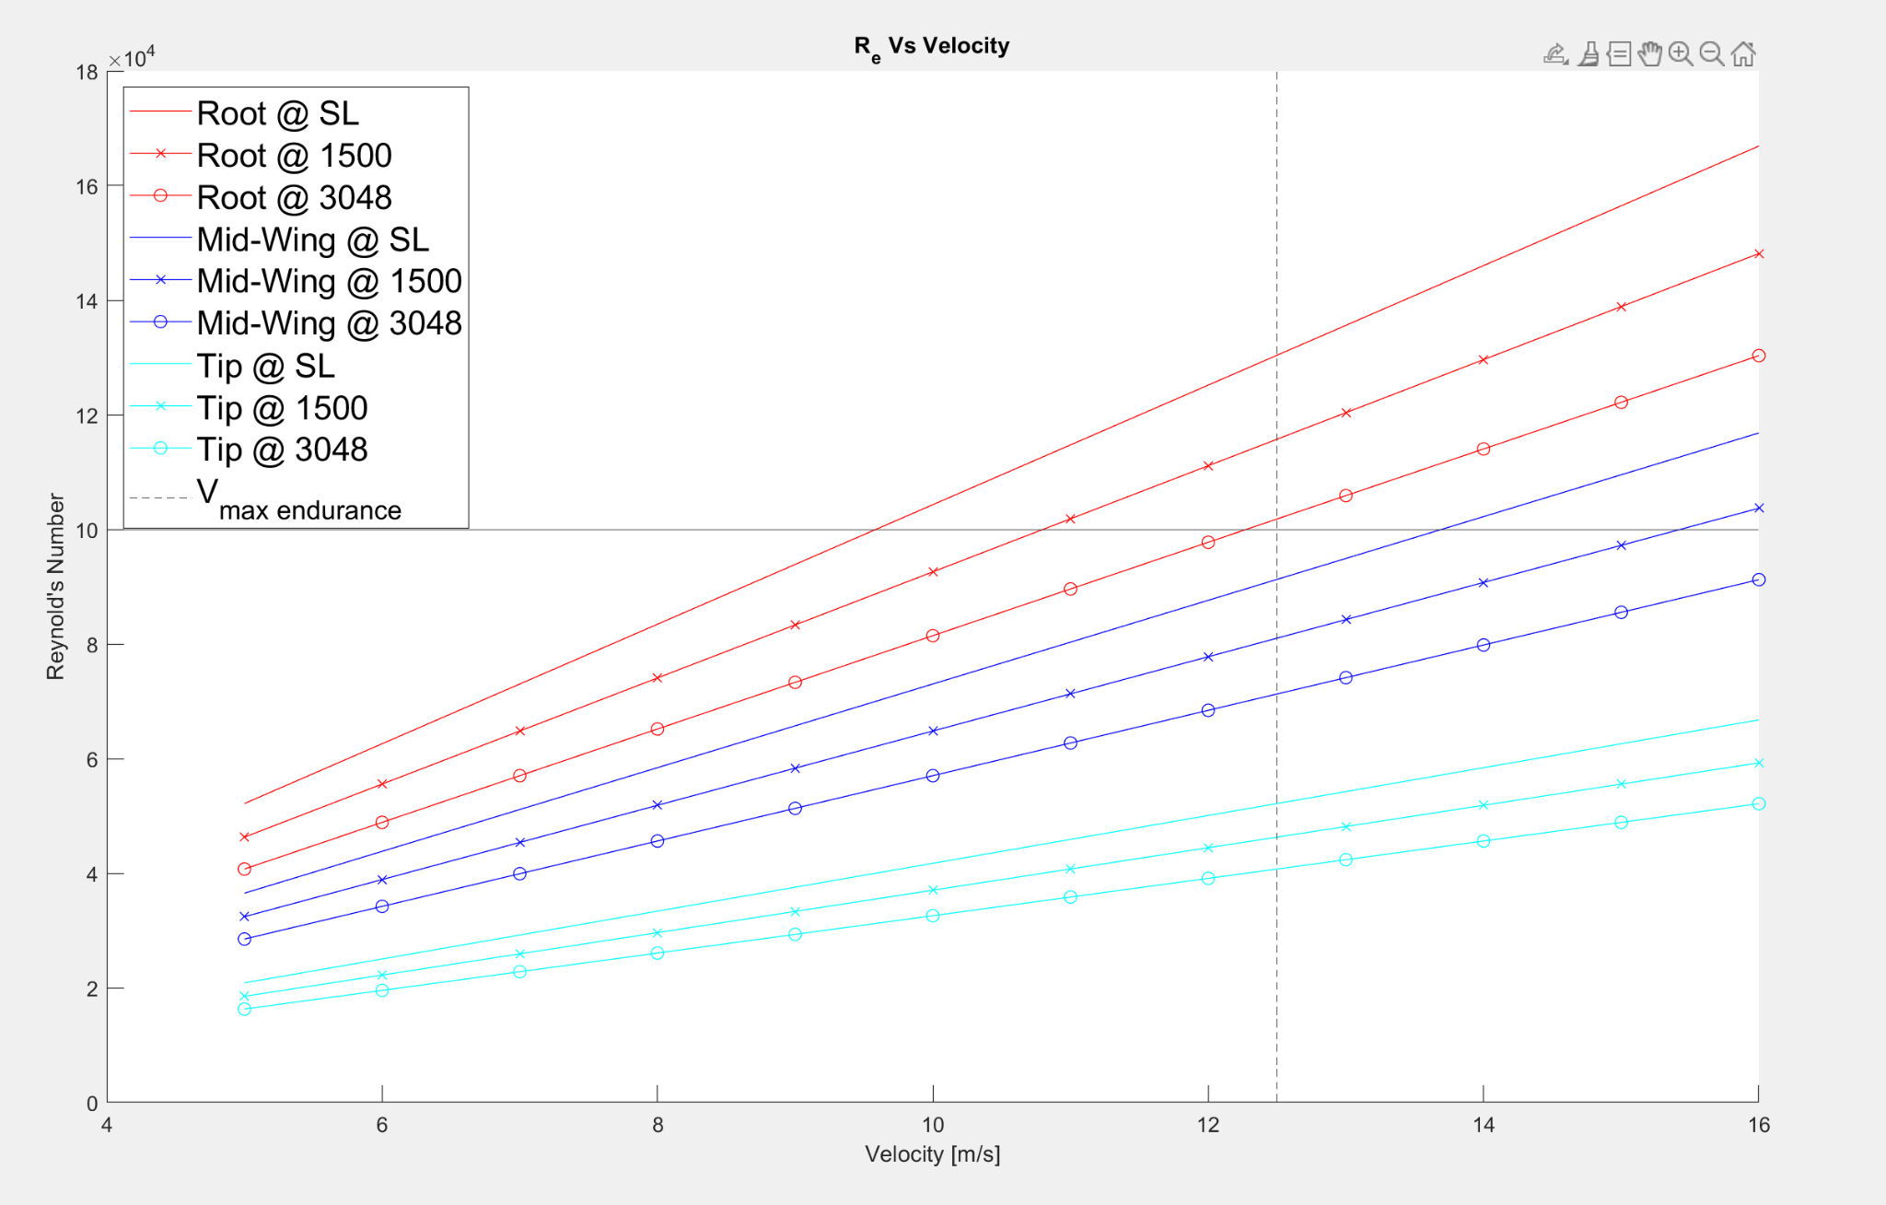
Aerodynamics - Backup Prior Reynolds Number Analysis
Appendix Slide

Slide 69
Aerodynamics - Estimation of Body CL and CD
Appendix Slide
Stanford Model:
Wetted Area and Flat Plate Skin Friction

Slide 70
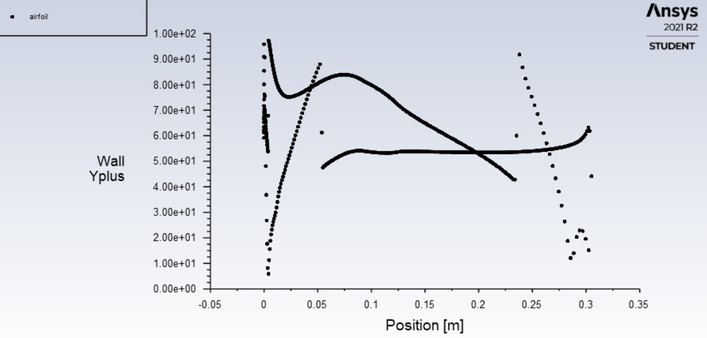
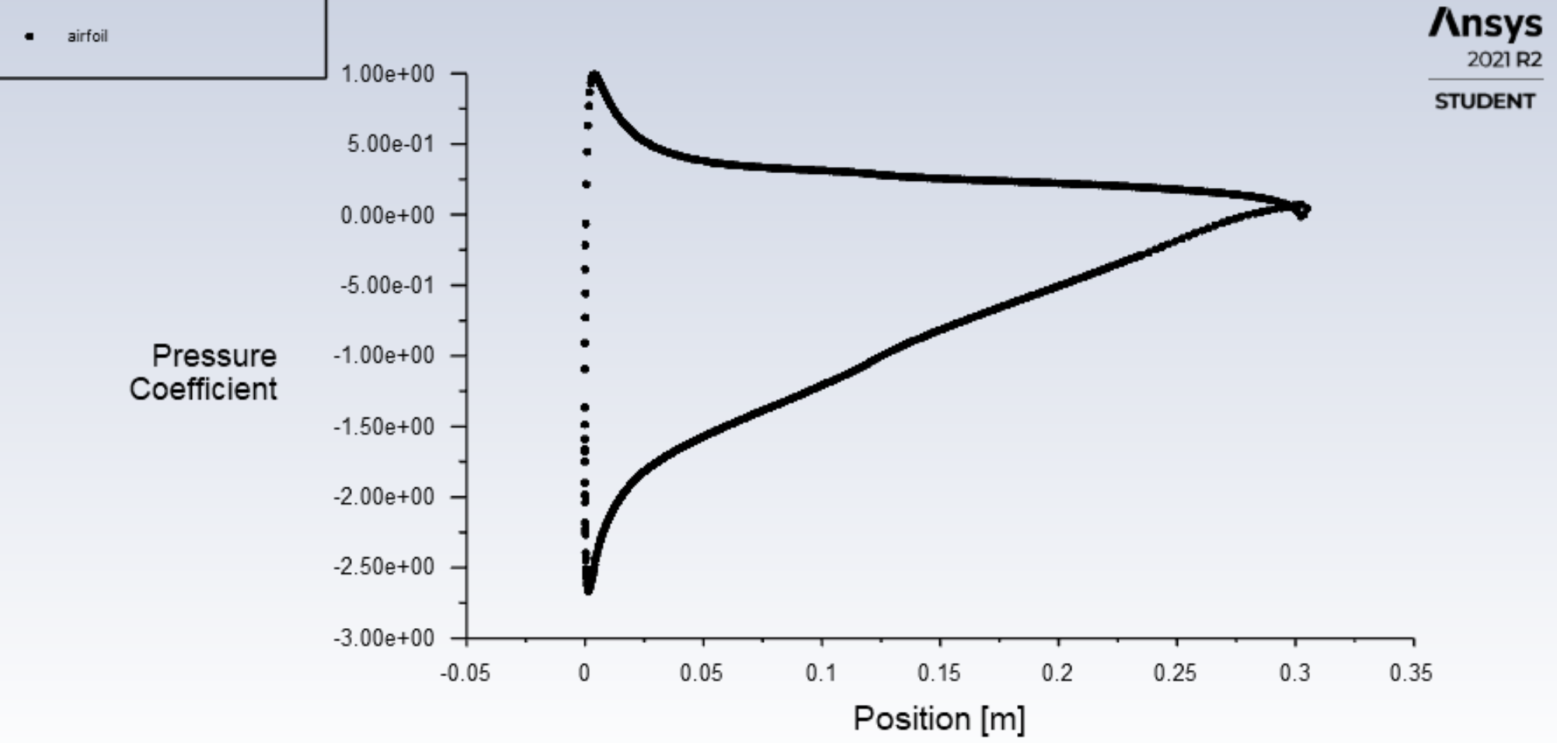
Aerodynamics - Backup
Appendix Slide
CFD: Sensitivity analysis
Notes:
Started with a basic 2d CFD simulation and decreased cell count to see error induced. Allows us to understand a bare minimum cell count for “accurate” results with quantifiable error.

Slide 71
Aerodynamics Values- Backup
Appendix Slide
Cruise: 4.8° AOA / 16.4 m/s |  | Max: 11.5° / 22 m/s
C_{L} (Cruise) | 0.7991 | C_{L} (Max) | 1.402
C_{D} (Cruise) | 0.0319 | C_{D} (Max) | 0.0716
C_{L}/C_{D} (Cruise) | 25.06 | C_{L}/C_{D} (Max) | 19.59
Lift (Cruise) | 72.1 (N) | Lift (Max) | 199.7 (N)
Drag (Cruise) | 5.9 (N) | Drag (Max) | 22.9(N)

Slide 72
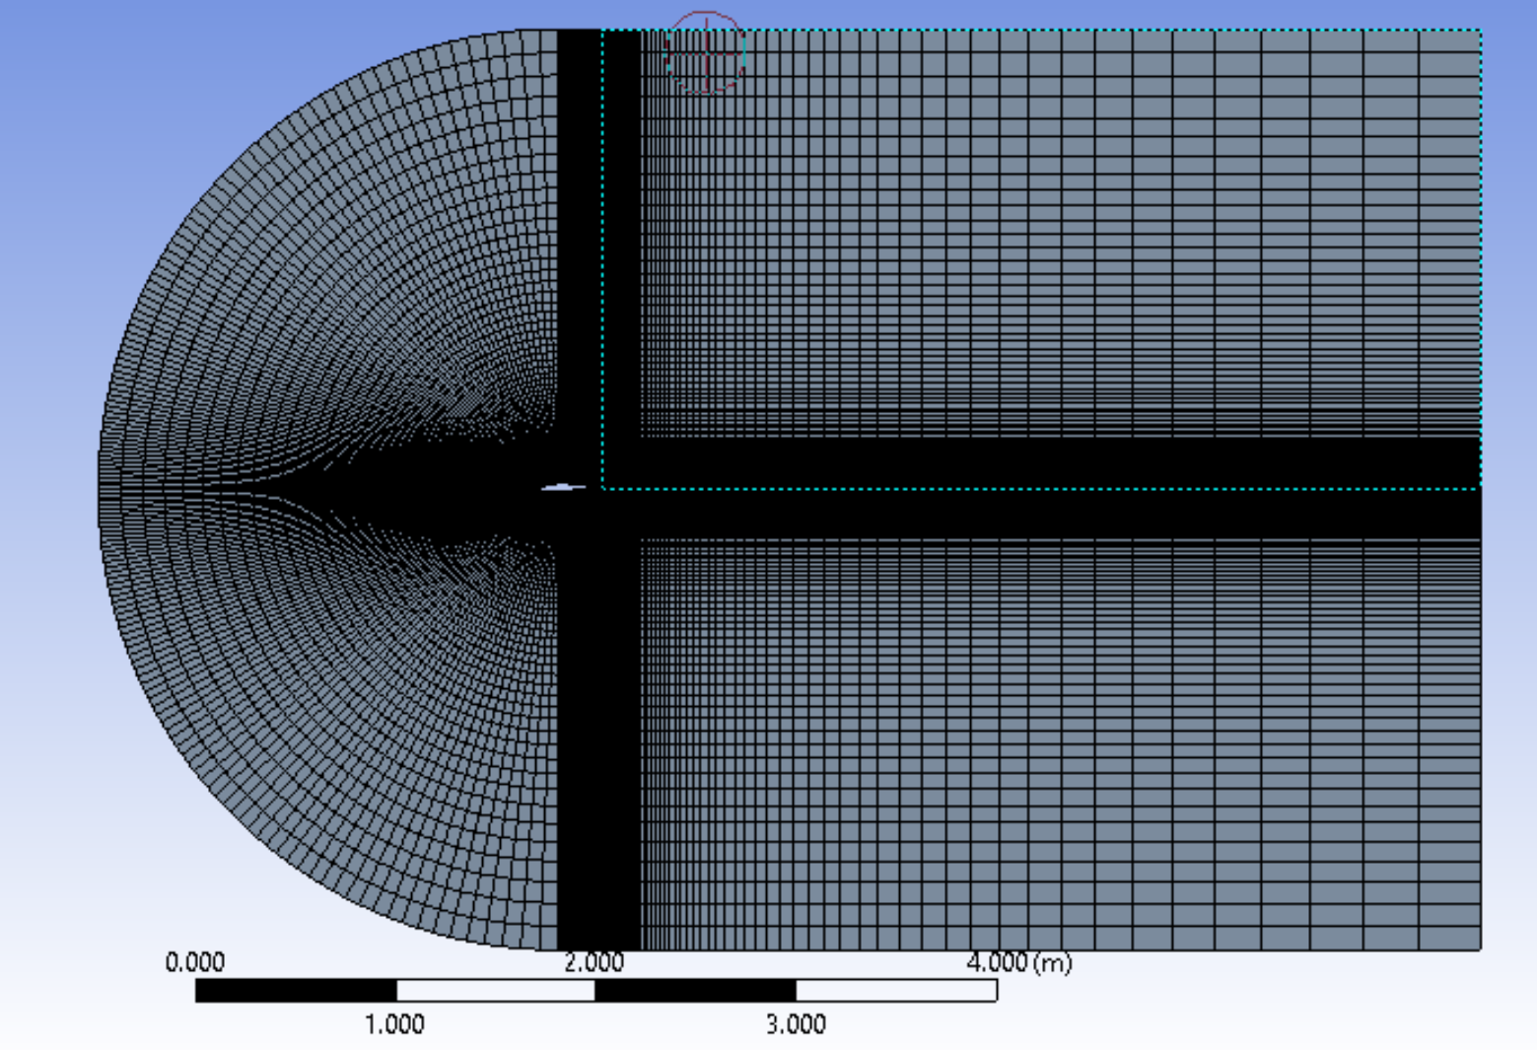
Aerodynamics - Backup
Appendix Slide
Objectives: CFD model verification
Total Elements = 45,000

Slide 73
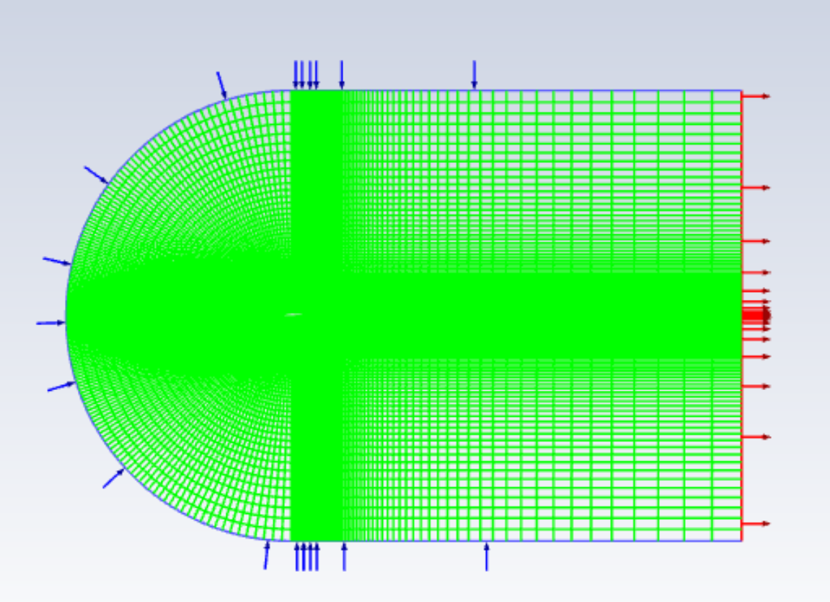
Aerodynamics - Backup
Appendix Slide
Objectives: CFD model verification
Standard sea level atmospheric conditions applied

Slide 74
Aerodynamics - Backup
Appendix Slide
Objectives: CFD model verification

Slide 75
Aerodynamics - Backup
Appendix Slide
Objectives: CFD model verification

Slide 76
Aerodynamics - Backup
Appendix Slide
Objectives: CFD model verification
Mesh refinement can be seen
Total number of cells now 45,735

Slide 77
Aerodynamics - Backup
Appendix Slide
Objectives: CFD model verification
Resulting Y+ and Coefficient of Pressure distribution

Slide 78
Verification and Validation - Aerodynamics - Backup
Aero - Wind Tunnel
Objective | Verify Aerodynamic Characteristics of Wing and Body
Description | Quantify Lift and Drag
Model Comparison | Potential Flow Estimates of Lift and Drag
Expectation | Increase in Predicted Drag
Validation Against FRs | Aerodynamic surfaces optimize lift and minimize drag to meet FR1 & FR3
Setup
3D printed model of wing scaled according to Reynold’s number
Use Smead Wind tunnel or TBD

Slide 79
Propulsion - Backup

Slide 80
Propulsion - Backup
Appendix Slide
Motor Selection
Criteria:
Power
Thrust
Current Draw
Weight
Battery Needed
Size
Cost
Target Climbout Power | 950-1050 W
Target Climbout Thrust | 8.2-8.8 lbf

Slide 81
Propulsion: Max Endurance - Backup
Results | IMP | SI
T_{req} Endurance | .901 lbf | 4.00 N
P_{req} Endurance | .109 hp | 81.6 W
V_{req} Endurance | 27.3 mph | 12.2 m/s
CL_{req} Endurance | 1.42 | 1.42
T_{req} Climbout | 8.20 lbf | 36.5 N
P_{req} Climbout | 1.28 hp | 957 W
CL_{req} Climbout | .975 | .975
V_{req} Climbout | 35.1 mph | 15.7 m/s
T_{req} Headwind | 0.78 lbf | 3.47 N
P_{req} Headwind | 0.121 hp | 90.4 W
CL_{req} Headwind | .871 | .871
V_{req} Headwind | 35 mph | 15.6 m/s
Endurance Maximizing Velocity (Minimum P_{req} ) [1]
Coefficient of Lift (Lift = Weight) [2]
Thrust (Thrust = Drag) [1]
Power [2]
Endurance Flight satisfies FR1

Slide 82
Design Requirement - Propulsion System Optimization
Results | IMP | SI
T_{req} Endurance | .901 lbf | 4.00 N
P_{req} Endurance | .109 hp | 81.6 W
V_{req} Endurance | 27.3 mph | 12.2 m/s
CL_{req} Endurance | 1.42 | 1.42
T_{req} Climbout | 8.20 lbf | 36.5 N
P_{req} Climbout | 1.28 hp | 957 W
CL_{req} Climbout | .975 | .975
V_{req} Climbout | 35.1 mph | 15.7 m/s
T_{req} Headwind | 0.78 lbf | 3.47 N
P_{req} Headwind | 0.121 hp | 90.4 W
CL_{req} Headwind | .871 | .871
V_{req} Headwind | 35 mph | 15.6 m/s
Levels of Success for Climbout: (measured from ground)
ɣ₁ = 5.71°
ɣ₂ = 11.3°
ɣ₃ = 21.8°**
**outside Small Angle Approx
Rate of Climb (RoC) :
L
𝛼
T
θ
θ
γ
W
θ
Satisfies Climbout FR3
Notes:
FR3 is met if the thrust generated from propulsion system is greater than the model’s estimated required thrust for level 3 climbout.
FR1 is met if the thrust generated from the propulsion system is greater than the model’s estimated required thrust while simultaneously reducing current draw as much as possible.
P_req = Power required for steady level unaccelerated flight

Slide 83
Propulsion: Headwind
Results | IMP | SI
T_{req} Endurance | .901 lbf | 4.00 N
P_{req} Endurance | .109 hp | 81.6 W
V_{req} Endurance | 27.3 mph | 12.2 m/s
CL_{req} Endurance | 1.42 | 1.42
T_{req} Climbout | 8.20 lbf | 36.5 N
P_{req} Climbout | 1.28 hp | 957 W
CL_{req} Climbout | .975 | .975
V_{req} Climbout | 35.1 mph | 15.7 m/s
T_{req} Headwind | 0.78 lbf | 3.47 N
P_{req} Headwind | 0.121 hp | 90.4 W
CL_{req} Headwind | .871 | .871
V_{req} Headwind | 35 mph | 15.6 m/s
Requirement for Headwind: 30 mph Headwind
L
T
D
V_{wind}
W

Slide 84
Propulsion
Appendix Slide
Motor Selection
T-Motor winner of down-selection process
Real-world problems
Scorpion a strong 2nd place
E-Flite is a valuable resource for testing
Scorpion SII-4025-520KV
T-Motor AM480 650KV
E-Flite 470KV
Notes:
A low Kv motor has more winds of thinner wire—it will carry more volts at fewer amps, produce higher torque, and swing a bigger prop. A high Kv motor has fewer winds of thicker wire that carry more amps at fewer volts and spin a smaller prop at high revolutions.

Slide 85
Propulsion - Backup
Appendix Slide
Scorpion Sll 520KV with 15x8E APC Propeller
Performance Criteria | Motor Specification | Target Specification(climbout)
Power [W] | 925.9 | 950
Thrust [grams] | 3970 | 3950
Current [amps] | 50 | Lower is Better
Weight [grams] | 353 | Lower is Better
Cost [$] | 150 | Lower is Better
Compatible Battery | 6s 3500-5000mah | Smaller is Better

Slide 86
Propulsion - Backup
Appendix Slide
Static Testing
Goal: Obtain quantitative data for thrust dependent of current draw and percent throttle as a means to validate motor specs and pick ideal propeller size
Motor
3D Printed Motor Mount
Load cell (½)
Arduino
ESC

Slide 87
Propulsion - Backup
Appendix Slide
Static Testing

Slide 88
Propulsion - Backup
Appendix Slide
Static Testing

Slide 89
Propulsion - Backup
Appendix Slide
Thrust Vs. Amps Metrics
Notes:
This is data that is handed to team 1b

Slide 90
Electronics - Backup

Slide 91
Electronics - Servo Selection (Assumptions) - Backup
Appendix Slide
Key Assumptions:
The induced forces on the control surface will be applied to the trailing edge
When servo is torquing, no jitters from the control surfaces will be experienced (i.e. equilibrium condition is satisfied)
Air density is set at sea level (𝝆_{SL} = 1.225 kg/m³)
Control surface with largest area will drive calculations
A_{Wing} = 2 in. x 48 in. (modeled after Tempest Aircraft)

Slide 92
Electronics - Servo Selection (Assumptions) - Backup
Appendix Slide
Appended Assumptions:
Aircraft will experience Incompressible Flow
Reynolds Number = 1✕ 10⁵
Wing geometry of NACA 4412 airfoil
Airfoil experiences total velocity of V_{total} = 25.144 m/s
Average chord length, c̅ = 8 in = 0.2032 m
Control surface is hinged at 75% of wing chord

Slide 93
Electronics - Payload
Appendix Slide
LILY GO T-BEAM:
Portable Long Range Radios
18650 Battery: 72 hours of power
Multiple frequencies available
433/868/915 Mhz
GPS Capable
Weight: 82.2g (2.82 oz)
Working Temp: -40℃ + 85℃
Cost Effective: $40 per radio

Slide 94
Electronics - Servo Selection (Torque Calculations) - Backup
Appendix Slide
Hinge Moment/Span:
-0.1672 Nm/span
-0.1698 Nm = -24.05 oz-in.
Selected Servo Properties:
Factor of Safety (FoS) = 2
Thin design
Lightweight

Slide 95
Verification and Validation - Electronics / Servos - Backup
Servo Parameters
V_{cruise} = 16.4 m/s
Max Gust Speed = 9.144 m/s
Objective | Model servo performance based on manufacture mechanical and electrical details.
Description | Analyze input and output power of servo to calculate servo efficiency and determine operational range.
Model Comparison | N/A. This model is uniquely affected by the aircraft’s flight path and weather conditions.
Expectation | High servo loading correlates to high amperage draw and low loading reflects low current draw.
Validation Requirements | Place inline current sensor within circuit during test flight to analyze true amperage demand of servos.
Notes:
How we cave man eliminated it without being able to quantify

Slide 96
Li-Po vs Li-Ion Batteries - Backup
Appendix Slide
Li-Po Batteries
Li-Ion Batteries
Pros:
Cons:
Pros:
Cons:
Lower profile
Higher cost
Higher power density
No built in protection
Longer lifespan
Low power density
Less likely to overheat
Shorter lifespan
Pre assembled units
Known overheating issues
Customizable
Voltage
Current
Capacity
Requires additional manufacturing
Notes:
Appendix

Slide 97
Li-Ion Trades - Backup
Appendix Slide
Best capacity per mass battery:
LG F1L1865 (18650)
3350 mAh
4.87 A (Too small)
$6.99
45 g
Lishen LR2170SD (21700)
5000 mAh
9.6 A
$4.99*
68 g
Final selection: Lishen LR2170SD
* Bulk order discount (~ 15 %)
Notes:
Appendix

Slide 98
Battery Pack - Backup
Appendix Slide
Notes:
Appendix

Slide 99
Electronics - Thermal Testing - Backup
Appendix Slide

Slide 100
CAD Model - Backup

Slide 101
TALON - Electronics Housing Design - Backup
Appendix Slide
Focus: Provide seamless access to electrical components such as battery, motor, and flight controller without complete disassembly or hassle
Features: Rapidly removable canopy for ease of access into electronics bay

Slide 102
TALON - Payload Bay Design - Backup
Appendix Slide
Focus: Provide a mass and volume for user to fill with mission specific payload while not disturbing aircraft dynamics and flight characteristics
Features : Provides rapid interchangeability and spacious room for various user defined payloads
Notes:
Important because modularity

Slide 103
TALON - Mounting - Backup
Appendix Slide
Concepts Considered: 3D printing clips
Focus: Provide access to crucial components without jeopardizing mission performance
Features: Rapid removal and securing for minimal down time between service and operation

Slide 104
TALON - Wing Integration Design - Backup
Appendix Slide
Concepts Considered: Integrated Wing and FishBAC Control Surfaces
Focus: Integrating the wing with fuselage while providing structural support
Features: Three piece system based on dovetail connections for rapid interchangeability and servicing. Structural reinforcement for wings at critical shear point along the fuselage interface
Notes:
Highlight wing harness b/c it needs to be portable so important and modularity

Slide 105
Aircraft Dynamics - Backup
Appendix Slide
Objective: Maintain controllability and establish inherent stability to reduce flightpath deviation and energy draw for correction

Slide 106
Aircraft Dynamics - Backup
Appendix Slide
Objective: Maintain controllability and establish inherent stability to reduce flightpath deviation and energy draw for correction
 | Volume coefficient | Surface Area [ft^2] | Span [ft] | Weight [lbs]
Horizontal Tail Estimates | 0.40 | 0.85 | 1.69 | 0.35
Vertical Tail Estimates | 0.02 | 0.36 | 0.73 | 0.15

Slide 107
Aircraft Dynamics - Backup
Appendix Slide
Objective: Maintain controllability and establish inherent stability to reduce flightpath deviation and energy draw for correction
Cm_alpha = -1.9849
Neutral Point = 51.1% Chord
SM = 0.3377 % chord = 4.05 inches
Cn_beta =

Slide 108
Modular Design - Backup
Appendix Slide
Carbon Fiber Bar
Carbon Fiber Rod
Clevis Pin

Slide 109
Design Requirement - Endurance through Aerodynamics
Predicted Aerodynamic Characteristics - Potential Flow Theory
Cruise: 4.8° AOA / 16.4 m/s |  | Max: 11.5° / 22 m/s
C_{L} (Cruise) | 0.7991 | C_{L} (Max) | 1.402
C_{D} (Cruise) | 0.0319 | C_{D} (Max) | 0.0716
C_{L}/C_{D} (Cruise) | 25.06 | C_{L}/C_{D} (Max) | 19.59
Lift (Cruise) | 72.1 (N) | Lift (Max) | 199.7 (N)
Drag (Cruise) | 5.9 (N) | Drag (Max) | 22.9(N)
Albatross (Bird)
20:1
U-2 (Spy Plane):
25.6:1 (12 Hrs)
Rutan Voyager
27:1 (216 Hrs)
Notes:
What is MAX? MAx AOA before Stall? Maximum achievable speed? Not sure why its worth talking about.
Albatross is highly efficient bird able to fly 100km /day without flapping wings, with 22:1 glide ratio
U-2 spyplane - prolific recon plane with 12 hr unrefueled endurance
Rutan Voyageer: first plane to circumnavigate the globe unrefueled, non stop. 216 hoursa
Sources: https://en.wikipedia.org/wiki/Rutan_Voyager, https://en.wikipedia.org/wiki/Lift-to-drag_ratio

Slide 110
Structures - Backup

Slide 111
Verification and Validation - Structures - Landing
ANSYS Wing Setup - Landing
Fixed support at wing harness
Acceleration determined to be:
5.00 m/s² (+y)
4.90 m/s² (-z)
Standard Earth gravity
Large deflections ON - account for nonlinear behavior
Stiffness changes as material deforms
Simulation run until 1% solution convergence
Limitations
Assumed entirely solid wing
Unable to test inclusion of carbon fiber supports
Meshing limitations with complex geometry
Used typical XPS foam values
⍴ = 48 kg/m³
E = 80.12 MPa
3D Print properties difficult to estimate - Wing harness set as ABS plastic
Notes:
How we cave man eliminated it without being able to quantify

Slide 112
Verification and Validation - Structures - Landing
Wing Launch - Total Deformation [Top] / Wing Bending Stress [Bottom] / Harness Bending Stress [Bottom-Right]
Wing Landing Simulation | Wing Results | XPS Wing Allowed | ABS Harness Results | Harness Allowed
Max. Tensile Bending Stress | 340 kPa | 234 kPa | 1.058 MPa | 14.85 MPa
Max. Compressive Bending Stress | 347 kPa | 234 kPa | 0.984 MPa | 14.85 MPa
Total Tip Deflection | 0.165 m 6.5 in | 0.08 - 0.2 m 3.0 - 7.8 in | N/A | N/A
Notes:
How we cave man eliminated it without being able to quantify

Slide 113
Verification and Validation - Structures - Landing
ANSYS Fuselage Setup - Landing
Fixed support on furthest side of simulated soil from fuselage
Velocity of fuselage set to:
0.5 m/s² (-y in ANSYS coordinates)
10.0 m/s² (+z in ANSYS coordinates)
Standard Earth gravity over entire system
Large deflections on to account for potential nonlinear behavior
Used typical values of soft clay for soil composition
⍴ = 1.3 g/cm³
E = 3 MPa
Coefficient of static/dynamic friction: 0.3/0.2
Limitations
Assumed primary fuselage thickness of 0.5 in.
Assumed solid ABS plastic for tail connection
Meshing limitations with complex geometry
Main fuselage was assumed to be high density polyethylene plastic with similar properties to 3D printing materials
External forces applied for weight of wings and tail
Notes:
How we cave man eliminated it without being able to quantify

Slide 114
Verification and Validation - Structures - Landing
Fuselage Landing - Fuselage deformation on impact
Fuselage Landing Simulation | Results
Max. Tail Connector Deflection | 0.6 in
Notes:
How we cave man eliminated it without being able to quantify

Slide 115
Verification and Validation - Structures - Landing
Fuselage Landing - Normal Stress [Top] / Shear Stress [Bottom]
Wing Launch Simulation | Results
Max. Shear Stress [MPa] | 0.447
Max. Normal Stress [MPa] | 1.916
Max. Shear Strain [m/m] | 0.000749
Max. Normal Strain [m/m] | 0.000343
Notes:
How we cave man eliminated it without being able to quantify

Slide 116
Verification and Validation - Structures
Structures - Wing Tensile Testing
Objective | Confirm that XPS foam reinforced with carbon fiber rods satisfies our aircraft structural requirements
Description | Perform tensile testing on a sample of XPS with carbon fiber rods and strips inserted
Model Comparison | Confirm that tensile testing results are consistent with previously found flexure testing results.
Expectation | Yield Strength greater than 298 kPa with an acceptable factor of safety of 1.5
Validation Against FRs | Wing able to support the takeoff loads imparted by level 3 success of FR3
Notes:
How we cave man eliminated it without being able to quantify

Slide 117
Structures Backup Slide
Rectangular Wing Lift Distribution:
Bending Stress:
Bending Stress Along Wing:
Moment of Inertia of Wing:
Bending Stiffness:
Notes:
How we cave man eliminated it without being able to quantify

Slide 118
Structures Backup Slide
V_climbout = 16.4m/s
Time to 50 feet = 3.05s
Upwards acceleration to 20ft: 1.31m/s^2
L = m(g + a_z) = 6.4kg(9.81m/s^2 + 1.31m/s) = 75.6N = 37.8N/wing
Notes:
How we cave man eliminated it without being able to quantify

Slide 119
Verification and Validation - Operator Launch - Backup
Goals:
Simulate an operator overhead TALON launch
Test Parameters:
Controlled Repeatable Launch
1 Step overhead throw
Minimal launch angle
20lb Med ball
1.33X TALON weight
Testing:
Non fatigued Launch
Launch under normal heart rate
Launch under operational stress
Upper body workout + 1 mile run
No rest
Results:
Controlled launch velocity of 6.1 m/s (20 ft/s)
39% of the required 15.7 m/s TALON launch velocity
Notes:
How we cave man eliminated it without being able to quantify

Slide 120
Risk Matrix Criteria - Scoring - Backup
Appendix Slide

Slide 121
Manufacturing - Timetable
Source | Items | Shipping Lead-times | Shipping Location
Mohr Composites | Foam Wings | 1 week | USA
Plastic Anvil Workshop | 3D printed materials | 6 days | N/A
Mcmaster Carr | Carbon fiber, Misc. hardware | 2 days | USA
Hobbytown | Electronics | N/A | N/A
Amazon | Resin for 3D printing | 1 day | USA
Fleer Auto Reconditioning | Painting and Monokote | 2 days | N/A
Horizon Hobby | Electronics | 3 days | USA
Notes:
How we cave man eliminated it without being able to quantify

Slide 122
Manufacturing - Task List
Task | Time Required | Reliance on prior task completion
Materials Testing | 1 day | No
Wind Tunnel Testing | 1 day | No
Wing assembly | 11 days | Yes
Wing Testing | 5 days | Yes
Electronics Harness assembly | 3 days | No
Electronics Stress Test | 2 days | Yes
Full Vehicle Assembly | 14 days | Yes
Full Vehicle Test | 3 days | Yes
Notes:
How we cave man eliminated it without being able to quantify

Slide 123
26_JAN_2017_Florida_Keys_5R_4G_3Bxxxxxxxxxxxxxxxxxxxxxxxxxxxxxxxxxxxxxxxxxxxxxxxxxxxxxxxxxxxxxxxxxxxxxxxxxxxxxxxxxxxxxxxxxxxxxxxxxxxxxx
Sources
[1] Traub, Lance W., et al. “Range and Endurance Estimates for Battery-Powered Aircraft.” Journal of Aircraft, 22 May 2012, https://arc.aiaa.org/doi/10.2514/1.C031027.
[2] Anderson, J. D., & Bowden, M. L. (2022). Introduction to flight. McGraw-Hill.
[3] PROPDRIVE v2 5050 580KV Brushless Outrunner Motor. (n.d.). Retrieved October 8, 2021, from https://hobbyking.com/en_us/propdrive-v2-5050-580kv-brushless-outrunner-motor.html#qa[bW9kZT03JnBhZ2U9MSZxdWVzdGlvbl9zZWFyY2hfY29udGVudD0=].
[4] Performance data. APC Propellers. (2021, March 9). Retrieved October 8, 2021, from https://www.apcprop.com/technical-information/performance-data/
[5] T.H.G. Megson, in Aircraft Structures for Engineering Students (Sixth Edition), 2017
[6] W. C. Young, Roark’s Formulas for Stress & Strain, McGraw-Hill, 6th ed., 1989, p. 34.
[7] S. P. Timoshenko and J. N. Goodier, Theory of Elasticity, 3rd ed., McGraw-Hill, New York, 1969, Sec 109.

