Slide 1
High Endurance Rapidly Deployable Collaborative UAS (HERD-CU)
Preliminary Design Review
11 October 2021
Customer: Professor John K. Mah
Selmo Almeida
Nicholas Boender
Anthony Danna
Ethan Fleer
Collin Kasunic
John Oliver
Jason Peloquin (Project Manager)
Vyacheslav Rychenko
Patrick Tippens
Zachary Vanlangendonck
Dante Vigil
Christian Williams
Notes:
Flip the slide template. Title on the left and make more space in general. Move the page numbers to the right side. Mka the timeline on the bottom of each slide to half the slide. Include transition slides to give a pause moment.

Slide 2
Presentation Outline
Appendix Slide
Project Overview
Baseline Designs
Feasibility Studies
Summary
Logistics
Notes:
Take our the abcd… from the project overview. Keep the baseline design details

Slide 3
Definitions
Appendix Slide
UAS: Unmanned Aerial System- includes ground systems, launch systems, and any UAV(s) required to provide required overwatch duration.
UAV: Unmanned Aerial Vehicle - a single aircraft
CONOPS: Concept of Operations
FMC: Fully Mission Capable
GTOW: Gross Takeoff Weight
MTOW: Maximum Takeoff Weight
MSL: Mean Sea Level
RFP: Request for Proposal
Overview
Baseline Designs
Feasibility Analysis
Summary
Logistics
Notes:
Move this to the appendix. Announce what each acronym means. Can have acronyms but just say the full name.

Slide 4
Mission Statement
Appendix Slide
The purpose of Phase 1 of the High Endurance Rapidly Deployable Collaborative UAS (HERD-CU) is to develop a high endurance, human-portable, rapidly deployable unmanned aerial vehicle capable of supporting mission overwatch profiles that demand agility, low cost, high persistence, and broad coverage capability.
BIG PINE KEY
Overview
Baseline Designs
Feasibility Analysis
Summary
Logistics
Notes:
Too many words. Split into two slides? Change the bolding or color (highlight or underline) important takeaways from slide.

Slide 5
Design Objectives
Appendix Slide
Key Design Objectives:
Single UAV Endurance of up to 4 hours, UAS endurance up to 12 hours
3UAVs ⨉ 4hr = 12hr endurance
Low weight and single-operator portable
Total system less than 50 lbs and less than 5ft disassembled
Single operator launched without a runway
Under $5,000 build cost (omitting R&D)
Operational Envelope up to 10k ft MSL
Mission-capable payload bay
Operational in inclement conditions, rain, cold, and heat
BIG PINE KEY
Overview
Baseline Designs
Feasibility Analysis
Summary
Logistics
Notes:
Too many words. Split into two slides? Change the bolding or color (highlight or underline) important takeaways from slide.

Slide 6
Why Build a New UAV?
Appendix Slide
Current UAS solutions:
Lack high endurance
Expensive
Lack portability
Require extensive training
CU HERD solution:
Cumulative UAS endurance of greater than 12 hours
UAV prototype cost < $5,000
Single operator transport, launch and service
Overview
Baseline Designs
Feasibility Analysis
Summary
Logistics
Notes:
Refit this onto the screen. Make the CONOPS take the whole page! Too much encroaching on the concops with the format!
Make so the numbers and stages are more reasonable. Shift grass up and add black box at the bottom similar to box 3!

Slide 7
Concept of Operations (CONOPS)
Overview
Baseline Designs
Feasibility Analysis
Summary
Logistics

Slide 8
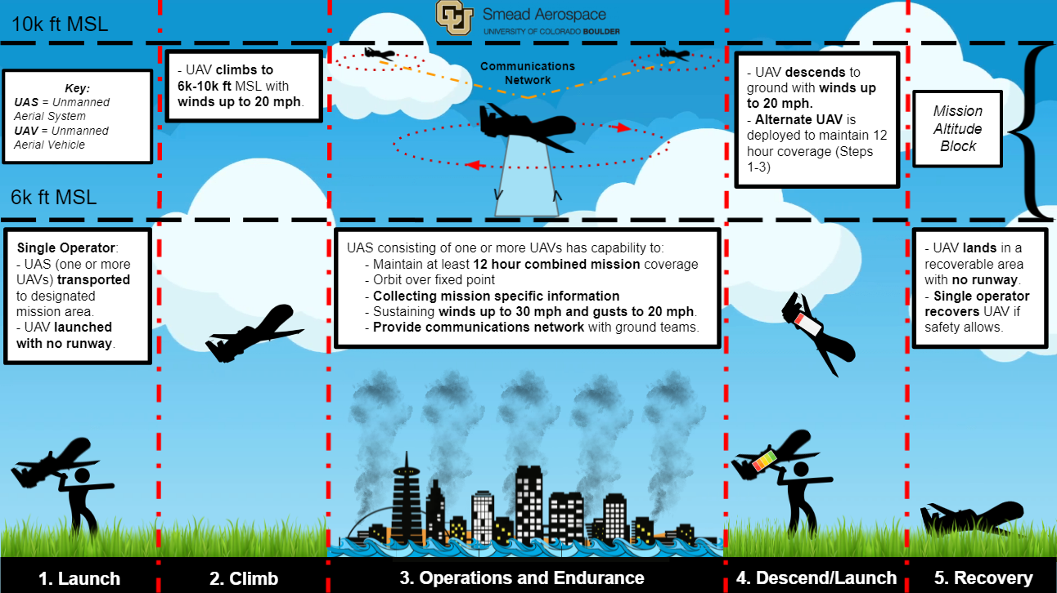
Appendix Slide

Slide 9
Functional Block Diagram (FBD)
Overview
Baseline Designs
Feasibility Analysis
Summary
Logistics

Slide 10
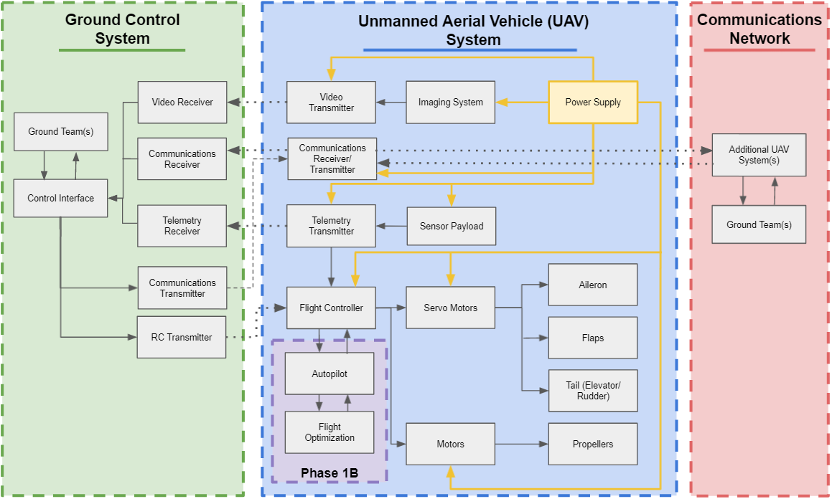
FBD
KEY:
Physical connections
Connections via wireless method
Power supply connections
(illustrate subsystem
complexity and importance)
Appendix Slide

Slide 11
Functional Requirements
Appendix Slide
FR1: The UAS shall provide a continuous overwatch window of 12 hours through the use of one or more UAVs (i.e. three UAVs each with 4 hours of endurance is acceptable).
FR2: UAS (including all UAVs and their supporting equipment) shall be transported, launched, recovered, and operated by a single person to satisfy Requirement 1 under a 10 minute launch window per UAV.
Overview
Baseline Designs
Feasibility Analysis
Summary
Logistics
Notes:
Slides 9 and 10 are repetitive with slide 6. Might think about combining and removing less important info. Use colors to distinguish between which ones we will talk about in the presentation and the general list from contractor!
Better explain the FR1 to essentially show that 3 UAVs times 4 hours is 12 hour mission for example/

Slide 12
Functional Requirements
Appendix Slide
FR3: UAS shall have short takeoff and landing capabilities to deploy in areas with unprepared launch surfaces and obstructed climb windows as specified by the customer.
FR4: UAV shall provide a payload bay to house a sensor suite.
Overview
Baseline Designs
Feasibility Analysis
Summary
Logistics

Slide 13
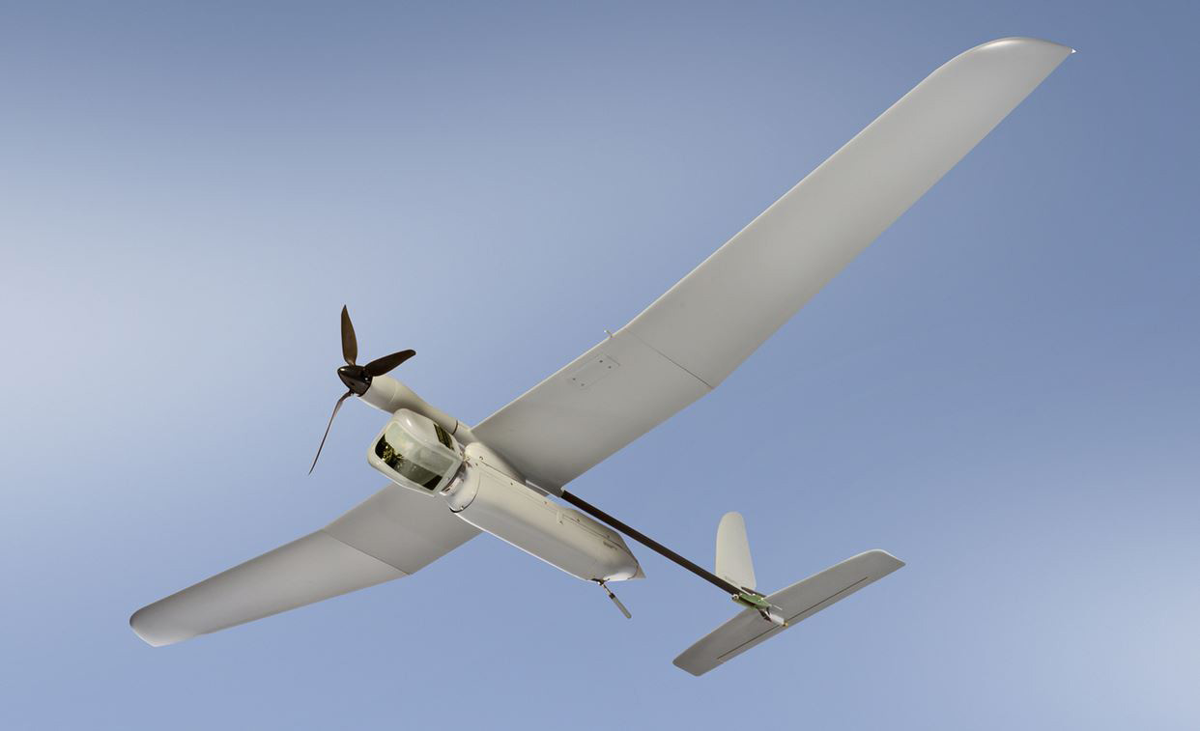
Baseline Design
Appendix Slide
Conventional Fixed Wing Aircraft
High C_{L}/C_{D}
Mid/High range Aspect Ratio
Slight Wing Taper
Electric Propulsion System
Modular Payload Bay
Elbit Skylark
Overview
Baseline Designs
Feasibility Analysis
Summary
Logistics
Notes:
Add visuals to this to complement the words! Maybe a CAD model if time?

Slide 14
Critical Project Elements
Appendix Slide
Project Elements
Airframe Structure
Critical Project Elements
Aerodynamics and Wing Design
Aerodynamics and Wing Design
Avionics
Focus of Preliminary Design Review
Propulsion
Propulsion
Mechanics
Earth
Airframe Structure
Safety Considerations
Simulations and Systems
Overview
Baseline Designs
Feasibility Analysis
Summary
Logistics

Slide 15
Feasibility Analysis
Overview
Baseline Designs
Feasibility Analysis
Summary
Logistics

Slide 16
Aerodynamics and Wing Design
Appendix Slide
Span | 10ft
AR | ?
Chord | ?
Taper | ?
Airfoil | ?
Cl | ?
Cd | ?
AoA | ?
Design Considerations:
Aspect Ratio (AR) - Slide 17-18
Taper Ratio (λ) - Slide 19
Bending Moment - Slide 20
Airfoil - Slide 21 - 22
Lift Coefficient (C_{L}) - Slide 23 - 25
Drag Polar (C_{D}) - Slide 26-27
AoA - Slide 28
Span Efficiency - Slide 29
Performance - Slide 30
10ft Span partially satisfies FR2
Overview
Baseline Designs
Feasibility Analysis
Summary
Logistics

Slide 17
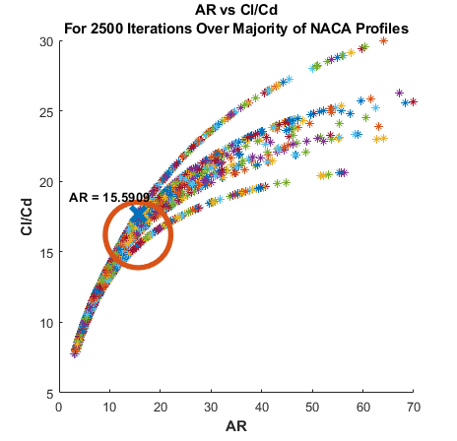
Aerodynamics and Wing Design
Appendix Slide
Aspect Ratio (AR):
Defined as wingspan, b,
squared over the planform wing area, S.
b²/S
Affect aircraft
Performance parameters:
Endurance
Maneuverability
Stability
Span | 10ft
AR | 15.59
Chord | ?
Taper | ?
Airfoil | ?
Cl | ?
Cd | ?
AoA | ?
Overview
Baseline Designs
Feasibility Analysis
Summary
Logistics

Slide 18
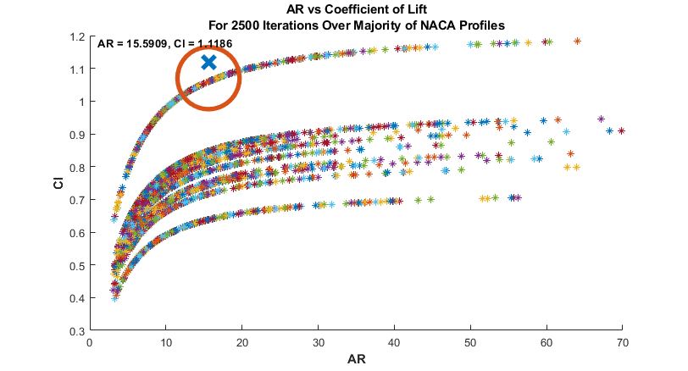
Aerodynamics and Wing Design
Appendix Slide
Span | 10ft
AR | 15.59
Chord | ?
Taper | ?
Airfoil | ?
Cl | ?
Cd | ?
AoA | ?
Span | 10ft
AR | 15.59
Chord | ?
Taper | ?
Airfoil | ?
Cl | ?
Cd | ?
AoA | ?
Overview
Baseline Designs
Feasibility Analysis
Summary
Logistics

Slide 19
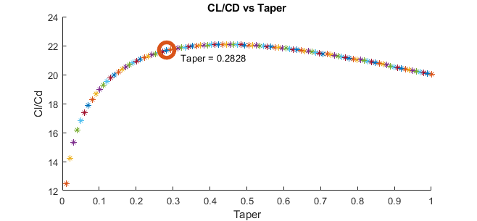
Aerodynamics and Wing Design
Appendix Slide
Taper Ratio (λ): A ratio of root and tip chords
Affects CL/CD
Span | 10ft
AR | 15.59
Chord | 12in
Taper | 0.283
Airfoil | ?
Cl | ?
Cd | ?
AoA | ?
Overview
Baseline Designs
Feasibility Analysis
Summary
Logistics

Slide 20
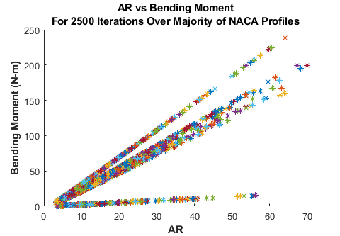
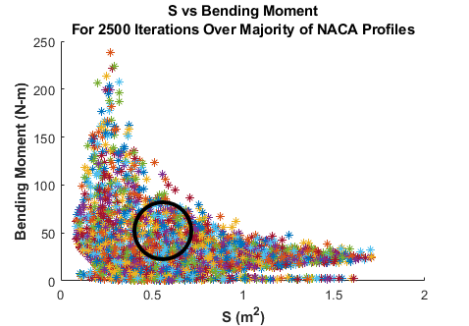
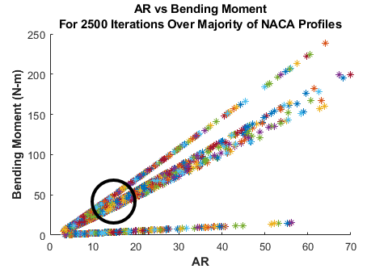
Aerodynamics and Wing Design
Appendix Slide
Bending Moment:
Metric for how much load is held by each wing’s area.
Vortex Panel Method
Span | 10ft
AR | 15.59
Chord | 12in
Taper | 0.283
Airfoil | ?
Cl | ?
Cd | ?
AoA | ?
Overview
Baseline Designs
Feasibility Analysis
Summary
Logistics

Slide 21
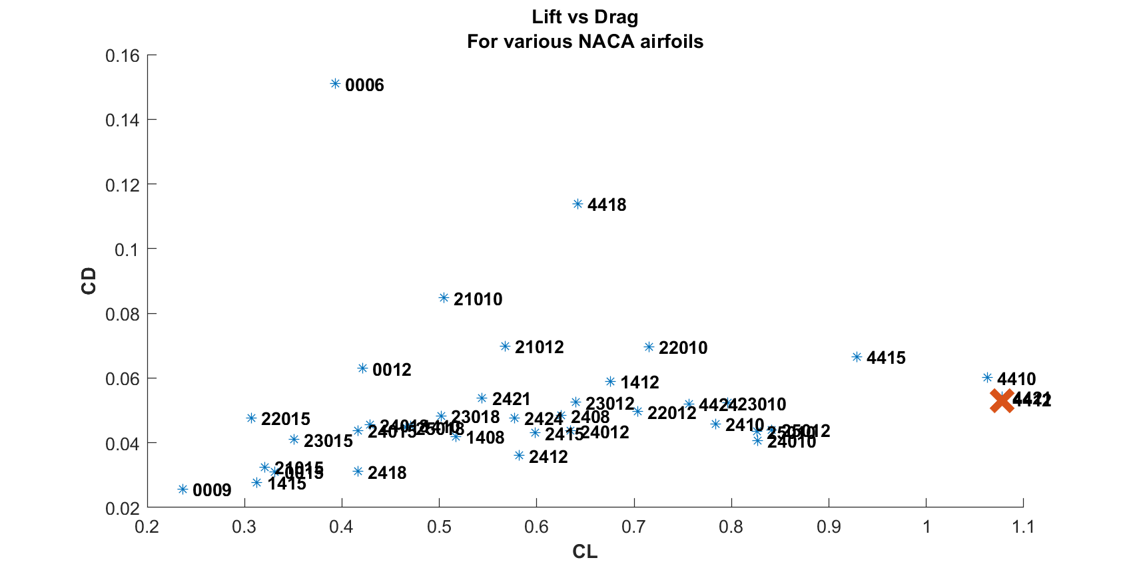
Aerodynamics and Wing Design
Appendix Slide
Camber: NACA profiles determine thickness and camber
Span | 10ft
AR | 15.59
Chord | 12in
Taper | 0.283
Airfoil | NACA 4412
Cl | ?
Cd | ?
AoA | ?
Overview
Baseline Designs
Feasibility Analysis
Summary
Logistics

Slide 22
Aerodynamics and Wing Design
Appendix Slide
NACA 4412
Span | 10ft
AR | 15.59
Chord | 12in
Taper | 0.283
Airfoil | NACA 4412
Cl | ?
Cd | ?
AoA | ?
Overview
Baseline Designs
Feasibility Analysis
Summary
Logistics

Slide 23
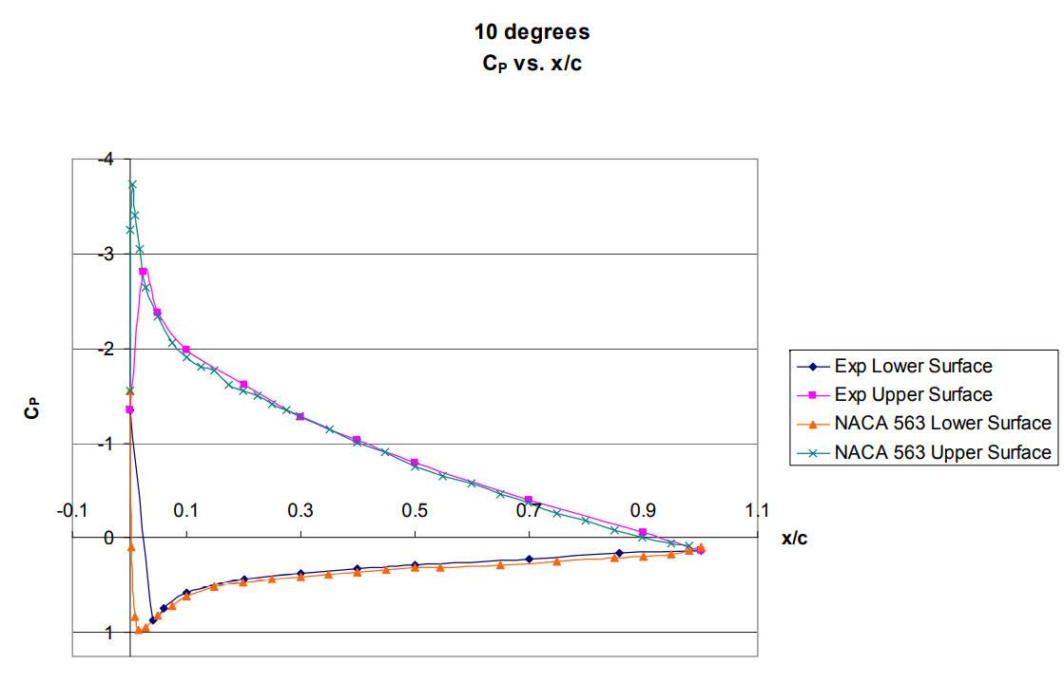
Aerodynamics and Wing Design
Appendix Slide
Generated Lift (C_{L}):
The ratio of lifting force to the force produced by dynamic pressure multiplied by area
SLUF L = W
Lift is quantified by the area created by a pressure distribution across an airfoil
Span | 10ft
AR | 15.59
Chord | 12in
Taper | 0.283
Airfoil | NACA 4412
Cl | 1.118
Cd | ?
AoA | ?
Overview
Baseline Designs
Feasibility Analysis
Summary
Logistics

Slide 24
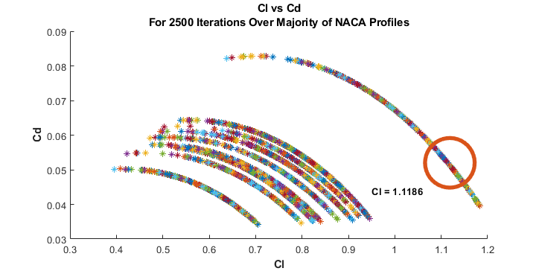
Aerodynamics and Wing Design
Appendix Slide
Span | 10ft
AR | 15.59
Chord | 12in
Taper | 0.283
Airfoil | NACA 4412
Cl | 1.118
Cd | ?
AoA | ?
Overview
Baseline Designs
Feasibility Analysis
Summary
Logistics

Slide 25
Aerodynamics and Wing Design
Appendix Slide
Span | 10ft
AR | 15.59
Chord | 12in
Taper | 0.283
Airfoil | NACA 4412
Cl | 1.118
Cd | ?
AoA | ?
Overview
Baseline Designs
Feasibility Analysis
Summary
Logistics

Slide 26
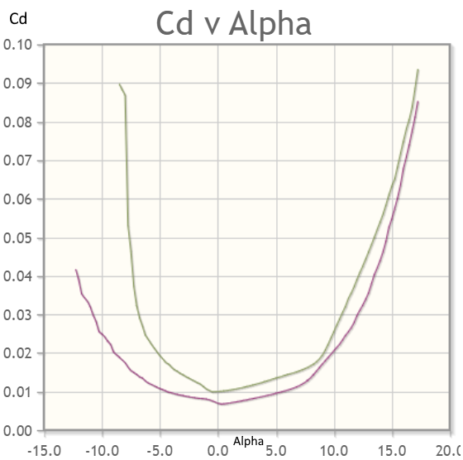
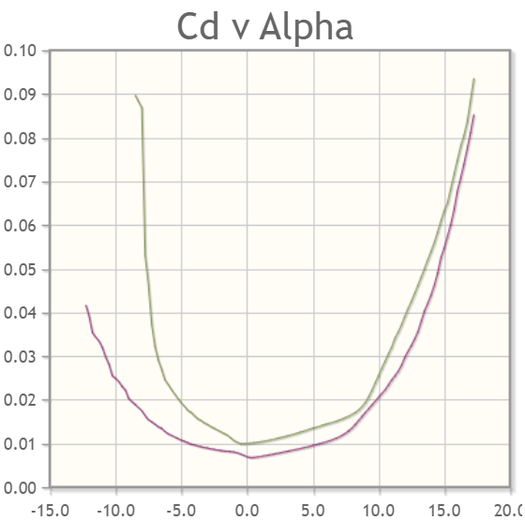
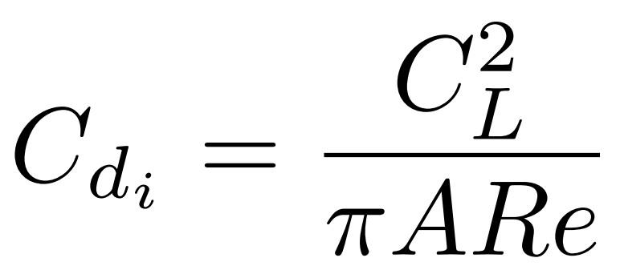
Aerodynamics and Wing Design
Appendix Slide
Drag Polar (C_{D}):
C_{D}= C_{D0}+C_{Di}
C_{D0} - Zero-lift drag coef.
Drag from size, speed and altitude
XFOIL Data interpolated
C_{Di} - Induced drag coef. at min. Power
Drag from lift and vortices
Span | 10ft
AR | 15.59
Chord | 12in
Taper | 0.283
Airfoil | NACA 4412
Cl | 1.118
Cd | ?
AoA | ?
Overview
Baseline Designs
Feasibility Analysis
Summary
Logistics
Notes:
Explain the terms better because PAB don’t know aircraft stuff.

Slide 27
Aerodynamics and Wing Design
Appendix Slide
Drag Polar (C_{D}):
C_{D}= C_{D0}+ C_{Di} = 0.063338
C_{D0} = 0.030567
C_{Di} = 0.032771
Span | 10ft
AR | 15.59
Chord | 12in
Taper | 0.283
Airfoil | NACA 4412
Cl | 1.118
Cd | 0.063
AoA | ?
Overview
Baseline Designs
Feasibility Analysis
Summary
Logistics
Notes:
Explain the terms better because PAB don’t know aircraft stuff.

Slide 28
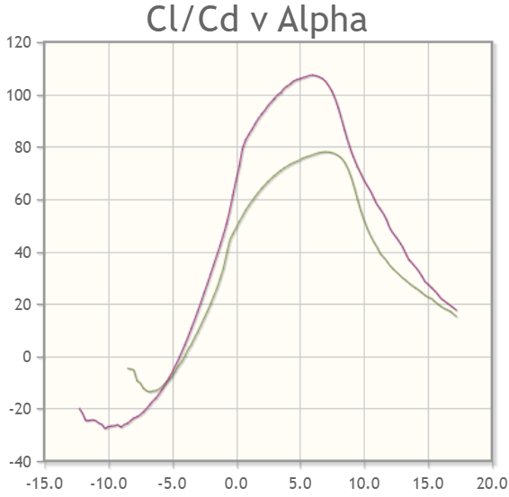
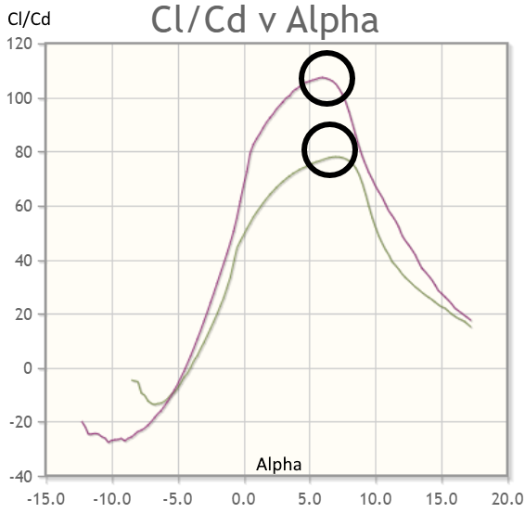
Aerodynamics and Wing Design
Appendix Slide
AoA: Angle the wing is flying through the air
AoI: Angle between chord line and fuselage
Span | 10ft
AR | 15.59
Chord | 12in
Taper | 0.283
Airfoil | NACA 4412
Cl | 1.118
Cd | 0.063
AoA | 7.989°
Overview
Baseline Designs
Feasibility Analysis
Summary
Logistics

Slide 29
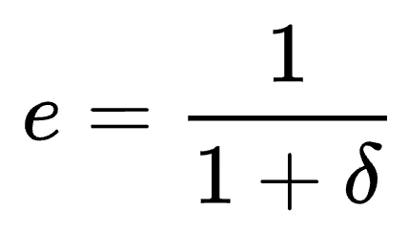
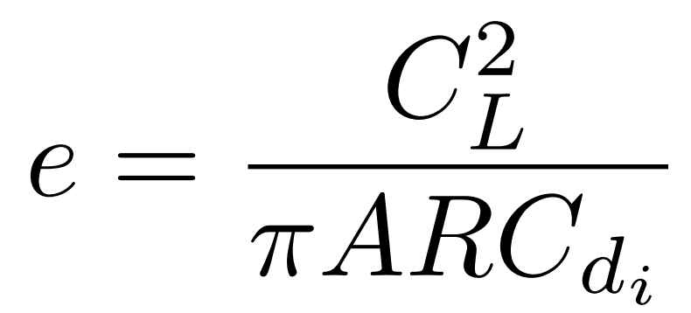
Aerodynamics and Wing Design
Appendix Slide
Span Efficiency Factor
change in drag with lift of a three-dimensional wing
- 0.7795447459 - 0.7795436358
Span | 10ft
AR | 15.59
Chord | 12in
Taper | 0.283
Airfoil | NACA 4412
Cl | 1.118
Cd | 0.063
AoA | 7.989°
Overview
Baseline Designs
Feasibility Analysis
Summary
Logistics
Notes:
DO NOT CHANGE IMAGE ASPECT RATIO

Slide 30
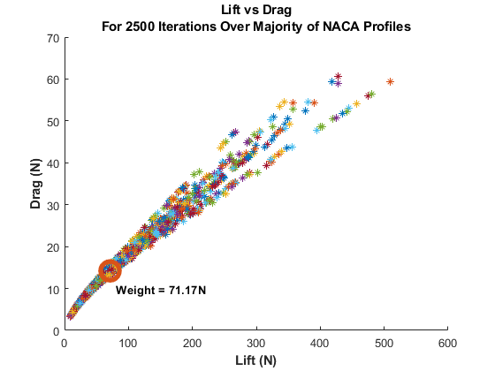
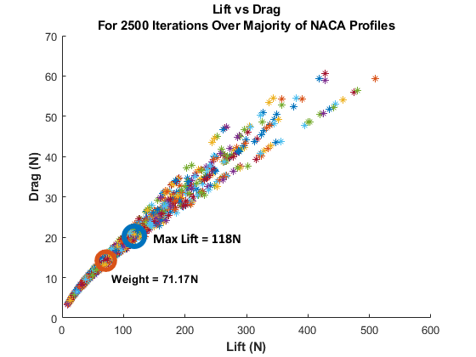
Aerodynamics and Wing Design
Appendix Slide
Performance:
Max Lift - 118N
Weight - 71N
Drag - 19.5N
Span | 10ft
AR | 15.59
Chord | 12in
Taper | 0.283
Airfoil | NACA 4412
Cl | 1.118
Cd | 0.063
AoA | 7.989°
Overview
Baseline Designs
Feasibility Analysis
Summary
Logistics

Slide 31
Propulsion: Feasibility Goals
Appendix Slide
Propulsion - What do we need to know?
Levels of Success and FR’s
Max Endurance Flight (FR1)
Climbout (LS & FR3)
30 mph headwind (LS)
Does the Market support it?
Motor and Propellor combinations
Overview
Baseline Designs
Feasibility Analysis
Summary
Logistics

Slide 32
Propulsion: Variables
Appendix Slide
Variable | Estimate by Aero Model | Estimate used in Prop Model | Typical Market Values
Weight (W) | 7.25 kg (16 lbs) | 7.25 kg (16 lbs) | 4 kg to 7 kg (9 lbs to 15 lbs)
Span Efficiency Factor (e) | .779 | .75 | .6 to .9
Chord Length (c) | .3048 m (12”) | .3048 m (12”) | .1778 m to 0.381 m (7” to 15”)
Taper Ratio (C_{tip} / C_{root} ) | .2828 | .2828 | .3 to 1
Aspect Ratio (AR) | 15.6 | 15.6 | 10 to 18
Wing Area (S) | .596 m² (6.41 ft²) | .596 m² (6.41 ft²) | .25 m² to 1 m² (2.69 ft² to 10.76 ft²)
Span (s) | 3.048 m (10 ft) | 3.048 m (10 ft) | 2 m to 3 m (6.56 ft to 9.84 ft)
Zero Lift Drag (C_{D0} ) | .015 | .02 | .01 to .05
Propellor Efficiency (η) | ~ | 60% [1] | 75% to 90%
Overview
Baseline Designs
Feasibility Analysis
Summary
Logistics

Slide 33
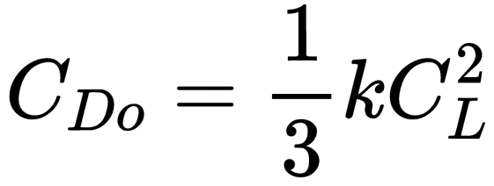
Propulsion: Max Endurance
Results | IMP | SI
T_{req} END
P_{req} END
V_{req} END
CL_{req} END
T_{req} Climbout
P_{req} Climbout
CL_{req} Climbout
V_{req} Climbout
T_{req} Headwind
P_{req} Headwind
CL_{req} Headwind
V_{req} Headwind
Appendix Slide
Results | IMP | SI
T_{req} END | .861 lbf | 3.83 N
P_{req} END | .107 hp | 79.8 W
V_{req} END | 28 mph | 12.5 m/s
CL_{req} END | 1.48 | 1.48
Endurance Maximizing Velocity (Minimum P_{req} ) [1]
Coefficient of Lift (Lift = Weight) [2]
Thrust (Thrust = Drag) [1]
Power [2]
Endurance Flight satisfies FR1
Overview
Baseline Designs
Feasibility Analysis
Summary
Logistics

Slide 34
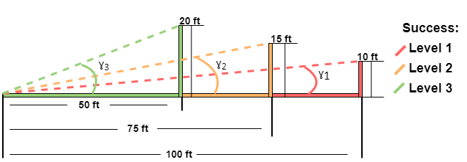
Propulsion: Climbout
Results | IMP | SI
T_{req} END | .861 lbf | 3.83 N
P_{req} END | .107 hp | 79.8 W
V_{req} END | 28 mph | 12.5 m/s
CL_{req} END | 1.48 | 1.48
T_{req} Climbout
P_{req} Climbout
CL_{req} Climbout
V_{req} Climbout
T_{req} Headwind
P_{req} Headwind
CL_{req} Headwind
V_{req} Headwind
Appendix Slide
Levels of Success for Climbout: (measured from ground)
ɣ₁ = 5.71°
ɣ₂ = 11.3°
ɣ₃ = 21.8°**
**outside Small Angle Approx
T_{req} Climbout | 8.16 lbf | 36.3 N
P_{req} Climbout | 1.33 hp | 993 W
CL_{req} Climbout | .975 | .975
V_{req} Climbout | 36.7 mph | 16.4 m/s
Rate of Climb (RoC) [2]:
L
𝛼
T
θ
θ
γ
D
W
θ
Climbout satisfies FR3
Overview
Baseline Designs
Feasibility Analysis
Summary
Logistics

Slide 35
Propulsion: Headwind
Results | IMP | SI
T_{req} END | .861 lbf | 3.83 N
P_{req} END | .107 hp | 79.8 W
V_{req} END | 28 mph | 12.5 m/s
CL_{req} END | 1.48 | 1.48
T_{req} Climbout | 8.16 lbf | 36.3 N
P_{req} Climbout | 1.33 hp | 993 W
CL_{req} Climbout | .975 | .975
V_{req} Climbout | 36.7 mph | 16.4 m/s
T_{req} Headwind
P_{req} Headwind
CL_{req} Headwind
V_{req} Headwind
Appendix Slide
Requirement for Headwind: 30 mph Headwind
L
T
D
V_{wind}
W
T_{req} Headwind | 0.75 lbf | 3.34 N
P_{req} Headwind | 0.116 hp | 86.84 W
CL_{req} Headwind | .950 | .950
V_{req} Headwind | 35 mph | 15.6 m/s
Overview
Baseline Designs
Feasibility Analysis
Summary
Logistics

Slide 36
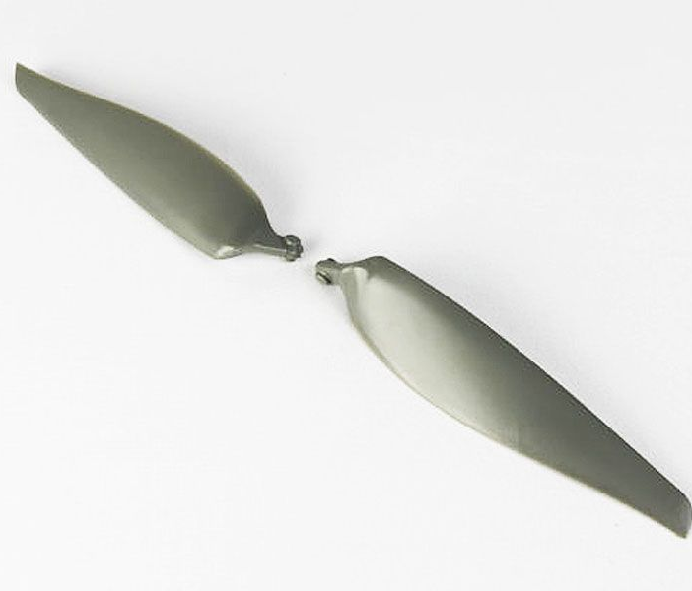
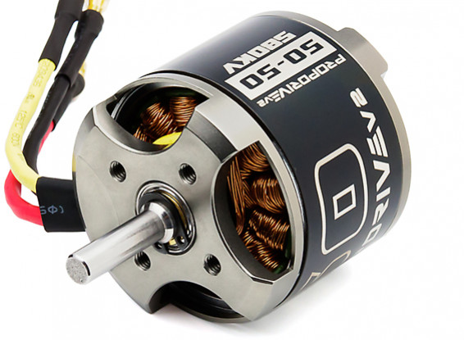
Propulsion: Market Analysis
Results | IMP | SI
T_{req} END | .861 lbf | 3.83 N
P_{req} END | .107 hp | 79.8 W
V_{req} END | 28 mph | 12.5 m/s
CL_{req} END | 1.48 | 1.48
T_{req} Climbout | 8.16 lbf | 36.3 N
P_{req} Climbout | 1.33 hp | 993 W
CL_{req} Climbout | .975 | .975
V_{req} Climbout | 36.7 mph | 16.4 m/s
T_{req} Headwind | 0.75 lbf | 3.34 N
P_{req} Headwind | 0.116 hp | 86.84 W
CL_{req} Headwind | .950 | .950
V_{req} Headwind | 35 mph | 15.6 m/s
Appendix Slide
[3] [4]
Proof of Feasibility 1: PROPDRIVE v2 5050 580KV Brushless Outrunner Motor and APC
14x10 Folding Propeller Blade Set
Battery: 4-6S (22.2 V LiPo)
Power: 2000W Continuous
Max Thrust: ~ 52.5 N
Specific Flight Condition (PROPDRIVE Data Sheet)
18.5V - 1077W - 60.7A - 4.03kg thrust ~ 39.5 N
𝛼 = 12.5°
𝛼 = 6.8°
𝛼 = 6.8°
Overview
Baseline Designs
Feasibility Analysis
Summary
Logistics
Notes:
https://www.banggood.com/Racerstar-Racing-Edition-4108-BR4108-600KV-4-6S-Brushless-Motor-For-500-550-600-for-RC-Drone-FPV-Racing-p-1122900.html?cur_warehouse=CN
https://www.hobbypartz.com/02p-motor-607-mt4008-kv600.html

Slide 37
Endurance Estimations
Appendix Slide
Equation used by RC aircraft pilots to determine endurance
Does not factor in unpowered glide
Factors Climbout and Cruise
Assumes mid-full throttle during climbout phase
Equation used in Tempest Estimates [1]
Does not factor in unpowered glide
Does not factor in climbout
Factors more battery parameters
Parameter | Value
B_{capacity} | 6,000mAh
B_{discharge} | 90%
Battery Packs | 5
I_{takeoff} | 60A
I_{cruise} | 3.0A
R.O.C | 6.1 m/s
Time to M.A. | .5 - 4 min
Parameter | Value
B_{capacity} | 6,000mAh
B_{discharge} | 90%
Battery Packs | 5
V | 22.2 V
Rt | 1
n | 1.3
η_{prop} | 60%
This methodology for endurance passes FR1
This methodology for endurance
passes FR1
Overview
Baseline Designs
Feasibility Analysis
Summary
Logistics
Notes:
https://www.banggood.com/Racerstar-Racing-Edition-4108-BR4108-600KV-4-6S-Brushless-Motor-For-500-550-600-for-RC-Drone-FPV-Racing-p-1122900.html?cur_warehouse=CN
https://www.hobbypartz.com/02p-motor-607-mt4008-kv600.html

Slide 38
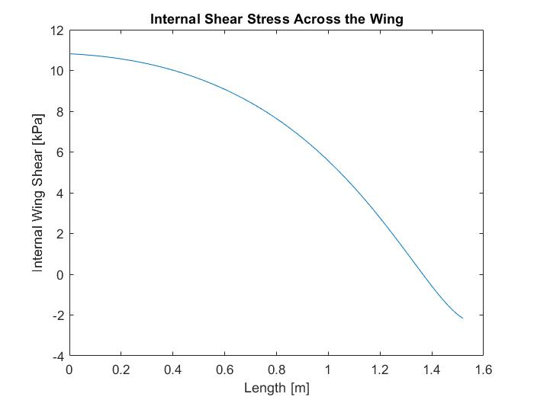
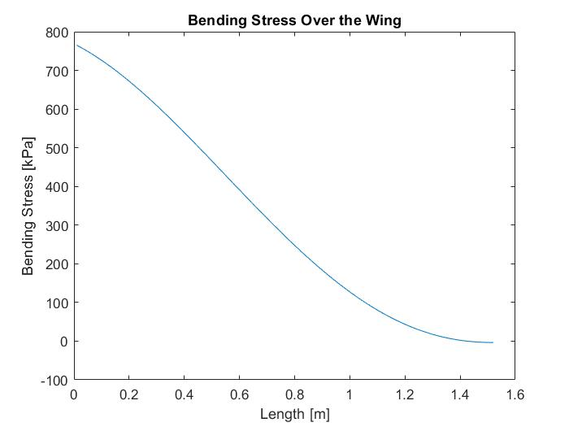
Airframe Structure: Aircraft Loading Conditions
Appendix Slide
Maximum expected loading values determined from structural analysis:
Maximum Tensile Stress: 765.1 kPa
Maximum Compressive Stress: 765.1 kPa
Maximum Shear Stress: 10.8 kPa
Overview
Baseline Designs
Feasibility Analysis
Summary
Logistics

Slide 39
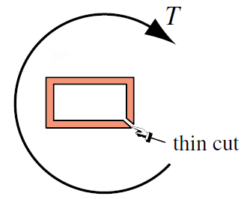
Airframe Structure: Open Thin Wall Approximation
Appendix Slide
Torsional analysis of wing root and tip:
Assumed constant open thin walled rectangular cross-section for Expanded Polystyrene (EPS) foam - open thin walled analysis gives worst case torque
Lowest shear strength candidate material
Results:
Maximum allowable torque at root: 57.354 N-m
Maximum allowable torque at tip: 12.491 N-m
Expected values experienced by vehicle:
Expected torque at root: 4.995 N-m
Expected torque at tip: 1.088 N-m
Overview
Baseline Designs
Feasibility Analysis
Summary
Logistics

Slide 40
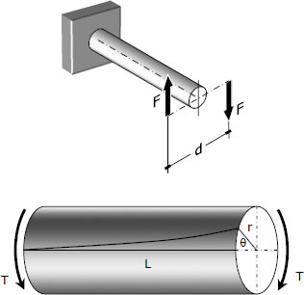
Airframe Structure: Open Thin Wall Approximation
Appendix Slide
Determining twist angle after applied torque for EPS
Open thin walled approximation gives limiting case for maximum twist angle
Maximum allowable twist angle for root: 11.3°
Maximum allowable twist angle for tip: 21.1°
Expected values experienced by vehicle:
Expected twist angle for root: 1.36°
Expected twist angle for tip: 3.48°
Maximum Expected Tip Deflection
Assumes load is applied entirely at wingtip
Maximum EPS foam tip deflection: 3.28 cm
Overview
Baseline Designs
Feasibility Analysis
Summary
Logistics

Slide 41
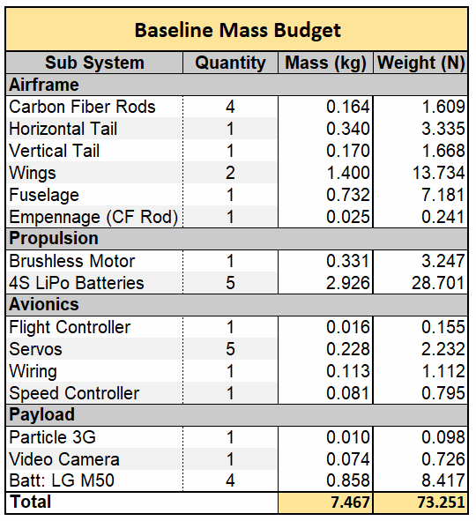
Aircraft Preliminary Mass Budget
Appendix Slide
UAV Specifications:
Total Mass: 7.47 kg
Weight: 16.46 lbs (73.25 N)
Approximate UAS weight for 12hr. overwatch
2 FMC UAVs, 2 auxiliary batteries, 1 receiver
Total UAS Weight: 46.60 lbs (207.29 N)
Payload weight of 2.1 lbs (9.34 N)
Cumulative Endurance Satisfies FR1
Demonstration Payload Capacity Satisfies FR3
Total UAS Weight Satisfies FR4
Overview
Baseline Designs
Feasibility Analysis
Summary
Logistics

Slide 42
Cost Estimates
Appendix Slide
Cost based on market estimates
Amazon
SparkFun
Home Depot
Hobby Sites
Independent Retailers
Overestimates
Include shipping estimates
Assume expensive options
Cost Estimates
Sub System | Quantity | Cost ($)
Airframe
Carbon Fiber Rods | 4 | 7.57
3D Printing Resin | Mass Approximation | 373.5
Balsa Wood | Surface Area Approx. | 15.06
Propulsion
Brushless Motor | 1 | 68.72
Propellor | 1 | 12
4S LiPo Batteries | 5 | 300
Avionics
Flight Controller | 1 | 300
Servos | 5 | 750
Wiring | 1 | 50
Speed Controller | 1 | 50
Payload
Particle 3G | 1 | 100
Total UAV Cost |  | 2026.84
Cost of 2 UAVs |  | 4053.70
Notes:
https://docs.google.com/spreadsheets/d/1Z1zK1ah4jcD0RY_jm0Z3KQHR5nCHbvbiWtiiujIvGak/edit?usp=sharing

Slide 43
Summary
Overview
Baseline Designs
Feasibility Analysis
Summary
Logistics

Slide 44
Status Summary
Appendix Slide
Key Takeaways Going Forward:
Feasibility analysis shows the aircraft will fly
Significant structures & materials analysis must occur to determine airframe integrity upon skid landing
Endurance is a primary concern
Additional Motor & Propeller Analysis & Endurance testing is needed
Custom Lithium Ion Battery pack options need to be explored
Design Feature | Requirement | Feasibility
Span 10ft | FR2
Short Takeoff | FR3
Payload | FR4
Endurance | FR1
UAS < 50lbs | FR2
Overview
Baseline Designs
Feasibility Analysis
Summary
Logistics

Slide 45
Logistics/Gantt Chart
Overview
Baseline Designs
Feasibility Analysis
Summary
Logistics

Slide 46
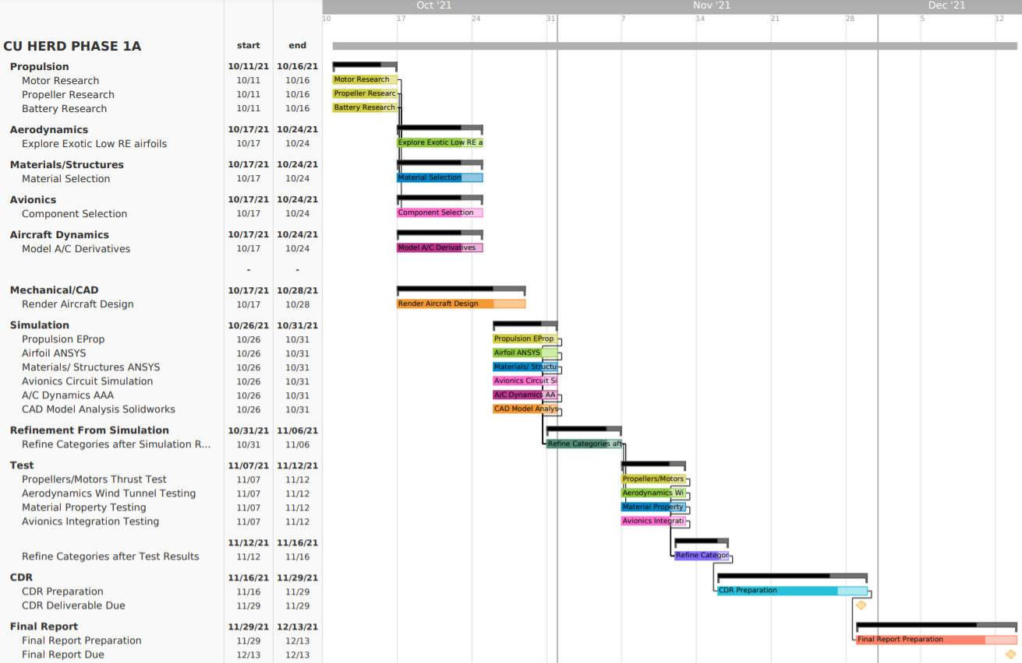
Critical Path
CDR
Final Report

Slide 47
Questions?
Overview
Baseline Designs
Feasibility Analysis
Summary
Logistics

Slide 48
26_JAN_2017_Florida_Keys_5R_4G_3Bxxxxxxxxxxxxxxxxxxxxxxxxxxxxxxxxxxxxxxxxxxxxxxxxxxxxxxxxxxxxxxxxxxxxxxxxxxxxxxxxxxxxxxxxxxxxxxxxxxxxxx
Appendix
Aerodynamics and Wing Design - Slide 16
Aspect Ratio - Slide 17
Taper Ratio - Slide 19
Bending Moment - Slide 20
Airfoil - Slide 21
Lift Coefficient - Slide 23
Drag Polar - Slide 26
AoA - Slide 28
Span Efficiency - Slide 29
Performance - Slide 30
Aircraft Dynamics - Slide 75
Avionics and Electronics - Slide 52
Baseline Design - Slide 13
Backup Slides - Slide 49
CONOPS - Slide 8
Cost Estimates - Slide 40
Critical Project Elements - Slide 14
Design Objectives - Slide 5
Endurance Estimations - Slide 37
FBD - Slide 10
Functional Requirements
Primary - Slide 11
Secondary - Slide 50
Gantt Chart - Slide 46
Mass Budget - Slide 41
Materials - Slide 54
Mission Statement - Slide 4
NACA 4412 Data - Slide 70
Other Marketed Solutions - Slide 63
Overview - Slide 2
Propulsion - Slide 31
Feasibility Goals - Slide 31
Derivations - Slide 32Market Analysis- Slide 36
Sources - Slide 77
Status Summary - Slide 44
Structures - Slide 38, Slide 58
Wing Specifications - Slide 74

Slide 49
Backup Slides

Slide 50
Functional Requirements
Appendix Slide
FR4: UAS shall provide a payload bay to house a sensor suite.
FR5: UAS shall operate up to a maximum altitude of 10,000 ft. MSL.
FR6: UAS shall adhere to FAA 14 CFR Part 107, SMALL UNMANNED AIRCRAFT SYSTEMS, contingent on waivers.
Overview
Baseline Designs
Feasibility Analysis
Summary
Logistics

Slide 51
Functional Requirements
Appendix Slide
FR7: UAS shall maintain a minimum of 80% operational capabilities in customer specified environmental conditions.
FR8: UAS will maintain a FMC standby posture.
FR9: UAS total flyaway cost shall not exceed 5,000 USD for a single air vehicle along with the required launch and recovery system.

Slide 52
Avionics & Electronics
Appendix Slide
Avionics system - (Pending Further Research)
Flight Controller
Control Surface Servos
Telemetry Receiver (for flight)
Gyroscope
Speed Controller
Altimeter

Slide 53
Potential Payloads
Appendix Slide
Avionics system - Payload Bay
Video Camera
3G/LTE Communications relay
IR Sensors
Other to-be-determined components

Slide 54
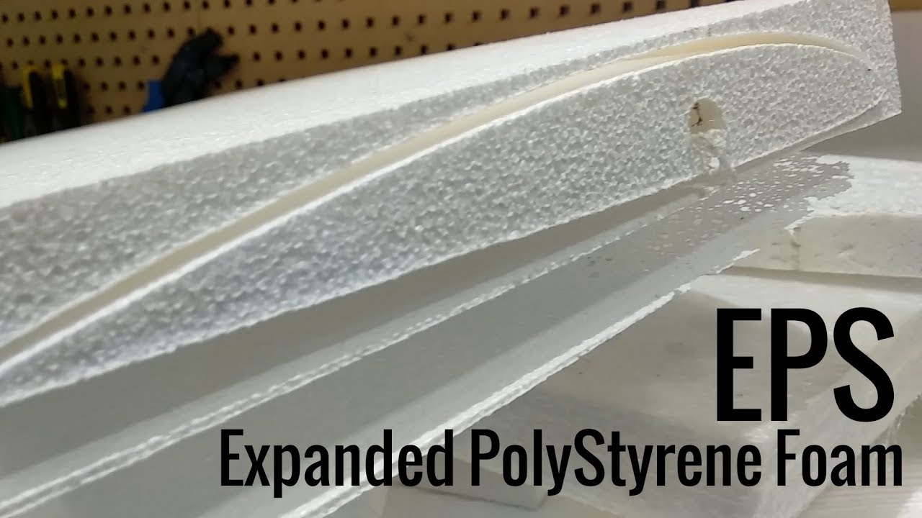
Airframe Structure: Foam Candidate Material Selection
Appendix Slide
Expanded Polystyrene Foam
Heavily used in RC market for wings and fuselages
Matweb Material Data:
http://www.matweb.com/search/datasheettext.aspx?matguid=5f099f2b5eeb41cba804ca0bc64fa62f
Tensile Strength, Yield | 47.1 - 51.0 MPa
Compressive Strength, Yield | 0.0400 - 10.9 MPa
Shear Strength | 0.124 - 0.300 MPa
Overview
Baseline Designs
Feasibility Analysis
Summary
Logistics

Slide 55
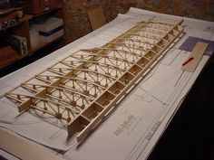
Airframe Structure: Wood Candidate Material Selection
Appendix Slide
Balsa Wood
Potential use for wing/fuselage spars and ribs
Matweb Material Data:
http://www.matweb.com/search/datasheet.aspx?matguid=81c269f50f424573a4f9978cfcb41bc8
Tensile Strength | 73.0 MPa (Axial) / 1.00 MPa (Perpendicular)
Compressive Strength | 6.90 MPa (Axial) / 1.00 MPa (Perpendicular)
Shear Strength | 1.10 MPa
Overview
Baseline Designs
Feasibility Analysis
Summary
Logistics

Slide 56
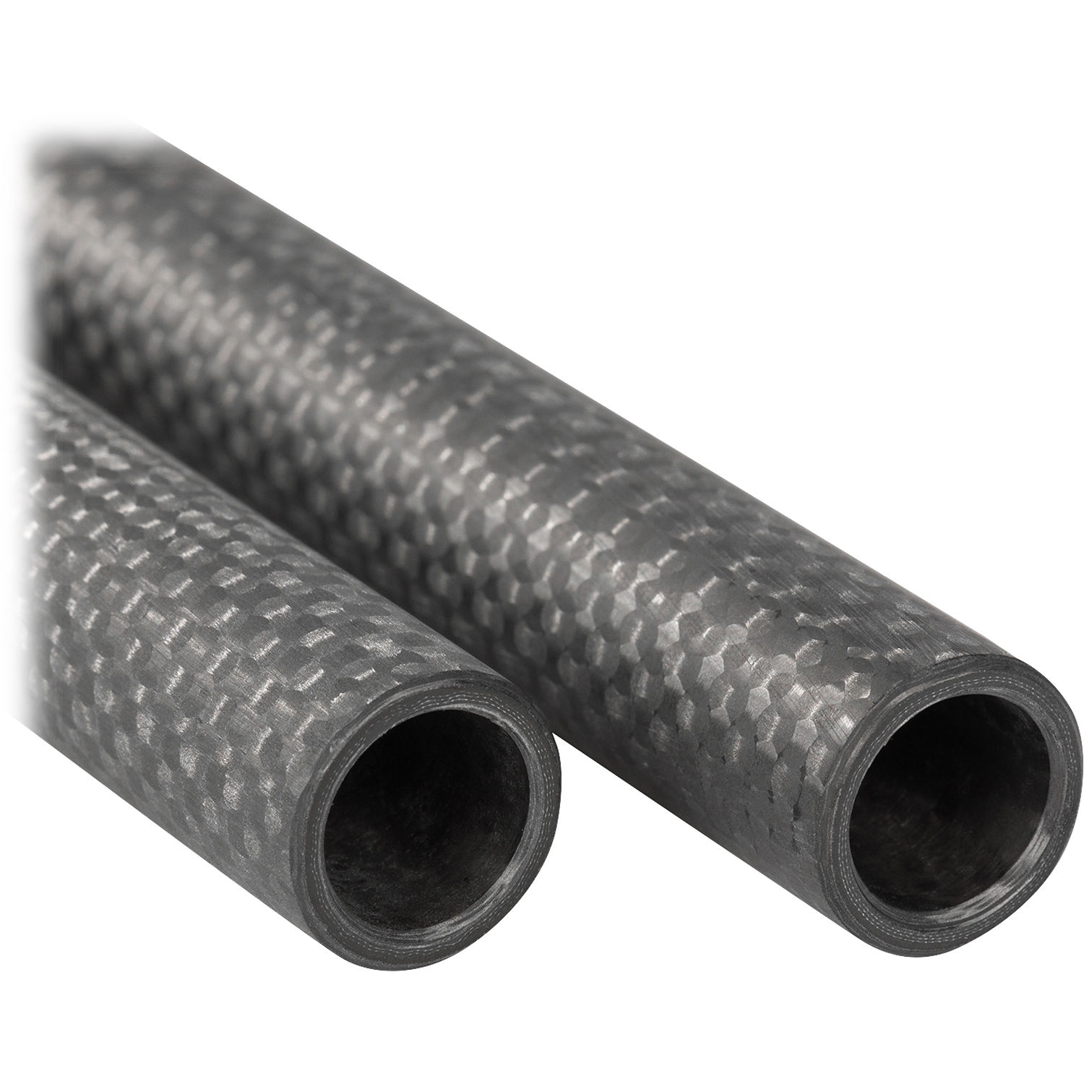
Airframe Structure: Composite Candidate Material Selection
Appendix Slide
Carbon Fiber
Potential use for wing and fuselage structural support
Matweb Material Data:
http://matweb.com/search/datasheet.aspx?matguid=5df1e45601214077b674daa817cba3d3&ckck=1
Tensile Strength | 110.0 MPa
Compressive Strength | 110.0 MPa
Shear Strength | 260.0 MPa
Overview
Baseline Designs
Feasibility Analysis
Summary
Logistics
Notes:
https://www.cstsales.com/hm_carbon_shapes.html

Slide 57
Airframe Structure: Composite Candidate Material Selection
Appendix Slide
3D Printed Resin
Potential use for wing skin & structural support
Material Data:
Tensile Strength | 55.7 MPa
Compressive Strength | 34.0 MPa
Shear Strength | TBD
Overview
Baseline Designs
Feasibility Analysis
Summary
Logistics

Slide 58
Structures
Appendix Slide
Developing a Structural Model:
Load Factor Equations: T.H.G. Megson, in Aircraft Structures for Engineering Students (Sixth Edition), 2017
Bank (θ = 2.47°):
Sharp-Edge Gust (30 ft/s or 9.144 ms/s):
Total (n = 1.0542):

Slide 59
Airframe Structure: Closed Thin Wall Approximation
Appendix Slide
OTW ɑ & 𝛃 approximation: (ref: W. C. Young, Roark’s Formulas for Stress & Strain, McGraw-Hill, 6th ed., 1989, p. 34.)

Slide 60
Airframe Structure: Closed Thin Wall Approximation
Appendix Slide
CTW Equations (ref: S. P. Timoshenko and J. N. Goodier, Theory of Elasticity, 3rd ed., McGraw-Hill, New York, 1969, Sec 109.). Assumed rectangular cross-section.
Shear flow: Shear:
Ae = Enclosed area
GJ: Torsional Rigidity
(Shear modulus * polar MOI)
Twist angle:

Slide 61
Airframe Structure: Open Thin Wall Approximation
Appendix Slide
OTW Equations (ref: S. P. Timoshenko and J. N. Goodier, Theory of Elasticity, 3rd ed., McGraw-Hill, New York, 1969, Sec 109.)
Assumed constant wall thickness for max shear
Shear:
GJ: Torsional Rigidity
(Shear modulus * polar MOI)
Twist angle:

Slide 62
Airframe Structure: Distributed Load & Tip Deflection
Appendix Slide
Tip deflection assumes maximum load applied at wing tip only
Distributed load function via Anderson, John D. Introduction to Flight. New York: McGraw-Hill, 1985.
Bending moment and max shear, compression, and tension assume beam model for wing
Distributed Load Function:
Bending Stress:
(t/2) is distance from neutral axis, M is bending moment, I is MOI about neutral axis
Tip Deflection: F is maximum force over wing, E is Young’s Modulus

Slide 63
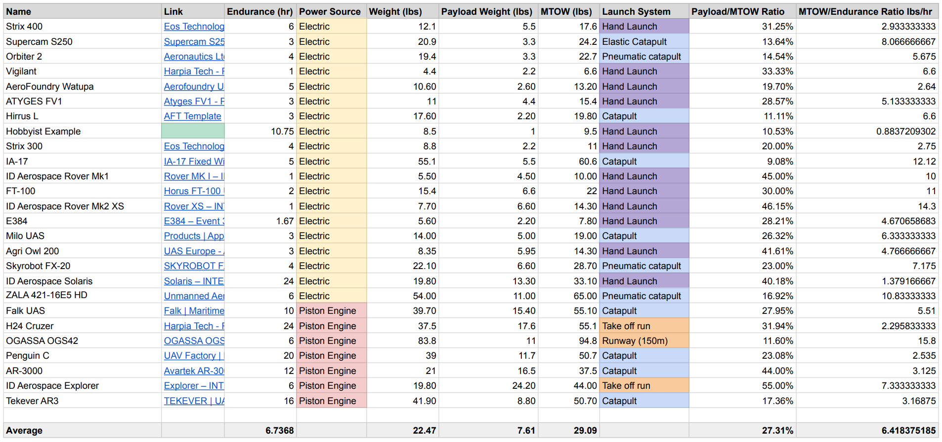
Other Marketed Solutions
Appendix Slide

Slide 64
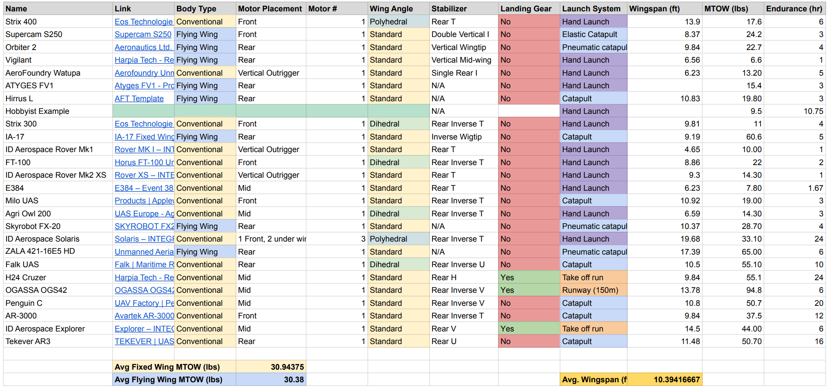
Other Marketed Solutions
Appendix Slide

Slide 65
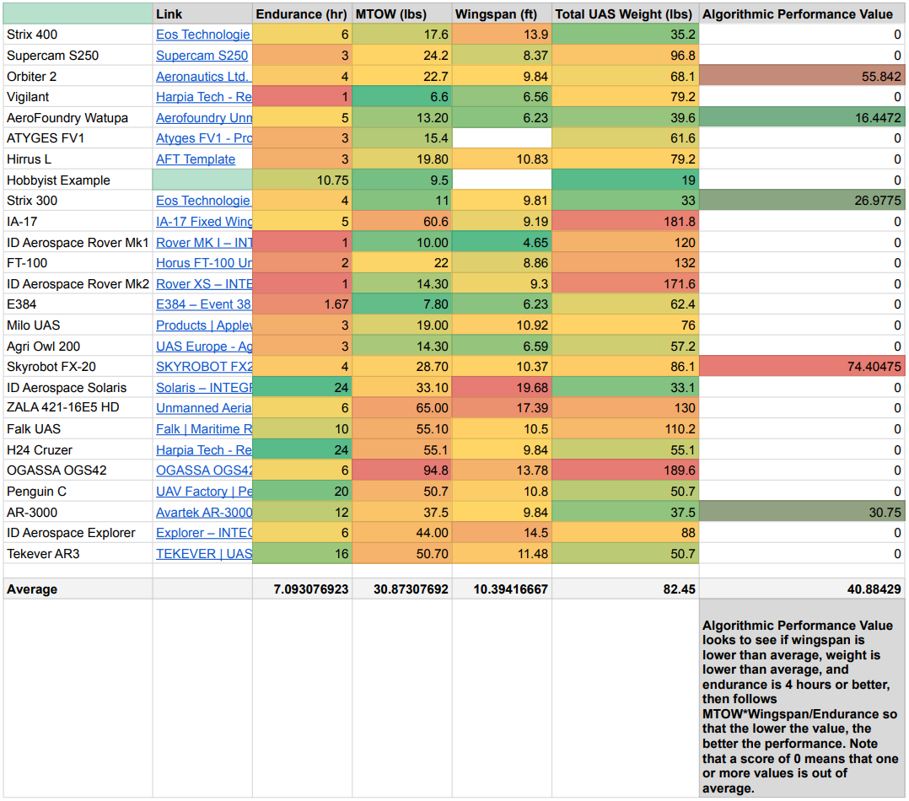
Other Marketed Solutions
Appendix Slide

Slide 66
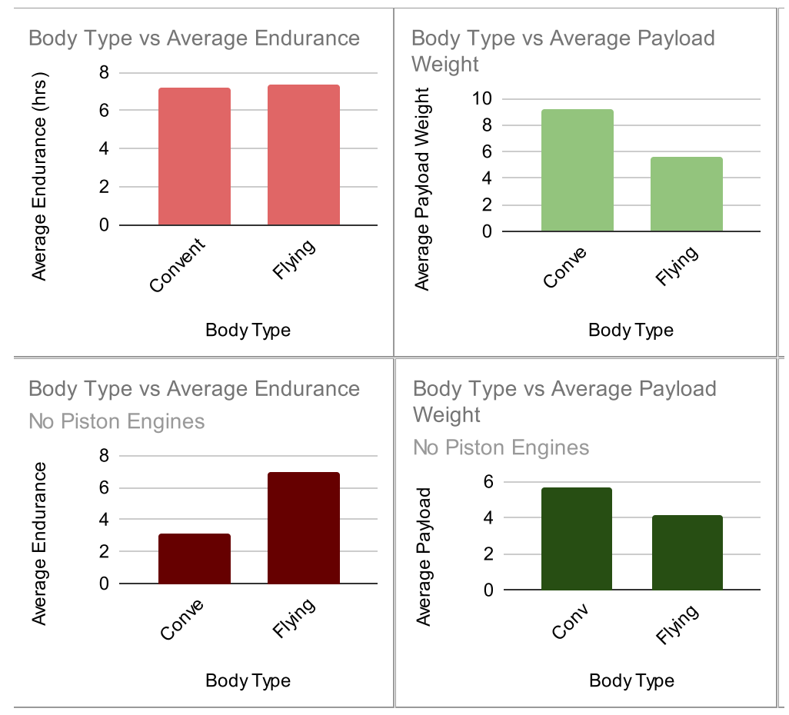
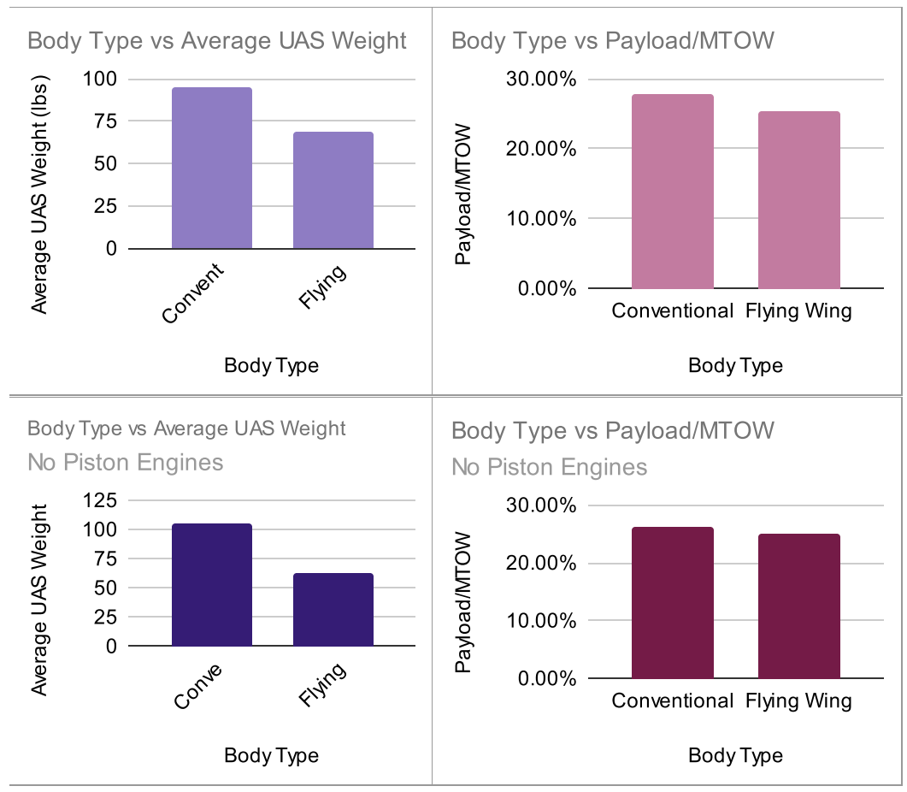
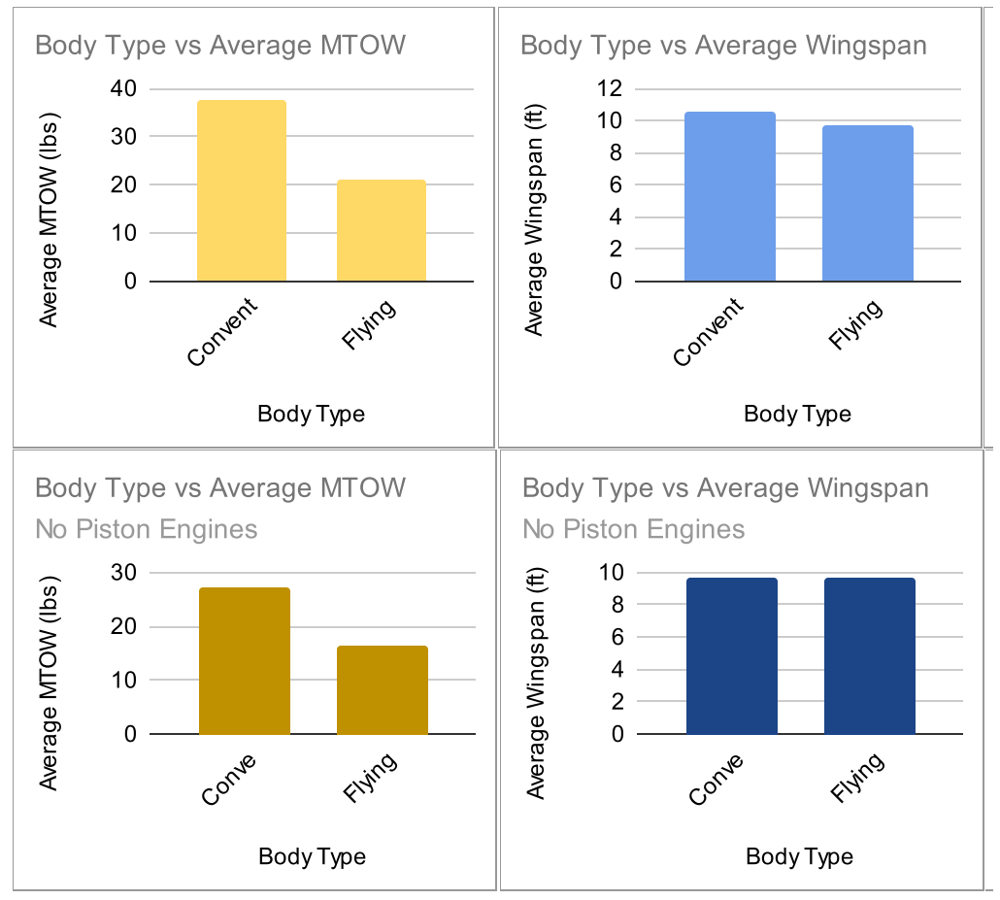
Other Marketed Solutions: Weight Comparisons
Appendix Slide

Slide 67
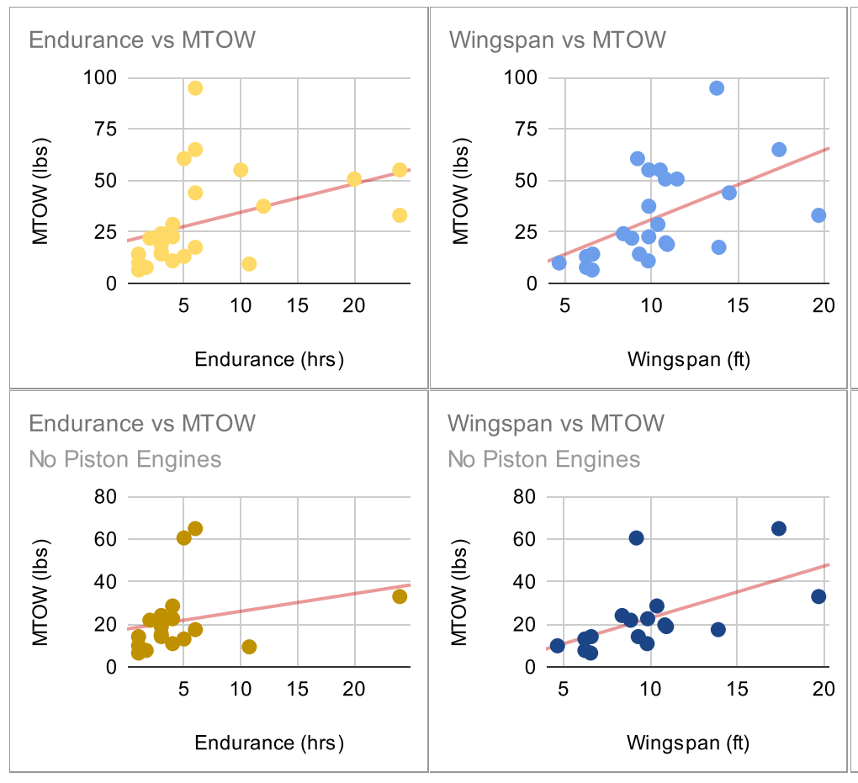
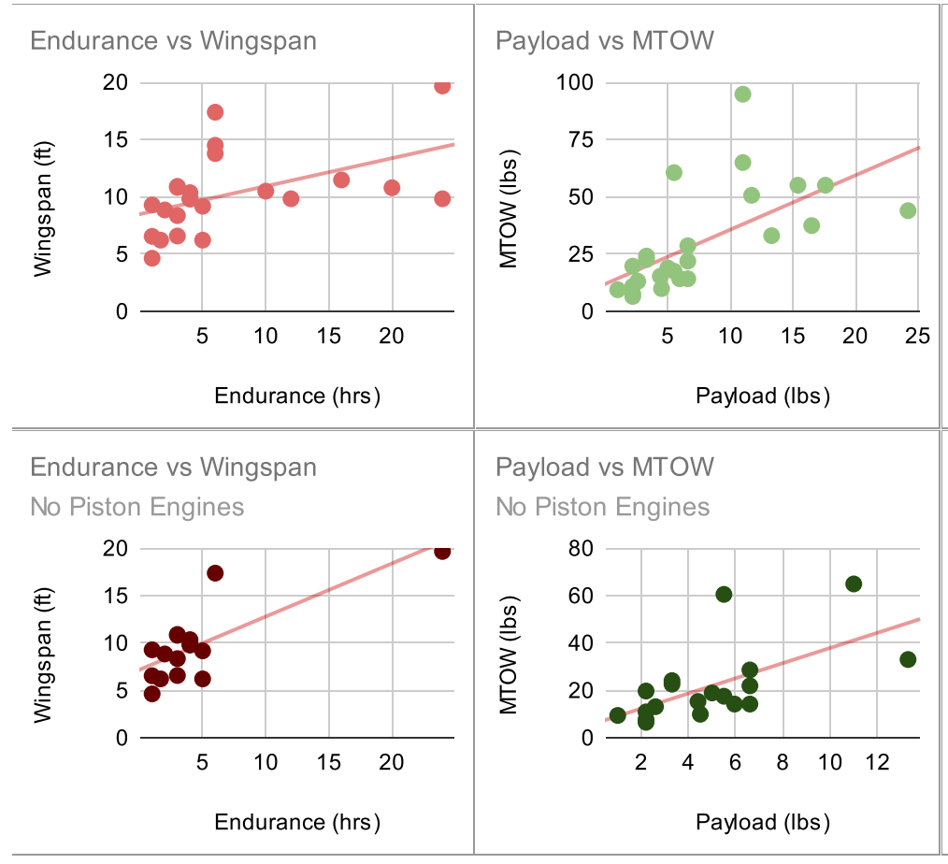
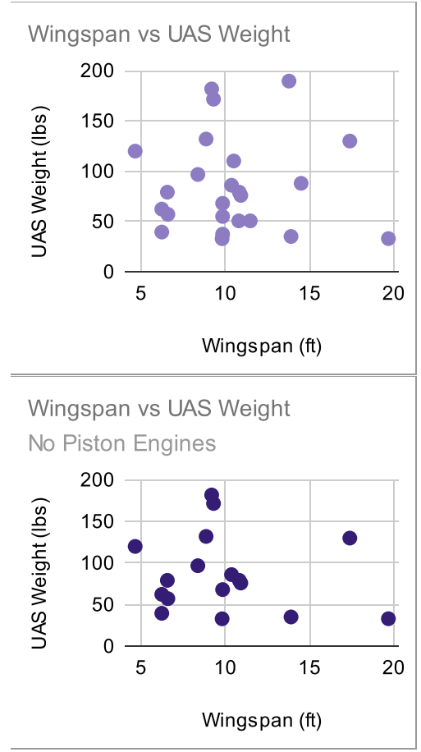
Other Marketed Solutions: Wingspan vs MTOW
Appendix Slide

Slide 68
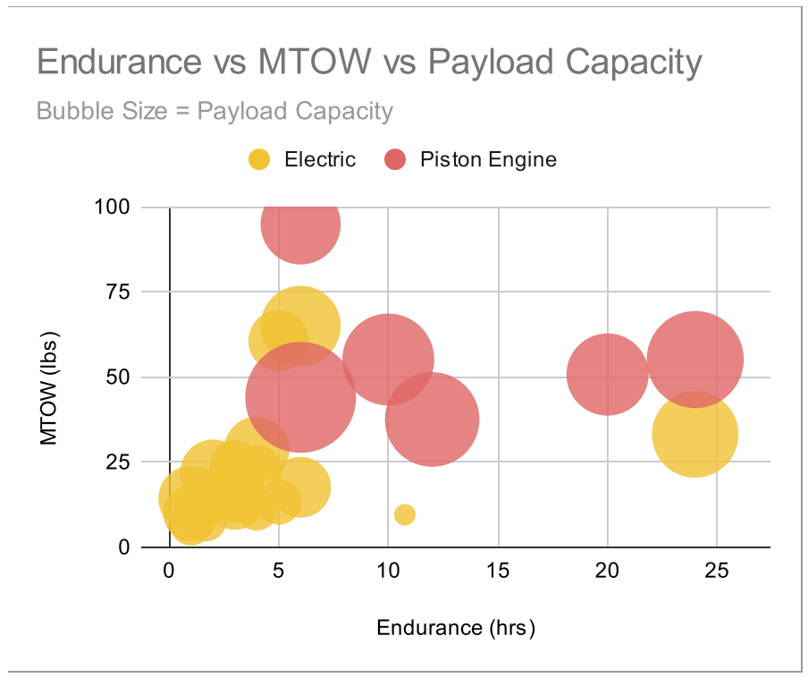
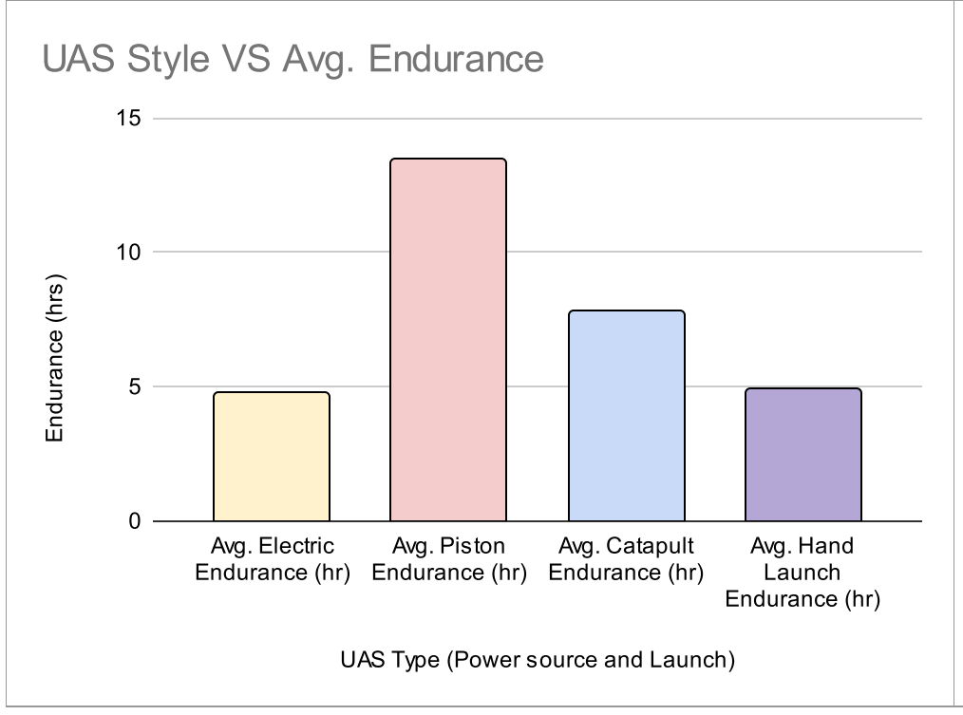
Other Marketed Solutions: Endurance Comparisons
Appendix Slide

Slide 69
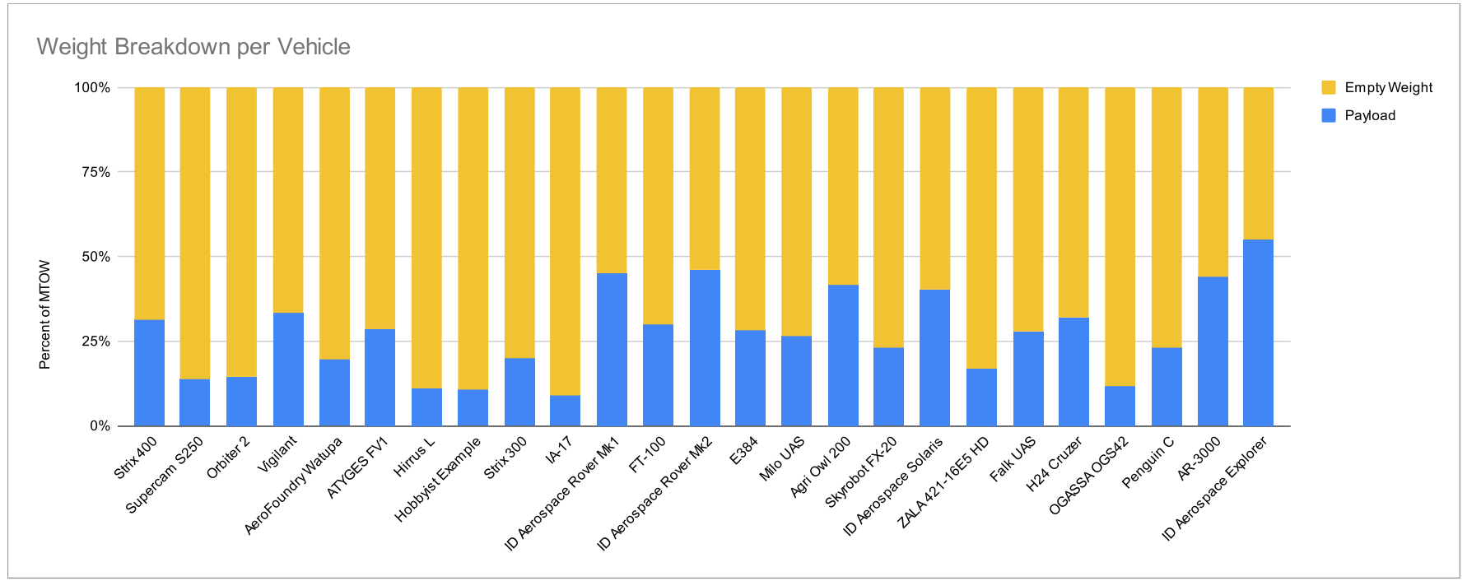
26_JAN_2017_Florida_Keys_5R_4G_3Bxxxxxxxxxxxxxxxxxxxxxxxxxxxxxxxxxxxxxxxxxxxxxxxxxxxxxxxxxxxxxxxxxxxxxxxxxxxxxxxxxxxxxxxxxxxxxxxxxxxxxx
Other Marketed Solutions: Weight vs Payload
Appendix Slide

Slide 70
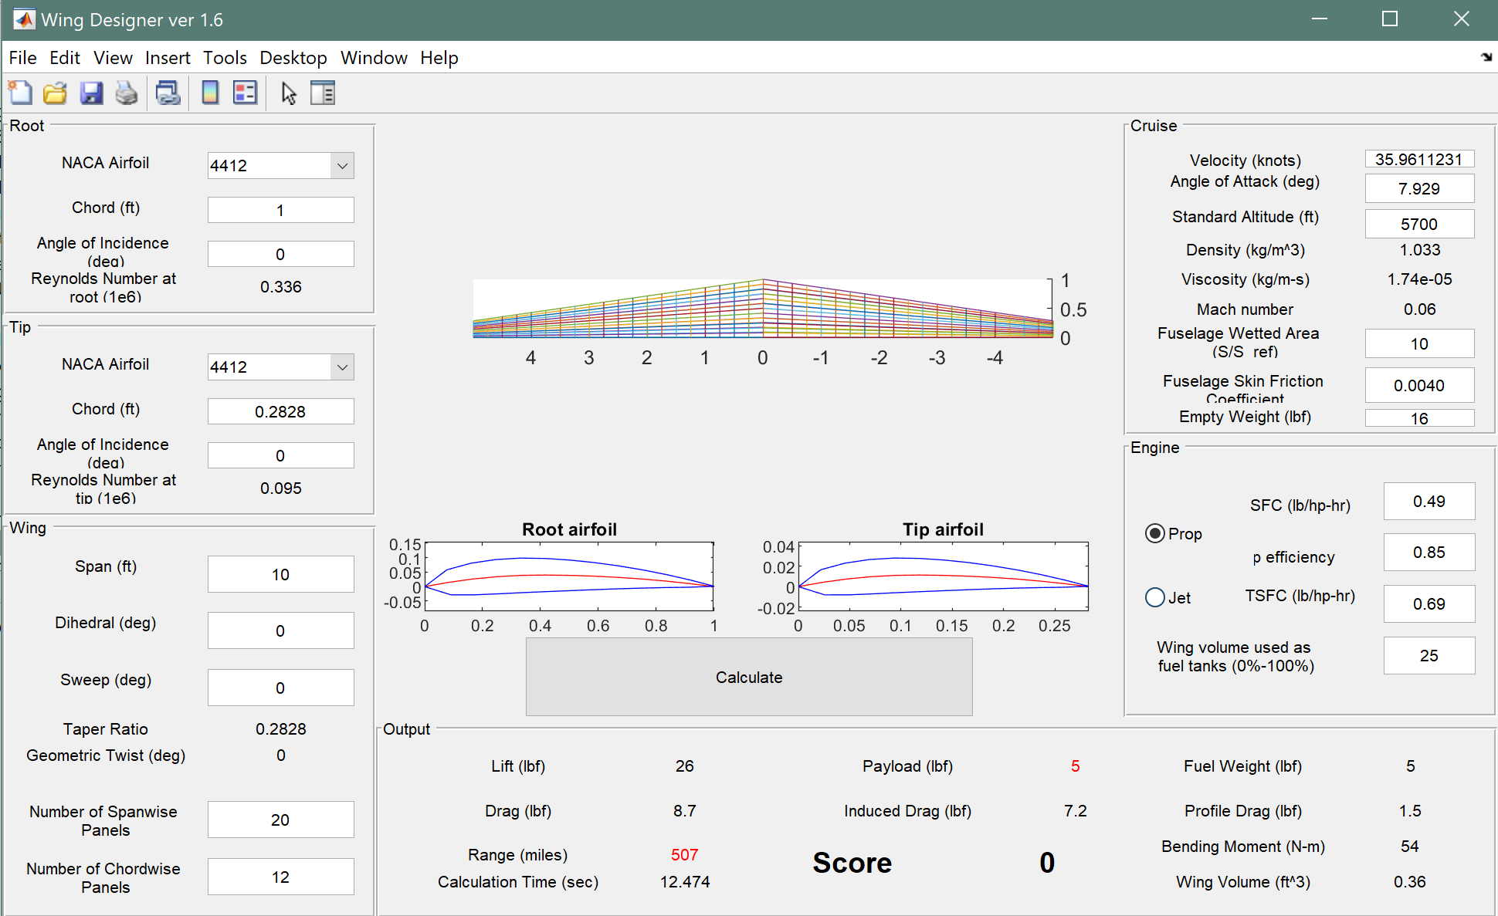
NACA 4412 Data
Appendix Slide
Confirmation:
Matlab Wing
Designer
ver 1.6
written by
Phillip J. Root and
John R. Rogers
Span | 10ft
AR | 15.59
Chord | 12in
Taper | 0.283
Airfoil | NACA 4412
Cl | 1.118
Cd | 0.063
AoA | 7.989°

Slide 71
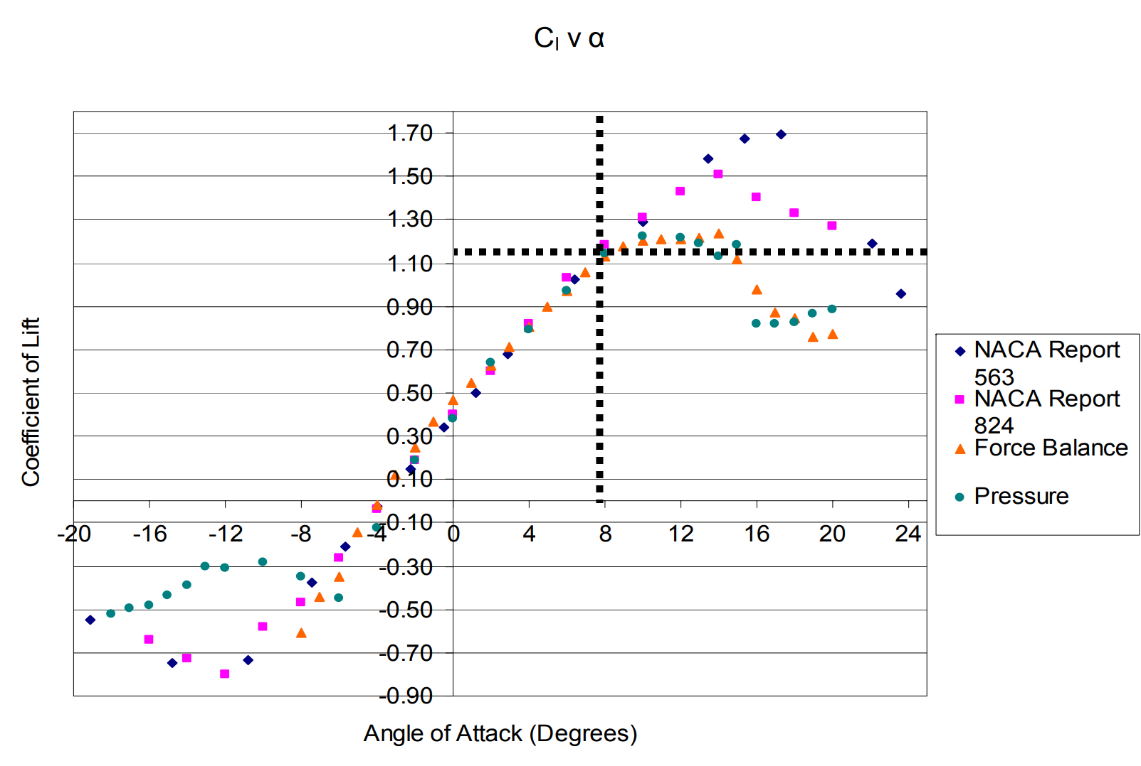
NACA 4412 Data
Appendix Slide
Confirmation:
Baylor-
NACA 4412
Wind Tunnel
Span | 10ft
AR | 15.59
Chord | 12in
Taper | 0.283
Airfoil | NACA 4412
Cl | 1.118
Cd | 0.063
AoA | 7.989°

Slide 72
NACA 4412 Data
Appendix Slide
Validation:
Matlab Wing Design code (Phillip J. Root and John R. Rogers)
Baylor NACA 4412 Wind Tunnel Studies
Ansys Fluent CFD
Span | 10ft
AR | 15.59
Chord | 12in
Taper | 0.283
Airfoil | NACA 4412
Cl | 1.118
Cd | 0.063
AoA | 7.989°

Slide 73
NACA 4412 Data
Appendix Slide
Confirmation: CFD - Computational Fluid Dynamics
Ansys Fluent
Cl = 1.1553
Cd = 0.0227
Span | 10ft
AR | 15.59
Chord | 12in
Taper | 0.283
Airfoil | NACA 4412
Cl | 1.118
Cd | 0.063
AoA | 7.989°

Slide 74
Aerodynamics and Wing Design: Wing Specifications
Appendix Slide
Parameter: | Specification:
Span | 10ft
AR | 15.59
Chord | 12in
Taper | 0.283
Airfoil | NACA 4412
Cl | 1.118
Cd | 0.063
AoA | 7.989°
Notes:
Explain what Wing Designer 1.6 means and what where we found it!

Slide 75
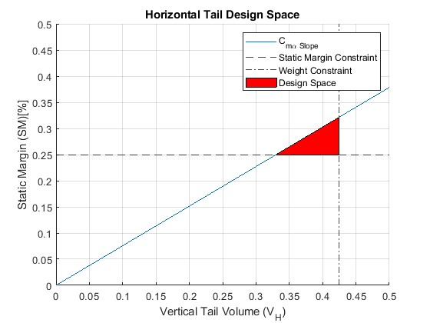
Aircraft Dynamics
Appendix Slide
Pitch Stiffness
Range of Values
Static Margin: 0.25 - 0.32 %
Horizontal Tail Volume: 0.33 - 0.42 ft³
Horizontal Weight: 0.58 - 0.75 lbs
Horizontal Surface Area: 0.71 - 0.91 ft²
Horizontal Span: 1.41 - 1.81 ft
Notes:
Assumptions:
Alpha aw is small
z/c is negligible compared to vehicle scope
Alpha wb-epsilon is small
Zt is negligible
Mac,t is negligible
Mp is negligible
Lt = 3 ft
W tail = 1lb
Partial Epsion wrt alpha = 0.35
Rho = 9.919
Horz tail cord = .5
Thickness = 1 inch

Slide 76
Aircraft Dynamics
Appendix Slide
Yaw Stiffness
Range of Values
Static Margin: 0.25 - 0.32 %
Vertical Tail Volume: 0.02 - 0.01 ft³
Vertical Weight: 0.42 - 0.25 lbs
Vertical Surface Area: 0.5 - 0.3 ft²
Vertical Span: 1.01 - 0.60 ft

Slide 77
26_JAN_2017_Florida_Keys_5R_4G_3Bxxxxxxxxxxxxxxxxxxxxxxxxxxxxxxxxxxxxxxxxxxxxxxxxxxxxxxxxxxxxxxxxxxxxxxxxxxxxxxxxxxxxxxxxxxxxxxxxxxxxxx
Appendix Slide
Sources
[1] Traub, Lance W., et al. “Range and Endurance Estimates for Battery-Powered Aircraft.” Journal of Aircraft, 22 May 2012, https://arc.aiaa.org/doi/10.2514/1.C031027.
[2] Anderson, J. D., & Bowden, M. L. (2022). Introduction to flight. McGraw-Hill.
[3] PROPDRIVE v2 5050 580KV Brushless Outrunner Motor. (n.d.). Retrieved October 8, 2021, from https://hobbyking.com/en_us/propdrive-v2-5050-580kv-brushless-outrunner-motor.html#qa[bW9kZT03JnBhZ2U9MSZxdWVzdGlvbl9zZWFyY2hfY29udGVudD0=].
[4] Performance data. APC Propellers. (2021, March 9). Retrieved October 8, 2021, from https://www.apcprop.com/technical-information/performance-data/
[5] T.H.G. Megson, in Aircraft Structures for Engineering Students (Sixth Edition), 2017
[6] W. C. Young, Roark’s Formulas for Stress & Strain, McGraw-Hill, 6th ed., 1989, p. 34.
[7] S. P. Timoshenko and J. N. Goodier, Theory of Elasticity, 3rd ed., McGraw-Hill, New York, 1969, Sec 109.

