Slide 1
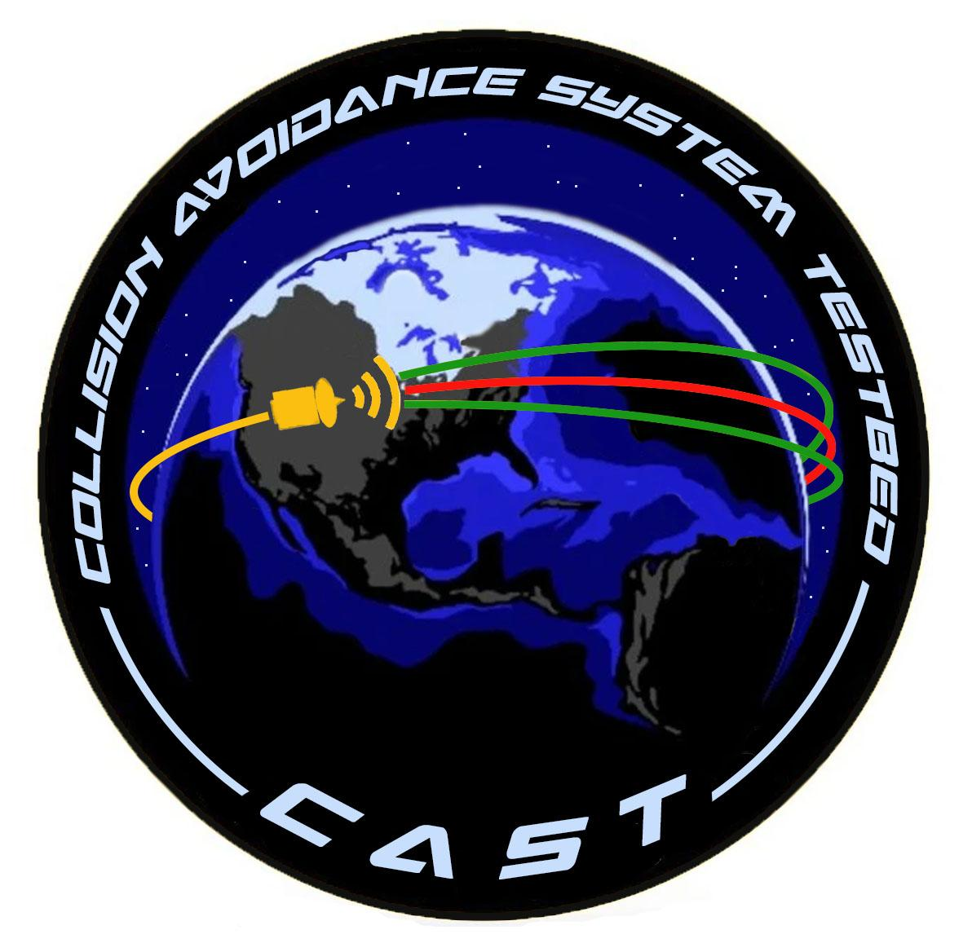
Collision Avoidance System Testbed
Critical Design Review
Customer: John Reed and United Launch Alliance
Team members: Trace Valade, Adam Holdridge, Angel Hoffman, Cameron Turman, Conner Martin, Griffin Van Anne, Hugo Stetz, Isaac Goldner, Jason Balke, Reade Warner, Roland Bailey, Sam Hartman
Advisor: Prof. John Mah

Slide 2
Presentation Outline
Project Overview
Design Solution
Critical Project Elements
Requirements and their Satisfaction
Risk Analysis
Verification and Validation
Project Summary and Planning

Slide 3
Project Overview

Slide 4
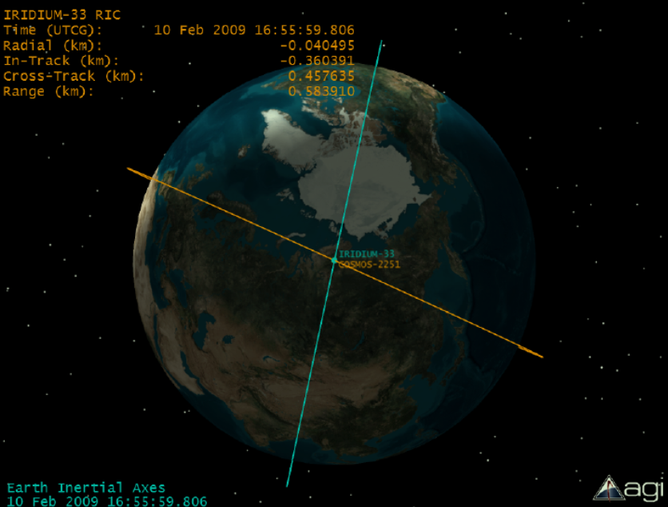
Project Motivation
Space is cluttered. At orbital velocities, any colliding object may pose a mission ending threat to spacecraft.
Typical ground station debris tracking allows errors up to tens of kilometers
If incoming object is detected at the last minute, need to decide between ending the mission, or making a reaction maneuver
Credit: CelesTrak
Notes:
Reade

Slide 5
Updates from PDR
Not feasible to scale down relative orbital motion to physically representable scales
Time frame
Available resources
Previously, we have shown near rectilinear motion in plane of collision
Feasible to create control law, state estimator, and collision detection algorithm for unscaled, rectilinear motion
Feasible for reaction maneuver to match acceleration profile of thruster
Notes:
Value added - although not scaled from orbital scenario (besides acceleration profile) we are able to verify the control law in a physical implementation

Slide 6
Project Objectives
Implement physical 2D demonstration that implements a detect and react algorithm
Detect foreign incoming object in detection space of testing environment
Perform state estimation and motion prediction of foreign object
Develop control law that determines reaction maneuver in relative frame while mimicking thruster motion
Prove control law against various collision scenarios

Slide 7
Collision Scenario Varieties
Test cases involve changing aspects of the incoming object’s trajectory:
Incoming object
Spacecraft
2σ prediction
Collision Angle
Increased Speed of Incoming Object
Near-miss Situation

Slide 8
Functional Requirements
The test system shall consist of a physical testbed capable of creating relative motion between two objects
The test system shall be capable of detecting a live, incoming object
The test system shall be capable of determining if a collision will occur
The test system shall be capable of avoiding a physical collision using motion characteristic of a thruster response in orbit

Slide 9
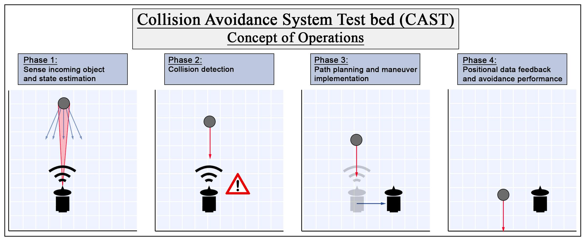
CONOPs

Slide 10
CONOPs

Slide 11
CONOPs
Notes:
Phase 2 Collision determination
Phase 1 Sense incoming object, collision detection and state estimation

Slide 12
CONOPs

Slide 13
CONOPs

Slide 14
Design Solution

Slide 15
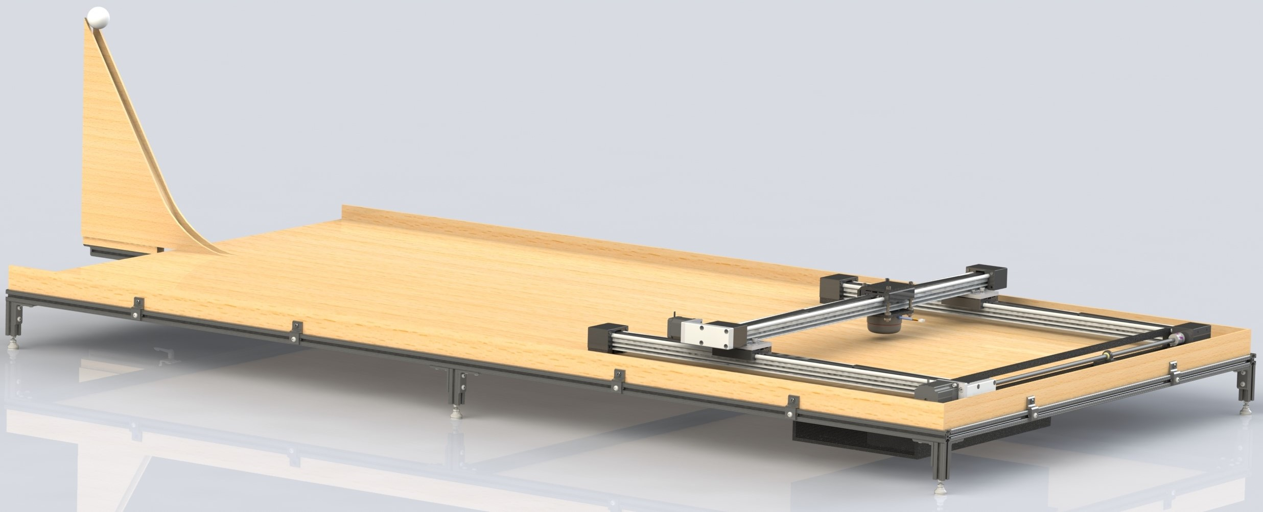
Design Overviews
Launch Ramp
4’x8’ Test Area
IGUS Gantry
LIDAR Sensor
X
Y
Electronics

Slide 16
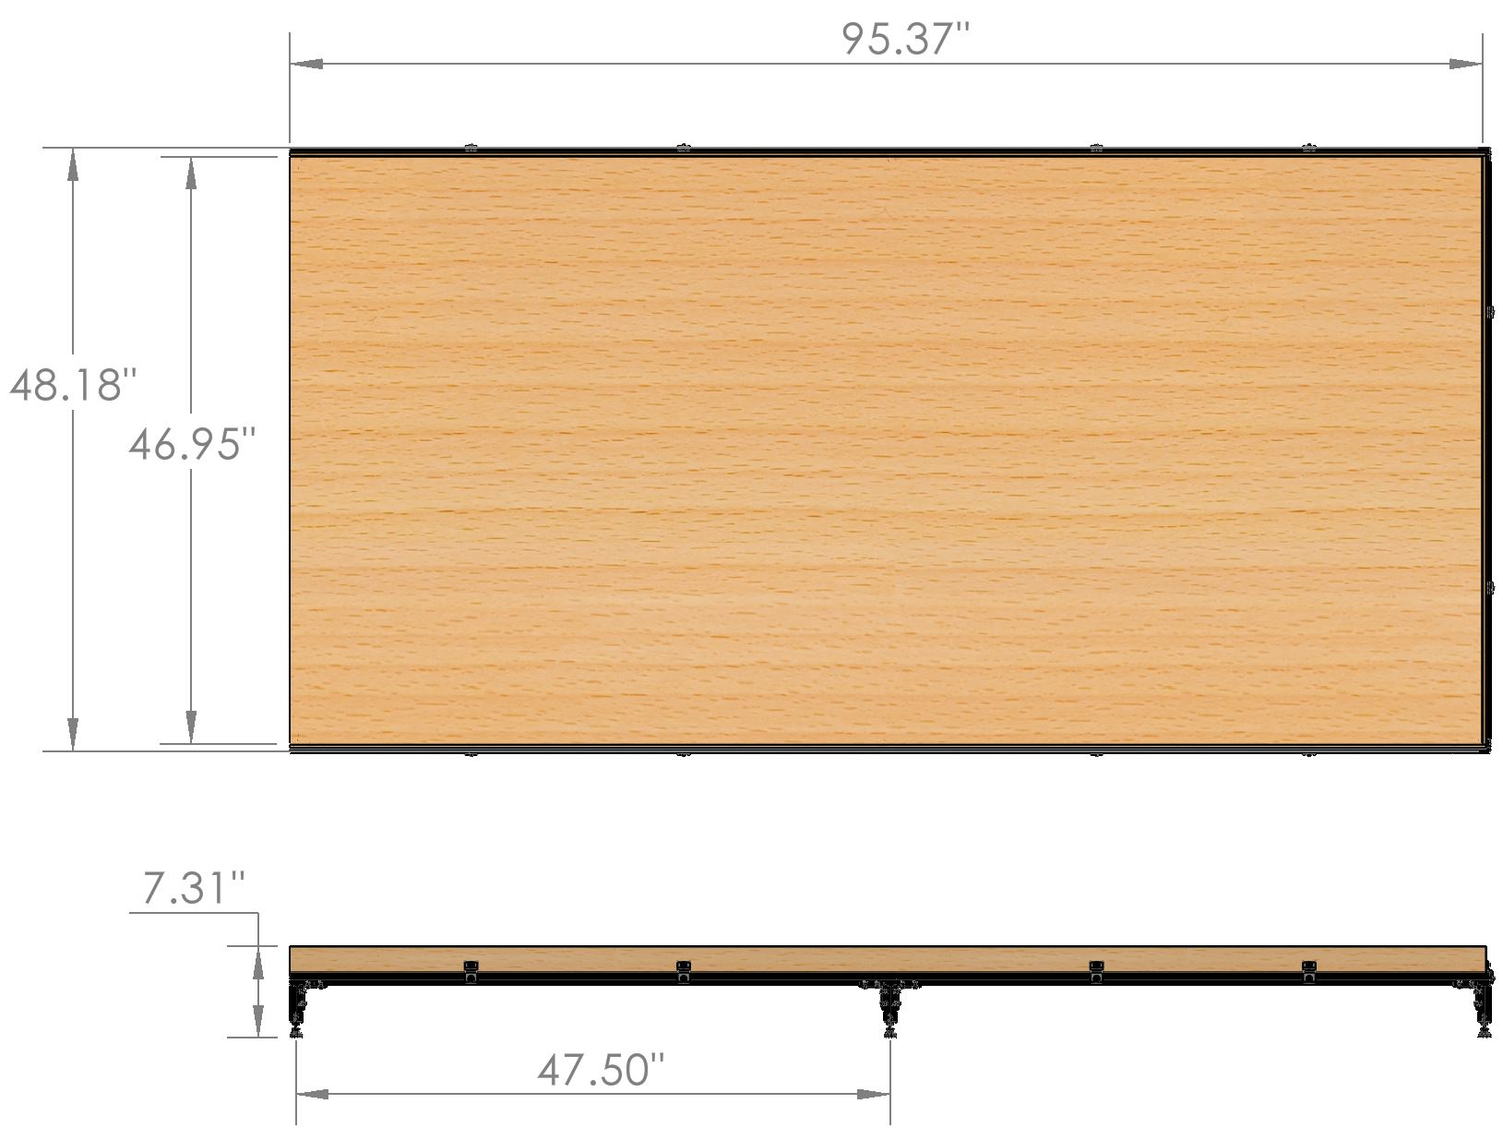
Testing Environment Design
4x8 foot testing environment
MDF FOS > 100
Frame
80/20 aluminum frame
Aluminum L-brackets

Slide 17
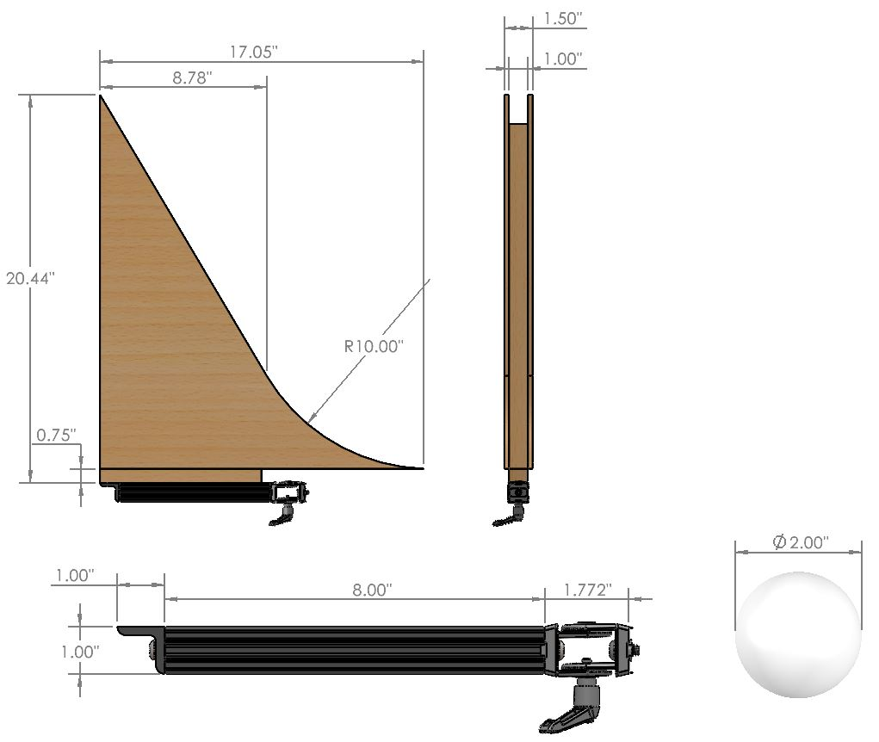
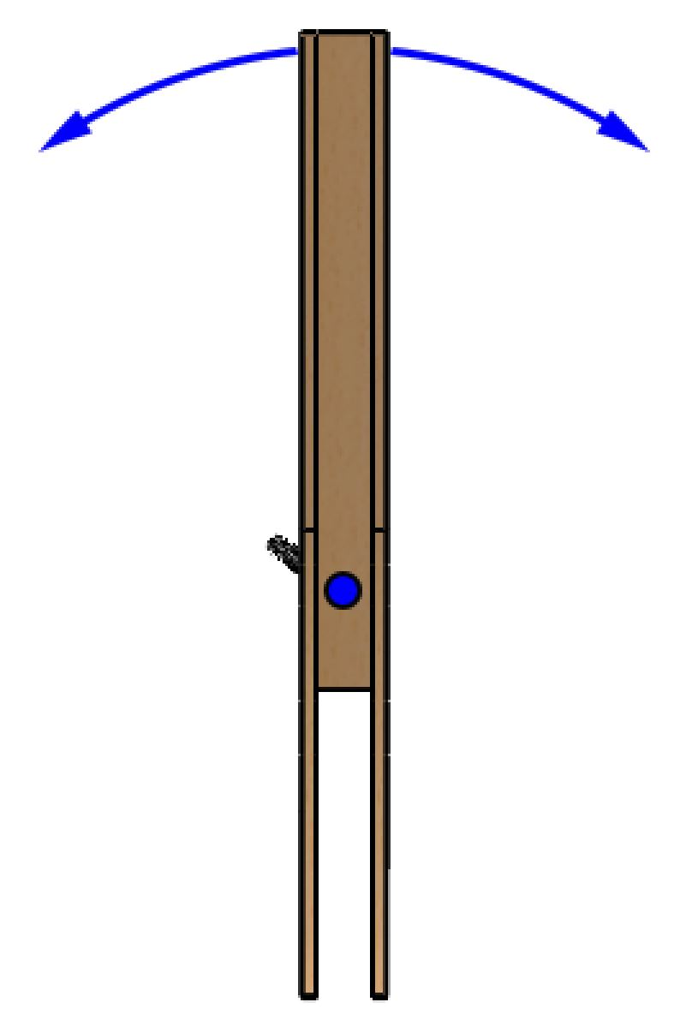
Launching Mechanism Design
Supports 0 - 2 m/s launch
Rubber ball
Size limited by gantry height
Pivot Joint
+/- 60° rotation
Incremental starting positions to vary velocity
0° - 40° Launch Angle
Top View

Slide 18
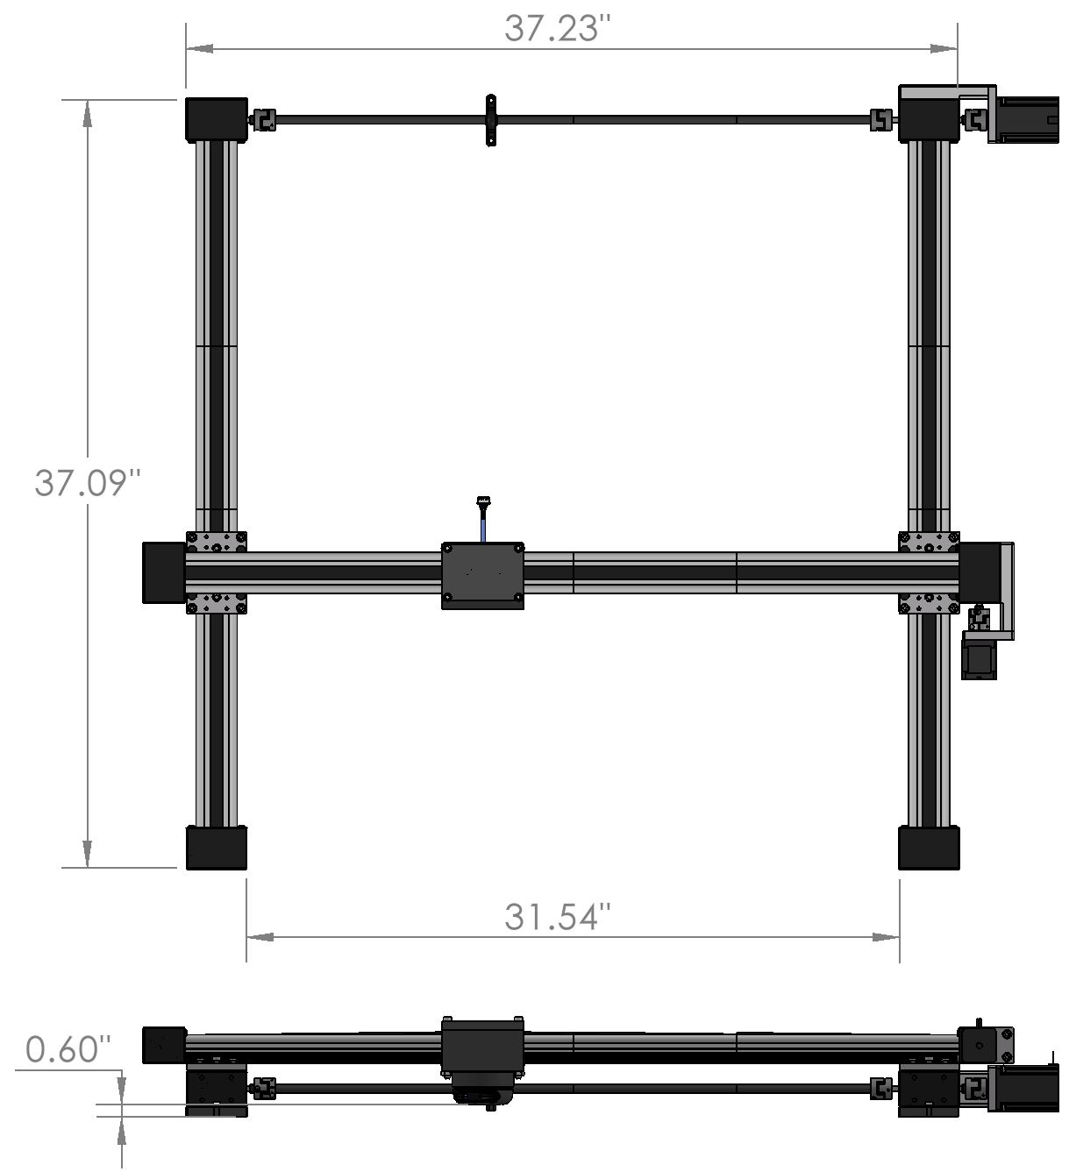
Maneuvering Subsystem Design
Drylin E flat gantry
Workspace: 1x1m
Belt driven linear actuator
2x NEMA23 stepper motors
Top speed 0.5 m/s
Top acceleration 0.538 m/s/s
Mounting bracket
Maneuvering accuracy requirement driven by ability to model acceleration profile with <5% error
X
Y
Notes:
System has been designed by IGUS to meet all acceleration, velocity, and accuracy requirements - Do not think we need to spend more time discussing this. We have proof in backup

Slide 19
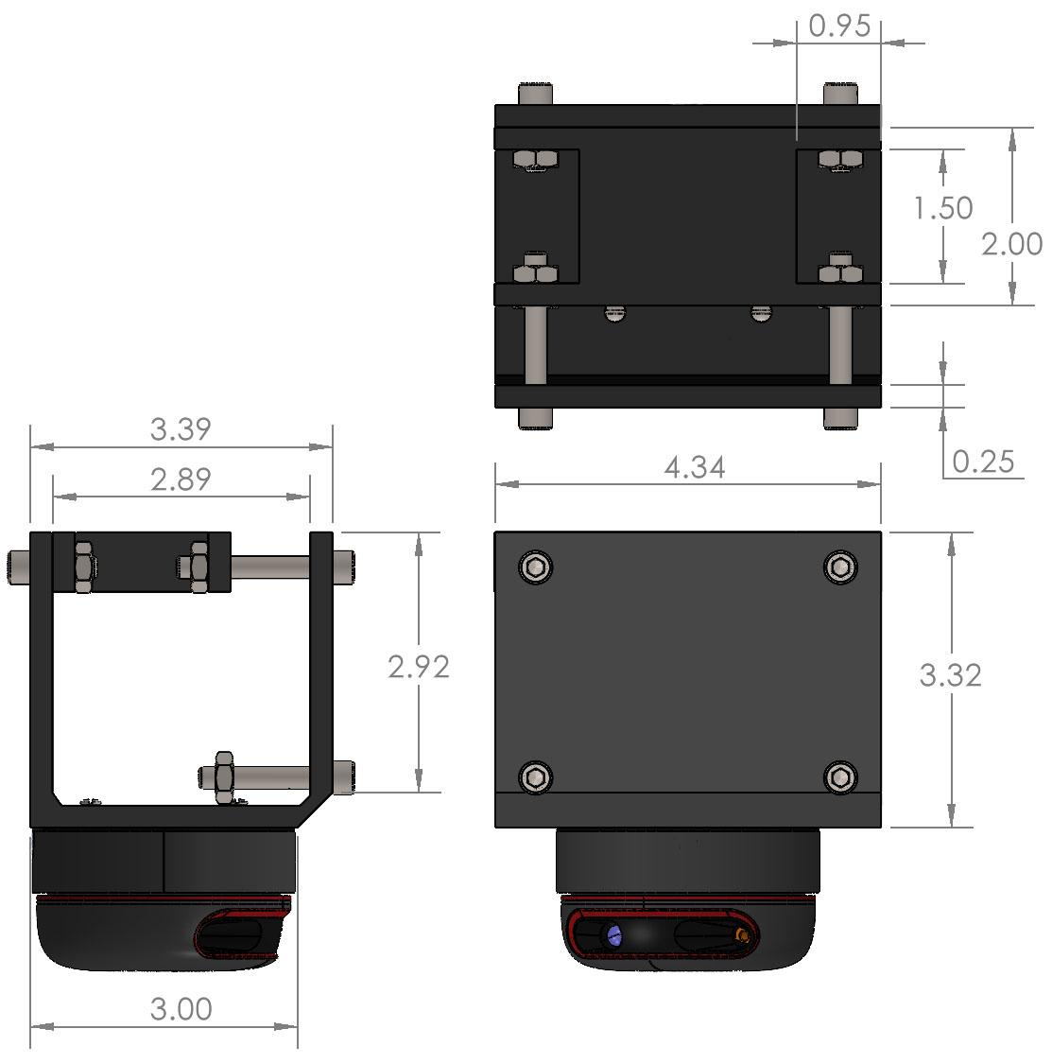
Sensing Subsystem Design
RPLIDAR A2M8 360° Laser Range Scanner
Sample Rate: 2 - 8 kHz
Scan Rate: 5 - 15 Hz
Distance Range: 0.15 - 12m
Angular Resolution 0.45° - 1.35°
Distance Resolution: <1.0% distance
Range/bearing measurements

Slide 20
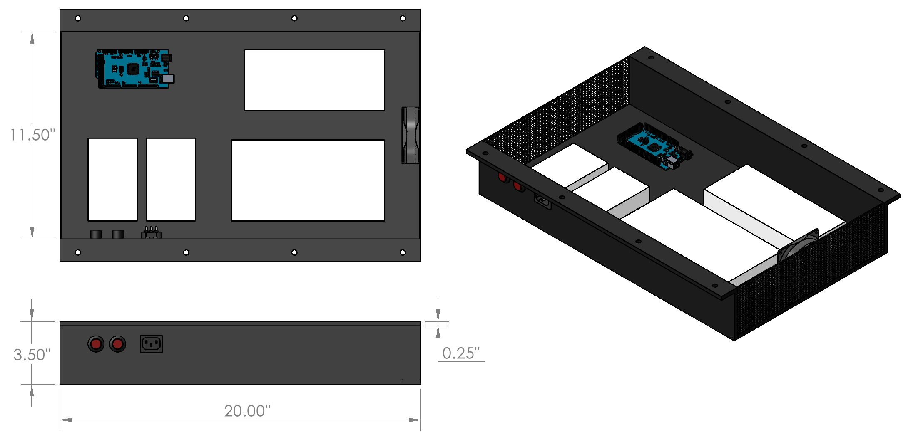
Electronic Component Housing
2 power supplies
400W and 100W
Include kill switches
2 closed loop stepper drivers
Arduino Mega 2560
120V AC power receptacle
12V fan for heat dissipation
100W
400W
Stepper Drivers

Slide 21
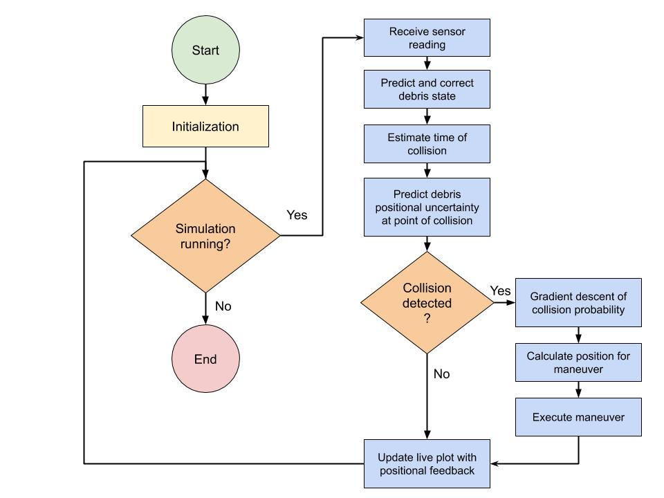
Software Flowchart

Slide 22
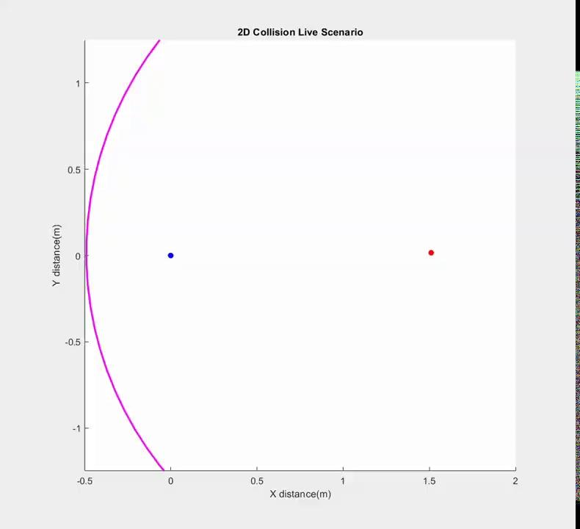
Simulation

Slide 23
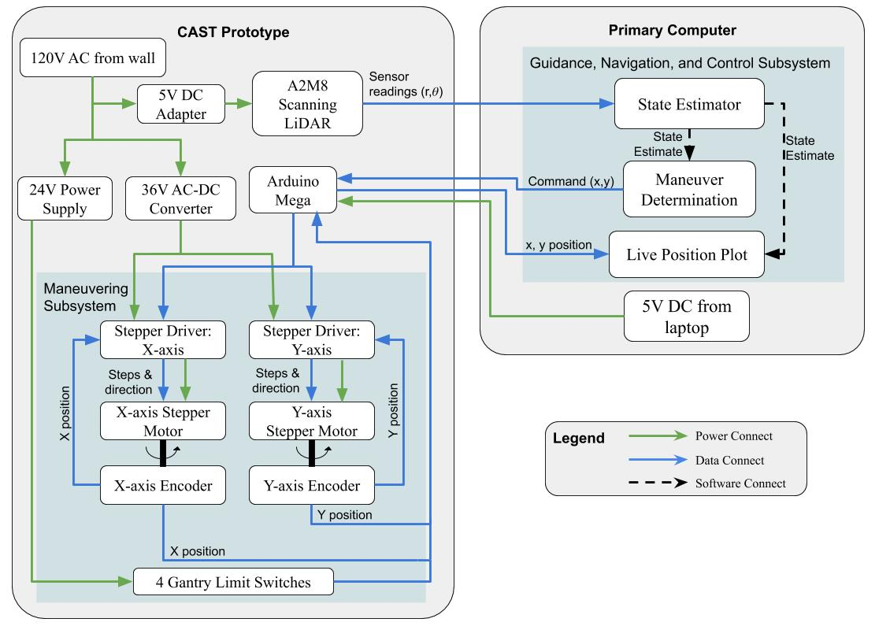
Functional Block Diagram

Slide 24
Critical Project Elements

Slide 25
Critical Project Elements
CPE | Reasoning
State Estimation | A state estimator must be implemented to process raw sensor data. This processed state is used in forward propagation to estimate collision probability.
Control Algorithm | A working control algorithm is necessary to produce a maneuver which ensures successful avoidance.
Maneuver Planning | Without proper acceleration profiling, the avoidance maneuver will not be representative of spacecraft motion.
Electronics | The electrical components are essential for the communication of sensor data as well as maneuvering commands.
Sensing | Appropriate sensing of an incoming object is an essential step in detecting potential collisions and confirming successful avoidance.
Mechanical | A mechanical system must provide an environment to test the state estimation, control algorithm, and physical maneuvering.
Notes:
Sensing - involved choosing a sensor that would meet accuracy requirements for state estimation
Mechanical - Gantry robot provided and validated by IGUS which means it is not as important to talk about here

Slide 26
Requirements and their Satisfaction

Slide 27
Requirements Flowdown
Functional Requirement | Design Requirement
FR3 The test system shall be capable of detecting an incoming object | State estimation from sensor readings
 | Collision probability from state estimation
FR4 The test system shall be capable of avoiding a collision using motion characteristic of a thruster response in orbit | Receiving and acting upon maneuvering commands based on received sensor data
 | Sufficient force generation to avoid a collision with the covariance ellipse of the incoming object state estimation
 | Maneuver with less than 5% deviation in acceleration from a scaled orbital response acceleration curve
Notes:
These two FR address the identified CPE’s

Slide 28
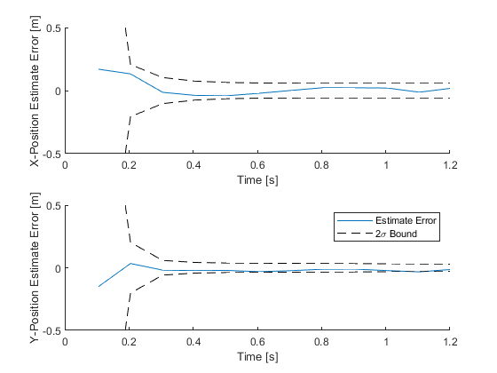
State Estimation: Kalman Filter
Optimal estimator for gaussian process noise
Allows for “online” prediction
Linearized measurements
Estimation error driven to within 60mm (slightly larger than incoming object)
Requirement | Satisfaction
DR 3.1: The test system avoidance algorithm shall be capable of estimating the state of an incoming object from sensor data, with state estimation error less than the 2σ estimate bound | Estimation error proven to be within 2σ estimation bound
For 1m/s, angled collision scenario
Notes:
-Kalman filter proven to be optimal estimator for discrete time systems with additive white gaussian noise
-Only need to keep one measurement and then toss it out (want our system to be very fast and don’t need to invert large matrices)
-Our sensor is range bearing and we need to convert to x and y position. This is done before feeding into filter. We are debiasing the converted measurement based on state prediction
-Final estimation error gets down to 60mm
-Satisfaction: proven we can get a good enough idea of where the object is

Slide 29
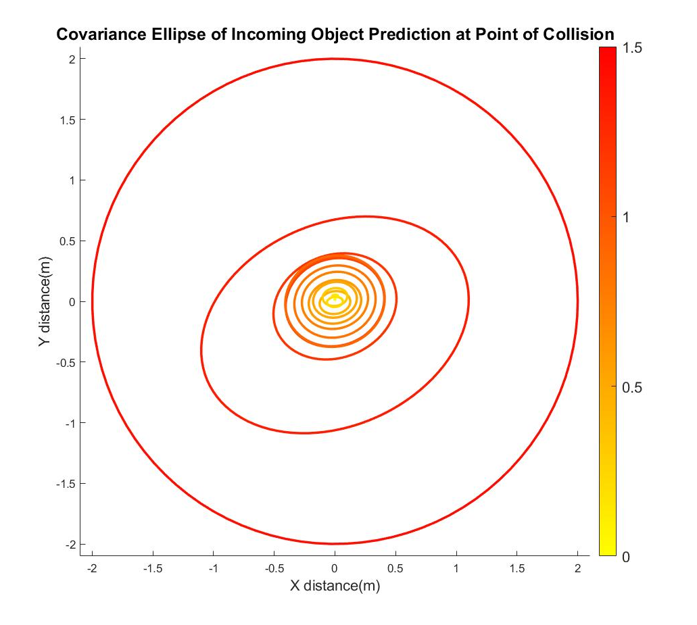
State Estimation: Forward Propagation
Minimum covariance radius driven to 366mm with 1.2s to collision
With 25ms for calculation delay, this allows 1.175s to maneuver
Maneuver will allow us 371mm of travel. Putting us outside the 2σ bound
Time Until Collision(s)
Requirement | Satisfaction
DR 2.6: The detection sensor sampling rate shall be high enough to drive the 2 sigma covariance ellipse into an avoidable region. | A2M8 sensor provides sufficient information to drive 2σ to avoidable region
Notes:
-The covariance on the plot is 95% confident that the object will be there at the time of collision
-Satisfaction: more measurements we have, the tighter the covariance

Slide 30
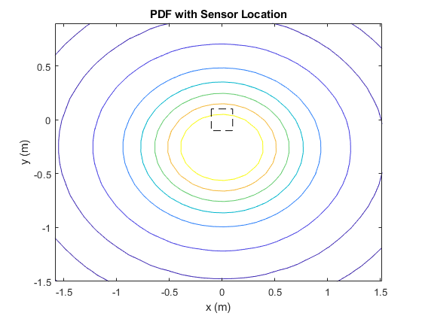
Control Algorithm: Collision Threshold Probability
Integrating the probability density function (PDF) over the area of the sensor mount gives the collision probability
Probability threshold ensures gantry does not maneuver too soon
Probability threshold set at 25%
Current thrust available: Gantry acceleration corresponds to roughly 275 N for a 500 kg satellite
Requirement | Satisfaction
DR 3.2: The test system avoidance algorithm shall be capable of predicting collision probability from state estimation data | Probability threshold is set to a level which allows the spacecraft to maneuver with sufficient time to avoid debris

Slide 31
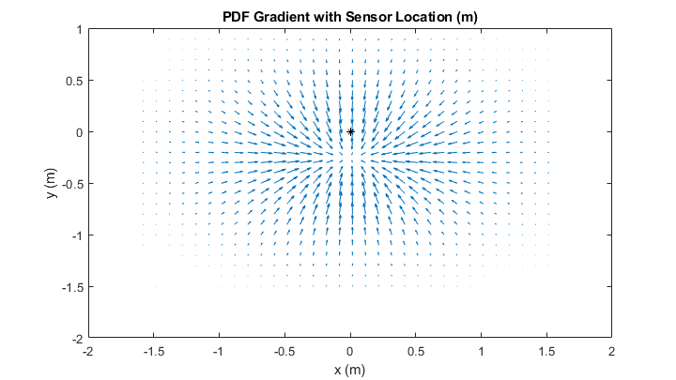
Control Algorithm: Direction Determination
The gradient of the PDF at the gantries location gives the direction towards highest collision probability
Move opposite of this direction to decrease probability of collision
Lookup table for maneuvering directions
Requirement | Satisfaction
DR 4.2: The test system shall generate sufficient force to avoid a collision with the covariance ellipse of the incoming object state estimation for a subset of the possible relative velocities (0m/s to 2m/s) | Gradient descent gives fastest decrease in collision probability. Maneuver in calculated direction until outside 2σ collision covariance.
Notes:
Talk about lookup table
From lookup table, maneuver commanded to stepper motors

Slide 32
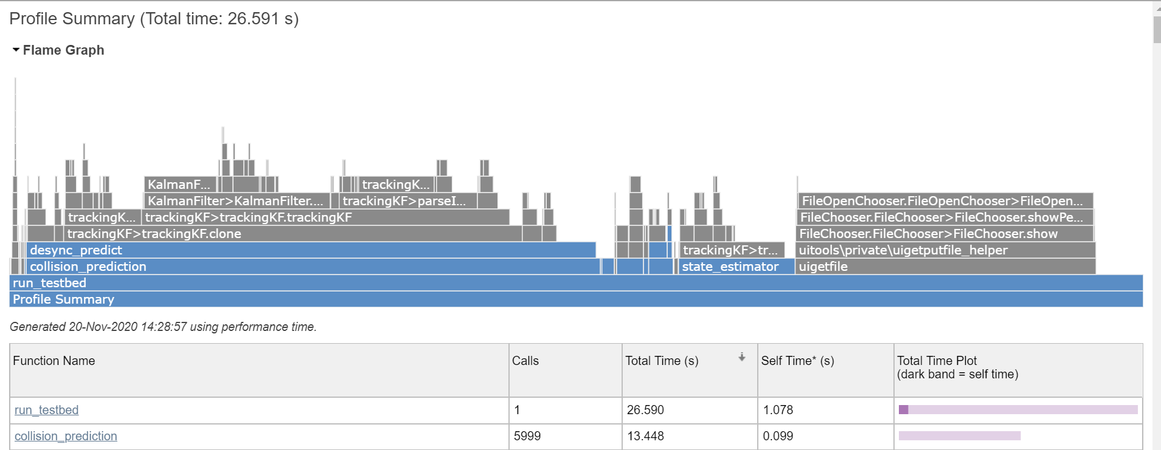
Control Algorithm: Update Rate
Nyquist sampling theorem states that the controller should be sampled at least twice as fast as the process time constant, we will use 10x as fast for safety.
Process time constant estimated via maximum distance and velocity: 6.3ms.
Loop runtime is dominated by filter propagation: 2.2ms per loop. 4.1ms margin.
IMAGE
Requirement | Satisfaction
DR 4.1: The test system shall be capable of receiving and acting upon maneuvering commands based on received sensor data as an object is incoming (a live scenario) | Empirical timing measurements during development.

Slide 33
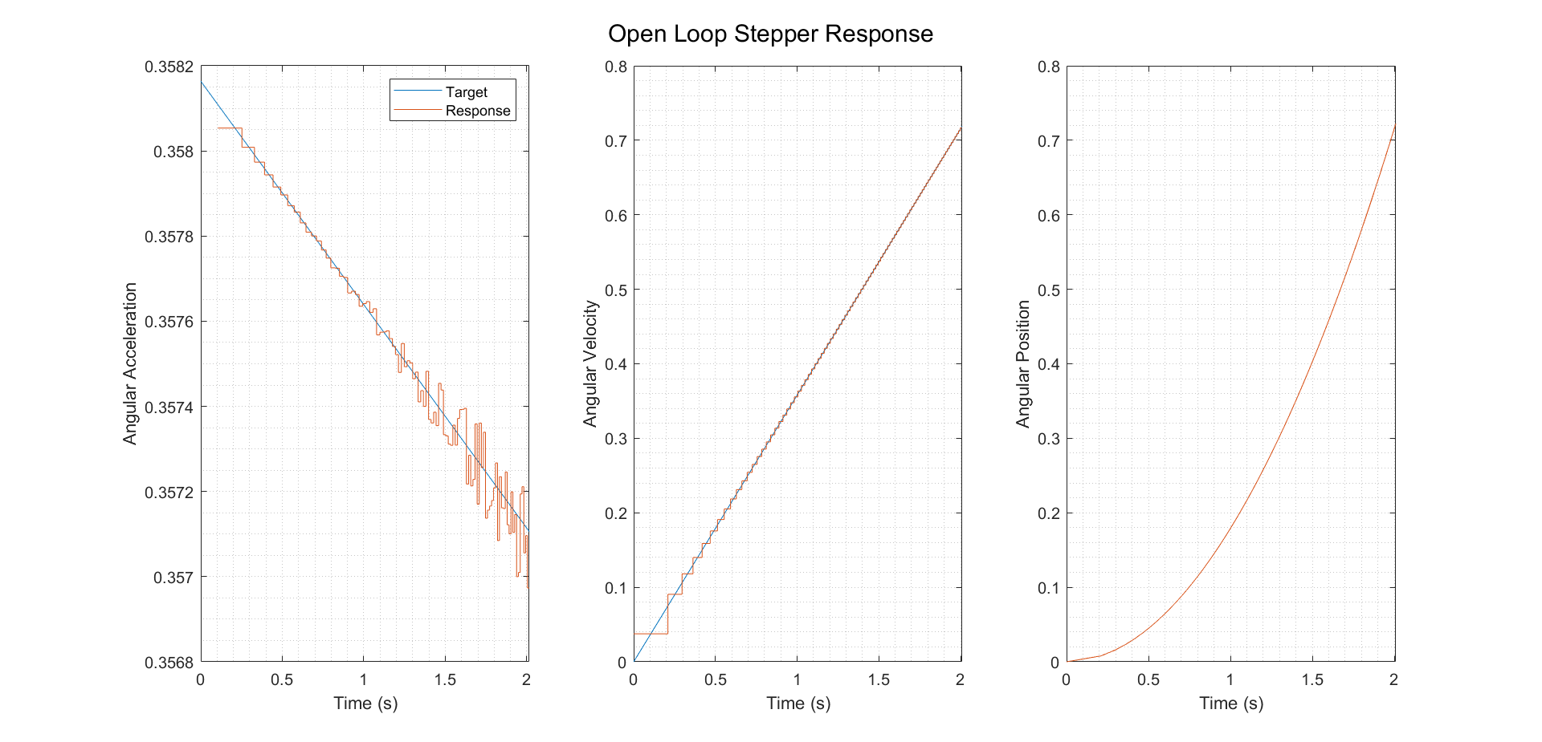
Maneuver: Stepper Motor Thruster Tracking
Acceleration tracking with open loop control of an ideal stepper motor
Thrust decays linearly over the desired time scale
Rounding errors cause jitter when step delay is small.
Cumulative acceleration error is 0.79% of the initial acceleration.
Requirement | Satisfaction
DR 4.3: The test system shall produce a maneuver that does not deviate more than 5% in acceleration from a chosen scaled orbital response acceleration curve | Open loop cumulative acceleration error on linear acceleration decay is 0.79% of initial acceleration, PID control variate is step delay in clock cycles.

Slide 34
Risk Analysis

Slide 35
Risk Analysis
ID | Risk
A | Structural Failure
B | COVID Shutdown
C | Shipping Delays
D | Shorting Electronics
E | Shorting Motors
F | Weather Interference
G | Medical or Personal Emergency
H | Communication Losses
I | Insufficient Data Rate
J | Gantry System Malfunction
ID | Risk
K | Failure to Interface
L | Excess of Noise Invalidates Sensor Reading
M | Budget Violation
N | Limit Switch Failure
O | Improper Gantry Operation
P | Computation Time
Q | Collision Object Damages System
R | Bodily Injury
S | Overheating Electronics
T | Damage on Arrival
Negligible Risk | Low Risk | Medium Risk | High Risk
Risk Assessment Matrix - CAST |  | Probability
 |  | Frequent | Likely | Occasional | Seldom | Unlikely
Severity | Catastrophic |  | P | B | C, J, K | T
 | Critical |  |  | I | M | A,E,G
 | Moderate |  |  | F | D | L,N,O
 | Negligible |  |  |  | S | H,Q,R
Notes:
“And here are the risks that we’ll actually discuss. The rest of the risk analysis can be found in our backup slides.

Slide 36
Risk Analysis
ID | Risk | Mitigation
C | Shipping Delays | -Early order of gantry -Shipped from RI via FedEx
I | Insufficient Data Rate | -Research conducted into data rate -Simplify acceleration profile
J | Gantry System Malfunction | -Warranty services - Replace parts
K | Failure to Interface | - Power and protocol schematics - Research into normal interfacing - Confirmation of our general interfacing path - Point to point circuit debugging
Negligible Risk | Low Risk | Medium Risk | High Risk
Risk Assessment Matrix - CAST |  | Probability
 |  | Frequent | Likely | Occasional | Seldom | Unlikely
Severity | Catastrophic
 | Critical |  |  |  |  | C, J, K
 | Moderate |  |  |  | I
 | Negligible

Slide 37
Risk Analysis
ID | Risk | Mitigation
M | Budget Violation | -Full budget set -Margin for additional expenses maintained
P | Computation Time | -Computational optimizations -Parallel processing -Offload maneuvering
T | Damage on Arrival | -Warranty services utilized -Scheduling
Negligible Risk | Low Risk | Medium Risk | High Risk
Risk Assessment Matrix - CAST |  | Probability
 |  | Frequent | Likely | Occasional | Seldom | Unlikely
Severity | Catastrophic
 | Critical |  |  |  |  | T
 | Moderate |  |  | P |  | M
 | Negligible

Slide 38
Verification and Validation
Notes:
Reade

Slide 39
Test Plan Overview
Component Level | Sub-System | Full System
Launching Mechanism Test | Gantry Characterization and Test | Necessary Maneuver Test
Lidar Sensor | Gantry Vibration Characterization Test | Clear No-Maneuver Test
Software Unit Testing | Sensor/Software Integration | Covariance Ellipse Collision Test / Questionable Cases
Notes:
Reade - These are key tests that have been deemed important in some way (complicated, high risk, final product, etc). Many other tests are planned.

Slide 40
Component Level Testing
Test | Objective | Requirement Motivation | Key Measurements | Predictive Model
Launching Mechanism | Ensure objects can be launched within required velocity and angle bounds | DR: 1.1, 1.2, 1.5 | Object position vs Time | Rolling sphere motion developed from rigid body kinematics
Lidar Sensor | Determine if sensor is ready for integration Characterize sensor (accuracy, precision, etc.) | DR: 2.1, 2.1.2, 2.2 | Measured Object Position vs Time | Motion of sensed object
Software Unit Testing | Verify code portions and functions | (FR: 1-4 DR: 3.2) | Code Outputs | Expected Code Outputs
Notes:
Reade

Slide 41
2. Subsystem Level Testing
Test | Objective | Requirement Motivation | Key Measurements | Predictive Model
Gantry Characterization and Test | Confirm Gantry can be moved in a way to represent a realistic thrust curve Verify positional feedback is accurate | DR: 4.1, 4.2 | Gantry max acceleration, max speed, position, encoder feedback | Gantry Documentation, Thrust Curve/Blowdown Model
Vibration Characterization Test | Characterize system vibration Confirm sensor will be unaffected | DR: 2.5 | Vibration (acceleration) in out of plane directions | Vibration Model (and Lidar Data Sheet)
Sensor/Software Integration | Confirm ability to sense an incoming object and accurately estimate its state and predict trajectory | DR: 2.1, 2.2, 2.3, 2.4 DR: 3.2 | Object position vs Time (Trajectory) and predicted trajectory based on sensor data | 2D Linear Motion Kinematics
Notes:
Reade

Slide 42
3. Full System Level Testing
Full System Test | Objective | Requirement Motivation | Key Measurements | Predictive Model
Miss Case | Full System Integration No Maneuver | FR: 1-4 DR: 1.3, 2.7, 3.2, 4.1, 4.2 | Incoming object state estimation in collision plane, gantry position, object position vs time | Control laws, incoming object trajectory, full system simulation
Collision Case | Full System Integration Maneuver to avoid collision
Questionable Cases | Full System Integration Maneuver to avoid covariance ellipse
Notes:
Reade

Slide 43
Test Plan
Test | Location | Special Test Equipment | Approximate Date
Launching Mechanism | AERO Building | Video Analysis/Tracking Software | Feb 01
Lidar Sensor |  | Video Analysis/Tracking Software | Jan 23
Software Unit Testing |  | N/A | Jan 18
Gantry Characterization | AERO Building | Accelerometer, Calipers | Feb 17
Vibration Characterization |  | Accelerometer | Feb 17
Software/Sensor Integration |  | Video Analysis/Tracking Software | Feb 12
All Full System Tests | AERO | N/A | Mar 18
Notes:
Reade

Slide 44
Project Summary and Planning

Slide 45
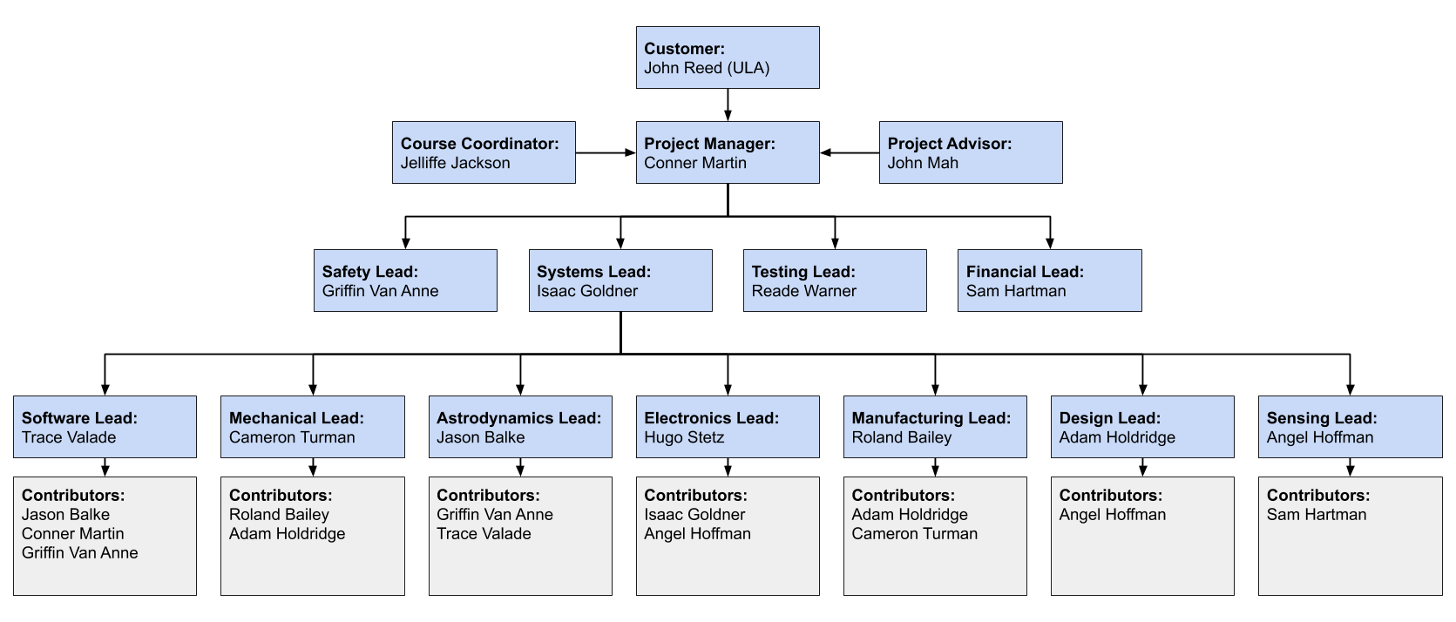
Organizational Chart

Slide 46
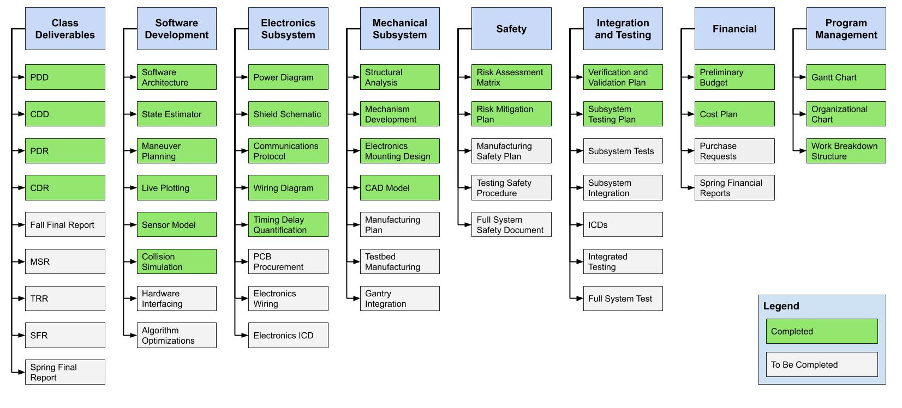
Work Breakdown Structure
Notes:
PCB
Algorithim optimizations
-Subsystem testing and integration

Slide 47
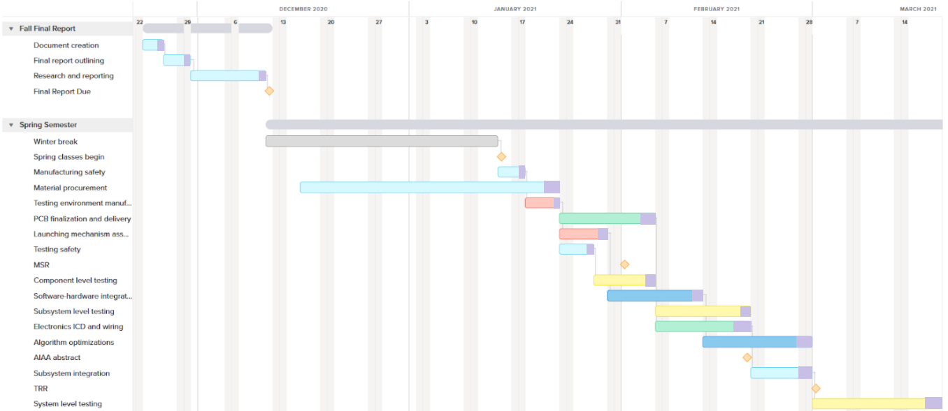
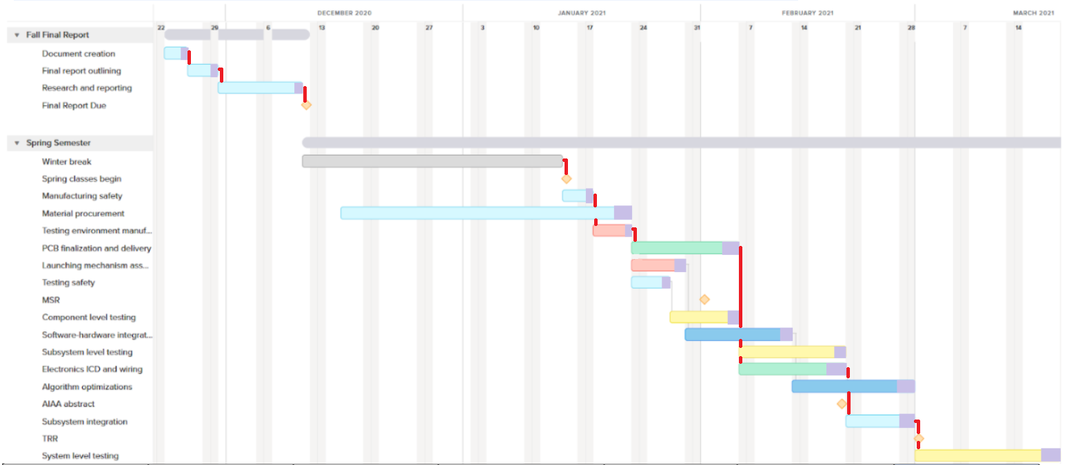
Work Plan
Key
Testing
General
Manufacturing
Electronics
Software
Margin
Critical Path
Notes:
Highlight path to system level

Slide 48
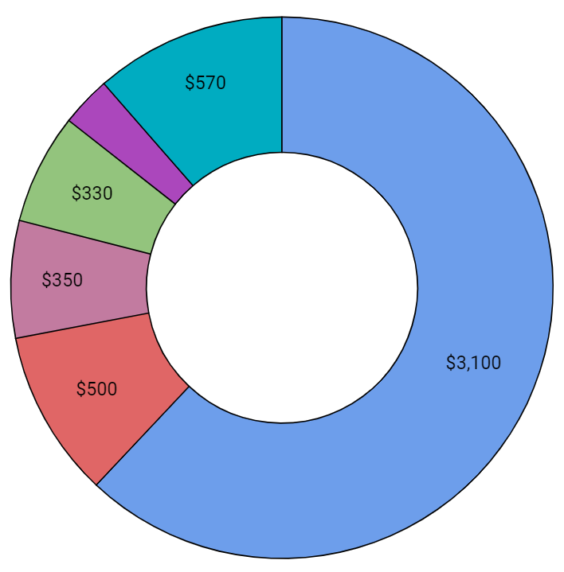
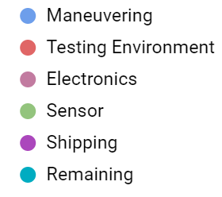
Cost Plan
 | Budget ($) | Expected ($) | Lead Time
Maneuvering | 3100 | 3070 | 4-6 Weeks
Testing Environment | 500 | 460 | 0-2 Weeks
Electronics | 350 | 310 | 0-2 Weeks
Sensor | 330 | 319 | 0-2 Weeks
Shipping | 150 | 150
Total | 4430 | 4310
Remaining | 570 | 690

Slide 49
Questions?

Slide 50
Backup Slides

Slide 51
Backup Slide Directory
General
CONOPs
Block Diagram
V&V Plans
Budget Breakdown
Risk Analysis
Requirements
Components List
Full Test Outline
Maneuvering
IGUS Quote
IGUS App Review
Past Scaling
Thruster Model
Launching Velocity
Vibration Analysis
Thermal Analysis
Structural Analysis
Electronics
Wiring Diagram
Power
Timing Delays
PCB
Software
Planar Deviation
Estimation Error
Linearizing Measurements

Slide 52
Full System Test Outline
Launch incoming object along desired trajectory
Clear miss cases (maneuver required)
Clear collision cases (no maneuver)
Case where object won’t collide but object covariance ellipse could (Near collision case, maneuver required)
Sensor outputs data on potential colliding object position and time
Determine speed, trajectory, and covariance of oncoming object (state estimation)
Control laws determine:
If maneuver is necessary
Direction and acceleration of maneuver
Maneuver plan sent to testbed
Testbed maneuvers
Avoidance of colliding object (and its 2σ covariance ellipse) verified through visual confirmation, live plot, and post data analysis (DR 1.5)
Notes:
Reade

Slide 53
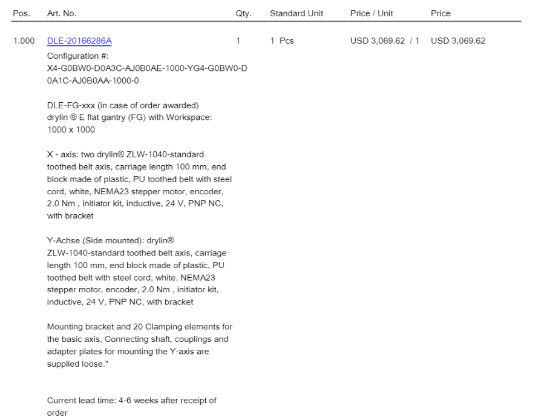
Quote from IGUS
Back

Slide 54
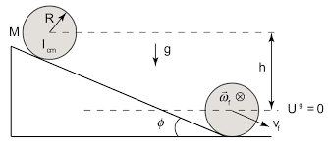
Launching Velocity Analysis
Rigid Body Conservation of Energy
Rolling without slipping
Incoming object treated as solid sphere
Moment of Inertia: I = ⅖ MR²
Results:
30°, 7.5cm tall ramp sufficient for 1m/s
30°, 0.3m tall ramp sufficient for 2m/s
Credit: MITOPENCOURSEWARE
Requirement | Satisfaction
DR 1.5: Incoming object maintain velocity within 5% | Ramp can generate sufficient velocity, table can be tilted to account for velocity if frictional losses are too great
Back

Slide 55
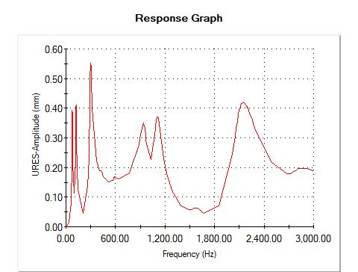
Vibration Analysis
Stepping induced vibration
Vibration increases with speed
Main concern is resonance
Frequency sweep of beams
Direction of maximum resonance
0.5mm negligible relative to foreign object size (<1%)
Vibration will not interfere with object detection
Back
Requirement | Satisfaction
DR 2.5: The sensor shall be capable of detecting an object while the maneuvering system is operating | Maximum resonance in beam structure adds 0.5 mm of amplitude to stepping motion

Slide 56
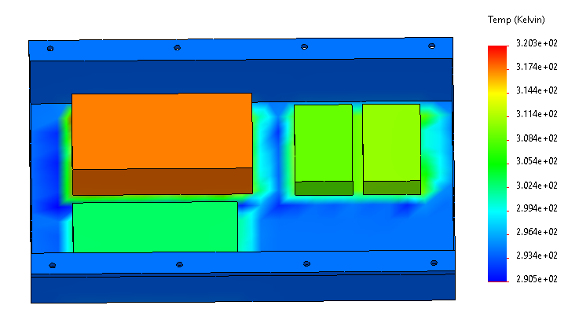
Thermal Analysis
Forced convection with 12V fan
All waste power treated as heat
Utilize component efficiencies
Max allowable temperature of 50° C from power supply specs
Actual max of 47.1° C reached
Actual temperatures much lower due to lower required current
Figure at right is severe worst case scenario
Back

Slide 57
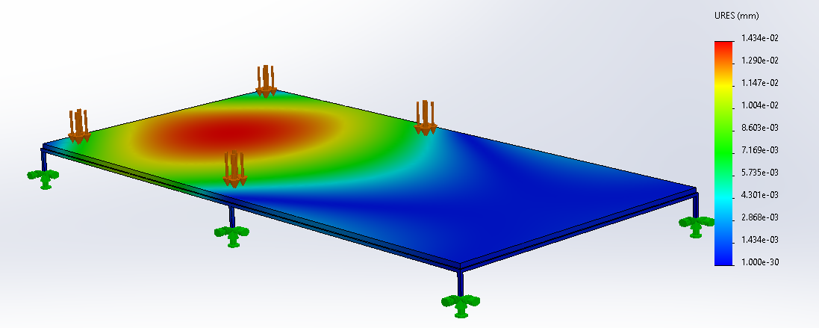
MDF Structural Analysis
Max displacement of 0.014 mm
FOS > 100 everywhere
Back

Slide 58
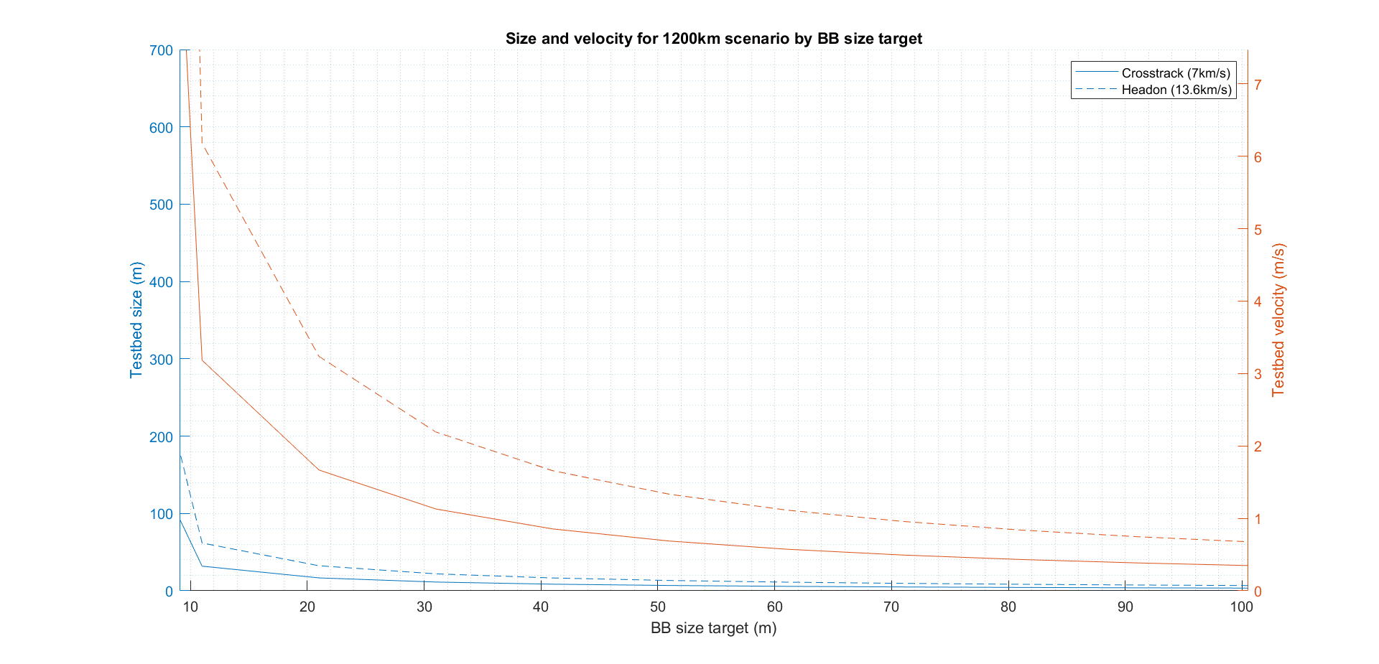
Past Scaling Results
Back

Slide 59
Components List
Electronics
CL57T Closed Loop Stepper Driver
RS232 Adapter Cable to USB 2.0
Switching power supply - 400W, 36V,11A
Switching power supply - 100W, 24V, 4.5A
Arduino Mega 2560
Arduino cable
Power plug to pigtail
12 gauge wire (100 ft)
24 gauge wire (100 ft)
Shielding wire mesh
12 fan
Switch
5V wall adapter
Power receptacle
PCBs
Mesh for electronics enclosure
Extra Connections
Sensor
RPLIDAR A2M8 360° Laser Scanner
RPLIDAR A2M8 360° Laser Scanner
Component
1mx1m Linear Rail Gantry
Back
Testing Environment
T-Slot Framing
Anti-Slit Leveling Mount
Uncoated High-speed Steel Tap
Silver Corner Bracket Large
Silver Corner Bracket Small
Hanger for Solid Panels (Wall Bracket)
End-Feed Single Nut w/ Button Head
Inline Pivot
T-Slot Framing
MDF
Ramp
Wall
Fastening hardware
Maneuvering
1mx1m Linear Rail Gantry

Slide 60
Risk Analysis
ID | Risk | Description | Mitigation
A | Structural Failure | Failure or breakage of either the ramp system, MDF platform, structural supports, or gantry system. | Analytic structural analysis performed on all built components, IGUS load analysis and solidworks load analysis of the entire system.
B | COVID Shutdown | Spike in COVID cases that requires partial or complete shutdown of project operations. | None
C | Shipping Delays | Shipment of Gantry from IGUS is delayed or severely delayed due to COVID conditions or unforeseen circumstances. | Early order of Gantry with estimated lead time of 4-6 weeks gives several week margin before the beginning of the semester.
D | Shorting Electronics | Surging or misconnecting electronics in a way that destroys or damages damages beyond repair. | Careful research into electronics design and verification of proper connections by subject matter experts preceding testing.
Negligible Risk | Low Risk | Medium Risk | High Risk
Risk Assessment Matrix - CAST |  | Probability
 |  | Frequent | Likely | Occasional | Seldom | Unlikely
Severity | Catastrophic |  |  | B |  | I,J,K,T
 | Critical |  |  | P | C,M | A,E,G
 | Moderate |  |  | F | D | L,N,O
 | Negligible |  |  |  | S | H,Q,R
Back

Slide 61
Risk Analysis
ID | Risk | Description | Mitigation
E | Shorting Motors | Surging or misconnecting motors in a way that destroys or damages them beyond repair. | Careful attention will be given to motor design specifications and power sources.
F | Weather Interference | Adverse weather conditions that prevent meeting, access to facilities, or testing. | Significant time buffer accounted for to ease stress on time constraints.
G | Medical or Personal Emergency | A team member becomes ill or suffers from some other personal emergency that prohibits or serves as a serious obstacle to them continuing work on the project. | Safety precautions taken by all members to avoid illness, subsystems filled with enough people to replace if a subsystem leader or someone in that subsystem can no longer continue.
H | Communication Losses | Packets are lost at a rate that makes full operation of the system fail. | Ensuring connections are fully correct and that better connections are created if needed.
Negligible Risk | Low Risk | Medium Risk | High Risk
Risk Assessment Matrix - CAST |  | Probability
 |  | Frequent | Likely | Occasional | Seldom | Unlikely
Severity | Catastrophic |  |  | B |  | I,J,K,T
 | Critical |  |  | P | C,M | A,E,G
 | Moderate |  |  | F | D | L,N,O
 | Negligible |  |  |  | S | H,Q,R
Back

Slide 62
Risk Analysis
ID | Risk | Description | Mitigation
I | Insufficient Data Rate | The data rate is not fast enough to produce desired response in time to avoid collision. | Shorthand analysis of data rate required and time delay produced by data rate.
J | Gantry System Malfunction | The gantry system is delivered improperly calibrated or damaged to the point where it does not work correctly and the solution to this issue cannot be found. | Warranty services will be utilized.
K | Failure to Interface | Interface does not work as intended and/or communication between different components requires technological expertise outside of the scope of current team skill. | Detailed research into documentation of similar protocols has been done in order to ensure that .
L | Excess of Noise Invalidates Sensor Reading | The noise around or within the testbed environment is too prominent to accurately rely on sensor readings | Testbed designed to reduce external visual noise, and sensor noise parameters studied and tested.
Negligible Risk | Low Risk | Medium Risk | High Risk
Risk Assessment Matrix - CAST |  | Probability
 |  | Frequent | Likely | Occasional | Seldom | Unlikely
Severity | Catastrophic |  |  | B |  | I,J,K,T
 | Critical |  |  | P | C,M | A,E,G
 | Moderate |  |  | F | D | L,N,O
 | Negligible |  |  |  | S | H,Q,R
Back

Slide 63
Risk Analysis
ID | Risk | Description | Mitigation
M | Budget Violation | The $5000 budget is violated due to replacement of purchased items or other unforeseen circumstances. | Budget analysis performed and additional budget put aside to replace any needed attributes.
N | Limit Switch Failure | The limit switch for the motor is not connected properly or malfunctions causing damage to the motor when it’s design limits are exceeded. | Electronics diagram created and careful care will be taken in ensuring exactly correct connections that follow this diagram prior to testing.
O | Improper Operation of Gantry | Gantry is connected to the system improperly, or specifications of the Gantry are violated during the experiment. | Application review for the Gantry produced by IGUS reviewed in detail, and all specifications not exceeded.
P | Computation Time | The algorithm takes too long to run, and the Gantry can not respond to the collision object in time to avoid it. | Computation shortcuts will be used if needed, and if the computation time is still an issue the Gantry will predict experimental collisions based on ballistic experiments of common trajectories.
Negligible Risk | Low Risk | Medium Risk | High Risk
Risk Assessment Matrix - CAST |  | Probability
 |  | Frequent | Likely | Occasional | Seldom | Unlikely
Severity | Catastrophic |  |  | B |  | I,J,K,T
 | Critical |  |  | P | C,M | A,E,G
 | Moderate |  |  | F | D | L,N,O
 | Negligible |  |  |  | S | H,Q,R
Back

Slide 64
Risk Analysis
ID | Risk | Description | Mitigation
Q | Collision Object Damages System | The collision object colliding with either the gantry or anything else on the testbed causes damage to the system. | If deemed necessary, padding will be used along surfaces with the potential to receive a collision from the object.
R | Bodily Injury | The gantry or collision object movement causes the bodily injury of a team member. | The safety lead will be in charge of ensuring that safety protocols and common sense are being followed during all tests.
S | Overheating Electronics | Electronics systems overheat due to external temperatures and/or overuse. | Breaks will be taken during long periods of testing, and tests will be done sparingly and with thought in mind for exactly what needs to be accomplished prior to each test as detailed in the test plan.
T | Damage on Arrival | Shipped items are damaged on arrival and either need repairs or complete replacement. | Warranty services will be utilized, and adjustments to plans will be made accordingly.
Negligible Risk | Low Risk | Medium Risk | High Risk
Risk Assessment Matrix - CAST |  | Probability
 |  | Frequent | Likely | Occasional | Seldom | Unlikely
Severity | Catastrophic |  |  | B |  | I,J,K,T
 | Critical |  |  | P | C,M | A,E,G
 | Moderate |  |  | F | D | L,N,O
 | Negligible |  |  |  | S | H,Q,R
Back

Slide 65
CONOPs
Back

Slide 66
Functional Block Diagram
Back

Slide 67
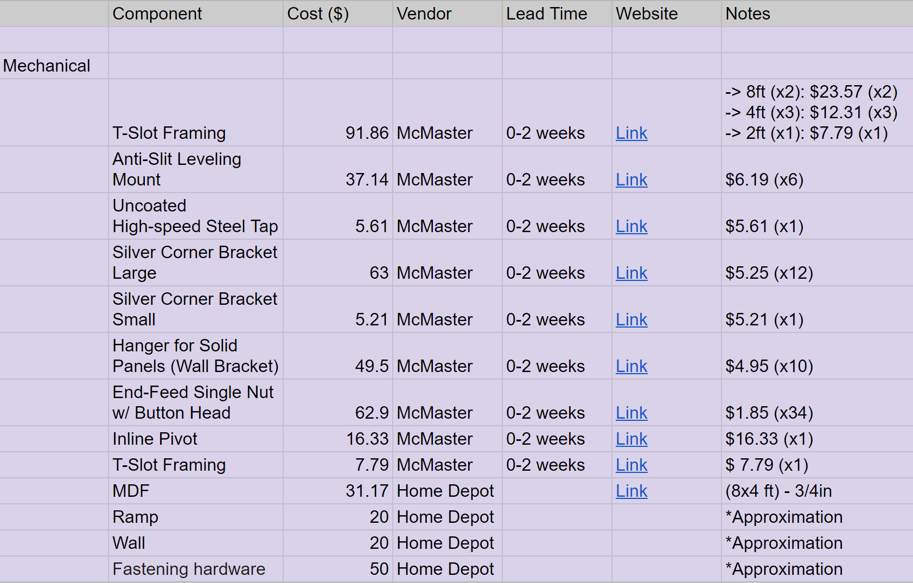
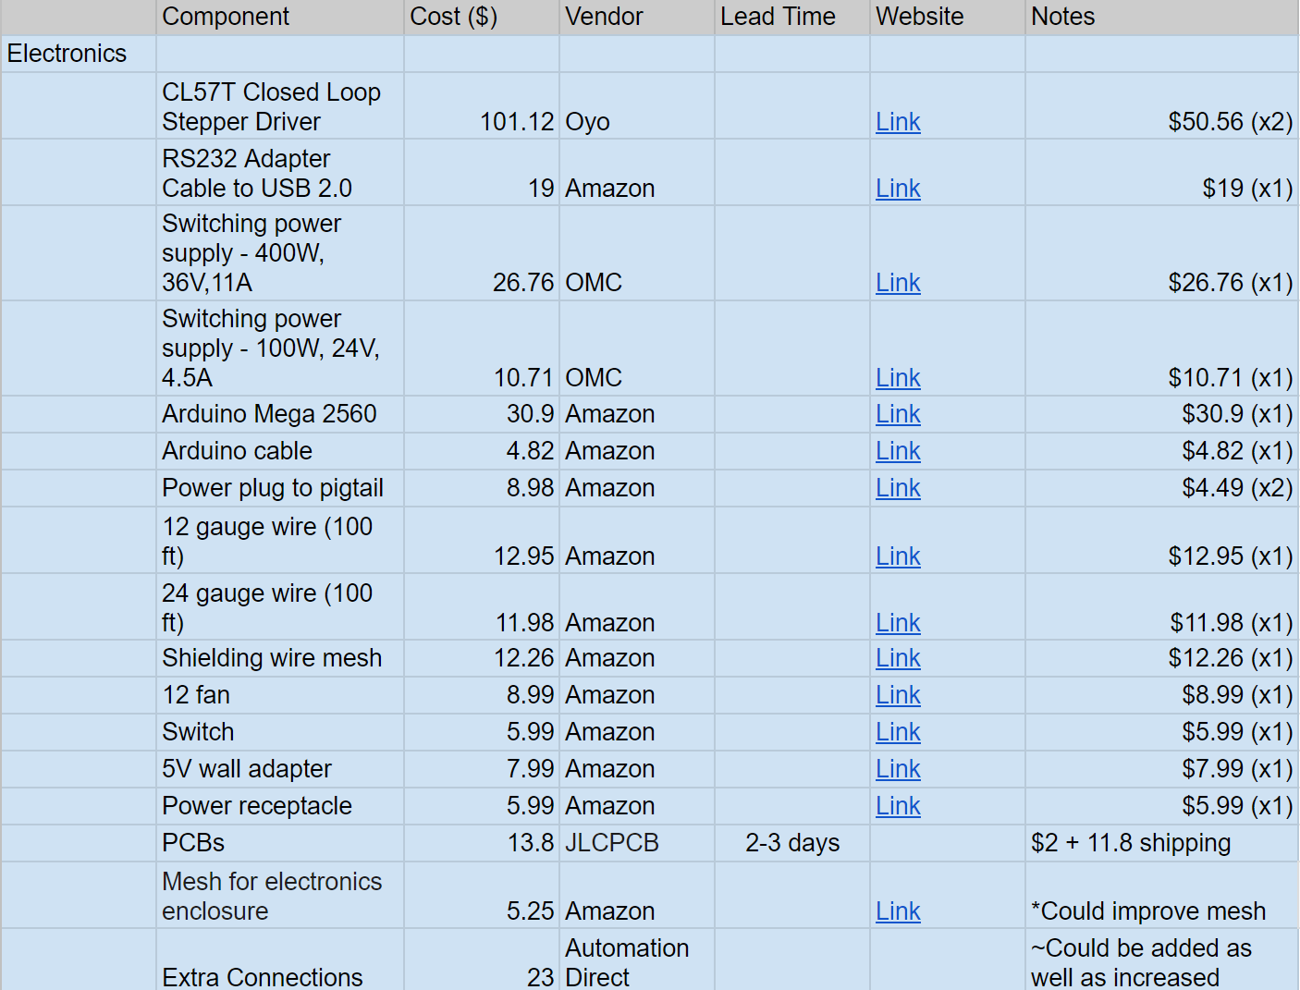
Cost Plan Breakdown
Back

Slide 68
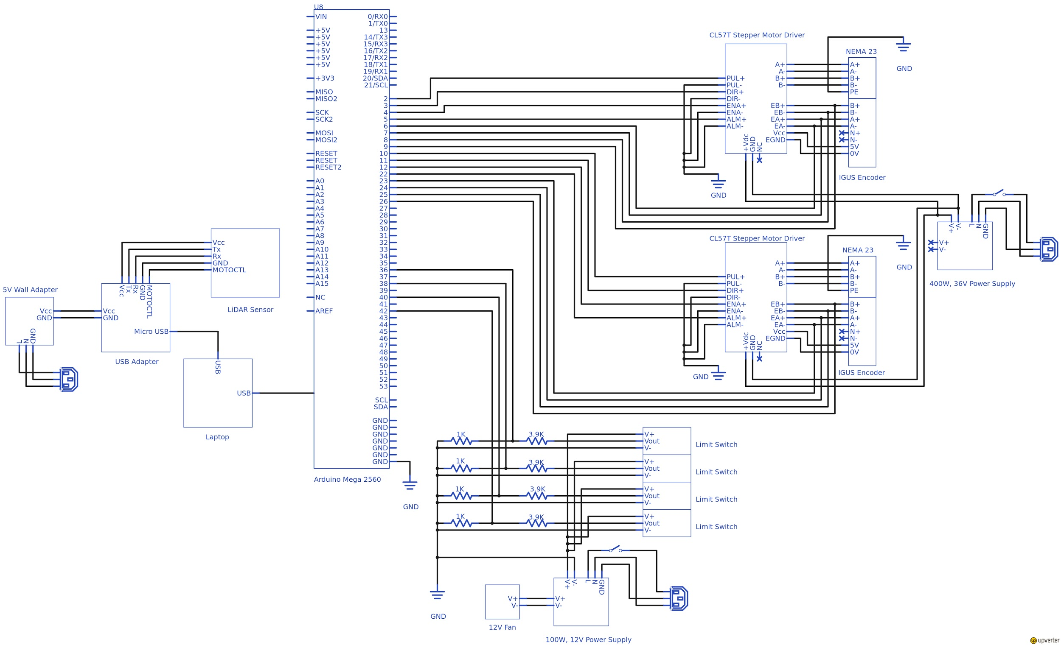
Electronics Wiring Diagram
Back

Slide 69
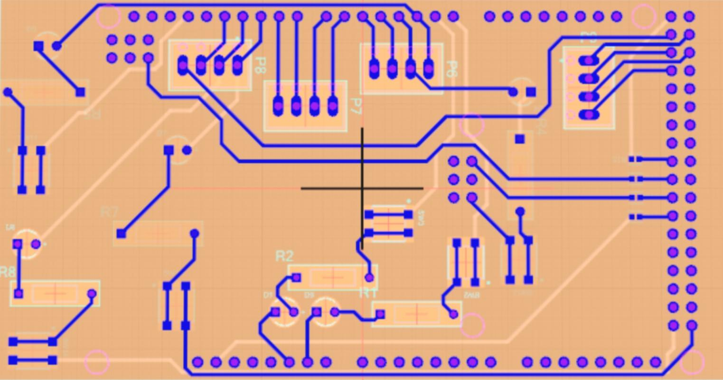
Electronics PCB
Back
2 layer
0.5080 mm trace width

Slide 70
Electronics PCB
Back
Legend
330k ohm resistors
4 way female terminal block
Switch
LED
470k resistor

Slide 71
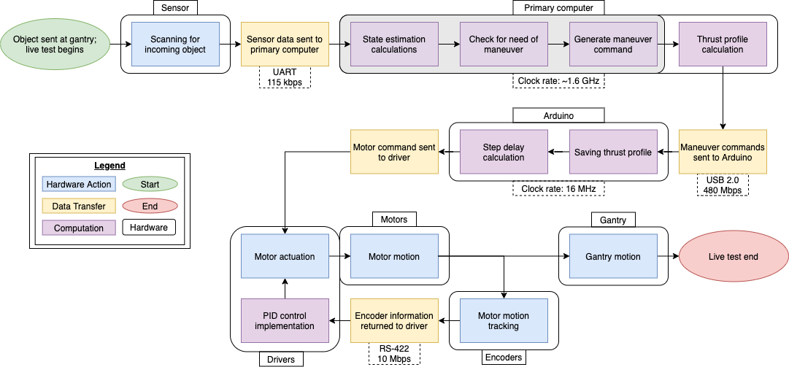
Timing Delays
Back
Notes:
A visual walkthrough of the time steps that constitute a live test.

Slide 72
Timing Delays
Accounting for major time delays:
Back
Action | Location | Expected Timespan
Transfer of sensor data to primary computer | Sensor-primary computer connection | 0.1 ms
State estimation; maneuver check and generation | Primary computer | 2 ms
Thrust profile pull | Primary computer | 2 ms
Thrust profile transfer to Arduino | Primary computer-Arduino connection | 0.13 ms
Saving thrust profile | Arduino | Negligible
Step delay calculation | Arduino | 1.4 ms
Generation of motor commands | Arduino | Negligible
Total: |  | 5.63 ms
Our need:
Our process time constant is...
Our delay time (applying a 10% sampling rule) is thus...

Slide 73
Timing Delays
Back
Notes:
A visual walkthrough of the time steps that constitute a live test.

Slide 74
Timing Delays
Back
Unknown data packet size.
Estimated transfer speed: 0.1 ms
Speed unknown but can be easily found.
Estimated speed: 2 ms
(No slower than main loop)
Main loop iteration rate currently ~900 Hz.
Final rate estimated at ~500 Hz.
Resultant iteration speed: 2 ms
Notes:
The sensor data packet size is unknown because the data format and length changes depending on what is detected, according to the RPLIDAR datasheet.
The main loop iteration rate is provided by the software team after running the main loop many times and timing it.

Slide 75
Timing Delays
Thrust profile estimated size: 8 kB
Transfer rate: 480 Mbps
Resultant speed: 0.13 ms
Back
Using instruction clock cycle lengths with clock rate...
Theoretical calculation speed: 1.4 ms

Slide 76
Timing Delays
Back
At the lowest level, mechanical and electrical components add negligible additional time delays.

Slide 77
Timing Delays
Action | Location | Expected Timespan
Transfer of sensor data to primary computer | Sensor-primary computer connection | 0.1 ms
State estimation and maneuver check and generation | Primary computer | 2 ms
Thrust profile pull | Primary computer | 2 ms
Thrust profile transfer to Arduino | Primary computer-Arduino connection | 0.13 ms
Saving thrust profile | Arduino | Negligible
Step delay calculation | Arduino | 1.4 ms
Generation of motor commands | Arduino | Negligible
Transfer of motor commands to drivers | Arduino-driver connection | Negligible
Motor actuation | Drivers | Negligible
Motor motion | Motors | 0
Motor motion tracking | Encoders | 0
Encoder information returned to driver | Encoder-drivers connections | Negligible
PID control implementation | Drivers | Negligible
Updated motor actuation | Drivers | Negligible
Updated motor motion | Motors | 0
Gantry motion | Gantry | 0
Total: |  | 5.63 ms
Back

Slide 78
Design Requirements
Back
Requirement | Parent Requirement | Requirement Text
DR1.1 | FR1 | The test system shall be capable of creating various trajectories of the incoming object to create a collision or miss scenario
DR1.2 | FR1 | The incoming object trajectory shall be within the plane of collision. In other words, the trajectory of the avoidance maneuver and the incoming object will reside within the same 2D domain.
DR1.3 | FR1 | The test system shall be fully functional after repeated detect and react procedures, where full functionality is defined as the ability to sense position and velocity data for an incoming object, integrate this data into the avoidance algorithm software, and perform an avoidance maneuver
DR1.4 | FR1 | The total cost of the test bed system shall be less than $5000
DR1.5 | FR1 | The incoming object shall maintain constant velocity to within 5% of its initial velocity upon launch

Slide 79
Design Requirements
Requirement | Parent Requirement | Requirement Text
DR2.1 | FR2 | The sensor shall be capable of detecting one incoming object
DR2.1.2 | FR2 | The sensor shall be capable of sensing an incoming sphere of 50mm or greater diameter
DR2.2 | FR2 | The sensor shall be capable of returning distance and bearing measurements of the incoming object
DR2.3 | FR2 | The sensor shall be capable of sensing within a preset domain of a 2x1 meter rectangle
DR2.4 | FR2 | The sensor field of view shall be at least 30 degrees
DR2.5 | FR2 | The sensor shall be capable of detecting an object while the maneuvering system is operating
DR2.6 | FR2 | The detection sensor sampling rate shall be high enough to drive the 2 sigma covariance ellipse into an avoidable region, where the avoidable region is defined as the 2D domain of the max distance the maneuvering system can operate in at any given time until collision
DR2.7 | FR2 | A reorientation maneuver shall not be required for the test system to sense an incoming object
Back

Slide 80
Design Requirements
Back
Requirement | Parent Requirement | Requirement Text
DR3.1 | FR3 | The test system avoidance algorithm shall be capable of estimating the state of an incoming object from sensor data, with state estimation error less than the 2 sigma estimate bound
DR3.2 | FR3 | The test system avoidance algorithm shall be capable of predicting collision probability from state estimation data
DR3.3 | FR3 | The test system avoidance algorithm, maneuvering hardware, and sensor shall be capable communicating data between subsystems
DR4.1 | FR4 | The test system shall be capable of receiving and acting upon maneuvering commands based on received sensor data as an object is incoming (a live scenario)
DR4.2 | FR4 | The test system shall generate sufficient force to avoid a collision with the covariance ellipse of the incoming object state estimation for a subset of the possible relative velocities (0m/s to 2m/s)
DR4.3 | FR4 | The test system shall produce a maneuver that does not deviate more than 5% in acceleration from a chosen scaled orbital response acceleration curve

Slide 81
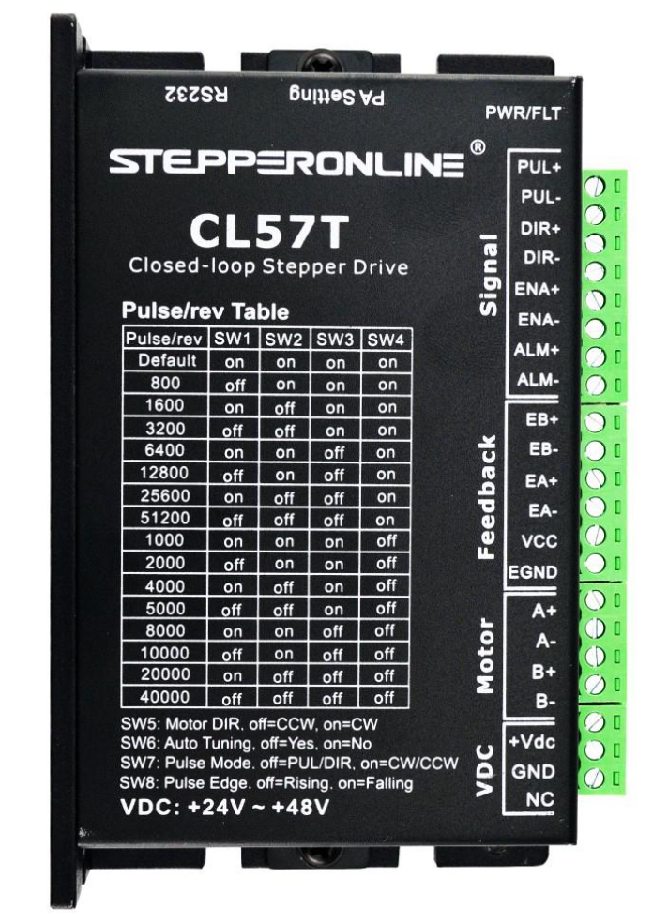
Electronics: Power
Closed loop stepper motor drivers used to close loop on position
Powered at 36 V
Power encoders with 5 V
Limit switches detect axis limits
PNP normally closed type
24 V
Arduino Mega selected over Uno due to DIO pin count
Back
Requirement | Satisfaction
DR 1.3: The test system avoidance algorithm, maneuvering hardware, and sensor shall be capable communicating data between subsystems | Stepper motors, stepper motor drivers, encoders, Arduino, sensor, and limit switches are provided sufficient power to operate and successfully pass data

Slide 82
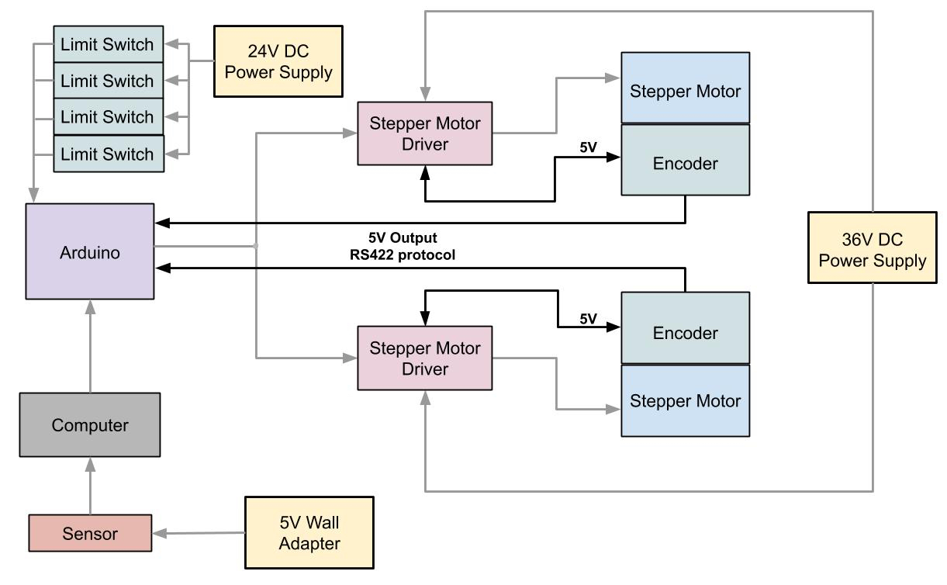
Electronics: Power (Encoder)
Back
 | Voltage
Encoder: Output | 5 V
Stepper Motor Driver: Input | 5 V
Arduino Digital: Input | 5V
Stepper Motor Driver: Output | 5 V
Encoder: Input | 5 V

Slide 83
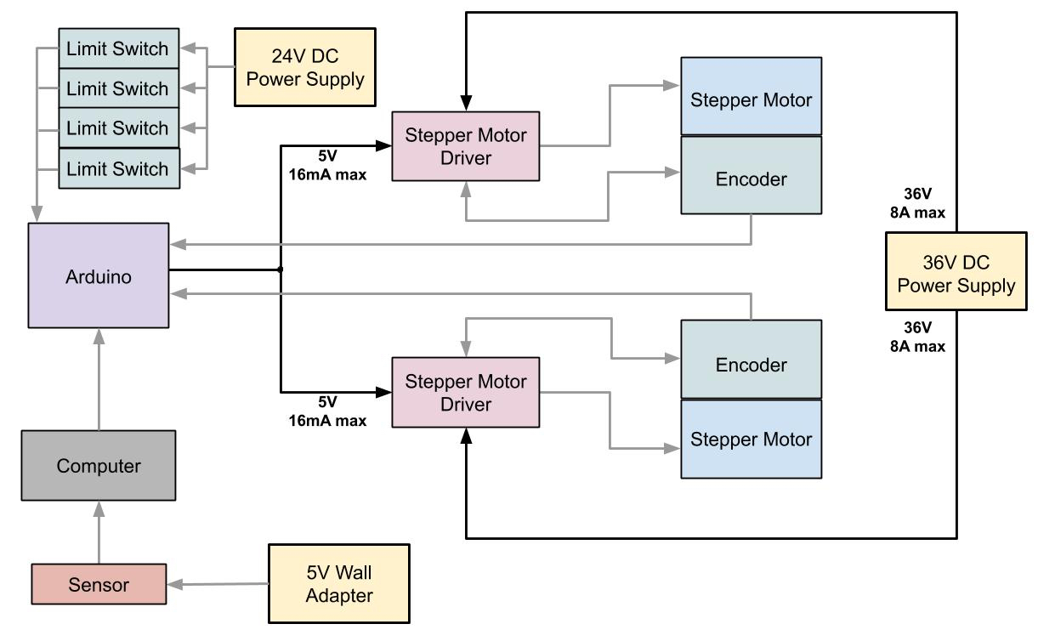
Electronics: Power (Stepper Motor Driver)
 | Current | Voltage
Arduino Digital: Output | 0-20 mA | 5 V
Stepper Motor Driver Control Signal: Input | 7-16 mA | 4.5-24 V
Back
DC Power Supply: Output | 0-11 A | 36 V
Stepper Motor Driver Power: Input | 0-8 A | 24-48 V

Slide 84
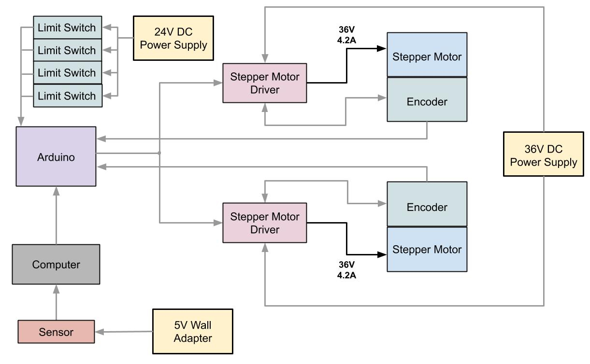
Electronics: Power (Stepper Motor)
Back
 | Current | Voltage
Stepper Motor Driver: Output | 0-8 A | 36V
Stepper Motor: Input | 4.2 A | 24-48 V

Slide 85
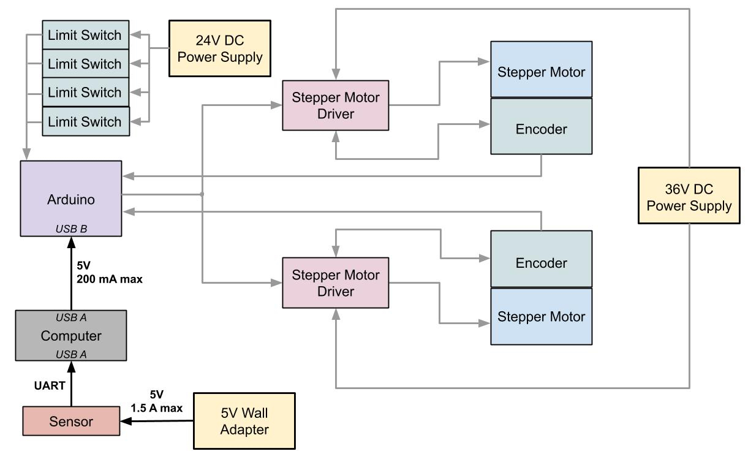
Electronics: Power (Sensor & Arduino)
Back
 | Current | Voltage
Wall Adapter: Output | 0-2 A | 5 V
Sensor: Input | 0-1.5 A | 5 V
Computer: Output | 0-500 mA | 5V
Arduino: Input | 0-200 mA | 5V

Slide 86
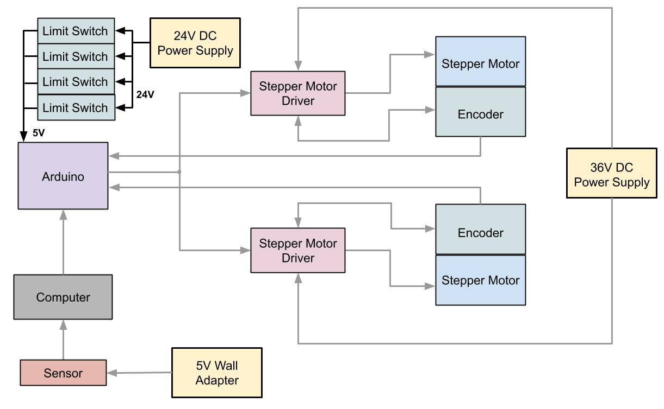
Electronics: Power (Limit Switches)
Back
 | Current | Voltage
DC Power Supply: Output | 0-4.5 A | 24 V
Limit Switch: Input | 0-300 mA | 24 V
Limit Switch: Output | 5 mA | 5 V (voltage divider)
Arduino: Input | 20 mA | 5 V

Slide 87
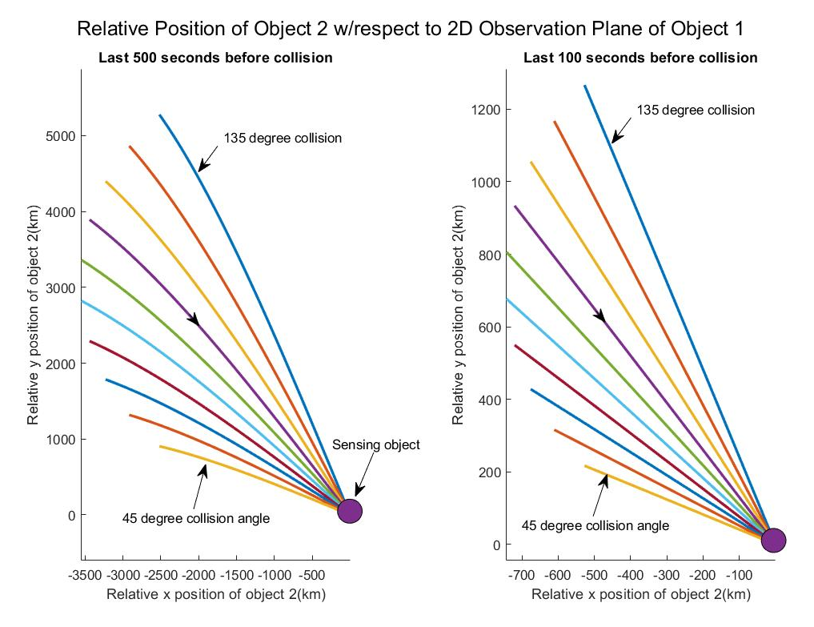
Planar Deviation Analysis
Purpose:
Can the full-scale collision be accurately scaled to a 2D rectilinear test-bed?
Assumptions:
Both objects orbiting at same altitude
Both objects in circular orbits
Simplified 2-body problem without perturbations
Results:
Under 100s → R² of 0.999, max deviation of 4°
Small planar deviation
Very linear relative motion
Accurate 2D representation of 3D environment for 100 seconds is feasible
Back
Notes:
Griffin
Based off circular orbit monte carlo
Time Interval
Max planar deviation
R²
500s
20.0°
0.97874
100s
4.09°
0.99997

Slide 88
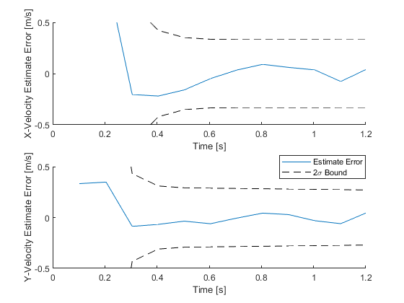
Estimation Error
Back

Slide 89
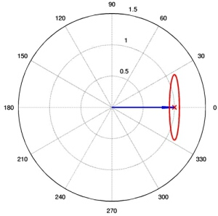
Linearizing Measurements
Conversion from polar to cartesian yields statistical bias
De-bias measurement covariance before running through linear KF
Condition error statistics on state prediction
Lianmeng Jiao, Quan Pan, Xiaoxue Feng, Feng Yang. A robust converted measurement Kalman filter
for target tracking. 2012 31st Chinese Control Conference (CCC), Jul 2012, Hefei, China. pp.3754-
3758. hal-01081009
Back
Credit: buffalo.edu
Requirement | Satisfaction
DR 3.1: The test system avoidance algorithm shall be capable of predicting collision probability from sensor data | We can use direct sensor measurements if we debias the conversion to cartesian

Slide 90
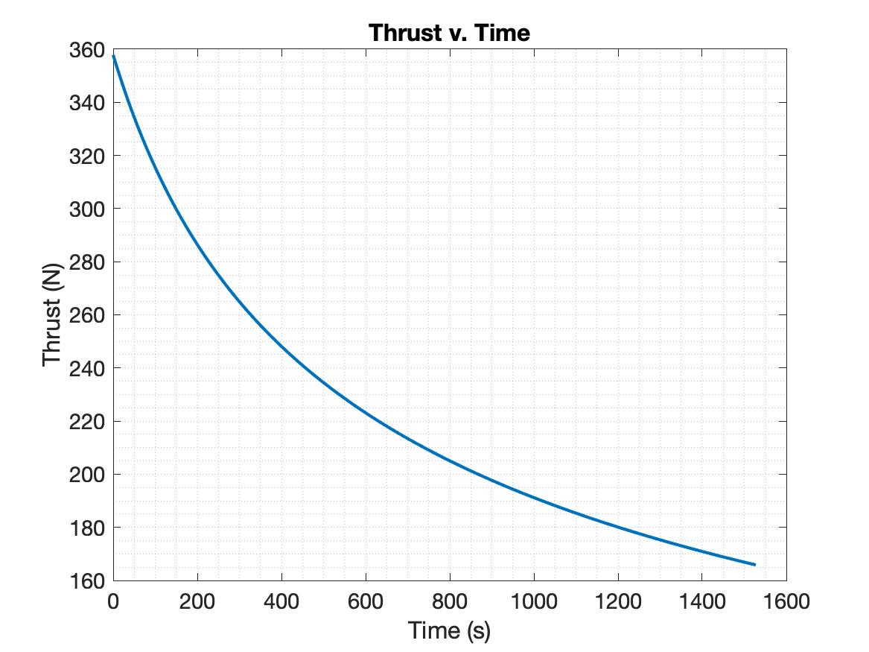
Thruster Blowdown Model
MR-107s hydrazine monopropellant thruster
Selected due to available thrust and current use on orbit
Thrust computed over time based on blowdown model
Results indicate approximately linear decrease in thrust over ~30s burn
Back
Requirement | Satisfaction
DR 4.3: The test system shall produce a maneuver that does not deviate more than 5% in acceleration from a chosen scaled orbital response acceleration curve | Acceleration of stepper motor maneuvering system can be modelled off of an approximately linearly decreasing acceleration to maintain <5% acceleration error

Slide 91
Electronics: Timing
Accounting for major time delays:
Back
Action | Location | Expected Timespan
Transfer of sensor data to primary computer | Sensor-primary computer connection | 0.1 ms
State estimation; maneuver check and generation | Primary computer | 2 ms
Thrust profile pull | Primary computer | 2 ms
Thrust profile transfer to Arduino | Primary computer-Arduino connection | 0.13 ms
Saving thrust profile | Arduino | Negligible
Step delay calculation | Arduino | 1.4 ms
Generation of motor commands | Arduino | Negligible
Total: |  | 5.63 ms
Our need:
Our process time constant is...
Our delay time (applying a 10% sampling rule) is thus...

