Slide 1
BUBO BUBO Test Readiness Review March 3rd, 2020
Presenters: Charlotte Bellerjeau, Andrew Fendel, Karim Krarti, Kaitlyn Olson, Jesse Williams
Customers: Dr. Brian Argrow and Christopher Choate Advisor: Dr. Donna Gerren
Team: Charlotte Bellerjeau, Andrew Fendel, Keaton Fitton, Ethan Gabrielle, Karim Krarti, Nickolas Mororo, Kaitlyn Olson, Seif Said, Jesse Williams, Jeremy Yanowitz

Slide 2
Overview

Slide 3
Project Purpose
The goal of BUBO BUBO is to design, build, and test an unmanned, radio-controlled (RC), box-wing aircraft. The aircraft will be a scalable data collection platform for a Flush Air Data Sensing (FADS) system, which will collect pressure data to aid in the study of turbulence by Dr. Brian Argrow of the University of Colorado Boulder.

Slide 4
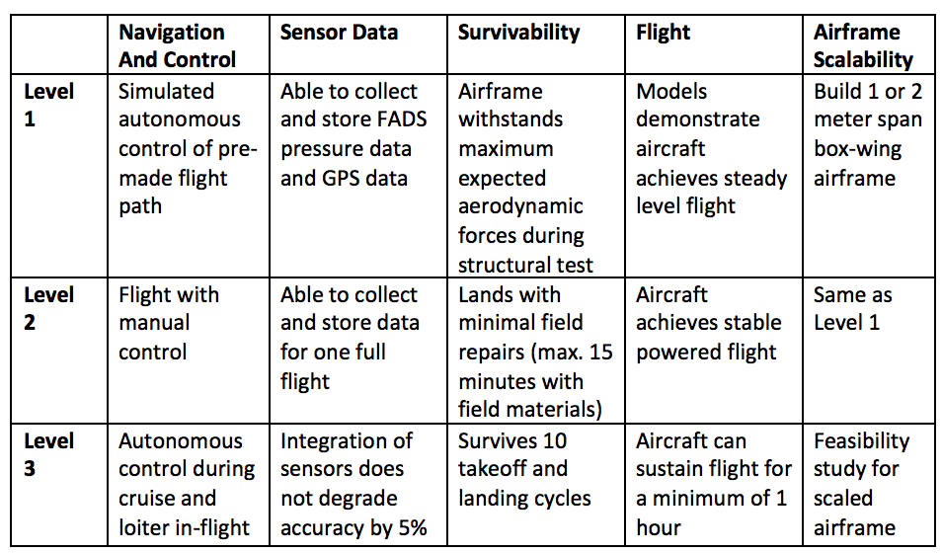
Specific Objectives – Levels of Success
Notes:
Because FADS is not critical for first flight, manufacturing has been pushed to allow test flight preperation

Slide 5
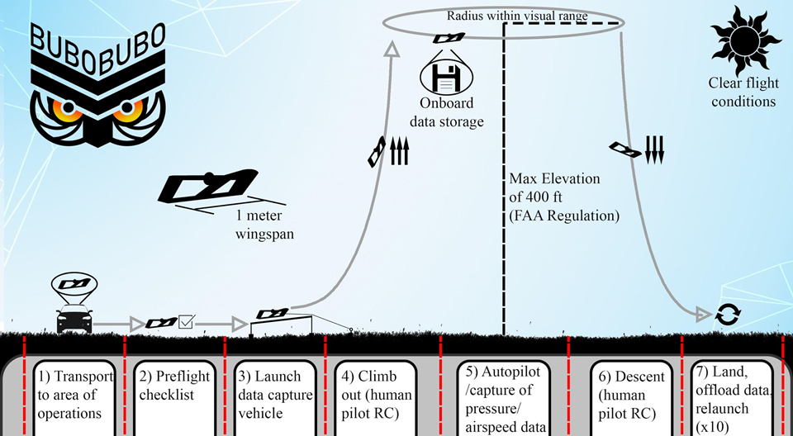

Slide 6
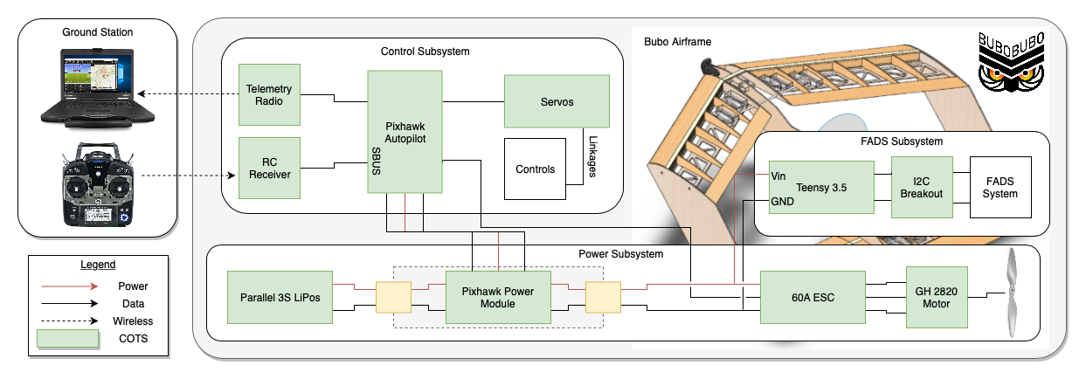
Functional Block Diagram Of BUBO BUBO for Manufacturing Status Review

Slide 7
Critical Project Elements
Aerodynamics
Controls
Power
Propulsion
FADS
Structures
Configuration
Gains
Power Distribution
Propulsive Setup
Placement
System Integration
Stability
Stability
Component Placement
Efficiency
Integration
Structural Integrity
Flight Performance
Flight Performance
Endurance
Relative Wind Recovery
Survivability
Pressure Distribution
Control Surfaces
Materials

Slide 8
Design Overview

Slide 9
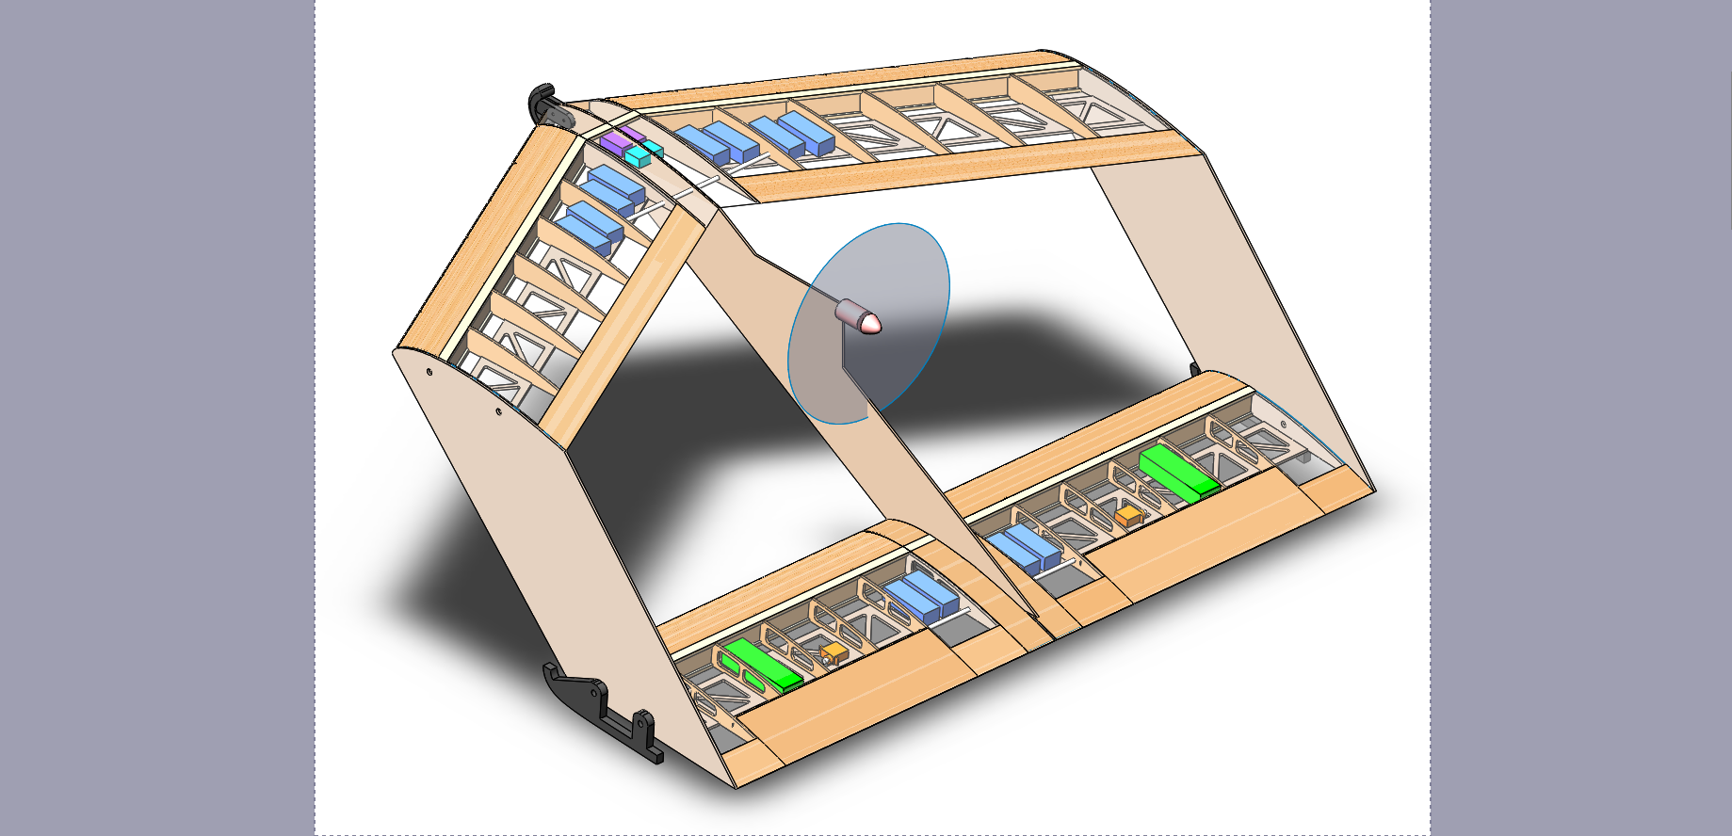
Baseline Design
Box-wing Configuration
Top wing swept back 30°
Bottom wing straight
1 m span
0.3 m chord
0.3 m stagger
0.3 m gap
Total Mass: 3.65 kg
NACA 6412
NACA 23112

Slide 10
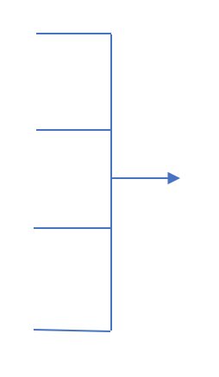
Boom Design
In order to address negative static margin and improve longitudinal stability, a ballasted boom was added to the front of the aircraft
Extensive vibrational analysis has been done for the boom
Concluded that vibrations will not resonate with any natural frequencies, and are small enough to not have any significant effect during regular flight
Unballasted C.G. Location
Unballasted Mass
Boom Quadratic Solver
Boom Length
Desired C.G. Location
Ballast Mass
Notes:
Boom reduces risk of damage to top wing and eliminates the unstable tumble mode

Slide 11
Schedule

Slide 12
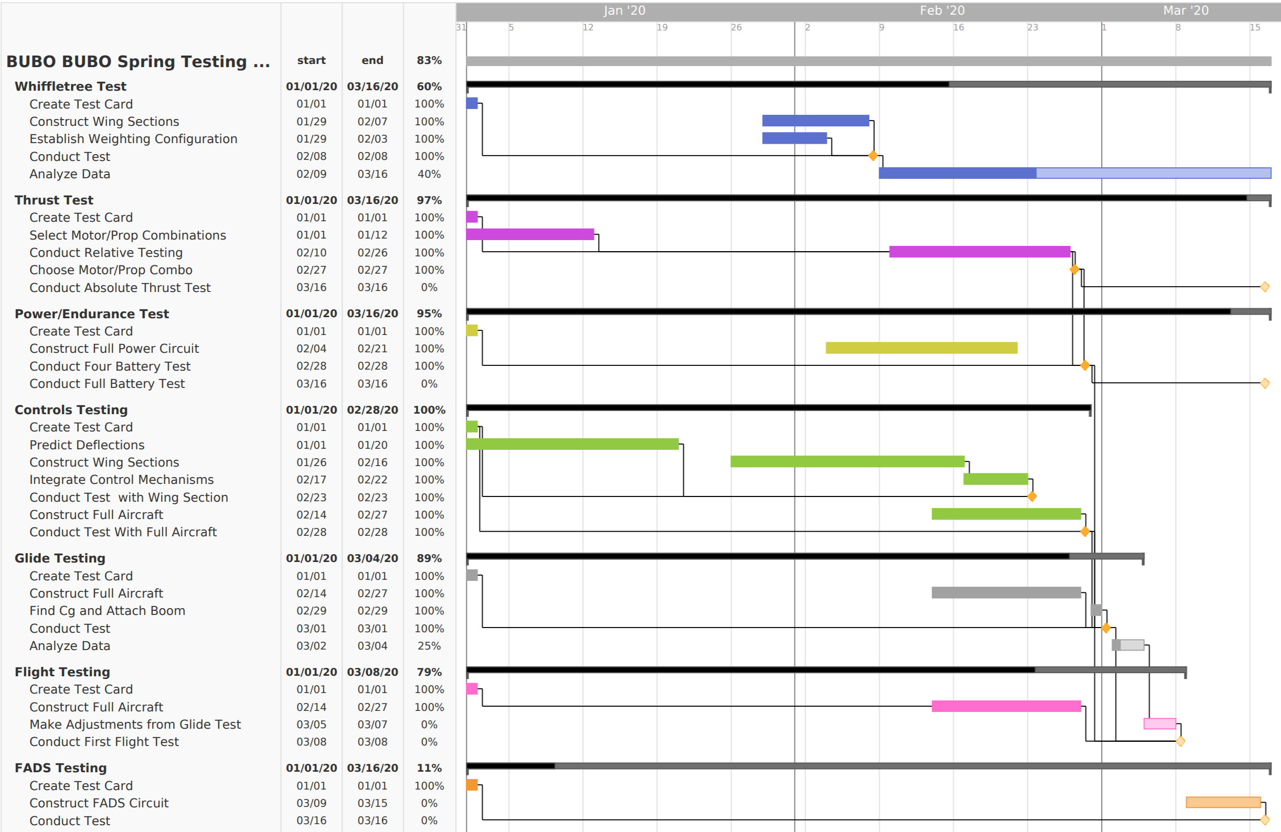
Notes:
Note any major changes since CDR
Whiffletree testing pushed back by one week → this is due to the need for the CAD to be modified/updated to account for our airfoil change
Note that we previously planned to start manufacturing the first full airframe before the whiffletree test was completed, we have decided to wait until the results of the whiffletree testing are conclusive to begin construction of the full airframe, otherwise we could be wasting materials if the whiffletree test shows previously undiscovered failures
Flight test pushed back by one week → this is due to the dependency on the whiffletree test which also got pushed, NOTE: flight test is a parred down version of the full plane (no sensors, minimal battery, going for very minimal flight time just a take off a circle and a landing to prove feasibility of flight)
Discuss need for margin on appropriate tasks
- Plenty of margin for power and endurance testing to chan
Note major milestones

Slide 13
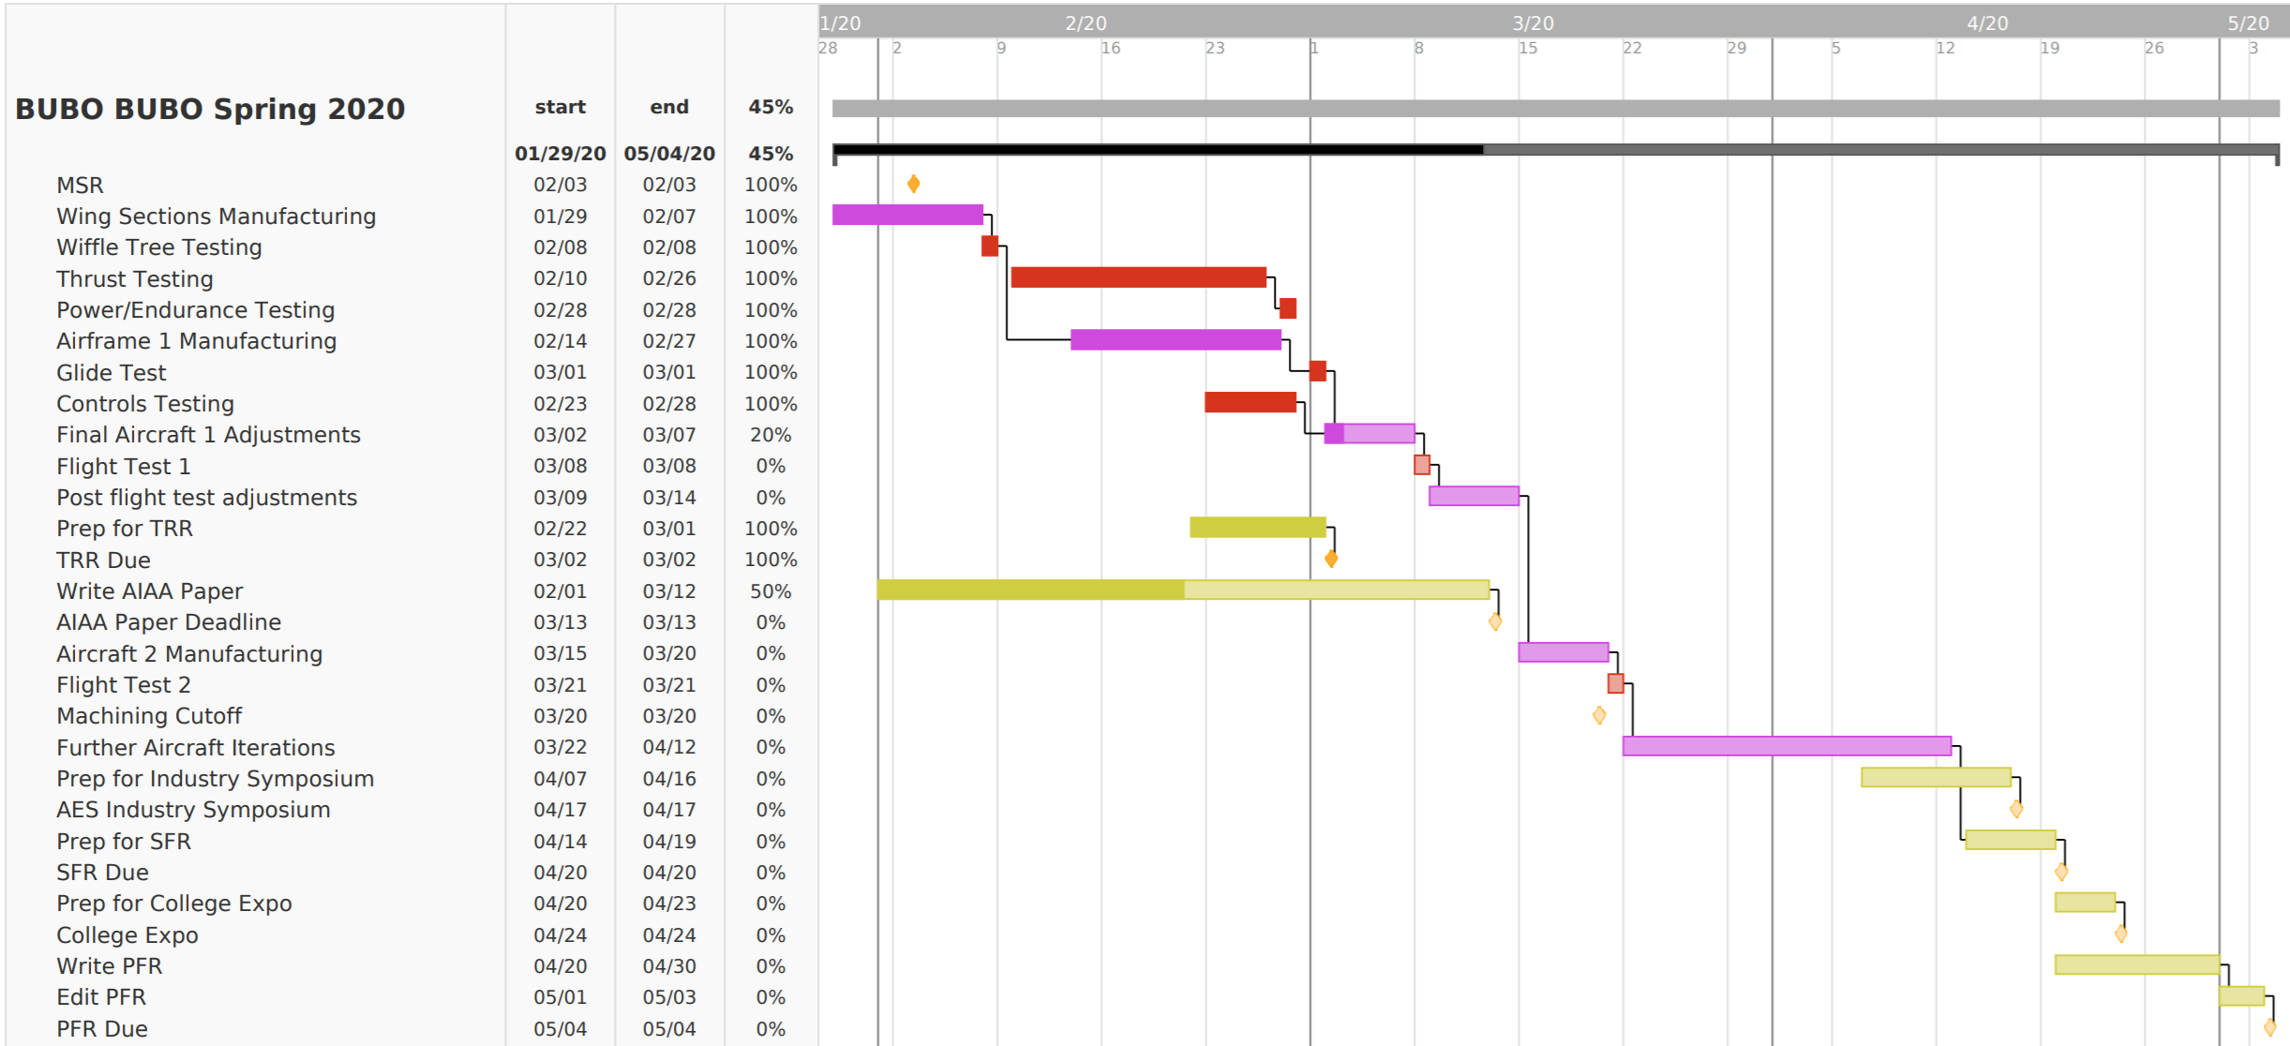
Overall Schedule
Critical Path
Deliverables
Manufacturing/Assembly
Testing

Slide 14
Testing

Slide 15
Test Overview
Whiffletree
Static Thrust
Controls
Power and endurance
Flight Test
Flight test readiness (Glide test)
FADS
Whiffletree
Static Thrust
Controls
Power and endurance
Flight Test
Flight test readiness (Glide test)
FADS

Slide 16
Whiffletree Test
Verifying: stress models and finite element analysis
Validating: ability to withstand expected aerodynamic loads, survivability requirement

Slide 17
Whiffletree Test Setup and Procedure
Whiffletree used in ASEN 2001
Straps placed on ribs
Whiffletree assembled so weight is distributed close to expected aerodynamic loading conditions
Added weight in 5/2.5 lb increments
For top wing, to failure
For bottom wing, until bucket was full
Safety Considerations
Safety goggles
Floor protection
Kept all team members away from testing setup

Slide 18
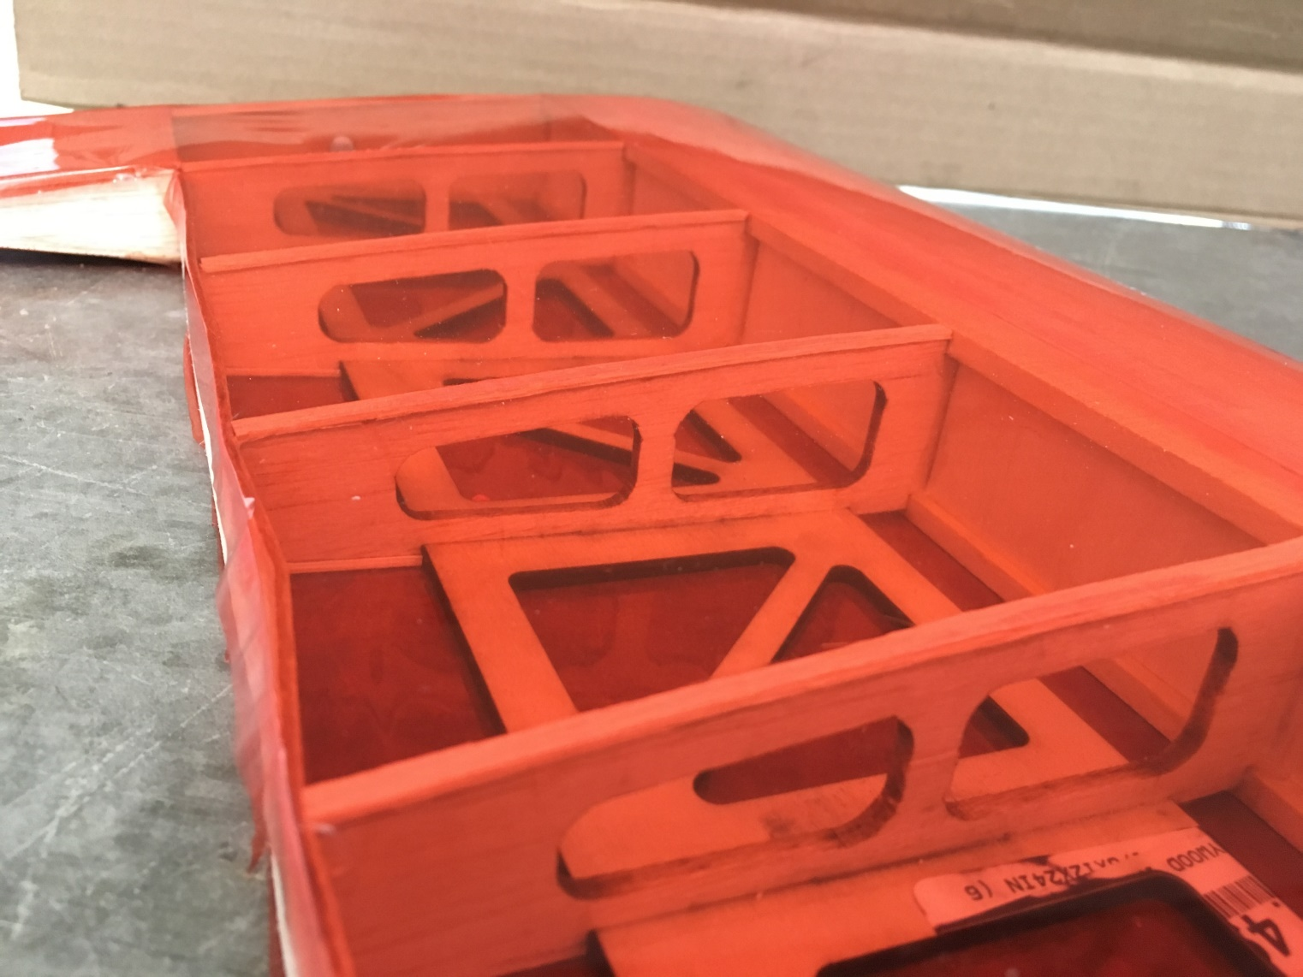
Whiffletree Results
Top (Swept) wing:
Max Load: 70lb
Failure Mode: trailing edge bent downwards
Bottom (Straight) wing
Max Load: 65lbs
Failure Mode: 3 middle ribs
Conclusion: Airframe will withstand expected flight loads
Notes:
This is important to us because it means construction of the full airframe could begin and so testing can continue on schedule.
These results are currently being analyzed to validated our finite element analysis and to identify areas where structure could be reduced or eliminated to aid in weight reduction

Slide 19
Whiffletree Results
Top (Swept) wing:
Max Load: 70lb
Failure Mode: trailing edge bent downwards
Bottom (Straight) wing
Max Load: 65lbs
Failure Mode: 3 middle ribs
Conclusion: Airframe will withstand expected flight loads
Notes:
This is important to us because it means construction of the full airframe could begin and so testing can continue on schedule.
These results are currently being analyzed to validated our finite element analysis and to identify areas where structure could be reduced or eliminated to aid in weight reduction

Slide 20
Whiffletree Results
Top (Swept) wing:
Max Load: 70lb
Failure Mode: trailing edge bent downwards
Bottom (Straight) wing
Max Load: 65lbs
Failure Mode: 3 middle ribs
Conclusion: Airframe will withstand expected flight loads
Notes:
This is important to us because it means construction of the full airframe could begin and so testing can continue on schedule.
These results are currently being analyzed to validated our finite element analysis and to identify areas where structure could be reduced or eliminated to aid in weight reduction
Eliminates the risk of plane breaking apart under flight loads

Slide 21
Static Thrust Test
Verifying: Propulsion performance models
Validating: Thrust and Endurance requirements

Slide 22
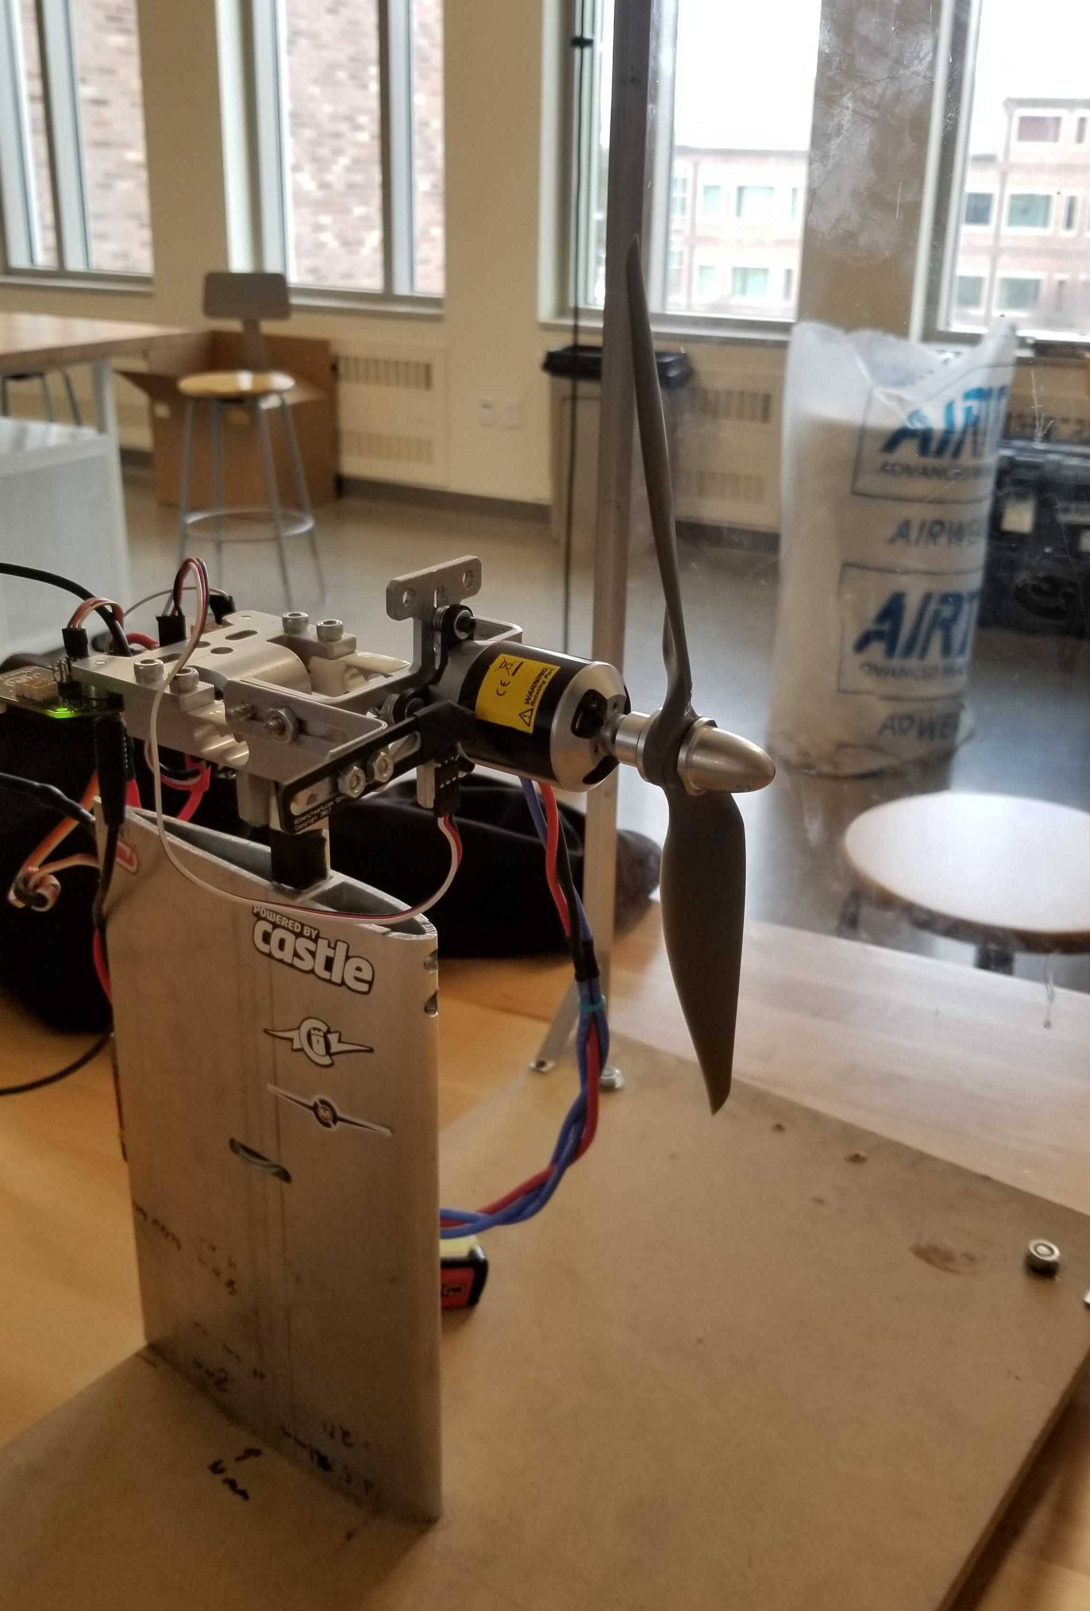
Static Thrust Test: Setup and Procedure
Informs motor choice and confirms thrust is appropriate for flight
Safety Considerations
Balanced propeller prior to test
Slowly throttled motor up to full to make sure vibrations would not cause issue.
Shielding of motor and propeller to protect all individuals involved
DBF Static Thrust Stand
Uncertain results due to uncalibrated equipment
Notes:
Thrust testing Measures thrust of motor/propeller combination
This information, along with our models, is intended to aid in motor/propeller selection

Slide 23
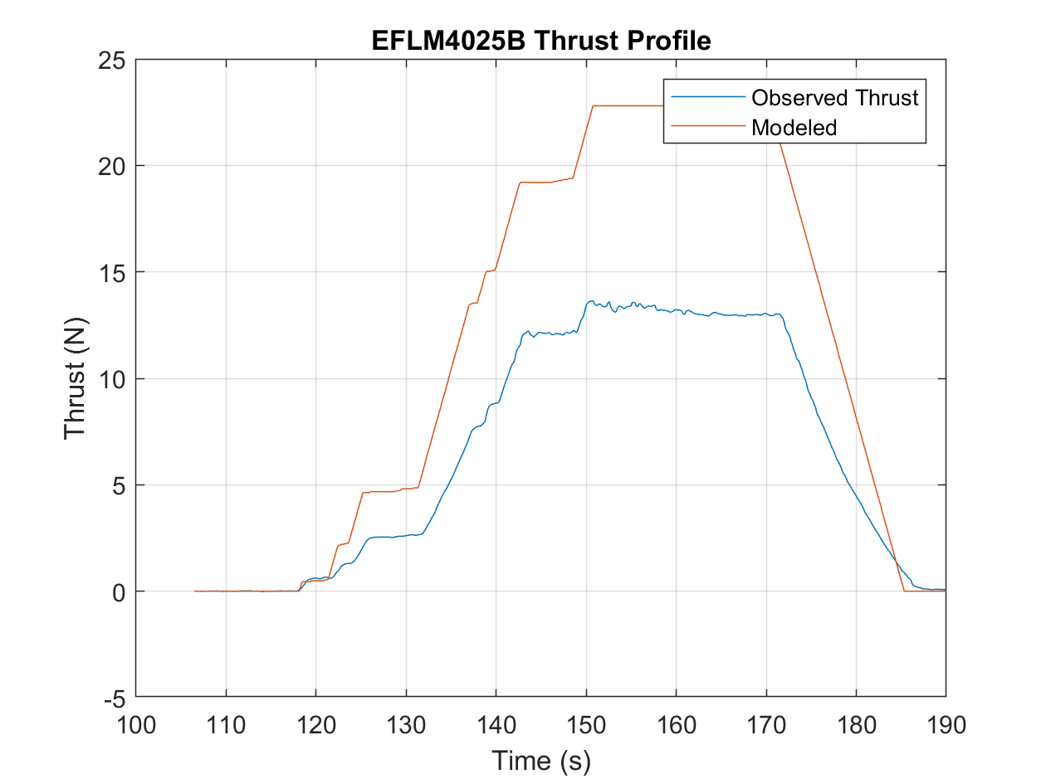
Static Thrust Testing Results
Propulsion: ELM4025-B and APC 10x7E
Chosen for small size and existing testing data
Obtained data is compared to model predictions
59.5% discrepancy discovered
Causes:
Load cell proportional calibration error.
Motor unable to accelerate to expected maximum RPM.
Conclusion: Test stand results can be scaled based on comparison to models and manufacturer performance estimates until test stand can be fixed.
Notes:
Magnitude is uncertain, thrust profiles appear accurate.
A linear calibration error is possible.
Rectify by comparison to models and manufacturer performance estimates.

Slide 24
Controls Test
Verifying: modeled gains are appropriate, desired deflections are attainable
Validating: navigation and control requirements

Slide 25
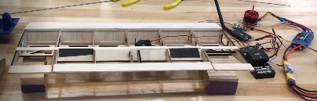
Controls Test Setup and Procedure
Manual Test
Elevons remotely connected to controller
Test roll and pitch maneuvers in each direction, verifying that elevon response is appropriate
Modify gains to allow for maximum elevon deflection
Autopilot Test
Connected elevons to PixHawk controller
Rotated PixHawk and checked for appropriate elevon response

Slide 26
Controls Results
Verified correct elevon responses
Lengthened servo arms to reach desired maximum deflection of at least 30 degrees
Elevon response is adequate to move forward to glide testing and flight testing

Slide 27
Flight Test
Verifying: aerodynamic stability, structural models on takeoff and in-flight
Validating: flight stability and takeoff/landing survivability requirements
Notes:
This is the only test we have left on our critical path and it is scheduled for __(insert date here)____

Slide 28
Safety Considerations for Flight Testing
Obtaining permission from Dan Hesselius, Director of CU Flight Operations, before any flight testing
Will be piloting maiden flight test
Checking battery status before connecting to electronics
Extensive testing done on every subsystem before full flight test
Separately and integrated
Clearing flight space before launch

Slide 29
Flight Test Readiness
Glide test verified airframe stability, control responses.
Notes:
Glide test verified airframe stability, control responses

Slide 30
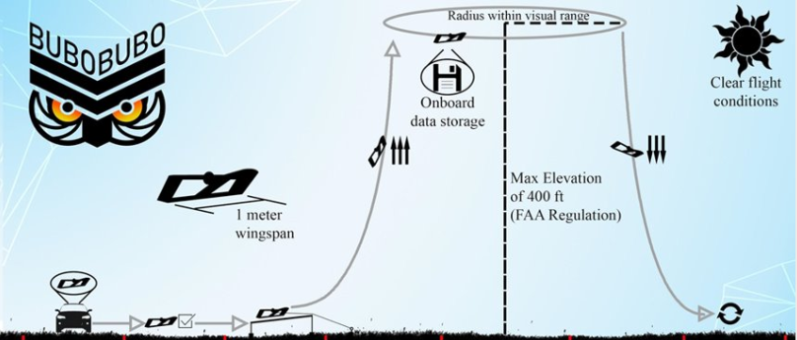
Flight Test Setup and Procedure
Location: CU Boulder South
Pilots: Dan Hesselius and Jeremy Yanowitz
Pre-flight checklist
Launch aircraft from table bungie
Ascend to cruising altitude
Perform several maneuvers and obtain Cooper-Harper rating for each
Descend and land safely
Identify any damage and determine re-flight time

Slide 31
Flight Test Results
Obtain Cooper-Harper ratings for each maneuver
Identify where improvements must be made
Maneuver | 1 | 2 | 3 | 4 | 5 | 6 | 7 | 8 | 9 | 10
Takeoff
Ascent
Steady flight
30° banked turn
Descent
Landing
Flight Performance
Desired performance
Adequate performance
Control
No control

Slide 32
Testing Status Recap
Notes:
This is the only test we have left on our critical path and it is scheduled for __(insert date here)____

Slide 33
Whiffletree Status
= Completed
= In Progress
= Planned
Produce wing section pieces
Assemble whiffletree
Monokote wing section
Assemble complete wing section
Perform whiffletree test

Slide 34
Static Thrust Testing
= Completed
= In Progress
Motor 1 (GH SMJ) Preliminary Test
Motor 2 (EFLM4025B) Thrust Test
= Planned
Motor 2 Endurance Test

Slide 35
Controls
= Completed
Manual Control Setup
= In Progress
= Planned
Test the PixHawk
Test the GPS Module
Integrate Components
Integrate the Components with Control Surfaces
Test the Telemetry Kit
Verify Elevons Deflection Behavior
Integrate the System into the Airframe
Ground Test
Flight Test
Expected: March 8

Slide 36
Power
= Completed
= In Progress
Initial Functional Model Circuit
= Planned
Dynamometer Data Collection Circuit
Airframe Wiring & Component Layout Test Circuit
Autopilot Integration Circuit
Endurance Test Circuit
Aircraft Final Circuit

Slide 37
Flight test readiness (Glide test)
= Completed
= In Progress
Construct full airframe
= Planned
Verify no aeroelasticity issues
Complete preliminary glide test
Ensure control system is functional
Practice synchronized longboarding

Slide 38
Flight Test
= Completed
= In Progress
Produce full airframe
= Planned
Integrate electronics, power, propulsion
Verify systems integration
Certification, FAA Registration
Conduct glide test
Perform flight test
Expected: March 8

Slide 39
FADS
= Completed
FADS Circuit Designed
= In Progress
Parts Ordered
= Planned
FADS Functional Circuit Built
Expected: March 15
Expected: March 14
FADS Pressure Isolation Test
Preliminary Data Collection Test
Full Airframe Integration
Expected: March 16

Slide 40
Budget

Slide 41
Notes:
MK II is about $800 less than we spent on the first iteration because we had several fixed costs from buying tools (like a heat gun) and a few bulk items (like our carbon fiber tubes) that will not need to repurchase. In addition, we are not implementing the FADS system into the first airframe to prevent damage to the system in the case of a crash on the first flight.

Slide 42
MK II Structure
Glue, Accelerator, Wood Filler | $108.78
Balsa Wood | $167.20
Bass Wood | $19.35
Birch Plywood | $130.95
Aluminum Rods | $3.04
Boom Dowels | $3.68
Ultracoat | $45.97
Tooling (screws, sandpaper, etc.) | $22.31
MK II Propulsion
ESC | $26.99
Batteries | $456.81
Propeller | $3.21
Motor | $100.00
MK II Electronics
Flight Controller (Pixhawk) | $330.00
Telemetry Radio | $22.99
Receiver | $39.55
Wires | $19.98
Arduino (Teensy 3.5) | $24.95
Buck DC to DC Converter | $11.25
XT60H Bullet Connector | $9.99
Notes:
This budget for MK II represents a total loss on MK I (like if the plane caught fire and we lost everything in it). We are not expecting to actually spend $1547 on the second iteration of our aircraft, but we budgeted for it just in case.
These charts show the items that would need to be repurchased that have been accounted for in this budget.
The yellow items here are more expensive items that we don’t want to have to replace if possible. To mitigate this budget risk, we are doing our maiden flight of MK I with only 4 batteries instead of 16 and we have reinforced the structure surrounding the pixhawk to attempt to protect it as much as possible in the case of a rough landing.

Slide 43
Total Spent: $2728.57, 48%
Total Remaining: $2921.43, 52%
Notes:
MK II Spending Thus Far
$45.97 on monokote
$130.95 on plywood

Slide 44
Electronics & Controls

Slide 45
Propulsion

Slide 46
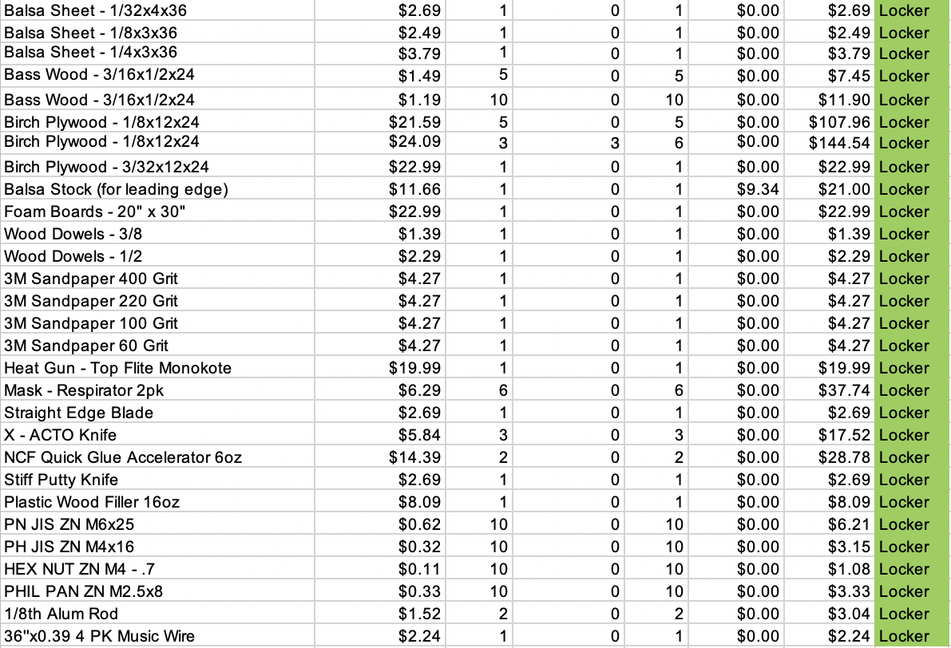
Airframe

Slide 47
FADS

Slide 48
Thank You
Questions?

Slide 49
Directory
Title
Overview Title
Project Purpose
Levels of Success
CONOPS
FBD
Critical Project Elements
Design Overview
Baseline Design
Boom Design
Schedule Title
Testing Schedule
Overall Schedule
Testing Title
Test Overview
Whiffletree Test Title
Whiffletree Setup and Procedure
Whiffletree Results
Whiffletree Results zoomed
Whiffletree Results
Static Thrust Test Title
Thrust Test Setup and Procedure
Thrust Testing Results
Future Thrust Testing
Controls Test Title
Controls Test Setup and Procedure
Control Test Video
Controls Results
Flight Test Title
Flight Test Readiness (Glide video)
Flight Test Setup and Procedure
Flight Test Results
Testing Status Recap Title
Whiffletree Status
Static Thrust Test Status
Controls Status
Power Status
Flight Readiness (Glide Test) Status
Flight Test Status
FADS Status
Budget Title
Current Budget
MK II Budget
Spent vs Remaining Budget
Electronics and Controls Procurement
Propulsion Procurement
Airframe Procurement
FADS Procurement
Questions
Directory
Backup Slides Title
Boom Design Backup Title
Boom Trade Studies (1 vs 2)
Boom Trade Study (Eigenvalues)
Boom Design Solver
Boom Vibrational Analysis Formulation
Boom Equivalent Torsional Spring Constant
Boom Vibrational Analysis Initial Conditions
Boom Analysis Results (Short Time Scale)
Boom Analysis Result (Long Time Scale)
Boom Analysis Results (Frequencies)
Thrust Testing Backup Title
Propulsion Models
Propulsion Models (Assumptions, Margins, and Limitations)
Propulsion Model Verification
Using Models to Aid Motor Selecion
E-flite 25 Power 1250 Kv Motor
Static Thrust Test Video
Flight Testing Backup Title
Cooper Harper Descriptions
Flight Checkout
Flight Test Preparation
Electrical Backup Title
Main Circuit
FADS Circuit

Slide 50
Backup Slides

Slide 51
Boom Design and Vibrational Analysis

Slide 52
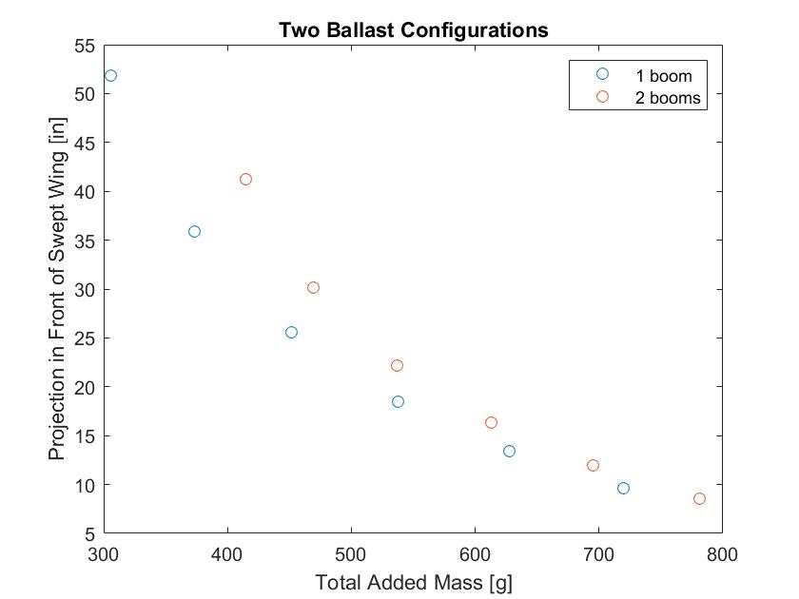
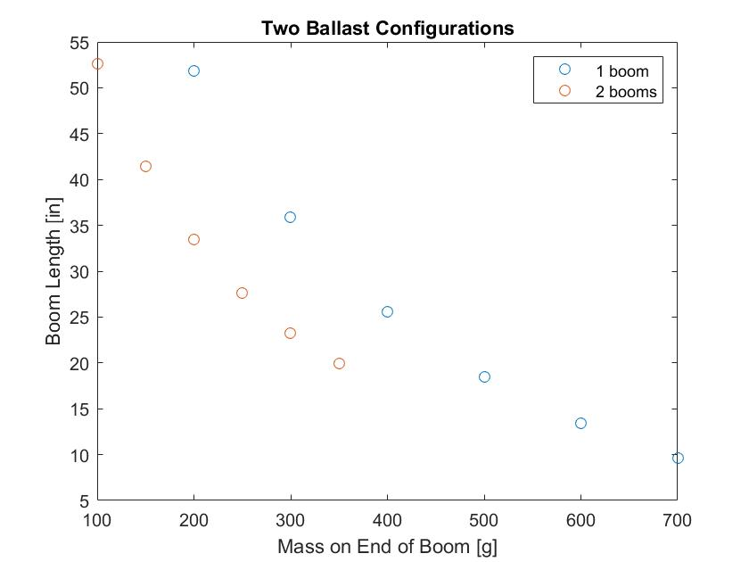
Boom Design Trade Studies
Investigated weight of boom mass vs necessary weight in order to select an adequate combination

Slide 53
Boom Design Trade Study
Stability modes are minimally impacted by the choice.

Slide 54
Boom Design Solver
Using center of gravity equation, the following quadratic equation was developed, with the only unknown parameter being the boom length, L
where
m = boom mass
m_{ac} = unballasted aircraft mass
q = mass/length of dowel
x = location of dowel's start relative to unballasted C.G.
x_{cg} = location of desired C.G.
x_{ac} = location of unballasted C.G.
This equation was then solved to find the required boom length

Slide 55
Boom Vibrational Analysis Formulation
Equations of motion were found using Lagrange's equation, an energy method:
Energies and Rayleigh's dissipation function are given by:
And q_{s} represents each degree of freedom:

Slide 56
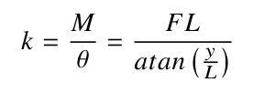
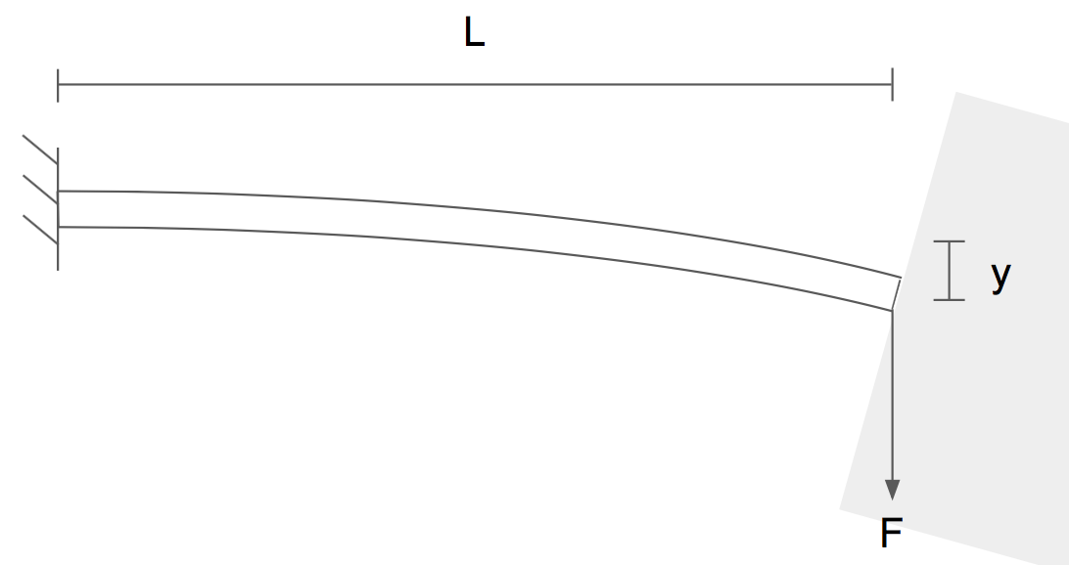
Boom Equivalent Torsional Spring Constant
Apply a known force at a known length, measure resulting vertical displacement and calculate k according to:

Slide 57
Boom Vibrational Analysis Initial Conditions
In order to determine the initial displacements of the boom, the aircraft's pitch and yaw responses to both 10° perturbations and natural modes were examined
Represents maximum expected in-flight perturbations
The maximum pitch and yaw rates were found and converted into linear boom velocity assuming rigid body motion
Displacements resulting from drag induced moments during these rotations then found and used as initial conditions, with an additional factor of safety of 2:
θ_{1,0} = 7.6919e-4º
θ_{2,0} = 2.0435e-4º

Slide 58
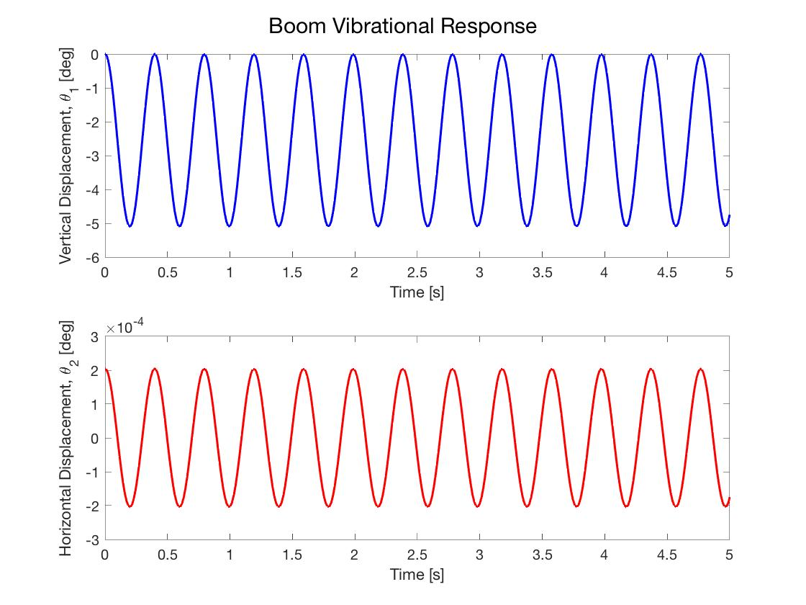
Boom Vibrational Analysis Results
Lagrange's equation yields the following equations of motion:
Numeric simulation produced time response plots

Slide 59
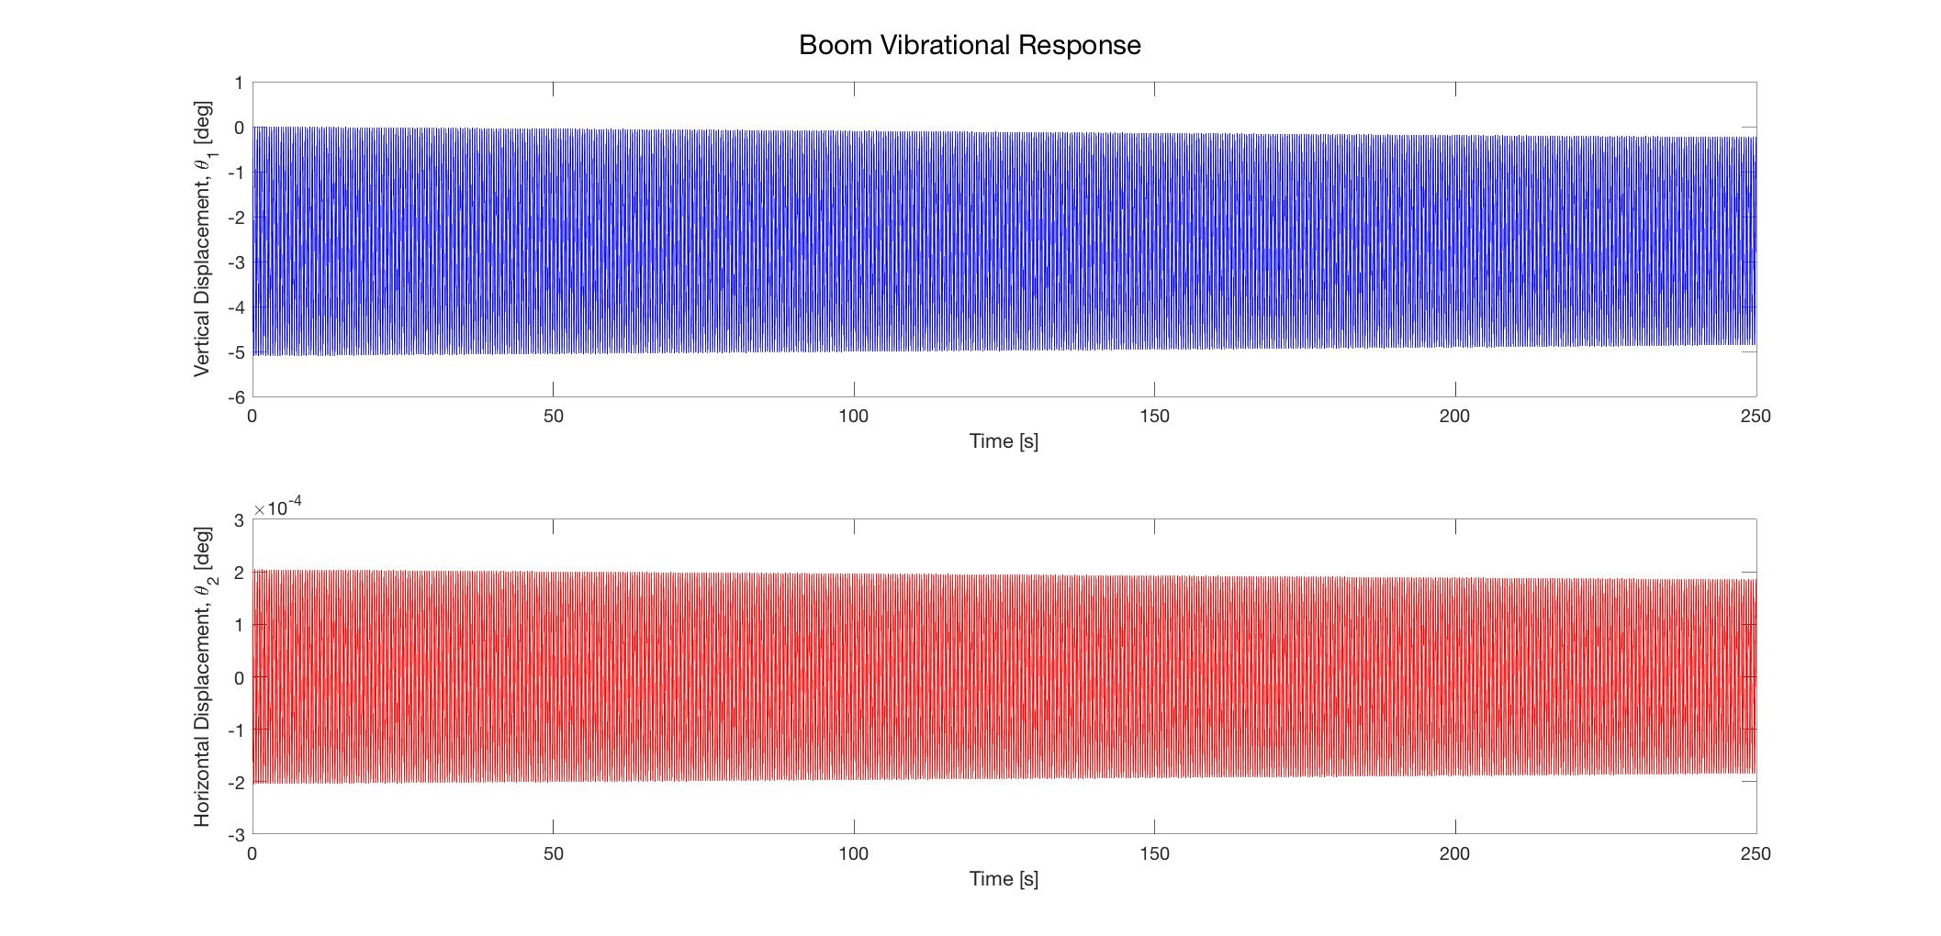
Boom Vibrational Analysis Results
Extended time series to show (slight) effect of drag dissipation

Slide 60
Boom Vibrational Analysis Results
Vibration oscillation frequencies:
f₁ = 2.578 Hz f₂ = 2.518 Hz
Natural frequencies of oscillatory modes:
f_{long mode} = 0.0787 Hz
f_{lat mode} = 0.653 Hz
Motor frequency range:
7,000 – 15,000 rpm ≈ 116 – 250 Hz
Therefore concluded resonance with the boom won't be an issue

Slide 61
Thrust Testing

Slide 62
Propulsion Models

Slide 63
Propulsion Models
Margins and Limitations
•AVL Drag:
•Estimated at 4 N, FoS of 2.5 is applied due to uncertainty
•Accounts for air density via:
• Does not consider changes in Reynold’s number due to altitude.
Assumptions
Cruise Airspeed: 14.5 m/s
Stall Airspeed: 7.5 m/s
Target Thrust: 10 N
Maximum Thrust: 20 - 30 N

Slide 64
Propulsion Model Verification

Slide 65
Using Models to Aid Motor Selection
General Rationale:
Full throttle flight condition defines the desired max RPM.
Max RPM defines Kv (In conjunction with battery voltages)
Power estimates defines desired maximum motor power load.
The Ideal Motor (33% throttle @ cruise)
1372.5 RPM/V (Kv)
1390.4 W @max
285.14 W @cruise
125.2 A @max
The Ideal Motor (50% throttle @ cruise)
1156.1 RPM/V (Kv)
662.64 W @max
236.65 W @cruise
59.7 A @max

Slide 66
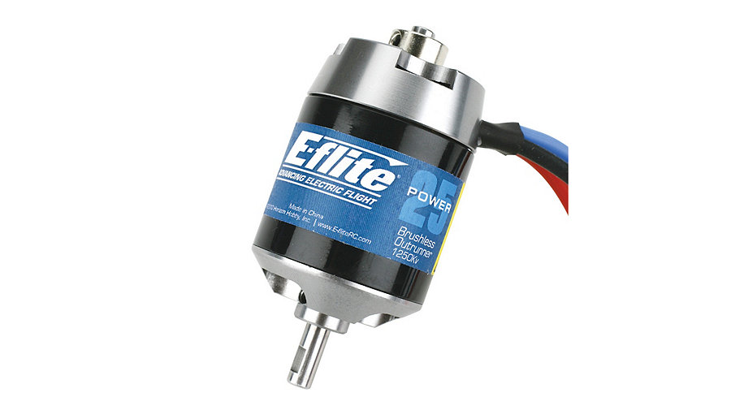
E-flite 25 Power 1250 Kv Motor (EFLM4025B)
Specifications/Features
1250 kV
50 A (continuous)
58 A (burst)
850 W (continuous)
183 g
Can produce easily enough thrust to overcome drag even with 2.5 FoS. Capable of running 8-12 inch propellers, allowing for a range of flight requirements.

Slide 67
Flight Testing

Slide 68
Cooper-Harper Rating Descriptions
1 - Excellent, highly desirable
Pilot compensation not a factor
2 - Good, negligible deficiencies
Pilot compensation not a factor
3 - Fair, some mildly unpleasant deficiencies
Minimal pilot compensation required
4 - Minor but annoying deficiencies
Moderate pilot compensation
5 - Moderately objectionable deficiencies
Considerable pilot compensation
6 - Very objectionable, yet tolerable deficiencies
Extensive pilot compensation
7 - Major deficiencies
Adequate performance not attainable with maximum tolerable pilot compensation
8 - Major deficiencies
Considerable pilot compensation for any control
9 - Major deficiencies
Intense pilot concentration required for control
10 - Major deficiencies, unpilotable
Control will be lost during operation

Slide 69
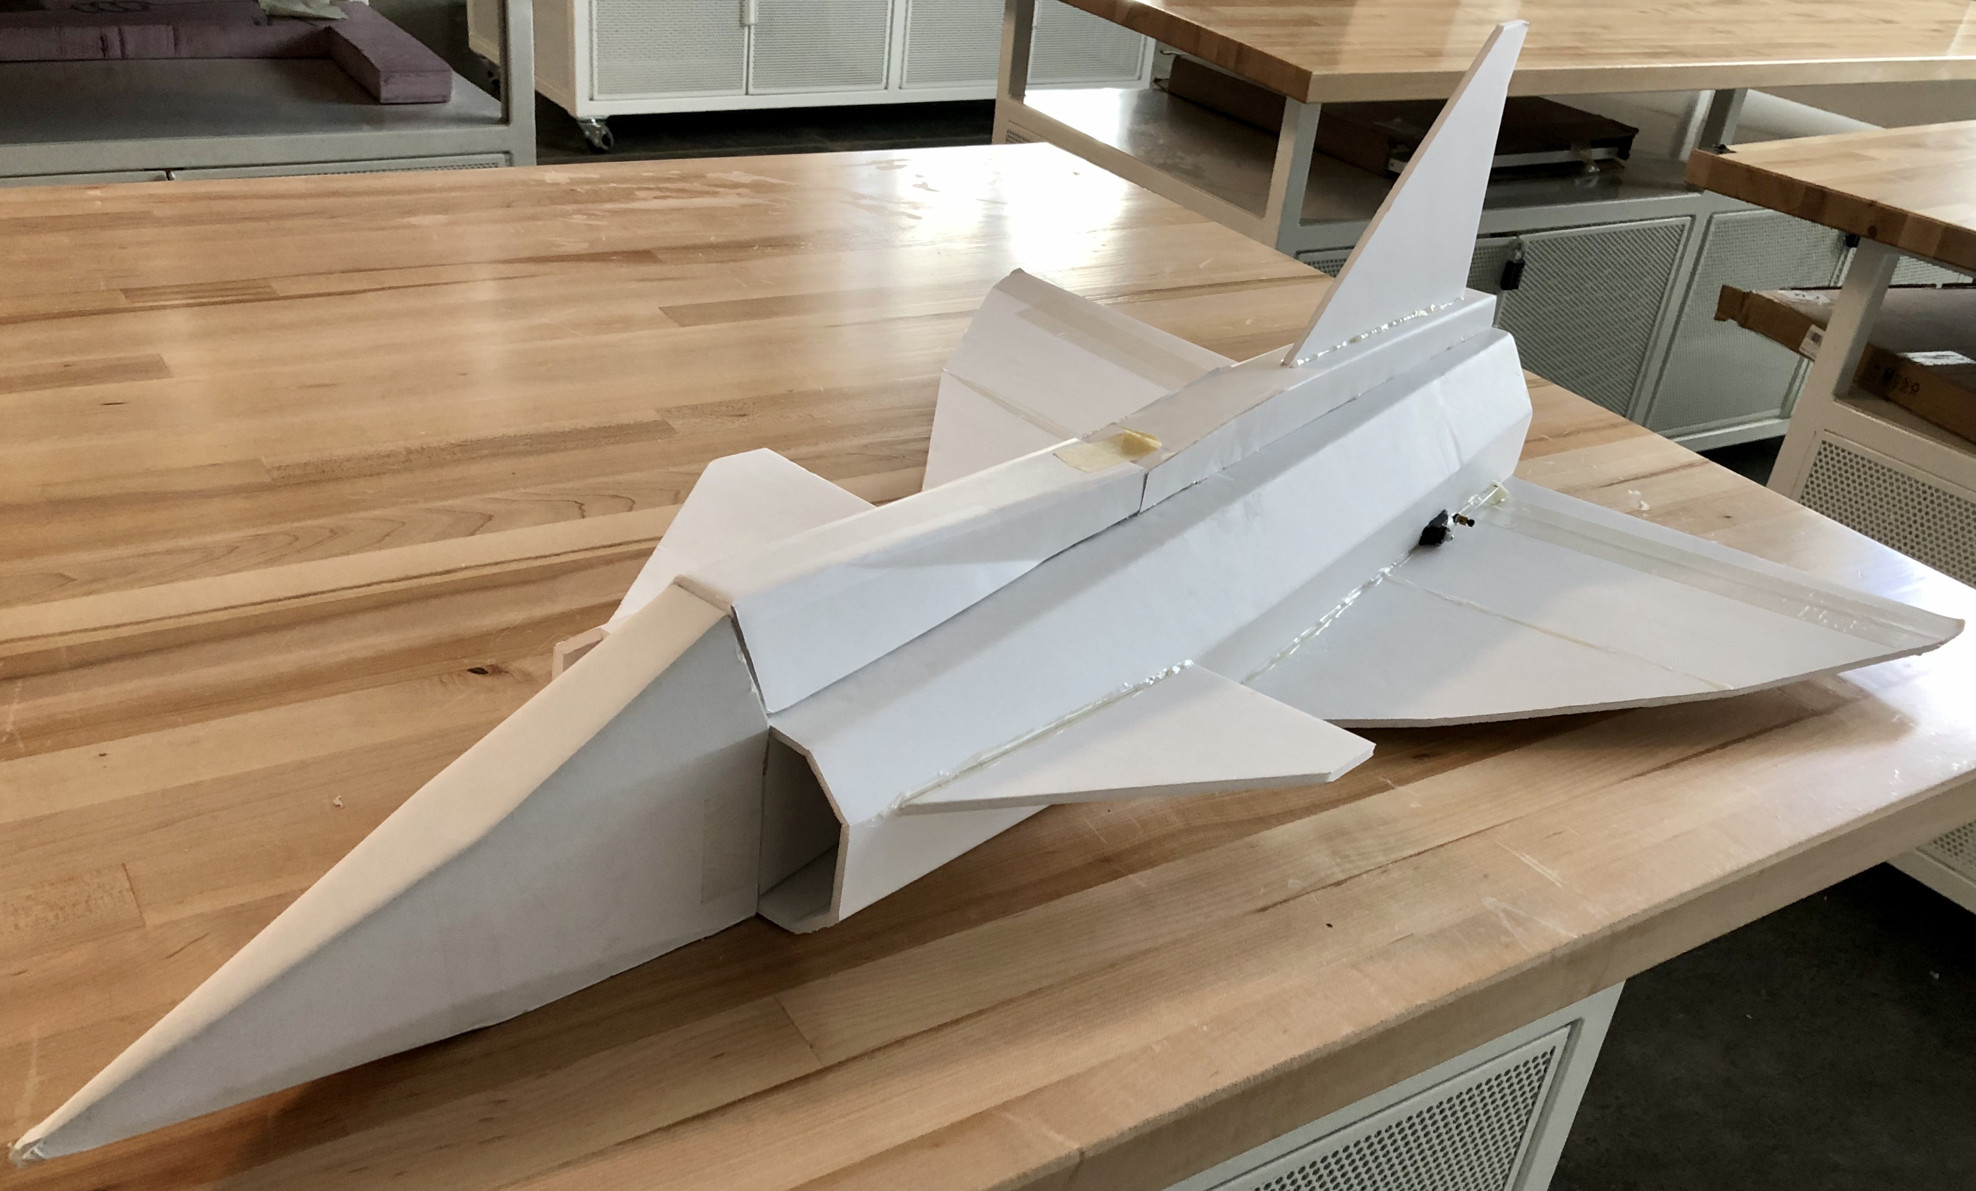
Flight Checkout
Steps to BUBO flight testing:
Flight Director Dan Hesselius requires proof of piloting ability
Wants to see piloting of a fast, difficult to control aircraft
Built ducted fan, elevon-only jet to fulfill requirements
Shares control setup with BUBO
Flight checkout scheduled
Another step:
MSR Goal: Will acquire one FAA sUAS Registration Number to use on test airframes.
Must wait for Temp License before applying --> still pending

Slide 70
Flight Testing Preparation
Flight testing will be conducted under FAA 14 CFR Part 107
Requires test pilot to hold FAA Remote Pilot Certificate
Airmen Knowledge Test Taken (2/1/2020) (Passed)
Remote Pilot Certificate applied for
Expecting Temp License later this week
Will acquire one FAA sUAS Registration Number to use on test airframes.
Must wait for Temp License before applying
Costs $5 per registration number
Can be swapped between airframes as long as only one is airborne at a time

Slide 71
Electrical

Slide 72
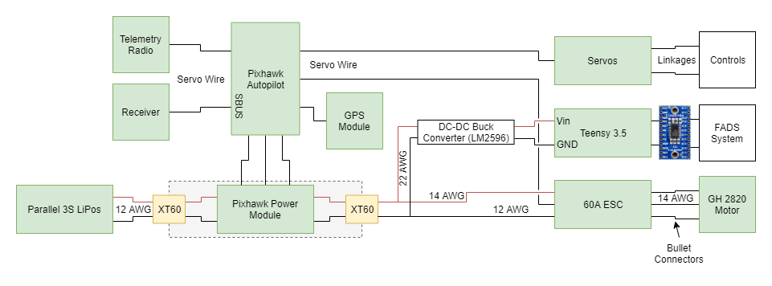
Main Circuit
Aircraft Circuit Design / Analysis complete, ready for manufacturing
Switch from passive resistor voltage control to DC-DC buck converter for powering FADS system – more robust solution

Slide 73
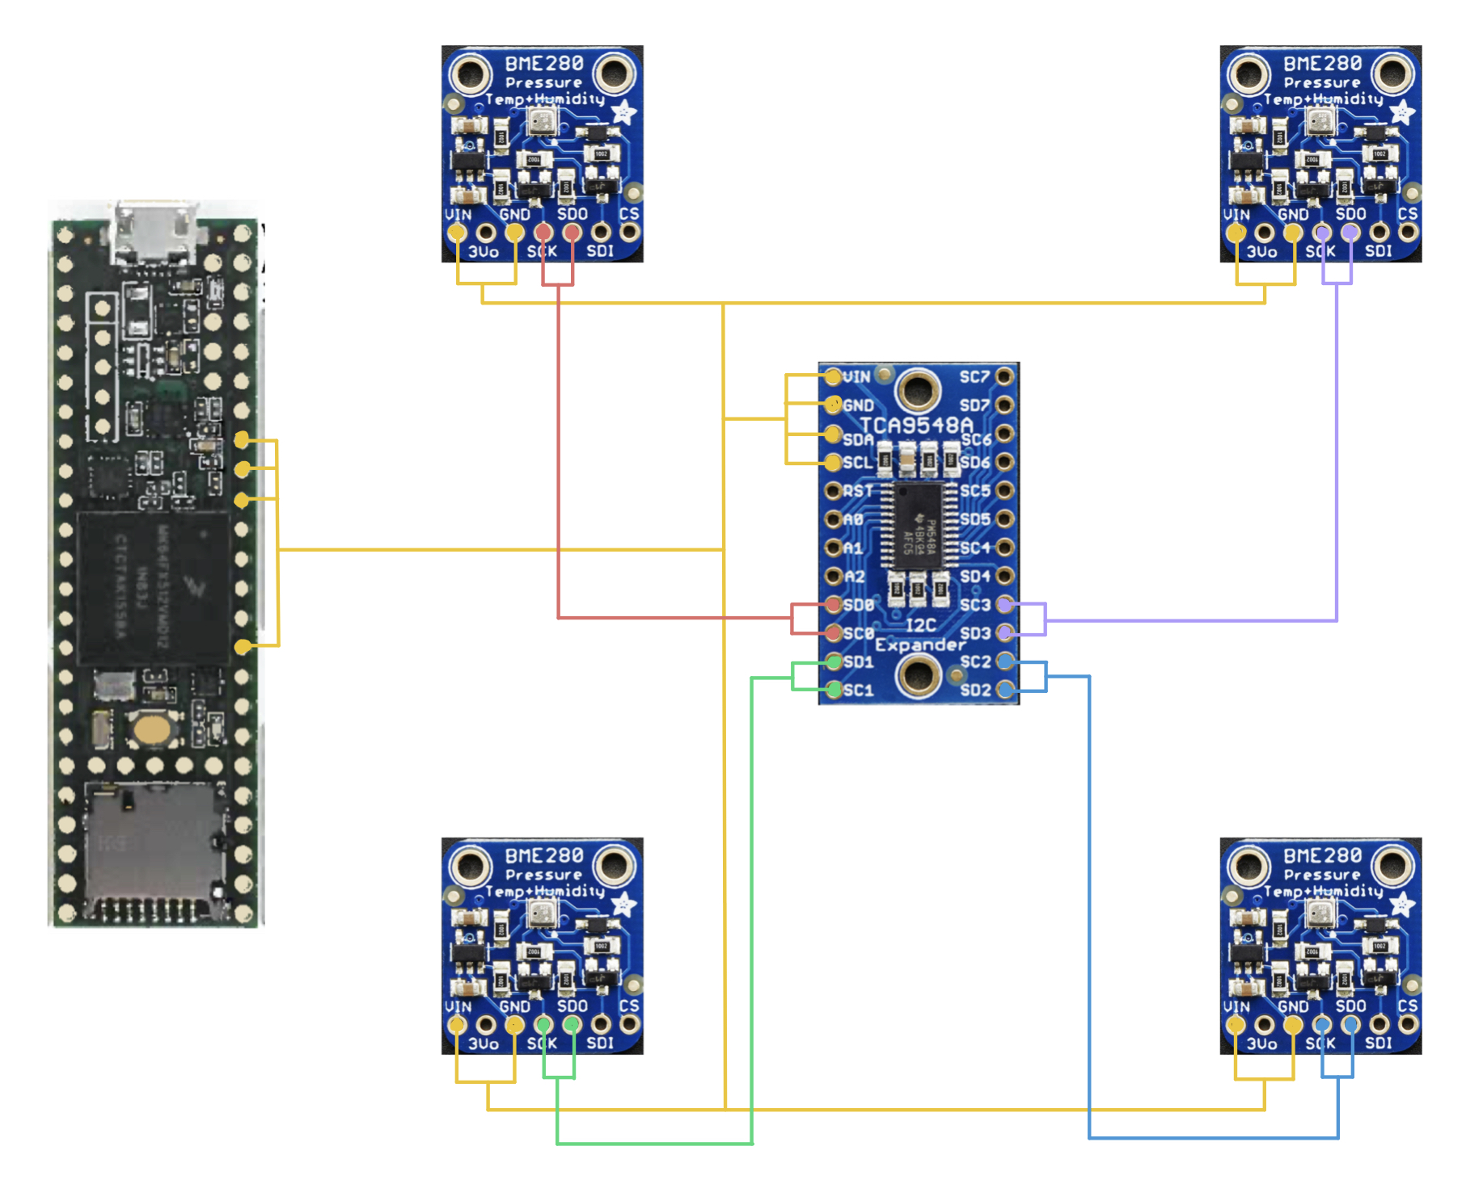
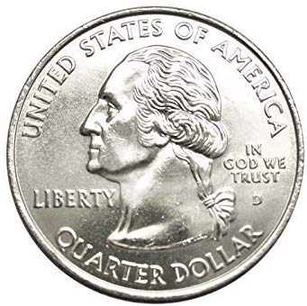
FADS Cicuit
FADS Circuit Design complete
Using Teensy for motor testing as well as FADS data collection
Teensy acquired but awaiting orders of I2C Mux and Transducers
Code developed for data collection, awaiting motor testing
Taking low priority as not essential to achieve flight <-- top priority
* quarter for scale

