Slide 1
ASEN 4018 Senior Projects Spring 2018 Test Readiness Review
TEAM: Omar Alshamsi, Meer Baker, Eric Bergman, Jack Lambert, Eli Landers, Quentin Moore, Alex Mulvaney, Donald Palomino, Wyatt Raich, Brody Rosipajla, Aytac Teker, Eric Zhao
Customer: Robert Leben
Advisor: John Mah

Slide 2
Project Objectives
Mission Statement: BEACAN will design, build, and test a miniaturized ocean drifter. The drifter shall be capable of collecting positional coordinates and transmitting coordinates to a communications satellite. Secondary, the team will develop a drifter deployment mechanism.
Final Customer Deliverables:
1 deployment mechanism, 2 drifters (1 for testing)
Notes:
- Add edited levels of success

Slide 3
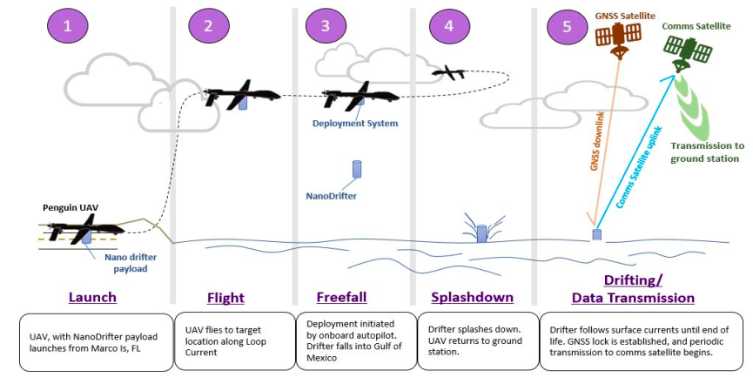
Customer CONOPS
1
2
3

Slide 4
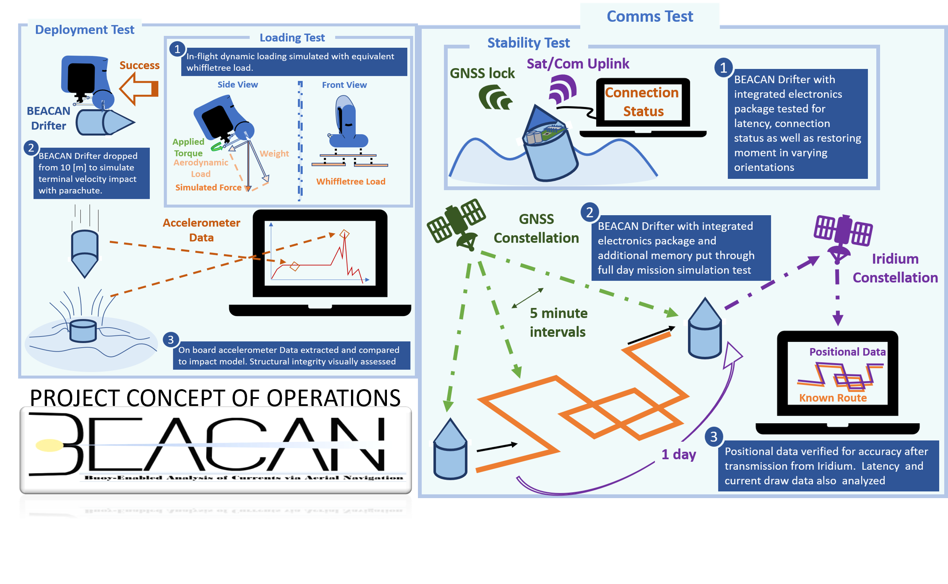
Testing CONOPS

Slide 5
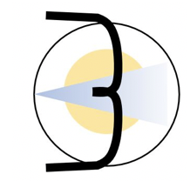
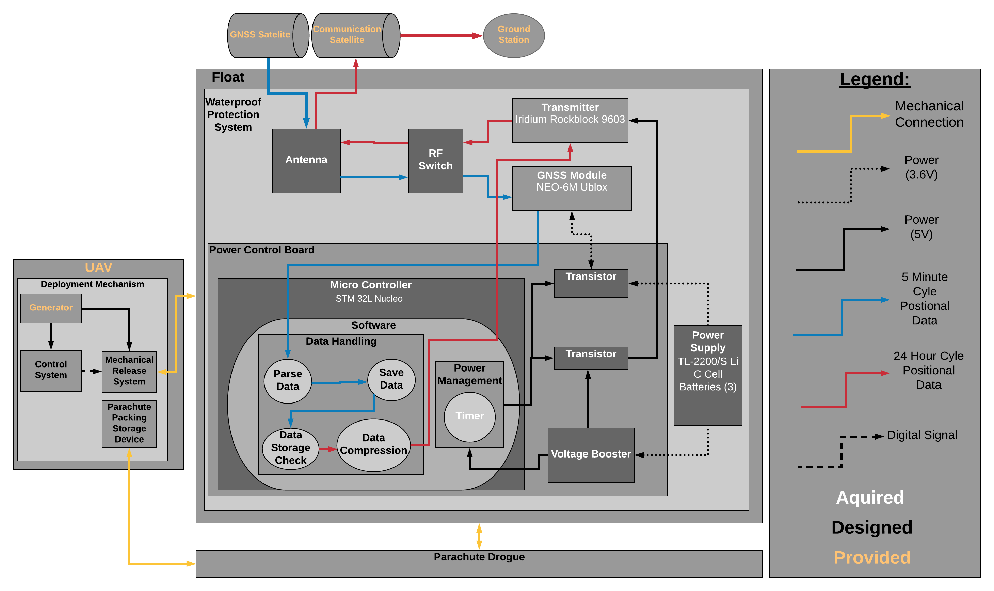
Design Solution: Functional Block Diagram
Notes:
Here we have the deployment mechanism. A external power source will supply a load to motor. This will release the float and parachute. Within the float we have the Power Control Board with power supply indicated by black lines. The blue lines indicate a 5 minute cycle which you can see run down from the GNSS satellite to our antenna, into the GNSS module and finally to the microcontroller where the data will be parsed and stored. Notice that we have only one antenna which will operate for both the reception and transmission of which the red lines indicate. The red lines show the process that will happen every 24 hours. The data will be compressed, sent to the transmitter which will communicate the data to the Iridium satellite who will finally send the data to the ground station.

Slide 6
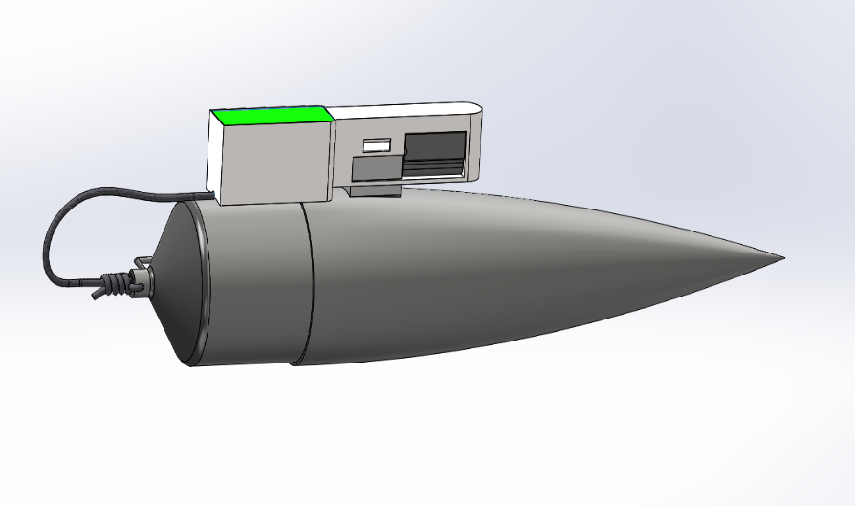
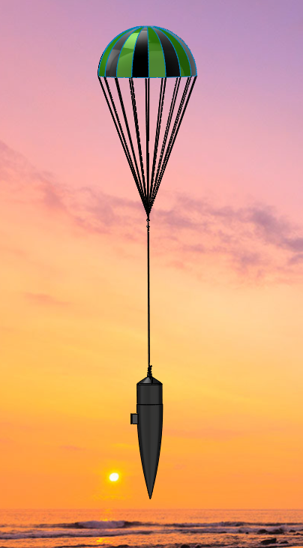
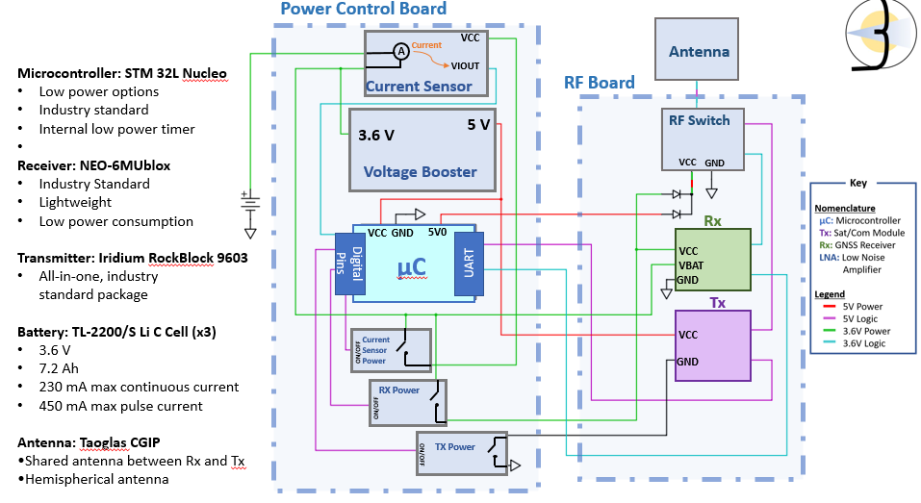
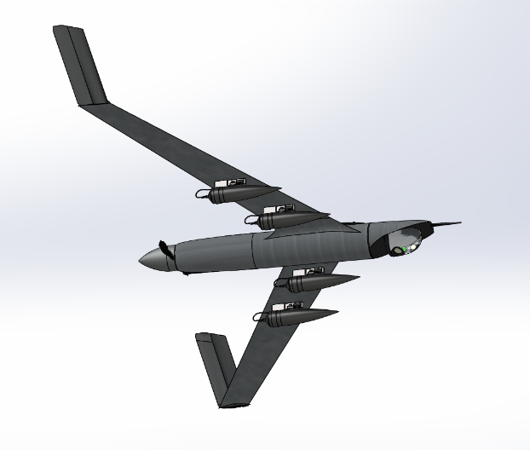
CDR Baseline Design
Deployment Mechanism | Structure | Electronics
Total Mass: 32 [g] Total Cost: $115 | Total Mass: 273.5[g] Total Cost: $90.92 | Total Mass: 290 [g] Total Cost: $401.49
Parachute
16 [cm]
30 [cm]
Antenna
3.4 [cm]
2.6 [cm]
46 [cm]
Polystyrene Packing
Linear Motor
100 [cm]
RF COM Boards
38 [cm]
Power Control Board
8 [cm]
C-Cell Batteries

Slide 7
Critical Project Elements
System | Driving Requirements
Communication Systems | • Shall take position data every 5 minutes to an accuracy of 60 [m] • Shall transmit position data every 24 hours
Electronics/Power Systems | • Shall survive impact at terminal velocity • 3-month power
Structures | • Structural integrity post impact • Flotation Stability
COST: manufacturing 1 drifter shall not exceed $1000
MASS: 4 drifters and deployment mechanism shall not exceed 2.7 kg

Slide 8
Levels of Success Overview
Level 1: Individual Component Selection | Level 2: Prototype | Level 3: Integration
Structural Design/ Testing Method Communications Design/ Testing Method Power System Design/ Testing Method Deployment Design/ Testing Method | Float Manufactured: Individual structural testing Software: Individual functions complete/ tested Electronics: Individual component testing/ validation Power: Testing/ Validation Deployment Mechanism Manufactured: Pass individual tests, including parachute tests. Integrated electronic/ software validation | 24 Hour day in the life test Drifter/ Deployment integration 24 - hour GPS collection Iridium Communication

Slide 9
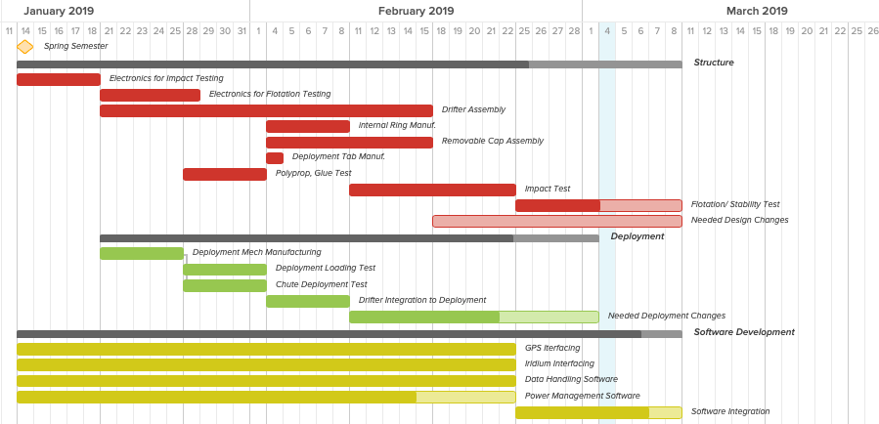
Notes:
UPDATE?

Slide 10
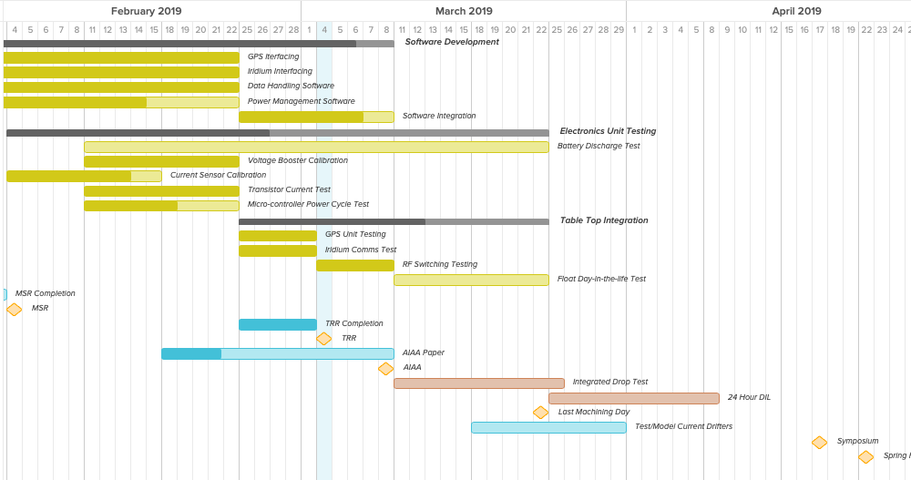
Testing/ Integration
Notes:
UPDATE?

Slide 11
Structural Testing
Test | Method​ | Status​
Glue Tension Test | Instron Machine, shear test | Complete
Water Sealing Test | Place in water for 1 week | Complete
Impact Test | Drop from 2 ft interval heights up to 20 [ft] Record acceleration Use highspeed camera to obtain velocity right before impact | Complete
Underwater Displacement | Record drops from 20ft. Use processing software to determine distance from impact to submersion to emersion. | Complete

Slide 12
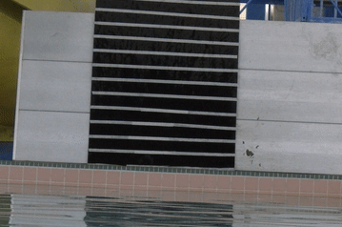
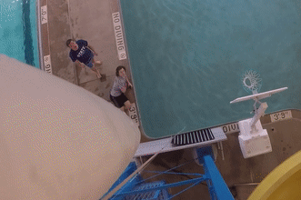
Drop Test
3”

Slide 13
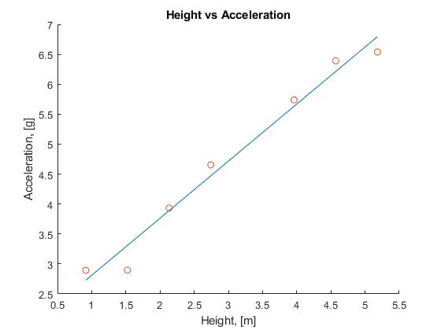
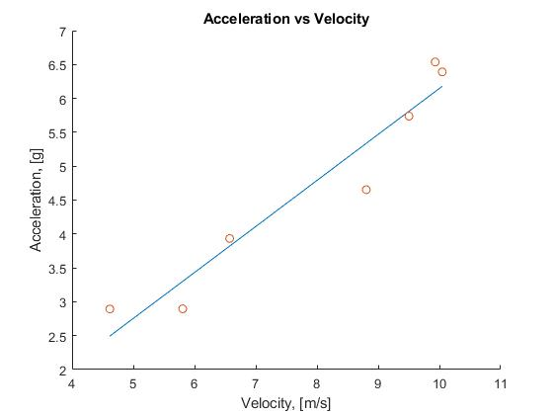
Acceleration Data
$$V_{term}=9.48 \left[m/s\right]$$
Theoretical Model | Experimental Result (from linear fit)
a = 53.3 [G] @ Terminal | a = ~6.00 [G] @ Terminal

Slide 14
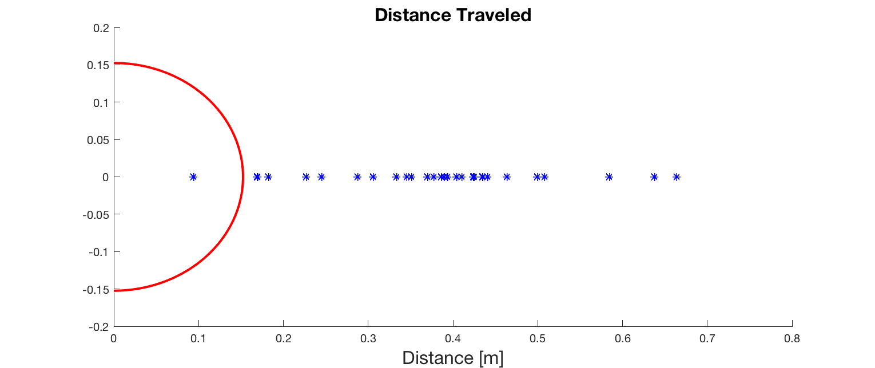
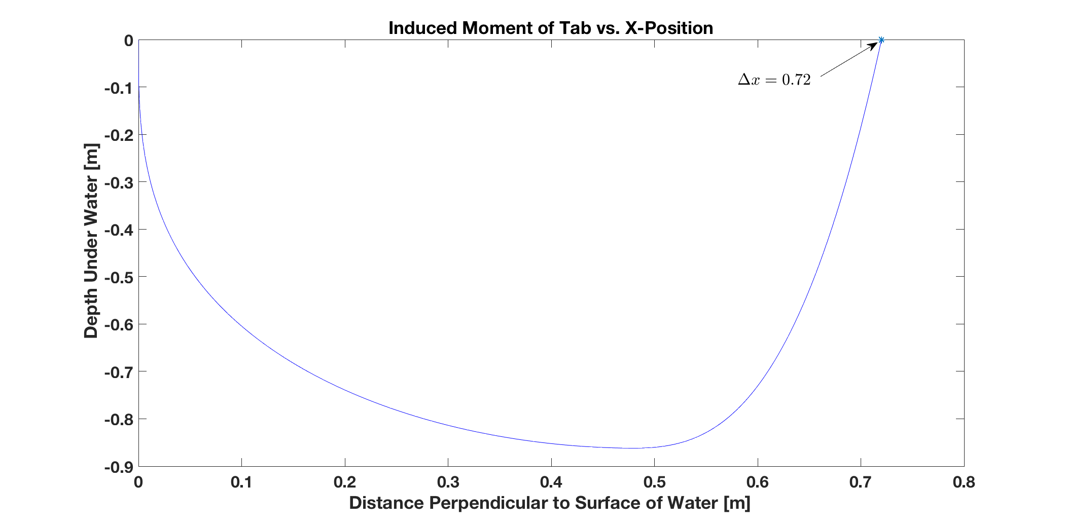
Underwater Displacement Test - Data
Underwater Trajectory

Slide 15
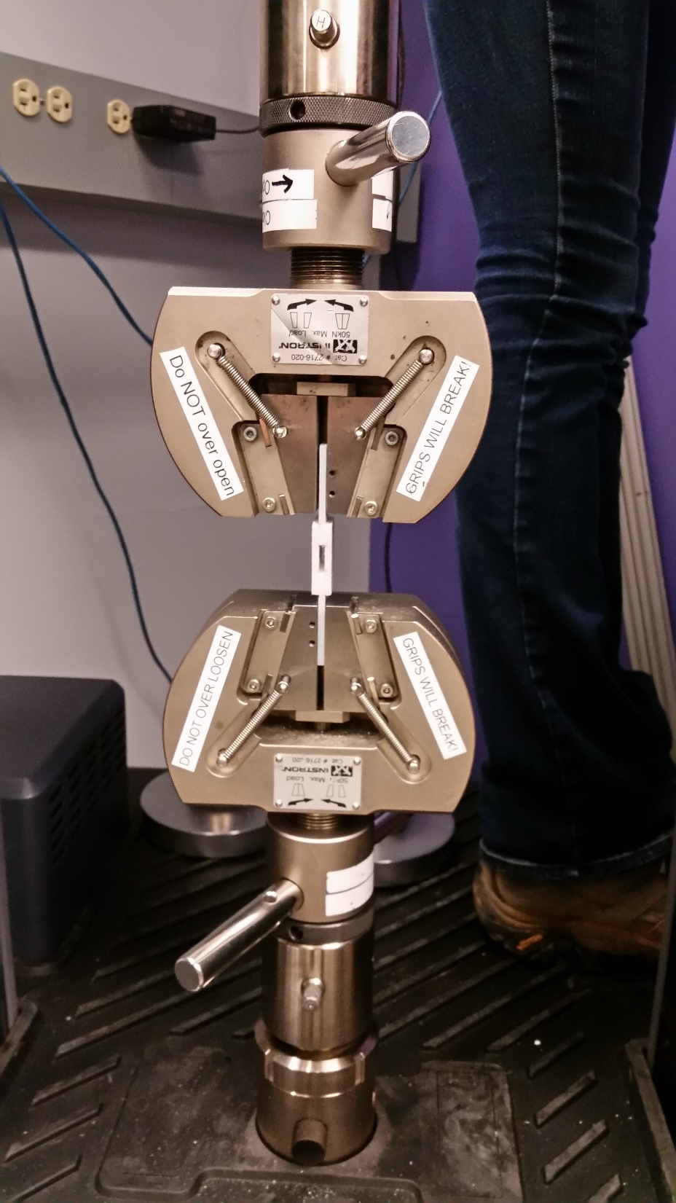
Glue Strength Test
Test Procedure:
Apply primer and adhesive to various areas of PPE test strips
Allow glue to bond for 24-hours minimum
Use tension test machine to pull samples until failure

Slide 16
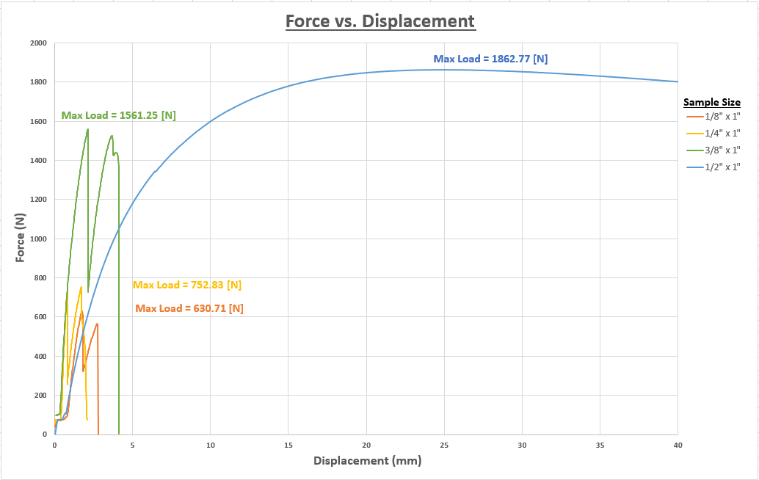
Glue Strength Test – Data & Conclusion
Maximum predicted force on glued portion of drifter = 326.5 [N]
Height of ring glued to float = 0.496”
PPE expected to yield prior to glue failure
Adhesive Area

Slide 17
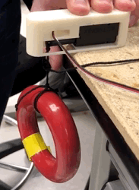
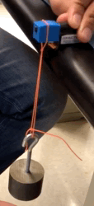
Deployment Tests
Test | Method​ | Status​
Deployment Mechanism Load Test | Load DM with drifter simulated weight | Complete
Linear Actuator Friction Test | Activate LA while DM is under drifter simulated weight | Complete
Tab Waterproofing Test | Bolt on tab to drifter with silicone rubber gasket Submerge underwater for a day | In progress
Drifter Separation Test | Load drifter onto DM at negative inclination relative to UAV Release drifter in exhaust of wind tunnel | In progress
Engineering Tower Integrated Drop Test | Load drifter and parachute onto DM Release drifter with parachute from top of EC tower | Not started
ECD 3-20
Notes:
Deployment Mechanism Load Test -A weight simulating that of the drifter will be loaded onto the pin of the DM. Verification is confirmed is it does not fail
Linear Actuator Friction Test - With the same weight loaded onto a tab, the LA will be activated to pull the pin from the tab. Verification is confirmed if LA overcomes friction.
Tab Waterproofing Test - The drifter will be submerged underwater for a day. Verification is confirmed if drifter internals do not have moisture.
Drifter Separation Test - The drifter will be loaded onto the DM at a negative elevation relative to the UAV's orientation and then released.
Drop Test - The drifter and parachute is loaded onto the DM and then released from the top of the engineering tower. Verification is confirmed if parachute successfully deploys and slows the speed of descent of the drifter without damage to its structure or components.

Slide 18
Electronics Tests
Test | Method​ | Status​
Battery Discharge | Record voltage discharge over time at nominal current draw | Not started
Voltage Booster Calibration | Verify correct output voltage Record component efficiency at various output currents | Not started
Current Sensor Calibration | Record voltage output at various input currents Calculate zero current output and current sensitivity | In progress
Transistor Current Test | Verify current switching performance of transistors | Completed
Micro-Controller Power Cycle | Verify software power cycle timing Record component current draw | In progress
GPS Unit Test | Establish serial communication between STM32L0 micro-controller and GPS unit | Completed
Iridium Comms Test | Establish serial communication between STM32L0 micro-controller and Iridium Rockblock unit Fill Iridium buffer with random messages and transmit those message to nearby satellite | Completed
RF Switch Test | Plug an external antenna to the RF switch Control the RF switch's logic gates using STM32 Connect a GPS or an Iridium unit to the RF switch and test the signal quality | Completed
ECD 3-20
ECD 3-15
ECD 3-7
ECD 3-20

Slide 19
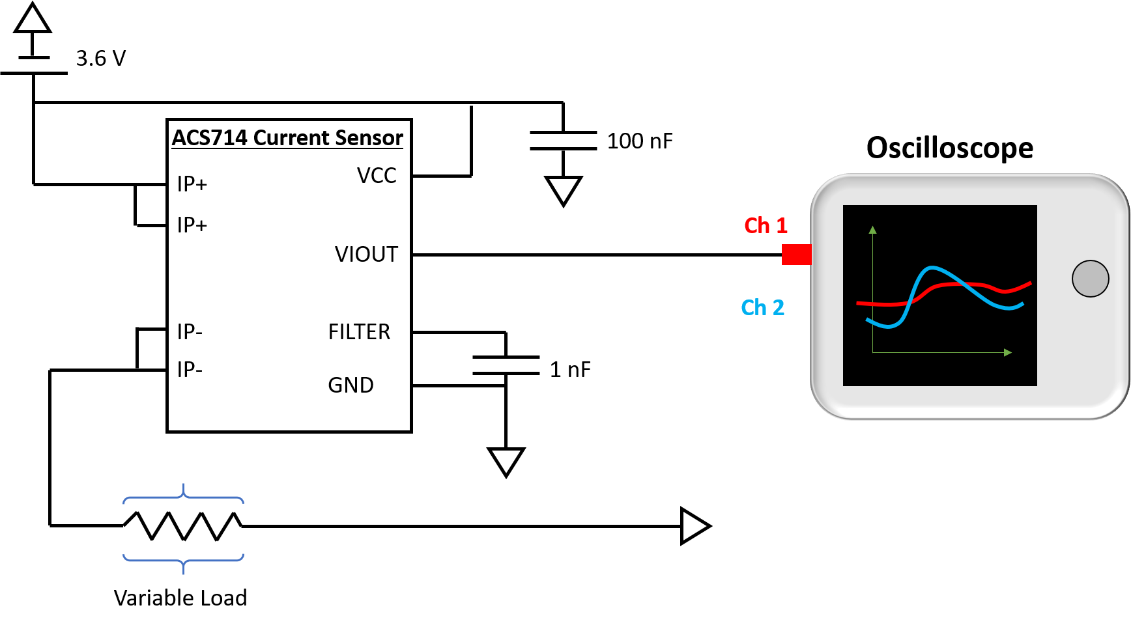
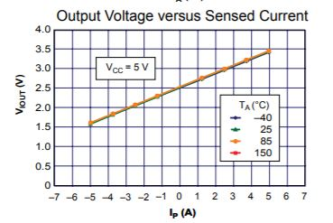
Current Sensor Test
In Progress
ECD 3-7
Objective:
To enable measurement of component current draw – critical for power budget.
Test Procedure:
Calibrate ACS714 current sensor
Use current sensor to measure current draw of all electrical components
5

Slide 20
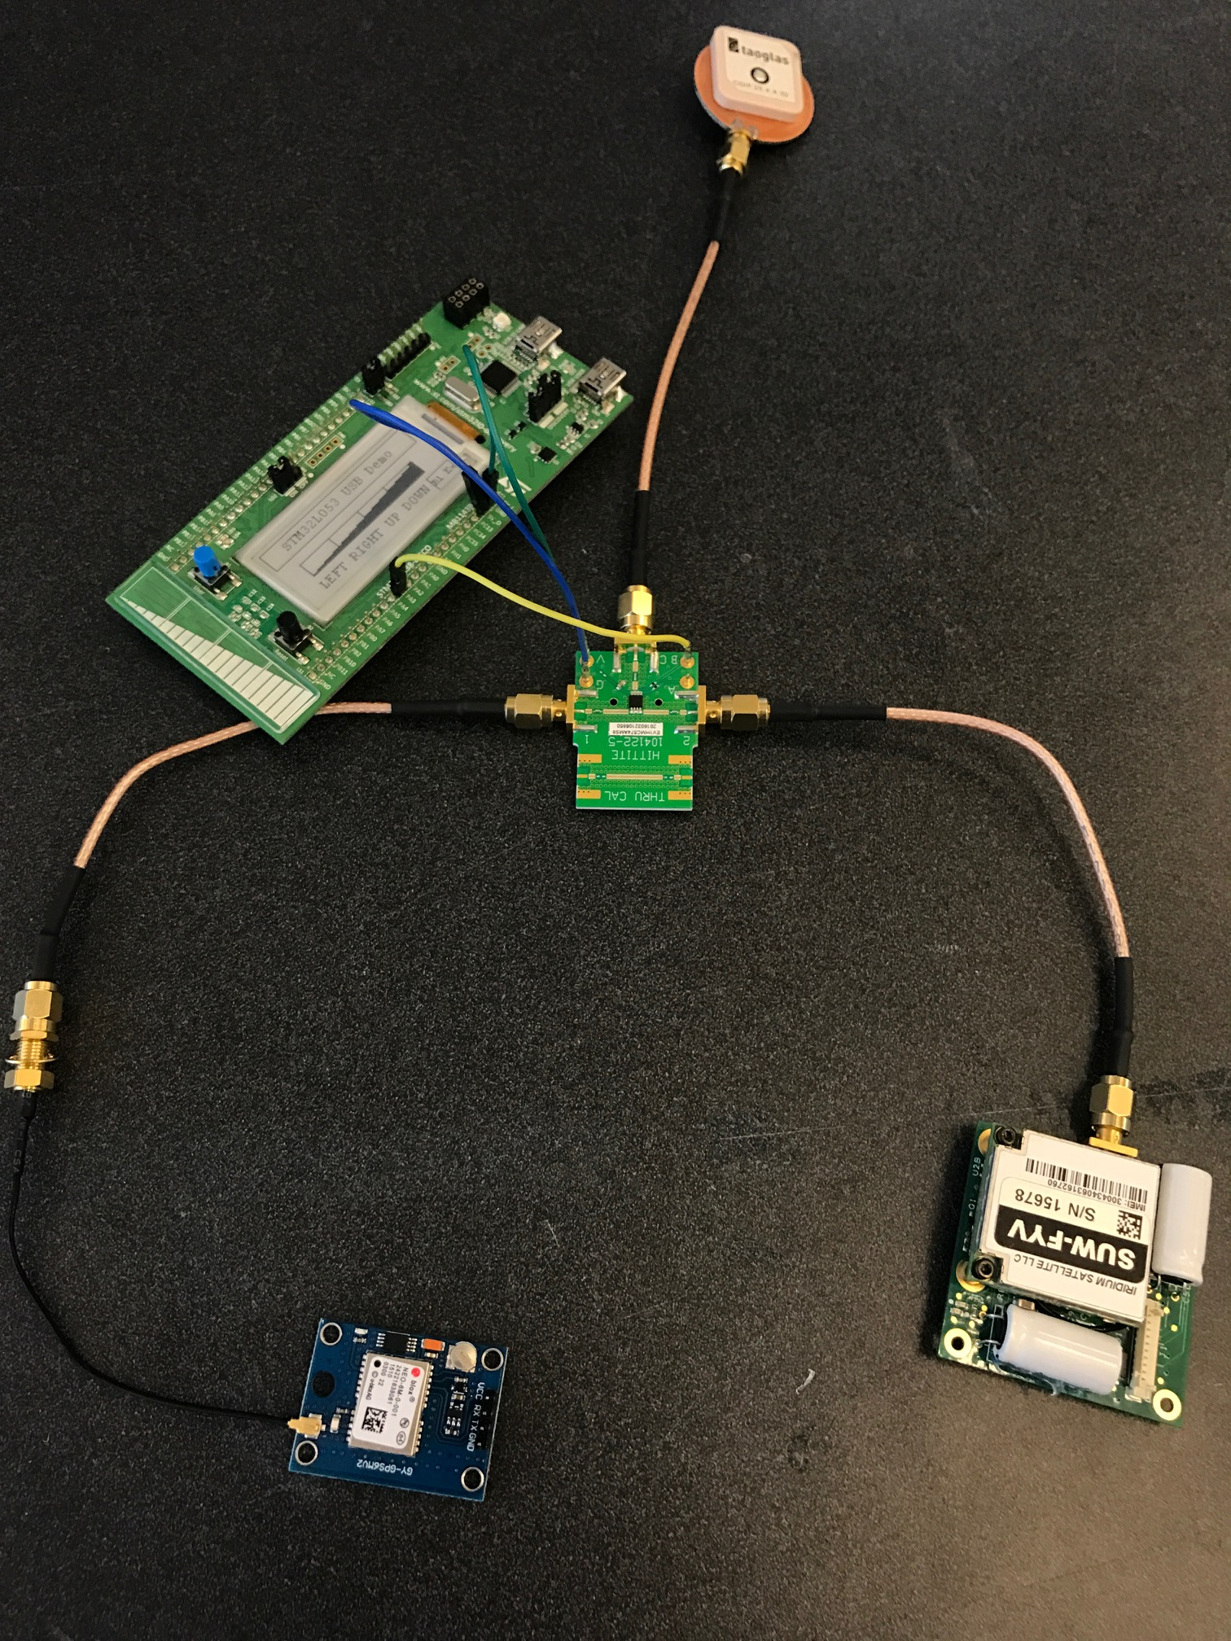
RF Test
Complete
Objectives:
To quantify functionality of integrated GPS (Complete)
To quantify functionality of transmitter(Complete)
To quantify functionality of RF switch(Complete)
Test Equipment and Facilities
STM32 Micro-controller
GPS unit
Iridium Rockblock unit
External Antenna
RF switch
Test Procedure:
Connect the external antenna to the RF switch using an SMA cord
Control the RF switch's logic gate using STM32 micro-controller
Test signal quality of the GPS and the Iridium transmitter individually

Slide 21
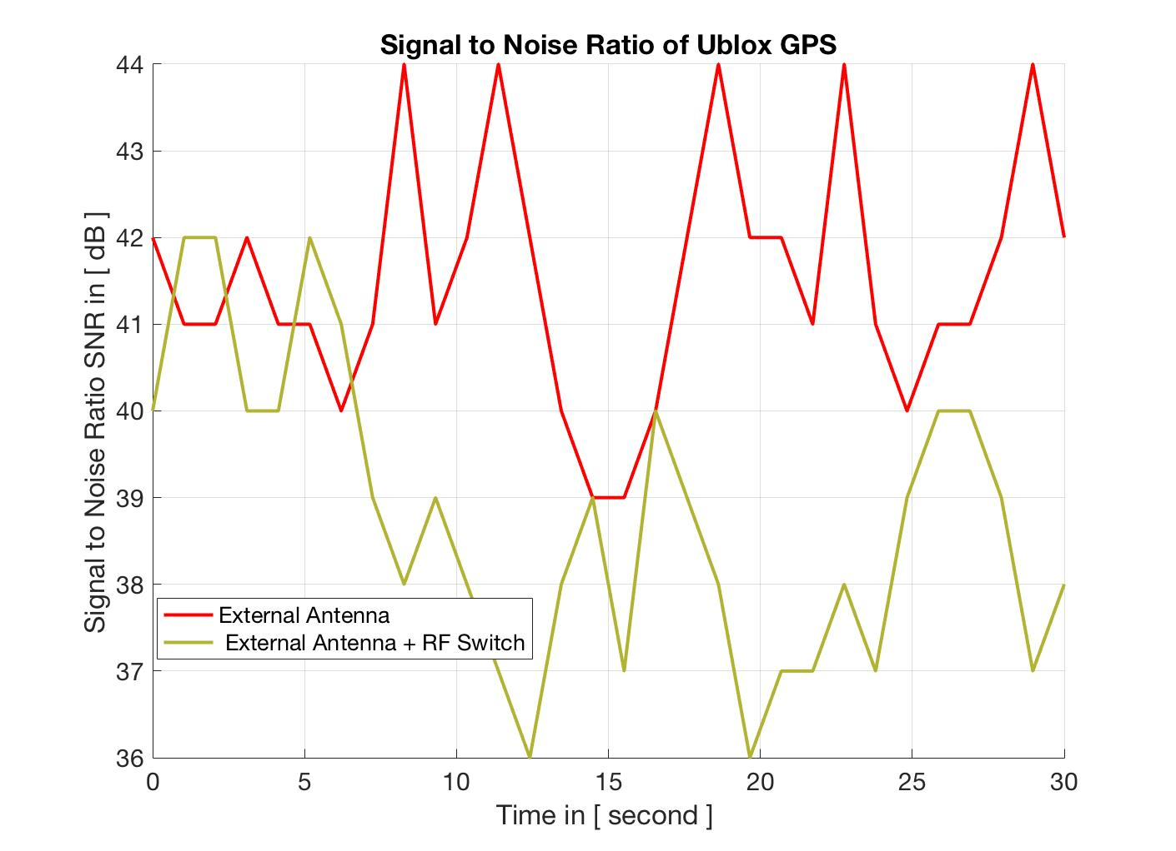
RF Test – Signal to Noise Data

Slide 22
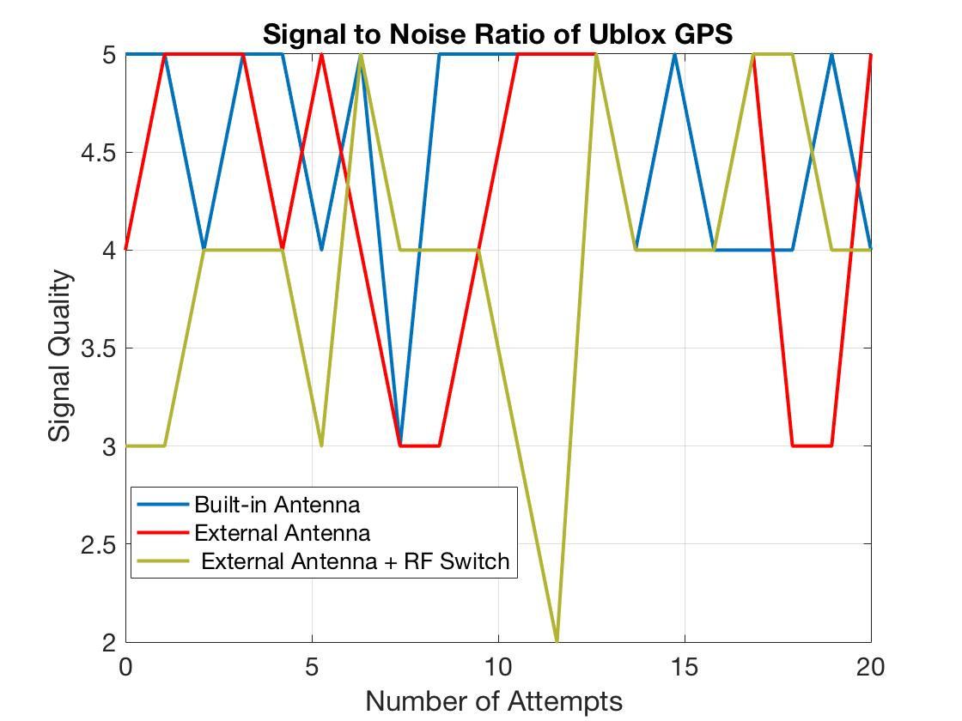
RF Test – Signal Quality Data
Signal Quality of Iridium Transmitter ​

Slide 23
Software Testing
Test | Method​ | Status​
GPS Interfacing | An Alive LED blinks once a fix is received GPS data captured and verified for accuracy | Completed
Iridium Interfacing | "Hello world" message is sent to the Iridium buffer, then transmitted Message is received on personal email | Completed
Data Handling | Verify compression algorithm performance Time compression algorithm execution time on microcontroller | In-progress
Power Management | Verify sleep mode current draw Verify successful control of power to different components | In-progress
Integrated Electronics Testing | Run day in the life test of integrated electronic hardware/software | Not started
ECD 3-8
ECD 3-8
ECD 3-22

Slide 24
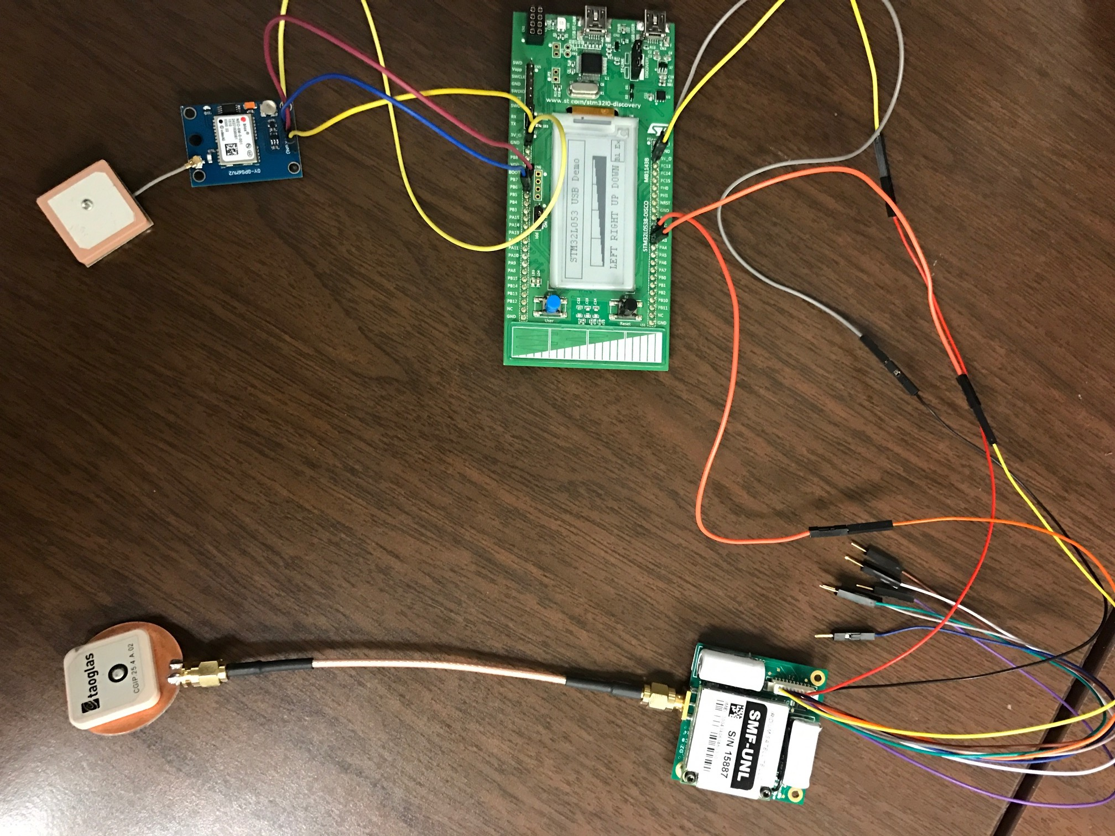
RX/TX Software Functionality Test
Complete
Objective:
To verify Iridium software on microcontroller can communicate with GPS and transmitter
Test Equipment and Facilities
GPS
Transmitter
Microcontroller
Iridium software
Test Procedure:
Write and compile Iridium software on PC
Push software onto microcontroller
Communicate with GPS
Communicate with transmitter

Slide 25
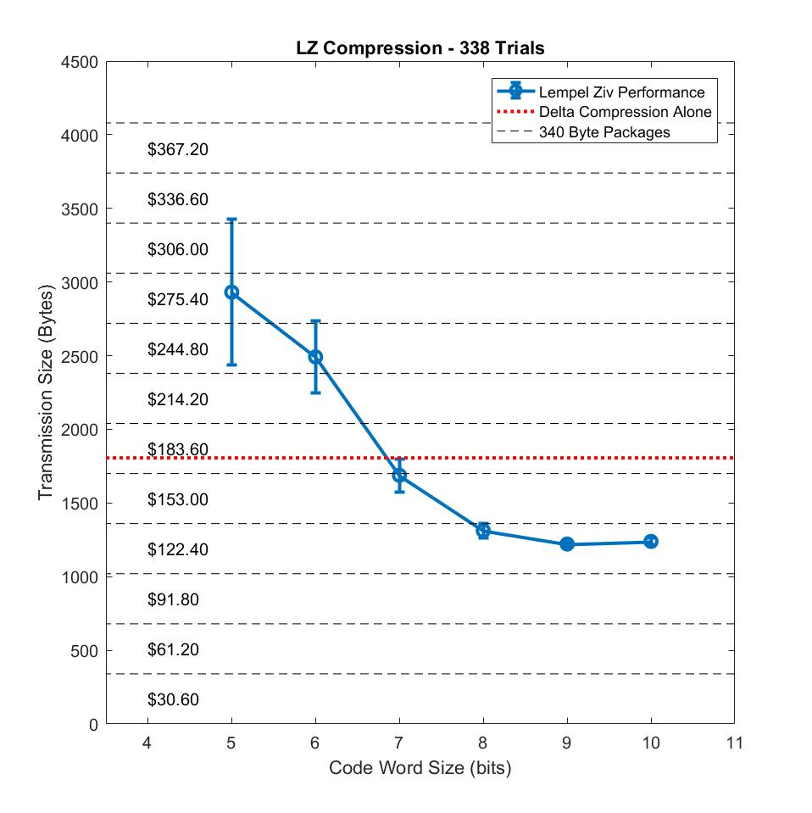
Data Compression Test
In-Progress
Objective:
Verify the effectiveness and optimize performance of custom data compression algorithm
Test Equipment and Facilities
GPS data
Compression algorithm
Test Procedure:
Gather simulated positioning data
Run data through compression algorithm
Cost for 90 days
Optimized Performance

Slide 26
Integrated Tests
Test | Method​ | Status​
24 Hour Day in the Life | Place integrated drifter in the pool for 24 hours, collect and store positional coordinates. At the end of 24 hours, send data to Iridium constellation and validate successful transmission. | Not started
Integrated Drop Test | Drop drifter from deployment mechanism at height, engineering tower, looking into potential UAV drop | Not started
ECD 3-20 for AIAA
ECD 3-20 for AIAA

Slide 27
Engineering Tower Integrated Drop Test
Objective:
To verify the full deployment of the parachute and drifter.
Test Equipment and Facilities:
Engineering tower
Safety helmets, safety harness
Arduino
Drifter, parachute, and deployment mechanism
Test Procedure:
Have spotters on the ground with caution tape to ensure walking pedestrians are not hit.
Connect deployment mechanism to Arduino
Secure drifter's tab with the DM's pin and load parachute in its housing
Hold out full assembly out of tower with a safety harness on and activate linear actuator to deploy the drifter

Slide 28
Safety Concerns
No major project testing safety concerns
Possible minor safety items:
Structural:
Dropping weighted drifter from heights
Drowning in pool environment
Deployment Mechanism:
None
Electrical:
Explosive hazard from lithium batteries if severely mishandled
Electrocution hazard, moderately high amperage.
Software:
None

Slide 29
Structural Component | Original Mass [g] | Updated Mass [g] | Obtained
Molded Ogive Float | 130 | < 120.2 | Yes
12” CFC-12 Parachute | 24 | 41.3 | Yes
Nylon Shroud Lines & Swivel | 31.2 |  | Yes
Adhesive | 16.7 | 16.7 | Yes
Band-Connection | 9.6 | -- | Yes
End Cap | -- | 31 | Yes
Threaded Insert |  | 10 | Yes
Gimbal Joint | 30 | 10 | Yes
Gasket | 10 | 4 | Yes
Packing Peanuts (Full Vol.) | 3 | 3 | Yes
(1/16”) Steel Cable (100 [cm] in length) | 15 | 15 | Yes
Crimp | 2 (x2) | 4 | Yes
Deployment Mechanism | 139 (x2) | 32(x4) | Yes
DM Logic Board | 25 | 8 | Yes
Electronic Component | Original Mass [g] | Updated Mass [g] | Obtained
Toaglass CGIP | 5 | 9.5 | YES
Iridium RockBlock 9603 | 26 | 39 | YES
NEO-6M Ublox | 4.5 | 4.5 | YES
PCB | 5 | 5 | YES
RF Switch | 2.5 | 2.5 | YES
SMA Cord | 13.6 (x4) | 8.8 (x4) | YES
SMA Adapter | 2.1 | 2.1 | YES
Diode | 0.1 (x2) | 0.1 (x2) | YES
TL-2200/S Battery | 50.5 (x3) | 50.5 (x3) | YES
Current Sensor | 1.3 | 1.3 | YES
Capacitor | 0.1 (x4) | 0.1 (x4) | YES
STM 32L Nucleo | 7.5 | -- | YES
STM32L0538-DISCO | -- | 21 | YES
BJT Transistor | 0.1 (x3) | 0.1 (x3) | YES
Resistor | 0.1 (x5) | 0.1 (x5) | YES
Bipolar Transistor | 0.1 (x2) | 0.1 (x2) | YES
Inductor | 0.1 | 0.1 | YES

Slide 30
Structural Component | Unit Cost | Amount Purchase | Total
Nose Cone Float | $20.74 | 3 | $62.22
12” CFC-12 Parachute | $50.00 | 2 | $100
Adhesive | $4.99 | 3 | $14.97
Band-Connection | $2.99 | 1 | $2.99
End Cap Material | $33.43 | 1 | $33.43
Threaded Insert | " | " | "
Gasket Material | $3.25 | 1 | $3.25
Packing Peanuts (Full Vol.) | $4.95 | 1 | $4.95
(1/16”) Steel Cable (100 [cm] in length) | $6.99 | 3 | $20.97
Linear Actuator | $70 | 1 | $70.00
Electronic Component | Unit Cost | Amount Purchased | Total
Toaglass CGIP | $6.88 | 2 | $13.76
Iridium RockBlock 9603 | $249.95 | 2 | $499.98
NEO-6M Ublox | $24.99 | 2 | $49.98
PCB | $2.49 | 2 | $4.98
RF Switch | $111.38 | 2 | $222.64
SMA Cord | $11.44 | 6 | $68.84
SMA Adapter | $0.79 | 2 | $1.58
Diode | $0.40 | 4 | $1.60
TL-2200/S Battery | $13.13 | 6 | $78.78
Current Sensor | $5.30 | 2 | $10.60
Capacitor | $1.12 | 4 | $4.48
STM 32L Nucleo | $10.99 | 2 | $21.98
STM32L0538-DISCO | $23.38 | 2 | $46.76
BJT Transistor | $4.95 | 1 | $4.95
Resistor | $0.75 | 4 | $3.00
Inductor | $1.76 | 2 | $3.52
Step Up Converter | $.75 | 10 | $7.50
Future Data Package | $122
Electronics | $1044.93
Structures | $312.78
Total | $1657.71
Remaining | $3342.29

Slide 31
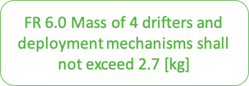
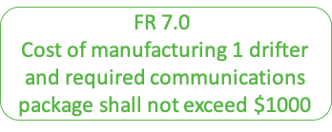
Total Mass Limit [g] | 2,700
Original Mass Projection [g] | 2,393
Current Mass Projection [g] | 2,319
Unit Cost Limit | $1,000
Electronics/ Communications | $630.00
Structures/ Deployment | $127.36
Total | $757.36

Slide 32
Backup slides

Slide 33
Allocate Memory
Status
GPS
GPS
Delta Compression
Time To Transmit?
Continuous Process
NO
TX
YES
LZ
Package
Iridium
Sleep

Slide 34
Functional Requirements
Functional Requirement | Description
FR 1.0 | Drifter shall be capable of following ocean currents in the Gulf of Mexico
FR 2.0 | Drifter shall maintain a 3-month lifespan
FR 3.0 | Drifter shall be deployed from an altitude of 300 [m]
FR 4.0 | The drifter shall measure and store position coordinates
FR 5.0 | Drifter shall transmit stored position coordinates to a ground station up to 800 [km]
FR 6.0 | Mass of 4 drifters and deployment mechanisms shall not exceed 2.7 [kg]
FR 7.0 | Cost of manufacturing 1 drifter and required communications package shall not exceed $1000
FR 8.0 | The deployment mechanism system shall deploy each drifter individually

Slide 35
Subsystem | Test Objective | Method | Status
Structural | Verify flotation of nosecone | Install dummy mass into nosecone Place in water | Success
Structural | Verify nosecone is waterproof | Install threaded ring into nosecone Install rubber gasket Tighten end cap Place in water for 24 hours | Success
Electronics | Transistors functionality | Connect transistors to functioning circuit Measure current output?????? | Success
Electronics | GPS functionality | Plug GPS into PC Attach antenna Verify received positional data | Success
Electronics | TX functionality | Plug transmitter into PC Attach antenna Verify signal can be sent | Success
Electronics
Software | Verify sleep functionality | Write sleep function code Compile Verify functionality on PC/Micro-C ????? | In-Progress (est. completion date: 3/6)
Software | Verify circuit timing | Write timing code Compile Verify timing functionality on PC | In-Progress (est. completion date: 3/6)
Software |  | d | In-Progress (est. completion date: 3/6)
Software |  | d

Slide 36
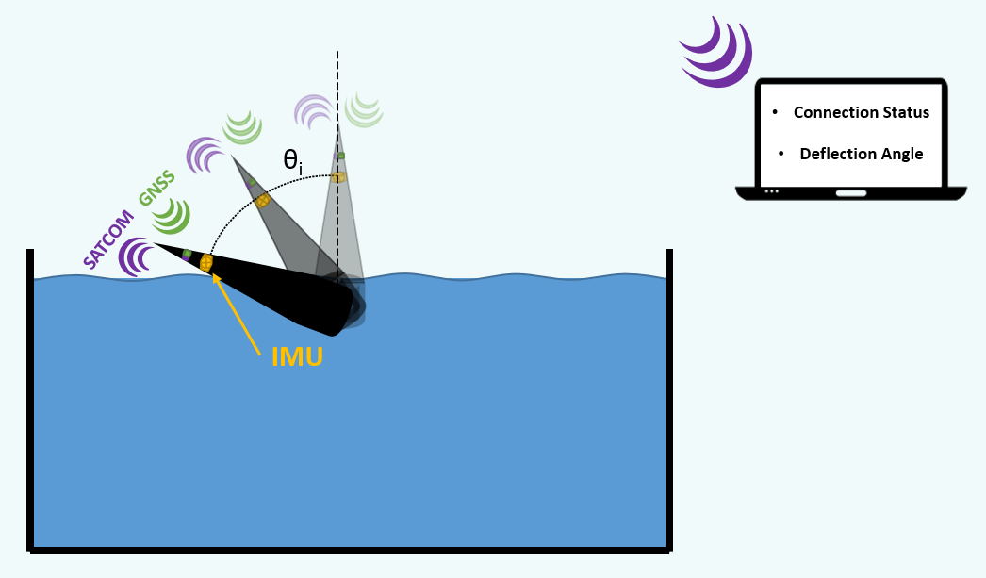
Stability Test
In-Progress
(ECD: 3/15)
Objectives:
To quantify the stability the drifter when exposed to a disturbance
To verify RX and TX capabilities of drifter in unsteady water
Test Equipment and Facilities
9-axis IMU
Integrated GPS, transmitter, antenna, and power source
East Boulder Rec Center pool
Test Procedure:
Install all electrical components into drifter
Expose drifter to disturbance during receiving and transmission periods
Ensure that signals were adequately received and sent by drifter

Slide 37
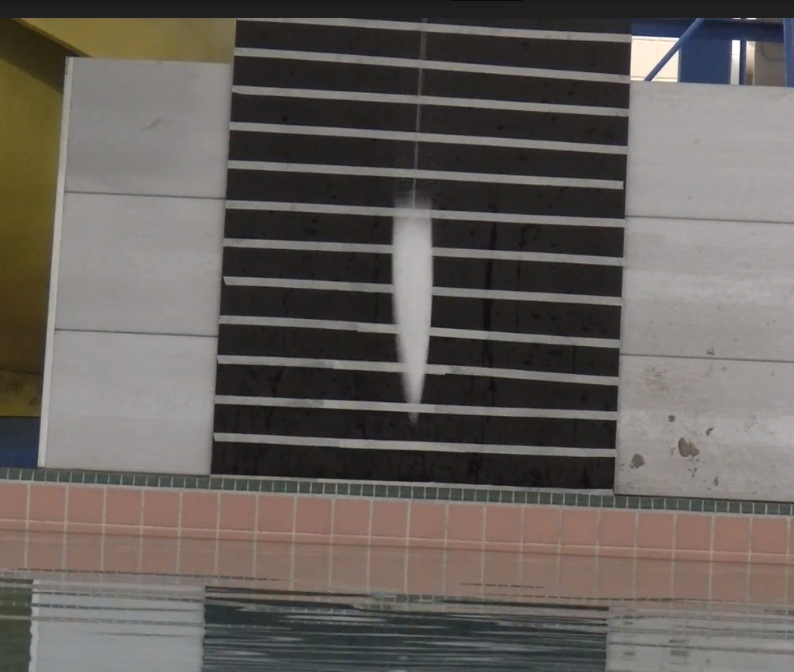
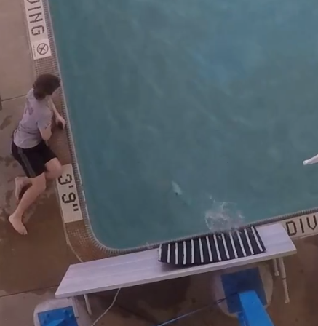
Drop Test
Complete
Objectives:
To verify structural and electronic survivability upon impact with water from a height of 300 [m].
To ensure that parachute does not land on drifter after water impact.
Test Procedure:
Install accelerometer into drifter nosecone.
Place pre-measured distance marker at water impact location
Place slow-motion camera across from water impact location at impact level height
Attach rope with 2-ft. interval marking to end of drifter
Drop drifter into water while recording with camera
Record acceleration at water impact
Record horizontal surfacing distance
Repeat drop at current height for a total of 2?? trials
Repeat steps 4-6 at each 2-ft. marking until max height is reached
3”

Slide 39
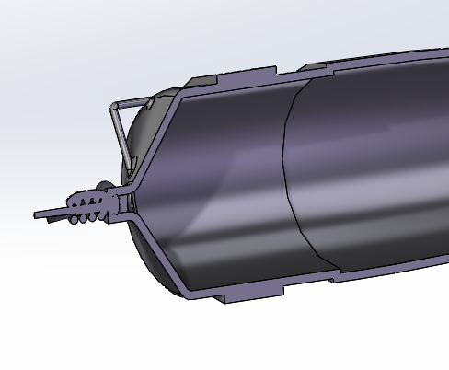
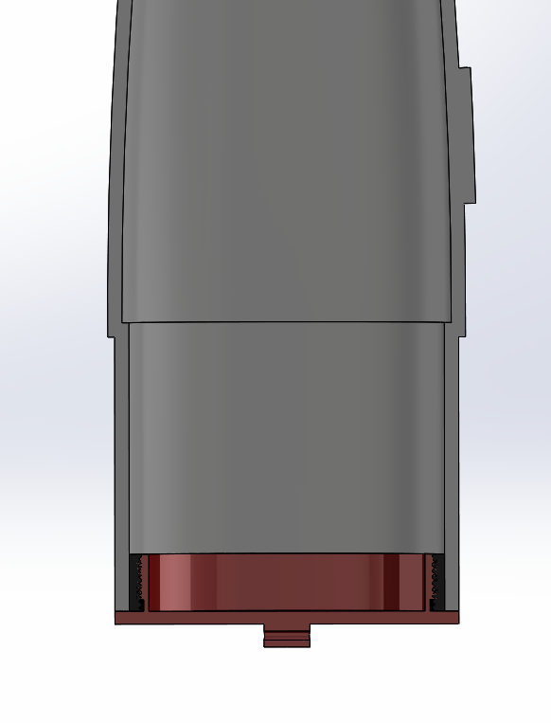
Major Design Changes
Float Seal | Microcontroller
Design Requirements: Mass: +21.6 [g] Cost: +$11.00 | Mass: +21 [g] Cost: +12.39$
Original Design: Glued Band Connection
Current Design: Internal Threaded Insert and Threaded End Cap
Reason for Change:
Create mechanical seal using gasket, does not rely on glue for waterproofing
Reduce testing and component installation complexities
Closer resemblance to customer’s final ideal product
Injection molded with threaded end cap
Original Design: STM 32L Nucleo
Cross Sectional Zoom View
Current Design: STM32L0538-DISCO
Reason for Change:
Nucleo only supported one USART connection
DICSO utilizes the same STM 32L microprocessor, but is incorporated onto a board that allows for two USART connections
Glue
Glue
Nosecone cut along line
Notes:
Reduce content in slides? Only using for quick review.

Slide 40
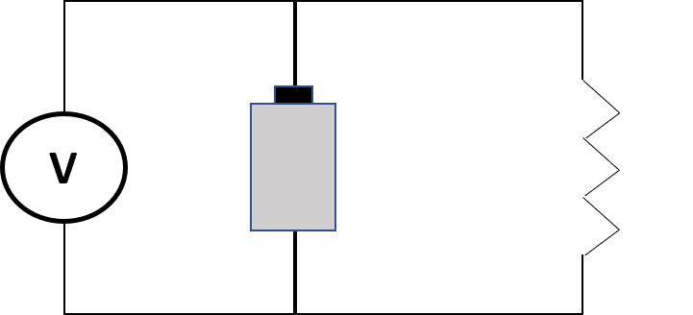
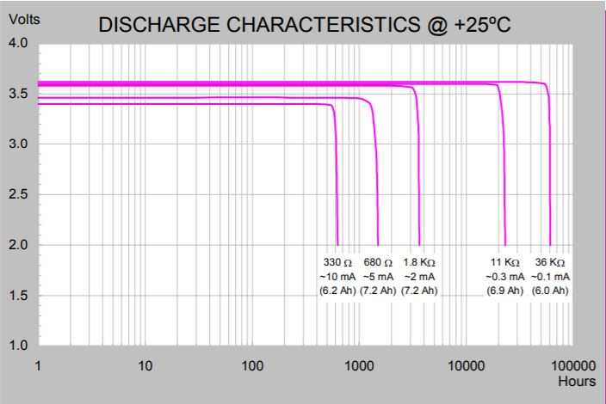
Battery Discharge Test
In-Progress
(ECD: 3/15)
Objective:
Quantify amount of time until complete battery discharge from expected average current drifter load
Test Equipment and Facilities
Battery
Simulated load
Current level and time recorder
Test Procedure:
Connect dummy load to battery
Allow discharge to occur
Record battery voltage and time
Compare battery capacity with manufacture data

Slide 41
Voltage Booster Test
In-Progress
(ECD: 3/20)
Objective:
To verify the efficiency of the COTS voltage booster
Test Equipment and Facilities
Battery (Power supply?)
Voltage booster
Output voltage reader
Test Procedure:
Attach Battery (Power supply?) to voltage booster

Slide 42
Power Test
In-Progress
(ECD: 3/22)
Objective:
To measure actual power used by final drifter components
Test Equipment and Facilities
Drifter batteries
Voltage booster
Current sensor
Microcontroller
GPS
Transmitter
Test Procedure:
Supply power to microcontroller, GPS, and transmitter from batteries and voltage booster
Record power being used with current sensor
Graphic of power test setup here?

Slide 43
Drop Test – Conclusions
Acceleration
Experimental results:
Velocity vs g-force line of best fit: $y=mx+b$
Extrapolating to XX m/s (the predicted terminal velocity of the drifter with the parachute), the expected g-force will be XX g’s
Model results:
Using Army research paper measuring impact pressure comparing impact pressure on cones at impact with water, at XX m/s, the expected g-force was XX g’s.
Known overestimate
Displacement
Experimental Results:
85% of all landings resulted in the drifter traveling at least 6” away from its original impact location.
Model Results:
A predicted turning radius resulted in this much travel
Conclusions:
The structure and the electronics will remain functional after water impact.
The drifter will travel far enough underwater, away from the impact location, such that the parachute will not land on it.

