Slide 1
BACCHUS
Balloon Altitude Command Control Housing for Unmanned Sensing
Test Readiness Review
Sponsored by: Urban Sky
Advisor: John Mah
February 16, 2022

Slide 2
Agenda
Project Overview Libby, Tanisha, Ben
Schedule Ben
Test Readiness David, Leah, Tanisha, Kailey, Libby
Budget David

Slide 3
Project Overview

Slide 4
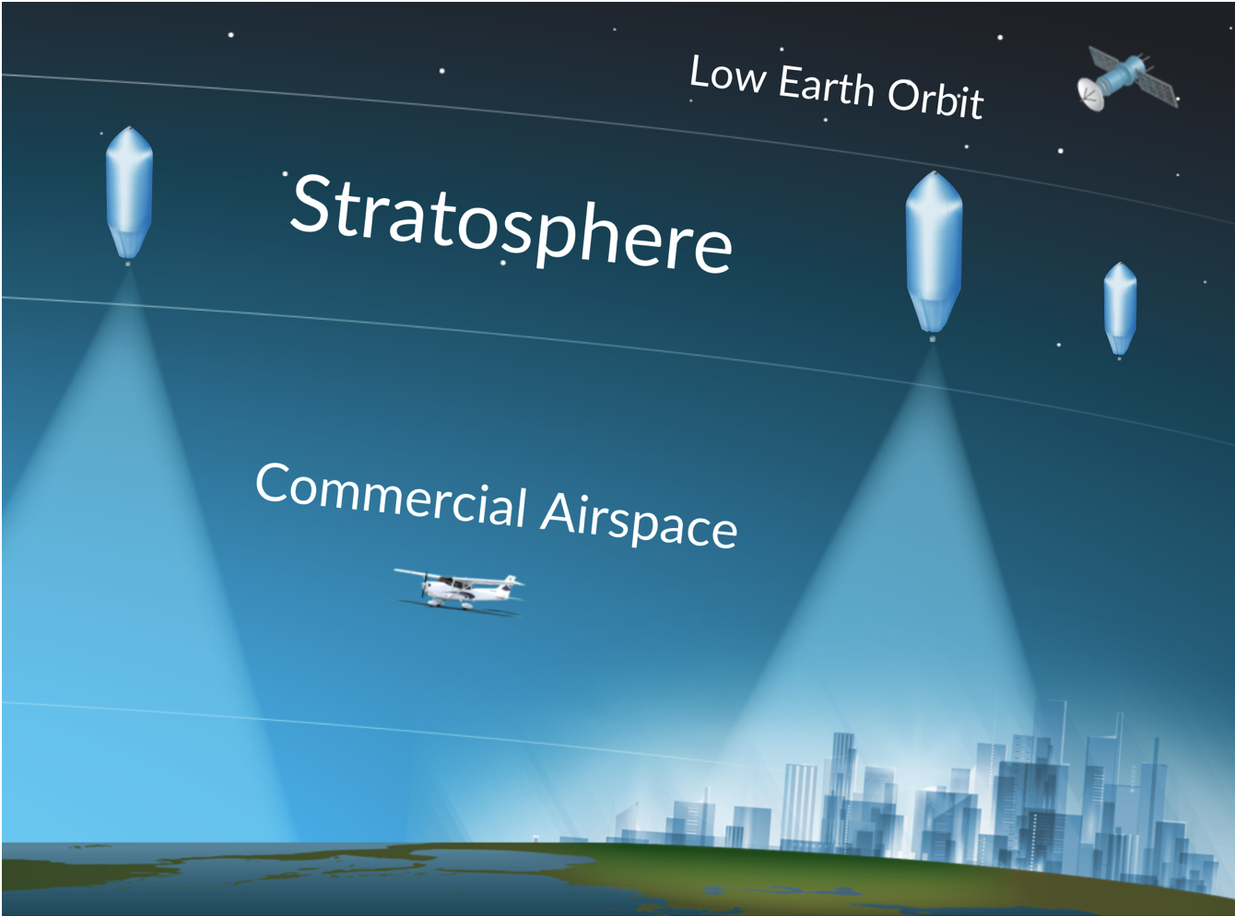
Background and Motivation
Background
Sponsor Urban Sky uses high altitude balloons to sense and record ground information across large regions of land.
Motivation
Urban Sky wants a cheaper balloon platform that still supports their sensors and mission duration (1 day).
Mission Statement
The Balloon Altitude Command Control Housing for Unmanned Sensing (BACCHUS) team will develop, build, and test a semi-autonomous system to control the ascent, descent, and hover of an off-the-shelf high altitude latex balloon.
Notes:
Libby

Slide 5
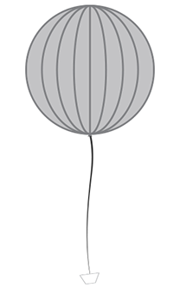
Out of scope
BACCHUS CONOPS
Data
Commands
Satellite
Satellite
Positive Vertical Rate
Satellite
1. Controlled Descent
OR
Vertical
Hover
Closed loop feedback
OR
OR
2. Burst + Parachute
Negative Vertical Rate
Ground Station
Ground Station
Ground Station
Ground Software
Ground Software
Ground Software
Notes:
Libby

Slide 6
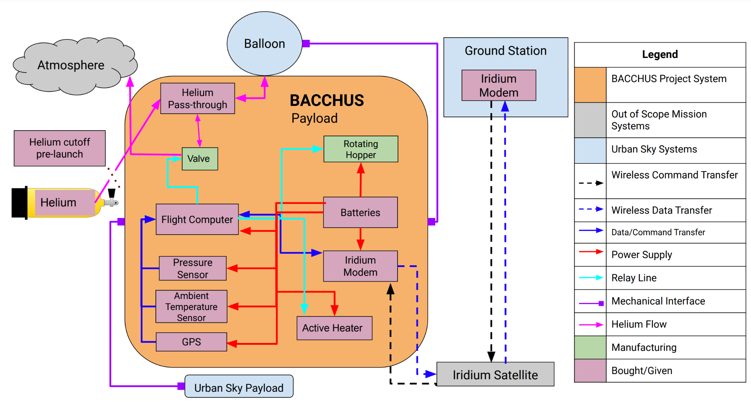
Functional Block Diagram - System
Notes:
Libby

Slide 7
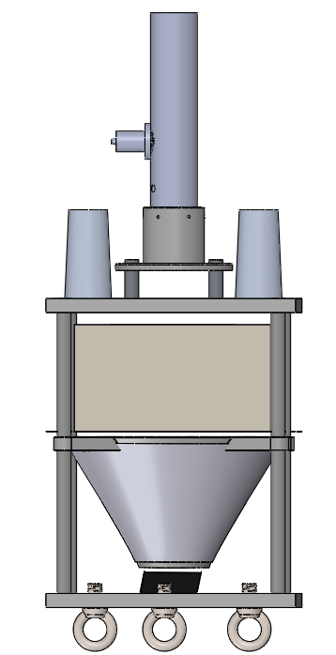
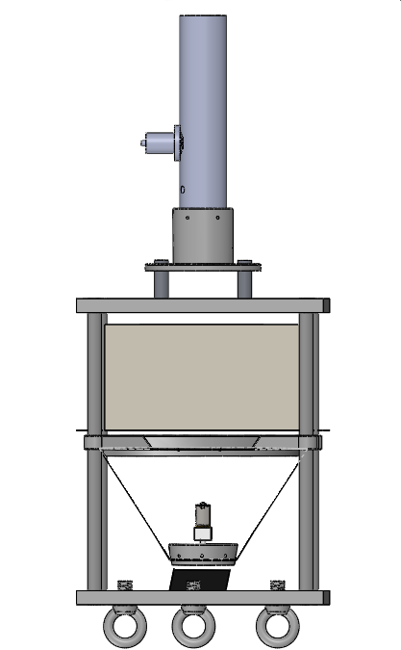
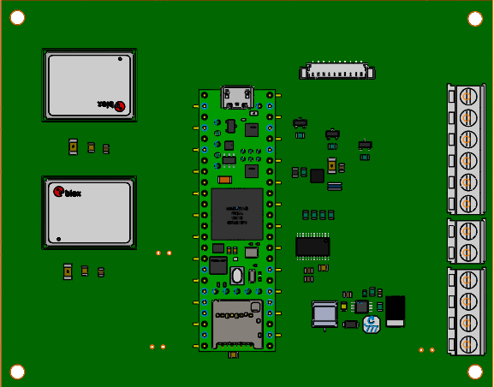
Baseline Design
Current mass: 2.52 lbs
Venting System
GPS Antennas
Electronics Board
Electronics Bay
Carbon Fiber Housing
Hopper System
Notes:
Ben

Slide 8
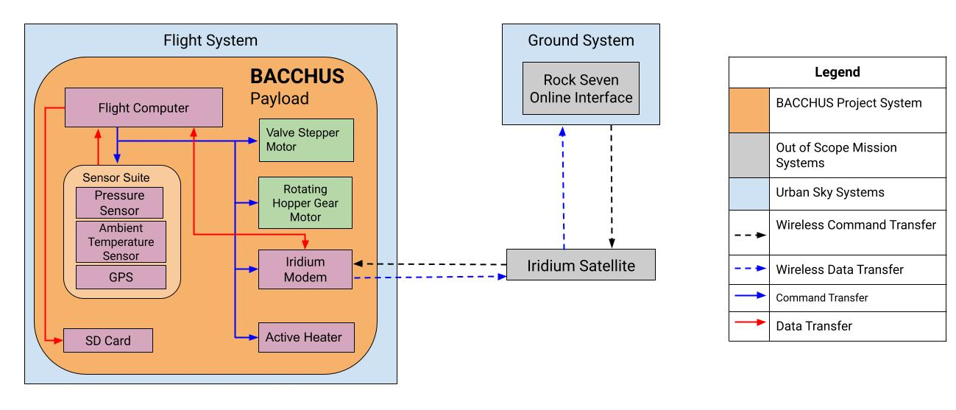
Functional Block Diagram - Software
Notes:
Tanisha

Slide 9
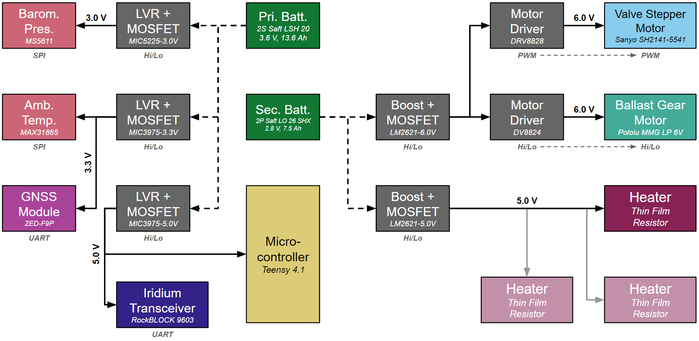
Functional Block Diagram - Electrical
*Ability to connect 2 additional independent heaters
Notes:
Tanisha
Say that all components (sensors, transceivers, motor drivers, etc.) connect back to the microcontroller. Also mention that dashed lines are “unfiltered” and “unregulated” power direct from the battery. Finally, you can say that we have the ability of connecting 2 additional and independently controlled heaters if needed.

Slide 10
Baseline Design Updates
Valve System Updates:
Got rid of the fan, reducing complexity. This allowed for requirements to be altered.
There was concern with the original valve leaking. After various trade studies, a new design was selected.
The original design was modular so changes could easily be made if necessary.
Hopper Updates:
The original hopper design could not be 3D printed.
Instead of having a square design, it was made circular which rescues needed materials and manufacturing complexity.
This will ultimately result in the system being more lightweight and reliable.
Notes:
Ben

Slide 11
Levels of Success
Project Elements | Level 1 | Level 2 | Level 3
Performance | Ascent rate to 0 ± .5 m/s once for 1 hour minimum | Ascent rate to 0 ± .25 m/s once for 6 hours minimum | Ascent rate to 0 ± .25 m/s multiple times for 6 hours minimum
 |  |  | Control ascent rate to from [-3,5] m/s with ± 0.25 tolerance
 |  | Ascend to pop maneuver | Controlled descent landing maneuver
Mission Duration | Stay on for 24 hours but not control rate for full duration
Mounting | Attach to balloon and allow filling and a 5G impact
 | Attach to Urban Sky payload and withstand 5G impact
Operations |  | Operate up to 70,000 ft and maintain communication | Operate up to 80,000 ft and maintain communication
 | Send and receive commands from ground station
Regulatory | Mass must be less than 6 lbs and density less than 3 oz/in²
 | Break away from the balloon system at a force less than or equal to 50 lbf

Slide 12
Functional Requirements
# | Functional Requirement | Level of Success
1 | Control the precise vertical rate of the balloon system | Performance
2 | Communicate between ground and flight systems | Operations
3 | Operate in standard environments up to stratospheric altitudes | Regulatory
4 | Mechanically integrate to balloon | Mounting
5 | Mechanically integrate to accompanying payloads | Mounting
6 | Operate independently from accompanying payload during all phases of flight | Mounting
7 | Restricted in mass and size | Regulatory
8 | Recoverable and reusable | Performance

Slide 13
Critical Project Elements
CPE #1 | Control | BACCHUS must possess the ability to be commanded by the ground station to create an ascent rate. To create this rate, BACCHUS will perform some form of manipulation to change the balloon system’s mass and volume properties according to a derived control law. Failure of this would result in the incorrect ascent rate causing the balloon system to deviate from its course causing a potential mission failure or loss of the system.
CPE #2 | Mass | The customer has levied a tight mass constraint on our system as there are federal regulations and requirements that the entire system must abide by. Failure to comply with this constraint would result in our system not being flown.
CPE #3 | Integration with Heritage System | BACCHUS must mechanically integrate with existing payload as well as the balloon. Failure to do so would result in mechanical failure and the failure of the balloon.
CPE #4 | Meeting Federal Requirements | BACCHUS will be part of a system operating in regulated environments and needs to meet all of those requirements levied by the customer to operate in this space. This may include rigorous tests to prove flight readiness. Failure to meet these requirements would result in BACCHUS’ inability to fly and complete its mission.
Notes:
Ben

Slide 14
Schedule

Slide 15
Schedule - Full Picture
Notes:
Ben

Slide 16
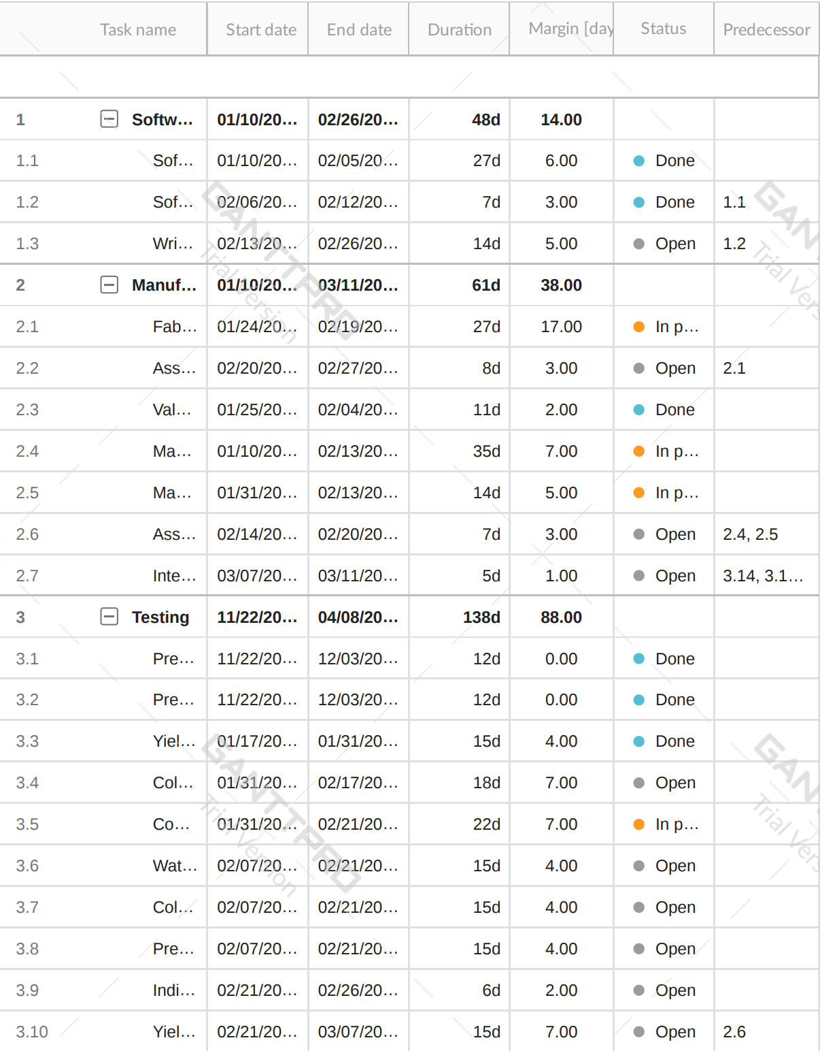
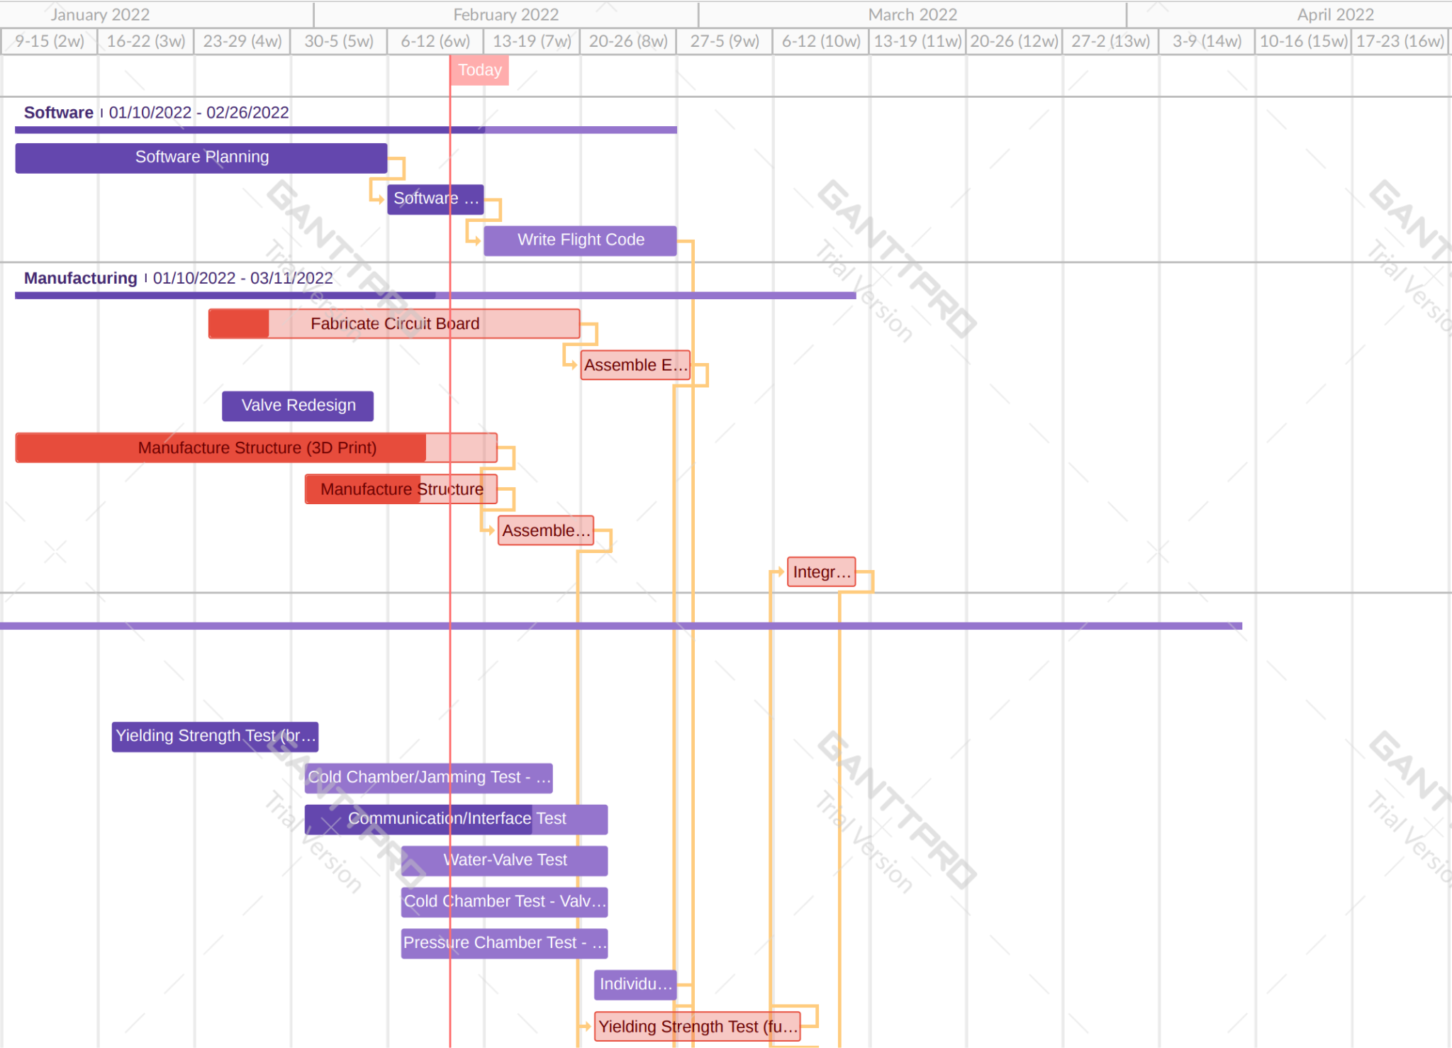
Schedule - Manufacturing Focus
Notes:
Ben

Slide 17
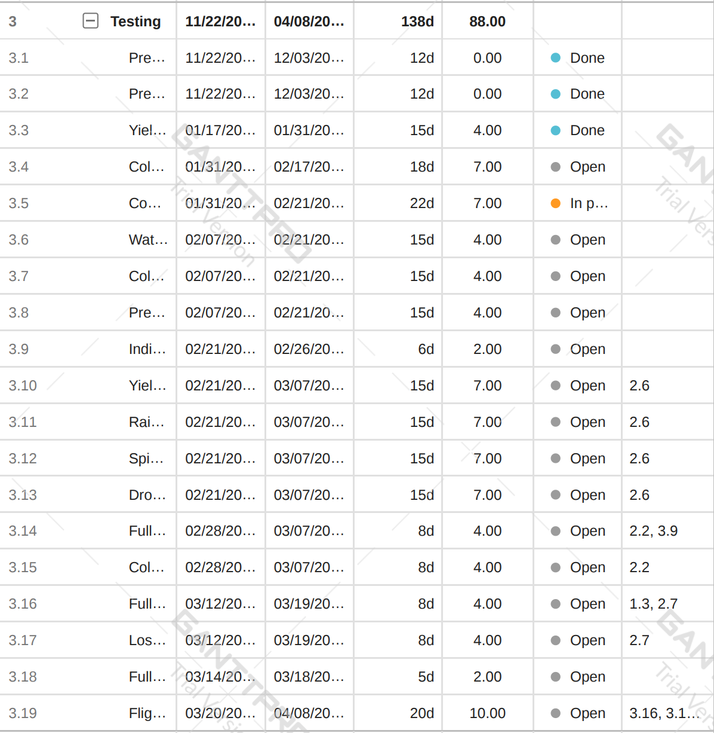
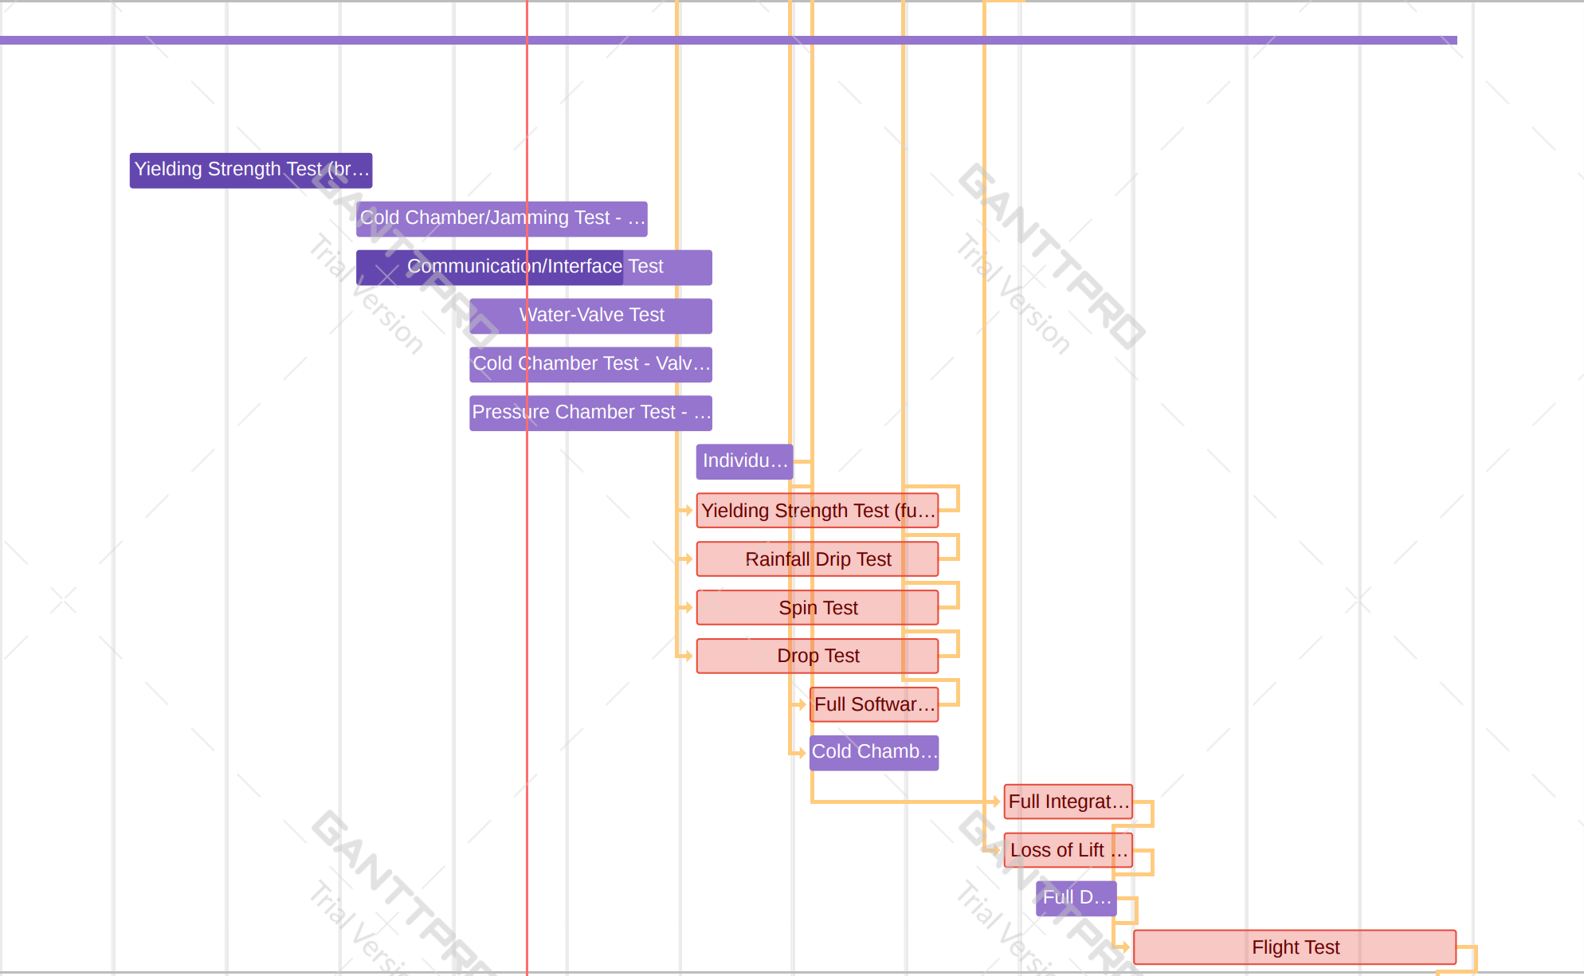
Schedule - Testing Focus
Notes:
Ben

Slide 18
Test Readiness

Slide 19
Overall Testing Flow
Component Testing
11/22 - 2/25
Break Chord Test
Ascent System Test
Descent System Test
Software Library Test
Subsystem Testing
1/31 - 3/18
Communic-ations Test
Electronics Test
Structural Tests
Loss of Lift Test
System Testing
3/14 - 4/06
Full- Duration Bench Test
Flight Test
Notes:
Leah

Slide 20
Testing Rationale (Component Level)
Test Needed | Requirements Verified | Verification/Validation | Pass Criteria
Preliminary Cold Chamber Test (Fan - Descent) | 3.2 | Verification | Fan is able to sustain cold temperatures down to -55°C.
Prelim. Vacuum Chamber Test (Fan - Descent) | 3.1 | Verification | Fan is able to sustain pressures down to 70 kpa.
Yielding Strength Test (Break Chords) | 5.1, 5.1.1, 5.1.2, 7.3 | Verification | The three break chords break at a force of >42 lbf and <62 lbf
Cold Chamber/Jamming Test (Hopper - Ascent) | 3.2, | Verification | Hopper system is able to sustain cold temperatures down to -55°C without any signs of jamming.
Valve Test | 1.2, 3.2, 4.2 | Verification | Valve remains sealed under direct filling pressure.
Cold Chamber Test (Motor - Descent) | 3.2 | Verification | Stepper motor is able to sustain cold temperatures down to -55°C.
Vacuum Chamber Test (Motor - Descent) | 3.1 | Verification | Stepper motor is able to sustain pressures down to 70 kpa.
Individual Component Software Library Test | 2.1 | Verification | Electronics board and iridium modem interface correctly.
Notes:
David
Three levels of tests: Component, Subsystem, System

Slide 21
Testing Rationale (Subsystem Level)
Test Needed | Requirements Verified | Verification/Validation | Pass Criteria
Communications/Interface Test | 2.1 | Verification | Iridium modem is able to send and receive messages.
Cold Chamber Test (Electronics) | 3.2 | Verification | Electronics with active heater are able to sustain cold temperatures down to -55°C.
Spin Test | 3.3 | Verification | Structure is able to sustain shaking and turbulence with minimal damage.
Drop Test | 3.3, 8.2 | Verification | Structure is able to survive a significant impact of approximately 5G’s.
Rainfall Drip Test | 3.4 | Verification | Structure is able to resist water without any significant material affects.
Yielding Strength Test (Structural) | 4.1, 5.1, 5.1.1, 5.1.2, 7.3 | Verification | The three break chords break at a force of >42 lbf and <62 lbf with material frictional effects included.
Loss of Lift Test | 1.1, 1.2, 1.3, 1.4 | Verification | Both ascent and descent systems are able to actuate to obtain a 0-5 m/s ascent rate and 0-3 m/s descent rate.
Notes:
David

Slide 22
Testing Rationale (System Level)
Test Needed | Requirements Verified | Verification/Validation | Pass Criteria
Full-Duration Bench Test | 1.3, 1.4, 6.2 | Validation | All components operate continuously for 5 hours in a benchtop environment.
Flight Test | 1.1, 1.2, 1.3, 1.4, 6.2, 8.1, 8.2 | Validation | All subsystems integrate correctly and all requirements are satisfied.
Notes:
David

Slide 23
Testing Safety
Safety Concerns
Safety Precautions
Vacuum Chamber Test
Drop/Spin Test
Flight Test
Conduct Test at Urban Sky with customer, review safety precautions before test, ensure clear workspace.
Follow test procedure, ensure clear and open space.
Consult with Urban Sky team members to develop detailed test plan, conduct integration test prior to ensure individual components are operating, notify FAA.
Notes:
Leah

Slide 24
Completed Tests

Slide 25
Completed Test: Break Chords (verification)
DR 5.1.2: The interface shall have a minimum load-bearing capability of 30 lbf
DR 7.3: Shall break away from balloon and accompanying payload when subjected to an impact force of no more than 50 lbf
Test 1
Rationale/Motivation:
To ensure that attachment strengths fall within 30 lbf to 50 lbf range.
To verify individual strength of each break chord.
Test Procedure:
Tie break chord to bucket and continuously fill bucket with water until chords breaks.
Weigh bucket of water.
Measurements:
Weight of bucket
Pass Criteria:
Pass: break chords sustain 14 lbf and break at anything greater than 20.67 lbf.
Fail: consider new design options and reconduct test.
14 lb
15 lb Break Chord
Test 2
*breaks
> 20 lb
Deadline: 1/31
*Note: three break chords will be used in the actual design and will be required to break at a force >42 lbf and <62 lbf.
Completed: 1/28
Notes:
Leah
50 + 12 = 62 lbf
Facility used

Slide 26
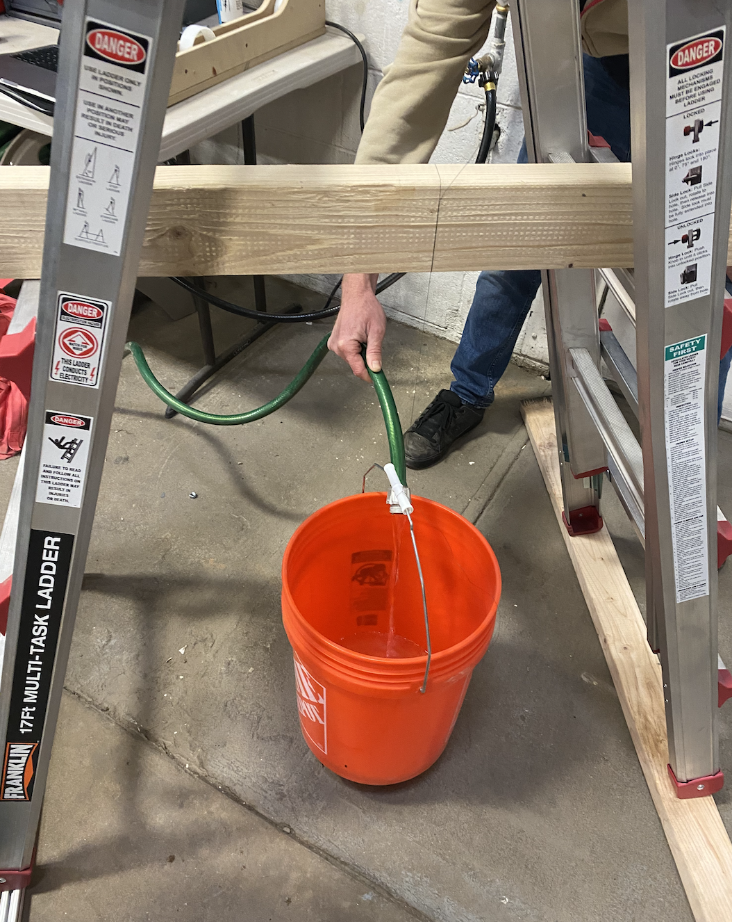
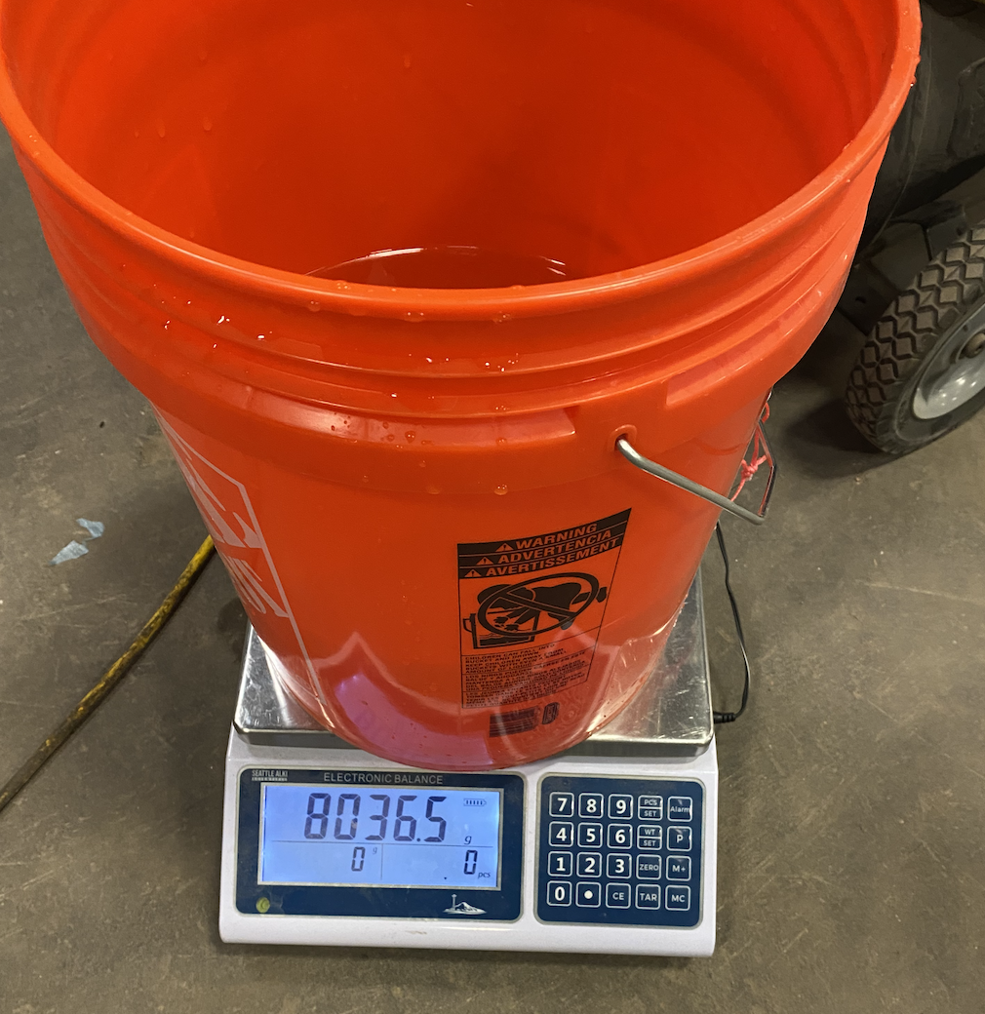
Completed Test: Break Chords
Ladder
15 lb Break
Chord
Wooden
Beam
Bucket filled with water
8036.5 g = 17.72 lb
Notes:
Leah
Go over procedure & facility used

Slide 27
Current Test Status
Test Conducted | Validated/Verified: | Risks Reduced | Pass?
Yielding Strength Test (Break Chords) | Strength of break chords, ability to sustain a loading force, satisfy FAA regulations | FAA requirement satisfaction Twisting and lateral mitigation Materials risk reduced - already acquired | Yes
Notes:
Leah
Reminder of level of success - we can sustain a practical load while lying within the FAA requirements

Slide 28
Completed Test: Communications Test
DR 1: BACCHUS shall control the precise vertical rate of the balloon
DR 2: BACCHUS shall communicate between ground and flight systems
DR 7: BACCHUS shall operate independently from accompanying payloads during all phases of flight
Rationale/Motivation:
To ensure that the communication interface works
To understand potential delays and account for them in the flight code
Test Procedure:
Send message from RockBlock and measure how long it takes to transmit.
Measure signal strength and verify message transmission
Repeat with different material obstructing antenna
Measurements:
Signal Strength
Message transmission time
Pass Criteria:
Pass: The RockBlock is able to send and receive messages in under 5 minutes in all scenarios
Fail: Redesign software and requirements to account for lag in communication. Redesign RockBlock placement
Deadline: 2/21
Completed: 2/13
Notes:
Leah
50 + 12 = 62 lbf
Facility used

Slide 29
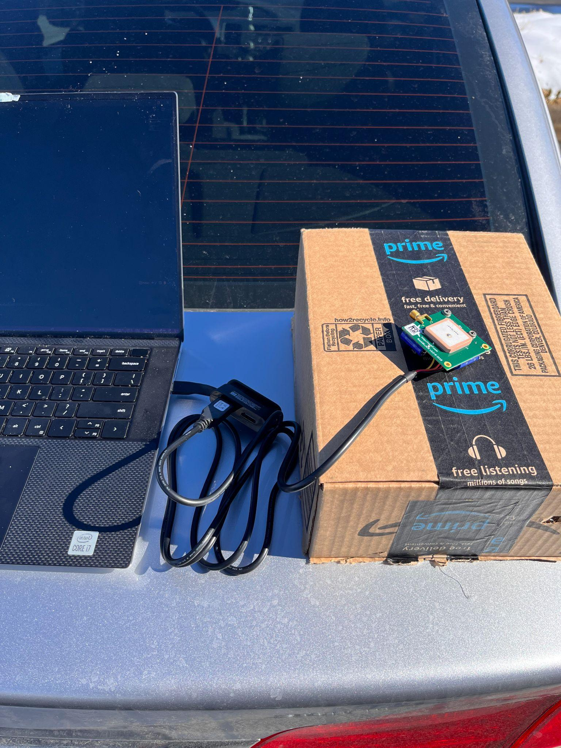
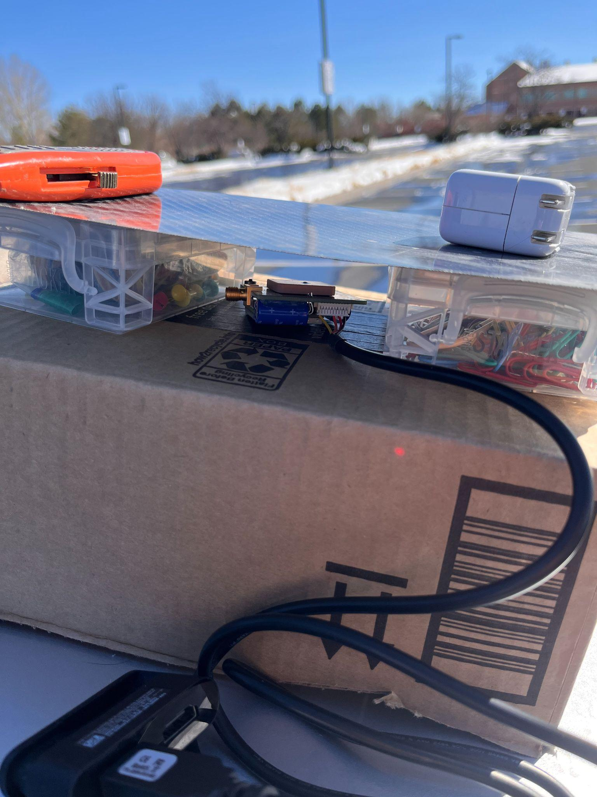
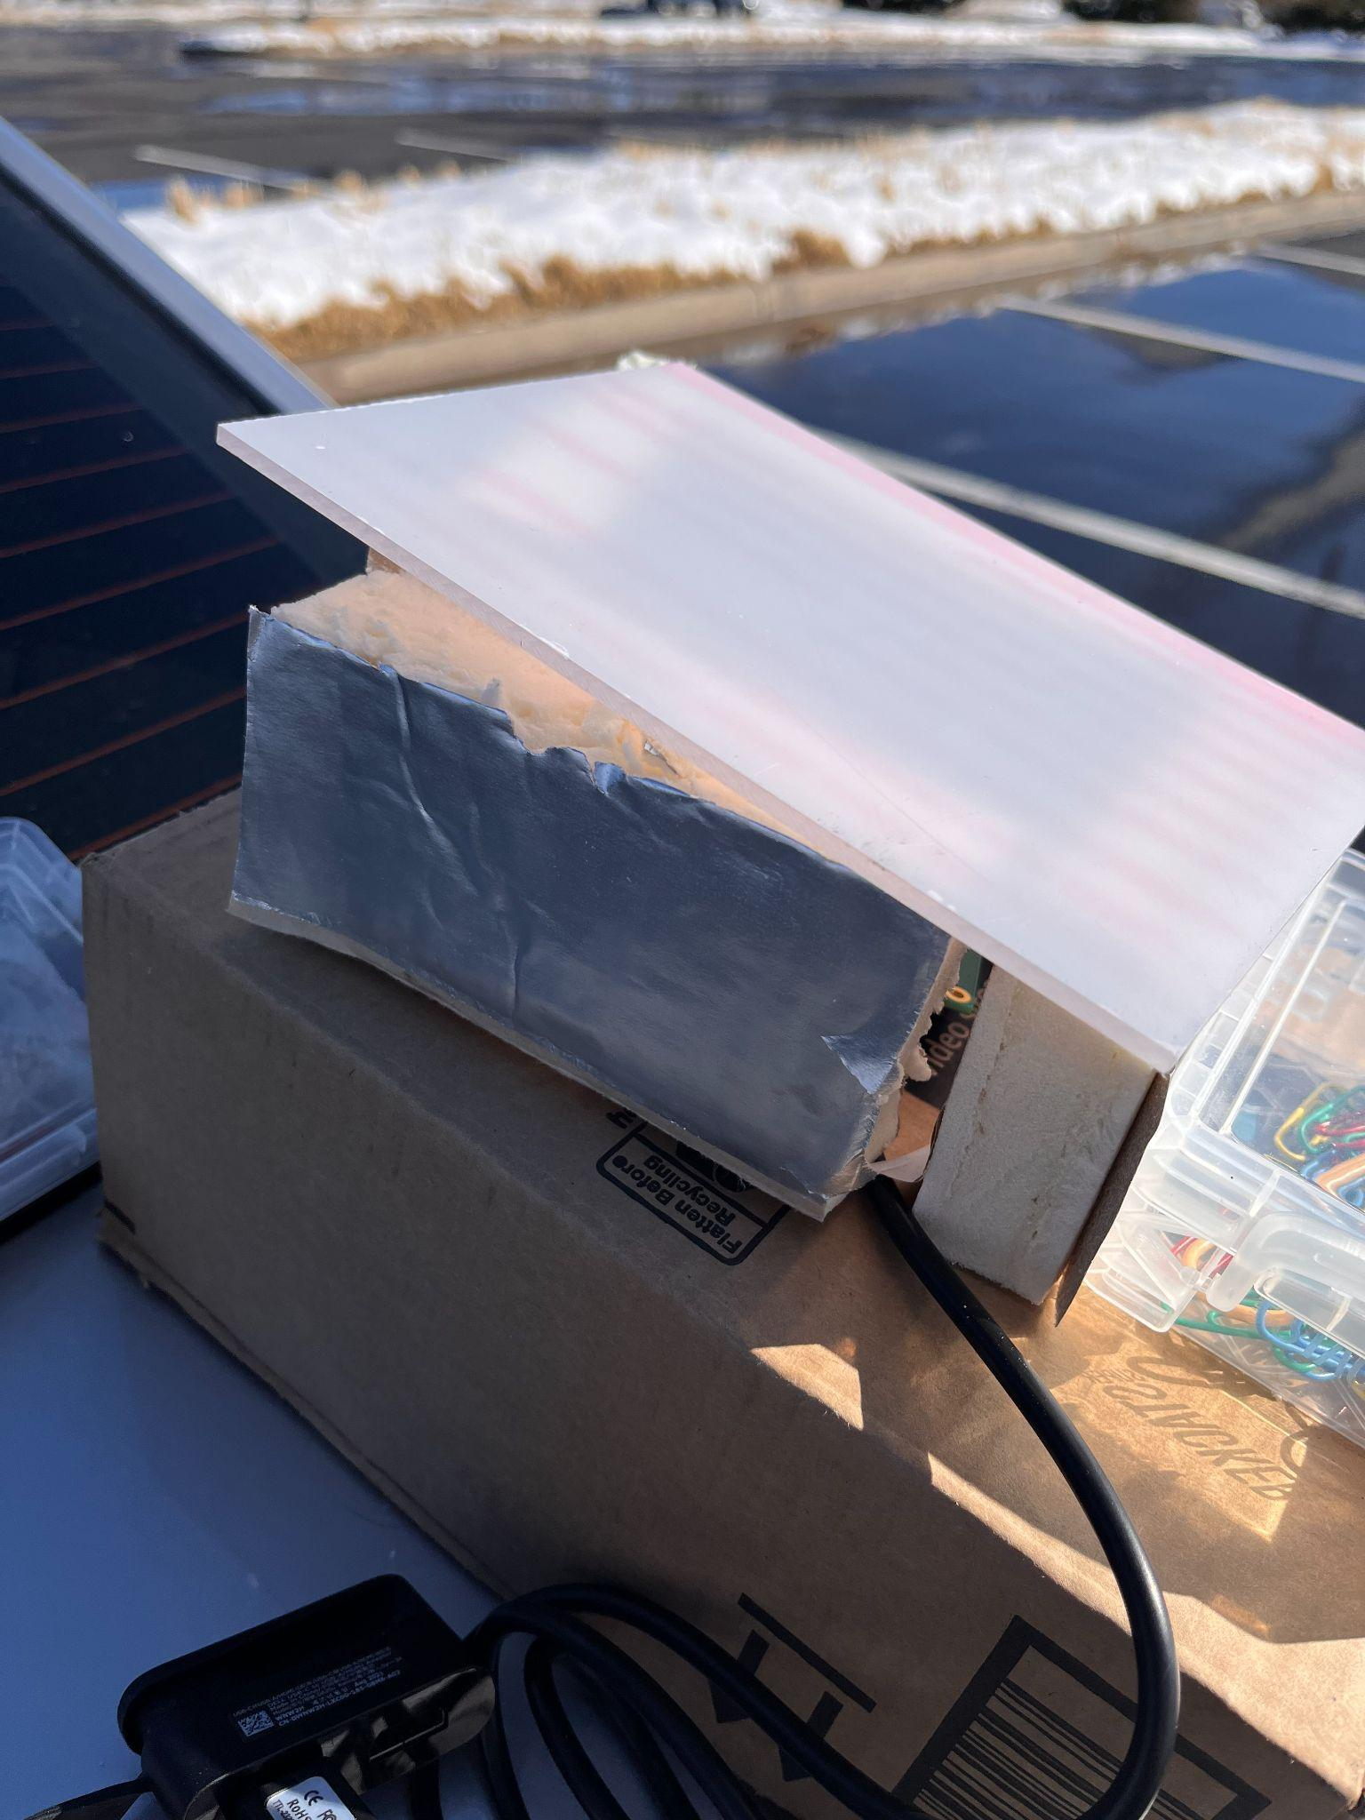
Completed Tests: Communications Test
Notes:
Tanisha

Slide 30
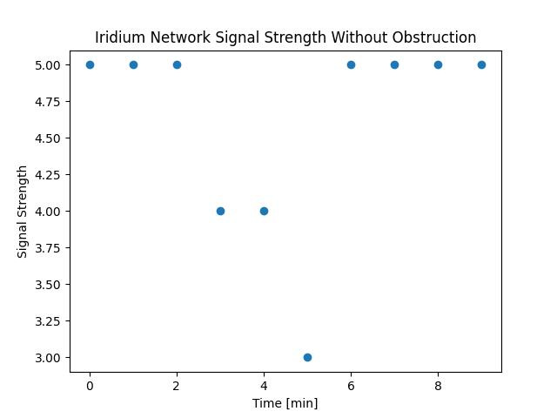
Completed Tests: Communications Test
Test 1: No Obstruction
Message Transmission Test
Signal Strength Test
Message Length | 42 bytes
Signal Strength | 5
Transmission Time | 28.3s
Notes:
Tanisha

Slide 31
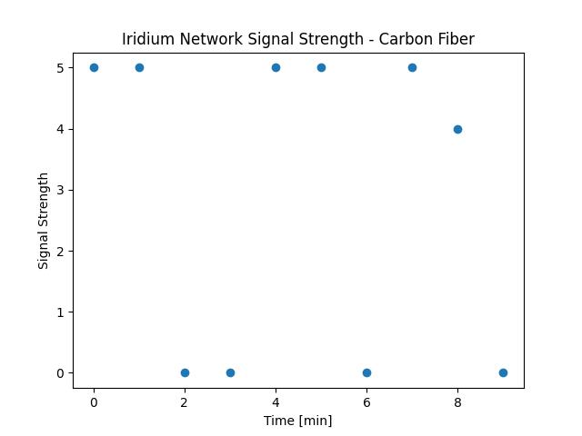
Completed Tests: Communications Test
Test 1: Carbon Fiber
Message Transmission Test
Signal Strength Test
Message Length | 42 bytes
Signal Strength | 5
Transmission Time | 26.7 s
Notes:
Tanisha

Slide 32
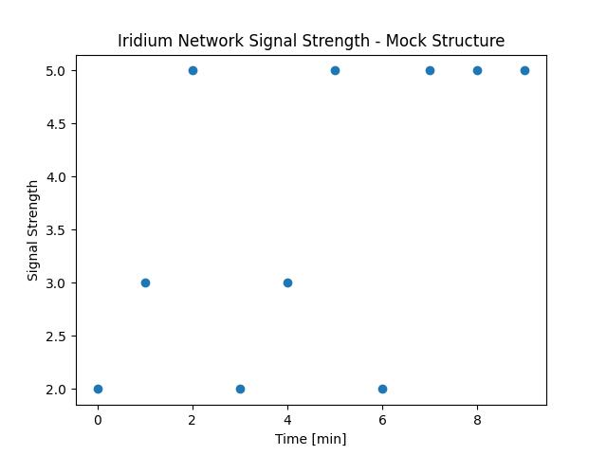
Completed Tests: Communications Test
Test 1: Insulation & Polycarbonate
Message Transmission Test
Signal Strength Test
Message Length | 42 bytes
Signal Strength | 5
Transmission Time | 33.5 s
Notes:
Tanisha

Slide 33
Current Test Status
Test Conducted | Validated/Verified: | Risks Reduced | Pass?
Yielding Strength Test (Break Chords) | Strength of break chords, ability to sustain a loading force, satisfy FAA requirements | FAA requirement satisfaction Twisting and lateral mitigation Materials risk reduced - already acquired | Yes
Communications Test | Ability to send and receive messages. | Communication error Loss of contact Flight plan mode failure | Yes
Notes:
Tanisha

Slide 34
Upcoming Tests

Slide 35
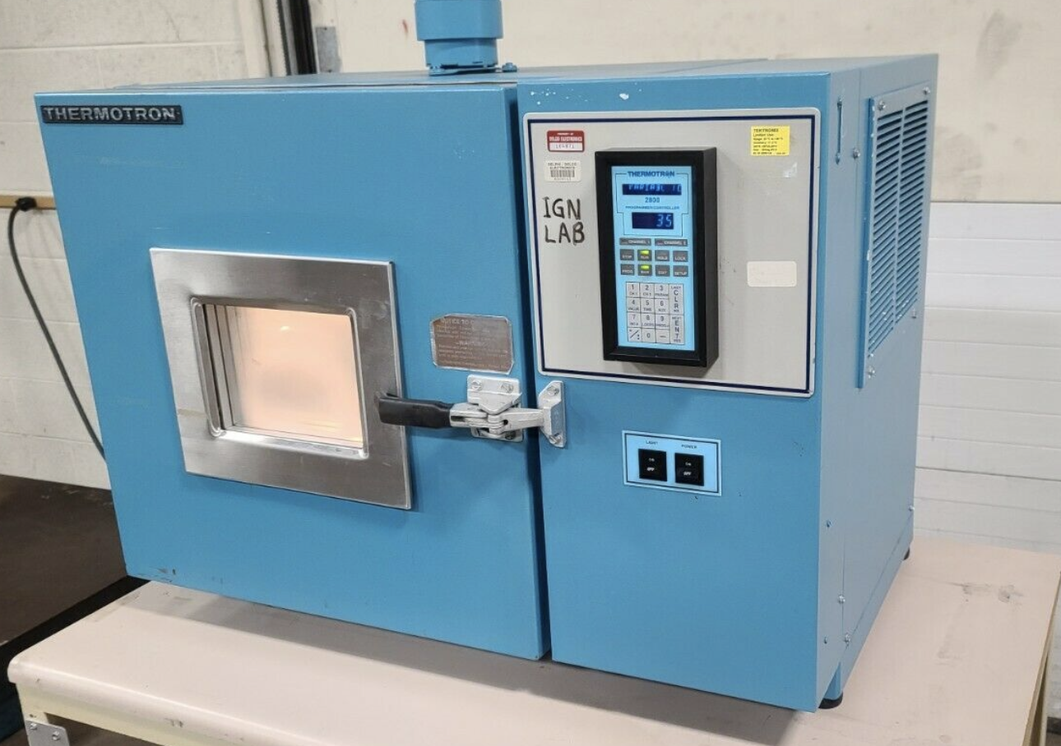
Cold Chamber Test (verification)
DR 3.2: BACCHUS shall operate at standard temperatures present from sea-level to stratospheric altitudes, for a range around 40°C to -55°C
Rationale/Motivation:
To show the effect of the cold environment on the hopper system
(ascent) and valve/motor (descent).
Procedure:
Run cold chamber at a constant temperature and motor at a
constant speed until steady state is reached.
Ascent system: Run hopper system to ensure BB’s do not freeze.
Descent system: Assemble valve to motor and re-run cold chamber.
Visually monitor current on power supply.
Measurements:
Ascent system: current draw, motor temperature, chamber temperature.
Descent system: motor temperature, chamber temperature.
Pass Criteria:
Pass: DC motor spins without interruption while drawing consistent current. Stepper motor actuates with precise steps to open or close the valve at required angles.
Fail: consider new design options and reconduct test.
Deadline: 2/21
Planning/Set-up

Slide 36
Cold Chamber Test: Ascent System
Power
Data
Power Supply
Power Supply
Rotating Hopper System
Thermocouple
DC Motor
DC Motor
Cold Chamber
Gear
Cold Chamber
NI DAQ
Computer with LabVIEW VI
NI DAQ
Computer with LabVIEW VI
Power Supply
Power Supply
Notes:
Idk if we want to track the RPM of the motor…ask ab this monday

Slide 37
Cold Chamber Test: Descent System
Power Supply
Arduino
Arduino
Power
Data
Power Supply
Thermocouple
Stepper Motor
Stepper Motor
Rotating Gate Valve
Cold Chamber
Cold Chamber
Computer with LabVIEW VI
Computer with LabVIEW VI
NI DAQ
NI DAQ
Power Supply
Power Supply
Notes:
Idk if we want to track the RPM of the motor…ask ab this monday

Slide 38
Current Test Status
Test Conducted | Validated/Verified: | Risks Reduced | Pass?
Yielding Strength Test (Break Chords) | Strength of break chords, ability to sustain a loading force | FAA requirement satisfaction Twisting and lateral mitigation Materials risk reduced - already acquired | Yes
Communications Test | Ability to send and receive messages. | Communication error Loss of contact Flight plan mode failure
Cold Chamber Test (Ascent/Descent) | Both ascent and descent systems can operate in a cold environment. | Venting mitigation, flow rate and jams Hopper jamming reduction Freezing risk mitigation - BB pellets | TBD

Slide 39
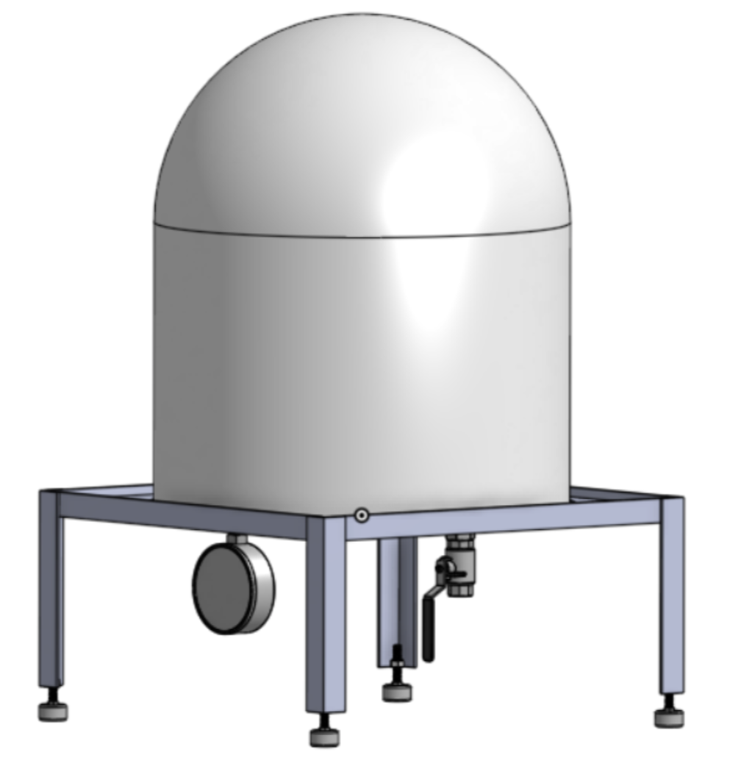
Vacuum Chamber Test (verification)
DR 3.2: BACCHUS shall operate at standard pressures present from sea level to stratospheric altitudes
Rationale/Motivation:
To show the effect of the low pressure environment on both the DC motor (ascent) and stepper motor (descent).
Procedure:
Run vacuum chamber at a decreasing pressure, track temperature of both motors using a thermocouple and track the current draw of motor.
Ascent system: Run DC motor (ascent) at a constant speed until steady state is reached.
Descent system: Run stepper motor (descent) at a constant speed until steady state is reached.
Measurements:
Ascent system: current draw, motor temperature, temperature of chamber.
Descent system: motor temperature, temperature of chamber.
Pass Criteria:
Pass: DC motor spins without interruption while drawing consistent current. Stepper motor actuates with precise steps to open or close the valve at required angles.
Fail: consider new design options and reconduct test.
Deadline: 2/21
Planning/Set-up

Slide 40
Vacuum Chamber Test: Ascent/Descent
Ascent Diagram
Descent Diagram
Power
Data
DMM
Power Supply
Arduino
Power Supply
DC Motor
Thermocouple
Stepper Motor
Thermocouple
Vacuum Chamber
Vacuum Chamber
Computer with LabVIEW VI
Power Supply
Computer with LabVIEW VI
Power Supply
NI DAQ
NI DAQ
Notes:
Idk if we want to track the RPM of the motor

Slide 41
Current Test Status
Test Conducted | Validated/Verified: | Risks Reduced | Pass?
Yielding Strength Test (Break Chords) | Strength of break chords, ability to sustain a loading force | FAA requirement satisfaction Twisting and lateral mitigation Materials risk reduced - already acquired | Yes
Communications Test | Ability to send and receive messages. | Communication error Loss of contact Flight plan mode failure | Yes
Cold Chamber Test (Ascent/Descent) | Both ascent and descent systems can operate in a cold environment. | Venting mitigation, flow rate and jams Hopper jamming reduction Freezing risk mitigation - BB pellets | TBD
Vacuum Chamber Test (Ascent/Descent) | Both ascent and descent systems can operate in a low pressure environment. | Venting mitigation, flow rate and jams BB pellet flow rate analysis | TBD

Slide 42
Valve Test (verification)
DR 4.2: BACCHUS shall provide a pass-through to fill/empty the balloon of lifting gas when attached.
Balloon filled with helium
Rationale/Motivation:
To show the effect of the high pressure filling process on the valve.
Procedure:
Fill balloon with helium and observe how the filling pressure affects the closed valve.
Measurements:
Volume of balloon after fully filled.
Pass Criteria:
Pass: Valve stays fully sealed and no leaking occurs.
Fail: consider new design options and reconduct test.
PVC Pipe
Deadline: 2/21
Rotating gate valve
Planning/Set-up
Notes:
Positive pressure test for valve not in vacuum chamber, fill the balloon with whole valve assembly attached to PVC tube and see how valve behaves to the air pressure

Slide 43
Current Test Status
Test Conducted | Validated/Verified: | Risks Reduced | Pass?
Yielding Strength Test (Break Chords) | Strength of break chords, ability to sustain a loading force | FAA requirement satisfaction Twisting and lateral mitigation Materials risk reduced - already acquired | Yes
Communications Test | Ability to send and receive messages. | Communication error Loss of contact Flight plan mode failure | Yes
Cold Chamber Test (Ascent/Descent) | Both ascent and descent systems can operate in a cold environment. | Venting mitigation, flow rate and jams Hopper jamming reduction Freezing risk mitigation - BB pellets | TBD
Vacuum Chamber Test (Ascent/Descent) | Both ascent and descent systems can operate in a low pressure environment. | Venting mitigation, flow rate and jams BB pellet flow rate analysis | TBD
Valve Test | Valve is able to sustain direct filling pressure → worst case scenario. | Venting risk mitigation - flow rate Mechanical risk reduced - jams | TBD

Slide 44
Flight Test (validation)
DR 1.1/1.2: Vertical control system shall be able to change the balloon’s ascent/descent rate to speeds up to 5m/s / 3m/s.
DR 8.1: BACCHUS shall be flight-ready within a week downtime between flights.
Rationale/Motivation:
To verify the correct integration and operation of all subsystems.
To prove effective attachment to Urban Sky payload.
Procedure:
Fill balloon with helium needed to obtain a hover around 20 km (65,617 ft).
Interface with Iridium constellations using Rock Seven RockBLOCK modem.
Actuate ascent and descent systems.
Measurements:
Ascent, hover, and descent rates from GPS system.
Pass Criteria:
Pass: performance metrics from customer are satisfied, a 5m/s ascent rate, 3m/s descent rate, and 0m/s hover is achieved.
Fail: refine requirements to better satisfy requirements, consider reconducting subsystem tests and another flight test.
Urban Sky Payload
Deadline: 4/06
Not Started

Slide 45
Current Test Status
Test Conducted | Validated/Verified: | Risks Reduced | Pass?
Yielding Strength Test (Break Chords) | Strength of break chords, ability to sustain a loading force | FAA requirement satisfaction Twisting and lateral mitigation Materials risk reduced - already acquired | Yes
Communications Test | Ability to send and receive messages. | Communication error Loss of contact Flight plan mode failure
Cold Chamber Test (Ascent/Descent) | Both ascent and descent systems can operate in a cold environment. | Venting mitigation, flow rate and jams Hopper jamming reduction Freezing risk mitigation - BB pellets | TBD
Vacuum Chamber Test (Ascent/Descent) | Both ascent and descent systems can operate in a low pressure environment. | Venting mitigation, flow rate and jams BB pellet flow rate analysis | TBD
Valve Test | Valve is able to sustain direct filling pressure → worst case scenario. | Venting risk mitigation - flow rate Mechanical risk reduced - jams | TBD
Flight Test | Balloon Dynamical Model (Balloon Film Temperature Model, Balloon Pressure Differential Model), control law | N/A | TBD

Slide 46
Risk Assessment
Test | Major Risk Mitigated | Subsystem
Cold Chamber, Vacuum, Valve, Flight | Venting uncertainty | Mechanical, Electronics
Break chord, Communications, Flight | FAA requirements met | Mechanical, Software & Electronics
Cold Chamber, Vacuum, Flight | BB pellet flow rate | Mechanical, Electronics
Communication, Flight | Communication Failure | Software, Electronics
Notes:
Libby

Slide 47
Budget

Slide 48
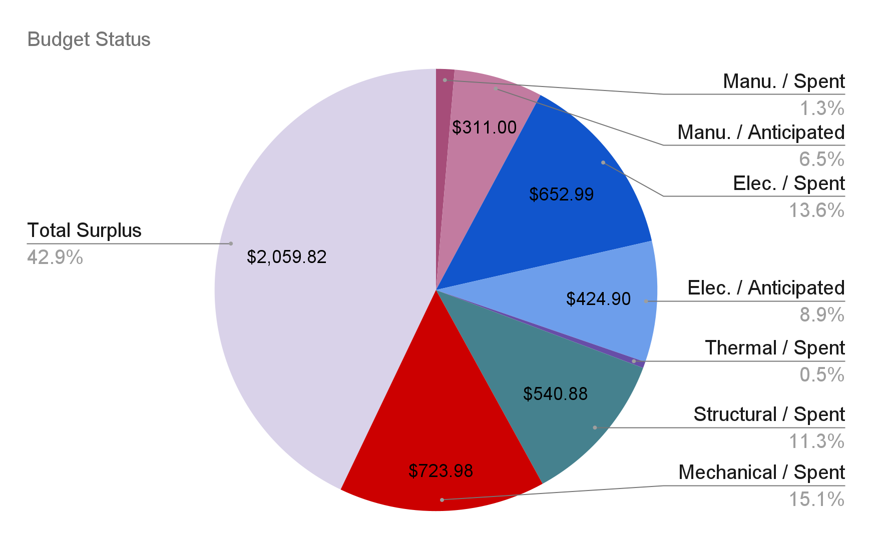
Budget Status
Notes:
Running tally of numbers on side of screen

Slide 49
Remaining Purchases
Component | Quantity | Total Price | Lead Time
PCB Board Manufacturing | 1 | $311 | 4 days
Antenna | 2 | $358 | 1-2 weeks
Batteries | 2 | $45 | 1-2 weeks
Notes:
David
Blow up and lead time

Slide 50
Acknowledgements
We want to acknowledge and express our thanks to
Our advisor, Prof. Mah, for all of his guidance and feedback
Our customer, Urban Sky for this opportunity and for their support throughout
Colin Claytor for reviewing our presentation

Slide 51
Questions?

Slide 52
Appendix

Slide 53
Mechanical

Slide 54
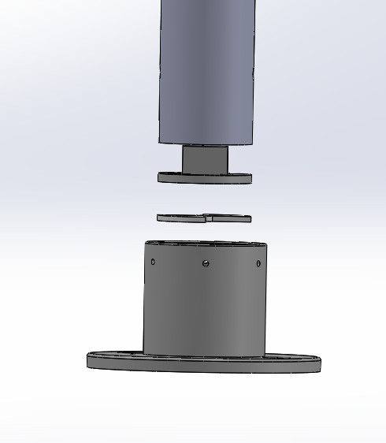
Valve Design - Expanded View
PVC Pipe
Motor Casing
Rotating Piece
Casing and Bottom Piece

Slide 55
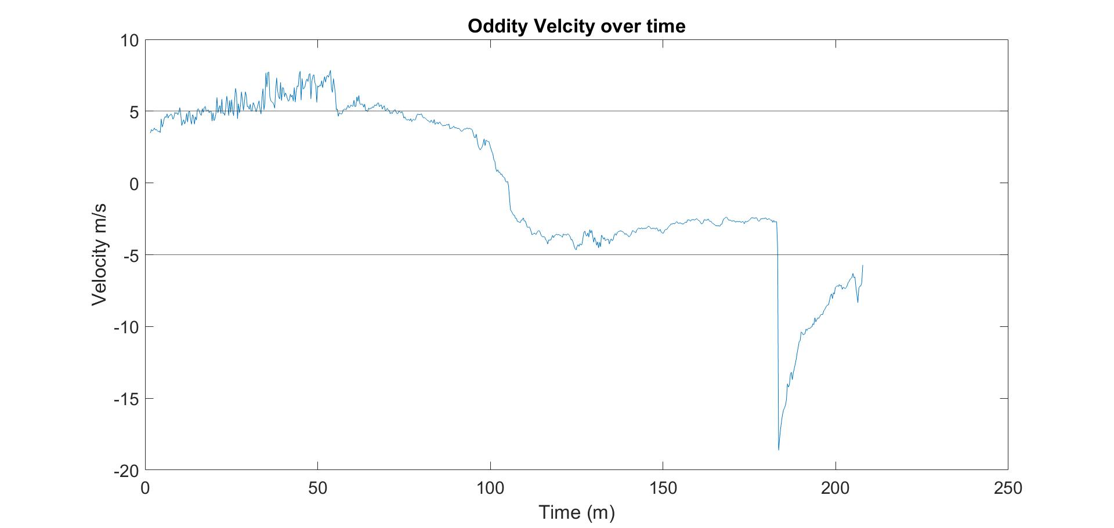
Oddity Velocity Flight Data

Slide 56
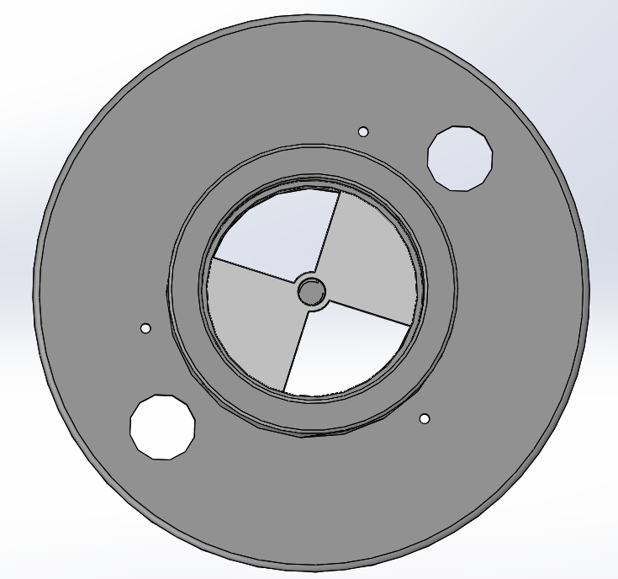
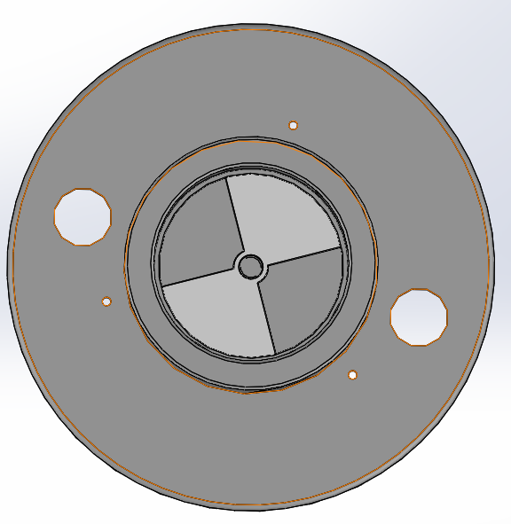
Valve Design
Air Flow Open
Air Flow Closed

Slide 57
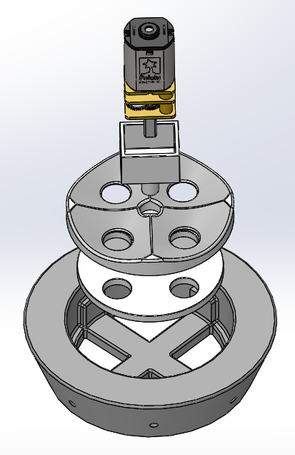
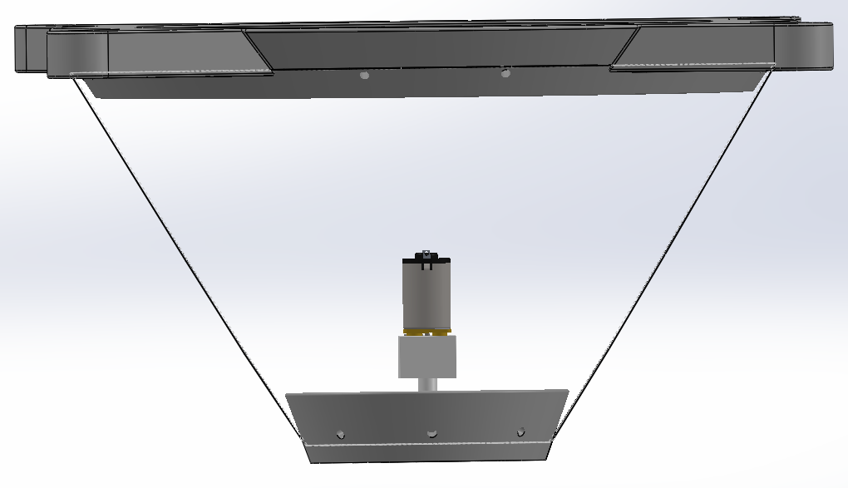
Hopper Design
Motor Casing
Static Gear
Rotating Gear
Single Wrapped Polycarbonate Sheet
Casing

Slide 58
Electrical

Slide 59
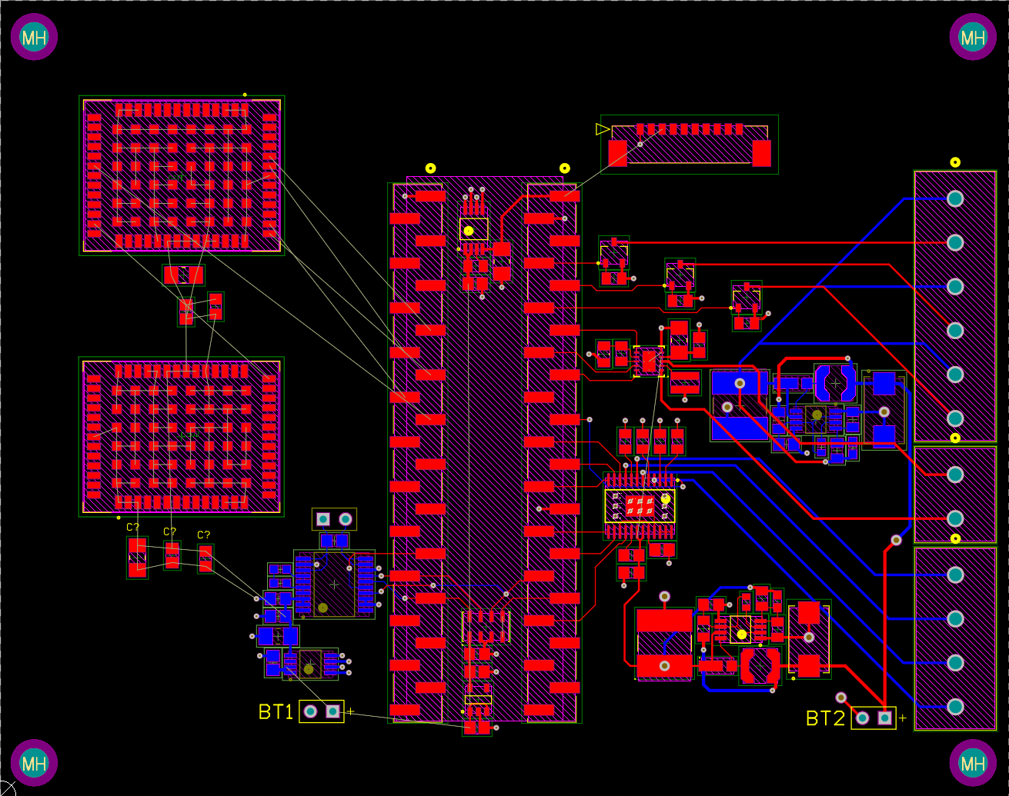
PCB Design – All Layers (2D View)

Slide 60
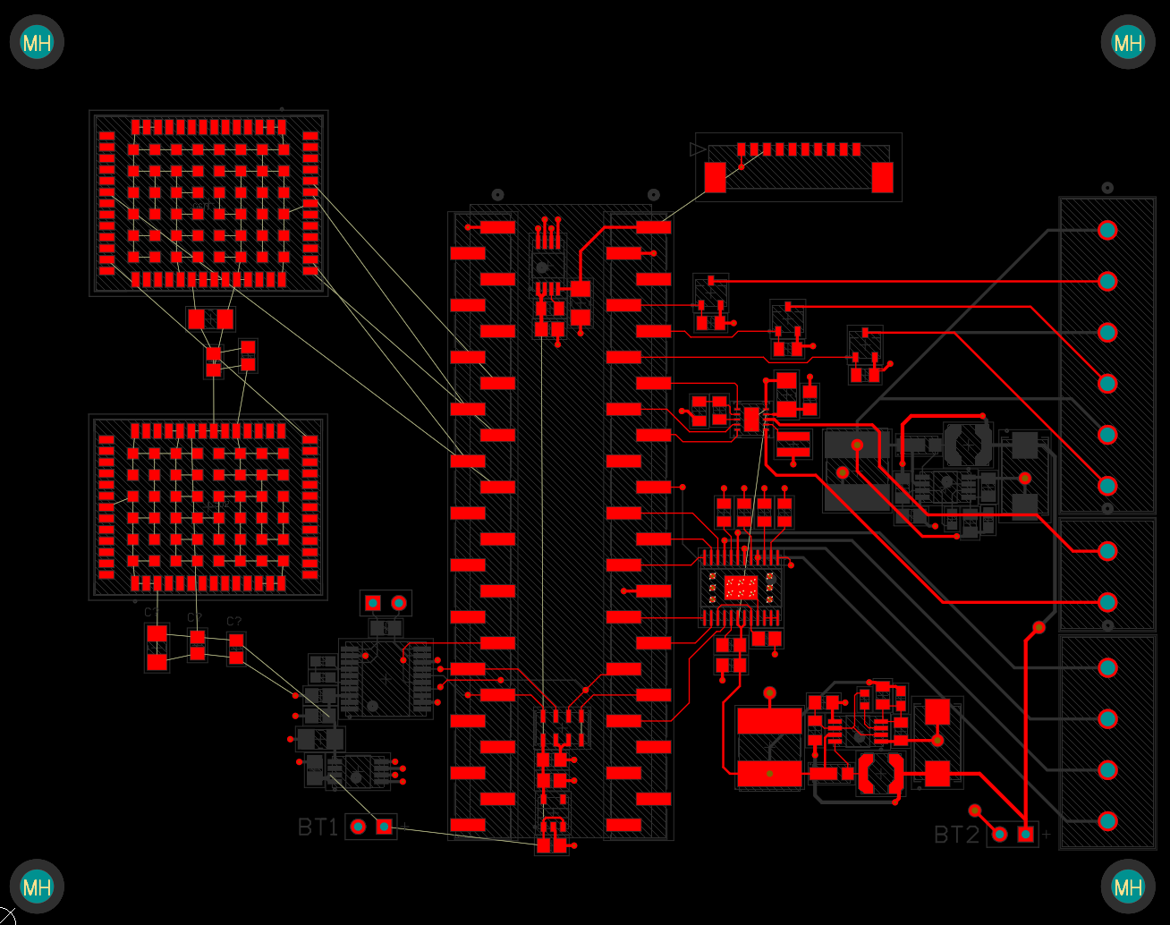
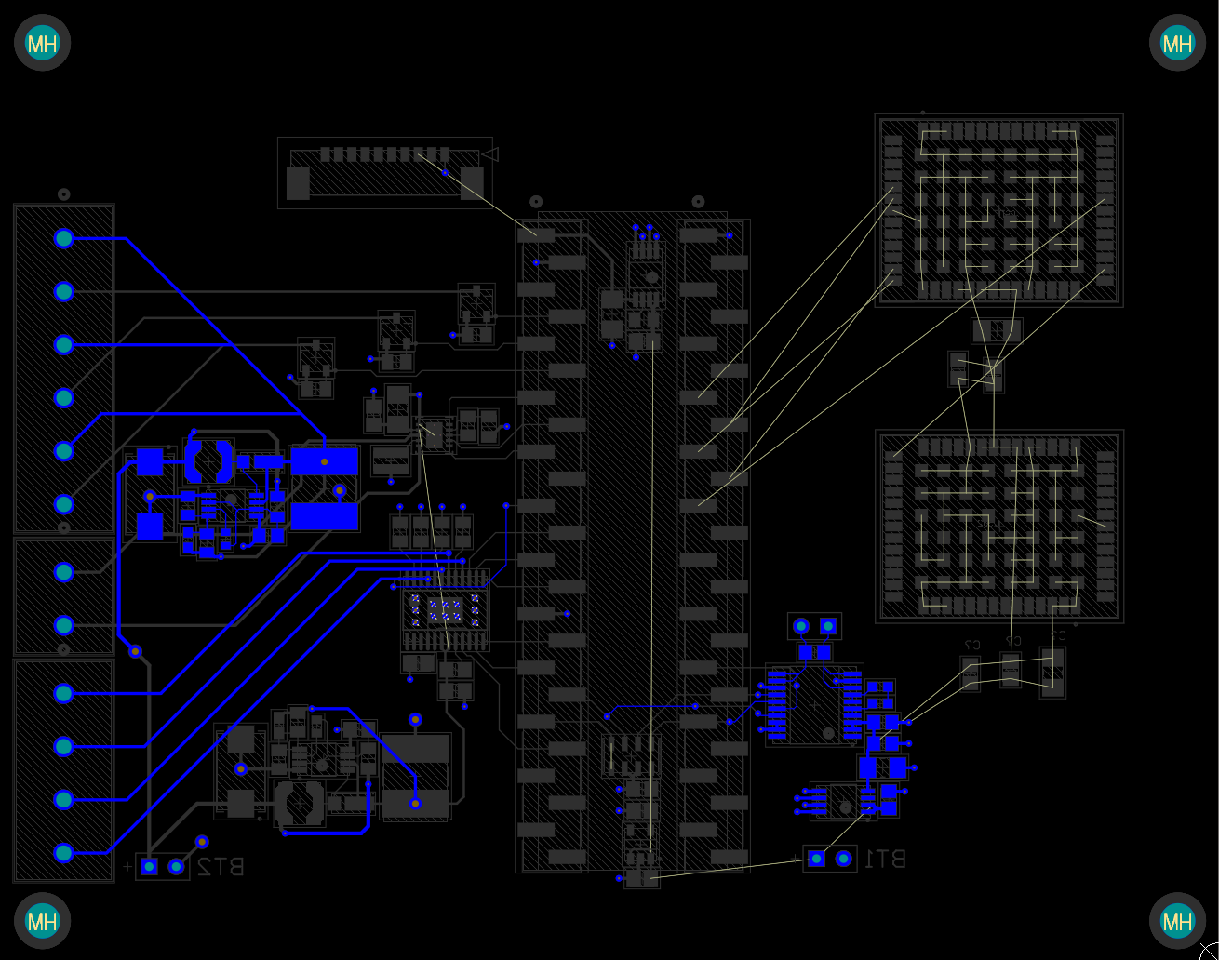
PCB Design – Top & Bot Layers (2D View)

Slide 61
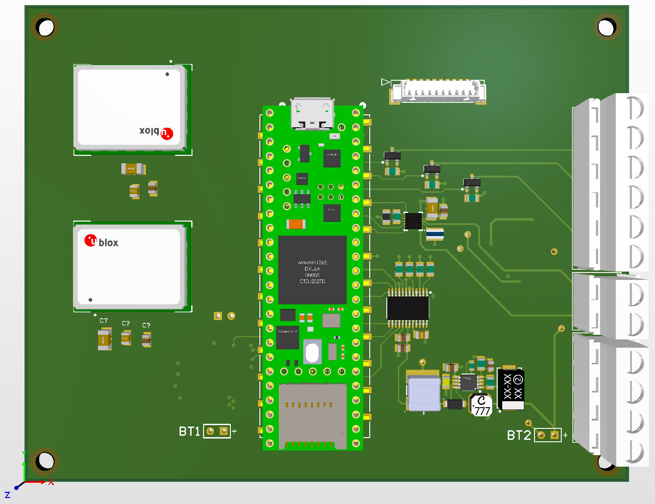
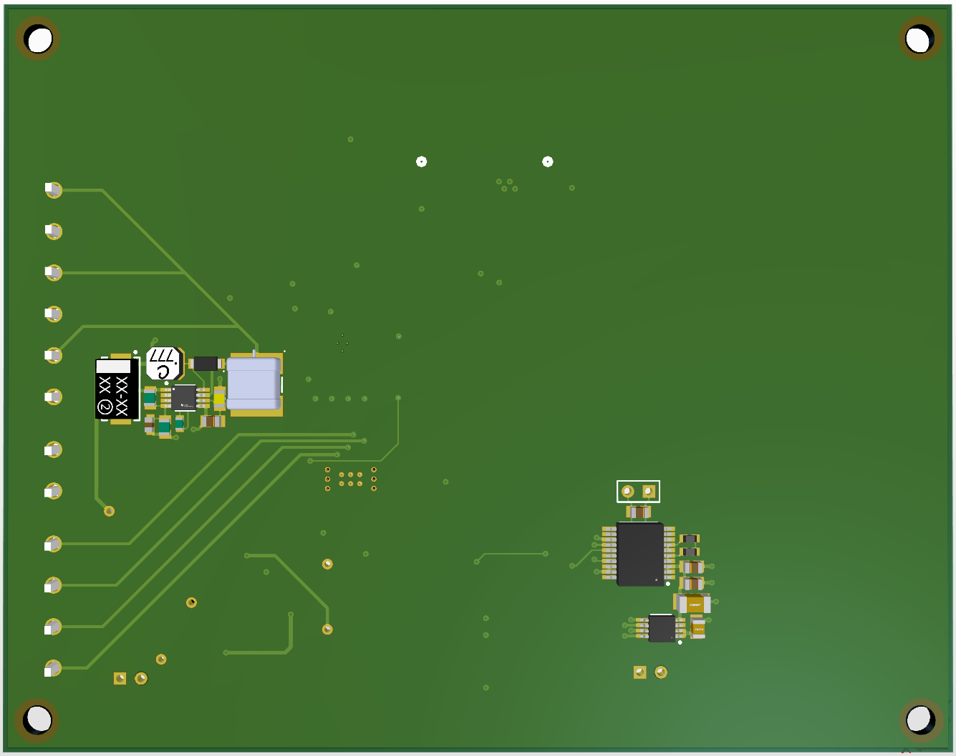
PCB Design – Top & Bot Layers (3D View)

Slide 62
Testing

Slide 63
Test Name | Equipment Needed | Facilities Needed | Safety
Preliminary Cold Chamber Test | fan, thermocouple, dry ice, foam cooler, NI DAQ, power supply | PILOT Lab | Test Complete
Preliminary Vacuum Chamber Test | fan, thermocouple, Arduino, power supply | Urban Sky vacuum chamber | Test Complete
Yielding Strength Test (break chords) | break chords, dummy weights, balloon | N/A | Test Complete
Cold Chamber/Jamming Test - Ascent | rotating gear system, DC motor, gear, BB pellets | Urban Sky cold chamber
Communications/Interface test | Iridium RockBLOCK GPS module | N/A | Test Complete
Cold Chamber Test - Electronics | electronics bay/components, thermocouples, active heater | Urban Sky cold chamber
Drop Test | BACCHUS structure | N/A
Rainfall Drip Test | BACCHUS structure, water, strainer | N/A
Yielding Strength Test (full structure) | BACCHUS structure, dummy weights balloon | N/A
Loss of Lift Test | BACCHUS system, balloon | Urban Sky
Full Duration Bench Test | BACCHUS components | N/A
Flight Test | BACCHUS system, balloon | Urban Sky
Spin Test | BACCHUS system, rope | N/A
Notes:
Kailey

Slide 64
Other Test Considerations
Cold Chamber/Vacuum Chamber Test Uncertainties:
No accurate way of measuring motor speed.
DC Motor: track current to ensure motor spins without interruption (consistent current draw → consistent RPM)
Stepper Motor: observe motor motion to ensure precise steps to open or closer valve.
Expand Scope of Valve Test:
Figure out a way to measure the mass flow rate of air flowing out of balloon and through valve.
Know temperature and know velocity of balloon exit because know cross section area.
Could put static pressure port at valve.

Slide 65
Test Procedures
Cold Chamber Test Procedure
Step-by-Step Procedure:
Connect the motor to the power supply.
For the stepper motor, connect first to arduino and then to power supply.
Place one thermocouple on the motor and another thermocouple in the chamber.
Connect both thermocouples to NI DAQ device.
Connect NI DAQ to power supply and computer with LabVIEW VI set up.
Run the cold chamber at a constant temperature and motor at a constant speed until steady state is reached.
Ascent system:
Visually monitor current on power supply and take note of values in consistent time intervals.
After the motor is confirmed to be operating properly, run the motor with the hopper system to ensure BB’s do not freeze.
Descent system:
After the motor is confirmed to be operating properly, assemble the valve to the motor and re-run the cold chamber.
Actuate stepper motor with the precise steps necessary to open/close the valve.

Slide 66
Test Procedures
Vacuum Chamber Test Procedure
Step-by-Step Procedure:
Connect the motor to the power supply.
For the stepper motor, connect first to arduino and then to power supply.
Place one thermocouple on the motor and another thermocouple in the chamber.
Connect both thermocouples to NI DAQ device.
Connect NI DAQ to power supply and computer with LabVIEW VI set up.
Run vacuum chamber at a decreasing pressure and motor at a constant speed until steady state is reached.
Ascent system:
Visually monitor current on power supply and take note of values in consistent time intervals.
After the motor is confirmed to be operating properly, run the motor with the hopper system to ensure BB’s do not freeze.
Descent system:
After the motor is confirmed to be operating properly, assemble the valve to the motor and re-run the cold chamber.
Actuate stepper motor with the precise steps necessary to open/close the valve.

Slide 67
Test Procedures
Valve Test Procedure
Step-by-Step Procedure:
Connect the balloon to the PVC pipe.
Connect valve to PVC pipe.
Fill the balloon with helium.
Observe how the valve reacts to pressure.
Apply soapy water to the exterior of valve (if bubbling occurs, there is leaking).

Slide 68
Test Procedures
Loss of Lift Test Procedure
Step-by-Step Procedure:
Attach a 10 lb will attached to the bottom of the BACCHUS system.
Fill the balloon with helium.
Initially, there will be free-lift, so the scale will read a value lower than the 10 lb mass.
The difference between the scale reading and the actual 10 lb mass represents the upward pulling force.
Simulate a transition to the float state.
Valve off helium from the balloon until the scale reads exactly 10 lb.
Drop ballast or vent helium.
If ballast is dropped from the system, it is expected that the scale would once again read a value below 10 lb representing an upward pull, and thus, the ascent phase of flight.
Helium will be vented from the balloon until the scale reads higher than 10 lb. Here, the mass of the system is greater than the upward pulling force representing the descent phase of flight.
Calculate the rate of both the ascent and descent from the change in lift force.

Slide 69
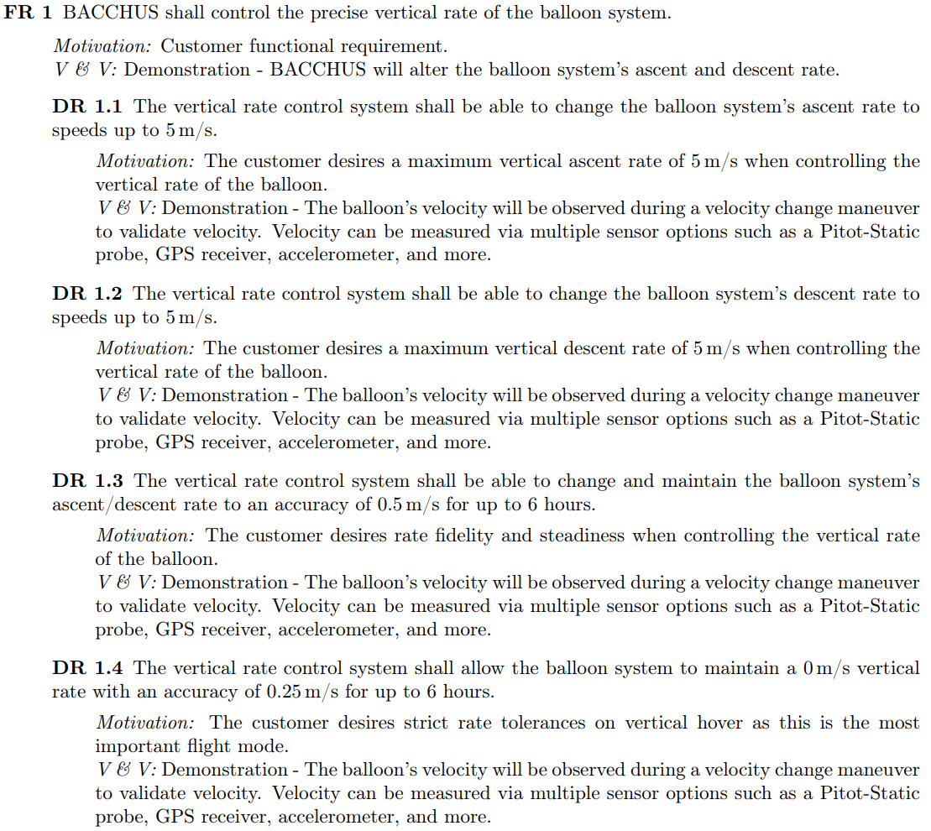
FR 1 Design Requirements

Slide 70
FR 2 Design Requirements

Slide 71
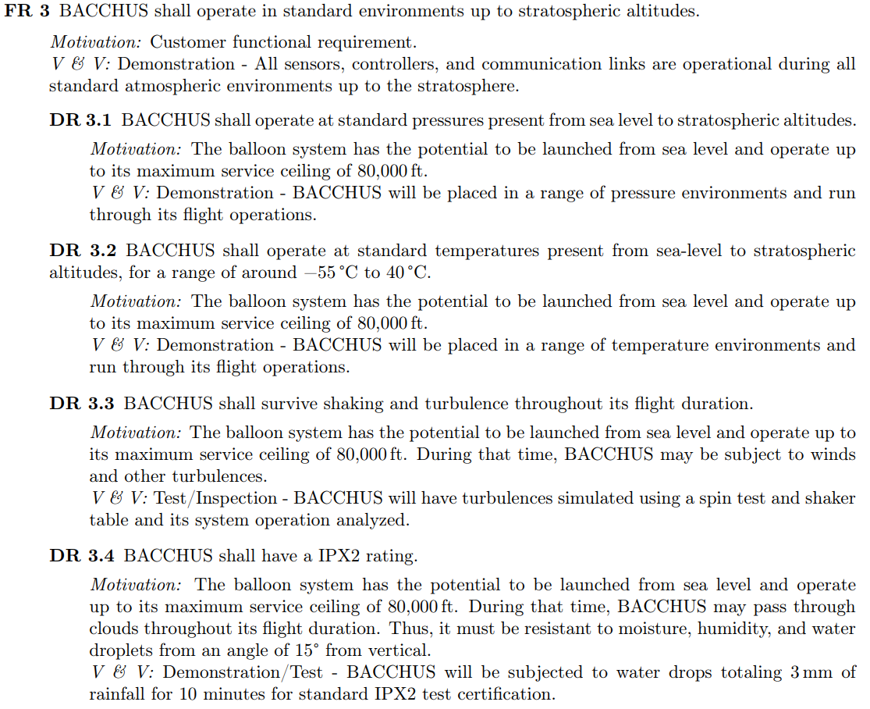
FR 3 Design Requirements

Slide 72
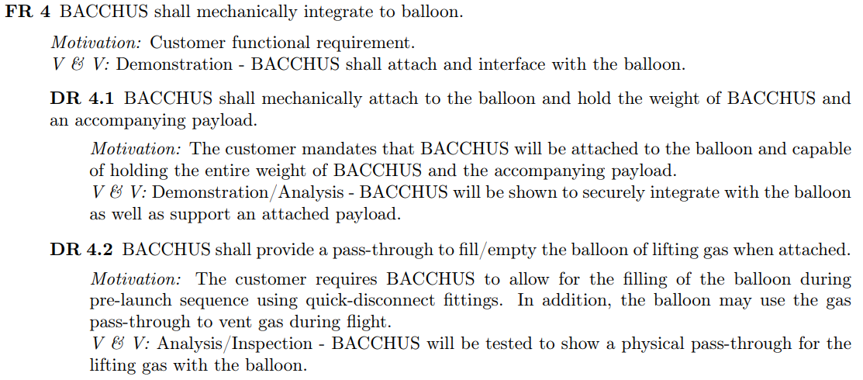
FR 4 Design Requirements

Slide 73
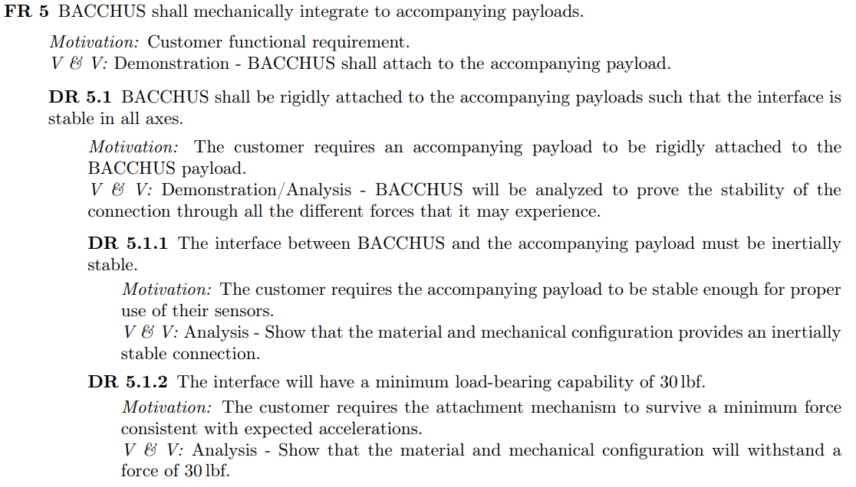
FR 5 Design Requirements

Slide 74
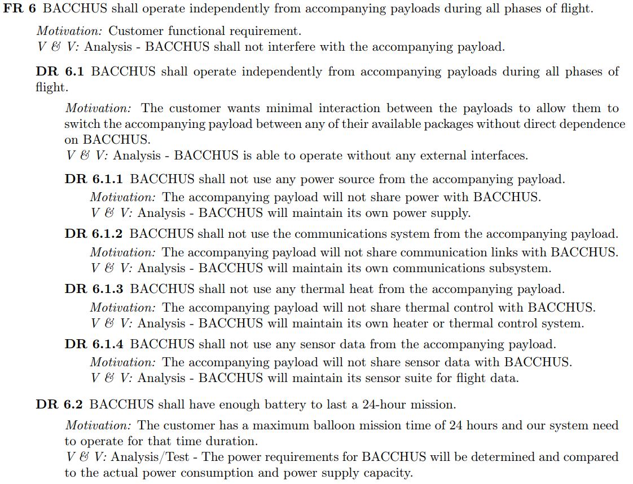
FR 6 Design Requirements

Slide 75
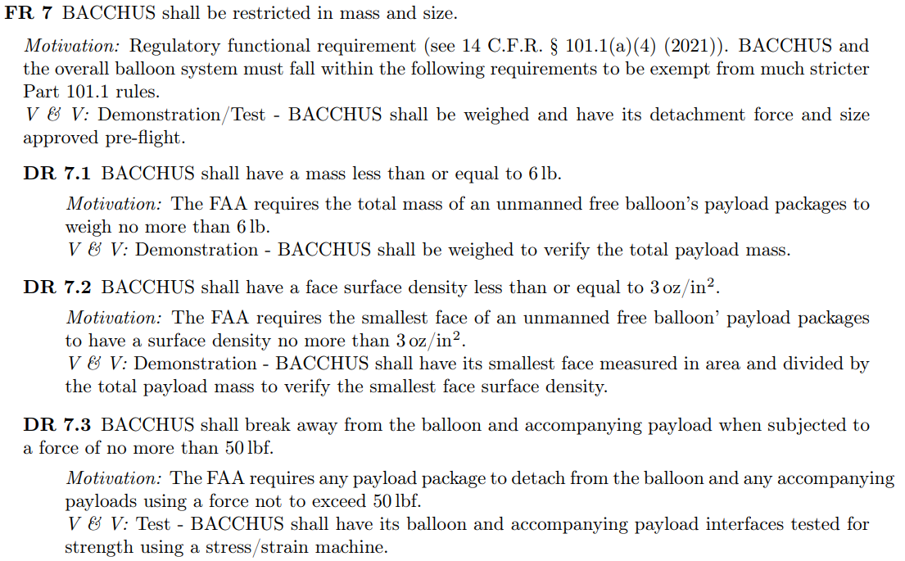
FR 7 Design Requirements

Slide 76
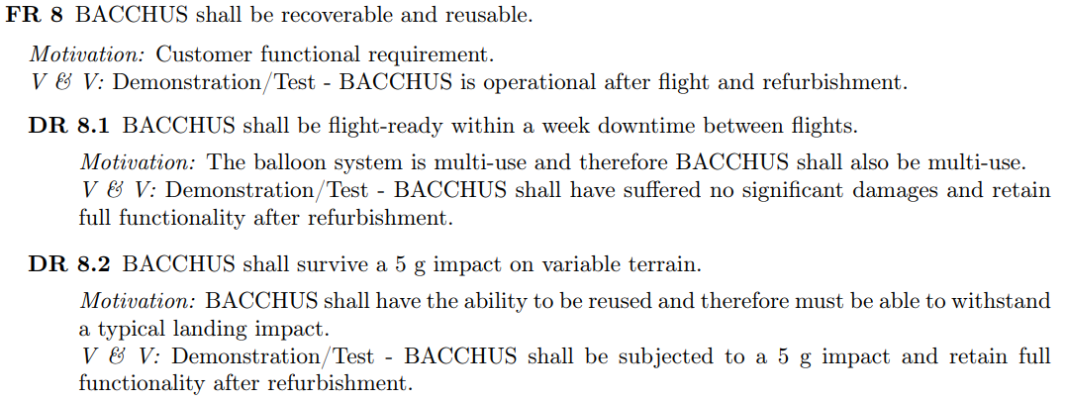
FR 8 Design Requirements

