Slide 1
BACCHUS
Balloon Altitude Command Control Housing for Unmanned Sensing
Critical Design Review
November 29, 2021
Sponsored by: Urban Sky
Advisor: John Mah

Slide 2
Agenda
Project Overview Libby Moore
Design Solution Libby Moore, Thyme Zuschlag, William Gravel
Critical Project Elements Libby Moore
Design Requirement Derrick Choi & Thyme Zuschlag
Project Risks Libby Moore
Verification and Validation Kailey Rex
Project Planning David Shaw & Ben Chupik

Slide 3
Project Overview

Slide 4
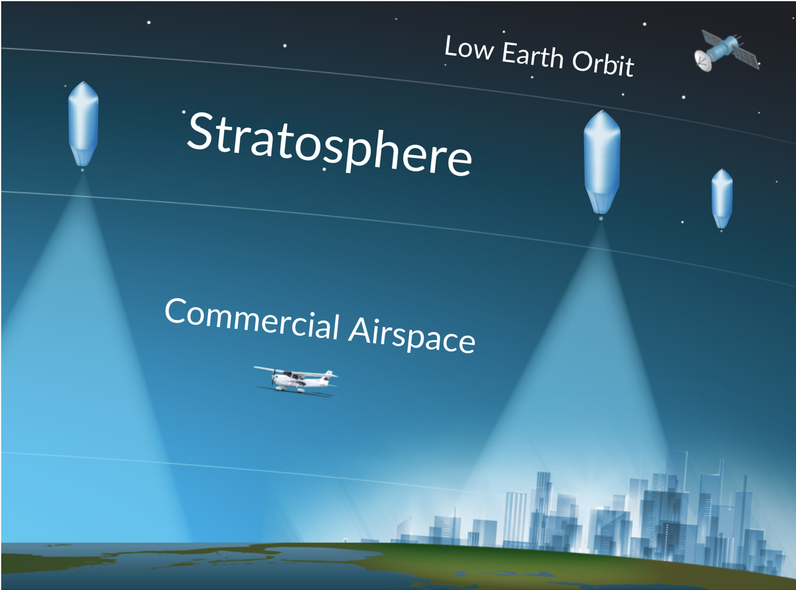
Background and Motivation
Background
Sponsor Urban Sky uses high altitude balloons to sense and record ground information across large regions of land.
Motivation
Urban Sky wants a cheaper balloon platform that still supports their sensors and mission duration (1 day).
Mission Statement
The Balloon Altitude Command Control Housing for Unmanned Sensing (BACCHUS) team will develop, build, and test a semi-autonomous system to control the ascent, descent, and hover of an off-the-shelf high altitude latex balloon.

Slide 5
Primary Objectives
 | Objective
1 | Control the ascent of the balloon up to 5 m/s with a ± 0.5 m/s tolerance by dropping ballast (biodegradable BB pellets)
2 | Control the descent of the balloon up to 5 m/s with a ± 0.5 m/s tolerance by venting helium
3 | Maintain a vertical hover with a ± 0.25 m/s tolerance averaged over 5 minutes, for up to 6 hours
4 | Mechanically interface with the balloon and the Urban Sky payload
5 | Communicate between payload and ground station

Slide 6
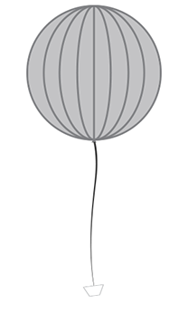
Out of scope
BACCHUS CONOPS
Data
Commands
Satellite
Satellite
Positive Vertical Rate
Satellite
1. Controlled Descent
OR
Vertical
Hover
Closed loop feedback
OR
OR
2. Burst + Parachute
Negative Vertical Rate
Ground Station
Ground Station
Ground Station
Ground Software
Ground Software
Ground Software

Slide 7
Design Solution

Slide 8
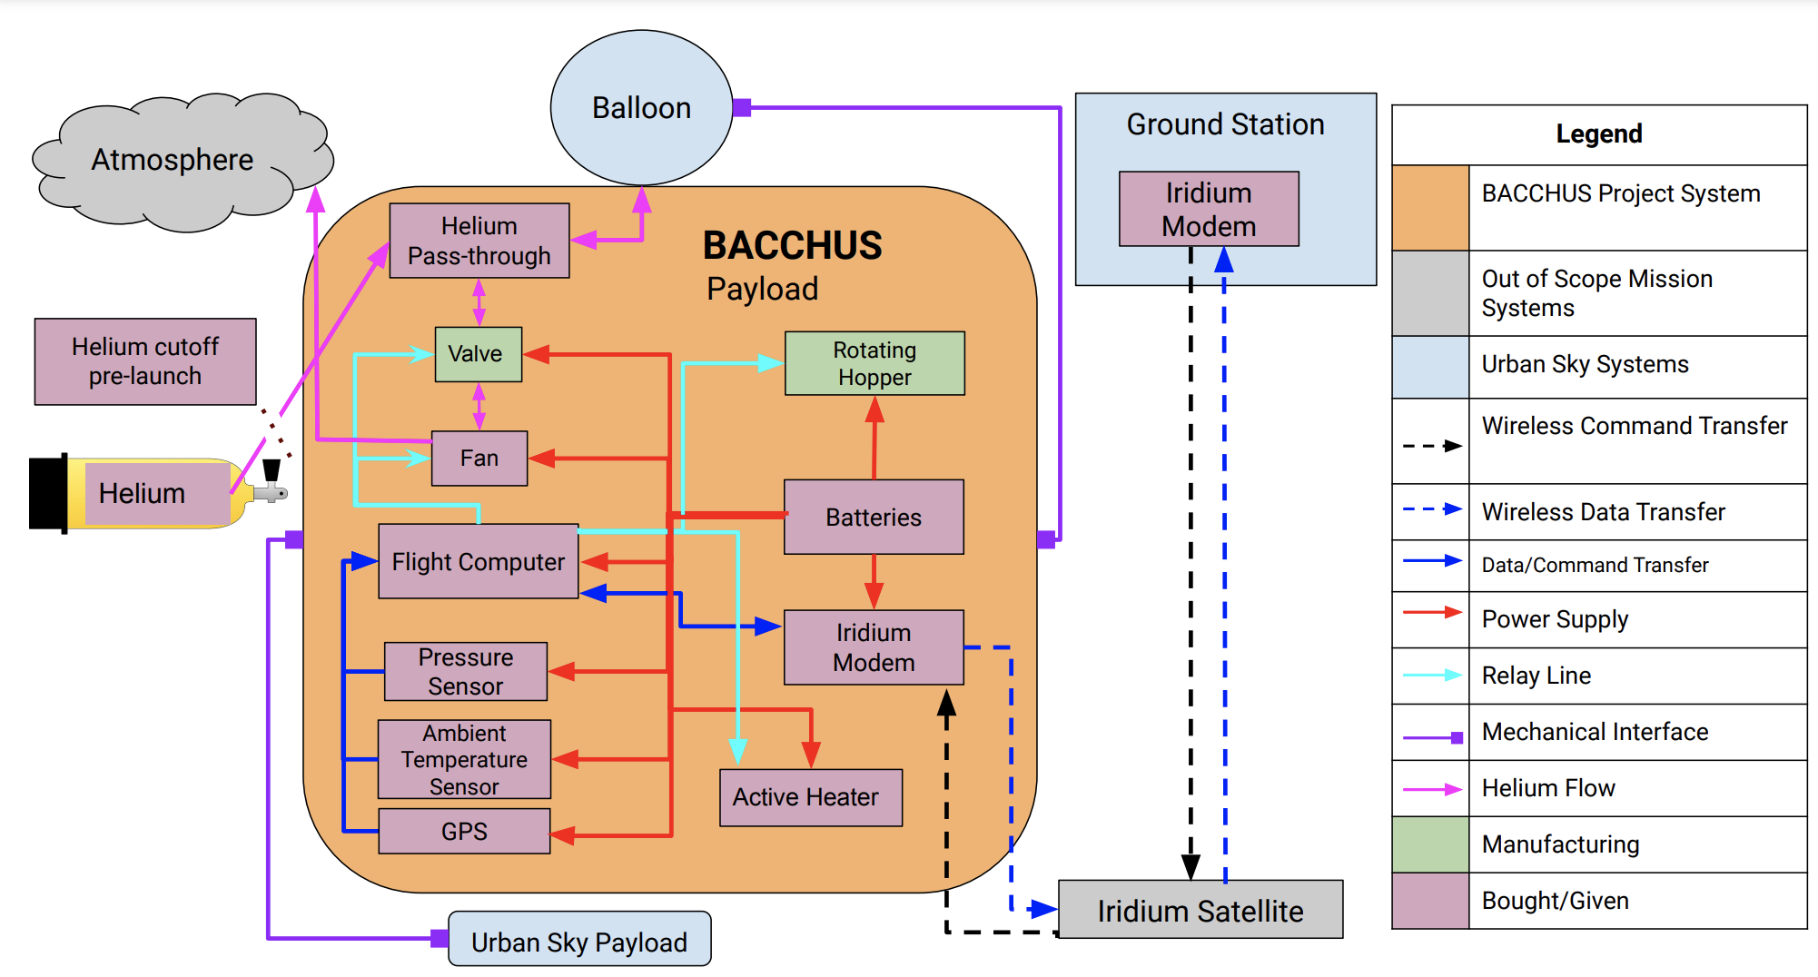
Functional Block Diagram
Notes:
Libby

Slide 9
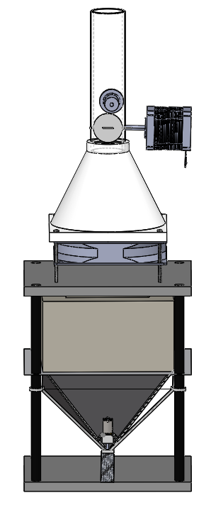
CAD Model
~20 in
Mechanical
Electronics
Structural
Helium Quick Disconnect
Valve & Stepper Motor
Markforged 3D Printed Carbon Fiber Filled Nylon
Fan
3/16” Polycarbonate
Insulated Electronics Bay
Rigid ⅜” Carbon Fiber Rods
1/32” Carbon Fiber Sheet
Rotating Gears
Structural Truss
7 in
Notes:
Thyme

Slide 10
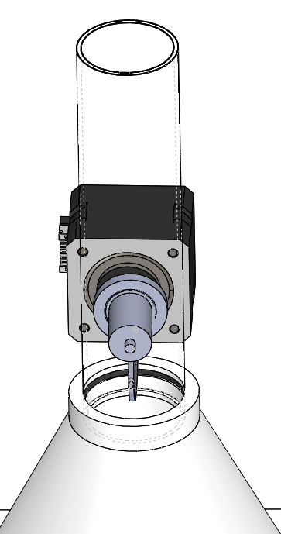
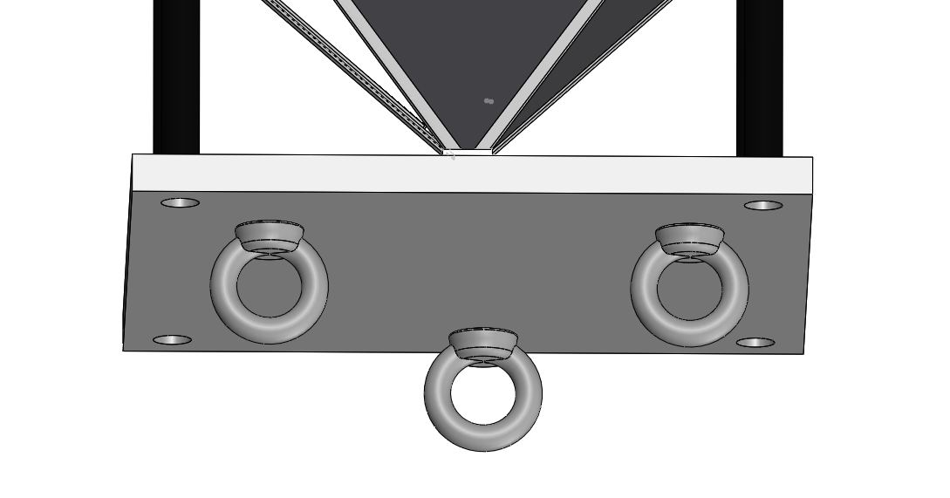
Payload Interface/Balloon Interface
35mm
Balloon Attachment Point
Butterfly Valve
⅜” NPT HFC Coupling
Eye Bolts
20 lb Break Line
7” x 7” Baseplate
O Ring Seal
Notes:
Thyme
Need to change the type of eye bolts used, no thread through the polycarbonate: https://www.mcmaster.com/3018T14/

Slide 11
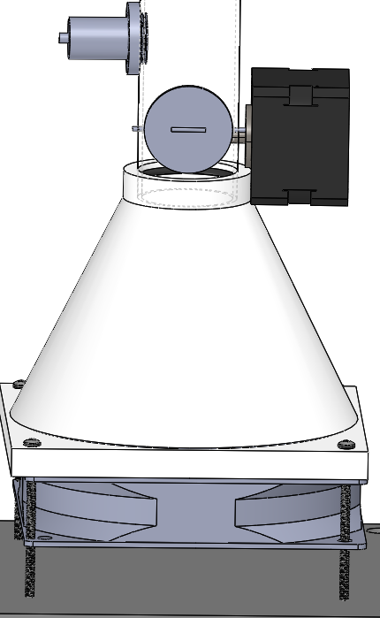
Venting Helium
Venting Specifics
Off the shelf venting rate of 2.7 m³/min
The valve will control when venting occurs
*Ongoing testing to quantify effectiveness of fan at different altitudes and temperatures
**Passive venting from differential pressure under investigation
Butterfly Valve
120mm Fan
Notes:
Will

Slide 12
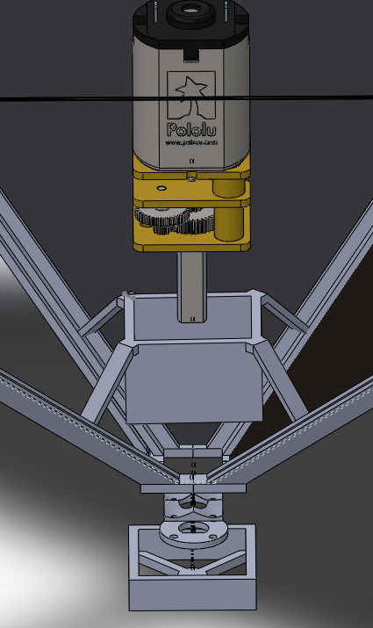
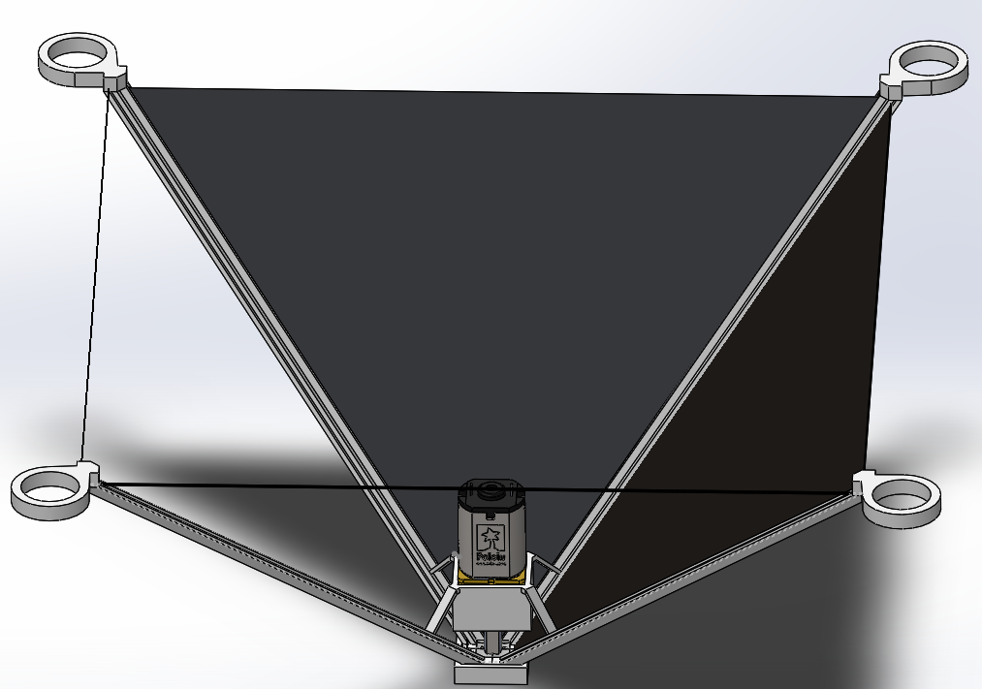
Dropping Ballast
5.8”
DC Motor
Hopper (AKA Ballast Container)
0.25-mm-thick Carbon Fiber Sheeting
3”
Motor Casing
Sloped Plate
Rotating
Gear
Polyethylene Terephthalate Glycol (PETG) Printed Supports
Gear Harness
7mm
Notes:
Will
Would talk about materials here too?

Slide 13
Control Law
PD Control of Velocity
(Control based on velocity and acceleration)
Notes:
Will

Slide 14
Electronics Detailed Block Diagram
Notes:
Will
Acronyms

Slide 15
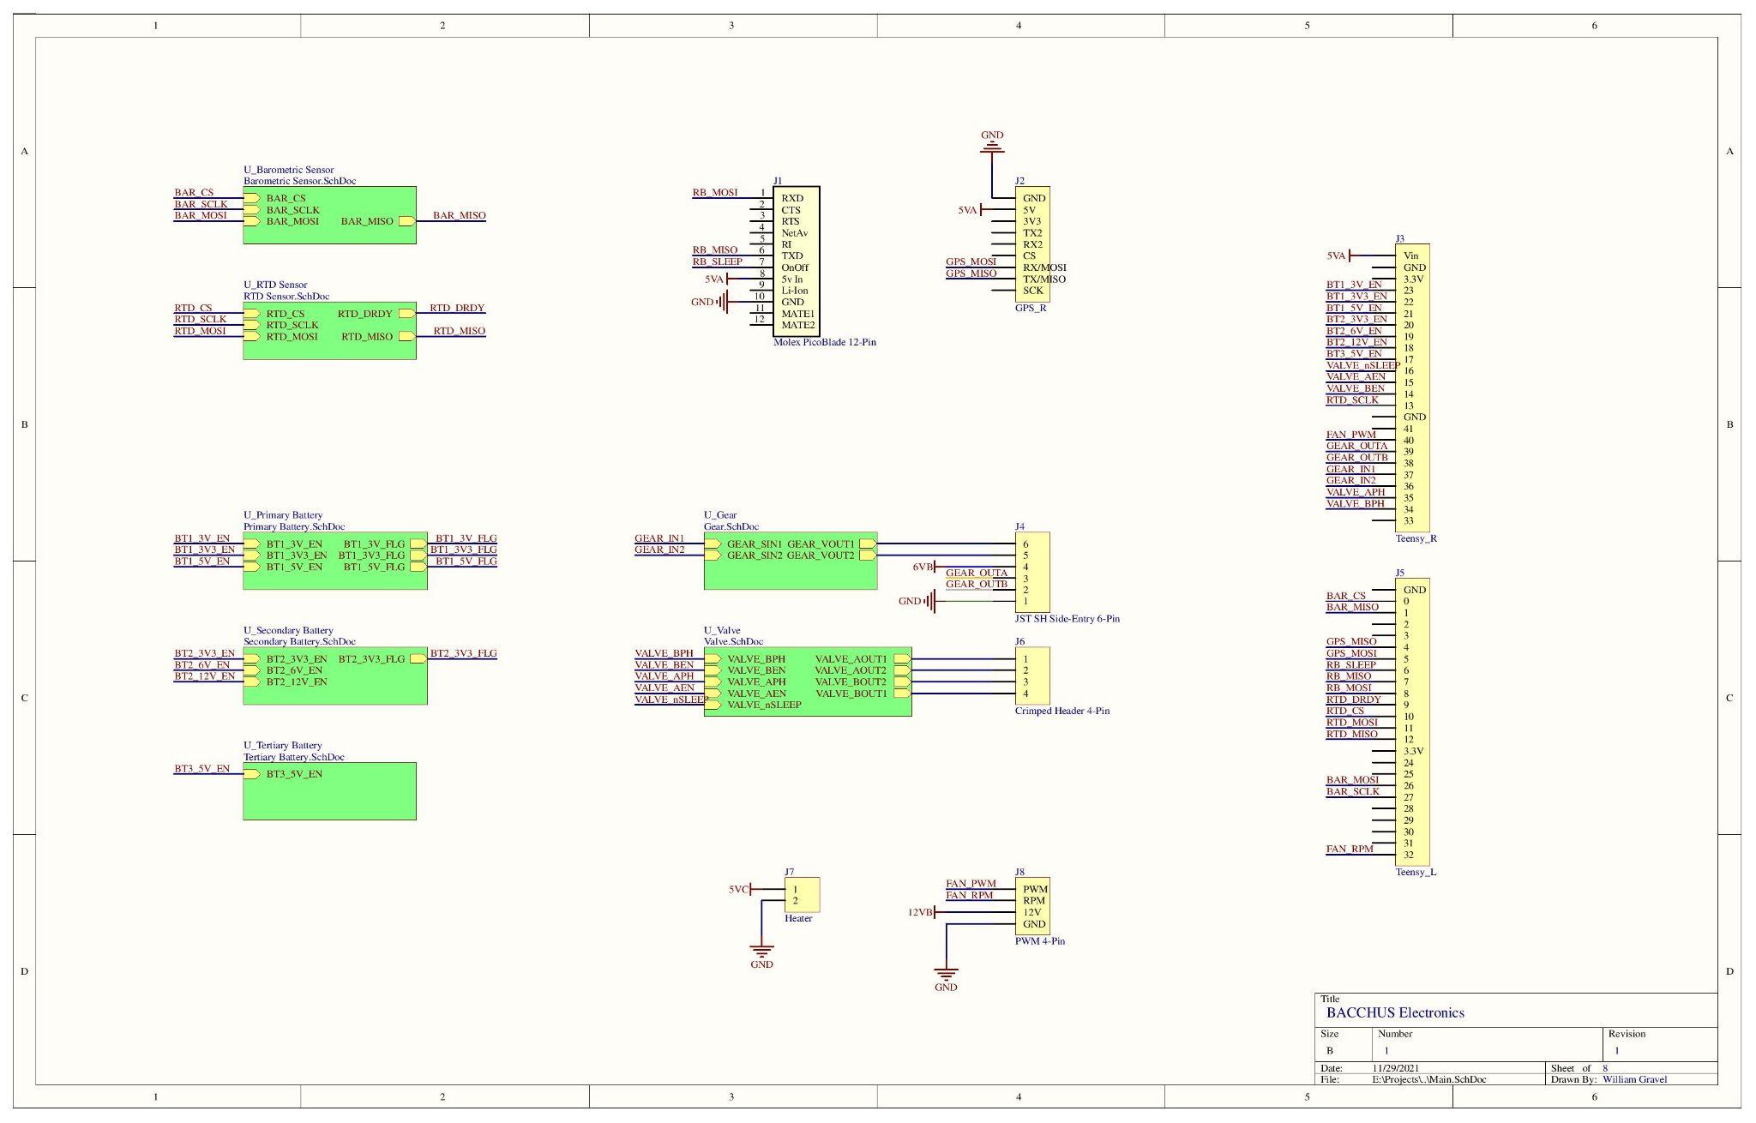
Electronics Schematic Overview
Notes:
Will

Slide 16
Critical Project Elements

Slide 17
Critical Project Elements
CPE #1 | Control | BACCHUS must possess the ability to be commanded by the ground station to create an ascent rate. To create this rate, BACCHUS will perform some form of manipulation to change the balloon system’s mass and volume properties according to a derived control law. Failure of this would result in the incorrect ascent rate causing the balloon system to deviate from its course causing a potential mission failure or loss of the system.
CPE #2 | Mass | The customer has levied a tight mass constraint on our system as there are federal regulations and requirements that the entire system must abide by. Failure to comply with this constraint would result in our system not being flown.
CPE #3 | Integration with Heritage System | BACCHUS must mechanically integrate with existing payload as well as the balloon. Failure to do so would result in mechanical failure and the failure of the balloon.
CPE #4 | Meeting Federal Requirements | BACCHUS will be part of a system operating in regulated environments and needs to meet all of those requirements levied by the customer to operate in this space. This may include rigorous tests to prove flight readiness. Failure to meet these requirements would result in BACCHUS’ inability to fly and complete its mission.
Notes:
Libby

Slide 18
Design Requirements

Slide 19
Requirements Overview
Relevant Requirements: | CPE’s covered
BACCHUS must ascend and descend up to ±5 m/s with a ±0.5 m/s tolerance | CPE #1
BACCHUS must hover at ±0 m/s with a ±0.25 m/s tolerance averaged over 5 minutes | CPE #1
BACCHUS must hover for 6 hours | CPE #1
BACCHUS must weigh less than 6 lbs | CPE #2, CPE #3
BACCHUS must break off of the balloon when a 50 lbf or greater force is applied | CPE #3, CPE #4
Notes:
Derick

Slide 20
Balloon Dynamical Model
Model Assumptions:
Standard Atmosphere
Ideal Gas Relations
R_{He} = constant
Spherical balloon
Drag Coefficient = 0.3
Continuous change in mass
Drag incorporates random uniform wind

Slide 21
Balloon Model Updates
Balloon Hoop Stress:
Model Updates:
Switched from ISA to COESA atmospheric model
Incorporated feedback control
Calculated balloon film temperature change due to solar radiative heat, reflected heat and convective heat
Added pressure differential between internal and ambient due to tension
Added random uniform wind vector
Young-Laplace Pressure Differential:
Balloon Skin Temperature Differential:

Slide 22
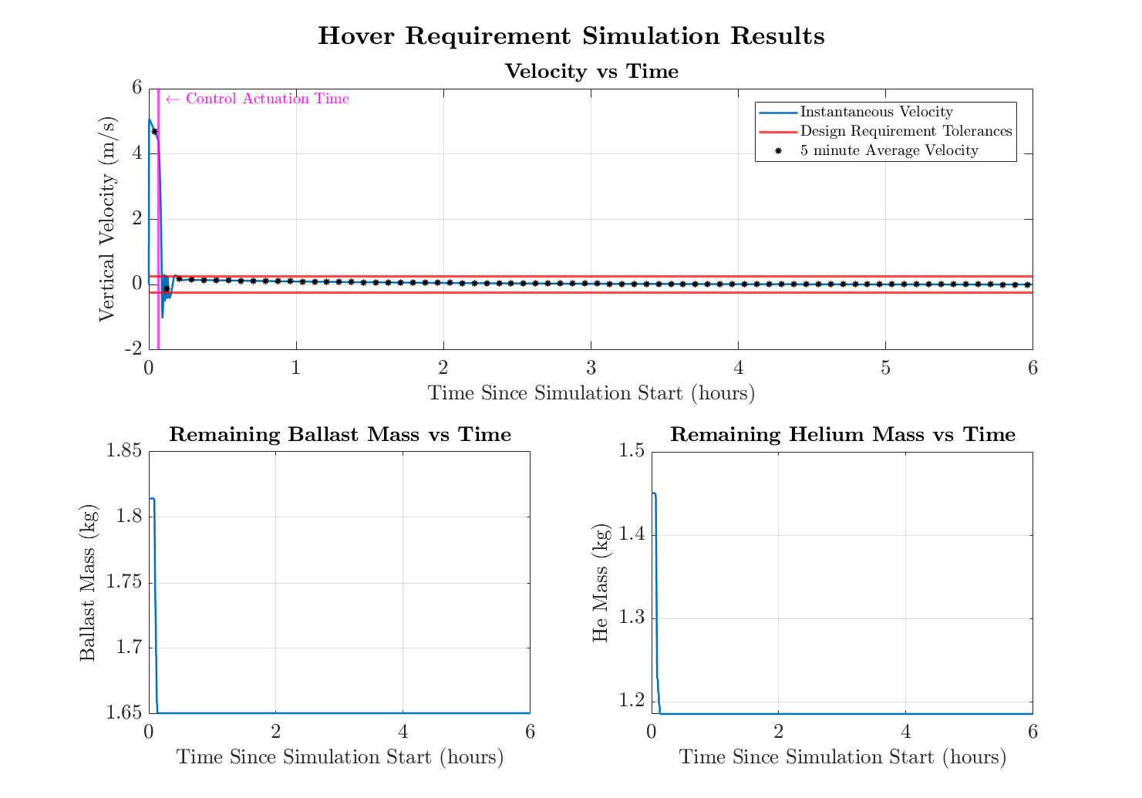
Hover
Requirement: Maintain ± 0 m/s with a ± 0.25 m/s accuracy for up to 6 hours
Initial Conditions:
Initial height: 40000 ft (~12192 m)
Initial Velocity: 0 m/s
Ballast onboard: 1.81 kg (4 lbs)
Helium onboard: 1.45 kg
Command:
Go to a hover (zero velocity) for 6 hours
Notes:
Derrick
Starting from 5 m/s descent at 40000ft and command to 0 m/s no wind

Slide 23
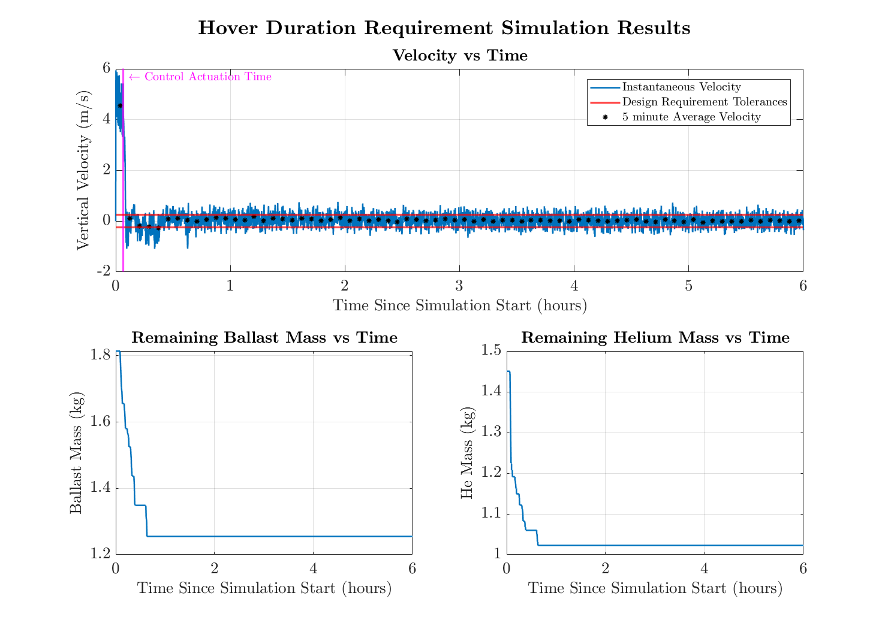
Hover Duration
Requirement: Maintain a Hover for 6 hours
Initial Conditions:
Initial height: 40000 ft (~12192 m)
Initial Velocity: 0 m/s
Ballast onboard: 1.81kg (4 lbs)
Helium onboard: 1.45 kg
Wind (random): [-1.5, 1.5] m/s uniformly distributed
Command:
Go to a hover (zero velocity) for 6 hours
Notes:
Derrick
Height 40000ft, initial speed of 0 m/s
Random constant wind vector for each control loop actuation

Slide 24
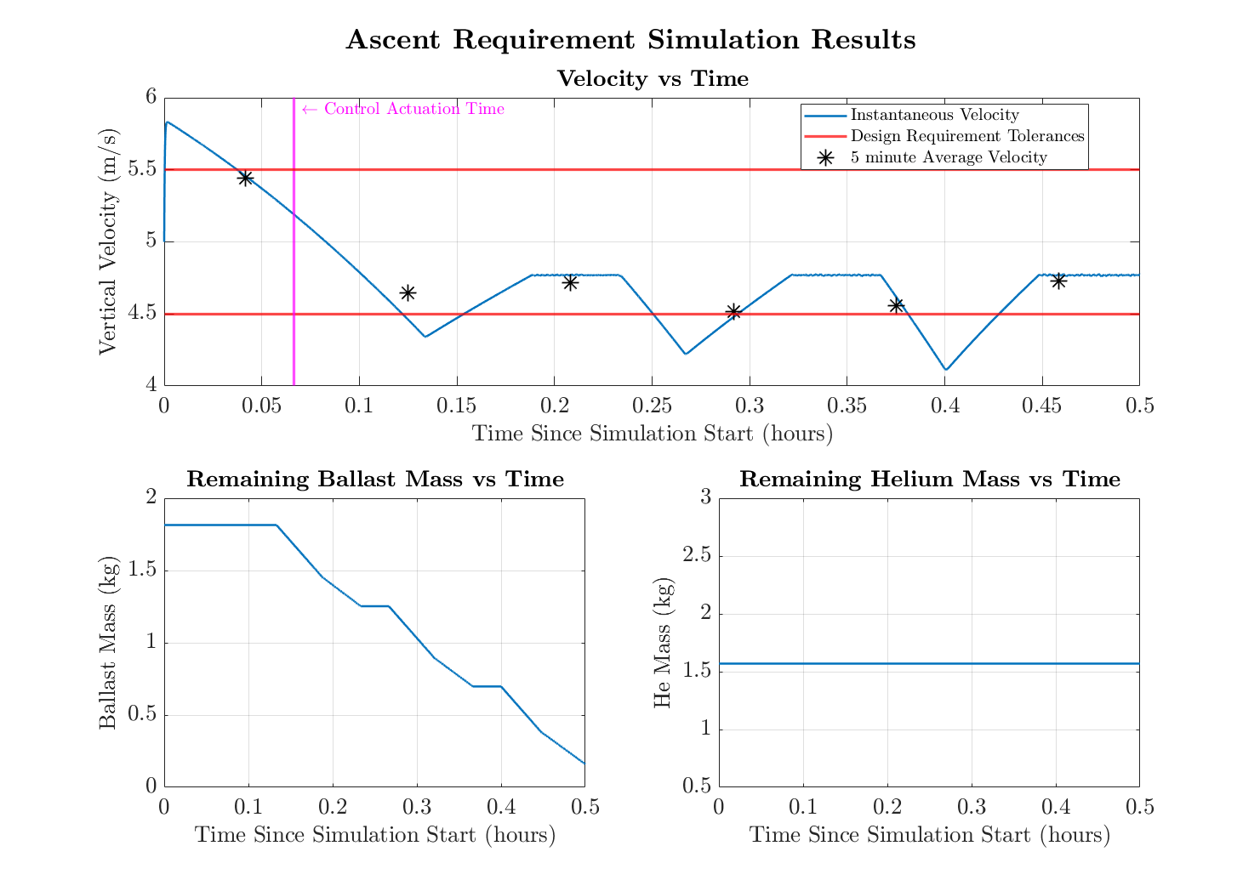
Ascent
Requirement: Maintain + 5 m/s with a ± 0.5 m/s accuracy
Initial Conditions:
Initial height: 40000 ft (~12192 m)
Initial Velocity: 5 m/s
Ballast onboard: 1.81 kg (4 lbs)
Helium onboard: 1.57 kg
Command:
Go to 5 m/s ascent rate
Notes:
Derrick
Start at 0 m/s at altitude of zero (sea level) command to 5 m/s no wind

Slide 25
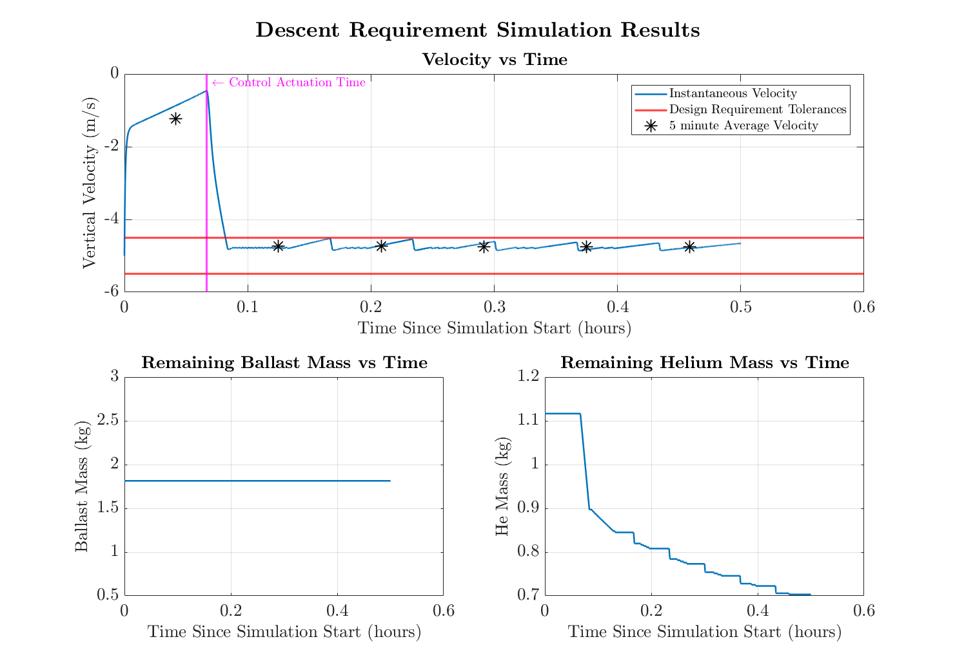
Descent
Requirement: Maintain - 5 m/s with a ± 0.5 m/s accuracy
Initial Conditions:
Initial height: 40000 ft (~12192 m)
Initial Velocity: -5 m/s
Ballast onboard: 1.81 kg (4 lbs)
Helium onboard: 1.12 kg
Command:
Go to 5 m/s descent rate
Notes:
Derick
Start at 60000ft, 0 m/s, command to descent rate of 5 m/s

Slide 26
Mass Requirements
Requirement: Payload cannot exceed 6lbs
Mass Breakdown
Electrical ~ 528.08 g
Thermal ~ 82.68 g
Structural ~ 217 g
Mechanical ~ 453.83 g
Total Fixed Mass: 1.28 kg (2.82 lb)
This leaves 1.44 kg (3.18 lb) for ballast mass.
[minimum required ballast: 1.18 kg (2.6 lb)]
Notes:
Thyme

Slide 27
Breaking Requirement
Requirement: Payload must separate from balloon at any external force greater than 50 lbf
Breaking Requirement
Two 20 lb break cords will hold the balloon attachment tube to the funnel fan mount.
Balloon attachment tube to funnel will be friction-fitted together with a lubricated o-ring seal, keeping air in but will easily slip out if break cords snap
**Zip tied to balloon attachment tube and 3D printed funnel (Urban Sky Heritage)
20 lb Break Line
Notes:
Thyme

Slide 28
Project Risks

Slide 29
Risk Introduction
Risk Type | Risk ID | Risk | Effect
Technical | Vent | Uncertainty in our venting capacity | The descent system may over- or under-actuate, potentially not satisfying velocity requirements.
Schedule | Materials | Long wait times for materials & possible supply shortages | This could push back our manufacturing our parts and testing them.
Technical | Ballast | Limited ballast budget | This could hinder both an ascent maneuver or an ascent to pop recovery.
Technical | Jam | Rotating hopper jamming | This will affect the flow rate of ballast dropping and the velocity requirements
Technical | Freeze | BB pellets freezing within container | This would block the BB’s from dispensing into the hopper correctly
Notes:
Libby

Slide 30
Risk Pre-Mitigation
 | Negligible likelihood | Low likelihood | Likely | High Likelihood | Near Certainty
Negligible severity
Low severity |  |  |  |  | Materials
Severe |  |  |  | Ballast Vent
High severity
Catastrophic |  |  | Jam | Freeze
Notes:
Libby

Slide 31
Risk Matrix Post-Mitigation
Pre-mitigation | Post-mitigation
Mitigation
 | Negligible likelihood | Low likelihood | Likely | High Likelihood | Near Certainty
Negligible severity
Low severity
Severe
High severity
Catastrophic
Vent: Testing our fan early to reduce uncertainty. Control law mitigates over venting by precise ballast dropping.
Jam
Materials: Ordering any parts early, 3D printing and manufacturing our own components
Materials
Ballast
Materials
Ballast: Alerting user when ballast is dropped and the approximate mass remaining as a percentage.
Freeze
Ballast
Vent
Vent
Jam: Changing the direction of the gear to unblock the jam if one is detected & altering dispenser shape.
Jam
Freeze
Freeze: Inserting a moisture absorbing packet in the BB container.
Notes:
Libby

Slide 32
Verification & Validation

Slide 33
Test Scope | Verification Procedure Name | Design Requirements Covered | Verification Type
Subsystem Level | Jamming Test | 1.1 | Test
 | Communication/Interface Test | 2.1 | Test
 | Vacuum-Chamber Test | 3.1 | Test
 | Cold-Chamber Test | 3.2 | Test
 | Yielding Strength Test | 5.1, 7.3 | Test/Analysis
 | Battery Endurance Test | 6.2 | Test
System Level | Loss of Lift Test | 1.1, 1.2 | Test
 | Full-Duration Bench Test | 1.1, 1.2, 1.3, 1.4 | Test
 | Spin Test/Shaker Table Test | 3.3 | Test
 | Rainfall-Drip Test | 3.4 | Test
 | Independent Operation Demonstration | 6.1 | Demonstration
 | Mass/Density Demonstration | 7.1, 7.2 | Demonstration
 | Flight Test | 8.1 | Test/Demonstration
 | Drop/Impact Test | 8.2 | Test
Notes:
Kailey

Slide 34
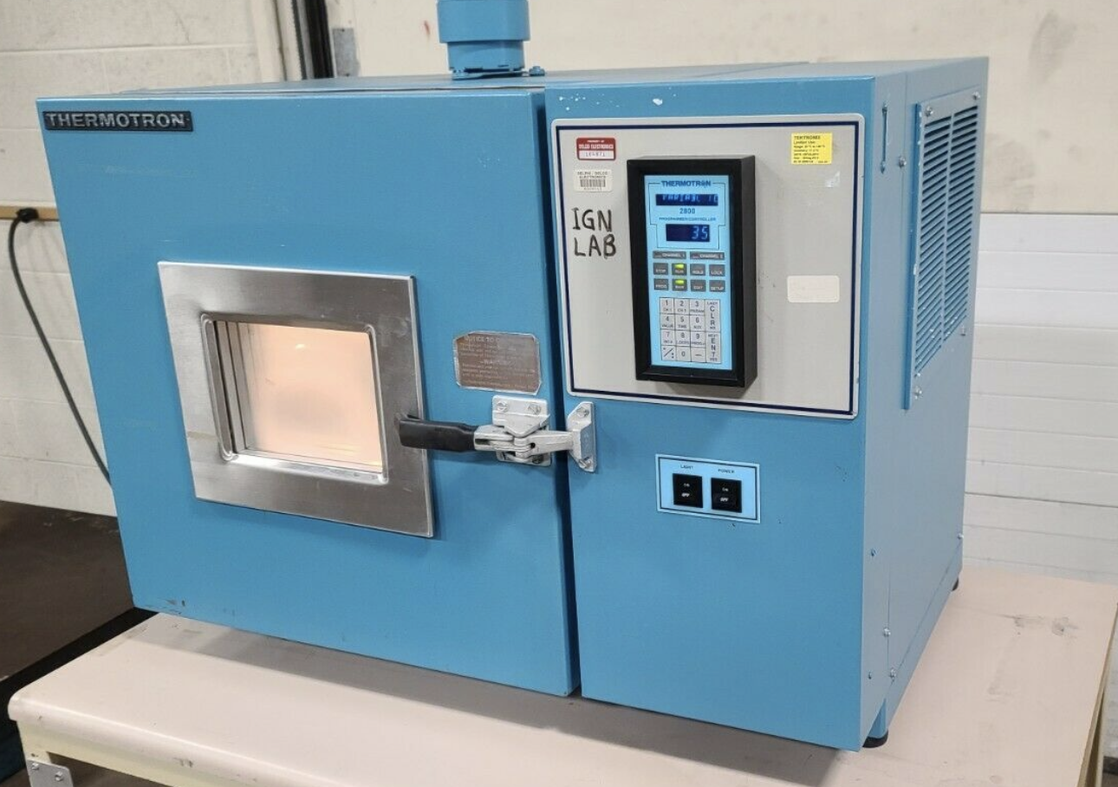
Mechanical (descent): Cold Chamber Test
DR 3.2: BACCHUS shall operate at temperatures ranging from sea-level to near space (40°C to -55°C)
Objective:
To show the effect of the cold environment on the volumetric flow rate over time.
To determine the efficiency of the fan at cold temperatures.
Plan:
Run cold-chamber at constant temperature and fan at constant RPM until steady state is reached
Use pitot probe to measure differential pressure
Measurements:
Differential Pressure
Flow velocity
Volumetric flow rate
Pass Criteria:
Fan functions at predicted rates
Notes:
Kailey

Slide 35
Mechanical (descent): Cold Chamber Test
Power
Data
Power Supply
Pitot probe
Thermocouple
Fan
NI DAQ
Cold-Chamber
Computer with LabVIEW VI
Notes:
Need to specify voltage of power supply, pitot probe measures total pressure and static pressure to determine the velocity pressure from which the velocity can be derived

Slide 36
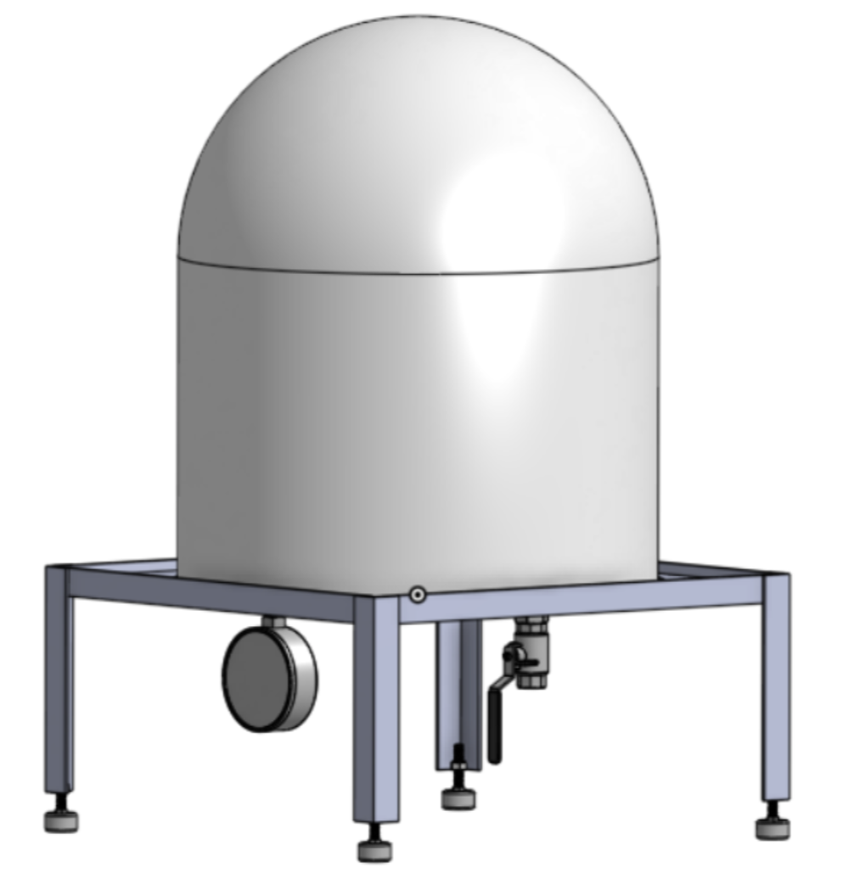
Mechanical (descent): Vacuum Chamber Test
DR 3.1: BACCHUS shall operate at pressures ranging from sea-level to near space (113,900 N/m^2 to 1.1 N/m^2)
Objective:
To show the effect of the low pressure environment on the volumetric flow rate over time.
To determine the efficiency of the fan at low pressures.
Plan:
Run vacuum-chamber at constant pressure and fan at constant RPM until steady state is reached.
Obtain differential pressure measurements.
Measurements:
Differential Pressure
Flow velocity
Volumetric flow rate
Pass Criteria:
Fan functions at predicted rates

Slide 37
Mechanical (descent): Vacuum Chamber Test
Power
Data
Power Supply
Venturi Tube
Fan
Absolute Pressure Sensor
Temperature Sensor
NI DAQ
Computer with LabVIEW VI
Pressure Port
Ambient Pressure Port
Vacuum Chamber
Power Supply
Notes:
Need to specify voltage of power supply, differential pressure sensors will measure the pressure drop between the throat and the inlet and relate it to the volumetric flow rate. Velocity calculated from bernoulli’s

Slide 38
Mechanical (ascent): Jamming Test
DR 1.1: The vertical rate control system shall be able to change the balloon's ascent rate to speeds up to 5m/s
Power Supply
Objective:
To ensure that the BB's do not jam inside the gear motor.
Rotating Hopper System
Plan:
Run rotating hopper system for period of time
Multiple trials will be conducted
DC Motor
Measurements:
RPM of gear
Pass Criteria:
No jamming occurs during test (inspection)
Gear
Notes:
Need to specify voltage of power supply

Slide 39
Structural: Yielding Strength Test (break chords)
DR 5.1.2: The interface will have a minimum load-bearing capability of 30 lbf
DR 7.3: Shall break away from balloon and accompanying payload when subjected to a force of no more than 50 lbf
Test 1
Objective:
To ensure that attachment strengths fall within 30 lbf to 50 lbf range.
6 lb
15 lb
Plan:
Attach 6 lb weight to each break chord to represent half-weight of BACCHUS + Urban Sky payload
Test 1: Attach 9 lb weight to each break chord for a total of 15 lbs each
Test 2: Attach 14 lb weight to each break chord for a total of 20 lbs each
9 lb
20lb Break Chord
Test 2
*breaks
6 lb
Pass Criteria:
Break chord sustains 30 lbf but breaks at 50 lbf
20 lb
14 lb

Slide 40
Structural: Yielding Strength Test (system)
DR 5.1.2: The interface will have a minimum load-bearing capability of 30 lbf
DR 7.3: Shall break away from balloon and accompanying payload when subjected to a force of no more than 50 lbf
Test 1
Test 2
Objective:
To ensure that attachment strengths fall within 30 lbf to 50 lbf range.
20lb break chord
Plan:
Attach 6 lb weight to BACCHUS system to represent Urban Sky payload
Test 1: attach additional 24 lb weight for a total of 30 lb
Test 2: attach additional 34 lb weight for a total of 40 lb
Carbon fiber
Polycarbonate
Epoxy adhesive
*breaks
Pass Criteria:
Break chord sustains 30 lbf but breaks at 50 lbf
6 lb
30 lb
6 lb
40 lb
24 lb
34 lb
Notes:
Polycarbonate base plates, carbon fiber rods, epoxy adhesive

Slide 41
System: Loss of Lift Test
DR 1.1: The vertical rate control system shall be able to change the balloon's ascent rate to speeds up to 5m/s
DR 1.2: The vertical rate control system shall be able to change the balloon's descent rate to speeds up to 5 m/s
Objective:
To show the response of lifting force to hopper system and valve actions.
To prove vertical rate control.
Plan:
Fill balloon to obtain neutral buoyancy
Drop ballast or vent helium
Calculate rate from force differential
Neutral Buoyancy
Measurements:
Force differential/Acceleration
Vertical Rate
Pass Criteria:
Both ascent and descent mechanisms function as expected and rates are within desired bounds.

Slide 42
Project Planning

Slide 43
Cost Plan
Subsystem | Cost
Mechanical | $245.88
Structural | $376.47
Electronics | $505.70
Thermal | $33
Total | $1,161.05
Notes:
David
What’s bought/provided/building?
PCB manufacturing will cost money

Slide 44
Major Test Plan Overview
Test Name | Equipment Needed | Facilities Needed | Safety Precautions
Cold-Chamber Test | Thermocouple, pitot-probe, NI DAQ, power supply | Urban Sky cold-chamber | Ensure dry-ice is handled correctly
Vacuum-Chamber Test | Venturi tube, NI DAQ, power supply | Urban Sky vacuum-chamber | Ensure seal is secured and proper protocols are taken
Yielding Strength Test | Dummy weights | N/A | Ensure weight is handled properly
Drop/Impact Test | Dummy weights, accelerometer | Aero building balcony | Ensure clear area for dropping
Spin Test | Dummy weights, accelerometer | N/A | Ensure clear area for spinning
Shaker Table Test | Shaker table | Shaker table from PILOT lab | Ensure correct operation of shaker table
Loss of Lift | BACCHUS system, helium | Urban Sky facility | Ensure system is handled properly
Flight Test | Full BACCHUS system and Urban Sky payload, helium | Urban Sky facility | Ensure correct connection/operations of systems
Notes:
Why test is needed
Test plan overview
8 major tests
Cold Chamber and Vaccum Chamber test the most dangerous to tester
Rest of tests primarily pose risks to bystanders
Facilities mostly provided by Urban Sky

Slide 45
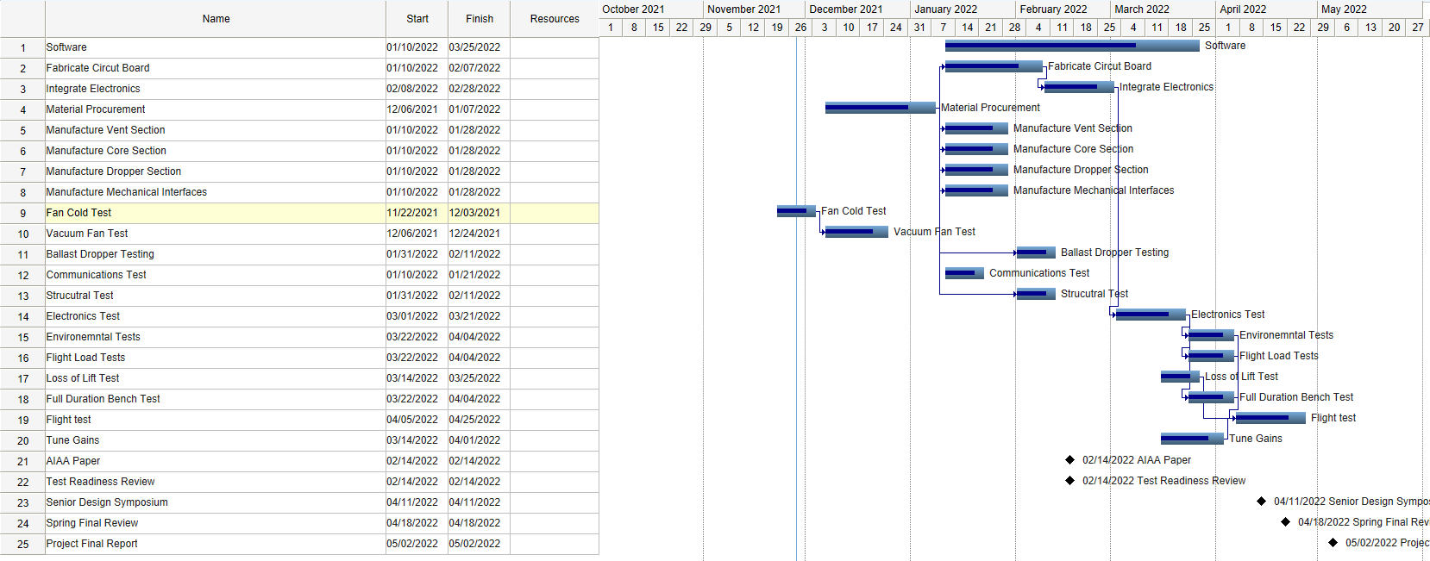
Gantt Chart
Notes:
Ben

Slide 46
Acknowledgements
We want to acknowledge and express our thanks to
Our advisor, Prof. Mah, for all of his guidance and feedback
Our customer, Urban Sky for this opportunity and for their support throughout
Prof. Wingate for her help with the structural analysis
Prof. Schwartz for her help with the validation of our electronics
Prof. Lawrence for his knowledge pertaining to high altitude balloons
Emma Markovich for reviewing our presentation
Stanford graduates Andrey Shusko, Paige Brown, and Kai Marshland, for answering our questions regarding the ballast release mechanism

Slide 47
Questions?

Slide 48
Appendix

Slide 49
Quick Links
Main Presentation
Title
Project Overview
Design Solution
Critical Project Elements
Design Requirements
Project Risks
Verification and Validation
Project Planning
Appendix
Verification/Validation and Testing
Mechanical
Structural
Software
Controls
Modeling
Thermal
Mass and Cost Budget

Slide 50
Organization Chart

Slide 51
V&V/Testing

Slide 52
Links - Requirement V&V
Function Requirement 1:
DR 1.1: demonstration/test
DR 1.2: demonstration/test
DR 1.3: demonstration/test
DR 1.4: demonstration/test
Function Requirement 2:
DR 2.1: demonstration/test
FFunction Requirement 3:
DR 3.1: test
DR 3.2: test
DR 3.3: test
DR 3.4: test
FFunction Requirement 4:
DR 4.1: demonstration
DR 4.2: inspection
Function Requirement 5:
DR 5.1: analysis
DR 5.1.1: analysis
DR 5.1.2: analysis
Function Requirement 6:
DR 6.1: analysis
DR 6.1.1-6.1.4: analysis
DR 6.2: analysis
Function Requirement 7:
DR 7.1: demonstration
DR 7.2: demonstration
DR 7.3: test
Function Requirement 8:
DR 8.1: demonstration
DR 8.2: test

Slide 53
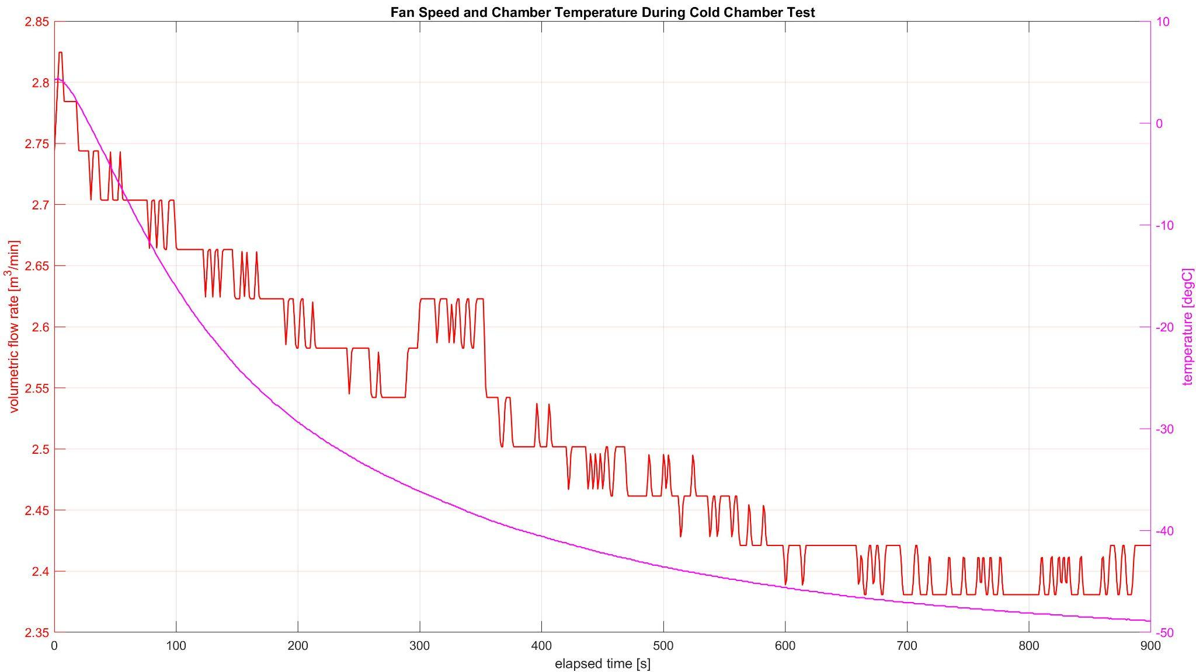
Preliminary Results: Cold-Chamber Test
Test Limitations and Assumptions
Relatively small test chamber
Assuming recirculating air effects on fan to be negligible
No direct flow speed or volumetric flow rate measurement
Assuming fan speed ratios and volumetric flow rate ratios to be identical
No internal pressure measurement
Assuming constant standard atmospheric internal pressure

Slide 54
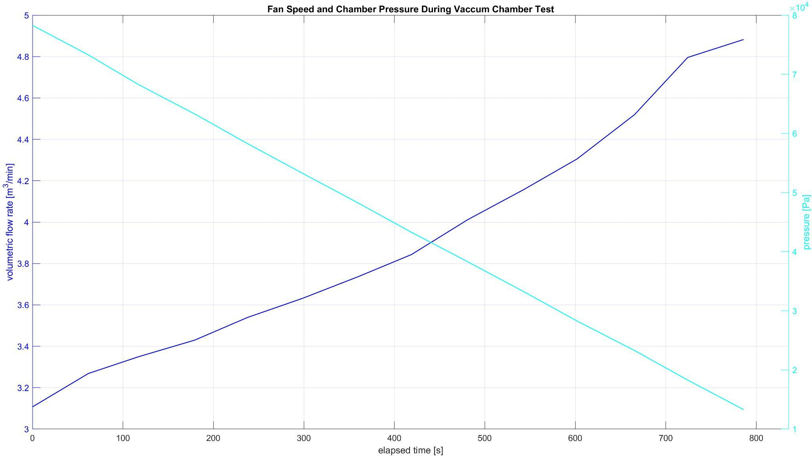
Preliminary Results: Vacuum-Chamber Test
Test Limitations and Assumptions
Relatively small test chamber
Assuming recirculating air effects on fan to be negligible
No direct flow speed or volumetric flow rate measurement
Assuming fan speed ratios and volumetric flow rate ratios to be identical
No internal temperature measurement
Assuming constant standard atmospheric internal temperature

Slide 55
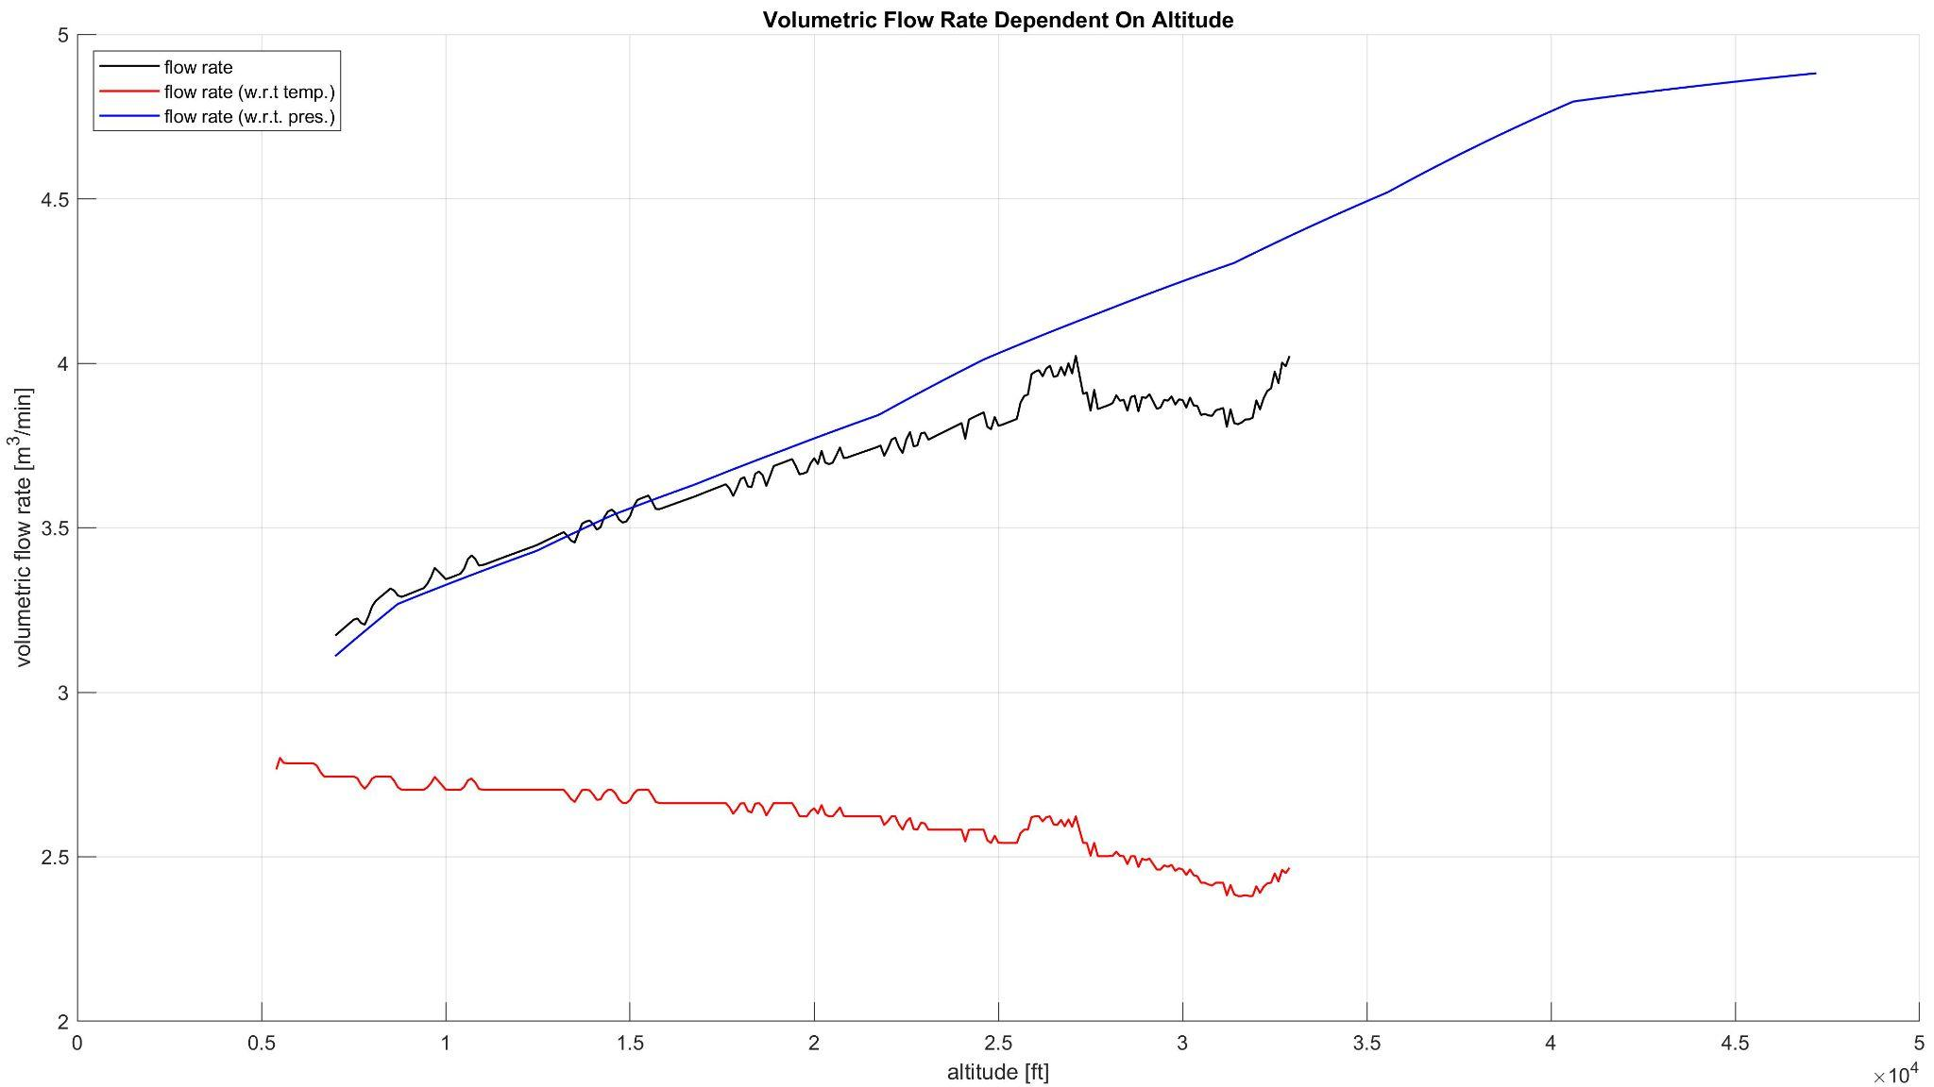
Preliminary Results: Thermo-Vac Test (1/2)
Test Limitations and Assumptions
Relatively small test chamber
Assuming recirculating air effects on fan to be negligible
No direct flow speed or volumetric flow rate measurement
Assuming fan speed ratios and volumetric flow rate ratios to be identical
No combined thermo-vac test data
Assuming temp-based and pressure-based fan efficiencies to be compatible

Slide 56
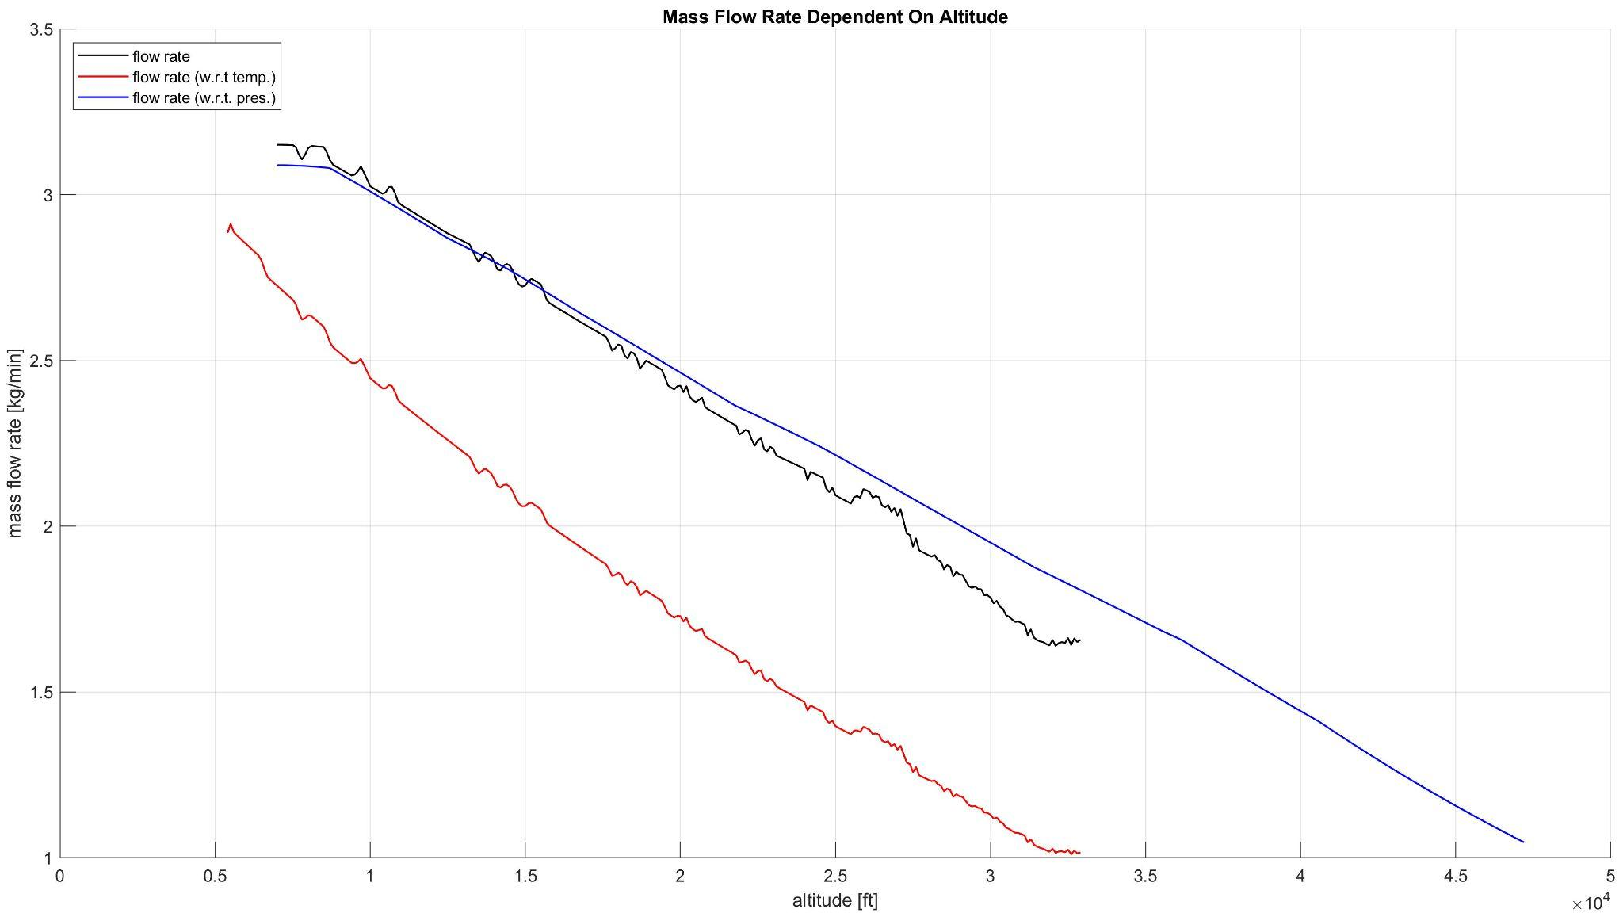
Preliminary Results: Thermo-Vac Test (2/2)
Test Limitations and Assumptions
Relatively small test chamber
Assuming recirculating air effects on fan to be negligible
No direct flow speed or volumetric flow rate measurement
Assuming fan speed ratios and volumetric flow rate ratios to be identical
No combined thermo-vac test data
Assuming temp-based and pressure-based fan efficiencies to be compatible

Slide 57
Requirement V&V
Design Requirement | Verification Method | Verification Procedure Name
1.1, 1.2, 1.3, 1.4 | Test | Full-Duration Bench Test
2.1 | Test | Communication/Interface Test
3.1 | Test | Vacuum-Chamber Test
3.2 | Test | Cold-Chamber Test
3.3 | Test | Shaker-Table Test
3.4 | Test | Rainfall-Drip Test
4.1 | Demonstration | Mechanical Attachment Demonstration
4.2 | Inspection | Pass-through Inspection

Slide 58
Requirement V&V Continued
Design Requirement | Verification Method | Verification Procedure Name
5.1, 5.1.1, 5.1.2 | Analysis | Inertia Analysis, Yielding Strength Test
6.1, 6.1.1, 6.1.2, 6.1.3, 6.1.4 | Analysis | Independent System Operation Demonstration
7.3 | Demonstration | Yielding Strength Test
8.1 | Test | Cold-Chamber Test
8.2 | Test | Impact Test

Slide 59
Major Test Timeline
December | January | February | March | April
Cold-Chamber Test (descent) Vacuum-Chamber Test (descent) Incoming Flow Test | Jamming Test Cold-Chamber Test (ascent) Vacuum-Chamber Test (ascent) | Yielding-Strength Test Communication/Interface Test Battery Endurance Test Insulation Test Rainfall-Drip Test | Full-Duration Bench Test Drop Test Impact Test Spin Test Shaker Table Test Loss of Lift Test | Flight Test
Notes:
David

Slide 60
Manufacturing Overview
To Be 3-D Printed:
Cone - Nylon
Gear System - PETG
Motor Casing - PETG
Hopper Skeleton - PETG
*Prusament PETG (Proprietary PETG Blend)
Other:
3/16” Polycarbonate Plates - Laser Cut
3/8” Carbon Fiber Rods - Band Saw
Insulation for Electronics - Band Saw/Table Saw/Compound Saw
Polycarbonate Weave - Exacto Knife

Slide 61
Mechanical

Slide 62
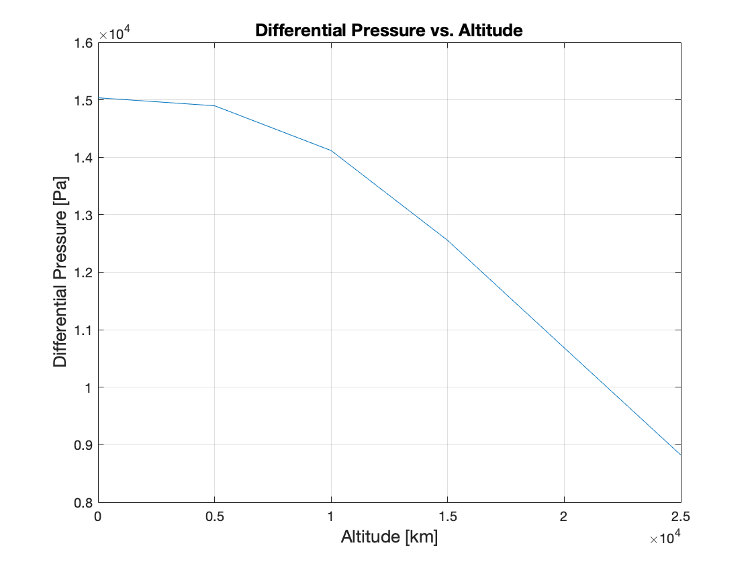
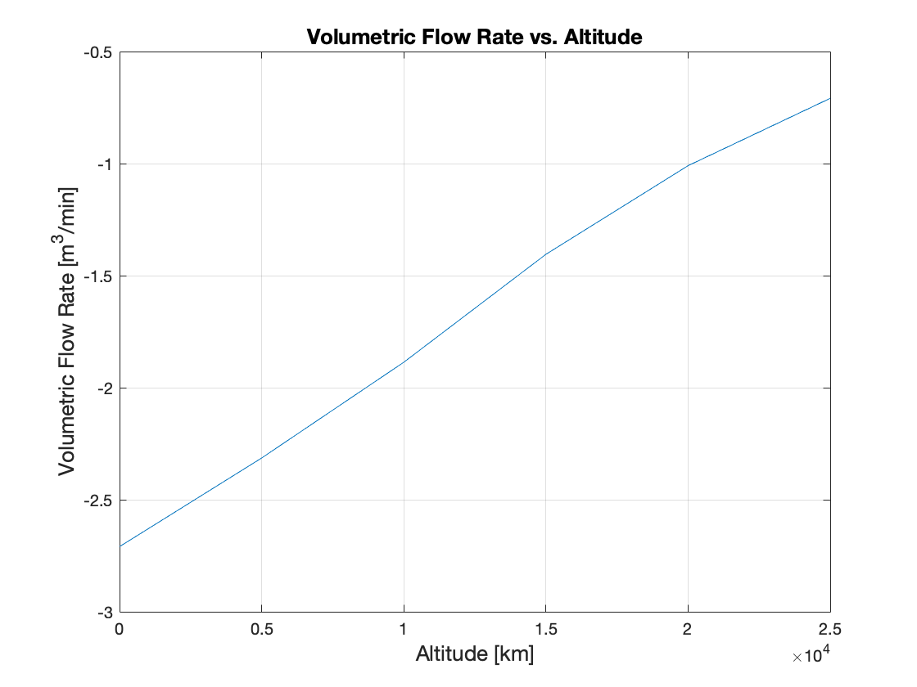
Passive Venting Plots

Slide 63
Structural

Slide 64
Structures and Material Specifications
3/16” Impact Resistant Polycarbonate Sheeting
Link
⅜” Rigid Carbon Fiber Rod
Link
1/32” Carbon Fiber Sheet
Link
Specifications
Tensile Strength: 8,900 psi (min)
Impact Strength: 12-18 ft-lbs/in
Weight per in²: 0.005375 lb
Specifications
Tensile Strength: 150,000 psi
Length needed: 4ft
Specifications
Minimum Flexural Strength: 89,000psi
3M Epoxy Adhesive
Link
Nylon Breakaway Cord
Link
3D Printed Nylon
Link
Specifications
Minimum temperature: -252C
Shear Strength at -55C: 3000 psi
Specifications
Tensile Strength: 51 MPa (yield)
Density: 1.1 g/cm^3
Flexural Strength: 50 MPa
Specifications
Tested Tensile Strength: 25 lbs

Slide 65
Interfaces
IF1 - balloon to nozzle: industrial strength zip ties (Urban Sky heritage)
IF2 - nozzle to cone: rubber gasket to airtight seal and 2x25lb break chords
IF3 - cone to fan: epoxy
IF4 - fan to venting chamber: epoxy for now or end screws
IF5 - venting chamber to electronics bay: exoskeleton rods
IF6 - electronics bay to ballast: base plate with carbon fiber sheet with foam
IF7 - carbon fiber rods to skeleton: 3D printed connectors/epoxy
IF8 - bottom sheet to US payload: epoxy

Slide 66
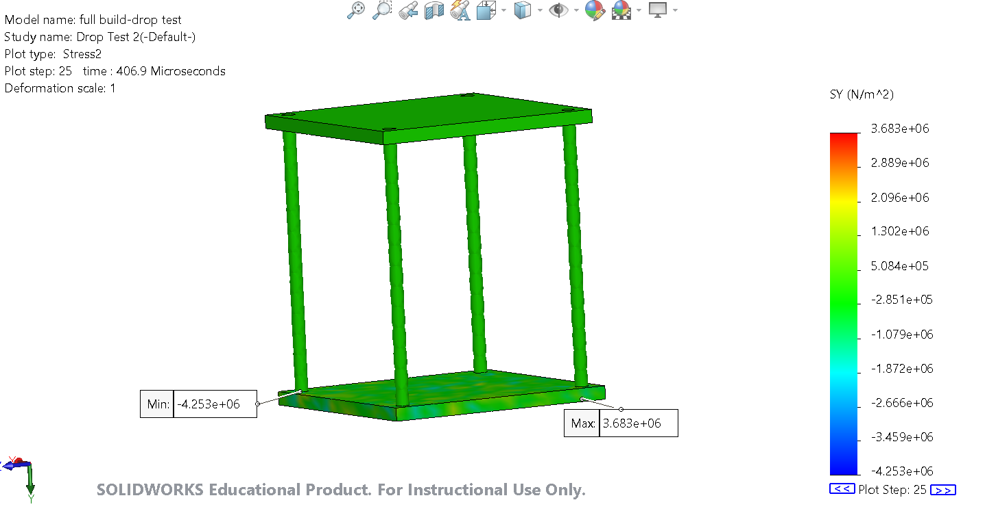
Drop Tests
Polycarbonate Yield Strength : 7x10^7 N/m^2
Carbon Fiber Yield Strength: 1 x 10^9 N/m^2
Max Y Stress: 3.683 x 10^6 N/m^2

Slide 67
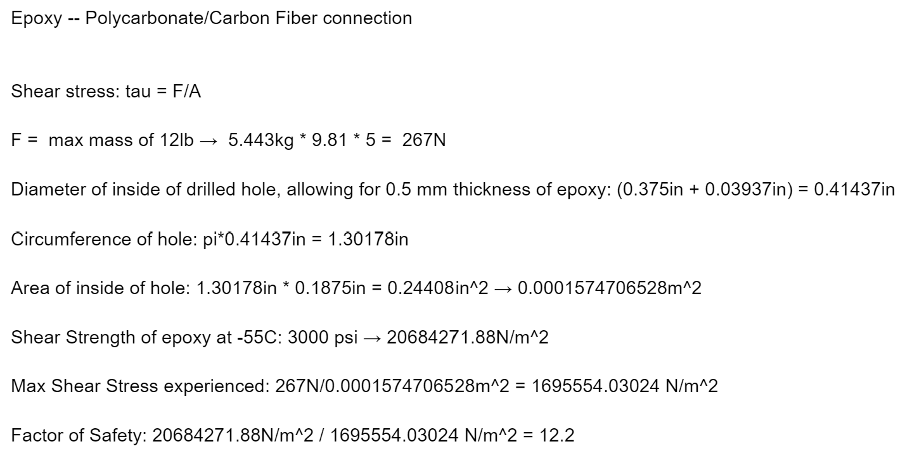
Epoxy Stress Calculation

Slide 68
Software

Slide 69
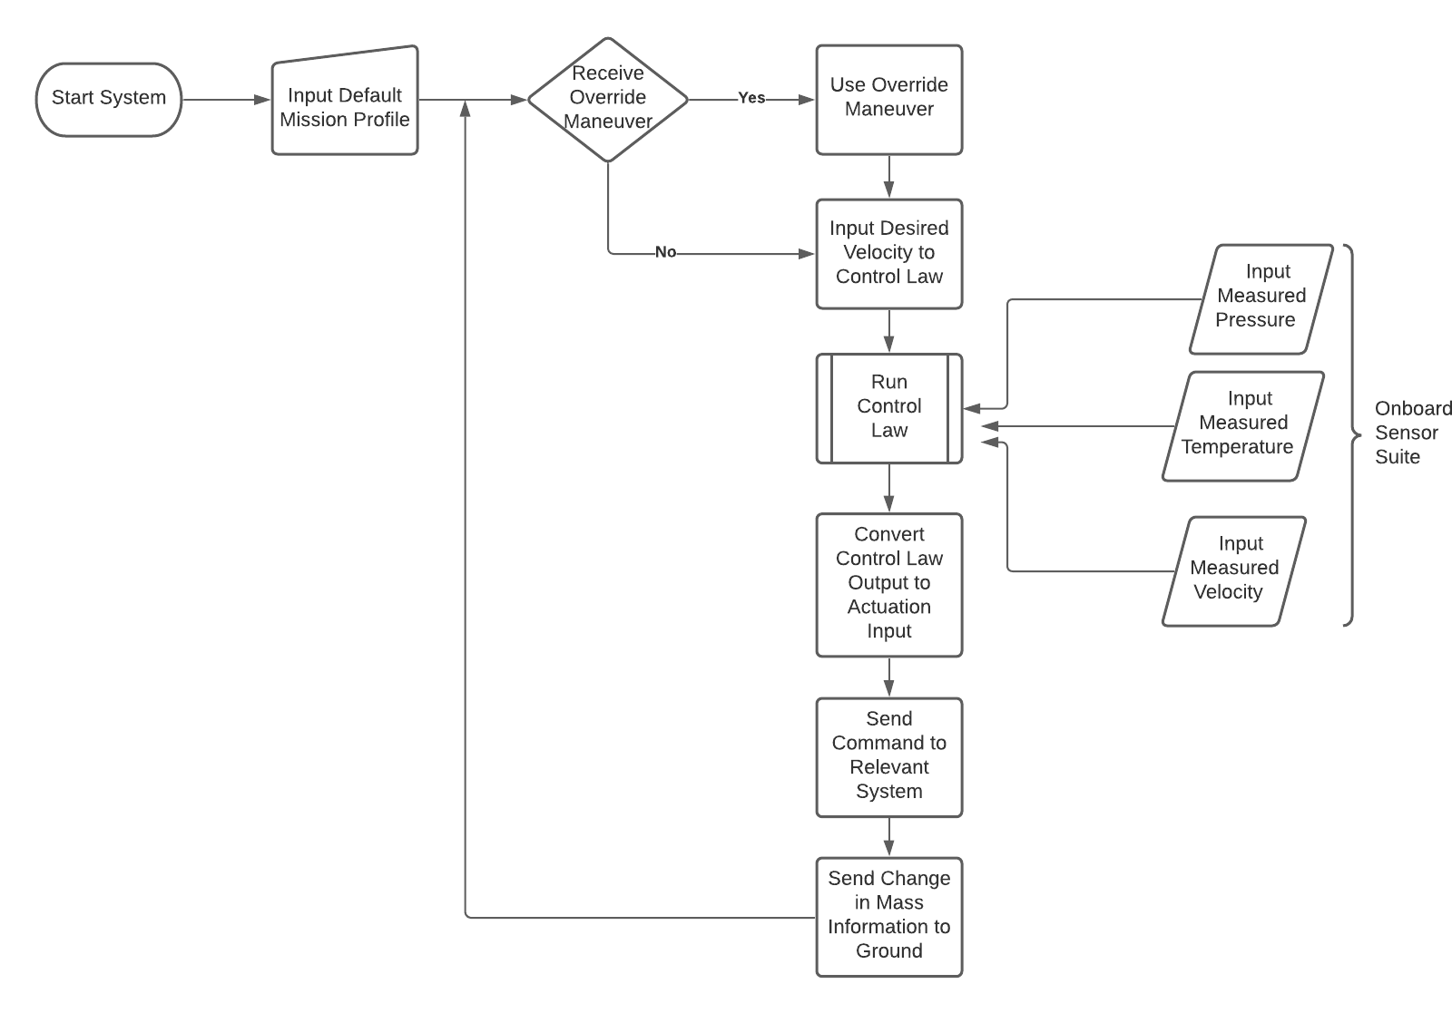
Software Flow Chart
Legend
- On Ground
- During Flight
- Communications

Slide 70
Additional Software Info.
Example Default Mission Profile
Example Ground Interface
% Time to start first maneuver
t0 = 10 %min
% First velocity to target
v1 = 5 %m/s
% start second maneuver this amount of time after achieving first target velocity
dT = 30 %min
Current Altitude:
Current Velocity:
Time:
Next Planned Maneuver:
Mass Remaining:
Helium Remaining:
Current Diameter Estimate:
Burst Diameter:
Notes:
This is an example of a flight profile. Target velocities and start times will likely be input in vectors.

Slide 71
Controls

Slide 72
Linearized Equations of Motion
Ballast Dropping:
Helium Venting:

Slide 73
Linearized Model
Purpose:
Get a simplified model to analyze gains
Non linear model:
Assumptions made:
Density is constant
Mass dropped is negligible (mass dropped is much less than total mass)
Gravity is constant
Small Disturbance Theory
Initial helium and ballast mass induces a hover
Internal Pressure and Temperature is the same as ambient conditions
No wind

Slide 74
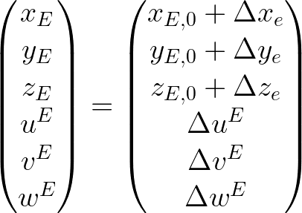
Linearized Model-Small Disturbance Theory
Small Disturbance Linearization:
(Around Steady Hover)
Split into 2 models, one for ascent (dropping ballast) and one for descent (venting helium)
Ascent
At hover, buoyancy force equals force of gravity
These terms can cancel out in the equation, which leaves:
Doing a linearization around steady hover using small disturbance theory*:
At steady hover, velocity, acceleration, and amount of ballast required to drop are zero. So,
* product of two 𝛥 terms are zero, and 0 subscript denotes steady hover condition

Slide 75
Linearized Model-Small Disturbance Theory
Descent
Similar to Ascent, but with control on helium mass
At hover condition:
This leaves the following:
Doing a linearization about steady hover using small disturbance theory* yields:
At steady hover, velocity, acceleration, and amount of ballast required to drop are zero. So,
* product of two 𝛥 terms are zero, and 0 subscript denotes steady hover condition

Slide 76
Linearized Model - EOM
Ascent
Descent

Slide 77
Gain Selection
Methodology:
PD control on velocity to control velocity and be able to damp out
Want different gains for both dropping and venting for better tuning
Selection:
Iteratively selected gains and ran simulations
Initial selection was based on a Δw of 5m/s and looking at the Δm returned and making it reasonable
Further refinement in the non linear model

Slide 78
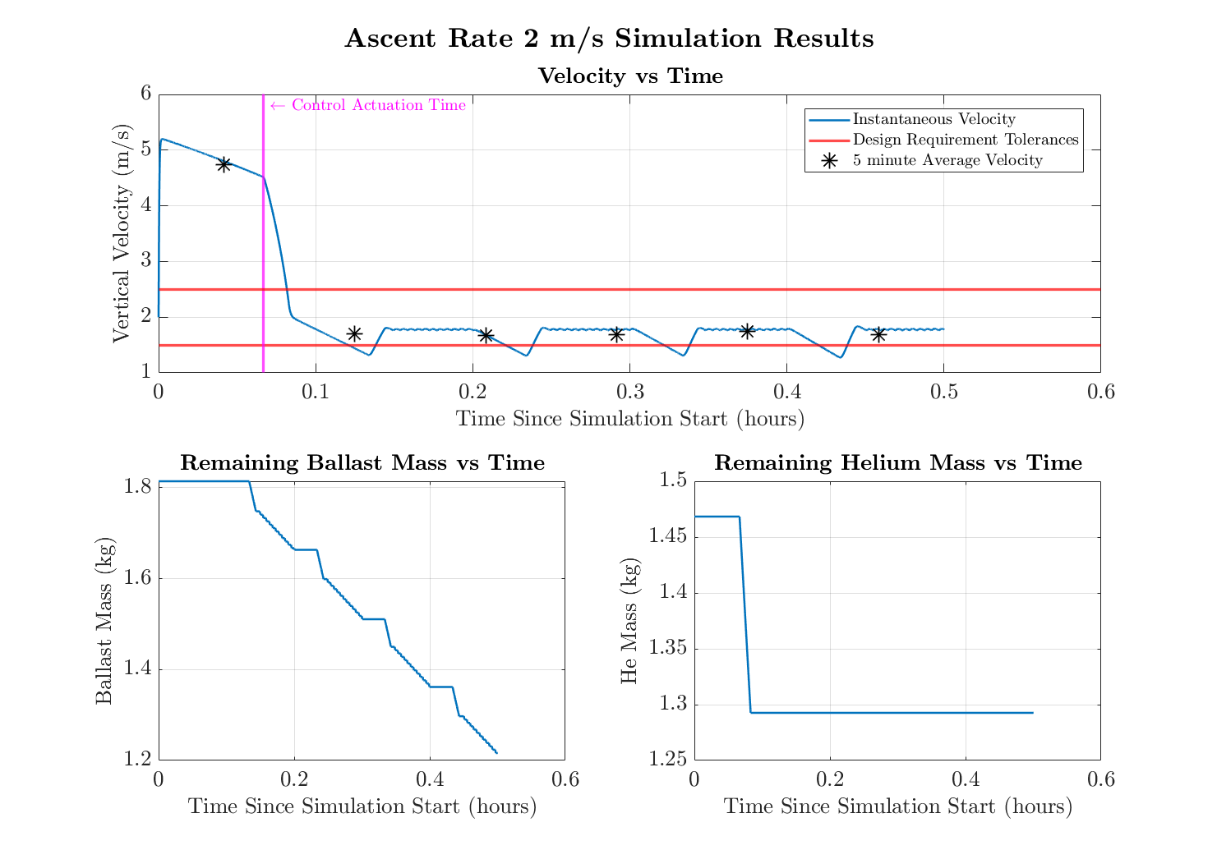
Ascent Rate Control (lower velocity)
Purpose: Further demonstrate that control system will not run out of ballast
Initial Conditions:
Initial height: 40000 ft (~12192 m)
Initial Velocity: 2 m/s
Ballast onboard: 1.81 kg (4 lbs)
Helium onboard: 1.47 kg
Command:
Go to 2 m/s ascent rate

Slide 79
Modeling

Slide 80
Full Force-Balance Model
Assumptions:
COESA Model to find P, T, 𝜌_{air}
T_{film} = T_{He}
R_{He} = 2077.3 J/(kg*K)
g = 9.81 m/s²
Spherical balloon
Drag due to balloon and wind
C_{D} = 0.3 (From Kaymont)
Ideal Gas
Fan has constant dV/dt and Ballast Dropper has constant dm/dt
P_{He} calculated from Young-LaPlace relation
T_{film} calculated from thermal radiation model

Slide 81
Model Limitations and Rationale
Controls
No rotational stabilities implemented
Out of scope
Ballast dropping is continuous rather than discrete
Compatibility with ODE45
Wind is uniformly distributed random values and constant during a control actuation
No reliable dataset on stratospheric wind
Initial conditions derived from force balance
Assumes fan achieves optimal performance
Will be updated as a result of testing
Coordinate frame is fixed at balloon neck
Nearly identical to payload frame
Pressure Differential
Helium density calculated from atmospheric conditions
Drastically reduces computation time
Assumes elastic deformation of balloon film
Reduces complexity and shortens computation time
Assumes uniform circumferential strain
Based on spherical assumption
Thermal - Film/Helium Temperature
Assume helium temperature equals film temperature
Removes complexity due to convection
Neglects heat loss from balloon
Complex and will be caught by controls if causes change in state
Notes:
Control Assumptions:
Not considering any rotational dynamics and any stabilities
Frame fixed at the balloon neck is nearly identical to one fixed at the payload (no need for rotation matrices)
Uniformly distributed random wind
Continuous model for dropping ballast when in reality it is discrete
Initial conditions derived from force balance so that it will tend to a zero acceleration
Optimal performance of the fan is achieved (i.e 2.7 m^3/min)
Pressure assumptions:
Thermal model Assumptions:

Slide 82
Pressure Differential Model
Assumptions:
Spherical balloon
Ideal Gas
Elastic Deformation
E = 0.1 GPa
Undeformed r₀ from Kaymont
Helium density from atmospheric values
Thickness derived from volume and surface area
t << r
P_{amb}
F_{tension}
𝜎
r
Balloon
Stress-Strain Relation
Young-LaPlace Equation for Spheres:
P_{He} = P_{amb} + dP

Slide 83
Film Temperature Model
Assumptions:
Spherical balloon
Uniform temperature distribution across balloon film
Balloon skin temperature is equal to helium temperature
Solar heat and reflected solar heat are zero at night
Neglects any heat loss from balloon
Solar Heat
Balloon
Convection between air and balloon film
Reflected Solar Heat
Temperature Differential Equation:
Earth

Slide 84
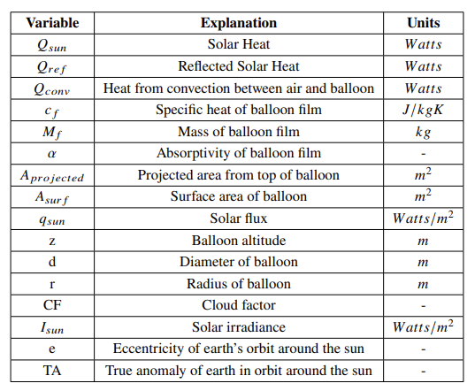
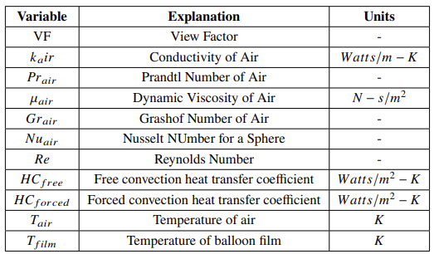
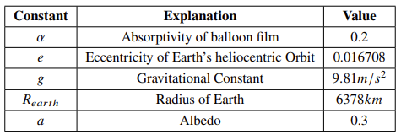
Film Temperature Model (cont.)
Nomenclature and Constants:

Slide 85
Film Temperature Model (cont.)
Solar Heat
If z is above cloud layer:
Else:

Slide 86
Film Temperature Model (cont.)
Heat due to Convection

Slide 87
Film Temperature Model (cont.)
Reflected Solar Heat

Slide 88
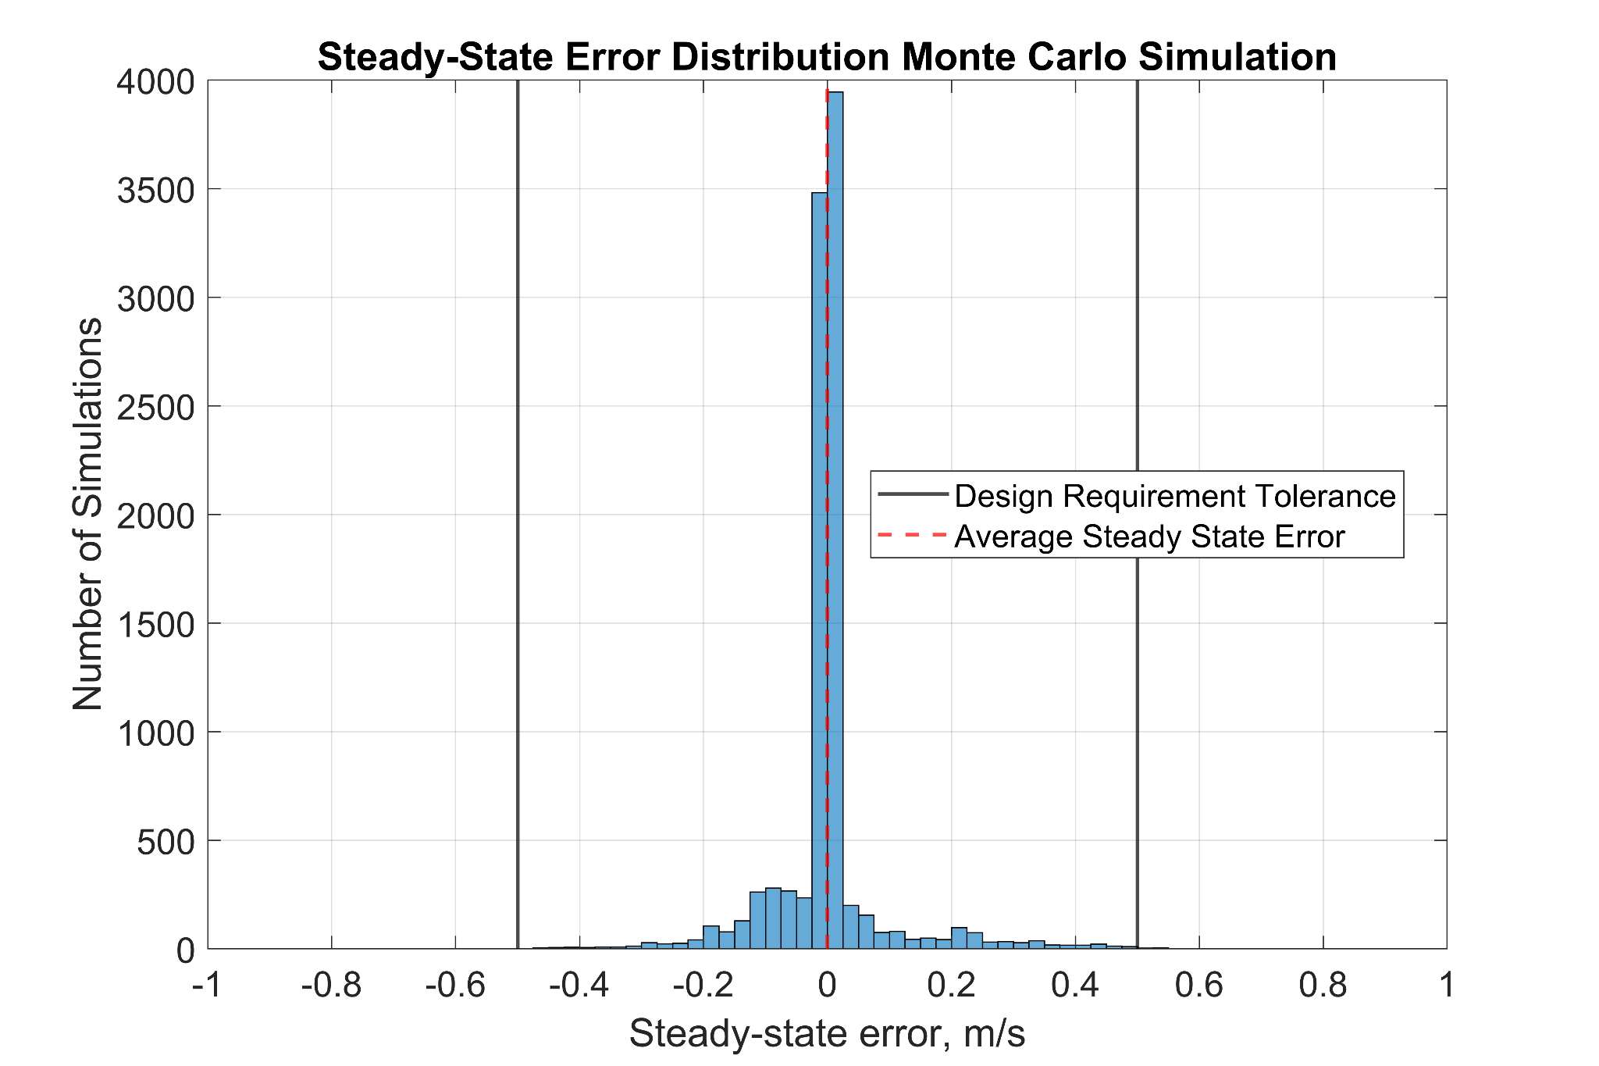
Wind Uncertainty
Performed Monte Carlo Simulation
Number of Simulations: 10000
Parameters varied (sampled from uniform distribution)
Time that balloon experiences wind
Wind velocity components
Initial Conditions
40,000 ft (~12192 m)
Descending 0 m/s
Command to Hover
Metric: steady-state error in velocity
96.64% of simulations within design requirement tolerance

Slide 89
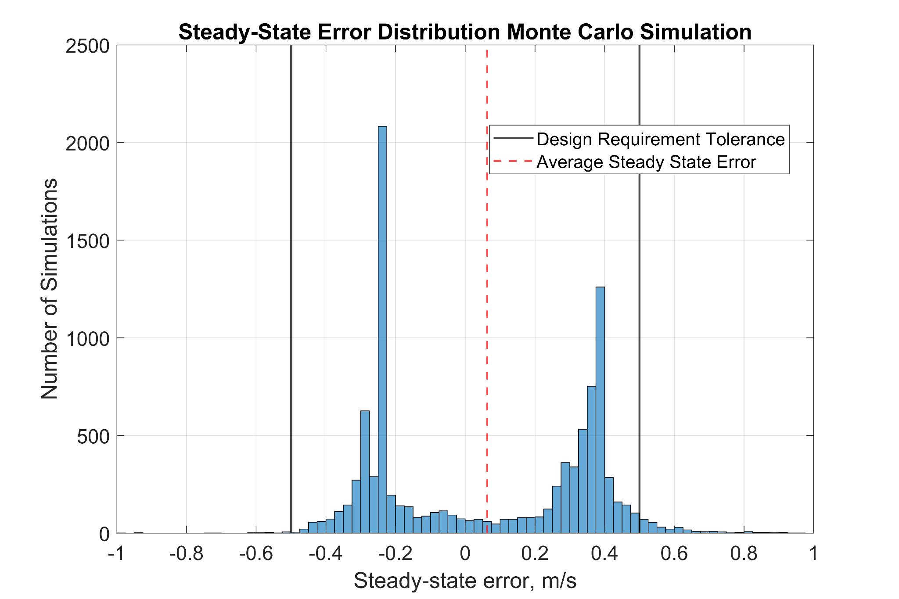
Wind Uncertainty (cont.)
Monte Carlo Simulation:
Number of Simulations: 10000
Parameters varied (sampled from uniform distribution)
Time that balloon experiences wind
Wind velocity components
Commanded Velocity
Initial Conditions
40000 ft (~18288 m)
Hovering (0 m/s)
Command to any velocity between -5 and 5 m/s
Metric: steady-state error in velocity
96.88% of simulations within design requirement tolerance

Slide 90
Ballast Dropping Uncertainty
We will be conducting tests in order to determine probability of jamming.
We designed the gear system with the intent that it will prevent jamming transitions and jamming when the ballast is actually released.
The Stanford team used a similar gear design and would it seize once per 2000 pellets (and never irreversibly) and never experienced issues with the dispenser.
Since we are planning to detect a jam and include the irreversibly, we will have to test in order to find any uncertainties we have not taken into account yet.

Slide 91
Thermal

Slide 92
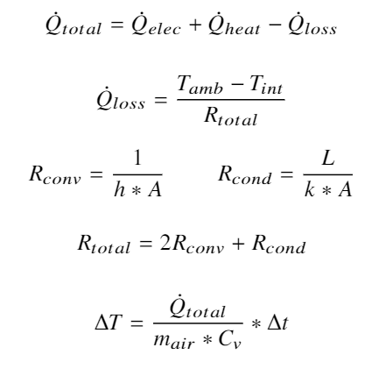
Thermal Model
Updates
Removed assumptions
Closed system
Negligible radiation
Negligible heat dissipation from electronics
Added assumptions
Heater is in direct contact with electronics and battery
Heater choice
Icstation 5V 1W flexible polyimide heating film

Slide 93
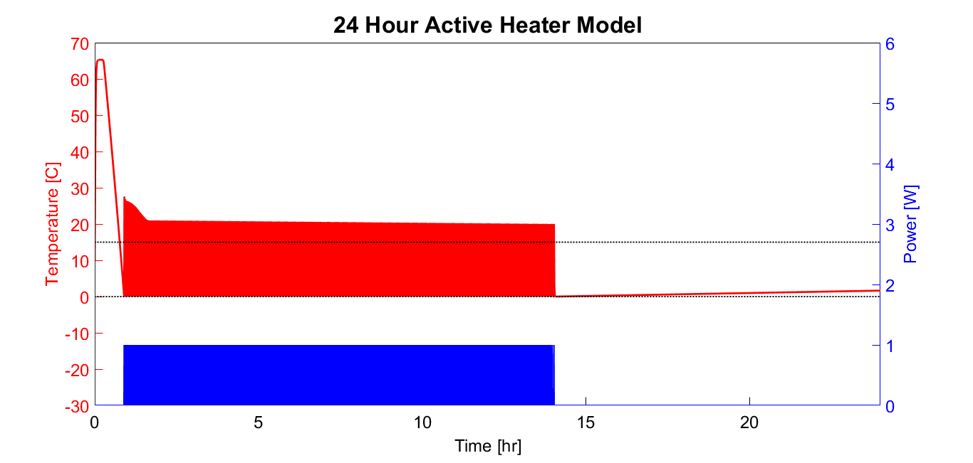
Thermal Model - 24hrs

Slide 94
Thermal Model - 24hrs
Overheats to maximum 65.28C at the start
Electronics maximum operation temperature 85C
Factor of Safety of 1.30
Includes wait time on the ground
At around 14 hours convection heat loss becomes small
Temperature is maintained by electronics and insulation
Heater remains off
Thermal overshoot
Discussed in following slides

Slide 95
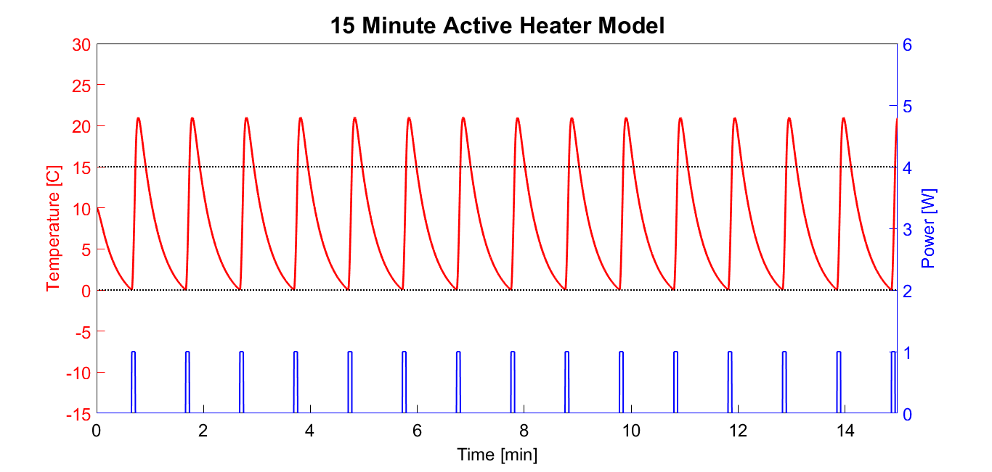
Thermal Model - 15min

Slide 96
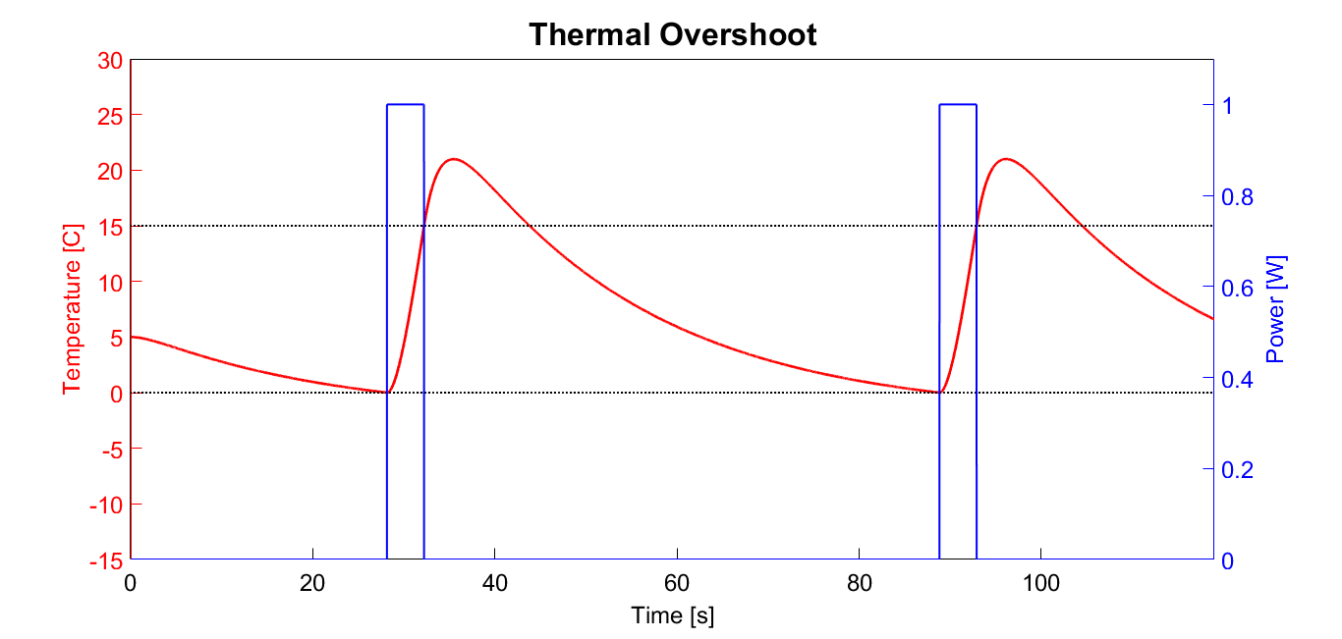
Thermal Model - 2min

Slide 97
Thermal Model - Thermal Overshoot
Heat retention of electronics board causes the temperature to continue to increase past when the heater turns off
If this occurs in testing, adjustments can be made to the temperature tolerances so it doesn’t heat above 15C

Slide 98
Electrical

Slide 99
Electronics Acronyms and Abbreviations
Detailed Block Diagram
RTD: Resistance Temperature Detector
ADC: Analog to Digital Converter
LVR: Linear Voltage Regulator
GNSS: Global Navigation Satellite System
Pri. Batt.: Primary Battery
Sec. Batt.: Secondary Battery
Tri. Batt.: Tertiary Battery
Circuit Schematics
BAR: Barometric Sensor
BT: Battery
GEAR: Brushed DC Motor
GPS: GPS Module
RB: RockBLOCK 9603
RTD: Ambient Temperature Sensor
VALVE: Stepper Motor

Slide 100
Circuit Schematics (1/8)

Slide 101
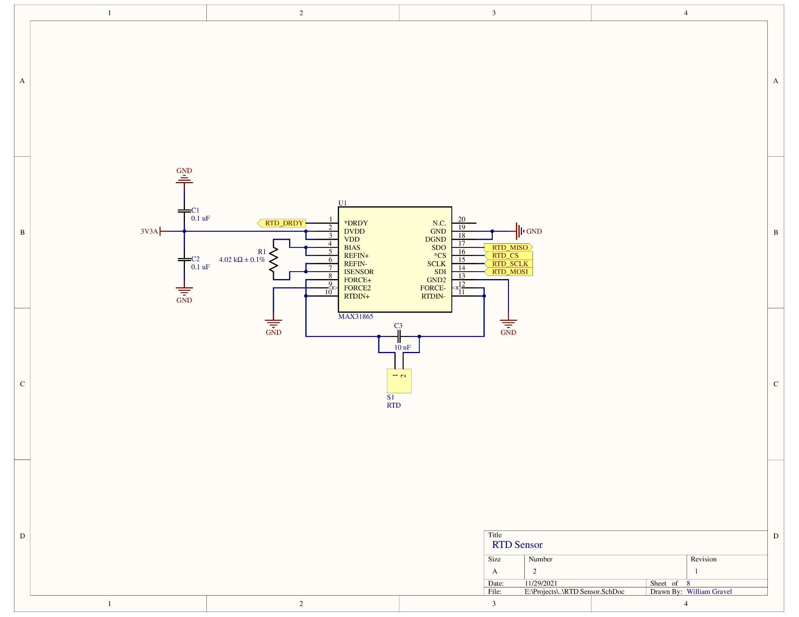
Circuit Schematics (2/8)

Slide 102
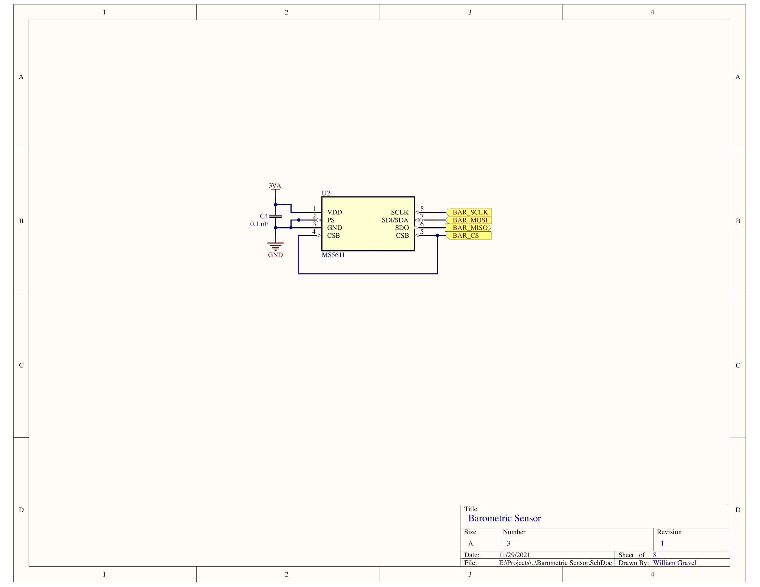
Circuit Schematics (3/8)

Slide 103
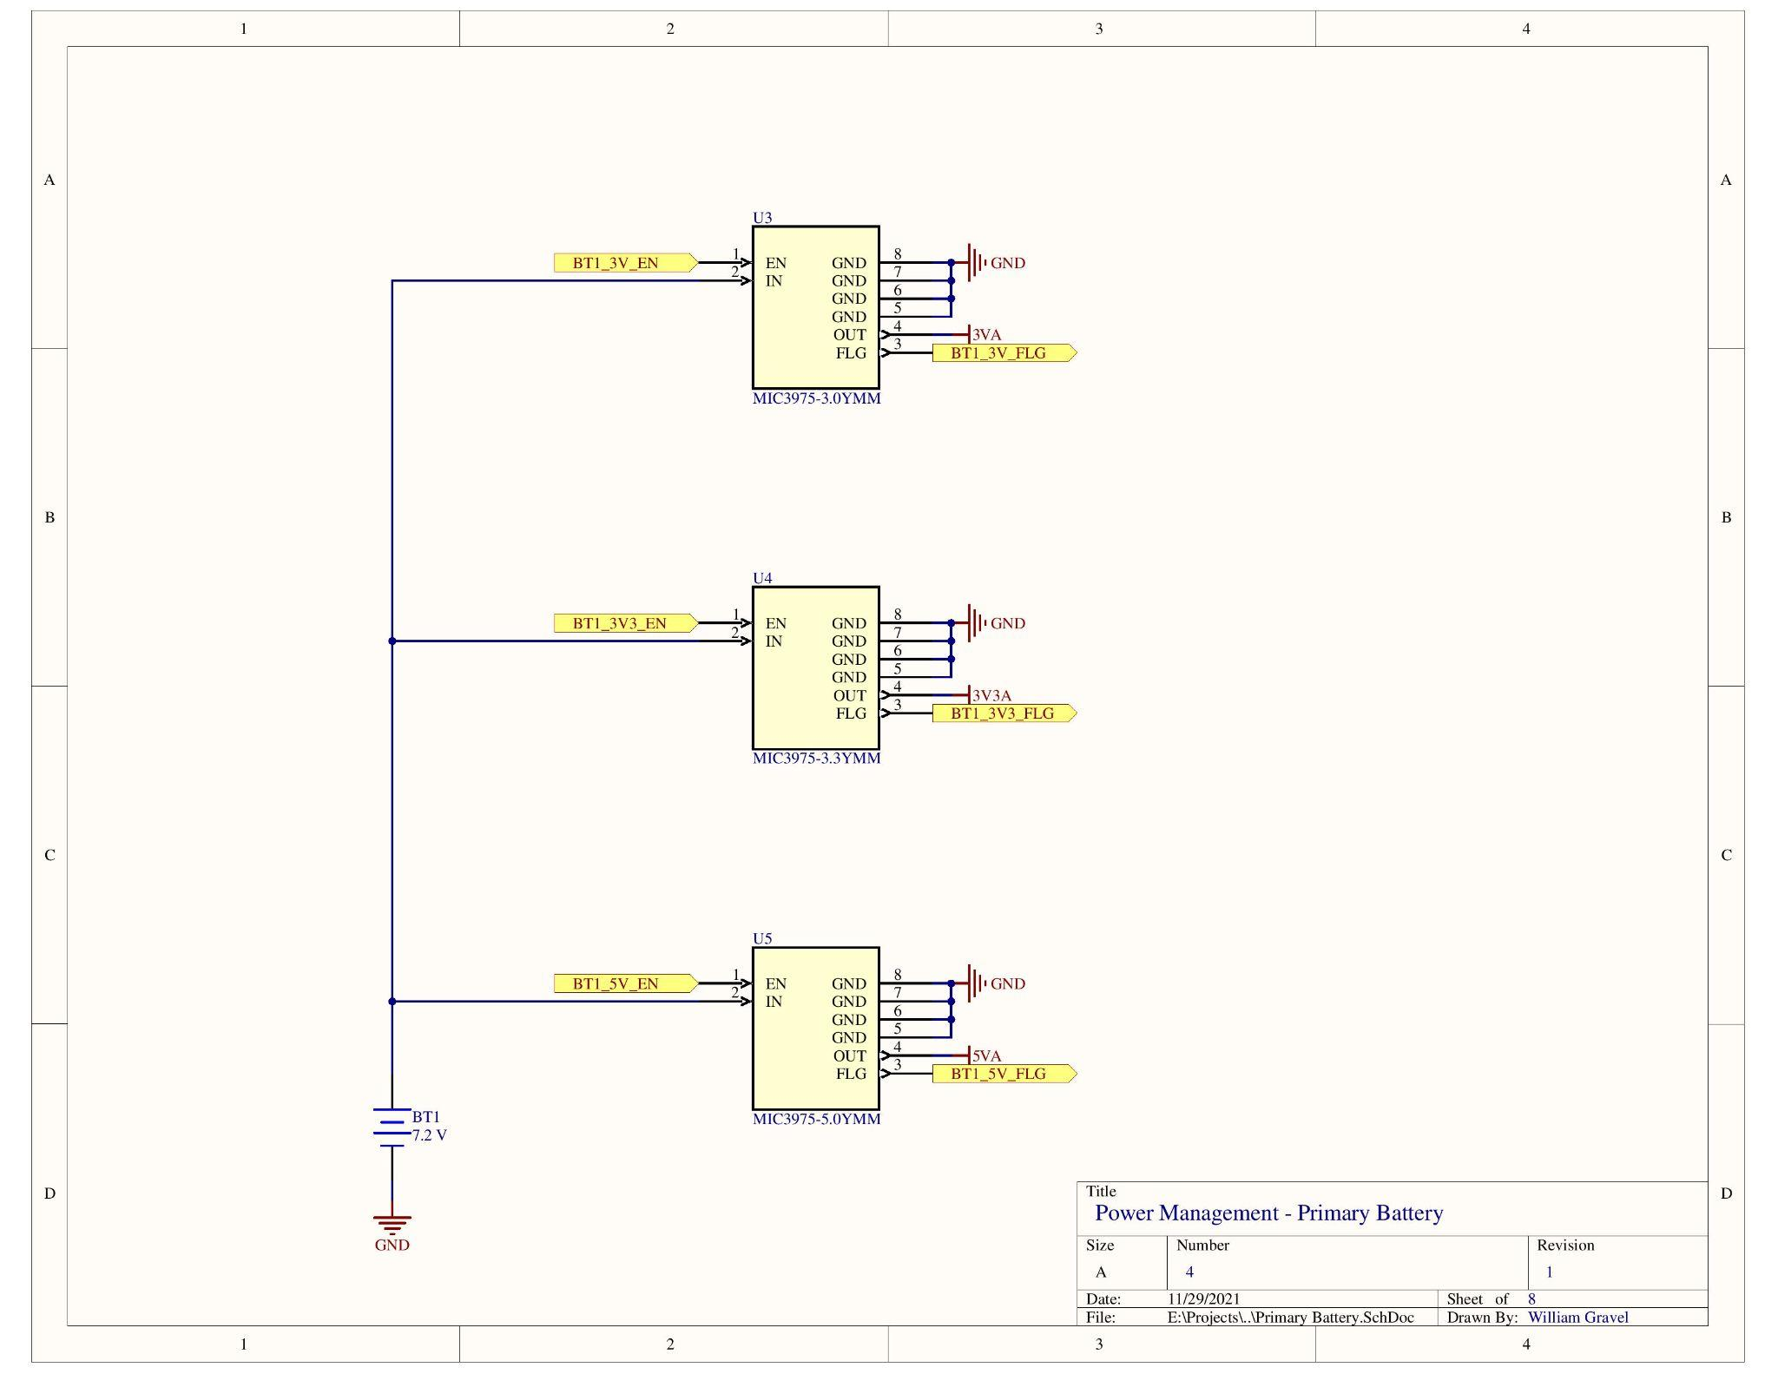
Circuit Schematics (4/8)

Slide 104
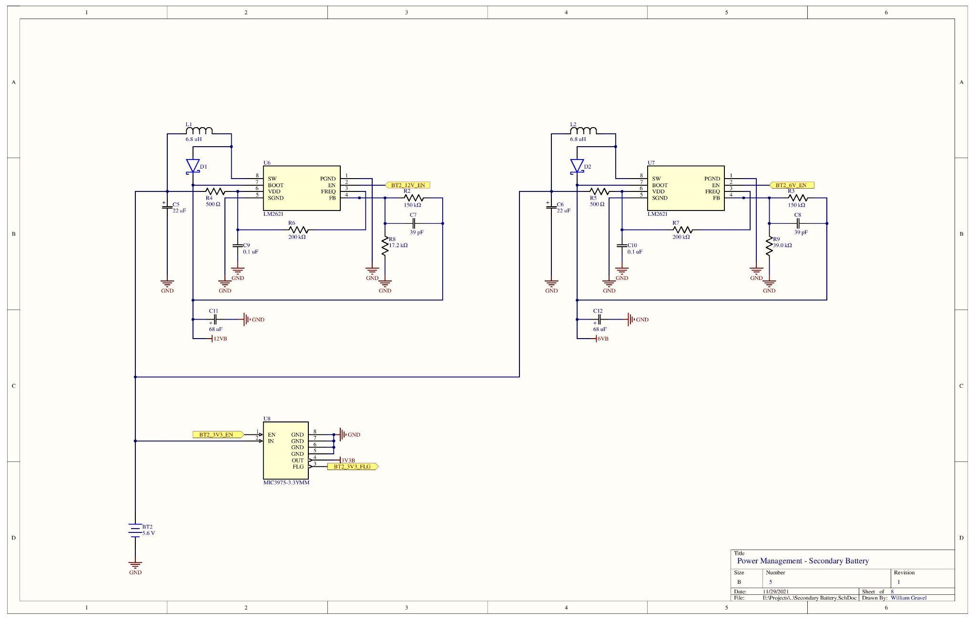
Circuit Schematics (5/8)

Slide 105
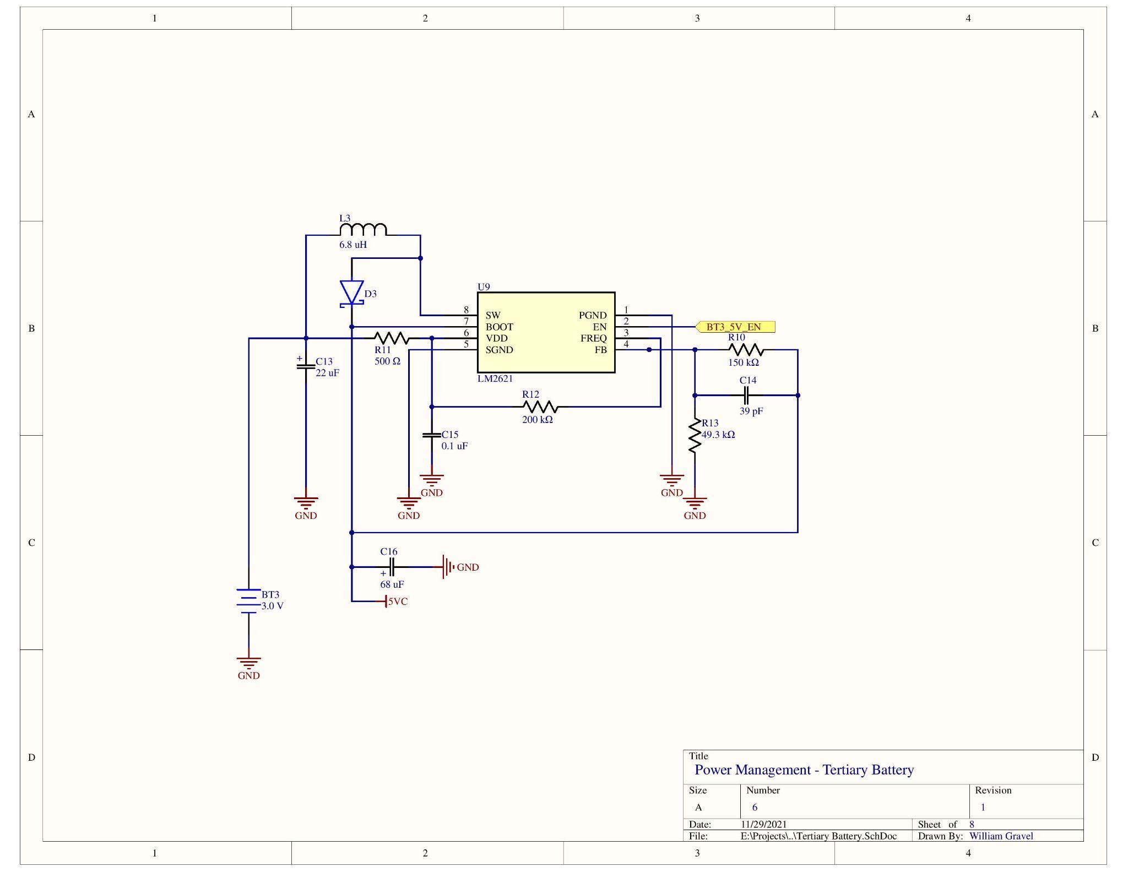
Circuit Schematics (6/8)

Slide 106
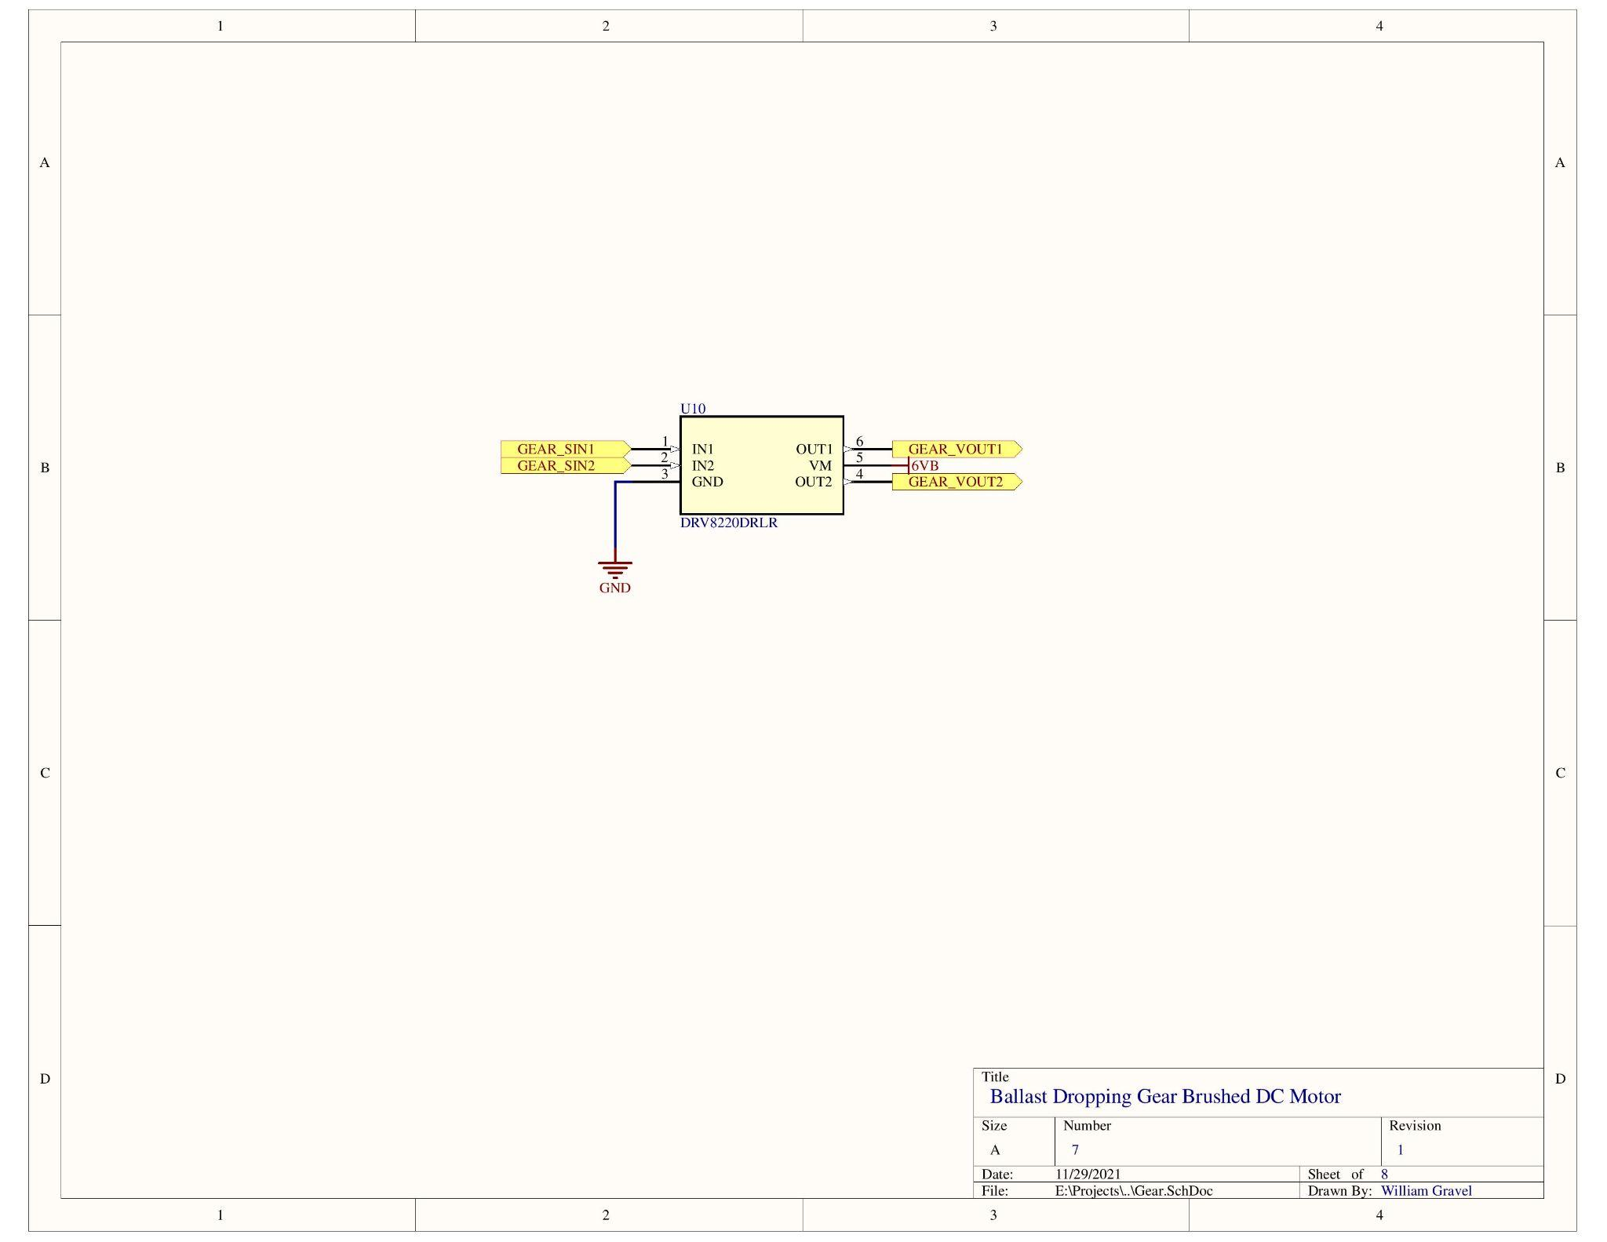
Circuit Schematics (7/8)

Slide 107
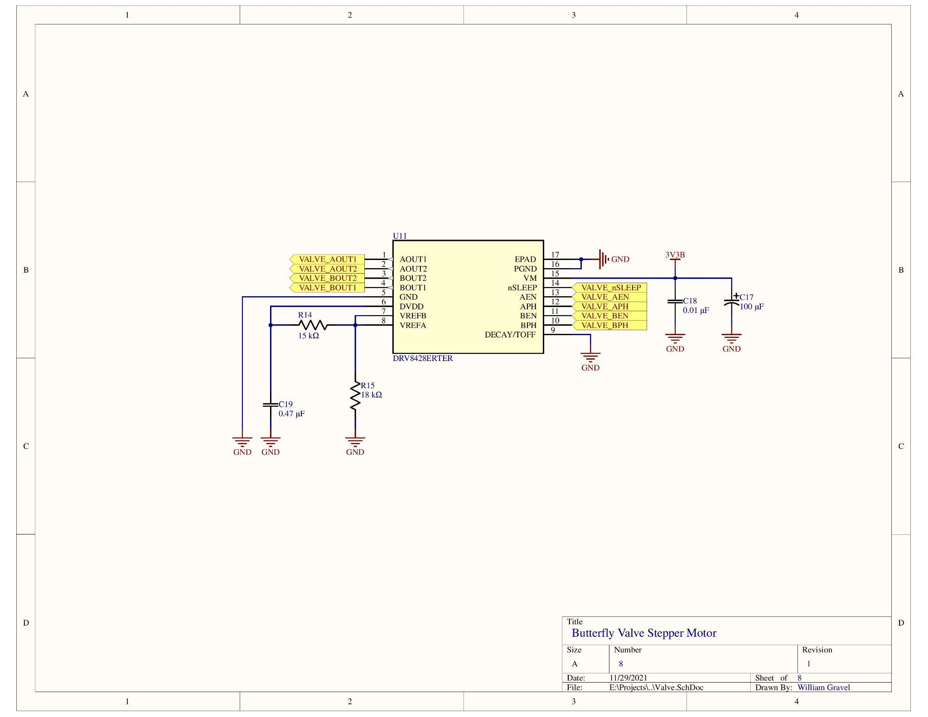
Circuit Schematics (8/8)

Slide 108
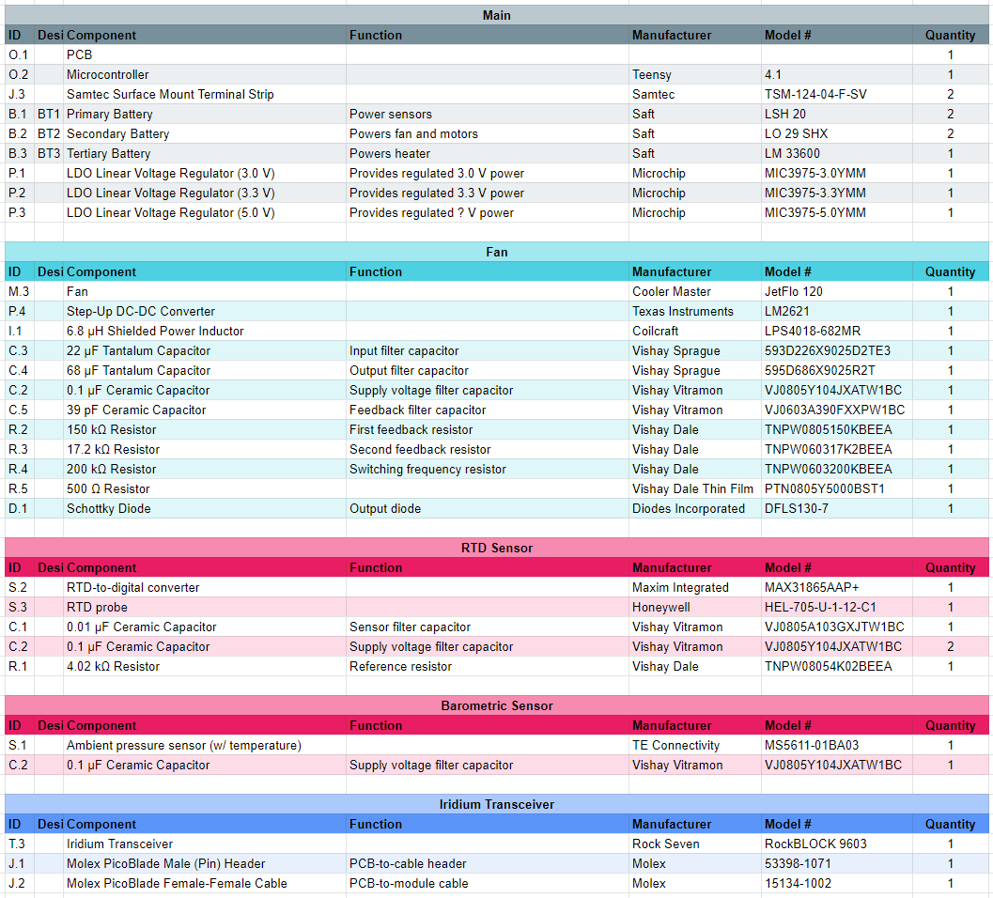
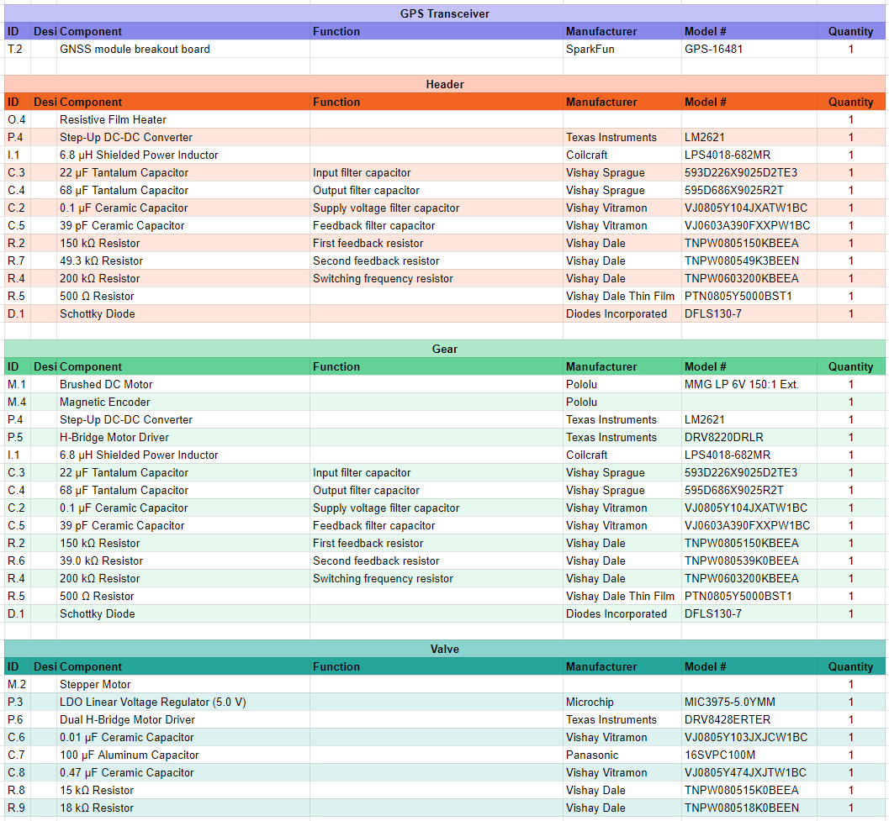
Bill of Materials

Slide 109
Mass/Cost Budget

Slide 110
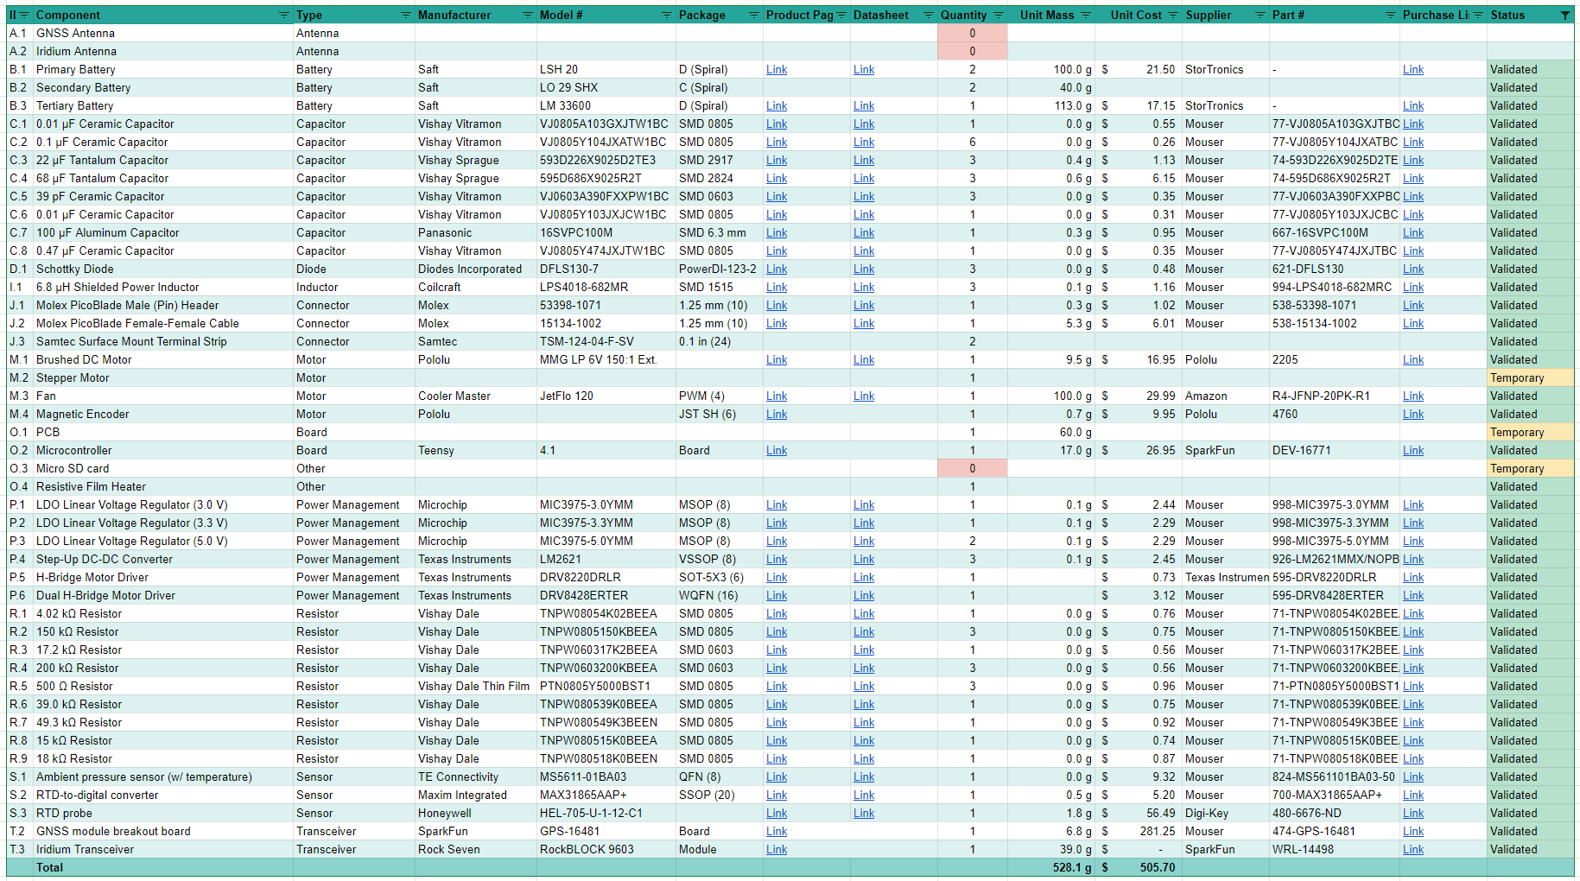
Specific Mass/Cost Breakdown - Electrical

Slide 111
Specific Mass Breakdown - Mechanical
Part | Mass (g)
Helium Quick Disconnect | 11.33
Butterfly Valve | 5
Stepper Motor (AKA Servo) | 105
Fan | 100
DC Motor | 9.5
Gear System and Dry Pack | 15
Tube | 72
Cone | 136
Total | 453.8
Notes:
I have 46ish g for the cone

Slide 112
Specific Mass Breakdown - Structures
Part | Mass (g)
Carbon Fiber Rod (x4) | 112
Polycarbonate Baseplates (x2) | 80
Carbon Fiber Hopper Panels (x4) | 12
Carbon Fiber Sheet (x1) | 3
Eyebolts (x4) | 10
Total | 217

Slide 113
Specific Mass Breakdown - Thermal
Part | Mass (g)
Insulation | 80
Heater | 2.68
Total | 82.68

Slide 114
Specific Cost Breakdown - Structural

Slide 115
Specific Cost Breakdown - Mechanical

Slide 116
Specific Cost Breakdown - Thermal

