Slide 1
BACCHUS
Balloon Altitude Command Control Housing for Unmanned Sensing
Preliminary
Design Review
Urban Sky // CU Boulder
October 20th, 2021

Slide 2
Agenda
Project Overview Ben Chupik
Feasibility Analysis
Modeling and Controls Elijah Vance
Structural Bryce Glacken
Mechanical Connor Baldwin
Thermal Leah Selman
Electrical Tanisha Anand
Conclusion Ben Chupik

Slide 3
Project Overview

Slide 4
Background & Motivation
Urban Sky sensors require a low vertical velocity for accurate data collection.
Will improve Urban Sky sensing capability by controlling the balloon’s vertical rate.
Current solution:
Two main motivations:
Current zero pressure balloons can stop at precise altitudes, but are expensive.
Cost: Reduce the cost of launches
Customization: Stop at multiple altitudes
Overview
Controls
Structural
Mechanical
Thermal
Electrical
Conclusion
Appendices

Slide 5
Mission Statement
The Balloon Altitude Command Control Housing for Unmanned Sensing (BACCHUS) team will develop, build, and test a semi-autonomous system to control the ascent, descent, and hover of an off-the-shelf high altitude latex balloon.
Overview
Controls
Structural
Mechanical
Thermal
Electrical
Conclusion
Appendices

Slide 6
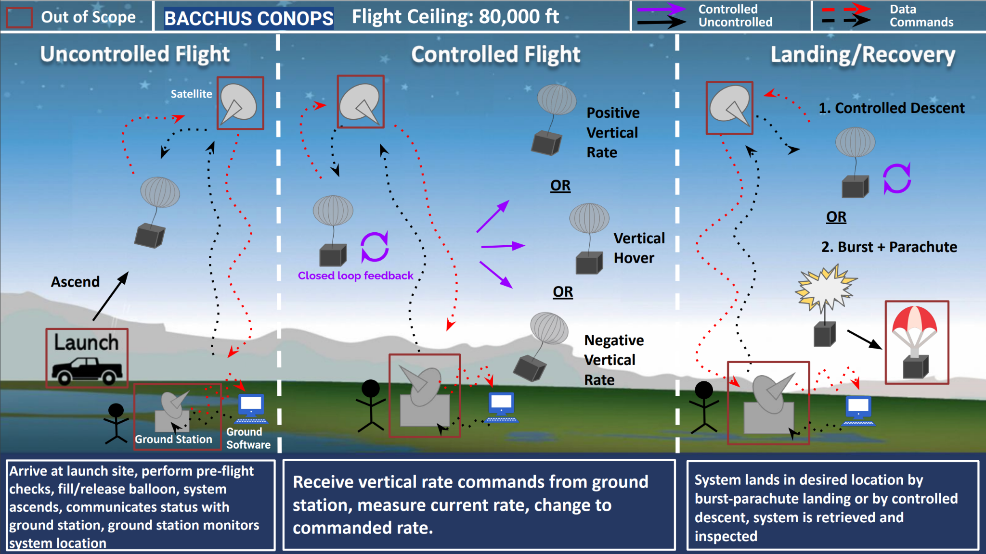

Slide 8
.

Slide 9
Functional Requirements
Code | Functional Requirement
FR 1 | BACCHUS shall control the precise vertical rate of the balloon system
FR 2 | BACCHUS shall communicate between ground and flight systems
FR 3 | BACCHUS shall operate in standard environments up to stratospheric altitudes
FR 4 | BACCHUS shall mechanically integrate to balloon
Code | Functional Requirement
FR 5 | BACCHUS shall mechanically integrate to accompanying payloads
FR 6 | BACCHUS shall operate independently from accompanying payload during all phases of flight
FR 7 | BACCHUS shall be restricted in mass and size
FR 8 | BACCHUS shall be recoverable and reusable
Overview
Controls
Structural
Mechanical
Thermal
Electrical
Conclusion
Appendices

Slide 10
Updates from CDD: Ascent Mechanism
Rotating Hopper
Justification for Baseline Design
Fixed rate control
Requires DC motor
In order to simplify the complexity of the control law, it was determined that it is most feasible to release a fixed amount of ballast at a time.
Final Choice: Rotating Hopper
Pipe Dispenser
Variable rate control
Requires at least 3 actuators
Overview
Controls
Structural
Mechanical
Thermal
Electrical
Conclusion
Appendices
Notes:
Should go before Baseline Design section (per conversation w Mah) - only feasibility for hopper

Slide 11
Updates from CDD: Thermal Subsystem
Insulation
Justification for Baseline Design
Low mass, cost, & power
Not very effective
The thermal model showed that using insulation alone would not be enough to maintain a temperature above the minimum required.
An active heater provides control and takes little extra effort as opposed to a passive heater.
Final Choice: Active Heater with Insulation
Passive Heater
Effective heating
Potential to overheat
Active Heater
Effective thermal control
Increased complexity
Overview
Controls
Structural
Mechanical
Thermal
Electrical
Conclusion
Appendices
Notes:
Trade studies chose insulation alone, however a thermal model showed that insulation wouldn’t be enough, so the three design considerations were brought back for feasibility analyses. More on this in the Thermal Feasibility slides.

Slide 12
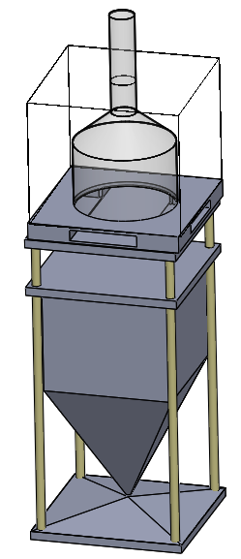
Baseline Design
Balloon attachment point
~20 in
Descent System: Fan venting system
Thermally insulated electronics bay
Current BACCHUS weight estimate Without Ballast: 2.05 lbs
With Ballast: 3.95 lbs
Weight Limit: 6 lbs
Not Final
Ascent System: Dropper system
Accompanying payload attachment
Overview
Controls
Structural
Mechanical
Thermal
Electrical
Conclusion
Appendices
Notes:
Include image of both rotating hopper and pipe dispenser to support previous slide for baseline design justification

Slide 13
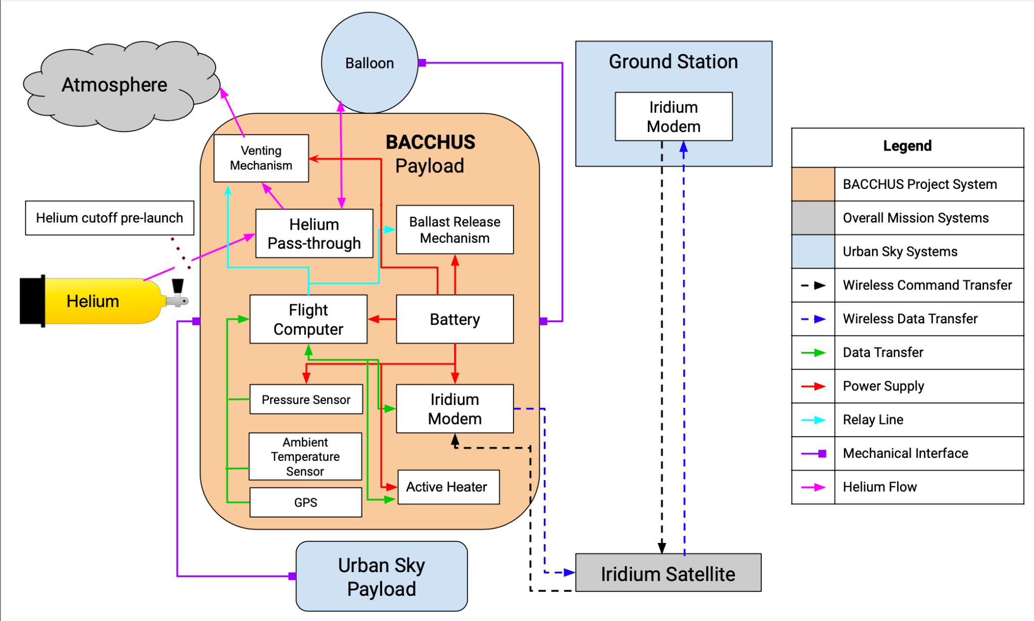
Functional Block Diagram

Slide 14
Critical Project Elements
CPE | Description
T.1 | BACCHUS must be able to interface with the provided communication system in order to properly send and receive commands and data.
T.2 | BACCHUS must be able to change to ascent and descent rate up to ±5 m/s with a fidelity of 0.25 m/s.
T.3 | The system mass must be under 6 lbs.
T.4 | BACCHUS must be able to operate in a near zero pressure environment.
T.5 | BACCHUS must be able to operate in cold temperatures present in the stratosphere reaching -55°C.
Overview
Controls
Structural
Mechanical
Thermal
Electrical
Conclusion
Appendices

Slide 15
Critical Project Elements
CPE | Description
L.1 | BACCHUS must mechanically integrate with existing payload as well as the balloon.
L.2 | Due to COVID-19, the ability to produce, procure, and test may be hindered because of any supply issues or campus closures
V.1 | BACCHUS will be part of a system operating in regulated environments and needs to meet all of those requirements levied by the customer to operate in this space.
V.2 | BACCHUS will be operating in a near space environment. This will cause issues when validating and testing the system.
V.3 | The control law needs to be developed and tested.
Overview
Controls
Structural
Mechanical
Thermal
Electrical
Conclusion
Appendices

Slide 16
Feasibility Analysis

Slide 17
Feasibility Analysis Preview
System | Subsystem | Description | CPEs | Requirements
Modeling and Controls | - | Ability to predict balloon behavior for design and validation. Ability to implement controls. | T.2, L.1, V.3 | FR1 FR2
Structural | - | Ability to integrate with balloon and accompanying payload. Ability to withstand landing impact. | T.3, L.1, V.1 | FR3, FR4, FR5, FR6, FR7, FR8
Mechanical | Ascent System | Ability to release ballast with granular control. | T.2, L.1 | FR1, FR6
 | Descent System | Ability to vent helium with granular control. | T.2, L.1 | FR1, FR6
Thermal | - | Ability to maintain operational temperature. | T.5, L.1, V.2 | FR3
Electrical | Power | Ability to power system for mission duration. | T.1, T.2, T.4, L.1 | FR2, FR3, FR6
 | State Determination | Ability to measure vertical rate, altitude, temperature, and pressure. | T.2, L.1, V.3 | FR1, FR6
Overview
Controls
Structural
Mechanical
Thermal
Electrical
Conclusion
Appendices

Slide 18
Modeling and
Controls Feasibility

Slide 19
Modeling and Controls Feasibility Overview
Relevant Requirements (Ascent)
Relevant Requirements (Descent)
DR 1.1: The vertical rate control system shall be able to change the balloon system’s ascent rate to speeds up to 5 m/s.
DR 1.2: The vertical rate control system shall be able to change the balloon system’s descent rate to speeds up to 5 m/s.
DR 1.3: The vertical rate control system shall be able to change and maintain the balloon system’s ascent/descent rate to an accuracy of 0.5 m/s for up to 6 hours.
DR 1.3: The vertical rate control system shall allow the balloon system to maintain a 0 m/s vertical rate with an accuracy of 0.25 m/s for up to 6 hours.
Overview
Controls
Structural
Mechanical
Thermal
Electrical
Conclusion
Appendices

Slide 20
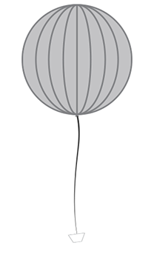
Dynamics Model
F_{B}
F_{D}
Model Assumptions:
International Standard Atmosphere
P_{amb} = P_{He}
R_{He} = const.
Spherical Balloon
Balloon Drag Only (C_{D} = 0.3)
No lateral forces (Preliminary Model)
Ideal Gas Relations
F_{g}
Overview
Controls
Structural
Mechanical
Thermal
Electrical
Conclusion
Appendices

Slide 21
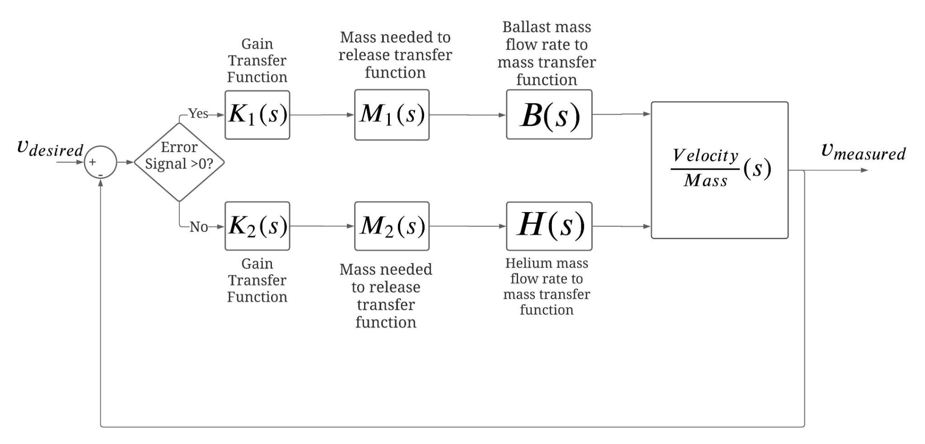
Control Block Diagram
Overview
Controls
Structural
Mechanical
Thermal
Electrical
Conclusion
Appendices

Slide 22
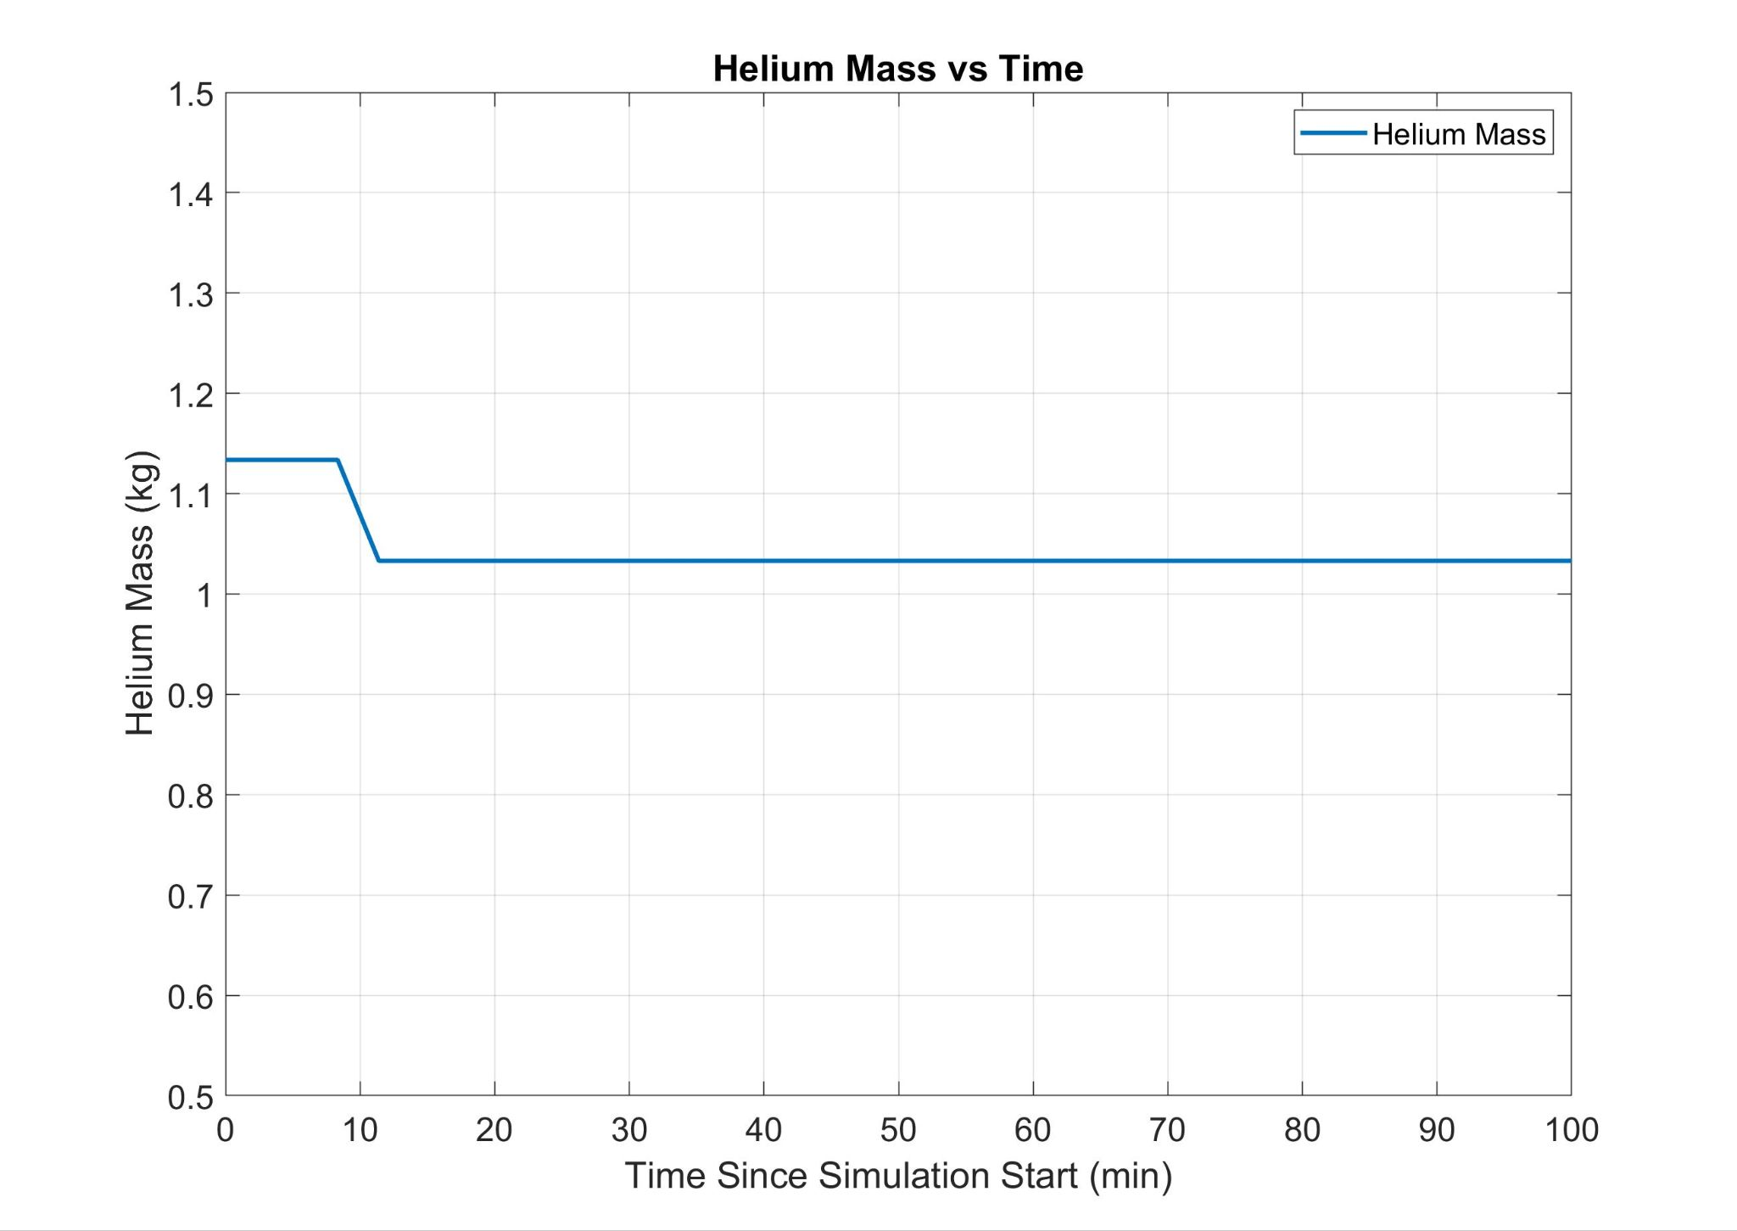
Venting Control Feasibility
Example Scenario #1
Preliminary Feed-Forward Control
Worst-Case Scenario
Ascent-to-Hover Maneuver
Initial Conditions:
Altitude: service ceiling (24 km)
Rate: 5 m/s ascent
Ballast mass: 1.81 kg (4 lb)
Helium mass: 1.13 kg (2.5 lb)
Control Response:
Helium vented: 109.5 g (0.22 lb)
Vent duration: 5 min 10 sec
Time to tolerance: 6 min 26 sec
Overview
Controls
Structural
Mechanical
Thermal
Electrical
Conclusion
Appendices

Slide 23
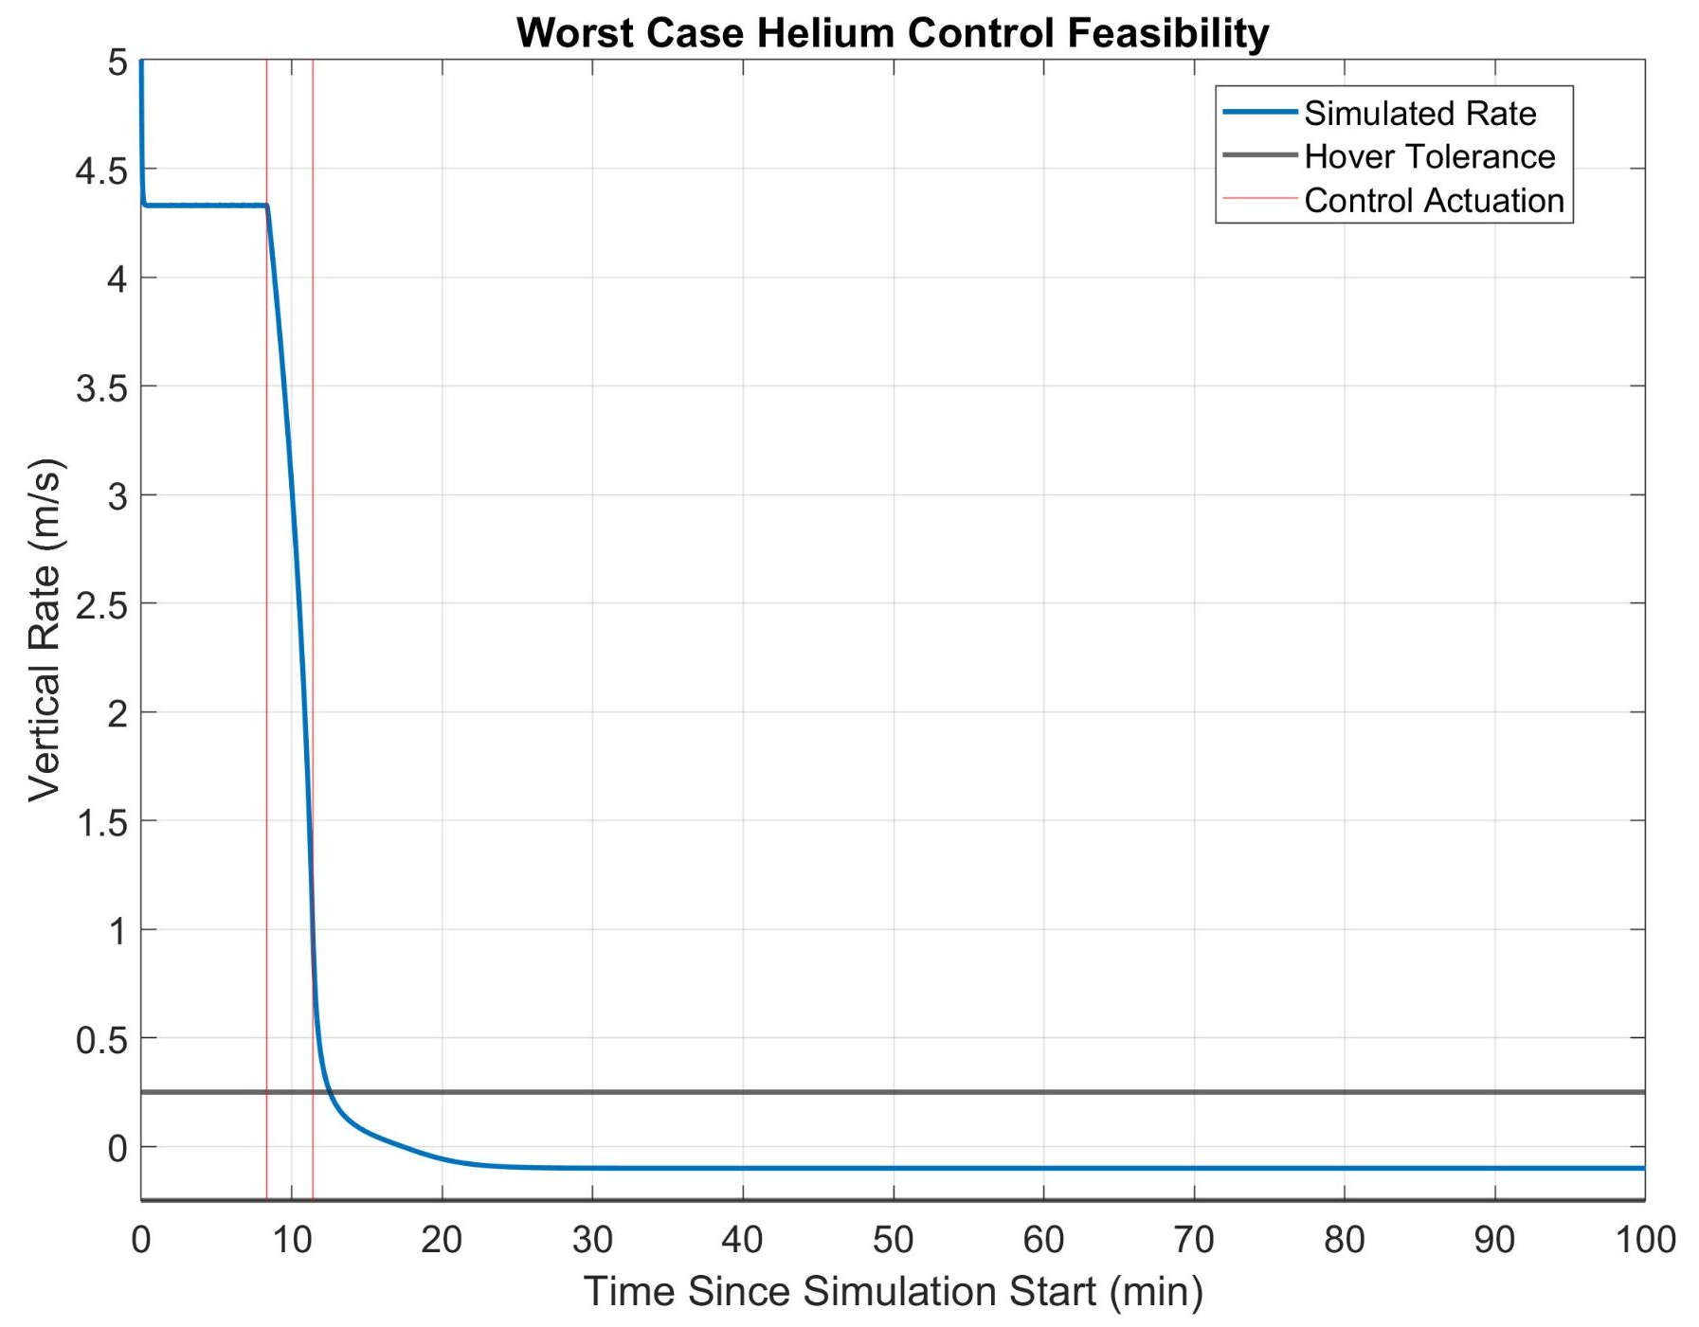
Venting Control Feasibility
Example Scenario #1
Preliminary Feed-Forward Control
Worst-Case Scenario
Ascent-to-Hover Maneuver
Initial Conditions:
Altitude: service ceiling (24 km)
Rate: 5 m/s ascent
Ballast mass: 1.81 kg (4 lb)
Helium mass: 1.13 kg (2.5 lb)
Control Response:
Helium vented: 109.5 g (0.22 lb)
Vent duration: 5 min 10 sec
Time to tolerance: 6 min 26 sec
Overview
Controls
Structural
Mechanical
Thermal
Electrical
Conclusion
Appendices

Slide 24
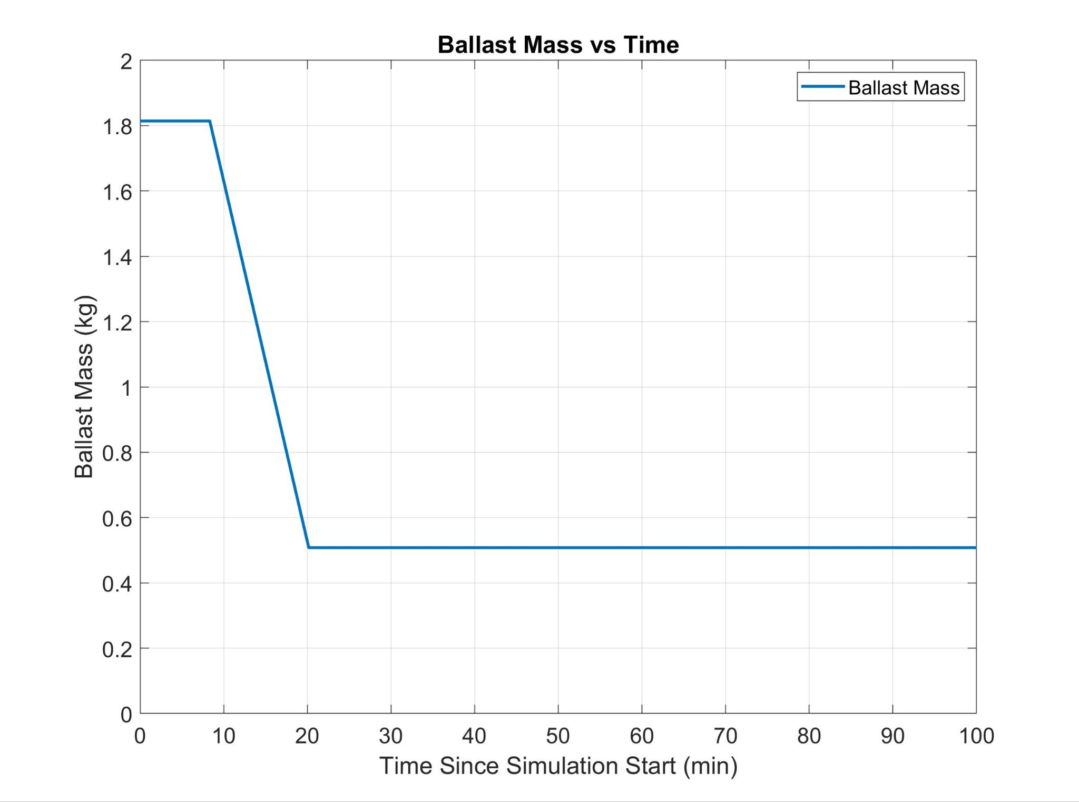
Ballast Control Feasibility
Example Scenario #2
Preliminary Feed-Forward Control
Worst-Case Scenario
Descent-to-Hover Maneuver
Initial Conditions:
Altitude: troposphere (5 km)
Rate: 5 m/s descent
Ballast mass: 1.81 kg (4 lb)
Helium mass: 0.82 kg (1.8 lb)
Control Response:
Ballast released: 1.31 kg (2.89 lb)
Release duration: 11 min 50 sec
Time to tolerance: 12 min
Overview
Controls
Structural
Mechanical
Thermal
Electrical
Conclusion
Appendices

Slide 25
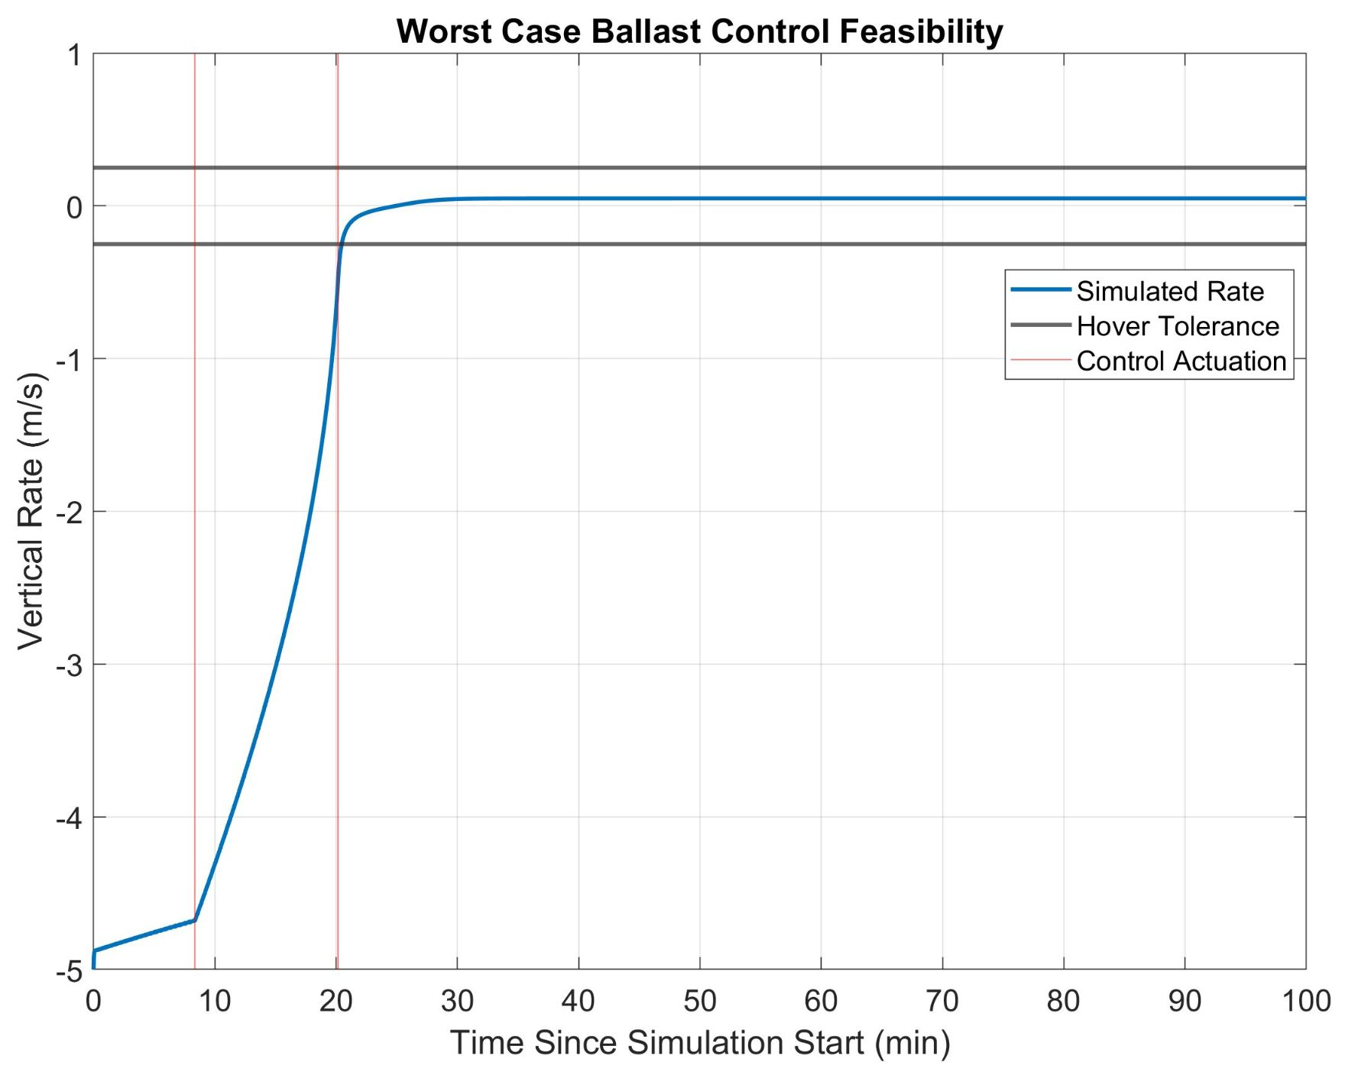
Ballast Control Feasibility
Example Scenario #2
Preliminary Feed-Forward Control
Worst-Case Scenario
Descent-to-Hover Maneuver
Initial Conditions:
Altitude: troposphere (5 km)
Rate: 5 m/s descent
Ballast mass: 1.81 kg (4 lb)
Helium mass: 0.82 kg (1.8 lb)
Control Response:
Ballast released: 1.31 kg (2.89 lb)
Release duration: 11 min 50 sec
Time to tolerance: 12 min
Overview
Controls
Structural
Mechanical
Thermal
Electrical
Conclusion
Appendices

Slide 26
Cumulative Feasibility Results
System | Subsystem | Description | CPEs | Requirements | Feasible?
Modeling and Controls | - | Ability to predict balloon behavior for design and validation. Ability to implement controls. | T.2, L.1, V.3 | FR1 | Yes
Overview
Controls
Structural
Mechanical
Thermal
Electrical
Conclusion
Appendices

Slide 27
Structural Feasibility

Slide 28
Structural Feasibility Overview
Relevant Requirements
Structural Considerations
FR 4: BACCHUS shall mechanically integrate to balloon.
Balloon Attachment:
Must survive a 133.4 N (30 lbf) impact
Must not withstand a 222.4 N (50 lbf) force
Must allow helium to pass through
Payload Attachment:
Must survive a 133.4 N (30 lbf) impact
Sizing Restrictions:
Maximum mass: 2.72 kg (6 lb)
Maximum density: 13.18 g/cm² (3 oz/in²)
FR 5: BACCHUS shall mechanically integrate to accompanying payloads.
FR 7: BACCHUS shall be restricted in mass and size.
FR 8: BACCHUS shall be recoverable and reusable.
Overview
Controls
Structural
Mechanical
Thermal
Electrical
Conclusion
Appendices

Slide 29
Structure Overview
Material Choice Needs
High strength to weight ratio
High fracture toughness
Easily manufacturable
Easy access to internals
⅛” Impact Resistant Polycarbonate
¼” Threaded Aluminum Rods
7x7” polycarbonate
Specifications
. Total Weight: ~0.56 kg (1.23 lb)
Total Material Cost: ~$80
Dimensions: ~7”x7”x20”
12” aluminum rods
Overview
Controls
Structural
Mechanical
Thermal
Electrical
Conclusion
Appendices
Notes:
FUNCTIONS:
Provides housing for payload
Provides general protection from the elements- thermal insulation will likely be integrated into parts of the structure
Provides solid base for all other components to attach to, including all internals and also the balloon itself and the lower Urban Sky camera payload
Provides impact resistance in the event of a harder landing
Should probably be accessible for easily getting to the internals- no sealing or glue
NEEDS:
Must have high strength-to-weight ratio
Goal of this system is to be as light as possible
Relatively high fracture toughness
Withstand 5G impact
Easily manufacturable with our current resources
? Possibly worth looking into UV resistant materials
Likely need to take large temperature ranges into consideration, -60c is very low

Slide 30
Structural Attachments
Payload Interface
NEED: Equilaterally spaced rigid attachment points for camera payload that can withstand 30 lbf, but less than 50 lbf.
Balloon Interface
NEED: Structural attachment to balloon, while still allowing for helium passthrough and integration with venting system.
BACCHUS will integrate to the Urban Sky camera payload through the use of three structural eye bolts drilled into the polycarbonate base, along with 40 lbf break cord.
BACCHUS will integrate to the balloon through the use of a threaded PVC pipe that screws onto both the balloon neck adapter and the helium venting system.
7x7”
Bottom view
6”
Overview
Controls
Structural
Mechanical
Thermal
Electrical
Conclusion
Appendices
Notes:
Polycarbonate will be the main component of the housing, as it is very lightweight and generally easy to work with. Pieces will be held together with bolts for easy disassembly.
Carbon fiber or aluminum tubes will be incorporated into the four sides of the housing in order to securely hold the lower dispersal pyramid in place and provide further structural support
These tubes will likely act as a frame for the insulated portion, where foam will be the main wall material
Questions
What is the needed thickness of the polycarbonate/acrylic?
What is the needed diameter of the tubing?

Slide 31
Structure Impact Needs
Impact of 30 lbf
Must withstand an impact of 5 g’s with no compromise to structure -- translating into a force of 30 lbf
Payload Separation under 50 lbf
BACCHUS and the attached payload must separate if subject to a force no greater than 50 lbf
Aluminum rods provide main structural support, and have a very high impact resistance.
Greatest possibility of failure:
The edges of the polycarbonate sheeting near the drilled holes. Further testing is needed to fully explore the structural integrity of this preliminary design.
The payloads will attach using 40 lbf break cord
Overview
Controls
Structural
Mechanical
Thermal
Electrical
Conclusion
Appendices
Notes:
50 lb (FAA), 30 lb (Urban Sky) - add footnote?
Show direct relation to requirements
Consider contingency plan - alternative if polycarbonate does not work
ADD DENSITY REQUIREMENT

Slide 32
Cumulative Feasibility Results
System | Subsystem | Description | CPEs | Requirements | Feasible?
Modeling and Controls | - | Ability to predict balloon behavior for design and validation. Ability to implement controls. | T.2, L.1, V.3 | FR1 | Yes
Structural | - | Ability to integrate with balloon and accompanying payload. Ability to withstand landing impact. | T.3, L.1, V.1 | FR3, FR4, FR5, FR6, FR7, FR8 | Yes
Overview
Controls
Structural
Mechanical
Thermal
Electrical
Conclusion
Appendices

Slide 33
Mechanical Feasibility

Slide 34
Mechanical Feasibility Overview
Relevant Requirements (Ascent)
Relevant Requirements (Descent)
DR 1.1: The vertical rate control system shall be able to change the balloon system’s ascent rate to speeds up to 5 m/s.
DR 1.2: The vertical rate control system shall be able to change the balloon system’s descent rate to speeds up to 5 m/s.
DR 1.3: The vertical rate control system shall be able to change and maintain the balloon system’s
ascent/descent rate to an accuracy of 0.5 m/s for up to 6 hours.
DR 1.3: The vertical rate control system shall allow the balloon system to maintain a 0 m/s vertical rate with an accuracy of 0.25 m/s for up to 6 hours.
Overview
Controls
Structural
Mechanical
Thermal
Electrical
Conclusion
Appendices

Slide 35
Ascent System: Key Characteristics
Power
(worst case scenario)
Ballast Release Rate
Weight
~release rate of 1.84 g/s (4 BBs at 0.46 g each)
~10.8 min to release ballast for desired rate (worst case scenario*)
1.5 V starting
6 V operating
~4 lb ballast
~2 lb payload
Cost
(worst case scenario)
$15.95 for DC motor
~$50 for Gear System
$47.99/2300 BBs for Ballast (x2)
~$15 Ballast container
Total: $176.93
*Desired ascent rate 0-5 m/s at ground level
*can be dropped 1.5 times with a 4 lb ballast
DC Motor: 0.021 lb
Gear System: 0.25 lb
DC Motor = Polou - 150:1 Micro Metal Gearmotor LP 6V
Overview
Controls
Structural
Mechanical
Thermal
Electrical
Conclusion
Appendices
Notes:
Specific Gear: 150:1 Micro Metal Gearmotor LP 6V
Maybe list % of total budget for power, weight, and cost
Also show CAD model
A drop can occur 1.5 times at lowest altitude, 2.42 times at median altitude, 4.27 times at maximum altitude

Slide 36
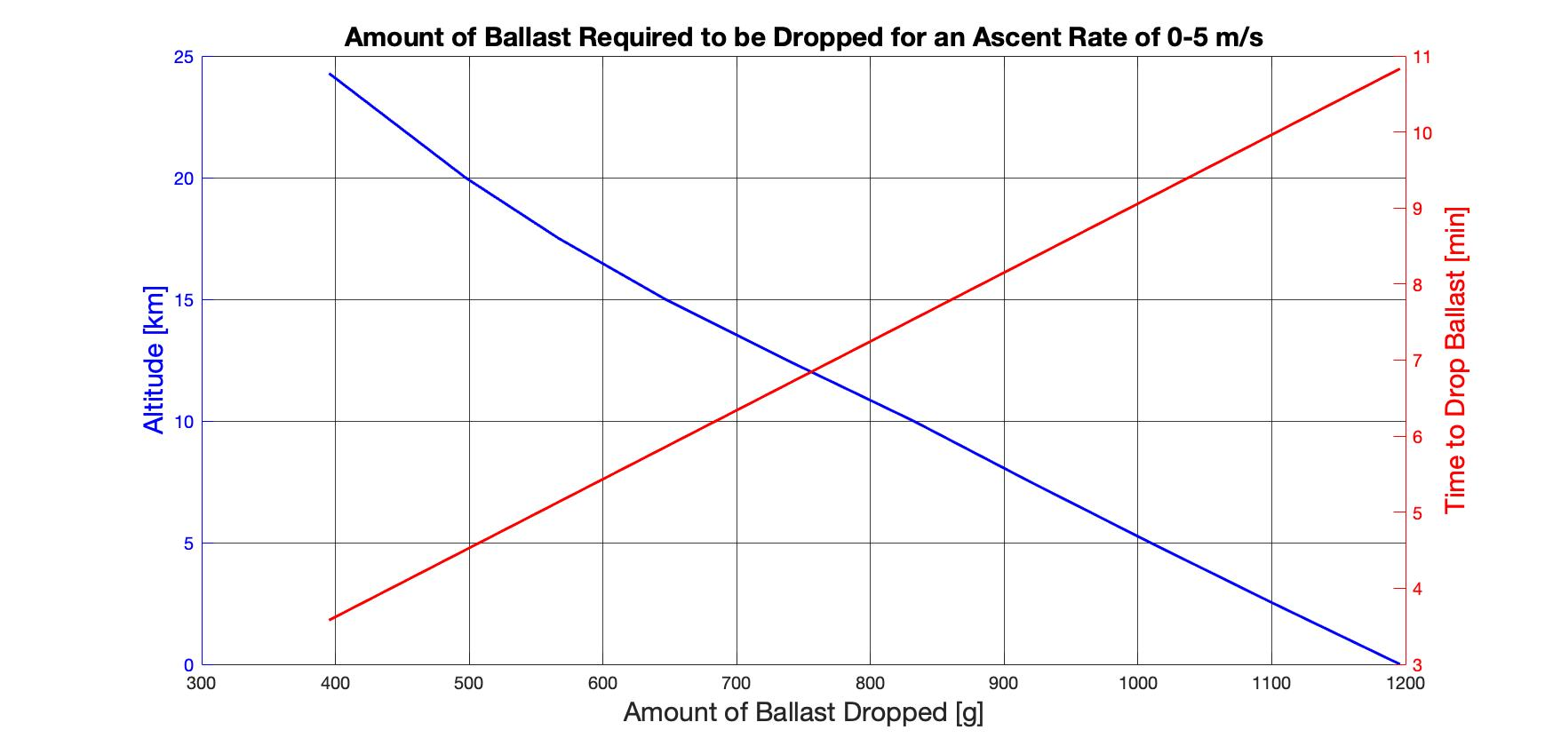
Ascent System Feasibility: Rate Control
Desired ascent rate 0-5 m/s
Overview
Controls
Structural
Mechanical
Thermal
Electrical
Conclusion
Appendices
Notes:
This graph shows the amount of ballast needed per altitude to achieve the desired ascent rate. This graph also shows the time it takes to drop the required amount of ballast to achieve the desired ascent rate.
Methodology/assumptions: The controls models is used to calculate the mass of ballast required to be dropped to raise the balloon to the desired ascent rate of 0-5 m/s. This model was fed the current rate, altitude, as well as the payload/skin mass. Furthermore, the time vector was calculated by dividing the calculated required ballast drop mass by the rate at which the ballast will be dropped. The rate at which the ballast will be dropped is 1.84 g/s (0.46 g per BB so 4 BBs)
Make sure to clearly identify the differences between the two plots (Mention colors!)
Drop Calculations:
A drop can occur 1.5 times at lowest altitude, 2.42 times at median altitude, 4.27 times at maximum altitude
Introduce ballast dropped first

Slide 37
Ascent System Feasibility: Rate Control
Desired ascent rate 0-5 m/s
At 20 km 500 g ballast is dropped in 4.7 minutes
Overview
Controls
Structural
Mechanical
Thermal
Electrical
Conclusion
Appendices
Notes:
This graph shows the amount of ballast needed per altitude to achieve the desired ascent rate. This graph also shows the time it takes to drop the required amount of ballast to achieve the desired ascent rate.
Methodology/assumptions: The controls models is used to calculate the mass of ballast required to be dropped to raise the balloon to the desired ascent rate of 0-5 m/s. This model was fed the current rate, altitude, as well as the payload/skin mass. Furthermore, the time vector was calculated by dividing the calculated required ballast drop mass by the rate at which the ballast will be dropped. The rate at which the ballast will be dropped is 1.84 g/s (0.46 g per BB so 4 BBs)
Make sure to clearly identify the differences between the two plots (Mention colors!)
Drop Calculations:
A drop can occur 1.5 times at lowest altitude, 2.42 times at median altitude, 4.27 times at maximum altitude
Introduce ballast dropped first

Slide 38
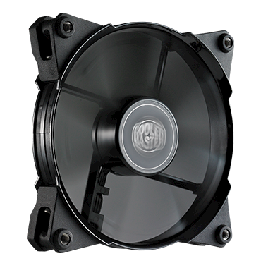
Descent System Feasibility: Rate Control
Power & Thermals:
0.4 A drawn
12V DC operating voltage
Estimated -40℃ min. operating temperature
Helium Vent Rate:
2.7 m³/min
~5 min to achieve desired descent rate (Worst case Scenario)
0-(-5) m/s desired
Weight & Cost:
$30
0.1 kg (0.22 lb)
Overview
Controls
Structural
Mechanical
Thermal
Electrical
Conclusion
Appendices
Notes:
https://www.coolermaster.com/catalog/legacy-products/cooling/jetflo-120/#image-Item1
Mention power concerns, low temp testing in the future
Emphasize what is feasible and the focus
Our project does not have a time to competition requirement.

Slide 39
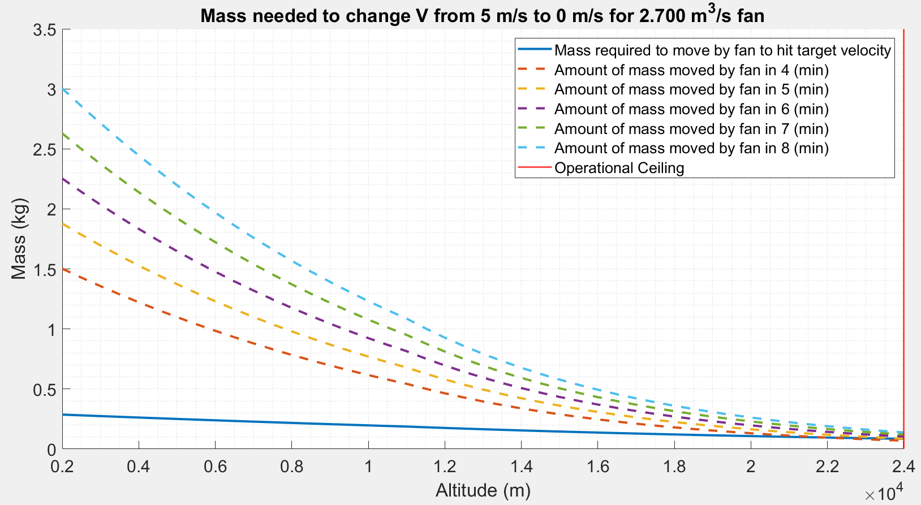
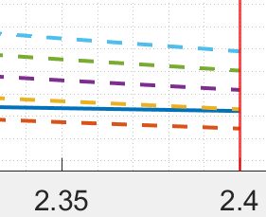
Descent System Feasibility: Rate Control
Feasible vent condition
Overview
Controls
Structural
Mechanical
Thermal
Electrical
Conclusion
Appendices
Notes:
Show feasibility why was that important
Show why time was important.
At the higher alt with lowest density, the time constraints matter more
Why 7, at atmosphere is takes a while to vent. We just want to show that its reasonable to achieve at high altitude

Slide 40
Cumulative Feasibility Results
System | Subsystem | Description | CPEs | Requirements | Feasible?
Modeling and Controls | - | Ability to predict balloon behavior for design and validation. Ability to implement controls. | T.2, L.1, V.3 | FR1 | Yes
Structural | - | Ability to integrate with balloon and accompanying payload. Ability to withstand landing impact. | T.3, L.1, V.1 | FR3, FR4, FR5, FR6, FR7, FR8 | Yes
Mechanical | Ascent System | Ability to release ballast with granular control. | T.2, L.1 | FR1, FR6 | Yes
 | Descent System | Ability to vent helium with granular control. | T.2, L.1 | FR1, FR6 | **Yes
Overview
Controls
Structural
Mechanical
Thermal
Electrical
Conclusion
Appendices
Notes:
Need cfd of the fan. And temperature range of the fan

Slide 41
Thermal Feasibility

Slide 42
Thermal Feasibility Overview
Relevant Requirements
Thermal Considerations
DR 3.2: BACCHUS shall operate at standard temperatures present from sea-level to stratospheric altitudes, for a range of around −55°C to 40°C.
Internal Temperature Range:
Minimum: -40°C
Ideal: 25°C
Maximum: 85°C
Heat Loss Sources:
Minimum ambient temperature: -55°C
Maximum mission duration: 24 hours
Power Requirements:
Input: 5 V, 200 mA
Output: 1 W
Final Design:
Polyisocyanurate Foam Insulation
Resistive Heater
DR 6.1.3: The accompanying payload will not share thermal control with BACCHUS.
DR 6.2: BACCHUS shall have enough battery to last a 24-hour mission.
Overview
Controls
Structural
Mechanical
Thermal
Electrical
Conclusion
Appendices

Slide 43
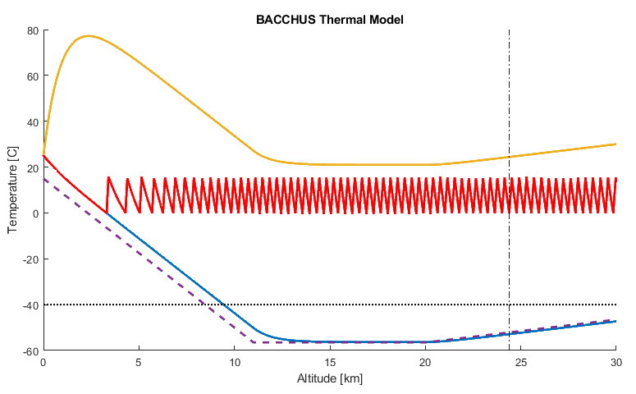
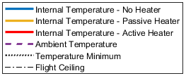
Thermal Model
Overview
Controls
Structural
Mechanical
Thermal
Electrical
Conclusion
Appendices

Slide 44
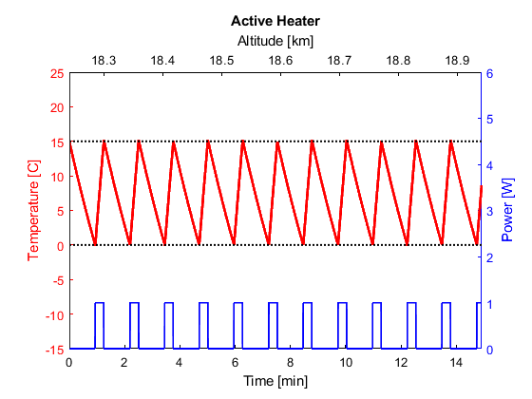
Active Heating
Greater control
Temperature stays near baseline
Does not overheat
Minimum temperature well within acceptable range
Overview
Controls
Structural
Mechanical
Thermal
Electrical
Conclusion
Appendices

Slide 45
Cumulative Feasibility Results
System | Subsystem | Description | CPEs | Requirements | Feasible?
Modeling and Controls | - | Ability to predict balloon behavior for design and validation. Ability to implement controls. | T.2, L.1, V.3 | FR1 | Yes
Structural | - | Ability to integrate with balloon and accompanying payload. Ability to withstand landing impact. | T.3, L.1, V.1 | FR3, FR4, FR5, FR6, FR7, FR8 | Yes
Mechanical | Ascent System | Ability to release ballast with granular control. | T.2, L.1 | FR1, FR6 | Yes
 | Descent System | Ability to vent helium with granular control. | T.2, L.1 | FR1, FR6 | **Yes
Thermal | - | Ability to maintain operational temperature. | T.5, L.1, V.2 | FR3 | Yes
Overview
Controls
Structural
Mechanical
Thermal
Electrical
Conclusion
Appendices

Slide 46
Electrical Feasibility

Slide 47
Power Feasibility Overview
Relevant Requirements
Battery Design Options
DR 3.2: BACCHUS shall operate at standard temperatures present from sea-level to stratospheric altitudes, for a range of around −55°C to 40°C.
Manufacturers:
Saft, Energizer, Duracell
Chemistries:
Li-SOCl2, Li-SO2, Li-FeS2, Li-MnO2, Ni-Mh, Alkaline, Li-Po
Tentative Battery Choice:
Saft LSH 20, 3.6V/13,000 mAh (x2 in series)
Considered Specifications:
Maximum Continuous Current
Nominal Capacity
Nominal Voltage
Typical Weight
Operating Temperature Range
DR 6.1: BACCHUS shall operate independently from accompanying payloads during all phases of flight.
DR 6.2: BACCHUS shall have enough battery to last a 24-hour mission.
Overview
Controls
Structural
Mechanical
Thermal
Electrical
Conclusion
Appendices

Slide 48
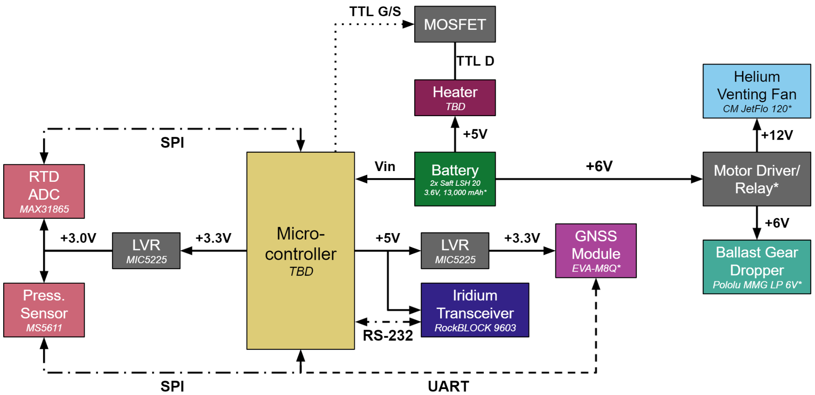
Detailed Block Diagram
*Subject to change
Overview
Controls
Structural
Mechanical
Thermal
Electrical
Conclusion
Appendices
Notes:
Proof of concept
Subject to change - vent and ballast drop powered

Slide 49
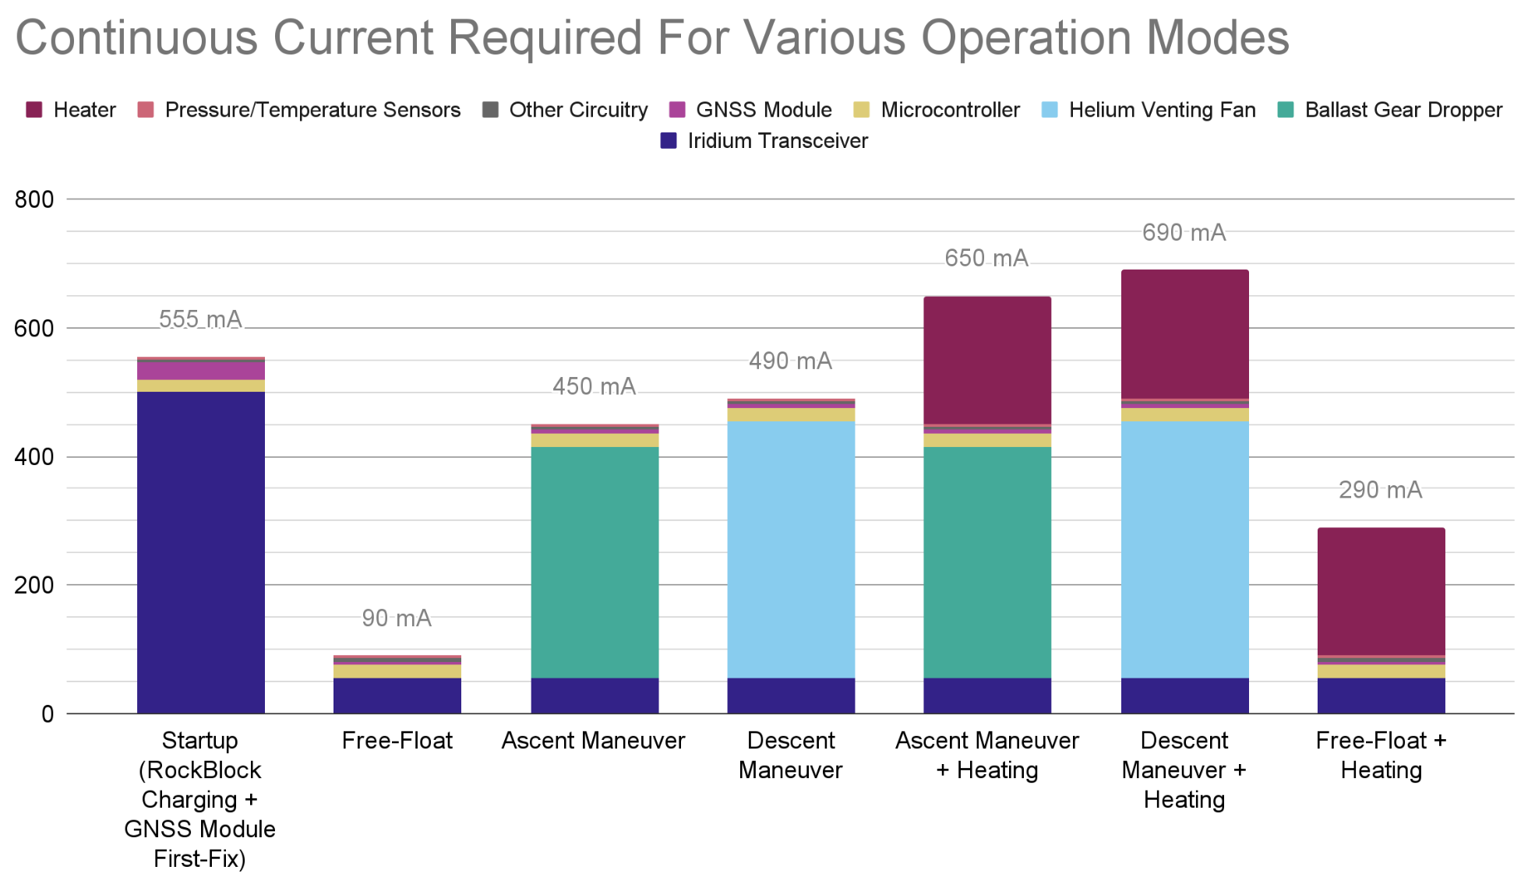
Current Draw
Battery current budget:
Typical batteries evaluated allow for a maximum continuous current of more than 1.3 A.
Maximum current draw:
Startup sequence, mainly due to 500 mA needed to initially charge RockBLOCK 9603’s super-capacitor.
Typical current draw:
Nominal current draw for normal operation is under 100 mA, which prevents battery voltage and capacity degradation.
Overview
Controls
Structural
Mechanical
Thermal
Electrical
Conclusion
Appendices
Notes:
Mention worst case scenario
Mention time doesn’t take too much time so voltage doesn’t

Slide 50
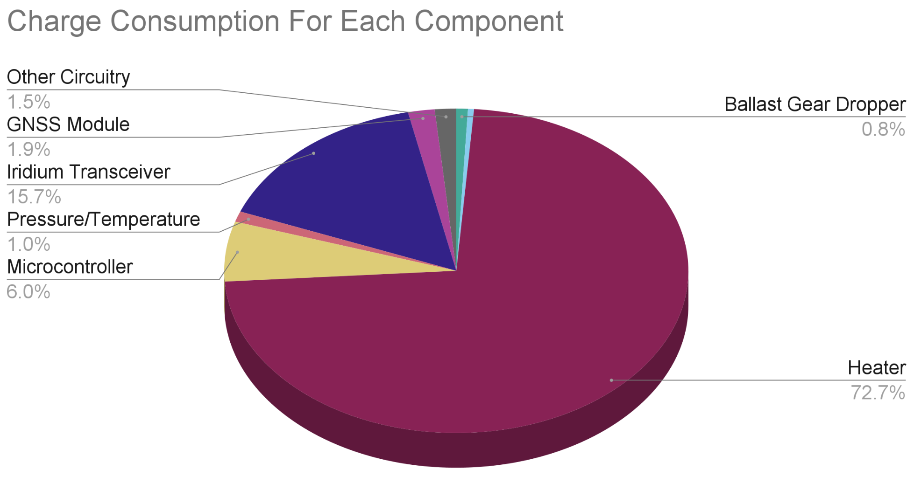
Charge Consumption
Battery capacity budget:
Typical batteries evaluated allow for a total charge capacity of up to 14,000 mAh at room temperature.
Largest consumption:
RockBLOCK 9603, mainly due to 1-minute message frequency and keeping it in active mode (sleep mode is very efficient).
Total charge drained:
Around 8,000 mAh. Since supply voltage degrades as charge is drained, this would need to be at most ~80% of total capacity.
Overview
Controls
Structural
Mechanical
Thermal
Electrical
Conclusion
Appendices
Notes:
Charge consumption during 24 hr mission duration
RockBlock uses most of the charge since it transmits messages often
ascent /Descent doesn’t use too much charge since they aren’t on for too long

Slide 51
State Determination Feasibility Overview
Relevant Requirements
Tentative Sensor Suite
DR 1.3: The vertical rate control system shall be able to change and maintain the balloon system’s ascent/descent rate to an accuracy of 0.5 m/s for up to 6 hours.
Measurement Sensors:
Barometric Pressure Sensor, Resistance Temperature Detector (RTD) Sensor, GNSS Module
Required Measurements:
Vertical Rate
Altitude
Internal Temperature
Ambient Temperature
Ambient Pressure
DR 1.4: The vertical rate control system shall allow the balloon system to maintain a 0 m/s vertical
rate with an accuracy of 0.25 m/s for up to 6 hours.
DR 3.2: BACCHUS shall operate at standard pressures present from sea level to stratospheric altitudes.
DR 3.2: BACCHUS shall operate at standard temperatures present from sea-level to stratospheric altitudes, for a range of around −55°C to 40°C.
Overview
Controls
Structural
Mechanical
Thermal
Electrical
Conclusion
Appendices

Slide 52
Measurement Ranges & Accuracies
Measurement | Range |  | Accuracy (at -40°C)
 | Required* | Expected | Desired† | Expected
Vertical Rate GPS | ≤ 10 m/s | ≤ 500 m/s | ≤ 0.1 m/s | ±0.1 to ±0.25 m/s
Altitude GPS | ≤ 24.4 km (80,000 ft) | ≤ 50 km (164,000 ft) | ≤ 20 m | ±5.0 to ±12.5 m
Internal Temp. Barom. | ≥ -40°C | ≥ -40°C | ≤ 1°C | -0.4 to +1.9°C
Ambient Temp. RTD | ≥ -65°C | ≥ -200°C | ≤ 1°C | ±0.6°C
Ambient Press. Barom. | ≥ 28 mbar | ≥ 10 mbar | ≤ 3 mbar | -2.7 to +1.7 mbar
*defined from mission profile
†defined from model tolerances (preliminary)
Range: All sensor measurement ranges exceed the required ranges for the expected maneuvers and an altitude service range of 0 to 80,000 ft.
Accuracy: Most sensor accuracies hit the desired tolerances. The GPS measurement is the biggest uncertainty due to horizontal vs. vertical accuracies.
Overview
Controls
Structural
Mechanical
Thermal
Electrical
Conclusion
Appendices

Slide 53
Cumulative Feasibility Results
System | Subsystem | Description | CPEs | Requirements | Feasible?
Modeling and Controls | - | Ability to predict balloon behavior for design and validation. Ability to implement controls. | T.2, L.1, V.3 | FR1 | Yes
Structural | - | Ability to integrate with balloon and accompanying payload. Ability to withstand landing impact. | T.3, L.1, V.1 | FR3, FR4, FR5, FR6, FR7, FR8 | Yes
Mechanical | Ascent System | Ability to release ballast with granular control. | T.2, L.1 | FR1, FR6 | Yes
 | Descent System | Ability to vent helium with granular control. | T.2, L.1 | FR1, FR6 | **Yes
Thermal | - | Ability to maintain operational temperature. | T.5, L.1, V.2 | FR3 | Yes
Electrical | Power | Ability to power system for mission duration. | T.1, T.2, T.4, L.1 | FR2, FR3, FR6 | Yes
 | State Determination | Ability to measure vertical rate, altitude, temperature, and pressure. | T.2, L.1, V.3 | FR1, FR6 | **Yes
Overview
Controls
Structural
Mechanical
Thermal
Electrical
Conclusion
Appendices

Slide 54
Conclusion

Slide 55
Feasibility Analysis Summary
System | Subsystem | Feasible? | Future Work
Modeling and Controls | - | Yes | Implement feedback control Test control laws with non-linear balloon model Implement radiative thermal effects Implement mechanism startup and shut off Validate model with flight data
Structural | - | Yes | Perform FEM analysis for structural skeleton Improve impact simulation
Mechanical | Ascent System | Yes | Determine ideal gear sequence for ballast drop Determine ideal gear torque and driver configuration
 | Descent System | **Yes | Perform CFD analysis for fan flow Research lower voltage fan options
Thermal | - | Yes | Develop more complex thermal model with fewer assumptions Research resistive heater options
Electrical | Power | Yes | Further research into battery options Determine full circuit schematic Develop rigorous battery draining model
 | State Determination | **Yes | Further research into GPS vert. accuracy Perform sensor accuracy tests Develop model to test sensor combinations
Overview
Controls
Structural
Mechanical
Thermal
Electrical
Conclusion
Appendices

Slide 56
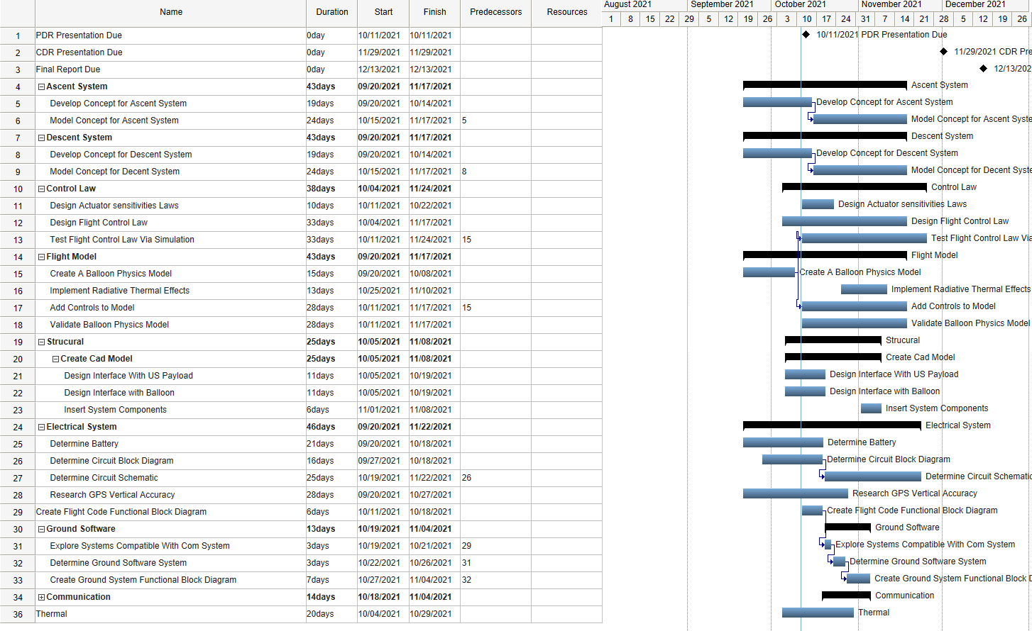
Path Moving Forward
Milestone
Task Grouping
Task
Overview
Controls
Structural
Mechanical
Thermal
Electrical
Conclusion
Appendices
Notes:
Cold testing of fan, minimum change in altitude for vent/dropper

Slide 57
Acknowledgements
We want to acknowledge and express our thanks to
Our advisor, Prof. Mah, for all of his guidance and feedback
Our customer, Urban Sky for this opportunity and for their support throughout
Prof. Frew for his help with the preliminary control law
Prof. Schwartz for her help with the validation of our electronics
Prof. Akos for his help with the accuracy of vertical GPS measurements
TA Colin Claytor for giving us feedback on our presentation
Stanford graduates, Andrey Shusko, Paige Brown, and Kai Marshland, for answering our questions regarding the ballast release mechanism

Slide 58
References
“Ago, Helen 3 years, et al. “Choosing the Right Motor For Your Project - DC vs Stepper vs Servo Motors.” Lastest Open Tech From Seeed, 29 June 2021, https://www.seeedstudio.com/blog/2019/04/01/choosing-the-right-motor-for-your-project-dc-vs-stepper-vs-servo-motors/.
Fusco, M.J., Isenberg, D.R., and Pickard, X., “Development of a High-Altitude Balloon Controlled Ascent System,” Institute of Electrical and Electronics Engineers, 2020.
Smith. T.P., “Balloon Calculations,” Department of Physics and Astronomy, Dartmouth University, July 2012.
“Stepper Motors vs. DC Motors - What's the Difference?” Thomasnet® - Product Sourcing and Supplier Discovery Platform - Find North American Manufacturers, Suppliers and Industrial Companies, https://www.thomasnet.com/articles/machinery-tools-supplies/stepper-motors-vs-dc-motors/.
Voss, H. D., Ramm, N. A., and Dailey, J., “Understanding High-Altitude Balloon Flight Fundamentals,” 3rd Annual Academic High-Altitude Conference, June 2012.

Slide 59
Questions?

Slide 60
Supporting Materials

Slide 61
Quick Links
Main Presentation | Backup Slides
Project Overview | Administrative
Feasibility Analysis Summary | Design Requirements
Modeling and Controls Feasibility | Modeling and Controls
Structural Feasibility | Structural
Mechanical Feasibility | Mechanical
Thermal Feasibility | Thermal
Electrical Feasibility | Electrical
Conclusion | Finances

Slide 62
Administrative
Quick Links

Slide 63
Organization Chart

Slide 64
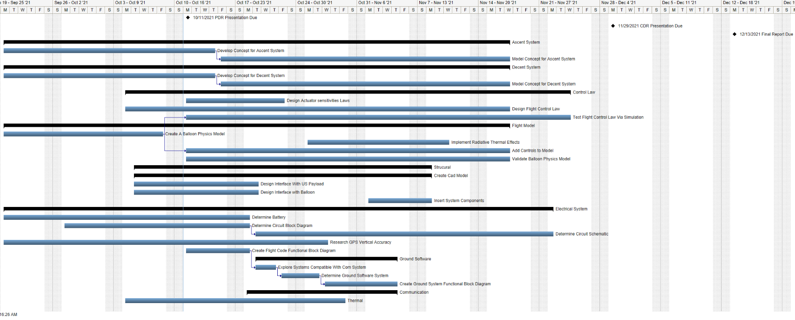
Gantt Chart

Slide 65
Design Requirements
Quick Links

Slide 66
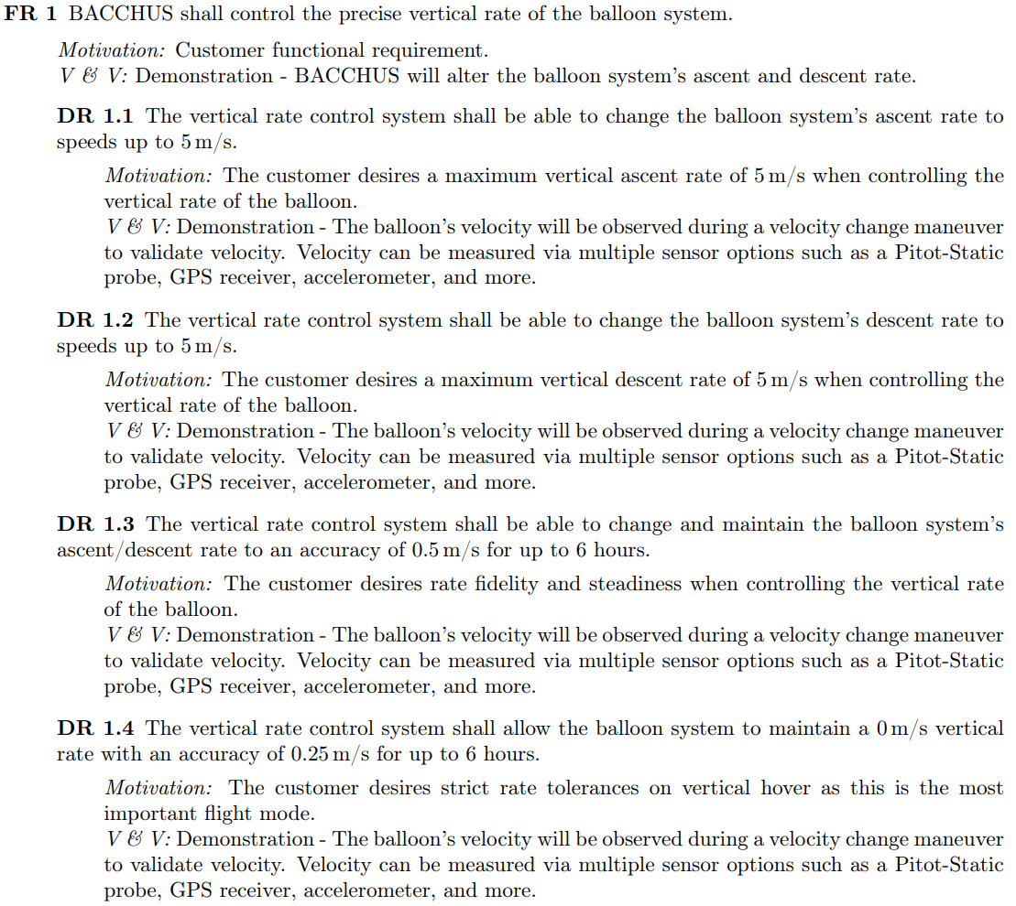
FR 1 Design Requirements

Slide 67
FR 2 Design Requirements

Slide 68
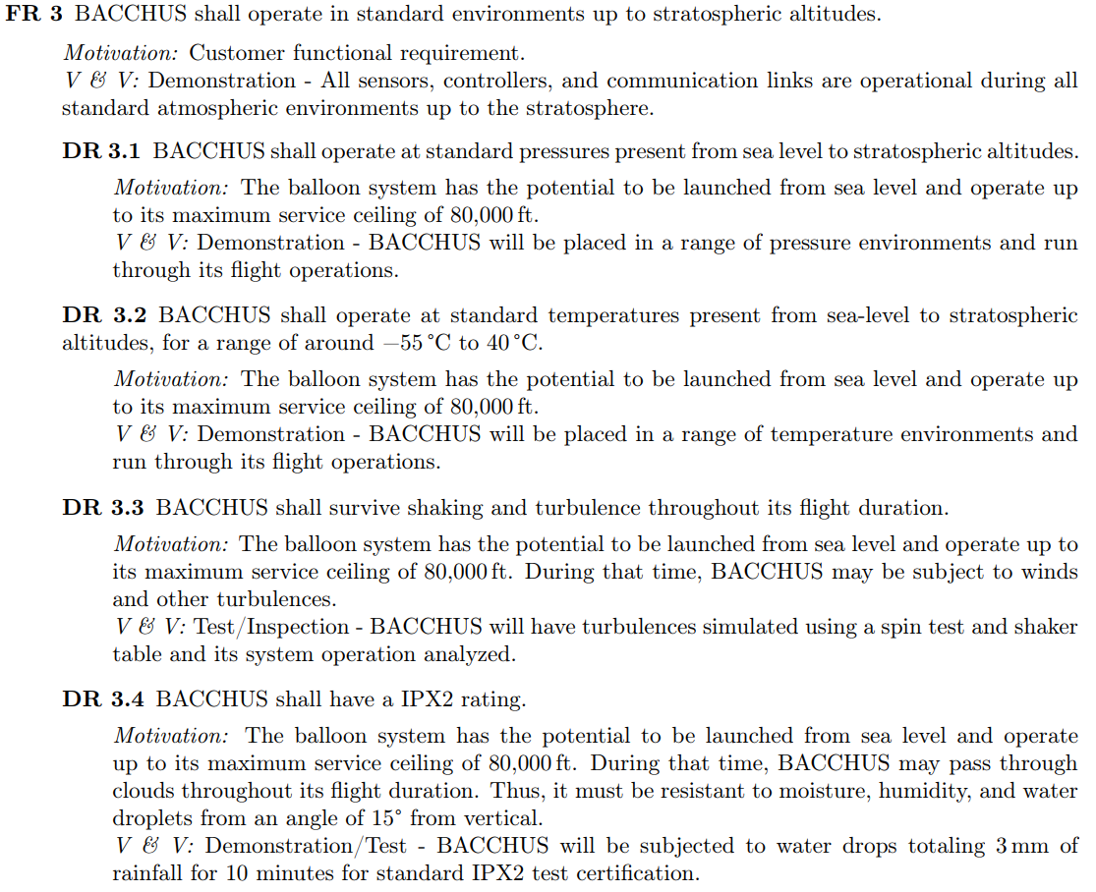
FR 3 Design Requirements

Slide 69
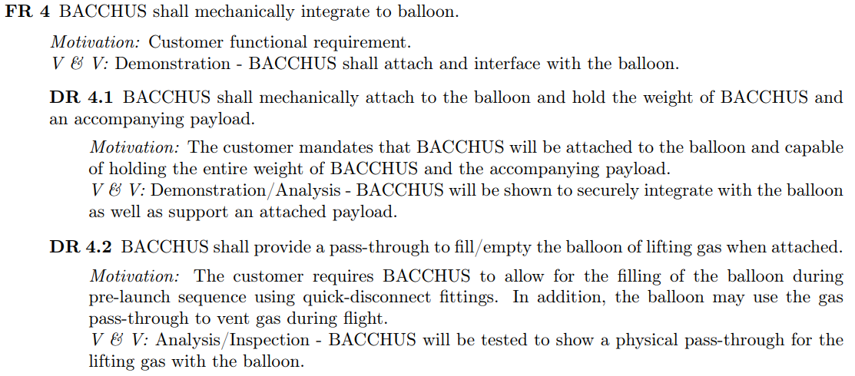
FR 4 Design Requirements

Slide 70
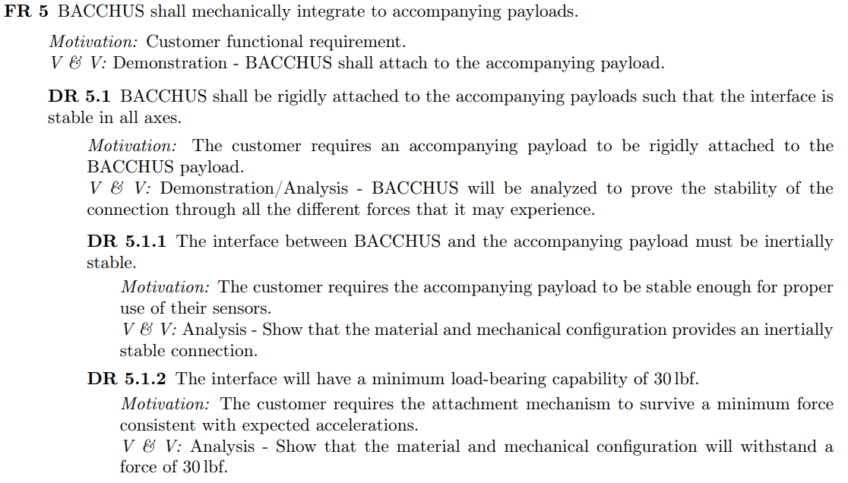
FR 5 Design Requirements

Slide 71
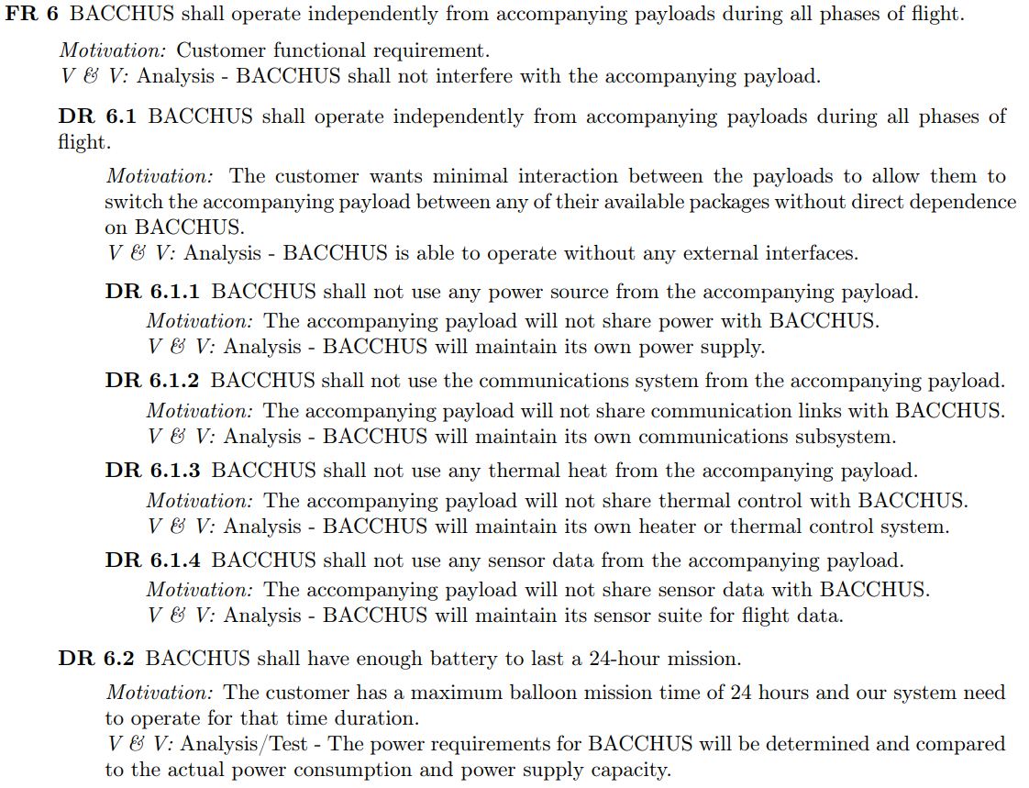
FR 6 Design Requirements

Slide 72
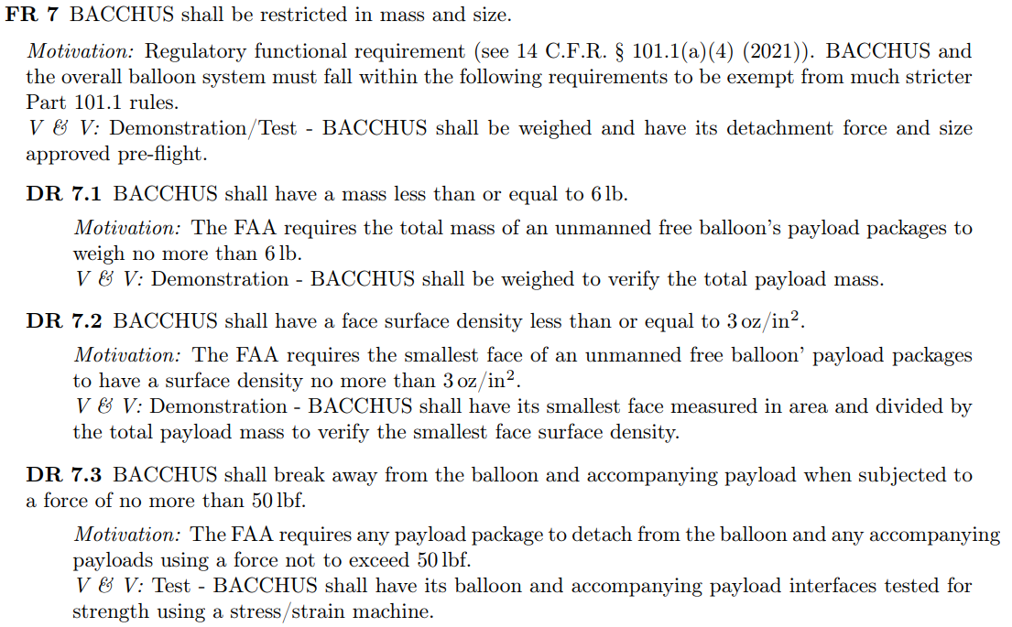
FR 7 Design Requirements

Slide 73
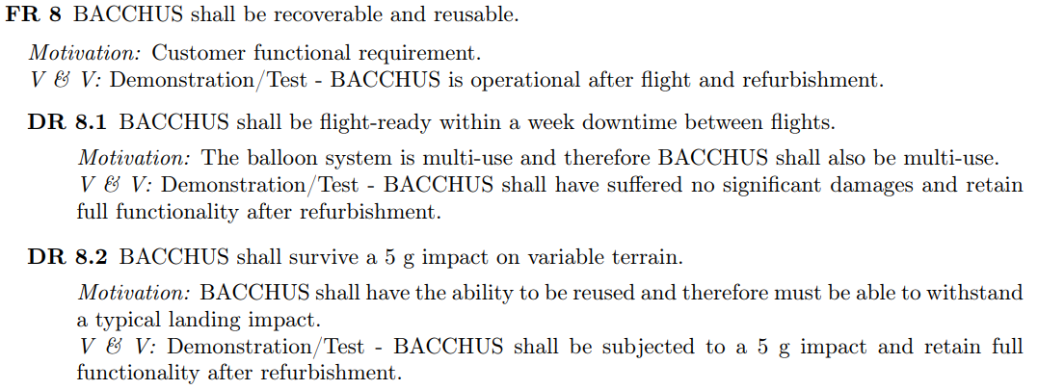
FR 8 Design Requirements

Slide 74
Modeling and Controls
Slide 50: Quick Links - General

Slide 75
Modeling and Controls Assumptions
Worst-Case Scenario Assumptions
Venting maneuver takes place at service ceiling
Maximum rate changes for each maneuver
Simplifying Assumptions
Ambient air properties dependent on International Standard Atmosphere model
Ideal gas properties
No pressure or temperature gradient across balloon fabric
Constant gas constants and gravitational acceleration
Spherical balloon
Drag only due to balloon (taken from datasheet)
No lateral forces
Instantaneous full-power actuation for both mechanisms
Constant mass flow rates for both mechanisms

Slide 76
Full Force Balance Equations
Full List of Assumptions:
International Standard Atmosphere to find P, T, 𝜌_{air}
P_{amb} = P_{He}
T_{amb} = T_{He}
Preliminary model neglects radiation (Will include for CDR)
R_{He} = 2077.3 J/(kg*K)
g = 9.81 m/s²
Spherical Balloon
Drag due to Balloon Only
C_{D} = 0.3 (From Kaymont Balloon Data)
No lateral forces (i.e. wind)
Ideal Gas
No start/stop time for fan or ballast dropper (Will include for CDR)
Fan has constant dV/dt and Ballast Dropper has constant dm/dt

Slide 77
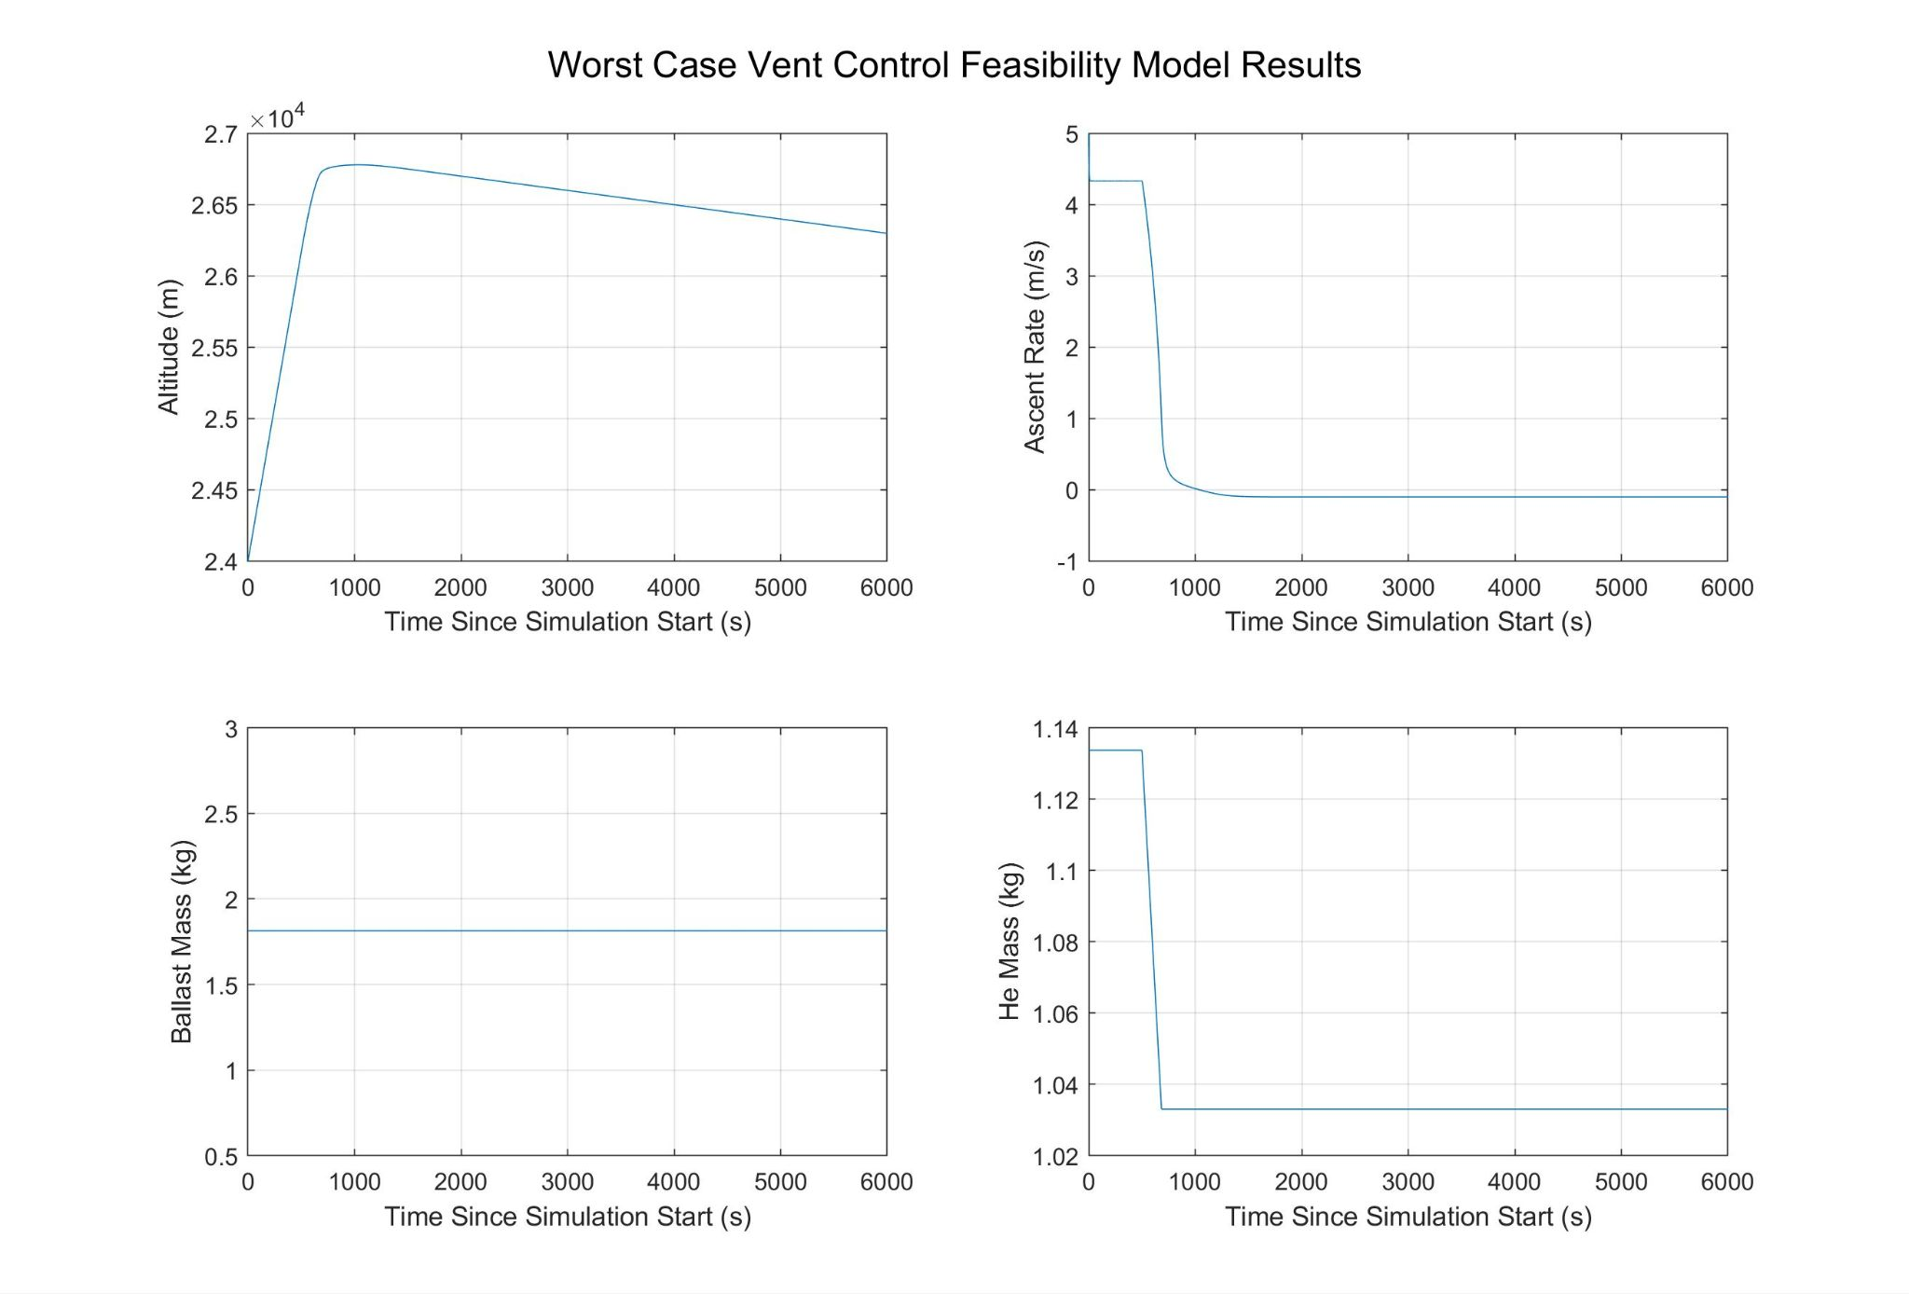
Additional Vent Modeling Results

Slide 78
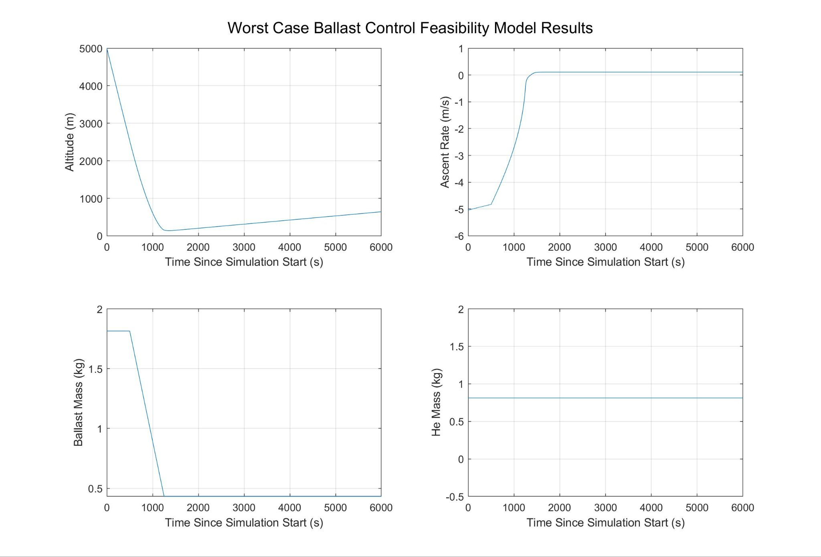
Additional Ballast Modeling Results

Slide 79
Balloon Linearized Model
← (Mass as control inputs)

Slide 80
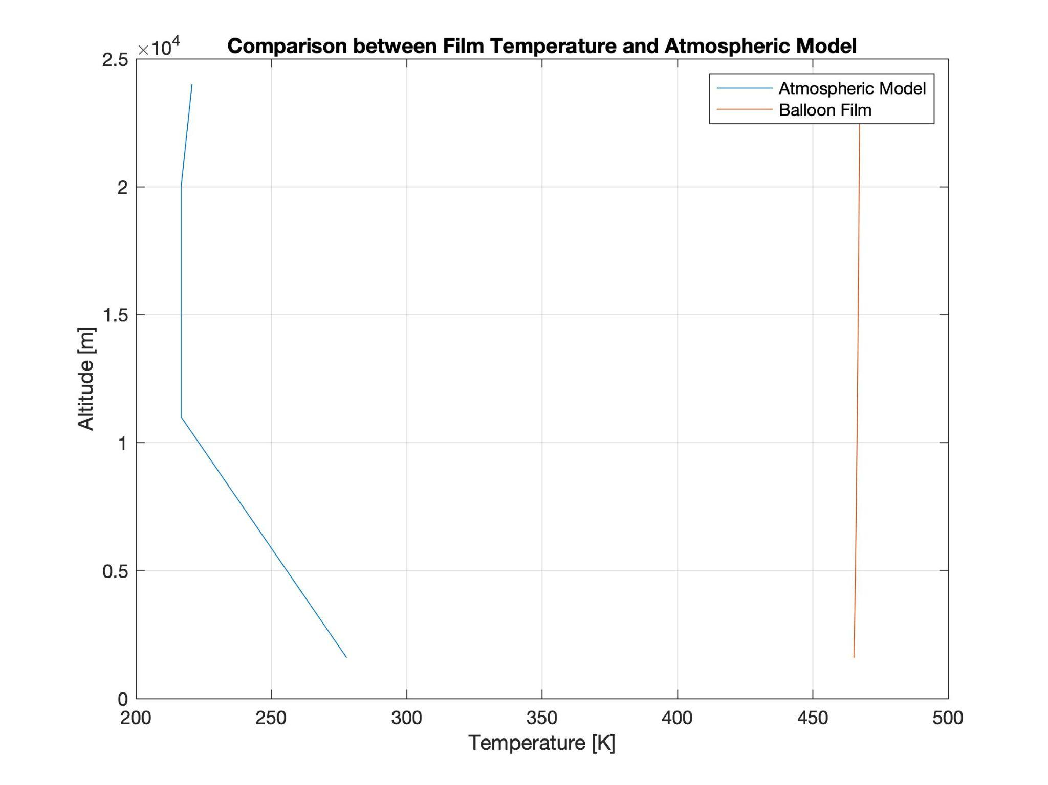
Thermal Modeling

Slide 81
Structural
Slide 50: Quick Links - General

Slide 82
Structure Material Specifications
⅛” Impact Resistant Polycarbonate Sheeting
Link
¼”-20 Aluminum 6061 Threaded Rod
Link
Total Cost Estimate
~$16, Polycarbonate sheet
~$15, Aluminum tubing
~$4, Fasteners
Specifications
Tensile Strength: 8,900 psi (min)
Impact Strength: 12-18 ft-lbs/in
Weight per in²: 0.005375 lb
Preliminary Strength Analysis
Apprx. surface area needed: 136 in²
Specifications
Tensile Strength: 40,000 psi
Weight per foot: 0.122 lb
Apprx. length needed: 4ft
Total Weight Estimate
Fasteners
3x eye nuts
22x hex nuts
3x 40 lb break-strength zip ties
~1.23 lbs
Notes:
Polycarbonate will be the main component of the housing, as it is very lightweight and generally easy to work with. Pieces will be held together with bolts for easy disassembly.
Carbon fiber or aluminum tubes will be incorporated into the four sides of the housing in order to securely hold the lower dispersal pyramid in place and provide further structural support
These tubes will likely act as a frame for the insulated portion, where foam will be the main wall material
Questions
What is the needed thickness of the polycarbonate/acrylic?
What is the needed diameter of the tubing?

Slide 83
Balloon-BACCHUS Attachment
https://launchwithus.com/products/weather-balloon-quick-fill-inflation-system-with-regulator
Balloon neck stretches over PVC, held in place with series of zip ties
Filling attachment allows for balloon to be inflated
Integrated plug and structural attachment point integrates with payload

Slide 84
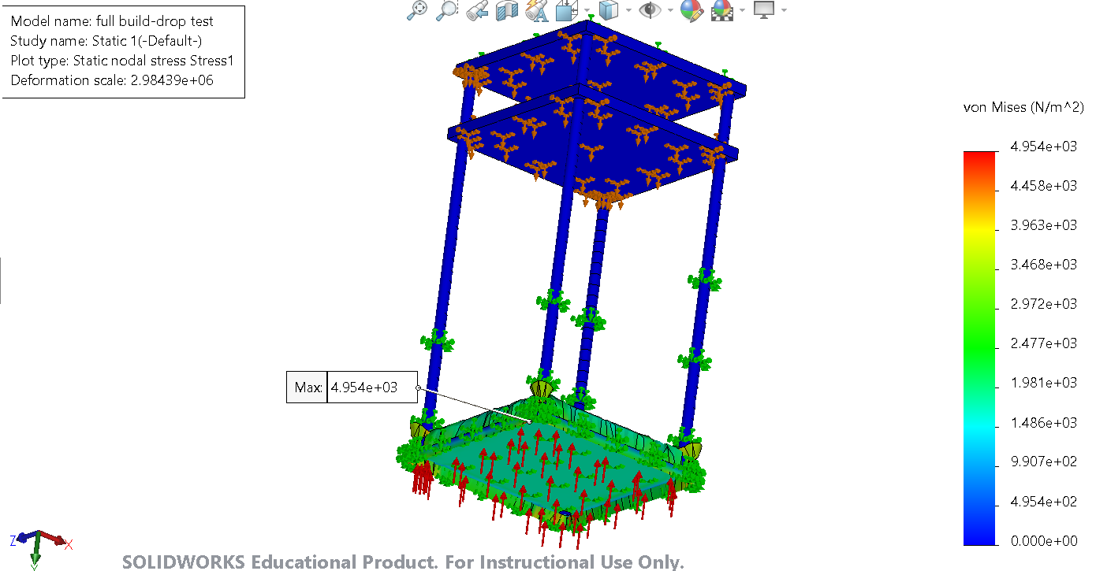
30 lbf Drop Test- Stress
Max von Mises Stress: ~5000 Pa
Polycarbonate Yield Strength: 72 MPa

Slide 85
Mechanical
Slide 50: Quick Links - General

Slide 86
Mechanical Assumptions
Worst-Case Scenario Assumptions
Ballast drop
Sea level
0 m/s initial ascent rate
5 m/s desired ascent rate
Venting
25 km altitude
5 m/s initial ascent rate
0 m/s desired ascent rate
Simplifying Assumptions
Physical performance of fan does not change with temperature
Maximum fan RPM achieved instantaneously
Assuming Ideal helium flow
All model assumptions

Slide 87
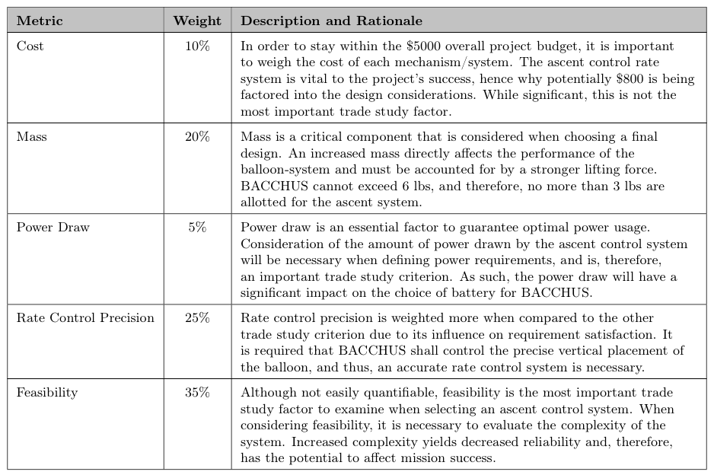
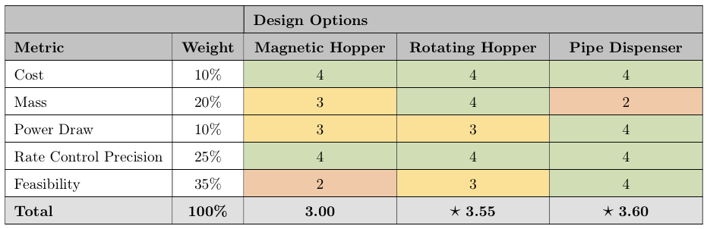
Ballast Release Mechanism Trade Study

Slide 88
Ballast/ Venting Limitations
Ballast
Venting
Mass needed to dump to go from 0 -> 5 m/s = 0.5 kg (5 times)
Mass needed to dump to go from 0 -> 0.25 m/s = 0.044 kg
Helium Mass needed to fly ~ 0.8 kg
Mass needed to hover @ 20km = .4 kg
Mass needed to vent to go from 5 -> 0 m/s = 0.1 kg
Mass needed to vent to go from 0.25-> 0 m/s = 0.00023 kg

Slide 89
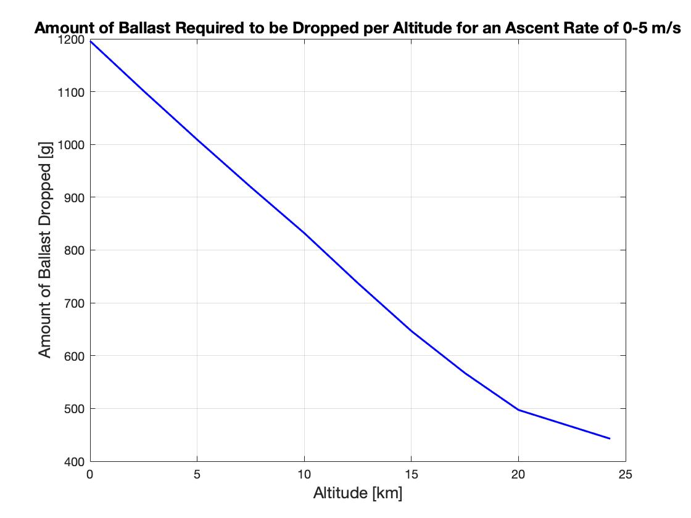
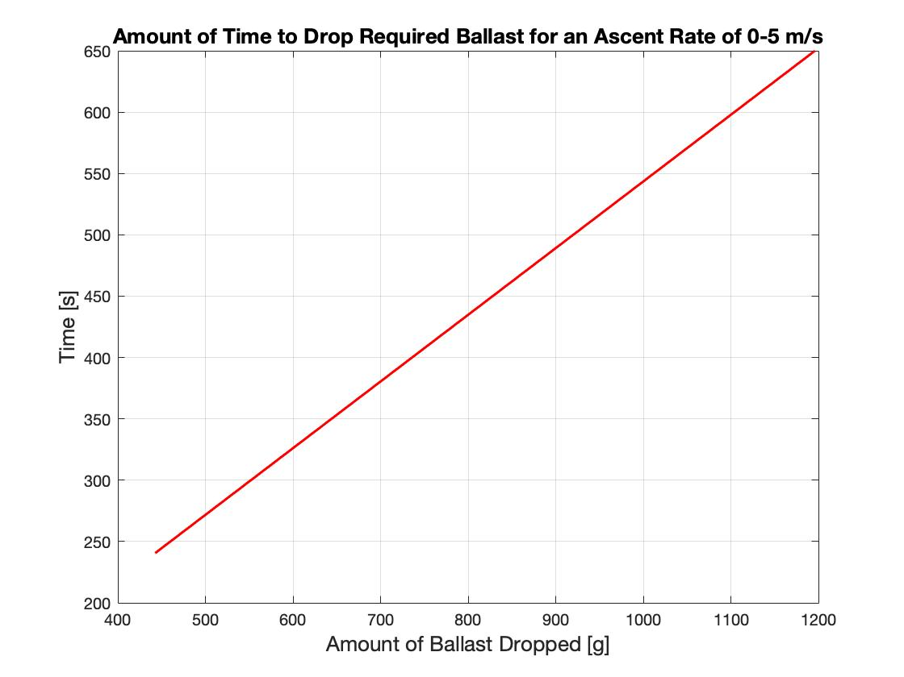
Ascent System Feasibility: Rate Control
Desired ascent rate 0-5 m/s

Slide 90
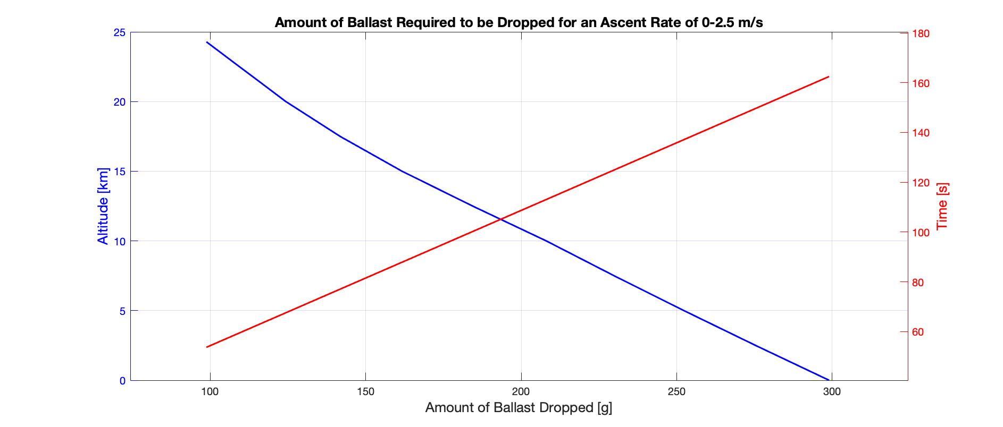
Realistic Example
Notes:
At 60,000 feet (~18 km), in order to get from 0 to 2.5 m/s, 138 g of ballast will need to be released. This will take just over one minute to occur. These are more realistic conditions for this project.

Slide 91
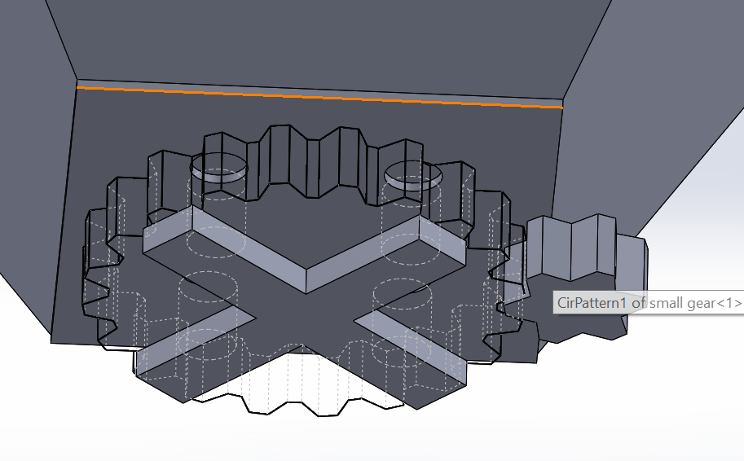
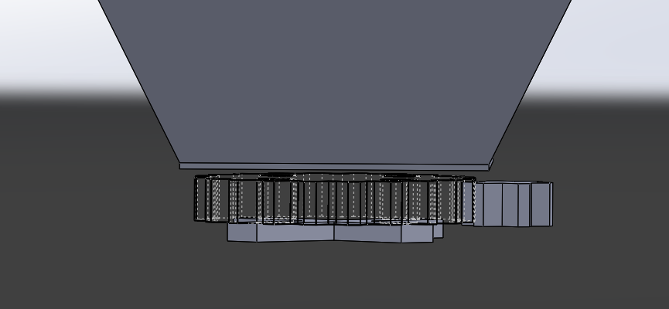
Dropper Mechanism
Rotating Gear

Slide 92
DC Motor Selection Trade Study (Ascent)
 | Cost | Operation at Cold Temps | Mass | Rated Voltage | Feasibility | Weighted Score
Polou - 150:1 Micro Metal Gearmotor LP 6V | 4 | 5 | 5 (.021 lb) | 4 (6 V) | 3 | 4.15
GM37 Geared Motor with Encoder-DC Motor-1:43-16CPR | 3 | 3 | 3 (.216 lb) | 3 (12 V) | 5 | 3.5
Step Motor 42BYGH47-401A | 4 | 3 | 1 (0.83 lb) | 1 (24 V) | 3 | 2.25
RoboMaster C620 Brushless DC Motor Speed Controller | 1 | 3 | 5 (0.08 lb) | 1 (24 V) | 3 | 2.8
4MM Planetary Gear Motor | 3 | 3 | 5 (.011 lb) | 5 (5 V) | 3 | 3.9

Slide 93
DC Motor Selection
DC (Brush) Motor:
Pros:
Simple operation, Easier to control (microcontroller not required)
At low speeds, high torque can be achieved
Relatively inexpensive
Low energy consumption
Commonly used for drones to control the rotational speed
Can run continuously
High efficiency
Best used when constant torque is required
Cons:
Potential system interference due to electromagnetic noise
Limited speed due to brushed heating
Step Motor:
Pros:
Allow for precise positioning
Have maximum torque at low speeds
Position can be determined at all times
Cons:
Relatively less efficient
Limited high speed torque
The current consumption is independent of load and, therefore, they constantly draw maximum current.
Cannot be powered for long periods of time
Notes:
Simple operation: apply voltage to begin driving the motor and slow down the motor by lowering the voltage (this can be easily controlled).

Slide 94
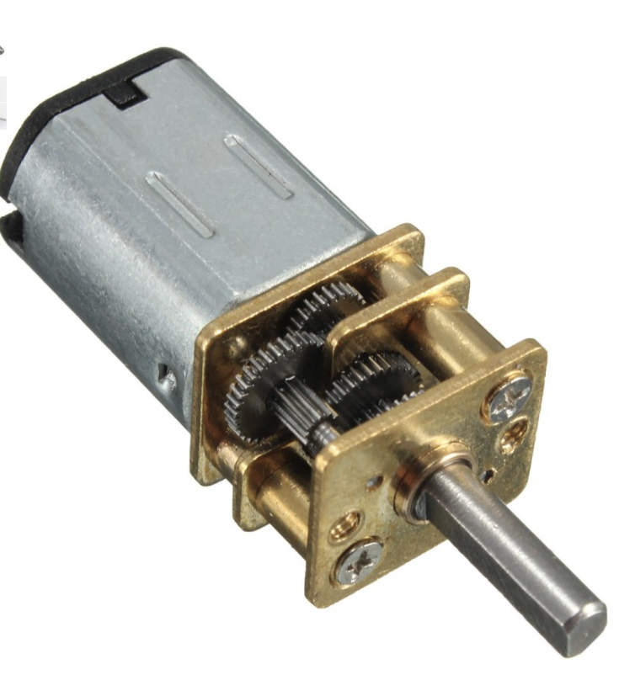
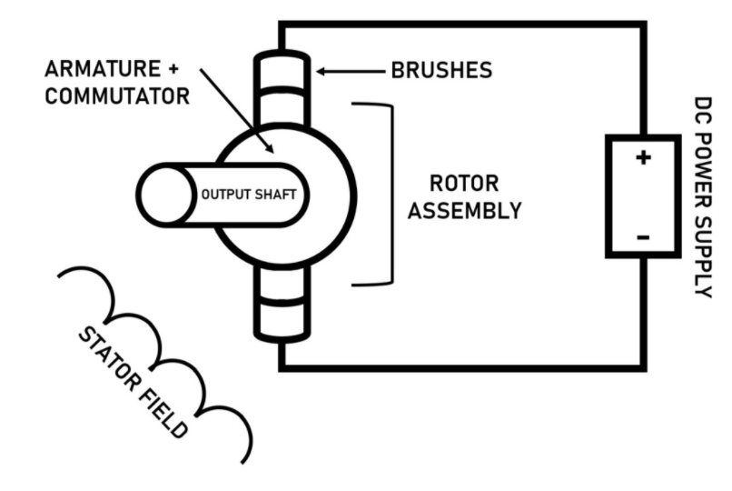
DC Motor Selection (Ascent)
Final Selection: Polou - 150:1 Micro Metal Gearmotor LP 6V

Slide 95
Fan Selection Trade Study (Descent
 | Cost | Flow Rate at Sea level | Mass | Power Draw | Control Precision | Aggregate Score
NF 12 | 3 | 5 | 3 | 5 | 3 | 3.8
Jetflo 120 | 3 | 5 | 5 | 2 | 3 | 4.1
Kaze Flex 120 | 4 | 5 | 4 | 1 | 3 | 3.8
Aer P 120 | 4 | 4 | 4 | 3 | 4 | 3.9
Riing h14 | 1 | 3 | 4 | 3 | 2 | 2.9
Notes:
POLYOXYMETHYLENE (POM)
Thermal concerns

Slide 96
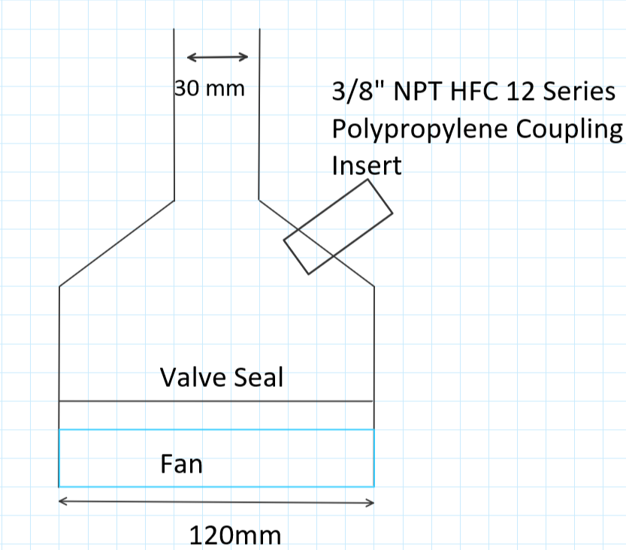
Vent Mechanism

Slide 97
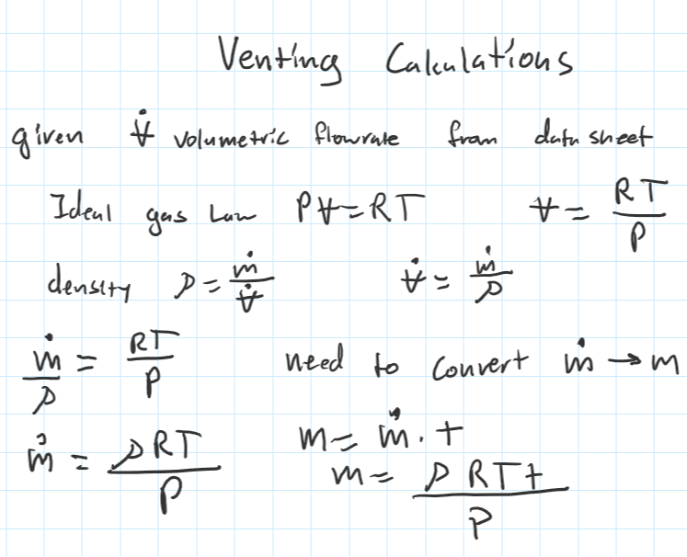
Venting Calculations

Slide 98
Thermal
Slide 50: Quick Links - General

Slide 99
Thermal Assumptions
Worst-Case Scenario Assumptions
Balloon remains at -55°C for 24 hours
No heat contribution from electronics
Simplifying Assumptions
Heat from solar radiation is negligible
Air is heated uniformly
Heater turns on and off instantaneously
Standard atmospheric air properties
Constant specific heat of air
Closed system

Slide 100
Insulation Trade Study
 | Cost [10%] | Density (Mass) [30%] | Conductivity [35%] | Feasibility [25%] | Weighted Score
Expanded Polystyrene | 5 | 4 | 3 | 2 | 3.25
Extruded Polystyrene | 3 | 2 | 4 | 4 | 3.3
Polyisocyanurate | 3 | 3 | 5 | 3 | 3.7

Slide 101
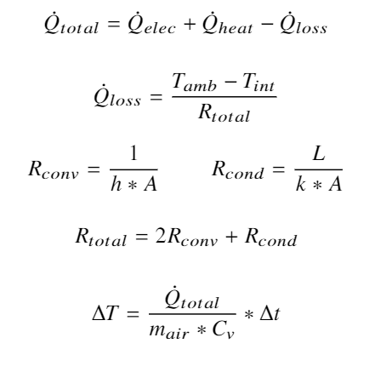
Thermal Model Calculations

Slide 102
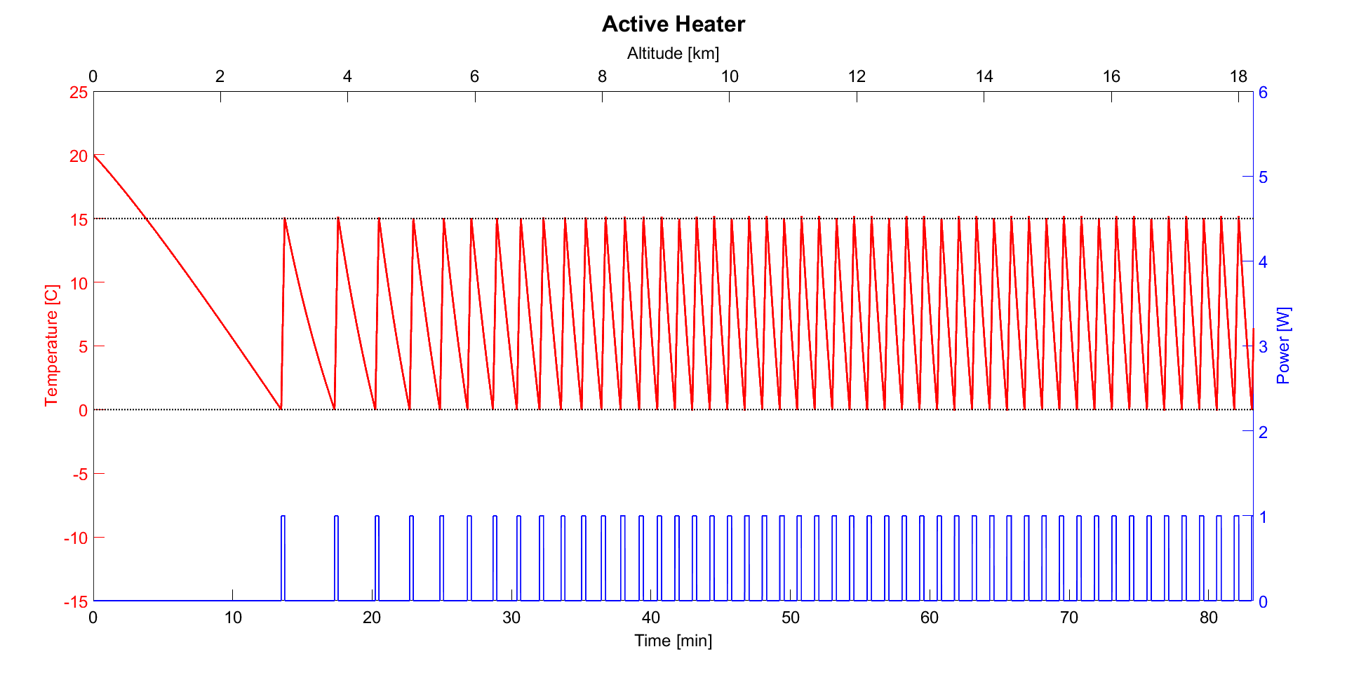
Thermal Mission Model - Initial Ascent

Slide 103
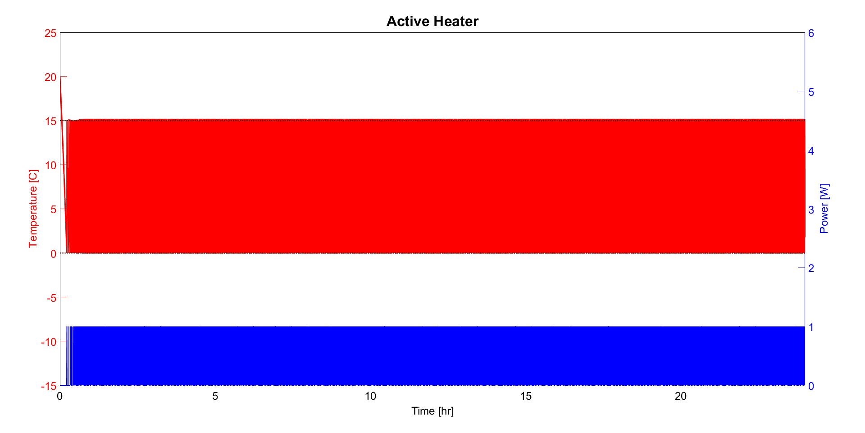
Thermal Mission Model - 24hrs

Slide 104
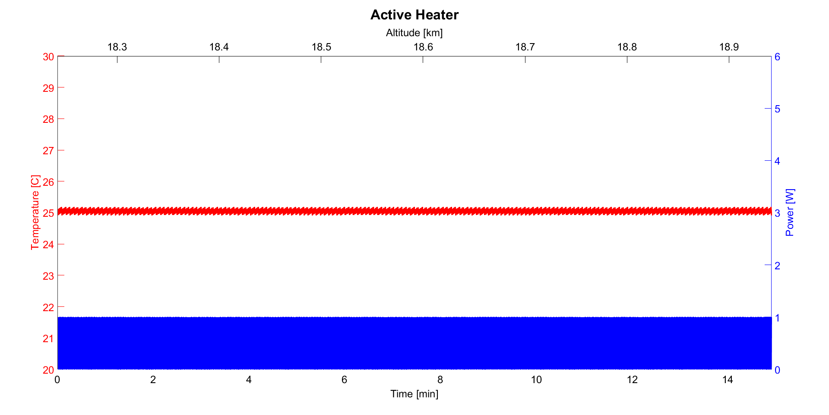
Thermal Model - Ideal Temperature

Slide 105
Electrical
Slide 50: Quick Links - General

Slide 106
Electrical Assumptions
Worst-Case Scenario Assumptions
Poor sky coverage for RockBLOCK 9603 and EVA-M8Q antennas
Maximum oversampling ratio for MS5611
Auto-conversion mode and bias on for MAX31865
Current consumption at stall for gear motor
Gear motor actuation for 10.8 mins
Venting fan actuation for 5 mins
RockBLOCK 9603 supercapacitor charging for 30 seconds
One message sent/received by RockBLOCK 9603 every minute
Heater activation for 25% of mission duration
Simplifying Assumptions
Instantaneous power draw at required current
No loss of accuracy due to self-heating
Vertical accuracy is 2 to 5 times worse than horizontal accuracy for GPS measurements

Slide 107
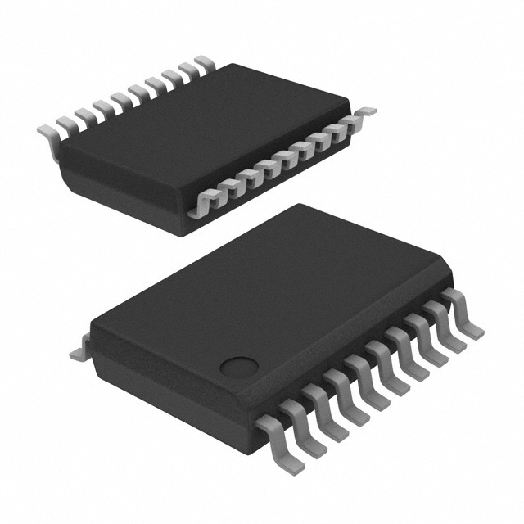
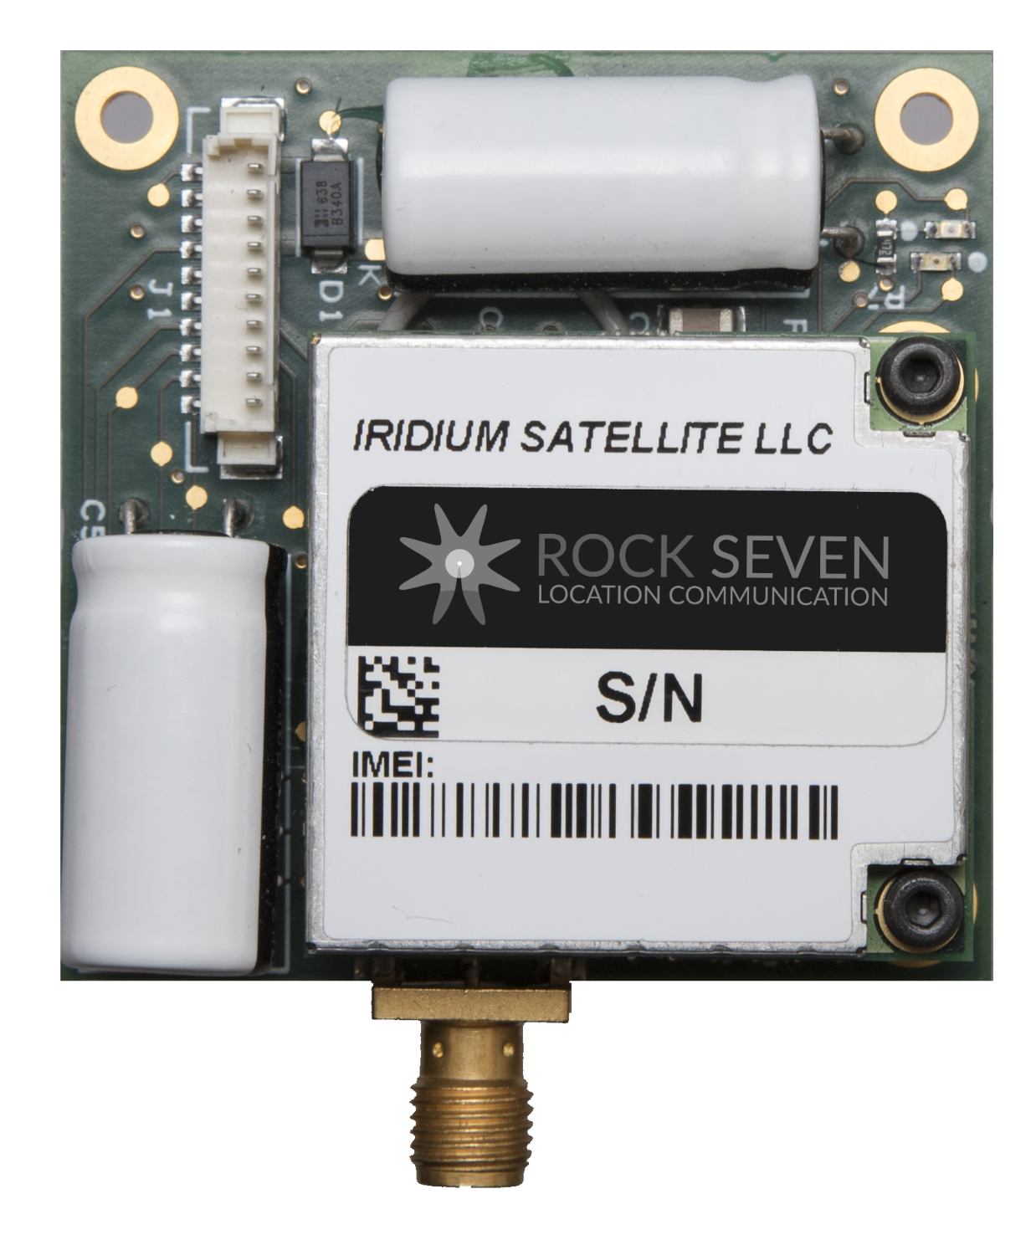
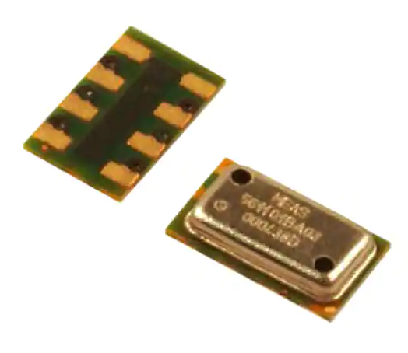
Selected Components
Maxim Integrated MAX31865
Rock Seven
RockBLOCK 9603
TE Connectivity
MS5611
u-blox
EVA-M8Q

Slide 108
Power Cycle Results
Component Function | Model | Charge Consumption
RTD-to-Digital Converter | MAX31865 | 84.00 mAh
Barometric Pressure Sensor | MS5611 | 0.32 mAh
Iridium Satellite Transceiver | RockBLOCK 9603 | 1263.75 mAh
GNSS Module | EVA-M8Q | 148.96 mAh
Venting Fan | JetFlow 120 | 33.33 mAh
Gear Motor | Gearmotor LP | 64.80 mAh
Microcontroller |  | 480.00 mAh
Heater |  | 5851.18 mAh
Other |  | 120.00 mAh
Total |  | 8046.34 mAh

Slide 109
Barometric Pressure Sensor - Power Budget
Operation | Current Draw
Peak (during conv.) | 1.4 mA
Standby | 0.14 μA

Slide 110
Iridium Transceiver - Power Budget
Operation | Current Draw
Charging | 500 mA
Idle | 50 mA
Active (during msg.) | 55 mA

Slide 111
Barometric Pressure Sensor - Meas. Errors

Slide 112
Finances
Slide 50: Quick Links - General

Slide 113
Current Preliminary Budget
System | Estimated Cost | Budget Allotted
Electrical & Comms | $212.21 | $500
Thermal | $23.64 | $1000
Structural | $193.40 | $2500
Mechanical | $226.95 | $1000
Total | $656.20 | $5000

