Slide 1
Advanced Tracking of Orbital Motion for Inter-satellite Clusters
Andrew Dellsite, Adam Farmer, Camilla Hallin, Corey
Huffman, Nate Lee, Brendan Lutes, Jamison McGinley,
Anastasia Muszynski, Hunter Peery, Jarrod Puseman,
Erin Shimoda, Emily Webb
Notes:
Jarrod: 6-13
Anastasia: 25-28
Corey: 1-5
Brendan: 20-24
Nate: 29-36
Andrew: 14-19

Slide 3
SYSTEM CONSISTS OF SENSOR PACKAGE AND BEACON PACKAGE
2
BEACON RECEIVES PROBE SIGNAL
1
SENSOR EMITS PROBE SIGNAL
BEACON
BEACON REPLIES WITH UNIQUE REPLY SEQUENCE
3
SENSOR

Slide 4
4
Software calculates relative position of Beacon
Relative Position (Range and Heading)
Alarm Flag Status
Alarm Trigger: Position varies from expected path by > 10% of range
Flight Computer Analog

Slide 5
5
BEACON TRANSLATES THROUGH KNOWN PATH
BEACON
SENSOR
6
ONGOING: SYSTEM OUTPUTS
Relative Position (Range and Heading)
Alarm Flag Status
Alarm Trigger: Position varies from expected path by >10% of range

Slide 6
Design Overview
Design Overview
Project Schedule and Budget
Test Readiness
Notes:
Brief description of design with respect to CDR, major changes to design, review of critical project elements and critical issues since CDR/FFR

Slide 7
Critical Project Elements
Designation | CPE | Critical Characteristics
CPE-1 | Two-way Range Finding | Range finding is the first of two critical components necessary for the sensor package to accurately determine the beacon’s relative position.
CPE-2 | Phase Interferometry | Heading calculations are the second of two critical components necessary for the sensor package to accurately determine the beacon’s relative position.
CPE-3 | Data Flow | Accurate models for the data flow rates are necessary to improve range and heading calculations.
CPE-4 | Electrical Components | All electrical components must operate within the temperature constraints defined by FR5.
CPE-5 | Testing | Testing will need to verify and validate that each functional requirement is met.

Slide 8
Success Criteria
Critical Project Elements | Level 1 | Level 2 | Level 3
Two-Way Range Finding | Compute range. | Range to within 2%. | Calculate and filter position estimates implementing filtering.
Phase Interferometry | Calculate heading. | Compute position of beacon to within 2%.
Data Handling | Beacon and sensor can individually complete all software processes, on Pi. | Beacon and sensor individually complete all software, including SDR programs. | Sensor and Beacon communicate with each other.
Electrical Components | Operable given power and environmental constraints. | N/A | N/A
Testing | Phase 1 - Stationary Test. | Phase 2 - Relative Motion Test & Phase 3 - Cluster Motion Test | Phase 4 - Non-Linear Cluster Motion Test.

Slide 9
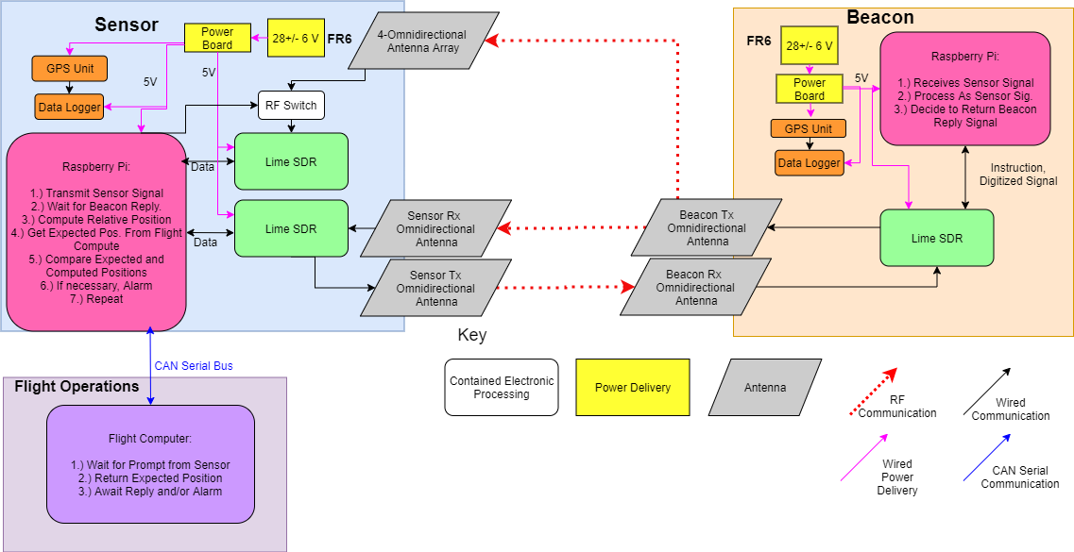
FBD
Notes:
Hunter

Slide 10
Review of Structural Design
Receiving
(Rx) Antenna(s)
Transmitting (Tx) Antenna(s)
Raspberry Pi
PiCAN 2
Power Board
LimeSDR
Battery
GPS Device

Slide 11
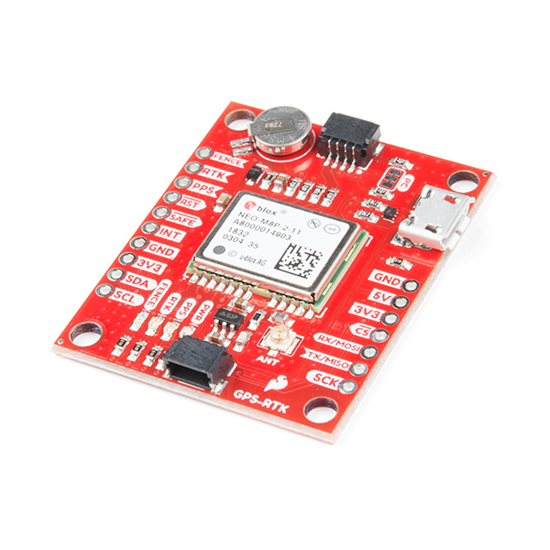
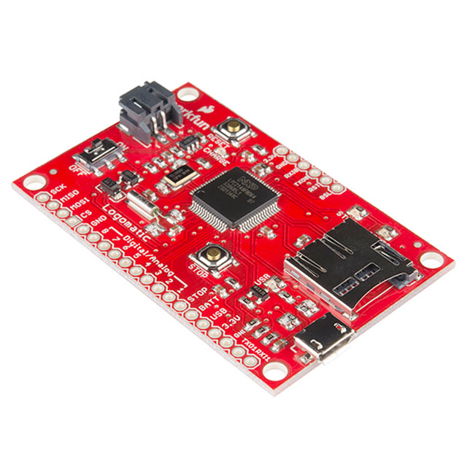
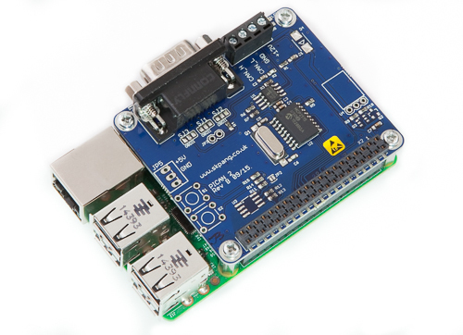
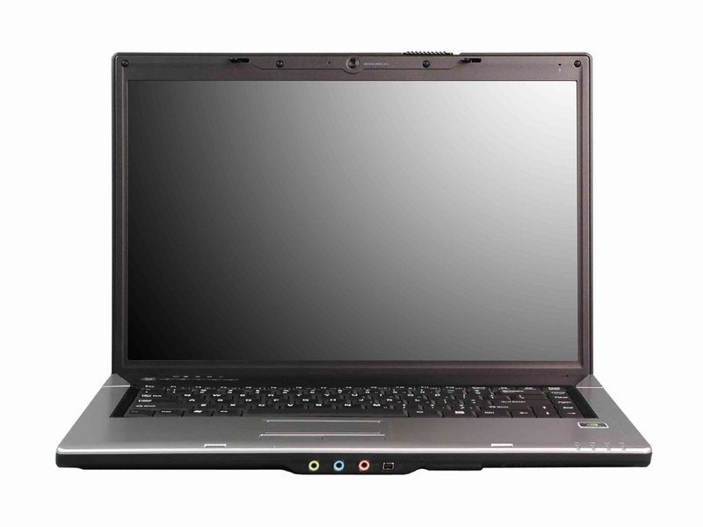
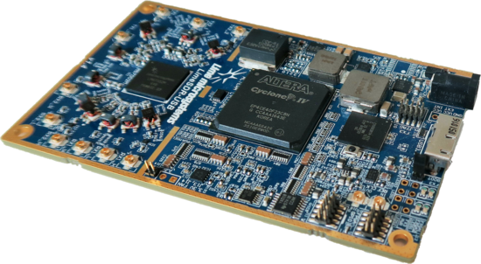
Software Solution
Component Breakdown:
LimeSDR with pre-programmed open source firmware.
Raspberry Pi 4 running stripped down OS to execute Python scripts via shell scripting.
Flight Computer with Windows, Mac OS, or Linux, and serial connection to report nominal path
WIG-12772 data logger from SparkFun
GPS 15005 GPS Module from SparkFun
GPS 15005
I2C
USB
CAN
Lime SDR
Ras. Pi, PiCAN 2
Flight Computer
Data Logger
Design Solution
Project Schedule and Budget
Test Readiness

Slide 12
Progress Since MSR
Electrical:
Received custom PCB, soldered all necessary electrical components
Completed power output tests on board
Completed SDR to computer through board communication test
Hardware:
Received additional standoffs, fasteners and completed housing packages
Completed full systems power test
Received all necessary backup hardware
Completed preliminary test 1
Software:
Completed software skeleton code
Continuing work on implementing extended Kalman filter
Design Solution
Project Schedule and Budget
Test Readiness

Slide 13
Critical Issues
Critical Project Elements | Update Pertinent Issues
Two-Way Range Finding | N/A
Phase Interferometry | Recall: Purchase RF switch. Update: Hardware obtained, tested switching with Pi
Data Handling | Recall: PiCAN working Update: Not actually working. Sends continuous message, not discrete bytes. Recall: SDR architecture planned at high level Update: Beginning to make progress, but still not finished.
Electrical Components | Short on power board found during initial inspection. Fixed via resoldering some components.
Testing | Recall: RTK Constraints Update: Marshall Mesa Drive and Costco for Phases 3/4.

Slide 14
Project Schedule and Budget
Design Overview
Project Schedule and Budget
Test Readiness
Notes:
Brief description of design with respect to CDR, major changes to design, review of critical project elements and critical issues since CDR/FFR

Slide 15
Parts/Material Procurement
Red: Large Risk
Orange: Small Risk
Important Parts | Status
SDR | Received
Linear Antennas | Received
GPS | Received
GPS Antenna | Received
Data Logger and Serial Breakout | Received
PiCAN 2 | Received
USB to CAN | Received
Battery | Received
Important Parts | Status
Housing Material | Received
Roof Rack Fiberglass | Received
Nuts/Screws/Bolts etc. | Received
Raspberry Pi | Received
Cables and Power Hubs | Received
Custom PCB | Received
Board Components | Received
Design Solution
Project Schedule and Budget
Test Readiness
Notes:
Battery and SDR have government implications for ordering and at least 3 weeks lead time. We have 1 backup SDR and 1 backup battery

Slide 16
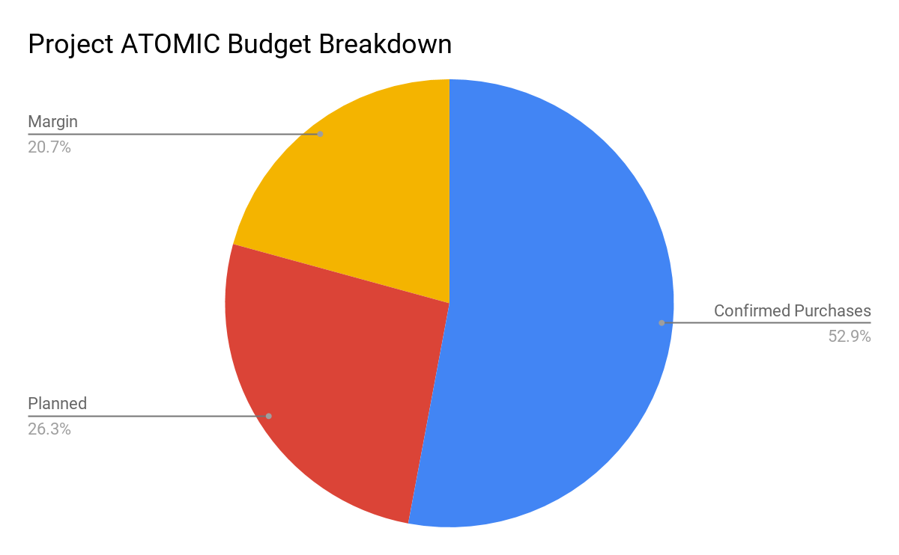
Financial Status/Budget
Atomic Budget Breakdown:
Confirmed Purchases: $3,259
___________________________________
Expected Future Costs: $500
Total Budget: $6,000
Total Expense: $3,759
___________________________________
Expected Margin: $2,241
Note: Additional backup components and new antennas may decrease the expected margin
Design Solution
Project Schedule and Budget
Test Readiness

Slide 17
Spring Gantt Chart
Key
Green: Testing Subteam Blue: System Level Testing
Orange: Hardware Subteam Pink: Software Subteam
: Critical Path
Design Solution
Project Schedule and Budget
Test Readiness
Notes:
-Schedule covers what was done since MSR and what is currently being worked on
-Subteam Colors
-Critical Path
-Where we are at & Float/slack time
- Milestones!

Slide 18
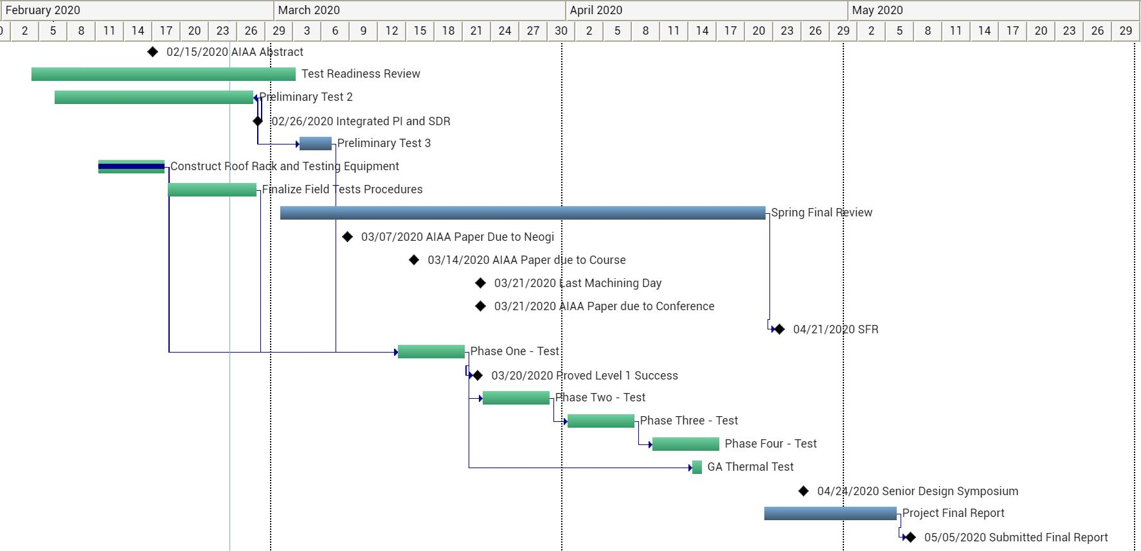
Testing Schedule
Notes:
-Critical Path
-Slack time for each testing phase - 3 total weeks of float time
-On track? -
-

Slide 19
Test Plan
Test ID | Approx. Testing Date | Location
Preliminary Level 1 | Late January 2020 | Aerospace Building
Preliminary Level 2 | Late January - Late February 2020 | Aerospace Building
Preliminary Level 3 | Early March 2020 | Aerospace Building
Phase One | Mid March 2020 | Aerospace Building
Phase Two | Early April 2020 | Marshall Drive/Discovery Drive
Phase Three | Mid April 2020 | Discovery Drive
Phase Four | Mid-Late April | Superior Costco
GA Thermal Test | Late April | General Atomics, Centennial CO
Green: Completed
Yellow: In progress
Design Solution
Project Schedule and Budget
Test Readiness

Slide 20
Test Readiness
Design Overview
Project Schedule and Budget
Test Readiness
Notes:
Mention that Preliminary Test 1 was component-level, involving a power-on and basic operation test.

Slide 21
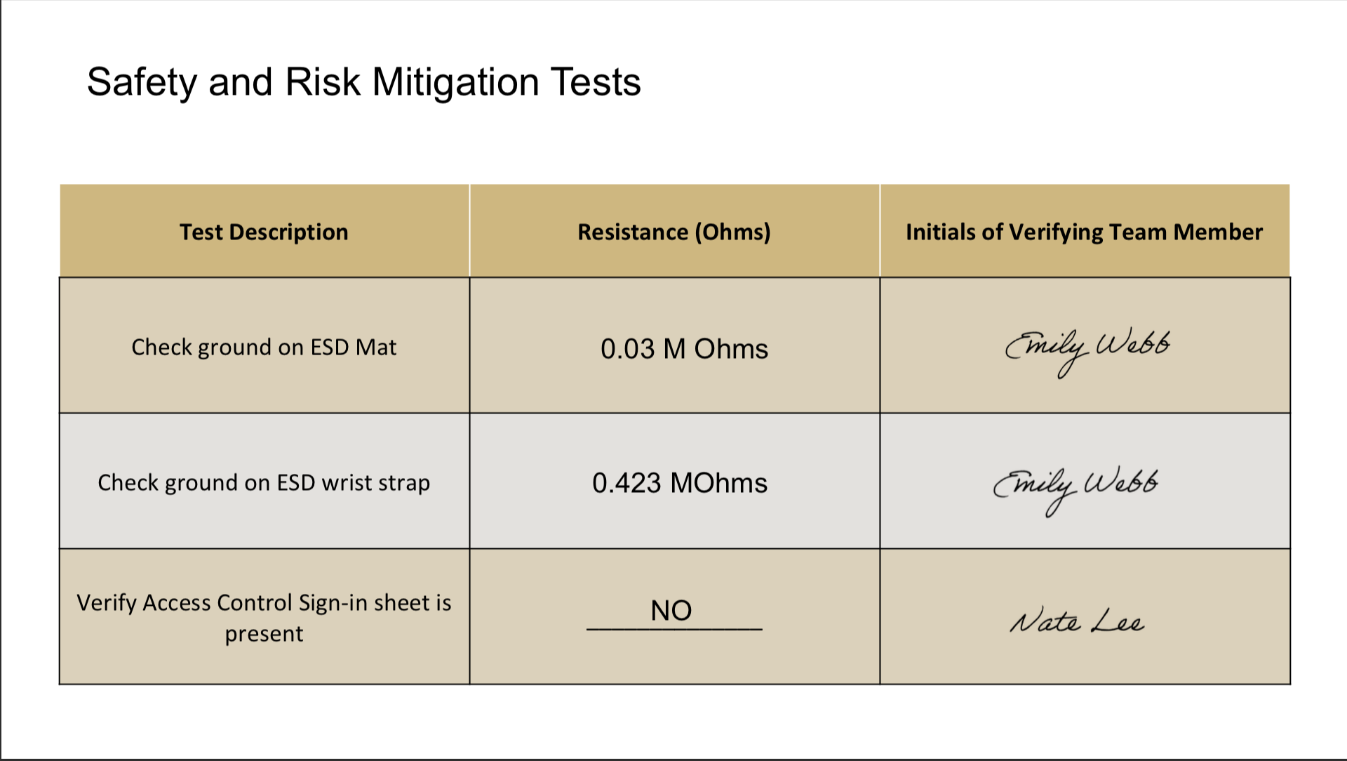
Test Procedure Development
Desire to standardized testing procedures
Designated lead from test team for each test
Test cards with sign-off on each task for accountability
Design Solution
Project Schedule and Budget
Test Readiness

Slide 22
Preliminary Level 2 Testing Status
Test | Status
1 - Integrating SDR and Pi | In Progress
2 - Pi to PiCAN 2 to Flight computer integration | Completed
3 - SDR Tx and Rx verification (cabled) | Completed
4 - SDR Tx and Rx verification (RF) | Completed
5 - GPS and data logger integration | Completed
6 - Power Board Test | Completed
7 - RF Switch Test | Completed
8 - Software Test: Position Calculation | In Progress
9 - Software Full Integration Test - Full Data Flow | In Progress
1
February 1st
5
2
March 1st
3
4
6
7
8
9
March 8th

Slide 23
Preliminary Test Level 2:
SDR and Pi Integration
Procedure:
Generate GNU Companion Block Flow
Create Python Code from GNU Companion and load to Pi
Connect Hardware to the SDR and Pi
Allow the Pi to run the SDR and collect Data
Verify proper data collection and storage on Pi
Test Overview: Verify that the Raspberry Pi can effectively communicate and integrate with the SDR.
Rationale: Correct Pi and SDR communication will be vital to mission operation and data collection
Location: Ann and H.J. Smead Aerospace Building
Equipment Required: Raspberry Pi, SDR, USB Cables, Mouse, Keyboard, Screen
USB
Rasp. Pi
Lime SDR

Slide 24
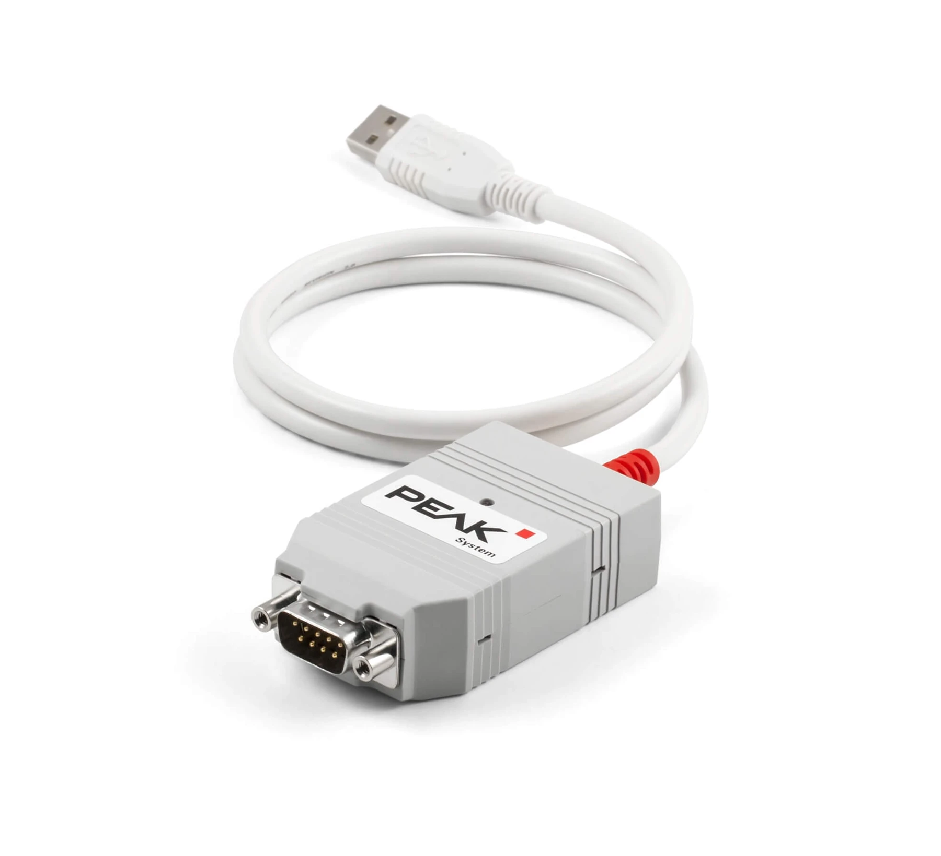
Preliminary Test Level 2:
Pi to PiCan to Test Computer ✅
Test Overview: Verify that the Pi can communicate with the flight computer via the PiCAN 2 bus.
Rationale: Proper PiCan operation is required for successful operation of the alarm
Location: Ann and H.J. Smead Aerospace Building
Equipment Required: Raspberry Pi, PiCan, Test Computer
Procedure:
Connect Pi, PiCan, and Test Computer
Verify Proper code installation onto test computer
Download and copy CAN test programs to Pi
Send a CAN message specified in User Guide
Verify data appears on CAN-View on flight computer
USB
CAN
Rasp. Pi
PiCAN 2
Flight Computer

Slide 25
Preliminary Test Level 2:
SDR Tx/Rx Verification ✅
Procedure:
Connect Tx/Rx ports between the SDRs and connect SDRs to Pi’s
Upload GNU Companion Tx/Rx code to appropriate Pi’s
Allow both Pis to run code, transmitting and receiving predetermined signals
Verify that the Rx SDR and collected and stored the correct signal
Switch the SDR’s to verify Tx/Rx capabilities of both
Test Overview: Verify that the SDRs are able to communicate and successfully send and receive RF signals
Rationale: Proper RF Tx/Rx operation is required for all the position measurements needed for mission success
Location: Ann and H.J. Smead Aerospace Building
Equipment Required: SDRs, Pis, Test Computer, Antennas, USBs
RF Signal
Lime SDR
Lime SDR

Slide 26
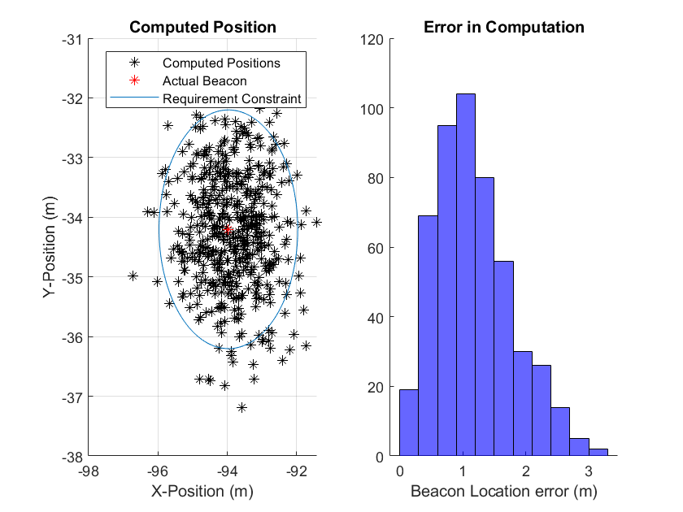
Preliminary Test Level 2:
Software Full Integration
Test Overview: Verify that all of the code functions we have written operate correctly and pass the correct data and variables between each section in our code skeleton
Rationale: It's important to separately verify the code is functioning before integrating with hardware, to aid in troubleshooting in later testing.
Location: Ann and H.J. Smead Aerospace Building
Equipment Required: Test Computer
Procedure:
Pass the fully assembled code skeleton a test input RF signal
Verify that the code operates on the signal correctly, calculating the correct position and outputting it correctly

Slide 27
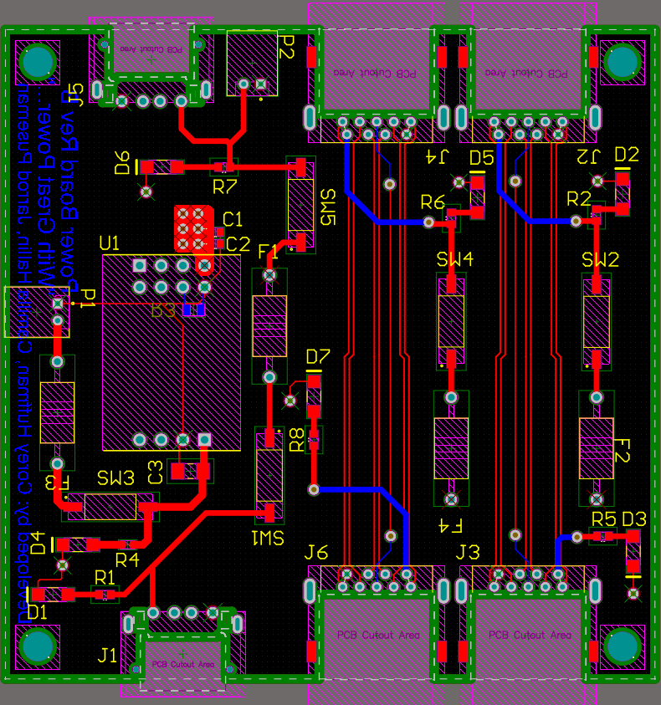
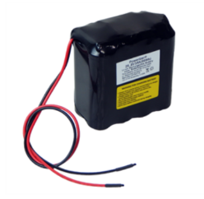
Preliminary Test Level 3:
System Full-Power by Battery
Procedure:
Fully assemble the sensor and beacon packages
Connect all components to onboard battery power
Verify that all components of both packages are fully powered and operating nominally using indicator LEDs
Test Overview: Verify that the fully assembled beacon and sensor can be powered remotely by the onboard batteries
Rationale: Powering the sensor and beacon during test is essential to testing levels 1-4
Location: Ann and H.J. Smead Aerospace Building
Equipment Required: Fully integrated sensor and beacon packages, battery, power board
28.8V
3.3V

Slide 28
Preliminary Test Level 3:
Sensor and Beacon Tx/Rx RF Test
Procedure:
Fully assemble the sensor and beacon packages and upload flight code.
Connect all components to onboard battery power
Allow sensor to transmit to beacon, and beacon to reply. Sensor will collect position data.
Move beacon package in linear and then in circular pattern away from sensor.
Verify that the sensor was able to correctly catalog the beacon’s position.
Test Overview: Verify that the beacon and the sensor are able to function nominally as entire packages, collecting and storing position data over time
Rationale: This is the final system level test before testing levels 1-4. This will verify that our packages are working correctly before putting them on cars for our levels of success tests
Location: Ann and H.J. Smead Aerospace Building
Facilities Required: Costco Parking Lot
Equipment Required: Fully integrated sensor and beacon packages
RF Signal
Beacon
Sensor

Slide 29
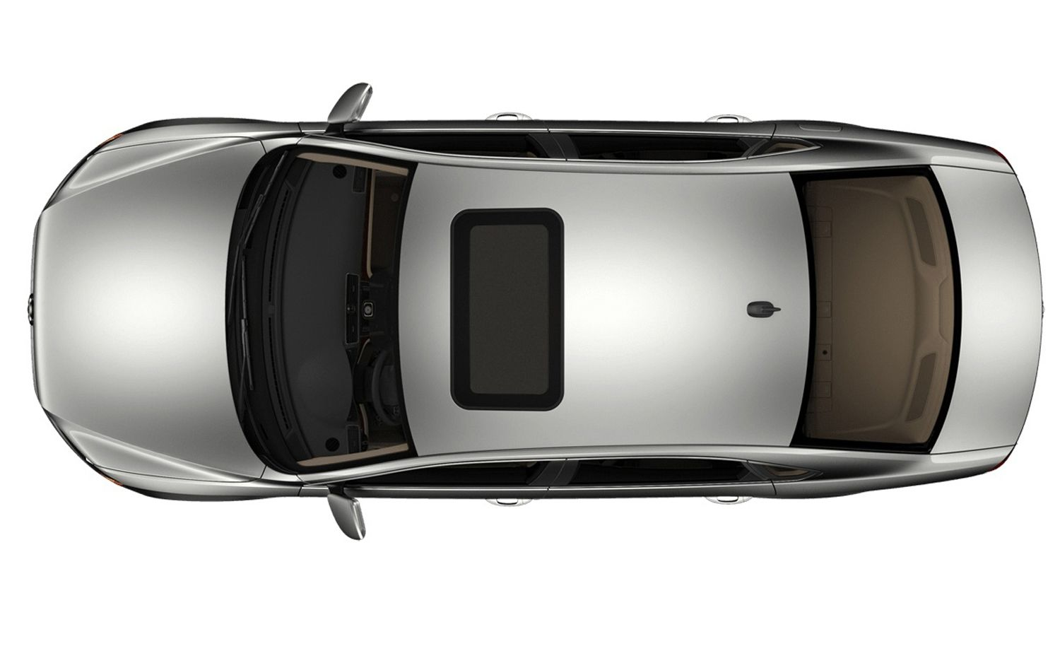
Field Test Phase 1:
Stationary Location Finding
Procedure:
Test/Safety Leads Briefing
Hardware Check
Sensor and beacon begin transmitting and receiving RF signals
Verify correct data collection, filtering, and storage
Test Overview: Sensor and beacon will have fixed positions and test location finding functionality
Rationale: To check the location finding ability of the sensor and beacon package
Location: CU Boulder Aerospace Building North lawn
Equipment Required: Project Atomic Test Equipment. No special equipment
Stationary

Slide 30
Field Test Phase 2:
Beacon Motion Test
Procedure:
Test/Safety Lead Briefing
Hardware Check
Beacon begins to translate at 10 mph then 15 mph, transmitting and receiving RF signals
Verify correct data collection, filtering and storage
Test Overview: Sensor will be fixed, beacon will be translated along path with vehicle
Rationale: To test the location finding abilities of the sensor under beacon motion
Location: Marshall Drive Boulder CO/Discovery Drive Boulder CO
Equipment Required: Project Atomic Test Equipment. No special equipment
Beacon Moving

Slide 31
Field Test Phase 3:
Cluster Motion Test
Test Overview: Sensor and beacon will translate along known path and system will find location of beacon from sensor. Will test tracking ability on linear dynamics*
Rationale: To test the location finding abilities of the sensor under sensor and beacon motion
Location: Discovery Drive Boulder CO
Equipment Required: Project Atomic Test Equipment. No special equipment
Procedure:
Test/Safety Lead Briefing
Hardware Check
Cars begin to translate at 10 mph then 15 mph, transmitting and receiving RF signals
Verify correct data collection, filtering and storage
Beacon & Sensor Moving

Slide 32
Field Test Phase 4:
Nonlinear Dynamics
Procedure:
Test Lead Briefing
Safety Briefing
Hardware Check
Cars begin to translate on path at 10 mph then 15 mph, transmitting and receiving RF signals
Verify correct data collection, filtering and storage
Test Overview: Vehicles will drive in adjacent circles in a parking lot.
Rationale: To test nonlinear dynamics and its effect on the position determination with the EKF
Location: Superior Costco Parking Lot
Equipment Required: No special equipment required. Project Atomic test equipment.

Slide 33
GA Thermal Test
Test Overview: The sensor and Beacon will tested for operation in a thermal chamber with their Tx/Rx pins connected
Rationale: To verify the temperature requirements in FR5
Location: General Atomics Thermal Chamber in Centennial, Colorado
Facilities Required: GA thermal chamber
Equipment Required: Thermal chamber specific hardware. Project Atomic testing hardware
Procedure:
Clean off hardware
Run cables through throughput
Start thermal chamber and range temperature
Check operation throughout temperature range
Design Solution
Project Schedule and Budget
Test Readiness

Slide 34
Next Steps
Hardware
Program the SDR with GNU Radio
Transmit/Receive/Demodulate signals with SDR
Test timing on SDR
Software
Finish Nonlinear Filtering
Integrate Pi with PiCAN
Integrate with the SDR
Ground Station Computer Nominal Path Software
Testing
Finish Preliminary Level Testing
Begin field tests
Design Solution
Project Schedule and Budget
Test Readiness

Slide 35
Acknowledgements
Thank you to...
General Atomics Ben Kragt
Tommy Romano
Zach Koch
CU Boulder
Dr. Neogi
Dr. Rainville
Matt Rhode
Dr. Lahijanian
…
And all members of the PAB

Slide 36
Any Questions?
Advanced Tracking of Orbital Motion for Inter-satellite Clusters
Notes:
Are there any questions?

Slide 37
ATOMIC Appendix:
Completed Test Cards and Test Plans

Slide 38
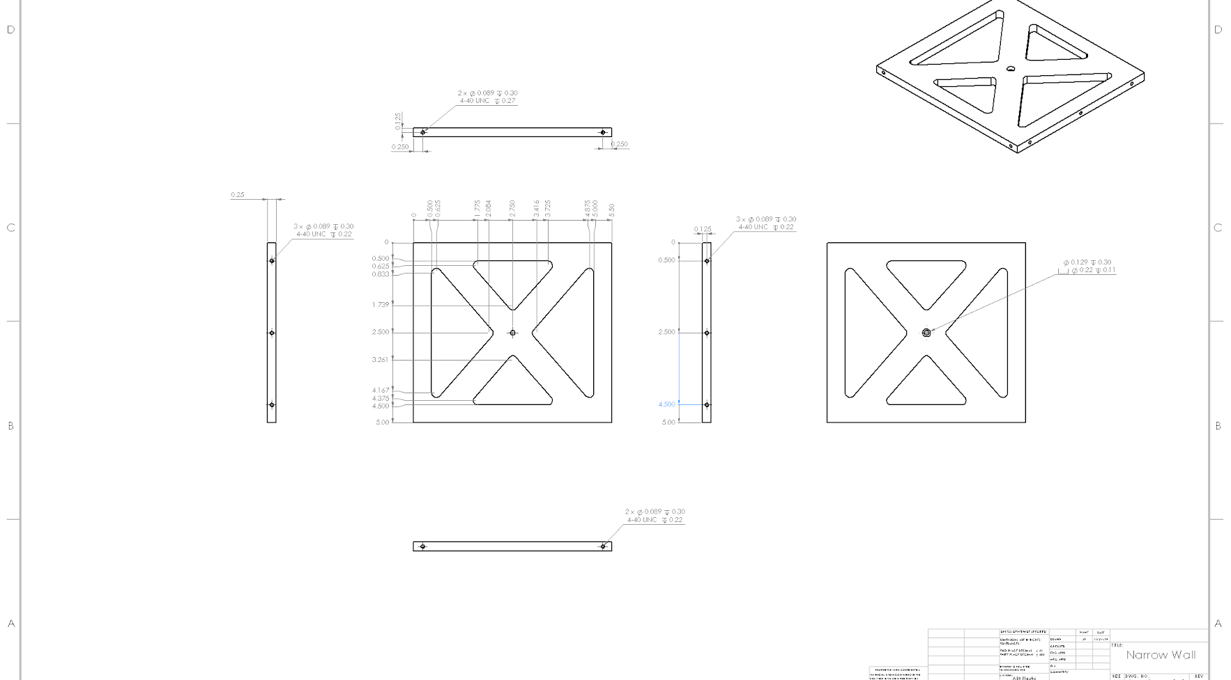
Smaller Wall Panel

Slide 39
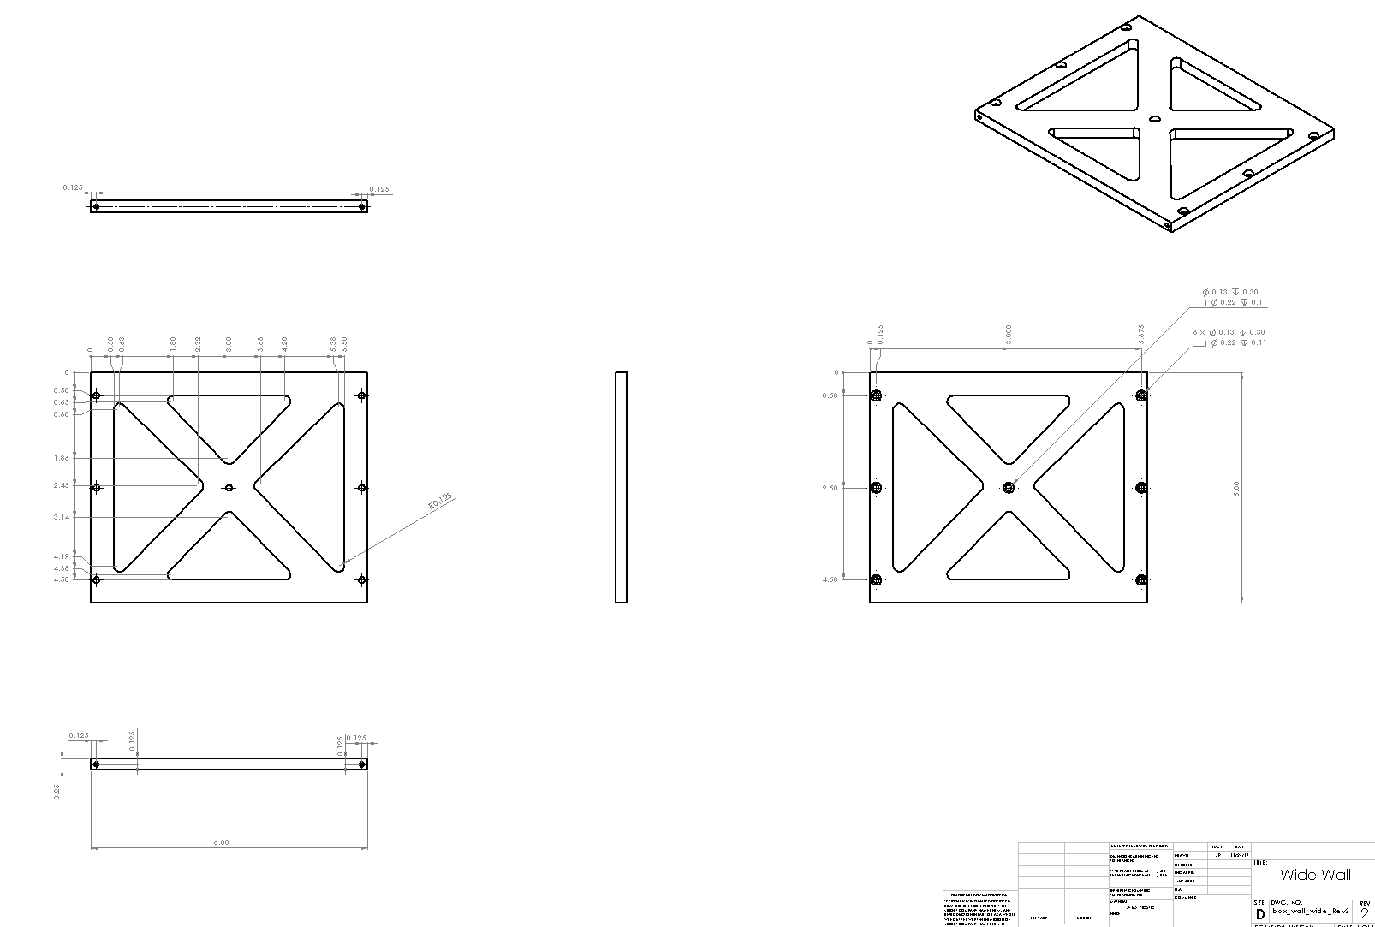
Larger Wall Panel

Slide 40
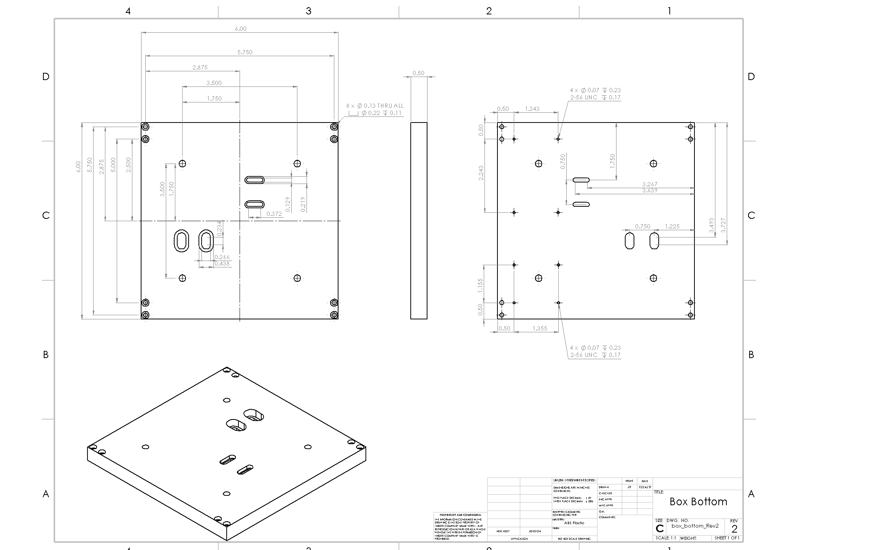
Floor Piece

Slide 41
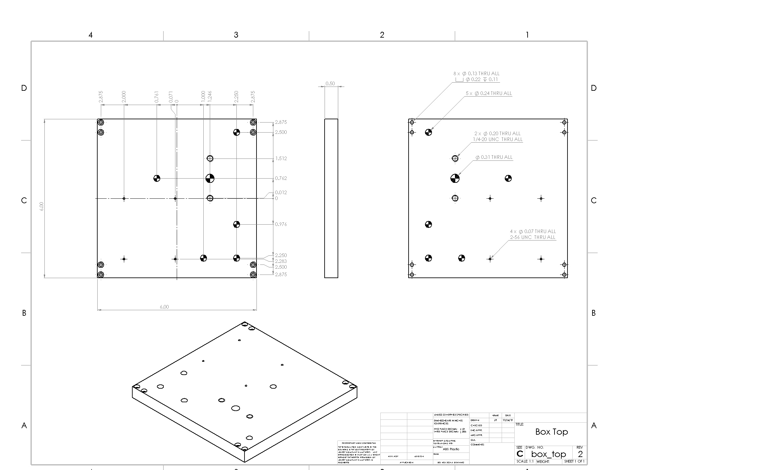
Top Panel

Slide 42
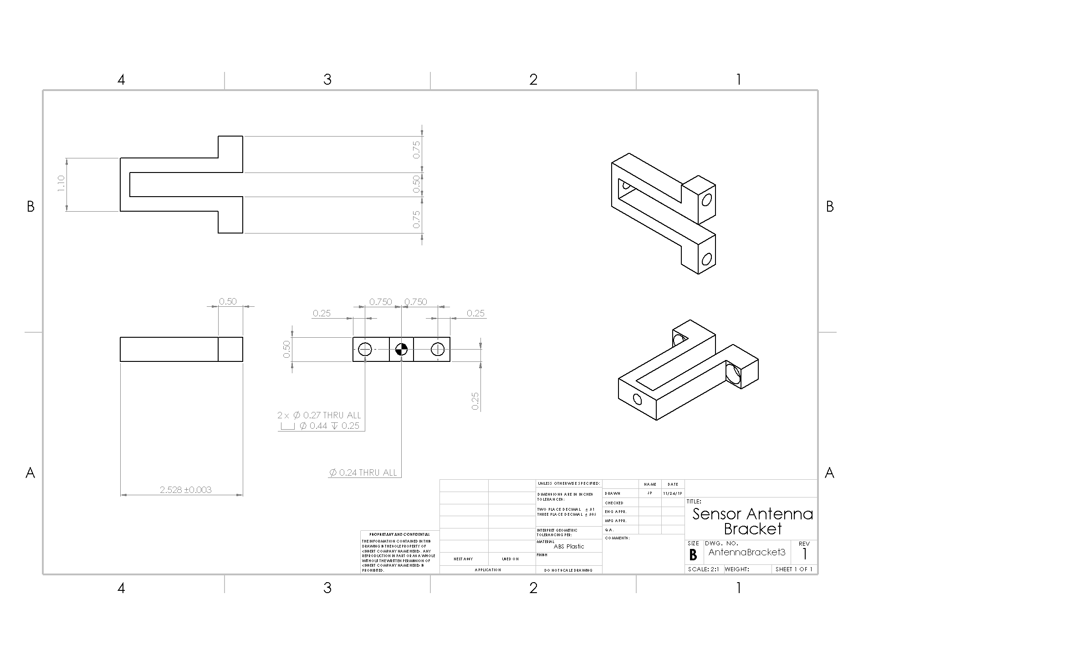
Antenna Bracket

Slide 43
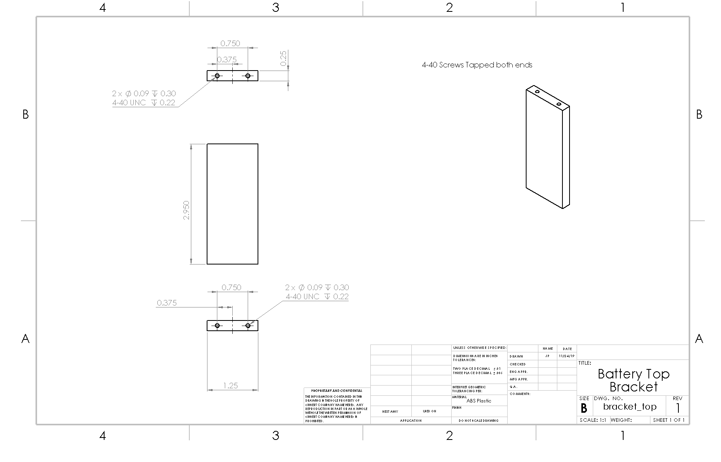
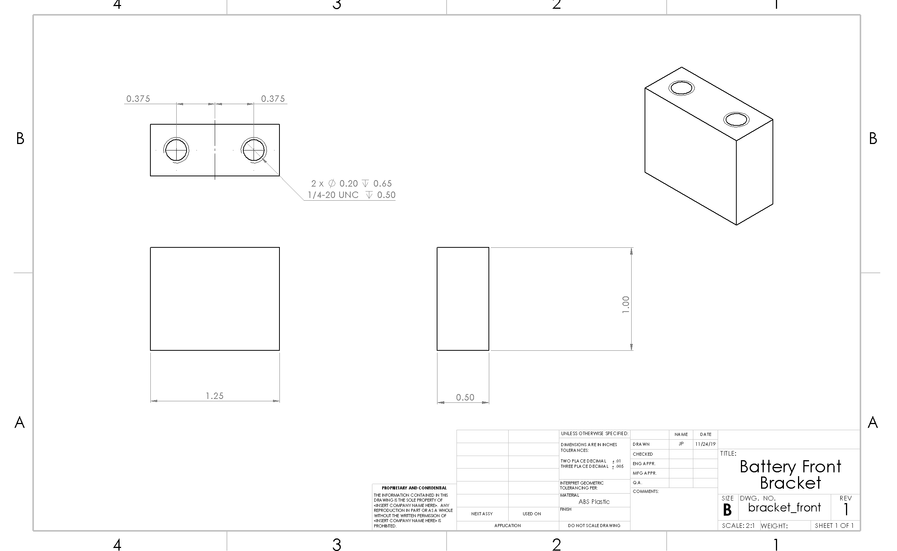
Battery Bracket

Slide 44
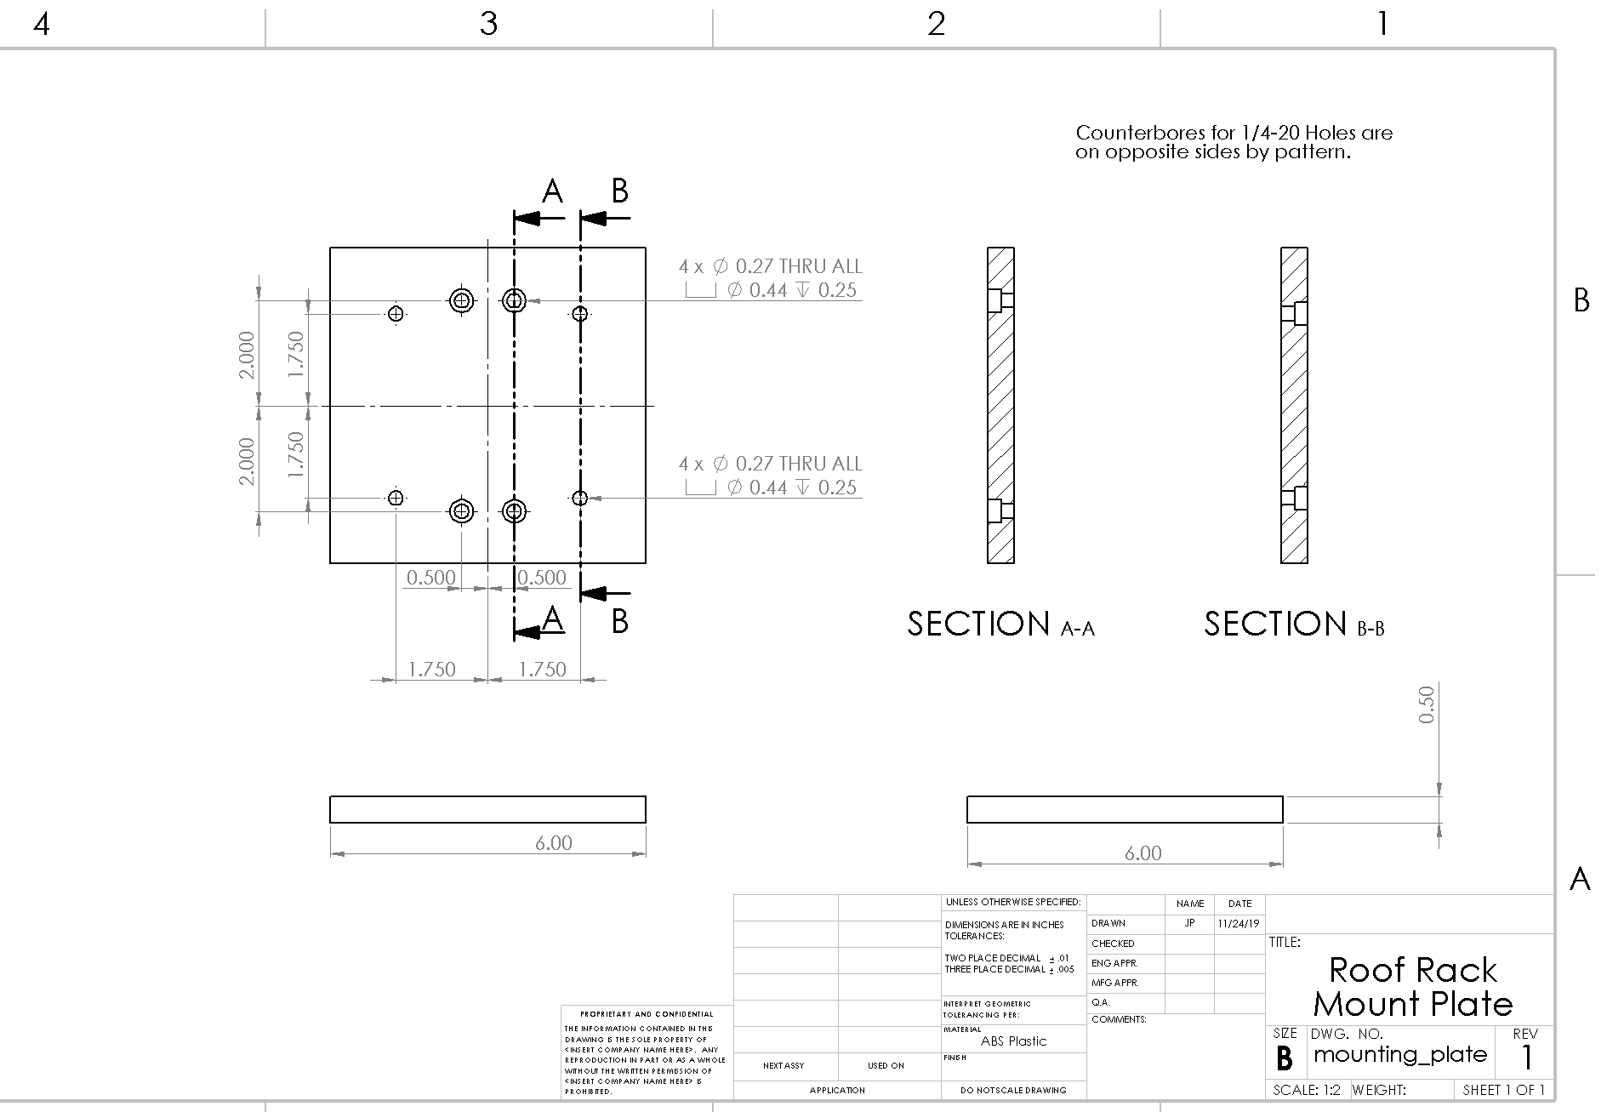
Test Mounting Plate

Slide 45
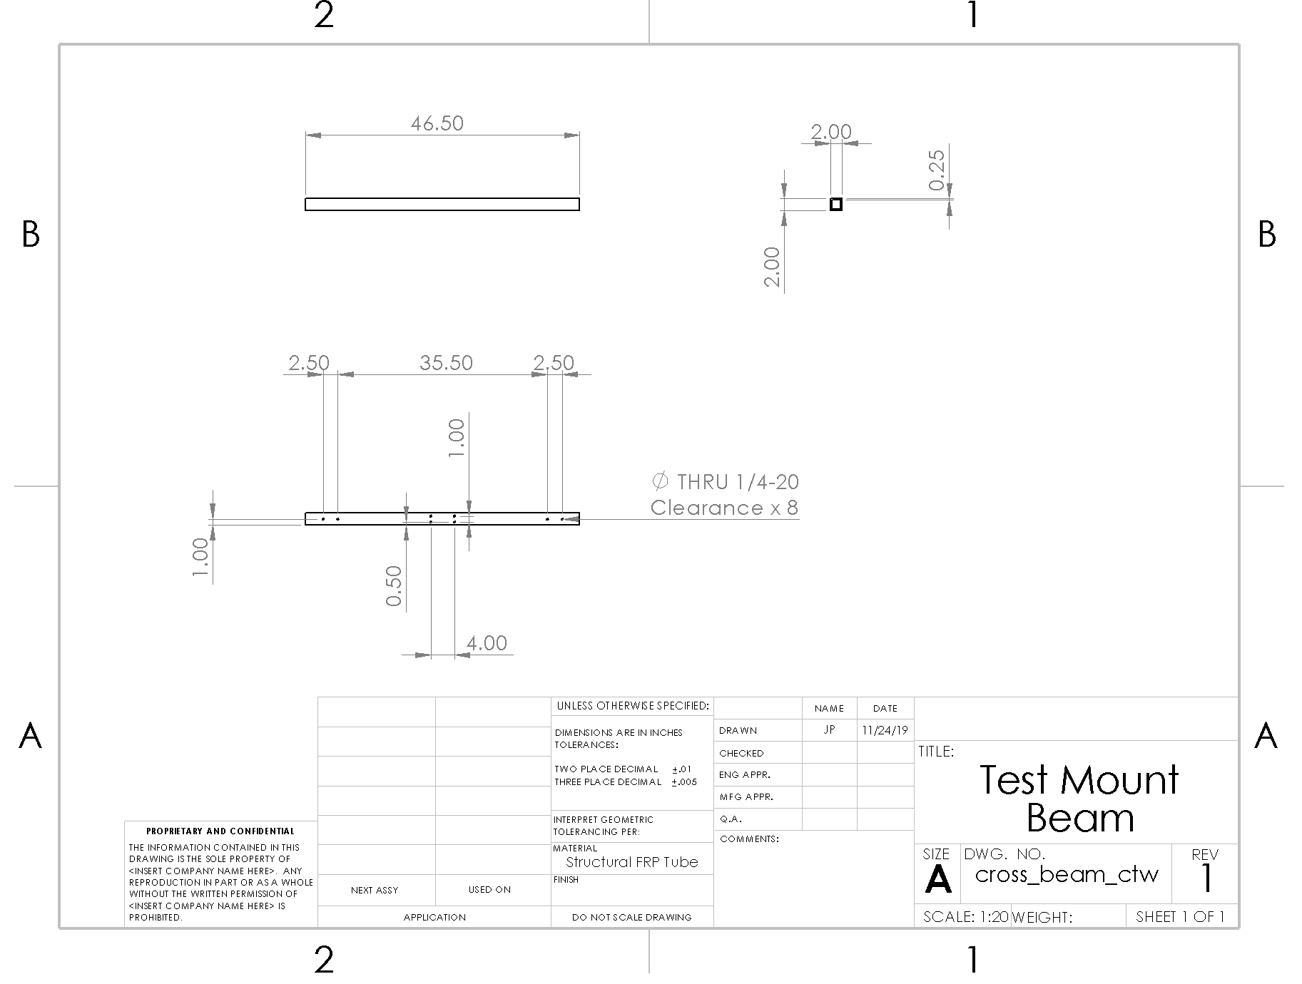
Test Mounting Tube

Slide 46
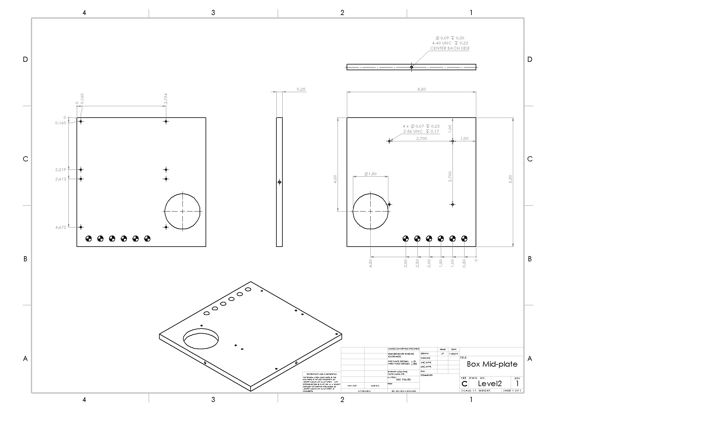
Mid-level Mounting Deck

Slide 47
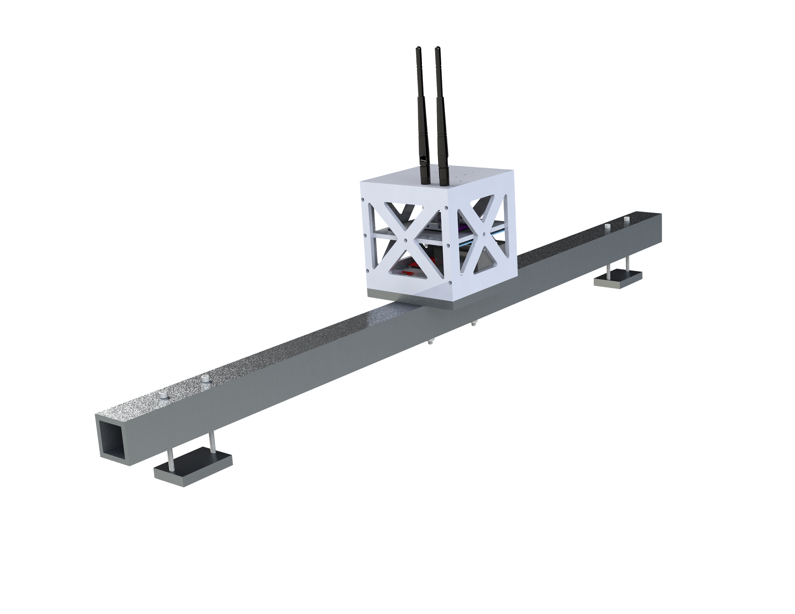
Testing Configuration
Fastening/Construction: Beacon and sensor both mount via ¼-20 SHCS to the mounting plate attached to the fiberglass tube
Mounting Methods: ½-20 x 4” bolts used to tighten clamps on ends to existing rails on team members’ cars.

