Slide 1

Advanced Tracking of Orbital Motion for Inter-satellite Clusters
Final Oral Review -
Andrew Dellsite, Adam Farmer, Camilla Hallin, Corey
Huffman, Nate Lee, Brendan Lutes, Jamison McGinley,
Anastasia Muszynski, Hunter Peery, Jarrod Puseman,
Erin Shimoda, Emily Webb

Slide 2
Project Purpose and Objectives
Project Purpose and Objectives
Design Description
Test Overview
Test Results
Systems Engineering
Project Management

Slide 3

Mission Statement
“The long term goal of this project is to investigate satellite-to-satellite tracking feasibility through a prototype solution. The ground based beacon and sensor packages will provide an analog for General Atomics to continue to analyze the optimal methods for tracking satellites in an ever cluttered space environment.”

Slide 4
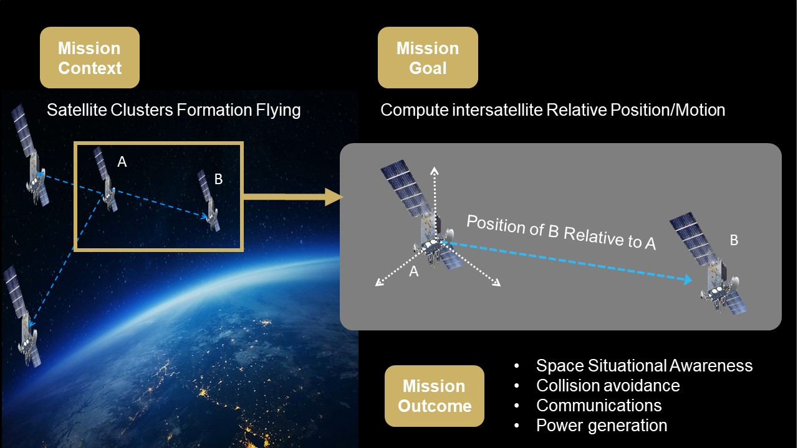

Slide 5
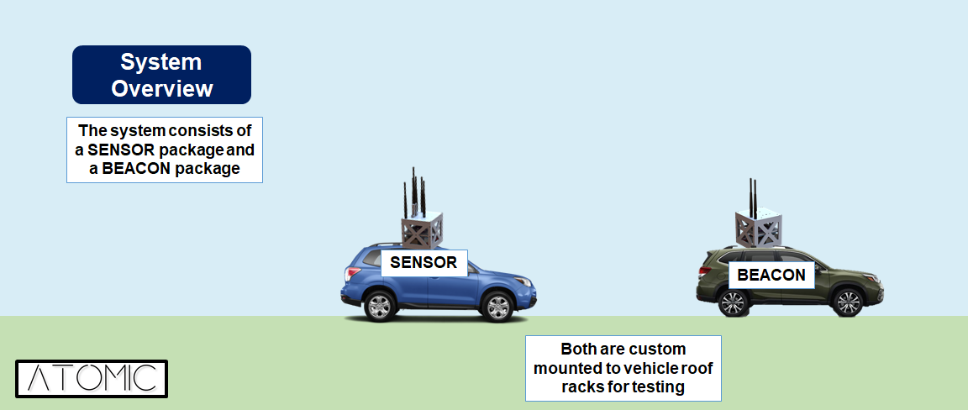
Concept of Operations

Slide 6
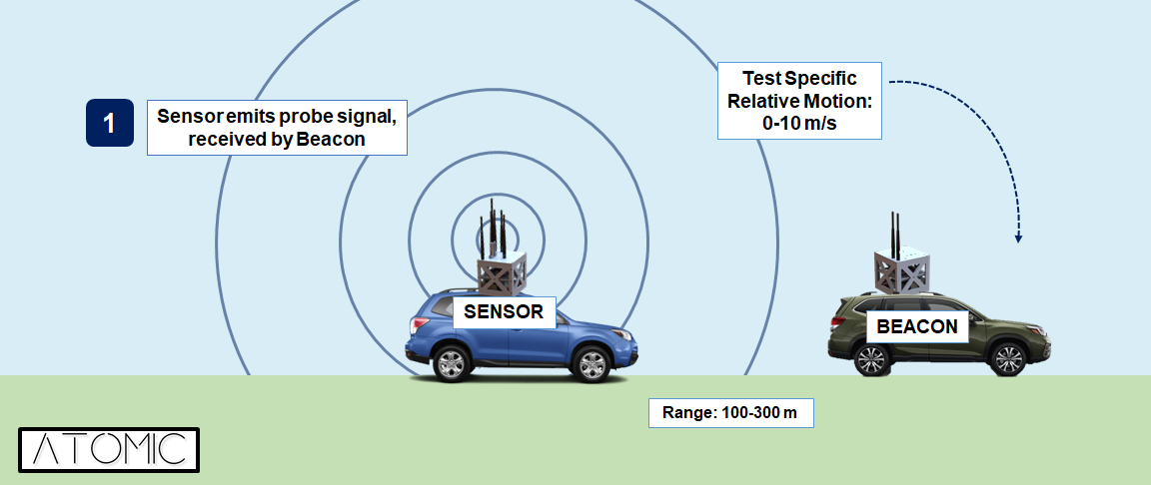
Concept of Operations

Slide 7
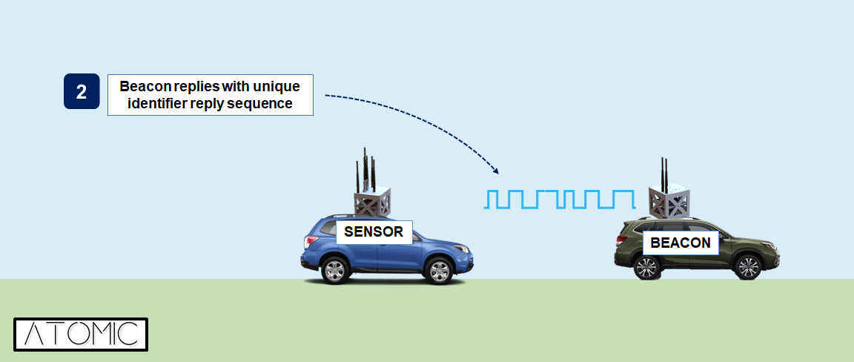
Concept of Operations

Slide 8
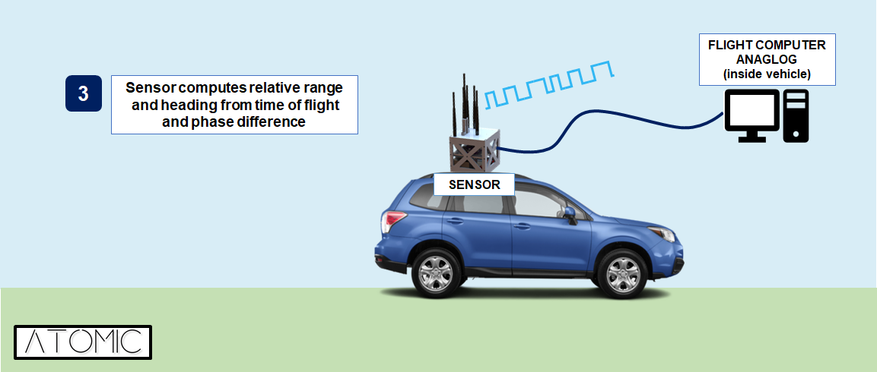
Concept of Operations

Slide 9
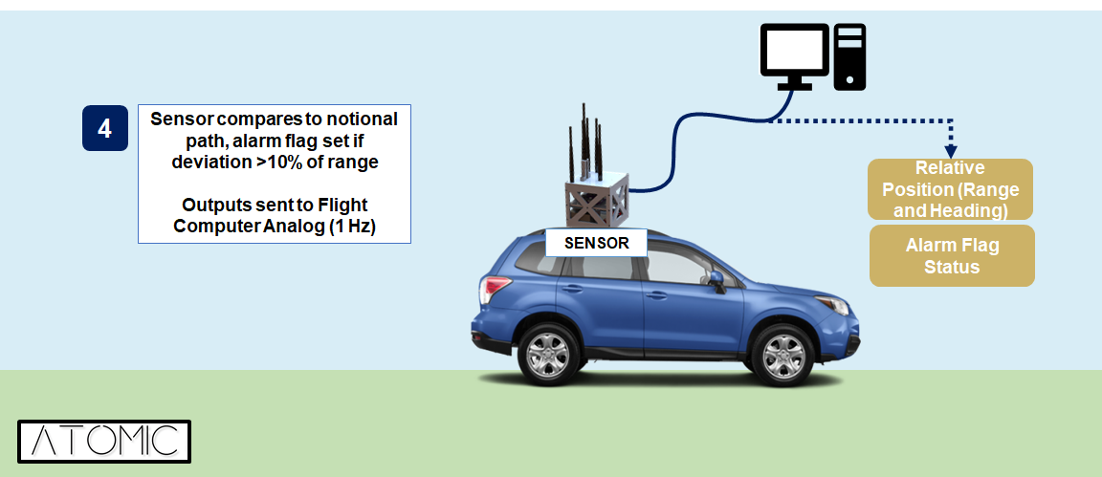
Concept of Operations

Slide 10
Functional Requirements
The beacon shall transmit RF signals between 2 and 4 GHz (S-Band).
The sensor shall receive RF signals transmitted by the beacon.
The sensor shall track relative position of the beacon within a 2% error bound 66.7% of the time.
The tracking system shall alert the operator if the satellite drifts more than 10% of the range away from a predetermined notional path.
The beacon system shall operate between -20°C and 50°C, inclusive.
The beacon system shall be powered by a 28 ± 6V unregulated power supply.
Project Purpose and Objectives
Design
Description
Test Overview
Test Results
Systems Engineering
Project
Management

Slide 11
Success Criteria
Critical Project Elements | Level 1 | Level 2 | Level 3
Two-Way Range Finding | Compute range. | Range to within 2%. | Calculate and filter position estimates implementing filtering.
Phase Interferometry | Calculate heading. | Compute position of beacon to within 2%.
Data Handling | Beacon and sensor can individually complete all software processes, on Pi. | Beacon and sensor individually complete all software, including SDR programs. | Sensor and Beacon communicate with each other.
Electrical Components | Operable given power and environmental constraints. | N/A | N/A
Testing | Phase 1 - Stationary Test. | Phase 2 - Relative Motion Test & Phase 3 - Cluster Motion Test | Phase 4 - Non-Linear Cluster Motion Test.

Slide 12
Design Description
Project Purpose and Objectives
Design Description
Test Overview
Test Results
Systems Engineering
Project Management

Slide 13
Critical Project Elements
Designation | CPE | Critical Characteristics
CPE-1 | Two-way Range Finding | Range finding is the first of two critical components necessary for the sensor package to accurately determine the beacon’s relative position.
CPE-2 | Phase Interferometry | Heading calculations are the second of two critical components necessary for the sensor package to accurately determine the beacon’s relative position.
CPE-3 | Data Flow | Accurate models for the data flow rates are necessary to improve range and heading calculations.
CPE-4 | Electrical Components | All electrical components must operate within the temperature constraints defined by FR5.
CPE-5 | Testing | Testing will need to verify and validate that each functional requirement is met.

Slide 14
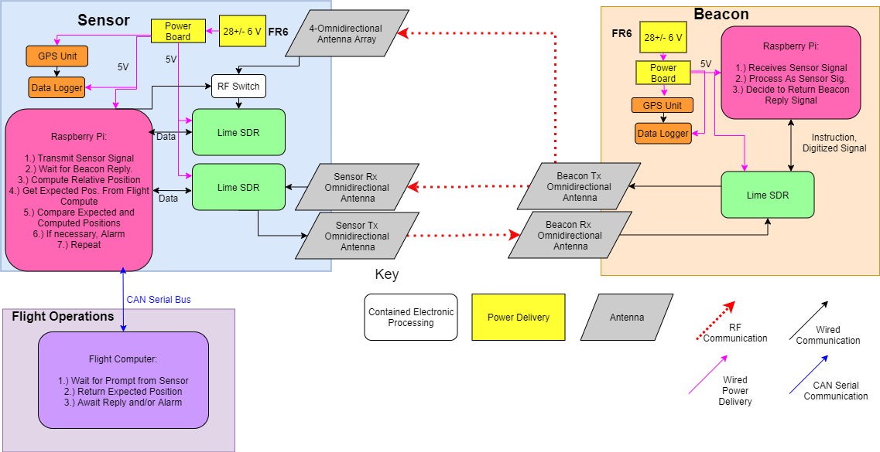
FBD

Slide 15
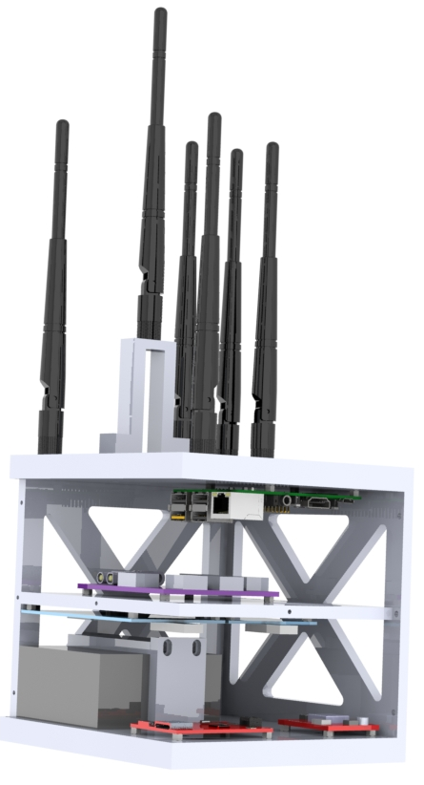
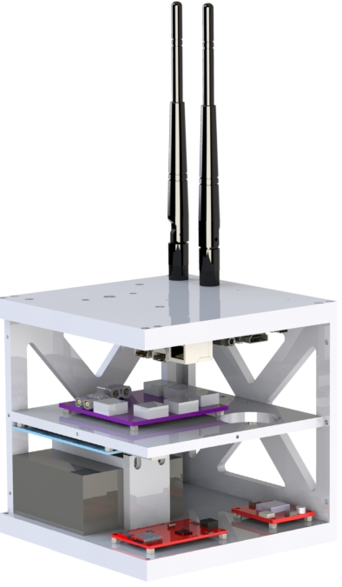
Review of Structural Design
Receiving
(Rx) Antenna(s)
Transmitting (Tx) Antenna(s)
Raspberry Pi
PiCAN 2
Power Board
LimeSDR
Battery
GPS Device
Beacon
Sensor

Slide 16
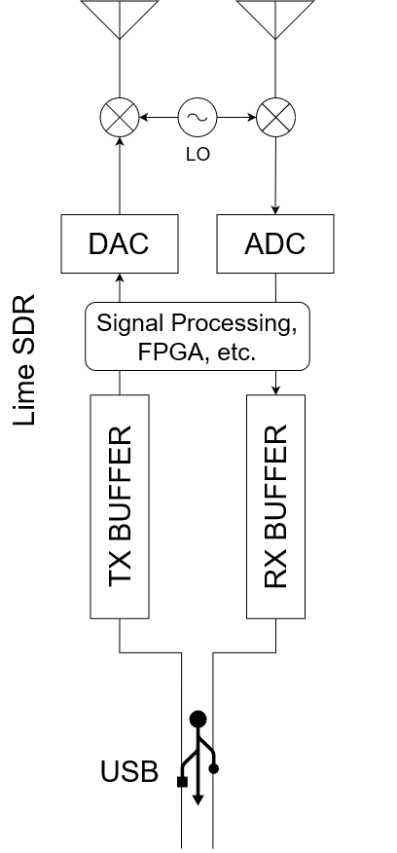
Changes Since TRR
Hardware: Removed part of the structure
Found that the structure limited space for cables
Allowed for ease of cable management
Software: Switched from GNURadio to SoapySDR for programing the SDR to improve timing accuracy
GNURadio: SDR development toolkit that generates signal processing blocks in python
SoapySDR: C++ Application Programming Interface (API) with C and Python wrappers
  Increased flexibility of metadata retrieval
  Could retrieve timestamps directly from SDR
Timing synchronized up to this line
SoapySDR: obtains timestamps from here
Lime SDR
Timing worsens as we progress
Timing extremely inconsistent over USB
GNURadio: generates timestamps here
Raspberry Pi
Project Purpose and Objectives
Design
Description
Test Overview
Test Results
Systems Engineering
Project
Management

Slide 17
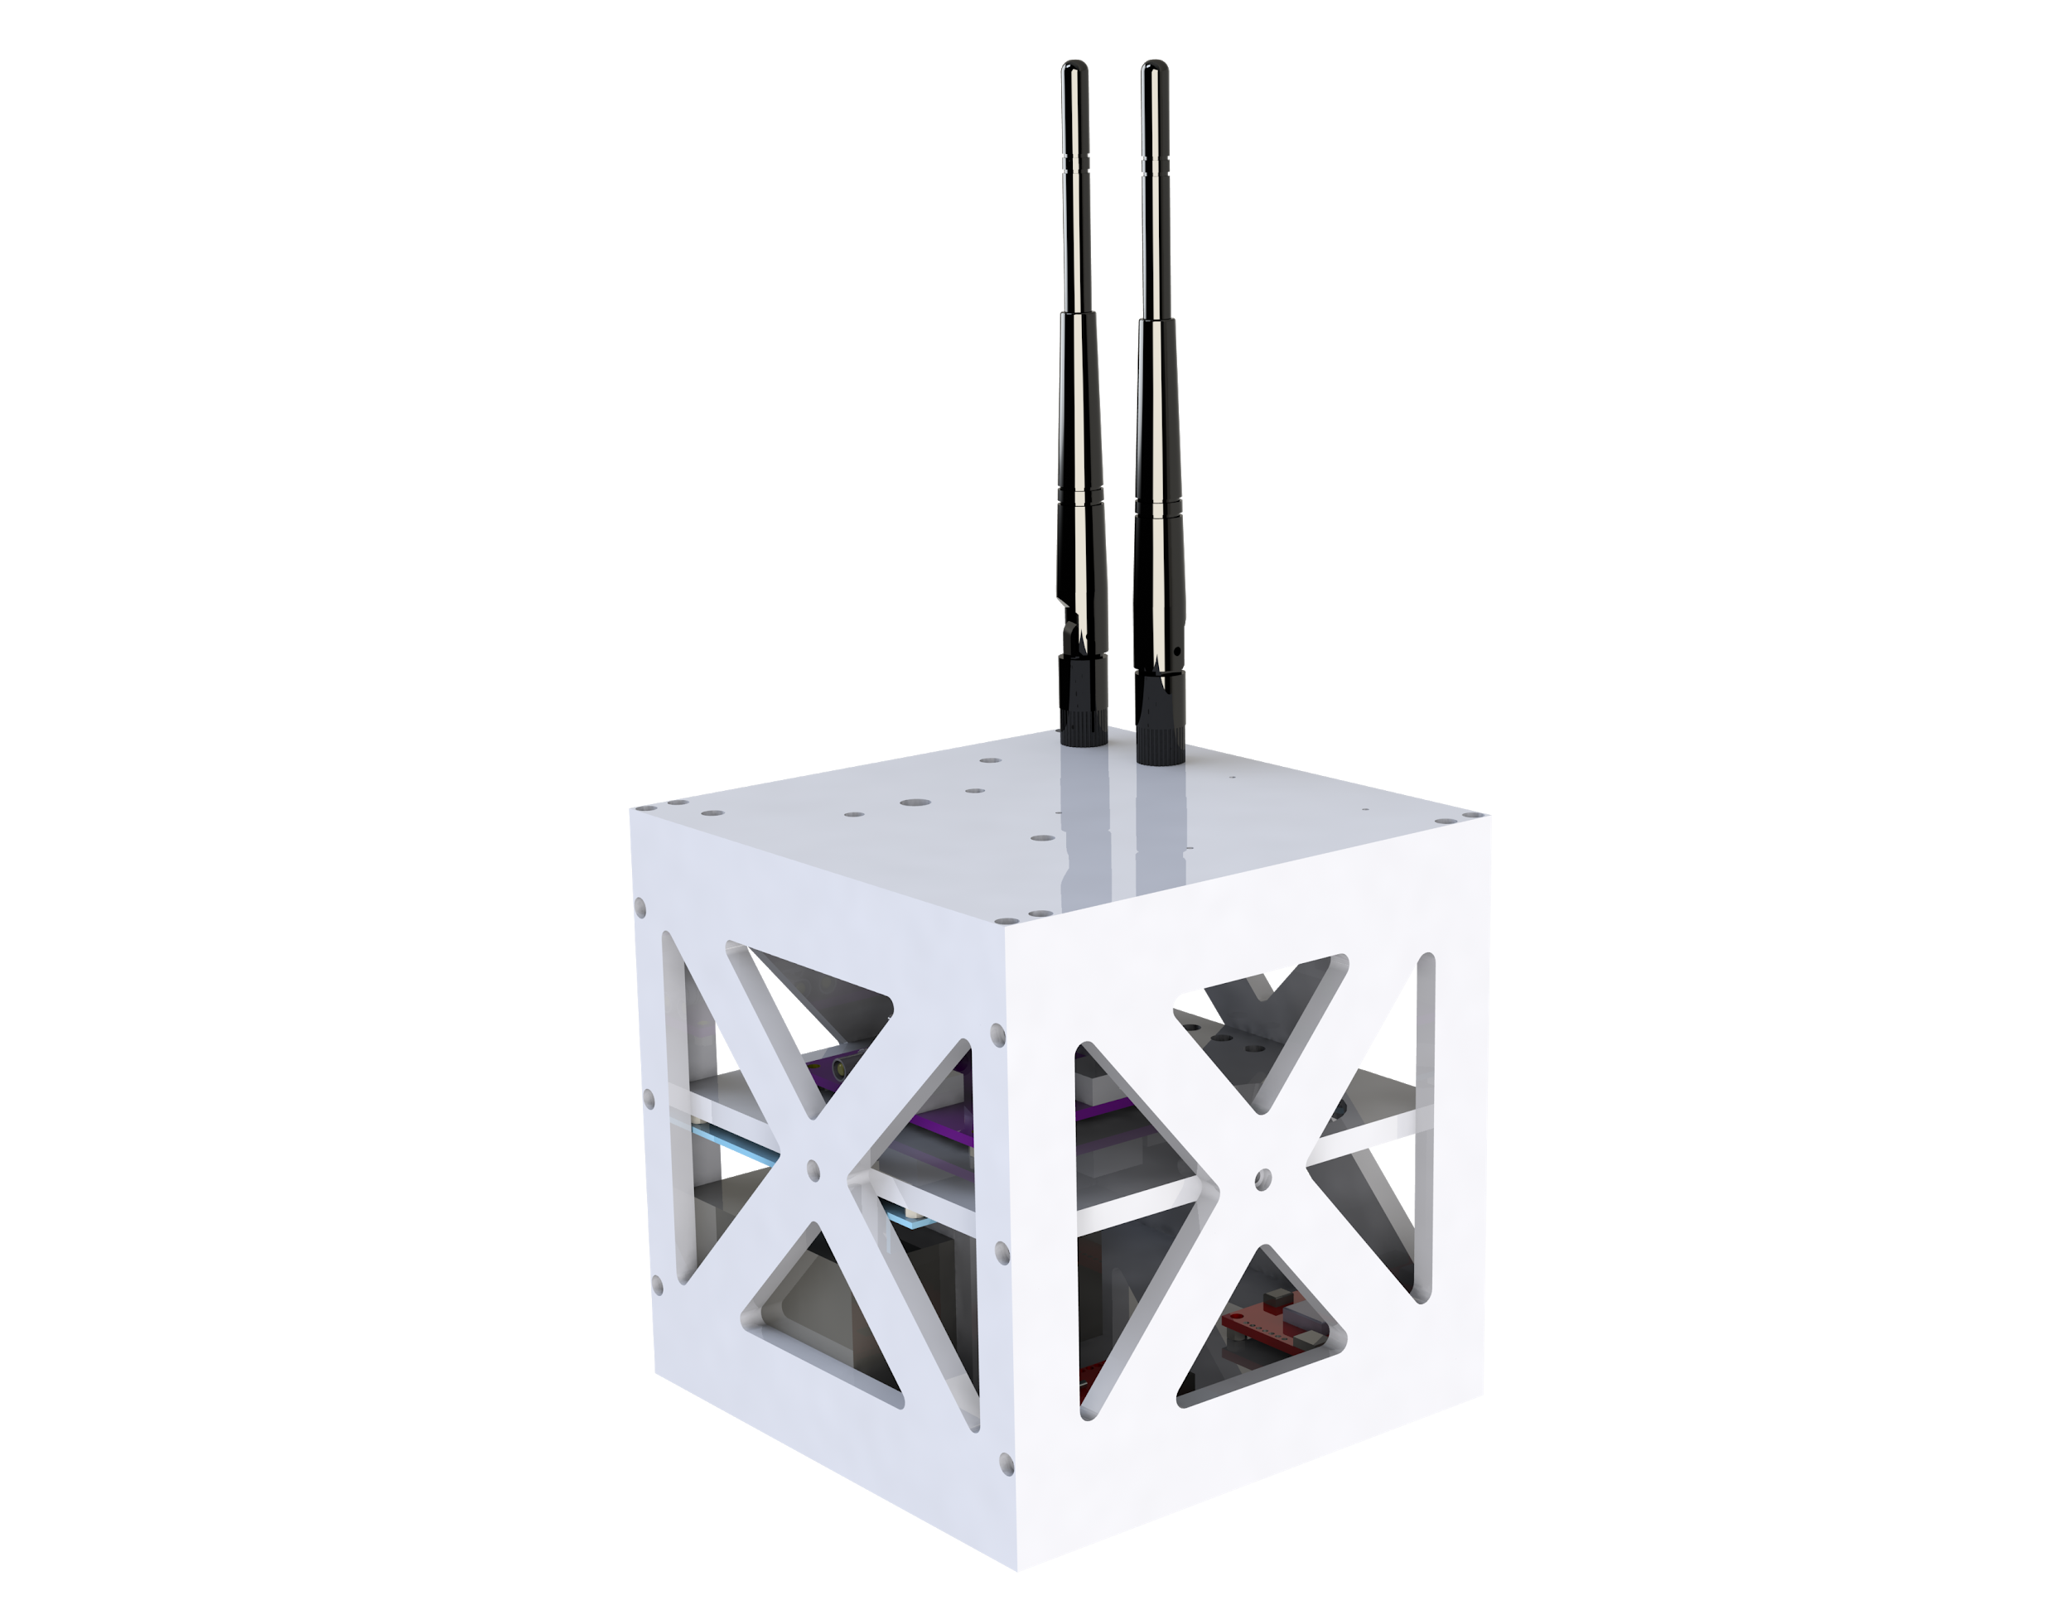
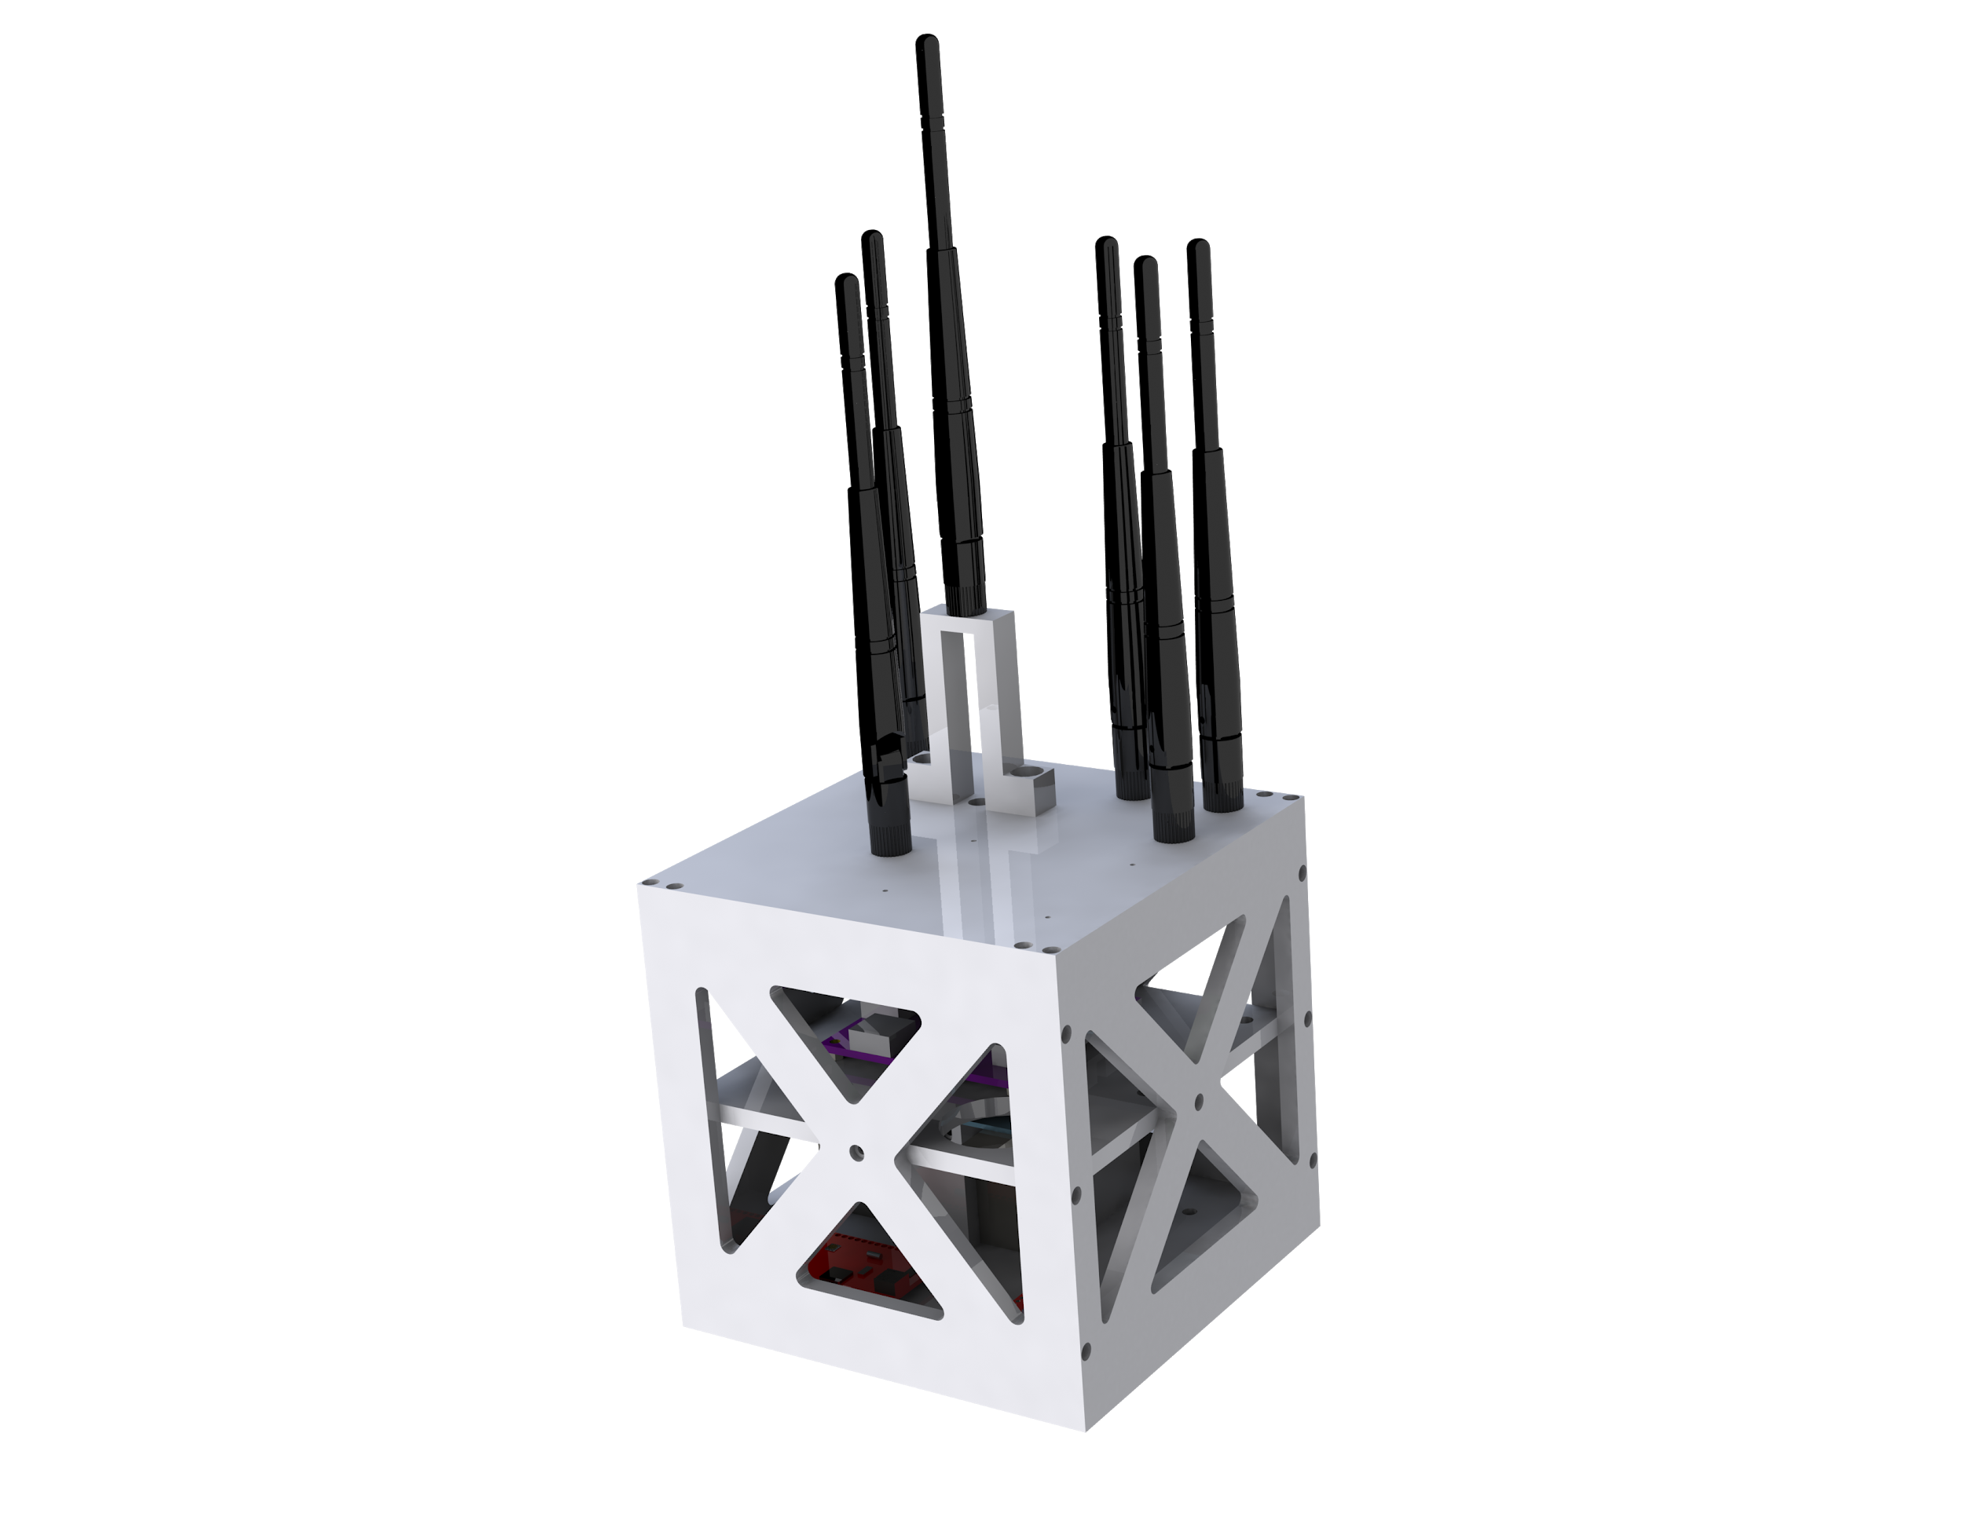
Hardware Solutions:
10.67 cm
Sensor
Mass: 2.390 kg
Additional SDR: one for range finding, one for heading
6 Antennas: 1 Range Tx + 1 Range Rx + 4 Heading Rx
Material: ABS Plastic
16.59 cm
10.67 cm
15.24 cm
15.24 cm
15.24 cm
15.24 cm
Beacon
Mass: 2.036 kg
Material: ABS Plastic
15.24 cm
15.24 cm
Project Purpose and Objectives
Design
Description
Test Overview
Test Results
Systems Engineering
Project
Management

Slide 18
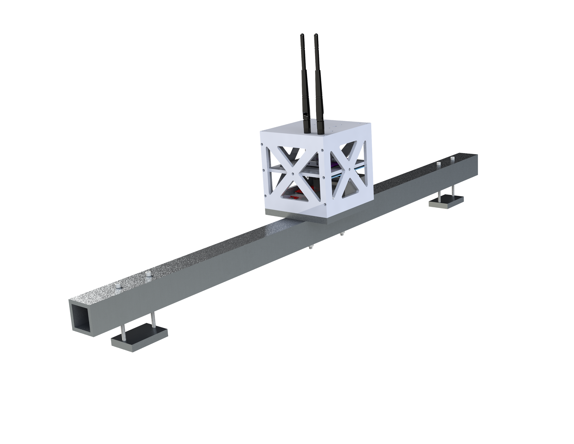
Hardware Solution
System Mass:
Sensor: 5.65 kg
Beacon: 5.30 kg
Test Mount Alone: 3.26 kg
Fastening/Construction: Beacon and sensor both mount to the mounting plate attached to the fiberglass tube
Test mount clamps to existing roof rack rails of team members’ vehicles
Project Purpose and Objectives
Design
Description
Test Overview
Test Results
Systems Engineering
Project
Management

Slide 19
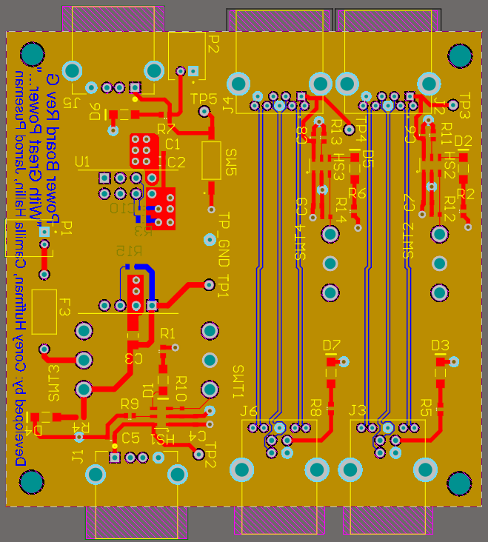
Powerboard Solution
3.00 in
Programmable DC-DC Power converter from 28 +/- 6V to 5V
Toggle Switches and indicator LEDs for unit testing and control
USB3.0 high speed data bypass - required iteration and revision with guidance from a professional electrical engineer.
3.00 in
Project Purpose and Objectives
Design
Description
Test Overview
Test Results
Systems Engineering
Project
Management

Slide 20
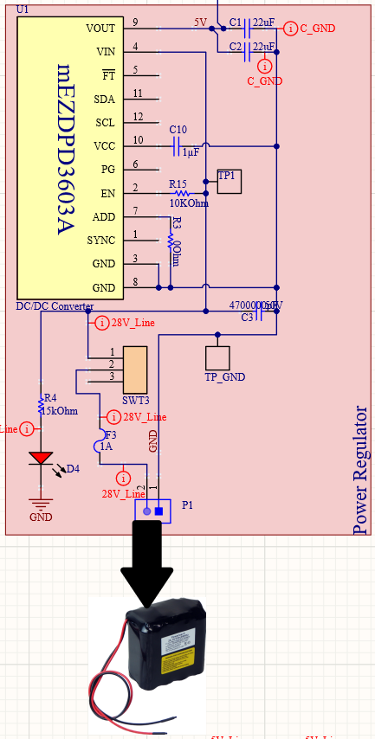
Powerboard: Regulator
Monolithic mEZDPD3603A DC-DC converter used
Toggle switch for complete system control
Red “on” indicator LED
1A fast burning fuse for current protection
Project Purpose and Objectives
Design
Description
Test Overview
Test Results
Systems Engineering
Project
Management

Slide 21
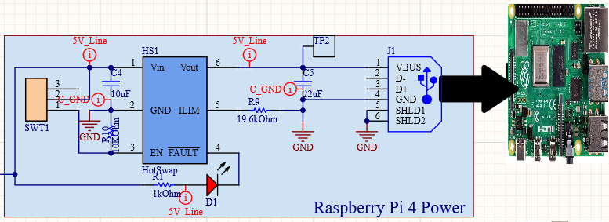
Powerboard: Pi Power
Richtek RT9728BHGE HotSwap used for over- current protection
Toggle switch for subsystem control
Red “Fault” indicator LED
Project Purpose and Objectives
Design
Description
Test Overview
Test Results
Systems Engineering
Project
Management

Slide 22
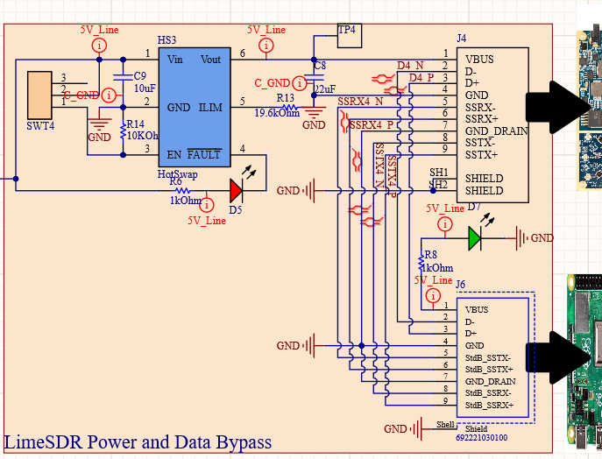
Powerboard: Lime Power and Data Bypass
Richtek RT9728BHGE HotSwap used for over- current protection
Toggle switch for subsystem control
Green “On” indicator LED for RPi
Red “Fault” indicator LED
Data pass through with high-speed USB3.0 protocol
Project Purpose and Objectives
Design
Description
Test Overview
Test Results
Systems Engineering
Project
Management

Slide 23
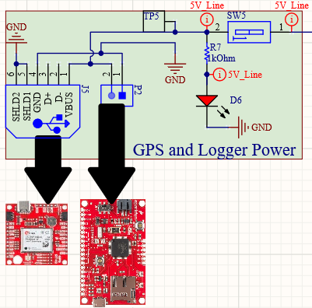
Powerboard: GPS and Data Logger Power
Slide switch for subsystem control
Red “on” indicator LED

Slide 24
Software Solution
 | Written/ Tested
 | In Progress/ Limited Testing
 | Not started/ Not Tested
Libraries used: RPi.GPIO, time, numpy, soapySDR, matplotlib (only for development)
Initialize
Generate Complex Msg
Transmit Poll/Identifier
Development:
Testing:
Packages: Sensor & Beacon
Development:
Testing:
Packages: Sensor & Beacon
Development:
Testing:
Packages: Sensor & Beacon
Create Soapy Device Object using Lime Drivers
Set Frequency, Rx/Tx Channel, Bandwidth, Gains, Antenna, Sample Frequency
Create Complex 32 bit Tx/ Rx Streams
Create Binary Data with correct samples per bit
Create time vector for transmit length
Create IQ data:
exp( f 2 π t i + BIN ⋅ π i)
Get current time from SDR
Write to Tx Buffer
Stream Scheduled to start at t_start= t0+10us
Activate Tx Stream
Tunable Parameters:
Gains, Lime Device Serial Number
Tunable Parameters:
Code length, “Amplitude”
Tunable Parameters:
Scheduled time difference

Slide 25
Software Solution
 | Written/ Tested
 | In Progress/ Limited Testing
 | Not started/ Not Tested
Libraries used: RPi.GPIO, time, numpy, soapySDR, matplotlib (only for development)
Beacon Receive
Identify Poll Message
Find TOF
Development:
Testing:
Packages: Beacon
Development:
Testing:
Packages: Beacon
Development:
Testing:
Packages: Sensor
Activate Rx Buffer
Read buffer
Get ns Time stamps
Use numpy.correlate to correlate Poll Msg (generated) to rx_buffer
Find max argument
Compare with threshold
If met, send response
Use numpy.correlate to correlate Poll Msg (generated) to rx_buffer
Find max argument
Get time of max arg
Subtract Processing Time
Tunable Parameters:
Buffer Length
Tunable Parameters:
Threshold
Tunable Parameters:
Processing Time

Slide 26
Software Solution
 | Written/ Tested
 | In Progress/ Limited Testing
 | Not started/ Not Tested
Libraries used: RPi.GPIO, time, numpy, soapySDR, matplotlib (only for development)
Switch Antenna
Get Phase Difference
Find and Send Position
Development:
Testing:
Packages: Sensor
Development:
Testing:
Packages: Sensor
Development:
Testing:
Packages: Sensor
Specified antenna mode input
Adjust GPIO pins to match antenna mode
Let switch settle
From Rx Buffer data, subtract phase for current antenna
Call Switch antenna
Receive new buffer/phase
Call Switch Antenna
Receive new buffer/phase
Using TOF find range
Using Phase Differences find heading
Compare to notional path
Output to PiCAN
Tunable Parameters:
Switch settle time
Tunable Parameters:
None (unless phase offset is uncovered during calibration)
Tunable Parameters:
Notional Path

Slide 27
Test Overview
Project Purpose and Objectives
Design Description
Test Overview
Test Results
Systems Engineering
Project Management

Slide 28
Major Tests
Functional Preliminary Tests
Phase 1 - Stationary Test
Phase 2 - Simple Motion Test
Phase 3 - Crossing Paths
Phase 4 - Nonlinear Motion
Thermal Test
Project Purpose and Objectives
Design
Description
Test Overview
Test Results
Systems Engineering
Project
Management

Slide 29
Preliminary Tests
Level 1: Component Level
Level 2: Sub-system Level
Level 3:
System Level
Component Level
🗸 Lime SDR
🗸 GPS
🗸 Raspberry Pi
🗸 Data Logger
🗸 Power On Tests
🗸 Boot Tests
🗸 Software Upload Tests
🗸 Basic functionality tests
Satisfy FR 1, 2, & 6
Individual Assemblies
🗸 Beacon
🗸 Sensor
Beacon Integration
▸ Raspberry Pi/SDR
🗸 GPS/Data logger
Sensor Integration
▸ Raspberry Pi/SDR
🗸 GPS/Data logger
🗸 Tx/Rx Software test
Satisfy FR 3 & 4
Overall System
✕ Beacon/Sensor
Overall Integration Tests
✕ Send RF between components both ways
✕ Receive RF between components both ways
Satisfy FR 1, 2, 3, & 4
KEY: 🗸 Complete ▸ In Progress ✕ Not completed
Project Purpose and Objectives
Design
Description
Test Overview
Test Results
Systems Engineering
Project
Management

Slide 30
Phase 1
Bird’s Eye-view of Testing Paths:
Description:
Both the sensor and beacon are stationary, at a range of 100 m, with various headings.
Purpose:
To characterize the accuracy of the tracking system (Noise) as a function of heading.
Tuning KF
Most Direct comparison to models (Two-way range-finding and phase interferometry)
Testing Against FR: 3
BEACON
(Stationary)
100 m
Sensor will be rotated at 30-degree increments to characterize accuracy as a function of relative heading.
SENSOR
(Stationary)
Project Purpose and Objectives
Design
Description
Test Overview
Test Results
Systems Engineering
Project
Management

Slide 31
Phase 2
Bird’s Eye-view of Testing Paths:
Description:
The sensor is stationary, and the beacon translates at a speed of 10 m/s.
Purpose:
To characterize the accuracy of the tracking system as a function of range.
To test the alarm system
Testing Against FR: 3, 4
Beacon translates in a linear path away from sensor.
10 m/s
BEACON
(Translating)
100 m - 300 m
SENSOR
(Stationary)
Project Purpose and Objectives
Design
Description
Test Overview
Test Results
Systems Engineering
Project
Management

Slide 32
Phase 3
Bird’s Eye-view of Testing Paths:
Description:
Both the sensor and beacon move, at intersecting courses perpendicular to each other.
Purpose:
To characterize the accuracy of the tracking at higher relative velocities
Create an accuracy vs. velocity profile
Testing Against FR: 3, 4
BEACON
(Translating)
50m-300m
10 m/s
Beacon and Sensor translate in linear perpendicular paths away from each-other.
SENSOR
5 m/s
(Translating)
Project Purpose and Objectives
Design
Description
Test Overview
Test Results
Systems Engineering
Project
Management

Slide 33

Phase 4
Description:
Testing Nonlinear Dynamics using circular paths
Purpose:
To test the nonlinear filter
Compare accuracy to that obtained using linear dynamics
Testing Against FR: 3, 4
Projected Vehicle Paths:
DOPE VIDEO

Slide 34
General Atomics Thermal Test
Title: | Sub-System Test | Sensor/Beacon Test
Status: | Not Completed | Not Completed
Objective: | Verify beacon and sensor packages individually operate in the specified temperature range | Verify the entire system works as specified in the temperature range
Requirements Verified | FR3, FR5 | FR3, FR5
Test Location | General Atomics Centennial, CO | General Atomics Centennial, CO
Project Purpose and Objectives
Design
Description
Test Overview
Test Results
Systems Engineering
Project
Management

Slide 35
Test Results
Project Purpose and Objectives
Design Description
Test Overview
Test Results
Systems Engineering
Project Management

Slide 36
Predicted Test Results: Context of CPE 1
Two-Way Range Finding
Projected Collected Data (In Theory):
Time of Flight
  Stored as scalar value recorded at our sample rate
  Applies following equation to get range:
Truth Data
  Stored in coordinates with time stamps
  Difference in coordinates gives relative position, take vector norm for distance
Data from each test will be analyzed to characterize:
  Phase 1 : Straight Accuracy
  Phase 2: Accuracy vs Ranges
  Phase 3: Accuracy vs Rel. Speed
  Phase 4: Accuracy vs Time (Compare against filter)
x: Distance [m]
c: Speed of Light [m/s]
t: Time [s]
Project Purpose and Objectives
Design
Description
Test Overview
Test Results
Systems Engineering
Project
Management

Slide 37
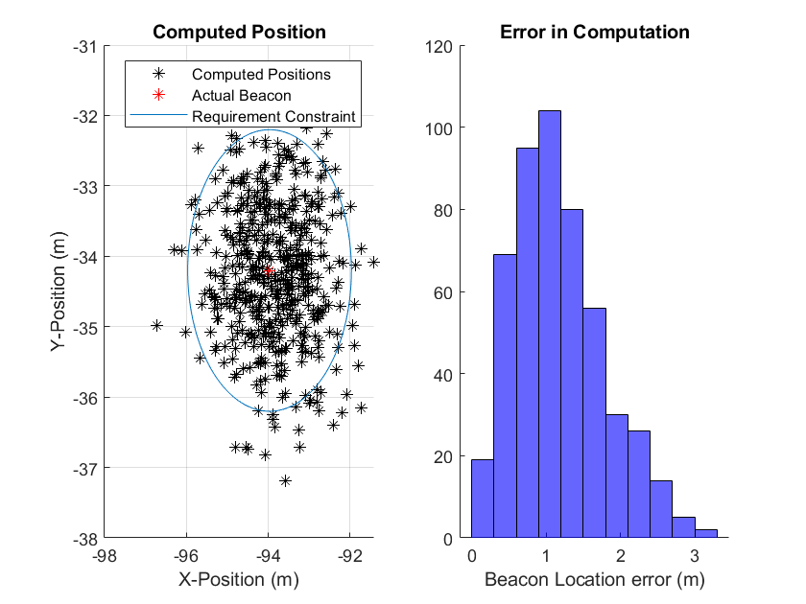
Predicted Test Results: Context of CPE 1
Two-Way Range Finding
Model Predictions of the Data for Each Test
Phase 1: Model from fall semester (right) predicts how well the position can be calculated given time of flight calculations.
Phase 2: Same model applies: no expected change in measurement accuracy compared to phase 1
Phase 3: First model assumed relative velocities negligible. Model modified to incorporate motion while timing
  Error introduced by lost timing from vehicle motion: 1.4 cm
Phase 4: Nonlinear dynamics require the addition of the EKF.
Project Purpose and Objectives
Design
Description
Test Overview
Test Results
Systems Engineering
Project
Management

Slide 38
Predicted Test Results- Context of CPE 1
Two-Way Range-Finding
Validation - Comparing the Model and Truth Data
“Did we build the thing to do what we said it would do?”
Line Losses?
Compare means of range predictions.
If measured range variance is greater than predicted...
Indicates poor model of errors. Should investigate sources of error.
(Revisit Assumptions)
2% Accuracy met? (FR3)
SDR Clock?
Compare measured variance and estimated variance.
Processing Time?
If bias in range mean exists...
If fixable (shorter, direct wires, recalibration), fix. Retest.
If not (ie processing time), update model (and Kalman filter) with new uncertainty.
Indicates poor calibration of equipment. Should recalibrate the timing errors.

Slide 39
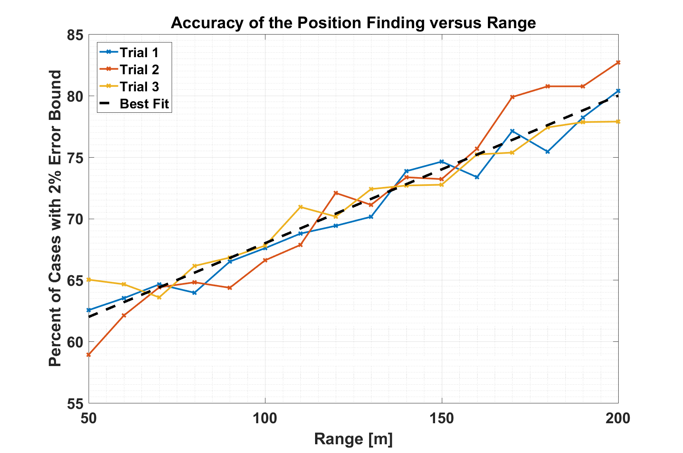
Predicted Test Results: Context of CPE 2
Phase Interferometry
Collected Data (In Theory):
State Estimates
  Stored in matrix form for each test:
[time, x, y, z, vx, vy, vz];
  A data file set from each test (can compare trials for consistency/redundancy)
Truth Data from GPS units
  Stored in coordinates with time stamps
  Difference in coordinates gives relative position, then a conversion from minutes/seconds to meters
Data from each test will be compiled into the following profiles (Combined with range-finding to get position)
  Phase 1 : Straight Accuracy
  Phase 2: Accuracy vs Ranges
  Phase 3: Accuracy vs Rel. Speed
  Phase 4: Accuracy vs Time (Compare against filter)
Hypothetical Data
(First part of predicted profile)

Slide 40


Predicted Test Results: Context of CPE 2
Phase Interferometry
Model Predictions of the Data for Each Test
Phase 1 Test (Stationary): First model from fall predicts the accuracy of the phase interferometry on stationary target
Phase 2: Same model applies: wave front assumed to be perpendicular in model, so range does not affect the model
Phase 3: First model assumed relative velocities negligible - spurred addition to the model to accurately capture velocity effects.
  At worst case, found frequency shift of 100 Hz. Corresponds to .0051° heading error, or 9 mm at 100 meters
  Cumulative position error (range and heading combined) 1.68 cm
Phase 4: Nonlinear filter would have been created, and test data run through the filter (truth model testing). This data would be used to model the expected outcome of this test.
Doppler Equation for Frequency
Artificial Wavelength Shift
Project Purpose and Objectives
Design
Description
Test Overview
Test Results
Systems Engineering
Project
Management

Slide 41
Predicted Test Results: Context of CPE 2
Phase Interferometry
Validation - Comparing the Model and Truth Data
“Did we build the thing to do what we said it would do?”
If measured variances are greater than predicted or if correlation exists
Antenna Wobble?
Compare means of position predictions.
Indicates poor model of errors. Will investigate sources of error.
(Revisit Assumptions)
2% Accuracy met? (FR3)
Wave Front Shape?
Compare measured variance and estimated variance.
If bias in position mean exists...
SDR Clock
Range bias indicates poor calibration. Should recalibrate.
If fixable (ie additional bracketry), fix. Retest.
If not (ie processing time), update model (and Kalman filter) with new uncertainty.
Heading bias indicates poor mounting. Adjust via transformation matrices

Slide 42
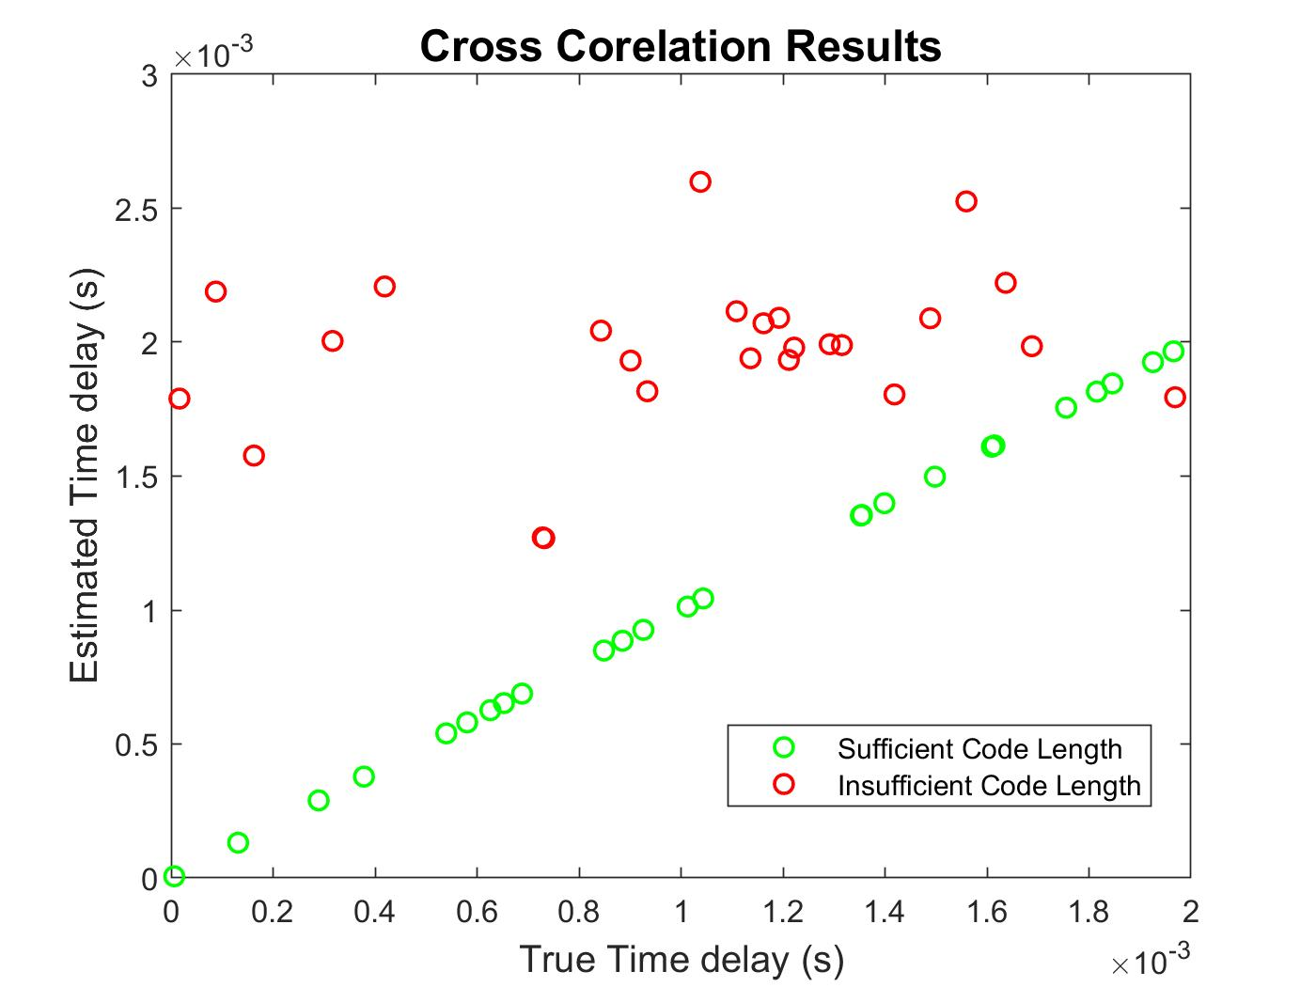
Predicted Test Results: Context of CPE 3
Data Flow
Model to be Validated: Estimated Timing Budget
Data to collect
  Sensor processing time (using calibration routine)
  Beacon processing time (using calibration routine)
  Overall update rate (CAN Bus)
Computations
Sample Mean, Sample Standard Deviation
Compare to prediction/requirement
  Is 1 Hz Requirement met?
  Is Sensor or Beacon bottlenecking process?
Change/Update
  If faster than predicted, can we afford to average MORE points?
  If slower, consider sending shorter code or averaging fewer points (impact on accuracy)

Slide 43
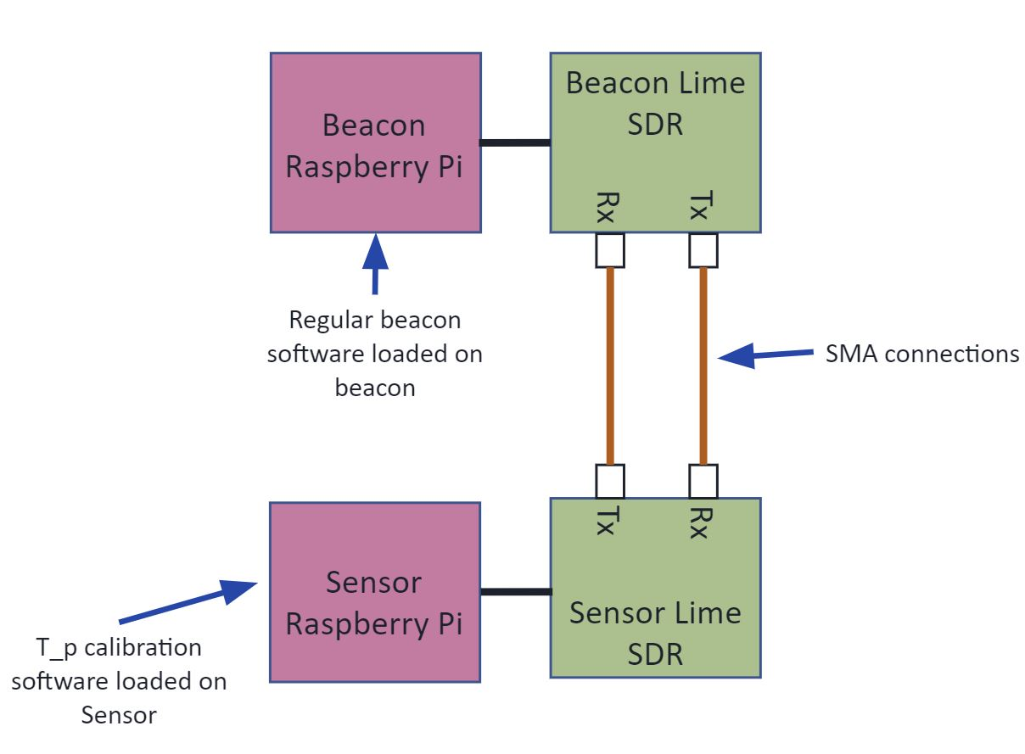
Predicted Test Results: Context of CPE 3
Data Flow
Model to be Validated: Processing Time in Two Way TOF Model
Process
  Connect Beacon Tx directly to Rx
  Simulate Poll message (same Sense poll routine code)
  Repeat runtime until Beacon begins reply routine
Compare to prediction/requirement
  Compare to current offset (should be updated)
  If STDEV is larger than error estimate (ns), adjust timing error estimate
Change/Update
  Decrease latency with priority interrupts
  Decrease uncertainty by also sending a timestamp
  Faster system so uncertainty is lower
Project Purpose and Objectives
Design
Description
Test Overview
Test Results
Systems Engineering
Project
Management

Slide 44
Predicted Test Results: Context of CPE 3
GPS Data Flow
GOAL 1: Define a notional path prior to test
GOAL 2: Take GPS truth data during test, and compare to calculated data following test
GPS
Define notional path for given test prior to test
GPS
Position truth data taken during test
Pi
Position data calculated during test
COMPUTER
Coordinate transformation to put GPS position data into useful coordinate system
COMPUTER (Post-Processing)
Description of Notional Path loaded onto Pi
Transform GPS coordinates into relative coordinate system
Align timestamps and use linear interpolation to compare the position data, as seen in CPE 1, 2
Pi
Outside 10 m?
Notional path
Compare data
Current measured path
Send Alert

Slide 45
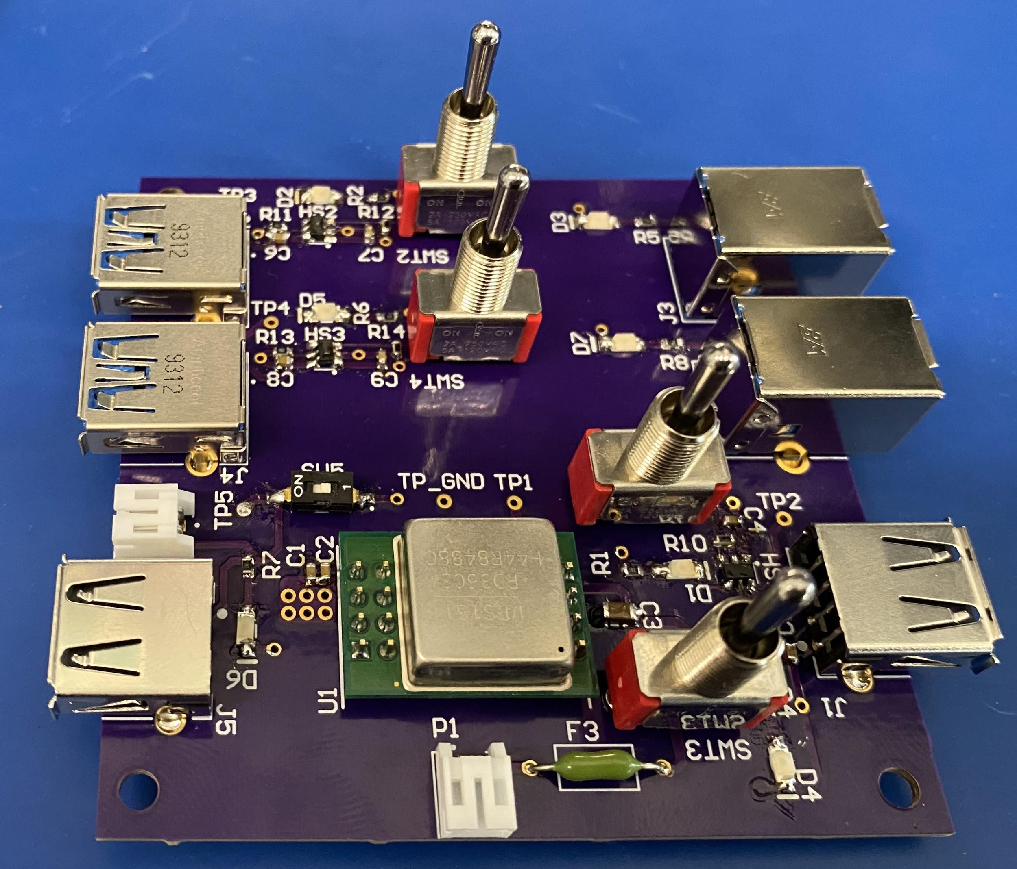
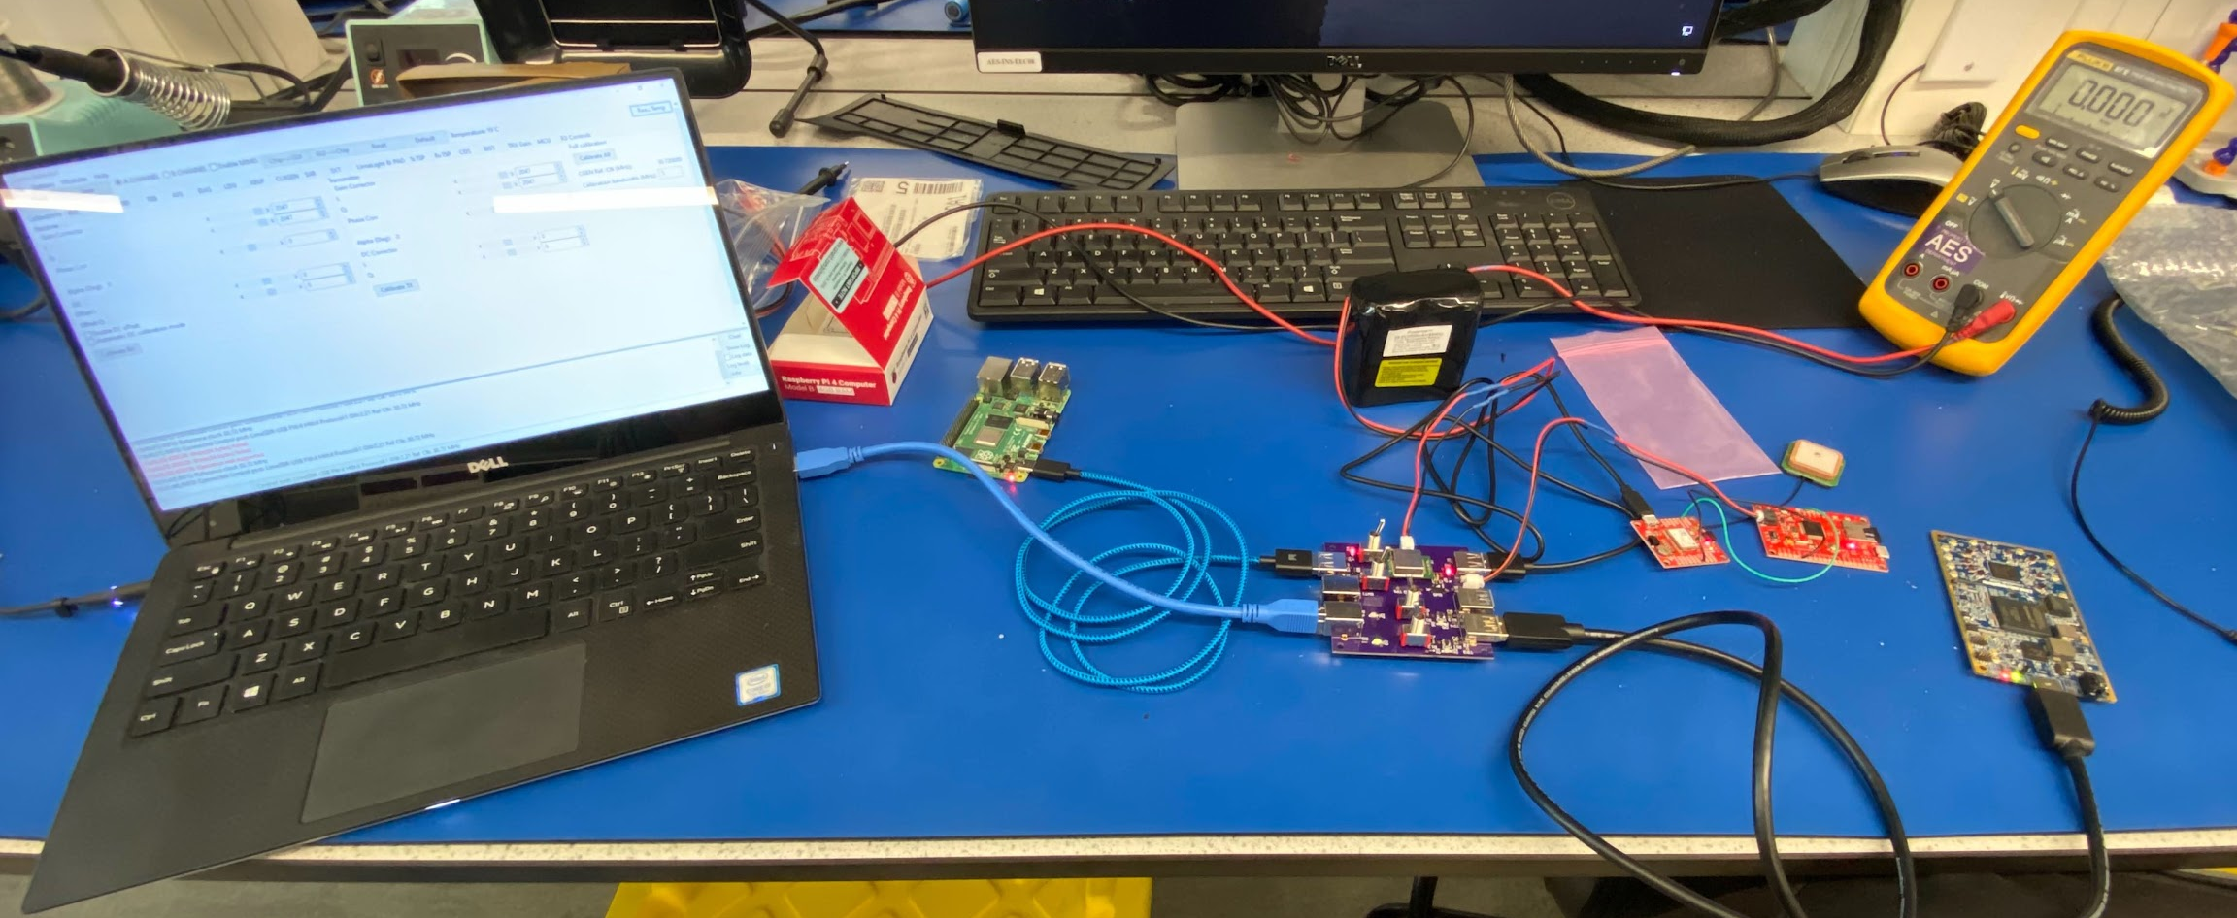
Completed Test Results: Context of CPE 4
Electrical Components Voltage Output
Must be able to convert 28 ± 6V unregulated power to 5 volts for system usage as defined by FR6
A board was designed and built up to manage a DC-DC conversation and data bypass
Tests were done upon build up for power and connection speed
Verification of power conversion and USB3.0 high speed communication was successful
Project Purpose and Objectives
Design
Description
Test Overview
Test Results
Systems Engineering
Project
Management

Slide 46
Predicted Test Results: Context of CPE 4
Temperature Constraint (-20 to 50°C)
 | Temperature Range | Meets FR5?
Software Defined Radio | -40 to 85 °C | Yes
RaspberryPi | 0 to 50°C ambient | No (but demonstrated to function outside datasheet range)
GPS and Data Logger | -40 to 85 °C | Yes
Power Board | -25 to 85 °C | Yes
Antennas | Unknown | Unknown
Battery | -20 to 70 °C discharged, -5 to 50 °C charged | Yes for discharged, no for charged
PICAN | Unknown | Yes (compatible with Pi)
Cables | -65°C to 165°C (estimate) | Yes

Slide 47
Completed Tests: Context of CPE 5
Testing
Preliminary Level One tests were completed as of March 20.
All individual components powered on and individually performed their desired functions.
Preliminary Level Two tests were partially complete as of March 20.
SDRs were able to communicate messages to each other while cabled and through antenna transmission.
PiCAN capture of data from Pi to flight computer successful
SDR/Pi integration completed in terms of hardware, transmit/receive test not successful
Full software integration not achieved
Project Purpose and Objectives
Design
Description
Test Overview
Test Results
Systems Engineering
Project
Management

Slide 48
Systems Engineering
Project Purpose and Objectives
Design Description
Test Overview
Test Results
Systems Engineering
Project Management

Slide 49
Trade Studies
Study | Outcome | Reasoning
Radio | Integrated* | Low cost/weight, ease of use
Range-Finding Method | Two-Way Range Finding | History, accuracy, and reliability
Position Determination | Phase Interferometry | Little to no effects from interference, accurate
Testing Methodology | Car | Feasible, low cost, controllable
Attitude Determination | Not included in scope | Could not reliably produce accurate results with limited budget
* Results eventually overturned in favor of Software-Defined Radio due to cost, schedule, and its variable programming.

Slide 50
Development of Requirements
Customer wanted a satellite tracking method (could be ground based or SST).
System must be operable between -20°C and 50°C. (FR 5)
System must communicate using CAN serial protocol. (DR 4.2)
System must be powered by 28 ± 6V unregulated power supply. (FR 6)
System must alert operator if satellite has drifted from predetermined path. (FR 4)
  To alert the operator, the system must be able to track the satellite with a certain degree of accuracy (not specified by customer). (FR 3)
System should be able to operate beyond Earth orbit.
  Addressed in initial project development, which led the team to steer clear of any satellite tracking methods reliant on GPS.
  This led to the development of FRs 1 and 2.
Project Purpose and Objectives
Design
Description
Test Overview
Test Results
Systems Engineering
Project
Management

Slide 51
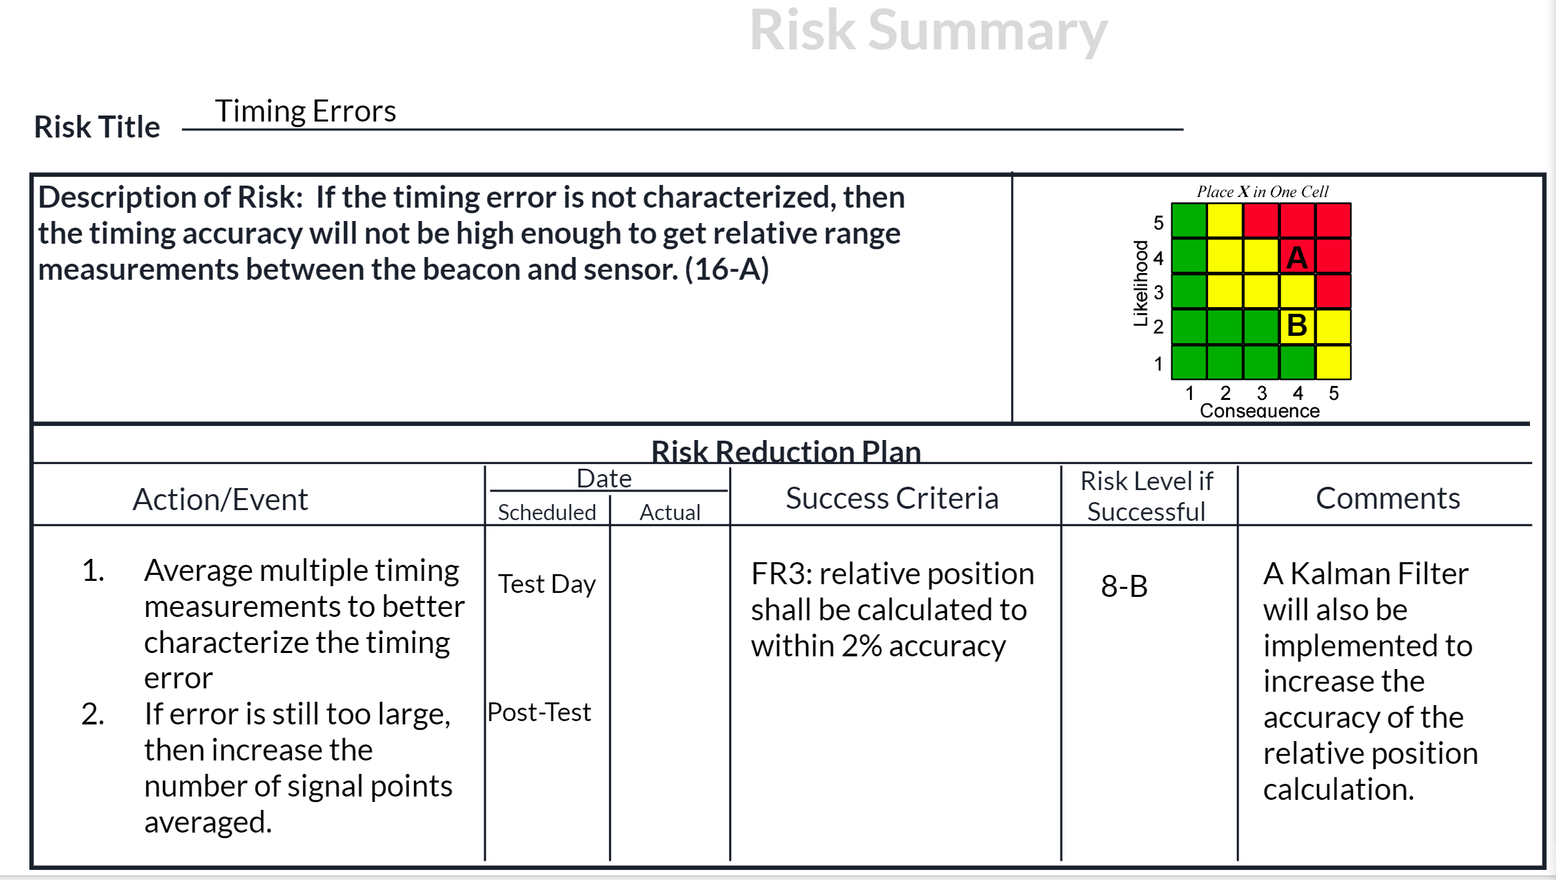
Predicted/Assessed Risks
Image (right) shows risk summary and risk reduction plan.
These were used for each design risk identified before CDR.
Project Purpose and Objectives
Design
Description
Test Overview
Test Results
Systems Engineering
Project
Management

Slide 52

Systems Engineering Challenge:
Vague Project Definition
Customer defined requirements from GA were few and far between, requiring the team to rapidly narrow the scope of the project.
  Satellite to Satellite tracking vs. Ground Station Tracking
  Descoping attitude determination
  Use of RF to determine position/range
  Emphasis on cubesats
Project Purpose and Objectives
Design
Description
Test Overview
Test Results
Systems Engineering
Project
Management

Slide 53
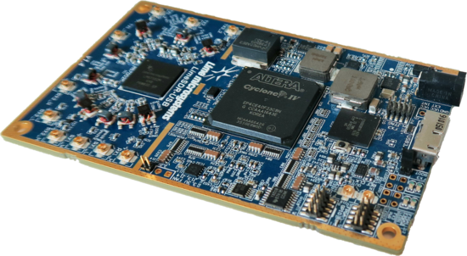
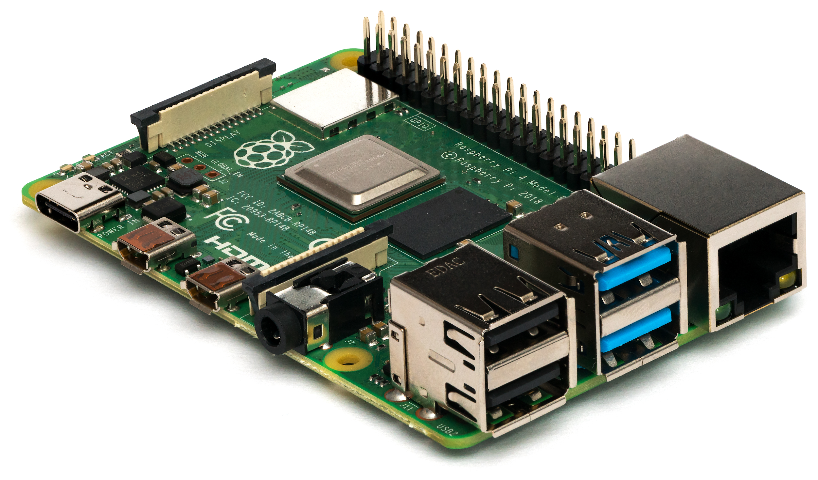
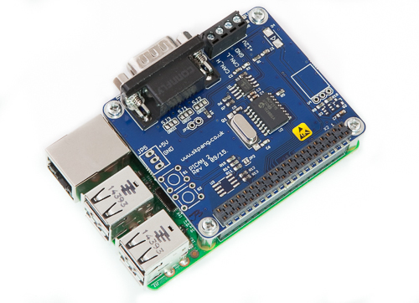

Key Takeaways
Documentation and organization are crucial.
  Better documentation in early phases of design would have facilitated organization and communication between team members.
  All-team meetings were less important as time went on; emphasis should have been placed on subsystem meetings.
Subsystems can be difficult to separate and manage individually.
  Small team meant people worked on multiple subsystems at once.
  Team was divided into hardware, software, and testing teams.
  Traditional subsystem divisions weren’t applicable due to nature of project.
Project Purpose and Objectives
Design
Description
Test Overview
Test Results
Systems Engineering
Project
Management

Slide 54
Project Management
Project Purpose and Objectives
Design Description
Test Overview
Test Results
Systems Engineering
Project Management

Slide 55
Challenges and Successes
Successes
Challenges
Team worked well with GA to define functional requirements
Project Definition and Scope Management : defining the scope of the project and mitigating against creep out of scope
On Time: all milestones were met on time and the project was still on schedule
Schedule Management: minimal experience to base time estimations on
Team Chemistry: worked well as a team and were productive with a defined objective
Communication: steep learning curve with project components and difficult keep everyone updated
Project Purpose and Objectives
Design
Description
Test Overview
Test Results
Systems Engineering
Project
Management

Slide 56
Lessons Learned
The team determines the success of the project.
Managing style changes depending on the team and the project.
Managing is easier when you have a technical understanding of the project
Bus analogy… Many things only one person knew well.
Engineering expertise/resources outside the team are invaluable
Project Purpose and Objectives
Design
Description
Test Overview
Test Results
Systems Engineering
Project
Management

Slide 57
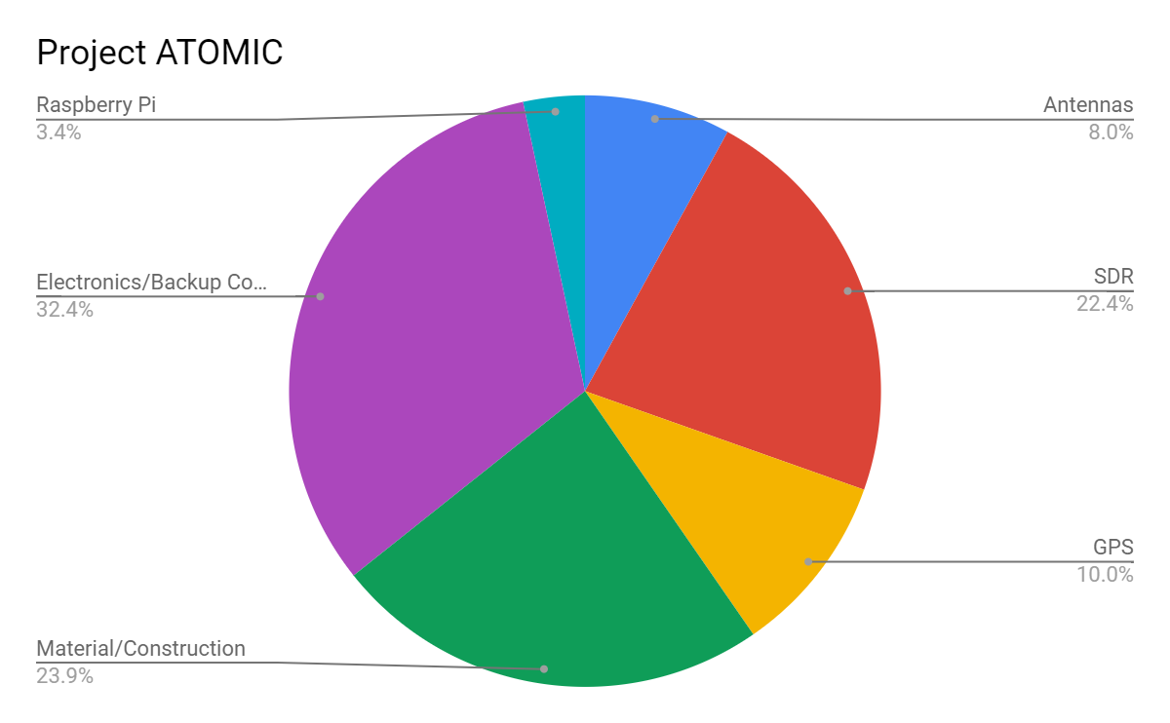
Initial Budget - CDR
Initial budget for EEF application funding: $6,000 dollars including 15% margin
Below is budget breakdown from CDR. Expected costs were reduced to about $5,000
Despite several components that were purchased to solve unforeseen issues, we came very close to this budget.
Pie chart to the right shows the component breakdown from CDR
Project Purpose and Objectives
Design
Description
Test Overview
Test Results
Systems Engineering
Project
Management

Slide 58
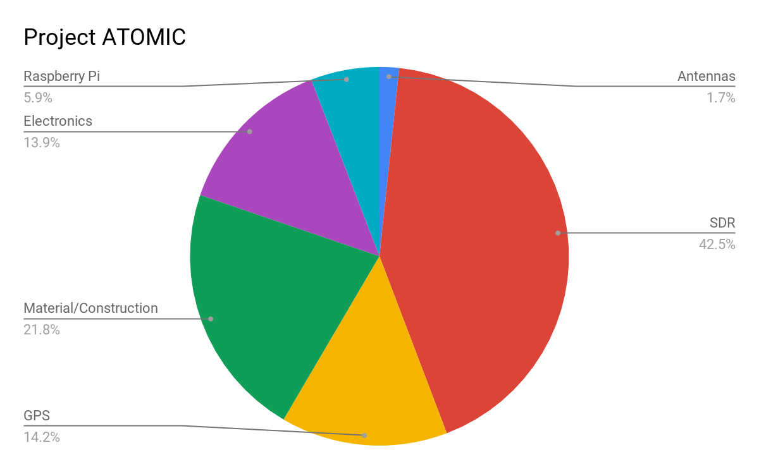
Budget Progression - FOR
Expenses Through 20 March | $4,750.87
Expected Additional Expenses | $200
Total Expected Expenses | $4,950.87
Expected Margin (Total Budget: $6,000) | $1,049.13
Budgetary Changes:
Antenna cost reduced from an expected $320 to $47.
Spent $300 less than projected on materials/construction
Spent additional $300 to buy another SDR
Overall, budget estimates were over 90% accurate.

Slide 59
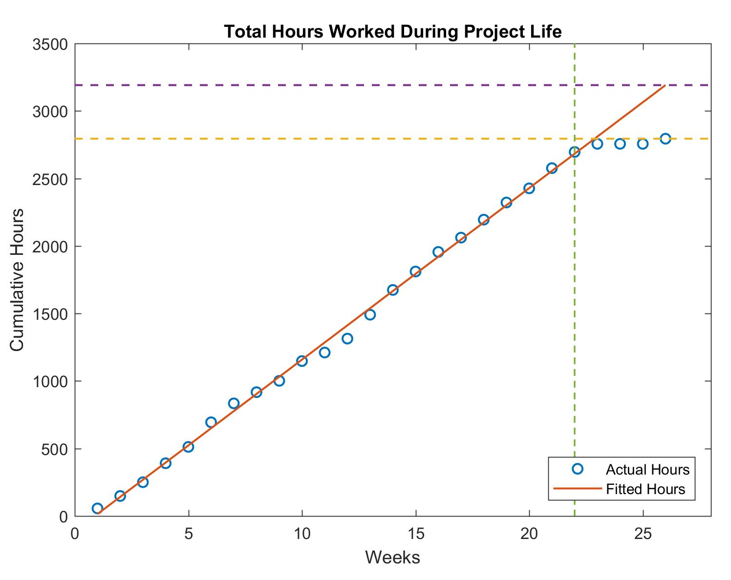
Industry Cost of Project
Total Projected Hours: 3191 hr
Overhead rate: 200%
Based on an average salary: $65,000/2080 hr
Projected Hours Worked
Actual Hours Worked
Indirect Costs
Total: | ~$200,000
Direct Costs
Labor: | ~$100,000
Materials & Parts: | $4,750.87
Total Project Cost: | $304,750.87
Project Work Stopped
Project Purpose and Objectives
Design
Description
Test Overview
Test Results
Systems Engineering
Project
Management

Slide 60
Acknowledgements
Thank you to...
General Atomics
Ben Kragt
Tommy Romano
Zach Koch
CU Boulder
Dr. Neogi
Dr. Rainville
Dr. Palo
Matt Rhode
Dr. Lahijanian
…
And all members of the PAB

Slide 61
Any Questions?
Advanced Tracking of Orbital Motion for Inter-satellite Clusters

Slide 62
ATOMIC Appendix:

Slide 63
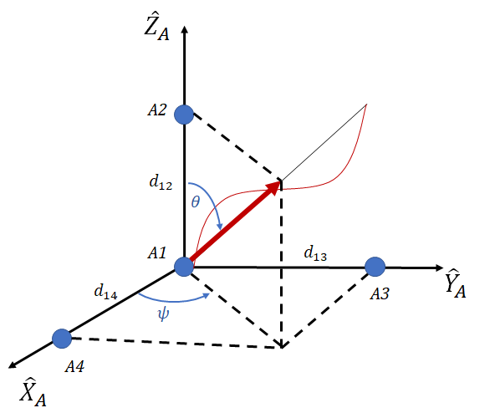
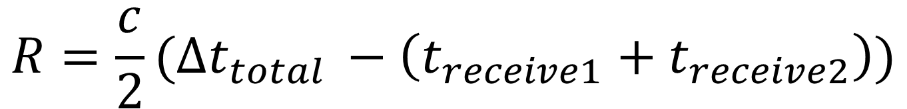
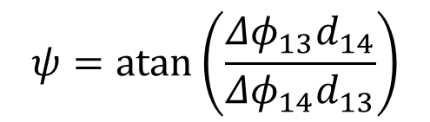
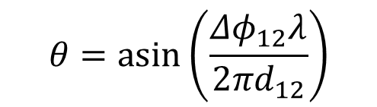
Basic Model for Position Finding
Basic Ranging Equation
Elevation Equation
Elevation Equation
Position Vector in Cartesian Coordinates

Slide 64
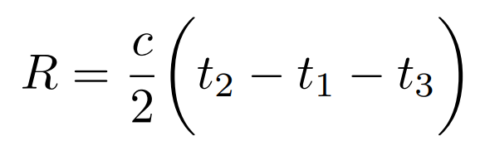
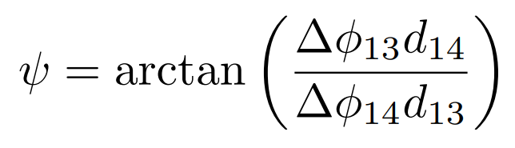
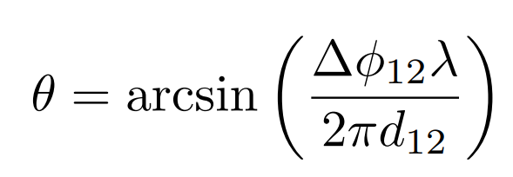
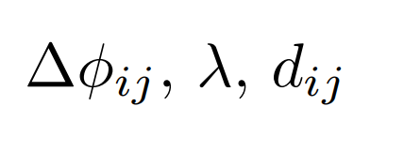
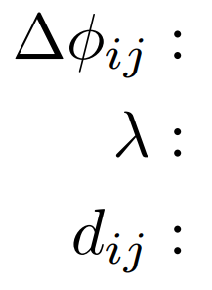
Sources of Error, Error Mitigation
Range
Azimuth and Elevation
Variables: c, t₁, t₂, t₃
Sources of Error:
c: Well known, uncertainty negligible
t₁: Raspberry Pi Clock
t₂: SDR clock, signal noise*, message
length*
t₃: SDR Throughput**, Pi Processing**,
USB Communication Time**
*Non-quantifiable, but methods to address
**Bias parts of error will be calibrated out
Variables:
Sources of Error:
Phase Measurement Error
Inaccuracy of Transmission Frequency
Antenna Wobble and Phase Center Shift

Slide 65
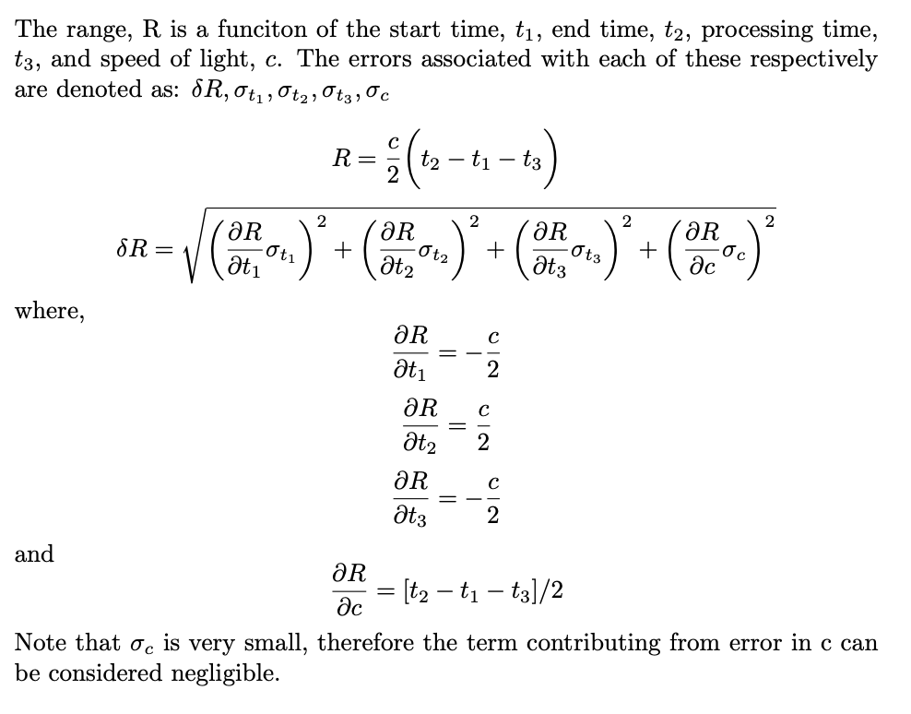
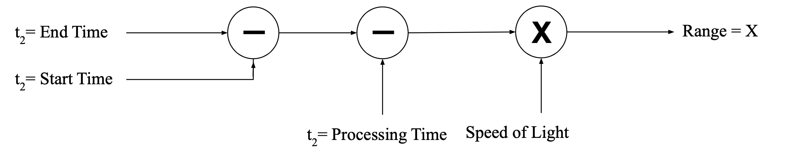
Expected Error - Range

Slide 66
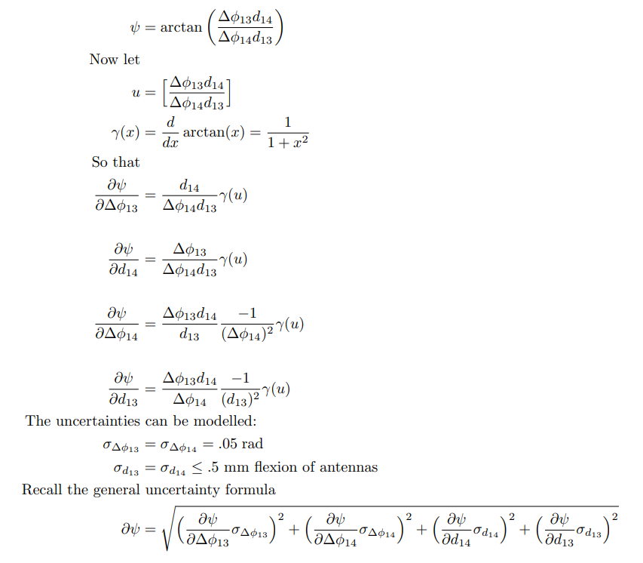
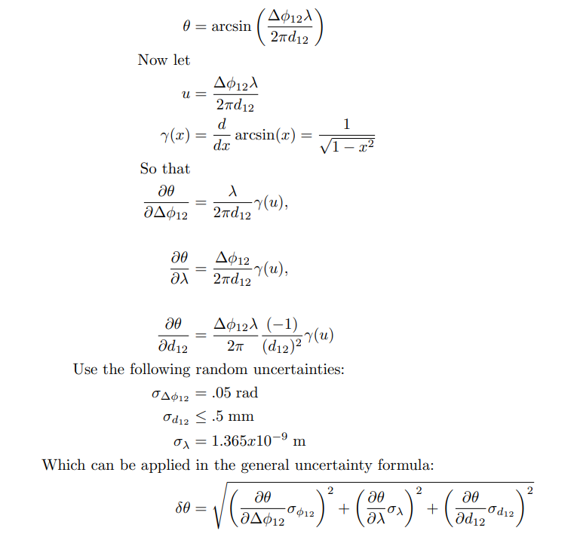
Expected Error Azimuth and Elevation

Slide 67
Monte Carlo:
Phase and Range Error
Motivation:
Demonstrate feasibility with phase and range error, using range error found previously
Summary:
Error chosen from normal random variable N(0,1) phase scaled by 0.1 rad, range scaled by 2m
Still averaging 20 pts
Converting heading error to position error
Conclusion:
Mean of Error: 1.18 m
Std. Deviation of the Error: 0.61 m
Percent of Cases within 2m: 88.6 %
Meets 2 % Requirement - Feasible
Notes:
Even with range and position error 20 points were sufficient

Slide 68
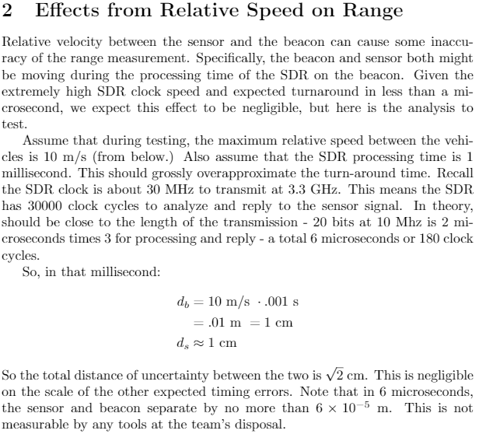
Relative Velocity Timing Error

Slide 69
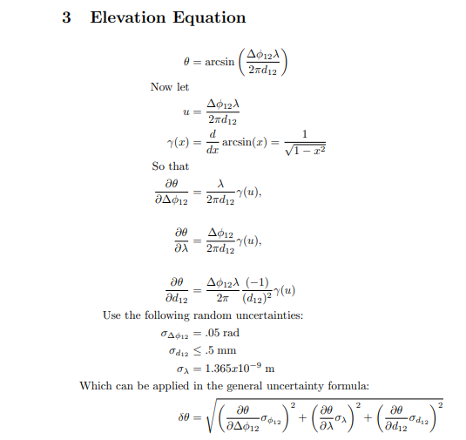
Doppler Shifting 1

Slide 70
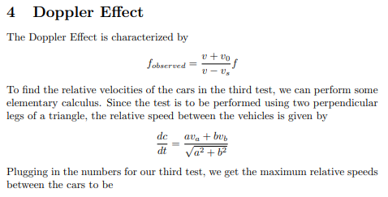
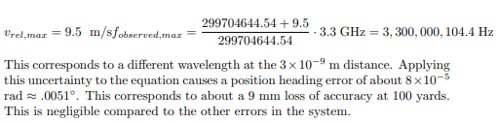
Doppler Shifting 2

Slide 71

Beacon Transmission
FR 1: The beacon shall transmit RF signals between 2 and 4 GHz (S-band).
DR 1.1: The beacon shall have an antenna(s) to transmit RF signals.
DR 1.1.1: The beacon antenna shall have a resonant frequency between 2 and 4 Ghz.
DR 1.2: The beacon and testing equipment shall be constructed materials transparent to RF.
Lime SDR: Continuous frequency range: 100 kHz – 3.8 GHz
Antennas: Omni-directional antenna set, covering frequency ranges 800-960 MHz, 1710-2170 MHz, and 2400-2700 MHz.
Materials: ABS plastic and nylon are primary construction materials, commonly used radome materials
Design Solution
Requirement Satisfaction
Risk Analysis
Verification & Validation
Advanced Development
Project Planning

Slide 72
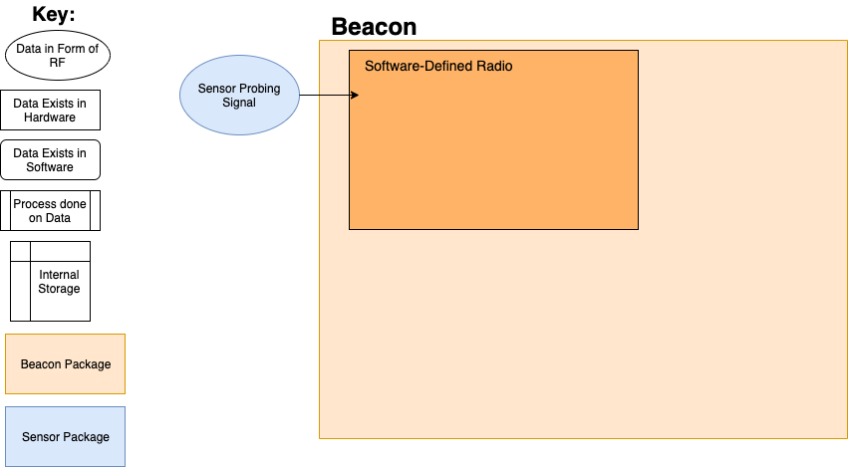
Beacon Data Flow Diagram
Design Solution
Requirement Satisfaction
Risk Analysis
Verification & Validation
Advanced Development
Project Planning

Slide 73
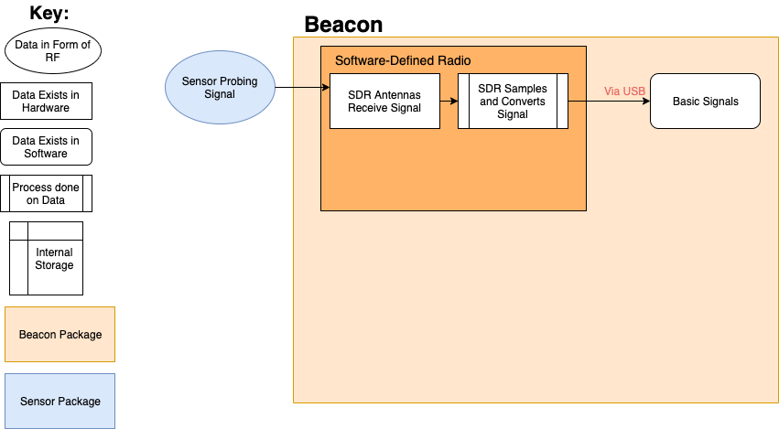
Beacon Data Flow Diagram
Design Solution
Requirement Satisfaction
Risk Analysis
Verification & Validation
Advanced Development
Project Planning

Slide 74

Beacon Data Flow Diagram
Design Solution
Requirement Satisfaction
Risk Analysis
Verification & Validation
Advanced Development
Project Planning

Slide 75

Beacon Data Flow Diagram
Design Solution
Requirement Satisfaction
Risk Analysis
Verification & Validation
Advanced Development
Project Planning

Slide 76

Beacon Data Flow Diagram
Design Solution
Requirement Satisfaction
Risk Analysis
Verification & Validation
Advanced Development
Project Planning

Slide 77
Sensor Reception/Transmission
FR 2: The sensor shall receive RF signals transmitted by the beacon.
DR 2.1: The sensor shall have an antenna(s) to receive RF signals.
DR 2.1.1: The sensor antennas shall have a resonant frequency between 2 and 4 Ghz.
DR 2.2: The sensor and testing equipment shall be constructed materials transparent to RF.
Lime SDR: Continuous frequency range: 100 kHz – 3.8 GHz
Antennas: Omni-directional antenna set, covering frequency ranges 800-960 MHz, 1710-2170 MHz, and 2400-2700 MHz.
Materials: ABS plastic and nylon are primary construction materials, commonly used radome materials
Design Solution
Requirement Satisfaction
Risk Analysis
Verification & Validation
Advanced Development
Project Planning

Slide 78

Sensor Data Flow Diagram
Design Solution
Requirement Satisfaction
Risk Analysis
Verification & Validation
Advanced Development
Project Planning

Slide 79

Sensor Data Flow Diagram
Design Solution
Requirement Satisfaction
Risk Analysis
Verification & Validation
Advanced Development
Project Planning

Slide 80

Sensor Data Flow Diagram
Design Solution
Requirement Satisfaction
Risk Analysis
Verification & Validation
Advanced Development
Project Planning

Slide 81

Sensor Data Flow Diagram
Design Solution
Requirement Satisfaction
Risk Analysis
Verification & Validation
Advanced Development
Project Planning

Slide 82

Sensor Data Flow Diagram
Design Solution
Requirement Satisfaction
Risk Analysis
Verification & Validation
Advanced Development
Project Planning

Slide 83

Sensor Data Flow Diagram
Design Solution
Requirement Satisfaction
Risk Analysis
Verification & Validation
Advanced Development
Project Planning

Slide 84

Sensor Data Flow Diagram
Design Solution
Requirement Satisfaction
Risk Analysis
Verification & Validation
Advanced Development
Project Planning

Slide 85
Software Flow Chart for SDR’s
SDR Code (Beacon)
SDR Code (Sensor)
Pi Code
Receive Poll
Transmit Poll
Average Time and Phase Measurements
Filter
Switch Antenna
Receive Response
+
Code
Compute Heading and Range
Demodulate
Auto Correlate
Extract Phase
Calculate Position Estimate
Completed
Compare Code
Report
In Progress
Filter Position Estimate
To Do
Begin Transmit
Wait
Design Solution
Project Schedule and Budget
Manufacturing

Slide 86

Kalman Filter Testing

Slide 87




Extended/Unscented Kalman Filter
Motivation: With the addition of Phase 4 testing, nonlinear dynamics need to be accounted for.
Implementation: For a discrete time step, k: Input: Q, R, u_{k}, z_{k}, P_{k-1}, x_{k-1} Output: P_{k}, x_{k}
Predict:
Correct:
Differences from Linear Filter: Computation of G_{k}, H_{k}
Next Step: Unscented Kalman Filter (UKF)
Design Solution
Project Schedule and Budget
Manufacturing

Slide 88






Feasible Cluster Configurations
Formation flying is optimal for observational missions where multiple satellites create a synthetic aperture, to simulate one large satellite
Most proposed cluster missions intended for LEO orbit
Generally separation distances of .25-6 km
Important design considerations include:
  Passive safety (will the satellites collide if control is lost)
  Stability in presence of perturbations (gravitational, atmospheric, etc.)
  Packing ratio (minimize distance, important for communication, coordinating maneuvers)
  Scalability (how easily can new satellites be added to formation)
  Cone angle (important for observations)
Sample formations shown that satisfy passive safety and stability ^{[1]}
  Shown in the Radial, Intrack, Crosstrack (RIC) reference frame that travels with the cluster
See-Saw Configuration
Stacked Configuration
Cross Configuration
Chopstick Configuration
Nested Configuration
Circles-In Circles Configuration

