Slide 1
ATLAS
Articulated Transporter for Local Acquisition
and Storage
TEST READINESS REVIEW
March 2nd, 2020
Advisor: Dr. Jean Koster
Customer: Barbara Streiffert and Jet Propulsion Laboratory
Presenters: Pierce Costello, Sage Herrin, Miriam Rosenshein, Kelan Crespin, Ender Kerr, Emily Weidenfeller
Team: Clara Bader, Jamison Bunnell, Wyatt George, Jason Leng, Charles MacCraiger, Colton Kalbacher

Slide 2
Presentation Outline
Overview
CONOPS
FBD with Focus on Testing
Design Overview
CPE’s with Focus on Testing
Schedule
Schedule Overview with Critical Testing Elements
Test Readiness
Phase I: Component Testing
Phase II: Subsystem Integration & Testing
Phase III: System Integration and Full-System Testing
Budget

Slide 3
CONOPS
Docked Child Rover
1
2
Child Rover Completes Mission
3
4
Ground Station
Deploy
Arm Stows
Retrieve Child Rover
Dock Successful
Mother rover follows path of child rover.
Comms b/w ATLAS and Ground Station
Transition
Deploy
CSR mission, HERMES
Retrieve
Notes:
Mention project purpose and objectives in this slide - mention human operator
As you work through conops animations
Notes from previous slide presentations for purpose and objective:
The Problem:
The mother rover lacks the capability to deploy, retrieve, and store the child scout rover.
Mission Statement:
ATLAS shall provide the capabilities to deploy, retrieve, and store the child scout rover while maintaining the capabilities of heritage projects
Main Objectives
Support the weight of the child scout rover during deployment, retrieval, and storage.
Retrieve and deploy the child scout rover based on ground station commands.
Receive ground station commands and send data wirelessly to ground station.
Sense the position and orientation of the child scout rover.
Operate in a mission defined forest environment.

Slide 4
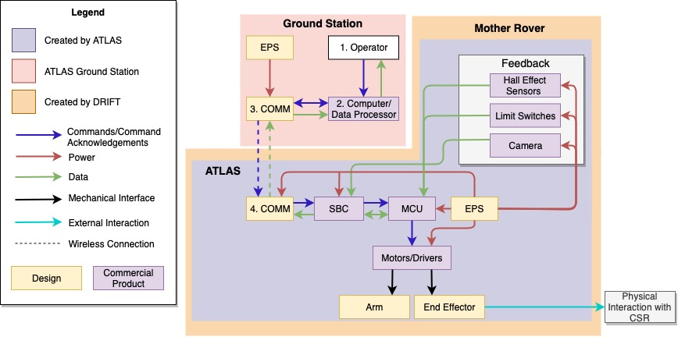
Functional Block Diagram
Notes:
FBD - focus on testing - critical elements to be tested -- motors
Hardware actuation
GUI feedback works correctly - shows limit switches etc.

Slide 5
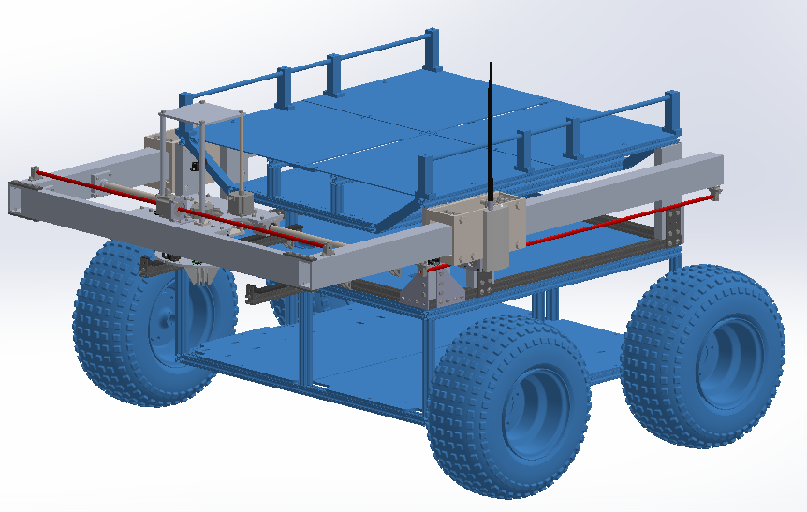
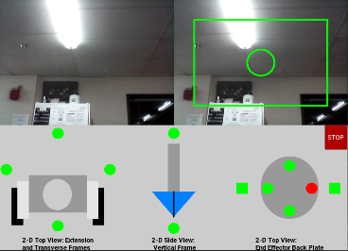
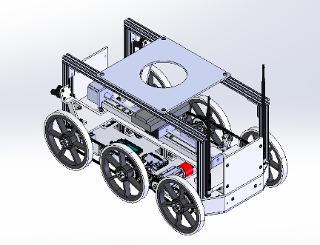
Design Overview System Interface
Child Scout Rover with Interface Plate
Ground Station
Mother Rover and Child Scout Carrying Arm
Notes:
How does baseline design work?
Mention human operatorrrr

Slide 6
Critical Project Elements
Video Transmission
Communication Testing
Motor Integration
Motor Testing
Software Integration
Human Interaction
Notes:
Testing emphasis - critical issues update from msr, etc.

Slide 7
Scheduling
Notes:
Review the whole project schedule, showing overall progress toward goals. In this case, the status
should be described with an emphasis on testing. Highlight any major changes in the project
schedule since MSR.
A comprehensive project schedule was presented for the spring semester that describes all
major tasks especially with respect to Test Readiness, milestones and relates the critical path.
Tasks potentially needing to use margin were described. (17-20 pts)

Slide 8
Schedule Overview
Feb. 21st
Feb. 29th Software
March 14th + 4 Days
March 18th + 1 Week
April 4th + 1 Week
Integration of Subsystems & Testing
Component Testing
Subsystem Assembly
Subsystem Testing
Full System Testing
Software Code
Electronic Parts
Vertical Frame
End Effector
Software & Electronics Assembly
Vertical Frame
End Effector Assembly
Software & Electronics Subsystem Testing
Extension Frame
Roller
CSR Modification
Electrical & Software + Hardware Components
Motor Actuation Test
Clamping Test
Secure CSR
Vibration Test
Hardware Integrated Actuation
Angle of Retrieval
Pick Up Test
Notes:
If they would like to see gantt online can set up a meeting to go over it - too difficult to present.

Slide 9
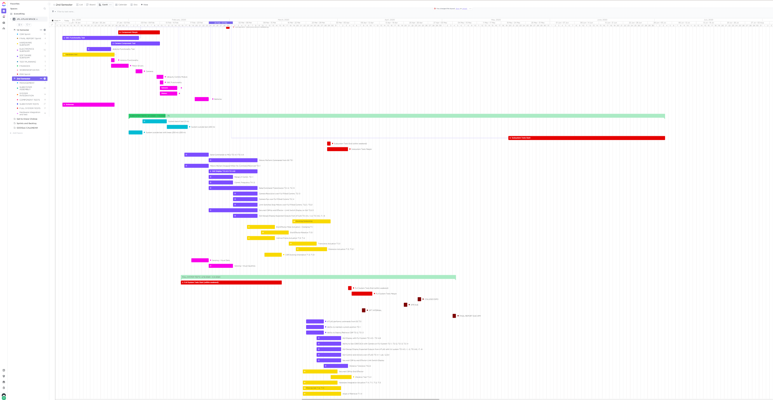
Milestones and Critical Path
Component testing
Communications testing
TRR Due
Subsystem testing
Vertical Frame Testing
Integration testing
Day In The Life Testing
Full system tests end

Slide 10
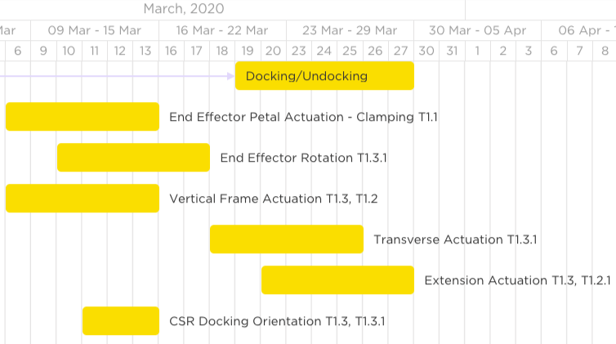

Slide 11
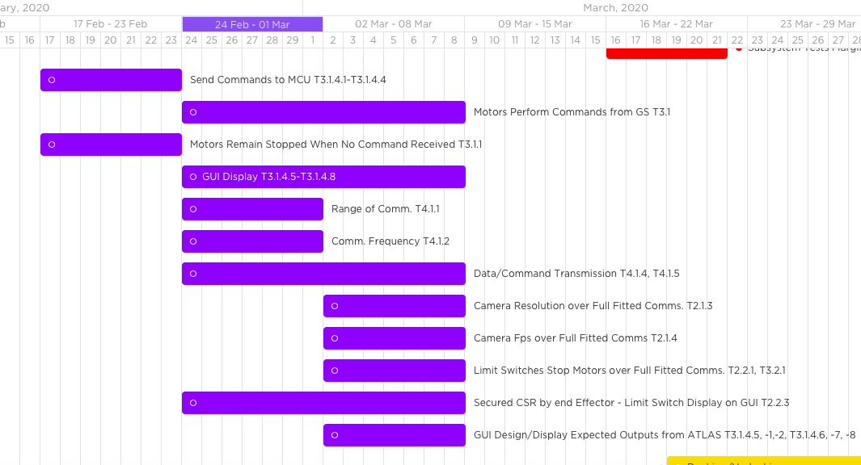
Notes:
Mention gannt in context in backup
If they would like to see gantt online can set up a meeting to go over it - too difficult to present.

Slide 12
Test Readiness

Slide 13
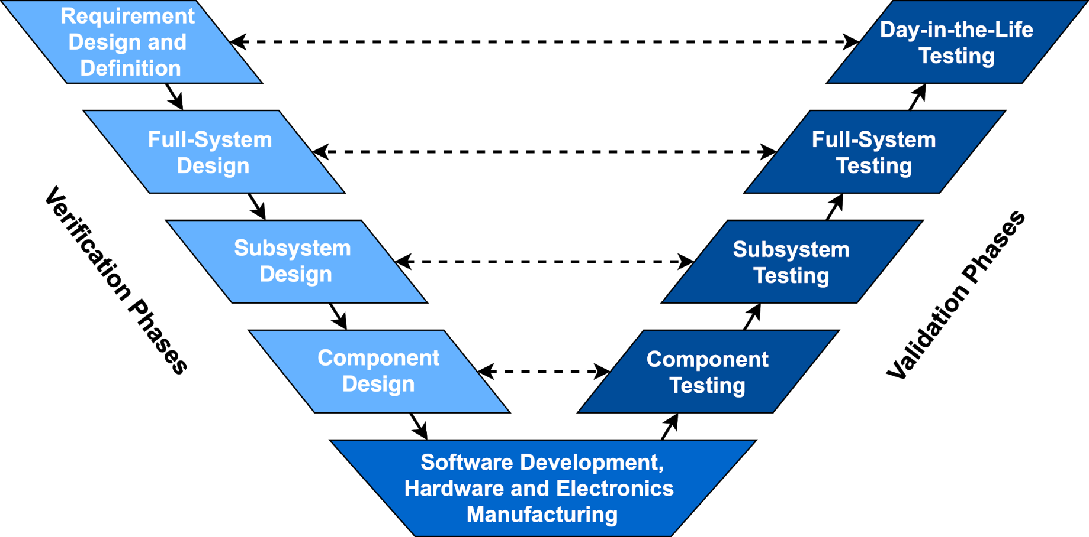
Project Progress and Testing Status

Slide 14
Overall Testing Status
Component Testing 2/1/2020 - 2/21/2020 | Subsystem Integration & Testing 2/24/2020 - 3/20/2020 | System Integration and Full-System Testing 3/22/2020 - 4/10/2020
Motor Testing Motor response testing Component fit testing Software Unit Testing SBC Functionality Camera Transmission Arduino Functions Sensing/Electronics Testing Camera Resolution FOV Camera Camera FPS Limit Switches Hall Effect Communications Testing Ubiquiti Functionality | Hardware Testing CSR Docking End Effector Petal Clamping End Effector Rotation Vertical/Transverse/Extension Frame Actuation Vibration Test Software Testing Commands to MCU Motor Performance Camera Resolution/FPS GUI Output as Expected Sensing/Electronics Limit Switches Data/Command Transmission Data Rate Communications Testing Range of Communication | Hardware Integrated Actuation Pick-up Test Angle of Retrieval Test Software Atlas Performs Commands Stationkeeping GUI Display Sensing/Electronics Tolerance Limit Switch Display/Signal Day-in-the-Life Test
*Completed
Notes:
This is a summary of our upcoming testing. Will have visual indication of completed vs not completed.

Slide 15
Phase I: Component Testing

Slide 16
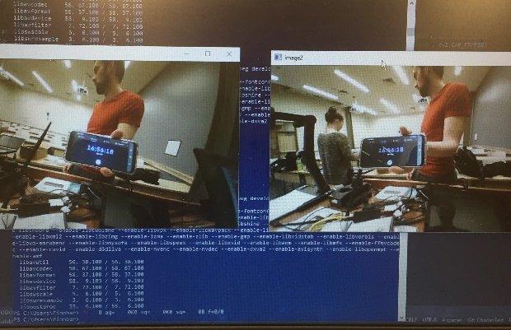
Component Test: Video, SBC, and Ubiquiti Radios
Objective: Characterizes the performance qualities of the video cameras, SBC, and Ubiquiti radios.
Success Criteria: Wireless transmission of video at various FPS and resolution from SBC to GS
Validate Requirements: T2.1.3, T2.1.4, T4.1.4
Risk Mitigated?
Results: SBC can transmit video camera feeds with required latency at a range of 10 meters.
Issues: Video resolution and frame rate needed to be lowered to reach required latency.
Status: Will complete by March 4
Measuring Video Latency with Timestamp
Frame Rate | 30 FPS | 30 FPS | 15 FPS | 15 FPS
Resolution | 720p | 360p | 720p | 360p
Latency | > 1000ms | >1000 ms | > 500 ms | < 500 ms
✔ Acceptable

Slide 17
Phase II: Subsystem Integration &
Testing

Slide 18
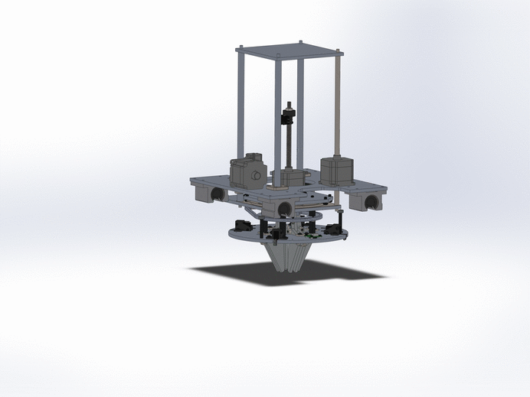
Subsystem: Motor Integration and Test
Objective:
Verify that the motors are functioning as predicted (compare predicted speeds with actual)
Verify that the software and motor drivers are interacting with the motors correctly (compare commanded speeds with actual)
Validate requirements associated with motor
Success Criteria:
Commanded speed should match the measured velocity.
Performance characterized by how closely commanded velocity matches expected RPM and linear velocity under load of CSR
Requirements Validated:
T1.3 | The CSCA shall retrieve the CSR when it is in operational position.
T1.2 | The CSCA shall deploy the CSR.
Notes:
Risks associated with force required being so close to expected force provided. Also so many components interacting together.
Why is this critical?
What does this achieve?
What variables and under what conditions are being tested?
How?
Expected results?
What is a satisfactory result?
What lvl of success does this test leave us at?
7:51
And the test matrix get the variables and conditions

Slide 19
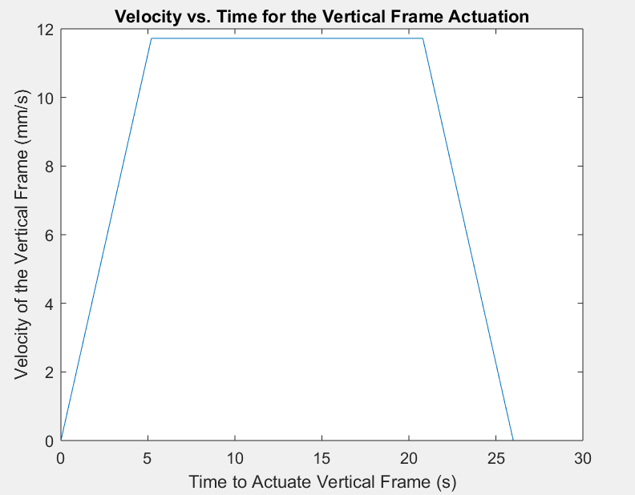
Subsystem: Predictive Motor Models to Validate
Risk Mitigation:
Measure of expected speed improves ability to accurately control ATLAS
Status: Completed by March 13th
Testing for: Motor Linear Velocity under load
Key Variables: Software mode (commanded speeds)
Level of Success Achieved:
Structures - Level 2
Control - Level 1
Notes:
Software: Arduino sketches will be used to command motors on the CSCA. Motor drivers are rated to operate at a maximum of 3.0 amps with cooling and at or below 175 degrees Celsius.
Procedure:
Mount vertical frame to test stand
Ensure CSR is secure on end effector/vertical frame
Upload software to arduino
Connect motor controllers and motor
Command motor drivers to actuate the motors at various set speeds and measure time to fully actuate the vertical frame at each commanded speed.
Compare the measured speed with the speed defined to the motor drivers and those from the performance prediction plots.
What variables and under what conditions are being tested?
How?
Expected results?
What is a satisfactory result?
What lvl of success does this test leave us at?

Slide 20
Subsystem: Hardware Integration Test Design
Procedure:
Mount vertical frame to test stand
Secure CSR on end effector
Upload software to arduino
Connect motor controllers and motor
Command motor drivers to actuate the motors at various set speeds
Measure time to fully actuate the vertical frame at each commanded speed
Compare the measured speed with the speed defined to the motor drivers
Compare measured speed with performance prediction plots
 | Weighted | Unweighted
1 mm/s
3 mm/s
6 mm/s
9 mm/s
12 mm/s
Notes:
Objective: Models Verified/ Requirements Validated
Success Criteria: Expected outcome
Risks mitigated: Why is this important to our project and maybe what risks have we considered with the test itself.
Status: Current status. Planned? In progress? Completed? Include the date

Slide 21
Phase III: System Integration and
Full-System Testing

Slide 22
Full-System Test - Deployment T1.2
Objective: Validate functional requirements in lab environment and real environment
Success Criteria:
Complete full system tests, meet functional requirements.
Validate all related models from CDR.
Risk Mitigated: Reduces risk for potential failures during the real mission.
Status:
March 23 - April 4 (Margin until April 10th)
Will have premade checklist
Performed near field near Aero. Building
T3.2, T4.1- Data & Comms.
+/- 5° from 0° plane
T3.1 Remote Control
T2.1 - Sensors
T2.2 - Avoidance of damage
T5.1 power
Notes:
What is being tested for?
Functional requirements related to deployment of CSR and actuation of arm
Validating models from CDR linked to design requirements that support functional requirements
Ability to deploy CSR

Slide 23
Full-System Test - Retrieval T1.3
Lab environment
Real Environment
T3.2, T4.1- Data & Comms.
+/- 5° from 0° plane
T3.1 Remote Control
T2.1 - Sensors
T2.2 - Avoidance of damage
T5.1 power

Slide 24
Full-System Test - Storage T1.1 & T1.4
Lab environment
Real Environment
< 5 inches.
T1.1.1 Secured CSR
T1.1.1.2 End Effector Clamping
T1.1.1.3 Pin Shear Force
T1.1.1.4 Interface Plate Bending
T1.4.1 Vibration Test

Slide 25
Budget

Slide 26
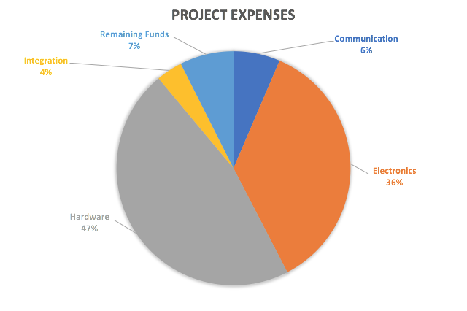
Financial Status
Hardware: $2,882.57
Electronics: $2,226.42
Integration: $225
Communications: $399.16
Total Expenses: $5,733.15
EEF Funding: $1,194
Total Budget: $6,194
Remaining Funds: $460.85
Notes:
Jacquelyn sent me receipt totals of the spending that she did and according to her numbers she spent $1511.05 before we ever received the P-card. So, with EEF funding of $1194 combined with a remaining budget of $777.90 would leave the team with $460.85 in order to cover the deficit of spending currently on Jacquelyns end whenever it catches back up to us with the finance department. This is the without the monitor purchase currently

Slide 27
Procurement Status
Integration:
All major items received
Electronics:
x3 NEMA 23 Non-captive linear actuator (Due March 6th & March 18th)
x4 NEMA 23 Lead Screws (Due March 6th & March 18th)
Power:
All major items received
Hardware:
All major items received
Communications:
All major items received
Items Still to Order:
No significant project parts still need to be ordered
With $460.85 funds remaining, enough has been allocated to purchase another driving motor in case of emergency

Slide 28
Questions?

Slide 29
Backup Slides

Slide 30
Phase I: Backup Component &
Subsystem Testing

Slide 31
Component Testing: Batteries
TalentCell 3000mAh Batteries:
Planned Testing:
Endurance test to find if meets mission duration
Tested by powering Arduino Due and Tinkerboard
Can be used to test motor drivers/stepper motors
WindyNation 100Ah Batteries:
Planned Testing:
Endurance test to monitor temperature and heating of motor drivers/motors
Notes:
I wrote some shit with Kel but idk what I’m talking about. *Insert I have no idea what I’m doing meme* - Jamo

Slide 32
Component Tests Backup
Motors component tests
Motor drivers tested with smaller motors initially to prove functionality
NEMA 23 motors tested with drivers once motors arrived (prolonged shipping)
Deals with requirements T3.1.2 and T3.1.3
Limit switches tested with single motor, verified that motors can be stopped within an acceptable amount of time
Requirement T3.2.1
Hall effect sensor verified to send data to user when activated, not done with motor yet

Slide 33
Phase II: Backup Subsystem
Integration & Testing

Slide 34
Subsystem: SBC, Comms, and Video Transmission
Objective: Determine GUI FPS impact on video latency and video quality
Requirements being Validated: T2.1.3, T2.1.4, T4.1.4
Success Criteria: Consistent video quality and video latency reduced to acceptable levels.
Risks Mitigated: Operator cannot operate ATLAS if video latency is too high or video quality prevents vision of operational area.
Status: Planned for March 4th
 | GUI 5 FPS | GUI 15 FPS | GUI 30 FPS | GUI 60 FPS | GUI 120 FPS | GUI 240 FPS
Video Latency | Link | Link | Link | Link | Link | Link
Video Artifacts | Link | Link | Link | Link | Link | Link
Packet Latency | Link | Link | Link | Link | Link | Link
Packet Loss | Link | Link | Link | Link | Link | Link

Slide 35
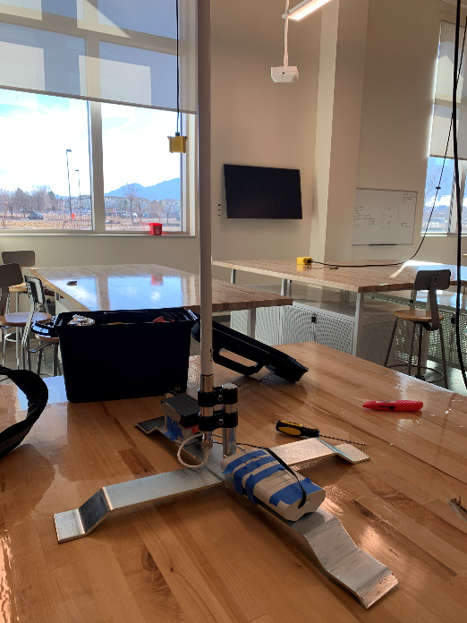
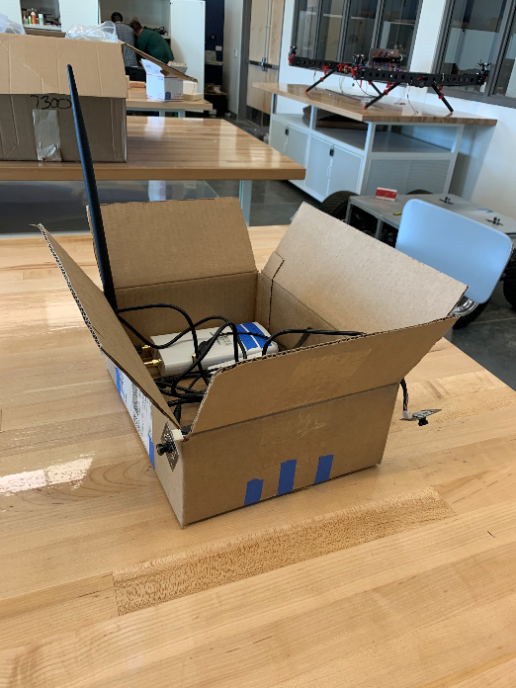
Subsystem: Communication Subsystem Test
Purpose:
To test that the assembled communication system can transmit data and video the distance required.
Requirements being Validated:
Procedure:
Setup the SBC to transmit video to the GS. Record data with ping commands and video latency with synchronized stopwatches at incremental distance up to 260 meters.
T4.1.1 | The ATLAS communication subsystem shall communicate up to distance of 250 meters with the GS.

Slide 36
Subsystem: Communication Subsystem Test
Results:
Battery Power Issue
Unstable video latency
Unacceptable video quality
Diagnostics:
Outdoor temperature draining battery charge
Signal Interference at short range
Potential Issues:
Antenna Interference
SBC/Comms System Damaged
Code Issue
Next Steps:
Vary fixed parameters to isolate issue
Ensure batteries are kept warm during future testing in cold weather

Slide 37
Limit Switch Testing
Individual limit switch tested with stopping motor upon activation
Primarily for reqt. T2.2.1/T3.2.1, component test successful
Next test will be to integrate onto hardware and test with hardware config.
Implementation of limit switches (and hall effect sensors) to prevent mechanical damage to the CSCA
Testing will verify that both physical limit switch is working and software limit switch logic is working as expected

Slide 38
Subsystem: Motor Testing
Purpose: Test functionality and motor performance under load. Important test to verify that components of the CSCA respond as expected and stay within expected current limits.
General procedure:
Power on arduino, motor drivers, and ground station/means of commanding motors
Command motors controlling extension, transverse, vertical, rotation, and end effector components individually
Monitor temperature and current during test to determine if motor drivers are performing within their specified limit
Verify motors can actuate under mission-equivalent load
Requirements Verified
T3.1.1, T3.1.2, T3.1.3
Status
Will be completed week of 3.9.20
Test will provide info on motor/driver performance over time
Notes:
Previously slide 42, moved to backup per koster’s komment
Test stand - vertical frame /secured csr test! - combines electrical, software, and hardware (not a full system test though), using fake CSR and test stand
Talk about expectation for motors, stands to test motors, and what we plan to learn from the test, and how that will verify the initial model
Talk about how we want to test the motors (test stands)
What data we are collecting to verify the model

Slide 39
Phase III: Backup System Integration
and Full-System Testing

Slide 40
Hardware Integration & Full System Tests
Hardware full system tests not covered in main slides- link to day in the life tests - and main hardware tests linked to requirements
Hardware Integrated Actuation
Show and go over general test plan, V&V, etc.
Angle of Retrieval
Show and go over general test plan, V&V, etc.
Pick Up Test
Show and go over general test plan, V&V, etc.

Slide 41
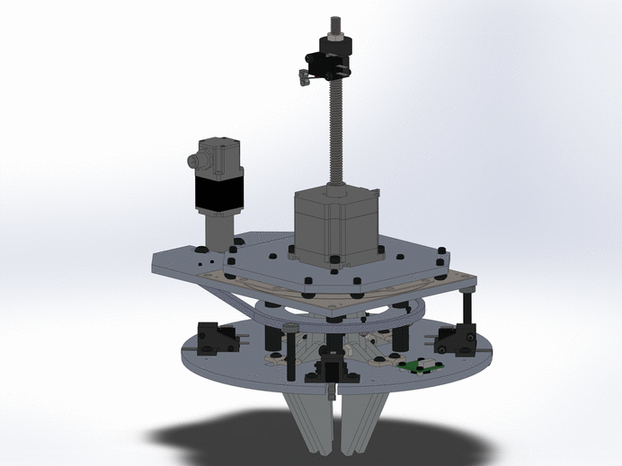
Hardware Angle of Retrieval Test
Risk: Reduces risk for potential docking
failures during the real mission.
Procedure:
Orient CSR in non-nominal orientation
Reorient CSR to acceptable docking position(Parallel to MR)
Validation of Models (Most Critical):
Rotational Motor Analysis
Grasping Mechanism
Petal Deflection
Clamping Force
Requirements
T1.1
T1.1.5
T1.3

Slide 42
Hardware Pick Up Test
Risk: Reduces risk for potential docking
failures during the real mission.
Procedure:
Orient CSR underneath of vertical frame
Actuate vertically to interface and grasp CSR
Lift CSR into upper docked position
Validation of Models (Most Critical):
Vertical Motor Analysis
Grasping Mechanism
CSR Clamp Interface
Requirements
T1.1
T1.1.1
T1.3.1.3
T1.4

Slide 43
Scheduling

Slide 44
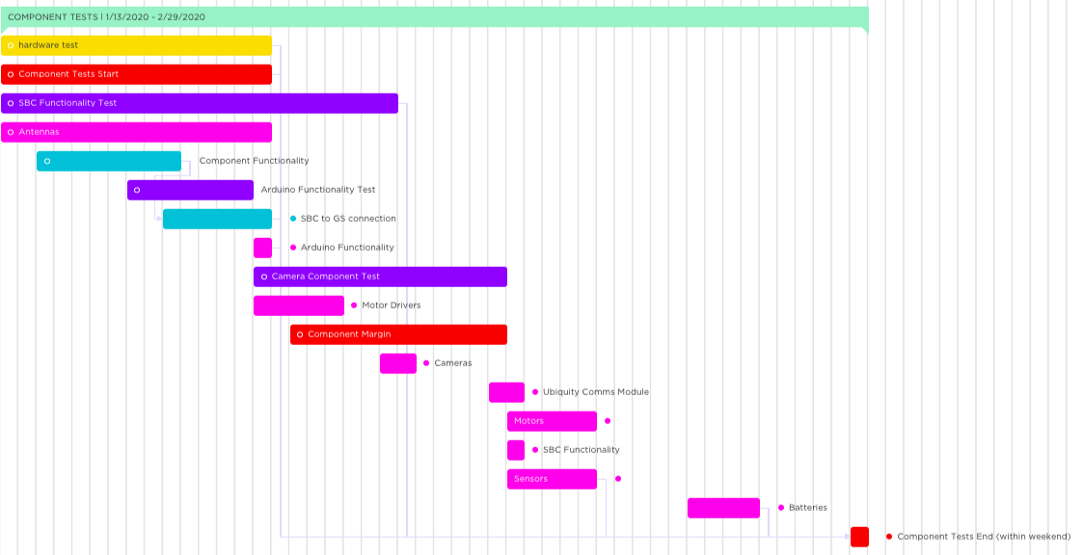
Component Tests

Slide 45
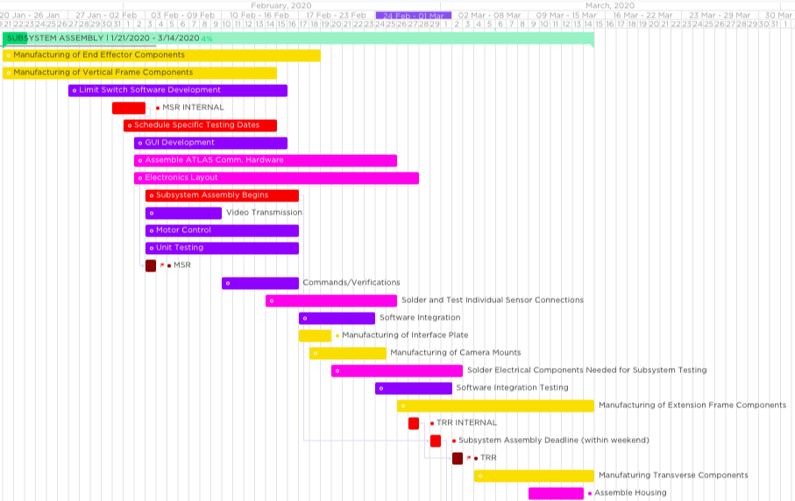
Subsystem Assembly
March 2nd, TRR DUE

Slide 46
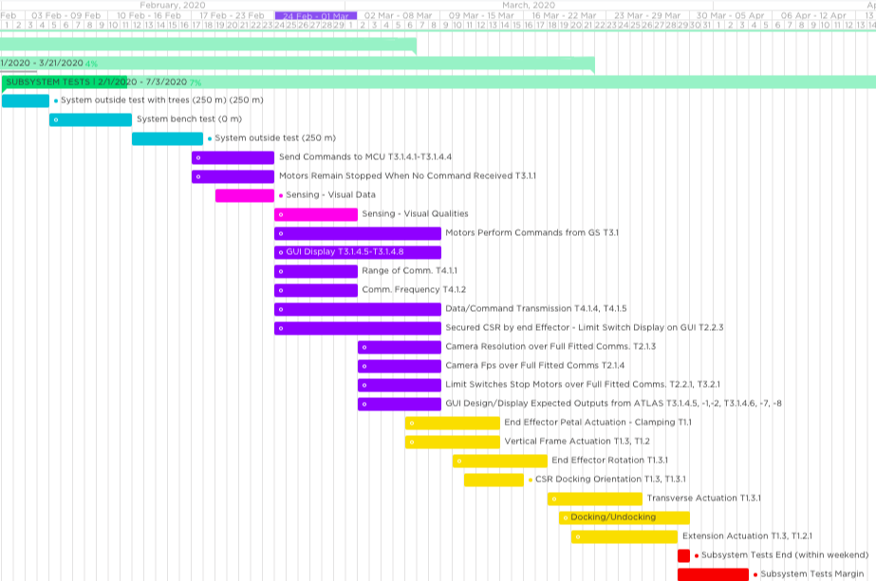
Subsystem Tests
Feb. 23rd
March 8th
March 8th
March 8th
March 13th
March 29th
Margin - April 3rd

Slide 47
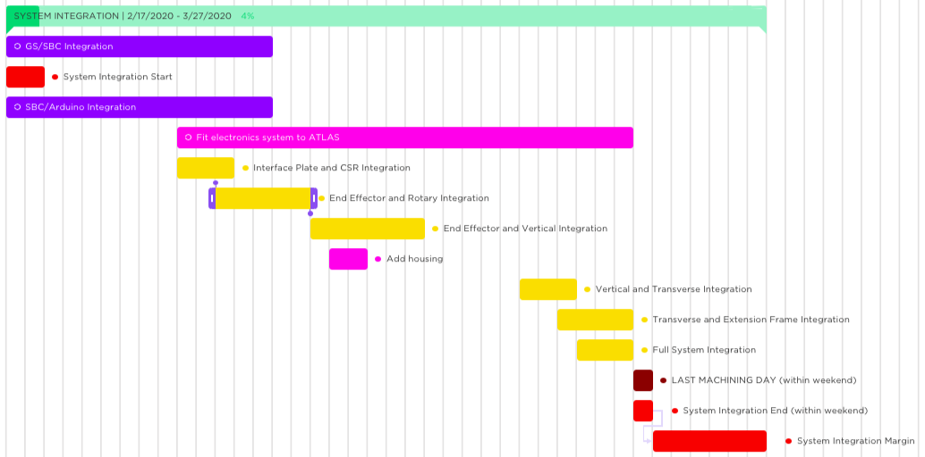
Subsystem Integration

Slide 48
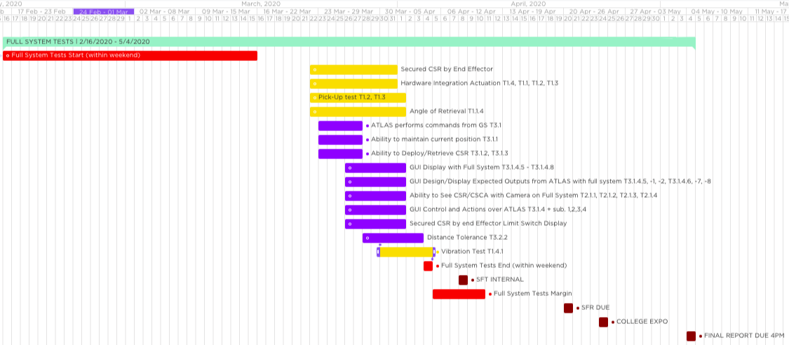
Full System Tests
April 4th, full system tests end
Margin Full System Tests - April 10th
College Expo - April 24th

Slide 49
Levels of Success
Criteria | Structure | Control | Communication | Sensors
Level 1 | Deploy/retrieve the CSR on flat ground. | Control laws move motors in an intended direction. | The ground station communicates with ATLAS while 0 meters away. | Sensors provide one view of the CSR.
Level 2 | Deploy/retrieve the CSR on a flat plane and carry the CSR on a flat plane | Control laws move motors, in an intended direction, with a latency less than 1 second. | The ground station communicates 250 meters away from ATLAS with 0 trees per acre. | Sensors provide visual data (100°) of the CSR from two angles (above CSR and from the MR POV)
Level 3 | Deploy/retrieve the CSR on a flat plane and carry the CSR on planes between -20° and +20°. | Control laws allow for joint stationkeeping. Controls move motors, in an intended direction, with a latency less than 1 second. | The ground station communicates 250 meters away from ATLAS with ~100 trees per acre. | Sensors provide visual data (100°) of the CSR from two angles (above CSR and from the MR POV). Limit switches prevent damage by preventing frames from extending outside their operational zone.
Level 4 | Deploy/retrieve the CSR on a flat plane (+/- 5° from the horizon) and carry the CSR on planes between -20° and +20°. | Control laws allow for joint stationkeeping. Control laws move motors, in an intended direction, with a latency less than 300 milliseconds. | The ground station communicates 250 meters away from ATLAS with ~170 trees per acre. | Visual camera has 120° with overlaid guidelines to guide the driving of the CSCA. Limit switches prevent damage by preventing frames from extending outside their operational zone.
Notes:
Old levels of success:
Criteria
Structure
Control
Communication
Sensors
Environment
Level 1
- The CSCA is able to lift and carry the weight of CSR.
- The MR is able to remain
level with the CSCA
installed.
- The CSCA is able to manipulate retrieval system
- The CSCA is able to receive commands and transmit sensor data
- The sensors are able to function independently from each other and the arm
- The sensors shall be able to record data and send it to a on board controller - The sensors shall include
visual and positional sensors
- The CSCA is able pick up CSR
from flat surface in nominal conditions (TBD)
- The CSCA shall be able to transport the rover over flat
surfaces
Level 2
- The CSCA is able to support weight of CSR plus a factor of safety (TBD) at TBD extension - The MR shall remain level while the CSCA is holding the CSR
- The CSCA is able to attach to and lift CSR
- The CSCA is able to respond to manual motion commands by the GS
- The CSCA shall be able to process and send data to the GS through communications subsystem
- The CSCA is able to know where the arm and grasper are in terms of defines coordinate system (TBD)
- The CSCA is able to wirelessly send and receive test signals between the CSCA and GS
- The sensors are able to return location and image data
- The CSCA is able to transport CSR in a stowed configuration over terrain traversable by the MR
Level 3
- The CSCA is able to be able to support the weight of CSR while extending or retracting
- The CSCA is able to send position data (TBD) to the GS
- The CSCA is able to retrieve and deploy with GS
- The CSCA is able to wirelessly send sensor data to the GS
- The CSCA is able to wirelessly receive command data from the GS
provide location data of the CSR to a specified accuracy (TBD)
- The sensors are able to communicate data to the CSCA and GS
- The sensors are able to transmit images of the ground at potential deployment locations to the GS
- The sensors are able to determine the orientation of the CSR with respect to the MR to a specified accuracy TBD
Level 4
- The CSCA is able to undock and deploy the CSR autonomously
- The CSCA is able to stow arm without rover autonomously
- The CSCA is able to autonomously retrieve the CSR
- The CSCA is able to communicate with the GS at maximum operational range of MR (500 m)

