Slide 1
ALL-Electric ROver
for Sample Storage
Team: David Koester (PM), Emily Mitzak
Owen Kaufmann, Aaron Buller,
Adam Trunko, Benjamin Lodwick,
Keaton Paquin, Max Malden,
Patrick Riley, Ricardo Lopez-Abadia
Underlined: Presenters
Sponsor: Jet Propulsion Laboratory, Barbara Streiffert
Advisor: Dr. Jean Koster
Test Readiness Review
Notes:
25 min time limit!

Slide 2
PROJECT OVERVIEW

Slide 3
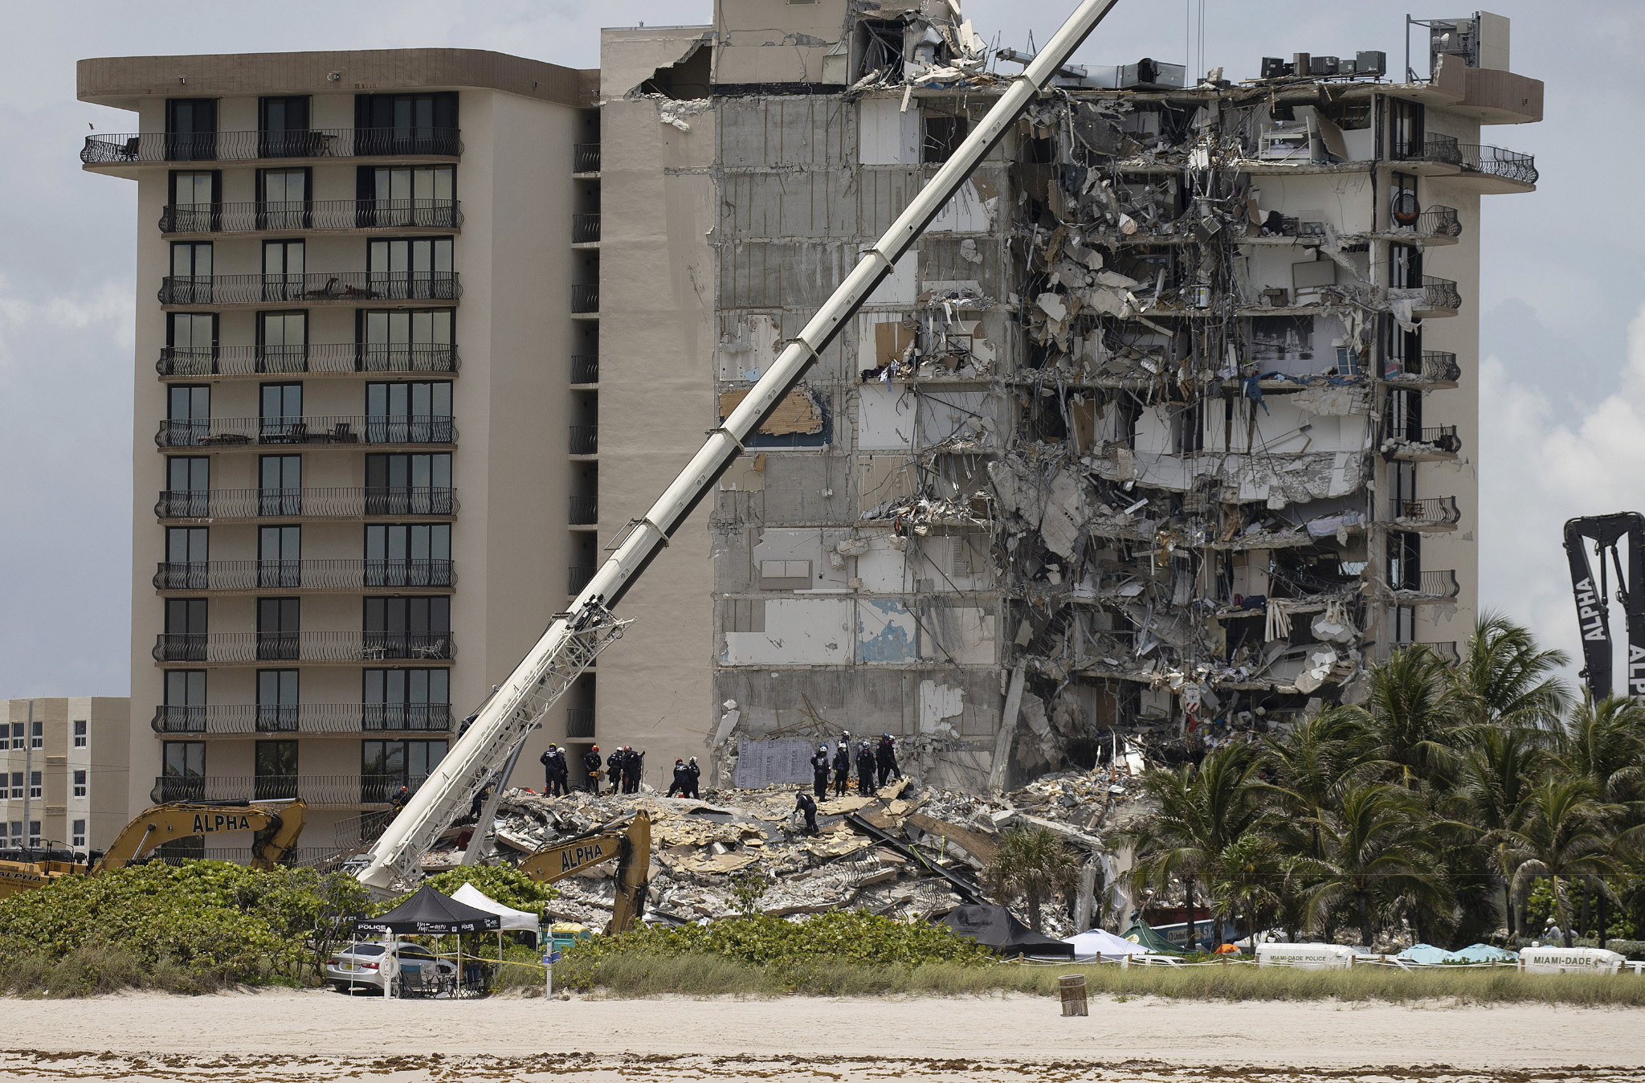
Motivation
Accessibility to certain areas on Earth may be better suited for robots than humans
Building collapse
Natural disaster zones
Samples may be required but risk to humans is too high
Mitigating the risk to humans in acquiring samples requires:
Rover that collects and stores sample of interest
Courtesy: NPR
Timeline
Motivation
Updates
Schedule
Testing
Budget
Notes:
Notes for Presentation:
-Why are we doing this?
-Some areas are impractical for humans to access
-Location
-Environmental Hazards

Slide 4
Objectives:
AEROSS: All Electric ROver for Sample Storage
To create a user controlled rover (AEROSS) that will:
Collect a rock sample
Store the sample in a collection container
Deposit the sample at a specified location for later retrieval
Timeline
Motivation
Updates
Schedule
Testing
Budget
Notes:
David
Keeping rock here, make sure to specify this.
The All-Electric ROver for Sample Storage (AEROSS) team will provide JPL with a child rover that will collect a rock, put the rock in a capsule and deposit the rock in a specific location. The child rover will also have the ability to communicate with a team-manufactured ground station

Slide 5
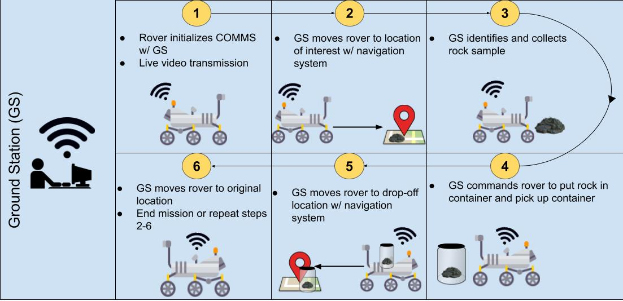
CONOPS:
Timeline
Motivation
Updates
Schedule
Testing
Budget
Notes:
Rico
Make sure to specify semi-autonomous

Slide 6
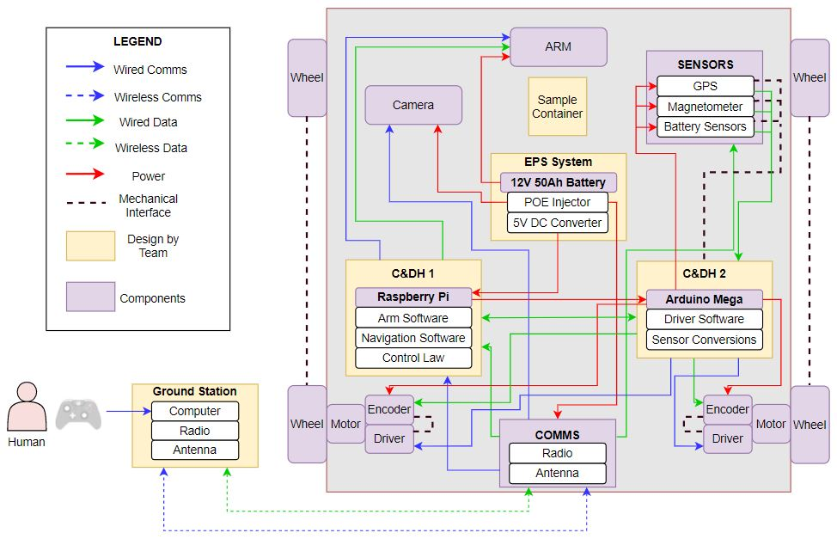
Functional Block Diagram:
Timeline
Motivation
Updates
Schedule
Testing
Budget
Notes:
Ben
Laser pointer when presenting

Slide 7
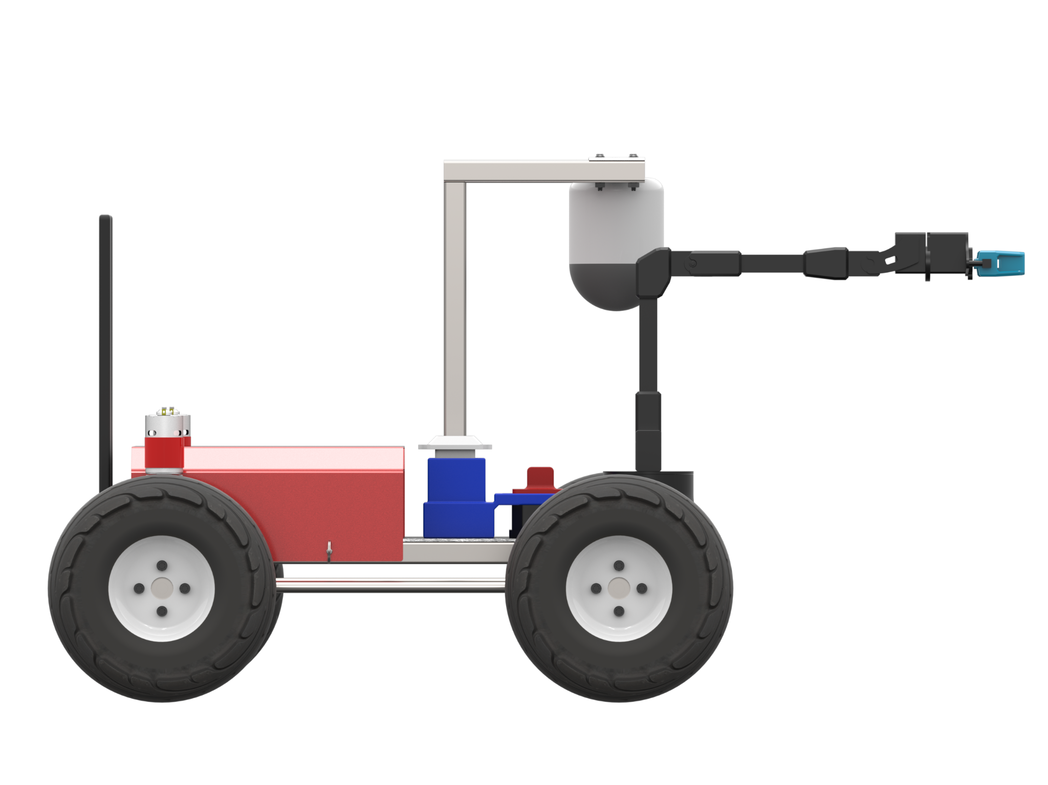
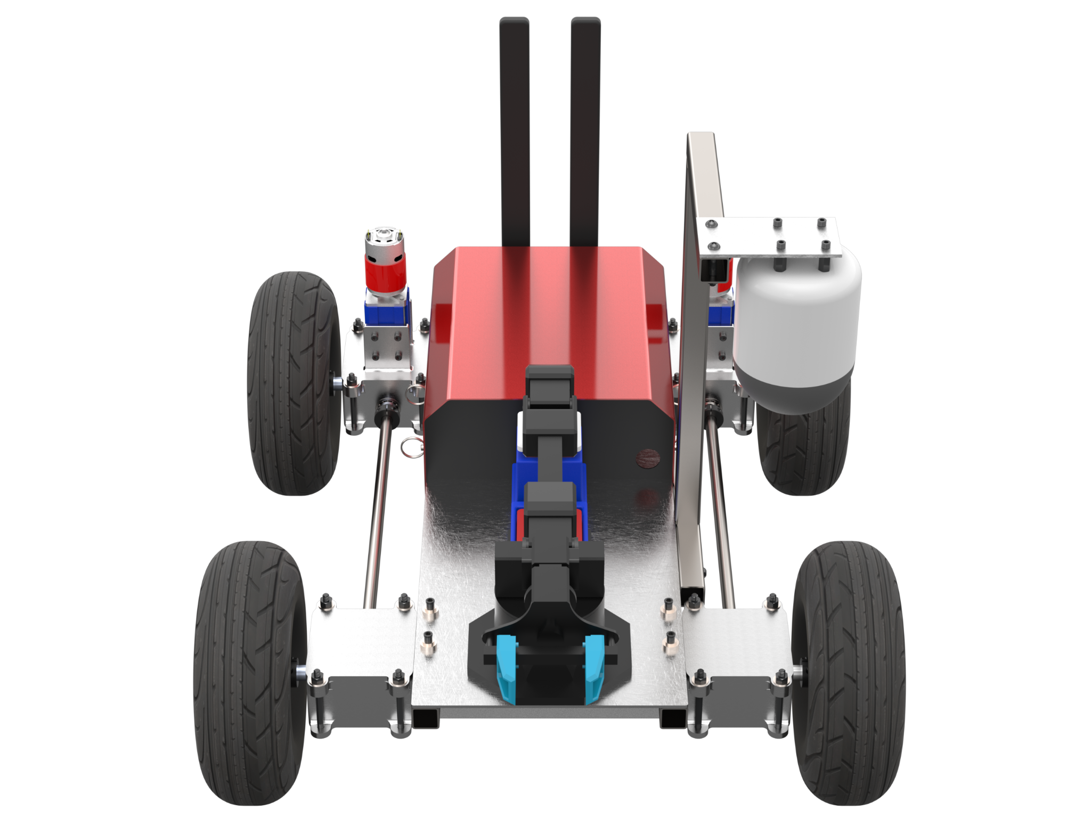
Baseline Design
Presentation Layout
MASS: 25 kg
61.7 cm
Height
Sample Acquisition
Sample Deposit
Communication
Navigation
50.8 cm
Wheelbase
57.4 cm
Track
Timeline
Motivation
Updates
Schedule
Testing
Budget

Slide 8
Critical Project Elements
CPE | Description | FR:
Sample Acquisition | The rover must able to identify, collect, and store a sample of interest | 1,2
Sample Deposit | The rover must be able to deposit the collected sample at a specified location for later retrieval | 3
Navigation | The rover must be able to navigate over a defined terrain towards a sample of interest and return to a specified location | 4
Communication | The rover must be able to communicate with the ground station in order to receive control commands and relay live video data | 5,6
Timeline
Motivation
Updates
Schedule
Testing
Budget

Slide 9
Updates

Slide 10
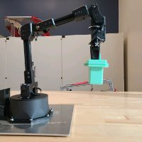
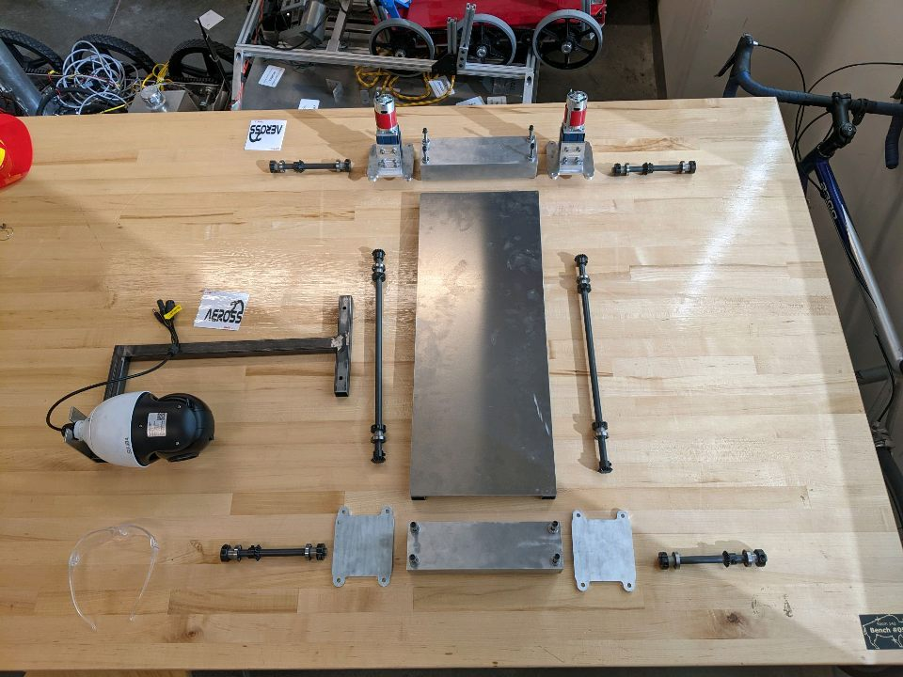
Updates: Manufacturing Status
Reactor X 200 Robotic Arm acquired
AEROSS frame, axels, camera mount, motor brackets manufactured
Timeline
Motivation
Updates
Schedule
Testing
Budget

Slide 11
Updates: Testing Updates
EPS
SOFTWARE
Tests Completed:
Voltage Sensor
Camera mobility
Tests In Progress
Current Sensor
GPS Receiver
Magnetometer
Arm
Battery Discharge
Tests Needed:
Motor Encoder/Driver
Arduino/Rpi interface
Full sensor integration with Arduino
Full power integration
Tests Completed:
Ground Station to Rover Communications Software
Ground Station data flow
Rover data flow
Tests in Progress
Arm Control
Current Sensor
Magnetometer
Tests Needed
Ground Station GUI
Pi to Arduino serial communication
Navigation and Loss of Comms algorithms
Full software integration
Timeline
Motivation
Updates
Schedule
Testing
Budget
Notes:
I changed the title. what was it before. eps status. ok this is definitely more accurate. cool.

Slide 12
Schedule

Slide 13
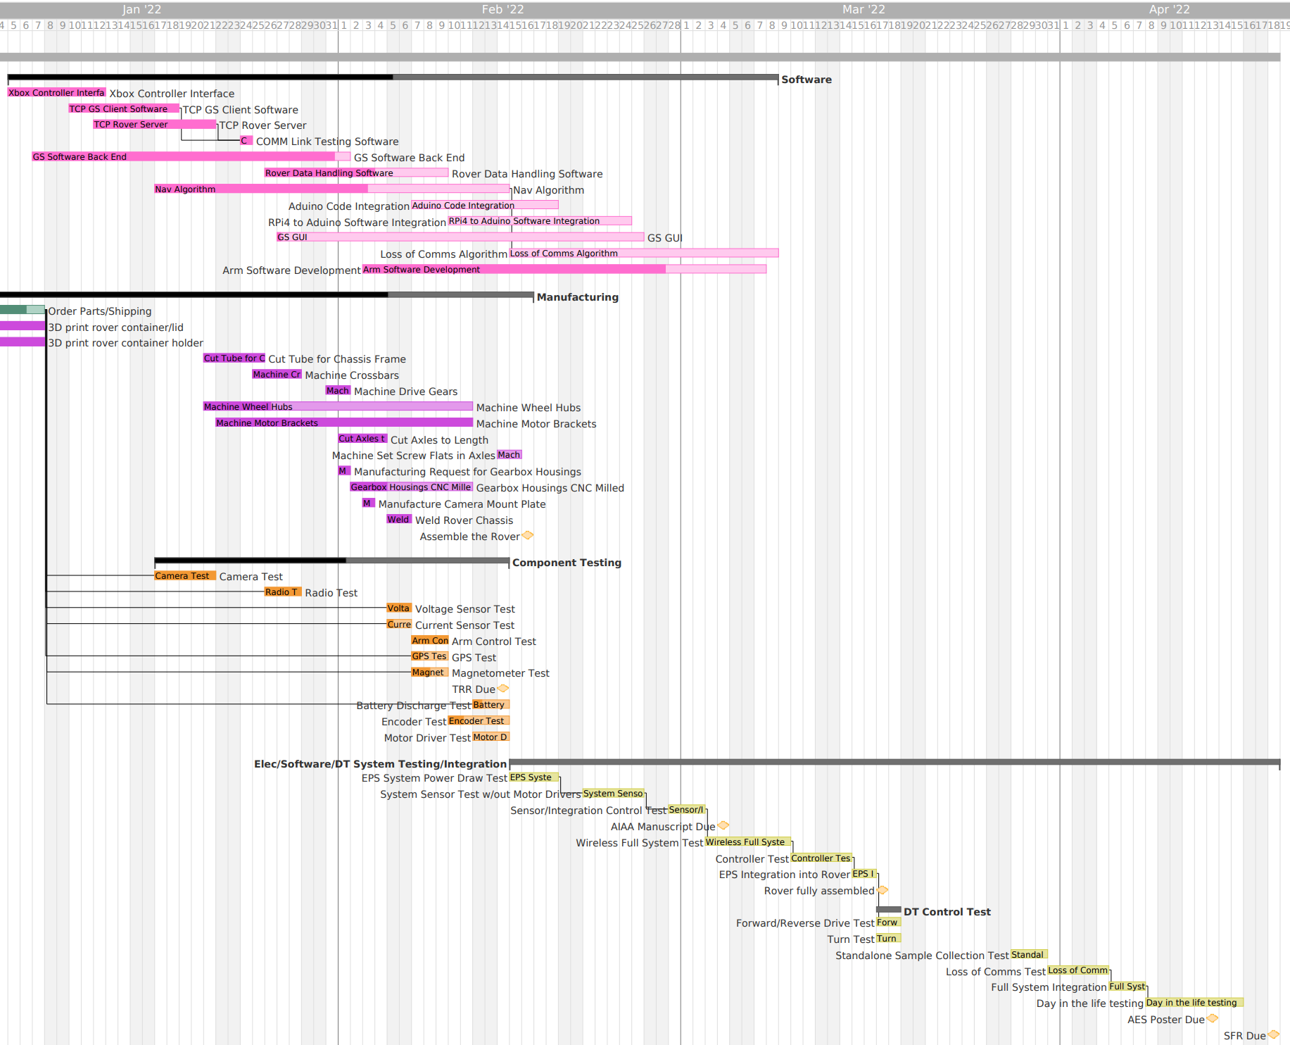
Legend:
Software
Manufacturing
Component Testing
System Testing
Testing Described in Detail
Milestones
Critical Path
Timeline
Motivation
Updates
Schedule
Testing
Budget
Notes:
HIGH LEVEL GANTT

Slide 14
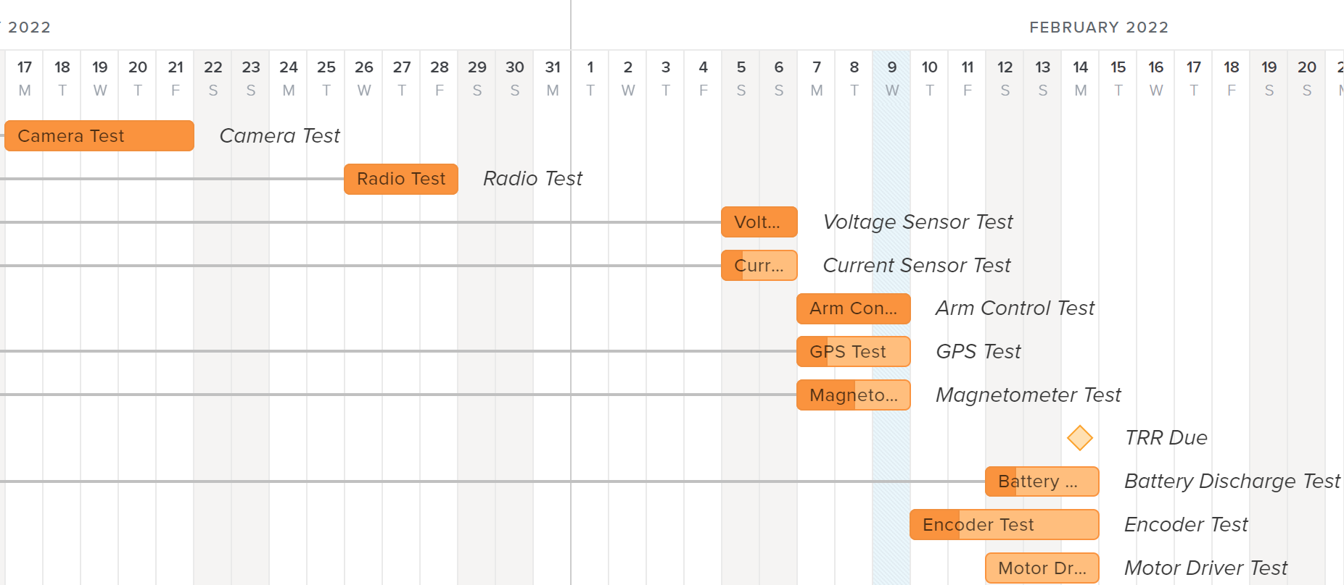
Component Testing
Testing Described in Detail
Timeline
Motivation
Updates
Schedule
Testing
Budget
Notes:
Next few weeks gantt

Slide 15
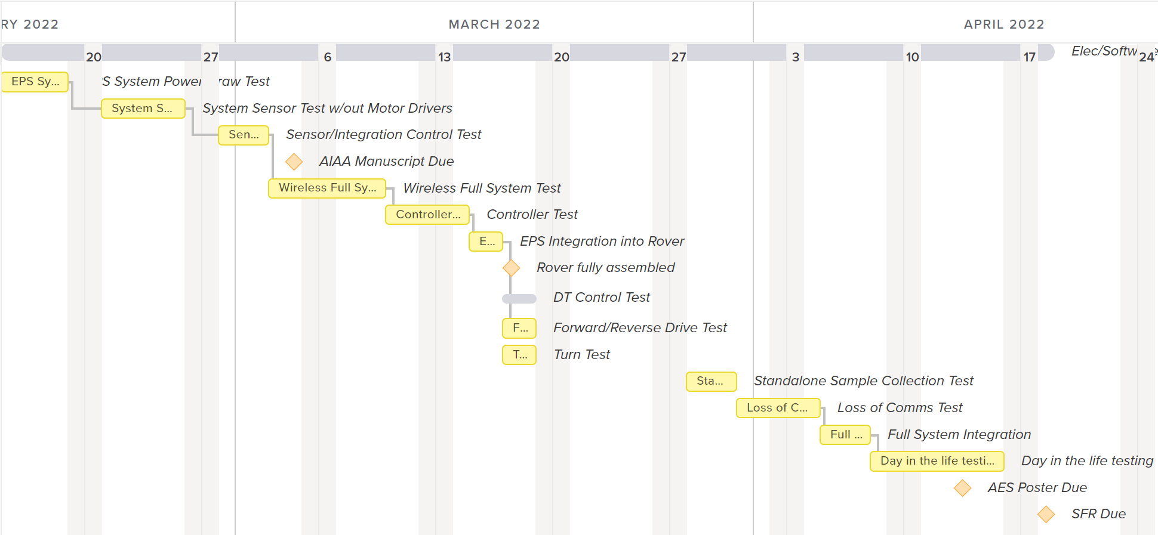
Sub/Full-System Testing
Testing Described in Detail
Timeline
Motivation
Updates
Schedule
Testing
Budget

Slide 16
Testing

Slide 17
Overview
System | Test | Facilities | Model Validated | Status | Expected Date
Component | Radio | Aero Backyard | Data Rate/Power Received | Completed (Passed) | 1/28
 | GPS | Boulder County PCN | N/A | Completed (Failed) | 2/12
Subsystem | Mock Sample Coll. (Wired) | Projects Room | N/A | Completed (Passed) | 2/5
Full System | Day in Life | Aero Backyard | CONOPs | Not Started | 4/8
Timeline
Motivation
Updates
Schedule
Testing
Budget
Notes:
Talk about the motor encoder, GPS, and magnetometer and radio. These are the ones we have some concrete V and V we could do

Slide 18
GPS Test
Purpose:
Ensure GPS can achieve <= 1m accuracy 75% of the time
Characterize accuracy of GPS receiver
Ensure accurate location data is being received
Verify preliminary code
Risk Reduction:
Reduction of failure in software
Reduction of > 1m radius from the sample location
Equipment:
GPS sensor, Jumper wires, Micro-USB, Laptop, GPS antenna, Boulder PCN*
FR3: AEROSS shall be able to deposit the container at a location specified by the ground station
DR3.1: Deposit the sample container within 1m radius of specified location by the ground station
FR4: AEROSS shall drive to a specified location and return to its original location
DR4.2: Return to its original location upon loss of communications with the ground station
Testing Procedure Overview
Assemble Hardware
Run code
Record results for 1 hour
Take moving average of measurements
Compare results to known Boulder PCN* value
Deadline: 2/9
Completed: 2/12
*PCN - Primary Control Network
Timeline
Motivation
Updates
Schedule
Testing
Budget

Slide 19
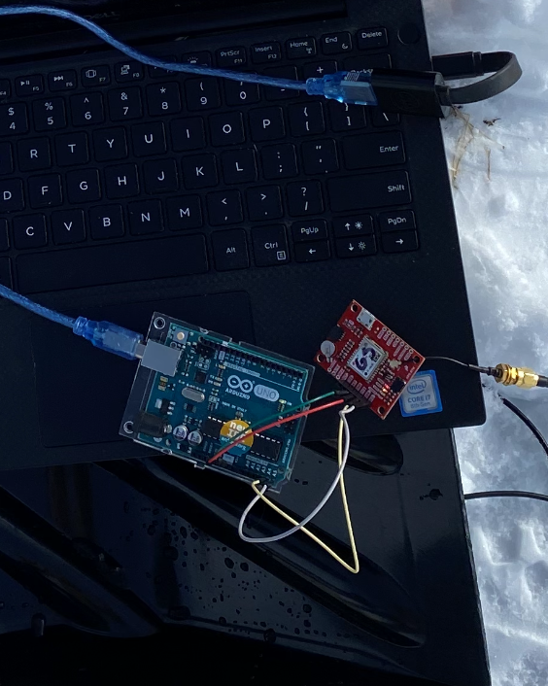
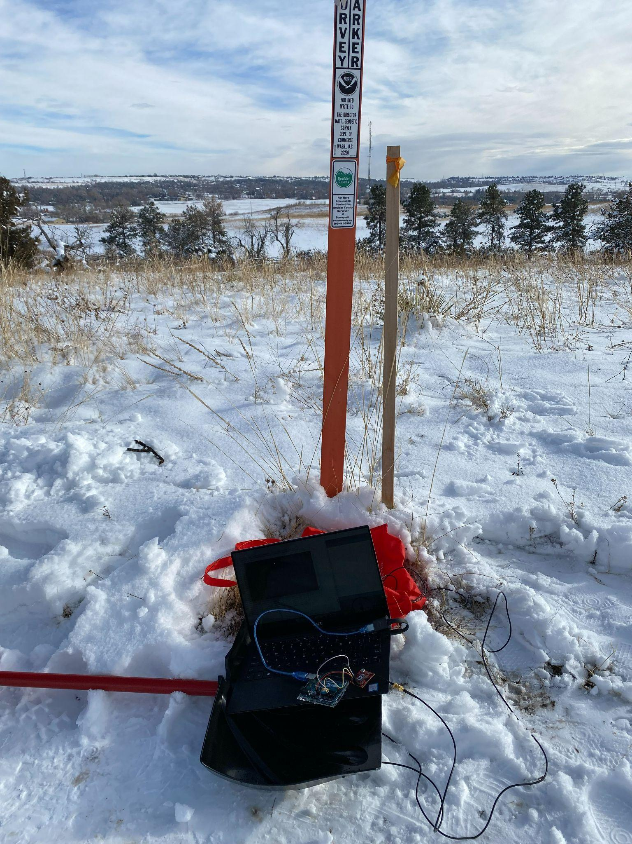
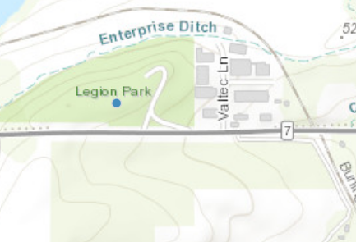
GPS Test
Equipment:
GPS sensor, Jumper wires, Micro-USB, Laptop, GPS antenna, Boulder PCN*
Lat = 40° ”N , Long = 105° ”W

Slide 20
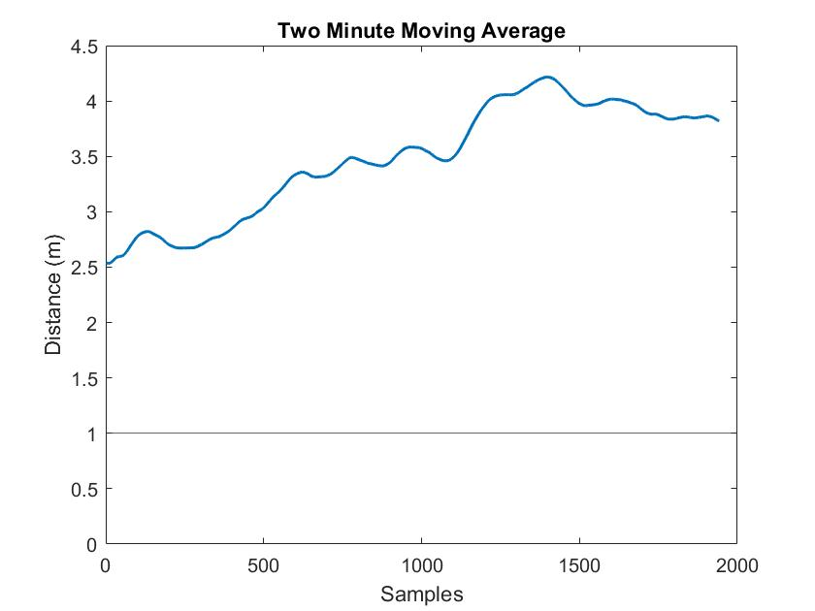
GPS Test
Pass Criteria
Accuracy is <= 1m at least 75% of the time
Preliminary code is working
Expected Results:
PASS: continue coding and move to sensor subsys. test
FAIL: debug code, retest, talk with customer about req
Observed Results
50% of measurements do not fall within 2.5m range
Data averaging did not improve accuracy to <= 1m
- FAIL
Next Steps
Test at other survey markers
Lat/Long could have been skewed at this marker
Research other GPS models
Timeline
Motivation
Updates
Schedule
Testing
Budget
Notes:
Talk about the motor encoder, GPS, and magnetometer and radio. These are the ones we have some concrete V and V we could do

Slide 21
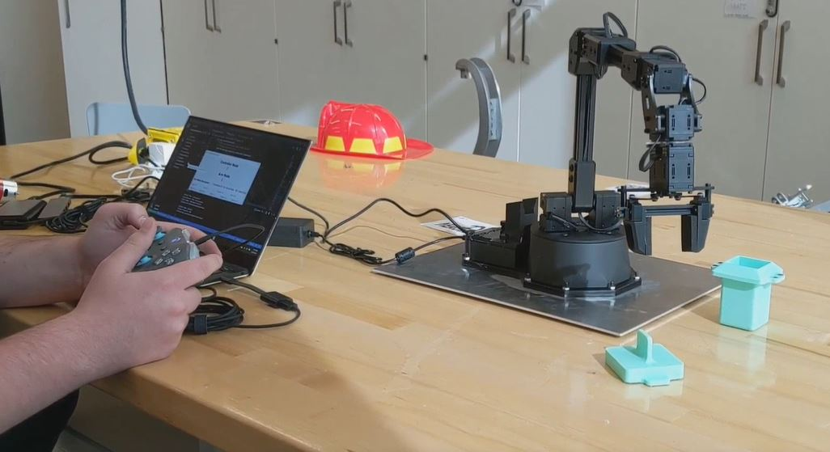
Arm Test
Deadline: 2/10
Completed: 2/5
FR1: AEROSS shall collect a sample
DR1.1: Collect a sample of interest that is less than 2 lbs
DR1.2: Collect a sample of interest that is 20 mm at its largest dimension
FR.2: AEROSS shall store a sample
DR2.3: Store a sample of interest that is 20 mm at its largest dimension
DR2.2: Acquire the sample collection container
Purpose:
Verify mobility of arm
Verify expected weight capacity and torque
Verify preliminary software
Risk Reduction:
Confirms ability to pick up sample and storage container
Less chance of propagating software issues
Equipment:
Robotic Arm, Mounting plate, Xbox Controller, Laptop, Raspberry Pi, Micro USB cable, Ethernet cable
Testing Procedure Overview
Secure arm on mounting plate
Power on arm and Raspberry Pi
Plug arm into Raspberry Pi
Connect Xbox controller
Run provided test code
Test custom-built Rover and GS software with controller
Verify arm moves as expected
Timeline
Motivation
Updates
Schedule
Testing
Budget

Slide 22
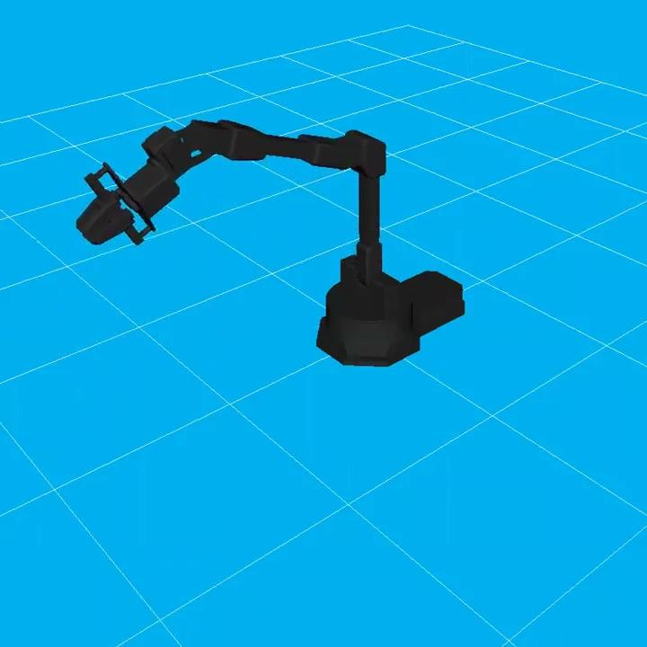
Arm Test
Pass Criteria
Arm mobility is as specified in data sheet
Arm can withstand weight of sample and container
Expected Results:
PASS: continue coding, begin hardware integration
FAIL: debug code, retest until arm is functional
Observed Results:
Software has bugs in it – FIXED
Arm has full mobility - FAIL
Arm can pick up sample container with max sample weight - PASS
Conclusions:
Wired Sample Collection - PASS
Sensitive controls - need to be careful with maneuvers as we close in on sample container and sample
Model of Arm and Software
In-person demo of wired sample collection (2x speed)
Timeline
Motivation
Updates
Schedule
Testing
Budget

Slide 23
Radio Test
FR5: AEROSS shall send and receive information to and from ground station
DR5.4: Send and receive no less than 20 Mbps to and from the ground station
DR5.5: Communicate with the ground station at a maximum of 100m
Deadline: 1/28
Completed: 1/28
Purpose:
Verify rovers’ ability to send data at a rate no less than 20 Mbps, at a max of 100m
Power received is no less than -100dB
Risk Reduction:
Confirms ability to send data packets at 100m distance
Equipment:
Rocket M2 Radio,ARGOS Ground Station, POE adapter, Ethernet Cord, Ethernet to USB-C adapter, Antennas, 2 12V portable battery packs, Tape Measurer, Laptop
Testing Procedure Overview
Assemble Hardware
Configure IP on computer
Log onto radio IP address
At 5m, perform ping test, speed test, and received power test
Repeat step 4, move 5m each time
Record necessary values
Timeline
Motivation
Updates
Schedule
Testing
Budget

Slide 24
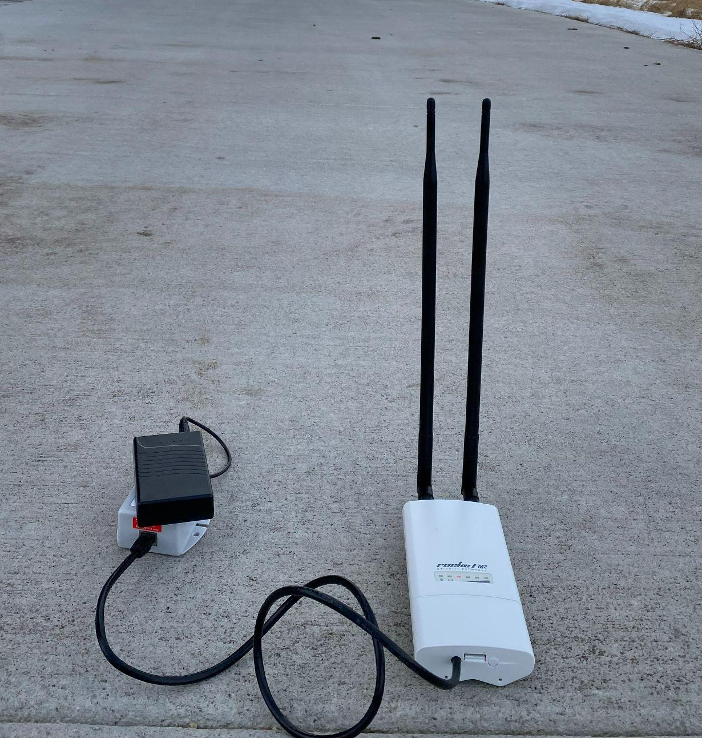
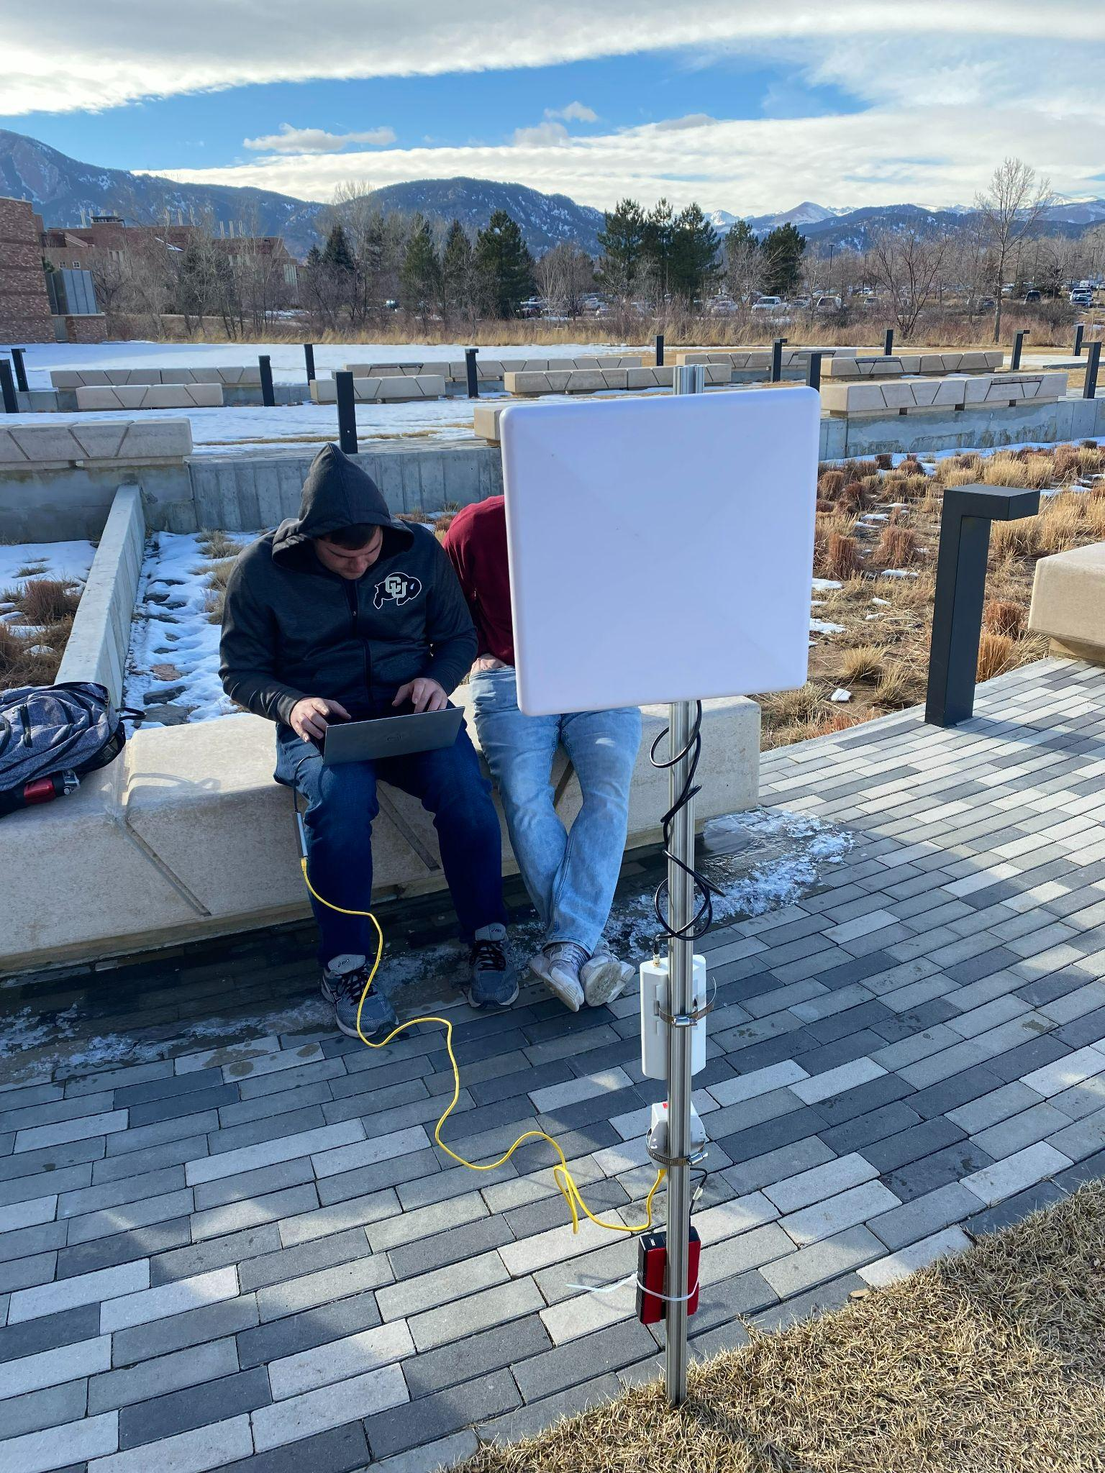
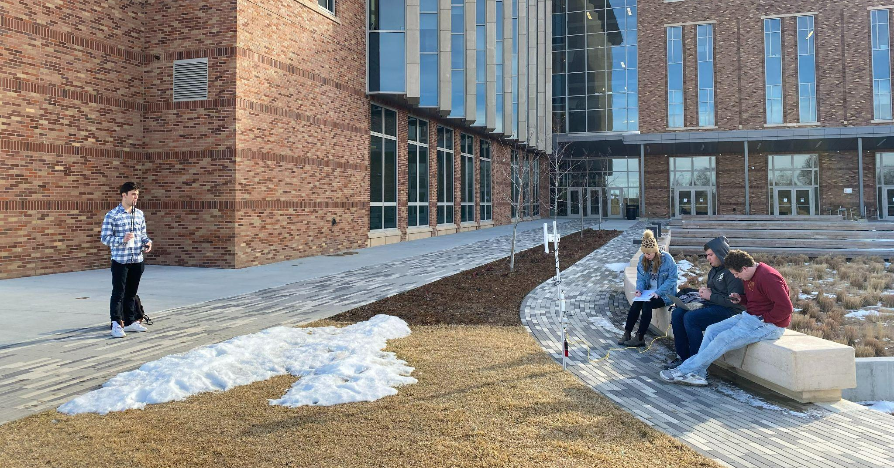
Ground Station
Rocket M2 Radio
5 m

Slide 25
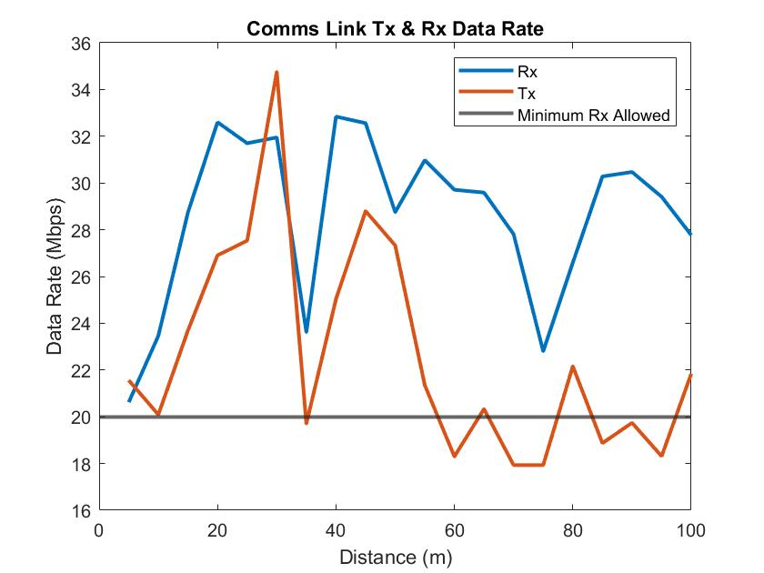
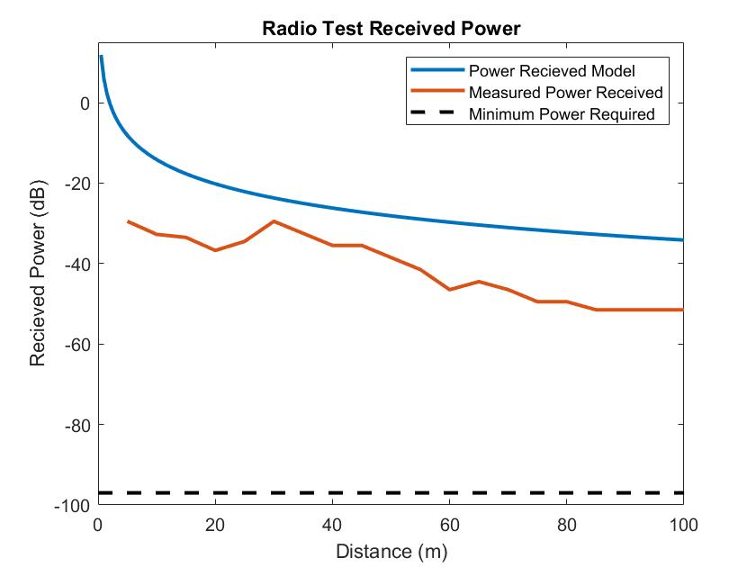
Radio Test
Pass Criteria
Rx Data rate is >20 Mbps
Received Power is > -100 dBm
Receive all packets at 100m max distance
Expected Results:
PASS: continue coding, begin sensor data retrieval test
FAIL: debug code, check connections, check battery, check temp ratings
Observed Results:
Battery shut down after ~2 hours outside – Watch temp
Mitigation: Observe performance during full integration. If this is still an issue add insulation
Data rate and received power achieved at 100m with no packet loss! – PASS
Conclusions:
Ping Test, Speed Test, Received Power at 100m – PASS
Timeline
Motivation
Updates
Schedule
Testing
Budget

Slide 26
Full Integration
FR1: Collect a sample
FR2: Store a sample in container
FR3: Be able to deposit the container at a location specified by the G.S.
FR4: Drive to a specified location and return to its original location
FR5: Send and receive information to and from G.S.
FR6: Have video capability
Deadline: 4/15
Not Started
Purpose:
Verify rover’s ability to successfully perform a full mission
Risk Reduction:
Proves satisfaction of FRs and DRs
Equipment:
Full AEROSS assembly
Testing Procedure Overview
Assemble AEROSS rover
Perform Rover Start Up Sequence
Camera Test
Drive Train Test with controller
Arm Test (wireless sample collection)
Full simulation of day in life and LOS
Repeat 3 times, changing type of surface (Grass, Gravel, Snow (if applicable) )
Timeline
Motivation
Updates
Schedule
Testing
Budget

Slide 27
Full Integration Step Through
Testing Procedure Overview
Assemble AEROSS rover
Perform Rover Start Up Sequence
Camera Test
Drive Train Test with controller
Forwards, Reverse, Turn
Arm Test (wireless sample collection)
Full simulation of day in life
Rover Start Up Sequence (Stationary)
Power all systems
Confirm all sensors and camera are sending data back to G.S.
Confirm G.S. can communicate with AEROSS
Drivetrain Test (with controller)
Drive forward, reverse, and turn
Arm Test (with controller)
Wireless Sample Collection
Day in Life
Sample collection, Sample deposit, Return to OG location
Loss of Comms Test
Pre Day In Life
Timeline
Motivation
Updates
Schedule
Testing
Budget
Notes:
Possibly elim
Emph on 27
I’ll talk about this slide in the one before. But I think we should keep it here so the PAB has a nice reference to help them out

Slide 28
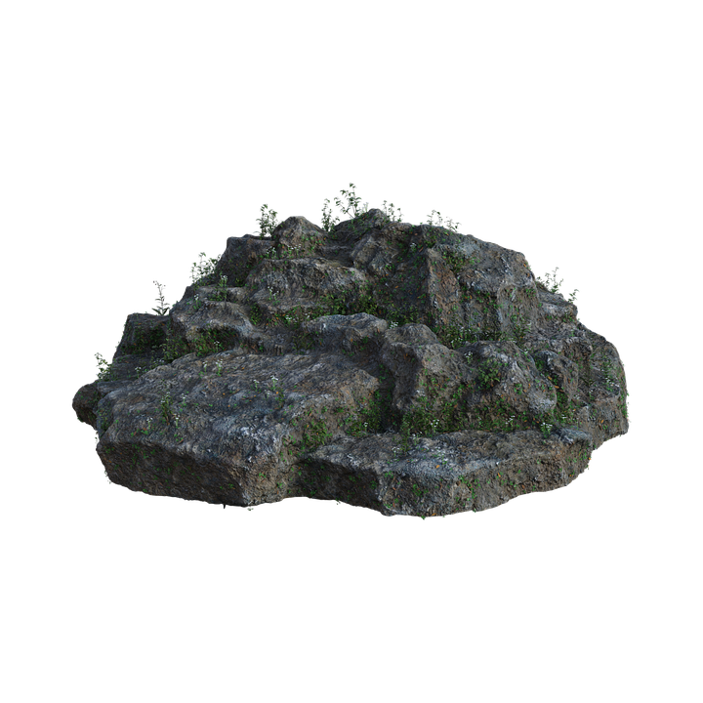
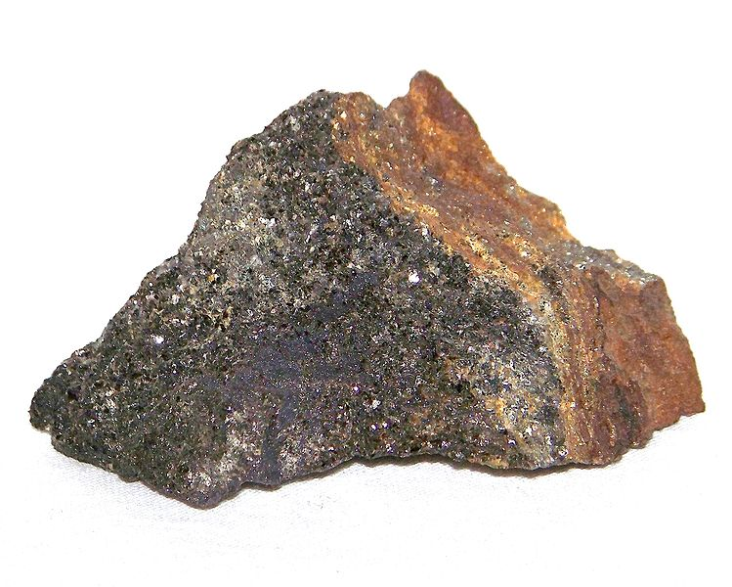
Full Integration CONOPS
0 m
Distance (m)
100 m (max)
*Ground Station Mockup
Establish comms with rover
Send GPS and heading data to G.S. for X min
Manually drive to specified deposit location (user input) via GPS, compass, and camera
Return to G.S. to restart/end mission
Manually drive to given sample location (user input) via GPS, compass, and camera
Begin data transmission to/from rover
Identify sample via camera
Manually collect sample via arm controller
Use camera and arm to grab sample container and place on ground
*Wireless comms maintained through mission
Manually store sample and attach lid via arm controller

Slide 29
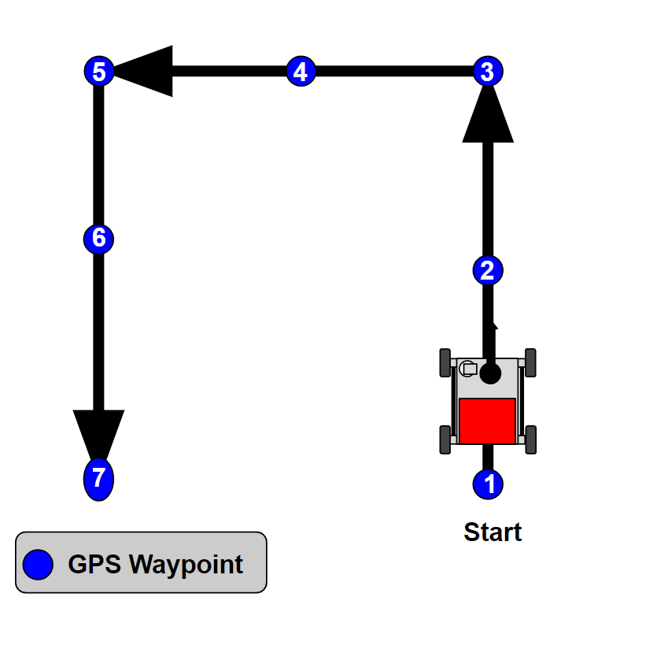
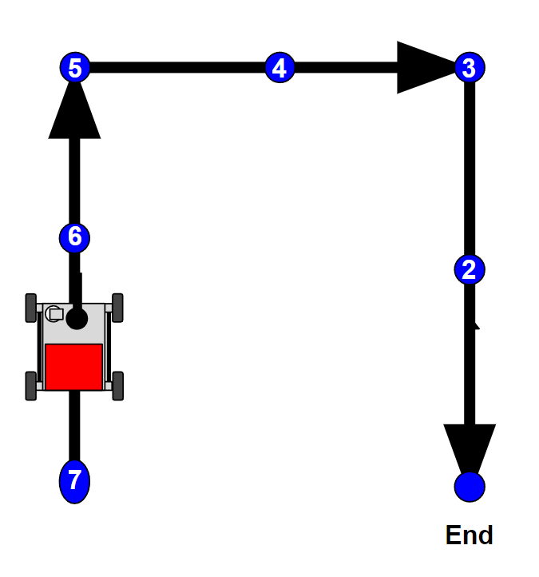
Full Integration Loss of Signal
*Ground Station Mockup
Establish comms with rover
Manually drive the rover through predetermined course via compass and camera, setting GPS waypoints along the way
Manually disconnect comms with rover
Rover travels backwards using previous GPS waypoints as a guide, until returning to within 1 m of start
Begin data transmission to/from rover
*Repeats every 10 meters

Slide 30
Budget

Slide 31
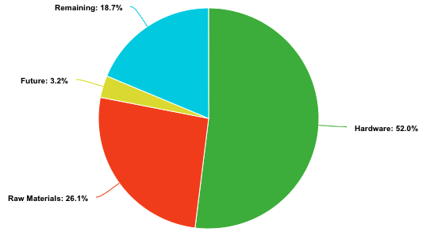
Budget
Sub-Team | Amount
Hardware | $2599.15
Raw Materials | $1304.36
Future | $200
Remaining | $936.49
Item | Amount
X200 Arm | $1800
Ubiquiti Radios | $180
LifePo Battery | $220
Timeline
Motivation
Updates
Schedule
Testing
Budget

Slide 32
Future Uncertainty
Sub-Team | Item | Need Met | Impact on Progress
EPS | Multiple Power Budget Improvements | Increase amount of power provided to run all systems | None
Manufacturing | Welding Gas | Rover frame Welding | None
Communications | Arduino Mega | Software interfacing | Alternate Arduino backup
Manufacturing | Battery Housing | Safely house battery | Manufacturing delay ~5 days
Estimated Amount | $200
Timeline
Motivation
Updates
Schedule
Testing
Budget
Notes:
Add costs for uncertainty

Slide 33
Questions?

Slide 34
Backup Slides

Slide 35
Backup Slides
Other Tests
Voltage Sensor Test
Current Sensor Test
Magnetometer Sensor Test
Battery Discharge Test
Motor Encoder Test
Other Aspects
Communications
Electronics/Arm
Power Budget
Loss of Comms Algorithm
Financial Budget

Slide 36
Voltage Sensor Test
Deadline: 2/6
Completed: 2/7
Purpose:
Verify rover will be able to read the needed voltage values throughout the mission
Risk Reduction:
Confirms ability to monitor battery life
Equipment:
Voltage Sensor, Arduino Mega, Multimeter, Computer, Jumper Wires, 3.3V Battery, 1 Ohm Resistor, Alligator Clips
Testing Procedure Overview
Assemble Hardware
Run code
Record results for four different voltages
Compare results to measured values with a multimeter

Slide 37
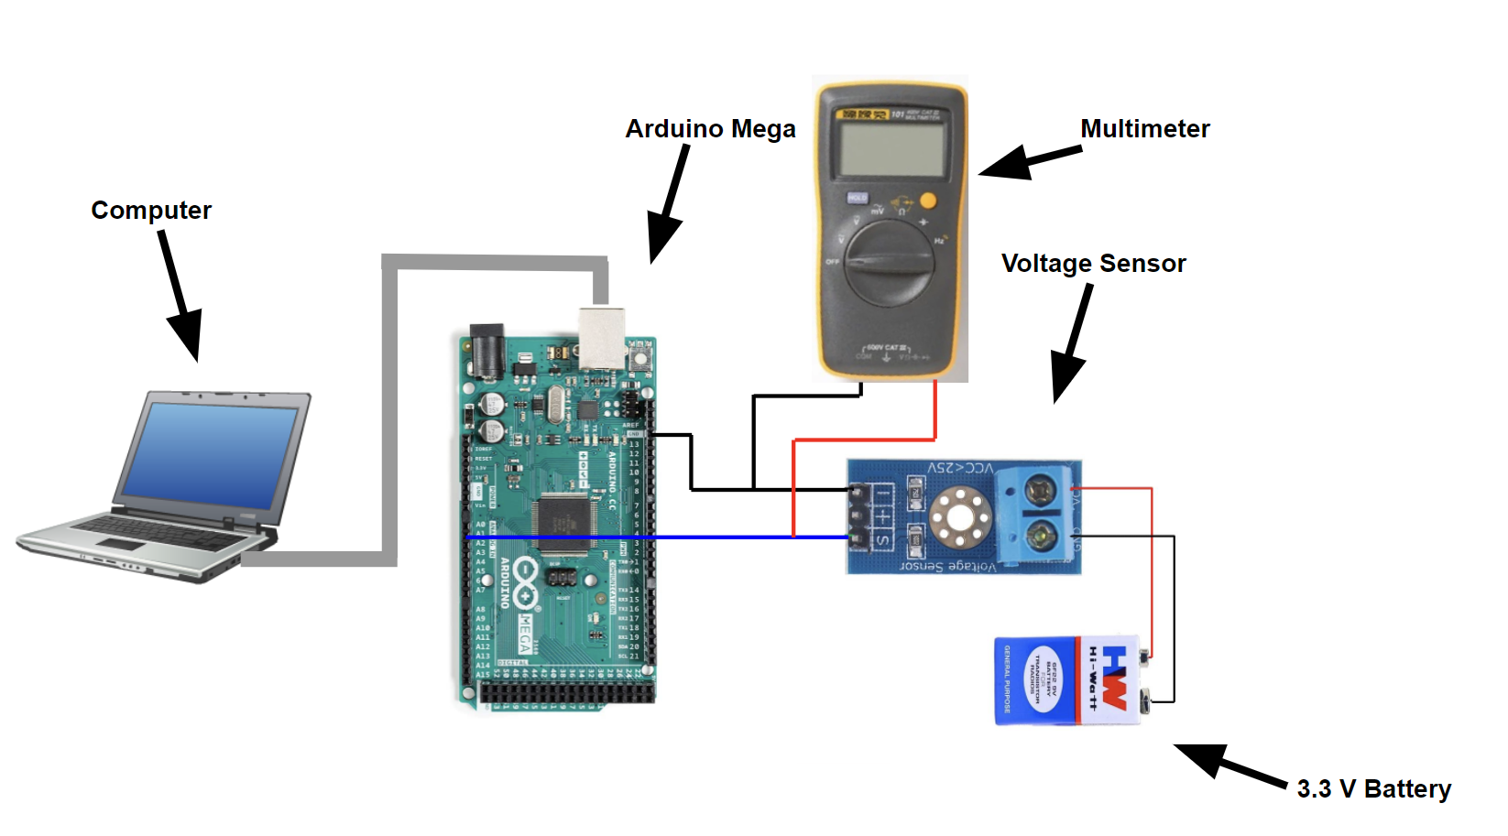
Voltage Sensor Test
Pass Criteria
Accuracy is within 0.1V of the measured values
Preliminary code is working
Expected Results:
PASS: continue coding and move to sensor subsys. test
FAIL: debug code, retest

Slide 38
Current Sensor Test
Deadline: 2/14
In Progress
Purpose:
Verify rover will be able to read the needed current values throughout the mission
Risk Reduction:
Confirms ability to monitor battery life
Equipment:
Current Sensor, Arduino Mega, Multimeter, Computer, Jumper Wires, 5V Battery, 200 Ohm ¼ Watt Rating Resistor, Alligator Clips
Testing Procedure Overview
Assemble Hardware
Run code
Record results for recorded current values
Compare results to measured values with a multimeter

Slide 39
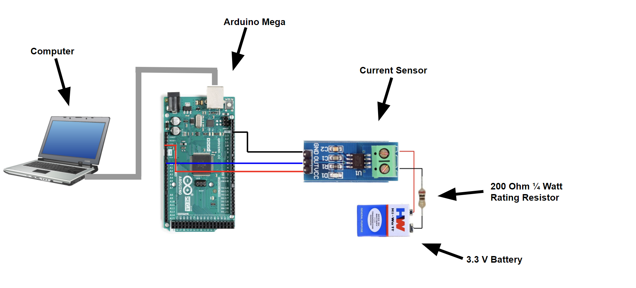
Current Sensor Test
Pass Criteria
Accuracy is within 0.1A of the measured values
Preliminary code is working
Expected Results:
PASS: continue coding and move to sensor subsys. test
FAIL: debug code, retest

Slide 40
Magnetometer Sensor Test
Deadline: 2/16
In Progress
Purpose:
Verify rover will be able to know the direction and heading at all times
Risk Reduction:
Confirms ability to navigate with direction
Equipment:
Magnetometer, Arduino Mega, Computer, Jumper Wires, Alligator Clips
Testing Procedure Overview
Assemble Hardware
Run code
Record results for heading angle between 0°-360°
Compare results to a compass and ensure it is accurate

Slide 41
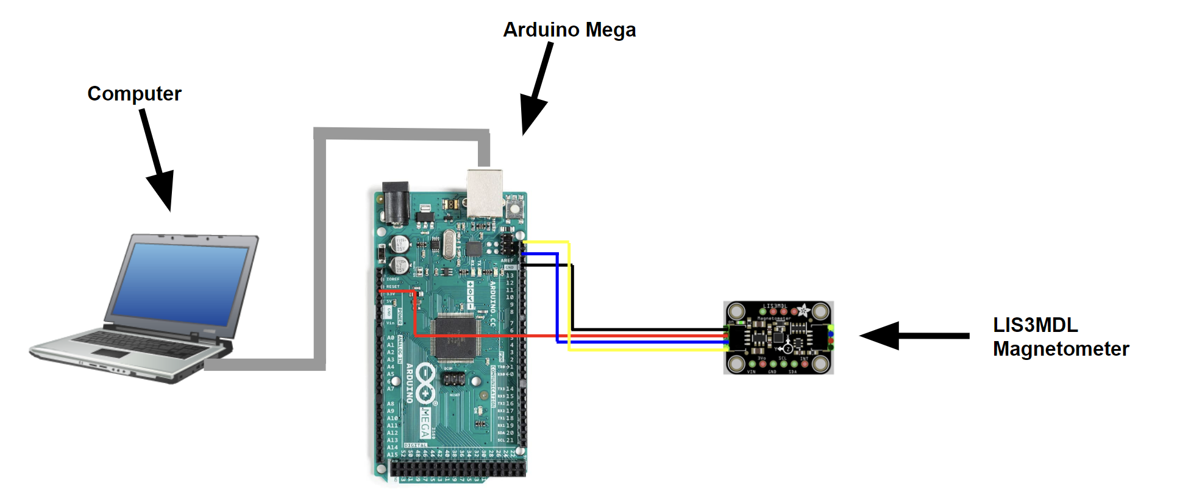
Magnetometer Sensor Test
Pass Criteria
Accuracy is within 0.1A of the real life values
Preliminary code is working
Expected Results:
PASS: continue coding and move to sensor subsys. test
FAIL: debug code, retest

Slide 42
Battery Discharge Test
Deadline: 2/14
In Progress
Purpose:
Measure the amount of time it takes to discharge the battery
Provide an expected battery life of the rover, when all components are plugged in
Risk Reduction:
Confirms ability to monitor battery life
Provides time measure for mission life of rover
Equipment:
Voltage Sensor, Arduino Mega, 12V 50Ah LiFePO Battery, Computer, Jumper Wires, 3 Ohm 500W Resistor, Safety Glasses, Alligator Clips
Testing Procedure Overview
Assemble Hardware
Turn on the battery
Record results for recorded voltage values every five minutes
Compare results to a known LiFePO discharge graph

Slide 43
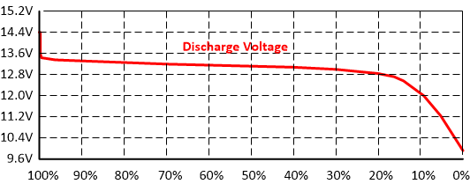
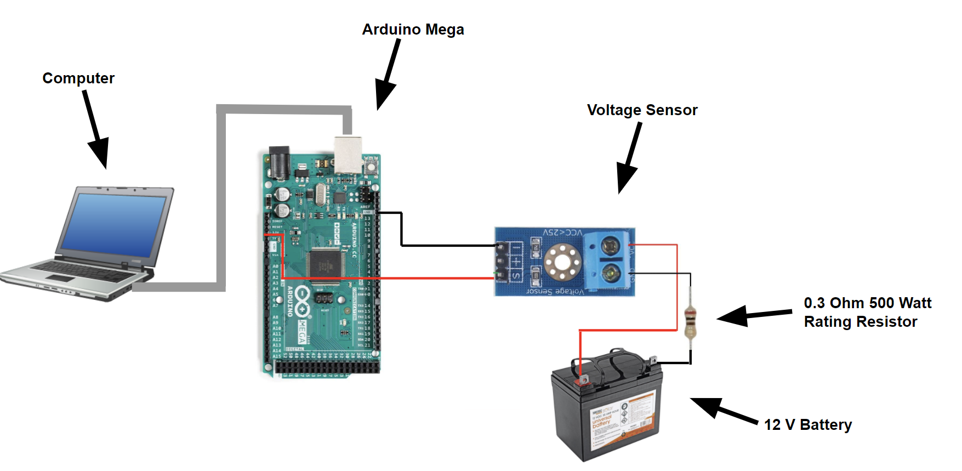
Battery Discharge Test
Pass Criteria
Accurate data when compared to the model
Can create our own battery discharge graph
Expected Results:
PASS: have a graph, move on to further tests
FAIL: redo the test, make new graph

Slide 44
Motor Encoder Test
Deadline: 2/14
In Progress
Purpose:
Verify the motor encoders accurately read the spin rate of the motors
Verify proper integration of the motor encoders, motor drivers, and motors
Risk Reduction:
Confirms ability to navigate and read spin rate
Confirms drive train can turn the wheels
Equipment:
Motor Encoder, Motor, Motor Driver, Computer, Jumper Wires
Testing Procedure Overview
Assemble Hardware
Run code
Record results for voltage values for spin rate
Compare results to a multimeter

Slide 45
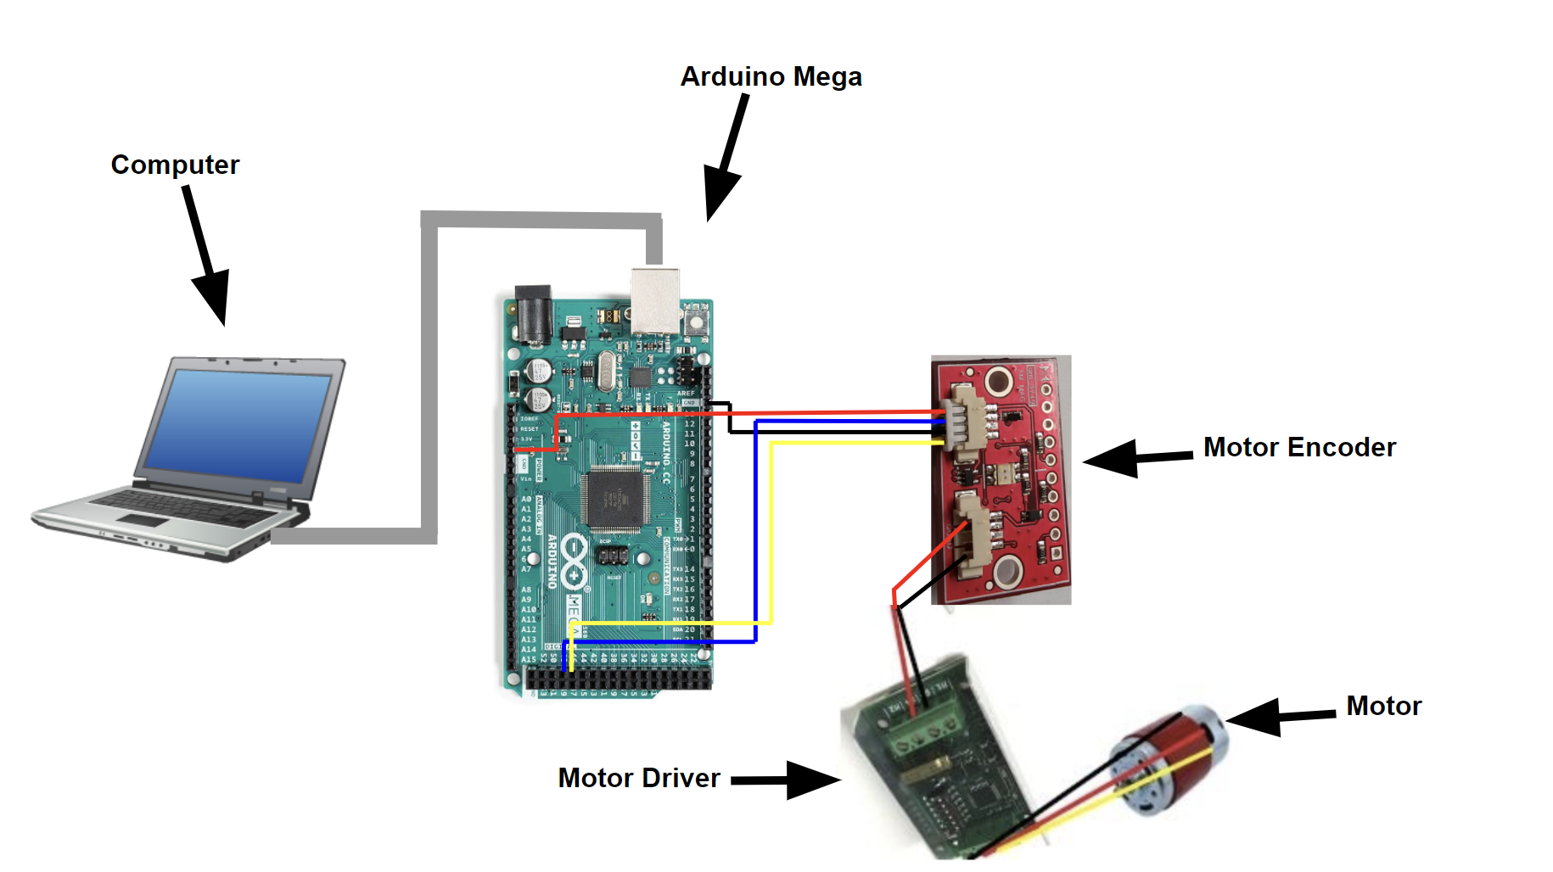
Motor Encoder Test
Pass Criteria
Accuracy is within 0.1V of the measured values
Preliminary code is working
Expected Results:
PASS: continue coding and move to sensor subsys. test
FAIL: debug code, retest

Slide 46
Computational Resource Estimation
Computation Rate
Rough Expected Rover Data Rate: 10.3 Mbps
Ubuntu Server RAM consumption worst case is 2GB
Raspberry Pi has 4GB of RAM giving us about 2GB of margin at any given time.
Using a 32GB SD card for storage
OS: 1.75GB
Software Packages: 2GB
Rover Data
Data Source | Estimated % | Total Data
Camera* | 85 % | 7 Mbps
Commands/Sensors | 15 % | 1.24 Mbps
Totals | 100% | 8.24 Mbps
Margin | 125% | 10.3 Mbps
* As of now camera data is being sent straight across the network and won’t be processed by the Raspberry Pi

Slide 47
Communications & Data Main Hardware
Hardware | Mass(lbs) | Dimensions(in) | Specs
Rocket M2 Radio | 1.1 | 6.3 x 3.15 x 1.18 | Up to 150 Mbps
PoE Network Switch | 0.55 | 3.94 x 3.86 x 0.98 | 5-port PoE config
Raspberry Pi | 0.11 | 3.94 x 2.76 x 1.18 | 4GB of RAM PoE capability High perf. processor
Arduino Mega | 0.079 | 4.61 x 2.36 x 0.98 | 54 dig I/O pins 16 analog pins
Antenna | 0.22 | 15.36 | 12 dBi Omni-directional 2.4 GHz

Slide 48
Communications & Data Sensors
Sensors | Dimensions (in) | Specs
Magnetometer /Accelerometer | 1.0 x 0.7 x 0.2 | 3-axis 1mg accel. sensitivity
GPS | 7.2 x 6.3 x 2.8 | ProPak-V3 Novatel GPS Receiver:
Laser Pointer | 0.94 x 0.59 | 5mW laser power 650 nm wavelength
Camera | 6.3 x 3.9 | Sunba 405-D20X 3° Vert. FOV 90° Horiz FOV

Slide 49
Satisfaction: Communications
Estimation of Data Rate for Rover
Engineer from Lunar Outpost
Most rover applications camera accounted for 85% of total data.
Used 7 Mbps as 85% of rover data
Typical amount for 1080p @ 30fps
Built in a margin of 25%
Total expected data: 10.3 Mbps
Equipment is more than capable of handling this data rate so addition analysis was done assuming 20 Mbps.
Rover Data
Data Source | Estimated % | Total Data
Camera | 85 % | 7 Mbps
Commands/Sensors | 15 % | 1.24 Mbps
Totals | 100% | 8.24 Mbps
Margin | 125% | 10.3 Mbps

Slide 50
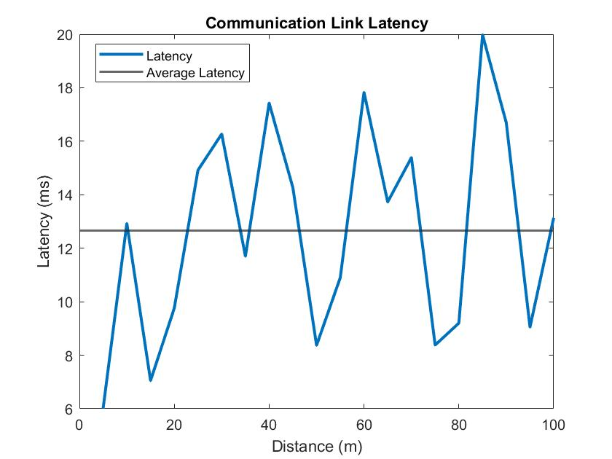
Communications Link Latency

Slide 51
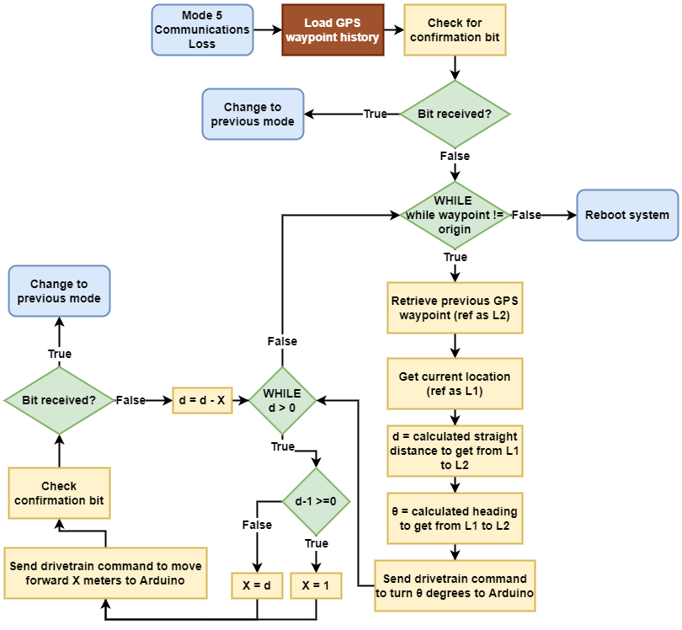
Loss of Communications Algorithm

Slide 52
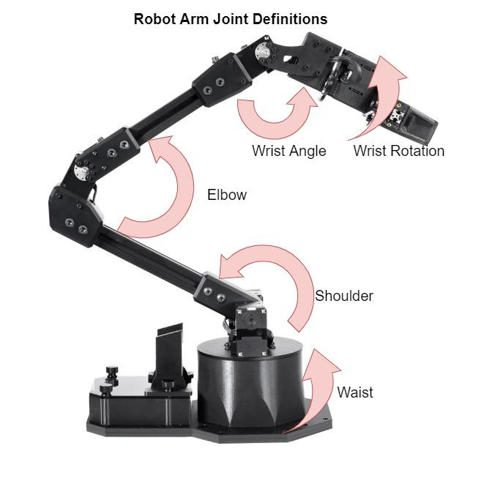
Robotic Arm Joint & Position Definition
Specs
5 DOF robotic arm
2 XM-430 servos
3 XL-430 servos
Weight: 1.9 kg
Reach: 550 mm
360 deg turn capability
Pre-assembled
Built in ROS software
Maximum payload: 0.43 kg

Slide 53
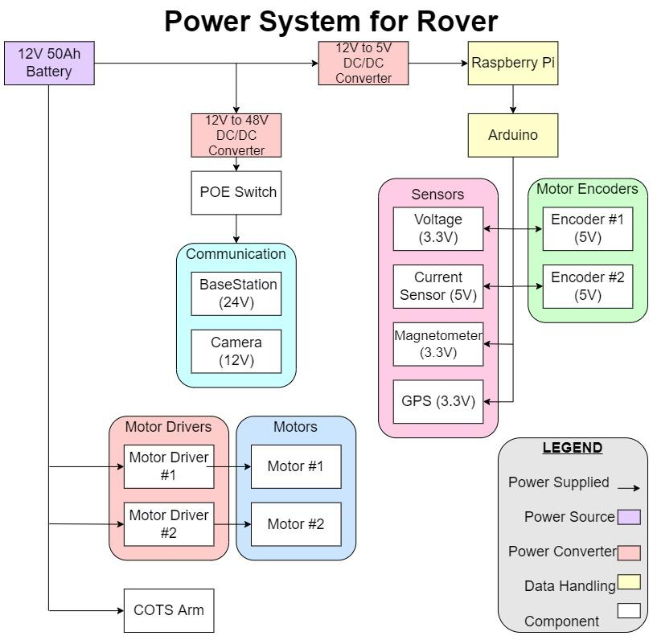
Electronics Functional Block Diagram
USB-A to USB-C
(Serial)
TCP
Digital
Analog
I2C
SPI
USB-A to Micro-USB (Serial)

Slide 54
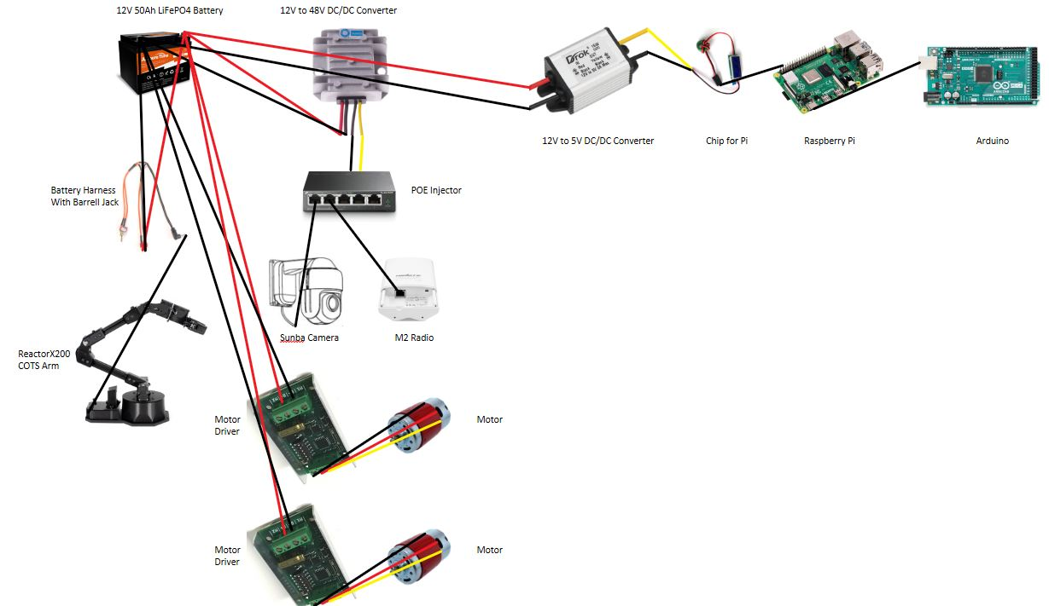
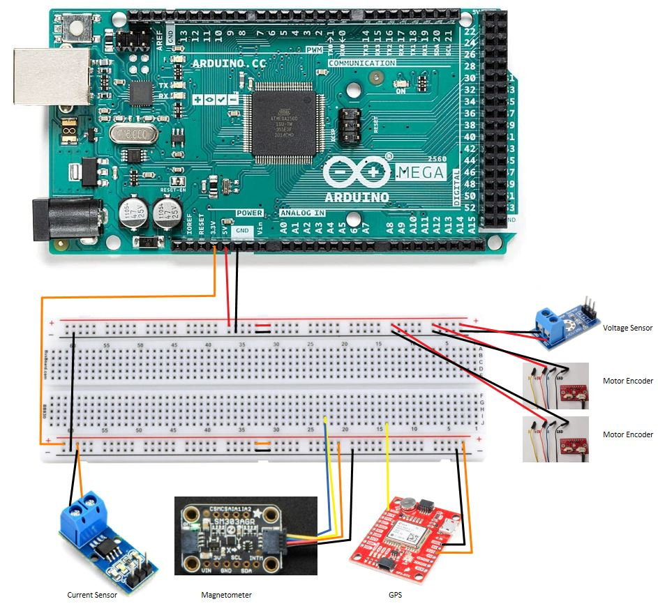
Electronics Pin Assignment

Slide 55
Power Budget

Slide 56
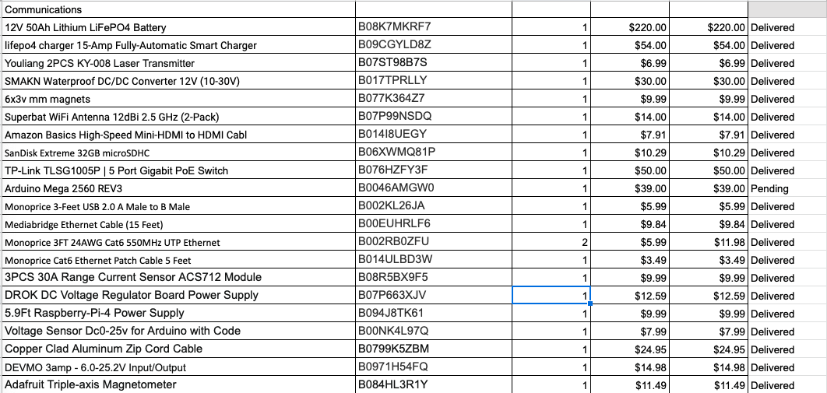
Budget

Slide 57
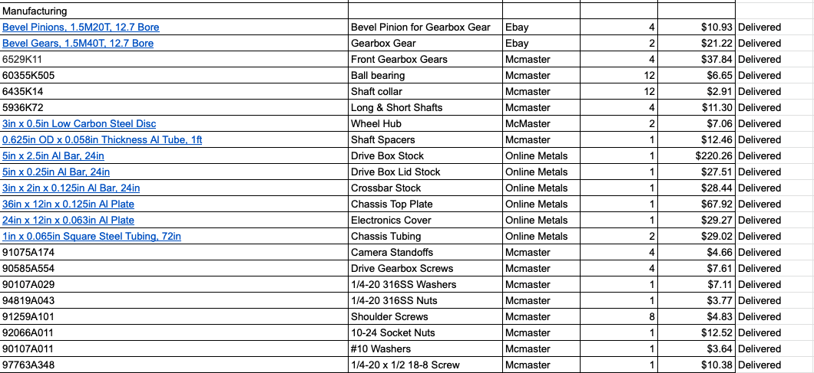
Budget

Slide 58
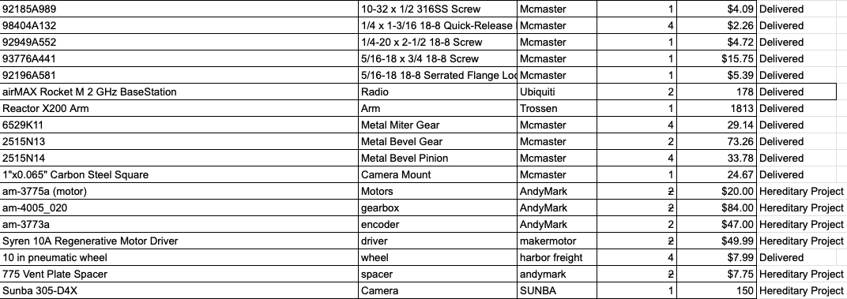
Budget

