Slide 1
ALL-Electric ROver
for Sample Storage
Team: David Koester (PM), Emily Mitzak
Owen Kaufmann, Aaron Buller,
Adam Trunko, Benjamin Lodwick,
Keaton Paquin, Max Malden,
Patrick Riley, Ricardo Lopez-Abadia
Underlined: Presenters
Sponsor: Jet Propulsion Laboratory, Barbara Streiffert
Advisor: Dr. Jean Koster
Notes:
25 min time limit!

Slide 2
Presentation Layout
Presentation Layout
Project Description
3. Baseline Design
1.A. Motivation
3.A. Sample Collection
1.B. Mission Statement
3.B. Drive Train
1.C. Functional Requirements
3.C. Uplink
3.D. Downlink
2. CONOPS
4. Feasibility Analyzes
2.A. Mission Objectives
4.A. Sample Collection
2.B. Functional Block Diagram
4.B. Drive Train
4.C. COMMS
5. Summary
5.A. Status
5.B. Future Studies Needed

Slide 3
PROJECT DESCRIPTION

Slide 4
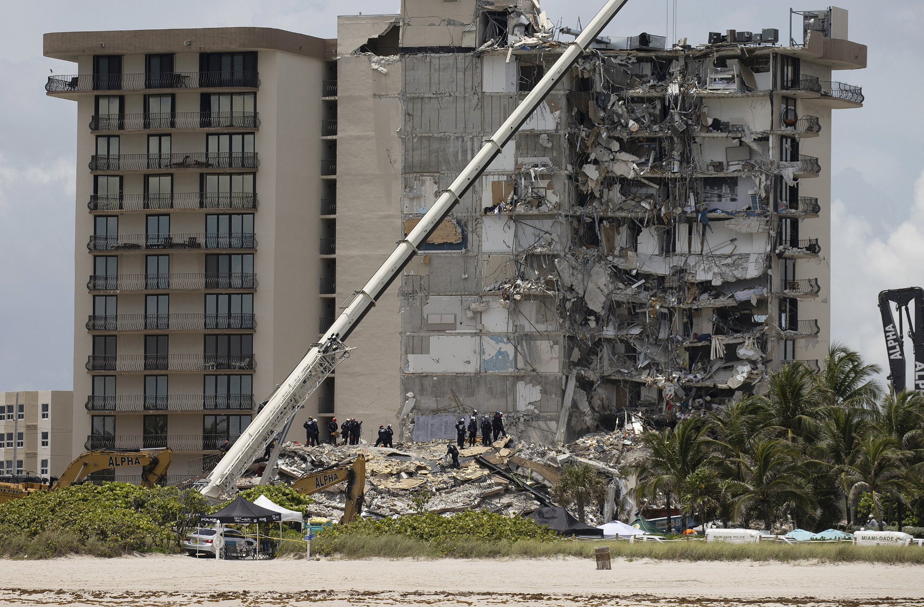
Motivation
Accessibility to certain areas on Earth may be better suited for robots than humans
Building collapse
Natural disaster zones
Samples may be required but risk to humans is too high
Mitigating the risk to humans in acquiring samples requires:
Rover that collects and stores sample of interest (SOI)
Courtesy: NPR
Timeline
Project Description
CONOPS
Baseline Design
Baseline Feasibility
Summary
Notes:
Notes for Presentation:
-Why are we doing this?
-Some areas are impractical for humans to access
-Location
-Environmental Hazards

Slide 5
Mission Statement
The All-electric ROver for Sample Storage (AEROSS) team will provide JPL with a child rover that will collect a sample, put the sample in a capsule and deposit the sample in a specific location. The child rover will also have the ability to communicate with the mother rover from the previous senior project, DRIFT.
Timeline
Project Description
CONOPS
Baseline Design
Baseline Feasibility
Summary
Notes:
Too busy, cut down on wording

Slide 6
Functional Requirements
FR.1 AEROSS shall be able to collect, store, and deposit a sample that is less than 2 lbs
FR.2 AEROSS shall be able to collect, store, and deposit a sample that is 20 mm at its largest dimension
FR.3 AEROSS shall be able to deposit a sample at a location of interest (LOI) with +/- 2cm of accuracy
FR.4 AEROSS shall be able to drive to a specified LOI and return to its original location within a radius of 100 m and have 360 degree turn capability
FR.5 AEROSS shall be able to send and receive information from a ground station or mother rover
FR.6 AEROSS shall have video capability with a greater than 100 degree field of view
Sample Collection
Drive Train
COMMS
Timeline
Timeline
Project Description
Project Description
CONOPS
CONOPS
Baseline Design
Baseline Design
Baseline Feasibility
Baseline Feasibility
Summary
Summary
Notes:
Highlight words
1 - collect, store, deposit, 2lbs
2 - collect, store, deposit, 20mm
3 - deposit LOI, 2cm accuracy
4 - specified LOI, return OG location, rad 100m, 360 deg turn
5 - send and receive info
6 - video capability, FOV 100

Slide 7
CONOPS
Notes:
Not sure if we should have this as a separate section or just keep it in the project overview stuff

Slide 8
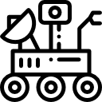
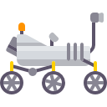
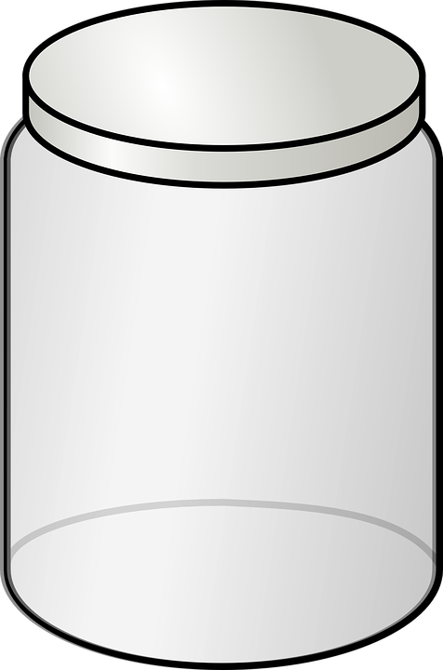
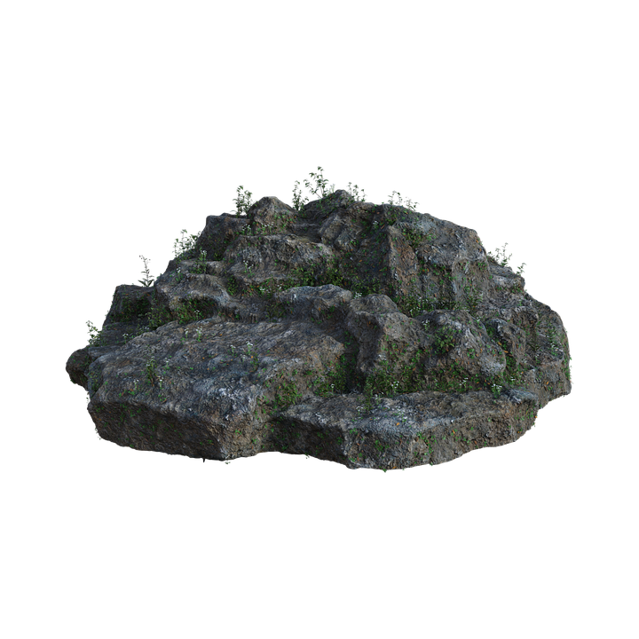
CONOPS
1
2
3
4
5
Establish
Communication
Identify and Collect
Sample
Deposit
Sample
Return to Mother
Drive to LOI
Timeline
Timeline
Project Description
Project Description
CONOPS
CONOPS
Baseline Design
Baseline Design
Baseline Feasibility
Baseline Feasibility
Summary
Summary
Notes:
Highlight words
1 - collect, store, deposit, 2lbs
2 - collect, store, deposit, 20mm
3 - deposit LOI, 2cm accuracy
4 - specified LOI, return OG location, rad 100m, 360 deg turn
5 - send and receive info
6 - video capability, FOV 100

Slide 9
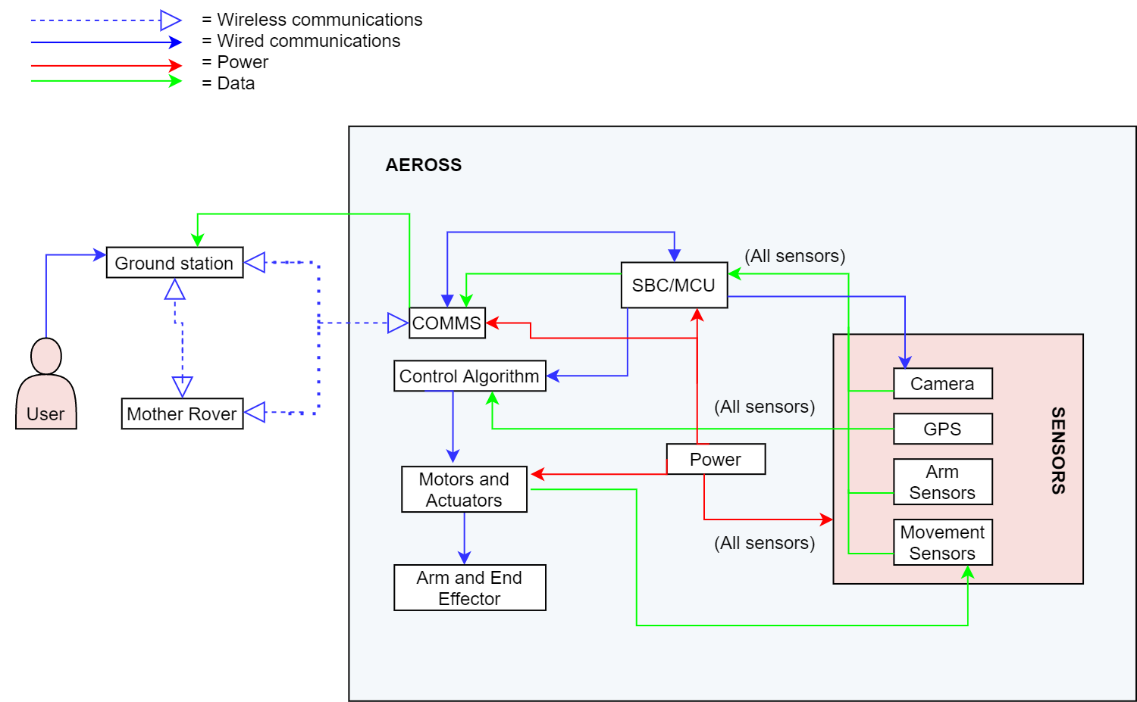
Functional Block Diagram
Timeline
Project Description
CONOPS
Baseline Design
Baseline Feasibility
Summary
Notes:
Highlight words
1 - collect, store, deposit, 2lbs
2 - collect, store, deposit, 20mm
3 - deposit LOI, 2cm accuracy
4 - specified LOI, return OG location, rad 100m, 360 deg turn
5 - send and receive info
6 - video capability, FOV 100

Slide 10
Baseline Design

Slide 11
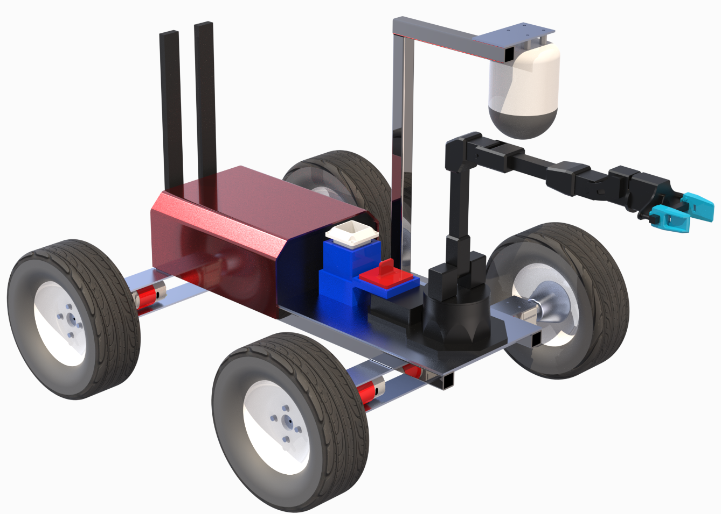
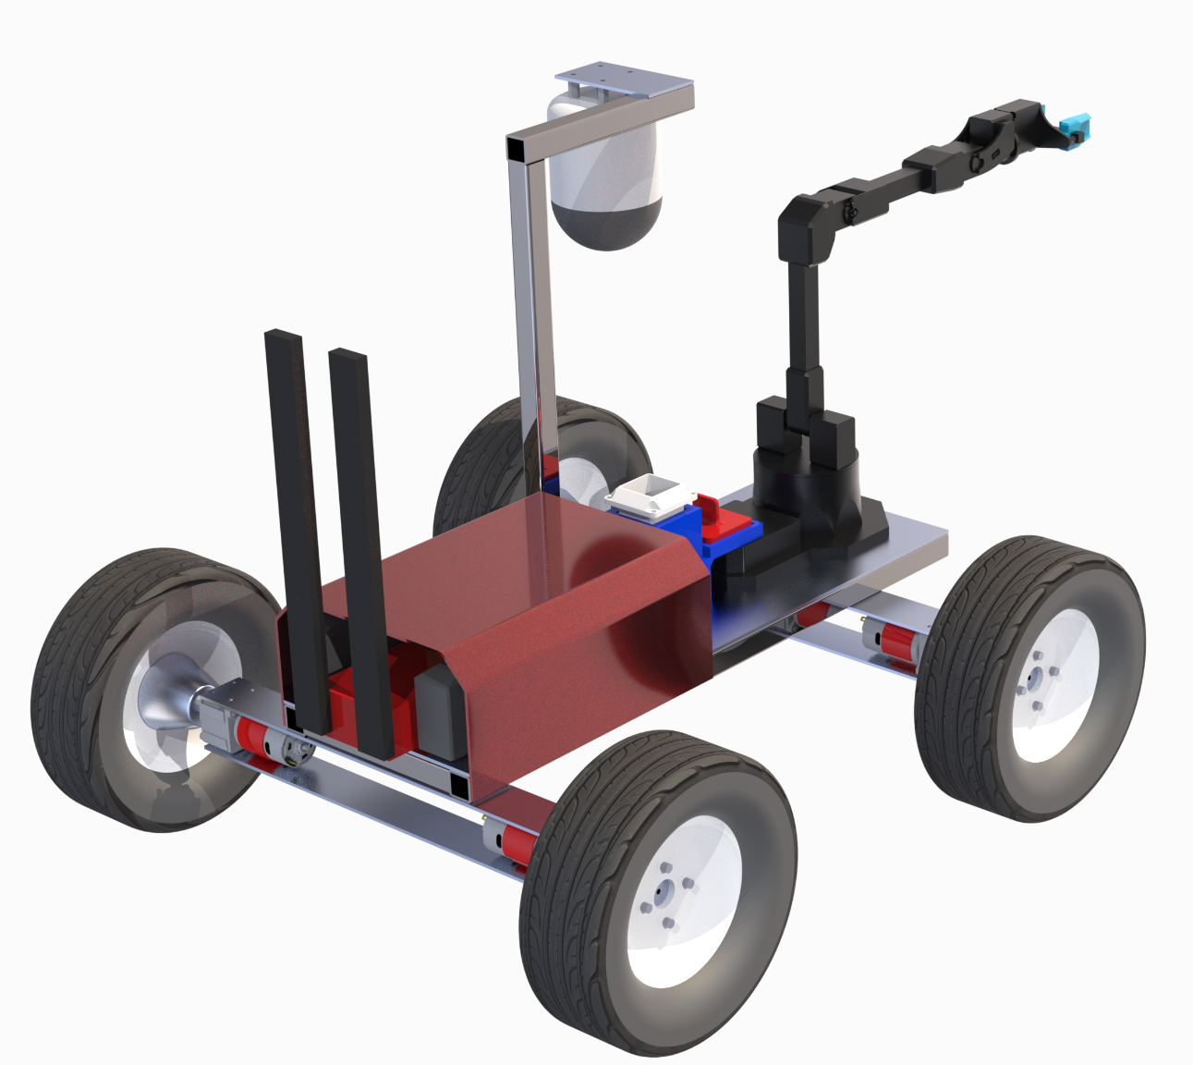
Baseline Design: Overview

Slide 12
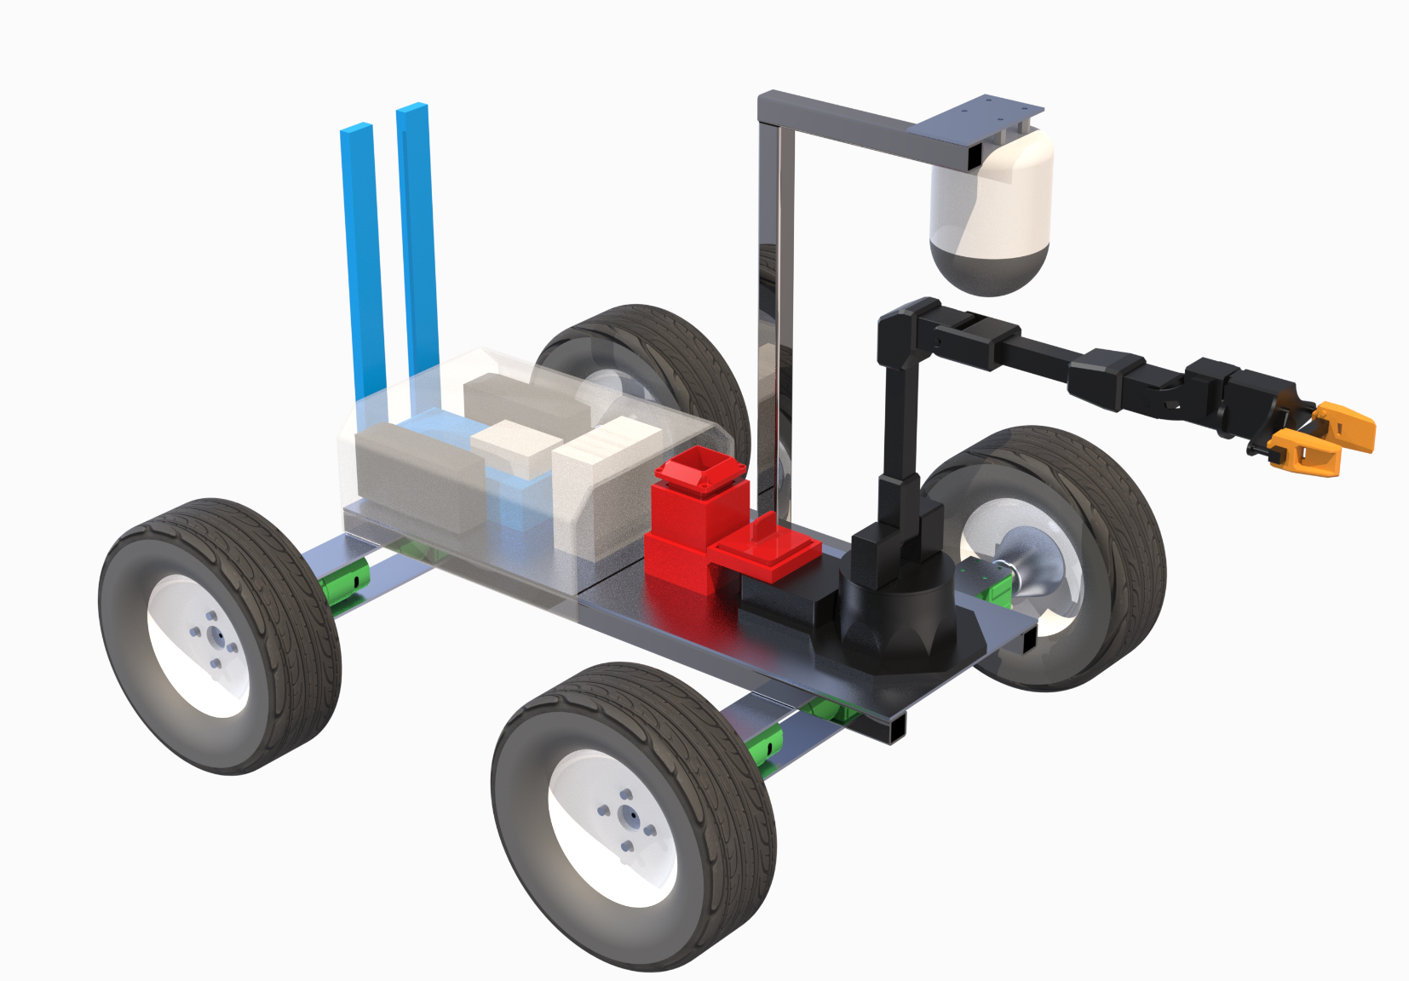
Baseline Design: Overview
Sample Collection Device
Sample Collection Container
Drive Train
Communications

Slide 13
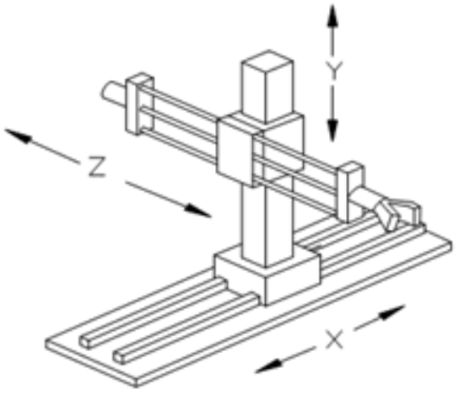
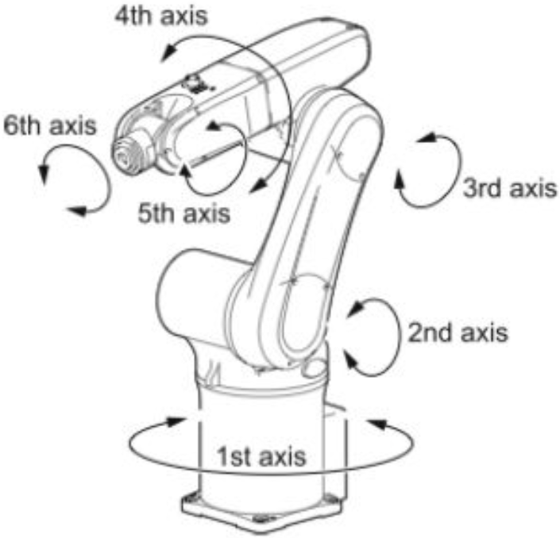
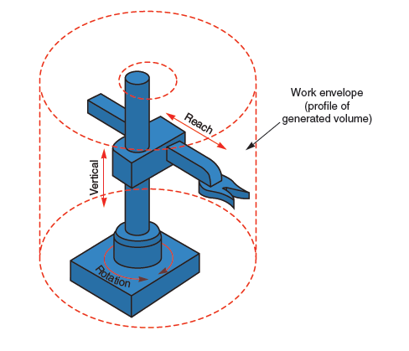
Sample Collection Device
Design Options Considered
Rectangular Arm Geometry
Cylindrical Arm Geometry
Articulating Arm
FR.1 | Collect, store, and deposit a sample that is less than 2 lbs
FR.2 | Collect, store, and deposit a sample that is 20 mm at its largest dimension
FR.3 | Deposit a sample at a LOI with +/- 2cm of accuracy
Rectangular Arm
Articulating Arm
Cylindrical Arm
Timeline
Project Description
CONOPS
Baseline Design
Baseline Feasibility
Summary
Notes:
Discuss what the requirements fundamentally require.
Needs to have sufficient power to lift a sample of any significant weight
End effector needs to be able to close such that the distance between each gripper is less then 2 cm
Put on slide FR1,2,3 and then we can talk about them

Slide 14
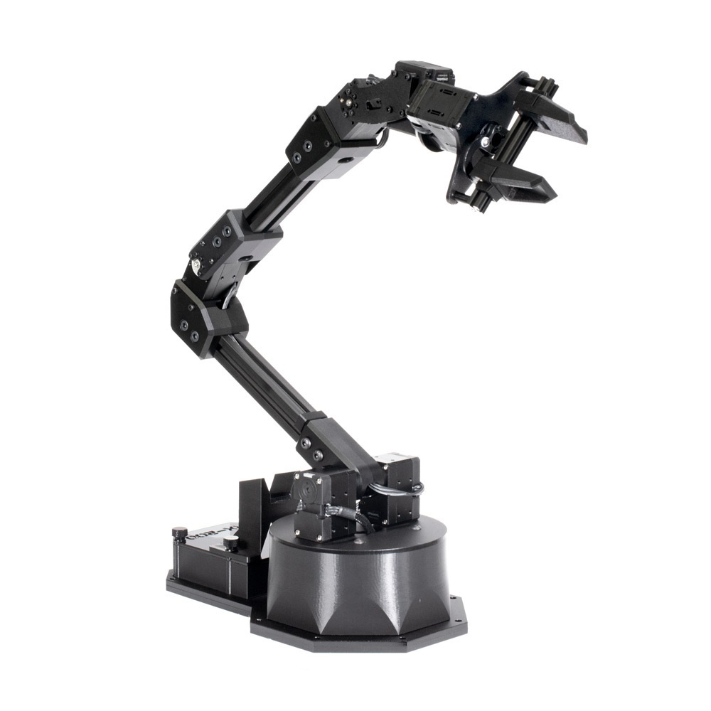
Sample Collection Device Cont.
Purpose:
Sample acquisition
Transfer of sample to storage
Sample deposit
Trade options: Articulating arm, Rectangular arm, Cylindrical arm
Benefits:
Multiple DOFs
Widely available for off the shelf purchase
Many come pre-assembled/tested
Many include built in ROS software
2 cm
Timeline
Timeline
Project Description
Project Description
CONOPS
CONOPS
Baseline Design
Baseline Design
Baseline Feasibility
Baseline Feasibility
Summary
Summary
Notes:
ADD REASONING!!
Busy need to cut down

Slide 15
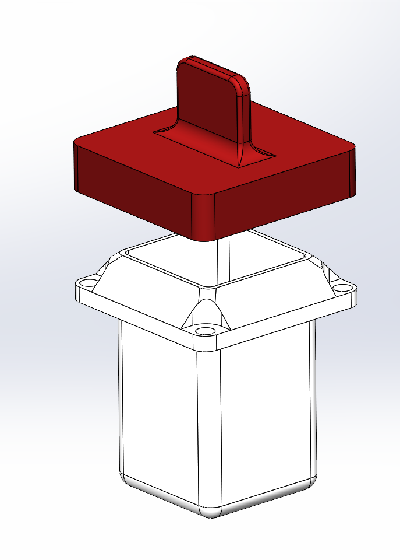
Sample Storage Apparatus
Purpose: To store a 2cm sample and be deposited at a specified location.
Trade Options: Screw top, Vacuum seal, Heat seal, Spring locking lid,Swing top, Magnetic top.
Benefits:
Self-centering lid
3D printable for rapid iteration
Positive containment of sample and isolation from environment
Timeline
Timeline
Project Description
Project Description
CONOPS
CONOPS
Baseline Design
Baseline Design
Baseline Feasibility
Baseline Feasibility
Summary
Summary
Notes:
ADD REASONING!!
Busy need to cut down

Slide 16
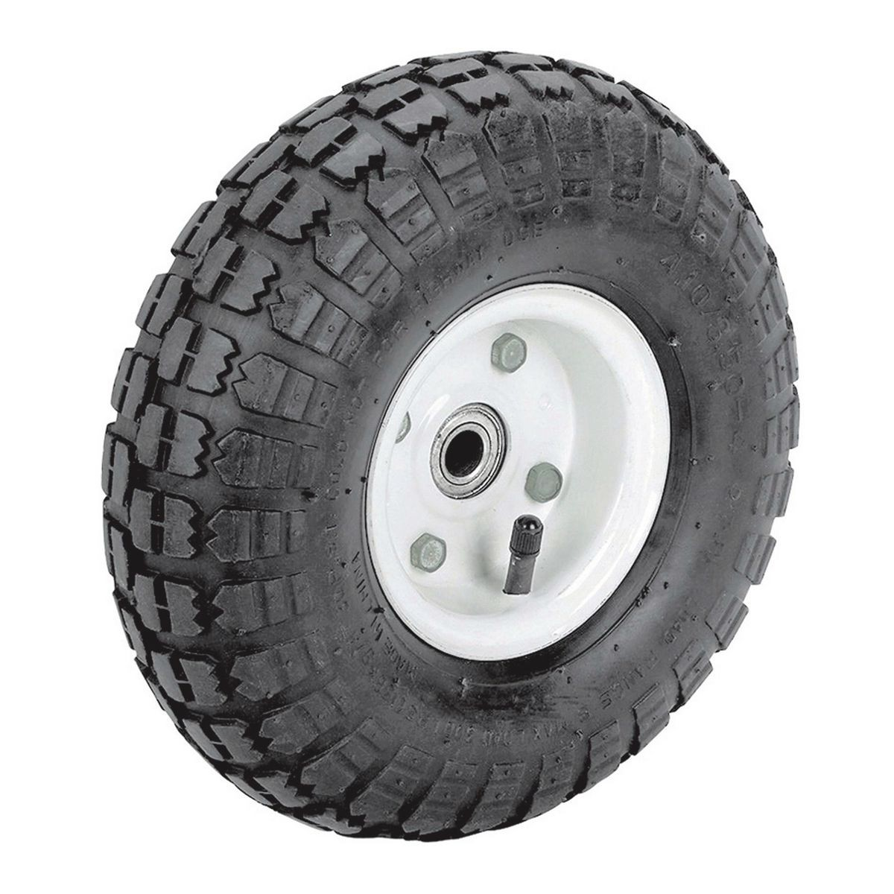
Drivetrain
Drivetrain: Baseline Design
Purpose:
Movement to and from specified LOI
Trade options: 4 Wheels, 6 Wheels, Rocker-Bogie, Tank Treads, Legs
Criteria:
Maneuver through underbrush
360 degree turns
Solution: 4 Wheel Configuration
Stable and mechanical simple
4WD
Size: 10in. Tire
Cost: $7.99/each (~$32 for 4)
Timeline
Timeline
Timeline
Project Description
Project Description
Project Description
CONOPS
CONOPS
CONOPS
Baseline Design
Baseline Design
Baseline Design
Baseline Feasibility
Baseline Feasibility
Baseline Feasibility
Summary
Summary
Summary

Slide 17
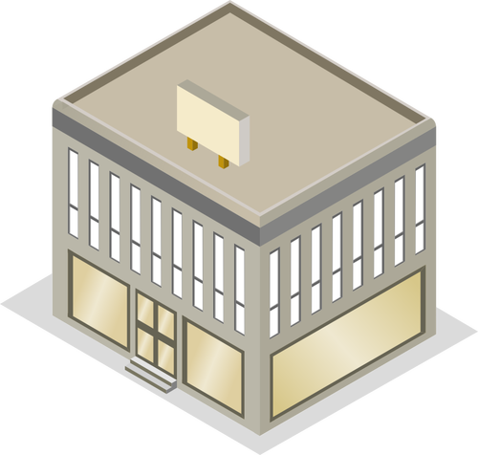
Communications
Drivetrain: Baseline Design
Purpose
Wireless two-way communications
Data transmission
Trade options: Point to Point Radio, Cellular Network, Satellite Internet Network, Optical
Needs:
Data Rate: 10-15 Mbps
Range: 100m
Transmission through one obstacle
Benefits
Integration
Distance
Low power draw
AEROSS
Ground Station
Commands
Data & Video
Mother Rover
FR.5 | AEROSS shall be able to send and receive information from a ground station or mother rover
Timeline
Timeline
Project Description
Project Description
CONOPS
CONOPS
Baseline Design
Baseline Design
Baseline Feasibility
Baseline Feasibility
Summary
Summary

Slide 18
Baseline Feasibility

Slide 19
Sample Weight Analysis
FR.1: AEROSS shall be able to collect, store, and deposit a sample of less than 2 lbs
Feasibility Items:
Can the rover acquire, transport, and deposit a sample without stalling?
Assumptions:
Motor stalls at 4.1 Nm
Lever arm is parallel to the ground
Largest sample mass: 0.0337 kg
Arm mass centered at arm midpoint
Variables:
m_s = sample mass = 0.0337 kg
m_c = container mass= ?
m_a = arm mass= 0.5962
d = distance to joint = 0.55 m
𝞽_max = max torque = 4.1 Nm
Timeline
Project Description
CONOPS
Baseline Design
Baseline Feasibility
Summary
Notes:
BREAK INTO TWO SLIDES WAY TOO BUSY!

Slide 20
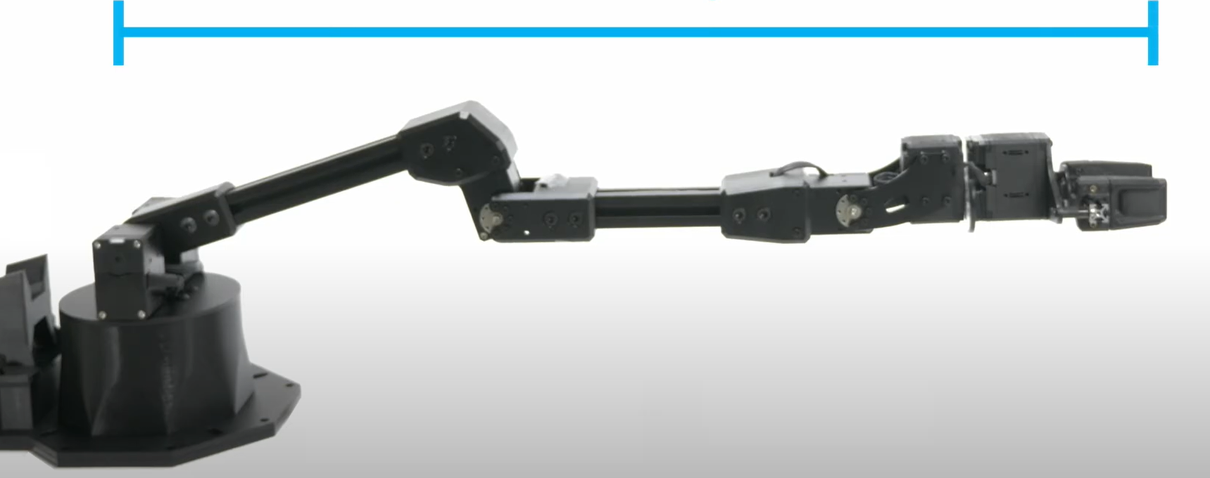
Sample Weight Analysis Cont.
FR.1: AEROSS shall be able to collect, store, and deposit a sample of less than 2 lbs
Torque Analysis:
d = 0.55 m
Result:
If the mass of the sample containment unit is less than 0.43 kg, the sample collection arm will not stall.
Feasible: YES!
4.1 Nm
F_y = 0.16395 N
F_y = 2.64633+9.81m_c
Timeline
Project Description
CONOPS
Baseline Design
Baseline Feasibility
Summary
Notes:
Sig figs!!!
Model should be first before math
Explain model
EM - changed 0.4281 to 0.43 kg 10/6/21

Slide 21
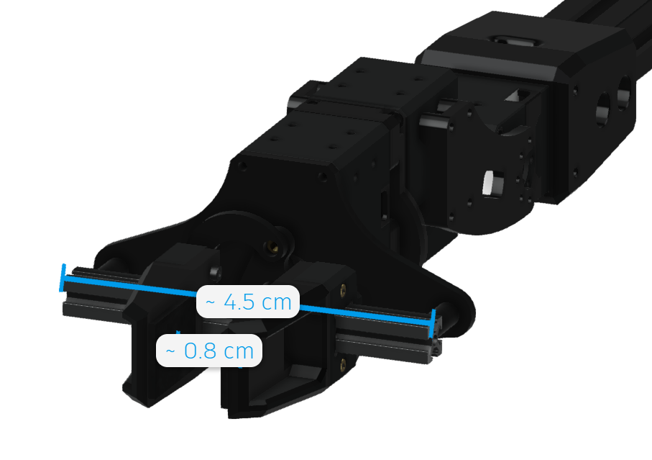
Sample Size Acquisition
FR.2 AEROSS shall be able to collect, store, and deposit a sample that is 20 mm at its largest dimension
Feasibility Item:
Can the collection arm acquire a sample no greater than 2 cm at its maximum dimension?
Assumptions
Grip strength sufficient to secure sample
From Developer:
End effectors can deploy to a maximum span of 4.5 cm and retract to 0 cm.
Feasible? YES!
Since the end effector can span a distance of 0-4.5 cm, it can also accommodate a 2cm sample
Timeline
Project Description
CONOPS
Baseline Design
Baseline Feasibility
Summary

Slide 22
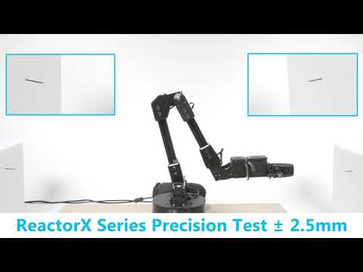
Sample Collection Device Accuracy
FR.3: AEROSS shall be able to deposit the rock at a location specified by the ground station or the mother rover with 2 cm accuracy.
Feasibility Item:
Can the rover deposit the sample at a specified LOI with +/- 2 cm of accuracy?
Resources:
ROS software packages are included in the COTS option
Able to control the position of the arm
Feasible: YES!
Timeline
Project Description
CONOPS
Baseline Design
Baseline Feasibility
Summary
Notes:
Need to ask dr koster
Explain ROS, COTS, LOI

Slide 23
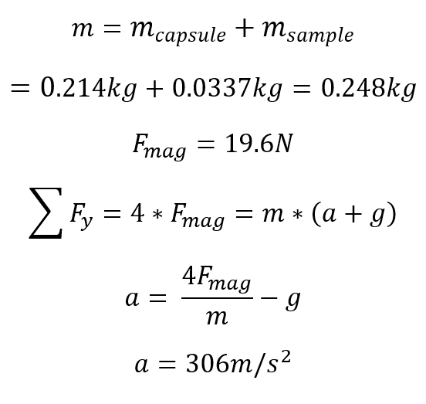
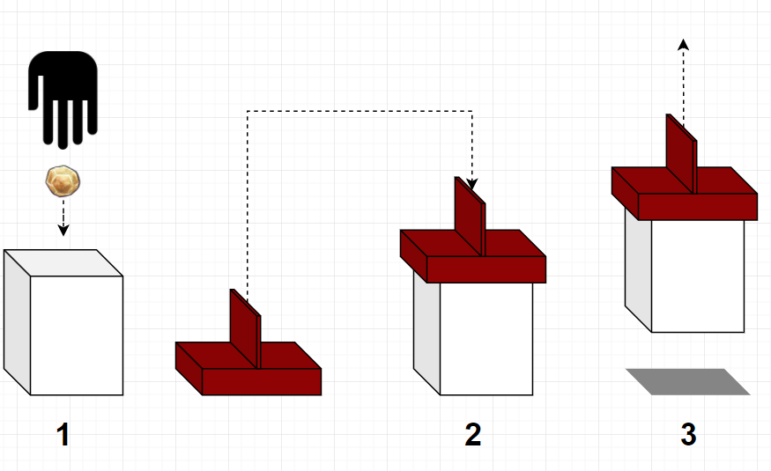
Sample Storage Feasibility
Feasibility item:
Can the sample capsule be lifted from the lid without the lid detaching?
Assumptions:
Repeatable pull force of 19.6 N per magnet
Uniform loading on all magnets
Conclusion:
The acceleration necessary to rip the lid off well exceeds the capabilities of the arm.
Feasible: YES!
Timeline
Project Description
CONOPS
Baseline Design
Baseline Feasibility
Summary
Notes:
Ask dr koster if its even worth it

Slide 24
Sample Collection/Storage Summary
Conclusions
Capable of lifting a sample of less than 2lbs
Capable of acquiring a sample that is 2 cm at its largest dimension
Capable of depositing the sample with +/- 2 cm of accuracy
Capable of storing the sample throughout the missions duration
Articulating arm is a feasible solution to effect satisfaction of FR.1, FR.2, FR.3
Timeline
Project Description
CONOPS
Baseline Design
Baseline Feasibility
Summary

Slide 25
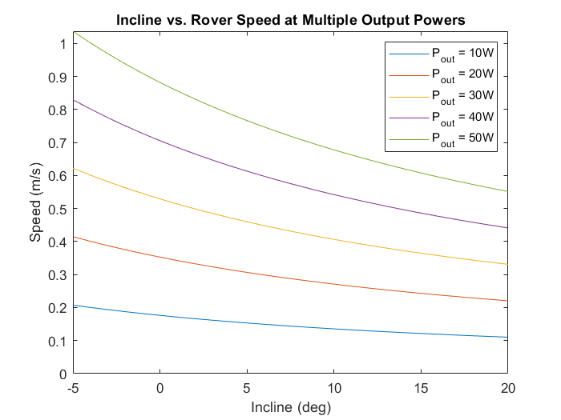
Drivetrain Motor Feasibility
Drivetrain: Obstacle Maneuverability Feasibility Analysis
FR.4: AEROSS shall be able to drive to a specified LOI and return to its original location within a radius of 100 m and have 360 degree turn capability.
DR.1.4: AEROSS shall be able to deposit the rock at a location specified by the ground station or the mother rover with 2 cm accuracy.
Feasibility Item:
Can AEROSS successfully move through underbrush?
Assumptions:
Body-centered COM
Grounded
No slipping
3 in. Kentucky Bluegrass
Vehicle mass of 10kg
Clay-dirt terrain + additional grass resistance
Feasible? YES!
Model shows success
Timeline
Project Description
CONOPS
Baseline Design
Baseline Feasibility
Summary

Slide 26
Drivetrain Turning Feasibility
Drivetrain: Turning Feasibility Analysis
FR.4: AEROSS shall be able to drive to a specified LOI and return to its original location within a radius of 100 m and have 360 degree turn capability.
DR.1.4: AEROSS shall be able to deposit the rock at a location specified by the ground station or the mother rover with 2 cm accuracy.
Feasibility Item:
Can AEROSS perform a 360 degree turn?
Can the drivetrain support the axial loads?
Assumptions:
Body-centered COM
Grounded
No angular acceleration
Feasible? YES!
4WD
Timeline
Project Description
CONOPS
Baseline Design
Baseline Feasibility
Summary

Slide 27
Communications Analysis
Feasibility Item:
Communicate with the ground station at a distance of 100m
Assumptions:
P_{Rx} > R_{x}
Losses: Free Space, Cable
Hardware Assumptions
Radio & Antenna Specs
Transmit Power (P_{Tx}) | 28 dB
Receiver Sensitivity (R_{x}) | -97 dB
Radio Frequency (f) | 2432 MHz
Transmit Antenna Gain (G_{Tx}) | 10 dBi
Receive Antenna Gain (G_{Rx}) | 10 dBi
Timeline
Timeline
Project Description
Project Description
CONOPS
CONOPS
Baseline Design
Baseline Design
Baseline Feasibility
Baseline Feasibility
Summary
Summary

Slide 28
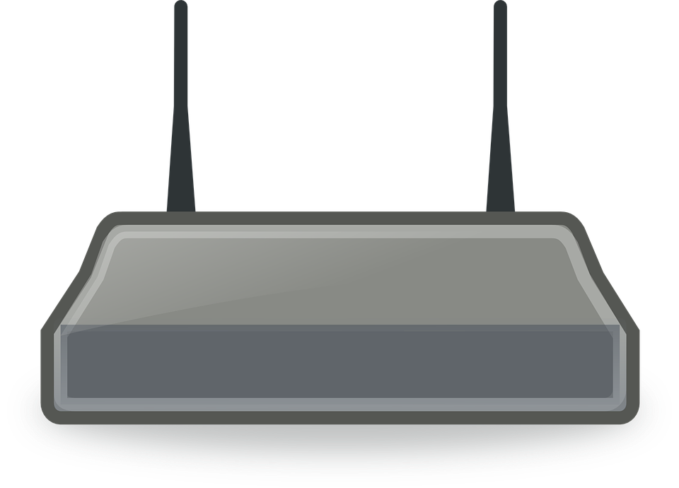
Communications Analysis Cont.
Link Budget Equations:
Free Space Loss
Results:
P_{Rx}= -34.16dB > R_{x}= -97dB
Link Margin: 62.84 dB > 0
Clear path communication at 100m: FEASIBLE
Power Transmitted
Power
Received
Timeline
Timeline
Project Description
Project Description
CONOPS
CONOPS
Baseline Design
Baseline Design
Baseline Feasibility
Baseline Feasibility
Summary
Summary

Slide 29
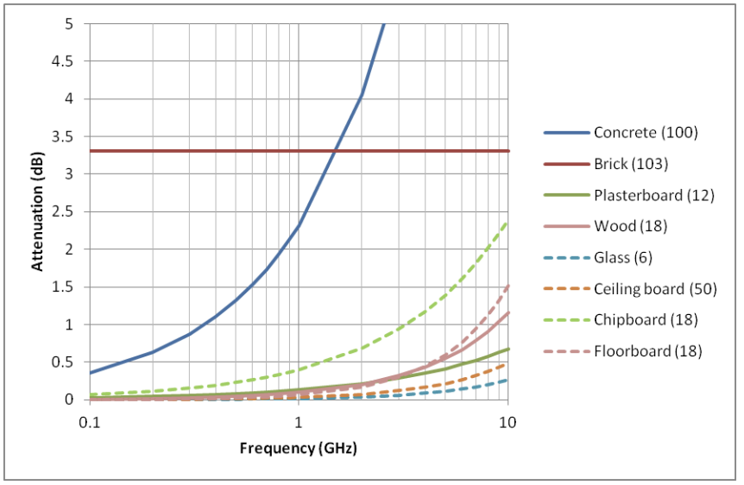
Communications Analysis Cont.
Feasibility Item:
Communication through obstacles at 100m
Assumptions:
Most attenuative material: concrete
No metallic obstacles
Results
Max attenuation of 2.4 GHz: 4.3 dB
Link Margin: 58.54 dB > 0
Communication through obstacles at 100m: FEASIBLE
Timeline
Timeline
Project Description
Project Description
CONOPS
CONOPS
Baseline Design
Baseline Design
Baseline Feasibility
Baseline Feasibility
Summary
Summary
Notes:
-could not find data on attenuation through obstacles. We have a rough approximation of losses through obstacles such as glass, the human body, and a brick wall. All these losses are around 2-5 dB. Therefore, our LM is enough to account for these losses if need be.
-signal is decreased through obstructions and over distance

Slide 30
Summary

Slide 31
Status Summary
System | Feasible | Reasoning
Collection Device | Yes | Capable of collecting, storing, and depositing sample within the required specifications (FR.1,FR.2,FR.3)
Communication | Yes | Communication is reliable throughout Rover journey up to 100m in any direction even when obstructions are encountered (FR.5, FR.6)
Drivetrain | Yes | Capable of transporting AEROSS to and from the LOI through underbrush and making 360 degree turns (FR.4)
Timeline
Project Description
CONOPS
Baseline Design
Baseline Feasibility
Summary
Notes:
-could not find data on attenuation through obstacles. We have a rough approximation of losses through obstacles such as glass, the human body, and a brick wall. All these losses are around 2-5 dB. Therefore, our LM is enough to account for these losses if need be.
-signal is decreased through obstructions and over distance

Slide 32
Status Summary
System | Feasible | Reasoning
Power | Yes | Capable of supplying necessary 169 W of power needed for all subsystems in order to drive to a specified LOI and back
Finance | Yes | Budget is well within expected maximum amount of $5000
Timeline
Project Description
CONOPS
Baseline Design
Baseline Feasibility
Summary
Notes:
-could not find data on attenuation through obstacles. We have a rough approximation of losses through obstacles such as glass, the human body, and a brick wall. All these losses are around 2-5 dB. Therefore, our LM is enough to account for these losses if need be.
-signal is decreased through obstructions and over distance

Slide 33
Studies Needed

Slide 34
Studies Needed
Sample Collection Device
Software
Sample Collection Container
Magnets
Fish Trap
Trash Can (Swing Top)
Communications
Obstacle Communication
Camera Compatibility
Power
Arm Battery Supply
Battery Type
Endurance
Drivetrain
Terrain Study
Articulated Arm
Sample Container
4-Wheel Drivetrain
Timeline
Project Description
CONOPS
Baseline Design
Baseline Feasibility
Summary
Notes:
-could not find data on attenuation through obstacles. We have a rough approximation of losses through obstacles such as glass, the human body, and a brick wall. All these losses are around 2-5 dB. Therefore, our LM is enough to account for these losses if need be.
-signal is decreased through obstructions and over distance

Slide 35
References
[1] Akin, D., “Terramechanics I” Available: https://spacecraft.ssl.umd.edu/academics/788XF18/788XF16.terramechanics1x.pdf.
[2] Fujiwara, D., Tsujikawa, N., Oshima, T., Iizuka, K., “Estimation of Resistance Force at Steady-State Sinkage for Cylindrical Wheel-Typed Lunar/Planetary Exploration Rovers with Function of Push Pull Locomotion,” Available: https://robomechjournal.springeropen.com/articles/10.1186/s40648-020-00183-0.
[3] Hernandez, J., “What led to the Florida condo collapse? here's what we know so far,” NPR Available: https://www.npr.org/sections/live-updates-miami-area-condo-collapse/2021/06/29/1010976101/timeline-what-we-know-so-far-about-what-led-up-to-the-surfside-condo-collapse.
[4] Laughery, S., Gerhart, G., Goetz, R., “Bekker's Terramechanics Model for Off-road Vehicle Research” Available:https://www.researchgate.net/publication/235069513_Bekker's_Terramechanics_Model_for_Off-Road_Vehicle_Research.
[5] Leader, M., Rege, R., Potts, N., Gullikson, A., Curran, N., Dhaliwal, J., Kring, D., “Velocity of a Rover as a Function of Slope of Lunar Terrain”. Available: https://www.hou.usra.edu/meetings/lpsc2014/pdf/2683.pdf.

Slide 36
References
[6] N/A, N. A., “Robotis dynamixel XM430-W350-T Dynamixel-X TTL servo robot actuator,” T Available: https://smartrobotworks.com/XM430-W350-T.asp?utm_term=xm430-w350-t&utm_campaign=Robotis&utm_source=adwords&utm_medium=ppc&hsa_tgt=kwd-929036099981&hsa_grp=106129260922&hsa_src=g&hsa_net=adwords&hsa_mt=e&hsa_ver=3&hsa_ad=449096700607&hsa_acc=9041622380&hsa_kw=xm430-w350-t&hsa_cam=10571979064&gclid=Cj0KCQjwnoqLBhD4ARIsAL5JedLmoYkrYfmOj_qqBm8ZA0B6zrtJnZDLHybuzLowmM-hMwH_Z5x1WDgaAsLVEALw_wcB.
[7]“ReactorX 200 Robot Arm,” Trossen Robotics, N/A.
[8] Rudd, R., Building Materials and Propagation Final Report Available: https://paperzz.com/doc/6838686/building-materials-and-propagation-final-report.

Slide 37
Questions?

Slide 38
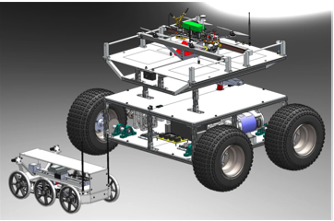
Mother Rover (DRIFT)
Mobile Child Rover Operational Base
Maintain Communication (FR3)
Command Child
GPS Commands
Video Feed
Send data to GS
Child Rover Commands
Capsule Deposit (FR1)

Slide 39
Drivetrain: Motor Feasibility Analysis
Drivetrain: Motor Feasibility Analysis
Feasibility Item
Can AEROSS drive on a slope?
Assumptions
No slipping
No wheel tread or grousers
No bulldozing resistance
Rover is simulated as a single wheel with an applied weight of one fourth of the rover mass
No benefits from in-line and side-by-side wheel arrangement
Maximum soil stress is 0.2*wheel entrance angle
Vehicle mass of 10kg
Clay-dirt terrain + additional grass resistance
Timeline
Project Description
CONOPS
Baseline Design
Baseline Feasibility
Summary

Slide 40
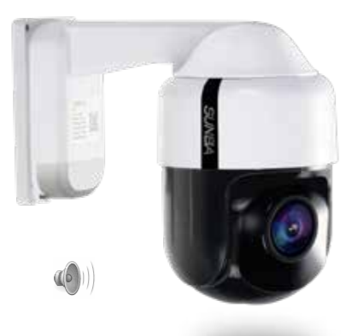
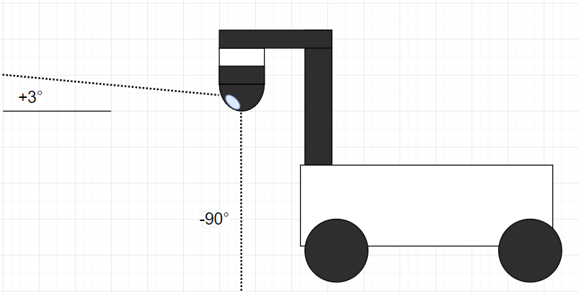
Baseline Design: Camera
Trade Options: Handheld Camera, action camera, FPV Camera, PTZ Camera
Purpose:
To transmit video to the mother rover or ground station
Needs:
>100 degree field of view
Solution:
Sunba 305-D4X
1080p-30 output
IP66 Ingress protection
28-115 field of view
3° -90° tilt, 0-340° endless pan
Max power consumption: 25W (12V 2A)
AEROSS shall have video capability with a greater than 100 degree field of view
FR.6
Timeline
Timeline
Project Description
Project Description
CONOPS
CONOPS
Baseline Design
Baseline Design
Baseline Feasibility
Baseline Feasibility
Summary
Summary

Slide 41
Feasibility: Communications
Values used for link budget analysis:
Transmitter Power Ptx = 28dB | Tx/Rx Losses Ltx/Lrx = 1dB | Free Space Path Loss FSPL = 80.16dB | Frequency (f) f = 2432 MHz | Receiver Power Prx = -34.16 dB
Gains Gtx/Grx = 10dBi | Distance D = 100m | Speed of Light (c) C = 3*10^8 | Receiver Sensitivity Rx = -97dB | Miscellaneous Loss Lm = 0dB
Conductor Loss k1=0.2 | Insulation Loss k2=0.011 | Connection Loss Factor CLF=0.12
Free Space Path Loss:
Link Margin:
Link Budget Equation:
Cable Loss Equation:
Timeline
Timeline
Project Description
Project Description
CONOPS
CONOPS
Baseline Design
Baseline Design
Baseline Feasibility
Baseline Feasibility
Summary
Summary

Slide 42
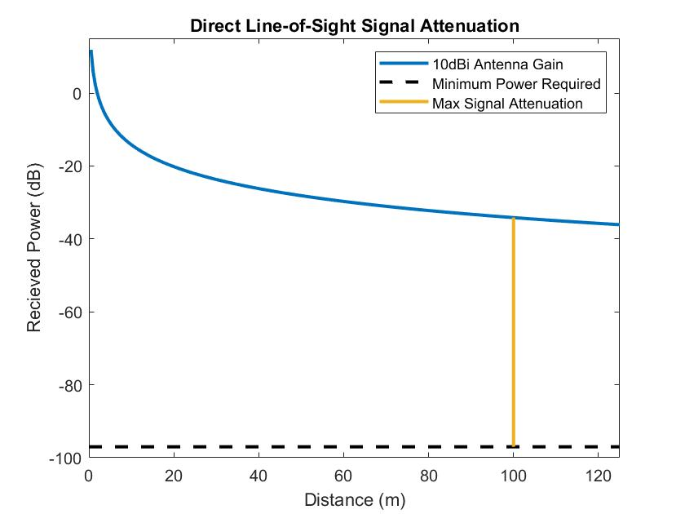
Feasibility: Communications
Free Space Path Loss as a function of distance.
Assumes antenna gains of 10dBi
Timeline
Timeline
Project Description
Project Description
CONOPS
CONOPS
Baseline Design
Baseline Design
Baseline Feasibility
Baseline Feasibility
Summary
Summary

Slide 43
Power Budget
Component | Average Current (A) | Voltage (V) | Power Required (W)
Sample Collection Arm | 5 | 12 | 60
Camera | 1 | 24 | 24
Motors | 3.33 | 12 | 40
Radio | 1.67 | 12 | 20
Processor | 2 | 12 | 24
Microcontroller | 0.2 | 5 | 1
 |  | Total | 169
Timeline
Timeline
Project Description
Project Description
CONOPS
CONOPS
Baseline Design
Baseline Design
Baseline Feasibility
Baseline Feasibility
Summary
Summary

Slide 44
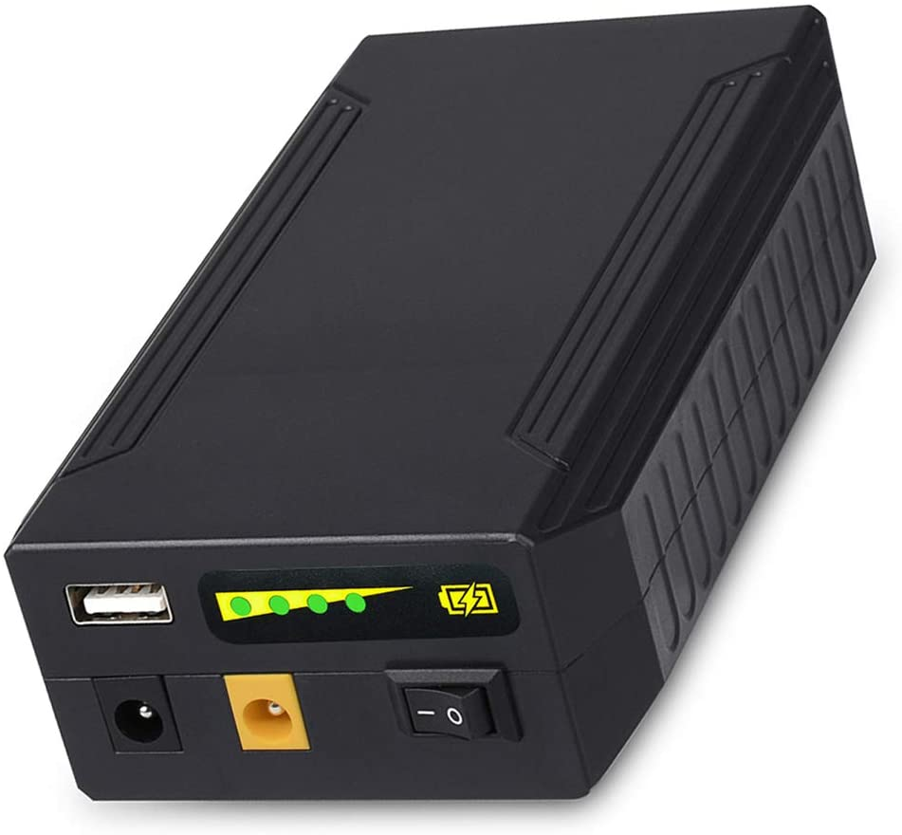
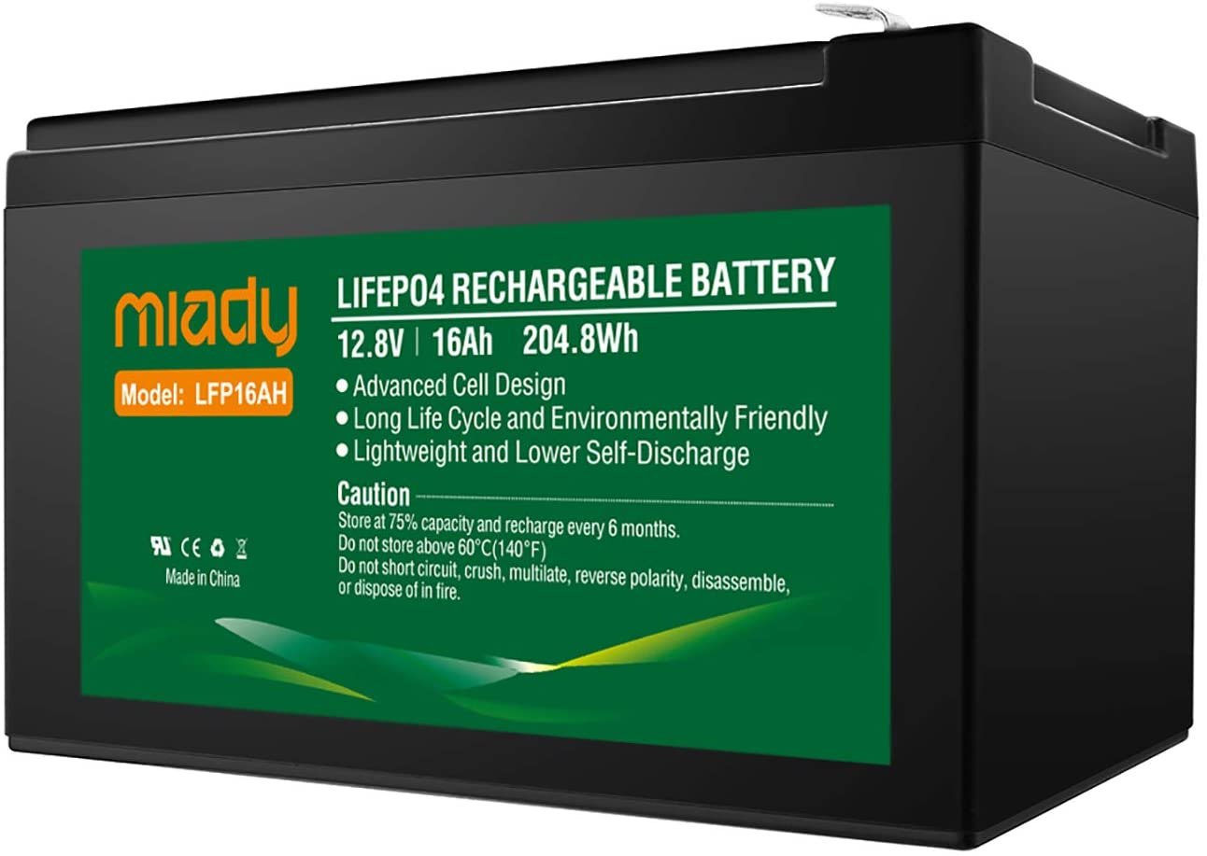
Baseline Design: EPS
Trade Options: Li-Ion Battery, Li-Po Battery
Purpose:
Provide power to all components on the rover
Needs:
Power supply
Charger for battery
Wiring
On-going Study
Which battery has the best endurance
What is the power supply that comes with the arm
Determine which battery will be used
FR2. | AEROSS shall be able to drive to a specified LOI and return to its original location
Li-Po
Li-Ion
Timeline
Timeline
Project Description
Project Description
CONOPS
CONOPS
Baseline Design
Baseline Design
Baseline Feasibility
Baseline Feasibility
Summary
Summary

Slide 45
Feasibility: EPS
Power Needed
169 W
Li-Ion gives off 132 Wh
Would need two batteries
Li-Po gives off 205 Wh
Would only need one battery
Each battery would be FEASIBLE in terms of power, but need to determine which is better for the mission
Battery Option | Power Needed | Power Available
Li-Ion | 169 W | 132 W
Li-Po | 169 W | 205 W
Timeline
Timeline
Project Description
Project Description
CONOPS
CONOPS
Baseline Design
Baseline Design
Baseline Feasibility
Baseline Feasibility
Summary
Summary

Slide 46
Baseline Design: On-Board Processing
Trade Options: SBC, Microcontroller, FPGA
Purpose:
As shown by the driving requirements AEROSS must have a processor that is able to handle commands, control, and video processing for the rover.
Needs:
The main need of the processing system will be to process video from the camera.
The processor must have enough memory and processing power to handle the live video stream as well as commands from the communication system.
DR4.1 | AEROSS shall be able to send movement data, such as position and speed, back to the mother rover or ground station.
DR4.2 | AEROSS shall have video capability.
Comms
Microcontroller: Used for interfacing with motors and sample collection.
SBC: Used for interfacing with Comms, Camera, & Microcontroller
Camera
Timeline
Timeline
Project Description
Project Description
CONOPS
CONOPS
Baseline Design
Baseline Design
Baseline Feasibility
Baseline Feasibility
Summary
Summary

Slide 47
Feasibility: On-Board Processing
Feasibility Item
Can handle all the system data for the rover
Assumptions
Camera will account for 85% of total data needed to be handled by the rover.
A margin of 25% will be added to the final calculation
Camera will be streaming at 1080p & 30fps
Results:
Standard SBCs under $100 have 2-4GB of memory which is plenty to handle the calculated 10.3 Mbps of data.
Thus using an SBC is FEASIBLE
Rover Data
Data Source | Estimated % | Total Data
Camera | 85 % | 7 Mbps
Commands/Sensors | 15 % | 1.24 Mbps
Totals | 100% | 8.24 Mbps
Margin | 125% | 10.3 Mbps
Timeline
Timeline
Project Description
Project Description
CONOPS
CONOPS
Baseline Design
Baseline Design
Baseline Feasibility
Baseline Feasibility
Summary
Summary

Slide 48
Baseline Design: Sample Storage Apparatus
Criteria Weight
Criteria | Weight | Driving Requirements | Reasoning
Durability | 0.3 | DR1.2 | The durability metric is considered one of the most vital criteria for the sample collection apparatus, given that this metric is a large contributing factor for AEROSS’s lifetime.
Mechanical Complexity | 0.25 | DR1.1, DR1.2, DR1.3 | The sample storage apparatus is a mechanical system that is needed to load and seal the sample inside the sample capsule. This metric can greatly increase or reduce the amount of onboard functions.
Material Options | 0.15 | DR1.2, DR1.3 | The least vital metric of this system. Given all the materials considered will fulfill the mission requirements, having extra options is not mission critical.
Availability | 0.3 | N/A | The availability metric is considered to be one of the most important for criteria for this system, as this will not only impact the AEROSS’s lifetime.
Timeline
Timeline
Project Description
Project Description
CONOPS
CONOPS
Baseline Design
Baseline Design
Baseline Feasibility
Baseline Feasibility
Summary
Summary

Slide 49
Baseline Design: Sample Storage Apparatus
Trade Study
Criteria | Weight | Vacuum Seal | Screw Top | Heat Seal | Spring Locking Lid | Swing Top | Magnetic Seal | Fish Trap
Durability | 0.3 | 1 | 5 | 1 | 5 | 3 | 5 | 3
Mechanical Complexity | 0.25 | 2 | 2 | 4 | 1 | 2 | 5 | 2
Material Options | 0.15 | 1 | 4 | 1 | 4 | 3 | 3 | 3
Availability | 0.3 | 5 | 3 | 5 | 3 | 3 | 3 | 3
Total | 1 | 2.45 | 3.5 | 2.95 | 3.25 | 2.75 | 4.1 | 2.75
Rank |  | 6 | 2 | 4 | 3 | 5 | 1 | 5
Timeline
Timeline
Project Description
Project Description
CONOPS
CONOPS
Baseline Design
Baseline Design
Baseline Feasibility
Baseline Feasibility
Summary
Summary

Slide 50
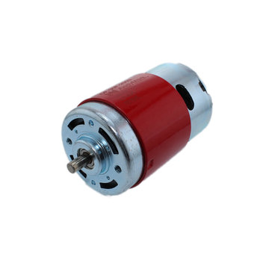
Drivetrain
Specs:
Motor: AndyMark 775 Redline Motor am-3775a
Gearbox: AndyMark 57 Sport Gearbox
Wheels: Haul Master 10 in. Pneumatic Tire With White Hub
Cost:
Motor: $20/each
Gearbox: $96/each
Wheel: $7.99/each
Supply:
Andymark - Shipping Not Included
Wheel: Harbor Freight - Shipping not included
Total:
$496+shipping (4 motors, 4 gearboxes, 4 wheels)

Slide 51
Sample Collection Arm
Specs:
Homemade 3D printer Arm
ReactorX 200 COTS Arm
Cost:
Homemade: $189
ReactorX: $1696
Supply:
Homemade: Amazon - Free Delivery
ReactorX: Trossen Robotics Interbot - Shipping not included
Total:
$189/$1696+shipping

Slide 52
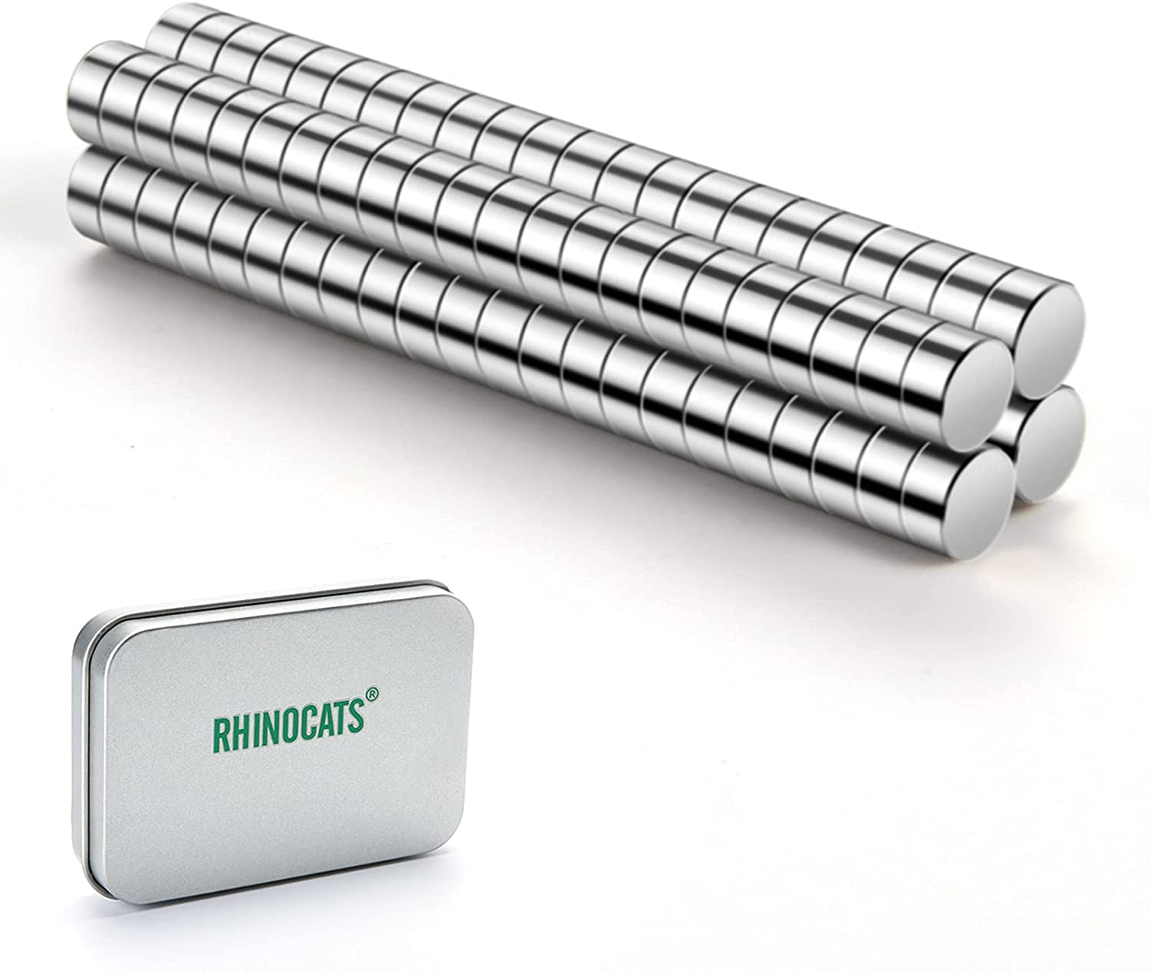
Sample Collection Capsule
Specs:
3D printed capsule
6x3 mm magnets(8)
Cost:
Magnets: $6.99
3D Print: $15.99/spool (2.2 kg)
Supply:
Magnets: Amazon - Free Delivery
3D Print: California Filament - Free Shipping
Total:
$38.97 (1 Magnet(Pack of 60), 2 Spools)

Slide 53
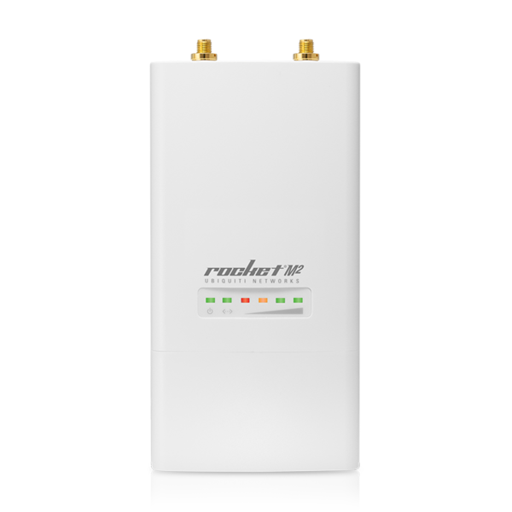
Communications
Specs:
Antenna: Techtoo Wifi Antenna
Radio: Ubiquiti Rocket M2
Sensors: Ultrasonic Sensors HC-SRO4
Cost:
Antenna: $15.99
Radio: $89
Sensors: $9.59
Supply:
Amazon - Free Shipping
UI - Shipping Not Included
Amazon - Free Shipping
Total:
$114.58

Slide 54
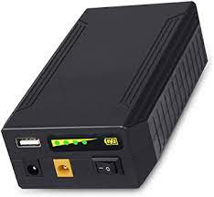
Power
Specs:
TalentCell Rechargeable Battery
Cost:
$69.99
Supply:
Amazon - Free Delivery
Total:
$139.98 (2 batteries)

Slide 55
Budget Breakdown
DriveTrain
Motors/Gearboxes/Wheels: $496+shipping
Sample Collection Arm:
Raw Engineer/ReactorX: $189/$1696
Sample Collection Capsule
3D Print/Magnets: $38.97
Communications:
Antenna/Radio/Sensor: $114.58
Power:
Rechargeable Battery: $139.98
Hardware Budget
Arm Design 1: $817.53+ Shipping
Arm Design 2: $2485.53 + Shipping
Interface/Software
Processing/Integration: $500
Discretionary Fund
Replace Parts/Adjust Pieces: Arm Design 1: $3500/ Arm Design 2: $1800
Total Estimated Expenses:
$1500/$3200*
*total expenses dependent on arm design choice

Slide 56
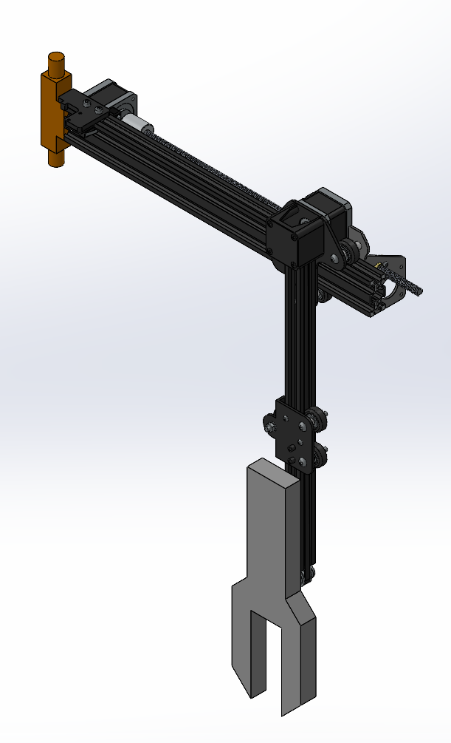
Sample Collection Arm
Trade options: Articulated arm, Rectangular arm, Cylindrical arm
Purpose:
Pick up rock sample
Store in sample capsule
Deposit sample at a specified LOI
Solution: Ender 3 component reconfiguration
Stepper motor open loop control over USB
Maximum Power Draw: 30W (4x 4.83V 1.5A)
Cost: $180
Timeline
Timeline
Project Description
Project Description
CONOPS
CONOPS
Baseline Design
Baseline Design
Baseline Feasibility
Baseline Feasibility
Summary
Summary

Slide 57
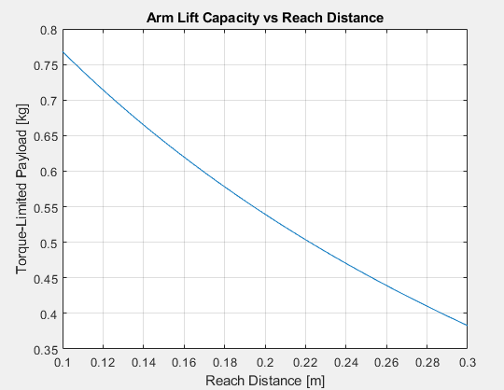
Sample Collection Device
Analysis Topic:
Motor Arm Stall Torque
Assumptions:
Each linkage modeled as point mass at CG.
Arm extends horizontally outward with bend in elbow.
Arm will lift sample using shoulder joint.
Results:
At maximum reach, motor will stall out at 380g payload.
Timeline
Project Description
CONOPS
Baseline Design
Baseline Feasibility
Summary
Notes:
Possibly include error bounds on this graph
-present that we analytically and numerically found the stall

Slide 58
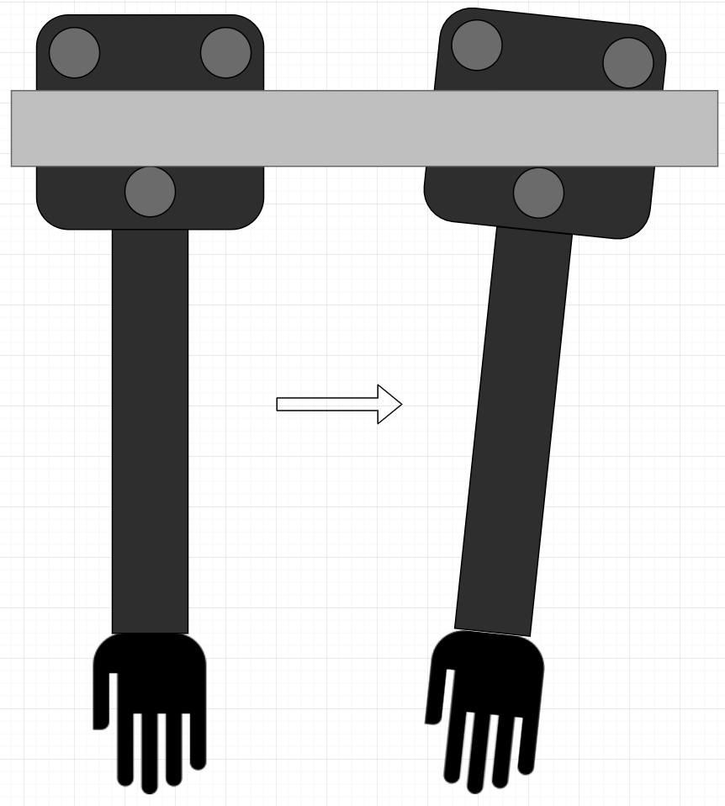
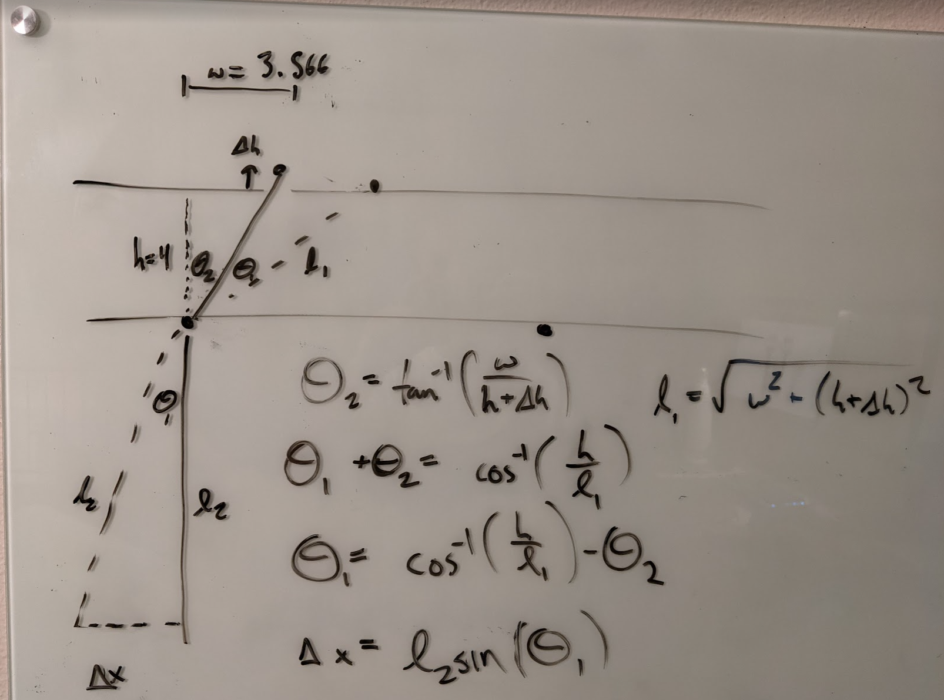
Sample Collection Device Cont.
DR1.4: AEROSS collector rover shall be able to deposit the rock at a location specified by the ground station or the mother rover with 2 cm accuracy.
Feasibility Item:
2cm arm accuracy
Assumptions:
Primary source of error in the arm is the vertical axis wobble.
Result:
Roller distance must be within 0.75mm vertical tolerance (feasible).
Timeline
Project Description
CONOPS
Baseline Design
Baseline Feasibility
Summary

Slide 59
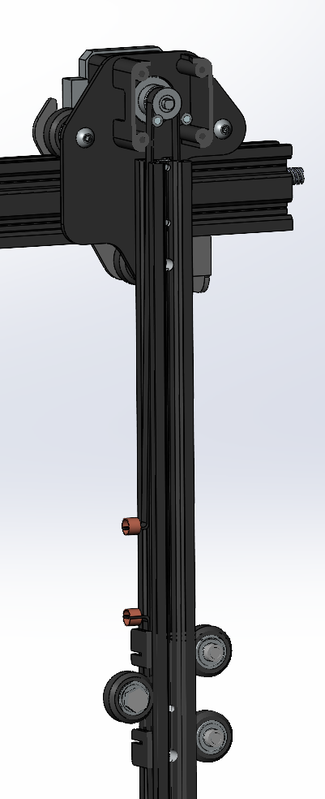
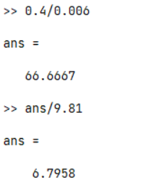
Sample Collection Device Cont.
DR1.2: AEROSS collector rover shall be able to pick up a rock that is <2lbs.
Feasibility Item:
Lifting strength
Assumptions:
Frictionless drive
Pulley diameter: 6mm
Result:
Lifting capacity of 6.8kg without gear reduction, including the grabber (feasible)
Timeline
Project Description
CONOPS
Baseline Design
Baseline Feasibility
Summary

