Slide 1
ALL-Electric ROver
for Sample Storage
Team: David Koester (PM), Emily Mitzak
Owen Kaufmann, Aaron Buller,
Adam Trunko, Benjamin Lodwick,
Keaton Paquin, Max Malden,
Patrick Riley, Ricardo Lopez-Abadia
Underlined: Presenters
Sponsor: Jet Propulsion Laboratory, Barbara Streiffert
Advisor: Dr. Jean Koster
CRITICAL DESIGN REVIEW
Notes:
25 min time limit!

Slide 2
Presentation Layout
Presentation Layout
Project Overview
Design Solution
Critical Project Elements
Design Requirements/ Satisfaction
Project Risk
Verification and Validation
Project Planning

Slide 3
PROJECT OVERVIEW

Slide 4
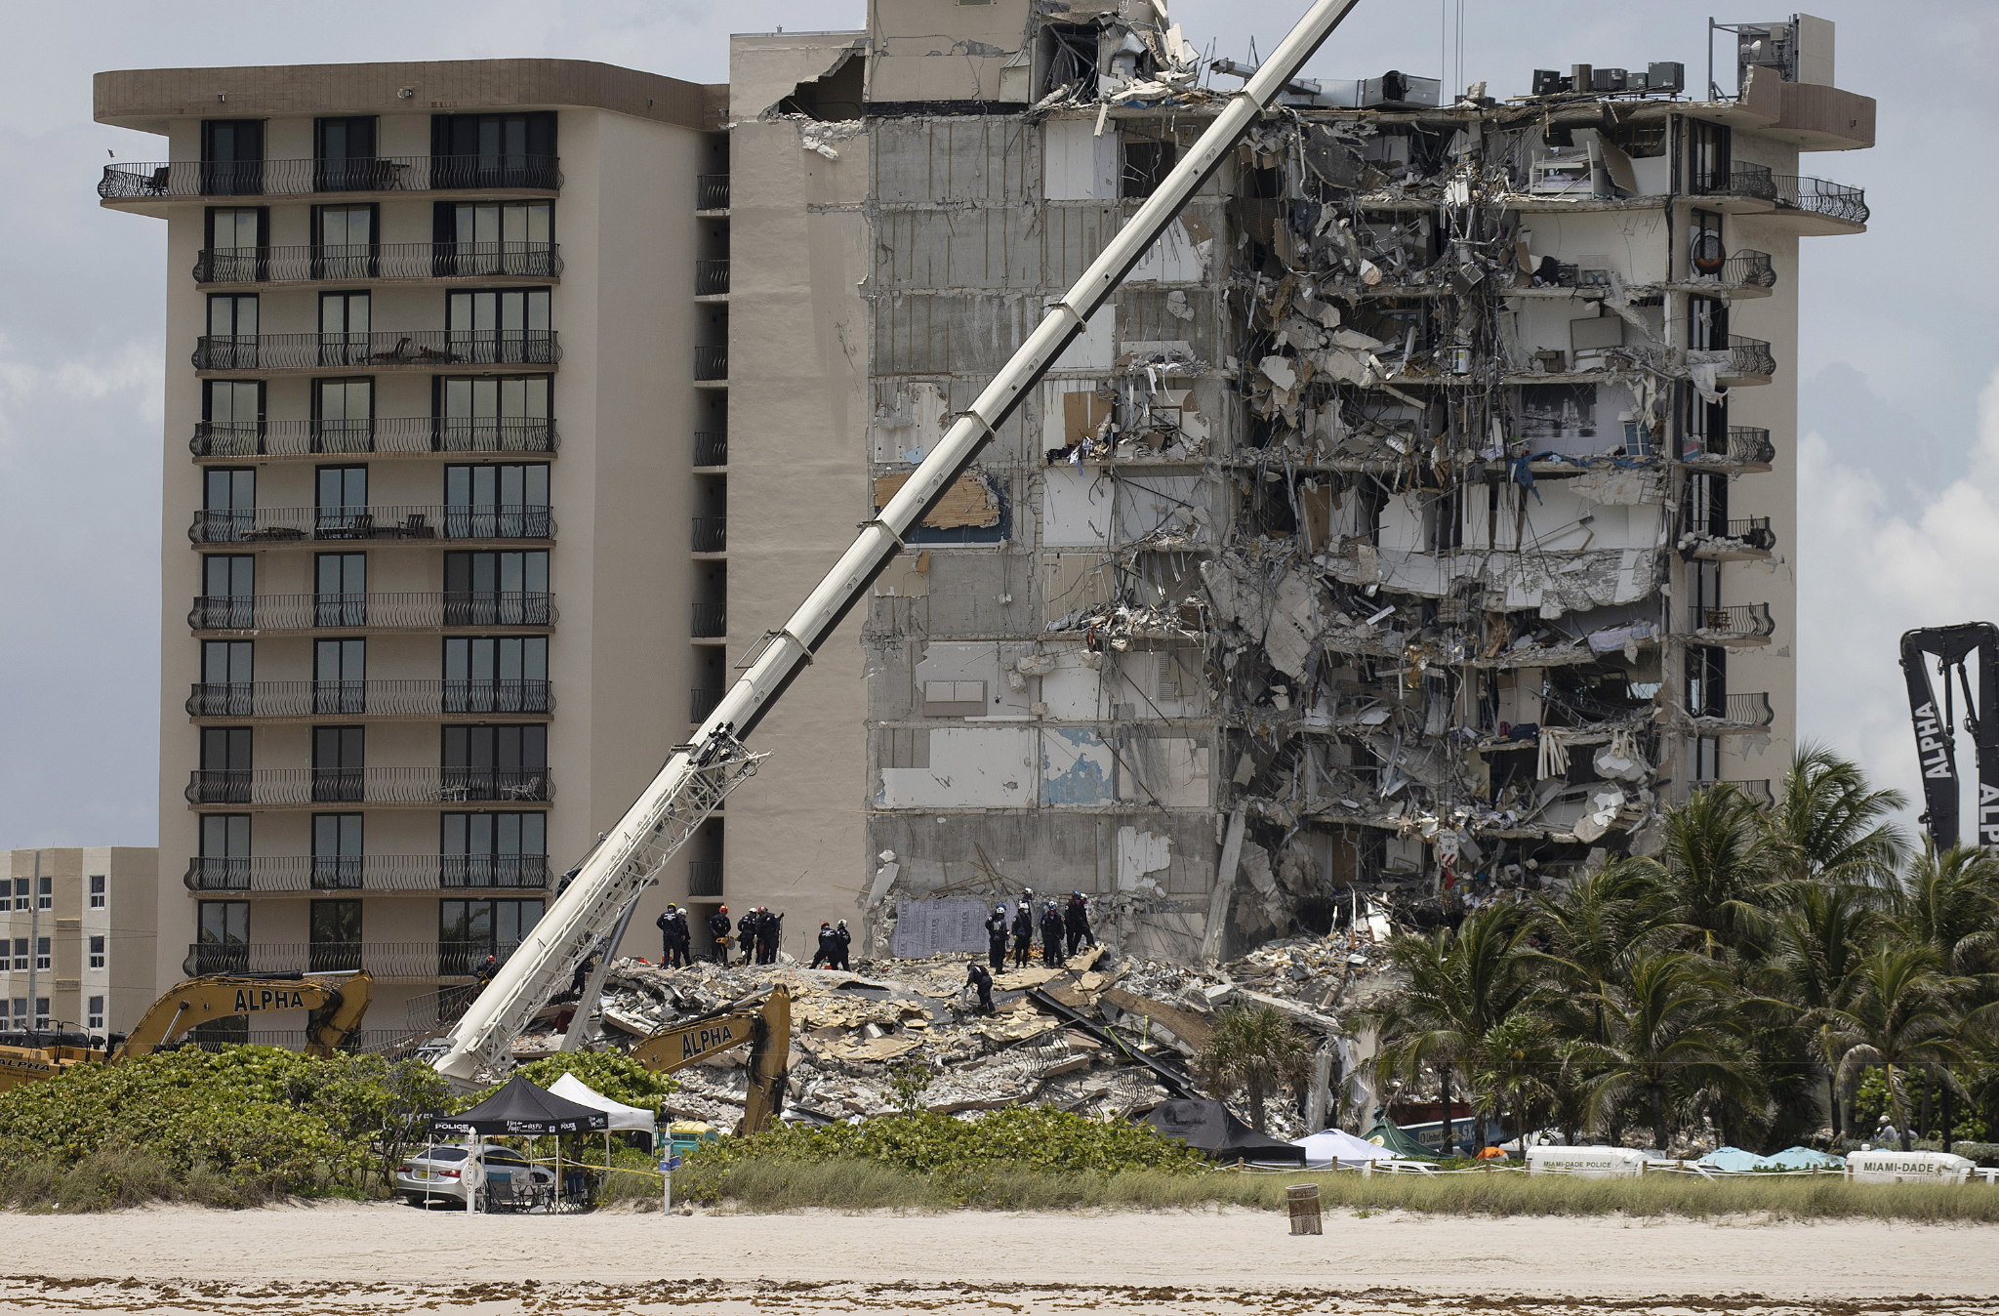
Motivation
Accessibility to certain areas on Earth may be better suited for robots than humans
Building collapse
Natural disaster zones
Samples may be required but risk to humans is too high
Mitigating the risk to humans in acquiring samples requires:
Rover that collects and stores sample of interest
Courtesy: NPR
Timeline
Project
Overview
Design Solution
CPE’s
DR’s
Satisfaction
Risks
Verification
Validation
Planning
Notes:
Notes for Presentation:
-Why are we doing this?
-Some areas are impractical for humans to access
-Location
-Environmental Hazards

Slide 5
Objectives - AEROSS
All-Electric ROver for Sample Storage
Presentation Layout
To create a user controlled rover that will:
Collect a rock sample
Store the sample in a collection container
Deposit the sample at a specified location for later retrieval
Timeline
Project
Overview
Design Solution
CPE’s
DR’s
Satisfaction
Risks
Verification
Validation
Planning
Notes:
David
Keeping rock here, make sure to specify this.
The All-Electric ROver for Sample Storage (AEROSS) team will provide JPL with a child rover that will collect a rock, put the rock in a capsule and deposit the rock in a specific location. The child rover will also have the ability to communicate with a team-manufactured ground station

Slide 6
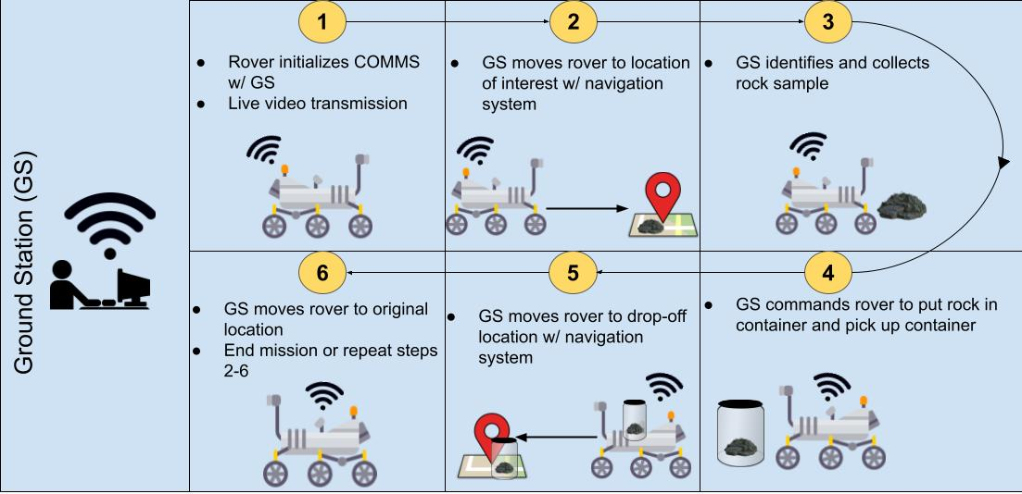
CONOPS
Presentation Layout
Timeline
Project
Overview
Design Solution
CPE’s
DR’s
Satisfaction
Risks
Verification
Validation
Planning
Notes:
Rico
Make sure to specify semi-autonomous

Slide 7
Functional Requirements
Presentation Layout
AEROSS shall:
FR.1 Be able to collect a sample
FR.2 Store a sample in container
FR.3 Be able to deposit the container at a location specified by the ground station
FR.4 Drive to a specified location and return to its original location
FR.5 Send and receive information to and from ground station
FR.6 Have video capability
Sample Collection
Drive Train
COMMS
Timeline
Project
Overview
Design Solution
CPE’s
DR’s
Satisfaction
Risks
Verification
Validation
Planning
Notes:
David
Make sure to specify semi-autonomous

Slide 8
Design Solution
Notes:
INCLUDE DIMENSIONS ON EVERYTHING!!!!!!!!!!!

Slide 9
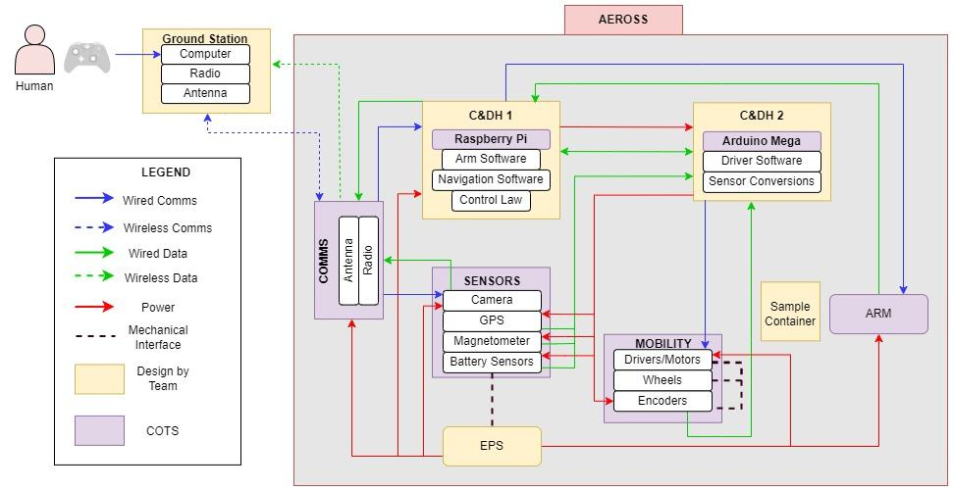
Functional Block Diagram
Presentation Layout
Timeline
Project
Overview
Project
Overview
Design Solution
Design Solution
CPE’s
DR’s
Satisfaction
Risks
Verification
Validation
Planning
Notes:
Ben
Laser pointer when presenting

Slide 10
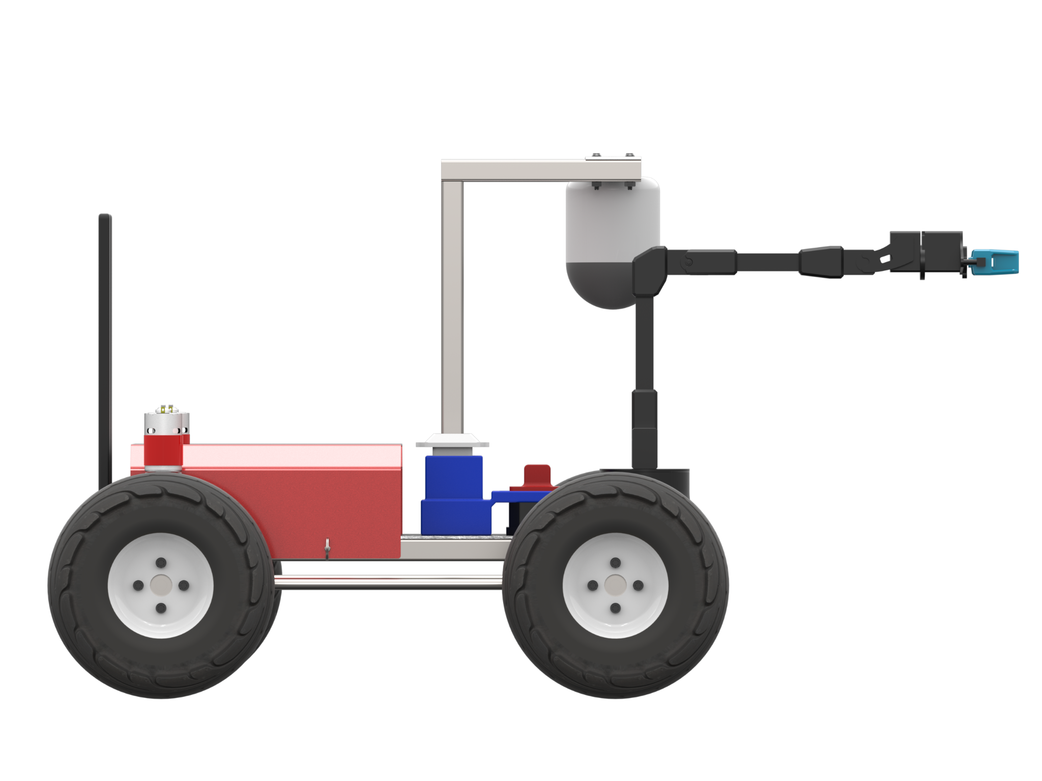
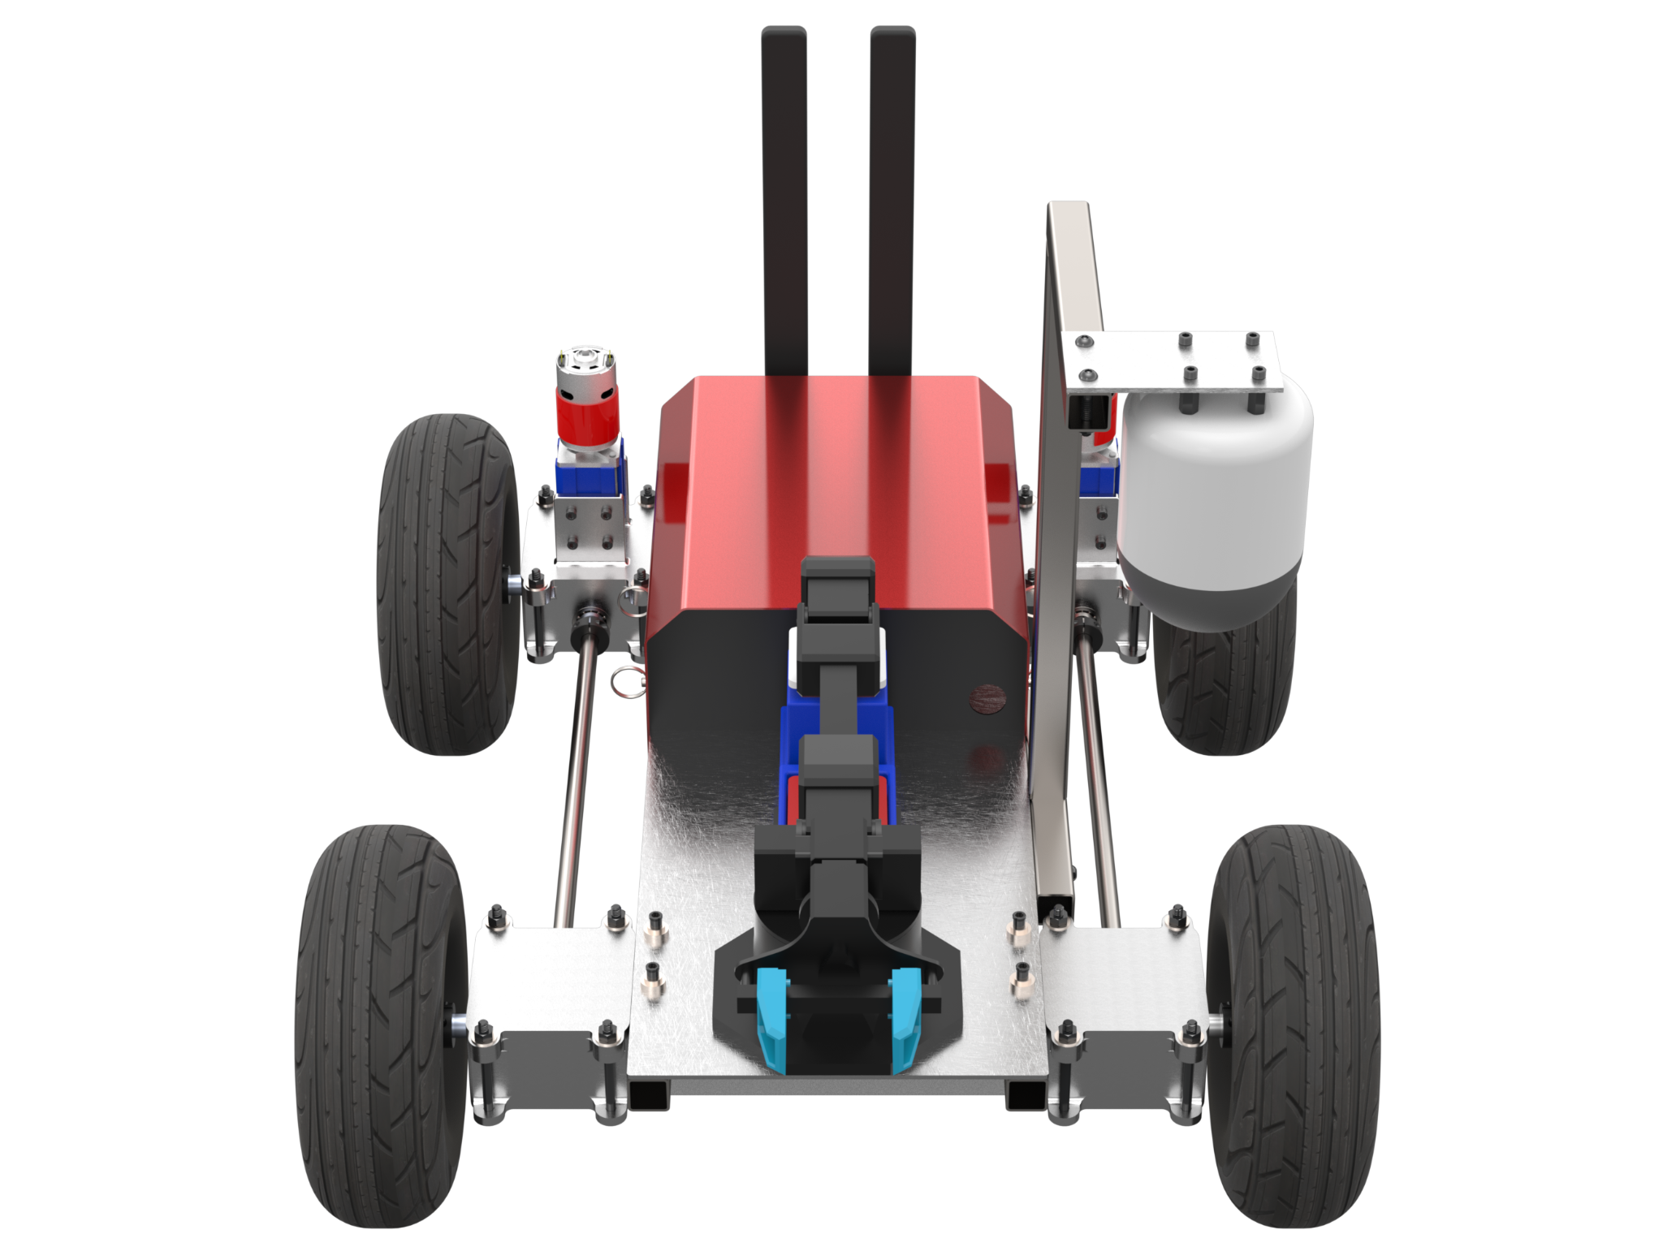
Rover Dimensions
Presentation Layout
MASS: 25 kg
61.7 cm
Height
50.8 cm
Wheelbase
57.4 cm
Track
Timeline
Project
Overview
Design Solution
CPE’s
DR’s
Satisfaction
Risks
Verification
Validation
Planning
Notes:
Patrick
Make sure to point w/ laser what we want explained

Slide 11
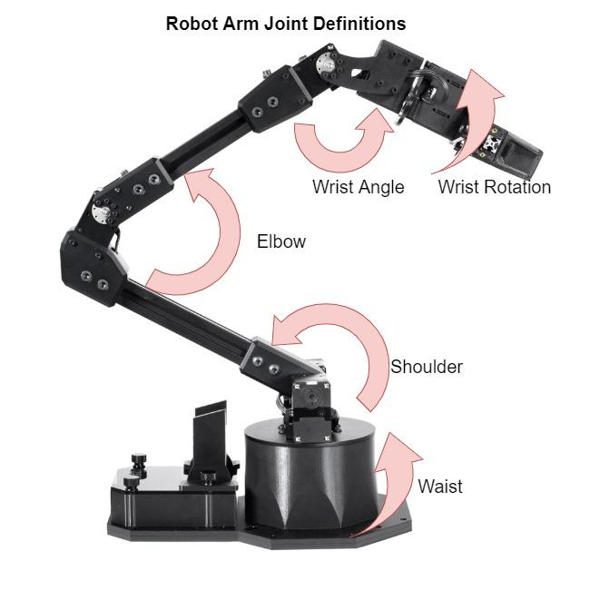
Robotic Arm Joint & Position Definition
FR.1 AEROSS shall be able to collect a sample
Presentation Layout
Specs
5 DOF robotic arm
2 XM-430 servos
3 XL-430 servos
Weight: 1.9 kg
Reach: 550 mm
360 deg turn capability
Pre-assembled
Built in ROS software
Maximum payload: 0.43 kg
Timeline
Project
Overview
Design Solution
CPE’s
DR’s
Satisfaction
Risks
Verification
Validation
Planning
Notes:
Ben

Slide 12
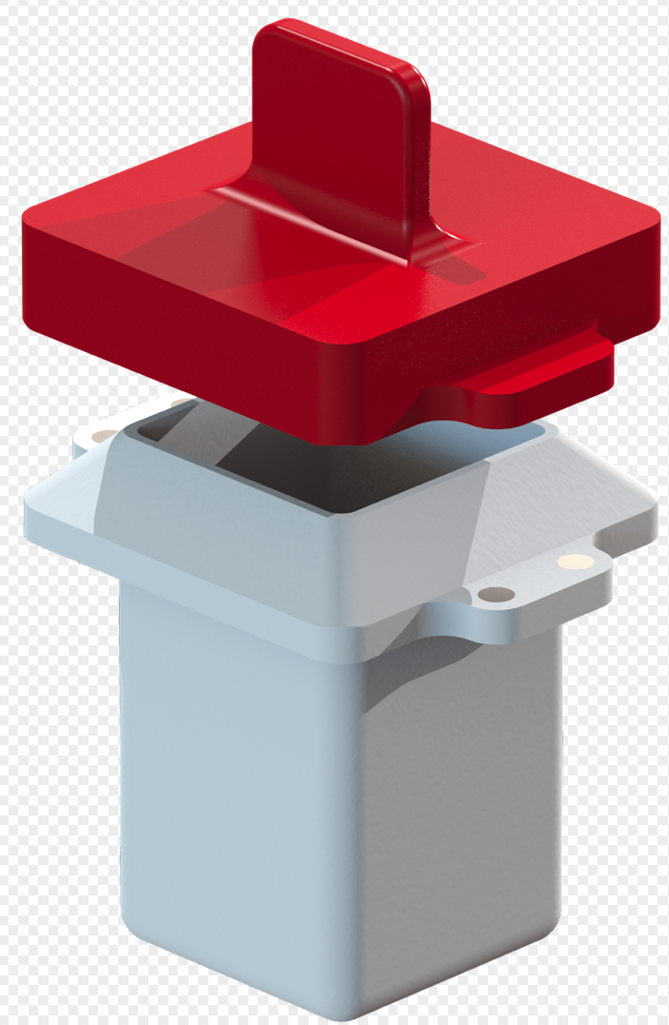
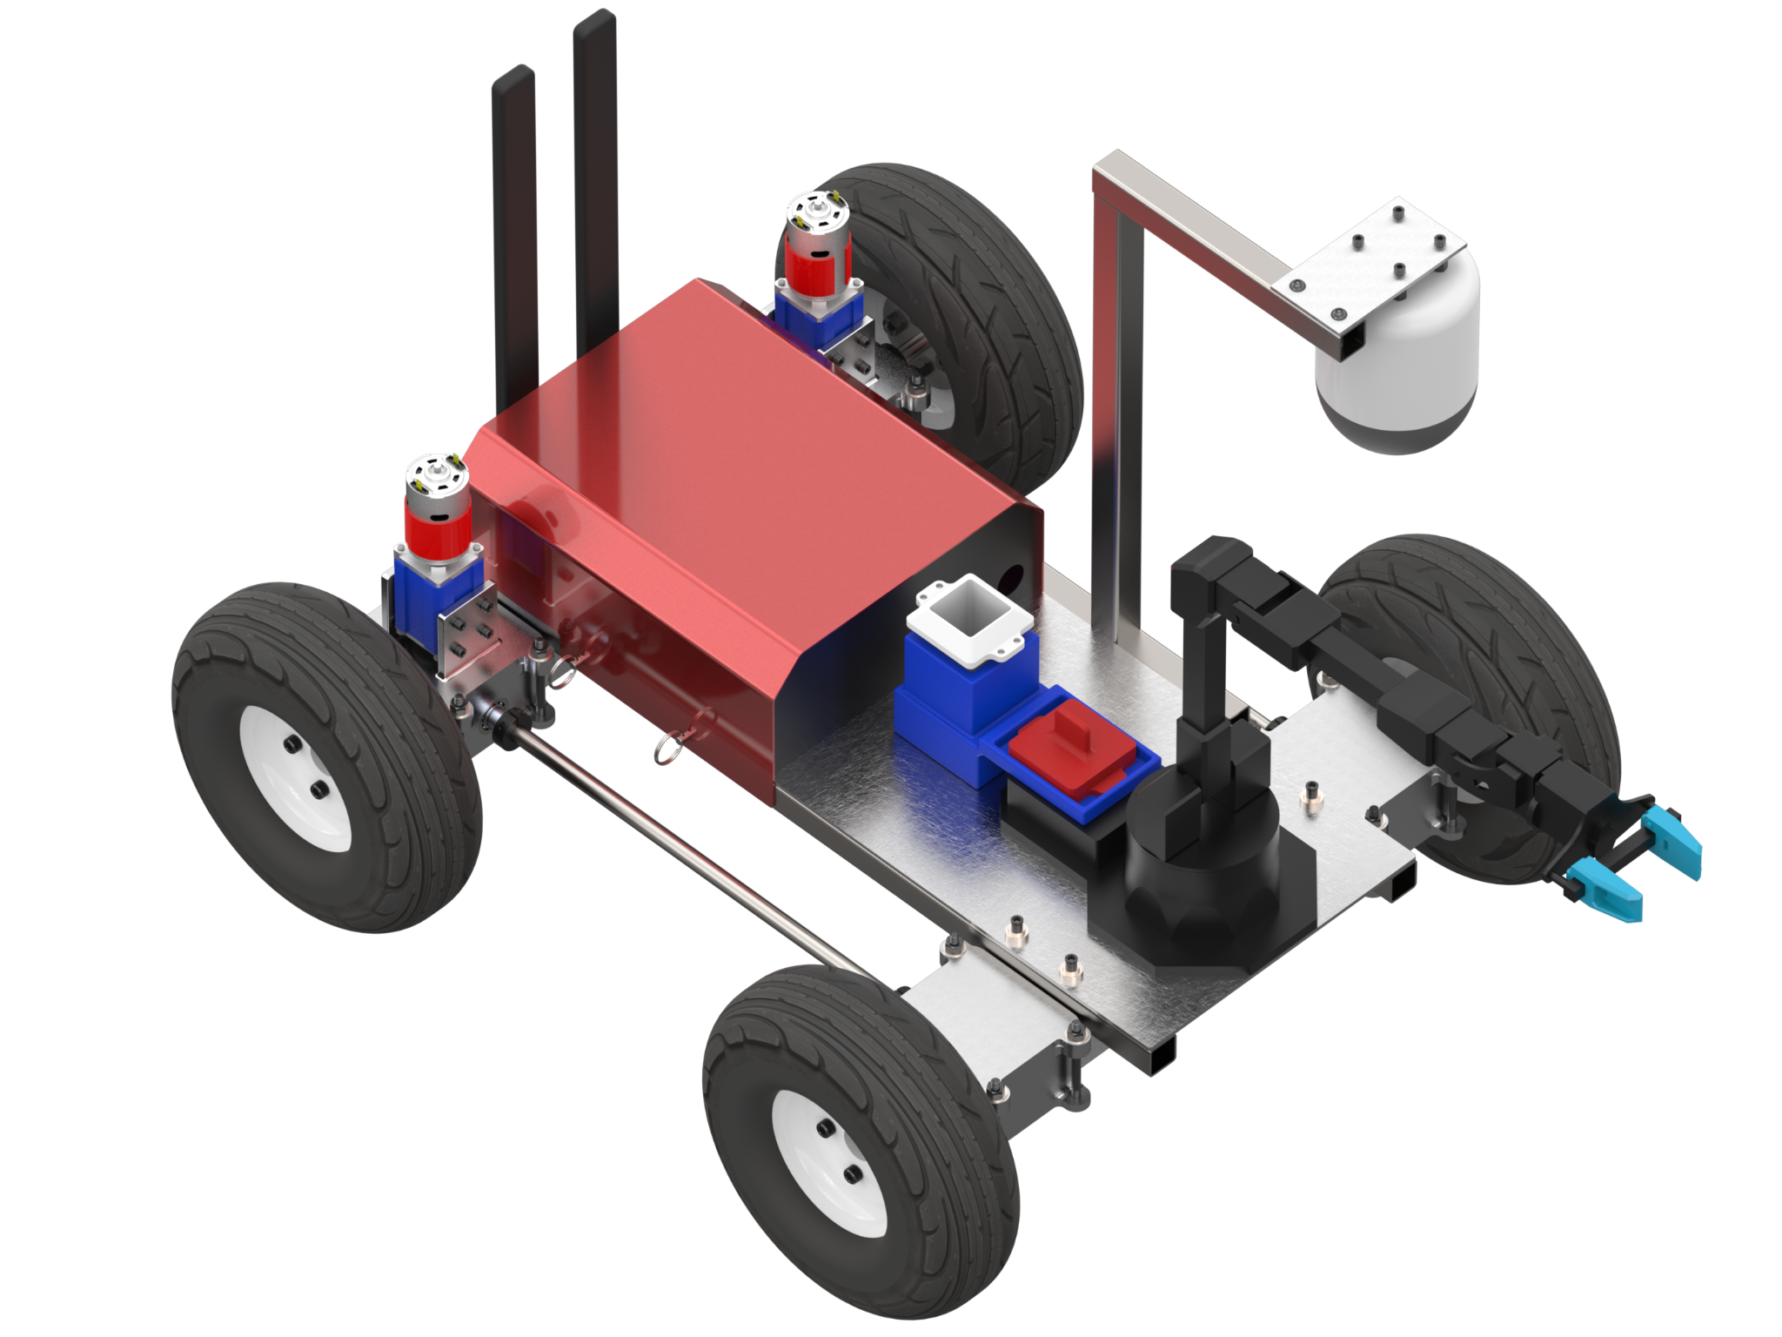
Sample Storage Unit
FR.2 - AEROSS shall store a sample in a container
FR.3 - AEROSS shall be able to deposit the container at a location specified by the ground station
Presentation Layout
Self-Centering Lid
Mouth: 4 X 4 cm
Height: 7.5 cm
Width: 6.3 cm
Magnet locks (19.6 N force)
Timeline
Project
Overview
Design Solution
CPE’s
DR’s
Satisfaction
Risks
Verification
Validation
Planning
Notes:
Max
19.6 N of magnetic force (per magnet? For all magnets?)
Add FR - in title?
Discuss arm prior to capsule
Store a 2cm sample to be deposited at a specified location.
Discuss holding cell on rover

Slide 13
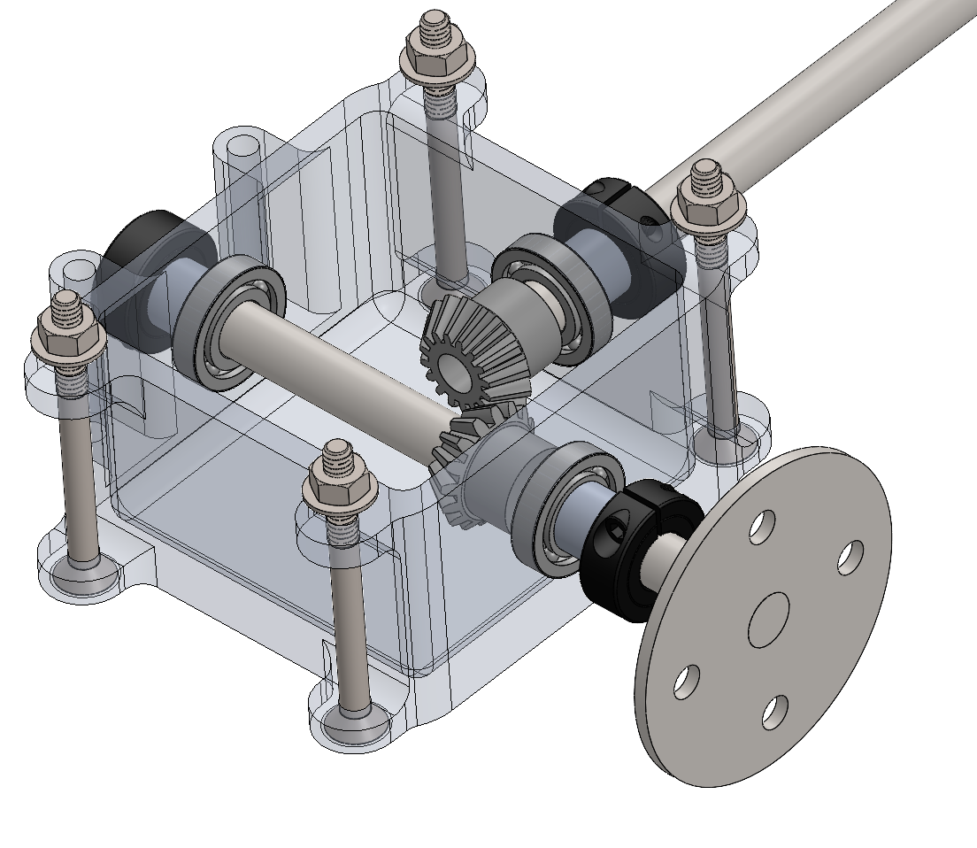
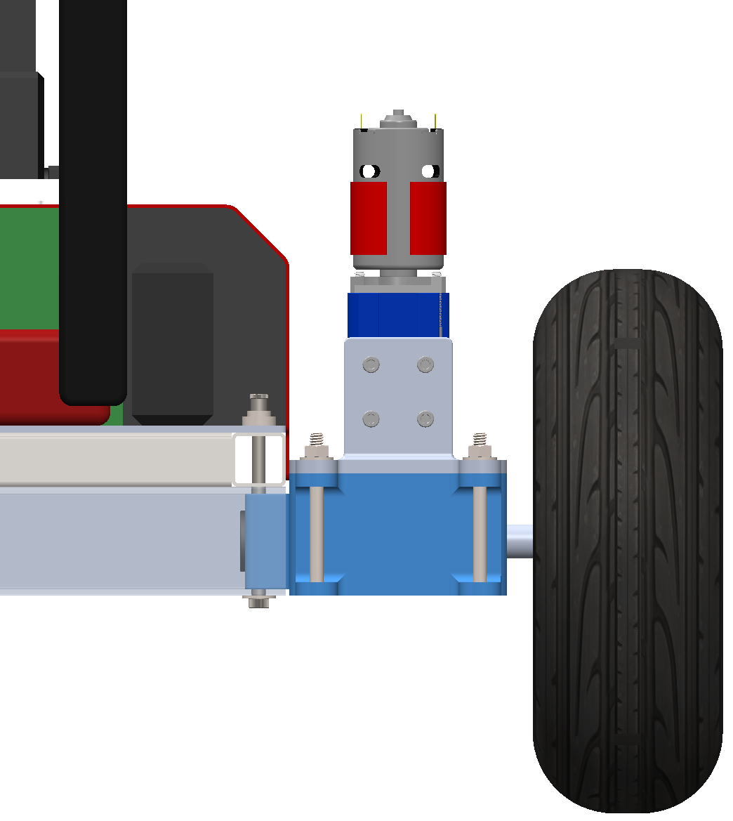
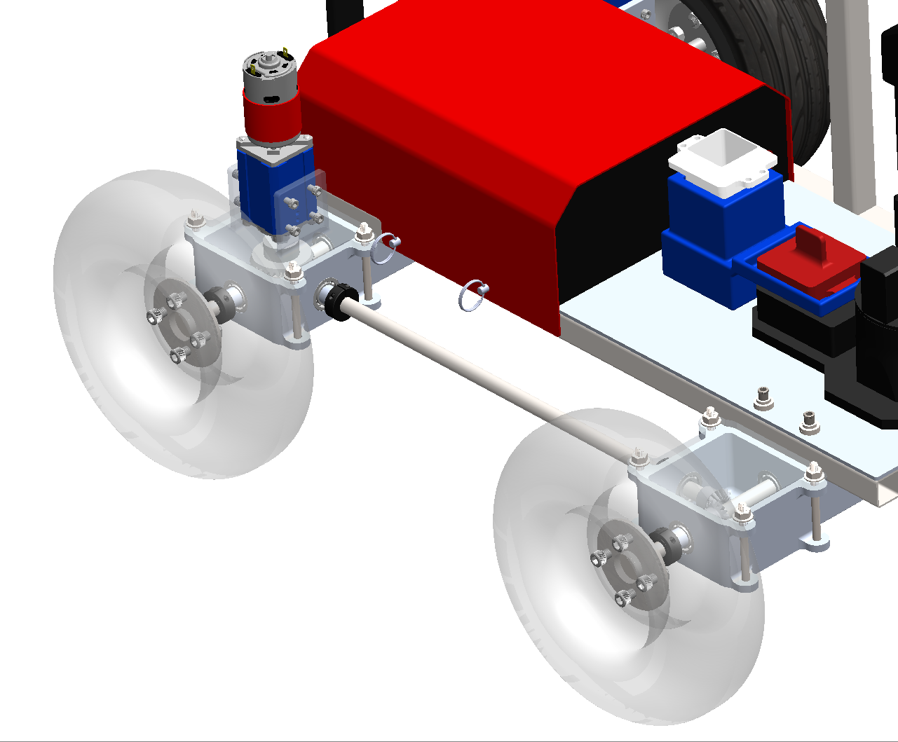
Drivetrain
FR.4 - AEROSS shall drive to a specified location and return to its original location.
Presentation Layout
Software:
Power/Measurement System
Hardware:
Drive Shaft Configuration
10 cm
25.4 cm
Wheel Diameter
50.8 cm
Wheelbase
57.4 cm
Track
Timeline
Project
Overview
Design Solution
CPE’s
DR’s
Satisfaction
Risks
Verification
Validation
Planning
Notes:
Patrick
Verbally communicate terrain (‘defined later in presentation’)

Slide 14
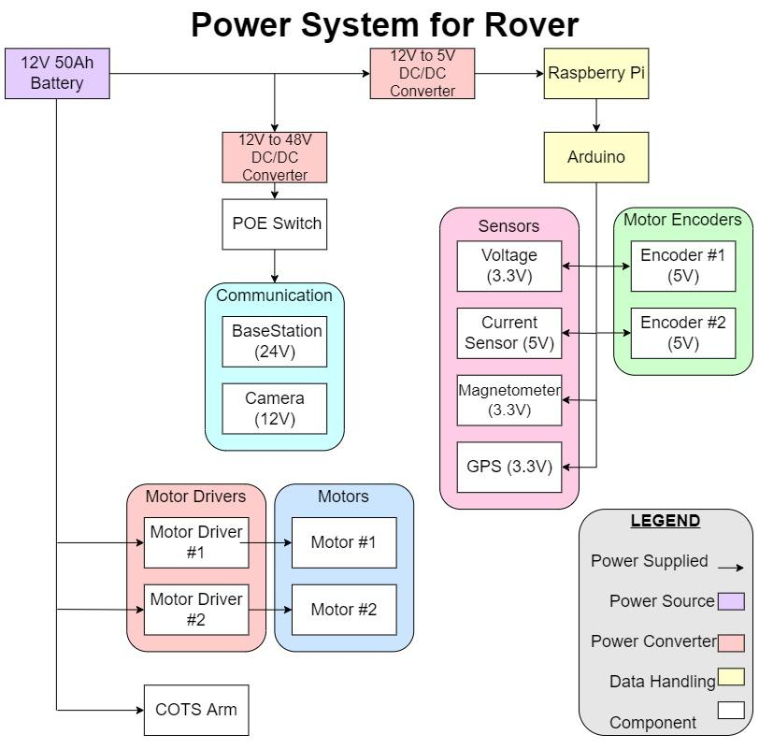
Electronic Functional Block Diagram Rover
FR.4 - AEROSS shall drive to a specified location and return to its original location
Presentation Layout
Major Elements for EPS
12V 50Ah LiFePO4 Battery
DC/DC Converter 12V Step Up to 48V
DC/DC Converter 12V Step Down to 5V
Software
Python
Arduino IDE
Timeline
Project
Overview
Design Solution
CPE’s
DR’s
Satisfaction
Risks
Verification
Validation
Planning
Notes:
Ben

Slide 15
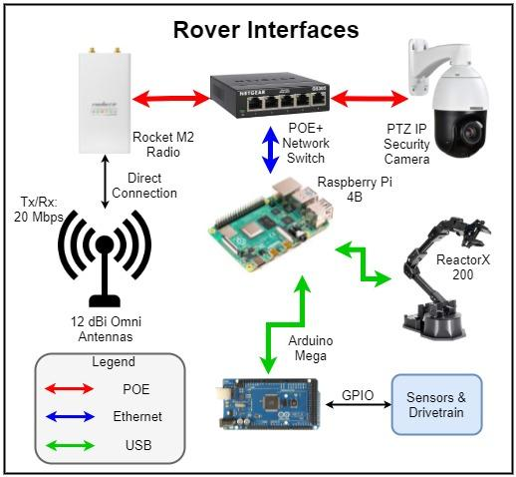
Communications & Data Main Hardware
FR.5 - AEROSS shall send and receive data from the ground station
FR.6 - AEROSS shall have video capability
Presentation Layout
Timeline
Project
Overview
Design Solution
CPE’s
DR’s
Satisfaction
Risks
Verification
Validation
Planning
Notes:
Rico

Slide 16
Communications & Data Main Hardware
FR.5 - AEROSS shall send and receive data from the ground station
FR.6 - AEROSS shall have video capability
Presentation Layout
Omni-directional Antenna
Used to amplify and Receive Signals
12 dBi gain
Timeline
Project
Overview
Design Solution
CPE’s
DR’s
Satisfaction
Risks
Verification
Validation
Planning
Notes:
Rico

Slide 17
Communications & Data Main Hardware
FR.5 - AEROSS shall send and receive data from the ground station
FR.6 - AEROSS shall have video capability
Presentation Layout
Rocket M2 Radio
Used to interchange between digital data and RF signals
150 Mbps
Timeline
Project
Overview
Design Solution
CPE’s
DR’s
Satisfaction
Risks
Verification
Validation
Planning
Notes:
Rico

Slide 18
Communications & Data Main Hardware
FR.5 - AEROSS shall send and receive data from the ground station
FR.6 - AEROSS shall have video capability
Presentation Layout
Sensors and Drive Train
Magnetometer/Accelerometer
Heading accuracy: .267
GPS
Accuracy (Before averaging): 1.5m
Encoders/Drivers
Speed and location
Battery Sensors
Voltage and current readings
Timeline
Project
Overview
Design Solution
CPE’s
DR’s
Satisfaction
Risks
Verification
Validation
Planning
Notes:
Rico

Slide 19
Communications & Data Main Hardware
FR.5 - AEROSS shall send and receive data from the ground station
FR.6 - AEROSS shall have video capability
Presentation Layout
Sunba 405-D20X Camera
Used for video capability
FOV: 90 degrees
Timeline
Project
Overview
Design Solution
CPE’s
DR’s
Satisfaction
Risks
Verification
Validation
Planning
Notes:
Rico

Slide 20
Critical Project Elements

Slide 21
Critical Project Elements
Presentation Layout
CPE | Icon | Description | FR:
Sample Acquisition |  | The rover must able able to identify, collect, and store a sample of interest | 1,2
Sample Deposit |  | The rover must be able to deposit the collected sample at a specified location for later retrieval | 3
Navigation |  | The rover must be able to navigate over a defined terrain towards a sample of interest and return to a specified location | 4
Communication |  | The rover must be able to communicate with the ground station in order to receive control commands and relay live video data | 5,6
Timeline
Project
Overview
Design Solution
CPE’s
DR’s
Satisfaction
Risks
Verification
Validation
Planning
Notes:
David
Keeping as sample

Slide 22
Design Requirements and their Satisfaction

Slide 23
Design Requirements: Sample Collection
Presentation Layout
AEROSS shall:
FR.1 Be able to collect a sample
DR1.1 Be able to collect a sample of interest that is less than 2 lbs
DR1.2 Be able to collect a sample of interest that is 20mm at its largest dimension
Utilize the ReactorX 200 API
Code to control the arm was created and simulated to show feasibility
Python ArmControl class developed as a solution for robotic arm control
Tracks current arm position
Timeline
Project
Overview
Design Solution
CPE’s
DR’s
Satisfaction
Risks
Verification
Validation
Planning
Notes:
Ben

Slide 24
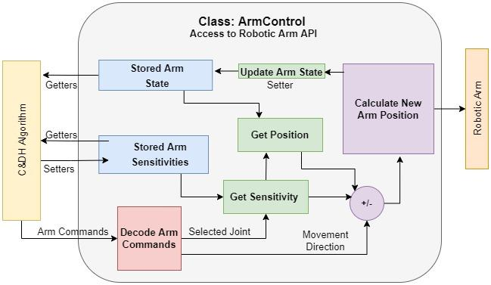
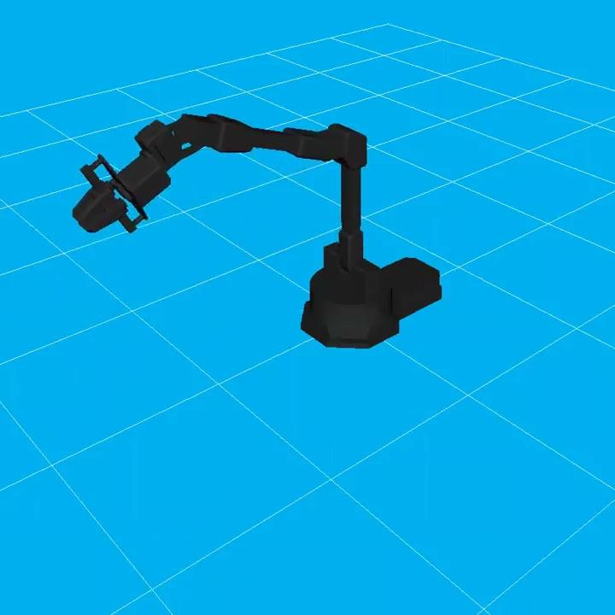
Satisfaction: Robotic Arm
Presentation Layout
This analysis confirms DR1.1 and DR1.2
Timeline
Project
Overview
Design Solution
CPE’s
DR’s
Satisfaction
Risks
Verification
Validation
Planning
Notes:
Ben

Slide 25
Design Requirements: Drive Train
Presentation Layout
AEROSS shall:
FR.4 Drive to a specified location and return to its original location
DR4.1 Be able to drive up to 100m in any direction from start location
DR4.2 Return to its original location upon loss of communications with GS
DR4.3 Be able to drive forward and reverse
DR4.4 Be able to make a 360 degree turn
DR4.5 Be able to drive in underbrush
Timeline
Project
Overview
Design Solution
CPE’s
DR’s
Satisfaction
Risks
Verification
Validation
Planning
Notes:
Patrick

Slide 26
Satisfaction: Drivetrain Terrain Analysis
Presentation Layout
Power to overcome resistances.
Straight line
Rolling resistance
Gravitational resistance (slope)
Turning
Frictional resistance
Terrain definition
No terrain or wheel deformation
Bound terrain by frictional coefficient
μ_{max} = 0.44
Bounded by turning power requirement
μ_{min} = 0.10
Bounded by straight-line driving slipping
Expected frictional coefficient range (0.20 - 0.35)
AEROSS definition of underbrush
This analysis confirms DR4.3, DR4.4, and DR4.5
Timeline
Project
Overview
Design Solution
CPE’s
DR’s
Satisfaction
Risks
Verification
Validation
Planning
Notes:
Patrick

Slide 27
Design Requirements: Navigation and Control
Presentation Layout
AEROSS shall:
FR.3 Deposit the container at a location specified by the ground station
DR3.1 Deposit the sample container w/in 1m radius of specified location by GS
FR.4 Drive to a specified location and return to its original location
DR4.2 Return to original location upon loss of communications with GS
Timeline
Project
Overview
Design Solution
CPE’s
DR’s
Satisfaction
Risks
Verification
Validation
Planning
Notes:
Keaton - stay within one line
The satisfaction of these requirements are shown with the following diagrams
GPS location accuracy over sampled time
Rover movement flow chart
Loss of communications flow chart

Slide 28
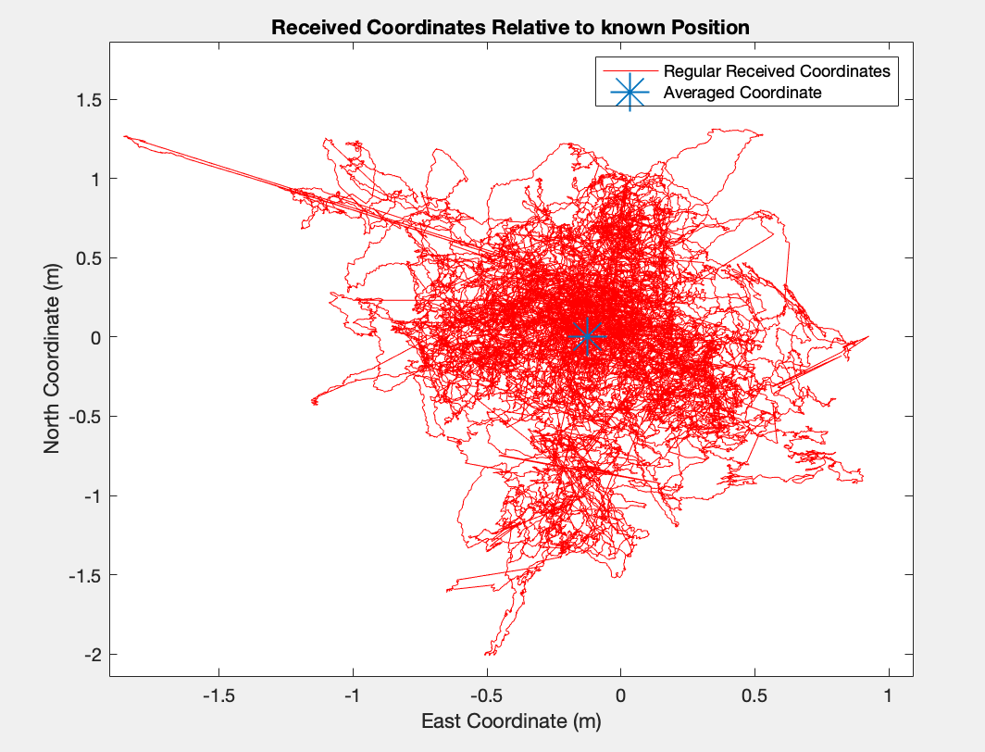
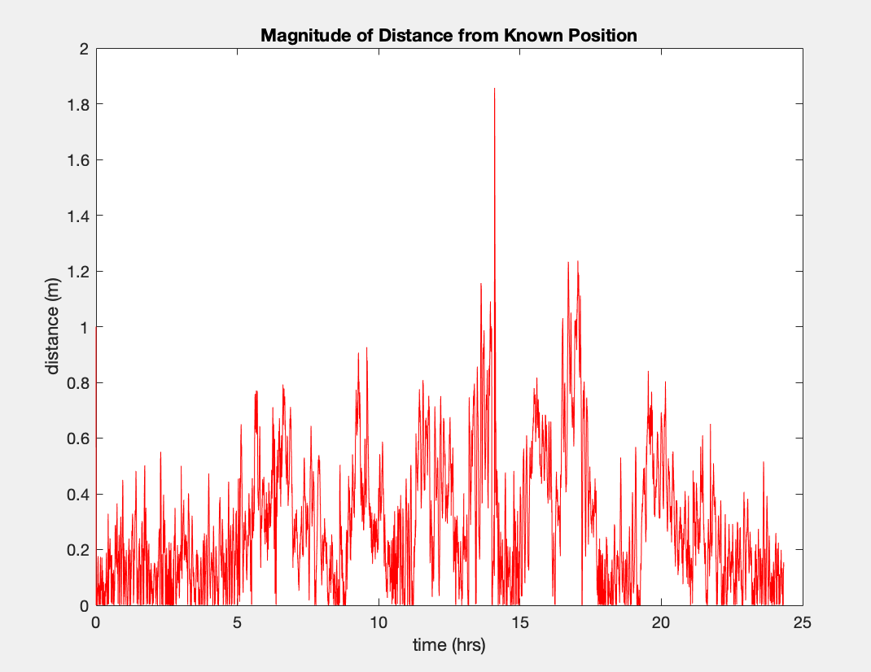
Satisfaction: GPS Accuracy
Presentation Layout
Novatel GPS receiver measuring data over 25 hour period
Received coordinates averages in order to improve accuracy
Averaged data taken over all possible 2 minute periods (120 data points)
Timeline
Project
Overview
Design Solution
CPE’s
DR’s
Satisfaction
Risks
Verification
Validation
Planning
Notes:
Rico
Novatel GPS receiver measuring data over 25 hour period
Distance of data points taken over 10 minute periods averaged
Frequency of averaged accuracy values were calculated
Values with less than 1 meter of accuracy are .062% likely
This analysis confirms DR.1
DR.1: AEROSS shall be able to deposit sample container within 1m radius of LOI indicated by ground station
DR.1: AEROSS shall be able to deposit sample container within 1m radius of LOI indicated by ground station

Slide 29
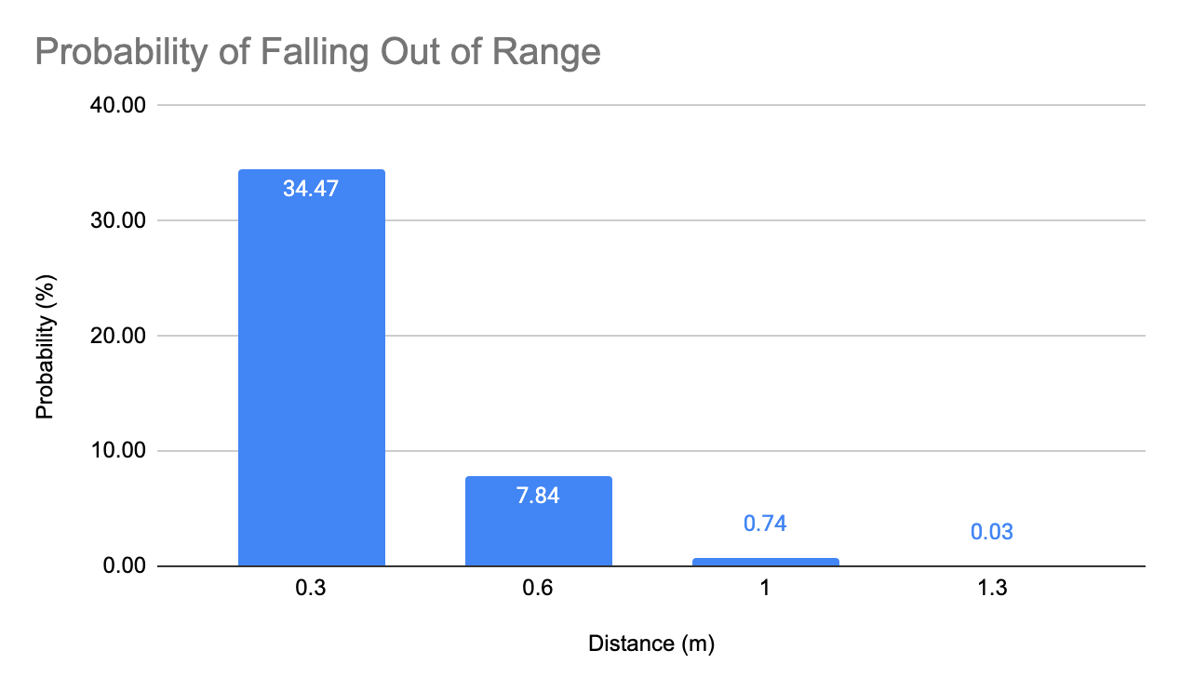
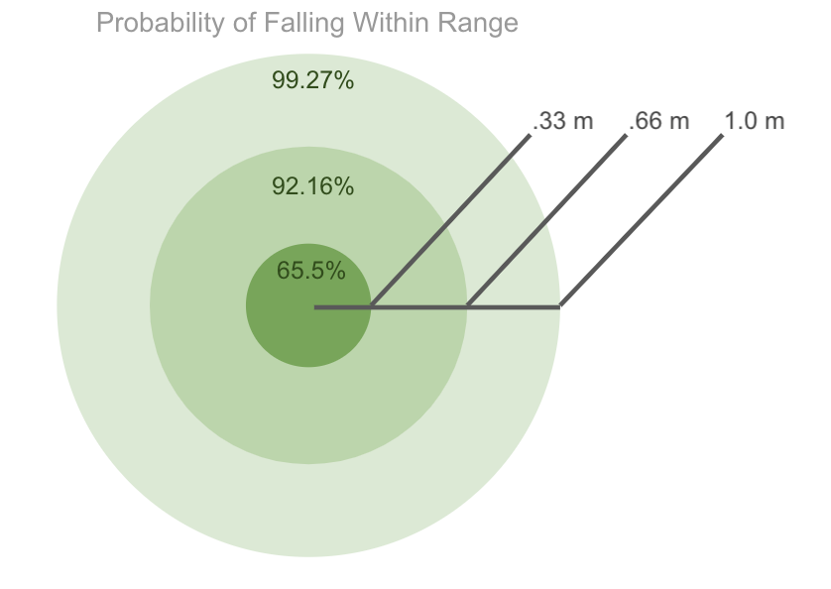
Satisfaction: GPS Accuracy
Presentation Layout
This analysis confirms DR3.1
Timeline
Project
Overview
Design Solution
CPE’s
DR’s
Satisfaction
Risks
Verification
Validation
Planning
Notes:
Rico
Novatel GPS receiver measuring data over 25 hour period
Distance of data points taken over 10 minute periods averaged
Frequency of averaged accuracy values were calculated
Values with less than 1 meter of accuracy are .062% likely
This analysis confirms DR.1
DR.1: AEROSS shall be able to deposit sample container within 1m radius of LOI indicated by ground station
DR.1: AEROSS shall be able to deposit sample container within 1m radius of LOI indicated by ground station

Slide 30
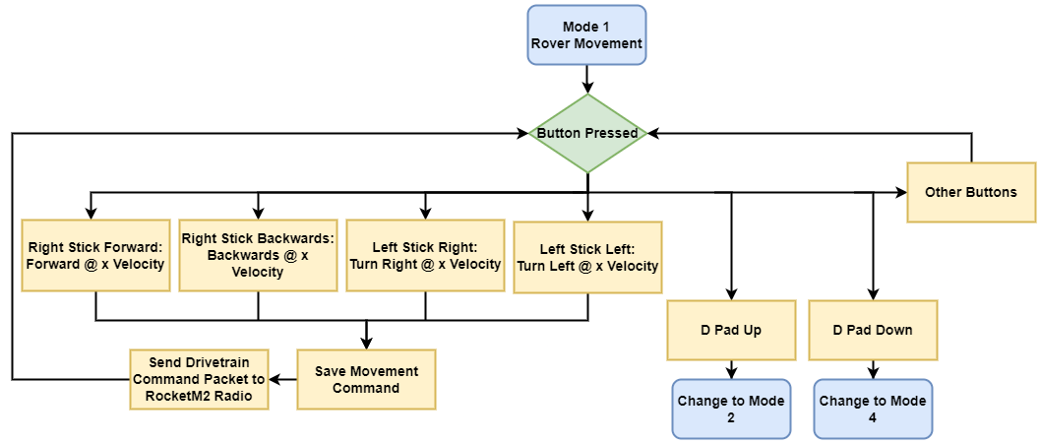
Satisfaction: Rover Movement Mode
Presentation Layout
This confirms FR.4
Timeline
Project
Overview
Design Solution
CPE’s
DR’s
Satisfaction
Risks
Verification
Validation
Planning
Notes:
Keaton - get rid of all bullet points, and change layout to make text bigger to improve reasability

Slide 31
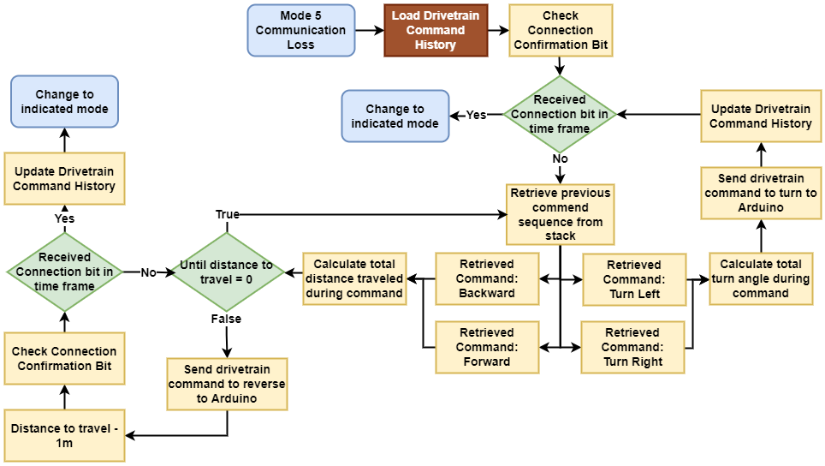
Satisfaction: Communication Loss
Presentation Layout
This confirms DR4.3
Timeline
Project
Overview
Design Solution
CPE’s
DR’s
Satisfaction
Risks
Verification
Validation
Planning
Notes:
Keaton - scrap all the text on this slide. Need the entire space for a larger font and explain what we are doing really carefully. Take time to guide through with a laser pointer

Slide 32
Design Requirements: Comms & Software
Presentation Layout
AEROSS shall:
FR.5 Send and receive information to and from the ground station (GS).
DR5.1 Send GPS coordinates to the GS.
DR5.2 Send time stamped live video and images to the GS.
DR5.3 Send on-board sensor data to the GS.
DR5.4 Send and receive no less than 20 Mbps to and from GS.
DR5.5 Communicate with GS at a maximum distance of 100m.
Timeline
Project
Overview
Design Solution
CPE’s
DR’s
Satisfaction
Risks
Verification
Validation
Planning
Notes:
Max

Slide 33
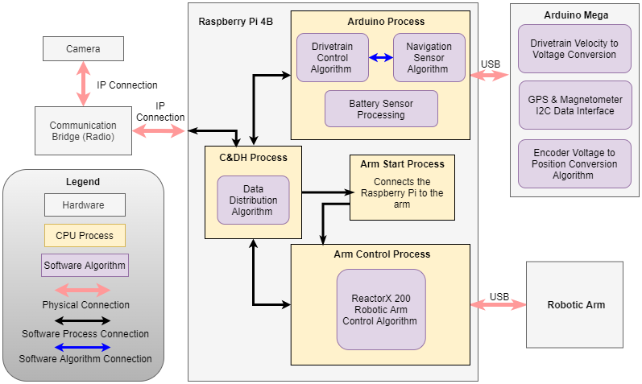
Presentation Layout
Satisfaction: Rover Software Diagram
This confirms DR5.1, DR5.2, and DR5.3
Timeline
Project
Overview
Design Solution
CPE’s
DR’s
Satisfaction
Risks
Verification
Validation
Planning
Notes:
Keaton - get rid of all the text on the slide. The increase the font size for easier readability
Raspberry Pi Processing
Quad core Cortex-A72
Allows for “parallel” execution of software processes.
Four Processes
C&DH
Arm Start
Arm Control
Arduino Control
“Idle” Processes allow for compute resource conservation.

Slide 34
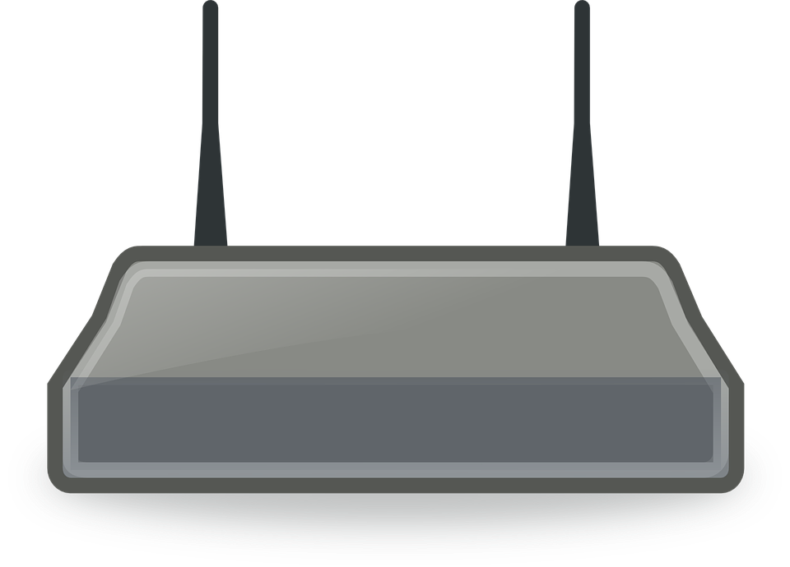
Satisfaction: Communications
Presentation Layout
Link Budget Equations:
Free Space Loss
Results:
P_{Rx}= -34.16dB > R_{x}= -75dB
Link Margin: 40.84 dB > 0
Power Transmitted
Power
Received
This confirms DR5.4 & DR5.5
Timeline
Project
Overview
Design Solution
CPE’s
DR’s
Satisfaction
Risks
Verification
Validation
Planning
Notes:
Rico

Slide 35
Project Risks

Slide 36
Project Risks-Risk Assessment
Presentation Layout
# | System | Point of Failure | Mode of Failure | Consequence | Likelihood Level | Impact Level | Mitigation Plan | Residual Likelihood Level | Residual Impact Level
1 | Sample Collection | Robotic Arm | Mechanical Failure | Failure to uphold FR.1,FR.2,FR.3 - Collect, Store and Deposit Sample | Medium | High | Create Intended Use Document | Low | High
2 | COMMS | Communication Software | Wireless/Wired Connection Failure | Failure to uphold FR.5,FR.6 - Send/Receive Data from GS | Medium | High | Record Movement History | Medium | Medium
3 | COMMS | Camera | Loss of Video Feed | Failure to uphold FR.4 - Locate Sample FR.5,FR.6 - Send/Receive Data from GS | Low | High | Create Installation Guide | Low | Medium
4 | Location Data | GPS/Encoder | Measurement Error | Failure to uphold FR.4 - Locate Sample | High | Medium | Modeling/ Testing | Medium | Medium
Timeline
Project
Overview
Design Solution
CPE’s
DR’s
Satisfaction
Risks
Verification
Validation
Planning
Notes:
Max

Slide 37
Project Risks Matrices
Presentation Layout
Pre Mitigation Plan |  | Impact Level
 |  | Low | Medium | High
Likelihood Level | High |  | 4
 | Medium |  |  | 1,2
 | Low |  |  | 3
Post Mitigation Plan |  | Impact Level
 |  | Low | Medium | High
Likelihood Level | High
 | Medium |  | 2,4
 | Low |  | 3 | 1
Timeline
Project
Overview
Design Solution
CPE’s
DR’s
Satisfaction
Risks
Verification
Validation
Planning
Notes:
2 - mention w/out obstacles interfering with comms
Max
Re-evaluate impact level

Slide 38
Verification and Validation

Slide 39
Verification and Validation - Drivetrain
Presentation Layout
DR4.1: Drive up to 100m in any direction from start location
DR4.4: Have the ability to turn 360 degrees
Objective:
Verify rover can travel 100 m from origin
Confirm 360 degree turn capability
Plan:
Command rover to drive 100 m
Command rover perform a 360 degree turn
Measurements:
Distance from origin
Motor encoder
Pass Criteria:
No motor stall
Commands executed as intended
Timeline
Project
Overview
Design Solution
CPE’s
DR’s
Satisfaction
Risks
Verification
Validation
Planning
Notes:
Patrick

Slide 40
Verification and Validation - Sample Collection
Presentation Layout
DR1.2: Be able to collect a sample of interest that is 20 mm at its largest dimension
Objective:
Confirm functionality of sample collection device
Plan:
Place 20mm sample within reach of sample collection device
Command arm to acquire the sample, and transport it to collection container
Measurements:
Distance from intended target
Pass Criteria
Intended acquisition location within tolerance from actual
Sample transported from original location to collection container
Timeline
Project
Overview
Design Solution
CPE’s
DR’s
Satisfaction
Risks
Verification
Validation
Planning
Notes:
Max

Slide 41
Verification and Validation - COMM’s
Presentation Layout
DR5.2: Be able to send time stamped live video and images to the ground station
DR5.5: Be able to communicate with ground station at a maximum distance of 100m
Objective:
Confirm ability to send information to rover at 100m distance
Confirm ability to receive information from rover at 100m distance
Plan:
Send command to rover at 100 m distance to move backwards
Receive video data from rover at 100m distance
Measurements:
Distance from origin to destination
Pass Criteria:
GS acquires live video feed from rover at 100m
Timeline
Project
Overview
Design Solution
CPE’s
DR’s
Satisfaction
Risks
Verification
Validation
Planning
Notes:
Keaton

Slide 42
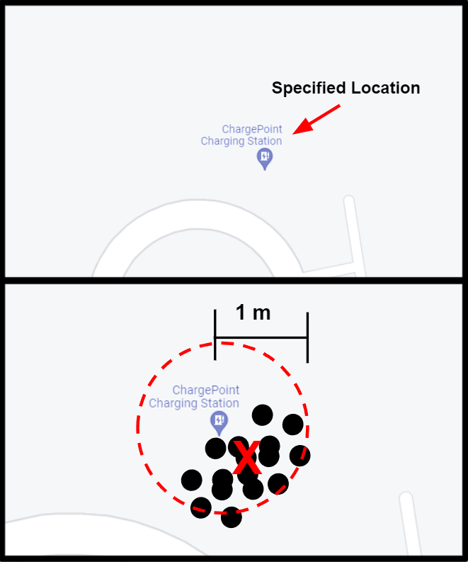
Verification and Validation - Navigation and Controls
Presentation Layout
DR3.1: Deposit the sample container w/in 1 m radius of a specified location by the ground station
Objective:
Verify GPS accuracy of 1 m radius at specified sample location
Plan:
Record data using GPS sensor at specified sample location
Measurements:
Latitude and longitude
Pass Criteria
Reported position w/in 1 m radius at specified sample location
Timeline
Project
Overview
Design Solution
CPE’s
DR’s
Satisfaction
Risks
Verification
Validation
Planning
Notes:
Keaton

Slide 43
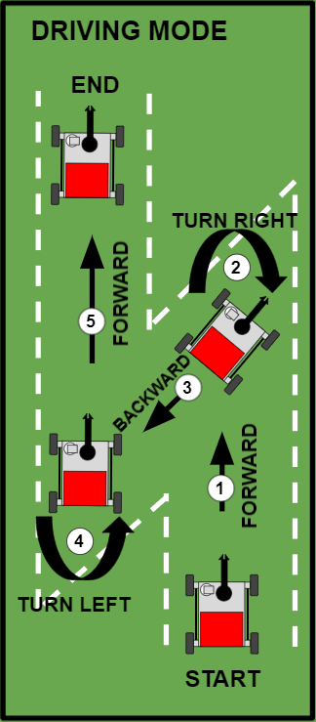
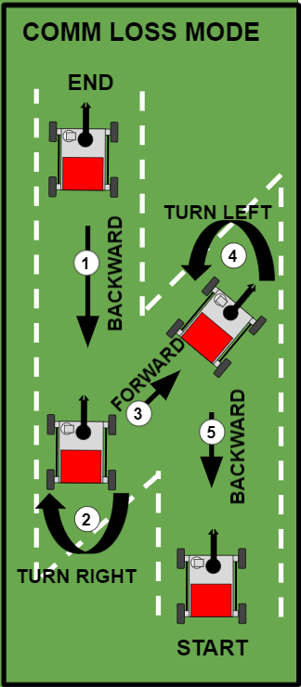
Verification and Validation - Navigation and Controls
Presentation Layout
DR4.2: Return to original location upon loss of communications with ground station
Objective:
Verify rover can travel back to origin after loss of comms
Plan:
Drive through track, enter comm loss mode at the end
Measurements:
Odometry and distance from origin
Pass Criteria
Able to properly follow the track in reverse
Timeline
Project
Overview
Design Solution
CPE’s
DR’s
Satisfaction
Risks
Verification
Validation
Planning
Notes:
Keaton - text is too long, take only one of the modes (i.e. driving mode) put the comm loss mode in the backup slides, make background plain color

Slide 44
Project Planning

Slide 45
WBS
Presentation Layout
Management
Structures
Manufacturing
Electronics/Software
Testing/Integration
Deliverables
Admin
Requirement Identification
Preliminary Fabrication
Robotic Arm
Ground Station
Drivetrain
Sample ID
PDD
Organizational Chart
Preliminary Design
Software Selection
Software Selection
Software Selection
Sample Collection
Preliminary Hardware Testing
Configure Test Software
Sample Deposit
CDD
Preliminary Structural Analysis
Configure Test Software
Design Preliminary Interface
Gantt Chart
Integration
Container Re-stock
PDR
Software Simulation
Software Simulation
RIsk Matrices
Finalize Design
Full System Test
Design Code for in house software
Nav to LOI
CDR
Integration
Integration
Finalize Budget
Final Structural Analysis
Nav to Origin
FFR
Full System Test
Full System Test
Full System Test
Part Ordering
Skid Steer
TRR
Data Stream
SFR
Key:
Full Int Test
Complete
In Progress
Future Work
Timeline
Project
Overview
Design Solution
CPE’s
DR’s
Satisfaction
Risks
Verification
Validation
Planning
Notes:
david

Slide 46
Organizational Chart
Presentation Layout
Barbara Streiffert
Customer
Jean Koster
Advisor
David Koester
Project Manager
Emily Mitzak
Systems Engineer
Adam Trunko
Manufacturing Lead
Max Malden
Financial Lead
Ricardo Lopez-Abadia
Software Lead
Owen Kaufmann
Testing/Safety Lead
Aaron Buller
Communications Lead
Patrick Riley
Structural Lead
Keaton Paquin
Controls Lead
Benjamin Lodwick
EPS Lead
Timeline
Project
Overview
Design Solution
CPE’s
DR’s
Satisfaction
Risks
Verification
Validation
Planning
Notes:
David- add JPL logo

Slide 47
Test Plan
Presentation Layout
Test Name: | CPE: | Location: | Scheduled Date: | Hazards
Communications |  | Grass Field | February | N/A
Vehicle Movement |  | Grass Field | February | N/A
Sample Collection/Drop Off |  | Grass field | March | N/A
Timeline
Project
Overview
Design Solution
CPE’s
DR’s
Satisfaction
Risks
Verification
Validation
Planning
Notes:
david

Slide 48
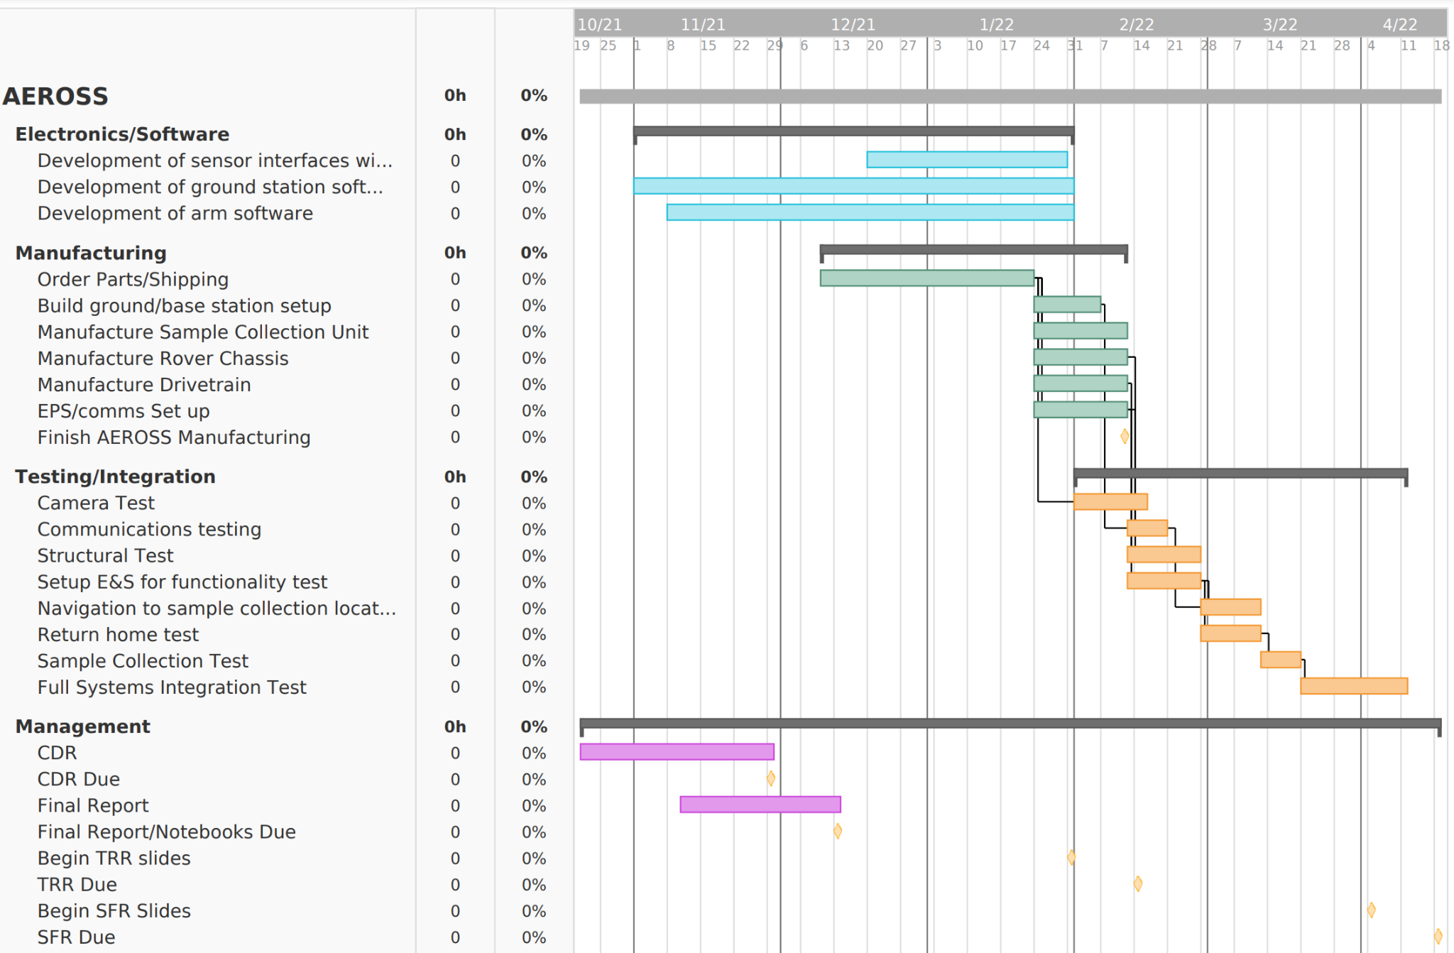
Plan for Next Semester
Presentation Layout
Timeline
Project
Overview
Design Solution
CPE’s
DR’s
Satisfaction
Risks
Verification
Validation
Planning
Notes:
david

Slide 49
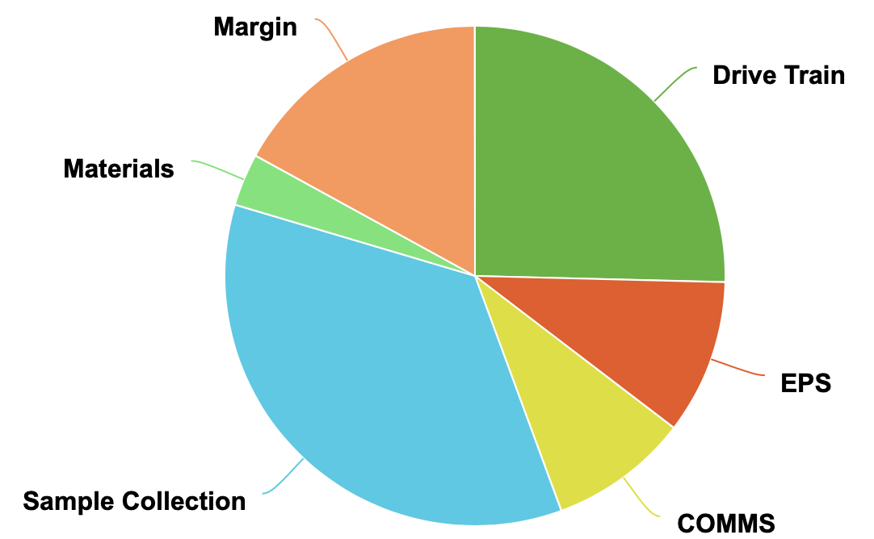
Project Planning-Cost Plan
Presentation Layout
System | Cost
Drive Train | $1270
EPS | $500
Comms | $450
SC | $1760
Material | $170
Margin | $850
Timeline
Project
Overview
Design Solution
CPE’s
DR’s
Satisfaction
Risks
Verification
Validation
Planning
Notes:
Change from pie chart to list

Slide 50
References
Presentation Layout
[1] Akin, D., “Terramechanics I” Available: https://spacecraft.ssl.umd.edu/academics/788XF18/788XF16.terramechanics1x.pdf.
[2] Beall, Abigail., “Meet the robots going places humans can’t reach.” Available: Meet the robots going places humans cannot reach | T3
[3] Fujiwara, D., Tsujikawa, N., Oshima, T., Iizuka, K., “Estimation of Resistance Force at Steady-State Sinkage for Cylindrical Wheel-Typed Lunar/Planetary Exploration Rovers with Function of Push Pull Locomotion,” Available: https://robomechjournal.springeropen.com/articles/10.1186/s40648-020-00183-0.
[4] Hernandez, J., “What led to the Florida condo collapse? here's what we know so far,” NPR Available: https://www.npr.org/sections/live-updates-miami-area-condo-collapse/2021/06/29/1010976101/timeline-what-we-know-so-far-about-what-led-up-to-the-surfside-condo-collapse.
[5] Laughery, S., Gerhart, G., Goetz, R., “Bekker's Terramechanics Model for Off-road Vehicle Research” Available:https://www.researchgate.net/publication/235069513_Bekker's_Terramechanics_Model_for_Off-Road_Vehicle_Research.
[6] Leader, M., Rege, R., Potts, N., Gullikson, A., Curran, N., Dhaliwal, J., Kring, D., “Velocity of a Rover as a Function of Slope of Lunar Terrain”. Available: https://www.hou.usra.edu/meetings/lpsc2014/pdf/2683.pdf.
Notes:
david

Slide 51
References
Presentation Layout
[7] N/A, N. A., “Robotis dynamixel XM430-W350-T Dynamixel-X TTL servo robot actuator,” T Available: https://smartrobotworks.com/XM430-W350-T.asp?utm_term=xm430-w350-t&utm_campaign=Robotis&utm_source=adwords&utm_medium=ppc&hsa_tgt=kwd-929036099981&hsa_grp=106129260922&hsa_src=g&hsa_net=adwords&hsa_mt=e&hsa_ver=3&hsa_ad=449096700607&hsa_acc=9041622380&hsa_kw=xm430-w350-t&hsa_cam=10571979064&gclid=Cj0KCQjwnoqLBhD4ARIsAL5JedLmoYkrYfmOj_qqBm8ZA0B6zrtJnZDLHybuzLowmM-hMwH_Z5x1WDgaAsLVEALw_wcB.
[8]“ReactorX 200 Robot Arm,” Trossen Robotics, N/A.
[9] Rudd, R., Building Materials and Propagation Final Report Available: https://paperzz.com/doc/6838686/building-materials-and-propagation-final-report.
Notes:
david

Slide 52
Questions?

Slide 53
Backup Slides

Slide 54
Functional Requirements
Presentation Layout
AEROSS shall:
FR.1 Be able to collect a sample
FR.2 Store a sample in container
FR.3 Be able to deposit the container at a location specified by the ground station
FR.4 Drive to a specified location and return to its original location
FR.5 Send and receive information to and from ground station
FR.6 Have video capability
Sample Collection
Drive Train
COMMS
Notes:
David
Make sure to specify semi-autonomous

Slide 55
Design Requirements: Overview
Presentation Layout
FR: | Design Requirement Description
1 | DR1.1: AEROSS shall be able to collect a sample of interest that is less than 2 lbs DR1.2: AEROSS shall be able to collect a sample of interest that is 20 mm at its largest dimension
2 | DR2.1: AEROSS shall be able to store a sample of interest that is 20 mm at its largest dimension DR2.2: AEROSS shall be able to acquire the sample collection container
3 | DR3.1: AEROSS shall be able to deposit the sample container within 1m radius of specified location by the ground station
4 | DR4.1: AEROSS shall be able to drive up to 100m in any direction from start location DR4.2: AEROSS shall return to its original location upon loss of communications with the ground station DR4.3: AEROSS shall be able to drive forward and reverse DR4.4: AEROSS shall be able to make a 360 degree turn DR4.5: AEROSS shall be able to drive in underbrush
5 | DR5.1: AEROSS shall be able to send GPS coordinates to the ground station DR5.2: AEROSS shall be able to send time stamped live video and images to the ground station DR5.3: AEROSS shall be able to send onboard sensor data to the ground station DR5.4: AEROSS shall be able to send and receive no less than 20 Mbps to and from the ground station DR5.5: AEROSS shall be able to communicate with the ground station at a maximum of 100m
6 | DR6.1: AEROSS shall have video capability with a greater than 100 degree FOV

Slide 56
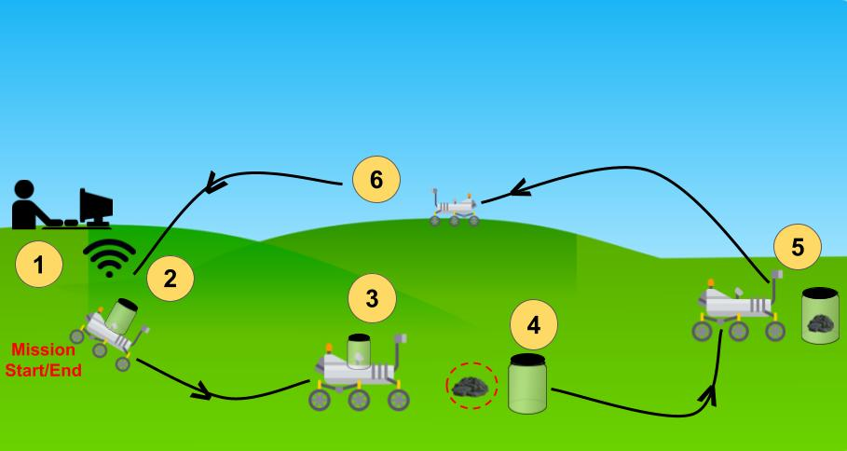
CONOPS
Presentation Layout
Notes:
Rico
Make sure to specify semi-autonomous

Slide 57
CONOPS
Presentation Layout
Notes:
Rico
Make sure to specify semi-autonomous

Slide 58
Extra Design Solution Slides

Slide 59
Design Solution- Overview
Presentation Layout
Drivetrain
Robotic Arm
Sample Storage Unit
Camera
COMMs
Ground Station (not pictured)
EPS
Rover
Ground Station
Notes:
David

Slide 60
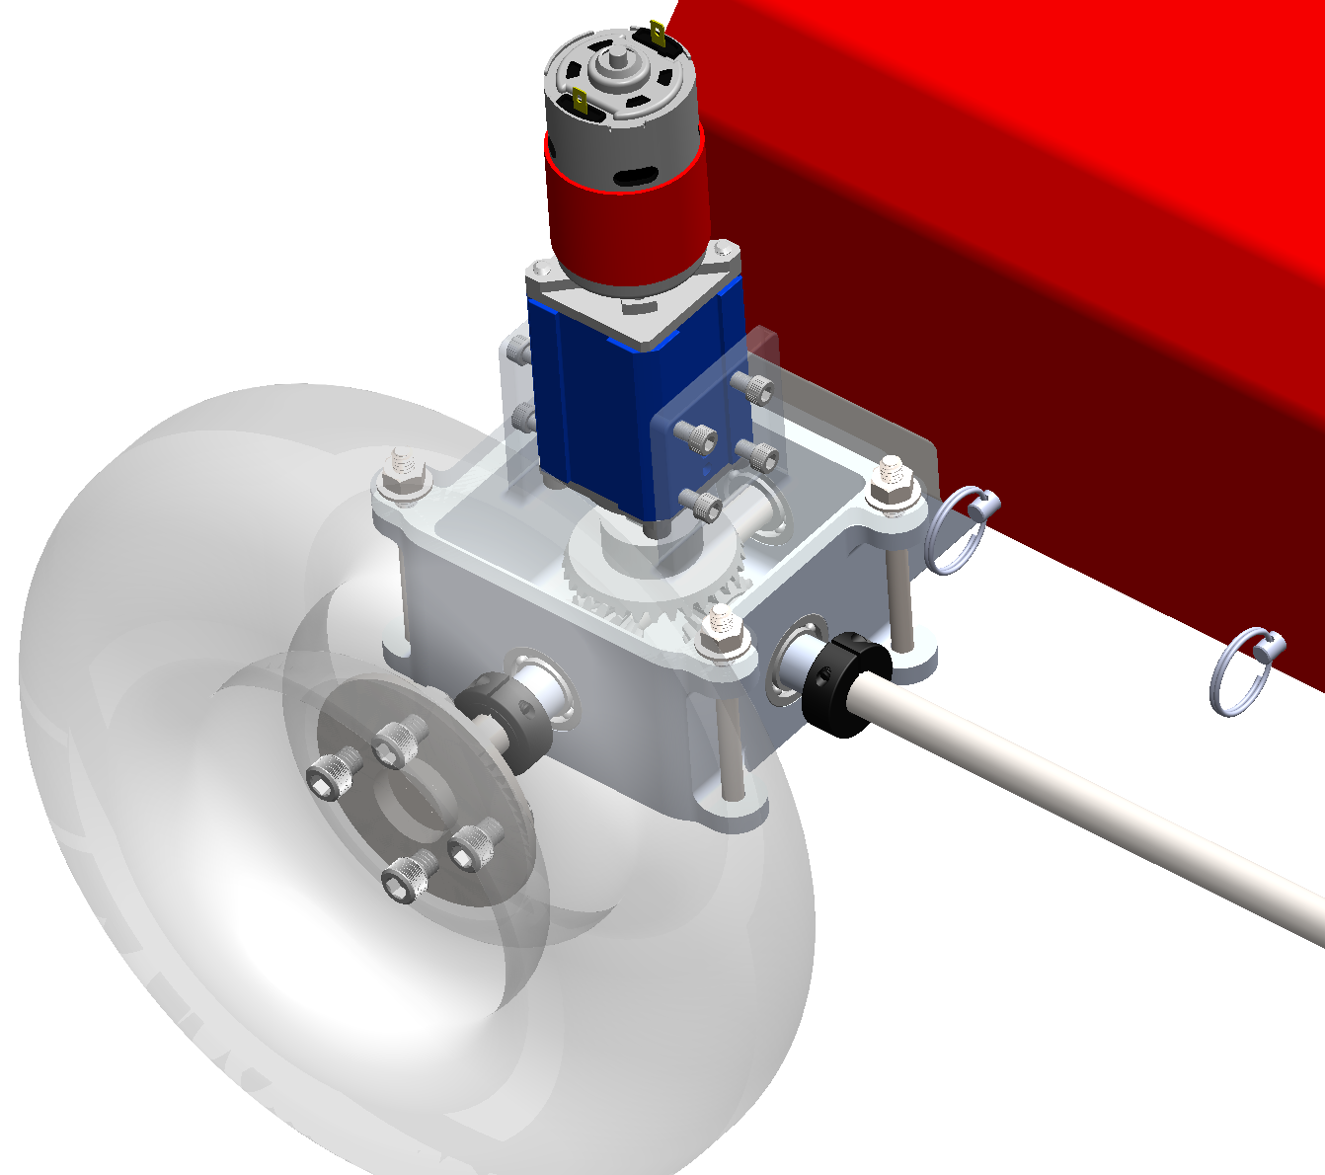
Drivetrain
Presentation Layout
DR4.1 DR4.2 | Drive to specified location within 100m radius and have 360 degree turn capability
Software:
Power/Measurement System
Hardware:
Drive Shaft Configuration
Notes:
Patrick

Slide 61
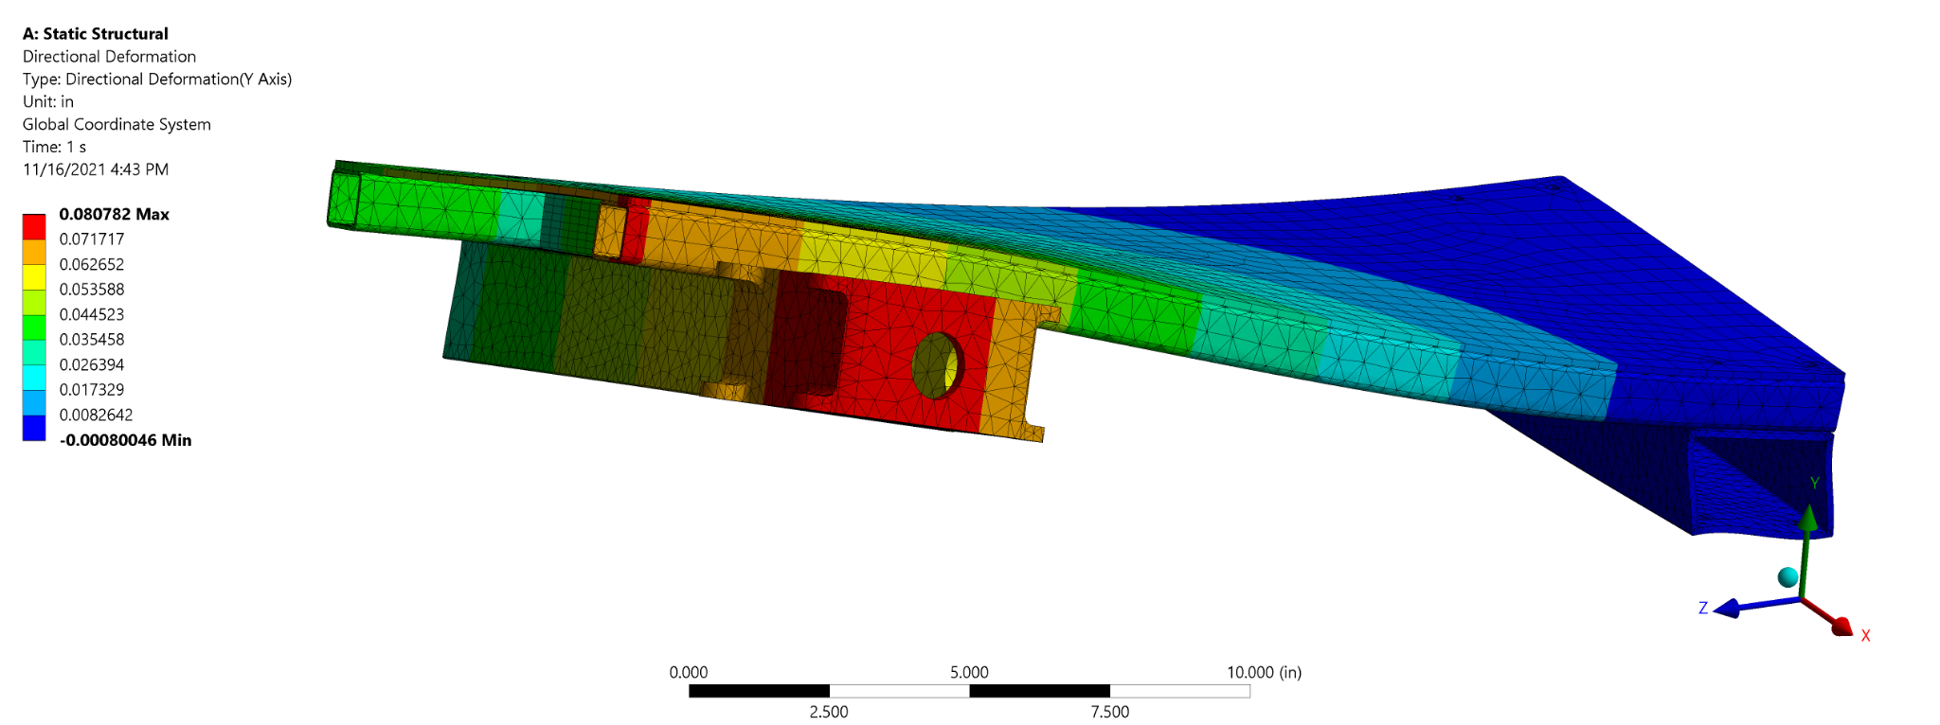
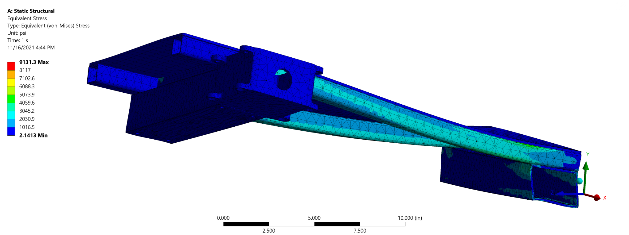
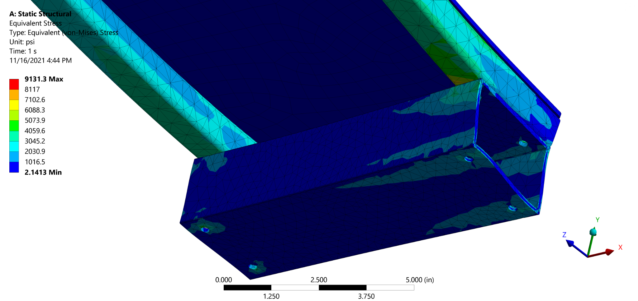
Structural Analysis
Presentation Layout

Slide 62
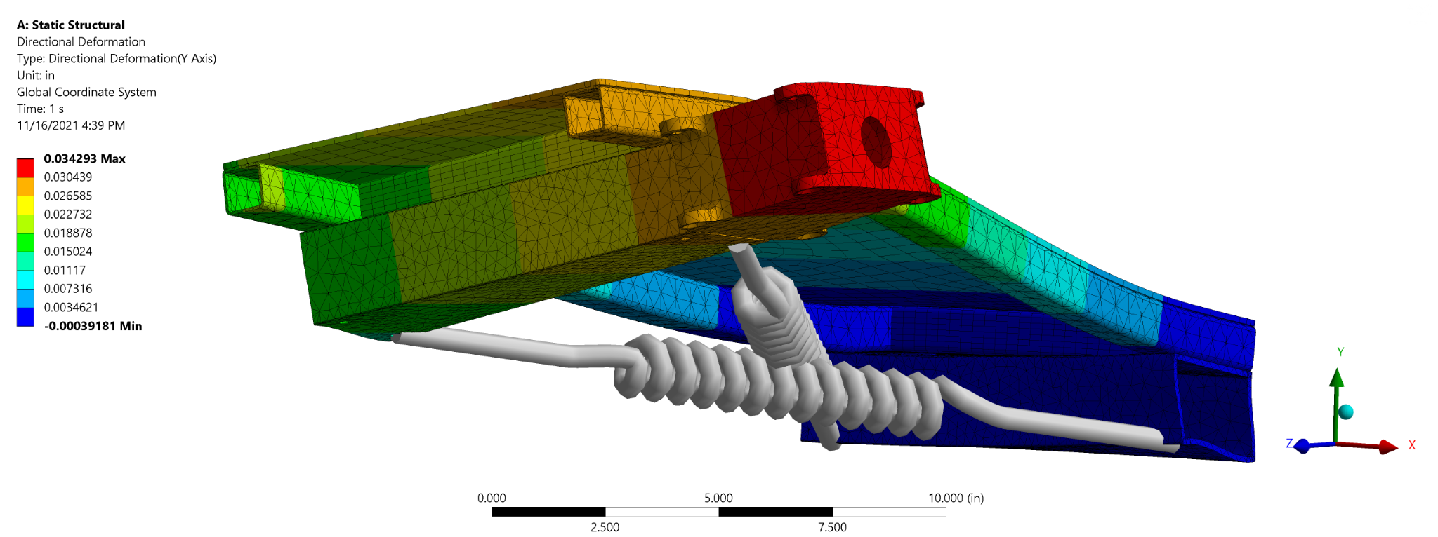
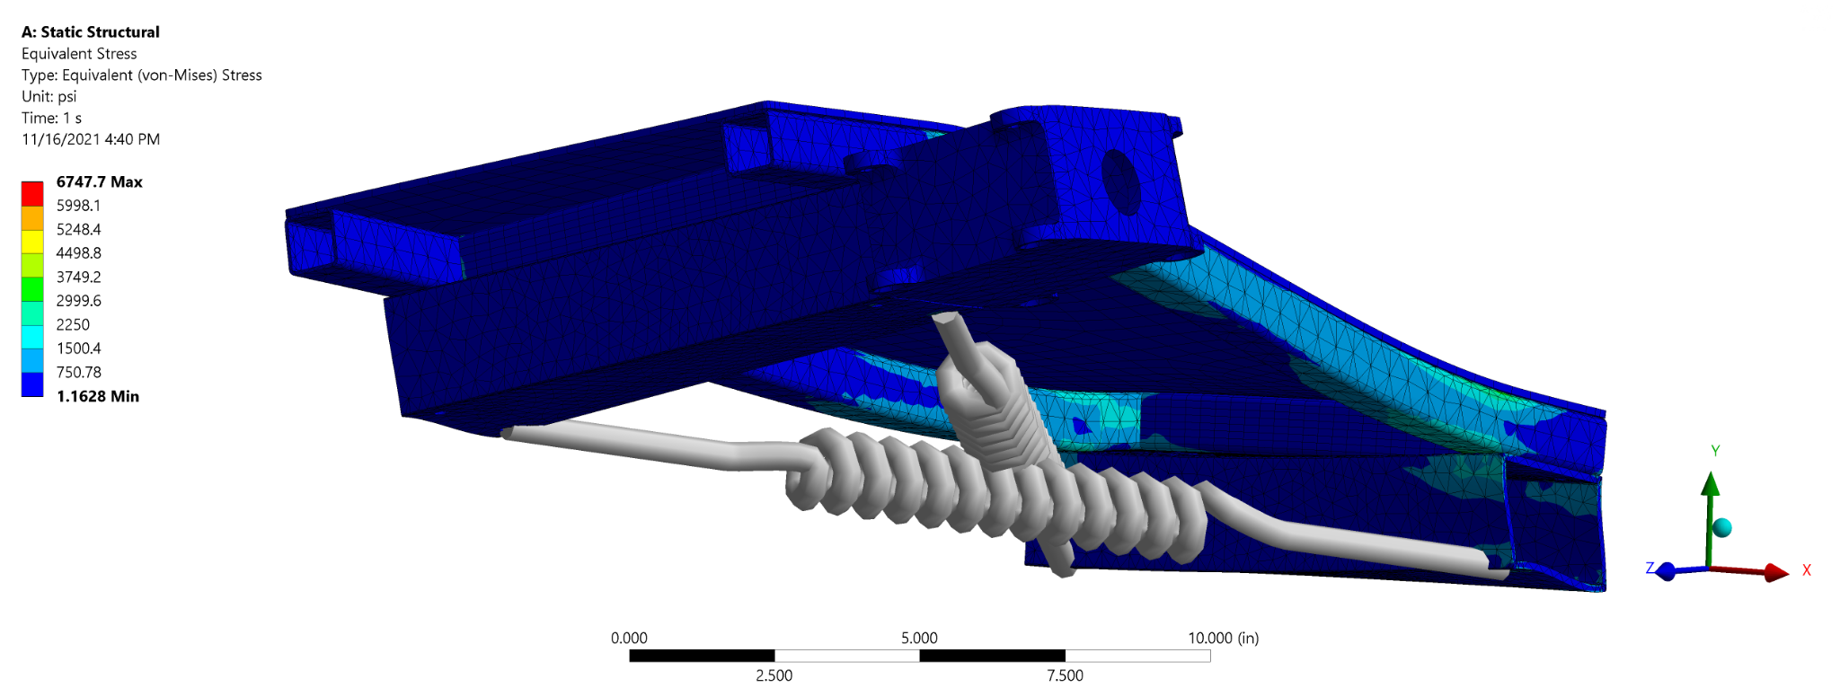
Structural Analysis
Presentation Layout

Slide 63
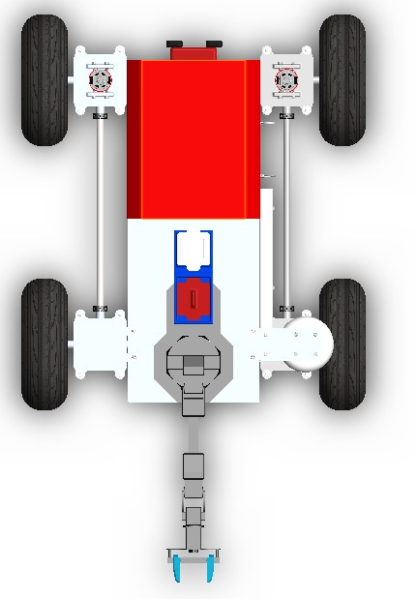
Camera
FR.6 - AEROSS shall have video capability
Presentation Layout
PTZ Camera - Sunba 405-D20X
Horizontal Field of View
Rotation
Vertical Field of View
Weight (kg): 1.36
Dim (cm): 16 x 9.9
>100°
Notes:
Max

Slide 64
Project Risks

Slide 65
Project Risks-Risk Table
Presentation Layout
Number | Risk Description | Effect
1 | Robotic Arm Failure | Functional Failure
2 | Loss of COMM’s with Rover | Functional Failure
3 | Damage to onboard COMM’s hardware | Functional Failure
4 | Budget exceeds $5,000 | Inability to manufacture AEROSS
5 | Camera Failure | Functional Failure
6 | GPS/Motor Encoder Sensor Failure | Failure of accuracy requirements
7 | Supply Delays | Schedule delay
Notes:
Max

Slide 66
Project Risks-Before Mitigation
Presentation Layout
Risk Key
Robotic arm is damaged
Loss of COMM’s between AEROSS and GS
Damage to onboard COMM’s hardware
Budget exceeds $5,000
Camera failure
GPS/Motor encoder sensor failure
Supply delays
 |  |  | Impact Level
 |  | Low | Mild | Medium | High
Likelihood Level | High |  |  | 7
 | Medium |  |  |  | 1,2,4,6,3
 | Low |  |  |  | 5
Notes:
2 - mention w/out obstacles interfering with comms
Max
Re-evaluate impact level

Slide 67
Project Risks-Mitigation Strategy
Presentation Layout
Number | Risk Description | Mitigation
1 | Robotic Arm Failure | Create Intended Use Document
2 | Loss of COMM’s with Rover | Reverse Until COMM’s are re-gained
3 | Damage to onboard COMM’s hardware | Create Installation Guide
4 | Budget exceeds $5,000 | Finalize all hardware with overhead
5 | Camera Failure | Create Installation Guide
6 | GPS/Motor Encoder Sensor Failure | Modeling/Testing
7 | Supply Delays | Order hardware ASAP
Notes:
Patrick

Slide 68
Project Risks-After Mitigation
Presentation Layout
Risk Key
Robotic arm is damaged
 |  |  | Impact Level
 |  | Low | Mild | Medium | High
Likelihood Level | High
 | Medium |  |  |  | 1
 | Low |  |  |  | 1
Notes:
Patrick

Slide 69
Project Risks-After Mitigation
Presentation Layout
Risk Key
Robotic arm is damaged
Loss of COMM’s between AEROSS and GS
 |  |  | Impact Level
 |  | Low | Mild | Medium | High
Likelihood Level | High
 | Medium |  | 2 |  | 1,2
 | Low |  |  |  | 1
Notes:
Patrick

Slide 70
Project Risks-After Mitigation
Presentation Layout
Risk Key
Robotic arm is damaged
Loss of COMM’s between AEROSS and GS
Damage to onboard COMM’s hardware
 |  |  | Impact Level
 |  | Low | Mild | Medium | High
Likelihood Level | High
 | Medium |  | 2 |  | 1,2,3
 | Low |  |  |  | 1,3
Notes:
Patrick

Slide 71
Project Risks-After Mitigation
Presentation Layout
Risk Key
Robotic arm is damaged
Loss of COMM’s between AEROSS and GS
Damage to onboard COMM’s hardware
Budget exceeds $5,000
 |  |  | Impact Level
 |  | Low | Mild | Medium | High
Likelihood Level | High
 | Medium |  | 2 |  | 1,2,3,4
 | Low |  |  | 4 | 1,3
Notes:
Patrick

Slide 72
Project Risks-After Mitigation
Presentation Layout
Risk Key
Robotic arm is damaged
Loss of COMM’s between AEROSS and GS
Damage to onboard COMM’s hardware
Budget exceeds $5,000
Camera failure
 |  |  | Impact Level
 |  | Low | Mild | Medium | High
Likelihood Level | High
 | Medium |  | 2 |  | 1,2,3,4
 | Low |  |  | 4,5 | 1,3,5
Notes:
Patrick

Slide 73
Project Risks-After Mitigation
Presentation Layout
Risk Key
Robotic arm is damaged
Loss of COMM’s between AEROSS and GS
Damage to onboard COMM’s hardware
Budget exceeds $5,000
Camera failure
GPS/Motor encoder sensor failure
 |  |  | Impact Level
 |  | Low | Mild | Medium | High
Likelihood Level | High
 | Medium |  | 2 |  | 1,2,3,4,6
 | Low |  |  | 4,5,6 | 1,3,5
Notes:
Patrick

Slide 74
Project Risks-After Mitigation
Presentation Layout
Risk Key
Robotic arm is damaged
Loss of COMM’s between AEROSS and GS
Damage to onboard COMM’s hardware
Budget exceeds $5,000
Camera failure
GPS/Motor encoder sensor failure
Supply delays
 |  |  | Impact Level
 |  | Low | Mild | Medium | High
Likelihood Level | High |  |  | 7
 | Medium |  | 2 | 7 | 1,2,3,4,6
 | Low |  |  | 4,5,6 | 1,3,5
Notes:
Patrick

Slide 75
Project Risks-After Mitigation
Presentation Layout
Risk Key
Robotic arm is damaged
Loss of COMM’s between AEROSS and GS
Damage to onboard COMM’s hardware
Budget exceeds $5,000
Camera failure
GPS/Motor encoder sensor failure
Supply delays
 |  |  | Impact Level
 |  | Low | Mild | Medium | High
Likelihood Level | High
 | Medium |  | 2 | 7
 | Low |  |  | 4,5,6 | 1,3
Notes:
Patrick

Slide 76
Drivetrain

Slide 77
Satisfaction: Drivetrain Power Analysis
Presentation Layout
Expected power draw of 133W.
Total energy used (100m and back): 5.7 Wh.
Vehicle run time of 1.87 hours.
This analysis partially confirms DR4.1
Further confirmation in communications section.
Notes:
Patrick

Slide 78
Satisfaction: Drivetrain Motor & Motor Driver Analysis
Presentation Layout
AndyMark 775 RedLine motor
Brushed DC motor
Capable of forward or reverse rotation based on polarity.
SyRen 10A motor driver
Capable of commanding a motor to rotate in both the forward and reverse directions.
This analysis partially confirms DR4.3.
Notes:
Patrick

Slide 79
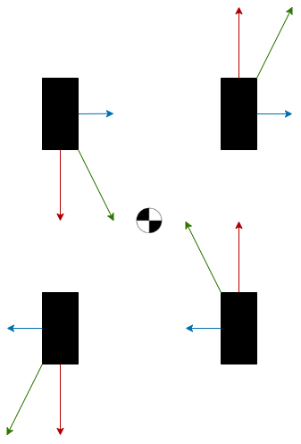
Satisfaction: Drivetrain Terrain Analysis Free Body Diagrams
Presentation Layout
Turning FBD
Straight-Line FBD
Notes:
Patrick

Slide 80
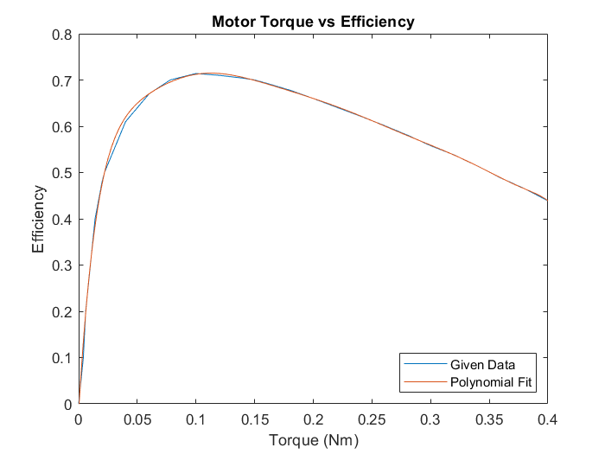
Drivetrain
Friction Analysis - Motor Efficiency
Presentation Layout
Notes:
Patrick

Slide 81
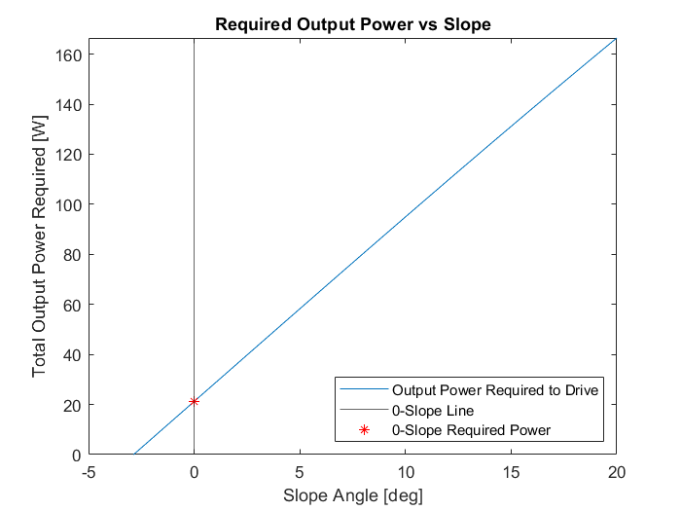
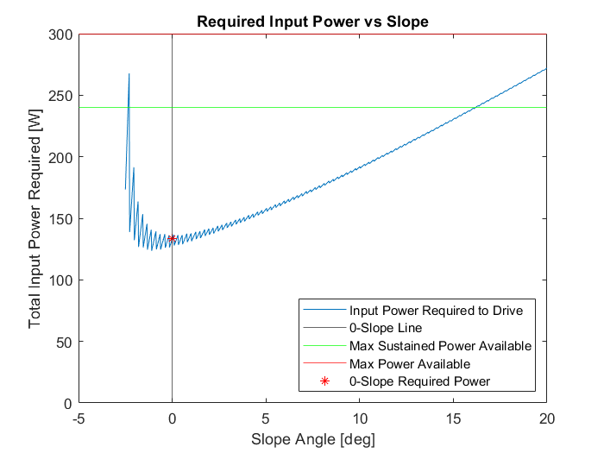
Drivetrain
Friction Analysis - Straight Line Driving
Presentation Layout
Note y-axis scale change
Notes:
Patrick

Slide 82
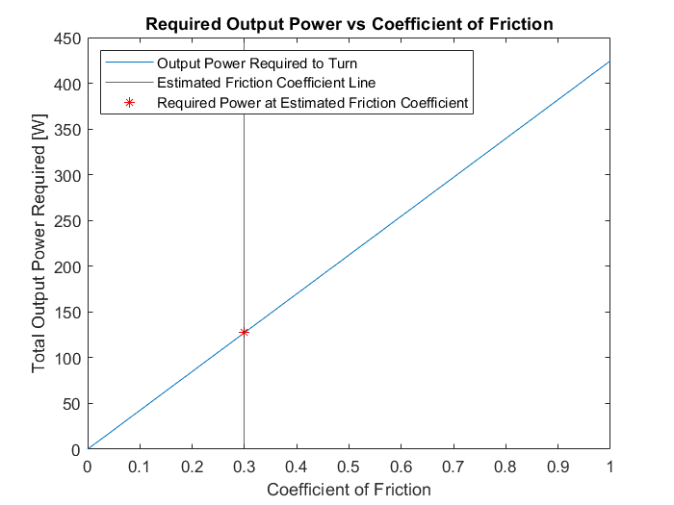
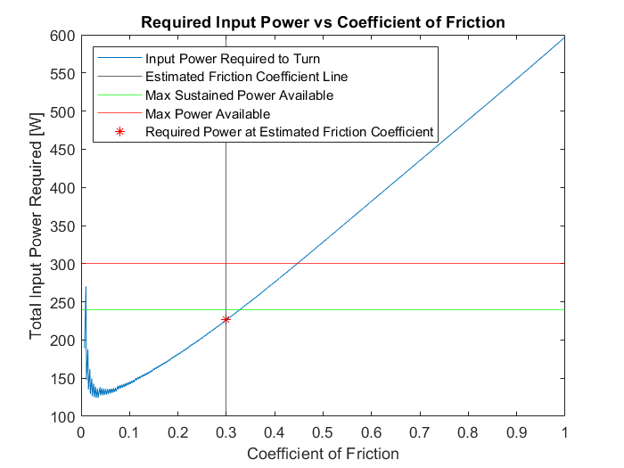
Drivetrain
Friction Analysis - Turning
Presentation Layout
Note y-axis scale change
Notes:
Patrick

Slide 83
Drivetrain
Summarized Structural Calculations
Presentation Layout
Gear teeth shear:
FOS: 26.3
Drive shaft torsion:
FOS: 22.3
Single wheel loading:
FOS: 5.75
Notes:
Patrick

Slide 84
Sample Collection

Slide 85
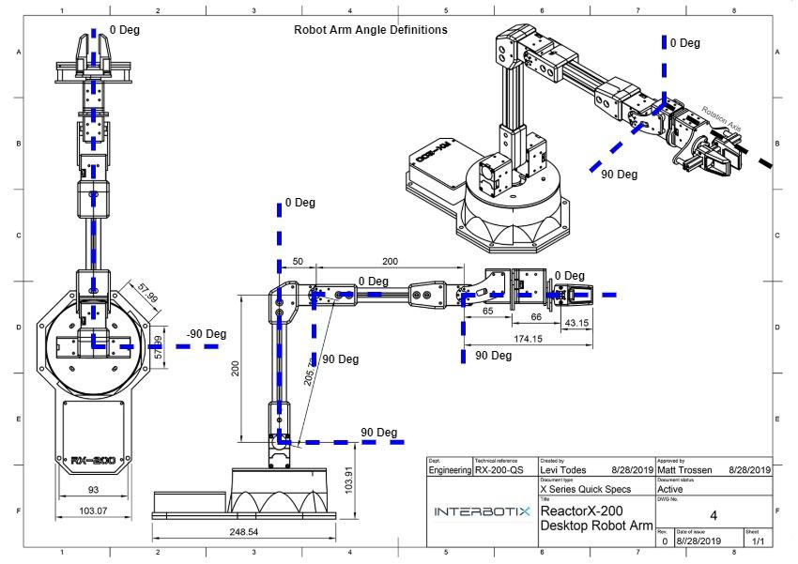
Robotic Arm Joint & Position Definition
Presentation Layout

Slide 86
Sample Weight Analysis
FR.1: AEROSS shall be able to collect, store, and deposit a sample of less than 2 lbs
Feasibility Items:
Can the rover acquire, transport, and deposit a sample without stalling?
Assumptions:
Motor stalls at 4.1 Nm
Lever arm is parallel to the ground
Largest sample mass: 0.0337 kg
Arm mass centered at arm midpoint
Variables:
m_s = sample mass = 0.0337 kg
m_c = container mass= ?
m_a = arm mass= 0.5962
d = distance to joint = 0.55 m
𝞽_max = max torque = 4.1 Nm
Notes:
BREAK INTO TWO SLIDES WAY TOO BUSY!

Slide 87
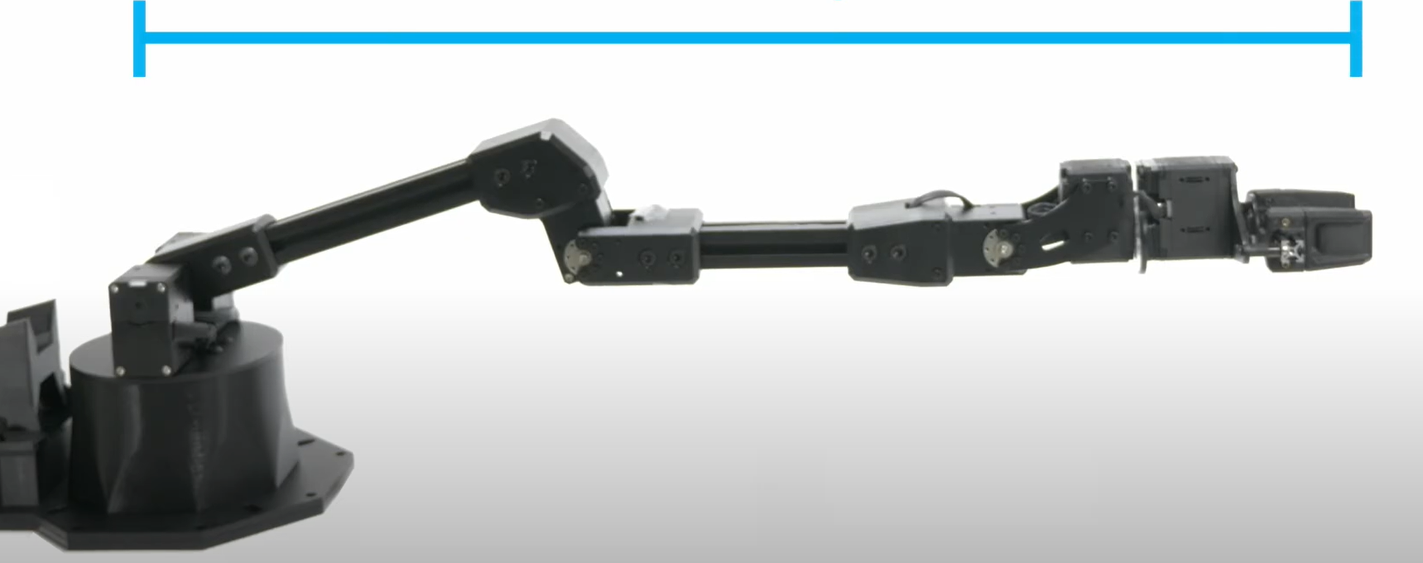
Sample Weight Analysis Cont.
FR.1: AEROSS shall be able to collect, store, and deposit a sample of less than 2 lbs
Torque Analysis:
d = 0.55 m
Result:
If the mass of the sample containment unit is less than 0.43 kg, the sample collection arm will not stall.
Feasible: YES!
4.1 Nm
F_y = 0.16395 N
F_y = 2.64633+9.81m_c
Notes:
Sig figs!!!
Model should be first before math
Explain model
EM - changed 0.4281 to 0.43 kg 10/6/21

Slide 88
Navigation and Control

Slide 89
Satisfaction: GPS Accuracy
Presentation Layout
Novatel GPS receiver measuring data over 25 hour period
Distance is greater than 1m in a significant number of cases
Averaged data taken over all possible 2 minute periods (120 data points)
Notes:
Rico
Novatel GPS receiver measuring data over 25 hour period
Distance of data points taken over 10 minute periods averaged
Frequency of averaged accuracy values were calculated
Values with less than 1 meter of accuracy are .062% likely
This analysis confirms DR.1
DR.1: AEROSS shall be able to deposit sample container within 1m radius of LOI indicated by ground station
DR.1: AEROSS shall be able to deposit sample container within 1m radius of LOI indicated by ground station

Slide 90
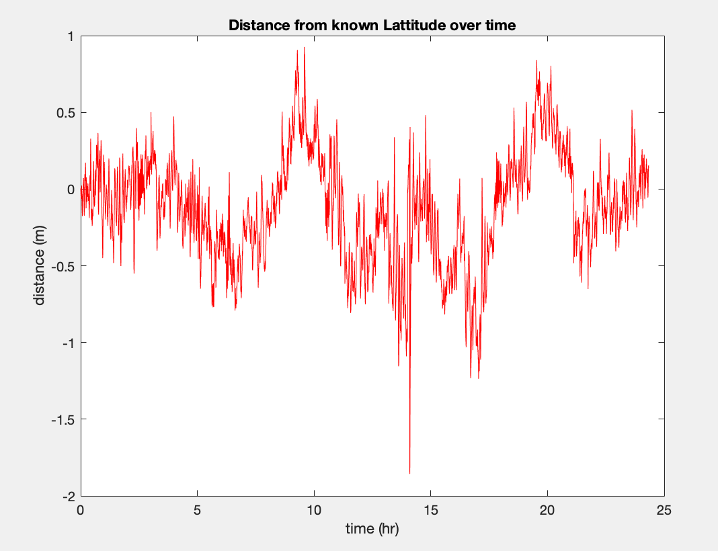
Satisfaction: GPS Accuracy
Presentation Layout
Notes:
Rico
Novatel GPS receiver measuring data over 25 hour period
Distance of data points taken over 10 minute periods averaged
Frequency of averaged accuracy values were calculated
Values with less than 1 meter of accuracy are .062% likely
This analysis confirms DR.1
DR.1: AEROSS shall be able to deposit sample container within 1m radius of LOI indicated by ground station
DR.1: AEROSS shall be able to deposit sample container within 1m radius of LOI indicated by ground station

Slide 91
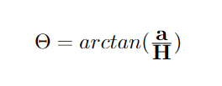
Navigation and Control: Heading Accuracy
Presentation Layout
a, sensor accuracy
Adafruit LSM303AGR Accelerometer Magnetometer
1.5 mGauss/LSB magnetic sensitivity (a)
Earth magnetic field intensity (H) ranges from 0.35 to 0.65 G (Gauss)
Magnetic North
Sensed North
H, earth's magnetic field intensity
𝚹, heading accuracy
Heading accuracy of 𝚹 = 0.267°
Magnetometer

Slide 92
Navigation and Control: Control Software Overview
Presentation Layout
Xbox Controller
GS Controlled
Notes:
Keaton

Slide 93
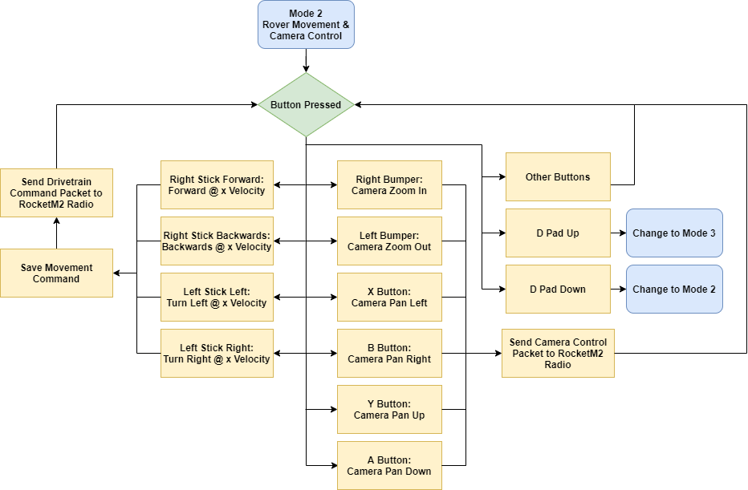
Navigation and Controls: Rover and Camera Control Diagram
Presentation Layout

Slide 94
Navigation and Controls: Arm Control Diagram
Presentation Layout

Slide 95
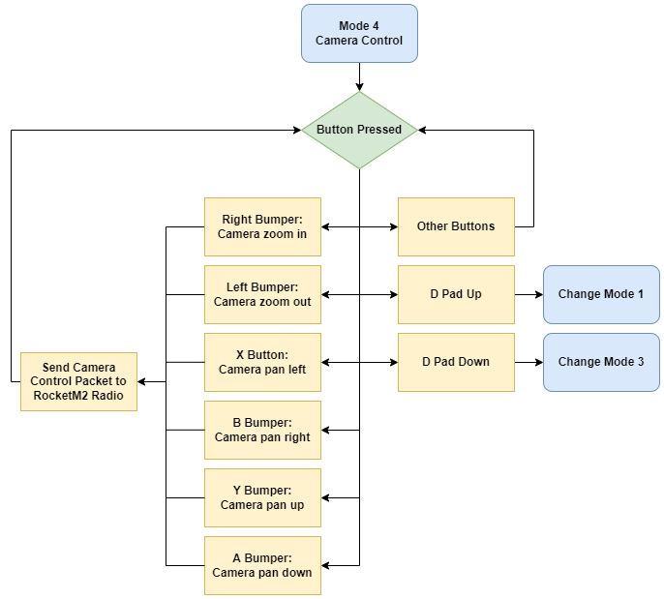
Navigation and Control: Camera Control Diagram
Presentation Layout

Slide 96
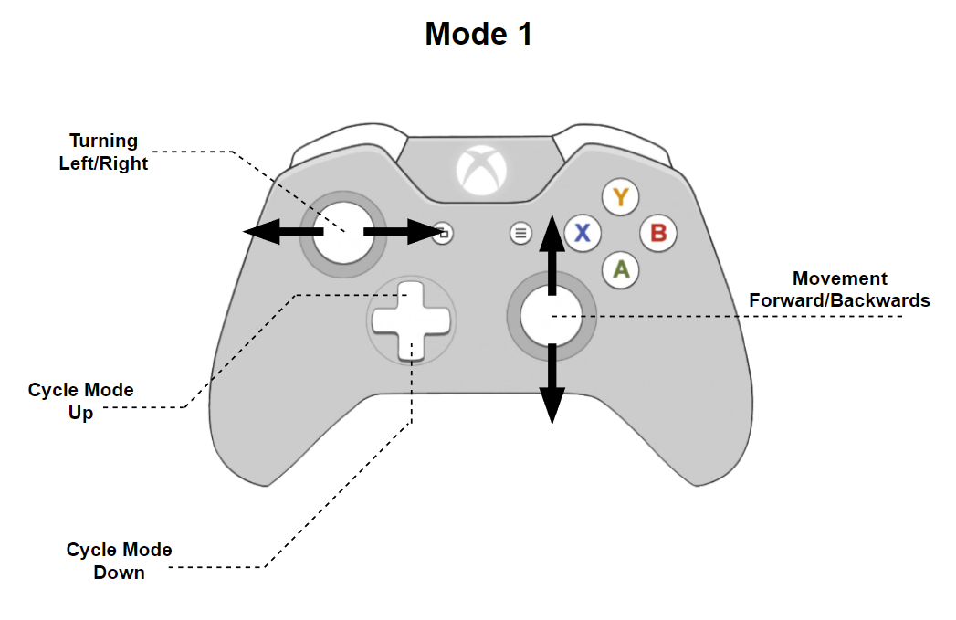
Navigation and Control: Xbox Controller Layout Mode 1
Presentation Layout
Mode 1 - Rover Movement Controls
Joysticks allow for vector gradients
Outputs:
4 varying values (LS/RS)
2 fixed values (D-Up/D-Down)
Notes:
Edit Mode 2

Slide 97
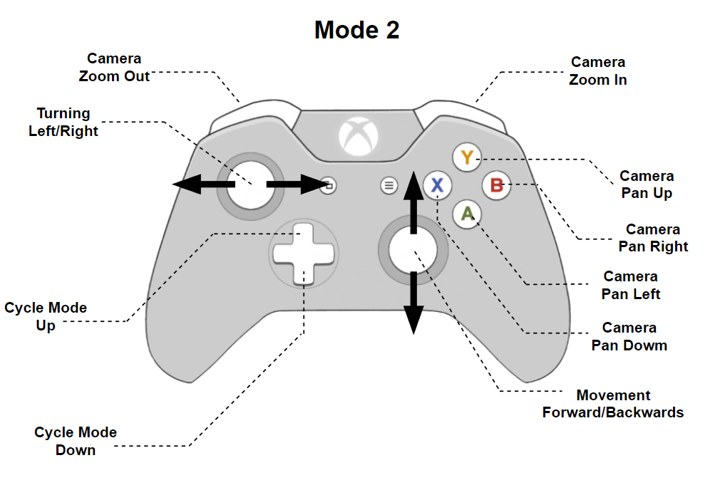
Navigation and Control: Xbox Controller Layout Mode 2
Presentation Layout
Mode 2 - Rover Movement & Camera Controls
Joysticks allow for vector gradients
Outputs:
4 varying values (LS/RS)
8 fixed values (D-Up/D-Down/LB/RB/X,Y,A,B)
Notes:
Edit Mode 2

Slide 98
Navigation and Control: Xbox Controller Layout Mode 3
Presentation Layout
Mode 3 - Arm Controls
Joysticks allow for vector gradients
Outputs:
8 varying values (LS/RS)
9 fixed values (D-Up/D-Down/LB/RB/X,Y,A,B, Home)

Slide 99
Navigation and Control: Xbox Controller Layout Mode 4
Presentation Layout
Mode 4 - Camera Control
Outputs:
8 fixed values (D-Up/D-Down/LB/RB/X,Y,A,B)

Slide 100
Communication and Software

Slide 101
Communications & Data Main Hardware
FR.4 - AEROSS shall send and receive data from the ground station
FR.5 - AEROSS shall have video capability
Presentation Layout
Hardware | Mass(lbs) | Dimensions(in) | Specs
Rocket M2 Radio | 1.1 | 6.3 x 3.15 x 1.18 | Up to 150 Mbps
PoE Network Switch | 0.55 | 3.94 x 3.86 x 0.98 | 5-port PoE config
Raspberry Pi | 0.11 | 3.94 x 2.76 x 1.18 | 4GB of RAM PoE capability High perf. processor
Arduino Mega | 0.079 | 4.61 x 2.36 x 0.98 | 54 dig I/O pins 16 analog pins
Antenna | 0.22 | 15.36 | 12 dBi Omni-directional 2.4 GHz
Notes:
Rico

Slide 102
Communications & Data Sensors
FR.4 - AEROSS shall send and receive data from the ground station
FR.5 - AEROSS shall have video capability
C&DH: Sensors
Presentation Layout
Sensors | Dimensions (in) | Specs
Magnetometer /Accelerometer | 1.0 x 0.7 x 0.2 | 3-axis 1mg accel. sensitivity
GPS | 7.2 x 6.3 x 2.8 | ProPak-V3 Novatel GPS Receiver:
Laser Pointer | 0.94 x 0.59 | 5mW laser power 650 nm wavelength
Camera | 6.3 x 3.9 | Sunba 405-D20X 3° Vert. FOV 90° Horiz FOV
Notes:
Rico

Slide 103
Ground Station
Presentation Layout
Hardware:
Tripod
XBox Controller
Laptop
12dBi Omni-directional Antenna
Rocket M2 Radio
Software: Python
User Interface (UI): PyQt library
GS software: custom built with python Libraries
Notes:
Ben

Slide 104
Electronic Functional Block Diagram GS
FR.5 - AEROSS shall send and receive information to and from ground station
Presentation Layout
Major Elements for EPS
12V 6Ah Li-Ion Battery Pack
POE Injector Switch 12V to 24V
AirMax Rocket M2 GHz BaseStation
Software
Python
Notes:
Ben

Slide 105
Satisfaction: Ground Station GUI
Presentation Layout
Critical for monitoring and controlling the rover.
Built using the PyQt library.
Contains
Video Feed
Map
Rover Speed/Position
Battery Data & Percent
COMMS Status
Arm Position
Controller Mode
Notes:
Max

Slide 106
Satisfaction: Ground Station Software
Presentation Layout
Notes:
Max
Xbox Controller decoded based on selected mode
Packets from controller and GUI are added to buffer
Sent by IP to Rover
Incoming rover data is decoded and displayed on GS GUI

Slide 107
Communications: Rover Data Flow w/ Pin Out
Presentation Layout

Slide 108
Rover Software: C&DH Algorithm
Presentation Layout

Slide 109
Rover Software: Data Packets
Presentation Layout
Data packets will be sent and received using the Python “socket” library.
P2P Network allows for communication between the devices using TCP/IP
Socket accepts only string values as inputs
Use the JSON format to create the “stream”
Use json.dumps() to encode the data
Send that data using the socket to the rover
Use json.loads() to decode the data from string format into a Python dictionary
Send dictionary to data distribution

Slide 110
Satisfaction: Communications
Presentation Layout
Values used for link budget analysis:
Transmitter Power Ptx = 28dB | Tx/Rx Losses Ltx/Lrx = 1dB | Free Space Path Loss FSPL = 80.16dB | Frequency (f) f = 2432 MHz | Receiver Power Prx = -34.16 dB
Gains Gtx/Grx = 10dBi | Distance D = 100m | Speed of Light (c) C = 3*10^8 | Receiver Sensitivity Rx = -75dB | Miscellaneous Loss Lm = 0dB
Conductor Loss k1=0.2 | Insulation Loss k2=0.011 | Connection Loss Factor CLF=0.12
Free Space Path Loss:
Link Margin:
Link Budget Equation:
Cable Loss Equation:
Notes:
Rico

Slide 111
Satisfaction: Communications
Presentation Layout
Notes:
Rico

Slide 112
Satisfaction: Communications
Presentation Layout
Estimation of Data Rate for Rover
Engineer from Lunar Outpost
Most rover applications camera accounted for 85% of total data.
Used 7 Mbps as 85% of rover data
Typical amount for 1080p @ 30fps
Built in a margin of 25%
Total expected data: 10.3 Mbps
Equipment is more than capable of handling this data rate so addition analysis was done assuming 20 Mbps.
Rover Data
Data Source | Estimated % | Total Data
Camera | 85 % | 7 Mbps
Commands/Sensors | 15 % | 1.24 Mbps
Totals | 100% | 8.24 Mbps
Margin | 125% | 10.3 Mbps
Notes:
Rico

Slide 113
Budgets

Slide 114
Financial Budget
Presentation Layout

Slide 115
Financial Budget Cont
Presentation Layout

Slide 116
Financial Budget Cont
Presentation Layout

Slide 117
Mass Budget
Presentation Layout
Subsystem | Mass (kg)
Camera | 2.43
Arm | 1.90
Sample Container | 0.452
Drivetrain | 10.6
Electronics/COMMS | 4.32
Body Frame | 5.29
TOTAL | 25
Subsystem Components Legend:
Drivetrain: wheels, motors, gearboxes, gearbox housing, and driveshaft
Electronics: battery, boards, antenna, sensors
Camera: camera and camera stand
Sample container: sample capsule, lid, and housing

Slide 118
Power Budget Rover
Presentation Layout
Component | Average Current (A) | Supply Voltage (V) | Power Total (W)
Raspberry Pi 4 Model B | 3 | 5 | 15
TP-Link TLSG1005P | 5 Port Gigabit PoE Switch | 1.25 | 48 | 60
ReactorX 200 COTS Arm | 5 | 12 | 60
Syren 10A Regenerative Motor Driver | 5.5 | 12 | 66
Syren 10A Regenerative Motor Driver | 5.5 | 12 | 66
Am-3773a Encoder | 0.04 | 5 | 0.2
Am-3773a Encoder | 0.04 | 5 | 0.2
Total | 17.33 | 99 | 267.4
Chosen battery is 12V 50Ah LiFePO4 Battery which outputs 600Wh
With a FOS of 1.2, we have 500Wh to use
This means we can run the Rover for 1.87 hours

Slide 119
Power Budget Ground Station
Presentation Layout
Component | Average Current (A) | Supply Voltage (V) | Power Total (W)
Tycon Systems DC to DC Converter | 2 | 12 | 24
Total | 2 | 12 | 24
Chosen battery pack is TalentCell 12V 6000mAh which outputs 72Wh
With a FOS of 1.2, we have 60Wh to use
This means we can run the Ground Station for 2.5 hours

Slide 120
Motivation
Presentation Layout
Need:
To expand Accessibility
Why:
Scientific research
How:
User controlled sample collection rover
Robot exploring Egyptian Pyramid (source [2])
Notes:
David

Slide 121
Presentation Layout
Driving Requirements
Functional Requirement | Requirement Summary | Associated CPE | Satisfied?
FR.1, FR.2 | Collect and Store a Sample |  | Yes
FR.3 | Deposit a Sample |  | Yes
FR.4 | Navigate to sample and back to OG location |  | Yes
FR.5, FR.6 | Send and Receive info to GS |  | Yes

