Slide 1
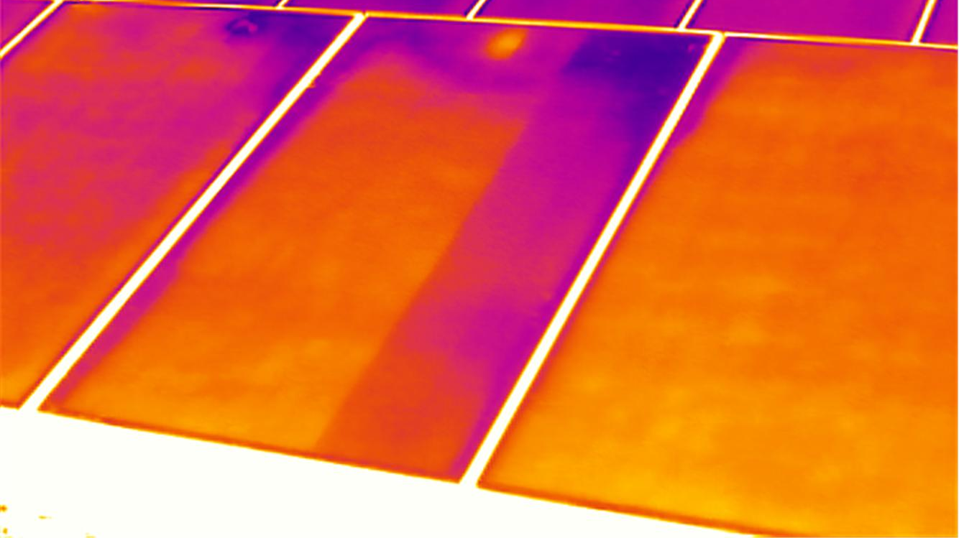



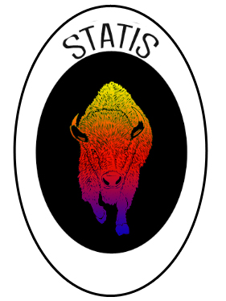
Preliminary Design Review
October 14, 2014
Cameron Comeau, Daniel Flora, Smith Johnston, Alexander Potter, Maria Rocco, Evan Schomer, Dylan Stewart, Sarah Wilson, Ashley Zerr

Slide 2
Agenda
Section | Presenter
Overview | Cameron
Requirements | Dylan
Sensor Selection | Smith
Mechanical | Alexander
Thermal | Daniel, Cameron
Electrical | Dylan
Summary | Smith

Slide 3
Overview
Overview
Sensor Selection
Summary
Requirements
Mechanical
Electrical
Thermal

Slide 4
Project Statement
The intent is to design, build and validate the functionality of a test bed that will characterize a range of commercial off the shelf (COTS) non-contact infrared temperature sensors, by testing their accuracy and precision over variable distance and temperature and on different target surfaces when compared to contact based temperature sensors, in a simulated space environment.
Overview
Sensor Selection
Summary
Requirements
Mechanical
Electrical
Thermal

Slide 5
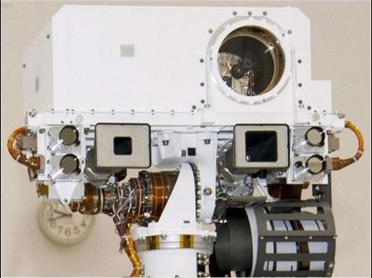
Motivation
Reduce the need for the complex wiring systems.
    Single point failures, expensive and time consuming reliability testing.
  Inability of current sensors to record accurate temperature data where direct contact is not an option.
      Mirrors - Contact sensors would mar and reduce the effectiveness of the surface.
Removes need for contact temperature sensing on moving parts
MSL Mast ^{[2]}
Multiple wires spanning over moveable joints.
Overview
Sensor Selection
Summary
Requirements
Mechanical
Electrical
Thermal
Notes:
Complex wiring … currently used for recording temperature data aboard spacecraft

Slide 6
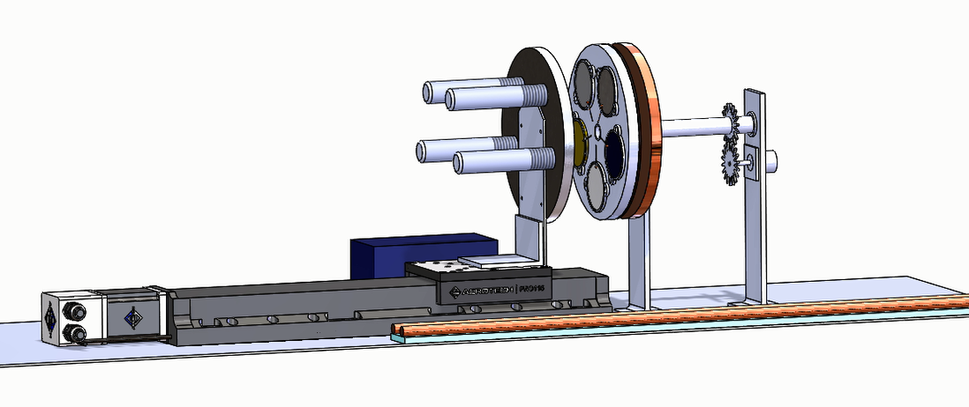
Design Overview
Heater
Target Wheel
Sensor Wheel
Radiator Disk
IR Sensors
Cold Finger
(provided by Ball)
Heater
8”
Stepper Motor
ADC
Gear System
Hollow Shaft
Copper wires
Targets
50”
Aerotek Pro 115 Linear Stage (provided by Ball)
Insulated rails for Thermal Straps

Slide 7
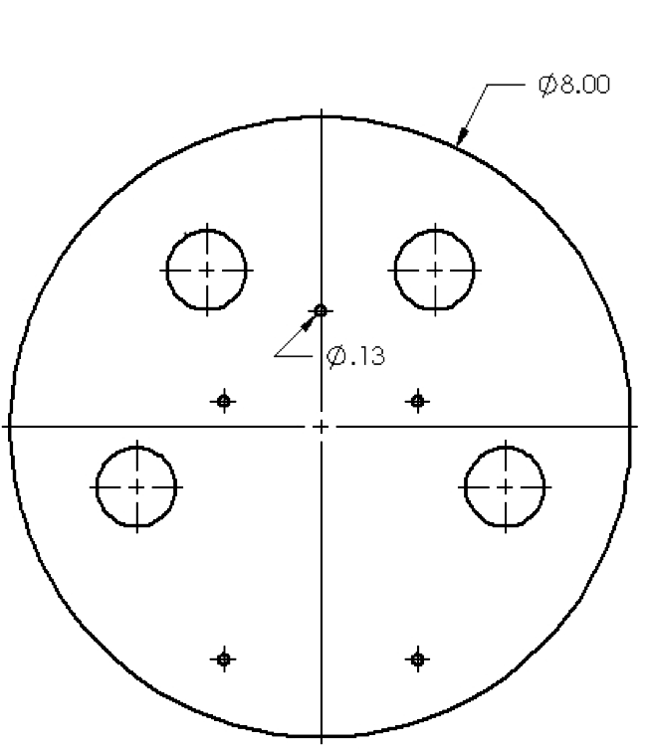
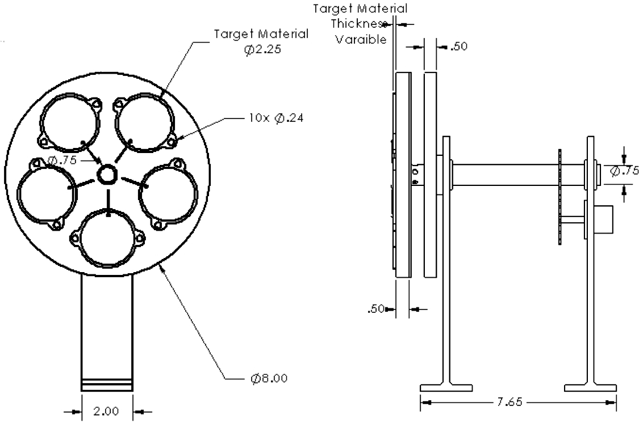
Testbed Overview
All dimensions are in INCHES
”
”
”
”
”
”
Thermistor
”
”
”
”
SENSOR WHEEL
TARGET WHEEL
Overview
Sensor Selection
Summary
Requirements
Mechanical
Electrical
Thermal

Slide 8
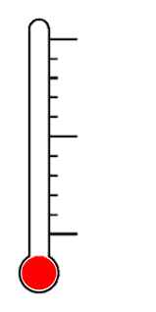

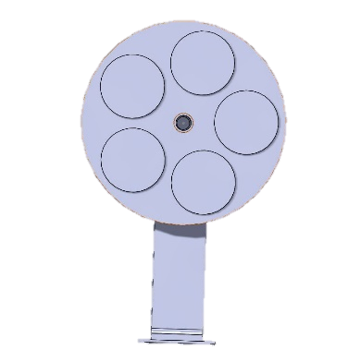

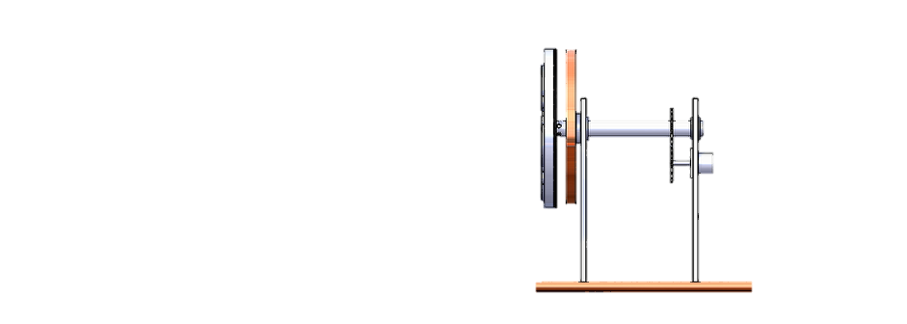
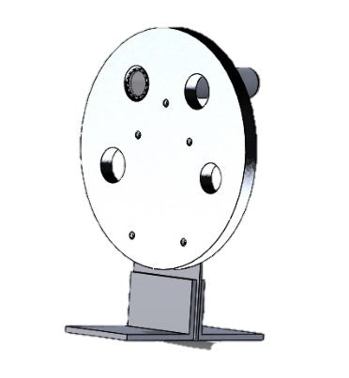
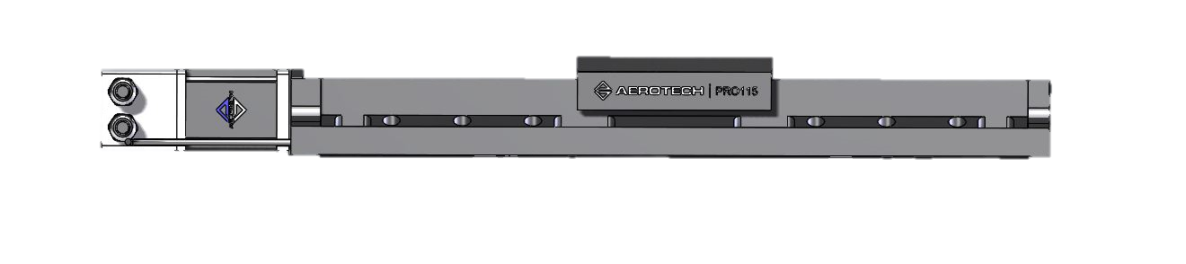
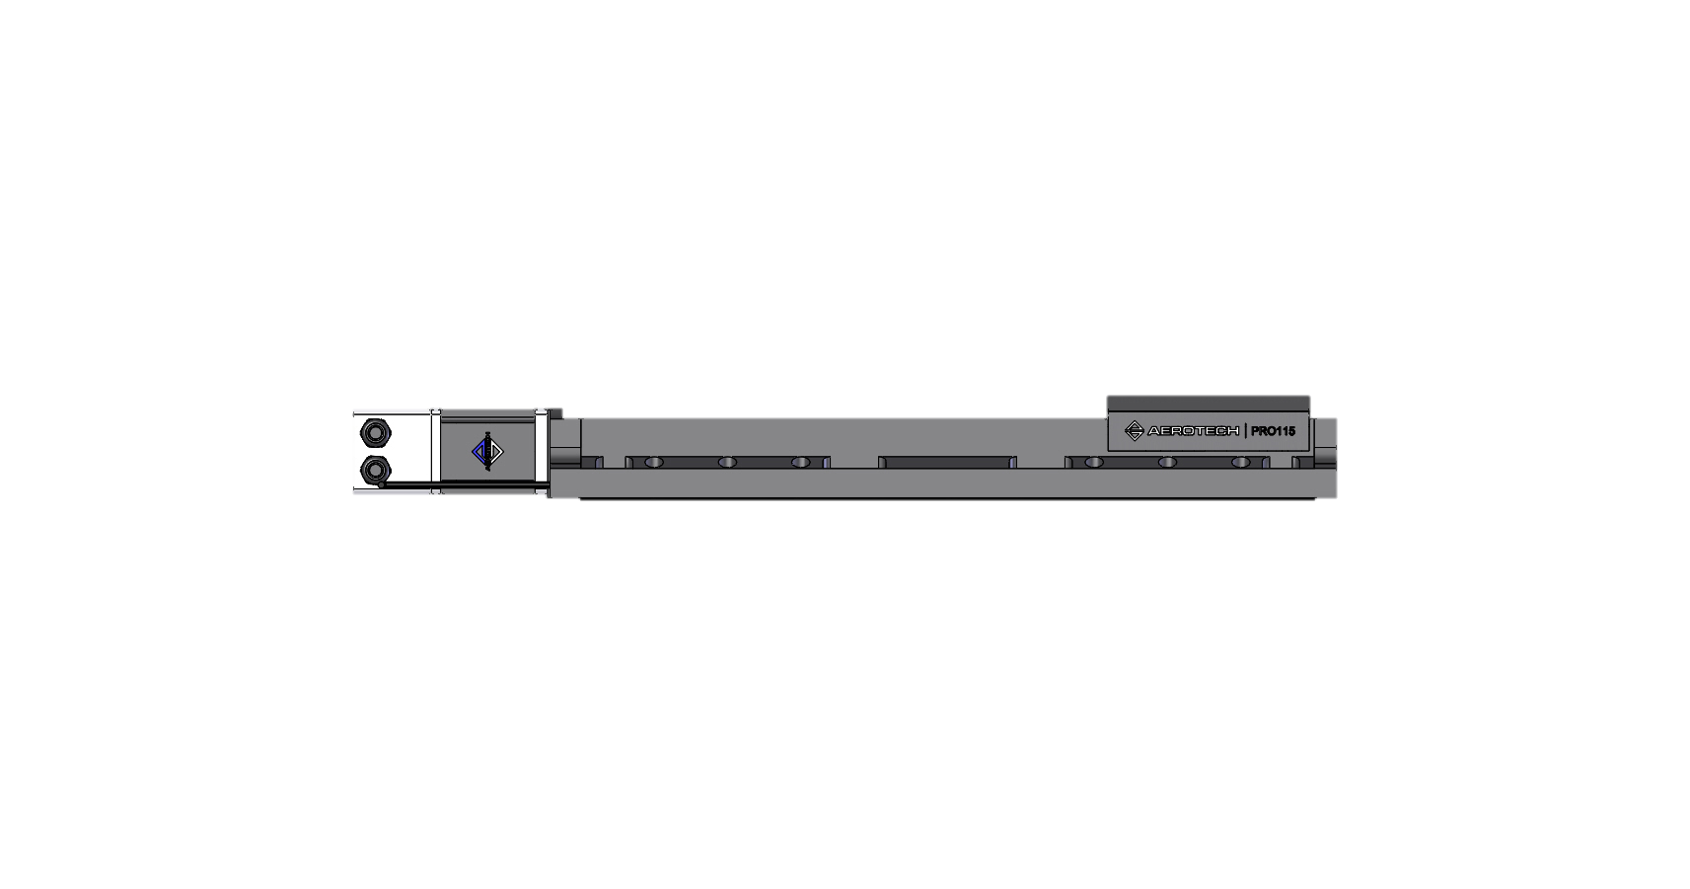
Concept of Operations
Thermistors Pressure Gauge
Ball’s TVAC (SIDE VIEW)
FRONT VIEW
Test CPU
LABVIEW VI
Simultaneous testing of all 4 sensors
Target Wheel
Sensor Wheel
Temp, Distance, Motor
Target ID
Sensor ID Controls/Data Collection
Target Wheel
Stepper Motor
Radiator Plate
Finite Distance Steps
Sensor Wheel
3x37 or 2x25 pin Feed-through
Pro115 Mechanical-bearing Ball Screw Linear Stage (Provided by Ball)
Setup
TEST CYCLE – Conduct Tests According to Data Collection Cycle
Takedown
Adjust Temperature
Data Collection
Rotate through each Target
Data Collection
Adjust Distance
Data Collection
Remove STATIS, Re-Pressurize TVAC
Insert STATIS, De-pressurize TVAC
Overview
Sensor Selection
Summary
Requirements
Mechanical
Electrical
Thermal
4 hours
7 hours for all cycles
1 hour

Slide 9
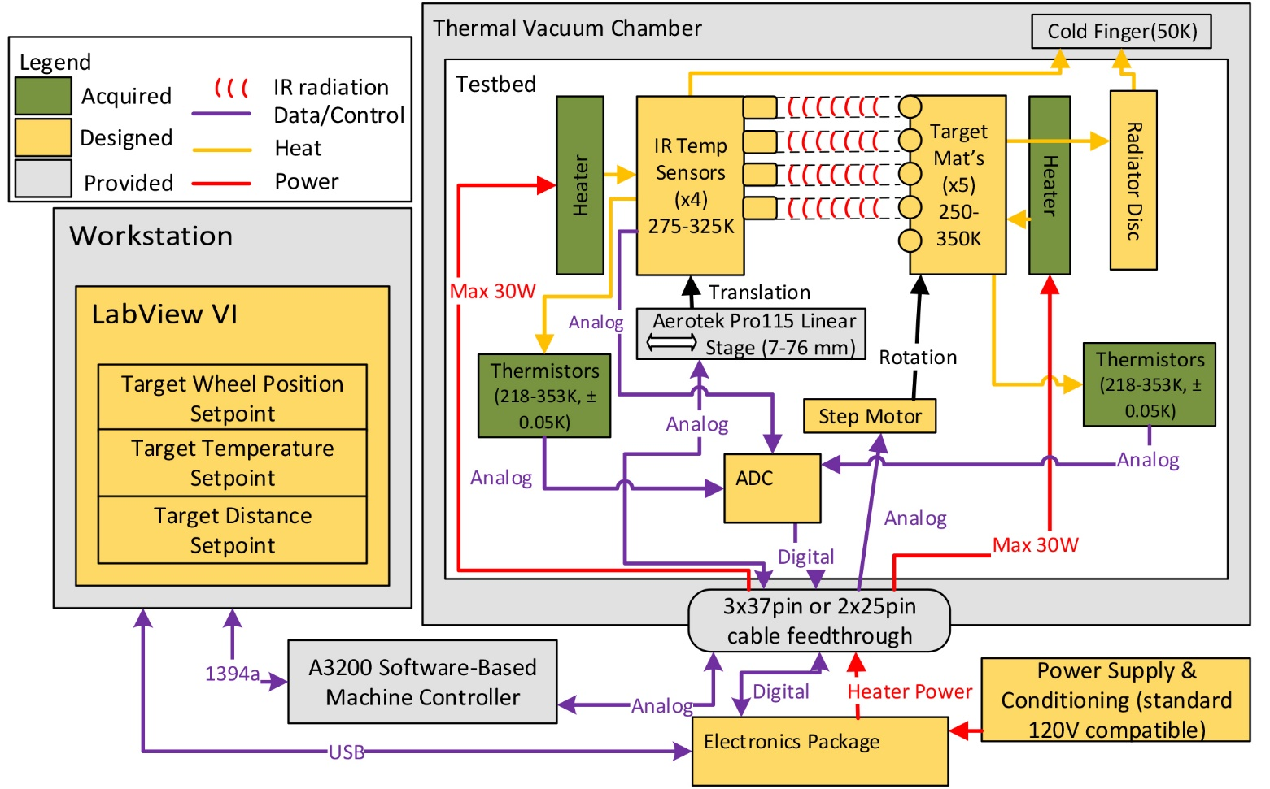
Functional Block Diagram

Slide 10
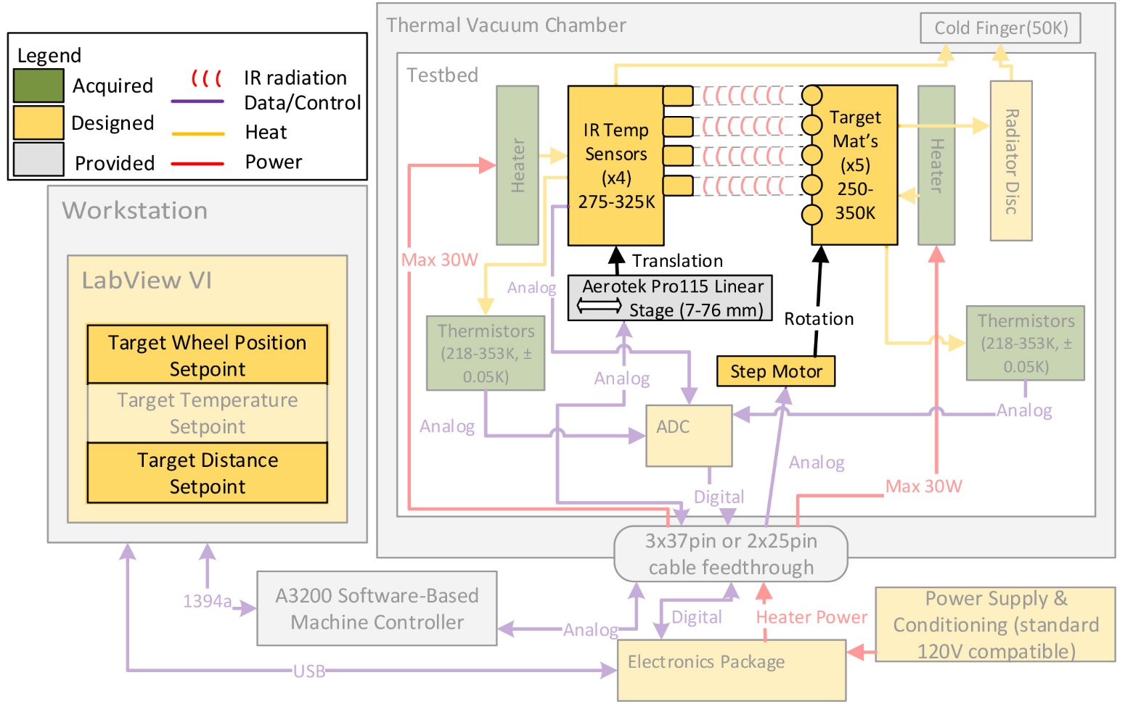
Functional Block Diagram - Mechanical

Slide 11
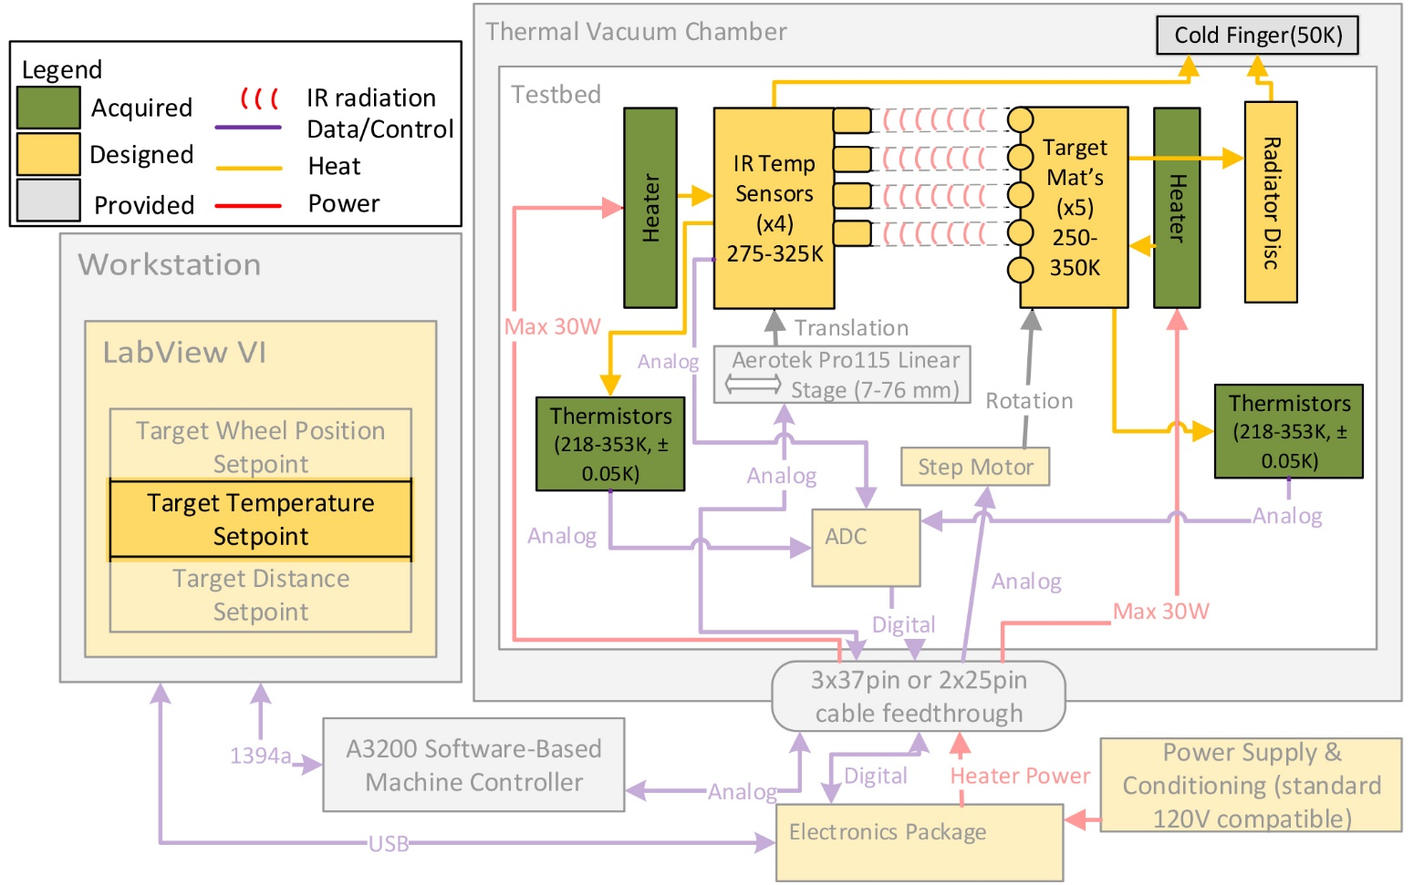
Functional Block Diagram - Thermal

Slide 12
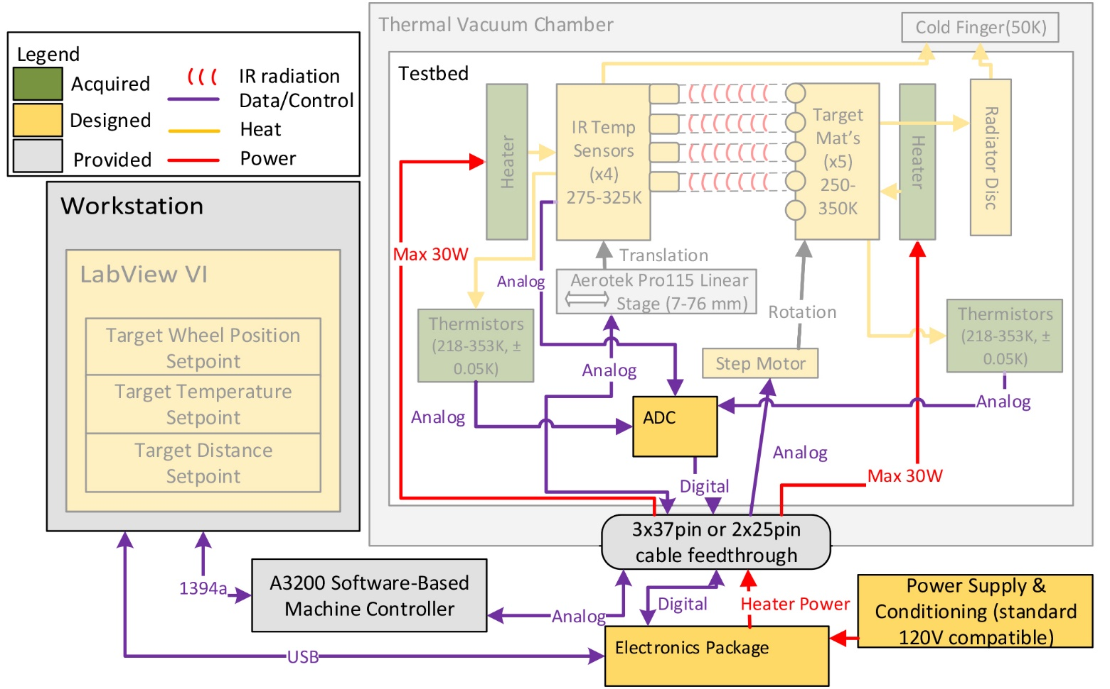
Functional Block Diagram - Electrical

Slide 13
Requirements
Overview
Sensor Selection
Summary
Requirements
Mechanical
Electrical
Thermal

Slide 14
Functional Requirements
FR 1: STATIS shall vary parameters (temperature, distance, materials) relevant to characterizing the performance of COTS non-contact infrared temperature sensors.
FR 2: STATIS shall collect measurement data (temperature, distance, materials) required to characterize the performance of the COTS IR sensors.
FR 3: STATIS shall be designed for use within Ball Aerospace’s thermal vacuum chamber.
Overview
Sensor Selection
Summary
Requirements
Mechanical
Electrical
Thermal

Slide 15
Critical Project Feasibility Elements
CPFE.1: Sensor Selection
CPFE.2: Mechanical System
CPFE.3: Thermal Modeling
CPFE.4: Electrical and Software Systems
CPFE.5: TVAC Integration
Overview
Sensor Selection
Summary
Requirements
Mechanical
Electrical
Thermal

Slide 16
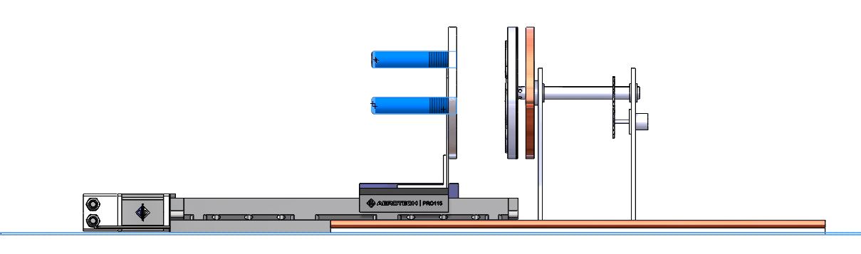
Sensor Selection
Overview
Sensor Selection
Summary
Requirements
Mechanical
Electrical
Thermal
Notes:
Why are we talking about this first

Slide 17
CPFE.1 Sensor Selection
The commercial off-the-shelf infrared temperature sensors used in STATIS are critical as they drive:
  Structural design dimensions
    Targets are constrained such that the sensor field of view (FOV) lies entirely within the target.
  Budgetary constraints
    TVAC compatible sensors cost ~$500-800
Overview
Sensor Selection
Summary
Requirements
Mechanical
Electrical
Thermal

Slide 18
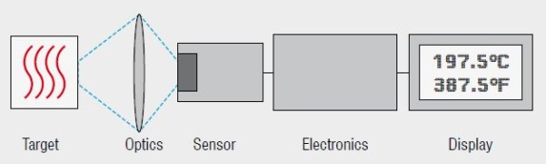
IR Sensors– Overview
Radiation Emitted by Targets
Radiation Absorbed by Detector
Voltage Converted to Temperature Measurement
Data Output as Voltage
Microprocessor
Detector
Non-Contact IR Temperature Sensor
Overview
Sensor Selection
Summary
Requirements
Mechanical
Electrical
Thermal

Slide 19
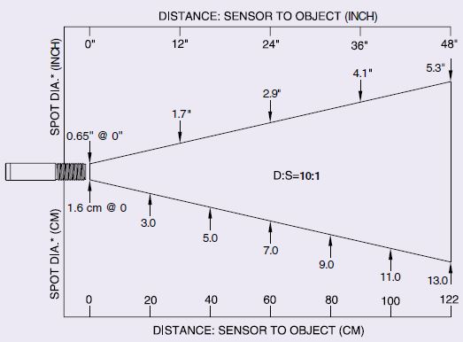
IR Sensors– D:S Ratio and FOV
IR temperature sensors have a field of view that “captures” the IR radiation.
D:S = Distance : Size ratio
Ranges from 2:1 to >300:1
Field of view (FOV) ranges according to D:S ratio
Worst case 1.5” FOV
[4]
Overview
Sensor Selection
Summary
Requirements
Mechanical
Electrical
Thermal

Slide 20
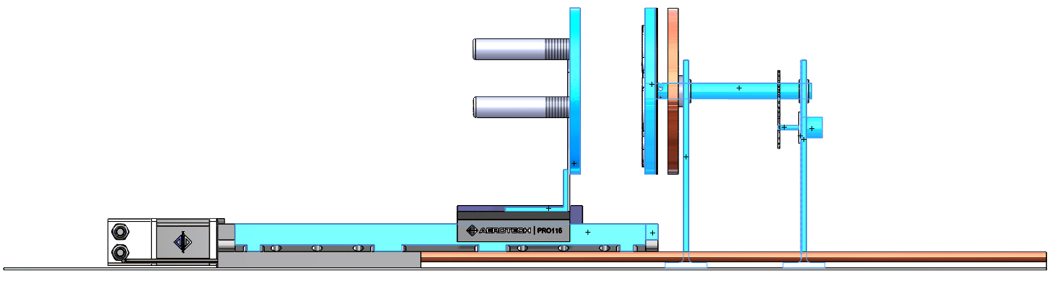
Mechanical System
Target Disk (rotating)
Radiator Disk (fixed)
Sensor Wheel (translating)
Hollow Shaft (rotating with targets)
Aerotek 115 Linear Stage
Stepper Motor
Gearing
Overview
Sensor Selection
Summary
Requirements
Mechanical
Electrical
Thermal

Slide 21
CPFE.2 Mechanical System
Mechanical system is critical as it drives:
  Manufacturability and geometric tolerancing
    Maintain sensor FOV within target patch.
  Budgetary constraints
    Supply sufficient torque to drive target wheel.
    Sufficient TVAC compatible motors cost ~$700-2000+.
Overview
Sensor Selection
Summary
Requirements
Mechanical
Electrical
Thermal

Slide 22
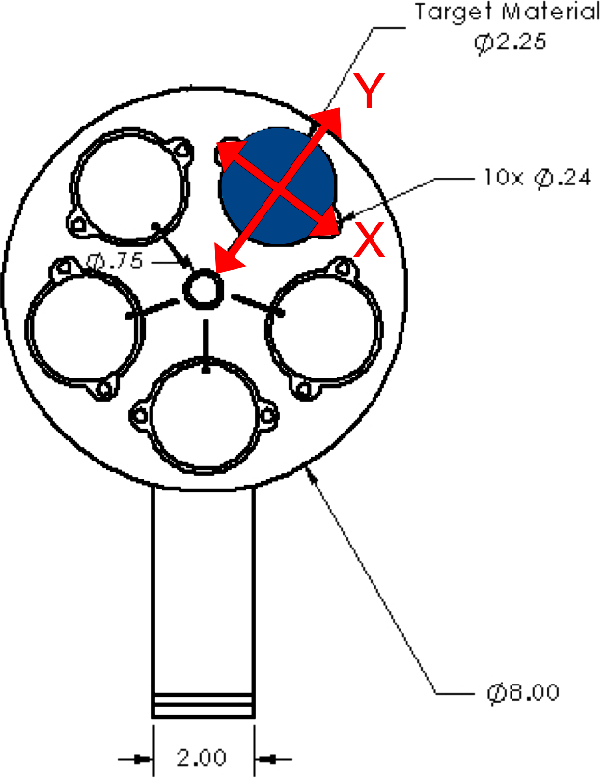
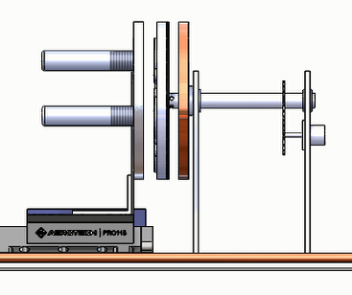
IR Sensors – FOV Analysis
Shaft Axis
Overview
Sensor Selection
Summary
Requirements
Mechanical
Electrical
Thermal

Slide 23
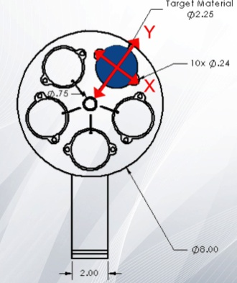
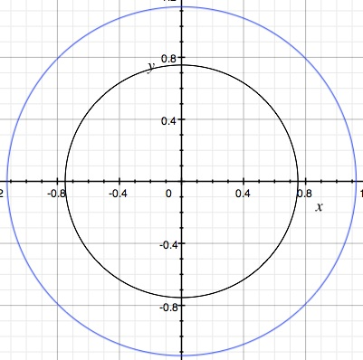
Geometric Tolerances
Target, 2.25 inch diameter
y
Δ =0.375”
x
IR sensors’ FOV must fall within target surface.
Largest FOV will govern the size of the targets.
1.5 safety factor on FOV.
Nominal Viewing (units of inches)
IR sensor FOV
1.5 inch diameter
Overview
Sensor Selection
Summary
Requirements
Mechanical
Electrical
Thermal

Slide 24
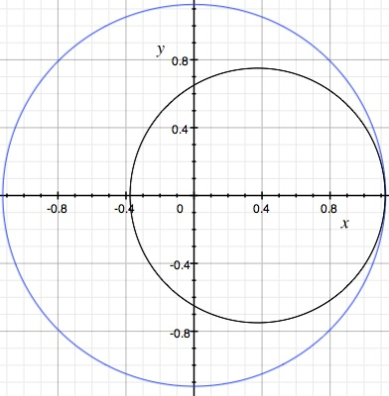
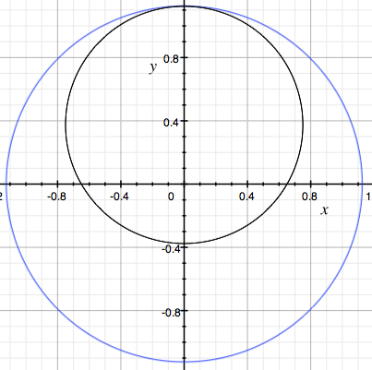
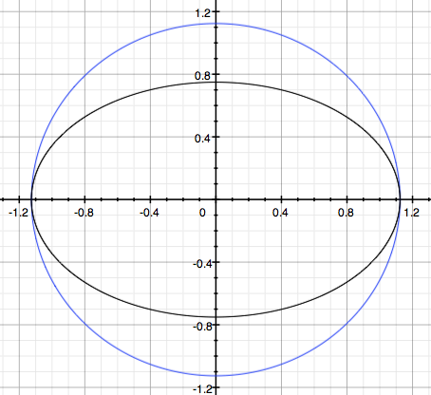
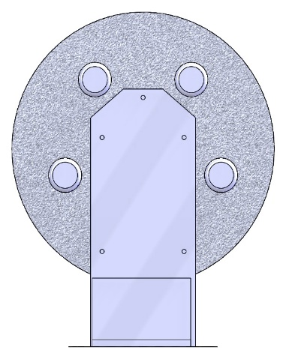
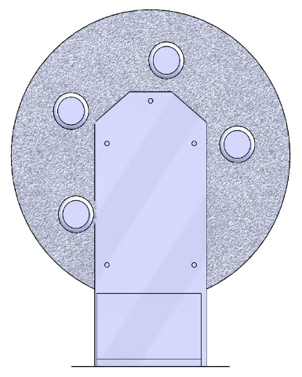
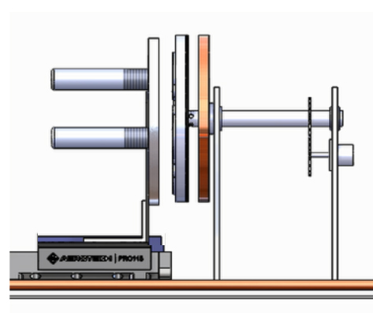
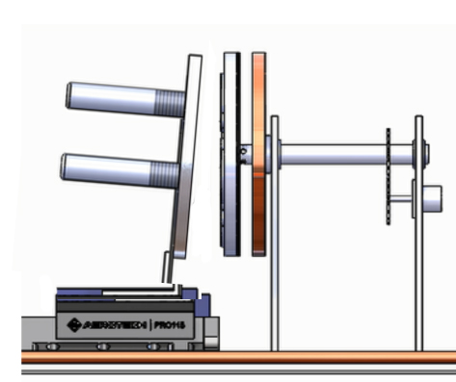
Sensor-Target Alignment Errors
y
y
y
x
x
x
=IR sensor FOV
x direction shift
y direction shift
Elliptical FOV growth (x or y)
Tolerable 0.06 inch error > 0.005 inch machining precision
FEASIBLE
In plane rotation
Wheel tilt

Slide 25
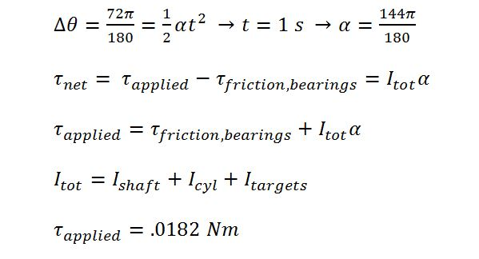
Torque Consideration
Assumptions:
Only Resistance caused by contact in axle bearings
Moment of Inertia is of targets, target wheel, and axle
1:1 Gear Ratio
72 degree rotation angle
τ
Stepper Motor
Axle
Target Wheel
Gear System
FEASIBLE
0.02
Overview
Sensor Selection
Summary
Requirements
Mechanical
Electrical
Thermal
Notes:
Sensors drive this (FOV – size of target – size of wheel – weight of wheel)

Slide 26
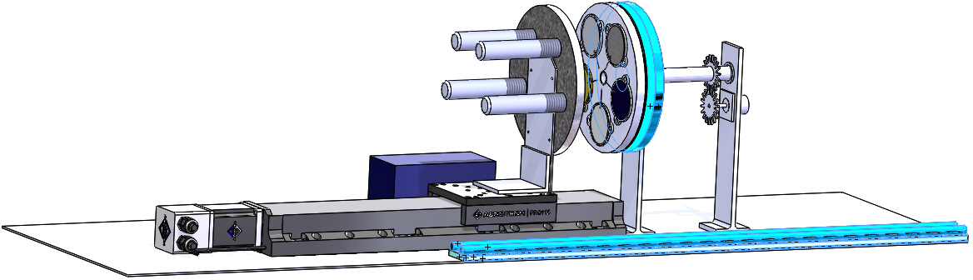
Thermal System
Cold Finger
Overview
Sensor Selection
Summary
Requirements
Mechanical
Electrical
Thermal

Slide 27
CPFE.3 Thermal Modeling
Thermal modeling is critical as it drives:
  Thermal rejection and heater design
    Sufficient heat rejection and addition to reach target temperatures.
Overview
Sensor Selection
Summary
Requirements
Mechanical
Electrical
Thermal

Slide 28
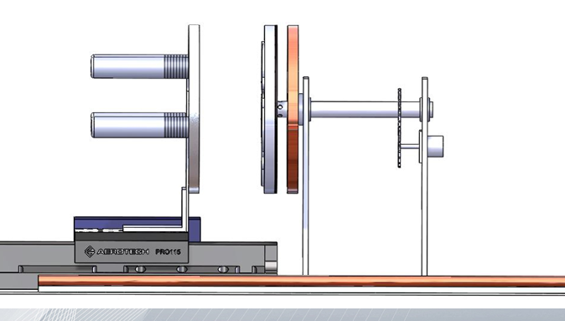
Thermal System Layout
Key:
Heater
Conductor
Thermistor
Heater
Thermistors
Copper radiator plate
Heater
Copper conductive
wires
Cold Finger
Thermistor
Copper conductivewires
Cold finger
connectors
Copper conduction rails (2x)

Slide 29
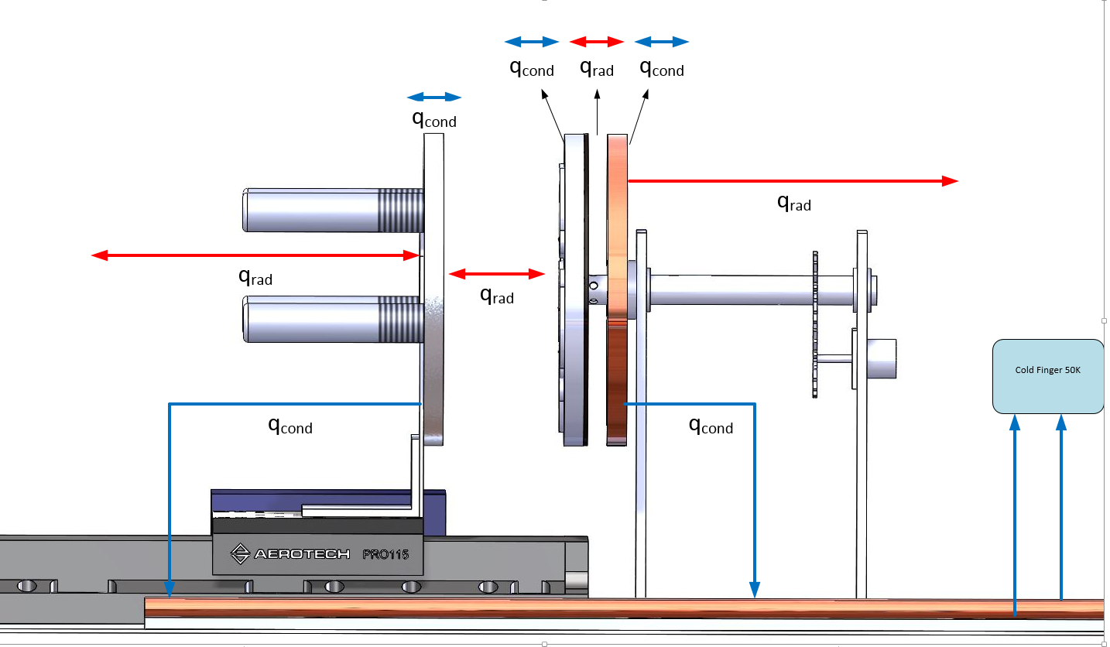
Heat Transfer Overview
Key:
Radiation
Conduction
q_{in}
q_{in}

Slide 30
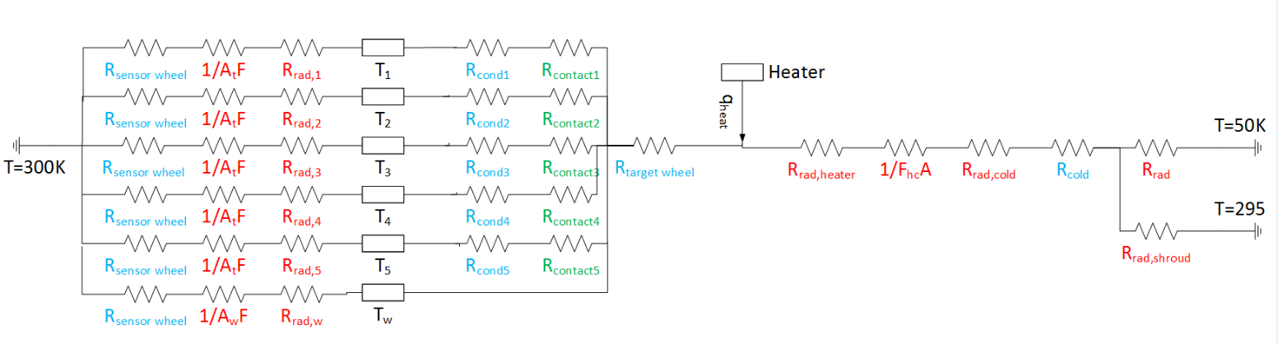
Thermal Circuit Overview - Targets
Radiation
Temps
Cond.
Contact
Cold Finger
R_{cond}
Sensorwheel
R_{cond}
Shroud
Assumptions:
1D heat transfer
Boundary Conditions: Sensor Wheel: 300 K
  Cold Finger: 50 K
  Shroud: 295 K
Key:
Radiation
Conduction
Contact
Overview
Sensor Selection
Summary
Requirements
Mechanical
Electrical
Thermal

Slide 31
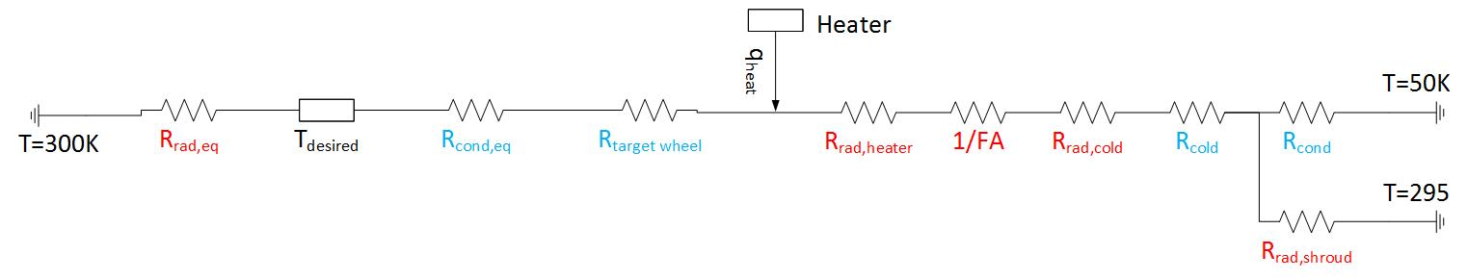
Thermal Circuit Overview - Targets
EQUIVALENT CIRCUIT:
Cold finger
Sensorwheel
Target
Shroud
Assumptions:
All targets and front of target wheel are at the same temperature
1D heat transfer
Boundary Conditions: Sensor Wheel: 300 K
  Cold Finger: 50 K
  Shroud: 295 K
Overview
Sensor Selection
Summary
Requirements
Mechanical
Electrical
Thermal

Slide 32
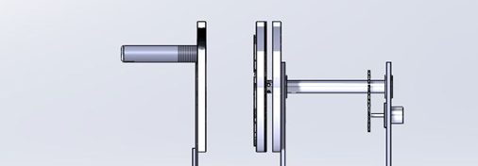
Sensors to Targets
Key:
Radiation
Conduction
cold finger
q_{rad,sensors}
sensorwheel
Shroud
Calculated the rate of heat transfer between the sensor wheel (assumed a constant 300K) and the targets
Overview
Sensor Selection
Summary
Requirements
Mechanical
Electrical
Thermal

Slide 33
Conduction through Targets
q=-q_{rad,sens}
cold finger
q_{rad,sens}
sensorwheel
T_{heater}
Shroud
Enforced equal rate of heat transfer on the other side, determined equivalent heater temperature
Key:
Radiation
Conduction
Overview
Sensor Selection
Summary
Requirements
Mechanical
Electrical
Thermal

Slide 34
Heater to Cold Finger
cold finger
sensorwheel
Shroud
Key:
Radiation
Conduction
Determine the equivalent rate of heat transfer occurring in the opposite “cold” direction, sum the two sides together to determine total power required by the heater
Cold Finger
Overview
Sensor Selection
Summary
Requirements
Mechanical
Electrical
Thermal

Slide 35
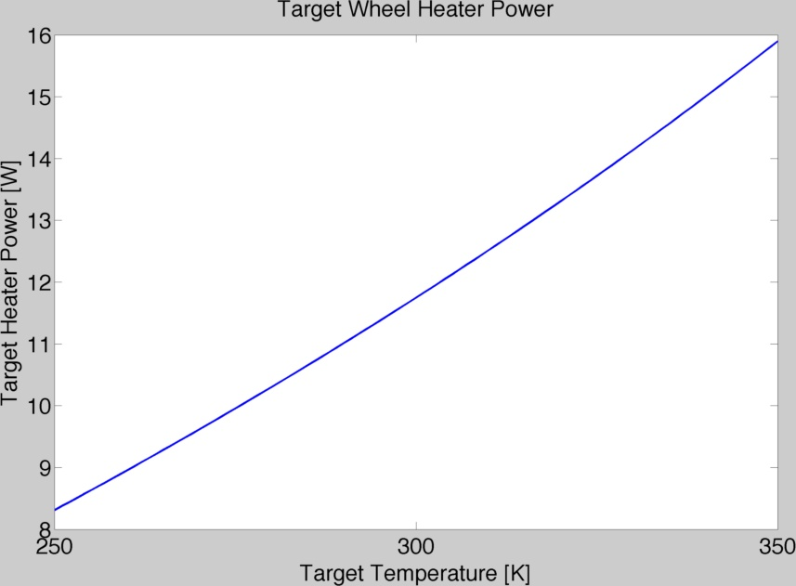
Heat Required for Targets at Steady State
Max heater power = 16 W
FEASIBLE.
Overview
Sensor Selection
Summary
Requirements
Mechanical
Electrical
Thermal

Slide 36
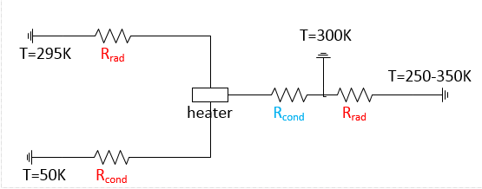
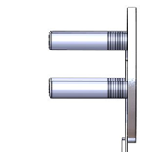

Thermal Circuit Overview - Sensors
Shroud
Targets
Cold finger
Key:
Radiation
Conduction
Overview
Sensor Selection
Summary
Requirements
Mechanical
Electrical
Thermal

Slide 37
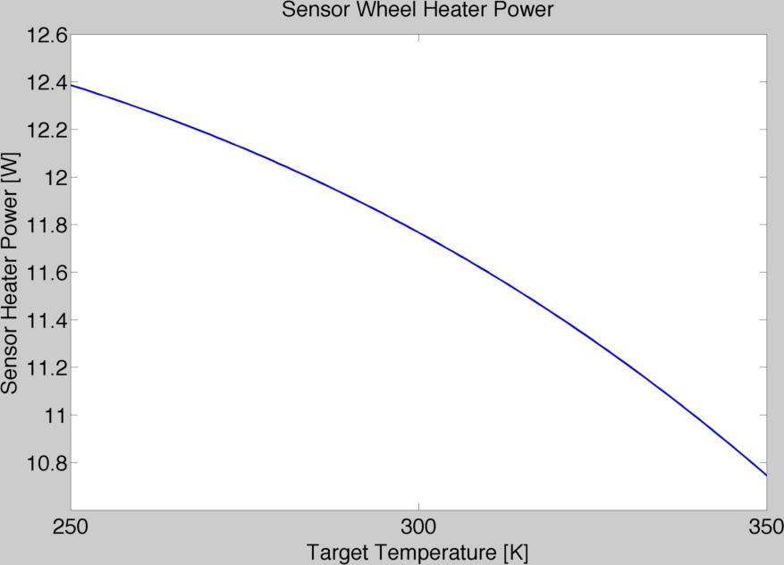
Heat Required for Sensors at Steady State
Max heater power = 13 W
FEASIBLE.
Overview
Sensor Selection
Summary
Requirements
Mechanical
Electrical
Thermal

Slide 38
Cooling Rate
Use of Lumped Capacitance Method
System begins at ambient temperature (T=300K)
System must reach starting temperature (T=250K) within 4 hours (240 minutes)
Component | Time to Cooldown (min)
Target Wheel | 128.4
Graphite Target | 2.4
Glass Target | 7.6
Paint Target | 3.04E-6
Chromated Aluminum Target | 3.42E-6
Anodized Aluminum Target | 3.34E-6
Cool Down= 128.4 min < 240 min
FEASIBLE.
Overview
Sensor Selection
Summary
Requirements
Mechanical
Electrical
Thermal

Slide 39
Heating Rate
Power required based on chosen time to heat up
  15 minutes for 10 K
  7.5 minutes for 10 K
Times are multiples of minimum specified by DR 3.5.1
  t = time required to heat up
  m = mass of component
  c = specific heat
  T_{f} = final temperature
  T_{i} = initial temperature
Overview
Sensor Selection
Summary
Requirements
Mechanical
Electrical
Thermal

Slide 40
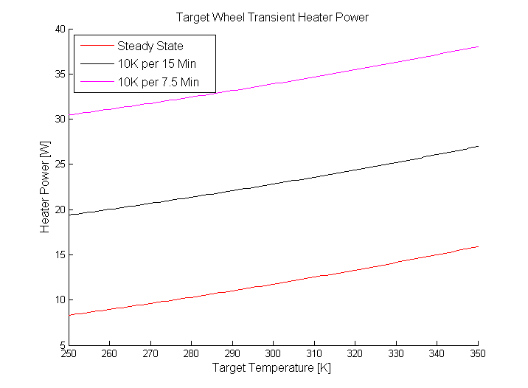
Heating Power Requirements
Max heater power = 40 W
FEASIBLE.
Overview
Sensor Selection
Summary
Requirements
Mechanical
Electrical
Thermal

Slide 41
Electrical and Software Systems
Overview
Sensor Selection
Summary
Requirements
Mechanical
Electrical
Thermal

Slide 42
CPFE.4 Electrical and Software Systems
Electrical system is critical as it drives:
  Target Temperature Measurement
    Thermistor Accuracy = 1K
    Thermistor Precision = 0.1K standard deviation over 30 sec.
    Software system is critical as it drives:
  Schedule
    Development time for software interfaces between workstation, machine controller, and microprocessor
Overview
Sensor Selection
Summary
Requirements
Mechanical
Electrical
Thermal

Slide 43
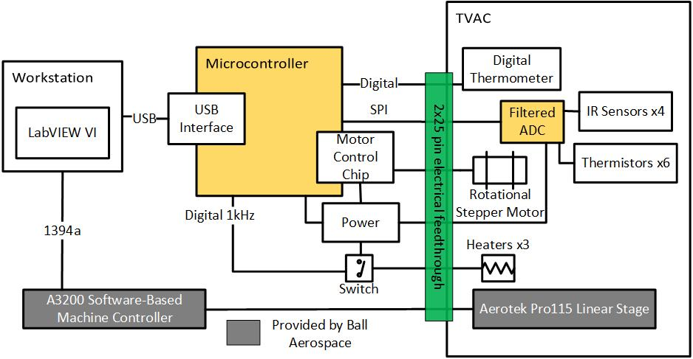
Electrical Overview
Overview
Sensor Selection
Summary
Requirements
Mechanical
Electrical
Thermal
Notes:
Microcontroller external to TVAC
ADC internal to TVAC to reduce signal noise
Stage control handled by separate controller

Slide 44
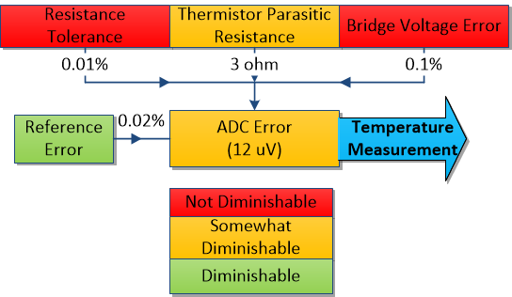
Contact Temperature Error
Wheatstone bridge to measure thermistor resistance
Uncalibrated
0.8K
Calibrated
0.4K
Requires 16-bit ADC for 0.05K resolution
Overview
Sensor Selection
Summary
Requirements
Mechanical
Electrical
Thermal

Slide 45
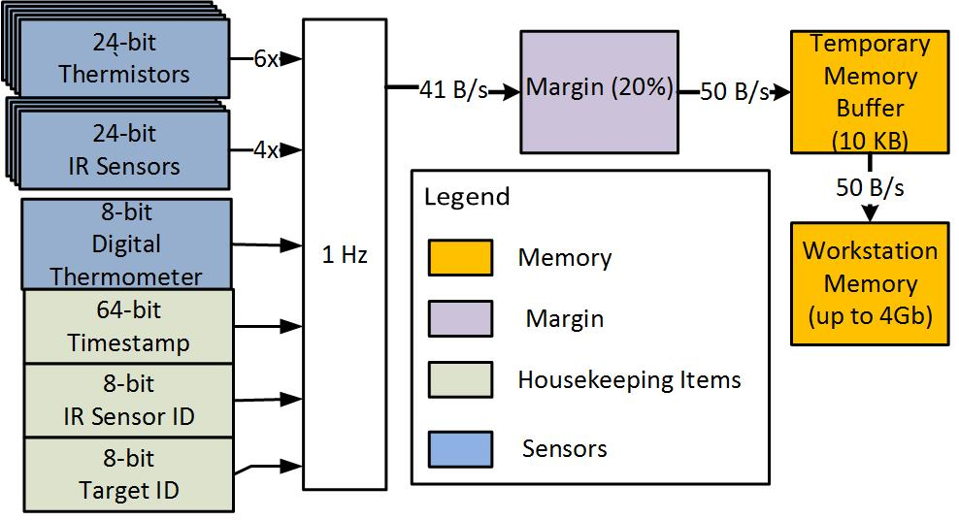
Data Budget Summary
50B/s
Overview
Sensor Selection
Summary
Requirements
Mechanical
Electrical
Thermal

Slide 46
Power Budget Summary
104 Watts
Includes 20% Power Margin
Overview
Sensor Selection
Summary
Requirements
Mechanical
Electrical
Thermal
Notes:
Heater color for total power doesn’t match above

Slide 47
Software Control
LabVIEW GUI
User control of system
  Target temp setpoint
  Distance setpoint
  Target wheel position setpoint
Record data
Provide feedback to user
Automate testing
Embedded Firmware
Realize control loops
Data acquisition
Overview
Sensor Selection
Summary
Requirements
Mechanical
Electrical
Thermal

Slide 48
Software Overview
Overview
Sensor Selection
Summary
Requirements
Mechanical
Electrical
Thermal
Notes:
LabVIEW controls setpoints
Microcontroller realizes feedback control & data acquisition
Data fed back to LabVIEW and saved to CSV
Feedback control for temperature, feed forward control for target wheel position and distance

Slide 49
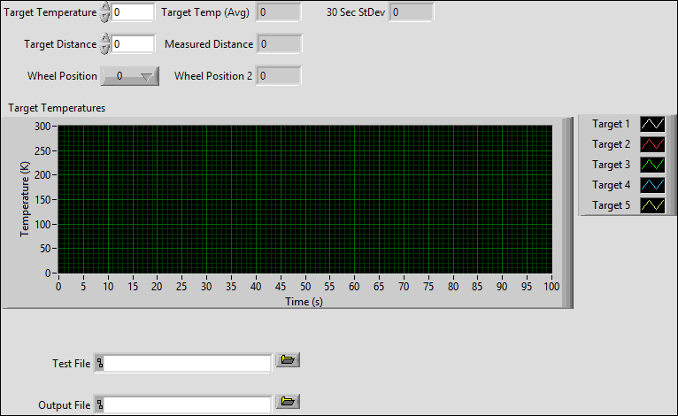
Control Interface Mockup
User Input
User Feedback
Data Visualization
Test Automation
Record Data
Overview
Sensor Selection
Summary
Requirements
Mechanical
Electrical
Thermal

Slide 50
Summary
Overview
Sensor Selection
Summary
Requirements
Mechanical
Electrical
Thermal

Slide 51
CPFE.5 TVAC Integration
Integration is critical as it drives:
  Financial budget
    All materials entering the thermal vacuum chamber must meet Ball Aerospace’s outgassing specifications.
  Test procedure
    Tests must complete in a 12 hour thermal vacuum testing window.
Overview
Sensor Selection
Summary
Requirements
Mechanical
Electrical
Thermal

Slide 52
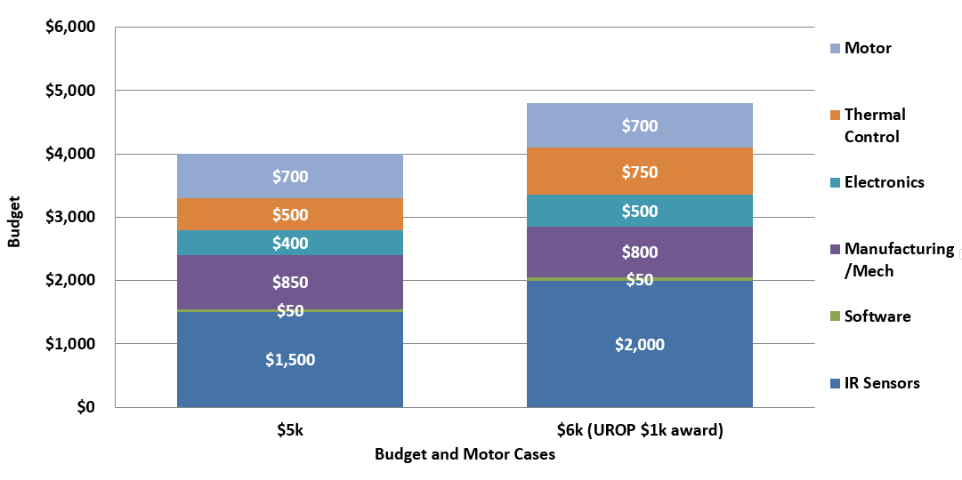
Financial Case Studies
CASE 2
CASE 1
Margin
Motor
IR Sensors
Notes:
BIGGER ERROR BUDGET…

Slide 53
Time Budget
0.2
Pump Down
Heating
Margin
Assuming:
30 sec per collection
5 sec per rotation
10 sec per translation
15 min per heat-up
For 11 Temps
  For 3 Distances
    For 5 Targets
Overview
Sensor Selection
Summary
Requirements
Mechanical
Electrical
Thermal

Slide 54
Risk Matrix
Not finding 4 IR sensors within budget
Not finding a TVAC rated motor within budget
Not finding sufficient heaters for thermal testing
Accurately calibrate heater control system outside TVAC
Purchasing Schedule Risk (order/delivery time frames)
Software Development Time
Access to Ball’s Facilities and Hardware
Thermal modeling accuracy
3 |  | 5,6
7 | 2 | 8 | 1
4
High
Importance
Low
Low
Probability of Failure
High
Overview
Sensor Selection
Summary
Requirements
Mechanical
Electrical
Thermal

Slide 55
Critical Path Moving Forward
Manufacturing and Tolerancing Studies
Thermal Modeling
  Higher dimensional thermal studies, advanced model with access to thermal software
Major Component Selection
  Motor, Sensor, Heater, Electronics Selection
Electronics Circuit
Software Development and Framework
Integration and Interface Control
Overview
Sensor Selection
Summary
Requirements
Mechanical
Electrical
Thermal

Slide 56
Questions?

Slide 57
REFERENCES:
[2] Head of Mast on Mars Rover Curiosity. (2012, August 17). Retrieved October 9, 2014, from http://www.nasa.gov/mission_pages/msl/multimedia/pia15106-anno.html
[3]Boano, C. (n.d.). TempLab: A Testbed Infrastructure to Study the Impact of Temperature on Wireless Sensor Networks. Retrieved September 23, 2014, from http://www.carloalbertoboano.com/documents/boano14templab.pdf
[4] Visible Infrared Imaging Radiometer Suite (VIIRS). (2014, September 14). Retrieved September 15, 2014, from http://npp.gsfc.nasa.gov/viirs.html
[5] Brinton, T. Pentagon Acquisition Chief OKs Weather Satellite Plan. (2010, August 24). Retrieved October 12, 2014, from http://www.spacenews.com/article/pentagon-acquisition-chief-oks-weather-satellite-plan
[6] Student-polished space mirrors ready for launch. (2002, June 24). Retrieved October 12, 2014, from http://spaceflightnow.com/news/n0206/24starshine4/
[7] Compact Non-Contact Infrared Temperature Sensor/Transmitter. Retrieved September 3, 2014, from http://www.omega.com/Temperature/pdf/OS137.pdf
[8] Mclennan VSS/VSH Extreme Environment Stepper Motors. Retrieved October 5, 2014.

Slide 58
Backup Slides

Slide 59
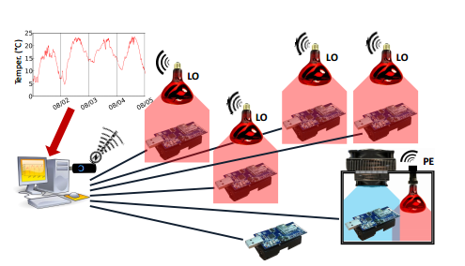
Background
TempLab[3] : Testbed created to study the impact of temperature differentials on wireless sensor networks.
  Sensed the accuracy and precision of the wireless components.
Notes:
Utilized infrared heating lamps to heat up electrical components.
Commanded the temperatures of the components.

Slide 60
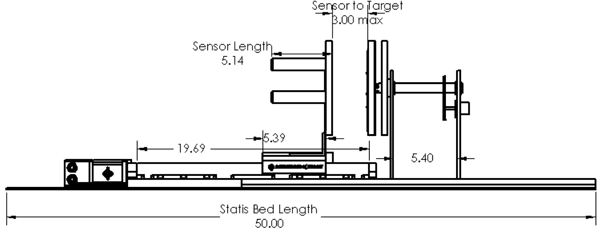
Testbed Overview
All dimensions are in INCHES
Overview
Sensor Selection
Summary
Requirements
Mechanical
Electrical
Thermal

Slide 61
Requirements

Slide 62
Functional Requirement 1
STATIS shall vary parameters relevant to characterizing the performance of COTS non-contact infrared temperature sensors.
DR 1.1 The distance between the target surface and non-contact infrared temperature sensor shall be adjustable through user input commands.
DR 1.2 The temperature of the target surface shall be adjustable through user input commands.
DR 1.3 Every target surface temperature will be measured by every non-contact IR temperature sensor during the allotted test time.

Slide 63
Functional Requirement 2
STATIS shall collect measurement data required to characterize the performance of the COTS IR sensors.
DR 2.1 The temperatures of the target surfaces shall be collected using conventional contact sensors.
DR 2.2 The distance between the non-contact infrared temperature sensors and targets shall be known.
DR 2.3 The sensor under test (SUT) and target under test (TUT) pair (STP) shall be known.
DR 2.4 Upon completion of any test sequence, a file shall be created that contains data requested in DR 2.2 and DR 2.3.
DR 2.5 All data shall be timestamped relative to the start of each test sequence.

Slide 64
Functional Requirement 3
STATIS shall be designed for use within Ball Aerospace’s thermal vacuum chamber.
DR 3.1 All required electronic connections between STATIS and test computer shall be compatible with the thermal vacuum cable pass-through.
DR 3.2 The IR temperature sensors shall remain within the temperature range of 275 to 325K.
DR 3.3 The electronics package in the test chamber shall remain within the operating temperature range of the most temperature sensitive device.
DR 3.4 All STATIS components entering the thermal vacuum chamber shall operate within the vacuum environment.
DR 3.5 Testing operations performed by STATIS shall be elected and organized so that testing may be completed within 12 hours inside a thermal vacuum chamber.
DR 3.6 The testbed shall fit within the size constraints of the cylindrical thermal vacuum chamber.

Slide 65
Sensor Selection - Backup

Slide 66

IR Sensor Selection Parameters
Field of View (FOV)
  D:S – min 2:1
Cost - 30 – 50% of budget
Geometry
  Similar cylindrical housing
  Smaller sensors can have a cylindrical housing manufactured
Electrical Interface
  adaptable electronics system design
Operating Temperature
  275K – 325K
D = 24mm
L = 127mm
[5]

Slide 67


Infrared Background
Moran, Michael J., Howard Shapiro, Bruce Munson, and David DeWitt. Introduction to Thermal Systems Engineering: Thermodynamics, Fluid Mechanics, and Heat Transfer. New York: Wiley, 2003. Print.
Moran, Michael J., Howard Shapiro, Bruce Munson, and David DeWitt. Introduction to Thermal Systems Engineering: Thermodynamics, Fluid Mechanics, and Heat Transfer. New York: Wiley, 2003. Print.
IR radiation has a wavelength ranging from 0.7 to 1000μm (long wavelength)
Depending on the material and sensor capability, wavelengths from 0.7 to 14μm have enough energy to be detected by a range of IR temperature sensors

Slide 68



Emissivity Background
Kirchoff’s Law
  $ε= \frac{R(T)}{R^{bb}(T)}$ , $α= \frac{R(T)}{R^{bb}(T)}$
The emissivity of a material is different for different wavelengths
Moran, Michael J., Howard Shapiro, Bruce Munson, and David DeWitt. Introduction to Thermal Systems Engineering: Thermodynamics, Fluid Mechanics, and Heat Transfer. New York: Wiley, 2003. Print.
http://www.micro-epsilon.com/download/products/cat--thermoMETER-Infrared--en-us.pdf

Slide 69
Geometric Tolerancing

Slide 70
Geometric Tolerances
Each IR sensors’ FOV should fall only on its’ target surface for the best data collection and sensor characterization. This means that the target array and the IR sensor cluster must be properly aligned.
The sensitivities or tolerances are evaluated in a worst case configuration: maximum viewing distance of 3 inches (largest FOV 2:1).
Target, 2.25 inch diameter
Δ=R-r
IR sensor FOV, 1.5 inch diameter
Nominal Viewing (units of inches)

Slide 71
Translational Alignment
The difference in the target radius and FOV radius (1.125 in and 0.75 in respectively) gives a bound on the translational alignment between the sensor array and target disk:Δ=R-r, Δ=0.375 inches if it occurs in one direction only within the x-y plane.
x direction sensitivity
y direction sensitivity

Slide 72



Translational Alignment
Another possibility is that a translational positioning error exists in the x and y directions. In this case, their combined effect must not exceed a magnitude of 0.375 inches.
Assuming the errors in x and y are the same:

Slide 73
Rotational Alignment: Error in IR Sensor Cluster
Changing the angle of the sensor array about the x or y axes, while keeping the target disk fixed, may be approximated by assuming that a sensors’ FOV translates across the target a distance equal to the magnitude of arc length swept out by a misalignment angle theta.
This implies the approximation s=rθ≅Δ
the angle is being swept out at a 3 inch radius, and must not produce an arc length greater than Δ
s=rθ≅Δ, θ≅Δ/r, θ = ±4.5°
Rotation about y
Rotation about x

Slide 74
Rotational Alignment: In Plane Rotation (about shaft axis)
Using the same approximation s=rθ≅Δ, the arc length traveled by a misalignment error about the shaft axis (by the target disk) may be approximated as the linear displacement of the FOV off target. Doing similar calculations, but where r is the distance from the center of the target disk to the middle of the target (2.2 inches).
s=rθ≅Δ, θ=±9.6°
Rotation about shaft axis

Slide 75


Rotational Alignment: Error in IR Target Disk
Keeping the IR sensor array fixed and changing the angle of the target disk about the x or y axes, may be approximated by finding the cross section (projection) of a circular FOV viewing a skewed plane.
This assumes a locally cylindrical FOV,
such that the mapped FOV is an ellipse
has centered between its’ foci
(symmetric about target center).

Slide 76


Rotational Alignment: Error in IR Target Disk
Rearranging and solving for the angle .
It is found that at dt=2.25 inches
and ds=1.5 inches, the angle at which
the semi-major axis of the mapped
ellipse is larger than the target radius
is 48 degrees, pictured Right.

Slide 77


Rotational Alignment: Gear Slip
The target array will be driven by a step motor through a gear. The gearing interface provides another possible error source. This error would occur in-plane (about z).
Arc length equivalence:

Slide 78



Additive Error
Accounting for each error, recall the quadrature sum:
All errors produce displacements in the x-y plane, which gives two perpendicular directions:
recall Δ=0.375 inches
e_{x} and e_{y} each have components discussed on the previous slide. Assuming all errors exist and have the same strength, each must be 0.06 inches or less.
This magnitude applied to the most sensitive error source, sensor array tilt, gives ± 1.2°.

Slide 79
Geometric Tolerances Summary
Most sensitive translational alignment: 0.27 inches max each in the x-y plane.
Most sensitive rotational alignment: rotation of sensor cluster about x or y axes.
Machining precision: around 5/1000^{ths} of an inch.

Slide 80
Mechanical Design

Slide 81

Motor Feasibility
Phytron Extreme Environment Stepper Motor
  VSS HV 32
Vacuum Rated to 10^-7 hPa
With in budget
Provides proper torque and error allowances
  Holding Torque 40mNm,
  Design Voltage 42 VDC
  Step accuracy of 5% for 1.8 degrees
32 mm
11 mm

Slide 82
Thermal Systems - Backup

Slide 83

Heater Feasibility
Minco Polymide Thermofoil Patch Heaters
Suitable for vacuum environment
With in budget
Temp Range: 73K – 473K
6-10 in

Slide 84

Thermal Resistance Equations

Slide 85


View Factor

Slide 86

Thermal Circuit Overview – Target Emissivity
Radiation
Temps
Cond.
Contact
R_{cond}
With the resulting heater power, back-solved for the heat transfer rate through each path and determined the equivalent temperature of each separate target
Overview
Sensor Selection
Summary
Requirements
Mechanical
Electrical
Thermal

Slide 87

Sensitivity of Varying Emissivity
Overview
Sensor Selection
Summary
Requirements
Mechanical
Electrical
Thermal

Slide 88

Lumped Capacitance Method

Slide 89

Lumped Capacitance Radiation Coefficient

Slide 90

Lumped Capacitance Viability

Slide 91

Lumped Capacitance Equations
$h_{rad}=εσ\left(T_{s}+T_{surr}\right)\left(T_{s}^{2}+T_{sur}^{2}\right)$
$L_{c}=\frac{Volume}{surface area}$
$Bi=\frac{h_{rad}L_{c}}{k}$
  Must be less than 0.1 to use method
$t=\frac{ρVc_{p}}{h_{rad}A_{s}}\ln\left(\frac{T_{i}−T_{surr}}{T−T_{surr}}\right)$

Slide 92
Electrical and Software Backup Slides

Slide 93

Contact Temperature Error
Voltage Supply
Error
Thermistor Error
Uncalibrated
0.8K
Calibrated
0.4K
Measure differential voltage with reference resistance using a Wheatstone bridge
Requires 16-bit ADC for 0.05K resolution
Absolute Temperature Knowledge 1.0K
  0.8 K maximum error uncalibrated
  0.4 K temperature error with calibration
Electrical noise (0.1K STD) includes ADC, thermal noise floor less than 137 uV (0.05K step size)
Overview
Sensor Selection
Summary
Requirements
Mechanical
Electrical
Thermal

Slide 94


Thermistor Wheatstone Bridge
Measure differential voltage with reference resistance
Meets 1 K absolute temperature knowledge requirement
Requires 16-bit ADC for 0.05K resolution
Wheatstone Bridge

Slide 95
Component Selection Options
ADC | Reference V | Bitdepth
LTC2451 | 2-5V | 16
MCP3421 | 2.048V | 18
ADS1113 | 5V | 16
AD7799 | 2-5V | 24
AD7793 | 2-5V | 24
ADS1242 | 2-5V | 24
ADS1255 | 2-5V | 24
Thermistor | 25C Resistance | Accuracy
PR502J2 | 5k | 0.05C
PR103J2 | 10k | 0.05C
PR503J2 | 50k | 0.05C
PR222J2 | 2.252k | 0.05C
PS103J2 | 10k | 0.1C
Microcontroller | COM | Voltage
SAM3X8E | I2C, SPI, SD, USART/UART | 3.3
ATmega2560 | SPI, UART, I2C | 5
ATSAM4S8CA | I2C, SPI, SD, UART/USART | 3.3
Voltage Reference | Output Voltage | Accuracy
LT1027ECS8 | 5V | 0.10%
ADR01AUJZ | 10V | 0.10%
MAX6126AASA50 | 5V | 0.10%
LM4050AEM3 | 10V | 0.10%
Resistor | Resistance | Accuracy
408-1640-1-ND | 33k ohm | 0.01%
408-1657-1-ND | 47k ohm | 0.01%
408-1654-2-ND | 33k ohm | 0.01%

Slide 96


Thermistor - Current Source
Current Source

Slide 97
Workstation Software - LabVIEW
Drivers available
  Stage controller (via Ball Aerospace)
  Microcontroller (LabVIEW LINX library and Arduino toolkit)
Minimal additional user interface programming required
Team familiarity

